Slide 1
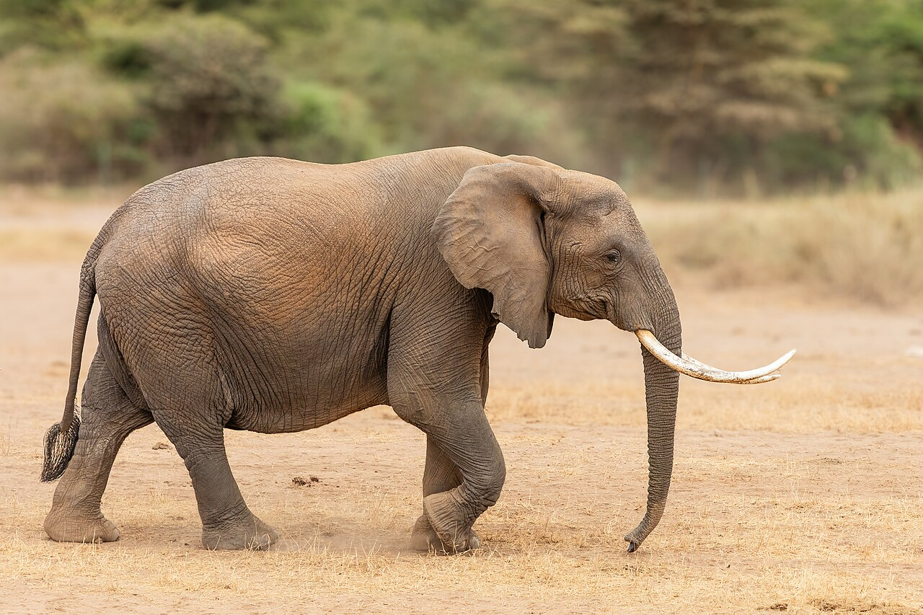
NEUR 411 · NEUROETHOLOGY · FALL 2026
Lecture 52
Elephants III:
elephant Neuroethics, the Neurobiology of Captivity, and Behavioral Pathology
Date TBD
Photo: African elephant.
Jordan Lopez, Ph.D.
Professor of Neurobiology & Biomedical Engineering
Notes:
Elephants III: elephant Neuroethics, the Neurobiology of Captivity, and Behavioral Pathology
Lecture 52. NEUR 411 · NEUROETHOLOGY · FALL 2026. Date TBD.
Image: Photo: African elephant. Credit: Bijay Chaurasia. License: CC BY-SA 4.0. Source: https://commons.wikimedia.org/wiki/File:African_Elephant_at_Amboseli_National_Park-070A5584.jpg
References:
Brian J. Greco, Cheryl L. Meehan, Jen N. Hogan, Katherine A. Leighty, Jill Mellen, Georgia J. Mason, Joy A. Mench (2016). The Days and Nights of Zoo Elephants: Using Epidemiology to Better Understand Stereotypic Behavior of African Elephants (Loxodonta africana) and Asian Elephants (Elephas maximus) in North American Zoos. PLOS ONE 11: e0144276. https://doi.org/10.1371/journal.pone.0144276

Slide 2
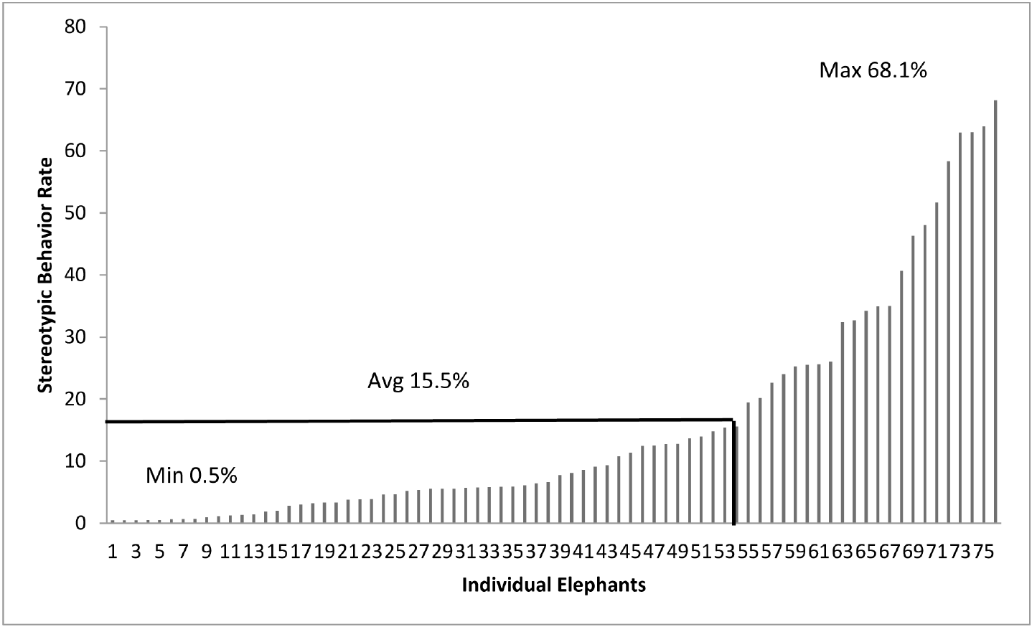
Stereotypy is defined by a repetitive behavioral pattern
A stereotypy is a repetitive, relatively invariant behavior without an evident immediate goal. Greco and colleagues recorded stereotypic activity in zoo-housed African elephants, Loxodonta africana, and Asian elephants, Elephas maximus, rather than classifying every repeated movement as abnormal.
Observers used a behavioral coding system and repeated daytime and nighttime observations. Performance was expressed relative to active observation time, allowing feeding, locomotion, and repetitive movements to be distinguished within each animal’s activity budget.
Stereotypy can indicate a welfare problem, but its presence is not a direct measurement of neuronal injury or a psychiatric diagnosis. Repeated walking toward food differs from invariant pacing without an apparent immediate goal; context and the operational definition determine which behavior enters the measure.
Greco (2016), Fig. 5. Individual daytime stereotypy rates.
Photo: African elephant.
Greco et al. (2016)
02
Notes:
• A stereotypy is a repetitive, relatively invariant behavior without an evident immediate goal. Greco and colleagues recorded stereotypic activity in zoo-housed African elephants, Loxodonta africana, and Asian elephants, Elephas maximus, rather than classifying every repeated movement as abnormal.
• Observers used a behavioral coding system and repeated daytime and nighttime observations. Performance was expressed relative to active observation time, allowing feeding, locomotion, and repetitive movements to be distinguished within each animal’s activity budget.
• Stereotypy can indicate a welfare problem, but its presence is not a direct measurement of neuronal injury or a psychiatric diagnosis. Repeated walking toward food differs from invariant pacing without an apparent immediate goal; context and the operational definition determine which behavior enters the measure.
References:
Brian J. Greco, Cheryl L. Meehan, Jen N. Hogan, Katherine A. Leighty, Jill Mellen, Georgia J. Mason, Joy A. Mench (2016). The Days and Nights of Zoo Elephants: Using Epidemiology to Better Understand Stereotypic Behavior of African Elephants (Loxodonta africana) and Asian Elephants (Elephas maximus) in North American Zoos. PLOS ONE 11: e0144276. https://doi.org/10.1371/journal.pone.0144276
Figure: Greco (2016), Fig. 5. Individual daytime stereotypy rates.
Figure source: https://doi.org/10.1371/journal.pone.0144276
Image: Photo: African elephant. Credit: Bijay Chaurasia. License: CC BY-SA 4.0. Source: https://commons.wikimedia.org/wiki/File:African_Elephant_at_Amboseli_National_Park-070A5584.jpg

Slide 3
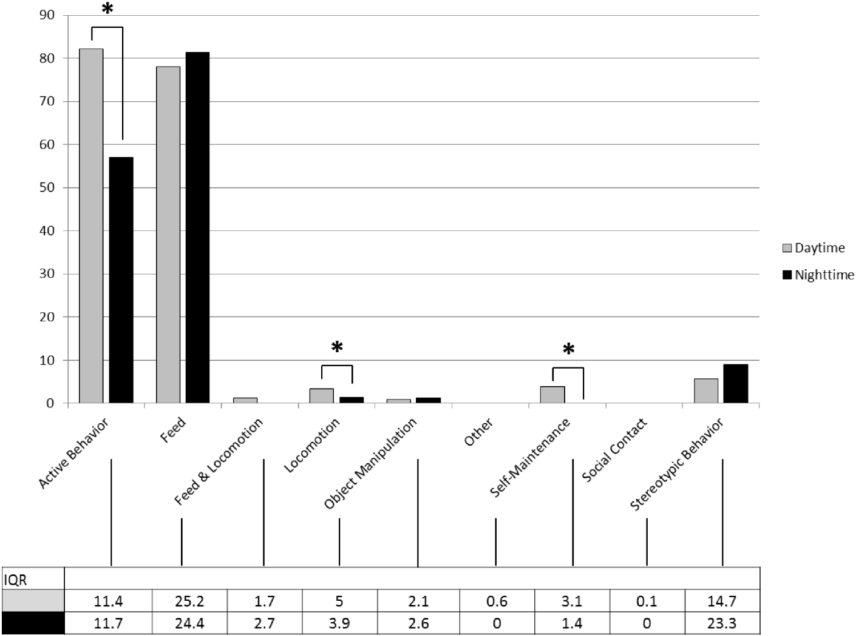
Active-time percentages differ from whole-day exposure
An activity budget partitions observed time among defined behaviors. Greco and colleagues distinguished active periods from rest before calculating the proportion of active observations allocated to feeding, locomotion, stereotypy, and other categories.
Elephants were active during approximately eighty percent of daytime observations and sixty percent of nighttime observations. Feeding and stereotypic behavior were prominent active categories in both periods, while locomotion and self-maintenance were more frequent during the day.
A percentage of active time must not be interpreted as the same percentage of all twenty-four hours. Excluding rest changes the denominator. Comparison across studies requires matching behavioral definitions, observation periods, and denominators before differences are attributed to environmental conditions or individual welfare.
Greco (2016), Fig. 1. Daytime and nighttime activity budgets.
Greco et al. (2016)
03
Notes:
• An activity budget partitions observed time among defined behaviors. Greco and colleagues distinguished active periods from rest before calculating the proportion of active observations allocated to feeding, locomotion, stereotypy, and other categories.
• Elephants were active during approximately eighty percent of daytime observations and sixty percent of nighttime observations. Feeding and stereotypic behavior were prominent active categories in both periods, while locomotion and self-maintenance were more frequent during the day.
• A percentage of active time must not be interpreted as the same percentage of all twenty-four hours. Excluding rest changes the denominator. Comparison across studies requires matching behavioral definitions, observation periods, and denominators before differences are attributed to environmental conditions or individual welfare.
References:
Brian J. Greco, Cheryl L. Meehan, Jen N. Hogan, Katherine A. Leighty, Jill Mellen, Georgia J. Mason, Joy A. Mench (2016). The Days and Nights of Zoo Elephants: Using Epidemiology to Better Understand Stereotypic Behavior of African Elephants (Loxodonta africana) and Asian Elephants (Elephas maximus) in North American Zoos. PLOS ONE 11: e0144276. https://doi.org/10.1371/journal.pone.0144276
Figure: Greco (2016), Fig. 1. Daytime and nighttime activity budgets.
Figure source: https://doi.org/10.1371/journal.pone.0144276

Slide 4
Individuals differ substantially in daytime stereotypy
Greco and colleagues quantified the rate of stereotypic behavior separately for each observed elephant. Among animals performing stereotypy, daytime rates ranged from approximately one half of one percent to sixty-eight percent of active observation time.
The individual distribution includes low and high performers rather than one uniform zoo-elephant phenotype. Repeated observations and standardized coding allowed researchers to relate this variation to documented housing conditions, management practices, species, and life histories.
A group average conceals animals that rarely performed the behavior and animals for which it occupied much of active time. The measured heterogeneity supports individual monitoring; it does not identify whether a high-performing animal has a particular neural lesion, whether its current enclosure caused the behavior, or whether the behavior began before arrival.
Greco (2016), Fig. 5. Individual daytime stereotypy rates.
Greco et al. (2016)
04
Notes:
• Greco and colleagues quantified the rate of stereotypic behavior separately for each observed elephant. Among animals performing stereotypy, daytime rates ranged from approximately one half of one percent to sixty-eight percent of active observation time.
• The individual distribution includes low and high performers rather than one uniform zoo-elephant phenotype. Repeated observations and standardized coding allowed researchers to relate this variation to documented housing conditions, management practices, species, and life histories.
• A group average conceals animals that rarely performed the behavior and animals for which it occupied much of active time. The measured heterogeneity supports individual monitoring; it does not identify whether a high-performing animal has a particular neural lesion, whether its current enclosure caused the behavior, or whether the behavior began before arrival.
References:
Brian J. Greco, Cheryl L. Meehan, Jen N. Hogan, Katherine A. Leighty, Jill Mellen, Georgia J. Mason, Joy A. Mench (2016). The Days and Nights of Zoo Elephants: Using Epidemiology to Better Understand Stereotypic Behavior of African Elephants (Loxodonta africana) and Asian Elephants (Elephas maximus) in North American Zoos. PLOS ONE 11: e0144276. https://doi.org/10.1371/journal.pone.0144276
Figure: Greco (2016), Fig. 5. Individual daytime stereotypy rates.
Figure source: https://doi.org/10.1371/journal.pone.0144276

Slide 5
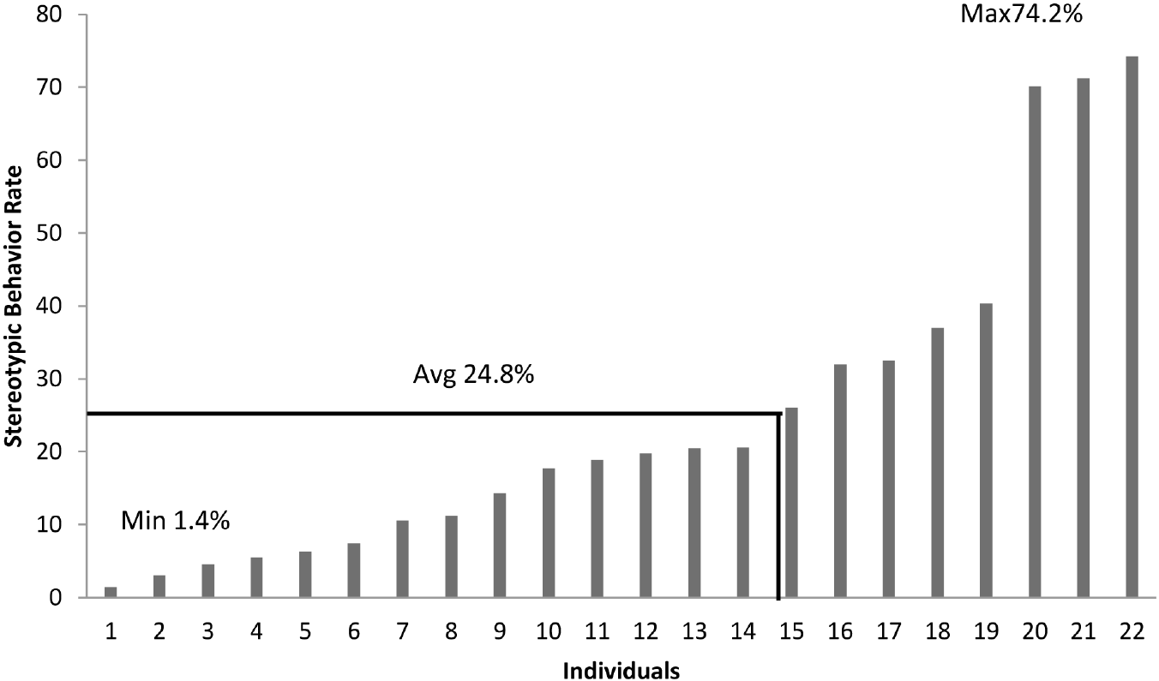
Night observations detect substantial repetitive activity
Nighttime behavioral recording samples a period that routine visitor-hour observation can miss. Greco and colleagues measured stereotypy during active nighttime observations using the same broad behavioral categories employed during daytime recording.
Among stereotypy-performing animals, nighttime rates ranged from approximately one to seventy-four percent of active observation time, with a mean near twenty-five percent. Daytime and nighttime measurements were associated, but the night record provided additional information about the animal’s daily environment.
A nocturnal rate is not equivalent to a sleep measurement, and activity does not establish insomnia without appropriate physiological evidence. Night surveillance can identify repetitive activity during indoor confinement while remaining distinct from electroencephalography, which measures electrical brain activity and was not used in this study.
Greco (2016), Fig. 6. Individual nighttime stereotypy rates.
Greco et al. (2016)
05
Notes:
• Nighttime behavioral recording samples a period that routine visitor-hour observation can miss. Greco and colleagues measured stereotypy during active nighttime observations using the same broad behavioral categories employed during daytime recording.
• Among stereotypy-performing animals, nighttime rates ranged from approximately one to seventy-four percent of active observation time, with a mean near twenty-five percent. Daytime and nighttime measurements were associated, but the night record provided additional information about the animal’s daily environment.
• A nocturnal rate is not equivalent to a sleep measurement, and activity does not establish insomnia without appropriate physiological evidence. Night surveillance can identify repetitive activity during indoor confinement while remaining distinct from electroencephalography, which measures electrical brain activity and was not used in this study.
References:
Brian J. Greco, Cheryl L. Meehan, Jen N. Hogan, Katherine A. Leighty, Jill Mellen, Georgia J. Mason, Joy A. Mench (2016). The Days and Nights of Zoo Elephants: Using Epidemiology to Better Understand Stereotypic Behavior of African Elephants (Loxodonta africana) and Asian Elephants (Elephas maximus) in North American Zoos. PLOS ONE 11: e0144276. https://doi.org/10.1371/journal.pone.0144276
Figure: Greco (2016), Fig. 6. Individual nighttime stereotypy rates.
Figure source: https://doi.org/10.1371/journal.pone.0144276

Slide 6
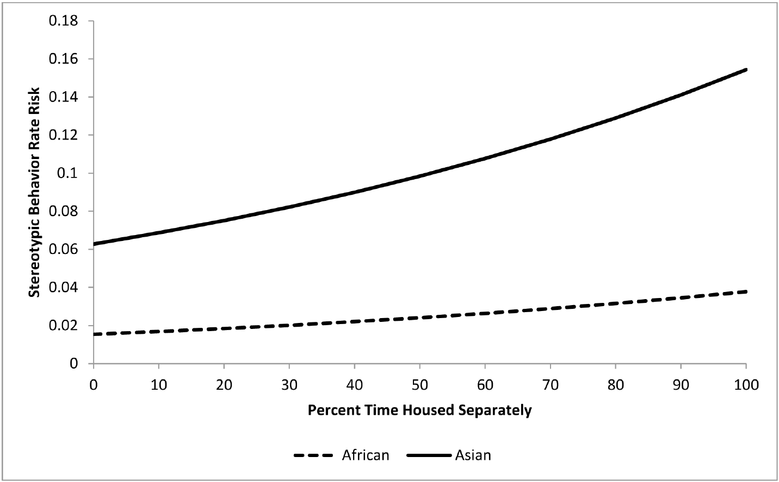
Separate housing is associated with more stereotypy
Epidemiology examines how measured outcomes vary with exposures across a population. Greco and colleagues combined behavioral observations with management records to examine separate housing while accounting for other recorded characteristics.
More daytime spent housed separately was associated with higher stereotypy risk. In the published model, each ten-percentage-point increase in separate housing corresponded to approximately a nine-percent increase in the risk measure, with other modeled exposures held constant.
Separate housing was not randomly assigned, and animals may have been separated because of health, compatibility, or management concerns. The association therefore supports scrutiny of social restriction without proving that isolation alone caused every repetitive behavior. Ethical decisions about separation must also consider aggression risk and the welfare of prospective social partners.
Greco (2016), Fig. 7. Modeled association with separate housing.
Greco et al. (2016)
06
Notes:
• Epidemiology examines how measured outcomes vary with exposures across a population. Greco and colleagues combined behavioral observations with management records to examine separate housing while accounting for other recorded characteristics.
• More daytime spent housed separately was associated with higher stereotypy risk. In the published model, each ten-percentage-point increase in separate housing corresponded to approximately a nine-percent increase in the risk measure, with other modeled exposures held constant.
• Separate housing was not randomly assigned, and animals may have been separated because of health, compatibility, or management concerns. The association therefore supports scrutiny of social restriction without proving that isolation alone caused every repetitive behavior. Ethical decisions about separation must also consider aggression risk and the welfare of prospective social partners.
References:
Brian J. Greco, Cheryl L. Meehan, Jen N. Hogan, Katherine A. Leighty, Jill Mellen, Georgia J. Mason, Joy A. Mench (2016). The Days and Nights of Zoo Elephants: Using Epidemiology to Better Understand Stereotypic Behavior of African Elephants (Loxodonta africana) and Asian Elephants (Elephas maximus) in North American Zoos. PLOS ONE 11: e0144276. https://doi.org/10.1371/journal.pone.0144276
Figure: Greco (2016), Fig. 7. Modeled association with separate housing.
Figure source: https://doi.org/10.1371/journal.pone.0144276

Slide 7
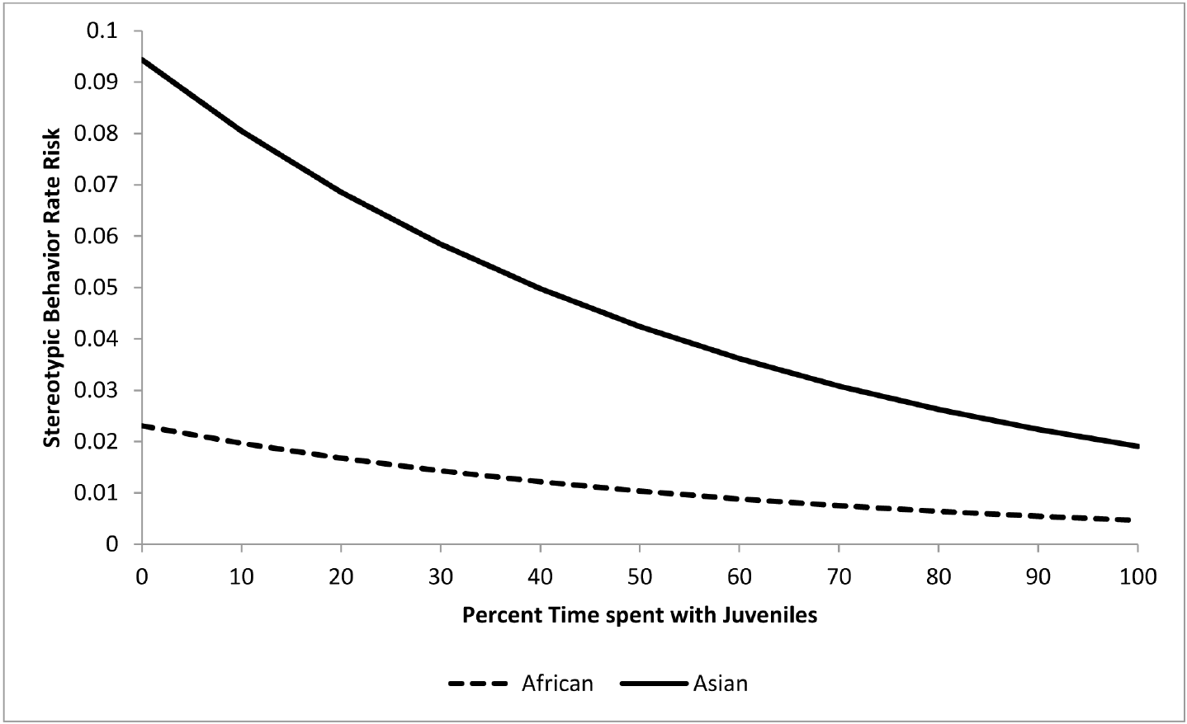
Juvenile contact is associated with lower daytime risk
Greco and colleagues measured the proportion of time adults spent with juvenile elephants. Greater juvenile contact was associated with lower modeled daytime stereotypy risk after consideration of the other recorded management and demographic variables.
A ten-percentage-point increase in juvenile contact corresponded to approximately a fifteen-percent reduction in the model’s risk measure. Juvenile exposure was recorded as a management variable; the study did not experimentally isolate play, caregiving, learning, or another particular interaction.
The result is consistent with benefits of socially varied environments, but it does not establish a universal prescription to introduce a calf to every group. Compatibility and the juvenile’s own welfare remain separate considerations. The behavioral association cannot be assigned to oxytocin release or a specific social circuit because neither was measured.
Greco (2016), Fig. 8. Modeled association with juvenile contact.
Photo: African elephant.
Greco et al. (2016)
07
Notes:
• Greco and colleagues measured the proportion of time adults spent with juvenile elephants. Greater juvenile contact was associated with lower modeled daytime stereotypy risk after consideration of the other recorded management and demographic variables.
• A ten-percentage-point increase in juvenile contact corresponded to approximately a fifteen-percent reduction in the model’s risk measure. Juvenile exposure was recorded as a management variable; the study did not experimentally isolate play, caregiving, learning, or another particular interaction.
• The result is consistent with benefits of socially varied environments, but it does not establish a universal prescription to introduce a calf to every group. Compatibility and the juvenile’s own welfare remain separate considerations. The behavioral association cannot be assigned to oxytocin release or a specific social circuit because neither was measured.
References:
Brian J. Greco, Cheryl L. Meehan, Jen N. Hogan, Katherine A. Leighty, Jill Mellen, Georgia J. Mason, Joy A. Mench (2016). The Days and Nights of Zoo Elephants: Using Epidemiology to Better Understand Stereotypic Behavior of African Elephants (Loxodonta africana) and Asian Elephants (Elephas maximus) in North American Zoos. PLOS ONE 11: e0144276. https://doi.org/10.1371/journal.pone.0144276
Figure: Greco (2016), Fig. 8. Modeled association with juvenile contact.
Figure source: https://doi.org/10.1371/journal.pone.0144276
Image: Photo: African elephant. Credit: Bijay Chaurasia. License: CC BY-SA 4.0. Source: https://commons.wikimedia.org/wiki/File:African_Elephant_at_Amboseli_National_Park-070A5584.jpg

Slide 8
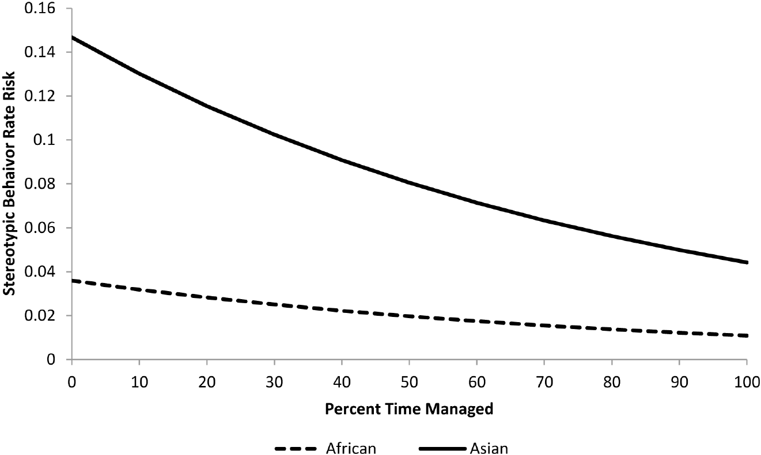
Managed activity has a conditional behavioral association
Managed activity included structured interactions within the recorded zoo-management system. Greco and colleagues related the proportion of time in these activities to stereotypy while also considering housing separation, juvenile exposure, transfer history, and species.
More managed activity was associated with lower daytime stereotypy risk. The published model linked an additional ten percentage points of managed time to an approximately twelve-percent reduction in its risk measure under the recorded conditions.
This category does not establish that every training method, work demand, or human interaction improves welfare. Duration and broad category are not measurements of voluntariness or experience. An observed association supports evaluation of the particular practices studied; it cannot justify coercive activity or replace assessment of physical health, social contact, and behavioral choice.
Greco (2016), Fig. 9. Modeled association with managed activities.
Greco et al. (2016)
08
Notes:
• Managed activity included structured interactions within the recorded zoo-management system. Greco and colleagues related the proportion of time in these activities to stereotypy while also considering housing separation, juvenile exposure, transfer history, and species.
• More managed activity was associated with lower daytime stereotypy risk. The published model linked an additional ten percentage points of managed time to an approximately twelve-percent reduction in its risk measure under the recorded conditions.
• This category does not establish that every training method, work demand, or human interaction improves welfare. Duration and broad category are not measurements of voluntariness or experience. An observed association supports evaluation of the particular practices studied; it cannot justify coercive activity or replace assessment of physical health, social contact, and behavioral choice.
References:
Brian J. Greco, Cheryl L. Meehan, Jen N. Hogan, Katherine A. Leighty, Jill Mellen, Georgia J. Mason, Joy A. Mench (2016). The Days and Nights of Zoo Elephants: Using Epidemiology to Better Understand Stereotypic Behavior of African Elephants (Loxodonta africana) and Asian Elephants (Elephas maximus) in North American Zoos. PLOS ONE 11: e0144276. https://doi.org/10.1371/journal.pone.0144276
Figure: Greco (2016), Fig. 9. Modeled association with managed activities.
Figure source: https://doi.org/10.1371/journal.pone.0144276

Slide 9
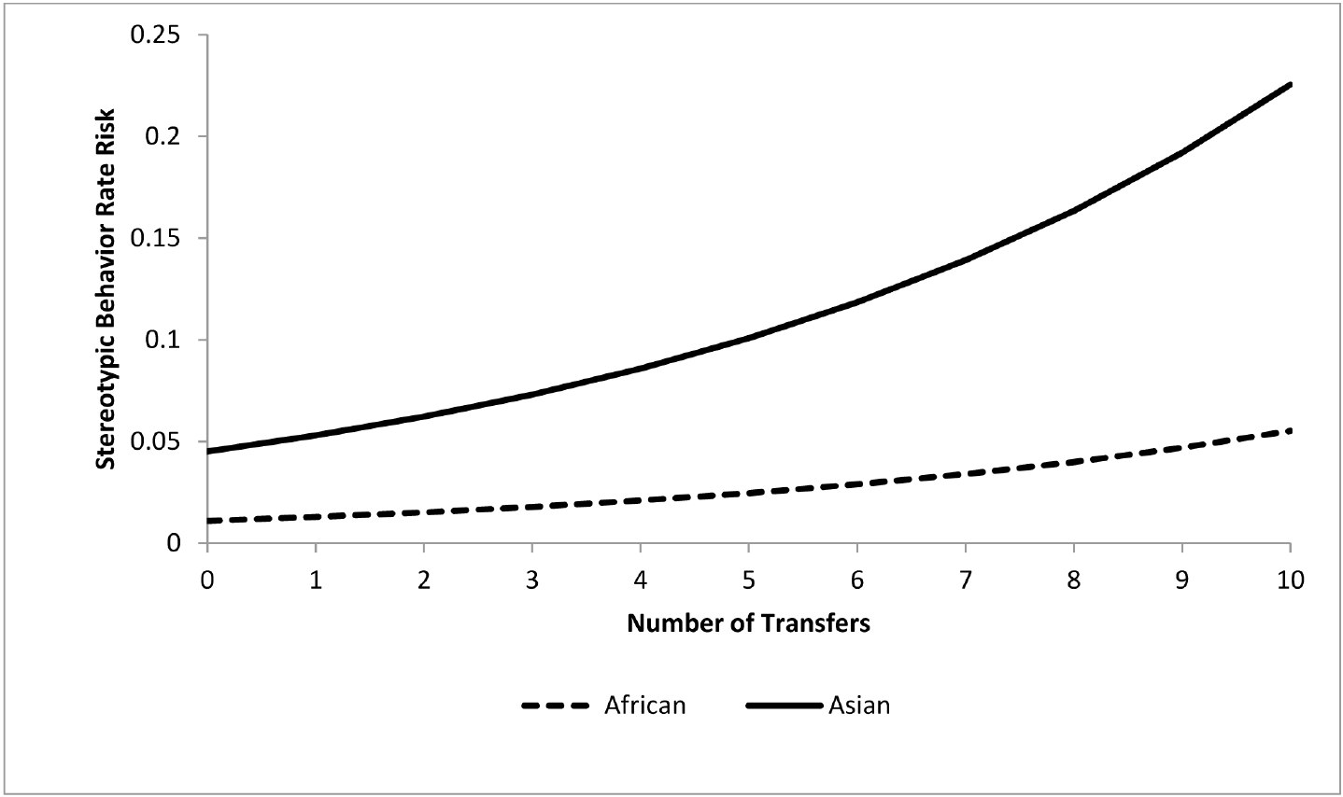
Transfer history is associated with repetitive behavior
A transfer moves an elephant between institutions and can coincide with changes in familiar partners, keepers, routines, and surroundings. Greco and colleagues used recorded lifetime transfer histories rather than inferring them from the animal’s current behavior.
More transfers were associated with greater daytime stereotypy risk; the model estimated approximately an eighteen-percent increase in its risk measure per additional transfer. A related association also appeared in the nighttime model, supporting consideration of life history in current welfare assessment.
The analysis does not isolate separation distress from transport, age, selection for transfer, or earlier environments. It also does not establish that every transfer worsens welfare: relocation can provide improved conditions. The evidence identifies a risk association that should inform prospective planning and monitoring, without diagnosing trauma from transfer count alone.
Greco (2016), Fig. 10. Modeled association with transfers.
Photo: African elephant.
Greco et al. (2016)
09
Notes:
• A transfer moves an elephant between institutions and can coincide with changes in familiar partners, keepers, routines, and surroundings. Greco and colleagues used recorded lifetime transfer histories rather than inferring them from the animal’s current behavior.
• More transfers were associated with greater daytime stereotypy risk; the model estimated approximately an eighteen-percent increase in its risk measure per additional transfer. A related association also appeared in the nighttime model, supporting consideration of life history in current welfare assessment.
• The analysis does not isolate separation distress from transport, age, selection for transfer, or earlier environments. It also does not establish that every transfer worsens welfare: relocation can provide improved conditions. The evidence identifies a risk association that should inform prospective planning and monitoring, without diagnosing trauma from transfer count alone.
References:
Brian J. Greco, Cheryl L. Meehan, Jen N. Hogan, Katherine A. Leighty, Jill Mellen, Georgia J. Mason, Joy A. Mench (2016). The Days and Nights of Zoo Elephants: Using Epidemiology to Better Understand Stereotypic Behavior of African Elephants (Loxodonta africana) and Asian Elephants (Elephas maximus) in North American Zoos. PLOS ONE 11: e0144276. https://doi.org/10.1371/journal.pone.0144276
Figure: Greco (2016), Fig. 10. Modeled association with transfers.
Figure source: https://doi.org/10.1371/journal.pone.0144276
Image: Photo: African elephant. Credit: Bijay Chaurasia. License: CC BY-SA 4.0. Source: https://commons.wikimedia.org/wiki/File:African_Elephant_at_Amboseli_National_Park-070A5584.jpg

Slide 10
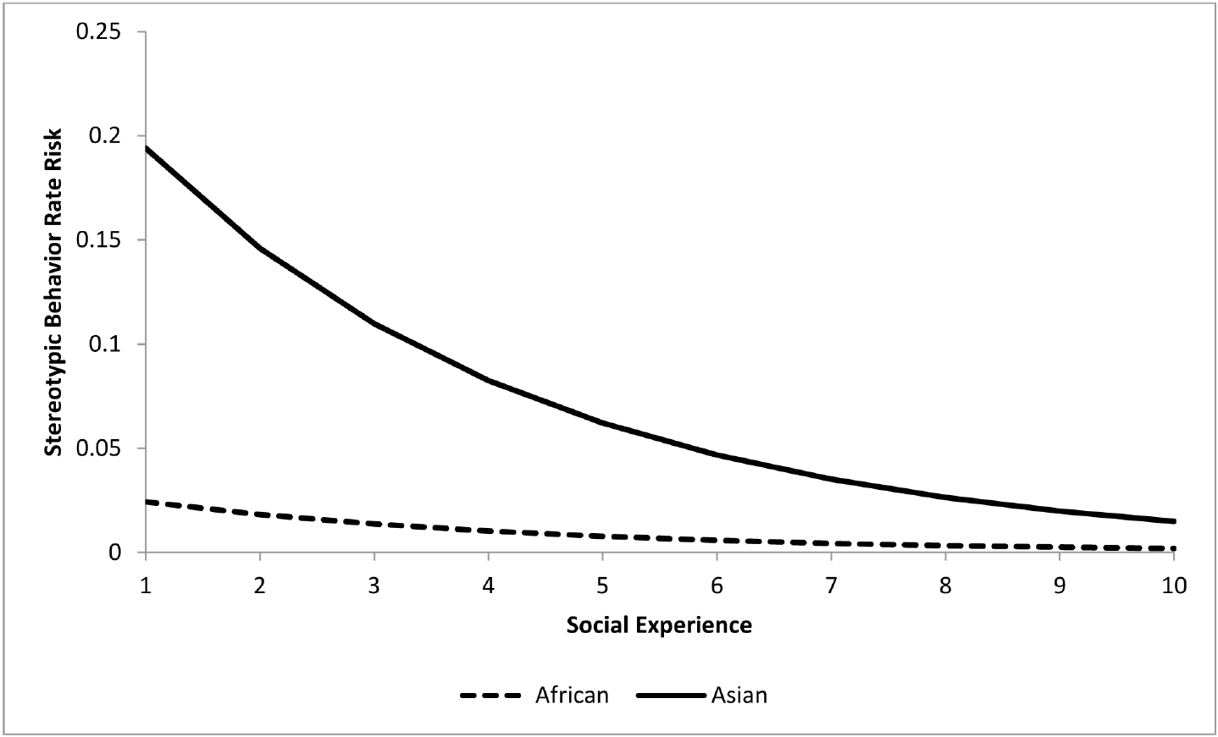
Social experience predicts nighttime behavior
Greco and colleagues constructed a social experience score from time spent with different numbers of conspecific companions. A conspecific is another member of the same species; the score therefore describes opportunities for elephant social contact rather than human interaction.
Higher nighttime social experience was associated with lower modeled stereotypy risk. Each additional unit of the score corresponded to approximately a twenty-five-percent reduction in the model’s risk measure, with the other retained exposures held constant.
A numerical exposure score cannot establish the quality of every relationship. Affiliation, aggression, kinship, and the ability to withdraw may differ among groups with similar scores. The finding supports attention to nighttime social conditions while leaving relationship quality and the mechanism linking contact to repetitive behavior unresolved.
Greco (2016), Fig. 11. Modeled association with social experience.
Greco et al. (2016)
10
Notes:
• Greco and colleagues constructed a social experience score from time spent with different numbers of conspecific companions. A conspecific is another member of the same species; the score therefore describes opportunities for elephant social contact rather than human interaction.
• Higher nighttime social experience was associated with lower modeled stereotypy risk. Each additional unit of the score corresponded to approximately a twenty-five-percent reduction in the model’s risk measure, with the other retained exposures held constant.
• A numerical exposure score cannot establish the quality of every relationship. Affiliation, aggression, kinship, and the ability to withdraw may differ among groups with similar scores. The finding supports attention to nighttime social conditions while leaving relationship quality and the mechanism linking contact to repetitive behavior unresolved.
References:
Brian J. Greco, Cheryl L. Meehan, Jen N. Hogan, Katherine A. Leighty, Jill Mellen, Georgia J. Mason, Joy A. Mench (2016). The Days and Nights of Zoo Elephants: Using Epidemiology to Better Understand Stereotypic Behavior of African Elephants (Loxodonta africana) and Asian Elephants (Elephas maximus) in North American Zoos. PLOS ONE 11: e0144276. https://doi.org/10.1371/journal.pone.0144276
Figure: Greco (2016), Fig. 11. Modeled association with social experience.
Figure source: https://doi.org/10.1371/journal.pone.0144276

Slide 11
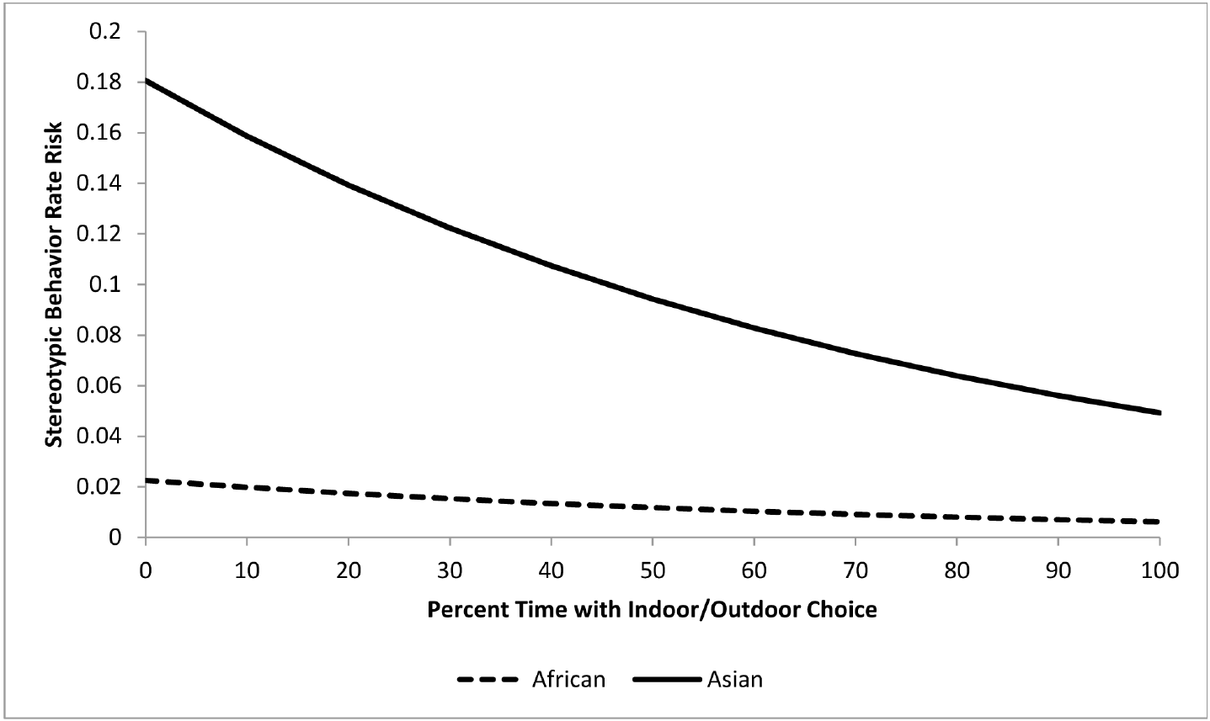
Indoor–outdoor choice has a distinct nighttime association
Choice in this study meant access to indoor and outdoor areas rather than being assigned exclusively to one location. Greco and colleagues recorded the proportion of nighttime during which elephants could move between these environments.
Greater indoor–outdoor choice was associated with lower nighttime stereotypy risk. An additional ten percentage points of choice time corresponded to approximately a thirteen-percent reduction in the published model’s risk measure, after considering social experience and transfer history.
This is an association with an operational opportunity, not a direct measurement of perceived control. Climate, space, resources, and management may differ alongside access. The result supports evaluating available options as part of welfare assessment while avoiding the unsupported claim that access alone repairs a particular neural pathway or guarantees good welfare.
Greco (2016), Fig. 12. Modeled association with indoor–outdoor choice.
Photo: African elephant.
Greco et al. (2016)
11
Notes:
• Choice in this study meant access to indoor and outdoor areas rather than being assigned exclusively to one location. Greco and colleagues recorded the proportion of nighttime during which elephants could move between these environments.
• Greater indoor–outdoor choice was associated with lower nighttime stereotypy risk. An additional ten percentage points of choice time corresponded to approximately a thirteen-percent reduction in the published model’s risk measure, after considering social experience and transfer history.
• This is an association with an operational opportunity, not a direct measurement of perceived control. Climate, space, resources, and management may differ alongside access. The result supports evaluating available options as part of welfare assessment while avoiding the unsupported claim that access alone repairs a particular neural pathway or guarantees good welfare.
References:
Brian J. Greco, Cheryl L. Meehan, Jen N. Hogan, Katherine A. Leighty, Jill Mellen, Georgia J. Mason, Joy A. Mench (2016). The Days and Nights of Zoo Elephants: Using Epidemiology to Better Understand Stereotypic Behavior of African Elephants (Loxodonta africana) and Asian Elephants (Elephas maximus) in North American Zoos. PLOS ONE 11: e0144276. https://doi.org/10.1371/journal.pone.0144276
Figure: Greco (2016), Fig. 12. Modeled association with indoor–outdoor choice.
Figure source: https://doi.org/10.1371/journal.pone.0144276
Image: Photo: African elephant. Credit: Bijay Chaurasia. License: CC BY-SA 4.0. Source: https://commons.wikimedia.org/wiki/File:African_Elephant_at_Amboseli_National_Park-070A5584.jpg

Slide 12
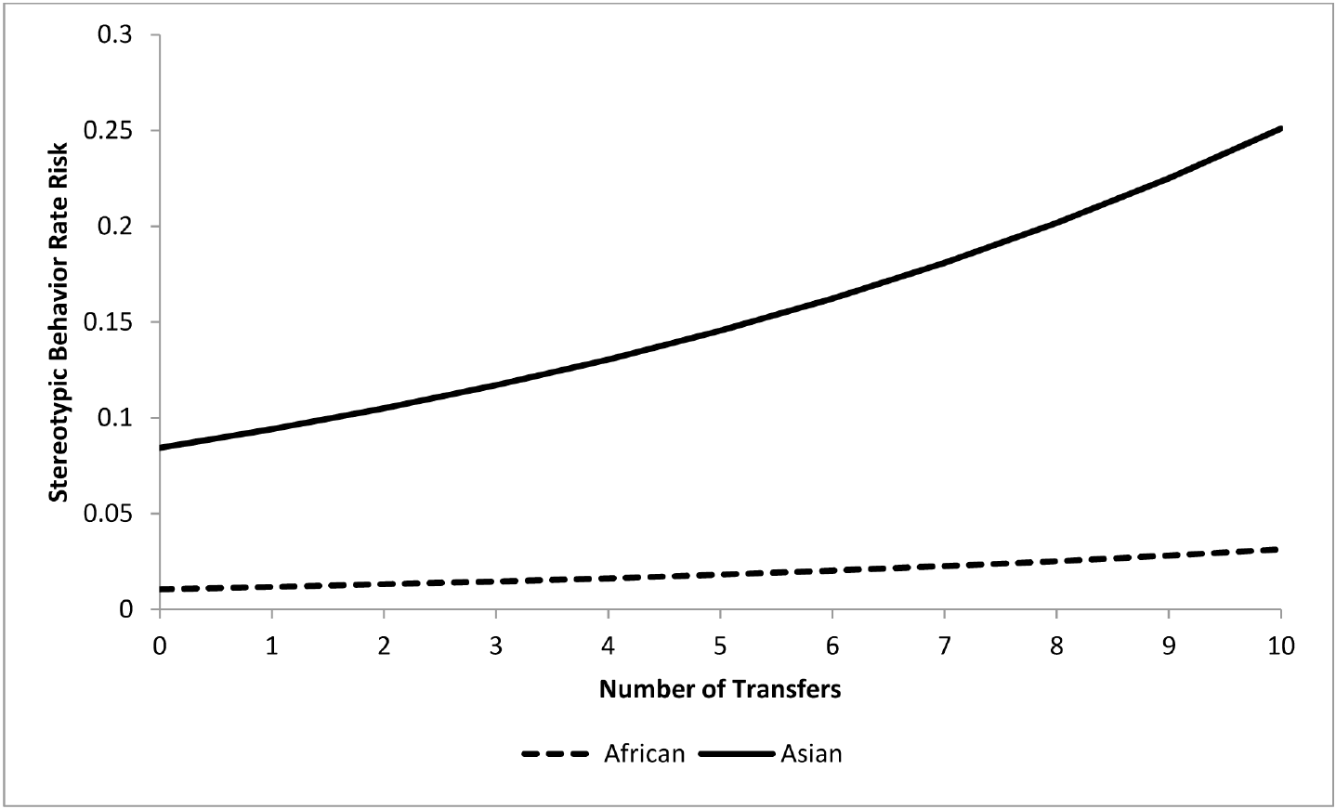
Day and night models retain different environmental terms
The daytime and nighttime analyses did not retain identical combinations of exposures. Daytime associations included separate housing, juvenile contact, and managed activity, while nighttime associations included social experience and indoor–outdoor choice.
Transfer history was associated with stereotypy in both periods. The nighttime model estimated approximately a twelve-percent increase in its risk measure per additional transfer, compared with the somewhat larger daytime estimate.
These models describe outcomes under different observed conditions rather than identifying two separate disease mechanisms. Housing schedules and opportunities for contact differ across the day. A management change should therefore be evaluated throughout the full daily cycle, with the understanding that correlated environmental variables and unmeasured history limit causal interpretation.
Greco (2016), Fig. 13. Nighttime transfer association.
Greco et al. (2016)
12
Notes:
• The daytime and nighttime analyses did not retain identical combinations of exposures. Daytime associations included separate housing, juvenile contact, and managed activity, while nighttime associations included social experience and indoor–outdoor choice.
• Transfer history was associated with stereotypy in both periods. The nighttime model estimated approximately a twelve-percent increase in its risk measure per additional transfer, compared with the somewhat larger daytime estimate.
• These models describe outcomes under different observed conditions rather than identifying two separate disease mechanisms. Housing schedules and opportunities for contact differ across the day. A management change should therefore be evaluated throughout the full daily cycle, with the understanding that correlated environmental variables and unmeasured history limit causal interpretation.
References:
Brian J. Greco, Cheryl L. Meehan, Jen N. Hogan, Katherine A. Leighty, Jill Mellen, Georgia J. Mason, Joy A. Mench (2016). The Days and Nights of Zoo Elephants: Using Epidemiology to Better Understand Stereotypic Behavior of African Elephants (Loxodonta africana) and Asian Elephants (Elephas maximus) in North American Zoos. PLOS ONE 11: e0144276. https://doi.org/10.1371/journal.pone.0144276
Figure: Greco (2016), Fig. 13. Nighttime transfer association.
Figure source: https://doi.org/10.1371/journal.pone.0144276

Slide 13
Population associations do not diagnose an individual
Greco and colleagues documented a broad range of individual stereotypy rates while estimating associations across the studied population. A population association identifies a tendency under measured conditions; it does not determine the cause of one elephant’s behavior.
Management decisions can use that evidence to identify exposures worth assessing, including separation and transfer history. Repeated observation of the same individual can determine whether a proposed change is followed by altered activity, social contact, or repetitive behavior.
Neuroethics concerns ethical questions involving nervous systems, behavior, and mental experience. The empirical finding supplies evidence about a potential harm; deciding what restrictions are justified also requires an explicit ethical judgment. A risk model cannot by itself establish a psychiatric diagnosis, a moral ranking of animals, or the acceptability of every captive environment.
Greco (2016), Fig. 5. Individual daytime stereotypy rates.
Greco et al. (2016)
13
Notes:
• Greco and colleagues documented a broad range of individual stereotypy rates while estimating associations across the studied population. A population association identifies a tendency under measured conditions; it does not determine the cause of one elephant’s behavior.
• Management decisions can use that evidence to identify exposures worth assessing, including separation and transfer history. Repeated observation of the same individual can determine whether a proposed change is followed by altered activity, social contact, or repetitive behavior.
• Neuroethics concerns ethical questions involving nervous systems, behavior, and mental experience. The empirical finding supplies evidence about a potential harm; deciding what restrictions are justified also requires an explicit ethical judgment. A risk model cannot by itself establish a psychiatric diagnosis, a moral ranking of animals, or the acceptability of every captive environment.
References:
Brian J. Greco, Cheryl L. Meehan, Jen N. Hogan, Katherine A. Leighty, Jill Mellen, Georgia J. Mason, Joy A. Mench (2016). The Days and Nights of Zoo Elephants: Using Epidemiology to Better Understand Stereotypic Behavior of African Elephants (Loxodonta africana) and Asian Elephants (Elephas maximus) in North American Zoos. PLOS ONE 11: e0144276. https://doi.org/10.1371/journal.pone.0144276
Figure: Greco (2016), Fig. 5. Individual daytime stereotypy rates.
Figure source: https://doi.org/10.1371/journal.pone.0144276

Slide 14
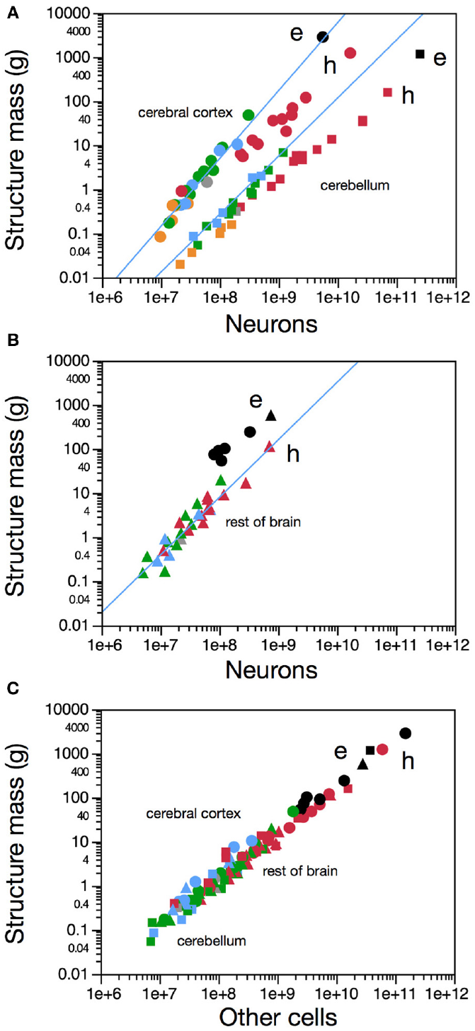
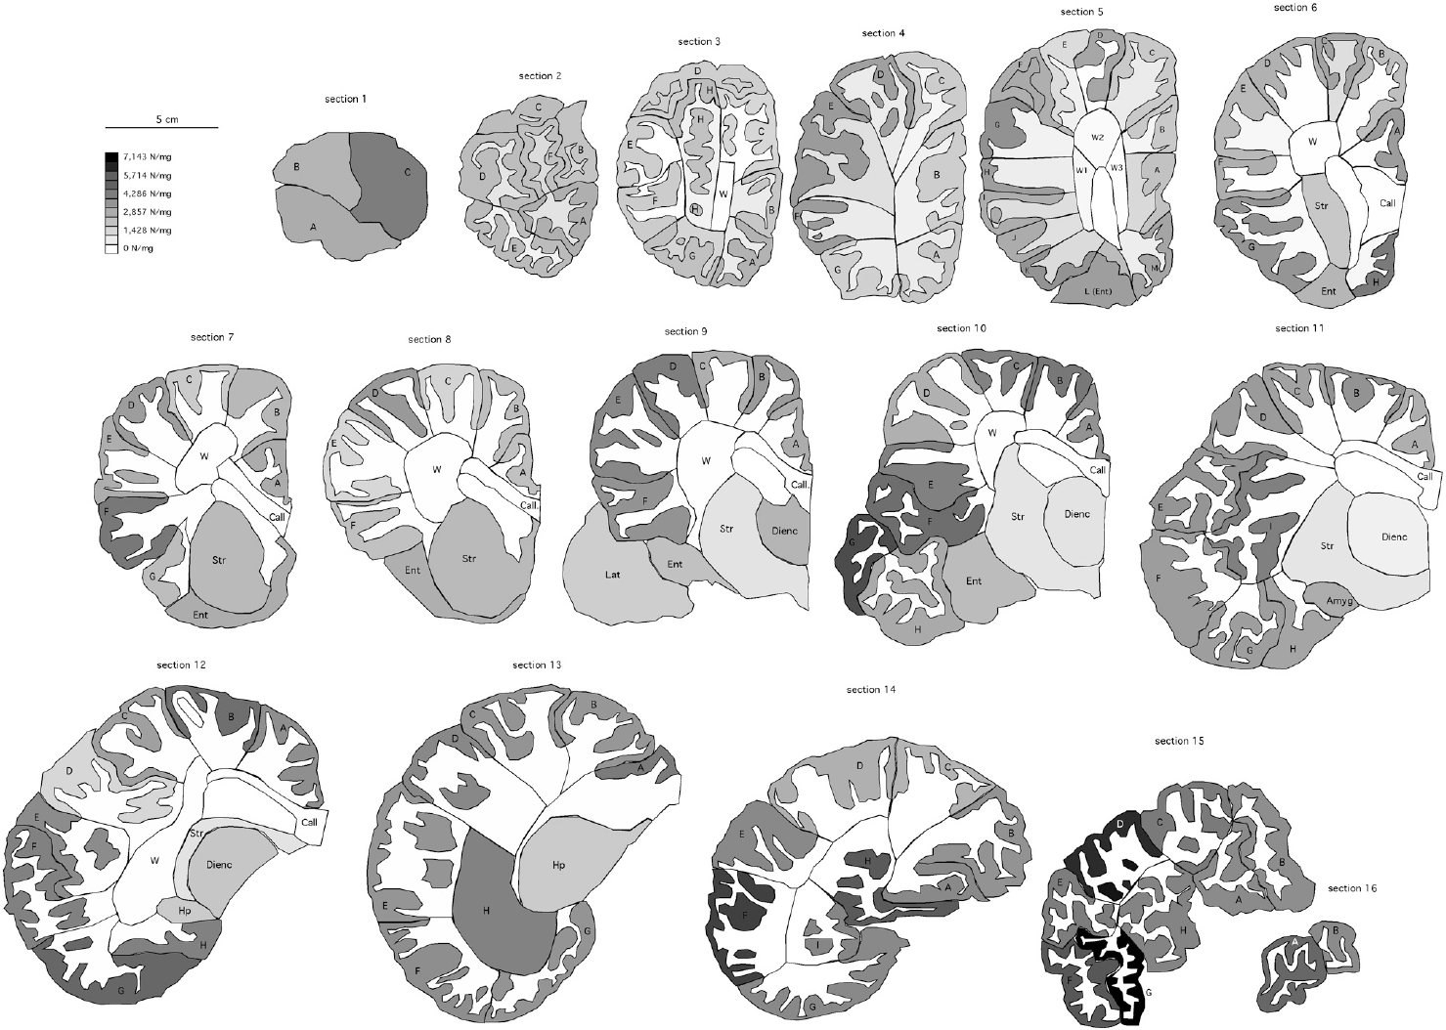
Brain mass and neuron number are separate measurements
Herculano-Houzel and colleagues measured the cellular composition of an African elephant brain. A neuron is a specialized cell that receives and transmits neural signals; total brain mass includes neurons, other cells, fibers, and extracellular components.
The sampled brain weighed approximately 4.6 kilograms and contained about 257 billion neurons. The investigators compared regional cell counts with previously measured mammalian species, rather than equating a larger mass directly with a larger cerebral-cortex neuron population.
The preparation was anatomical tissue, not a comparison of captive and wild elephants before and after an intervention. Its counts establish structural composition under the study’s methods. They do not measure the animal’s subjective experience, determine cognitive ability from mass alone, or establish that captivity altered its neuronal population.
Herculano-Houzel (2014), Fig. 1(A–C). Regional mass and cell-count scaling.
Herculano-Houzel (2014), Fig. 4. Original cortical sections and density map.
Herculano-Houzel et al. (2014)
14
Notes:
• Herculano-Houzel and colleagues measured the cellular composition of an African elephant brain. A neuron is a specialized cell that receives and transmits neural signals; total brain mass includes neurons, other cells, fibers, and extracellular components.
• The sampled brain weighed approximately 4.6 kilograms and contained about 257 billion neurons. The investigators compared regional cell counts with previously measured mammalian species, rather than equating a larger mass directly with a larger cerebral-cortex neuron population.
• The preparation was anatomical tissue, not a comparison of captive and wild elephants before and after an intervention. Its counts establish structural composition under the study’s methods. They do not measure the animal’s subjective experience, determine cognitive ability from mass alone, or establish that captivity altered its neuronal population.
References:
Suzana Herculano-Houzel, Kamilla Avelino-de-Souza, Kleber Neves, Jairo Porfírio, Débora Messeder, Larissa Mattos Feijó, José Maldonado, Paul R. Manger (2014). The elephant brain in numbers. Frontiers in Neuroanatomy 8: 46. https://doi.org/10.3389/fnana.2014.00046
Figure: Herculano-Houzel (2014), Fig. 1(A–C). Regional mass and cell-count scaling.
Figure source: https://doi.org/10.3389/fnana.2014.00046
Figure: Herculano-Houzel (2014), Fig. 4. Original cortical sections and density map.
Figure source: https://doi.org/10.3389/fnana.2014.00046

Slide 15
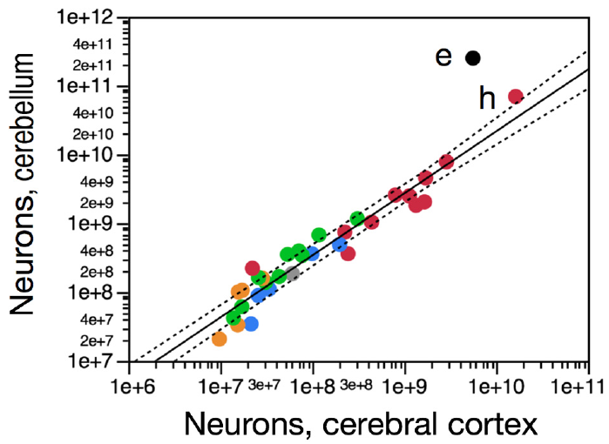
Cerebellar neurons dominate the sampled elephant brain
The cerebellum is a major brain division involved in coordinating neural processing, including sensorimotor functions. Herculano-Houzel and colleagues found approximately 251 billion neurons in the sampled elephant cerebellum, accounting for about ninety-eight percent of total brain neurons.
The cerebellar-to-cortical neuron ratio was approximately an order of magnitude greater than the relationship reported across the comparison mammals. This unusual regional distribution distinguishes total neuron number from the number located in cerebral cortex.
The authors proposed a possible relationship with elephant sensorimotor specialization, but did not record activity during trunk behavior or manipulate cerebellar circuits. The proposal remains separate from the measured cell counts. Neither a high cerebellar count nor the comparative ratio establishes a neural explanation for stereotypy or captivity-related distress.
Herculano-Houzel (2014), Fig. 5. Cerebellar and cortical neuron-number comparison.
Herculano-Houzel (2014), Fig. 4. Original cortical sections and density map.
Herculano-Houzel et al. (2014)
15
Notes:
• The cerebellum is a major brain division involved in coordinating neural processing, including sensorimotor functions. Herculano-Houzel and colleagues found approximately 251 billion neurons in the sampled elephant cerebellum, accounting for about ninety-eight percent of total brain neurons.
• The cerebellar-to-cortical neuron ratio was approximately an order of magnitude greater than the relationship reported across the comparison mammals. This unusual regional distribution distinguishes total neuron number from the number located in cerebral cortex.
• The authors proposed a possible relationship with elephant sensorimotor specialization, but did not record activity during trunk behavior or manipulate cerebellar circuits. The proposal remains separate from the measured cell counts. Neither a high cerebellar count nor the comparative ratio establishes a neural explanation for stereotypy or captivity-related distress.
References:
Suzana Herculano-Houzel, Kamilla Avelino-de-Souza, Kleber Neves, Jairo Porfírio, Débora Messeder, Larissa Mattos Feijó, José Maldonado, Paul R. Manger (2014). The elephant brain in numbers. Frontiers in Neuroanatomy 8: 46. https://doi.org/10.3389/fnana.2014.00046
Figure: Herculano-Houzel (2014), Fig. 5. Cerebellar and cortical neuron-number comparison.
Figure source: https://doi.org/10.3389/fnana.2014.00046
Figure: Herculano-Houzel (2014), Fig. 4. Original cortical sections and density map.
Figure source: https://doi.org/10.3389/fnana.2014.00046

Slide 16
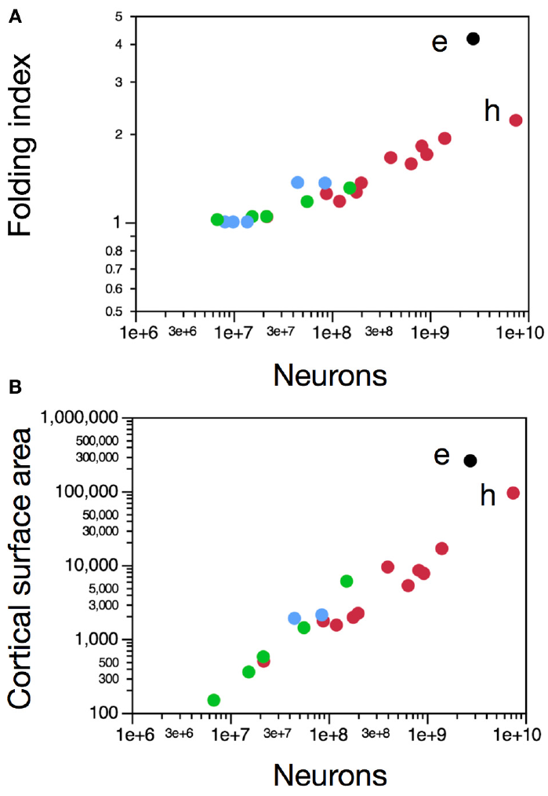
Cortical folding does not directly count neurons
The cerebral cortex is the folded outer gray-matter sheet of the cerebral hemispheres. Herculano-Houzel and colleagues measured cortical surface area, folding, and cellular composition, permitting these anatomical quantities to be compared independently.
The sampled cortex had approximately 5.6 billion neurons despite a cortical mass exceeding that of the human comparison. Its folding index was approximately 4.2, and neurons were distributed over a comparatively large cortical surface.
More folding therefore did not imply more cortical neurons than the human reference. This comparison does not rank the moral significance of species or measure an elephant’s social experience. Structural organization can constrain a biological account, while claims about captivity-induced cortical change require an exposure comparison that this study did not provide.
Herculano-Houzel (2014), Fig. 2(A–B). Cortical folding and surface area comparisons.
Herculano-Houzel (2014), Fig. 4. Original cortical sections and density map.
Herculano-Houzel et al. (2014)
16
Notes:
• The cerebral cortex is the folded outer gray-matter sheet of the cerebral hemispheres. Herculano-Houzel and colleagues measured cortical surface area, folding, and cellular composition, permitting these anatomical quantities to be compared independently.
• The sampled cortex had approximately 5.6 billion neurons despite a cortical mass exceeding that of the human comparison. Its folding index was approximately 4.2, and neurons were distributed over a comparatively large cortical surface.
• More folding therefore did not imply more cortical neurons than the human reference. This comparison does not rank the moral significance of species or measure an elephant’s social experience. Structural organization can constrain a biological account, while claims about captivity-induced cortical change require an exposure comparison that this study did not provide.
References:
Suzana Herculano-Houzel, Kamilla Avelino-de-Souza, Kleber Neves, Jairo Porfírio, Débora Messeder, Larissa Mattos Feijó, José Maldonado, Paul R. Manger (2014). The elephant brain in numbers. Frontiers in Neuroanatomy 8: 46. https://doi.org/10.3389/fnana.2014.00046
Figure: Herculano-Houzel (2014), Fig. 2(A–B). Cortical folding and surface area comparisons.
Figure source: https://doi.org/10.3389/fnana.2014.00046
Figure: Herculano-Houzel (2014), Fig. 4. Original cortical sections and density map.
Figure source: https://doi.org/10.3389/fnana.2014.00046

Slide 17
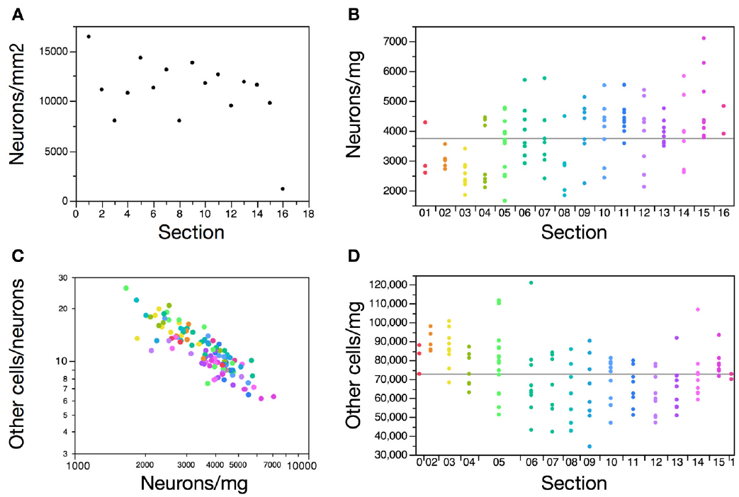
Cortical tissue contains regional density differences
Neuronal density is the number of neurons within a specified amount of tissue. Herculano-Houzel and colleagues sampled cortical sections along the anterior–posterior axis, from the front toward the back of the hemisphere.
Anterior cortical sections had lower neuronal densities than much of the remaining cortex. The number of neurons beneath a unit of cortical surface also varied, so a uniform density assumption would not adequately describe the entire sampled hemisphere.
The investigators measured tissue composition rather than electrical activity or behavior during captivity. A regional difference can reflect normal anatomical organization; it is not evidence of a lesion. Assigning the distribution to stress, deprivation, or a particular behavioral pathology would require additional histological and exposure-controlled evidence.
Herculano-Houzel (2014), Fig. 3(A–D). Anterior–posterior cortical cell distributions.
Herculano-Houzel (2014), Fig. 4. Original cortical sections and density map.
Herculano-Houzel et al. (2014)
17
Notes:
• Neuronal density is the number of neurons within a specified amount of tissue. Herculano-Houzel and colleagues sampled cortical sections along the anterior–posterior axis, from the front toward the back of the hemisphere.
• Anterior cortical sections had lower neuronal densities than much of the remaining cortex. The number of neurons beneath a unit of cortical surface also varied, so a uniform density assumption would not adequately describe the entire sampled hemisphere.
• The investigators measured tissue composition rather than electrical activity or behavior during captivity. A regional difference can reflect normal anatomical organization; it is not evidence of a lesion. Assigning the distribution to stress, deprivation, or a particular behavioral pathology would require additional histological and exposure-controlled evidence.
References:
Suzana Herculano-Houzel, Kamilla Avelino-de-Souza, Kleber Neves, Jairo Porfírio, Débora Messeder, Larissa Mattos Feijó, José Maldonado, Paul R. Manger (2014). The elephant brain in numbers. Frontiers in Neuroanatomy 8: 46. https://doi.org/10.3389/fnana.2014.00046
Figure: Herculano-Houzel (2014), Fig. 3(A–D). Anterior–posterior cortical cell distributions.
Figure source: https://doi.org/10.3389/fnana.2014.00046
Figure: Herculano-Houzel (2014), Fig. 4. Original cortical sections and density map.
Figure source: https://doi.org/10.3389/fnana.2014.00046

Slide 18
Density maps preserve anatomical measurement boundaries
Herculano-Houzel and colleagues reconstructed cortical sections and mapped their measured neuronal densities. The original sections provide anatomical context for the cell-count results, while the displayed density scale reports the quantity measured in the study.
An isotropic fractionator estimates cell numbers after tissue is dissociated into a suspension of nuclei. Neuron-associated labeling distinguishes neuronal nuclei from the total nuclear population; repeated sampling is used to estimate the proportion identified as neuronal.
Dissociation supports quantitative counting but removes the intact connections among the original cells. Consequently, this preparation cannot establish synaptic strength, transmitter release, receptor function, or which neurons were active during repetitive behavior. The anatomical map and counting method should not be mistaken for a functional scan of the elephant’s mental state.
Herculano-Houzel (2014), Fig. 4. Original cortical sections and density map.
Herculano-Houzel et al. (2014)
18
Notes:
• Herculano-Houzel and colleagues reconstructed cortical sections and mapped their measured neuronal densities. The original sections provide anatomical context for the cell-count results, while the displayed density scale reports the quantity measured in the study.
• An isotropic fractionator estimates cell numbers after tissue is dissociated into a suspension of nuclei. Neuron-associated labeling distinguishes neuronal nuclei from the total nuclear population; repeated sampling is used to estimate the proportion identified as neuronal.
• Dissociation supports quantitative counting but removes the intact connections among the original cells. Consequently, this preparation cannot establish synaptic strength, transmitter release, receptor function, or which neurons were active during repetitive behavior. The anatomical map and counting method should not be mistaken for a functional scan of the elephant’s mental state.
References:
Suzana Herculano-Houzel, Kamilla Avelino-de-Souza, Kleber Neves, Jairo Porfírio, Débora Messeder, Larissa Mattos Feijó, José Maldonado, Paul R. Manger (2014). The elephant brain in numbers. Frontiers in Neuroanatomy 8: 46. https://doi.org/10.3389/fnana.2014.00046
Figure: Herculano-Houzel (2014), Fig. 4. Original cortical sections and density map.
Figure source: https://doi.org/10.3389/fnana.2014.00046

Slide 19
Anatomical counts cannot establish captivity-induced injury
The elephant cell-count study provides regional anatomy and comparisons with other mammals. It does not include a matched captive-versus-wild exposure experiment or a longitudinal neural measurement before and after changes in housing.
A claim of captivity-induced neural injury requires evidence that an exposure changed neural tissue or function, with alternatives such as age, disease, and individual history addressed. Differences among species in cortical and cerebellar neuron counts answer a different question.
The lack of such an experiment does not establish that captivity has no neural effects. It limits the mechanism that can be asserted from these particular data. Ethical concern can be supported by behavioral or physiological evidence without presenting unmeasured neuron loss, receptor changes, or a human psychiatric diagnosis as an established elephant finding.
Herculano-Houzel (2014), Fig. 1(A–C). Regional mass and cell-count scaling.
Herculano-Houzel (2014), Fig. 4. Original cortical sections and density map.
Herculano-Houzel et al. (2014)
19
Notes:
• The elephant cell-count study provides regional anatomy and comparisons with other mammals. It does not include a matched captive-versus-wild exposure experiment or a longitudinal neural measurement before and after changes in housing.
• A claim of captivity-induced neural injury requires evidence that an exposure changed neural tissue or function, with alternatives such as age, disease, and individual history addressed. Differences among species in cortical and cerebellar neuron counts answer a different question.
• The lack of such an experiment does not establish that captivity has no neural effects. It limits the mechanism that can be asserted from these particular data. Ethical concern can be supported by behavioral or physiological evidence without presenting unmeasured neuron loss, receptor changes, or a human psychiatric diagnosis as an established elephant finding.
References:
Suzana Herculano-Houzel, Kamilla Avelino-de-Souza, Kleber Neves, Jairo Porfírio, Débora Messeder, Larissa Mattos Feijó, José Maldonado, Paul R. Manger (2014). The elephant brain in numbers. Frontiers in Neuroanatomy 8: 46. https://doi.org/10.3389/fnana.2014.00046
Figure: Herculano-Houzel (2014), Fig. 1(A–C). Regional mass and cell-count scaling.
Figure source: https://doi.org/10.3389/fnana.2014.00046
Figure: Herculano-Houzel (2014), Fig. 4. Original cortical sections and density map.
Figure source: https://doi.org/10.3389/fnana.2014.00046

Slide 20
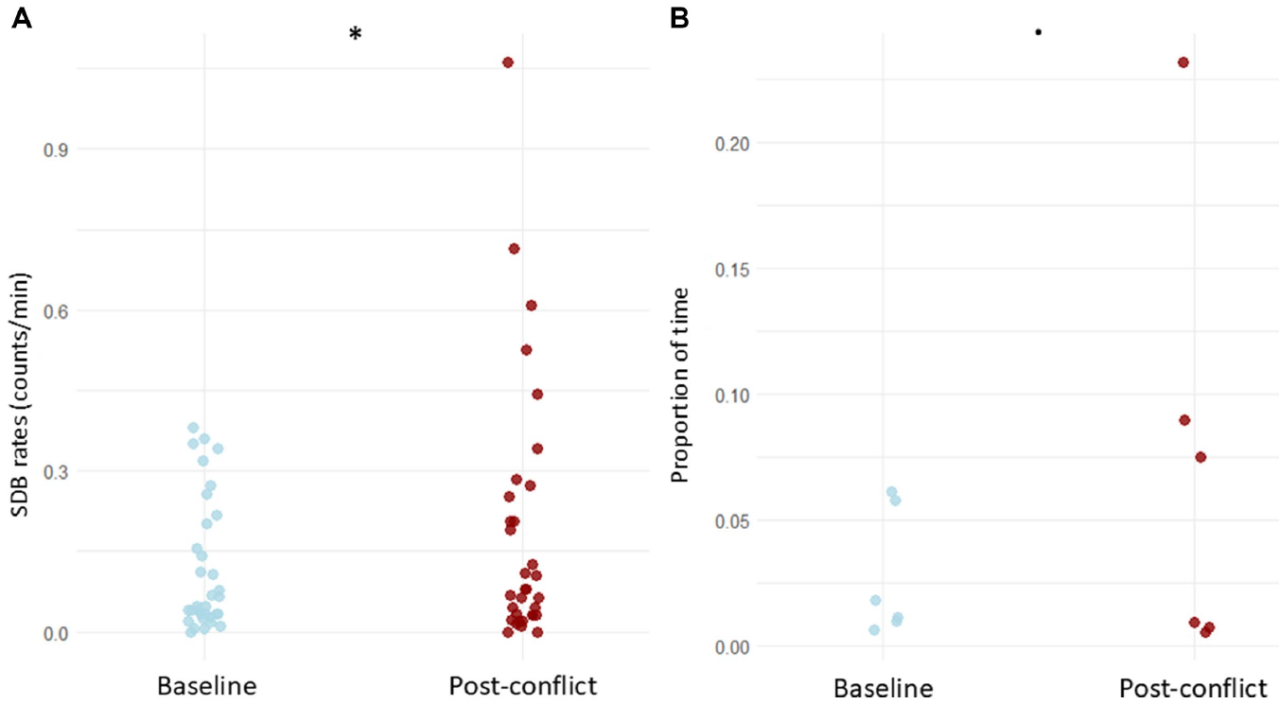
Self-directed behavior increases after social conflict
Self-directed behaviors are actions directed toward the animal’s own body, including mouth touching and head shaking. Vilela and colleagues compared these behaviors in captive Asian elephants during baseline observation and after recipients experienced aggression.
Focal recording continued for ten minutes after a conflict. Expected counts of self-directed behaviors were approximately forty percent greater in the post-conflict context than in the corresponding baseline, with the comparison matched to the relevant social condition.
The result supports a context-sensitive behavioral indicator of social stress. It does not mean that every dust bath or head shake expresses anxiety; the inference comes from the change following a recorded event. No receptor assay or brain recording was used to identify the neural mechanism underlying that change.
Vilela (2025), Fig. 1(A–B). Baseline and post-conflict self-directed behavior.
Vilela et al. (2025)
20
Notes:
• Self-directed behaviors are actions directed toward the animal’s own body, including mouth touching and head shaking. Vilela and colleagues compared these behaviors in captive Asian elephants during baseline observation and after recipients experienced aggression.
• Focal recording continued for ten minutes after a conflict. Expected counts of self-directed behaviors were approximately forty percent greater in the post-conflict context than in the corresponding baseline, with the comparison matched to the relevant social condition.
• The result supports a context-sensitive behavioral indicator of social stress. It does not mean that every dust bath or head shake expresses anxiety; the inference comes from the change following a recorded event. No receptor assay or brain recording was used to identify the neural mechanism underlying that change.
References:
Sofia Vilela, Peini Chen, So Murakami, Yusuke Tanabe, Shinya Yamamoto (2025). Self-directed behavior reflects social stress in captive Asian elephants. Frontiers in Veterinary Science 12: 1629664. https://doi.org/10.3389/fvets.2025.1629664
Figure: Vilela (2025), Fig. 1(A–B). Baseline and post-conflict self-directed behavior.
Figure source: https://doi.org/10.3389/fvets.2025.1629664

Slide 21
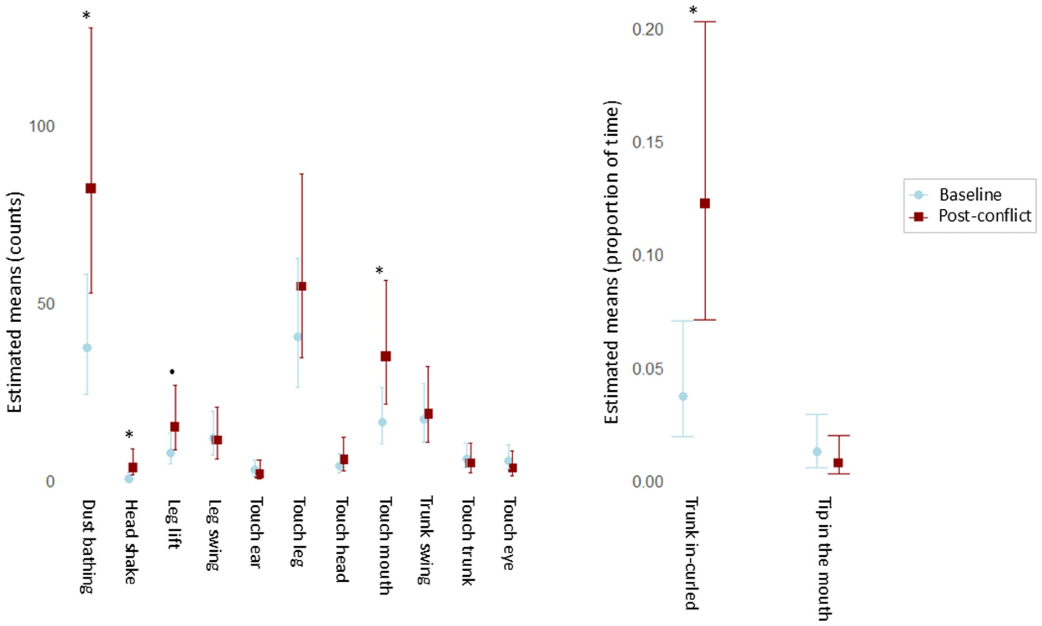
Different self-directed actions have different responses
Vilela and colleagues distinguished brief self-directed events from behaviors measured as durations. Events were counted relative to observation time, whereas sustained postures were expressed as the proportion of time occupied by the behavior.
Mouth touching, head shaking, and dust bathing showed prominent post-conflict changes among the recorded events. Holding the trunk curled inward also changed after aggression, while several other scored actions did not display the same response.
Pooling all movements without these definitions would conceal differences among actions and measurement scales. The findings concern changes within the observed social context, not a diagnostic checklist that can classify every elephant from one gesture. Environmental conditions and the individual baseline remain necessary for interpreting the recorded behavior.
Vilela (2025), Fig. 2(A–B). Behavior-specific post-conflict comparisons.
Vilela et al. (2025)
21
Notes:
• Vilela and colleagues distinguished brief self-directed events from behaviors measured as durations. Events were counted relative to observation time, whereas sustained postures were expressed as the proportion of time occupied by the behavior.
• Mouth touching, head shaking, and dust bathing showed prominent post-conflict changes among the recorded events. Holding the trunk curled inward also changed after aggression, while several other scored actions did not display the same response.
• Pooling all movements without these definitions would conceal differences among actions and measurement scales. The findings concern changes within the observed social context, not a diagnostic checklist that can classify every elephant from one gesture. Environmental conditions and the individual baseline remain necessary for interpreting the recorded behavior.
References:
Sofia Vilela, Peini Chen, So Murakami, Yusuke Tanabe, Shinya Yamamoto (2025). Self-directed behavior reflects social stress in captive Asian elephants. Frontiers in Veterinary Science 12: 1629664. https://doi.org/10.3389/fvets.2025.1629664
Figure: Vilela (2025), Fig. 2(A–B). Behavior-specific post-conflict comparisons.
Figure source: https://doi.org/10.3389/fvets.2025.1629664

Slide 22
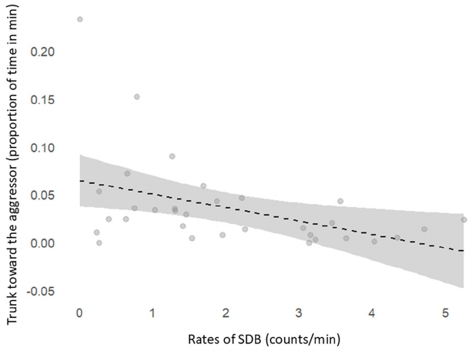
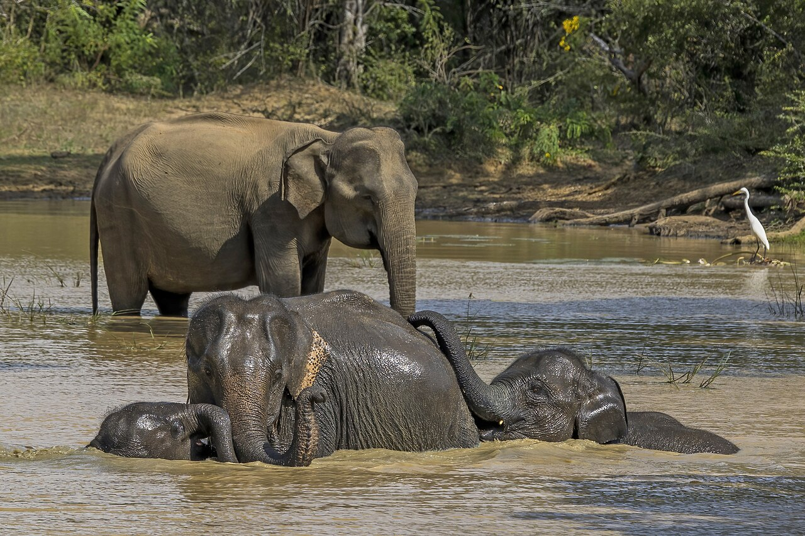
Trunk orientation can compete with self-directed activity
After aggression, Vilela and colleagues also measured how long the victim oriented its trunk toward the aggressor. This measure described attention to the other animal’s location without assuming that trunk orientation revealed a particular thought or intention.
Higher rates of self-directed events were associated with a lower proportion of time directing the trunk toward the aggressor. The relationship was recorded during post-conflict observation rather than established by experimentally changing one behavior.
The actions can reflect different responses to the same event or compete for available time. The association does not prove that self-directed behavior reduces vigilance or relieves distress. It also does not establish a specific attentional circuit, because neuronal activity and transmitter-dependent signaling were not measured in these elephants.
Vilela (2025), Fig. 3. Trunk orientation and self-directed behavior.
Photo: Asian elephant.
Vilela et al. (2025)
22
Notes:
• After aggression, Vilela and colleagues also measured how long the victim oriented its trunk toward the aggressor. This measure described attention to the other animal’s location without assuming that trunk orientation revealed a particular thought or intention.
• Higher rates of self-directed events were associated with a lower proportion of time directing the trunk toward the aggressor. The relationship was recorded during post-conflict observation rather than established by experimentally changing one behavior.
• The actions can reflect different responses to the same event or compete for available time. The association does not prove that self-directed behavior reduces vigilance or relieves distress. It also does not establish a specific attentional circuit, because neuronal activity and transmitter-dependent signaling were not measured in these elephants.
References:
Sofia Vilela, Peini Chen, So Murakami, Yusuke Tanabe, Shinya Yamamoto (2025). Self-directed behavior reflects social stress in captive Asian elephants. Frontiers in Veterinary Science 12: 1629664. https://doi.org/10.3389/fvets.2025.1629664
Figure: Vilela (2025), Fig. 3. Trunk orientation and self-directed behavior.
Figure source: https://doi.org/10.3389/fvets.2025.1629664
Image: Photo: Asian elephant. Credit: Charles J. Sharp. License: CC BY-SA 4.0. Source: https://commons.wikimedia.org/wiki/File:Sri_Lankan_elephant_(Elephas_maximus_maximus)_female_and_young_6.jpg

Slide 23
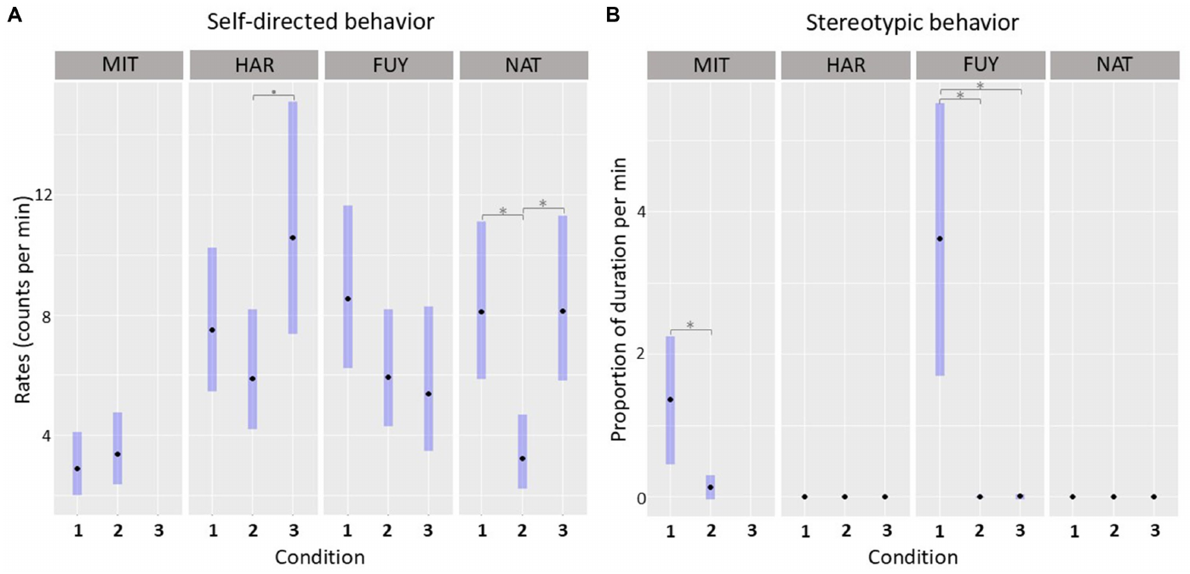
Social stress indicators do not equal stereotypy
Vilela and colleagues followed changes in social composition and aggression across different observation conditions. Baseline self-directed behavior varied among individuals, and the animal not observed receiving aggression had particularly low self-directed levels.
The measured relationship between baseline self-directed behavior and stereotypy was not a consistent correlation across the observed conditions. Stereotypy and post-conflict self-directed events therefore could not be treated as interchangeable measurements of the same behavioral state.
An acute response to aggression differs from a persistent repetitive pattern. Monitoring both can provide complementary information, while neither establishes an elephant diagnosis of post-traumatic stress disorder. That human clinical category cannot be inferred from repetitive movement or an aggression history without an independently validated species-appropriate diagnostic framework.
Vilela (2025), Fig. 4(A–B). Individual responses across social conditions.
Vilela et al. (2025)
23
Notes:
• Vilela and colleagues followed changes in social composition and aggression across different observation conditions. Baseline self-directed behavior varied among individuals, and the animal not observed receiving aggression had particularly low self-directed levels.
• The measured relationship between baseline self-directed behavior and stereotypy was not a consistent correlation across the observed conditions. Stereotypy and post-conflict self-directed events therefore could not be treated as interchangeable measurements of the same behavioral state.
• An acute response to aggression differs from a persistent repetitive pattern. Monitoring both can provide complementary information, while neither establishes an elephant diagnosis of post-traumatic stress disorder. That human clinical category cannot be inferred from repetitive movement or an aggression history without an independently validated species-appropriate diagnostic framework.
References:
Sofia Vilela, Peini Chen, So Murakami, Yusuke Tanabe, Shinya Yamamoto (2025). Self-directed behavior reflects social stress in captive Asian elephants. Frontiers in Veterinary Science 12: 1629664. https://doi.org/10.3389/fvets.2025.1629664
Figure: Vilela (2025), Fig. 4(A–B). Individual responses across social conditions.
Figure source: https://doi.org/10.3389/fvets.2025.1629664

Slide 24
Fecal metabolites reflect delayed adrenal output
Glucocorticoids are adrenal hormones associated with metabolic regulation and responses to challenge. Bansiddhi and colleagues measured fecal glucocorticoid metabolites in Asian tourist-camp elephants, providing a noninvasive measure after circulating hormones had been metabolized and excreted.
The overall reported mean was approximately fifty-three nanograms per gram of fecal material. This concentration differs in units and biological time course from serum cortisol measured in nanograms per milliliter of blood.
Excretion creates a delay between an event and the sampled fecal signal. A single concentration cannot identify the animal’s instantaneous mental state or the particular neural input responsible for secretion. The study therefore evaluated management, health, and behavior alongside hormone measurements rather than treating the hormone alone as a welfare diagnosis.
Photo: Asian elephant.
Bansiddhi et al. (2019)
24
Notes:
• Glucocorticoids are adrenal hormones associated with metabolic regulation and responses to challenge. Bansiddhi and colleagues measured fecal glucocorticoid metabolites in Asian tourist-camp elephants, providing a noninvasive measure after circulating hormones had been metabolized and excreted.
• The overall reported mean was approximately fifty-three nanograms per gram of fecal material. This concentration differs in units and biological time course from serum cortisol measured in nanograms per milliliter of blood.
• Excretion creates a delay between an event and the sampled fecal signal. A single concentration cannot identify the animal’s instantaneous mental state or the particular neural input responsible for secretion. The study therefore evaluated management, health, and behavior alongside hormone measurements rather than treating the hormone alone as a welfare diagnosis.
References:
Pakkanut Bansiddhi, Janine L. Brown, Jaruwan Khonmee, Treepradab Norkaew, Korakot Nganvongpanit, Veerasak Punyapornwithaya, Taweepoke Angkawanish, Chaleamchat Somgird, Chatchote Thitaram (2019). Management factors affecting adrenal glucocorticoid activity of tourist camp elephants in Thailand and implications for elephant welfare. PLOS ONE 14: e0221537. https://doi.org/10.1371/journal.pone.0221537
Image: Photo: Asian elephant. Credit: Charles J. Sharp. License: CC BY-SA 4.0. Source: https://commons.wikimedia.org/wiki/File:Sri_Lankan_elephant_(Elephas_maximus_maximus)_female_and_young_6.jpg

Slide 25
Adrenal activity and stereotypy need not move together
Bansiddhi and colleagues scored stereotypic behavior alongside fecal glucocorticoid metabolites in tourist-camp elephants. Animals without recorded stereotypy had higher adjusted metabolite concentrations than animals that performed stereotypy under the studied conditions.
This direction differs from a simple expectation that more repetitive behavior must accompany higher hormone output. The authors discussed a coping explanation, in which performing repetitive activity might relate to altered arousal, but did not experimentally test whether the activity reduced distress.
The observation establishes a dissociation between two proposed welfare indicators. It does not prove that stereotypy is beneficial or that low glucocorticoid concentrations guarantee good welfare. Neural mechanisms involving particular neurotransmitters, receptors, or feedback circuits remain proposed explanations rather than direct elephant measurements in this study.
Photo: Asian elephant.
Bansiddhi et al. (2019)
25
Notes:
• Bansiddhi and colleagues scored stereotypic behavior alongside fecal glucocorticoid metabolites in tourist-camp elephants. Animals without recorded stereotypy had higher adjusted metabolite concentrations than animals that performed stereotypy under the studied conditions.
• This direction differs from a simple expectation that more repetitive behavior must accompany higher hormone output. The authors discussed a coping explanation, in which performing repetitive activity might relate to altered arousal, but did not experimentally test whether the activity reduced distress.
• The observation establishes a dissociation between two proposed welfare indicators. It does not prove that stereotypy is beneficial or that low glucocorticoid concentrations guarantee good welfare. Neural mechanisms involving particular neurotransmitters, receptors, or feedback circuits remain proposed explanations rather than direct elephant measurements in this study.
References:
Pakkanut Bansiddhi, Janine L. Brown, Jaruwan Khonmee, Treepradab Norkaew, Korakot Nganvongpanit, Veerasak Punyapornwithaya, Taweepoke Angkawanish, Chaleamchat Somgird, Chatchote Thitaram (2019). Management factors affecting adrenal glucocorticoid activity of tourist camp elephants in Thailand and implications for elephant welfare. PLOS ONE 14: e0221537. https://doi.org/10.1371/journal.pone.0221537
Image: Photo: Asian elephant. Credit: Charles J. Sharp. License: CC BY-SA 4.0. Source: https://commons.wikimedia.org/wiki/File:Sri_Lankan_elephant_(Elephas_maximus_maximus)_female_and_young_6.jpg

Slide 26
Physical health changes the interpretation of hormone data
Bansiddhi and colleagues assessed body condition, foot health, and wounds alongside fecal hormone metabolites. Body condition is a structured estimate of an animal’s tissue reserves, while foot and wound scores describe visible physical health features.
Most recorded elephants had relatively high body-condition scores, and wounds of several documented origins occurred. Animals with wounds attributed to multiple causes had the highest reported metabolite concentrations among the wound-origin comparisons, approximately seventy-four nanograms per gram.
Hormone differences can therefore accompany physical condition and injury rather than a single social exposure. An association does not isolate pain intensity or establish a neural lesion, but it requires health assessment when interpreting the endocrine measure. Low behavioral activity should likewise not be assumed to reflect calmness without considering mobility limitations.
Photo: Asian elephant.
Bansiddhi et al. (2019)
26
Notes:
• Bansiddhi and colleagues assessed body condition, foot health, and wounds alongside fecal hormone metabolites. Body condition is a structured estimate of an animal’s tissue reserves, while foot and wound scores describe visible physical health features.
• Most recorded elephants had relatively high body-condition scores, and wounds of several documented origins occurred. Animals with wounds attributed to multiple causes had the highest reported metabolite concentrations among the wound-origin comparisons, approximately seventy-four nanograms per gram.
• Hormone differences can therefore accompany physical condition and injury rather than a single social exposure. An association does not isolate pain intensity or establish a neural lesion, but it requires health assessment when interpreting the endocrine measure. Low behavioral activity should likewise not be assumed to reflect calmness without considering mobility limitations.
References:
Pakkanut Bansiddhi, Janine L. Brown, Jaruwan Khonmee, Treepradab Norkaew, Korakot Nganvongpanit, Veerasak Punyapornwithaya, Taweepoke Angkawanish, Chaleamchat Somgird, Chatchote Thitaram (2019). Management factors affecting adrenal glucocorticoid activity of tourist camp elephants in Thailand and implications for elephant welfare. PLOS ONE 14: e0221537. https://doi.org/10.1371/journal.pone.0221537
Image: Photo: Asian elephant. Credit: Charles J. Sharp. License: CC BY-SA 4.0. Source: https://commons.wikimedia.org/wiki/File:Sri_Lankan_elephant_(Elephas_maximus_maximus)_female_and_young_6.jpg

Slide 27
A management category is not a complete welfare measure
The tourist-camp analysis considered work type, duration of activity, walking, rest, and health rather than relying on one tourism label. Different camps combined these practices in different ways, creating correlated exposures within the observational data.
The authors concluded that behavioral and physiological measures can provide different information and should be assessed together. Walking opportunity, physical condition, and wounds supply additional context for a glucocorticoid result or the absence of observed stereotypy.
A broad label such as riding or non-riding does not establish the conditions experienced throughout an elephant’s day. Ethical evaluation requires the actual restrictions, health risks, social conditions, and opportunities to withdraw to be specified. These value judgments should be distinguished from a claim that the study measured a particular conscious experience or neural injury.
Photo: Asian elephant.
Bansiddhi et al. (2019)
27
Notes:
• The tourist-camp analysis considered work type, duration of activity, walking, rest, and health rather than relying on one tourism label. Different camps combined these practices in different ways, creating correlated exposures within the observational data.
• The authors concluded that behavioral and physiological measures can provide different information and should be assessed together. Walking opportunity, physical condition, and wounds supply additional context for a glucocorticoid result or the absence of observed stereotypy.
• A broad label such as riding or non-riding does not establish the conditions experienced throughout an elephant’s day. Ethical evaluation requires the actual restrictions, health risks, social conditions, and opportunities to withdraw to be specified. These value judgments should be distinguished from a claim that the study measured a particular conscious experience or neural injury.
References:
Pakkanut Bansiddhi, Janine L. Brown, Jaruwan Khonmee, Treepradab Norkaew, Korakot Nganvongpanit, Veerasak Punyapornwithaya, Taweepoke Angkawanish, Chaleamchat Somgird, Chatchote Thitaram (2019). Management factors affecting adrenal glucocorticoid activity of tourist camp elephants in Thailand and implications for elephant welfare. PLOS ONE 14: e0221537. https://doi.org/10.1371/journal.pone.0221537
Image: Photo: Asian elephant. Credit: Charles J. Sharp. License: CC BY-SA 4.0. Source: https://commons.wikimedia.org/wiki/File:Sri_Lankan_elephant_(Elephas_maximus_maximus)_female_and_young_6.jpg

Slide 28
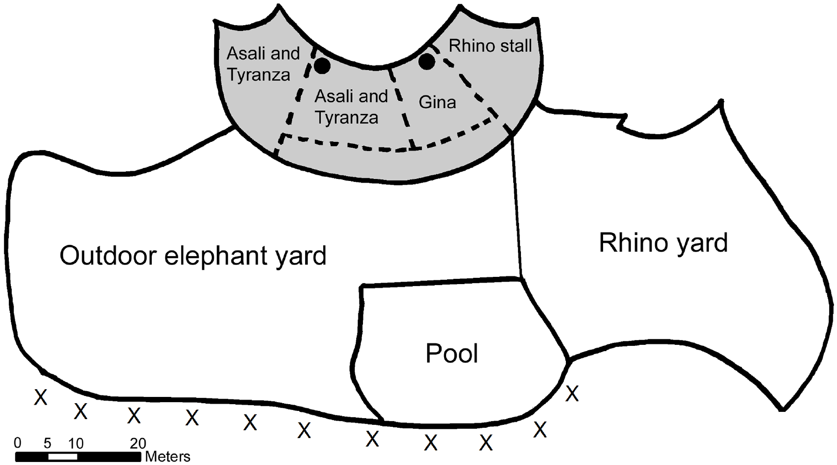
Flooring renovation provides a within-animal comparison
Boyle and colleagues studied female African elephants before, during, and after replacement of indoor flooring with a rubberized surface. The preparation combined daytime outdoor observations, nighttime indoor recordings, and repeated serum cortisol sampling.
The original exhibit map identifies the renovated area and the locations used for behavioral recording. Comparing each elephant with its own prior observations reduces some effects of stable individual differences, such as long-standing behavioral tendencies.
The renovation also included a construction period and temporary changes in indoor access. It was not a randomized flooring experiment with an unchanged parallel control group. Observed changes can therefore inform management evaluation while remaining potentially influenced by season, pregnancy, disruption, and other conditions that varied over the study.
Boyle (2015), Fig. 1. Published exhibit map and recording locations.
Boyle et al. (2015)
28
Notes:
• Boyle and colleagues studied female African elephants before, during, and after replacement of indoor flooring with a rubberized surface. The preparation combined daytime outdoor observations, nighttime indoor recordings, and repeated serum cortisol sampling.
• The original exhibit map identifies the renovated area and the locations used for behavioral recording. Comparing each elephant with its own prior observations reduces some effects of stable individual differences, such as long-standing behavioral tendencies.
• The renovation also included a construction period and temporary changes in indoor access. It was not a randomized flooring experiment with an unchanged parallel control group. Observed changes can therefore inform management evaluation while remaining potentially influenced by season, pregnancy, disruption, and other conditions that varied over the study.
References:
Sarah A. Boyle, Beth Roberts, Brittany M. Pope, Margaret R. Blake, Stephen E. Leavelle, Jennifer J. Marshall, Andrew Smith, Amanda Hadicke, Josephine F. Falcone, Katrina Knott, Andrew J. Kouba (2015). Assessment of Flooring Renovations on African Elephant (Loxodonta africana) Behavior and Glucocorticoid Response. PLOS ONE 10: e0141009. https://doi.org/10.1371/journal.pone.0141009
Figure: Boyle (2015), Fig. 1. Published exhibit map and recording locations.
Figure source: https://doi.org/10.1371/journal.pone.0141009

Slide 29
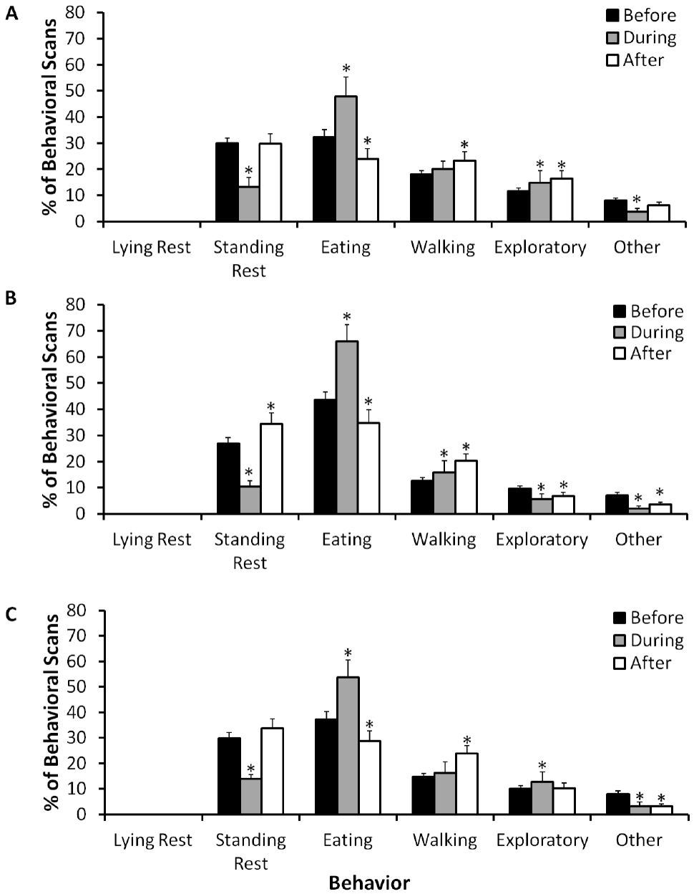
Daytime walking increases after indoor renovation
Boyle and colleagues used repeated scan sampling to construct daytime outdoor activity budgets. Scan sampling records the behavior occurring at scheduled observation points rather than continuously counting every movement throughout the day.
After renovation, all studied females spent more daytime observations walking and fewer eating. Outdoor recording occurred approximately between nine in the morning and four in the afternoon, while the flooring itself had been changed inside the elephant house.
The daytime response extends beyond direct contact with the new surface, but it does not isolate a sensory or neural cause. Construction history, routine, and the opportunity to use different spaces can influence activity. Less daytime eating also should not be interpreted as a nutritional improvement without information about intake and body condition.
Boyle (2015), Fig. 2(A–C). Daytime activity before, during, and after renovation.
Boyle et al. (2015)
29
Notes:
• Boyle and colleagues used repeated scan sampling to construct daytime outdoor activity budgets. Scan sampling records the behavior occurring at scheduled observation points rather than continuously counting every movement throughout the day.
• After renovation, all studied females spent more daytime observations walking and fewer eating. Outdoor recording occurred approximately between nine in the morning and four in the afternoon, while the flooring itself had been changed inside the elephant house.
• The daytime response extends beyond direct contact with the new surface, but it does not isolate a sensory or neural cause. Construction history, routine, and the opportunity to use different spaces can influence activity. Less daytime eating also should not be interpreted as a nutritional improvement without information about intake and body condition.
References:
Sarah A. Boyle, Beth Roberts, Brittany M. Pope, Margaret R. Blake, Stephen E. Leavelle, Jennifer J. Marshall, Andrew Smith, Amanda Hadicke, Josephine F. Falcone, Katrina Knott, Andrew J. Kouba (2015). Assessment of Flooring Renovations on African Elephant (Loxodonta africana) Behavior and Glucocorticoid Response. PLOS ONE 10: e0141009. https://doi.org/10.1371/journal.pone.0141009
Figure: Boyle (2015), Fig. 2(A–C). Daytime activity before, during, and after renovation.
Figure source: https://doi.org/10.1371/journal.pone.0141009

Slide 30
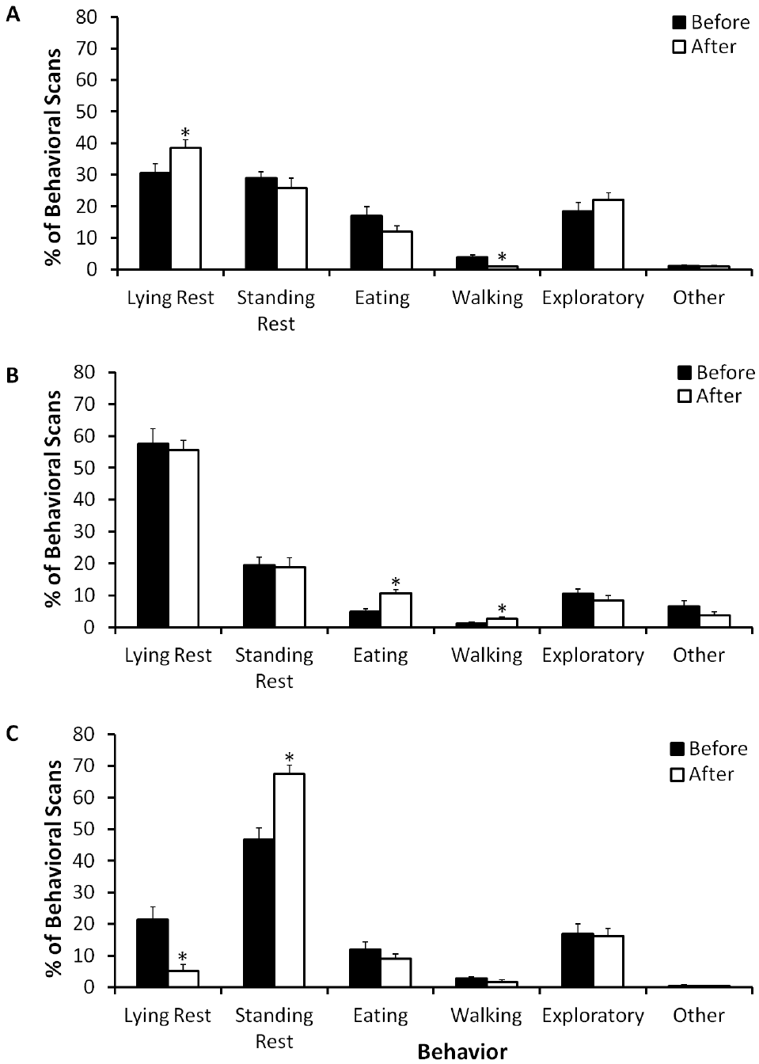
Nighttime rest differs among individual elephants
Night recordings in the flooring study sampled indoor behavior from the evening until morning husbandry. Lying rest and standing rest were scored separately, allowing rest posture to be distinguished from total inactivity.
The oldest elephant showed the least lying rest before renovation, occupying approximately thirteen percent of nightly scans, compared with roughly thirty-five and fifty-seven percent in the younger females. These percentages describe sampled behavior, not electrical sleep stages.
Age, health, and individual history can contribute to posture differences. A low lying-rest percentage cannot identify one cause without further assessment, and standing rest is not equivalent to an absence of sleep. The comparison supports individual evaluation rather than a universal nighttime posture threshold applied regardless of physical condition.
Boyle (2015), Fig. 3(A–C). Nighttime activity before and after renovation.
Boyle et al. (2015)
30
Notes:
• Night recordings in the flooring study sampled indoor behavior from the evening until morning husbandry. Lying rest and standing rest were scored separately, allowing rest posture to be distinguished from total inactivity.
• The oldest elephant showed the least lying rest before renovation, occupying approximately thirteen percent of nightly scans, compared with roughly thirty-five and fifty-seven percent in the younger females. These percentages describe sampled behavior, not electrical sleep stages.
• Age, health, and individual history can contribute to posture differences. A low lying-rest percentage cannot identify one cause without further assessment, and standing rest is not equivalent to an absence of sleep. The comparison supports individual evaluation rather than a universal nighttime posture threshold applied regardless of physical condition.
References:
Sarah A. Boyle, Beth Roberts, Brittany M. Pope, Margaret R. Blake, Stephen E. Leavelle, Jennifer J. Marshall, Andrew Smith, Amanda Hadicke, Josephine F. Falcone, Katrina Knott, Andrew J. Kouba (2015). Assessment of Flooring Renovations on African Elephant (Loxodonta africana) Behavior and Glucocorticoid Response. PLOS ONE 10: e0141009. https://doi.org/10.1371/journal.pone.0141009
Figure: Boyle (2015), Fig. 3(A–C). Nighttime activity before and after renovation.
Figure source: https://doi.org/10.1371/journal.pone.0141009

Slide 31
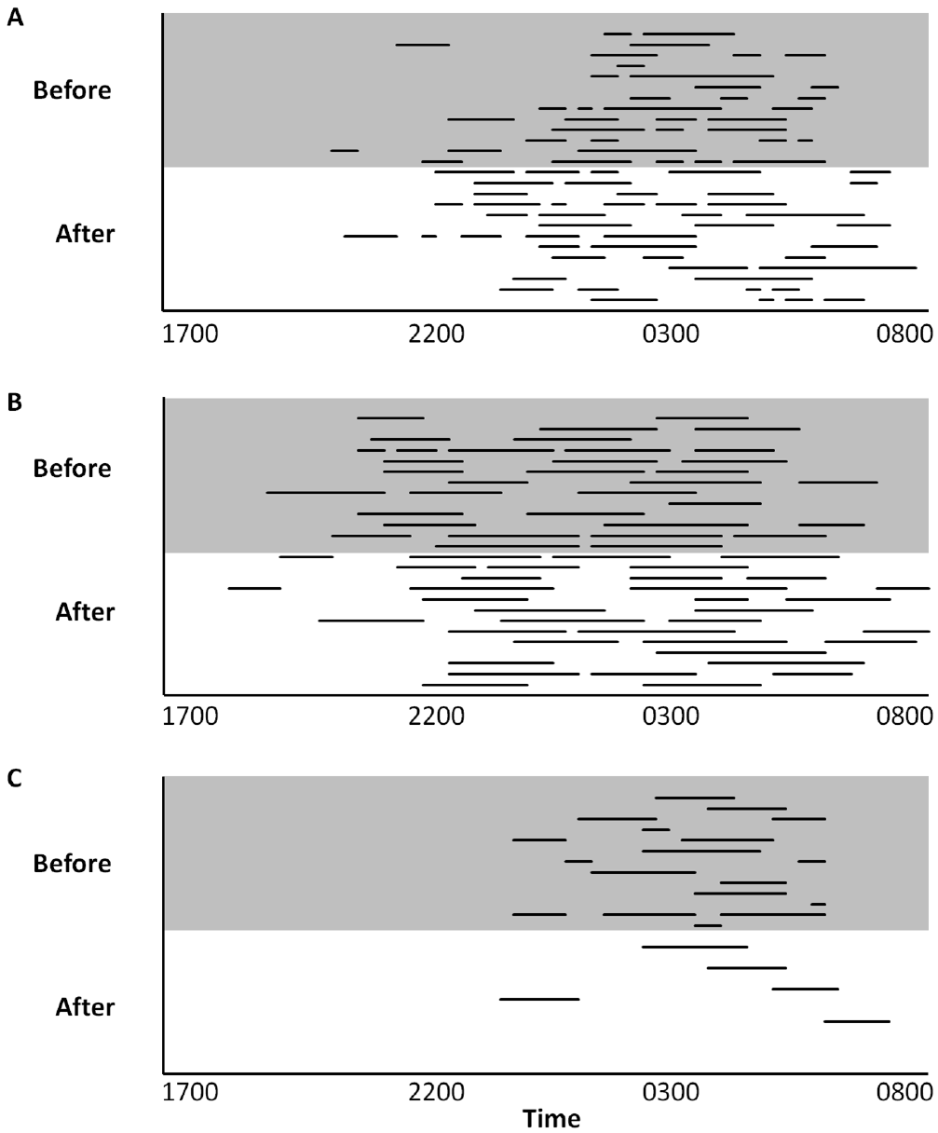
Recumbent rest has a measurable temporal pattern
Recumbent rest means resting while lying down. Boyle and colleagues recorded the timing and duration of these episodes during the thirteen nights before and thirteen nights after the flooring change.
The episode record preserves differences among individuals and shows when lying occurred across the night. An activity-budget percentage alone would not distinguish a few long episodes from many brief episodes producing a similar total.
Event structure can inform assessment of comfortable rest opportunities, but an observed lying episode does not establish a particular sleep stage. The study did not use brain electrical recordings to separate rapid-eye-movement sleep from other states. Claims about restored sleep circuitry would therefore exceed the behavioral and endocrine measurements actually collected.
Boyle (2015), Fig. 4(A–C). Timing and duration of recumbent rest.
Boyle et al. (2015)
31
Notes:
• Recumbent rest means resting while lying down. Boyle and colleagues recorded the timing and duration of these episodes during the thirteen nights before and thirteen nights after the flooring change.
• The episode record preserves differences among individuals and shows when lying occurred across the night. An activity-budget percentage alone would not distinguish a few long episodes from many brief episodes producing a similar total.
• Event structure can inform assessment of comfortable rest opportunities, but an observed lying episode does not establish a particular sleep stage. The study did not use brain electrical recordings to separate rapid-eye-movement sleep from other states. Claims about restored sleep circuitry would therefore exceed the behavioral and endocrine measurements actually collected.
References:
Sarah A. Boyle, Beth Roberts, Brittany M. Pope, Margaret R. Blake, Stephen E. Leavelle, Jennifer J. Marshall, Andrew Smith, Amanda Hadicke, Josephine F. Falcone, Katrina Knott, Andrew J. Kouba (2015). Assessment of Flooring Renovations on African Elephant (Loxodonta africana) Behavior and Glucocorticoid Response. PLOS ONE 10: e0141009. https://doi.org/10.1371/journal.pone.0141009
Figure: Boyle (2015), Fig. 4(A–C). Timing and duration of recumbent rest.
Figure source: https://doi.org/10.1371/journal.pone.0141009

Slide 32
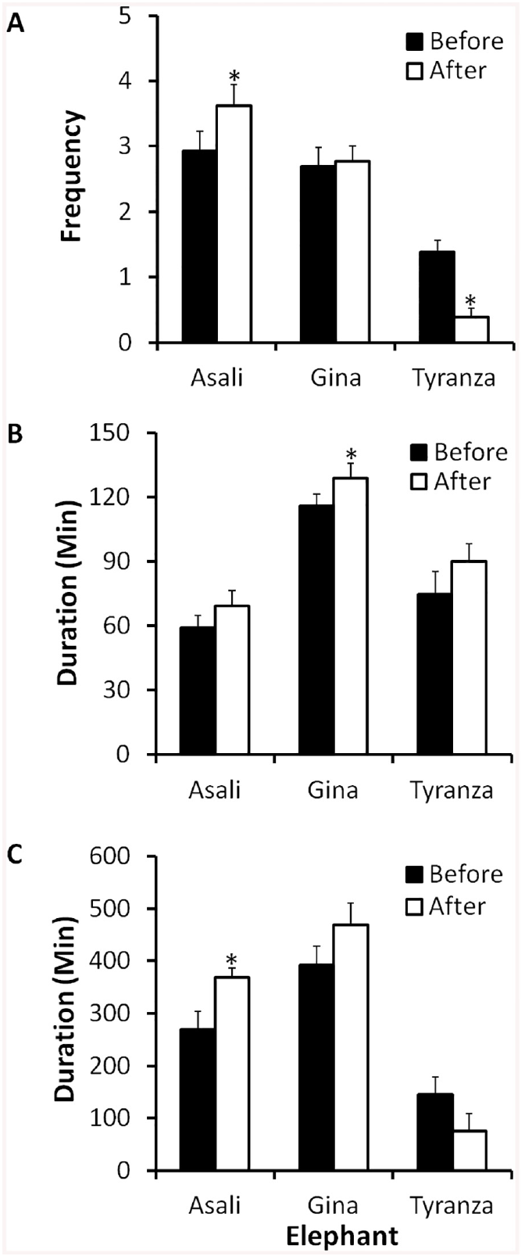
Flooring responses are not uniform across the group
Boyle and colleagues compared the frequency of lying-rest events, their duration, and the interval spanning the first and last episode of the night. Those outcomes address different aspects of nighttime behavior.
Following renovation, one female increased lying rest, while another increased standing rest. Responses therefore were not identical even though the animals experienced the same broad flooring intervention and were observed with the same measurement framework.
An intervention can change behavior for some individuals without producing a universal group response. That heterogeneity should not be dismissed as proof that the surface has no effect, nor converted into a claim that every animal benefited equally. Repeated individual measurements are needed to evaluate the actual outcome and competing explanations.
Boyle (2015), Fig. 5(A–C). Rest-event frequency and duration.
Boyle et al. (2015)
32
Notes:
• Boyle and colleagues compared the frequency of lying-rest events, their duration, and the interval spanning the first and last episode of the night. Those outcomes address different aspects of nighttime behavior.
• Following renovation, one female increased lying rest, while another increased standing rest. Responses therefore were not identical even though the animals experienced the same broad flooring intervention and were observed with the same measurement framework.
• An intervention can change behavior for some individuals without producing a universal group response. That heterogeneity should not be dismissed as proof that the surface has no effect, nor converted into a claim that every animal benefited equally. Repeated individual measurements are needed to evaluate the actual outcome and competing explanations.
References:
Sarah A. Boyle, Beth Roberts, Brittany M. Pope, Margaret R. Blake, Stephen E. Leavelle, Jennifer J. Marshall, Andrew Smith, Amanda Hadicke, Josephine F. Falcone, Katrina Knott, Andrew J. Kouba (2015). Assessment of Flooring Renovations on African Elephant (Loxodonta africana) Behavior and Glucocorticoid Response. PLOS ONE 10: e0141009. https://doi.org/10.1371/journal.pone.0141009
Figure: Boyle (2015), Fig. 5(A–C). Rest-event frequency and duration.
Figure source: https://doi.org/10.1371/journal.pone.0141009

Slide 33
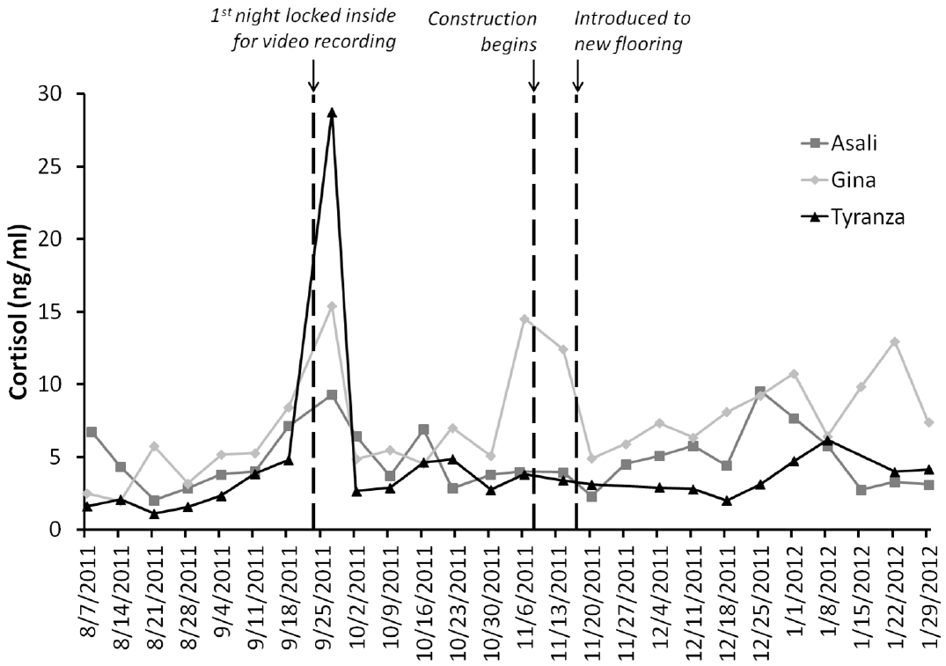
Serum cortisol is reported in blood concentration units
Cortisol is a glucocorticoid measured here in serum, the fluid remaining after blood clotting. Boyle and colleagues collected blood repeatedly and used an enzyme immunoassay to quantify cortisol across the flooring-renovation period.
Baseline concentrations for the studied females were approximately three, four and a half, and five nanograms per milliliter. Two females remained near baseline across the intervention, while the pregnant female had elevated concentrations during construction and afterward.
The hormonal response therefore did not match a uniform stress reaction in every animal. Pregnancy and the construction disruption complicate a flooring-specific interpretation. Serum concentration is a physiological measure at collection, not a direct neural recording or an independent determination of whether the elephant experienced the renovation positively or negatively.
Boyle (2015), Fig. 6. Serum cortisol profiles across renovation.
Boyle et al. (2015)
33
Notes:
• Cortisol is a glucocorticoid measured here in serum, the fluid remaining after blood clotting. Boyle and colleagues collected blood repeatedly and used an enzyme immunoassay to quantify cortisol across the flooring-renovation period.
• Baseline concentrations for the studied females were approximately three, four and a half, and five nanograms per milliliter. Two females remained near baseline across the intervention, while the pregnant female had elevated concentrations during construction and afterward.
• The hormonal response therefore did not match a uniform stress reaction in every animal. Pregnancy and the construction disruption complicate a flooring-specific interpretation. Serum concentration is a physiological measure at collection, not a direct neural recording or an independent determination of whether the elephant experienced the renovation positively or negatively.
References:
Sarah A. Boyle, Beth Roberts, Brittany M. Pope, Margaret R. Blake, Stephen E. Leavelle, Jennifer J. Marshall, Andrew Smith, Amanda Hadicke, Josephine F. Falcone, Katrina Knott, Andrew J. Kouba (2015). Assessment of Flooring Renovations on African Elephant (Loxodonta africana) Behavior and Glucocorticoid Response. PLOS ONE 10: e0141009. https://doi.org/10.1371/journal.pone.0141009
Figure: Boyle (2015), Fig. 6. Serum cortisol profiles across renovation.
Figure source: https://doi.org/10.1371/journal.pone.0141009

Slide 34
Unchanged cortisol does not erase a behavioral response
In the flooring study, changes in activity and rest occurred alongside cortisol concentrations that remained near baseline in two females. Behavioral and endocrine outcomes therefore provided overlapping but nonidentical information about the intervention.
A surface change might alter comfort, posture, or activity without producing a large sustained change in the sampled blood hormone. Conversely, altered cortisol during pregnancy or disruption need not be caused only by contact with the new floor.
The data do not identify a specific nociceptive pathway or establish that pain was reduced. Nociception is neural processing of potentially damaging stimuli, which requires evidence distinct from a rest-posture change. Practical assessment can combine behavior and health records while retaining this distinction between a plausible mechanism and a measured outcome.
Boyle (2015), Fig. 3(A–C). Nighttime activity before and after renovation.
Boyle et al. (2015)
34
Notes:
• In the flooring study, changes in activity and rest occurred alongside cortisol concentrations that remained near baseline in two females. Behavioral and endocrine outcomes therefore provided overlapping but nonidentical information about the intervention.
• A surface change might alter comfort, posture, or activity without producing a large sustained change in the sampled blood hormone. Conversely, altered cortisol during pregnancy or disruption need not be caused only by contact with the new floor.
• The data do not identify a specific nociceptive pathway or establish that pain was reduced. Nociception is neural processing of potentially damaging stimuli, which requires evidence distinct from a rest-posture change. Practical assessment can combine behavior and health records while retaining this distinction between a plausible mechanism and a measured outcome.
References:
Sarah A. Boyle, Beth Roberts, Brittany M. Pope, Margaret R. Blake, Stephen E. Leavelle, Jennifer J. Marshall, Andrew Smith, Amanda Hadicke, Josephine F. Falcone, Katrina Knott, Andrew J. Kouba (2015). Assessment of Flooring Renovations on African Elephant (Loxodonta africana) Behavior and Glucocorticoid Response. PLOS ONE 10: e0141009. https://doi.org/10.1371/journal.pone.0141009
Figure: Boyle (2015), Fig. 3(A–C). Nighttime activity before and after renovation.
Figure source: https://doi.org/10.1371/journal.pone.0141009

Slide 35
Construction and the final environment differ
The flooring intervention included a transient renovation phase and a later period of access to the new surface. Boyle and colleagues separated these phases when describing hormone profiles and changes in behavior.
During construction the animals did not have normal indoor access, and one female’s cortisol increased. Later behavioral changes occurred after the renovated space became available, so an immediate construction response and a sustained housing response should not be conflated.
The study supports measuring both implementation costs and later outcomes of a proposed welfare improvement. It does not establish a fully controlled causal estimate for the floor material. Ethical decisions about renovation should consider disruption and individual vulnerability while using the observed post-intervention behavior to evaluate the result.
Boyle (2015), Fig. 6. Serum cortisol profiles across renovation.
Boyle et al. (2015)
35
Notes:
• The flooring intervention included a transient renovation phase and a later period of access to the new surface. Boyle and colleagues separated these phases when describing hormone profiles and changes in behavior.
• During construction the animals did not have normal indoor access, and one female’s cortisol increased. Later behavioral changes occurred after the renovated space became available, so an immediate construction response and a sustained housing response should not be conflated.
• The study supports measuring both implementation costs and later outcomes of a proposed welfare improvement. It does not establish a fully controlled causal estimate for the floor material. Ethical decisions about renovation should consider disruption and individual vulnerability while using the observed post-intervention behavior to evaluate the result.
References:
Sarah A. Boyle, Beth Roberts, Brittany M. Pope, Margaret R. Blake, Stephen E. Leavelle, Jennifer J. Marshall, Andrew Smith, Amanda Hadicke, Josephine F. Falcone, Katrina Knott, Andrew J. Kouba (2015). Assessment of Flooring Renovations on African Elephant (Loxodonta africana) Behavior and Glucocorticoid Response. PLOS ONE 10: e0141009. https://doi.org/10.1371/journal.pone.0141009
Figure: Boyle (2015), Fig. 6. Serum cortisol profiles across renovation.
Figure source: https://doi.org/10.1371/journal.pone.0141009

Slide 36
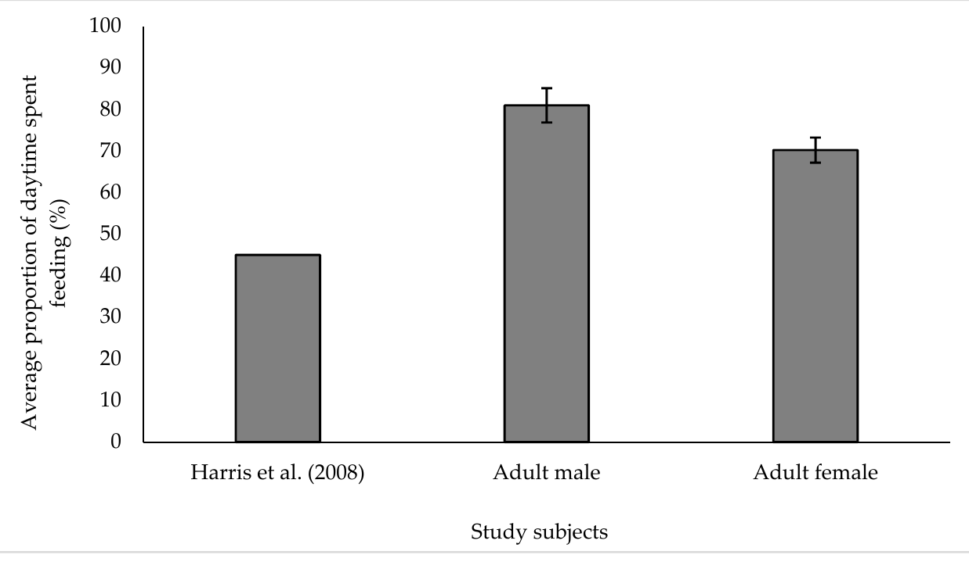
Foraging time can expand under altered husbandry
Finch and colleagues assessed Asian elephants at ZSL Whipsnade Zoo using repeated behavioral observations and nighttime recordings. Hay nets, dispersed browse, and grass paddocks provided opportunities to obtain food across the enclosure rather than at a single feeding point.
The adult male spent approximately eighty-one percent of daytime feeding, and adult females approximately seventy percent. These values exceeded the historical forty-five-percent comparison cited in the study, although that reference was not a simultaneously observed control group.
Longer feeding time can reflect extended foraging opportunity, but duration alone does not establish appropriate energy intake or freedom from hunger. The study’s historical comparison combines different observation periods and husbandry conditions; it cannot isolate one enrichment device as the cause of the difference.
Finch (2020), Fig. 2. Daytime feeding and historical comparison.
Finch et al. (2020)
36
Notes:
• Finch and colleagues assessed Asian elephants at ZSL Whipsnade Zoo using repeated behavioral observations and nighttime recordings. Hay nets, dispersed browse, and grass paddocks provided opportunities to obtain food across the enclosure rather than at a single feeding point.
• The adult male spent approximately eighty-one percent of daytime feeding, and adult females approximately seventy percent. These values exceeded the historical forty-five-percent comparison cited in the study, although that reference was not a simultaneously observed control group.
• Longer feeding time can reflect extended foraging opportunity, but duration alone does not establish appropriate energy intake or freedom from hunger. The study’s historical comparison combines different observation periods and husbandry conditions; it cannot isolate one enrichment device as the cause of the difference.
References:
Katherine Finch, Fiona Sach, Malcolm Fitzpatrick, Nic Masters, Lewis J. Rowden (2020). Longitudinal Improvements in Zoo-Housed Elephant Welfare: A Case Study at ZSL Whipsnade Zoo. Animals 10: 2029. https://doi.org/10.3390/ani10112029
Figure: Finch (2020), Fig. 2. Daytime feeding and historical comparison.
Figure source: https://doi.org/10.3390/ani10112029

Slide 37
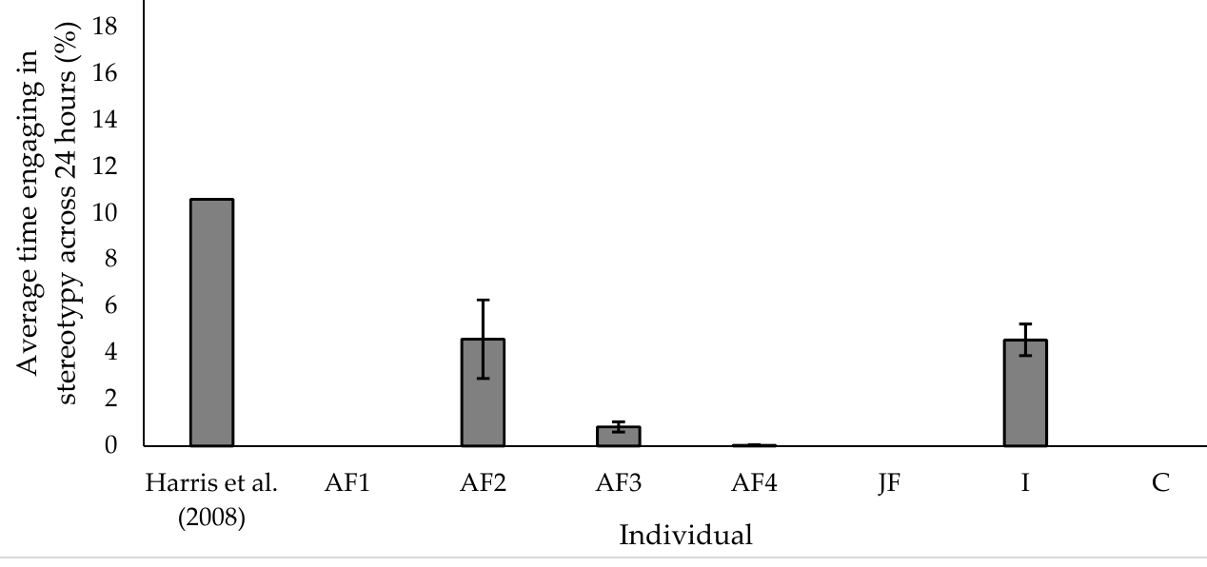
Improved conditions can accompany low stereotypy
The Whipsnade study recorded relatively low stereotypy compared with the cited historical population. Several individuals were not observed performing stereotypic behavior, and pacing accounted for approximately seventy-seven percent of the stereotypy that was recorded.
Observation across daytime and nighttime periods supplied more information than visitor-hour recording alone. Individual results were retained rather than assuming every member of the group responded alike to the institution’s housing and management conditions.
The comparison supports the possibility of improved behavioral outcomes within human care, but does not establish that every aspect of welfare was optimal. Historical differences, selection, life history, and measurement limits remain relevant. Absence of observed stereotypy is not proof of unrestricted agency or an absence of negative experience.
Finch (2020), Fig. 3. Individual stereotypy and historical comparison.
Finch et al. (2020)
37
Notes:
• The Whipsnade study recorded relatively low stereotypy compared with the cited historical population. Several individuals were not observed performing stereotypic behavior, and pacing accounted for approximately seventy-seven percent of the stereotypy that was recorded.
• Observation across daytime and nighttime periods supplied more information than visitor-hour recording alone. Individual results were retained rather than assuming every member of the group responded alike to the institution’s housing and management conditions.
• The comparison supports the possibility of improved behavioral outcomes within human care, but does not establish that every aspect of welfare was optimal. Historical differences, selection, life history, and measurement limits remain relevant. Absence of observed stereotypy is not proof of unrestricted agency or an absence of negative experience.
References:
Katherine Finch, Fiona Sach, Malcolm Fitzpatrick, Nic Masters, Lewis J. Rowden (2020). Longitudinal Improvements in Zoo-Housed Elephant Welfare: A Case Study at ZSL Whipsnade Zoo. Animals 10: 2029. https://doi.org/10.3390/ani10112029
Figure: Finch (2020), Fig. 3. Individual stereotypy and historical comparison.
Figure source: https://doi.org/10.3390/ani10112029

Slide 38
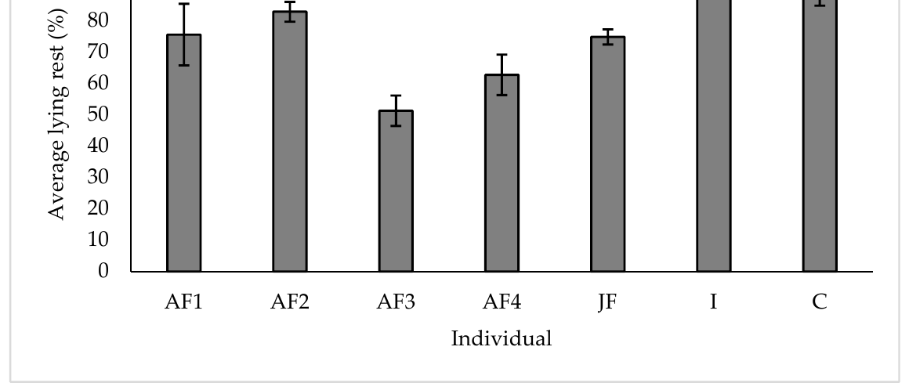
Rest posture complements other behavioral measures
Finch and colleagues quantified the proportion of total resting time spent lying rather than standing. All observed subjects engaged in nightly lying rest, and each spent more than half of its recorded resting time recumbent.
The youngest individuals had the greatest lying-rest proportions. The facility provided deep sand and social groupings, but these features were not independently randomized, so their separate effects could not be estimated from the case study.
The denominator is resting time, not the entire night or a physiological measure of sleep duration. Rest posture, feeding, social association, and stereotypy describe different dimensions of the animal’s daily behavior. Their combination supports a more complete assessment while leaving direct claims about brain state or subjective satisfaction untested.
Finch (2020), Fig. 5. Proportion of rest spent lying.
Finch et al. (2020)
38
Notes:
• Finch and colleagues quantified the proportion of total resting time spent lying rather than standing. All observed subjects engaged in nightly lying rest, and each spent more than half of its recorded resting time recumbent.
• The youngest individuals had the greatest lying-rest proportions. The facility provided deep sand and social groupings, but these features were not independently randomized, so their separate effects could not be estimated from the case study.
• The denominator is resting time, not the entire night or a physiological measure of sleep duration. Rest posture, feeding, social association, and stereotypy describe different dimensions of the animal’s daily behavior. Their combination supports a more complete assessment while leaving direct claims about brain state or subjective satisfaction untested.
References:
Katherine Finch, Fiona Sach, Malcolm Fitzpatrick, Nic Masters, Lewis J. Rowden (2020). Longitudinal Improvements in Zoo-Housed Elephant Welfare: A Case Study at ZSL Whipsnade Zoo. Animals 10: 2029. https://doi.org/10.3390/ani10112029
Figure: Finch (2020), Fig. 5. Proportion of rest spent lying.
Figure source: https://doi.org/10.3390/ani10112029

Slide 39
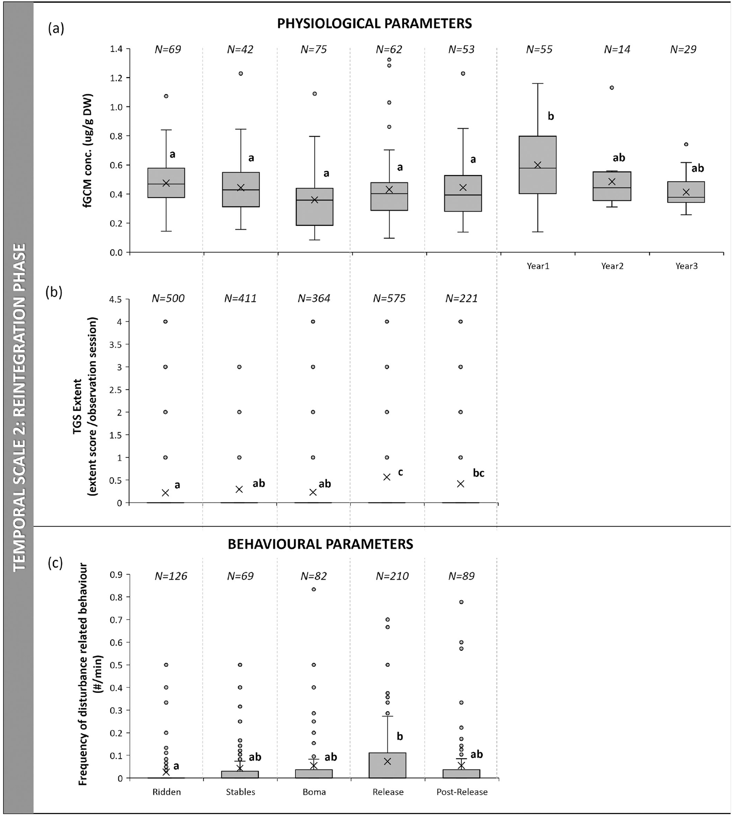
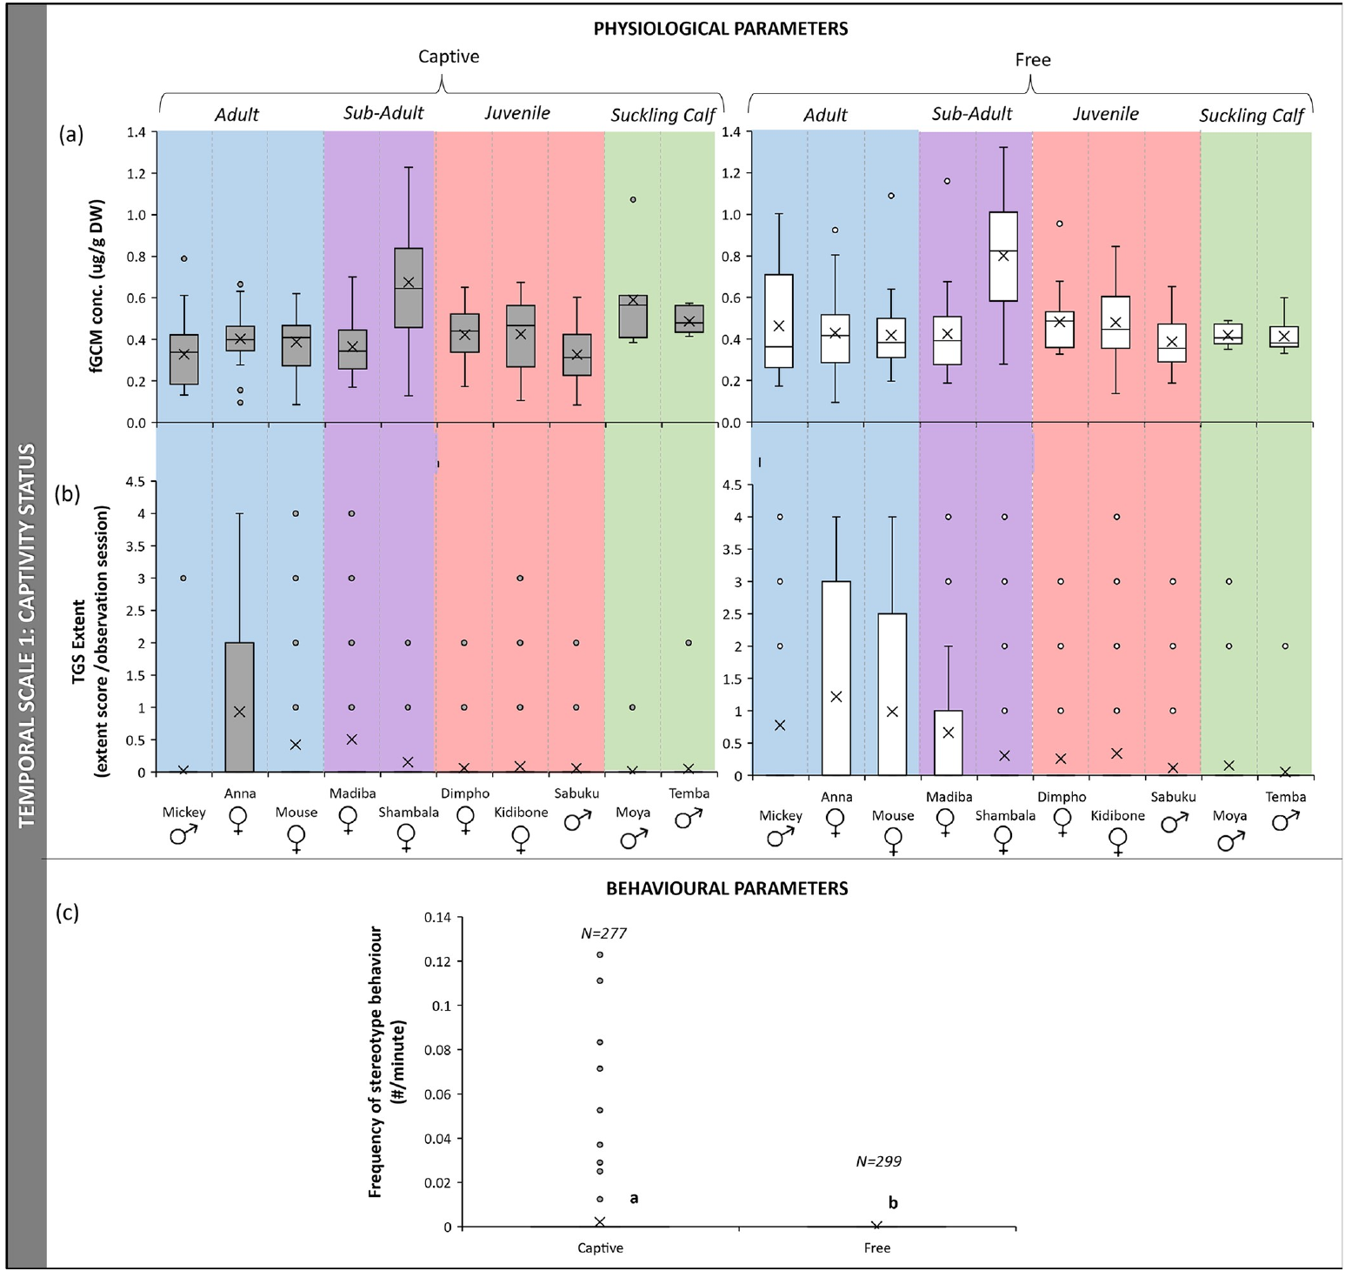
Reintegration is followed through multiple phases
Pretorius and colleagues followed African elephants transitioning from captivity into a free-ranging setting. They measured fecal glucocorticoid metabolites, temporal gland secretion, and defined behavioral responses across successive management and release phases.
A temporal gland is an elephant gland located beside the eye; the extent of visible secretion was scored as a physiological indicator. Measures were retained separately because hormone excretion, visible secretion, and immediate behavior have different biological time courses.
The release was a real management transition rather than a randomized laboratory manipulation. Group history, environment, and time changed together. The longitudinal record nevertheless permits the immediate release period to be distinguished from later adaptation, without assuming that a single post-release measurement represents the entire transition.
Pretorius (2023), Fig. 2(a–c). Reintegration-phase physiology and behavior.
Pretorius (2023), Fig. 1(a–c). Captivity and post-release physiological and behavioral measures.
Pretorius et al. (2023)
39
Notes:
• Pretorius and colleagues followed African elephants transitioning from captivity into a free-ranging setting. They measured fecal glucocorticoid metabolites, temporal gland secretion, and defined behavioral responses across successive management and release phases.
• A temporal gland is an elephant gland located beside the eye; the extent of visible secretion was scored as a physiological indicator. Measures were retained separately because hormone excretion, visible secretion, and immediate behavior have different biological time courses.
• The release was a real management transition rather than a randomized laboratory manipulation. Group history, environment, and time changed together. The longitudinal record nevertheless permits the immediate release period to be distinguished from later adaptation, without assuming that a single post-release measurement represents the entire transition.
References:
Yolanda Pretorius, Tamara Eggeling, Andre Ganswindt (2023). Identifying potential measures of stress and disturbance during a captive to wild African elephant reintegration. PLOS ONE 18: e0291293. https://doi.org/10.1371/journal.pone.0291293
Figure: Pretorius (2023), Fig. 2(a–c). Reintegration-phase physiology and behavior.
Figure source: https://doi.org/10.1371/journal.pone.0291293
Figure: Pretorius (2023), Fig. 1(a–c). Captivity and post-release physiological and behavioral measures.
Figure source: https://doi.org/10.1371/journal.pone.0291293

Slide 40
Stereotypy was not observed after release
Pretorius and colleagues recorded stereotypic behavior during the earlier captive phases but did not observe it after the elephants were released. Behavioral frequency was expressed as occurrences per minute of group observation.
The captivity-to-release comparison followed the same group, retaining information about its earlier experience. Elimination from the observed record indicates a substantial behavioral change under the new conditions, rather than requiring that repetitive patterns persist irreversibly.
Non-observation during the study is not proof that no episode ever occurred outside sampling. The result also does not establish repair of a particular brain lesion or reversal of every consequence of captivity. It provides direct behavioral evidence of change while the neural mechanism and broader individual welfare outcomes remain separate questions.
Pretorius (2023), Fig. 1(a–c). Captivity and post-release physiological and behavioral measures.
Pretorius et al. (2023)
40
Notes:
• Pretorius and colleagues recorded stereotypic behavior during the earlier captive phases but did not observe it after the elephants were released. Behavioral frequency was expressed as occurrences per minute of group observation.
• The captivity-to-release comparison followed the same group, retaining information about its earlier experience. Elimination from the observed record indicates a substantial behavioral change under the new conditions, rather than requiring that repetitive patterns persist irreversibly.
• Non-observation during the study is not proof that no episode ever occurred outside sampling. The result also does not establish repair of a particular brain lesion or reversal of every consequence of captivity. It provides direct behavioral evidence of change while the neural mechanism and broader individual welfare outcomes remain separate questions.
References:
Yolanda Pretorius, Tamara Eggeling, Andre Ganswindt (2023). Identifying potential measures of stress and disturbance during a captive to wild African elephant reintegration. PLOS ONE 18: e0291293. https://doi.org/10.1371/journal.pone.0291293
Figure: Pretorius (2023), Fig. 1(a–c). Captivity and post-release physiological and behavioral measures.
Figure source: https://doi.org/10.1371/journal.pone.0291293

Slide 41
Release indicators do not change in a single direction
In the immediate captivity-versus-release comparison, visible temporal gland secretion increased after release, whereas fecal glucocorticoid metabolites did not show a clear difference between the compared periods. Observed stereotypy disappeared from the post-release record.
These outcomes are not contradictory measurements of one identical quantity. Visible secretion can change over a different timescale from excreted hormone metabolites, and a repetitive behavior can stop while an animal responds actively to a novel environment.
The findings prevent the claim that release must immediately lower every proposed stress measure. They also prevent treating increased secretion as proof that captivity was preferable. A transition can remove restrictions while imposing short-term challenges; the empirical assessment must specify which outcome and interval are being evaluated.
Pretorius (2023), Fig. 1(a–c). Captivity and post-release physiological and behavioral measures.
Pretorius et al. (2023)
41
Notes:
• In the immediate captivity-versus-release comparison, visible temporal gland secretion increased after release, whereas fecal glucocorticoid metabolites did not show a clear difference between the compared periods. Observed stereotypy disappeared from the post-release record.
• These outcomes are not contradictory measurements of one identical quantity. Visible secretion can change over a different timescale from excreted hormone metabolites, and a repetitive behavior can stop while an animal responds actively to a novel environment.
• The findings prevent the claim that release must immediately lower every proposed stress measure. They also prevent treating increased secretion as proof that captivity was preferable. A transition can remove restrictions while imposing short-term challenges; the empirical assessment must specify which outcome and interval are being evaluated.
References:
Yolanda Pretorius, Tamara Eggeling, Andre Ganswindt (2023). Identifying potential measures of stress and disturbance during a captive to wild African elephant reintegration. PLOS ONE 18: e0291293. https://doi.org/10.1371/journal.pone.0291293
Figure: Pretorius (2023), Fig. 1(a–c). Captivity and post-release physiological and behavioral measures.
Figure source: https://doi.org/10.1371/journal.pone.0291293

Slide 42
Longer follow-up changes the endocrine interpretation
Pretorius and colleagues separated the first, second, and third years after release. Fecal glucocorticoid metabolite concentrations were higher during the first year than in the preceding phases, indicating that short post-release comparisons did not capture the full endocrine trajectory.
Later concentrations declined descriptively, but the corrected comparison did not establish a reliable first-versus-third-year difference. The published phase record should therefore not be summarized as a conclusively proven complete physiological recovery by year three.
A prolonged adjustment period is compatible with changing environmental and social demands, but the study does not isolate the cause of each phase difference. Long follow-up is necessary to distinguish a transient response from a lasting outcome, while preserving the uncertainty in individual and group comparisons.
Pretorius (2023), Fig. 2(a–c). Reintegration-phase physiology and behavior.
Pretorius (2023), Fig. 1(a–c). Captivity and post-release physiological and behavioral measures.
Pretorius et al. (2023)
42
Notes:
• Pretorius and colleagues separated the first, second, and third years after release. Fecal glucocorticoid metabolite concentrations were higher during the first year than in the preceding phases, indicating that short post-release comparisons did not capture the full endocrine trajectory.
• Later concentrations declined descriptively, but the corrected comparison did not establish a reliable first-versus-third-year difference. The published phase record should therefore not be summarized as a conclusively proven complete physiological recovery by year three.
• A prolonged adjustment period is compatible with changing environmental and social demands, but the study does not isolate the cause of each phase difference. Long follow-up is necessary to distinguish a transient response from a lasting outcome, while preserving the uncertainty in individual and group comparisons.
References:
Yolanda Pretorius, Tamara Eggeling, Andre Ganswindt (2023). Identifying potential measures of stress and disturbance during a captive to wild African elephant reintegration. PLOS ONE 18: e0291293. https://doi.org/10.1371/journal.pone.0291293
Figure: Pretorius (2023), Fig. 2(a–c). Reintegration-phase physiology and behavior.
Figure source: https://doi.org/10.1371/journal.pone.0291293
Figure: Pretorius (2023), Fig. 1(a–c). Captivity and post-release physiological and behavioral measures.
Figure source: https://doi.org/10.1371/journal.pone.0291293

Slide 43
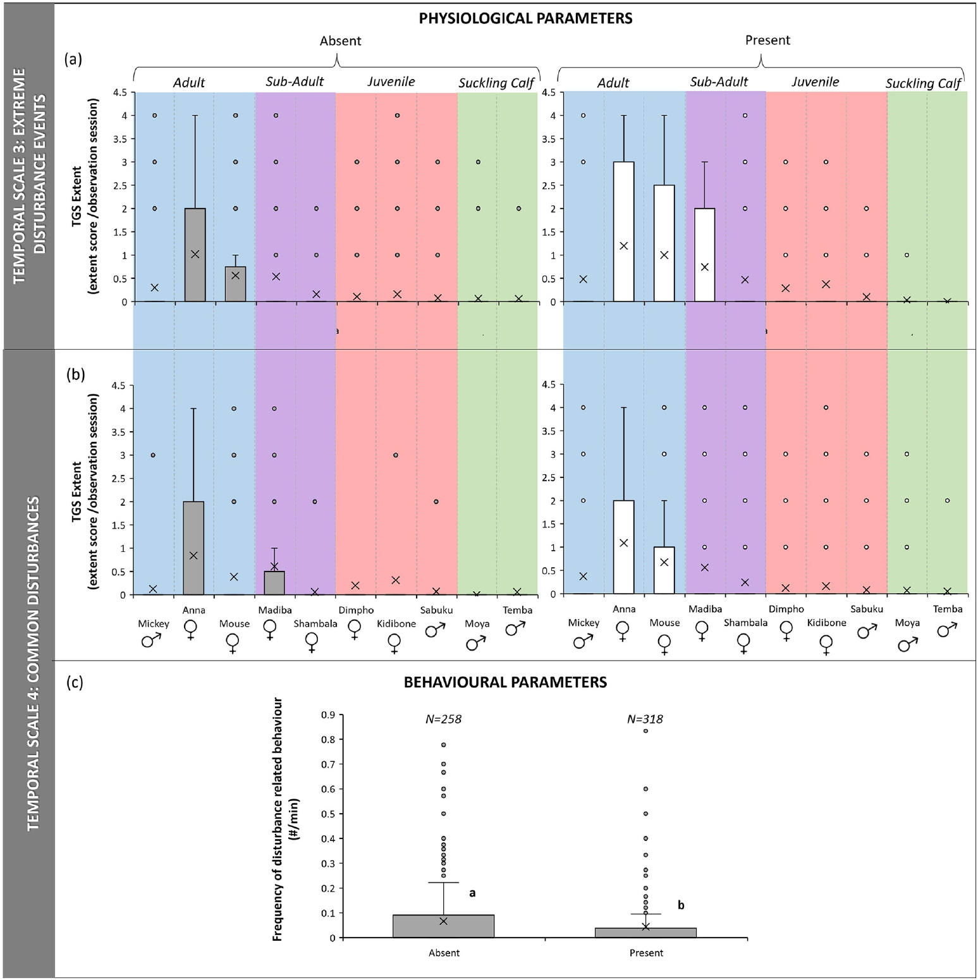
Disturbances change secretion and behavior differently
The reintegration study distinguished extreme infrequent disturbances from common immediate disturbances. This classification separated unusual events from the routine presence of environmental stimuli that elephants could encounter repeatedly.
Temporal gland secretion was greater on days with extreme disturbance events, but the frequency of the scored disturbance-related behaviors did not show the same clear difference. For common immediate disturbances, some group behavioral frequencies were lower when the disturbances were present.
A physiological indicator and a behavioral category therefore need not register every event identically. The observations cannot establish a single stress threshold that applies to all stimuli and elephants. Interpretation depends on event type, familiarity, behavioral opportunity, observation scale, and the interval between an event and the collected measure.
Pretorius (2023), Fig. 3(a–c). Responses to environmental disturbance.
Pretorius et al. (2023)
43
Notes:
• The reintegration study distinguished extreme infrequent disturbances from common immediate disturbances. This classification separated unusual events from the routine presence of environmental stimuli that elephants could encounter repeatedly.
• Temporal gland secretion was greater on days with extreme disturbance events, but the frequency of the scored disturbance-related behaviors did not show the same clear difference. For common immediate disturbances, some group behavioral frequencies were lower when the disturbances were present.
• A physiological indicator and a behavioral category therefore need not register every event identically. The observations cannot establish a single stress threshold that applies to all stimuli and elephants. Interpretation depends on event type, familiarity, behavioral opportunity, observation scale, and the interval between an event and the collected measure.
References:
Yolanda Pretorius, Tamara Eggeling, Andre Ganswindt (2023). Identifying potential measures of stress and disturbance during a captive to wild African elephant reintegration. PLOS ONE 18: e0291293. https://doi.org/10.1371/journal.pone.0291293
Figure: Pretorius (2023), Fig. 3(a–c). Responses to environmental disturbance.
Figure source: https://doi.org/10.1371/journal.pone.0291293

Slide 44
Behavioral improvement does not prove neural repair
The reintegration study supplies direct evidence that observed stereotypy can disappear following a transition to free-ranging conditions. It does not include neural imaging, receptor binding, electrophysiology, or histological comparisons before and after release.
A mechanistic explanation identifies the biological processes connecting an exposure to an outcome. Candidate explanations for behavioral change can involve altered opportunities, social experience, or arousal, but none of those possibilities establishes a measured change in a particular elephant circuit.
The appropriate inference is behavioral plasticity under changed conditions, with the causal contribution of individual environmental features unresolved. Ethical concern about the original repetitive behavior does not require inventing a neural lesion. Conversely, behavioral improvement alone cannot establish that every prior physical or psychological harm has been reversed.
Pretorius (2023), Fig. 1(a–c). Captivity and post-release physiological and behavioral measures.
Pretorius et al. (2023)
44
Notes:
• The reintegration study supplies direct evidence that observed stereotypy can disappear following a transition to free-ranging conditions. It does not include neural imaging, receptor binding, electrophysiology, or histological comparisons before and after release.
• A mechanistic explanation identifies the biological processes connecting an exposure to an outcome. Candidate explanations for behavioral change can involve altered opportunities, social experience, or arousal, but none of those possibilities establishes a measured change in a particular elephant circuit.
• The appropriate inference is behavioral plasticity under changed conditions, with the causal contribution of individual environmental features unresolved. Ethical concern about the original repetitive behavior does not require inventing a neural lesion. Conversely, behavioral improvement alone cannot establish that every prior physical or psychological harm has been reversed.
References:
Yolanda Pretorius, Tamara Eggeling, Andre Ganswindt (2023). Identifying potential measures of stress and disturbance during a captive to wild African elephant reintegration. PLOS ONE 18: e0291293. https://doi.org/10.1371/journal.pone.0291293
Figure: Pretorius (2023), Fig. 1(a–c). Captivity and post-release physiological and behavioral measures.
Figure source: https://doi.org/10.1371/journal.pone.0291293

Slide 45
Ethical judgments require values and evidence
The disappearance of observed stereotypy after release is an empirical outcome, while deciding whether an earlier restriction was justified is a normative judgment. Normative claims specify what ought to be done, rather than only describing what was measured.
Pretorius and colleagues also documented short-term physiological challenges during the transition, so assessment must distinguish immediate adjustment from later behavioral outcomes. A policy that considers only one indicator or one time point can omit relevant consequences for the individual.
Evidence about health, social opportunity, choice, and behavior can inform duties to prevent harm and evaluate alternatives. It cannot alone assign a numerical moral value to neuronal count or identify an elephant’s subjective experience. Neuroethical reasoning should state its values explicitly and preserve the limits of the biological evidence on which it relies.
Pretorius (2023), Fig. 1(a–c). Captivity and post-release physiological and behavioral measures.
Pretorius et al. (2023)
45
Notes:
• The disappearance of observed stereotypy after release is an empirical outcome, while deciding whether an earlier restriction was justified is a normative judgment. Normative claims specify what ought to be done, rather than only describing what was measured.
• Pretorius and colleagues also documented short-term physiological challenges during the transition, so assessment must distinguish immediate adjustment from later behavioral outcomes. A policy that considers only one indicator or one time point can omit relevant consequences for the individual.
• Evidence about health, social opportunity, choice, and behavior can inform duties to prevent harm and evaluate alternatives. It cannot alone assign a numerical moral value to neuronal count or identify an elephant’s subjective experience. Neuroethical reasoning should state its values explicitly and preserve the limits of the biological evidence on which it relies.
References:
Yolanda Pretorius, Tamara Eggeling, Andre Ganswindt (2023). Identifying potential measures of stress and disturbance during a captive to wild African elephant reintegration. PLOS ONE 18: e0291293. https://doi.org/10.1371/journal.pone.0291293
Figure: Pretorius (2023), Fig. 1(a–c). Captivity and post-release physiological and behavioral measures.
Figure source: https://doi.org/10.1371/journal.pone.0291293

Slide 46
Key takeaways
Stereotypy: Repetitive behavior is a contextual welfare indicator, not a diagnosis of neural injury or human psychiatric disease.
Social conditions and choice: Separation, social experience, transfers, and indoor–outdoor access have observational associations with stereotypy.
Complementary indicators: Glucocorticoids, self-directed behavior, repetitive activity, health, and rest measure different processes.
Individual outcomes: Flooring and husbandry responses vary among elephants; evaluate behavior and physiology over time.
Neural evidence: Anatomical cell counts establish brain composition, not captivity-induced neuronal damage or subjective experience.
Neuroethical inference: Behavioral improvement after release can coexist with adjustment stress; ethical conclusions require explicit values and careful causal claims.
Greco et al. (2016); Herculano-Houzel et al. (2014); Vilela et al. (2025); Pretorius et al. (2023)
46
Notes:
Brian J. Greco, Cheryl L. Meehan, Jen N. Hogan, Katherine A. Leighty, Jill Mellen, Georgia J. Mason, Joy A. Mench (2016). The Days and Nights of Zoo Elephants: Using Epidemiology to Better Understand Stereotypic Behavior of African Elephants (Loxodonta africana) and Asian Elephants (Elephas maximus) in North American Zoos. PLOS ONE 11: e0144276. https://doi.org/10.1371/journal.pone.0144276
Sarah A. Boyle, Beth Roberts, Brittany M. Pope, Margaret R. Blake, Stephen E. Leavelle, Jennifer J. Marshall, Andrew Smith, Amanda Hadicke, Josephine F. Falcone, Katrina Knott, Andrew J. Kouba (2015). Assessment of Flooring Renovations on African Elephant (Loxodonta africana) Behavior and Glucocorticoid Response. PLOS ONE 10: e0141009. https://doi.org/10.1371/journal.pone.0141009
Suzana Herculano-Houzel, Kamilla Avelino-de-Souza, Kleber Neves, Jairo Porfírio, Débora Messeder, Larissa Mattos Feijó, José Maldonado, Paul R. Manger (2014). The elephant brain in numbers. Frontiers in Neuroanatomy 8: 46. https://doi.org/10.3389/fnana.2014.00046
Sofia Vilela, Peini Chen, So Murakami, Yusuke Tanabe, Shinya Yamamoto (2025). Self-directed behavior reflects social stress in captive Asian elephants. Frontiers in Veterinary Science 12: 1629664. https://doi.org/10.3389/fvets.2025.1629664
Pakkanut Bansiddhi, Janine L. Brown, Jaruwan Khonmee, Treepradab Norkaew, Korakot Nganvongpanit, Veerasak Punyapornwithaya, Taweepoke Angkawanish, Chaleamchat Somgird, Chatchote Thitaram (2019). Management factors affecting adrenal glucocorticoid activity of tourist camp elephants in Thailand and implications for elephant welfare. PLOS ONE 14: e0221537. https://doi.org/10.1371/journal.pone.0221537
Katherine Finch, Fiona Sach, Malcolm Fitzpatrick, Nic Masters, Lewis J. Rowden (2020). Longitudinal Improvements in Zoo-Housed Elephant Welfare: A Case Study at ZSL Whipsnade Zoo. Animals 10: 2029. https://doi.org/10.3390/ani10112029
Yolanda Pretorius, Tamara Eggeling, Andre Ganswindt (2023). Identifying potential measures of stress and disturbance during a captive to wild African elephant reintegration. PLOS ONE 18: e0291293. https://doi.org/10.1371/journal.pone.0291293

