Slide 1
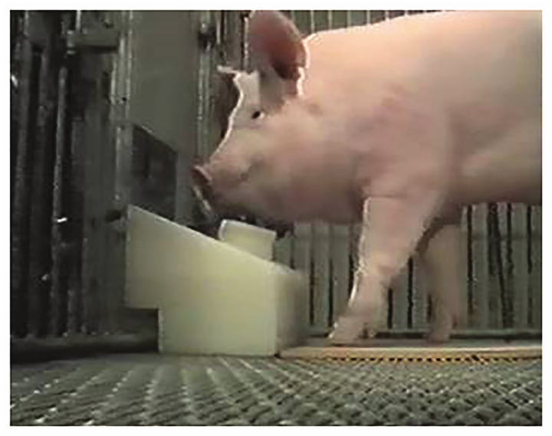
NEUR 411 · NEUROETHOLOGY · FALL 2026
Lecture 87
Pigs:
brain & sensory neuroanatomy, olfactory exploration, learning and memory, and social cognition
Date TBD
Jordan Lopez, Ph.D.
Professor of Neurobiology & Biomedical Engineering
Croney & Boysen (2021), Fig. 2. Study pig operating a snout-controlled joystick.
Notes:
Pigs: brain & sensory neuroanatomy, olfactory exploration, learning and memory, and social cognition
Lecture 87. NEUR 411 · NEUROETHOLOGY · FALL 2026. Date TBD.
Figure: Croney & Boysen (2021), Fig. 2. Study pig operating a snout-controlled joystick.
Figure source: https://doi.org/10.3389/fpsyg.2021.631755
References:
Croney Candace C, Boysen Sarah T (2021). Acquisition of a Joystick-Operated Video Task by Pigs ( Sus scrofa ). Frontiers in Psychology 12:631755. https://doi.org/10.3389/fpsyg.2021.631755

Slide 2
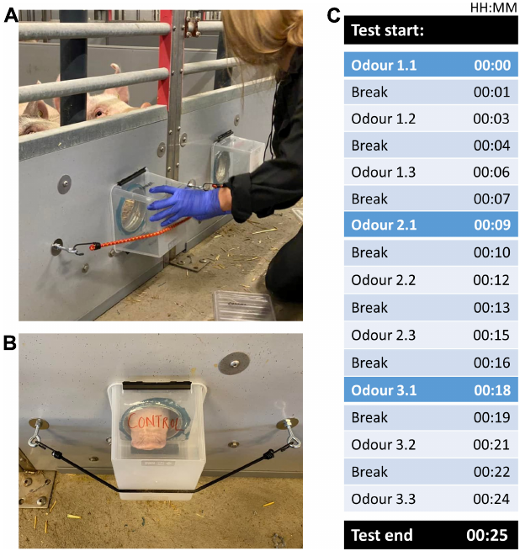
Pigs investigate odors without food reinforcement
Pigs explore their surroundings through the snout, combining movement with chemical sampling. Olfactory exploration is investigation directed toward odor sources, rather than a trained response to obtain food. Rørvang and colleagues measured spontaneous odor investigation in domestic pigs, Sus scrofa, living with a familiar partner.
An odor box was attached to an opening in the pen wall, with a control opening available for comparison. Each odor was presented for 1 min, three times, with 2-min intervals. Sniffing was scored when the snout was within 8 cm of the opening.
Investigation declined when the same odor returned and increased when a different odor appeared. Feeding-related actions were more frequent at the odor opening than at the control opening. Chemical information therefore changed exploratory behavior without requiring a food-reward training procedure.
Rørvang et al. (2023), Fig. 2(A–C). Odor presentation apparatus and timing.
Rørvang et al. (2023)
02
Notes:
• Pigs explore their surroundings through the snout, combining movement with chemical sampling. Olfactory exploration is investigation directed toward odor sources, rather than a trained response to obtain food. Rørvang and colleagues measured spontaneous odor investigation in domestic pigs, Sus scrofa, living with a familiar partner.
• An odor box was attached to an opening in the pen wall, with a control opening available for comparison. Each odor was presented for 1 min, three times, with 2-min intervals. Sniffing was scored when the snout was within 8 cm of the opening.
• Investigation declined when the same odor returned and increased when a different odor appeared. Feeding-related actions were more frequent at the odor opening than at the control opening. Chemical information therefore changed exploratory behavior without requiring a food-reward training procedure.
References:
Rørvang Maria Vilain, Schild Sarah-Lina Aagaard, Stenfelt Johanna, Grut Rebecca, Gadri Moses A., Valros Anna, Nielsen Birte L., Wallenbeck Anna (2023). Odor exploration behavior of the domestic pig ( Sus scrofa ) as indicator of enriching properties of odors. Frontiers in Behavioral Neuroscience 17:1173298. https://doi.org/10.3389/fnbeh.2023.1173298
Figure: Rørvang et al. (2023), Fig. 2(A–C). Odor presentation apparatus and timing.
Figure source: https://doi.org/10.3389/fnbeh.2023.1173298

Slide 3
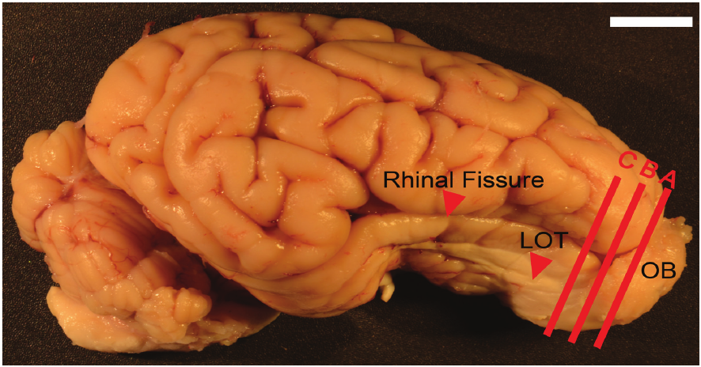
A large olfactory cortex borders the folded cerebrum
Neuroanatomy describes the arrangement of nervous tissue and its component structures. The pig cerebrum contains a folded outer cortex, while prominent olfactory structures occupy the rostral and ventral forebrain. Brunjes and colleagues examined pig brains with stains that distinguish cell bodies, neuronal processes, and myelinated axons.
The brains in this anatomical study were approximately 10 cm long and weighed about 90 g. The rhinal fissure, a surface groove, extended over 5 cm and separated ventral olfactory cortex from the more convoluted neocortex. These dimensions describe the studied animals, rather than a fixed size for every pig breed.
The olfactory bulb projected from the front of the brain and continued into the olfactory peduncle, the stalk connecting it to the forebrain. This organization places the first central odor-processing structure beside extensive cortical tissue that receives and transforms its output.
Brunjes et al. (2016), Fig. 1. Pig brain and rhinal fissure; 1-cm scale bar.
Brunjes et al. (2016)
03
Notes:
• Neuroanatomy describes the arrangement of nervous tissue and its component structures. The pig cerebrum contains a folded outer cortex, while prominent olfactory structures occupy the rostral and ventral forebrain. Brunjes and colleagues examined pig brains with stains that distinguish cell bodies, neuronal processes, and myelinated axons.
• The brains in this anatomical study were approximately 10 cm long and weighed about 90 g. The rhinal fissure, a surface groove, extended over 5 cm and separated ventral olfactory cortex from the more convoluted neocortex. These dimensions describe the studied animals, rather than a fixed size for every pig breed.
• The olfactory bulb projected from the front of the brain and continued into the olfactory peduncle, the stalk connecting it to the forebrain. This organization places the first central odor-processing structure beside extensive cortical tissue that receives and transforms its output.
References:
Brunjes Peter C., Feldman Sanford, Osterberg Stephen K. (2016). The Pig Olfactory Brain: A Primer. Chemical Senses 41:415–425. https://doi.org/10.1093/chemse/bjw016
Figure: Brunjes et al. (2016), Fig. 1. Pig brain and rhinal fissure; 1-cm scale bar.
Figure source: https://doi.org/10.1093/chemse/bjw016

Slide 4
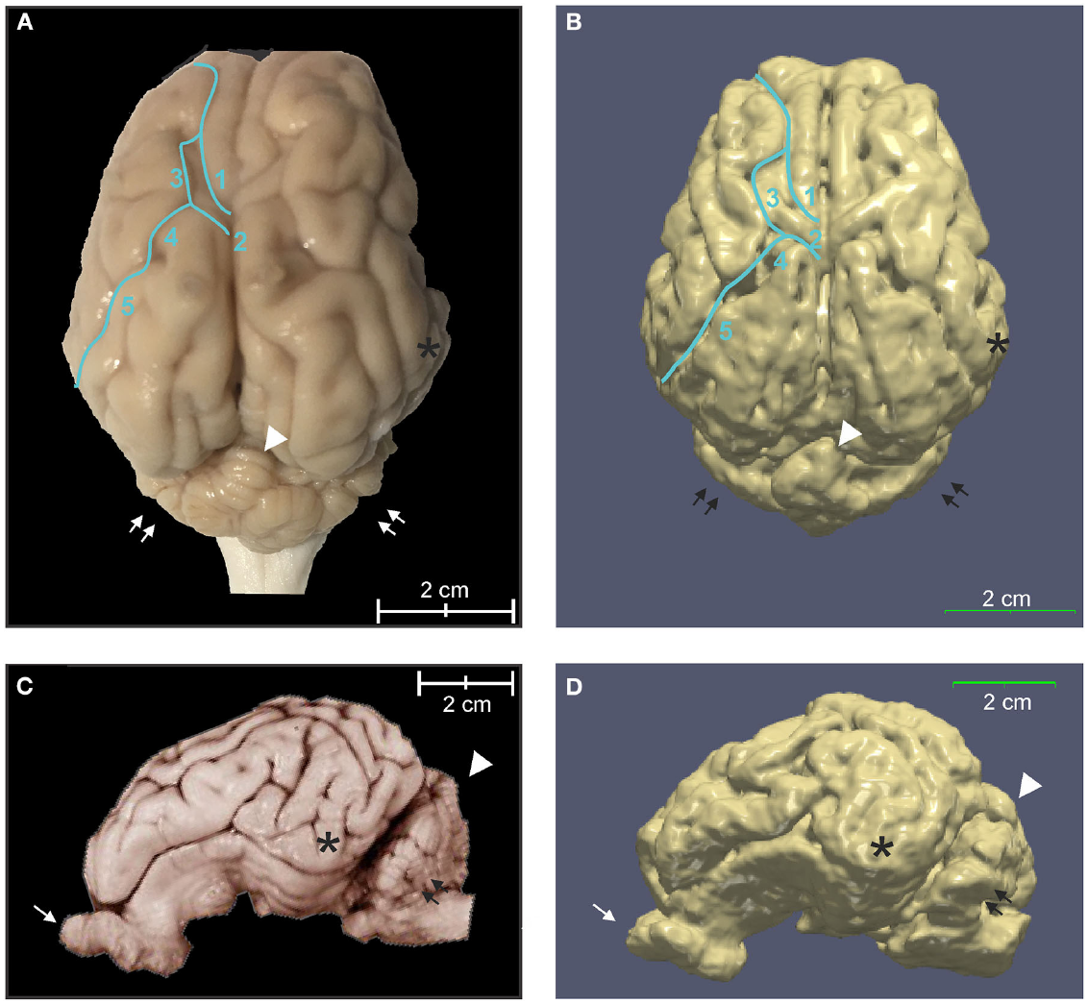
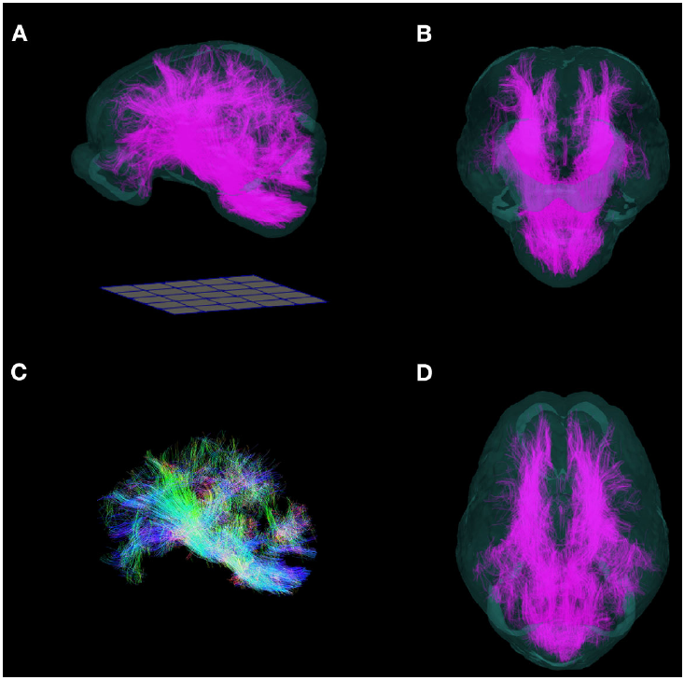
MRI separates cortical folds from white matter pathways
Magnetic resonance imaging, or MRI, measures signals from tissue to resolve internal anatomy without cutting the brain. Chang and colleagues registered adult Yucatan micropig scans into a common spatial coordinate system. Their template retained recognizable cortical grooves and the prominent olfactory bulbs seen in fixed specimens.
Gray matter contains concentrated neuronal cell bodies and local processes; white matter contains bundles of axons, many surrounded by myelin. Tissue segmentation separated these compartments from cerebrospinal fluid. Registration reduced differences in position while preserving the anatomy needed to compare corresponding structures.
A separate diffusion analysis estimated the orientations of white matter bundles from water movement. The resulting pathways were structural estimates, rather than recordings of signals traveling through axons. Fixed anatomy, tissue segmentation, and diffusion measurements provide complementary descriptions of the same brain.
Chang et al. (2020), Fig. 6(A–D). Fixed brain specimens and cortical surface reconstructions.
Chang et al. (2020), Fig. 8(A–D). Published whole-brain tractography with direction-coded fibers.
Chang et al. (2020); Brunjes et al. (2016)
04
Notes:
• Magnetic resonance imaging, or MRI, measures signals from tissue to resolve internal anatomy without cutting the brain. Chang and colleagues registered adult Yucatan micropig scans into a common spatial coordinate system. Their template retained recognizable cortical grooves and the prominent olfactory bulbs seen in fixed specimens.
• Gray matter contains concentrated neuronal cell bodies and local processes; white matter contains bundles of axons, many surrounded by myelin. Tissue segmentation separated these compartments from cerebrospinal fluid. Registration reduced differences in position while preserving the anatomy needed to compare corresponding structures.
• A separate diffusion analysis estimated the orientations of white matter bundles from water movement. The resulting pathways were structural estimates, rather than recordings of signals traveling through axons. Fixed anatomy, tissue segmentation, and diffusion measurements provide complementary descriptions of the same brain.
References:
Chang Stephano J, Santamaria Andrea J, Sanchez Francisco J, Villamil Luz M, Pinheiro Saraiva Pedro, Rodriguez Jose, Nunez-Gomez Yohjans, Opris Ioan, Solano Juan P, Guest James D, Noga Brian R (2020). In vivo Population Averaged Stereotaxic T2w MRI Brain Template for the Adult Yucatan Micropig. Frontiers in Neuroanatomy 14:599701. https://doi.org/10.3389/fnana.2020.599701
Brunjes Peter C., Feldman Sanford, Osterberg Stephen K. (2016). The Pig Olfactory Brain: A Primer. Chemical Senses 41:415–425. https://doi.org/10.1093/chemse/bjw016
Figure: Chang et al. (2020), Fig. 6(A–D). Fixed brain specimens and cortical surface reconstructions.
Figure source: https://doi.org/10.3389/fnana.2020.599701
Figure: Chang et al. (2020), Fig. 8(A–D). Published whole-brain tractography with direction-coded fibers.
Figure source: https://doi.org/10.3389/fnana.2020.599701

Slide 5
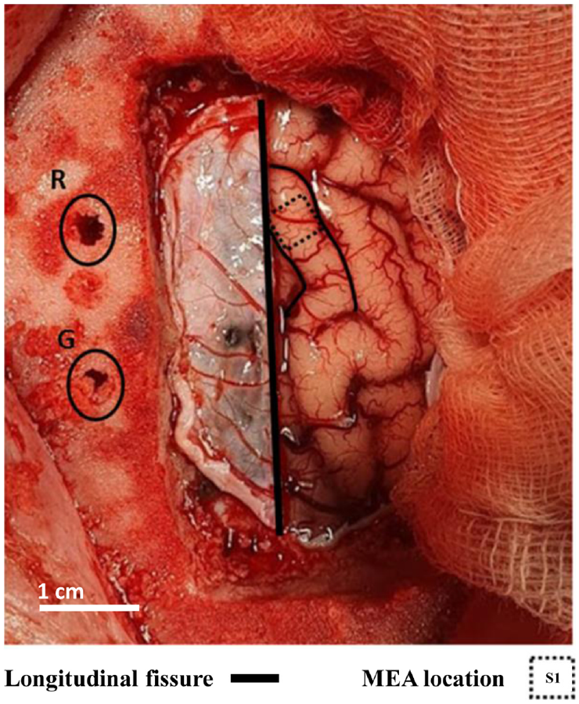
Peripheral stimulation reaches pig somatosensory cortex
Primary somatosensory cortex, or S1, is a cortical region that receives information about bodily stimulation. Janjua and colleagues electrically stimulated the ulnar nerve in anesthetized pigs and recorded the resulting cortical activity. The ulnar nerve carries signals from the forelimb; this preparation tested a limb pathway rather than snout sensation.
A 16-channel microelectrode array sampled activity within the exposed cortex. An evoked potential is a voltage response time-locked to a controlled stimulus. Averaging repeated responses retained stimulus-related activity while reducing fluctuations that were unrelated to the stimulation.
The first negative component, called N1, occurred within the 30–50 ms interval after peripheral stimulation. This delay includes transmission through peripheral and central pathways. A repeatable cortical response connects a precisely timed bodily input to measurable neuronal population activity.
Janjua et al. (2021), Fig. 1. Exposed cortex and recording location in primary somatosensory cortex.
Janjua et al. (2021)
05
Notes:
• Primary somatosensory cortex, or S1, is a cortical region that receives information about bodily stimulation. Janjua and colleagues electrically stimulated the ulnar nerve in anesthetized pigs and recorded the resulting cortical activity. The ulnar nerve carries signals from the forelimb; this preparation tested a limb pathway rather than snout sensation.
• A 16-channel microelectrode array sampled activity within the exposed cortex. An evoked potential is a voltage response time-locked to a controlled stimulus. Averaging repeated responses retained stimulus-related activity while reducing fluctuations that were unrelated to the stimulation.
• The first negative component, called N1, occurred within the 30–50 ms interval after peripheral stimulation. This delay includes transmission through peripheral and central pathways. A repeatable cortical response connects a precisely timed bodily input to measurable neuronal population activity.
References:
Janjua Taha Al Muhammadee, Nielsen Thomas Gomes Nørgaard dos Santos, Andreis Felipe Rettore, Meijs Suzan, Jensen Winnie (2021). The effect of peripheral high-frequency electrical stimulation on the primary somatosensory cortex in pigs. IBRO Neuroscience Reports 11:112–118. https://doi.org/10.1016/j.ibneur.2021.08.004
Figure: Janjua et al. (2021), Fig. 1. Exposed cortex and recording location in primary somatosensory cortex.
Figure source: https://doi.org/10.1016/j.ibneur.2021.08.004

Slide 6
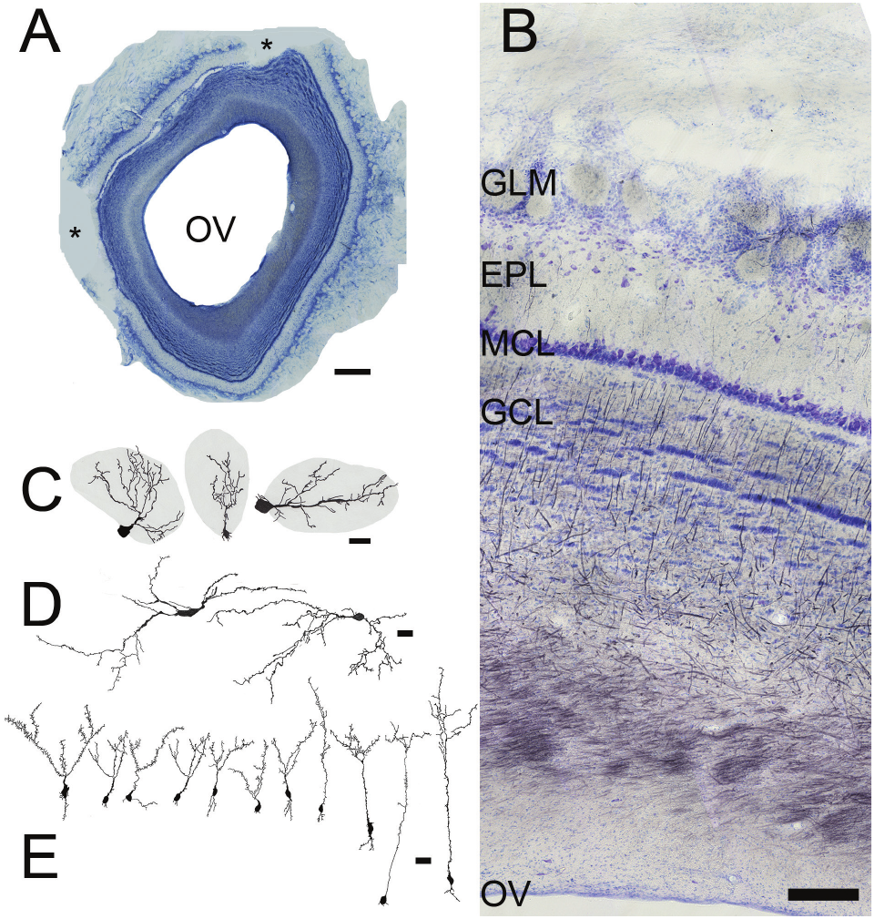
The olfactory bulb organizes sensory input into layers
The olfactory bulb is the first major brain structure receiving axons from nasal olfactory sensory neurons. The pig bulb in the anatomical study weighed about 3 g and occupied about 3 mL. Coronal sections, cuts across the rostrocaudal axis, exposed its concentric tissue layers around a large olfactory ventricle.
Nissl staining labels cell bodies, while myelin staining emphasizes axon-rich tissue. The superficial olfactory nerve layer contains incoming sensory axons. Beneath it lie glomeruli, the external plexiform layer, the mitral cell layer, and the granule cell region.
The external plexiform layer contains relatively few cell bodies but many neuronal processes and synapses. Deep white matter includes axons arriving from higher regions. Odor input therefore enters a layered network that also receives signals from outside the bulb.
Brunjes et al. (2016), Fig. 2(A–E). Bulb layers, olfactory ventricle, and neuronal morphology.
Brunjes et al. (2016)
06
Notes:
• The olfactory bulb is the first major brain structure receiving axons from nasal olfactory sensory neurons. The pig bulb in the anatomical study weighed about 3 g and occupied about 3 mL. Coronal sections, cuts across the rostrocaudal axis, exposed its concentric tissue layers around a large olfactory ventricle.
• Nissl staining labels cell bodies, while myelin staining emphasizes axon-rich tissue. The superficial olfactory nerve layer contains incoming sensory axons. Beneath it lie glomeruli, the external plexiform layer, the mitral cell layer, and the granule cell region.
• The external plexiform layer contains relatively few cell bodies but many neuronal processes and synapses. Deep white matter includes axons arriving from higher regions. Odor input therefore enters a layered network that also receives signals from outside the bulb.
References:
Brunjes Peter C., Feldman Sanford, Osterberg Stephen K. (2016). The Pig Olfactory Brain: A Primer. Chemical Senses 41:415–425. https://doi.org/10.1093/chemse/bjw016
Figure: Brunjes et al. (2016), Fig. 2(A–E). Bulb layers, olfactory ventricle, and neuronal morphology.
Figure source: https://doi.org/10.1093/chemse/bjw016

Slide 7
Glomeruli bring sensory axons into local networks
A glomerulus is a rounded region of neuropil, the interwoven axons and dendrites where neurons communicate. Pig olfactory glomeruli lie beneath the superficial sensory nerve layer. Brunjes and colleagues estimated about 11,000 glomeruli in the bulbs they examined.
Glomerular cross-sectional areas varied from approximately 2,400 to 42,000 µm², with larger examples often found dorsally. Incoming sensory axons branch within these regions and contact the dendrites of bulb neurons. The glomerular arrangement distributes nasal input across many local processing sites.
Periglomerular interneurons have cell bodies around glomeruli and dendrites extending into them. An interneuron acts within a local circuit rather than primarily projecting to a distant target. These cells place local regulation beside the initial contacts between sensory axons and bulb output neurons.
Brunjes et al. (2016), Fig. 2(A–E). Glomerular layer and adjacent bulb circuitry.
Brunjes et al. (2016)
07
Notes:
• A glomerulus is a rounded region of neuropil, the interwoven axons and dendrites where neurons communicate. Pig olfactory glomeruli lie beneath the superficial sensory nerve layer. Brunjes and colleagues estimated about 11,000 glomeruli in the bulbs they examined.
• Glomerular cross-sectional areas varied from approximately 2,400 to 42,000 µm², with larger examples often found dorsally. Incoming sensory axons branch within these regions and contact the dendrites of bulb neurons. The glomerular arrangement distributes nasal input across many local processing sites.
• Periglomerular interneurons have cell bodies around glomeruli and dendrites extending into them. An interneuron acts within a local circuit rather than primarily projecting to a distant target. These cells place local regulation beside the initial contacts between sensory axons and bulb output neurons.
References:
Brunjes Peter C., Feldman Sanford, Osterberg Stephen K. (2016). The Pig Olfactory Brain: A Primer. Chemical Senses 41:415–425. https://doi.org/10.1093/chemse/bjw016
Figure: Brunjes et al. (2016), Fig. 2(A–E). Glomerular layer and adjacent bulb circuitry.
Figure source: https://doi.org/10.1093/chemse/bjw016

Slide 8
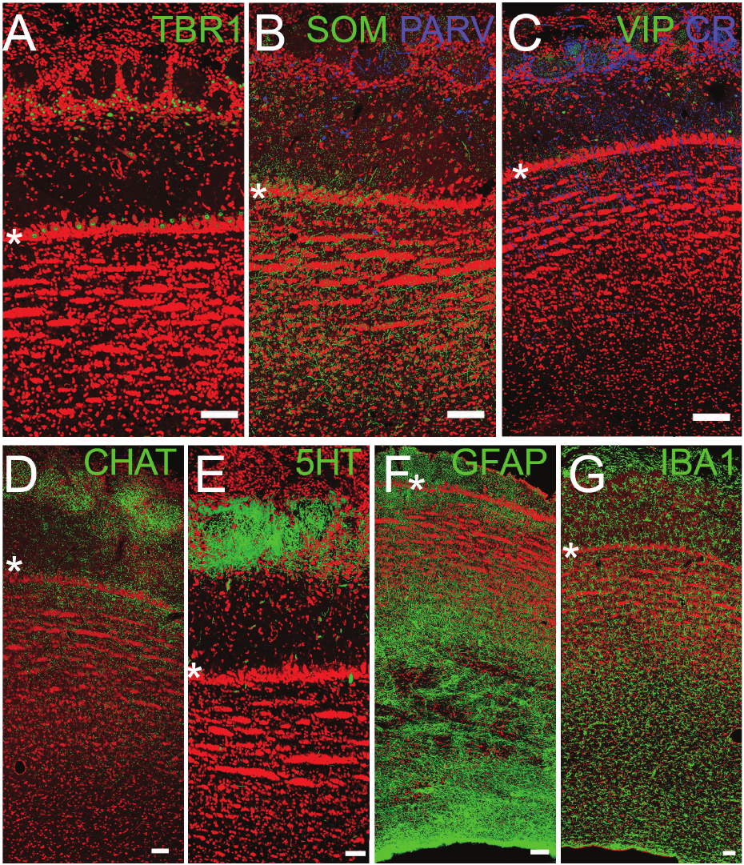
Mitral and tufted cells carry bulb output forward
Mitral cells and tufted cells are principal projection neurons of the olfactory bulb. A projection neuron sends an axon to another region. These cells receive sensory-related input in glomeruli and convey processed activity toward olfactory cortex.
The transcription factor TBR1, a protein regulating gene expression, labeled projection neurons in pig bulb sections. Fluorescent immunohistochemistry used antibodies to locate the protein in tissue. Asterisks marked the mitral cell layer, and the published sections carried 100-µm scale bars.
The axons of mitral and tufted cells leave the caudal bulb to form the lateral olfactory tract. Their dendrites also occupy the external plexiform layer, where they interact with granule cells. The same output neurons therefore combine incoming sensory information with local circuit influences before signaling to cortex.
Brunjes et al. (2016), Fig. 3(A–G). Projection neurons, interneurons, modulatory fibers, and glia.
Brunjes et al. (2016)
08
Notes:
• Mitral cells and tufted cells are principal projection neurons of the olfactory bulb. A projection neuron sends an axon to another region. These cells receive sensory-related input in glomeruli and convey processed activity toward olfactory cortex.
• The transcription factor TBR1, a protein regulating gene expression, labeled projection neurons in pig bulb sections. Fluorescent immunohistochemistry used antibodies to locate the protein in tissue. Asterisks marked the mitral cell layer, and the published sections carried 100-µm scale bars.
• The axons of mitral and tufted cells leave the caudal bulb to form the lateral olfactory tract. Their dendrites also occupy the external plexiform layer, where they interact with granule cells. The same output neurons therefore combine incoming sensory information with local circuit influences before signaling to cortex.
References:
Brunjes Peter C., Feldman Sanford, Osterberg Stephen K. (2016). The Pig Olfactory Brain: A Primer. Chemical Senses 41:415–425. https://doi.org/10.1093/chemse/bjw016
Figure: Brunjes et al. (2016), Fig. 3(A–G). Projection neurons, interneurons, modulatory fibers, and glia.
Figure source: https://doi.org/10.1093/chemse/bjw016

Slide 9
Inhibitory interneurons diversify olfactory processing
GABA, gamma-aminobutyric acid, is a major inhibitory neurotransmitter in mammalian local circuits. A neurotransmitter is a chemical released by a neuron to influence another cell. Pig bulb tissue contained GABAergic interneuron classes identified by additional protein or peptide markers.
Parvalbumin and calretinin are calcium-binding proteins; somatostatin and vasoactive intestinal polypeptide, or VIP, are peptides. Antibodies against these markers labeled distinct neuronal populations around glomeruli and within the external plexiform layer. Marker expression identifies cellular diversity without directly measuring each cell’s firing pattern.
Granule cells extend dendrites into the external plexiform layer, beside mitral and tufted dendrites. GABA can open GABA-A receptors, ligand-gated ion channels that conduct chloride. Their effect depends on the chloride gradient; in mature circuits they commonly constrain firing. This general mechanism explains why the identified interneurons could regulate bulb output, rather than showing receptor currents measured in these pigs. The anatomical study establishes the cellular arrangement; the effects of individual pig interneuron classes on odor-guided choices require physiological testing.
Brunjes et al. (2016), Fig. 3(A–G). Marked interneuron populations in the pig bulb.
Brunjes et al. (2016)
09
Notes:
• GABA, gamma-aminobutyric acid, is a major inhibitory neurotransmitter in mammalian local circuits. A neurotransmitter is a chemical released by a neuron to influence another cell. Pig bulb tissue contained GABAergic interneuron classes identified by additional protein or peptide markers.
• Parvalbumin and calretinin are calcium-binding proteins; somatostatin and vasoactive intestinal polypeptide, or VIP, are peptides. Antibodies against these markers labeled distinct neuronal populations around glomeruli and within the external plexiform layer. Marker expression identifies cellular diversity without directly measuring each cell’s firing pattern.
• Granule cells extend dendrites into the external plexiform layer, beside mitral and tufted dendrites. GABA can open GABA-A receptors, ligand-gated ion channels that conduct chloride. Their effect depends on the chloride gradient; in mature circuits they commonly constrain firing. This general mechanism explains why the identified interneurons could regulate bulb output, rather than showing receptor currents measured in these pigs. The anatomical study establishes the cellular arrangement; the effects of individual pig interneuron classes on odor-guided choices require physiological testing.
References:
Brunjes Peter C., Feldman Sanford, Osterberg Stephen K. (2016). The Pig Olfactory Brain: A Primer. Chemical Senses 41:415–425. https://doi.org/10.1093/chemse/bjw016
Figure: Brunjes et al. (2016), Fig. 3(A–G). Marked interneuron populations in the pig bulb.
Figure source: https://doi.org/10.1093/chemse/bjw016

Slide 10
Cholinergic and serotonergic fibers enter olfactory circuits
Neuromodulation changes how a neural circuit responds, rather than simply adding another copy of the sensory stimulus. Pig olfactory bulbs contained fibers labeled for cholinergic and serotonergic systems. These inputs were especially prominent near glomeruli, where nasal sensory information first enters the bulb network.
Acetylcholine is the transmitter of cholinergic neurons. Choline acetyltransferase, or ChAT, is the enzyme used to synthesize it and served as a tissue marker. Serotonin, also called 5-HT, was detected with a separate antibody, identifying another chemically distinct input.
Glomerular sensory processing occurs in tissue that also receives these modulatory fibers. Antibody omission controls produced no staining, supporting the specificity of the anatomical labeling. The fiber distributions locate candidate sites for state-dependent regulation; they do not measure transmitter release during sniffing or establish a receptor-specific behavioral effect.
Brunjes et al. (2016), Fig. 3(A–G). Cholinergic and serotonergic fibers within bulb layers.
Brunjes et al. (2016)
10
Notes:
• Neuromodulation changes how a neural circuit responds, rather than simply adding another copy of the sensory stimulus. Pig olfactory bulbs contained fibers labeled for cholinergic and serotonergic systems. These inputs were especially prominent near glomeruli, where nasal sensory information first enters the bulb network.
• Acetylcholine is the transmitter of cholinergic neurons. Choline acetyltransferase, or ChAT, is the enzyme used to synthesize it and served as a tissue marker. Serotonin, also called 5-HT, was detected with a separate antibody, identifying another chemically distinct input.
• Glomerular sensory processing occurs in tissue that also receives these modulatory fibers. Antibody omission controls produced no staining, supporting the specificity of the anatomical labeling. The fiber distributions locate candidate sites for state-dependent regulation; they do not measure transmitter release during sniffing or establish a receptor-specific behavioral effect.
References:
Brunjes Peter C., Feldman Sanford, Osterberg Stephen K. (2016). The Pig Olfactory Brain: A Primer. Chemical Senses 41:415–425. https://doi.org/10.1093/chemse/bjw016
Figure: Brunjes et al. (2016), Fig. 3(A–G). Cholinergic and serotonergic fibers within bulb layers.
Figure source: https://doi.org/10.1093/chemse/bjw016

Slide 11
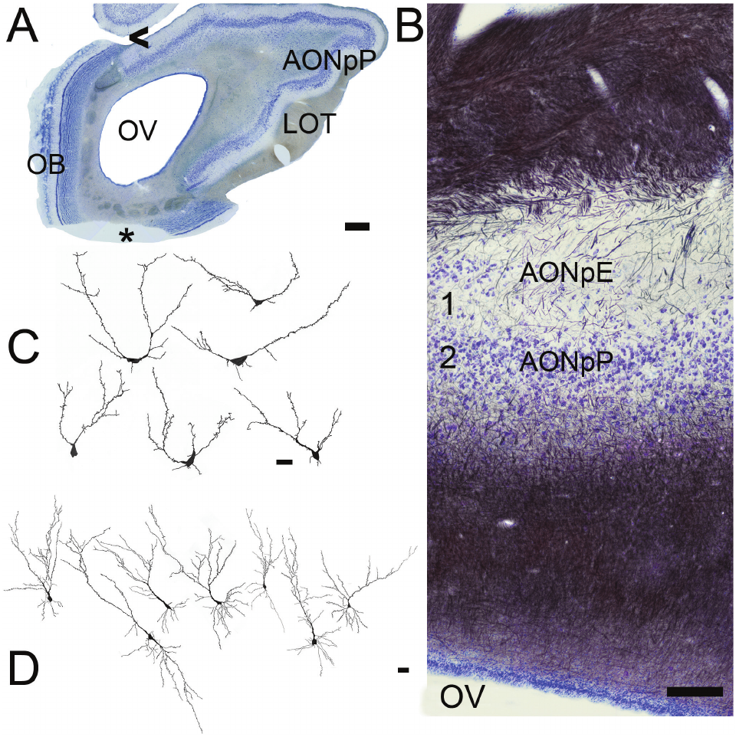
The anterior olfactory nucleus links bulb and cortex
The anterior olfactory nucleus, or AON, occupies much of the olfactory peduncle. Its larger subdivision, pars principalis, has a superficial process-rich layer and a deeper cell-rich layer. Pig sections distinguished these layers with Nissl and myelin stains.
Bulb axon collaterals enter the superficial layer alongside the apical dendrites of pyramidal neurons. An apical dendrite extends toward the cortical surface, whereas basal dendrites spread nearer the cell body. This arrangement brings bulb-derived signals into contact with cortical projection neurons.
Pig AON pyramidal cells had more branches and greater total dendritic length than the rodent cells used for comparison. The reported pig apical dendritic length was about 2,256 µm, compared with 992 µm in rats. A larger dendritic arbor provides more extended tissue over which inputs can converge, without itself determining odor sensitivity.
Brunjes et al. (2016), Fig. 5(A–D). Anterior olfactory nucleus layers and neuronal morphology.
Brunjes et al. (2016)
11
Notes:
• The anterior olfactory nucleus, or AON, occupies much of the olfactory peduncle. Its larger subdivision, pars principalis, has a superficial process-rich layer and a deeper cell-rich layer. Pig sections distinguished these layers with Nissl and myelin stains.
• Bulb axon collaterals enter the superficial layer alongside the apical dendrites of pyramidal neurons. An apical dendrite extends toward the cortical surface, whereas basal dendrites spread nearer the cell body. This arrangement brings bulb-derived signals into contact with cortical projection neurons.
• Pig AON pyramidal cells had more branches and greater total dendritic length than the rodent cells used for comparison. The reported pig apical dendritic length was about 2,256 µm, compared with 992 µm in rats. A larger dendritic arbor provides more extended tissue over which inputs can converge, without itself determining odor sensitivity.
References:
Brunjes Peter C., Feldman Sanford, Osterberg Stephen K. (2016). The Pig Olfactory Brain: A Primer. Chemical Senses 41:415–425. https://doi.org/10.1093/chemse/bjw016
Figure: Brunjes et al. (2016), Fig. 5(A–D). Anterior olfactory nucleus layers and neuronal morphology.
Figure source: https://doi.org/10.1093/chemse/bjw016

Slide 12
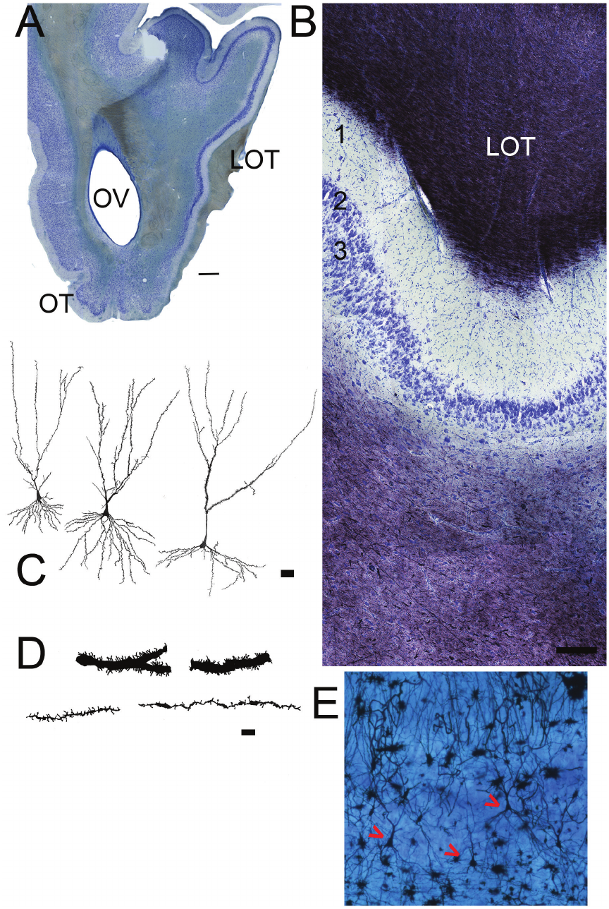
Piriform cortex separates input and cellular layers
Piriform cortex is an olfactory cortical region receiving bulb output through the lateral olfactory tract. In pigs, it extends caudally from the anterior olfactory nucleus along the lateral forebrain. The tissue has a superficial plexiform layer and two deeper cellular layers.
Layer 1 contains sensory-related axon collaterals and dendritic processes. Layer 2 is thin and densely packed, while layer 3 is broader with more scattered large cells. Golgi staining, which reveals individual neuronal shapes, resolved pyramidal neurons and their dendritic spines at micrometer scales.
Dendritic spines are small protrusions that provide sites for synaptic input. Pig piriform neurons differed in dendritic caliber and spine density. These anatomical differences coexist with projection neurons, interneurons, and modulatory fibers, providing a cellular substrate for processing information beyond the first bulb relay.
Brunjes et al. (2016), Fig. 7(A–E). Anterior piriform cortex layers, dendrites, and pyramidal cells.
Brunjes et al. (2016)
12
Notes:
• Piriform cortex is an olfactory cortical region receiving bulb output through the lateral olfactory tract. In pigs, it extends caudally from the anterior olfactory nucleus along the lateral forebrain. The tissue has a superficial plexiform layer and two deeper cellular layers.
• Layer 1 contains sensory-related axon collaterals and dendritic processes. Layer 2 is thin and densely packed, while layer 3 is broader with more scattered large cells. Golgi staining, which reveals individual neuronal shapes, resolved pyramidal neurons and their dendritic spines at micrometer scales.
• Dendritic spines are small protrusions that provide sites for synaptic input. Pig piriform neurons differed in dendritic caliber and spine density. These anatomical differences coexist with projection neurons, interneurons, and modulatory fibers, providing a cellular substrate for processing information beyond the first bulb relay.
References:
Brunjes Peter C., Feldman Sanford, Osterberg Stephen K. (2016). The Pig Olfactory Brain: A Primer. Chemical Senses 41:415–425. https://doi.org/10.1093/chemse/bjw016
Figure: Brunjes et al. (2016), Fig. 7(A–E). Anterior piriform cortex layers, dendrites, and pyramidal cells.
Figure source: https://doi.org/10.1093/chemse/bjw016

Slide 13
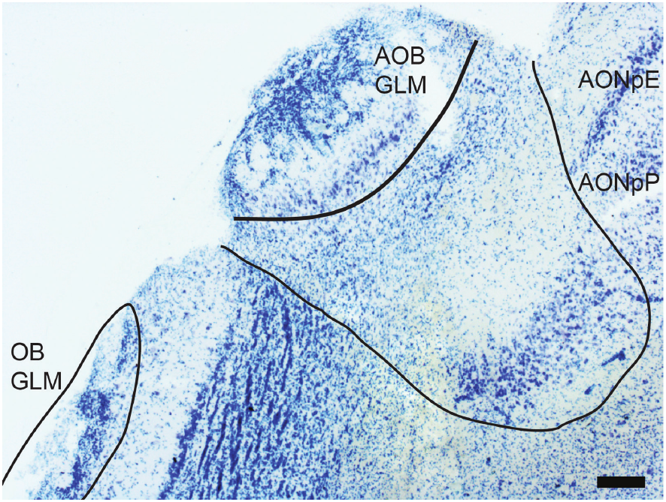
The accessory bulb receives a distinct nasal pathway
The vomeronasal organ is a nasal chemosensory structure with a pathway to the accessory olfactory bulb. The pig accessory bulb lies on the dorsomedial surface of the caudal main bulb. Brunjes and colleagues localized it where the main olfactory nerve and glomerular layers thin and disappear.
The accessory bulb contains superficial glomeruli, a combined external plexiform and mitral-cell zone, and a densely packed granule-cell region. The original anatomical panel retained a 30-µm scale bar. These compartments provide an identifiable second chemosensory route beside the main bulb.
A pheromone is a chemical signal acting between members of the same species. Its behavioral classification does not by itself identify the sensory pathway detecting it. Main and accessory olfactory anatomy must therefore be distinguished from claims about which route mediates a particular pig social or reproductive response.
Brunjes et al. (2016), Fig. 4. Accessory bulb and neighboring anterior olfactory structures.
Brunjes et al. (2016)
13
Notes:
• The vomeronasal organ is a nasal chemosensory structure with a pathway to the accessory olfactory bulb. The pig accessory bulb lies on the dorsomedial surface of the caudal main bulb. Brunjes and colleagues localized it where the main olfactory nerve and glomerular layers thin and disappear.
• The accessory bulb contains superficial glomeruli, a combined external plexiform and mitral-cell zone, and a densely packed granule-cell region. The original anatomical panel retained a 30-µm scale bar. These compartments provide an identifiable second chemosensory route beside the main bulb.
• A pheromone is a chemical signal acting between members of the same species. Its behavioral classification does not by itself identify the sensory pathway detecting it. Main and accessory olfactory anatomy must therefore be distinguished from claims about which route mediates a particular pig social or reproductive response.
References:
Brunjes Peter C., Feldman Sanford, Osterberg Stephen K. (2016). The Pig Olfactory Brain: A Primer. Chemical Senses 41:415–425. https://doi.org/10.1093/chemse/bjw016
Figure: Brunjes et al. (2016), Fig. 4. Accessory bulb and neighboring anterior olfactory structures.
Figure source: https://doi.org/10.1093/chemse/bjw016

Slide 14
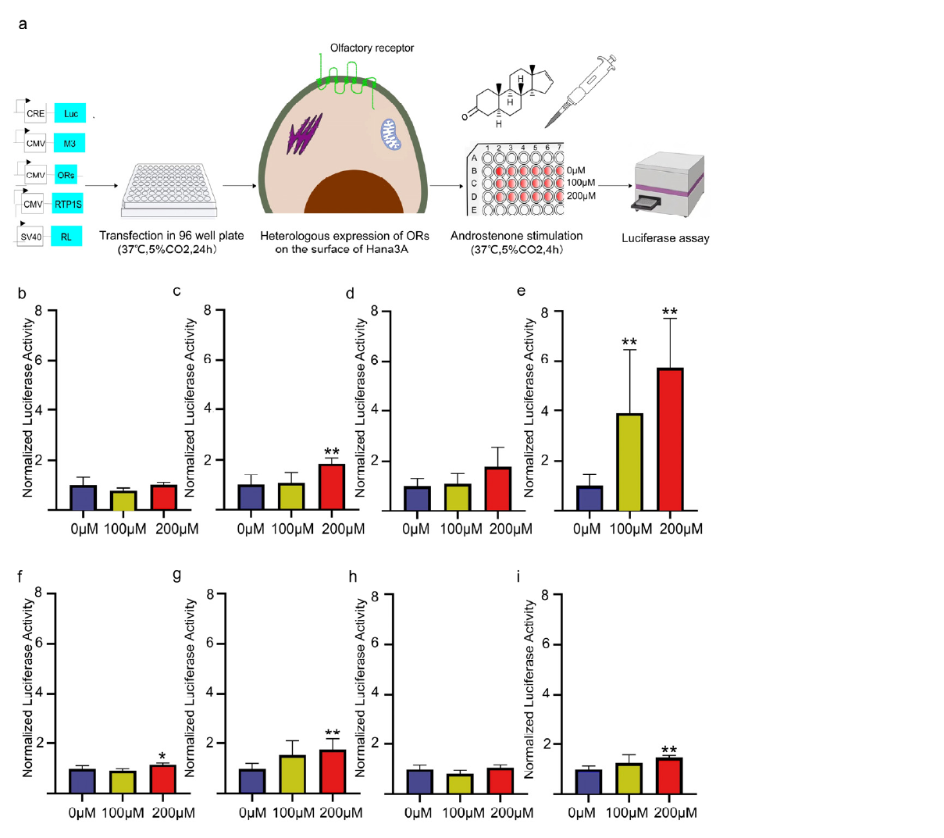
OR7D4 links androstenone to a receptor response
Androstenone is a steroid odorant associated with boar chemical signals. Yang and colleagues tested pig olfactory receptors in cultured Hana 3A cells. Heterologous expression places a receptor into a different cellular system so its response can be measured under controlled conditions.
Olfactory receptors are G protein-coupled receptors, membrane proteins that activate intracellular signaling through G proteins. The assay combined receptor expression with signaling-support proteins and a cyclic AMP-sensitive reporter. Cyclic AMP, or cAMP, is an intracellular messenger; the reporter converted pathway activation into measurable light production.
Pig OR7D4 responded to androstenone at 100 µM and produced a stronger response at 200 µM. Cells without the expressed receptor supplied a control. This experiment identifies receptor activation, while odor perception and mating-related behavior depend on subsequent neural processing in the intact animal.
Yang et al. (2025), Fig. 2(a–i). Heterologous receptor assay and concentration-dependent responses.
Yang et al. (2025)
14
Notes:
• Androstenone is a steroid odorant associated with boar chemical signals. Yang and colleagues tested pig olfactory receptors in cultured Hana 3A cells. Heterologous expression places a receptor into a different cellular system so its response can be measured under controlled conditions.
• Olfactory receptors are G protein-coupled receptors, membrane proteins that activate intracellular signaling through G proteins. The assay combined receptor expression with signaling-support proteins and a cyclic AMP-sensitive reporter. Cyclic AMP, or cAMP, is an intracellular messenger; the reporter converted pathway activation into measurable light production.
• Pig OR7D4 responded to androstenone at 100 µM and produced a stronger response at 200 µM. Cells without the expressed receptor supplied a control. This experiment identifies receptor activation, while odor perception and mating-related behavior depend on subsequent neural processing in the intact animal.
References:
Yang Peidong, Luo Tingting, Yang Shuqi, Zhang Anjing, Tang Yuan, Chen Li, Wang Jinyong, Zhao Yongju, Zhong Zhining, Li Xuemin, Han Ziyin, Zhang Yupei, Tang Yue, Ma Jideng, Jin Long, Long Keren, Li Mingzhou, Lu Lu, Popławski Tomasz (2025). Identification of Olfactory Receptors Responding to Androstenone and the Key Structure Determinant in Domestic Pig. Current Issues in Molecular Biology 47:13. https://doi.org/10.3390/cimb47010013
Figure: Yang et al. (2025), Fig. 2(a–i). Heterologous receptor assay and concentration-dependent responses.
Figure source: https://doi.org/10.3390/cimb47010013

Slide 15
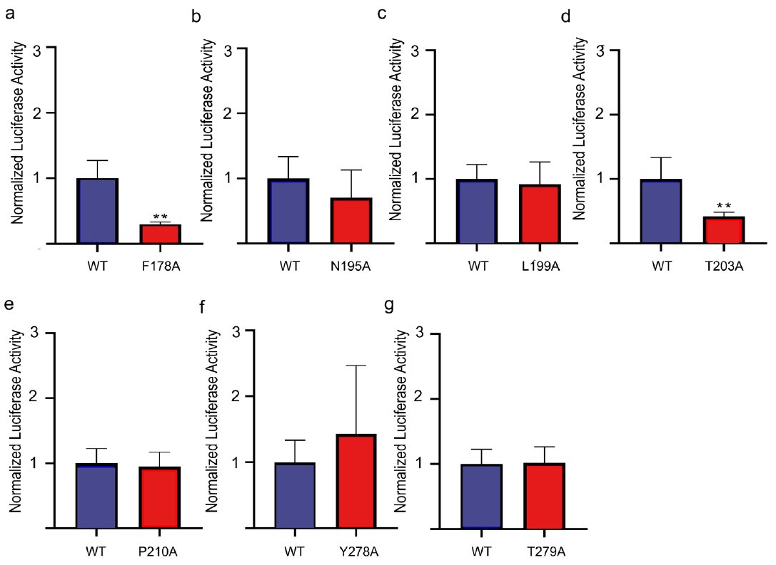
Specific receptor residues support odor recognition
A receptor’s amino-acid sequence contributes to its interaction with an odor molecule. Yang and colleagues first predicted candidate sites in the binding cavity of pig OR7D4, then tested them by site-directed mutagenesis, a targeted change in the sequence encoding the receptor.
Alanine substitution replaced selected residues with alanine, allowing the response of each altered receptor to be compared with the unmodified receptor. With 200 µM androstenone, F178A and T203A substantially reduced the reporter response. The names specify the original amino acid, its position, and the substituted amino acid.
These tests connect molecular structure to a measured signaling response. The binding-site model guided the candidates, while the cell assay supplied experimental evidence for their contribution. Reduced signaling could reflect ligand interaction or other effects on receptor function, so the result is more specific than a claim about an animal’s complete olfactory ability.
Yang et al. (2025), Fig. 4(a–g). Responses of OR7D4 alanine-substitution mutants.
Yang et al. (2025)
15
Notes:
• A receptor’s amino-acid sequence contributes to its interaction with an odor molecule. Yang and colleagues first predicted candidate sites in the binding cavity of pig OR7D4, then tested them by site-directed mutagenesis, a targeted change in the sequence encoding the receptor.
• Alanine substitution replaced selected residues with alanine, allowing the response of each altered receptor to be compared with the unmodified receptor. With 200 µM androstenone, F178A and T203A substantially reduced the reporter response. The names specify the original amino acid, its position, and the substituted amino acid.
• These tests connect molecular structure to a measured signaling response. The binding-site model guided the candidates, while the cell assay supplied experimental evidence for their contribution. Reduced signaling could reflect ligand interaction or other effects on receptor function, so the result is more specific than a claim about an animal’s complete olfactory ability.
References:
Yang Peidong, Luo Tingting, Yang Shuqi, Zhang Anjing, Tang Yuan, Chen Li, Wang Jinyong, Zhao Yongju, Zhong Zhining, Li Xuemin, Han Ziyin, Zhang Yupei, Tang Yue, Ma Jideng, Jin Long, Long Keren, Li Mingzhou, Lu Lu, Popławski Tomasz (2025). Identification of Olfactory Receptors Responding to Androstenone and the Key Structure Determinant in Domestic Pig. Current Issues in Molecular Biology 47:13. https://doi.org/10.3390/cimb47010013
Figure: Yang et al. (2025), Fig. 4(a–g). Responses of OR7D4 alanine-substitution mutants.
Figure source: https://doi.org/10.3390/cimb47010013

Slide 16
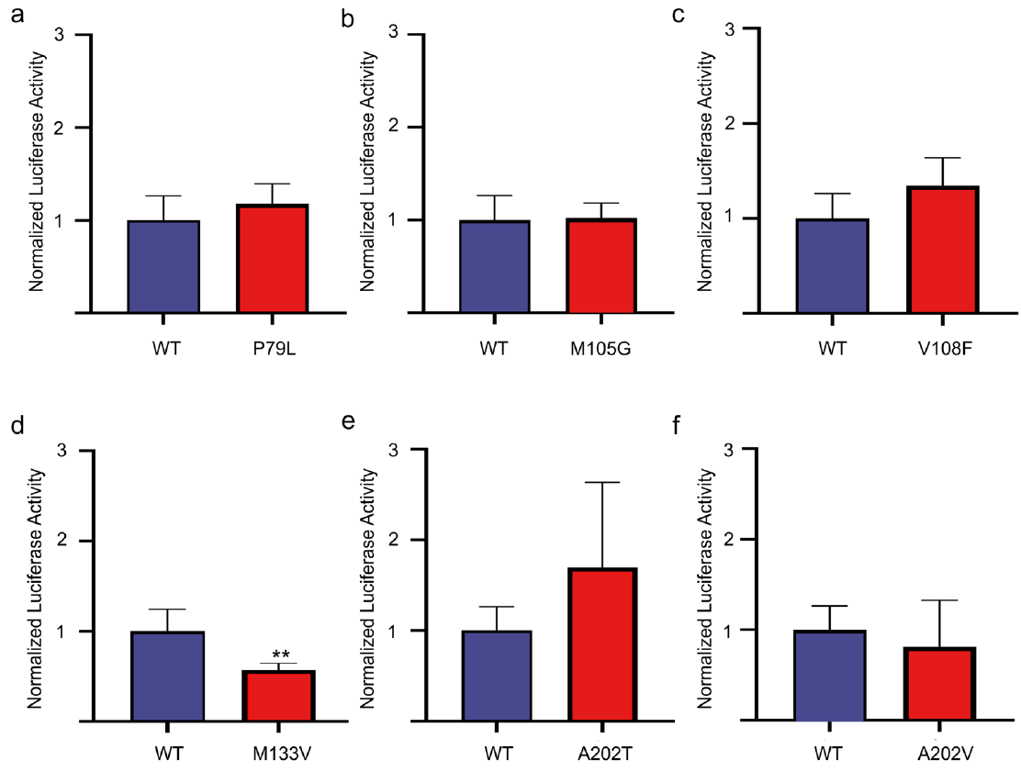
A natural OR7D4 variant alters the cellular response
Genetic polymorphism means that alternative DNA sequences occur within a population. Yang and colleagues examined naturally occurring sequence differences in pig OR7D4. A nonsynonymous variant changes the amino acid encoded by the gene and can therefore alter the receptor protein.
The M133V variant replaces methionine with valine at position 133. Compared with the original receptor, it reduced the response to 200 µM androstenone in the cultured-cell assay. Other tested substitutions did not produce the same reduction under the assay conditions.
The comparison holds the chemical stimulus and assay system constant while changing receptor sequence. It establishes a molecular source of variation in odorant responsiveness. Whether pigs carrying this variant differ in detection thresholds, social behavior, or reproductive performance remains a separate question for intact-animal experiments.
Yang et al. (2025), Fig. 5(a–f). Responses of naturally occurring OR7D4 sequence variants.
Yang et al. (2025)
16
Notes:
• Genetic polymorphism means that alternative DNA sequences occur within a population. Yang and colleagues examined naturally occurring sequence differences in pig OR7D4. A nonsynonymous variant changes the amino acid encoded by the gene and can therefore alter the receptor protein.
• The M133V variant replaces methionine with valine at position 133. Compared with the original receptor, it reduced the response to 200 µM androstenone in the cultured-cell assay. Other tested substitutions did not produce the same reduction under the assay conditions.
• The comparison holds the chemical stimulus and assay system constant while changing receptor sequence. It establishes a molecular source of variation in odorant responsiveness. Whether pigs carrying this variant differ in detection thresholds, social behavior, or reproductive performance remains a separate question for intact-animal experiments.
References:
Yang Peidong, Luo Tingting, Yang Shuqi, Zhang Anjing, Tang Yuan, Chen Li, Wang Jinyong, Zhao Yongju, Zhong Zhining, Li Xuemin, Han Ziyin, Zhang Yupei, Tang Yue, Ma Jideng, Jin Long, Long Keren, Li Mingzhou, Lu Lu, Popławski Tomasz (2025). Identification of Olfactory Receptors Responding to Androstenone and the Key Structure Determinant in Domestic Pig. Current Issues in Molecular Biology 47:13. https://doi.org/10.3390/cimb47010013
Figure: Yang et al. (2025), Fig. 5(a–f). Responses of naturally occurring OR7D4 sequence variants.
Figure source: https://doi.org/10.3390/cimb47010013

Slide 17
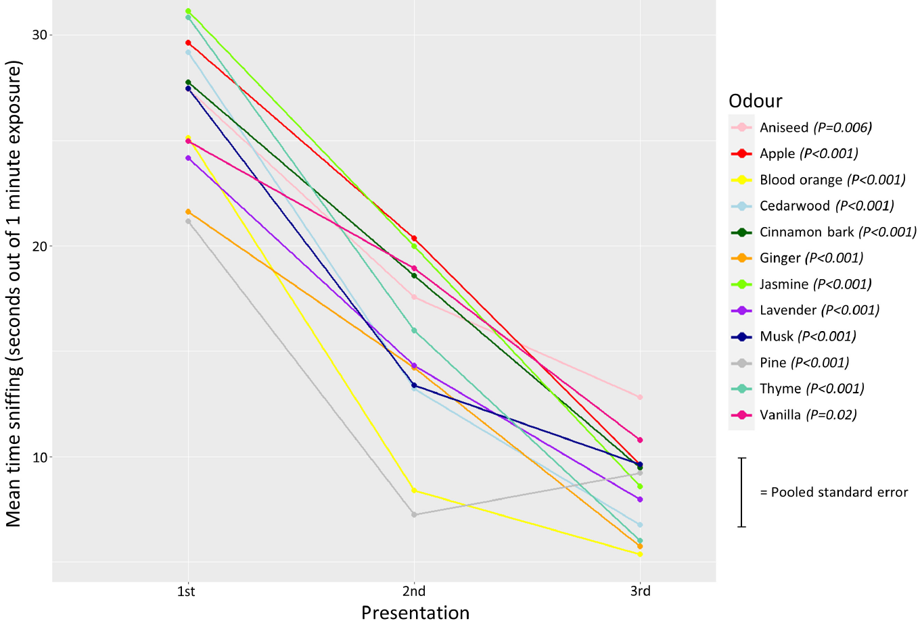
Repeated odors reduce spontaneous investigation
Habituation is a decrease in response when a stimulus repeats. Pig pairs received three 1-min presentations of the same odor, separated by 2-min intervals. Rørvang and colleagues compared the time spent sniffing across these presentations rather than training pigs to choose a rewarded odor.
Sniffing duration fell across repetitions for all included odors. Odors were tested through a protected opening, and the same pen also contained a control opening. The animals’ movements remained free, allowing the response to be expressed as approach and sustained investigation.
The declining response reflects a change in engagement with a repeated chemical stimulus. It is a behavioral measure, not a direct recording of olfactory receptor adaptation or synaptic depression. Changing the odor after repetition tests whether the pigs can still investigate a new stimulus when responding to the old one has declined.
Rørvang et al. (2023), Fig. 5. Sniffing duration across three presentations of each odor.
Rørvang et al. (2023)
17
Notes:
• Habituation is a decrease in response when a stimulus repeats. Pig pairs received three 1-min presentations of the same odor, separated by 2-min intervals. Rørvang and colleagues compared the time spent sniffing across these presentations rather than training pigs to choose a rewarded odor.
• Sniffing duration fell across repetitions for all included odors. Odors were tested through a protected opening, and the same pen also contained a control opening. The animals’ movements remained free, allowing the response to be expressed as approach and sustained investigation.
• The declining response reflects a change in engagement with a repeated chemical stimulus. It is a behavioral measure, not a direct recording of olfactory receptor adaptation or synaptic depression. Changing the odor after repetition tests whether the pigs can still investigate a new stimulus when responding to the old one has declined.
References:
Rørvang Maria Vilain, Schild Sarah-Lina Aagaard, Stenfelt Johanna, Grut Rebecca, Gadri Moses A., Valros Anna, Nielsen Birte L., Wallenbeck Anna (2023). Odor exploration behavior of the domestic pig ( Sus scrofa ) as indicator of enriching properties of odors. Frontiers in Behavioral Neuroscience 17:1173298. https://doi.org/10.3389/fnbeh.2023.1173298
Figure: Rørvang et al. (2023), Fig. 5. Sniffing duration across three presentations of each odor.
Figure source: https://doi.org/10.3389/fnbeh.2023.1173298

Slide 18
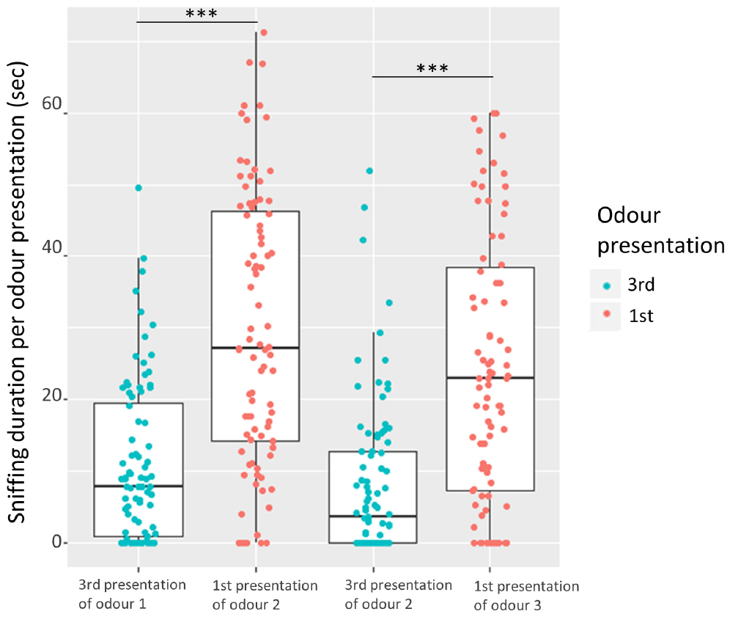
New odors restore investigation and redirect behavior
Dishabituation is recovery of a response after a stimulus change. Sniffing increased when pigs received a new odor after three presentations of the preceding odor. The reported increases were approximately 19 s and 16 s for the two successive odor-change comparisons.
The pigs therefore remained capable of renewed investigation despite their declining response to repetition. This comparison separates stimulus-specific change from a simple progressive loss of movement or interest in the entire apparatus. It also provides behavioral evidence that the chemical presentations were distinguishable.
Odor-directed activity included licking, biting, and rooting, with feeding-related behavior more frequent at the odor opening than at the control. Overall sniffing duration did not reliably separate all odor identities. An odor that attracts investigation therefore need not have a unique or universally preferred value for the pigs.
Rørvang et al. (2023), Fig. 6. Renewed sniffing when a different odor follows a repeated odor.
Rørvang et al. (2023)
18
Notes:
• Dishabituation is recovery of a response after a stimulus change. Sniffing increased when pigs received a new odor after three presentations of the preceding odor. The reported increases were approximately 19 s and 16 s for the two successive odor-change comparisons.
• The pigs therefore remained capable of renewed investigation despite their declining response to repetition. This comparison separates stimulus-specific change from a simple progressive loss of movement or interest in the entire apparatus. It also provides behavioral evidence that the chemical presentations were distinguishable.
• Odor-directed activity included licking, biting, and rooting, with feeding-related behavior more frequent at the odor opening than at the control. Overall sniffing duration did not reliably separate all odor identities. An odor that attracts investigation therefore need not have a unique or universally preferred value for the pigs.
References:
Rørvang Maria Vilain, Schild Sarah-Lina Aagaard, Stenfelt Johanna, Grut Rebecca, Gadri Moses A., Valros Anna, Nielsen Birte L., Wallenbeck Anna (2023). Odor exploration behavior of the domestic pig ( Sus scrofa ) as indicator of enriching properties of odors. Frontiers in Behavioral Neuroscience 17:1173298. https://doi.org/10.3389/fnbeh.2023.1173298
Figure: Rørvang et al. (2023), Fig. 6. Renewed sniffing when a different odor follows a repeated odor.
Figure source: https://doi.org/10.3389/fnbeh.2023.1173298

Slide 19
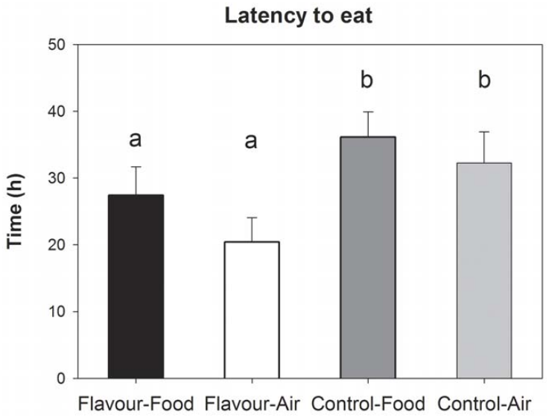
Familiar maternal flavor shortens the return to feeding
Perinatal learning is experience-dependent change acquired around birth. Oostindjer and colleagues fed sows an anethole-flavored diet during late gestation and lactation. Anethole is an odor-active flavor compound, and piglets subsequently encountered it after weaning either in food or in the air.
Piglets with maternal flavor exposure began eating after about 24 h, compared with about 35 h in controls. The postweaning presentation route did not produce a corresponding difference in food intake or growth. Familiarity therefore affected the transition to feeding without creating a simple increased preference for flavored feed.
Previously exposed piglets also played more and performed fewer damaging manipulative behaviors. The results support a familiar-odor contribution to adaptation around weaning. The design distinguishes familiarity acquired through maternal experience from the immediate nutritional consequences of placing a flavor in the food.
Oostindjer et al. (2011), Fig. 2. Latency to eat after weaning with familiar flavor exposure.
Oostindjer et al. (2011)
19
Notes:
• Perinatal learning is experience-dependent change acquired around birth. Oostindjer and colleagues fed sows an anethole-flavored diet during late gestation and lactation. Anethole is an odor-active flavor compound, and piglets subsequently encountered it after weaning either in food or in the air.
• Piglets with maternal flavor exposure began eating after about 24 h, compared with about 35 h in controls. The postweaning presentation route did not produce a corresponding difference in food intake or growth. Familiarity therefore affected the transition to feeding without creating a simple increased preference for flavored feed.
• Previously exposed piglets also played more and performed fewer damaging manipulative behaviors. The results support a familiar-odor contribution to adaptation around weaning. The design distinguishes familiarity acquired through maternal experience from the immediate nutritional consequences of placing a flavor in the food.
References:
Oostindjer Marije, Bolhuis J Elizabeth, Simon Kristina, van den Brand Henry, Kemp Bas, Skoulakis Efthimios M C (2011). Perinatal Flavour Learning and Adaptation to Being Weaned: All the Pig Needs Is Smell. PLoS ONE 6:e25318. https://doi.org/10.1371/journal.pone.0025318
Figure: Oostindjer et al. (2011), Fig. 2. Latency to eat after weaning with familiar flavor exposure.
Figure source: https://doi.org/10.1371/journal.pone.0025318

Slide 20
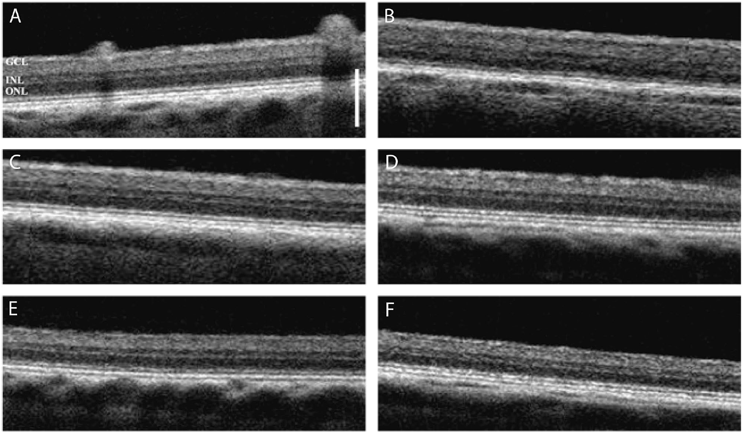
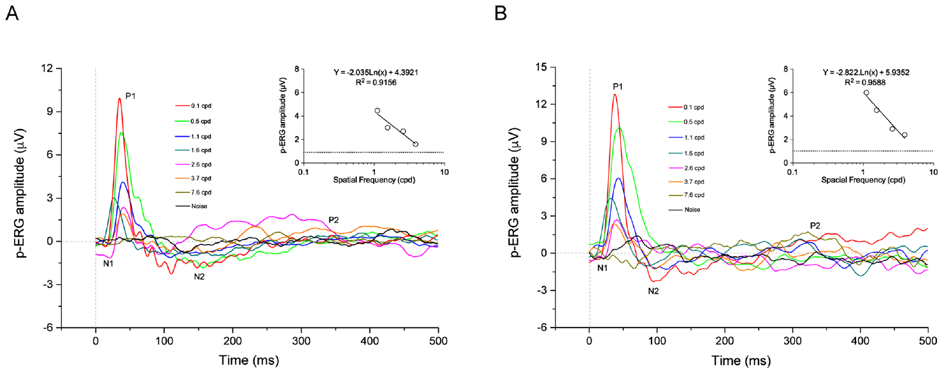
Retinal activity constrains visual discrimination tasks
Electroretinography, or ERG, records electrical responses generated by the retina. Ventrella and colleagues used reversing visual patterns to assess pig retinal responses to spatial detail. Spatial frequency, expressed in cycles per degree, describes how many light-dark pattern cycles occupy a degree of visual angle.
Pattern-evoked responses became smaller as spatial frequency increased. The estimated retinal spatial acuity was about 5.7 cycles per degree at 16 weeks and 6.2 cycles per degree at 19 weeks. Optical coherence tomography and histology confirmed intact retinal structure in the studied eyes.
Retinal ganglion cells carry output from the retina toward the brain, and pattern ERG provides information about their population function. Retinal electrical acuity is distinct from a freely moving animal’s task performance. Stimulus size and viewing conditions remain necessary considerations when interpreting a pig’s visual learning errors.
Ventrella et al. (2022), Fig. 1(A–F). Retinal layer anatomy in optical coherence tomography.
Ventrella et al. (2022), Fig. 3(A–B). Pattern electroretinogram responses to increasing spatial frequency.
Ventrella et al. (2022)
20
Notes:
• Electroretinography, or ERG, records electrical responses generated by the retina. Ventrella and colleagues used reversing visual patterns to assess pig retinal responses to spatial detail. Spatial frequency, expressed in cycles per degree, describes how many light-dark pattern cycles occupy a degree of visual angle.
• Pattern-evoked responses became smaller as spatial frequency increased. The estimated retinal spatial acuity was about 5.7 cycles per degree at 16 weeks and 6.2 cycles per degree at 19 weeks. Optical coherence tomography and histology confirmed intact retinal structure in the studied eyes.
• Retinal ganglion cells carry output from the retina toward the brain, and pattern ERG provides information about their population function. Retinal electrical acuity is distinct from a freely moving animal’s task performance. Stimulus size and viewing conditions remain necessary considerations when interpreting a pig’s visual learning errors.
References:
Ventrella Domenico, Maya-Vetencourt José Fernando, Elmi Alberto, Barone Francesca, Aniballi Camilla, Muscatello Luisa Vera, Mete Maurizio, Pertile Grazia, Benfenati Fabio, Bacci Maria Laura (2022). The p-ERG spatial acuity in the biomedical pig under physiological conditions. Scientific Reports 12:15479. https://doi.org/10.1038/s41598-022-19925-8
Figure: Ventrella et al. (2022), Fig. 1(A–F). Retinal layer anatomy in optical coherence tomography.
Figure source: https://doi.org/10.1038/s41598-022-19925-8
Figure: Ventrella et al. (2022), Fig. 3(A–B). Pattern electroretinogram responses to increasing spatial frequency.
Figure source: https://doi.org/10.1038/s41598-022-19925-8

Slide 21
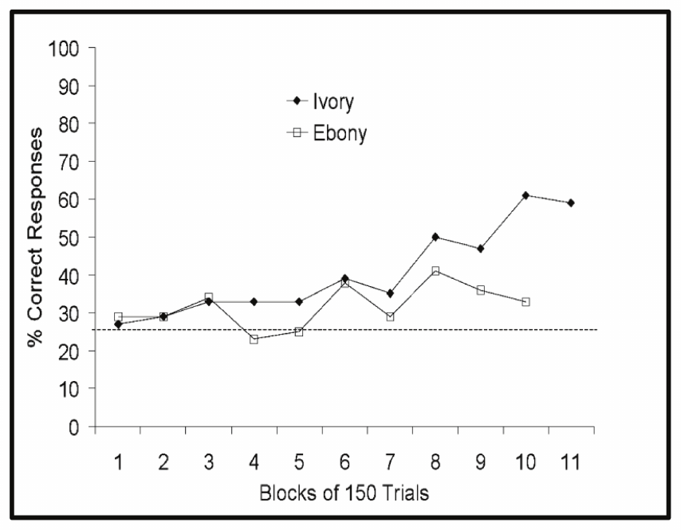
Pigs learn a snout-controlled cursor task
Operant learning occurs when consequences change the probability of an action. Croney and Boysen trained pigs to move a joystick with the snout, controlling a cursor on a computer screen. Contact between the cursor and a target produced an auditory signal and a food reward.
The cursor moved at 8 cm/s, and target positions varied around the screen. In the one-wall condition, first cursor movements succeeded on 34% and 76% of trials for the two micropigs, compared with a 25% chance expectation. Yorkshire pigs also performed above chance, but the animals differed greatly in accuracy.
The task combined visual discrimination, learned action-outcome relationships, and snout motor control. Body size, eye position, and direction-specific response biases influenced performance. The successful cursor movements establish learning of a computer-mediated task while the motor constraints help explain why accuracy alone is not a pure measure of cognition.
Croney & Boysen (2021), Fig. 2. Study pig operating the joystick with its snout.
Croney & Boysen (2021), Fig. 4. One-wall target performance of the micropigs.
Croney & Boysen (2021)
21
Notes:
• Operant learning occurs when consequences change the probability of an action. Croney and Boysen trained pigs to move a joystick with the snout, controlling a cursor on a computer screen. Contact between the cursor and a target produced an auditory signal and a food reward.
• The cursor moved at 8 cm/s, and target positions varied around the screen. In the one-wall condition, first cursor movements succeeded on 34% and 76% of trials for the two micropigs, compared with a 25% chance expectation. Yorkshire pigs also performed above chance, but the animals differed greatly in accuracy.
• The task combined visual discrimination, learned action-outcome relationships, and snout motor control. Body size, eye position, and direction-specific response biases influenced performance. The successful cursor movements establish learning of a computer-mediated task while the motor constraints help explain why accuracy alone is not a pure measure of cognition.
References:
Croney Candace C, Boysen Sarah T (2021). Acquisition of a Joystick-Operated Video Task by Pigs ( Sus scrofa ). Frontiers in Psychology 12:631755. https://doi.org/10.3389/fpsyg.2021.631755
Figure: Croney & Boysen (2021), Fig. 2. Study pig operating the joystick with its snout.
Figure source: https://doi.org/10.3389/fpsyg.2021.631755
Figure: Croney & Boysen (2021), Fig. 4. One-wall target performance of the micropigs.
Figure source: https://doi.org/10.3389/fpsyg.2021.631755

Slide 22
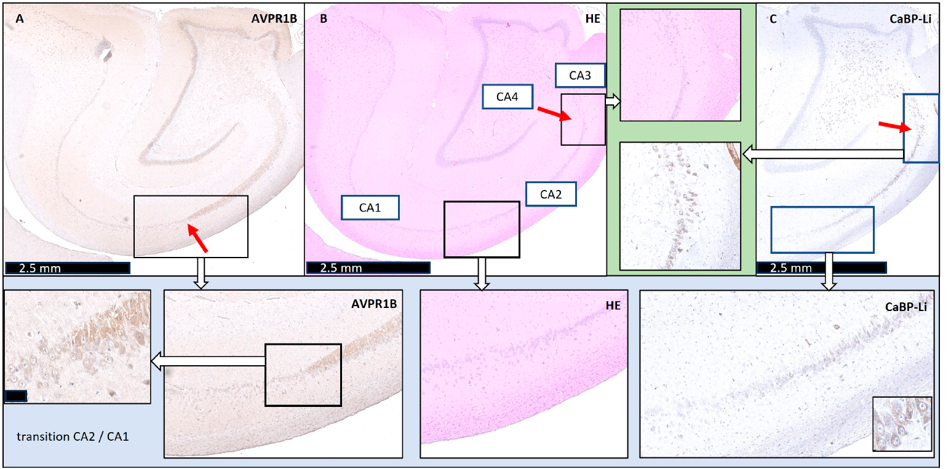
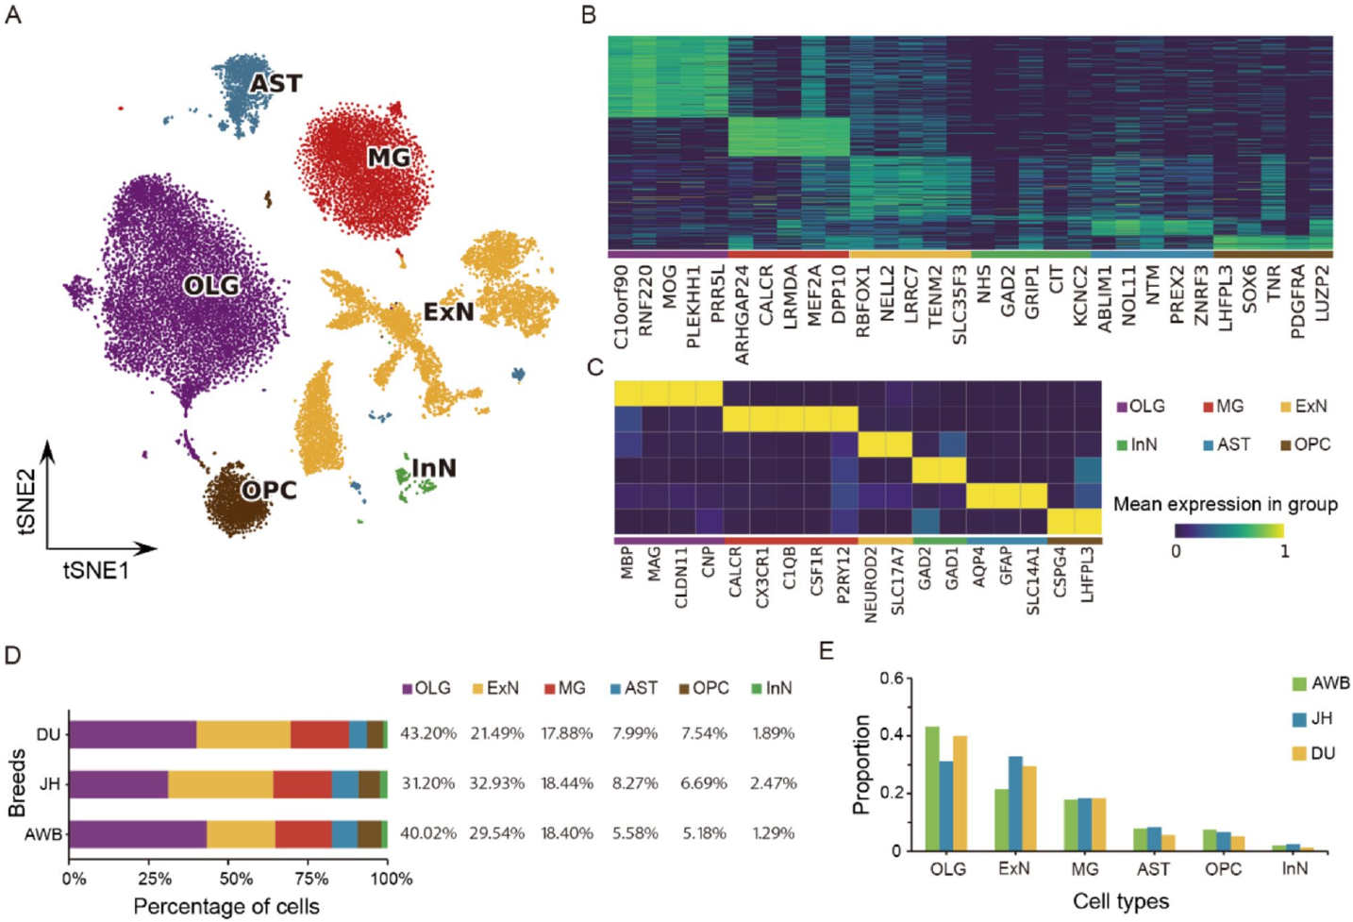
Hippocampal tissue contains distinct neural cell types
The hippocampus is a medial forebrain structure associated with learning, memory, and stress regulation. Xu and colleagues sampled hippocampal tissue from wild boar, Jinhua pigs, and Duroc pigs. Single-nucleus RNA sequencing measures gene transcripts in individual nuclei rather than averaging all cells together.
The atlas identified excitatory neurons, inhibitory neurons, astrocytes, microglia, oligodendrocytes, and oligodendrocyte progenitor cells. Excitatory and inhibitory refer to the typical effects of neuronal signaling on other cells. Astrocytes support neuronal metabolism; microglia are resident immune cells; oligodendrocytes form myelin, the insulating sheath around axons. Oligodendrocyte progenitors are precursor cells that can develop into myelin-forming cells.
All three groups contained these broad classes, although their transcript distributions differed. Renz and colleagues’ stained sections locate hippocampal subregions, with CA2 extending about 2.5 mm. The colored RNA clusters organize gene-expression similarity rather than moment-to-moment firing. The atlas identifies cellular populations for future physiological work; it did not record memory activity while pigs navigated or performed a recognition task.
Renz et al. (2024), Fig. 1(A–C). Published hippocampal sections identify CA1 through CA4 and receptor-defined boundaries.
Xu et al. (2026), Fig. 1(A–E). Gene-expression clusters and hippocampal cell-type markers.
Xu et al. (2026); Renz et al. (2024)
22
Notes:
• The hippocampus is a medial forebrain structure associated with learning, memory, and stress regulation. Xu and colleagues sampled hippocampal tissue from wild boar, Jinhua pigs, and Duroc pigs. Single-nucleus RNA sequencing measures gene transcripts in individual nuclei rather than averaging all cells together.
• The atlas identified excitatory neurons, inhibitory neurons, astrocytes, microglia, oligodendrocytes, and oligodendrocyte progenitor cells. Excitatory and inhibitory refer to the typical effects of neuronal signaling on other cells. Astrocytes support neuronal metabolism; microglia are resident immune cells; oligodendrocytes form myelin, the insulating sheath around axons. Oligodendrocyte progenitors are precursor cells that can develop into myelin-forming cells.
• All three groups contained these broad classes, although their transcript distributions differed. Renz and colleagues’ stained sections locate hippocampal subregions, with CA2 extending about 2.5 mm. The colored RNA clusters organize gene-expression similarity rather than moment-to-moment firing. The atlas identifies cellular populations for future physiological work; it did not record memory activity while pigs navigated or performed a recognition task.
References:
Xu Lingyao, Jiang Jinyun, Zhuang Yizheng, Wei Xingyu, Xie Qinqin, Yu Pengfei, Liu Shuang, Cao Caiyun, Sun Jiabao, Gu Jiamin, Zhang Zhenyang, Zhao Wei, Zhang Zhe, Wang Qishan, Pan Yuchun, Wang Zhen (2026). Single-nucleus atlas provides insights into changes in the evolution of the pig hippocampus. BMC Biology 24:86. https://doi.org/10.1186/s12915-026-02560-4
Renz Miriam, Siegert Pascal, Mohnke Katja, Ruemmler Robert, Frauenknecht Katrin, Sommer Clemens, Harder Anja, Kietzmann Thomas (2024). Precise Definition of Porcine Hippocampal Cornu Ammonis 2: High Histoarchitectural Similarity to Humans but Unequal Sensitivity to Hypoxia. Biomedicines 12:1896. https://doi.org/10.3390/biomedicines12081896
Figure: Renz et al. (2024), Fig. 1(A–C). Published hippocampal sections identify CA1 through CA4 and receptor-defined boundaries.
Figure source: https://doi.org/10.3390/biomedicines12081896
Figure: Xu et al. (2026), Fig. 1(A–E). Gene-expression clusters and hippocampal cell-type markers.
Figure source: https://doi.org/10.1186/s12915-026-02560-4

Slide 23
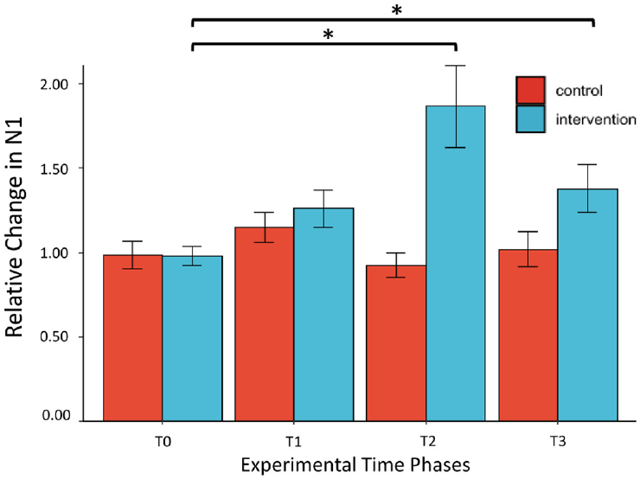
Strong peripheral input produces lasting cortical changes
Long-term potentiation, or LTP, is a sustained increase in the strength of synaptic responses after activity. Janjua and colleagues used a pig preparation to test an LTP-like pain model. High-frequency stimulation of the ulnar nerve preceded repeated measurements of the cortical response to test pulses.
The induction protocol used four stimulation trains at 100 Hz, with 15-mA pulses lasting 1,000 µs. Cortical N1 amplitude increased after this intervention, with a clear enhancement 45 min later relative to unstimulated controls. Population voltage responses therefore changed after a defined history of peripheral activity.
NMDA receptors are glutamate-gated ion channels important for activity-dependent plasticity; anesthetic effects on these receptors motivated adjustments in the recording preparation. This experiment measured cortical potentiation after peripheral stimulation, not receptor currents or learning during behavior. LTP-like physiological plasticity and successful memory performance are related research domains with different direct measurements.
Janjua et al. (2021), Fig. 1. Cortical location of the implanted recording array.
Janjua et al. (2021), Fig. 4. Cortical N1 response change after high-frequency stimulation.
Janjua et al. (2021)
23
Notes:
• Long-term potentiation, or LTP, is a sustained increase in the strength of synaptic responses after activity. Janjua and colleagues used a pig preparation to test an LTP-like pain model. High-frequency stimulation of the ulnar nerve preceded repeated measurements of the cortical response to test pulses.
• The induction protocol used four stimulation trains at 100 Hz, with 15-mA pulses lasting 1,000 µs. Cortical N1 amplitude increased after this intervention, with a clear enhancement 45 min later relative to unstimulated controls. Population voltage responses therefore changed after a defined history of peripheral activity.
• NMDA receptors are glutamate-gated ion channels important for activity-dependent plasticity; anesthetic effects on these receptors motivated adjustments in the recording preparation. This experiment measured cortical potentiation after peripheral stimulation, not receptor currents or learning during behavior. LTP-like physiological plasticity and successful memory performance are related research domains with different direct measurements.
References:
Janjua Taha Al Muhammadee, Nielsen Thomas Gomes Nørgaard dos Santos, Andreis Felipe Rettore, Meijs Suzan, Jensen Winnie (2021). The effect of peripheral high-frequency electrical stimulation on the primary somatosensory cortex in pigs. IBRO Neuroscience Reports 11:112–118. https://doi.org/10.1016/j.ibneur.2021.08.004
Figure: Janjua et al. (2021), Fig. 1. Cortical location of the implanted recording array.
Figure source: https://doi.org/10.1016/j.ibneur.2021.08.004
Figure: Janjua et al. (2021), Fig. 4. Cortical N1 response change after high-frequency stimulation.
Figure source: https://doi.org/10.1016/j.ibneur.2021.08.004

Slide 24
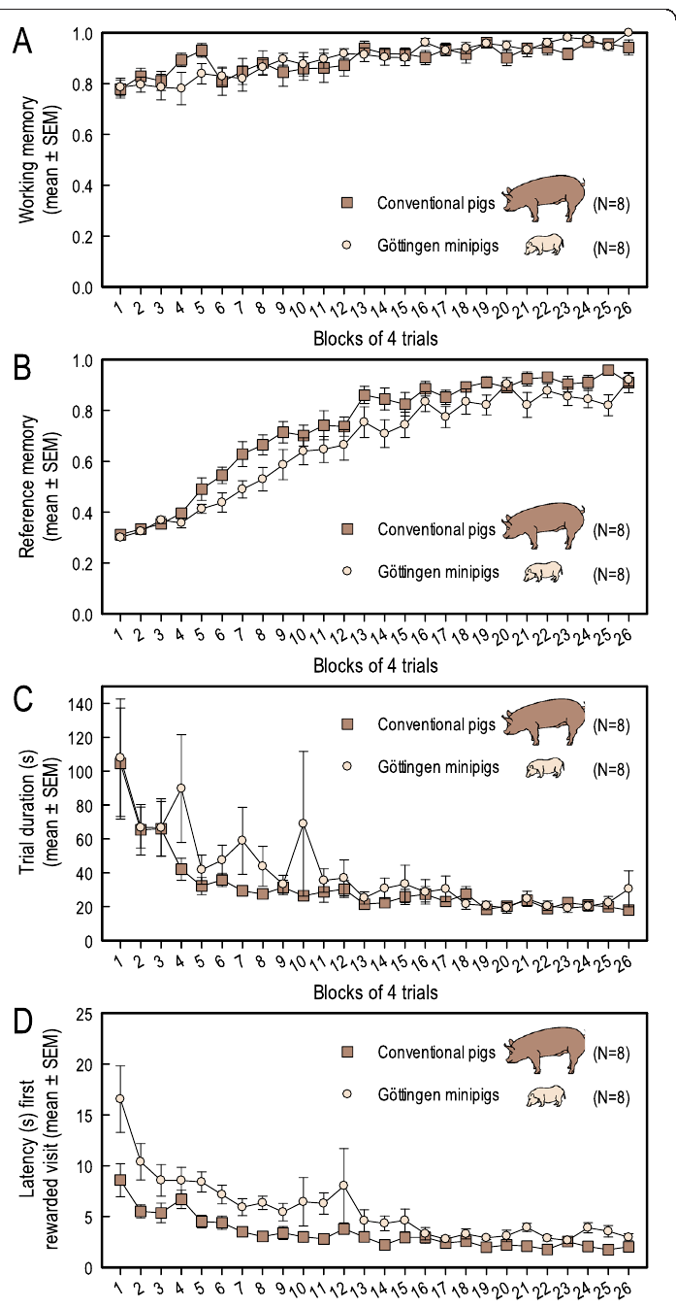
A holeboard separates working and reference memory
Working memory retains information needed within the current task episode. Reference memory retains rules or locations that remain useful across episodes. Gieling and colleagues trained conventional pigs and Göttingen minipigs to recover food from four rewarded locations among 16 bowls.
Working-memory performance reflected avoiding revisits to already emptied rewarded bowls. Reference-memory performance reflected preferentially visiting the locations that were rewarded across trials. These measures can therefore improve differently, even when both contribute to finding all four rewards.
Both pig types approached nearly error-free performance after roughly 100 training trials. Trial duration also declined as the task became familiar. A consistent reward map and within-trial depletion make it possible to distinguish persistent spatial knowledge from memory for what the pig has already collected.
Gieling et al. (2013), Fig. 1(A–D). Acquisition of the spatial holeboard task in two pig types.
Gieling et al. (2013)
24
Notes:
• Working memory retains information needed within the current task episode. Reference memory retains rules or locations that remain useful across episodes. Gieling and colleagues trained conventional pigs and Göttingen minipigs to recover food from four rewarded locations among 16 bowls.
• Working-memory performance reflected avoiding revisits to already emptied rewarded bowls. Reference-memory performance reflected preferentially visiting the locations that were rewarded across trials. These measures can therefore improve differently, even when both contribute to finding all four rewards.
• Both pig types approached nearly error-free performance after roughly 100 training trials. Trial duration also declined as the task became familiar. A consistent reward map and within-trial depletion make it possible to distinguish persistent spatial knowledge from memory for what the pig has already collected.
References:
Gieling Elise, Wehkamp Welmoed, Willigenburg Remco, Nordquist Rebecca E, Ganderup Niels-Christian, van der Staay Franz Josef (2013). Performance of conventional pigs and Göttingen miniature pigs in a spatial holeboard task: effects of the putative muscarinic cognition impairer Biperiden. Behavioral and Brain Functions : BBF 9:4. https://doi.org/10.1186/1744-9081-9-4
Figure: Gieling et al. (2013), Fig. 1(A–D). Acquisition of the spatial holeboard task in two pig types.
Figure source: https://doi.org/10.1186/1744-9081-9-4

Slide 25
Odor and sight controls isolate learned food locations
A spatial memory task must distinguish remembering a food location from simply smelling or seeing the reward. The pig holeboard contained a 4 × 4 arrangement of bowls within a 530 × 530 cm arena. A red ball covered each bowl, preventing direct visual access to its contents.
Fresh food was also placed beneath false bottoms in all bowls, including unrewarded locations, reducing informative odor differences. Pigs lifted the covering balls with their snouts, and sensors recorded bowl visits. Entry doors varied across trials, so a single fixed approach route was insufficient.
Accurate visits increased while search duration decreased during training. These controls connect performance to the learned configuration more directly than an openly baited food search. They also preserve the pig’s natural snout action as the response used to uncover a remembered location.
Gieling et al. (2013), Fig. 1(A–D). Improved accuracy and shorter search times during acquisition.
Gieling et al. (2013)
25
Notes:
• A spatial memory task must distinguish remembering a food location from simply smelling or seeing the reward. The pig holeboard contained a 4 × 4 arrangement of bowls within a 530 × 530 cm arena. A red ball covered each bowl, preventing direct visual access to its contents.
• Fresh food was also placed beneath false bottoms in all bowls, including unrewarded locations, reducing informative odor differences. Pigs lifted the covering balls with their snouts, and sensors recorded bowl visits. Entry doors varied across trials, so a single fixed approach route was insufficient.
• Accurate visits increased while search duration decreased during training. These controls connect performance to the learned configuration more directly than an openly baited food search. They also preserve the pig’s natural snout action as the response used to uncover a remembered location.
References:
Gieling Elise, Wehkamp Welmoed, Willigenburg Remco, Nordquist Rebecca E, Ganderup Niels-Christian, van der Staay Franz Josef (2013). Performance of conventional pigs and Göttingen miniature pigs in a spatial holeboard task: effects of the putative muscarinic cognition impairer Biperiden. Behavioral and Brain Functions : BBF 9:4. https://doi.org/10.1186/1744-9081-9-4
Figure: Gieling et al. (2013), Fig. 1(A–D). Improved accuracy and shorter search times during acquisition.
Figure source: https://doi.org/10.1186/1744-9081-9-4

Slide 26
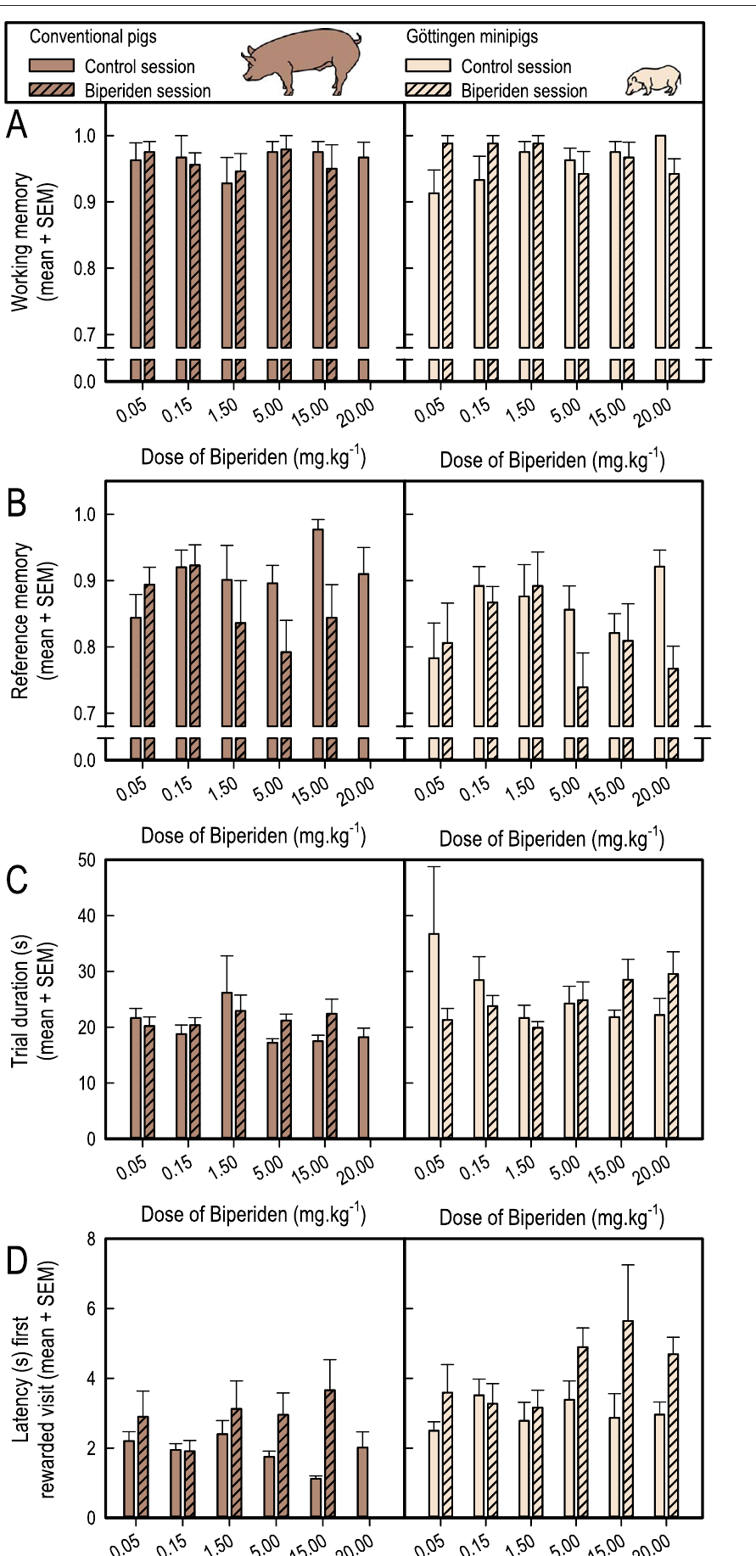
Muscarinic blockade has mixed effects on learned search
Muscarinic receptors are G protein-coupled receptors activated by acetylcholine. Gieling and colleagues tested biperiden, an antagonist with preference for the M1 muscarinic subtype. An antagonist reduces receptor activation by its transmitter, allowing a candidate signaling contribution to be challenged pharmacologically.
Pigs received oral biperiden 1.5 h before holeboard testing, across doses from 0.05 to 20 mg/kg. Reference-memory effects were modest and appeared at high doses; working-memory effects were inconsistent. Dry mouth and sedation also appeared, particularly at the higher doses.
The animals had already learned the task close to its performance ceiling. Changes in food consumption, motivation, and motor behavior complicate interpretation of a high-dose drug effect. The pig experiment therefore yielded weaker support for a selective memory impairment than a simple prediction that M1 blockade must abolish accurate search.
Gieling et al. (2013), Fig. 3(A–D). Biperiden effects on accuracy, search duration, and first-reward latency.
Gieling et al. (2013)
26
Notes:
• Muscarinic receptors are G protein-coupled receptors activated by acetylcholine. Gieling and colleagues tested biperiden, an antagonist with preference for the M1 muscarinic subtype. An antagonist reduces receptor activation by its transmitter, allowing a candidate signaling contribution to be challenged pharmacologically.
• Pigs received oral biperiden 1.5 h before holeboard testing, across doses from 0.05 to 20 mg/kg. Reference-memory effects were modest and appeared at high doses; working-memory effects were inconsistent. Dry mouth and sedation also appeared, particularly at the higher doses.
• The animals had already learned the task close to its performance ceiling. Changes in food consumption, motivation, and motor behavior complicate interpretation of a high-dose drug effect. The pig experiment therefore yielded weaker support for a selective memory impairment than a simple prediction that M1 blockade must abolish accurate search.
References:
Gieling Elise, Wehkamp Welmoed, Willigenburg Remco, Nordquist Rebecca E, Ganderup Niels-Christian, van der Staay Franz Josef (2013). Performance of conventional pigs and Göttingen miniature pigs in a spatial holeboard task: effects of the putative muscarinic cognition impairer Biperiden. Behavioral and Brain Functions : BBF 9:4. https://doi.org/10.1186/1744-9081-9-4
Figure: Gieling et al. (2013), Fig. 3(A–D). Biperiden effects on accuracy, search duration, and first-reward latency.
Figure source: https://doi.org/10.1186/1744-9081-9-4

Slide 27
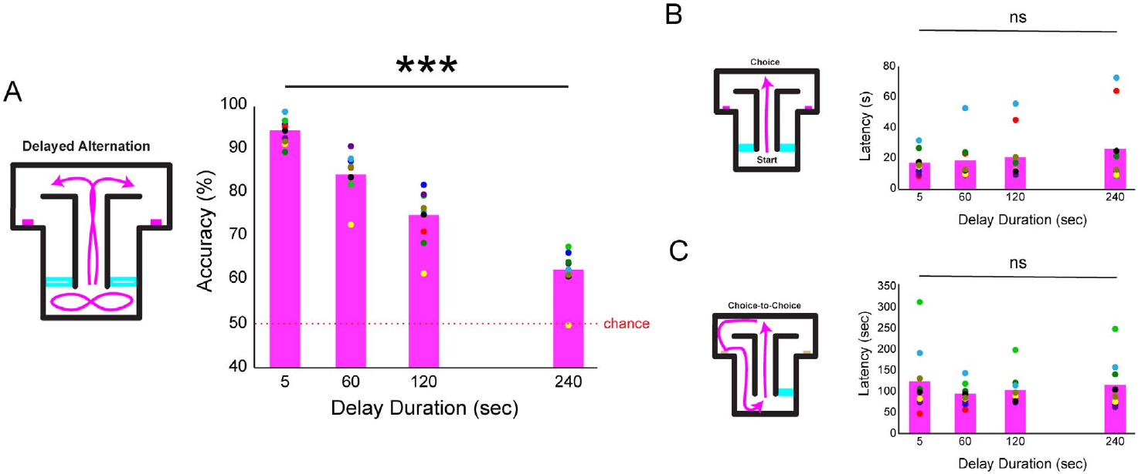
Imposed delays weaken alternation in a T-maze
Spatial alternation means selecting the opposite location from the one visited previously. Allen and colleagues built an automated pig T-maze with corridors, controlled doors, cameras, and reward dispensers. Pigs naturally alternated, allowing the previous choice to become the information needed for the next correct response.
Imposed delays of 5, 60, 120, or 240 s separated relevant task events. Accuracy declined sharply as these delays increased. Choice latencies did not change in the same way, separating the accuracy loss from a simple slowing of movement toward the choice point.
Self-paced intervals were not associated with a corresponding accuracy decline. Body-position and head-direction analyses could distinguish subsequent turns during short delays but not long ones. The combined timing and tracking results constrain explanations based entirely on persistent posture rather than retained information.
Allen et al. (2023), Fig. 3(A–C). Delayed spatial alternation and choice latencies.
Allen et al. (2023)
27
Notes:
• Spatial alternation means selecting the opposite location from the one visited previously. Allen and colleagues built an automated pig T-maze with corridors, controlled doors, cameras, and reward dispensers. Pigs naturally alternated, allowing the previous choice to become the information needed for the next correct response.
• Imposed delays of 5, 60, 120, or 240 s separated relevant task events. Accuracy declined sharply as these delays increased. Choice latencies did not change in the same way, separating the accuracy loss from a simple slowing of movement toward the choice point.
• Self-paced intervals were not associated with a corresponding accuracy decline. Body-position and head-direction analyses could distinguish subsequent turns during short delays but not long ones. The combined timing and tracking results constrain explanations based entirely on persistent posture rather than retained information.
References:
Allen L M, Murphy D A, Roldan V, Moussa M N, Draper A, Delgado A, Aguiar M, Capote M A, Jarome T J J, Lee K, Mattfeld A T, Prather R, Allen T A (2023). Testing spatial working memory in pigs using an automated T-maze. Oxford Open Neuroscience 2:kvad010. https://doi.org/10.1093/oons/kvad010
Figure: Allen et al. (2023), Fig. 3(A–C). Delayed spatial alternation and choice latencies.
Figure source: https://doi.org/10.1093/oons/kvad010

Slide 28
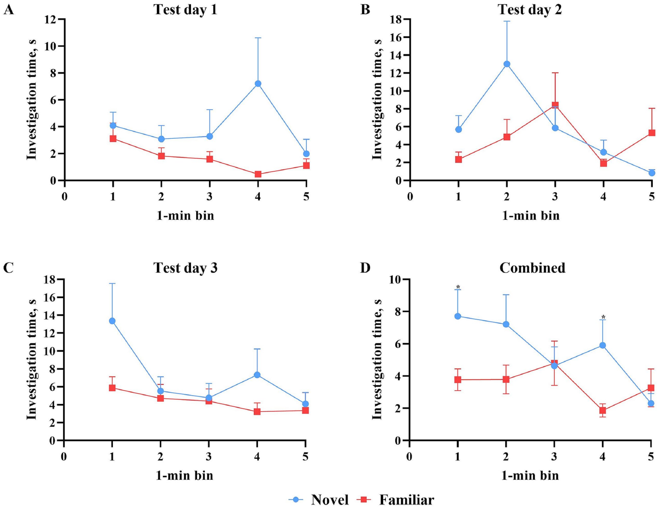
Novel object preference depends on testing history
Recognition memory supports distinguishing a previously encountered item from a new one. Golden and Dilger tested young pigs after a 48-h delay between object familiarization and recognition testing. The test paired a familiar object with a novel object during 5 min of free exploration.
The recognition index is the fraction of total object investigation directed toward the novel object. A value of 0.50 represents equal investigation of the two objects. On the first test day, the mean index was about 0.69, while later test days with the same familiar object lost the consistent novelty preference.
Objects matched in color, height, and material, and fixed mountings reduced differences in manipulability. Matte arena walls limited distracting reflections. Memory, object attractiveness, and familiarity with the testing procedure all contribute to exploratory responses, so repeated test history is part of the measurement.
Golden & Dilger (2025), Fig. 5(A–D). Novel and familiar object investigation over three test days.
Golden & Dilger (2025)
28
Notes:
• Recognition memory supports distinguishing a previously encountered item from a new one. Golden and Dilger tested young pigs after a 48-h delay between object familiarization and recognition testing. The test paired a familiar object with a novel object during 5 min of free exploration.
• The recognition index is the fraction of total object investigation directed toward the novel object. A value of 0.50 represents equal investigation of the two objects. On the first test day, the mean index was about 0.69, while later test days with the same familiar object lost the consistent novelty preference.
• Objects matched in color, height, and material, and fixed mountings reduced differences in manipulability. Matte arena walls limited distracting reflections. Memory, object attractiveness, and familiarity with the testing procedure all contribute to exploratory responses, so repeated test history is part of the measurement.
References:
Golden Rebecca K., Dilger Ryan N. (2025). Validating an updated protocol for the novel object recognition task in young pigs. Frontiers in Behavioral Neuroscience 19:1480389. https://doi.org/10.3389/fnbeh.2025.1480389
Figure: Golden & Dilger (2025), Fig. 5(A–D). Novel and familiar object investigation over three test days.
Figure source: https://doi.org/10.3389/fnbeh.2025.1480389

Slide 29
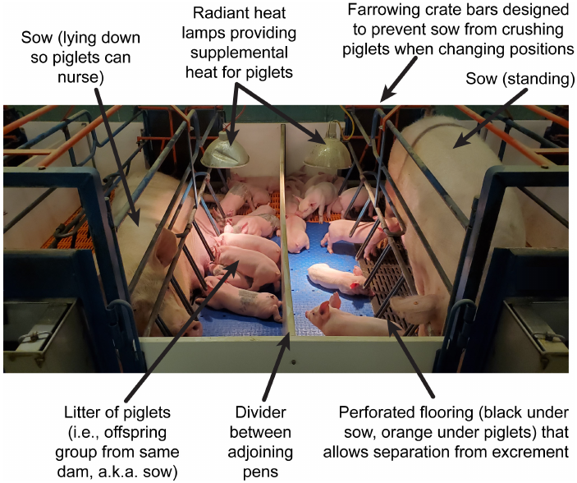
Rearing alters developmental rates more than total growth
Developmental trajectory describes how a biological measure changes with age. Fil and colleagues followed pigs reared by a sow or artificially reared from postnatal day 2 until week 4. After week 4, the animals lived in the same group environment until week 24.
MRI measurements followed brain macrostructure and microstructure across development. Whole-brain, gray-matter, white-matter, and cerebrospinal-fluid growth patterns were broadly similar between rearing groups. Some regional measures differed in early developmental rate, including measures related to myelination.
Myelination is formation of the insulating sheath around axons and changes how neural pathways mature. Recognition testing at weeks 4 and 8 found little overall influence of rearing group. Regional developmental differences therefore coexisted with broadly similar whole-brain growth and recognition outcomes.
Fil et al. (2021), Fig. 2. Published photograph of the sow-reared preparation.
Fil et al. (2021)
29
Notes:
• Developmental trajectory describes how a biological measure changes with age. Fil and colleagues followed pigs reared by a sow or artificially reared from postnatal day 2 until week 4. After week 4, the animals lived in the same group environment until week 24.
• MRI measurements followed brain macrostructure and microstructure across development. Whole-brain, gray-matter, white-matter, and cerebrospinal-fluid growth patterns were broadly similar between rearing groups. Some regional measures differed in early developmental rate, including measures related to myelination.
• Myelination is formation of the insulating sheath around axons and changes how neural pathways mature. Recognition testing at weeks 4 and 8 found little overall influence of rearing group. Regional developmental differences therefore coexisted with broadly similar whole-brain growth and recognition outcomes.
References:
Fil Joanne E, Joung Sangyun, Hayes Courtney A, Dilger Ryan N (2021). Influence of Rearing Environment on Longitudinal Brain Development, Object Recognition Memory, and Exploratory Behaviors in the Domestic Pig ( Sus scrofa ). Frontiers in Neuroscience 15:649536. https://doi.org/10.3389/fnins.2021.649536
Figure: Fil et al. (2021), Fig. 2. Published photograph of the sow-reared preparation.
Figure source: https://doi.org/10.3389/fnins.2021.649536

Slide 30
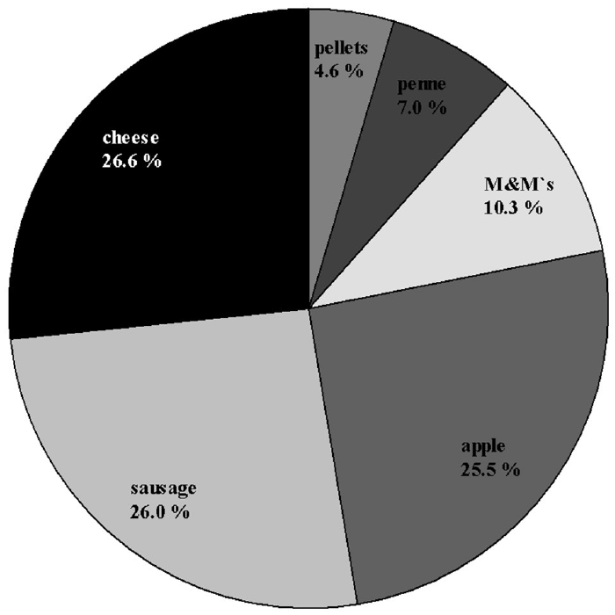
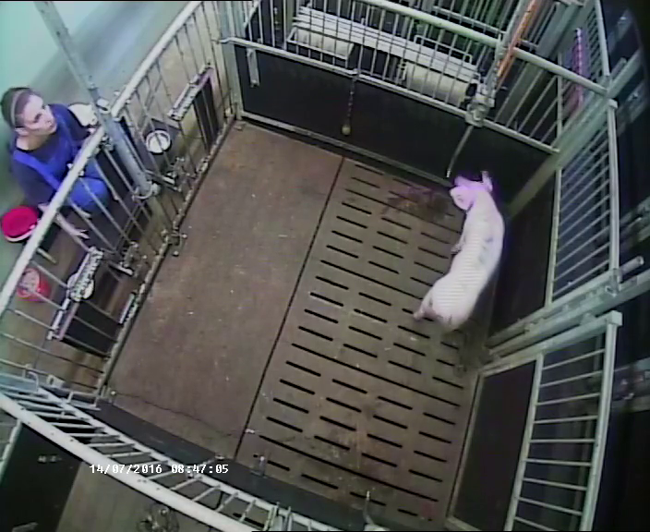
Preferred reward quality extends tolerated waiting
Delay maintenance requires sustaining a choice while a desired outcome remains unavailable. Zebunke and colleagues offered piglets either a larger amount of a preferred food or a more preferred food type. A smaller or less preferred immediate reward remained available while the pig waited.
Delays increased through 2, 4, 8, 16, 24, and 32 s. The largest successfully mastered delay was 8 s in the quantity contrast and 24 s in the quality contrast. A more attractive kind of food therefore supported longer waiting than simply receiving more of the same food.
Food preferences were measured before the delay test, and side assignments were balanced across animals. The original waiting recording captures a maintained choice while both options remain visible. Reward properties and the availability of an alternative jointly determine the demand placed on inhibitory control.
Zebunke et al. (2018), Fig. 2. Food choices in the preference test preceding delay testing.
Click video to play in Slide Show. Zebunke et al. (2018), Supplementary Video 1. Waiting for the delayed reward.
Zebunke et al. (2018)
30
Notes:
• Delay maintenance requires sustaining a choice while a desired outcome remains unavailable. Zebunke and colleagues offered piglets either a larger amount of a preferred food or a more preferred food type. A smaller or less preferred immediate reward remained available while the pig waited.
• Delays increased through 2, 4, 8, 16, 24, and 32 s. The largest successfully mastered delay was 8 s in the quantity contrast and 24 s in the quality contrast. A more attractive kind of food therefore supported longer waiting than simply receiving more of the same food.
• Food preferences were measured before the delay test, and side assignments were balanced across animals. The original waiting recording captures a maintained choice while both options remain visible. Reward properties and the availability of an alternative jointly determine the demand placed on inhibitory control.
References:
Zebunke Manuela, Kreiser Maren, Melzer Nina, Langbein Jan, Puppe Birger (2018). Better, Not Just More—Contrast in Qualitative Aspects of Reward Facilitates Impulse Control in Pigs. Frontiers in Psychology 9:2099. https://doi.org/10.3389/fpsyg.2018.02099
Figure: Zebunke et al. (2018), Fig. 2. Food choices in the preference test preceding delay testing.
Figure source: https://doi.org/10.3389/fpsyg.2018.02099
Article-provided recording: Zebunke et al. (2018), Supplementary Video 1. Waiting for the delayed reward.
• Waiting for the delayed reward. The complete source scene, original playback speed and audio are preserved; the published figure on this slide supplies the quantitative evidence.
Article DOI: https://doi.org/10.3389/fpsyg.2018.02099
Original media URL: https://pmc-oa-opendata.s3.amazonaws.com/PMC6232270.1/Video_1.MP4
Credit: Zebunke Manuela, Kreiser Maren, Melzer Nina, Langbein Jan, Puppe Birger (2018). Better, Not Just More—Contrast in Qualitative Aspects of Reward Facilitates Impulse Control in Pigs. Frontiers in Psychology 9:2099. https://doi.org/10.3389/fpsyg.2018.02099
License: https://creativecommons.org/licenses/by/4.0/ This is an open-access article distributed under the terms of the Creative Commons Attribution License (CC BY). The use, distribution or reproduction in other forums is permitted, provided the original author(s) and the copyright owner(s) are credited and that the original publication in this journal is cited, in accordance with accepted academic practice. No use, distribution or reproduction is permitted which does not comply with these terms.
Compatibility: H.264/yuv420p MP4 with AAC audio where present, at original resolution. Full scene and timing preserved; no speed changes, overlays, generated frames or scientific edits.
Playback: click the recording in PowerPoint Slide Show. The credited original article figure remains a static fallback. Full media decode and embedded relationships were checked; interactive PowerPoint playback was unavailable in this environment.

Slide 31
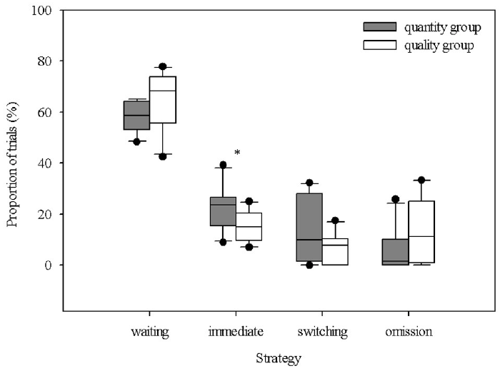
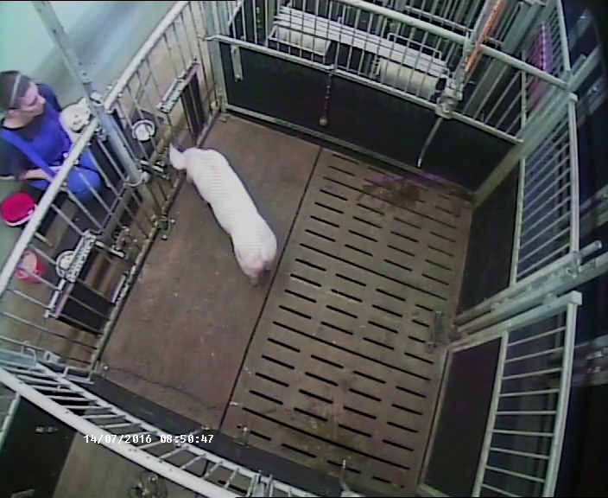
An immediate choice differs from failed waiting
An immediate choice selects the available reward without first committing to waiting. In the pig delay-maintenance apparatus, the animal placed its head through one of two openings. Choosing the immediate side brought the food tray forward at once.
The quantity-contrast pigs chose the immediate reward more often than pigs offered a strong quality contrast. A trial also ended without a choice if the pig did not select an opening within 30 s. Immediate choice, waiting, and omission were scored separately rather than combined into one undifferentiated failure measure.
The original immediate-reward recording contains the action and its prompt food consequence. A preference for immediate food can reflect reward valuation as well as inhibitory control. The experiment therefore compares strategies under a specified reward arrangement instead of assigning a general impulsivity label to every quick choice.
Zebunke et al. (2018), Fig. 4. Waiting, immediate choice, switching, and omission strategies.
Click video to play in Slide Show. Zebunke et al. (2018), Supplementary Video 2. Choosing the immediate reward.
Zebunke et al. (2018)
31
Notes:
• An immediate choice selects the available reward without first committing to waiting. In the pig delay-maintenance apparatus, the animal placed its head through one of two openings. Choosing the immediate side brought the food tray forward at once.
• The quantity-contrast pigs chose the immediate reward more often than pigs offered a strong quality contrast. A trial also ended without a choice if the pig did not select an opening within 30 s. Immediate choice, waiting, and omission were scored separately rather than combined into one undifferentiated failure measure.
• The original immediate-reward recording contains the action and its prompt food consequence. A preference for immediate food can reflect reward valuation as well as inhibitory control. The experiment therefore compares strategies under a specified reward arrangement instead of assigning a general impulsivity label to every quick choice.
References:
Zebunke Manuela, Kreiser Maren, Melzer Nina, Langbein Jan, Puppe Birger (2018). Better, Not Just More—Contrast in Qualitative Aspects of Reward Facilitates Impulse Control in Pigs. Frontiers in Psychology 9:2099. https://doi.org/10.3389/fpsyg.2018.02099
Figure: Zebunke et al. (2018), Fig. 4. Waiting, immediate choice, switching, and omission strategies.
Figure source: https://doi.org/10.3389/fpsyg.2018.02099
Article-provided recording: Zebunke et al. (2018), Supplementary Video 2. Choosing the immediate reward.
• Choosing the immediate reward. The complete source scene, original playback speed and audio are preserved; the published figure on this slide supplies the quantitative evidence.
Article DOI: https://doi.org/10.3389/fpsyg.2018.02099
Original media URL: https://pmc-oa-opendata.s3.amazonaws.com/PMC6232270.1/Video_2.MP4
Credit: Zebunke Manuela, Kreiser Maren, Melzer Nina, Langbein Jan, Puppe Birger (2018). Better, Not Just More—Contrast in Qualitative Aspects of Reward Facilitates Impulse Control in Pigs. Frontiers in Psychology 9:2099. https://doi.org/10.3389/fpsyg.2018.02099
License: https://creativecommons.org/licenses/by/4.0/ This is an open-access article distributed under the terms of the Creative Commons Attribution License (CC BY). The use, distribution or reproduction in other forums is permitted, provided the original author(s) and the copyright owner(s) are credited and that the original publication in this journal is cited, in accordance with accepted academic practice. No use, distribution or reproduction is permitted which does not comply with these terms.
Compatibility: H.264/yuv420p MP4 with AAC audio where present, at original resolution. Full scene and timing preserved; no speed changes, overlays, generated frames or scientific edits.
Playback: click the recording in PowerPoint Slide Show. The credited original article figure remains a static fallback. Full media decode and embedded relationships were checked; interactive PowerPoint playback was unavailable in this environment.

Slide 32
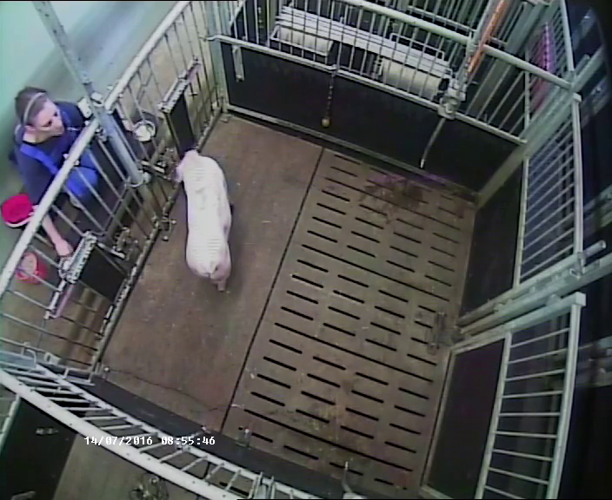
Switching abandons a previously chosen delayed reward
Switching occurs when a pig initially selects the delayed reward and then moves to the immediate option before the delay finishes. The two reward options remained visible throughout the interval. The animal could revise its choice rather than being forced to complete the first decision.
The published switching recording preserves this sequence: initial commitment, continued availability of the alternative, and a change of opening. The delay schedule ranged from 2 to 32 s, and the study separately scored switching from choosing the immediate reward at the outset.
A delay-choice task fixes the consequence after the initial choice, while delay maintenance continues to test behavior during waiting. These procedures impose different demands. Comparisons of pig waiting times must therefore preserve whether switching was possible and whether actual food remained visible.
Zebunke et al. (2018), Fig. 4. Behavioral strategies across reward-quality and reward-quantity conditions.
Click video to play in Slide Show. Zebunke et al. (2018), Supplementary Video 3. Switching from waiting to the immediate reward.
Zebunke et al. (2018)
32
Notes:
• Switching occurs when a pig initially selects the delayed reward and then moves to the immediate option before the delay finishes. The two reward options remained visible throughout the interval. The animal could revise its choice rather than being forced to complete the first decision.
• The published switching recording preserves this sequence: initial commitment, continued availability of the alternative, and a change of opening. The delay schedule ranged from 2 to 32 s, and the study separately scored switching from choosing the immediate reward at the outset.
• A delay-choice task fixes the consequence after the initial choice, while delay maintenance continues to test behavior during waiting. These procedures impose different demands. Comparisons of pig waiting times must therefore preserve whether switching was possible and whether actual food remained visible.
References:
Zebunke Manuela, Kreiser Maren, Melzer Nina, Langbein Jan, Puppe Birger (2018). Better, Not Just More—Contrast in Qualitative Aspects of Reward Facilitates Impulse Control in Pigs. Frontiers in Psychology 9:2099. https://doi.org/10.3389/fpsyg.2018.02099
Figure: Zebunke et al. (2018), Fig. 4. Behavioral strategies across reward-quality and reward-quantity conditions.
Figure source: https://doi.org/10.3389/fpsyg.2018.02099
Article-provided recording: Zebunke et al. (2018), Supplementary Video 3. Switching from waiting to the immediate reward.
• Switching from waiting to the immediate reward. The complete source scene, original playback speed and audio are preserved; the published figure on this slide supplies the quantitative evidence.
Article DOI: https://doi.org/10.3389/fpsyg.2018.02099
Original media URL: https://pmc-oa-opendata.s3.amazonaws.com/PMC6232270.1/Video_3.MP4
Credit: Zebunke Manuela, Kreiser Maren, Melzer Nina, Langbein Jan, Puppe Birger (2018). Better, Not Just More—Contrast in Qualitative Aspects of Reward Facilitates Impulse Control in Pigs. Frontiers in Psychology 9:2099. https://doi.org/10.3389/fpsyg.2018.02099
License: https://creativecommons.org/licenses/by/4.0/ This is an open-access article distributed under the terms of the Creative Commons Attribution License (CC BY). The use, distribution or reproduction in other forums is permitted, provided the original author(s) and the copyright owner(s) are credited and that the original publication in this journal is cited, in accordance with accepted academic practice. No use, distribution or reproduction is permitted which does not comply with these terms.
Compatibility: H.264/yuv420p MP4 with AAC audio where present, at original resolution. Full scene and timing preserved; no speed changes, overlays, generated frames or scientific edits.
Playback: click the recording in PowerPoint Slide Show. The credited original article figure remains a static fallback. Full media decode and embedded relationships were checked; interactive PowerPoint playback was unavailable in this environment.

Slide 33
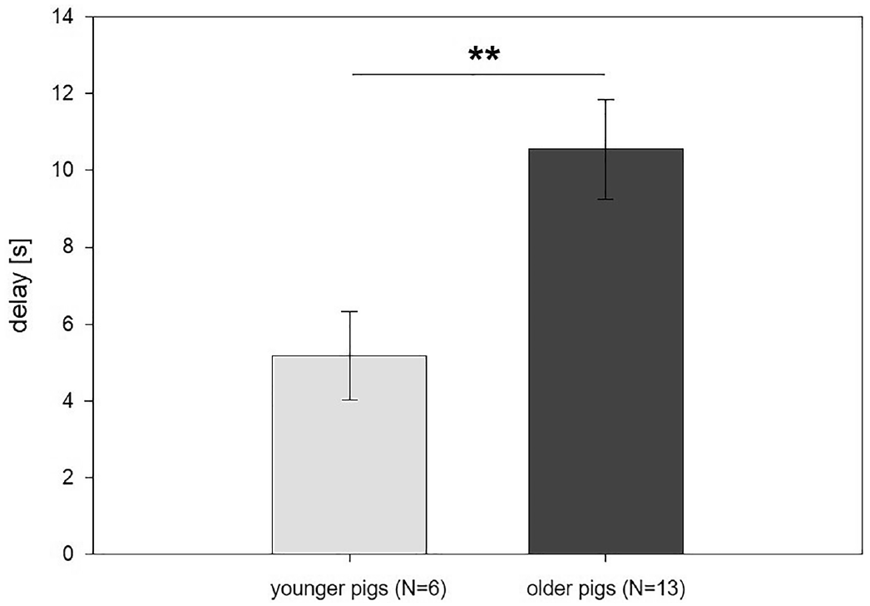
Older piglets wait longer under matched reward rules
Ontogeny is change during an individual’s development. Krause and colleagues compared young and older pigs in a delay-of-gratification task. Animals first learned that a white cup predicted a small reward and a black cup predicted a larger reward, then faced increasing delays for the larger option.
At approximately 9 weeks, the pigs tolerated an average maximum delay of 5.2 s. At approximately 16 weeks, the corresponding delay was 10.6 s. This age difference emerged within a procedure that established reward preferences and trained the visual discrimination before introducing waiting.
The result connects developmental stage to performance under explicit reward and timing rules. It does not identify a single neural circuit responsible for the change. Age comparisons are interpretable only alongside the perceptual training and reward conditions that determine what the animal is being asked to inhibit.
Krause et al. (2021), Fig. 3. Maximum tolerated delay in younger and older pigs.
Krause et al. (2021)
33
Notes:
• Ontogeny is change during an individual’s development. Krause and colleagues compared young and older pigs in a delay-of-gratification task. Animals first learned that a white cup predicted a small reward and a black cup predicted a larger reward, then faced increasing delays for the larger option.
• At approximately 9 weeks, the pigs tolerated an average maximum delay of 5.2 s. At approximately 16 weeks, the corresponding delay was 10.6 s. This age difference emerged within a procedure that established reward preferences and trained the visual discrimination before introducing waiting.
• The result connects developmental stage to performance under explicit reward and timing rules. It does not identify a single neural circuit responsible for the change. Age comparisons are interpretable only alongside the perceptual training and reward conditions that determine what the animal is being asked to inhibit.
References:
Krause Annika, Kreiser Maren, Puppe Birger, Tuchscherer Armin, Düpjan Sandra (2021). The effect of age on discrimination learning and self-control in a marshmallow test for pigs. Scientific Reports 11:18287. https://doi.org/10.1038/s41598-021-97770-x
Figure: Krause et al. (2021), Fig. 3. Maximum tolerated delay in younger and older pigs.
Figure source: https://doi.org/10.1038/s41598-021-97770-x

Slide 34
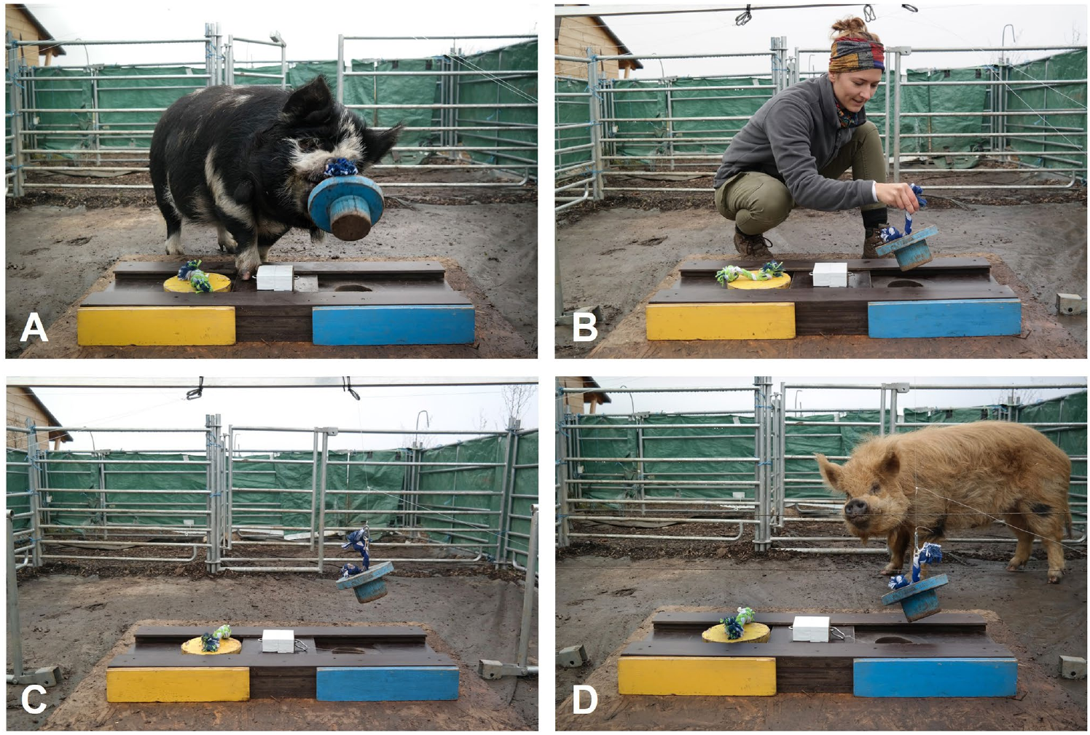
Pigs learn object movements without an active model
Emulation is learning about an outcome or object movement without necessarily copying the demonstrator’s exact action. Veit and colleagues gave free-ranging pigs a two-step food apparatus. A pig first had to remove a plug, then slide a cover to expose the food compartment.
Demonstrations used a conspecific, a human, self-moving objects, or self-moving objects beside an inactive conspecific. The self-moving condition was a ghost control, removing an active social agent while preserving the relevant object movements. Previously tested non-observers supplied a separate comparison.
Observers interacted longer with the relevant plug and solved the task more often than non-observers. Success did not differ reliably across the four demonstration types. The common information was how the apparatus moved, supporting object-based learning rather than requiring imitation of another pig’s action.
Veit et al. (2023), Fig. 3(A–D). Conspecific, human, ghost, and social-ghost demonstrations.
Veit et al. (2023)
34
Notes:
• Emulation is learning about an outcome or object movement without necessarily copying the demonstrator’s exact action. Veit and colleagues gave free-ranging pigs a two-step food apparatus. A pig first had to remove a plug, then slide a cover to expose the food compartment.
• Demonstrations used a conspecific, a human, self-moving objects, or self-moving objects beside an inactive conspecific. The self-moving condition was a ghost control, removing an active social agent while preserving the relevant object movements. Previously tested non-observers supplied a separate comparison.
• Observers interacted longer with the relevant plug and solved the task more often than non-observers. Success did not differ reliably across the four demonstration types. The common information was how the apparatus moved, supporting object-based learning rather than requiring imitation of another pig’s action.
References:
Veit Ariane, Weißhaupt Stefanie, Bruat Arnaud, Wondrak Marianne, Huber Ludwig (2023). Emulative learning of a two-step task in free-ranging domestic pigs. Animal Cognition 26:929–942. https://doi.org/10.1007/s10071-022-01740-3
Figure: Veit et al. (2023), Fig. 3(A–D). Conspecific, human, ghost, and social-ghost demonstrations.
Figure source: https://doi.org/10.1007/s10071-022-01740-3

Slide 35
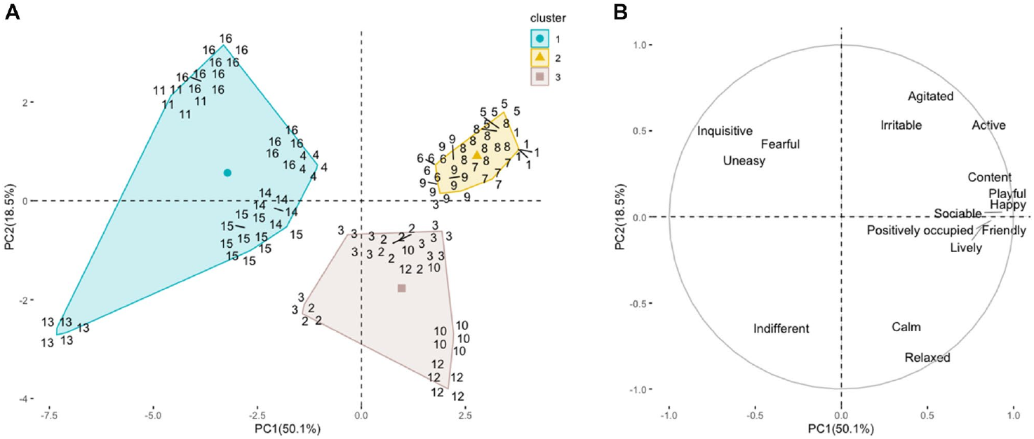
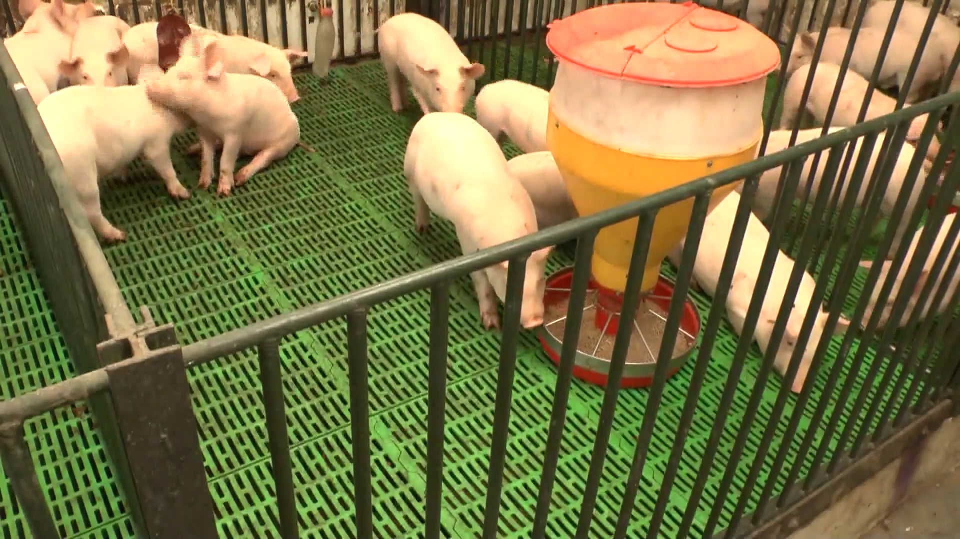
Consonant sound accompanies active positive behavior
Consonance describes combinations of musical tones with relatively stable harmonic relationships. Zapata and colleagues exposed growing pigs to composed musical pieces and assessed their behavioral expression. The original consonant-music recording accompanies the study’s positive-expression condition.
Qualitative behavioral assessment, or QBA, scores the overall manner of behavior using defined descriptors. Ratings were made on 125-mm scales, and the analyst scored randomized videos without sound. This procedure reduced direct knowledge of which music accompanied the recorded animals.
Consonant pieces grouped with more playful, friendly, sociable, and positively occupied expression. The finding concerns observer-rated behavioral responses under these experimental conditions. The terms describe a measured pattern of expression rather than direct access to a pig’s subjective emotional experience.
Zapata et al. (2022), Fig. 2(A–B). Musical-piece groupings and behavioral-expression scores.
Click video to play in Slide Show. Zapata et al. (2022), Supplementary Video 1. Behavior during consonant music.
Zapata et al. (2022)
35
Notes:
• Consonance describes combinations of musical tones with relatively stable harmonic relationships. Zapata and colleagues exposed growing pigs to composed musical pieces and assessed their behavioral expression. The original consonant-music recording accompanies the study’s positive-expression condition.
• Qualitative behavioral assessment, or QBA, scores the overall manner of behavior using defined descriptors. Ratings were made on 125-mm scales, and the analyst scored randomized videos without sound. This procedure reduced direct knowledge of which music accompanied the recorded animals.
• Consonant pieces grouped with more playful, friendly, sociable, and positively occupied expression. The finding concerns observer-rated behavioral responses under these experimental conditions. The terms describe a measured pattern of expression rather than direct access to a pig’s subjective emotional experience.
References:
Zapata Cardona Juliana, Ceballos Maria Camila, Tarazona Morales Ariel Marcel, David Jaramillo Edimer, Rodríguez Berardo de Jesús (2022). Music modulates emotional responses in growing pigs. Scientific Reports 12:3382. https://doi.org/10.1038/s41598-022-07300-6
Figure: Zapata et al. (2022), Fig. 2(A–B). Musical-piece groupings and behavioral-expression scores.
Figure source: https://doi.org/10.1038/s41598-022-07300-6
Article-provided recording: Zapata et al. (2022), Supplementary Video 1. Behavior during consonant music.
• Behavior during consonant music. The complete source scene, original playback speed and audio are preserved; the published figure on this slide supplies the quantitative evidence.
Article DOI: https://doi.org/10.1038/s41598-022-07300-6
Original media URL: https://pmc-oa-opendata.s3.amazonaws.com/PMC8888585.1/41598_2022_7300_MOESM2_ESM.mp4
Credit: Zapata Cardona Juliana, Ceballos Maria Camila, Tarazona Morales Ariel Marcel, David Jaramillo Edimer, Rodríguez Berardo de Jesús (2022). Music modulates emotional responses in growing pigs. Scientific Reports 12:3382. https://doi.org/10.1038/s41598-022-07300-6
License: Open Access This article is licensed under a Creative Commons Attribution 4.0 International License, which permits use, sharing, adaptation, distribution and reproduction in any medium or format, as long as you give appropriate credit to the original author(s) and the source, provide a link to the Creative Commons licence, and indicate if changes were made. The images or other third party material in this article are included in the article's Creative Commons licence, unless indicated otherwise in a credit line to the material. If material is not included in the article's Creative Commons licence and your intended use is not permitted by statutory regulation or exceeds the permitted use, you will need to obtain permission directly from the copyright holder. To view a copy of this licence, visit http://creativecommons.org/licenses/by/4.0/ .
Compatibility: H.264/yuv420p MP4 with AAC audio where present, at original resolution. Full scene and timing preserved; no speed changes, overlays, generated frames or scientific edits. Delivery compression uses H.264 CRF 28 without spatial cropping or resizing.
Playback: click the recording in PowerPoint Slide Show. The credited original article figure remains a static fallback. Full media decode and embedded relationships were checked; interactive PowerPoint playback was unavailable in this environment.

Slide 36
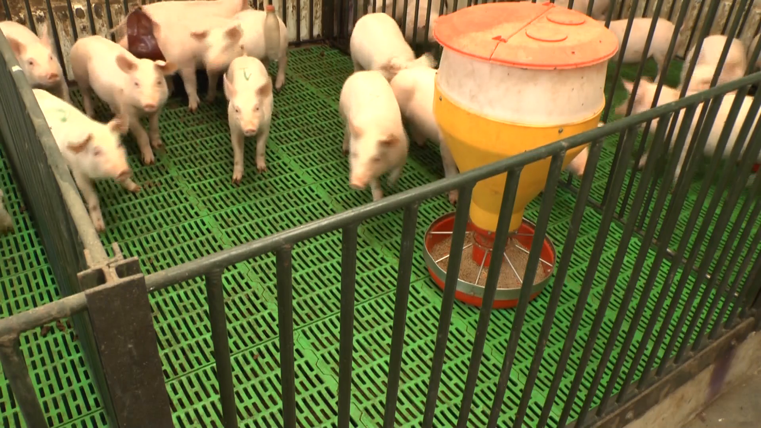
Dissonant sound accompanies fearful behavior
Dissonance describes musical combinations with less stable harmonic relationships. In the pig sound study, dissonant pieces grouped with higher scores on the dimension containing fearful and uneasy expression. The corresponding original recording preserves the animals’ movements and the sound presented to them.
The behavioral scoring used the same descriptor set and 125-mm scales across sound conditions. Removing audio during the scoring sessions limited expectations based on the soundtrack. Contrasting the sound conditions therefore involved a common assessment procedure rather than separate definitions of positive and negative behavior.
Composed pieces also differ in acoustic features beyond harmony. Their behavioral grouping supports an association between the tested pieces and expression, while isolating a causal effect of consonance alone would require matched acoustic manipulations. No auditory or limbic neuronal recordings were made in this experiment.
Zapata et al. (2022), Fig. 2(A–B). Dissonant-piece groupings and behavioral-expression dimensions.
Click video to play in Slide Show. Zapata et al. (2022), Supplementary Video 2. Behavior during dissonant music.
Zapata et al. (2022)
36
Notes:
• Dissonance describes musical combinations with less stable harmonic relationships. In the pig sound study, dissonant pieces grouped with higher scores on the dimension containing fearful and uneasy expression. The corresponding original recording preserves the animals’ movements and the sound presented to them.
• The behavioral scoring used the same descriptor set and 125-mm scales across sound conditions. Removing audio during the scoring sessions limited expectations based on the soundtrack. Contrasting the sound conditions therefore involved a common assessment procedure rather than separate definitions of positive and negative behavior.
• Composed pieces also differ in acoustic features beyond harmony. Their behavioral grouping supports an association between the tested pieces and expression, while isolating a causal effect of consonance alone would require matched acoustic manipulations. No auditory or limbic neuronal recordings were made in this experiment.
References:
Zapata Cardona Juliana, Ceballos Maria Camila, Tarazona Morales Ariel Marcel, David Jaramillo Edimer, Rodríguez Berardo de Jesús (2022). Music modulates emotional responses in growing pigs. Scientific Reports 12:3382. https://doi.org/10.1038/s41598-022-07300-6
Figure: Zapata et al. (2022), Fig. 2(A–B). Dissonant-piece groupings and behavioral-expression dimensions.
Figure source: https://doi.org/10.1038/s41598-022-07300-6
Article-provided recording: Zapata et al. (2022), Supplementary Video 2. Behavior during dissonant music.
• Behavior during dissonant music. The complete source scene, original playback speed and audio are preserved; the published figure on this slide supplies the quantitative evidence.
Article DOI: https://doi.org/10.1038/s41598-022-07300-6
Original media URL: https://pmc-oa-opendata.s3.amazonaws.com/PMC8888585.1/41598_2022_7300_MOESM3_ESM.mp4
Credit: Zapata Cardona Juliana, Ceballos Maria Camila, Tarazona Morales Ariel Marcel, David Jaramillo Edimer, Rodríguez Berardo de Jesús (2022). Music modulates emotional responses in growing pigs. Scientific Reports 12:3382. https://doi.org/10.1038/s41598-022-07300-6
License: Open Access This article is licensed under a Creative Commons Attribution 4.0 International License, which permits use, sharing, adaptation, distribution and reproduction in any medium or format, as long as you give appropriate credit to the original author(s) and the source, provide a link to the Creative Commons licence, and indicate if changes were made. The images or other third party material in this article are included in the article's Creative Commons licence, unless indicated otherwise in a credit line to the material. If material is not included in the article's Creative Commons licence and your intended use is not permitted by statutory regulation or exceeds the permitted use, you will need to obtain permission directly from the copyright holder. To view a copy of this licence, visit http://creativecommons.org/licenses/by/4.0/ .
Compatibility: H.264/yuv420p MP4 with AAC audio where present, at original resolution. Full scene and timing preserved; no speed changes, overlays, generated frames or scientific edits. Delivery compression uses H.264 CRF 28 without spatial cropping or resizing.
Playback: click the recording in PowerPoint Slide Show. The credited original article figure remains a static fallback. Full media decode and embedded relationships were checked; interactive PowerPoint playback was unavailable in this environment.

Slide 37
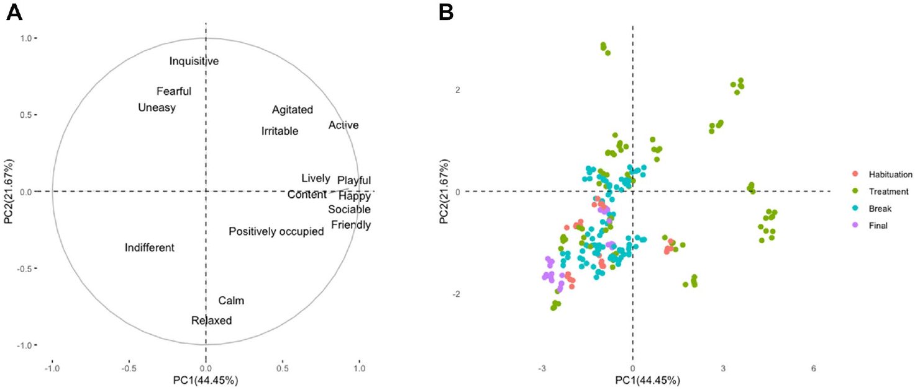
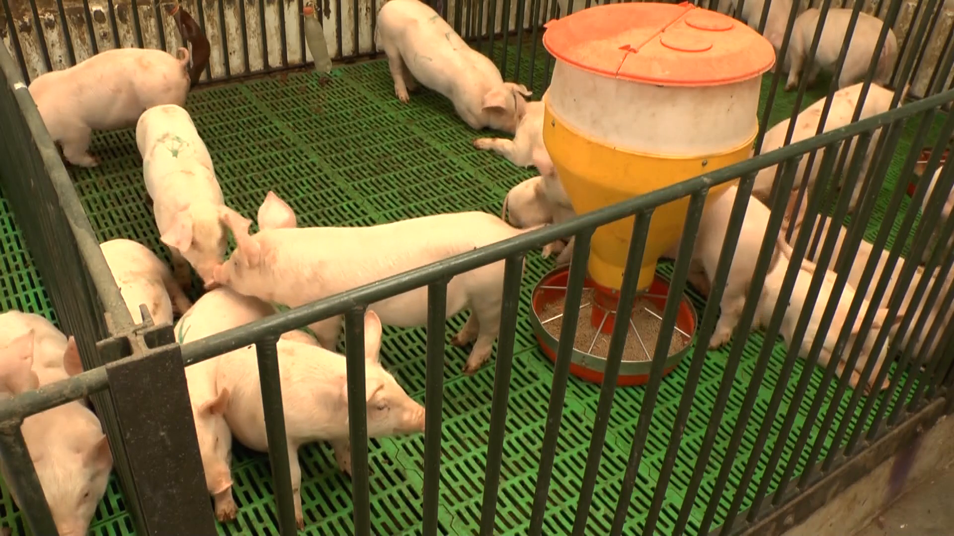
Silent breaks reveal behavior outside the sound stimulus
A comparison period measures behavior when the experimental stimulus is absent or differs from the treatment. The musical-stimulation protocol included breaks between pieces. The original break recording contains calm, relaxed, and occupied behavior without an ongoing musical treatment.
Behavioral-expression scores during treatment were spread more widely than scores during habituation, breaks, and the final period. Both positive and negative dimensions were elevated during treatment because different pieces produced different patterns. A single average response to all music would obscure that variation.
The break comparison places sound-associated activity against the animals’ behavior within the same experimental setting. Calm behavior during a break is not automatically an effect caused by the preceding music. The timing of the comparison is part of the interpretation of the recorded response.
Zapata et al. (2022), Fig. 1(A–B). Behavioral-expression scores during treatment and comparison periods.
Click video to play in Slide Show. Zapata et al. (2022), Supplementary Video 3. Calm and occupied behavior during a break.
Zapata et al. (2022)
37
Notes:
• A comparison period measures behavior when the experimental stimulus is absent or differs from the treatment. The musical-stimulation protocol included breaks between pieces. The original break recording contains calm, relaxed, and occupied behavior without an ongoing musical treatment.
• Behavioral-expression scores during treatment were spread more widely than scores during habituation, breaks, and the final period. Both positive and negative dimensions were elevated during treatment because different pieces produced different patterns. A single average response to all music would obscure that variation.
• The break comparison places sound-associated activity against the animals’ behavior within the same experimental setting. Calm behavior during a break is not automatically an effect caused by the preceding music. The timing of the comparison is part of the interpretation of the recorded response.
References:
Zapata Cardona Juliana, Ceballos Maria Camila, Tarazona Morales Ariel Marcel, David Jaramillo Edimer, Rodríguez Berardo de Jesús (2022). Music modulates emotional responses in growing pigs. Scientific Reports 12:3382. https://doi.org/10.1038/s41598-022-07300-6
Figure: Zapata et al. (2022), Fig. 1(A–B). Behavioral-expression scores during treatment and comparison periods.
Figure source: https://doi.org/10.1038/s41598-022-07300-6
Article-provided recording: Zapata et al. (2022), Supplementary Video 3. Calm and occupied behavior during a break.
• Calm and occupied behavior during a break. The complete source scene, original playback speed and audio are preserved; the published figure on this slide supplies the quantitative evidence.
Article DOI: https://doi.org/10.1038/s41598-022-07300-6
Original media URL: https://pmc-oa-opendata.s3.amazonaws.com/PMC8888585.1/41598_2022_7300_MOESM4_ESM.mp4
Credit: Zapata Cardona Juliana, Ceballos Maria Camila, Tarazona Morales Ariel Marcel, David Jaramillo Edimer, Rodríguez Berardo de Jesús (2022). Music modulates emotional responses in growing pigs. Scientific Reports 12:3382. https://doi.org/10.1038/s41598-022-07300-6
License: Open Access This article is licensed under a Creative Commons Attribution 4.0 International License, which permits use, sharing, adaptation, distribution and reproduction in any medium or format, as long as you give appropriate credit to the original author(s) and the source, provide a link to the Creative Commons licence, and indicate if changes were made. The images or other third party material in this article are included in the article's Creative Commons licence, unless indicated otherwise in a credit line to the material. If material is not included in the article's Creative Commons licence and your intended use is not permitted by statutory regulation or exceeds the permitted use, you will need to obtain permission directly from the copyright holder. To view a copy of this licence, visit http://creativecommons.org/licenses/by/4.0/ .
Compatibility: H.264/yuv420p MP4 with AAC audio where present, at original resolution. Full scene and timing preserved; no speed changes, overlays, generated frames or scientific edits. Delivery compression uses H.264 CRF 28 without spatial cropping or resizing.
Playback: click the recording in PowerPoint Slide Show. The credited original article figure remains a static fallback. Full media decode and embedded relationships were checked; interactive PowerPoint playback was unavailable in this environment.

Slide 38
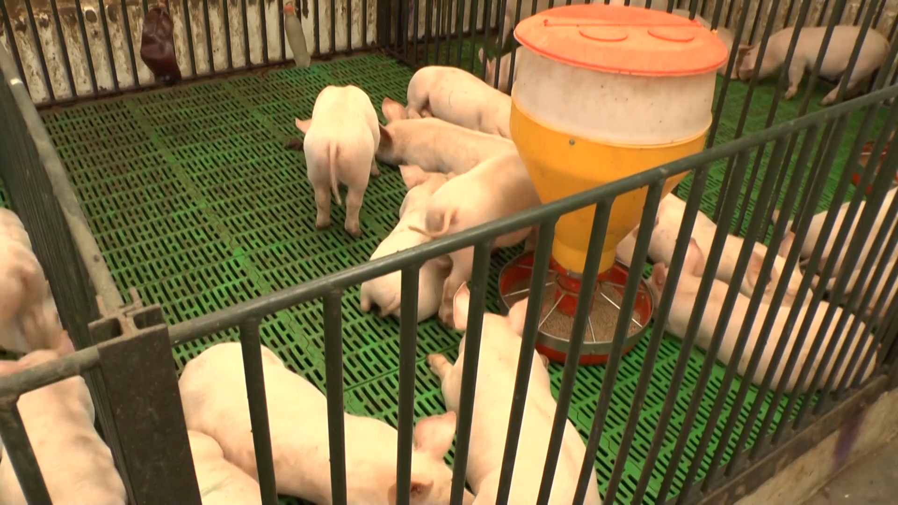
The final period separates sustained activity from settling
The musical-stimulation study also measured a final period after the treatment sequence. Calm and relaxed descriptors had their highest average scores during this period. The original final-period recording preserves the behavioral state used for that comparison.
Habituation and final recordings lasted 30 min, with a 5-min fragment selected for blinded scoring. The selected fragments came from the interval between minutes 10 and 30. Using defined observation windows limited differences introduced by unequal recording duration.
Treatment periods contained more varied active expression, while the final period had a narrower calm and relaxed profile. This temporal separation distinguishes responses during sound exposure from behavior later in the session. It does not establish that all music produces a lasting calming effect.
Zapata et al. (2022), Fig. 1(A–B). Behavioral scores across habituation, treatment, break, and final periods.
Click video to play in Slide Show. Zapata et al. (2022), Supplementary Video 4. Calm and relaxed behavior in the final period.
Zapata et al. (2022)
38
Notes:
• The musical-stimulation study also measured a final period after the treatment sequence. Calm and relaxed descriptors had their highest average scores during this period. The original final-period recording preserves the behavioral state used for that comparison.
• Habituation and final recordings lasted 30 min, with a 5-min fragment selected for blinded scoring. The selected fragments came from the interval between minutes 10 and 30. Using defined observation windows limited differences introduced by unequal recording duration.
• Treatment periods contained more varied active expression, while the final period had a narrower calm and relaxed profile. This temporal separation distinguishes responses during sound exposure from behavior later in the session. It does not establish that all music produces a lasting calming effect.
References:
Zapata Cardona Juliana, Ceballos Maria Camila, Tarazona Morales Ariel Marcel, David Jaramillo Edimer, Rodríguez Berardo de Jesús (2022). Music modulates emotional responses in growing pigs. Scientific Reports 12:3382. https://doi.org/10.1038/s41598-022-07300-6
Figure: Zapata et al. (2022), Fig. 1(A–B). Behavioral scores across habituation, treatment, break, and final periods.
Figure source: https://doi.org/10.1038/s41598-022-07300-6
Article-provided recording: Zapata et al. (2022), Supplementary Video 4. Calm and relaxed behavior in the final period.
• Calm and relaxed behavior in the final period. The complete source scene, original playback speed and audio are preserved; the published figure on this slide supplies the quantitative evidence.
Article DOI: https://doi.org/10.1038/s41598-022-07300-6
Original media URL: https://pmc-oa-opendata.s3.amazonaws.com/PMC8888585.1/41598_2022_7300_MOESM5_ESM.mp4
Credit: Zapata Cardona Juliana, Ceballos Maria Camila, Tarazona Morales Ariel Marcel, David Jaramillo Edimer, Rodríguez Berardo de Jesús (2022). Music modulates emotional responses in growing pigs. Scientific Reports 12:3382. https://doi.org/10.1038/s41598-022-07300-6
License: Open Access This article is licensed under a Creative Commons Attribution 4.0 International License, which permits use, sharing, adaptation, distribution and reproduction in any medium or format, as long as you give appropriate credit to the original author(s) and the source, provide a link to the Creative Commons licence, and indicate if changes were made. The images or other third party material in this article are included in the article's Creative Commons licence, unless indicated otherwise in a credit line to the material. If material is not included in the article's Creative Commons licence and your intended use is not permitted by statutory regulation or exceeds the permitted use, you will need to obtain permission directly from the copyright holder. To view a copy of this licence, visit http://creativecommons.org/licenses/by/4.0/ .
Compatibility: H.264/yuv420p MP4 with AAC audio where present, at original resolution. Full scene and timing preserved; no speed changes, overlays, generated frames or scientific edits. Delivery compression uses H.264 CRF 28 without spatial cropping or resizing.
Playback: click the recording in PowerPoint Slide Show. The credited original article figure remains a static fallback. Full media decode and embedded relationships were checked; interactive PowerPoint playback was unavailable in this environment.

Slide 39
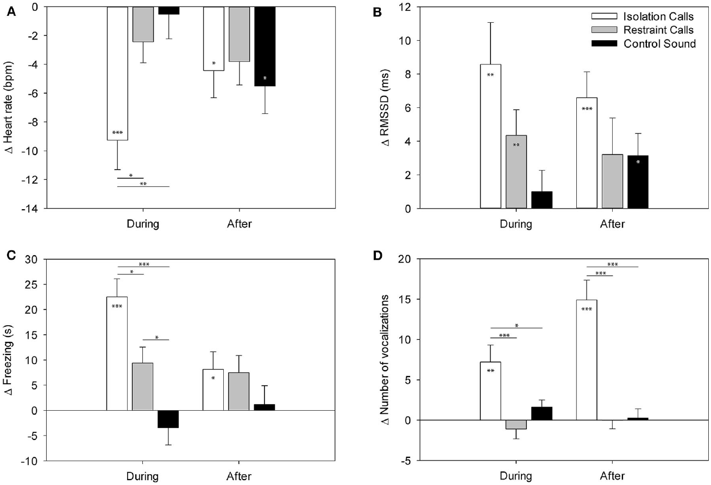
Conspecific calls change behavior and autonomic activity
Vocal communication transfers information through sounds produced by another animal. Leliveld and colleagues played pig calls from isolation and restraint contexts, alongside a control sound. Isolation recordings contained more low-frequency elements, while restraint recordings contained more high-frequency elements.
The low- and high-frequency call clusters had mean peak frequencies of approximately 211 Hz and 2,742 Hz. During isolation-call playback, pigs froze more, explored less, and vocalized more than during the comparison sounds. Heart rate also decreased more during isolation-call playback.
Autonomic activity regulates functions such as heart rate alongside overt movement. Parallel measurements of freezing, exploration, vocal output, and cardiac responses therefore separate several components of the reaction. Context-related call structure changes receiver behavior even when the calling pig is absent.
Leliveld et al. (2020), Fig. 2(A–D). Heart rate, variability, freezing, and vocal responses during playback.
Leliveld et al. (2020)
39
Notes:
• Vocal communication transfers information through sounds produced by another animal. Leliveld and colleagues played pig calls from isolation and restraint contexts, alongside a control sound. Isolation recordings contained more low-frequency elements, while restraint recordings contained more high-frequency elements.
• The low- and high-frequency call clusters had mean peak frequencies of approximately 211 Hz and 2,742 Hz. During isolation-call playback, pigs froze more, explored less, and vocalized more than during the comparison sounds. Heart rate also decreased more during isolation-call playback.
• Autonomic activity regulates functions such as heart rate alongside overt movement. Parallel measurements of freezing, exploration, vocal output, and cardiac responses therefore separate several components of the reaction. Context-related call structure changes receiver behavior even when the calling pig is absent.
References:
Leliveld Lisette M C, Düpjan Sandra, Tuchscherer Armin, Puppe Birger (2020). Hemispheric Specialization for Processing the Communicative and Emotional Content of Vocal Communication in a Social Mammal, the Domestic Pig. Frontiers in Behavioral Neuroscience 14:596758. https://doi.org/10.3389/fnbeh.2020.596758
Figure: Leliveld et al. (2020), Fig. 2(A–D). Heart rate, variability, freezing, and vocal responses during playback.
Figure source: https://doi.org/10.3389/fnbeh.2020.596758

Slide 40
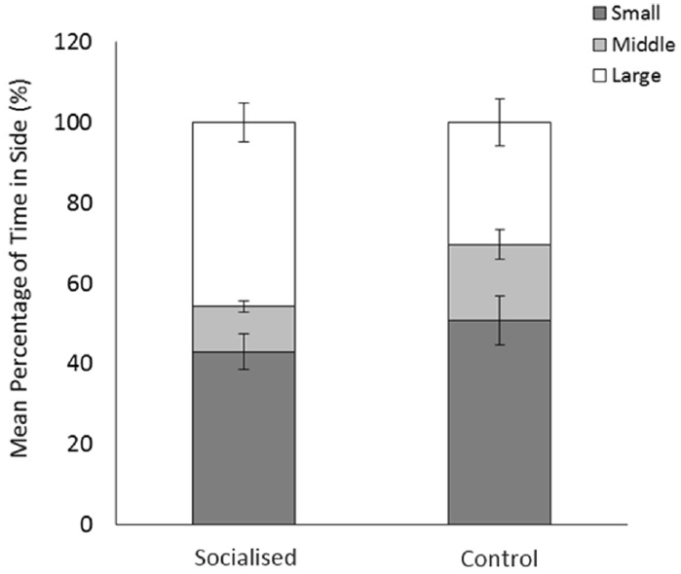
Early social experience changes later social choices
Socialization is experience interacting with other individuals during development. Weller and colleagues allowed some litters to meet non-littermates from about 15 days of age, while controls remained within their litter. After weaning, pigs completed food, reversal, social-preference, and manipulative tasks.
In the social-preference test, pigs could approach larger or smaller unfamiliar stimulus pigs in opposite T-maze arms. The maximum observation interval was 180 s. Previously socialized pigs spent more time near the larger individuals and left the central area more quickly than controls.
Food-reward performance and puzzle-box success did not improve generally with socialization. The effects were therefore task-specific rather than a uniform increase in learning ability. Early exposure to unfamiliar pigs changed later social approach under conditions that distinguished body-size-related partner choices.
Weller et al. (2020), Fig. 5. Time near larger and smaller unfamiliar stimulus pigs.
Weller et al. (2020)
40
Notes:
• Socialization is experience interacting with other individuals during development. Weller and colleagues allowed some litters to meet non-littermates from about 15 days of age, while controls remained within their litter. After weaning, pigs completed food, reversal, social-preference, and manipulative tasks.
• In the social-preference test, pigs could approach larger or smaller unfamiliar stimulus pigs in opposite T-maze arms. The maximum observation interval was 180 s. Previously socialized pigs spent more time near the larger individuals and left the central area more quickly than controls.
• Food-reward performance and puzzle-box success did not improve generally with socialization. The effects were therefore task-specific rather than a uniform increase in learning ability. Early exposure to unfamiliar pigs changed later social approach under conditions that distinguished body-size-related partner choices.
References:
Weller Jennifer E., Turner Simon P., Futro Agnieszka, Donbavand Jo, Brims Mark, Arnott Gareth (2020). The influence of early life socialisation on cognition in the domestic pig ( Sus scrofa domestica ). Scientific Reports 10:19077. https://doi.org/10.1038/s41598-020-76110-5
Figure: Weller et al. (2020), Fig. 5. Time near larger and smaller unfamiliar stimulus pigs.
Figure source: https://doi.org/10.1038/s41598-020-76110-5

Slide 41
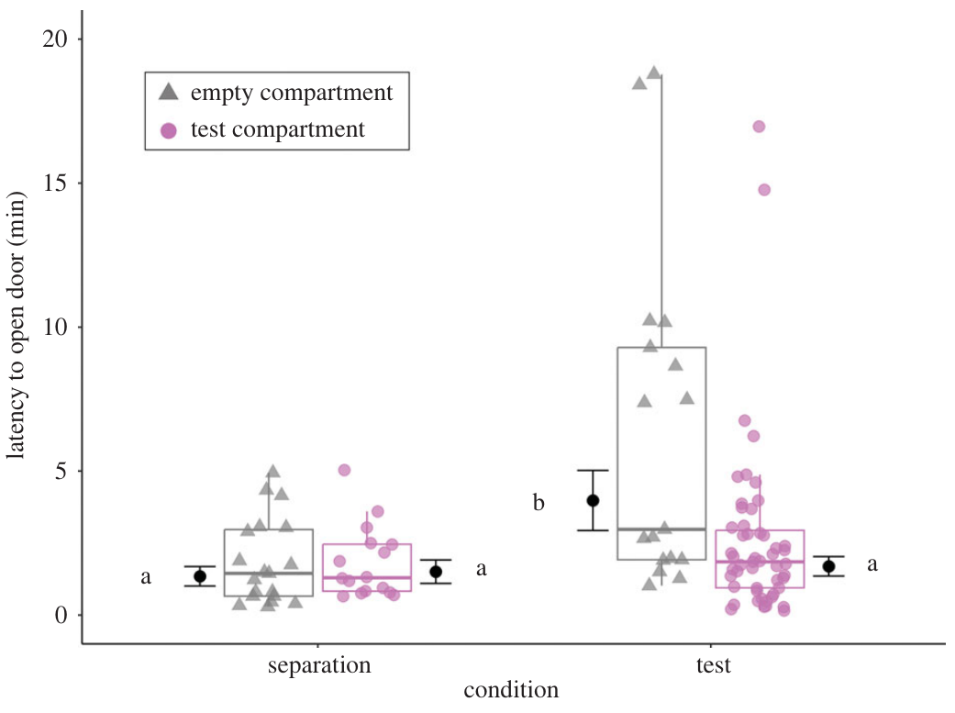
Pigs preferentially release a trapped group member
Targeted helping is action directed toward another individual’s apparent need. Moscovice and colleagues attached two identical compartments to pig home pens. A door could be opened by lifting a handle with the snout, and only one compartment contained a trapped group member during testing.
Pigs released the trapped individual in 85% of trials within the 20-min observation window, with a median release latency of 2.2 min. They opened the occupied compartment more often and sooner than the empty one. Greater attention toward the trapped pig and its distress signals predicted helping.
The empty-compartment control distinguishes release behavior from indiscriminate interest in opening doors. Empathy, responding to another individual’s state, is one possible explanation; restoring contact or ending aversive signals are alternatives. The measured result is selective release associated with social attention and apparent need.
Moscovice et al. (2023), Fig. 2. Door opening for occupied versus empty compartments.
Moscovice et al. (2023)
41
Notes:
• Targeted helping is action directed toward another individual’s apparent need. Moscovice and colleagues attached two identical compartments to pig home pens. A door could be opened by lifting a handle with the snout, and only one compartment contained a trapped group member during testing.
• Pigs released the trapped individual in 85% of trials within the 20-min observation window, with a median release latency of 2.2 min. They opened the occupied compartment more often and sooner than the empty one. Greater attention toward the trapped pig and its distress signals predicted helping.
• The empty-compartment control distinguishes release behavior from indiscriminate interest in opening doors. Empathy, responding to another individual’s state, is one possible explanation; restoring contact or ending aversive signals are alternatives. The measured result is selective release associated with social attention and apparent need.
References:
Moscovice Liza R, Eggert Anja, Manteuffel Christian, Rault Jean-Loup (2023). Spontaneous helping in pigs is mediated by helper's social attention and distress signals of individuals in need. Proceedings of the Royal Society B: Biological Sciences 290:20230665. https://doi.org/10.1098/rspb.2023.0665
Figure: Moscovice et al. (2023), Fig. 2. Door opening for occupied versus empty compartments.
Figure source: https://doi.org/10.1098/rspb.2023.0665

Slide 42
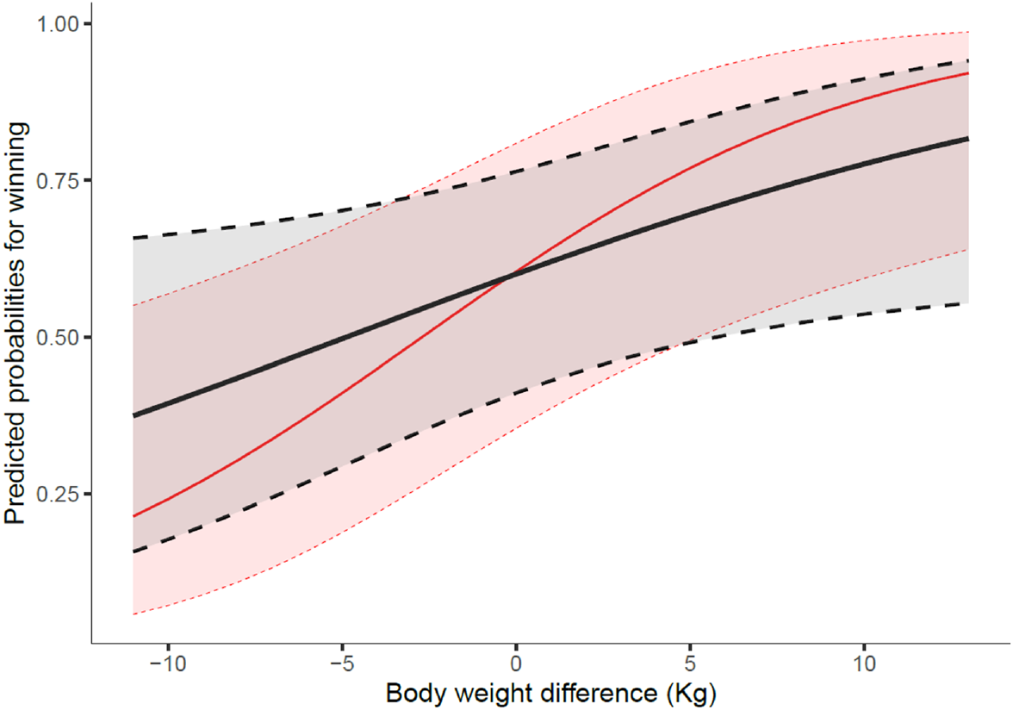
Third-party intervention can benefit the intervener
Third-party intervention occurs when a bystander joins a conflict already involving two individuals. Maffezzini and colleagues observed the first 30 min after pigs were grouped with familiar and unfamiliar partners. Interventions ranged from nose contact to fighting involving three animals.
An intervener was more likely to win than an initial opponent of equal body weight. Entry into a conflict did not depend simply on having a familiar participant present. Once intervening, pigs attacked unfamiliar initiators more often than familiar ones.
Two-against-one fights lasted longer than other three-animal fights, and post-conflict aggression was common. These patterns differ from an assumption that intervention is necessarily consoling or cooperative. The outcome and the intervener’s own benefits provide information needed to interpret a socially directed action.
Maffezzini et al. (2023), Fig. 3. Winning probability depends on body-mass difference and intervention status.
Maffezzini et al. (2023)
42
Notes:
• Third-party intervention occurs when a bystander joins a conflict already involving two individuals. Maffezzini and colleagues observed the first 30 min after pigs were grouped with familiar and unfamiliar partners. Interventions ranged from nose contact to fighting involving three animals.
• An intervener was more likely to win than an initial opponent of equal body weight. Entry into a conflict did not depend simply on having a familiar participant present. Once intervening, pigs attacked unfamiliar initiators more often than familiar ones.
• Two-against-one fights lasted longer than other three-animal fights, and post-conflict aggression was common. These patterns differ from an assumption that intervention is necessarily consoling or cooperative. The outcome and the intervener’s own benefits provide information needed to interpret a socially directed action.
References:
Maffezzini Nicole, Turner Simon P, Bolhuis J Elizabeth, Arnott Gareth, Camerlink Irene (2023). Third-party intervention and post-conflict behaviour in agonistic encounters of pigs ( Sus scrofa ). Frontiers in Zoology 20:28. https://doi.org/10.1186/s12983-023-00508-w
Figure: Maffezzini et al. (2023), Fig. 3. Winning probability depends on body-mass difference and intervention status.
Figure source: https://doi.org/10.1186/s12983-023-00508-w

Slide 43
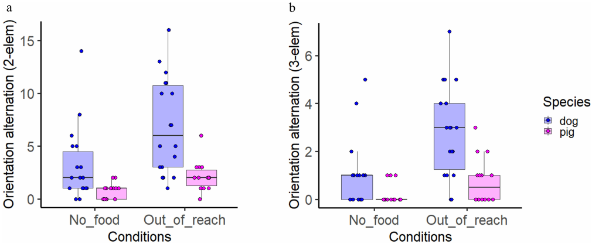
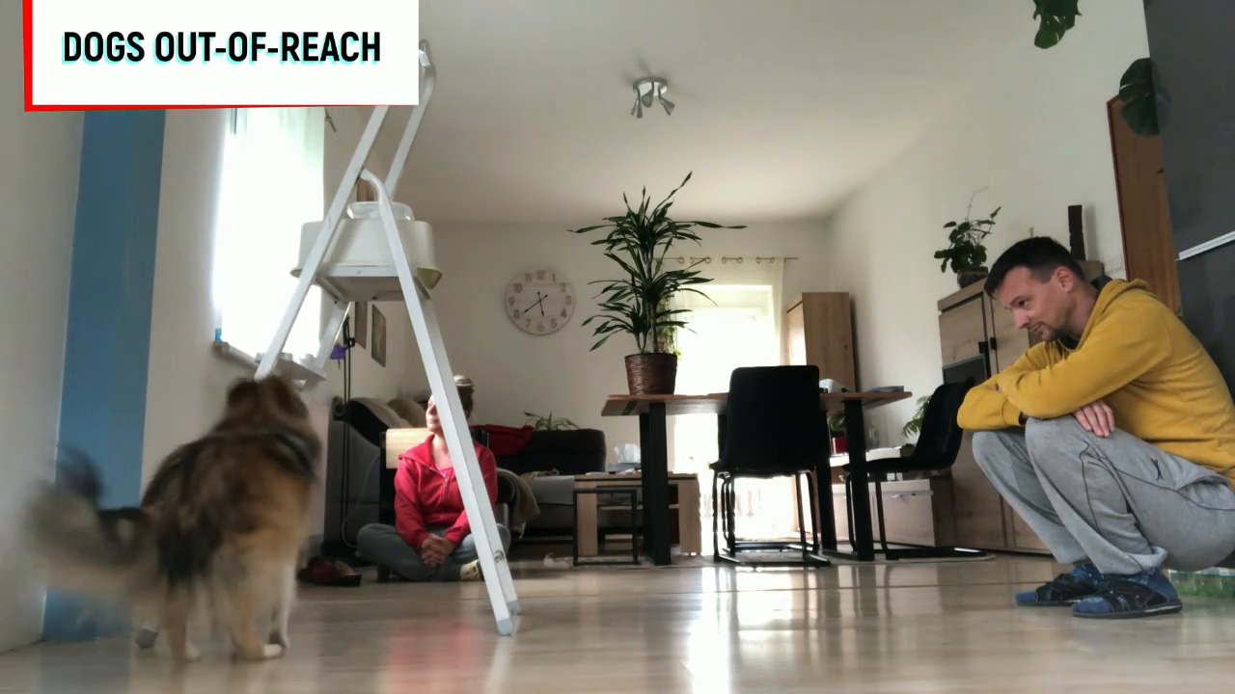
Pigs alternate attention toward inaccessible food
Orientation alternation is a sequence in which an animal directs attention between two targets, here a human and a food container. Pérez and colleagues tested companion pigs and dogs with reachable food, snout-inaccessible food, and a no-food comparison. Humans occupied controlled positions beside the target.
Both species alternated orientation more often when food was present but inaccessible than when food was absent. Dogs alternated more frequently than pigs, while pigs showed more physical interaction with humans. The original study recording contains the complete out-of-reach examples for both species.
Two-element and stricter three-element orientation sequences produced consistent condition effects. This comparison identifies human-directed behavior associated with an inaccessible goal. Interpreting it as intentional communication remains a hypothesis; the measured sequences do not require attributing a human-like understanding of the observer’s knowledge.
Pérez et al. (2025), Fig. 3(a–b). Orientation alternations in pigs and dogs across task conditions.
Click video to play in Slide Show. Pérez et al. (2025), Supplementary video material: rsos242178_si_005.mp4. Pig and dog behavior in the out-of-reach condition.
Pérez et al. (2025)
43
Notes:
• Orientation alternation is a sequence in which an animal directs attention between two targets, here a human and a food container. Pérez and colleagues tested companion pigs and dogs with reachable food, snout-inaccessible food, and a no-food comparison. Humans occupied controlled positions beside the target.
• Both species alternated orientation more often when food was present but inaccessible than when food was absent. Dogs alternated more frequently than pigs, while pigs showed more physical interaction with humans. The original study recording contains the complete out-of-reach examples for both species.
• Two-element and stricter three-element orientation sequences produced consistent condition effects. This comparison identifies human-directed behavior associated with an inaccessible goal. Interpreting it as intentional communication remains a hypothesis; the measured sequences do not require attributing a human-like understanding of the observer’s knowledge.
References:
Pérez Fraga Paula, Lehoczki Fanni, Andics Attila (2025). Companion pigs alternate orientation between humans and snout-inaccessible targets. Royal Society Open Science 12:242178. https://doi.org/10.1098/rsos.242178
Figure: Pérez et al. (2025), Fig. 3(a–b). Orientation alternations in pigs and dogs across task conditions.
Figure source: https://doi.org/10.1098/rsos.242178
Article-provided recording: Pérez et al. (2025), Supplementary video material: rsos242178_si_005.mp4. Pig and dog behavior in the out-of-reach condition.
• Pig and dog behavior in the out-of-reach condition. The complete source scene, original playback speed and audio are preserved; the published figure on this slide supplies the quantitative evidence.
Article DOI: https://doi.org/10.1098/rsos.242178
Original media URL: https://ndownloader.figshare.com/files/57260846
Credit: Pérez Fraga Paula, Lehoczki Fanni, Andics Attila (2025). Companion pigs alternate orientation between humans and snout-inaccessible targets. Royal Society Open Science 12:242178. https://doi.org/10.1098/rsos.242178
License: https://creativecommons.org/licenses/by/4.0/
Compatibility: H.264/yuv420p MP4 with AAC audio where present, at original resolution. Full scene and timing preserved; no speed changes, overlays, generated frames or scientific edits. Delivery compression uses H.264 CRF 28 without spatial cropping or resizing.
Playback: click the recording in PowerPoint Slide Show. The credited original article figure remains a static fallback. Full media decode and embedded relationships were checked; interactive PowerPoint playback was unavailable in this environment.

Slide 44
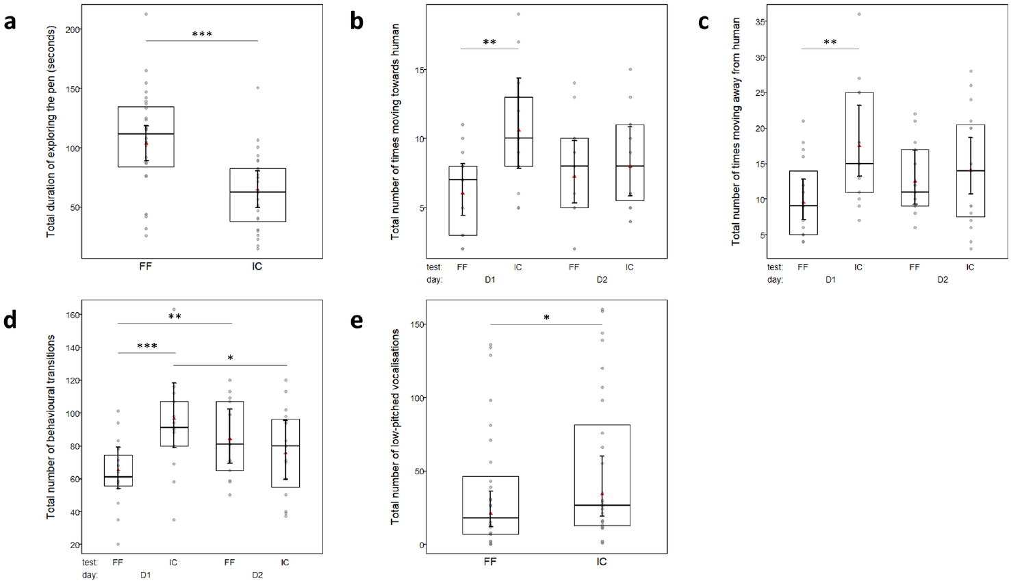
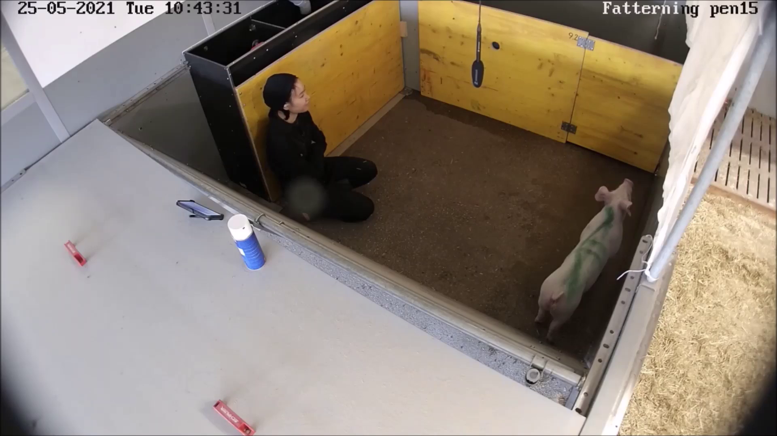
Imposed gentle contact changes exploratory behavior
Imposed contact means that the human initiates touch within a defined interaction procedure. Truong and colleagues compared this approach with free form interaction with the same familiar human. Each test lasted 5 min, and the original imposed-contact recording preserves the interaction used in the study.
Pigs spent about 65 s exploring the pen during imposed contact, compared with about 104 s during free form interaction. Low-pitched vocalizations were also more frequent during imposed contact. Movement toward and away from the human differed most clearly on the first test day.
The familiar-human comparison reduces variation from encountering a different person. Gentle touch therefore does not have a single behavioral consequence independent of how it is delivered. The interaction procedure changed the opportunities for exploration and movement as well as the amount of human contact.
Truong et al. (2024), Fig. 1(a–e). Exploration, movement transitions, and vocalization measures.
Click video to play in Slide Show. Truong et al. (2024), Supplementary Video 2. Imposed gentle tactile contact.
Truong et al. (2024)
44
Notes:
• Imposed contact means that the human initiates touch within a defined interaction procedure. Truong and colleagues compared this approach with free form interaction with the same familiar human. Each test lasted 5 min, and the original imposed-contact recording preserves the interaction used in the study.
• Pigs spent about 65 s exploring the pen during imposed contact, compared with about 104 s during free form interaction. Low-pitched vocalizations were also more frequent during imposed contact. Movement toward and away from the human differed most clearly on the first test day.
• The familiar-human comparison reduces variation from encountering a different person. Gentle touch therefore does not have a single behavioral consequence independent of how it is delivered. The interaction procedure changed the opportunities for exploration and movement as well as the amount of human contact.
References:
Truong Suzanne, Schmitt Oceane, Rault Jean-Loup (2024). On your terms or mine: pigs’ response to imposed gentle tactile contact vs. free form interaction with a familiar human. Scientific Reports 14:25249. https://doi.org/10.1038/s41598-024-76451-5
Figure: Truong et al. (2024), Fig. 1(a–e). Exploration, movement transitions, and vocalization measures.
Figure source: https://doi.org/10.1038/s41598-024-76451-5
Article-provided recording: Truong et al. (2024), Supplementary Video 2. Imposed gentle tactile contact.
• Imposed gentle tactile contact. Source recording was inspected against Table 1: Video 1 shows a responsive kneeling human; Video 2 shows the timed approach, touch, and withdrawal sequence. Full scene, speed and audio preserved.
Article DOI: https://doi.org/10.1038/s41598-024-76451-5
Original media URL: https://pmc-oa-opendata.s3.amazonaws.com/PMC11502703.1/41598_2024_76451_MOESM2_ESM.mp4
Credit: Truong Suzanne, Schmitt Oceane, Rault Jean-Loup (2024). On your terms or mine: pigs’ response to imposed gentle tactile contact vs. free form interaction with a familiar human. Scientific Reports 14:25249. https://doi.org/10.1038/s41598-024-76451-5
License: Open Access This article is licensed under a Creative Commons Attribution 4.0 International License, which permits use, sharing, adaptation, distribution and reproduction in any medium or format, as long as you give appropriate credit to the original author(s) and the source, provide a link to the Creative Commons licence, and indicate if changes were made. The images or other third party material in this article are included in the article’s Creative Commons licence, unless indicated otherwise in a credit line to the material. If material is not included in the article’s Creative Commons licence and your intended use is not permitted by statutory regulation or exceeds the permitted use, you will need to obtain permission directly from the copyright holder. To view a copy of this licence, visit http://creativecommons.org/licenses/by/4.0/ .
Compatibility: H.264/yuv420p MP4 with AAC audio where present, at original resolution. Full scene and timing preserved; no speed changes, overlays, generated frames or scientific edits.
Playback: click the recording in PowerPoint Slide Show. The credited original article figure remains a static fallback. Full media decode and embedded relationships were checked; interactive PowerPoint playback was unavailable in this environment.

Slide 45
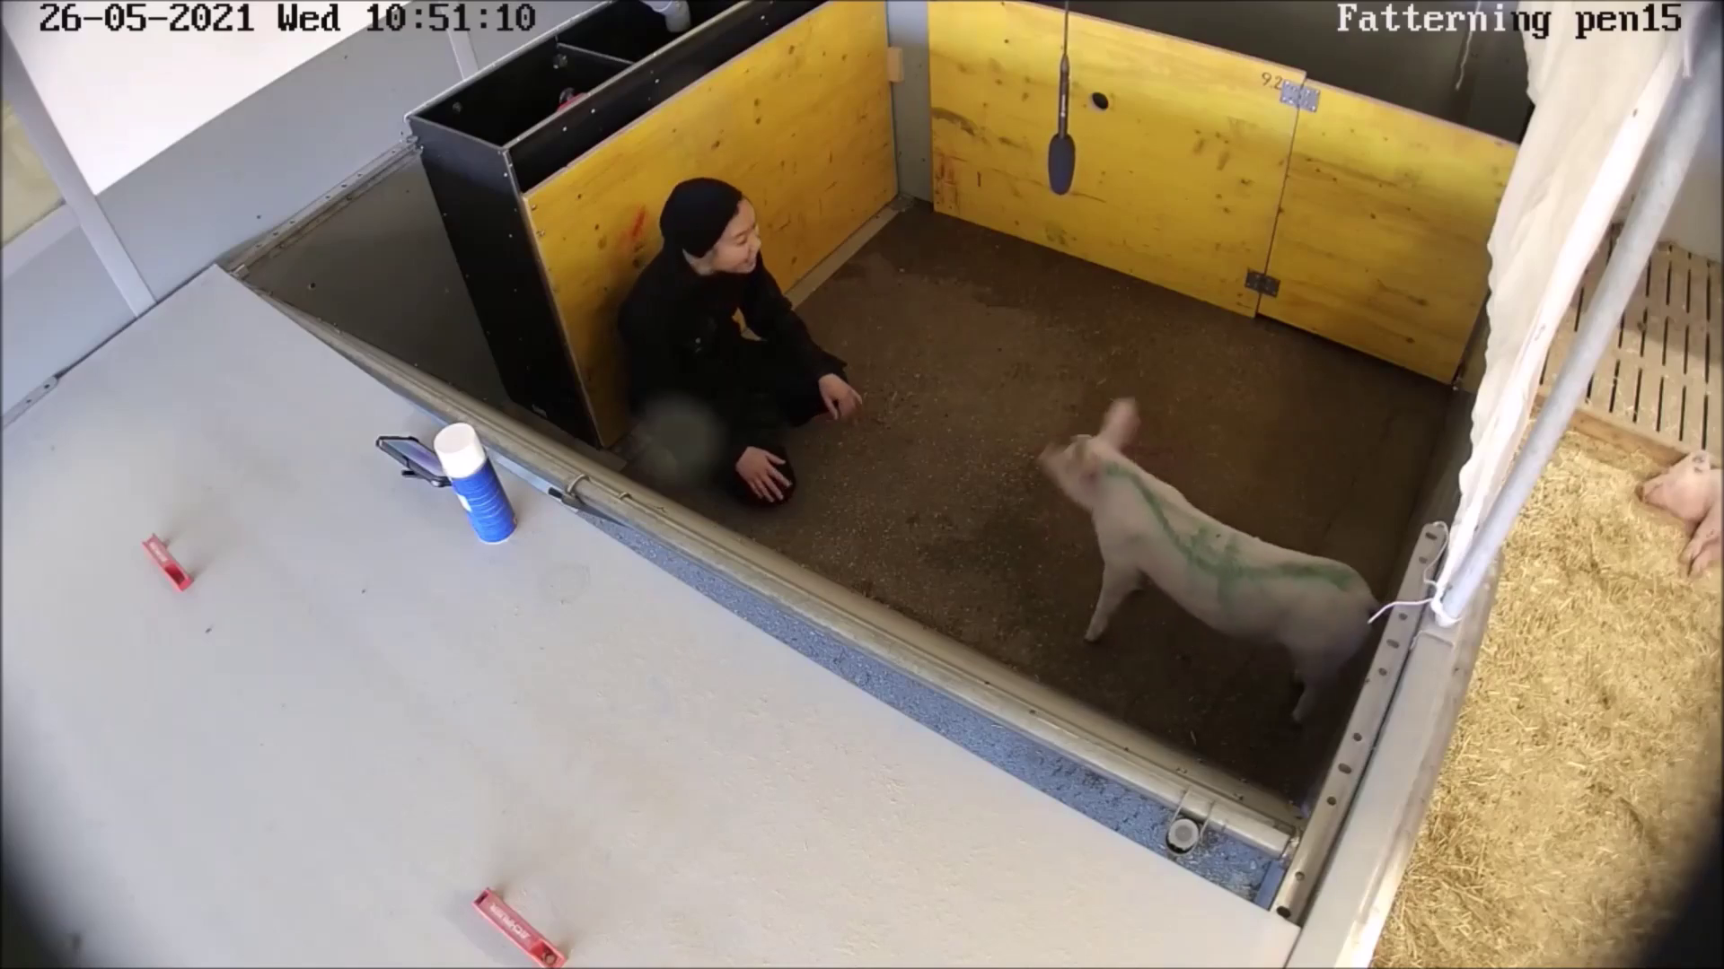
Free form interaction permits voluntary engagement
Free form interaction allows the pig and familiar human to interact without the same imposed-touch procedure. The original free form recording provides a direct comparison with the preceding study condition. Pigs spent more of the 5-min session exploring the pen and emitted fewer low-pitched vocalizations.
All pigs became more willing to approach the familiar person over the habituation and testing period. The median approach latency declined from 300 s before habituation to 7 s after testing. Median avoidance distance declined from 0.5 m to 0 m.
Familiarity and interaction style therefore describe different aspects of the human-pig relationship. Shorter approach latency measures willingness to approach, while session behavior describes what happens during contact. Together they distinguish experience with a person from the immediate effects of a particular form of handling.
Truong et al. (2024), Fig. 1(a–e). Behavior during free form and imposed-contact sessions.
Click video to play in Slide Show. Truong et al. (2024), Supplementary Video 1. Free form interaction with a familiar human.
Truong et al. (2024)
45
Notes:
• Free form interaction allows the pig and familiar human to interact without the same imposed-touch procedure. The original free form recording provides a direct comparison with the preceding study condition. Pigs spent more of the 5-min session exploring the pen and emitted fewer low-pitched vocalizations.
• All pigs became more willing to approach the familiar person over the habituation and testing period. The median approach latency declined from 300 s before habituation to 7 s after testing. Median avoidance distance declined from 0.5 m to 0 m.
• Familiarity and interaction style therefore describe different aspects of the human-pig relationship. Shorter approach latency measures willingness to approach, while session behavior describes what happens during contact. Together they distinguish experience with a person from the immediate effects of a particular form of handling.
References:
Truong Suzanne, Schmitt Oceane, Rault Jean-Loup (2024). On your terms or mine: pigs’ response to imposed gentle tactile contact vs. free form interaction with a familiar human. Scientific Reports 14:25249. https://doi.org/10.1038/s41598-024-76451-5
Figure: Truong et al. (2024), Fig. 1(a–e). Behavior during free form and imposed-contact sessions.
Figure source: https://doi.org/10.1038/s41598-024-76451-5
Article-provided recording: Truong et al. (2024), Supplementary Video 1. Free form interaction with a familiar human.
• Free form interaction with a familiar human. Source recording was inspected against Table 1: Video 1 shows a responsive kneeling human; Video 2 shows the timed approach, touch, and withdrawal sequence. Full scene, speed and audio preserved.
Article DOI: https://doi.org/10.1038/s41598-024-76451-5
Original media URL: https://pmc-oa-opendata.s3.amazonaws.com/PMC11502703.1/41598_2024_76451_MOESM1_ESM.mp4
Credit: Truong Suzanne, Schmitt Oceane, Rault Jean-Loup (2024). On your terms or mine: pigs’ response to imposed gentle tactile contact vs. free form interaction with a familiar human. Scientific Reports 14:25249. https://doi.org/10.1038/s41598-024-76451-5
License: Open Access This article is licensed under a Creative Commons Attribution 4.0 International License, which permits use, sharing, adaptation, distribution and reproduction in any medium or format, as long as you give appropriate credit to the original author(s) and the source, provide a link to the Creative Commons licence, and indicate if changes were made. The images or other third party material in this article are included in the article’s Creative Commons licence, unless indicated otherwise in a credit line to the material. If material is not included in the article’s Creative Commons licence and your intended use is not permitted by statutory regulation or exceeds the permitted use, you will need to obtain permission directly from the copyright holder. To view a copy of this licence, visit http://creativecommons.org/licenses/by/4.0/ .
Compatibility: H.264/yuv420p MP4 with AAC audio where present, at original resolution. Full scene and timing preserved; no speed changes, overlays, generated frames or scientific edits.
Playback: click the recording in PowerPoint Slide Show. The credited original article figure remains a static fallback. Full media decode and embedded relationships were checked; interactive PowerPoint playback was unavailable in this environment.

Slide 46
Key takeaways
Olfactory organization. Pig sensory axons enter bulb glomeruli; mitral and tufted output reaches layered olfactory cortex, alongside local inhibition and modulatory input.
Molecular recognition. Pig OR7D4 responds to androstenone, and targeted or natural sequence changes can reduce the receptor’s measured signaling response.
Exploration and familiarity. Repeated odors reduce investigation, new odors restore it, and familiar maternal flavor can shorten the return to feeding after weaning.
Memory controls. Holeboards distinguish working from reference memory; food concealment, odor controls, imposed delays, and object matching make task outcomes interpretable.
Reward-dependent inhibition. Waiting depends on reward quality, age, and whether switching remains possible; one delay score is not a context-free measure of self-control.
Social interpretation. Selective helping, orientation alternation, and conflict intervention require different controls; socially directed behavior does not by itself identify empathy or a neural mechanism.
Brunjes et al. (2016); Rørvang et al. (2023); Yang et al. (2025); Gieling et al. (2013); Zebunke et al. (2018); Moscovice et al. (2023)
46
Notes:
Brunjes Peter C., Feldman Sanford, Osterberg Stephen K. (2016). The Pig Olfactory Brain: A Primer. Chemical Senses 41:415–425. https://doi.org/10.1093/chemse/bjw016
Rørvang Maria Vilain, Schild Sarah-Lina Aagaard, Stenfelt Johanna, Grut Rebecca, Gadri Moses A., Valros Anna, Nielsen Birte L., Wallenbeck Anna (2023). Odor exploration behavior of the domestic pig ( Sus scrofa ) as indicator of enriching properties of odors. Frontiers in Behavioral Neuroscience 17:1173298. https://doi.org/10.3389/fnbeh.2023.1173298
Yang Peidong, Luo Tingting, Yang Shuqi, Zhang Anjing, Tang Yuan, Chen Li, Wang Jinyong, Zhao Yongju, Zhong Zhining, Li Xuemin, Han Ziyin, Zhang Yupei, Tang Yue, Ma Jideng, Jin Long, Long Keren, Li Mingzhou, Lu Lu, Popławski Tomasz (2025). Identification of Olfactory Receptors Responding to Androstenone and the Key Structure Determinant in Domestic Pig. Current Issues in Molecular Biology 47:13. https://doi.org/10.3390/cimb47010013
Gieling Elise, Wehkamp Welmoed, Willigenburg Remco, Nordquist Rebecca E, Ganderup Niels-Christian, van der Staay Franz Josef (2013). Performance of conventional pigs and Göttingen miniature pigs in a spatial holeboard task: effects of the putative muscarinic cognition impairer Biperiden. Behavioral and Brain Functions : BBF 9:4. https://doi.org/10.1186/1744-9081-9-4
Zebunke Manuela, Kreiser Maren, Melzer Nina, Langbein Jan, Puppe Birger (2018). Better, Not Just More—Contrast in Qualitative Aspects of Reward Facilitates Impulse Control in Pigs. Frontiers in Psychology 9:2099. https://doi.org/10.3389/fpsyg.2018.02099
Moscovice Liza R, Eggert Anja, Manteuffel Christian, Rault Jean-Loup (2023). Spontaneous helping in pigs is mediated by helper's social attention and distress signals of individuals in need. Proceedings of the Royal Society B: Biological Sciences 290:20230665. https://doi.org/10.1098/rspb.2023.0665

