Slide 1
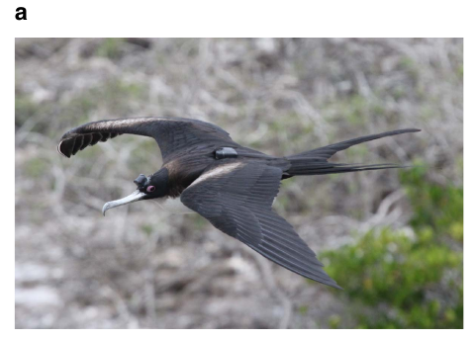
NEUR 411 · NEUROETHOLOGY · FALL 2026
Lecture 89
Unihemispheric Sleep in Animals:
Comparative brain/neuro anatomy & organization, hemispheric specialization, predator vigilance, and the neural boundaries of consciousness
Rattenborg et al. (2016), Fig. 1(a). Great frigatebird with a head-mounted EEG logger.
Date TBD
Jordan Lopez, Ph.D.
Professor of Neurobiology & Biomedical Engineering
Notes:
Unihemispheric Sleep in Animals: Comparative brain/neuro anatomy & organization, hemispheric specialization, predator vigilance, and the neural boundaries of consciousness
Lecture 89. NEUR 411 · NEUROETHOLOGY · FALL 2026. Date TBD.
Figure: Rattenborg et al. (2016), Fig. 1(a). Great frigatebird with a head-mounted EEG logger.
Figure source: https://doi.org/10.1038/ncomms12468
References:
Rattenborg NC, Voirin B, Cruz SM, Tisdale R, Dell'Omo G, Lipp HP, Wikelski M, Vyssotski AL. (2016). Evidence that birds sleep in mid-flight. Nature communications 7:12468. https://doi.org/10.1038/ncomms12468

Slide 2
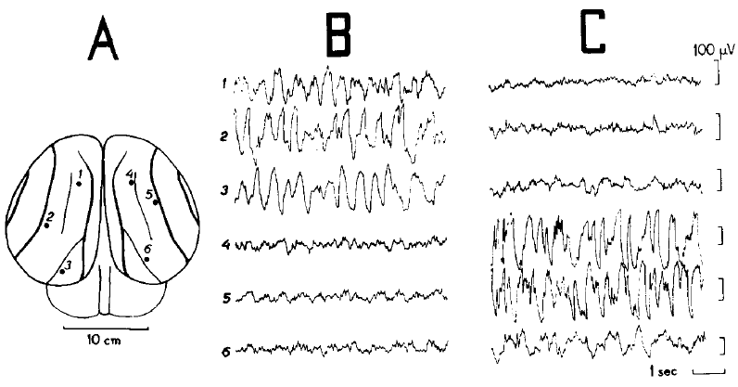
Sleep can occupy one hemisphere at a time
Unihemispheric slow-wave sleep is a state in which one cerebral hemisphere expresses the large, slow electrical fluctuations associated with sleep while the other expresses low-amplitude activity resembling wakefulness. The cerebral hemispheres are the left and right divisions of the forebrain. Their states can differ within the same animal at the same moment.
Mukhametov and colleagues recorded electrical activity from both sides of the dolphin brain during extended observations in a tank. Slow waves appeared on one side while the opposite side retained a desynchronized pattern. Later, the side expressing slow waves could change.
The sleeping dolphin was often quiet and nearly motionless apart from movements of its fins and flukes. Hemispheric electrical state and overt movement therefore supplied different information: an inactive body could accompany two different patterns of brain activity.
Mukhametov et al. (1977), Fig. 1(A–C). Electrode positions and different electrical states in the two hemispheres.
Mukhametov et al. (1977)
02
Notes:
• Unihemispheric slow-wave sleep is a state in which one cerebral hemisphere expresses the large, slow electrical fluctuations associated with sleep while the other expresses low-amplitude activity resembling wakefulness. The cerebral hemispheres are the left and right divisions of the forebrain. Their states can differ within the same animal at the same moment.
• Mukhametov and colleagues recorded electrical activity from both sides of the dolphin brain during extended observations in a tank. Slow waves appeared on one side while the opposite side retained a desynchronized pattern. Later, the side expressing slow waves could change.
• The sleeping dolphin was often quiet and nearly motionless apart from movements of its fins and flukes. Hemispheric electrical state and overt movement therefore supplied different information: an inactive body could accompany two different patterns of brain activity.
• The recordings were made from parietal and occipital sites. In this classic preparation, unilateral slow waves occurred during behavioral rest; continuous swimming was not required to identify the electrophysiological state.
References:
Mukhametov LM, Supin AY, Polyakova IG. (1977). Interhemispheric asymmetry of the electroencephalographic sleep patterns in dolphins. Brain research 134:581-584. https://doi.org/10.1016/0006-8993(77)90835-6
Figure: Mukhametov et al. (1977), Fig. 1(A–C). Electrode positions and different electrical states in the two hemispheres.
Figure source: https://doi.org/10.1016/0006-8993(77)90835-6

Slide 3
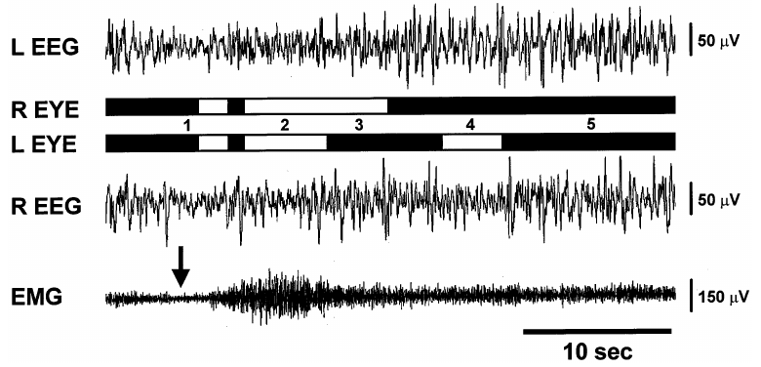
Bilateral EEG separates sleep from eye closure
An electroencephalogram, or EEG, measures voltage differences generated by populations of neurons near recording electrodes. Recording both hemispheres allows researchers to distinguish bilateral sleep from an asymmetric state. Observing only one eye supplies behavioral information without measuring the electrical state of both sides of the brain.
In mallards, simultaneous EEG and eye recordings linked unilateral eye closure to greater slow-wave activity in the opposite hemisphere. Closure of both eyes accompanied bilateral slow-wave sleep or rapid eye movement sleep, a sleep state with wake-like electrical activity and characteristic eye movements.
The combination of signals resolves an ambiguity in quiet behavior. An open eye may occur during asymmetric sleep, but wakefulness also produces open eyes. The EEG pattern supplies the neural classification, while the eye recording specifies which visual channel remains available.
Rattenborg et al. (1999), Fig. 5. Bilateral EEG, eye state, and neck-muscle activity during mallard sleep.
Rattenborg et al. (1999)
03
Notes:
• An electroencephalogram, or EEG, measures voltage differences generated by populations of neurons near recording electrodes. Recording both hemispheres allows researchers to distinguish bilateral sleep from an asymmetric state. Observing only one eye supplies behavioral information without measuring the electrical state of both sides of the brain.
• In mallards, simultaneous EEG and eye recordings linked unilateral eye closure to greater slow-wave activity in the opposite hemisphere. Closure of both eyes accompanied bilateral slow-wave sleep or rapid eye movement sleep, a sleep state with wake-like electrical activity and characteristic eye movements.
• The combination of signals resolves an ambiguity in quiet behavior. An open eye may occur during asymmetric sleep, but wakefulness also produces open eyes. The EEG pattern supplies the neural classification, while the eye recording specifies which visual channel remains available.
• The traces include a 10 s time scale. Muscle recordings describe movement and tone, while the left and right EEG channels distinguish regional electrical state.
References:
Rattenborg NC, Lima SL, Amlaner CJ. (1999). Facultative control of avian unihemispheric sleep under the risk of predation. Behavioural brain research 105:163-172. https://doi.org/10.1016/s0166-4328(99)00070-4
Figure: Rattenborg et al. (1999), Fig. 5. Bilateral EEG, eye state, and neck-muscle activity during mallard sleep.
Figure source: https://doi.org/10.1016/s0166-4328(99)00070-4

Slide 4
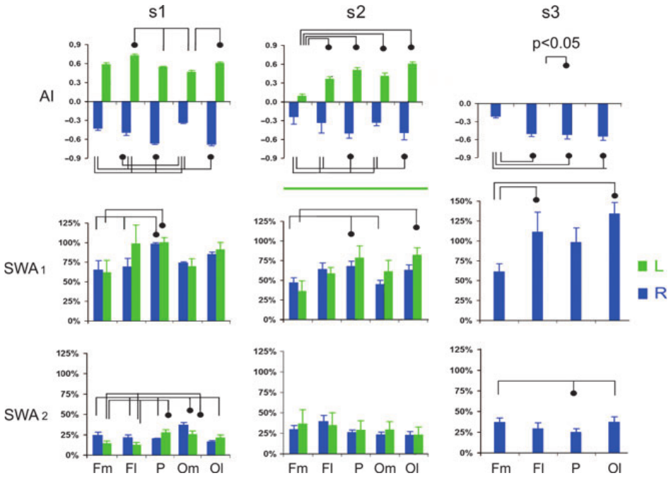
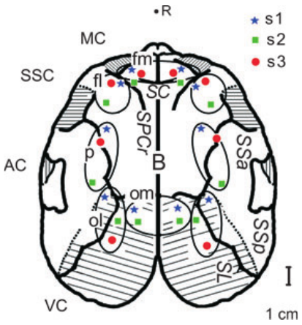
Slow-wave power describes local cortical state
Slow-wave activity, or SWA, is the amount of EEG signal power within a low-frequency band. In the fur-seal study, the band was 1.2–4.0 Hz, meaning approximately one to four oscillations each second. More power in this band indicates stronger slow fluctuations at the recording site.
Electrodes sampled several positions across each cerebral cortex, the outer gray-matter tissue of the cerebral hemispheres. During asymmetric sleep, left and right recordings differed across a broad area, but the size of the difference depended on the position of the electrodes.
Posterior and lateral sites often expressed greater asymmetry than medial frontal sites. A hemisphere therefore contains regional variation within its overall sleep state. Comparing matched positions on the two sides separates this anatomical variation from the difference between hemispheres.
Lyamin et al. (2012), Fig. 3. Regional slow-wave power during asymmetric sleep.
Lyamin et al. (2012), Fig. 1. Cortical recording locations in northern fur seals.
Lyamin et al. (2012)
04
Notes:
• Slow-wave activity, or SWA, is the amount of EEG signal power within a low-frequency band. In the fur-seal study, the band was 1.2–4.0 Hz, meaning approximately one to four oscillations each second. More power in this band indicates stronger slow fluctuations at the recording site.
• Electrodes sampled several positions across each cerebral cortex, the outer gray-matter tissue of the cerebral hemispheres. During asymmetric sleep, left and right recordings differed across a broad area, but the size of the difference depended on the position of the electrodes.
• Posterior and lateral sites often expressed greater asymmetry than medial frontal sites. A hemisphere therefore contains regional variation within its overall sleep state. Comparing matched positions on the two sides separates this anatomical variation from the difference between hemispheres.
• The study compared frontal, parietal, and occipital recordings. Slow-wave power is an aggregate electrical measure, rather than a direct count of neuronal spikes or a measurement of awareness.
References:
Lyamin OI, Pavlova IF, Kosenko PO, Mukhametov LM, Siegel JM. (2012). Regional differences in cortical electroencephalogram (EEG) slow wave activity and interhemispheric EEG asymmetry in the fur seal. Journal of sleep research 21:603-611. https://doi.org/10.1111/j.1365-2869.2012.01023.x
Figure: Lyamin et al. (2012), Fig. 3. Regional slow-wave power during asymmetric sleep.
Figure source: https://doi.org/10.1111/j.1365-2869.2012.01023.x
Figure: Lyamin et al. (2012), Fig. 1. Cortical recording locations in northern fur seals.
Figure source: https://doi.org/10.1111/j.1365-2869.2012.01023.x

Slide 5
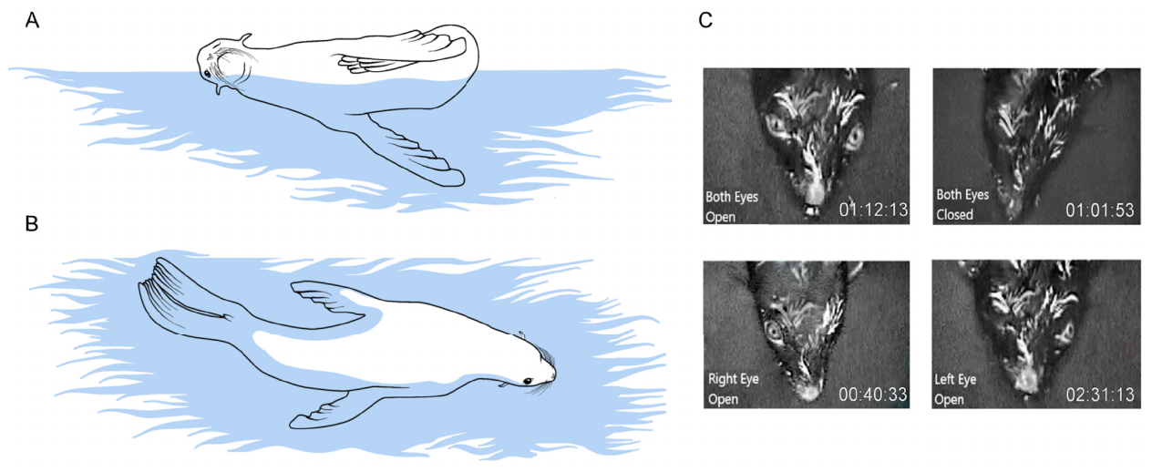
Open eyes provide intermittent visual monitoring
Contralateral means on the opposite side; ipsilateral means on the same side. During fur-seal unihemispheric sleep, the eye opposite the hemisphere with greater slow-wave activity was almost continuously closed. The opposite eye opened intermittently while its associated hemisphere retained a more activated electrical pattern.
The investigators recorded seals resting at the water surface in a prone posture that allowed both eyes to remain visible. The eye associated with the activated hemisphere opened for about 1.9 s at a time, approximately eight times per minute. It was open during about one quarter of the unihemispheric-sleep period.
Visual vigilance was therefore intermittent rather than a continuously open-eye state. Short openings repeatedly restored access to the surrounding environment while the other eye stayed closed. Eye behavior and bilateral EEG together linked sensory sampling to hemispheric state.
Kendall-Bar et al. (2019), Fig. 1(A–D). Aquatic sleep postures and asymmetric eye states.
Kendall-Bar et al. (2019)
05
Notes:
• Contralateral means on the opposite side; ipsilateral means on the same side. During fur-seal unihemispheric sleep, the eye opposite the hemisphere with greater slow-wave activity was almost continuously closed. The opposite eye opened intermittently while its associated hemisphere retained a more activated electrical pattern.
• The investigators recorded seals resting at the water surface in a prone posture that allowed both eyes to remain visible. The eye associated with the activated hemisphere opened for about 1.9 s at a time, approximately eight times per minute. It was open during about one quarter of the unihemispheric-sleep period.
• Visual vigilance was therefore intermittent rather than a continuously open-eye state. Short openings repeatedly restored access to the surrounding environment while the other eye stayed closed. Eye behavior and bilateral EEG together linked sensory sampling to hemispheric state.
• The prone posture removed the problem of an eye being hidden by the water or by the body. The closed eye opposite the sleeping hemisphere was closed during approximately 99% of the scored time.
References:
Kendall-Bar JM, Vyssotski AL, Mukhametov LM, Siegel JM, Lyamin OI. (2019). Eye state asymmetry during aquatic unihemispheric slow wave sleep in northern fur seals (Callorhinus ursinus). PloS one 14:e0217025. https://doi.org/10.1371/journal.pone.0217025
Figure: Kendall-Bar et al. (2019), Fig. 1(A–D). Aquatic sleep postures and asymmetric eye states.
Figure source: https://doi.org/10.1371/journal.pone.0217025

Slide 6
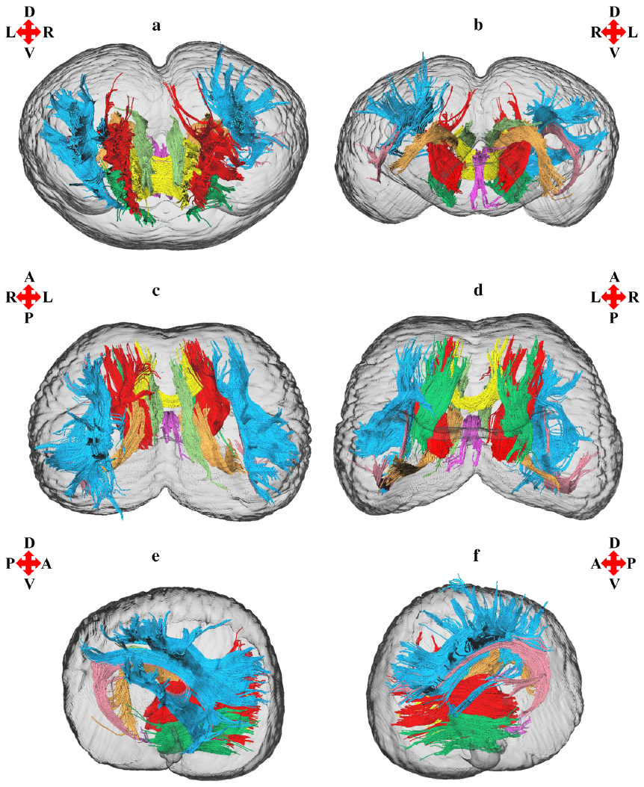
Dolphin white-matter pathways are asymmetric
White matter contains axons that connect neural populations, many wrapped in insulating myelin. Diffusion tensor imaging measures directional differences in water diffusion within brain tissue. Tractography uses those differences to estimate bundles of pathways through the brain.
Wright and colleagues reconstructed white-matter pathways in a bottlenose dolphin brain. Many bundles had larger estimated volumes on the left, whereas the arcuate fasciculus, an association pathway linking regions within a hemisphere, had a rightward bias. Different pathways therefore had different structural asymmetries.
These reconstructions describe the organization through which signals can travel. Structural lateralization and alternating sleep are different biological properties: a permanent left–right difference in a pathway can coexist with a sleep state that changes sides over time.
Wright et al. (2018), Fig. 1. Diffusion-based reconstructions within the dolphin cerebral hemispheres.
Wright et al. (2018)
06
Notes:
• White matter contains axons that connect neural populations, many wrapped in insulating myelin. Diffusion tensor imaging measures directional differences in water diffusion within brain tissue. Tractography uses those differences to estimate bundles of pathways through the brain.
• Wright and colleagues reconstructed white-matter pathways in a bottlenose dolphin brain. Many bundles had larger estimated volumes on the left, whereas the arcuate fasciculus, an association pathway linking regions within a hemisphere, had a rightward bias. Different pathways therefore had different structural asymmetries.
• These reconstructions describe the organization through which signals can travel. Structural lateralization and alternating sleep are different biological properties: a permanent left–right difference in a pathway can coexist with a sleep state that changes sides over time.
• Tractography estimates pathway trajectories from diffusion measurements. The paper interprets behavioral roles as hypotheses; tract volume alone does not establish what an individual pathway computes.
References:
Wright AK, Theilmann RJ, Ridgway SH, Scadeng M. (2018). Diffusion tractography reveals pervasive asymmetry of cerebral white matter tracts in the bottlenose dolphin (Tursiops truncatus). Brain structure & function 223:1697-1711. https://doi.org/10.1007/s00429-017-1525-9
Figure: Wright et al. (2018), Fig. 1. Diffusion-based reconstructions within the dolphin cerebral hemispheres.
Figure source: https://doi.org/10.1007/s00429-017-1525-9

Slide 7
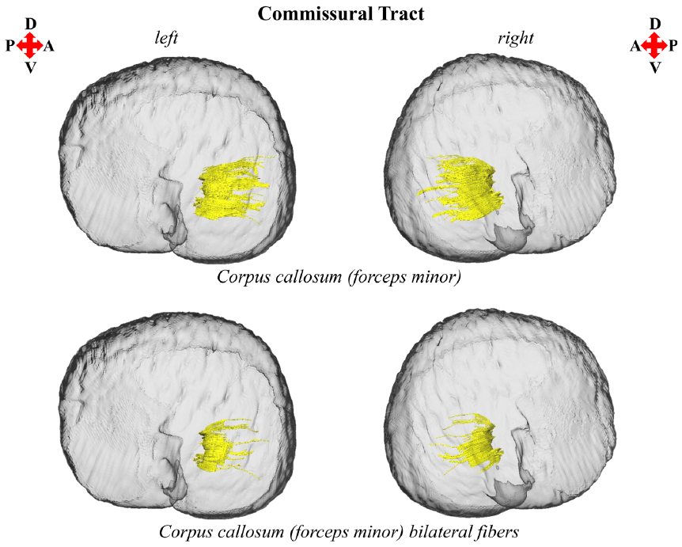
Commissures link the cerebral hemispheres
A commissure is a bundle of axons crossing between the two sides of the nervous system. The corpus callosum connects cerebral regions across the midline, and dolphin tractography reconstructed this pathway within the brain.
The corpus callosum is relatively small in cetaceans compared with their large cerebral hemispheres. Reduced crossing connectivity has been proposed to facilitate hemispheric independence. This is a structural hypothesis about communication between neural populations, rather than a directly measured switch for sleep.
Each hemisphere also contains association pathways linking regions on the same side. Neural organization consequently includes both within-side integration and between-side communication. Unihemispheric sleep occurs in a connected brain whose two sides can express different electrical states.
Wright et al. (2018), Fig. 5. Left and right corpus-callosum tract reconstructions.
Wright et al. (2018)
07
Notes:
• A commissure is a bundle of axons crossing between the two sides of the nervous system. The corpus callosum connects cerebral regions across the midline, and dolphin tractography reconstructed this pathway within the brain.
• The corpus callosum is relatively small in cetaceans compared with their large cerebral hemispheres. Reduced crossing connectivity has been proposed to facilitate hemispheric independence. This is a structural hypothesis about communication between neural populations, rather than a directly measured switch for sleep.
• Each hemisphere also contains association pathways linking regions on the same side. Neural organization consequently includes both within-side integration and between-side communication. Unihemispheric sleep occurs in a connected brain whose two sides can express different electrical states.
• The tract images locate the crossing pathways. They should not be interpreted as direct measurements of information transfer during a sleeping episode.
References:
Wright AK, Theilmann RJ, Ridgway SH, Scadeng M. (2018). Diffusion tractography reveals pervasive asymmetry of cerebral white matter tracts in the bottlenose dolphin (Tursiops truncatus). Brain structure & function 223:1697-1711. https://doi.org/10.1007/s00429-017-1525-9
Figure: Wright et al. (2018), Fig. 5. Left and right corpus-callosum tract reconstructions.
Figure source: https://doi.org/10.1007/s00429-017-1525-9

Slide 8
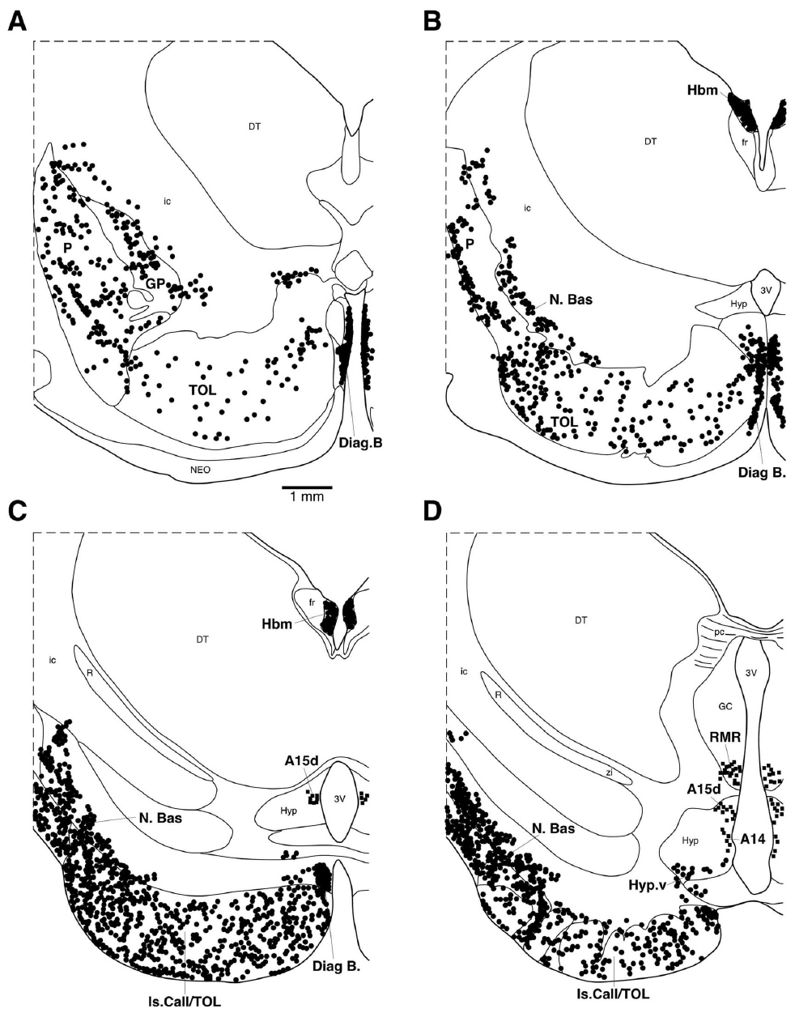
Porpoises retain familiar sleep-regulating nuclei
A nucleus is an anatomically identifiable group of neurons within the brain. Dell and colleagues mapped neurotransmitter-associated nuclei in the harbor porpoise, an odontocete, or toothed cetacean. The main systems also occur in mammals whose hemispheres usually sleep together.
Immunohistochemistry uses antibodies to detect particular proteins in tissue. Transmitter-associated markers identified cholinergic, noradrenergic, and serotonergic populations. Calcium-binding proteins supplied indirect markers of neurons associated with GABA, gamma-aminobutyric acid, an inhibitory transmitter. Their positions could be related to a series of coronal sections, slices running across the brain from side to side.
No novel sleep nucleus was required to describe the porpoise organization. Differences concerned the size, distribution, and connections of familiar systems. Comparative neuroanatomy therefore places unusual sleep behavior within a recognizable mammalian organization of state-regulating neurons.
Dell et al. (2016), Fig. 1(A–D). Coronal maps of neurotransmitter-associated porpoise nuclei.
Dell et al. (2016)
08
Notes:
• A nucleus is an anatomically identifiable group of neurons within the brain. Dell and colleagues mapped neurotransmitter-associated nuclei in the harbor porpoise, an odontocete, or toothed cetacean. The main systems also occur in mammals whose hemispheres usually sleep together.
• Immunohistochemistry uses antibodies to detect particular proteins in tissue. Transmitter-associated markers identified cholinergic, noradrenergic, and serotonergic populations. Calcium-binding proteins supplied indirect markers of neurons associated with GABA, gamma-aminobutyric acid, an inhibitory transmitter. Their positions could be related to a series of coronal sections, slices running across the brain from side to side.
• No novel sleep nucleus was required to describe the porpoise organization. Differences concerned the size, distribution, and connections of familiar systems. Comparative neuroanatomy therefore places unusual sleep behavior within a recognizable mammalian organization of state-regulating neurons.
• The study mapped tissue markers rather than firing during sleep. The same marker identifies a biochemical cell population without specifying its moment-to-moment state-dependent activity.
References:
Dell LA, Patzke N, Spocter MA, Siegel JM, Manger PR. (2016). Organization of the sleep-related neural systems in the brain of the harbour porpoise (Phocoena phocoena). The Journal of comparative neurology 524:1999-2017. https://doi.org/10.1002/cne.23929
Figure: Dell et al. (2016), Fig. 1(A–D). Coronal maps of neurotransmitter-associated porpoise nuclei.
Figure source: https://doi.org/10.1002/cne.23929

Slide 9
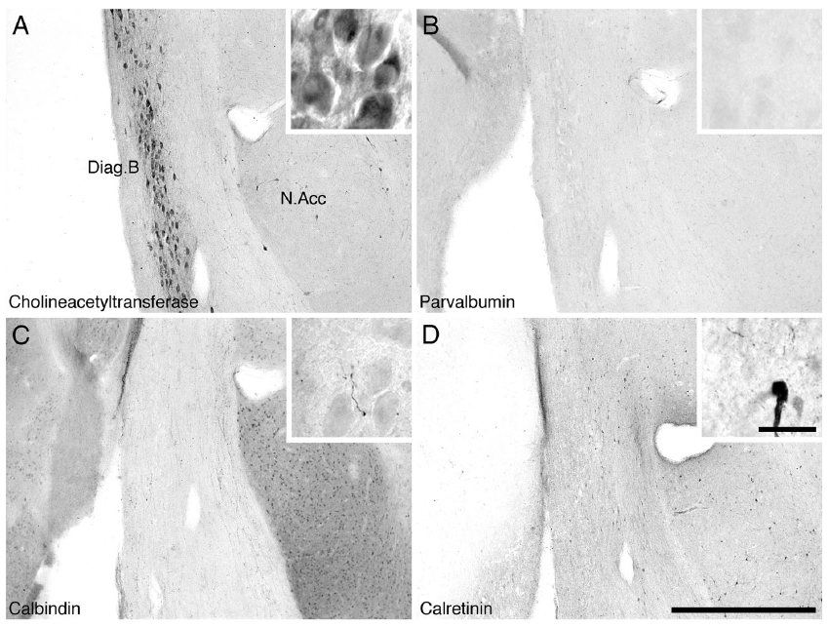
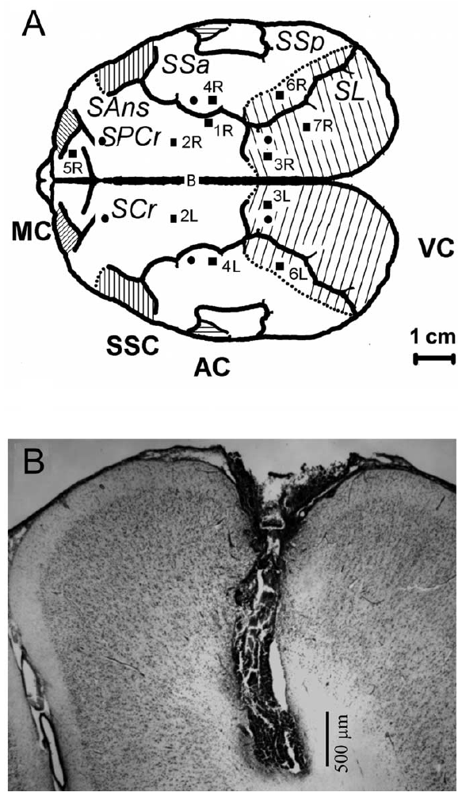
Basal-forebrain neurons supply acetylcholine
The basal forebrain contains groups of neurons near the ventral front of the brain that participate in cortical state regulation. Acetylcholine is a neurotransmitter released by cholinergic neurons. Antibodies against choline acetyltransferase, the enzyme that synthesizes acetylcholine, identified these cells in the porpoise.
Cholinergic neurons occurred in the medial septal and diagonal-band regions, recognizable subdivisions of the basal forebrain. Their organization resembled the corresponding system in other mammals. This anatomy provides a comparative foundation for studying cortical acetylcholine release in fur seals.
Chemical identity and release are complementary measurements. Tissue staining locates cells equipped to synthesize a transmitter; microdialysis during natural behavior measures extracellular transmitter near a probe. Together, the porpoise anatomy and seal physiology connect neuronal organization to state-dependent cortical chemistry.
Dell et al. (2016), Fig. 2(A–D). Choline-acetyltransferase-positive basal-forebrain neurons.
Lapierre et al. (2007), Fig. 1(A–B). Cortical microdialysis sites and probe placement.
Dell et al. (2016); Lapierre et al. (2007)
09
Notes:
• The basal forebrain contains groups of neurons near the ventral front of the brain that participate in cortical state regulation. Acetylcholine is a neurotransmitter released by cholinergic neurons. Antibodies against choline acetyltransferase, the enzyme that synthesizes acetylcholine, identified these cells in the porpoise.
• Cholinergic neurons occurred in the medial septal and diagonal-band regions, recognizable subdivisions of the basal forebrain. Their organization resembled the corresponding system in other mammals. This anatomy provides a comparative foundation for studying cortical acetylcholine release in fur seals.
• Chemical identity and release are complementary measurements. Tissue staining locates cells equipped to synthesize a transmitter; microdialysis during natural behavior measures extracellular transmitter near a probe. Together, the porpoise anatomy and seal physiology connect neuronal organization to state-dependent cortical chemistry.
• The cell stain is not a recording of neurotransmitter release. The comparative physiological study measures release in a different species, so its state-dependent result should be credited to fur seals.
References:
Dell LA, Patzke N, Spocter MA, Siegel JM, Manger PR. (2016). Organization of the sleep-related neural systems in the brain of the harbour porpoise (Phocoena phocoena). The Journal of comparative neurology 524:1999-2017. https://doi.org/10.1002/cne.23929
Lapierre JL, Kosenko PO, Lyamin OI, Kodama T, Mukhametov LM, Siegel JM. (2007). Cortical acetylcholine release is lateralized during asymmetrical slow-wave sleep in northern fur seals. The Journal of neuroscience : the official journal of the Society for Neuroscience 27:11999-12006. https://doi.org/10.1523/JNEUROSCI.2968-07.2007
Figure: Dell et al. (2016), Fig. 2(A–D). Choline-acetyltransferase-positive basal-forebrain neurons.
Figure source: https://doi.org/10.1002/cne.23929
Figure: Lapierre et al. (2007), Fig. 1(A–B). Cortical microdialysis sites and probe placement.
Figure source: https://doi.org/10.1523/JNEUROSCI.2968-07.2007

Slide 10
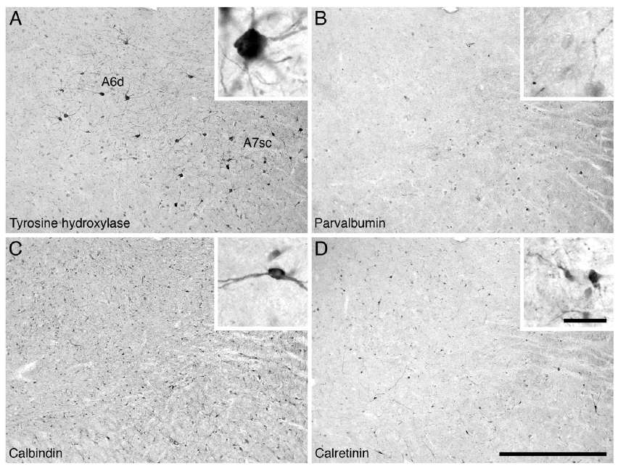
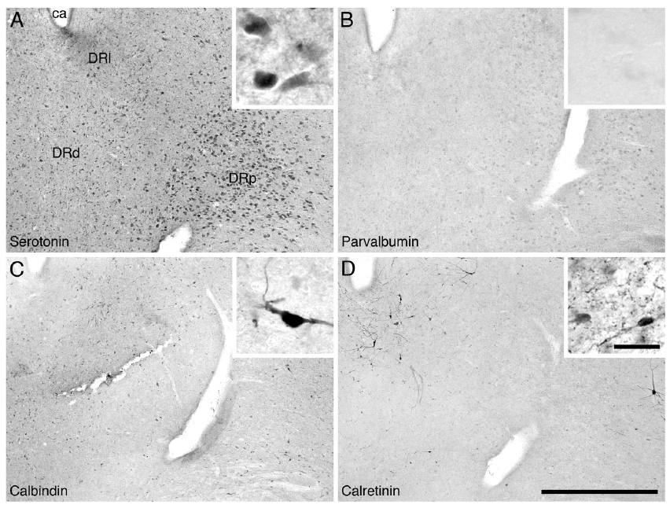
Brainstem transmitter systems remain distributed
The brainstem connects the forebrain with the spinal cord and contains several state-regulating neuronal groups. The porpoise locus coeruleus complex contained neurons marked by tyrosine hydroxylase, an enzyme involved in catecholamine synthesis. These populations correspond to noradrenergic systems in other mammals.
Noradrenaline, also called norepinephrine, is a transmitter associated with arousal and behavioral activation. Serotonin-positive neurons occupied the raphe nuclei, a collection of midline brainstem groups. These populations supply another distributed transmitter system associated with sleep and waking.
The porpoise possessed familiar transmitter systems, with an unusually large noradrenergic population relative to several comparison mammals. Different locus-coeruleus subdivisions varied in cell density and position. Structural differences in these familiar populations supply candidate mechanisms for state regulation, while physiological recordings identify the transmitter changes expressed during an actual sleep episode.
Dell et al. (2016), Fig. 4(A–D). Tyrosine-hydroxylase-positive locus-coeruleus populations.
Dell et al. (2016), Fig. 5(A–D). Serotonin-positive raphe populations.
Dell et al. (2016)
10
Notes:
• The brainstem connects the forebrain with the spinal cord and contains several state-regulating neuronal groups. The porpoise locus coeruleus complex contained neurons marked by tyrosine hydroxylase, an enzyme involved in catecholamine synthesis. These populations correspond to noradrenergic systems in other mammals.
• Noradrenaline, also called norepinephrine, is a transmitter associated with arousal and behavioral activation. Serotonin-positive neurons occupied the raphe nuclei, a collection of midline brainstem groups. These populations supply another distributed transmitter system associated with sleep and waking.
• The porpoise possessed familiar transmitter systems, with an unusually large noradrenergic population relative to several comparison mammals. Different locus-coeruleus subdivisions varied in cell density and position. Structural differences in these familiar populations supply candidate mechanisms for state regulation, while physiological recordings identify the transmitter changes expressed during an actual sleep episode.
• Cholinergic pontine neurons were also present in the laterodorsal and pedunculopontine regions. The tissue study supports the presence and organization of these systems without testing causal hemispheric switching.
References:
Dell LA, Patzke N, Spocter MA, Siegel JM, Manger PR. (2016). Organization of the sleep-related neural systems in the brain of the harbour porpoise (Phocoena phocoena). The Journal of comparative neurology 524:1999-2017. https://doi.org/10.1002/cne.23929
Figure: Dell et al. (2016), Fig. 4(A–D). Tyrosine-hydroxylase-positive locus-coeruleus populations.
Figure source: https://doi.org/10.1002/cne.23929
Figure: Dell et al. (2016), Fig. 5(A–D). Serotonin-positive raphe populations.
Figure source: https://doi.org/10.1002/cne.23929

Slide 11
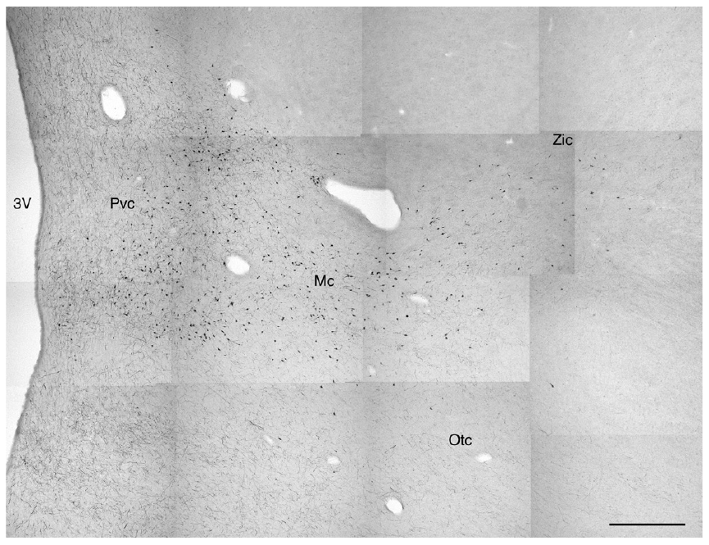
Orexin neurons occupy the lateral hypothalamus
The hypothalamus is a forebrain region involved in coordinating physiological and behavioral states. Orexin, also called hypocretin, is a neuropeptide, a transmitter made from a short chain of amino acids. Porpoise orexin-positive neurons occupied the lateral hypothalamic region.
Immunohistochemical staining identified orexin-containing cell bodies and their processes. The perifornical group lies near the fornix, a prominent white-matter pathway; additional cells extend laterally. This spatial organization resembles that of orexin populations in other mammals.
Orexin belongs to the wider network associated with arousal. The porpoise and giraffe possessed both larger magnocellular and smaller parvocellular orexin-positive neurons. The porpoise findings complement cortical transmitter measurements in seals: the anatomical map identifies a candidate state-regulating population, while physiological recordings distinguish the chemical changes accompanying particular sleep states.
Dell et al. (2012), Fig. 4. Orexin-positive neurons in the lateral hypothalamus.
Dell et al. (2012)
11
Notes:
• The hypothalamus is a forebrain region involved in coordinating physiological and behavioral states. Orexin, also called hypocretin, is a neuropeptide, a transmitter made from a short chain of amino acids. Porpoise orexin-positive neurons occupied the lateral hypothalamic region.
• Immunohistochemical staining identified orexin-containing cell bodies and their processes. The perifornical group lies near the fornix, a prominent white-matter pathway; additional cells extend laterally. This spatial organization resembles that of orexin populations in other mammals.
• Orexin belongs to the wider network associated with arousal. The porpoise and giraffe possessed both larger magnocellular and smaller parvocellular orexin-positive neurons. The porpoise findings complement cortical transmitter measurements in seals: the anatomical map identifies a candidate state-regulating population, while physiological recordings distinguish the chemical changes accompanying particular sleep states.
• The study used antibodies to orexin-A. It did not measure orexin release during unihemispheric sleep; proposed participation in state regulation derives from anatomical comparison and prior mammalian physiology.
References:
Dell LA, Patzke N, Bhagwandin A, Bux F, Fuxe K, Barber G, Siegel JM, Manger PR. (2012). Organization and number of orexinergic neurons in the hypothalamus of two species of Cetartiodactyla: A comparison of giraffe (Giraffa camelopardalis) and harbour porpoise (Phocoena phocoena). Journal of Chemical Neuroanatomy 44:98–109. https://doi.org/10.1016/j.jchemneu.2012.06.001
Figure: Dell et al. (2012), Fig. 4. Orexin-positive neurons in the lateral hypothalamus.
Figure source: https://doi.org/10.1016/j.jchemneu.2012.06.001

Slide 12
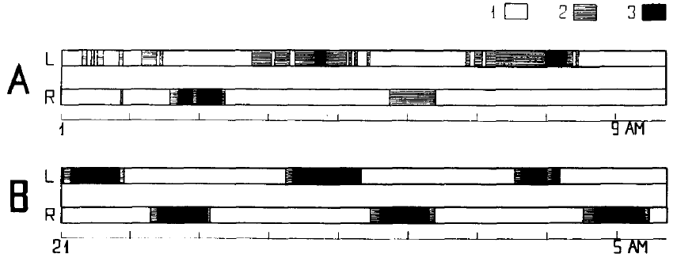
Dolphin hemispheres alternate their EEG states
The dolphin recordings contained extended periods of low-amplitude activity in both hemispheres, interspersed with slow waves expressed predominantly on one side. An electrocorticogram, or ECoG, is an electrical recording made at or near the cortical surface. Simultaneous left and right ECoG traces resolved this changing relationship.
The investigators classified short epochs according to the amount and amplitude of slow activity. Strong delta activity could occupy one hemisphere while the other retained a waking-like pattern. Across a long recording, the side expressing the stronger slow waves changed repeatedly.
The alternation separated hemispheric state from a permanent anatomical preference for one side. Different cortical recording sites could also begin or end synchronized activity at different times. Sleep organization therefore varied both across the midline and among locations within one hemisphere.
Mukhametov et al. (1977), Fig. 2(A–B). Left and right cortical-state sequences across extended recordings.
Mukhametov et al. (1977), Fig. 1(A–C). Cortical locations and bilateral electrical recordings.
Mukhametov et al. (1977)
12
Notes:
• The dolphin recordings contained extended periods of low-amplitude activity in both hemispheres, interspersed with slow waves expressed predominantly on one side. An electrocorticogram, or ECoG, is an electrical recording made at or near the cortical surface. Simultaneous left and right ECoG traces resolved this changing relationship.
• The investigators classified short epochs according to the amount and amplitude of slow activity. Strong delta activity could occupy one hemisphere while the other retained a waking-like pattern. Across a long recording, the side expressing the stronger slow waves changed repeatedly.
• The alternation separated hemispheric state from a permanent anatomical preference for one side. Different cortical recording sites could also begin or end synchronized activity at different times. Sleep organization therefore varied both across the midline and among locations within one hemisphere.
• The classic study did not identify a conventional REM episode. Neck-muscle activity was frequently absent even during wakefulness, so a silent muscle channel alone could not identify REM sleep in this preparation.
References:
Mukhametov LM, Supin AY, Polyakova IG. (1977). Interhemispheric asymmetry of the electroencephalographic sleep patterns in dolphins. Brain research 134:581-584. https://doi.org/10.1016/0006-8993(77)90835-6
Figure: Mukhametov et al. (1977), Fig. 2(A–B). Left and right cortical-state sequences across extended recordings.
Figure source: https://doi.org/10.1016/0006-8993(77)90835-6
Figure: Mukhametov et al. (1977), Fig. 1(A–C). Cortical locations and bilateral electrical recordings.
Figure source: https://doi.org/10.1016/0006-8993(77)90835-6

Slide 13
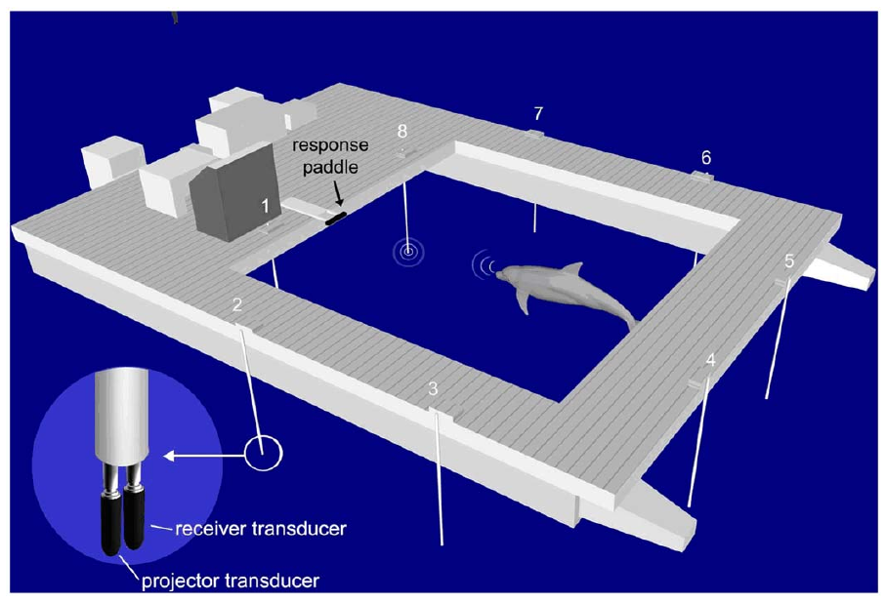
Echolocation supports prolonged vigilant behavior
Echolocation is active sensing in which an animal emits sound and uses returning echoes to investigate objects. Dolphins produce brief clicks and listen for echoes. Branstetter and colleagues coupled each animal’s clicks to underwater electronic targets that simulated returning echoes from particular locations.
Eight projector–receiver stations surrounded an experimental enclosure. A target echo prompted the dolphin to report detection by touching a response paddle. The task required repeated acoustic interrogation, detection of a target among stations, and a learned motor response.
Dolphins maintained this behavior during multi-day sessions. One animal completed a 15-day session with near-perfect target detection. Sustained performance linked active acoustic sampling to repeated responses over a duration far longer than a conventional short attention test.
Branstetter et al. (2012), Fig. 1. Electronic target stations and dolphin response apparatus.
Branstetter et al. (2012)
13
Notes:
• Echolocation is active sensing in which an animal emits sound and uses returning echoes to investigate objects. Dolphins produce brief clicks and listen for echoes. Branstetter and colleagues coupled each animal’s clicks to underwater electronic targets that simulated returning echoes from particular locations.
• Eight projector–receiver stations surrounded an experimental enclosure. A target echo prompted the dolphin to report detection by touching a response paddle. The task required repeated acoustic interrogation, detection of a target among stations, and a learned motor response.
• Dolphins maintained this behavior during multi-day sessions. One animal completed a 15-day session with near-perfect target detection. Sustained performance linked active acoustic sampling to repeated responses over a duration far longer than a conventional short attention test.
• The article’s apparatus is a published reconstruction of the experimental pen. It is retained as the original figure, rather than redrawn. The study measured performance continuously but did not record EEG.
References:
Branstetter BK, Finneran JJ, Fletcher EA, Weisman BC, Ridgway SH. (2012). Dolphins can maintain vigilant behavior through echolocation for 15 days without interruption or cognitive impairment. PloS one 7:e47478. https://doi.org/10.1371/journal.pone.0047478
Figure: Branstetter et al. (2012), Fig. 1. Electronic target stations and dolphin response apparatus.
Figure source: https://doi.org/10.1371/journal.pone.0047478

Slide 14
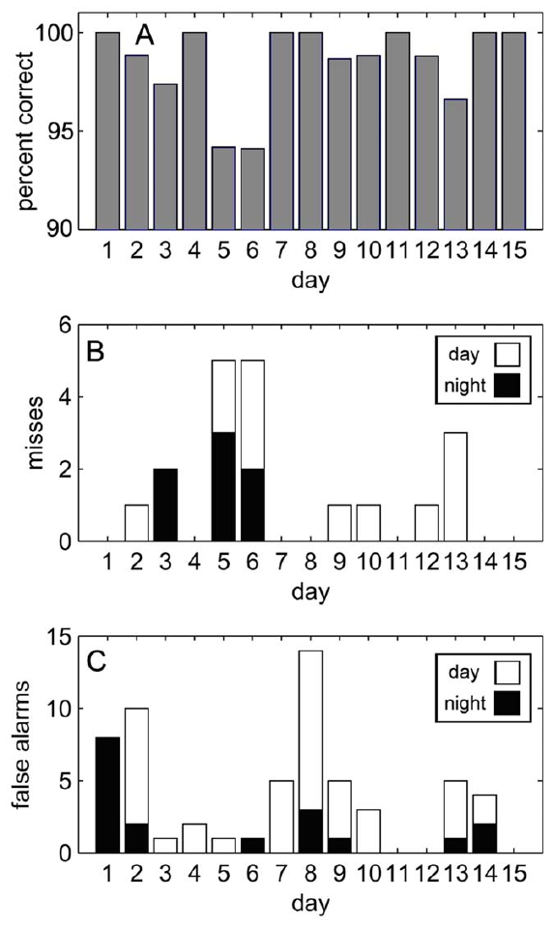
Detection performance and sleep are separate measures
A vigilance task measures the ability to detect relevant events over time. In the dolphin experiment, successful paddle responses established that the animal continued to use click-dependent target information. They did not identify which hemisphere was asleep at the moment of a response, because the experiment contained no simultaneous EEG.
The animal maintained high detection performance across the 15-day session without a progressive decline. Target accuracy, false alarms, and response latency described different aspects of performance: finding the target, avoiding inappropriate responses, and completing the response promptly.
Click production also varied with time of day and with individual behavioral strategy. Continuous access to a sensory task is compatible with changing sampling rates. Dolphin vigilance is therefore described by acoustic output and target responses, whereas unihemispheric sleep is described by bilateral electrical recordings.
Branstetter et al. (2012), Fig. 6(A–C). Detection, false alarms, and response latency across the 15-day session.
Branstetter et al. (2012)
14
Notes:
• A vigilance task measures the ability to detect relevant events over time. In the dolphin experiment, successful paddle responses established that the animal continued to use click-dependent target information. They did not identify which hemisphere was asleep at the moment of a response, because the experiment contained no simultaneous EEG.
• The animal maintained high detection performance across the 15-day session without a progressive decline. Target accuracy, false alarms, and response latency described different aspects of performance: finding the target, avoiding inappropriate responses, and completing the response promptly.
• Click production also varied with time of day and with individual behavioral strategy. Continuous access to a sensory task is compatible with changing sampling rates. Dolphin vigilance is therefore described by acoustic output and target responses, whereas unihemispheric sleep is described by bilateral electrical recordings.
• Successful detection should not be equated with a measurement of subjective consciousness. The behavioral finding and the classic sleep recordings come from different preparations.
References:
Branstetter BK, Finneran JJ, Fletcher EA, Weisman BC, Ridgway SH. (2012). Dolphins can maintain vigilant behavior through echolocation for 15 days without interruption or cognitive impairment. PloS one 7:e47478. https://doi.org/10.1371/journal.pone.0047478
Figure: Branstetter et al. (2012), Fig. 6(A–C). Detection, false alarms, and response latency across the 15-day session.
Figure source: https://doi.org/10.1371/journal.pone.0047478

Slide 15
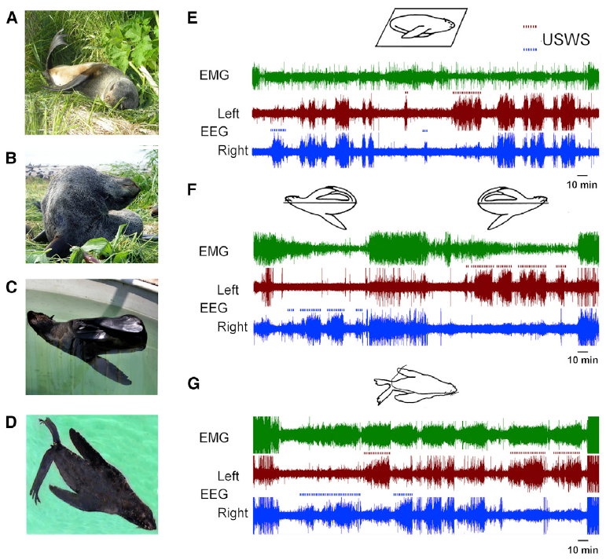
Fur seals change sleep organization between habitats
Northern fur seals are semiaquatic mammals, animals that use both land and water. On land they express bilateral slow-wave sleep and REM sleep. In seawater, their sleep shifts toward a pronounced left–right difference in slow-wave activity while the body remains at the surface.
The aquatic sleeping posture often raises the head and several flippers above the water. One flipper supplies movements that maintain the posture. The study recorded EEG, muscle activity, and behavior as the same animals moved between land-based and seawater conditions.
Environmental context therefore changes the organization of sleep within one species. A fur seal is neither obligatorily bilateral like a typical terrestrial sleeper nor obligatorily unihemispheric like the classic dolphin pattern. Its natural range of states connects habitat demands with reversible changes in brain and body activity.
Lyamin et al. (2018), Fig. 1(A–G). Fur-seal postures and EEG states on land and in water.
Lyamin et al. (2018)
15
Notes:
• Northern fur seals are semiaquatic mammals, animals that use both land and water. On land they express bilateral slow-wave sleep and REM sleep. In seawater, their sleep shifts toward a pronounced left–right difference in slow-wave activity while the body remains at the surface.
• The aquatic sleeping posture often raises the head and several flippers above the water. One flipper supplies movements that maintain the posture. The study recorded EEG, muscle activity, and behavior as the same animals moved between land-based and seawater conditions.
• Environmental context therefore changes the organization of sleep within one species. A fur seal is neither obligatorily bilateral like a typical terrestrial sleeper nor obligatorily unihemispheric like the classic dolphin pattern. Its natural range of states connects habitat demands with reversible changes in brain and body activity.
• The switch occurs without changing the species or its anatomical organization. The same animal can express both forms of slow-wave sleep, permitting within-animal comparisons of physiological state.
References:
Lyamin OI, Kosenko PO, Korneva SM, Vyssotski AL, Mukhametov LM, Siegel JM. (2018). Fur Seals Suppress REM Sleep for Very Long Periods without Subsequent Rebound. Current biology : CB 28:2000-2005.e2. https://doi.org/10.1016/j.cub.2018.05.022
Figure: Lyamin et al. (2018), Fig. 1(A–G). Fur-seal postures and EEG states on land and in water.
Figure source: https://doi.org/10.1016/j.cub.2018.05.022

Slide 16
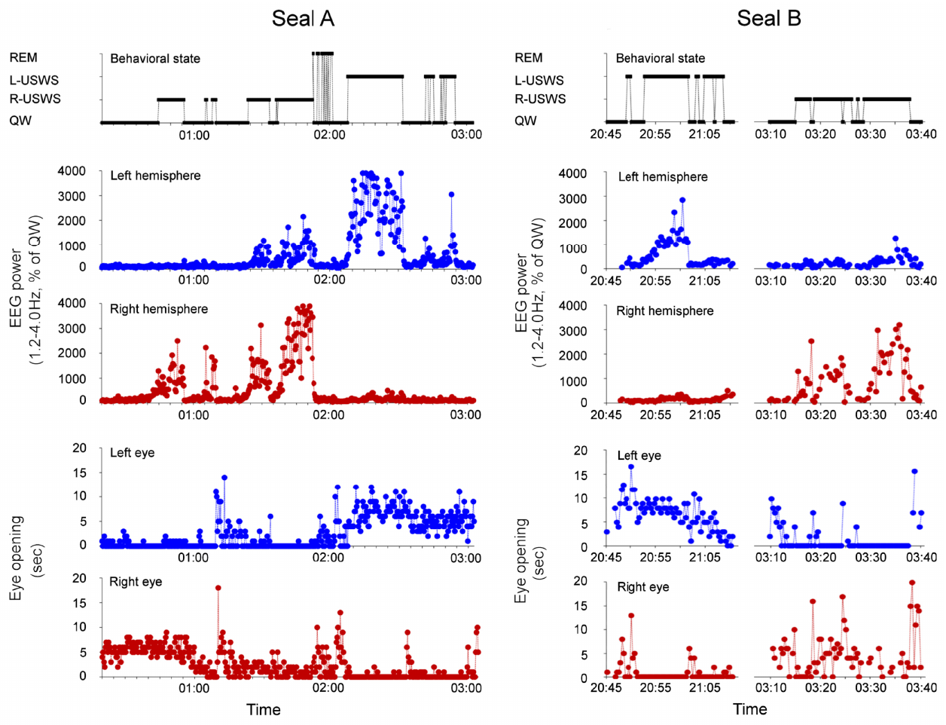
Aquatic sleep links eye state to EEG asymmetry
Fur seals resting prone at the water surface provided simultaneous visibility of both eyes. During right-hemisphere slow-wave sleep, the left eye remained closed while the right eye opened intermittently. When the sleeping side changed, the eye relationship changed with it.
The researchers matched second-by-second eye observations to bilateral EEG power. Slow-wave activity was calculated relative to quiet waking for each hemisphere, allowing comparisons with that hemisphere’s own waking baseline. The stronger-slow-wave side and the eye opposite it changed together across the record.
The association was expressed within natural bouts of rest rather than inferred from isolated photographs. Quiet waking, unihemispheric sleep, and brief REM episodes occupied different portions of the record. Coordinated eye and EEG changes identified how visual access varied as the neural state changed.
Kendall-Bar et al. (2019), Fig. 2(A–B). Hemispheric EEG power and eye openings during aquatic rest.
Kendall-Bar et al. (2019)
16
Notes:
• Fur seals resting prone at the water surface provided simultaneous visibility of both eyes. During right-hemisphere slow-wave sleep, the left eye remained closed while the right eye opened intermittently. When the sleeping side changed, the eye relationship changed with it.
• The researchers matched second-by-second eye observations to bilateral EEG power. Slow-wave activity was calculated relative to quiet waking for each hemisphere, allowing comparisons with that hemisphere’s own waking baseline. The stronger-slow-wave side and the eye opposite it changed together across the record.
• The association was expressed within natural bouts of rest rather than inferred from isolated photographs. Quiet waking, unihemispheric sleep, and brief REM episodes occupied different portions of the record. Coordinated eye and EEG changes identified how visual access varied as the neural state changed.
• The two prone seals allowed both pupils to be scored. Hidden-eye periods and electrical artifacts were excluded rather than assigned an eye or sleep state.
References:
Kendall-Bar JM, Vyssotski AL, Mukhametov LM, Siegel JM, Lyamin OI. (2019). Eye state asymmetry during aquatic unihemispheric slow wave sleep in northern fur seals (Callorhinus ursinus). PloS one 14:e0217025. https://doi.org/10.1371/journal.pone.0217025
Figure: Kendall-Bar et al. (2019), Fig. 2(A–B). Hemispheric EEG power and eye openings during aquatic rest.
Figure source: https://doi.org/10.1371/journal.pone.0217025

Slide 17
Sleep asymmetry differs across cortical sites
The fur-seal cortex expressed different slow-wave intensities at different anatomical positions. Parietal sites lie over the upper and posterior portion of the cerebral cortex; occipital sites lie farther toward the rear. These posterior regions often had stronger slow-wave activity than frontal regions during asymmetric sleep.
Bilateral electrode pairs sampled corresponding positions on each side. Comparing the pairs revealed a broadly distributed asymmetry rather than a difference confined to one small visual area. The largest differences occurred in occipital-lateral and parietal recordings.
Regional sampling changes the apparent strength of hemispheric specialization. A frontal recording can report a smaller difference than a posterior recording during the same episode. Anatomical location therefore belongs to the definition of what a measured EEG asymmetry represents.
Lyamin et al. (2012), Fig. 3. Slow-wave power across matched cortical locations.
Lyamin et al. (2012), Fig. 1. Bilateral frontal, parietal, and occipital recording sites.
Lyamin et al. (2012)
17
Notes:
• The fur-seal cortex expressed different slow-wave intensities at different anatomical positions. Parietal sites lie over the upper and posterior portion of the cerebral cortex; occipital sites lie farther toward the rear. These posterior regions often had stronger slow-wave activity than frontal regions during asymmetric sleep.
• Bilateral electrode pairs sampled corresponding positions on each side. Comparing the pairs revealed a broadly distributed asymmetry rather than a difference confined to one small visual area. The largest differences occurred in occipital-lateral and parietal recordings.
• Regional sampling changes the apparent strength of hemispheric specialization. A frontal recording can report a smaller difference than a posterior recording during the same episode. Anatomical location therefore belongs to the definition of what a measured EEG asymmetry represents.
• The result differs from the frontal predominance often described in other mammals. It describes a spatial gradient in fur-seal recordings rather than a universal anatomical distribution of deep sleep.
References:
Lyamin OI, Pavlova IF, Kosenko PO, Mukhametov LM, Siegel JM. (2012). Regional differences in cortical electroencephalogram (EEG) slow wave activity and interhemispheric EEG asymmetry in the fur seal. Journal of sleep research 21:603-611. https://doi.org/10.1111/j.1365-2869.2012.01023.x
Figure: Lyamin et al. (2012), Fig. 3. Slow-wave power across matched cortical locations.
Figure source: https://doi.org/10.1111/j.1365-2869.2012.01023.x
Figure: Lyamin et al. (2012), Fig. 1. Bilateral frontal, parietal, and occipital recording sites.
Figure source: https://doi.org/10.1111/j.1365-2869.2012.01023.x

Slide 18
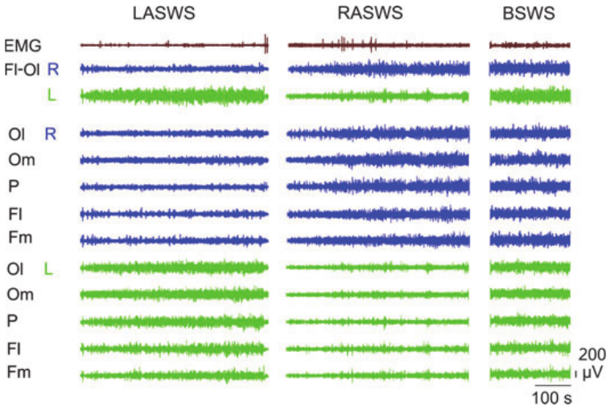
Regional activation can occur within a sleeping side
Local activation refers to a wake-like electrical pattern restricted to part of an otherwise sleeping brain. Most strongly asymmetric fur-seal episodes combined slow-wave sleep on one side with waking-like activity on the other. A smaller group combined sleep in both hemispheres with activation restricted to a region.
The investigators used multiple electrodes rather than a single left–right pair. This made it possible to identify episodes in which the apparent state depended on the recording site. Approximately nine tenths of asymmetric slow-wave episodes met the study’s unihemispheric classification.
The remaining episodes expanded the range between globally bilateral sleep and a clean hemispheric division. Local cortical regions can differ while neighboring regions remain in a similar state. A hemispheric label captures a dominant pattern, while the full recording preserves the regional organization within it.
Lyamin et al. (2012), Fig. 2. Simultaneous regional EEG traces during asymmetric sleep.
Lyamin et al. (2012), Fig. 1. Locations of the cortical electrode pairs.
Lyamin et al. (2012)
18
Notes:
• Local activation refers to a wake-like electrical pattern restricted to part of an otherwise sleeping brain. Most strongly asymmetric fur-seal episodes combined slow-wave sleep on one side with waking-like activity on the other. A smaller group combined sleep in both hemispheres with activation restricted to a region.
• The investigators used multiple electrodes rather than a single left–right pair. This made it possible to identify episodes in which the apparent state depended on the recording site. Approximately nine tenths of asymmetric slow-wave episodes met the study’s unihemispheric classification.
• The remaining episodes expanded the range between globally bilateral sleep and a clean hemispheric division. Local cortical regions can differ while neighboring regions remain in a similar state. A hemispheric label captures a dominant pattern, while the full recording preserves the regional organization within it.
• The regional exception changes interpretation of a single-channel recording. A low-voltage channel cannot automatically represent the electrical state of every region in that hemisphere.
References:
Lyamin OI, Pavlova IF, Kosenko PO, Mukhametov LM, Siegel JM. (2012). Regional differences in cortical electroencephalogram (EEG) slow wave activity and interhemispheric EEG asymmetry in the fur seal. Journal of sleep research 21:603-611. https://doi.org/10.1111/j.1365-2869.2012.01023.x
Figure: Lyamin et al. (2012), Fig. 2. Simultaneous regional EEG traces during asymmetric sleep.
Figure source: https://doi.org/10.1111/j.1365-2869.2012.01023.x
Figure: Lyamin et al. (2012), Fig. 1. Locations of the cortical electrode pairs.
Figure source: https://doi.org/10.1111/j.1365-2869.2012.01023.x

Slide 19
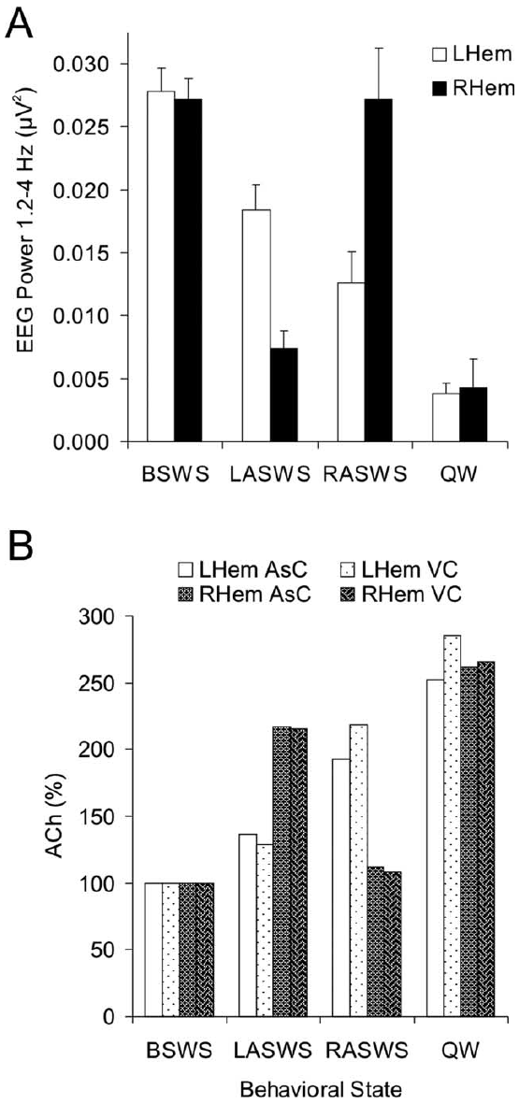
Acetylcholine tracks the activated hemisphere
Microdialysis samples extracellular chemicals through a small permeable probe placed in tissue. Lapierre and colleagues measured cortical acetylcholine from both hemispheres while recording fur-seal sleep and waking. The chemical samples were matched to the states expressed during their collection.
Acetylcholine release was lowest during bilateral slow-wave sleep and higher during waking and REM sleep. During asymmetric slow-wave sleep, release was greater on the side with low-voltage, waking-like EEG activity. The opposite side retained lower acetylcholine release together with stronger slow waves.
The chemical difference followed functional state rather than a permanently favored hemisphere. Either side could become the more activated side. The association links cortical acetylcholine to local EEG activation within a single animal whose two hemispheres experience the same surrounding environment.
Lapierre et al. (2007), Fig. 1(A–B). Cortical probe locations and histological verification.
Lapierre et al. (2007), Fig. 6(A–B). Lateralized acetylcholine release across sleep and waking states.
Lapierre et al. (2007)
19
Notes:
• Microdialysis samples extracellular chemicals through a small permeable probe placed in tissue. Lapierre and colleagues measured cortical acetylcholine from both hemispheres while recording fur-seal sleep and waking. The chemical samples were matched to the states expressed during their collection.
• Acetylcholine release was lowest during bilateral slow-wave sleep and higher during waking and REM sleep. During asymmetric slow-wave sleep, release was greater on the side with low-voltage, waking-like EEG activity. The opposite side retained lower acetylcholine release together with stronger slow waves.
• The chemical difference followed functional state rather than a permanently favored hemisphere. Either side could become the more activated side. The association links cortical acetylcholine to local EEG activation within a single animal whose two hemispheres experience the same surrounding environment.
• The study sampled release rather than manipulating cholinergic cells or receptors. It establishes a state-linked chemical association that is much more spatially specific than a whole-animal waking measurement.
References:
Lapierre JL, Kosenko PO, Lyamin OI, Kodama T, Mukhametov LM, Siegel JM. (2007). Cortical acetylcholine release is lateralized during asymmetrical slow-wave sleep in northern fur seals. The Journal of neuroscience : the official journal of the Society for Neuroscience 27:11999-12006. https://doi.org/10.1523/JNEUROSCI.2968-07.2007
Figure: Lapierre et al. (2007), Fig. 6(A–B). Lateralized acetylcholine release across sleep and waking states.
Figure source: https://doi.org/10.1523/JNEUROSCI.2968-07.2007
Figure: Lapierre et al. (2007), Fig. 1(A–B). Cortical probe locations and histological verification.
Figure source: https://doi.org/10.1523/JNEUROSCI.2968-07.2007

Slide 20
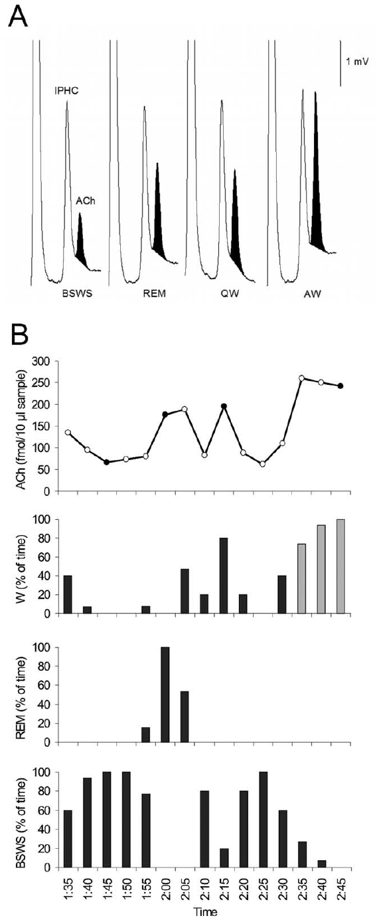
Microdialysis resolves chemical state differences
A microdialysis probe contains a membrane through which extracellular molecules enter a flowing sampling solution. The collected fluid is analyzed by high-performance liquid chromatography, a separation method that distinguishes chemical compounds before their detection. This supplies a chemical measure alongside the EEG.
The EEG resolves electrical fluctuations over seconds, whereas each chemical sample integrates release over its collection period. The investigators therefore classified the behavior and electrical state present during each sample. Samples dominated by bilateral sleep, waking, or asymmetric sleep could then be compared.
Within asymmetric sleep, acetylcholine release differed between the activated and slow-wave sides. During symmetric states, release changed more similarly in both hemispheres. Separating the time scales of electrical and chemical measurements connects a rapidly changing neural signal to a slower sample of its surrounding chemistry.
Lapierre et al. (2007), Fig. 1(A–B). Probe placement within the cortex.
Lapierre et al. (2007), Fig. 3(A–D). Electrical state and cortical acetylcholine over sampling periods.
Lapierre et al. (2007)
20
Notes:
• A microdialysis probe contains a membrane through which extracellular molecules enter a flowing sampling solution. The collected fluid is analyzed by high-performance liquid chromatography, a separation method that distinguishes chemical compounds before their detection. This supplies a chemical measure alongside the EEG.
• The EEG resolves electrical fluctuations over seconds, whereas each chemical sample integrates release over its collection period. The investigators therefore classified the behavior and electrical state present during each sample. Samples dominated by bilateral sleep, waking, or asymmetric sleep could then be compared.
• Within asymmetric sleep, acetylcholine release differed between the activated and slow-wave sides. During symmetric states, release changed more similarly in both hemispheres. Separating the time scales of electrical and chemical measurements connects a rapidly changing neural signal to a slower sample of its surrounding chemistry.
• Microdialysis measures extracellular concentration influenced by release and removal. It does not measure the spikes of a single cell, and the chemical sample cannot be assigned second-by-second transitions finer than its collection interval.
References:
Lapierre JL, Kosenko PO, Lyamin OI, Kodama T, Mukhametov LM, Siegel JM. (2007). Cortical acetylcholine release is lateralized during asymmetrical slow-wave sleep in northern fur seals. The Journal of neuroscience : the official journal of the Society for Neuroscience 27:11999-12006. https://doi.org/10.1523/JNEUROSCI.2968-07.2007
Figure: Lapierre et al. (2007), Fig. 3(A–D). Electrical state and cortical acetylcholine over sampling periods.
Figure source: https://doi.org/10.1523/JNEUROSCI.2968-07.2007
Figure: Lapierre et al. (2007), Fig. 1(A–B). Probe placement within the cortex.
Figure source: https://doi.org/10.1523/JNEUROSCI.2968-07.2007

Slide 21
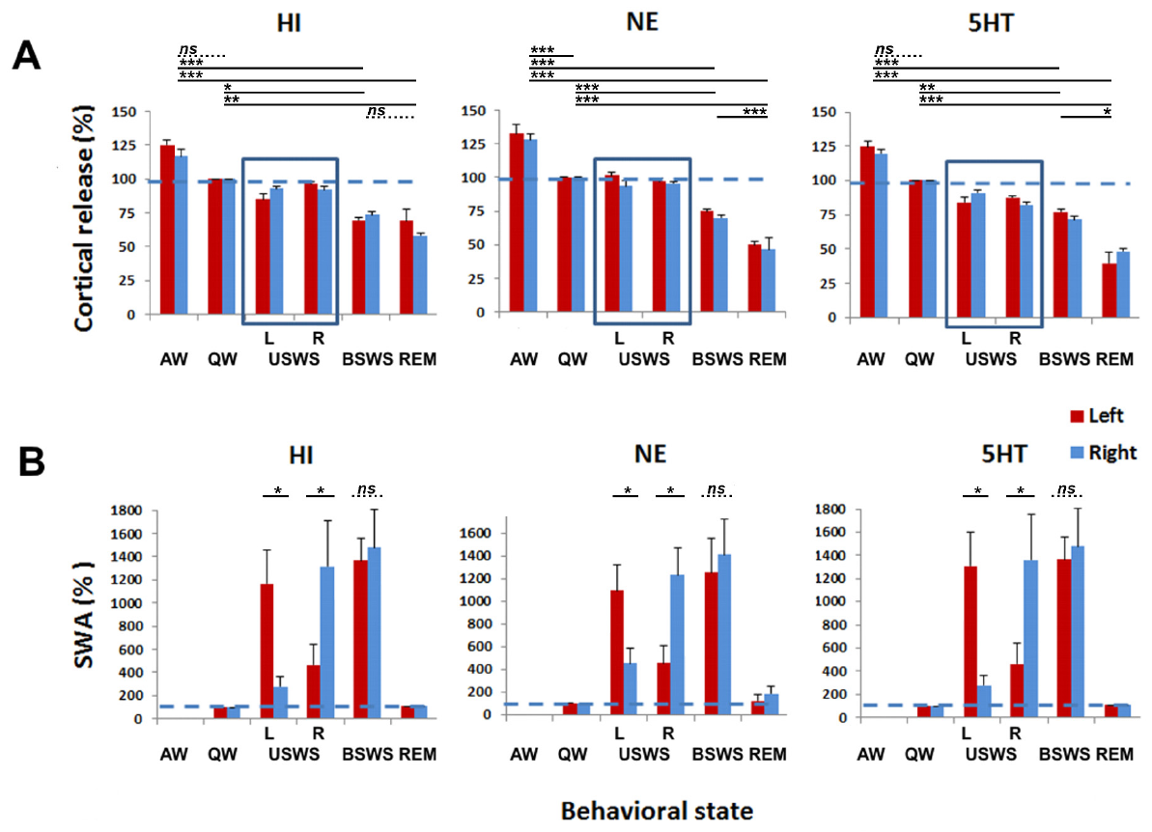
Serotonin remains similar across the two sides
Serotonin, also called 5-hydroxytryptamine or 5-HT, is a transmitter produced by brainstem raphe populations. Fur-seal microdialysis measured its extracellular release during natural sleep and waking. Release increased during active waking and was lowest during REM sleep.
During unihemispheric sleep, cortical serotonin did not develop the pronounced lateralization previously measured for acetylcholine. The hemispheres expressed different EEG states while their serotonin measurements remained similar. A waking-like cortical pattern therefore occurred without an accompanying one-sided increase in every arousal-associated transmitter.
Behavioral context also influenced release. Feeding and other activating conditions raised monoamine measurements beyond quieter waking conditions. Serotonin release tracked features of whole-animal activation differently from the local acetylcholine difference between the two cerebral hemispheres.
Lyamin et al. (2016), Fig. 4(A–B). Cortical histamine, noradrenaline, and serotonin across behavioral states.
Dell et al. (2016), Fig. 5(A–D). Comparative cetacean serotonin-positive raphe anatomy.
Lyamin et al. (2016); Dell et al. (2016)
21
Notes:
• Serotonin, also called 5-hydroxytryptamine or 5-HT, is a transmitter produced by brainstem raphe populations. Fur-seal microdialysis measured its extracellular release during natural sleep and waking. Release increased during active waking and was lowest during REM sleep.
• During unihemispheric sleep, cortical serotonin did not develop the pronounced lateralization previously measured for acetylcholine. The hemispheres expressed different EEG states while their serotonin measurements remained similar. A waking-like cortical pattern therefore occurred without an accompanying one-sided increase in every arousal-associated transmitter.
• Behavioral context also influenced release. Feeding and other activating conditions raised monoamine measurements beyond quieter waking conditions. Serotonin release tracked features of whole-animal activation differently from the local acetylcholine difference between the two cerebral hemispheres.
• The raphe anatomy comes from the porpoise study, while the release measurements come from northern fur seals. This comparison preserves the distinction between anatomical cell identity and physiological release.
References:
Lyamin OI, Lapierre JL, Kosenko PO, Kodama T, Bhagwandin A, Korneva SM, Peever JH, Mukhametov LM, Siegel JM. (2016). Monoamine Release during Unihemispheric Sleep and Unihemispheric Waking in the Fur Seal. Sleep 39:625-636. https://doi.org/10.5665/sleep.5540
Dell LA, Patzke N, Spocter MA, Siegel JM, Manger PR. (2016). Organization of the sleep-related neural systems in the brain of the harbour porpoise (Phocoena phocoena). The Journal of comparative neurology 524:1999-2017. https://doi.org/10.1002/cne.23929
Figure: Lyamin et al. (2016), Fig. 4(A–B). Cortical histamine, noradrenaline, and serotonin across behavioral states.
Figure source: https://doi.org/10.5665/sleep.5540
Figure: Dell et al. (2016), Fig. 5(A–D). Comparative cetacean serotonin-positive raphe anatomy.
Figure source: https://doi.org/10.1002/cne.23929

Slide 22
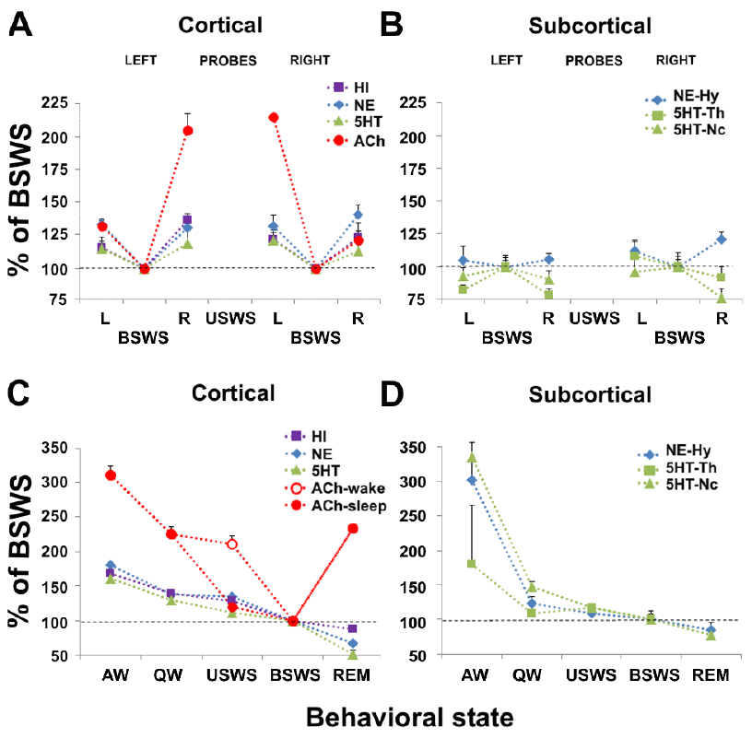
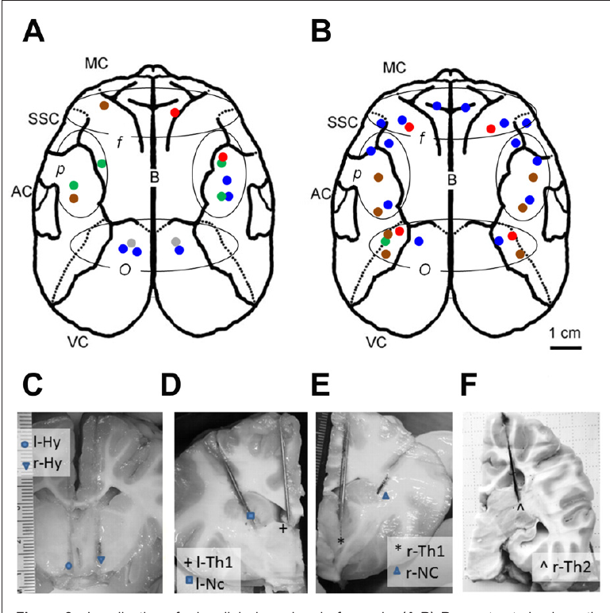
Monoamines differ from lateralized acetylcholine
Monoamines are a chemical class of transmitters that includes serotonin, noradrenaline, and histamine. Histamine participates in arousal-related signaling, while noradrenaline is associated with the locus-coeruleus system. Fur-seal recordings compared all three with previously measured cortical acetylcholine.
Histamine and noradrenaline were higher during active waking and lower during REM sleep. Like serotonin, neither consistently separated into high release on the activated side and low release on the slow-wave side during unihemispheric sleep. Acetylcholine had the distinctive lateralized relationship.
The activated hemisphere consequently combines a waking-like EEG with a transmitter profile that is not simply a miniature copy of whole-animal active waking. Local cortical activation and global behavioral arousal recruit overlapping systems in different ways. The chemical comparison specifies which measured signals covary with hemispheric state.
Lyamin et al. (2016), Fig. 7(A–D). Monoamine release across bilateral and asymmetric states.
Lyamin et al. (2016), Fig. 2(A–F). Cortical and subcortical microdialysis sites.
Lyamin et al. (2016)
22
Notes:
• Monoamines are a chemical class of transmitters that includes serotonin, noradrenaline, and histamine. Histamine participates in arousal-related signaling, while noradrenaline is associated with the locus-coeruleus system. Fur-seal recordings compared all three with previously measured cortical acetylcholine.
• Histamine and noradrenaline were higher during active waking and lower during REM sleep. Like serotonin, neither consistently separated into high release on the activated side and low release on the slow-wave side during unihemispheric sleep. Acetylcholine had the distinctive lateralized relationship.
• The activated hemisphere consequently combines a waking-like EEG with a transmitter profile that is not simply a miniature copy of whole-animal active waking. Local cortical activation and global behavioral arousal recruit overlapping systems in different ways. The chemical comparison specifies which measured signals covary with hemispheric state.
• The recordings include cortical and selected subcortical sites. Their similarity across hemispheres challenges an interpretation in which every activating transmitter must rise exclusively on the wake-like side.
References:
Lyamin OI, Lapierre JL, Kosenko PO, Kodama T, Bhagwandin A, Korneva SM, Peever JH, Mukhametov LM, Siegel JM. (2016). Monoamine Release during Unihemispheric Sleep and Unihemispheric Waking in the Fur Seal. Sleep 39:625-636. https://doi.org/10.5665/sleep.5540
Figure: Lyamin et al. (2016), Fig. 7(A–D). Monoamine release across bilateral and asymmetric states.
Figure source: https://doi.org/10.5665/sleep.5540
Figure: Lyamin et al. (2016), Fig. 2(A–F). Cortical and subcortical microdialysis sites.
Figure source: https://doi.org/10.5665/sleep.5540

Slide 23
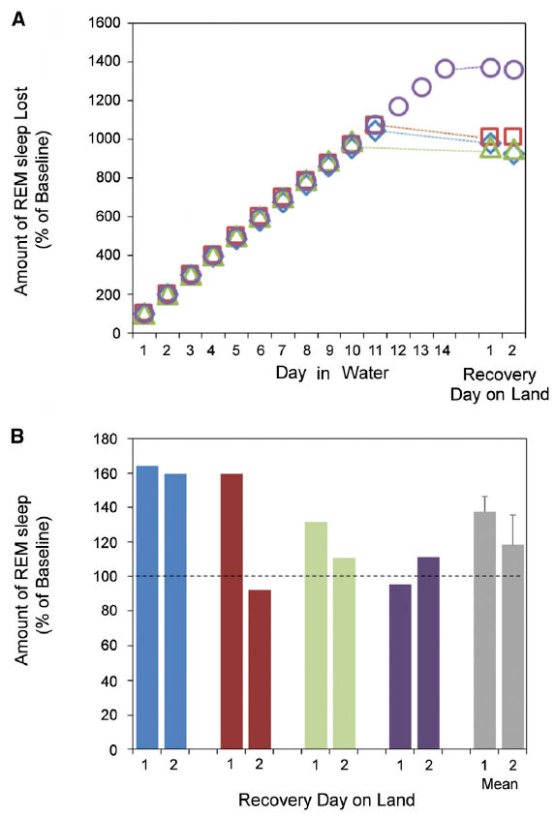
Water suppresses fur-seal REM without a large rebound
Sleep rebound is an increase in a sleep state after a period in which that state was reduced. Fur seals sharply reduced REM sleep while kept in seawater for days or weeks. The reduction accompanied the shift from bilateral toward asymmetric slow-wave sleep.
After returning to land-based baseline conditions, the seals expressed little or no compensatory REM increase. The accumulated reduction in REM during the water period therefore differed from the large rebound often produced by repeated laboratory awakenings in terrestrial mammals.
The authors proposed a hypothesis that REM helps reverse brain-temperature or metabolic changes associated with bilateral non-REM sleep. The fur-seal result connects habitat-dependent REM reduction with reduced bilateral slow-wave sleep. It places the regulation of REM within the organization of the preceding non-REM state.
Lyamin et al. (2018), Fig. 4(A–B). Accumulated REM reduction and subsequent recovery sleep.
Lyamin et al. (2018)
23
Notes:
• Sleep rebound is an increase in a sleep state after a period in which that state was reduced. Fur seals sharply reduced REM sleep while kept in seawater for days or weeks. The reduction accompanied the shift from bilateral toward asymmetric slow-wave sleep.
• After returning to land-based baseline conditions, the seals expressed little or no compensatory REM increase. The accumulated reduction in REM during the water period therefore differed from the large rebound often produced by repeated laboratory awakenings in terrestrial mammals.
• The authors proposed a hypothesis that REM helps reverse brain-temperature or metabolic changes associated with bilateral non-REM sleep. The fur-seal result connects habitat-dependent REM reduction with reduced bilateral slow-wave sleep. It places the regulation of REM within the organization of the preceding non-REM state.
• The temperature/metabolism account is the article’s hypothesis, not a directly measured mechanism in this experiment. The physiological finding is the naturalistic reduction of REM with minimal rebound after return to baseline conditions.
References:
Lyamin OI, Kosenko PO, Korneva SM, Vyssotski AL, Mukhametov LM, Siegel JM. (2018). Fur Seals Suppress REM Sleep for Very Long Periods without Subsequent Rebound. Current biology : CB 28:2000-2005.e2. https://doi.org/10.1016/j.cub.2018.05.022
Figure: Lyamin et al. (2018), Fig. 4(A–B). Accumulated REM reduction and subsequent recovery sleep.
Figure source: https://doi.org/10.1016/j.cub.2018.05.022

Slide 24
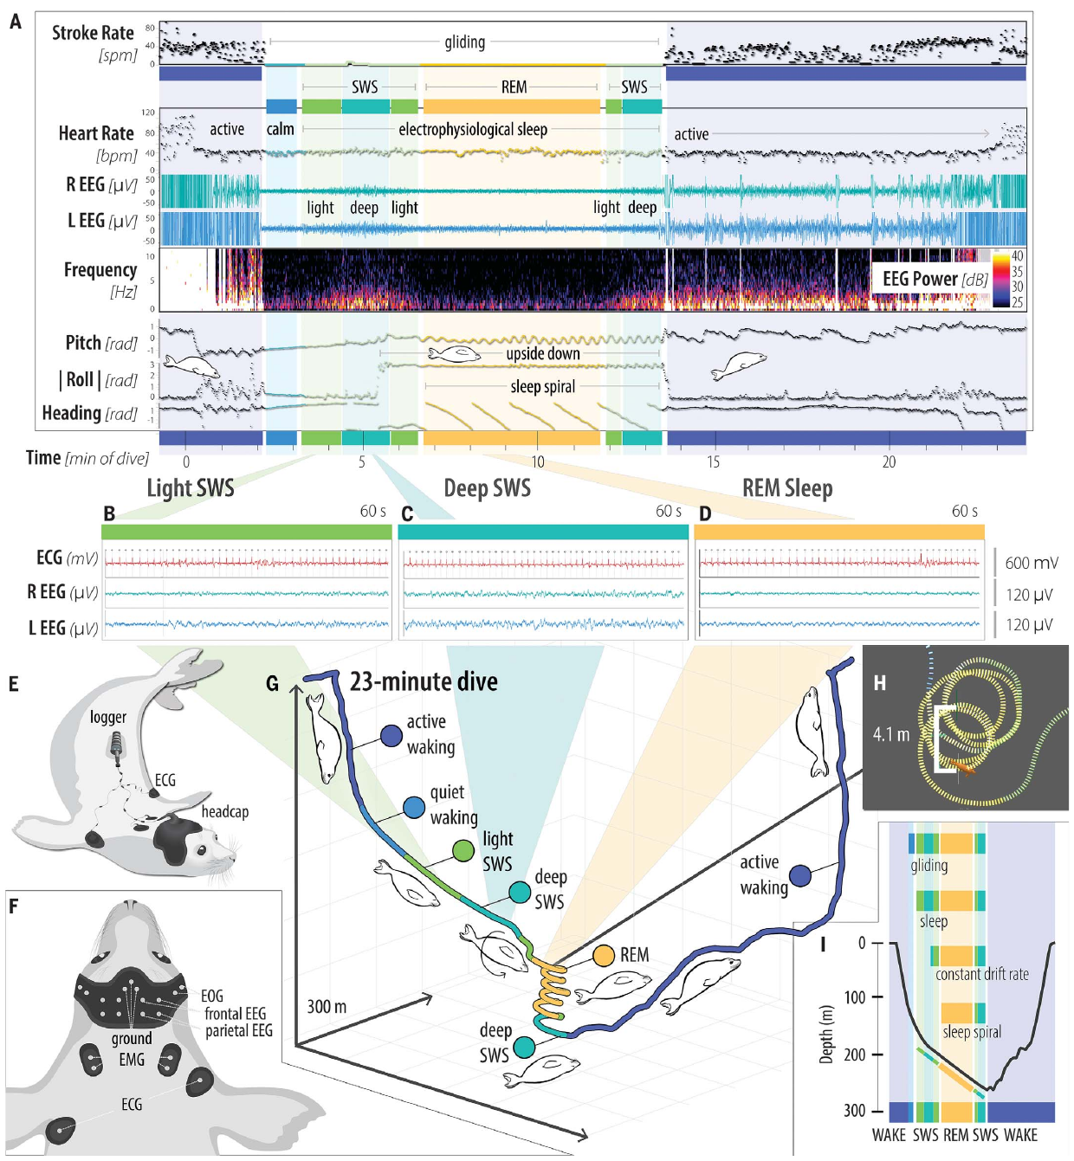
Elephant seals sleep with both hemispheres at depth
Northern elephant seals use a different aquatic strategy from fur seals. Portable EEG recordings detected bilateral slow-wave sleep and REM sleep during deep drift dives, dives in which the animal reduces active stroking and descends largely under the influence of buoyancy.
Slow waves appeared in both hemispheres while the seal descended. During REM sleep, low-voltage brain activity accompanied changes in heart rhythm and body orientation. Sleep episodes occurred at depths reaching 377 m in the recorded dives, placing neural sleep within a physically protected underwater interval.
The brain-state recordings anchored later estimates from movement and depth data. A low-activity dive was classified as sleep only after its behavioral pattern had been related to measured EEG. Bilateral diving sleep therefore provides an alternative to maintaining one wake-like hemisphere at the surface.
Kendall-Bar et al. (2023), Fig. 1(A–I). Bilateral EEG, physiology, and three-dimensional sleep-dive trajectories.
Kendall-Bar et al. (2023)
24
Notes:
• Northern elephant seals use a different aquatic strategy from fur seals. Portable EEG recordings detected bilateral slow-wave sleep and REM sleep during deep drift dives, dives in which the animal reduces active stroking and descends largely under the influence of buoyancy.
• Slow waves appeared in both hemispheres while the seal descended. During REM sleep, low-voltage brain activity accompanied changes in heart rhythm and body orientation. Sleep episodes occurred at depths reaching 377 m in the recorded dives, placing neural sleep within a physically protected underwater interval.
• The brain-state recordings anchored later estimates from movement and depth data. A low-activity dive was classified as sleep only after its behavioral pattern had been related to measured EEG. Bilateral diving sleep therefore provides an alternative to maintaining one wake-like hemisphere at the surface.
• The EEG recordings established the sleeping dive pattern. The much larger tracking dataset used a model trained against those observations, so its sleep estimates should be distinguished from direct brain recordings.
References:
Kendall-Bar JM, Williams TM, Mukherji R, Lozano DA, Pitman JK, Holser RR, Keates T, Beltran RS, Robinson PW, Crocker DE, Adachi T, Lyamin OI, Vyssotski AL, Costa DP. (2023). Brain activity of diving seals reveals short sleep cycles at depth. Science (New York, N.Y.) 380:260-265. https://doi.org/10.1126/science.adf0566
Figure: Kendall-Bar et al. (2023), Fig. 1(A–I). Bilateral EEG, physiology, and three-dimensional sleep-dive trajectories.
Figure source: https://doi.org/10.1126/science.adf0566

Slide 25
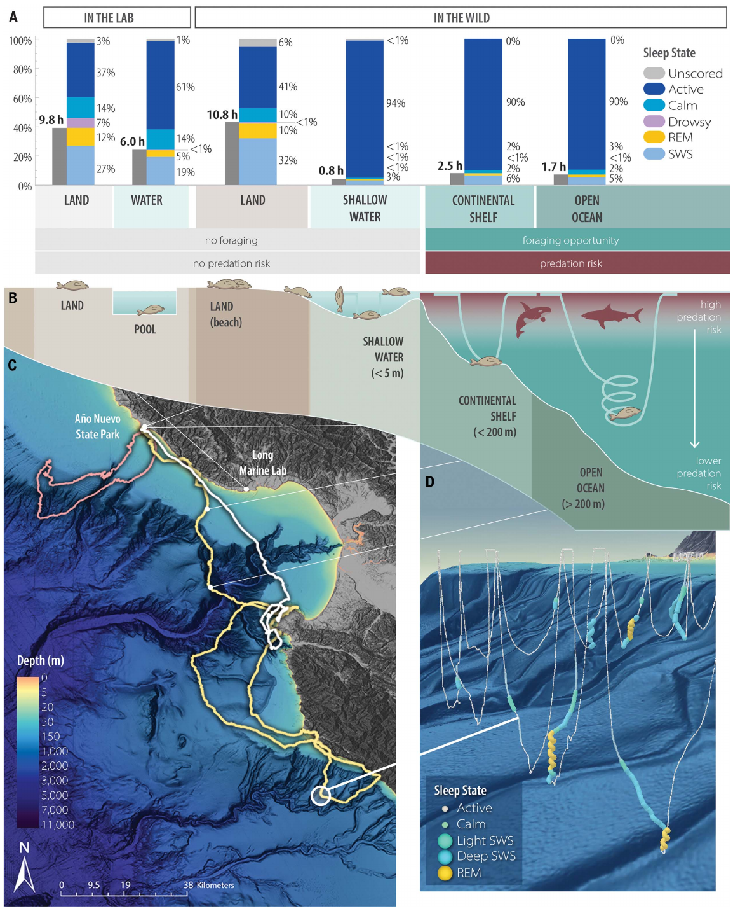
Diving sleep changes posture and movement
Elephant seals stopped active swimming during sleep dives and entered descending glides. Bilateral slow-wave sleep often occurred while the animal maintained a stable posture. Transition into REM sleep could bring loss of postural control and an upside-down orientation.
Sleep spirals are circular descending trajectories associated with these changes in orientation. EEG, body acceleration, and depth were synchronized to reconstruct the sequence within each dive. The study linked a three-dimensional movement pattern to measured sleep states rather than diagnosing sleep solely from a slow descent.
At sea, modeled sleep averaged about 2 h per day during long foraging migrations, compared with much longer sleep on land. The seals concentrate short sleep opportunities into dives while maintaining extensive daily foraging. Their movement pattern connects the location and timing of rest to oceanic habitat use.
Kendall-Bar et al. (2023), Fig. 2(A–D). Sleep allocation and resting postures from land to the open ocean.
Kendall-Bar et al. (2023)
25
Notes:
• Elephant seals stopped active swimming during sleep dives and entered descending glides. Bilateral slow-wave sleep often occurred while the animal maintained a stable posture. Transition into REM sleep could bring loss of postural control and an upside-down orientation.
• Sleep spirals are circular descending trajectories associated with these changes in orientation. EEG, body acceleration, and depth were synchronized to reconstruct the sequence within each dive. The study linked a three-dimensional movement pattern to measured sleep states rather than diagnosing sleep solely from a slow descent.
• At sea, modeled sleep averaged about 2 h per day during long foraging migrations, compared with much longer sleep on land. The seals concentrate short sleep opportunities into dives while maintaining extensive daily foraging. Their movement pattern connects the location and timing of rest to oceanic habitat use.
• The sleep spiral concerns northern elephant seals rather than surface-sleeping northern fur seals. The daily at-sea estimate is based on validated dive-pattern modeling, whereas the sleep-state transitions were directly EEG-recorded.
References:
Kendall-Bar JM, Williams TM, Mukherji R, Lozano DA, Pitman JK, Holser RR, Keates T, Beltran RS, Robinson PW, Crocker DE, Adachi T, Lyamin OI, Vyssotski AL, Costa DP. (2023). Brain activity of diving seals reveals short sleep cycles at depth. Science (New York, N.Y.) 380:260-265. https://doi.org/10.1126/science.adf0566
Figure: Kendall-Bar et al. (2023), Fig. 2(A–D). Sleep allocation and resting postures from land to the open ocean.
Figure source: https://doi.org/10.1126/science.adf0566
Optional article recording, not embedded: Movie S1 is listed in the original article; publisher and University of California supplement requests returned HTTP 403. Original published figures remain available. Original media URL: https://www.science.org/doi/suppl/10.1126/science.adf0566/suppl_file/science.adf0566_movie_s1.mp4 Article DOI: https://doi.org/10.1126/science.adf0566

Slide 26
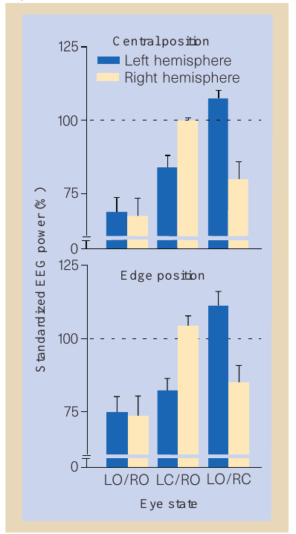
Exposed mallards increase asymmetric sleep
Mallards sleeping in a row experience different opportunities for detecting an approaching threat. Birds at the ends have an exposed outer side, whereas birds in central positions are flanked by neighbors. Rattenborg and colleagues changed group position while measuring eye state and bilateral EEG.
The proportion of sleep spent unihemispherically rose from about 12% in central positions to about 32% at the edges. Edge birds therefore altered the distribution of sleep states rather than simply remaining awake throughout the rest period. One side continued to express slow waves while the other supplied greater access to visual information.
Group position created a reversible social context for the sleeping animal. The same type of neural state became more common where the environment was less screened by other birds. This links the use of asymmetric sleep to a measurable change in exposure.
Rattenborg et al. (1999), Fig. 1. Hemispheric EEG power at central and exposed edge positions.
Rattenborg et al. (1999)
26
Notes:
• Mallards sleeping in a row experience different opportunities for detecting an approaching threat. Birds at the ends have an exposed outer side, whereas birds in central positions are flanked by neighbors. Rattenborg and colleagues changed group position while measuring eye state and bilateral EEG.
• The proportion of sleep spent unihemispherically rose from about 12% in central positions to about 32% at the edges. Edge birds therefore altered the distribution of sleep states rather than simply remaining awake throughout the rest period. One side continued to express slow waves while the other supplied greater access to visual information.
• Group position created a reversible social context for the sleeping animal. The same type of neural state became more common where the environment was less screened by other birds. This links the use of asymmetric sleep to a measurable change in exposure.
• The manipulation altered position within a group rather than introducing a live predator. The behavioral consequence was increased use of unihemispheric sleep at the exposed ends.
References:
Rattenborg NC, Lima SL, Amlaner CJ. (1999). Half-awake to the risk of predation. Nature 397:397-398. https://doi.org/10.1038/17037
Figure: Rattenborg et al. (1999), Fig. 1. Hemispheric EEG power at central and exposed edge positions.
Figure source: https://doi.org/10.1038/17037

Slide 27
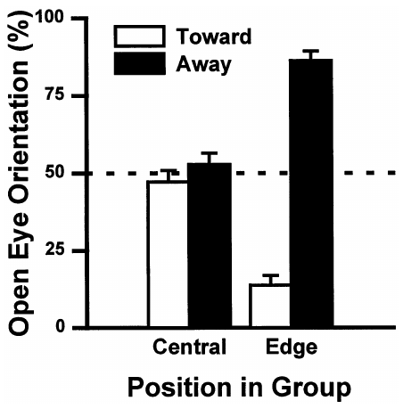
The open eye faces the exposed environment
During unilateral eye closure, an edge mallard could direct its open eye toward its neighbors or away from the group. The outward direction supplied access to the side with no neighboring bird. Central birds had other ducks on both sides and lacked this single exposed direction.
Edge birds oriented the open eye outward during about 86% of unilateral-eye-closure time. Central birds were close to an even split between the two directions. Eye orientation therefore changed together with group position, placing the available visual channel toward the exposed environment.
Sensory guidance here concerns which part of the surroundings can supply visual input during sleep. The amount of asymmetric sleep specifies how often one eye is available; head and eye orientation specify where that available channel points. The two behavioral adjustments operate together.
Rattenborg et al. (1999), Fig. 4. Open-eye orientation in central and edge mallards.
Rattenborg et al. (1999)
27
Notes:
• During unilateral eye closure, an edge mallard could direct its open eye toward its neighbors or away from the group. The outward direction supplied access to the side with no neighboring bird. Central birds had other ducks on both sides and lacked this single exposed direction.
• Edge birds oriented the open eye outward during about 86% of unilateral-eye-closure time. Central birds were close to an even split between the two directions. Eye orientation therefore changed together with group position, placing the available visual channel toward the exposed environment.
• Sensory guidance here concerns which part of the surroundings can supply visual input during sleep. The amount of asymmetric sleep specifies how often one eye is available; head and eye orientation specify where that available channel points. The two behavioral adjustments operate together.
• Orientation was scored during unilateral eye closure. The finding concerns directed visual availability, rather than evidence that every passing object was consciously perceived.
References:
Rattenborg NC, Lima SL, Amlaner CJ. (1999). Facultative control of avian unihemispheric sleep under the risk of predation. Behavioural brain research 105:163-172. https://doi.org/10.1016/s0166-4328(99)00070-4
Figure: Rattenborg et al. (1999), Fig. 4. Open-eye orientation in central and edge mallards.
Figure source: https://doi.org/10.1016/s0166-4328(99)00070-4

Slide 28
Mallards respond to threats during asymmetric sleep
An approaching visual stimulus tested whether the open eye could support a behavioral response during unihemispheric sleep. The researchers presented a simulated looming attack while monitoring the duck’s eye state and brain activity. Looming is rapid visual expansion associated with an object approaching the observer.
The ducks initiated escape responses with an average latency of approximately 165 ms. The response occurred when the stimulus was presented to the open-eye side. Simultaneous slow-wave activity in the opposite hemisphere preserved the distinction between behavioral detection and a fully bilateral waking state.
Fast escape links sensory access to action while part of the brain remains in a sleeping electrical state. The exposed eye supports a defensive response, and the other hemisphere continues to express slow waves. Predator vigilance therefore has an observable behavioral consequence in this preparation.
Rattenborg et al. (1999), Fig. 5. EEG and eye-state relationships during asymmetric mallard sleep.
Rattenborg et al. (1999), Fig. 1. Hemispheric power under different group-position conditions.
Rattenborg et al. (1999); Rattenborg et al. (1999)
28
Notes:
• An approaching visual stimulus tested whether the open eye could support a behavioral response during unihemispheric sleep. The researchers presented a simulated looming attack while monitoring the duck’s eye state and brain activity. Looming is rapid visual expansion associated with an object approaching the observer.
• The ducks initiated escape responses with an average latency of approximately 165 ms. The response occurred when the stimulus was presented to the open-eye side. Simultaneous slow-wave activity in the opposite hemisphere preserved the distinction between behavioral detection and a fully bilateral waking state.
• Fast escape links sensory access to action while part of the brain remains in a sleeping electrical state. The exposed eye supports a defensive response, and the other hemisphere continues to express slow waves. Predator vigilance therefore has an observable behavioral consequence in this preparation.
• The primary Nature report gives the approximately 0.165 s escape latency. The visual attack was simulated, so the demonstrated outcome is stimulus-evoked escape rather than survival against a live predator.
References:
Rattenborg NC, Lima SL, Amlaner CJ. (1999). Half-awake to the risk of predation. Nature 397:397-398. https://doi.org/10.1038/17037
Rattenborg NC, Lima SL, Amlaner CJ. (1999). Facultative control of avian unihemispheric sleep under the risk of predation. Behavioural brain research 105:163-172. https://doi.org/10.1016/s0166-4328(99)00070-4
Figure: Rattenborg et al. (1999), Fig. 5. EEG and eye-state relationships during asymmetric mallard sleep.
Figure source: https://doi.org/10.1016/s0166-4328(99)00070-4
Figure: Rattenborg et al. (1999), Fig. 1. Hemispheric power under different group-position conditions.
Figure source: https://doi.org/10.1038/17037

Slide 29
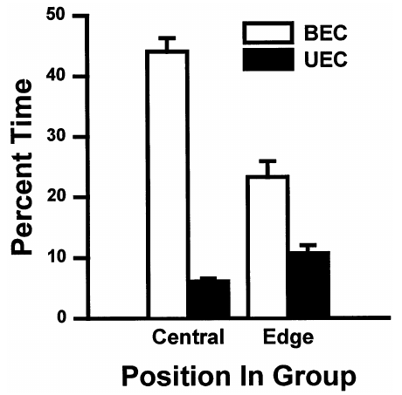
Group position changes the mallard sleep strategy
Unilateral eye closure and bilateral eye closure partition a resting mallard’s sleep behavior. Edge birds spent more time with one eye closed and less time with both eyes closed than centrally positioned birds. Bilateral EEG identified the neural states associated with these eye patterns.
The change was not explained simply by increasing REM sleep, which occurred with both eyes closed. Edge position favored the asymmetric slow-wave pattern that retained an available visual channel. The animal adjusted the type of sleep expressed under different social exposure conditions.
This flexibility differs from a fixed left-eye or right-eye preference. A change in position changes which side faces away from the group, and the sleeping bird can redirect its available eye accordingly. The organization of vigilance follows the surrounding arrangement rather than a permanently selected hemisphere.
Rattenborg et al. (1999), Fig. 3. Bilateral and unilateral eye-closure time at central and edge positions.
Rattenborg et al. (1999)
29
Notes:
• Unilateral eye closure and bilateral eye closure partition a resting mallard’s sleep behavior. Edge birds spent more time with one eye closed and less time with both eyes closed than centrally positioned birds. Bilateral EEG identified the neural states associated with these eye patterns.
• The change was not explained simply by increasing REM sleep, which occurred with both eyes closed. Edge position favored the asymmetric slow-wave pattern that retained an available visual channel. The animal adjusted the type of sleep expressed under different social exposure conditions.
• This flexibility differs from a fixed left-eye or right-eye preference. A change in position changes which side faces away from the group, and the sleeping bird can redirect its available eye accordingly. The organization of vigilance follows the surrounding arrangement rather than a permanently selected hemisphere.
• Position comparisons were combined with eye-direction scoring and EEG. Their agreement supports a behavioral adjustment of sleep organization to the available view of the surrounding environment.
References:
Rattenborg NC, Lima SL, Amlaner CJ. (1999). Facultative control of avian unihemispheric sleep under the risk of predation. Behavioural brain research 105:163-172. https://doi.org/10.1016/s0166-4328(99)00070-4
Figure: Rattenborg et al. (1999), Fig. 3. Bilateral and unilateral eye-closure time at central and edge positions.
Figure source: https://doi.org/10.1016/s0166-4328(99)00070-4

Slide 30
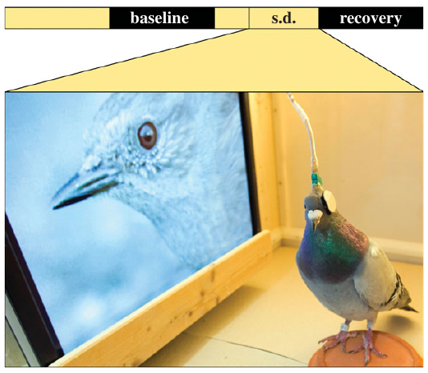
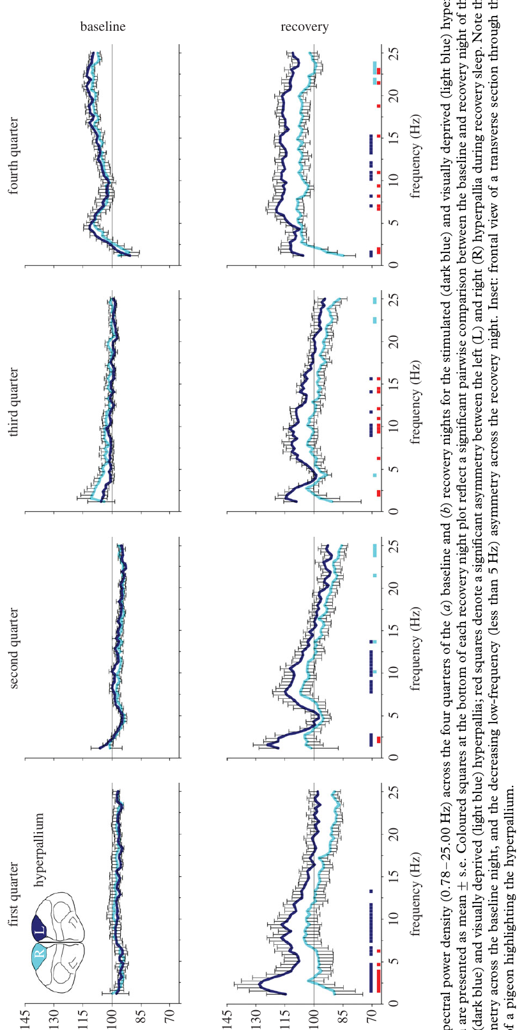
Unilateral visual experience changes pigeon sleep
Sleep homeostasis is the regulation of sleep according to prior waking and sleep history. Lesku and colleagues kept pigeons awake for 8 h while they watched a moving video through one eye. The other eye was covered, creating unequal visual input while both sides shared the same prolonged waking period.
The hyperpallium, a dorsal avian forebrain region receiving visual information, showed stronger subsequent slow-wave activity on the side associated with the stimulated eye. The sleep response therefore depended on the history of input to a particular neural region, not only on whole-animal time awake.
The mesopallium, another pallial region sampled in the experiment, showed a more symmetric recovery response. Local visual activation and overall waking duration consequently produced different spatial patterns. Prior brain use changed where subsequent sleep was most intense.
Lesku et al. (2011), Fig. 1. Unilateral video viewing during prolonged waking.
Lesku et al. (2011), Fig. 2(a–d). Hyperpallial anatomy and subsequent hemispheric slow-wave activity.
Lesku et al. (2011)
30
Notes:
• Sleep homeostasis is the regulation of sleep according to prior waking and sleep history. Lesku and colleagues kept pigeons awake for 8 h while they watched a moving video through one eye. The other eye was covered, creating unequal visual input while both sides shared the same prolonged waking period.
• The hyperpallium, a dorsal avian forebrain region receiving visual information, showed stronger subsequent slow-wave activity on the side associated with the stimulated eye. The sleep response therefore depended on the history of input to a particular neural region, not only on whole-animal time awake.
• The mesopallium, another pallial region sampled in the experiment, showed a more symmetric recovery response. Local visual activation and overall waking duration consequently produced different spatial patterns. Prior brain use changed where subsequent sleep was most intense.
• The source’s old statement that reptiles lack comparable sleep states should not be generalized to current reptile research. This slide uses the experiment’s local homeostasis result, not that historical evolutionary claim.
References:
Lesku JA, Vyssotski AL, Martinez-Gonzalez D, Wilzeck C, Rattenborg NC. (2011). Local sleep homeostasis in the avian brain: convergence of sleep function in mammals and birds? Proceedings. Biological sciences 278:2419-2428. https://doi.org/10.1098/rspb.2010.2316
Figure: Lesku et al. (2011), Fig. 1. Unilateral video viewing during prolonged waking.
Figure source: https://doi.org/10.1098/rspb.2010.2316
Figure: Lesku et al. (2011), Fig. 2(a–d). Hyperpallial anatomy and subsequent hemispheric slow-wave activity.
Figure source: https://doi.org/10.1098/rspb.2010.2316

Slide 31
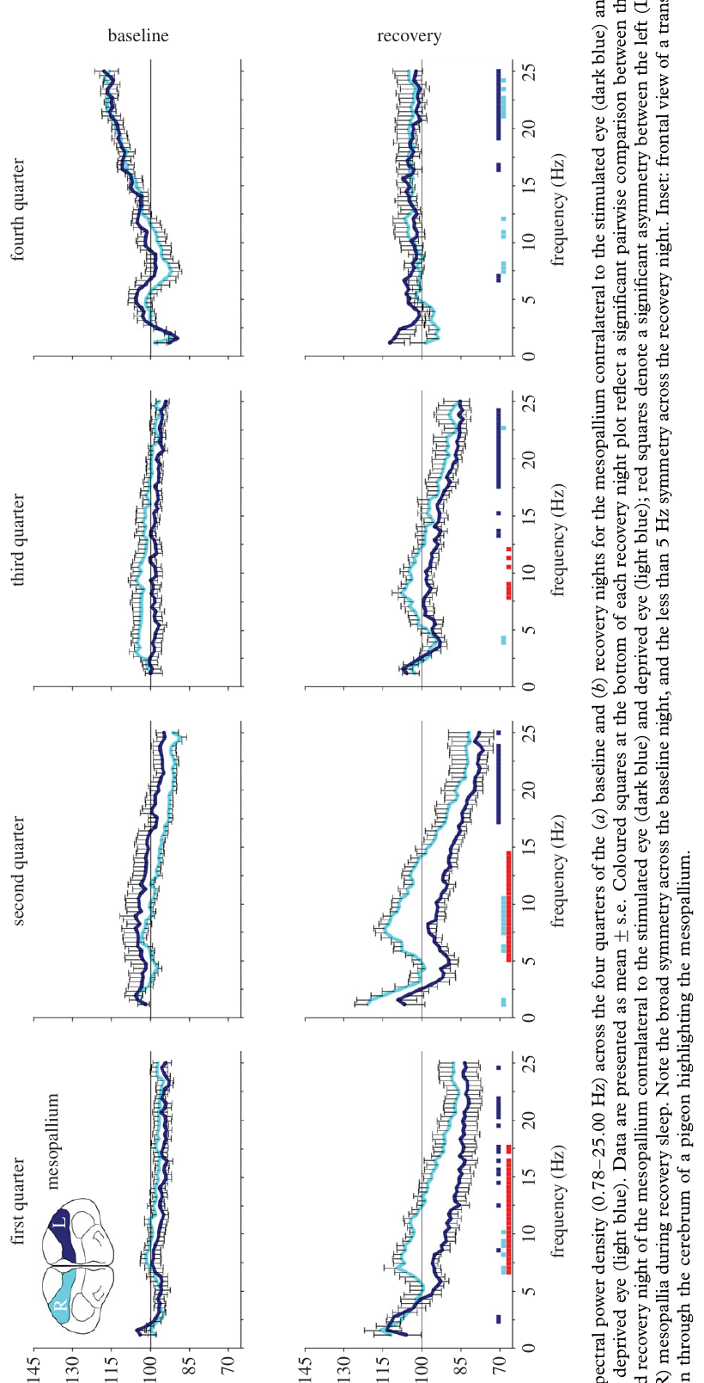
Visual use and waking duration have different effects
The stimulated and visually deprived pigeon hemispheres experienced the same duration of enforced waking. Their visual histories differed because the eye cover reduced input to one side. Comparing the two recordings separated a local sensory-use effect from the shared effect of remaining awake.
In the hyperpallium, the stimulated side expressed greater low-frequency power during subsequent recovery sleep. In the mesopallium, both sides increased together. Recovery sleep is sleep following the prolonged waking manipulation, during which the resulting changes in sleep intensity can be measured.
The slope of individual slow waves also changed with recovery. A steeper wave is a faster change in the recorded voltage, and the authors discussed its relationship to synchronized neuronal activity. The anatomical specificity of the response links sleep intensity to prior local processing.
Lesku et al. (2011), Fig. 3(a–d). Mesopallial recording anatomy and symmetric recovery responses.
Lesku et al. (2011), Fig. 2(a–d). Region-specific visual-history effects in the hyperpallium.
Lesku et al. (2011)
31
Notes:
• The stimulated and visually deprived pigeon hemispheres experienced the same duration of enforced waking. Their visual histories differed because the eye cover reduced input to one side. Comparing the two recordings separated a local sensory-use effect from the shared effect of remaining awake.
• In the hyperpallium, the stimulated side expressed greater low-frequency power during subsequent recovery sleep. In the mesopallium, both sides increased together. Recovery sleep is sleep following the prolonged waking manipulation, during which the resulting changes in sleep intensity can be measured.
• The slope of individual slow waves also changed with recovery. A steeper wave is a faster change in the recorded voltage, and the authors discussed its relationship to synchronized neuronal activity. The anatomical specificity of the response links sleep intensity to prior local processing.
• The proposed relationship between wave slope and synaptic strength is a hypothesis; the experiment directly measured EEG power and voltage-wave slopes, not synaptic strength.
References:
Lesku JA, Vyssotski AL, Martinez-Gonzalez D, Wilzeck C, Rattenborg NC. (2011). Local sleep homeostasis in the avian brain: convergence of sleep function in mammals and birds? Proceedings. Biological sciences 278:2419-2428. https://doi.org/10.1098/rspb.2010.2316
Figure: Lesku et al. (2011), Fig. 3(a–d). Mesopallial recording anatomy and symmetric recovery responses.
Figure source: https://doi.org/10.1098/rspb.2010.2316
Figure: Lesku et al. (2011), Fig. 2(a–d). Region-specific visual-history effects in the hyperpallium.
Figure source: https://doi.org/10.1098/rspb.2010.2316

Slide 32
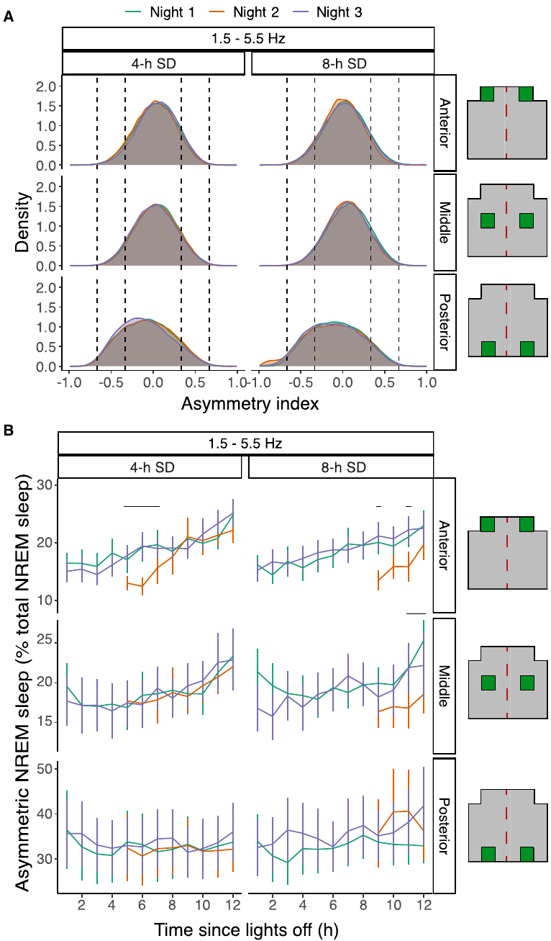
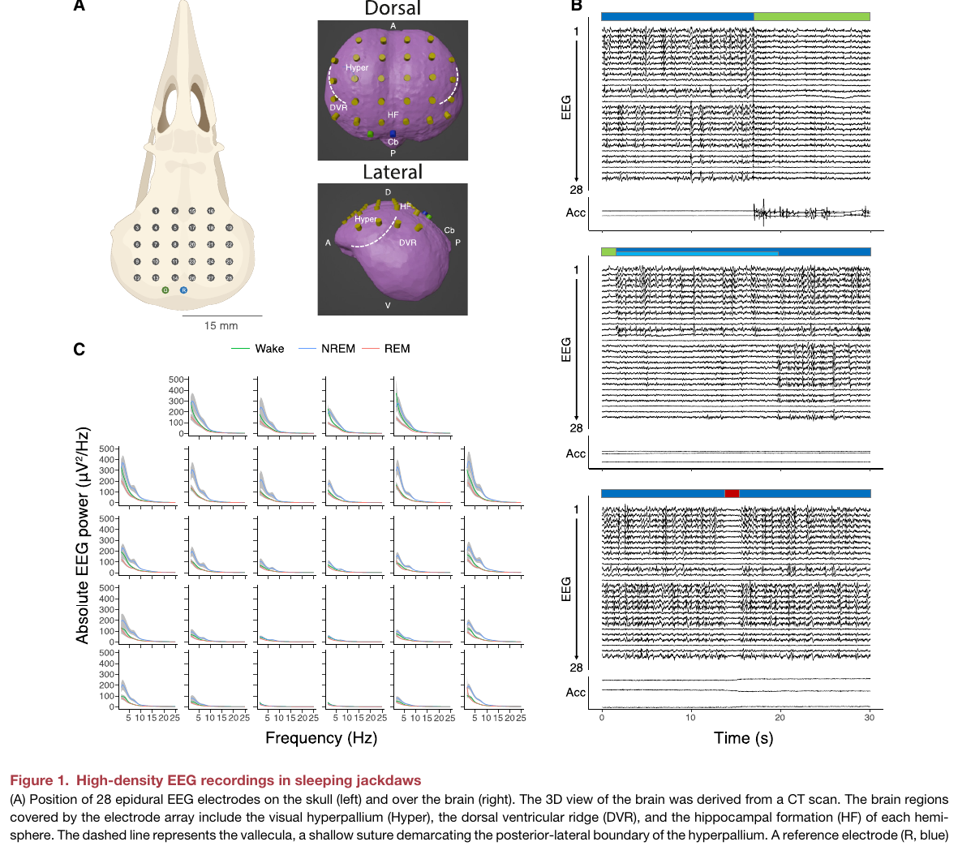
Sleep pressure favors more symmetric bird sleep
Sleep pressure is the tendency toward sleep that grows with extended waking. High-density EEG in European jackdaws sampled many sites across the dorsal forebrain. Recordings compared ordinary nights with nights following 4 h or 8 h of sleep deprivation.
Early in the normal sleep period and after deprivation, jackdaws expressed less asymmetric non-REM sleep. Non-REM sleep, or NREM, is the sleep category characterized here by slow-wave electrical activity rather than the activated pattern of REM. More intense sleep was accompanied by more similar activity across the two hemispheres.
As the night progressed, asymmetric sleep became more prominent. The opportunity to retain a relatively activated side therefore changed with the history of sleep loss and recovery. Vigilance-related asymmetry competes with the tendency for both sides to express deeper sleep after prolonged waking.
van Hasselt et al. (2025), Fig. 4(A–B). Sleep-pressure-dependent hemispheric asymmetry.
van Hasselt et al. (2025), Fig. 1(A–D). High-density recording array and jackdaw brain locations.
van Hasselt et al. (2025)
32
Notes:
• Sleep pressure is the tendency toward sleep that grows with extended waking. High-density EEG in European jackdaws sampled many sites across the dorsal forebrain. Recordings compared ordinary nights with nights following 4 h or 8 h of sleep deprivation.
• Early in the normal sleep period and after deprivation, jackdaws expressed less asymmetric non-REM sleep. Non-REM sleep, or NREM, is the sleep category characterized here by slow-wave electrical activity rather than the activated pattern of REM. More intense sleep was accompanied by more similar activity across the two hemispheres.
• As the night progressed, asymmetric sleep became more prominent. The opportunity to retain a relatively activated side therefore changed with the history of sleep loss and recovery. Vigilance-related asymmetry competes with the tendency for both sides to express deeper sleep after prolonged waking.
• The study concerns European jackdaws, not geese. Its high-density recordings distinguish regional differences as well as the overall difference between the two hemispheres.
References:
van Hasselt SJ, Martinez-Gonzalez D, Mekenkamp GJ, Vyssotski AL, Verhulst S, Beckers GJL, Rattenborg NC, Meerlo P. (2025). Sleep pressure causes birds to trade asymmetric sleep for symmetric sleep. Current biology : CB 35:1918-1926.e3. https://doi.org/10.1016/j.cub.2025.03.008
Figure: van Hasselt et al. (2025), Fig. 4(A–B). Sleep-pressure-dependent hemispheric asymmetry.
Figure source: https://doi.org/10.1016/j.cub.2025.03.008
Figure: van Hasselt et al. (2025), Fig. 1(A–D). High-density recording array and jackdaw brain locations.
Figure source: https://doi.org/10.1016/j.cub.2025.03.008
Optional article recording, not embedded: The paper lists Videos S1–S3. Publisher supplementary endpoints returned HTTP 403; exact recording-file links and their contents could not be verified, so no unverified recording was embedded. Original media URL: https://doi.org/10.1016/j.cub.2025.03.008 Article DOI: https://doi.org/10.1016/j.cub.2025.03.008

Slide 33
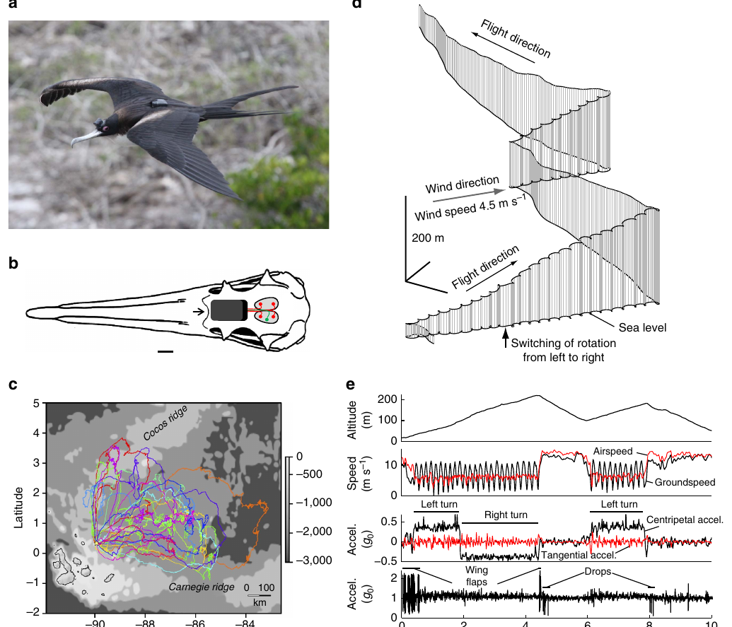
Frigatebirds can sleep while remaining airborne
Great frigatebirds can remain over the ocean for many days. A head-mounted logger recorded bilateral EEG and acceleration while GPS recorded location and altitude. Electrodes sampled the hyperpallium, enabling electrical-state measurements during natural flight rather than after landing.
The typical flight pattern combined circular rising in thermals with straighter descending glides. Thermals are rising air currents that supply lift. Slow-wave sleep occurred mainly during non-flapping flight, when the EEG changed from low-amplitude waking activity to sustained slow waves.
The slow waves were absent during much larger flapping movements and were not coupled to small head movements. This comparison separated neural sleep activity from motion-related recording artifacts. The birds could remain aloft while the brain expressed a recognizable sleeping pattern.
Rattenborg et al. (2016), Fig. 1(a–e). Bird-mounted recording, flight paths, and head acceleration.
Rattenborg et al. (2016)
33
Notes:
• Great frigatebirds can remain over the ocean for many days. A head-mounted logger recorded bilateral EEG and acceleration while GPS recorded location and altitude. Electrodes sampled the hyperpallium, enabling electrical-state measurements during natural flight rather than after landing.
• The typical flight pattern combined circular rising in thermals with straighter descending glides. Thermals are rising air currents that supply lift. Slow-wave sleep occurred mainly during non-flapping flight, when the EEG changed from low-amplitude waking activity to sustained slow waves.
• The slow waves were absent during much larger flapping movements and were not coupled to small head movements. This comparison separated neural sleep activity from motion-related recording artifacts. The birds could remain aloft while the brain expressed a recognizable sleeping pattern.
• Supplementary Movie 1 reconstructs recorded flight trajectories from the article’s data. It is an author-provided movie, not a newly generated reconstruction. The EEG independently establishes sleep during the corresponding study.
References:
Rattenborg NC, Voirin B, Cruz SM, Tisdale R, Dell'Omo G, Lipp HP, Wikelski M, Vyssotski AL. (2016). Evidence that birds sleep in mid-flight. Nature communications 7:12468. https://doi.org/10.1038/ncomms12468
Figure: Rattenborg et al. (2016), Fig. 1(a–e). Bird-mounted recording, flight paths, and head acceleration.
Figure source: https://doi.org/10.1038/ncomms12468
Optional article recording, not embedded: Supplementary Movie 1 was downloaded but its original AVI emits decoder errors and non-monotonic timestamps; retained as an optional source link rather than modifying or repairing scientific frames. Original media URL: https://pmc-oa-opendata.s3.amazonaws.com/PMC4976198.1/ncomms12468-s2.avi Article DOI: https://doi.org/10.1038/ncomms12468

Slide 34
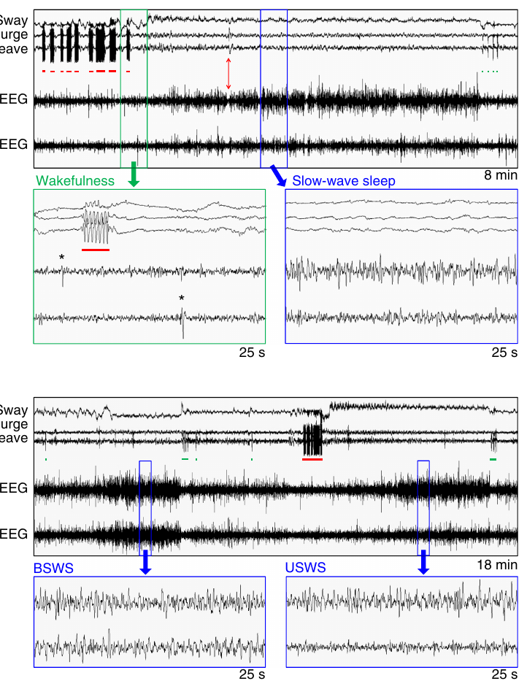
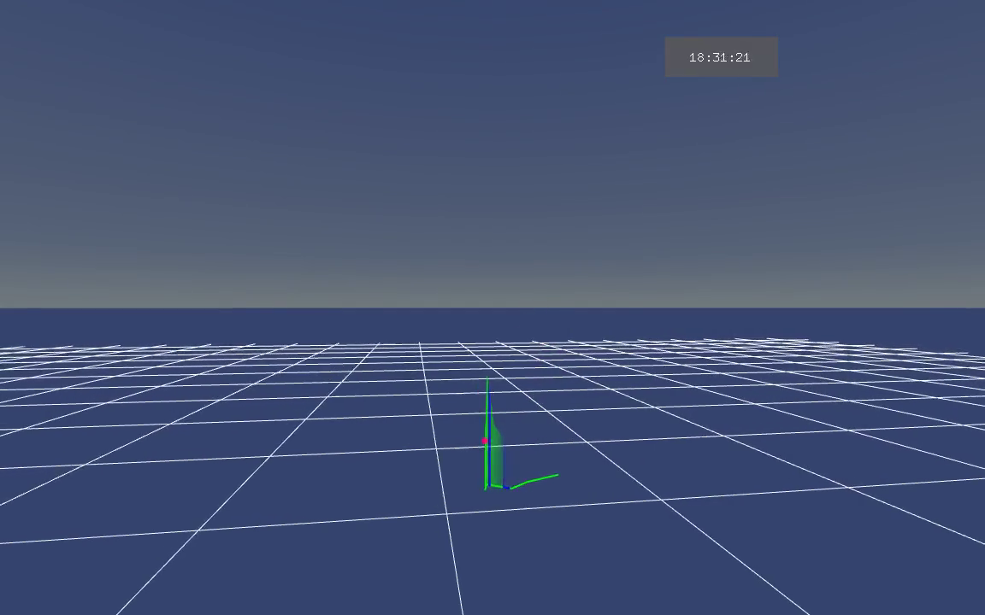
Flight EEG resolves unilateral and bilateral sleep
Frigatebirds expressed both asymmetric and bilateral slow-wave sleep during flight. Bilateral slow-wave sleep means that both recorded hemispheres contain sustained slow waves at the same time. Flight therefore continued even when neither recorded side retained the ordinary waking EEG pattern.
Simultaneous acceleration measurements identified flapping, gliding, and head movement. These measurements were synchronized with left and right EEG, connecting electrical state to the ongoing flight mode. Slow-wave episodes were embedded within a longer record dominated by waking.
The bilateral episodes change the interpretation of aerial sleep. Maintaining flight does not always require one hemisphere to remain electrically wake-like. Aerodynamic support and ongoing movement can continue through neural states that differ from the states expressed during active searching and foraging.
Rattenborg et al. (2016), Fig. 2(a–b). Bilateral and asymmetric slow-wave sleep during flight.
Rattenborg et al. (2016), Supplementary Movie 2. Recorded flight trajectory with scored sleep episodes.
Rattenborg et al. (2016)
34
Notes:
• Frigatebirds expressed both asymmetric and bilateral slow-wave sleep during flight. Bilateral slow-wave sleep means that both recorded hemispheres contain sustained slow waves at the same time. Flight therefore continued even when neither recorded side retained the ordinary waking EEG pattern.
• Simultaneous acceleration measurements identified flapping, gliding, and head movement. These measurements were synchronized with left and right EEG, connecting electrical state to the ongoing flight mode. Slow-wave episodes were embedded within a longer record dominated by waking.
• The bilateral episodes change the interpretation of aerial sleep. Maintaining flight does not always require one hemisphere to remain electrically wake-like. Aerodynamic support and ongoing movement can continue through neural states that differ from the states expressed during active searching and foraging.
• Supplementary Movie 2 places scored sleep episodes along the original three-dimensional flight trajectory. The trajectory movie is a visualization published by the authors, while the EEG traces supply the physiological state evidence.
References:
Rattenborg NC, Voirin B, Cruz SM, Tisdale R, Dell'Omo G, Lipp HP, Wikelski M, Vyssotski AL. (2016). Evidence that birds sleep in mid-flight. Nature communications 7:12468. https://doi.org/10.1038/ncomms12468
Figure: Rattenborg et al. (2016), Fig. 2(a–b). Bilateral and asymmetric slow-wave sleep during flight.
Figure source: https://doi.org/10.1038/ncomms12468
Article-provided recording: Rattenborg et al. (2016), Supplementary Movie 2. Recorded flight trajectory with scored sleep episodes.
• Recorded flight trajectory with scored sleep episodes. This is an author-published visualization of recorded data, not a camera view of the flight.
Article DOI: https://doi.org/10.1038/ncomms12468
Original media URL: https://pmc-oa-opendata.s3.amazonaws.com/PMC4976198.1/ncomms12468-s3.avi
Credit: Rattenborg NC, Voirin B, Cruz SM, Tisdale R, Dell'Omo G, Lipp HP, Wikelski M, Vyssotski AL.
License: Creative Commons Attribution 4.0 International, as supplied with the article.
Compatibility: H.264/yuv420p MP4 conversion; original dimensions, timing, scene, and audio retained. No overlays, recoloring, or speed changes. Unedited source frame provides the poster.
Playback: click the recording in PowerPoint Slide Show. The credited original article figure remains a static fallback. Full media decode and embedded relationships were checked; interactive PowerPoint playback was unavailable in this environment.

Slide 35
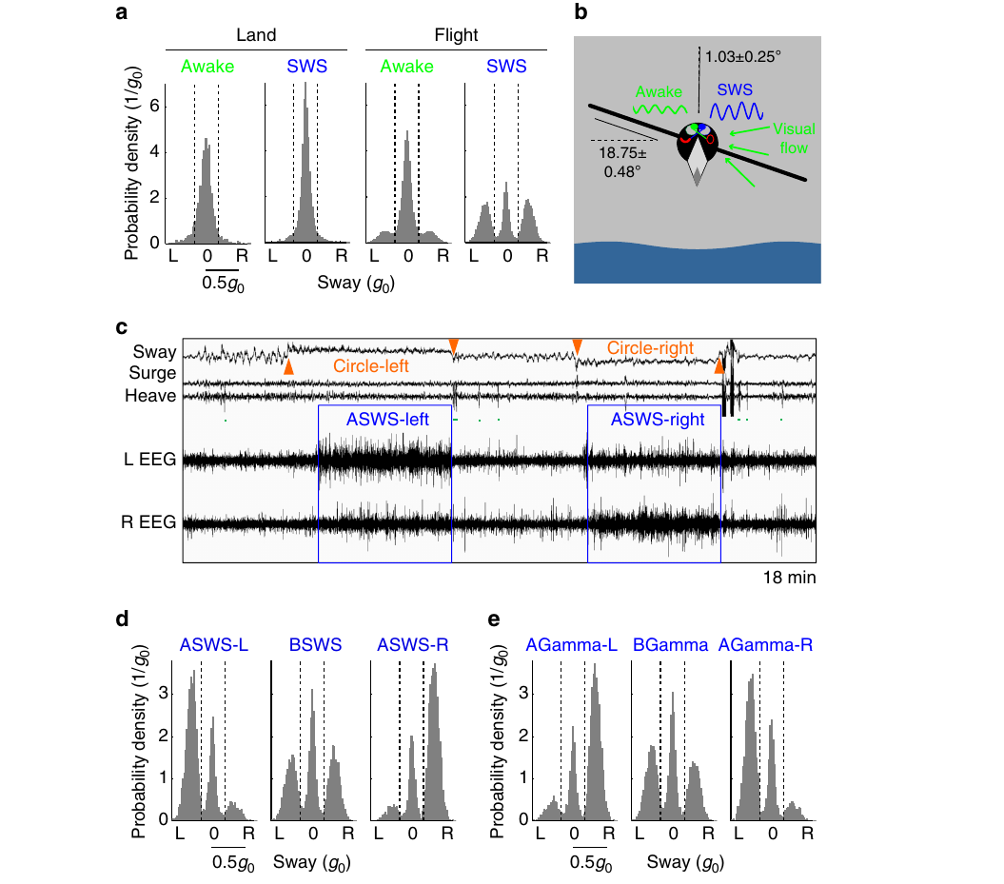
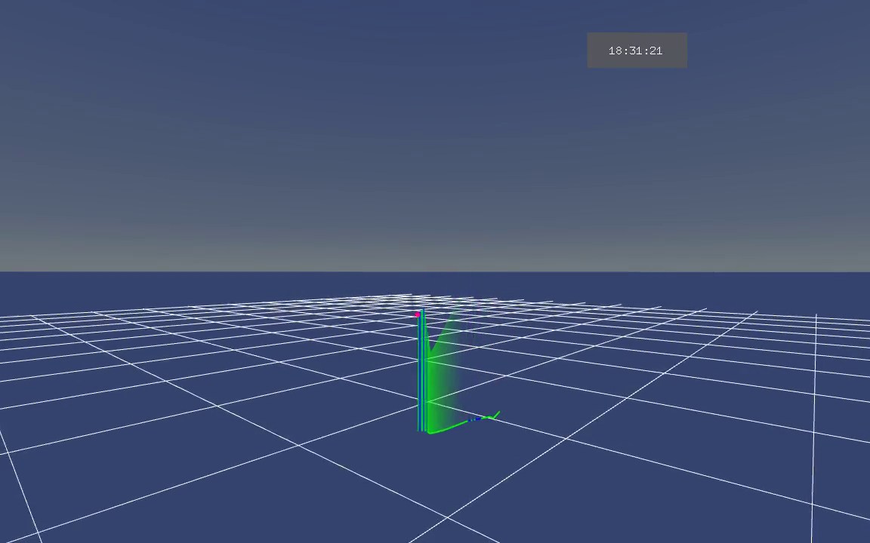
Turning direction accompanies EEG asymmetry
Circling flight produced sideways acceleration measured by the head-mounted logger. During asymmetric slow-wave sleep, the hemisphere on the side toward which the bird turned tended to express greater slow-wave activity. The pattern reversed when circling direction reversed.
The eye opposite the more activated hemisphere would face into the turn under the usual avian crossing relationship between eye and hemisphere. The authors proposed the hypothesis that this arrangement could help monitor the flight path and other birds within a circling air current. Direct gaze during flight was not measured.
The relationship couples neural lateralization to an ongoing directional behavior rather than assigning one hemisphere a fixed aerial role. Left and right turns occurred with corresponding differences in electrical state. Flight geometry therefore provides a changing behavioral reference for hemispheric activation.
Rattenborg et al. (2016), Fig. 3(a–e). EEG asymmetry, lateral acceleration, and circling direction.
Rattenborg et al. (2016), Supplementary Movie 3. Recorded flight trajectory with sleep episodes and high-altitude ascents.
Rattenborg et al. (2016)
35
Notes:
• Circling flight produced sideways acceleration measured by the head-mounted logger. During asymmetric slow-wave sleep, the hemisphere on the side toward which the bird turned tended to express greater slow-wave activity. The pattern reversed when circling direction reversed.
• The eye opposite the more activated hemisphere would face into the turn under the usual avian crossing relationship between eye and hemisphere. The authors proposed the hypothesis that this arrangement could help monitor the flight path and other birds within a circling air current. Direct gaze during flight was not measured.
• The relationship couples neural lateralization to an ongoing directional behavior rather than assigning one hemisphere a fixed aerial role. Left and right turns occurred with corresponding differences in electrical state. Flight geometry therefore provides a changing behavioral reference for hemispheric activation.
• Supplementary Movie 3 records another original trajectory containing sleeping episodes and high-altitude ascents. The movie preserves the authors’ timing and annotations; the gaze interpretation remains their hypothesis.
References:
Rattenborg NC, Voirin B, Cruz SM, Tisdale R, Dell'Omo G, Lipp HP, Wikelski M, Vyssotski AL. (2016). Evidence that birds sleep in mid-flight. Nature communications 7:12468. https://doi.org/10.1038/ncomms12468
Figure: Rattenborg et al. (2016), Fig. 3(a–e). EEG asymmetry, lateral acceleration, and circling direction.
Figure source: https://doi.org/10.1038/ncomms12468
Article-provided recording: Rattenborg et al. (2016), Supplementary Movie 3. Recorded flight trajectory with sleep episodes and high-altitude ascents.
• Recorded flight trajectory with sleep episodes and high-altitude ascents. This is an author-published visualization of recorded data, not a camera view of the flight.
Article DOI: https://doi.org/10.1038/ncomms12468
Original media URL: https://pmc-oa-opendata.s3.amazonaws.com/PMC4976198.1/ncomms12468-s4.avi
Credit: Rattenborg NC, Voirin B, Cruz SM, Tisdale R, Dell'Omo G, Lipp HP, Wikelski M, Vyssotski AL.
License: Creative Commons Attribution 4.0 International, as supplied with the article.
Compatibility: H.264/yuv420p MP4 conversion; original dimensions, timing, scene, and audio retained. No overlays, recoloring, or speed changes. Unedited source frame provides the poster.
Playback: click the recording in PowerPoint Slide Show. The credited original article figure remains a static fallback. Full media decode and embedded relationships were checked; interactive PowerPoint playback was unavailable in this environment.

Slide 36
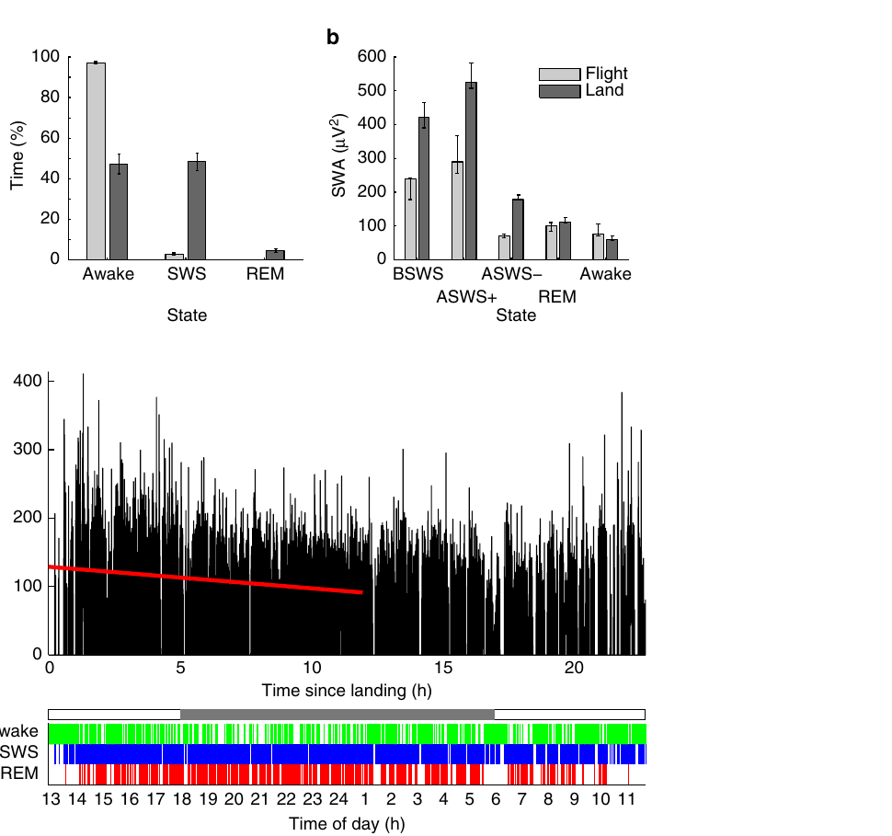
Airborne sleep is much shorter than sleep on land
Frigatebirds slept for about 0.69 h per day while airborne, approximately 41 min. This was only about 7.4% of the time spent sleeping on land. The birds therefore did not preserve their usual daily sleep duration by distributing a full land-like sleep quota into flight.
Airborne sleep was also shallower, with lower slow-wave intensity than on land. After landing, the birds expressed much more sleep, and the recorded slow-wave pattern changed across the subsequent rest period. Sleep amount and sleep intensity are separate measurements of this contrast.
The flight record was dominated by waking despite the ability to sleep asymmetrically. The authors interpreted the ecological demand for attention as often exceeding the vigilance available during half-brain sleep. A capacity to sleep while moving does not imply that the animal uses that capacity for most of its journey.
Rattenborg et al. (2016), Fig. 4(a–c). Sleep allocation and slow-wave activity during flight and after landing.
Rattenborg et al. (2016)
36
Notes:
• Frigatebirds slept for about 0.69 h per day while airborne, approximately 41 min. This was only about 7.4% of the time spent sleeping on land. The birds therefore did not preserve their usual daily sleep duration by distributing a full land-like sleep quota into flight.
• Airborne sleep was also shallower, with lower slow-wave intensity than on land. After landing, the birds expressed much more sleep, and the recorded slow-wave pattern changed across the subsequent rest period. Sleep amount and sleep intensity are separate measurements of this contrast.
• The flight record was dominated by waking despite the ability to sleep asymmetrically. The authors interpreted the ecological demand for attention as often exceeding the vigilance available during half-brain sleep. A capacity to sleep while moving does not imply that the animal uses that capacity for most of its journey.
• The reduced flight sleep is a measured natural behavioral state, not a forced laboratory deprivation schedule. The study did not experimentally determine which specific ecological event prevented each potential sleep episode.
References:
Rattenborg NC, Voirin B, Cruz SM, Tisdale R, Dell'Omo G, Lipp HP, Wikelski M, Vyssotski AL. (2016). Evidence that birds sleep in mid-flight. Nature communications 7:12468. https://doi.org/10.1038/ncomms12468
Figure: Rattenborg et al. (2016), Fig. 4(a–c). Sleep allocation and slow-wave activity during flight and after landing.
Figure source: https://doi.org/10.1038/ncomms12468

Slide 37
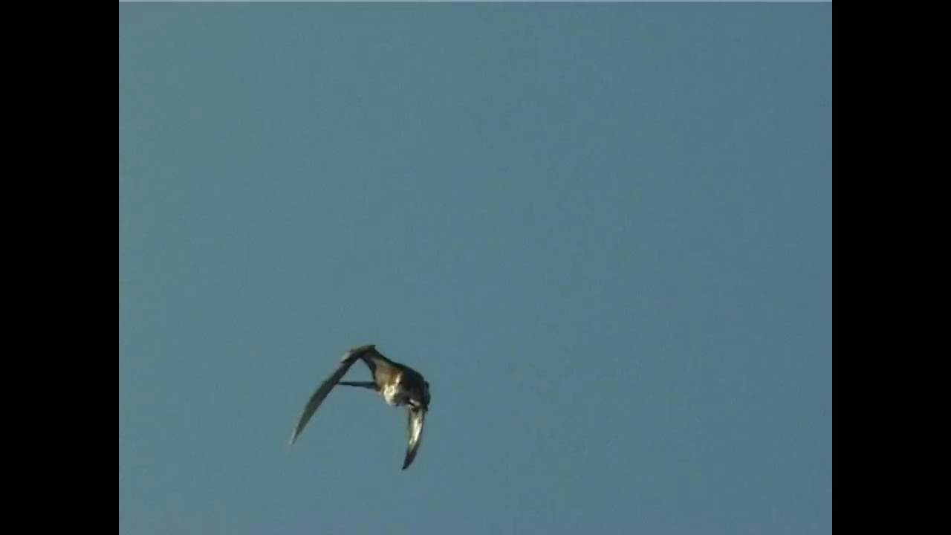
Brief REM-like episodes occur during flight
Frigatebird slow-wave episodes occasionally shifted into brief activated EEG patterns accompanied by head dropping and twitching. The investigators classified these as apparent REM episodes because the combination resembled REM recorded after the birds returned to land.
The wings continued to support flight while the head could lose its usual posture. Changes in head orientation therefore need not imply a complete loss of aerial control. The coordinated electrical and acceleration records distinguished these short episodes from the longer slow-wave state.
A supplementary recording of a preening juvenile magnificent frigatebird includes a brief downward drop when the awake bird pulls in a wing. Dropping and head movements can occur in several behavioral conditions. Their interpretation depends on the accompanying neural record, rather than on a single visible movement.
Rattenborg et al. (2016), Fig. 2(a–b). Flight EEG and head movement around sleeping episodes.
Rattenborg et al. (2016), Supplementary Movie 4. Awake preening and a brief drop while preening in a juvenile magnificent frigatebird.
Rattenborg et al. (2016)
37
Notes:
• Frigatebird slow-wave episodes occasionally shifted into brief activated EEG patterns accompanied by head dropping and twitching. The investigators classified these as apparent REM episodes because the combination resembled REM recorded after the birds returned to land.
• The wings continued to support flight while the head could lose its usual posture. Changes in head orientation therefore need not imply a complete loss of aerial control. The coordinated electrical and acceleration records distinguished these short episodes from the longer slow-wave state.
• A supplementary recording of a preening juvenile magnificent frigatebird includes a brief downward drop when the awake bird pulls in a wing. Dropping and head movements can occur in several behavioral conditions. Their interpretation depends on the accompanying neural record, rather than on a single visible movement.
• Supplementary Movie 4 concerns Fregata magnificens, whereas the flight-EEG study concerns Fregata minor. It is an awake preening example, not an EEG-confirmed REM episode. This species and condition distinction must be maintained when teaching the clip.
References:
Rattenborg NC, Voirin B, Cruz SM, Tisdale R, Dell'Omo G, Lipp HP, Wikelski M, Vyssotski AL. (2016). Evidence that birds sleep in mid-flight. Nature communications 7:12468. https://doi.org/10.1038/ncomms12468
Figure: Rattenborg et al. (2016), Fig. 2(a–b). Flight EEG and head movement around sleeping episodes.
Figure source: https://doi.org/10.1038/ncomms12468
Article-provided recording: Rattenborg et al. (2016), Supplementary Movie 4. Awake preening and a brief drop while preening in a juvenile magnificent frigatebird.
• Awake preening and a wing drop in a juvenile magnificent frigatebird. The awake preening clip is not an EEG-confirmed sleep recording.
Article DOI: https://doi.org/10.1038/ncomms12468
Original media URL: https://pmc-oa-opendata.s3.amazonaws.com/PMC4976198.1/ncomms12468-s5.avi
Credit: Rattenborg NC, Voirin B, Cruz SM, Tisdale R, Dell'Omo G, Lipp HP, Wikelski M, Vyssotski AL. Original Movie 4 recorded by Giacomo Dell’Omo (G.D’O.), as credited in the supplement.
License: Creative Commons Attribution 4.0 International, as supplied with the article.
Compatibility: H.264/yuv420p MP4 conversion; original dimensions, timing, scene, and audio retained. No overlays, recoloring, or speed changes. Unedited source frame provides the poster.
Playback: click the recording in PowerPoint Slide Show. The credited original article figure remains a static fallback. Full media decode and embedded relationships were checked; interactive PowerPoint playback was unavailable in this environment.

Slide 38
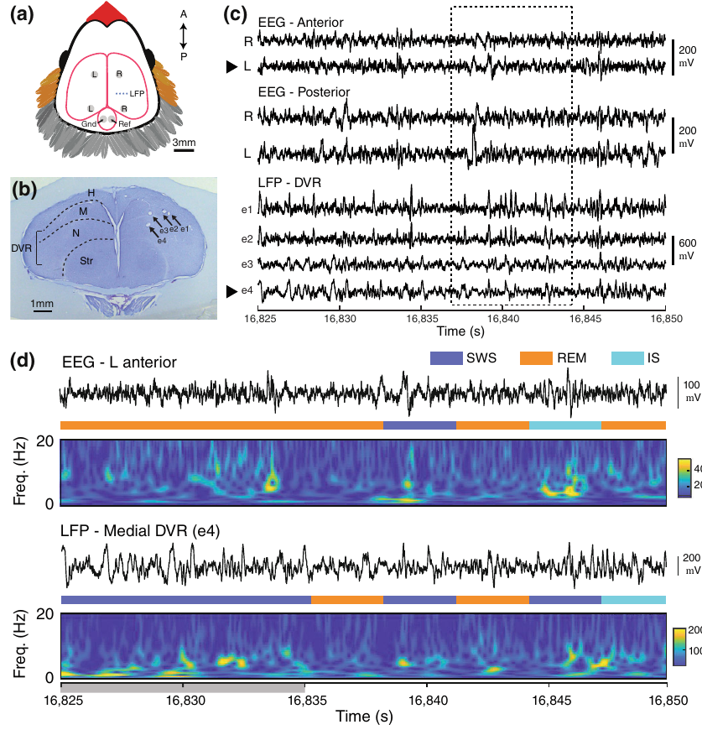
Bird sleep states extend across pallial regions
The pallium is the broad forebrain territory containing much of the circuitry for sensory processing and higher integration in birds. Its organization differs from the layered mammalian neocortex. Zebra-finch recordings sampled both surface EEG and signals from deeper pallial sites.
A local field potential, or LFP, measures extracellular voltage near an implanted electrode. Yeganegi and Ondracek recorded from the dorsal ventricular ridge, a group of deeper pallial structures, as well as the hyperpallium. Each site was scored independently rather than being assigned a state solely from the surface EEG.
Sleep classifications could differ across simultaneously recorded locations. Some deeper sites shared temporal state patterns more closely with one another than with surface recordings. Local differences therefore occurred within the avian forebrain even without an experimental manipulation of preceding visual experience.
Yeganegi et al. (2025), Fig. 1(a–d). Pallial recording anatomy and simultaneous zebra-finch electrical signals.
Yeganegi et al. (2025)
38
Notes:
• The pallium is the broad forebrain territory containing much of the circuitry for sensory processing and higher integration in birds. Its organization differs from the layered mammalian neocortex. Zebra-finch recordings sampled both surface EEG and signals from deeper pallial sites.
• A local field potential, or LFP, measures extracellular voltage near an implanted electrode. Yeganegi and Ondracek recorded from the dorsal ventricular ridge, a group of deeper pallial structures, as well as the hyperpallium. Each site was scored independently rather than being assigned a state solely from the surface EEG.
• Sleep classifications could differ across simultaneously recorded locations. Some deeper sites shared temporal state patterns more closely with one another than with surface recordings. Local differences therefore occurred within the avian forebrain even without an experimental manipulation of preceding visual experience.
• The study recorded natural sleep without selectively recruiting one region beforehand. Its result extends local sleep organization beyond the deprivation-and-visual-use manipulation in pigeons.
References:
Yeganegi H, Ondracek JM. (2025). Local sleep in songbirds: different simultaneous sleep states across the avian pallium. Journal of sleep research 34:e14344. https://doi.org/10.1111/jsr.14344
Figure: Yeganegi et al. (2025), Fig. 1(a–d). Pallial recording anatomy and simultaneous zebra-finch electrical signals.
Figure source: https://doi.org/10.1111/jsr.14344

Slide 39
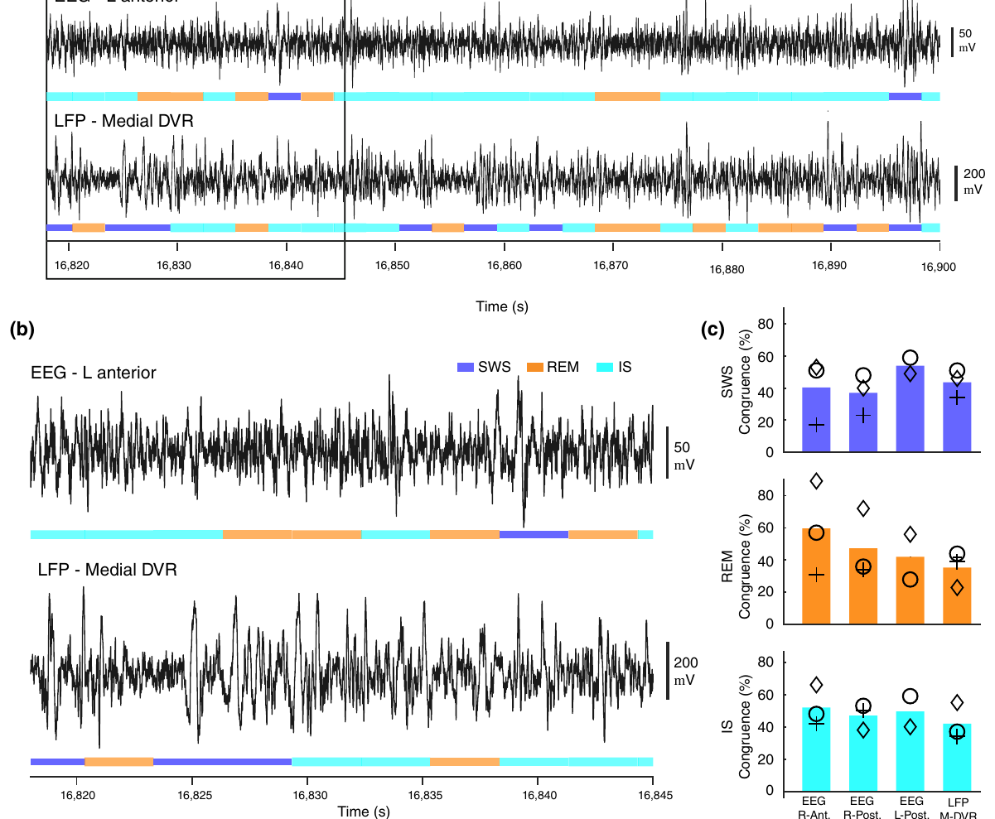
Songbird regions can enter different sleep states
Simultaneous zebra-finch recordings contained intervals in which different pallial sites met different sleep-stage criteria. A surface hyperpallial signal and a deeper dorsal-ventricular-ridge signal could diverge in their slow-wave or activated electrical patterns within the same time interval.
Independent scoring preserved these mismatches. Assigning every site the stage detected at one electrode would instead erase regional differences by definition. The experiment compared the timing of transitions across locations as well as the frequency content of their electrical activity.
The resulting state congruence, agreement in sleep classification between sites, varied with anatomical location. Deeper sites had a strong role in the timing of shared states. Brain-wide labels therefore summarize a dominant pattern while local recordings retain transitions and states expressed by particular neural territories.
Yeganegi et al. (2025), Fig. 3(a–c). Differences between hyperpallial and deeper local electrical patterns.
Yeganegi et al. (2025), Fig. 1(a–d). Positions of simultaneous pallial recordings.
Yeganegi et al. (2025)
39
Notes:
• Simultaneous zebra-finch recordings contained intervals in which different pallial sites met different sleep-stage criteria. A surface hyperpallial signal and a deeper dorsal-ventricular-ridge signal could diverge in their slow-wave or activated electrical patterns within the same time interval.
• Independent scoring preserved these mismatches. Assigning every site the stage detected at one electrode would instead erase regional differences by definition. The experiment compared the timing of transitions across locations as well as the frequency content of their electrical activity.
• The resulting state congruence, agreement in sleep classification between sites, varied with anatomical location. Deeper sites had a strong role in the timing of shared states. Brain-wide labels therefore summarize a dominant pattern while local recordings retain transitions and states expressed by particular neural territories.
• The electrical mismatch is a measured regional property. It does not require the claim that a bird consciously experiences multiple states at once, which was not tested.
References:
Yeganegi H, Ondracek JM. (2025). Local sleep in songbirds: different simultaneous sleep states across the avian pallium. Journal of sleep research 34:e14344. https://doi.org/10.1111/jsr.14344
Figure: Yeganegi et al. (2025), Fig. 3(a–c). Differences between hyperpallial and deeper local electrical patterns.
Figure source: https://doi.org/10.1111/jsr.14344
Figure: Yeganegi et al. (2025), Fig. 1(a–d). Positions of simultaneous pallial recordings.
Figure source: https://doi.org/10.1111/jsr.14344

Slide 40
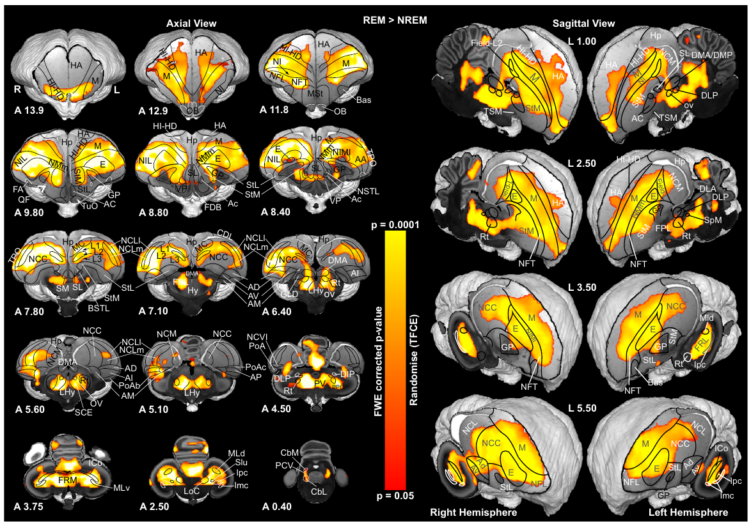
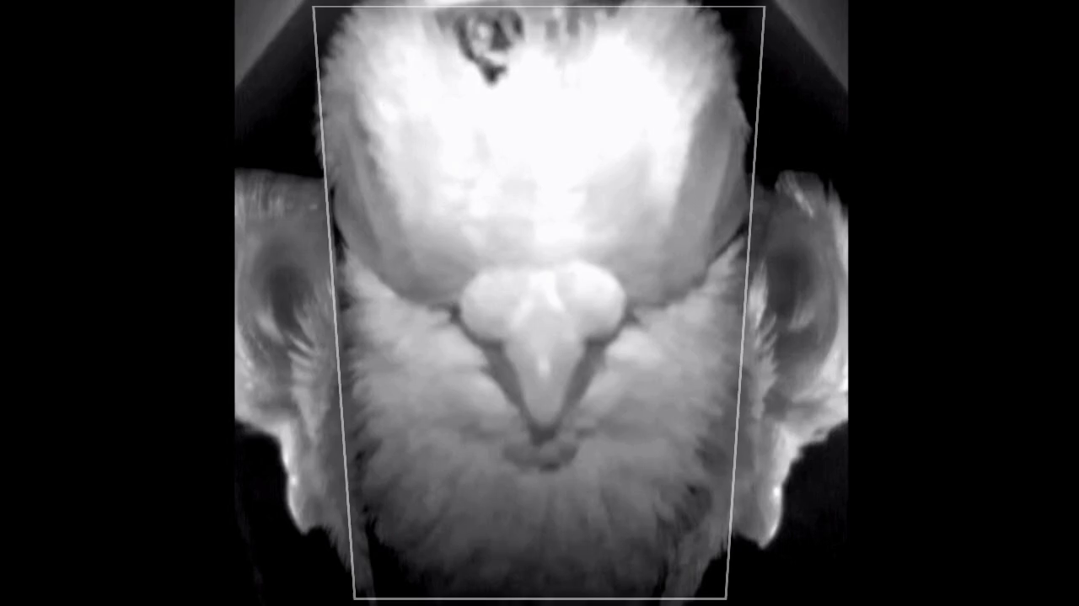
Pigeon REM activates broad brain territories
Functional magnetic resonance imaging, or fMRI, measures changes in signals associated with blood oxygenation and flow. The BOLD signal, blood-oxygen-level-dependent signal, supplies an indirect measure of neural activity. Naturally sleeping pigeons were habituated to head fixation within the scanner.
REM sleep produced widespread increases in BOLD signal relative to NREM sleep, including regions involved in visual processing. Eye and beak observations supported sleep-state classification. The original supplementary recording captures transitions marked by pupil constriction and rapid eye and bill movements.
Cerebrospinal fluid, or CSF, surrounds the brain and occupies its ventricles. Ventricular CSF flow increased during NREM relative to waking but dropped during REM. Neural activation and fluid-flow measures consequently changed in different directions across the two sleep states.
Ungurean et al. (2023), Fig. 2(a–b). Brain-wide REM-associated BOLD activation in sleeping pigeons.
Ungurean et al. (2023), Supplementary Movie 1. A head-fixed pigeon cycles between NREM and REM during fMRI.
Ungurean et al. (2023)
40
Notes:
• Functional magnetic resonance imaging, or fMRI, measures changes in signals associated with blood oxygenation and flow. The BOLD signal, blood-oxygen-level-dependent signal, supplies an indirect measure of neural activity. Naturally sleeping pigeons were habituated to head fixation within the scanner.
• REM sleep produced widespread increases in BOLD signal relative to NREM sleep, including regions involved in visual processing. Eye and beak observations supported sleep-state classification. The original supplementary recording captures transitions marked by pupil constriction and rapid eye and bill movements.
• Cerebrospinal fluid, or CSF, surrounds the brain and occupies its ventricles. Ventricular CSF flow increased during NREM relative to waking but dropped during REM. Neural activation and fluid-flow measures consequently changed in different directions across the two sleep states.
• The article does not measure dream content or waste removal directly. Its measurements concern sleep-associated BOLD activation and ventricular CSF flow. Supplementary Movie 1 shows the original head-fixed bird cycling between NREM and REM.
References:
Ungurean G, Behroozi M, Böger L, Helluy X, Libourel PA, Güntürkün O, Rattenborg NC. (2023). Wide-spread brain activation and reduced CSF flow during avian REM sleep. Nature communications 14:3259. https://doi.org/10.1038/s41467-023-38669-1
Figure: Ungurean et al. (2023), Fig. 2(a–b). Brain-wide REM-associated BOLD activation in sleeping pigeons.
Figure source: https://doi.org/10.1038/s41467-023-38669-1
Article-provided recording: Ungurean et al. (2023), Supplementary Movie 1. A head-fixed pigeon cycles between NREM and REM during fMRI.
• A head-fixed pigeon cycles between NREM and REM during fMRI. Pupil constriction, rapid eye movements, and bill movements accompany REM; the recording begins and ends in NREM.
Article DOI: https://doi.org/10.1038/s41467-023-38669-1
Original media URL: https://pmc-oa-opendata.s3.amazonaws.com/PMC10241905.1/41467_2023_38669_MOESM4_ESM.mp4
Credit: Ungurean G, Behroozi M, Böger L, Helluy X, Libourel PA, Güntürkün O, Rattenborg NC.
License: Creative Commons Attribution 4.0 International, as supplied with the article.
Compatibility: H.264/yuv420p MP4 conversion; original dimensions, timing, scene, and audio retained. No overlays, recoloring, or speed changes. Unedited source frame provides the poster.
Playback: click the recording in PowerPoint Slide Show. The credited original article figure remains a static fallback. Full media decode and embedded relationships were checked; interactive PowerPoint playback was unavailable in this environment.

Slide 41
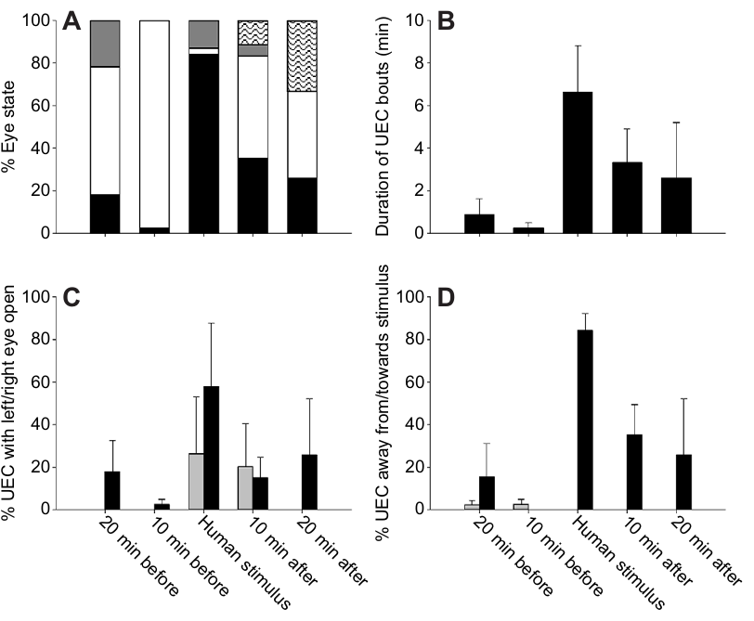
Crocodiles direct one open eye toward intruders
Juvenile saltwater crocodiles sometimes rested with one eye closed and the other open. Unilateral eye closure describes this visible behavior without assigning an electrical sleep state. Kelly and colleagues compared ordinary rest with exposure to another crocodile or to a human.
The crocodiles directed the available eye preferentially toward the nearby animal or human. Human presence also increased unilateral-eye-closure behavior, and the effect persisted after the person withdrew. The resting animal changed its sensory orientation according to a stimulus in its surroundings.
This study used behavioral observations without bilateral EEG, so it establishes directed eye use rather than confirmed unihemispheric sleep. The distinction changes the cross-species comparison: crocodiles share a vigilance-related eye pattern with birds and marine mammals, while the neural state underlying that pattern remains a separate measurement.
Kelly et al. (2015), Fig. 2(A–D). Eye-state duration and orientation around social and human stimuli.
Kelly et al. (2015)
41
Notes:
• Juvenile saltwater crocodiles sometimes rested with one eye closed and the other open. Unilateral eye closure describes this visible behavior without assigning an electrical sleep state. Kelly and colleagues compared ordinary rest with exposure to another crocodile or to a human.
• The crocodiles directed the available eye preferentially toward the nearby animal or human. Human presence also increased unilateral-eye-closure behavior, and the effect persisted after the person withdrew. The resting animal changed its sensory orientation according to a stimulus in its surroundings.
• This study used behavioral observations without bilateral EEG, so it establishes directed eye use rather than confirmed unihemispheric sleep. The distinction changes the cross-species comparison: crocodiles share a vigilance-related eye pattern with birds and marine mammals, while the neural state underlying that pattern remains a separate measurement.
• The absence of EEG changes the classification of the evidence and therefore belongs in the teaching content. Resting eye behavior alone should not be used to add crocodiles to an electrophysiologically confirmed USWS list.
References:
Kelly ML, Peters RA, Tisdale RK, Lesku JA. (2015). Unihemispheric sleep in crocodilians? The Journal of experimental biology 218:3175-3178. https://doi.org/10.1242/jeb.127605
Figure: Kelly et al. (2015), Fig. 2(A–D). Eye-state duration and orientation around social and human stimuli.
Figure source: https://doi.org/10.1242/jeb.127605

Slide 42
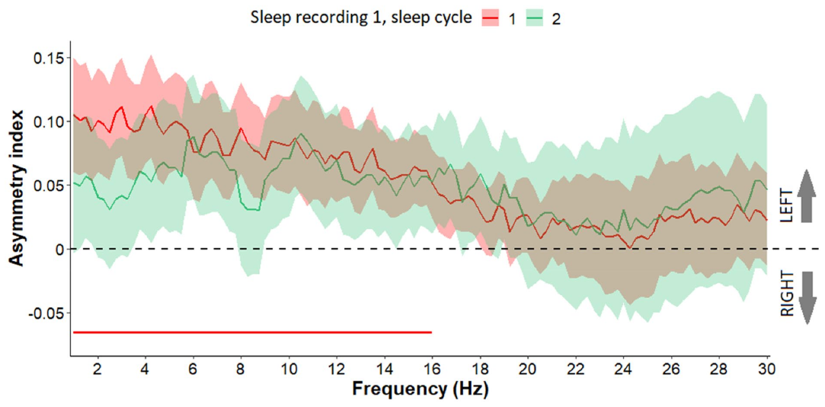
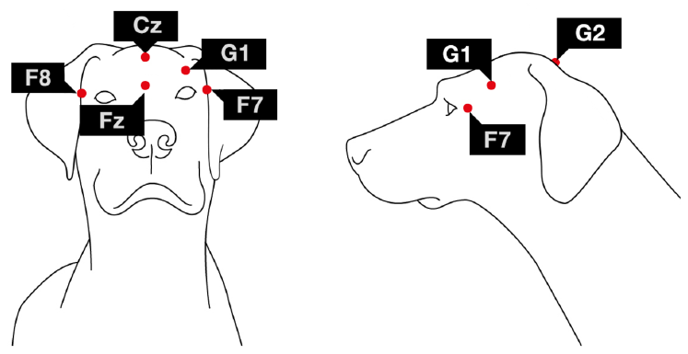
Dogs show smaller NREM hemispheric differences
Family dogs slept during afternoon recordings at the same location on two occasions. Polysomnography combines measurements such as EEG, eye activity, and muscle signals to classify sleep. Bilateral channels permitted comparison of left and right activity during NREM sleep.
In the first sleep cycle of the first recording, low-frequency activity was stronger on the left. This directional difference was reduced in the corresponding cycle of the second recording. Other frequency ranges changed in the strength of asymmetry between successive sleep cycles.
The dogs’ pattern was a difference within NREM sleep rather than the pronounced sleep-versus-wake division found in dolphins. It also differed from the human first-night pattern in its direction and dynamics. Comparative sleep asymmetry includes several neural organizations rather than one universal half-brain strategy.
Reicher et al. (2021), Fig. 3. Dog NREM asymmetry across the first and second sleep cycles.
Reicher et al. (2021), Fig. 1. Noninvasive bilateral recording positions in dogs.
Reicher et al. (2021)
42
Notes:
• Family dogs slept during afternoon recordings at the same location on two occasions. Polysomnography combines measurements such as EEG, eye activity, and muscle signals to classify sleep. Bilateral channels permitted comparison of left and right activity during NREM sleep.
• In the first sleep cycle of the first recording, low-frequency activity was stronger on the left. This directional difference was reduced in the corresponding cycle of the second recording. Other frequency ranges changed in the strength of asymmetry between successive sleep cycles.
• The dogs’ pattern was a difference within NREM sleep rather than the pronounced sleep-versus-wake division found in dolphins. It also differed from the human first-night pattern in its direction and dynamics. Comparative sleep asymmetry includes several neural organizations rather than one universal half-brain strategy.
• The dogs were measured during 3 h afternoon opportunities. The study discusses adaptation-like processes, but it did not test predator surveillance or demonstrate that one hemisphere remained awake.
References:
Reicher V, Kis A, Simor P, Bódizs R, Gácsi M. (2021). Interhemispheric asymmetry during NREM sleep in the dog. Scientific reports 11:18817. https://doi.org/10.1038/s41598-021-98178-3
Figure: Reicher et al. (2021), Fig. 3. Dog NREM asymmetry across the first and second sleep cycles.
Figure source: https://doi.org/10.1038/s41598-021-98178-3
Figure: Reicher et al. (2021), Fig. 1. Noninvasive bilateral recording positions in dogs.
Figure source: https://doi.org/10.1038/s41598-021-98178-3

Slide 43


Human first-night sleep includes asymmetric responses
The first-night effect is altered sleep when a person initially sleeps in an unfamiliar recording environment. Tamaki and colleagues combined sleep recordings with source-localized measurements of brain activity. During the first night, slow-wave activity was lower on the left within one tested network than on the right.
The asymmetry was reduced on the second recording night. Unusual sounds also produced stronger left-sided responses on the first night, with more awakenings in trials favoring that side. Standard repeated sounds did not produce the same hemispheric difference in response.
This was a regional difference during sleep rather than an entire waking hemisphere. The authors proposed a night-watch hypothesis, in which asymmetric reactivity contributes to environmental monitoring in an unfamiliar setting. Familiarity changed both the slow-wave difference and the response to unusual sensory events.
Tamaki et al. (2016), Fig. 1(A–C). First- and second-night slow-wave asymmetry and sleep-onset relationships.
Tamaki et al. (2016), Fig. 2(A–B). Responses to deviant and standard sounds across nights.
Tamaki et al. (2016)
43
Notes:
• The first-night effect is altered sleep when a person initially sleeps in an unfamiliar recording environment. Tamaki and colleagues combined sleep recordings with source-localized measurements of brain activity. During the first night, slow-wave activity was lower on the left within one tested network than on the right.
• The asymmetry was reduced on the second recording night. Unusual sounds also produced stronger left-sided responses on the first night, with more awakenings in trials favoring that side. Standard repeated sounds did not produce the same hemispheric difference in response.
• This was a regional difference during sleep rather than an entire waking hemisphere. The authors proposed a night-watch hypothesis, in which asymmetric reactivity contributes to environmental monitoring in an unfamiliar setting. Familiarity changed both the slow-wave difference and the response to unusual sensory events.
• The sleep asymmetry was region-specific rather than a global waking state on one side. Deviant and standard sounds separated responses to unusual events from responses to repetition. No actual predator threat was tested.
References:
Tamaki M, Bang JW, Watanabe T, Sasaki Y. (2016). Night Watch in One Brain Hemisphere during Sleep Associated with the First-Night Effect in Humans. Current biology : CB 26:1190-1194. https://doi.org/10.1016/j.cub.2016.02.063
Figure: Tamaki et al. (2016), Fig. 1(A–C). First- and second-night slow-wave asymmetry and sleep-onset relationships.
Figure source: https://doi.org/10.1016/j.cub.2016.02.063
Figure: Tamaki et al. (2016), Fig. 2(A–B). Responses to deviant and standard sounds across nights.
Figure source: https://doi.org/10.1016/j.cub.2016.02.063

Slide 44


Detection and awakening measure different operations
An auditory oddball sequence contains common standard sounds interrupted by less frequent deviant sounds. During slow-wave sleep, the human experiment presented these sounds to one ear at a time. Unusual sounds evoked different responses from repeated standards.
First-night awakenings were more common for trials favoring left-hemisphere processing. In a behavioral experiment, participants tapped a finger after awakening to a deviant sound. Faster overall responses on the first night reflected earlier awakening rather than a shorter motor delay after awakening.
The sequence separates several operations: sensory-evoked brain activity, transition out of sleep, and an instructed action after awakening. A response recorded during sleep is therefore distinct from conscious reporting after the sleeper becomes awake. The timing of each measurement determines which operation the experiment identifies.
Tamaki et al. (2016), Fig. 4(A–B). Awakening frequency and behavioral response timing.
Tamaki et al. (2016), Fig. 3(A–B). Arousal differences across hemispheric trials and recording nights.
Tamaki et al. (2016)
44
Notes:
• An auditory oddball sequence contains common standard sounds interrupted by less frequent deviant sounds. During slow-wave sleep, the human experiment presented these sounds to one ear at a time. Unusual sounds evoked different responses from repeated standards.
• First-night awakenings were more common for trials favoring left-hemisphere processing. In a behavioral experiment, participants tapped a finger after awakening to a deviant sound. Faster overall responses on the first night reflected earlier awakening rather than a shorter motor delay after awakening.
• The sequence separates several operations: sensory-evoked brain activity, transition out of sleep, and an instructed action after awakening. A response recorded during sleep is therefore distinct from conscious reporting after the sleeper becomes awake. The timing of each measurement determines which operation the experiment identifies.
• The study sampled the first sleep cycle. It did not establish all-night alternation between hemispheres. Participants’ finger responses occurred after awakening and should not be described as reports made while still asleep.
References:
Tamaki M, Bang JW, Watanabe T, Sasaki Y. (2016). Night Watch in One Brain Hemisphere during Sleep Associated with the First-Night Effect in Humans. Current biology : CB 26:1190-1194. https://doi.org/10.1016/j.cub.2016.02.063
Figure: Tamaki et al. (2016), Fig. 4(A–B). Awakening frequency and behavioral response timing.
Figure source: https://doi.org/10.1016/j.cub.2016.02.063
Figure: Tamaki et al. (2016), Fig. 3(A–B). Arousal differences across hemispheric trials and recording nights.
Figure source: https://doi.org/10.1016/j.cub.2016.02.063

Slide 45
Local sleep changes the meaning of a whole-brain label
Unihemispheric sleep divides the dominant electrical state across the cerebral midline. Regional sleep differences can also occur within a hemisphere or between surface and deeper sites. Fur-seal and zebra-finch recordings reveal these spatial differences when several locations are measured simultaneously.
Behavior provides another level of organization. Frigatebirds continue aerodynamic movement during both asymmetric and bilateral sleep; mallards can respond to looming threats during an asymmetric episode. Movement, sensory responsiveness, and slow-wave activity therefore describe different components of an animal’s state.
Consciousness concerns experience, while EEG, transmitter release, eye opening, and task responses are measured physiological or behavioral variables. The studies constrain which processes continue during sleep and where sleep-related activity occurs. They support a spatially distributed account of state without supplying a direct measure of another animal’s subjective experience.
Yeganegi et al. (2025), Fig. 1(a–d). Simultaneous local recordings across the avian pallium.
Rattenborg et al. (2016), Fig. 3(a–e). Flight direction and hemispheric electrical asymmetry.
Lyamin et al. (2012); Yeganegi et al. (2025); Rattenborg et al. (2016)
45
Notes:
• Unihemispheric sleep divides the dominant electrical state across the cerebral midline. Regional sleep differences can also occur within a hemisphere or between surface and deeper sites. Fur-seal and zebra-finch recordings reveal these spatial differences when several locations are measured simultaneously.
• Behavior provides another level of organization. Frigatebirds continue aerodynamic movement during both asymmetric and bilateral sleep; mallards can respond to looming threats during an asymmetric episode. Movement, sensory responsiveness, and slow-wave activity therefore describe different components of an animal’s state.
• Consciousness concerns experience, while EEG, transmitter release, eye opening, and task responses are measured physiological or behavioral variables. The studies constrain which processes continue during sleep and where sleep-related activity occurs. They support a spatially distributed account of state without supplying a direct measure of another animal’s subjective experience.
• The boundaries established here are boundaries between measured neural states and retained functions. Claims about subjective experience require evidence beyond the measurements made in these papers.
References:
Lyamin OI, Pavlova IF, Kosenko PO, Mukhametov LM, Siegel JM. (2012). Regional differences in cortical electroencephalogram (EEG) slow wave activity and interhemispheric EEG asymmetry in the fur seal. Journal of sleep research 21:603-611. https://doi.org/10.1111/j.1365-2869.2012.01023.x
Yeganegi H, Ondracek JM. (2025). Local sleep in songbirds: different simultaneous sleep states across the avian pallium. Journal of sleep research 34:e14344. https://doi.org/10.1111/jsr.14344
Rattenborg NC, Voirin B, Cruz SM, Tisdale R, Dell'Omo G, Lipp HP, Wikelski M, Vyssotski AL. (2016). Evidence that birds sleep in mid-flight. Nature communications 7:12468. https://doi.org/10.1038/ncomms12468
Figure: Yeganegi et al. (2025), Fig. 1(a–d). Simultaneous local recordings across the avian pallium.
Figure source: https://doi.org/10.1111/jsr.14344
Figure: Rattenborg et al. (2016), Fig. 3(a–e). Flight direction and hemispheric electrical asymmetry.
Figure source: https://doi.org/10.1038/ncomms12468

Slide 46
Key takeaways
Hemispheric state. Unihemispheric slow-wave sleep combines stronger slow waves on one side with waking-like activity on the other. Bilateral EEG distinguishes this state from eye closure alone.
Comparative anatomy. Cetaceans retain familiar cholinergic, monoaminergic, and orexinergic systems. Anatomical differences supply mechanistic hypotheses, while chemical release and EEG measure physiological state.
Chemical specificity. Fur-seal cortical acetylcholine is lateralized with EEG activation; measured serotonin, noradrenaline, and histamine do not acquire the same consistent hemispheric separation.
Vigilance and sleep pressure. Mallards adjust sleep and eye direction to group exposure. Prior visual use changes local pigeon sleep, while higher jackdaw sleep pressure favors more symmetric sleep.
Aquatic and aerial alternatives. Fur seals favor asymmetric surface sleep, elephant seals sleep bilaterally during deep dives, and frigatebirds express both forms during flight while greatly reducing daily sleep.
Neural boundaries. Local EEG state, ongoing movement, sensory responses, awakening, and conscious reporting are different measurements. Cross-species comparisons preserve these distinctions.
Primary studies cited throughout
46
Notes:
Rattenborg NC, Lima SL, Amlaner CJ. (1999). Half-awake to the risk of predation. Nature 397:397-398. https://doi.org/10.1038/17037
Branstetter BK, Finneran JJ, Fletcher EA, Weisman BC, Ridgway SH. (2012). Dolphins can maintain vigilant behavior through echolocation for 15 days without interruption or cognitive impairment. PloS one 7:e47478. https://doi.org/10.1371/journal.pone.0047478
Lapierre JL, Kosenko PO, Lyamin OI, Kodama T, Mukhametov LM, Siegel JM. (2007). Cortical acetylcholine release is lateralized during asymmetrical slow-wave sleep in northern fur seals. The Journal of neuroscience : the official journal of the Society for Neuroscience 27:11999-12006. https://doi.org/10.1523/JNEUROSCI.2968-07.2007
Lyamin OI, Lapierre JL, Kosenko PO, Kodama T, Bhagwandin A, Korneva SM, Peever JH, Mukhametov LM, Siegel JM. (2016). Monoamine Release during Unihemispheric Sleep and Unihemispheric Waking in the Fur Seal. Sleep 39:625-636. https://doi.org/10.5665/sleep.5540
Kendall-Bar JM, Vyssotski AL, Mukhametov LM, Siegel JM, Lyamin OI. (2019). Eye state asymmetry during aquatic unihemispheric slow wave sleep in northern fur seals (Callorhinus ursinus). PloS one 14:e0217025. https://doi.org/10.1371/journal.pone.0217025
Lyamin OI, Pavlova IF, Kosenko PO, Mukhametov LM, Siegel JM. (2012). Regional differences in cortical electroencephalogram (EEG) slow wave activity and interhemispheric EEG asymmetry in the fur seal. Journal of sleep research 21:603-611. https://doi.org/10.1111/j.1365-2869.2012.01023.x
Lyamin OI, Kosenko PO, Korneva SM, Vyssotski AL, Mukhametov LM, Siegel JM. (2018). Fur Seals Suppress REM Sleep for Very Long Periods without Subsequent Rebound. Current biology : CB 28:2000-2005.e2. https://doi.org/10.1016/j.cub.2018.05.022
Rattenborg NC, Voirin B, Cruz SM, Tisdale R, Dell'Omo G, Lipp HP, Wikelski M, Vyssotski AL. (2016). Evidence that birds sleep in mid-flight. Nature communications 7:12468. https://doi.org/10.1038/ncomms12468
Lesku JA, Vyssotski AL, Martinez-Gonzalez D, Wilzeck C, Rattenborg NC. (2011). Local sleep homeostasis in the avian brain: convergence of sleep function in mammals and birds? Proceedings. Biological sciences 278:2419-2428. https://doi.org/10.1098/rspb.2010.2316
Dell LA, Patzke N, Spocter MA, Siegel JM, Manger PR. (2016). Organization of the sleep-related neural systems in the brain of the harbour porpoise (Phocoena phocoena). The Journal of comparative neurology 524:1999-2017. https://doi.org/10.1002/cne.23929
Wright AK, Theilmann RJ, Ridgway SH, Scadeng M. (2018). Diffusion tractography reveals pervasive asymmetry of cerebral white matter tracts in the bottlenose dolphin (Tursiops truncatus). Brain structure & function 223:1697-1711. https://doi.org/10.1007/s00429-017-1525-9
Tamaki M, Bang JW, Watanabe T, Sasaki Y. (2016). Night Watch in One Brain Hemisphere during Sleep Associated with the First-Night Effect in Humans. Current biology : CB 26:1190-1194. https://doi.org/10.1016/j.cub.2016.02.063
Kelly ML, Peters RA, Tisdale RK, Lesku JA. (2015). Unihemispheric sleep in crocodilians? The Journal of experimental biology 218:3175-3178. https://doi.org/10.1242/jeb.127605
van Hasselt SJ, Martinez-Gonzalez D, Mekenkamp GJ, Vyssotski AL, Verhulst S, Beckers GJL, Rattenborg NC, Meerlo P. (2025). Sleep pressure causes birds to trade asymmetric sleep for symmetric sleep. Current biology : CB 35:1918-1926.e3. https://doi.org/10.1016/j.cub.2025.03.008
Yeganegi H, Ondracek JM. (2025). Local sleep in songbirds: different simultaneous sleep states across the avian pallium. Journal of sleep research 34:e14344. https://doi.org/10.1111/jsr.14344
Kendall-Bar JM, Williams TM, Mukherji R, Lozano DA, Pitman JK, Holser RR, Keates T, Beltran RS, Robinson PW, Crocker DE, Adachi T, Lyamin OI, Vyssotski AL, Costa DP. (2023). Brain activity of diving seals reveals short sleep cycles at depth. Science (New York, N.Y.) 380:260-265. https://doi.org/10.1126/science.adf0566
Ungurean G, Behroozi M, Böger L, Helluy X, Libourel PA, Güntürkün O, Rattenborg NC. (2023). Wide-spread brain activation and reduced CSF flow during avian REM sleep. Nature communications 14:3259. https://doi.org/10.1038/s41467-023-38669-1
Rattenborg NC, Lima SL, Amlaner CJ. (1999). Facultative control of avian unihemispheric sleep under the risk of predation. Behavioural brain research 105:163-172. https://doi.org/10.1016/s0166-4328(99)00070-4
Mukhametov LM, Supin AY, Polyakova IG. (1977). Interhemispheric asymmetry of the electroencephalographic sleep patterns in dolphins. Brain research 134:581-584. https://doi.org/10.1016/0006-8993(77)90835-6
Reicher V, Kis A, Simor P, Bódizs R, Gácsi M. (2021). Interhemispheric asymmetry during NREM sleep in the dog. Scientific reports 11:18817. https://doi.org/10.1038/s41598-021-98178-3
Dell LA, Patzke N, Bhagwandin A, Bux F, Fuxe K, Barber G, Siegel JM, Manger PR. (2012). Organization and number of orexinergic neurons in the hypothalamus of two species of Cetartiodactyla: A comparison of giraffe (Giraffa camelopardalis) and harbour porpoise (Phocoena phocoena). Journal of Chemical Neuroanatomy 44:98–109. https://doi.org/10.1016/j.jchemneu.2012.06.001

