Slide 1
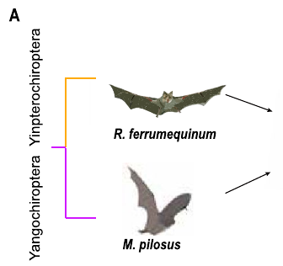
NEUR 411 · NEUROETHOLOGY · FALL 2026
Lecture 16
Bat echolocation I:
CF-FM bats and Doppler-shift compensation (Suga)
Wednesday, September 30, 2026
Jordan Lopez, Ph.D.
Professor of Neurobiology & Biomedical Engineering
Wang et al. (2025), Fig. 1(A). CF and FM study bats.
Notes:
Bat echolocation I: CF-FM bats and Doppler-shift compensation (Suga)
Lecture 16. NEUR 411 · NEUROETHOLOGY · FALL 2026. Wednesday, September 30, 2026.
Figure: Wang et al. (2025), Fig. 1(A). CF and FM study bats.
Figure source: https://doi.org/10.1111/1755-0998.14101

Slide 2
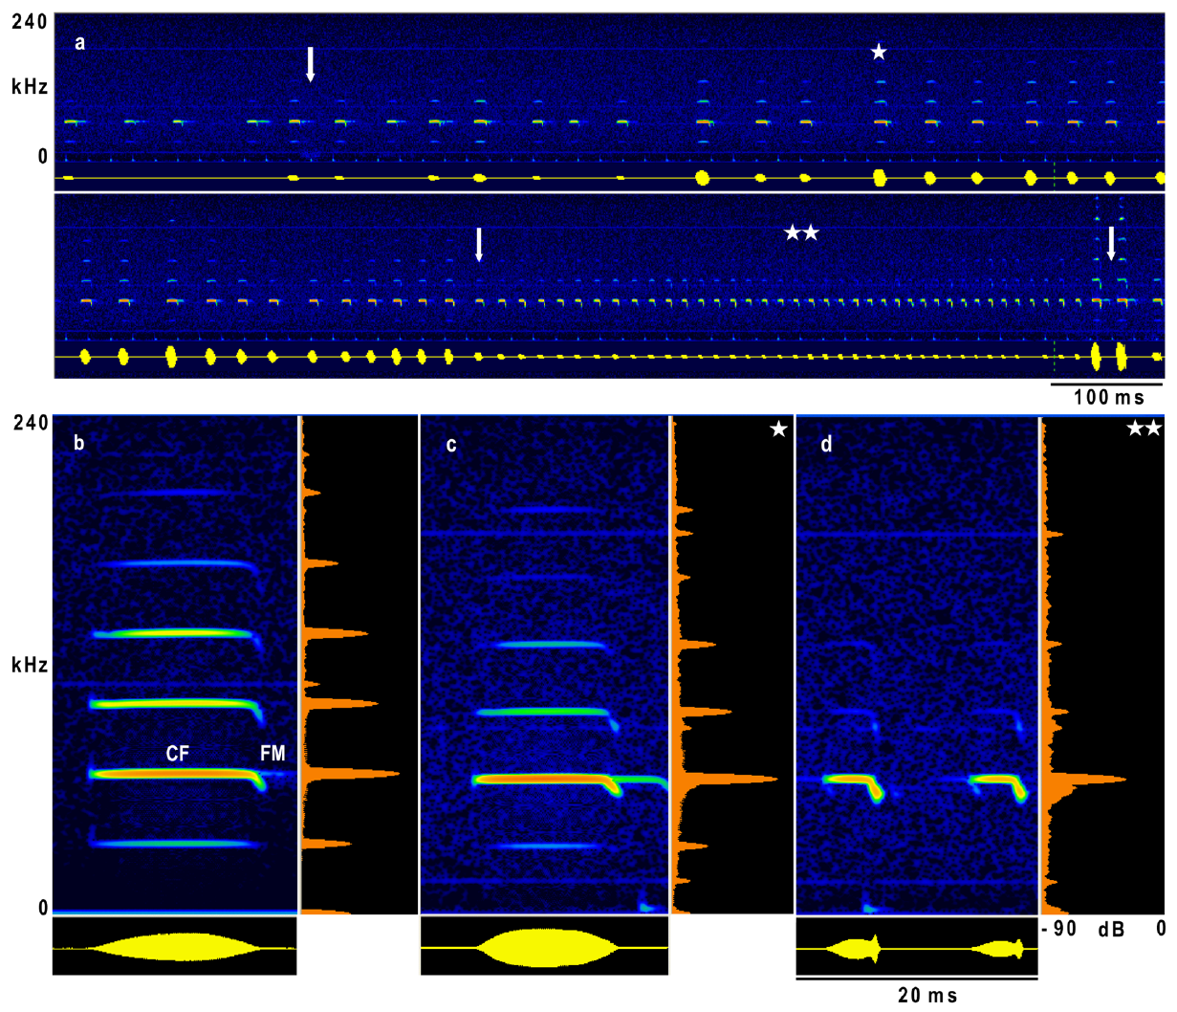
CF-FM calls combine a sustained tone and a short sweep
Echolocating bats make sounds and listen for the echoes that bounce back from objects. A constant-frequency (CF) part holds one frequency for most of the call. A frequency-modulated (FM) part sweeps across frequencies. CF-FM bats add a brief downward sweep to a long tone, so both parts sit in each call. Active sensing means the bat emits the sound and then receives the echo.
The bat Hipposideros armiger emits calls with several harmonics. A harmonic is a frequency at a whole-number multiple of the lowest frequency. The second harmonic is the strongest one. In the animals that Schoeppler and colleagues studied, its CF part sits near 65 to 66 kHz. The harmonics give the call several frequency bands at once.
Schoeppler and colleagues recorded these calls during flight. A narrowband carrier and a changing sweep sit together inside one call. The signal is not a pure tone. The carrier stays steady while the sweep changes over a short time at the end of the call. Those flight recordings include the approach toward a landing target.
Schoeppler et al. (2018), Fig. 1(a–d). Flight call sequence and CF-FM structure, in kHz and ms.
Schoeppler et al. (2018); Suga et al. (1975)
02
Notes:
• An echolocating bat supplies its own acoustic input by producing a call and receiving reflections. Constant frequency describes the sustained part of that call, whereas frequency modulation describes the brief change in frequency at its end.
• A harmonic belongs to a series of frequencies related by whole-number multiples. The second harmonic was the strongest component in these Hipposideros armiger recordings. Its frequency was near 65 to 66 kilohertz, which is above the human audible range.
• The recordings include stationary calling and flight toward a landing grid. The sustained component remained present during the final approach, although the calls became shorter and the higher harmonics weakened. The CF and FM labels describe acoustic components, not two separate calls.
References:
Schoeppler D, Schnitzler H-U, Denzinger A (2018). Precise Doppler shift compensation in the hipposiderid bat, Hipposideros armiger. Scientific Reports 8:4598. https://doi.org/10.1038/s41598-018-22880-y
Suga N, Simmons JA, Jen PH-S (1975). Peripheral specialization for fine analysis of Doppler-shifted echoes in the auditory system of the “CF-FM” bat Pteronotus parnellii. Journal of Experimental Biology 63(1):161–192. https://doi.org/10.1242/jeb.63.1.161
Figure: Schoeppler et al. (2018), Fig. 1(a–d). Flight call sequence and CF-FM structure, in kHz and ms.
Figure source: https://doi.org/10.1038/s41598-018-22880-y

Slide 3
Flutter changes the echoes carried by the CF component
Flutter is the regular beating motion of an insect's wings. Bats that detect flutter receive echoes whose loudness and frequency change as the wings move. A long CF part gives the bat a steady carrier. The changes in the echo ride on that carrier, so the bat can measure them. The steady carrier makes small echo changes easier to track.
The auditory fovea is a region of the hearing system with a fine, sharp tuning. In CF-FM bats, that region covers the returning CF frequency. Most of the ear's detail goes to one narrow band, not to all ultrasonic frequencies equally. That band covers the frequency of the returning CF echo in these bats.
Flight can shift the echo carrier away from that band. The bat corrects for this shift with Doppler-shift compensation. Compensation brings the echo from a stationary target back near the preferred frequency. Then the small changes caused by flutter fall in the band where the ear is most sensitive. Compensation keeps the steady carrier near the most sensitive band.
Schoeppler et al. (2018), Fig. 1(a–d). Flight call sequence and CF-FM structure, in kHz and ms.
Schoeppler et al. (2018); Suga et al. (1975)
03
Notes:
• An insect wing changes position and orientation repeatedly during a wingbeat. The resulting echo can change in both amplitude and frequency. A long constant-frequency call provides a carrier whose fluctuations can be resolved by a hearing system specialized for that band.
• The term auditory fovea refers to unequal representation: a narrow range of frequencies receives unusually fine tuning and extensive representation. It does not mean that the ear is equally sensitive to every part of an ultrasonic call.
• Self-motion also changes echo frequency, even when the reflecting object is stationary. Compensation reduces that large shift of the carrier. It does not require the bat to remove every smaller fluctuation produced by a moving wing. Suga’s peripheral recordings and the flight observations address different parts of this combined sensory strategy.
References:
Schoeppler D, Schnitzler H-U, Denzinger A (2018). Precise Doppler shift compensation in the hipposiderid bat, Hipposideros armiger. Scientific Reports 8:4598. https://doi.org/10.1038/s41598-018-22880-y
Suga N, Simmons JA, Jen PH-S (1975). Peripheral specialization for fine analysis of Doppler-shifted echoes in the auditory system of the “CF-FM” bat Pteronotus parnellii. Journal of Experimental Biology 63(1):161–192. https://doi.org/10.1242/jeb.63.1.161
Figure: Schoeppler et al. (2018), Fig. 1(a–d). Flight call sequence and CF-FM structure, in kHz and ms.
Figure source: https://doi.org/10.1038/s41598-018-22880-y

Slide 4
CF and FM name parts of one call
The recordings came from two settings. In one, a bat called while it stayed in place. In the other, the bat flew toward a landing grid, and its calls were recorded through that approach. The two settings give calls from the same species under different conditions. Comparing them shows how calls change when the bat approaches a landing target.
During the final approach, the sustained CF part remained present. Over the same stretch, the calls became shorter and the higher harmonics became weaker. The steady tone stayed in place while the rest of the call changed around it. Its frequency stayed within a narrow range throughout the approach. The shrinking calls still carried that same carrier.
The CF and FM labels name acoustic components of one call, not two separate calls. Each call holds both parts. The steady tone near 65 to 66 kHz lies above the range of human hearing, so people hear none of it. The brief sweep at the end takes up a small share of the call.
Schoeppler et al. (2018), Fig. 1(a–d). Flight call sequence and CF-FM structure, in kHz and ms.
Schoeppler et al. (2018)
03a
Notes:
• CF and FM name parts of one call.
• Explanation 1.
– The recordings came from two settings
– In one, a bat called while it stayed in place. In the other, the bat flew toward a landing grid, and its calls were recorded through that approach. The two settings give calls from the same species under different conditions. Comparing them shows how calls change when the bat approaches a landing target.
• Explanation 2.
– During the final approach, the sustained CF part remained present
– Over the same stretch, the calls became shorter and the higher harmonics became weaker. The steady tone stayed in place while the rest of the call changed around it. Its frequency stayed within a narrow range throughout the approach. The shrinking calls still carried that same carrier.
• Explanation 3.
– The CF and FM labels name acoustic components of one call, not two separate calls
– Each call holds both parts. The steady tone near 65 to 66 kHz lies above the range of human hearing, so people hear none of it. The brief sweep at the end takes up a small share of the call.
• Source.
– The figure and the measurements come from Schoeppler et al. (2018).
– Each statement is tied to the recordings or observations of that study.
References:
Schoeppler D, Schnitzler H-U, Denzinger A (2018). Precise Doppler shift compensation in the hipposiderid bat, Hipposideros armiger. Scientific Reports 8:4598. https://doi.org/10.1038/s41598-018-22880-y

Slide 5
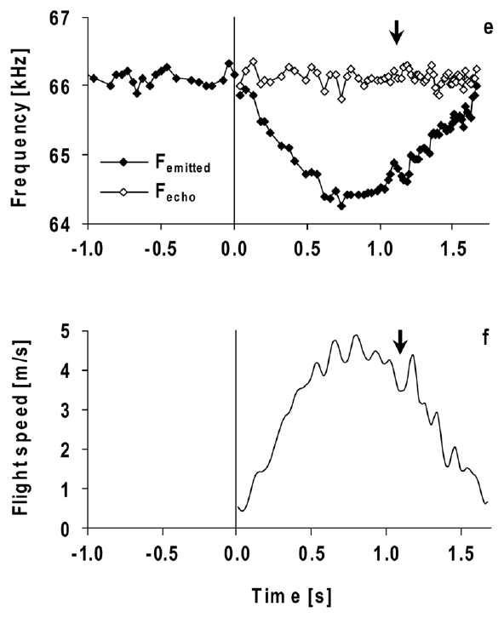
Approaching a reflector raises returning echo frequency
A Doppler shift is a change in frequency caused by motion between a sound source, a reflector and a receiver. When a bat flies toward a stationary object, the echo comes back at a higher frequency than the call. The faster the bat flies, the larger the rise in frequency. Closing speed sets how large the shift becomes.
Doppler-shift compensation lowers the frequency of later calls as the bat approaches. The bat controls the returning CF frequency, not the emitted one. To hold the echo steady, the bat must change its emitted CF frequency during flight. This adjustment keeps the echo near one band across the approach, and it happens from call to call.
Schoeppler and colleagues recorded calls and rebuilt the flight path toward a grid. The call frequency fell as the bat sped up. It rose again as the bat slowed. Schuller and colleagues then changed the echo frequency in stationary bats, and the bats changed their calls too. Their calls changed even though no flight was involved.
Schoeppler et al. (2018), Fig. 2(e–f). Measured emission and flight speed, with calculated echo frequency.
Schuller et al. (1974); Schoeppler et al. (2018)
04
Notes:
• A stationary reflector can return a frequency-shifted echo when the bat itself is moving. Motion toward the reflector raises the returning frequency. The bat counters this by lowering the frequency it emits on later calls.
• Compensation is an adjustment of the outgoing signal based on the returning signal. The bat can maintain a relatively stable echo frequency while producing a sequence of calls whose frequencies differ substantially.
• Free-flight recordings connect the adjustment to natural movement, but movement also changes distance, echo intensity, and other conditions. Artificial-echo playback provides a separate causal test. A stationary animal changes its call frequency when only the frequency of its acoustic feedback is altered, establishing that physical acceleration is not required to evoke the response.
References:
Schuller G, Beuter K, Schnitzler H-U (1974). Response to frequency shifted artificial echoes in the bat Rhinolophus ferrumequinum. Journal of Comparative Physiology 89(3):275–286. https://doi.org/10.1007/BF00696191
Schoeppler D, Schnitzler H-U, Denzinger A (2018). Precise Doppler shift compensation in the hipposiderid bat, Hipposideros armiger. Scientific Reports 8:4598. https://doi.org/10.1038/s41598-018-22880-y
Figure: Schoeppler et al. (2018), Fig. 2(e–f). Measured emission and flight speed, with calculated echo frequency.
Figure source: https://doi.org/10.1038/s41598-018-22880-y

Slide 6
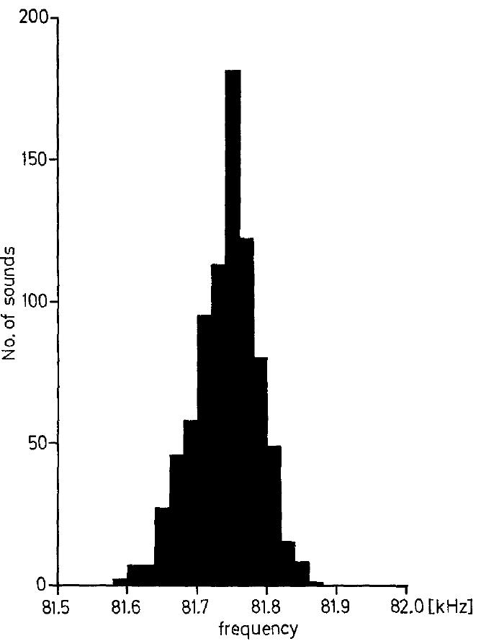
Resting frequency is an individual calling baseline
The resting frequency is the average CF frequency of calls from a stationary bat. In greater horseshoe bats, Rhinolophus ferrumequinum, each bat's resting frequency fell between about 81 and 84.2 kHz. Each bat has its own baseline. The baseline is measured while the bat sits still. Each bat's own value sits in a narrow range.
Schuller and colleagues measured the central CF part of each call. They left out the first and last 5 ms, where the FM sweeps occur. Repeated calls from one bat clustered tightly around its baseline. Playing back unshifted calls did not change that baseline in a consistent way. The measurement window kept the constant part of the call.
The resting frequency gives a reference for measuring changes in emitted frequency. Returning echoes sit at a different reference point. Each bat needs its resting frequency measured in the same session as its echo data. Both values then come from the same conditions, so the difference between them stays interpretable. Values from another session can differ for reasons unrelated to compensation.
Schuller et al. (1974), Fig. 1. Distribution of CF frequencies in a stationary horseshoe bat.
Schuller et al. (1974)
05
Notes:
• The resting frequency is calculated from a series of calls made while the bat is stationary. It is an individual baseline, rather than a single frequency assigned to an entire species.
• These horseshoe bats called near 81 to 84.2 kilohertz. The measurements excluded the beginning and end of each call because those portions include frequency sweeps. The central sustained portion supplied the estimate of constant frequency.
• Unshifted playback controlled for the presence of an additional acoustic signal. It did not cause a systematic change in resting frequency. Frequency-shifted playback could therefore be compared against a baseline that was not simply altered by any echo presentation. The eventual frequency of a compensated echo must still be distinguished from this emission baseline.
References:
Schuller G, Beuter K, Schnitzler H-U (1974). Response to frequency shifted artificial echoes in the bat Rhinolophus ferrumequinum. Journal of Comparative Physiology 89(3):275–286. https://doi.org/10.1007/BF00696191
Figure: Schuller et al. (1974), Fig. 1. Distribution of CF frequencies in a stationary horseshoe bat.
Figure source: https://doi.org/10.1007/BF00696191

Slide 7
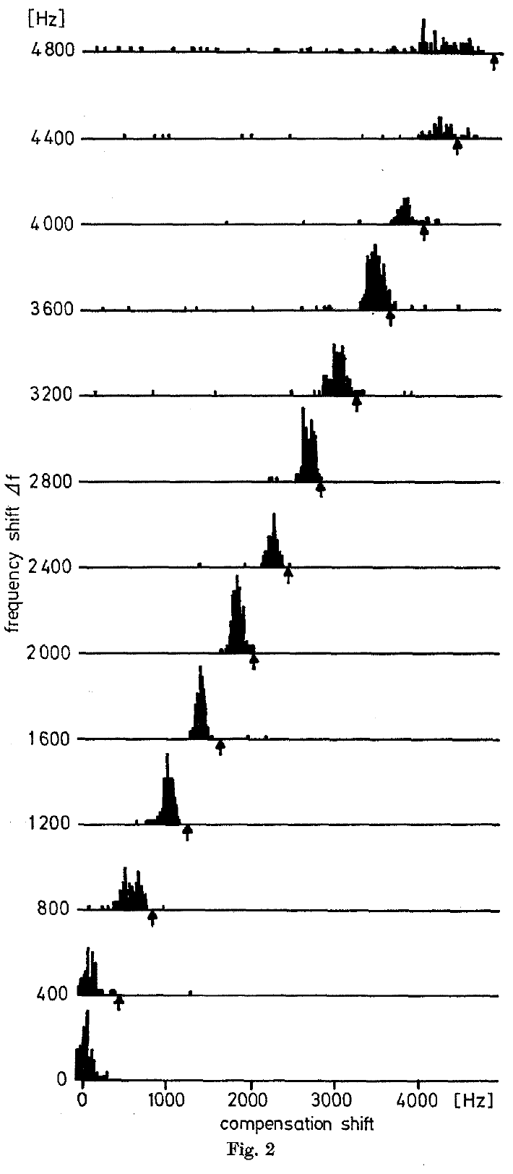
Shifted playback causes subsequent calls to fall in pitch
Schuller and colleagues sent each horseshoe bat's own call back through an electronic frequency shifter. The bat sat in place, though it could move its head. A microphone and a loudspeaker stood 34 cm in front of it, so the playback reached it directly. The shifted sound acted as an artificial echo of the bat's call.
When the echo was shifted upward, the bat's later calls fell in CF frequency. Larger upward shifts called for greater lowering of the outgoing frequency. The bat changed its calls even though no real object was approaching. The lowering was a response to the imposed shift, not a fixed setting. The effect grew with the size of the shift.
This closed-loop playback keeps each returning sound matched to the bat's latest call. The bat's response depends on the imposed frequency mismatch. The response needs no real motion toward an object. The bat's call sets the frequency of the next echo it hears. Each step in that loop uses the bat's own sound.
Schuller et al. (1974), Fig. 2. Emission-frequency compensation under increasing positive echo shifts, in Hz.
Schuller et al. (1974)
06
Notes:
• The returning sound was made from the bat’s own vocalization. Its frequency was changed electronically and it was played back to the animal. As the animal changed its next call, the playback changed with that call while retaining the imposed shift.
• The horseshoe bat remained stationary. An upward change in playback frequency nevertheless caused it to lower subsequent emissions. The response settled after a short sequence of calls, rather than being a fixed change caused by a single prerecorded tone.
• The intervention establishes an auditory contribution to frequency control. It does not identify the neurons that compare feedback with a preferred frequency, and it does not recreate every property of a naturally moving target. Natural Doppler shifts and an electronic shift can differ in how they affect the frequency-modulated parts of a call.
References:
Schuller G, Beuter K, Schnitzler H-U (1974). Response to frequency shifted artificial echoes in the bat Rhinolophus ferrumequinum. Journal of Comparative Physiology 89(3):275–286. https://doi.org/10.1007/BF00696191
Figure: Schuller et al. (1974), Fig. 2. Emission-frequency compensation under increasing positive echo shifts, in Hz.
Figure source: https://doi.org/10.1007/BF00696191

Slide 8
Playback and flight shifts can act differently
A natural Doppler shift and an electronic shift can affect a call in different ways. The difference is most visible in the frequency-modulated parts of the call, where the frequency is changing. Flight adds its own Doppler change on top of any echo shift. A playback may not reproduce every feature of a flight echo.
The lowering built up over a short run of calls. The emitted frequency settled at a new level after several calls, rather than jumping in one step. A single prerecorded tone did not produce that pattern. The response unfolded call by call, as each new echo arrived. The bat's later calls moved to a new level as the sequence went on.
Schuller's test kept the bat in one place, so its calls changed without any flight motion. The playback supplied the whole frequency change by itself. That design isolates the effect of the echo from the effect of movement. Movement was held constant across the whole test. In flight, the echo frequency is set by the bat's approach speed.
Schuller et al. (1974), Fig. 2. Emission-frequency compensation under increasing positive echo shifts, in Hz.
Schuller et al. (1974)
06a
Notes:
• Playback and flight shifts can act differently.
• Explanation 1.
– A natural Doppler shift and an electronic shift can affect a call in different ways
– The difference is most visible in the frequency-modulated parts of the call, where the frequency is changing. Flight adds its own Doppler change on top of any echo shift. A playback may not reproduce every feature of a flight echo.
• Explanation 2.
– The lowering built up over a short run of calls
– The emitted frequency settled at a new level after several calls, rather than jumping in one step. A single prerecorded tone did not produce that pattern. The response unfolded call by call, as each new echo arrived. The bat's later calls moved to a new level as the sequence went on.
• Explanation 3.
– Schuller's test kept the bat in one place, so its calls changed without any flight motion
– The playback supplied the whole frequency change by itself. That design isolates the effect of the echo from the effect of movement. Movement was held constant across the whole test. In flight, the echo frequency is set by the bat's approach speed.
• Source.
– The figure and the measurements come from Schuller et al. (1974).
– Each statement is tied to the recordings or observations of that study.
References:
Schuller G, Beuter K, Schnitzler H-U (1974). Response to frequency shifted artificial echoes in the bat Rhinolophus ferrumequinum. Journal of Comparative Physiology 89(3):275–286. https://doi.org/10.1007/BF00696191

Slide 9
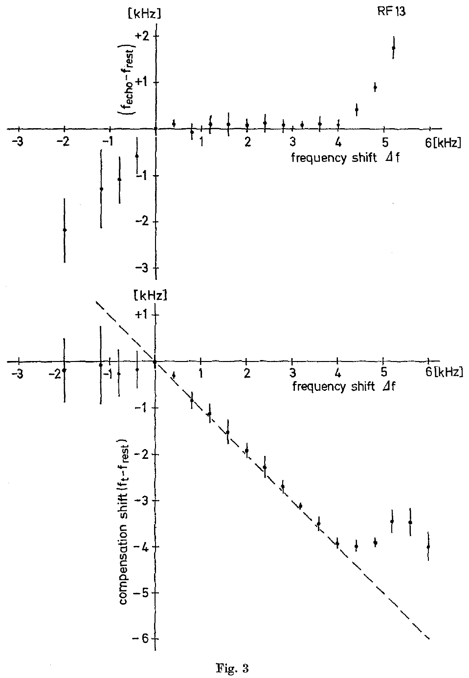
Compensated echoes sit slightly above resting frequency
The reference frequency is the returning CF frequency that the bat holds during compensation. In Schuller's experiments, the bats lowered their calls by slightly less than the upward shift added to the echo. The echo stayed a little above the resting frequency. The bat held the echo steady rather than the call. Compensation was measured across each bat's range of shifts.
The gap between reference and resting frequency was about 50 to 300 Hz in the bats studied. Within one bat, that gap stayed fairly constant across its compensation range. The emitted frequency changed by a much larger amount over the same range. The results came from several bats, each with its own gap.
Compensation keeps the feedback near a reference frequency rather than the resting baseline. A small, steady offset can exist alongside a large change in emitted frequency. The offset gives the feedback a small positive bias. A bat can make a large downward change and keep that bias. That combination is a feature of the control, not an error.
Schuller et al. (1974), Fig. 3. Echo-frequency offset and emission compensation across imposed shifts, in kHz.
Schuller et al. (1974)
07
Notes:
• An artificial echo combines the bat’s current emitted frequency with the shift added by the playback apparatus. Lowering emission by slightly less than that added shift leaves the returning echo slightly above the resting baseline.
• The authors called the stabilized returning frequency the reference frequency. The offset between this reference and resting frequency was about 50 to 300 hertz, depending on the animal. Within an animal, that offset remained similar as the imposed shift increased.
• An emission change and an echo-frequency error are different measurements. A bat can make a large downward change in emitted frequency and still retain a small positive offset in feedback. The regulated echo band is therefore not identical to the average call frequency measured at rest.
References:
Schuller G, Beuter K, Schnitzler H-U (1974). Response to frequency shifted artificial echoes in the bat Rhinolophus ferrumequinum. Journal of Comparative Physiology 89(3):275–286. https://doi.org/10.1007/BF00696191
Figure: Schuller et al. (1974), Fig. 3. Echo-frequency offset and emission compensation across imposed shifts, in kHz.
Figure source: https://doi.org/10.1007/BF00696191

Slide 10
Early playback tests found little response to lower echoes
In the 1974 experiments, downward shifts of artificial echoes did not raise the emitted frequency. The bats kept calling near their resting frequency, although their calls became a little less regular. The early results suggested that only echoes above the reference band lowered the call. Upward shifts alone produced a clear change in the call.
That 1974 study did not vary the sound intensity in a systematic way. The downward shifts were not matched to the bats' hearing at each frequency. So the early test could not show how sound level changed the response. The downward shifts were tested at levels the bats could not hear as well.
Metzner and colleagues later tested feedback above and below resting frequency at comparable levels above hearing threshold. Their results changed the earlier view of one-sided control. Lower-frequency feedback did change the call once the sound was loud enough. The later data came from comparable levels, which made the tests fairer. Lower echoes proved to matter once the test was fair.
Schuller et al. (1974), Fig. 2. Emission-frequency compensation under increasing positive echo shifts, in Hz.
Schuller et al. (1974); Metzner et al. (2002)
08
Notes:
• The original playback experiments produced a clear decrease in emission for positive shifts, but did not produce a comparable increase for negative shifts. That result described behavior under the tested conditions.
• Frequency and audibility are coupled in a sharply tuned hearing system. A sound below the most sensitive band may have to be much louder to be equally audible. Comparing feedback at the same physical sound level is therefore not necessarily comparing equal auditory stimulation.
• The later study controlled playback level relative to hearing threshold. Under those conditions, lower-frequency echoes did raise emitted frequency. The historical difference is a change in experimental conditions and interpretation, rather than evidence that the bat’s nervous system acquired a new ability between studies.
References:
Schuller G, Beuter K, Schnitzler H-U (1974). Response to frequency shifted artificial echoes in the bat Rhinolophus ferrumequinum. Journal of Comparative Physiology 89(3):275–286. https://doi.org/10.1007/BF00696191
Metzner W, Zhang S, Smotherman M (2002). Doppler-shift compensation behavior in horseshoe bats revisited: auditory feedback controls both a decrease and an increase in call frequency. Journal of Experimental Biology 205(11):1607–1616. https://doi.org/10.1242/jeb.205.11.1607
Figure: Schuller et al. (1974), Fig. 2. Emission-frequency compensation under increasing positive echo shifts, in Hz.
Figure source: https://doi.org/10.1007/BF00696191

Slide 11
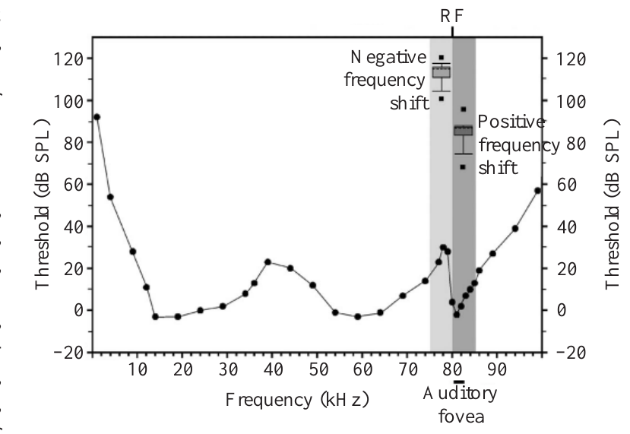
Equal sound levels need not produce equal audibility
An audiogram shows the quietest sound that an animal can detect at each frequency. The horseshoe bat's most sensitive band lies near its preferred echo frequency. Its sensitivity drops at some lower frequencies, so equal loudness at the ear is not equal hearing. A bat's sensitive band is narrow, so the threshold changes quickly away from it.
Sound pressure level measures the physical amplitude of a sound. Sensation level measures how far a sound sits above the hearing threshold at its frequency. The same sound pressure level can give different sensation levels at different frequencies. Physical intensity and audibility are different quantities. Audibility depends on the frequency of the sound as well as its level.
Metzner and colleagues played positive and negative shifts at about the same level above threshold. Lower-frequency feedback needed louder playback to reach that level. This design isolated the direction of a shift from the drop in audibility that occurs away from the sensitive band. The response also depends on audibility, not on sign alone.
Metzner et al. (2002), Fig. 1. Auditory thresholds and playback ranges; audiogram credited in the paper to Long and Schnitzler (1975).
Metzner et al. (2002); Long & Schnitzler (1975)
09
Notes:
• An audiogram is a frequency-by-frequency measure of detection threshold. A low threshold means that a relatively weak sound can be detected. The narrow sensitive band in a horseshoe bat makes the relation between physical intensity and audibility strongly dependent on frequency.
• Sound pressure level measures the sound itself. Sensation level expresses that sound relative to the threshold at the tested frequency. A playback below the sensitive band can require a higher sound pressure level to achieve comparable auditory stimulation.
• The experiment therefore adjusted intensity as well as frequency. Comparing sufficiently audible feedback on both sides of resting frequency tested whether lower-frequency information could participate in call control. The audiogram reproduced in the article supplies the threshold context; the compensation measurements are the study’s behavioral intervention.
References:
Metzner W, Zhang S, Smotherman M (2002). Doppler-shift compensation behavior in horseshoe bats revisited: auditory feedback controls both a decrease and an increase in call frequency. Journal of Experimental Biology 205(11):1607–1616. https://doi.org/10.1242/jeb.205.11.1607
Long GR, Schnitzler H-U (1975). Behavioural audiograms from the bat, Rhinolophus ferrumequinum. Journal of Comparative Physiology 100:211–219. https://doi.org/10.1007/BF00614531
Figure: Metzner et al. (2002), Fig. 1. Auditory thresholds and playback ranges; audiogram credited in the paper to Long and Schnitzler (1975).
Figure source: https://doi.org/10.1242/jeb.205.11.1607

Slide 12
The threshold curve came from earlier audiograms
The threshold curve comes from earlier work. Long and Schnitzler measured behavioral audiograms in the greater horseshoe bat, Rhinolophus ferrumequinum, in 1975. The playback study used that curve as its threshold context, so the audiogram is a reference rather than a new measurement. The study itself measured the response to playback, not the threshold. The threshold curve is an input to the playback design.
A behavioral audiogram is built from the sounds that an animal responds to. Each frequency gets its own threshold. So the curve covers the whole range of playback frequencies that the team tested. Frequencies far from the sensitive band need more sound to reach the same audibility. Hearing sensitivity at a frequency sets how loud a sound must be to be detected.
Playback levels were set relative to each frequency's threshold. A lower-frequency sound needed more intensity to be heard as well as a higher one. Matched levels allow the team to compare shifts on both sides of the resting frequency on fair terms. That gave a fair test of the direction of the shift. That made the sound level a controlled quantity.
Metzner et al. (2002), Fig. 1. Auditory thresholds and playback ranges; audiogram credited in the paper to Long and Schnitzler (1975).
Metzner et al. (2002); Long & Schnitzler (1975)
09a
Notes:
• The threshold curve came from earlier audiograms.
• Explanation 1.
– The threshold curve comes from earlier work
– Long and Schnitzler measured behavioral audiograms in the greater horseshoe bat, Rhinolophus ferrumequinum, in 1975. The playback study used that curve as its threshold context, so the audiogram is a reference rather than a new measurement. The study itself measured the response to playback, not the threshold. The threshold curve is an input to the playback design.
• Explanation 2.
– A behavioral audiogram is built from the sounds that an animal responds to
– Each frequency gets its own threshold. So the curve covers the whole range of playback frequencies that the team tested. Frequencies far from the sensitive band need more sound to reach the same audibility. Hearing sensitivity at a frequency sets how loud a sound must be to be detected.
• Explanation 3.
– Playback levels were set relative to each frequency's threshold
– A lower-frequency sound needed more intensity to be heard as well as a higher one. Matched levels allow the team to compare shifts on both sides of the resting frequency on fair terms. That gave a fair test of the direction of the shift. That made the sound level a controlled quantity.
• Source.
– The figure and the measurements come from Metzner et al. (2002); Long & Schnitzler (1975).
– Each statement is tied to the recordings or observations of that study.
References:
Metzner W, Zhang S, Smotherman M (2002). Doppler-shift compensation behavior in horseshoe bats revisited: auditory feedback controls both a decrease and an increase in call frequency. Journal of Experimental Biology 205(11):1607–1616. https://doi.org/10.1242/jeb.205.11.1607
Long GR, Schnitzler H-U (1975). Behavioural audiograms from the bat, Rhinolophus ferrumequinum. Journal of Comparative Physiology 100:211–219. https://doi.org/10.1007/BF00614531

Slide 13
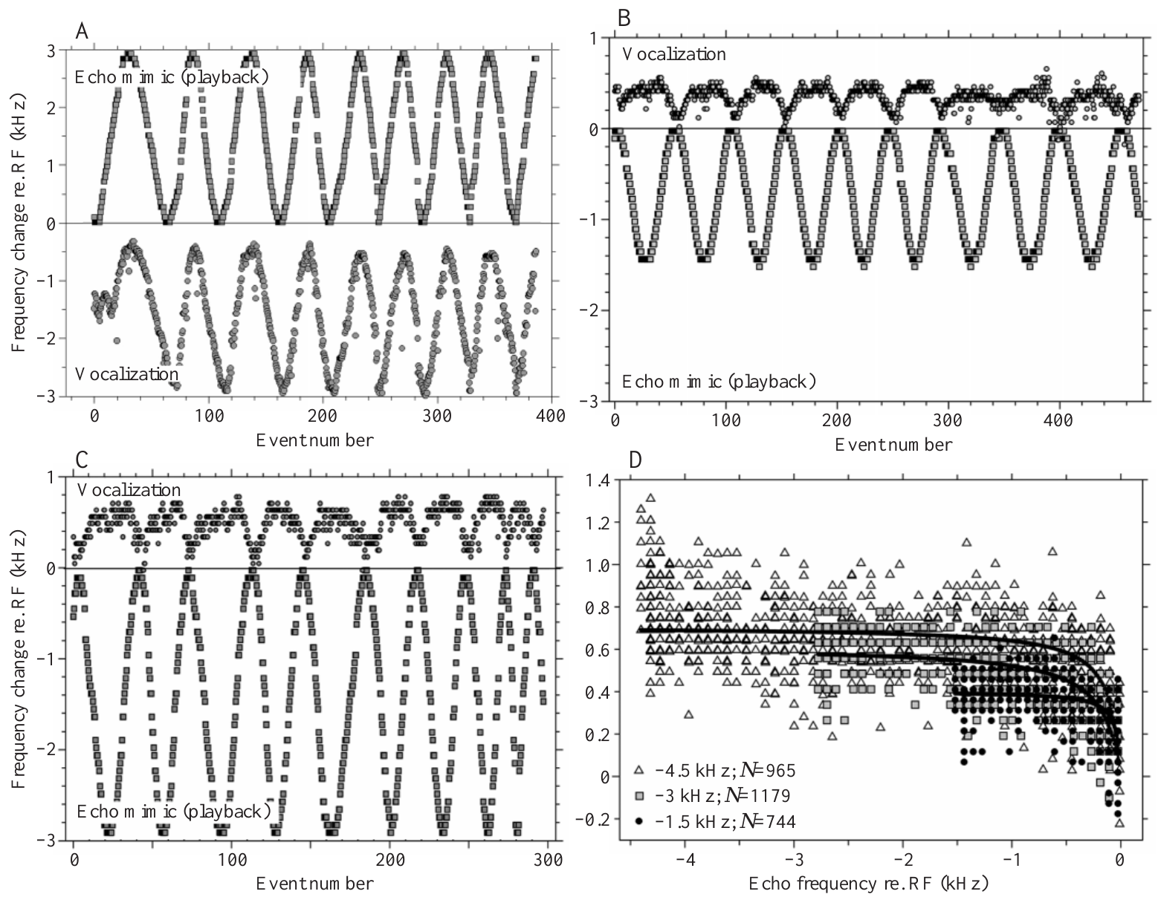
Audible lower-frequency echoes raise emitted frequency
Metzner and colleagues varied the frequency of each bat's own call and sent it back as an echo. The shift rose and fell in a smooth, repeating cycle. The echo shifts went both above and below the bat's resting frequency, so the bat heard echo mimics on both sides of its baseline.
Positive shifts made the emitted frequency fall. At strong enough playback levels, negative shifts made the emitted frequency rise above the resting frequency. The bat's calls followed each change in the echo, in the opposite direction, cycle after cycle. Each cycle produced a matching change in the call. The bats' call frequency tracked the modulation through the playback.
The bat's vocal system uses feedback from both sides of the resting band. This two-way response rules out the idea that lower echoes have no effect on call frequency. The correction is still weaker in the downward direction than in the upward one. This is evidence that the feedback loop operates across the whole resting band.
Metzner et al. (2002), Fig. 2(A–D). Call and playback changes for positive and negative frequency shifts.
Metzner et al. (2002)
10
Notes:
• The playback shift changed gradually and repeatedly rather than remaining at a single value. The animal heard an echo mimic whose frequency depended on its current call and the experimentally imposed modulation.
• When the echo mimic was shifted upward, the bat lowered emission. When it was shifted downward and presented loudly enough, the bat raised emission above its resting frequency. The change occurred systematically over repeated cycles of the imposed modulation.
• The presence of an upward vocal correction establishes that feedback below resting frequency can influence the control system. The amount of correction remained smaller in that direction. Sensory participation and compensation completeness are separate claims, and only the former is required to reject a strictly one-sided auditory-feedback account.
References:
Metzner W, Zhang S, Smotherman M (2002). Doppler-shift compensation behavior in horseshoe bats revisited: auditory feedback controls both a decrease and an increase in call frequency. Journal of Experimental Biology 205(11):1607–1616. https://doi.org/10.1242/jeb.205.11.1607
Figure: Metzner et al. (2002), Fig. 2(A–D). Call and playback changes for positive and negative frequency shifts.
Figure source: https://doi.org/10.1242/jeb.205.11.1607

Slide 14
Upward vocal corrections are smaller than downward ones
In Metzner and colleagues' playback experiments, bats countered about 95 percent of positive shifts. For negative shifts, the bats corrected only up to about 22 percent of the range. A rise above the resting frequency was possible, but it was small next to the fall. This asymmetry is the central result of the study.
A negative shift as large as 4.5 kHz produced a largest emission increase of 1.51 kHz. The bats heard the lower echo and changed their calls. The change fell far short of the shift, so the upward correction was incomplete. The bats still shifted their calls in the right direction. The response was smaller in size, not absent.
The authors suggested that the larynx limits how far the bat can raise its call. This idea is about the vocal apparatus itself. The experiment measured the calls that resulted, not the larynx. The larynx limit is a hypothesis for later work. Direct tests of the larynx would need other methods.
Metzner et al. (2002), Fig. 2(A–D). Call and playback changes for positive and negative frequency shifts.
Metzner et al. (2002)
11
Notes:
• Compensation performance describes how much of the imposed frequency shift is countered by the bat’s emission change. The correction for positive shifts was much more complete than the correction for negative shifts.
• The reported comparison was approximately 95 percent versus up to 22 percent. In one negative-shift condition, a shift of 4.5 kilohertz produced a maximum emission increase of 1.51 kilohertz. The animal responded to the feedback without fully cancelling it.
• The vocal apparatus must convert an auditory correction into a change in the call. The authors proposed that laryngeal constraints contribute to the smaller upward range. The experiment itself measured vocal output during playback; it did not directly measure the mechanical limit of an isolated laryngeal muscle.
References:
Metzner W, Zhang S, Smotherman M (2002). Doppler-shift compensation behavior in horseshoe bats revisited: auditory feedback controls both a decrease and an increase in call frequency. Journal of Experimental Biology 205(11):1607–1616. https://doi.org/10.1242/jeb.205.11.1607
Figure: Metzner et al. (2002), Fig. 2(A–D). Call and playback changes for positive and negative frequency shifts.
Figure source: https://doi.org/10.1242/jeb.205.11.1607

Slide 15
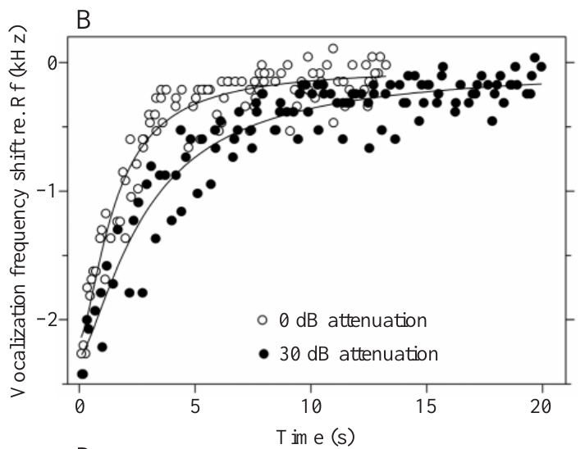
Louder feedback accelerates correction in both directions
Metzner and colleagues weakened the echo mimic with attenuation, which lowers the signal level. They then stepped the frequency up and down. Stronger feedback made the bats adjust their calls faster, in both directions. Speed depended on how loud the echo was. The adjustments were tracked in both directions. Attenuation of 30 dB was the weakest condition tested.
After a negative step, the time constant fell from about 2.28 seconds at 30 dB attenuation to 0.89 seconds with no attenuation. The shorter time constant means the bat's call reached its new frequency sooner when the echo was louder. Those numbers come from the reported response time constants. Both values come from one set of recordings.
Speed depends on how audible the echo is, not only on the direction of the frequency change. A rule that sorts echoes by their sign alone would miss this effect. The bat's control system must use loudness as well as direction. Loudness and direction both enter the response. The control is set by more than one feature of the echo.
Metzner et al. (2002), Fig. 3(B). Call-frequency recovery under strong and attenuated feedback, in seconds.
Metzner et al. (2002)
12
Notes:
• Attenuating an echo mimic by 30 decibels makes it weaker than the unattenuated playback. The study compared correction trajectories across different playback levels while controlling the imposed frequency change.
• Stronger feedback accelerated call-frequency recovery and accelerated the lowering response to a positive shift. The reported time constants were on the order of a second for the stronger conditions and longer for weaker feedback.
• The time constant was measured from the vocal trajectory, using the progress toward the final correction. It is not a directly measured conduction delay in a single neuron. The experiment constrains the behavior of the entire feedback loop and requires an account that includes the strength of the returning acoustic signal.
References:
Metzner W, Zhang S, Smotherman M (2002). Doppler-shift compensation behavior in horseshoe bats revisited: auditory feedback controls both a decrease and an increase in call frequency. Journal of Experimental Biology 205(11):1607–1616. https://doi.org/10.1242/jeb.205.11.1607
Figure: Metzner et al. (2002), Fig. 3(B). Call-frequency recovery under strong and attenuated feedback, in seconds.
Figure source: https://doi.org/10.1242/jeb.205.11.1607

Slide 16
Positive steps also recover faster with louder feedback
The time constant was measured from the vocal trajectory. It tracks progress toward the adjusted call frequency. It describes the whole feedback loop, not the conduction delay of a single neuron. The loop includes the strength of the returning acoustic signal, so loudness enters the measure. The measurements came from each bat's own calls during playback.
For positive steps, the constant dropped from about 1.64 seconds to 0.75 seconds as feedback grew stronger. Positive steps recover faster than negative steps at both reported feedback levels. The shorter values at zero attenuation show the same ordering. Both sets of values come from the same recordings. A negative step moves the echo to a lower frequency than before.
Both directions show faster recovery with stronger echoes. The sign of the step and the loudness of the echo both set the speed of the response. A rule based on direction alone misses the loudness effect. The recovery speed tracks how loud the returning echo is. The bat's control loop, not one neuron, sets that speed.
Metzner et al. (2002), Fig. 3(B). Call-frequency recovery under strong and attenuated feedback, in seconds.
Metzner et al. (2002)
12a
Notes:
• Positive steps also recover faster with louder feedback.
• Explanation 1.
– The time constant was measured from the vocal trajectory
– It tracks progress toward the adjusted call frequency. It describes the whole feedback loop, not the conduction delay of a single neuron. The loop includes the strength of the returning acoustic signal, so loudness enters the measure. The measurements came from each bat's own calls during playback.
• Explanation 2.
– For positive steps, the constant dropped from about 1.64 seconds to 0.75 seconds as feedback grew stronger
– Positive steps recover faster than negative steps at both reported feedback levels. The shorter values at zero attenuation show the same ordering. Both sets of values come from the same recordings. A negative step moves the echo to a lower frequency than before.
• Explanation 3.
– Both directions show faster recovery with stronger echoes
– The sign of the step and the loudness of the echo both set the speed of the response. A rule based on direction alone misses the loudness effect. The recovery speed tracks how loud the returning echo is. The bat's control loop, not one neuron, sets that speed.
• Source.
– The figure and the measurements come from Metzner et al. (2002).
– Each statement is tied to the recordings or observations of that study.
References:
Metzner W, Zhang S, Smotherman M (2002). Doppler-shift compensation behavior in horseshoe bats revisited: auditory feedback controls both a decrease and an increase in call frequency. Journal of Experimental Biology 205(11):1607–1616. https://doi.org/10.1242/jeb.205.11.1607

Slide 17
Vocal correction is measured at the acoustic output
Metzner and colleagues shifted echo frequency and changed playback level in stationary horseshoe bats. The bats changed their calls even though they were not flying. The acoustic output changed, so the vocal change could be measured directly. The stationary setting removed flight from the experiment. Playback alone changed from trial to trial.
At comparable levels above hearing threshold, higher-frequency feedback lowered the next calls. Lower-frequency feedback raised them. The correction became faster as the echoes became easier to hear. The experiment ties an auditory mismatch to a change in the call. The change was measured in the same animal across trials. Each shift produced its own response.
The measured result is a change in the CF frequency of each call, tracked over time. Each call gives a readout of how far the bat corrected. The record shows how the bat's next call responded to the echo it had just heard. The record covers the calls that followed each playback.
Metzner et al. (2002), Fig. 3(B). Call-frequency recovery under strong and attenuated feedback, in seconds.
Metzner et al. (2002)
13
Notes:
• An auditory–vocal feedback experiment measures a sensory intervention and a change in emitted sound. Metzner and colleagues shifted echo frequency and varied playback intensity in stationary horseshoe bats. The acoustic output changed even without flight, establishing a feedback contribution to call-frequency control.
• At comparable levels above hearing threshold, higher-frequency feedback lowered subsequent emissions and lower-frequency feedback raised them. Correction became faster as echoes became more audible. These measurements link an auditory discrepancy to a vocal adjustment but leave the intervening neural and muscular steps unresolved.
• The experiment did not image the vocal apparatus, record its motor neurons or isolate a muscle-specific mechanism. Its established endpoint is a change in CF emission, measured in frequency and over time. A precise acoustic correction should therefore not be mistaken for a complete anatomical account of the feedback circuit.
References:
Metzner W, Zhang S, Smotherman M (2002). Doppler-shift compensation behavior in horseshoe bats revisited: auditory feedback controls both a decrease and an increase in call frequency. Journal of Experimental Biology 205(11):1607–1616. https://doi.org/10.1242/jeb.205.11.1607
Figure: Metzner et al. (2002), Fig. 3(B). Call-frequency recovery under strong and attenuated feedback, in seconds.
Figure source: https://doi.org/10.1242/jeb.205.11.1607

Slide 18
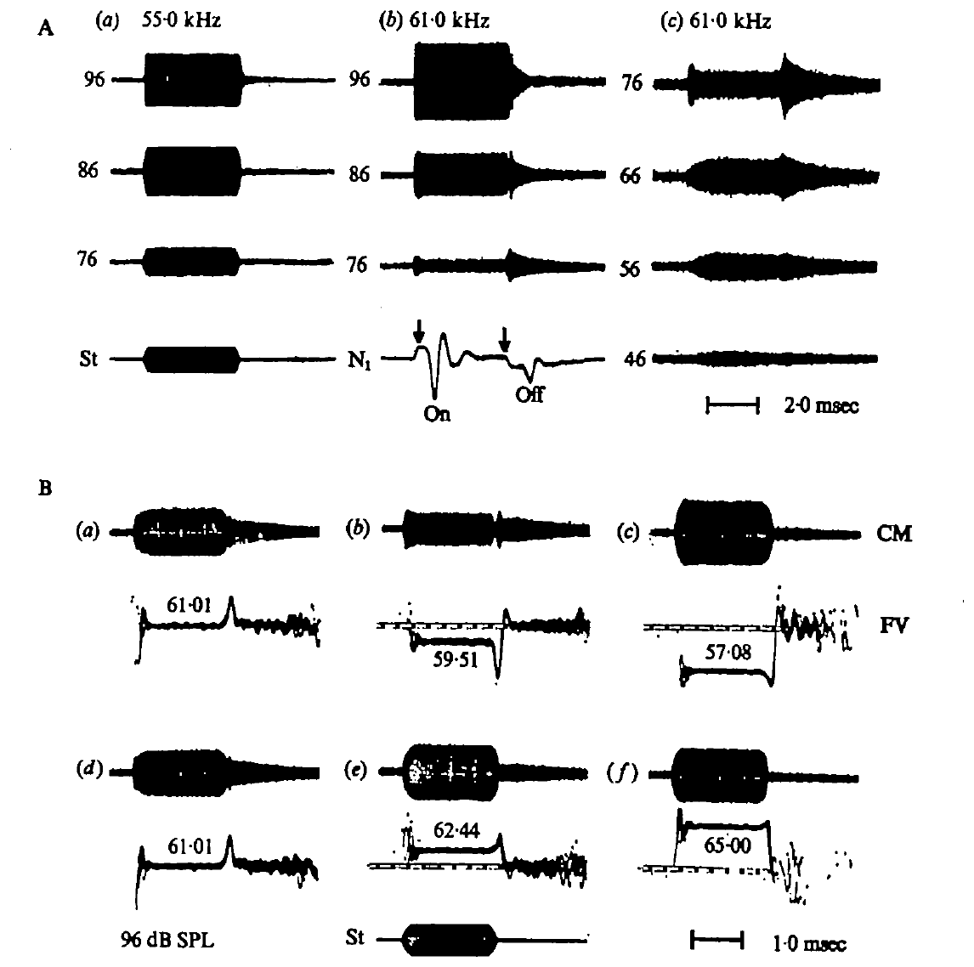
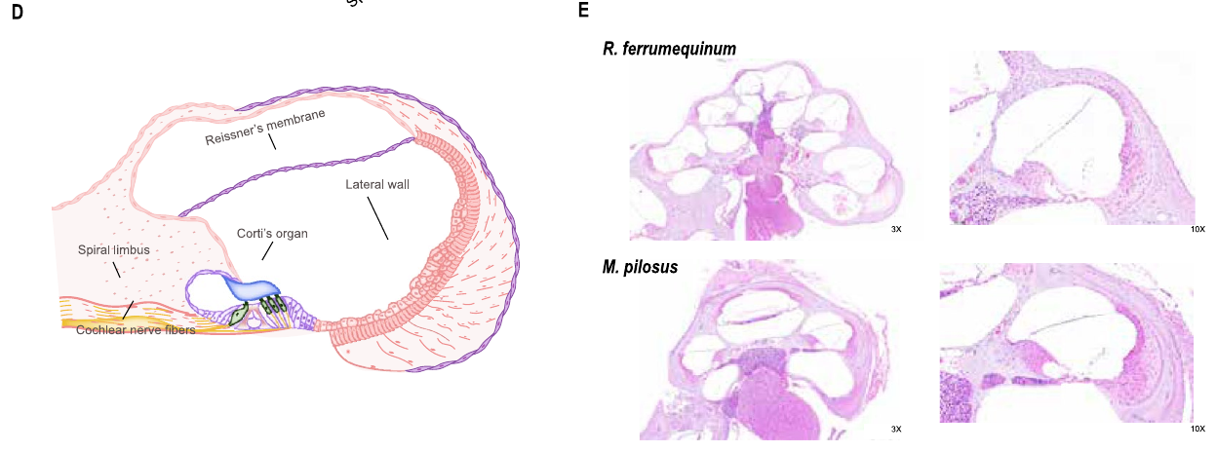
Cochlear recordings separate receptor and neural signals
The cochlea is the inner-ear structure that turns sound into receptor activity. Suga and colleagues placed an electrode at the round window and recorded the cochlear microphonic (CM). The CM is an electrical response that follows stimulation of the cochlea. The CM is recorded from the cochlea itself. That placement makes the CM a peripheral signal.
They also recorded the N1 response, the summed activity of primary auditory neurons. CM tracks receptor activity, while N1 tracks neural discharge. Brief tone bursts let the team compare responses at a sound's start and at its end. Both signals come from the same ear. Their timing can be compared on one time axis.
The CM stimuli lasted 4 ms and rose and fell quickly. The team controlled the stimulus frequency and sound pressure at the ear. The recordings test whether narrow frequency selectivity and offset responses start in the periphery, before any brain processing. Controlled sound pressure makes the stimuli comparable across animals. Short bursts also limit the middle-ear muscle reflex.
Wang et al. (2025), Fig. 1(D–E). Published cochlear anatomy and stained tissue sections.
Suga et al. (1975), Fig. 1(A–B). Round-window cochlear and neural responses to calibrated tone bursts.
Suga et al. (1975); Wang et al. (2025)
14
Notes:
• The round window provides a recording site near the cochlea. The cochlear microphonic follows acoustic stimulation and is a receptor-related electrical signal; it is not a count of action potentials from one neuron.
• The N1 signal represents the summed activity of primary auditory neurons. Recording both signals allows a receptor-related transient to be compared with a transient in neural discharge. Their similarity can support a peripheral origin for a neural response, although the two measurements are not interchangeable.
• Suga and colleagues presented controlled tone bursts and calibrated their amplitude at the ear. Short bursts exposed onset and offset effects while reducing interference from the middle-ear muscle reflex. The frequency dependence of these effects supplied evidence about the sharply tuned mechanical properties of the inner ear.
References:
Suga N, Simmons JA, Jen PH-S (1975). Peripheral specialization for fine analysis of Doppler-shifted echoes in the auditory system of the “CF-FM” bat Pteronotus parnellii. Journal of Experimental Biology 63(1):161–192. https://doi.org/10.1242/jeb.63.1.161
Wang X, Bao M, Wang H, Sun R, Dai W, Sun K, Zhu Y, Pu Y, Chu Y, Li X, Wang T, Zhang M, Lin A, Li J, Feng J (2025). Cochlear Cell Atlas of Two Laryngeal Echolocating Bats—New Evidence for the Adaptive Nervous Physiology in Constant Frequency Bat. Molecular Ecology Resources 25:e14101. https://doi.org/10.1111/1755-0998.14101
Figure: Suga et al. (1975), Fig. 1(A–B). Round-window cochlear and neural responses to calibrated tone bursts.
Figure source: https://doi.org/10.1242/jeb.63.1.161
Figure: Wang et al. (2025), Fig. 1(D–E). Published cochlear anatomy and stained tissue sections.
Figure source: https://doi.org/10.1111/1755-0998.14101

Slide 19
Cochlear anatomy links vibration to neural output
The cochlea is the coiled inner-ear structure that turns vibration into sensory activity. Wang and colleagues combined single-nucleus sequencing with stained sections of cochlear tissue. Their published sections show where sensory tissue, neural tissue and the lateral wall sit. This pairing gives both cell identities and tissue layout. The sections show where each cell type sits.
The sensory tissue holds hair cells and supporting cells. Spiral ganglion neurons carry cochlear signals toward the brainstem. The atlas found 14 cell types in the horseshoe bat and 13 in the FM bat, so the cochlea is made of several working parts. The neurosensory epithelium is one of the cochlear compartments.
Neither the staining nor the RNA sequencing measured Doppler compensation in flight. The two methods show the cell types that make up the cochlea. That cell-level map helps interpret earlier recordings of the ear. Those measurements fit a cellular framework, not a function. The framework supplies cell types to pair with recorded responses.
Wang et al. (2025), Fig. 1(D–E). Published cochlear anatomy and stained tissue sections.
Wang et al. (2025)
15
Notes:
• The cochlea is the coiled inner-ear structure that converts acoustic vibration into sensory activity. Wang and colleagues combined single-nucleus sequencing with hematoxylin-and-eosin tissue staining in the CF bat Rhinolophus ferrumequinum and the FM bat Myotis pilosus. Their published sections locate sensory tissue, neural tissue and the cochlear lateral wall.
• The neurosensory epithelium contains hair cells and supporting cells. Hair cells provide the sensory interface; spiral ganglion neurons carry cochlear information toward the brainstem. The atlas resolved 14 cell types in the horseshoe bat and 13 in the FM bat, distinguishing several cooperating tissue compartments rather than treating the cochlea as one uniform population.
• Anatomical localization and molecular classification describe where candidate mechanisms reside. Neither tissue staining nor RNA sequencing measured Doppler compensation during flight. Their contribution is a cellular framework for interpreting the peripheral specialization established by acoustic and electrophysiological experiments.
References:
Wang X, Bao M, Wang H, Sun R, Dai W, Sun K, Zhu Y, Pu Y, Chu Y, Li X, Wang T, Zhang M, Lin A, Li J, Feng J (2025). Cochlear Cell Atlas of Two Laryngeal Echolocating Bats—New Evidence for the Adaptive Nervous Physiology in Constant Frequency Bat. Molecular Ecology Resources 25:e14101. https://doi.org/10.1111/1755-0998.14101
Figure: Wang et al. (2025), Fig. 1(D–E). Published cochlear anatomy and stained tissue sections.
Figure source: https://doi.org/10.1111/1755-0998.14101

Slide 20
Two bat species share one cochlear atlas
The atlas compares a CF bat with an FM bat. The horseshoe bat is Rhinolophus ferrumequinum, and the FM bat is Myotis pilosus. Both species were studied with the same combined method of sequencing and tissue staining. The shared method makes the two atlases directly comparable. The atlas was built from two bats with different echolocation modes.
Hair cells provide the sensory interface of the cochlea. Supporting cells sit alongside them in the same sensory epithelium. The atlas treats this sensory epithelium as its own group, separate from the spiral ganglion neurons. Each compartment receives its own cell types in the analysis. The FM bat's atlas had 13 types, one fewer than the horseshoe bat.
The stained sections show the layout of the cochlea in both species. Neural tissue and sensory tissue appear as separate regions. Each region can then be matched with its molecular cell types. That step pairs the anatomy with the RNA data from the same tissue. Those cell types were then named by their gene expression.
Wang et al. (2025), Fig. 1(D–E). Published cochlear anatomy and stained tissue sections.
Wang et al. (2025)
15a
Notes:
• Two bat species share one cochlear atlas.
• Explanation 1.
– The atlas compares a CF bat with an FM bat
– The horseshoe bat is Rhinolophus ferrumequinum, and the FM bat is Myotis pilosus. Both species were studied with the same combined method of sequencing and tissue staining. The shared method makes the two atlases directly comparable. The atlas was built from two bats with different echolocation modes.
• Explanation 2.
– Hair cells provide the sensory interface of the cochlea
– Supporting cells sit alongside them in the same sensory epithelium. The atlas treats this sensory epithelium as its own group, separate from the spiral ganglion neurons. Each compartment receives its own cell types in the analysis. The FM bat's atlas had 13 types, one fewer than the horseshoe bat.
• Explanation 3.
– The stained sections show the layout of the cochlea in both species
– Neural tissue and sensory tissue appear as separate regions. Each region can then be matched with its molecular cell types. That step pairs the anatomy with the RNA data from the same tissue. Those cell types were then named by their gene expression.
• Source.
– The figure and the measurements come from Wang et al. (2025).
– Each statement is tied to the recordings or observations of that study.
References:
Wang X, Bao M, Wang H, Sun R, Dai W, Sun K, Zhu Y, Pu Y, Chu Y, Li X, Wang T, Zhang M, Lin A, Li J, Feng J (2025). Cochlear Cell Atlas of Two Laryngeal Echolocating Bats—New Evidence for the Adaptive Nervous Physiology in Constant Frequency Bat. Molecular Ecology Resources 25:e14101. https://doi.org/10.1111/1755-0998.14101

Slide 21
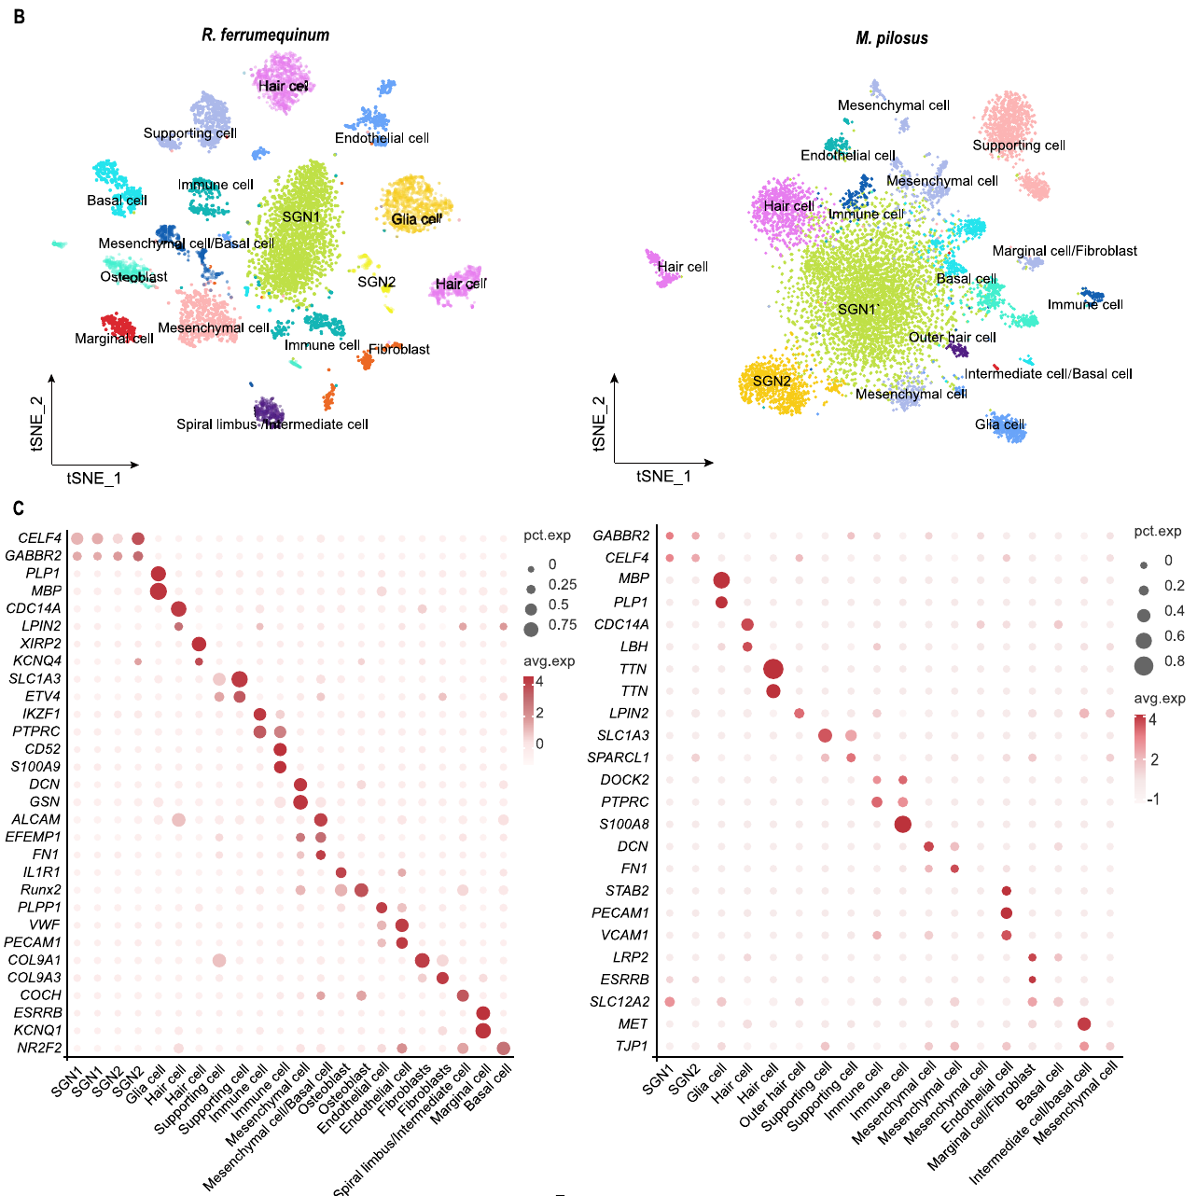
Nuclear RNA identifies distinct cochlear cell populations
Single-nucleus RNA sequencing measures the RNA inside individual cell nuclei. A marker gene is a gene whose expression pattern helps identify a cell type. Wang and colleagues grouped cochlear nuclei by their expression profiles. Single-nucleus sequencing gives one profile per nucleus. That profile allows the team to sort nuclei into groups.
They used more than 200 marker genes to label neural, sensory, immune and structural cells. The horseshoe bat had 14 cell types, and the FM bat had 13. Neural cells included two spiral-ganglion groups and glia. Marginal and basal cells made up the lateral-wall groups. Some groups held many nuclei, and others held few.
Each cluster on the plot is a group of cells with similar RNA. The clusters are molecular groups, not a physical map of the cochlea. A cell's RNA profile suggests possible functions. Firing thresholds and preferred echo frequencies need recordings from those cells. Those groupings are the atlas's main output. Those are candidates for later testing.
Wang et al. (2025), Fig. 1(B–C). Cell clusters and original marker-expression matrix.
Wang et al. (2025)
16
Notes:
• Single-nucleus RNA sequencing measures RNA associated with individual cell nuclei. A marker gene helps identify a cell population by its expression pattern. Wang and colleagues grouped cochlear nuclei using expression profiles and used more than 200 marker genes to support the identification of neural, sensory, immune and structural populations.
• Their species-specific analyses resolved 14 cell types in Rhinolophus ferrumequinum and 13 in Myotis pilosus. Neural populations included two spiral-ganglion categories and glial cells. Hair cells and supporting cells occupied the sensory compartment, while marginal and basal cells contributed to lateral-wall categories.
• The plotted expression clusters are molecular groupings, not a physical map of cochlear position or a measured frequency-tuning map. A cell’s RNA profile can identify candidate functions, but does not establish its firing threshold, preferred echo frequency or causal contribution to vocal feedback.
References:
Wang X, Bao M, Wang H, Sun R, Dai W, Sun K, Zhu Y, Pu Y, Chu Y, Li X, Wang T, Zhang M, Lin A, Li J, Feng J (2025). Cochlear Cell Atlas of Two Laryngeal Echolocating Bats—New Evidence for the Adaptive Nervous Physiology in Constant Frequency Bat. Molecular Ecology Resources 25:e14101. https://doi.org/10.1111/1755-0998.14101
Figure: Wang et al. (2025), Fig. 1(B–C). Cell clusters and original marker-expression matrix.
Figure source: https://doi.org/10.1111/1755-0998.14101

Slide 22
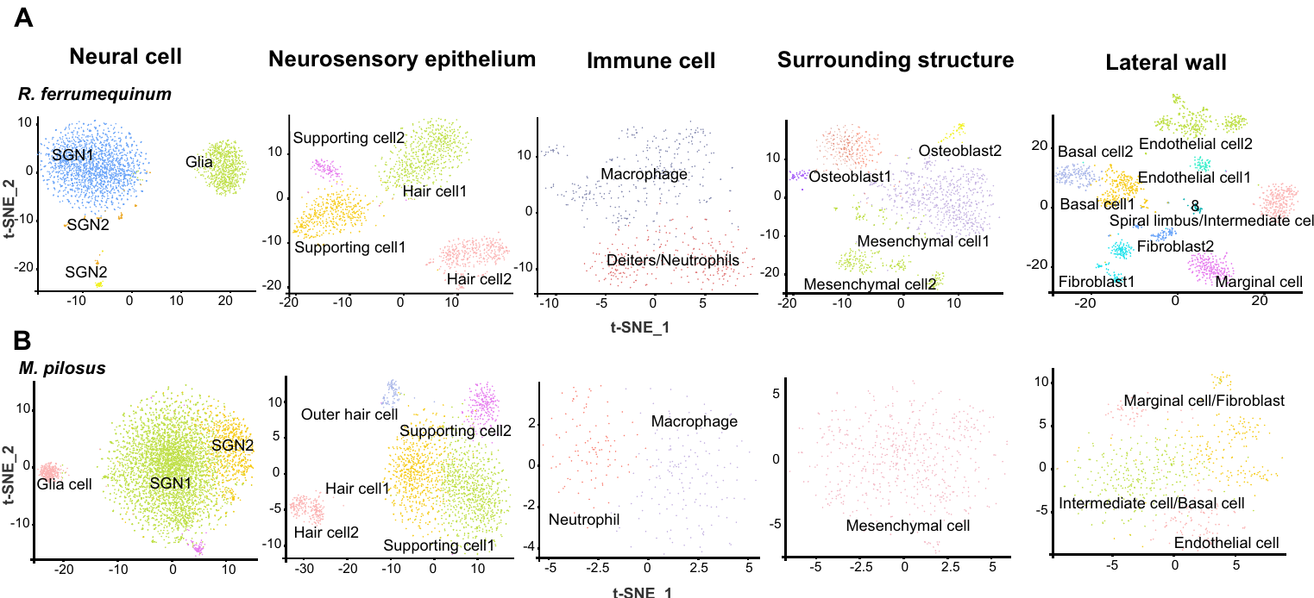
Spiral ganglion neurons carry peripheral auditory signals
Spiral ganglion neurons (SGNs) carry auditory signals from the cochlea toward the brainstem. Wang and colleagues sorted them into SGN1 and SGN2 groups in both bats. These labels describe gene-expression groups. They are not the onset and offset response types that Suga measured. Their names come from expression, not from physiology. Neurons in both groups carry signals toward the brainstem.
The neural group expressed genes such as CELF4 and GABBR2. Glial cells were marked by markers including MBP and PLP1. The analysis also separated hair cells and supporting cells from the neural cells, so each species difference could be placed in a tissue. Each marker identified a cell population in the atlas.
The atlas found two main SGN categories. It did not record the tuning of individual SGNs. A proposed match between one SGN group and narrow CF tuning is still a hypothesis. Recordings from single neurons would test that match. Neural tuning was not one of the measurements. Single-neuron recordings are the way to answer that tuning question.
Wang et al. (2025), Fig. 2(A–B). Classified neural and sensory populations.
Wang et al. (2025)
17
Notes:
• Spiral ganglion neurons, or SGNs, are cochlear sensory neurons that convey auditory information toward the brainstem. Wang and colleagues distinguished SGN1 and SGN2 expression categories in both bats. These labels refer to molecular populations in this analysis rather than the onset and offset response categories measured by Suga.
• The neural grouping was supported by expression of genes including CELF4 and GABBR2. Glial cells were identified using markers including MBP and PLP1. The same analysis separated hair cells and supporting cells from neural populations, allowing species differences to be assigned to particular tissue compartments.
• The atlas found two principal SGN categories, but did not record individual SGN tuning curves. A proposed association between a molecular category and narrowly tuned CF processing therefore remains an interpretation. RNA identity must be linked to recordings before a specific cell population can be assigned an established echo-frequency computation.
References:
Wang X, Bao M, Wang H, Sun R, Dai W, Sun K, Zhu Y, Pu Y, Chu Y, Li X, Wang T, Zhang M, Lin A, Li J, Feng J (2025). Cochlear Cell Atlas of Two Laryngeal Echolocating Bats—New Evidence for the Adaptive Nervous Physiology in Constant Frequency Bat. Molecular Ecology Resources 25:e14101. https://doi.org/10.1111/1755-0998.14101
Figure: Wang et al. (2025), Fig. 2(A–B). Classified neural and sensory populations.
Figure source: https://doi.org/10.1111/1755-0998.14101

Slide 23
Hair-cell markers locate candidate channel mechanisms
A hair cell is a sensory epithelial cell whose mechanically sensitive parts respond to displacement. In the atlas, the genes CDC14A, XIRP2, Kcnq4 and LBH helped identify hair-cell groups. KCNQ4 is a potassium-channel gene, so its RNA marks a possible channel, not a measured current. The atlas places it in the sensory epithelium.
Supporting cells had their own markers, including SLC1A3, SPARCL1 and ETV4. Sensory transduction depends on several cell types working together in the cochlea, not on hair cells alone. Each marker identifies a cell population, not a function. Markers were used together to label each group. Each group was checked against several markers.
The study did not block KCNQ4 or measure channel gating. It also did not test compensation after any channel change. Gene expression, membrane currents and behavior are three separate kinds of evidence. The gene data supply candidates, nothing more. Channel function needs direct measurement of currents. Electrical recordings would supply those currents.
Wang et al. (2025), Fig. 2(A–B). Sensory and supporting-cell populations.
Wang et al. (2025)
18
Notes:
• A hair cell is a sensory epithelial cell whose mechanically sensitive structures respond to displacement. In the atlas, expression of CDC14A, XIRP2, Kcnq4 and LBH helped identify hair-cell populations. KCNQ4 names a potassium-channel gene; detecting its RNA identifies a candidate cellular mechanism rather than measuring a potassium current.
• Wang and colleagues separated sensory epithelial populations from spiral ganglion neurons and cochlear lateral-wall cells. Their 14-category horseshoe-bat atlas therefore places a channel-associated marker in a tissue context. Supporting-cell markers included SLC1A3, SPARCL1 and ETV4, emphasizing that sensory transduction depends on a multicellular environment.
• The study did not selectively block KCNQ4, measure channel gating or test compensation after a channel intervention. It cannot establish that KCNQ4 alone creates the auditory fovea. The molecular evidence complements peripheral recordings while preserving the distinction between expressed genes, functional membrane currents and behavior.
References:
Wang X, Bao M, Wang H, Sun R, Dai W, Sun K, Zhu Y, Pu Y, Chu Y, Li X, Wang T, Zhang M, Lin A, Li J, Feng J (2025). Cochlear Cell Atlas of Two Laryngeal Echolocating Bats—New Evidence for the Adaptive Nervous Physiology in Constant Frequency Bat. Molecular Ecology Resources 25:e14101. https://doi.org/10.1111/1755-0998.14101
Figure: Wang et al. (2025), Fig. 2(A–B). Sensory and supporting-cell populations.
Figure source: https://doi.org/10.1111/1755-0998.14101

Slide 24
Sensory cells are separated from neurons and wall cells
Wang and colleagues separated the sensory epithelial populations from the spiral ganglion neurons. They also separated them from the cochlear lateral-wall cells. Each group forms its own population in the atlas. The separate groups make it possible to ask which tissue holds each marker. The sensory group and the neural group carry different marker genes.
The horseshoe-bat atlas has 14 categories in total. Placing a channel marker in that framework shows which tissue expresses it. That places the marker in a tissue context. A tissue context is a different thing from a measured channel, and the atlas supplies just that first step. Each category is a tissue-level grouping of cells, not a single cell.
Gene expression tells the team where a gene is active in the tissue. The channel's gating and its current need separate experiments. Blocking the channel in tissue would be one such experiment. The atlas supplies the tissue location for the candidate, and nothing more. Those are three separate steps, and each needs its own data.
Wang et al. (2025), Fig. 2(A–B). Sensory and supporting-cell populations.
Wang et al. (2025)
18a
Notes:
• Sensory cells are separated from neurons and wall cells.
• Explanation 1.
– Wang and colleagues separated the sensory epithelial populations from the spiral ganglion neurons
– They also separated them from the cochlear lateral-wall cells. Each group forms its own population in the atlas. The separate groups make it possible to ask which tissue holds each marker. The sensory group and the neural group carry different marker genes.
• Explanation 2.
– The horseshoe-bat atlas has 14 categories in total
– Placing a channel marker in that framework shows which tissue expresses it. That places the marker in a tissue context. A tissue context is a different thing from a measured channel, and the atlas supplies just that first step. Each category is a tissue-level grouping of cells, not a single cell.
• Explanation 3.
– Gene expression tells the team where a gene is active in the tissue
– The channel's gating and its current need separate experiments. Blocking the channel in tissue would be one such experiment. The atlas supplies the tissue location for the candidate, and nothing more. Those are three separate steps, and each needs its own data.
• Source.
– The figure and the measurements come from Wang et al. (2025).
– Each statement is tied to the recordings or observations of that study.
References:
Wang X, Bao M, Wang H, Sun R, Dai W, Sun K, Zhu Y, Pu Y, Chu Y, Li X, Wang T, Zhang M, Lin A, Li J, Feng J (2025). Cochlear Cell Atlas of Two Laryngeal Echolocating Bats—New Evidence for the Adaptive Nervous Physiology in Constant Frequency Bat. Molecular Ecology Resources 25:e14101. https://doi.org/10.1111/1755-0998.14101

Slide 25
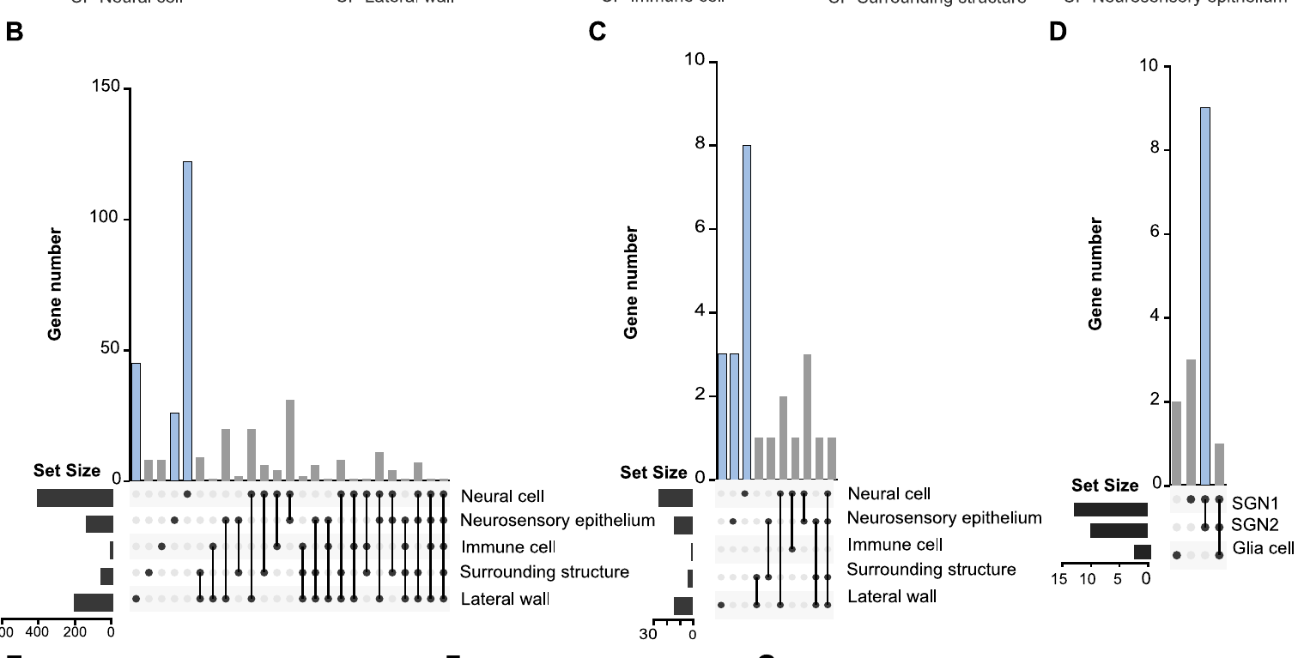
CF-associated expression is concentrated in neural cells
Differential expression means that a gene is measured at different levels in two groups. Wang and colleagues mapped gene sets from earlier CF-bat work onto their cochlear atlas. Nervous-system genes in those sets were most common in neural cells. The gene sets came from earlier work in CF bats. The team tested many genes at once across cell types.
The two spiral-ganglion groups held most of this signal. The analysis also found 1365 upregulated genes across neural cells, sensory epithelium and lateral-wall cells. It combined whole-tissue comparisons with single-nucleus data to place the signal in specific cells. Most of the signal came from neural cells. The neural cells held the largest share of these genes.
Enrichment in SGN1 and SGN2 gives focused ideas about peripheral neural specialization. These are expression measurements of genes, not recordings of responses to sound. They show which cells carry the genes, and not how those cells respond to sound. The data are about gene levels, not about firing. Firing would need electrical recordings from the same cells.
Wang et al. (2025), Fig. 3(B–D). CF-associated genes across cell classes.
Wang et al. (2025)
19
Notes:
• Differential expression describes a difference in measured gene abundance between comparison groups. Wang and colleagues mapped previously identified CF-associated gene sets onto their cochlear cell atlas. The mapped nervous-system-related genes were concentrated in neural cells, particularly the two spiral-ganglion categories.
• The analysis localized a broader set of 1365 upregulated genes across neural cells, sensory epithelium and lateral-wall cells. It combined whole-tissue expression comparisons with single-nucleus localization, separating a cochlear-wide molecular signal into candidate cellular sources. These are expression measurements rather than recordings of acoustic responses.
• Enrichment in SGN1 and SGN2 supports focused hypotheses about peripheral neural specialization. It does not establish that every mapped gene is necessary for CF hearing, or that its expression changes during compensation. Species differences, tissue preparation and cell classification remain relevant when connecting molecular patterns to behavior.
References:
Wang X, Bao M, Wang H, Sun R, Dai W, Sun K, Zhu Y, Pu Y, Chu Y, Li X, Wang T, Zhang M, Lin A, Li J, Feng J (2025). Cochlear Cell Atlas of Two Laryngeal Echolocating Bats—New Evidence for the Adaptive Nervous Physiology in Constant Frequency Bat. Molecular Ecology Resources 25:e14101. https://doi.org/10.1111/1755-0998.14101
Figure: Wang et al. (2025), Fig. 3(B–D). CF-associated genes across cell classes.
Figure source: https://doi.org/10.1111/1755-0998.14101

Slide 26
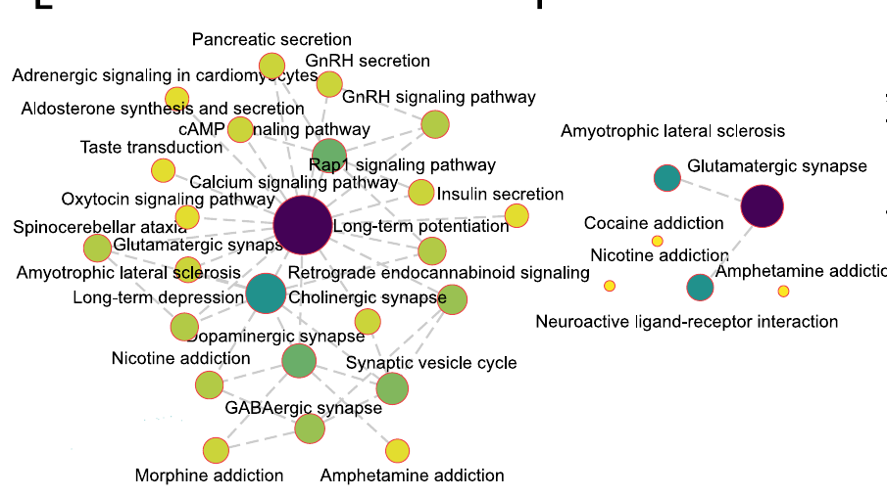
Calcium pathways are candidate components of CF tuning
Pathway enrichment asks whether a gene set holds more genes from one biological process than expected. In Wang and colleagues' spiral-ganglion analysis, calcium signaling sat at the center of the horseshoe-bat pathway network. The FM-bat comparison highlighted a glutamatergic-synapse pathway instead. The horseshoe-bat network is the focus of the analysis. The networks are drawn from annotated genes.
Calcium signaling covers processes that respond to calcium levels and to calcium-sensitive proteins. A glutamatergic synapse uses glutamate to signal between cells. The networks were built from gene-expression categories. Their lines show shared annotations, not wiring between cells. Glutamate is an excitatory transmitter in many neural systems. Calcium-sensitive proteins change their activity as calcium levels change.
The pathway gives a molecular candidate for studying CF-specific hearing. The team recorded no calcium levels, channel currents or transmitter release. So the pathway suggests a process to test, not a known chain from one channel to neuron firing. A channel would need its own current recordings. Ion currents and neuron firing are separate measurements.
Wang et al. (2025), Fig. 3(E–F). Published pathway networks from cochlear neural cells.
Wang et al. (2025)
20
Notes:
• Pathway enrichment asks whether a measured gene set contains many genes assigned to a biological process. In Wang and colleagues’ spiral-ganglion analysis, calcium signaling occupied a central position in the horseshoe-bat pathway network. The FM-bat comparison instead emphasized a glutamatergic-synapse pathway among its identified neural categories.
• Calcium signaling refers to cellular processes regulated by calcium availability and calcium-sensitive proteins. A glutamatergic synapse uses glutamate-associated signaling between cells. The networks were constructed from gene-expression categories; their connections indicate relationships among annotated pathways, not demonstrated synaptic wiring.
• The difference provides a molecular candidate for investigating CF-associated auditory specialization. No calcium concentration, channel current or transmitter-release rate was measured in this experiment. A pathway assignment therefore cannot be converted into an established sequence in which one channel changes SGN firing and thereby produces Doppler-shift compensation.
References:
Wang X, Bao M, Wang H, Sun R, Dai W, Sun K, Zhu Y, Pu Y, Chu Y, Li X, Wang T, Zhang M, Lin A, Li J, Feng J (2025). Cochlear Cell Atlas of Two Laryngeal Echolocating Bats—New Evidence for the Adaptive Nervous Physiology in Constant Frequency Bat. Molecular Ecology Resources 25:e14101. https://doi.org/10.1111/1755-0998.14101
Figure: Wang et al. (2025), Fig. 3(E–F). Published pathway networks from cochlear neural cells.
Figure source: https://doi.org/10.1111/1755-0998.14101

Slide 27
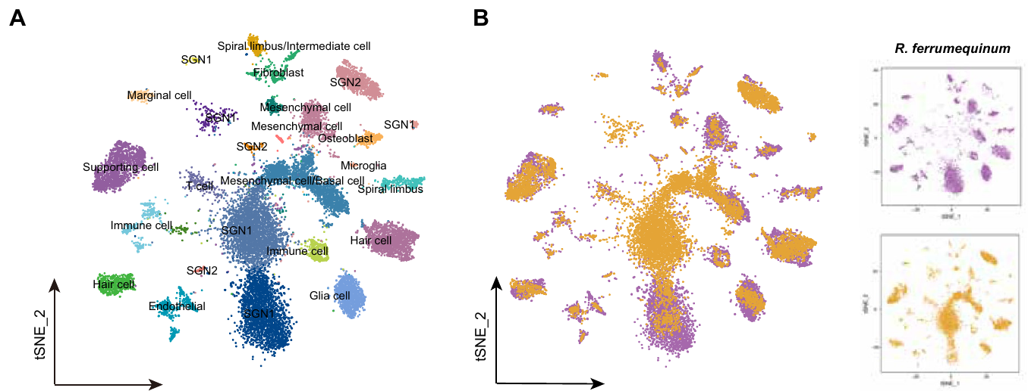
Orthologous genes permit a controlled species comparison
Orthologous genes are genes in different species that were inherited from one ancestral gene. Wang and colleagues used 8,607 orthologous genes to build one cochlear atlas for the horseshoe bat and the FM bat. This gives both species a common comparison space. The atlas then covers both species in one framework.
The joint analysis found 26 expression clusters. It assigned familiar cochlear identities, including SGNs, glial cells, supporting cells and hair cells. Some clusters came mostly from one species. Others drew cells from both species. Familiar cochlear identities still held across both species. The joint analysis resolved the clusters with shared labels.
A shared gene list makes the two species easier to compare, but echolocation is not the only difference between them. The two species also differ in ancestry and physiology. A CF-type expression pattern is a candidate adaptation to test with more species. That is a reason to test more species. Wider sampling would show whether the pattern repeats.
Wang et al. (2025), Fig. 4(A–B). Joint cell atlas and species distribution.
Wang et al. (2025)
21
Notes:
• Orthologous genes are corresponding genes in different species inherited from a common ancestral gene. Wang and colleagues used 8607 orthologous genes to construct a joint cochlear atlas for Rhinolophus ferrumequinum and Myotis pilosus. This provides a common comparison space rather than comparing unrelated species-specific marker lists.
• The joint analysis resolved 26 expression clusters and assigned familiar cochlear identities, including SGNs, glial cells, supporting cells and hair cells. Some clusters were dominated by one species, while others contained contributions from both. The separation preserves both shared cellular organization and species-associated expression differences.
• A shared gene framework improves comparability but does not isolate echolocation mode from every other species difference. These two species also differ in ancestry and physiology. A CF-associated expression pattern is therefore a candidate adaptation, requiring wider comparative sampling or direct manipulation before its contribution to hearing can be established.
References:
Wang X, Bao M, Wang H, Sun R, Dai W, Sun K, Zhu Y, Pu Y, Chu Y, Li X, Wang T, Zhang M, Lin A, Li J, Feng J (2025). Cochlear Cell Atlas of Two Laryngeal Echolocating Bats—New Evidence for the Adaptive Nervous Physiology in Constant Frequency Bat. Molecular Ecology Resources 25:e14101. https://doi.org/10.1111/1755-0998.14101
Figure: Wang et al. (2025), Fig. 4(A–B). Joint cell atlas and species distribution.
Figure source: https://doi.org/10.1111/1755-0998.14101

Slide 28
One comparison space for two species
The joint atlas gives a common comparison space for both species. It avoids comparing two unrelated marker lists, one for each species. Both species are measured against the same set of genes. That shared set makes differences in cell types easier to spot. Cells from both species can be placed on one shared map. This makes the atlas a single resource.
The joint map keeps two things in view. One is shared cellular organization. The other is species-specific expression differences. The map shows both without merging them into one pattern. Some clusters hold cells from both species, and others hold cells from a single species. The cluster identities came from expression profiles, not from species labels.
The shared gene list makes the species easier to compare. Call type is one trait among several that separate these two bats. Other traits can add to the expression differences that the joint map shows. The joint map offers a starting list of candidate genes for later tests. The expression comparison is one line of evidence among several.
Wang et al. (2025), Fig. 4(A–B). Joint cell atlas and species distribution.
Wang et al. (2025)
21a
Notes:
• One comparison space for two species.
• Explanation 1.
– The joint atlas gives a common comparison space for both species
– It avoids comparing two unrelated marker lists, one for each species. Both species are measured against the same set of genes. That shared set makes differences in cell types easier to spot. Cells from both species can be placed on one shared map. This makes the atlas a single resource.
• Explanation 2.
– The joint map keeps two things in view
– One is shared cellular organization. The other is species-specific expression differences. The map shows both without merging them into one pattern. Some clusters hold cells from both species, and others hold cells from a single species. The cluster identities came from expression profiles, not from species labels.
• Explanation 3.
– The shared gene list makes the species easier to compare
– Call type is one trait among several that separate these two bats. Other traits can add to the expression differences that the joint map shows. The joint map offers a starting list of candidate genes for later tests. The expression comparison is one line of evidence among several.
• Source.
– The figure and the measurements come from Wang et al. (2025).
– Each statement is tied to the recordings or observations of that study.
References:
Wang X, Bao M, Wang H, Sun R, Dai W, Sun K, Zhu Y, Pu Y, Chu Y, Li X, Wang T, Zhang M, Lin A, Li J, Feng J (2025). Cochlear Cell Atlas of Two Laryngeal Echolocating Bats—New Evidence for the Adaptive Nervous Physiology in Constant Frequency Bat. Molecular Ecology Resources 25:e14101. https://doi.org/10.1111/1755-0998.14101

Slide 29
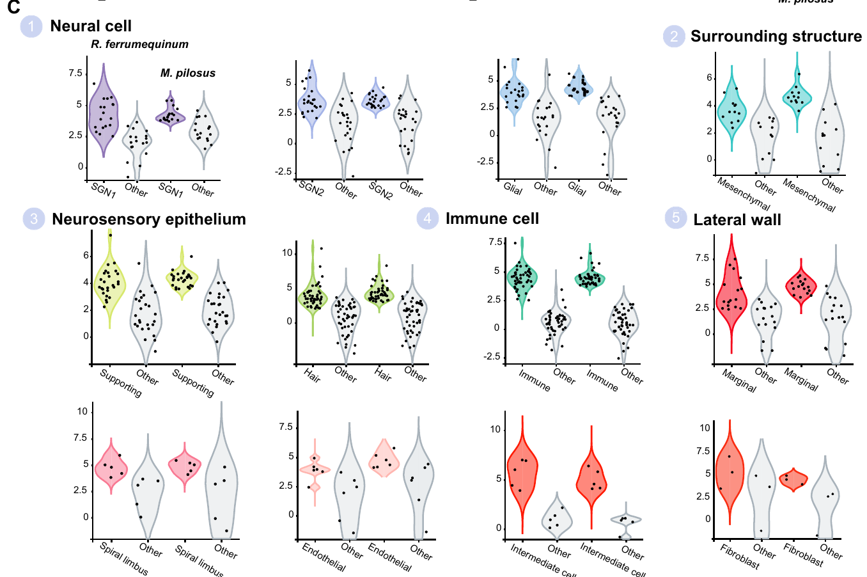
Neural expression categories differ between CF and FM bats
Wang and colleagues compared matching cochlear cell types from their joint 26-cluster atlas. Spiral-ganglion cells had shared neural expression features in both bats. Differences between the species appeared inside those broader cell identities. Each matched pair came from one cell type. The matches made the species differences easier to see.
Gene-expression distributions show how RNA levels vary from cell to cell in a population. The team kept each cell type fixed while comparing expression in the CF and FM species. That allows them to ask whether a neural group is shared and whether its gene profile differs. Each species provides the same set of cell types.
Similar RNA profiles can still hide different neural behavior. Two neurons with the same RNA may respond to different frequency ranges. Electrical recordings from those neurons would show their tuning directly. Two cells can share RNA and still differ in function. Neural behavior is a separate property from RNA content. Each property needs its own measurement.
Wang et al. (2025), Fig. 4(C). Cross-species expression distributions in identified cell types.
Wang et al. (2025)
22
Notes:
• Wang and colleagues compared corresponding cochlear cell types using their joint 26-cluster atlas. Spiral-ganglion populations shared neuronal expression features, while species-associated differences appeared within those broader identities. The distinction concerns the molecular organization of peripheral auditory cells rather than the existence of an entirely separate sensory organ.
• Gene-expression distributions describe how RNA abundance varies across a cellular population. The published comparisons preserved cell-type identity while evaluating expression across the CF and FM species. This makes it possible to ask whether a neural category is conserved and whether its molecular profile differs between echolocation strategies.
• Molecular heterogeneity does not directly measure acoustic bandwidth. A relatively uniform RNA population could still contain physiologically diverse neurons, and similar RNA profiles need not guarantee identical tuning. The study supports targeted electrophysiological tests rather than assigning a measured kilohertz range to an expression cluster.
References:
Wang X, Bao M, Wang H, Sun R, Dai W, Sun K, Zhu Y, Pu Y, Chu Y, Li X, Wang T, Zhang M, Lin A, Li J, Feng J (2025). Cochlear Cell Atlas of Two Laryngeal Echolocating Bats—New Evidence for the Adaptive Nervous Physiology in Constant Frequency Bat. Molecular Ecology Resources 25:e14101. https://doi.org/10.1111/1755-0998.14101
Figure: Wang et al. (2025), Fig. 4(C). Cross-species expression distributions in identified cell types.
Figure source: https://doi.org/10.1111/1755-0998.14101

Slide 30
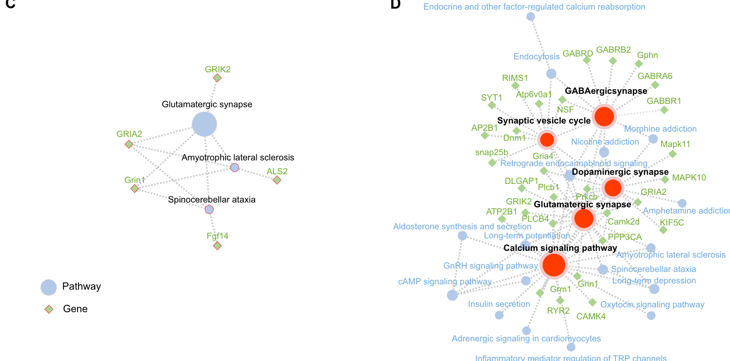
GABA receptor pathways suggest testable inhibitory roles
GABA is an inhibitory transmitter in many neural systems. Wang and colleagues found a GABAergic-synapse pathway among the highly expressed genes of one horseshoe-bat SGN group. The analysis assigned 233 highly expressed genes to that group. This pathway comes from the SGN1 category, not the whole cochlea. The atlas is a map of RNA, not a map of currents.
The pathway included GABA-A and GABA-B receptor annotations. These are two distinct receptor classes through which GABA can act on a cell. The authors suggested that these receptors help control CF processing and vocal compensation. The idea ties GABA signaling to vocal compensation. That idea is still a proposal in the paper.
The atlas measured RNA. It did not measure receptor binding, synaptic inhibition or the effect of a blocking drug. A test of this idea would need drugs or genetic tools that block each receptor class, plus recordings and a behavioral compensation test. The chain has several separate steps. Each step needs its own experiment.
Wang et al. (2025), Fig. 5(C–D). Original neuronal expression and pathway-enrichment panels.
Wang et al. (2025)
23
Notes:
• GABA is an inhibitory transmitter in many neural systems. Wang and colleagues identified GABAergic-synapse pathway enrichment in a horseshoe-bat SGN1 category, alongside glutamatergic, dopaminergic pathways associated with the transmitter dopamine, and calcium-signaling pathways. Their analysis associated 233 highly expressed genes with this species-specific neuronal category.
• The pathway included GABA A and GABA B receptor annotations. These name distinct receptor classes through which GABA can influence cellular signaling. The atlas measured RNA, not receptor binding, synaptic inhibition or a response to a pharmacological blocker. Its two receptor annotations therefore identify candidates rather than a demonstrated inhibitory circuit.
• The authors proposed a connection to specialized CF processing and vocal compensation. That proposal does not establish that cochlear GABA receptors perform the auditory comparison controlling call frequency. A causal account requires receptor-specific interventions, neuronal measurements and a behavioral compensation assay in the same mechanistic chain.
References:
Wang X, Bao M, Wang H, Sun R, Dai W, Sun K, Zhu Y, Pu Y, Chu Y, Li X, Wang T, Zhang M, Lin A, Li J, Feng J (2025). Cochlear Cell Atlas of Two Laryngeal Echolocating Bats—New Evidence for the Adaptive Nervous Physiology in Constant Frequency Bat. Molecular Ecology Resources 25:e14101. https://doi.org/10.1111/1755-0998.14101
Figure: Wang et al. (2025), Fig. 5(C–D). Original neuronal expression and pathway-enrichment panels.
Figure source: https://doi.org/10.1111/1755-0998.14101

Slide 31
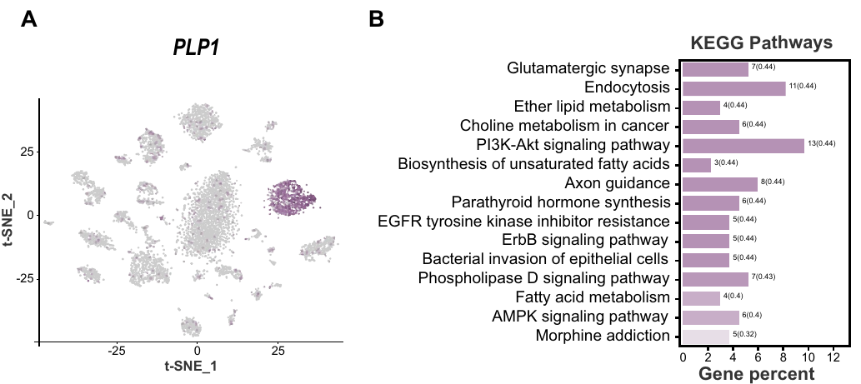
Glial signaling is inferred from expression relationships
Glial cells help neurons and interact with them. Glia are not the main carriers of the sensory signal. Wang and colleagues marked the glia with PLP1 and examined their most highly expressed genes. The category is a small group of cells in the atlas. Its expression pattern is the basis for the analysis.
The genes in this group suggested roles in cell communication and in helping neurons. The horseshoe-bat atlas tells glia apart from SGN1 and SGN2. So the team can study glial expression on its own, apart from neuron expression. The atlas measured expression, not signaling. Communication was inferred from gene lists.
Ligand-receptor inference predicts that one cell can signal to another when the first makes a signaling molecule and the second makes the matching receptor. The study proposed adhesion and growth signals between neurons and glia. The glia remain a candidate part of the sensory environment. The idea awaits testing. Testing would decide its importance.
Wang et al. (2025), Fig. 6(A–B). Glial marker localization and functional gene categories.
Wang et al. (2025)
24
Notes:
• Glial cells support and interact with neurons without being classified as the principal signal-carrying sensory neurons. Wang and colleagues localized PLP1 expression in their cochlear atlas and examined highly expressed genes within the glial category. The analysis associated this category with cell communication and several neural-support processes.
• The horseshoe-bat atlas distinguishes glia from SGN1 and SGN2, allowing support-cell expression to be studied separately from neuronal expression. Ligand–receptor inference predicts possible communication when one cell class expresses a signaling molecule and another expresses a corresponding receptor. Such inference is based on molecular compatibility, not direct observation of transmission.
• The study proposed interactions involving neural adhesion and growth-associated signaling. It did not stimulate glia, measure a resulting SGN membrane response or test an alteration of echo compensation. Glial molecular specialization remains a candidate contributor to the sensory environment rather than an established moment-to-moment Doppler controller.
References:
Wang X, Bao M, Wang H, Sun R, Dai W, Sun K, Zhu Y, Pu Y, Chu Y, Li X, Wang T, Zhang M, Lin A, Li J, Feng J (2025). Cochlear Cell Atlas of Two Laryngeal Echolocating Bats—New Evidence for the Adaptive Nervous Physiology in Constant Frequency Bat. Molecular Ecology Resources 25:e14101. https://doi.org/10.1111/1755-0998.14101
Figure: Wang et al. (2025), Fig. 6(A–B). Glial marker localization and functional gene categories.
Figure source: https://doi.org/10.1111/1755-0998.14101

Slide 32
Glia are inferred from molecular matches
Ligand-receptor inference rests on molecular compatibility. It is not direct observation of signal transmission. The analysis found matching molecules, not a signal that was passed between cells. Matching molecules are a hint, and the hint needs testing. The analysis of expression data produces a candidate list, not a demonstrated pathway. Matches are predicted from the gene lists of the two cell classes.
The study did not stimulate the glia. It also did not measure a resulting response in the SGN membrane. The proposed adhesion and growth signals remain a hypothesis about cell communication. That hypothesis rests on gene expression alone. The proposed signals are candidates that a stimulation experiment could confirm or reject. The study named these signals as a possibility.
A test would stimulate the glia and record the SGNs at the same time. Only that experiment could show whether the proposed signal changes neuron firing. Such a test would need stimulation and recording tools placed in the cochlea. Until then, the glia remain candidates in the atlas. The test would also show the size of any response.
Wang et al. (2025), Fig. 6(A–B). Glial marker localization and functional gene categories.
Wang et al. (2025)
24a
Notes:
• Glia are inferred from molecular matches.
• Explanation 1.
– Ligand-receptor inference rests on molecular compatibility
– It is not direct observation of signal transmission. The analysis found matching molecules, not a signal that was passed between cells. Matching molecules are a hint, and the hint needs testing. The analysis of expression data produces a candidate list, not a demonstrated pathway. Matches are predicted from the gene lists of the two cell classes.
• Explanation 2.
– The study did not stimulate the glia
– It also did not measure a resulting response in the SGN membrane. The proposed adhesion and growth signals remain a hypothesis about cell communication. That hypothesis rests on gene expression alone. The proposed signals are candidates that a stimulation experiment could confirm or reject. The study named these signals as a possibility.
• Explanation 3.
– A test would stimulate the glia and record the SGNs at the same time
– Only that experiment could show whether the proposed signal changes neuron firing. Such a test would need stimulation and recording tools placed in the cochlea. Until then, the glia remain candidates in the atlas. The test would also show the size of any response.
• Source.
– The figure and the measurements come from Wang et al. (2025).
– Each statement is tied to the recordings or observations of that study.
References:
Wang X, Bao M, Wang H, Sun R, Dai W, Sun K, Zhu Y, Pu Y, Chu Y, Li X, Wang T, Zhang M, Lin A, Li J, Feng J (2025). Cochlear Cell Atlas of Two Laryngeal Echolocating Bats—New Evidence for the Adaptive Nervous Physiology in Constant Frequency Bat. Molecular Ecology Resources 25:e14101. https://doi.org/10.1111/1755-0998.14101

Slide 33
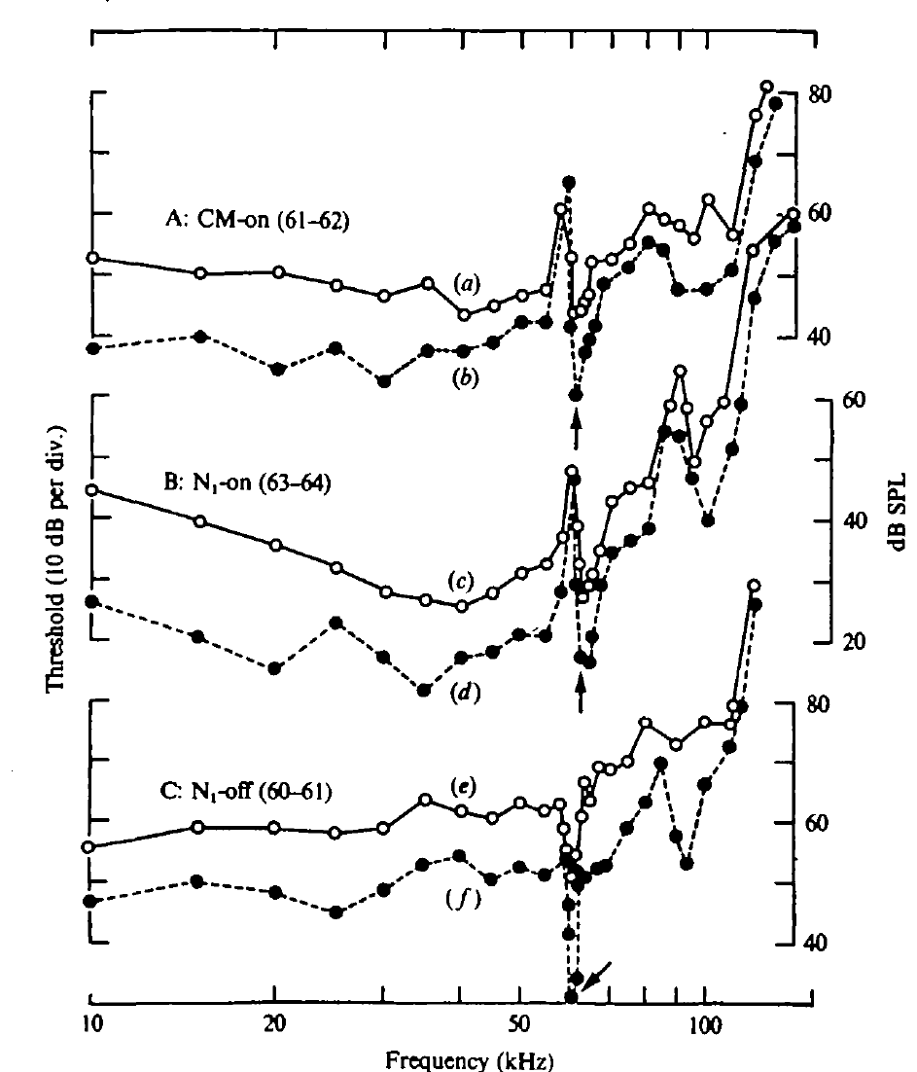
The cochlear response is sharply tuned near CF2
CF2 is the constant-frequency part of the second harmonic. In the mustached bat, Pteronotus parnellii, CF2 lies near 61 to 62 kHz. The cochlear microphonic threshold curve has a sharp sensitivity notch in about the same band. Sensitivity is highest in the notch. The notch shows a narrow band of receptor sensitivity.
The best frequency depends on which response is measured. CM onset is most sensitive near 61 to 62 kHz. Summed neural onset is most sensitive near 63 to 64 kHz. Summed neural offset is most sensitive near 60 to 61 kHz. These differences matter for interpreting thresholds. Each measurement has its own best band.
A sharply tuned receptor response shows that the ear sharpens sound before the brain processes it. The onset response also depends on the timing of the sound's edges. So the best frequency of a neural response can differ from the receptor's best frequency. The ear's selectivity begins with the receptor. That is the peripheral part of the story.
Wang et al. (2025), Fig. 1(D–E). Published cochlear anatomy and stained tissue sections.
Suga et al. (1975), Fig. 2(A–C). Threshold notches of CM onset, neural onset, and neural offset, in kHz.
Suga et al. (1975); Wang et al. (2025)
25
Notes:
• The second harmonic of the constant-frequency call is abbreviated CF2. Its frequency was about 61 to 62 kilohertz in the mustached bats studied. The receptor-related threshold curve had a narrow notch near that range.
• The minimum threshold of a response identifies the sound level required to evoke it. The recorded CM onset, neural onset, and neural offset signals did not have identical best frequencies. An onset response measures a different event from discharge at the cessation of the same sound.
• The narrow CM sensitivity supports a peripheral specialization. Suga and colleagues related the displaced neural onset minimum to the time course of cochlear excitation. A population onset measure is therefore not a complete substitute for sustained hearing sensitivity or for the tuning of individual neurons.
References:
Suga N, Simmons JA, Jen PH-S (1975). Peripheral specialization for fine analysis of Doppler-shifted echoes in the auditory system of the “CF-FM” bat Pteronotus parnellii. Journal of Experimental Biology 63(1):161–192. https://doi.org/10.1242/jeb.63.1.161
Wang X, Bao M, Wang H, Sun R, Dai W, Sun K, Zhu Y, Pu Y, Chu Y, Li X, Wang T, Zhang M, Lin A, Li J, Feng J (2025). Cochlear Cell Atlas of Two Laryngeal Echolocating Bats—New Evidence for the Adaptive Nervous Physiology in Constant Frequency Bat. Molecular Ecology Resources 25:e14101. https://doi.org/10.1111/1755-0998.14101
Figure: Suga et al. (1975), Fig. 2(A–C). Threshold notches of CM onset, neural onset, and neural offset, in kHz.
Figure source: https://doi.org/10.1242/jeb.63.1.161
Figure: Wang et al. (2025), Fig. 1(D–E). Published cochlear anatomy and stained tissue sections.
Figure source: https://doi.org/10.1111/1755-0998.14101

Slide 34
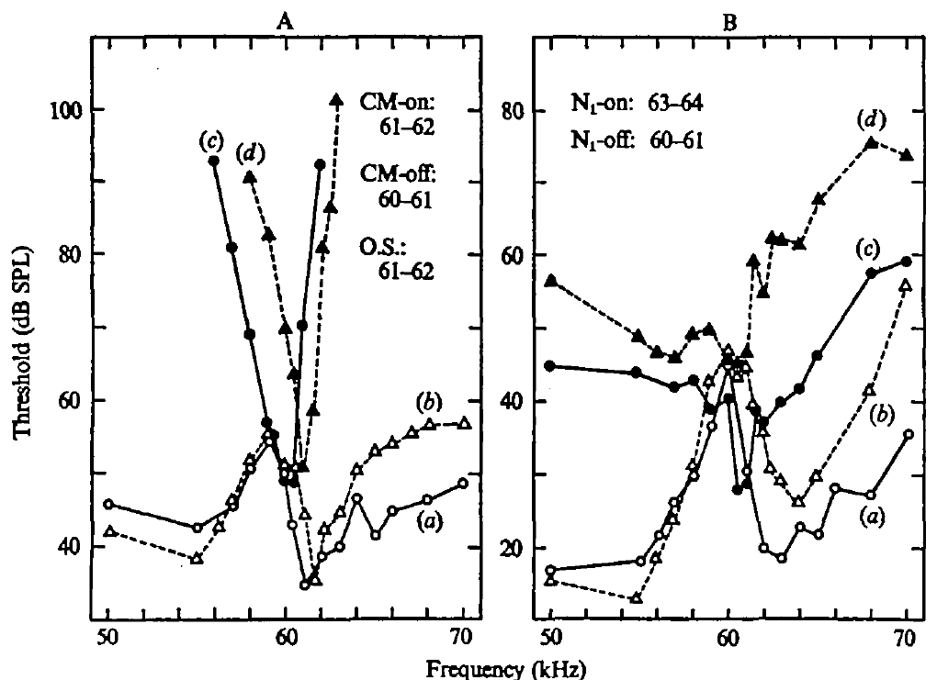
A cochlear resonator prolongs excitation after sound ends
A resonator responds most strongly near one frequency. It can keep moving after the driving sound stops. Near the CF2 band, Suga and colleagues saw the CM activity build up and decay slowly, more slowly than responses farther from that band. Resonance here is a property of the cochlea. Its tuning and its ringing come from one property.
The residual CM activity after the tone ended is called CM-after. Its timing matches mechanical ringing in the inner ear. A neural offset response occurred alongside these events. It did not need a second sound pulse. The neural response followed the cochlear activity. That sequence suggests a peripheral origin. The origin is peripheral, not central.
The same tuning that sharpens frequency also stretches the response in time. A sharply ended tone can keep the receptor excited for a while. At each frequency, the ear's response follows its own pattern over time. Frequency and time are tied together in the cochlea. Both properties come from one resonant structure.
Wang et al. (2025), Fig. 1(D–E). Published cochlear anatomy and stained tissue sections.
Suga et al. (1975), Fig. 3(A–B). Different best frequencies of cochlear and neural onset and offset responses.
Suga et al. (1975); Wang et al. (2025)
26
Notes:
• Mechanical resonance combines frequency preference with persistence in time. A system that is strongly energized near its resonant frequency can continue moving after the external driving sound stops.
• The recorded cochlear microphonic had a slow build-up and residual activity near the tuned CF band. Suga and colleagues called the residual activity CM-after. The measurements connected the neural activity at stimulus offset to events already present in the cochlear signal.
• The external acoustic envelope specifies when sound is delivered, whereas the cochlear envelope specifies how the peripheral response develops. Those envelopes differed near resonance. A neural response after the stimulus cannot consequently be assumed to originate from a central rebound mechanism solely because the loudspeaker has become silent.
References:
Suga N, Simmons JA, Jen PH-S (1975). Peripheral specialization for fine analysis of Doppler-shifted echoes in the auditory system of the “CF-FM” bat Pteronotus parnellii. Journal of Experimental Biology 63(1):161–192. https://doi.org/10.1242/jeb.63.1.161
Wang X, Bao M, Wang H, Sun R, Dai W, Sun K, Zhu Y, Pu Y, Chu Y, Li X, Wang T, Zhang M, Lin A, Li J, Feng J (2025). Cochlear Cell Atlas of Two Laryngeal Echolocating Bats—New Evidence for the Adaptive Nervous Physiology in Constant Frequency Bat. Molecular Ecology Resources 25:e14101. https://doi.org/10.1111/1755-0998.14101
Figure: Suga et al. (1975), Fig. 3(A–B). Different best frequencies of cochlear and neural onset and offset responses.
Figure source: https://doi.org/10.1242/jeb.63.1.161
Figure: Wang et al. (2025), Fig. 1(D–E). Published cochlear anatomy and stained tissue sections.
Figure source: https://doi.org/10.1111/1755-0998.14101

Slide 35
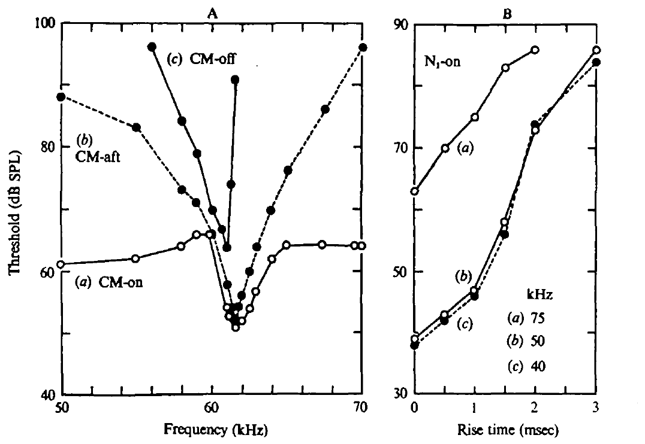
Onset synchrony depends on the sound envelope
The envelope is the changing amplitude of a sound over time. Slow build-up in the cochlea can spread out the first impulses of individual neurons. A summed onset response gets smaller when those impulses are less synchronized. Sound rise time changes how the impulses line up. Synchrony determines the size of the summed potential.
Suga and colleagues lengthened the rise time of tones away from the resonant band. A 1 ms rise raised the summed onset threshold by about 8 dB over an abrupt rise. A 3 ms rise raised it much more. Each step in rise time raised the threshold further. The result is a threshold effect, not a loss of sensitivity.
A weak summed response can appear even when each neuron stays sensitive. Spread-out timing can produce the apparent threshold shift. Timing across a population and sensitivity of single neurons are separate properties. The summed response measures population timing. Single-neuron sensitivity is a different measure. Both measures can change independently. Each one is measured separately.
Wang et al. (2025), Fig. 1(D–E). Published cochlear anatomy and stained tissue sections.
Suga et al. (1975), Fig. 4(A–B). Cochlear transients and the dependence of neural onset threshold on rise time.
Suga et al. (1975); Wang et al. (2025)
27
Notes:
• The amplitude envelope determines how quickly a sound reaches its sustained level. Individual neurons need not fire their first impulses at precisely the same time when excitation rises slowly.
• A summed onset potential depends on those impulses overlapping in time. If they are spread out, the recorded population peak can be smaller without requiring every neuron to become less responsive. The experiment lengthened the stimulus rise time at frequencies away from resonance to test this timing effect independently.
• The onset threshold rose when the sound rose more slowly. That result supports the interpretation that resonance can alter the apparent neural onset sensitivity by changing synchronization. It does not require the entire auditory system to prefer the frequency at which the largest summed onset response happens to be measured.
References:
Suga N, Simmons JA, Jen PH-S (1975). Peripheral specialization for fine analysis of Doppler-shifted echoes in the auditory system of the “CF-FM” bat Pteronotus parnellii. Journal of Experimental Biology 63(1):161–192. https://doi.org/10.1242/jeb.63.1.161
Wang X, Bao M, Wang H, Sun R, Dai W, Sun K, Zhu Y, Pu Y, Chu Y, Li X, Wang T, Zhang M, Lin A, Li J, Feng J (2025). Cochlear Cell Atlas of Two Laryngeal Echolocating Bats—New Evidence for the Adaptive Nervous Physiology in Constant Frequency Bat. Molecular Ecology Resources 25:e14101. https://doi.org/10.1111/1755-0998.14101
Figure: Suga et al. (1975), Fig. 4(A–B). Cochlear transients and the dependence of neural onset threshold on rise time.
Figure source: https://doi.org/10.1242/jeb.63.1.161
Figure: Wang et al. (2025), Fig. 1(D–E). Published cochlear anatomy and stained tissue sections.
Figure source: https://doi.org/10.1111/1755-0998.14101

Slide 36
A late response may come from the cochlea
The acoustic envelope sets when the sound is delivered. The cochlear envelope sets how the peripheral response develops. Near resonance, the two envelopes differed from each other. That difference can make a late neural response appear after the sound has stopped. The rise time of a sound is one part of its envelope. Near resonance, the cochlear build-up is slow.
A neural response after a tone can begin without any central rebound. The loudspeaker goes silent, but the cochlea keeps ringing. A late response can come from the cochlea itself. The ringing is a peripheral event that starts before the brain gets involved. A rebound would require a second source of excitation after the loudspeaker stops.
Evidence for a central rebound would need its own recordings from central neurons. The silent loudspeaker alone supplies none of that evidence. Suga's cochlear recordings offer a peripheral explanation that comes first in the chain. The cochlear ringing gives a testable alternative that an experiment can check directly. The rise-time test isolated the effect of the rise itself.
Wang et al. (2025), Fig. 1(D–E). Published cochlear anatomy and stained tissue sections.
Suga et al. (1975), Fig. 4(A–B). Cochlear transients and the dependence of neural onset threshold on rise time.
Suga et al. (1975)
27a
Notes:
• A late response may come from the cochlea.
• Explanation 1.
– The acoustic envelope sets when the sound is delivered
– The cochlear envelope sets how the peripheral response develops. Near resonance, the two envelopes differed from each other. That difference can make a late neural response appear after the sound has stopped. The rise time of a sound is one part of its envelope. Near resonance, the cochlear build-up is slow.
• Explanation 2.
– A neural response after a tone can begin without any central rebound
– The loudspeaker goes silent, but the cochlea keeps ringing. A late response can come from the cochlea itself. The ringing is a peripheral event that starts before the brain gets involved. A rebound would require a second source of excitation after the loudspeaker stops.
• Explanation 3.
– Evidence for a central rebound would need its own recordings from central neurons
– The silent loudspeaker alone supplies none of that evidence. Suga's cochlear recordings offer a peripheral explanation that comes first in the chain. The cochlear ringing gives a testable alternative that an experiment can check directly. The rise-time test isolated the effect of the rise itself.
• Source.
– The figure and the measurements come from Suga et al. (1975).
– Each statement is tied to the recordings or observations of that study.
References:
Suga N, Simmons JA, Jen PH-S (1975). Peripheral specialization for fine analysis of Doppler-shifted echoes in the auditory system of the “CF-FM” bat Pteronotus parnellii. Journal of Experimental Biology 63(1):161–192. https://doi.org/10.1242/jeb.63.1.161

Slide 37
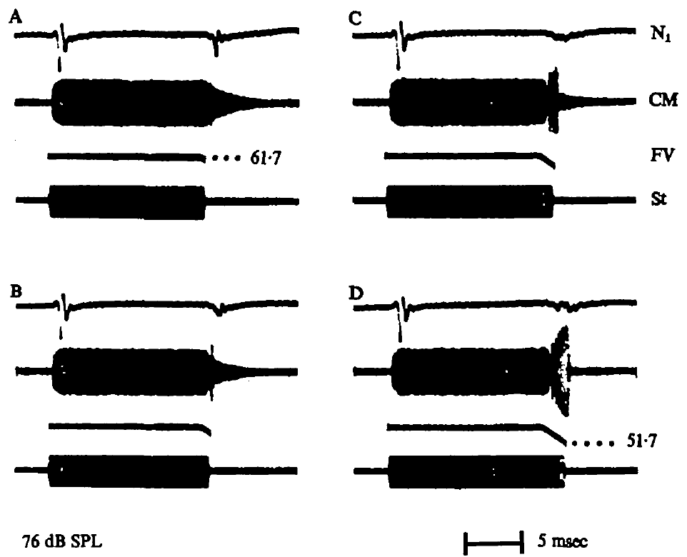
Terminal FM suppresses cochlear offset transients
Suga and colleagues compared a CF tone that ended abruptly with the same tone followed by a downward FM sweep. The added sweep changed the cochlear response after the tone. The sweep changed the tail of the response, not just the tone itself. The tone and the sweep were both delivered to the ear.
The terminal sweep reduced the residual CM activity. It also reduced the summed neural offset response under the conditions tested. The size of the effect depended on how long the sweep lasted and how wide it was. The effect was measured on the summed and residual signals. Both signals come from the cochlea.
The CF and FM parts of a call interact in the time course of the cochlear response. A brief FM ending can change how the resonant system stops responding to CF sound. These results come from controlled tones played to the ear. The result describes peripheral mechanics. It concerns the timing of the response tail.
Suga et al. (1975), Fig. 8(A–D). Terminal FM changes cochlear ringing and the summed neural offset response.
Suga et al. (1975)
28
Notes:
• A pure CF tone with an abrupt ending can leave a resonating cochlear response. The experiment added a downward frequency sweep to the end of that tone, creating a CF-FM stimulus more similar to a bat’s call.
• The cochlear residual response and the summed neural offset response were reduced. Changing the duration and extent of the terminal sweep changed the outcome, so the components cannot be treated as independent sounds whose responses simply add together.
• This interaction was measured in controlled peripheral recordings. It establishes that a brief FM ending can alter how the resonant system stops responding to CF stimulation. It does not directly measure prey capture or prove that the same degree of suppression occurs for every natural call and echo.
References:
Suga N, Simmons JA, Jen PH-S (1975). Peripheral specialization for fine analysis of Doppler-shifted echoes in the auditory system of the “CF-FM” bat Pteronotus parnellii. Journal of Experimental Biology 63(1):161–192. https://doi.org/10.1242/jeb.63.1.161
Figure: Suga et al. (1975), Fig. 8(A–D). Terminal FM changes cochlear ringing and the summed neural offset response.
Figure source: https://doi.org/10.1242/jeb.63.1.161

Slide 38
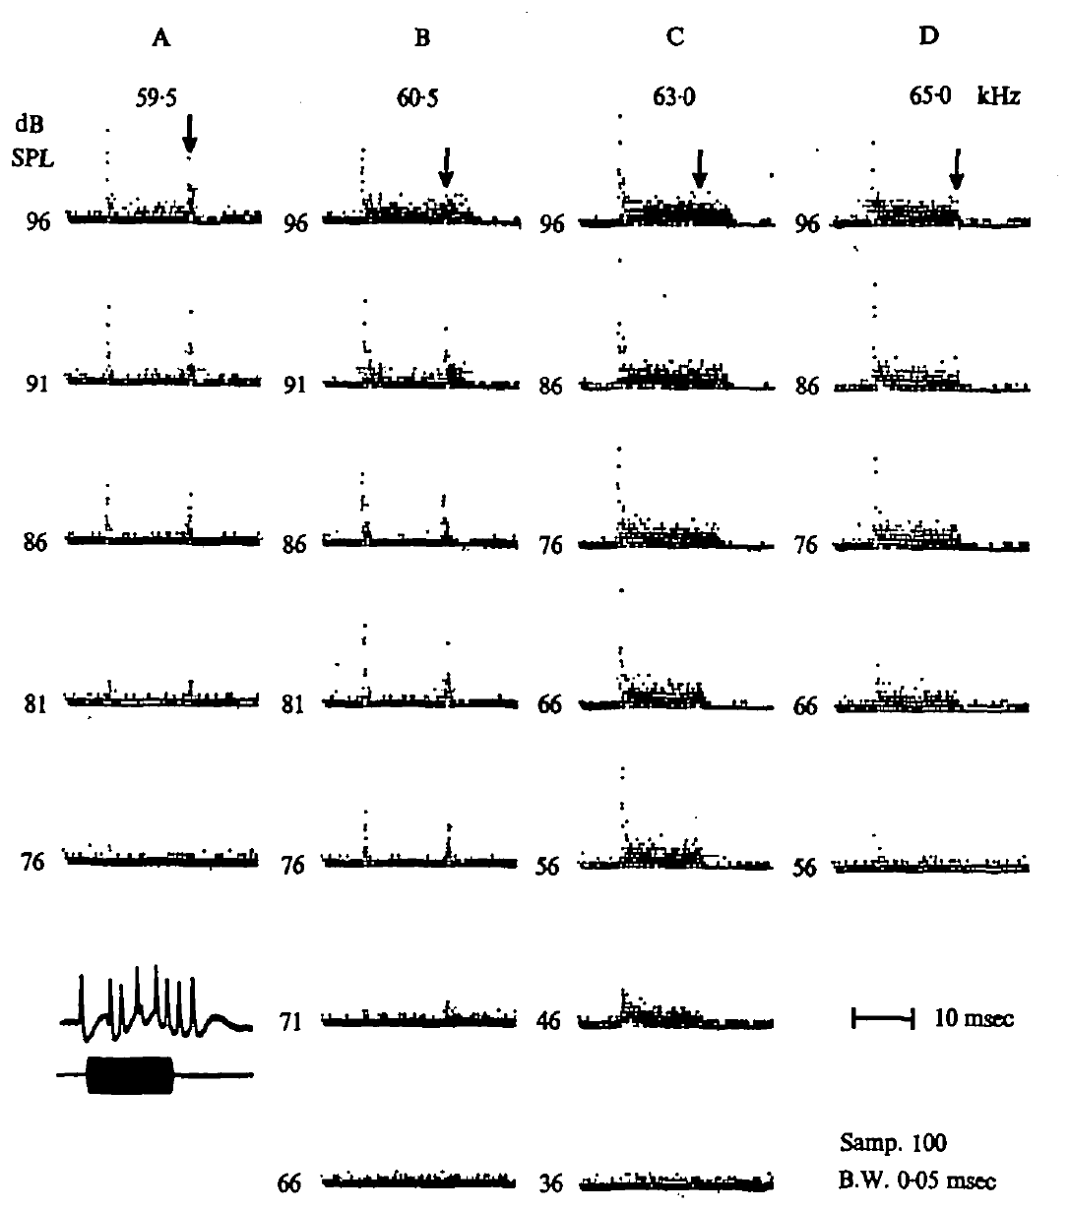
Peripheral neurons can discharge when a tone ends
Suga and colleagues recorded individual peripheral auditory neurons in the auditory nerve and nearby cochlear nucleus. A post-stimulus-time histogram lines up impulses from repeated trials to the start of the same stimulus. It shows when each neuron fires. Impulse timing relative to tone onset was the measured quantity. Each neuron's record was built from many trials.
Some neurons fired during the tone and then produced a burst of impulses after it ended. At some frequencies and levels, that offset burst stayed prominent even when sustained firing was weak. The burst was easy to spot in the histogram. Its timing was tied to the tone's end. Sustained firing stayed weak at those settings.
These offset bursts add up to the summed N1 offset signal. The neurons that produced them also responded to excitatory tones. So the same cells carried both kinds of activity, not a separate group for offsets. The summed signal is an average over many neurons. The single neurons supply the detail behind that average.
Suga et al. (1975), Fig. 9(A–D). Single-neuron responses across tone frequency and level, with offset discharges.
Suga et al. (1975)
29
Notes:
• An individual neuron’s impulse times can be compared across repeated presentations of a tone. Aligning those times to stimulus onset produces a post-stimulus-time histogram, which distinguishes onset, sustained, and later activity.
• The sampled neurons included auditory-nerve and nearby cochlear-nucleus recordings. Some neurons produced a distinct cluster of impulses after the tone ended. At lower levels or particular frequencies, this offset cluster could remain conspicuous while the sustained response was much weaker.
• The observation supplies a cellular counterpart to the summed neural offset potential. These were not necessarily neurons with an exclusive offset-only function. The data relate individual activity to peripheral transients and cannot be used to assign the same response to a specific cortical cell type.
References:
Suga N, Simmons JA, Jen PH-S (1975). Peripheral specialization for fine analysis of Doppler-shifted echoes in the auditory system of the “CF-FM” bat Pteronotus parnellii. Journal of Experimental Biology 63(1):161–192. https://doi.org/10.1242/jeb.63.1.161
Figure: Suga et al. (1975), Fig. 9(A–D). Single-neuron responses across tone frequency and level, with offset discharges.
Figure source: https://doi.org/10.1242/jeb.63.1.161

Slide 39
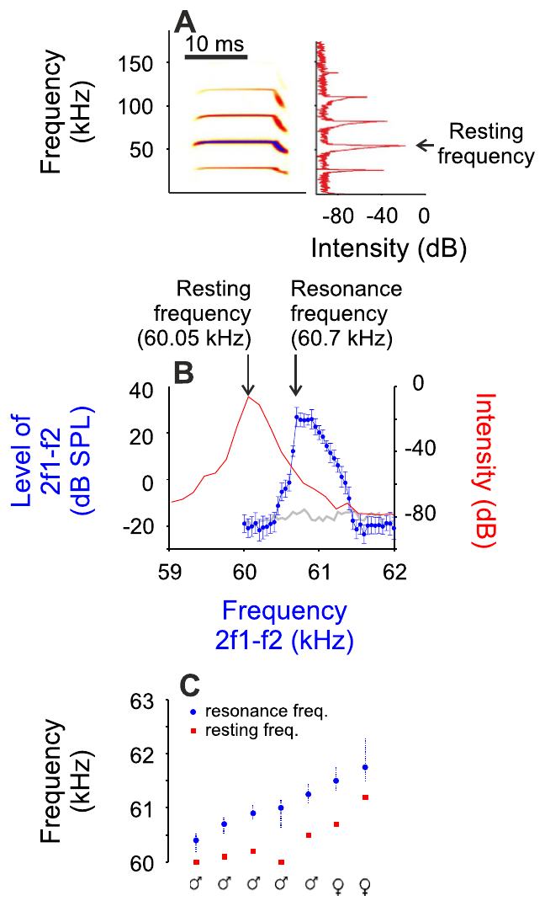
Resonance frequency differs from the resting call baseline
The resonance frequency is the frequency where the peripheral resonant system responds most strongly. Macías and colleagues compared it with the resting second-harmonic call frequency in mustached bats. Resting calls ranged from 60 to 61.2 kHz in their animals. Macías and colleagues used acoustic data for both values. The resting value came from calls, and the resonance came from hearing.
The resonance estimate usually sat above the emitted baseline. The team combined acoustic recordings with recordings from the auditory midbrain. They focused on sharply tuned neurons close to the specialized band, in the same animals. The midbrain is an auditory relay station. Neural tuning was judged relative to the individual bat.
A reference set by vocal emission can differ from one set by sensory response. The behavioral compensation studies show a similar gap between resting and reference frequencies. Each bat has its own pair of values. A bat's resting value can be lower than its resonance estimate. This pattern appeared in the mustached bats studied.
Macías et al. (2016), Fig. 1(A–C). Resting emissions and cochlear resonance estimates.
Macías et al. (2016)
30
Notes:
• Resonance frequency is the frequency at which the peripheral resonant system responds especially strongly. Macías and colleagues distinguished it from the resting second-harmonic call frequency in mustached bats. Resting emissions ranged from 60 to 61.2 kHz in their animals, while the resonance estimate generally lay above the emitted baseline.
• They combined acoustic recordings with auditory-midbrain recordings and examined sharply tuned neurons near the specialized band. A reference defined from vocal emission therefore need not coincide exactly with a reference defined from the sensory response. This distinction parallels the resting-versus-reference frequency difference in behavioral compensation experiments.
• The measurement distinguishes two biologically related frequency values rather than assigning one universal CF frequency to the species. Neural tuning was evaluated relative to the individual bat’s acoustic and peripheral specialization. It does not follow that every midbrain cell near this band contributes directly to the vocal feedback pathway.
References:
Macías S, Hechavarría JC, Kössl M (2016). Sharp temporal tuning in the bat auditory midbrain overcomes spectral-temporal trade-off imposed by cochlear mechanics. Scientific Reports 6:29129. https://doi.org/10.1038/srep29129
Figure: Macías et al. (2016), Fig. 1(A–C). Resting emissions and cochlear resonance estimates.
Figure source: https://doi.org/10.1038/srep29129

Slide 40
Resonance estimates belong to individual bats
The measurements give each bat its own values rather than one species-wide CF frequency. The resting emission and the resonance estimate come from the same animals. Their gap was measured in each bat, not assumed. Each bat's pair of values is a separate data point. The two values come from one animal, measured at one time.
Neural tuning was judged against each bat's own acoustic and peripheral specialization. Not every midbrain cell near that band feeds the vocal feedback path. Candidate cells can be identified this way, one animal at a time. Macías and colleagues examined sharply tuned neurons near the specialized band. Each bat's neural and acoustic data form one matched set.
The midbrain recordings came from the same bats as the acoustic data. So each neuron's tuning can be set against its owner's resting and resonance values. That pairing gives the team individual-level evidence. Each bat's neural data sit beside its own acoustic data, so the match is within animal. Matched sets make the individual values easier to interpret.
Macías et al. (2016), Fig. 1(A–C). Resting emissions and cochlear resonance estimates.
Macías et al. (2016)
30a
Notes:
• Resonance estimates belong to individual bats.
• Explanation 1.
– The measurements give each bat its own values rather than one species-wide CF frequency
– The resting emission and the resonance estimate come from the same animals. Their gap was measured in each bat, not assumed. Each bat's pair of values is a separate data point. The two values come from one animal, measured at one time.
• Explanation 2.
– Neural tuning was judged against each bat's own acoustic and peripheral specialization
– Not every midbrain cell near that band feeds the vocal feedback path. Candidate cells can be identified this way, one animal at a time. Macías and colleagues examined sharply tuned neurons near the specialized band. Each bat's neural and acoustic data form one matched set.
• Explanation 3.
– The midbrain recordings came from the same bats as the acoustic data
– So each neuron's tuning can be set against its owner's resting and resonance values. That pairing gives the team individual-level evidence. Each bat's neural data sit beside its own acoustic data, so the match is within animal. Matched sets make the individual values easier to interpret.
• Source.
– The figure and the measurements come from Macías et al. (2016).
– Each statement is tied to the recordings or observations of that study.
References:
Macías S, Hechavarría JC, Kössl M (2016). Sharp temporal tuning in the bat auditory midbrain overcomes spectral-temporal trade-off imposed by cochlear mechanics. Scientific Reports 6:29129. https://doi.org/10.1038/srep29129

Slide 41
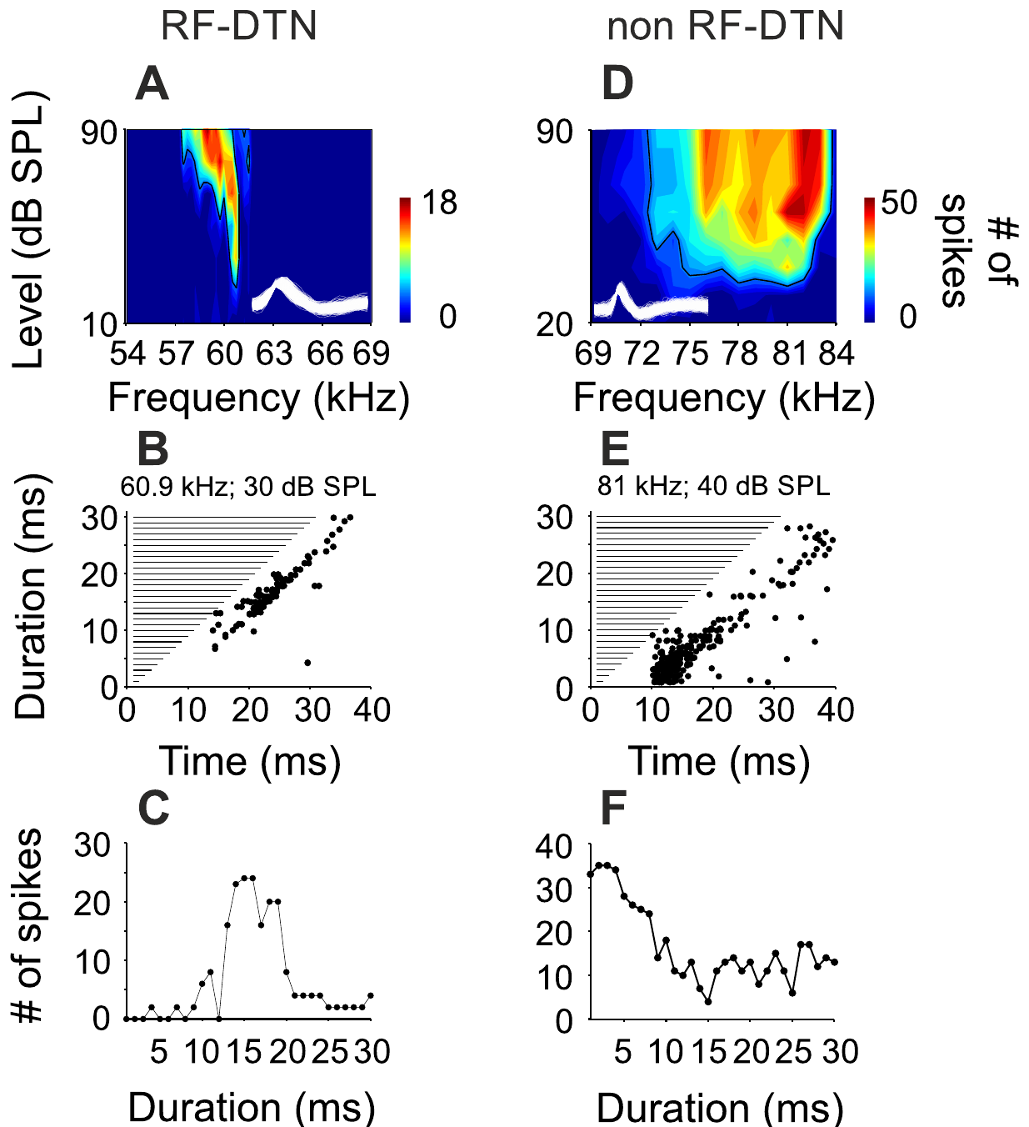
Midbrain neurons can prefer a narrow sound duration
A duration-tuned neuron responds most strongly to a narrow range of sound durations. Macías and colleagues recorded single neurons in the inferior colliculus, an auditory midbrain structure of the mustached bat. They varied the frequency, level and duration of pure tones. Each neuron was tested with a range of tone parameters.
One resonance-band neuron preferred 60.9 kHz, with a frequency bandwidth of 0.75 kHz. It preferred a 15 ms stimulus, with a duration bandwidth of 7 ms. A neuron tuned to 81 kHz had a broader 9 kHz frequency bandwidth and preferred a 3 ms stimulus. The team reported these bandwidths for each neuron.
Central neurons can be selective for both frequency and duration. Sharp duration tuning can occur even when the input from the ear is sharply tuned. The recordings used pure tones, so they show the responses to those tones. Duration selectivity is a central property of these neurons. It was measured with the same tones used for frequency.
Macías et al. (2016), Fig. 2(A–F). Frequency response areas and measured duration tuning.
Macías et al. (2016)
31
Notes:
• A duration-tuned neuron responds most strongly to a restricted range of sound durations. Macías and colleagues recorded single-neuron activity in the mustached bat’s inferior colliculus, an auditory midbrain structure. Pure-tone stimuli varied in frequency, sound level and duration, separating several dimensions of response selectivity.
• One resonance-band neuron preferred 60.9 kHz, with a frequency bandwidth of 0.75 kHz. It preferred a 15-ms stimulus, with a duration bandwidth of 7 ms. A comparison neuron tuned to 81 kHz had a broader 9-kHz frequency bandwidth and preferred a 3-ms stimulus.
• These examples establish joint spectral and temporal selectivity in central auditory neurons. They do not measure the neuron’s synaptic inputs or identify its transmitter. Sharp duration tuning can coexist with sharply tuned peripheral input, so long cochlear ringing does not force every central response to be temporally broad.
References:
Macías S, Hechavarría JC, Kössl M (2016). Sharp temporal tuning in the bat auditory midbrain overcomes spectral-temporal trade-off imposed by cochlear mechanics. Scientific Reports 6:29129. https://doi.org/10.1038/srep29129
Figure: Macías et al. (2016), Fig. 2(A–F). Frequency response areas and measured duration tuning.
Figure source: https://doi.org/10.1038/srep29129

Slide 42
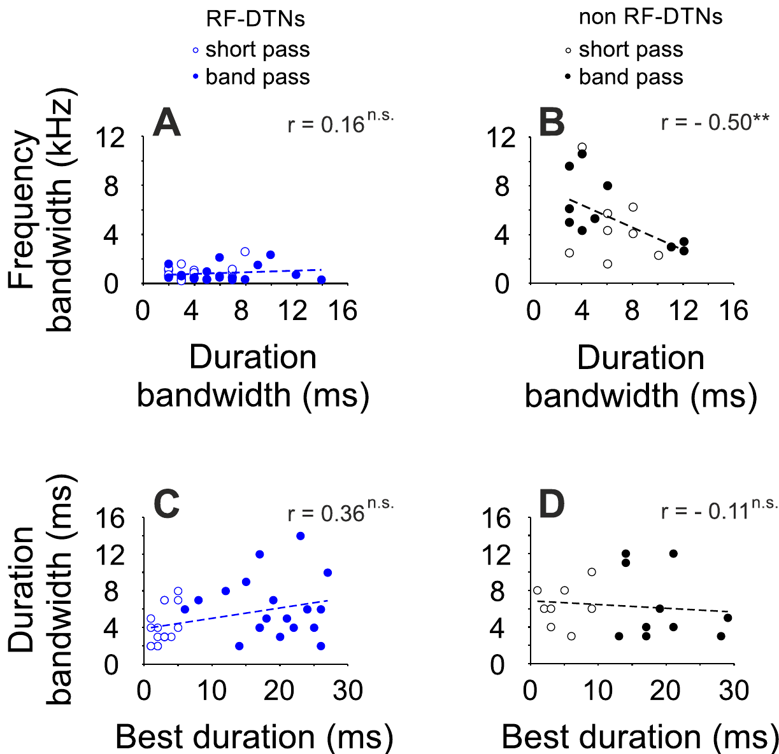
Sharp spectral tuning need not sacrifice duration tuning
A spectral-temporal trade-off means that finer frequency resolution comes with poorer timing resolution. Cochlear resonance keeps the response going after a sound ends. Macías and colleagues asked whether that peripheral property limits duration-selective neurons in the midbrain. Macías and colleagues tested it with single neurons. The question was about the midbrain, not the cochlea.
They measured frequency bandwidth 10 dB above threshold and duration bandwidth across durations. Neurons in the resonance band did not follow the usual rule of narrow frequency tuning with broad duration tuning. Neurons outside that band did follow it. Each neuron supplied both bandwidths. That pairing allowed a direct test of the trade-off.
The result applies to central responses to controlled pure tones. The cochlea still rings after a sound ends. Even so, central processing can give sharp timing filters from a peripheral input that is narrowly tuned. Peripheral input was narrowband in this species. The midbrain can sharpen timing on its own. That is the main point of the result.
Macías et al. (2016), Fig. 4(A–D). Relations between frequency and duration bandwidths.
Macías et al. (2016)
32
Notes:
• A spectral–temporal trade-off occurs when finer frequency resolution accompanies poorer temporal resolution. Cochlear resonance can sustain activity after sound offset, extending the peripheral response. Macías and colleagues asked whether this peripheral property constrains duration-selective neurons in the auditory midbrain.
• They measured frequency bandwidth at 10 dB above threshold and duration bandwidth across stimulus durations. Resonance-band neurons did not follow the expected relation between narrow frequency tuning and broad duration tuning. Neurons outside that specialized band displayed the more conventional relationship between the two response dimensions.
• The result concerns central response selectivity under controlled pure-tone stimulation. It does not mean cochlear ringing disappeared or that every auditory neuron overcomes the trade-off. Instead, central processing can produce sharp temporal filtering despite a peripheral input specialized for narrowband frequency analysis.
References:
Macías S, Hechavarría JC, Kössl M (2016). Sharp temporal tuning in the bat auditory midbrain overcomes spectral-temporal trade-off imposed by cochlear mechanics. Scientific Reports 6:29129. https://doi.org/10.1038/srep29129
Figure: Macías et al. (2016), Fig. 4(A–D). Relations between frequency and duration bandwidths.
Figure source: https://doi.org/10.1038/srep29129

Slide 43
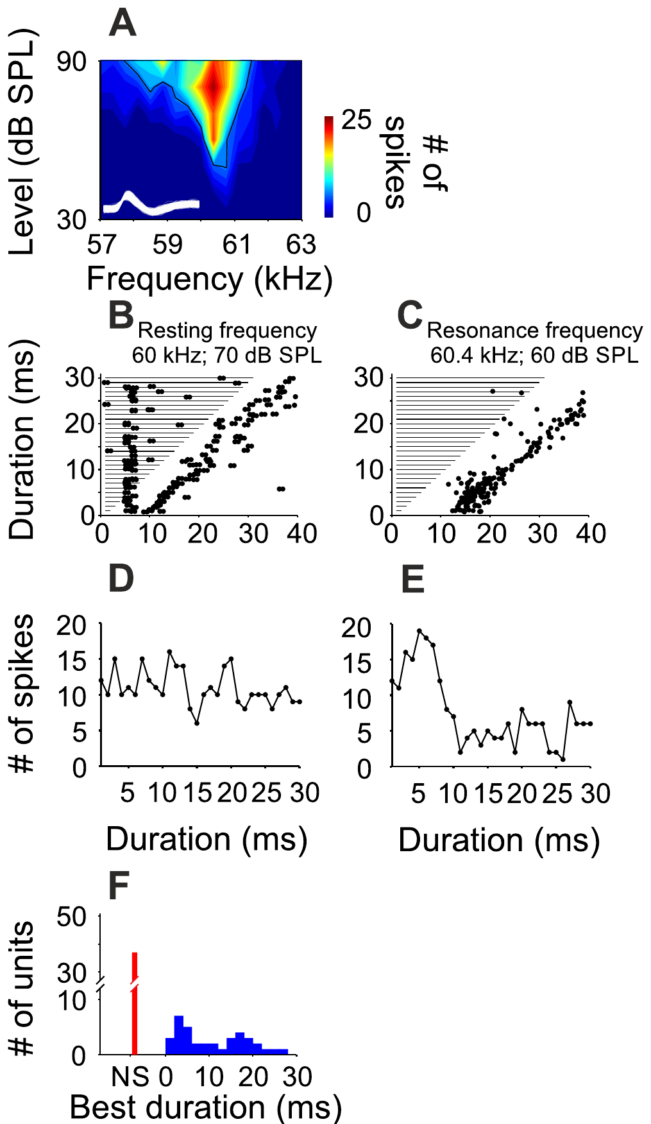
A small frequency change can reorganize duration tuning
Macías and colleagues tested the same resonance-band neurons with tones at the resting-call frequency and at the resonance frequency. The resting frequency sits just below the specialized band. Changing just the tone frequency shows its effect on each neuron. The conditions differed in frequency. Cell identity was constant across both conditions.
Duration selectivity was clear at resonance and often absent at the resting frequency. Preferred durations at resonance clustered near 4 ms and 17 ms. At the resting frequency, the response often stayed broad across durations. The response changed a lot across a small frequency gap. Duration preference shifted with the carrier.
A neuron's duration preference depends on the carrier frequency. Each carrier frequency gives the neuron its own duration profile. Spectral input and central timing processing interact in these neurons. The effect shows that tones at different frequencies are processed differently in time. Each carrier frequency sets its own timing window. That window controls which durations a neuron prefers.
Macías et al. (2016), Fig. 5(A–F). Responses at resting and resonance frequencies.
Macías et al. (2016)
33
Notes:
• Macías and colleagues tested the same resonance-band neurons with tones at the individual resting-call frequency and at the resonance frequency. This within-neuron comparison controlled cell identity while changing the acoustic frequency. The resting frequency lay just below the specialized resonant band.
• Duration selectivity was clear at resonance but often absent at the resting frequency. Preferred durations at resonance clustered near 4 ms and 17 ms. The response to resting-frequency stimulation could instead remain broad across durations, despite the small spectral separation between the two stimulus conditions.
• Frequency-dependent temporal filtering means that a neuron’s response to duration depends on the carrier frequency. It cannot be described adequately by one duration preference measured at any arbitrary tone frequency. The experiment supports interaction between spectral input and central temporal processing without directly identifying the synapses responsible.
References:
Macías S, Hechavarría JC, Kössl M (2016). Sharp temporal tuning in the bat auditory midbrain overcomes spectral-temporal trade-off imposed by cochlear mechanics. Scientific Reports 6:29129. https://doi.org/10.1038/srep29129
Figure: Macías et al. (2016), Fig. 5(A–F). Responses at resting and resonance frequencies.
Figure source: https://doi.org/10.1038/srep29129

Slide 44
Holding the neuron fixed isolates frequency
Each neuron served as its own control in this design. The team changed the tone frequency and nothing else between the two conditions. Cell identity stayed constant across them. That design removes differences between neurons from the picture. The resting frequency lies just below the resonant band, so the change was small. Changing one value at a time keeps the design clean.
The change in duration tuning must come from the tone frequency, not from a difference between neurons. The same cell gave a sharp duration preference at one frequency and a broad response at another. Cell identity alone fails to explain that contrast. That sharp preference was not present at the lower tone, so the pattern is frequency-specific.
The result shows that tone frequency and central timing processing work together. Identifying the synapses behind this interaction needs other experiments. The recordings already show the effect in single neurons, which makes it concrete. Central processing can filter timing in a frequency-dependent way. The effect depends on the carrier and not on any single fixed duration.
Macías et al. (2016), Fig. 5(A–F). Responses at resting and resonance frequencies.
Macías et al. (2016)
33a
Notes:
• Holding the neuron fixed isolates frequency.
• Explanation 1.
– Each neuron served as its own control in this design
– The team changed the tone frequency and nothing else between the two conditions. Cell identity stayed constant across them. That design removes differences between neurons from the picture. The resting frequency lies just below the resonant band, so the change was small. Changing one value at a time keeps the design clean.
• Explanation 2.
– The change in duration tuning must come from the tone frequency, not from a difference between neurons
– The same cell gave a sharp duration preference at one frequency and a broad response at another. Cell identity alone fails to explain that contrast. That sharp preference was not present at the lower tone, so the pattern is frequency-specific.
• Explanation 3.
– The result shows that tone frequency and central timing processing work together
– Identifying the synapses behind this interaction needs other experiments. The recordings already show the effect in single neurons, which makes it concrete. Central processing can filter timing in a frequency-dependent way. The effect depends on the carrier and not on any single fixed duration.
• Source.
– The figure and the measurements come from Macías et al. (2016).
– Each statement is tied to the recordings or observations of that study.
References:
Macías S, Hechavarría JC, Kössl M (2016). Sharp temporal tuning in the bat auditory midbrain overcomes spectral-temporal trade-off imposed by cochlear mechanics. Scientific Reports 6:29129. https://doi.org/10.1038/srep29129

Slide 45
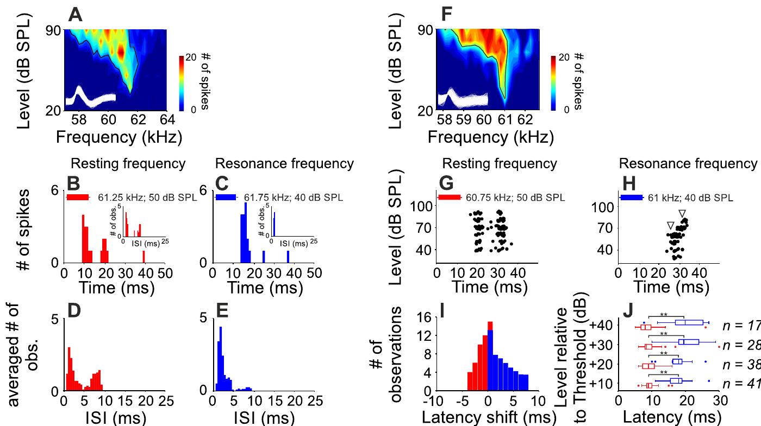
Resonance-band inhibition is still a hypothesis
Inhibition lowers a neuron's output through synapses or through the cell membrane. Macías and colleagues proposed frequency-specific inhibition. In that idea, inhibition would explain why resonance-band neurons select a duration despite the cochlea's ringing. Inhibition is a common mechanism in auditory processing. The idea accounts for the duration tuning seen at resonance.
The spike timing and latency changed between resting and resonance stimulation. The authors considered excitation and inhibition that arrive at offset times. They weighed two versions of that model, coincidence and anti-coincidence accounts. The spike timing was measured at each stimulus frequency. Latency also shifted with the stimulus frequency. Resting and resonance responses differed in both patterns.
The study blocked no inhibitory transmitter and recorded no inhibitory current. The data fit a central filtering idea. Naming the specific receptor or channel would take additional experiments, and the compensation behavior is a separate measurement. The result is a hypothesis about central filtering. The authors offered the model as a proposal.
Macías et al. (2016), Fig. 6(A–J). Frequency-dependent response timing and latency shifts.
Macías et al. (2016)
34
Notes:
• Inhibition reduces neuronal output through synaptic or membrane mechanisms. Macías and colleagues proposed frequency-specific inhibition to explain why resonance-band neurons could be selective for duration despite cochlear ringing. Their recordings measured output spikes under different stimulus frequencies and sound levels.
• The published response patterns and latency changes differed between resting and resonance stimulation. Duration tuning could be present at resonance but absent just below it. The authors considered temporally offset excitation and inhibition, including coincidence and anti-coincidence accounts, as explanations for this frequency-dependent selectivity.
• No inhibitory transmitter was blocked in this study, and no inhibitory synaptic current was directly recorded. The evidence therefore supports a central filtering hypothesis rather than proving a particular GABA receptor or channel mechanism. Behavioral compensation and central duration tuning also remain separate measured phenomena, even though both depend on the specialized CF band.
References:
Macías S, Hechavarría JC, Kössl M (2016). Sharp temporal tuning in the bat auditory midbrain overcomes spectral-temporal trade-off imposed by cochlear mechanics. Scientific Reports 6:29129. https://doi.org/10.1038/srep29129
Figure: Macías et al. (2016), Fig. 6(A–J). Frequency-dependent response timing and latency shifts.
Figure source: https://doi.org/10.1038/srep29129

Slide 46
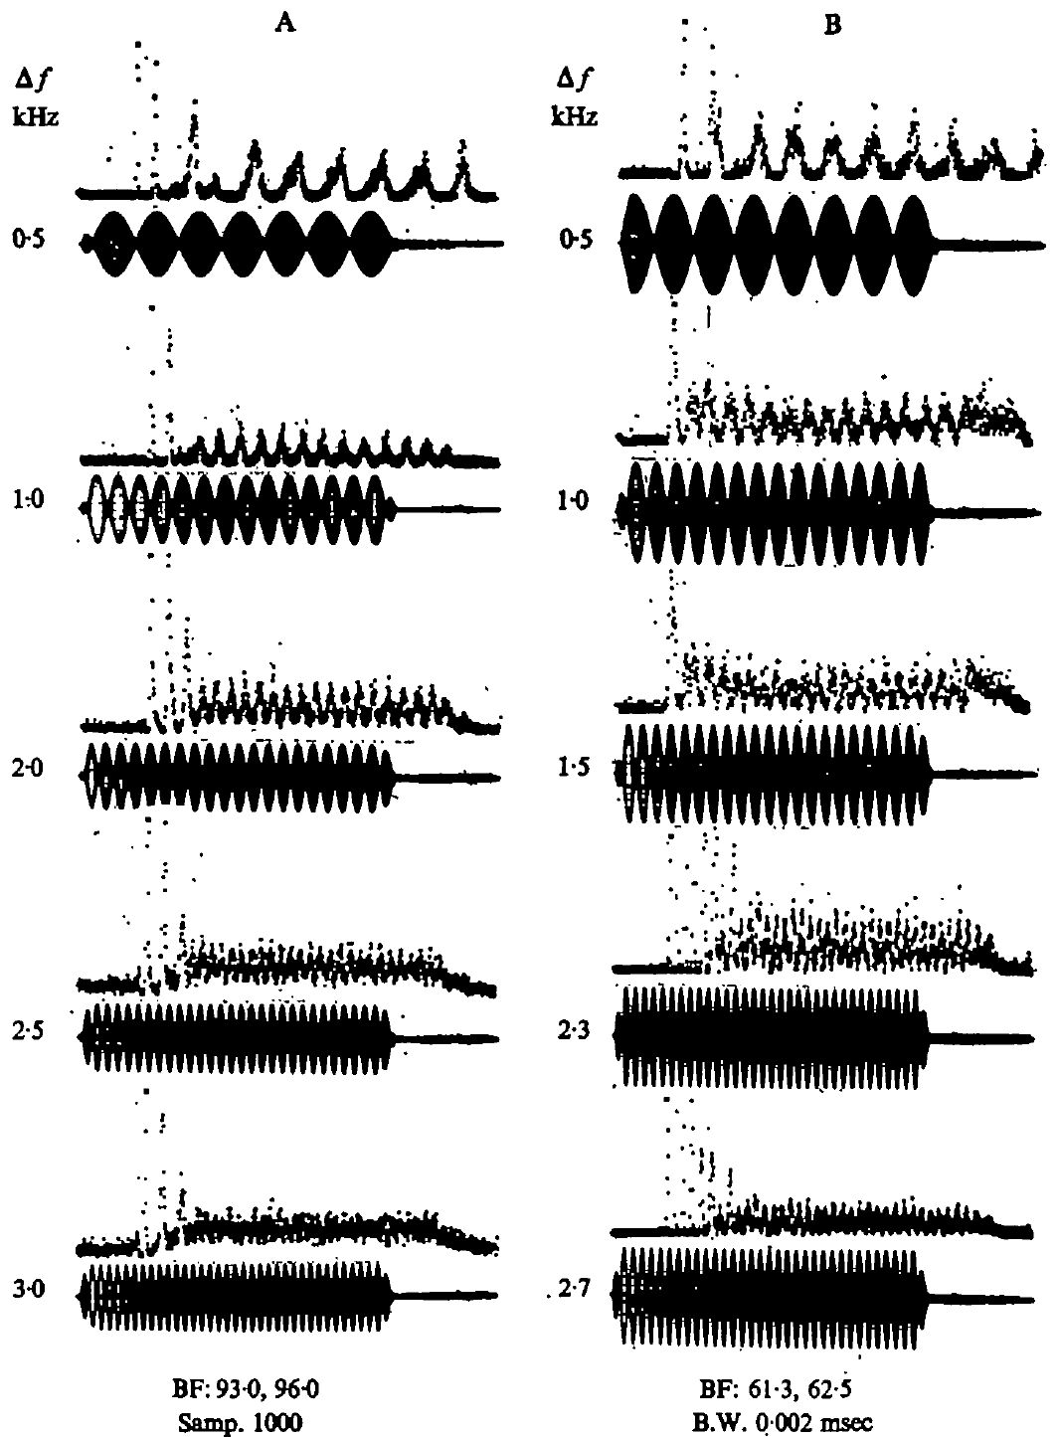
Peripheral impulses can track beats between nearby tones
Beats are repeating loudness fluctuations that occur when two tones of slightly different frequency overlap. Suga and colleagues played paired tones and recorded whether peripheral neurons followed those fluctuations. Changing the gap between the tones changed the beat rate. The tones were paired at fixed frequency separations. Each pair gave a different beat rate.
Phase locking means a neuron fires at the same point in each cycle of a repeating sound. Peripheral neurons could phase-lock to beats up to about 3 kHz. The timing of their impulses carried more than the average count of impulses. Phase locking can carry timing information. Timing and count carry different information about the tone.
Timing gives a second code, alongside the frequency code from sharply tuned neurons. Outgoing calls and returning echoes can overlap and produce beats. The paired-tone recordings show which signal the ear can carry, not which one a flying bat uses. The timing code and the frequency code work side by side. Both are available to the auditory system.
Suga et al. (1975), Fig. 18(A–B). Peripheral impulse timing follows beat envelopes at different frequency separations.
Suga et al. (1975)
35
Notes:
• Two nearby tone frequencies produce a repeating change in their combined amplitude. Those fluctuations are beats. The experiment changed the difference between the tones and measured the times at which peripheral neurons discharged.
• Phase locking refers to a consistent relation between impulse timing and a phase of the repeating amplitude pattern. The neurons could follow beat rates up to approximately 3 kilohertz. Their impulse timing therefore supplied information beyond the average number of impulses produced by a tone.
• Suga and colleagues related this property to overlap between outgoing signals and echoes. That is a potential temporal representation of frequency difference, alongside the representation supplied by sharply tuned neurons. The laboratory recordings demonstrate the available peripheral signal; they do not select one exclusive behavioral cue for natural flight.
References:
Suga N, Simmons JA, Jen PH-S (1975). Peripheral specialization for fine analysis of Doppler-shifted echoes in the auditory system of the “CF-FM” bat Pteronotus parnellii. Journal of Experimental Biology 63(1):161–192. https://doi.org/10.1242/jeb.63.1.161
Figure: Suga et al. (1975), Fig. 18(A–B). Peripheral impulse timing follows beat envelopes at different frequency separations.
Figure source: https://doi.org/10.1242/jeb.63.1.161

Slide 47
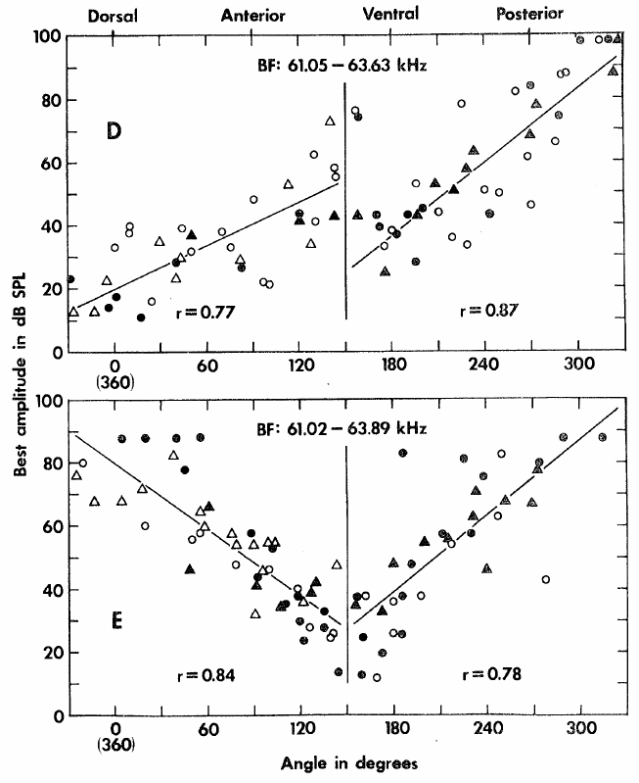
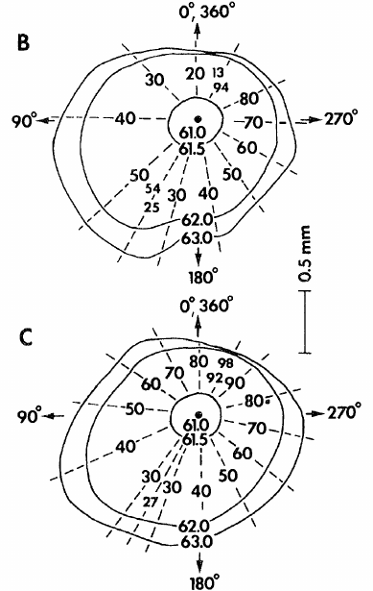
The cortex devotes extensive space to the CF echo band
The primary auditory cortex receives organized input from the ear. In Suga's mustached-bat study, the Doppler-shifted CF processing area covers about 2.3 mm2. That is roughly 30 percent of the primary auditory cortex. The area is large for one frequency band. Its size is one measure of the bat's CF specialization.
Its neurons cluster near 61 to 63 kHz, the band of the CF parts of emitted calls and echoes. The large area mirrors the peripheral specialization. It adds cortical response properties beyond each neuron's best frequency. The map of these neurons follows the frequency range of the calls. The band lies well within the bat's ultrasonic range.
Tonotopy means that frequency preference changes in an orderly way across the cortex. Suga looked at neurons with the same best frequency and found that they differed in preferred sound amplitude. So the enlarged CF area holds neurons with different sound-level preferences. Those neurons were sorted by preferred amplitude. Each group then gave its own response curve.
Suga (1977), Fig. 2(D–E). Measured best amplitude varies with cortical position, in dB SPL and degrees.
Suga (1977), Fig. 2(B–C). Original cortical maps, 0.5 mm.
Suga (1977)
36
Notes:
• The primary auditory cortex contains an organized representation of sound. Suga described an unusually large region concerned with the constant-frequency echo band of the mustached bat, occupying roughly 30 percent of that cortical area.
• Tonotopy means that frequency preference changes systematically with location. Within the enlarged CF region, many neurons could share similar best frequencies. The experiment therefore measured their response to sound amplitude as well as frequency.
• The cortical representation adds another dimension to the peripheral frequency code. The measured area and tuning describe auditory representation, not proof that this entire cortical region is necessary for every compensation response. Suga also cautioned that the region’s specialization does not exclude responses to signals other than orientation calls and their echoes.
References:
Suga N (1977). Amplitude Spectrum Representation in the Doppler-Shifted-CF Processing Area of the Auditory Cortex of the Mustache Bat. Science 196(4285):64–67. https://doi.org/10.1126/science.190681
Figure: Suga (1977), Fig. 2(D–E). Measured best amplitude varies with cortical position, in dB SPL and degrees.
Figure source: https://doi.org/10.1126/science.190681
Figure: Suga (1977), Fig. 2(B–C). Original cortical maps, 0.5 mm.
Figure source: https://doi.org/10.1126/science.190681

Slide 48
The CF area also responds to other signals
Suga noted that the CF area also responds to signals other than orientation calls and their echoes. The area's specialization describes the typical neuron there. That specialization is not a rule for every neuron in the area. Other neurons respond to a broader set of sounds. The cortex there is organized by frequency, and this area is a large part of it.
Suga's mapping also recorded where along the cortex each neuron sat. Those positions tell the team which frequencies and levels sit next to each other. Neurons at neighboring sites can differ in level preference. The mapping showed how these properties change across the cortical surface. The map ties each site to a best frequency and a best amplitude.
The mapping was done in one species, the mustached bat. Its area of about 2.3 mm2 sets the scale of the map. A later study would need the same kind of mapping in other bats to test whether the pattern holds. The mapping is a single study in one species, so its pattern is a starting point rather than a general rule.
Suga (1977), Fig. 2(D–E). Measured best amplitude varies with cortical position, in dB SPL and degrees.
Suga (1977), Fig. 2(B–C). Original cortical maps, 0.5 mm.
Suga (1977)
36a
Notes:
• The CF area also responds to other signals.
• Explanation 1.
– Suga noted that the CF area also responds to signals other than orientation calls and their echoes
– The area's specialization describes the typical neuron there. That specialization is not a rule for every neuron in the area. Other neurons respond to a broader set of sounds. The cortex there is organized by frequency, and this area is a large part of it.
• Explanation 2.
– Suga's mapping also recorded where along the cortex each neuron sat
– Those positions tell the team which frequencies and levels sit next to each other. Neurons at neighboring sites can differ in level preference. The mapping showed how these properties change across the cortical surface. The map ties each site to a best frequency and a best amplitude.
• Explanation 3.
– The mapping was done in one species, the mustached bat
– Its area of about 2.3 mm2 sets the scale of the map. A later study would need the same kind of mapping in other bats to test whether the pattern holds. The mapping is a single study in one species, so its pattern is a starting point rather than a general rule.
• Source.
– The figure and the measurements come from Suga (1977).
– Each statement is tied to the recordings or observations of that study.
References:
Suga N (1977). Amplitude Spectrum Representation in the Doppler-Shifted-CF Processing Area of the Auditory Cortex of the Mustache Bat. Science 196(4285):64–67. https://doi.org/10.1126/science.190681

Slide 49
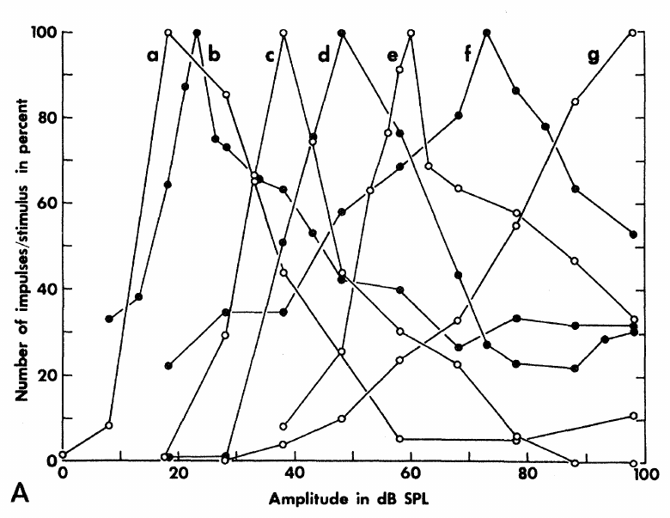
Some cortical neurons prefer an intermediate sound level
A best amplitude is the sound level that produces a neuron's largest response. Suga played 50 ms tones at each cortical neuron's best frequency. He counted impulses across a range of levels to find the best amplitude for each neuron. This measure is distinct from threshold. Thresholds mark the weakest sound that evokes a response.
Many CF-region neurons fired more as sound grew louder, reached a peak, and then fired less at higher levels. Other neurons increased their firing steadily with level. The best amplitude of a neuron differs from its minimum threshold. Counts were compared across the level series. Neurons at one best frequency showed different growth patterns.
An upper threshold is the level above which excitation becomes weak or stops. Upper thresholds make some neurons prefer middle sound levels. Frequency and sound level together decide which cortical neurons are most active. The upper threshold sets the peak of the response. Frequency and level interact in these neurons. Those interactions define the active populations.
Suga (1977), Fig. 1(A). Cortical impulse-count functions have different preferred sound levels.
Suga (1977)
37
Notes:
• The investigators held tone frequency at a neuron’s best frequency and increased sound level. Some neurons produced more impulses up to an intermediate amplitude, then produced fewer impulses as the sound became stronger.
• That rise followed by a fall is a nonmonotonic response. The amplitude giving the peak is the best amplitude. Minimum threshold is different: it identifies the weakest effective sound, not the level producing the maximum response.
• The loss of excitation at higher levels can create an upper threshold. Suga related this property to inhibitory interactions elsewhere in the auditory pathway. The cortical recordings establish level-selective response functions, while the origin of every neuron’s inhibitory input was not directly reconstructed in this mapping experiment.
References:
Suga N (1977). Amplitude Spectrum Representation in the Doppler-Shifted-CF Processing Area of the Auditory Cortex of the Mustache Bat. Science 196(4285):64–67. https://doi.org/10.1126/science.190681
Figure: Suga (1977), Fig. 1(A). Cortical impulse-count functions have different preferred sound levels.
Figure source: https://doi.org/10.1126/science.190681

Slide 50
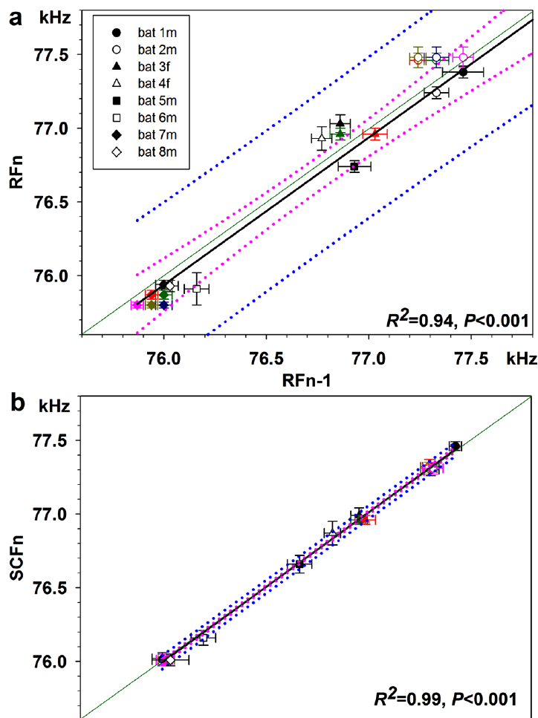
Communication calls need not share echolocation feedback
Liu and colleagues compared resting echolocation calls with short constant-frequency communication calls in greater horseshoe bats. The social calls look like shortened CF signals, and bats produce them during interactions with other bats. Recording both call types across days tested their frequency stability. The team used both call types from the same animals.
Resting echolocation frequency changed from day to day. The communication-call frequency stayed much more stable. Typical call durations also differed. Resting echolocation calls lasted about 47 ms, and the social calls lasted about 14 ms. The social calls showed the greatest stability. Their frequency varied little from day to day. Typical differences in duration were large.
The authors proposed that the bats control social calls differently, possibly with reduced or absent auditory feedback. The team did not block hearing during social calls. Stable social-call frequency fits this idea, and it leaves the role of hearing open. The research question was whether auditory control differs by call type.
Liu et al. (2013), Fig. 2(A–B). Daily frequency comparisons for echolocation and social calls.
Liu et al. (2013)
38
Notes:
• Liu and colleagues compared resting echolocation calls with short constant-frequency communication calls in greater horseshoe bats. These social calls resembled shortened CF signals but occurred during interactions between bats. Recording both call types across days tested whether similar acoustic signals shared the same frequency stability.
• Resting echolocation frequency varied across days, whereas the communication-call frequency remained much more stable. Typical call durations also differed: resting echolocation calls were approximately 47 ms, while the short social calls were approximately 14 ms. Frequency regulation therefore depended on vocal context rather than acoustic similarity alone.
• The authors proposed different feedback control for echolocation and communication, possibly including reduced or absent auditory feedback for the social calls. Their comparison did not directly interrupt feedback during social calling. Stable communication frequency supports that interpretation but does not prove that these calls are produced without auditory input.
References:
Liu Y, Feng J, Metzner W (2013). Different auditory feedback control for echolocation and communication in horseshoe bats. PLoS ONE 8(4):e62710. https://doi.org/10.1371/journal.pone.0062710
Figure: Liu et al. (2013), Fig. 2(A–B). Daily frequency comparisons for echolocation and social calls.
Figure source: https://doi.org/10.1371/journal.pone.0062710

Slide 51
Amplitude and frequency occupy cortical coordinates
Amplitopy is an orderly map of preferred sound amplitude across the cortex. In Suga's CF processing area, the contours of best frequency and the contours of best amplitude run in different directions across the surface. The orientations of the two contour sets differ. The map shows two organizing principles on one surface.
The best-amplitude map differed from animal to animal. In the posterior region, larger preferred amplitudes lay dorsally in every animal. The anterior region followed one of two arrangements. The map is structured, but no two bats had the same layout. The map layout varied from one bat to the next. Individual differences matter for interpretation.
Neurons that preferred 30 to 50 dB SPL covered more cortex than neurons that preferred 80 to 100 dB SPL. Suga proposed that this uneven share matches the amplitudes of echoes that bats commonly use. The distribution is uneven across the amplitude range. Neurons preferred the lower range more often. That is a measured pattern, not a rule for all bats.
Suga (1977), Fig. 2(D–E). Measured best amplitude varies with cortical position, in dB SPL and degrees.
Suga (1977), Fig. 2(B–C). Original cortical maps, 0.5 mm.
Suga (1977)
39
Notes:
• Amplitopy refers to a spatial ordering of preferred sound level, just as tonotopy refers to a spatial ordering of preferred frequency. The two properties do not have to change along the same direction across the cortical surface.
• Suga found a systematic relation between location and best amplitude, but the arrangement was not identical across all animals. Two patterns were described in the anterior part of the CF processing area, while the posterior pattern was more consistent.
• The maps gave more space to intermediate preferred sound levels than to very high preferred levels. The author proposed a relation to the amplitudes of echoes commonly used in echolocation. The mapping experiment measured neural preference and location; it did not independently sample the complete distribution of echoes encountered by a bat in nature.
References:
Suga N (1977). Amplitude Spectrum Representation in the Doppler-Shifted-CF Processing Area of the Auditory Cortex of the Mustache Bat. Science 196(4285):64–67. https://doi.org/10.1126/science.190681
Figure: Suga (1977), Fig. 2(D–E). Measured best amplitude varies with cortical position, in dB SPL and degrees.
Figure source: https://doi.org/10.1126/science.190681
Figure: Suga (1977), Fig. 2(B–C). Original cortical maps, 0.5 mm.
Figure source: https://doi.org/10.1126/science.190681

Slide 52
Frequency and amplitude maps share one surface
Tonotopy orders neurons by frequency, and amplitopy orders them by preferred level. Both orderings are spatial, so they can be drawn on the same cortical surface. Suga drew them together for the CF area. The two maps can run in different directions. The amplitude map adds a second organizing principle to the same surface.
The mapping measured neural preference at each cortical site. It was a neural measure, separate from any sampling of the echoes that bats hear in nature. The two kinds of data answer different questions. One measures the neurons, and the other measures the sound. The team recorded at many sites across the area to build the map.
A frequency map and an amplitude map of one area can guide later tests of how the cortex encodes frequency and level together. Those tests would track how one neuron responds across both frequency and level. The map gives them a starting point. That pattern describes the map, not the echoes themselves. Neurons at each site were tested with several sound levels.
Suga (1977), Fig. 2(D–E). Measured best amplitude varies with cortical position, in dB SPL and degrees.
Suga (1977), Fig. 2(B–C). Original cortical maps, 0.5 mm.
Suga (1977)
39a
Notes:
• Frequency and amplitude maps share one surface.
• Explanation 1.
– Tonotopy orders neurons by frequency, and amplitopy orders them by preferred level
– Both orderings are spatial, so they can be drawn on the same cortical surface. Suga drew them together for the CF area. The two maps can run in different directions. The amplitude map adds a second organizing principle to the same surface.
• Explanation 2.
– The mapping measured neural preference at each cortical site
– It was a neural measure, separate from any sampling of the echoes that bats hear in nature. The two kinds of data answer different questions. One measures the neurons, and the other measures the sound. The team recorded at many sites across the area to build the map.
• Explanation 3.
– A frequency map and an amplitude map of one area can guide later tests of how the cortex encodes frequency and level together
– Those tests would track how one neuron responds across both frequency and level. The map gives them a starting point. That pattern describes the map, not the echoes themselves. Neurons at each site were tested with several sound levels.
• Source.
– The figure and the measurements come from Suga (1977).
– Each statement is tied to the recordings or observations of that study.
References:
Suga N (1977). Amplitude Spectrum Representation in the Doppler-Shifted-CF Processing Area of the Auditory Cortex of the Mustache Bat. Science 196(4285):64–67. https://doi.org/10.1126/science.190681

Slide 53
Free flight lowers emission while preserving echo frequency
Schoeppler and colleagues studied Hipposideros armiger flying toward a landing grid. They recorded the calls and rebuilt each flight path. Then they used the measured flight speed to calculate the echo frequency from targets ahead. The reconstruction gave the speed at each moment. The flight path came from the same recordings. Calls and path were recorded together.
During acceleration, the emitted CF2 frequency fell. In one flight, the lowest emission came at a speed of 4.7 m/s. The calculated echo frequency stayed near the bat's reference band through the approach. The bat's emitted frequency dropped as its speed rose. Its echo frequency stayed near one band. Both facts come from a single flight.
The echo frequency is calculated from the call frequency and the bat's movement. No recording from the cochlea or from a microphone at the ear supplied it. Emitted and echo values come from different sources, so they count as separate measurements. The method joins calls and movement, which is its strength. Such a recording would need a microphone at the ear.
Schoeppler et al. (2018), Fig. 2(e–f). Measured emission and flight speed, with calculated echo frequency.
Schoeppler et al. (2018)
40
Notes:
• The bats flew toward a grid while calls and flight trajectories were recorded. The reconstruction supplied speed, and the investigators used that speed together with the emitted frequency to calculate the expected Doppler-shifted echo frequency.
• The emitted second-harmonic CF frequency fell as the bat accelerated. In the example flight, the lowest emission coincided with a speed of 4.7 metres per second. The calculated echo frequency changed far less than the emitted frequency.
• The result supplies a natural-flight counterpart to playback experiments. Its echo measure remains an estimate based on recorded calls and reconstructed movement. The method does not directly measure cochlear stimulation, and the distinction between recorded emission and calculated echo frequency is necessary when assessing the evidence for compensation precision.
References:
Schoeppler D, Schnitzler H-U, Denzinger A (2018). Precise Doppler shift compensation in the hipposiderid bat, Hipposideros armiger. Scientific Reports 8:4598. https://doi.org/10.1038/s41598-018-22880-y
Figure: Schoeppler et al. (2018), Fig. 2(e–f). Measured emission and flight speed, with calculated echo frequency.
Figure source: https://doi.org/10.1038/s41598-018-22880-y

Slide 54
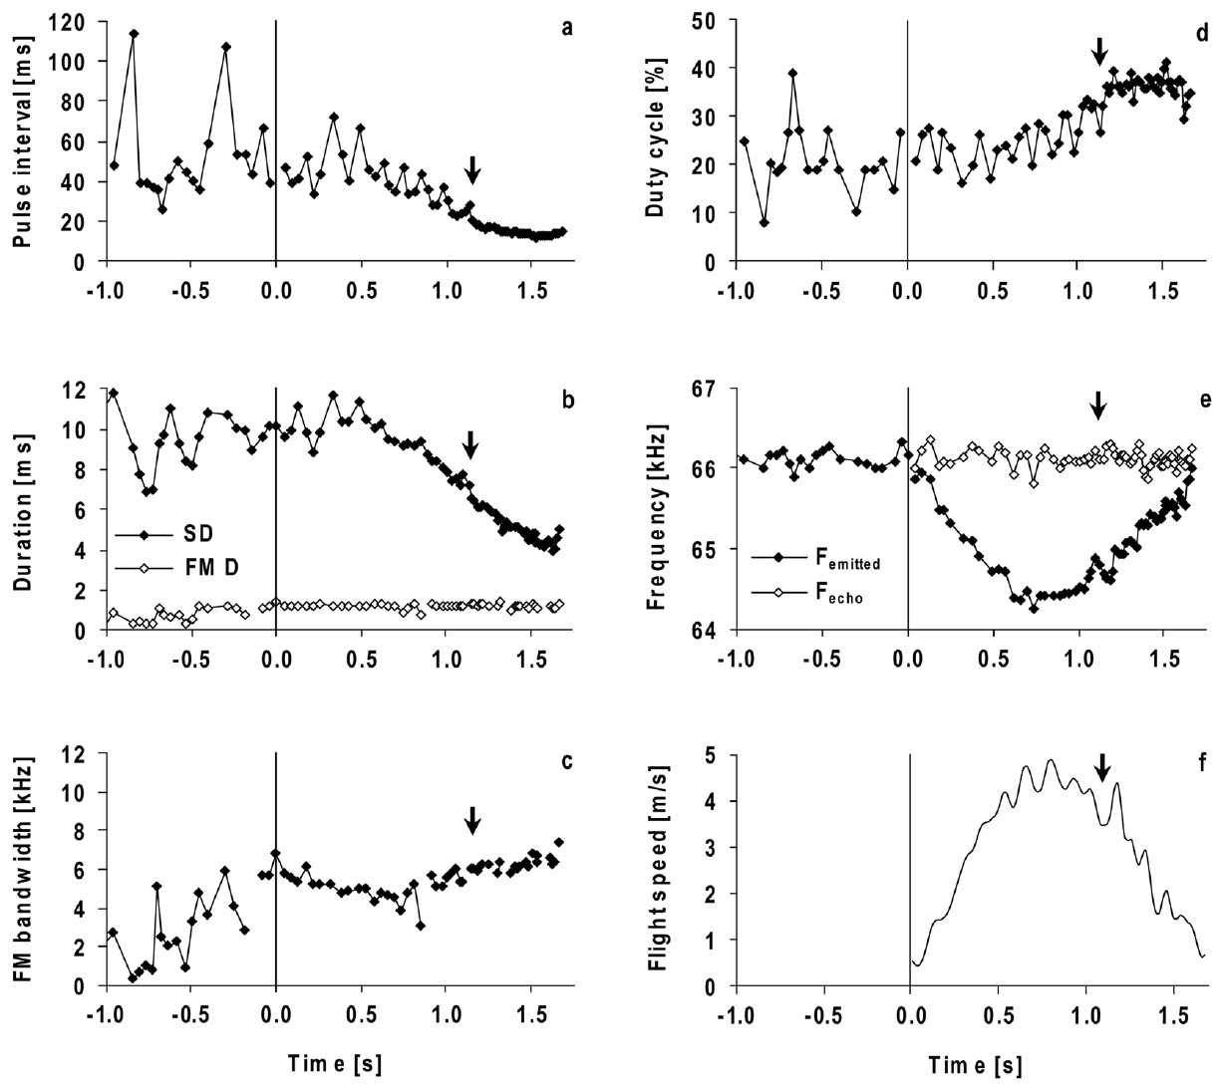
Approach changes call timing while CF is retained
The pulse interval is the time from one call to the next. The duty cycle is the share of time that a bat spends emitting sound. Both describe how often the bat samples its surroundings, whatever its CF frequency. Both are measured from the call sequence. They change with flight speed and approach.
In H. armiger, pulse intervals and call durations shrank as the bat neared the landing grid. In the final approach, calls averaged about 3 to 4 ms, and pulse intervals averaged about 11 to 12 ms. The duty cycle rose, and the CF part stayed in each call. Calls grew more frequent near the target.
The bat changed the timing of its sampling while it kept the CF frequency regulated. The terminal calls were not identical to the earlier ones. Timing, harmonic strength and the FM sweep all changed while the returning CF band stayed on target. The terminal sequence shows how timing and frequency can be controlled separately.
Schoeppler et al. (2018), Fig. 2(a–f). Call timing, FM properties, duty cycle, and compensation during approach.
Schoeppler et al. (2018)
41
Notes:
• Pulse interval measures the time from one call to the next. Duty cycle measures how much of the sequence is occupied by emitted sound. Shortening intervals and shortening calls can change duty cycle in different ways, so all three quantities must be measured.
• The Hipposideros armiger calls became shorter and more closely spaced near the landing grid. The final approach included calls of roughly 3 to 4 milliseconds and intervals of roughly 11 to 12 milliseconds. The sustained CF component was retained.
• The bat was therefore changing the timing of sampling at the same time that it controlled frequency. These measurements describe flight toward a landing target, not prey capture. The frequency, duration, interval, and harmonic changes belong to the observed approach behavior and should not be treated as identical results for every hunting situation.
References:
Schoeppler D, Schnitzler H-U, Denzinger A (2018). Precise Doppler shift compensation in the hipposiderid bat, Hipposideros armiger. Scientific Reports 8:4598. https://doi.org/10.1038/s41598-018-22880-y
Figure: Schoeppler et al. (2018), Fig. 2(a–f). Call timing, FM properties, duty cycle, and compensation during approach.
Figure source: https://doi.org/10.1038/s41598-018-22880-y

Slide 55
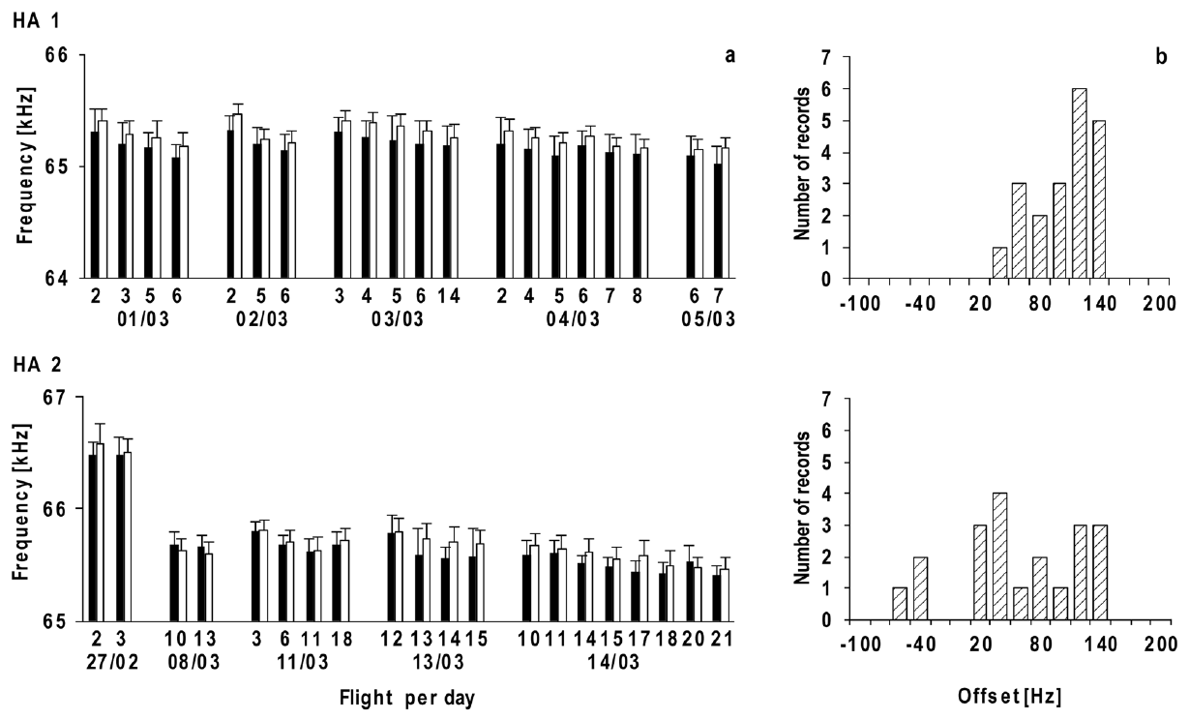
Resting and reference frequencies shift together
Schoeppler and colleagues measured the resting frequency just before each flight. They calculated the reference frequency from the echoes of that same flight. Both values changed between flights and across recording days. The offset was measured in each flight. The pair of values is the unit of the analysis. Each pair came from one flight day.
The two frequencies stayed closely coupled, though they were measured separately. The reference usually sat above the resting frequency by an average of about 80 Hz. In one bat, the reference frequency fell by about 1 kHz over nine days. The coupling held across the recording days. The pattern appeared across several flights.
A drifting reference frequency can still come with accurate compensation. Comparing an echo from one time with a resting call from another time can make the offset look larger. Both values have to come from the same time. Comparing values from the same day removes that error. The reference then tracks the true offset.
Schoeppler et al. (2018), Fig. 3(a–b). Paired resting and reference frequencies and their offsets across flights.
Schoeppler et al. (2018)
42
Notes:
• The investigators measured the resting call series just before take-off and paired it with the echo estimate from that particular flight. This pairing matters because both frequencies can change across time.
• The resting and reference values usually moved in the same direction. Their mean separation remained approximately 80 hertz even though one animal’s reference frequency declined by about a kilohertz over nine days.
• A precise control system can track a preferred state that itself changes. Using a resting value from an earlier session would mix that shift with the actual compensation offset. The observed coupling is therefore more informative than asking whether every call remains at one absolute frequency for the lifetime of an individual bat.
References:
Schoeppler D, Schnitzler H-U, Denzinger A (2018). Precise Doppler shift compensation in the hipposiderid bat, Hipposideros armiger. Scientific Reports 8:4598. https://doi.org/10.1038/s41598-018-22880-y
Figure: Schoeppler et al. (2018), Fig. 3(a–b). Paired resting and reference frequencies and their offsets across flights.
Figure source: https://doi.org/10.1038/s41598-018-22880-y

Slide 56
A precise control system can track a moving band
The resting frequency was measured just before each flight. The reference frequency was calculated from the echoes of that flight. The two values come from the same time window. Pairing them in time keeps the offset estimate honest. Each flight gives its own pair of values. Both measurements come from the same flight record.
A precise control system can track a preferred state that changes over time. The offset between reference and resting frequency stayed about 80 Hz on average. That stable average shows the offset holds even as both values move. The average offset of about 80 Hz held across the flights studied. Both values moved together across the flights.
Two values measured at one time give a cleaner offset than values from different days. Using a resting value from an earlier session would mix a band shift into the offset. A same-time baseline removes that mix. The same-time baseline is the only fair reference for the offset. The reference offset is then measured in the same session.
Schoeppler et al. (2018), Fig. 3(a–b). Paired resting and reference frequencies and their offsets across flights.
Schoeppler et al. (2018)
42a
Notes:
• A precise control system can track a moving band.
• Explanation 1.
– The resting frequency was measured just before each flight
– The reference frequency was calculated from the echoes of that flight. The two values come from the same time window. Pairing them in time keeps the offset estimate honest. Each flight gives its own pair of values. Both measurements come from the same flight record.
• Explanation 2.
– A precise control system can track a preferred state that changes over time
– The offset between reference and resting frequency stayed about 80 Hz on average. That stable average shows the offset holds even as both values move. The average offset of about 80 Hz held across the flights studied. Both values moved together across the flights.
• Explanation 3.
– Two values measured at one time give a cleaner offset than values from different days
– Using a resting value from an earlier session would mix a band shift into the offset. A same-time baseline removes that mix. The same-time baseline is the only fair reference for the offset. The reference offset is then measured in the same session.
• Source.
– The figure and the measurements come from Schoeppler et al. (2018).
– Each statement is tied to the recordings or observations of that study.
References:
Schoeppler D, Schnitzler H-U, Denzinger A (2018). Precise Doppler shift compensation in the hipposiderid bat, Hipposideros armiger. Scientific Reports 8:4598. https://doi.org/10.1038/s41598-018-22880-y

Slide 57
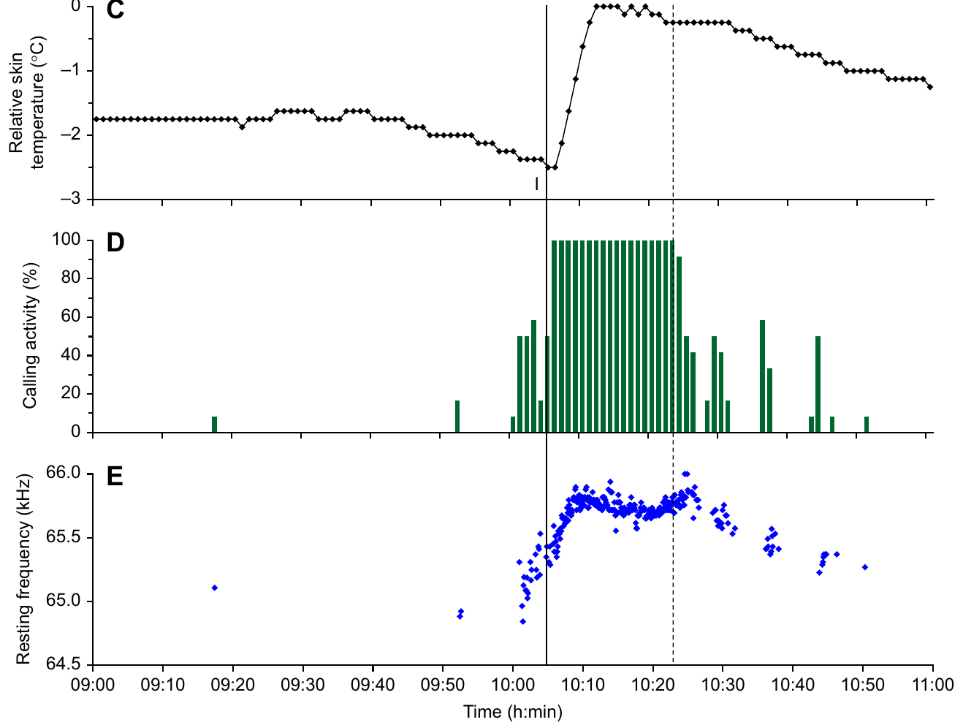
Resting call frequency rises as torpid bats warm
Torpor is a state of low physiological activity, here with a lower body temperature. Schoeppler and colleagues attached a miniature logger between the shoulder blades of Hipposideros armiger. The logger recorded skin temperature while the bats emitted calls. Calls were recorded at the same time. The logger stayed on the back during the recording.
When the experimenter entered the room, the resting bats became more active and warmer. Their resting CF2 frequency rose as they warmed. The largest rise during activation reached about 1.44 kHz, with no flight involved. Warming and calling rose together in the record. The peak frequency came before the peak temperature.
The paired recordings show how resting call frequency follows the animal's physiological state. Skin temperature is an indirect sign of internal temperature. Activation changes more than temperature alone, so the result describes a shift in the resting band. Skin temperature is a measurement at the surface. The temperature sensor sat on the back.
Schoeppler et al. (2022), Fig. 2(C–E). Skin temperature, calling activity, and resting CF2 frequency during activation.
Schoeppler et al. (2022)
43
Notes:
• Torpor involves reduced physiological activity and, in these recordings, a lower temperature before activation. The investigators measured skin temperature with a small logger on the back and recorded ultrasonic calls at the same time.
• Entering the room elicited increased calling and warming. As the bats activated, the frequency of their resting second-harmonic CF component rose, in some cases by as much as 1.44 kilohertz. Because these were resting calls, the change could not be assigned to compensation for flight speed.
• The paired recordings connect call frequency with physiological state. Skin temperature is an indirect indicator of internal temperature, and activation changes more than temperature alone. The measurements support a state-dependent shift of the resting band without directly proving how the temperature of the cochlear resonator changed.
References:
Schoeppler D, Denzinger A, Schnitzler H-U (2022). The resting frequency of echolocation signals changes with body temperature in the hipposiderid bat Hipposideros armiger. Journal of Experimental Biology 225(3):jeb243569. https://doi.org/10.1242/jeb.243569
Figure: Schoeppler et al. (2022), Fig. 2(C–E). Skin temperature, calling activity, and resting CF2 frequency during activation.
Figure source: https://doi.org/10.1242/jeb.243569

Slide 58
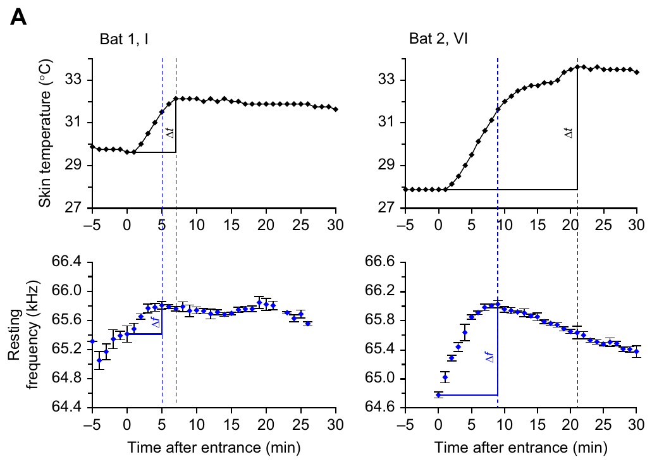
Frequency can peak before measured skin temperature
Schoeppler and colleagues compared the time of the maximum resting frequency with the time of the maximum skin temperature. The frequency maximum usually came earlier, while skin temperature kept rising. The timing comparison used the same recordings. The gap is a timing property of the activation. Both peaks came from one activation episode.
After the skin-temperature maximum, both values tended to fall. The gap in timing prevents a simple conversion of each skin-temperature change into a fixed frequency change during warming and cooling. The fall came after the temperature peak in each record. Both changes were tied to the same activation period. That shared timing is part of the record.
The authors suggested that the skin warms later than the tissues inside the body. The temperature inside the cochlea was never recorded in this experiment. So the warming explanation is an idea, not a measurement. Testing the explanation would need cochlear temperature data. The timing question is open for study.
Schoeppler et al. (2022), Fig. 3(A). Resting-frequency and skin-temperature peaks differ in time during activation.
Schoeppler et al. (2022)
44
Notes:
• The two signals were recorded together, but their peaks were not simultaneous. The bat’s resting frequency usually reached a maximum before the temperature measured at the skin reached its maximum.
• A sensor on the back does not necessarily follow the temperature inside the cochlea with the same timing. Internal tissues could warm earlier than the skin, but that possibility was not directly tested with a cochlear temperature probe.
• The later decline in both quantities supports their association while preserving the temporal difference. It would be incorrect to assign a universal kilohertz-per-degree conversion from these skin recordings. The source explicitly distinguishes its measured skin temperature from the unmeasured temperature at the inner-ear resonator.
References:
Schoeppler D, Denzinger A, Schnitzler H-U (2022). The resting frequency of echolocation signals changes with body temperature in the hipposiderid bat Hipposideros armiger. Journal of Experimental Biology 225(3):jeb243569. https://doi.org/10.1242/jeb.243569
Figure: Schoeppler et al. (2022), Fig. 3(A). Resting-frequency and skin-temperature peaks differ in time during activation.
Figure source: https://doi.org/10.1242/jeb.243569

Slide 59
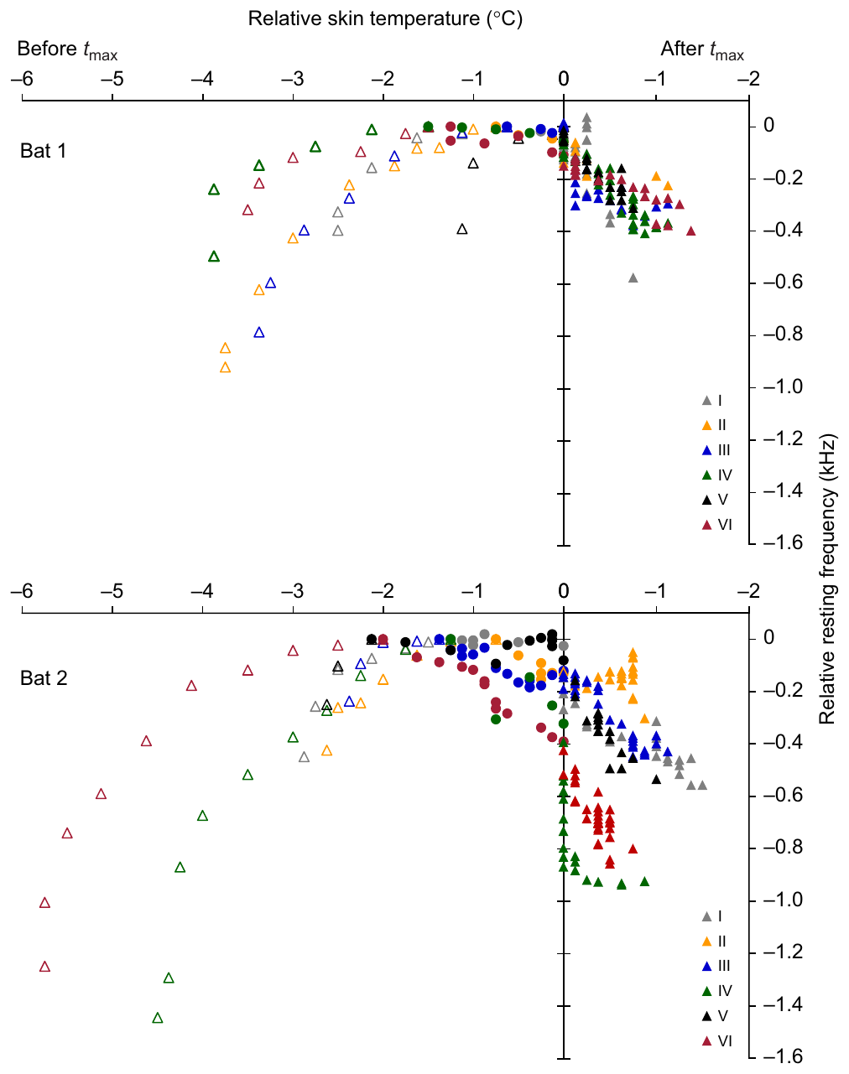
A changing sensory band can coexist with precise feedback
Resting frequency changes with the animal's physiological state. Resting and reference frequencies move together during flight. The feedback system can regulate around a preferred frequency that shifts with the animal's state. The regulation keeps the echo in a useful band. Precision and drift can coexist in one control system. The control relies on a moving target.
Schoeppler and colleagues proposed that the controlled variable is the activity of the cochlear foveal resonance system. Afferent pathways carry sensory activity to control centers. Efferent pathways carry motor commands to the vocal apparatus, which changes the next call. The proposal is an interpretation of the data. The proposed control target is the resonance system.
The warming study measured skin temperature and emitted frequency. It did not record cochlear activity or the neural circuit. The measured results are the shifts in resting frequency and the matching changes in skin temperature. Precise regulation and a moving preferred band can exist together. The resting-frequency shift is the most secure result.
Schoeppler et al. (2022), Fig. 5. Resting frequency covaries with skin temperature across activation and recovery.
Schoeppler et al. (2022); Schoeppler et al. (2018); Metzner et al. (2002)
45
Notes:
• The preferred acoustic band is not necessarily fixed permanently. The temperature study found state-linked changes in resting calls, and the flight study found that resting and reference frequencies remain coupled when their absolute values shift.
• The authors proposed regulation of activity in the cochlear resonance system. Afferent input carries sensory information into the nervous system. Efferent output changes the vocal apparatus, and the new call changes the acoustic feedback returning to the ear.
• That account connects the measured observations, but the warming experiment did not directly record the cochlear activity being proposed as the controlled variable. The strongest established claims remain the change in resting frequency, the relation to skin temperature, and the coupling of resting and reference frequencies measured in the separate flight study. Precise regulation and a changing preferred band are compatible.
References:
Schoeppler D, Denzinger A, Schnitzler H-U (2022). The resting frequency of echolocation signals changes with body temperature in the hipposiderid bat Hipposideros armiger. Journal of Experimental Biology 225(3):jeb243569. https://doi.org/10.1242/jeb.243569
Schoeppler D, Schnitzler H-U, Denzinger A (2018). Precise Doppler shift compensation in the hipposiderid bat, Hipposideros armiger. Scientific Reports 8:4598. https://doi.org/10.1038/s41598-018-22880-y
Metzner W, Zhang S, Smotherman M (2002). Doppler-shift compensation behavior in horseshoe bats revisited: auditory feedback controls both a decrease and an increase in call frequency. Journal of Experimental Biology 205(11):1607–1616. https://doi.org/10.1242/jeb.205.11.1607
Figure: Schoeppler et al. (2022), Fig. 5. Resting frequency covaries with skin temperature across activation and recovery.
Figure source: https://doi.org/10.1242/jeb.243569

Slide 60
Key takeaways
Echo frequency is the controlled signal. CF-FM bats lower emitted CF frequency as approach raises echo frequency, maintaining echoes near an individual reference band.
Resting and reference frequencies differ. The resting emission baseline usually lies slightly below the compensated echo reference; their offset must be measured at the same time.
Audible feedback acts in both directions. Horseshoe bats lower calls for higher echoes and can raise calls for sufficiently audible lower echoes, with unequal correction ranges.
The auditory fovea begins peripherally. Cochlear resonance and sharply tuned peripheral neurons concentrate sensitivity and selectivity near the CF2 echo band.
Neural codes include timing and population location. Midbrain neurons can retain narrow duration tuning near resonance; cortical populations organize frequency and preferred amplitude.
Precision can track a changing operating band. Resting and reference frequencies can shift together, and resting calls change during warming without a flight-induced Doppler shift.
Suga et al. (1975); Suga (1977); Schuller et al. (1974); Metzner et al. (2002); Schoeppler et al. (2018, 2022)
46
Notes:
Teaching transcript:
• Echo frequency is the controlled signal. CF-FM bats lower emitted CF frequency as approach raises echo frequency, maintaining echoes near an individual reference band.
• Resting and reference frequencies differ. The resting emission baseline usually lies slightly below the compensated echo reference; their offset must be measured at the same time.
• Audible feedback acts in both directions. Horseshoe bats lower calls for higher echoes and can raise calls for sufficiently audible lower echoes, with unequal correction ranges.
• The auditory fovea begins peripherally. Cochlear resonance and sharply tuned peripheral neurons concentrate sensitivity and selectivity near the CF2 echo band.
• Neural codes include timing and population location. Midbrain neurons can retain narrow duration tuning near resonance; cortical populations organize frequency and preferred amplitude.
• Precision can track a changing operating band. Resting and reference frequencies can shift together, and resting calls change during warming without a flight-induced Doppler shift.
References:
Long GR, Schnitzler H-U (1975). Behavioural audiograms from the bat, Rhinolophus ferrumequinum. Journal of Comparative Physiology 100:211–219. https://doi.org/10.1007/BF00614531
Suga N, Simmons JA, Jen PH-S (1975). Peripheral specialization for fine analysis of Doppler-shifted echoes in the auditory system of the “CF-FM” bat Pteronotus parnellii. Journal of Experimental Biology 63(1):161–192. https://doi.org/10.1242/jeb.63.1.161
Suga N (1977). Amplitude Spectrum Representation in the Doppler-Shifted-CF Processing Area of the Auditory Cortex of the Mustache Bat. Science 196(4285):64–67. https://doi.org/10.1126/science.190681
Schuller G, Beuter K, Schnitzler H-U (1974). Response to frequency shifted artificial echoes in the bat Rhinolophus ferrumequinum. Journal of Comparative Physiology 89(3):275–286. https://doi.org/10.1007/BF00696191
Metzner W, Zhang S, Smotherman M (2002). Doppler-shift compensation behavior in horseshoe bats revisited: auditory feedback controls both a decrease and an increase in call frequency. Journal of Experimental Biology 205(11):1607–1616. https://doi.org/10.1242/jeb.205.11.1607
Schoeppler D, Schnitzler H-U, Denzinger A (2018). Precise Doppler shift compensation in the hipposiderid bat, Hipposideros armiger. Scientific Reports 8:4598. https://doi.org/10.1038/s41598-018-22880-y
Schoeppler D, Denzinger A, Schnitzler H-U (2022). The resting frequency of echolocation signals changes with body temperature in the hipposiderid bat Hipposideros armiger. Journal of Experimental Biology 225(3):jeb243569. https://doi.org/10.1242/jeb.243569
Wang X, Bao M, Wang H, Sun R, Dai W, Sun K, Zhu Y, Pu Y, Chu Y, Li X, Wang T, Zhang M, Lin A, Li J, Feng J (2025). Cochlear Cell Atlas of Two Laryngeal Echolocating Bats—New Evidence for the Adaptive Nervous Physiology in Constant Frequency Bat. Molecular Ecology Resources 25:e14101. https://doi.org/10.1111/1755-0998.14101
Macías S, Hechavarría JC, Kössl M (2016). Sharp temporal tuning in the bat auditory midbrain overcomes spectral-temporal trade-off imposed by cochlear mechanics. Scientific Reports 6:29129. https://doi.org/10.1038/srep29129
Liu Y, Feng J, Metzner W (2013). Different auditory feedback control for echolocation and communication in horseshoe bats. PLoS ONE 8(4):e62710. https://doi.org/10.1371/journal.pone.0062710

