Slide 1
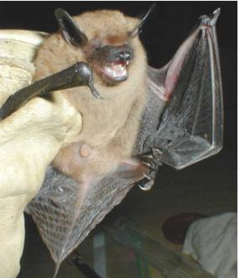
NEUR 411 · NEUROETHOLOGY · FALL 2026
Lecture 17
Bat echolocation II:
FM bats, target-range computation, clutter rejection
Friday, October 2, 2026
Jordan Lopez, Ph.D.
Professor of Neurobiology & Biomedical Engineering
Photo: Big brown bat (Eptesicus fuscus).
Notes:
Bat echolocation II: FM bats, target-range computation, clutter rejection
Lecture 17. NEUR 411 · NEUROETHOLOGY · FALL 2026. Friday, October 2, 2026.
Image: Photo: Big brown bat (Eptesicus fuscus). Credit: U.S. National Park Service, via Wikimedia Commons. License: Public domain (U.S. government work). Source: https://commons.wikimedia.org/wiki/File:Big_brown_bat.jpg

Slide 2
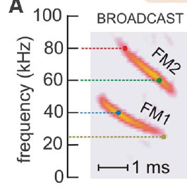
FM calls distribute acoustic energy across frequencies
Big brown bats emit FM sweeps, calls whose frequency falls during each call. Each call has two strong harmonics. The first harmonic, FM1, sweeps from about 55 to 25 kHz. The second harmonic, FM2, sweeps from about 110 to 50 kHz. The two harmonics are related by a twofold frequency ratio. Both fall within one broadcast.
These wide sweeps differ from a constant-frequency call, which holds one frequency. Each part of the sweep is sent at a different moment. Changes in frequency over time carry timing information. An echo preserves the timing of each frequency, so the bat receives the order in which the sound was sent and returned.
Behavioral filtering experiments test the two harmonics separately. Bats can judge echo delay with FM1 alone. When FM1 frequencies are missing, FM2 offers no substitute. Filtering removes one harmonic while the rest of the call stays in place. The result shows that FM1 carries information that FM2 lacks. The test isolates what each harmonic provides.
Bates et al. (2011), Fig. 1(A). Two downward FM harmonics in a big brown bat broadcast.
Bates et al. (2011); Ming et al. (2020)
02
Notes:
• Echolocation is active sensing with emitted sounds and returning echoes. A frequency-modulated sweep, or FM sweep, changes frequency during a call. Big brown bats, Eptesicus fuscus, emit downward sweeps with two prominent harmonics, components related by a twofold frequency ratio.
• Ming and colleagues describe FM1 sweeping approximately from 55 to 25 kHz and FM2 from 110 to 50 kHz. These wide frequency ranges differ from a sustained constant-frequency carrier. An echo preserves information about when different frequencies were transmitted and returned.
• Behavioral filtering experiments distinguish the contributions of these harmonics. FM1 can support echo-delay perception without FM2; FM2 cannot simply replace missing corresponding FM1 frequencies. The two acoustic components therefore contribute asymmetrically to the tested range judgments.
• A harmonic is defined by its frequency relationship to another component. FM1 and FM2 are not successive calls. They occur together within the broadcast, while each sweeps downward through its own frequency range.
References:
Bates ME, Simmons JA, Zorikov TV (2011). Bats use echo harmonic structure to distinguish their targets from background clutter. Science 333(6042):627–630. https://doi.org/10.1126/science.1202065
Ming C, Bates ME, Simmons JA (2020). How frequency hopping suppresses pulse-echo ambiguity in bat biosonar. Proceedings of the National Academy of Sciences 117(29):17288–17295. https://doi.org/10.1073/pnas.2001105117
Figure: Bates et al. (2011), Fig. 1(A). Two downward FM harmonics in a big brown bat broadcast.
Figure source: https://doi.org/10.1126/science.1202065

Slide 3
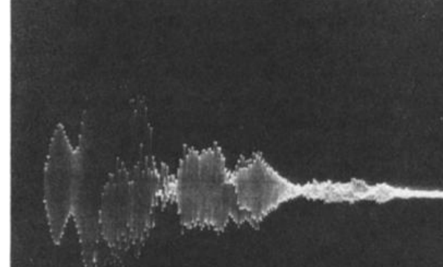
Echo delay specifies the round trip to a target
Echo delay is the time between an outgoing call and its returning echo. Sound travels from the bat to the target and back again. A more distant target sends back a later echo, because its sound covers more distance. Target range is the distance from the bat to the target. Longer delays mean farther targets.
Simmons trained bats to discriminate target distance. Electronic delay channels could change the arrival time of each echo. The loudspeakers stayed at fixed physical positions throughout. The timing changed, while the location of each loudspeaker stayed put. This arrangement left the physical setup unchanged across all conditions. The timing alone then carried the cue.
This separation allowed a direct test of the ranging cue. The bat judged relative simulated distance from echo arrival time alone. The loudspeaker's real distance never changed. Arrival time carried the whole judgment. The result isolates the timing cue from every physical location cue. The judgment depended on timing, not on where the loudspeaker sat.
Simmons (1973), Fig. 11. Recorded outgoing sound and target echo at a range of 30 cm.
Simmons (1973)
03
Notes:
• Echo delay is the interval between an outgoing call and its returning reflection. A more distant target produces a later echo because sound travels outward to the target and back to the bat. Target range is the distance from the bat to that reflector.
• Simmons recorded outgoing sounds and echoes while bats discriminated target distance. A target at 30 cm returned an echo after about 1.7 ms in the experimental conditions. Electronic delay channels could change this interval while keeping the loudspeakers at fixed physical positions.
• The resulting separation of acoustic delay from physical location permitted a direct behavioral test of the ranging cue. The bat could judge relative simulated distance from echo arrival time without receiving a corresponding change in the loudspeaker’s actual distance.
• The recorded echo followed the emitted call rather than arriving at the same time. Sound from apparatus supports also appeared in the recording, so the investigator distinguished target reflections from other returning sound.
References:
Simmons JA (1973). The resolution of target range by echolocating bats. Journal of the Acoustical Society of America 54(1):157–173. https://doi.org/10.1121/1.1913559
Figure: Simmons (1973), Fig. 11. Recorded outgoing sound and target echo at a range of 30 cm.
Figure source: https://doi.org/10.1121/1.1913559

Slide 4
Recordings isolate target echoes
Simmons recorded the outgoing call and the returning echo from a target at 30 cm. The echo arrived after the call, not at the same moment as the sound leaving the bat. Sound from the apparatus also appeared in the recording. The investigator separated target echoes from that other returning sound before measuring the delay.
In the experimental conditions, the echo from that target returned about 1.7 ms after the call. Electronic delay channels could change this interval directly. The loudspeakers kept fixed physical positions while the timing changed. Direct control over echo timing gave the experimenter a clean test of the ranging cue, with no physical movement required. Simulated range changed without moving anything.
Simmons recorded outgoing sounds and echoes while bats discriminated target distance. Each echo in the recording can be matched to the call that produced it. The recordings thus show the timing that bats had available during the task. Each recording pairs one outgoing sound with the echo that follows it. That pairing makes the delay readable directly.
Simmons (1973), Fig. 11. Recorded outgoing sound and target echo at a range of 30 cm.
Simmons (1973)
03a
Notes:
• Recordings isolate target echoes.
• Explanation 1.
– Simmons recorded the outgoing call and the returning echo from a target at 30 cm
– The echo arrived after the call, not at the same moment as the sound leaving the bat. Sound from the apparatus also appeared in the recording. The investigator separated target echoes from that other returning sound before measuring the delay.
• Explanation 2.
– In the experimental conditions, the echo from that target returned about 1.7 ms after the call
– Electronic delay channels could change this interval directly. The loudspeakers kept fixed physical positions while the timing changed. Direct control over echo timing gave the experimenter a clean test of the ranging cue, with no physical movement required. Simulated range changed without moving anything.
• Explanation 3.
– Simmons recorded outgoing sounds and echoes while bats discriminated target distance
– Each echo in the recording can be matched to the call that produced it. The recordings thus show the timing that bats had available during the task. Each recording pairs one outgoing sound with the echo that follows it. That pairing makes the delay readable directly.
• Source.
– The figure and the measurements come from Simmons (1973).
– Each statement comes from that study's recordings or observations.
References:
Simmons JA (1973). The resolution of target range by echolocating bats. Journal of the Acoustical Society of America 54(1):157–173. https://doi.org/10.1121/1.1913559

Slide 5
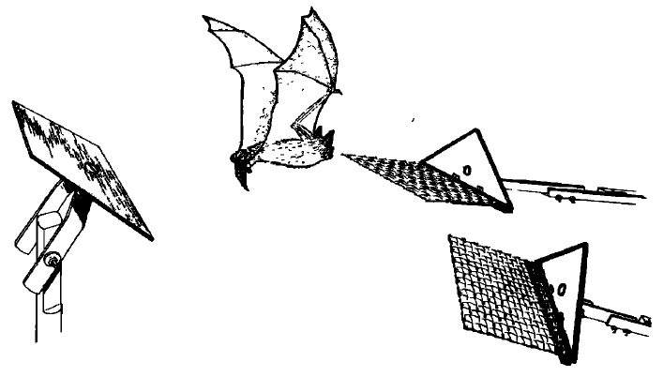
Bats can choose the nearer of two reflecting targets
Simmons trained bats to choose the nearer of two targets. Each correct choice led to food at the landing platform beside the nearer target. The bat had to compare the two echoes before it moved. Each decision had a clear answer, so the reward tracked accuracy. The task asked which target lay closer to the bat.
One target stayed at a fixed range, such as 30 or 60 cm. The other was brought progressively closer to it. The bat was tested on whether it could still pick the nearer target as the gap narrowed. Each step of the gap produced a new choice. The series ran until the two targets were equally far away.
Accuracy fell as the distance difference approached zero. When both targets sat at equal distances, the bats reached chance. The procedure measured how finely bats resolve differences in range between two targets. The bats never judged one target alone, so absolute distance was outside the task. Each comparison involved two targets presented together.
Simmons (1973), Fig. 1. Original two-target range-discrimination apparatus.
Simmons (1973)
04
Notes:
• Simmons trained bats to discriminate between two targets that differed in distance from a starting platform. The animal received food for moving to the landing platform associated with the nearer target. Discrimination here means choosing between simultaneously available alternatives.
• One target remained at a fixed range, such as 30 or 60 cm, while the other was brought progressively closer to that range. Vision was excluded so that visual distance cues could not explain the choices. The triangular targets had the same form.
• Performance deteriorated as the distance difference approached zero, reaching chance when both targets were equally distant. This procedure measured resolution of relative range differences. It did not measure the accuracy of an isolated absolute-distance estimate without a comparison target.
• The food contingency linked the correct choice to the nearer reflector. Equal target shape removed a simple object-form cue, and excluding vision isolated the use of acoustic information during the distance choice.
References:
Simmons JA (1973). The resolution of target range by echolocating bats. Journal of the Acoustical Society of America 54(1):157–173. https://doi.org/10.1121/1.1913559
Figure: Simmons (1973), Fig. 1. Original two-target range-discrimination apparatus.
Figure source: https://doi.org/10.1121/1.1913559

Slide 6
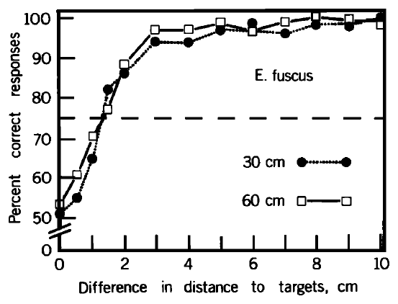
Near-range acuity remains similar at 30 and 60 cm
Range acuity is the smallest distance difference a bat can discriminate at a set level of accuracy. Simmons used 75 percent correct choices as that level. Each point on the curve shows how often the bats chose correctly at one distance difference. Larger differences produced higher accuracy. The curve rises as the difference grows.
Big brown bats discriminated differences of about 12 to 14 mm at both 30 cm and 60 cm. Doubling the target distance changed the discrimination curve very little. Larger distance differences were much easier to tell apart than small ones. The two curves looked alike across the tested range. Each curve reached its criterion at a similar difference.
Resolution in absolute distance units stayed roughly constant across these two distances. Echo loudness and propagation losses may matter for targets farther away. The data described here cover near-range targets. Resolution at longer distances needs a separate measurement. The pattern is clearest at these two distances. The same procedure applied at both distances.
Simmons (1973), Fig. 2. Range-discrimination performance at absolute distances of 30 and 60 cm.
Simmons (1973)
05
Notes:
• Range acuity is the smallest distance difference that supports a specified level of correct discrimination. Simmons used 75% correct choices as an operational criterion, between chance and nearly error-free performance in the two-target task.
• Big brown bats discriminated range differences of approximately 12–14 mm at absolute ranges of 30 and 60 cm. Doubling target distance within this near-range comparison produced little change in the discrimination curve. Larger distance differences were much easier to distinguish.
• The result supports approximately constant absolute resolution over these tested ranges. It does not establish that resolution remains independent of distance at every operating range. Echo audibility, propagation losses, and the conditions of the behavioral task constrain extrapolation to distant targets.
• The threshold was a behavioral criterion chosen for comparing curves. A distance difference of zero leaves no nearer target, so choices must approach chance even if the bat hears both targets clearly.
References:
Simmons JA (1973). The resolution of target range by echolocating bats. Journal of the Acoustical Society of America 54(1):157–173. https://doi.org/10.1121/1.1913559
Figure: Simmons (1973), Fig. 2. Range-discrimination performance at absolute distances of 30 and 60 cm.
Figure source: https://doi.org/10.1121/1.1913559

Slide 7
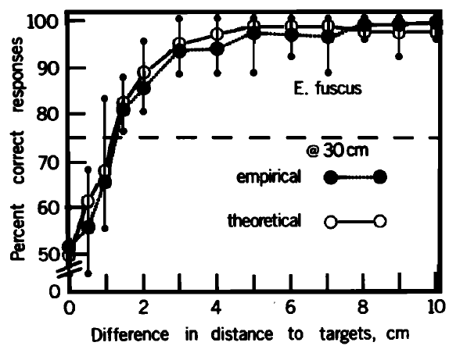
Behavioral resolution is narrower than target distance
At 30 cm, big brown bats chose almost without errors when two targets differed by several centimeters. Their accuracy fell as the difference shrank toward millimeters. Absolute distance and the smallest resolvable difference are different quantities. The threshold describes a difference between targets, not one target's distance. Resolution is a property of the gap between targets.
The analysis used the autocorrelation envelope of the recorded sonar signal. This measure shows how well a waveform matches delayed copies of itself. Rapid carrier fluctuations were removed first, leaving the slower shape of the signal. The result is a smooth curve of match against delay. The curve was computed from the call, not from the bats.
At 30 cm, the bats' accuracy declined in the same smooth way as the signal-based curve. The two curves agreed closely across the tested differences. Their shared decline marks the millimeter scale at which choices become unreliable. Accuracy stayed high for differences of several centimeters. The agreement is a match between two curves.
Simmons (1973), Fig. 3. Measured discrimination and the paper’s signal-based prediction at 30 cm.
Simmons (1973)
06
Notes:
• At an absolute range of 30 cm, big brown bats performed almost without errors when targets differed by several centimeters. Their choices became progressively less reliable as the separation fell toward the millimeter-scale threshold. Absolute target distance and resolvable distance difference are distinct quantities.
• Simmons compared this measured discrimination curve with a prediction derived from the recorded sonar signal. The prediction used the signal’s autocorrelation envelope, a measure of similarity between a waveform and delayed versions of itself, with rapid carrier fluctuations removed.
• Agreement supported a receiver matched to features of the transmitted signal. It did not directly identify the neurons performing that computation, and a correspondence between a behavioral curve and a signal-based prediction does not prove a unique cellular implementation.
• The empirical curve represents actual choices. The theoretical curve was published by the investigator as a prediction from the bat’s recorded signal. A matched receiver is a proposed interpretation of their relationship.
References:
Simmons JA (1973). The resolution of target range by echolocating bats. Journal of the Acoustical Society of America 54(1):157–173. https://doi.org/10.1121/1.1913559
Figure: Simmons (1973), Fig. 3. Measured discrimination and the paper’s signal-based prediction at 30 cm.
Figure source: https://doi.org/10.1121/1.1913559

Slide 8
Choices and prediction are separate curves
The measured curve shows the bats' actual choices at each difference between two targets. The other curve is a prediction that Simmons published from the recorded signal. The other curve comes from calculation, not from behavior. Each point on the measured curve counts correct choices at one difference. Both curves appear on one set of axes.
A matched receiver is a proposed interpretation of that agreement. It is not a demonstrated neural mechanism. Its role is to predict the curves, not to name neurons. Neurons that perform the matching were not identified in this study. Simmons described the receiver as a functional hypothesis. Its prediction was derived from the signal, not fitted to the choices.
Simmons plotted both curves at 30 cm, the same distance used for the measured choices. The prediction used a signal that the bats had produced. The result sets a behavioral measure beside a signal-based prediction, not a single cell's response. Both curves cover differences from millimeters to several centimeters. The match holds across that whole range.
Simmons (1973), Fig. 3. Measured discrimination and the paper’s signal-based prediction at 30 cm.
Simmons (1973)
06a
Notes:
• Choices and prediction are separate curves.
• Explanation 1.
– The measured curve shows the bats' actual choices at each difference between two targets
– The other curve is a prediction that Simmons published from the recorded signal. The other curve comes from calculation, not from behavior. Each point on the measured curve counts correct choices at one difference. Both curves appear on one set of axes.
• Explanation 2.
– A matched receiver is a proposed interpretation of that agreement
– It is not a demonstrated neural mechanism. Its role is to predict the curves, not to name neurons. Neurons that perform the matching were not identified in this study. Simmons described the receiver as a functional hypothesis. Its prediction was derived from the signal, not fitted to the choices.
• Explanation 3.
– Simmons plotted both curves at 30 cm, the same distance used for the measured choices
– The prediction used a signal that the bats had produced. The result sets a behavioral measure beside a signal-based prediction, not a single cell's response. Both curves cover differences from millimeters to several centimeters. The match holds across that whole range.
• Source.
– The figure and the measurements come from Simmons (1973).
– Each statement comes from that study's recordings or observations.
References:
Simmons JA (1973). The resolution of target range by echolocating bats. Journal of the Acoustical Society of America 54(1):157–173. https://doi.org/10.1121/1.1913559

Slide 9
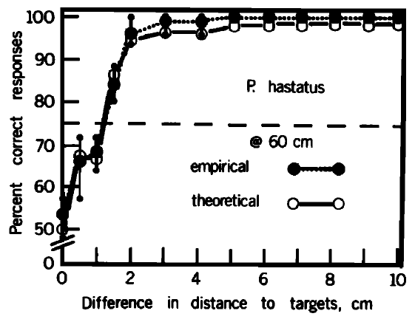
Range discrimination occurs across sonar signal types
Simmons tested range discrimination in several bat species. Two species, Eptesicus fuscus and Phyllostomus hastatus, used FM sounds. The other species combined constant-frequency and FM components in their sonar calls. Every species received the same general nearer-target task. Each species chose between two targets at different distances. Their signals differed in how they combined frequencies.
The first three species resolved differences of about 1 to 2 cm. Rhinolophus ferrumequinum had a threshold near 3 cm. Phyllostomus also resolved relative range well at 60 cm. Its resolution at 120 cm was similar, which shows that the ability held across these distances. Resolution stayed comparable as the target moved farther away.
Simmons inferred that the species use their signal components in different ways. The shared ability to compare target ranges held under the tested conditions. Differences in auditory processing among species form a separate question. Signal form alone never split the species into ranging and nonranging groups. Simmons drew these points from one experimental design.
Simmons (1973), Fig. 5. Range discrimination by Phyllostomus hastatus at 60 cm.
Simmons (1973)
07
Notes:
• Simmons compared range discrimination in bats using different sonar signals. Eptesicus fuscus and Phyllostomus hastatus used FM sounds, whereas the other tested species used combinations of constant-frequency and FM components. The species were tested with the same general nearer-target contingency.
• The first three species resolved differences near 1–2 cm; Rhinolophus ferrumequinum had a threshold nearer 3 cm. In Phyllostomus, discrimination at 60 and 120 cm had similar resolution. Signal form did not divide the animals into ranging and non-ranging groups.
• The paper inferred different contributions of signal components across species. These comparisons establish behavioral capabilities under the tested conditions, rather than an identical neural algorithm in all bats. Species-specific auditory processing must be distinguished from their shared ability to compare target ranges.
• The Phyllostomus data provide a second FM species comparison. Similar relative-range performance is evidence of a shared sensory capability, but it does not imply that the two species have identical call structure or auditory circuits.
References:
Simmons JA (1973). The resolution of target range by echolocating bats. Journal of the Acoustical Society of America 54(1):157–173. https://doi.org/10.1121/1.1913559
Figure: Simmons (1973), Fig. 5. Range discrimination by Phyllostomus hastatus at 60 cm.
Figure source: https://doi.org/10.1121/1.1913559

Slide 10
Electronic echoes isolate arrival time from other cues
Simmons used electronic target simulators to present echoes with controlled arrival times. A simulator captured the bat's call, delayed it, and returned it through a loudspeaker. Each channel had its own microphone, delay unit and speaker. Two channels could present two echoes with different arrival times. The apparatus kept each target's echo separate from the other.
The loudspeakers stayed in fixed positions, and overall level and spectrum were controlled. Early versions used one microphone for both speakers. That arrangement disrupted the bat's ability to inspect the two targets separately. Stable discrimination returned only after each channel had its own microphone. Aiming the call could not change the relative strength of the two echoes.
Using one microphone for each channel restored stable discrimination. A bat aims its call at an object, and the aim changes what that object returns. Artificial feedback must keep this aim-dependent return to imitate real inspection of two targets. Experimenters had to reproduce the natural coupling between aim and echo. The simulator was built around that requirement.
Simmons (1973), Fig. 11. Call and delayed echo recorded in the target-simulator experiment.
Simmons (1973)
08
Notes:
• An electronic target simulator captures a bat’s emitted sound, delays it, and returns it through a loudspeaker. Simmons used two independent microphone–delay–speaker channels to present echoes with different arrival times. The hardware could preserve other range-related acoustic properties while changing delay.
• The loudspeakers remained fixed, and overall level and spectrum were controlled. A first arrangement with one microphone feeding both speakers disrupted the animal’s ability to inspect targets separately. Using one microphone for each channel restored stable discrimination.
• This control revealed that directional sampling is part of the task. A bat aims its call toward an object, changing the information returned by that object. Artificial feedback must preserve that active relationship if the experiment is to approximate separate acoustic inspection of two targets.
• The one-microphone arrangement returned strong echoes from both sides irrespective of the bat’s pointing direction. The two-microphone arrangement let the animal change relative echo strength by directing its broadcast toward one side.
References:
Simmons JA (1973). The resolution of target range by echolocating bats. Journal of the Acoustical Society of America 54(1):157–173. https://doi.org/10.1121/1.1913559
Figure: Simmons (1973), Fig. 11. Call and delayed echo recorded in the target-simulator experiment.
Figure source: https://doi.org/10.1121/1.1913559

Slide 11
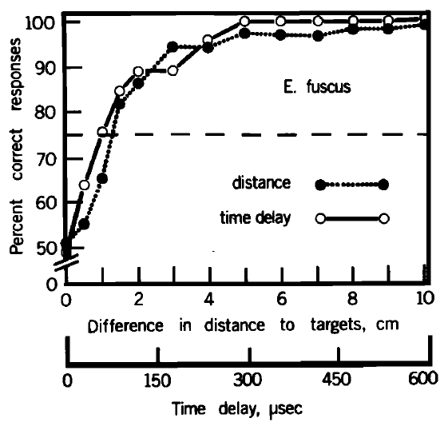
Echo arrival time can support the range judgment
Simmons compared discrimination of physical targets with discrimination of electronically delayed echoes. In the simulator, the two alternatives differed in arrival time. The loudspeakers stayed still, and the bat still chose the echo for the nearer target. Both conditions used the same general choice task. The change altered how range reached the bat.
At a simulated range of 30 cm, the electronic-delay curve and the physical-distance curve were closely similar. The bat's judgments followed arrival time in the same way that they followed real distance in the physical task. Two separate methods gave the same answer. Accuracy in both conditions rose as the difference grew.
Echo timing can carry this relative-range judgment in big brown bats. This test keeps the same species and task while changing the way range is conveyed. Similar performance after that change is the evidence for timing as the cue. Timing alone is enough for the judgment. The delivery of range was the variable that changed.
Simmons (1973), Fig. 13. Physical-range and electronic-delay discrimination at a 30-cm reference range.
Simmons (1973)
09
Notes:
• Simmons compared physical-target discrimination with discrimination of electronically delayed echoes. In the simulator, the alternatives differed in arrival time rather than in the loudspeakers’ actual positions. The animal was still rewarded for selecting the echo corresponding to the nearer target.
• At a simulated range of 30 cm, the electronic-delay and physical-distance performance curves were closely similar. Arrival-time differences corresponding to about 1 cm of range could be discriminated in the controlled feedback task. The figure retains both distance and delay scales.
• Echo timing is therefore sufficient to mediate this relative-range judgment in big brown bats. The experiment does not imply that bats ignore spectral, directional, or intensity information in natural scenes; those variables were controlled here to isolate a particular ranging cue.
• The comparison uses the same species and general task while changing how range is conveyed. Similar performance after this change is the evidence that arrival time can carry the required distance information.
References:
Simmons JA (1973). The resolution of target range by echolocating bats. Journal of the Acoustical Society of America 54(1):157–173. https://doi.org/10.1121/1.1913559
Figure: Simmons (1973), Fig. 13. Physical-range and electronic-delay discrimination at a 30-cm reference range.
Figure source: https://doi.org/10.1121/1.1913559

Slide 12
Arrival-time differences of about 1 cm
The electronic-delay experiment could discriminate arrival-time differences corresponding to about 1 cm of range. Simmons set the simulated range at 30 cm as the reference distance for that comparison. Both conditions used the same bats and a comparable choice task. The result is reported as a difference in arrival time, not in position. The loudspeaker positions also stayed fixed.
The plot keeps both the physical distance scale and the electronic delay scale. Spectral, directional and intensity cues were controlled, so timing was the remaining cue under test. Those controlled variables matter in natural scenes, which carry all of the cues together. The experiment isolated one cue on purpose. The two scales can be read against each other.
Physical-range and electronic-delay discrimination were both measured at a 30 cm reference range. The electronic curve matched the physical one closely. The mode of delivery was the one difference between the two conditions. The reference was the same 30 cm in both conditions. The two curves were compared across the tested differences. Both curves appear on one shared scale.
Simmons (1973), Fig. 13. Physical-range and electronic-delay discrimination at a 30-cm reference range.
Simmons (1973)
09a
Notes:
• Arrival-time differences of about 1 cm.
• Explanation 1.
– The electronic-delay experiment could discriminate arrival-time differences corresponding to about 1 cm of range
– Simmons set the simulated range at 30 cm as the reference distance for that comparison. Both conditions used the same bats and a comparable choice task. The result is reported as a difference in arrival time, not in position. The loudspeaker positions also stayed fixed.
• Explanation 2.
– The plot keeps both the physical distance scale and the electronic delay scale
– Spectral, directional and intensity cues were controlled, so timing was the remaining cue under test. Those controlled variables matter in natural scenes, which carry all of the cues together. The experiment isolated one cue on purpose. The two scales can be read against each other.
• Explanation 3.
– Physical-range and electronic-delay discrimination were both measured at a 30 cm reference range
– The electronic curve matched the physical one closely. The mode of delivery was the one difference between the two conditions. The reference was the same 30 cm in both conditions. The two curves were compared across the tested differences. Both curves appear on one shared scale.
• Source.
– The figure and the measurements come from Simmons (1973).
– Each statement comes from that study's recordings or observations.
References:
Simmons JA (1973). The resolution of target range by echolocating bats. Journal of the Acoustical Society of America 54(1):157–173. https://doi.org/10.1121/1.1913559

Slide 13
A matched receiver is a functional hypothesis
A matched receiver processes an incoming echo against the structure of the transmitted signal. Cross-correlation measures how similar two signals are as their timing is shifted. Simmons proposed a neural version of this operation as a model for the bat's ranging. The model compares each echo with the call itself. That model treats the call as the template.
The measured range-discrimination curves resembled predictions based on the envelopes of the recorded calls' autocorrelation functions. The idea concerns extracting echo arrival time from a broadband signal, not from a single frequency. This explains why the frequency range of the call matters. The broadband structure carries the timing information. The envelope removes fast carrier detail.
Behavioral agreement with the prediction suggests a computation that the bat performs. The agreement fits several neural circuits, and it names none of them. Simmons also allowed representations spread across frequency and time, instead of a copy of the waveform. The proposal describes a function, so the biology behind it still needs study.
Simmons (1973), Fig. 3. Behavioral range resolution compared with the published receiver prediction.
Simmons (1973)
10
Notes:
• A matched receiver processes an incoming echo in relation to the structure of the transmitted signal. Cross-correlation measures similarity between two signals as their relative timing is varied. Simmons proposed a neural equivalent of this operation from the relationship between acoustic structure and behavioral resolution.
• The measured range-discrimination curves resembled predictions based on the envelopes of recorded calls’ autocorrelation functions. The hypothesis concerns extraction of echo arrival time from a broadband signal rather than measurement of a single acoustic frequency.
• The paper explicitly allowed neural representations distributed across frequency and time instead of literal waveform comparison. Behavioral agreement with a prediction supports a computational relationship, but it does not establish a permanent call template, a specific synaptic circuit, or direct neural copying of the acoustic waveform.
• Cross-correlation in the paper is a proposed functional description of the receiver. The distinction between a successful mathematical description and its biological implementation is essential when interpreting the behavioral curves.
References:
Simmons JA (1973). The resolution of target range by echolocating bats. Journal of the Acoustical Society of America 54(1):157–173. https://doi.org/10.1121/1.1913559
Figure: Simmons (1973), Fig. 3. Behavioral range resolution compared with the published receiver prediction.
Figure source: https://doi.org/10.1121/1.1913559

Slide 14
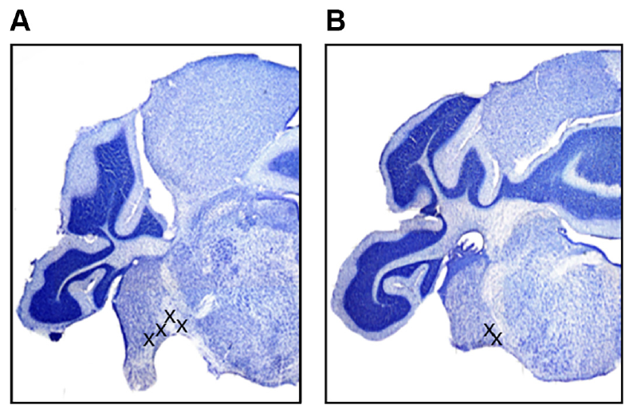
Timing is registered early in the auditory pathway
The cochlear nucleus is the first central relay that receives input from the auditory nerve. The inferior colliculus is an auditory midbrain center that gets ascending input from brainstem nuclei. Simmons and colleagues compared timing in both structures in big brown bats. Both sites lie along the same ascending route. Both sites were examined in the same animals.
The team recorded in the ventral cochlear nucleus and the inferior colliculus under anesthesia. Each recording site was later marked, and the stained tissue showed where each electrode had been placed. The placement of every electrode was checked afterward. The recordings reached the sites that the marks identified. Recording sites were confirmed after the experiment.
The test asked whether precise timing appears only in the midbrain or already exists in an early relay. The recordings sampled particular regions of the cochlear nucleus. Other regions of the nucleus were not sampled in this study. The result applies to the sampled regions. The sampled regions set the limits of the claim.
Simmons et al. (2024), Fig. 2(A–B). Histological sections locating ventral cochlear-nucleus recordings.
Simmons et al. (2024)
11
Notes:
• The cochlear nucleus is the first central relay receiving auditory-nerve input from the ear. The inferior colliculus is an auditory midbrain center receiving ascending inputs from brainstem nuclei. Simmons and colleagues compared population timing in these two structures in big brown bats.
• Electrodes recorded in the ventral cochlear nucleus and inferior colliculus during anesthesia. Histological lesions identified cochlear-nucleus sites near the entry of the eighth cranial nerve and near the trapezoid body. The recovered positions restricted the anatomical interpretation of the recordings.
• The comparison tested whether precise timing emerged only at the midbrain or was already present in an early relay. It sampled particular regions rather than every subdivision of the cochlear nucleus, so the findings cannot be assigned uniformly to all neurons or pathways in that structure.
• The stained tissue establishes where the electrode had been placed. Recording location matters because the cochlear nucleus contains subdivisions with different cells and projection patterns, rather than one homogeneous population.
References:
Simmons AM, Warnecke M, Simmons JA (2024). Microseconds-level coding of echo delay in the auditory brainstem of an FM-echolocating bat. Journal of Neurophysiology 132(6):2012–2022. https://doi.org/10.1152/jn.00305.2024
Figure: Simmons et al. (2024), Fig. 2(A–B). Histological sections locating ventral cochlear-nucleus recordings.
Figure source: https://doi.org/10.1152/jn.00305.2024

Slide 15
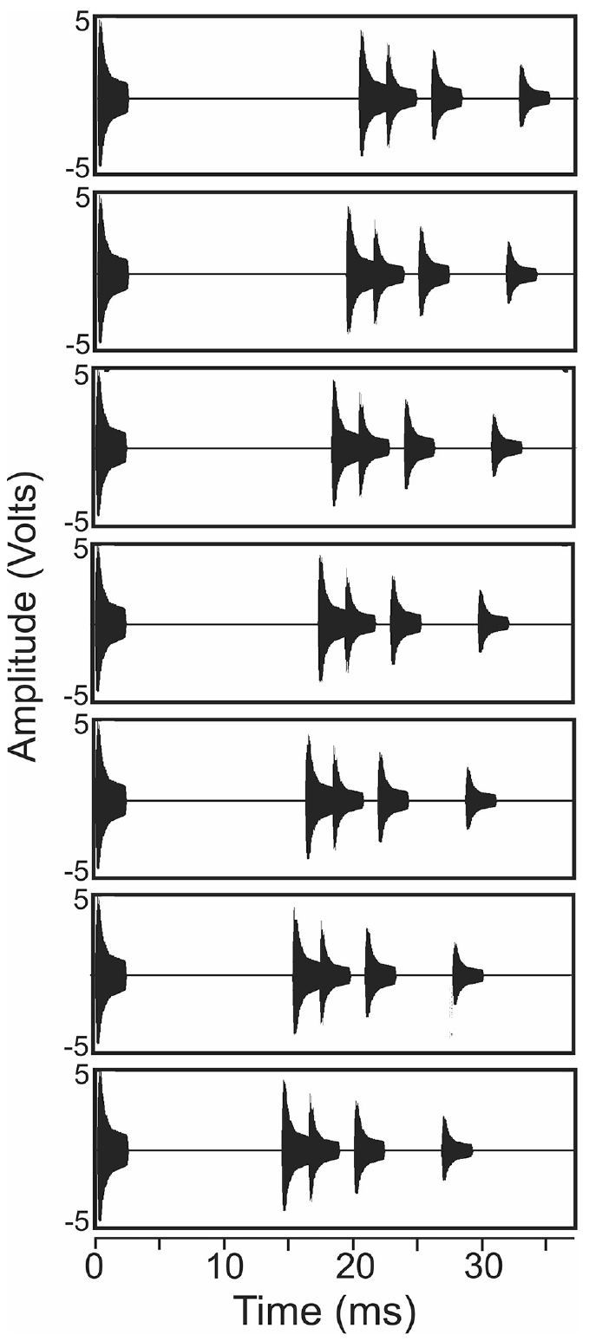
Echo cascades approximate a scene with several objects
An echo cascade is a series of echoes that arrive after one broadcast. Simmons and colleagues built stimuli from a short downward FM broadcast followed by four echoes. The echoes shared a spectrum but differed in amplitude. Each stimulus imitated several objects near a flying bat. The series was designed as a controlled sequence.
Changing the delay of the first echo altered the simulated scene while keeping the cascade's general structure. The first echo was the only element whose timing changed across the series. The later echoes kept their order and their spacing. The design tested timing across a sequence of echoes, not a single tone.
The anesthetized preparation could not show ongoing vocal choices or obstacle avoidance. Each waveform still imitates a bat approaching several objects. The stimuli were controlled sound sequences, not recordings of a bat flying past real targets. The experiment asked about the neural response, not about flight. The series approximates a scene, not a live flight.
Simmons et al. (2024), Fig. 1. Published broadcast–echo waveforms with first-echo delays from 20.4 to 14.4 ms.
Simmons et al. (2024)
12
Notes:
• An echo cascade is a sequence of reflections arriving after one broadcast. Simmons and colleagues constructed stimuli containing a 2.5-ms downward FM broadcast followed by four echoes with the same spectral content and different amplitudes. The stimulus approximated multiple reflectors near a flying bat.
• The first echo arrived at delays from 20.4 to 14.4 ms in 1-ms steps. Subsequent echo intervals were 2.1, 3.5, and 6.8 ms. FM1 swept from 50 to 20 kHz and FM2 from 100 to 40 kHz.
• Changing the first-echo delay altered the simulated scene while preserving its general cascade structure. This design tested timing during a sequence of echoes rather than an isolated tone. The anesthetized preparation did not measure ongoing vocal choice or obstacle-avoidance behavior.
• Each plotted waveform begins with a broadcast and then contains four echoes. The series is a controlled acoustic approximation of approaching a set of reflectors, not a recording of a bat actually flying past those objects.
References:
Simmons AM, Warnecke M, Simmons JA (2024). Microseconds-level coding of echo delay in the auditory brainstem of an FM-echolocating bat. Journal of Neurophysiology 132(6):2012–2022. https://doi.org/10.1152/jn.00305.2024
Figure: Simmons et al. (2024), Fig. 1. Published broadcast–echo waveforms with first-echo delays from 20.4 to 14.4 ms.
Figure source: https://doi.org/10.1152/jn.00305.2024

Slide 16
Echo spacing in the cascade
After the first echo, the later echo intervals were 2.1, 3.5 and 6.8 ms. The first echo moved in 1-ms steps across a span of about 6 ms. Each waveform in the series keeps this fixed cascade pattern. The stimuli were built by the experimenters, not captured from a flying bat. The later intervals stayed the same across stimuli.
The broadcast lasted 2.5 ms in every stimulus. Its FM1 part swept from 50 to 20 kHz, and its FM2 part from 100 to 40 kHz. The four echoes shared that spectral content. The echo amplitudes were set separately for each of the four echoes. The same broadcast began every waveform in the series. The echo amplitudes formed the only other difference.
Each plotted waveform begins with a broadcast and then contains four echoes. The series is a controlled acoustic approximation of approaching a set of targets. The waveforms show the stimulus, not an animal's behavior. Each waveform's first echo arrives at a different delay in the series. The echo series mimics approach, but it is a constructed sound.
Simmons et al. (2024), Fig. 1. Published broadcast–echo waveforms with first-echo delays from 20.4 to 14.4 ms.
Simmons et al. (2024)
12a
Notes:
• Echo spacing in the cascade.
• Explanation 1.
– After the first echo, the later echo intervals were 2.1, 3.5 and 6.8 ms
– The first echo moved in 1-ms steps across a span of about 6 ms. Each waveform in the series keeps this fixed cascade pattern. The stimuli were built by the experimenters, not captured from a flying bat. The later intervals stayed the same across stimuli.
• Explanation 2.
– The broadcast lasted 2.5 ms in every stimulus
– Its FM1 part swept from 50 to 20 kHz, and its FM2 part from 100 to 40 kHz. The four echoes shared that spectral content. The echo amplitudes were set separately for each of the four echoes. The same broadcast began every waveform in the series. The echo amplitudes formed the only other difference.
• Explanation 3.
– Each plotted waveform begins with a broadcast and then contains four echoes
– The series is a controlled acoustic approximation of approaching a set of targets. The waveforms show the stimulus, not an animal's behavior. Each waveform's first echo arrives at a different delay in the series. The echo series mimics approach, but it is a constructed sound.
• Source.
– The figure and the measurements come from Simmons et al. (2024).
– Each statement comes from that study's recordings or observations.
References:
Simmons AM, Warnecke M, Simmons JA (2024). Microseconds-level coding of echo delay in the auditory brainstem of an FM-echolocating bat. Journal of Neurophysiology 132(6):2012–2022. https://doi.org/10.1152/jn.00305.2024

Slide 17
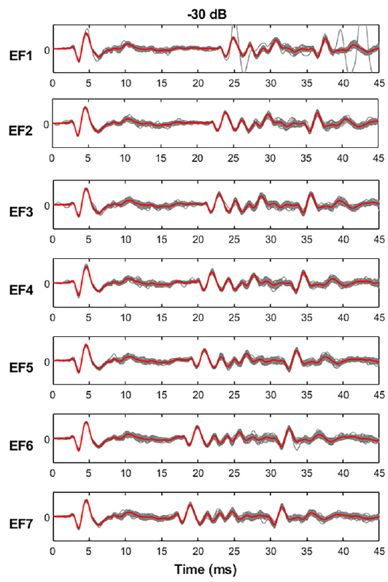
Population potentials register calls and echoes
A local field potential, or LFP, is an extracellular voltage signal that carries the coordinated activity of a neuronal population. Simmons and colleagues filtered their recordings to study low-frequency population waveforms in the cochlear nucleus. The waveform sums many neurons into one trace. Low-pass filtering removes the fast spikes from the trace.
Each broadcast and the first echo produced a prominent negative peak followed by a positive peak. Repeated presentations of the same stimulus produced closely overlapping early responses. Later parts of the cascade varied more from trial to trial. The early peaks were the most repeatable part of the signal. The early peaks were the most reproducible part.
The timing of a population response can serve as a signal for registering sound events. The LFP names no single cell as its source. The recorded voltage adds up activity from neurons inside the electrode's recording field. Population timing and single-cell timing are different measures. A spike from one identified cell is a different event.
Simmons et al. (2024), Fig. 2(A–B). Histological sections locating ventral cochlear-nucleus recordings.
Simmons et al. (2024), Fig. 3, left column. Repeated cochlear-nucleus responses at −30 dB attenuation.
Simmons et al. (2024)
13
Notes:
• A local field potential, or LFP, is an extracellular voltage signal reflecting coordinated activity in a neuronal population. Simmons and colleagues filtered recordings to examine low-frequency population waveforms rather than treating every deflection as a single neuron’s action potential.
• In the cochlear nucleus, each broadcast and the first echo produced a prominent negative peak followed by a positive peak. Repeated presentations of the same echo-flow stimulus produced closely overlapping early responses. Later parts of the cascade had more variable waveforms.
• The consistency of a population response provides a candidate timing signal for registering acoustic events. LFP timing does not identify the exact contributing cells, nor does it establish which downstream decoder reads the response. The measured signal combines neuronal activity within the electrode’s recording field.
• The early peaks can be measured repeatedly from the same population signal. A field-potential peak is not equivalent to a spike from one identified cell, so population timing and single-cell timing must remain distinct.
References:
Simmons AM, Warnecke M, Simmons JA (2024). Microseconds-level coding of echo delay in the auditory brainstem of an FM-echolocating bat. Journal of Neurophysiology 132(6):2012–2022. https://doi.org/10.1152/jn.00305.2024
Figure: Simmons et al. (2024), Fig. 3, left column. Repeated cochlear-nucleus responses at −30 dB attenuation.
Figure source: https://doi.org/10.1152/jn.00305.2024
Figure: Simmons et al. (2024), Fig. 2(A–B). Histological sections locating ventral cochlear-nucleus recordings.
Figure source: https://doi.org/10.1152/jn.00305.2024

Slide 18
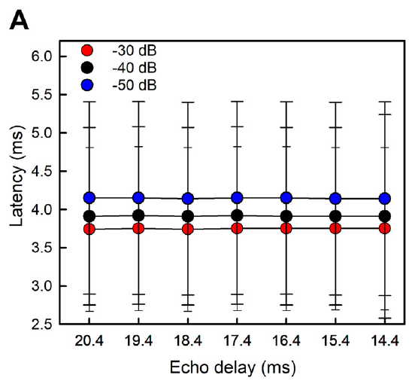
Broadcast latency changes with acoustic level
Response latency is the time from a stimulus event to a specified neural response. In the cochlear nucleus, Simmons and colleagues measured the first negative LFP peak after the broadcast. The measured event stayed the same across stimulus conditions. The broadcast was the reference event for every comparison. Every comparison was made against that broadcast peak.
Mean broadcast latencies were 3.7, 3.9 and 4.2 ms at three attenuation settings. Greater attenuation makes the sound weaker, and the latency grew as the sound got weaker. The broadcast latency stayed similar when just the later echo delay changed. The latency shift came from the sound level. Those three settings were stimulus conditions, not measurement errors.
Sound level can shift the timing of an early population response, even when the broadcast starts at the same moment. A timing-based range code must allow for level-dependent delays. A sound onset yields no single fixed neural latency. The response time depends on how loud the sound is. Level, not delay, moved the broadcast response.
Simmons et al. (2024), Fig. 2(A–B). Histological sections locating ventral cochlear-nucleus recordings.
Simmons et al. (2024), Fig. 4(A). Cochlear-nucleus broadcast latency at three attenuation settings.
Simmons et al. (2024)
14
Notes:
• Response latency is the time from a stimulus event to a specified neural response. In the cochlear nucleus, Simmons and colleagues measured the first negative LFP peak after the broadcast. The event used for measurement was kept consistent across stimulus conditions.
• Mean broadcast latencies were 3.7, 3.9, and 4.2 ms at attenuation settings of −30, −40, and −50 dB. Greater attenuation means a weaker presented sound. The broadcast’s latency remained similar when only the later echo delay changed.
• Acoustic level can therefore shift the timing of an early population response even when the broadcast itself starts at the same time. A timing-based range code must accommodate level-dependent response delays rather than assuming that every sound onset produces a fixed neural latency.
• The attenuation values are stimulus settings, not uncertainty terms. The broadcast remained the same event across the echo-flow series, while the first reflection moved earlier in time as simulated range decreased.
References:
Simmons AM, Warnecke M, Simmons JA (2024). Microseconds-level coding of echo delay in the auditory brainstem of an FM-echolocating bat. Journal of Neurophysiology 132(6):2012–2022. https://doi.org/10.1152/jn.00305.2024
Figure: Simmons et al. (2024), Fig. 4(A). Cochlear-nucleus broadcast latency at three attenuation settings.
Figure source: https://doi.org/10.1152/jn.00305.2024
Figure: Simmons et al. (2024), Fig. 2(A–B). Histological sections locating ventral cochlear-nucleus recordings.
Figure source: https://doi.org/10.1152/jn.00305.2024

Slide 19
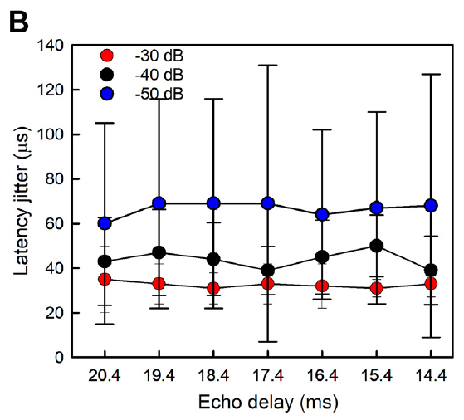
Broadcast timing varies by tens of microseconds
Latency jitter is the trial-to-trial spread in the timing of a defined neural response. A small jitter means that repeated presentations evoke that response at nearly the same time. Jitter is a different measure from mean latency, which is how long the response takes to arrive. The two measures describe different features of the same response.
Timing became more variable as the stimulus weakened. The jitter of the broadcast peak grew across the three attenuation settings. Across the seven later echo delays, the broadcast peak stayed comparatively steady. The stability across delays shows that the timing held as the echo moved. The spread is measured across repeated presentations of the same stimulus.
Precision on this scale makes population timing a candidate component of echo processing. It is not the same as a behavioral threshold. The recordings indicate that the population responds precisely, not that each neuron in it does. Population precision and single-neuron precision are distinct claims. A tight response can still be a late one.
Simmons et al. (2024), Fig. 2(A–B). Histological sections locating ventral cochlear-nucleus recordings.
Simmons et al. (2024), Fig. 4(B). Cochlear-nucleus broadcast latency jitter in μs.
Simmons et al. (2024)
15
Notes:
• Latency jitter is the trial-to-trial spread in the timing of a defined neural response. A small jitter indicates that repeated sound presentations evoke that event at nearly the same time. It differs from the mean latency, which measures how long the response takes to arrive.
• For the cochlear-nucleus broadcast peak, the paper reported mean jitter values of 32, 44, and 67 μs at −30, −40, and −50 dB attenuation. Timing became more variable as the stimulus weakened, while remaining comparatively stable across the seven later-echo delays.
• Precision on this scale supports population timing as a potential component of echo processing. It is not the same as a behavioral threshold, and it does not demonstrate that each individual neuron in the recorded population has equally precise responses.
• A response may arrive several milliseconds after a sound and still be repeatable within tens of microseconds. Mean delay and repeatability describe different features of the signal and should not be conflated.
References:
Simmons AM, Warnecke M, Simmons JA (2024). Microseconds-level coding of echo delay in the auditory brainstem of an FM-echolocating bat. Journal of Neurophysiology 132(6):2012–2022. https://doi.org/10.1152/jn.00305.2024
Figure: Simmons et al. (2024), Fig. 4(B). Cochlear-nucleus broadcast latency jitter in μs.
Figure source: https://doi.org/10.1152/jn.00305.2024
Figure: Simmons et al. (2024), Fig. 2(A–B). Histological sections locating ventral cochlear-nucleus recordings.
Figure source: https://doi.org/10.1152/jn.00305.2024

Slide 20
Jitter rises as the broadcast weakens
The cochlear-nucleus broadcast peak had mean jitter values of 32, 44 and 67 μs at −30, −40 and −50 dB attenuation. The three settings differ in how loud the stimulus was. Greater attenuation makes the stimulus weaker. Timing was least precise at the quietest setting. The jitter values were reported for the same cochlear-nucleus peak.
A response can arrive several milliseconds after a sound and still repeat within tens of microseconds. Mean delay and repeatability are separate measures of the same response. Latency and jitter answer different questions about one event. The broadcast peak was late, but its repeats were tight. Each value in these recordings was a repeatability measure, not a delay.
Across the delays, the jitter changed only slightly. That stability held within each sound level. Sound level, not echo delay, set the size of the jitter. The seven delays covered the full cascade used in the study. Those seven delays were tested at all three sound levels. The first-echo jitter values are reported in the same figure.
Simmons et al. (2024), Fig. 2(A–B). Histological sections locating ventral cochlear-nucleus recordings.
Simmons et al. (2024), Fig. 4(B). Cochlear-nucleus broadcast latency jitter in μs.
Simmons et al. (2024)
15a
Notes:
• Jitter rises as the broadcast weakens.
• Explanation 1.
– The cochlear-nucleus broadcast peak had mean jitter values of 32, 44 and 67 μs at −30, −40 and −50 dB attenuation
– The three settings differ in how loud the stimulus was. Greater attenuation makes the stimulus weaker. Timing was least precise at the quietest setting. The jitter values were reported for the same cochlear-nucleus peak.
• Explanation 2.
– A response can arrive several milliseconds after a sound and still repeat within tens of microseconds
– Mean delay and repeatability are separate measures of the same response. Latency and jitter answer different questions about one event. The broadcast peak was late, but its repeats were tight. Each value in these recordings was a repeatability measure, not a delay.
• Explanation 3.
– Across the delays, the jitter changed only slightly
– That stability held within each sound level. Sound level, not echo delay, set the size of the jitter. The seven delays covered the full cascade used in the study. Those seven delays were tested at all three sound levels. The first-echo jitter values are reported in the same figure.
• Source.
– The figure and the measurements come from Simmons et al. (2024).
– Each statement comes from that study's recordings or observations.
References:
Simmons AM, Warnecke M, Simmons JA (2024). Microseconds-level coding of echo delay in the auditory brainstem of an FM-echolocating bat. Journal of Neurophysiology 132(6):2012–2022. https://doi.org/10.1152/jn.00305.2024

Slide 21
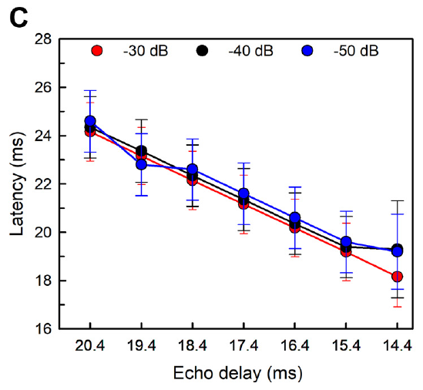
First-echo responses follow the changing delay
The first returning echo in the cascade moved earlier as the simulated target came closer. Cochlear-nucleus response peaks occurred earlier relative to the broadcast onset. The neural signal kept the order of the seven imposed echo delays. Each delay produced a peak at its own time. The peaks followed the timing of the simulated scene.
Simmons and colleagues also measured amplitude-latency trading, a shift in response timing that comes with a change in sound level. Both the echo response and the broadcast response showed this trade. Each sound level moved the peak by a measurable amount. The shift affected both the echo and the broadcast. The measured shifts were reported per decibel of level.
Echo timing and echo strength both change the measured latency. Accurate timing survives this effect, but response latency is not a clean timestamp that ignores level. The timing signal must be read with the sound level in mind. Level and delay together set the measured peak time. Measured peak times depend on both inputs at once.
Simmons et al. (2024), Fig. 2(A–B). Histological sections locating ventral cochlear-nucleus recordings.
Simmons et al. (2024), Fig. 4(C). First-echo latency tracks experimentally shortened echo delay.
Simmons et al. (2024)
16
Notes:
• The first returning echo in the cascade moved earlier as the simulated target approached. Cochlear-nucleus response peaks consequently occurred earlier relative to the broadcast onset. The neural signal preserved the ordering of the seven experimentally imposed echo delays.
• Simmons and colleagues also quantified amplitude–latency trading, the shift in response timing associated with a change in sound level. The first echo’s cochlear-nucleus response changed by about 18 μs per dB, while the corresponding broadcast measure was about 20 μs per dB.
• Echo timing and echo strength thus influence the measured latency together. These are separable experimental relationships, but they coexist in the auditory signal. The result supports accurate registration of relative timing while showing that response latency is not an uncorrected acoustic timestamp independent of level.
• A weaker sound can evoke a later neural response even if its physical arrival time is unchanged. This level effect is distinct from moving the echo itself earlier in the controlled stimulus sequence.
References:
Simmons AM, Warnecke M, Simmons JA (2024). Microseconds-level coding of echo delay in the auditory brainstem of an FM-echolocating bat. Journal of Neurophysiology 132(6):2012–2022. https://doi.org/10.1152/jn.00305.2024
Figure: Simmons et al. (2024), Fig. 4(C). First-echo latency tracks experimentally shortened echo delay.
Figure source: https://doi.org/10.1152/jn.00305.2024
Figure: Simmons et al. (2024), Fig. 2(A–B). Histological sections locating ventral cochlear-nucleus recordings.
Figure source: https://doi.org/10.1152/jn.00305.2024

Slide 22
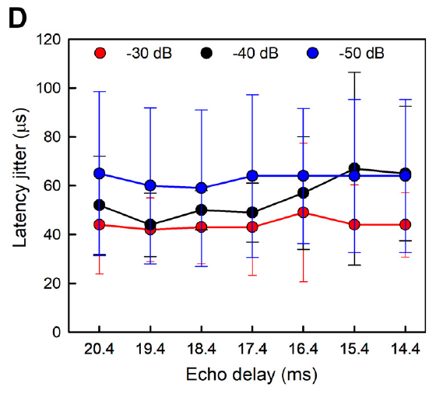
First-echo jitter is stable across the tested delays
Simmons and colleagues compared the trial-to-trial timing precision of the first-echo response across delays from 20.4 to 14.4 ms. The cochlear-nucleus peak moved with acoustic delay. Its repeatability stayed fairly stable across that range. The peak moved in time while its spread stayed small. The series covered seven first-echo delays in 1-ms steps.
Weaker stimuli made the response more variable. The stability across delays was measured at each sound level. Stable precision across delays holds at every level the study tested, though each level has its own spread. Sound level changes the spread more than the delay does. Each level had its own spread of timing values.
The result sets apart where a moving event is represented from how precisely it is timed. The measurements apply to a prominent population peak in the ventral cochlear nucleus under anesthesia. The peak says nothing about one neuron tuned to a single target distance. Population timing and neuron selectivity are different properties.
Simmons et al. (2024), Fig. 2(A–B). Histological sections locating ventral cochlear-nucleus recordings.
Simmons et al. (2024), Fig. 4(D). First-echo latency jitter at seven delays and three sound levels.
Simmons et al. (2024)
17
Notes:
• Simmons and colleagues compared trial-to-trial timing precision of the first-echo response across delays from 20.4 to 14.4 ms. The cochlear-nucleus peak shifted with acoustic delay, but its repeatability remained relatively stable across that tested range.
• Mean jitter values for this peak were 44, 50, and 63 μs at the three attenuation levels. The overall value was about 54 μs. Weaker stimuli increased the variability, so stability across echo delays did not imply complete independence from all acoustic variables.
• The result separates the representation of a moving event from the precision of that representation. It applies to a prominent population-response peak in the ventral cochlear nucleus under anesthesia. It does not identify an individual neuron tuned exclusively to a particular target distance.
• Delay selectivity and response-time precision are different measurements. A precise onset response may register many successive delays without having a sharply peaked preference for only one of them.
References:
Simmons AM, Warnecke M, Simmons JA (2024). Microseconds-level coding of echo delay in the auditory brainstem of an FM-echolocating bat. Journal of Neurophysiology 132(6):2012–2022. https://doi.org/10.1152/jn.00305.2024
Figure: Simmons et al. (2024), Fig. 4(D). First-echo latency jitter at seven delays and three sound levels.
Figure source: https://doi.org/10.1152/jn.00305.2024
Figure: Simmons et al. (2024), Fig. 2(A–B). Histological sections locating ventral cochlear-nucleus recordings.
Figure source: https://doi.org/10.1152/jn.00305.2024

Slide 23
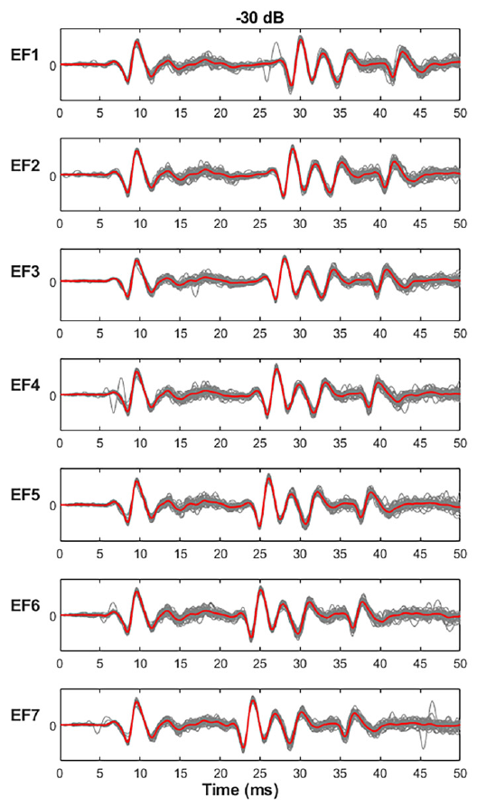
Midbrain responses retain precise onset timing
The inferior colliculus integrates ascending auditory information from several brainstem pathways. Simmons and colleagues reanalyzed midbrain LFPs from the same animals used for the cochlear-nucleus comparison. The stimuli and timing measurements were identical. The midbrain data match the earlier relay in design. These recordings reused the earlier stimulus set. That reuse kept the test fair.
Broadcast responses in the inferior colliculus had longer mean latencies than those in the cochlear nucleus. Early broadcast and echo peaks still lined up closely across repetitions. The responses stayed reliable from one trial to the next. The longer delay left the peaks sharp. Mean latency was longer, but the peaks kept their order.
A later response can still be precise. The study measured delay and repeatability as separate properties. The midbrain recordings keep precise population timing, while the cells responsible for it remain unidentified. Repeatability and latency are separate features of one response. Repeatability was judged separately from mean delay. Each site gave its own repeatability values.
Simmons et al. (2024), Fig. 5, left column. Repeated inferior-colliculus responses at −30 dB attenuation.
Simmons et al. (2024)
18
Notes:
• The inferior colliculus integrates ascending auditory information from multiple brainstem pathways. Simmons and colleagues reanalyzed midbrain LFPs from the same animals used for the cochlear-nucleus comparison, applying the same echo-flow stimuli and timing measurements.
• Broadcast responses in the inferior colliculus had mean latencies of 6.7, 7.0, and 7.5 ms at the three attenuation levels. These values were longer than cochlear-nucleus latencies, consistent with additional processing before a midbrain response. Early broadcast and echo peaks remained closely aligned across repetitions.
• A later mean response need not have poorer temporal precision. The study measured propagation and repeatability separately. The recordings support retention of precise population timing at the midbrain, while leaving the responsible cells and contributions of parallel ascending inputs unresolved.
• The added latency is the time required before a midbrain response occurs. The waveform’s consistency across repetitions is a separate property, so additional processing time does not by itself imply a loss of timing precision.
References:
Simmons AM, Warnecke M, Simmons JA (2024). Microseconds-level coding of echo delay in the auditory brainstem of an FM-echolocating bat. Journal of Neurophysiology 132(6):2012–2022. https://doi.org/10.1152/jn.00305.2024
Figure: Simmons et al. (2024), Fig. 5, left column. Repeated inferior-colliculus responses at −30 dB attenuation.
Figure source: https://doi.org/10.1152/jn.00305.2024

Slide 24
Later responses can stay precise
The midbrain broadcast latencies were 6.7, 7.0 and 7.5 ms across the three settings. Those latencies are longer than the cochlear-nucleus latencies at the same settings. The added latency is the time needed before a midbrain response occurs. Midbrain responses arrive later, after more processing has occurred. Those cochlear-nucleus latencies were measured in the same animals.
The consistency of the waveform across repetitions is a separate property. Extra processing time by itself says little about precision. This property was measured separately from the latency. Early midbrain peaks stayed closely aligned from one repetition to the next. Those responses were recorded from the same stimuli at both sites. Each peak was measured for its own timing.
The midbrain data came from the same animals as the cochlear-nucleus data. Identical stimuli and timing measures were applied at both sites. This design isolates the midbrain step from differences in animals or stimuli. Each site produced its own latency and its own jitter values. Those jitter values were close to the cochlear-nucleus values. Both sites showed that pattern.
Simmons et al. (2024), Fig. 5, left column. Repeated inferior-colliculus responses at −30 dB attenuation.
Simmons et al. (2024)
18a
Notes:
• Later responses can stay precise.
• Explanation 1.
– The midbrain broadcast latencies were 6.7, 7.0 and 7.5 ms across the three settings
– Those latencies are longer than the cochlear-nucleus latencies at the same settings. The added latency is the time needed before a midbrain response occurs. Midbrain responses arrive later, after more processing has occurred. Those cochlear-nucleus latencies were measured in the same animals.
• Explanation 2.
– The consistency of the waveform across repetitions is a separate property
– Extra processing time by itself says little about precision. This property was measured separately from the latency. Early midbrain peaks stayed closely aligned from one repetition to the next. Those responses were recorded from the same stimuli at both sites. Each peak was measured for its own timing.
• Explanation 3.
– The midbrain data came from the same animals as the cochlear-nucleus data
– Identical stimuli and timing measures were applied at both sites. This design isolates the midbrain step from differences in animals or stimuli. Each site produced its own latency and its own jitter values. Those jitter values were close to the cochlear-nucleus values. Both sites showed that pattern.
• Source.
– The figure and the measurements come from Simmons et al. (2024).
– Each statement comes from that study's recordings or observations.
References:
Simmons AM, Warnecke M, Simmons JA (2024). Microseconds-level coding of echo delay in the auditory brainstem of an FM-echolocating bat. Journal of Neurophysiology 132(6):2012–2022. https://doi.org/10.1152/jn.00305.2024

Slide 25
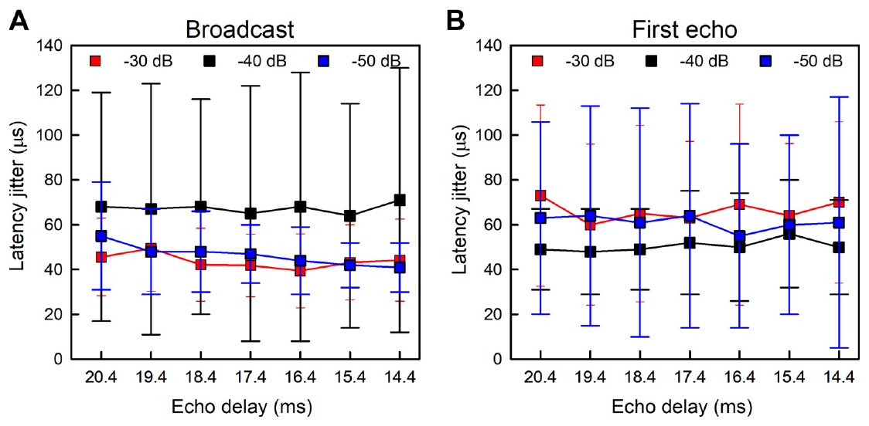
Timing is similarly precise in two auditory relays
Simmons and colleagues compared the timing precision of two early auditory relays. The cochlear nucleus and the inferior colliculus both produced early population peaks for the broadcast and for the first echo. The two sites were recorded in the same animals. Both sites received identical stimuli. The test covered both broadcast and first-echo peaks.
Timing precision changed little between the two relays. The result matches precise timing that enters the ascending pathway and gets carried upward. Identical response latencies at the two relays are not required for this result. Precision carried forward from the first relay to the midbrain. That pattern holds for both the broadcast and the first echo.
This conclusion applies to the recorded LFP events and not to every feature of the pathway. Other regions or response measures could be transformed further. Similar population variability at two sites leaves the carrying projection open. Projection routes were not traced in this study. This study traced no projection routes directly. Other pathways may carry similar timing.
Simmons et al. (2024), Fig. 6(A–B). Midbrain latency jitter for broadcast and first-echo responses.
Simmons et al. (2024)
19
Notes:
• Simmons and colleagues found mean inferior-colliculus jitter values of about 52 μs for the broadcast and 59 μs for the first echo. These were similar to the corresponding cochlear-nucleus values of approximately 48 and 54 μs.
• The comparison provides little evidence that timing precision was dramatically sharpened between these sampled early and midbrain populations. It is consistent with precise timing already entering the ascending pathway and being preserved. The result does not require identical response latencies at the two relays.
• This inference concerns the recorded LFP events, not every neural feature in the pathway. Other regions or response measures could undergo additional transformations. A similarity between two population measurements cannot identify the anatomical projection carrying all of the precise timing information.
• The data compare response variability, not just the time of each peak. The cochlear nucleus responded earlier than the inferior colliculus, but the variability in the early response was of a similar order at both locations.
References:
Simmons AM, Warnecke M, Simmons JA (2024). Microseconds-level coding of echo delay in the auditory brainstem of an FM-echolocating bat. Journal of Neurophysiology 132(6):2012–2022. https://doi.org/10.1152/jn.00305.2024
Figure: Simmons et al. (2024), Fig. 6(A–B). Midbrain latency jitter for broadcast and first-echo responses.
Figure source: https://doi.org/10.1152/jn.00305.2024

Slide 26
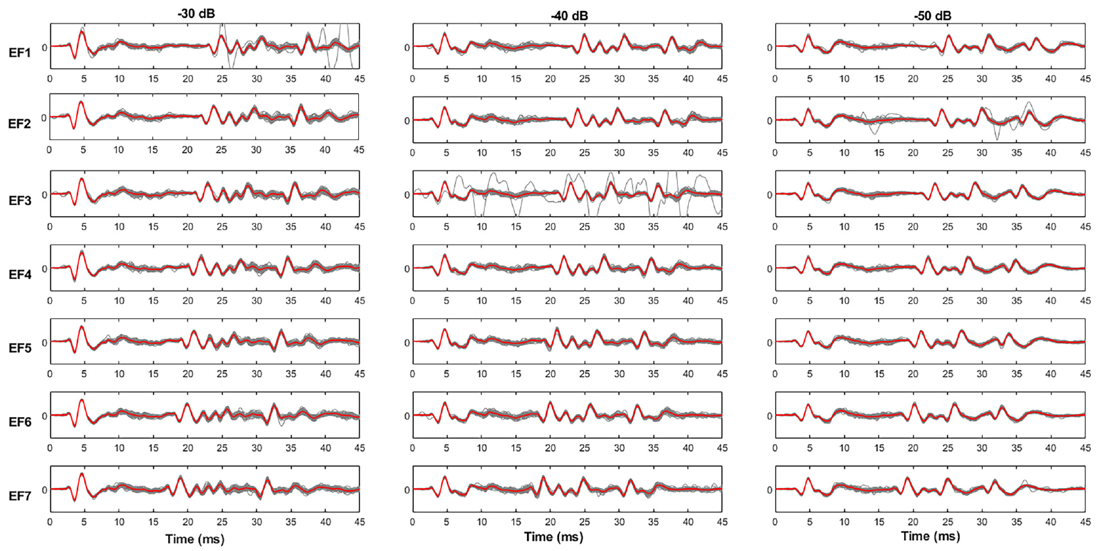
Later echoes have more variable population responses
A broadcast followed by several echoes drives an evolving auditory response. Simmons and colleagues measured prominent positive LFP peaks throughout the four-echo cascade, along with the early negative peak. Each echo added a new peak to the response. The response grew more complex with each echo. The response takes on more structure as echoes accumulate.
The later positive peaks varied more than the earliest negative peak. The variability of these later peaks grew across the cascade, and the midbrain showed a similar pattern. Those values were still below one millisecond. The later peaks were less precise but still tightly timed. The earliest negative peak stayed the most precise measure.
The authors attributed the extra variability to the recruitment of more neurons during the longer sequence. That account interprets population waveforms. It names no specific recruited cell, and the precision depends on which peak is measured. Precision depends on the peak chosen for analysis. The precision values are reported separately for each peak.
Simmons et al. (2024), Fig. 3. Cochlear-nucleus responses throughout the seven echo-flow sequences.
Simmons et al. (2024)
20
Notes:
• A broadcast followed by several reflections recruits an evolving auditory response rather than four independent copies of one onset event. Simmons and colleagues measured prominent positive LFP peaks throughout the four-echo cascade as well as the early negative peak.
• Cochlear-nucleus timing variability for the later positive peaks was around 124 μs across the cascade, and the comparable inferior-colliculus value was about 111 μs. These values were larger than the tens-of-microseconds jitter of the earliest negative peaks, while remaining below a millisecond.
• The authors linked the increased variability to recruitment of additional neurons during the extended sequence. That account is an interpretation of population waveforms, rather than direct identification of every recruited cell. Precision depends on which event and which portion of a response are measured.
• The earliest negative response and the later positive peaks are distinct events in the same field potential. Their different variability prevents one number from describing every part of the auditory response.
References:
Simmons AM, Warnecke M, Simmons JA (2024). Microseconds-level coding of echo delay in the auditory brainstem of an FM-echolocating bat. Journal of Neurophysiology 132(6):2012–2022. https://doi.org/10.1152/jn.00305.2024
Figure: Simmons et al. (2024), Fig. 3. Cochlear-nucleus responses throughout the seven echo-flow sequences.
Figure source: https://doi.org/10.1152/jn.00305.2024

Slide 27
Measured brainstem precision leaves a perceptual gap
A 2024 study reports behavioral echo-delay acuity of about 1 μs or less in specialized psychophysical tasks. The population-response jitter in these recordings was usually tens of microseconds. Neural repeatability came close to that behavioral scale without reaching it. The gap between the two is about one order of magnitude. Each value comes from a different kind of experiment.
The authors proposed that precisely timed population signals feed the eventual range computation. Combining information across frequencies and responses could sharpen a readout. The experiment never identified such a decoder or measured its precision. The decoder remains a proposal. A decoder would need to combine many responses across frequencies. No such readout was measured in the experiment.
The temporal sampling and the restricted recording sites also limit interpretation. The recordings indicate precise early and midbrain population activity, but the full mechanism of perceptual hyperacuity is still open. Both the sampling rate and the recording sites set the scope of the result. Both limits belong to the recordings, not to the bats.
Simmons et al. (2024), Fig. 6(A–B). Midbrain latency jitter for broadcast and first-echo responses.
Simmons et al. (2024), Fig. 2(A–B). Histological sections locating ventral cochlear-nucleus recordings.
Simmons et al. (2024)
21
Notes:
• The 2024 study discusses behavioral echo-delay acuity reaching approximately 1 μs or less in specialized psychophysical tasks. Its population-response jitter values were usually tens of microseconds. Neural repeatability approached this behavioral scale without reaching it.
• The authors proposed that precisely timed population signals contribute to the eventual range computation. Combining information across frequencies and responses could improve a readout, but the experiment did not directly identify such a decoder or measure its achieved precision.
• The temporal sampling and restricted recording sites also limit interpretation. A 20-kHz digitization rate places important constraints on very small timing estimates. The established finding is precise early and midbrain population activity; the complete mechanism of perceptual hyperacuity remains unresolved.
• The behavioral threshold and neural measurement came from different tasks and preparations. The brainstem data cannot be described as a complete explanation of one-microsecond perception, because the observed variability remained larger and the decoder was not tested.
References:
Simmons AM, Warnecke M, Simmons JA (2024). Microseconds-level coding of echo delay in the auditory brainstem of an FM-echolocating bat. Journal of Neurophysiology 132(6):2012–2022. https://doi.org/10.1152/jn.00305.2024
Figure: Simmons et al. (2024), Fig. 6(A–B). Midbrain latency jitter for broadcast and first-echo responses.
Figure source: https://doi.org/10.1152/jn.00305.2024
Figure: Simmons et al. (2024), Fig. 2(A–B). Histological sections locating ventral cochlear-nucleus recordings.
Figure source: https://doi.org/10.1152/jn.00305.2024

Slide 28
The decoder remains untested
The recordings were digitized at 20 kHz. That rate places important constraints on very small timing estimates. Sampling at that rate sets how precisely a latency can be measured. Restricted recording sites add a second limit on interpretation. The recordings were made under anesthesia, so they describe no ongoing behavior. The timing values come from averages across trials.
The behavioral and neural values come from different tasks and preparations. The brainstem data explain only part of one-microsecond perception, because its variability stayed larger. The behavioral value comes from specialized tasks. The neural value comes from anesthetized recordings. Each number answers a different question about timing. The neural values measure population timing, not perception.
The authors identified precisely timed population signals as candidate inputs to a range readout. The experiment never directly identified such a decoder. Precisely timed population signals are one proposed input to that computation. The authors offered that idea without testing a decoder. The recordings supply the timing data for such a model. The proposal is about population timing, not single neurons.
Simmons et al. (2024), Fig. 6(A–B). Midbrain latency jitter for broadcast and first-echo responses.
Simmons et al. (2024), Fig. 2(A–B). Histological sections locating ventral cochlear-nucleus recordings.
Simmons et al. (2024)
21a
Notes:
• The decoder remains untested.
• Explanation 1.
– The recordings were digitized at 20 kHz
– That rate places important constraints on very small timing estimates. Sampling at that rate sets how precisely a latency can be measured. Restricted recording sites add a second limit on interpretation. The recordings were made under anesthesia, so they describe no ongoing behavior. The timing values come from averages across trials.
• Explanation 2.
– The behavioral and neural values come from different tasks and preparations
– The brainstem data explain only part of one-microsecond perception, because its variability stayed larger. The behavioral value comes from specialized tasks. The neural value comes from anesthetized recordings. Each number answers a different question about timing. The neural values measure population timing, not perception.
• Explanation 3.
– The authors identified precisely timed population signals as candidate inputs to a range readout
– The experiment never directly identified such a decoder. Precisely timed population signals are one proposed input to that computation. The authors offered that idea without testing a decoder. The recordings supply the timing data for such a model. The proposal is about population timing, not single neurons.
• Source.
– The figure and the measurements come from Simmons et al. (2024).
– Each statement comes from that study's recordings or observations.
References:
Simmons AM, Warnecke M, Simmons JA (2024). Microseconds-level coding of echo delay in the auditory brainstem of an FM-echolocating bat. Journal of Neurophysiology 132(6):2012–2022. https://doi.org/10.1152/jn.00305.2024

Slide 29
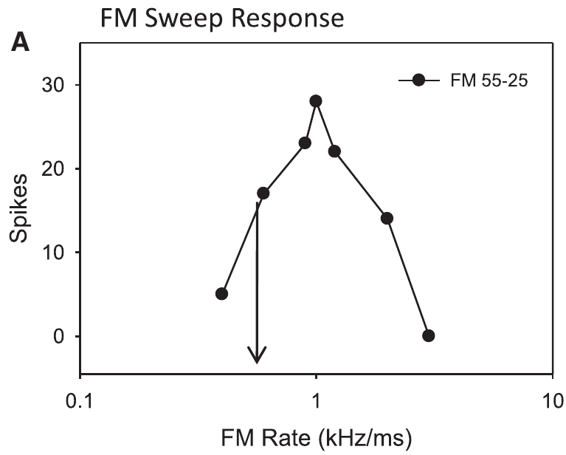
Pallid-bat midbrain neurons select downward sweeps
Sweep direction selectivity is a neuron's difference in response to upward and downward frequency changes. Williams and Fuzessery studied this property in the inferior colliculus of the pallid bat, Antrozous pallidus. Its echolocation call sweeps down from about 60 to 30 kHz. The call's downward sweep is the stimulus that the neurons prefer.
The researchers recorded single neurons in the high-frequency midbrain region with extracellular electrodes. Broad sweeps lasted from 0.5 to 100 ms, so both sweep direction and sweep rate could vary. Responses were measured near each neuron's auditory threshold. The neurons were tested with sweeps of many durations. Each neuron was tested across a range of durations.
Many neurons responded strongly to downward sweeps and weakly to upward sweeps. The experiment focused on neurons whose selectivity came from inhibitory sidebands. Neurons driven by duration tuning or asymmetric facilitation were excluded from the analysis. The group studied was defined by its mechanism. Their responses were compared across sweep rates. Those responses were measured at threshold.
Williams & Fuzessery (2011), Fig. 2(A). A pallid-bat neuron’s response depends on FM sweep rate.
Williams & Fuzessery (2011)
22
Notes:
• Sweep direction selectivity is a difference in neuronal response to upward and downward frequency changes. Williams and Fuzessery studied this property in the inferior colliculus of the pallid bat, Antrozous pallidus, whose echolocation call sweeps downward approximately from 60 to 30 kHz.
• Extracellular electrodes recorded individual neurons in the high-frequency midbrain region. Broad sweeps were presented over durations from 0.5 to 100 ms, allowing direction and sweep rate, the frequency change per unit time, to vary. Responses were measured near the neuron’s auditory threshold.
• Many recorded neurons responded strongly to downward sweeps and weakly to upward sweeps. The experiment isolated inhibitory-sideband mechanisms; neurons whose selectivity depended on duration tuning or asymmetrical facilitation were excluded. Its conclusions therefore concern a defined subset of FM-sensitive neurons.
• The pallid bat is a different species from the big brown bat used in the ranging experiments. Its midbrain recordings provide evidence about FM feature processing, not a direct behavioral test of big brown bat range perception.
References:
Williams AJ, Fuzessery ZM (2011). Differential roles of GABAergic and glycinergic input on FM selectivity in the inferior colliculus of the pallid bat. Journal of Neurophysiology 106(5):2523–2535. https://doi.org/10.1152/jn.00569.2011
Figure: Williams & Fuzessery (2011), Fig. 2(A). A pallid-bat neuron’s response depends on FM sweep rate.
Figure source: https://doi.org/10.1152/jn.00569.2011

Slide 30
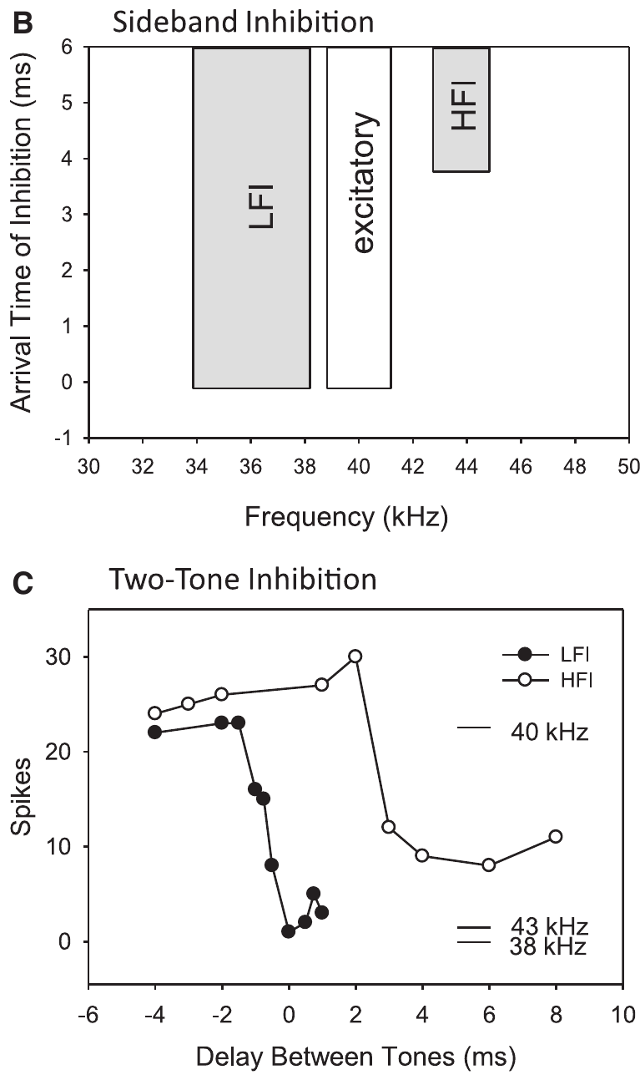
Inhibitory sidebands flank the excitatory band
An excitatory band contains the sounds that evoke a neuron's spikes. An inhibitory sideband contains frequencies that suppress an otherwise effective response. Williams and Fuzessery mapped these sidebands on both sides of a neuron's preferred frequencies. The sidebands lay in the frequency regions beside the excitatory band. Those sidebands are the frequency regions that suppress.
They used pairs of tones to find the sidebands. Low-frequency inhibition, or LFI, usually arrived early relative to excitation. High-frequency inhibition, or HFI, usually arrived later and could suppress slow downward sweeps. The two forms of inhibition differ in when they act. The tones were presented in pairs, one excitatory and one inhibitory.
A sweep crosses these frequency regions in a fixed order. Reversing the sweep direction changes when inhibition and excitation begin. Changing the sweep rate changes the time between them. Frequency tuning and input timing together select particular FM sounds. Each sweep reaches the neuron in a particular order. Sweep rate and direction both change the input order.
Williams & Fuzessery (2011), Fig. 2(B–C). Frequency-sideband organization and two-tone suppression timing.
Williams & Fuzessery (2011)
23
Notes:
• An excitatory frequency band contains sounds that evoke a neuron’s spikes. An inhibitory sideband contains frequencies that suppress an otherwise effective response. The inhibitory frequencies need not produce a visible excitatory response when presented alone.
• Williams and Fuzessery mapped sidebands on either side of a neuron’s preferred frequencies using pairs of tones. Low-frequency inhibition, or LFI, generally arrived early relative to excitation. High-frequency inhibition, or HFI, generally arrived later and could suppress slow downward sweeps.
• A sweep crosses these frequency regions in an ordered sequence. Reversing sweep direction changes when the inhibitory and excitatory inputs are activated. Changing sweep rate alters the time between them. Frequency tuning and relative input timing therefore interact to select particular FM sounds.
• An inhibitory sideband is defined functionally by suppression of a response to another sound. The two-tone test reveals suppression that would be missed by recording only the response to isolated tones.
References:
Williams AJ, Fuzessery ZM (2011). Differential roles of GABAergic and glycinergic input on FM selectivity in the inferior colliculus of the pallid bat. Journal of Neurophysiology 106(5):2523–2535. https://doi.org/10.1152/jn.00569.2011
Figure: Williams & Fuzessery (2011), Fig. 2(B–C). Frequency-sideband organization and two-tone suppression timing.
Figure source: https://doi.org/10.1152/jn.00569.2011

Slide 31
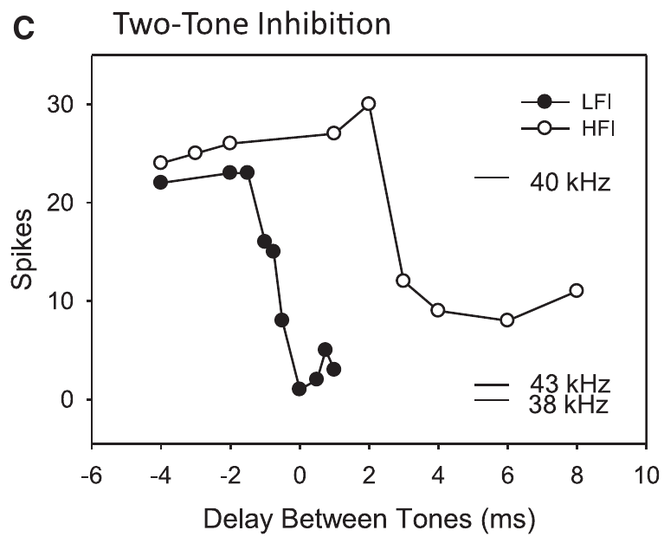
Two-tone tests measure relative inhibitory arrival
Williams and Fuzessery paired a 5-ms excitatory tone with a 20-ms tone placed in an inhibitory sideband. They varied the interval between the two tones. They then measured how much the neuron's response to the excitatory tone dropped. The experiment tested the timing of suppression. Each interval between the tones produced a separate measurement.
Suppression still occurred when the inhibitory tone started later. That result shows the inhibitory pathway can act sooner than the excitatory one. If the inhibitory tone starts earlier, its effect reaches the neuron relatively late. Inhibition can act before excitation in the same neuron. The effect depends on which tone starts first.
The two-tone method predicted which frequency sequences would be suppressed. A low-frequency tone with early inhibition can block an upward sweep before excitation begins. A high-frequency tone with delayed action can block a slow downward sweep. The prediction matched the sweeps that were suppressed. Each prediction can be checked against the measured suppression.
Williams & Fuzessery (2011), Fig. 2(C). Suppression varies with the interval between excitatory and inhibitory tones.
Williams & Fuzessery (2011)
24
Notes:
• Williams and Fuzessery paired a 5-ms excitatory tone with a 20-ms tone in an inhibitory sideband. They varied the interval between the tones and measured how much the neuron’s response to the excitatory sound was reduced.
• Suppression despite a later inhibitory-tone onset indicates that the inhibitory pathway can act sooner than the excitatory pathway. If the inhibitory sound must begin earlier, its effect arrives relatively late. The measured quantity is a functional timing relationship, not a direct recording of a synaptic current.
• This two-tone inhibition method predicted which frequency sequences would be suppressed. A low-frequency tone with early inhibitory action can block an upward sweep before it reaches excitation. A high-frequency tone with delayed action can preferentially block a slow downward sweep.
• The experiment changes acoustic timing to infer when inhibition becomes effective at the recorded neuron. It does not expose the complete anatomical route or measure the transmitter release time at every intervening synapse.
References:
Williams AJ, Fuzessery ZM (2011). Differential roles of GABAergic and glycinergic input on FM selectivity in the inferior colliculus of the pallid bat. Journal of Neurophysiology 106(5):2523–2535. https://doi.org/10.1152/jn.00569.2011
Figure: Williams & Fuzessery (2011), Fig. 2(C). Suppression varies with the interval between excitatory and inhibitory tones.
Figure source: https://doi.org/10.1152/jn.00569.2011

Slide 32
Two-tone timing reveals inhibitory arrival
The two-tone experiment reveals suppression that recordings of isolated tones alone would miss. A sideband can suppress a response without producing a visible response when presented by itself. That is why the paired-tone test is needed. The inhibitory tone outlasted the excitatory one in these pairs. Both tones were presented to the same neuron. Those tones defined the test.
The method infers when inhibition becomes effective at the recorded neuron. Experiments that vary acoustic timing reveal the functional timing of inhibition. The measured quantity is functional timing, not a direct recording of synaptic current. Each tone interval in the series gave one data point. The timing is an estimate from the tone sequence. The measurement is indirect.
The 5-ms excitatory tone was shorter than the 20-ms inhibitory tone. Its onset could fall before, during or after the excitatory tone as the interval varied. Each interval produced its own level of suppression. The response was measured as the drop in excitatory firing. The same neuron was used across all intervals. Each pair was one test.
Williams & Fuzessery (2011), Fig. 2(C). Suppression varies with the interval between excitatory and inhibitory tones.
Williams & Fuzessery (2011)
24a
Notes:
• Two-tone timing reveals inhibitory arrival.
• Explanation 1.
– The two-tone experiment reveals suppression that recordings of isolated tones alone would miss
– A sideband can suppress a response without producing a visible response when presented by itself. That is why the paired-tone test is needed. The inhibitory tone outlasted the excitatory one in these pairs. Both tones were presented to the same neuron. Those tones defined the test.
• Explanation 2.
– The method infers when inhibition becomes effective at the recorded neuron
– Experiments that vary acoustic timing reveal the functional timing of inhibition. The measured quantity is functional timing, not a direct recording of synaptic current. Each tone interval in the series gave one data point. The timing is an estimate from the tone sequence. The measurement is indirect.
• Explanation 3.
– The 5-ms excitatory tone was shorter than the 20-ms inhibitory tone
– Its onset could fall before, during or after the excitatory tone as the interval varied. Each interval produced its own level of suppression. The response was measured as the drop in excitatory firing. The same neuron was used across all intervals. Each pair was one test.
• Source.
– The figure and the measurements come from Williams & Fuzessery (2011).
– Each statement comes from that study's recordings or observations.
References:
Williams AJ, Fuzessery ZM (2011). Differential roles of GABAergic and glycinergic input on FM selectivity in the inferior colliculus of the pallid bat. Journal of Neurophysiology 106(5):2523–2535. https://doi.org/10.1152/jn.00569.2011

Slide 33
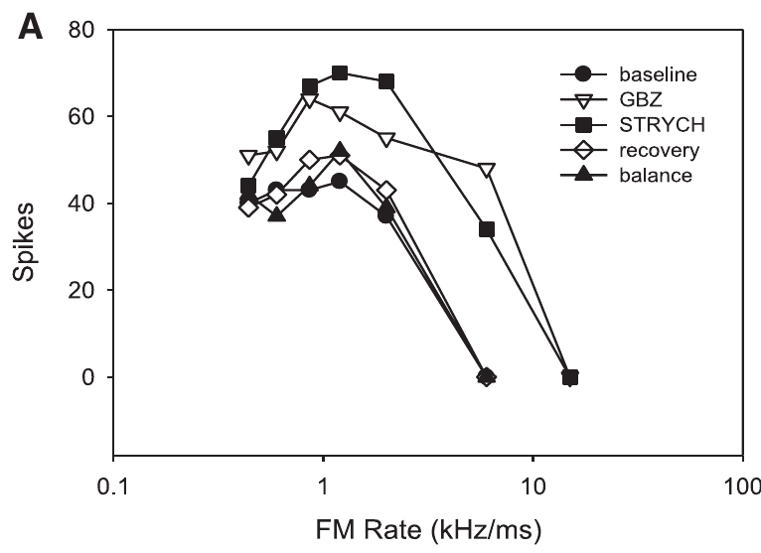
Receptor blockers test local inhibitory inputs
GABA and glycine are the inhibitory transmitters studied here. Gabazine blocks GABA-A receptors, and strychnine blocks glycine receptors. Each drug tests the role of one inhibitory input in the neuron's responses. Two drugs allow the two inputs to be tested separately. Blocking one receptor leaves the other input unchanged. Each drug answers a separate question about inhibition.
Williams and Fuzessery delivered the drugs near recorded neurons by microiontophoresis, which moves a drug out of a pipette with electrical current. They compared a baseline, drug application and recovery. A balance-electrode current control checked whether the current alone changed responses. The control tested the current, not the drug. The steps ran in that order.
Responses often rose during receptor blockade and returned toward baseline after about 10 to 30 minutes. These controls indicate a receptor-dependent local effect. A rise in firing alone says little about selectivity, so responses to each sweep direction and rate were compared. The sweeps defined the selectivity measure. These effects were measured at each sweep rate.
Williams & Fuzessery (2011), Fig. 1(A). Responses during baseline, receptor blockade, recovery, and current control.
Williams & Fuzessery (2011)
25
Notes:
• GABA and glycine are inhibitory neurotransmitters in the auditory pathways studied here. Their ionotropic GABAA and glycine receptors mediate inhibitory membrane conductances. Gabazine blocks GABAA receptors; strychnine blocks glycine receptors, permitting tests of each input’s contribution.
• Williams and Fuzessery delivered the blockers near recorded neurons by microiontophoresis, movement of drug from a small pipette using electrical current. They compared baseline, drug application, and recovery. A balance-electrode current control tested whether current alone changed the response.
• Responses commonly increased during receptor blockade and returned toward baseline after application stopped, typically over 10–30 minutes. These controls support a receptor-dependent local effect. Increased firing alone does not establish loss of selectivity; responses to different sweep directions and rates must also be compared.
• Opening an inhibitory receptor’s ion channel changes the membrane conductance and reduces the effectiveness of excitation under these conditions. Blocking that receptor removes its local contribution, while other inhibitory inputs or inherited tuning can remain.
References:
Williams AJ, Fuzessery ZM (2011). Differential roles of GABAergic and glycinergic input on FM selectivity in the inferior colliculus of the pallid bat. Journal of Neurophysiology 106(5):2523–2535. https://doi.org/10.1152/jn.00569.2011
Figure: Williams & Fuzessery (2011), Fig. 1(A). Responses during baseline, receptor blockade, recovery, and current control.
Figure source: https://doi.org/10.1152/jn.00569.2011

Slide 34
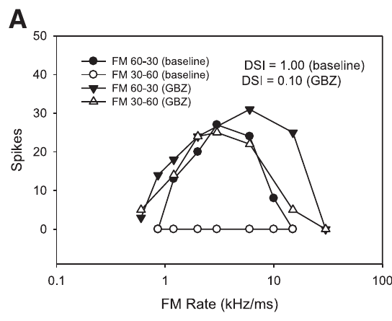
Blocking inhibition can admit upward FM responses
Downward-selective neurons normally responded weakly to upward sweeps, even when those sweeps crossed the excitatory band. After local GABA-A or glycine receptor blockade, many neurons responded strongly to upward sweeps. Many of them lost much of their direction preference. The loss was visible in the sweep responses. Direction preference was strong in these neurons before blockade.
Williams and Fuzessery compared both directions across sweep rates. Gabazine and strychnine each reduced the preference for downward sweeps. Applying both drugs together removed the preference in a larger fraction of neurons. The two blockers acted through different receptor classes. The results showed what each drug removed. Each drug acted on its own receptor class.
Responses to upward sweeps that had been ineffective suggest that local inhibition helps create or sharpen direction preference. Inhibition acts as a filter on which sweeps can drive the neuron. Removing that filter makes upward sweeps pass. The upward sweep becomes effective once the filter is gone. The upward response appeared after blockade.
Williams & Fuzessery (2011), Fig. 3(A). Gabazine alters responses to upward and downward FM sweeps.
Williams & Fuzessery (2011)
26
Notes:
• Downward-selective neurons normally responded weakly to upward sweeps even when the sweeps crossed the excitatory band. After local GABAA or glycine receptor blockade, many neurons produced stronger upward-sweep responses and lost much of their direction selectivity.
• Williams and Fuzessery compared both directions across sweep rates, rather than inferring selectivity from the response to one sound. Gabazine and strychnine could each reduce the preference for downward sweeps. Combined application removed the preference in an even larger fraction of the tested neurons.
• The appearance of responses to previously ineffective upward sweeps supports a role for local inhibition in creating or refining direction selectivity. The result does not imply that every direction-selective neuron depends on both receptor classes or that all FM selectivity originates in the inferior colliculus.
• Removing inhibition can change which sounds evoke spikes, not just increase the total spike count. A neuron that begins responding to upward sweeps has changed its stimulus preference even if its downward response also increases.
References:
Williams AJ, Fuzessery ZM (2011). Differential roles of GABAergic and glycinergic input on FM selectivity in the inferior colliculus of the pallid bat. Journal of Neurophysiology 106(5):2523–2535. https://doi.org/10.1152/jn.00569.2011
Figure: Williams & Fuzessery (2011), Fig. 3(A). Gabazine alters responses to upward and downward FM sweeps.
Figure source: https://doi.org/10.1152/jn.00569.2011

Slide 35
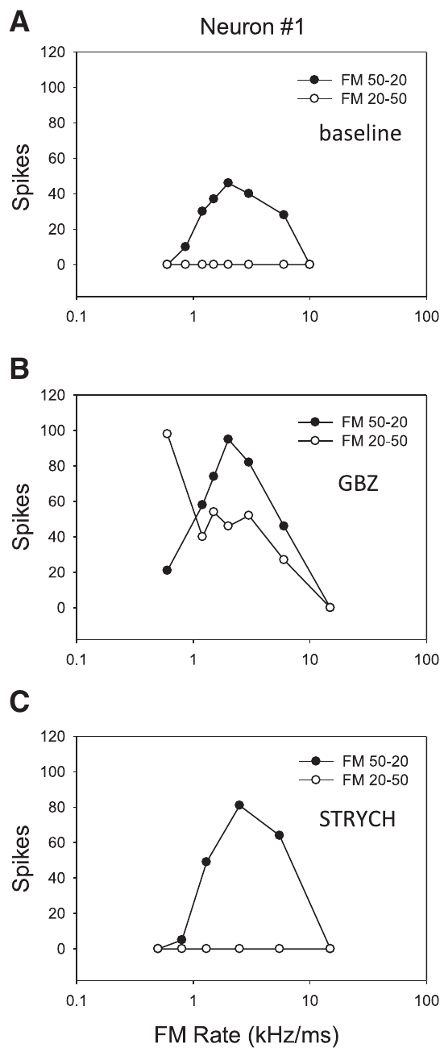
Neurons depend on different inhibitory inputs
Williams and Fuzessery applied gabazine and strychnine separately to individual neurons. This within-neuron test asked whether a population-level similarity hid differences among the neurons' receptor pathways. The test used the same neuron under each drug. Each neuron served as its own control. Each drug was tested alone in that cell. The design avoids comparing different cells.
In one published example, gabazine removed direction selectivity while strychnine left it intact. Other examples showed the reverse pattern or sensitivity to either blocker. Baseline direction preference was compatible with several inhibitory arrangements, so no single pathway explained every neuron. Each neuron had its own profile. Each example came from one neuron.
These measurements identify which receptor classes a neuron depends on at the recording site. They show a local dependence on one receptor class. The spectral position and relative timing of an inhibitory input also decide whether it can suppress a sweep. The site and the timing both set the outcome. Each neuron had its own result.
Williams & Fuzessery (2011), Fig. 4(A–C). One neuron loses direction selectivity with gabazine but retains it with strychnine.
Williams & Fuzessery (2011)
27
Notes:
• Williams and Fuzessery applied gabazine and strychnine separately to the same neurons. This within-neuron comparison tested whether an apparent population similarity concealed differences in the receptor pathways supporting individual neurons’ preferences.
• In one published example, gabazine removed direction selectivity whereas strychnine did not. Other examples showed the reverse pattern or sensitivity to either blocker. Baseline direction preference was therefore compatible with several inhibitory-input arrangements rather than one uniform transmitter mechanism.
• The measurements identify functional dependence on receptor classes at the recording site. They do not identify every presynaptic source or establish that receptor distribution alone determines selectivity. Spectral position and relative timing of the inhibitory input also influence whether that input can suppress a sweep.
• The three conditions were obtained from the same neuron, so differences between blockers cannot be attributed simply to sampling different neurons. A remaining direction preference after one drug means that the blocked pathway was not essential by itself.
References:
Williams AJ, Fuzessery ZM (2011). Differential roles of GABAergic and glycinergic input on FM selectivity in the inferior colliculus of the pallid bat. Journal of Neurophysiology 106(5):2523–2535. https://doi.org/10.1152/jn.00569.2011
Figure: Williams & Fuzessery (2011), Fig. 4(A–C). One neuron loses direction selectivity with gabazine but retains it with strychnine.
Figure source: https://doi.org/10.1152/jn.00569.2011

Slide 36
Two blockers, one neuron
The three conditions were obtained from the same neuron. Differences between the two blockers could not be explained by sampling different neurons. Baseline, gabazine and strychnine conditions were all measured in that one cell. The design kept neuron identity constant across conditions, which makes the drug effects directly comparable. The three measurements were made on that single cell.
A direction preference that remains after one drug shows that the blocked pathway is not essential by itself. Other inputs or inherited tuning can keep the preference in place. Gabazine and strychnine were applied separately to the same neuron. The result describes one pathway at a time. A single neuron can depend on one inhibitory input and not the other.
A receptor class by itself is not enough to fix that outcome. Each neuron's arrangement of inputs sets its own outcome. Two neurons with the same receptor class can respond differently to the same sweep. Each drug condition used the same sweeps, and the outcome was read from those responses. This covers each neuron's inputs.
Williams & Fuzessery (2011), Fig. 4(A–C). One neuron loses direction selectivity with gabazine but retains it with strychnine.
Williams & Fuzessery (2011)
27a
Notes:
• Two blockers, one neuron.
• Explanation 1.
– The three conditions were obtained from the same neuron
– Differences between the two blockers could not be explained by sampling different neurons. Baseline, gabazine and strychnine conditions were all measured in that one cell. The design kept neuron identity constant across conditions, which makes the drug effects directly comparable. The three measurements were made on that single cell.
• Explanation 2.
– A direction preference that remains after one drug shows that the blocked pathway is not essential by itself
– Other inputs or inherited tuning can keep the preference in place. Gabazine and strychnine were applied separately to the same neuron. The result describes one pathway at a time. A single neuron can depend on one inhibitory input and not the other.
• Explanation 3.
– A receptor class by itself is not enough to fix that outcome
– Each neuron's arrangement of inputs sets its own outcome. Two neurons with the same receptor class can respond differently to the same sweep. Each drug condition used the same sweeps, and the outcome was read from those responses. This covers each neuron's inputs.
• Source.
– The figure and the measurements come from Williams & Fuzessery (2011).
– Each statement comes from that study's recordings or observations.
References:
Williams AJ, Fuzessery ZM (2011). Differential roles of GABAergic and glycinergic input on FM selectivity in the inferior colliculus of the pallid bat. Journal of Neurophysiology 106(5):2523–2535. https://doi.org/10.1152/jn.00569.2011

Slide 37
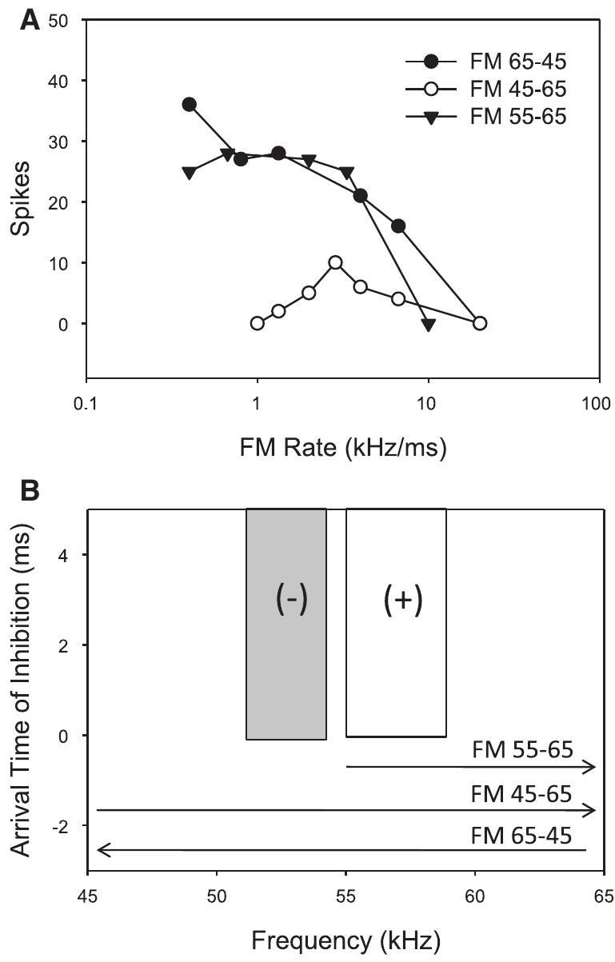
Removing low frequencies removes direction tuning
An upward sweep reaches low frequencies before it reaches a neuron's excitatory band. If low-frequency inhibition acts early, it can prevent spikes when excitation arrives. A downward sweep meets excitation before it crosses that low-frequency region. The order of frequencies decides which inhibition is active first. The neuron's excitatory band lies above those frequencies.
Williams and Fuzessery removed the low frequencies from upward sweeps to test this idea. In one published neuron, upward and downward sweeps then evoked similar responses. The removed frequencies had overlapped the neuron's low-frequency inhibitory sideband. The manipulation removed the early inhibition. The removal left the excitatory band intact. The sweeps then passed through excitation first.
Changing the stimulus spectrum removed a timing-dependent source of suppression without using a drug. The result backs the sideband mechanism. The site where inhibitory selectivity forms still needs a local drug test to confirm it. The drug test would confirm the site of action. Local drug tests would show where the effect occurs.
Williams & Fuzessery (2011), Fig. 5(A–B). Removing the low-frequency inhibitory region permits upward-sweep responses.
Williams & Fuzessery (2011)
28
Notes:
• An upward sweep encounters low frequencies before reaching a neuron’s excitatory frequency band. If low-frequency inhibition acts early, it can prevent spikes when excitation arrives. A downward sweep reaches excitation before crossing that low-frequency inhibitory region.
• Williams and Fuzessery tested this relationship by removing low frequencies from upward sweeps. A published neuron responded similarly to upward and downward sweeps when frequencies below 55 kHz were excluded from the upward stimulus. Those excluded frequencies overlapped its low-frequency inhibitory sideband.
• Changing the stimulus spectrum thus removed a timing-dependent source of suppression without using a drug. The finding supports the sideband mechanism, but by itself cannot locate where the inhibitory selectivity is constructed. Local pharmacological tests are needed to assess the inferior-colliculus contribution.
• The manipulation preserves a sweep through the excitatory band while preventing stimulation of the lower inhibitory frequencies. The neuron can then respond to an upward sweep that was ineffective when the inhibitory frequencies were included.
References:
Williams AJ, Fuzessery ZM (2011). Differential roles of GABAergic and glycinergic input on FM selectivity in the inferior colliculus of the pallid bat. Journal of Neurophysiology 106(5):2523–2535. https://doi.org/10.1152/jn.00569.2011
Figure: Williams & Fuzessery (2011), Fig. 5(A–B). Removing the low-frequency inhibitory region permits upward-sweep responses.
Figure source: https://doi.org/10.1152/jn.00569.2011

Slide 38
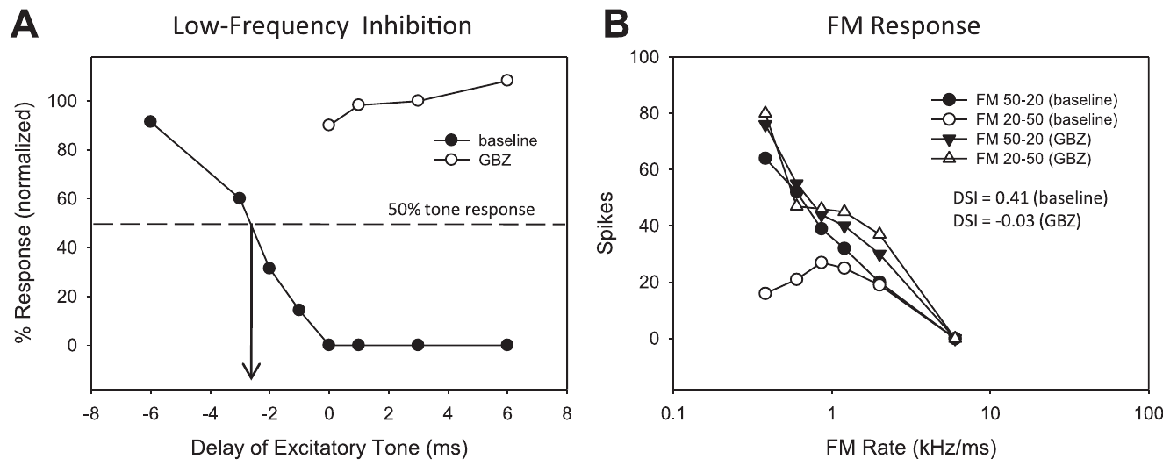
Low-frequency inhibition shapes direction tuning
Williams and Fuzessery measured low-frequency two-tone suppression before and during receptor blockade. They then tested the same neuron's responses to upward and downward sweeps. The two measures showed how the inhibitory mechanism and direction selectivity changed together. Both measures came from the same neuron. The paired design tested both measures in one neuron.
When gabazine removed low-frequency inhibition in the published example, an inhibitory tone stopped suppressing excitation. The neuron gained upward-sweep responses and lost its strong direction preference. Similar changes appeared in other neurons tested with either blocker. The same pattern held across the neurons tested. The neuron's upward-sweep responses rose during blockade. Those changes happened together.
The paired measurements indicate that LFI helps cause direction selectivity in these neurons. They are more specific than a general rise in firing after a drug. Other cellular sources of inhibition in the sampled neurons were not identified. The sampled neurons are the group the result describes. The sampled neurons were a subset of the population.
Williams & Fuzessery (2011), Fig. 6(A–B). Gabazine removes low-frequency suppression and reduces direction selectivity.
Williams & Fuzessery (2011)
29
Notes:
• Williams and Fuzessery measured low-frequency two-tone suppression before and during receptor blockade, then tested the same neuron’s responses to upward and downward sweeps. This linked a change in the inferred inhibitory mechanism to a change in FM selectivity.
• When gabazine eliminated low-frequency inhibition in the published example, an inhibitory tone no longer suppressed excitation. The neuron simultaneously gained upward-sweep responses and lost its strong direction preference. Similar associations occurred across the relevant neurons tested with either blocker.
• The paired measurements support LFI as a causal contributor to direction selectivity in these neurons. They are more specific than a general increase in firing after a drug. The experiment still does not reveal every cellular source of the inhibitory input or exclude other mechanisms in neurons outside the sampled subset.
• The inhibitory test and the FM test probe different consequences of the same receptor manipulation. Their linked change supports the proposed mechanism without requiring a diagram of an unmeasured synaptic circuit.
References:
Williams AJ, Fuzessery ZM (2011). Differential roles of GABAergic and glycinergic input on FM selectivity in the inferior colliculus of the pallid bat. Journal of Neurophysiology 106(5):2523–2535. https://doi.org/10.1152/jn.00569.2011
Figure: Williams & Fuzessery (2011), Fig. 6(A–B). Gabazine removes low-frequency suppression and reduces direction selectivity.
Figure source: https://doi.org/10.1152/jn.00569.2011

Slide 39
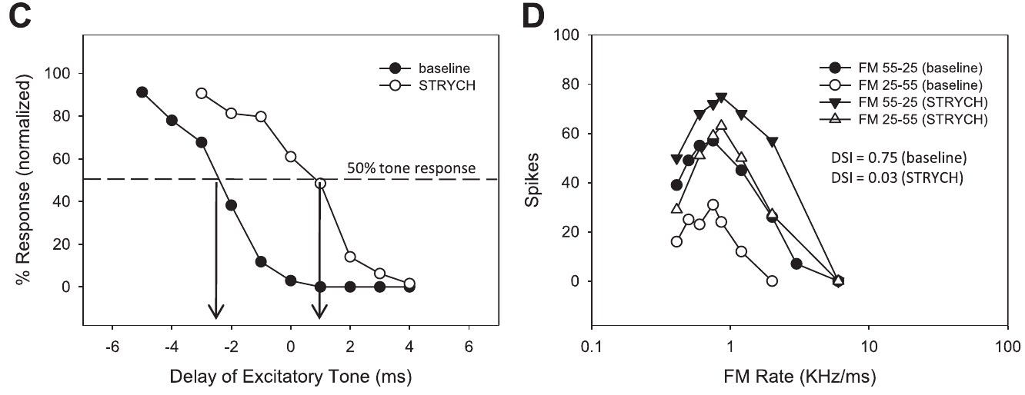
Delayed inhibition can lose its directional effect
Inhibition can keep substantial strength and still arrive too late to block excitation. A neuron's stimulus preference can change even when the inhibition has not vanished. Selectivity depends on timing as well as on the size of suppression. Timing and strength both shape the response. Strength alone is not the deciding factor.
In one Williams and Fuzessery example, strychnine moved the inferred LFI arrival from −2.5 to +1.0 ms relative to excitation. That delay of 3.5 ms left measurable suppression in place. The neuron's strong downward preference was largely lost. The shift in arrival time was the change that mattered. The inferred arrival time came from the two-tone test.
With inhibition late, an upward sweep could evoke excitation before the inhibition took effect. The order of inhibitory and excitatory inputs thus helps set direction selectivity. Residual inhibition still matters in other neurons. Each neuron responds to the order of its inputs. Excitation then reached the neuron before the inhibition did. The shift is a timing effect.
Williams & Fuzessery (2011), Fig. 6(C–D). Delayed low-frequency inhibition accompanies reduced FM direction preference.
Williams & Fuzessery (2011)
30
Notes:
• Inhibition need not disappear completely for a neuron’s stimulus preference to change. The inhibitory effect can retain substantial strength but arrive too late to prevent excitation. Selectivity depends on timing as well as on the magnitude of suppression.
• In one Williams and Fuzessery example, strychnine shifted the inferred LFI arrival from −2.5 to +1.0 ms relative to excitation, a 3.5-ms delay. The neuron’s strong downward preference was largely lost even though measurable inhibitory suppression remained.
• An upward sweep could now evoke excitation before that inhibition became effective. The result supports temporal ordering of inhibitory and excitatory inputs as a determinant of direction selectivity. It does not mean that all residual inhibition is irrelevant or that receptor blockade uniformly changes input timing in every neuron.
• Negative and positive arrival values indicate relative order in the two-tone measurement. After the shift, excitation could occur before inhibition took effect, so a strong inhibitory input no longer necessarily prevented the initial response.
References:
Williams AJ, Fuzessery ZM (2011). Differential roles of GABAergic and glycinergic input on FM selectivity in the inferior colliculus of the pallid bat. Journal of Neurophysiology 106(5):2523–2535. https://doi.org/10.1152/jn.00569.2011
Figure: Williams & Fuzessery (2011), Fig. 6(C–D). Delayed low-frequency inhibition accompanies reduced FM direction preference.
Figure source: https://doi.org/10.1152/jn.00569.2011

Slide 40
A 3.5-ms shift flips the preference
Negative and positive arrival values in the two-tone test give the relative order of two inputs. In the published example, the inhibitory input shifted by 3.5 ms in that order. Before the shift, inhibition arrived first. Those values came from the two-tone measurements of the same neuron. The arrival values were measured in milliseconds. Those values were negative before the shift.
Measurable suppression still existed after the shift. The timing of that suppression had changed, though its size had not. Late inhibition could not stop an early excitatory response. The neuron responded to upward sweeps that earlier inhibition had blocked. The neuron had responded strongly to downward sweeps before the drug. Its response to upward sweeps was small before blockade.
Selectivity in this example depended on the order of inputs more than on their size. Changing when the suppression arrives changed the preference. Its strength was measurable at the end of the shift. The shift changed the timing of one input alone. Timing alone changed the preference in that example. The example puts the order of inputs in focus.
Williams & Fuzessery (2011), Fig. 6(C–D). Delayed low-frequency inhibition accompanies reduced FM direction preference.
Williams & Fuzessery (2011)
30a
Notes:
• A 3.5-ms shift flips the preference.
• Explanation 1.
– Negative and positive arrival values in the two-tone test give the relative order of two inputs
– In the published example, the inhibitory input shifted by 3.5 ms in that order. Before the shift, inhibition arrived first. Those values came from the two-tone measurements of the same neuron. The arrival values were measured in milliseconds. Those values were negative before the shift.
• Explanation 2.
– Measurable suppression still existed after the shift
– The timing of that suppression had changed, though its size had not. Late inhibition could not stop an early excitatory response. The neuron responded to upward sweeps that earlier inhibition had blocked. The neuron had responded strongly to downward sweeps before the drug. Its response to upward sweeps was small before blockade.
• Explanation 3.
– Selectivity in this example depended on the order of inputs more than on their size
– Changing when the suppression arrives changed the preference. Its strength was measurable at the end of the shift. The shift changed the timing of one input alone. Timing alone changed the preference in that example. The example puts the order of inputs in focus.
• Source.
– The figure and the measurements come from Williams & Fuzessery (2011).
– Each statement comes from that study's recordings or observations.
References:
Williams AJ, Fuzessery ZM (2011). Differential roles of GABAergic and glycinergic input on FM selectivity in the inferior colliculus of the pallid bat. Journal of Neurophysiology 106(5):2523–2535. https://doi.org/10.1152/jn.00569.2011

Slide 41
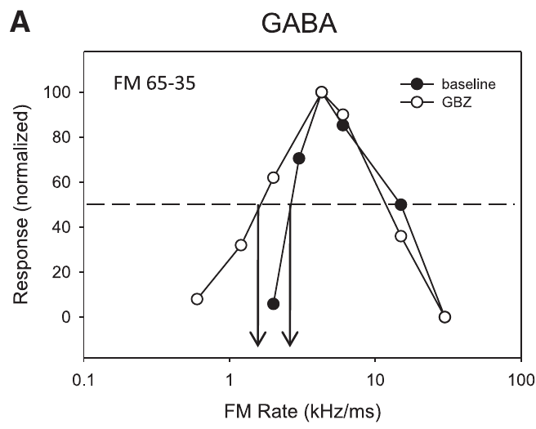
Sweep-rate tuning is more resistant to local blockade
Fast-pass rate selectivity means a neuron responds better to rapid FM sweeps than to slow ones. Williams and Fuzessery compared this property with direction selectivity during local receptor blockade in the pallid-bat inferior colliculus. Both properties depend on the sweep. The two were tested under the same drugs. Rate and direction are both sweep properties.
Gabazine left fast-pass selectivity intact in the rate-selective neurons tested, even when firing changed. Strychnine eliminated it in a minority of neurons, which then responded to slow downward sweeps. Direction selectivity was generally more fragile than rate selectivity. Each drug affected each property differently. Fast-pass preference survived gabazine in the neurons tested.
The different outcomes show that direction and rate are separate forms of tuning. Retained rate selectivity fits inheritance from lower auditory levels in many neurons. Local inhibition may still influence the responses and the exact rate threshold. The exact threshold depends on the neuron and the sweep. Sweep rate and direction were tested as separate features.
Williams & Fuzessery (2011), Fig. 7(A). Fast-pass sweep-rate preference remains during GABA_A receptor blockade.
Williams & Fuzessery (2011)
31
Notes:
• Fast-pass rate selectivity means that a neuron responds better to rapid FM sweeps than to sufficiently slow sweeps. Williams and Fuzessery compared this feature with direction selectivity during local inhibitory receptor blockade in the pallid-bat inferior colliculus.
• Gabazine did not eliminate fast-pass selectivity in the rate-selective neurons tested, even when firing changed. Strychnine could eliminate it in a minority of neurons, allowing responses to slow downward sweeps. Direction selectivity was generally more vulnerable to either blocker.
• The different outcomes indicate that FM direction and rate are not interchangeable forms of tuning. Retention of rate selectivity is consistent with inheritance from lower auditory levels in many neurons. It does not prove that local inhibitory circuitry has no influence on their responses or on their exact rate threshold.
• The gabazine example retains weak responses to the slowest sweeps. The presence of stronger responses elsewhere in the tuning curve does not by itself mean that the fast-pass preference has disappeared.
References:
Williams AJ, Fuzessery ZM (2011). Differential roles of GABAergic and glycinergic input on FM selectivity in the inferior colliculus of the pallid bat. Journal of Neurophysiology 106(5):2523–2535. https://doi.org/10.1152/jn.00569.2011
Figure: Williams & Fuzessery (2011), Fig. 7(A). Fast-pass sweep-rate preference remains during GABA_A receptor blockade.
Figure source: https://doi.org/10.1152/jn.00569.2011

Slide 42
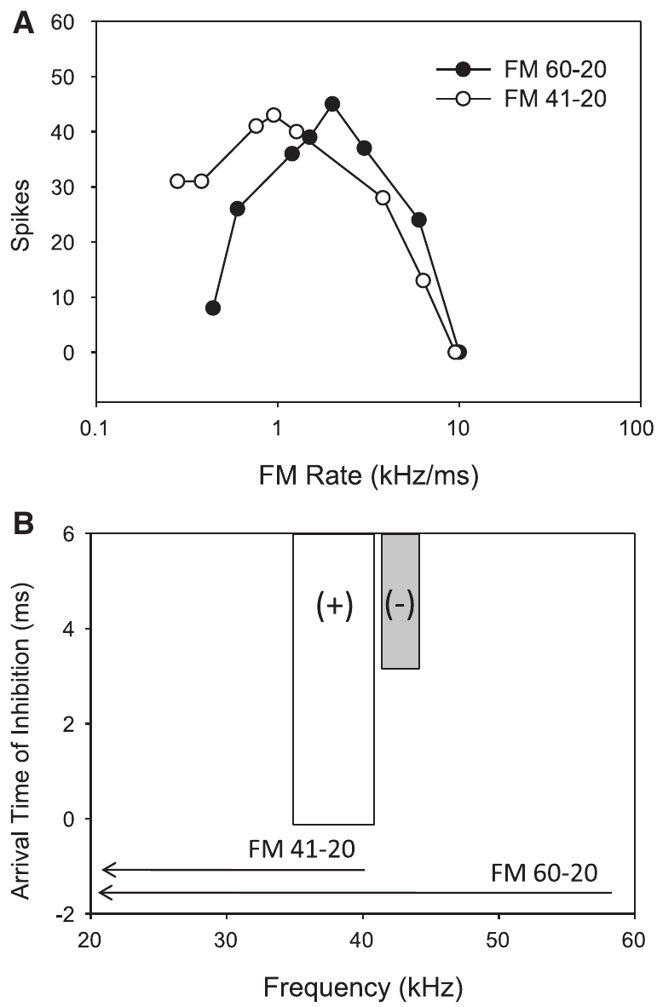
High-frequency inhibition can reject slow sweeps
A downward sweep activates high frequencies before it reaches the lower excitatory frequencies. If HFI arrives after excitation, a fast sweep can still evoke spikes. If HFI arrives before excitation, a slow sweep is blocked. This ordering creates a fast-pass filter for sweep rate. The filter selects the faster sweeps. The filter responds to the sweep's path.
Williams and Fuzessery removed the high-frequency part of a downward sweep. A neuron selective for fast sweeps began responding to slow sweeps once that part was gone. The removed frequencies had driven its inhibitory sideband. The removal released the neuron from suppression. Removing those frequencies left the slow sweep's excitation unopposed. Its response changed when that part was removed.
The response depends on both the spectral path of the sweep and its duration. The result favors a role for HFI in rate selectivity. The origin of the inhibitory sideband was not the focus of the experiment. The source of the sideband stays open. Duration and spectrum both matter here. Other methods would be needed to locate that source.
Williams & Fuzessery (2011), Fig. 8(A–B). Removing high-frequency inhibitory input permits responses to slow downward sweeps.
Williams & Fuzessery (2011)
32
Notes:
• A downward sweep activates high frequencies before reaching lower excitatory frequencies. Delayed HFI can arrive after excitation during a fast sweep, allowing spikes, but before excitation during a slow sweep, preventing the response. This ordering creates a fast-pass filter for sweep rate.
• Williams and Fuzessery removed the high-frequency portion of a downward sweep to test this mechanism. A neuron selective for fast sweeps began responding to slow sweeps when frequencies above 41 kHz were excluded. Those frequencies had activated its inhibitory sideband.
• The response depends on both the sweep’s spectral path and its duration. The experiment supports a role for HFI in rate selectivity rather than treating slow sweeps as inherently ineffective excitatory sounds. It does not identify the anatomical source of the inhibitory sideband.
• With the high-frequency region omitted, the sweep still crosses frequencies capable of exciting the neuron. The new response to slow sweeps indicates that the removed high frequencies had suppressed those responses.
References:
Williams AJ, Fuzessery ZM (2011). Differential roles of GABAergic and glycinergic input on FM selectivity in the inferior colliculus of the pallid bat. Journal of Neurophysiology 106(5):2523–2535. https://doi.org/10.1152/jn.00569.2011
Figure: Williams & Fuzessery (2011), Fig. 8(A–B). Removing high-frequency inhibitory input permits responses to slow downward sweeps.
Figure source: https://doi.org/10.1152/jn.00569.2011

Slide 43
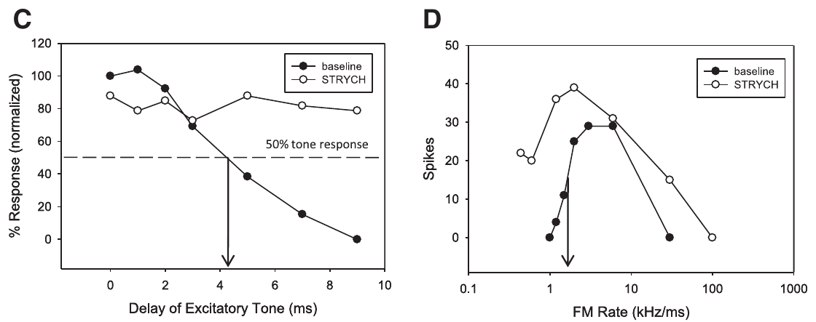
Glycine blockade can remove high-frequency suppression
Williams and Fuzessery paired high-frequency two-tone suppression measures with downward-sweep rate tuning. They tested whether the neurons that lost fast-pass selectivity also lost the sideband that was proposed to create it. The two measures came from the same neurons. This test set the sideband beside the rate preference. Two-tone suppression was measured for the neurons.
In a published strychnine example, HFI disappeared and the neuron gained responses to slow sweeps. Gabazine examples kept both HFI and fast-pass selectivity. Local glycinergic input helped set this form of rate tuning in the affected neurons. The receptor affected the sideband directly. The neuron then responded to slow sweeps it had ignored.
The finding concerns one receptor pathway and explains only part of FM tuning. Many rate-selective neurons kept their preference after blockade. Other rate mechanisms and upstream inputs were not removed by this experiment. The glycine effect covers only part of the rate tuning. The rate-selective neurons showed mixed outcomes across drugs. Two drugs gave different results.
Williams & Fuzessery (2011), Fig. 9(C–D). Strychnine removes high-frequency suppression and fast-pass rate selectivity.
Williams & Fuzessery (2011)
33
Notes:
• Williams and Fuzessery paired measurements of high-frequency two-tone suppression with measurements of downward-sweep rate tuning. This tested whether the neurons losing fast-pass selectivity also lost the inhibitory sideband proposed to create it.
• In a published strychnine example, HFI was eliminated and the neuron gained responses to slow sweeps. Gabazine examples retained both HFI and fast-pass selectivity. Local glycinergic input therefore supported this form of rate tuning in the affected neurons.
• The finding is a selective contribution of a receptor pathway, not a universal assignment of every FM property to glycine. Many rate-selective neurons retained their preference after blockade, and the study’s inference concerns sideband-based selectivity. Other rate mechanisms and upstream contributions were not eliminated by this experiment.
• The pharmacological result agrees with the earlier spectral-removal test. One manipulation prevents stimulation of the inhibitory frequencies; the other removes a local receptor contribution to their suppressive action.
References:
Williams AJ, Fuzessery ZM (2011). Differential roles of GABAergic and glycinergic input on FM selectivity in the inferior colliculus of the pallid bat. Journal of Neurophysiology 106(5):2523–2535. https://doi.org/10.1152/jn.00569.2011
Figure: Williams & Fuzessery (2011), Fig. 9(C–D). Strychnine removes high-frequency suppression and fast-pass rate selectivity.
Figure source: https://doi.org/10.1152/jn.00569.2011

Slide 44
Glycine and sideband suppression agree
The pharmacological result agrees with the earlier spectral-removal test. Two manipulations gave matching results on rate tuning. Removing high frequencies from the stimulus and blocking glycine receptors both produced a similar change. Each manipulation tested the same sideband from a different side. Both manipulations changed rate tuning in the same direction. Both results agree on the sideband.
The other manipulation removes a local receptor role in the suppression. Together, the two results implicate the same sideband. Each test isolated a different step of the suppression. Agreement between separate methods strengthens the case for a sideband effect. Glycine receptors mediate the inhibitory input at that site. The two methods are separate, so their agreement carries weight.
The gabazine examples kept their high-frequency suppression and fast-pass preference. Gabazine left this sideband intact. In the strychnine example, the sideband was eliminated, so the rate tuning changed with it. The same pattern held for the rate tuning, which fell with the sideband. Rate tuning stayed intact in those gabazine neurons. The contrast between the two drugs is the central result.
Williams & Fuzessery (2011), Fig. 9(C–D). Strychnine removes high-frequency suppression and fast-pass rate selectivity.
Williams & Fuzessery (2011)
33a
Notes:
• Glycine and sideband suppression agree.
• Explanation 1.
– The pharmacological result agrees with the earlier spectral-removal test
– Two manipulations gave matching results on rate tuning. Removing high frequencies from the stimulus and blocking glycine receptors both produced a similar change. Each manipulation tested the same sideband from a different side. Both manipulations changed rate tuning in the same direction. Both results agree on the sideband.
• Explanation 2.
– The other manipulation removes a local receptor role in the suppression
– Together, the two results implicate the same sideband. Each test isolated a different step of the suppression. Agreement between separate methods strengthens the case for a sideband effect. Glycine receptors mediate the inhibitory input at that site. The two methods are separate, so their agreement carries weight.
• Explanation 3.
– The gabazine examples kept their high-frequency suppression and fast-pass preference
– Gabazine left this sideband intact. In the strychnine example, the sideband was eliminated, so the rate tuning changed with it. The same pattern held for the rate tuning, which fell with the sideband. Rate tuning stayed intact in those gabazine neurons. The contrast between the two drugs is the central result.
• Source.
– The figure and the measurements come from Williams & Fuzessery (2011).
– Each statement comes from that study's recordings or observations.
References:
Williams AJ, Fuzessery ZM (2011). Differential roles of GABAergic and glycinergic input on FM selectivity in the inferior colliculus of the pallid bat. Journal of Neurophysiology 106(5):2523–2535. https://doi.org/10.1152/jn.00569.2011

Slide 45
Local and inherited selectivity can coexist
The inferior colliculus receives inhibitory and excitatory inputs from several ascending pathways, along with local and commissural pathways. The paper identifies GABAergic sources, including the dorsal nucleus of the lateral lemniscus. Lower brainstem regions can supply both GABAergic and glycinergic inputs. The sources are many, and they arrive from several levels. Those inputs come from several levels.
Blocking receptors near a recorded neuron tests inhibition acting at that site. A direction preference that disappears was created or sharpened locally. A rate preference that persists may already be present in incoming activity. Local and incoming inputs can each carry a preference. Receptor blockade isolates the local part of that inhibition.
Williams and Fuzessery inferred substantial local construction of direction selectivity. They inferred greater inheritance of sideband-based rate selectivity. The same response property can be inherited, changed or rebuilt at successive auditory levels. Each level can modify what it receives. Direction preference, by contrast, depended on local receptor action in many cells. The sources are many.
Williams & Fuzessery (2011), Fig. 3(A). Direction tuning before and during GABA receptor blockade.
Williams & Fuzessery (2011), Fig. 7(A). FM rate selectivity persists during inhibitory receptor blockade.
Williams & Fuzessery (2011)
34
Notes:
• The inferior colliculus receives inhibitory and excitatory inputs from several ascending pathways as well as local and commissural connections. The paper identifies GABAergic sources including the dorsal nucleus of the lateral lemniscus; lower brainstem regions can supply both GABAergic and glycinergic inputs.
• Receptor blockade near a recorded neuron tests the contribution of inhibition acting at that site. A direction preference that disappears was created or refined locally. A rate preference that persists may already be present in incoming activity, although resistant local mechanisms cannot be excluded completely.
• Williams and Fuzessery inferred substantial local construction of direction selectivity and greater inheritance of sideband-based rate selectivity. They did not directly map the full presynaptic circuit. The same response property can be inherited, transformed, or reconstructed at successive auditory levels.
• Ascending inputs need not begin as neutral carriers of frequency. They can already be selective for sound patterns. Local integration may preserve their preference or modify it when selective and nonselective signals converge.
References:
Williams AJ, Fuzessery ZM (2011). Differential roles of GABAergic and glycinergic input on FM selectivity in the inferior colliculus of the pallid bat. Journal of Neurophysiology 106(5):2523–2535. https://doi.org/10.1152/jn.00569.2011
Figure: Williams & Fuzessery (2011), Fig. 3(A). Direction tuning before and during GABA receptor blockade.
Figure source: https://doi.org/10.1152/jn.00569.2011
Figure: Williams & Fuzessery (2011), Fig. 7(A). FM rate selectivity persists during inhibitory receptor blockade.
Figure source: https://doi.org/10.1152/jn.00569.2011

Slide 46
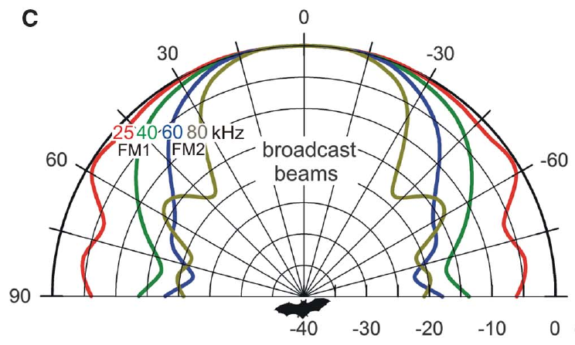
The two harmonics have different beam widths
The sonar beam is the directional spread of a bat's emitted sound, and its width depends on frequency. Bates and colleagues describe a horizontal beam spanning about 70 degrees to each side at 25 kHz. At 80 kHz, the beam is about 30 degrees wide. The lower frequency spreads much farther to the side.
A target near the beam axis receives both FM1 and FM2 strongly. Objects off to the side receive proportionally less FM2 because its beam is narrower. The harmonic balance of the returning echo carries information about where the object sat in the beam. The balance depends on the object's position. The balance changes with the object's angle.
This difference can help a bat tell a forward target from lateral clutter. Clutter means echoes from objects irrelevant to the current target. Harmonic differences alone leave open whether bats use them to reduce interference, which the behavioral tests examined. The tests examined the behavior directly. Bats use echo structure in this task.
Bates et al. (2011), Fig. 1(C). Published frequency-dependent horizontal beam patterns.
Bates et al. (2011)
35
Notes:
• The sonar beam is the directional distribution of a bat’s emitted sound. Its width depends on frequency. Bates and colleagues describe a horizontal beam spanning about 70° to each side at 25 kHz, compared with about 30° at 80 kHz.
• A target near the beam axis receives both FM1 and FM2 strongly. Objects off to the side receive proportionally less high-frequency FM2 because its beam is narrower. The returning echo’s harmonic balance therefore contains information related to where the reflecting object was ensonified.
• This acoustic relationship can help distinguish a forward target from lateral clutter, reflections from objects irrelevant to the current target. Beam width alone does not establish successful neural segregation; the behavioral experiments tested whether bats use the resulting harmonic differences to reduce interference.
• High frequencies are not simply absent from every lateral echo. Their relative strength declines with direction, and the experiment tested the perceptual consequence of this difference by manipulating harmonics electronically.
References:
Bates ME, Simmons JA, Zorikov TV (2011). Bats use echo harmonic structure to distinguish their targets from background clutter. Science 333(6042):627–630. https://doi.org/10.1126/science.1202065
Figure: Bates et al. (2011), Fig. 1(C). Published frequency-dependent horizontal beam patterns.
Figure source: https://doi.org/10.1126/science.1202065

Slide 47
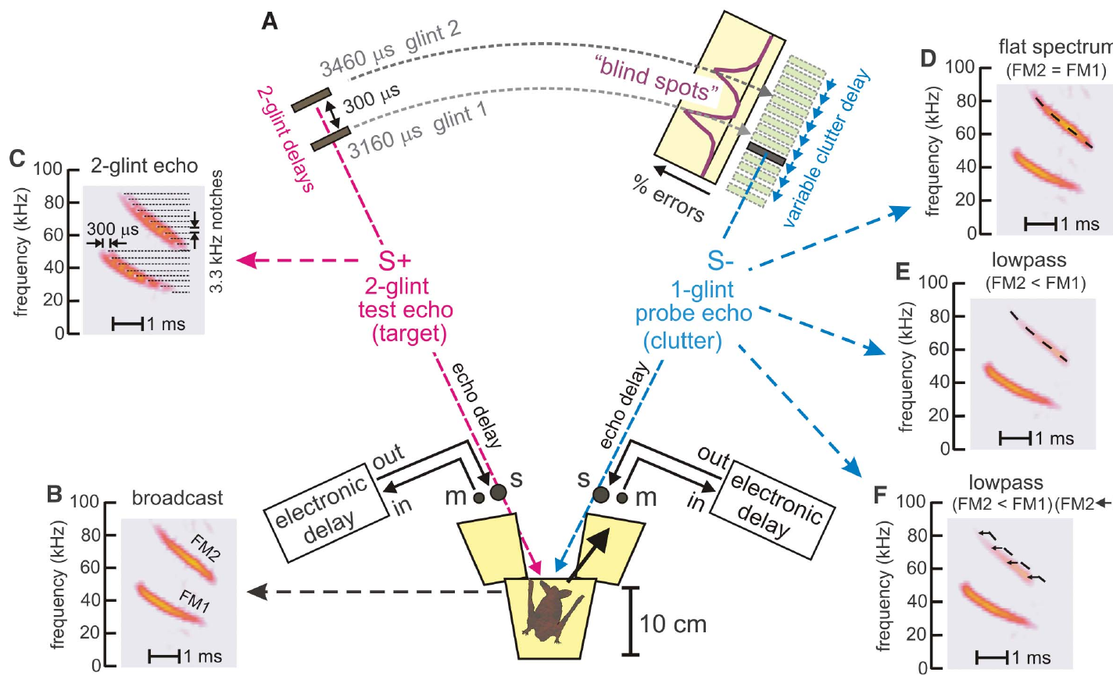
A two-glint echo provides a structured target
An acoustic glint is a return from one part of a target. Bates and colleagues used a rewarded virtual target with two glints, at delays of 3,160 and 3,460 μs. The 300-μs gap produced a structured echo with two separate returns. The target had two parts with a set spacing. Each glint returns sound from one part.
A bat perched on a Y platform and emitted calls. Microphones captured those calls and returned them through electronic delay channels. An unrewarded probe with one glint came from the opposite loudspeaker, and its delay was varied around the two rewarded glint delays. The probe's delay was the variable under test. Each trial ended with one choice.
The design measured how another echo interfered with perception of the target's structure and timing. Its value was the ability to change one echo property while keeping the rest of the task fixed. The target was electronic, not a natural insect recording. Each part of the setup could be changed on its own.
Bates et al. (2011), Fig. 2(A–F). Two-choice apparatus and controlled target and probe echoes.
Bates et al. (2011)
36
Notes:
• An acoustic glint is a reflection from one part of a target. Bates and colleagues used a rewarded virtual target containing two glints at delays of 3,160 and 3,460 μs. The 300-μs separation created a structured echo rather than one isolated reflection.
• A bat on a Y-shaped platform emitted calls that microphones captured and returned through electronic delay channels. The unrewarded probe contained one glint and was presented from the opposite loudspeaker. Its delay was varied around the two rewarded glint delays.
• The design measured how another echo interfered with perception of the target’s structure and timing. The electronic target provided controlled harmonic content and delay; it was not a natural insect recording. Its value was the ability to change one echo property while retaining the rest of the task.
• The bat was rewarded for choosing the two-glint target. Moving the probe in delay tested when a separate reflection interfered with that choice, while electronic filters permitted independent manipulation of the two harmonics.
References:
Bates ME, Simmons JA, Zorikov TV (2011). Bats use echo harmonic structure to distinguish their targets from background clutter. Science 333(6042):627–630. https://doi.org/10.1126/science.1202065
Figure: Bates et al. (2011), Fig. 2(A–F). Two-choice apparatus and controlled target and probe echoes.
Figure source: https://doi.org/10.1126/science.1202065

Slide 48
Two glints and a Y-shaped platform
The bat sat on the Y platform and chose between two targets. Microphones captured its calls, which electronic delay channels then returned from loudspeakers. The bat was rewarded for choosing the two-glint target. Its probe timing spanned the region around both rewarded delays. The apparatus offered two choices on each trial. The choice tested target structure, not the probe.
The probe contained one glint, so it carried less structure than the target. Electronic filters allowed the two harmonics to be manipulated independently. Each manipulation left the rest of the procedure the same. The probe was unrewarded, so choosing it counted as an error. Harmonic balance was the factor under test. Its delay set the timing of that interference.
Electronic construction allowed the experimenters to set glint delays exactly. No natural insect echo was used in the study. Choices were counted for each probe delay. The rewarded target kept the same two glints throughout, with a 300-μs spacing. Harmonic content was adjusted with filters, not with the target's structure. Each probe delay was tested around both glint delays.
Bates et al. (2011), Fig. 2(A–F). Two-choice apparatus and controlled target and probe echoes.
Bates et al. (2011)
36a
Notes:
• Two glints and a Y-shaped platform.
• Explanation 1.
– The bat sat on the Y platform and chose between two targets
– Microphones captured its calls, which electronic delay channels then returned from loudspeakers. The bat was rewarded for choosing the two-glint target. Its probe timing spanned the region around both rewarded delays. The apparatus offered two choices on each trial. The choice tested target structure, not the probe.
• Explanation 2.
– The probe contained one glint, so it carried less structure than the target
– Electronic filters allowed the two harmonics to be manipulated independently. Each manipulation left the rest of the procedure the same. The probe was unrewarded, so choosing it counted as an error. Harmonic balance was the factor under test. Its delay set the timing of that interference.
• Explanation 3.
– Electronic construction allowed the experimenters to set glint delays exactly
– No natural insect echo was used in the study. Choices were counted for each probe delay. The rewarded target kept the same two glints throughout, with a 300-μs spacing. Harmonic content was adjusted with filters, not with the target's structure. Each probe delay was tested around both glint delays.
• Source.
– The figure and the measurements come from Bates et al. (2011).
– Each statement comes from that study's recordings or observations.
References:
Bates ME, Simmons JA, Zorikov TV (2011). Bats use echo harmonic structure to distinguish their targets from background clutter. Science 333(6042):627–630. https://doi.org/10.1126/science.1202065

Slide 49
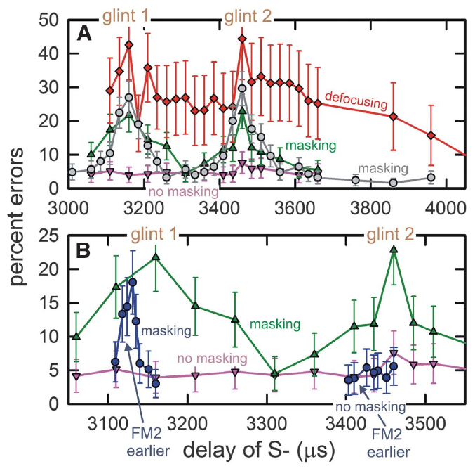
Similar echo delays can create masking blind spots
Masking is interference by one sound with the perception of another. In the Bates experiment, a flat-spectrum probe echo caused a sharp rise in errors when its delay came close to either glint of the rewarded target. Flat spectrum means FM1 and FM2 are roughly balanced. The probe was the source of the interference.
The masking regions extended roughly 50 μs to either side of each target glint. A separate error peak appeared near 3,160 μs and another near 3,460 μs. Errors stayed low when the probe's delay lay outside these regions. The errors clustered around the two glint delays. Masking peaks were sharp near each glint.
A probe can disrupt a target judgment even when it comes from a different direction. The blind spot is a delay region with impaired discrimination. It is not anatomical damage or a loss of hearing. The bats still heard the sounds clearly. Those regions are delays, not places in space. Errors came from wrong choices, not from silence.
Bates et al. (2011), Fig. 3(A–B). Discrimination errors peak near the two target-glint delays.
Bates et al. (2011)
37
Notes:
• Masking is interference by one sound with perception of another. In the Bates experiment, a flat-spectrum probe echo produced a sharp increase in errors when its delay approached either glint of the rewarded target. Flat-spectrum here means relatively balanced FM1 and FM2 content.
• The masking regions extended roughly 50 μs to either side of each target glint. A separate error peak occurred near 3,160 μs and near 3,460 μs. Baseline errors were low when the probe’s delay lay outside these regions.
• Temporal proximity can therefore disrupt a target judgment even when echoes come from different directions. The operational “blind spot” is a delay region with impaired discrimination, not anatomical damage or complete inability to hear sound. The experiment measured the chosen target’s perceptual interference under controlled feedback conditions.
• Masking was measured through incorrect choices, not disappearance of an auditory-nerve response. The bat could still receive acoustic input while being less able to distinguish the rewarded target from the probe.
References:
Bates ME, Simmons JA, Zorikov TV (2011). Bats use echo harmonic structure to distinguish their targets from background clutter. Science 333(6042):627–630. https://doi.org/10.1126/science.1202065
Figure: Bates et al. (2011), Fig. 3(A–B). Discrimination errors peak near the two target-glint delays.
Figure source: https://doi.org/10.1126/science.1202065

Slide 50
Weakening FM2 can prevent a probe from masking
Low-pass filtering weakens higher frequencies more than lower ones. Bates and colleagues applied mild low-pass filtering to the probe echo. This reduced FM2 relative to FM1 by an average of about 1.5 dB, approximating the harmonic imbalance of nearby lateral clutter. The filter imitated a nearby object off to the side. The filter reduces FM2 most.
The filtered probe no longer produced the masking peaks that the balanced probe made at similar delays. The rewarded target kept its structure. The probe changed, so the improvement came from the probe, not from an easier target. The target stayed the same in every condition. The probe still existed acoustically after filtering.
A small harmonic imbalance can change interference strongly in this task. The result suggests that bats use echo spectral structure to reject clutter. Not every natural clutter echo has this spectrum, and filtering can damage target information. The effect depends on the spectrum of each echo. The imbalance was modest but effective.
Bates et al. (2011), Fig. 3(A–B). Low-pass probe echoes reduce masking; timing compensation can restore it.
Bates et al. (2011)
38
Notes:
• Low-pass filtering weakens higher frequencies more than lower frequencies. Bates and colleagues applied mild low-pass filtering to the probe echo, reducing FM2 relative to FM1 by an average of about 1.5 dB. This approximated harmonic imbalance in nearby lateral clutter.
• The filtered probe no longer produced the masking peaks caused by the balanced probe at similar delays. The experiment retained the rewarded target’s structure and changed the interfering echo, so the improvement was not caused by making the target itself easier through a new target delay.
• A small harmonic imbalance could therefore strongly alter interference in the task. The result supports use of echo spectral structure for clutter rejection. It does not imply that every natural clutter echo has the same spectrum or that filtering always leaves target information intact.
• The probe still existed acoustically after filtering. The important change was its diminished ability to interfere with the target choice, rather than simple removal of the entire sound from the stimulus sequence.
References:
Bates ME, Simmons JA, Zorikov TV (2011). Bats use echo harmonic structure to distinguish their targets from background clutter. Science 333(6042):627–630. https://doi.org/10.1126/science.1202065
Figure: Bates et al. (2011), Fig. 3(A–B). Low-pass probe echoes reduce masking; timing compensation can restore it.
Figure source: https://doi.org/10.1126/science.1202065

Slide 51
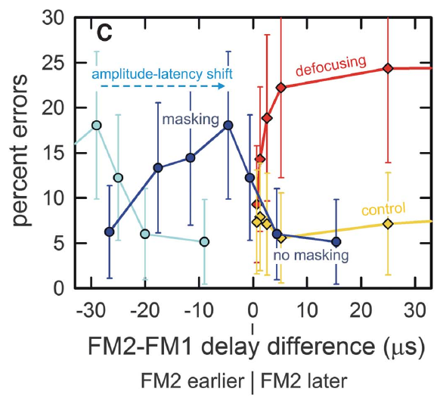
Harmonic timing links acuity and clutter rejection
Bates and colleagues proposed that weaker FM2 evokes a later neural response through amplitude-latency trading. Responses to the two harmonics then fall out of alignment. The authors read this misalignment as defocusing, a loss of a sharply specified echo-delay percept. The proposal ties level to timing. This idea predicts a shift in response timing for weaker sounds.
For the roughly 1.5-dB reduction in FM2, the proposed relative latency shift was about 24 μs. Advancing FM2 electronically by about 25 to 45 μs restored masking of the first target glint. The advance matched the level-dependent timing shift. The electronic advance undid the proposed delay. The predicted shift was checked electronically.
This manipulation ties harmonic timing to the trade-off between precise delay perception and resistance to clutter. Neural responses were inferred from earlier timing measurements, and this behavioral experiment recorded none. Recovery differed between the two glints. The two glints responded differently to the same advance. The result depends on the timing of both harmonics.
Bates et al. (2011), Fig. 3(C). Harmonic timing differences relate delay defocusing to masking recovery.
Bates et al. (2011)
39
Notes:
• Bates and colleagues proposed that weaker FM2 evokes later neural responses through amplitude–latency trading. Responses to the two harmonics then become misaligned. They interpreted this mismatch as defocusing, loss of a sharply specified echo-delay percept.
• For the roughly 1.5-dB FM2 reduction, the proposed relative latency shift was about 24 μs. Advancing FM2 electronically by approximately 25–45 μs restored masking of the first target glint, consistent with compensation for that level-dependent timing shift.
• The manipulation links harmonic timing to the trade-off between precise delay perception and resistance to clutter. Neural responses were inferred from prior timing measurements rather than recorded in this behavioral experiment. Recovery differed between the two target glints, so the result is not a uniform restoration of every part of the target image.
• The experiment altered acoustic timing to test a proposed neural-timing consequence of harmonic attenuation. Agreement with that prediction supports the mechanism while preserving the distinction between measured choices and inferred response alignment.
References:
Bates ME, Simmons JA, Zorikov TV (2011). Bats use echo harmonic structure to distinguish their targets from background clutter. Science 333(6042):627–630. https://doi.org/10.1126/science.1202065
Figure: Bates et al. (2011), Fig. 3(C). Harmonic timing differences relate delay defocusing to masking recovery.
Figure source: https://doi.org/10.1126/science.1202065

Slide 52
Advance and recovery differ by glint
The advance was applied to FM2, the harmonic that had been weakened. Its size was checked against the timing shift predicted for a 1.5-dB reduction. The predicted shift came from the proposed amplitude-latency trading. The advance is a timing manipulation, not a level change. It moved FM2 earlier while FM1 stayed where it was. Its size was set by the proposed shift.
The timing measurements used to infer these responses were recorded earlier. The behavioral test changed the harmonic balance of one probe. Masking returned when the advance was applied. Masking was measured as incorrect choices. Masking was judged on each target glint separately. Recovery was uneven across the two glints. The proposed mechanism concerns FM2 timing only.
This experiment recorded choices, not the neural responses that the timing shift describes. Neural timing was inferred from earlier data, while this study measured choices. The result shows how harmonic timing bears on the trade-off between delay precision and clutter resistance. Each prediction in this series came from timing data, not from neural recordings. The advance tested that prediction on the choices of the bats.
Bates et al. (2011), Fig. 3(C). Harmonic timing differences relate delay defocusing to masking recovery.
Bates et al. (2011)
39a
Notes:
• Advance and recovery differ by glint.
• Explanation 1.
– The advance was applied to FM2, the harmonic that had been weakened
– Its size was checked against the timing shift predicted for a 1.5-dB reduction. The predicted shift came from the proposed amplitude-latency trading. The advance is a timing manipulation, not a level change. It moved FM2 earlier while FM1 stayed where it was. Its size was set by the proposed shift.
• Explanation 2.
– The timing measurements used to infer these responses were recorded earlier
– The behavioral test changed the harmonic balance of one probe. Masking returned when the advance was applied. Masking was measured as incorrect choices. Masking was judged on each target glint separately. Recovery was uneven across the two glints. The proposed mechanism concerns FM2 timing only.
• Explanation 3.
– This experiment recorded choices, not the neural responses that the timing shift describes
– Neural timing was inferred from earlier data, while this study measured choices. The result shows how harmonic timing bears on the trade-off between delay precision and clutter resistance. Each prediction in this series came from timing data, not from neural recordings. The advance tested that prediction on the choices of the bats.
• Source.
– The figure and the measurements come from Bates et al. (2011).
– Each statement comes from that study's recordings or observations.
References:
Bates ME, Simmons JA, Zorikov TV (2011). Bats use echo harmonic structure to distinguish their targets from background clutter. Science 333(6042):627–630. https://doi.org/10.1126/science.1202065

Slide 53
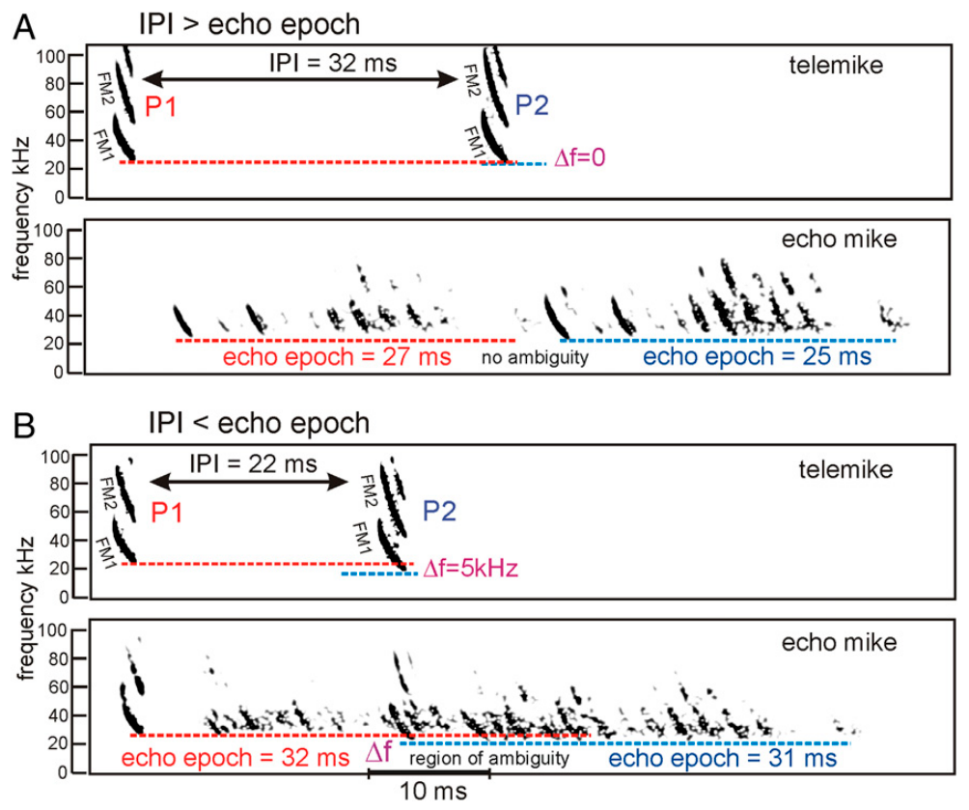
Rapid calling can mix echoes from different broadcasts
The interpulse interval, or IPI, is the time between successive broadcasts. The echo epoch is the period in which echoes from one broadcast return from objects spread through a scene. A distant target may return its echo after a nearer one. Long echo epochs can overlap the next broadcast. Each broadcast has its own echo epoch.
Ming and colleagues discuss cases in which the IPI becomes shorter than the echo epoch. Their examples compare a 32-ms IPI with shorter echo epochs and a 22-ms IPI with overlapping epochs. Echoes from one broadcast can arrive after the next broadcast has already been emitted. The overlap changes which broadcast each echo belongs to.
This produces pulse-echo ambiguity, which is uncertainty about which broadcast made an echo. Measuring delay from the wrong broadcast assigns the wrong range. Rapid updates for nearby obstacles can conflict with waiting for distant echoes to return. Each broadcast must be matched to its echo. A longer interval reduces the overlap between broadcasts.
Ming et al. (2020), Fig. 2(A–B). Separate and overlapping echo epochs at different interpulse intervals.
Ming et al. (2020)
40
Notes:
• The interpulse interval, or IPI, is the time between successive broadcasts. The echo epoch is the period during which reflections from one broadcast return from objects distributed across a scene. A long-range reflector may return sound after a nearer one.
• Ming and colleagues discuss cases in which the IPI becomes shorter than the echo epoch. Their published examples compare a 32-ms IPI with shorter echo epochs and a 22-ms IPI with overlapping epochs. Echoes from one broadcast can arrive after the next broadcast has occurred.
• This creates pulse–echo ambiguity, uncertainty about which broadcast generated a reflection. Measuring delay from the wrong broadcast assigns an incorrect range. Rapid updates needed for nearby obstacles can therefore conflict with waiting for all distant echoes to finish returning.
• An echo’s arrival time alone does not label its originating call if echo streams overlap. The examples in this paper were published to describe the ambiguity created by rapid calling in extended scenes.
References:
Ming C, Bates ME, Simmons JA (2020). How frequency hopping suppresses pulse-echo ambiguity in bat biosonar. Proceedings of the National Academy of Sciences 117(29):17288–17295. https://doi.org/10.1073/pnas.2001105117
Figure: Ming et al. (2020), Fig. 2(A–B). Separate and overlapping echo epochs at different interpulse intervals.
Figure source: https://doi.org/10.1073/pnas.2001105117

Slide 54
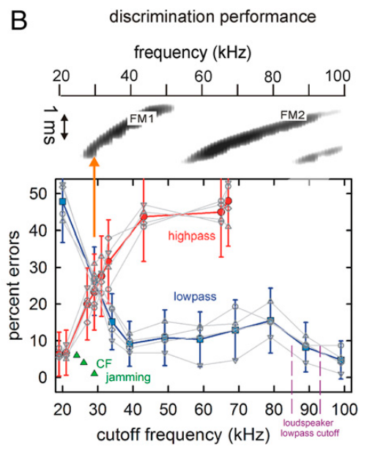
Lowest FM1 frequencies anchor the tested delay percept
Ming and colleagues used a two-choice virtual-echo task to find which frequencies carry target discrimination. They removed either the high or the low frequencies from the rewarded two-glint echo. The unrewarded comparison echo stayed broadband. The task compared two echoes at once. The task tested which frequency bands carried the delay percept.
Low-pass filtering kept discrimination effective when only about 25 to 30 kHz remained. High-pass filtering, which removed that low-frequency end, disrupted performance. Most higher FM1 frequencies and all of FM2 were still present in that condition. The lowest FM1 frequencies carried the information. That end anchors the delay percept in this task.
The authors proposed that frequency hopping, shifts of several kilohertz between broadcasts, could use this low-frequency anchor to separate overlapping echo streams. The filtering result is a measured behavior. The full pulse-assignment mechanism remains a model, not a recording from identified neurons. The anchor is the low end of FM1. The mechanism is still a proposal.
Ming et al. (2020), Fig. 3(B). Opposite effects of low-pass and high-pass filtering on echo discrimination.
Ming et al. (2020)
41
Notes:
• Ming and colleagues used a two-choice virtual-echo task to test which frequency regions supported target discrimination. They progressively removed either high or low frequencies from the rewarded two-glint echo while keeping the unrewarded comparison echo broadband.
• Low-pass filtering left discrimination effective when only approximately 25–30 kHz remained. High-pass filtering that removed this low-frequency end disrupted performance even while most higher FM1 frequencies and FM2 remained. The two filtering directions therefore had very different effects.
• The authors proposed that frequency hopping, shifts of several kilohertz between broadcasts, could use this low-frequency anchor to segregate overlapping echo streams. The filtering result is measured behavior; the full pulse-assignment mechanism and its SCAT receiver implementation remain proposed or modeled explanations rather than direct neural recordings.
• The key experimental asymmetry is between retaining the bottom of FM1 and removing it. The frequency-hopping account applies this result to overlapping broadcasts, but the filtering test itself does not record an identified neuronal pulse-assignment circuit.
References:
Ming C, Bates ME, Simmons JA (2020). How frequency hopping suppresses pulse-echo ambiguity in bat biosonar. Proceedings of the National Academy of Sciences 117(29):17288–17295. https://doi.org/10.1073/pnas.2001105117
Figure: Ming et al. (2020), Fig. 3(B). Opposite effects of low-pass and high-pass filtering on echo discrimination.
Figure source: https://doi.org/10.1073/pnas.2001105117

Slide 55
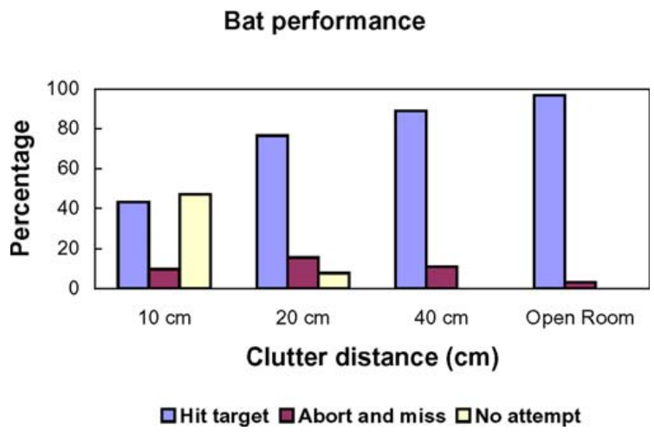
Nearby vegetation reduces prey-capture success
Moss and colleagues studied freely flying big brown bats catching tethered insects near a plant. Synchronized ultrasound recordings and high-speed video were combined into reconstructed three-dimensional flight paths. An open-room condition served as the control without the plant's echoes. Each trial recorded the sounds and the flight together. The bats were free to fly during the trials.
With the insect 10 cm from vegetation, bats hit or captured it in about 40 percent of trials. They made no attempt in nearly half. Hits or captures rose to almost 80 percent at 20 cm and about 90 percent at 40 cm. Open-room performance was nearly complete. Each condition varied the spacing between insect and plant.
Clutter reduced both the willingness to attempt an interception and the success once the bat approached. The combined hit-or-capture measure is broader than successful consumption. The difficulty appears at these particular vegetation spacings. The spacing sets how hard each capture is. The vegetation made successful capture less likely at close spacing. The categories show the stage of failure.
Moss et al. (2006), Fig. 2. Interception outcomes at three plant–target separations and in an open room.
Moss et al. (2006)
42
Notes:
• Moss and colleagues studied freely flying big brown bats capturing tethered insects near a plant. Synchronized ultrasound recordings and high-speed video linked emitted sounds to reconstructed three-dimensional flight paths. The open-room condition provided a comparison without the plant’s nearby echo clutter.
• With the insect 10 cm from vegetation, bats hit or captured it in about 40% of trials and made no attempt in nearly half. Hits or captures increased to almost 80% at 20 cm and about 90% at 40 cm. Open-room performance was nearly complete.
• Clutter therefore affected both willingness to attempt interception and success after approach. The combined hit/capture measure is broader than successful consumption. The experiment reveals difficulty under controlled vegetation spacing rather than a universal minimum separation for catching prey in natural habitats.
• The behavioral categories distinguish failure to attempt from an attempted approach that missed or was aborted. A decline in the combined success measure cannot automatically be assigned to failure of target detection alone.
References:
Moss CF, Bohn K, Gilkenson H, Surlykke A (2006). Active listening for spatial orientation in a complex auditory scene. PLoS Biology 4(4):e79. https://doi.org/10.1371/journal.pbio.0040079
Figure: Moss et al. (2006), Fig. 2. Interception outcomes at three plant–target separations and in an open room.
Figure source: https://doi.org/10.1371/journal.pbio.0040079

Slide 56
Hits, captures and attempts differ
The behavioral categories separate a failure to attempt from an attempted approach that missed or was aborted. Each category marks a different step of the interception. Counting them apart shows where clutter had its effect. Hits and captures are one outcome, while attempts are another. Those categories were scored for each trial. Each category counts a separate outcome.
A decline in the combined measure may not come from failed detection alone. An attempt can fail after detection has occurred. Some approaches end in a miss or an abort instead of a capture. Each of those outcomes is counted in a separate category. Attempts and captures respond to clutter in different ways. Clutter affects each step in the sequence.
The open-room condition gave the baseline for these categories. Near the vegetation, echoes from the plant arrived alongside the echo from the insect. The categories show whether the bat failed to try or failed after trying. The bat's approach path was part of the measured behavior. The plant's echoes entered the approach as competing sound.
Moss et al. (2006), Fig. 2. Interception outcomes at three plant–target separations and in an open room.
Moss et al. (2006)
42a
Notes:
• Hits, captures and attempts differ.
• Explanation 1.
– The behavioral categories separate a failure to attempt from an attempted approach that missed or was aborted
– Each category marks a different step of the interception. Counting them apart shows where clutter had its effect. Hits and captures are one outcome, while attempts are another. Those categories were scored for each trial. Each category counts a separate outcome.
• Explanation 2.
– A decline in the combined measure may not come from failed detection alone
– An attempt can fail after detection has occurred. Some approaches end in a miss or an abort instead of a capture. Each of those outcomes is counted in a separate category. Attempts and captures respond to clutter in different ways. Clutter affects each step in the sequence.
• Explanation 3.
– The open-room condition gave the baseline for these categories
– Near the vegetation, echoes from the plant arrived alongside the echo from the insect. The categories show whether the bat failed to try or failed after trying. The bat's approach path was part of the measured behavior. The plant's echoes entered the approach as competing sound.
• Source.
– The figure and the measurements come from Moss et al. (2006).
– Each statement comes from that study's recordings or observations.
References:
Moss CF, Bohn K, Gilkenson H, Surlykke A (2006). Active listening for spatial orientation in a complex auditory scene. PLoS Biology 4(4):e79. https://doi.org/10.1371/journal.pbio.0040079

Slide 57
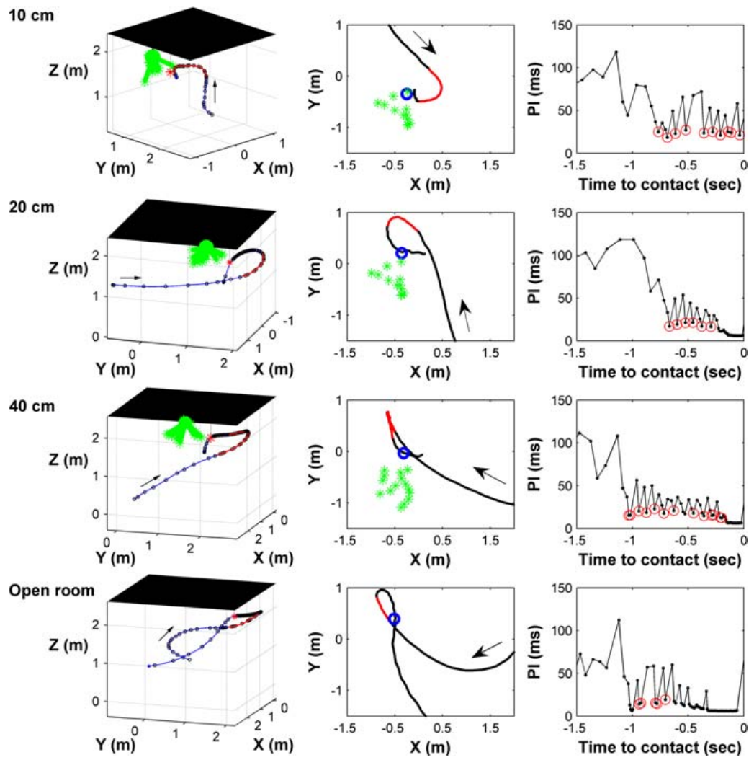
Flight paths change target–clutter separation
Bats in the Moss experiment often flew alongside the vegetation and the insect before turning toward the target. The approach was not a straight line through the plant's strongest echo direction. The flight geometry changed the angle between prey and background. The route itself carried the bat around the clutter. The bats adjusted their path before turning.
As the insect moved closer to the vegetation, the final direct approach grew shorter and the late turn grew sharper. Three-dimensional trajectories and emitted pulse intervals were measured together. The strongest changes in turning happened in the final 50 to 100 ms before contact. Those late changes were the largest. Each change followed the insect's distance.
The authors read these trajectories as reducing interference. By flying this way, the bat ensonified the prey off axis from the vegetation for part of the approach. This interpretation rests on the geometry, not on a recording of the bat's internal spatial map. The map was never measured. The bats' behavior was the measured quantity.
Moss et al. (2006), Fig. 4. Measured flight paths and pulse intervals for clutter and open-room trials.
Moss et al. (2006)
43
Notes:
• Bats in the Moss experiment often flew alongside the vegetation and insect before turning toward the target. The approach was not simply a straight line through the plant’s strongest echo direction. Flight geometry altered the angular relationship between prey and background.
• As the target was placed closer to vegetation, the final direct approach became shorter and the late turn more abrupt. Three-dimensional trajectories and emitted pulse intervals were measured together. Strong changes in turning occurred mainly during the final 50–100 ms before contact.
• The authors interpreted these trajectories as reducing interference by ensonifying prey off axis from vegetation during part of the approach. The paths are measured behavior, whereas that masking-reduction function is an interpretation supported by geometry. It was not tested by recording the bat’s full internal spatial representation.
• Moving changes which objects lie in the emitted beam and the relative timing of their echoes. The animal can therefore alter the acoustic scene through its trajectory as well as through the structure of individual calls.
References:
Moss CF, Bohn K, Gilkenson H, Surlykke A (2006). Active listening for spatial orientation in a complex auditory scene. PLoS Biology 4(4):e79. https://doi.org/10.1371/journal.pbio.0040079
Figure: Moss et al. (2006), Fig. 4. Measured flight paths and pulse intervals for clutter and open-room trials.
Figure source: https://doi.org/10.1371/journal.pbio.0040079

Slide 58
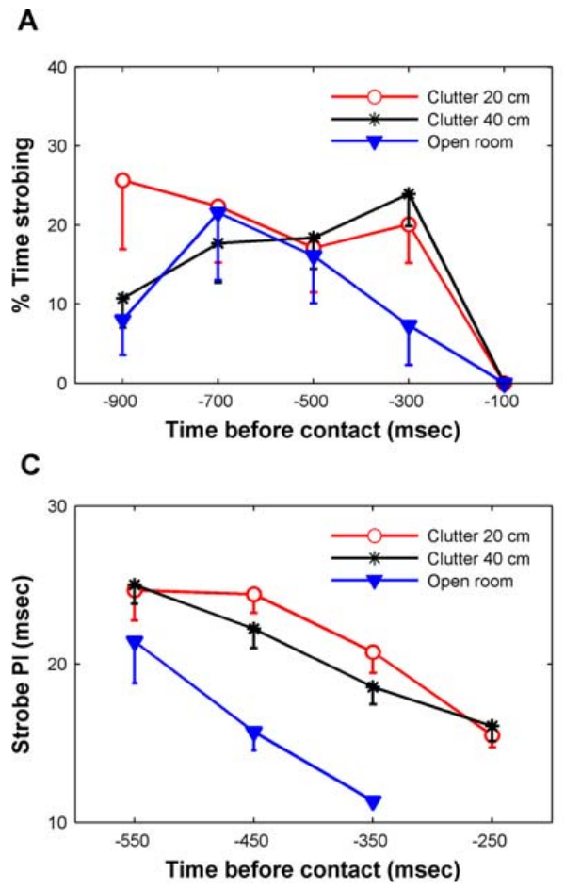
Sonar strobe groups control repeated scene sampling
Sonar strobe groups are clusters of calls separated from neighboring calls or groups by longer intervals. Moss and colleagues identified groups with stable internal intervals when they contained three or more sounds. Grouping occurred during the approach, before the terminal capture phase. The groups appeared as the bat neared its prey. Stable internal intervals defined each group.
Within each group, pulse intervals shortened as the bat closed in on its target. Calls in the clutter conditions tended to fall into groups with shorter intervals than calls in the open room. The grouping added structure beyond a general rise in call rate. The groups had a pattern of their own.
The authors proposed that repeated sampling at stable intervals could sharpen the spatial representation of the scene. The study measured vocal timing and behavior. It recorded vocal timing and behavior, and the perceptual benefit remains a hypothesis. The benefit is a proposal, not a measurement. The perceptual part of the claim is still open.
Moss et al. (2006), Fig. 10(A,C). Strobing occurrence and within-group pulse intervals during approach.
Moss et al. (2006)
44
Notes:
• Sonar strobe groups are clusters of calls separated from neighboring calls or groups by longer intervals. Moss and colleagues identified groups with stable internal intervals when they contained three or more sounds. This temporal organization occurred during approach before the terminal capture phase.
• Within groups, pulse intervals shortened as the bat approached its target. Calls in the clutter conditions tended to be grouped at shorter intervals than calls in the open room. The group pattern added structure beyond an overall increase in call rate.
• The authors proposed that repeated sampling at stable intervals could sharpen the spatial representation of the scene. The study measured vocal timing and behavior, not the proposed improvement in a neuronal population code. Grouping is therefore an established motor pattern with a hypothesized perceptual function.
• A group is defined by its relationship to the neighboring intervals, rather than simply by a high average call rate. Stable timing within groups can coexist with changes in group spacing as the bat approaches the insect.
References:
Moss CF, Bohn K, Gilkenson H, Surlykke A (2006). Active listening for spatial orientation in a complex auditory scene. PLoS Biology 4(4):e79. https://doi.org/10.1371/journal.pbio.0040079
Figure: Moss et al. (2006), Fig. 10(A,C). Strobing occurrence and within-group pulse intervals during approach.
Figure source: https://doi.org/10.1371/journal.pbio.0040079

Slide 59
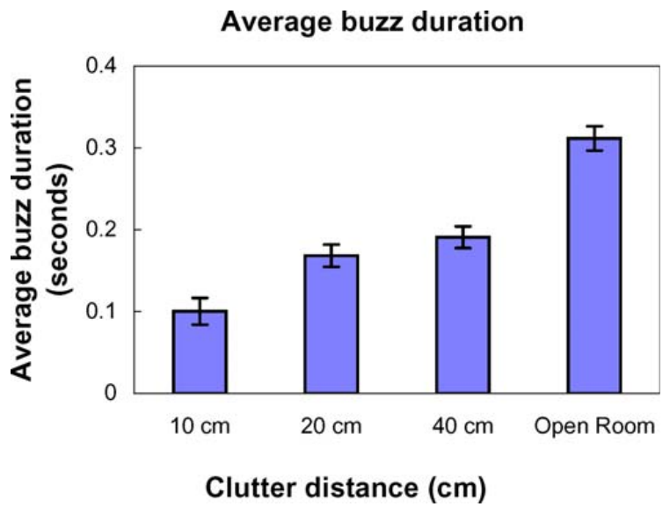
The terminal buzz shortens near vegetation
The terminal buzz is the rapid-call sequence right before prey interception. Moss and colleagues defined buzz-II calls by pulse intervals of 10 ms or less. They compared buzz duration across plant-target separations and the open-room condition. The buzz was measured at every separation. Shorter buzz durations were the main outcome of that comparison.
Mean buzz-II duration fell from more than 300 ms in the open room to about 200 ms at 40 cm from vegetation and about 100 ms at 10 cm. Prey capture still succeeded sometimes with the shorter buzz, including at the closest separation. The shorter buzz still led to captures. The buzz shortened at every separation tested.
The authors proposed that extended clutter echoes make prolonged rapid calling less useful. The observed shortening ties vocal timing to scene structure. Successful interception combined changes in call groups, final approach geometry and buzz duration. The buzz was one of several changes. The shortened buzz changes the timing of the final approach. Each measure is part of one interception.
Moss et al. (2006), Fig. 8. Buzz-II duration varies with target–vegetation separation.
Moss et al. (2006)
45
Notes:
• The terminal buzz is the rapid-call sequence immediately before prey interception. Moss and colleagues defined buzz-II calls by pulse intervals of 10 ms or less and compared its duration across plant–target separations and the open-room condition.
• Mean buzz-II duration declined from over 300 ms in the open room to about 200 ms at 40 cm from vegetation and about 100 ms at 10 cm. Prey capture was still sometimes successful with the shorter buzz, including at the closest tested separation.
• The authors proposed that extended clutter echoes reduce the usefulness of prolonged rapid calling. The observed adjustment connects vocal timing to scene structure, but it does not directly establish the neural masking mechanism. Successful interception can involve coordinated changes in call groups, final approach geometry, and buzz duration.
• A shorter terminal buzz is not simply proof that the bat has stopped sampling. The animal continues vocalizing and has already adjusted its approach and earlier call-group pattern, so several measured behaviors contribute to the final interception.
References:
Moss CF, Bohn K, Gilkenson H, Surlykke A (2006). Active listening for spatial orientation in a complex auditory scene. PLoS Biology 4(4):e79. https://doi.org/10.1371/journal.pbio.0040079
Figure: Moss et al. (2006), Fig. 8. Buzz-II duration varies with target–vegetation separation.
Figure source: https://doi.org/10.1371/journal.pbio.0040079

Slide 60
Key takeaways
Echo delay carries target range. Controlled electronic-delay experiments support relative-range judgments without changing the reflector’s physical distance.
Timing precision and latency differ. Population responses can arrive after milliseconds while repeating within tens of microseconds; weaker sounds can shift their latency.
Inhibition selects FM features. Early low-frequency inhibition shapes direction preference; delayed high-frequency inhibition can reject slow downward sweeps.
Harmonic structure affects clutter interference. Weakening FM2 can reduce masking, and compensating harmonic timing can restore part of that interference.
Call assignment is part of ranging. Overlapping echo epochs create pulse–echo ambiguity; lowest FM1 frequencies anchor the tested delay percept.
Active sensing changes the scene. Bats adjust flight paths, call groups, and terminal-buzz duration near vegetation; proposed neural benefits remain distinct from measured behavior.
Simmons (1973); Bates et al. (2011); Williams & Fuzessery (2011); Simmons et al. (2024); Moss et al. (2006); Ming et al. (2020)
46
Notes:
Teaching transcript:
• Echo delay carries target range. Controlled electronic-delay experiments support relative-range judgments without changing the reflector’s physical distance.
• Timing precision and latency differ. Population responses can arrive after milliseconds while repeating within tens of microseconds; weaker sounds can shift their latency.
• Inhibition selects FM features. Early low-frequency inhibition shapes direction preference; delayed high-frequency inhibition can reject slow downward sweeps.
• Harmonic structure affects clutter interference. Weakening FM2 can reduce masking, and compensating harmonic timing can restore part of that interference.
• Call assignment is part of ranging. Overlapping echo epochs create pulse–echo ambiguity; lowest FM1 frequencies anchor the tested delay percept.
• Active sensing changes the scene. Bats adjust flight paths, call groups, and terminal-buzz duration near vegetation; proposed neural benefits remain distinct from measured behavior.
References:
Simmons JA (1973). The resolution of target range by echolocating bats. Journal of the Acoustical Society of America 54(1):157–173. https://doi.org/10.1121/1.1913559
Bates ME, Simmons JA, Zorikov TV (2011). Bats use echo harmonic structure to distinguish their targets from background clutter. Science 333(6042):627–630. https://doi.org/10.1126/science.1202065
Williams AJ, Fuzessery ZM (2011). Differential roles of GABAergic and glycinergic input on FM selectivity in the inferior colliculus of the pallid bat. Journal of Neurophysiology 106(5):2523–2535. https://doi.org/10.1152/jn.00569.2011
Simmons AM, Warnecke M, Simmons JA (2024). Microseconds-level coding of echo delay in the auditory brainstem of an FM-echolocating bat. Journal of Neurophysiology 132(6):2012–2022. https://doi.org/10.1152/jn.00305.2024
Moss CF, Bohn K, Gilkenson H, Surlykke A (2006). Active listening for spatial orientation in a complex auditory scene. PLoS Biology 4(4):e79. https://doi.org/10.1371/journal.pbio.0040079
Ming C, Bates ME, Simmons JA (2020). How frequency hopping suppresses pulse-echo ambiguity in bat biosonar. Proceedings of the National Academy of Sciences 117(29):17288–17295. https://doi.org/10.1073/pnas.2001105117

