Slide 1
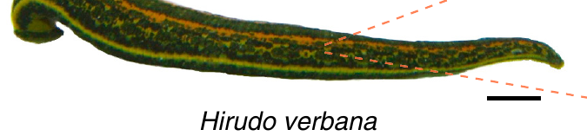
NEUR 411 · NEUROETHOLOGY · FALL 2026 · Lecture 6
Central pattern generators I: leech swimming and crawling (Kristan)
Friday, September 4, 2026
Jordan Lopez, Ph.D.
Ashaber et al. (2021), Fig. 1. Medicinal leech Hirudo verbana; original 1 cm scale bar.
Notes:
Central pattern generators I: leech swimming and crawling (Kristan)
Friday, September 4, 2026
Ashaber et al. (2021), Fig. 1. Medicinal leech Hirudo verbana; original 1 cm scale bar.
Source: https://doi.org/10.7554/eLife.61881
Full reference: M. Ashaber; Y. Tomina; P. Kassraian; E. A. Bushong; W. B. Kristan Jr; M. H. Ellisman; D. A. Wagenaar (2021). Anatomy and activity patterns in a multifunctional motor neuron and its surrounding circuits. eLife 10:e61881. https://doi.org/10.7554/eLife.61881

Slide 2
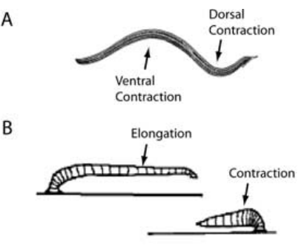
Swimming and crawling reorganize the same muscles
Leech swimming alternates contractions of the dorsal and ventral longitudinal muscles, producing bends that pass from the front of the animal toward its tail.
  Crawling recruits these muscles for a different sequence, because circular-muscle contraction first elongates the body and longitudinal-muscle contraction then shortens it. Attachment and release of the front and rear suckers convert that changing body length into forward movement across the substrate.
Briggman and Kristan elicited both behaviors in the same isolated nervous system and recorded their output through motor nerves and individual neurons.
  Swimming occurred at approximately 1–1.5 Hz, whereas crawling occurred at approximately 0.04–0.1 Hz, so the common motor apparatus operated at markedly different rates. The longitudinal muscles also changed their relationship, alternating across the body during swimming and contracting together during crawl shortening.
A central pattern generator, or CPG, produces a patterned rhythm through interactions within the nervous system, without requiring a rhythmic sensory stimulus to specify every cycle.
  Both leech motor patterns persisted in the isolated nerve cord, and most neurons that oscillated during swimming also oscillated during crawling. Their participation therefore depended on how the shared population was organized in time, together with cells recruited specifically for the muscle actions of each behavior.
Briggman & Kristan (2006), Fig. 1(A,B). Published swimming and crawling movement sequences.
Briggman & Kristan (2006)
2
Notes:
Teaching transcript:
Leech swimming consists of alternating contractions of dorsal and ventral longitudinal muscles, producing a wave that travels toward the tail. Crawling instead alternates elongation, driven by circular muscles, with shortening, driven by longitudinal muscles. The front and rear suckers attach and release to convert these changes into forward movement.
Briggman and Kristan elicited both motor patterns in the same isolated nervous system while monitoring motor nerves and recording individual neurons. Swimming occurred at approximately 1–1.5 Hz, whereas crawling oscillations occurred at approximately 0.04–0.1 Hz. The different rhythms reorganized common motor outputs.
A central pattern generator, or CPG, is a neural circuit capable of producing a patterned rhythm without requiring rhythmic sensory input. Central generation does not imply that sensory feedback, descending signals, or the mechanical environment are irrelevant to the realized movement.
Dorsal refers to the back surface and ventral to the belly surface. Longitudinal muscle contraction shortens the body; circular muscle contraction contributes to elongation. These muscle arrangements give the same animal two distinct forms of locomotion.
References:
K. L. Briggman; W. B. Kristan Jr (2006). Imaging dedicated and multifunctional neural circuits generating distinct behaviors. Journal of Neuroscience 26(42):10925–10933. https://doi.org/10.1523/JNEUROSCI.3265-06.2006
Briggman & Kristan (2006), Fig. 1(A,B). Published swimming and crawling movement sequences.
Figure source: https://doi.org/10.1523/JNEUROSCI.3265-06.2006

Slide 3
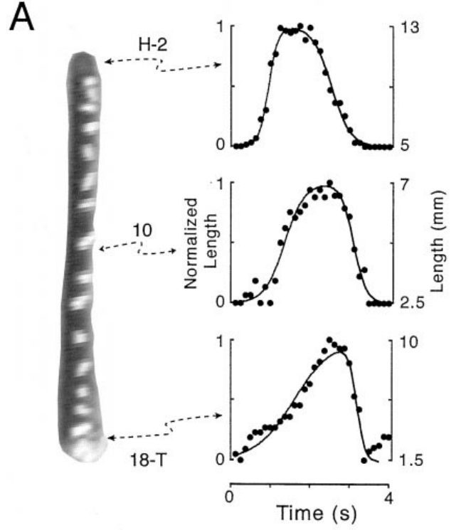
Segmental markers resolve the components of a crawl
Cacciatore and colleagues measured crawling by attaching small thread markers at segment boundaries and following how the distances between them changed during a step.
  This analysis described the kinematics, meaning the movement and its timing, while preserving the contribution of individual body regions. The investigators examined vermiform steps, in which the animal stayed near the substrate, allowing successive regions of the body to be followed throughout elongation and shortening.
Video digitized at 4–10 frames per second supplied at least 25 observations during each step, from which the researchers reconstructed segmental length changes.
  Anterior segments generally elongated before posterior segments, and the subsequent change to shortening also progressed toward the tail. A single step therefore contained a sequence of local changes, with neighboring regions reaching the same movement phase at different times.
Crawling steps continued after removal of both the head and tail brains, placing circuitry capable of organizing a step within the remaining midbody nervous system.
  The marker analysis could follow that continuing movement using the same segment boundaries as in intact animals. Because the leech retained its midbody ganglia and body wall, the preparation preserved local motor circuitry and the peripheral interactions through which the surviving system produced an overt crawl.
Cacciatore et al. (2000), Fig. 2(A). Marked leech and measured regional length changes.
Cacciatore et al. (2000)
3
Notes:
Teaching transcript:
Kinematics describes movement without assigning its underlying forces or neural causes. Cacciatore and colleagues attached small thread markers to segment boundaries in adult leeches and recorded crawling from above. Their analysis used vermiform steps, in which the body remained near the substrate, rather than steps with a raised body loop.
Video was digitized at 4–10 frames per second, with at least 25 frames per step. Distances between markers yielded segmental length changes. Anterior segments generally elongated earlier than posterior ones; the reverse transition to shortening also propagated toward the tail.
The preparation connects whole-animal movement to regional timing. Marker displacement measures body deformation, not motor-neuron firing. The investigators excluded searching movements, so these results characterize stereotyped steps on a smooth surface rather than every possible form of crawling.
The study used adults weighing 2–4 g, allowed recovery after marker implantation, and calibrated spatial measurements with a visible grid. These controls reduced confusion between image scale, recovery effects, and actual changes in movement.
References:
T. W. Cacciatore; R. Rozenshteyn; W. B. Kristan Jr (2000). Kinematics and modeling of leech crawling: evidence for an oscillatory behavior produced by propagating waves of excitation. Journal of Neuroscience 20(4):1643–1655. https://doi.org/10.1523/JNEUROSCI.20-04-01643.2000
Cacciatore et al. (2000), Fig. 2(A). Marked leech and measured regional length changes.
Figure source: https://doi.org/10.1523/JNEUROSCI.20-04-01643.2000

Slide 4
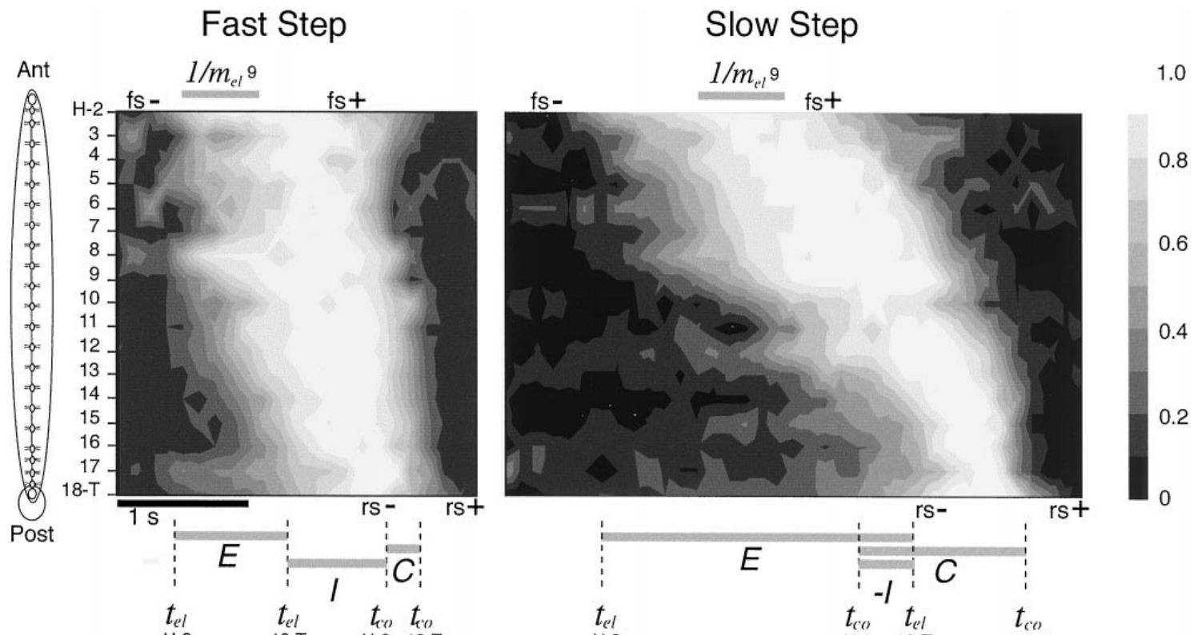
Crawl duration changes the speed of traveling waves
During a crawl, elongation and contraction each propagate from anterior to posterior, so their timing depends on where a segment lies along the body.
  Cacciatore and colleagues followed segment lengths during fast and slow steps and found that both waves moved through successive regions. A change in one segment could therefore begin while another segment remained in the preceding movement phase.
Typical stereotyped steps lasted approximately 2–10 s, with slower steps containing longer delays in the passage of the movement waves along the animal.
  Anterior segments could already begin shortening while posterior regions were still elongating. Elongation and contraction consequently overlapped within the whole animal even though each local segment passed through those actions in sequence.
The rates at which an individual segment lengthened or shortened remained relatively stable as the duration of the whole step changed.
  Much of the slowing arose from longer intersegmental delays, which increased the time needed to carry the sequence through the body. A neural account of crawling therefore has to organize both the local elongation–shortening pattern and the adjustable timing that links one segment with the next. The delay between successive segments changes how long their movement phases overlap, distributing elongation and contraction across different regions within the same ongoing step.
Cacciatore et al. (2000), Fig. 3. Measured segment-length sequences during fast and slow steps.
Cacciatore et al. (2000)
4
Notes:
Teaching transcript:
Cacciatore and colleagues compared segmental length changes during fast and slow crawling steps. Propagation means that a change begins in successive body regions at different times. Both elongation and contraction propagated from anterior to posterior segments rather than occurring simultaneously throughout the body.
Typical stereotyped steps lasted approximately 2–10 s. Slower steps contained slower wave propagation and changes in the interval between elongation and contraction. Anterior regions could begin contracting while posterior regions were still elongating, so whole-body elongation and contraction were not strictly separate blocks.
These observations constrain a neural explanation of crawling to account for regional timing and variable step duration. The recorded waves are behavioral data. The paper’s proposed excitation-chain model is an explanatory construction and does not establish that its specific simulated neurons exist in the leech.
A contour representation of measured length preserves the sequence of local lengthening and shortening. The important experimental relationship is that different portions of the body can occupy different movement phases during one step.
References:
T. W. Cacciatore; R. Rozenshteyn; W. B. Kristan Jr (2000). Kinematics and modeling of leech crawling: evidence for an oscillatory behavior produced by propagating waves of excitation. Journal of Neuroscience 20(4):1643–1655. https://doi.org/10.1523/JNEUROSCI.20-04-01643.2000
Cacciatore et al. (2000), Fig. 3. Measured segment-length sequences during fast and slow steps.
Figure source: https://doi.org/10.1523/JNEUROSCI.20-04-01643.2000

Slide 5
Each midbody ganglion controls the segment it sits in
The leech nerve cord contains 21 midbody ganglia between the head and tail brains, with each ganglion controlling the corresponding body segment.
  A midbody ganglion contains roughly 400 neurons, including sensory cells, interneurons, and motor neurons. Peripheral root nerves connect these cells with the body wall, while bundles of axons called connectives carry communication between neighboring ganglia.
Cutting a root nerve interrupts communication between a ganglion and its segment, whereas cutting a connective interrupts communication along the central nerve cord.
  These operations preserve different parts of the system. A root lesion can leave central pathways across the operated region intact, while a connective lesion can leave muscles and sensory receptors attached to the ganglia on either side of the cut.
Within each ganglion, neuronal cell bodies surround a central neuropil, where branching processes make chemical and electrical synaptic contacts.
  Identified neurons recur in corresponding locations across segments, allowing cells such as DE-3, CV, and the longitudinal inhibitors to be recognized repeatedly. This organization permits recordings from a defined cell to be related to local motor output and to the activity of neighboring segmental circuits. Synaptic contacts in the neuropil join sensory information with premotor and motor activity, placing the local movement pathway within the repeated organization of each ganglion.
Cacciatore et al. (2000), Fig. 2(A). Marked leech and measured regional length changes.
Ashaber et al. (2021); Kearney et al. (2022)
4a
Notes:
The marker experiments on slides 3 and 4 measure segments; everything later in the deck manipulates the ganglia that run those segments, so the layout of the leech nervous system is worth having in hand.
The body plan repeats.
Kearney and colleagues describe 21 nearly identical midbody segments, each controlled by its own midbody ganglion that contains all the sensory and motor neurons innervating that segment.
Ashaber and colleagues give the size of each ganglion as roughly 400 neurons, small enough that most of them can be imaged at once.
Roots and connectives are different cuts.
Cacciatore's denervation on slide 5 cut roots and kept connectives; Yu's transection on slide 13 cut the cord and kept the body; the isolated cords of slides 6 and 28 removed the body entirely.
Knowing which route each surgery spares is what allows the deck to attribute coordination to central or peripheral pathways.
Identified neurons make comparison possible.
Somata sit in a shell around the neuropil, and each identified cell has a recognizable position and size, which is how DE-3, CV and the inhibitors can be found again in every preparation.
Ashaber and colleagues add that a single ganglion captures the pathway from sensory input through interneuronal rhythms to motor output, which is why so many experiments use one.
References:
M. Ashaber; Y. Tomina; P. Kassraian; E. A. Bushong; W. B. Kristan Jr; M. H. Ellisman; D. A. Wagenaar (2021). Anatomy and activity patterns in a multifunctional motor neuron and its surrounding circuits. eLife 10:e61881. https://doi.org/10.7554/eLife.61881
G. Kearney; M. Radice; A. Sanchez Merlinsky; L. Szczupak (2022). Intersegmental interactions give rise to a global network. Frontiers in Neural Circuits 16:843731. https://doi.org/10.3389/fncir.2022.843731

Slide 6
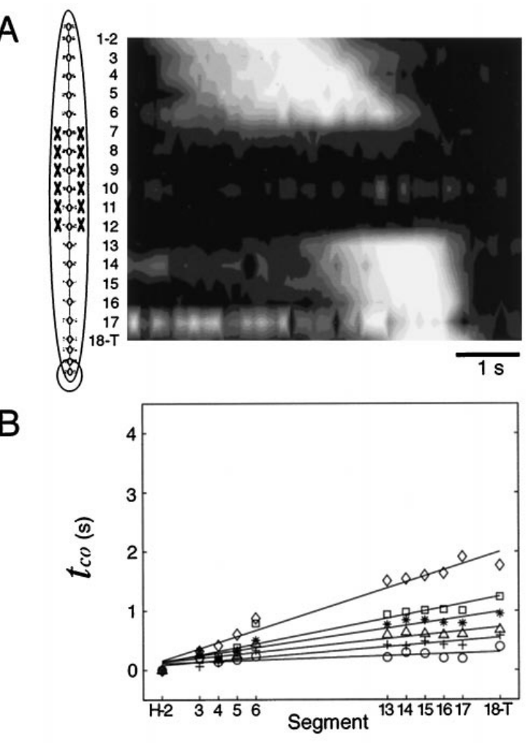
Crawl waves can cross denervated body segments
Cacciatore and colleagues cut the peripheral nerve roots of segments 7–12 while preserving the central connectives that linked their ganglia with the rest of the cord.
  The operation denervated those body regions, removing their normal neural input to muscles and their sensory communication back to the ganglia. Central axons could still pass through the operated region and connect neural circuits on its anterior and posterior sides.
The denervated body segments became flaccid, while elongation and contraction waves continued through the innervated regions on both sides of the surgery.
  The relationship between intersegmental delay and step duration remained broadly continuous across the operated region. Timing could therefore pass through a stretch of cord whose associated body wall had lost its normal sensory and motor connections. The innervated posterior segments could still enter their corresponding movement phases after activity passed through the centrally connected but peripherally disconnected region.
The retained central pathway carried coordination across the lesion, while sensory perturbations elsewhere could still alter the crawling sequence.
  When the investigators imposed stretch on the body, the transition between elongation and contraction became much longer. The crawl generator thus combined central propagation of the step with input from the body that adjusted the timing of its movement phases.
Cacciatore et al. (2000), Fig. 7(A,B). Movement timing after removal of peripheral innervation.
Cacciatore et al. (2000)
5
Notes:
Teaching transcript:
Cacciatore and colleagues severed the peripheral nerve roots of segments 7–12 while preserving the central connectives between ganglia. Denervation removes neural communication with the body wall. In this preparation it removed both sensory input and motor output in the operated segments, rather than selectively removing sensory neurons.
The denervated segments became flaccid, but elongation and contraction waves continued in the innervated regions on either side. Segmental delays and their relationship to step duration did not acquire a marked discontinuity across the operated region. The comparison used each animal’s movements before and after surgery.
Central communication can therefore coordinate crawl timing across a region deprived of its normal peripheral loop. This result does not establish that sensory feedback has no role in intact crawling, and it does not identify the central neurons that carry coordination across the lesion.
Connectives are axon bundles linking successive ganglia. Preserving them was essential: cutting both the nerve roots and the connectives would have confounded loss of peripheral feedback with loss of communication along the nervous system.
References:
T. W. Cacciatore; R. Rozenshteyn; W. B. Kristan Jr (2000). Kinematics and modeling of leech crawling: evidence for an oscillatory behavior produced by propagating waves of excitation. Journal of Neuroscience 20(4):1643–1655. https://doi.org/10.1523/JNEUROSCI.20-04-01643.2000
Cacciatore et al. (2000), Fig. 7(A,B). Movement timing after removal of peripheral innervation.
Figure source: https://doi.org/10.1523/JNEUROSCI.20-04-01643.2000

Slide 7
A crawl model passes excitation down the body as a wave
Cacciatore and colleagues proposed a descending excitation-chain model in which activity launched near the front of the leech passes backward through successive segmental circuits.
  A parallel descending pathway accompanies the chain, and each segment enters elongation and then contraction as the activity reaches it. The proposal addresses the measured sequence of segmental movements and the ability to vary the duration of a crawl step.
Longer delays between successive elements of the modeled chain slow the passage of the step while preserving the basic local pattern of movement.
  This reproduces the finding that slower crawling depends strongly on intersegmental delay, with comparatively stable rates of elongation and shortening within each segment. A step can therefore last longer because the sequence travels more slowly along the body. In this proposed organization, the adjustable interval lies between the recruitment of successive segmental circuits rather than in the speed of their individual muscle actions.
Central propagation in the model can cross ganglia whose peripheral roots have been cut, because the remaining connectives still transmit activity along the cord.
  That arrangement corresponds to the continuing crawl waves observed across denervated segments. Swimming has a different temporal organization, with repeated segmental oscillations held in coordinated phase relationships, whereas the crawl model organizes the progression of an adjustable step through an excitation sequence.
Cacciatore et al. (2000), Fig. 7(A,B). Movement timing after removal of peripheral innervation.
Cacciatore et al. (2000)
5a
Notes:
Slide 5 shows crawl waves crossing denervated segments; the paper's model of how a crawl step is generated makes that result expected rather than surprising.
The two behaviors reward different properties.
Cacciatore and colleagues contrast behaviors such as swimming that require regular rhythmicity and strict phase relationships with crawling, whose success depends more on flexibility.
A generator for crawling should therefore allow each step to be lengthened or shortened easily.
The model is a propagating chain, not a ring of oscillators.
An oscillator at the front starts a wave of activity that travels through excitatory neuronal chains, and a descending pathway runs alongside it.
Together these pathways reproduced the observed intersegmental lags, the coordination between phases and the range of step durations.
The comparison with swimming sharpens the distinction.
Swimming segments each oscillate and lock their phases through the connectives and, as slides 13 to 15 reveal, through the moving body.
A chain that simply relays excitation needs no local feedback to keep order, consistent with intact coordination across the denervated segments 7 to 12.
References:
T. W. Cacciatore; R. Rozenshteyn; W. B. Kristan Jr (2000). Kinematics and modeling of leech crawling: evidence for an oscillatory behavior produced by propagating waves of excitation. Journal of Neuroscience 20(4):1643–1655. https://doi.org/10.1523/JNEUROSCI.20-04-01643.2000

Slide 8
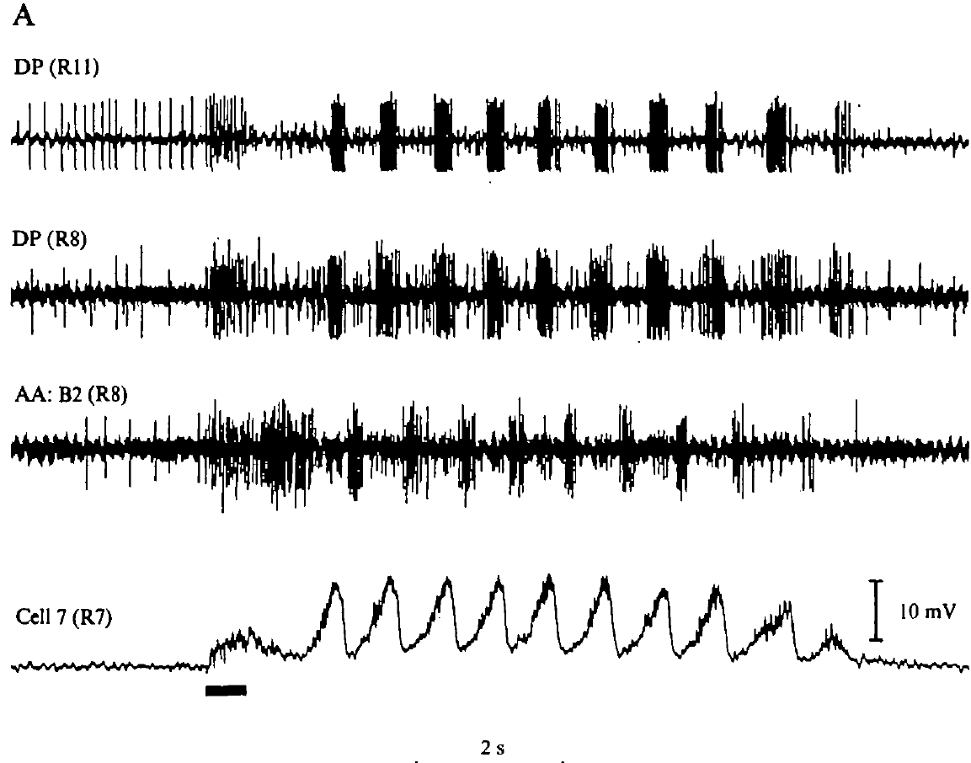
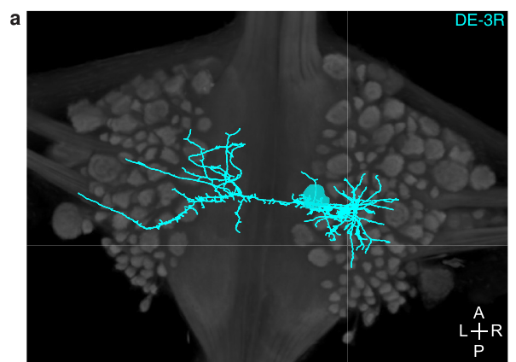
An isolated cord generates a swim-like motor rhythm
Kristan and Calabrese placed the isolated leech nerve cord in physiological saline and recorded from segmental nerves after removing its connections with the body wall.
  Brief electrical stimulation initiated repeated bursts in dorsal and ventral motor pathways. Because the cord lacked attached muscles and moving body segments, those repeated bursts arose within the remaining central nervous system.
A stimulus train of approximately 10–20 Hz for 0.5–1 s could initiate a motor episode that continued after the train ended.
  The subsequent activity alternated between dorsal and ventral pathways at a swim-like rate. Intracellular recordings also contained rhythmic changes in motor-neuron voltage, relating the extracellular nerve bursts to the membrane activity of the cells producing the output.
This centrally generated motor pattern is fictive swimming, a recognizable locomotor program recorded while the corresponding movement is absent.
  The initiating stimulus supplies excitation that starts the episode, while the cord supplies the timing of the recurring bursts. The frequency of the brief stimulus train differs from the frequency of the resulting swim rhythm, so the pattern persists through ongoing interactions in the neural circuit. The repeated motor bursts provide a neural measure of the program within the isolated preparation, where the motor pathways remain recordable after removal of the muscles and body wall that normally produce swimming movement.
Kristan & Calabrese (1976), Fig. 1(A). Motor-nerve bursts and intracellular oscillations in an isolated cord.
Ashaber et al. (2021), Fig. 7(a). Reconstructed DE-3 arbor over a dorsal micro-CT image.
Kristan & Calabrese (1976); Ashaber et al. (2021)
6
Notes:
Teaching transcript:
Kristan and Calabrese removed the nerve cord from the body wall and recorded from segmental nerves in physiological saline. Brief electrical stimulation initiated repeated bursts in dorsal and ventral motor pathways. The isolated cord had no attached body capable of producing the usual stretch feedback.
A stimulus train of approximately 10–20 Hz for 0.5–1 s could initiate an episode that continued after the stimulation ended. Rhythmic motor activity resembled the pattern recorded during swimming in semi-intact animals. Intracellular motor-neuron recordings contained rhythmic membrane-potential changes associated with the nerve bursts.
The persistence of patterned activity without the peripheral body establishes a central source for the basic swim rhythm. It does not establish normal propulsion, intact sensory calibration, or a particular identified pacemaker neuron. A motor program recorded without the corresponding movement is called fictive locomotion.
An intracellular electrode records voltage within an individual neuron; an extracellular electrode records signals outside cells, here from nerve bundles. The two methods connect membrane-potential oscillations to motor impulses without requiring actual movement.
References:
W. B. Kristan Jr; R. L. Calabrese (1976). Rhythmic swimming activity in neurones of the isolated nerve cord of the leech. Journal of Experimental Biology 65(3):643–668. https://doi.org/10.1242/jeb.65.3.643
M. Ashaber; Y. Tomina; P. Kassraian; E. A. Bushong; W. B. Kristan Jr; M. H. Ellisman; D. A. Wagenaar (2021). Anatomy and activity patterns in a multifunctional motor neuron and its surrounding circuits. eLife 10:e61881. https://doi.org/10.7554/eLife.61881
Kristan & Calabrese (1976), Fig. 1(A). Motor-nerve bursts and intracellular oscillations in an isolated cord.
Figure source: https://doi.org/10.1242/jeb.65.3.643
Ashaber et al. (2021), Fig. 7(a). Reconstructed DE-3 arbor over a dorsal micro-CT image.
Figure source: https://doi.org/10.7554/eLife.61881

Slide 9
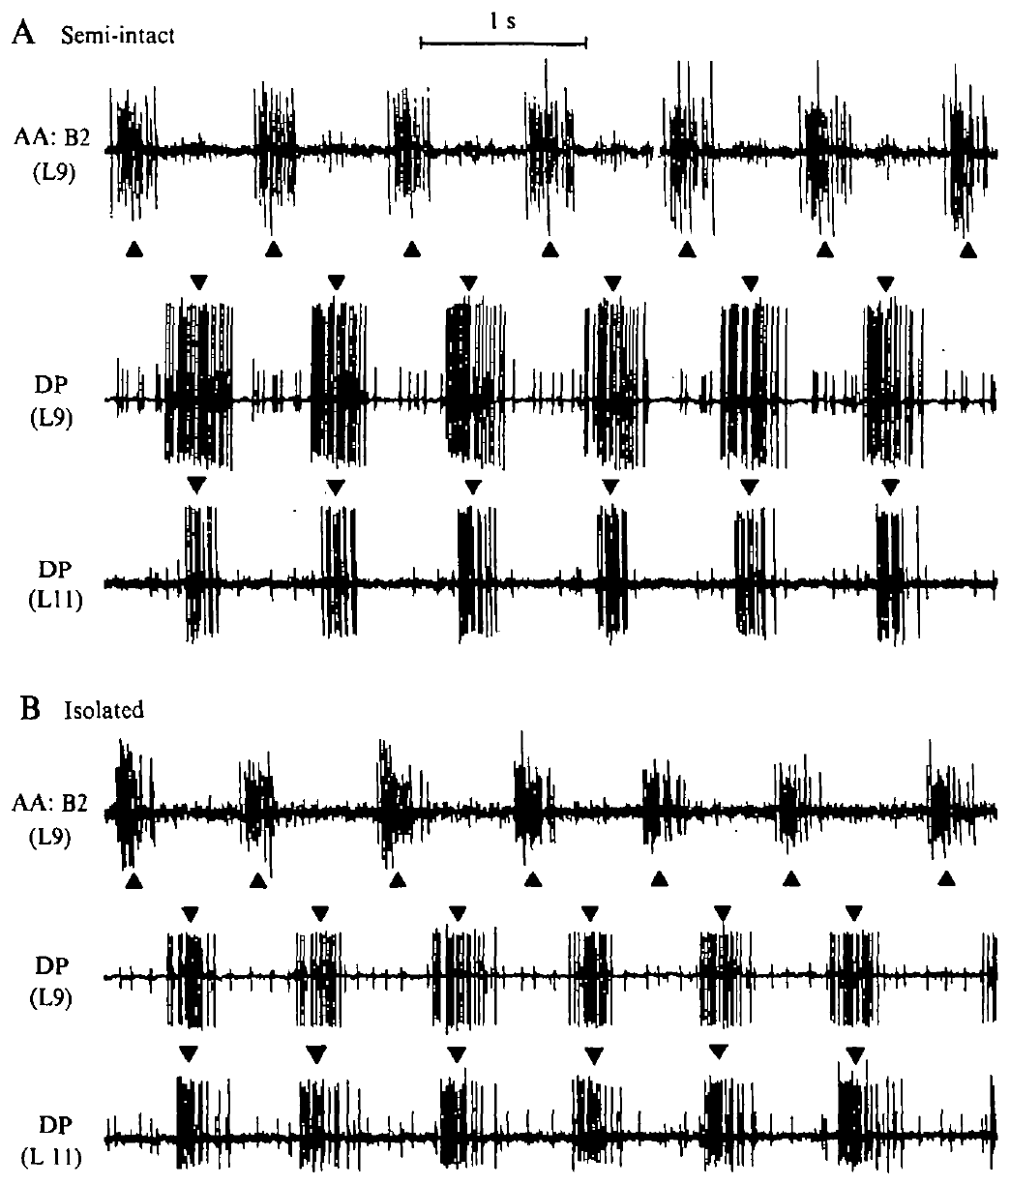
The same preparation retains rhythm after isolation
Kristan and Calabrese followed a swimming preparation as its remaining body wall was disconnected, keeping recordings from the same identified motor nerves.
  Before complete isolation, the semi-intact preparation retained peripheral tissue capable of movement and feedback. Removing that tissue left the central cord and its motor-nerve recordings available for following the continuing rhythm.
Bursts in the dorsal and ventral excitor pathways continued to alternate after the final peripheral connections were removed.
  In an example semi-intact recording, the swim cycle lasted about 1 s, with corresponding dorsal bursts in two segments separated by approximately 50 ms. Following the same pathways through isolation preserved the identity of the outputs used to recognize the motor pattern.
The researchers measured burst timing from the midpoint of each burst, giving a consistent reference even when burst duration changed.
  Equivalent events in successive cycles defined the cycle period, while equivalent events in different segments defined their delay. These measurements allowed the ongoing central alternation to be described alongside the changes in timing that followed removal of input from the body. A longer burst can change its first-spike timing even when its midpoint retains a comparable position, making the chosen event relevant to interpreting phase relationships.
Ashaber et al. (2021), Fig. 7(a). Reconstructed DE-3 arbor over a dorsal micro-CT image.
Kristan & Calabrese (1976), Fig. 2(A,B). Semi-intact and subsequently isolated motor-nerve recordings.
Kristan & Calabrese (1976); Ashaber et al. (2021)
7
Notes:
Teaching transcript:
Kristan and Calabrese first recorded a swimming rhythm from a semi-intact preparation and then disconnected its remaining body wall. Semi-intact means that part of the animal remains capable of movement while another part is opened for recording. Keeping the same recording nerves permitted comparison before and after isolation.
Dorsal-excitor and ventral-excitor bursts continued to alternate after the cord was separated from peripheral tissue. In the illustrated semi-intact recording the cycle period was about 1 s, and homologous dorsal bursts in two segments were separated by approximately 50 ms.
The within-preparation comparison strengthens the interpretation that central circuitry can generate the alternating pattern. It also reveals why preserving a recognizable rhythm is different from preserving every aspect of normal timing. Peripheral removal can alter phase relationships even when the central oscillation remains active.
A cycle period is the interval between successive equivalent events in one rhythm. The investigators used burst midpoints rather than the first spike alone, making their timing definition consistent across bursts of differing duration.
References:
W. B. Kristan Jr; R. L. Calabrese (1976). Rhythmic swimming activity in neurones of the isolated nerve cord of the leech. Journal of Experimental Biology 65(3):643–668. https://doi.org/10.1242/jeb.65.3.643
M. Ashaber; Y. Tomina; P. Kassraian; E. A. Bushong; W. B. Kristan Jr; M. H. Ellisman; D. A. Wagenaar (2021). Anatomy and activity patterns in a multifunctional motor neuron and its surrounding circuits. eLife 10:e61881. https://doi.org/10.7554/eLife.61881
Kristan & Calabrese (1976), Fig. 2(A,B). Semi-intact and subsequently isolated motor-nerve recordings.
Figure source: https://doi.org/10.1242/jeb.65.3.643
Ashaber et al. (2021), Fig. 7(a). Reconstructed DE-3 arbor over a dorsal micro-CT image.
Figure source: https://doi.org/10.7554/eLife.61881

Slide 10
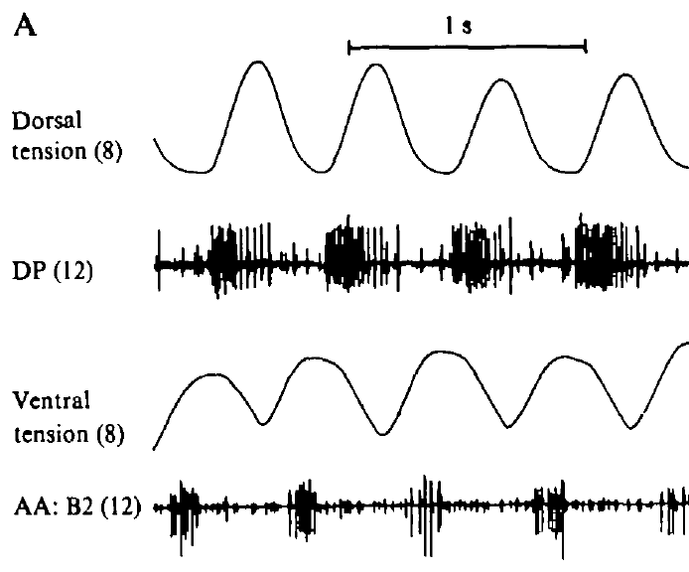
Motor bursts predict alternating muscle contractions
Kristan and Calabrese retained one innervated body segment while isolating the remaining cord, allowing muscle contraction to be recorded together with centrally generated motor activity.
  Tension transducers measured contractions of the dorsal and ventral longitudinal muscles in that segment. Recordings from motor nerves elsewhere along the cord followed the neural pattern that accompanied the muscle responses.
The dorsal and ventral muscle tensions rose in alternation, matching the alternating organization of the corresponding excitatory motor pathways.
  An excitor promotes contraction of its target muscle, so a dorsal burst favors bending in one direction and a ventral burst favors bending in the other. The retained segment converted the motor program into the expected alternating mechanical actions.
The recorded ganglion and the contracting segment lay at different positions along the nerve cord, so their timing included the delay associated with propagation between segments.
  Repeated dorsal–ventral alternation bends each segment up and down, while rearward progression organizes those local bends into a traveling body wave. Coordinated displacement of the wave toward the tail provides the movement pattern used in leech swimming. The local alternation supplies the bend, and the delay between regions determines where that bend lies relative to the rest of the swimming body.
Ashaber et al. (2021), Fig. 7(a). Reconstructed DE-3 arbor over a dorsal micro-CT image.
Kristan & Calabrese (1976), Fig. 3(A). Body-wall tension and motor-nerve activity in a nearly isolated preparation.
Kristan & Calabrese (1976); Ashaber et al. (2021)
8
Notes:
Teaching transcript:
Kristan and Calabrese retained one innervated body segment while separating the rest of the nerve cord from the periphery. Tension transducers measured the dorsal and ventral longitudinal muscle contractions in that segment. Motor-nerve activity was recorded from another ganglion along the cord.
Dorsal and ventral tension rose in alternating phases. Bursts in the corresponding excitatory motor pathways were related to the matching muscle contractions. The body-wall segment and recorded ganglion were separated spatially, so their events included the delay associated with propagation along the cord.
An excitor is a motor neuron whose output promotes contraction of its target muscle. The agreement between nerve timing and tension links the electrical pattern to the expected motor action. It does not make an isolated nerve recording a direct measure of swimming thrust or whole-animal displacement.
An inhibitory motor neuron can relax the matching muscle territory and inhibit its excitatory motor neurons. Alternating excitation and inhibition organize contraction across the dorsal and ventral body wall rather than simply turning every motor neuron on together.
References:
W. B. Kristan Jr; R. L. Calabrese (1976). Rhythmic swimming activity in neurones of the isolated nerve cord of the leech. Journal of Experimental Biology 65(3):643–668. https://doi.org/10.1242/jeb.65.3.643
M. Ashaber; Y. Tomina; P. Kassraian; E. A. Bushong; W. B. Kristan Jr; M. H. Ellisman; D. A. Wagenaar (2021). Anatomy and activity patterns in a multifunctional motor neuron and its surrounding circuits. eLife 10:e61881. https://doi.org/10.7554/eLife.61881
Kristan & Calabrese (1976), Fig. 3(A). Body-wall tension and motor-nerve activity in a nearly isolated preparation.
Figure source: https://doi.org/10.1242/jeb.65.3.643
Ashaber et al. (2021), Fig. 7(a). Reconstructed DE-3 arbor over a dorsal micro-CT image.
Figure source: https://doi.org/10.7554/eLife.61881

Slide 11
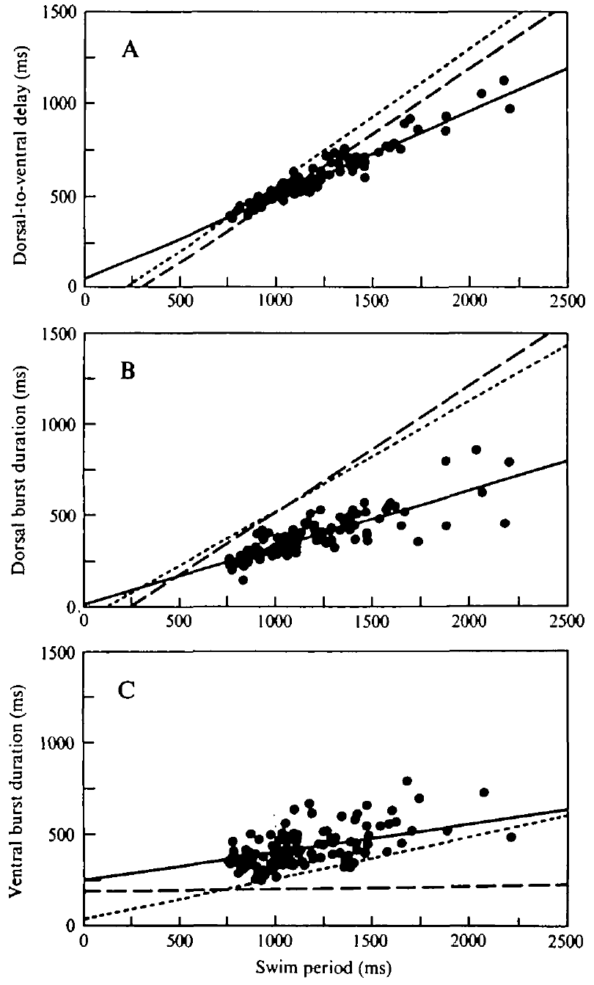
Isolation changes dorsal–ventral timing relationships
The phase of a motor burst describes where it occurs within the repeating swim cycle, allowing dorsal and ventral timing to be followed as the cycle becomes faster or slower.
  Kristan and Calabrese measured the interval between these bursts over different periods. Some isolated cords retained period-dependent delays, while others maintained a more nearly constant fractional phase relationship.
In semi-intact preparations, the duration of a dorsal-excitor burst increased more strongly with cycle period than in isolated preparations expressing the constant-phase pattern.
  Ventral-excitor burst duration depended less strongly on period and differed less between the timing states. Removal of peripheral tissue therefore altered particular components of the burst pattern within an ongoing central rhythm.
Sensory input from the attached body wall contributes to the phasing of dorsal and ventral activity, changing when each muscle group becomes active during a cycle.
  A fixed fractional phase lag occupies the same proportion of each cycle, so its absolute duration grows as the cycle becomes longer. Tracking both time delay and fractional phase describes how the neural pattern is calibrated across swimming speeds. An unchanged delay in milliseconds instead occupies a smaller fraction of a slow cycle, so the two timing rules produce different patterns as swimming rate changes.
Ashaber et al. (2021), Fig. 7(a). Reconstructed DE-3 arbor over a dorsal micro-CT image.
Kristan & Calabrese (1976), Fig. 5(A–C). Measured phase-delay and burst-duration relationships.
Kristan & Calabrese (1976); Ashaber et al. (2021)
9
Notes:
Teaching transcript:
Phase describes the position of an event within a repeating cycle. Kristan and Calabrese compared dorsal-to-ventral burst delays over different swim periods. Some isolated preparations retained period-dependent delays, whereas others expressed an approximately constant fractional phase lag.
In semi-intact preparations, dorsal-excitor burst duration increased more strongly with cycle period. In constant-phase isolated preparations, its dependence on period was weaker. Ventral-excitor burst duration was comparatively less dependent on cycle period and did not distinguish the two timing states in the same way.
Central rhythm production and normal phase calibration are separate properties. The study supports a contribution of peripheral input to the timing relationships expressed during swimming. Isolation does not force every preparation into an identical state, and the comparisons do not identify a single receptor or synaptic connection responsible for the change.
A time delay in milliseconds and a phase lag as a fraction of the cycle are related measurements, but they answer different questions. A fixed fraction requires the absolute delay to grow when the cycle becomes longer.
References:
W. B. Kristan Jr; R. L. Calabrese (1976). Rhythmic swimming activity in neurones of the isolated nerve cord of the leech. Journal of Experimental Biology 65(3):643–668. https://doi.org/10.1242/jeb.65.3.643
M. Ashaber; Y. Tomina; P. Kassraian; E. A. Bushong; W. B. Kristan Jr; M. H. Ellisman; D. A. Wagenaar (2021). Anatomy and activity patterns in a multifunctional motor neuron and its surrounding circuits. eLife 10:e61881. https://doi.org/10.7554/eLife.61881
Kristan & Calabrese (1976), Fig. 5(A–C). Measured phase-delay and burst-duration relationships.
Figure source: https://doi.org/10.1242/jeb.65.3.643
Ashaber et al. (2021), Fig. 7(a). Reconstructed DE-3 arbor over a dorsal micro-CT image.
Figure source: https://doi.org/10.7554/eLife.61881

Slide 12
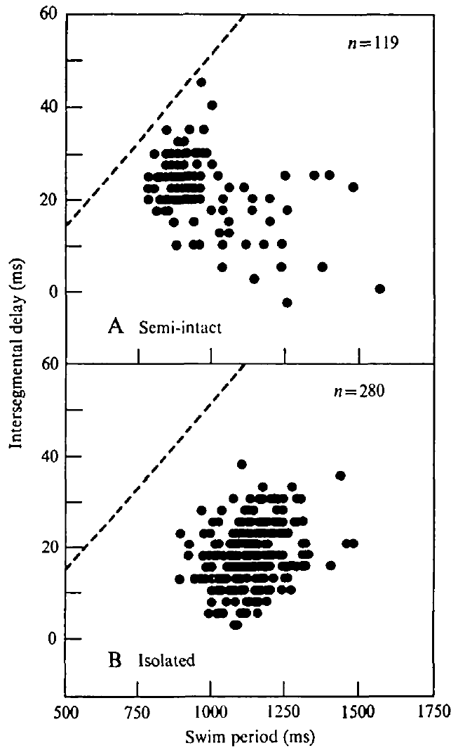
Central delays do not fully reproduce the intact wave
An intersegmental delay measures the separation between equivalent bursts in different ganglia, expressing how the motor pattern progresses along the nerve cord.
  Kristan and Calabrese recorded homologous dorsal-excitor activity in separated segments and calculated the delay per segment. Posterior bursts generally followed anterior bursts, giving the centrally generated pattern its rearward direction.
Semi-intact and isolated cords expressed shorter delays than those inferred from the traveling movements of intact swimming leeches.
  In intact animals, the delay increased clearly with cycle period, whereas that relationship was absent in the reduced preparations. The cord retained a recognizable rhythmic sequence while its progression along the body changed with the available peripheral connections.
Kristan and Calabrese proposed that sensory feedback matches propagation delay to cycle period, helping preserve the shape of the intact swimming wave across speeds.
  When delay grows together with period, the phase lag per segment remains approximately constant. Successive regions then occupy corresponding positions within the body wave even as the animal completes its strokes more quickly or more slowly. This proportional relationship links the repeating neural output with the spatial progression of the body wave, allowing the animal to retain similar bending relationships at different stroke rates.
Ashaber et al. (2021), Fig. 7(a). Reconstructed DE-3 arbor over a dorsal micro-CT image.
Kristan & Calabrese (1976), Fig. 6(A,B). Intersegmental motor-burst delay versus swim period.
Kristan & Calabrese (1976); Ashaber et al. (2021)
10
Notes:
Teaching transcript:
Intersegmental delay is the time separating equivalent activity in different segments. Kristan and Calabrese recorded homologous dorsal-excitor bursts from separated ganglia and expressed the resulting delay per segment. Posterior bursts generally followed anterior bursts, consistent with a rearward-moving motor pattern.
Delays in semi-intact and isolated cords were shorter than the delays inferred from intact swimming movements. The clear increase of intact movement delay with cycle period was absent in the reduced preparations. Their delay distributions remained variable despite a recognizable central rhythm.
A chain of centrally coupled neurons can generate directional timing without recreating the complete intact body wave. Peripheral feedback can adjust the relationship between propagation and period. The preparation comparison supports that contribution, but differences in movement and nerve-recording measures also limit a direct numerical equivalence.
In intact animals the traveling wave is measured through body movement; in the isolated cord it is measured through motor impulses. The study explicitly compares these related levels without treating their delays as automatically identical.
References:
W. B. Kristan Jr; R. L. Calabrese (1976). Rhythmic swimming activity in neurones of the isolated nerve cord of the leech. Journal of Experimental Biology 65(3):643–668. https://doi.org/10.1242/jeb.65.3.643
M. Ashaber; Y. Tomina; P. Kassraian; E. A. Bushong; W. B. Kristan Jr; M. H. Ellisman; D. A. Wagenaar (2021). Anatomy and activity patterns in a multifunctional motor neuron and its surrounding circuits. eLife 10:e61881. https://doi.org/10.7554/eLife.61881
Kristan & Calabrese (1976), Fig. 6(A,B). Intersegmental motor-burst delay versus swim period.
Figure source: https://doi.org/10.1242/jeb.65.3.643
Ashaber et al. (2021), Fig. 7(a). Reconstructed DE-3 arbor over a dorsal micro-CT image.
Figure source: https://doi.org/10.7554/eLife.61881

Slide 13
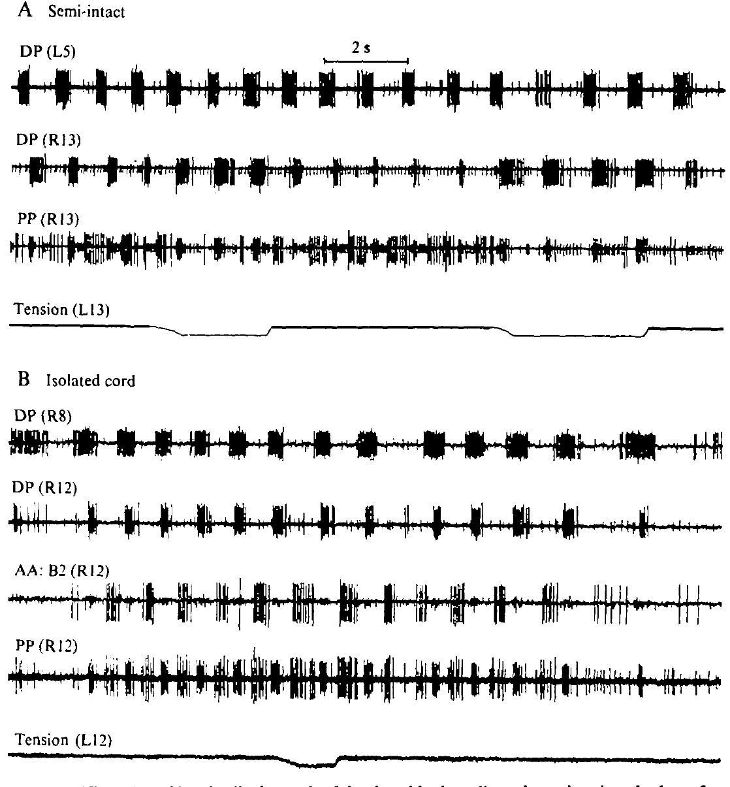
Stretch modifies bursts differently across preparations
Kristan and Calabrese stretched a dorsal body-wall flap while recording the swim rhythm, applying a controlled mechanical input to the remaining sensory pathways.
  The flap was attached to a tension transducer so that its stretch could be imposed during motor activity. This manipulation provided movement-related feedback to a nervous system already expressing the swimming pattern.
In semi-intact preparations, stretch prolonged dorsal-excitor bursts and shortened ventral-excitor bursts, sometimes suppressing the ventral burst during the perturbation.
  The ongoing cycle could retain its general period while the distribution of activity within that cycle changed. Stretch therefore changed the time allocated to opposing muscle pathways as the pattern continued.
When little peripheral tissue remained, the same kind of stretch could lengthen the period of the whole cord, and stronger perturbations could stop the episode.
  The effect depended on the preparation and the strength of the input. Sensory signals arriving through one retained region had a larger influence on the shared timing when the cord had lost the stabilizing input normally supplied by many moving segments. The same sensory event can therefore reshape one portion of a cycle or alter the interval between cycles, depending on the remaining inputs stabilizing the preparation.
Ashaber et al. (2021), Fig. 7(a). Reconstructed DE-3 arbor over a dorsal micro-CT image.
Kristan & Calabrese (1976), Fig. 9(A,B). Body-wall stretch during semi-intact and nearly isolated rhythms.
Kristan & Calabrese (1976); Ashaber et al. (2021)
11
Notes:
Teaching transcript:
Kristan and Calabrese attached a dorsal body-wall flap to a tension transducer and imposed longitudinal stretch during swimming activity. Sensory feedback is information generated by the body or environment that returns to the neural controller. Stretch provided a controlled perturbation rather than relying on spontaneous changes in movement.
In the semi-intact preparation, stretch prolonged dorsal-excitor bursts and shortened, or sometimes abolished, ventral-excitor bursts without changing the cycle period. In a nearly isolated preparation retaining one innervated segment, moderate stretch changed burst durations and could lengthen the overall period.
Feedback can alter both the motor output and, under reduced conditions, the rhythm-generating network. The experiment does not establish one uniform effect of stretch under every condition. The remaining innervation and the extent of peripheral removal determine which feedback pathways can influence the rhythm.
A weak or moderate stretch and a strong stretch need not produce the same outcome. The source reports that stronger perturbations could stop the rhythm, so period lengthening is not an unrestricted linear rule.
References:
W. B. Kristan Jr; R. L. Calabrese (1976). Rhythmic swimming activity in neurones of the isolated nerve cord of the leech. Journal of Experimental Biology 65(3):643–668. https://doi.org/10.1242/jeb.65.3.643
M. Ashaber; Y. Tomina; P. Kassraian; E. A. Bushong; W. B. Kristan Jr; M. H. Ellisman; D. A. Wagenaar (2021). Anatomy and activity patterns in a multifunctional motor neuron and its surrounding circuits. eLife 10:e61881. https://doi.org/10.7554/eLife.61881
Kristan & Calabrese (1976), Fig. 9(A,B). Body-wall stretch during semi-intact and nearly isolated rhythms.
Figure source: https://doi.org/10.1242/jeb.65.3.643
Ashaber et al. (2021), Fig. 7(a). Reconstructed DE-3 arbor over a dorsal micro-CT image.
Figure source: https://doi.org/10.7554/eLife.61881

Slide 14
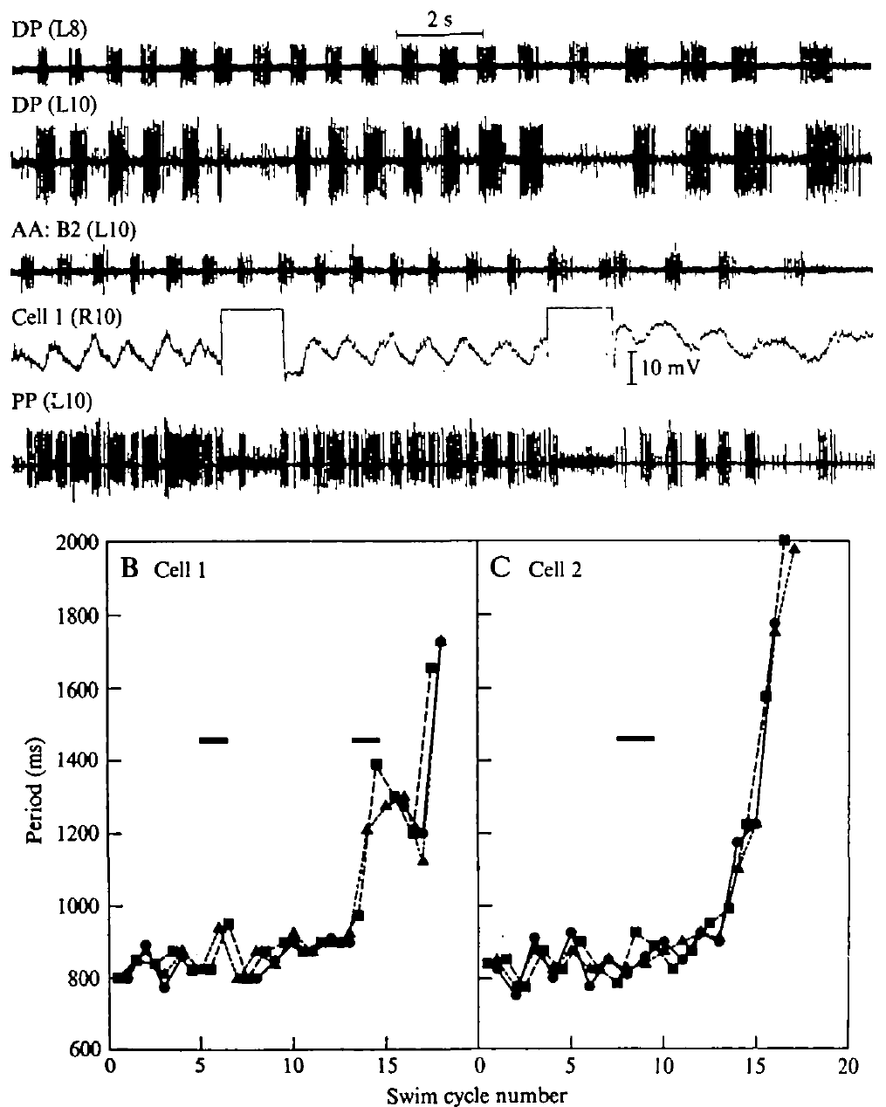
A dorsal inhibitor can slow the isolated swim rhythm
The dorsal inhibitor, cell 1, acts on a longitudinal motor pathway and can also influence the rhythm expressed by the isolated leech cord.
  Kristan and Calabrese injected depolarizing current into identified inhibitory motor neurons during swimming episodes. Stimulation of cell 1 suppressed the associated dorsal excitor locally while motor recordings followed the effect in other ganglia.
Activating cell 1 lengthened the swim period across the cord, including activity recorded two segments away from the stimulated neuron.
  In one episode, the period increased from approximately 825 to 940 ms during the first current passage. The local intervention therefore changed the timing of a distributed pattern as well as the activity of the nearby motor pathway. A distant change in period relates the activated cell to the shared timing process, extending its influence beyond suppression of the adjacent dorsal motor pathway.
Comparable stimulation of the ventral inhibitor, cell 2, left the period largely unchanged, and cell 1 had a different effect when more peripheral tissue remained attached.
  The cell 1 response resembled the period lengthening produced by stretch in a reduced preparation. Kristan and Calabrese proposed that these inputs converge on a route into the oscillator, with the surrounding sensory state influencing how strongly that route changes the rhythm.
Ashaber et al. (2021), Fig. 7(a). Reconstructed DE-3 arbor over a dorsal micro-CT image.
Kristan & Calabrese (1976), Fig. 8(A–C). Effects of current injection into identified inhibitory motor neurons.
Kristan & Calabrese (1976); Ashaber et al. (2021)
12
Notes:
Teaching transcript:
Kristan and Calabrese injected depolarizing current into identified motor neurons during an isolated-cord swim episode. Depolarization moves membrane voltage toward a less negative value and can increase firing. The dorsal inhibitor, cell 1, was stimulated strongly enough to suppress the associated dorsal excitor locally.
Cell 1 stimulation lengthened the period across the cord, including a recording two segments away. In one episode, the period increased from approximately 825 to 940 ms during the first current passage. Comparable stimulation of the ventral inhibitor, cell 2, did not produce the same period change.
The effect is specific evidence that cell 1 can influence the isolated oscillator, rather than proof that every motor neuron is a rhythm generator. The same manipulation did not reset period in the semi-intact preparation. Network state and peripheral input therefore constrain the behavioral significance of this feedback route.
An inhibitor can influence the motor pattern through more than its peripheral muscle connection. Current injection tests the functional effect of activating the identified cell; it does not by itself reveal all intervening synapses.
References:
W. B. Kristan Jr; R. L. Calabrese (1976). Rhythmic swimming activity in neurones of the isolated nerve cord of the leech. Journal of Experimental Biology 65(3):643–668. https://doi.org/10.1242/jeb.65.3.643
M. Ashaber; Y. Tomina; P. Kassraian; E. A. Bushong; W. B. Kristan Jr; M. H. Ellisman; D. A. Wagenaar (2021). Anatomy and activity patterns in a multifunctional motor neuron and its surrounding circuits. eLife 10:e61881. https://doi.org/10.7554/eLife.61881
Kristan & Calabrese (1976), Fig. 8(A–C). Effects of current injection into identified inhibitory motor neurons.
Figure source: https://doi.org/10.1242/jeb.65.3.643
Ashaber et al. (2021), Fig. 7(a). Reconstructed DE-3 arbor over a dorsal micro-CT image.
Figure source: https://doi.org/10.7554/eLife.61881

Slide 15
Stepwise reduction assigns each swim feature to its source
Alternating dorsal and ventral motor bursts persist as the leech preparation is reduced from a semi-intact animal to a completely isolated cord.
  Kristan and Calabrese also examined cords retaining a single innervated segment, preserving a restricted source of feedback. Across these preparations, recurring motor alternation remained a property of the central circuitry that survived peripheral removal.
The relationship between intersegmental delay and swim period was strongest in the intact moving animal, while dorsal–ventral phasing changed after complete isolation.
  These findings assign different aspects of the motor pattern to interactions with the body. The central system generates recurrent activity, and returning sensory signals adjust the timing through which successive muscles and segments participate in that activity.
Stretch and cell 1 stimulation produced larger changes in the shared cycle period when the preparation retained little peripheral tissue.
  With many body segments attached, their effects were concentrated more strongly on burst shape and local timing. Input from multiple moving regions therefore stabilizes the distributed rhythm while still allowing sensory events to reshape the contraction pattern within individual cycles. The centrally recurring sequence and its peripheral calibration therefore contribute different features to the motor output recorded during the same swim episode.
Kristan & Calabrese (1976), Fig. 9(A,B). Body-wall stretch during semi-intact and nearly isolated rhythms.
Kristan & Calabrese (1976)
12a
Notes:
Slides 6 to 12 each compare two preparations; lined up together, they form a ladder of reduction that sorts the swim pattern into central and sensory components.
The design holds measurement constant and varies the body.
Kristan and Calabrese recorded motor nerves at every level, from the semi-intact animal down to the completely isolated cord, and compared them with movements of intact swimmers.
Changes between levels can then be attributed to the tissue removed rather than to a different way of measuring.
Each feature has a level where it disappears.
The alternating rhythm on slides 6 and 7 never disappears, the period dependence of intersegmental delay on slide 10 is missing from both reduced preparations, and the phase relations on slide 9 differ between semi-intact and isolated cords.
The authors conclude that sensory input determines dorsal-ventral phasing and matches delay to period.
Perturbations reveal a stabilizing role.
Stretch on slide 11 and cell 1 stimulation on slide 12 change only burst durations in the semi-intact preparation but change the period of the whole cord when little periphery remains.
Kristan and Calabrese interpret this as sensory input stabilizing the centrally generated rhythm.
References:
W. B. Kristan Jr; R. L. Calabrese (1976). Rhythmic swimming activity in neurones of the isolated nerve cord of the leech. Journal of Experimental Biology 65(3):643–668. https://doi.org/10.1242/jeb.65.3.643

Slide 16
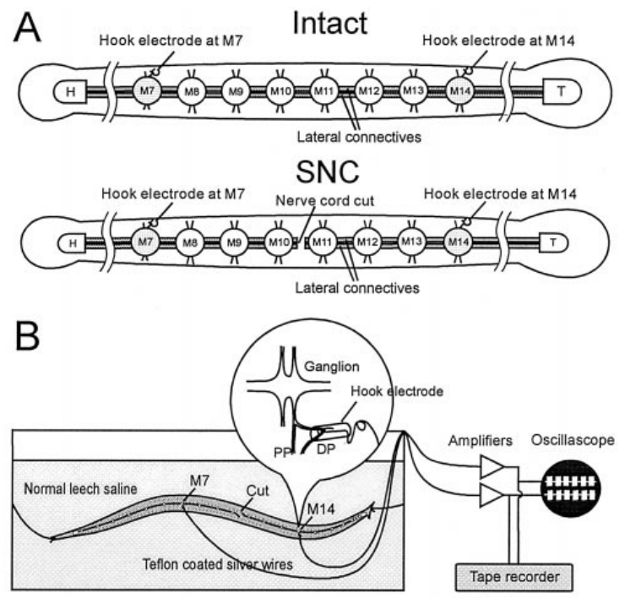
Implanted electrodes connect swim impulses to movement
Yu and colleagues implanted hook electrodes on dorsal posterior nerves so that DE-3 motor bursts could be recorded while leeches continued to move.
  DE-3 is an identified dorsal longitudinal excitor whose impulses form the largest motor unit in these nerves. Combining implanted recordings with video related the electrical timing of dorsal output to the traveling body wave.
The investigators cut the central nerve cord between midbody ganglia M10 and M11, with recordings at M7 and M14 positioned on opposite sides of the interruption.
  This transection severed direct central communication across the lesion while leaving the body continuous. Muscles and sensory receptors could still interact mechanically through the moving animal and return information to the surviving cord regions.
The preparation preserved the peripheral route by which movement in one region could influence motor activity on the other side of the cut.
  Earlier work had emphasized central intersegmental connections in swim coordination. Recording neural output during actual movement made it possible to follow how the two separated central regions behaved when their common body continued to bend through a swim cycle. This arrangement kept a possible sensory coupling route available on both sides, because each separated neural region still received information from its attached moving segments.
Ashaber et al. (2021), Fig. 7(a). Reconstructed DE-3 arbor over a dorsal micro-CT image.
Yu et al. (1999), Fig. 2(A,B). Original recording preparation and implanted-electrode experiment.
Yu et al. (1999); Ashaber et al. (2021)
13
Notes:
Teaching transcript:
Yu and colleagues implanted hook electrodes on dorsal posterior nerves in leeches whose bodies could still move. The largest motor unit in these nerves was used to monitor the dorsal excitor DE-3. Video and electrical recordings linked the progression of the body wave with activity on either side of a central cord transection.
The cord was cut between midbody ganglia M10 and M11. Recording sites at M7 and M14 bracketed the interruption. Intact preparations and preparations with a severed cord provided the critical comparison while retaining peripheral muscles and sensory receptors.
This design tests whether coordination can cross a central interruption through routes associated with the moving body. It does not isolate one stretch receptor or one reflex pathway. The implanted signals provide direct motor timing while the behavioral records establish whether the body remained coordinated.
A transection is a surgical cut through a neural pathway. The lesion severed the connecting nerve cord while leaving the surrounding body continuous, which differs fundamentally from separating the animal into two physical halves.
References:
X. Yu; B. Nguyen; W. O. Friesen (1999). Sensory feedback can coordinate the swimming activity of the leech. Journal of Neuroscience 19(11):4634–4643. https://doi.org/10.1523/JNEUROSCI.19-11-04634.1999
M. Ashaber; Y. Tomina; P. Kassraian; E. A. Bushong; W. B. Kristan Jr; M. H. Ellisman; D. A. Wagenaar (2021). Anatomy and activity patterns in a multifunctional motor neuron and its surrounding circuits. eLife 10:e61881. https://doi.org/10.7554/eLife.61881
Yu et al. (1999), Fig. 2(A,B). Original recording preparation and implanted-electrode experiment.
Figure source: https://doi.org/10.1523/JNEUROSCI.19-11-04634.1999
Ashaber et al. (2021), Fig. 7(a). Reconstructed DE-3 arbor over a dorsal micro-CT image.
Figure source: https://doi.org/10.7554/eLife.61881

Slide 17
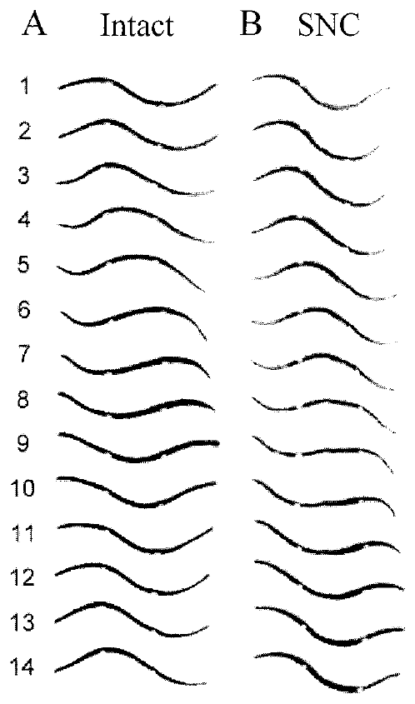
Body continuity permits swimming after cord transection
Leeches with a cord transection between M10 and M11 retained a rearward-moving body wave that passed through regions on both sides of the lesion.
  Yu and colleagues followed beads at M7 and M14 to measure the timing of wave troughs and crests before and after surgery. The markers preserved identifiable body locations as the animal changed shape.
The phase lag between M7 and M14 increased from roughly 147° to 170° after transection, and the animals swam more slowly.
  Their continuing body wave therefore had altered timing across the cut, with posterior motion following anterior motion after a larger fraction of the cycle. The whole-body pattern persisted while the speed and precision of its coordination changed.
When the researchers subsequently separated the animals into anterior and posterior halves, the coordinated wave disappeared across those physically disconnected regions.
  Maintaining body continuity had provided the remaining route for coupling after the neural pathway was interrupted. Movement of the shared body could deform neighboring regions and activate sensory pathways that aligned the rhythms generated by the surviving central circuits. A bend generated anteriorly can alter the mechanical state farther back, giving the posterior sensory pathways information about motion initiated by the other cord region.
Yu et al. (1999), Fig. 3(A,B). Measured body-wave sequences before and after a central cut.
Yu et al. (1999)
14
Notes:
Teaching transcript:
Yu and colleagues videotaped the same leeches before and after cutting the nerve cord between M10 and M11. Beads placed at M7 and M14 allowed timing of troughs and crests at defined body locations. Unimplanted controls and animals with beads helped separate surgery effects from effects of the movement markers.
The severed-cord animals could retain a rearward-progressing body wave spanning the lesion. Their phase lag between M7 and M14 increased from roughly 147° before the cut to roughly 170° afterward. They also swam more slowly, so persistence of coordination did not mean normal performance was fully preserved.
A continuous body provides a route through which movement-dependent feedback can coordinate separated central regions. The result supports peripheral coordination when direct central communication is interrupted. It does not imply that the intact animal normally dispenses with central intersegmental connections.
The investigators later cut the animals physically into anterior and posterior halves. Those halves lacked the coordinated whole-body wave, strengthening the interpretation that continuity of the peripheral body matters after the neural lesion.
References:
X. Yu; B. Nguyen; W. O. Friesen (1999). Sensory feedback can coordinate the swimming activity of the leech. Journal of Neuroscience 19(11):4634–4643. https://doi.org/10.1523/JNEUROSCI.19-11-04634.1999
Yu et al. (1999), Fig. 3(A,B). Measured body-wave sequences before and after a central cut.
Figure source: https://doi.org/10.1523/JNEUROSCI.19-11-04634.1999

Slide 18
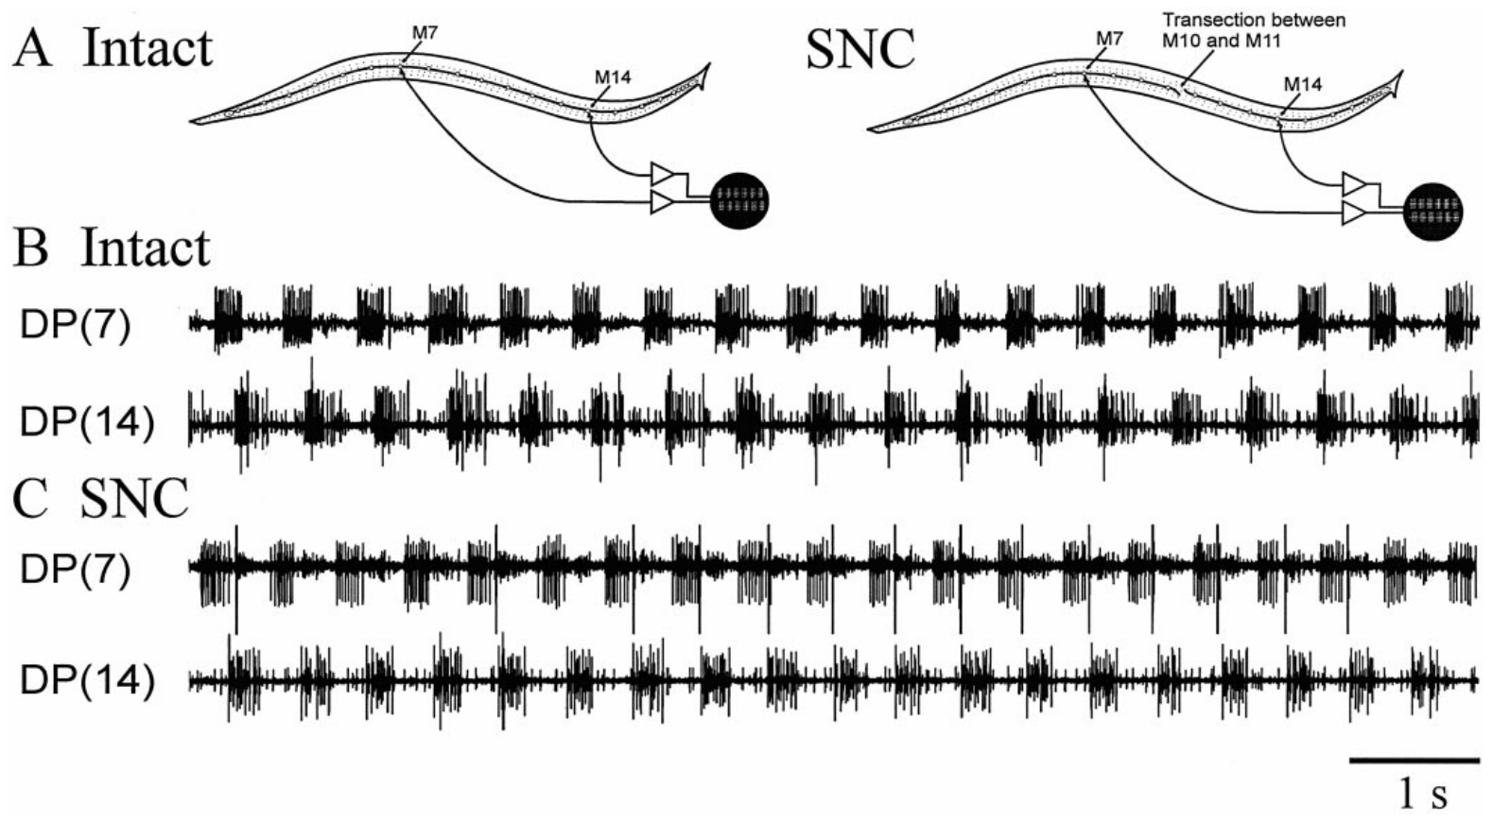
Motor recordings confirm coordination across the lesion
Implanted recordings from M7 and M14 followed the phase of DE-3 bursts on opposite sides of the central transection while the leech expressed swimming movements.
  Yu and colleagues retained the same recording sites before and after the cut, allowing each region's motor output to be followed through the intervention. Video established the body movement accompanying the recorded neural sequence.
The motor bursts remained phase related across the severed cord, although their lag was larger and more variable than before surgery.
  Comparable coordination was absent when direct intersegmental connections were interrupted in an isolated cord lacking the moving body. The attached animal therefore supplied a route through which the separated neural regions could continue to influence one another.
Yu and colleagues concluded that sensory feedback can coordinate swimming after direct central communication between the regions has been interrupted.
  Each surviving cord region still contains central circuitry capable of generating rhythmic activity. Signals arising from the shared body's movement align those local rhythms, combining central production of each motor cycle with peripheral coupling of the regions participating in the wave. The motor records establish that the coordinated movement included related neural timing, with posterior excitor bursts occupying a repeatable position in the anterior cycle.
Yu et al. (1999), Fig. 6(A–C). In situ motor-nerve records in intact and severed-cord leeches.
Ashaber et al. (2021), Fig. 7(a). Reconstructed DE-3 arbor over a dorsal micro-CT image.
Yu et al. (1999); Ashaber et al. (2021)
15
Notes:
Teaching transcript:
Yu and colleagues compared DE-3 burst timing at M7 and M14 while the body moved. This electrical measurement tested whether apparent coordination in video corresponded to coordinated neural output. The same implanted sites could be examined before and after the midbody nerve cord was cut.
Motor bursts remained phase related across the cut while the animal expressed coordinated swimming. The lag was larger and more variable than in intact preparations. Isolated cords whose direct intersegmental connections were severed lacked the comparable coordination available when the body was present.
The combined electrical and behavioral evidence supports feedback-dependent coupling between disconnected central regions. It does not establish that muscles alone transmit the signal without sensory neurons. The relevant peripheral route includes body mechanics and the return of movement-related information to each remaining neural circuit.
A motor rhythm can remain centrally generated within each cord region while sensory signals coordinate the regions. Central generation and feedback-dependent coordination are compatible properties of the same behavior.
References:
X. Yu; B. Nguyen; W. O. Friesen (1999). Sensory feedback can coordinate the swimming activity of the leech. Journal of Neuroscience 19(11):4634–4643. https://doi.org/10.1523/JNEUROSCI.19-11-04634.1999
M. Ashaber; Y. Tomina; P. Kassraian; E. A. Bushong; W. B. Kristan Jr; M. H. Ellisman; D. A. Wagenaar (2021). Anatomy and activity patterns in a multifunctional motor neuron and its surrounding circuits. eLife 10:e61881. https://doi.org/10.7554/eLife.61881
Yu et al. (1999), Fig. 6(A–C). In situ motor-nerve records in intact and severed-cord leeches.
Figure source: https://doi.org/10.1523/JNEUROSCI.19-11-04634.1999
Ashaber et al. (2021), Fig. 7(a). Reconstructed DE-3 arbor over a dorsal micro-CT image.
Figure source: https://doi.org/10.7554/eLife.61881

Slide 19
Two coupling routes make segment coordination redundant
Central connectives and movement-dependent sensory pathways provide two routes for coordinating segmental activity in the leech nervous system.
  Crawl waves crossed segments whose peripheral roots had been cut when the connectives remained intact. Swimming waves crossed a central transection when the surrounding body, muscles, and sensory pathways remained continuous.
These lesion results reveal redundant coupling, in which more than one pathway can sustain an organized sequence across segments.
  The retained route supports continuing movement, while its individual properties shape the resulting performance. Transected swimmers had slower movement and larger, more variable intersegmental lags, corresponding to the changed coupling available through their shared body. Redundancy concerns the retained ability to organize movement, while the larger lag describes how the surviving route changes the detailed relationship between the coordinated regions.
In an intact leech, central and peripheral pathways act together as the rhythm passes along the animal.
  Central communication provides direct interactions between ganglia, while sensory feedback conveys information about actual body deformation. The intact combination links the period of the neural rhythm with the propagation and shape of the body wave, adjusting coordination as the speed and mechanical conditions of movement change.
Yu et al. (1999), Fig. 3(A,B). Measured body-wave sequences before and after a central cut.
Cacciatore et al. (2000); Yu et al. (1999)
15a
Notes:
Slide 5 for crawling and slides 13 to 15 for swimming each cut one link between segments; placed side by side, they show two sufficient routes rather than one essential route.
The lesions spared opposite routes.
Cacciatore and colleagues cut peripheral roots in segments 7 to 12 and left the connectives; Yu and colleagues cut the connectives between M10 and M11 and left the body continuous.
Each surgery therefore tested whether the spared route could coordinate segments without the other.
Sufficiency of each route implies redundancy.
Yu and colleagues conclude that intersegmental coordination can be achieved by sensory feedback alone, without the interactions conveyed by the nerve cord.
The cost of relying on one route shows up as a phase lag that grew from about 147 to about 170 degrees and a slower swim.
Each route also supplies something the other lacks.
Kristan and Calabrese found that delay scaling with period, a feature of intact swimming, is missing from reduced cords, which points to the periphery for that adjustment.
Central connections, for their part, deliver tighter and faster coupling than the body can provide.
References:
X. Yu; B. Nguyen; W. O. Friesen (1999). Sensory feedback can coordinate the swimming activity of the leech. Journal of Neuroscience 19(11):4634–4643. https://doi.org/10.1523/JNEUROSCI.19-11-04634.1999
T. W. Cacciatore; R. Rozenshteyn; W. B. Kristan Jr (2000). Kinematics and modeling of leech crawling: evidence for an oscillatory behavior produced by propagating waves of excitation. Journal of Neuroscience 20(4):1643–1655. https://doi.org/10.1523/JNEUROSCI.20-04-01643.2000
W. B. Kristan Jr; R. L. Calabrese (1976). Rhythmic swimming activity in neurones of the isolated nerve cord of the leech. Journal of Experimental Biology 65(3):643–668. https://doi.org/10.1242/jeb.65.3.643

Slide 20
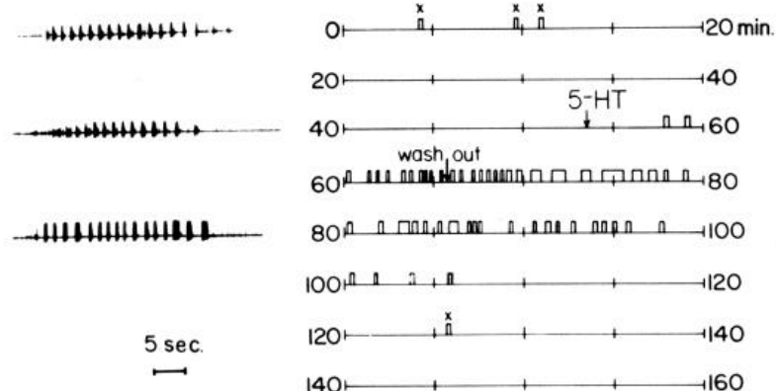
Serotonin increases the availability of the swim program
Serotonin, also called 5-hydroxytryptamine or 5-HT, changes the likelihood that the isolated leech cord expresses the swimming program.
  Willard applied the transmitter to cords in physiological saline and monitored their motor bursts. Swimming could recur without additional electrical stimulation, while a stimulus that previously produced one episode could elicit several episodes during serotonin exposure.
Concentrations of approximately 0.5–10 μM induced spontaneous swimming, and concentrations as low as 50 nM increased the number of episodes following stimulation.
  Exposure and subsequent washout followed the change in circuit state as the substance became available and was removed. The recurring bursts retained their organization through the central swim-generating circuitry.
The modulatory action makes the nervous system more ready to express a motor program, extending its influence across multiple cycles and episodes.
  Serotonin supplies a chemical state signal, while interactions within the cord determine the sequence of dorsal and ventral bursts. The resulting behavior reflects both the availability of the swim program and the timing generated once that program becomes active. A change in episode number therefore measures access to the active motor state, whereas the recurring burst interval measures the timing expressed within that state.
Willard (1981), Fig. 1. Swim episodes before, during and after serotonin exposure.
Ashaber et al. (2021), Fig. 7(a). Reconstructed DE-3 arbor over a dorsal micro-CT image.
Willard (1981); Ashaber et al. (2021)
16
Notes:
Teaching transcript:
Serotonin, also called 5-hydroxytryptamine or 5-HT, is a neurotransmitter that can modulate circuit activity. Willard applied serotonin to isolated leech nerve cords and monitored swim bursts in motor nerves. This preparation tested a neural effect without requiring a moving body.
Serotonin promoted repeated swimming episodes without additional electrical stimulation and increased responses to stimuli that previously evoked only one episode. Approximately 0.5–10 μM induced spontaneous swimming; concentrations as low as 50 nM elicited additional episodes after stimulation. Exposure and washout separated the drug effect from baseline excitability.
Serotonin changes the likelihood that a patterned program is expressed, rather than supplying a sequence of timed muscle commands. This pharmacology does not establish a particular serotonin receptor subtype or ion-channel target. The central circuit still supplies the rhythm once the modulated state permits its expression.
A neuromodulator changes the operation of a circuit over a broader interval than a single precisely timed synaptic event. The observation concerns access to the swim pattern and should not be converted into an unsupported molecular receptor assignment.
References:
A. L. Willard (1981). Effects of serotonin on the generation of the motor program for swimming by the medicinal leech. Journal of Neuroscience 1(9):936–944. https://doi.org/10.1523/JNEUROSCI.01-09-00936.1981
M. Ashaber; Y. Tomina; P. Kassraian; E. A. Bushong; W. B. Kristan Jr; M. H. Ellisman; D. A. Wagenaar (2021). Anatomy and activity patterns in a multifunctional motor neuron and its surrounding circuits. eLife 10:e61881. https://doi.org/10.7554/eLife.61881
Willard (1981), Fig. 1. Swim episodes before, during and after serotonin exposure.
Figure source: https://doi.org/10.1523/JNEUROSCI.01-09-00936.1981
Ashaber et al. (2021), Fig. 7(a). Reconstructed DE-3 arbor over a dorsal micro-CT image.
Figure source: https://doi.org/10.7554/eLife.61881

Slide 21
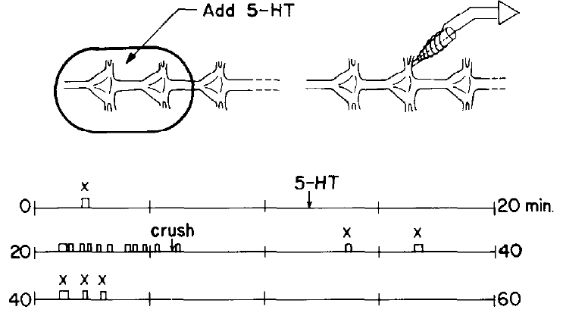
Serotonin can act on a restricted region of the cord
Willard confined serotonin to two ganglia within a chamber while maintaining the rest of an isolated cord in ordinary physiological saline.
  This arrangement separated the region directly exposed to the modulator from the more extensive neural tissue expressing the motor program. The barrier retained the local chemical exposure while central connectives continued through the preparation.
Serotonin acting within the restricted region enabled swimming episodes throughout the larger cord, recruiting motor pathways beyond the exposed ganglia.
  When the connectives between the treated region and the remainder of the cord were crushed, the relevant communication was interrupted. The distant effect therefore traveled through central neural connections from the chemically altered tissue.
A local change in modulatory state can recruit a distributed motor network when the exposed neurons retain access to other ganglia.
  The treated region influences a circuit extending along the cord, where interconnected segmental pathways participate in repeated swimming bursts. This organization permits a restricted source of excitation or modulation to alter the availability of a whole-body motor pattern. Axons leaving the exposed region transmit the consequence of its changed activity to ganglia that continue to sit in the untreated bathing solution.
Willard (1981), Fig. 3. Restricted serotonin application and cord-disconnection tests.
Ashaber et al. (2021), Fig. 7(a). Reconstructed DE-3 arbor over a dorsal micro-CT image.
Willard (1981); Ashaber et al. (2021)
17
Notes:
Teaching transcript:
Willard placed a barrier around two ganglia and applied serotonin only to that region of an isolated cord. Peripheral tissue was absent, and the remainder of the cord was maintained in normal saline. This localized exposure tested whether the drug had to reach every segment directly.
After serotonin reached the restricted chamber, the larger cord could generate swimming episodes. Crushing connectives between the exposed region and the remaining cord interrupted the relevant communication. The exposed region could therefore influence distant parts through connections along the central nervous system.
A local modulatory action can recruit a distributed motor circuit. The experiment does not establish that the two exposed ganglia contain the sole rhythm-generating kernel. The effect depends on their access to other ganglia, and crushing a connective interrupts many axons rather than a single identified pathway.
The preparation separates the site of chemical exposure from the site of distributed motor expression. Keeping the bathing solutions separate made this a test of communication along the cord rather than simple drug diffusion throughout the dish.
References:
A. L. Willard (1981). Effects of serotonin on the generation of the motor program for swimming by the medicinal leech. Journal of Neuroscience 1(9):936–944. https://doi.org/10.1523/JNEUROSCI.01-09-00936.1981
M. Ashaber; Y. Tomina; P. Kassraian; E. A. Bushong; W. B. Kristan Jr; M. H. Ellisman; D. A. Wagenaar (2021). Anatomy and activity patterns in a multifunctional motor neuron and its surrounding circuits. eLife 10:e61881. https://doi.org/10.7554/eLife.61881
Willard (1981), Fig. 3. Restricted serotonin application and cord-disconnection tests.
Figure source: https://doi.org/10.1523/JNEUROSCI.01-09-00936.1981
Ashaber et al. (2021), Fig. 7(a). Reconstructed DE-3 arbor over a dorsal micro-CT image.
Figure source: https://doi.org/10.7554/eLife.61881

Slide 22
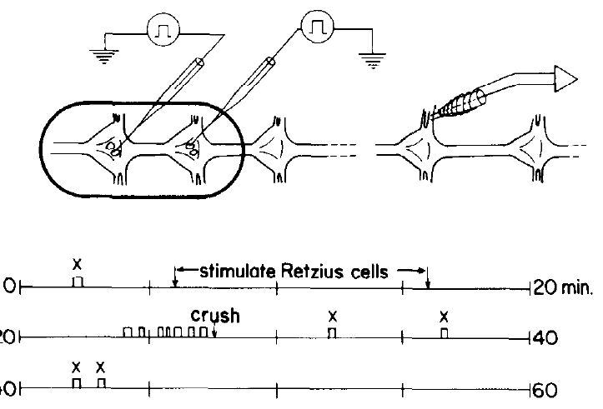
Retzius-cell stimulation releases an effective modulator
Willard stimulated Retzius neurons, identified serotonin-containing cells within leech ganglia, while recording the swimming output of the surrounding nervous system.
  A small chamber confined the saline bathing the stimulated cells, allowing released material to accumulate near the preparation. The experiment related activity in an identified neuronal source to both chemical release and expression of the motor program.
Retzius-cell stimulation evoked swimming reliably when the surrounding volume was less than approximately 50 μl, and serotonin was detected in the solution after stimulation.
  Larger volumes diluted the released substance and produced a less reliable motor effect. Biochemical purification and a calibrated snail-heart bioassay supplied evidence for the identity and availability of the released serotonin.
Serotonin was also detected in the blood sinus surrounding the nerve cord, providing a circulating route by which the substance could reach locomotor circuits.
  Local release from Retzius cells and access through the surrounding circulation therefore provide different delivery arrangements for the same modulator. Either route can change the chemical environment in which the central swim circuitry operates. The released substance must reach an effective concentration around its targets, linking the surrounding volume to how strongly stimulation changes the motor state.
Willard (1981), Fig. 4. Retzius stimulation in a small chamber and resulting swim episodes.
Ashaber et al. (2021), Fig. 7(a). Reconstructed DE-3 arbor over a dorsal micro-CT image.
Willard (1981); Ashaber et al. (2021)
18
Notes:
Teaching transcript:
Willard stimulated identified Retzius neurons, serotonin-containing cells in leech ganglia, while recording the swim program. A small chamber confined the saline around the stimulated cells. This design tested whether neuronal release could reproduce the effect of bath-applied serotonin.
Stimulation evoked swimming when the surrounding volume was small, less than approximately 50 μl. Serotonin was detected in the bathing solution after stimulation. Larger surrounding volumes did not provide the same reliable effect, consistent with dilution of a released substance.
The results link an identified serotonergic source with circuit modulation and chemical release. They do not prove that Retzius cells provide all serotonin acting during intact swimming. Willard also found serotonin in the blood sinus surrounding the cord, indicating that neuronal and circulating access must be distinguished.
The source used biochemical purification followed by a calibrated snail-heart bioassay to detect serotonin. Detecting released substance supplies evidence beyond simply observing that current injection into a cell altered motor output.
References:
A. L. Willard (1981). Effects of serotonin on the generation of the motor program for swimming by the medicinal leech. Journal of Neuroscience 1(9):936–944. https://doi.org/10.1523/JNEUROSCI.01-09-00936.1981
M. Ashaber; Y. Tomina; P. Kassraian; E. A. Bushong; W. B. Kristan Jr; M. H. Ellisman; D. A. Wagenaar (2021). Anatomy and activity patterns in a multifunctional motor neuron and its surrounding circuits. eLife 10:e61881. https://doi.org/10.7554/eLife.61881
Willard (1981), Fig. 4. Retzius stimulation in a small chamber and resulting swim episodes.
Figure source: https://doi.org/10.1523/JNEUROSCI.01-09-00936.1981
Ashaber et al. (2021), Fig. 7(a). Reconstructed DE-3 arbor over a dorsal micro-CT image.
Figure source: https://doi.org/10.7554/eLife.61881

Slide 23
Serotonin acts as a slow state signal, not a swim command
Neuromodulation changes how a circuit responds over an interval extending across many individual synaptic events, allowing its excitability and motor output to depend on chemical state.
  Serotonin increased the occurrence and persistence of swimming episodes in the leech cord. The recurring burst sequence continued to be generated by the central swim circuitry once that circuitry became active.
The local serotonin experiments linked a restricted chemical source with a distributed change in the availability of the swimming program.
  Exposing two ganglia recruited activity farther along the cord, while Retzius stimulation produced an effective influence when released substance accumulated in a small volume. Concentration and central communication therefore both shaped how a local modulatory action reached the larger network.
The blood sinus provides additional access for circulating serotonin around the cord, complementing release from nearby identified neurons.
  These routes allow the surrounding chemical state to alter how readily sensory or electrical excitation elicits swimming. A stimulus can consequently be followed by several episodes because the network remains in a state favorable to repeated expression of its existing rhythm.
Willard (1981), Fig. 4. Retzius stimulation in a small chamber and resulting swim episodes.
Willard (1981)
18a
Notes:
Slides 16 to 18 present three serotonin experiments; the distinction between transmission and modulation ties them into one picture of what serotonin does to the swim system.
Two timescales of chemical signaling.
A transmitter that opens ion channels directly produces a postsynaptic response that starts and ends within milliseconds of each spike.
A modulator alters properties such as excitability and synaptic strength, so its influence outlasts any single spike and spans many cycles of a rhythm.
The serotonin experiments carry the signature of modulation.
On slide 16, spontaneous swimming and extra episodes appeared under serotonin and disappeared after washout, without serotonin specifying when each burst occurred.
Slides 17 and 18 add that a restricted exposure and release into a small chamber were both enough to change the behavior of the cord.
Two delivery routes converge on one effect.
Willard detected serotonin in the bathing solution after Retzius stimulation and also in the blood sinus surrounding the cord.
Local release and circulation can both raise serotonin around the ganglia, shifting the whole cord toward expressing the swim program.
References:
A. L. Willard (1981). Effects of serotonin on the generation of the motor program for swimming by the medicinal leech. Journal of Neuroscience 1(9):936–944. https://doi.org/10.1523/JNEUROSCI.01-09-00936.1981

Slide 24
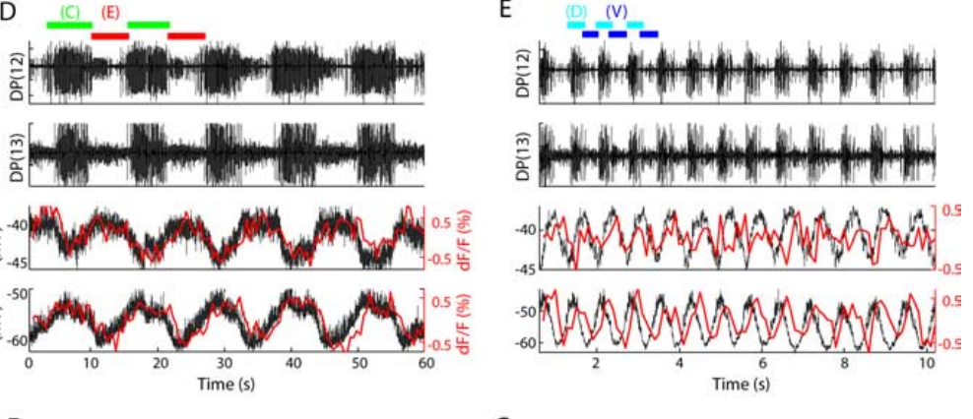
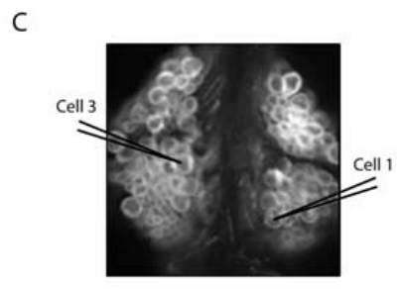
Voltage-sensitive imaging captures two rhythms in one cord
A voltage-sensitive dye changes its optical signal as the membrane voltage changes, allowing many leech neurons to be monitored during the same motor episode.
  Briggman and Kristan imaged an exposed ganglion while eliciting swimming and crawling in one isolated cord. Intracellular recordings from cells 1 and 3 checked the relationship between each cell's optical signal and its electrical activity.
Cells 1 and 3 oscillated approximately 180° apart during crawling and approximately 90° apart during swimming, changing their timing relationship with the expressed behavior.
  Example frequencies were about 0.09 Hz for crawling and 1.3 Hz for swimming. The simultaneous records therefore captured differences in both the speed of the rhythm and the phases occupied by identified neurons.
Staining the cell bodies allowed recordings from roughly 80% of the approximately 400 neurons in a ganglion, extending the observations across a large neuronal population.
  Optical signals followed rhythmic voltage changes that included excitation and inhibition, while the intracellular calibration preserved their relationship to membrane activity. The preparation could then reveal which neurons participated in both behaviors and how their relative timing changed. Tracking each neuron in both states preserves its identity as the cycle becomes slower and the same cell moves to a different relative phase.
Briggman & Kristan (2006), Fig. 1(D,E). Simultaneous optical and intracellular motor-cell signals.
Briggman & Kristan (2006), Fig. 1(C). Dorsal ganglion surface with identified recording cells.
Briggman & Kristan (2006)
19
Notes:
Teaching transcript:
A voltage-sensitive dye changes its optical signal with membrane voltage. Briggman and Kristan imaged an exposed segmental ganglion while eliciting swimming and crawling in the same isolated cord. Intracellular recordings from cells 1 and 3 checked whether the optical signals tracked the identified neurons.
Optical and electrical records preserved the different rhythms and phase relationships. Cell 1 and cell 3 oscillated approximately 180° apart during crawling but approximately 90° apart during swimming. Example frequencies were 0.09 Hz for crawling and 1.3 Hz for swimming.
The calibration supports interpreting optical fluctuations as neuronal activity rather than assuming every fluorescence change is a spike. Dye kinetics introduce a temporal lag, and the optical sampling was slower than the electrical recording. Phase-associated imaging is therefore evidence about population dynamics, not a substitute for every intracellular waveform.
The investigators acquired swimming images at 20 frames per second and formed ratioed signals at 10 Hz. Crawling was slower and could be sampled less frequently. Simultaneous electrical records supplied the faster reference.
References:
K. L. Briggman; W. B. Kristan Jr (2006). Imaging dedicated and multifunctional neural circuits generating distinct behaviors. Journal of Neuroscience 26(42):10925–10933. https://doi.org/10.1523/JNEUROSCI.3265-06.2006
Briggman & Kristan (2006), Fig. 1(D,E). Simultaneous optical and intracellular motor-cell signals.
Figure source: https://doi.org/10.1523/JNEUROSCI.3265-06.2006
Briggman & Kristan (2006), Fig. 1(C). Dorsal ganglion surface with identified recording cells.
Figure source: https://doi.org/10.1523/JNEUROSCI.3265-06.2006

Slide 25
Voltage imaging records inhibition that calcium imaging misses
Voltage-sensitive dyes report changes in membrane potential, including subthreshold depolarization and hyperpolarization that occur between action potentials.
  Calcium indicators primarily follow increases in intracellular calcium associated with activity, with their signals shaped by the rise and decay of that calcium. Voltage imaging therefore provides access to inhibitory as well as excitatory portions of the locomotor cycle.
During swimming, cell 257 became strongly hyperpolarized, while the longitudinal inhibitors DI-1 and VI-2 were suppressed during activity in DE-3.
  These changes place identified neurons in distinct electrical states even when they produce few or no spikes. Recording membrane voltage preserves the difference between active inhibition and a cell simply having little action-potential activity. A more negative membrane potential moves the cell farther from spike threshold, allowing suppression to contribute directly to which parts of the shared population remain active.
The rapid response of voltage-sensitive dyes can resolve phase within a swim cycle lasting approximately a second, preserving the timing relationships between participating neurons.
  Ashaber and colleagues extended this approach with a double-sided microscope, imaging both surfaces of a ganglion simultaneously and recording 250 neurons. Access to the dorsal and ventral populations expanded the set of cells that could be followed within one preparation.
Briggman & Kristan (2006), Fig. 1(D,E). Simultaneous optical and intracellular motor-cell signals.
Briggman & Kristan (2006); Ashaber et al. (2021)
19a
Notes:
Slide 19 calibrates the voltage-sensitive dye against intracellular recordings; the reason this dye, rather than a calcium indicator, was used explains what the later phase maps could capture.
Calcium and voltage report different events.
Calcium entry is tied mostly to action potentials, so a calcium indicator is a spike detector with slow kinetics.
Ashaber and colleagues chose a fast voltage dye because it captures both excitatory and inhibitory synaptic potentials that calcium imaging could not detect.
Inhibition is central to the leech patterns.
The hyperpolarization of cell 257 on slide 25 and the suppression of inhibitory motor neurons during DE-3 bursts on slides 29 and 36 are all subthreshold events.
Coherence and phase on slide 20 depend on following each cell's voltage through the whole cycle, including its inhibited phase.
Coverage and speed made population maps possible.
Briggman and Kristan recorded from about 80 percent of the roughly 400 neurons of a ganglion, which is how they counted swim and crawl participants.
The later double-sided imaging reached 250 neurons in one run, matching the scale of the earlier study.
References:
K. L. Briggman; W. B. Kristan Jr (2006). Imaging dedicated and multifunctional neural circuits generating distinct behaviors. Journal of Neuroscience 26(42):10925–10933. https://doi.org/10.1523/JNEUROSCI.3265-06.2006
M. Ashaber; Y. Tomina; P. Kassraian; E. A. Bushong; W. B. Kristan Jr; M. H. Ellisman; D. A. Wagenaar (2021). Anatomy and activity patterns in a multifunctional motor neuron and its surrounding circuits. eLife 10:e61881. https://doi.org/10.7554/eLife.61881

Slide 26
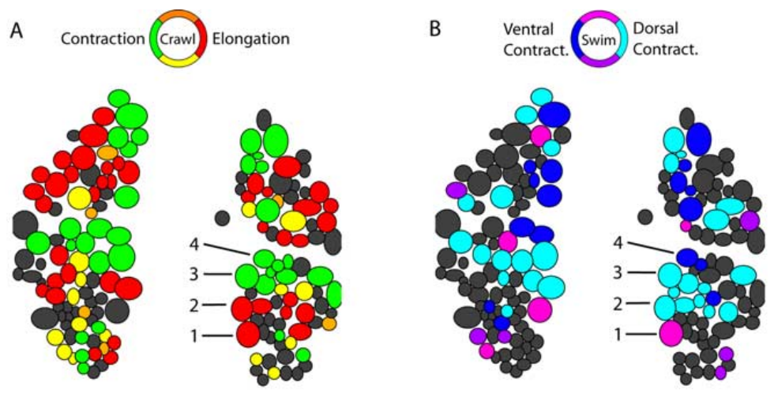
Dorsal neurons change their phase across behaviors
Briggman and Kristan measured each optically recorded cell's phase relative to a reference motor neuron during swimming and crawling in the same ganglion.
  Their analysis used coherence, which describes how consistently two signals share an oscillation at a particular frequency. A reliably coherent cell could be assigned a position within the motor cycle expressed by the preparation.
Many dorsal neurons participated in both rhythms while changing their relative phase, reorganizing the timing of their relationships with other active cells.
  Swimming alternates dorsal and ventral longitudinal contraction, whereas crawl shortening recruits those longitudinal muscle groups together. The different phase maps therefore corresponded to different ways of organizing shared motor resources.
A neuron can remain a member of both active populations while its timing changes enough to support a different functional role.
  A phase shift relative to the reference neuron changes which partners are active together and which participate during an opposing part of the cycle. These changes reorganize the effective circuit through the pattern of activity expressed by its existing neurons. The phase map therefore describes temporal organization within a fixed anatomical population, including the partners whose signals overlap during a particular part of each motor program.
Briggman & Kristan (2006), Fig. 2(A,B). Measured dorsal-surface phase maps for crawling and swimming.
Briggman & Kristan (2006)
20
Notes:
Teaching transcript:
Briggman and Kristan calculated the phase of each optically recorded cell relative to a reference motor neuron. Coherence measures how consistently two signals share an oscillation at a specified frequency. Cells that oscillated consistently could be assigned a phase within the corresponding motor cycle.
The dorsal ganglion contained cells active during both rhythms, but their phases were reorganized. The relationship between longitudinal excitors and inhibitors differed because swimming alternates dorsal and ventral contraction whereas crawling coactivates longitudinal muscle groups during shortening. The measured phase maps came from the same preparation.
A cell’s participation in both rhythms does not imply that it serves the same functional role in each. Phase maps constrain which neurons are candidates for shared circuitry. They do not establish the direction or transmitter of a connection, which requires additional anatomical or physiological evidence.
The displayed panels are the measured maps. The paper also contains predicted maps based on previously known motor functions, but predicted and recorded activity are different kinds of evidence and are kept separate.
References:
K. L. Briggman; W. B. Kristan Jr (2006). Imaging dedicated and multifunctional neural circuits generating distinct behaviors. Journal of Neuroscience 26(42):10925–10933. https://doi.org/10.1523/JNEUROSCI.3265-06.2006
Briggman & Kristan (2006), Fig. 2(A,B). Measured dorsal-surface phase maps for crawling and swimming.
Figure source: https://doi.org/10.1523/JNEUROSCI.3265-06.2006

Slide 27
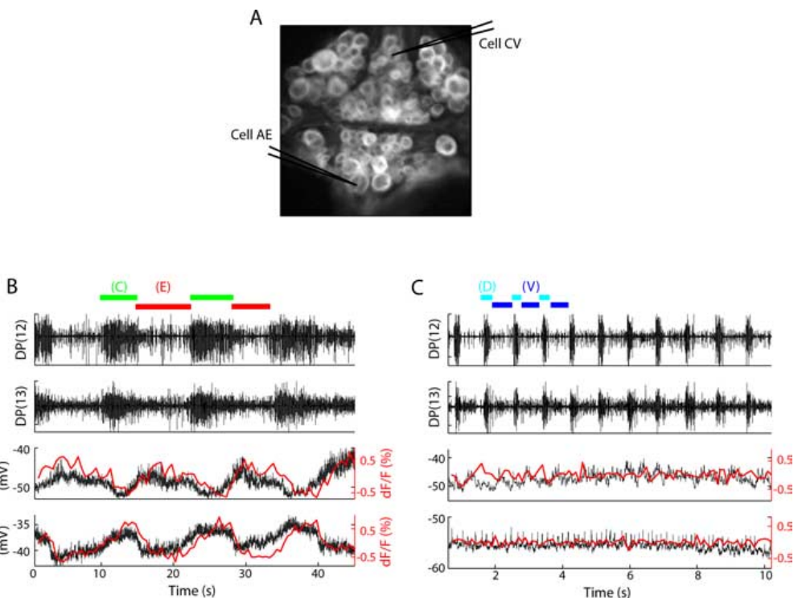
Circular-muscle cells participate selectively in crawling
Briggman and Kristan combined voltage imaging of the ventral ganglion surface with intracellular recordings from the circular excitor CV and the annulus erector AE.
  CV promotes circular-muscle contraction associated with elongation, while AE provides a recognizable motor output related to body form during crawling. These identified cells linked the optical population signals with specific elements of the motor pattern.
During crawling, CV and AE oscillated approximately 180° apart, placing them in opposing portions of the slower locomotor cycle.
  During swimming, neither cell expressed the corresponding rhythmic activity in the same preparation. Agreement between the intracellular and optical records preserved the behavior-dependent participation of the identified cells across recording methods.
Circular-muscle excitation contributes a movement phase that is prominent during crawling, when the segment elongates before the longitudinal muscles shorten it.
  Swimming instead depends on alternating dorsal and ventral longitudinal contractions to bend the body. The shared longitudinal machinery therefore operates alongside selectively recruited motor cells whose participation matches the distinct mechanical requirements of crawling. The two identified recordings relate selective participation to a defined peripheral task, because elongation requires activation of circular muscle before the longitudinal shortening phase begins.
Briggman & Kristan (2006), Fig. 3(A–C). Ventral ganglion and motor-cell activity during the two rhythms.
Briggman & Kristan (2006)
21
Notes:
Teaching transcript:
Briggman and Kristan recorded the ventral ganglion surface and simultaneously impaled cells CV and AE. CV is a circular-muscle excitor associated with body elongation. AE, the annulus erector motor neuron, provides a recognizable output associated with crawling and changes in body form.
CV and AE oscillated approximately 180° apart during crawling. Neither displayed the corresponding rhythmic oscillation during swimming in the same preparation. The optical and intracellular records agreed on this distinction, providing a control against mistaking a weak optical signal for behavioral inactivity.
Shared muscle and neural resources coexist with selectively participating cells. The absence of a coherent swim oscillation in these records does not mean that a neuron is permanently silent or incapable of responding to another stimulus. It specifies its recorded contribution under the elicited motor conditions.
A dedicated component participates in one of the compared rhythms; a multifunctional component participates in more than one. These labels describe the tested behaviors and should not be extended automatically to all possible actions of the animal.
References:
K. L. Briggman; W. B. Kristan Jr (2006). Imaging dedicated and multifunctional neural circuits generating distinct behaviors. Journal of Neuroscience 26(42):10925–10933. https://doi.org/10.1523/JNEUROSCI.3265-06.2006
Briggman & Kristan (2006), Fig. 3(A–C). Ventral ganglion and motor-cell activity during the two rhythms.
Figure source: https://doi.org/10.1523/JNEUROSCI.3265-06.2006

Slide 28
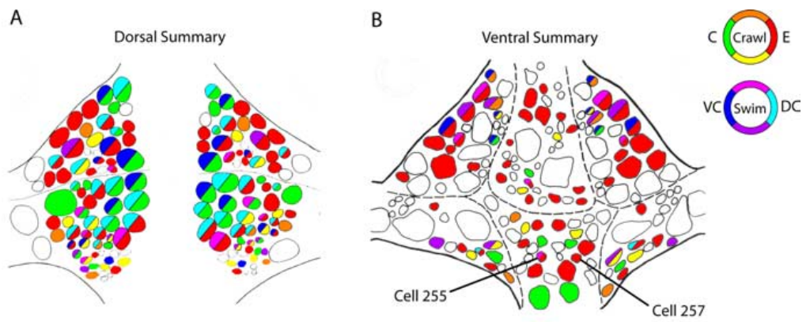
Swimming neurons overlap the crawl population
Briggman and Kristan identified neurons with reproducible phase-associated activity during swimming, crawling, or both behaviors across dorsal and ventral ganglion recordings.
  The analysis assigned participation from the measured activity of each cell during the motor rhythm. Corresponding positions in the ganglion allowed the population results to be related across experiments and to recognizable identified neurons.
The recorded population contained about 90 swimming-associated cells and 188 crawling-associated cells, with 84 cells participating in both motor rhythms.
  Most of the observed swimming population was therefore included within the larger crawling population. Crawling combined extensive reuse of those cells with recruitment of additional neurons involved in its slower and mechanically different movement sequence.
The phase maps revealed distinctive activity in previously unidentified cells, guiding intracellular examination of interneurons 255 and 257.
  Following these candidates with current injection and membrane-potential recordings related their population activity to their effects on the motor patterns. The functional organization contained both multifunctional neurons whose timing changed across behaviors and cells whose rhythmic participation was concentrated in crawling. The additional crawl population can provide the inputs and outputs needed for elongation, while the overlapping population retains access to the longitudinal pathways used by both programs.
Briggman & Kristan (2006), Fig. 5(A,B). Summary maps of measured shared and selective participation.
Briggman & Kristan (2006)
22
Notes:
Teaching transcript:
Briggman and Kristan combined reproducible phase-associated activity across dorsal and ventral imaging experiments. The summary distinguished cells active in both rhythms from cells coherent with only swimming or only crawling. Cells lacking reliable activity were not assigned a behavior merely from anatomical position.
The identified population included about 90 swimming-associated and 188 crawling-associated cells. Of the swimming-associated cells, 84 also oscillated with crawling. Thus most of the observed swim population participated in the slower crawl rhythm, while crawling recruited many additional cells.
The numerical overlap describes recorded rhythmic participation, not proof that every participating neuron generates the rhythm. Some cells may receive the pattern rather than construct it. Nevertheless, the data reject a simple account in which the two behaviors use entirely separate, nonoverlapping neuronal populations.
The summary maps merge measured participation across preparations. They provide a guide to shared network membership; they are not a complete synaptic wiring diagram and do not determine which connections are causally necessary.
References:
K. L. Briggman; W. B. Kristan Jr (2006). Imaging dedicated and multifunctional neural circuits generating distinct behaviors. Journal of Neuroscience 26(42):10925–10933. https://doi.org/10.1523/JNEUROSCI.3265-06.2006
Briggman & Kristan (2006), Fig. 5(A,B). Summary maps of measured shared and selective participation.
Figure source: https://doi.org/10.1523/JNEUROSCI.3265-06.2006

Slide 29
One small ganglion reuses its neurons across behaviors
A leech ganglion containing roughly 400 neurons contributes to swimming, crawling, and local bending by organizing shared cells into behavior-dependent activity patterns.
  Ashaber and colleagues examined how this compact nervous system supplies multiple outputs through existing neuronal connections. The different behaviors recruit overlapping populations whose temporal relationships determine how common muscles are activated.
The dorsal excitor DE-3 alternates with the ventral excitor VE-4 during swimming but fires together with VE-4 during crawl shortening.
  During local bending, DE-3 acts with its contralateral partner and VE-4 to move the body wall away from touch. The same motor neuron therefore contributes to distinct actions according to the other cells recruited alongside it and the timing of their activity.
Crawling recruits additional neurons associated with elongation, including circular-muscle excitors and the selectively crawl-associated interneuron 257.
  Its population is approximately twice the size of the swimming-associated population in the optical recordings. Shared longitudinal cells provide a common motor apparatus, while additional participants and altered phases organize the elongation–shortening sequence required for movement across a surface. The behavior expressed by a shared motor neuron consequently depends on the ensemble firing with it, including ipsilateral, contralateral, and circular-muscle pathways recruited in that state.
Briggman & Kristan (2006), Fig. 2(A,B). Measured dorsal-surface phase maps for crawling and swimming.
Briggman & Kristan (2006); Ashaber et al. (2021)
22a
Notes:
Slides 20 to 22 count the cells active in each rhythm; what that overlap buys the animal, and what the remaining dedicated cells contribute, follows from the roles of individual motor neurons.
Multifunctionality is an economy.
Ashaber and colleagues observe that many circuits in central nervous systems control more than one behavior, and that this may help small animals use constrained neural hardware efficiently.
In the leech, each segmental ganglion of about 400 cells is responsible for at least three distinct movements.
DE-3 plays three parts.
During swimming DE-3 alternates with the ventral excitor and controls the dorsal flexion phase; during crawling it is active with VE-4 and controls contraction.
During local bending it cooperates with its contralateral homolog and VE-4 to deform the body wall precisely, the reconfiguration slide 23 catches in the switch between cells 3 and 4.
Dedicated cells supply behavior-specific phases.
Briggman and Kristan found more than twice as many crawl participants as swim participants, and CV, AE and cell 257 on slides 21 and 25 belong to the crawl-only group.
These cells serve circular-muscle elongation and annulus erection, actions with no counterpart in a swim stroke.
References:
K. L. Briggman; W. B. Kristan Jr (2006). Imaging dedicated and multifunctional neural circuits generating distinct behaviors. Journal of Neuroscience 26(42):10925–10933. https://doi.org/10.1523/JNEUROSCI.3265-06.2006
M. Ashaber; Y. Tomina; P. Kassraian; E. A. Bushong; W. B. Kristan Jr; M. H. Ellisman; D. A. Wagenaar (2021). Anatomy and activity patterns in a multifunctional motor neuron and its surrounding circuits. eLife 10:e61881. https://doi.org/10.7554/eLife.61881

Slide 30
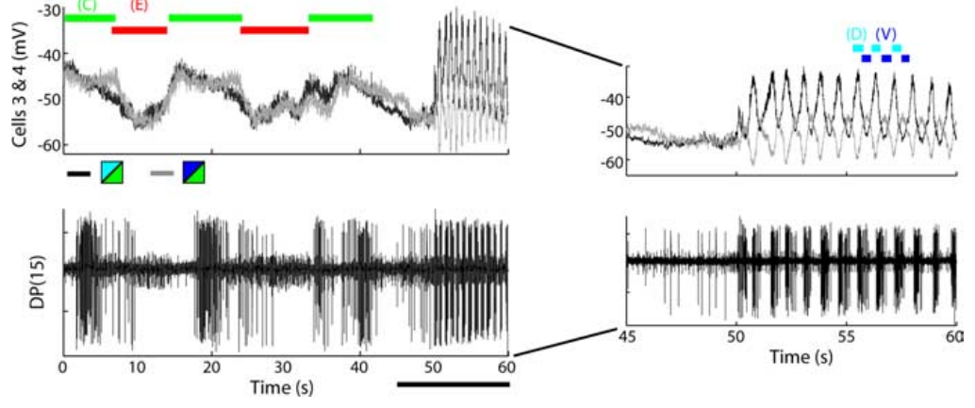
Shared cells change phase at a behavioral switch
During switches between crawling and swimming, Briggman and Kristan maintained recordings from identified motor neurons while motor-nerve output identified the behavior being expressed.
  This followed the same cells through a change in circuit state. Their phase relationships could therefore be related directly to the transition between the slower crawling pattern and the faster swimming pattern.
The longitudinal excitors DE-3 and VE-4, also identified as cells 3 and 4, fired together during the shortening phase of crawling.
  During swimming, their activity became approximately opposed, matching the alternation between dorsal and ventral contraction. The shift could occur within 1–2 s, allowing the same muscles to enter a different movement pattern rapidly.
The behavioral switch changes which parts of the shared circuit are active together, reorganizing the motor output through existing neuronal pathways.
  Synchronous dorsal and ventral longitudinal excitation shortens a segment during crawling, while their alternating activation bends it up and down during swimming. The changing electrical relationship between DE-3 and VE-4 therefore supplies a direct cellular correlate of the change in movement. A rapid change in synchrony is sufficient to alter how the common muscle groups work together, converting simultaneous shortening into alternating dorsal and ventral bending.
Briggman & Kristan (2006), Fig. 6(E). Motor and intracellular signals at a crawl-to-swim transition.
Briggman & Kristan (2006)
23
Notes:
Teaching transcript:
Briggman and Kristan observed switches between crawling and swimming while maintaining recordings from identified motor cells. This comparison follows individual neurons across a state change rather than comparing separate animals assigned to different behaviors. Motor-nerve output identified the behavior expressed on either side of the switch.
Cells 3 and 4 were in phase during crawl-related longitudinal contraction but became approximately out of phase during swimming. The transition could occur within 1–2 s. Their relationship therefore changed on a time scale much shorter than any anatomical rebuilding of the neurons.
The shared circuit can express alternative dynamical configurations through changes in active interactions and input. The recordings establish rapid reorganization but do not identify its complete molecular trigger. Structural overlap permits flexible use of the same cells; it does not by itself specify the mechanism selecting one motor pattern.
A dynamical configuration describes the timing and relationships of active neurons. The interpretation concerns changes in circuit operation, not a claim that the neuron’s anatomical identity changes when the animal switches locomotor behavior.
References:
K. L. Briggman; W. B. Kristan Jr (2006). Imaging dedicated and multifunctional neural circuits generating distinct behaviors. Journal of Neuroscience 26(42):10925–10933. https://doi.org/10.1523/JNEUROSCI.3265-06.2006
Briggman & Kristan (2006), Fig. 6(E). Motor and intracellular signals at a crawl-to-swim transition.
Figure source: https://doi.org/10.1523/JNEUROSCI.3265-06.2006

Slide 31
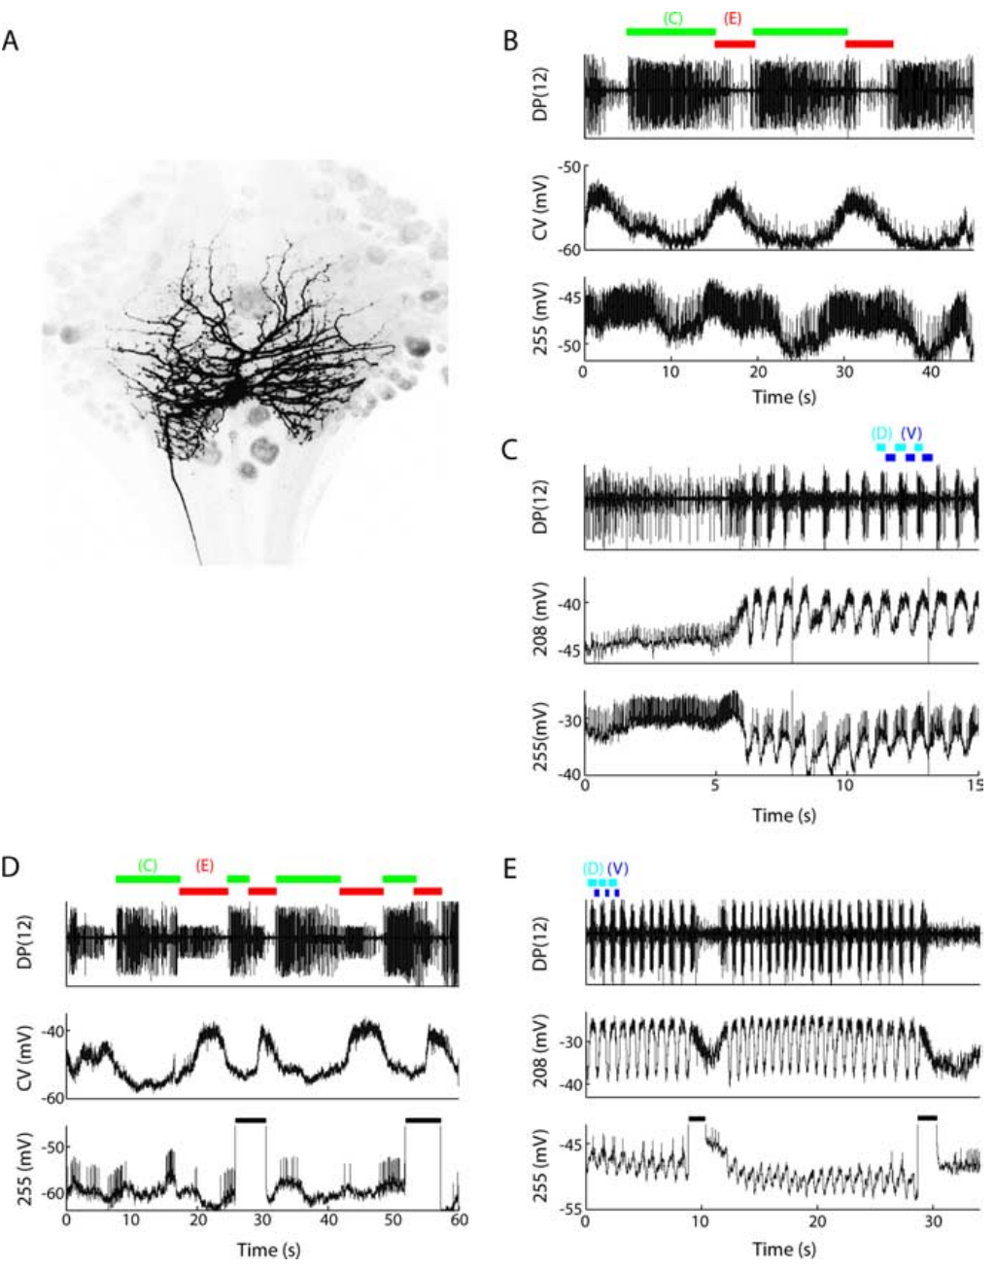
Cell 255 can perturb both locomotor rhythms
Cell 255 is an interneuron identified by its ventral soma, bilateral branches, and projection through a central connective between ganglia.
  Briggman and Kristan related this anatomy to its electrical activity during both locomotor programs. The cell depolarized during crawl elongation and also oscillated during swimming, placing it within the populations active in each behavior.
Depolarizing cell 255 during crawl contraction ended that phase early and shortened the overall step period by approximately 21%.
  Depolarization during elongation left the period largely unchanged, so the effect depended on when the current entered the ongoing cycle. Activating the same neuron during swimming could slow the rhythm or terminate the episode.
The state-dependent responses establish a multifunctional interneuron whose activity can alter both motor patterns through its existing access to the locomotor network.
  During crawling, the neuron has a particularly effective influence at the transition away from contraction. Its different consequences during swimming follow the organization of the circuit in that behavior, where the shared population expresses a faster and differently phased rhythm. Its central arbor and connective projection provide access to pathways beyond its own soma, while phase-dependent current effects follow the changing susceptibility of the active network. The effective contraction-phase pulse brings forward the transition into elongation, shortening the time required to complete the ongoing step. The altered transition changes the time remaining before the next repeated contraction phase.
Briggman & Kristan (2006), Fig. 7(A–E). Identified cell 255 morphology and recordings with perturbations.
Briggman & Kristan (2006)
24
Notes:
Teaching transcript:
Briggman and Kristan identified cell 255 by its ventral soma position, morphology, and activity. An interneuron communicates within the nervous system rather than directly innervating a peripheral muscle. Cell 255 had bilateral arbors and projected through a central connective, supporting its interneuronal identity.
Cell 255 depolarized during crawl elongation and oscillated during swimming. Depolarizing it during crawl contraction ended that phase early and shortened the step period by approximately 21%. Depolarization during elongation did not change the period; stimulation during swimming could slow or terminate the episode.
Current injection supplies causal evidence beyond correlation with a rhythm. The phase specificity argues that the effect depends on the current circuit state. The absence of a consistent effect from hyperpolarizing the cell prevents treating this experiment as proof that cell 255 alone is necessary for either rhythm.
The original figure includes the filled cell and recordings during both behaviors. A cell can influence two patterns in different ways: accelerating a transition in one and reducing or terminating activity in the other.
References:
K. L. Briggman; W. B. Kristan Jr (2006). Imaging dedicated and multifunctional neural circuits generating distinct behaviors. Journal of Neuroscience 26(42):10925–10933. https://doi.org/10.1523/JNEUROSCI.3265-06.2006
Briggman & Kristan (2006), Fig. 7(A–E). Identified cell 255 morphology and recordings with perturbations.
Figure source: https://doi.org/10.1523/JNEUROSCI.3265-06.2006

Slide 32
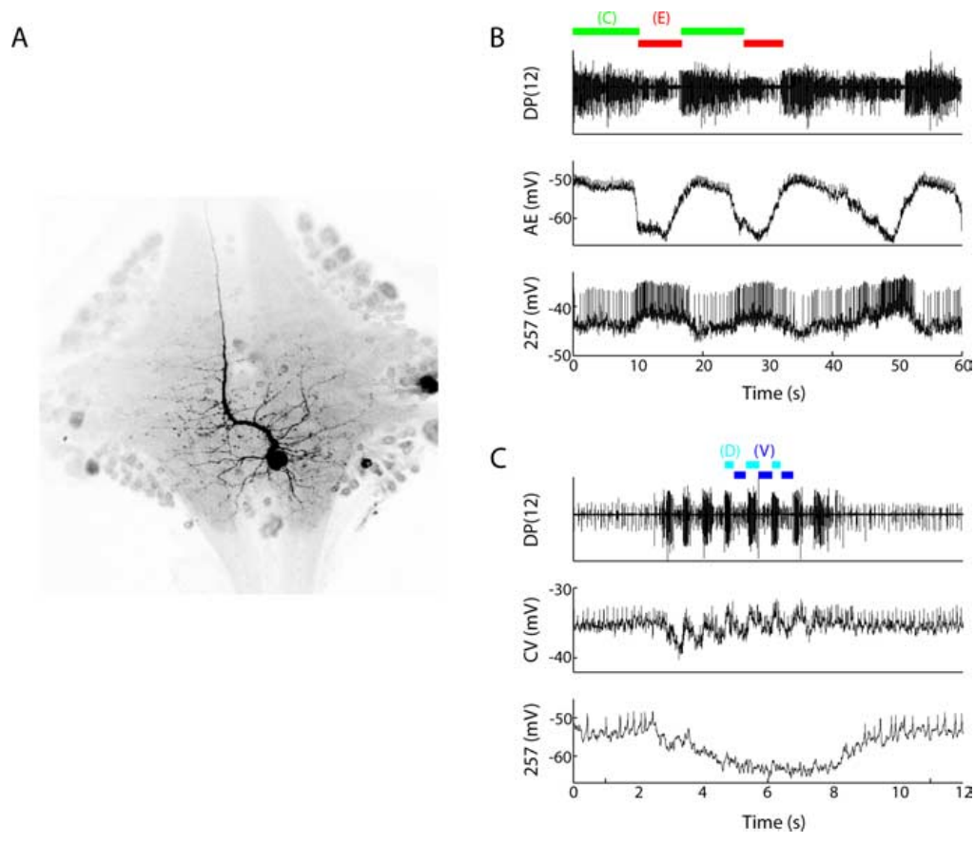
Cell 257 participates selectively during crawling
Cell 257 is a ventral interneuron whose axon projects through an anterior connective, giving it central access beyond the ganglion containing its soma.
  Briggman and Kristan recorded its membrane activity together with the annulus erector motor neuron while the same preparation expressed crawling and swimming. The cell's morphology and activity distinguished it from the multifunctional interneuron 255.
During crawling, cell 257 depolarized and fired during elongation, placing its activity within the phase when the animal lengthens its body.
  During swimming, it became strongly hyperpolarized and lacked a coherent swim-related oscillation. The electrical records retained a 20 mV voltage calibration and a 2 s time reference for following the change in the membrane response. Hyperpolarization during swimming also differs from crawl elongation, when the same identified neuron reaches a voltage range supporting spikes alongside the elongation-related motor activity.
The hyperpolarization indicates that the active swimming state holds this crawl-associated cell at a more negative membrane potential, reducing its opportunity to fire.
  Depolarizing or hyperpolarizing cell 257 left the measured locomotor rhythms largely unchanged in the tested preparation. Its selective activity therefore identifies participation in the crawl population, while the observed motor pattern remains distributed across the interacting neurons of the network.
Briggman & Kristan (2006), Fig. 8(A–C). Cell 257 anatomy and crawl-versus-swim intracellular recordings.
Briggman & Kristan (2006)
25
Notes:
Teaching transcript:
Briggman and Kristan identified cell 257 as a ventral interneuron with a projection through an anterior connective. Its morphology differed from cell 255, and its activity was recorded together with the annulus erector cell. The comparison used crawling and swimming in the same preparation.
During crawling, cell 257 depolarized and fired with the elongation phase. During swimming it became strongly hyperpolarized and did not express a coherent swim rhythm. The published recordings preserve a 20 mV calibration and a 2 s time bar for the swimming comparison.
This pattern supports selectively crawl-associated participation. Depolarizing or hyperpolarizing a single cell 257 did not consistently perturb either rhythm, so participation does not establish an initiating or indispensable role. The distinction between observing a cell’s phase and causally controlling the pattern is essential to interpreting population maps.
Hyperpolarization moves membrane voltage toward a more negative value and can reduce spiking. The recording establishes behavior-dependent suppression of cell 257, while leaving the full source of that inhibition unresolved.
References:
K. L. Briggman; W. B. Kristan Jr (2006). Imaging dedicated and multifunctional neural circuits generating distinct behaviors. Journal of Neuroscience 26(42):10925–10933. https://doi.org/10.1523/JNEUROSCI.3265-06.2006
Briggman & Kristan (2006), Fig. 8(A–C). Cell 257 anatomy and crawl-versus-swim intracellular recordings.
Figure source: https://doi.org/10.1523/JNEUROSCI.3265-06.2006

Slide 33
Correlation, sufficiency and necessity are separate tests
A neuron's correlation with a rhythm identifies a recurring relationship between its activity and the ongoing motor cycle, while current injection tests how changing that activity affects the circuit.
  Cell 257 oscillated during crawling, but depolarizing or hyperpolarizing it left the measured rhythms largely unchanged. Cell 255 participated in both behaviors and could alter their expression when stimulated.
The effect of an identified cell also depends on the preparation and circuit state in which it is activated or suppressed.
  The dorsal inhibitor cell 1 lengthened the swim period in an isolated cord, whereas its influence differed with more peripheral tissue attached. These findings relate a neuron's causal influence to the network and sensory pathways available during the manipulation.
The descending neuron R3b-1 was sufficient and necessary for coordinated fictive crawling under the whole-cord conditions used by Puhl and colleagues.
  Activating the cell organized segmental bursting, while suppressing it disrupted the coordinated pattern even when local activity remained. This command relationship concerns the organization of distributed generators, linking an identified descending input with their shared period and orderly progression. A local generator can keep producing bursts while losing its proper relationship with other segments, so coordination is a measurable property beyond the persistence of rhythmic discharge.
Briggman & Kristan (2006), Fig. 7(A–E). Identified cell 255 morphology and recordings with perturbations.
Briggman & Kristan (2006); Puhl et al. (2012)
25a
Notes:
Slides 24 and 25 report opposite outcomes for two interneurons; sorting the deck's single-cell experiments by the kind of evidence they provide makes the difference interpretable.
Each test answers a different question.
Recording activity during a rhythm asks whether a cell takes part; injecting depolarizing current asks whether it can drive the behavior; injecting hyperpolarizing current asks whether the behavior survives without it.
Puhl and colleagues describe R3b-1 as a command neuron in the strictest sense because it passed both causal tests.
The deck's cells span the scale.
Briggman and Kristan classify cell 255 as multifunctional because it oscillates with and can perturb both rhythms, and cell 257 as dedicated to crawling.
Kristan and Calabrese's cell 1 on slide 12 is evidence that even a motor neuron can act back on an isolated oscillator.
Distributed circuits blunt single-cell silencing.
Imaging on slide 22 placed scores of cells in each rhythm, so removing one rarely removes a unique function.
A descending neuron whose single axon projects through every ganglion is different, since its signal has no parallel carrier once its partner is excluded.
References:
K. L. Briggman; W. B. Kristan Jr (2006). Imaging dedicated and multifunctional neural circuits generating distinct behaviors. Journal of Neuroscience 26(42):10925–10933. https://doi.org/10.1523/JNEUROSCI.3265-06.2006
J. G. Puhl; M. A. Masino; K. A. Mesce (2012). Necessary, sufficient and permissive: a single locomotor command neuron important for intersegmental coordination. Journal of Neuroscience 32(49):17646–17657. https://doi.org/10.1523/JNEUROSCI.2249-12.2012
W. B. Kristan Jr; R. L. Calabrese (1976). Rhythmic swimming activity in neurones of the isolated nerve cord of the leech. Journal of Experimental Biology 65(3):643–668. https://doi.org/10.1242/jeb.65.3.643

Slide 34
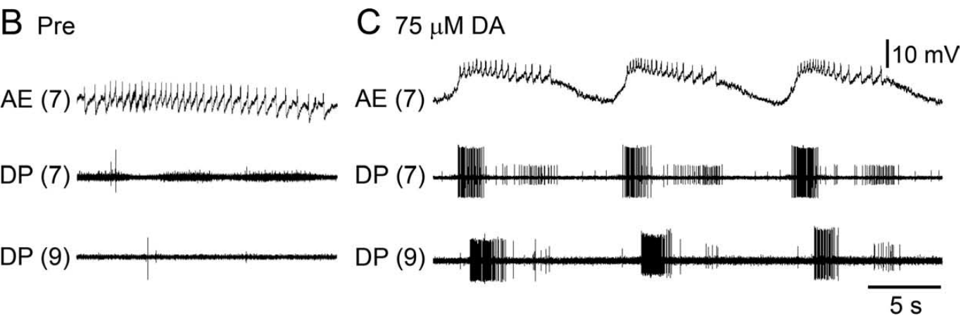
Dopamine recruits crawl-like activity in an isolated CNS
Puhl and Mesce applied dopamine to isolated whole leech nervous systems containing the cephalic and segmental ganglia but lacking the moving peripheral body.
  Motor-nerve recordings and intracellular recordings from identified neurons followed the emergence of locomotor output. The preparation retained communication along the cord while removing the usual muscles and movement-related sensory signals.
At approximately 75 μM dopamine, previously quiet motor nerves developed repeated bursts in the dorsal excitor DE-3.
  Crawl-like activity could emerge after about 3 min and subsequently acquire anterior-to-posterior propagation. Some cords became coordinated during exposure, while others developed the coordinated sequence during washout, following the change in the chemical state of the tissue.
Every isolated ganglion tested along the cord could express dopamine-induced crawl-like activity, commonly continuing for approximately 5–15 min.
  The capacity to produce the local rhythm was therefore distributed through the segmental nervous system. Dopamine made that activity available within individual ganglia, while their interactions in a longer cord organized the progression of the motor pattern across segments. The later acquisition of anterior-to-posterior order reflects coordination between active regions, adding a spatial sequence to the rhythmic capacity already present within individual ganglia.
Puhl & Mesce (2008), Fig. 1(B,C). Motor activity before and during dopamine exposure.
Ashaber et al. (2021), Fig. 7(a). Reconstructed DE-3 arbor over a dorsal micro-CT image.
Puhl & Mesce (2008); Ashaber et al. (2021)
26
Notes:
Teaching transcript:
Dopamine is a neurotransmitter that can alter the functional state of locomotor circuits. Puhl and Mesce superfused isolated whole leech nervous systems with dopamine while monitoring motor nerves and an identified motor neuron. The preparation retained the cephalic and segmental ganglia but lacked the peripheral body.
At approximately 75 μM dopamine, previously quiet motor nerves developed repeated DE-3 bursts. Crawl-like activity could emerge after about 3 min and later acquire anterior-to-posterior propagation. Some preparations became coordinated during dopamine exposure, while others did so during washout.
Dopamine is sufficient to make a crawl-like motor program available in this preparation. The result is not a measurement of natural dopamine concentration at each receptor or proof that dopamine alone determines intact behavioral choice. Local pattern activation and intersegmental coordination remain distinguishable outcomes.
The supplied concentration is a bath concentration chosen for the experimental preparation. It should not be equated with a measured concentration at an endogenous release site.
References:
J. G. Puhl; K. A. Mesce (2008). Dopamine activates the motor pattern for crawling in the medicinal leech. Journal of Neuroscience 28(16):4192–4200. https://doi.org/10.1523/JNEUROSCI.0136-08.2008
M. Ashaber; Y. Tomina; P. Kassraian; E. A. Bushong; W. B. Kristan Jr; M. H. Ellisman; D. A. Wagenaar (2021). Anatomy and activity patterns in a multifunctional motor neuron and its surrounding circuits. eLife 10:e61881. https://doi.org/10.7554/eLife.61881
Puhl & Mesce (2008), Fig. 1(B,C). Motor activity before and during dopamine exposure.
Figure source: https://doi.org/10.1523/JNEUROSCI.0136-08.2008
Ashaber et al. (2021), Fig. 7(a). Reconstructed DE-3 arbor over a dorsal micro-CT image.
Figure source: https://doi.org/10.7554/eLife.61881

Slide 35
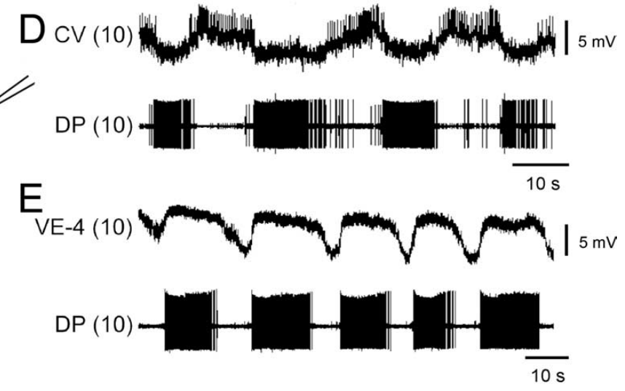
Crawling alternates circular and longitudinal excitation
During dopamine-induced fictive crawling, Puhl and Mesce recorded the circular excitor CV together with the ventral longitudinal excitor VE-4 and dorsal posterior nerve activity.
  The nerve recording identified the large motor unit of DE-3, providing a reference for the longitudinal contraction phase. Simultaneous intracellular recordings related each identified cell's voltage and spikes to that phase.
CV fired approximately 180° out of phase with DE-3, becoming hyperpolarized by about 2–4 mV during the dorsal longitudinal burst.
  Its spikes were suppressed while DE-3 was active, placing circular-muscle excitation in the opposing part of the cycle. VE-4 instead depolarized and fired alongside DE-3, coordinating ventral and dorsal longitudinal contraction.
The resulting sequence alternates elongation and shortening, matching the mechanical organization of a crawl step within one segment.
  Circular-muscle contraction narrows and lengthens the segment while longitudinal excitors are quiet. The following joint activation of DE-3 and VE-4 shortens the body region, with the activity of these defined muscle pathways establishing the identity of the fictive crawl pattern. The antagonistic muscle actions occupy successive phases, with the inhibition of CV during longitudinal output preventing their simultaneous recruitment during the contraction-related burst.
Puhl & Mesce (2008), Fig. 2(D,E). CV and VE-4 activity relative to the DE-3 motor burst.
Ashaber et al. (2021), Fig. 7(a). Reconstructed DE-3 arbor over a dorsal micro-CT image.
Puhl & Mesce (2008); Ashaber et al. (2021)
27
Notes:
Teaching transcript:
Puhl and Mesce recorded intracellularly from the circular excitor CV and the ventral longitudinal excitor VE-4 during dopamine-induced fictive crawling. Simultaneous dorsal posterior nerve recordings monitored DE-3, the dorsal longitudinal excitor. This pairing identified the motor pattern through several muscle-related outputs.
CV activity was approximately 180° out of phase with DE-3. During the DE-3 burst, CV hyperpolarized by approximately 2–4 mV and its spikes were suppressed. VE-4 instead depolarized and fired in phase with DE-3, consistent with coordinated dorsal and ventral shortening.
Correct muscle-group phasing is stronger evidence for a crawl program than a slow DE-3 burst alone. The recordings establish patterned excitation and suppression in the motor outputs. They do not identify every interneuron that imposes the phase relationships or directly measure the resulting muscle force.
Antagonist muscle actions have opposing mechanical effects. Here circular-muscle activity favors elongation while longitudinal-muscle activity favors shortening; their alternating recruitment is part of the definition of the crawl pattern.
References:
J. G. Puhl; K. A. Mesce (2008). Dopamine activates the motor pattern for crawling in the medicinal leech. Journal of Neuroscience 28(16):4192–4200. https://doi.org/10.1523/JNEUROSCI.0136-08.2008
M. Ashaber; Y. Tomina; P. Kassraian; E. A. Bushong; W. B. Kristan Jr; M. H. Ellisman; D. A. Wagenaar (2021). Anatomy and activity patterns in a multifunctional motor neuron and its surrounding circuits. eLife 10:e61881. https://doi.org/10.7554/eLife.61881
Puhl & Mesce (2008), Fig. 2(D,E). CV and VE-4 activity relative to the DE-3 motor burst.
Figure source: https://doi.org/10.1523/JNEUROSCI.0136-08.2008
Ashaber et al. (2021), Fig. 7(a). Reconstructed DE-3 arbor over a dorsal micro-CT image.
Figure source: https://doi.org/10.7554/eLife.61881

Slide 36
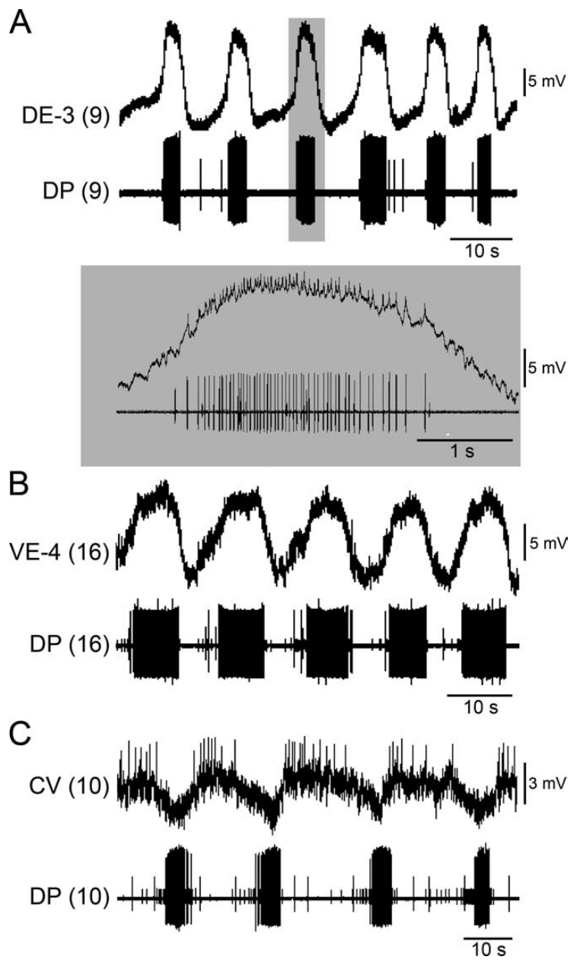
A single ganglion can express the local crawl pattern
Puhl and Mesce applied dopamine to single segmental ganglia separated from both the cephalic nervous system and the neighboring ganglia.
  Intracellular recordings followed DE-3, VE-4, and CV, while an extracellular motor-nerve recording monitored local output. The preparation confined the rhythm-generating circuitry to one ganglion and its retained neuronal processes.
Dopamine elicited repeated activity with crawl-appropriate phase relationships across the three identified classes of motor neuron.
  DE-3 depolarizations reached approximately 12–16 mV, with spikes occurring on the slower voltage wave. Each intracellular DE-3 spike matched the largest extracellular motor unit one for one, establishing the identity of the signal used to follow the rhythm.
Single ganglia expressed cycle periods near 15 s, similar to the periods recorded in longer cords under the corresponding fictive conditions.
  A local circuit therefore supplied the timing of its recurring elongation–contraction pattern, while connections between ganglia could organize those local patterns into a sequence. The central capacity for crawl-like rhythm production is repeated along the segmental cord. The one-for-one spike match also permits continuing extracellular monitoring after an intracellular recording changes, preserving a recognizable measure of the identified dorsal motor output.
Ashaber et al. (2021), Fig. 7(a). Reconstructed DE-3 arbor over a dorsal micro-CT image.
Puhl & Mesce (2008), Fig. 3(A–C). Identified excitatory motor-cell activity in isolated ganglia.
Puhl & Mesce (2008); Ashaber et al. (2021)
28
Notes:
Teaching transcript:
Puhl and Mesce separated individual segmental ganglia from the rest of the nerve cord and applied dopamine. This reduction removed descending input and intersegmental communication. Intracellular recordings identified DE-3, VE-4, and CV while a motor-nerve recording monitored the local output.
Dopamine induced repeated, appropriately phased activity in all three motor-cell classes. DE-3 depolarizations reached approximately 12–16 mV, with smaller spikes riding on the slow voltage wave. Intracellular DE-3 spikes matched the largest extracellular motor unit one for one, validating the nerve-based monitor.
A segmental ganglion contains circuitry sufficient for local crawl-like pattern production under these conditions. A single ganglion cannot establish a full front-to-back behavioral sequence by itself. Local rhythm-generating capacity therefore does not settle how the intact cord coordinates segments or chooses the next movement.
A slow wave is a membrane-potential fluctuation on which faster action potentials can ride. The agreement between intracellular spikes and the nerve unit checks cell identity, while the slow wave reflects the patterned drive reaching that motor neuron.
References:
J. G. Puhl; K. A. Mesce (2008). Dopamine activates the motor pattern for crawling in the medicinal leech. Journal of Neuroscience 28(16):4192–4200. https://doi.org/10.1523/JNEUROSCI.0136-08.2008
M. Ashaber; Y. Tomina; P. Kassraian; E. A. Bushong; W. B. Kristan Jr; M. H. Ellisman; D. A. Wagenaar (2021). Anatomy and activity patterns in a multifunctional motor neuron and its surrounding circuits. eLife 10:e61881. https://doi.org/10.7554/eLife.61881
Puhl & Mesce (2008), Fig. 3(A–C). Identified excitatory motor-cell activity in isolated ganglia.
Figure source: https://doi.org/10.1523/JNEUROSCI.0136-08.2008
Ashaber et al. (2021), Fig. 7(a). Reconstructed DE-3 arbor over a dorsal micro-CT image.
Figure source: https://doi.org/10.7554/eLife.61881

Slide 37
A half-center model explains alternation within one ganglion
A proposed half-center oscillator organizes alternating activity through reciprocal inhibition between two groups of neurons that participate in opposing phases of the movement.
  In a crawl-related model, one group excites elongation pathways such as CV and the other excites contraction pathways such as DE-3 and VE-4. Activity in one group suppresses the other until the balance of excitation and inhibition permits a phase transition.
The single ganglion acts as a local rhythmic module, with premotor nonspiking neurons, or NS neurons, providing access between motor pathways and the rhythm-generating network.
  Strongly hyperpolarizing an NS neuron can stop the crawl rhythm of an isolated ganglion. Its effect therefore reaches the organization of repeated activity as well as the immediate output to muscles.
The crawl generator also inhibits touch-sensitive cells in phase with DE-3 bursting, providing a corollary discharge associated with the motor command.
  This signal conveys the occurrence of contraction to sensory neurons within the same system. The ganglion consequently organizes both the outgoing muscle pattern and a phase-dependent change in sensory processing during its internally generated locomotor cycle. An internally generated signal arriving at the sensory cell changes its responsiveness according to the ongoing motor phase, coupling sensation to the timing of the animal’s own action.
Puhl & Mesce (2008), Fig. 3(A–C). Identified excitatory motor-cell activity in isolated ganglia.
Puhl & Mesce (2008); Kearney et al. (2022)
28a
Notes:
Slide 28 places a complete crawl generator in each ganglion; the concepts used to describe such generators explain how one ganglion could alternate two antagonistic phases.
Segmented locomotion is built from modules.
Puhl and Mesce frame their work around the idea of unit burst generators coupled along the body, a scheme whose biological basis had been revealed in only a few animals.
Their finding that every isolated ganglion could produce dopamine-induced crawling identifies the leech module.
Mutual inhibition produces alternation.
Kearney and colleagues summarize earlier proposals that crawling is controlled by a half-center oscillator, two neuron groups driving the elongation and contraction motor neurons.
The antiphase of CV with DE-3 and VE-4 on slide 27, and of the inhibitors with DE-3 on slide 29, is the output such an oscillator should produce.
Other cells tap into the generator.
Hyperpolarizing an NS neuron with a strong pulse abolished both the DE-3 bursts and the rhythmic inhibition of touch cells, evidence that NS reaches the generator itself rather than only the motor neurons.
An internal copy of the motor command sent to sensory neurons allows the ganglion to distinguish its own movement from external touch.
References:
J. G. Puhl; K. A. Mesce (2008). Dopamine activates the motor pattern for crawling in the medicinal leech. Journal of Neuroscience 28(16):4192–4200. https://doi.org/10.1523/JNEUROSCI.0136-08.2008
G. Kearney; M. Radice; A. Sanchez Merlinsky; L. Szczupak (2022). Intersegmental interactions give rise to a global network. Frontiers in Neural Circuits 16:843731. https://doi.org/10.3389/fncir.2022.843731

Slide 38
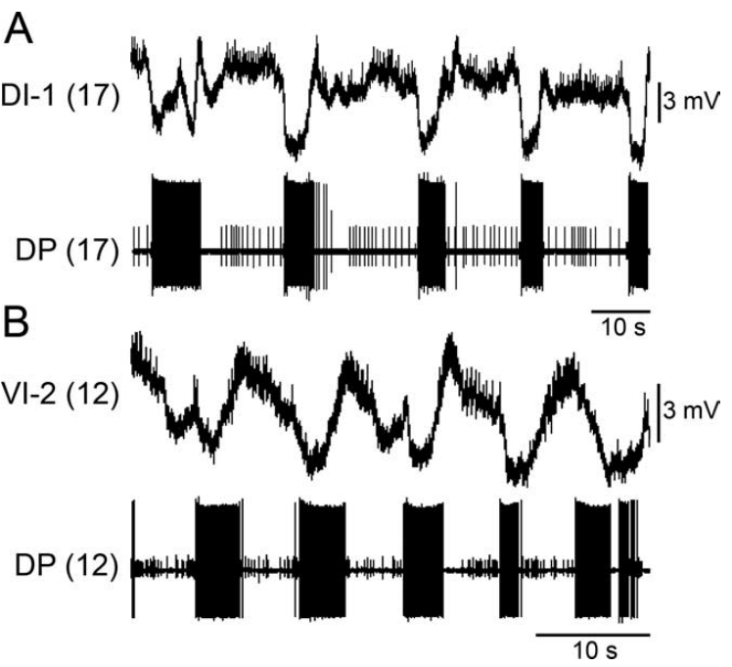
Inhibitory motor cells alternate with contraction outputs
The longitudinal inhibitors DI-1 and VI-2 participate in dopamine-induced crawling with timing largely opposite to the contraction-related bursts of DE-3.
  Puhl and Mesce recorded these identified neurons in isolated ganglia while using DE-3 activity to locate the contraction phase. The resulting records followed inhibitory motor pathways within the same cycle as the longitudinal excitatory output.
DI-1 was suppressed during contraction and became more active as that phase approached its termination, favoring release of the longitudinal muscle from excitation.
  VI-2 also produced inhibitory postsynaptic potentials in VE-4, reducing activity in the ventral longitudinal excitor. An inhibitory postsynaptic potential moves the receiving cell toward a state in which firing is less likely.
These inhibitory motor neurons influence the movement through both peripheral and central actions, shaping how contraction ends and elongation becomes possible.
  At the body wall, their output promotes relaxation of longitudinal muscle fibers. Within the ganglion, inhibition of an excitatory motor neuron reduces the signal driving contraction, coordinating withdrawal of central excitation with relaxation of the peripheral target. Withdrawing excitation and promoting relaxation together reduce longitudinal shortening, allowing the circular-muscle pathway to lengthen the segment during the next active phase.
Ashaber et al. (2021), Fig. 7(a). Reconstructed DE-3 arbor over a dorsal micro-CT image.
Puhl & Mesce (2008), Fig. 4(A,B). DI-1 and VI-2 activity relative to DE-3 during fictive crawling.
Puhl & Mesce (2008); Ashaber et al. (2021)
29
Notes:
Teaching transcript:
Puhl and Mesce recorded the dorsal inhibitor DI-1 and ventral inhibitor VI-2 in isolated ganglia during dopamine-induced crawling. Both are motor neurons associated with inhibition of longitudinal muscle pathways. Simultaneous DE-3 recording identified the contraction-related output of the same local circuit.
Their activity was largely opposite to DE-3 bursting. DI-1 was suppressed during the contraction phase and became more active toward its termination. VI-2 could produce inhibitory potentials in VE-4, directly connecting an inhibitory motor pathway with reduced activity in a longitudinal excitor.
An inhibitory postsynaptic potential is a synaptic voltage change that reduces the likelihood of firing in the receiving neuron. These recordings support coordinated inhibitory and excitatory contributions to alternating movement phases. The experiment does not assign a transmitter or receptor subtype solely from the direction of the voltage change.
Postsynaptic refers to the receiving side of a synapse. Recording a voltage change in VE-4 while identifying VI-2 activity links cell timing to inhibition, but molecular identification requires evidence beyond a membrane-potential trace.
References:
J. G. Puhl; K. A. Mesce (2008). Dopamine activates the motor pattern for crawling in the medicinal leech. Journal of Neuroscience 28(16):4192–4200. https://doi.org/10.1523/JNEUROSCI.0136-08.2008
M. Ashaber; Y. Tomina; P. Kassraian; E. A. Bushong; W. B. Kristan Jr; M. H. Ellisman; D. A. Wagenaar (2021). Anatomy and activity patterns in a multifunctional motor neuron and its surrounding circuits. eLife 10:e61881. https://doi.org/10.7554/eLife.61881
Puhl & Mesce (2008), Fig. 4(A,B). DI-1 and VI-2 activity relative to DE-3 during fictive crawling.
Figure source: https://doi.org/10.1523/JNEUROSCI.0136-08.2008
Ashaber et al. (2021), Fig. 7(a). Reconstructed DE-3 arbor over a dorsal micro-CT image.
Figure source: https://doi.org/10.7554/eLife.61881

Slide 39
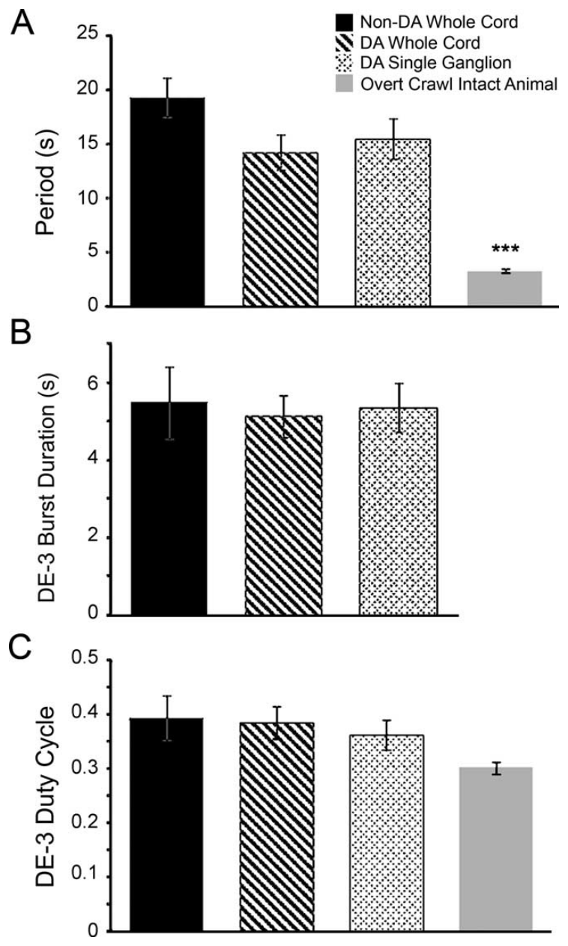
Fictive crawl rhythms resemble spontaneous crawling
Puhl and Mesce followed cycle period and DE-3 burst duration across dopamine-induced crawling in whole cords and single ganglia, spontaneous fictive activity, and overt crawling movements.
  The recordings related the rate of the repeated pattern to the duration of its contraction-related output. Video supplied the corresponding movement measurements when an intact body expressed a crawl.
Fictive crawl periods were commonly on the order of 10–15 s, while overt crawling in the measured animals averaged approximately 3.3 s.
  The neural preparations therefore expressed the recognizable pattern more slowly than the moving animal. Across fictive conditions, the portion of each cycle occupied by DE-3 bursting remained broadly similar despite differences in preparation and induction.
The duty cycle is the fraction of a cycle occupied by a defined active phase, here the contraction-related DE-3 burst.
  Its similarity across dopamine-induced, spontaneous, and electrically induced fictive patterns relates the drug-evoked activity to the motor program available within the nervous system. Cycle period and duty cycle together describe how fast the sequence repeats and how much of it is allocated to contraction. A similar active fraction can occur at different periods because both the burst and its surrounding quiet interval may expand or contract together.
Ashaber et al. (2021), Fig. 7(a). Reconstructed DE-3 arbor over a dorsal micro-CT image.
Puhl & Mesce (2008), Fig. 7. Original quantitative comparisons of crawl period and duty cycle.
Puhl & Mesce (2008); Ashaber et al. (2021)
30
Notes:
Teaching transcript:
Puhl and Mesce compared dopamine-induced rhythms in whole cords and single ganglia with spontaneous or electrically induced fictive crawling. They also measured overt crawling from video. The comparisons used cycle period and the duration of contraction-related DE-3 bursts to test similarity of motor organization.
Fictive crawling had periods on the order of 10–15 s in these preparations, whereas overt crawling averaged approximately 3.3 s. The fraction of a fictive cycle occupied by DE-3 bursting was broadly similar across the neural preparations despite their differences in size and induction method.
A duty cycle is the fraction of a repeating cycle occupied by a defined active phase. Comparable duty cycles support a shared pattern, but slower fictive periods limit equivalence with intact movement. The reduced preparation exposes central activity without recreating every sensory, mechanical, or motivational condition of natural crawling.
The overt contraction measurement used sucker release and attachment, while the fictive contraction proxy used DE-3 activity. Those measurements are related but not identical, so the result supports a motor-pattern comparison rather than complete behavioral identity.
References:
J. G. Puhl; K. A. Mesce (2008). Dopamine activates the motor pattern for crawling in the medicinal leech. Journal of Neuroscience 28(16):4192–4200. https://doi.org/10.1523/JNEUROSCI.0136-08.2008
M. Ashaber; Y. Tomina; P. Kassraian; E. A. Bushong; W. B. Kristan Jr; M. H. Ellisman; D. A. Wagenaar (2021). Anatomy and activity patterns in a multifunctional motor neuron and its surrounding circuits. eLife 10:e61881. https://doi.org/10.7554/eLife.61881
Puhl & Mesce (2008), Fig. 7. Original quantitative comparisons of crawl period and duty cycle.
Figure source: https://doi.org/10.1523/JNEUROSCI.0136-08.2008
Ashaber et al. (2021), Fig. 7(a). Reconstructed DE-3 arbor over a dorsal micro-CT image.
Figure source: https://doi.org/10.7554/eLife.61881

Slide 40
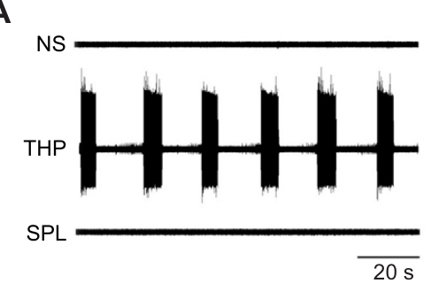
Phosphodiesterase inhibition can recruit slow bursting
Cyclic AMP, or cAMP, is an intracellular signaling molecule whose availability depends partly on its breakdown by phosphodiesterase enzymes.
  Crisp and colleagues tested phosphodiesterase inhibitors in isolated leech ganglia to examine a possible intracellular route into crawl-like bursting. Blocking breakdown prolongs the availability of cyclic nucleotides inside the cells exposed to the drug.
Applying 4.4 mM theophylline elicited recurring DE-3 bursts after approximately 10–20 min, following an initially quiet period in normal saline.
  A polar theophylline-related compound that blocked extracellular adenosine receptors produced a different outcome and failed to evoke the same rhythm. The active treatment therefore had an effect associated with its access to intracellular signaling.
The results were consistent with a cAMP-associated contribution to burst generation, connecting the pharmacology with a signaling route often recruited by DA1-like dopamine receptors.
  Increasing intracellular cAMP can change membrane processes through which a cell sustains depolarization and generates repeated bursts. Crisp and colleagues developed this proposed route alongside direct measurements of cAMP and tests of the ion-dependent processes supporting the induced rhythm. Prolonging a second messenger changes the cell’s internal signaling state over many spikes, giving the treatment a route into the slower processes underlying recurring motor bursts.
Crisp et al. (2012), Fig. 1(A). Theophylline, saline and extracellular-action control recordings.
Ashaber et al. (2021), Fig. 7(a). Reconstructed DE-3 arbor over a dorsal micro-CT image.
Crisp et al. (2012); Ashaber et al. (2021)
31
Notes:
Teaching transcript:
Crisp and colleagues tested whether cyclic AMP signaling could contribute to dopamine-associated crawling. Cyclic AMP, or cAMP, is an intracellular signaling molecule. A phosphodiesterase is an enzyme that breaks down cyclic nucleotides; inhibiting it can prolong their intracellular availability.
Bath application of 4.4 mM theophylline caused DE-3 bursting after approximately 10–20 min in isolated ganglia. A polar theophylline-related compound that blocked extracellular adenosine receptors without reproducing intracellular phosphodiesterase inhibition did not induce the same rhythm. Normal-saline recordings supplied the untreated comparison.
The control supports an intracellular contribution rather than attributing bursting simply to adenosine receptor blockade. It does not prove that theophylline acts exclusively through one enzyme or that dopamine uses an identical pathway. The measured endpoint is slow motor bursting, whose complete phase organization must be tested separately.
A polar drug may cross membranes less readily than a related nonpolar compound. The control used this distinction to separate extracellular receptor effects from the intracellular effects being investigated.
References:
K. M. Crisp; B. R. Gallagher; K. A. Mesce (2012). Mechanisms contributing to the dopamine induction of crawl-like bursting in leech motoneurons. Journal of Experimental Biology 215(17):3028–3036. https://doi.org/10.1242/jeb.069245
M. Ashaber; Y. Tomina; P. Kassraian; E. A. Bushong; W. B. Kristan Jr; M. H. Ellisman; D. A. Wagenaar (2021). Anatomy and activity patterns in a multifunctional motor neuron and its surrounding circuits. eLife 10:e61881. https://doi.org/10.7554/eLife.61881
Crisp et al. (2012), Fig. 1(A). Theophylline, saline and extracellular-action control recordings.
Figure source: https://doi.org/10.1242/jeb.069245
Ashaber et al. (2021), Fig. 7(a). Reconstructed DE-3 arbor over a dorsal micro-CT image.
Figure source: https://doi.org/10.7554/eLife.61881

Slide 41
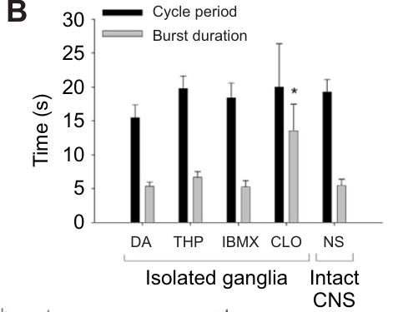
Phosphodiesterase inhibition elevates cyclic AMP
Crisp and colleagues measured cAMP after applying IBMX, a phosphodiesterase inhibitor, using an enzyme immunoassay to quantify the intracellular messenger.
  An immunoassay detects a target through molecular binding, allowing the biochemical response to be followed separately from the electrical pattern. The treatment was therefore evaluated through both the chemical change in neural tissue and its recurring motor output.
After 30 min in 0.5 mM IBMX, measured cAMP increased from approximately 12.9 to 29.4 pmol per ml in the extract.
  IBMX and dopamine each supported DE-3 bursts with periods near 20 s, and rhythmic bursting continued when the two were applied together. Their actions converged on preparations capable of expressing a slow recurring output.
The authors proposed a sodium-dependent timing mechanism through which phosphodiesterase inhibition and dopamine could promote rhythmicity in the crawl-related circuit.
  Dopamine also changed the responses of identified motor neurons in ways that differed from phosphodiesterase inhibition. The resulting account includes a cAMP-associated route into burst timing together with additional dopamine-sensitive processes shaping the activity of individual motor cells. The immunoassay describes messenger abundance in the treated tissue, while the motor recording describes the temporal output generated under the corresponding pharmacological state.
Ashaber et al. (2021), Fig. 7(a). Reconstructed DE-3 arbor over a dorsal micro-CT image.
Crisp et al. (2012), Fig. 1(B). Measured burst periods and durations across experimental conditions.
Crisp et al. (2012); Ashaber et al. (2021)
32
Notes:
Teaching transcript:
Crisp and colleagues applied the phosphodiesterase inhibitor IBMX to leech neural tissue and measured cAMP using an enzyme immunoassay. An immunoassay uses molecular binding to quantify a target substance. This measurement checked whether the proposed intracellular signal actually increased after treatment.
After 30 min in 0.5 mM IBMX, extract cAMP increased from approximately 12.9 to 29.4 pmol per ml. IBMX and dopamine could each support DE-3 bursts with periods near 20 s, and their coapplication did not abolish rhythmic bursting.
The biochemical and physiological results are consistent with a cAMP-associated route to rhythmicity. They do not directly identify a DA1-like receptor or prove that dopamine and IBMX converge on one molecular pathway. That receptor-based explanation remains a proposal requiring receptor-specific evidence in the relevant circuit cells.
DA1-like signaling often involves increases in cAMP, but similarity of downstream effects is not a receptor-identification assay. The original paper explicitly separates possible common pathways from mechanisms that could operate in parallel.
References:
K. M. Crisp; B. R. Gallagher; K. A. Mesce (2012). Mechanisms contributing to the dopamine induction of crawl-like bursting in leech motoneurons. Journal of Experimental Biology 215(17):3028–3036. https://doi.org/10.1242/jeb.069245
M. Ashaber; Y. Tomina; P. Kassraian; E. A. Bushong; W. B. Kristan Jr; M. H. Ellisman; D. A. Wagenaar (2021). Anatomy and activity patterns in a multifunctional motor neuron and its surrounding circuits. eLife 10:e61881. https://doi.org/10.7554/eLife.61881
Crisp et al. (2012), Fig. 1(B). Measured burst periods and durations across experimental conditions.
Figure source: https://doi.org/10.1242/jeb.069245
Ashaber et al. (2021), Fig. 7(a). Reconstructed DE-3 arbor over a dorsal micro-CT image.
Figure source: https://doi.org/10.7554/eLife.61881

Slide 42
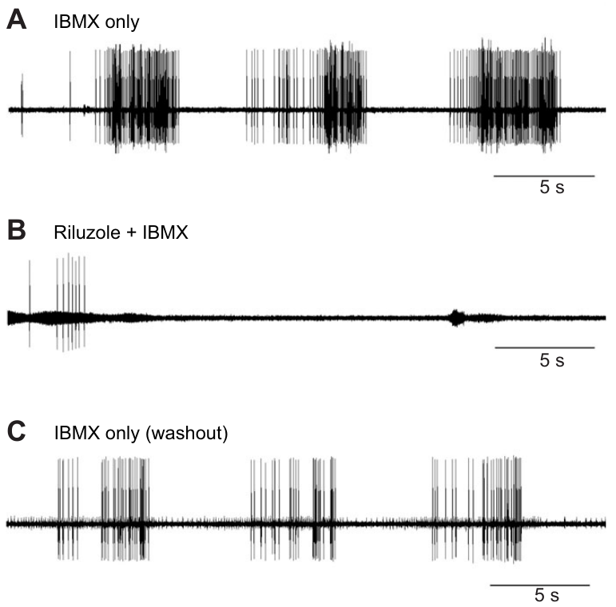
Persistent sodium entry contributes to induced bursting
A persistent sodium current supplies inward current over a longer interval than the brief sodium entry responsible for the rising phase of a single action potential.
  Sustained inward drive can maintain a depolarizing plateau on which several spikes occur. Crisp and colleagues used riluzole to examine the contribution of a persistent sodium-current component during IBMX-induced DE-3 bursting.
Applying 200 μM riluzole stopped the repeated bursts while IBMX remained in the bath, although the preparation could still produce impulses.
  When riluzole was washed out and IBMX exposure continued, the recurring bursts returned. The intervention therefore changed the organization of sustained rhythmic output while leaving the capacity for individual spikes available.
The response supports a sodium-dependent contribution to the induced timing process, linking the slower depolarizing drive with the repeated contraction-related bursts.
  Continued IBMX during the interruption retained the phosphodiesterase-inhibiting treatment. Riluzole sensitivity therefore placed the affected sodium-dependent process downstream of, or alongside, the cAMP-associated influence proposed to make bursting available. The continuing capacity for isolated impulses separates the prolonged inward process supporting a burst plateau from the brief regenerative events occurring on top of it.
Ashaber et al. (2021), Fig. 7(a). Reconstructed DE-3 arbor over a dorsal micro-CT image.
Crisp et al. (2012), Fig. 2(A–C). IBMX-induced bursts, riluzole blockade and washout recovery.
Crisp et al. (2012); Ashaber et al. (2021)
33
Notes:
Teaching transcript:
Crisp and colleagues tested IBMX-induced bursting with riluzole, a drug used to inhibit a persistent sodium-current component. A persistent current continues beyond the brief inward current associated with an action potential. Sustained sodium entry can support a prolonged depolarization on which spikes occur.
Application of 200 μM riluzole stopped the rhythmic DE-3 bursts despite continued IBMX exposure. The preparations could still fire impulses, and washing out riluzole while retaining IBMX restored bursting. The within-preparation recovery distinguishes rhythm disruption from irreversible loss of neuronal viability.
The result supports a sodium-dependent contribution to the induced timing mechanism. It does not directly measure the persistent current in an identified oscillator neuron or establish a channel gene. Pharmacological sensitivity and preserved spiking constrain the explanation without completing its molecular identification.
Riluzole was applied at 200 μM. Continued action potentials after loss of repetitive bursting help separate excitability from the slower dynamics that generate a rhythm; pharmacology still cannot establish the responsible sodium-channel gene.
References:
K. M. Crisp; B. R. Gallagher; K. A. Mesce (2012). Mechanisms contributing to the dopamine induction of crawl-like bursting in leech motoneurons. Journal of Experimental Biology 215(17):3028–3036. https://doi.org/10.1242/jeb.069245
M. Ashaber; Y. Tomina; P. Kassraian; E. A. Bushong; W. B. Kristan Jr; M. H. Ellisman; D. A. Wagenaar (2021). Anatomy and activity patterns in a multifunctional motor neuron and its surrounding circuits. eLife 10:e61881. https://doi.org/10.7554/eLife.61881
Crisp et al. (2012), Fig. 2(A–C). IBMX-induced bursts, riluzole blockade and washout recovery.
Figure source: https://doi.org/10.1242/jeb.069245
Ashaber et al. (2021), Fig. 7(a). Reconstructed DE-3 arbor over a dorsal micro-CT image.
Figure source: https://doi.org/10.7554/eLife.61881

Slide 43
Crawl-like bursting persists without normal calcium influx
Crisp and colleagues replaced extracellular calcium with nickel or cobalt while testing theophylline-induced DE-3 bursting in isolated leech ganglia.
  These divalent ions interfere with normal calcium entry as they replace calcium in the bathing solution. The substitution changed the ionic conditions under which the slow burst-generating process operated.
Rhythmic bursting persisted when 1.8 mM nickel replaced 1.8 mM calcium, preserving a recurring contraction-related output in the altered saline.
  Example average periods were approximately 20.4 s in calcium-containing saline and 22.3 s with nickel substitution. Burst durations also remained within a similar range, retaining both the repetition and the extended active phase of the response.
The timing mechanism could therefore continue under conditions that suppressed normal calcium influx, consistent with a prominent contribution from sodium-dependent inward drive.
  Riluzole sensitivity provided a complementary intervention affecting that drive during induced bursting. Together, these ion-dependent responses describe the membrane processes through which a prolonged depolarization and recurring DE-3 activity were maintained in the treated ganglion. The preserved active interval indicates that the treated membrane could still maintain depolarization long enough to support a group of spikes within each recurring cycle.
Ashaber et al. (2021), Fig. 7(a). Reconstructed DE-3 arbor over a dorsal micro-CT image.
Crisp et al. (2012), Fig. 1(B). Original comparison of induced burst timing across treatments.
Crisp et al. (2012); Ashaber et al. (2021)
34
Notes:
Teaching transcript:
Crisp and colleagues replaced extracellular calcium with an equimolar concentration of nickel or cobalt while testing theophylline-induced DE-3 bursting. Calcium entry normally participates in several membrane and synaptic processes. Ion substitution tested whether normal calcium influx was required for the observed rhythmic output.
Bursting persisted in saline with 1.8 mM nickel replacing 1.8 mM calcium. Example average cycle periods were approximately 20.4 s in calcium-containing saline and 22.3 s in nickel-containing saline. Burst durations also remained in a similar range.
These observations favor a timing contribution that can operate without normal calcium entry under the experimental treatment. They do not imply that calcium is unnecessary for every synapse or for natural crawling. Ion substitution alters several processes, and the result must remain specific to the drug-induced bursting tested in the isolated preparation.
The comparative timing panel contextualizes the induced bursts, while the ion-replacement result is reported in the article text. The timing comparison does not independently test the ion-replacement condition.
References:
K. M. Crisp; B. R. Gallagher; K. A. Mesce (2012). Mechanisms contributing to the dopamine induction of crawl-like bursting in leech motoneurons. Journal of Experimental Biology 215(17):3028–3036. https://doi.org/10.1242/jeb.069245
M. Ashaber; Y. Tomina; P. Kassraian; E. A. Bushong; W. B. Kristan Jr; M. H. Ellisman; D. A. Wagenaar (2021). Anatomy and activity patterns in a multifunctional motor neuron and its surrounding circuits. eLife 10:e61881. https://doi.org/10.7554/eLife.61881
Crisp et al. (2012), Fig. 1(B). Original comparison of induced burst timing across treatments.
Figure source: https://doi.org/10.1242/jeb.069245
Ashaber et al. (2021), Fig. 7(a). Reconstructed DE-3 arbor over a dorsal micro-CT image.
Figure source: https://doi.org/10.7554/eLife.61881

Slide 44
Potassium-current blockade changes the active fraction
Outward potassium current opposes depolarization and can help terminate a burst by bringing the membrane back toward a less excitable voltage.
  Crisp and colleagues applied clotrimazole, a blocker associated with intermediate-conductance calcium-dependent potassium channels, during recordings from the crawl-related motor circuit. The intervention examined how reducing an outward influence changed the duration of activity.
At 25 μM clotrimazole, DE-3 bursts repeated at periods near 20 s, while their duration increased to approximately 13.5 s.
  Dopamine or phosphodiesterase inhibition produced bursts nearer 5 s under the corresponding conditions. The clotrimazole treatment therefore enlarged the active portion of each cycle while preserving a broadly similar interval between repeated bursts.
An outward-current contribution to burst termination can regulate how much of the cycle is occupied by longitudinal contraction.
  Extending DE-3 activity leaves a shorter interval for the opposing elongation phase before the next burst begins. Appropriate crawling requires the contraction-related drive to end in time for circular-muscle excitation and body extension to occupy their part of the movement sequence. The quiet interval between bursts provides a temporal opportunity for the opposing muscle group, making termination as relevant as burst initiation to the movement sequence.
Ashaber et al. (2021), Fig. 7(a). Reconstructed DE-3 arbor over a dorsal micro-CT image.
Crisp et al. (2012), Fig. 1(B). Published burst-period and burst-duration comparison.
Crisp et al. (2012); Ashaber et al. (2021)
35
Notes:
Teaching transcript:
Crisp and colleagues tested clotrimazole, a blocker associated with intermediate-conductance calcium-dependent potassium channels. Potassium efflux generally opposes depolarization under these conditions. Removing an outward current can therefore alter how long an excitable cell remains active during a burst.
At 25 μM clotrimazole, DE-3 bursts occurred with cycle periods near 20 s, comparable to the other induction methods. Their duration increased to approximately 13.5 s, compared with approximately 5 s under dopamine or phosphodiesterase inhibition. The active fraction of the cycle was consequently much larger.
The result separates period from burst termination and supports an outward-current contribution to pattern shape. Clotrimazole can also affect sodium–potassium pump activity, so this experiment does not uniquely identify one potassium-channel subtype as the endogenous dopamine target. The channel account remains pharmacologically supported and incomplete.
The sodium–potassium pump uses energy to maintain ionic gradients and can contribute an outward electrical effect. A drug that influences both a channel and the pump requires caution when assigning its entire physiological effect to one target.
References:
K. M. Crisp; B. R. Gallagher; K. A. Mesce (2012). Mechanisms contributing to the dopamine induction of crawl-like bursting in leech motoneurons. Journal of Experimental Biology 215(17):3028–3036. https://doi.org/10.1242/jeb.069245
M. Ashaber; Y. Tomina; P. Kassraian; E. A. Bushong; W. B. Kristan Jr; M. H. Ellisman; D. A. Wagenaar (2021). Anatomy and activity patterns in a multifunctional motor neuron and its surrounding circuits. eLife 10:e61881. https://doi.org/10.7554/eLife.61881
Crisp et al. (2012), Fig. 1(B). Published burst-period and burst-duration comparison.
Figure source: https://doi.org/10.1242/jeb.069245
Ashaber et al. (2021), Fig. 7(a). Reconstructed DE-3 arbor over a dorsal micro-CT image.
Figure source: https://doi.org/10.7554/eLife.61881

Slide 45
Separate currents set when a crawl burst starts and stops
A prolonged locomotor burst depends on membrane processes that initiate, sustain, and terminate depolarization, allowing an active phase to recur within a slower rhythm.
  Persistent sodium entry provides a proposed source of sustained inward drive after the membrane approaches threshold. Spikes can then ride on a plateau whose duration extends far beyond the brief voltage excursion of an individual action potential.
Outward potassium current can build during the active phase and restore a more negative voltage when its influence outweighs the remaining inward current.
  The pharmacological findings fit different contributions to this sequence. Riluzole stopped recurring bursts, while clotrimazole extended their duration to about 13.5 s within a cycle still lasting approximately 20 s.
These membrane contributions give the crawl-related circuit separate control over repetition and active-phase duration, shaping both the presence of the rhythm and its motor pattern.
  Continued bursting after nickel replaced calcium describes additional ionic conditions tolerated by the timing mechanism. The animal's contraction–elongation sequence depends on both a recurring inward drive and timely withdrawal of contraction-related activity. Changing burst duration while retaining a similar period alters duty cycle, so the balance of these membrane processes determines the fraction of time available for each muscle action.
Crisp et al. (2012), Fig. 2(A–C). IBMX-induced bursts, riluzole blockade and washout recovery.
Crisp et al. (2012)
35a
Notes:
Slides 31 to 35 test one drug or ion substitution at a time; combined, they outline a burst mechanism with a sodium-dependent start and a potassium-dependent end.
Positive feedback sustains the plateau.
A persistent sodium current does not inactivate quickly, so depolarization that opens it is reinforced for as long as the membrane stays depolarized.
Crisp and colleagues suggest that phosphodiesterase inhibitors and dopamine activate a sodium-influx-dependent timing mechanism capable of setting the crawl rhythm.
Outward current terminates the burst.
Clotrimazole on slide 35 blocks intermediate-conductance calcium-dependent potassium channels, and with that outward current reduced, bursts lasted far longer while cycles kept roughly the same length.
Riluzole on slide 33 had the complementary effect, abolishing rhythmic bursting while leaving impulse generation intact.
Calcium entry is not the timer.
Bursting persisted when cobalt or nickel replaced calcium, as slide 34 reports, which points away from calcium influx as the rhythm-setting step.
The remaining candidates, sodium entry and potassium exit, match the riluzole and clotrimazole results.
References:
K. M. Crisp; B. R. Gallagher; K. A. Mesce (2012). Mechanisms contributing to the dopamine induction of crawl-like bursting in leech motoneurons. Journal of Experimental Biology 215(17):3028–3036. https://doi.org/10.1242/jeb.069245

Slide 46
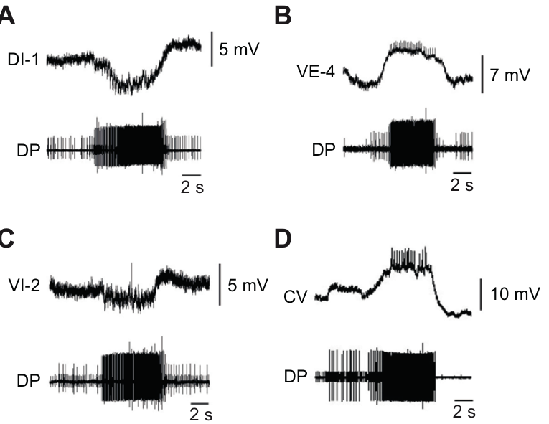
A slow rhythm can retain the wrong motor-cell phase
Crisp and colleagues recorded several identified motor neurons during IBMX-induced DE-3 bursting, following the relative phase of their activity within the same cycle.
  VE-4 depolarized together with DE-3, placing the dorsal and ventral longitudinal excitors in a shared active phase. The longitudinal inhibitors DI-1 and VI-2 became hyperpolarized during those bursts.
The circular excitor CV also fired with DE-3 under IBMX, placing circular-muscle excitation in the contraction-related portion of the rhythm.
  During dopamine-induced crawling, CV instead fires in the opposing phase, when longitudinal activity is suppressed and the segment elongates. The two treatments therefore produced different motor-cell relationships within a slow recurring output.
Correct patterning of elongation and contraction depends on assigning the muscle pathways to appropriate phases as well as generating a recurring burst.
  Circular contraction during longitudinal shortening would oppose the usual sequence that lengthens and then shortens a segment. Dopamine's actions on motor-neuron responses supply additional influences that can place CV activity in the elongation phase of the crawl. The same period can consequently contain different muscle commands, with simultaneous antagonistic excitation producing a different mechanical consequence from an alternating elongation and contraction sequence.
Crisp et al. (2012), Fig. 3(A–D). Identified motor-cell activity during IBMX-induced bursting.
Ashaber et al. (2021), Fig. 7(a). Reconstructed DE-3 arbor over a dorsal micro-CT image.
Crisp et al. (2012); Ashaber et al. (2021)
36
Notes:
Teaching transcript:
Crisp and colleagues recorded several identified motor cells while IBMX induced DE-3 bursts in isolated ganglia. This tested whether a drug that reproduced approximate crawl timing also reproduced the full crawl motor pattern. Simultaneous intracellular and motor-nerve recordings established relative phase within the same cycle.
The longitudinal excitor VE-4 depolarized with DE-3, while inhibitors DI-1 and VI-2 were hyperpolarized during those bursts. However, the circular excitor CV fired in phase with DE-3 under IBMX. During the usual dopamine-induced crawl pattern, CV instead participates in the opposing elongation phase.
Rhythm generation and correct motor patterning are separable. Reproducing a slow period does not establish that every muscle group will be activated appropriately. The mismatch supports additional dopamine actions beyond the phosphodiesterase-sensitive timing route, without identifying all of the responsible receptor subtypes or interneurons.
If circular and longitudinal excitors fire together, their usual antagonistic mechanical actions can conflict. The preparation records neural outputs rather than intact muscle deformation, so the predicted movement consequence remains distinct from the measured phase error.
References:
K. M. Crisp; B. R. Gallagher; K. A. Mesce (2012). Mechanisms contributing to the dopamine induction of crawl-like bursting in leech motoneurons. Journal of Experimental Biology 215(17):3028–3036. https://doi.org/10.1242/jeb.069245
M. Ashaber; Y. Tomina; P. Kassraian; E. A. Bushong; W. B. Kristan Jr; M. H. Ellisman; D. A. Wagenaar (2021). Anatomy and activity patterns in a multifunctional motor neuron and its surrounding circuits. eLife 10:e61881. https://doi.org/10.7554/eLife.61881
Crisp et al. (2012), Fig. 3(A–D). Identified motor-cell activity during IBMX-induced bursting.
Figure source: https://doi.org/10.1242/jeb.069245
Ashaber et al. (2021), Fig. 7(a). Reconstructed DE-3 arbor over a dorsal micro-CT image.
Figure source: https://doi.org/10.7554/eLife.61881

Slide 47
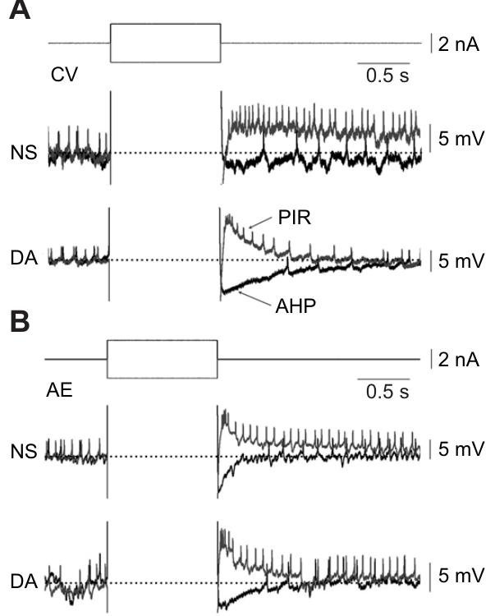
Dopamine reshapes rebound after inhibition
Post-inhibitory rebound is an increase in depolarization or firing after inhibition ends, allowing the release from one phase to recruit activity in the next.
  Crisp and colleagues evoked this response in the circular excitor CV and annulus erector AE using hyperpolarizing current pulses. The defined input made it possible to follow each neuron's recovery during changes in chemical state.
At 75 μM dopamine, CV expressed a larger rebound peak, a shorter rebound duration, and an enhanced afterhyperpolarization following the response.
  AE also had a shorter rebound, so the effect extended across two crawl-related motor neurons. The perturbing current was −1 nA for 500 ms, providing a reproducible period of inhibition before the subsequent voltage response.
Dopamine therefore altered the strength and duration of recovery from inhibition in different ways, increasing CV's initial rebound while shortening its later activity.
  A strong early response can favor prompt recruitment when the opposing phase ends, while an enhanced afterhyperpolarization helps curtail that recruitment. These cellular changes affect how motor neurons participate in an alternating pattern generated by the surrounding circuit. The larger early voltage excursion and shorter discharge window therefore affect different portions of the motor response, providing separate influences on recruitment and termination.
Ashaber et al. (2021), Fig. 7(a). Reconstructed DE-3 arbor over a dorsal micro-CT image.
Crisp et al. (2012), Fig. 4(A,B). Current pulses and rebound responses in CV and AE.
Crisp et al. (2012); Ashaber et al. (2021)
37
Notes:
Teaching transcript:
Crisp and colleagues applied hyperpolarizing current pulses to CV and AE motor neurons before and during dopamine exposure. Post-inhibitory rebound is increased depolarization or firing after an inhibitory influence ends. An afterhyperpolarization is a more negative voltage following activity or a rebound response.
At 75 μM dopamine, CV had a larger rebound peak but a shorter rebound duration and enhanced afterhyperpolarization. AE also had a shortened rebound response. Current pulses of −1 nA for 500 ms provided a defined perturbation rather than relying on variable network inhibition.
The effect shows that peak voltage, response duration, and subsequent inhibition can change differently under one modulator. It does not support a simple rule that dopamine uniformly increases excitability. The channel processes responsible for each component were not isolated directly by these current-pulse measurements.
A sharper but shorter rebound can change when a motor neuron fires without increasing its total activity. The experiment measures the cell’s response to a controlled input, while its actual phase in the network also depends on synaptic drive.
References:
K. M. Crisp; B. R. Gallagher; K. A. Mesce (2012). Mechanisms contributing to the dopamine induction of crawl-like bursting in leech motoneurons. Journal of Experimental Biology 215(17):3028–3036. https://doi.org/10.1242/jeb.069245
M. Ashaber; Y. Tomina; P. Kassraian; E. A. Bushong; W. B. Kristan Jr; M. H. Ellisman; D. A. Wagenaar (2021). Anatomy and activity patterns in a multifunctional motor neuron and its surrounding circuits. eLife 10:e61881. https://doi.org/10.7554/eLife.61881
Crisp et al. (2012), Fig. 4(A,B). Current pulses and rebound responses in CV and AE.
Figure source: https://doi.org/10.1242/jeb.069245
Ashaber et al. (2021), Fig. 7(a). Reconstructed DE-3 arbor over a dorsal micro-CT image.
Figure source: https://doi.org/10.7554/eLife.61881

Slide 48
Rebound from inhibition can place CV in the elongation phase
During dopamine-induced crawling, the circular excitor CV is inhibited while DE-3 bursts and becomes active when the contraction-related phase ends.
  Post-inhibitory rebound provides a proposed cellular contribution to this transition. Hyperpolarization permits recovery of membrane processes that can supply inward drive when the inhibitory influence is released, helping the cell approach firing threshold.
Dopamine increased CV's rebound peak while shortening its duration and strengthening the afterhyperpolarization that followed it.
  These changes favor an early response after inhibition lifts and a more restricted period of subsequent activity. Reduced firing to steady depolarizing current further concentrates the cell's responsiveness around the transition out of the inhibited phase.
Phosphodiesterase inhibitors produced a different pattern of cellular responsiveness, increasing resting discharge and allowing CV to fire together with the contraction-related DE-3 burst.
  Dopamine therefore acts on the motor-neuron membrane response as well as the routes that make slow bursting available. Appropriate crawl output depends on placing circular excitation within elongation and terminating it before the next longitudinal contraction. The preceding inhibited state prepares the rebound, so CV’s response depends on both its current chemical environment and the phase-dependent input it has just received.
Crisp et al. (2012), Fig. 4(A,B). Current pulses and rebound responses in CV and AE.
Crisp et al. (2012); Puhl & Mesce (2008)
37a
Notes:
Slide 27 gives CV's phase during normal fictive crawling, slide 36 reports that phase lost under IBMX, and slides 37 and 38 show what dopamine does to CV's membrane; together they suggest how CV is timed.
CV's timing follows inhibition.
Puhl and Mesce recorded a hyperpolarization of a few millivolts in CV during each DE-3 burst, with CV firing in the opposite half of the cycle.
A neuron that fires as soon as inhibition ends will automatically sit in the phase after contraction, which is elongation.
Dopamine tunes the rebound.
With dopamine present, CV's rebound after a current pulse peaked higher but lasted less time, followed by a deeper afterhyperpolarization.
A brief, strong rebound produces a well-timed burst that does not spill into the following contraction.
The PDI comparison supports the idea.
Crisp and colleagues report that dopamine lowered motoneuron excitability, whereas phosphodiesterase inhibitors increased resting discharge rates.
They propose that multiple dopamine receptor subtypes shape the phase relationships and membrane properties of particular crawl neurons, which would explain why CV's phase is restored only by dopamine.
References:
K. M. Crisp; B. R. Gallagher; K. A. Mesce (2012). Mechanisms contributing to the dopamine induction of crawl-like bursting in leech motoneurons. Journal of Experimental Biology 215(17):3028–3036. https://doi.org/10.1242/jeb.069245
J. G. Puhl; K. A. Mesce (2008). Dopamine activates the motor pattern for crawling in the medicinal leech. Journal of Neuroscience 28(16):4192–4200. https://doi.org/10.1523/JNEUROSCI.0136-08.2008

Slide 49
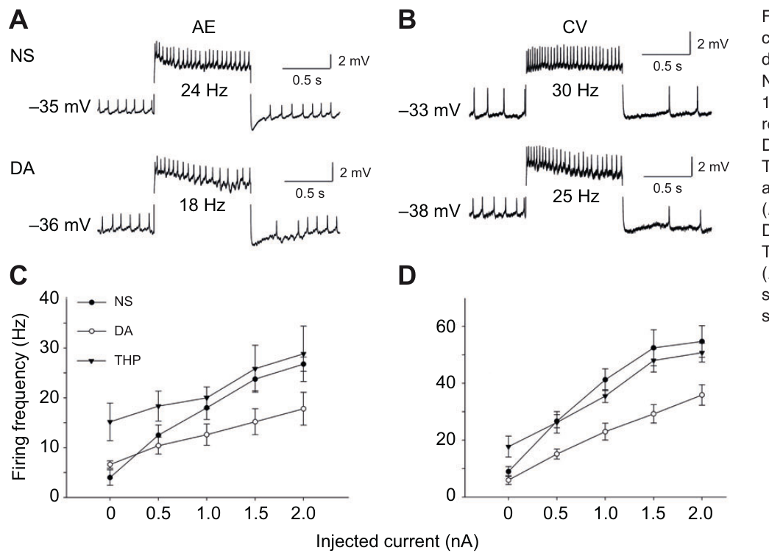
Dopamine can promote pattern while reducing excitability
Excitability describes how readily a neuron produces spikes in response to an input, and it can change differently from the availability of a whole motor program.
  Crisp and colleagues injected depolarizing current into CV and AE before and during dopamine exposure. The resulting discharge measured their direct response to a controlled input while the chemical state of the preparation changed.
For a +1 nA input, AE firing fell from approximately 18 to 12.6 Hz, and CV firing fell from approximately 41.2 to 23 Hz during dopamine.
  Theophylline had a different effect and increased resting discharge in the tested cells. Dopamine's influence on these neurons therefore included a reduction in their response to sustained excitation.
Reduced steady firing can coexist with stronger expression of a coordinated locomotor pattern when the modulator also shapes phase-dependent responses and rhythm generation.
  Dopamine changed rebound properties and the phase in which CV participated, while making crawl-related output available within the ganglion. Crisp and colleagues related this combination to several dopamine-sensitive processes, including receptor-dependent actions extending beyond cAMP-associated burst timing. A cell can be less responsive to a constant excitatory current while remaining appropriately recruited by transient release from inhibition within the complete motor cycle.
Crisp et al. (2012), Fig. 5(A–D). Motor-cell firing responses and original current–frequency plots.
Ashaber et al. (2021), Fig. 7(a). Reconstructed DE-3 arbor over a dorsal micro-CT image.
Crisp et al. (2012); Ashaber et al. (2021)
38
Notes:
Teaching transcript:
Crisp and colleagues injected depolarizing current into CV and AE and compared firing before and during dopamine exposure. Excitability here refers to the relationship between injected current and the resulting discharge. Testing that relationship separates direct cellular responsiveness from the presence of a network rhythm.
For a +1 nA input, average AE firing fell from approximately 18 to 12.6 Hz during dopamine; average CV firing fell from approximately 41.2 to 23 Hz. Theophylline did not reproduce the same reduction and instead increased resting discharge in the tested cells.
Dopamine can favor a patterned output while reducing the response of particular motor neurons to steady excitation. Timing, phase, and input responsiveness are different properties. The mismatch with theophylline supports multiple modulatory effects, but does not prove which receptor or conductance accounts for each difference.
The traces in the original figure represent individual examples, while the text here uses the article’s average current-response values. The distinction prevents an illustrative trace from being treated as the population average.
References:
K. M. Crisp; B. R. Gallagher; K. A. Mesce (2012). Mechanisms contributing to the dopamine induction of crawl-like bursting in leech motoneurons. Journal of Experimental Biology 215(17):3028–3036. https://doi.org/10.1242/jeb.069245
M. Ashaber; Y. Tomina; P. Kassraian; E. A. Bushong; W. B. Kristan Jr; M. H. Ellisman; D. A. Wagenaar (2021). Anatomy and activity patterns in a multifunctional motor neuron and its surrounding circuits. eLife 10:e61881. https://doi.org/10.7554/eLife.61881
Crisp et al. (2012), Fig. 5(A–D). Motor-cell firing responses and original current–frequency plots.
Figure source: https://doi.org/10.1242/jeb.069245
Ashaber et al. (2021), Fig. 7(a). Reconstructed DE-3 arbor over a dorsal micro-CT image.
Figure source: https://doi.org/10.7554/eLife.61881

Slide 50
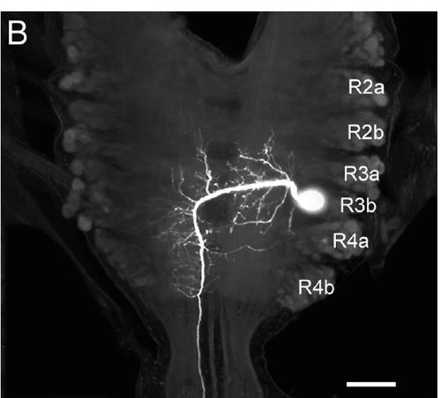
A descending neuron reaches distributed crawl circuitry
The paired descending neuron R3b-1 has its cell body in the subesophageal ganglion and projects posteriorly through the leech nerve cord.
  Puhl and colleagues filled the identified neuron with Neurobiotin and used confocal imaging to follow its processes. The anatomical reconstruction established access from the cephalic region to distributed segmental circuitry.
The R3b-1 axon extends along the cord and forms branches within segmental ganglia, with some processes crossing the midline.
  This provides access to both sides of the local nervous system as the descending projection passes through successive regions. The cephalic and segmental images retain 100 μm scale bars, preserving the scale of the recorded arborization.
A descending cell with access to successive ganglia can recruit many local crawl generators through the same longitudinal pathway.
  Its branches place the command-related input within the segmental networks that organize circular and longitudinal motor activity. The resulting arrangement permits an anterior signal to influence the onset, period, and coordination of a movement pattern expressed throughout the body. Branches within successive ganglia place the descending influence beside each repeated local generator, allowing one active projection to affect the sequence expressed across many body regions.
Puhl et al. (2012), Fig. 2(B). Confocal anatomy of the identified descending R3b-1 neuron.
Puhl et al. (2012)
39
Notes:
Teaching transcript:
Puhl and colleagues identified the paired descending neuron R3b-1 within the subesophageal ganglion. A descending projection carries signals from an anterior neural region toward more posterior circuitry. Neurobiotin filling and confocal imaging established the cell’s soma and arborization in the cephalic region.
R3b-1 has an axon that extends through the nerve cord, with branches in segmental ganglia. Some processes cross the midline, providing anatomical access to both sides. The published cephalic and segmental images preserve 100 μm scale bars.
The anatomy permits one cell to influence many local motor circuits, but a visible arbor is not proof of a synapse onto every nearby neuron. Its functional role must be tested with recording and perturbation. The descending arrangement also does not make R3b-1 the sole possible source of local crawl rhythmicity.
The subesophageal ganglion is a fused cephalic neural region below the esophagus. The bilateral pairing matters because manipulating one cell without excluding its counterpart could leave a parallel source of descending influence.
References:
J. G. Puhl; M. A. Masino; K. A. Mesce (2012). Necessary, sufficient and permissive: a single locomotor command neuron important for intersegmental coordination. Journal of Neuroscience 32(49):17646–17657. https://doi.org/10.1523/JNEUROSCI.2249-12.2012
Puhl et al. (2012), Fig. 2(B). Confocal anatomy of the identified descending R3b-1 neuron.
Figure source: https://doi.org/10.1523/JNEUROSCI.2249-12.2012

Slide 51
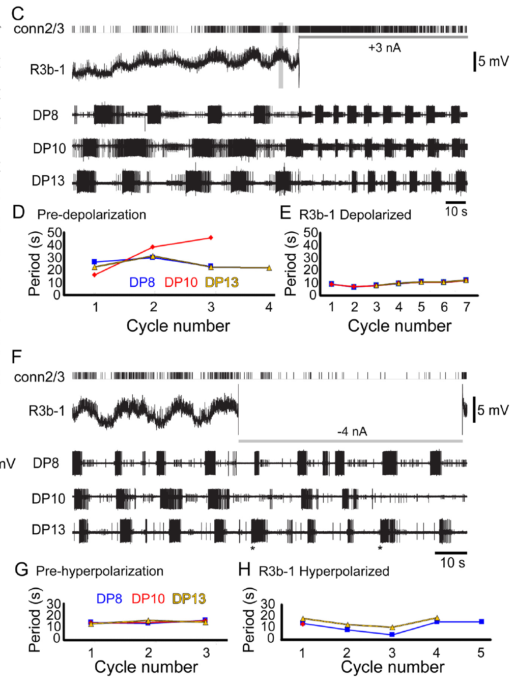
R3b-1 activity controls coordination in a defined state
Puhl and colleagues manipulated one R3b-1 neuron after excluding the contralateral cell's influence, while recording DE-3 output from several segments in a dopamine-biased preparation.
  This arrangement followed the effect of an identified descending signal on distributed crawl-related activity. Local generators remained available along the cord while the firing of the selected neuron was changed.
A +3 nA current increased R3b-1 activity and organized irregular segmental bursts into coordinated fictive crawling.
  In one example, periods near 27–29 s changed to approximately 10 s across the recorded segments. A −4 nA current disrupted the shared period and orderly sequence even when some local bursts continued.
Under these conditions, R3b-1 supplied both a command for coordination and an influence on the rate of the crawl cycle.
  Activating the neuron organized the distributed output, while suppressing it disrupted the coordinated behavior expressed by the preparation. The continuing local bursts during disruption locate part of its contribution in bringing segmental activity into a common temporal pattern. The common period is a relationship among generators, while each local burst reflects the activity retained within one region. Manipulating R3b-1 changes both the rate at which coordinated cycles recur and the temporal alignment through which several regions participate in them. A shared descending influence can therefore synchronize when local contraction phases begin, while local circuitry supplies the intervening pattern of muscle-related activity.
Puhl et al. (2012), Fig. 4(C–H). Depolarization and hyperpolarization with multisegment recordings.
Puhl et al. (2012)
40
Notes:
Teaching transcript:
Puhl and colleagues excluded the contralateral R3b-1 influence and recorded DE-3 output from several segments while manipulating the remaining cell. Dopamine biased the preparation toward crawling. This design tested one descending neuron’s effect on a distributed rhythm under specified conditions.
A +3 nA current increased R3b-1 spiking and converted irregular segmental bursting into coordinated fictive crawling. In one example, periods changed from roughly 27–29 s to approximately 10 s across the recording sites. A −4 nA current disrupted their common period and crawl-specific coordination, even when some local bursts continued.
R3b-1 activity was sufficient and necessary for coordinated output in the tested preparation and state. Local burst persistence prevents equating disruption of coordination with complete abolition of every segmental oscillator. The result is a conditional causal role, not a universal claim that this cell is required for all rhythms under all conditions.
The extracellular connective recording verified changes in R3b-1 spiking during intracellular current injection. This control separates an intended voltage manipulation from evidence that the neuron’s propagated activity actually changed.
References:
J. G. Puhl; M. A. Masino; K. A. Mesce (2012). Necessary, sufficient and permissive: a single locomotor command neuron important for intersegmental coordination. Journal of Neuroscience 32(49):17646–17657. https://doi.org/10.1523/JNEUROSCI.2249-12.2012
Puhl et al. (2012), Fig. 4(C–H). Depolarization and hyperpolarization with multisegment recordings.
Figure source: https://doi.org/10.1523/JNEUROSCI.2249-12.2012

Slide 52
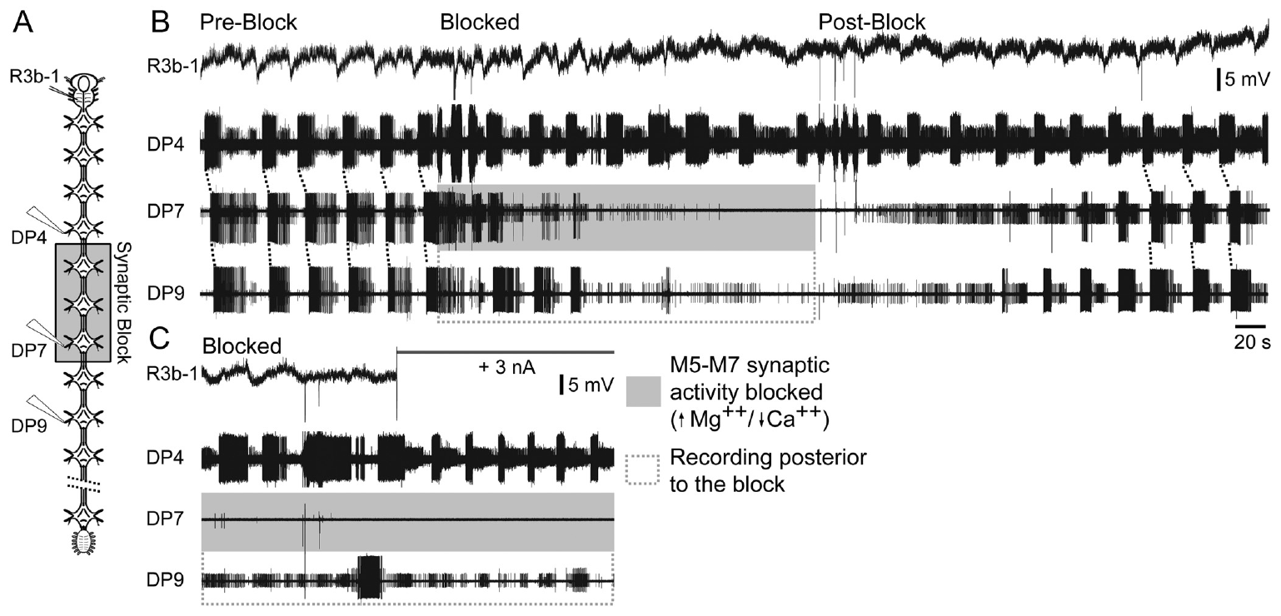
A command signal must interact with segmental networks
R3b-1 communicates with local segmental networks as its descending axon passes through ganglia containing crawl-generating circuitry.
  Puhl and colleagues applied high-magnesium, low-calcium saline to a restricted region to suppress chemical synaptic transmission while retaining axonal conduction. Motor recordings sampled activity within that region and in ganglia outside it.
Regional synaptic blockade disrupted ordinary crawl coordination, and additional R3b-1 spikes failed to restore the usual distributed pattern through the affected tissue.
  Rhythmic activity could remain in other parts of the cord, while their normal intersegmental organization changed. The descending axon therefore reached a network whose chemical interactions had become unavailable within the treated region.
The command-related influence depends on synaptic interactions inside the segmental ganglia, where local circuits transform descending activity into appropriately phased motor output.
  A permissive input enables a generator to operate, while the active network supplies the recurring sequence and its relationships with neighboring generators. Coordinated crawling emerges through the combined operation of the descending pathway and the segmental circuitry it recruits. Axonal conduction preserves arrival of the descending spike, while local chemical transmission determines which neuronal processes can respond to that arrival in each treated ganglion.
Puhl et al. (2012), Fig. 6(A–C). Regional synaptic blockade during descending-neuron stimulation.
Puhl et al. (2012)
41
Notes:
Teaching transcript:
Puhl and colleagues tested whether R3b-1 commands coordination directly or must interact with local segmental circuits. High-magnesium, low-calcium saline blocked chemical transmission in a restricted region while the axon remained capable of conducting. Motor recordings sampled ganglia within and outside the blocked region.
The synaptic blockade altered the coordinated pattern. Depolarizing R3b-1 did not restore ordinary crawl coordination simply by sending more descending spikes through the affected region. Appropriate rhythmic activity could remain elsewhere without the expected full intersegmental organization.
A permissive signal enables a local network to operate rather than specifying every event independently. The results support cooperation between descending input and segmental circuitry. Regional saline blockade affects many synapses, so it does not identify a single local relay or prove that every coordinating interaction is chemical.
In this experiment, preserving axonal conduction while reducing synaptic transmission made it possible to distinguish passage of the command neuron’s signal from successful interaction with the circuits that organize the rhythm.
References:
J. G. Puhl; M. A. Masino; K. A. Mesce (2012). Necessary, sufficient and permissive: a single locomotor command neuron important for intersegmental coordination. Journal of Neuroscience 32(49):17646–17657. https://doi.org/10.1523/JNEUROSCI.2249-12.2012
Puhl et al. (2012), Fig. 6(A–C). Regional synaptic blockade during descending-neuron stimulation.
Figure source: https://doi.org/10.1523/JNEUROSCI.2249-12.2012

Slide 53
Dopamine decides which program R3b-1 commands
Stimulating R3b-1 could elicit swimming in one chemical state, while stimulation after dopamine exposure elicited crawling through the same descending pathway.
  The axon continued to reach the same sequence of segmental ganglia, but those networks expressed a different motor program. The behavior recruited by a command-related cell therefore depends on the functional state of its targets.
Dopamine also induced crawl-like bursting in R3b-1 itself, including after ascending input from segmental crawl oscillators had been removed.
  The modulator consequently altered the descending neuron's own firing pattern as well as the activity available in the ganglia it reached. Both portions of the pathway became organized around the slower crawling rhythm.
This state-dependent recruitment allows a shared descending signal to initiate locomotion while neuromodulation biases the expressed gait.
  Dopamine promotes crawl-related activity in local ganglia and reshapes motor-neuron responses associated with elongation and contraction. Serotonin promotes expression of swimming, providing a complementary chemical influence on the repertoire generated by overlapping cells in the leech cord. The modulation of R3b-1 after ascending input was removed places part of the state change within the command neuron, alongside the established dopamine-sensitive changes in its targets.
Puhl et al. (2012), Fig. 2(B). Confocal anatomy of the identified descending R3b-1 neuron.
Puhl et al. (2012); Puhl & Mesce (2008)
41a
Notes:
Slides 39 to 41 study R3b-1 in dopamine-treated cords; the paper's broader findings explain why the dopamine context matters for what this command neuron does.
One neuron, two behaviors.
Puhl and colleagues report that R3b-1 had previously been shown to activate swimming, but with dopamine present crawling became the exclusive locomotor pattern it produced.
The neuron therefore does not encode a single movement; it activates whichever program the state of the cord favors.
Dopamine shapes the command neuron as well as its targets.
Dopamine exposure produced bursting in R3b-1 with periods matching fictive crawling, even when ascending inputs from crawl oscillators were removed.
Its targets, the segmental crawl generators of slide 28, are activated by dopamine independently of any descending input.
Amines act as internal context.
The authors describe dopamine as an internal contextual cue that integrates functional layers of the nervous system for adaptive behavior.
Serotonin's effect on swim readiness on slide 16 is the counterpart for the other gait.
References:
J. G. Puhl; M. A. Masino; K. A. Mesce (2012). Necessary, sufficient and permissive: a single locomotor command neuron important for intersegmental coordination. Journal of Neuroscience 32(49):17646–17657. https://doi.org/10.1523/JNEUROSCI.2249-12.2012
J. G. Puhl; K. A. Mesce (2008). Dopamine activates the motor pattern for crawling in the medicinal leech. Journal of Neuroscience 28(16):4192–4200. https://doi.org/10.1523/JNEUROSCI.0136-08.2008
A. L. Willard (1981). Effects of serotonin on the generation of the motor program for swimming by the medicinal leech. Journal of Neuroscience 1(9):936–944. https://doi.org/10.1523/JNEUROSCI.01-09-00936.1981

Slide 54
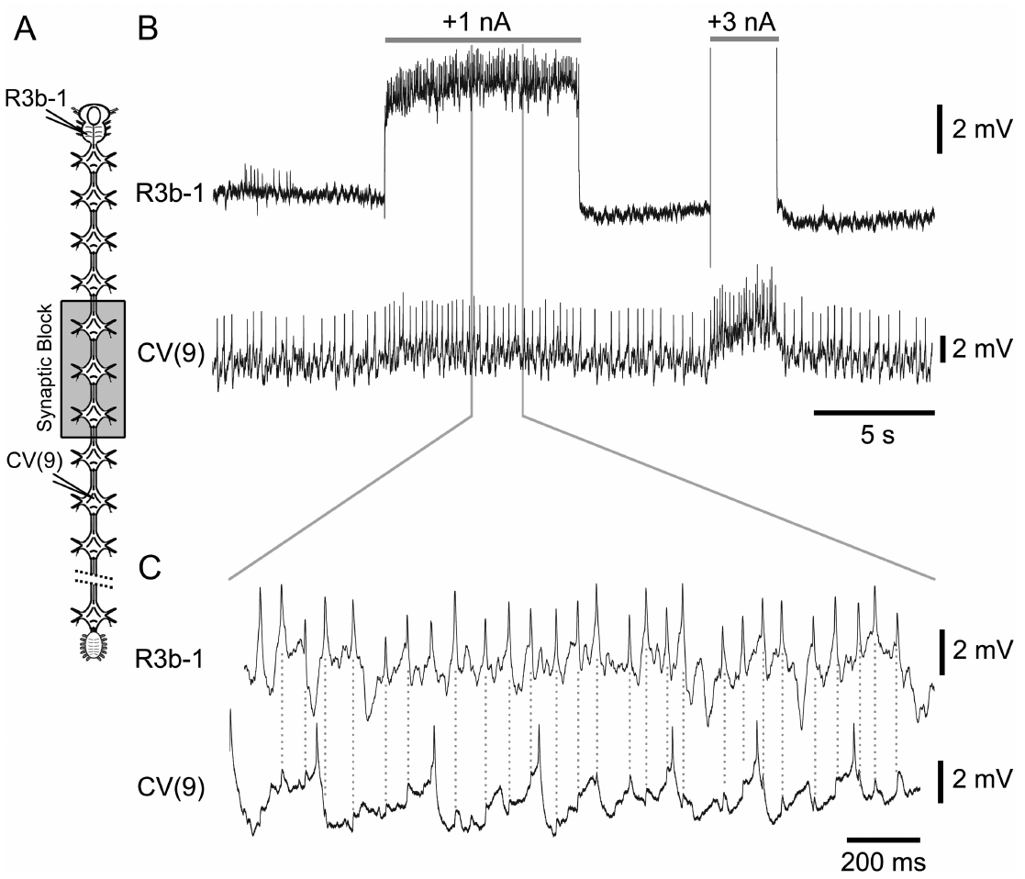
A motor follower tests a specific descending connection
Puhl and colleagues recorded R3b-1 together with CV, the circular-muscle excitor associated with crawl elongation, to follow a defined descending influence on a motor neuron.
  Stimulating the identified presynaptic cell generated a known spike train, while intracellular recording measured the subsequent voltage response in CV. Regional changes in synaptic transmission altered the pathways available between those events.
R3b-1 stimulation produced excitatory follower responses in CV, relating descending activity to a motor output that helps begin the elongation phase.
  Expanded recordings preserved the timing between the descending spike and the resulting motor-cell potential. Reduced-transmission conditions provided additional information about the route through which the response reached CV.
Access to a circular excitor gives the descending neuron a functional entry into the elongation–contraction sequence organized by segmental crawl circuitry.
  Exciting CV promotes the muscle action that lengthens a body segment before longitudinal contraction shortens it. This connection therefore places a command-related signal within the local motor pathway that participates in initiating and pacing the repeated crawl step. The follower response gives a defined motor pathway through which a descending spike can alter local voltage, connecting the anatomical projection with an elongation-related cellular effect.
Puhl et al. (2012), Fig. 7(A–C). R3b-1 stimulation and the response of circular excitor CV.
Puhl et al. (2012)
42
Notes:
Teaching transcript:
Puhl and colleagues recorded R3b-1 together with CV while applying regional synaptic blockade and stimulating the descending cell. CV is a crawl-related circular-muscle excitor. A defined presynaptic spike train permits testing a more specific connection than simply observing that both cells oscillate during crawling.
R3b-1 stimulation produced excitatory responses in CV consistent with a synaptic follower relationship. The published expanded recording retains the relationship between the descending spike and the subsequent motor-cell potential. Comparing the response under reduced-transmission conditions supplied evidence about the connecting route.
This supports a functional pathway from descending input to a motor output associated with elongation. It does not establish that R3b-1 directly controls every crawl neuron or that this connection alone generates the entire rhythm. The broader pattern still depends on interactions among local circuits and motor pathways.
An excitatory postsynaptic potential is a voltage change that promotes firing in a receiving neuron. A reproducible response to a defined presynaptic event is stronger evidence for connectivity than a shared phase during a long motor episode.
References:
J. G. Puhl; M. A. Masino; K. A. Mesce (2012). Necessary, sufficient and permissive: a single locomotor command neuron important for intersegmental coordination. Journal of Neuroscience 32(49):17646–17657. https://doi.org/10.1523/JNEUROSCI.2249-12.2012
Puhl et al. (2012), Fig. 7(A–C). R3b-1 stimulation and the response of circular excitor CV.
Figure source: https://doi.org/10.1523/JNEUROSCI.2249-12.2012

Slide 55
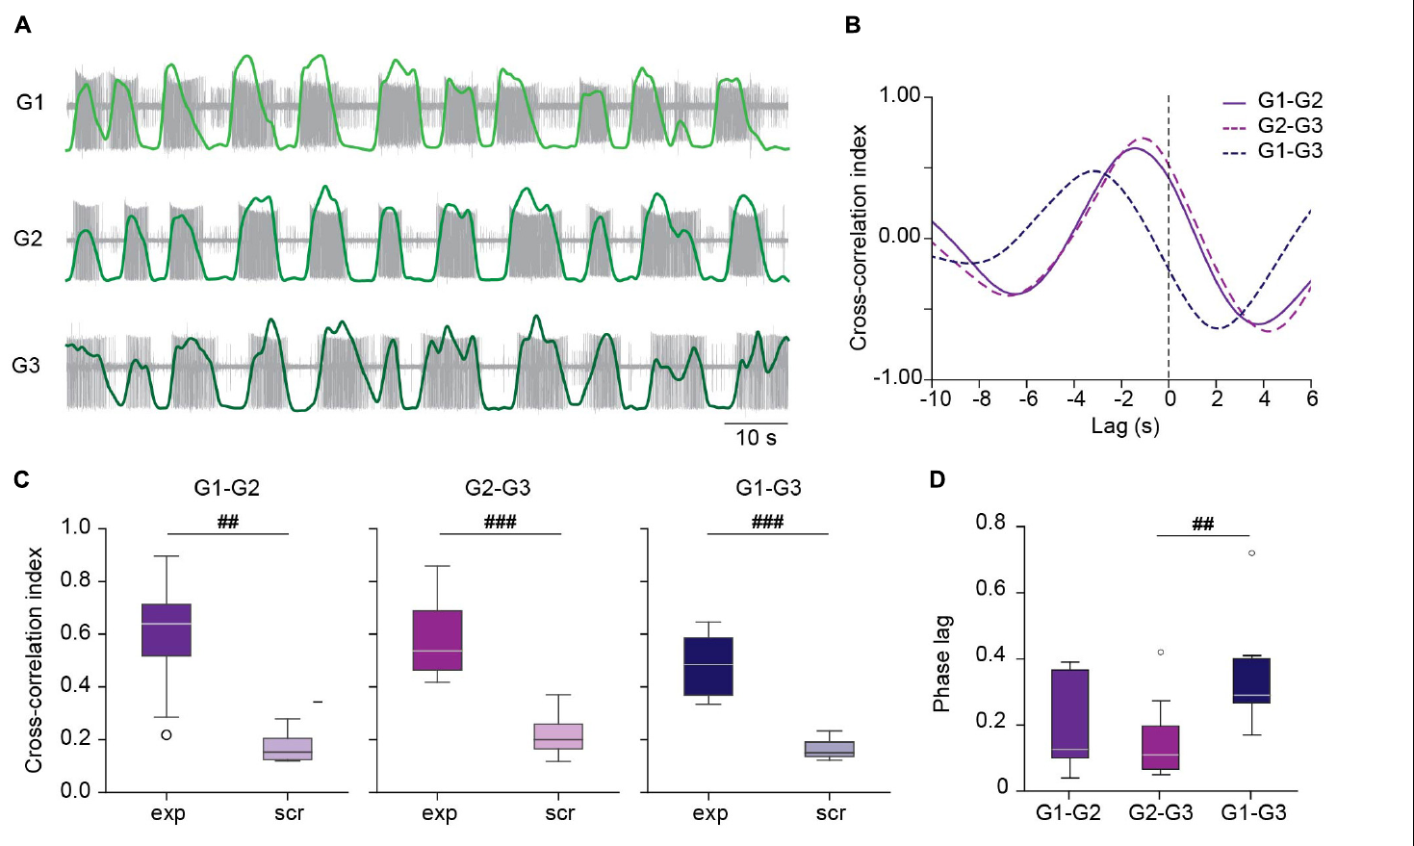
Short ganglion chains can coordinate without the brain
Kearney and colleagues recorded dopamine-induced crawling in chains of three ganglia, retaining short-range central interactions while removing the brain and the moving peripheral body.
  Motor-nerve recordings followed DE-3 bursts in successive ganglia. Each region contained a local generator, and the remaining connectives permitted neighboring regions to interact through the central nervous system.
Bursts progressed in a consistent order with a median phase lag near 0.12 of a cycle per segment, organizing the short chain into a temporal sequence.
  Combining recordings from unrelated chains in a scrambled arrangement removed the strong relationship. The observed order therefore arose through interactions within the connected preparation, rather than merely through similar average rates of independent bursting.
Intact crawling leeches had a phase lag nearer 0.03 per segment and a period near 5 s, while the isolated chains repeated at periods closer to 10 s.
  Short central networks can therefore coordinate a crawl-like sequence, while the intact system expresses a faster and more closely spaced progression. Descending input and sensory interaction with the moving body contribute to that broader organization. A phase lag specifies the proportion of a cycle separating adjacent bursts, so a smaller lag corresponds to closer temporal spacing relative to the step period.
Kearney et al. (2022), Fig. 3(A–D). Measured chain activity and scrambled-recording comparisons.
Ashaber et al. (2021), Fig. 7(a). Reconstructed DE-3 arbor over a dorsal micro-CT image.
Kearney et al. (2022); Ashaber et al. (2021)
43
Notes:
Teaching transcript:
Kearney and colleagues studied dopamine-induced crawling in isolated chains of three ganglia. This preparation lacked both the cephalic brain and the moving peripheral body. Motor-nerve recordings tested whether local circuits could express a coordinated sequence through their remaining central connections.
DE-3 bursts followed a consistent order through the chain, with a median phase lag near 0.12 of a cycle per segment. Combining recordings from different chains in a scrambled control eliminated the strong temporal relationship. The coordination therefore could not be explained simply by independent rhythms of similar average frequency.
The result establishes central coordination without a descending command in this reduced context. It qualifies broader necessity claims based on different preparations. The intact animal and a short, dopamine-treated chain need not use identical coordination mechanisms, and additional descending or sensory input may improve speed and flexibility.
A scrambled comparison preserves individual recordings but removes their shared experimental timing. It tests whether a temporal relationship depends on the cells having been active together, rather than on common average properties.
References:
G. Kearney; M. Radice; A. Sanchez Merlinsky; L. Szczupak (2022). Intersegmental interactions give rise to a global network. Frontiers in Neural Circuits 16:843731. https://doi.org/10.3389/fncir.2022.843731
M. Ashaber; Y. Tomina; P. Kassraian; E. A. Bushong; W. B. Kristan Jr; M. H. Ellisman; D. A. Wagenaar (2021). Anatomy and activity patterns in a multifunctional motor neuron and its surrounding circuits. eLife 10:e61881. https://doi.org/10.7554/eLife.61881
Kearney et al. (2022), Fig. 3(A–D). Measured chain activity and scrambled-recording comparisons.
Figure source: https://doi.org/10.3389/fncir.2022.843731
Ashaber et al. (2021), Fig. 7(a). Reconstructed DE-3 arbor over a dorsal micro-CT image.
Figure source: https://doi.org/10.7554/eLife.61881

Slide 56
Coupled ganglia resist perturbations that stop a lone ganglion
A strong hyperpolarizing pulse in a premotor NS neuron stopped the crawl rhythm when the neuron belonged to an isolated ganglion.
  In the middle ganglion of a connected three-ganglion chain, the corresponding perturbation instead slowed the rhythm to about 80% of its control rate. Neighboring generators continued to interact with the affected local network.
The coupled chain maintained a shared sequence while absorbing a disturbance that could terminate rhythmicity in the smaller preparation.
  Its behavior therefore depended on interactions across the local generators, which reduced the independent influence of any one module on the repeating rhythm. Central coupling helped keep the perturbed region participating in activity organized across the chain.
The NS perturbation still reduced DE-3 firing in the middle ganglion to about 30% of control and weakened discharge in neighboring ganglia.
  The premotor neuron consequently retained a strong influence on motor output while the larger network sustained the rhythm. Coupling can preserve coordination across a local disturbance even as the strength of the contraction-related command changes. The perturbation therefore changes discharge strength more strongly than the persistence of the shared cycle, revealing how coupling distributes control across the connected ganglia.
Kearney et al. (2022), Fig. 3(A–D). Measured chain activity and scrambled-recording comparisons.
Kearney et al. (2022)
43a
Notes:
On slide 43 a three-ganglion chain coordinates without the brain; the paper's perturbation experiment reveals how strongly the chained generators bind together.
The test compares a lone ganglion with a chained one.
In isolated ganglia, moderate NS hyperpolarization slows the crawl pattern and a pulse of about minus 5 nA shuts it down completely, which also silenced the rhythmic inhibition of touch cells.
Applied in the middle of a chain, the same pulse left the pattern clearly present, and minus 10 nA did no further damage.
The result rules out a set of independent modules.
Kearney and colleagues reason that coordination by an element outside the generators would have allowed the local perturbation to prevail.
The loss of local power instead implies that coupling among neighboring generators makes the system refractory to local perturbation.
Motor output and rhythm separate.
NS kept its strong local effect on DE-3 firing and spread a weaker effect to neighboring ganglia, consistent with a cord-spanning excitatory pathway that NS can inhibit.
Its influence on the generator itself, so decisive on slide 28's single ganglion, was largely overruled by the neighbors.
References:
G. Kearney; M. Radice; A. Sanchez Merlinsky; L. Szczupak (2022). Intersegmental interactions give rise to a global network. Frontiers in Neural Circuits 16:843731. https://doi.org/10.3389/fncir.2022.843731
J. G. Puhl; K. A. Mesce (2008). Dopamine activates the motor pattern for crawling in the medicinal leech. Journal of Neuroscience 28(16):4192–4200. https://doi.org/10.1523/JNEUROSCI.0136-08.2008

Slide 57
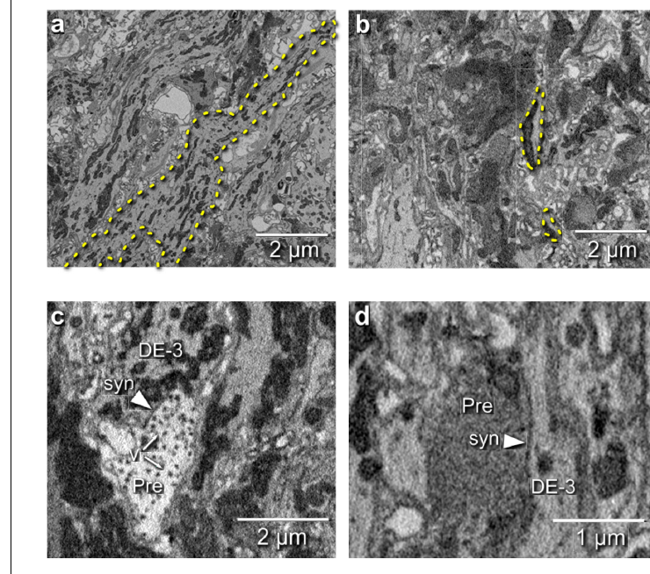
Electron microscopy locates inputs onto a motor neuron
Ashaber and colleagues combined voltage-sensitive imaging and serial blockface electron microscopy within the same leech ganglion, connecting measured activity with reconstructed synaptic anatomy.
  Functional imaging first related identified cells to fictive swimming and crawling. Fine structural imaging then followed the processes and contacts through which those cells could supply input to the shared motor network.
Reconstruction of DE-3 identified 531 input synapses, with presynaptic processes traced toward their cell bodies to establish candidate partners.
  The investigators examined terminal structure and used transmission electron microscopy from another ganglion to evaluate the appearance of small vesicles. The resulting map located individual communication sites along the motor neuron's arbor.
Of those inputs, 44 synapses came from neurons in neighboring ganglia, adding intersegmental sources to the local presynaptic population.
  Among partners making at least two contacts, the longitudinal inhibitor DI-1 supplied 52 synapses, the largest contribution from an identified neuron. The fixed input anatomy therefore included both local inhibitory access and communication from other regions of the segmental nervous system. Tracing a partner toward its soma links the contact map with identified cells, allowing anatomical convergence to be related to the populations followed in functional imaging.
Ashaber et al. (2021), Fig. 7(a). Reconstructed DE-3 arbor over a dorsal micro-CT image.
Ashaber et al. (2021), Fig. 6(a–d). Electron-microscopic neurites and synaptic contacts onto DE-3.
Ashaber et al. (2021)
44
Notes:
Teaching transcript:
Ashaber and colleagues combined voltage-sensitive imaging with serial blockface electron microscopy in the same leech ganglion. Electron microscopy resolves fine cellular structure using electron-based imaging. The same-tissue design connects functional identity with an anatomical reconstruction rather than comparing unrelated specimens.
They reconstructed the DE-3 motor neuron and identified 531 input synapses. Presynaptic partners could be traced toward their somata, linking contacts to candidate neurons. Distinct terminal appearances were examined, and transmission electron microscopy from another ganglion helped check the interpretation of small vesicles.
A synapse is a specialized communication site between neurons. Structural contacts establish where anatomical input can reach DE-3, but their appearance alone does not identify transmitter, receptor, sign, or functional strength. Those assignments require physiological or independently established cell information.
Serial blockface imaging repeatedly images and removes a thin surface layer from an embedded sample. The published electron micrographs preserve micrometer scale bars and distinguish an actual contact from a mere crossing of reconstructed processes.
References:
M. Ashaber; Y. Tomina; P. Kassraian; E. A. Bushong; W. B. Kristan Jr; M. H. Ellisman; D. A. Wagenaar (2021). Anatomy and activity patterns in a multifunctional motor neuron and its surrounding circuits. eLife 10:e61881. https://doi.org/10.7554/eLife.61881
Ashaber et al. (2021), Fig. 6(a–d). Electron-microscopic neurites and synaptic contacts onto DE-3.
Figure source: https://doi.org/10.7554/eLife.61881
Ashaber et al. (2021), Fig. 7(a). Reconstructed DE-3 arbor over a dorsal micro-CT image.
Figure source: https://doi.org/10.7554/eLife.61881

Slide 58
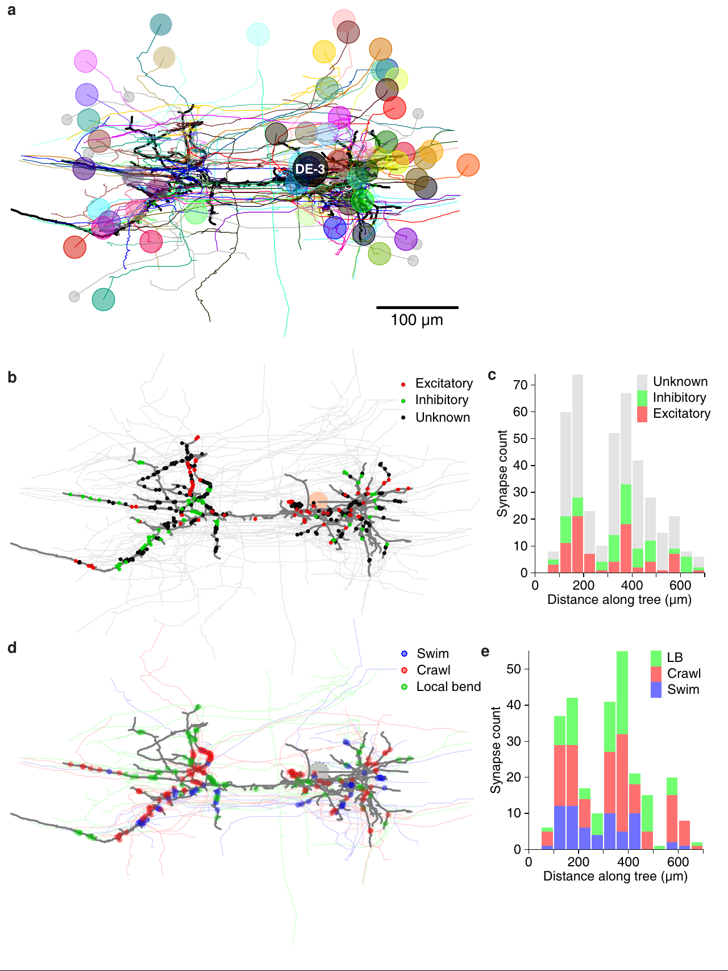
Behavior-specific inputs remain distributed along DE-3
Ashaber and colleagues matched reconstructed presynaptic partners of DE-3 with the voltage-sensitive activity recorded during fictive swimming and crawling in the same ganglion.
  This linked the locations of individual synapses with the behaviors and phases in which their source neurons participated. The analysis followed how different functional populations converged on one motor neuron.
Swimming-associated and crawling-associated inputs were distributed across the DE-3 arbor, rather than occupying separate large branches dedicated to the two behaviors.
  Excitatory and inhibitory categories also lacked a simple large-scale separation into distinct territories. Inputs with different functional relationships therefore reached overlapping portions of the shared motor neuron.
Many presynaptic partners were themselves multifunctional, changing their activity relationships as the ganglion expressed a different motor pattern.
  Ashaber and colleagues consequently attributed a central role to the premotor network in generating behavior-specific timing. DE-3 receives that changing pattern through an existing arbor, with its motor output depending on which converging partners become active and how their signals coincide. Convergence places inputs from several functional categories on the same motor arbor, making the temporal combination reaching that arbor relevant to its behavior-dependent output.
Ashaber et al. (2021), Fig. 10(a–e). Original anatomical distribution of synapses and behavior-associated inputs.
Ashaber et al. (2021)
45
Notes:
Teaching transcript:
Ashaber and colleagues matched presynaptic neurons in the anatomical reconstruction with their voltage-sensitive activity during fictive swimming and crawling. They then asked whether inputs associated with different behaviors occupied distinct regions of the shared DE-3 arbor. This combines functional participation with measured synapse locations.
Behavior-associated inputs were distributed across the motor neuron rather than segregated into separate large branches for swimming and crawling. Likewise, excitatory and inhibitory input categories did not form the simple large-scale spatial separation expected from a compartmentalized account. The activity and anatomical measurements came from the same ganglion.
A multifunctional motor neuron receives convergent inputs whose active relationships change with behavior. Distribution along the arbor does not mean that every synapse has equal effect or that local dendritic interactions are absent. The anatomy constrains spatial explanations while leaving state-dependent synaptic operation and conductance mechanisms for further testing.
The functional association was based on measured activity during the elicited patterns, not a new simulated motor circuit. Anatomical input count is also not identical to physiological synaptic strength, so the two kinds of evidence remain distinct.
References:
M. Ashaber; Y. Tomina; P. Kassraian; E. A. Bushong; W. B. Kristan Jr; M. H. Ellisman; D. A. Wagenaar (2021). Anatomy and activity patterns in a multifunctional motor neuron and its surrounding circuits. eLife 10:e61881. https://doi.org/10.7554/eLife.61881
Ashaber et al. (2021), Fig. 10(a–e). Original anatomical distribution of synapses and behavior-associated inputs.
Figure source: https://doi.org/10.7554/eLife.61881

Slide 59
DE-3 groups synchronized inputs differently for each behavior
Ashaber and colleagues examined local clusters of neighboring synapses on DE-3 and related their presynaptic partners to activity during swimming and crawling.
  Most clusters received contacts from several neurons, permitting spatially nearby inputs to have different combinations of functional partners. The analysis therefore joined the fixed locations of contacts with the changing timing of their sources.
Synchronized inputs matched spatial clusters at different length scales in the two rhythms, with swimming-associated groups extending about 61–65 μm along a neurite.
  During crawling, the strongest correspondence occurred over shorter distances of approximately 14–18 μm. The same arbor consequently contained spatial arrangements whose functional coordination differed with the pattern of presynaptic activity.
Inputs arriving close together in space and time can contribute to local summation, allowing branches to integrate groups of coincident synaptic events.
  Behavior-dependent synchrony therefore changes which contacts act together on the shared neuron. DE-3 can receive different motor-related input assemblies through a fixed set of synapses as the premotor population reorganizes its timing between swimming and crawling. The relevant assembly depends on coincident presynaptic activity, so one physical cluster can contribute to different functional groups when the timing of its partners changes.
Ashaber et al. (2021), Fig. 6(a–d). Electron-microscopic neurites and synaptic contacts onto DE-3.
Ashaber et al. (2021)
45a
Notes:
Slides 44 and 45 reconstruct DE-3 and find no large swim or crawl territories on its arbor; the paper's clustering analysis looks for organization at the scale of a few micrometers.
The search moved to small clusters.
The algorithm grouped synapses whose nearest neighbors lay within a set distance and whose overall extent stayed below a set limit, and then asked whether each group's partners shared a phase.
Most groups contained synapses from more than one partner, so clusters combine inputs from different cells.
Behavior changes the scale of synchrony.
The strongest correspondence between spatial and functional clusters occurred at an extent near 61 to 65 micrometers for swim trials and near 14 to 18 micrometers for crawl trials.
Synchronization extended over longer stretches of neurite during swimming than during crawling, within one unchanged anatomy.
Dendritic integration links clusters to output.
Ashaber and colleagues cite work in which branches act as integrative compartments and clustered inputs promote nonlinear integration.
An attractive interpretation in the paper is that clusters are the loci where inputs from synchronized presynaptic assemblies are integrated, the same assemblies whose timing changes at the switch on slide 23.
References:
M. Ashaber; Y. Tomina; P. Kassraian; E. A. Bushong; W. B. Kristan Jr; M. H. Ellisman; D. A. Wagenaar (2021). Anatomy and activity patterns in a multifunctional motor neuron and its surrounding circuits. eLife 10:e61881. https://doi.org/10.7554/eLife.61881

Slide 60
Key takeaways
The central swim generator produces recurring dorsal and ventral motor bursts after a brief stimulus to an isolated cord.
  The circuit supplies the repeated pattern, while sensory input from the moving body adjusts its timing and expression.
Sensory feedback coordinates separated cord regions when the peripheral body remains continuous after a central transection.
  Central connectives provide a second coordinating route, and both pathways contribute to the timing of intact locomotion.
Shared longitudinal motor neurons change their phase relationships when the nervous system switches between crawling and swimming.
  Additional crawl-associated cells supply elongation-related activity alongside the common longitudinal muscle pathways.
Burst timing and motor-cell phase depend on different cellular influences, as dopamine and phosphodiesterase inhibition produce different patterns of CV participation.
  Persistent sodium-dependent drive and outward potassium current contribute to burst maintenance and termination.
Neuromodulators bias the motor programs available to the network, with serotonin promoting swimming and dopamine promoting crawling.
  Their effects include changes in episode occurrence, motor-neuron responsiveness, and the pattern expressed by descending input.
Distributed segmental networks integrate descending commands and local interactions, allowing coordinated crawling under several preparation conditions.
  R3b-1 organizes whole-cord output in a defined state, while connected short chains retain their own central coordinating capacity.
Kristan & Calabrese (1976); Briggman & Kristan (2006); Crisp et al. (2012); Kearney et al. (2022)
46
Notes:
Central generation. The isolated cord produces a swim-like motor rhythm after brief stimulation, establishing central rhythmic capability without requiring a repeating peripheral stimulus.
Feedback and coordination. Sensory input adjusts phase, burst shape and body-wave timing; central rhythm generation does not make feedback unnecessary for normal locomotion.
Shared neurons, different patterns. Swimming and crawling reorganize overlapping neuronal populations: longitudinal excitors alternate in swimming but cooperate during crawl shortening.
Timing differs from patterning. Drug-induced slow bursting can retain an incorrect circular-muscle phase, so matching period alone does not establish the complete crawl motor program.
Modulation changes circuit state. Serotonin promotes swim expression; dopamine promotes crawling through effects that include rhythm availability, motor-cell phase and altered membrane responsiveness.
Causality depends on preparation. Descending R3b-1 controls coordination in defined whole-cord conditions, while short ganglion chains can coordinate centrally without the brain; anatomical input maps do not alone establish synaptic function.
References:
W. B. Kristan Jr; R. L. Calabrese (1976). Rhythmic swimming activity in neurones of the isolated nerve cord of the leech. Journal of Experimental Biology 65(3):643–668. https://doi.org/10.1242/jeb.65.3.643
X. Yu; B. Nguyen; W. O. Friesen (1999). Sensory feedback can coordinate the swimming activity of the leech. Journal of Neuroscience 19(11):4634–4643. https://doi.org/10.1523/JNEUROSCI.19-11-04634.1999
K. L. Briggman; W. B. Kristan Jr (2006). Imaging dedicated and multifunctional neural circuits generating distinct behaviors. Journal of Neuroscience 26(42):10925–10933. https://doi.org/10.1523/JNEUROSCI.3265-06.2006
J. G. Puhl; K. A. Mesce (2008). Dopamine activates the motor pattern for crawling in the medicinal leech. Journal of Neuroscience 28(16):4192–4200. https://doi.org/10.1523/JNEUROSCI.0136-08.2008
K. M. Crisp; B. R. Gallagher; K. A. Mesce (2012). Mechanisms contributing to the dopamine induction of crawl-like bursting in leech motoneurons. Journal of Experimental Biology 215(17):3028–3036. https://doi.org/10.1242/jeb.069245
J. G. Puhl; M. A. Masino; K. A. Mesce (2012). Necessary, sufficient and permissive: a single locomotor command neuron important for intersegmental coordination. Journal of Neuroscience 32(49):17646–17657. https://doi.org/10.1523/JNEUROSCI.2249-12.2012
M. Ashaber; Y. Tomina; P. Kassraian; E. A. Bushong; W. B. Kristan Jr; M. H. Ellisman; D. A. Wagenaar (2021). Anatomy and activity patterns in a multifunctional motor neuron and its surrounding circuits. eLife 10:e61881. https://doi.org/10.7554/eLife.61881
G. Kearney; M. Radice; A. Sanchez Merlinsky; L. Szczupak (2022). Intersegmental interactions give rise to a global network. Frontiers in Neural Circuits 16:843731. https://doi.org/10.3389/fncir.2022.843731

