Slide 1
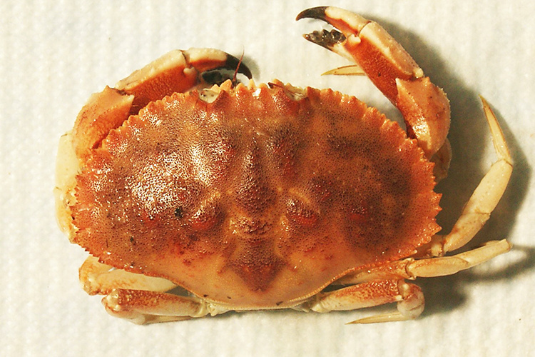
NEUR 411 · NEUROETHOLOGY · FALL 2026
Lecture 7
Central pattern generators II:
the lobster/crab stomatogastric ganglion (Marder & Selverston)
Wednesday, September 9, 2026
Jordan Lopez, Ph.D.
Professor of Neurobiology & Biomedical Engineering
Photo: Jonah crab (Cancer borealis). Courtesy NOAA Fisheries.
Notes:
Central pattern generators II: the lobster/crab stomatogastric ganglion (Marder & Selverston)
Lecture 7. NEUR 411 · NEUROETHOLOGY · FALL 2026. Wednesday, September 9, 2026.
Image: Photo: Jonah crab (Cancer borealis). Courtesy NOAA Fisheries. Credit: National Oceanic and Atmospheric Administration, NOAA Fisheries. License: U.S. government photograph; NOAA Fisheries permits reuse of NOAA-created photos with credit (https://www.fisheries.noaa.gov/disclaimer).. Source: https://www.fisheries.noaa.gov/species/jonah-crab

Slide 2
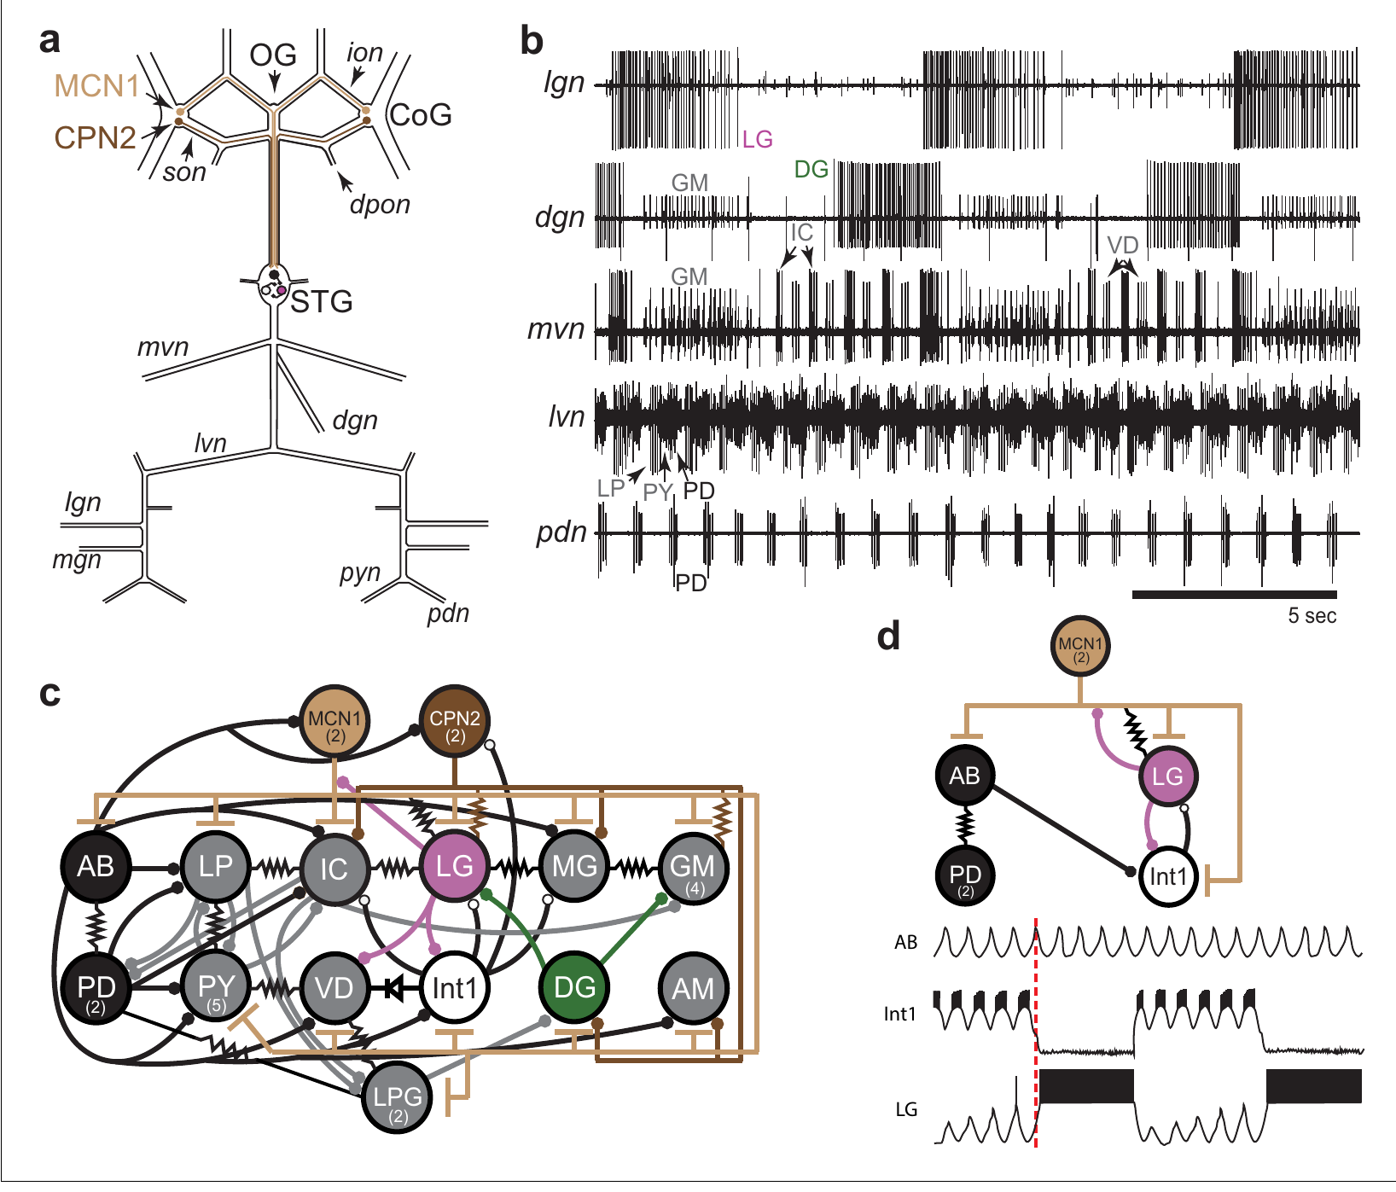
Two motor rhythms control processing in the foregut
The stomatogastric ganglion (STG) is a compact collection of neurons that controls movements of the crustacean foregut. In the Jonah crab, Cancer borealis, the gastric mill moves teeth used for chewing, whereas the pyloric system controls filtering. The two motor patterns operate on different timescales within the same ganglion. The foregut therefore receives separate commands for chewing and filtering, with each rhythm controlling the timing of the muscles that perform its part of food processing.
Powell and colleagues recorded identified motor nerves simultaneously in an isolated nervous system. The pyloric rhythm was approximately 1 Hz, while the slower gastric mill rhythm was approximately 0.1 Hz. A burst is a group of action potentials separated from the next group by a quieter interval. Their approximately tenfold difference in frequency allows several filtering cycles to occur during one chewing cycle while the two programs remain active in the same preparation.
The gastric mill breaks food down through movements of the teeth, while the pyloric system filters particles and pumps material toward the hindgut. Several stomatogastric neurons participate in both patterns, placing the slower and faster rhythms in a shared neural network. Their timing must preserve each program's sequence while coordinating processing through successive portions of the foregut.
Powell et al. (2021), Fig. 1(a–d). STG anatomy, gastric and pyloric recordings and circuit connections
Powell et al. (2021); Garcia et al. (2015)
02
Notes:
• The stomatogastric ganglion (STG) is a compact collection of neurons that controls movements of the crustacean foregut. In the Jonah crab, Cancer borealis, the gastric mill moves teeth used for chewing, whereas the pyloric system controls filtering. The two motor patterns operate on different timescales within the same ganglion.
– The gastric mill and pyloric systems are motor systems inside the foregut, rather than two names for the same set of muscles.
• Powell and colleagues recorded identified motor nerves simultaneously in an isolated nervous system. The pyloric rhythm was approximately 1 Hz, while the slower gastric mill rhythm was approximately 0.1 Hz. A burst is a group of action potentials separated from the next group by a quieter interval.
– An action potential is a brief regenerative voltage change that travels along an axon; a nerve recording detects the spikes sent toward muscles.
• The preparation retains central circuitry but removes normal food movement and most peripheral feedback. Its recordings identify coordinated motor commands; they do not measure tooth forces, particle transport or the amount of food swallowed.
– A central pattern generator produces rhythmic neural output without requiring a separate sensory trigger for every cycle.
References:
Powell D, Haddad SA, Gorur-Shandilya S, Marder E. (2021). Coupling between fast and slow oscillator circuits in Cancer borealis is temperature-compensated. eLife 10: e60454. https://doi.org/10.7554/elife.60454
Garcia VJ, Daur N, Temporal S, Schulz DJ, Bucher D. (2015). Neuropeptide receptor transcript expression levels and magnitude of ionic current responses show cell type-specific differences in a small motor circuit. Journal of Neuroscience 35: 6786-6800. https://doi.org/10.1523/jneurosci.0171-15.2015
Figure: Powell et al. (2021), Fig. 1(a–d). STG anatomy, gastric and pyloric recordings and circuit connections
Figure source: https://doi.org/10.7554/elife.60454

Slide 3
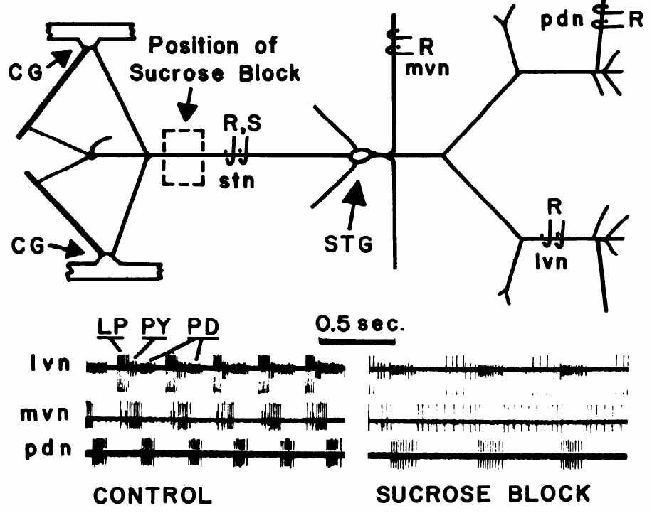
Input removal changes an isolated pyloric rhythm
Miller and Selverston isolated the stomatogastric nervous system of the spiny lobster, Panulirus interruptus. The STG remained connected to anterior ganglia through the stomatogastric nerve (stn). Electrodes on outgoing nerves detected the activity of motor neurons supplying the pyloric muscles. The retained nerve supplied the local ganglion with signals from regions that normally regulate the state in which its motor circuit operates.
An isotonic sucrose solution around a short segment of the stn reversibly blocked impulse conduction. Comparing the same preparation before and during the block separated the local circuit from ongoing input supplied by other ganglia. The published control and blocked records use a 0.5 s timescale. Replacing the blocking solution restored conduction, allowing the local pattern to be followed as access to descending input changed within one preparation.
Descending activity recruits a bursting state in PD, LP, and VD, neurons that can otherwise fire tonically or remain quiet when those inputs are absent. The same local connections consequently operate with different membrane dynamics as the input state changes. Modulation alters the activity available within identified neurons and, through their synapses, reorganizes the motor pattern expressed by the ganglion.
Miller & Selverston (1982), Fig. 1. Dissected lobster nerves and motor activity with and without input
Miller & Selverston (1982)
03
Notes:
• Miller and Selverston isolated the stomatogastric nervous system of the spiny lobster, Panulirus interruptus. The STG remained connected to anterior ganglia through the stomatogastric nerve (stn). Electrodes on outgoing nerves detected the activity of motor neurons supplying the pyloric muscles.
– Isotonic means that the solution has an osmotic concentration suitable for the tissue; the local sucrose pool blocks conduction through the input nerve.
• An isotonic sucrose solution around a short segment of the stn reversibly blocked impulse conduction. Comparing the same preparation before and during the block separated the local circuit from ongoing input supplied by other ganglia. The published control and blocked records use a 0.5 s timescale.
– The control is the same nervous system before its descending input is blocked, so differences are not comparisons between different animals.
• Input blockade changed the pyloric motor pattern even though the local neurons and their connections remained present. Central rhythm generation therefore depends on circuit state as well as connectivity. A disconnected preparation cannot be treated as an unchanged copy of the intact animal.
– The experiment tests the contribution of input to the ganglion, without requiring the experimenter to remove each descending neuron individually.
References:
Miller JP, Selverston AI. (1982). Mechanisms underlying pattern generation in lobster stomatogastric ganglion as determined by selective inactivation of identified neurons. II. Oscillatory properties of pyloric neurons. Journal of Neurophysiology 48: 1378-1391. https://doi.org/10.1152/jn.1982.48.6.1378
Figure: Miller & Selverston (1982), Fig. 1. Dissected lobster nerves and motor activity with and without input
Figure source: https://doi.org/10.1152/jn.1982.48.6.1378

Slide 4
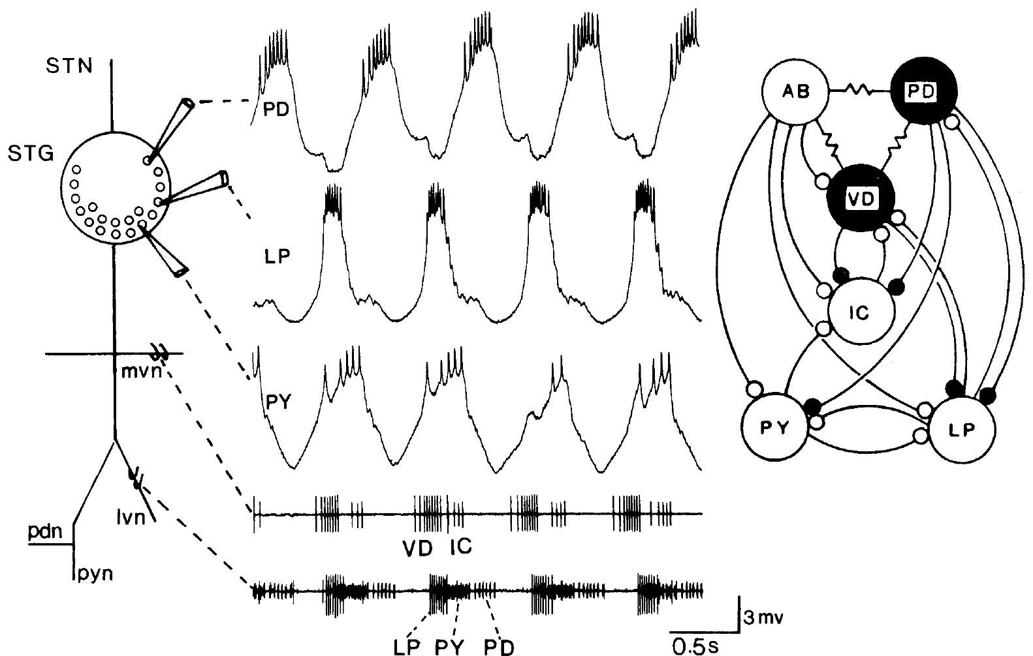
Identified motor neurons connect spikes to muscle output
Stomatogastric neurons can be identified by the muscles their axons innervate and by the nerves carrying those axons. The lobster ganglion contains about 30 neurons, with identifiable cells supplying the different motor pathways of its foregut circuit. The pyloric dilator (PD) neurons, lateral pyloric (LP) neuron and pyloric (PY) neurons form recognizable classes within its pyloric motor system. The identified classes link central activity with defined peripheral muscle targets, preserving the identity of the motor pathway across different preparations and interventions.
Hooper and Marder combined intracellular recordings from neuron cell bodies with extracellular recordings from the lateral and median ventricular nerves. Intracellular recording measures membrane voltage through an electrode inside a cell; extracellular recording detects spikes outside cells, including spikes traveling along axons. Simultaneous recordings follow the same impulse inside the cell and as it travels along the nerve, relating membrane activity to the outgoing motor signal.
Identified neurons provide a consistent cellular organization for studying how modulation changes the circuit. Hooper and Marder could isolate AB, LP, and PY and apply proctolin directly, relating each cell's peptide sensitivity to its effects within the connected network. Changes in a recorded motor nerve could then be attributed to the activity of particular neurons and their known muscle pathways.
Hooper & Marder (1987), Fig. 1. Lobster STG anatomy, identified recordings and pyloric connections
Hooper & Marder (1987); Rosenbaum & Marder (2018)
04
Notes:
• Stomatogastric neurons can be identified by the muscles their axons innervate and by the nerves carrying those axons. The lobster ganglion contains about 30 neurons. The pyloric dilator (PD) neurons, lateral pyloric (LP) neuron and pyloric (PY) neurons form recognizable classes within its pyloric motor system.
– A motor neuron sends its axon toward muscle; an interneuron communicates primarily with other neurons rather than directly innervating a muscle.
• Hooper and Marder combined intracellular recordings from neuron cell bodies with extracellular recordings from the lateral and median ventricular nerves. Intracellular recording measures membrane voltage through an electrode inside a cell; extracellular recording detects spikes outside cells, including spikes traveling along axons.
– The nerve records distinguish motor units by their characteristic spike patterns and correspondence with an intracellular recording.
• Matching a cell-body spike to a nerve spike establishes the recorded neuron’s output pathway. Its name identifies a motor role, but does not specify its intrinsic rhythm-generating ability, transmitter or response to a modulator. Those properties require separate physiological experiments.
– The count is species-dependent: the crab preparations studied by Rosenbaum and Marder contain 26–27 STG neurons, rather than the lobster count.
References:
Hooper SL, Marder E. (1987). Modulation of the lobster pyloric rhythm by the peptide proctolin. Journal of Neuroscience 7: 2097-2112. https://doi.org/10.1523/jneurosci.07-07-02097.1987
Rosenbaum P, Marder E. (2018). Graded Transmission without Action Potentials Sustains Rhythmic Activity in Some But Not All Modulators That Activate the Same Current. Journal of Neuroscience 38: 8976-8988. https://doi.org/10.1523/jneurosci.2632-17.2018
Figure: Hooper & Marder (1987), Fig. 1. Lobster STG anatomy, identified recordings and pyloric connections
Figure source: https://doi.org/10.1523/jneurosci.07-07-02097.1987

Slide 5
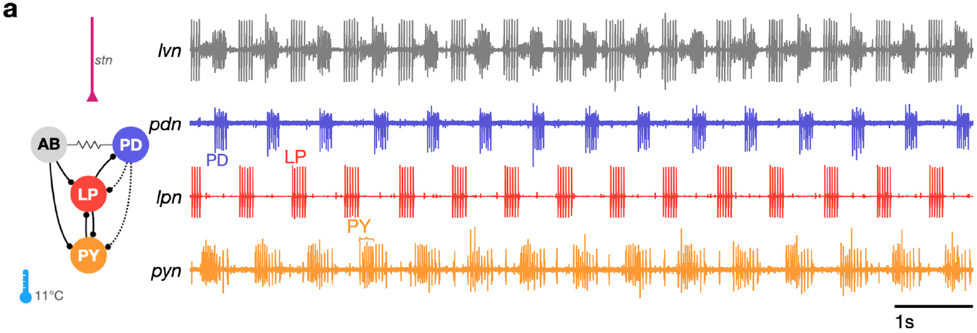
Crab pyloric output repeats in three ordered phases
The crab pyloric rhythm is triphasic: three neuron groups burst in a repeating sequence. PD activity is followed by LP activity and then PY activity. These motor commands activate different foregut muscles, organizing filtering movements rather than a synchronous contraction of the entire pyloric region. Alternation among the three groups organizes successive muscle actions, allowing food to move through the pyloric structures in the appropriate sequence.
Gorur-Shandilya and colleagues recorded separate PD, LP and PY motor nerves together with the mixed lateral ventricular nerve. The dedicated nerves separated units that overlapped in the mixed recording. Under baseline conditions at 11°C, the three groups retained their characteristic order on a 1 s timescale. The dedicated recordings retain a reference for each motor class even when spikes overlap in the nerve carrying signals from several neurons.
Identifying units becomes more difficult when the motor pattern is irregular, because spike timing supplies less guidance about which neurons are active together. PY includes several neurons that can fire nearly synchronously, and LPG also contributes impulses to the pyloric nerve. Dedicated nerve recordings preserve the relevant output identities so that changes in the triphasic pattern can be followed through perturbations.
Gorur-Shandilya et al. (2022), Fig. 1(a). Identified motor nerves resolve the regular crab pyloric rhythm
Gorur-Shandilya et al. (2022)
05
Notes:
• The crab pyloric rhythm is triphasic: three neuron groups burst in a repeating sequence. PD activity is followed by LP activity and then PY activity. These motor commands activate different foregut muscles, organizing filtering movements rather than a synchronous contraction of the entire pyloric region.
– The anterior burster, abbreviated AB, is an interneuron electrically coupled to the two PD motor neurons.
• Gorur-Shandilya and colleagues recorded separate PD, LP and PY motor nerves together with the mixed lateral ventricular nerve. The dedicated nerves separated units that overlapped in the mixed recording. Under baseline conditions at 11°C, the three groups retained their characteristic order on a 1 s timescale.
– An electrical synapse allows current to pass between coupled cells; a chemical synapse uses transmitter released by one cell to affect another.
• A mixed nerve signal can contain several identifiable neurons, but overlapping spikes become difficult to assign during irregular activity. Separate nerve recordings provide a control on unit identification. A regular sequence describes circuit output; it does not establish which neuron generates the rhythm.
– The dedicated pyloric dilator, lateral pyloric and pyloric nerves provide independent recordings of the motor groups.
References:
Gorur-Shandilya S, Cronin EM, Schneider AC, Haddad SA, Rosenbaum P, Bucher D, Nadim F, Marder E. (2022). Mapping circuit dynamics during function and dysfunction. eLife 11: e76579. https://doi.org/10.7554/elife.76579
Figure: Gorur-Shandilya et al. (2022), Fig. 1(a). Identified motor nerves resolve the regular crab pyloric rhythm
Figure source: https://doi.org/10.7554/elife.76579

Slide 6
Rebound from shared inhibition sets the triphasic order
The AB and PD pacemaker group bursts at the start of every cycle and, while it fires, inhibits both LP and PY. Each follower therefore spends the pacemaker burst hyperpolarized, and its own burst can begin only after that inhibition fades. The common inhibitory interval places both follower groups below their usual firing threshold before the next part of the sequence begins.
Postinhibitory rebound helps determine which follower reaches firing threshold first after the shared pacemaker inhibition declines. PY carries a much larger A-type potassium current than LP, which slows its recovery, so LP reaches threshold first. Once PY begins firing, its glutamatergic inhibition ends the LP burst, and the PD, LP, PY sequence follows from who inhibits whom and how fast each cell recovers. An A-type current carries a transient outward potassium influence, so its greater contribution in PY delays the return from inhibition relative to LP.
The PD–LP–PY sequence converts a shared pacemaker cycle into an ordered series of muscle commands for filtering and transport through the foregut. Each follower's response combines the inhibition it receives with its own recovery currents. LP loses its orderly rhythmic place when the relevant inhibition is removed, linking the sequence to continuing interactions between the pacemaker and the follower cells.
Hooper & Marder (1987), Fig. 1. Lobster STG anatomy, identified recordings and pyloric connections
Hooper & Marder (1987); Tang et al. (2010); Martinez et al. (2019)
05a
Notes:
• Slide 5 shows the three groups bursting in order, and slide 4 names the cells. The order itself comes from inhibition and recovery, which the circuit connections on these slides make possible.
• The pacemaker burst silences both followers at once.
– Tang and colleagues describe LP and PY as firing on rebound from inhibition by the AB and PD neurons, so the pacemaker burst is a shared starting gun for both followers.
– That makes the end of pacemaker inhibition the reference point from which each follower's delay is measured.
• Different rebound speeds create the sequence.
– Martinez and colleagues report that PY and VD carry much higher levels of the A-type current than LP, and that this current has a larger effect on their post-inhibitory spiking.
– A larger outward A-current holds PY below threshold longer after inhibition ends, which is why LP fires in the middle of the cycle and PY last.
– Tang and colleagues add that PY activity terminates the LP burst, so the follower that starts last also ends the one before it.
• The sequence has a mechanical purpose.
– More-Potdar and Golowasch describe the pyloric muscles moving food through structures that trap particles by size, a peristaltic process that needs the correct contraction order.
– Slide 23 shows LP losing organized bursting when its glutamatergic inhibition is blocked, which is the cellular version of a muscle group falling out of sequence.
References:
Hooper SL, Marder E. (1987). Modulation of the lobster pyloric rhythm by the peptide proctolin. Journal of Neuroscience 7: 2097-2112. https://doi.org/10.1523/jneurosci.07-07-02097.1987
Tang LS, Goeritz ML, Caplan JS, Taylor AL, Fisek M, Marder E. (2010). Precise temperature compensation of phase in a rhythmic motor pattern. PLoS Biology 8: e1000469. https://doi.org/10.1371/journal.pbio.1000469
Martinez D, Anwar H, Bose A, Bucher DM, Nadim F. (2019). Short-term synaptic dynamics control the activity phase of neurons in an oscillatory network. eLife 8: e46911. https://doi.org/10.7554/elife.46911
More-Potdar S, Golowasch J. (2023). Oscillatory network spontaneously recovers both activity and robustness after prolonged removal of neuromodulators. Frontiers in Cellular Neuroscience 17: 1280575. https://doi.org/10.3389/fncel.2023.1280575

Slide 7
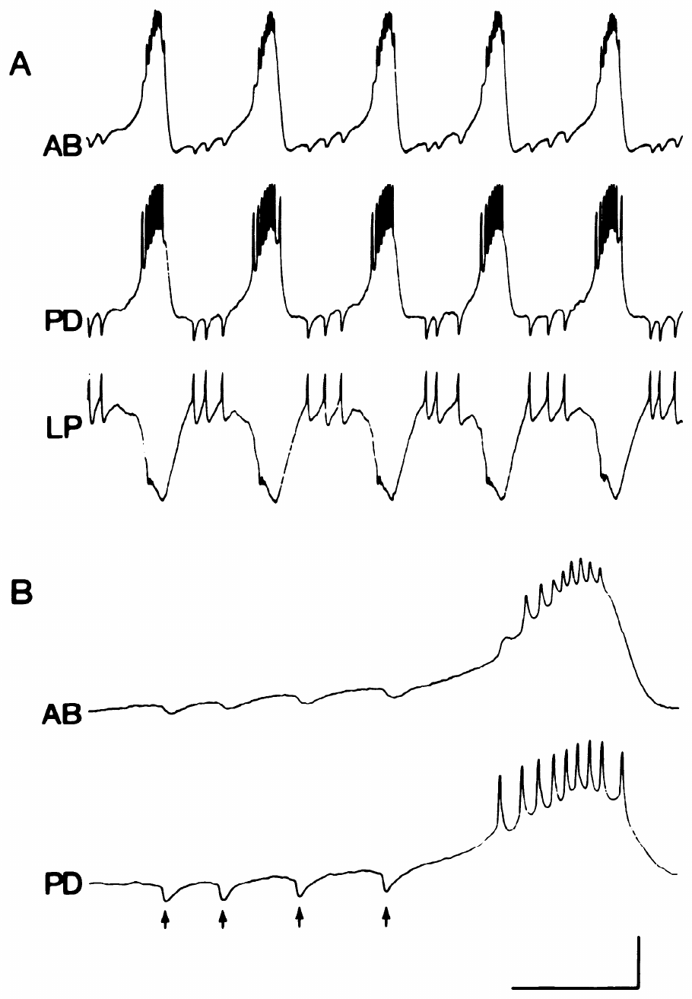
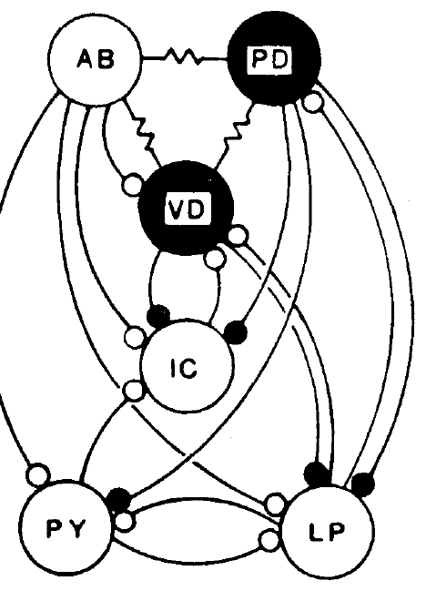
Electrical coupling synchronizes AB and PD activity
Eisen and Marder recorded the lobster anterior burster (AB) interneuron, a PD motor neuron and the LP motor neuron simultaneously. AB and PD underwent synchronous slow voltage oscillations, with spikes concentrated during their depolarized portions. Electrical coupling permits voltage changes in one cell to influence the other. The synchronized slow voltage waves make AB and PD act as a pacemaker group, with their electrical junctions passing subthreshold changes between the coupled partners.
LP spikes were followed by inhibitory voltage changes in both PD and AB. An inhibitory postsynaptic potential (IPSP) is a synaptically produced voltage response that reduces the likelihood of firing under the tested conditions. In AB, these responses were smaller and slower than those recorded in PD. The response recorded in AB followed a slower route through the coupled system, preserving the influence of LP feedback on both pacemaker partners.
LP makes a chemical inhibitory connection onto PD, and the resulting voltage change spreads into AB through electrical coupling. AB therefore receives feedback through its coupled partner, while the inhibitory transmitter is released at the LP-to-PD synapse. The combined route allows follower activity to alter the pacemaker ensemble, with the smaller and slower AB response reflecting propagation through the intervening electrical pathway.
Hooper & Marder (1987), Fig. 1(right). Lobster pyloric circuit
Eisen & Marder (1982), Fig. 2(A–B). Synchronous AB–PD bursts and LP-evoked inhibitory potentials
Eisen & Marder (1982); Hooper & Marder (1987)
06
Notes:
• Eisen and Marder recorded the lobster anterior burster (AB) interneuron, a PD motor neuron and the LP motor neuron simultaneously. AB and PD underwent synchronous slow voltage oscillations, with spikes concentrated during their depolarized portions. Electrical coupling permits voltage changes in one cell to influence the other.
– The slow voltage wave is distinct from the individual action potentials riding on its depolarized portion.
• LP spikes were followed by inhibitory voltage changes in both PD and AB. An inhibitory postsynaptic potential (IPSP) is a synaptically produced voltage response that reduces the likelihood of firing under the tested conditions. In AB, these responses were smaller and slower than those recorded in PD.
– Electrical current spreading from PD could account for an inhibitory response in AB even if LP releases no transmitter directly onto AB.
• The detailed recordings used calibrations of 4 mV and 0.5 s. A spike-associated response in a coupled cell can arrive indirectly through another neuron. Temporal association alone therefore does not establish a direct chemical synapse from LP to AB.
– Selective deletion and independent current injection are needed to distinguish those alternative pathways.
References:
Eisen JS, Marder E. (1982). Mechanisms underlying pattern generation in lobster stomatogastric ganglion as determined by selective inactivation of identified neurons. III. Synaptic connections of electrically coupled pyloric neurons. Journal of Neurophysiology 48: 1392-1415. https://doi.org/10.1152/jn.1982.48.6.1392
Hooper SL, Marder E. (1987). Modulation of the lobster pyloric rhythm by the peptide proctolin. Journal of Neuroscience 7: 2097-2112. https://doi.org/10.1523/jneurosci.07-07-02097.1987
Figure: Eisen & Marder (1982), Fig. 2(A–B). Synchronous AB–PD bursts and LP-evoked inhibitory potentials
Figure source: https://doi.org/10.1152/jn.1982.48.6.1392
Figure: Hooper & Marder (1987), Fig. 1(right). Lobster pyloric circuit
Figure source: https://doi.org/10.1523/jneurosci.07-07-02097.1987

Slide 8
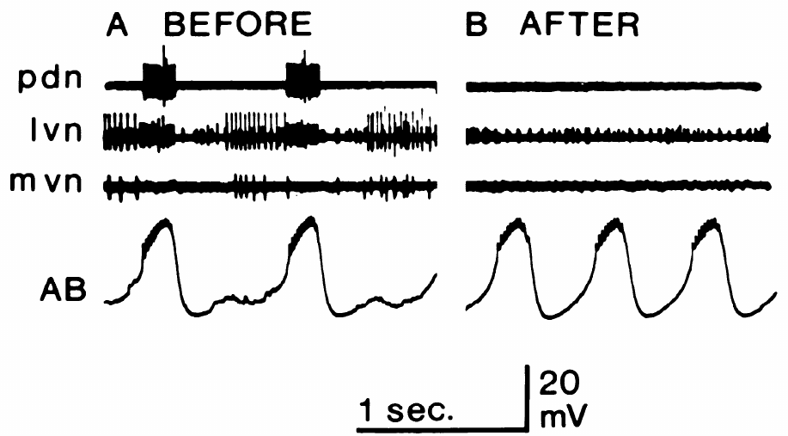
An isolated AB neuron retains endogenous bursting
Miller and Selverston tested whether a neuron could oscillate after its known synaptic inputs were removed. Photoinactivation used an intracellularly injected dye and illumination to disable selected cells. A sucrose block simultaneously removed impulse-mediated input through the stomatogastric nerve. Disabling identified local cells and blocking the input nerve reduced the sources of synaptic drive capable of maintaining an observed oscillation in AB.
After PD, LP and ventricular dilator neurons were disabled, AB retained spontaneous slow oscillations. In the published before-and-after recordings, outgoing spikes from the deleted neurons disappeared while the intracellular AB oscillation remained. The voltage and time calibrations were 20 mV and 1 s. The remaining AB voltage wave continued to alternate between more negative and more depolarized states as the identified deleted outputs disappeared.
AB functions as an endogenous burster under these isolation conditions, generating recurring slow depolarizations through the processes that remain within the cell. It was distinctive among the tested pyloric neurons in maintaining spontaneous bursting after the relevant inputs were removed. Within the connected circuit, its oscillation reaches PD through electrical coupling and supplies a recurring influence to the follower pathways inhibited by the pacemaker group.
Miller & Selverston (1982), Fig. 2(A–B). AB retains slow bursting after other inputs are removed
Hooper & Marder (1987), Fig. 1(right). Lobster pyloric circuit
Miller & Selverston (1982); Hooper & Marder (1987)
07
Notes:
• Miller and Selverston tested whether a neuron could oscillate after its known synaptic inputs were removed. Photoinactivation used an intracellularly injected dye and illumination to disable selected cells. A sucrose block simultaneously removed impulse-mediated input through the stomatogastric nerve.
– The dye was lucifer yellow; illumination made the filled cells inactive while recordings tracked the remaining network.
• After PD, LP and ventricular dilator neurons were disabled, AB retained spontaneous slow oscillations. In the published before-and-after recordings, outgoing spikes from the deleted neurons disappeared while the intracellular AB oscillation remained. The voltage and time calibrations were 20 mV and 1 s.
– The absence of the other cells’ output spikes and synaptic potentials checked whether the isolation was effective.
• An endogenous burster generates recurring depolarizations without the synaptic inputs tested in this isolation procedure. AB met that operational criterion. The experiment identifies a cell-level source of rhythmicity, while leaving the specific ionic mechanism of its oscillation unresolved.
– Endogenous bursting is a physiological property under specified conditions, rather than a conclusion drawn from a cell’s name or its circuit position.
References:
Miller JP, Selverston AI. (1982). Mechanisms underlying pattern generation in lobster stomatogastric ganglion as determined by selective inactivation of identified neurons. II. Oscillatory properties of pyloric neurons. Journal of Neurophysiology 48: 1378-1391. https://doi.org/10.1152/jn.1982.48.6.1378
Hooper SL, Marder E. (1987). Modulation of the lobster pyloric rhythm by the peptide proctolin. Journal of Neuroscience 7: 2097-2112. https://doi.org/10.1523/jneurosci.07-07-02097.1987
Figure: Miller & Selverston (1982), Fig. 2(A–B). AB retains slow bursting after other inputs are removed
Figure source: https://doi.org/10.1152/jn.1982.48.6.1378
Figure: Hooper & Marder (1987), Fig. 1(right). Lobster pyloric circuit
Figure source: https://doi.org/10.1523/jneurosci.07-07-02097.1987

Slide 9
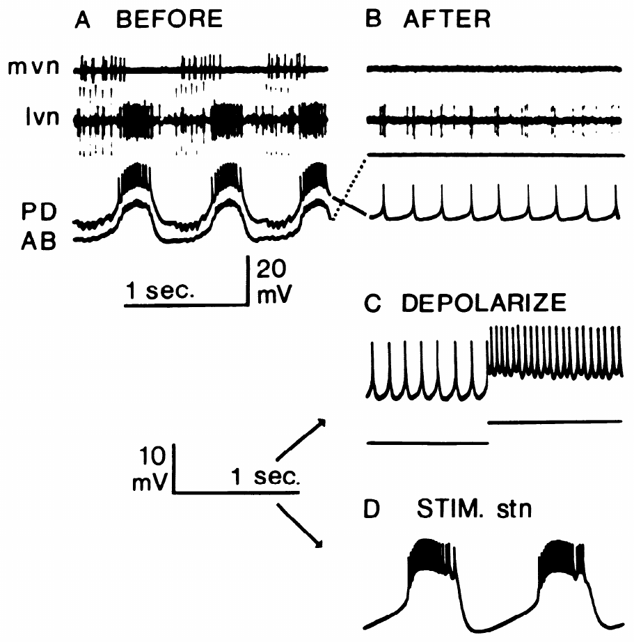
PD neurons become bursters when input recruits them
The two electrically coupled PD neurons did not behave like isolated AB. After AB and other relevant inputs were removed and the stn was blocked, PD fired tonically, meaning that spikes continued without the regularly separated slow depolarizing waves that define bursting. Tonic firing provides continuing impulses, while bursting groups those impulses within recurring slow depolarizations separated by more negative intervals.
Injecting depolarizing current increased tonic firing, but stimulation of the remaining input nerve recruited slow membrane oscillations. The published example used a 20 Hz stimulus train lasting 0.3 s. Oscillations outlasted the stimulus; across experiments they could continue for up to about a minute. The prolonged response placed the neuron in an oscillatory state lasting well beyond the brief input train that recruited it.
PD is a conditional burster, with its capacity for slow oscillations depending on an appropriate input state. Isolation from AB and descending activity exposed tonic discharge at baseline, while stimulation made the oscillatory response available. In the intact pacemaker group, these recruited properties interact with AB's endogenous oscillation through electrical coupling, allowing the synchronized ensemble to express a rhythm shaped by both cellular and network influences.
Hooper & Marder (1987), Fig. 1(right). Lobster pyloric circuit
Miller & Selverston (1982), Fig. 3(A–D). Isolated PD is tonic; nerve stimulation recruits bursting
Miller & Selverston (1982); Hooper & Marder (1987)
08
Notes:
• The two electrically coupled PD neurons did not behave like isolated AB. After AB and other relevant inputs were removed and the stn was blocked, PD fired tonically, meaning that spikes continued without the regularly separated slow depolarizing waves that define bursting.
– The surviving PD cells were recorded after the cells supplying their normal phasic input had been disabled.
• Injecting depolarizing current increased tonic firing, but stimulation of the remaining input nerve recruited slow membrane oscillations. The published example used a 20 Hz stimulus train lasting 0.3 s. Oscillations outlasted the stimulus; across experiments they could continue for up to about a minute.
– A brief stimulation episode could change neuronal state for longer than the duration of the imposed spikes.
• PD is therefore a conditional burster: an appropriate input state permits rhythm-generating properties that are absent in the isolated baseline state. The stimulation activated a collection of inputs, so the result does not identify one transmitter, receptor or channel as its sole cause.
– Tonic current injection and nerve stimulation are different interventions; similar depolarization does not guarantee the same cellular response.
References:
Miller JP, Selverston AI. (1982). Mechanisms underlying pattern generation in lobster stomatogastric ganglion as determined by selective inactivation of identified neurons. II. Oscillatory properties of pyloric neurons. Journal of Neurophysiology 48: 1378-1391. https://doi.org/10.1152/jn.1982.48.6.1378
Hooper SL, Marder E. (1987). Modulation of the lobster pyloric rhythm by the peptide proctolin. Journal of Neuroscience 7: 2097-2112. https://doi.org/10.1523/jneurosci.07-07-02097.1987
Figure: Miller & Selverston (1982), Fig. 3(A–D). Isolated PD is tonic; nerve stimulation recruits bursting
Figure source: https://doi.org/10.1152/jn.1982.48.6.1378
Figure: Hooper & Marder (1987), Fig. 1(right). Lobster pyloric circuit
Figure source: https://doi.org/10.1523/jneurosci.07-07-02097.1987

Slide 10
AB and conditional PDs form one pacemaker kernel
An endogenous burster carries a complete oscillation mechanism in its own membrane, so its rhythm survives the loss of every synaptic input. A conditional burster holds the necessary currents in latent form; modulatory input must switch them on, and without that input the same cell fires tonically. The distinction concerns whether the oscillation is expressed in the isolated baseline state or becomes available after input changes the cell's operating conditions.
Electrical coupling merges both types into one unit. AB's slow wave spreads into the two PD cells, and PD's recruited oscillations feed back into AB, so the kernel bursts as a group although only AB can oscillate alone. Inside the intact circuit all three fire in synchrony, which is why only complete isolation could expose the difference. The electrical interaction makes the membrane dynamics of each partner available to the others as the synchronized slow wave develops.
After many hours of decentralization, PD neurons can acquire pacemaker properties, providing additional oscillatory capacity in a circuit that normally receives strong timing influence from AB. This delayed change occurs on a different timescale from the immediate recruitment produced by a brief input stimulus. The pacemaker group therefore combines its initial cellular organization with longer-term adjustments following prolonged loss of modulation.
Miller & Selverston (1982), Fig. 2(A–B). AB retains slow bursting after other inputs are removed
Miller & Selverston (1982); Eisen & Marder (1982); More-Potdar & Golowasch (2023)
08a
Notes:
• Slides 7 and 8 test AB and PD separately; the contrast between them, and the coupling on slide 6, explain how a group with one true oscillator behaves as a single pacemaker.
• Two kinds of bursting neuron.
– Miller and Selverston found that only AB continued to generate bursting pacemaker potentials when isolated, while the PD cells, previously thought to be endogenous bursters, fired tonically.
– Stimulating the stomatogastric nerve recruited the same kind of oscillation in PD, VD and LP, so the capacity was present but required an input to express it.
• Coupling hides the difference in the intact circuit.
– Eisen and Marder describe direct electrical coupling among AB, PD and VD, which allows slow voltage changes to pass between the cells.
– Since coupled cells fire together, recording them in the intact circuit cannot reveal which one generates the oscillation; photoinactivation of all partners was the only way to ask each cell alone.
• A latent pacemaker becomes useful after injury.
– More-Potdar and Golowasch point out that PD neurons may express pacemaker properties when the network is decentralized.
– They suggest that more effective pacemaker neurons could contribute to the recovery described on slide 45, where the rhythm returns without its modulatory inputs.
References:
Miller JP, Selverston AI. (1982). Mechanisms underlying pattern generation in lobster stomatogastric ganglion as determined by selective inactivation of identified neurons. II. Oscillatory properties of pyloric neurons. Journal of Neurophysiology 48: 1378-1391. https://doi.org/10.1152/jn.1982.48.6.1378
Eisen JS, Marder E. (1982). Mechanisms underlying pattern generation in lobster stomatogastric ganglion as determined by selective inactivation of identified neurons. III. Synaptic connections of electrically coupled pyloric neurons. Journal of Neurophysiology 48: 1392-1415. https://doi.org/10.1152/jn.1982.48.6.1392
More-Potdar S, Golowasch J. (2023). Oscillatory network spontaneously recovers both activity and robustness after prolonged removal of neuromodulators. Frontiers in Cellular Neuroscience 17: 1280575. https://doi.org/10.3389/fncel.2023.1280575

Slide 11
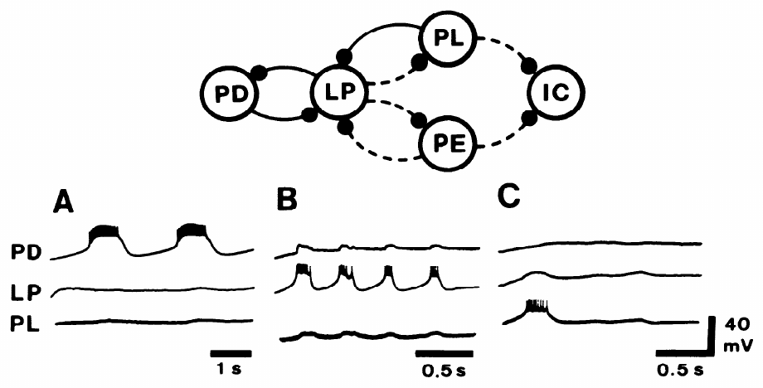
Input can recruit oscillations in follower neurons
Conditional oscillatory properties were available in several pyloric neurons when appropriate input recruited the responding membrane state. Miller and Selverston examined a reduced lobster network after disabling AB and the ventricular dilator neuron. PD, LP and a late-firing pyloric neuron remained available for intracellular recording and controlled membrane polarization. The retained cells preserved a smaller set of inhibitory and electrical interactions in which each neuron's voltage could be followed during input stimulation.
A 20 Hz input-nerve train lasting 0.5 s recruited voltage oscillations in the remaining neurons. Current injection suppressed selected cells to test whether an observed response required another cell’s activity. LP could express slow oscillations even when activity in the recorded PD and other pyloric cells was reduced. Polarizing individual cells changed the activity available through their connections while the remaining neurons continued to receive the recruited input state.
Several pyloric neurons express conditional oscillatory properties, including PD, LP, and the ventricular dilator VD under the relevant experimental conditions. Their ability to oscillate expands the rhythm-generating resources available when descending input changes cellular state. AB remains distinctive in the tested baseline isolation, while the connected circuit recruits contributions from cells whose oscillatory activity depends on the surrounding modulatory conditions.
Miller & Selverston (1982), Fig. 4(A–C). Nerve stimulation recruits conditional membrane oscillations
Hooper & Marder (1987), Fig. 1(right). Lobster pyloric circuit
Miller & Selverston (1982); Hooper & Marder (1987)
09
Notes:
• Conditional oscillation was not confined to PD. Miller and Selverston examined a reduced lobster network after disabling AB and the ventricular dilator neuron. PD, LP and a late-firing pyloric neuron remained available for intracellular recording and controlled membrane polarization.
– Hyperpolarization makes a membrane voltage more negative, and can suppress a neuron’s spike generation or bursting.
• A 20 Hz input-nerve train lasting 0.5 s recruited voltage oscillations in the remaining neurons. Current injection suppressed selected cells to test whether an observed response required another cell’s activity. LP could express slow oscillations even when activity in the recorded PD and other pyloric cells was reduced.
– The surviving neurons were not assumed to be independent merely because they were recorded separately; imposed polarization tested the contribution of their interactions.
• The ventricular dilator (VD) neuron is a pyloric motor neuron with conditional bursting in the study’s other isolation experiments. Oscillatory capacity thus belongs to several circuit members under appropriate input conditions; AB was distinctive in bursting spontaneously after the complete tested isolation.
– The isolation results separate spontaneous endogenous bursting from input-dependent expression of oscillatory properties.
References:
Miller JP, Selverston AI. (1982). Mechanisms underlying pattern generation in lobster stomatogastric ganglion as determined by selective inactivation of identified neurons. II. Oscillatory properties of pyloric neurons. Journal of Neurophysiology 48: 1378-1391. https://doi.org/10.1152/jn.1982.48.6.1378
Hooper SL, Marder E. (1987). Modulation of the lobster pyloric rhythm by the peptide proctolin. Journal of Neuroscience 7: 2097-2112. https://doi.org/10.1523/jneurosci.07-07-02097.1987
Figure: Miller & Selverston (1982), Fig. 4(A–C). Nerve stimulation recruits conditional membrane oscillations
Figure source: https://doi.org/10.1152/jn.1982.48.6.1378
Figure: Hooper & Marder (1987), Fig. 1(right). Lobster pyloric circuit
Figure source: https://doi.org/10.1523/jneurosci.07-07-02097.1987

Slide 12
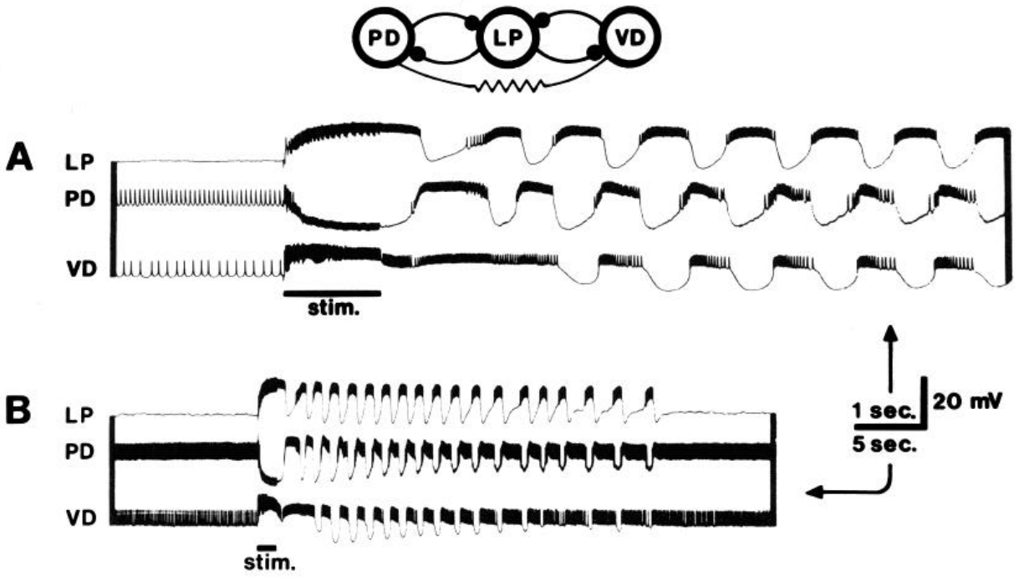
A brief input can recruit a reduced motor network
After removal of the spontaneously bursting AB neuron and several other cells, a reduced PD–LP–VD network could remain nonrhythmic when descending input was blocked. Its retained neurons had inhibitory interactions, but those connections alone did not produce continuous coordinated bursting in that state. The remaining inhibitory connections could influence activity when the necessary membrane processes were recruited by signals entering through the input nerve.
A 50 Hz stimulus train lasting 1.4 s in the stomatogastric nerve initiated an episode of coordinated activity. Intracellular recordings at both fast and slow time bases distinguished individual membrane waves from the longer duration of the recruited episode. The episode continued through repeated slow waves after the initiating train, placing the source of its continuing temporal organization within the responding circuit.
Sustained coordinated output depends on both network connectivity and the active state of its neurons. In the intact pyloric circuit, AB contributes spontaneous oscillation, while input-sensitive properties in PD, LP, and VD add their own responses to the shared activity. A brief descending stimulus can therefore recruit a longer motor episode by changing the cellular conditions under which the retained connections operate.
Miller & Selverston (1982), Fig. 5(A–B). Brief nerve stimulation recruits a reduced pyloric network
Hooper & Marder (1987), Fig. 1(right). Lobster pyloric circuit
Miller & Selverston (1982); Hooper & Marder (1987)
10
Notes:
• After removal of the spontaneously bursting AB neuron and several other cells, a reduced PD–LP–VD network could remain nonrhythmic when descending input was blocked. Its retained neurons had inhibitory interactions, but those connections alone did not produce continuous coordinated bursting in that state.
– The experiment removed AB, the neuron that had passed the spontaneous isolation test, before assessing the remaining network.
• A 50 Hz stimulus train lasting 1.4 s in the stomatogastric nerve initiated an episode of coordinated activity. Intracellular recordings at both fast and slow time bases distinguished individual membrane waves from the longer duration of the recruited episode.
– The slow recording resolves persistence after the stimulus; the fast recording resolves the relationships among individual voltage waves.
• A circuit can contain the connections needed for coordinated output while lacking the active cellular state that expresses it. The recruited episode supports a contribution of conditional membrane oscillations to motor-pattern stability. It does not imply that this reduced network reproduces every muscle command of the intact pyloric system.
– A synaptic connection constrains interactions, but the activity generated by those interactions also depends on the membrane properties of the connected cells.
References:
Miller JP, Selverston AI. (1982). Mechanisms underlying pattern generation in lobster stomatogastric ganglion as determined by selective inactivation of identified neurons. II. Oscillatory properties of pyloric neurons. Journal of Neurophysiology 48: 1378-1391. https://doi.org/10.1152/jn.1982.48.6.1378
Hooper SL, Marder E. (1987). Modulation of the lobster pyloric rhythm by the peptide proctolin. Journal of Neuroscience 7: 2097-2112. https://doi.org/10.1523/jneurosci.07-07-02097.1987
Figure: Miller & Selverston (1982), Fig. 5(A–B). Brief nerve stimulation recruits a reduced pyloric network
Figure source: https://doi.org/10.1152/jn.1982.48.6.1378
Figure: Hooper & Marder (1987), Fig. 1(right). Lobster pyloric circuit
Figure source: https://doi.org/10.1523/jneurosci.07-07-02097.1987

Slide 13
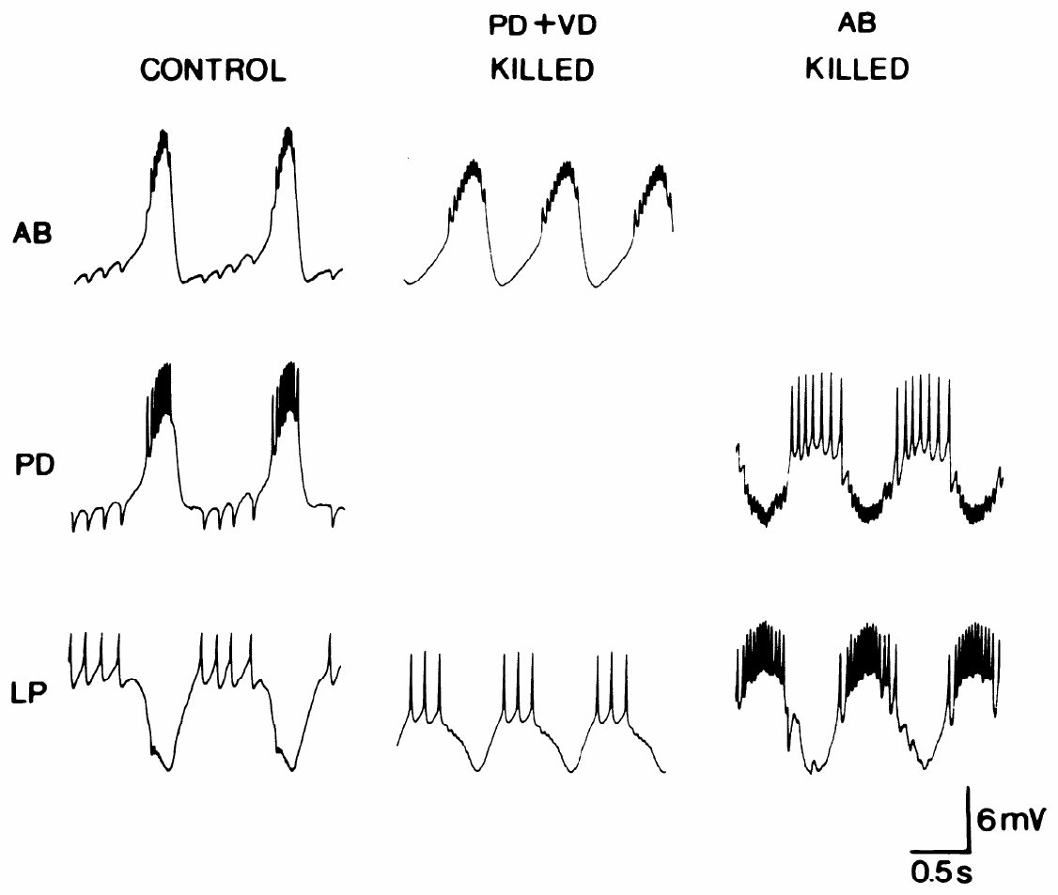
Selective deletion separates two inhibitory outputs
Synchronous activity of AB and PD produces a compound IPSP in LP. Eisen and Marder separated the contributing pathways by photoinactivating either AB or both PD neurons. The comparison preserved recordings from LP and from the surviving member of the coupled pacemaker group. Electrical synchronization normally activates the two presynaptic populations together, making their separate chemical contributions overlap in the recorded response.
With PD removed, AB bursts still inhibited LP. With AB removed, PD depolarizations also inhibited LP, but their responses had a different time course. The intact response therefore combined two chemical inhibitory outputs that were normally activated together by the electrically coupled cells. The surviving input retained its own time course, allowing the compound response to be understood as the sum of distinct synaptic pathways.
Removing PD also eliminated the LP-associated inhibitory response in AB, identifying an indirect feedback route through the electrically coupled partner. AB supplied a direct inhibitory output to LP, while LP's chemical feedback reached PD before spreading electrotonically to AB. The circuit consequently combines distinct transmitter-release sites with electrical propagation that distributes their voltage effects across the pacemaker ensemble.
Hooper & Marder (1987), Fig. 1(right). Lobster pyloric circuit
Eisen & Marder (1982), Fig. 4. Selective deletion separates AB and PD synaptic outputs
Eisen & Marder (1982); Hooper & Marder (1987)
11
Notes:
• Synchronous activity of AB and PD produces a compound IPSP in LP. Eisen and Marder separated the contributing pathways by photoinactivating either AB or both PD neurons. The comparison preserved recordings from LP and from the surviving member of the coupled pacemaker group.
– The pacemaker group consists of AB and its coupled PD neurons; their synchronous activity does not make their synapses identical.
• With PD removed, AB bursts still inhibited LP. With AB removed, PD depolarizations also inhibited LP, but their responses had a different time course. The intact response therefore combined two chemical inhibitory outputs that were normally activated together by the electrically coupled cells.
– Deletion assigns a component of a compound response to the cell that actually supplies it.
• LP-evoked IPSPs disappeared from AB when PD was removed. The same manipulation separated a direct AB-to-LP synapse from an indirect LP influence on AB through PD. Functional connectivity must distinguish transmitter release at a synapse from voltage propagation through an electrical connection.
– The loss of the LP response in AB after PD deletion is more discriminating than observing LP and AB activity at the same time.
References:
Eisen JS, Marder E. (1982). Mechanisms underlying pattern generation in lobster stomatogastric ganglion as determined by selective inactivation of identified neurons. III. Synaptic connections of electrically coupled pyloric neurons. Journal of Neurophysiology 48: 1392-1415. https://doi.org/10.1152/jn.1982.48.6.1392
Hooper SL, Marder E. (1987). Modulation of the lobster pyloric rhythm by the peptide proctolin. Journal of Neuroscience 7: 2097-2112. https://doi.org/10.1523/jneurosci.07-07-02097.1987
Figure: Eisen & Marder (1982), Fig. 4. Selective deletion separates AB and PD synaptic outputs
Figure source: https://doi.org/10.1152/jn.1982.48.6.1392
Figure: Hooper & Marder (1987), Fig. 1(right). Lobster pyloric circuit
Figure source: https://doi.org/10.1523/jneurosci.07-07-02097.1987

Slide 14
Deleting a coupled partner reveals chemical output
Current injected into AB leaks through gap junctions into PD, and current injected into PD leaks back. Stimulating either cell drives both, so inhibition recorded in LP mixes transmitter from the two partners. The coupled voltage change recruits both neurons' chemical outputs, so the postsynaptic response ordinarily contains overlapping contributions from the synchronized group.
Photoinactivation breaks the pair: a neuron filled with Lucifer yellow dies when illuminated, while unfilled neighbors survive. With PD gone, every remaining inhibitory response in LP must come from AB, and the reverse deletion isolates PD's share of the compound response. The recorded LP response then follows the chemical output of the surviving partner, preserving its characteristic ionic dependence and time course.
The deletions also assigned VD inhibition to AB, while electrical coupling linked AB, PD, and VD through direct junctional routes. Synchronous activity can therefore reach different targets through distinct chemical pathways even when the presynaptic cells share a voltage rhythm. The connected ensemble distributes a common timing signal while retaining the separate transmitter actions supplied by its constituent neurons.
Hooper & Marder (1987), Fig. 1(right). Lobster pyloric circuit
Eisen & Marder (1982), Fig. 4. Selective deletion separates AB and PD synaptic outputs
Eisen & Marder (1982); Miller & Selverston (1982)
11a
Notes:
• Slide 11 reports what photoinactivation revealed; the reason deletion was needed lies in the electrical coupling described on slide 6.
• Coupling defeats one-cell stimulation.
– A gap junction passes current in both directions, so depolarizing AB with an electrode also depolarizes PD, and the two then release transmitter together.
– Without deletion, a response in LP could not be assigned to either cell.
• Dye-sensitized photoinactivation removes one partner.
– Eisen and Marder used the Lucifer yellow method to kill either the single AB neuron or both PD neurons while recording the survivors.
– Slides 12 and 13 then measured each isolated component, which differed in time course, reversal potential, ion selectivity and pharmacology.
• Deletion also clarified the wiring of VD.
– Selective inactivation showed that the IPSP in VD is due solely to transmitter released by AB.
– Eisen and Marder suggest that coupling between nonidentical neurons offers a way to change synaptic characteristics within an otherwise fixed circuit.
References:
Eisen JS, Marder E. (1982). Mechanisms underlying pattern generation in lobster stomatogastric ganglion as determined by selective inactivation of identified neurons. III. Synaptic connections of electrically coupled pyloric neurons. Journal of Neurophysiology 48: 1392-1415. https://doi.org/10.1152/jn.1982.48.6.1392
Miller JP, Selverston AI. (1982). Mechanisms underlying pattern generation in lobster stomatogastric ganglion as determined by selective inactivation of identified neurons. II. Oscillatory properties of pyloric neurons. Journal of Neurophysiology 48: 1378-1391. https://doi.org/10.1152/jn.1982.48.6.1378

Slide 15
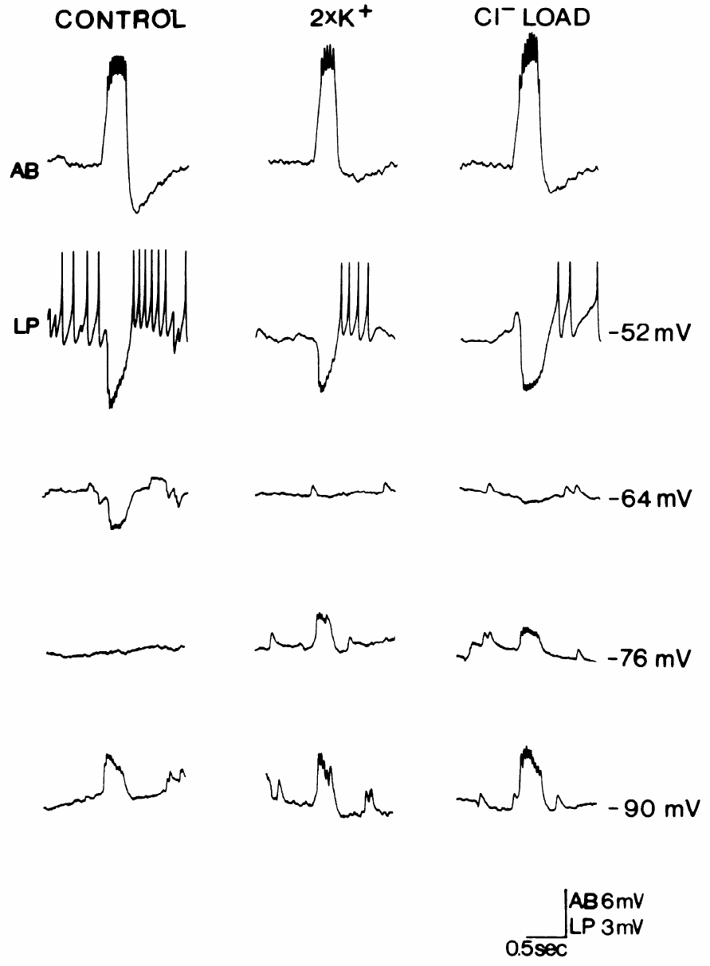
AB inhibition of LP depends strongly on chloride
After PD deletion, AB-to-LP inhibition could be tested without the overlapping PD output. Eisen and Marder varied LP membrane voltage and altered ionic conditions while evoking AB activity. The isolated response reversed near −64 mV in the published control experiment. Recording at several LP voltages followed how the isolated input changed as the postsynaptic membrane approached and crossed the response's reversal.
The reversal potential is the voltage at which a synaptic response changes sign. Doubling extracellular potassium did not shift the AB-evoked reversal appreciably. Increasing intracellular chloride shifted the response toward more positive voltages, implicating a substantial chloride contribution to its synaptic conductance. Changing the chloride gradient altered the voltage toward which the synaptic pathway drove LP, identifying the ions carrying an important part of the response.
The glutamatergic AB-to-LP synapse has a substantial chloride-dependent conductance, which can reduce firing by driving voltage toward reversal and by increasing membrane conductance. Near reversal, opening the pathway still changes how strongly other currents affect membrane voltage. Picrotoxin blocks this glutamatergic component while sparing the chemically distinct cholinergic inhibition supplied by PD, leaving different portions of the compound pacemaker input available.
Hooper & Marder (1987), Fig. 1(right). Lobster pyloric circuit
Eisen & Marder (1982), Fig. 5. Chloride loading changes the isolated AB-to-LP response
Eisen & Marder (1982); Hooper & Marder (1987)
12
Notes:
• After PD deletion, AB-to-LP inhibition could be tested without the overlapping PD output. Eisen and Marder varied LP membrane voltage and altered ionic conditions while evoking AB activity. The isolated response reversed near −64 mV in the published control experiment.
– Changing the postsynaptic holding voltage separates the response’s driving force from the amount of transmitter released.
• The reversal potential is the voltage at which a synaptic response changes sign. Doubling extracellular potassium did not shift the AB-evoked reversal appreciably. Increasing intracellular chloride shifted the response toward more positive voltages, implicating a substantial chloride contribution to its synaptic conductance.
– Increasing chloride inside LP changes the ionic gradient across its membrane, so a chloride-carrying response should reverse at a different voltage.
• A conductance describes how readily a membrane pathway carries electrical current. Chloride-dependent inhibition can oppose firing even when its voltage effect becomes small near reversal. These ionic manipulations constrain the mechanism of the synapse; they do not identify a molecular receptor subunit.
– The isolated AB response differed from the potassium-sensitive inhibition supplied by PD, despite the normal synchrony of the two presynaptic neurons.
References:
Eisen JS, Marder E. (1982). Mechanisms underlying pattern generation in lobster stomatogastric ganglion as determined by selective inactivation of identified neurons. III. Synaptic connections of electrically coupled pyloric neurons. Journal of Neurophysiology 48: 1392-1415. https://doi.org/10.1152/jn.1982.48.6.1392
Hooper SL, Marder E. (1987). Modulation of the lobster pyloric rhythm by the peptide proctolin. Journal of Neuroscience 7: 2097-2112. https://doi.org/10.1523/jneurosci.07-07-02097.1987
Figure: Eisen & Marder (1982), Fig. 5. Chloride loading changes the isolated AB-to-LP response
Figure source: https://doi.org/10.1152/jn.1982.48.6.1392
Figure: Hooper & Marder (1987), Fig. 1(right). Lobster pyloric circuit
Figure source: https://doi.org/10.1523/jneurosci.07-07-02097.1987

Slide 16
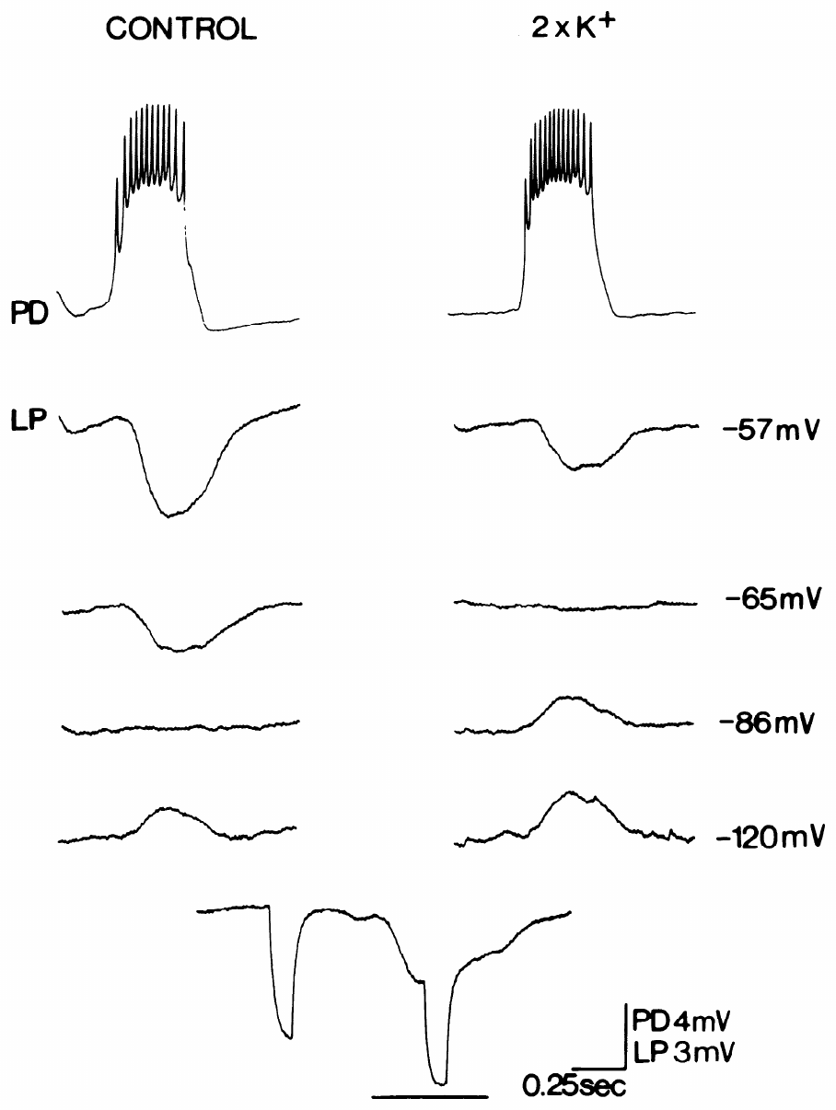
PD inhibition of LP is sensitive to potassium
Eisen and Marder isolated PD-to-LP transmission by disabling AB and VD, then depolarized PD with current pulses. LP was recorded at several membrane voltages to determine where the isolated inhibitory response changed sign. The control reversal in the published experiment was −86 mV. Removing the other inputs left the recorded voltage dependence associated with PD's chemical output onto the follower neuron.
Doubling extracellular potassium shifted that reversal to approximately −65 mV. Chloride loading did not produce the corresponding shift found for AB-to-LP inhibition. The PD response therefore depended strongly on potassium permeability, whereas the synchronized AB response had a different ionic basis. The potassium-sensitive shift connected the postsynaptic response to the gradient that determines potassium movement through the activated pathway.
An open synaptic pathway passes current according to its ionic selectivity and driving force, with driving force set by the difference between membrane voltage and reversal. The more negative reversal of PD's cholinergic input gives it a different voltage dependence from the glutamatergic AB and PY inputs. Near −80 mV in the crab recordings, these components can therefore carry currents in opposing directions within the same follower cell.
Hooper & Marder (1987), Fig. 1(right). Lobster pyloric circuit
Eisen & Marder (1982), Fig. 6. External potassium shifts the isolated PD-to-LP reversal
Eisen & Marder (1982); Hooper & Marder (1987)
13
Notes:
• Eisen and Marder isolated PD-to-LP transmission by disabling AB and VD, then depolarized PD with current pulses. LP was recorded at several membrane voltages to determine where the isolated inhibitory response changed sign. The control reversal in the published experiment was −86 mV.
– The current pulse reproduced presynaptic depolarization while allowing the experimenter to control when the PD response was evoked.
• Doubling extracellular potassium shifted that reversal to approximately −65 mV. Chloride loading did not produce the corresponding shift found for AB-to-LP inhibition. The PD response therefore depended strongly on potassium permeability, whereas the synchronized AB response had a different ionic basis.
– External potassium was an experimental manipulation of driving force, rather than a test of the number of potassium channels in the neuron.
• An ion’s concentration gradient and the postsynaptic voltage determine the direction of its contribution to synaptic current. Two inputs can both inhibit LP at its normal operating voltage while differing in reversal, kinetics and pharmacology. Their combined effect cannot be represented as two physiologically identical synapses.
– The measured ionic selectivity does not establish the identity of every channel protein involved in the synaptic response.
References:
Eisen JS, Marder E. (1982). Mechanisms underlying pattern generation in lobster stomatogastric ganglion as determined by selective inactivation of identified neurons. III. Synaptic connections of electrically coupled pyloric neurons. Journal of Neurophysiology 48: 1392-1415. https://doi.org/10.1152/jn.1982.48.6.1392
Hooper SL, Marder E. (1987). Modulation of the lobster pyloric rhythm by the peptide proctolin. Journal of Neuroscience 7: 2097-2112. https://doi.org/10.1523/jneurosci.07-07-02097.1987
Figure: Eisen & Marder (1982), Fig. 6. External potassium shifts the isolated PD-to-LP reversal
Figure source: https://doi.org/10.1152/jn.1982.48.6.1392
Figure: Hooper & Marder (1987), Fig. 1(right). Lobster pyloric circuit
Figure source: https://doi.org/10.1523/jneurosci.07-07-02097.1987

Slide 17
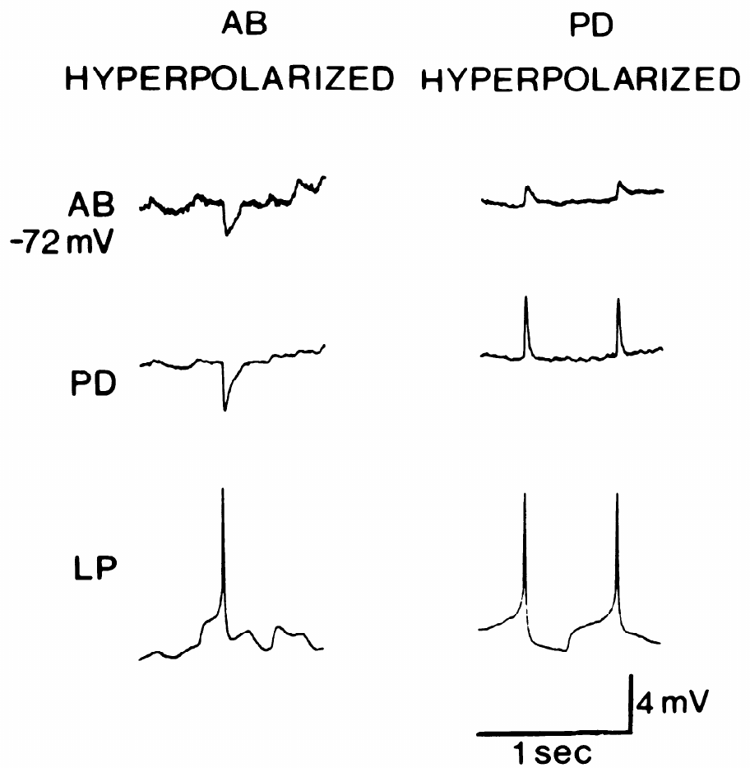
Electrical coupling can carry an indirect IPSP
An LP spike can produce a response in AB although chemical feedback directly targets PD. Eisen and Marder hyperpolarized AB or PD while recording all three cells. They tested whether the AB response followed AB voltage or the response generated in PD. Changing one pacemaker partner's voltage altered the conditions at its own membrane while electrical coupling retained communication with the other recorded cell.
Hyperpolarizing AB to approximately −72 mV did not reverse its LP-associated IPSP. Hyperpolarizing PD instead reversed the response in PD and the voltage response appearing in AB. The AB response therefore tracked a PD synaptic event carried through electrical coupling. Reversal following PD polarization located the origin of the response at the synaptic pathway entering PD before the voltage change reached AB.
Electrotonic spread passively carries a voltage change through the electrical pathway connecting AB and PD. An LP spike therefore produces chemical inhibition in PD and a smaller propagated response in AB. This feedback reaches the electrically synchronized group through one partner's chemical input, allowing activity in a follower neuron to influence both members of the pacemaker ensemble.
Hooper & Marder (1987), Fig. 1(right). Lobster pyloric circuit
Eisen & Marder (1982), Fig. 9. LP-evoked potentials reverse together during PD polarization
Eisen & Marder (1982); Hooper & Marder (1987)
14
Notes:
• An LP spike can produce a response in AB although chemical feedback directly targets PD. Eisen and Marder hyperpolarized AB or PD while recording all three cells. They tested whether the AB response followed AB voltage or the response generated in PD.
– The manipulation compared the two cells at similar negative voltages, but changed which cell was directly polarized.
• Hyperpolarizing AB to approximately −72 mV did not reverse its LP-associated IPSP. Hyperpolarizing PD instead reversed the response in PD and the voltage response appearing in AB. The AB response therefore tracked a PD synaptic event carried through electrical coupling.
– If LP released transmitter directly onto AB, changing AB’s own membrane voltage should govern the local synaptic reversal.
• Electrotonic spread is passive propagation of a voltage change through a connected electrical pathway. A neuron may receive such a propagated response without possessing the corresponding chemical synapse. A connection map based only on spike-correlated voltage changes can consequently assign the wrong presynaptic target.
– The results require a chemical LP-to-PD connection plus electrical propagation from PD into AB.
References:
Eisen JS, Marder E. (1982). Mechanisms underlying pattern generation in lobster stomatogastric ganglion as determined by selective inactivation of identified neurons. III. Synaptic connections of electrically coupled pyloric neurons. Journal of Neurophysiology 48: 1392-1415. https://doi.org/10.1152/jn.1982.48.6.1392
Hooper SL, Marder E. (1987). Modulation of the lobster pyloric rhythm by the peptide proctolin. Journal of Neuroscience 7: 2097-2112. https://doi.org/10.1523/jneurosci.07-07-02097.1987
Figure: Eisen & Marder (1982), Fig. 9. LP-evoked potentials reverse together during PD polarization
Figure source: https://doi.org/10.1152/jn.1982.48.6.1392
Figure: Hooper & Marder (1987), Fig. 1(right). Lobster pyloric circuit
Figure source: https://doi.org/10.1523/jneurosci.07-07-02097.1987

Slide 18
Driving force decides how strongly each synapse inhibits LP
Current flows through an open synaptic channel only when the membrane sits away from that synapse's reversal potential. The driving force, the gap between membrane voltage and reversal, sets both the direction and the size of the current a given conductance passes. At the reversal potential, opposing ionic influences balance for that synaptic pathway, while moving away from reversal permits a larger net current.
Near −58 mV, where isolated LP began firing in proctolin, the PD synapse, reversing near −86 mV, has a driving force of almost 30 mV and pulls LP strongly negative. The AB synapse, reversing near −64 mV, has only a few millivolts of driving force at the same voltage, so the two inputs differ in voltage impact even at similar conductance. The more negative PD reversal provides stronger hyperpolarizing drive at that voltage, even when the activated conductance is similar in size.
Hyperpolarization also changes the membrane currents that shape LP rebound after pacemaker inhibition ends. It activates the depolarizing h current and removes inactivation from the transient A-type potassium current. When inhibition declines, inward h current favors a return toward threshold while the available outward A-current delays that return, making subsequent burst onset depend on the voltage history imposed by the preceding synaptic input.
Eisen & Marder (1982), Fig. 6. External potassium shifts the isolated PD-to-LP reversal
Eisen & Marder (1982); Hooper & Marder (1987); Tang et al. (2010)
14a
Notes:
• Slides 12 and 13 report two reversal potentials; comparing each with LP's working voltage explains why the two inputs act so differently.
• Reversal potential and driving force.
– At the reversal potential the inward and outward flows of the permeant ions balance, so an open conductance passes no net current.
– Moving the membrane further from reversal enlarges the current through the same open channels.
• Applying it to LP.
– Slide 28 shows isolated LP responding to proctolin at about −58 mV, which places it near firing threshold.
– From there the PD input has close to thirty millivolts of driving force, while the AB input has only a few, which is why the two components on slide 11 look so different in amplitude.
• Why the hyperpolarization matters.
– Tang and colleagues describe how a larger inhibitory current increases activation of the h current and favors removal of inactivation from the A-type current.
– Slides 38 and 39 describe those two currents, so the strength of PD's inhibition feeds directly into the timing of LP's following burst.
References:
Eisen JS, Marder E. (1982). Mechanisms underlying pattern generation in lobster stomatogastric ganglion as determined by selective inactivation of identified neurons. III. Synaptic connections of electrically coupled pyloric neurons. Journal of Neurophysiology 48: 1392-1415. https://doi.org/10.1152/jn.1982.48.6.1392
Hooper SL, Marder E. (1987). Modulation of the lobster pyloric rhythm by the peptide proctolin. Journal of Neuroscience 7: 2097-2112. https://doi.org/10.1523/jneurosci.07-07-02097.1987
Tang LS, Goeritz ML, Caplan JS, Taylor AL, Fisek M, Marder E. (2010). Precise temperature compensation of phase in a rhythmic motor pattern. PLoS Biology 8: e1000469. https://doi.org/10.1371/journal.pbio.1000469

Slide 19
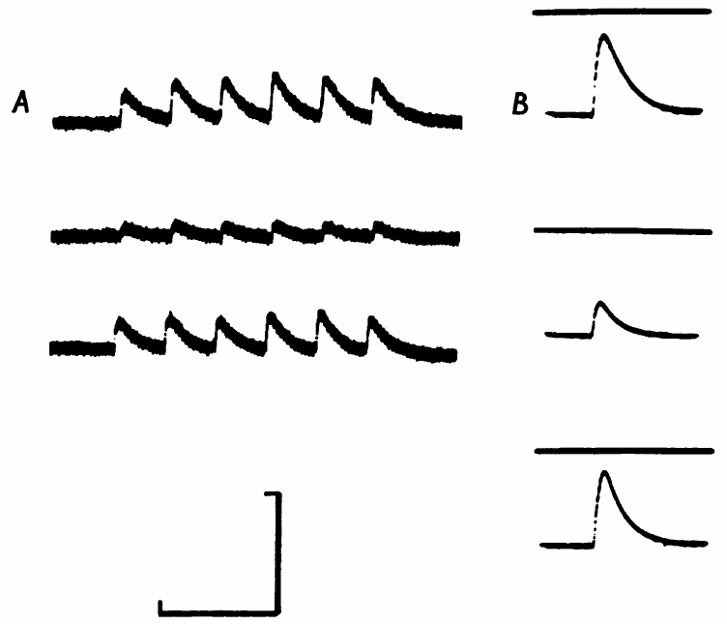
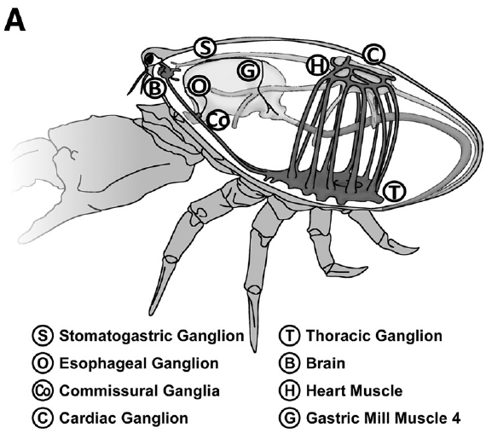
Acetylcholine excites the lobster dorsal dilator
Marder tested transmitter identity at the lobster PD-to-muscle junction. Acetylcholine (ACh) is a small-molecule neurotransmitter; applying it locally to the dorsal dilator produced a depolarizing response. Stimulating the PD motor nerve produced an excitatory junctional potential, the muscle voltage response to neural transmitter release. An excitatory junctional potential links transmitter release from the motor axon with the voltage change that recruits contraction in its muscle target.
Hexamethonium reversibly reduced both the nerve-evoked response and the response to applied ACh. Washout restored both responses toward their control amplitudes as the antagonist was removed from the postsynaptic preparation. Local ACh delivery and motor-nerve stimulation therefore interrogated a pharmacologically similar postsynaptic pathway in the same muscle system. Reversibility followed the availability of the postsynaptic pathway as the antagonist entered and then left the preparation during washout.
Marder related each identified motor neuron's muscle response and transmitter sensitivity to biochemical evidence for transmitter synthesis in the cell body. The survey covered eleven classes of excitatory STG motor neuron, including the PD pathway supplying the dorsal dilator. Applied acetylcholine reproduced an excitatory action and shared antagonist sensitivity with the nerve-evoked response, connecting a candidate chemical signal with a defined peripheral motor junction.
Garcia et al. (2015), Fig. 3(A). Crab foregut anatomy
Marder (1976), Fig. 2(A–B). Hexamethonium reversibly reduces nerve and ACh responses
Marder (1976); Garcia et al. (2015)
15
Notes:
• Marder tested transmitter identity at the lobster PD-to-muscle junction. Acetylcholine (ACh) is a small-molecule neurotransmitter; applying it locally to the dorsal dilator produced a depolarizing response. Stimulating the PD motor nerve produced an excitatory junctional potential, the muscle voltage response to neural transmitter release.
– Iontophoresis delivers a charged substance from a pipette with electrical current, allowing a localized test of the muscle’s response.
– The anatomical localization in Garcia and colleagues is from the crab; the transmitter and muscle experiments discussed here are from the spiny lobster.
• Hexamethonium reversibly reduced both the nerve-evoked response and the response to applied ACh. Washout restored them toward their control amplitudes. Local ACh delivery and motor-nerve stimulation therefore interrogated a pharmacologically similar postsynaptic pathway in the same muscle system.
– The comparison included normal saline, antagonist exposure and saline wash, separating a reversible drug action from irreversible tissue failure.
• A transmitter candidate is stronger when it reproduces the nerve response and shares its antagonist sensitivity. Drug sensitivity alone is insufficient because a compound may affect more than one receptor class. These experiments support cholinergic transmission without assigning a modern molecular receptor subtype.
– Excitation at the muscle does not mean that the same transmitter excites every neuron onto which PD releases it.
References:
Marder E. (1976). Cholinergic motor neurones in the stomatogastric system of the lobster. The Journal of Physiology 257: 63-86. https://doi.org/10.1113/jphysiol.1976.sp011356
Garcia VJ, Daur N, Temporal S, Schulz DJ, Bucher D. (2015). Neuropeptide receptor transcript expression levels and magnitude of ionic current responses show cell type-specific differences in a small motor circuit. Journal of Neuroscience 35: 6786-6800. https://doi.org/10.1523/jneurosci.0171-15.2015
Figure: Marder (1976), Fig. 2(A–B). Hexamethonium reversibly reduces nerve and ACh responses
Figure source: https://doi.org/10.1113/jphysiol.1976.sp011356
Figure: Garcia et al. (2015), Fig. 3(A). Crab foregut anatomy
Figure source: https://doi.org/10.1523/jneurosci.0171-15.2015

Slide 20
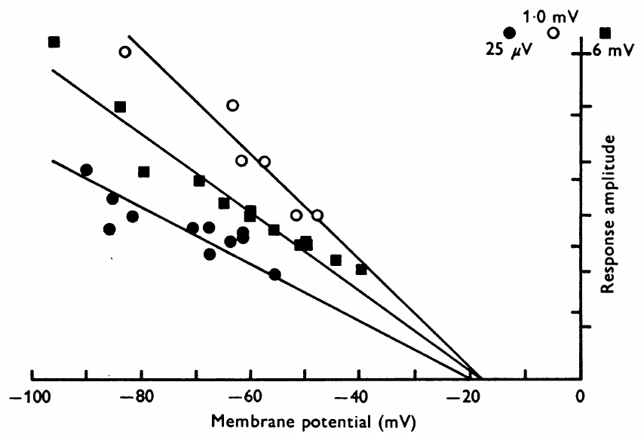
Nerve and ACh responses reverse at similar voltages
Marder compared the voltage dependence of applied ACh responses with the dorsal dilator’s nerve-evoked junctional responses. The muscle membrane was polarized to different voltages, and response amplitude was measured using intracellular and focal extracellular recording approaches. The imposed muscle voltage changed the driving force available to the response while the applied transmitter or stimulated motor pathway supplied the synaptic activation.
The ACh response extrapolated to a reversal near −18 mV in the recorded experiment. Nerve-evoked responses reversed in a similar negative voltage range. A depolarization makes the membrane less negative; its amplitude declines as the muscle voltage approaches the response’s reversal potential. As the membrane approached reversal, the net current through the activated pathway became smaller and the resulting depolarization declined.
A reversal near −18 mV is consistent with a receptor pathway carrying multiple cations, giving the muscle a depolarizing influence at its more negative resting voltage. Marder used small responses and controlled application timing when assessing this relationship because receptor desensitization and response size affect the voltage measurements. The similar nerve-evoked and acetylcholine responses connect the candidate transmitter with the ionic mechanism of muscle excitation.
Garcia et al. (2015), Fig. 3(A). Crab foregut anatomy
Marder (1976), Fig. 7. Nerve-evoked and ACh responses reverse at similar voltages
Marder (1976); Garcia et al. (2015)
16
Notes:
• Marder compared the voltage dependence of applied ACh responses with the dorsal dilator’s nerve-evoked junctional responses. The muscle membrane was polarized to different voltages, and response amplitude was measured using intracellular and focal extracellular recording approaches.
– Focal extracellular recording placed the electrode near an active junction, while intracellular recording measured the muscle fiber’s membrane voltage.
• The ACh response extrapolated to a reversal near −18 mV in the recorded experiment. Nerve-evoked responses reversed in a similar negative voltage range. A depolarization makes the membrane less negative; its amplitude declines as the muscle voltage approaches the response’s reversal potential.
– The reversal estimate summarizes an electrical property of the response; it is not the muscle’s resting voltage.
• Similar reversal behavior supports a shared postsynaptic ionic mechanism for the applied transmitter and the neural response. Receptor desensitization and large response amplitudes could distort the extrapolation, so Marder used small responses and controlled application timing. The agreement strengthens transmitter identification without directly observing individual molecules released from PD.
– Desensitization is a reduction in responsiveness during repeated or sustained agonist exposure, and can make successive application tests misleading.
References:
Marder E. (1976). Cholinergic motor neurones in the stomatogastric system of the lobster. The Journal of Physiology 257: 63-86. https://doi.org/10.1113/jphysiol.1976.sp011356
Garcia VJ, Daur N, Temporal S, Schulz DJ, Bucher D. (2015). Neuropeptide receptor transcript expression levels and magnitude of ionic current responses show cell type-specific differences in a small motor circuit. Journal of Neuroscience 35: 6786-6800. https://doi.org/10.1523/jneurosci.0171-15.2015
Figure: Marder (1976), Fig. 7. Nerve-evoked and ACh responses reverse at similar voltages
Figure source: https://doi.org/10.1113/jphysiol.1976.sp011356
Figure: Garcia et al. (2015), Fig. 3(A). Crab foregut anatomy
Figure source: https://doi.org/10.1523/jneurosci.0171-15.2015

Slide 21
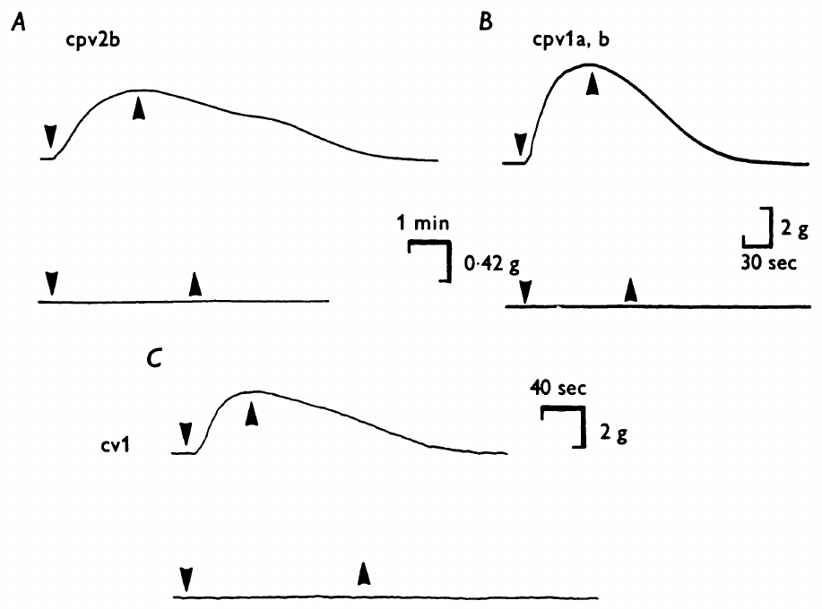
Motor-neuron classes differ in transmitter evidence
Marder screened muscles innervated by identified lobster motor-neuron classes with ACh and L-glutamate. Glutamate supplies another small-molecule transmitter candidate whose action can be followed at the identified foregut muscle targets. PD-innervated dilators and the VD-innervated muscle contracted in ACh, whereas the LP/PY region and inferior cardiac muscle responded to glutamate. The responses assigned different chemical sensitivities to motor targets within the same foregut system, following the muscle groups supplied by identified neurons.
An unresponsive bath application was checked against nerve-evoked contraction. In the LP/PY preparation, stimulation at 10 pulses/s for 2 s confirmed that the muscles were still viable. Choline acetyltransferase assays provided separate evidence for ACh synthesis in identified neuronal cell bodies. The enzyme measurements supplied a cellular source of evidence alongside the responses recorded from the peripheral targets of those motor neurons.
The evidence classified VD, LPG, GM, MG, LG, and DG as putatively cholinergic, while LP, PY, IC, and AM were glutamate candidates. These assignments distinguish the chemical signals supplied by different identified pathways. Central receptor properties then determine their effect on other STG neurons, including glutamatergic inhibition susceptible to picrotoxin and the cholinergic PD influence that persists when that inhibition is blocked.
Garcia et al. (2015), Fig. 3(A). Crab foregut anatomy
Marder (1976), Fig. 8(A–C). Dilator muscles contract in acetylcholine rather than glutamate
Marder (1976); Garcia et al. (2015)
17
Notes:
• Marder screened muscles innervated by identified lobster motor-neuron classes with ACh and L-glutamate. Glutamate is another small-molecule transmitter. PD-innervated dilators and the VD-innervated muscle contracted in ACh, whereas the LP/PY region and inferior cardiac muscle responded to glutamate.
– Choline acetyltransferase is the enzyme that synthesizes acetylcholine, so its presence supplies biochemical evidence distinct from a muscle’s drug response.
• An unresponsive bath application was checked against nerve-evoked contraction. In the LP/PY preparation, stimulation at 10 pulses/s for 2 s confirmed that the muscles were still viable. Choline acetyltransferase assays provided separate evidence for ACh synthesis in identified neuronal cell bodies.
– The inferior cardiac neuron is abbreviated IC; the name refers to a foregut motor neuron, rather than a neuron controlling the heart.
• The combined evidence assigned ACh or glutamate as transmitter candidates for different motor classes. The strongest detailed physiological identification concerned PD; several other assignments remained putative. A candidate inferred from muscle sensitivity and synthesis should be distinguished from complete proof of its release and action at every central synapse.
– A peripheral muscle can be excited by a transmitter that mediates inhibition at another target, because postsynaptic receptor and ionic mechanisms differ.
References:
Marder E. (1976). Cholinergic motor neurones in the stomatogastric system of the lobster. The Journal of Physiology 257: 63-86. https://doi.org/10.1113/jphysiol.1976.sp011356
Garcia VJ, Daur N, Temporal S, Schulz DJ, Bucher D. (2015). Neuropeptide receptor transcript expression levels and magnitude of ionic current responses show cell type-specific differences in a small motor circuit. Journal of Neuroscience 35: 6786-6800. https://doi.org/10.1523/jneurosci.0171-15.2015
Figure: Marder (1976), Fig. 8(A–C). Dilator muscles contract in acetylcholine rather than glutamate
Figure source: https://doi.org/10.1113/jphysiol.1976.sp011356
Figure: Garcia et al. (2015), Fig. 3(A). Crab foregut anatomy
Figure source: https://doi.org/10.1523/jneurosci.0171-15.2015

Slide 22
PD's acetylcholine excites muscle but inhibits LP
A transmitter's effect depends on the receptor it binds and the ions that receptor passes. At the dorsal dilator, ACh opens channels whose reversal near −18 mV lies well above the muscle's resting voltage, so positive ions flow in, the fiber depolarizes and contraction follows. The receptor's cation permeability allows the muscle membrane to approach a voltage that favors recruitment of contraction.
PD releases the same ACh onto LP, yet there it inhibits. Its synapse onto LP reverses near −86 mV and shifts when external potassium rises, the signature of a potassium-selective pathway, so opening it allows potassium to leave LP and moves the membrane away from threshold. The potassium-dependent postsynaptic pathway supplies a different response to the same released molecule because the target expresses a different receptor mechanism.
Pharmacological sensitivity follows the postsynaptic receptor pathway, allowing selected chemical inputs to be removed from LP while other inputs remain active. Picrotoxin suppresses glutamatergic inhibition from AB and PY but leaves PD's cholinergic influence available. The same transmitter can therefore excite a peripheral muscle and inhibit a central neuron, with the receptor's ionic mechanism determining the direction and strength of the target response.
Garcia et al. (2015), Fig. 3(A). Crab foregut anatomy
Marder (1976), Fig. 7. Nerve-evoked and ACh responses reverse at similar voltages
Marder (1976); Eisen & Marder (1982); Martinez et al. (2019)
17a
Notes:
• Slides 15 to 17 identify ACh as PD's transmitter at muscle, and slide 13 describes PD's inhibition of LP; putting them together separates transmitter identity from postsynaptic action.
• Excitation at the muscle.
– Marder found that iontophoretic ACh and the nerve-evoked junctional potentials in the dorsal dilator share the same apparent reversal potential.
– A reversal well above rest means the receptor channel admits cations, which depolarizes the fiber.
• Inhibition in the ganglion.
– Tang and colleagues refer to the PD component of LP's synaptic current as cholinergic, with a reversal potential below that of the glutamatergic inputs from AB and PY.
– The potassium sensitivity on slide 13 identifies the ion carrying that inhibitory current.
• Consequences for pharmacology.
– Martinez and colleagues blocked AB and PY inputs to LP with picrotoxin, and slide 23 notes that the PD synapse remained.
– Choosing a blocker by receptor class, not by the name of the transmitter, is what allows one input to be kept while the others are removed.
References:
Marder E. (1976). Cholinergic motor neurones in the stomatogastric system of the lobster. The Journal of Physiology 257: 63-86. https://doi.org/10.1113/jphysiol.1976.sp011356
Eisen JS, Marder E. (1982). Mechanisms underlying pattern generation in lobster stomatogastric ganglion as determined by selective inactivation of identified neurons. III. Synaptic connections of electrically coupled pyloric neurons. Journal of Neurophysiology 48: 1392-1415. https://doi.org/10.1152/jn.1982.48.6.1392
Tang LS, Goeritz ML, Caplan JS, Taylor AL, Fisek M, Marder E. (2010). Precise temperature compensation of phase in a rhythmic motor pattern. PLoS Biology 8: e1000469. https://doi.org/10.1371/journal.pbio.1000469
Martinez D, Anwar H, Bose A, Bucher DM, Nadim F. (2019). Short-term synaptic dynamics control the activity phase of neurons in an oscillatory network. eLife 8: e46911. https://doi.org/10.7554/elife.46911

Slide 23
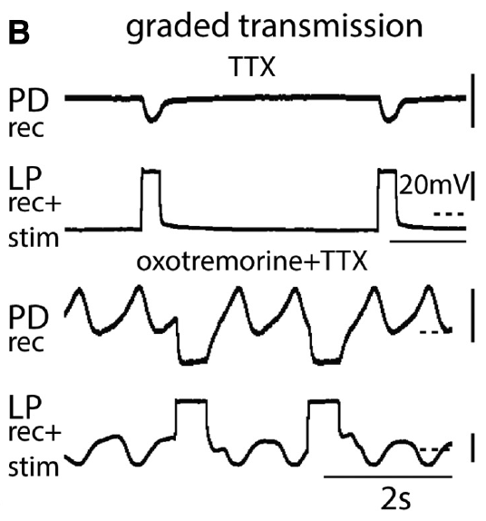
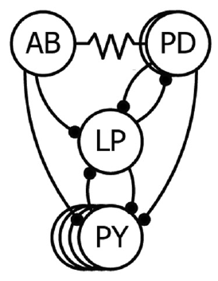
Slow presynaptic depolarization can release transmitter
In crab pyloric neurons, chemical transmission has both spike-mediated and graded components. Graded transmission varies with the presynaptic membrane potential and does not require a full action potential. Rosenbaum and Marder tested it while tetrodotoxin, or TTX, blocked the voltage-gated sodium channels needed for spiking. The graded component communicates the size and timing of a slow voltage wave, preserving synaptic influence during intervals with little spike activity.
LP was depolarized from −60 mV to −20 mV for 500 ms while PD was held near −50 mV. PD developed an inhibitory response despite the absence of presynaptic spikes. Holding the postsynaptic voltage constant reduced differences in response amplitude caused merely by changing driving force. The imposed voltages retained a defined presynaptic depolarization and postsynaptic driving force as transmitter-dependent inhibition developed in PD.
The LP-to-PD synapse carries information through both slow graded release and spike-associated release during an ordinary pyloric cycle. A slow presynaptic depolarization can recruit calcium entry and transmitter output while TTX suppresses sodium-dependent action potentials. The target consequently receives a synaptic influence shaped by the whole presynaptic voltage trajectory, including the changing membrane level between the spikes that normally ride on that trajectory.
Rosenbaum & Marder (2018), Fig. 1(C). Pyloric circuit
Rosenbaum & Marder (2018), Fig. 6(B). Presynaptic depolarization evokes graded inhibition without spikes
Rosenbaum & Marder (2018)
18
Notes:
• In crab pyloric neurons, chemical transmission has both spike-mediated and graded components. Graded transmission varies with the presynaptic membrane potential and does not require a full action potential. Rosenbaum and Marder tested it while tetrodotoxin, or TTX, blocked the voltage-gated sodium channels needed for spiking.
– Voltage-gated channels change their probability of opening when the membrane voltage changes; TTX selectively blocks a major sodium-dependent spike mechanism.
• LP was depolarized from −60 mV to −20 mV for 500 ms while PD was held near −50 mV. PD developed an inhibitory response despite the absence of presynaptic spikes. Holding the postsynaptic voltage constant reduced differences in response amplitude caused merely by changing driving force.
– The presynaptic voltage step and the postsynaptic voltage control separate transmitter-release conditions from the voltage at which the response is measured.
• The LP-to-PD pathway can therefore transmit a slow voltage signal through transmitter release. A motor circuit’s synaptic communication cannot be inferred exclusively from spike counts. This result concerns central synaptic potentials; it does not imply that a spike-free isolated circuit produces normal muscle contractions.
– An inhibitory graded response provides feedback to the pacemaker even when spikes have been experimentally removed.
References:
Rosenbaum P, Marder E. (2018). Graded Transmission without Action Potentials Sustains Rhythmic Activity in Some But Not All Modulators That Activate the Same Current. Journal of Neuroscience 38: 8976-8988. https://doi.org/10.1523/jneurosci.2632-17.2018
Figure: Rosenbaum & Marder (2018), Fig. 6(B). Presynaptic depolarization evokes graded inhibition without spikes
Figure source: https://doi.org/10.1523/jneurosci.2632-17.2018
Figure: Rosenbaum & Marder (2018), Fig. 1(C). Pyloric circuit
Figure source: https://doi.org/10.1523/jneurosci.2632-17.2018

Slide 24
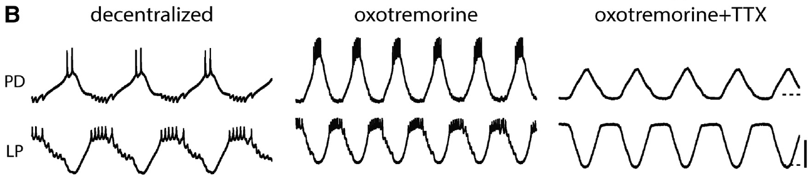
Muscarinic activation can sustain a spike-free rhythm
Rosenbaum and Marder first blocked descending input to the crab STG, then applied a modulator and finally added TTX. Oxotremorine is an agonist that activates muscarinic acetylcholine receptors. These receptors alter cellular state rather than supplying the brief muscle-junction response tested in the lobster experiments. Muscarinic receptor activation changed the operating state of the decentralized circuit, allowing its response to spike blockade to be followed under a defined modulator.
Oxotremorine at 10 μM increased the pyloric activity of the decentralized preparation. Addition of 0.1 μM TTX removed action potentials while PD and LP retained alternating slow membrane oscillations. Intracellular voltage records were essential because extracellular motor nerves no longer contained the usual spikes. The alternating voltage waves remained visible through intracellular electrodes even after nerve recordings lost the action potentials normally used to identify motor bursts.
Under oxotremorine and TTX, slow membrane oscillations and graded chemical interactions retained a coordinated rhythm within the central circuit. The relative phases of the neurons remained organized, and their intracellular waveforms resembled those of the intact pattern. The state established by muscarinic activation therefore supported recurring pacemaker and follower voltage dynamics through mechanisms that continued after sodium-dependent spikes were removed.
Rosenbaum & Marder (2018), Fig. 2(B). Oxotremorine sustains slow oscillations after spike blockade
Rosenbaum & Marder (2018), Fig. 1(C). Pyloric circuit
Rosenbaum & Marder (2018)
19
Notes:
• Rosenbaum and Marder first blocked descending input to the crab STG, then applied a modulator and finally added TTX. Oxotremorine is an agonist that activates muscarinic acetylcholine receptors. These receptors alter cellular state rather than supplying the brief muscle-junction response tested in the lobster experiments.
– An agonist is a substance that activates a receptor; muscarinic receptors are a class of acetylcholine receptor associated with slower modulation.
• Oxotremorine at 10 μM increased the pyloric activity of the decentralized preparation. Addition of 0.1 μM TTX removed action potentials while PD and LP retained alternating slow membrane oscillations. Intracellular voltage records were essential because extracellular motor nerves no longer contained the usual spikes.
– Decentralization removes descending modulatory input, making the bath-applied compound the controlled source of the tested modulatory drive.
• Slow voltage dynamics and graded inhibition can sustain central rhythmicity in this modulatory state. Persistence after sodium-channel blockade does not mean that spikes never contribute to the intact rhythm. Nor does it establish normal behavioral output, which requires commands to reach the muscles.
– The before-modulator, after-modulator and after-TTX sequence distinguishes restoration of a rhythm from its dependence on spiking.
References:
Rosenbaum P, Marder E. (2018). Graded Transmission without Action Potentials Sustains Rhythmic Activity in Some But Not All Modulators That Activate the Same Current. Journal of Neuroscience 38: 8976-8988. https://doi.org/10.1523/jneurosci.2632-17.2018
Figure: Rosenbaum & Marder (2018), Fig. 2(B). Oxotremorine sustains slow oscillations after spike blockade
Figure source: https://doi.org/10.1523/jneurosci.2632-17.2018
Figure: Rosenbaum & Marder (2018), Fig. 1(C). Pyloric circuit
Figure source: https://doi.org/10.1523/jneurosci.2632-17.2018

Slide 25
Graded release carries slow-wave timing without spikes
Transmitter release is triggered by calcium entering the presynaptic terminal through voltage-gated calcium channels. In graded transmission, a slow depolarization opens some of these channels without any spike, so release rises and falls continuously with presynaptic voltage. The amount released follows the activation of those channels as the presynaptic membrane moves through its depolarized and hyperpolarized portions.
TTX blocks voltage-gated sodium channels but spares calcium channels. It therefore removes spikes and spike-triggered release while leaving the slow-wave route intact, and a rhythm that survives TTX must be generated and coordinated by slow membrane oscillations and the graded synapses they drive. The retained calcium-dependent pathway allows a slowly varying presynaptic voltage to continue influencing the postsynaptic cell throughout the oscillation.
In the intact circuit, graded transmission preserves the timing of the entire slow wave, including portions in which a neuron fires few spikes. The postsynaptic conductance changes with the presynaptic voltage trajectory, carrying its duration and peak timing into the follower's response. Spike-mediated release adds to that communication, while the graded component supplies a continuing relationship between slow membrane dynamics in connected neurons.
Rosenbaum & Marder (2018), Fig. 1(C). Pyloric circuit
Rosenbaum & Marder (2018), Fig. 6(B). Presynaptic depolarization evokes graded inhibition without spikes
Rosenbaum & Marder (2018); Martinez et al. (2019)
19a
Notes:
• Slides 18 and 19 show inhibition and rhythm surviving TTX; the reason lies in how release depends on presynaptic voltage.
• Calcium links voltage to release.
– Depolarization opens voltage-gated calcium channels in the terminal, and the calcium that enters drives vesicle fusion.
– A spike opens many of these channels briefly, while a slow wave opens fewer for longer, so both routes lead to release.
• What TTX removes and what it leaves.
– Rosenbaum and Marder describe STG neurons releasing transmitter both as a graded function of presynaptic voltage that persists in TTX and in response to action potentials.
– Blocking sodium channels isolates the first route, which is why the slow alternation on slide 19 tests graded transmission directly.
• Timing travels in the waveform.
– Martinez and colleagues point out that postsynaptic responses depend on the trajectory of synaptic conductance, which presynaptic voltage trajectories shape.
– Slide 26 shows how sensitive LP is to the shape of that conductance, so the slow wave is a timing signal in its own right.
References:
Rosenbaum P, Marder E. (2018). Graded Transmission without Action Potentials Sustains Rhythmic Activity in Some But Not All Modulators That Activate the Same Current. Journal of Neuroscience 38: 8976-8988. https://doi.org/10.1523/jneurosci.2632-17.2018
Martinez D, Anwar H, Bose A, Bucher DM, Nadim F. (2019). Short-term synaptic dynamics control the activity phase of neurons in an oscillatory network. eLife 8: e46911. https://doi.org/10.7554/elife.46911

Slide 26
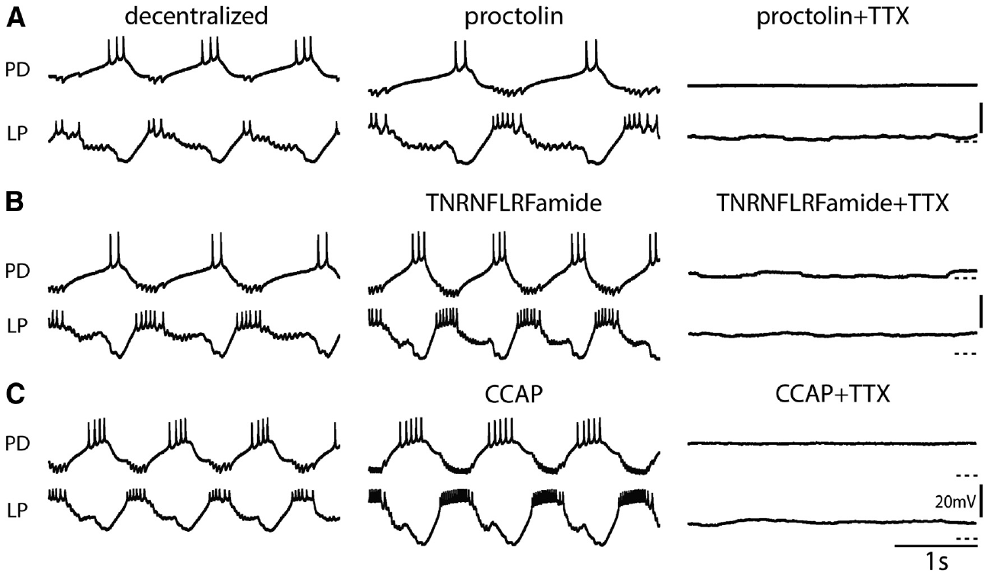
Similar activating peptides differ in spike dependence
Neuropeptides are short chains of amino acids released as chemical signals that can alter neuronal activity. Rosenbaum and Marder compared several peptides that activate the same modulator-activated inward current, I_MI, a voltage-dependent current carried by nonspecific cation channels, in different subsets of crab pyloric neurons. The inward influence favors depolarization, but its effect on a rhythm also depends on the neurons receiving it and their other active properties.
Proctolin, TNRNFLRFamide and crustacean cardioactive peptide, or CCAP, each at 1 μM, activated robust pyloric rhythms after decentralization. Adding TTX stopped the rhythms in the published examples. By contrast, oxotremorine and the tachykinin-related peptide CabTRP1a supported slow oscillations without spikes. These treatments preserved a common inward-current target while recruiting different forms of ongoing rhythmic activity in the remaining network.
Red pigment concentrating hormone, oxotremorine, and CabTRP1a supported spike-independent rhythmic states in the tested preparations, whereas proctolin, TNRNFLRFamide, and CCAP required spikes for the observed rhythms. Modulators therefore converge on I_MI while altering different combinations of cellular and synaptic processes. The expressed motor pattern depends on that complete state, including which neurons are recruited and how slow voltage waves and action potentials interact.
Rosenbaum & Marder (2018), Fig. 3(A–C). Proctolin, FLRFamide and CCAP rhythms stop in TTX
Rosenbaum & Marder (2018), Fig. 1(C). Pyloric circuit
Rosenbaum & Marder (2018)
20
Notes:
• Neuropeptides are short chains of amino acids released as chemical signals that can alter neuronal activity. Rosenbaum and Marder compared several peptides that activate the same modulator-activated inward current, IMI, a voltage-dependent current carried by nonspecific cation channels, in different subsets of crab pyloric neurons.
– An inward current carries net positive charge into the cell and can promote depolarization. Extracellular calcium blocks I_MI at strongly negative membrane voltages; relief of that block during depolarization can amplify slow voltage waves.
• Proctolin, TNRNFLRFamide and crustacean cardioactive peptide, or CCAP, each at 1 μM, activated robust pyloric rhythms after decentralization. Adding TTX stopped the rhythms in the published examples. By contrast, oxotremorine and the tachykinin-related peptide CabTRP1a supported slow oscillations without spikes.
– CabTRP1a means Cancer borealis tachykinin-related peptide Ia; its name identifies the peptide rather than a distinct neuron.
• Activation of a common inward current is not sufficient to predict whether a network can oscillate after spike blockade. Target-cell distributions, synaptic actions and other currents can differ among modulators. The experiment establishes state-dependent reliance on spikes, rather than one universal mechanism for all peptide-activated rhythms.
– Each compound was tested as a controlled bath application, so the comparison does not imply equal natural release patterns in the animal.
References:
Rosenbaum P, Marder E. (2018). Graded Transmission without Action Potentials Sustains Rhythmic Activity in Some But Not All Modulators That Activate the Same Current. Journal of Neuroscience 38: 8976-8988. https://doi.org/10.1523/jneurosci.2632-17.2018
Figure: Rosenbaum & Marder (2018), Fig. 3(A–C). Proctolin, FLRFamide and CCAP rhythms stop in TTX
Figure source: https://doi.org/10.1523/jneurosci.2632-17.2018
Figure: Rosenbaum & Marder (2018), Fig. 1(C). Pyloric circuit
Figure source: https://doi.org/10.1523/jneurosci.2632-17.2018

Slide 27
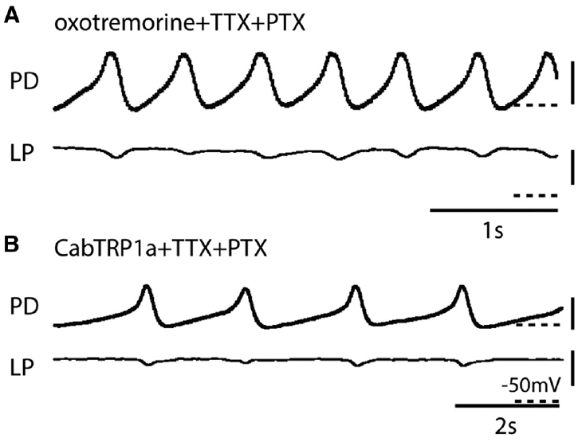
The pacemaker can oscillate without follower feedback
The AB–PD ensemble can be examined after feedback from glutamatergic follower neurons is blocked. Picrotoxin (PTX) blocks the relevant glutamatergic inhibitory synapses in this preparation. Rosenbaum and Marder combined PTX with TTX to separate pacemaker oscillation from spikes and major follower feedback. The drug combination removed two sources of interaction while intracellular electrodes continued to follow the voltage dynamics of the coupled pacemaker cells.
In oxotremorine or CabTRP1a, PD retained slow oscillations after both drugs were added. LP activity was greatly reduced, yet the remaining pacemaker wave continued. The intracellular records used 20 mV voltage calibration and 1–2 s time calibration. The surviving PD oscillation tracked the activity available within the AB–PD group after the major glutamatergic follower feedback was suppressed.
The electrically coupled AB–PD kernel retained rhythm-generating capacity in the oxotremorine and CabTRP1a states, with its speed depending on the modulator. Frequency remained stable in the oxotremorine condition after TTX, while it shifted in CabTRP1a. The pacemaker could therefore sustain a spike-free slow wave, but the properties of that wave still reflected the particular modulatory processes active in its cells.
Rosenbaum & Marder (2018), Fig. 1(C). Pyloric circuit
Rosenbaum & Marder (2018), Fig. 8(A–B). Isolated AB–PD oscillations persist in TTX with selected modulators
Rosenbaum & Marder (2018)
21
Notes:
• The AB–PD ensemble can be examined after feedback from glutamatergic follower neurons is blocked. Picrotoxin (PTX) blocks the relevant glutamatergic inhibitory synapses in this preparation. Rosenbaum and Marder combined PTX with TTX to separate pacemaker oscillation from spikes and major follower feedback.
– AB and PD remain electrically connected when follower chemical synapses are blocked, so the retained oscillator is an ensemble.
• In oxotremorine or CabTRP1a, PD retained slow oscillations after both drugs were added. LP activity was greatly reduced, yet the remaining pacemaker wave continued. The intracellular records used 20 mV voltage calibration and 1–2 s time calibration.
– TTX prevents the usual sodium-dependent spikes, while PTX removes a different component: the inhibitory feedback carried by glutamatergic synapses.
• The result localizes a rhythm-generating capability to the electrically coupled AB–PD group under these modulatory conditions. PTX is a pharmacological isolation procedure, not physical removal of every neuron. Persistence of the pacemaker does not specify which coupled member or which individual channel is sufficient on its own.
– The combination tests the dependence of the central voltage rhythm on two mechanisms without measuring the behavior of the whole crab.
References:
Rosenbaum P, Marder E. (2018). Graded Transmission without Action Potentials Sustains Rhythmic Activity in Some But Not All Modulators That Activate the Same Current. Journal of Neuroscience 38: 8976-8988. https://doi.org/10.1523/jneurosci.2632-17.2018
Figure: Rosenbaum & Marder (2018), Fig. 8(A–B). Isolated AB–PD oscillations persist in TTX with selected modulators
Figure source: https://doi.org/10.1523/jneurosci.2632-17.2018
Figure: Rosenbaum & Marder (2018), Fig. 1(C). Pyloric circuit
Figure source: https://doi.org/10.1523/jneurosci.2632-17.2018

Slide 28
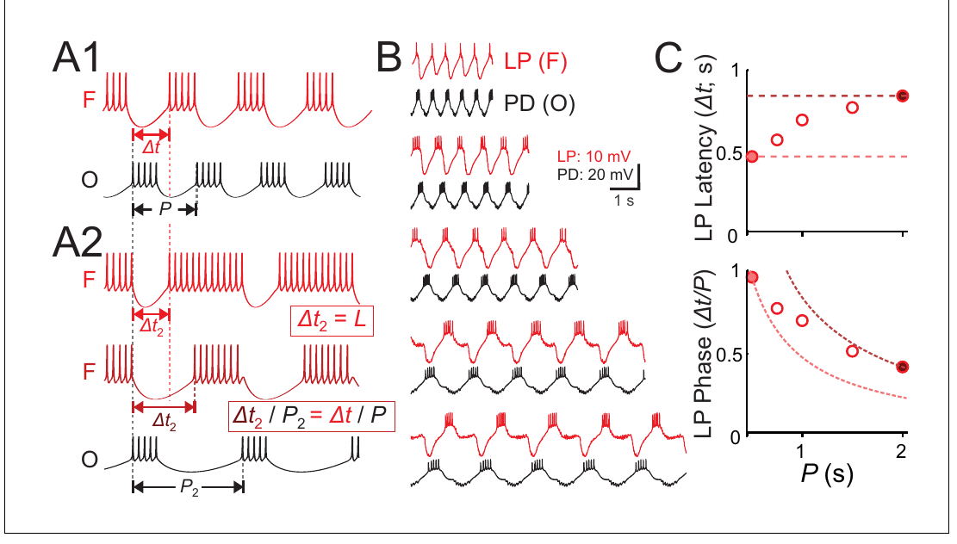
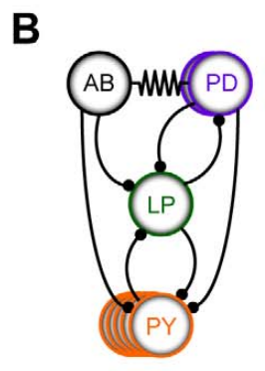
LP latency and phase change differently with period
Cycle period is the interval between successive starts of a rhythm. Latency is the time from a reference event to a response, whereas phase expresses that delay as a fraction of the cycle. A fixed latency therefore does not automatically preserve phase when the cycle changes. For a given absolute delay, increasing the cycle's duration places the response earlier when that same delay is expressed as a fraction of the cycle.
Martinez and colleagues voltage-clamped a crab PD neuron with a recorded waveform repeated at different periods. Voltage clamp holds a membrane to a commanded voltage by injecting the required current. LP followed the imposed rhythm, but its onset latency and normalized onset phase changed differently. The imposed waveform controlled the pacemaker's speed while the follower's membrane currents and remaining synaptic responses determined when LP reached threshold.
LP onset lay between the behavior expected from constant latency and constant phase when the pacemaker period alone was altered. Its delay and its normalized position in the cycle therefore depended differently on the imposed speed. Maintaining phase over a wider range requires the inhibitory waveform to change with period, allowing synaptic duration, strength, and peak timing to adjust the follower's return from inhibition.
Martinez et al. (2019), Fig. 1(A–C). Published timing alternatives and recorded PD–LP latency and phase
Tang et al. (2010), Fig. 2(B). Crab pyloric circuit
Martinez et al. (2019); Tang et al. (2010)
22
Notes:
• Cycle period is the interval between successive starts of a rhythm. Latency is the time from a reference event to a response, whereas phase expresses that delay as a fraction of the cycle. A fixed latency therefore does not automatically preserve phase when the cycle changes.
– The published conceptual alternatives distinguish constant delay from constant relative timing; the physiological records and measurements test where LP falls between those alternatives.
• Martinez and colleagues voltage-clamped a crab PD neuron with a recorded waveform repeated at different periods. Voltage clamp holds a membrane to a commanded voltage by injecting the required current. LP followed the imposed rhythm, but its onset latency and normalized onset phase changed differently.
– The voltage command used a waveform recorded from PD, so the experiment preserved a realistic presynaptic voltage shape while changing its repetition rate.
• The measured LP phase declined as period increased, rather than remaining perfectly constant. Imposed pacemaker waveforms separated the timing of inhibition from the free-running network’s normal adjustments. This preparation tests mechanisms of phase control, not a claim that natural pyloric phase is always invariant.
– The period range in the plotted experiment spans fractions of a second to around two seconds, with latency measured in seconds and phase expressed without units.
References:
Martinez D, Anwar H, Bose A, Bucher DM, Nadim F. (2019). Short-term synaptic dynamics control the activity phase of neurons in an oscillatory network. eLife 8: e46911. https://doi.org/10.7554/elife.46911
Tang LS, Goeritz ML, Caplan JS, Taylor AL, Fisek M, Marder E. (2010). Precise temperature compensation of phase in a rhythmic motor pattern. PLoS Biology 8: e1000469. https://doi.org/10.1371/journal.pbio.1000469
Figure: Martinez et al. (2019), Fig. 1(A–C). Published timing alternatives and recorded PD–LP latency and phase
Figure source: https://doi.org/10.7554/elife.46911
Figure: Tang et al. (2010), Fig. 2(B). Crab pyloric circuit
Figure source: https://doi.org/10.1371/journal.pbio.1000469

Slide 29
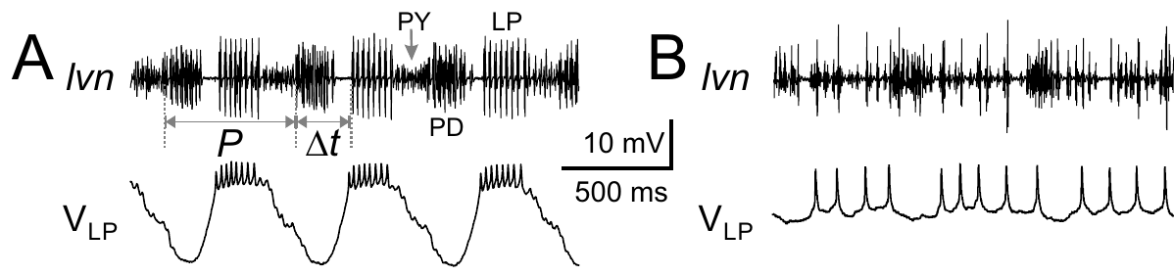
Glutamatergic input is required for normal LP bursts
Martinez and colleagues recorded LP intracellularly while monitoring the crab lateral ventricular nerve. LP normally received alternating inhibition from the pacemaker and other pyloric neurons. Its recurring bursts depended on those inputs interacting with its own membrane properties. The cell's return from alternating inhibitory inputs normally organizes its firing within the interval separating successive pacemaker bursts.
Bath application of 10 μM picrotoxin blocked glutamatergic inhibition from AB and PY. LP’s organized slow bursting disappeared while activity from other pyloric neurons remained visible on the nerve. The published comparison used a 500 ms time calibration and a 10 mV intracellular voltage calibration. The remaining nerve activity retained the contributions of other neurons while LP lost the recurring voltage pattern associated with its usual follower phase.
In this condition, LP's burst timing depended on its inputs, including the preceding inhibitory waveform and its interaction with the neuron's own membrane currents. When noise current was supplied after glutamatergic inhibition was blocked, the cell produced irregular bursts whose timing followed the preceding input. Rhythmic LP output in the connected network consequently arises through repeated synaptic organization of the follower's response.
Martinez et al. (2019), Fig. 2(A–B). Blocking glutamatergic input disrupts LP bursting
Tang et al. (2010), Fig. 2(B). Crab pyloric circuit
Martinez et al. (2019); Tang et al. (2010)
23
Notes:
• Martinez and colleagues recorded LP intracellularly while monitoring the crab lateral ventricular nerve. LP normally received alternating inhibition from the pacemaker and other pyloric neurons. Its recurring bursts depended on those inputs interacting with its own membrane properties.
– A follower neuron can generate spikes and rebound responses without generating a self-sustaining rhythm when its coordinating inhibition is removed.
• Bath application of 10 μM picrotoxin blocked glutamatergic inhibition from AB and PY. LP’s organized slow bursting disappeared while activity from other pyloric neurons remained visible on the nerve. The published comparison used a 500 ms time calibration and a 10 mV intracellular voltage calibration.
– Picrotoxin blocks the relevant glutamatergic inhibitory pathways here; it should not be treated as a universal blocker of every chemical synapse.
• Loss of LP rhythmicity after removal of particular inputs distinguishes a follower neuron from an autonomous oscillator in this condition. The remaining cholinergic PD synapse means that pharmacological isolation was incomplete. The experiment assigns a requirement to the blocked pathways, rather than proving that all synaptic inputs are interchangeable.
– The surviving nerve units help distinguish selective disruption of LP’s timing from a preparation-wide failure of neuronal activity.
References:
Martinez D, Anwar H, Bose A, Bucher DM, Nadim F. (2019). Short-term synaptic dynamics control the activity phase of neurons in an oscillatory network. eLife 8: e46911. https://doi.org/10.7554/elife.46911
Tang LS, Goeritz ML, Caplan JS, Taylor AL, Fisek M, Marder E. (2010). Precise temperature compensation of phase in a rhythmic motor pattern. PLoS Biology 8: e1000469. https://doi.org/10.1371/journal.pbio.1000469
Figure: Martinez et al. (2019), Fig. 2(A–B). Blocking glutamatergic input disrupts LP bursting
Figure source: https://doi.org/10.7554/elife.46911
Figure: Tang et al. (2010), Fig. 2(B). Crab pyloric circuit
Figure source: https://doi.org/10.1371/journal.pbio.1000469

Slide 30
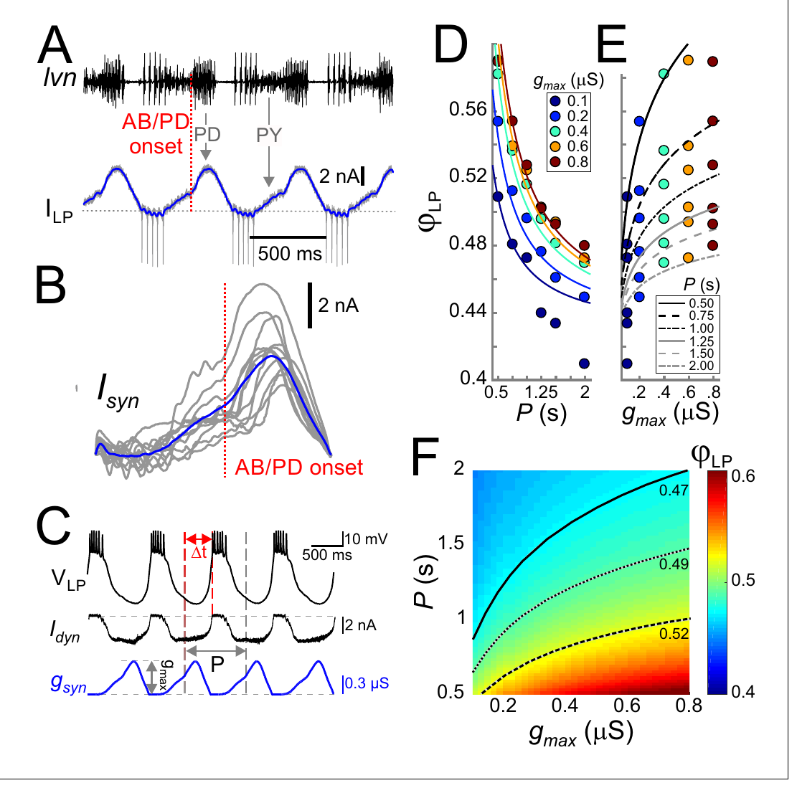
Dynamic clamp tests the timing effect of inhibition
Dynamic clamp injects an electrical current calculated from the recorded membrane voltage and a specified conductance. Martinez and colleagues used it to replace blocked input to a living LP neuron. The neuron’s own channels remained active while the experimenter controlled the inhibitory waveform. The calculated current changes with LP's measured voltage, retaining the voltage dependence expected when a synaptic conductance acts on a living neuron.
The physiological synaptic waveform was measured in voltage-clamped LP and aligned to pacemaker burst onset. Replaying a conductance based on that waveform recruited LP bursts. Increasing imposed conductance delayed LP onset, whereas lengthening the repetition period tended to move onset to an earlier fraction of the cycle. These changes altered the follower's recovery from inhibition while preserving its own active membrane response to the imposed input.
Synaptic strength and cycle period have opposing influences on LP onset, allowing changes in inhibition to adjust a follower's position as rhythm speed changes. Stronger conductance produced deeper hyperpolarization but a comparatively modest delay of the first spike. The result locates one contribution to phase regulation in the interaction between imposed inhibition and the rebound processes through which LP returns toward firing threshold.
Tang et al. (2010), Fig. 2(B). Crab pyloric circuit
Martinez et al. (2019), Fig. 3(A–F). Measured input, conductance replay and LP phase responses
Martinez et al. (2019); Tang et al. (2010)
24
Notes:
• Dynamic clamp injects an electrical current calculated from the recorded membrane voltage and a specified conductance. Martinez and colleagues used it to replace blocked input to a living LP neuron. The neuron’s own channels remained active while the experimenter controlled the inhibitory waveform.
– A conductance-based input changes current as the postsynaptic voltage changes, preserving a property that a fixed current pulse does not capture.
• The physiological synaptic waveform was measured in voltage-clamped LP and aligned to pacemaker burst onset. Replaying a conductance based on that waveform recruited LP bursts. Increasing imposed conductance delayed LP onset, whereas lengthening the repetition period tended to move onset to an earlier fraction of the cycle.
– The publication includes measured synaptic currents, replayed responses and phase measurements; these are distinct parts of the causal test.
• Opposing timing effects allow synaptic properties to compensate for changes in rhythm speed. The intervention tests the effect of a specified electrical input on a real neuron. It does not establish that the intact network naturally changes every waveform parameter in exactly the imposed manner.
– The amplitude of the synaptic conductance was measured in microsiemens, and the repetition period was measured in seconds.
References:
Martinez D, Anwar H, Bose A, Bucher DM, Nadim F. (2019). Short-term synaptic dynamics control the activity phase of neurons in an oscillatory network. eLife 8: e46911. https://doi.org/10.7554/elife.46911
Tang LS, Goeritz ML, Caplan JS, Taylor AL, Fisek M, Marder E. (2010). Precise temperature compensation of phase in a rhythmic motor pattern. PLoS Biology 8: e1000469. https://doi.org/10.1371/journal.pbio.1000469
Figure: Martinez et al. (2019), Fig. 3(A–F). Measured input, conductance replay and LP phase responses
Figure source: https://doi.org/10.7554/elife.46911
Figure: Tang et al. (2010), Fig. 2(B). Crab pyloric circuit
Figure source: https://doi.org/10.1371/journal.pbio.1000469

Slide 31
Three clamp methods fix different variables to test causes
Current clamp injects a chosen current and leaves voltage free to change, so the neuron's own channels shape its response. Voltage clamp forces the membrane to a commanded voltage and measures the current required, exposing channel and synaptic currents but preventing the cell from behaving freely. The experimental command determines the variable under direct control, while the remaining membrane behavior supplies the measured response.
Dynamic clamp splits control between experimenter and neuron. The experimenter specifies a conductance waveform, the neuron supplies its moment-to-moment voltage, and the injected current results from both, so a defined synaptic or leak input can be tested against an intact set of membrane currents. This arrangement preserves the neuron's active response to an input whose size, timing, and reversal properties can be changed independently.
In the pyloric experiments, voltage-clamping PD imposed pacemaker timing, while voltage-clamping LP measured synaptic waveforms and peptide-sensitive currents. Dynamic clamp then delivered altered inhibitory waveforms to LP, testing how particular features changed its burst onset. In the gastric circuit, adding or subtracting a leak conductance through dynamic clamp changed LG's ability to express rhythmic activity while its other membrane mechanisms remained present.
Martinez et al. (2019), Fig. 3(A–F). Measured input, conductance replay and LP phase responses
Martinez et al. (2019); Garcia et al. (2015); Städele et al. (2015)
24a
Notes:
• Slides 22, 24, 30, 38 and 41 use three different recording configurations; separating what each holds fixed explains what each experiment can conclude.
• Current clamp and voltage clamp.
– In current clamp the experimenter controls the input and reads the voltage, as in the rebound tests on slide 33.
– In voltage clamp the experimenter controls the voltage and reads the current, which is how the A-type and h currents on slides 38 and 39 were measured.
• Dynamic clamp as a hybrid.
– A conductance, unlike a fixed current, produces less current as the membrane approaches its reversal potential, so the injected signal behaves like a real synapse or leak.
– LP's own currents remain free to generate rebound, which is what makes the replayed inhibition on slide 24 a causal test.
• Matching method to question.
– Martinez and colleagues clamped PD to set the period, then measured LP's synaptic input in voltage clamp before replaying it in dynamic clamp.
– Städele and colleagues used the same hybrid method in LG, where a leak change alone was enough to stop or restore the gastric rhythm.
References:
Martinez D, Anwar H, Bose A, Bucher DM, Nadim F. (2019). Short-term synaptic dynamics control the activity phase of neurons in an oscillatory network. eLife 8: e46911. https://doi.org/10.7554/elife.46911
Garcia VJ, Daur N, Temporal S, Schulz DJ, Bucher D. (2015). Neuropeptide receptor transcript expression levels and magnitude of ionic current responses show cell type-specific differences in a small motor circuit. Journal of Neuroscience 35: 6786-6800. https://doi.org/10.1523/jneurosci.0171-15.2015
Städele C, Heigele S, Stein W. (2015). Neuromodulation to the Rescue: Compensation of Temperature-Induced Breakdown of Rhythmic Motor Patterns via Extrinsic Neuromodulatory Input. PLoS Biology 13: e1002265. https://doi.org/10.1371/journal.pbio.1002265

Slide 32
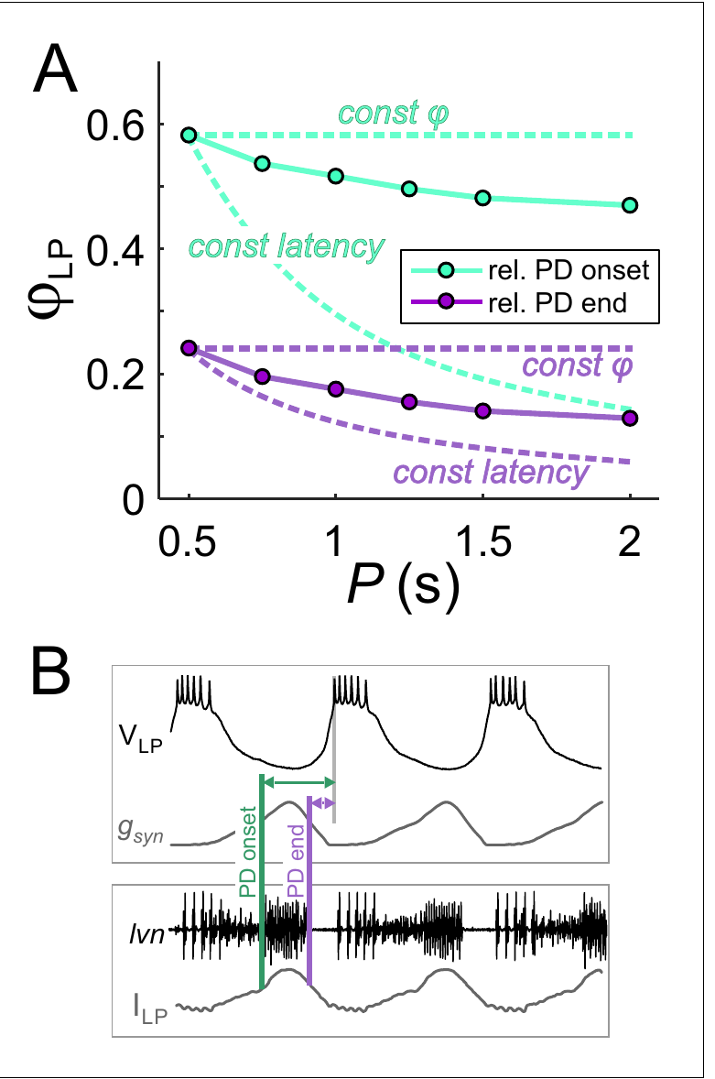
Inhibitory duty cycle contributes to phase control
Duty cycle is the fraction of a complete cycle occupied by an event. The duration of inhibition can remain a similar fraction of the pyloric cycle even as the absolute period changes. That relationship alters when an LP neuron is released from inhibition. Releasing the follower later in a longer cycle can preserve a similar normalized position even though the absolute inhibitory interval has increased.
Martinez and colleagues compared LP onset phase measured from the start of the imposed pacemaker burst with onset measured from its end. The same bursts produced different phase-versus-period relationships under the two reference definitions. Their dynamic-clamp experiments also varied inhibitory duration independently of other waveform features. Changing the reference event locates the response relative either to the beginning of inhibition or to the point when the cell is released from it.
When inhibition occupied 0.3 of each cycle, LP firing began after that inhibitory portion, tying its earliest available onset to a fraction of the current period. Maintaining inhibitory duration proportional to period promoted phase preservation more effectively than a fixed duration in milliseconds. The follower's stable motor phase can therefore emerge from coordinated input timing combined with its membrane response after release.
Tang et al. (2010), Fig. 2(B). Crab pyloric circuit
Martinez et al. (2019), Fig. 4(A–B). LP phase depends on the timing reference and inhibitory duty cycle
Martinez et al. (2019); Tang et al. (2010)
25
Notes:
• Duty cycle is the fraction of a complete cycle occupied by an event. The duration of inhibition can remain a similar fraction of the pyloric cycle even as the absolute period changes. That relationship alters when an LP neuron is released from inhibition.
– The reference event must be stated whenever a phase is reported, because onset-relative and offset-relative phases describe different delays.
• Martinez and colleagues compared LP onset phase measured from the start of the imposed pacemaker burst with onset measured from its end. The same bursts produced different phase-versus-period relationships under the two reference definitions. Their dynamic-clamp experiments also varied inhibitory duration independently of other waveform features.
– The authors compared a fixed-duration condition of 300 ms with a fixed-duty-cycle condition occupying 0.3 of each cycle in their systematic waveform experiments.
• Maintaining inhibitory duration proportional to period promoted phase maintenance more effectively than keeping duration fixed in milliseconds. The result concerns the timing of a controlled synaptic input. A stable motor phase can therefore emerge from coordinated input timing without requiring each neuron to retain a fixed absolute rebound latency.
– Coordinating synaptic duration with period changes the time available for recovery from inhibition and for subsequent depolarization.
References:
Martinez D, Anwar H, Bose A, Bucher DM, Nadim F. (2019). Short-term synaptic dynamics control the activity phase of neurons in an oscillatory network. eLife 8: e46911. https://doi.org/10.7554/elife.46911
Tang LS, Goeritz ML, Caplan JS, Taylor AL, Fisek M, Marder E. (2010). Precise temperature compensation of phase in a rhythmic motor pattern. PLoS Biology 8: e1000469. https://doi.org/10.1371/journal.pbio.1000469
Figure: Martinez et al. (2019), Fig. 4(A–B). LP phase depends on the timing reference and inhibitory duty cycle
Figure source: https://doi.org/10.7554/elife.46911
Figure: Tang et al. (2010), Fig. 2(B). Crab pyloric circuit
Figure source: https://doi.org/10.1371/journal.pbio.1000469

Slide 33
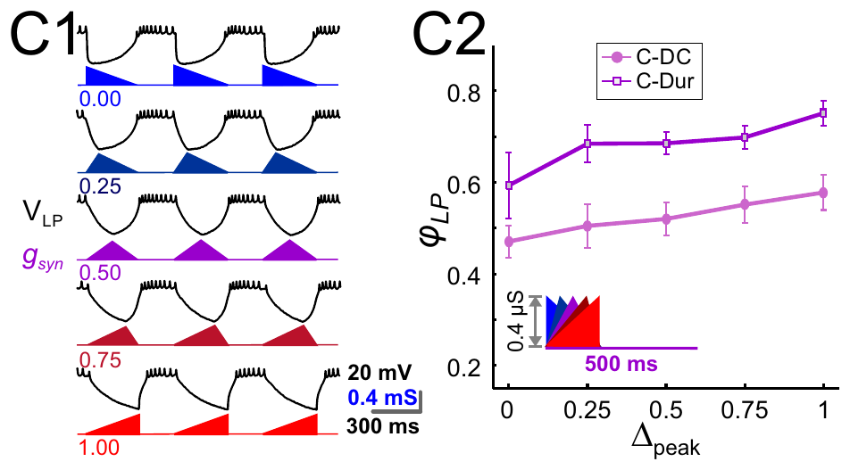
Later inhibitory peaks delay a follower’s activity
Martinez and colleagues varied the position of the peak within an imposed inhibitory conductance while keeping its period and amplitude controlled. A peak phase specifies when the conductance reaches its maximum within the active inhibitory interval. The waveform was delivered by dynamic clamp to a living LP neuron. The maximum conductance can move within an inhibitory episode even when its overall amplitude and repetition rate remain unchanged.
Moving the peak later shifted the onset of LP firing to a later pyloric phase. The published recording examples used a 500 ms period and compared several peak positions. They separated a change in inhibitory timing from a change in the neuron’s identity or its natural synaptic wiring. The delayed peak prolonged effective suppression later in the cycle, shifting the time at which the follower recovered toward threshold.
Changing peak phase and amplitude together delayed LP more than changing either feature alone, extending the range of periods over which onset could stay at a similar phase. Martinez and colleagues related these coordinated waveform changes to short-term synaptic depression. History-dependent changes in the presynaptic input therefore provide a route through which inhibition can scale with rhythm speed and regulate the follower's recovery.
Martinez et al. (2019), Fig. 6(C1–C2). Later inhibitory peaks delay LP activity in dynamic clamp
Tang et al. (2010), Fig. 2(B). Crab pyloric circuit
Martinez et al. (2019); Tang et al. (2010)
26
Notes:
• Martinez and colleagues varied the position of the peak within an imposed inhibitory conductance while keeping its period and amplitude controlled. A peak phase specifies when the conductance reaches its maximum within the active inhibitory interval. The waveform was delivered by dynamic clamp to a living LP neuron.
– Short-term synaptic depression is a transient reduction of a synapse’s efficacy during repeated activation, followed by recovery when activation is reduced.
• Moving the peak later shifted the onset of LP firing to a later pyloric phase. The published recording examples used a 500 ms period and compared several peak positions. They separated a change in inhibitory timing from a change in the neuron’s identity or its natural synaptic wiring.
– The input shapes are experimental conductances specified by the authors, and the voltage responses are recordings from the biological LP neuron.
• Amplitude, duration and peak position can jointly influence release from inhibition. The authors’ mathematical analysis proposes how short-term synaptic depression could coordinate these features as period changes. The imposed-waveform recordings directly establish timing sensitivity; the proposed natural coordination requires a separate mechanistic inference.
– The published inference about depression should be distinguished from an experiment that selectively blocks the molecular mechanism of depression in the intact circuit.
References:
Martinez D, Anwar H, Bose A, Bucher DM, Nadim F. (2019). Short-term synaptic dynamics control the activity phase of neurons in an oscillatory network. eLife 8: e46911. https://doi.org/10.7554/elife.46911
Tang LS, Goeritz ML, Caplan JS, Taylor AL, Fisek M, Marder E. (2010). Precise temperature compensation of phase in a rhythmic motor pattern. PLoS Biology 8: e1000469. https://doi.org/10.1371/journal.pbio.1000469
Figure: Martinez et al. (2019), Fig. 6(C1–C2). Later inhibitory peaks delay LP activity in dynamic clamp
Figure source: https://doi.org/10.7554/elife.46911
Figure: Tang et al. (2010), Fig. 2(B). Crab pyloric circuit
Figure source: https://doi.org/10.1371/journal.pbio.1000469

Slide 34
Phase holds only when inhibition scales with the cycle
LP fires once the pacemaker's inhibition fades and its own rebound brings it to threshold. If inhibition and rebound took fixed times, a longer cycle would leave the delay unchanged and LP's phase would fall; phase stays constant only if the delay grows in proportion to the period. The delay includes the interval of effective inhibition and the subsequent voltage recovery produced by LP's own membrane currents.
Three features of the input supply that growth. Inhibition occupying a constant fraction of the cycle stretches the silent period itself; a stronger synapse in slow rhythms deepens and prolongs suppression; and a later conductance peak keeps LP inhibited longer. Each delays LP more in slow cycles, offsetting the advance that period alone would cause. These waveform properties change the voltage history from which the follower rebounds, coordinating release from inhibition with the length of the ongoing cycle.
Temperature changes recruit another set of adjustments that preserve relative timing while the circuit accelerates. During warming, pacemaker voltage trajectories scale with cycle duration, and the peak of LP's synaptic current remains near a consistent fraction of the input. Phase maintenance therefore depends on the physiological route through which period changes, with synaptic history and temperature sensitivity shaping the relevant waveform in different conditions.
Tang et al. (2010), Fig. 2(B). Crab pyloric circuit
Martinez et al. (2019), Fig. 4(A–B). LP phase depends on the timing reference and inhibitory duty cycle
Martinez et al. (2019); Tang et al. (2010)
26a
Notes:
• Slides 22 to 26 vary period, duration, strength and peak timing one at a time; together they explain what an input must do for LP's phase to stay fixed.
• Why fixed delays fail.
– Phase is the delay divided by the period, so a delay that stays the same in milliseconds becomes a smaller fraction of a longer cycle.
– Slide 22 shows LP falling between the two extremes when only the pacemaker period is changed.
• How the input compensates.
– Martinez and colleagues found that inputs with constant duty cycle preserved phase far better than inputs of constant duration, and that phase increased with both synaptic strength and peak phase.
– Short-term depression makes pyloric inhibition stronger at longer periods, so the circuit has a built-in way to strengthen inhibition as the rhythm slows.
• Temperature uses other rules.
– Martinez and colleagues contrast their constant-temperature results with temperature experiments, in which presynaptic voltage trajectories scaled with period and the synaptic peak phase did not depend on period.
– Slides 36 and 37 show phase constancy across a fourfold change in frequency, achieved through adjustments different from those that operate at one temperature.
References:
Martinez D, Anwar H, Bose A, Bucher DM, Nadim F. (2019). Short-term synaptic dynamics control the activity phase of neurons in an oscillatory network. eLife 8: e46911. https://doi.org/10.7554/elife.46911
Tang LS, Goeritz ML, Caplan JS, Taylor AL, Fisek M, Marder E. (2010). Precise temperature compensation of phase in a rhythmic motor pattern. PLoS Biology 8: e1000469. https://doi.org/10.1371/journal.pbio.1000469

Slide 35
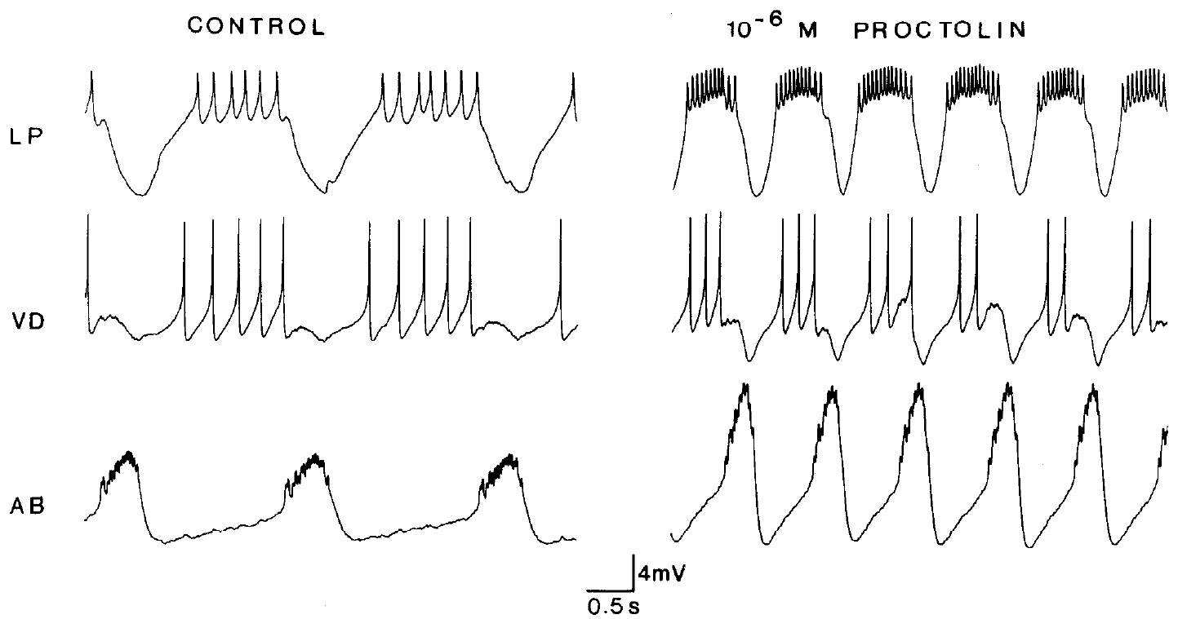
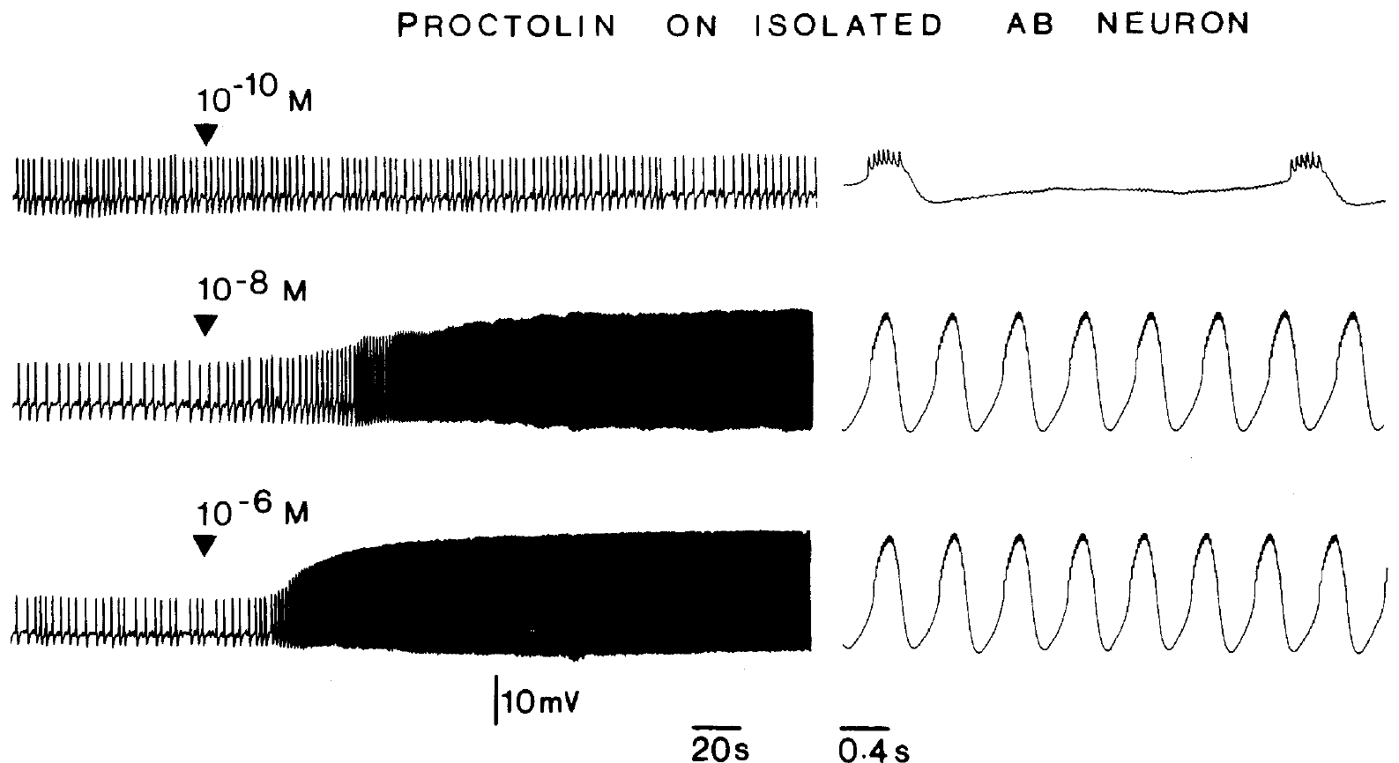
Proctolin changes the lobster pacemaker’s oscillation
Proctolin is a five-amino-acid neuropeptide that modulates the lobster pyloric circuit. Hooper and Marder applied it to the isolated stomatogastric preparation after descending input was blocked. Intracellular recordings separated slow membrane oscillations from the spikes generated during each depolarized phase. Separating descending input from peptide application followed the direct state change produced when proctolin reached the retained local circuit.
At 1 μM proctolin, AB oscillation amplitude increased and follower-neuron activity changed. In isolated AB, progressively higher peptide concentrations recruited stronger activity. Saline wash between applications returned the neuron toward its baseline, providing a control for reversibility and persistent peptide effects. The isolated pacemaker's response related concentration-dependent peptide action to a change in the magnitude and rate of its slow depolarizations.
Direct excitation of AB can accelerate the connected pyloric rhythm because the pacemaker's voltage wave reaches PD through electrical coupling and times inhibition of follower cells. Additional direct proctolin targets contribute their own changes in activity, which propagate through the existing synapses. The network response therefore contains both altered pacemaker timing and redistribution of activity among the cells receiving that timing signal.
Hooper & Marder (1987), Fig. 4. Proctolin changes AB oscillations and the activity of follower cells
Hooper & Marder (1987), Fig. 6. Proctolin excites the isolated AB neuron in a concentration-dependent manner
Hooper & Marder (1987)
27
Notes:
• Proctolin is a five-amino-acid neuropeptide that modulates the lobster pyloric circuit. Hooper and Marder applied it to the isolated stomatogastric preparation after descending input was blocked. Intracellular recordings separated slow membrane oscillations from the spikes generated during each depolarized phase.
– A peptide can alter a circuit without replacing its established synaptic connections or supplying a new rhythmic command on every cycle.
• At 1 μM proctolin, AB oscillation amplitude increased and follower-neuron activity changed. In isolated AB, progressively higher peptide concentrations recruited stronger activity. Saline wash between applications returned the neuron toward its baseline, providing a control for reversibility and persistent peptide effects.
– The isolated AB series included 0.1 nM, 10 nM and 1 μM applications, with at least 45 minutes of saline wash between tests.
• The network response combined direct peptide actions on selected neurons with consequences propagated through their existing connections. Increased activity in a motor neuron did not by itself establish a direct receptor-mediated action on that cell. Isolation was required to distinguish a peptide target from a synaptic follower of another target.
– The concentration-dependent response identifies a physiological action of proctolin; these recordings alone do not identify its receptor’s molecular sequence.
References:
Hooper SL, Marder E. (1987). Modulation of the lobster pyloric rhythm by the peptide proctolin. Journal of Neuroscience 7: 2097-2112. https://doi.org/10.1523/jneurosci.07-07-02097.1987
Figure: Hooper & Marder (1987), Fig. 4. Proctolin changes AB oscillations and the activity of follower cells
Figure source: https://doi.org/10.1523/jneurosci.07-07-02097.1987
Figure: Hooper & Marder (1987), Fig. 6. Proctolin excites the isolated AB neuron in a concentration-dependent manner
Figure source: https://doi.org/10.1523/jneurosci.07-07-02097.1987

Slide 36
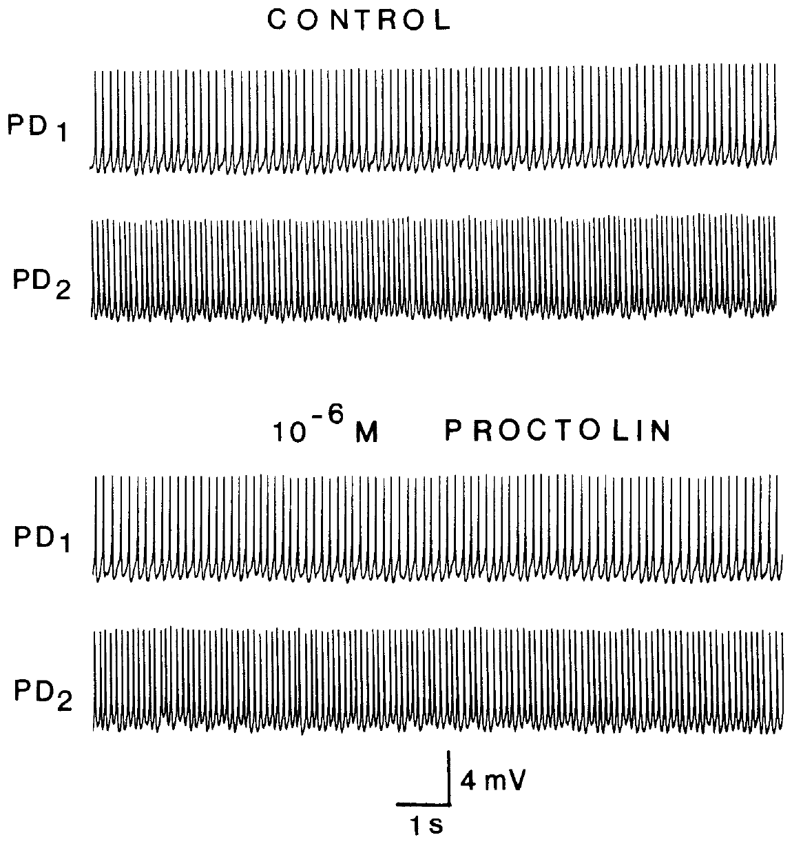
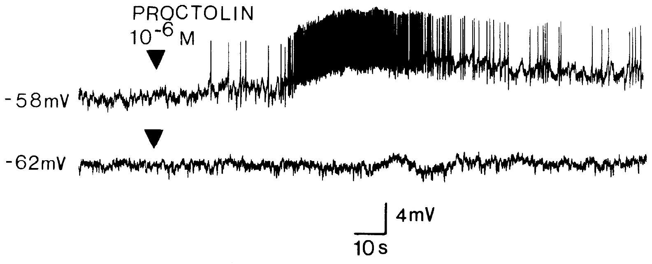
Direct peptide targets differ from affected motor cells
Hooper and Marder isolated lobster PD neurons from their major synaptic inputs, then applied 1 μM proctolin. The PD cells continued tonic firing without the direct peptide response found in isolated AB. In the intact circuit, however, PD activity changed because PD remained electrically coupled to the peptide-responsive AB neuron. Electrical coupling preserved an indirect route by which a peptide-sensitive pacemaker neuron could alter the voltage trajectory and firing of its insensitive partner.
An isolated LP neuron responded differently depending on its membrane voltage. At approximately −58 mV, proctolin caused depolarization and spiking. At approximately −62 mV in the same neuron, that response was absent. Voltage-dependent expression of modulation can therefore obscure a response during a single baseline test. The depolarized state brought LP into a range where the inward modulatory influence could recruit firing, making its response depend on membrane voltage.
Proctolin's direct target sensitivity and the connections between neurons jointly determine the expressed circuit response. In LP, excitation near threshold preferentially strengthens the depolarized part of the cycle, when declining inhibition permits the cell to fire. In PD, the changed activity can arrive through AB's electrical influence, allowing a neuron to participate in the peptide-modified pattern through the response of its coupled partner.
Hooper & Marder (1987), Fig. 7. Isolated PD neurons retain tonic activity in proctolin
Hooper & Marder (1987), Fig. 9. The isolated LP response depends on membrane voltage
Hooper & Marder (1987)
28
Notes:
• Hooper and Marder isolated lobster PD neurons from their major synaptic inputs, then applied 1 μM proctolin. The PD cells continued tonic firing without the direct peptide response found in isolated AB. In the intact circuit, however, PD activity changed because PD remained electrically coupled to the peptide-responsive AB neuron.
– Electrical coupling provides a route by which an AB change affects PD even when isolated PD is insensitive to the tested proctolin application.
• An isolated LP neuron responded differently depending on its membrane voltage. At approximately −58 mV, proctolin caused depolarization and spiking. At approximately −62 mV in the same neuron, that response was absent. Voltage-dependent expression of modulation can therefore obscure a response during a single baseline test.
– Two electrodes allowed the experimenter to record LP voltage while using injected current to set its starting membrane potential.
• A modulator’s circuit effect depends on target-cell properties and the connections transmitting their effects. Failure to respond in one voltage state does not prove that a neuron lacks a relevant receptor. Conversely, changed activity in the connected circuit does not prove that the modulator acts directly on that motor neuron.
– The observed voltage dependence motivates tests over several membrane states; it does not establish a particular channel’s gating mechanism from these traces alone.
References:
Hooper SL, Marder E. (1987). Modulation of the lobster pyloric rhythm by the peptide proctolin. Journal of Neuroscience 7: 2097-2112. https://doi.org/10.1523/jneurosci.07-07-02097.1987
Figure: Hooper & Marder (1987), Fig. 7. Isolated PD neurons retain tonic activity in proctolin
Figure source: https://doi.org/10.1523/jneurosci.07-07-02097.1987
Figure: Hooper & Marder (1987), Fig. 9. The isolated LP response depends on membrane voltage
Figure source: https://doi.org/10.1523/jneurosci.07-07-02097.1987

Slide 37
Proctolin reshapes the whole rhythm through a few targets
Proctolin acts directly on only a few pyloric neurons, yet the whole motor pattern changes. Electrical coupling relays its excitation of AB into the PD cells, so the entire pacemaker kernel bursts more strongly and more often, and every follower receives its inhibition on a faster schedule. The common change in pacemaker timing reaches the followers through recurring inhibition, altering when their opportunities to fire become available.
A neuron insensitive to direct peptide application can still change its activity through altered synaptic input from peptide-responsive partners. VD showed no response to proctolin when isolated, yet its activity fell as concentration rose in the intact circuit, and deleting identified neurons linked such indirect changes to the cells the peptide excites directly. The changed response of a peptide-insensitive neuron can therefore arise from altered input supplied by directly affected presynaptic cells.
Proctolin redistributes activity across the motor population, with LP gaining activity while VD loses it as the network changes state. Their targets consequently receive a different balance of excitation during the recurring pyloric pattern. Frequency and phase relationships both change through the combined direct and indirect actions, reorganizing contraction among foregut muscles through the same identified neuronal connections.
Hooper & Marder (1987), Fig. 4. Proctolin changes AB oscillations and the activity of follower cells
Hooper & Marder (1987), Fig. 6. Proctolin excites the isolated AB neuron in a concentration-dependent manner
Hooper & Marder (1987)
28a
Notes:
• Slides 27 and 28 identify proctolin's direct targets; following those effects through the circuit wiring explains how a few targets change the whole pattern.
• The pacemaker spreads the effect.
– Hooper and Marder found that pyloric cycle frequency increased with proctolin concentrations from about one nanomolar to one micromolar.
– The coupling described on slide 6 carries AB's stronger oscillation into PD, so the whole kernel speeds up together.
• Followers respond through connections.
– Isolated neurons other than AB, LP and PY were unaffected by proctolin, so changes in those cells within the circuit must arise from their synaptic inputs.
– Hooper and Marder deleted individual neurons from the circuit to connect the direct effects on isolated cells with the frequency and phase changes of the intact pattern.
• The pattern is reshaped.
– LP activity increased and VD activity decreased with rising concentration, so the relative contributions of the motor neurons change.
– Hooper and Marder conclude that the connectivity between directly affected and unaffected neurons shapes the network's response to the peptide.
References:
Hooper SL, Marder E. (1987). Modulation of the lobster pyloric rhythm by the peptide proctolin. Journal of Neuroscience 7: 2097-2112. https://doi.org/10.1523/jneurosci.07-07-02097.1987

Slide 38
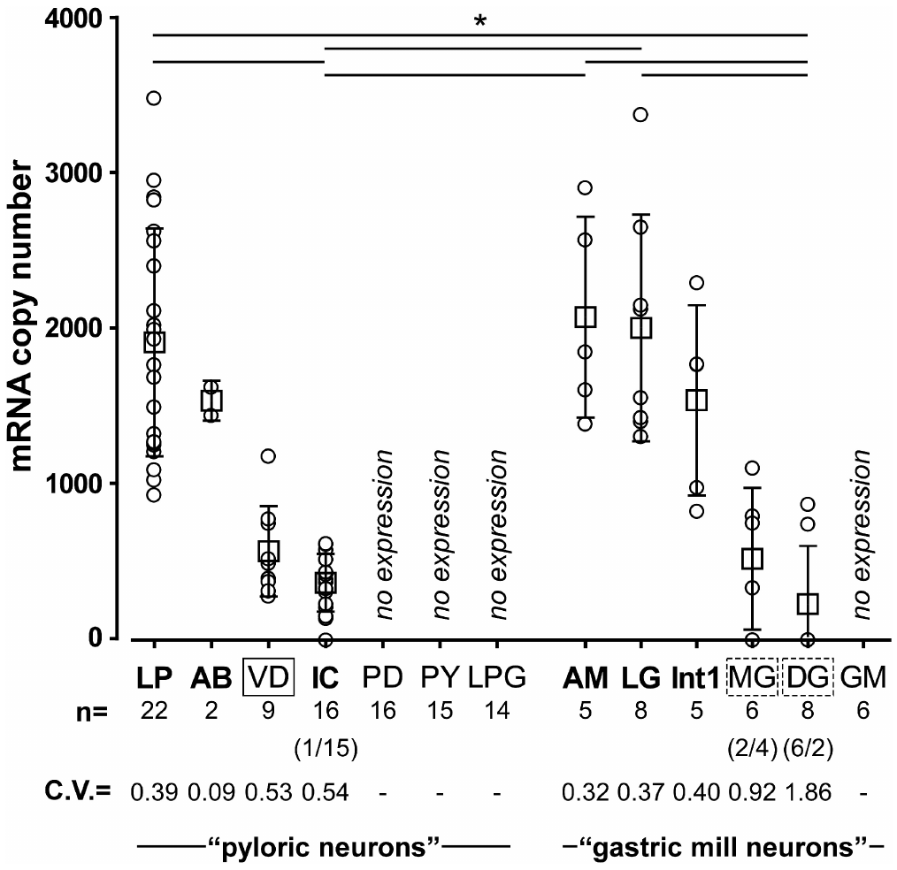
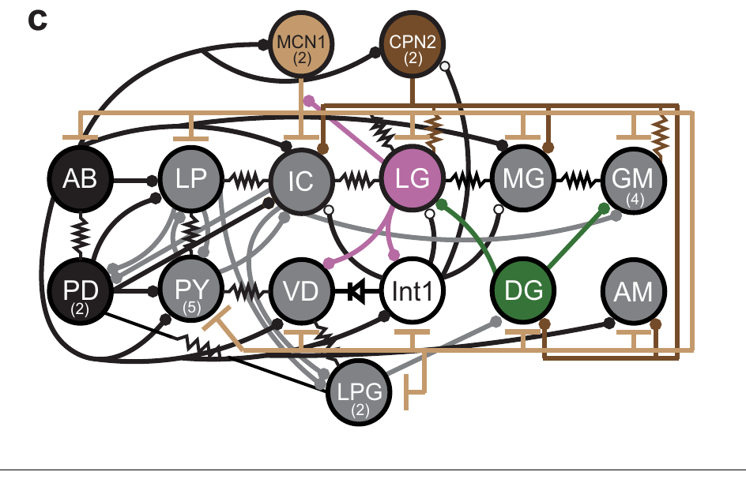
CCAP receptor transcripts differ among neuron classes
Garcia and colleagues identified a candidate CCAP receptor transcript in the crab nervous system. A transcript is an RNA copy of a gene used in protein production. The candidate sequence resembled known peptide receptors and predicted a receptor with seven membrane-spanning segments. The predicted membrane-spanning organization was consistent with a receptor capable of linking an extracellular peptide signal to intracellular processes.
Single-cell quantitative PCR measured receptor RNA from individually identified neurons. PCR amplifies a selected nucleic-acid sequence so its abundance can be estimated. LP generally contained more receptor transcript than IC, while expression was low or undetectable in several other STG classes. Measuring RNA in individually identified cells preserved the association between receptor expression and the neuron classes examined physiologically.
Candidate CCAP receptor RNA broadly followed the neuron classes in which CCAP activated I_MI, while VD expressed the transcript with a different measured physiological response. In VD, CCAP strengthened graded synaptic transmission onto LG. Receptor expression can therefore accompany modulation of a synapse even where the characteristic intrinsic inward-current response is absent, extending the peptide's influence across different cellular endpoints.
Powell et al. (2021), Fig. 1(c). Crab STG circuit
Garcia et al. (2015), Fig. 4. CCAP receptor transcript abundance differs across identified neurons
Garcia et al. (2015); Powell et al. (2021)
29
Notes:
• Garcia and colleagues identified a candidate CCAP receptor transcript in the crab nervous system. A transcript is an RNA copy of a gene used in protein production. The candidate sequence resembled known peptide receptors and predicted a receptor with seven membrane-spanning segments.
– The seven-segment topology and sequence similarity support a G-protein-coupled receptor candidate, rather than identifying a ligand-gated ion channel.
• Single-cell quantitative PCR measured receptor RNA from individually identified neurons. PCR amplifies a selected nucleic-acid sequence so its abundance can be estimated. LP generally contained more receptor transcript than IC, while expression was low or undetectable in several other STG classes.
– A G protein participates in intracellular signaling after receptor activation; those signaling steps can alter a different membrane protein that carries current.
• Transcript distribution broadly matched the cells in which CCAP activates IMI. VD was an exception: receptor RNA was present without a detected current response. RNA abundance does not measure membrane receptor protein or identify every downstream effect of activation.
– The transcript and physiological measurements are complementary, but the study did not equate each RNA molecule with one functional membrane receptor.
References:
Garcia VJ, Daur N, Temporal S, Schulz DJ, Bucher D. (2015). Neuropeptide receptor transcript expression levels and magnitude of ionic current responses show cell type-specific differences in a small motor circuit. Journal of Neuroscience 35: 6786-6800. https://doi.org/10.1523/jneurosci.0171-15.2015
Powell D, Haddad SA, Gorur-Shandilya S, Marder E. (2021). Coupling between fast and slow oscillator circuits in Cancer borealis is temperature-compensated. eLife 10: e60454. https://doi.org/10.7554/elife.60454
Figure: Garcia et al. (2015), Fig. 4. CCAP receptor transcript abundance differs across identified neurons
Figure source: https://doi.org/10.1523/jneurosci.0171-15.2015
Figure: Powell et al. (2021), Fig. 1(c). Crab STG circuit
Figure source: https://doi.org/10.7554/elife.60454

Slide 39
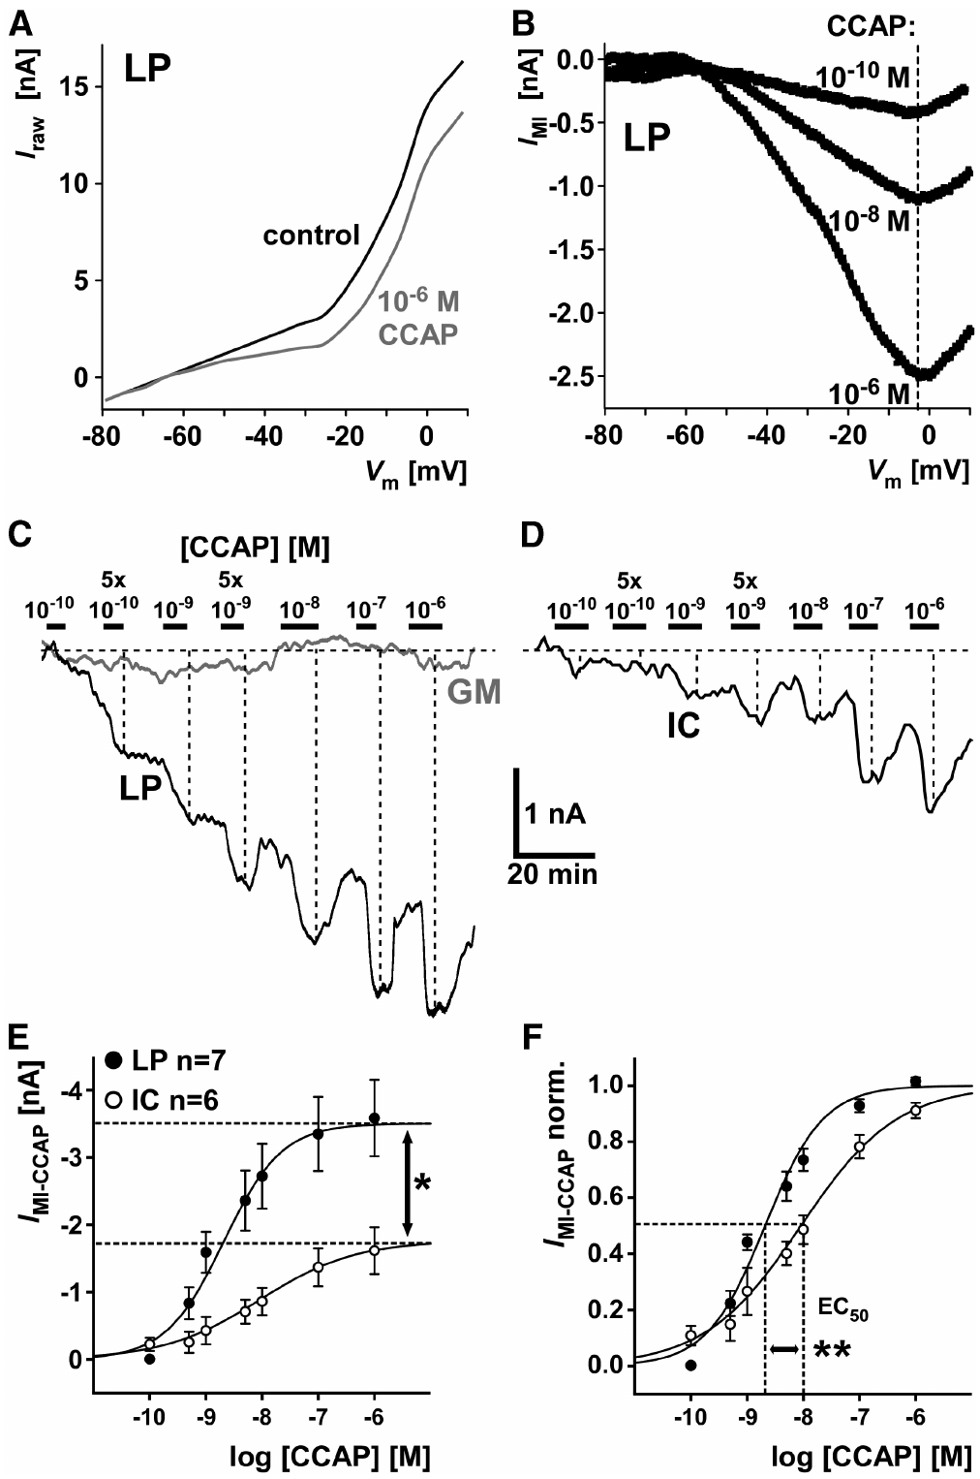
The same peptide produces different current responses
Garcia and colleagues voltage-clamped identified crab neurons while applying CCAP at controlled concentrations. They measured I_MI, a voltage-dependent modulator-activated inward current, by subtracting control currents from currents measured in peptide. LP and IC differed in both response magnitude and concentration dependence. Holding voltage during peptide application separated the modulator-dependent inward current from the spontaneous spiking pattern that the cell might otherwise express.
LP generated larger inward currents and responded more strongly at low concentrations than IC. Current measurements at −20 mV distinguished a cell’s concentration-response relationship from its spontaneous firing pattern. Increasing CCAP could saturate the response, so added peptide eventually produced little additional current. Saturation reflected the finite response available through the activated pathway, so further increases in concentration eventually produced little additional inward current.
LP's greater sensitivity at low CCAP concentrations permits a modest peptide increase to affect that neuron more strongly than IC. The two neuron classes consequently enter different levels of activation under the same surrounding concentration. As the concentration rises, recruitment approaches each cell's available response, making circuit modulation depend on both the dose-response relationship and the distribution of sensitive neurons.
Powell et al. (2021), Fig. 1(c). Crab STG circuit
Garcia et al. (2015), Fig. 7(A–F). CCAP current amplitude and concentration dependence differ between LP and IC
Garcia et al. (2015); Powell et al. (2021)
30
Notes:
• Garcia and colleagues voltage-clamped identified crab neurons while applying CCAP at controlled concentrations. They measured IMI, a voltage-dependent modulator-activated inward current, by subtracting control currents from currents measured in peptide. LP and IC differed in both response magnitude and concentration dependence.
– Saturation means that increasing the ligand no longer increases the measured response substantially under the tested conditions.
• LP generated larger inward currents and responded more strongly at low concentrations than IC. Current measurements at −20 mV distinguished a cell’s concentration-response relationship from its spontaneous firing pattern. Increasing CCAP could saturate the response, so added peptide eventually produced little additional current.
– The current–voltage measurements retained the voltage dependence of the inward current, while the concentration series tested sensitivity to the ligand.
• Both cells possessed the capacity for peptide-activated inward current, yet the same bath concentration did not produce equivalent activation. Receptor abundance and access to downstream channel mechanisms are possible contributors. The physiological comparison does not establish a one-to-one conversion between receptor transcript count and current amplitude.
– The source’s receptor RNA comparison and current comparison support cell-specific modulation without defining the complete molecular composition of the I_MI channel.
References:
Garcia VJ, Daur N, Temporal S, Schulz DJ, Bucher D. (2015). Neuropeptide receptor transcript expression levels and magnitude of ionic current responses show cell type-specific differences in a small motor circuit. Journal of Neuroscience 35: 6786-6800. https://doi.org/10.1523/jneurosci.0171-15.2015
Powell D, Haddad SA, Gorur-Shandilya S, Marder E. (2021). Coupling between fast and slow oscillator circuits in Cancer borealis is temperature-compensated. eLife 10: e60454. https://doi.org/10.7554/elife.60454
Figure: Garcia et al. (2015), Fig. 7(A–F). CCAP current amplitude and concentration dependence differ between LP and IC
Figure source: https://doi.org/10.1523/jneurosci.0171-15.2015
Figure: Powell et al. (2021), Fig. 1(c). Crab STG circuit
Figure source: https://doi.org/10.7554/elife.60454

Slide 40
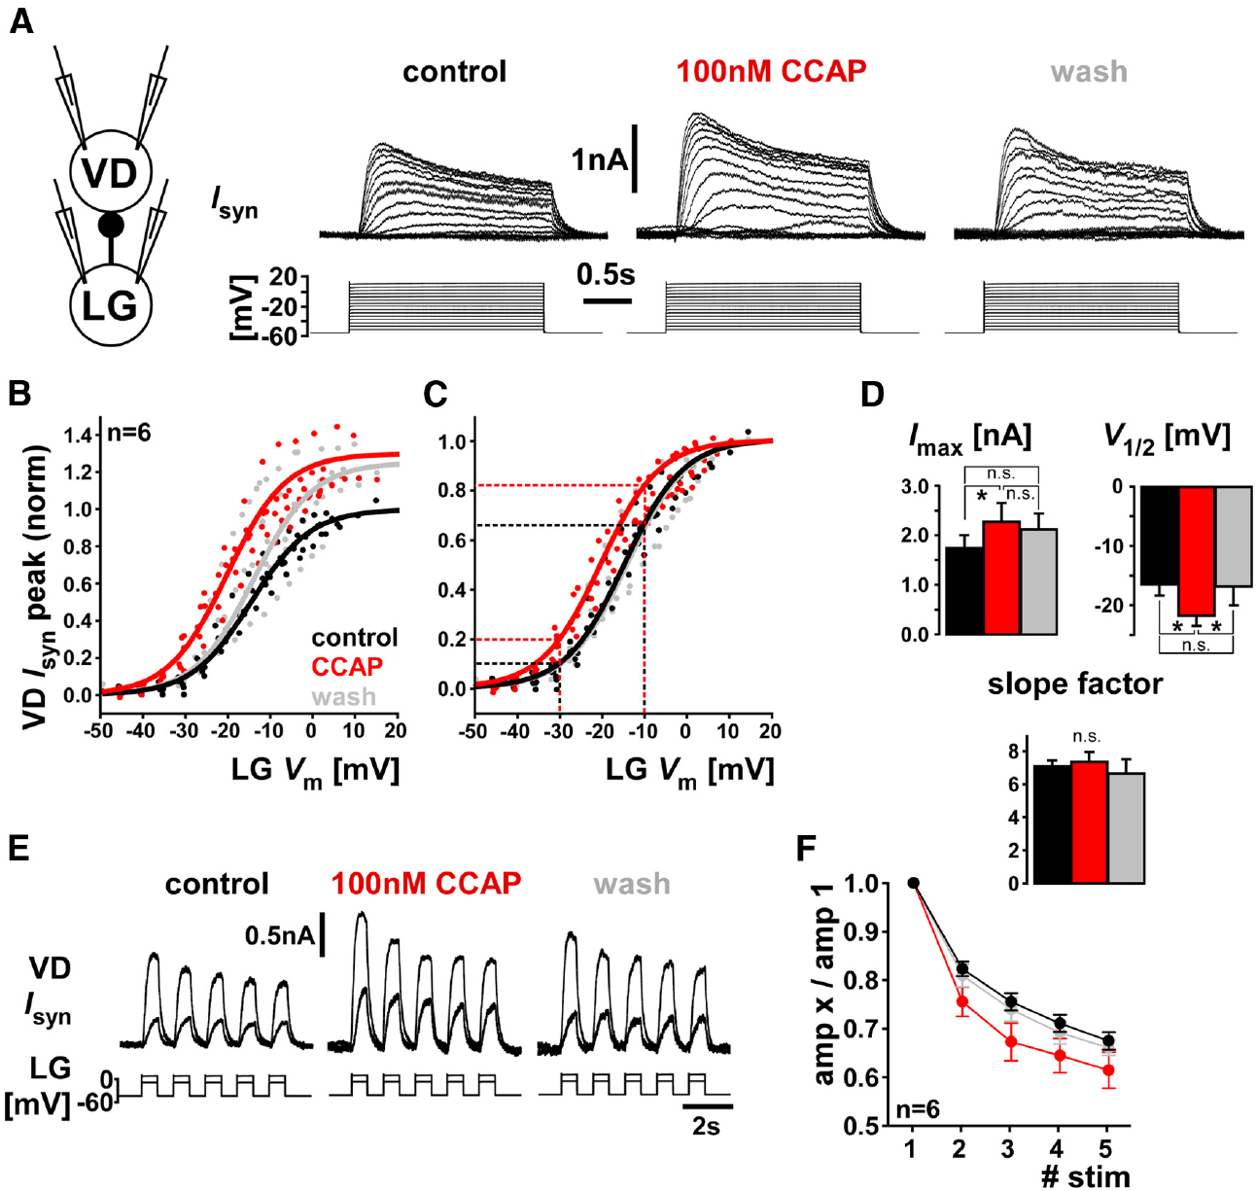
CCAP can modulate a synapse without activating I_MI
The crab VD neuron expressed candidate CCAP receptor RNA but lacked a detected CCAP-induced I_MI response. Garcia and colleagues tested a different physiological endpoint: the graded inhibitory synapse from VD to the lateral gastric neuron, LG, a motor neuron participating in the gastric mill rhythm. Recording a defined presynaptic voltage step and a clamped postsynaptic current followed the graded synapse independently of changing spontaneous motor discharge.
VD voltage steps evoked postsynaptic current in voltage-clamped LG. Application of 100 nM CCAP strengthened this response, and washout returned it toward control. The comparison measured the same synapse under controlled presynaptic and postsynaptic voltages, rather than inferring synaptic strength from uncontrolled spike counts. The reversible enhancement changed the amount of inhibitory current reaching a gastric motor neuron through a defined pyloric pathway.
CCAP modulation of the VD-to-LG synapse supplies a route from a pyloric neuron into the slower gastric mill circuit. The response accompanies receptor transcript expression in VD even though CCAP-induced I_MI was absent from the measured intrinsic-current endpoint. Peptide action therefore depends on the intracellular and synaptic processes available in the target cell, with receptor signaling capable of strengthening communication between the two motor programs.
Garcia et al. (2015), Fig. 5(A–F). CCAP strengthens graded transmission and changes short-term synaptic dynamics
Garcia et al. (2015)
31
Notes:
• The crab VD neuron expressed candidate CCAP receptor RNA but lacked a detected CCAP-induced IMI response. Garcia and colleagues tested a different physiological endpoint: the graded inhibitory synapse from VD to the lateral gastric neuron, LG, a motor neuron participating in the gastric mill rhythm.
– The lateral gastric motor neuron is associated with the protraction component of the gastric mill rhythm, and receives input from neurons shared with other motor patterns.
• VD voltage steps evoked postsynaptic current in voltage-clamped LG. Application of 100 nM CCAP strengthened this response, and washout returned it toward control. The comparison measured the same synapse under controlled presynaptic and postsynaptic voltages, rather than inferring synaptic strength from uncontrolled spike counts.
– The publication measured graded synaptic current across presynaptic voltage steps and during an imposed waveform, separating voltage-dependent release from natural circuit firing.
• A peptide receptor can influence synaptic transmission even when one particular intrinsic current is absent. The VD result resolves an apparent mismatch between transcript expression and IMI response. It does not establish that receptor activation follows identical intracellular signaling steps in VD, LP and IC.
– A negative result for one current assay should not be treated as a negative result for every form of modulation in that cell.
References:
Garcia VJ, Daur N, Temporal S, Schulz DJ, Bucher D. (2015). Neuropeptide receptor transcript expression levels and magnitude of ionic current responses show cell type-specific differences in a small motor circuit. Journal of Neuroscience 35: 6786-6800. https://doi.org/10.1523/jneurosci.0171-15.2015
Figure: Garcia et al. (2015), Fig. 5(A–F). CCAP strengthens graded transmission and changes short-term synaptic dynamics
Figure source: https://doi.org/10.1523/jneurosci.0171-15.2015

Slide 41
Convergent peptides share one current and can occlude
Peptide receptors such as the CCAP receptor are G-protein-coupled: binding starts an intracellular signaling cascade instead of opening a channel directly. In STG neurons, cascades started by several different peptide receptors converge on a common population of channels carrying the modulator-activated inward current. The receptor-specific signaling steps can therefore recruit overlapping downstream conductances even when the initial chemical signals differ.
Convergence produces occlusion when one peptide has already recruited the portion of the shared current available to a second peptide. Once saturating CCAP has opened every available channel of that current in LP, proctolin applied on top adds nothing more; in IC, by contrast, saturating CCAP opened only about two-thirds of the current, leaving room for proctolin to add the rest. The remaining available current in IC permits an additional response to the second peptide, whereas LP has already approached its shared channel capacity.
This occlusion links the response to combined peptides with the capacity of the common inward-current pathway. In LP, adding CCAP to proctolin produced little further narrowing of output differences among animals, consistent with convergence near saturation. The influence of a second modulator consequently depends on how much of the shared response is already recruited and on the other cellular effects supplied by each signal.
Garcia et al. (2015), Fig. 5(A–F). CCAP strengthens graded transmission and changes short-term synaptic dynamics
Garcia et al. (2015); Schneider et al. (2022)
31a
Notes:
• Slides 29 to 32 describe receptor transcripts, current responses and peptide combinations separately; convergence onto one current links them.
• Metabotropic receptors and convergence.
– Garcia and colleagues identified the CCAP receptor candidate by its sequence similarity to G-protein-coupled receptors, and slide 20 names several peptides that all activate the same current.
– Schneider and colleagues describe the subcellular pathways of excitatory neuropeptide receptors in the STG converging downstream on that current.
• Occlusion as a test of a shared pool.
– Garcia and colleagues applied proctolin after saturating CCAP to ask whether any current remained for the second peptide to open.
– Full occlusion in LP and partial occlusion in IC fit LP's several-fold higher receptor transcript levels on slide 29.
• Limits on combined modulation.
– Schneider and colleagues found no additional reduction of variability when CCAP was added, and attribute it to near-saturating activation of the shared current.
– When two peptides draw on one pool, their combined effect cannot exceed the size of that pool.
References:
Garcia VJ, Daur N, Temporal S, Schulz DJ, Bucher D. (2015). Neuropeptide receptor transcript expression levels and magnitude of ionic current responses show cell type-specific differences in a small motor circuit. Journal of Neuroscience 35: 6786-6800. https://doi.org/10.1523/jneurosci.0171-15.2015
Schneider AC, Itani O, Bucher D, Nadim F. (2022). Neuromodulation Reduces Interindividual Variability of Neuronal Output. eNeuro 9: ENEURO.0166-22.2022. https://doi.org/10.1523/eneuro.0166-22.2022

Slide 42
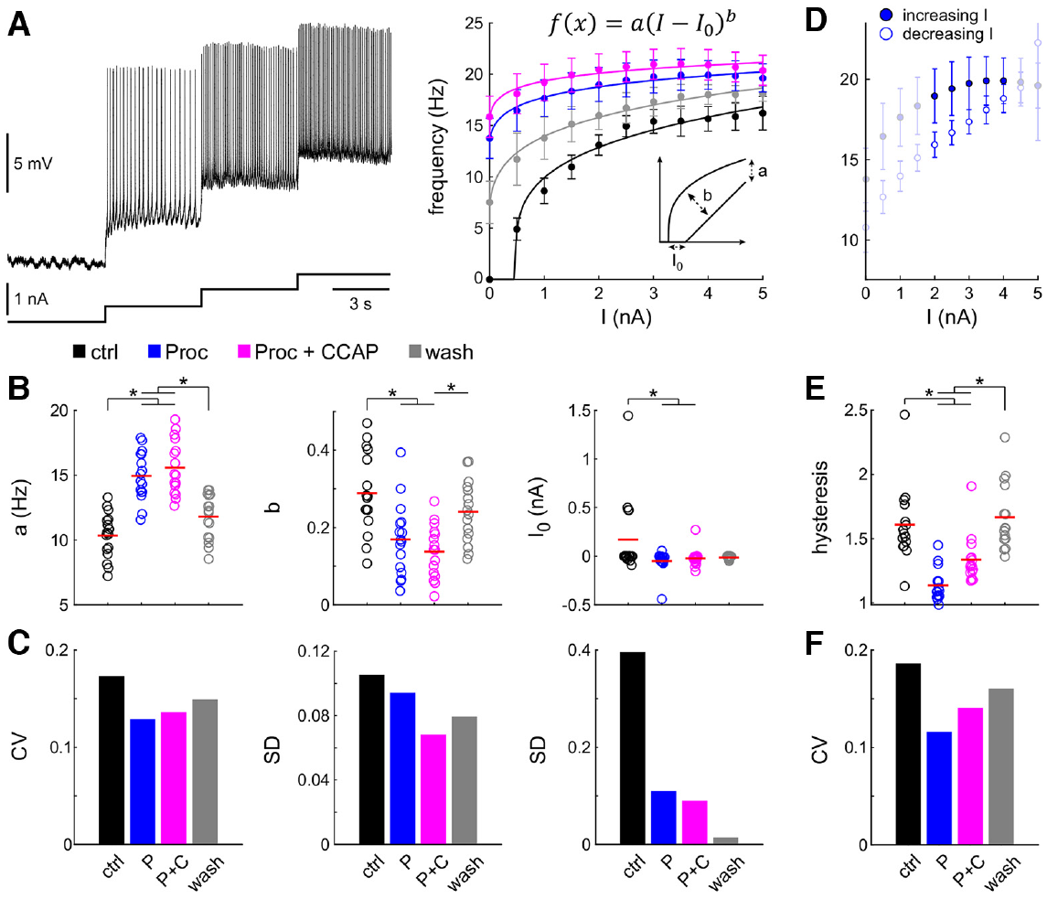
Modulators change excitability and reduce output variation
Excitability describes how readily a neuron generates action potentials in response to input. Schneider and colleagues isolated the crab LP neuron pharmacologically, then injected progressively larger depolarizing currents. The resulting firing-rate relationship was measured in control saline, proctolin, proctolin plus CCAP and wash. The injected-current series followed how each neuron converted a controlled excitatory input into action-potential output across the different peptide states.
Proctolin shifted the relationship so LP began firing at lower injected current. Adding CCAP further altered LP output through the combined modulatory state reached by the pharmacologically isolated neuron. Comparisons across animals found that neuronal firing responses became more similar in modulators, even though the underlying measured intrinsic and synaptic currents remained variable. The change in firing relationships therefore occurred alongside continued diversity in the conductances capable of contributing to each neuron's membrane response.
The modulators reduced interindividual differences in neuronal output, with the largest increase occurring in LP neurons that began with relatively low excitability. Firing moved toward a more similar upper range across cells as the peptide state changed. Different underlying combinations of intrinsic and synaptic properties can therefore converge on a more uniform response to excitation, preserving output through several cellular configurations.
Tang et al. (2010), Fig. 2(B). Crab pyloric circuit
Schneider et al. (2022), Fig. 3(A–F). Proctolin and CCAP change LP excitability and output variability
Schneider et al. (2022); Tang et al. (2010)
32
Notes:
• Excitability describes how readily a neuron generates action potentials in response to input. Schneider and colleagues isolated the crab LP neuron pharmacologically, then injected progressively larger depolarizing currents. The resulting firing-rate relationship was measured in control saline, proctolin, proctolin plus CCAP and wash.
– The firing-rate–current relationship measures spikes per second at a specified current in nanoamperes, making input and output explicit.
• Proctolin shifted the relationship so LP began firing at lower injected current. Adding CCAP further altered its output. Comparisons across animals found that neuronal firing responses became more similar in modulators, even though the underlying measured intrinsic and synaptic currents remained variable.
– The test included 1 μM proctolin and 1 μM CCAP, with wash recordings used to assess the reversibility of modulation.
• Interindividual variability means differences among animals of the same species. Neuromodulation can constrain that variability at the level of output without making every cellular parameter identical. The result concerns responses of isolated LP to controlled current, rather than all dimensions of the intact pyloric motor pattern.
– Similar activity can arise in neurons with different current magnitudes because output depends on the interaction of currents over the neuron’s operating voltage range.
References:
Schneider AC, Itani O, Bucher D, Nadim F. (2022). Neuromodulation Reduces Interindividual Variability of Neuronal Output. eNeuro 9: ENEURO.0166-22.2022. https://doi.org/10.1523/eneuro.0166-22.2022
Tang LS, Goeritz ML, Caplan JS, Taylor AL, Fisek M, Marder E. (2010). Precise temperature compensation of phase in a rhythmic motor pattern. PLoS Biology 8: e1000469. https://doi.org/10.1371/journal.pbio.1000469
Figure: Schneider et al. (2022), Fig. 3(A–F). Proctolin and CCAP change LP excitability and output variability
Figure source: https://doi.org/10.1523/eneuro.0166-22.2022
Figure: Tang et al. (2010), Fig. 2(B). Crab pyloric circuit
Figure source: https://doi.org/10.1371/journal.pbio.1000469

Slide 43
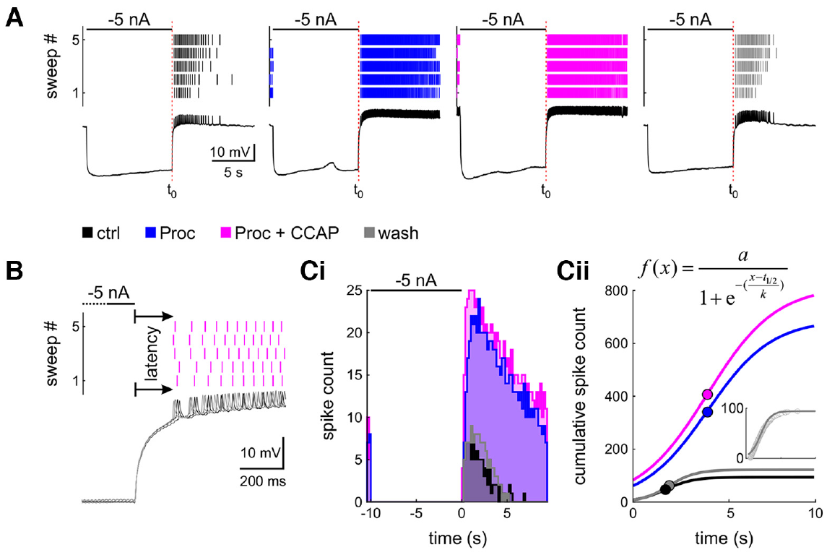
Peptide state changes rebound after inhibition
Postinhibitory rebound is renewed depolarization or firing after an inhibitory episode ends. Schneider and colleagues tested it in isolated crab LP neurons with a 5 s hyperpolarizing current pulse of −5 nA. Recording continued after release to measure the first spike and subsequent firing. The pulse imposed the same inhibitory history before release, allowing the subsequent return to firing to be followed in each chemical state.
Proctolin and proctolin plus CCAP shortened rebound latency and increased spike output relative to control saline. The recordings compared identical imposed inhibitory pulses across modulatory conditions. Across animals, several rebound-output differences became smaller in the peptide states. The first-spike timing and later discharge described separate portions of the rebound response as the inward modulatory influence became available.
Proctolin activates I_MI in LP, providing a regenerative inward contribution as the neuron recovers from inhibition. That added drive can shorten the return to threshold and increase subsequent spike output. Rebound consequently depends on the interaction between the preceding voltage history and the currents active in the current modulatory state, allowing an identical inhibitory episode to be followed by different burst timing and discharge.
Schneider et al. (2022), Fig. 4(A–C). Modulators alter LP rebound latency and subsequent firing
Tang et al. (2010), Fig. 2(B). Crab pyloric circuit
Schneider et al. (2022); Tang et al. (2010)
33
Notes:
• Postinhibitory rebound is renewed depolarization or firing after an inhibitory episode ends. Schneider and colleagues tested it in isolated crab LP neurons with a 5 s hyperpolarizing current pulse of −5 nA. Recording continued after release to measure the first spike and subsequent firing.
– The neuron’s voltage during inhibition changes the availability of voltage-dependent channels before the pulse ends.
• Proctolin and proctolin plus CCAP shortened rebound latency and increased spike output relative to control saline. The recordings compared identical imposed inhibitory pulses across modulatory conditions. Across animals, several rebound-output differences became smaller in the peptide states.
– Rebound latency was measured from the end of the imposed inhibitory current to the first detected action potential, not from the beginning of the pulse.
• The same neuron can therefore resume firing differently after the same inhibition when its modulatory state changes. Rebound is an interaction between prior voltage history and active membrane currents, rather than a fixed delay assigned to a cell type. The experiments do not isolate one current as the sole source of rebound.
– The wash condition checked the persistence of the altered response after peptide removal.
References:
Schneider AC, Itani O, Bucher D, Nadim F. (2022). Neuromodulation Reduces Interindividual Variability of Neuronal Output. eNeuro 9: ENEURO.0166-22.2022. https://doi.org/10.1523/eneuro.0166-22.2022
Tang LS, Goeritz ML, Caplan JS, Taylor AL, Fisek M, Marder E. (2010). Precise temperature compensation of phase in a rhythmic motor pattern. PLoS Biology 8: e1000469. https://doi.org/10.1371/journal.pbio.1000469
Figure: Schneider et al. (2022), Fig. 4(A–C). Modulators alter LP rebound latency and subsequent firing
Figure source: https://doi.org/10.1523/eneuro.0166-22.2022
Figure: Tang et al. (2010), Fig. 2(B). Crab pyloric circuit
Figure source: https://doi.org/10.1371/journal.pbio.1000469

Slide 44
Gastric mill activity alternates protraction and retraction
The crab gastric mill rhythm organizes chewing movements through alternating phases. LG participates in protraction, movement of the gastric teeth toward the chewing configuration, whereas other gastric motor neurons are associated with retraction, their return movement. The slower gastric rhythm interacts with the fast pyloric rhythm. Protraction and retraction organize opposing tooth movements, with the gastric motor neurons supplying the alternating muscle commands required for chewing.
Powell and colleagues recorded activity from identified gastric and pyloric motor nerves. Gastric activity included alternating LG and dorsal gastric, or DG, bursts, while PD continued its faster rhythm. Intracellular recordings linked LG activity to the inhibitory gastric interneuron Int1, meaning interneuron 1. The recordings followed the slower gastric alternation while the pyloric circuit continued completing several cycles during each gastric period.
LG and Int1 form a reciprocally inhibitory half-center, in which each active member suppresses the other. Descending MCN1 input excites LG, Int1, and the pyloric pacemaker, recruiting the gastric sequence within the larger active network. The resulting chewing rhythm depends on local inhibitory interactions and modulatory excitation, while pyloric input helps position gastric burst onset within the ongoing faster cycle.
Powell et al. (2021), Fig. 1(a–d). Gastric and pyloric circuits and their recorded interaction
Powell et al. (2021)
34
Notes:
• The crab gastric mill rhythm organizes chewing movements through alternating phases. LG participates in protraction, movement of the gastric teeth toward the chewing configuration, whereas other gastric motor neurons are associated with retraction, their return movement. The slower gastric rhythm interacts with the fast pyloric rhythm.
– LG and DG are gastric motor neurons, whereas Int1 is an interneuron within the central gastric circuit.
• Powell and colleagues recorded activity from identified gastric and pyloric motor nerves. Gastric activity included alternating LG and dorsal gastric, or DG, bursts, while PD continued its faster rhythm. Intracellular recordings linked LG activity to the inhibitory gastric interneuron Int1, meaning interneuron 1.
– Reciprocal inhibition means that each partner supplies inhibition to the other; the active partner suppresses its antagonist during its burst.
• LG and Int1 participate in a half-center, a reciprocally inhibitory arrangement in which activity in each member inhibits the other. That arrangement helps organize alternation but does not, by itself, establish sustained rhythm generation in every input state. Descending modulation supplies additional conditions for gastric activity.
– The slow rhythm operates near 0.1 Hz in the preparations discussed by Powell and colleagues, while the pyloric rhythm operates near 1 Hz.
References:
Powell D, Haddad SA, Gorur-Shandilya S, Marder E. (2021). Coupling between fast and slow oscillator circuits in Cancer borealis is temperature-compensated. eLife 10: e60454. https://doi.org/10.7554/elife.60454
Figure: Powell et al. (2021), Fig. 1(a–d). Gastric and pyloric circuits and their recorded interaction
Figure source: https://doi.org/10.7554/elife.60454

Slide 45
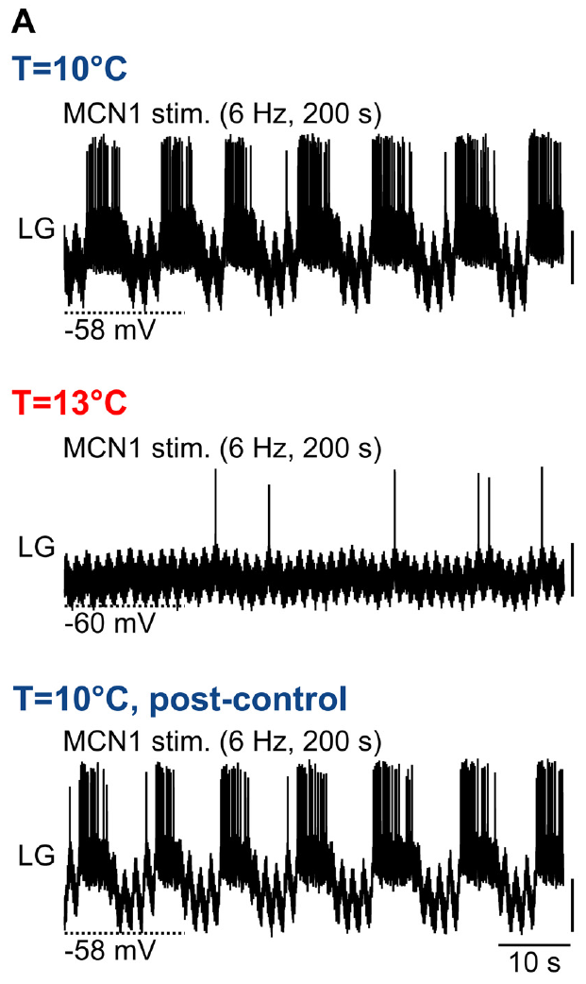
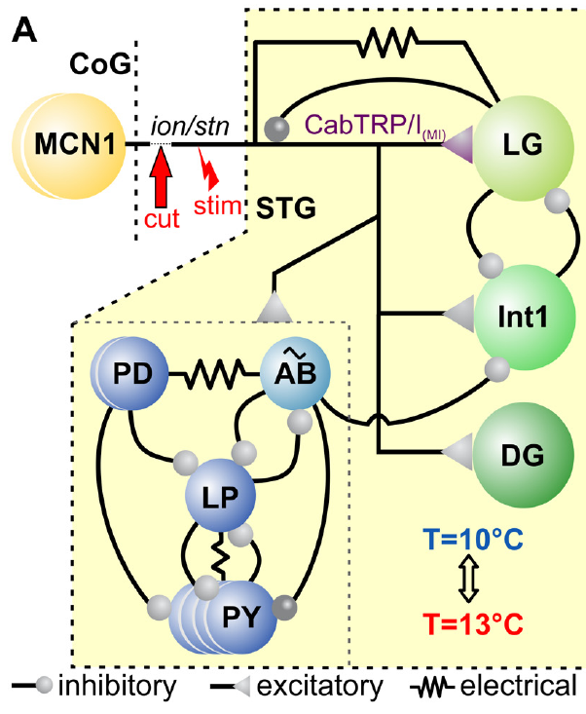
Descending MCN1 input recruits the gastric half-center
Modulatory commissural neuron 1 (MCN1) is a descending projection neuron whose cell body lies in a commissural ganglion. Its axon reaches the crab STG through the input nerves. Städele and colleagues controlled this input by stimulating the identified pathway after disconnecting other anterior influences. The controlled pathway supplied a defined descending spike rate to the local gastric circuitry while removing other anterior influences.
MCN1 releases the peptide CabTRP Ia, which activates an inward current in LG, and also supplies electrical and other synaptic influences within the gastric circuit. LG and Int1 inhibit one another, organizing opposing phases through reciprocal suppression within the gastric half-center. Rhythmic alternation therefore depends on a combination of imposed modulatory drive, intrinsic membrane properties and reciprocal inhibition. The inward drive supports LG's approach to threshold, and reciprocal inhibition organizes the opposing phases expressed after the circuit becomes active.
Continuous 6 Hz MCN1 stimulation at 10°C recruited recurring LG bursts, with the slow rhythm developing through the responding gastric circuit. The stimulus supplied tonic descending drive, while local inhibition and time-dependent excitation shaped its conversion into repeated protraction and retraction. This arrangement makes gastric timing depend on the interaction between a continuing projection-neuron signal and the state of the neurons receiving it.
Städele et al. (2015), Fig. 1(A). Gastric circuit
Städele et al. (2015), Fig. 2(A). Fixed 6 Hz MCN1 drive fails at 13°C and recovers after cooling
Städele et al. (2015)
35
Notes:
• Modulatory commissural neuron 1 (MCN1) is a descending projection neuron whose cell body lies in a commissural ganglion. Its axon reaches the crab STG through the input nerves. Städele and colleagues controlled this input by stimulating the identified pathway after disconnecting other anterior influences.
– A projection neuron sends an axon from one ganglion into another and can provide a modulatory state rather than a precisely timed command for every contraction.
• MCN1 releases the peptide CabTRP Ia, which activates an inward current in LG, and also supplies electrical and other synaptic influences within the gastric circuit. LG and Int1 inhibit one another. Rhythmic alternation therefore depends on a combination of imposed modulatory drive, intrinsic membrane properties and reciprocal inhibition.
– LG inhibits MCN1 terminals during its active phase, so a constant axonal stimulus does not guarantee constant effective peptide influence throughout the gastric cycle.
• At 10°C, continuous MCN1 stimulation at 6 Hz recruited recurring LG bursts in the published example. The stimulus itself was tonic, rather than patterned to match every LG burst. Slow gastric rhythmicity was thus generated by the responding circuit under sustained descending activation.
– The controlled stimulation establishes a defined gastric-rhythm state; naturally recruited gastric rhythms can receive additional descending and sensory inputs.
References:
Städele C, Heigele S, Stein W. (2015). Neuromodulation to the Rescue: Compensation of Temperature-Induced Breakdown of Rhythmic Motor Patterns via Extrinsic Neuromodulatory Input. PLoS Biology 13: e1002265. https://doi.org/10.1371/journal.pbio.1002265
Figure: Städele et al. (2015), Fig. 2(A). Fixed 6 Hz MCN1 drive fails at 13°C and recovers after cooling
Figure source: https://doi.org/10.1371/journal.pbio.1002265
Figure: Städele et al. (2015), Fig. 1(A). Gastric circuit
Figure source: https://doi.org/10.1371/journal.pbio.1002265

Slide 46
Feedback turns tonic MCN1 drive into slow LG bursts
LG inhibits the MCN1 axon terminals in the STG while it bursts, cutting the peptide and electrical drive that brought it to threshold. With its excitation withdrawn, LG falls silent, and Int1, released from LG's inhibition, takes over the active phase of the half-center. The local terminal inhibition changes how strongly the continuing descending spikes influence the gastric circuit during LG's active phase.
While LG is silent, the terminals recover and MCN1's slow excitation of LG builds again over several pyloric cycles. AB inhibits Int1 on every pyloric cycle, briefly easing Int1's hold on LG, and when the rising excitation meets one of these openings, LG crosses threshold and a new protraction burst begins. The recurring pyloric inhibition therefore supplies brief opportunities for LG to escape from Int1 as the slower excitation accumulates.
The gastric period spans several pyloric cycles, commonly around ten, as excitation recovers and builds between successive LG bursts. Its onset can occur when accumulated drive coincides with a favorable pyloric phase created by AB inhibition of Int1. The slow rhythm consequently retains a temporal relationship with the faster oscillator while generating its own cycle through recovery and reciprocal inhibitory interactions.
Städele et al. (2015), Fig. 1(A). Gastric circuit
Städele et al. (2015), Fig. 2(A). Fixed 6 Hz MCN1 drive fails at 13°C and recovers after cooling
Städele et al. (2015); Powell et al. (2021)
35a
Notes:
• Slide 35 shows tonic stimulation producing slow bursts; the feedback loops in the gastric circuit explain how a steady input becomes a rhythm about ten times slower than the pyloric one.
• LG switches off its own drive.
– Städele and colleagues list presynaptic inhibition of the MCN1 terminal among the mechanisms that shape the MCN1-elicited gastric rhythm, alongside CabTRP Ia release and electrical coupling.
– A burst that suppresses its own source of excitation is self-terminating, which hands the active phase to Int1.
• Excitation rebuilds and meets a pyloric window.
– Powell and colleagues describe slow excitation from MCN1 raising the peak disinhibition of LG over several cycles until LG crosses threshold in time with AB.
– Rhythmic AB inhibition of Int1 creates those windows, so the gastric burst starts on a pyloric beat.
• Slow rhythm and integer coupling follow.
– The approximately 0.1 hertz gastric rhythm and approximately 1 hertz pyloric rhythm on slide 2 give the ratio of about ten.
– Slide 44 shows the ratio staying near whole numbers during warming, which is expected if each LG burst must wait for an AB-timed window.
References:
Städele C, Heigele S, Stein W. (2015). Neuromodulation to the Rescue: Compensation of Temperature-Induced Breakdown of Rhythmic Motor Patterns via Extrinsic Neuromodulatory Input. PLoS Biology 13: e1002265. https://doi.org/10.1371/journal.pbio.1002265
Powell D, Haddad SA, Gorur-Shandilya S, Marder E. (2021). Coupling between fast and slow oscillator circuits in Cancer borealis is temperature-compensated. eLife 10: e60454. https://doi.org/10.7554/elife.60454

Slide 47
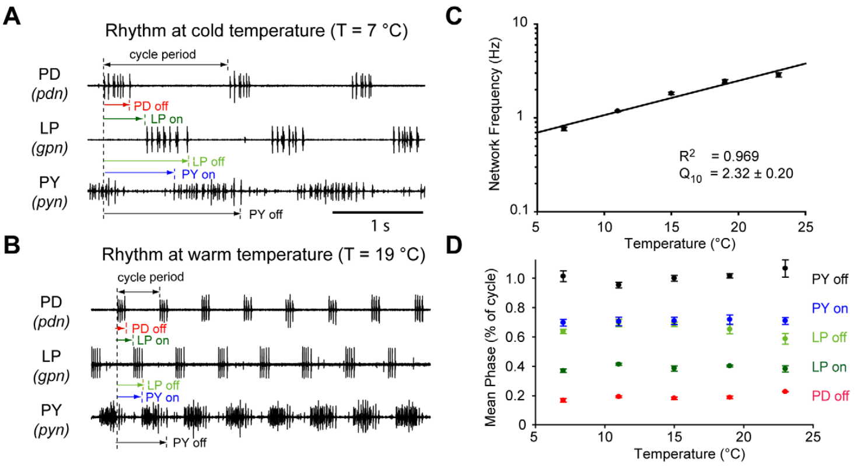
Warming speeds the pyloric rhythm about fourfold
Tang and colleagues tested the crab pyloric circuit over a temperature range relevant to an ectothermic animal. An ectotherm relies substantially on environmental conditions to determine body temperature. The isolated stomatogastric preparation was warmed gradually while outgoing motor activity was recorded. Temperature changes alter the rates of membrane and synaptic processes throughout the preparation, supplying a physiological perturbation relevant to the crab's environment.
Between 7°C and 23°C, pyloric rhythm frequency increased about fourfold. PD, LP and PY retained the characteristic burst sequence while completing cycles more quickly. Comparisons during warming and cooling checked whether the relationship depended on the direction of temperature change. Preserving the order while accelerating its repetition allows the muscles to continue receiving an organized filtering sequence at the warmer temperature.
The frequency temperature coefficient Q10 was approximately 2.3, describing the fold increase associated with a 10°C rise over the measured relationship. The pyloric network preserved coordination while its operating speed changed substantially. Its temperature robustness therefore concerned the relative organization of the motor output, with follower bursts remaining in their characteristic sequence as the duration available for each cycle shortened.
Tang et al. (2010), Fig. 1(A–D). Frequency increases while pyloric phase remains stable
Tang et al. (2010), Fig. 2(B). Crab pyloric circuit
Tang et al. (2010)
36
Notes:
• Tang and colleagues tested the crab pyloric circuit over a temperature range relevant to an ectothermic animal. An ectotherm relies substantially on environmental conditions to determine body temperature. The isolated stomatogastric preparation was warmed gradually while outgoing motor activity was recorded.
– The nerve recordings measure central motor commands in a preparation with its normal anterior modulatory connections retained.
• Between 7°C and 23°C, pyloric rhythm frequency increased about fourfold. PD, LP and PY retained the characteristic burst sequence while completing cycles more quickly. Comparisons during warming and cooling checked whether the relationship depended on the direction of temperature change.
– The recorded sequence persisted even though the absolute intervals separating successive bursts became shorter.
• The reported frequency temperature coefficient, Q10, was approximately 2.3; Q10 describes the fold change associated with a 10°C increase. Temperature compensation need not mean a constant frequency. Different output properties can remain coordinated even when the entire motor pattern accelerates.
– The observed frequency increase should be distinguished from a mechanism that holds a circadian period constant across temperature.
References:
Tang LS, Goeritz ML, Caplan JS, Taylor AL, Fisek M, Marder E. (2010). Precise temperature compensation of phase in a rhythmic motor pattern. PLoS Biology 8: e1000469. https://doi.org/10.1371/journal.pbio.1000469
Figure: Tang et al. (2010), Fig. 1(A–D). Frequency increases while pyloric phase remains stable
Figure source: https://doi.org/10.1371/journal.pbio.1000469
Figure: Tang et al. (2010), Fig. 2(B). Crab pyloric circuit
Figure source: https://doi.org/10.1371/journal.pbio.1000469

Slide 48
Relative burst timing remains stable during warming
Tang and colleagues measured each motor burst relative to the start of the PD burst. The onset phase specifies when a burst begins within a cycle, and the offset phase specifies when it ends. These fractions distinguish relative coordination from absolute delays measured in seconds. Using a fraction of the current cycle preserves the distinction between proportional timing and an unchanged interval measured in milliseconds.
Across 7°C to 23°C, PD, LP and PY onset and offset phases remained nearly constant despite the increase in frequency. When intracellular voltage trajectories were scaled to cycle duration, their characteristic temporal relationships also remained similar across the tested temperatures. The relative alignment persisted through shorter cycles, preserving the order and proportionate duration of the muscle-related output phases.
Warming increased both LP synaptic current and input conductance, while the amplitude of its total inhibitory voltage response remained broadly stable. Greater conductance makes a given current produce a smaller voltage change, allowing these temperature-sensitive processes to balance at the level of the response. Similar voltage trajectories can therefore coexist with changing underlying currents as the circuit maintains its phase relationships.
Tang et al. (2010), Fig. 1(A–D). Frequency increases while pyloric phase remains stable
Tang et al. (2010), Fig. 2(B). Crab pyloric circuit
Tang et al. (2010)
37
Notes:
• Tang and colleagues measured each motor burst relative to the start of the PD burst. The onset phase specifies when a burst begins within a cycle, and the offset phase specifies when it ends. These fractions distinguish relative coordination from absolute delays measured in seconds.
– The phase reference was the beginning of the PD burst, which is assigned the start of the pyloric cycle.
• Across 7°C to 23°C, PD, LP and PY onset and offset phases remained nearly constant despite the increase in frequency. When intracellular voltage trajectories were scaled to cycle duration, their characteristic temporal relationships also remained similar across the tested temperatures.
– A shorter delay in seconds can occupy the same fraction of a shorter cycle, so unchanged phase and increased frequency are compatible observations.
• The pyloric circuit therefore compensated the coordination of its motor output more closely than its speed. Stability of phase does not imply that every underlying conductance was temperature-invariant. The neuron’s membrane currents and synaptic input could change while their combined effect preserved the sequence.
– The intracellular trajectories were normalized by cycle duration; their alignment tests whether relative voltage timing persists as the cycles become faster.
References:
Tang LS, Goeritz ML, Caplan JS, Taylor AL, Fisek M, Marder E. (2010). Precise temperature compensation of phase in a rhythmic motor pattern. PLoS Biology 8: e1000469. https://doi.org/10.1371/journal.pbio.1000469
Figure: Tang et al. (2010), Fig. 1(A–D). Frequency increases while pyloric phase remains stable
Figure source: https://doi.org/10.1371/journal.pbio.1000469
Figure: Tang et al. (2010), Fig. 2(B). Crab pyloric circuit
Figure source: https://doi.org/10.1371/journal.pbio.1000469

Slide 49
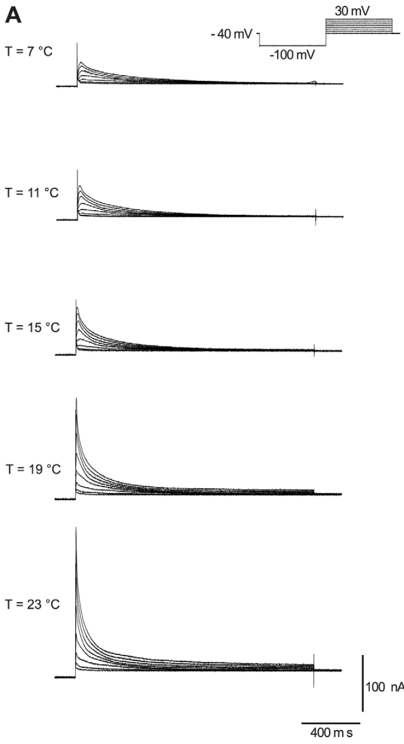
A transient potassium current opposes depolarization
The LP neuron contains the A-type potassium current, I_A, which activates during depolarization and then declines. Activation increases channel opening; inactivation reduces channel availability despite continuing depolarization. This transient outward current can oppose the return to firing after inhibition. Recovery from the preceding hyperpolarized state determines how much transient outward current is available when the membrane begins depolarizing again.
Tang and colleagues isolated I_A with voltage-clamp protocols that separated it from other potassium currents. Depolarizing test steps from −40 mV to +30 mV elicited transient currents at temperatures from 7°C to 23°C. The published families of currents use 100 nA and 400 ms calibrations. The test steps followed the voltage-dependent recruitment and subsequent loss of current availability over the temperature range examined in the circuit recordings.
Warming increased I_A magnitude and accelerated both activation and inactivation, with inactivation rate the most temperature-sensitive measured process. The stronger outward current opposed LP's depolarization, while its faster decline shortened the interval over which it could delay firing. These effects interact with inward rebound and synaptic inhibition, helping preserve the follower's phase as the complete pyloric cycle becomes shorter.
Tang et al. (2010), Fig. 2(B). Crab pyloric circuit
Tang et al. (2010), Fig. 4(A). Transient potassium-current recordings at five temperatures
Tang et al. (2010)
38
Notes:
• The LP neuron contains the A-type potassium current, IA, which activates during depolarization and then declines. Activation increases channel opening; inactivation reduces channel availability despite continuing depolarization. This transient outward current can oppose the return to firing after inhibition.
– Potassium current is outward over the tested depolarized range, carrying a voltage influence that opposes excitation.
• Tang and colleagues isolated IA with voltage-clamp protocols that separated it from other potassium currents. Depolarizing test steps from −40 mV to +30 mV elicited transient currents at temperatures from 7°C to 23°C. The published families of currents use 100 nA and 400 ms calibrations.
– Voltage clamp allows the current to be measured at controlled membrane voltages instead of inferring it from a changing burst waveform.
• Warming increased current magnitude and accelerated its activation and inactivation. A change in amplitude alone therefore does not predict its effect on burst delay; a stronger transient current may also disappear sooner. The measurements identify temperature-sensitive current behavior without proving that IA alone maintains LP phase.
– The time course matters because the inhibition preceding LP firing changes which channels are available when excitation resumes.
References:
Tang LS, Goeritz ML, Caplan JS, Taylor AL, Fisek M, Marder E. (2010). Precise temperature compensation of phase in a rhythmic motor pattern. PLoS Biology 8: e1000469. https://doi.org/10.1371/journal.pbio.1000469
Figure: Tang et al. (2010), Fig. 4(A). Transient potassium-current recordings at five temperatures
Figure source: https://doi.org/10.1371/journal.pbio.1000469
Figure: Tang et al. (2010), Fig. 2(B). Crab pyloric circuit
Figure source: https://doi.org/10.1371/journal.pbio.1000469

Slide 50
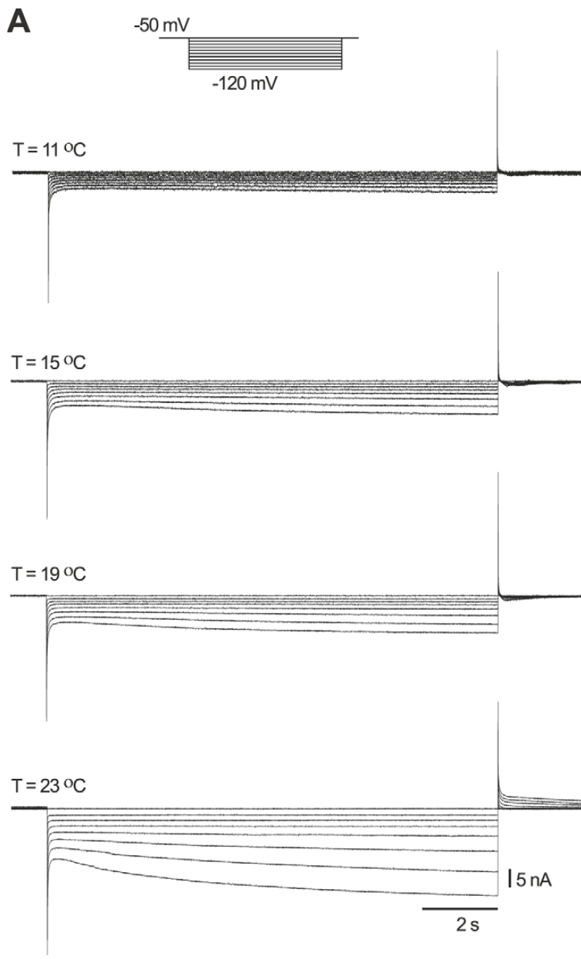
Hyperpolarization recruits an opposing inward current
The hyperpolarization-activated inward current, I_h, turns on as the membrane becomes more negative. It carries a depolarizing influence during and after inhibition, opposing the voltage effect of sustained inhibitory input. Its activation can therefore interact with the outward I_A current in determining LP rebound. The inward influence builds during hyperpolarization and contributes to the return toward threshold as inhibition begins to subside.
Tang and colleagues applied hyperpolarizing voltage steps from a holding potential near −50 mV, with test potentials extending to −120 mV. The slowly developing inward current was recorded at several temperatures. The published recordings have a 15 nA current calibration and a 2 s time calibration. The controlled voltage protocol separated the slowly developing current from the spontaneous oscillation that the neuron expresses in the connected motor circuit.
Warming increased I_h conductance and activation rate, altering its contribution to LP's recovery from inhibition. Its temperature sensitivity differed from those of I_A and synaptic transmission, so the timing response depended on their combined changes. LP models incorporating the measured current sensitivities showed less onset-phase drift during warming than models with temperature-insensitive currents, relating the cellular balance to the network's preserved coordination.
Tang et al. (2010), Fig. 2(B). Crab pyloric circuit
Tang et al. (2010), Fig. 5(A). Hyperpolarization-activated current recordings across temperature
Tang et al. (2010)
39
Notes:
• The hyperpolarization-activated inward current, Ih, turns on as the membrane becomes more negative. It carries a depolarizing influence during and after inhibition, opposing the voltage effect of sustained inhibitory input. Its activation can therefore interact with the outward IA current in determining LP rebound.
– An inward current need not create an action potential immediately; it can alter how quickly a neuron approaches the voltage range where spikes begin.
• Tang and colleagues applied hyperpolarizing voltage steps from a holding potential near −50 mV, with test potentials extending to −120 mV. The slowly developing inward current was recorded at several temperatures. The published recordings have a 15 nA current calibration and a 2 s time calibration.
– The current grows during a sustained hyperpolarizing step, unlike the transient decline of I_A during a depolarizing step.
• Warming increased Ih conductance and accelerated its activation. Its temperature sensitivity differed from that of IA and synaptic inhibition. The observed phase stability must therefore arise from combined processes; it cannot be attributed to every current changing by the same amount or remaining unchanged.
– The experiment measures an electrical current and its temperature dependence, rather than directly counting the channel proteins in the membrane.
References:
Tang LS, Goeritz ML, Caplan JS, Taylor AL, Fisek M, Marder E. (2010). Precise temperature compensation of phase in a rhythmic motor pattern. PLoS Biology 8: e1000469. https://doi.org/10.1371/journal.pbio.1000469
Figure: Tang et al. (2010), Fig. 5(A). Hyperpolarization-activated current recordings across temperature
Figure source: https://doi.org/10.1371/journal.pbio.1000469
Figure: Tang et al. (2010), Fig. 2(B). Crab pyloric circuit
Figure source: https://doi.org/10.1371/journal.pbio.1000469

Slide 51
Temperature-sensitive currents preserve LP phase
After the pacemaker's inhibition ends, two currents compete over LP's return to firing. The h current, opened by the preceding hyperpolarization, pushes LP toward threshold, while the A-type potassium current, freed from inactivation by the same hyperpolarization, opposes depolarization; their balance sets the rebound delay. The two currents retain the effects of the preceding inhibited state, allowing recent synaptic history to shape the next active phase.
Warming speeds every element: stronger inhibitory current, a larger and faster h current, and faster A-current activation and inactivation. These processes have Q10 values between about 1.8 and 4, so the push and the pull scale roughly together and LP's delay shortens along with the cycle. Their different sensitivities can still produce coordinated timing when the total inward and outward influences scale appropriately across the temperature range.
Among 1,270 model bursting neurons selected for suitable activity at one temperature, roughly 60% retained bursting with steadily increasing frequency across the tested range. Suitable conductances at a single temperature therefore coexist with additional requirements on their thermal sensitivities. A working circuit needs combinations that preserve the balance among excitation, inhibition, and recovery as temperature changes the rates of those processes.
Tang et al. (2010), Fig. 5(A). Hyperpolarization-activated current recordings across temperature
Tang et al. (2010)
39a
Notes:
• Slides 38 and 39 measure two currents separately; their opposing roles in rebound explain how LP's phase survives a fourfold change in speed.
• A push and a pull after inhibition.
– Tang and colleagues describe rebound firing after the AB and PD burst as enhanced by activation of the h current and delayed by activation of the A-type current.
– A larger inhibitory current increases activation of the first and removal of inactivation from the second.
• Similar temperature dependence keeps them in proportion.
– Q10 expresses how much a rate or amplitude changes over ten degrees, and the LP processes Tang and colleagues measured had Q10 values from about 1.8 to 4.
– Their models of LP held phase best when the currents contributing to phase had Q10 values close to that of the rhythm itself.
• Bursting itself is fragile.
– About 40% of the model bursting neurons failed to burst over the whole range or slowed down over part of it.
– Tang and colleagues argue that evolutionary pressure may restrict the temperature dependence of the processes contributing to compensation, even though channel numbers vary between animals.
References:
Tang LS, Goeritz ML, Caplan JS, Taylor AL, Fisek M, Marder E. (2010). Precise temperature compensation of phase in a rhythmic motor pattern. PLoS Biology 8: e1000469. https://doi.org/10.1371/journal.pbio.1000469

Slide 52
A weakly driven gastric rhythm fails after modest warming
Städele and colleagues held MCN1 stimulation constant near the minimum frequency that recruited a gastric mill rhythm at 10°C. They then warmed the crab STG to 13°C while recording LG. This isolated preparation lacked the anterior circuits that could naturally increase descending drive. Holding the descending stimulus near threshold left little additional drive available to compensate for a temperature-dependent change within LG and its local circuit.
LG’s regular bursts disappeared at 13°C with the same MCN1 stimulation. Cooling back to 10°C restored the recurring LG bursts while the same descending stimulation remained available. The published example used a 6 Hz stimulus throughout, separating temperature-dependent circuit failure from an intentional reduction of input frequency. The reversible failure followed warming under a continuing input, with recovery occurring as the local tissue returned to the cooler state.
At threshold drive, LG spike output declined progressively until rhythmic bursting stopped near 12.7°C. Stronger MCN1 stimulation moved the failure temperature to about 15.9°C, expanding the range over which the circuit expressed the gastric program. The thermal tolerance of this weakly driven network therefore depended on the amount of descending excitation available to counter the local effects of warming.
Städele et al. (2015), Fig. 1(A). Gastric circuit
Städele et al. (2015), Fig. 2(A). Fixed 6 Hz MCN1 drive fails at 13°C and recovers after cooling
Städele et al. (2015)
40
Notes:
• Städele and colleagues held MCN1 stimulation constant near the minimum frequency that recruited a gastric mill rhythm at 10°C. They then warmed the crab STG to 13°C while recording LG. This isolated preparation lacked the anterior circuits that could naturally increase descending drive.
– The within-preparation return to 10°C is a recovery control, reducing the likelihood that the lost bursting simply reflected irreversible damage.
• LG’s regular bursts disappeared at 13°C with the same MCN1 stimulation. Cooling back to 10°C restored them. The published example used a 6 Hz stimulus throughout, separating temperature-dependent circuit failure from an intentional reduction of input frequency.
– The term failure here refers to the absence of rhythmic LG bursting, even when some spikes or membrane activity remained.
• The failure was conditional on the weak, fixed drive and the isolated preparation. It does not establish that a living crab loses chewing after every 3°C temperature increase. A different input strength or naturally changing descending activity can preserve the slow motor rhythm at the same temperature.
– Input state must accompany any temperature threshold: the authors could raise the permissive temperature range by increasing MCN1 stimulation.
References:
Städele C, Heigele S, Stein W. (2015). Neuromodulation to the Rescue: Compensation of Temperature-Induced Breakdown of Rhythmic Motor Patterns via Extrinsic Neuromodulatory Input. PLoS Biology 13: e1002265. https://doi.org/10.1371/journal.pbio.1002265
Figure: Städele et al. (2015), Fig. 2(A). Fixed 6 Hz MCN1 drive fails at 13°C and recovers after cooling
Figure source: https://doi.org/10.1371/journal.pbio.1002265
Figure: Städele et al. (2015), Fig. 1(A). Gastric circuit
Figure source: https://doi.org/10.1371/journal.pbio.1002265

Slide 53
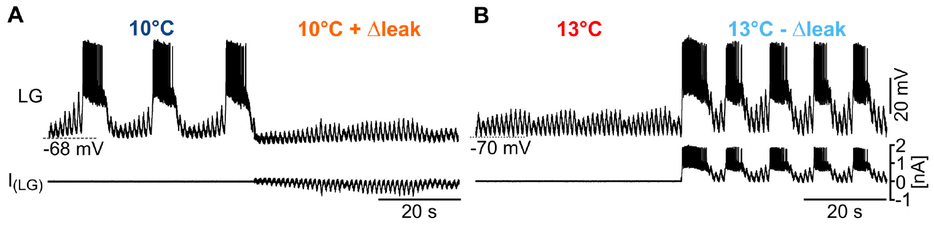
Leak conductance can stop or restore gastric bursting
A leak conductance is a membrane pathway that contributes current without the rapid voltage gating characteristic of spike-generating channels. Städele and colleagues found that warming reduced LG input resistance, so a given input current produced a smaller membrane-voltage change. Lower input resistance means that more current is required to produce a given depolarization, reducing the voltage effect of excitation arriving at LG.
Dynamic clamp added an effective leak to LG at 10°C during 7 Hz MCN1 stimulation, and bursting stopped. At 13°C, subtracting an effective leak restored recurring LG bursts while the MCN1 stimulus remained unchanged. Opposite interventions tested whether the conductance change was sufficient to alter circuit output. The opposing dynamic-clamp interventions changed the effective conductance while retaining the ongoing descending stimulus and the neuron's other membrane processes.
Warming increased LG leak conductance by approximately half, shunting incoming excitation, including the electrical influence of MCN1. Hyperpolarizing LG at 10°C to the warmer resting voltage preserved the rhythm, separating that voltage shift from the conductance increase. The leak intervention therefore affected the strength with which input could change the membrane potential, determining whether ongoing drive could recruit repeated LG activity.
Städele et al. (2015), Fig. 4(A–B). Added leak stops bursting; leak subtraction rescues it
Städele et al. (2015), Fig. 1(A). Gastric circuit
Städele et al. (2015)
41
Notes:
• A leak conductance is a membrane pathway that contributes current without the rapid voltage gating characteristic of spike-generating channels. Städele and colleagues found that warming reduced LG input resistance, so a given input current produced a smaller membrane-voltage change.
– Input resistance describes the voltage response to an injected current; a larger effective membrane conductance makes that response smaller.
• Dynamic clamp added an effective leak to LG at 10°C during 7 Hz MCN1 stimulation, and bursting stopped. At 13°C, subtracting an effective leak restored recurring LG bursts while the MCN1 stimulus remained unchanged. Opposite interventions tested whether the conductance change was sufficient to alter circuit output.
– The dynamic clamp used the measured voltage to calculate an added or subtracted current continuously, while the biological circuit remained active.
• Leak subtraction is an imposed electrical compensation, rather than direct removal of a channel protein. The causal result connects LG membrane responsiveness to gastric rhythmicity in this preparation. It does not establish that the animal compensates warming by physically closing exactly the channels represented in the clamp.
– The addition and subtraction tests are stronger evidence than observing a resistance change and a rhythm change at the same time.
References:
Städele C, Heigele S, Stein W. (2015). Neuromodulation to the Rescue: Compensation of Temperature-Induced Breakdown of Rhythmic Motor Patterns via Extrinsic Neuromodulatory Input. PLoS Biology 13: e1002265. https://doi.org/10.1371/journal.pbio.1002265
Figure: Städele et al. (2015), Fig. 4(A–B). Added leak stops bursting; leak subtraction rescues it
Figure source: https://doi.org/10.1371/journal.pbio.1002265
Figure: Städele et al. (2015), Fig. 1(A). Gastric circuit
Figure source: https://doi.org/10.1371/journal.pbio.1002265

Slide 54
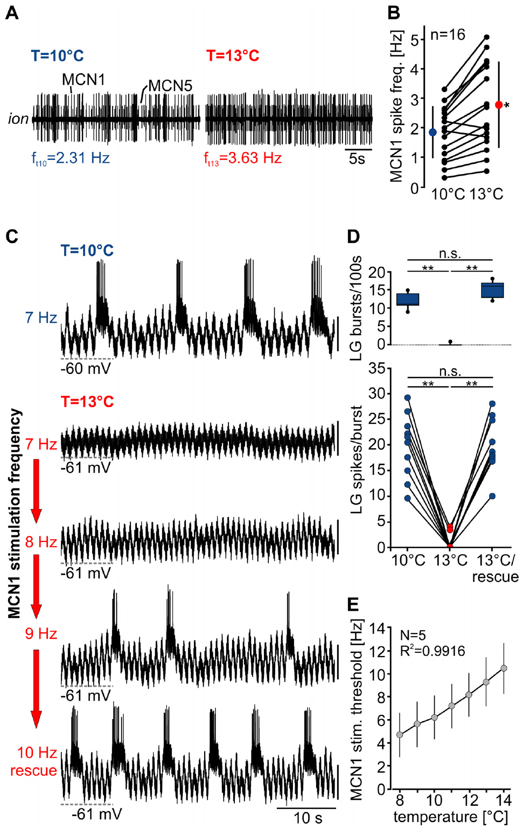
Stronger descending drive restores gastric output
The crab gastric mill rhythm persisted at 13°C in intact-animal recordings, despite failure of the isolated weakly driven preparation. Städele and colleagues tested whether descending MCN1 activity could supply compensatory input. They recorded MCN1 axonal activity from the commissural ganglion pathway during warming. The intact descending system retained temperature-sensitive input pathways capable of increasing excitation as the local ganglion became warmer.
MCN1 firing increased as the preparation warmed, supplying additional descending activity to the temperature-sensitive gastric circuit. In the published example it rose from 2.31 Hz at 10°C to 3.63 Hz at 13°C. In a separate controlled stimulation test, increasing imposed MCN1 activity from 7 Hz to 9 Hz at 13°C restored LG bursting; returning to 7 Hz removed that rescue. Returning the controlled stimulus to its lower rate removed the rescue, relating the recovered rhythm to the extra descending activity.
The increase in MCN1 firing compensated for temperature-sensitive LG responsiveness, supplying additional drive as leak reduced the voltage impact of input. Threshold stimulation rose by approximately 1 Hz per degree in the measured relationship. MCN1's own response to warming therefore supplied a route by which the larger nervous system could maintain gastric bursting over temperatures that stopped a weakly driven isolated circuit.
Städele et al. (2015), Fig. 1(A). Gastric circuit
Städele et al. (2015), Fig. 6(A–E). MCN1 activity increases with warming and stronger stimulation rescues LG
Städele et al. (2015)
42
Notes:
• The crab gastric mill rhythm persisted at 13°C in intact-animal recordings, despite failure of the isolated weakly driven preparation. Städele and colleagues tested whether descending MCN1 activity could supply compensatory input. They recorded MCN1 axonal activity from the commissural ganglion pathway during warming.
– The MCN1 recordings were made from the remaining nerve connected to its cell-body ganglion, so the measured firing was not inferred from LG output.
• MCN1 firing increased with temperature. In the published example it rose from 2.31 Hz at 10°C to 3.63 Hz at 13°C. In a separate controlled stimulation test, increasing imposed MCN1 activity from 7 Hz to 9 Hz at 13°C restored LG bursting; returning to 7 Hz removed that rescue.
– The controlled rescue changed stimulation frequency while holding the elevated STG temperature fixed.
• Descending drive can compensate a temperature-sensitive local circuit. The intact-animal comparison supports a role for naturally changing input but does not isolate MCN1 as the only compensatory pathway in vivo. Circuit robustness depends on the nervous-system components retained by the experimental preparation.
– The intact recordings and isolated stimulation experiments answer complementary questions: whether the rhythm survives in the animal, and whether stronger MCN1 drive can restore it in a defined circuit state.
References:
Städele C, Heigele S, Stein W. (2015). Neuromodulation to the Rescue: Compensation of Temperature-Induced Breakdown of Rhythmic Motor Patterns via Extrinsic Neuromodulatory Input. PLoS Biology 13: e1002265. https://doi.org/10.1371/journal.pbio.1002265
Figure: Städele et al. (2015), Fig. 6(A–E). MCN1 activity increases with warming and stronger stimulation rescues LG
Figure source: https://doi.org/10.1371/journal.pbio.1002265
Figure: Städele et al. (2015), Fig. 1(A). Gastric circuit
Figure source: https://doi.org/10.1371/journal.pbio.1002265

Slide 55
Pyloric and gastric circuits compensate warming differently
The pyloric and gastric circuits share one ganglion and similar currents, yet warming affects them differently. The pyloric rhythm keeps its pattern when only the STG is warmed and its descending inputs stay cool, so its compensation is built into the ganglion's own cells and synapses. Within the pyloric network, coordinated changes in synaptic and intrinsic membrane processes preserve the phase sequence as the cycle becomes faster.
The weakly driven gastric circuit responds to warming through a leak increase that must be opposed by sufficient modulatory drive. Warming increases LG leak, and only the modulator-activated inward current supplied by MCN1 from outside the ganglion offsets it, so the gastric rhythm's temperature tolerance moves with the activity of its projection neurons. The balance between outward leak and inward modulatory drive determines whether LG can reach the state needed for continued gastric bursting.
The two motor programs have different patterns of operation, with the pyloric rhythm continuously filtering and the gastric rhythm episodically chewing. Gastric projection neurons already integrate sensory and feeding-related signals that regulate its recruitment. Their temperature-dependent activity can therefore alter the available excitation together with those behavioral inputs, while the pyloric circuit retains substantial local compensation within the ganglion itself.
Städele et al. (2015), Fig. 6(A–E). MCN1 activity increases with warming and stronger stimulation rescues LG
Städele et al. (2015); Tang et al. (2010)
42a
Notes:
• Slides 36 to 43 present the pyloric and gastric temperature studies in turn; comparing them shows two different strategies for the same problem.
• Pyloric compensation is intrinsic.
– Städele and colleagues warmed only the STG and found the pyloric rhythm continuing without obvious change even at 19 degrees.
– That result places the pyloric compensation described on slides 37 to 39 inside the ganglion rather than in its inputs.
• Gastric compensation is extrinsic.
– The leak increase on slide 41 is opposed by the peptide-activated current of slide 43, and that current depends on MCN1 activity.
– Städele and colleagues conclude that temperature compensation in the gastric circuit is highly dependent on extrinsic input.
• Why two strategies.
– The authors suggest intrinsic compensation suits networks that must run continuously, while episodic generators can use their descending innervation.
– Descending pathways integrate multiple sensory modalities, so compensation through them can be adjusted to behavioral conditions.
References:
Städele C, Heigele S, Stein W. (2015). Neuromodulation to the Rescue: Compensation of Temperature-Induced Breakdown of Rhythmic Motor Patterns via Extrinsic Neuromodulatory Input. PLoS Biology 13: e1002265. https://doi.org/10.1371/journal.pbio.1002265
Tang LS, Goeritz ML, Caplan JS, Taylor AL, Fisek M, Marder E. (2010). Precise temperature compensation of phase in a rhythmic motor pattern. PLoS Biology 8: e1000469. https://doi.org/10.1371/journal.pbio.1000469

Slide 56
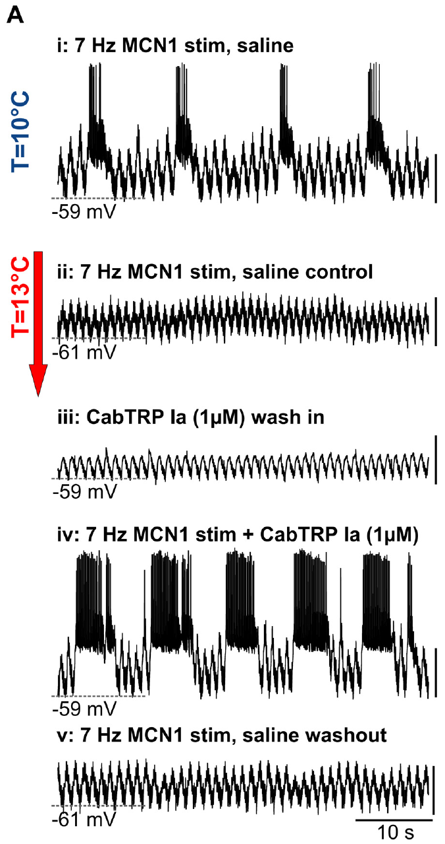
CabTRP Ia can rescue the rhythm with continuing input
Städele and colleagues applied 1 μM CabTRP Ia to the warmed crab STG. CabTRP Ia is a peptide cotransmitter of MCN1: cotransmission means that one neuron supplies more than one chemical signal. The peptide can strengthen the modulatory influence received by LG without increasing the imposed axonal stimulus frequency. The experiment increased one chemical component of descending influence while leaving the rate of the imposed MCN1 spike train available for separate control.
At 13°C, 7 Hz MCN1 stimulation alone failed to sustain LG bursts in the published example. CabTRP Ia together with continuing stimulation restored rhythmic bursting. Peptide application without the accompanying stimulation did not fully recreate that recovered rhythm, and washout removed the rescue. The rescue depended on the combined state produced by the peptide and the continuing projection-neuron input, with rhythmic activity declining again during washout.
The modulator-activated inward current I_MI has a negative-slope voltage region because extracellular calcium suppresses it more strongly at hyperpolarized voltages. In that range, it can oppose the functional effect of increased leak, helping LG respond to excitation. In the authors' model, larger leak required proportionately larger modulatory current, relating peptide action to the membrane balance that determines whether gastric bursting continues.
Städele et al. (2015), Fig. 1(A). Gastric circuit
Städele et al. (2015), Fig. 7(A). CabTRP Ia with continuing MCN1 drive restores LG bursts at 13°C
Städele et al. (2015)
43
Notes:
• Städele and colleagues applied 1 μM CabTRP Ia to the warmed crab STG. CabTRP Ia is a peptide cotransmitter of MCN1: cotransmission means that one neuron supplies more than one chemical signal. The peptide can strengthen the modulatory influence received by LG without increasing the imposed axonal stimulus frequency.
– The same neuron can release signals whose actions differ in time course and target, so bath application of one cotransmitter need not reproduce complete neuron stimulation.
• At 13°C, 7 Hz MCN1 stimulation alone failed to sustain LG bursts in the published example. CabTRP Ia together with continuing stimulation restored rhythmic bursting. Peptide application without the accompanying stimulation did not fully recreate that recovered rhythm, and washout removed the rescue.
– The experiment included peptide alone, peptide with continued MCN1 stimulation and peptide washout while the elevated temperature was maintained.
• The peptide and remaining MCN1 actions jointly maintained the effective drive needed for oscillation. Activation of IMI can counteract the temperature-associated loss of membrane responsiveness; the authors’ conductance model supports that explanation. The rescue recording itself does not identify every intervening signaling molecule or exclude additional MCN1 mechanisms.
– The mechanistic proposal is that additional inward current offsets the increased effective leak; molecular steps linking the peptide receptor to the channel were not resolved by this rescue experiment.
References:
Städele C, Heigele S, Stein W. (2015). Neuromodulation to the Rescue: Compensation of Temperature-Induced Breakdown of Rhythmic Motor Patterns via Extrinsic Neuromodulatory Input. PLoS Biology 13: e1002265. https://doi.org/10.1371/journal.pbio.1002265
Figure: Städele et al. (2015), Fig. 7(A). CabTRP Ia with continuing MCN1 drive restores LG bursts at 13°C
Figure source: https://doi.org/10.1371/journal.pbio.1002265
Figure: Städele et al. (2015), Fig. 1(A). Gastric circuit
Figure source: https://doi.org/10.1371/journal.pbio.1002265

Slide 57
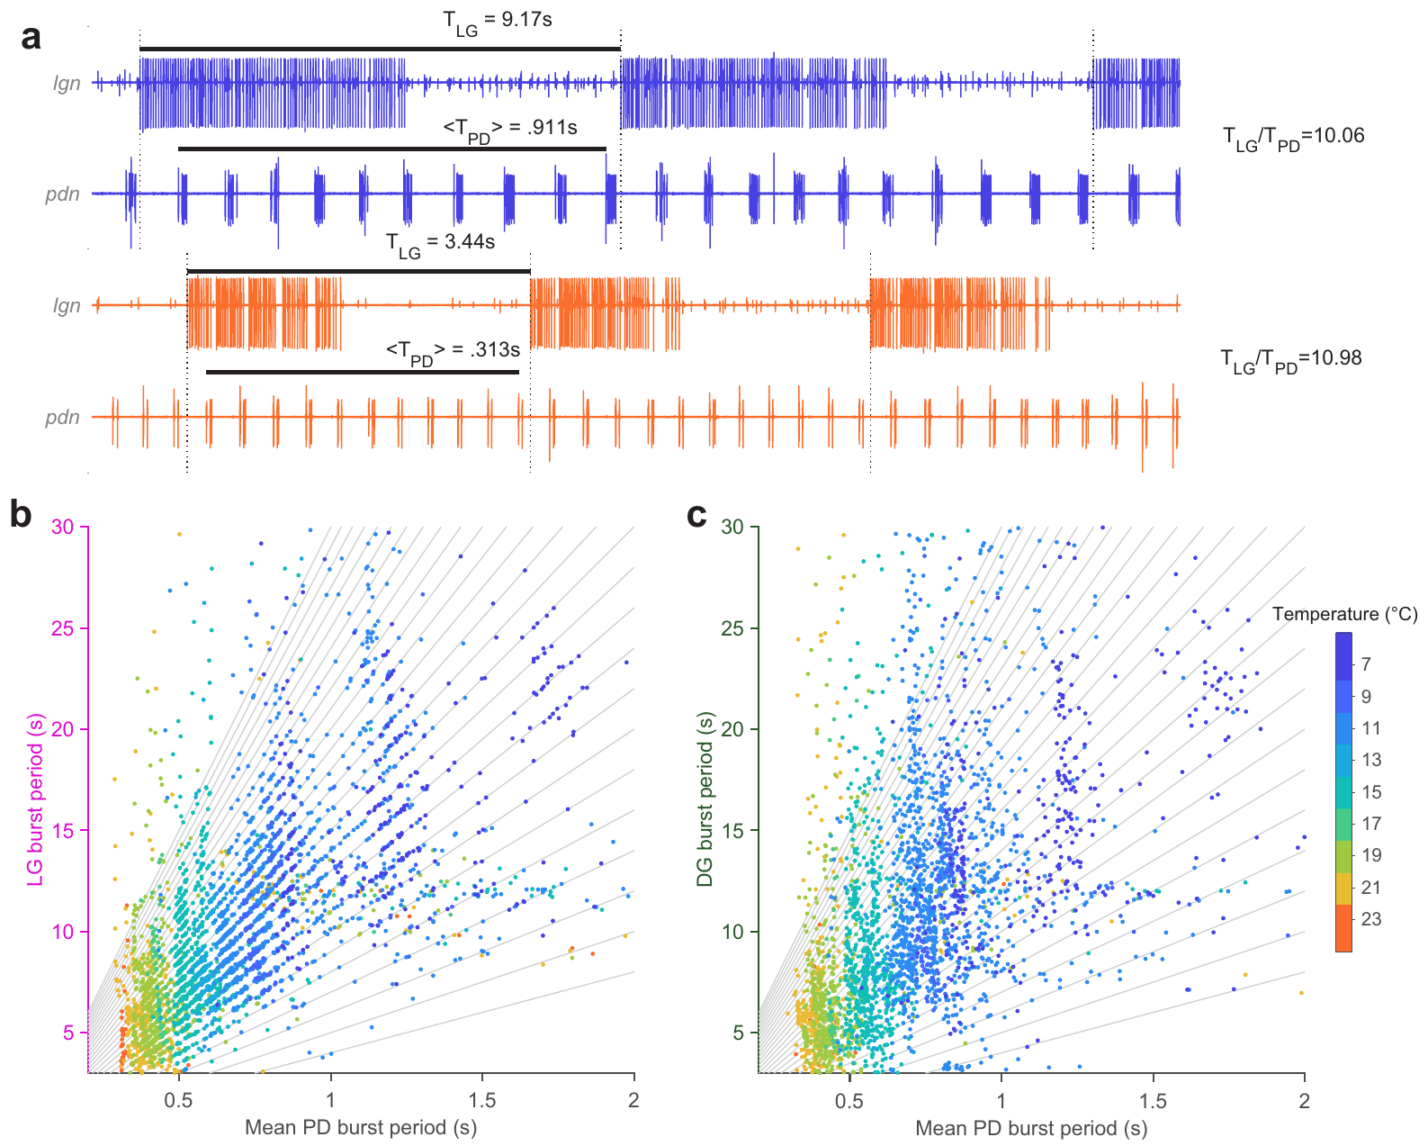
Fast and slow rhythms retain integer coupling
Integer coupling means that a slow rhythm’s cycle duration lies close to a whole-number multiple of a faster rhythm’s period. Powell and colleagues tested this relationship between crab gastric LG bursts and pyloric PD bursts while changing temperature from 7°C to 23°C. The relationship concerns the number of fast cycles fitting within one slow cycle, while each rhythm remains free to change its own speed.
Both rhythms accelerated, yet LG cycles remained close to integer numbers of PD cycles. In the published example, an LG cycle lasted 9.17 s with a mean PD period of 0.911 s at 7°C; at 23°C, the corresponding values were 3.44 s and 0.313 s. The integer number could change with the condition, while the slow cycle remained near a whole-number count of faster cycles. The corresponding ratios remained near whole numbers even though warming shortened both periods and could change the integer expressed in a given episode.
LG burst onset retained a preferred pyloric phase, while the relationship between DG and the fast rhythm was weaker. Both rhythms commonly accelerated with Q10 values around 2, helping retain their coordinated cycle ratio over the temperature change. The coupled system therefore preserved a relationship between slow chewing and fast filtering through relative phase and near-integer timing as both motor programs sped up.
Powell et al. (2021), Fig. 1(c). Crab STG circuit
Powell et al. (2021), Fig. 5(a–c). Gastric periods remain near integer multiples of pyloric periods
Powell et al. (2021)
44
Notes:
• Integer coupling means that a slow rhythm’s cycle duration lies close to a whole-number multiple of a faster rhythm’s period. Powell and colleagues tested this relationship between crab gastric LG bursts and pyloric PD bursts while changing temperature from 7°C to 23°C.
– The cycle ratios in the published example are approximately ten and eleven, so integer coupling does not mean an invariant ten-to-one ratio.
• Both rhythms accelerated, yet LG cycles remained close to integer numbers of PD cycles. In the published example, an LG cycle lasted 9.17 s with a mean PD period of 0.911 s at 7°C; at 23°C, the corresponding values were 3.44 s and 0.313 s. The integer number itself could change.
– AB inhibition of Int1 can create a brief reduction in inhibition of LG, contributing a pyloric-timed opportunity for LG burst initiation.
• Coordination therefore persisted without holding either oscillator’s frequency constant. LG burst starts retained a preferred pyloric phase, whereas DG coupling was weaker. These are empirical timing relationships; they do not establish that every gastric rhythm produced by every descending input follows the same coupling rule.
– The strong contrast with the weakly driven 2015 preparation is consistent with different circuit and input states, rather than a universal temperature threshold for gastric rhythms.
References:
Powell D, Haddad SA, Gorur-Shandilya S, Marder E. (2021). Coupling between fast and slow oscillator circuits in Cancer borealis is temperature-compensated. eLife 10: e60454. https://doi.org/10.7554/elife.60454
Figure: Powell et al. (2021), Fig. 5(a–c). Gastric periods remain near integer multiples of pyloric periods
Figure source: https://doi.org/10.7554/elife.60454
Figure: Powell et al. (2021), Fig. 1(c). Crab STG circuit
Figure source: https://doi.org/10.7554/elife.60454

Slide 58
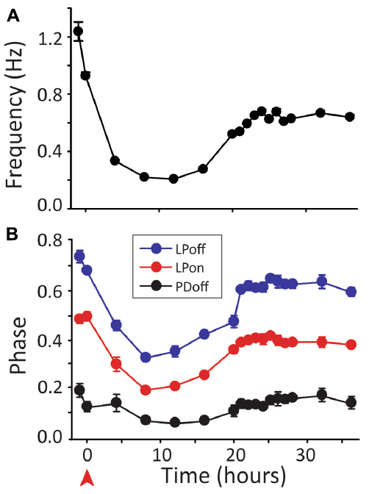

Circuit activity can recover after input removal
More-Potdar and Golowasch followed crab pyloric preparations for many hours after decentralization, removal of descending modulatory input. They recorded the outgoing motor rhythm over time and tested its phase relationships at different temperatures. Immediate slowing was therefore distinguished from the later state of the same circuit. Following the same preparation through the first day related the initial response to input removal with the later activity expressed after prolonged decentralization.
In the published time course, the study reported frequency recovery to approximately 75% of control and phases to within about 10% of control after approximately 24 h. Temperature tests found recovery of several phase relationships across the tested range, with incomplete recovery for some measures over the broadest range. Recovered timing could then be tested across temperature changes, examining the robustness of the reorganized output beyond its rate at a single temperature.
After prolonged input loss, the pyloric circuit regained temperature-robust phase relationships, with several measures varying about as little across 9–30°C as in preparations retaining their modulatory input. Recovery developed over hours alongside the return of frequency and phase toward the earlier output. The later circuit therefore expressed an adjusted functional state capable of maintaining coordinated motor timing under changing environmental conditions.
More-Potdar & Golowasch (2023), Fig. 1(B). Pyloric circuit
More-Potdar & Golowasch (2023), Fig. 2(A–B). Frequency and phase recover over hours after decentralization
More-Potdar & Golowasch (2023)
45
Notes:
• More-Potdar and Golowasch followed crab pyloric preparations for many hours after decentralization, removal of descending modulatory input. They recorded the outgoing motor rhythm over time and tested its phase relationships at different temperatures. Immediate slowing was therefore distinguished from the later state of the same circuit.
– Homeostatic regulation is compensatory adjustment that tends to restore a functional property after perturbation; recovery of output does not imply restoration of the original parameter values.
• In the published time course, the study reported frequency recovery to approximately 75% of control and phases to within about 10% of control after approximately 24 h. Temperature tests found recovery of several phase relationships across the tested range, with incomplete recovery for some measures over the broadest range.
– The study compared time-matched connected and decentralized preparations, reducing confusion between recovery and the ordinary passage of time in an isolated preparation.
• Long-term recovery supports regulation of functional output after loss of modulation. The authors propose homeostatic changes in intrinsic and synaptic properties; the experiment does not identify one uniquely responsible channel change. Near-normal baseline rhythmicity and resilience to temperature are distinct properties that require separate measurements.
– Recovery of motor-nerve output does not establish normal feeding behavior in a crab after removal of its descending inputs.
References:
More-Potdar S, Golowasch J. (2023). Oscillatory network spontaneously recovers both activity and robustness after prolonged removal of neuromodulators. Frontiers in Cellular Neuroscience 17: 1280575. https://doi.org/10.3389/fncel.2023.1280575
Figure: More-Potdar & Golowasch (2023), Fig. 2(A–B). Frequency and phase recover over hours after decentralization
Figure source: https://doi.org/10.3389/fncel.2023.1280575
Figure: More-Potdar & Golowasch (2023), Fig. 1(B). Pyloric circuit
Figure source: https://doi.org/10.3389/fncel.2023.1280575

Slide 59
Different conductance sets rebuild one pyloric output
A circuit is degenerate when many different combinations of conductances produce the same activity. Pyloric neurons fit this description: an identified cell can carry ion channel levels that differ several-fold between animals while its bursts and phases look alike. Different inward and outward currents can compensate for one another, allowing similar voltage trajectories and motor phases to arise from different cellular parameter combinations.
Degeneracy gives a decentralized circuit room to recover. Activity-dependent regulation can move each neuron's conductances to a new combination that restores output without restoring the original values; in PD, the A-type current falls within a day of decentralization and returns only after about five days. The changing current follows a timescale extending beyond the first recovered activity, allowing the network to move through several cellular configurations after input loss.
The A-type current in PD contributes an outward influence that can delay activity after inhibition, so reducing it favors earlier recruitment. Returning motor phases toward control therefore requires coordinated changes in additional intrinsic and synaptic properties. Recovery can restore a working temporal pattern through a new conductance combination, with regulation acting across the interacting processes that determine excitability, inhibition, and burst timing.
More-Potdar & Golowasch (2023), Fig. 1(B). Pyloric circuit
More-Potdar & Golowasch (2023), Fig. 2(A–B). Frequency and phase recover over hours after decentralization
More-Potdar & Golowasch (2023); Schneider et al. (2022); Tang et al. (2010)
45a
Notes:
• Slide 45 reports recovery after decentralization; degeneracy explains how recovery can happen without returning every channel to its old level.
• Same output, different parts.
– Schneider and colleagues point out that in a neuron present as a single copy per animal, channel conductances and their mRNA levels can vary several-fold while activity stays similar.
– Tang and colleagues make the same point for current densities in identified pyloric neurons.
• Recovery through reorganization.
– More-Potdar and Golowasch propose that the whole conductance space of each neuron reorganizes after decentralization, producing the same activity from a different combination.
– They cite a decrease in PD's A-type current a day after decentralization, with recovery to control values only after about five days.
• Many conductances must move together.
– A reduced A-type current would be expected to phase-advance bursting, which matches the early change after decentralization.
– Since that current alone recovers too slowly to explain recovery at 24 hours, simultaneous changes in synaptic currents and other conductances are needed.
References:
More-Potdar S, Golowasch J. (2023). Oscillatory network spontaneously recovers both activity and robustness after prolonged removal of neuromodulators. Frontiers in Cellular Neuroscience 17: 1280575. https://doi.org/10.3389/fncel.2023.1280575
Schneider AC, Itani O, Bucher D, Nadim F. (2022). Neuromodulation Reduces Interindividual Variability of Neuronal Output. eNeuro 9: ENEURO.0166-22.2022. https://doi.org/10.1523/eneuro.0166-22.2022
Tang LS, Goeritz ML, Caplan JS, Taylor AL, Fisek M, Marder E. (2010). Precise temperature compensation of phase in a rhythmic motor pattern. PLoS Biology 8: e1000469. https://doi.org/10.1371/journal.pbio.1000469

Slide 60
Key takeaways
The AB pacemaker retains endogenous bursting, while PD and several followers can express conditional oscillations under suitable input states. Electrical coupling combines AB and PD into a synchronized kernel whose activity depends on both cellular and network properties.
Electrical propagation and chemical inhibition provide distinct routes through the same identified network. AB and PD synchronize electrically while supplying chemically different outputs, and LP feedback reaches AB through its synapse on PD.
A transmitter's effect depends on the target receptor and its ionic mechanism. Acetylcholine excites the lobster dilator muscle while PD's central cholinergic input inhibits LP through a potassium-sensitive pathway.
Follower phase emerges from synaptic timing and membrane recovery, including inhibitory strength, duration, peak position, and rebound currents. Slow graded release carries these voltage-dependent influences through portions of the rhythm containing few or no spikes.
Neuromodulators recruit different cellular and synaptic states, even when their actions converge on the same inward current. Their target distribution, voltage dependence, and effects on transmission determine the resulting motor pattern.
Temperature robustness and recovery depend on the circuit state, with local current balance preserving pyloric phase and stronger MCN1 drive rescuing gastric output. Long-term decentralization also permits reorganization toward recovered frequency, coordination, and thermal tolerance.
Marder (1976); Miller & Selverston (1982); Eisen & Marder (1982); Tang et al. (2010); Städele et al. (2015); Rosenbaum & Marder (2018); Powell et al. (2021)
46
Notes:
References:
Powell D, Haddad SA, Gorur-Shandilya S, Marder E. (2021). Coupling between fast and slow oscillator circuits in Cancer borealis is temperature-compensated. eLife 10: e60454. https://doi.org/10.7554/elife.60454
Garcia VJ, Daur N, Temporal S, Schulz DJ, Bucher D. (2015). Neuropeptide receptor transcript expression levels and magnitude of ionic current responses show cell type-specific differences in a small motor circuit. Journal of Neuroscience 35: 6786-6800. https://doi.org/10.1523/jneurosci.0171-15.2015
Miller JP, Selverston AI. (1982). Mechanisms underlying pattern generation in lobster stomatogastric ganglion as determined by selective inactivation of identified neurons. II. Oscillatory properties of pyloric neurons. Journal of Neurophysiology 48: 1378-1391. https://doi.org/10.1152/jn.1982.48.6.1378
Hooper SL, Marder E. (1987). Modulation of the lobster pyloric rhythm by the peptide proctolin. Journal of Neuroscience 7: 2097-2112. https://doi.org/10.1523/jneurosci.07-07-02097.1987
Rosenbaum P, Marder E. (2018). Graded Transmission without Action Potentials Sustains Rhythmic Activity in Some But Not All Modulators That Activate the Same Current. Journal of Neuroscience 38: 8976-8988. https://doi.org/10.1523/jneurosci.2632-17.2018
Gorur-Shandilya S, Cronin EM, Schneider AC, Haddad SA, Rosenbaum P, Bucher D, Nadim F, Marder E. (2022). Mapping circuit dynamics during function and dysfunction. eLife 11: e76579. https://doi.org/10.7554/elife.76579
Eisen JS, Marder E. (1982). Mechanisms underlying pattern generation in lobster stomatogastric ganglion as determined by selective inactivation of identified neurons. III. Synaptic connections of electrically coupled pyloric neurons. Journal of Neurophysiology 48: 1392-1415. https://doi.org/10.1152/jn.1982.48.6.1392
Marder E. (1976). Cholinergic motor neurones in the stomatogastric system of the lobster. The Journal of Physiology 257: 63-86. https://doi.org/10.1113/jphysiol.1976.sp011356
Martinez D, Anwar H, Bose A, Bucher DM, Nadim F. (2019). Short-term synaptic dynamics control the activity phase of neurons in an oscillatory network. eLife 8: e46911. https://doi.org/10.7554/elife.46911
Tang LS, Goeritz ML, Caplan JS, Taylor AL, Fisek M, Marder E. (2010). Precise temperature compensation of phase in a rhythmic motor pattern. PLoS Biology 8: e1000469. https://doi.org/10.1371/journal.pbio.1000469
Schneider AC, Itani O, Bucher D, Nadim F. (2022). Neuromodulation Reduces Interindividual Variability of Neuronal Output. eNeuro 9: ENEURO.0166-22.2022. https://doi.org/10.1523/eneuro.0166-22.2022
Städele C, Heigele S, Stein W. (2015). Neuromodulation to the Rescue: Compensation of Temperature-Induced Breakdown of Rhythmic Motor Patterns via Extrinsic Neuromodulatory Input. PLoS Biology 13: e1002265. https://doi.org/10.1371/journal.pbio.1002265
More-Potdar S, Golowasch J. (2023). Oscillatory network spontaneously recovers both activity and robustness after prolonged removal of neuromodulators. Frontiers in Cellular Neuroscience 17: 1280575. https://doi.org/10.3389/fncel.2023.1280575

