Slide 1
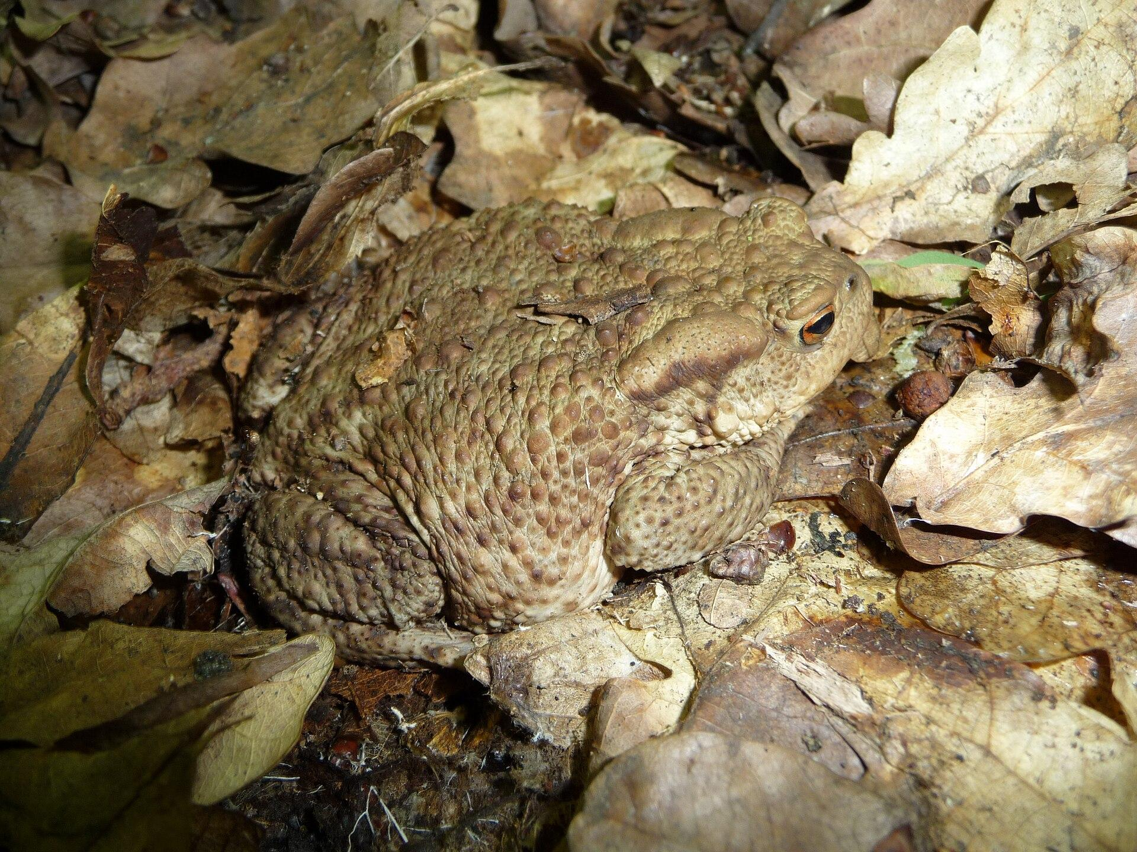
NEUR 411 · NEUROETHOLOGY · FALL 2026
Lecture 9
Amphibian prey capture I:
toad visual prey-catching and tectal feature detectors (Ewert)
Monday, September 14, 2026
Jordan Lopez, Ph.D.
Professor of Neurobiology & Biomedical Engineering
Photo: Common toad (Bufo bufo), the species used in Ewert's prey-catching studies.
Notes:
Amphibian prey capture I: toad visual prey-catching and tectal feature detectors (Ewert)
Lecture 9. NEUR 411 · NEUROETHOLOGY · FALL 2026. Monday, September 14, 2026.
Image: Photo: Common toad (Bufo bufo), the species used in Ewert's prey-catching studies. Credit: George Chernilevsky. License: Public domain. Source: https://commons.wikimedia.org/wiki/File:Bufo_bufo_2009_G1.jpg

Slide 2
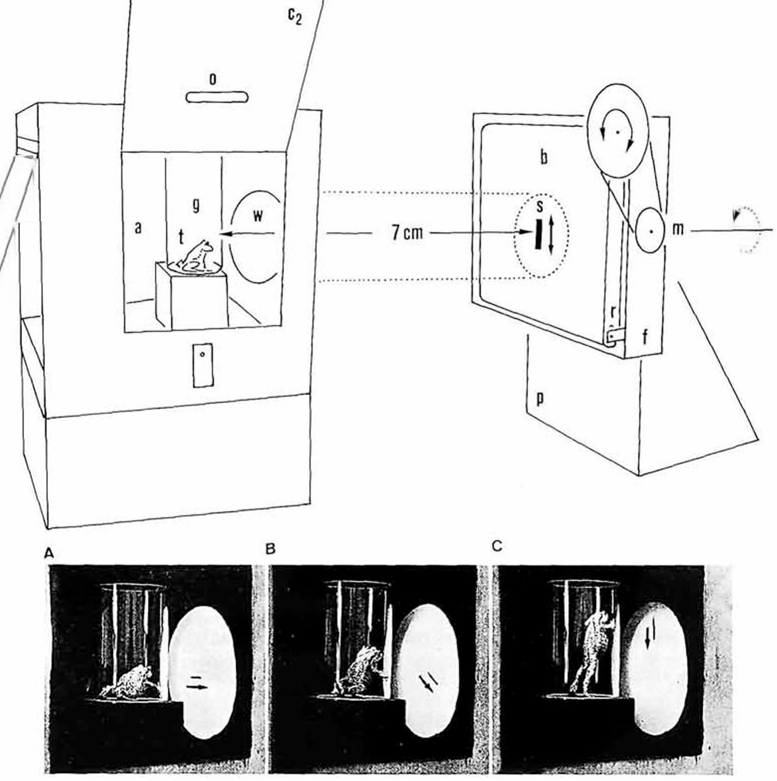
Common toads catch prey in a fixed sequence of acts
The common toad, Bufo bufo, is an active forager. Prey-catching proceeds as a sequence of acts: the toad orients (turns its head and body toward the object), approaches it, fixates it binocularly and finally snaps, flipping out its sticky tongue. Each act is ballistic, but the chain depends on where the prey moves. Orienting and approach position the body for binocular fixation before the final tongue strike, making visual selection part of the sequence preceding capture.
Ewert's laboratory measured the first act under controlled conditions. A toad sat in a glass vessel while a small cardboard object was driven past a window at a fixed distance of about 7 cm, and an observer counted the toad's turning responses. The controlled moving object retained visual motion and geometry while separating the first orienting act from later requirements for approaching and swallowing prey.
The sequence depends on the location and movement of the prey, with each completed act providing the starting position for the next. Frogs such as Rana esculenta often combine orientation and snapping in a more continuous event during sit-and-wait hunting. The actively foraging toad expresses a more separated series of movements, allowing the initial visual response to be measured before the animal commits to the final strike.
Ewert et al. (1979), Fig. 1. Apparatus: a toad (t) in a glass vessel watches a stimulus (s) moved past a window; photos A–C show turning toward it.
Ewert et al. (2001); Ewert et al. (1979)
02
Notes:
• The common toad is an active hunter, and Ewert broke its prey-catching into a sequence of separate acts.
– First it orients, turning toward the object; then it approaches, fixates the object with both eyes, and finally snaps with its tongue.
– Each act is fast and ballistic, but which act comes next depends on where the prey is.
• To measure the behavior, a toad sat in a glass vessel and a small piece of black cardboard was moved past a window about 7 centimeters away.
– Counting how often the toad turned toward the object gives a number for how prey-like that object is.
• Frogs like Rana esculenta wait for prey instead, often turning and snapping in one movement, and they snap at non-prey items more often than toads.
References:
Ewert JP, Buxbaum-Conradi H, Dreisvogt F, Glagow M, Merkel-Harff C, Röttgen A, Schürg-Pfeiffer E, Schwippert WW (2001). Neural modulation of visuomotor functions underlying prey-catching behaviour in anurans: perception, attention, motor performance, learning. Comparative Biochemistry and Physiology A 128: 417–461. https://doi.org/10.1016/S1095-6433(00)00333-0
Ewert JP, Arend B, Becker V, Borchers HW (1979). Invariants in configurational prey selection by Bufo bufo (L.). Brain, Behavior and Evolution 16: 38–51. https://doi.org/10.1159/000121822
Figure: Ewert et al. (1979), Fig. 1. Apparatus: a toad (t) in a glass vessel watches a stimulus (s) moved past a window; photos A–C show turning toward it.
Figure source: https://doi.org/10.1159/000121822

Slide 3
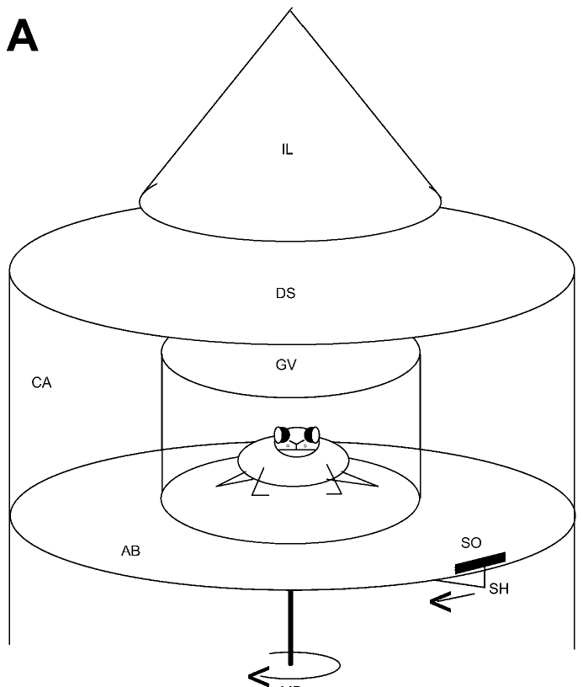
Turning toward a circling dummy measures prey value
In the standard dummy test, the toad sits in a glass vessel at the center of a cylindrical arena. A black cardboard object, the dummy, is moved around the vessel at constant angular velocity by a motor-driven holder. The repeated trajectory supplies comparable encounters with the same visual configuration while the animal remains in a defined position relative to the object. The fixed observation window permits response strength to be compared across changes in the object's visual properties, while the constant orbit preserves its distance and repeated trajectory. Turning remains available without a real prey item being caught, so repeated encounters sample the releasing effect of the controlled stimulus before consummatory feeding changes the trial.
Each time the object passes, a hungry toad turns to follow it. The number of orienting turns per 30 s is the measure of how strongly the stimulus releases prey-catching. The count describes the frequency with which the stimulus recruits the first motor act during the fixed observation interval.
The dummy test relates controlled shape, size, contrast, and speed to the strength of prey-oriented behavior. The same worm and antiworm configurations can also pass through neuronal receptive fields during single-cell recording. Behavioral turning and neural discharge therefore become responses to matched visual features, allowing configuration-dependent selectivity to be followed from the stimulus through different stages of the sensorimotor pathway.
Ewert et al. (2001), Fig. 2A. Arena for the dummy test: the toad in a glass vessel (GV) and the stimulus object (SO) driven around it by a motor (MD).
Ewert et al. (2001)
03
Notes:
• In the standard test the toad sits in a glass vessel in the middle of a round arena, and a black cardboard object circles around it at a constant speed.
– A hungry toad turns to follow the object each time it passes.
• The number of turns in 30 seconds is the measure of how prey-like the stimulus is.
• The strength of this method is control.
– Shape, size, contrast and speed can each be changed one at a time, and the same number can then be compared with neuron recordings, lesions and learning experiments.
References:
Ewert JP, Buxbaum-Conradi H, Dreisvogt F, Glagow M, Merkel-Harff C, Röttgen A, Schürg-Pfeiffer E, Schwippert WW (2001). Neural modulation of visuomotor functions underlying prey-catching behaviour in anurans: perception, attention, motor performance, learning. Comparative Biochemistry and Physiology A 128: 417–461. https://doi.org/10.1016/S1095-6433(00)00333-0
Figure: Ewert et al. (2001), Fig. 2A. Arena for the dummy test: the toad in a glass vessel (GV) and the stimulus object (SO) driven around it by a motor (MD).
Figure source: https://doi.org/10.1016/S1095-6433(00)00333-0

Slide 4
Orienting gives a graded readout of prey value
A key stimulus is the small set of cues that triggers a behavior, and a releasing mechanism is the neural process that recognizes those cues and starts the act. Ewert asked which visual cues form the toad's key stimulus for prey. The releasing mechanism transforms the relevant visual information into a motor command, linking stimulus classification with initiation of the first catching act.
A cardboard dummy isolates visual features by removing the odor, texture, and self-generated movements that accompany natural prey. It has no odor, texture or wriggling of its own, so any turning it releases depends on vision alone, and with speed and distance fixed, a change in turning can be assigned to the one dimension varied. Removing the natural prey's other properties concentrates the test on the moving visual configuration that reaches the animal's eyes.
Orienting provides a graded measure of the early response to a potential prey item, with stronger visual releasers producing more turns during the observation period. Approach, binocular fixation, and snapping introduce additional spatial and motor requirements later in the sequence. Measuring the first act therefore follows how a controlled object enters the prey-catching pathway before those later components determine whether an actual capture succeeds. The response score therefore concerns the probability of entering the catching sequence, while the later acts depend on the direction and distance established during orienting.
Ewert et al. (1979), Fig. 1. Apparatus: a toad (t) in a glass vessel watches a stimulus (s) moved past a window; photos A–C show turning toward it.
Ewert et al. (1979); Ewert (1997)
03a
Notes:
• The dummy paradigm rests on the ethological idea of a key stimulus, and its design choices each remove one alternative explanation for a change in turning.
• Key stimulus and releasing mechanism.
– Ewert framed his whole program around two questions: which features of an object release prey-catching, and which neurons evaluate them.
– His 1997 review uses exactly these terms, the key stimulus and the releasing mechanism, as the two concepts the toad work was meant to connect.
• What the dummy removes.
– A real mealworm smells, moves its own body and differs in texture, so a toad's response to it could rest on any of these cues.
– Slides 2 and 3 describe a black cardboard object moved by a motor at fixed distance and speed, which leaves only shape and motion to vary.
– On slide 4 that control allows the edge length along the path and the edge length across it to be changed one at a time.
• Why count turns.
– Orienting is the first act on slide 2, so it reflects recognition before the later acts of approach, fixation and snapping come into play.
– A count over a fixed time window yields a number that can rise or fall smoothly, which makes the later comparison with neuron classes on slide 11 possible.
References:
Ewert JP, Arend B, Becker V, Borchers HW (1979). Invariants in configurational prey selection by Bufo bufo (L.). Brain, Behavior and Evolution 16: 38–51. https://doi.org/10.1159/000121822
Ewert JP (1997). Neural correlates of key stimulus and releasing mechanism: a case study and two concepts. Trends in Neurosciences 20(8): 332–339. https://doi.org/10.1016/S0166-2236(96)01042-9

Slide 5
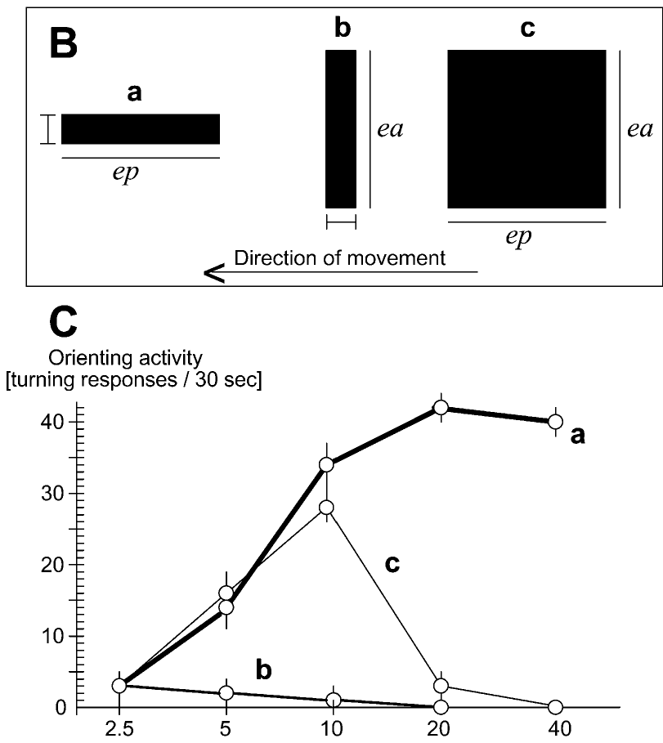
A worm is long along its direction of motion
Ewert varied two dimensions of a black rectangle. ep is its edge length parallel to the direction of movement and ea its edge length across the direction of movement. These dimensions describe the object relative to its own path, allowing the same physical rectangle to have different configurations when its movement direction changes.
Lengthening a 2.5-mm bar along ep, which produces a worm-like stripe, increased the turning rate steeply, to about 40 turns per 30 s at 20–40 mm. Lengthening the same bar along ea, an antiworm, abolished turning. Squares (ep = ea) became more effective up to about 10 mm and then lost their prey value as they grew larger. The square enlarged both dimensions together, revealing a rise and subsequent decline as the configuration became too extended across the path.
Ewert's features-relating algorithm describes the opposing effects of ep and ea on prey-oriented behavior. Extension along motion increases prey value, while extension across motion reduces it and supplies a particularly decisive rejecting feature. Large squares increase both dimensions and can enter a threat-related category, relating prey selection to the combined geometry of the moving image rather than its total area considered alone. The terms ep and ea remain defined by movement, so rotating the entire stimulus and trajectory together preserves their relation. The two-dimensional description links the increasing worm response and decreasing antiworm response through a common rule, while square enlargement changes both contributions together and shifts the effective balance toward rejection.
Ewert et al. (2001), Fig. 2B–C. Stimuli a (worm), b (antiworm) and c (square) and turning rate as each edge length increases (n = 20 toads).
Ewert et al. (2001); Ewert (1997)
04
Notes:
• Ewert used black rectangles and changed two dimensions separately.
– ep is the length along the direction of movement and ea is the length across it.
• The results were clear.
– Making a 2.5 millimeter bar longer along its direction of motion, a worm, raised the turning rate to about 40 turns per 30 seconds.
– Making the same bar longer across its direction of motion, an antiworm, abolished turning.
– Squares worked best around 10 millimeters and then stopped working as they grew.
• So the toad compares the two extensions instead of judging size.
– Length along the movement direction signals prey, length across it reduces prey value, and a large square that is big in both directions resembles a threat.
References:
Ewert JP, Buxbaum-Conradi H, Dreisvogt F, Glagow M, Merkel-Harff C, Röttgen A, Schürg-Pfeiffer E, Schwippert WW (2001). Neural modulation of visuomotor functions underlying prey-catching behaviour in anurans: perception, attention, motor performance, learning. Comparative Biochemistry and Physiology A 128: 417–461. https://doi.org/10.1016/S1095-6433(00)00333-0
Ewert JP (1997). Neural correlates of key stimulus and releasing mechanism: a case study and two concepts. Trends in Neurosciences 20(8): 332–339. https://doi.org/10.1016/S0166-2236(96)01042-9
Figure: Ewert et al. (2001), Fig. 2B–C. Stimuli a (worm), b (antiworm) and c (square) and turning rate as each edge length increases (n = 20 toads).
Figure source: https://doi.org/10.1016/S1095-6433(00)00333-0

Slide 6
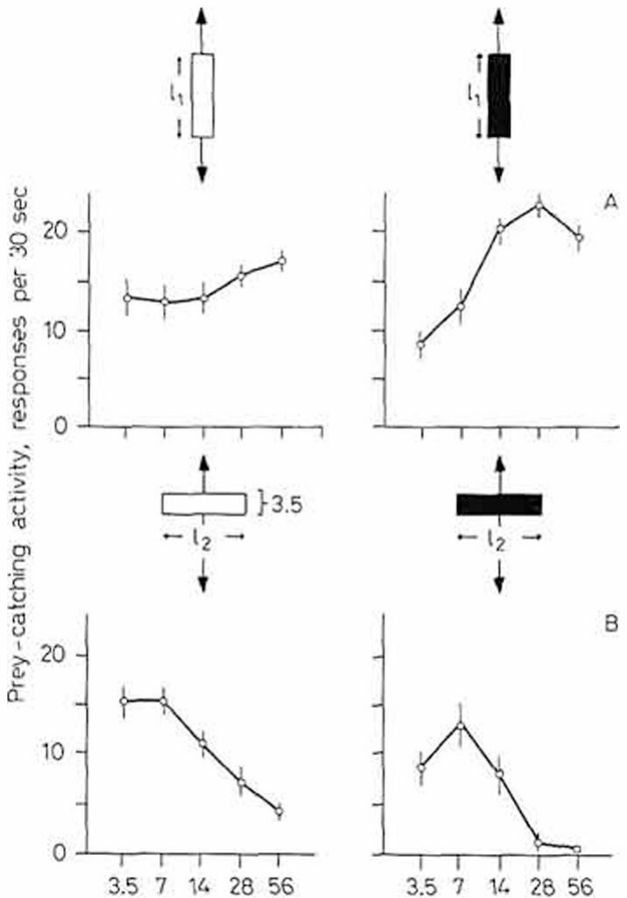
Worm preference holds for vertical motion and contrast
Ewert, Arend, Becker and Borchers asked whether the worm–antiworm distinction depends on how the stimulus moves. Stripes 3.5 mm wide were moved up and down in front of the toad at 16°/s. The experiment preserved the stripe width while changing whether its increasing length followed or crossed the vertical movement path.
When the stripe was elongated along its vertical path (worm), turning increased with length. When it was elongated perpendicular to its path (antiworm), turning decreased toward zero. The rule was the same as for horizontal motion: the axis that matters is defined by the direction of movement, not by gravity or the horizon. The preferred axis therefore rotates with motion, retaining the relationship between shape and trajectory when the object travels in a new direction.
The configurational preference also persisted with white stripes against black, although black stripes on white elicited stronger overall responding. Contrast polarity therefore changes the response level while the distinction between elongation along and across motion remains available. The toad's visual classification retains the relationship defining the worm configuration across both vertical movement and the tested reversal of the luminance pattern. A vertical worm retains its long axis along the path just as a horizontal worm does, preserving the feature relation while changing absolute orientation. Reversing black and white likewise changes the sign of contrast without changing that geometry, allowing general response strength and configurational classification to vary separately.
Ewert et al. (1979), Fig. 2. Turning to vertically moving stripes: worm-like (A) and antiworm-like (B), white on black (left) and black on white (right).
Ewert et al. (1979)
05
Notes:
• The next question was whether the worm rule depends on horizontal movement.
– Stripes were moved up and down in front of the toad instead of sideways.
• The answer was no.
– A stripe long along its vertical path was still a worm and drew more turning as it lengthened.
– A stripe long across its path was still an antiworm and was rejected.
• The same held for white stripes on a black background. Black on white gave stronger responses overall, but the worm–antiworm preference was the same.
References:
Ewert JP, Arend B, Becker V, Borchers HW (1979). Invariants in configurational prey selection by Bufo bufo (L.). Brain, Behavior and Evolution 16: 38–51. https://doi.org/10.1159/000121822
Figure: Ewert et al. (1979), Fig. 2. Turning to vertically moving stripes: worm-like (A) and antiworm-like (B), white on black (left) and black on white (right).
Figure source: https://doi.org/10.1159/000121822

Slide 7
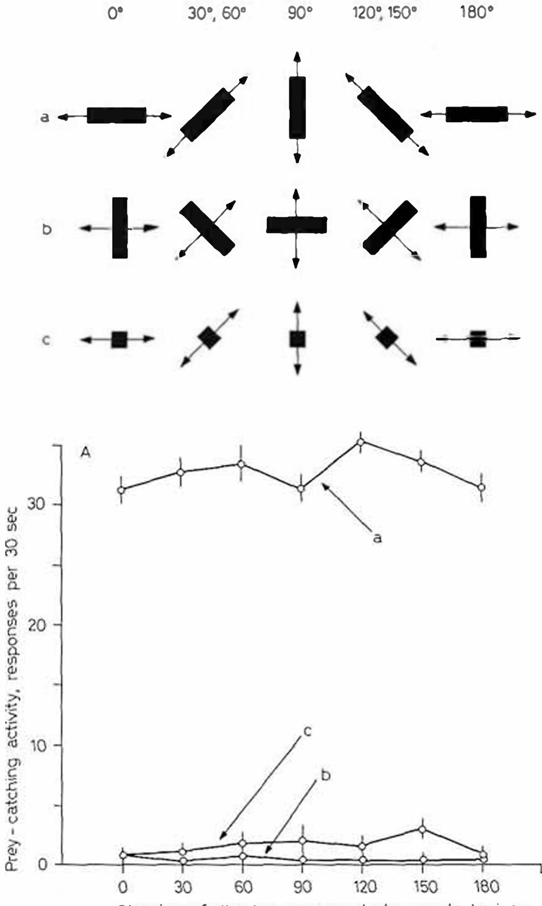
Prey selection is invariant to movement direction
Ewert et al. then moved the stimuli horizontally, diagonally at 30°, 60°, 120° and 150°, and vertically, always at 20°/s. A 2.5 × 30 mm stripe oriented along its direction of motion (a) was compared with the same stripe oriented across it (b) and with a small 2.5 × 2.5 mm square (c). The same dimensions appeared at several positions relative to the external visual field while their relationship with the movement path remained defined.
At every direction the worm released about 30 turns per 30 s, while the antiworm and the small square released almost none. The toad made essentially no errors in classifying worm against antiworm at any angle. The preferred configuration therefore continued to release orienting as the absolute direction changed, whereas the cross-motion stripe remained ineffective.
An invariant recognition rule preserves classification when another stimulus property changes within the tested conditions. Here, the relation between elongation and movement remained effective across horizontal, oblique, and vertical trajectories. The same configurational preference also survived changes in contrast polarity and within tested ranges of speed and distance, linking prey recognition to relative stimulus geometry rather than one fixed orientation in the visual field. The small square preserved the stripe width while removing its extended parallel dimension, and it remained ineffective across the trajectory series. The preferred worm therefore depended on more than the presence of a small moving dark element. Its elongated relation to the path continued to supply the relevant visual feature as the stimulus rotated through the field.
Ewert et al. (1979), Fig. 3A. Turning to a worm stripe (a), antiworm stripe (b) and small square (c) moved at different angles to the horizon.
Ewert et al. (1979)
06
Notes:
• Here the stimuli moved in many directions: sideways, diagonally and up and down.
– The worm, the antiworm and a small square were each tested at every angle.
• At every angle the worm drew about 30 turns in 30 seconds, while the antiworm and the small square drew almost none.
– The toad essentially never mistook one for the other.
• An invariant is a feature of recognition that stays the same when other things about the stimulus change. For the toad, the worm–antiworm decision is invariant to movement direction, contrast direction and, within limits, speed and distance.
References:
Ewert JP, Arend B, Becker V, Borchers HW (1979). Invariants in configurational prey selection by Bufo bufo (L.). Brain, Behavior and Evolution 16: 38–51. https://doi.org/10.1159/000121822
Figure: Ewert et al. (1979), Fig. 3A. Turning to a worm stripe (a), antiworm stripe (b) and small square (c) moved at different angles to the horizon.
Figure source: https://doi.org/10.1159/000121822

Slide 8
Motion turns stripe orientation into time and space
On a retinotopic map, motion decides how a stripe's two edge lengths reach the brain. A worm slides along its own axis, so one point of the visual field stays covered for a time that grows with its length. An antiworm covers a wide band of neighboring points at once, each only briefly. The successive retinal locations therefore experience a different temporal sequence even when the two stripes contain the same overall area.
A stationary stripe gives a round receptive field no such difference: rotated about the field's center, it covers the same area. Movement converts extension along the path into duration at each location and extension across it into breadth of simultaneous activity. Motion supplies the spatial and temporal differences needed for a proposed configuration-sensitive process operating within approximately circular receptive fields.
A mechanism relating duration at one location to simultaneous spatial breadth could retain the same worm preference at different movement angles. Both quantities are defined relative to the object's path through the retinotopic map. Ewert related this proposal to the roughly circular fields of T5(2) neurons, whose diameter in frog recordings was about 18°, providing a possible route from moving image geometry to direction-invariant selectivity. A point covered longer by a moving worm experiences a different duration from a point briefly crossed by a broad antiworm, even when the total image area matches. The proposed process can therefore use motion-generated temporal structure within a radially organized field to distinguish the configurations.
Ewert et al. (1979), Fig. 3A. Turning to a worm stripe (a), antiworm stripe (b) and small square (c) moved at different angles to the horizon.
Ewert et al. (1979); Schürg-Pfeiffer & Ewert (1981)
06a
Notes:
• The worm and antiworm rule is defined relative to the direction of motion, and the geometry of a moving stripe on a retinotopic map gives a concrete way to see why that matters.
• Two edges, two kinds of signal.
– When a 2.5 by 30 millimeter stripe moves lengthwise, any given spot in the visual field sees black for a long stretch of time, but only a narrow column of spots is covered at any one instant.
– Turn the same stripe crosswise and the pattern inverts: many neighboring spots are covered together, and each is uncovered again almost immediately.
• Why motion is required.
– Slide 13 introduces the retinotopic maps of tectum and pretectum, where neighboring places in the visual field are handled by neighboring neurons.
– Without motion, a round receptive field receives the same amount of black whichever way the stripe is turned, so orientation alone gives such a cell nothing to work with.
• Invariance follows.
– Slide 6 reports the same discrimination for horizontal, diagonal and vertical paths.
– If the brain compares time at a location with breadth across locations, that comparison is tied to the path of the stimulus and therefore works at any angle.
– The roughly 18 degree circular fields on slide 15 fit this kind of computation, although Ewert's papers present the comparison as a proposal about how inputs combine.
References:
Ewert JP, Arend B, Becker V, Borchers HW (1979). Invariants in configurational prey selection by Bufo bufo (L.). Brain, Behavior and Evolution 16: 38–51. https://doi.org/10.1159/000121822
Schürg-Pfeiffer E, Ewert JP (1981). Investigation of neurons involved in the analysis of gestalt prey features in the frog Rana temporaria. Journal of Comparative Physiology 141: 139–152. https://doi.org/10.1007/BF01342660

Slide 9
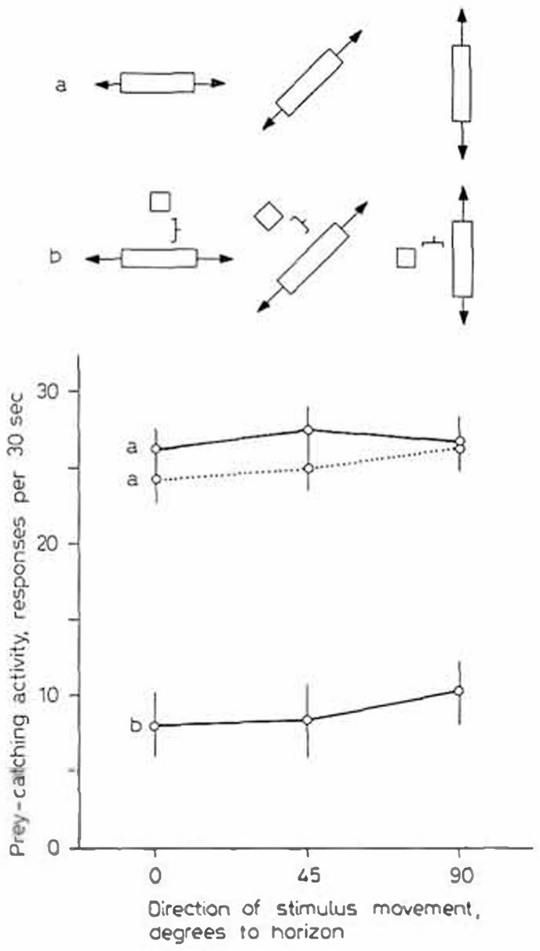
A nearby square reduces the prey value of a worm
Ewert et al. tested how a second element changes recognition. A 2.5 × 30 mm worm stripe was moved alone (a) or together with a 2.5 × 2.5 mm square placed 10 mm from it (b). The added square changed the spatial arrangement of the combined moving image while the original worm stripe remained present. The two elements moved together, making their separation part of the configuration reaching the visual system during each pass. The square retained a small local image while adding breadth to the complete moving arrangement. This changed the visual relation without replacing the original long stripe that had been an effective releaser when presented alone.
Adding the square reduced prey-catching from about 26 turns per 30 s to about 8–10 turns, at horizontal, diagonal and vertical directions alike. When the stripe was tested alone again (a'), responses returned to their original level. Recovery when the stripe was presented alone again related the reduced response to the accompanying visual element rather than a lasting loss of orienting.
The nearby square adds extension across the shared direction of movement, giving the combined configuration an antiworm-like component. Its inhibitory effect occurred across horizontal, diagonal, and vertical trajectories, preserving the relation between geometry and path. The toad therefore evaluates spatial relationships among moving elements, allowing an accompanying feature to reduce the prey value of an otherwise effective worm stripe. The reduced score occurred while the long stripe remained visible, indicating that an added spatial feature can suppress the otherwise effective relation between elongation and motion.
Ewert et al. (1979), Fig. 4. Turning to a worm stripe alone (a, a') and to the stripe with a small square 10 mm away (b), at 0°, 45° and 90°.
Ewert et al. (1979)
07
Notes:
• This experiment added a small square next to a worm stripe.
– The square sat 10 millimeters from the stripe and moved with it.
• The square sharply reduced turning, from about 26 to about 8 to 10 turns per 30 seconds, whatever the direction of movement.
– When the stripe was shown alone again, the toad responded normally.
• The square adds extent across the direction of motion, an antiworm feature, so the combined object looks less like prey.
References:
Ewert JP, Arend B, Becker V, Borchers HW (1979). Invariants in configurational prey selection by Bufo bufo (L.). Brain, Behavior and Evolution 16: 38–51. https://doi.org/10.1159/000121822
Figure: Ewert et al. (1979), Fig. 4. Turning to a worm stripe alone (a, a') and to the stripe with a small square 10 mm away (b), at 0°, 45° and 90°.
Figure source: https://doi.org/10.1159/000121822

Slide 10
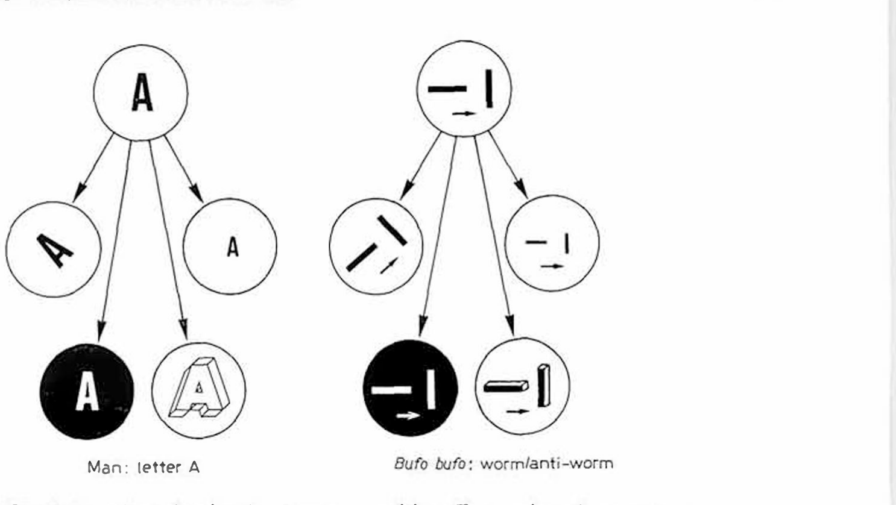
Recognition invariants resemble human object recognition
Ewert et al. compared the toad's prey recognition with how humans recognize a symbol. A person identifies the letter A whether it is tilted, small or large, or drawn in white on black. In the same way, a toad identifies a worm whether it moves horizontally or vertically, and whether it is black on white or white on black. The proposed common property is recognition across changes in the appearance or orientation of a stimulus, with the relevant relation preserved.
Ewert proposed that such invariants make the toad a useful model for the mechanism of object recognition. Neurons in the optic tectum and the thalamic–pretectal region respond to configurational features of moving stimuli, and their receptive fields are approximately radially symmetrical, so their selectivity must come from the way information about extension along and across the direction of movement is combined. Circular receptive-field geometry places the required selectivity in interactions among the signals representing the moving object's different dimensions.
Ewert used recognition invariants to connect behavioral classification with the computations available in tectal and pretectal populations. A worm retains its effective relation between length and motion as its trajectory rotates, just as a familiar symbol can retain identity across changes in size or contrast. The neural problem is therefore to preserve the relevant feature relationship while the exact distribution of retinal activity changes.
Ewert et al. (1979), Fig. 6. Invariants in pattern recognition: the letter A for a human and worm versus antiworm for Bufo bufo.
Ewert et al. (1979)
08
Notes:
• Ewert compared the toad's worm recognition with how we recognize the letter A.
– We recognize the A when it is tilted, smaller or larger, or white on black.
• The toad recognizes a worm when it moves in any direction and in either contrast, so its recognition also has invariants.
• That makes the toad a model for how a brain recognizes objects.
– The relevant neurons in the tectum and pretectum have roughly circular receptive fields, so their preference for worms has to come from how the brain combines information about length along and across the movement direction.
References:
Ewert JP, Arend B, Becker V, Borchers HW (1979). Invariants in configurational prey selection by Bufo bufo (L.). Brain, Behavior and Evolution 16: 38–51. https://doi.org/10.1159/000121822
Figure: Ewert et al. (1979), Fig. 6. Invariants in pattern recognition: the letter A for a human and worm versus antiworm for Bufo bufo.
Figure source: https://doi.org/10.1159/000121822

Slide 11
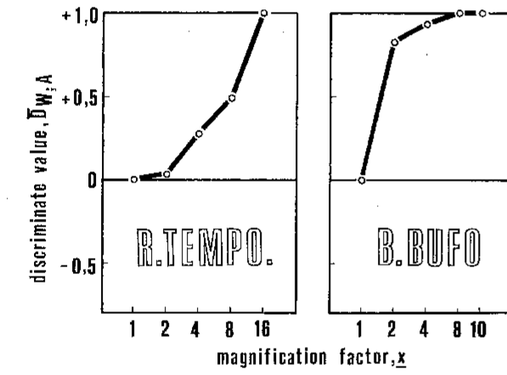
Frogs and toads differ in how sharply they reject antiworms
Schürg-Pfeiffer and Ewert compared configurational selectivity in the frog Rana temporaria and the toad Bufo bufo. They used a discriminant value, D(W,A), which equals +1 when only the worm releases a response, −1 when only the antiworm does and 0 when both are equally effective. The scale expresses the balance of the two responses, separating the preferred configuration from the total amount of movement elicited.
In both species D(W,A) rose with stripe length, so both prefer worms. The toad's curve rose steeply and reached +1 at short lengths, whereas the frog's rose gradually and reached +1 only for long stripes. The different slopes therefore describe how quickly increasing stripe length strengthens the animal's bias toward the worm configuration.
The toad's sharper configurational selectivity fits its actively hunting sequence, in which orienting and approach precede the final strike. Rana temporaria showed a more gradual preference, consistent with a sit-and-wait strategy and a lower threshold for snapping at nearby objects. These species-specific response curves connect the same visual feature relationship with different ways of recruiting the later prey-catching motor acts. The discriminant curve expresses the relative bias between configurations, so a steep rise toward +1 corresponds to strong worm preference over a short length range. A gradual rise allows responses to both stripes to persist over a broader range, linking species differences in the curve with the sharpness of behavioral acceptance.
Schürg-Pfeiffer & Ewert (1981), Fig. 12. Discriminant value for worm versus antiworm during prey-catching in R. temporaria and B. bufo as stripe length increases.
Schürg-Pfeiffer & Ewert (1981); Ewert et al. (2001)
09
Notes:
• Schürg-Pfeiffer and Ewert compared the common frog and the common toad with one number, the discriminant value.
– It is plus one if only the worm gets a response, minus one if only the antiworm does, and zero if they are equal.
• Both species prefer worms, but the toad is much sharper.
– The toad's value reaches plus one with short stripes, while the frog needs long stripes to discriminate completely.
• That matches how they hunt. The toad searches actively and is selective; the frog waits and snaps at more things, including non-prey.
References:
Schürg-Pfeiffer E, Ewert JP (1981). Investigation of neurons involved in the analysis of gestalt prey features in the frog Rana temporaria. Journal of Comparative Physiology 141: 139–152. https://doi.org/10.1007/BF01342660
Ewert JP, Buxbaum-Conradi H, Dreisvogt F, Glagow M, Merkel-Harff C, Röttgen A, Schürg-Pfeiffer E, Schwippert WW (2001). Neural modulation of visuomotor functions underlying prey-catching behaviour in anurans: perception, attention, motor performance, learning. Comparative Biochemistry and Physiology A 128: 417–461. https://doi.org/10.1016/S1095-6433(00)00333-0
Figure: Schürg-Pfeiffer & Ewert (1981), Fig. 12. Discriminant value for worm versus antiworm during prey-catching in R. temporaria and B. bufo as stripe length increases.
Figure source: https://doi.org/10.1007/BF01342660

Slide 12
Discriminant values separate preference from vigor
Raw turning counts mix two properties: how readily an animal responds at all, and how strongly it prefers one configuration. A frog with a low snapping threshold could respond more often than a toad to both stripes and still discriminate worse. D(W,A) depends only on the balance between worm and antiworm responses. Normalizing the relative responses allows selectivity to be followed when motivation or treatment changes the overall likelihood of acting.
White stripes on black lowered turning overall yet left the worm preference intact, a change in level without a change in selectivity. Under apomorphine, snapping rose while discrimination became less sharp. The response level and the relationship between configurations therefore provide separate descriptions of the stimulus-dependent behavior.
The D(W,A) measure can be applied to neuronal discharge as well as behavior, placing spike counts and turning counts on a comparable preference scale. A neuron can then be evaluated for whether its selectivity changes with stripe length in the same way as the animal's orienting. Matching curves connect particular processing stages with the configuration-dependent response while preserving the distinction between preference and general responsiveness. A difference in total turns can arise from motivation, motor threshold, or general contrast sensitivity, while the relative configuration curve follows which stimulus remains preferred. Applying the same measure to neuronal firing retains that distinction, allowing a high-rate cell and a lower-rate cell to share a similar preference despite different overall output.
Schürg-Pfeiffer & Ewert (1981), Fig. 12. Discriminant value for worm versus antiworm during prey-catching in R. temporaria and B. bufo as stripe length increases.
Schürg-Pfeiffer & Ewert (1981); Ewert et al. (1978)
09a
Notes:
• The discriminant value looks like a bookkeeping device, but it solves a real problem: separating how much an animal responds from what it prefers.
• Two properties hidden in one count.
– An animal that turns often to everything and an animal that turns rarely can still favor the worm by the same proportion.
– Their raw counts differ, yet the discriminant value treats them alike, since it registers only the balance between the two stripes.
– That matters for the frog and toad comparison on slide 9, since the sit-and-wait frog responds readily to many objects.
• Level and selectivity move independently.
– On slide 5, contrast direction changes response level while the configurational preference stays put.
– Under apomorphine on slide 27, snapping rises while discrimination becomes less acute, a case where the two properties move apart in the other direction.
• Putting neurons and behavior on one scale.
– Slides 11 and 12 rely on this normalization, because a neuron's spike count and a toad's turning count have no common units.
– Once both are expressed as discriminant values, the shape of the curve against stripe length can be compared directly, which is how T5(2) neurons were singled out.
References:
Schürg-Pfeiffer E, Ewert JP (1981). Investigation of neurons involved in the analysis of gestalt prey features in the frog Rana temporaria. Journal of Comparative Physiology 141: 139–152. https://doi.org/10.1007/BF01342660
Ewert JP, Borchers HW, von Wietersheim A (1978). Question of prey feature detectors in the toad's Bufo bufo (L.) visual system: a correlation analysis. Journal of Comparative Physiology 126: 43–47. https://doi.org/10.1007/BF01342649

Slide 13
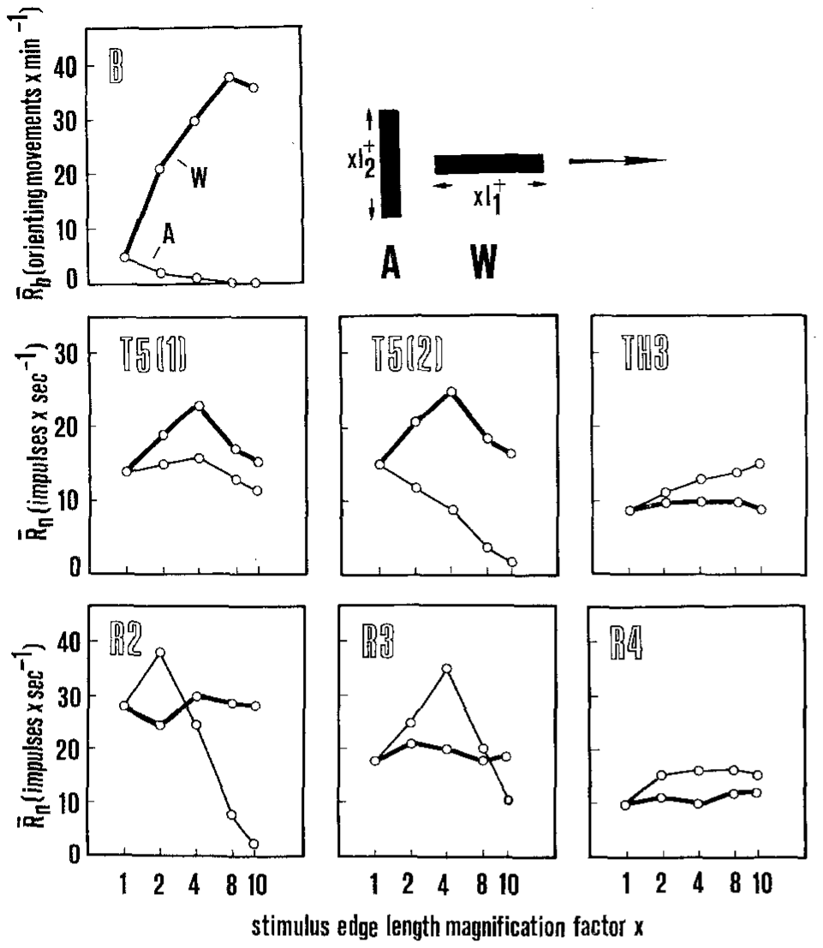
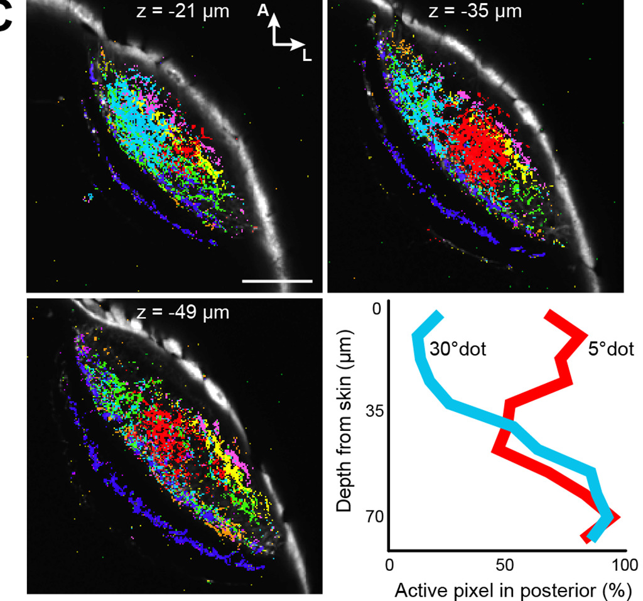
Retinal ganglion cells encode size, not configuration
In the 1950s Barlow and Lettvin proposed that a class of frog retinal ganglion cell acts as a "bug detector". Retinal ganglion cells are the output neurons of the retina. Toad ganglion cells fall into classes R1–R4, with excitatory receptive fields of about 2–3°, 4–6°, 8–10° and 12–16° respectively, each surrounded by an inhibitory zone. The excitatory center and inhibitory surround organize sensitivity to the extent of an image, dividing visual input among retinal output channels.
Ewert, Borchers and von Wietersheim recorded R2, R3 and R4 cells while worm-like (W) and antiworm-like (A) stripes crossed their receptive fields. R2 cells responded best to small stimuli of either configuration and declined as stripes lengthened in both orientations. The declining response to enlargement occurred for both orientations, relating the retinal discharge to size within the receptive field.
Retinal output supplies size-, contrast-, and movement-dependent information to later visual stages, while the animal's worm–antiworm relationship emerges through subsequent processing. The retinal response declines as either stripe outgrows the effective center, whereas prey-oriented turning rises for elongation along motion. Ewert and colleagues therefore located the relevant configurational organization in interactions beyond a single retinal ganglion-cell class.
Ewert et al. (1978), Fig. 1. Turning (B) and firing of tectal T5(1), T5(2), pretectal TH3 and retinal R2–R4 neurons to worm (W) and antiworm (A) stripes.
Förster et al. (2020), Fig. 3C. Zebrafish retinal axon terminals in the tectum colored by functional class; 5°-dot and 30°-dot inputs by depth.
Ewert et al. (1978); Ewert (1997); Förster et al. (2020)
10
Notes:
• Barlow and Lettvin in the 1950s suggested that a type of frog retinal ganglion cell was a bug detector.
– Ganglion cells are the output neurons of the retina, and in the toad they come in four classes, R1 to R4, with progressively larger receptive fields.
• Ewert's group tested R2, R3 and R4 cells with worm and antiworm stripes.
– R2 cells fired best to small objects of either kind and fired less as stripes got longer in either orientation.
• No retinal class matched the toad's behavior, which goes up for worms and down for antiworms. The retina reports size, contrast and movement, but it does not identify prey.
References:
Ewert JP, Borchers HW, von Wietersheim A (1978). Question of prey feature detectors in the toad's Bufo bufo (L.) visual system: a correlation analysis. Journal of Comparative Physiology 126: 43–47. https://doi.org/10.1007/BF01342649
Ewert JP (1997). Neural correlates of key stimulus and releasing mechanism: a case study and two concepts. Trends in Neurosciences 20(8): 332–339. https://doi.org/10.1016/S0166-2236(96)01042-9
Förster D, Helmbrecht TO, Mearns DS, Jordan L, Mokayes N, Baier H (2020). Retinotectal circuitry of larval zebrafish is adapted to detection and pursuit of prey. eLife 9: e58596. https://doi.org/10.7554/eLife.58596
Figure: Ewert et al. (1978), Fig. 1. Turning (B) and firing of tectal T5(1), T5(2), pretectal TH3 and retinal R2–R4 neurons to worm (W) and antiworm (A) stripes.
Figure source: https://doi.org/10.1007/BF01342649
Figure: Förster et al. (2020), Fig. 3C. Zebrafish retinal axon terminals in the tectum colored by functional class; 5°-dot and 30°-dot inputs by depth.
Figure source: https://doi.org/10.7554/eLife.58596

Slide 14
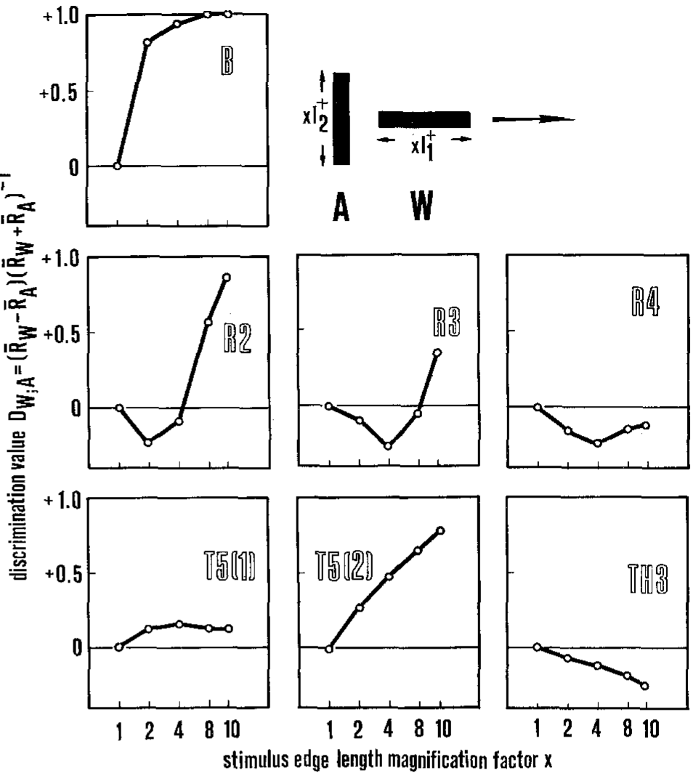
Only tectal T5(2) neurons match the toad's discrimination
Ewert et al. computed the discriminant value D(W,A) for behavior and for each neuron class, and correlated the stimulus–response curves. Relating the normalized responses across classes followed how preference developed between retinal output and the central populations receiving it.
The behavioral discriminant curve rose toward +1 as stripe length increased, expressing the animal's strong preference for the worm configuration. Retinal R2 and R3 values were negative for short stripes and rose only at long lengths; R4 stayed near zero. Tectal T5(1) neurons were sensitive to configuration but hardly discriminated, and pretectal TH3 neurons had negative values, preferring antiworms. The antiworm preference in TH3 supplied an opposing configurational signal to the worm-related output found in the tectal population.
T5(2) selectivity resembled the behavioral curve, with stronger responses to worm-like motion than to the antiworm configuration. Ewert distinguished sensitivity to a stimulus, selectivity resembling the animal's response, and specificity for one configuration. The recorded T5(2) neurons remained responsive to other effective objects, placing prey classification within a population of selectively tuned cells rather than assigning it to an exclusive single-object detector. A selective cell can still respond to more than one effective shape, so a square near its preferred size may evoke substantial discharge alongside the worm response. Reading several classes together preserves information about those alternative causes of firing, relating the behavioral category to a population pattern rather than one isolated rate.
Ewert et al. (1978), Fig. 2. Discriminant value D(W,A) for behavior (B) and for retinal (R2–R4), tectal (T5(1), T5(2)) and pretectal (TH3) neurons.
Ewert et al. (1978)
11
Notes:
• Ewert's group then compared every neuron class with behavior using the discriminant value.
– Behavior went to plus one; the retinal classes were negative or near zero for most stripe lengths.
• In the tectum, T5(1) neurons responded to the stimuli but barely told worm from antiworm.
– Pretectal TH3 neurons had negative values, meaning they preferred antiworms.
• Only tectal T5(2) neurons followed the behavior.
– Ewert called them selective, because they discriminate the way the toad does.
– But none were specific, responding only to worms, so there is no single worm-detector neuron.
References:
Ewert JP, Borchers HW, von Wietersheim A (1978). Question of prey feature detectors in the toad's Bufo bufo (L.) visual system: a correlation analysis. Journal of Comparative Physiology 126: 43–47. https://doi.org/10.1007/BF01342649
Figure: Ewert et al. (1978), Fig. 2. Discriminant value D(W,A) for behavior (B) and for retinal (R2–R4), tectal (T5(1), T5(2)) and pretectal (TH3) neurons.
Figure source: https://doi.org/10.1007/BF01342649

Slide 15
Selective cells need partners to identify prey
A selective neuron's firing rate alone is ambiguous. The frog T5(2) cell fired strongly to long worms but also to squares near 8°, so a moderate burst could come from a short worm, a medium square or an object at the edge of the field. The same rate can consequently arise from different shapes or positions, making the full pattern of active channels relevant to the object being processed.
The ambiguity shrinks when classes are read together. A worm drives T5(2) while leaving pretectal TH3, which favors extension across the path, nearly silent; a large square drives TH3 and the avoidance-like T5.4 class. The prey label lies in the pattern across classes. Threat-related and prey-related classes contribute different combinations of activity as extension along and across movement changes.
Pretecto-tectal inhibition allows the interaction between configurational channels to occur within the processing circuit itself. TH3 activity, strongest for large cross-motion features, suppresses tectal responsiveness, helping reject unsuitable objects while prey-related populations remain sensitive to worm configurations. The response category therefore depends on the combined excitatory and inhibitory pattern across neuronal classes, including the state in which those signals reach motor-related tectal output. The balance changes with the dimensions of the image, because a broad square recruits both prey-related excitation and the opposing threat-associated channels. The resulting combination can reduce effective prey output even when one constituent neuron remains responsive, preserving classification through the coordinated activity of the circuit.
Ewert et al. (1978), Fig. 2. Discriminant value D(W,A) for behavior (B) and for retinal (R2–R4), tectal (T5(1), T5(2)) and pretectal (TH3) neurons.
Ewert et al. (1978); Schürg-Pfeiffer & Ewert (1981); Ewert (1997)
11a
Notes:
• The absence of a specific worm detector is a statement about how information is distributed, and it explains why the deck moves from single cells to combinations of cell classes.
• One cell, many possible causes.
– The spike trains on slide 15 show the same T5(2) neuron responding well to an 8 degree square and to lengthening worms.
– Any given firing rate is therefore compatible with more than one object, and stimulus size, position in the field and configuration all trade off against each other.
• Reading several classes at once.
– Slide 16 lays out the classes side by side: T5.2 follows prey-catching, TH3 and T5.3 favor large extension across the path, and T5.4 follows avoidance.
– A worm and a large square differ sharply in the joint pattern across these classes even when one class alone might give similar rates.
– Ewert's sensorimotor codes on slide 20 are built on exactly this joint pattern.
• The circuit performs the comparison.
– The pretectum is not merely another class an experimenter can record; according to slide 18 it inhibits tectal neurons.
– So the brain does not need a separate decoder to compare T5(2) with TH3, since TH3 activity directly reduces tectal output when the stimulus is not prey-like.
References:
Ewert JP, Borchers HW, von Wietersheim A (1978). Question of prey feature detectors in the toad's Bufo bufo (L.) visual system: a correlation analysis. Journal of Comparative Physiology 126: 43–47. https://doi.org/10.1007/BF01342649
Schürg-Pfeiffer E, Ewert JP (1981). Investigation of neurons involved in the analysis of gestalt prey features in the frog Rana temporaria. Journal of Comparative Physiology 141: 139–152. https://doi.org/10.1007/BF01342660
Ewert JP (1997). Neural correlates of key stimulus and releasing mechanism: a case study and two concepts. Trends in Neurosciences 20(8): 332–339. https://doi.org/10.1016/S0166-2236(96)01042-9

Slide 16
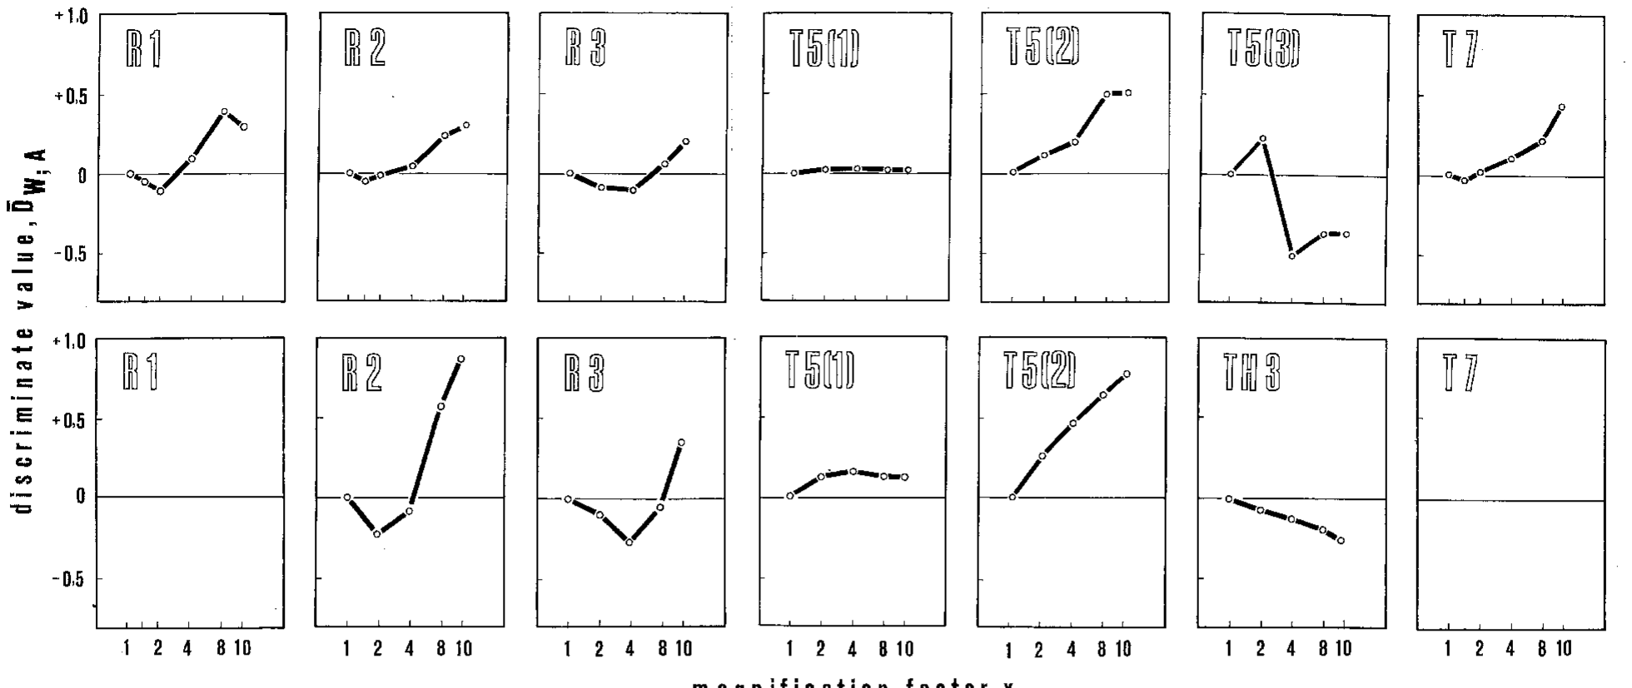
Frog tectal neurons show the same division of labor
Schürg-Pfeiffer and Ewert recorded 63 single neurons in the frog Rana temporaria: retinal classes R1–R3 and tectal classes T5(1), T5(2), T5(3) and T7. The identified classes retained a correspondence with the visual channels examined in toads, allowing their configuration-dependent responses to be followed in frogs.
Retinal cells preferred antiworms when stripes were shorter than their excitatory receptive field and worms only when stripes were longer, as expected from a centre–surround organization. Tectal T5(1) neurons showed almost no configurational preference, T5(2) neurons preferred worms, and T5(3) neurons preferred antiworms, resembling pretectal TH3 cells. The center–surround relation changes how the same stripe recruits excitation and inhibition as its dimensions exceed the retinal field.
Frog and toad populations preserved similar functional divisions, while the toad's retinal and tectal curves were more sharply selective in the measured classes. The difference included R2, R3, T5(1), and T5(2), paralleling the sharper worm–antiworm discrimination in toad behavior. Configurational organization therefore appears across the corresponding visual stages while its acuity varies with species-specific processing and prey-catching strategy.
Schürg-Pfeiffer & Ewert (1981), Fig. 11. Discriminant values of retinal and tectal neuron classes in R. temporaria (above) and B. bufo (below) versus stripe length.
Schürg-Pfeiffer & Ewert (1981)
12
Notes:
• The same analysis was done in the frog with 63 neurons from the retina and tectum.
– Retinal cells preferred antiworms for short stripes and worms for long stripes, which follows from their centre–surround receptive fields.
• In the tectum, three classes had three different preferences.
– T5(1) cells barely cared about configuration, T5(2) cells preferred worms, and T5(3) cells preferred antiworms, much like pretectal TH3 cells in the toad.
• Frog and toad have the same neuron classes, but the toad's are more selective, which matches its more selective behavior.
References:
Schürg-Pfeiffer E, Ewert JP (1981). Investigation of neurons involved in the analysis of gestalt prey features in the frog Rana temporaria. Journal of Comparative Physiology 141: 139–152. https://doi.org/10.1007/BF01342660
Figure: Schürg-Pfeiffer & Ewert (1981), Fig. 11. Discriminant values of retinal and tectal neuron classes in R. temporaria (above) and B. bufo (below) versus stripe length.
Figure source: https://doi.org/10.1007/BF01342660

Slide 17
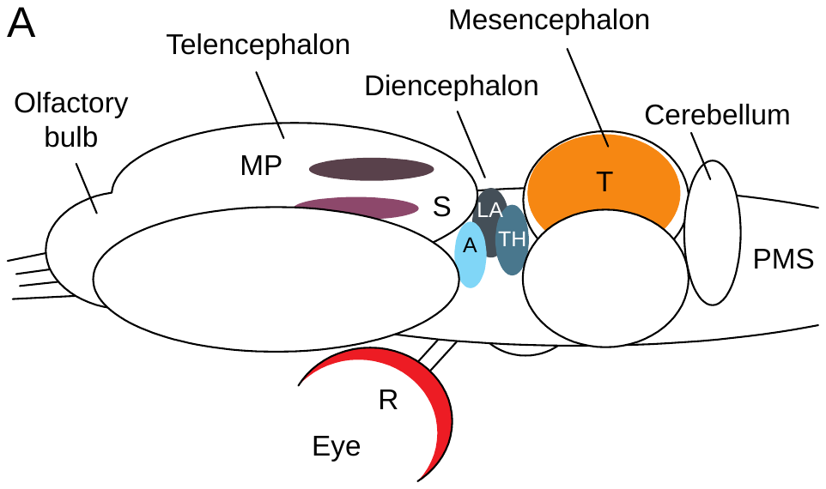
Retina, tectum and pretectum feed visual prey-catching
The optic tectum (T), in the roof of the midbrain, is the main target of the retina (R). It is homologous to the mammalian superior colliculus. The pretectal thalamic region (TH), at the boundary of diencephalon and midbrain, also receives retinal input. Both contain retinotopic maps, in which neighboring points in the visual field are represented by neighboring neurons. Retinotopy preserves the location of the stimulus within each map, allowing classification and spatial direction to be related in the descending output.
Outputs from tectum and pretectum descend to premotor and motor structures (PMS) in the medulla oblongata and spinal cord that generate orienting and snapping. The medullary and spinal pathways transform the selected visual response into the muscle activity needed to turn and strike at the target.
Forebrain structures alter the gating and learned value of the visual signal before it reaches the motor system. The striatum and lateral anterior thalamic nucleus participate in pathways that regulate tectal output through the pretectum. The medial pallium, homologous to the hippocampus, contributes to learning, linking the immediate visual configuration with prior experience and the motivational state in which prey-catching is expressed.
Ewert (1997), Fig. 1A. Anuran brain: retina (R), optic tectum (T), pretectal thalamus (TH), striatum (S), medial pallium (MP) and premotor–motor structures (PMS).
Ewert (1997); Ewert et al. (2001)
13
Notes:
• The main structures are the retina, the optic tectum and the pretectal thalamus.
– The tectum is in the roof of the midbrain and corresponds to the mammalian superior colliculus; the pretectum lies just in front of it.
– Both have retinotopic maps, where neighboring points in space map onto neighboring neurons.
• Their output goes down to premotor and motor structures in the medulla and spinal cord that produce turning and snapping.
• Forebrain areas modulate this pathway: the striatum and lateral anterior thalamus help gate responses, and the medial pallium, the amphibian hippocampus, is involved in learning.
References:
Ewert JP (1997). Neural correlates of key stimulus and releasing mechanism: a case study and two concepts. Trends in Neurosciences 20(8): 332–339. https://doi.org/10.1016/S0166-2236(96)01042-9
Ewert JP, Buxbaum-Conradi H, Dreisvogt F, Glagow M, Merkel-Harff C, Röttgen A, Schürg-Pfeiffer E, Schwippert WW (2001). Neural modulation of visuomotor functions underlying prey-catching behaviour in anurans: perception, attention, motor performance, learning. Comparative Biochemistry and Physiology A 128: 417–461. https://doi.org/10.1016/S1095-6433(00)00333-0
Figure: Ewert (1997), Fig. 1A. Anuran brain: retina (R), optic tectum (T), pretectal thalamus (TH), striatum (S), medial pallium (MP) and premotor–motor structures (PMS).
Figure source: https://doi.org/10.1016/S0166-2236(96)01042-9

Slide 18
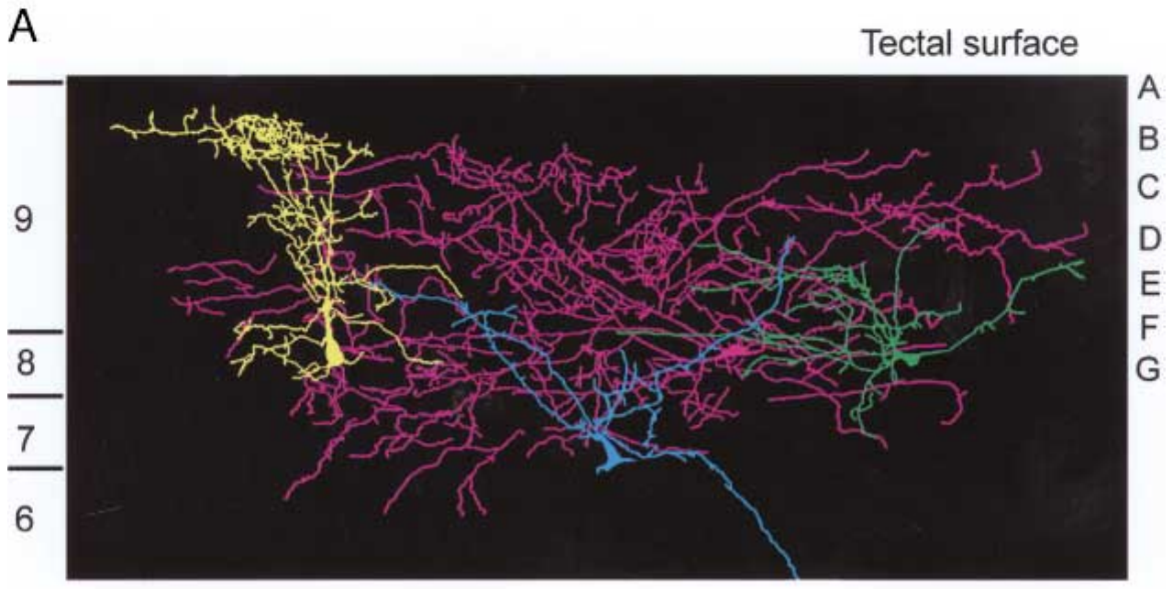
Tectal neurons collect input across retinal layers
Retinal ganglion cell axons end in different layers of the superficial tectum: R2 in laminae B–C, R3 in C–F and R4 in F–G. Neuropeptide-Y fibers from the pretectum end mainly in laminae B and C. The layered terminal arrangement preserves different retinal channels while placing pretectal input near portions of the same superficial tectal network.
Cobalt-lysine fills revealed T5.1 dendrites extending from lamina B through G, with one subtype spanning several retinal termination zones and another spreading laterally across the map. A large tectal neuron responded broadly to moving objects. The T5.2 pyramidal cell integrated input from layers 8 and 9 and sent its axon toward the medulla oblongata.
These overlapping dendritic fields provide an anatomical substrate for combining retinal classes with pretectal influence within a single tectal output pathway. Vertical arborization samples information arriving in different layers, while lateral spread supplies access across neighboring map positions. A descending axon then carries the resulting integrated activity toward premotor regions, connecting convergence in the visual map with the organization of an orienting or snapping response.
Ewert (1997), Fig. 2A. Cobalt-filled tectal neurons (T5.1 yellow and green, large neuron violet, T5.2 blue) spanning tectal laminae A–G.
Ewert (1997)
14
Notes:
• Each retinal class ends in its own layers of the tectum.
– R2 axons end in laminae B and C, R3 in C to F, and R4 in F and G, and inhibitory fibers from the pretectum end mainly in B and C.
• Tectal neurons reach across these layers.
– The yellow T5.1 cell has dendrites from lamina B to G, so it can combine several retinal classes.
– The blue T5.2 cell collects input from layers 8 and 9 and sends its axon down to the medulla.
• Because the dendrites cross layers, each tectal output neuron can mix several retinal channels and pretectal input.
References:
Ewert JP (1997). Neural correlates of key stimulus and releasing mechanism: a case study and two concepts. Trends in Neurosciences 20(8): 332–339. https://doi.org/10.1016/S0166-2236(96)01042-9
Figure: Ewert (1997), Fig. 2A. Cobalt-filled tectal neurons (T5.1 yellow and green, large neuron violet, T5.2 blue) spanning tectal laminae A–G.
Figure source: https://doi.org/10.1016/S0166-2236(96)01042-9

Slide 19
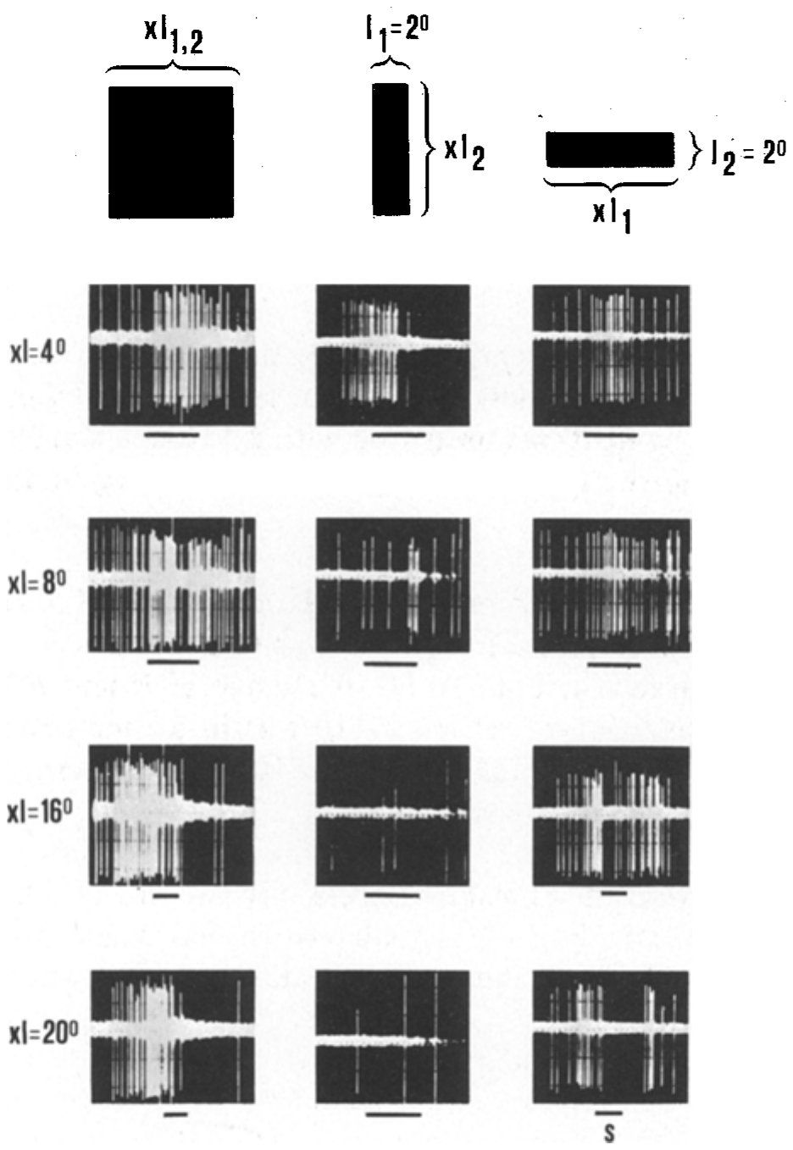
T5(2) neurons fire to worms but weakly to antiworms
Schürg-Pfeiffer and Ewert recorded T5(2) responses to squares, worms, and antiworms while varying the size of each stimulus. The same identified class could therefore be followed as extension increased along or across the movement direction. These recordings related the neuron's configuration-dependent firing to the visual relationship measured in prey-oriented behavior.
Square responses increased up to approximately 8° and then declined, while firing remained strong as a stripe lengthened along its movement path. Extending the stripe across that path progressively weakened the response. The preferred configuration therefore depended on the relation between stimulus dimensions and motion, with different response curves for enlargement in the two directions.
The roughly circular 18° excitatory receptive field supplies spatial access to objects moving at several angles, while its configurational preference depends on processing of their movement-related dimensions. Strong worm responses and declining antiworm responses resemble the behavioral selection rule. These relationships place the relevant computation in the interactions shaping the cell's input and output, rather than in a receptive field elongated along one fixed external axis. A circular field admits an object over multiple trajectories without rotating the neuron's anatomical receptive region. The stimulus still generates different duration and breadth relationships as it passes, supplying information through which a configuration-sensitive input network can preserve worm preference over those angles.
Schürg-Pfeiffer & Ewert (1981), Fig. 8. Spike trains of a T5(2) neuron to squares, antiworm (middle) and worm (right) stripes of 4–20° length; time scale 1 s.
Schürg-Pfeiffer & Ewert (1981)
15
Notes:
• These are spike trains from one frog T5(2) neuron.
– Squares drove it best at about 8 degrees, and larger squares drove it less.
• Worm-like stripes kept driving it strongly as they got longer, but antiworm stripes drove it less and less.
– That is the same preference the animal shows in behavior.
• Its receptive field is round, about 18 degrees across, so the preference cannot come from the shape of the field; it comes from how the cell's inputs combine length along and across the motion.
References:
Schürg-Pfeiffer E, Ewert JP (1981). Investigation of neurons involved in the analysis of gestalt prey features in the frog Rana temporaria. Journal of Comparative Physiology 141: 139–152. https://doi.org/10.1007/BF01342660
Figure: Schürg-Pfeiffer & Ewert (1981), Fig. 8. Spike trains of a T5(2) neuron to squares, antiworm (middle) and worm (right) stripes of 4–20° length; time scale 1 s.
Figure source: https://doi.org/10.1007/BF01342660

Slide 20
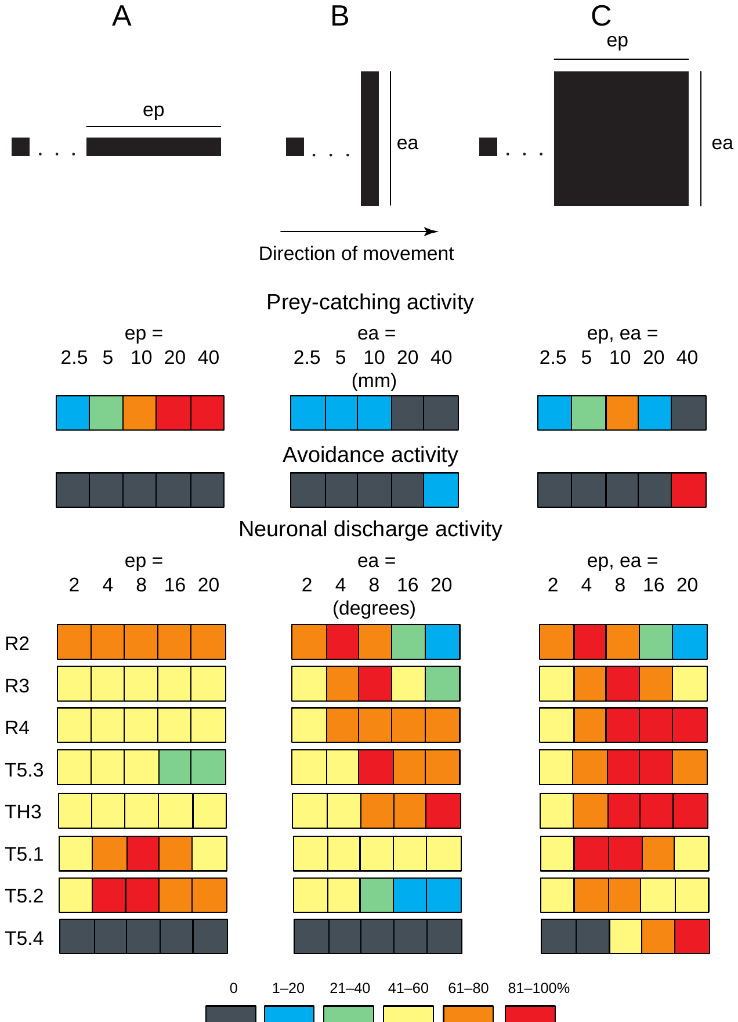
Retina, tectum and pretectum code ep and ea differently
The stimulus dimensions ep and ea describe extension parallel and perpendicular to movement, allowing behavior and neuronal classes to be characterized by their response to each relationship. Prey-catching increases with ep and decreases with ea. The response to enlarging squares combines these dimensions, rising at intermediate sizes before large objects recruit avoidance-related activity.
Prey-catching rose with ep, fell with ea and peaked for intermediate squares. Avoidance behavior showed the reverse, rising for large squares. Retinal R2, R3 and R4 cells responded to ea and to square area according to their receptive-field size. Pretectal TH3 and tectal T5.3 neurons responded best to large ea and large squares. Different response profiles therefore carry complementary information about the object, including retinal size channels and central classes favoring broad cross-motion extension.
Tectal T5.1 emphasizes ep, while T5.2 combines strong ep responses with weak ea responses, resembling prey-catching. T5.4 favors large extension in both dimensions, paralleling avoidance, while T5.3 and TH3 favor large ea and large squares. Ewert proposed that the combined activity of these streams defines perceptual categories, with prey- and predator-related ensembles supplying different patterns to downstream motor pathways. Each class contributes one part of the response pattern, with overlapping sensitivity allowing a single stimulus to excite several streams. Their distinct relations to ep, ea, and square size retain the information needed for different downstream actions.
Ewert (1997), Fig. 3. Relative responses to changes in ep (A), ea (B) and square size (C): behavior and R, T and TH neuron classes (color-coded %).
Ewert (1997)
16
Notes:
• This color table puts behavior and neurons on the same scale.
– Red means the strongest response and dark gray almost none.
• Prey-catching rises with length along the motion, falls with length across it, and peaks for medium squares; avoidance is the opposite.
– Retinal cells mainly track area, and pretectal TH3 and tectal T5.3 cells like large extensions across the motion.
• T5.2 neurons have the same pattern as prey-catching, and T5.4 neurons the pattern of avoidance.
– Ewert proposed that groups of such neurons define categories like prey and predator.
References:
Ewert JP (1997). Neural correlates of key stimulus and releasing mechanism: a case study and two concepts. Trends in Neurosciences 20(8): 332–339. https://doi.org/10.1016/S0166-2236(96)01042-9
Figure: Ewert (1997), Fig. 3. Relative responses to changes in ep (A), ea (B) and square size (C): behavior and R, T and TH neuron classes (color-coded %).
Figure source: https://doi.org/10.1016/S0166-2236(96)01042-9

Slide 21
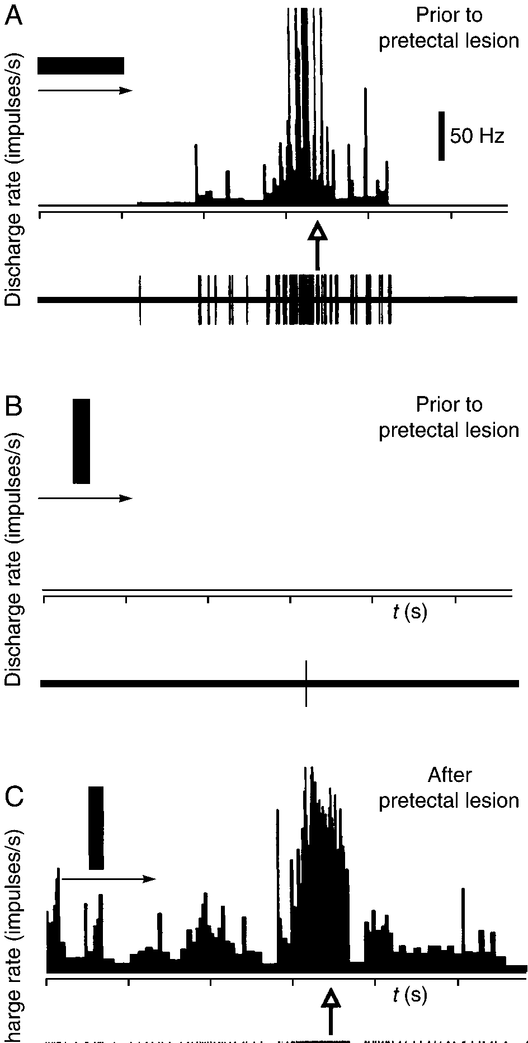
T5.2 activity precedes orienting in freely moving toads
To link neurons to behavior directly, Ewert's group implanted microelectrodes in the tectum of freely moving toads and recorded a T5.2 neuron while bars moved through its receptive field. The implanted recording followed neuronal discharge before and during a real orienting act, preserving the temporal relationship between visual input and movement. The recording followed the same visual pathway while the animal could perform the turn, joining neural selectivity with a naturally expressed motor event. The burst occurred before that event, placing its output in a time window from which descending activity could influence the premotor structures initiating the orientation toward the target.
A 2.5 × 20 mm bar moving in prey configuration produced a strong burst of spikes that preceded and "predicted" the toad's orienting movement toward the stimulus (arrow). The same bar moving at the same speed in non-prey configuration produced almost no activity, and the toad did not respond. The shared geometry and speed retained the visual object while its orientation relative to motion changed, relating both discharge and behavior to configuration.
A T5.2 burst preceding the turn can reach medullary premotor pathways through the neuron's descending projection. Its strong response to the prey configuration accompanied orientation toward that object, while the antiworm produced weak activity and little corresponding movement. The timing therefore connects configurationally selective tectal output with the early motor act that directs the toad toward potential prey. The descending burst can influence premotor cells before movement begins, placing the configuration-sensitive output in the appropriate temporal position to contribute to initiating the recorded turn.
Ewert (1997), Fig. 4A–C. A freely moving toad's T5.2 neuron: bar in prey (A) and non-prey (B) configuration before, and non-prey (C) after a pretectal lesion.
Ewert (1997); Ewert et al. (2001)
17
Notes:
• The strongest link came from recordings in toads that could move freely.
– An electrode in the tectum recorded a T5.2 neuron while a bar moved through its receptive field.
• When the bar moved as a worm, the neuron fired a strong burst, and that burst came just before the toad turned toward it.
– When the same bar moved as an antiworm, the neuron was almost silent and the toad did nothing.
• This ties the neuron's activity to the behavior, though by itself it is a correlation, not proof that the neuron causes the turn.
References:
Ewert JP (1997). Neural correlates of key stimulus and releasing mechanism: a case study and two concepts. Trends in Neurosciences 20(8): 332–339. https://doi.org/10.1016/S0166-2236(96)01042-9
Ewert JP, Buxbaum-Conradi H, Dreisvogt F, Glagow M, Merkel-Harff C, Röttgen A, Schürg-Pfeiffer E, Schwippert WW (2001). Neural modulation of visuomotor functions underlying prey-catching behaviour in anurans: perception, attention, motor performance, learning. Comparative Biochemistry and Physiology A 128: 417–461. https://doi.org/10.1016/S1095-6433(00)00333-0
Figure: Ewert (1997), Fig. 4A–C. A freely moving toad's T5.2 neuron: bar in prey (A) and non-prey (B) configuration before, and non-prey (C) after a pretectal lesion.
Figure source: https://doi.org/10.1016/S0166-2236(96)01042-9

Slide 22
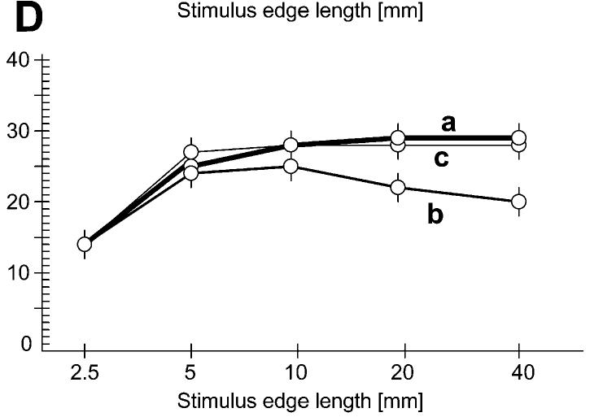
Pretectal lesions abolish the worm–antiworm distinction
After a pretectal lesion delivered through a second implanted electrode, the same T5.2 neuron fired strongly to the non-prey bar, and the toad oriented toward it (Fig. 4C). The neuron's receptive field also enlarged and it developed resting discharge. Following the same recorded neuron retained its identity as the neighboring inhibitory pathway was disrupted by the implanted lesion electrode.
In behavior, toads with bilateral pretectal lesions turned toward worms, antiworms and squares at similar rates. Antiworms, which normally abolish turning, became as effective as worms. The increased response generalized across the object configurations that intact animals normally treat differently during the orienting test. The lesion therefore altered the relation between configuration and response while leaving the external stimulus set and the capacity to turn available. An antiworm could now produce both tectal discharge and orientation, connecting loss of the usual inhibitory conditions with the broadened behavioral acceptance of the same previously ineffective object.
Pretectal lesions produced broader tectal responsiveness and inappropriate catching, including responses to large objects, textures, stationary targets, and self-induced image motion. Some animals snapped at objects beyond effective striking distance. The pretectal influence therefore helps restrict both the configurations and circumstances that reach the motor pathway, combining control of tectal excitation with the normal selection of suitable prey targets.
Ewert et al. (2001), Fig. 2D. Turning to worm (a), antiworm (b) and square (c) stimuli after bilateral pretectal thalamic lesions (n = 20 toads).
Ewert et al. (2001); Ewert (1997)
18
Notes:
• After a lesion of the pretectum, the same T5.2 neuron fired strongly to the antiworm bar, and the toad turned toward it.
– The neuron's receptive field also got bigger and it started firing spontaneously.
• Behaviorally, toads without a pretectum turned toward worms, antiworms and squares about equally.
– The antiworm, normally ignored, became as good as a worm.
• They also snapped at non-moving objects, at things too far away and at image motion caused by their own movement. The pretectum normally provides the inhibition that makes the tectum selective.
References:
Ewert JP, Buxbaum-Conradi H, Dreisvogt F, Glagow M, Merkel-Harff C, Röttgen A, Schürg-Pfeiffer E, Schwippert WW (2001). Neural modulation of visuomotor functions underlying prey-catching behaviour in anurans: perception, attention, motor performance, learning. Comparative Biochemistry and Physiology A 128: 417–461. https://doi.org/10.1016/S1095-6433(00)00333-0
Ewert JP (1997). Neural correlates of key stimulus and releasing mechanism: a case study and two concepts. Trends in Neurosciences 20(8): 332–339. https://doi.org/10.1016/S0166-2236(96)01042-9
Figure: Ewert et al. (2001), Fig. 2D. Turning to worm (a), antiworm (b) and square (c) stimuli after bilateral pretectal thalamic lesions (n = 20 toads).
Figure source: https://doi.org/10.1016/S1095-6433(00)00333-0

Slide 23
Pretectal inhibition subtracts antiworm drive
Tectal selectivity can be read as a balance of two inputs. Retinal excitation reaching T5.2 reports size, contrast and movement without regard to configuration, while pretectal TH3 output grows with extension across the path and cancels the excitation an antiworm brings. The proposed balance assigns different feature information to excitation and inhibition, allowing the final tectal response to depend on their configuration-specific interaction.
Recording one T5.2 cell before and after the lesion rules out a change in which cells were sampled. Its enlarged field and new resting discharge fit the loss of inhibition that normally trims the field's edges and holds baseline firing low. The new baseline firing indicates that a restraining influence normally operates even between effective moving targets within the tested visual conditions.
Pretectal input contributes to rejection of unsuitable prey configurations, with TH3 activity increasing for extension across the direction of motion. Its inhibitory influence reduces the tectal drive generated by those objects. After a lesion, prey-related output remains available but accepts a wider set of targets, producing overinclusive catching through the motor pathways that ordinarily receive a more selective tectal signal. Removing inhibition also enlarges the effective field because weaker inputs near its edge can now recruit spikes. Increased baseline firing exposes an additional influence of the pathway between targets. The same disruption therefore changes spatial extent, resting state, and feature-dependent output within the recorded tectal neuron.
Ewert et al. (2001), Fig. 2D. Turning to worm (a), antiworm (b) and square (c) stimuli after bilateral pretectal thalamic lesions (n = 20 toads).
Ewert (1997); Ewert et al. (2001); Ewert et al. (1978)
18a
Notes:
• Slides 10, 11, 16 and 18 together give a simple causal account of why T5.2 neurons prefer worms: excitation that is blind to configuration, minus inhibition that is not.
• Two inputs with different tuning.
– The retinal classes on slide 10 respond according to size and receptive-field size, and none of them separates worms from antiworms the way behavior does.
– Pretectal TH3 neurons on slides 11 and 16 have negative discriminant values and respond best to large extension across the path.
– When both reach a T5.2 neuron, an antiworm arrives with strong inhibition attached, while a worm arrives with little.
• The within-cell comparison.
– Slides 17 and 18 use the same chronically recorded neuron, with a second implanted electrode used to make the pretectal lesion.
– Comparing a cell with itself removes the worry that lesioned and intact animals simply had different neurons under the electrode.
– The bigger receptive field and the new spontaneous firing are what one expects when an inhibitory surround and tonic inhibition are taken away.
• What this means for the toad.
– A toad without the pretectum is not blind to prey; it over-responds, which tells us that the veto, not the detection, is what was lost.
– Ewert's 2001 review states that prey and non-prey discrimination rests on the interaction of the tectal stream with the pretectal thalamus.
References:
Ewert JP (1997). Neural correlates of key stimulus and releasing mechanism: a case study and two concepts. Trends in Neurosciences 20(8): 332–339. https://doi.org/10.1016/S0166-2236(96)01042-9
Ewert JP, Buxbaum-Conradi H, Dreisvogt F, Glagow M, Merkel-Harff C, Röttgen A, Schürg-Pfeiffer E, Schwippert WW (2001). Neural modulation of visuomotor functions underlying prey-catching behaviour in anurans: perception, attention, motor performance, learning. Comparative Biochemistry and Physiology A 128: 417–461. https://doi.org/10.1016/S1095-6433(00)00333-0
Ewert JP, Borchers HW, von Wietersheim A (1978). Question of prey feature detectors in the toad's Bufo bufo (L.) visual system: a correlation analysis. Journal of Comparative Physiology 126: 43–47. https://doi.org/10.1007/BF01342649

Slide 24
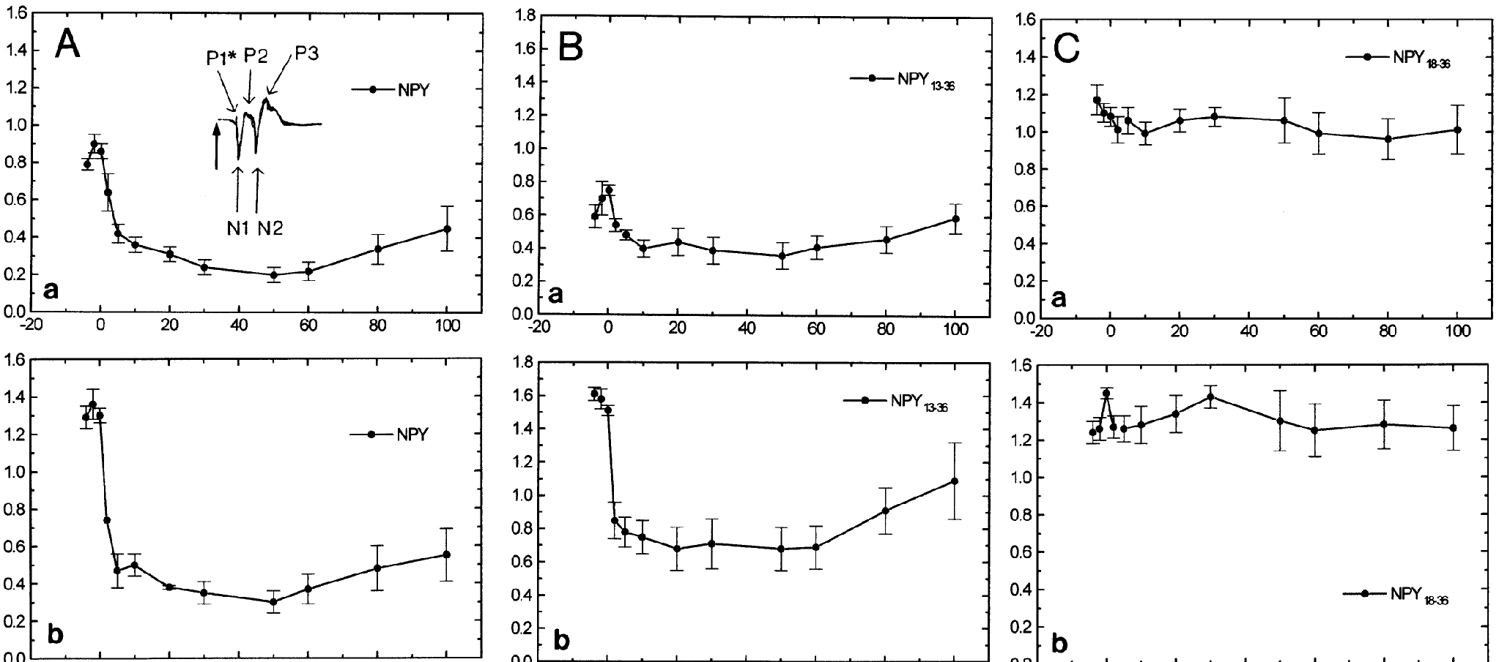
Neuropeptide Y carries pretecto-tectal inhibition
Neuropeptide Y (NPY) is a 36-amino-acid peptide transmitter. NPY-immunoreactive fibers in the superficial tectum originate in ipsilateral pretectal nuclei that match the recording sites of TH3 and TH4 neurons, which project to the tectum. The projection places a chemically identified inhibitory influence near retinal termination layers in the tectal region receiving the visual stimulus.
Schwippert et al. measured the tectal surface field potential in cane toads, evoked by diffuse light-on and light-off, before and after NPY was applied to the tectum. NPY reduced the excitatory N1 wave, which reflects retinal input, by about half within minutes, and the effect lasted more than an hour. The reduced field response persisted well beyond the first minutes of exposure, describing a sustained change in the effectiveness of retinal drive.
The Y2-active fragment NPY 13–36 reproduced the depression of the N1 response, while NPY 18–36 had a different outcome. This receptor-related sensitivity supported a proposed presynaptic influence on retinal terminals, where reduced transmitter release would weaken the drive arriving at tectal dendrites. The pretectal peptide pathway therefore supplies a route for changing visual transmission before the tectal output neuron integrates the incoming retinal signal.
Ewert et al. (2001), Fig. 5. N1 amplitude of the tectal field potential to light-on (a) and light-off (b) after NPY (A), NPY 13–36 (B) and NPY 18–36 (C).
Ewert et al. (2001); Ewert (1997)
19
Notes:
• Neuropeptide Y is a peptide transmitter used by the pretectal neurons that project to the tectum.
– NPY fibers in the tectum come from the same pretectal areas where TH3 and TH4 neurons are recorded.
• The experiment measured the tectal field potential evoked by turning a light on or off.
– Putting NPY on the tectum cut the first excitatory wave, the retinal input, roughly in half for over an hour.
• A fragment that activates Y2 receptors did the same, and a fragment that does not had no effect.
– Y2 receptors are often on presynaptic terminals, which fits the idea that NPY turns down retinal input to the tectum.
References:
Ewert JP, Buxbaum-Conradi H, Dreisvogt F, Glagow M, Merkel-Harff C, Röttgen A, Schürg-Pfeiffer E, Schwippert WW (2001). Neural modulation of visuomotor functions underlying prey-catching behaviour in anurans: perception, attention, motor performance, learning. Comparative Biochemistry and Physiology A 128: 417–461. https://doi.org/10.1016/S1095-6433(00)00333-0
Ewert JP (1997). Neural correlates of key stimulus and releasing mechanism: a case study and two concepts. Trends in Neurosciences 20(8): 332–339. https://doi.org/10.1016/S0166-2236(96)01042-9
Figure: Ewert et al. (2001), Fig. 5. N1 amplitude of the tectal field potential to light-on (a) and light-off (b) after NPY (A), NPY 13–36 (B) and NPY 18–36 (C).
Figure source: https://doi.org/10.1016/S1095-6433(00)00333-0

Slide 25
NPY scales retinal input before tectal cells see it
A surface field potential is the summed voltage of many synchronously active synapses, so N1 measures how strongly retinal terminals drive the tectum together. Diffuse flashes engage them without any pattern, isolating transmission strength from configuration. The field response follows a population of activated inputs, allowing a chemical change in transmission to be assessed across the stimulated retinal projection.
The fragments rule out a general effect of NPY-derived peptides: only the Y2-activating fragment acted. A presynaptic receptor lowers release from the terminal carrying it, scaling retinal input before tectal dendrites receive it. The receptor-sensitive fragment response places a more specific molecular route within the longer-lasting depression produced by the full peptide.
Pretectal NPY fibers terminate mainly in laminae B and C, overlapping the region receiving R2 retinal input. The projection is therefore positioned to influence a retinal class responsive to small objects. A depression lasting more than an hour can change the working level of tectal excitation across many encounters, relating a sustained inhibitory state to the visual signals available for prey-oriented behavior.
Ewert et al. (2001), Fig. 5. N1 amplitude of the tectal field potential to light-on (a) and light-off (b) after NPY (A), NPY 13–36 (B) and NPY 18–36 (C).
Ewert et al. (2001); Ewert (1997)
19a
Notes:
• The NPY experiment uses a population signal and a pair of peptide fragments, and both choices need explaining before the result can be tied to the anatomy on slide 14.
• What a field potential measures.
– A surface electrode does not see single spikes; it records the summed current of thousands of synapses that are active together.
– Turning a diffuse light on or off activates many retinal terminals at the same moment, so the first wave reflects how much transmitter those terminals release onto the tectum.
• Why two fragments.
– If NPY 13–36 and NPY 18–36 had both worked, the result could reflect some general property of NPY fragments.
– Only the Y2-activating fragment acted, which ties the depression to a receptor type that commonly sits on presynaptic terminals.
– Presynaptic inhibition reduces how much transmitter each incoming spike releases, so the signal is weakened at its source.
• Linking to the laminae.
– Slide 14 places R2 terminals in laminae B and C and the NPY fibers mainly in the same laminae.
– Slide 10 describes R2 cells as responding best to small stimuli, so the pretectal brake is located on the small-object retinal channel.
– The effect on slide 19 lasted more than an hour, much longer than a single prey encounter.
References:
Ewert JP, Buxbaum-Conradi H, Dreisvogt F, Glagow M, Merkel-Harff C, Röttgen A, Schürg-Pfeiffer E, Schwippert WW (2001). Neural modulation of visuomotor functions underlying prey-catching behaviour in anurans: perception, attention, motor performance, learning. Comparative Biochemistry and Physiology A 128: 417–461. https://doi.org/10.1016/S1095-6433(00)00333-0
Ewert JP (1997). Neural correlates of key stimulus and releasing mechanism: a case study and two concepts. Trends in Neurosciences 20(8): 332–339. https://doi.org/10.1016/S0166-2236(96)01042-9

Slide 26
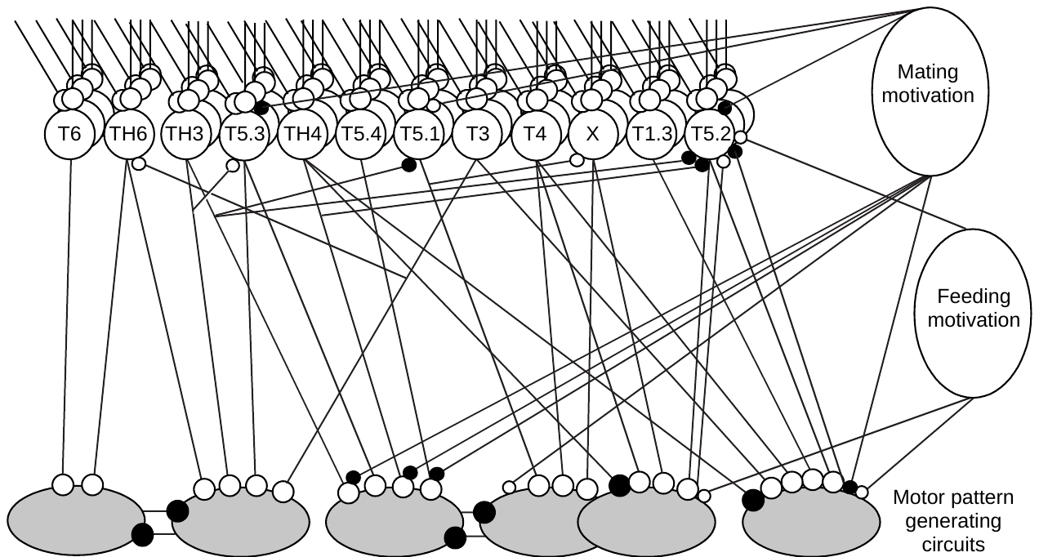
Sensorimotor codes combine many processing streams
Ewert proposed that behavior is released not by single detector neurons but by sensorimotor codes: combinations of activity across distributed processing streams. Each stream contributes a different mixture of visual information, allowing the selected motor act to depend on the pattern across several descending channels.
At least seven physiologically distinct types of tectal neurons, and several pretectal types, project to the medulla, as shown by antidromic stimulation. Each stream carries information about several stimulus properties (convergence), and each property is represented in several streams (divergence). Antidromic stimulation identifies a projecting axon by driving activity back toward its cell body, linking the recorded class with access to the medullary pathway.
Motivational state changes the activity of prey-related tectal output, with T5.2 responses weak in satiated animals during hunting and in unfed animals during the mating season. The same visual configuration therefore reaches motor systems through a state-dependent pattern of activity. Different combinations of these streams recruit snapping, orienting, avoidance, jumping, or ducking as the available visual evidence interacts with the animal's current behavioral priorities.
Ewert (1997), Fig. 5. Combinations of tectal (T) and pretectal (TH) streams, gated by feeding and mating motivation, select motor pattern circuits.
Ewert (1997)
20
Notes:
• Ewert's model replaces a single worm detector with combinations of active neuron types, which he called sensorimotor codes.
– At least seven types of tectal neurons and several pretectal types send axons down to the medulla.
• Each type carries information about several features, and each feature is carried by several types.
– A particular combination activates the motor circuit for snapping, turning, avoiding, jumping or ducking.
• Motivation filters these codes. T5.2 neurons respond weakly in a well-fed toad, and in the mating season, when toads approach mates instead of prey.
References:
Ewert JP (1997). Neural correlates of key stimulus and releasing mechanism: a case study and two concepts. Trends in Neurosciences 20(8): 332–339. https://doi.org/10.1016/S0166-2236(96)01042-9
Figure: Ewert (1997), Fig. 5. Combinations of tectal (T) and pretectal (TH) streams, gated by feeding and mating motivation, select motor pattern circuits.
Figure source: https://doi.org/10.1016/S0166-2236(96)01042-9

Slide 27
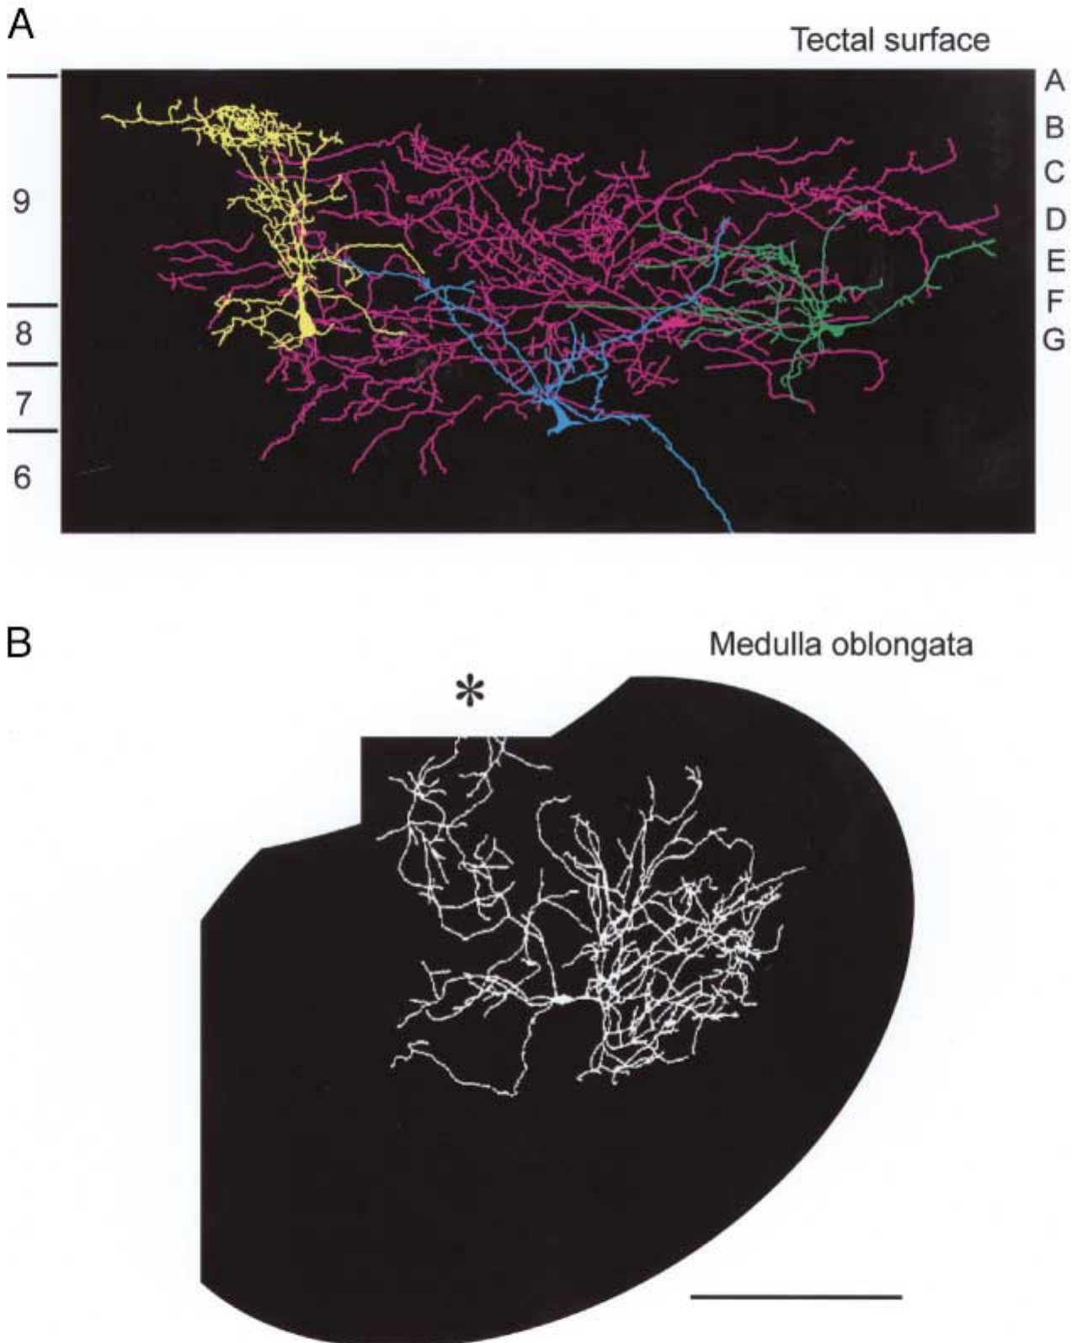
Medullary neurons converge inputs for snapping
Tectal and pretectal projection neurons send axons to premotor and motor structures in the medulla oblongata, the most caudal part of the brainstem. The descending channels provide a connection between classification in the visual maps and recruitment of the muscle-related pathways executing a prey-catching act.
In the medullary motor nucleus of the trigeminal nerve, which controls the jaw muscles, some neurons respond best to prey-like visual stimuli. A cobalt-filled medullary neuron has a richly branched dendritic tree extending into the lateral and medial reticular formation and into vestibular and spinocerebellar regions. The broad dendritic reach gives the recorded cell access to signals from several regions involved in orienting and motor coordination.
Ewert proposed coincidence detection as a way for converging descending inputs to recruit a ballistic act when their timing aligns. The recorded medullary anatomy provides access to multiple visual and premotor streams, while physiological evidence supports di- or polysynaptic routes from tectal snapping-related regions to medullary motor neurons. Their convergence can therefore combine distributed sensory activity within the pathway that organizes jaw and tongue-related behavior. Signals about target location, body orientation, and the selected response can converge through the neuron's extensive dendritic territory. The proposal concerns their temporal coincidence at a downstream stage, where the combined input can bring an appropriate motor pathway toward the threshold for releasing the ballistic act.
Ewert (1997), Fig. 2A–B. Tectal neurons converging inputs (A) and a cobalt-filled medullary neuron with dendrites spanning reticular and vestibular regions (B).
Ewert (1997)
21
Notes:
• The final steps happen in the medulla, the lowest part of the brainstem.
– Some neurons in the trigeminal motor nucleus, which drives the jaw muscles, respond best to prey-like visual stimuli.
• This filled medullary neuron has a huge dendritic tree reaching into several brainstem regions.
– That allows it to collect signals from many descending streams at once.
• Ewert suggested that the timing of those inputs, arriving together, could select the motor command. Recordings suggest only one or two synapses between the tectal snapping area and the medullary motor neurons.
References:
Ewert JP (1997). Neural correlates of key stimulus and releasing mechanism: a case study and two concepts. Trends in Neurosciences 20(8): 332–339. https://doi.org/10.1016/S0166-2236(96)01042-9
Figure: Ewert (1997), Fig. 2A–B. Tectal neurons converging inputs (A) and a cobalt-filled medullary neuron with dendrites spanning reticular and vestibular regions (B).
Figure source: https://doi.org/10.1016/S0166-2236(96)01042-9

Slide 28
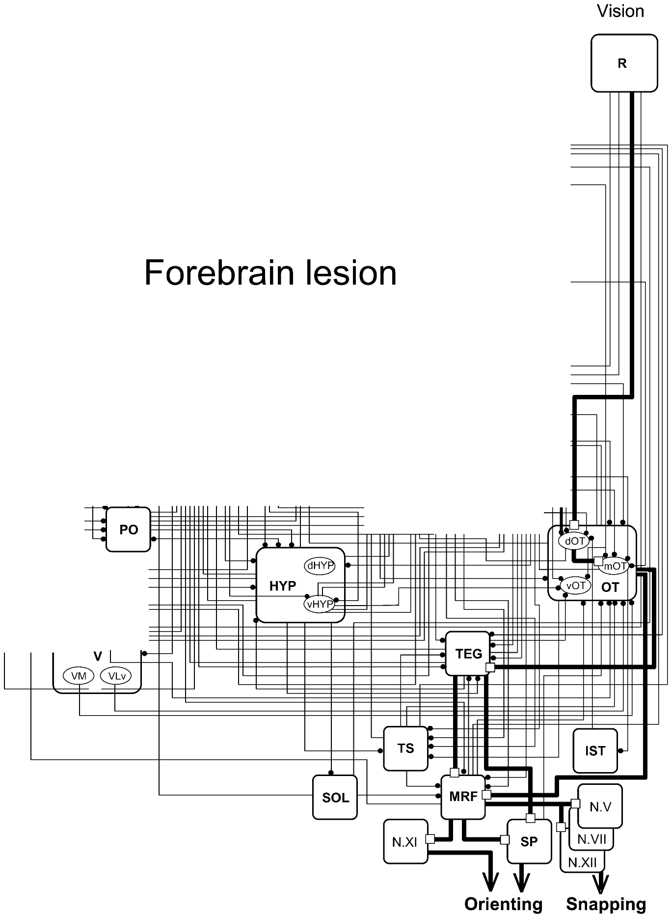
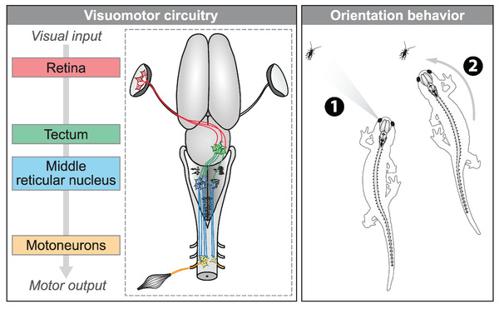
Without forebrain and pretectum, prey-catching is crude
Ewert ablated both telencephalic hemispheres together with the dorsal diencephalon, which contains the pretectum, sparing the eyes, optic chiasm, preoptic area, hypothalamus, pituitary and ventral thalamus. These toads readily oriented and snapped toward moving objects. Removing the telencephalon alone, by contrast, abolished prey orienting. The sequential ablations retained different balances of forebrain influence and pretectal restraint while preserving the downstream motor structures available for catching.
The remaining retino–tecto/tegmento–bulbar/spinal pathway, from retina to tectum, then through tegmentum and medullary reticular formation (MRF) to spinal and cranial motor nuclei, is therefore sufficient to release orienting and snapping. Without the pretectum, however, any moving image elicited prey-catching, and toads collided with obstacles and misjudged distance. The remaining pathway could generate the movements while its broad acceptance of targets exposed the contribution normally supplied by the removed visual and gating regions.
The retained retino–tecto/tegmento–bulbar/spinal route connects visual input with cranial and spinal motor systems through the tectum, tegmentum, and medullary reticular formation. Flaive and Ryczko traced a corresponding retinal-to-tectal-to-reticulospinal route in salamanders. These connections place basic orienting within a conserved descending organization, while the forebrain and pretectum regulate which objects and behavioral circumstances recruit that organization.
Ewert et al. (2001), Fig. 3. Retino–tecto–tegmento–bulbar/spinal pathway (bold) that remains after forebrain lesion.
Flaive & Ryczko (2022), Fig. 8. Salamander visuomotor circuit: retina, tectum, middle reticular nucleus and motoneurons for orienting.
Ewert et al. (2001); Flaive & Ryczko (2022)
22
Notes:
• Two lesions give opposite results.
– Removing only the cerebral hemispheres abolished prey orienting.
– Removing the hemispheres together with the dorsal diencephalon, which includes the pretectum, left toads that readily turned and snapped at moving objects.
• So the core pathway, retina to tectum to tegmentum and medulla to the motor nuclei, is enough to produce turning and snapping.
– But without the pretectum it is indiscriminate: any moving image triggers prey-catching, and the toads bump into obstacles and misjudge distance.
• Flaive and Ryczko found a matching chain in salamanders, from retina through tectum to reticulospinal neurons that steer the body toward prey.
References:
Ewert JP, Buxbaum-Conradi H, Dreisvogt F, Glagow M, Merkel-Harff C, Röttgen A, Schürg-Pfeiffer E, Schwippert WW (2001). Neural modulation of visuomotor functions underlying prey-catching behaviour in anurans: perception, attention, motor performance, learning. Comparative Biochemistry and Physiology A 128: 417–461. https://doi.org/10.1016/S1095-6433(00)00333-0
Flaive A, Ryczko D (2022). From retina to motoneurons: a substrate for visuomotor transformation in salamanders. Journal of Comparative Neurology 530(14): 2518–2536. https://doi.org/10.1002/cne.25348
Figure: Ewert et al. (2001), Fig. 3. Retino–tecto–tegmento–bulbar/spinal pathway (bold) that remains after forebrain lesion.
Figure source: https://doi.org/10.1016/S1095-6433(00)00333-0
Figure: Flaive & Ryczko (2022), Fig. 8. Salamander visuomotor circuit: retina, tectum, middle reticular nucleus and motoneurons for orienting.
Figure source: https://doi.org/10.1002/cne.25348

Slide 29
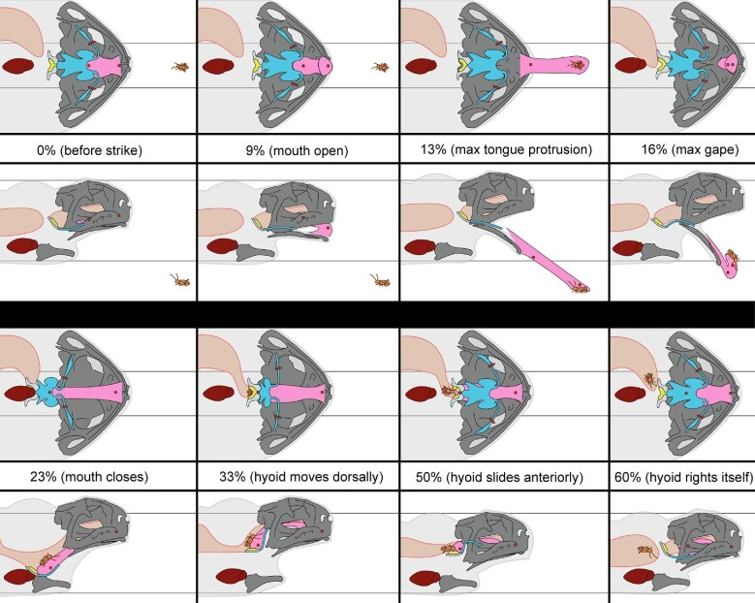
The tongue is flipped out and the hyoid swallows the prey
The consummatory snapping act launches the tongue toward the selected target before the internal transport and swallowing movements continue. Keeffe and colleagues used XROMM (X-ray Reconstruction of Moving Morphology), in which radio-opaque markers implanted in skeleton and tongue are tracked in biplanar X-ray video, to follow the cane toad, Rhinella marina, through the feeding cycle. The tracked internal structures connect the visible tongue strike with the skeletal and muscular movements that transport captured prey after the mouth closes.
The mouth opened at about 9% of the cycle, the tongue reached maximal protrusion at 13% and maximal gape at 16%, and the mouth closed with the prey at 23%. During transport and swallowing the hyoid apparatus moved dorsally and anteriorly, and the tongue stretched behind the skull, often more than during protrusion. The continued tongue and hyoid displacement places substantial feeding movement after initial protrusion, carrying the prey toward swallowing within the same sequence.
The hyoid apparatus moves dorsally and anteriorly during transport, while the tongue extends behind the skull and can lengthen more than during its initial outward strike. Similar kinematics across animals and across successful and unsuccessful attempts are consistent with a largely ballistic snapping pattern. The complete feeding sequence consequently includes rapid prey-directed launch followed by substantial internal movement that transfers the item toward swallowing.
Keeffe et al. (2022), Fig. 8. Phases of a cane toad feeding event from X-ray video, ventral and lateral views, with tongue (pink) and hyoid (blue).
Keeffe et al. (2022); Ewert et al. (2001)
23
Notes:
• Snapping is the final act, and Keeffe and colleagues filmed it with X-ray video in the cane toad.
– Markers in the bones and tongue let them reconstruct movements in three dimensions.
• The whole strike is quick and ordered.
– The mouth opens, the tongue is fully out by about 13 percent of the cycle, and the mouth closes on the prey by about 23 percent.
– Then the hyoid, the cartilage frame under the tongue, moves the prey back for swallowing.
• Strikes looked the same from toad to toad, and misses looked like hits, which fits the idea that once launched, the strike runs to completion.
References:
Keeffe R, Blob R, Blackburn D, Mayerl C (2022). XROMM analysis of feeding mechanics in toads: interactions of the tongue, hyoid, and pectoral girdle. Integrative Organismal Biology 4(1): obac045. https://doi.org/10.1093/iob/obac045
Ewert JP, Buxbaum-Conradi H, Dreisvogt F, Glagow M, Merkel-Harff C, Röttgen A, Schürg-Pfeiffer E, Schwippert WW (2001). Neural modulation of visuomotor functions underlying prey-catching behaviour in anurans: perception, attention, motor performance, learning. Comparative Biochemistry and Physiology A 128: 417–461. https://doi.org/10.1016/S1095-6433(00)00333-0
Figure: Keeffe et al. (2022), Fig. 8. Phases of a cane toad feeding event from X-ray video, ventral and lateral views, with tongue (pink) and hyoid (blue).
Figure source: https://doi.org/10.1093/iob/obac045

Slide 30
Snapping runs open-loop, so aiming happens first
A closed-loop movement is corrected by sensory feedback while it runs; an open-loop or ballistic movement is fully specified before it starts. Among the acts of the catching sequence, the snap is the clearest open-loop case. The distinction concerns how much the ongoing trajectory can be adjusted after launch, placing the demands of accurate selection before the fastest movement phase.
In the cane toad the eyes close at the start of the feeding cycle and reopen around the time the mouth shuts on the prey, while the tongue reaches full protrusion from rest in about 46 ms. Vision is unavailable during the strike, and the tongue, flipped out largely under its own inertia, follows a path set at launch. The closed eyes and rapid protrusion place the visual estimate of prey position before the tongue follows its launched path.
Binocular fixation and orienting position the animal before the ballistic strike, relating accurate capture to the visual and premotor activity preceding launch. Medullary convergence supplies a proposed route for triggering the act when the relevant descending signals coincide. Larval zebrafish also converge their eyes before the capture swim, linking target acquisition with a preparatory binocular state in another visually guided feeding system.
Keeffe et al. (2022), Fig. 8. Phases of a cane toad feeding event from X-ray video, ventral and lateral views, with tongue (pink) and hyoid (blue).
Keeffe et al. (2022); Ewert (1997); Bianco et al. (2011)
23a
Notes:
• The XROMM data explain why the toad's catching sequence puts fixation before snapping, and why misses look like hits.
• Two kinds of movement control.
– In a closed-loop movement, the senses keep reporting and the movement is adjusted on the way.
– In an open-loop movement, the nervous system computes the whole command in advance, and the movement then runs to completion.
• The evidence from the strike itself.
– Keeffe and colleagues found that their toads consistently closed their eyes during the prey capture phase, with closure beginning at the start of the cycle.
– Tongue tip protrusion from rest took about 46 milliseconds, and in frogs the tongue is flipped forward largely by inertia, so there is neither visual input nor time for correction.
• Where accuracy comes from.
– Slide 2 places binocular fixation immediately before the snap, which is where direction and distance must be settled.
– Slide 21 describes medullary neurons whose dendrites collect many descending streams, and Ewert suggested that coincident input selects the ballistic command.
– Slide 37 gives the same order in zebrafish, where eye convergence enlarges the binocular field before the strike.
References:
Keeffe R, Blob R, Blackburn D, Mayerl C (2022). XROMM analysis of feeding mechanics in toads: interactions of the tongue, hyoid, and pectoral girdle. Integrative Organismal Biology 4(1): obac045. https://doi.org/10.1093/iob/obac045
Ewert JP (1997). Neural correlates of key stimulus and releasing mechanism: a case study and two concepts. Trends in Neurosciences 20(8): 332–339. https://doi.org/10.1016/S0166-2236(96)01042-9
Bianco IH, Kampff AR, Engert F (2011). Prey capture behavior evoked by simple visual stimuli in larval zebrafish. Frontiers in Systems Neuroscience 5: 101. https://doi.org/10.3389/fnsys.2011.00101

Slide 31
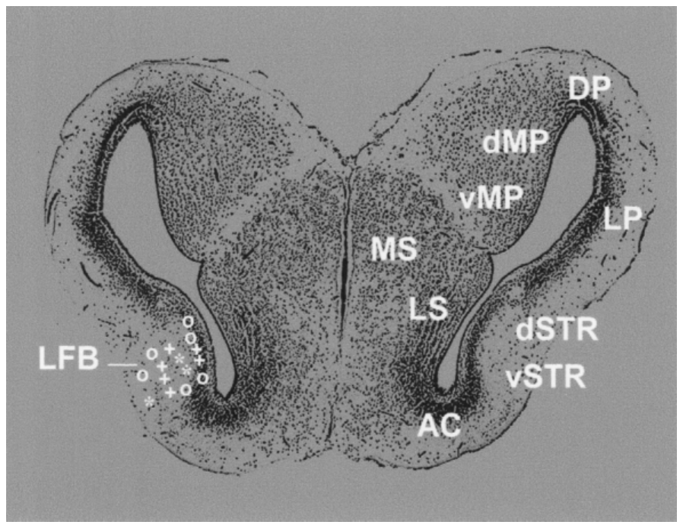
Visual neurons in the caudal ventral striatum
The amphibian striatum is homologous to part of the basal ganglia of amniotes, which in mammals participate in initiating and controlling orienting responses. Small lesions of the toad's caudal striatum, but not of the ventral medial pallium, produced prey neglect: visually guided prey-catching decreased. The lesion effect places the caudal striatum within the pathway regulating whether a visible prey stimulus reaches an orienting response.
Electrical stimulation of the striatum in freely moving toads did not elicit orienting, but it facilitated orienting toward a subliminal prey stimulus. There was even a retinotopic relation between stimulation sites and the parts of the visual field in which orienting was facilitated. The spatially matched facilitation indicates that striatal influence can release a visual response associated with a particular region of the sensory map.
Buxbaum-Conradi and Ewert recorded visual responses in the caudal ventral striatum, with sites extending from striatal gray matter into the lateral forebrain bundle. The recorded population provides a sensory input to a region whose stimulation facilitates orienting toward an otherwise weak prey stimulus. Its influence therefore concerns the availability of visually directed action, linking forebrain activity with the gating of a spatially defined prey response.
Ewert et al. (2001), Fig. 6. Recording sites of visually responsive striatal neurons (symbols) on a transverse section of the cane toad telencephalon.
Ewert et al. (2001)
24
Notes:
• The striatum in amphibians corresponds to part of the mammalian basal ganglia, which help start orienting movements.
– Small lesions of the toad's caudal striatum produced prey neglect, a drop in prey-catching.
• Stimulating the striatum did not cause turning by itself, but it made the toad more likely to turn toward a weak prey stimulus.
– The effect was even mapped to parts of the visual field, depending on where the electrode was.
• Recordings found visually responsive neurons in the caudal ventral striatum, marked by the symbols on this section.
References:
Ewert JP, Buxbaum-Conradi H, Dreisvogt F, Glagow M, Merkel-Harff C, Röttgen A, Schürg-Pfeiffer E, Schwippert WW (2001). Neural modulation of visuomotor functions underlying prey-catching behaviour in anurans: perception, attention, motor performance, learning. Comparative Biochemistry and Physiology A 128: 417–461. https://doi.org/10.1016/S1095-6433(00)00333-0
Figure: Ewert et al. (2001), Fig. 6. Recording sites of visually responsive striatal neurons (symbols) on a transverse section of the cane toad telencephalon.
Figure source: https://doi.org/10.1016/S1095-6433(00)00333-0

Slide 32
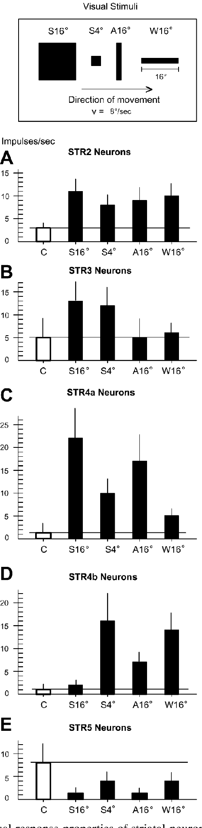
Striatal neurons signal motion, prey and threat
Buxbaum-Conradi and Ewert classified striatal neurons by their responses to a large square (S16°), a small square (S4°), an antiworm (A16°) and a worm (W16°). The stimulus set separated responses to general motion, compact objects, prey-like geometry, and a larger threat-related configuration within the same forebrain region.
STR2 neurons (about 32%) increased firing to any moving stimulus, behaving like motion detectors. STR3 neurons, approximately 15% of the classified population, preferred moving squares and contributed a compact-object response to the striatal signal. STR4a neurons responded well to the large threatening square, and STR4b neurons preferred prey-like worms and small squares. STR5 neurons (15%) had resting activity that was reduced by moving stimuli, especially threat. STR1 neurons remained largely uninfluenced by the tested moving stimuli, distinguishing them from the visually responsive classes recorded in the same region. These classes therefore carried different relationships between stimulus appearance and the excitation or suppression of ongoing striatal activity.
Striatal receptive fields covered the opposite eye's field or both visual fields, and most recorded neurons habituated with repeated presentation. Antidromic stimulation related lateral forebrain bundle output mainly to motion-responsive and compact-object classes. Broad visual access and adaptation allow the striatal population to signal the occurrence and relevance of an event, supplying state-dependent input to pathways that gate more spatially and configurationally organized tectal output. STR2 emphasizes general motion, STR3 compact moving squares, and STR4 subdivisions distinguish larger threat-like objects from prey-like configurations. STR5 decreases its ongoing activity especially during threatening stimulation, adding suppression to the pattern available in the striatal population. These broad response classes provide several ways for visual events to alter the permissive forebrain influence on the catching circuit.
Ewert et al. (2001), Fig. 7. Firing of STR2, STR3, STR4a, STR4b and STR5 neurons to a large square (S16°), small square (S4°), antiworm (A16°) and worm (W16°).
Ewert et al. (2001)
25
Notes:
• Striatal neurons fell into several types depending on what moving stimuli excited them.
– About a third, STR2, fired to any moving object, like motion detectors.
– STR3 preferred squares, STR4a responded to a large threatening square, and STR4b preferred worm-like prey.
• STR5 neurons had ongoing activity that moving stimuli, especially threats, turned down.
• Their receptive fields covered the whole visual field, and most stopped responding with repetition.
– This looks less like detailed shape analysis and more like signaling that something relevant has appeared, which fits a role in attention.
References:
Ewert JP, Buxbaum-Conradi H, Dreisvogt F, Glagow M, Merkel-Harff C, Röttgen A, Schürg-Pfeiffer E, Schwippert WW (2001). Neural modulation of visuomotor functions underlying prey-catching behaviour in anurans: perception, attention, motor performance, learning. Comparative Biochemistry and Physiology A 128: 417–461. https://doi.org/10.1016/S1095-6433(00)00333-0
Figure: Ewert et al. (2001), Fig. 7. Firing of STR2, STR3, STR4a, STR4b and STR5 neurons to a large square (S16°), small square (S4°), antiworm (A16°) and worm (W16°).
Figure source: https://doi.org/10.1016/S1095-6433(00)00333-0

Slide 33
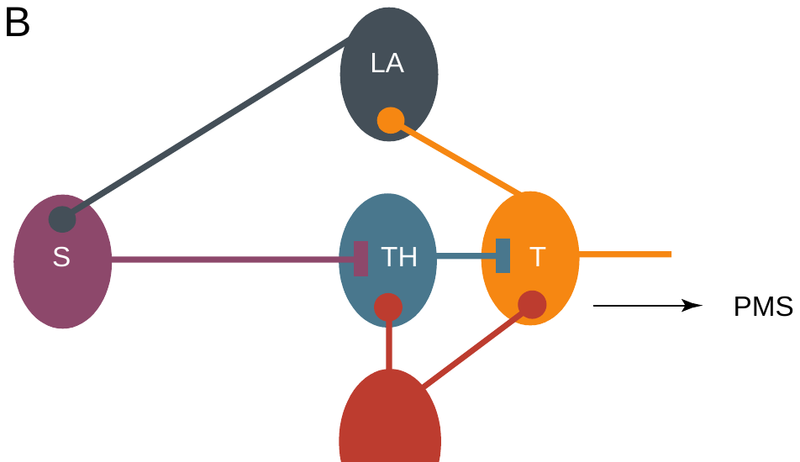
A striato-pretecto-tectal loop gates prey-catching
Ewert proposed a gating loop for directed attention, the translation of prey recognition into action. Retinal output reaches both tectum (T) and pretectum (TH), and pretecto-tectal inhibition distinguishes prey from non-prey. The model connects the sensory map with a forebrain route that controls how strongly its output reaches the descending motor pathway.
The striatum (S) receives tectal visual information through the lateral anterior thalamic nucleus (LA). It projects through the lateral forebrain bundle, which contains enkephalinergic fibers, to the pretectum, where it inhibits pretectal neurons. By reducing pretecto-tectal inhibition, the striatum disinhibits the tectum and releases tectal output to the motor systems. The two inhibitory stages transform increased striatal influence into a release of the tectal response already driven by retinal information.
The striato-pretecto-tectal loop accounts for the opposite effects of removing the striatum and removing the pretectum. Striatal loss leaves stronger pretectal restraint and reduced prey-catching, while pretectal loss releases catching toward a broader set of objects. In the intact animal, the balance preserves selective visual processing while allowing an appropriate prey signal to recruit orienting through the descending tectal pathway. Reduced pretectal inhibition changes the opportunity for existing retinal excitation to influence tectal output, connecting forebrain state with the same spatially organized visual representation.
Ewert (1997), Fig. 1B. Gating loop: striatum (S) receives tectal (T) input via lateral anterior thalamus (LA) and inhibits pretectum (TH), which inhibits tectum.
Ewert (1997); Ewert et al. (2001)
26
Notes:
• Ewert's gating loop ties the forebrain to the tectum.
– The tectum's visual information reaches the striatum through the lateral anterior thalamus.
– The striatum projects back to the pretectum and inhibits it.
• Because the pretectum inhibits the tectum, inhibiting the pretectum releases the tectum, which is disinhibition.
– A recognized prey can then trigger orienting.
• This explains both lesions. Without the striatum, the pretectum's inhibition wins and prey-catching fails; without the pretectum, the tectum responds to everything.
References:
Ewert JP (1997). Neural correlates of key stimulus and releasing mechanism: a case study and two concepts. Trends in Neurosciences 20(8): 332–339. https://doi.org/10.1016/S0166-2236(96)01042-9
Ewert JP, Buxbaum-Conradi H, Dreisvogt F, Glagow M, Merkel-Harff C, Röttgen A, Schürg-Pfeiffer E, Schwippert WW (2001). Neural modulation of visuomotor functions underlying prey-catching behaviour in anurans: perception, attention, motor performance, learning. Comparative Biochemistry and Physiology A 128: 417–461. https://doi.org/10.1016/S1095-6433(00)00333-0
Figure: Ewert (1997), Fig. 1B. Gating loop: striatum (S) receives tectal (T) input via lateral anterior thalamus (LA) and inhibits pretectum (TH), which inhibits tectum.
Figure source: https://doi.org/10.1016/S0166-2236(96)01042-9

Slide 34
Disinhibition permits orienting without driving it
Disinhibition is excitation by removal: when one inhibitory neuron silences another, the final target is freed to respond to excitation it already receives. The striatal signal is therefore permissive; the content passing the gate comes from retinal input about prey. The resulting response still depends on the excitatory information available at the final target when the restraining influence decreases.
Striatal stimulation alone produced no turn, as an open gate with no prey behind it releases nothing; paired with a subliminal prey stimulus, it made orienting likely. The retinotopic match between stimulation site and facilitated field position fits a release of inhibition confined to one part of the tectal map. The facilitated turn therefore remained directed toward a visible object in the matching field region, relating permissive forebrain influence to organized sensory content.
Striatal neurons' broad visual fields and habituating responses are consistent with an influence on whether a relevant visual event gains access to motor output. Tectal and pretectal populations supply more detailed configurational processing, while the striatal loop changes the inhibitory conditions governing their expression. A subliminal prey stimulus can consequently become effective when the corresponding tectal region is released from sufficient pretectal restraint.
Ewert (1997), Fig. 1B. Gating loop: striatum (S) receives tectal (T) input via lateral anterior thalamus (LA) and inhibits pretectum (TH), which inhibits tectum.
Ewert (1997); Ewert et al. (2001)
26a
Notes:
• The gating loop on slide 26 makes specific predictions about what striatal activity can and cannot do, and the stimulation data on slide 24 match them.
• Permissive versus instructive.
– An instructive signal tells a circuit what to do; a permissive signal only allows a circuit to act on information it already has.
– Inhibiting the pretectum removes a brake from the tectum, but if no prey is exciting the tectum, removing the brake changes nothing.
• Reading the stimulation experiment.
– On slide 24, striatal stimulation by itself did not produce orienting, which is exactly the permissive prediction.
– When a weak prey stimulus was also present, the same stimulation facilitated orienting, and the facilitated region of the visual field depended on the stimulation site.
• What striatal neurons report.
– Slide 25 describes striatal neurons with very large receptive fields that habituate, many of them simple motion detectors.
– These are poor properties for identifying objects but good ones for flagging that an object is worth attending to.
– Ewert's 2001 review connects the ventral striatum to directed attention on the basis of these response properties.
References:
Ewert JP (1997). Neural correlates of key stimulus and releasing mechanism: a case study and two concepts. Trends in Neurosciences 20(8): 332–339. https://doi.org/10.1016/S0166-2236(96)01042-9
Ewert JP, Buxbaum-Conradi H, Dreisvogt F, Glagow M, Merkel-Harff C, Röttgen A, Schürg-Pfeiffer E, Schwippert WW (2001). Neural modulation of visuomotor functions underlying prey-catching behaviour in anurans: perception, attention, motor performance, learning. Comparative Biochemistry and Physiology A 128: 417–461. https://doi.org/10.1016/S1095-6433(00)00333-0

Slide 35
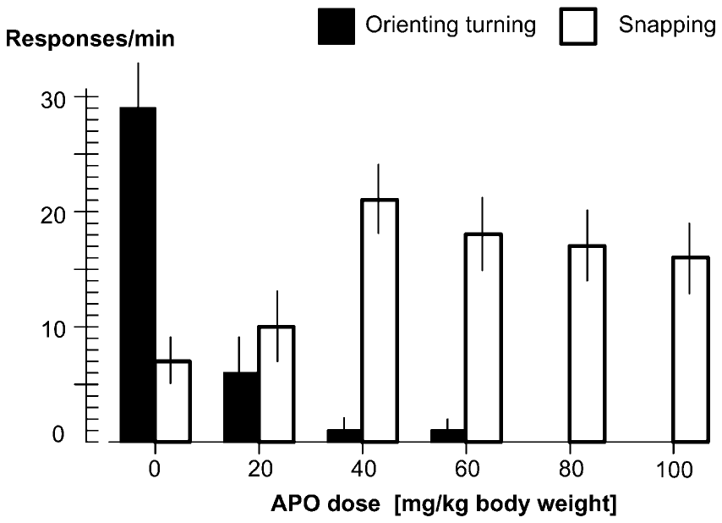
Apomorphine shifts toads from hunting to waiting
Apomorphine (APO) is an agonist at dopamine D1 and D2 receptors. Glagow and Ewert injected it into the lymph sac of common toads and measured prey-catching 20 min later. The systemic treatment changed dopaminergic signaling while the controlled prey test followed its effects on successive components of the catching sequence.
As the dose increased, prey-oriented turning fell from about 29 to near zero responses per minute, while snapping rose from about 7 to about 20. Toads that had been hunting sat motionless and "watched" for prey, snapping at items that came close: a shift from a hunting strategy to a waiting strategy, like that of Rana. The dissociation retained the animal's ability to snap at nearby prey while reducing the orienting acts normally used during active pursuit.
The apomorphine response peaked approximately 15–35 min after injection, with orienting returning around 70–90 min and a brief rebound in responding. Pretreatment with the D2 antagonist haloperidol prevented the changes. The drug-induced state preserved the basic configurational preference but reduced its acuity as the lower snapping threshold admitted more objects, shifting the balance from pursuit toward waiting for nearby prey. The receptor antagonist result relates the reversible behavioral state to a dopamine-sensitive pathway, while the different orienting and snapping responses locate its effect across separate motor channels.
Ewert et al. (2001), Fig. 9. Prey-oriented turning (black) and snapping (white) per minute 20 min after apomorphine at 0–100 mg/kg (n = 15 toads).
Ewert et al. (2001)
27
Notes:
• Apomorphine activates dopamine receptors, and it changed how toads hunt.
– With higher doses, turning toward prey dropped to almost nothing, while snapping roughly tripled.
• The toads stopped pursuing and sat still, snapping at anything that came close.
– That is a switch from an active hunting strategy to a sit-and-wait strategy, like the frog's.
• They still preferred prey-like objects, but less sharply. The effect peaked 15 to 35 minutes after injection, and haloperidol, which blocks D2 receptors, prevented it.
References:
Ewert JP, Buxbaum-Conradi H, Dreisvogt F, Glagow M, Merkel-Harff C, Röttgen A, Schürg-Pfeiffer E, Schwippert WW (2001). Neural modulation of visuomotor functions underlying prey-catching behaviour in anurans: perception, attention, motor performance, learning. Comparative Biochemistry and Physiology A 128: 417–461. https://doi.org/10.1016/S1095-6433(00)00333-0
Figure: Ewert et al. (2001), Fig. 9. Prey-oriented turning (black) and snapping (white) per minute 20 min after apomorphine at 0–100 mg/kg (n = 15 toads).
Figure source: https://doi.org/10.1016/S1095-6433(00)00333-0

Slide 36
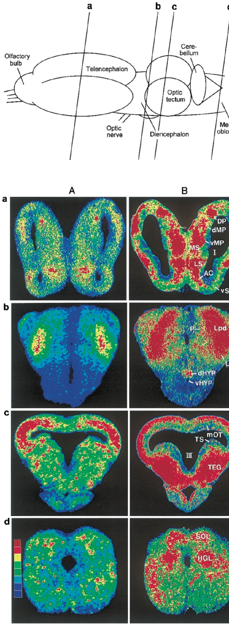
Apomorphine changes glucose use across the toad brain
The ¹⁴C-2-deoxyglucose (2DG) method measures local glucose utilization: 2DG is taken up like glucose but trapped in active cells, and autoradiography maps its accumulation in brain sections. Accumulation over the experimental interval provides a spatial measure of metabolic demand associated with the tissue's activity during the stimulus condition.
Glagow and Ewert compared APO-treated and untreated toads, both shown a moving prey-like stimulus, across 41 brain structures. In APO-treated toads, 2DG uptake increased in retinal projection fields, the dorsal tectal layers, pretectal Lpd and anterior thalamus. It decreased in the medial tectal layers, which contain T5.1 and T5.2 output neurons. The pattern therefore included increased activity in early visual regions alongside reduced activity in the tectal layers carrying prey-related output.
Apomorphine also increased uptake in the medial reticular formation and hypoglossal nucleus, regions associated with snapping and tongue control. Mesolimbic and limbic structures, including the nucleus accumbens, ventral tegmentum, ventral medial pallium, and medial septum, also showed increased uptake. The distributed metabolic pattern links the altered hunting strategy with changes across visual processing, motivational pathways, and the motor channels retained for striking at nearby items. Increased uptake in retinal projection regions and reduced uptake in medial tectum therefore describe different stages of the visual route under the same drug condition. Metabolic activation in snapping-associated structures follows the act that became more frequent, while the reduced tectal output corresponds to the orienting act that declined during the changed hunting strategy.
Ewert et al. (2001), Fig. 10. Color-coded 2DG uptake in transverse sections (a–d) of an untreated (A) and an apomorphine-treated (B) toad; blue low, red high.
Ewert et al. (2001)
28
Notes:
• The 2-deoxyglucose method shows which brain regions are working harder.
– The tracer is taken up like glucose but gets trapped in active cells, so autoradiography of brain sections maps activity, from blue for low to red for high.
• Apomorphine raised activity in the areas that receive retinal input, including the pretectum, and lowered it in the deep tectal layers that hold the output neurons.
– That fits stronger pretectal inhibition and weaker tectal output for turning.
• Activity also rose in snapping circuits in the medulla and in limbic and mesolimbic structures, all regions with dopamine fibers.
References:
Ewert JP, Buxbaum-Conradi H, Dreisvogt F, Glagow M, Merkel-Harff C, Röttgen A, Schürg-Pfeiffer E, Schwippert WW (2001). Neural modulation of visuomotor functions underlying prey-catching behaviour in anurans: perception, attention, motor performance, learning. Comparative Biochemistry and Physiology A 128: 417–461. https://doi.org/10.1016/S1095-6433(00)00333-0
Figure: Ewert et al. (2001), Fig. 10. Color-coded 2DG uptake in transverse sections (a–d) of an untreated (A) and an apomorphine-treated (B) toad; blue low, red high.
Figure source: https://doi.org/10.1016/S1095-6433(00)00333-0

Slide 37
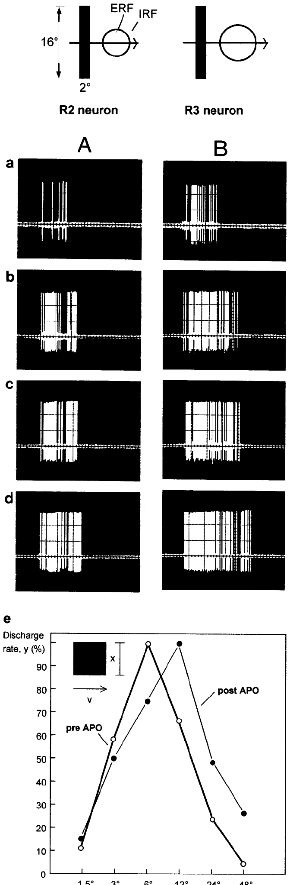
Dopamine enlarges retinal receptive fields
Glagow and Ewert recorded single retinal ganglion cell fibers in the tectum before and after APO, using a 2° × 16° bar moving across the receptive field in antiworm orientation. Following the same retinal fiber retained a defined visual output channel as the drug changed its effective receptive-field relationship.
R2 neurons (excitatory receptive field 6°) and R3 neurons (8°) fired strongly increasing discharge 10–25 min after APO. In R2 neurons, the size-tuning curve shifted: the stimulus size that drove the strongest response moved from 6° before APO to about 12° after APO, so the excitatory receptive field diameter roughly doubled. The shifted optimum therefore reflected a change in the size range supplying the strongest excitatory response within that identified retinal class.
Dopamine can weaken the horizontal-cell coupling associated with retinal surround inhibition, providing a proposed route for the enlarged effective excitatory field. The enhanced retinal output reaches both tectal and pretectal pathways. Ewert and colleagues proposed that its increased drive to pretectal inhibition contributes to the later reduction in tectal orienting output, relating an early increase in visual responsiveness to a different downstream motor consequence. A weaker inhibitory surround allows a larger object to remain effective before its extra extent suppresses the retinal response. The shift from an approximately 6° to a 12° optimum in R2 consequently describes a changed spatial balance within the early visual input. Its downstream consequences then depend on how the enhanced signal recruits tectal and pretectal pathways. Changing the surround alters the balance across image size, allowing a larger retinal region to contribute excitation before the surrounding inhibitory influence limits the response.
Ewert et al. (2001), Fig. 12. R2 (A) and R3 (B) discharges before (a) and 10–25 min after apomorphine (b–d); (e) R2 size tuning before and after.
Ewert et al. (2001)
29
Notes:
• Recordings from retinal ganglion cells showed that apomorphine made them more active.
– The same bar drove much more firing 10 to 25 minutes after the drug.
• The receptive fields also grew.
– For R2 cells, the best stimulus size moved from about 6 degrees to about 12 degrees, so the excitatory field roughly doubled.
• Dopamine in the retina uncouples the horizontal cells that create the inhibitory surround, which fits larger excitatory fields. More retinal input then feeds more pretectal inhibition onto the tectum.
References:
Ewert JP, Buxbaum-Conradi H, Dreisvogt F, Glagow M, Merkel-Harff C, Röttgen A, Schürg-Pfeiffer E, Schwippert WW (2001). Neural modulation of visuomotor functions underlying prey-catching behaviour in anurans: perception, attention, motor performance, learning. Comparative Biochemistry and Physiology A 128: 417–461. https://doi.org/10.1016/S1095-6433(00)00333-0
Figure: Ewert et al. (2001), Fig. 12. R2 (A) and R3 (B) discharges before (a) and 10–25 min after apomorphine (b–d); (e) R2 size tuning before and after.
Figure source: https://doi.org/10.1016/S1095-6433(00)00333-0

Slide 38
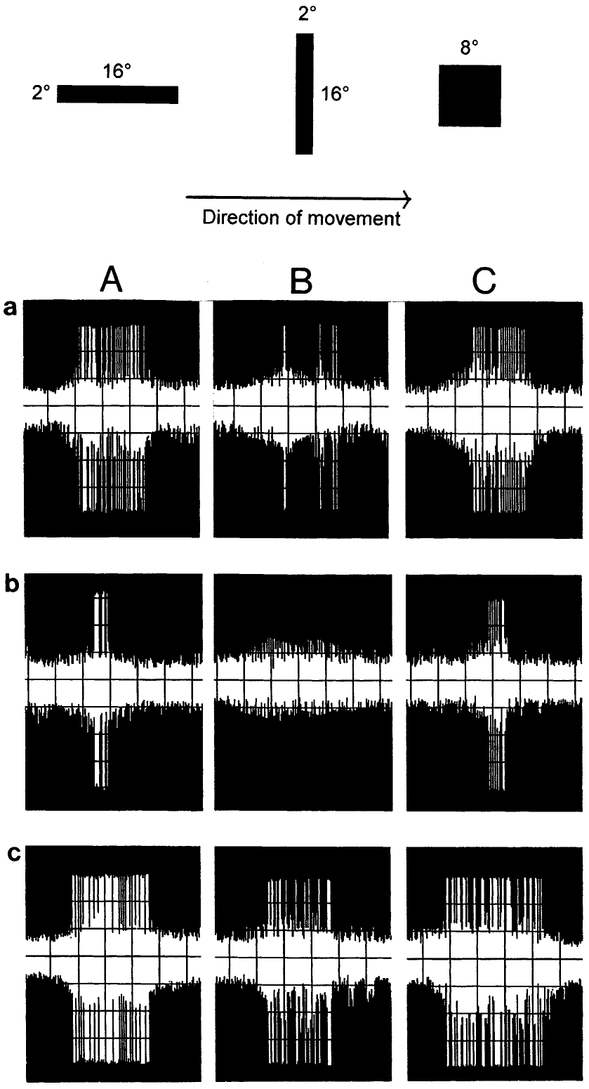
Apomorphine lowers T5.2 output but keeps its preference
At 35 min after APO, the tectal reduction phase, prey-selective T5.2 neurons fired less to a worm bar (A), an antiworm bar (B) and an 8° square (C), even though their retinal input had increased. T5.1 responses also declined during this phase, extending the reduction across the prey-related tectal output population. Their configurational preference was preserved: the worm still drove more spikes than the antiworm. The response retained its relative bias toward the worm while the overall amount of tectal output fell during the drug-associated reduction phase.
At about 75 min, during the tectal rebound phase, T5.2 responses increased again, matching the return of orienting behavior. The later rebound related recovery of neuronal discharge to recovery of the orienting behavior observed over the same drug time course.
The decrease in T5.2 output accompanied reduced metabolic activity in medial tectal layers and the suppression of prey-oriented turning. Pretectal TH3 and TH4 responses increased under apomorphine, supplying a proposed source of stronger inhibitory influence on that output. The pathway therefore retained its configurational organization while a drug-dependent change in the balance of input and inhibition reduced how strongly it drove the orienting system. A preserved worm preference means that the relative responses remain ordered even when the spike output to every tested object becomes smaller. The reduced overall drive can consequently lower orienting without erasing the underlying configuration relationship. Its recovery during the later rebound restores stronger access to the same selective descending pathway.
Ewert et al. (2001), Fig. 13. A T5.2 neuron's responses to worm (A), antiworm (B) and square (C) before (a), 35 min (b) and 75 min (c) after apomorphine.
Ewert et al. (2001)
30
Notes:
• Thirty-five minutes after apomorphine, T5.2 neurons fired less to all stimuli, even though their retinal input was larger.
– They still preferred the worm over the antiworm.
• By about 75 minutes their responses came back, at the same time as turning behavior returned.
• The time course matches behavior: less tectal output, less turning. Pretectal TH3 and TH4 neurons fired more under apomorphine, which fits the idea that extra pretectal inhibition reduces tectal output.
References:
Ewert JP, Buxbaum-Conradi H, Dreisvogt F, Glagow M, Merkel-Harff C, Röttgen A, Schürg-Pfeiffer E, Schwippert WW (2001). Neural modulation of visuomotor functions underlying prey-catching behaviour in anurans: perception, attention, motor performance, learning. Comparative Biochemistry and Physiology A 128: 417–461. https://doi.org/10.1016/S1095-6433(00)00333-0
Figure: Ewert et al. (2001), Fig. 13. A T5.2 neuron's responses to worm (A), antiworm (B) and square (C) before (a), 35 min (b) and 75 min (c) after apomorphine.
Figure source: https://doi.org/10.1016/S1095-6433(00)00333-0

Slide 39
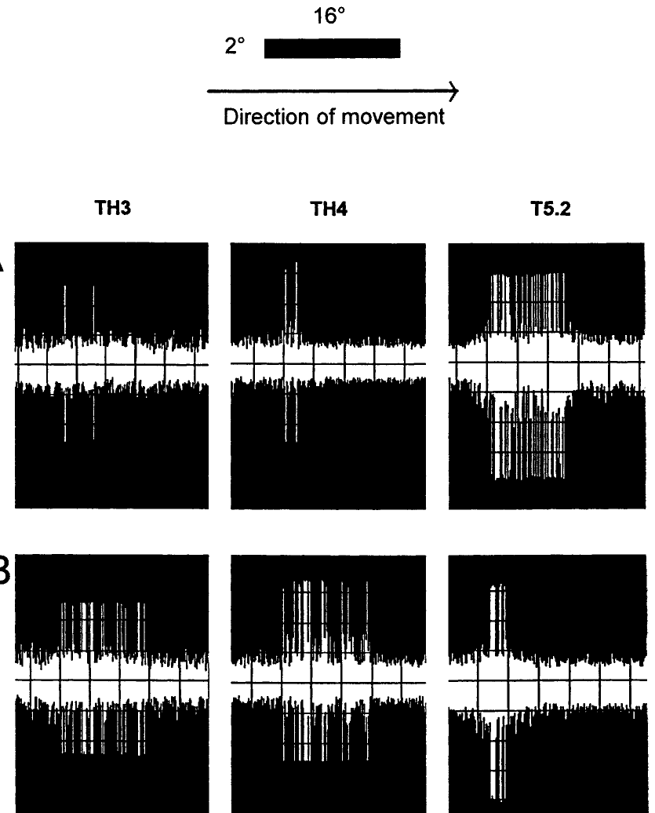
Apomorphine boosts pretectal TH3 and TH4 responses
Glagow and Ewert recorded pretectal TH3 and TH4 neurons, whose axons project to the tectum, and compared them with a tectal T5.2 neuron in the same stimulus condition: a 2° × 16° bar moving at 10°/s in prey configuration. The common visual condition preserved the prey-like configuration while responses were followed in central classes supplying opposing influences within the proposed gating circuit.
Before APO, TH3 and TH4 neurons responded only weakly to the prey-configured bar, while the T5.2 neuron responded strongly. About 35 min after APO, TH3 and TH4 discharges to the same bar increased markedly, and the T5.2 neuron's response decreased. The changed balance developed during the drug's tectal reduction phase, when the prey-related output and orienting behavior were both diminished.
The opposing pretectal increase and tectal decrease fit a model in which stronger retinal drive recruits more pretecto-tectal inhibition. That inhibition reduces output reaching orienting pathways despite enhanced activity earlier in the visual system. Ewert and colleagues also proposed that reduced striatal disinhibition of the pretectum could reinforce this state, combining altered visual drive with a forebrain contribution to the same inhibitory gate. The larger pretectal response to the unchanged prey-like bar increases a rejecting influence under a condition that normally favors tectal activity, altering the balance between the two streams.
Ewert et al. (2001), Fig. 14. Responses of pretectal TH3, TH4 and tectal T5.2 neurons to a prey-configured bar before (A) and 35 min after apomorphine (B).
Ewert et al. (2001)
31
Notes:
• This recording compared pretectal TH3 and TH4 neurons with a tectal T5.2 neuron, all shown the same prey-like bar.
– Before the drug, the pretectal neurons barely responded and the T5.2 neuron responded strongly.
• After apomorphine, the pretectal neurons fired much more and the T5.2 neuron fired less.
– The pretectum gets stronger while the tectum gets weaker.
• That fits the gating model: more retinal input drives more pretectal inhibition, which turns down the tectal output for turning toward prey.
References:
Ewert JP, Buxbaum-Conradi H, Dreisvogt F, Glagow M, Merkel-Harff C, Röttgen A, Schürg-Pfeiffer E, Schwippert WW (2001). Neural modulation of visuomotor functions underlying prey-catching behaviour in anurans: perception, attention, motor performance, learning. Comparative Biochemistry and Physiology A 128: 417–461. https://doi.org/10.1016/S1095-6433(00)00333-0
Figure: Ewert et al. (2001), Fig. 14. Responses of pretectal TH3, TH4 and tectal T5.2 neurons to a prey-configured bar before (A) and 35 min after apomorphine (B).
Figure source: https://doi.org/10.1016/S1095-6433(00)00333-0

Slide 40
Dopamine splits orienting from snapping
Apomorphine moved two acts of one sequence in opposite directions. Turning fell with tectal T5.2 output, while snapping rose together with glucose use in the hypoglossal nucleus, which drives the tongue, and the medial reticular formation. One drug can raise one act and lower another only when different circuits carry them. The two motor channels therefore remain separately adjustable even though they ordinarily occur as successive acts during the same feeding sequence.
The drugged toad matches the frog in two ways: little orienting with frequent snaps at nearby items, and broader acceptance of non-prey. With a lower snapping threshold, weaker stimuli reach the strike, flattening discrimination while its basic shape survives. The changed threshold allows more weakly effective objects to trigger a close-range strike while the reduced orienting output limits active pursuit.
In Ewert's interpretation, the dopaminergic state changes hunting strategy through the balance among motor channels. T5.2 retains a preference for worms, while its reduced output diminishes the pursuit-related turn. Enhanced snapping-related activity favors capture attempts when prey comes within range, allowing waiting and striking to replace active orientation and approach as the dominant expression of the feeding system. The same animal can therefore remain capable of recognizing effective prey-like features while expressing fewer pursuit movements and more nearby strikes. The drug shifts the gain and priority of the available motor channels, with the hunting configuration entering a network whose state now favors waiting over movement toward a more distant item.
Ewert et al. (2001), Fig. 10. Color-coded 2DG uptake in transverse sections (a–d) of an untreated (A) and an apomorphine-treated (B) toad; blue low, red high.
Ewert et al. (2001); Schürg-Pfeiffer & Ewert (1981)
31a
Notes:
• The apomorphine slides contain a dissociation that is easy to miss: the drug pushes orienting and snapping in opposite directions.
• Two acts, two channels.
– On slide 27, turning toward prey falls to near zero as the dose rises, while snapping roughly triples.
– Slide 28 reports reduced 2DG uptake in the medial tectal layers holding the orienting output neurons, alongside increased uptake in the hypoglossal nucleus and medial reticular formation.
– Slide 20 already lists separate motor-pattern circuits for turning and snapping, and the drug data push them independently.
• The toad becomes frog-like.
– Slide 9 describes the frog as a sit-and-wait predator with gradual worm and antiworm discrimination.
– The apomorphine toad sits still and strikes at nearby items, and its discrimination loses acuity while keeping its basic pattern, which is the frog's profile.
• Strategy, not appetite.
– On slide 30, T5.2 neurons keep their worm preference at 35 minutes, so configurational analysis is still running.
– Ewert's 2001 review proposes that hunting and waiting strategies depend on dose-dependent dopaminergic adjustments across retinal, pretecto-tectal, basal ganglionic, limbic and mesolimbic structures.
References:
Ewert JP, Buxbaum-Conradi H, Dreisvogt F, Glagow M, Merkel-Harff C, Röttgen A, Schürg-Pfeiffer E, Schwippert WW (2001). Neural modulation of visuomotor functions underlying prey-catching behaviour in anurans: perception, attention, motor performance, learning. Comparative Biochemistry and Physiology A 128: 417–461. https://doi.org/10.1016/S1095-6433(00)00333-0
Schürg-Pfeiffer E, Ewert JP (1981). Investigation of neurons involved in the analysis of gestalt prey features in the frog Rana temporaria. Journal of Comparative Physiology 141: 139–152. https://doi.org/10.1007/BF01342660

Slide 41
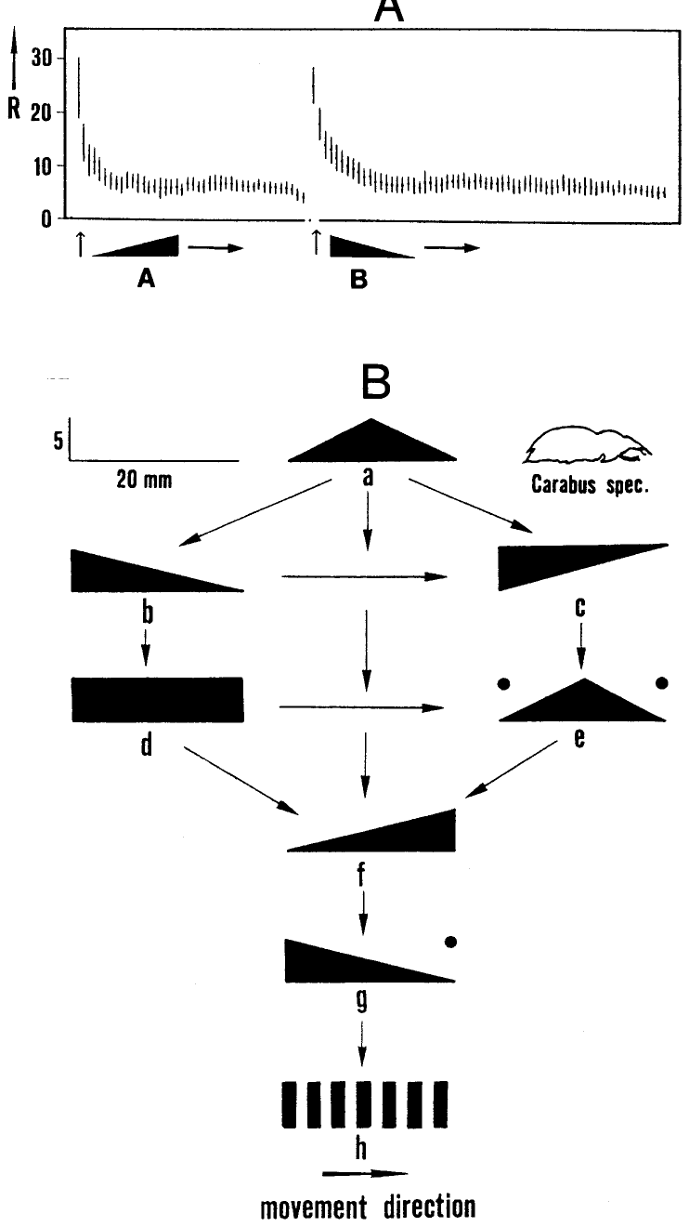
Habituation to prey dummies is stimulus-specific
Habituation is a decrease in response with repeated stimulation. When a prey dummy circles repeatedly, the toad's orienting gradually stops. Responding recovers if the stimulus is withheld, presented to another part of the visual field, or altered. Recovery with a changed object or field location retains evidence that the response remains available when relevant stimulus conditions differ.
Ewert and Kehl habituated toads to a black triangle moving with its narrow side leading (A). Immediately afterward the mirror-image triangle (B) elicited full responding, and it too habituated. The response decrement is therefore specific to stimulus features, which places the change in sensory and modulatory structures rather than in the motor system. The mirrored shape preserved a moving target while changing the leading and trailing configuration, linking habituation to features beyond general motion.
The dishabituation hierarchy revealed additional configurational distinctions, because some patterns restored responding after habituation to others while the reverse order had a different effect. Before repeated exposure, these stimuli could have similar releasing strength. Experience therefore changed the response according to the processed feature configuration, extending the animal's discrimination beyond the basic relation between worm elongation and movement. The leading and trailing edges differ between the mirrored triangles despite shared area and contrast, retaining a configurational signal for the central visual pathway. The newly effective pattern therefore reaches an available orienting system even after responding to the previous pattern has declined.
Ewert et al. (2001), Fig. 16. Stimulus-specific habituation to triangles A and B (A) and the dishabituation hierarchy of moving patterns (B); inset: beetle Carabus.
Ewert et al. (2001)
32
Notes:
• Habituation is a drop in responding to a repeated stimulus.
– A toad shown the same prey dummy over and over eventually stops turning toward it.
• The decline is specific to the stimulus.
– After habituating to one triangle, the toad responded fully to its mirror image.
– That means the change lies in recognition, not in fatigue of the motor system.
• Testing many pairs produced a hierarchy: some patterns renewed responding to others but not the reverse. So toads can tell apart features like leading and trailing edges that the basic worm rule does not capture.
References:
Ewert JP, Buxbaum-Conradi H, Dreisvogt F, Glagow M, Merkel-Harff C, Röttgen A, Schürg-Pfeiffer E, Schwippert WW (2001). Neural modulation of visuomotor functions underlying prey-catching behaviour in anurans: perception, attention, motor performance, learning. Comparative Biochemistry and Physiology A 128: 417–461. https://doi.org/10.1016/S1095-6433(00)00333-0
Figure: Ewert et al. (2001), Fig. 16. Stimulus-specific habituation to triangles A and B (A) and the dishabituation hierarchy of moving patterns (B); inset: beetle Carabus.
Figure source: https://doi.org/10.1016/S1095-6433(00)00333-0

Slide 42
Habituation spares the retina and the motor system
Two simpler processes can also make responses fade: motor fatigue, a decline in the muscles or pattern generators that execute the turn, and sensory adaptation, a decline in receptor or retinal responses to sustained stimulation. Either would weaken responses to any stimulus that uses the same pathway. These mechanisms act at different stages, so recovery and transfer to another stimulus can locate the functional change within the sensorimotor pathway.
The mirror-image triangle has the same area, contrast and speed as the habituated one and moves along the same path, so it drives the same retinal size classes and calls on the same turning movement. Full responding to it rules out both fatigue and adaptation and leaves a change at a stage where leading and trailing edges are told apart. The restored turns preserve the motor act while the changed leading-edge configuration provides an effective visual input to the remaining responsive system.
Habituation in striatal neurons and pallial regulatory loops supplies candidate central processes for the stimulus-specific behavioral change. The ventral medial pallium participates in pathways through which experience alters prey-related output. A repeatedly passing object can consequently lose its ability to recruit orienting while a different configuration at the same location still gains access to the response, retaining both visual processing and the movement capacity. The changed object can reuse the same muscles and much of the same visual input while reaching a different processed feature representation. Such selective recovery places the response decrement after basic detection and before a generalized failure of movement, within the pathways that connect the recognized stimulus with its releasing value.
Ewert et al. (2001), Fig. 16. Stimulus-specific habituation to triangles A and B (A) and the dishabituation hierarchy of moving patterns (B); inset: beetle Carabus.
Ewert et al. (2001)
32a
Notes:
• The mirror-image control on slide 32 is a compact piece of experimental logic that rules out two common alternatives to habituation.
• Three ways a response can fade.
– The motor system could tire, the sense organ or retina could adapt, or a central stage could learn that the stimulus is unimportant.
– Only the last is habituation in the strict sense, a form of non-associative learning.
• Why the mirror image is the right test.
– Mirror-image triangles share area, contrast and speed, which are the properties the retinal ganglion cell classes on slides 10 and 16 report.
– They also call on the same orienting turn, so a tired motor system would fail on both.
– Full recovery to the mirror image therefore means the decrement sits where configuration is coded.
• Where and why.
– Slide 25 notes that most striatal neurons habituate, and Ewert's 2001 review assigns stimulus-specific habituation to modulatory loops involving the ventral medial pallium.
– Behaviorally, the toad stops spending turns on an object that keeps passing uncaught while remaining fully responsive to anything new.
References:
Ewert JP, Buxbaum-Conradi H, Dreisvogt F, Glagow M, Merkel-Harff C, Röttgen A, Schürg-Pfeiffer E, Schwippert WW (2001). Neural modulation of visuomotor functions underlying prey-catching behaviour in anurans: perception, attention, motor performance, learning. Comparative Biochemistry and Physiology A 128: 417–461. https://doi.org/10.1016/S1095-6433(00)00333-0

Slide 43
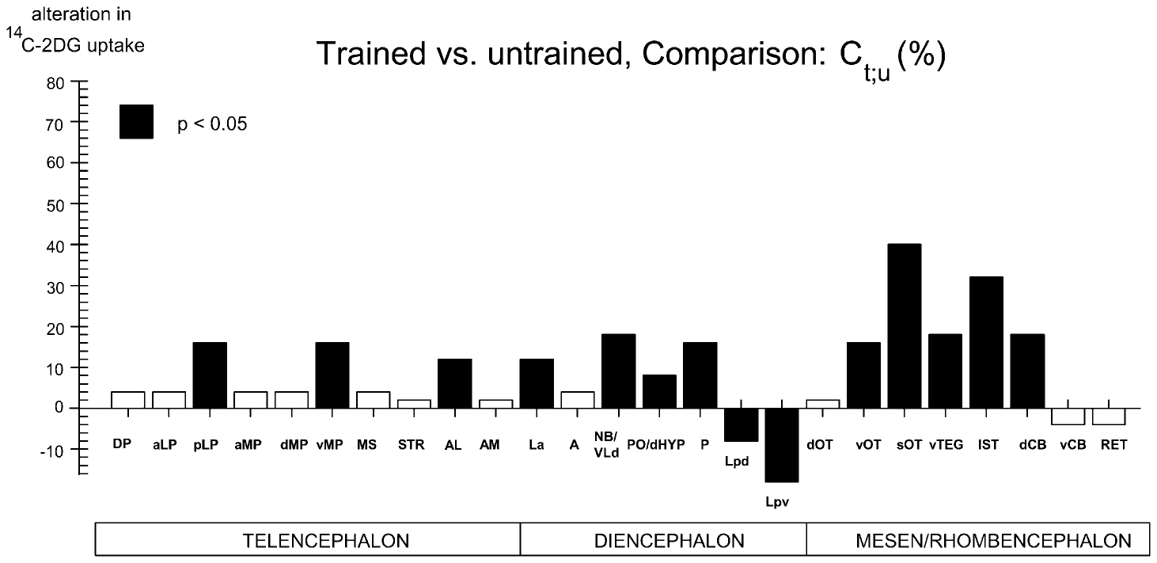
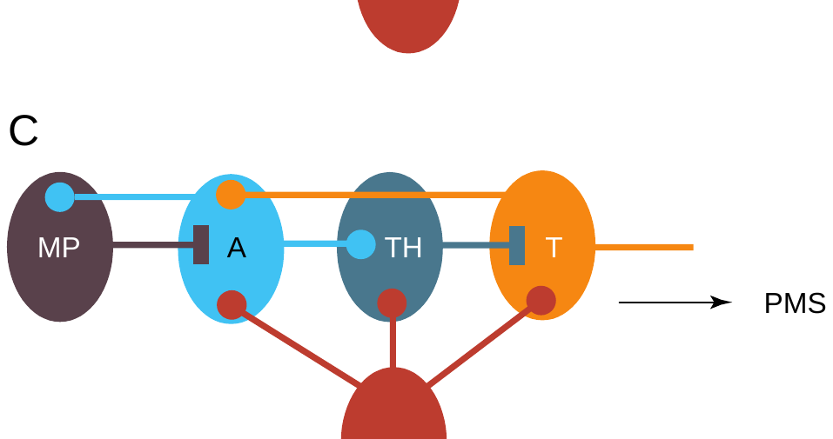
Hand-feeding teaches toads to treat a threat as prey
In the hand-feeding paradigm, a toad was allowed to catch a mealworm from the experimenter's hand once daily. The moving hand is a threatening stimulus, and naive toads hesitate. After about 7 weeks, toads oriented and snapped about eight times per minute toward the hand alone: the hand (conditioned stimulus) had been associated with prey (unconditioned stimulus). Repeated pairing linked the initially threatening visual event with successful prey capture, changing the cue that later recruited the catching sequence.
The effect generalized: antiworm bars and large moving squares were included in the prey schema. Controls exposed to hand and mealworm without contingency kept normal selectivity. Trained toads thus behaved like pretectally lesioned toads. The contingency determined the learned generalization, with antiworm bars and large squares entering the set of objects accepted during prey-catching.
In the 2DG recordings, hand-trained animals showed increased uptake in ventral medial pallium and tectal structures and reduced uptake in pretectal Lpd and Lpv when viewing a large moving square. Ewert proposed that pallial influence through anterior thalamic pathways reduces pretecto-tectal inhibition. Learning therefore changes the regulatory route through which a previously rejected configuration can reach tectal motor-related output.
Ewert et al. (2001), Fig. 18. 2DG uptake in trained versus untrained toads viewing a large square; filled bars significant.
Ewert (1997), Fig. 1C. Proposed learning loop: medial pallium (MP) inhibits pretecto-tectal inhibition via anterior thalamus (A).
Ewert et al. (2001); Ewert (1997)
33
Notes:
• In the hand-feeding experiment, toads took a mealworm from the experimenter's hand once a day.
– A moving hand is normally a threat, but after about seven weeks the toads turned and snapped at the hand alone.
• The learning spread.
– Trained toads also treated antiworms and large squares as prey, much like toads without a pretectum, while controls given hand and mealworm separately stayed normal.
• Brain activity mapping showed more activity in the ventral medial pallium and less in the pretectum. Ewert proposed that the pallium, through the anterior thalamus, switches off the pretectal inhibition.
References:
Ewert JP, Buxbaum-Conradi H, Dreisvogt F, Glagow M, Merkel-Harff C, Röttgen A, Schürg-Pfeiffer E, Schwippert WW (2001). Neural modulation of visuomotor functions underlying prey-catching behaviour in anurans: perception, attention, motor performance, learning. Comparative Biochemistry and Physiology A 128: 417–461. https://doi.org/10.1016/S1095-6433(00)00333-0
Ewert JP (1997). Neural correlates of key stimulus and releasing mechanism: a case study and two concepts. Trends in Neurosciences 20(8): 332–339. https://doi.org/10.1016/S0166-2236(96)01042-9
Figure: Ewert et al. (2001), Fig. 18. 2DG uptake in trained versus untrained toads viewing a large square; filled bars significant.
Figure source: https://doi.org/10.1016/S1095-6433(00)00333-0
Figure: Ewert (1997), Fig. 1C. Proposed learning loop: medial pallium (MP) inhibits pretecto-tectal inhibition via anterior thalamus (A).
Figure source: https://doi.org/10.1016/S0166-2236(96)01042-9

Slide 44
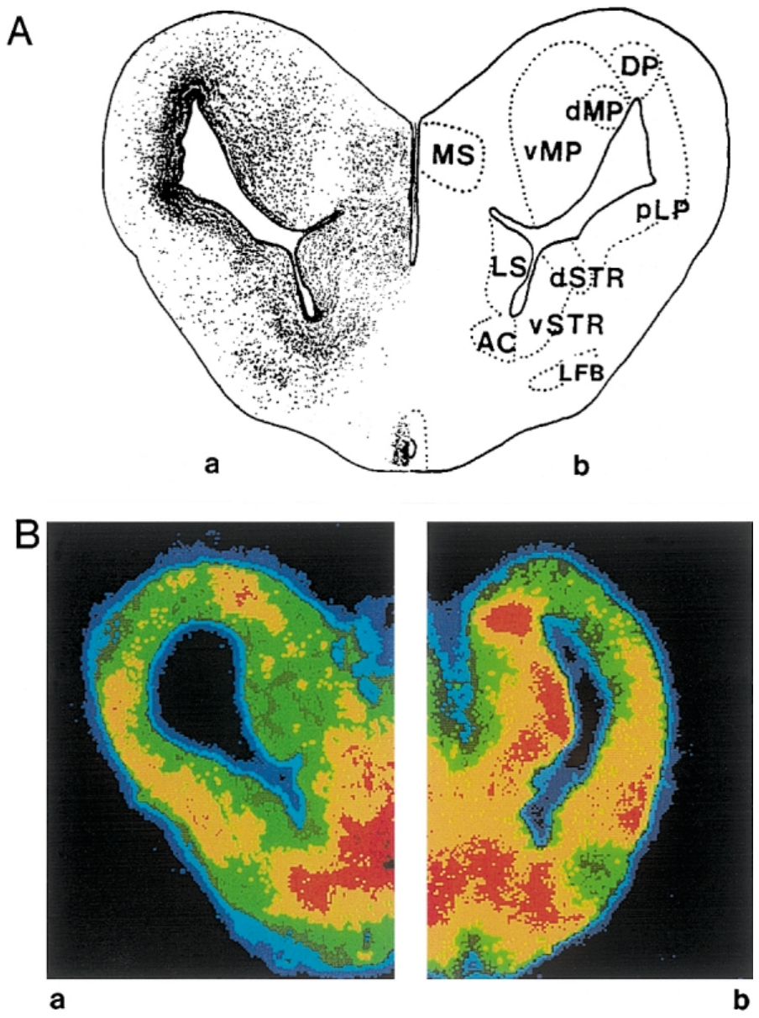
A prey-associated odor activates the hippocampal pallium
Merkel-Harff and Ewert paired the odor cineol with visual prey in repeated training sessions. In naive toads, cineol presented with prey reduced prey-catching; after training, the prey-associated odor facilitated prey-catching and reduced prey selectivity, and the odor alone elicited orienting movements in arbitrary directions. The repeated association changed the odor's effect on feeding, allowing the same chemical cue to acquire a facilitating influence through experience.
The 2DG autoradiography related the learned odor response to activity within the ventral medial pallium during the blinded test. In a binocularly enucleated (blinded) toad without odor stimulation, the caudal ventral medial pallium (vMP) showed no 2DG uptake. In a blinded toad stimulated with the prey-associated cineol, vMP uptake was strong. The blinded preparation retained olfactory stimulation while removing visual prey input, relating the measured pallial activity to the learned odor condition.
The ventral medial pallium, the amphibian hippocampal homolog, responded strongly to prey-associated cineol after training even when the animal lacked vision. Ewert and colleagues proposed that its output facilitates tectal T5.1 and T5.2 activity through hypothalamic pathways that reduce inhibitory restraint. The learned olfactory cue can therefore alter the motivational and gating conditions in which visual or internally available prey-catching responses are expressed. Odor-only orienting occurred in arbitrary directions because the facilitating cue lacked the visual position supplied by a real prey image. Learned value can therefore recruit the behavioral state without specifying an external target location, while the normal visually guided sequence adds spatial information through the tectal and related retinal maps.
Ewert et al. (2001), Fig. 22. Caudal telencephalon (A); 2DG uptake in vMP of a blinded toad without (Ba) and with (Bb) prey-associated cineol.
Ewert et al. (2001)
34
Notes:
• Here the cue was a smell.
– Toads learned that the odor cineol came with prey.
– Before training cineol reduced prey-catching, but afterward it increased prey-catching and made toads less choosy.
• Brain mapping showed where the learned odor acts.
– In blinded toads, the ventral medial pallium was silent without the odor and strongly active with the prey-associated odor.
• The ventral medial pallium is the amphibian hippocampus. Ewert proposed that it raises prey-catching motivation by releasing the tectal prey neurons from inhibition.
References:
Ewert JP, Buxbaum-Conradi H, Dreisvogt F, Glagow M, Merkel-Harff C, Röttgen A, Schürg-Pfeiffer E, Schwippert WW (2001). Neural modulation of visuomotor functions underlying prey-catching behaviour in anurans: perception, attention, motor performance, learning. Comparative Biochemistry and Physiology A 128: 417–461. https://doi.org/10.1016/S1095-6433(00)00333-0
Figure: Ewert et al. (2001), Fig. 22. Caudal telencephalon (A); 2DG uptake in vMP of a blinded toad without (Ba) and with (Bb) prey-associated cineol.
Figure source: https://doi.org/10.1016/S1095-6433(00)00333-0

Slide 45
Learning changes a cue's value, not its detection
Association with prey changed cineol from a suppressing cue into one that facilitated the expression of prey-catching. Before training it suppressed prey-catching, and after pairing with prey it facilitated it, although the odor itself was unchanged. What changed was the cue's learned value, assigned by structures linking the odor to its outcome. The cue's physical identity remained stable while experience altered the association through which it affected the prey-catching pathway.
Controls given the hand and the mealworm unpaired stayed as selective as untrained toads, which rules out familiarity with the hand. Blinding before the 2DG test meant that vMP activity during the odor arose without any sight of prey. The contingency control retained exposure to both events while separating the effect of their pairing from general experience with the hand and food.
Training changed the regulatory influence reaching pretectal and tectal circuits, with pallial pathways providing a route for context-dependent reduction of inhibition. Pretectal lesions permanently remove a larger set of restrictions, including normal target and distance selection. Learned facilitation instead changes the animal's response to an associated cue, linking prior outcome with the inhibitory conditions through which the catching sequence becomes available. The learned cue changes the readiness of the pathway rather than supplying the configuration or coordinates of a visible target. When prey is present, that readiness interacts with the retinal image, allowing prior association to change which signals become strong enough to recruit the next act in the feeding sequence.
Ewert et al. (2001), Fig. 22. Caudal telencephalon (A); 2DG uptake in vMP of a blinded toad without (Ba) and with (Bb) prey-associated cineol.
Ewert et al. (2001); Ewert (1997)
34a
Notes:
• The learning experiments on slides 33 and 34 change what a stimulus means to the toad without changing how it is sensed, and the controls are built to exclude simpler explanations.
• Value versus detection.
– The same cineol odor first reduced prey-catching and later increased it.
– Nothing about the odor or the nose changed between those tests, so the change must lie in structures that store what the odor predicts.
• What the controls exclude.
– The non-contingent group on slide 33 saw the hand and received mealworms as often as trained toads, but not together, and kept normal selectivity.
– Binocular enucleation on slide 34 removes vision, so the strong ventral medial pallium signal reflects the learned odor and not any visual prey cue.
• Same target, different routes.
– After pretectal loss on slides 18 and 22, toads strike at everything and misjudge distance.
– Trained toads also accepted antiworms and large squares, but the 2DG data on slide 33 point to reduced pretectal activity driven by pallial loops, which Ewert's 1997 scheme routes through the anterior thalamus.
References:
Ewert JP, Buxbaum-Conradi H, Dreisvogt F, Glagow M, Merkel-Harff C, Röttgen A, Schürg-Pfeiffer E, Schwippert WW (2001). Neural modulation of visuomotor functions underlying prey-catching behaviour in anurans: perception, attention, motor performance, learning. Comparative Biochemistry and Physiology A 128: 417–461. https://doi.org/10.1016/S1095-6433(00)00333-0
Ewert JP (1997). Neural correlates of key stimulus and releasing mechanism: a case study and two concepts. Trends in Neurosciences 20(8): 332–339. https://doi.org/10.1016/S0166-2236(96)01042-9

Slide 46
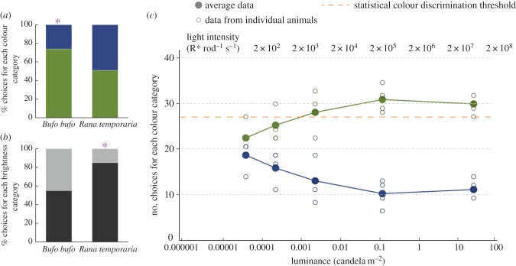
Toads use color when choosing prey
Yovanovich and colleagues tested whether toads (Bufo bufo) and frogs (Rana temporaria) use color in prey-catching. Moving prey dummies of different colors and brightness were presented at controlled light levels. The controlled brightness series followed wavelength-related choice while changing the light available to the receptors supporting the task.
At 40 cd/m², toads chose green dummies over blue ones about three times out of four, a significant color preference, whereas frogs showed no significant color preference but strongly preferred darker stimuli. The toads' green preference and the frogs' preference for darker objects described different visual properties guiding their prey-directed choices.
Color use depended on the behavioral task and light level. Toad green preference declined at the lowest intensities, when rod-dominated vision supported achromatic hunting, while frogs used blue–green differences when jumping toward illuminated windows down to the visual threshold. The prey and phototaxis responses therefore drew differently on the spectral information available within the amphibian visual system. A spectral preference can disappear while the ability to detect and pursue an object remains, because brightness-related signals continue supporting the achromatic prey response.
Yovanovich et al. (2017), Fig. 2. Prey choices by color (a) and brightness (b) in Bufo and Rana at 40 cd/m²; toad color choices across luminance (c).
Yovanovich et al. (2017)
35
Notes:
• Ewert's dummies were black and white, but toads also see color.
– Yovanovich and colleagues offered toads and frogs colored moving dummies.
• In good light, toads chose green over blue about three times out of four.
– Frogs did not show a color preference in prey-catching but strongly preferred darker objects.
• The toads' preference faded in very dim light, where only rods work. Frogs jumping toward light could tell blue from green even at the visual threshold, so whether color is used depends on the behavior.
References:
Yovanovich CAM, Koskela SM, Nevala N, Kondrashev SL, Kelber A, Donner K (2017). The dual rod system of amphibians supports colour discrimination at the absolute visual threshold. Philosophical Transactions of the Royal Society B 372: 20160066. https://doi.org/10.1098/rstb.2016.0066
Figure: Yovanovich et al. (2017), Fig. 2. Prey choices by color (a) and brightness (b) in Bufo and Rana at 40 cd/m²; toad color choices across luminance (c).
Figure source: https://doi.org/10.1098/rstb.2016.0066

Slide 47
Color vision needs two receptor types compared
A single photoreceptor type confounds wavelength with intensity: each absorbed photon produces the same signal whatever its color. Color discrimination requires comparing two receptor types with different spectral sensitivities. Comparing receptor outputs preserves information about wavelength that would otherwise remain confounded with the number of absorbed photons.
Amphibians have two rod types: green-sensitive rods peaking near 502 nm, the common vertebrate rod, and blue-sensitive rods peaking near 432 nm. Comparing them offers color vision when cones are silent, and the test stimuli were designed to excite the two rod types differently. The separate spectral peaks provide different relative responses to the blue and green stimuli used to test behavior under very low illumination.
Both species possess the two rod classes, while their ability to use those signals for color decisions depends on the downstream task pathway. Yovanovich and colleagues proposed rod comparison in phototaxis and a contribution from sensitive blue-sensitive cones to prey-color choice. In the dimmest hunting conditions, the toad retained prey-catching through an achromatic mode as the color preference disappeared.
Yovanovich et al. (2017), Fig. 2. Prey choices by color (a) and brightness (b) in Bufo and Rana at 40 cd/m²; toad color choices across luminance (c).
Yovanovich et al. (2017)
35a
Notes:
• Slide 35 reports that color use depends on the task, and the explanation starts with what any color vision system needs.
• The principle of univariance.
– A photoreceptor counts absorbed photons, and each absorbed photon has the same effect regardless of its wavelength.
– Wavelength only changes the probability that a photon is absorbed, so one receptor type cannot tell a dim green light from a brighter blue one; two types with different sensitivities can, by comparing their signals.
• The amphibian dual rod system.
– Yovanovich and colleagues list rod peaks of about 502 nanometers for the common rod type and about 432 nanometers for the blue-sensitive rods in Bufo bufo.
– Their blue and green stimuli were chosen to excite these two rod types quantifiably and differently.
• Why toads and frogs differ.
– The authors found the toads' color threshold in prey-catching consistent with blue-sensitive cones, which are very sensitive in amphibians.
– In phototaxis, frogs discriminated blue from green at threshold, which they explain by a comparison of the two rod signals in a pathway close to the motor output.
– Toads keep trying to catch prey in achromatic mode at very low light, so color is a dispensable cue for hunting.
References:
Yovanovich CAM, Koskela SM, Nevala N, Kondrashev SL, Kelber A, Donner K (2017). The dual rod system of amphibians supports colour discrimination at the absolute visual threshold. Philosophical Transactions of the Royal Society B 372: 20160066. https://doi.org/10.1098/rstb.2016.0066

Slide 48
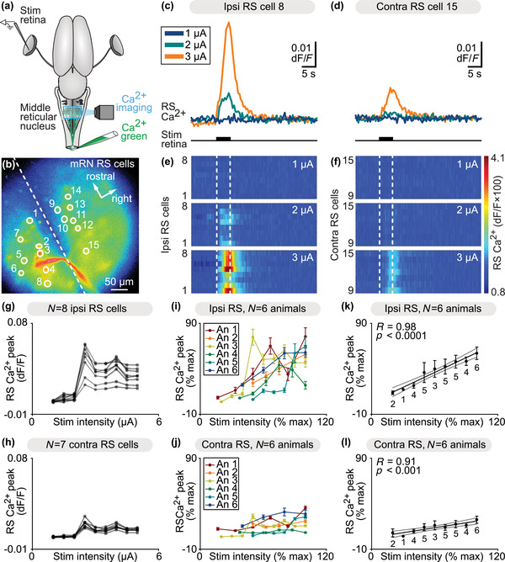
Retinal input reaches salamander reticulospinal neurons
Flaive and Ryczko used an isolated salamander brain with eyes attached. They stimulated the retina electrically and imaged calcium in reticulospinal (RS) neurons of the middle reticular nucleus, which control steering movements. The retained eyes and brain provided a route for following retinal excitation through central pathways ending in identified descending steering neurons.
Retinal stimulation evoked calcium responses in RS neurons, and response size grew with stimulus intensity. Responses on the side ipsilateral to the stimulated retina were larger than contralateral ones, a bias suited to turning toward one side. The intensity-dependent calcium response related stronger sensory recruitment to the activity reaching the reticulospinal population.
Blocking tectal glutamate receptors reduced retinally evoked reticulospinal responses, and tracing located tectal projections onto these steering-related cells. Their spinal contacts provide a route to motoneurons controlling body movement. The resulting retina-to-tectum-to-reticulospinal pathway supplies a cellular organization for visually guided orientation, linking the spatial visual response with descending control of the animal's turning movement. An ipsilateral bias in reticulospinal responses supplies an unequal descending signal appropriate for steering, while the tectal glutamate-sensitive relay links that bias to retinal activation. The preparation preserves the eyes and central pathway, allowing stimulus intensity and pharmacological intervention to change the signal reaching a defined population of movement-related neurons.
Flaive & Ryczko (2022), Fig. 7. Retinal stimulation evokes graded calcium responses in ipsilateral and contralateral reticulospinal neurons of the middle reticular nucleus.
Flaive & Ryczko (2022)
36
Notes:
• Flaive and Ryczko kept a salamander brain alive with the eyes attached.
– They stimulated the retina and watched calcium signals in reticulospinal neurons that control steering.
• The neurons responded more as the stimulus got stronger, and more on one side than the other, which is what a turning command needs.
– The colors in the heat maps show the size of the calcium response.
• Blocking glutamate receptors in the tectum reduced the responses, and tracing showed the connections. That gives a cell-by-cell route from eye to motoneurons for orienting toward prey.
References:
Flaive A, Ryczko D (2022). From retina to motoneurons: a substrate for visuomotor transformation in salamanders. Journal of Comparative Neurology 530(14): 2518–2536. https://doi.org/10.1002/cne.25348
Figure: Flaive & Ryczko (2022), Fig. 7. Retinal stimulation evokes graded calcium responses in ipsilateral and contralateral reticulospinal neurons of the middle reticular nucleus.
Figure source: https://doi.org/10.1002/cne.25348

Slide 49
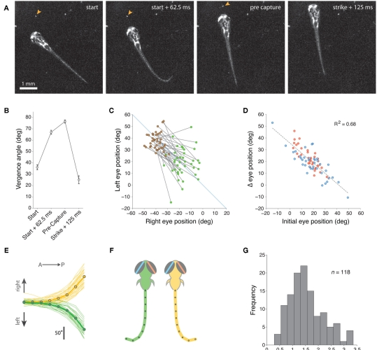
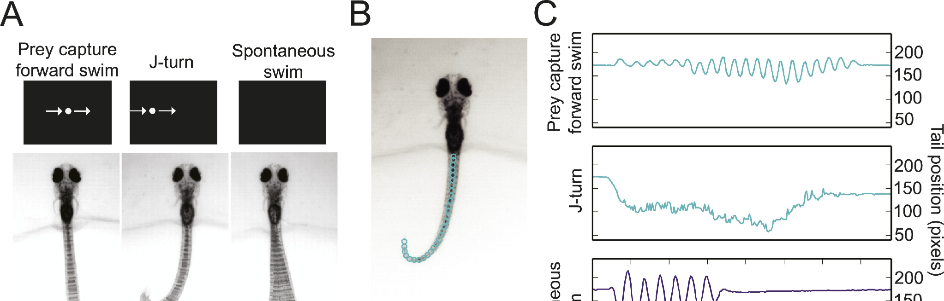
Zebrafish larvae converge their eyes to hunt prey
Larval zebrafish begin hunting paramecia at about 5 days after fertilization, and the accessibility of their brains makes them a modern model for the circuits Ewert studied. Their transparent, accessible nervous system permits hunting-related activity to be measured while the larva performs defined visual and motor components of capture.
Bianco, Kampff and Engert found that every prey-capture routine begins with eye convergence: both eyes rotate nasally, and vergence stays high during tracking and the capture swim before relaxing after the strike. Convergence enlarges the region of binocular overlap in front of the fish, which the authors proposed allows stereoscopic targeting of prey. Sustained convergence preserves the enlarged binocular region while the fish tracks and approaches the target before the final capture movement.
In virtual-reality tests, small spots near 1° recruited low-amplitude orienting, while larger spots near 10° recruited larger turns away. Hunting also included the characteristic J-turn, in which the tail bends into a held J shape. The behavioral sequence therefore combines size-dependent response selection with preparatory eye convergence and a specialized turning movement that positions the prey for capture. Eye convergence increases frontal binocular overlap, placing the target within a visual state maintained through tracking and the eventual capture movement.
Bianco et al. (2011), Fig. 2. A larva hunting a paramecium (arrowhead), eye vergence at each stage (B–D), J-turn tail shapes (E–F) and prey distance at strike (G).
Semmelhack et al. (2014), Fig. 1A–C. Prey-capture forward swim, J-turn and spontaneous swim to virtual stimuli, with tail-position traces.
Bianco et al. (2011); Semmelhack et al. (2014)
37
Notes:
• Zebrafish larvae hunt small paramecia from about five days old, and their transparent brains let us image the circuits.
– Every hunt starts with both eyes turning inward, called eye convergence.
• The eyes stay converged during tracking and capture.
– That increases the area seen by both eyes, which the authors suggest helps judge distance to the prey.
• Small moving spots drew small turns toward them, while large spots drew big turns away. Just like the toad, size decides between prey and threat.
References:
Bianco IH, Kampff AR, Engert F (2011). Prey capture behavior evoked by simple visual stimuli in larval zebrafish. Frontiers in Systems Neuroscience 5: 101. https://doi.org/10.3389/fnsys.2011.00101
Semmelhack JL, Donovan JC, Thiele TR, Kuehn E, Laurell E, Baier H (2014). A dedicated visual pathway for prey detection in larval zebrafish. eLife 3: e04878. https://doi.org/10.7554/eLife.04878
Figure: Bianco et al. (2011), Fig. 2. A larva hunting a paramecium (arrowhead), eye vergence at each stage (B–D), J-turn tail shapes (E–F) and prey distance at strike (G).
Figure source: https://doi.org/10.3389/fnsys.2011.00101
Figure: Semmelhack et al. (2014), Fig. 1A–C. Prey-capture forward swim, J-turn and spontaneous swim to virtual stimuli, with tail-position traces.
Figure source: https://doi.org/10.7554/eLife.04878

Slide 50
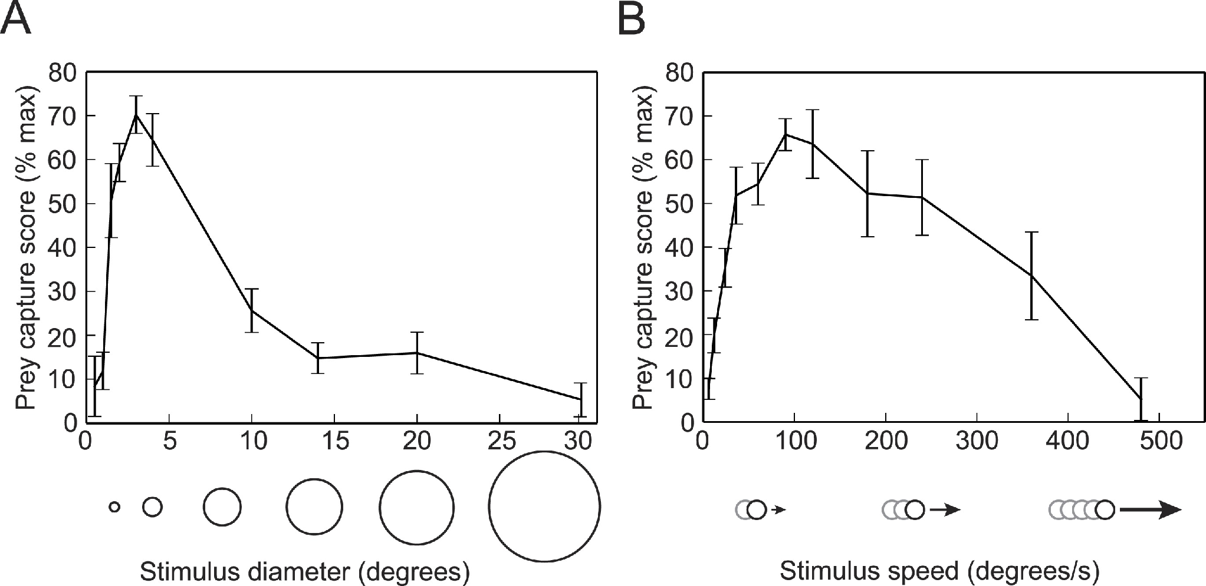
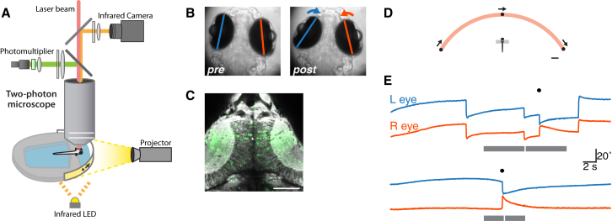
Small moving dots release zebrafish prey capture
Semmelhack and colleagues presented virtual prey to semi-restrained larvae whose tails were free to move. They distinguished prey-capture J-turns, in which the tail is held in a J shape to turn toward prey, and forward swims from spontaneous swims, using a machine-learning classifier of tail kinematics. The freely moving tail preserved the motor response while the visual stimulus could be varied independently of the larva's forward displacement.
A prey-capture score was tuned to stimulus size and speed: it peaked for dots of about 3° moving at about 90–100°/s, and fell sharply for dots of 10° or more. The tuning placed the most effective stimulus within a restricted combination of angular size and movement speed, rather than responding equally to every moving dot.
Bianco and Engert combined virtual hunting with two-photon tectal calcium imaging, following responses to combinations of size, speed, and contrast polarity. Hunting-related activity depended on these features jointly, relating prey classification to a multi-feature neural response. The larval assay therefore supplies a controlled route from defined visual conditions through tectal population activity to a recognizable capture-related movement.
Semmelhack et al. (2014), Fig. 2. Prey-capture score versus dot diameter (A) and speed (B) in semi-restrained larvae.
Bianco & Engert (2015), Fig. 1. Two-photon imaging during virtual hunting: setup, eye positions before and after convergence, and tectal imaging field.
Semmelhack et al. (2014); Bianco & Engert (2015)
38
Notes:
• Semmelhack and colleagues showed virtual dots to larvae held in agarose with the tail free.
– A computer classifier separated hunting movements, like J-turns, from ordinary swimming.
• Hunting was tuned to the dot.
– It peaked for dots about 3 degrees across moving at about 90 to 100 degrees per second and dropped off for big dots.
• Bianco and Engert imaged the tectum during the same kind of task and found that hunting depends on combinations of size, speed and contrast, a modern version of Ewert's configurational rules.
References:
Semmelhack JL, Donovan JC, Thiele TR, Kuehn E, Laurell E, Baier H (2014). A dedicated visual pathway for prey detection in larval zebrafish. eLife 3: e04878. https://doi.org/10.7554/eLife.04878
Bianco IH, Engert F (2015). Visuomotor transformations underlying hunting behavior in zebrafish. Current Biology 25(7): 831–846. https://doi.org/10.1016/j.cub.2015.01.042
Figure: Semmelhack et al. (2014), Fig. 2. Prey-capture score versus dot diameter (A) and speed (B) in semi-restrained larvae.
Figure source: https://doi.org/10.7554/eLife.04878
Figure: Bianco & Engert (2015), Fig. 1. Two-photon imaging during virtual hunting: setup, eye positions before and after convergence, and tectal imaging field.
Figure source: https://doi.org/10.1016/j.cub.2015.01.042

Slide 51
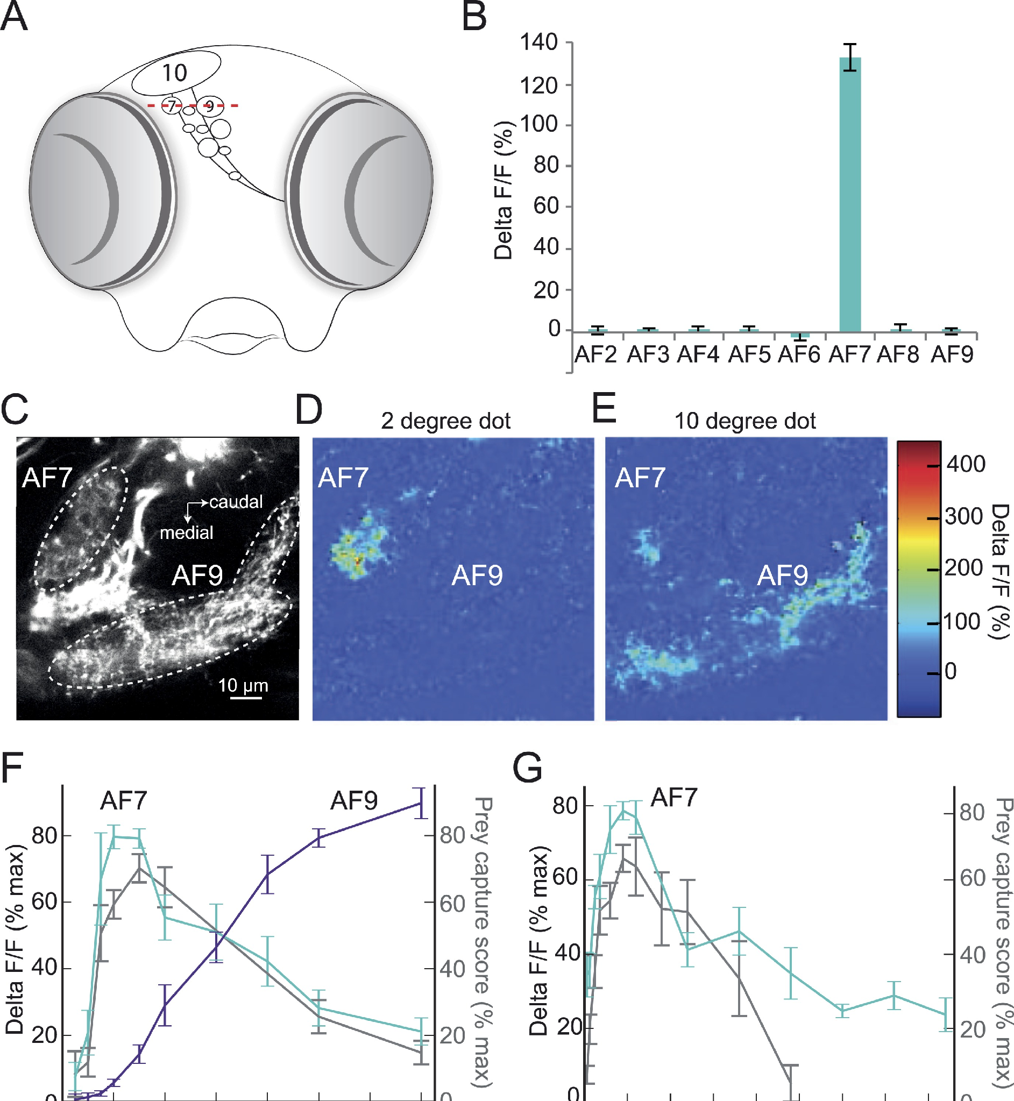
Pretectal area AF7 responds to prey-sized dots
Retinal ganglion cell axons in zebrafish end in ten arborization fields (AF1–AF10); AF10 is the tectum. Semmelhack and colleagues imaged calcium in retinal axons while presenting the optimal prey stimulus. Imaging the retinal terminals followed information entering different central targets before the downstream motor circuitry generated the hunting response.
Only AF7, a small pretectal field, responded strongly to a 2° dot. AF9 responded preferentially to a larger 10° dot, supplying a distinct size-related signal through the neighboring retinal target field. AF7's size tuning matched the behavioral prey-capture curve, whereas AF9's increased with size, and both were tuned to speed. The separate size preferences preserved distinct retinal channels for small prey-like objects and larger moving stimuli within neighboring pretectal regions.
Two classes of AF7-projecting retinal ganglion cell also send branches to the tectum, distributing prey-sized information to more than one visual target. AF7 therefore receives a specialized retinal channel whose size tuning resembles hunting behavior. The arrangement supplies parallel access to pretectal and tectal processing, allowing small-object information to participate in the network that recognizes prey and initiates capture. The branching axons distribute the same retinal cell's output to pretectal and tectal targets, allowing its small-object information to participate in parallel central routes. A field-specific lesion can therefore remove one terminal population while other branches retain the capacity to activate the tectum, an organization relevant to the residual prey-related behavior after AF7 intervention.
Semmelhack et al. (2014), Fig. 3A–G. Retinal arborization fields; AF7 responds to a 2° dot but AF9 to a 10° dot (color ΔF/F); size and speed tuning.
Semmelhack et al. (2014)
39
Notes:
• In zebrafish, retinal axons end in ten areas called arborization fields, and AF10 is the tectum.
– Imaging calcium in the retinal axons showed which areas respond to prey.
• Only AF7, in the pretectum, responded strongly to a small 2-degree dot.
– AF9 responded to larger dots instead, and AF7's size tuning matched the hunting behavior.
• So fish have a pretectal channel tuned to prey-sized objects, fed by retinal cells that also send branches to the tectum.
References:
Semmelhack JL, Donovan JC, Thiele TR, Kuehn E, Laurell E, Baier H (2014). A dedicated visual pathway for prey detection in larval zebrafish. eLife 3: e04878. https://doi.org/10.7554/eLife.04878
Figure: Semmelhack et al. (2014), Fig. 3A–G. Retinal arborization fields; AF7 responds to a 2° dot but AF9 to a 10° dot (color ΔF/F); size and speed tuning.
Figure source: https://doi.org/10.7554/eLife.04878

Slide 52
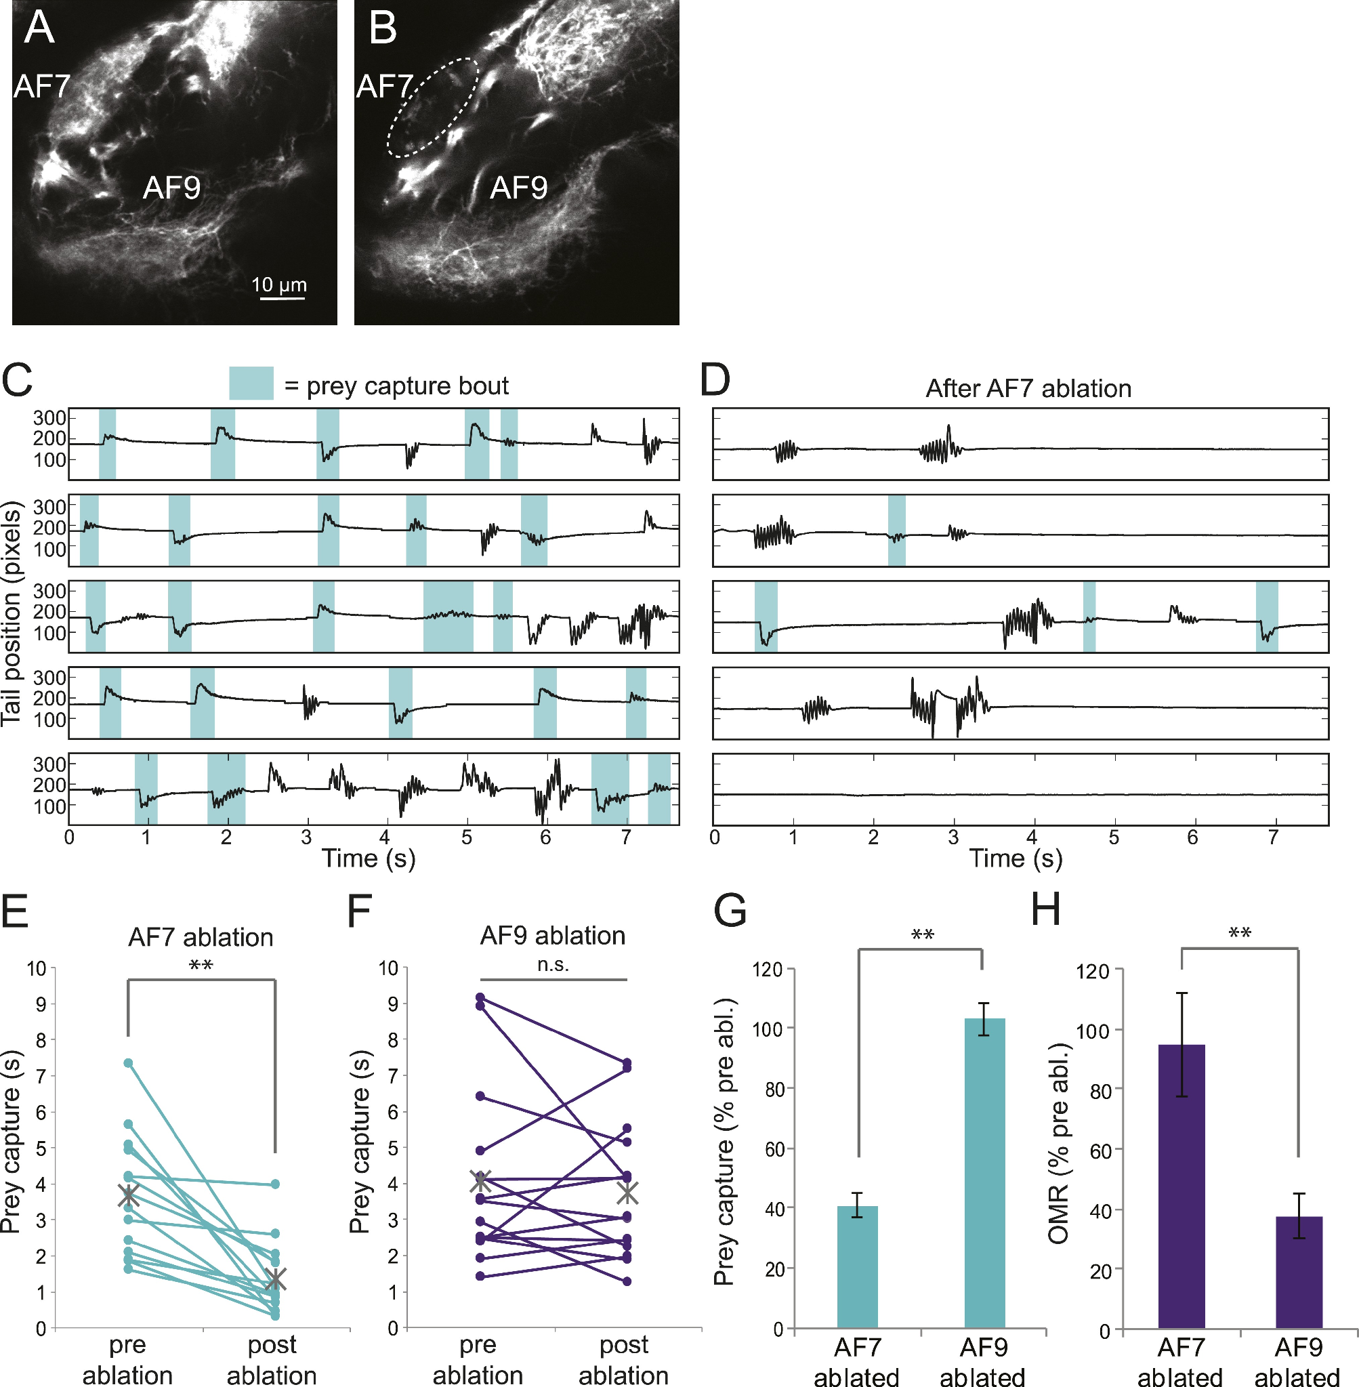
AF7 ablation impairs prey capture, not optomotor turning
To test whether AF7 is needed, Semmelhack and colleagues laser-ablated the retinal axons in AF7 or, as a control, in AF9. The targeted removal interrupted retinal terminals within one defined central field while preserving other visual regions for the subsequent behavior tests. The manipulation targeted a named retinal arborization field, preserving a distinction between removal of small-object input there and removal of neighboring large-object-related terminals. The subsequent tail recordings followed the same recognizable prey-capture acts used before intervention. Residual bouts could therefore be measured alongside the decline in time allocated to hunting and the separately tested response to moving gratings.
After AF7 ablation, prey-capture bouts (shaded in the tail traces) were greatly reduced, and the time spent in prey capture fell to about 40% of pre-ablation levels. AF9 ablation left prey capture near its prior level, preserving the hunting output after removal of the neighboring large-object-related input. The residual prey-related activity remained available but occupied a much smaller fraction of the larva's recorded behavior after the AF7 intervention.
The optomotor response remained after AF7 ablation but declined after AF9 ablation, giving the two interventions different behavioral effects. AF7-related neurons also projected to the tectum, the nucleus of the medial longitudinal fasciculus, and the hindbrain. The prey channel therefore has access to several central structures capable of linking visual classification with the descending organization of hunting movements.
Semmelhack et al. (2014), Fig. 6. AF7 before and after ablation (A–B); tail traces with prey-capture bouts (C–D); prey capture and optomotor response after AF7 or AF9 ablation (E–H).
Semmelhack et al. (2014)
40
Notes:
• Next, the AF7 axons were destroyed with a laser, and AF9 was destroyed in other fish as a control.
– Losing AF7 cut prey capture to about 40 percent, while losing AF9 had no effect on it.
• The optomotor response, swimming with moving stripes, showed the reverse.
– It was spared after AF7 ablation and reduced after AF9 ablation.
• So AF7 is specifically needed for hunting, and neurons reading out AF7 project to the tectum and to premotor areas.
References:
Semmelhack JL, Donovan JC, Thiele TR, Kuehn E, Laurell E, Baier H (2014). A dedicated visual pathway for prey detection in larval zebrafish. eLife 3: e04878. https://doi.org/10.7554/eLife.04878
Figure: Semmelhack et al. (2014), Fig. 6. AF7 before and after ablation (A–B); tail traces with prey-capture bouts (C–D); prey capture and optomotor response after AF7 or AF9 ablation (E–H).
Figure source: https://doi.org/10.7554/eLife.04878

Slide 53
Opposite deficits make the AF7 result specific
AF7 and AF9 ablation produced a double dissociation between prey capture and optomotor behavior. Removing AF7 retinal terminals reduced hunting while preserving grating-following responses, whereas AF9 intervention affected optomotor output while preserving capture. The distinct deficits relate the two visual behaviors to different central retinal target fields.
After AF7 ablation, neighboring retinal axons retained their route to the tectum, and tectal neurons continued responding to small stimuli. Behavioral scoring was performed without knowledge of the experimental group. The retained tectal response places the reduced hunting within a system that still received small-object visual input through the other surviving branches.
The AF7 channel supplies prey-related drive in larval zebrafish, while the toad pretectal pathway examined by Ewert supplies inhibitory rejection of unsuitable objects. Remaining hunting after the retinal-terminal lesion is consistent with additional routes, including tectal branches of the same projecting ganglion cells. Pretectal involvement therefore depends on the specific cell population and projection under study within each animal's visual system. The direction of a pretectal influence follows the neurons and target pathway involved, with one population supplying excitatory hunting drive and another supplying inhibition of unsuitable prey output. The surviving tectal collaterals also preserve a route for small-object information after AF7 terminals have been removed, consistent with remaining capture activity in the specific lesion preparation.
Semmelhack et al. (2014), Fig. 6. AF7 before and after ablation (A–B); tail traces with prey-capture bouts (C–D); prey capture and optomotor response after AF7 or AF9 ablation (E–H).
Semmelhack et al. (2014); Ewert et al. (2001)
40a
Notes:
• The AF7 ablation is persuasive because of its controls, and those controls are worth walking through before comparing the result with the toad.
• Double dissociation.
– A single lesion that reduces prey capture could simply have damaged the larva's vision or health.
– When a second lesion of similar size, in AF9, impairs a different visual behavior while sparing prey capture, a general explanation no longer fits either result.
• Checking the damage itself.
– Semmelhack and colleagues imaged the retinal axons passing near AF7 and found their projection to the tectum intact after ablation.
– They also recorded tectal neurons and found responses to small stimuli unchanged, and the experimenter scoring post-ablation behavior was blinded to group.
• Comparison with the toad.
– Removing the toad pretectum on slide 18 broadens prey-catching, while removing AF7 input on slide 40 narrows it.
– Slide 39 notes that AF7-projecting retinal cells also send collaterals to the tectum, and the authors suggest that incomplete ablation or other retinal inputs explain the residual hunting.
References:
Semmelhack JL, Donovan JC, Thiele TR, Kuehn E, Laurell E, Baier H (2014). A dedicated visual pathway for prey detection in larval zebrafish. eLife 3: e04878. https://doi.org/10.7554/eLife.04878
Ewert JP, Buxbaum-Conradi H, Dreisvogt F, Glagow M, Merkel-Harff C, Röttgen A, Schürg-Pfeiffer E, Schwippert WW (2001). Neural modulation of visuomotor functions underlying prey-catching behaviour in anurans: perception, attention, motor performance, learning. Comparative Biochemistry and Physiology A 128: 417–461. https://doi.org/10.1016/S1095-6433(00)00333-0

Slide 54
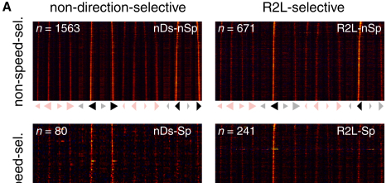
Tectal neurons combine features nonlinearly
Bianco and Engert imaged thousands of tectal neurons with GCaMP while larvae responded to moving spots that varied in size, speed, contrast polarity and direction. The stimulus series preserved several independently variable features, allowing the same neuron's response to be related to the particular conjunction it received.
They identified neurons tuned like the behavior: responsive to small, dark or bright, moving spots at hunting speeds, either regardless of direction or selective for left-to-right or right-to-left motion. These neurons showed nonlinear mixed selectivity: they responded strongly only to particular combinations of features, rather than summing feature preferences independently. Nonlinear selectivity makes the combined feature pattern more effective than would be predicted by adding separate responses to each property independently.
Small tectal assemblies became active before eye convergence, relating their feature-selective response to the initiation of the hunting sequence. Bianco and Engert proposed that these populations participate in prey recognition and premotor recruitment. Their activity provides a population-level route from a particular combination of visual properties to the preparatory motor state preceding the larva's approach and capture.
Bianco & Engert (2015), Fig. 5A. Calcium responses of tectal neurons selected by behavioral tuning regressors, grouped by direction and speed selectivity.
Bianco & Engert (2015)
41
Notes:
• Bianco and Engert imaged thousands of tectal neurons at once while fish watched moving spots.
– Some neurons were tuned like the behavior, to small spots moving at hunting speeds, some in any direction and some in one direction only.
• These cells needed the right combination of features, not just one.
– That is called nonlinear mixed selectivity, and it is the kind of combining Ewert inferred for T5.2 neurons.
• Small groups of tectal neurons became active just before the fish converged its eyes, which suggests they help trigger the hunt, much like the T5.2 bursts before orienting in toads.
References:
Bianco IH, Engert F (2015). Visuomotor transformations underlying hunting behavior in zebrafish. Current Biology 25(7): 831–846. https://doi.org/10.1016/j.cub.2015.01.042
Figure: Bianco & Engert (2015), Fig. 5A. Calcium responses of tectal neurons selected by behavioral tuning regressors, grouped by direction and speed selectivity.
Figure source: https://doi.org/10.1016/j.cub.2015.01.042

Slide 55
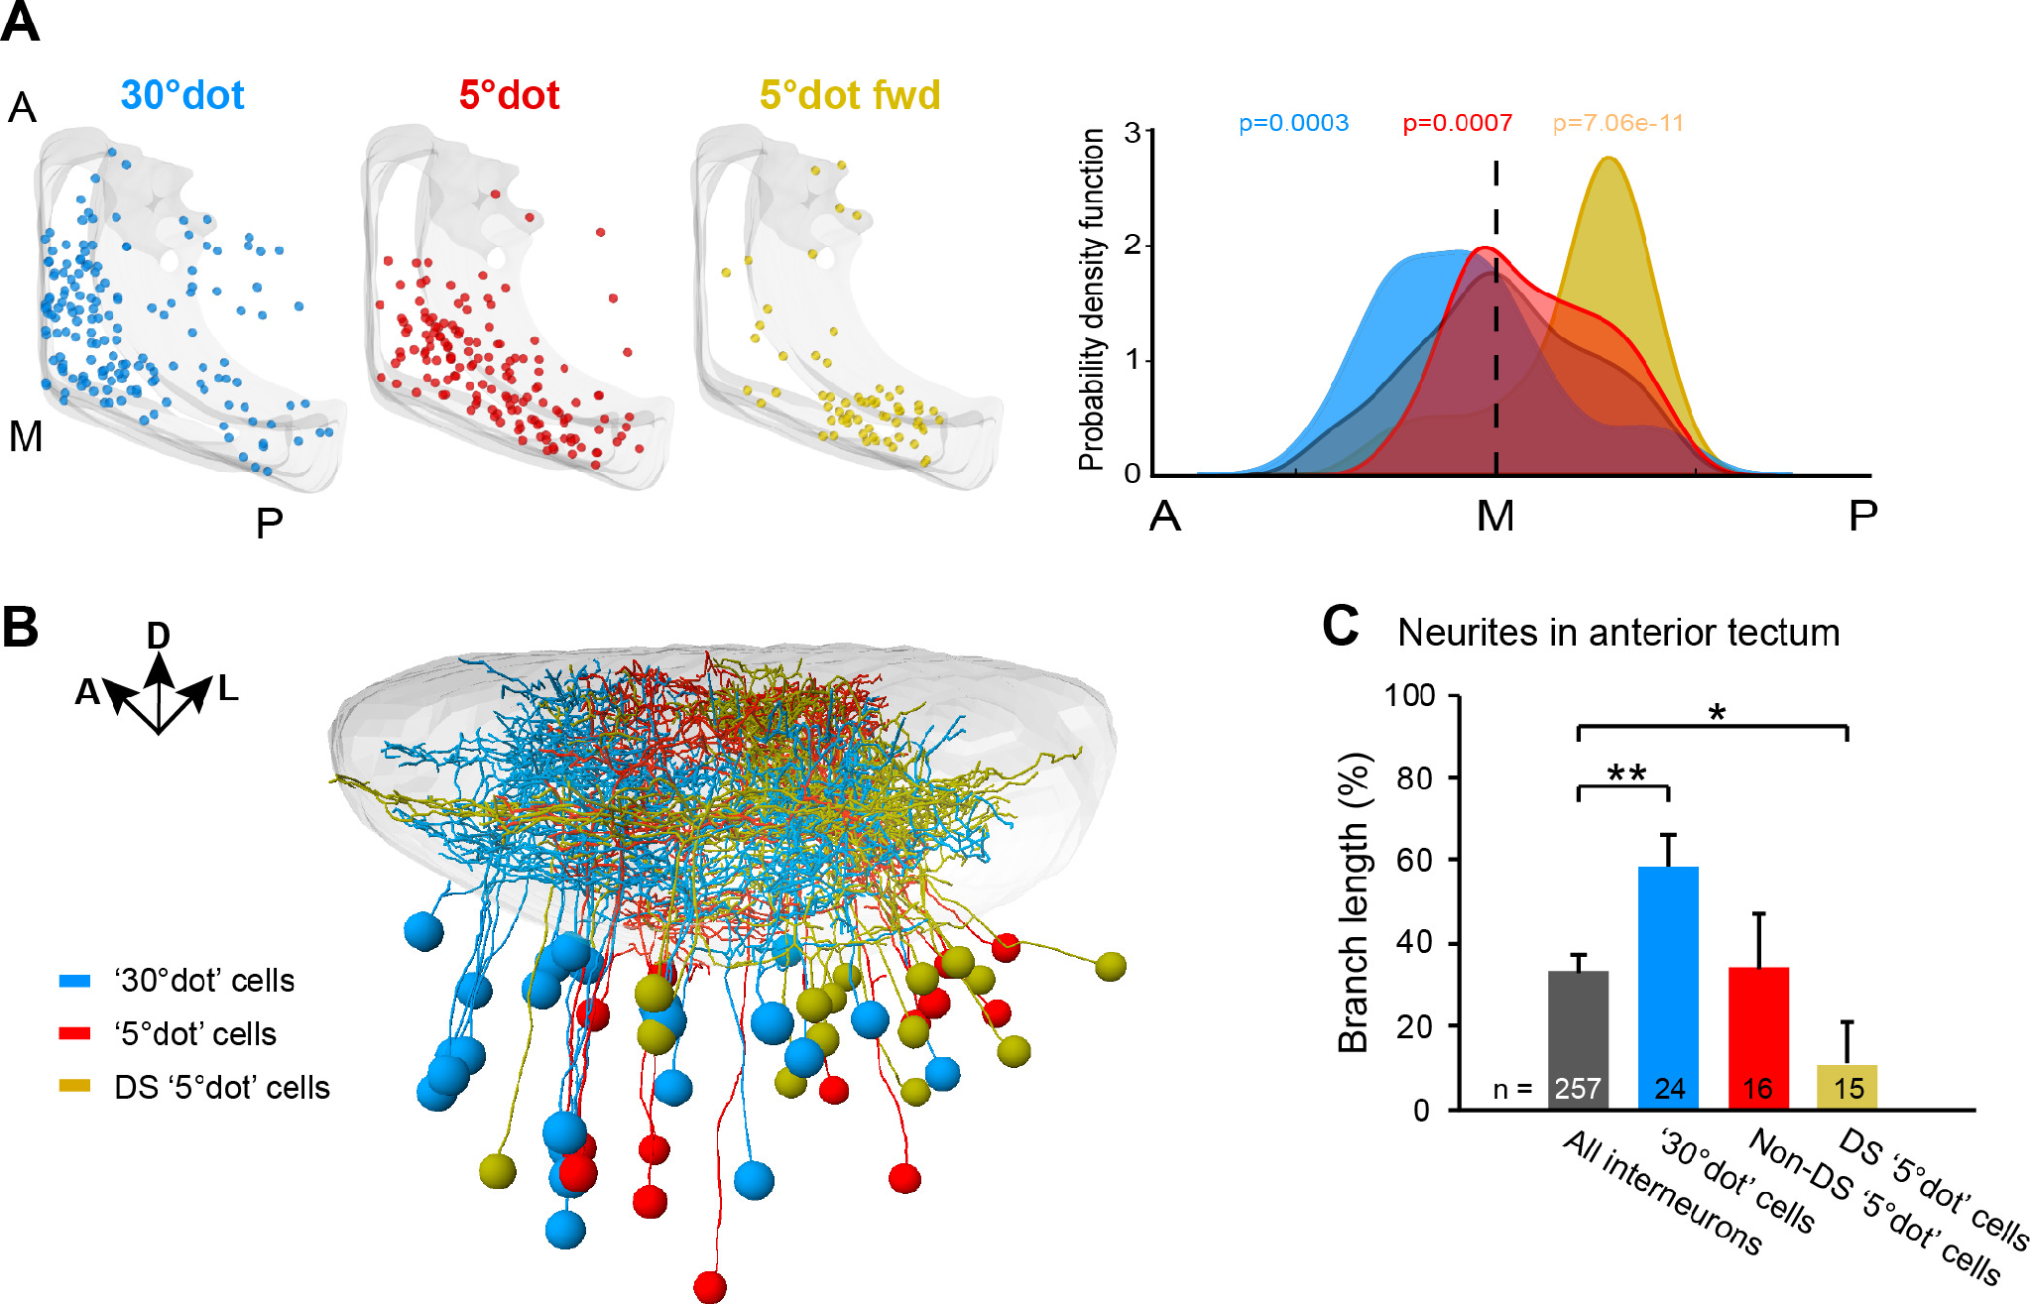
Anterior tectum is tuned to prey at close range
Prey is first seen in the peripheral visual field, which maps to the posterior tectum. As the larva turns and approaches, the prey image moves into the central binocular field, mapped to the anterior tectum, and appears larger. Approach changes both the retinal location and apparent size of the same target, bringing different portions of the tectal map into the hunting sequence.
Förster and colleagues imaged tectal neurons and found that cells responding to a small 5° dot, especially direction-selective ones, were concentrated in posterior and medial tectum. Cells tuned to a larger 30° dot were concentrated anteriorly, and anterior neurons were frequently not direction-selective. The spatial distribution of tuning therefore followed the visual conditions encountered during distant detection and close-range capture.
Ablating large-object-tuned tectal neurons impaired hunting, connecting the anterior representation with successful capture as the prey approaches. The map consequently contains cells suited to different stages of the behavior rather than one uniform small-object response. Posterior and medial populations follow smaller moving targets, while anterior cells supply information relevant when the target occupies a larger central binocular image.
Förster et al. (2020), Fig. 6. Positions of 30°-dot (blue), 5°-dot (red) and direction-selective 5°-dot (yellow) cells along the tectum; their neurite traces.
Förster et al. (2020)
42
Notes:
• Prey is first seen off to the side, which maps onto the back of the tectum, and as the fish approaches, the prey moves to the front of the visual field and looks bigger.
– Förster and colleagues asked whether the tectum is organized for this.
• Cells for small dots, especially direction-selective ones, sat in the posterior tectum, while cells for larger dots sat in the anterior tectum and were often not direction-selective.
• Killing the large-object cells impaired hunting, so the tectal map is laid out for distant prey in one place and close prey in another.
References:
Förster D, Helmbrecht TO, Mearns DS, Jordan L, Mokayes N, Baier H (2020). Retinotectal circuitry of larval zebrafish is adapted to detection and pursuit of prey. eLife 9: e58596. https://doi.org/10.7554/eLife.58596
Figure: Förster et al. (2020), Fig. 6. Positions of 30°-dot (blue), 5°-dot (red) and direction-selective 5°-dot (yellow) cells along the tectum; their neurite traces.
Figure source: https://doi.org/10.7554/eLife.58596

Slide 56
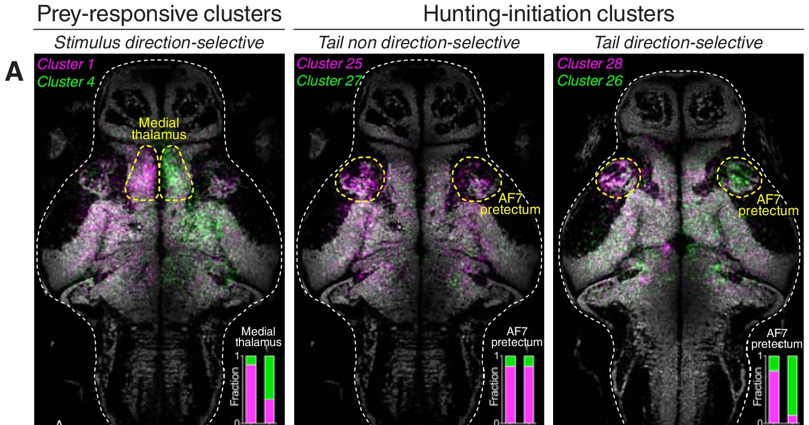
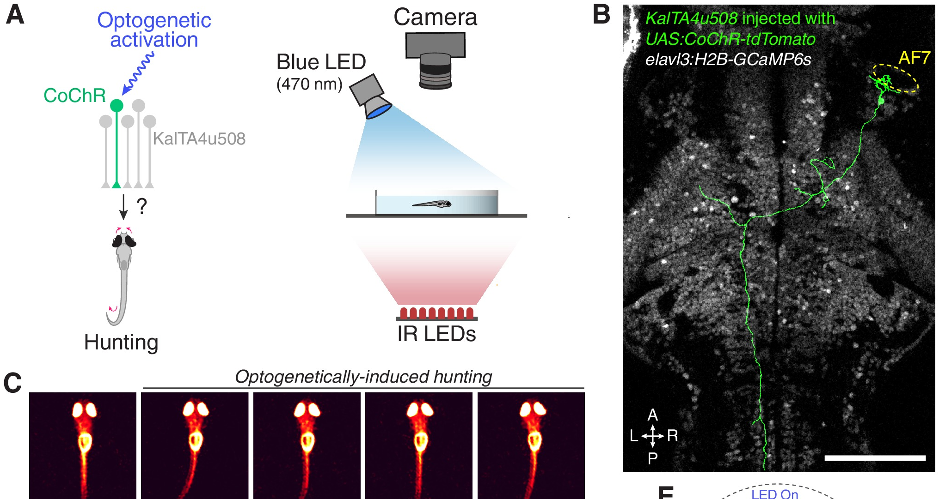
Single pretectal neurons can command hunting
Antinucci, Folgueira and Bianco imaged neurons across the larval brain during virtual hunting. A discrete region near AF7, the AF7-pretectum, contained a high density of neurons active specifically when larvae initiated hunting. The brain-wide recordings related activity in this discrete region to the transition into a recognized hunting motor state.
Using the KalTA4u508 line, they labeled two classes of these pretectal neurons, projecting to the ipsilateral tectum or to the contralateral tegmentum. Optogenetic stimulation of a single neuron of either class, using the light-gated channel CoChR, induced sustained hunting sequences, with eye convergence and J-turns, in the absence of prey. The prolonged convergence and turning sequence followed activation of an identified pretectal cell even when the normal visual prey stimulus was absent.
Ablating the AF7-pretectal neurons reduced prey-catching and prevented hunting elicited by stimulating the anterior-ventral tectum. Their projections to ipsilateral tectum or contralateral tegmentum therefore participate in a command-related pathway linking visual processing with the motor sequence. Antinucci and colleagues described a distributed command system capable of recruiting the sustained hunting state through the combined activity of these pretectal populations.
Antinucci et al. (2019), Fig. 2A–B. Brain maps of prey-responsive and hunting-initiation neuron clusters; the AF7-pretectum is outlined.
Antinucci et al. (2019), Fig. 5A–C. Optogenetic stimulation of a single KalTA4u508 pretectal neuron (B) induces hunting with eye convergence (C).
Antinucci et al. (2019)
43
Notes:
• Antinucci and colleagues found a small pretectal region whose neurons became active when fish started to hunt.
– Two classes project to the tectum or to the tegmentum.
• Activating just one of these neurons with light was enough to start a full hunting sequence, eye convergence and J-turns, with no prey present.
– Removing them reduced prey-catching and blocked hunting triggered from the tectum.
• These pretectal cells work like a command system for hunting. In toads, the pretectum mainly vetoes non-prey; in fish, part of it starts the hunt.
References:
Antinucci P, Folgueira M, Bianco IH (2019). Pretectal neurons control hunting behaviour. eLife 8: e48114. https://doi.org/10.7554/eLife.48114
Figure: Antinucci et al. (2019), Fig. 2A–B. Brain maps of prey-responsive and hunting-initiation neuron clusters; the AF7-pretectum is outlined.
Figure source: https://doi.org/10.7554/eLife.48114
Figure: Antinucci et al. (2019), Fig. 5A–C. Optogenetic stimulation of a single KalTA4u508 pretectal neuron (B) induces hunting with eye convergence (C).
Figure source: https://doi.org/10.7554/eLife.48114

Slide 57
Sufficiency and necessity test a command system
A command neuron was defined as a cell both necessary and sufficient to initiate a behavior. Activation with no natural stimulus tests sufficiency; removal tests necessity. Activity that merely precedes a behavior, like a T5.2 burst before orienting, meets neither test. The interventions relate a cell population to behavioral recruitment through both imposed activation and removal of its available influence.
One stimulated pretectal neuron evoked hunting in only about 20% of trials and after about 4 s, whereas stimulating the labeled population evoked it reliably within about 80 ms. Many cells acting together normally bring downstream pattern generators to threshold. The shorter and more reliable population response relates onset to the combined excitation supplied by many command-related cells.
The term command system describes distributed recruitment in which population activity brings downstream pattern-generating pathways into the hunting state. A single stimulated cell can contribute enough drive on some trials, while the labeled ensemble supplies a larger and more reliable input. The roughly 80 ms population latency and multi-second single-cell latency therefore reflect different levels of recruitment within the shared pathway initiating predatory behavior.
Antinucci et al. (2019), Fig. 2A–B. Brain maps of prey-responsive and hunting-initiation neuron clusters; the AF7-pretectum is outlined.
Antinucci et al. (2019), Fig. 5A–C. Optogenetic stimulation of a single KalTA4u508 pretectal neuron (B) induces hunting with eye convergence (C).
Antinucci et al. (2019); Ewert (1997); Bianco & Engert (2015)
43a
Notes:
• The pretectal hunting cells on slide 43 are described as a command system, and the term has a precise meaning that the experiments were designed to test.
• Two tests, two manipulations.
– Antinucci and colleagues quote the classic definition of a command neuron as both necessary and sufficient for initiating a behavior.
– Optogenetic activation in the absence of prey tests sufficiency, and ablation tests necessity.
– The T5.2 bursts on slide 17 and the tectal assemblies on slide 41 lead their behaviors in time, but timing alone tests neither property.
• What single-cell stimulation revealed.
– Stimulating one neuron produced hunting with low probability, around one trial in five, and with a long latency of about four seconds.
– Stimulating the whole labeled population produced hunting reliably and at short latency, about 80 milliseconds, comparable to natural hunting.
• Command system rather than command neuron.
– The authors adopt the looser definition used for interneurons whose activity accompanies and can induce a behavior, without requiring each cell to be necessary.
– Since one cell can release hunting, a few surviving cells could in principle suffice, which bears on why ablations reduce rather than abolish hunting.
References:
Antinucci P, Folgueira M, Bianco IH (2019). Pretectal neurons control hunting behaviour. eLife 8: e48114. https://doi.org/10.7554/eLife.48114
Ewert JP (1997). Neural correlates of key stimulus and releasing mechanism: a case study and two concepts. Trends in Neurosciences 20(8): 332–339. https://doi.org/10.1016/S0166-2236(96)01042-9
Bianco IH, Engert F (2015). Visuomotor transformations underlying hunting behavior in zebrafish. Current Biology 25(7): 831–846. https://doi.org/10.1016/j.cub.2015.01.042

Slide 58
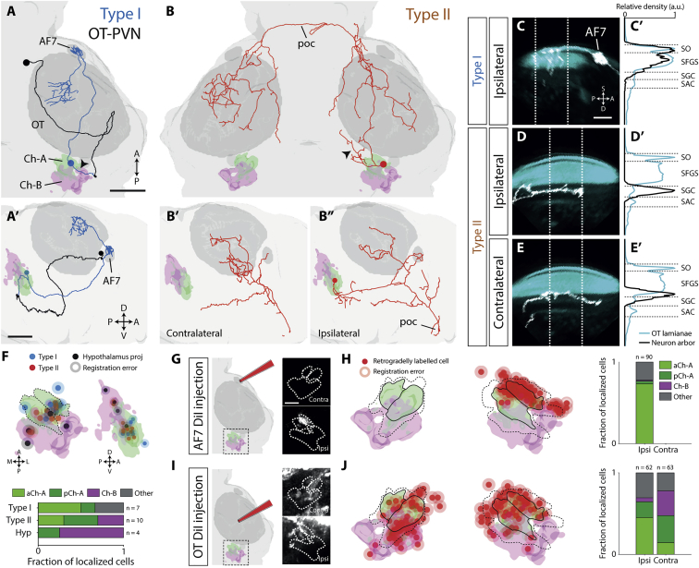
The nucleus isthmi sustains pursuit after hunting starts
The nucleus isthmi (NI) is a cholinergic nucleus reciprocally connected with the tectum; in amphibians its homolog has long been implicated in tectal function. Henriques and colleagues traced two types of NI projection neuron in zebrafish: type I projects ipsilaterally to retinorecipient laminae of tectum and pretectum, including AF7, and type II projects to both tectal hemispheres. The reciprocal projections place a cholinergic source of state-dependent feedback beside the visual populations receiving and classifying prey-related input.
After laser ablation of NI, larvae detected prey and initiated hunting as often as controls, but they failed to sustain prey-tracking sequences: the abort rate rose from 0.60 to 0.80 and the capture rate fell from 0.36 to 0.16. The increased abandonment of tracking sequences reduced successful captures, and the ablated larvae consequently consumed fewer paramecia. The preserved initiation and increased abortion locate the deficit mainly within maintenance of the ongoing tracking and pursuit sequence.
NI activity increased after hunting began, consistent with facilitation of the active pursuit state through its feedback to tectum and AF7-related pretectum. The lesion raised abortion from about 0.60 to 0.80 and reduced capture from about 0.36 to 0.16, leading to fewer consumed paramecia. The nucleus therefore supports continued engagement with a selected target after the initial visual event has already recruited hunting.
Henriques et al. (2019), Fig. 2. Traced type I and type II nucleus isthmi projection neurons and their targets in tectum and pretectum (AF7).
Henriques et al. (2019)
44
Notes:
• The nucleus isthmi is a cholinergic nucleus wired in loops with the tectum.
– One type of isthmic neuron projects to the tectum and pretectum on the same side, and another to both tectal halves.
• Without the nucleus isthmi, fish still noticed prey and started hunting.
– But they gave up more often: aborted hunts went from 60 to 80 percent and captures from 36 to 16 percent.
• So this nucleus helps keep the pursuit going once it has started, by boosting tectal and pretectal activity during the hunt.
References:
Henriques PM, Rahman N, Jackson SE, Bianco IH (2019). Nucleus isthmi is required to sustain target pursuit during visually guided prey-catching. Current Biology 29(11): 1771–1786.e5. https://doi.org/10.1016/j.cub.2019.04.064
Figure: Henriques et al. (2019), Fig. 2. Traced type I and type II nucleus isthmi projection neurons and their targets in tectum and pretectum (AF7).
Figure source: https://doi.org/10.1016/j.cub.2019.04.064

Slide 59

Pretectal prey detectors drive a hypothalamic feeding center
Muto and colleagues imaged calcium in freely swimming larvae. The inferior lobe of the hypothalamus (ILH), a feeding center, became active when a larva converged its eyes on prey and rose further after capture. The freely moving recording followed the feeding-related region as the larva entered its preparatory binocular state and completed a real capture.
Pretectal neurons were activated by paramecia: their activity rose as a larva approached prey, and in restrained larvae they responded best to virtual spots about 2–5° in size moving at intermediate speeds, matching the sizes and speeds of captured prey. The pretectal tuning related the upstream activity to visual conditions matching the small moving objects pursued during natural hunting.
Identified pretectal axons reached the inferior hypothalamic lobe, and activity in the two regions covaried during the feeding sequence. Pretectal ablation abolished capture, while silencing ILH neurons reduced feeding. Muto and colleagues proposed that this visual-to-hypothalamic pathway links prey detection with feeding motivation, placing the recognized target within a neural state that supports pursuit and consumption. The hypothalamic response increases further after a successful capture, linking its activity with more than the initial image of prey. Pretectal tuning supplies access to the visual features, while the feeding-related region follows the sequence through convergence and consumption, relating sensory classification to the state sustaining the animal's feeding behavior.
Muto et al. (2017), Fig. 2a–h. Pretectal (PT) calcium responses to paramecia during hunting; tuning to spot diameter (g) and speed (h).
Muto et al. (2017)
45
Notes:
• Muto and colleagues watched the hypothalamic feeding center, the inferior lobe, in swimming larvae.
– It switched on when the larva converged its eyes on prey and rose further after the catch.
• Pretectal neurons responded to paramecia and to virtual spots of prey size and speed.
– Single pretectal neurons sent axons to the feeding center, and their activity was correlated with it.
• Removing the pretectum abolished prey capture. The authors proposed that this pathway turns seeing prey into the motivation to feed, the same kind of motivational state that in toads controls how strongly T5.2 neurons respond.
References:
Muto A, Lal P, Ailani D, Abe G, Itoh M, Kawakami K (2017). Activation of the hypothalamic feeding centre upon visual prey detection. Nature Communications 8: 15029. https://doi.org/10.1038/ncomms15029
Figure: Muto et al. (2017), Fig. 2a–h. Pretectal (PT) calcium responses to paramecia during hunting; tuning to spot diameter (g) and speed (h).
Figure source: https://doi.org/10.1038/ncomms15029

Slide 60
Key takeaways
Toad prey selection depends on configuration relative to movement, with elongation along the path increasing prey value and cross-motion extension reducing it. The relationship remains effective across tested directions and contrast conditions.
Retinal, tectal, and pretectal populations supply different visual signals, with T5(2) selectivity resembling prey-oriented behavior. Their combined activity carries a richer classification than the discharge of an exclusive single-object detector.
Pretectal inhibition sharpens tectal selectivity, and NPY provides a chemically identified route for reducing retinal drive within the tectum. Removing pretectal restraint broadens effective targets and releases inappropriate catching.
Forebrain loops alter the availability and learned value of prey responses, linking striatal disinhibition and pallial learning with the tectal output pathway. Dopaminergic state shifts the balance between orienting and nearby snapping.
Converging sensorimotor streams recruit distinct motor acts, including turning, snapping, and avoidance through medullary pathways. Their expression depends on visual configuration, experience, and motivational state.
Zebrafish hunting recruits specialized retinal channels and distributed central populations, including AF7, feature-selective tectal assemblies, pretectal command-related cells, and feedback from nucleus isthmi. Hypothalamic pathways link prey detection with feeding-related state.
Ewert et al. (1978); Ewert (1997); Ewert et al. (2001); Semmelhack et al. (2014)
46
Notes:
Ewert JP, Borchers HW, von Wietersheim A (1978). Question of prey feature detectors in the toad's Bufo bufo (L.) visual system: a correlation analysis. Journal of Comparative Physiology 126: 43–47. https://doi.org/10.1007/BF01342649
Ewert JP, Arend B, Becker V, Borchers HW (1979). Invariants in configurational prey selection by Bufo bufo (L.). Brain, Behavior and Evolution 16: 38–51. https://doi.org/10.1159/000121822
Schürg-Pfeiffer E, Ewert JP (1981). Investigation of neurons involved in the analysis of gestalt prey features in the frog Rana temporaria. Journal of Comparative Physiology 141: 139–152. https://doi.org/10.1007/BF01342660
Ewert JP (1997). Neural correlates of key stimulus and releasing mechanism: a case study and two concepts. Trends in Neurosciences 20(8): 332–339. https://doi.org/10.1016/S0166-2236(96)01042-9
Ewert JP, Buxbaum-Conradi H, Dreisvogt F, Glagow M, Merkel-Harff C, Röttgen A, Schürg-Pfeiffer E, Schwippert WW (2001). Neural modulation of visuomotor functions underlying prey-catching behaviour in anurans: perception, attention, motor performance, learning. Comparative Biochemistry and Physiology A 128: 417–461. https://doi.org/10.1016/S1095-6433(00)00333-0
Keeffe R, Blob R, Blackburn D, Mayerl C (2022). XROMM analysis of feeding mechanics in toads: interactions of the tongue, hyoid, and pectoral girdle. Integrative Organismal Biology 4(1): obac045. https://doi.org/10.1093/iob/obac045
Yovanovich CAM, Koskela SM, Nevala N, Kondrashev SL, Kelber A, Donner K (2017). The dual rod system of amphibians supports colour discrimination at the absolute visual threshold. Philosophical Transactions of the Royal Society B 372: 20160066. https://doi.org/10.1098/rstb.2016.0066
Flaive A, Ryczko D (2022). From retina to motoneurons: a substrate for visuomotor transformation in salamanders. Journal of Comparative Neurology 530(14): 2518–2536. https://doi.org/10.1002/cne.25348
Bianco IH, Kampff AR, Engert F (2011). Prey capture behavior evoked by simple visual stimuli in larval zebrafish. Frontiers in Systems Neuroscience 5: 101. https://doi.org/10.3389/fnsys.2011.00101
Semmelhack JL, Donovan JC, Thiele TR, Kuehn E, Laurell E, Baier H (2014). A dedicated visual pathway for prey detection in larval zebrafish. eLife 3: e04878. https://doi.org/10.7554/eLife.04878
Bianco IH, Engert F (2015). Visuomotor transformations underlying hunting behavior in zebrafish. Current Biology 25(7): 831–846. https://doi.org/10.1016/j.cub.2015.01.042
Förster D, Helmbrecht TO, Mearns DS, Jordan L, Mokayes N, Baier H (2020). Retinotectal circuitry of larval zebrafish is adapted to detection and pursuit of prey. eLife 9: e58596. https://doi.org/10.7554/eLife.58596
Antinucci P, Folgueira M, Bianco IH (2019). Pretectal neurons control hunting behaviour. eLife 8: e48114. https://doi.org/10.7554/eLife.48114
Henriques PM, Rahman N, Jackson SE, Bianco IH (2019). Nucleus isthmi is required to sustain target pursuit during visually guided prey-catching. Current Biology 29(11): 1771–1786.e5. https://doi.org/10.1016/j.cub.2019.04.064
Muto A, Lal P, Ailani D, Abe G, Itoh M, Kawakami K (2017). Activation of the hypothalamic feeding centre upon visual prey detection. Nature Communications 8: 15029. https://doi.org/10.1038/ncomms15029

