Slide 1
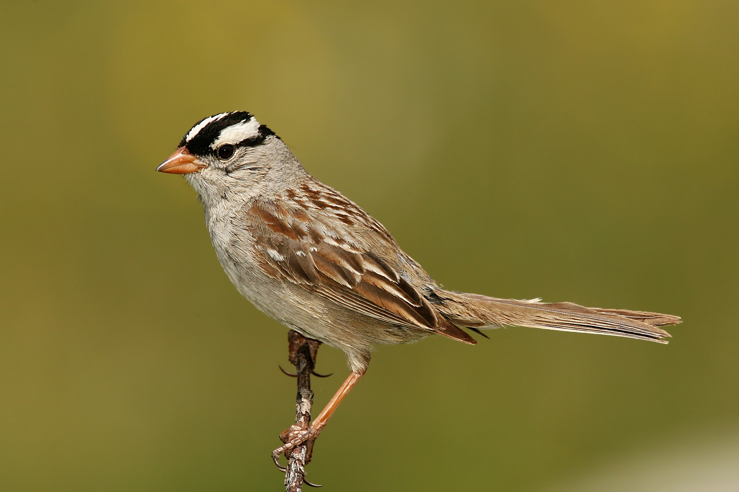
NEUR 411 · NEUROETHOLOGY · FALL 2026
Lecture 33
Vocal communication II:
song learning, sensitive periods, the template model (Marler & Konishi)
Friday, November 13, 2026
Jordan Lopez, Ph.D.
Professor of Neurobiology & Biomedical Engineering
Photo: White-crowned sparrow.
Notes:
Vocal communication II: song learning, sensitive periods, the template model (Marler & Konishi)
Lecture 33. NEUR 411 · NEUROETHOLOGY · FALL 2026. Friday, November 13, 2026.
Image: Photo: White-crowned sparrow. Credit: Wolfgang Wander. License: CC BY-SA 3.0. Source: https://commons.wikimedia.org/wiki/File:White-crowned-Sparrow.jpg

Slide 2
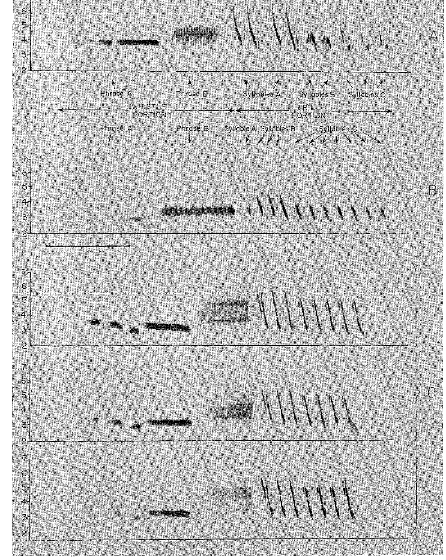
Song learning changes the structure of vocal output
Vocal learning changes the acoustic form of a sound through experience. In white-crowned sparrows, Zonotrichia leucophrys, males acquire distinctive song patterns from adult songs heard while young. This differs from learning when to emit an already available call.
Marler analyzed sound spectrograms, which display frequency against time. Whistle phrases and repeated trill syllables provided recognizable components for comparing a pupil's song with its training model.
A song can preserve its general whistle–trill organization yet fail to reproduce the tutor's detailed syllables. Vocal learning therefore requires assessment of acoustic structure, rather than simply counting how often a bird sings.
Whistle portions are comparatively sustained sounds, while trills contain repeated acoustic elements. Their frequency trajectories and repetition patterns distinguish a detailed copy from broad resemblance.
Marler (1970), Fig. 2. Whistle and trill portions of male song.
Marler (1970)
02
Notes:
• **Vocal learning** changes the acoustic form of a sound through experience. In white-crowned sparrows, _Zonotrichia leucophrys_, males acquire distinctive song patterns from adult songs heard while young. This differs from learning when to emit an already available call.
• Marler analyzed sound spectrograms, which display frequency against time. Whistle phrases and repeated trill syllables provided recognizable components for comparing a pupil's song with its training model.
• A song can preserve its general whistle–trill organization yet fail to reproduce the tutor's detailed syllables. Vocal learning therefore requires assessment of acoustic structure, rather than simply counting how often a bird sings.
• Whistle portions are comparatively sustained sounds, while trills contain repeated acoustic elements. Their frequency trajectories and repetition patterns distinguish a detailed copy from broad resemblance.
References:
Marler P (1970). A comparative approach to vocal learning: Song development in white-crowned sparrows. Journal of Comparative and Physiological Psychology 71(2, Pt. 2): 1–25. https://doi.org/10.1037/h0029144
Figure: Marler (1970), Fig. 2. Whistle and trill portions of male song.
Figure source: https://doi.org/10.1037/h0029144

Slide 3
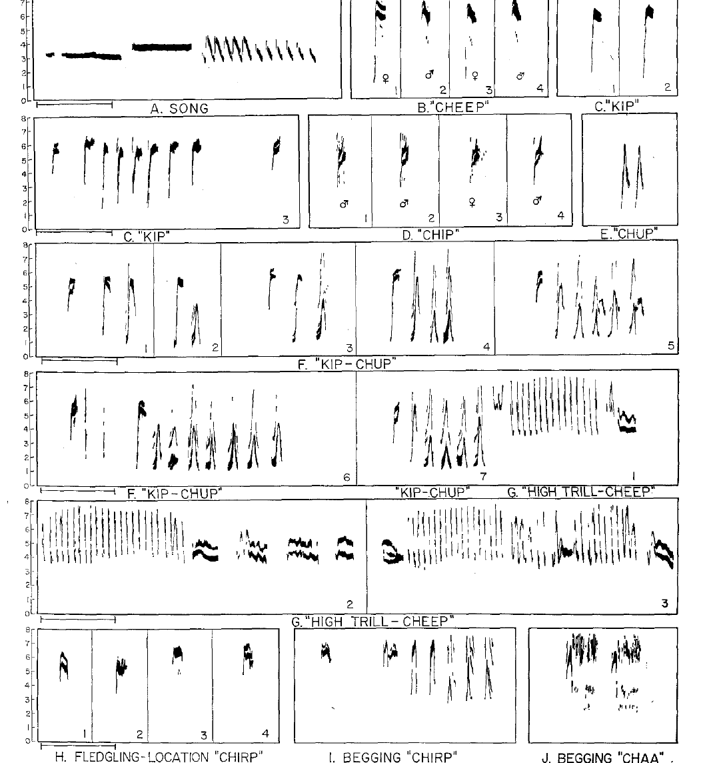
Song and calls have different developmental requirements
White-crowned sparrows produce several vocalizations, including short calls and the elaborate male song. A call is a relatively brief vocal signal; the song contains organized whistle and trill components repeated during the breeding season.
Marler's spectrograms distinguish adult calls from juvenile begging and location calls. Their different acoustic forms make it possible to identify which vocalization is being measured during development.
The learning experiments concern song structure, rather than every sound the species produces. Abnormal song after acoustic isolation cannot be generalized into a claim that all sparrow vocal behavior requires imitation.
The adult song is produced by males, whereas many shorter calls occur in both sexes. These differences prevent equating the song-learning experiment with acquisition of the entire vocal repertoire.
Marler (1970), Fig. 1. Major song and call vocalizations.
Marler (1970)
03
Notes:
• White-crowned sparrows produce several vocalizations, including short calls and the elaborate male song. A **call** is a relatively brief vocal signal; the song contains organized whistle and trill components repeated during the breeding season.
• Marler's spectrograms distinguish adult calls from juvenile begging and location calls. Their different acoustic forms make it possible to identify which vocalization is being measured during development.
• The learning experiments concern song structure, rather than every sound the species produces. Abnormal song after acoustic isolation cannot be generalized into a claim that all sparrow vocal behavior requires imitation.
• The adult song is produced by males, whereas many shorter calls occur in both sexes. These differences prevent equating the song-learning experiment with acquisition of the entire vocal repertoire.
References:
Marler P (1970). A comparative approach to vocal learning: Song development in white-crowned sparrows. Journal of Comparative and Physiological Psychology 71(2, Pt. 2): 1–25. https://doi.org/10.1037/h0029144
Figure: Marler (1970), Fig. 1. Major song and call vocalizations.
Figure source: https://doi.org/10.1037/h0029144

Slide 4
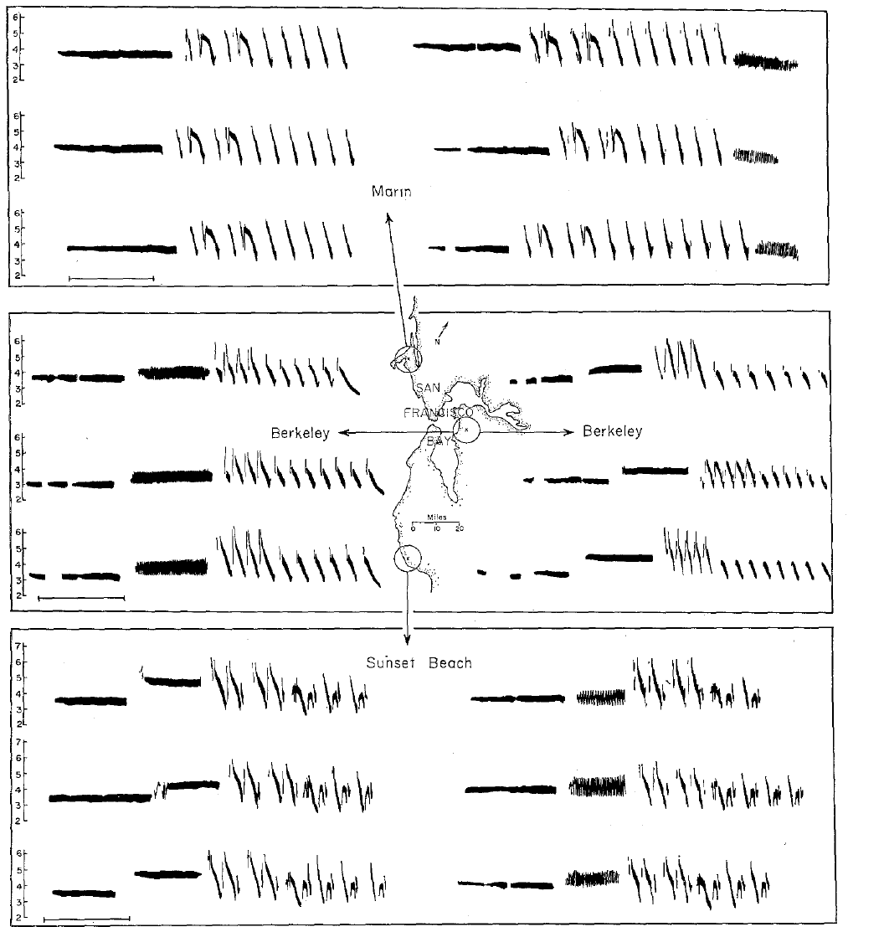
Local dialects provide acoustic models for learning
A dialect is a song pattern shared within a local population but differing from patterns elsewhere in the same species. Marler compared white-crowned sparrow songs from several parts of the San Francisco Bay area.
The populations shared broad species characteristics while differing in syllable structure and arrangement. These differences supplied alternative training models whose distinctive details could be recognized in later songs.
Geographical resemblance alone does not establish learning, because neighboring birds can also share ancestry and habitat. Controlled exposure to a particular dialect was required to separate the acoustic model from the bird's place of origin.
An alien dialect is still conspecific song. Learning its details would separate the source of an acoustic pattern from the pupil’s geographical population of origin.
Marler (1970), Fig. 3. Local song dialects.
Marler (1970)
04
Notes:
• A **dialect** is a song pattern shared within a local population but differing from patterns elsewhere in the same species. Marler compared white-crowned sparrow songs from several parts of the San Francisco Bay area.
• The populations shared broad species characteristics while differing in syllable structure and arrangement. These differences supplied alternative training models whose distinctive details could be recognized in later songs.
• Geographical resemblance alone does not establish learning, because neighboring birds can also share ancestry and habitat. Controlled exposure to a particular dialect was required to separate the acoustic model from the bird's place of origin.
• An alien dialect is still conspecific song. Learning its details would separate the source of an acoustic pattern from the pupil’s geographical population of origin.
References:
Marler P (1970). A comparative approach to vocal learning: Song development in white-crowned sparrows. Journal of Comparative and Physiological Psychology 71(2, Pt. 2): 1–25. https://doi.org/10.1037/h0029144
Figure: Marler (1970), Fig. 3. Local song dialects.
Figure source: https://doi.org/10.1037/h0029144

Slide 5
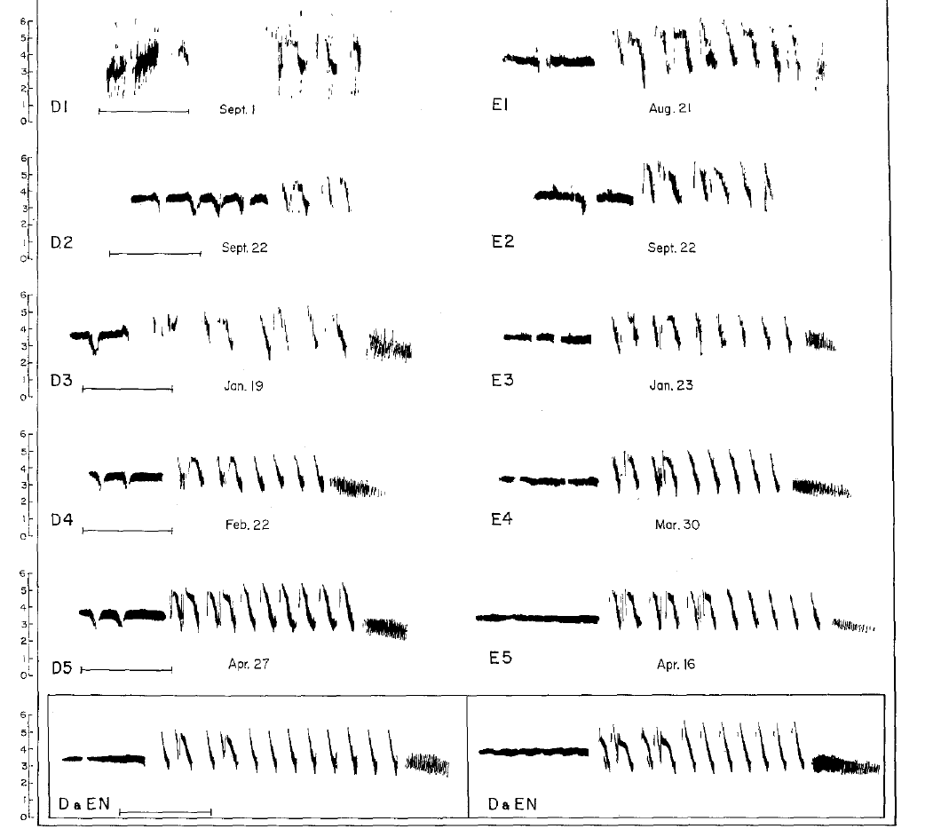
Field experience can precede laboratory isolation
A bird brought into isolation after spending time in the wild may already have heard a usable song model. Marler distinguished birds collected after fledging from birds collected as very young nestlings.
The songs of birds isolated after early field experience could retain local dialect characteristics. Those outcomes cannot be interpreted as normal development in the complete absence of adult song.
The age and acoustic history at collection are therefore part of the experimental treatment. Removing a bird from its natural environment does not erase information acquired before capture, even when its full song emerges much later.
The comparison songs from the capture area provide a reference for identifying retained dialect details. Without that reference, normal-looking adult structure cannot identify the source of learning.
Marler (1970), Fig. 4. Development following early field experience.
Marler (1970)
05
Notes:
• A bird brought into isolation after spending time in the wild may already have heard a usable song model. Marler distinguished birds collected after fledging from birds collected as very young nestlings.
• The songs of birds isolated after early field experience could retain local dialect characteristics. Those outcomes cannot be interpreted as normal development in the complete absence of adult song.
• The age and acoustic history at collection are therefore part of the experimental treatment. Removing a bird from its natural environment does not erase information acquired before capture, even when its full song emerges much later.
• The comparison songs from the capture area provide a reference for identifying retained dialect details. Without that reference, normal-looking adult structure cannot identify the source of learning.
References:
Marler P (1970). A comparative approach to vocal learning: Song development in white-crowned sparrows. Journal of Comparative and Physiological Psychology 71(2, Pt. 2): 1–25. https://doi.org/10.1037/h0029144
Figure: Marler (1970), Fig. 4. Development following early field experience.
Figure source: https://doi.org/10.1037/h0029144

Slide 6
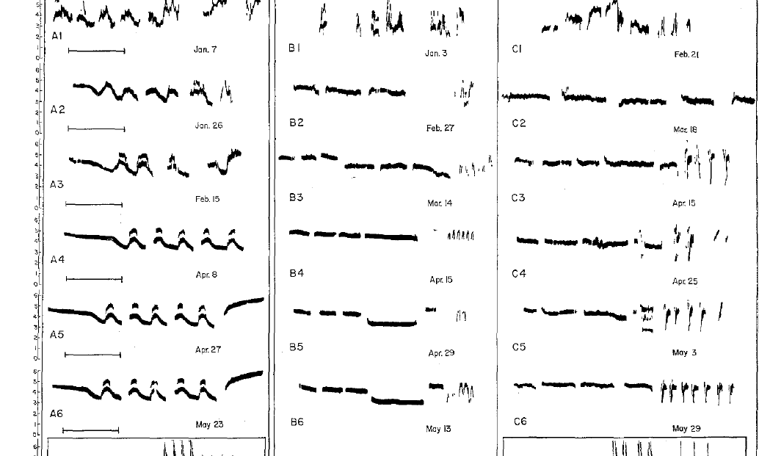
Early isolation prevents normal song development
Acoustic isolation excludes the adult song models normally available during development. Marler reared nestling white-crowned sparrows without normal adult song and compared their later vocalizations with natural dialects.
The isolates still sang, but their songs were simplified or abnormal in detailed syllable structure. Production of sound was therefore preserved while normal organization of the learned song was disrupted.
Isolation separates spontaneous vocal development from experience-dependent refinement. It does not imply that every component is learned: some broad tendencies can emerge without tutoring, while the detailed adult pattern depends on an appropriate acoustic environment.
The isolates’ developmental series retain a record of earlier vocal forms. Comparing only their final songs would conceal the gradual emergence of the abnormal mature patterns.
Marler (1970), Fig. 5. Song development in acoustic isolation.
Marler (1970)
06
Notes:
• **Acoustic isolation** excludes the adult song models normally available during development. Marler reared nestling white-crowned sparrows without normal adult song and compared their later vocalizations with natural dialects.
• The isolates still sang, but their songs were simplified or abnormal in detailed syllable structure. Production of sound was therefore preserved while normal organization of the learned song was disrupted.
• Isolation separates spontaneous vocal development from experience-dependent refinement. It does not imply that every component is learned: some broad tendencies can emerge without tutoring, while the detailed adult pattern depends on an appropriate acoustic environment.
• The isolates’ developmental series retain a record of earlier vocal forms. Comparing only their final songs would conceal the gradual emergence of the abnormal mature patterns.
References:
Marler P (1970). A comparative approach to vocal learning: Song development in white-crowned sparrows. Journal of Comparative and Physiological Psychology 71(2, Pt. 2): 1–25. https://doi.org/10.1037/h0029144
Figure: Marler (1970), Fig. 5. Song development in acoustic isolation.
Figure source: https://doi.org/10.1037/h0029144

Slide 7
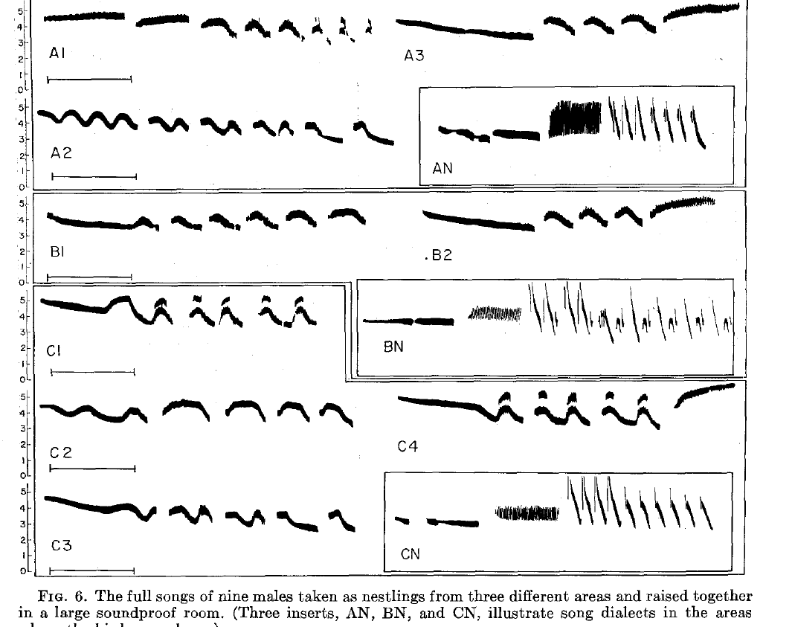
Young companions do not replace an adult song model
Marler also raised young white-crowned sparrows together while excluding adult song. Group isolation preserves interactions among young birds but removes the normal adult acoustic model.
The resulting songs remained abnormal. Their companions' developing vocalizations did not supply the same information as an established adult dialect under these experimental conditions.
This comparison distinguishes access to other birds from access to an appropriate tutor. A group can provide social stimulation without providing the mature song pattern needed for accurate imitation; the result does not establish that social interactions are irrelevant to learning.
Individual and group isolation both removed adult song. Their similar abnormal outcomes in this study identify a missing adult model rather than simply the absence of young companions.
Marler (1970), Fig. 6. Songs of group-isolated males.
Marler (1970)
07
Notes:
• Marler also raised young white-crowned sparrows together while excluding adult song. **Group isolation** preserves interactions among young birds but removes the normal adult acoustic model.
• The resulting songs remained abnormal. Their companions' developing vocalizations did not supply the same information as an established adult dialect under these experimental conditions.
• This comparison distinguishes access to other birds from access to an appropriate tutor. A group can provide social stimulation without providing the mature song pattern needed for accurate imitation; the result does not establish that social interactions are irrelevant to learning.
• Individual and group isolation both removed adult song. Their similar abnormal outcomes in this study identify a missing adult model rather than simply the absence of young companions.
References:
Marler P (1970). A comparative approach to vocal learning: Song development in white-crowned sparrows. Journal of Comparative and Physiological Psychology 71(2, Pt. 2): 1–25. https://doi.org/10.1037/h0029144
Figure: Marler (1970), Fig. 6. Songs of group-isolated males.
Figure source: https://doi.org/10.1037/h0029144

Slide 8
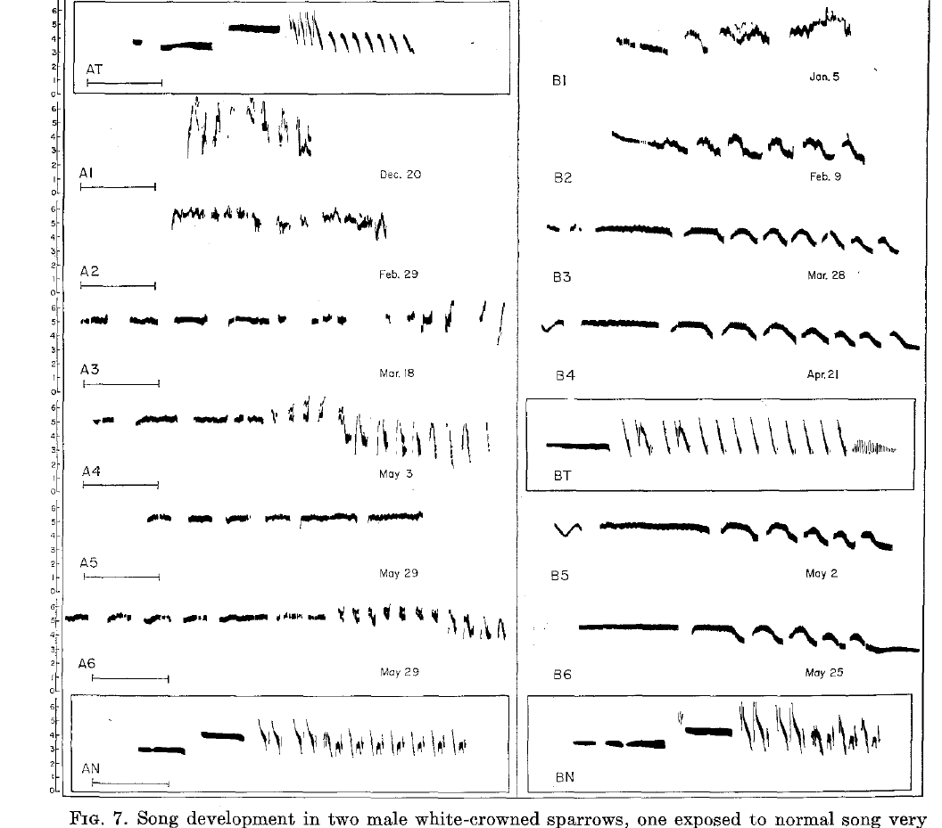
Very early playback does not guarantee song copying
Song exposure can be ineffective even when it occurs before the usual learning interval. Marler tested playback during the nestling phase and followed the later development of isolated males.
Exposure before about 10 days of age did not produce detailed copying comparable to effective early fledgling training. An acoustic signal's presence therefore does not by itself establish that the bird stores it as a song model.
The distinction concerns developmental responsiveness to the tested recordings. It does not establish an inability to hear every sound, nor does it imply that all kinds of early sensory experience have no developmental effects.
Marler (1970), Fig. 7. Development after very early or late exposure.
Marler (1970)
08
Notes:
• Song exposure can be ineffective even when it occurs before the usual learning interval. Marler tested playback during the nestling phase and followed the later development of isolated males.
• Exposure before about 10 days of age did not produce detailed copying comparable to effective early fledgling training. An acoustic signal's presence therefore does not by itself establish that the bird stores it as a song model.
• The distinction concerns developmental responsiveness to the tested recordings. It does not establish an inability to hear every sound, nor does it imply that all kinds of early sensory experience have no developmental effects.
References:
Marler P (1970). A comparative approach to vocal learning: Song development in white-crowned sparrows. Journal of Comparative and Physiological Psychology 71(2, Pt. 2): 1–25. https://doi.org/10.1037/h0029144
Figure: Marler (1970), Fig. 7. Development after very early or late exposure.
Figure source: https://doi.org/10.1037/h0029144

Slide 9
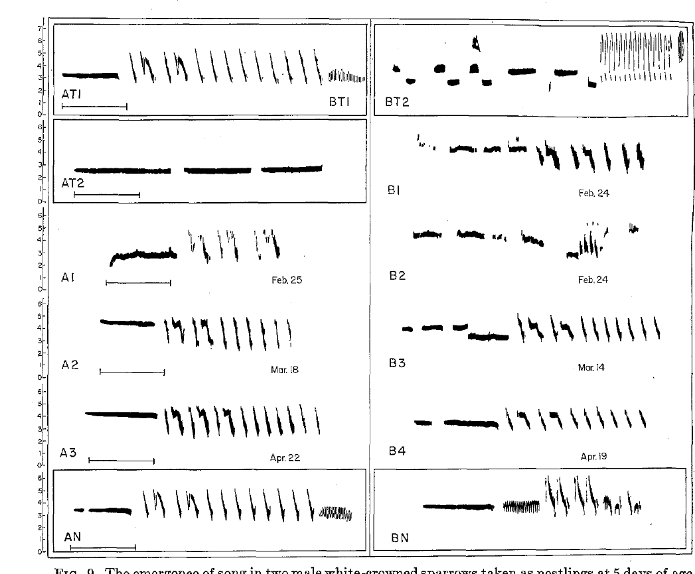
Early fledgling tutoring supports detailed imitation
Marler presented recorded songs to otherwise isolated young males during defined age intervals. Early tutoring included exposure from days 8–28 or days 35–56, followed by development without continued adult song.
The eventual songs were good copies of the white-crowned sparrow model, although a final vibrato component could be missing. Imitation here means reproduction of identifiable acoustic details, rather than merely a broadly normal song.
Because the mature song appeared long after tutoring, the recordings must have influenced information retained for later vocal development. The behavioral experiment establishes delayed learning without locating the stored information in a particular neuron.
After the recorded exposure ended, the young males remained isolated. Subsequent resemblance to the earlier model therefore did not require continued availability of that recording during mature singing.
Marler (1970), Fig. 9. Development after early conspecific and alien tutoring.
Marler (1970)
09
Notes:
• Marler presented recorded songs to otherwise isolated young males during defined age intervals. Early tutoring included exposure from days 8–28 or days 35–56, followed by development without continued adult song.
• The eventual songs were good copies of the white-crowned sparrow model, although a final vibrato component could be missing. **Imitation** here means reproduction of identifiable acoustic details, rather than merely a broadly normal song.
• Because the mature song appeared long after tutoring, the recordings must have influenced information retained for later vocal development. The behavioral experiment establishes delayed learning without locating the stored information in a particular neuron.
• After the recorded exposure ended, the young males remained isolated. Subsequent resemblance to the earlier model therefore did not require continued availability of that recording during mature singing.
References:
Marler P (1970). A comparative approach to vocal learning: Song development in white-crowned sparrows. Journal of Comparative and Physiological Psychology 71(2, Pt. 2): 1–25. https://doi.org/10.1037/h0029144
Figure: Marler (1970), Fig. 9. Development after early conspecific and alien tutoring.
Figure source: https://doi.org/10.1037/h0029144

Slide 10
A brief playback schedule can supply a usable model
In Marler's early training experiment, pupils heard two minutes of white-crowned sparrow song and two minutes of another species' song in morning and afternoon sessions. Presentation order alternated across sessions and days.
The recordings were played at six songs per minute. Effective learning therefore occurred from controlled episodes of exposure, rather than continuous access to a singing adult throughout development.
Alternating the order reduced a simple presentation-order explanation for selective copying. The experiment established that this schedule could support learning; it did not determine the minimum exposure required or prove that live tutoring and recorded tutoring are equivalent.
Harris’ sparrow song resembles white-crowned sparrow song more closely than the tested song sparrow recording. Neither alien pattern left a recognizable trace in the resulting copied songs.
Marler (1970), Fig. 9. Development after early conspecific and alien tutoring.
Marler (1970)
10
Notes:
• In Marler's early training experiment, pupils heard two minutes of white-crowned sparrow song and two minutes of another species' song in morning and afternoon sessions. Presentation order alternated across sessions and days.
• The recordings were played at six songs per minute. Effective learning therefore occurred from controlled episodes of exposure, rather than continuous access to a singing adult throughout development.
• Alternating the order reduced a simple presentation-order explanation for selective copying. The experiment established that this schedule could support learning; it did not determine the minimum exposure required or prove that live tutoring and recorded tutoring are equivalent.
• Harris’ sparrow song resembles white-crowned sparrow song more closely than the tested song sparrow recording. Neither alien pattern left a recognizable trace in the resulting copied songs.
References:
Marler P (1970). A comparative approach to vocal learning: Song development in white-crowned sparrows. Journal of Comparative and Physiological Psychology 71(2, Pt. 2): 1–25. https://doi.org/10.1037/h0029144
Figure: Marler (1970), Fig. 9. Development after early conspecific and alien tutoring.
Figure source: https://doi.org/10.1037/h0029144

Slide 11
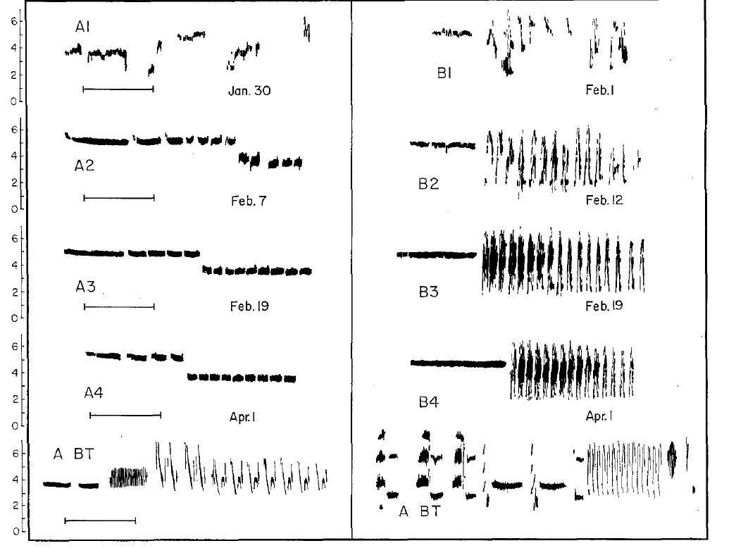
Later tutoring can spare organization without fine copying
Pupils trained from days 50–71 did not reproduce the training models in detailed syllable form. One developed an isolate-like song, whereas another retained a more normal division into whistle and trill portions.
This partial outcome distinguishes coarse song organization from accurate copying. A late experience can shift development toward species-typical structure without installing all the detailed features obtained after earlier training.
A sensitive period is an interval of enhanced responsiveness to experience. Its boundary depends on the measured outcome: loss of detailed imitation need not coincide with complete loss of every developmental influence from song exposure.
The whistle and trill division is a coarse organizational feature. Its survival in one late-trained male did not include matching the model’s detailed trill syllables.
Marler (1970), Fig. 10. Development after tutoring on days 50–71.
Marler (1970)
11
Notes:
• Pupils trained from days 50–71 did not reproduce the training models in detailed syllable form. One developed an isolate-like song, whereas another retained a more normal division into whistle and trill portions.
• This partial outcome distinguishes coarse song organization from accurate copying. A late experience can shift development toward species-typical structure without installing all the detailed features obtained after earlier training.
• A **sensitive period** is an interval of enhanced responsiveness to experience. Its boundary depends on the measured outcome: loss of detailed imitation need not coincide with complete loss of every developmental influence from song exposure.
• The whistle and trill division is a coarse organizational feature. Its survival in one late-trained male did not include matching the model’s detailed trill syllables.
References:
Marler P (1970). A comparative approach to vocal learning: Song development in white-crowned sparrows. Journal of Comparative and Physiological Psychology 71(2, Pt. 2): 1–25. https://doi.org/10.1037/h0029144
Figure: Marler (1970), Fig. 10. Development after tutoring on days 50–71.
Figure source: https://doi.org/10.1037/h0029144

Slide 12
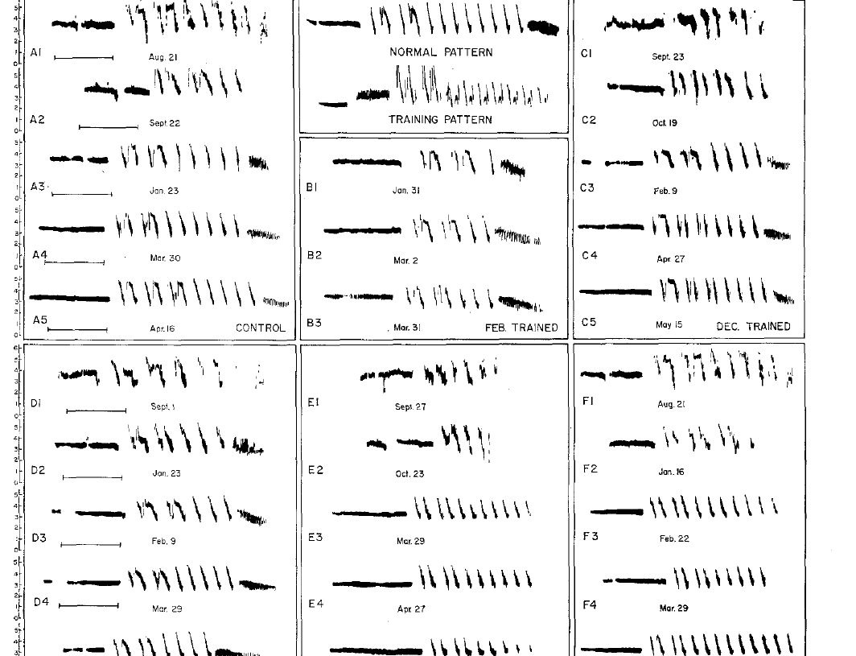
Late exposure does not simply rewrite established song
Marler tested song exposure at later ages as well as in early development. Playback around or after 100 days did not yield the detailed training-song reproduction associated with the earlier effective interval.
The outcome contrasts with the ability of younger pupils to acquire a specific dialect. Developmental age changed the effect of an acoustic model that could otherwise be suitable for the species.
These findings concern the tested subspecies and playback conditions. They support an age-dependent limitation on detailed song acquisition, rather than a universal rule that every songbird must stop learning at the same chronological age.
The later field-collected birds also had earlier acoustic histories. Their exposure records matter when distinguishing a new playback effect from information acquired before laboratory testing.
Marler (1970), Fig. 8. Songs after later field collection and playback.
Marler (1970)
12
Notes:
• Marler tested song exposure at later ages as well as in early development. Playback around or after 100 days did not yield the detailed training-song reproduction associated with the earlier effective interval.
• The outcome contrasts with the ability of younger pupils to acquire a specific dialect. Developmental age changed the effect of an acoustic model that could otherwise be suitable for the species.
• These findings concern the tested subspecies and playback conditions. They support an age-dependent limitation on detailed song acquisition, rather than a universal rule that every songbird must stop learning at the same chronological age.
• The later field-collected birds also had earlier acoustic histories. Their exposure records matter when distinguishing a new playback effect from information acquired before laboratory testing.
References:
Marler P (1970). A comparative approach to vocal learning: Song development in white-crowned sparrows. Journal of Comparative and Physiological Psychology 71(2, Pt. 2): 1–25. https://doi.org/10.1037/h0029144
Figure: Marler (1970), Fig. 8. Songs after later field collection and playback.
Figure source: https://doi.org/10.1037/h0029144

Slide 13
Conspecific and alien songs are not learned equally
A conspecific is a member of the same species; a heterospecific belongs to another species. Marler presented conspecific song alongside Harris' sparrow or song sparrow recordings during early tutoring.
The young white-crowned sparrows later copied the conspecific model, while recognizable effects of the other species' songs were absent. Equal availability of acoustic examples did not produce equal incorporation into adult song.
Selective acquisition supports a bias toward suitable song patterns. The comparison does not prove that alien songs were inaudible, because failing to imitate a signal and failing to detect it are different experimental outcomes.
The alien recordings were supplied in addition to conspecific tutoring. The resulting choice of copied pattern concerns selectivity under simultaneous access to those two categories of acoustic model.
Marler (1970), Fig. 9. Development after early conspecific and alien tutoring.
Marler (1970)
13
Notes:
• A **conspecific** is a member of the same species; a heterospecific belongs to another species. Marler presented conspecific song alongside Harris' sparrow or song sparrow recordings during early tutoring.
• The young white-crowned sparrows later copied the conspecific model, while recognizable effects of the other species' songs were absent. Equal availability of acoustic examples did not produce equal incorporation into adult song.
• Selective acquisition supports a bias toward suitable song patterns. The comparison does not prove that alien songs were inaudible, because failing to imitate a signal and failing to detect it are different experimental outcomes.
• The alien recordings were supplied in addition to conspecific tutoring. The resulting choice of copied pattern concerns selectivity under simultaneous access to those two categories of acoustic model.
References:
Marler P (1970). A comparative approach to vocal learning: Song development in white-crowned sparrows. Journal of Comparative and Physiological Psychology 71(2, Pt. 2): 1–25. https://doi.org/10.1037/h0029144
Figure: Marler (1970), Fig. 9. Development after early conspecific and alien tutoring.
Figure source: https://doi.org/10.1037/h0029144

Slide 14
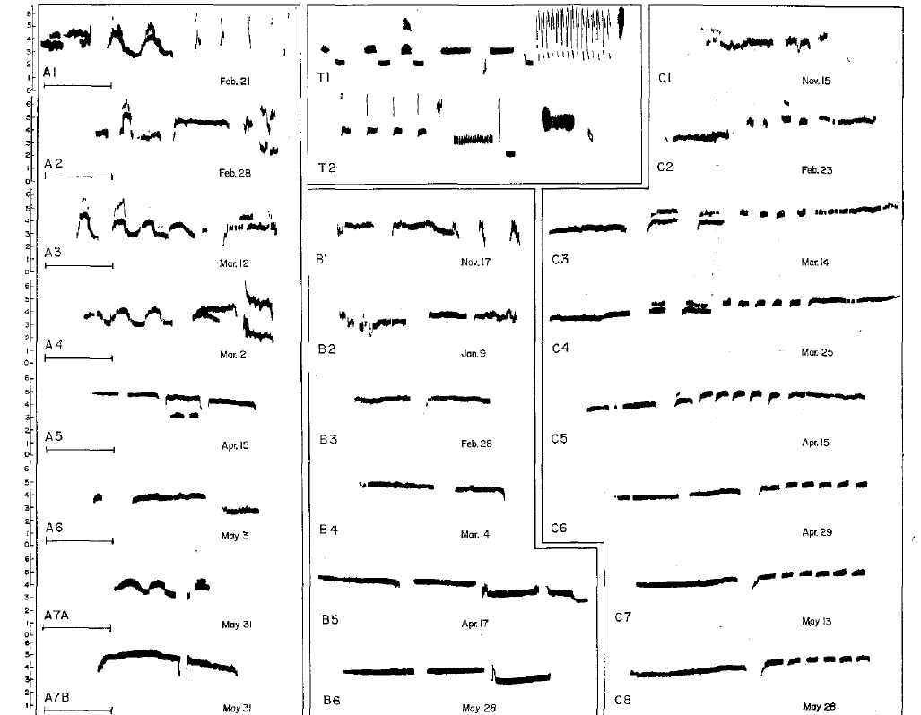
Alien song alone does not restore normal development
Marler tested whether excluding a competing conspecific model would permit white-crowned sparrows to copy song sparrow song. Individually isolated nestlings received the alien recordings from days 7–28.
Their later songs showed no detectable correspondence to those training songs and remained abnormal as white-crowned sparrow songs. The result differed from successful conspecific tutoring during a similar early interval.
The failure was therefore not explained solely by choosing a familiar conspecific model over an alien alternative. Under this playback procedure, another species' song did not provide an effective substitute for the acoustic information required for normal development.
Presenting alien song alone removed conspecific competition during training. The absence of recognizable alien copying nevertheless persisted, while the birds still developed their own abnormal songs.
Marler (1970), Fig. 11. Development with alien song alone.
Marler (1970)
14
Notes:
• Marler tested whether excluding a competing conspecific model would permit white-crowned sparrows to copy song sparrow song. Individually isolated nestlings received the alien recordings from days 7–28.
• Their later songs showed no detectable correspondence to those training songs and remained abnormal as white-crowned sparrow songs. The result differed from successful conspecific tutoring during a similar early interval.
• The failure was therefore not explained solely by choosing a familiar conspecific model over an alien alternative. Under this playback procedure, another species' song did not provide an effective substitute for the acoustic information required for normal development.
• Presenting alien song alone removed conspecific competition during training. The absence of recognizable alien copying nevertheless persisted, while the birds still developed their own abnormal songs.
References:
Marler P (1970). A comparative approach to vocal learning: Song development in white-crowned sparrows. Journal of Comparative and Physiological Psychology 71(2, Pt. 2): 1–25. https://doi.org/10.1037/h0029144
Figure: Marler (1970), Fig. 11. Development with alien song alone.
Figure source: https://doi.org/10.1037/h0029144

Slide 15
A learned target can guide vocalizations months later
An auditory template is a proposed internal specification against which developing vocal output can be evaluated. Marler inferred such a specification from early song exposure followed by much later reproduction of the training pattern.
The model separates acquiring a target from producing a mature imitation. A pupil can retain information about a song before the vocal system produces its final whistle and trill sequence.
The template is a functional hypothesis about information storage and matching. Accurate copying after a delay supports a retained target, but these behavioral data do not identify its cellular location or demonstrate a literal stored spectrogram.
Marler (1970), Fig. 9. Development after early conspecific and alien tutoring.
Marler (1970)
15
Notes:
• An **auditory template** is a proposed internal specification against which developing vocal output can be evaluated. Marler inferred such a specification from early song exposure followed by much later reproduction of the training pattern.
• The model separates acquiring a target from producing a mature imitation. A pupil can retain information about a song before the vocal system produces its final whistle and trill sequence.
• The template is a functional hypothesis about information storage and matching. Accurate copying after a delay supports a retained target, but these behavioral data do not identify its cellular location or demonstrate a literal stored spectrogram.
References:
Marler P (1970). A comparative approach to vocal learning: Song development in white-crowned sparrows. Journal of Comparative and Physiological Psychology 71(2, Pt. 2): 1–25. https://doi.org/10.1037/h0029144
Figure: Marler (1970), Fig. 9. Development after early conspecific and alien tutoring.
Figure source: https://doi.org/10.1037/h0029144

Slide 16
Species bias and learned detail can coexist
Marler proposed that the early template contains a coarse specification favoring species-appropriate sounds. Experience with an adult song would then refine that specification into the detailed pattern used during later development.
Selective conspecific learning and abnormal isolate songs motivated different parts of this account. A predisposition can restrict the acceptable model without already containing every syllable of the local dialect.
Predisposition means an initial bias in development, not a fully specified mature behavior. The proposed interaction between bias and experience explains why neither unrestricted imitation nor complete genetic specification describes the experimental outcomes adequately.
The coarse early specification is proposed, rather than directly recorded from the brain. The behavioral contrasts constrain its possible properties without identifying a cellular representation.
Marler (1970), Fig. 11. Development with alien song alone.
Marler (1970)
16
Notes:
• Marler proposed that the early template contains a coarse specification favoring species-appropriate sounds. Experience with an adult song would then refine that specification into the detailed pattern used during later development.
• Selective conspecific learning and abnormal isolate songs motivated different parts of this account. A predisposition can restrict the acceptable model without already containing every syllable of the local dialect.
• **Predisposition** means an initial bias in development, not a fully specified mature behavior. The proposed interaction between bias and experience explains why neither unrestricted imitation nor complete genetic specification describes the experimental outcomes adequately.
• The coarse early specification is proposed, rather than directly recorded from the brain. The behavioral contrasts constrain its possible properties without identifying a cellular representation.
References:
Marler P (1970). A comparative approach to vocal learning: Song development in white-crowned sparrows. Journal of Comparative and Physiological Psychology 71(2, Pt. 2): 1–25. https://doi.org/10.1037/h0029144
Figure: Marler (1970), Fig. 11. Development with alien song alone.
Figure source: https://doi.org/10.1037/h0029144

Slide 17
Hearing a tutor and hearing oneself serve different roles
The sensory phase acquires information from a tutor; the sensorimotor phase links that information to developing vocal production. In a template account, hearing a model and hearing the pupil's own voice perform different functions.
Marler's delayed imitation establishes that adult song exposure can precede mature production. Konishi's deafening findings, as discussed in the supplied Brainard and Doupe review, support a separate requirement for auditory feedback during refinement.
Removing access to the tutor and removing the pupil’s hearing after tutoring affect different stages of song development. A retained target alone is insufficient when the bird cannot use hearing to regulate its developing vocal output.
Marler (1970), Fig. 5. Song development in acoustic isolation.
Marler (1970); Brainard & Doupe (2000)
17
Notes:
• The **sensory phase** acquires information from a tutor; the **sensorimotor phase** links that information to developing vocal production. In a template account, hearing a model and hearing the pupil's own voice perform different functions.
• Marler's delayed imitation establishes that adult song exposure can precede mature production. Konishi's deafening findings, as discussed in the supplied Brainard and Doupe review, support a separate requirement for auditory feedback during refinement.
• Removing access to the tutor and removing the pupil’s hearing after tutoring affect different stages of song development. A retained target alone is insufficient when the bird cannot use hearing to regulate its developing vocal output.
References:
Marler P (1970). A comparative approach to vocal learning: Song development in white-crowned sparrows. Journal of Comparative and Physiological Psychology 71(2, Pt. 2): 1–25. https://doi.org/10.1037/h0029144
Brainard MS, Doupe AJ (2000). Auditory feedback in learning and maintenance of vocal behaviour. Nature Reviews Neuroscience 1: 31–40. https://doi.org/10.1038/35036205
Figure: Marler (1970), Fig. 5. Song development in acoustic isolation.
Figure source: https://doi.org/10.1037/h0029144

Slide 18
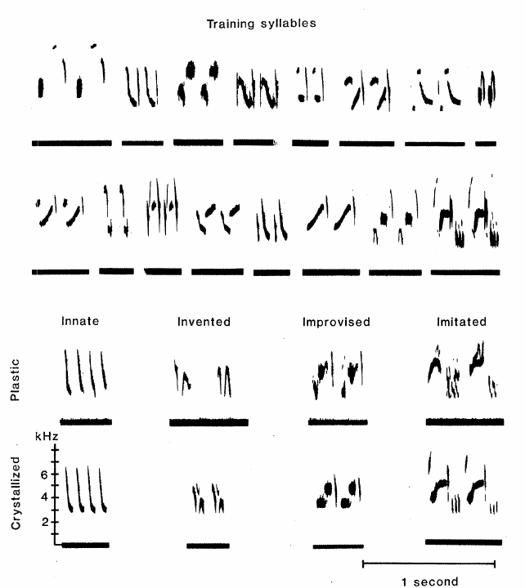
Swamp sparrows reproduce material heard in infancy
Marler and Peters studied swamp sparrows, Melospiza georgiana, reared with controlled recordings in infancy. Later songs contained syllables matching components of those recordings rather than an arbitrary adult pattern.
Training began between 16 and 26 days of age and continued for 40 days. The pupils were subsequently kept in separate soundproof chambers, removing continued access to the original acoustic models.
Detailed matching after this separation supports storage of song information. It is the correspondence between the later syllables and earlier training material, together with the untrained comparison, that distinguishes learning from independent maturation into a species-typical song.
The training material contained known syllable arrangements. That controlled history made it possible to compare later vocal units with actual earlier inputs instead of inferring a tutor from resemblance alone.
Marler & Peters (1981), Fig. 1. Training syllables and developing vocal material.
Marler & Peters (1981)
18
Notes:
• Marler and Peters studied **swamp sparrows**, _Melospiza georgiana_, reared with controlled recordings in infancy. Later songs contained syllables matching components of those recordings rather than an arbitrary adult pattern.
• Training began between 16 and 26 days of age and continued for 40 days. The pupils were subsequently kept in separate soundproof chambers, removing continued access to the original acoustic models.
• Detailed matching after this separation supports storage of song information. It is the correspondence between the later syllables and earlier training material, together with the untrained comparison, that distinguishes learning from independent maturation into a species-typical song.
• The training material contained known syllable arrangements. That controlled history made it possible to compare later vocal units with actual earlier inputs instead of inferring a tutor from resemblance alone.
References:
Marler P, Peters S (1981). Sparrows learn adult song and more from memory. Science 213(4509): 780–782. https://doi.org/10.1126/science.213.4509.780
Figure: Marler & Peters (1981), Fig. 1. Training syllables and developing vocal material.
Figure source: https://doi.org/10.1126/science.213.4509.780

Slide 19
Early subsong does not reproduce the stored syllables
Subsong is variable early singing without the stable syllable organization of mature song. Marler and Peters recorded the pupils repeatedly and classified vocalizations by acoustic stability and organization.
Early singing lacked recognizable rehearsal of the syllables that would later match the tutor material. The existence of some vocal activity therefore did not establish continuous practice of each memorized pattern.
The conclusion rests on the sampled recordings and spectrographic comparisons. It supports a long separation between learning and recognizable imitation, while avoiding the stronger claim that every possible vocalization throughout the entire interval was observed.
The early variable vocalizations differ from later recognizable syllables. Calling both stages singing does not mean that the same acoustic material was practiced continuously throughout development.
Marler & Peters (1981), Fig. 1. Training syllables and developing vocal material.
Marler & Peters (1981)
19
Notes:
• **Subsong** is variable early singing without the stable syllable organization of mature song. Marler and Peters recorded the pupils repeatedly and classified vocalizations by acoustic stability and organization.
• Early singing lacked recognizable rehearsal of the syllables that would later match the tutor material. The existence of some vocal activity therefore did not establish continuous practice of each memorized pattern.
• The conclusion rests on the sampled recordings and spectrographic comparisons. It supports a long separation between learning and recognizable imitation, while avoiding the stronger claim that every possible vocalization throughout the entire interval was observed.
• The early variable vocalizations differ from later recognizable syllables. Calling both stages singing does not mean that the same acoustic material was practiced continuously throughout development.
References:
Marler P, Peters S (1981). Sparrows learn adult song and more from memory. Science 213(4509): 780–782. https://doi.org/10.1126/science.213.4509.780
Figure: Marler & Peters (1981), Fig. 1. Training syllables and developing vocal material.
Figure source: https://doi.org/10.1126/science.213.4509.780

Slide 20
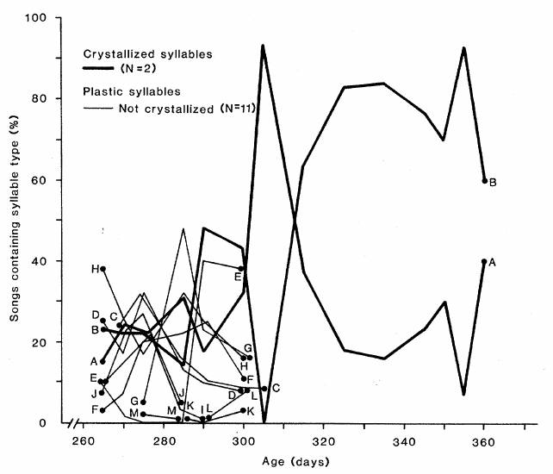
Recognizable rehearsal follows a long retention interval
The swamp sparrows' first recognizable attempts at memorized syllables occurred roughly 225 days after the last training exposure. More definite rehearsal of particular syllables followed about two weeks later.
The interval was approximately eight months, far longer than the immediate delay between hearing and repeating a sound. The birds began regular song development near adulthood rather than producing a mature copy during infancy.
This result supports long-lasting perceptual memory that can guide later motor learning. The retention interval does not itself identify the molecular substrate of memory, nor establish that a template must be stored in a single brain nucleus.
Marler & Peters (1981), Fig. 2. Syllable use across developmental age.
Marler & Peters (1981)
20
Notes:
• The swamp sparrows' first recognizable attempts at memorized syllables occurred roughly 225 days after the last training exposure. More definite rehearsal of particular syllables followed about two weeks later.
• The interval was approximately eight months, far longer than the immediate delay between hearing and repeating a sound. The birds began regular song development near adulthood rather than producing a mature copy during infancy.
• This result supports long-lasting perceptual memory that can guide later motor learning. The retention interval does not itself identify the molecular substrate of memory, nor establish that a template must be stored in a single brain nucleus.
References:
Marler P, Peters S (1981). Sparrows learn adult song and more from memory. Science 213(4509): 780–782. https://doi.org/10.1126/science.213.4509.780
Figure: Marler & Peters (1981), Fig. 2. Syllable use across developmental age.
Figure source: https://doi.org/10.1126/science.213.4509.780

Slide 21
Crystallization stabilizes previously variable syllables
Plastic song contains developing syllables whose acoustic form or combination remains variable. Crystallization is the transition to the more stable mature song pattern. Marler and Peters distinguished these states through repeated spectrographic analysis.
Mature swamp sparrow songs consisted of a roughly two-second series of repeated multinote syllables. Defined syllables and regular repetition emerged from earlier, less organized vocalizations.
The transition was not the first occurrence of every adult sound. It involved refinement and stabilization of material already present during development, making longitudinal recordings necessary for distinguishing acquisition from the final expression of a repertoire.
Stability was assessed across repeated renditions. A single well-formed syllable during plastic song therefore did not by itself establish that the adult pattern had crystallized.
Marler & Peters (1981), Fig. 1. Training syllables and developing vocal material.
Marler & Peters (1981)
21
Notes:
• **Plastic song** contains developing syllables whose acoustic form or combination remains variable. **Crystallization** is the transition to the more stable mature song pattern. Marler and Peters distinguished these states through repeated spectrographic analysis.
• Mature swamp sparrow songs consisted of a roughly two-second series of repeated multinote syllables. Defined syllables and regular repetition emerged from earlier, less organized vocalizations.
• The transition was not the first occurrence of every adult sound. It involved refinement and stabilization of material already present during development, making longitudinal recordings necessary for distinguishing acquisition from the final expression of a repertoire.
• Stability was assessed across repeated renditions. A single well-formed syllable during plastic song therefore did not by itself establish that the adult pattern had crystallized.
References:
Marler P, Peters S (1981). Sparrows learn adult song and more from memory. Science 213(4509): 780–782. https://doi.org/10.1126/science.213.4509.780
Figure: Marler & Peters (1981), Fig. 1. Training syllables and developing vocal material.
Figure source: https://doi.org/10.1126/science.213.4509.780

Slide 22
Plastic song contains material absent from adult song
A repertoire is the collection of distinct song types or syllables produced by an individual. During plastic song, swamp sparrows produced more distinct syllables than remained in their crystallized adult repertoires.
Marler and Peters tracked individual syllable types across age. Some copied training syllables were expressed temporarily and then disappeared, alongside other developing material.
Adult song therefore underestimates information revealed during learning. Failure to retain a copied syllable in the final repertoire does not establish failure to learn it; a developmental record can detect temporary expression that a single adult recording would miss.
The age record followed named syllable types as their use changed. A copied type could be temporarily expressed and later lost while other copied material remained in the adult repertoire.
Marler & Peters (1981), Fig. 2. Syllable use across developmental age.
Marler & Peters (1981)
22
Notes:
• A **repertoire** is the collection of distinct song types or syllables produced by an individual. During plastic song, swamp sparrows produced more distinct syllables than remained in their crystallized adult repertoires.
• Marler and Peters tracked individual syllable types across age. Some copied training syllables were expressed temporarily and then disappeared, alongside other developing material.
• Adult song therefore underestimates information revealed during learning. Failure to retain a copied syllable in the final repertoire does not establish failure to learn it; a developmental record can detect temporary expression that a single adult recording would miss.
• The age record followed named syllable types as their use changed. A copied type could be temporarily expressed and later lost while other copied material remained in the adult repertoire.
References:
Marler P, Peters S (1981). Sparrows learn adult song and more from memory. Science 213(4509): 780–782. https://doi.org/10.1126/science.213.4509.780
Figure: Marler & Peters (1981), Fig. 2. Syllable use across developmental age.
Figure source: https://doi.org/10.1126/science.213.4509.780

Slide 23
Imitation, improvisation, and invention contribute to song
Marler and Peters classified developing swamp sparrow syllables by their relation to the training recordings. Imitations matched models; improvisations resembled altered or poorly copied models; inventions lacked an identified model in the training set.
These categories occurred together during plastic song, and both copied and noncopied syllables could be discarded during crystallization. Adult development involved selection as well as acoustic refinement.
The classification depends on comparison with the known recordings. It does not establish a new neural mechanism for each category, and an unrecognized copy cannot be excluded merely by labeling a syllable an invention.
Copied and invented material mingled during plastic song. The reduction at crystallization therefore acted on both categories, rather than selectively retaining every syllable that matched the tutor.
Marler & Peters (1981), Fig. 1. Training syllables and developing vocal material.
Marler & Peters (1981)
23
Notes:
• Marler and Peters classified developing swamp sparrow syllables by their relation to the training recordings. **Imitations** matched models; **improvisations** resembled altered or poorly copied models; **inventions** lacked an identified model in the training set.
• These categories occurred together during plastic song, and both copied and noncopied syllables could be discarded during crystallization. Adult development involved selection as well as acoustic refinement.
• The classification depends on comparison with the known recordings. It does not establish a new neural mechanism for each category, and an unrecognized copy cannot be excluded merely by labeling a syllable an invention.
• Copied and invented material mingled during plastic song. The reduction at crystallization therefore acted on both categories, rather than selectively retaining every syllable that matched the tutor.
References:
Marler P, Peters S (1981). Sparrows learn adult song and more from memory. Science 213(4509): 780–782. https://doi.org/10.1126/science.213.4509.780
Figure: Marler & Peters (1981), Fig. 1. Training syllables and developing vocal material.
Figure source: https://doi.org/10.1126/science.213.4509.780

Slide 24
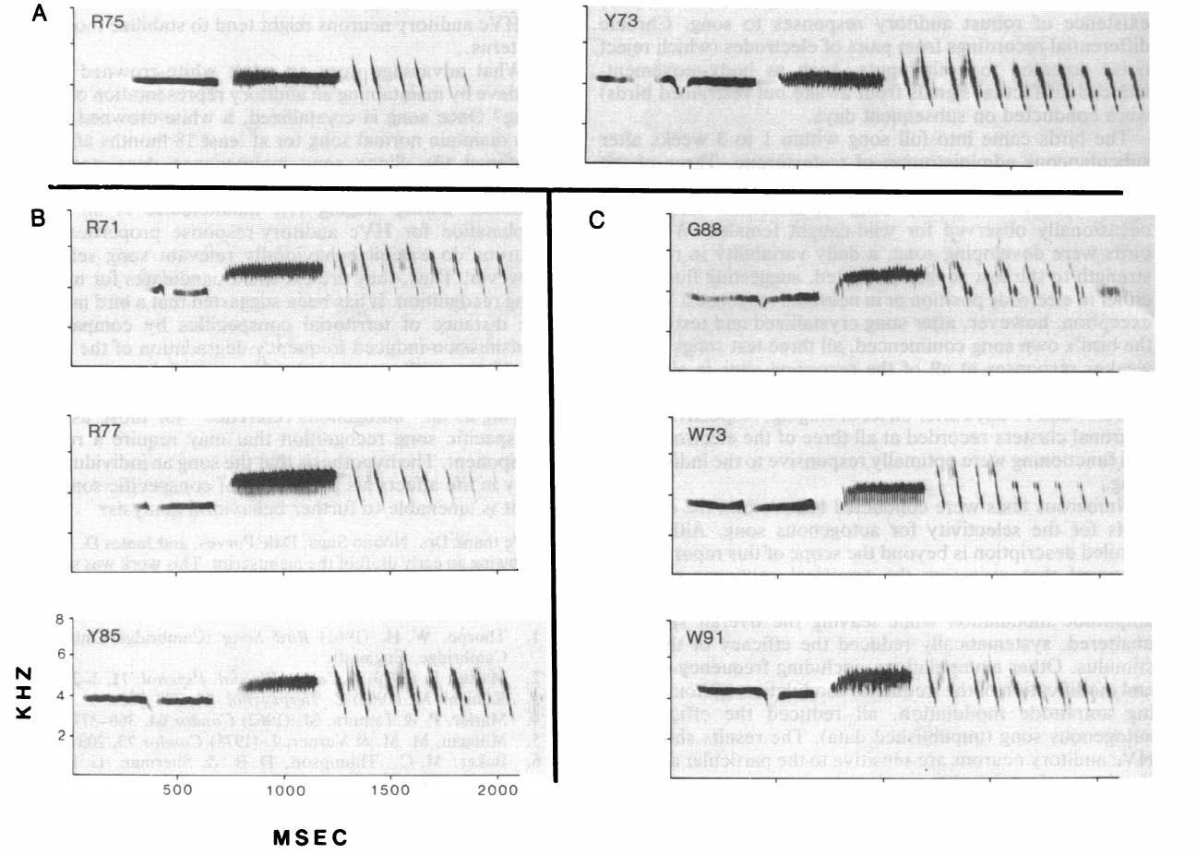
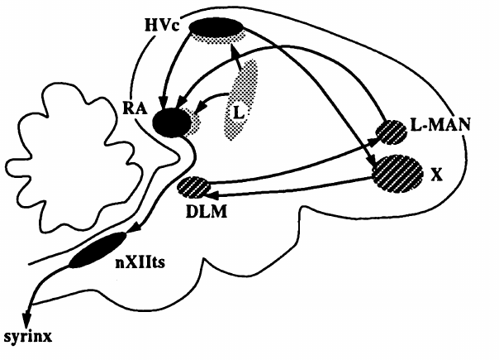
Own song can be distinguished from the tutor song
Autogenous song means the song produced by the individual itself. Margoliash and Konishi compared auditory responses in adult white-crowned sparrows to own song, other dialect songs, and a training model.
Their comparisons included laboratory-reared birds whose final songs differed from the model they had heard. A tutor recording and the bird's own vocal output were therefore separable acoustic stimuli.
This distinction is essential for interpreting a possible template. A neuron preferring own song is not automatically a neuron storing the tutor target, because the copied model and the resulting vocalization can share many features yet remain acoustically different.
The tutor is the acoustic source of the training model. Own song is the pupil’s resulting output; the distinction persists even when their shared features make them superficially similar.
Doupe & Konishi (1991), Fig. 1. Published anatomical locations and pathways.
Margoliash & Konishi (1985), Fig. 2. Own-song and same-dialect comparison spectrograms.
Margoliash & Konishi (1985)
24
Notes:
• **Autogenous song** means the song produced by the individual itself. Margoliash and Konishi compared auditory responses in adult white-crowned sparrows to own song, other dialect songs, and a training model.
• Their comparisons included laboratory-reared birds whose final songs differed from the model they had heard. A tutor recording and the bird's own vocal output were therefore separable acoustic stimuli.
• This distinction is essential for interpreting a possible template. A neuron preferring own song is not automatically a neuron storing the tutor target, because the copied model and the resulting vocalization can share many features yet remain acoustically different.
• The tutor is the acoustic source of the training model. Own song is the pupil’s resulting output; the distinction persists even when their shared features make them superficially similar.
References:
Margoliash D, Konishi M (1985). Auditory representation of autogenous song in the song system of white-crowned sparrows. Proceedings of the National Academy of Sciences USA 82(17): 5997–6000. https://doi.org/10.1073/pnas.82.17.5997
Doupe AJ, Konishi M (1991). Song-selective auditory circuits in the vocal control system of the zebra finch. Proceedings of the National Academy of Sciences USA 88(24): 11339–11343. https://doi.org/10.1073/pnas.88.24.11339
Figure: Margoliash & Konishi (1985), Fig. 2. Own-song and same-dialect comparison spectrograms.
Figure source: https://doi.org/10.1073/pnas.82.17.5997
Figure: Doupe & Konishi (1991), Fig. 1. Published anatomical locations and pathways.
Figure source: https://doi.org/10.1073/pnas.88.24.11339

Slide 25
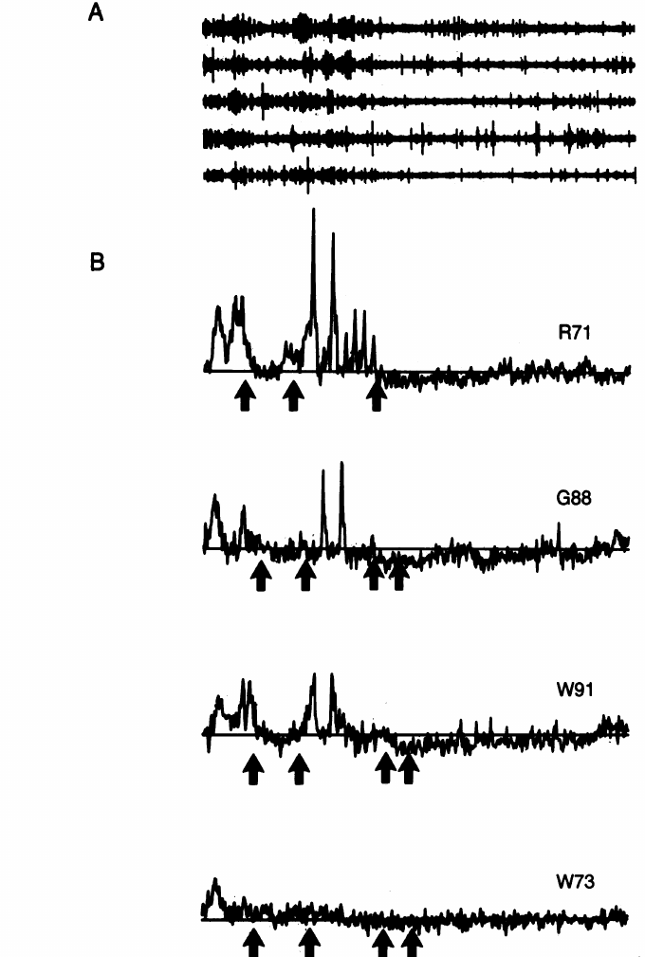
HVC responds strongly to playback of own song
HVC is a forebrain song nucleus involved in learned vocal control. In Margoliash and Konishi's adult sparrow recordings, playback of the bird's own song elicited strong responses from song-responsive neuronal clusters.
The study compared these responses with responses to other songs using the same recording site and controlled presentations. An amplitude-derived measure quantified the multiunit signal, which pools activity from several nearby neurons.
The larger own-song response establishes auditory selectivity in this preparation. It does not establish that the same clusters compute error during singing, because playback responsiveness and an active feedback comparison are different physiological measurements.
Own song and the alternative recordings were compared at the same neuronal cluster. This control avoids attributing a stimulus difference to measurements from unrelated recording sites.
Doupe & Konishi (1991), Fig. 1. Published anatomical locations and pathways.
Margoliash & Konishi (1985), Fig. 1. Multiunit responses to own and comparison songs.
Margoliash & Konishi (1985)
25
Notes:
• **HVC** is a forebrain song nucleus involved in learned vocal control. In Margoliash and Konishi's adult sparrow recordings, playback of the bird's own song elicited strong responses from song-responsive neuronal clusters.
• The study compared these responses with responses to other songs using the same recording site and controlled presentations. An amplitude-derived measure quantified the multiunit signal, which pools activity from several nearby neurons.
• The larger own-song response establishes auditory selectivity in this preparation. It does not establish that the same clusters compute error during singing, because playback responsiveness and an active feedback comparison are different physiological measurements.
• Own song and the alternative recordings were compared at the same neuronal cluster. This control avoids attributing a stimulus difference to measurements from unrelated recording sites.
References:
Margoliash D, Konishi M (1985). Auditory representation of autogenous song in the song system of white-crowned sparrows. Proceedings of the National Academy of Sciences USA 82(17): 5997–6000. https://doi.org/10.1073/pnas.82.17.5997
Doupe AJ, Konishi M (1991). Song-selective auditory circuits in the vocal control system of the zebra finch. Proceedings of the National Academy of Sciences USA 88(24): 11339–11343. https://doi.org/10.1073/pnas.88.24.11339
Figure: Margoliash & Konishi (1985), Fig. 1. Multiunit responses to own and comparison songs.
Figure source: https://doi.org/10.1073/pnas.82.17.5997
Figure: Doupe & Konishi (1991), Fig. 1. Published anatomical locations and pathways.
Figure source: https://doi.org/10.1073/pnas.88.24.11339

Slide 26
Same-dialect songs remain distinguishable in HVC
Songs from the same dialect share conspicuous structural features, making them a demanding comparison for own-song selectivity. Margoliash and Konishi tested own song against other songs from the Bodega Bay dialect.
The bird's own song generally elicited stronger multiunit responses even when the alternatives belonged to the same local acoustic tradition. Selectivity therefore extended beyond a simple distinction between two geographically different dialects.
The experiment supports sensitivity to individual song structure. It does not demonstrate behavioral recognition of the singer, because neuronal responses to recordings and the animal's discrimination or social response must be tested separately.
The alternatives shared the Bodega Bay dialect with the tested singers. Differences in response thus occurred despite common dialect structure, not only when the playback belonged to another population.
Doupe & Konishi (1991), Fig. 1. Published anatomical locations and pathways.
Margoliash & Konishi (1985), Fig. 2. Own-song and same-dialect comparison spectrograms.
Margoliash & Konishi (1985)
26
Notes:
• Songs from the same dialect share conspicuous structural features, making them a demanding comparison for own-song selectivity. Margoliash and Konishi tested own song against other songs from the Bodega Bay dialect.
• The bird's own song generally elicited stronger multiunit responses even when the alternatives belonged to the same local acoustic tradition. Selectivity therefore extended beyond a simple distinction between two geographically different dialects.
• The experiment supports sensitivity to individual song structure. It does not demonstrate behavioral recognition of the singer, because neuronal responses to recordings and the animal's discrimination or social response must be tested separately.
• The alternatives shared the Bodega Bay dialect with the tested singers. Differences in response thus occurred despite common dialect structure, not only when the playback belonged to another population.
References:
Margoliash D, Konishi M (1985). Auditory representation of autogenous song in the song system of white-crowned sparrows. Proceedings of the National Academy of Sciences USA 82(17): 5997–6000. https://doi.org/10.1073/pnas.82.17.5997
Doupe AJ, Konishi M (1991). Song-selective auditory circuits in the vocal control system of the zebra finch. Proceedings of the National Academy of Sciences USA 88(24): 11339–11343. https://doi.org/10.1073/pnas.88.24.11339
Figure: Margoliash & Konishi (1985), Fig. 2. Own-song and same-dialect comparison spectrograms.
Figure source: https://doi.org/10.1073/pnas.82.17.5997
Figure: Doupe & Konishi (1991), Fig. 1. Published anatomical locations and pathways.
Figure source: https://doi.org/10.1073/pnas.88.24.11339

Slide 27
Unusual learned sounds can acquire selective responses
Laboratory birds in Margoliash and Konishi's study produced unusual song components, including patterns absent from the natural songs used for comparison. Their neural responses still favored their own vocalizations.
These cases weaken an explanation based only on a fixed preference for the normal species song. HVC responses could be associated with an individual's acquired or self-produced acoustic pattern, including abnormal components.
Experience-dependent tuning is consistent with this result, but the adult comparison does not isolate tutor exposure from auditory feedback of the bird's own singing. Both histories can contribute to the correspondence between vocal output and neural selectivity.
The training paradigm included an unnatural upward-sweeping trill. Selective responses to abnormal own-song components weaken a purely fixed preference for the acoustic details normally heard in wild songs.
Doupe & Konishi (1991), Fig. 1. Published anatomical locations and pathways.
Margoliash & Konishi (1985), Fig. 2. Own-song and same-dialect comparison spectrograms.
Margoliash & Konishi (1985)
27
Notes:
• Laboratory birds in Margoliash and Konishi's study produced unusual song components, including patterns absent from the natural songs used for comparison. Their neural responses still favored their own vocalizations.
• These cases weaken an explanation based only on a fixed preference for the normal species song. HVC responses could be associated with an individual's acquired or self-produced acoustic pattern, including abnormal components.
• Experience-dependent tuning is consistent with this result, but the adult comparison does not isolate tutor exposure from auditory feedback of the bird's own singing. Both histories can contribute to the correspondence between vocal output and neural selectivity.
• The training paradigm included an unnatural upward-sweeping trill. Selective responses to abnormal own-song components weaken a purely fixed preference for the acoustic details normally heard in wild songs.
References:
Margoliash D, Konishi M (1985). Auditory representation of autogenous song in the song system of white-crowned sparrows. Proceedings of the National Academy of Sciences USA 82(17): 5997–6000. https://doi.org/10.1073/pnas.82.17.5997
Doupe AJ, Konishi M (1991). Song-selective auditory circuits in the vocal control system of the zebra finch. Proceedings of the National Academy of Sciences USA 88(24): 11339–11343. https://doi.org/10.1073/pnas.88.24.11339
Figure: Margoliash & Konishi (1985), Fig. 2. Own-song and same-dialect comparison spectrograms.
Figure source: https://doi.org/10.1073/pnas.82.17.5997
Figure: Doupe & Konishi (1991), Fig. 1. Published anatomical locations and pathways.
Figure source: https://doi.org/10.1073/pnas.88.24.11339

Slide 28
An auditory preference does not locate the tutor memory
A stronger response to own song supplies a possible representation of vocal output. It does not, by itself, identify the remembered target used to guide a pupil toward its tutor's song.
Margoliash and Konishi's comparisons separated own-song preference from general dialect responsiveness. Their adult recordings characterized stimulus selectivity rather than directly observing formation or retrieval of the early tutor memory.
A template hypothesis requires additional evidence linking a representation to learning. Correlation between a neuron's preferred stimulus and the mature song supports a candidate role, while a demonstrated teaching target would require measurements or interventions that connect it to acquisition and correction.
Doupe & Konishi (1991), Fig. 1. Published anatomical locations and pathways.
Margoliash & Konishi (1985), Fig. 1. Multiunit responses to own and comparison songs.
Margoliash & Konishi (1985)
28
Notes:
• A stronger response to own song supplies a possible representation of vocal output. It does not, by itself, identify the remembered target used to guide a pupil toward its tutor's song.
• Margoliash and Konishi's comparisons separated own-song preference from general dialect responsiveness. Their adult recordings characterized stimulus selectivity rather than directly observing formation or retrieval of the early tutor memory.
• A template hypothesis requires additional evidence linking a representation to learning. Correlation between a neuron's preferred stimulus and the mature song supports a candidate role, while a demonstrated teaching target would require measurements or interventions that connect it to acquisition and correction.
References:
Margoliash D, Konishi M (1985). Auditory representation of autogenous song in the song system of white-crowned sparrows. Proceedings of the National Academy of Sciences USA 82(17): 5997–6000. https://doi.org/10.1073/pnas.82.17.5997
Doupe AJ, Konishi M (1991). Song-selective auditory circuits in the vocal control system of the zebra finch. Proceedings of the National Academy of Sciences USA 88(24): 11339–11343. https://doi.org/10.1073/pnas.88.24.11339
Figure: Margoliash & Konishi (1985), Fig. 1. Multiunit responses to own and comparison songs.
Figure source: https://doi.org/10.1073/pnas.82.17.5997
Figure: Doupe & Konishi (1991), Fig. 1. Published anatomical locations and pathways.
Figure source: https://doi.org/10.1073/pnas.88.24.11339

Slide 29
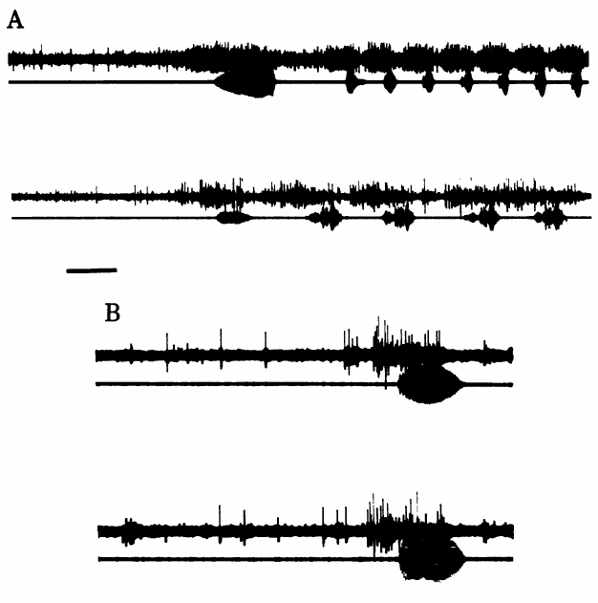
HVC activity is timed to the bird’s own singing
McCasland and Konishi implanted electrodes and recorded vocal output together with neural activity in freely moving birds. The experiment sampled canaries, white-crowned sparrows, and zebra finches.
Activity within HVC increased in temporal correspondence with song elements. Control recordings outside the nucleus lacked comparable song-locked changes, and postoperative songs were checked against recordings made before implantation.
These measurements connect HVC to the timing of vocal performance. Because extracellular multiunit recordings combine signals from nearby cells, they do not specify the role of every neuron or establish that each observed burst generates the corresponding sound element.
Songs recorded after electrode implantation were compared with preoperative songs. This check reduced an explanation in which the recording procedure itself created the abnormal vocal pattern under measurement.
Doupe & Konishi (1991), Fig. 1. Published anatomical locations and pathways.
McCasland & Konishi (1981), Fig. 1. HVC discharge during vocal production.
McCasland & Konishi (1981)
29
Notes:
• McCasland and Konishi implanted electrodes and recorded vocal output together with neural activity in freely moving birds. The experiment sampled canaries, white-crowned sparrows, and zebra finches.
• Activity within HVC increased in temporal correspondence with song elements. Control recordings outside the nucleus lacked comparable song-locked changes, and postoperative songs were checked against recordings made before implantation.
• These measurements connect HVC to the timing of vocal performance. Because extracellular multiunit recordings combine signals from nearby cells, they do not specify the role of every neuron or establish that each observed burst generates the corresponding sound element.
• Songs recorded after electrode implantation were compared with preoperative songs. This check reduced an explanation in which the recording procedure itself created the abnormal vocal pattern under measurement.
References:
McCasland JS, Konishi M (1981). Interaction between auditory and motor activities in an avian song control nucleus. Proceedings of the National Academy of Sciences USA 78(12): 7815–7819. https://doi.org/10.1073/pnas.78.12.7815
Doupe AJ, Konishi M (1991). Song-selective auditory circuits in the vocal control system of the zebra finch. Proceedings of the National Academy of Sciences USA 88(24): 11339–11343. https://doi.org/10.1073/pnas.88.24.11339
Figure: McCasland & Konishi (1981), Fig. 1. HVC discharge during vocal production.
Figure source: https://doi.org/10.1073/pnas.78.12.7815
Figure: Doupe & Konishi (1991), Fig. 1. Published anatomical locations and pathways.
Figure source: https://doi.org/10.1073/pnas.88.24.11339

Slide 30
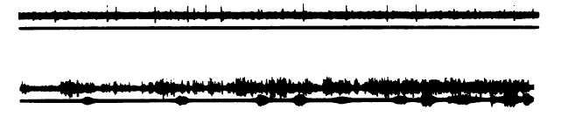
Song-related discharge persists without hearing
McCasland and Konishi compared song-associated HVC activity before and after deafening by removal of the cochlea, the inner-ear organ required for hearing. Song-related discharge remained in the deafened bird.
Persistence of that temporal pattern means the signal was not simply an auditory response driven by the sound of each produced syllable. A motor-associated component could occur when normal acoustic feedback was absent.
The result separates ongoing neural activity from immediate hearing. It does not imply that auditory feedback is unnecessary for normal development or long-term maintenance; the origin of a discharge and the plasticity of learned song are distinct questions.
McCasland & Konishi (1981), Fig. 2. Song-related discharge after deafening.
Doupe & Konishi (1991), Fig. 1. Published anatomical locations and pathways.
McCasland & Konishi (1981)
30
Notes:
• McCasland and Konishi compared song-associated HVC activity before and after deafening by removal of the cochlea, the inner-ear organ required for hearing. Song-related discharge remained in the deafened bird.
• Persistence of that temporal pattern means the signal was not simply an auditory response driven by the sound of each produced syllable. A motor-associated component could occur when normal acoustic feedback was absent.
• The result separates ongoing neural activity from immediate hearing. It does not imply that auditory feedback is unnecessary for normal development or long-term maintenance; the origin of a discharge and the plasticity of learned song are distinct questions.
References:
McCasland JS, Konishi M (1981). Interaction between auditory and motor activities in an avian song control nucleus. Proceedings of the National Academy of Sciences USA 78(12): 7815–7819. https://doi.org/10.1073/pnas.78.12.7815
Doupe AJ, Konishi M (1991). Song-selective auditory circuits in the vocal control system of the zebra finch. Proceedings of the National Academy of Sciences USA 88(24): 11339–11343. https://doi.org/10.1073/pnas.88.24.11339
Figure: McCasland & Konishi (1981), Fig. 2. Song-related discharge after deafening.
Figure source: https://doi.org/10.1073/pnas.78.12.7815
Figure: Doupe & Konishi (1991), Fig. 1. Published anatomical locations and pathways.
Figure source: https://doi.org/10.1073/pnas.88.24.11339

Slide 31
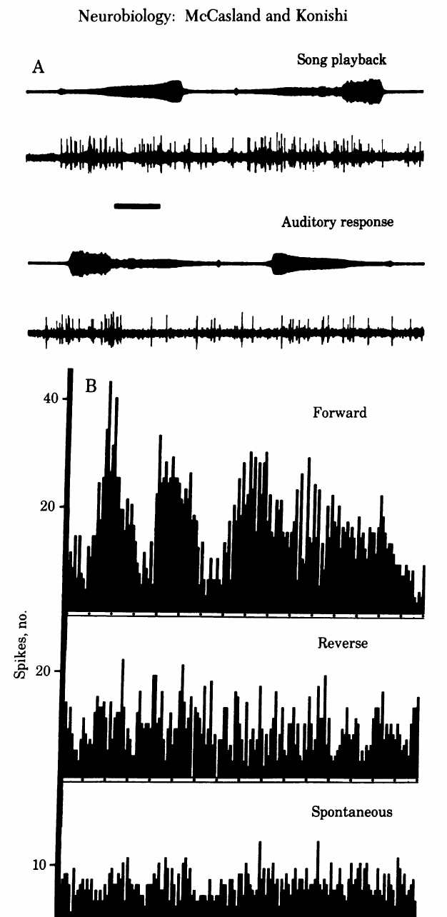
Reversed playback changes the auditory response
A recording can be played forward or reversed while neural activity is measured in a bird that is not singing. McCasland and Konishi found different HVC responses to these versions of song.
Reversal changes the temporal organization of the acoustic signal. The comparison tests whether responses depend on more than the presence of sound energy within a similar overall frequency range.
A forward preference supports temporal sensitivity in the auditory response. It does not isolate a single temporal feature, because reversing a waveform changes both the order of elements and their internal acoustic progression.
A forward and reverse comparison changes the arrangement of the same recorded material. The resulting response difference cannot be explained simply by replacing the stimulus with another singer’s song.
Doupe & Konishi (1991), Fig. 1. Published anatomical locations and pathways.
McCasland & Konishi (1981), Fig. 3. Forward and reverse playback responses.
McCasland & Konishi (1981)
31
Notes:
• A recording can be played forward or reversed while neural activity is measured in a bird that is not singing. McCasland and Konishi found different HVC responses to these versions of song.
• Reversal changes the temporal organization of the acoustic signal. The comparison tests whether responses depend on more than the presence of sound energy within a similar overall frequency range.
• A forward preference supports temporal sensitivity in the auditory response. It does not isolate a single temporal feature, because reversing a waveform changes both the order of elements and their internal acoustic progression.
• A forward and reverse comparison changes the arrangement of the same recorded material. The resulting response difference cannot be explained simply by replacing the stimulus with another singer’s song.
References:
McCasland JS, Konishi M (1981). Interaction between auditory and motor activities in an avian song control nucleus. Proceedings of the National Academy of Sciences USA 78(12): 7815–7819. https://doi.org/10.1073/pnas.78.12.7815
Doupe AJ, Konishi M (1991). Song-selective auditory circuits in the vocal control system of the zebra finch. Proceedings of the National Academy of Sciences USA 88(24): 11339–11343. https://doi.org/10.1073/pnas.88.24.11339
Figure: McCasland & Konishi (1981), Fig. 3. Forward and reverse playback responses.
Figure source: https://doi.org/10.1073/pnas.78.12.7815
Figure: Doupe & Konishi (1991), Fig. 1. Published anatomical locations and pathways.
Figure source: https://doi.org/10.1073/pnas.88.24.11339

Slide 32
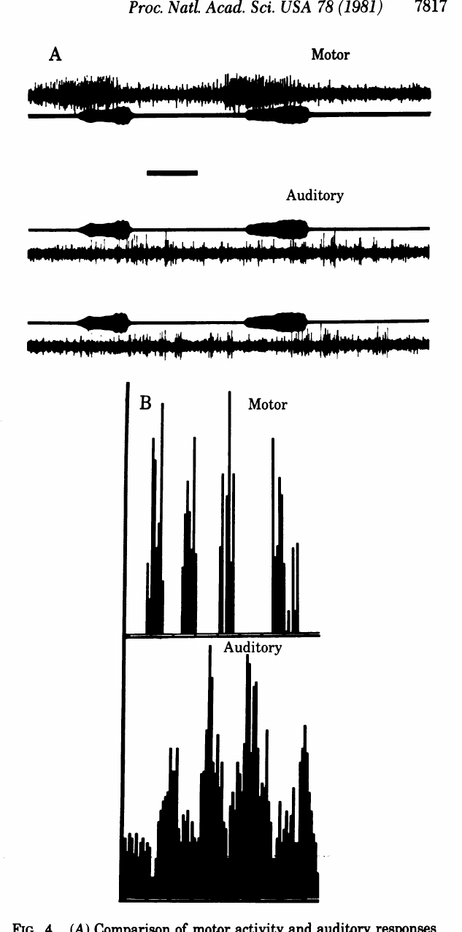
Playback and singing evoke distinguishable activity patterns
McCasland and Konishi compared activity recorded during singing with auditory responses to playback of the same song elements. The temporal discharge patterns were distinguishable rather than identical.
This comparison holds much of the acoustic content constant while changing whether the bird is producing the song. The recordings therefore implicate behavioral context and motor-associated activity in the measured response.
The result argues against treating every song-related HVC discharge as a passive response to hearing. It does not establish how an individual cell combines sensory and motor inputs, because the recordings characterize multiunit activity rather than a complete identified synaptic circuit.
The acoustic recording supplies a shared reference for aligning the two response patterns. Similar sound content therefore need not produce identical neural activity during listening and active production.
Doupe & Konishi (1991), Fig. 1. Published anatomical locations and pathways.
McCasland & Konishi (1981), Fig. 4. Motor and auditory discharge patterns.
McCasland & Konishi (1981)
32
Notes:
• McCasland and Konishi compared activity recorded during singing with auditory responses to playback of the same song elements. The temporal discharge patterns were distinguishable rather than identical.
• This comparison holds much of the acoustic content constant while changing whether the bird is producing the song. The recordings therefore implicate behavioral context and motor-associated activity in the measured response.
• The result argues against treating every song-related HVC discharge as a passive response to hearing. It does not establish how an individual cell combines sensory and motor inputs, because the recordings characterize multiunit activity rather than a complete identified synaptic circuit.
• The acoustic recording supplies a shared reference for aligning the two response patterns. Similar sound content therefore need not produce identical neural activity during listening and active production.
References:
McCasland JS, Konishi M (1981). Interaction between auditory and motor activities in an avian song control nucleus. Proceedings of the National Academy of Sciences USA 78(12): 7815–7819. https://doi.org/10.1073/pnas.78.12.7815
Doupe AJ, Konishi M (1991). Song-selective auditory circuits in the vocal control system of the zebra finch. Proceedings of the National Academy of Sciences USA 88(24): 11339–11343. https://doi.org/10.1073/pnas.88.24.11339
Figure: McCasland & Konishi (1981), Fig. 4. Motor and auditory discharge patterns.
Figure source: https://doi.org/10.1073/pnas.78.12.7815
Figure: Doupe & Konishi (1991), Fig. 1. Published anatomical locations and pathways.
Figure source: https://doi.org/10.1073/pnas.88.24.11339

Slide 33
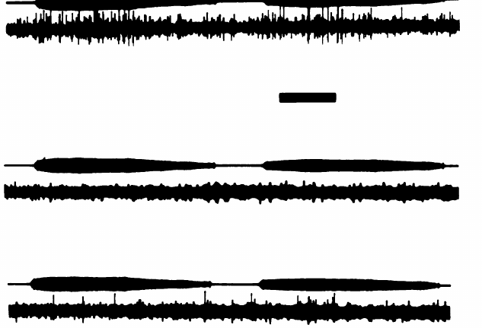
Auditory responsiveness is suppressed around singing
Playback during and after singing revealed a reduction in HVC auditory responses associated with vocal production. McCasland and Konishi described suppression that decayed over seconds after the song ended.
The same suppression was not explained by a simple continuous auditory response to every emitted sound. Vocal behavior changed the conditions under which a playback stimulus could evoke activity.
Gating is a change in access or responsiveness to sensory input associated with behavioral state. This observation complicates a passive feedback-comparator account; a circuit's response to playback in a silent bird cannot simply be assumed to describe its operation during singing.
Suppression persisted after the song terminated and then recovered. Its time course links auditory responsiveness to the preceding vocal behavior instead of merely the instantaneous presence of an acoustic stimulus.
Doupe & Konishi (1991), Fig. 1. Published anatomical locations and pathways.
McCasland & Konishi (1981), Fig. 5. Suppression of auditory responses around singing.
McCasland & Konishi (1981)
33
Notes:
• Playback during and after singing revealed a reduction in HVC auditory responses associated with vocal production. McCasland and Konishi described suppression that decayed over seconds after the song ended.
• The same suppression was not explained by a simple continuous auditory response to every emitted sound. Vocal behavior changed the conditions under which a playback stimulus could evoke activity.
• **Gating** is a change in access or responsiveness to sensory input associated with behavioral state. This observation complicates a passive feedback-comparator account; a circuit's response to playback in a silent bird cannot simply be assumed to describe its operation during singing.
• Suppression persisted after the song terminated and then recovered. Its time course links auditory responsiveness to the preceding vocal behavior instead of merely the instantaneous presence of an acoustic stimulus.
References:
McCasland JS, Konishi M (1981). Interaction between auditory and motor activities in an avian song control nucleus. Proceedings of the National Academy of Sciences USA 78(12): 7815–7819. https://doi.org/10.1073/pnas.78.12.7815
Doupe AJ, Konishi M (1991). Song-selective auditory circuits in the vocal control system of the zebra finch. Proceedings of the National Academy of Sciences USA 88(24): 11339–11343. https://doi.org/10.1073/pnas.88.24.11339
Figure: McCasland & Konishi (1981), Fig. 5. Suppression of auditory responses around singing.
Figure source: https://doi.org/10.1073/pnas.78.12.7815
Figure: Doupe & Konishi (1991), Fig. 1. Published anatomical locations and pathways.
Figure source: https://doi.org/10.1073/pnas.88.24.11339

Slide 34
Two song pathways converge on RA
Doupe and Konishi distinguished a direct HVC-to-RA route from an accessory route through Area X, DLM, and LMAN. Area X is a basal ganglia song nucleus; RA is a premotor nucleus; DLM lies in the thalamus; LMAN is the lateral magnocellular nucleus of the anterior neostriatum, using the paper’s historical terminology.
The paper's published anatomical diagram specifies these connections. Both pathways connect auditory-responsive portions of the song system to a nucleus involved in vocal output.
Convergence supplies a possible route for learning-related signals to influence performance. The diagram is anatomical context, not proof that each connection carries a tutor template or a measured error signal during song acquisition.
Doupe & Konishi (1991), Fig. 1. Published anatomical organization of song pathways.
Doupe & Konishi (1991)
34
Notes:
• Doupe and Konishi distinguished a direct HVC-to-RA route from an accessory route through Area X, DLM, and LMAN. **Area X** is a basal ganglia song nucleus; **RA** is a premotor nucleus; **DLM** lies in the thalamus; **LMAN** is the lateral magnocellular nucleus of the anterior neostriatum, using the paper’s historical terminology.
• The paper's published anatomical diagram specifies these connections. Both pathways connect auditory-responsive portions of the song system to a nucleus involved in vocal output.
• Convergence supplies a possible route for learning-related signals to influence performance. The diagram is anatomical context, not proof that each connection carries a tutor template or a measured error signal during song acquisition.
References:
Doupe AJ, Konishi M (1991). Song-selective auditory circuits in the vocal control system of the zebra finch. Proceedings of the National Academy of Sciences USA 88(24): 11339–11343. https://doi.org/10.1073/pnas.88.24.11339
Figure: Doupe & Konishi (1991), Fig. 1. Published anatomical organization of song pathways.
Figure source: https://doi.org/10.1073/pnas.88.24.11339

Slide 35
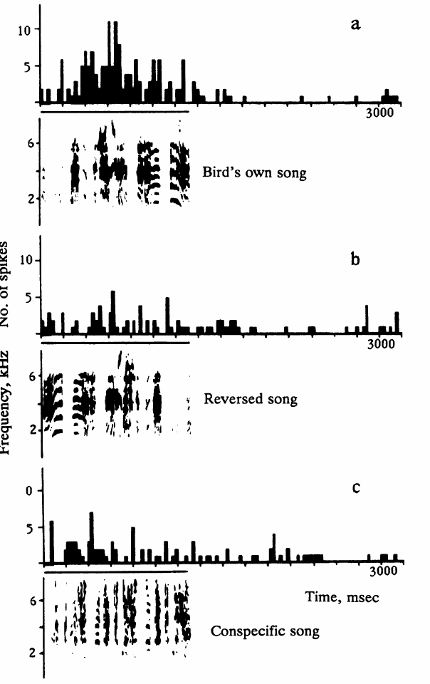
LMAN neurons prefer the individual’s own song
Doupe and Konishi recorded isolated auditory neurons in anesthetized adult male zebra finches. In LMAN, the bird's own song was more effective than songs produced by other zebra finches.
A peristimulus time histogram summarizes when spikes occur relative to repeated presentations of a stimulus. The histograms allow comparison of the temporal response to own song and alternative acoustic patterns.
Single-unit sampling narrows the measurement to an isolated neuronal signal, unlike a multiunit cluster. The own-song preference still does not establish that the neuron compares actual feedback with a tutor memory while the awake bird is singing.
Own song, reversed own song, and another finch’s song were tested against the same isolated response. This separates within-neuron acoustic preference from comparisons between different sampled neurons.
Doupe & Konishi (1991), Fig. 1. Published anatomical locations and pathways.
Doupe & Konishi (1991), Fig. 2. LMAN responses to own, reversed and conspecific song.
Doupe & Konishi (1991)
35
Notes:
• Doupe and Konishi recorded isolated auditory neurons in anesthetized adult male zebra finches. In LMAN, the bird's own song was more effective than songs produced by other zebra finches.
• A **peristimulus time histogram** summarizes when spikes occur relative to repeated presentations of a stimulus. The histograms allow comparison of the temporal response to own song and alternative acoustic patterns.
• Single-unit sampling narrows the measurement to an isolated neuronal signal, unlike a multiunit cluster. The own-song preference still does not establish that the neuron compares actual feedback with a tutor memory while the awake bird is singing.
• Own song, reversed own song, and another finch’s song were tested against the same isolated response. This separates within-neuron acoustic preference from comparisons between different sampled neurons.
References:
Doupe AJ, Konishi M (1991). Song-selective auditory circuits in the vocal control system of the zebra finch. Proceedings of the National Academy of Sciences USA 88(24): 11339–11343. https://doi.org/10.1073/pnas.88.24.11339
Figure: Doupe & Konishi (1991), Fig. 2. LMAN responses to own, reversed and conspecific song.
Figure source: https://doi.org/10.1073/pnas.88.24.11339
Figure: Doupe & Konishi (1991), Fig. 1. Published anatomical locations and pathways.
Figure source: https://doi.org/10.1073/pnas.88.24.11339

Slide 36
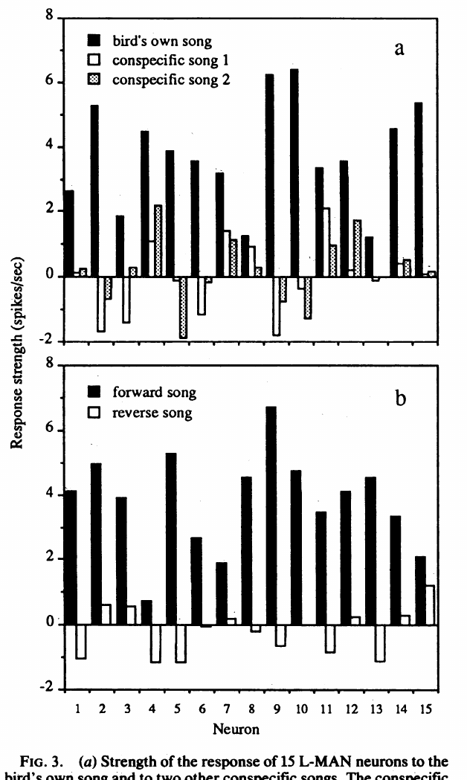
LMAN selectivity includes temporal song structure
Doupe and Konishi reversed the bird's own recorded song and compared its effect with forward playback. LMAN neurons responded much less effectively to the reversed version.
The manipulation retained overall spectral content while altering temporal structure. The response therefore depended on the acoustic signal's organization, rather than only on the presence of its constituent frequencies.
This control supports a complex auditory preference. It does not establish recognition of grammatical meaning, and it cannot separate sensitivity to syllable order from sensitivity to acoustic changes within reversed syllables; both are changed by whole-song reversal.
Whole-song reversal does not preserve the internal direction of acoustic sweeps. The control therefore tests temporal organization broadly rather than altering only the positions of intact syllables.
Doupe & Konishi (1991), Fig. 1. Published anatomical locations and pathways.
Doupe & Konishi (1991), Fig. 3. LMAN response strengths for song comparisons.
Doupe & Konishi (1991)
36
Notes:
• Doupe and Konishi reversed the bird's own recorded song and compared its effect with forward playback. LMAN neurons responded much less effectively to the reversed version.
• The manipulation retained overall spectral content while altering temporal structure. The response therefore depended on the acoustic signal's organization, rather than only on the presence of its constituent frequencies.
• This control supports a complex auditory preference. It does not establish recognition of grammatical meaning, and it cannot separate sensitivity to syllable order from sensitivity to acoustic changes within reversed syllables; both are changed by whole-song reversal.
• Whole-song reversal does not preserve the internal direction of acoustic sweeps. The control therefore tests temporal organization broadly rather than altering only the positions of intact syllables.
References:
Doupe AJ, Konishi M (1991). Song-selective auditory circuits in the vocal control system of the zebra finch. Proceedings of the National Academy of Sciences USA 88(24): 11339–11343. https://doi.org/10.1073/pnas.88.24.11339
Figure: Doupe & Konishi (1991), Fig. 3. LMAN response strengths for song comparisons.
Figure source: https://doi.org/10.1073/pnas.88.24.11339
Figure: Doupe & Konishi (1991), Fig. 1. Published anatomical locations and pathways.
Figure source: https://doi.org/10.1073/pnas.88.24.11339

Slide 37
Song responses extend through the accessory pathway
Doupe and Konishi also recorded auditory neurons in Area X and DLM, the nuclei upstream of LMAN in the accessory pathway. Own song was an effective stimulus in these areas as well.
Responses to simpler noise and tone stimuli differed among nuclei. LMAN was less readily excited by broadband noise and more strictly selective for forward song than the upstream populations sampled.
The comparison is consistent with different degrees of acoustic selectivity along the pathway. It does not prove that this adult circuit progressively constructs the juvenile tutor memory, because the recordings did not follow the development of individual pupils during learning.
Doupe & Konishi (1991), Fig. 1. Published anatomical organization of song pathways.
Doupe & Konishi (1991)
37
Notes:
• Doupe and Konishi also recorded auditory neurons in Area X and DLM, the nuclei upstream of LMAN in the accessory pathway. Own song was an effective stimulus in these areas as well.
• Responses to simpler noise and tone stimuli differed among nuclei. LMAN was less readily excited by broadband noise and more strictly selective for forward song than the upstream populations sampled.
• The comparison is consistent with different degrees of acoustic selectivity along the pathway. It does not prove that this adult circuit progressively constructs the juvenile tutor memory, because the recordings did not follow the development of individual pupils during learning.
References:
Doupe AJ, Konishi M (1991). Song-selective auditory circuits in the vocal control system of the zebra finch. Proceedings of the National Academy of Sciences USA 88(24): 11339–11343. https://doi.org/10.1073/pnas.88.24.11339
Figure: Doupe & Konishi (1991), Fig. 1. Published anatomical organization of song pathways.
Figure source: https://doi.org/10.1073/pnas.88.24.11339

Slide 38
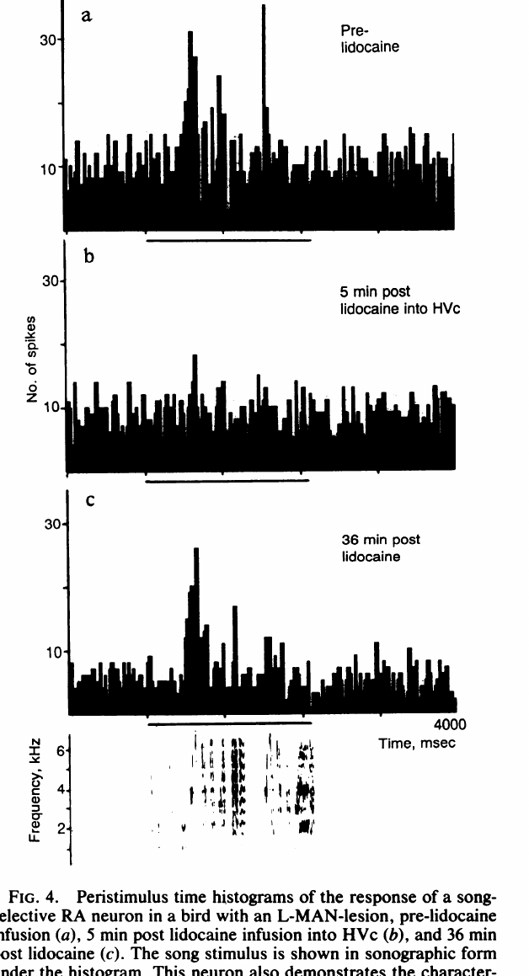
HVC silencing removes RA’s auditory song response
Doupe and Konishi recorded auditory responses in RA while altering its possible input sources. Song-selective RA responses remained after LMAN lesions or local anesthetic treatment of LMAN.
Injecting lidocaine into HVC reversibly abolished RA song responses. Lidocaine is the local anesthetic used in this experiment to silence the input region temporarily, separating its contribution from the activity recorded in RA.
The loss and recovery implicate HVC-dependent input in adult RA auditory responsiveness. They do not establish that LMAN has no learning function, because adult playback responses and juvenile learning can depend differently on the same pathway.
Persistence after LMAN disruption distinguishes that input from an indispensable adult auditory drive. The additional HVC treatment tests a dependency that the LMAN manipulation alone could not establish.
Doupe & Konishi (1991), Fig. 1. Published anatomical locations and pathways.
Doupe & Konishi (1991), Fig. 4. RA responses before, during and after HVC inactivation.
Doupe & Konishi (1991)
38
Notes:
• Doupe and Konishi recorded auditory responses in RA while altering its possible input sources. Song-selective RA responses remained after LMAN lesions or local anesthetic treatment of LMAN.
• Injecting lidocaine into HVC reversibly abolished RA song responses. **Lidocaine** is the local anesthetic used in this experiment to silence the input region temporarily, separating its contribution from the activity recorded in RA.
• The loss and recovery implicate HVC-dependent input in adult RA auditory responsiveness. They do not establish that LMAN has no learning function, because adult playback responses and juvenile learning can depend differently on the same pathway.
• Persistence after LMAN disruption distinguishes that input from an indispensable adult auditory drive. The additional HVC treatment tests a dependency that the LMAN manipulation alone could not establish.
References:
Doupe AJ, Konishi M (1991). Song-selective auditory circuits in the vocal control system of the zebra finch. Proceedings of the National Academy of Sciences USA 88(24): 11339–11343. https://doi.org/10.1073/pnas.88.24.11339
Figure: Doupe & Konishi (1991), Fig. 4. RA responses before, during and after HVC inactivation.
Figure source: https://doi.org/10.1073/pnas.88.24.11339
Figure: Doupe & Konishi (1991), Fig. 1. Published anatomical locations and pathways.
Figure source: https://doi.org/10.1073/pnas.88.24.11339

Slide 39
Reversible disruption separates input from lasting damage
In the RA recording example, Doupe and Konishi compared responses before HVC lidocaine, five minutes after treatment, and after recovery. The same cell's response changed while the song stimulus remained available.
A reversible effect is different from destruction of RA itself. Recovery supports a temporary interruption of input rather than an explanation requiring permanent loss of the recorded neuron.
The experiment establishes a dependency under the adult anesthetized preparation. It does not specify which HVC cell class supplied the input or reveal a complete feedback mechanism, because regional inactivation affects multiple neurons and local connections together.
The before-and-after sequence retains the song stimulus while changing the input region’s activity. Recovery adds evidence unavailable from a comparison involving only permanent destructive lesions.
Doupe & Konishi (1991), Fig. 1. Published anatomical locations and pathways.
Doupe & Konishi (1991), Fig. 4. RA responses before, during and after HVC inactivation.
Doupe & Konishi (1991)
39
Notes:
• In the RA recording example, Doupe and Konishi compared responses before HVC lidocaine, five minutes after treatment, and after recovery. The same cell's response changed while the song stimulus remained available.
• A reversible effect is different from destruction of RA itself. Recovery supports a temporary interruption of input rather than an explanation requiring permanent loss of the recorded neuron.
• The experiment establishes a dependency under the adult anesthetized preparation. It does not specify which HVC cell class supplied the input or reveal a complete feedback mechanism, because regional inactivation affects multiple neurons and local connections together.
• The before-and-after sequence retains the song stimulus while changing the input region’s activity. Recovery adds evidence unavailable from a comparison involving only permanent destructive lesions.
References:
Doupe AJ, Konishi M (1991). Song-selective auditory circuits in the vocal control system of the zebra finch. Proceedings of the National Academy of Sciences USA 88(24): 11339–11343. https://doi.org/10.1073/pnas.88.24.11339
Figure: Doupe & Konishi (1991), Fig. 4. RA responses before, during and after HVC inactivation.
Figure source: https://doi.org/10.1073/pnas.88.24.11339
Figure: Doupe & Konishi (1991), Fig. 1. Published anatomical locations and pathways.
Figure source: https://doi.org/10.1073/pnas.88.24.11339

Slide 40
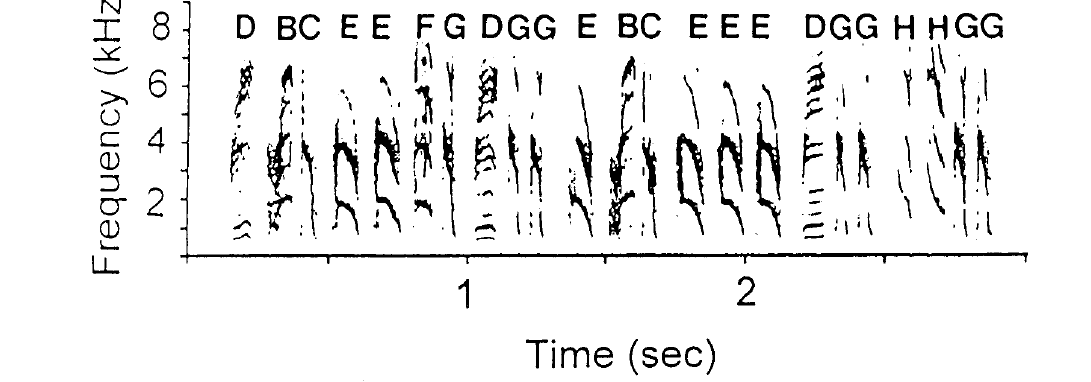
Adult Bengalese song retains variable note sequences
Bengalese finches, Lonchura striata var. domestica, produce learned songs with recurring motifs but variable note sequences. Okanoya and Yamaguchi distinguished individual notes from motifs, which are recurring groups of notes.
A spectrogram records frequency over time and permits corresponding note types to be followed across renditions. Adult variability in sequence can coexist with recognizable note identities.
A stable inventory is therefore different from an invariant sequence. This distinction matters when testing auditory feedback: a bird can preserve many acoustic units while changing the order or frequency with which it assembles them into song.
Notes were identified from acoustic form before their transition patterns were analyzed. The distinction between note identity and arrangement allows separate descriptions of the same adult vocal performance.
Okanoya & Yamaguchi (1997), Fig. 1. Adult Bengalese finch notes and motifs.
Okanoya & Yamaguchi (1997)
40
Notes:
• **Bengalese finches**, _Lonchura striata_ var. _domestica_, produce learned songs with recurring motifs but variable note sequences. Okanoya and Yamaguchi distinguished individual notes from motifs, which are recurring groups of notes.
• A **spectrogram** records frequency over time and permits corresponding note types to be followed across renditions. Adult variability in sequence can coexist with recognizable note identities.
• A stable inventory is therefore different from an invariant sequence. This distinction matters when testing auditory feedback: a bird can preserve many acoustic units while changing the order or frequency with which it assembles them into song.
• Notes were identified from acoustic form before their transition patterns were analyzed. The distinction between note identity and arrangement allows separate descriptions of the same adult vocal performance.
References:
Okanoya K, Yamaguchi A (1997). Adult Bengalese finches (Lonchura striata var. domestica) require real-time auditory feedback to produce normal song syntax. Journal of Neurobiology 33(4): 343–356. https://doi.org/10.1002/(SICI)1097-4695(199710)33:4<343::AID-NEU1>3.0.CO;2-A
Figure: Okanoya & Yamaguchi (1997), Fig. 1. Adult Bengalese finch notes and motifs.
Figure source: https://doi.org/10.1002/(SICI)1097-4695(199710)33:4<343::AID-NEU1>3.0.CO;2-A

Slide 41
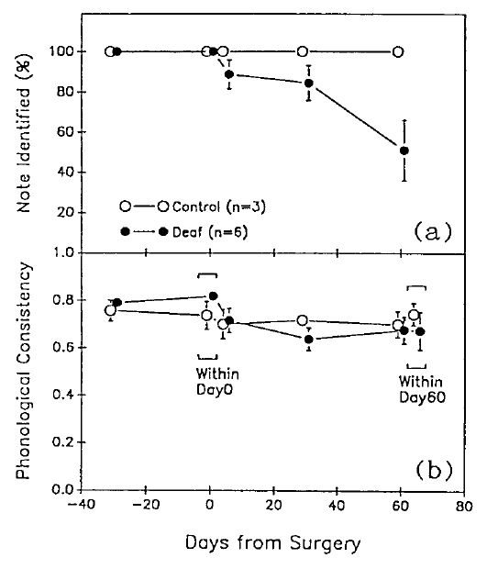
Adult deafening tests maintenance after learning
Okanoya and Yamaguchi removed auditory feedback after Bengalese finches had developed adult song. They compared subsequent recordings with each bird's preoperative song and with hearing controls.
Changes could arise within five days, even though the birds were not acquiring an entirely new juvenile repertoire. The experiment therefore tested maintenance and organization of a learned performance.
A closed-ended learner normally acquires its repertoire during a limited developmental interval. That label does not imply that adult production is independent of hearing: restricting acquisition of new material and maintaining existing material are separate functional properties.
Adult recordings established the preoperative song pattern. Subsequent changes therefore occurred after an existing repertoire had been acquired, rather than merely reflecting failure to hear a juvenile tutor.
Okanoya & Yamaguchi (1997), Fig. 3. Note types and similarity after surgery.
Okanoya & Yamaguchi (1997)
41
Notes:
• Okanoya and Yamaguchi removed auditory feedback after Bengalese finches had developed adult song. They compared subsequent recordings with each bird's preoperative song and with hearing controls.
• Changes could arise within five days, even though the birds were not acquiring an entirely new juvenile repertoire. The experiment therefore tested maintenance and organization of a learned performance.
• A **closed-ended learner** normally acquires its repertoire during a limited developmental interval. That label does not imply that adult production is independent of hearing: restricting acquisition of new material and maintaining existing material are separate functional properties.
• Adult recordings established the preoperative song pattern. Subsequent changes therefore occurred after an existing repertoire had been acquired, rather than merely reflecting failure to hear a juvenile tutor.
References:
Okanoya K, Yamaguchi A (1997). Adult Bengalese finches (Lonchura striata var. domestica) require real-time auditory feedback to produce normal song syntax. Journal of Neurobiology 33(4): 343–356. https://doi.org/10.1002/(SICI)1097-4695(199710)33:4<343::AID-NEU1>3.0.CO;2-A
Figure: Okanoya & Yamaguchi (1997), Fig. 3. Note types and similarity after surgery.
Figure source: https://doi.org/10.1002/(SICI)1097-4695(199710)33:4<343::AID-NEU1>3.0.CO;2-A

Slide 42
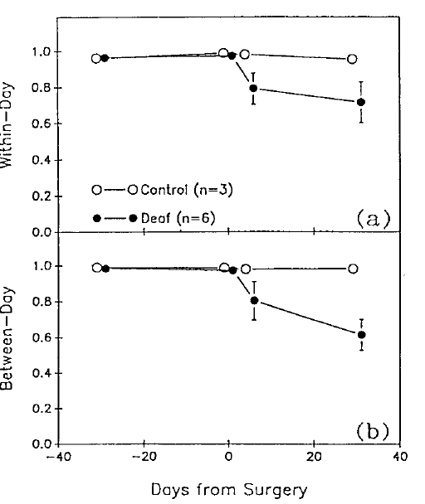
Sequence organization deteriorates after feedback loss
Okanoya and Yamaguchi followed transitions between recognizable song notes before and after deafening. They assessed whether a note was followed by the same alternatives with similar consistency across recordings.
Sequence organization became abnormal in deafened birds, while hearing controls retained more stable patterns. Song syntax here means the ordering of vocal units, rather than the semantic grammar of human language.
The comparison establishes a role for auditory feedback in maintaining adult sequence organization. It does not identify a particular comparator neuron or prove that every transition requires an instantaneous conscious response to hearing the preceding note.
The preoperative pattern supplies a personal reference for sequence change. The relevant comparison is not whether every rendition was identical, but whether its existing organization remained stable over time.
Okanoya & Yamaguchi (1997), Fig. 4. Sequence variation and consistency after surgery.
Okanoya & Yamaguchi (1997)
42
Notes:
• Okanoya and Yamaguchi followed transitions between recognizable song notes before and after deafening. They assessed whether a note was followed by the same alternatives with similar consistency across recordings.
• Sequence organization became abnormal in deafened birds, while hearing controls retained more stable patterns. **Song syntax** here means the ordering of vocal units, rather than the semantic grammar of human language.
• The comparison establishes a role for auditory feedback in maintaining adult sequence organization. It does not identify a particular comparator neuron or prove that every transition requires an instantaneous conscious response to hearing the preceding note.
• The preoperative pattern supplies a personal reference for sequence change. The relevant comparison is not whether every rendition was identical, but whether its existing organization remained stable over time.
References:
Okanoya K, Yamaguchi A (1997). Adult Bengalese finches (Lonchura striata var. domestica) require real-time auditory feedback to produce normal song syntax. Journal of Neurobiology 33(4): 343–356. https://doi.org/10.1002/(SICI)1097-4695(199710)33:4<343::AID-NEU1>3.0.CO;2-A
Figure: Okanoya & Yamaguchi (1997), Fig. 4. Sequence variation and consistency after surgery.
Figure source: https://doi.org/10.1002/(SICI)1097-4695(199710)33:4<343::AID-NEU1>3.0.CO;2-A

Slide 43
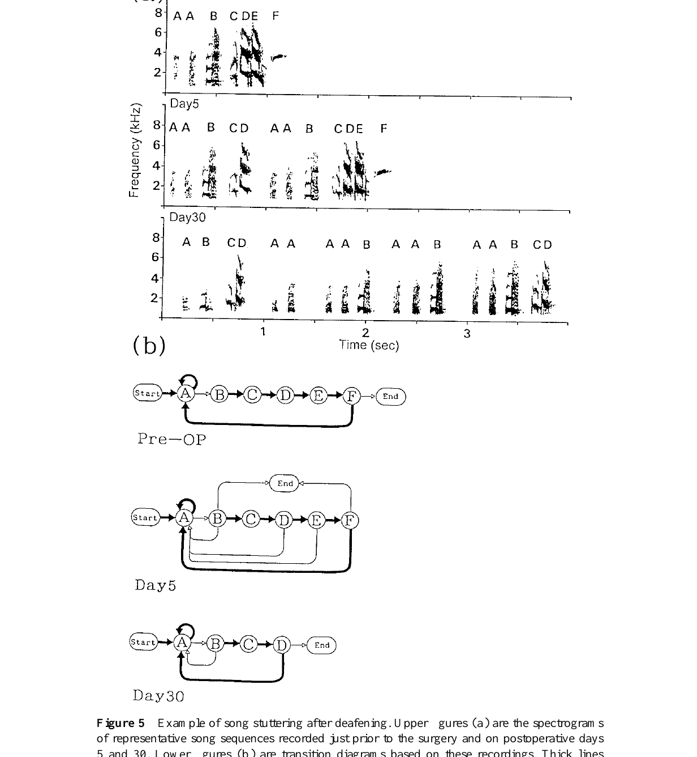
Stuttering can preserve notes while changing repetition
Some deafened Bengalese finches repeated particular notes excessively. Okanoya and Yamaguchi illustrated this stuttering with spectrograms and the corresponding changes in note-transition patterns.
The acoustic identity of a repeated note could remain recognizable even when its repetition became abnormal. Loss of hearing therefore affected the organization of an existing unit, rather than necessarily replacing every sound with a novel one.
This case separates the integrity of individual notes from control of their sequencing. It also prevents treating all post-deafening changes as one uniform loss of acoustic quality; different aspects of song can deteriorate in different ways.
The repeated note occupies a changed sequence context. Recognizing its acoustic identity makes the excess repetition measurable even when the bird retains the capacity to produce that sound.
Okanoya & Yamaguchi (1997), Fig. 5. Post-deafening stuttering.
Okanoya & Yamaguchi (1997)
43
Notes:
• Some deafened Bengalese finches repeated particular notes excessively. Okanoya and Yamaguchi illustrated this **stuttering** with spectrograms and the corresponding changes in note-transition patterns.
• The acoustic identity of a repeated note could remain recognizable even when its repetition became abnormal. Loss of hearing therefore affected the organization of an existing unit, rather than necessarily replacing every sound with a novel one.
• This case separates the integrity of individual notes from control of their sequencing. It also prevents treating all post-deafening changes as one uniform loss of acoustic quality; different aspects of song can deteriorate in different ways.
• The repeated note occupies a changed sequence context. Recognizing its acoustic identity makes the excess repetition measurable even when the bird retains the capacity to produce that sound.
References:
Okanoya K, Yamaguchi A (1997). Adult Bengalese finches (Lonchura striata var. domestica) require real-time auditory feedback to produce normal song syntax. Journal of Neurobiology 33(4): 343–356. https://doi.org/10.1002/(SICI)1097-4695(199710)33:4<343::AID-NEU1>3.0.CO;2-A
Figure: Okanoya & Yamaguchi (1997), Fig. 5. Post-deafening stuttering.
Figure source: https://doi.org/10.1002/(SICI)1097-4695(199710)33:4<343::AID-NEU1>3.0.CO;2-A

Slide 44
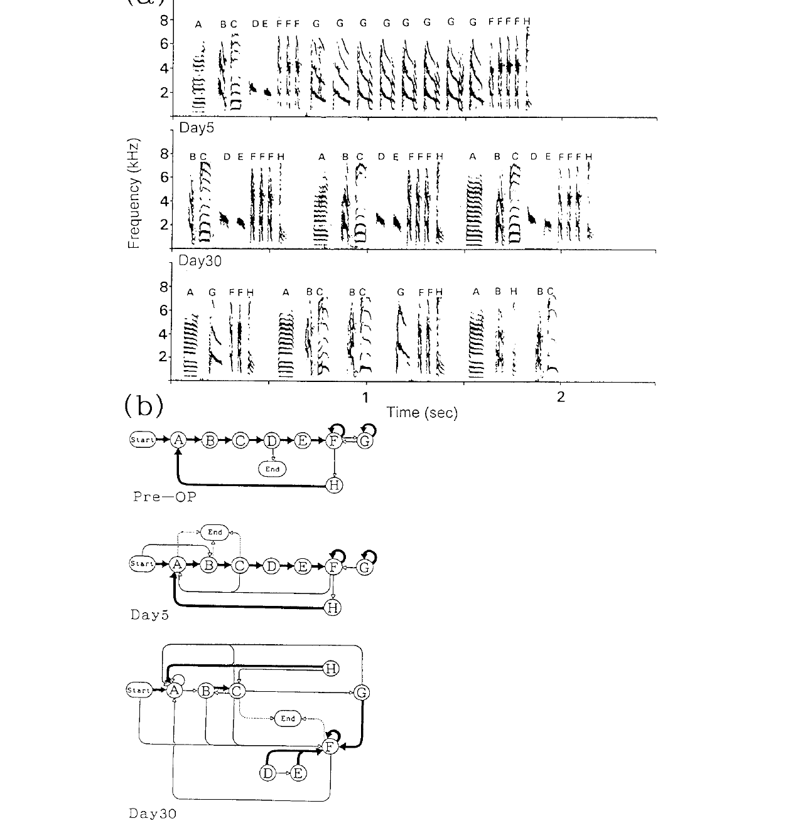
Scrambling changes relations among retained song units
Other deafened Bengalese finches developed scrambled song, with altered transitions among recognizable notes. Okanoya and Yamaguchi tracked these changes relative to the same individual's preoperative sequence.
The resulting organization differed from simple repetition of one note. Some expected units could be omitted, while new relationships among surviving units appeared as the song deteriorated.
These longitudinal examples support individual variation in the consequences of feedback loss. A group tendency does not require identical deterioration in every bird, and a single characteristic example cannot establish that all species or all adults respond to deafening in the same way.
The study’s spectrograms retain the original note labels across recordings. Those labels allow omissions and altered transitions to be distinguished from wholesale replacement of the acoustic repertoire.
Okanoya & Yamaguchi (1997), Fig. 6. Post-deafening scrambling.
Okanoya & Yamaguchi (1997)
44
Notes:
• Other deafened Bengalese finches developed **scrambled** song, with altered transitions among recognizable notes. Okanoya and Yamaguchi tracked these changes relative to the same individual's preoperative sequence.
• The resulting organization differed from simple repetition of one note. Some expected units could be omitted, while new relationships among surviving units appeared as the song deteriorated.
• These longitudinal examples support individual variation in the consequences of feedback loss. A group tendency does not require identical deterioration in every bird, and a single characteristic example cannot establish that all species or all adults respond to deafening in the same way.
• The study’s spectrograms retain the original note labels across recordings. Those labels allow omissions and altered transitions to be distinguished from wholesale replacement of the acoustic repertoire.
References:
Okanoya K, Yamaguchi A (1997). Adult Bengalese finches (Lonchura striata var. domestica) require real-time auditory feedback to produce normal song syntax. Journal of Neurobiology 33(4): 343–356. https://doi.org/10.1002/(SICI)1097-4695(199710)33:4<343::AID-NEU1>3.0.CO;2-A
Figure: Okanoya & Yamaguchi (1997), Fig. 6. Post-deafening scrambling.
Figure source: https://doi.org/10.1002/(SICI)1097-4695(199710)33:4<343::AID-NEU1>3.0.CO;2-A

Slide 45
A learned repertoire can remain dependent on hearing
The Bengalese finch experiments separate acquisition of song from maintenance of adult performance. Removing auditory feedback after learning disrupted sequence organization despite the persistence of recognizable vocal material.
Marler's early tutoring and memory experiments establish retained acoustic information; the adult deafening experiment establishes that stabilized production can still require sensory support. These are complementary requirements rather than interchangeable measurements.
The template model remains a functional account of stored targets and feedback-guided adjustment. The supplied studies establish several necessary relationships, while leaving the precise storage site and the mechanism converting mismatch into corrective neural change unresolved.
A sensory requirement for maintenance can persist beyond the interval for acquiring new song models. Stable adult performance therefore does not prove that the underlying motor control has become impervious to experience.
Okanoya & Yamaguchi (1997), Fig. 4. Sequence variation and consistency after surgery.
Okanoya & Yamaguchi (1997); Brainard & Doupe (2000)
45
Notes:
• The Bengalese finch experiments separate acquisition of song from maintenance of adult performance. Removing auditory feedback after learning disrupted sequence organization despite the persistence of recognizable vocal material.
• Marler's early tutoring and memory experiments establish retained acoustic information; the adult deafening experiment establishes that stabilized production can still require sensory support. These are complementary requirements rather than interchangeable measurements.
• The template model remains a functional account of stored targets and feedback-guided adjustment. The supplied studies establish several necessary relationships, while leaving the precise storage site and the mechanism converting mismatch into corrective neural change unresolved.
• A sensory requirement for maintenance can persist beyond the interval for acquiring new song models. Stable adult performance therefore does not prove that the underlying motor control has become impervious to experience.
References:
Okanoya K, Yamaguchi A (1997). Adult Bengalese finches (Lonchura striata var. domestica) require real-time auditory feedback to produce normal song syntax. Journal of Neurobiology 33(4): 343–356. https://doi.org/10.1002/(SICI)1097-4695(199710)33:4<343::AID-NEU1>3.0.CO;2-A
Brainard MS, Doupe AJ (2000). Auditory feedback in learning and maintenance of vocal behaviour. Nature Reviews Neuroscience 1: 31–40. https://doi.org/10.1038/35036205
Figure: Okanoya & Yamaguchi (1997), Fig. 4. Sequence variation and consistency after surgery.
Figure source: https://doi.org/10.1002/(SICI)1097-4695(199710)33:4<343::AID-NEU1>3.0.CO;2-A

Slide 46
Key takeaways
Sensitive periods depend on the outcome measured. Early playback supports detailed copying; later exposure can influence broad organization without reproducing tutor syllables.
Predispositions constrain learning. White-crowned sparrows learn conspecific models selectively under the tested playback conditions; experience supplies detailed dialect structure.
A retained target can precede mature singing. Swamp sparrows reproduce syllables heard months earlier, and adult repertoires omit material expressed during plastic song.
Own-song selectivity is not proof of tutor-memory storage. Konishi coauthored recordings establish auditory preferences and motor associations, while leaving the template’s exact neural substrate unresolved.
Behavioral state changes auditory responses. HVC playback responses differ from singing-related discharge and can be suppressed around vocal production.
Adult song stability can depend on feedback. Bengalese finch deafening disrupts sequence organization after acquisition; restricting repertoire learning does not imply independence from hearing.
Marler (1970); Marler & Peters (1981); Konishi coauthored studies; Okanoya & Yamaguchi (1997)
46
Notes:
Marler P (1970). A comparative approach to vocal learning: Song development in white-crowned sparrows. Journal of Comparative and Physiological Psychology 71(2, Pt. 2): 1–25. https://doi.org/10.1037/h0029144
Marler P, Peters S (1981). Sparrows learn adult song and more from memory. Science 213(4509): 780–782. https://doi.org/10.1126/science.213.4509.780
Margoliash D, Konishi M (1985). Auditory representation of autogenous song in the song system of white-crowned sparrows. Proceedings of the National Academy of Sciences USA 82(17): 5997–6000. https://doi.org/10.1073/pnas.82.17.5997
McCasland JS, Konishi M (1981). Interaction between auditory and motor activities in an avian song control nucleus. Proceedings of the National Academy of Sciences USA 78(12): 7815–7819. https://doi.org/10.1073/pnas.78.12.7815
Doupe AJ, Konishi M (1991). Song-selective auditory circuits in the vocal control system of the zebra finch. Proceedings of the National Academy of Sciences USA 88(24): 11339–11343. https://doi.org/10.1073/pnas.88.24.11339
Okanoya K, Yamaguchi A (1997). Adult Bengalese finches (Lonchura striata var. domestica) require real-time auditory feedback to produce normal song syntax. Journal of Neurobiology 33(4): 343–356. https://doi.org/10.1002/(SICI)1097-4695(199710)33:4<343::AID-NEU1>3.0.CO;2-A
Brainard MS, Doupe AJ (2000). Auditory feedback in learning and maintenance of vocal behaviour. Nature Reviews Neuroscience 1: 31–40. https://doi.org/10.1038/35036205

