Slide 1
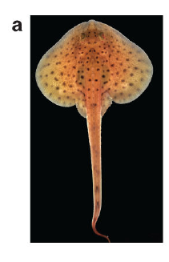
NEUR 411 · NEUROETHOLOGY · FALL 2026
Lecture 20
Electroreception I: passive sensing in sharks and rays (ampullae of Lorenzini)
Monday, October 12, 2026
Jordan Lopez, Ph.D.
Professor of Neurobiology & Biomedical Engineering
Bellono et al. (2017), Fig. 1(a). Little skate (Leucoraja erinacea).
Notes:
Electroreception I: passive sensing in sharks and rays (ampullae of Lorenzini)
Lecture 20. NEUR 411 · NEUROETHOLOGY · FALL 2026. Monday, October 12, 2026.
Figure: Bellono et al. (2017), Fig. 1(a). Little skate (Leucoraja erinacea).
Figure source: https://doi.org/10.1038/nature21401
• The little skate is one of the experimental animals studied here; the title image is an unmodified published photograph.
References:
Bellono NW, Leitch DB, Julius D (2017). Molecular basis of ancestral vertebrate electroreception. Nature 543(7645):391-396. https://doi.org/10.1038/nature21401

Slide 2
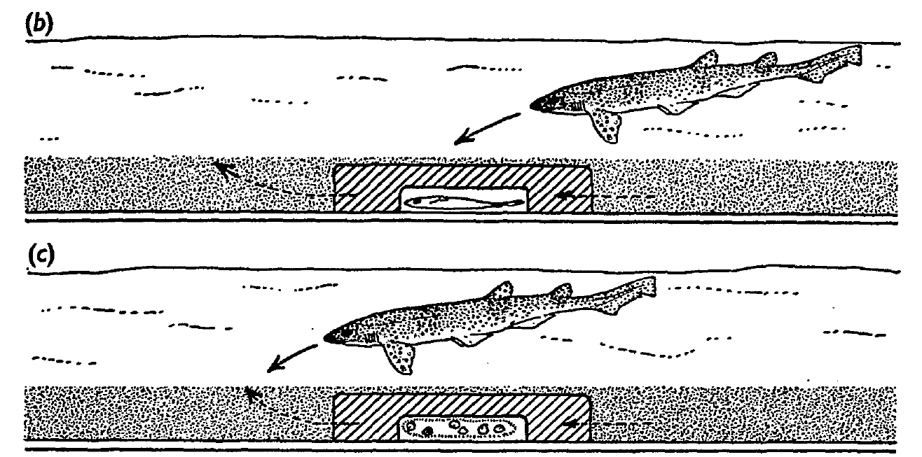
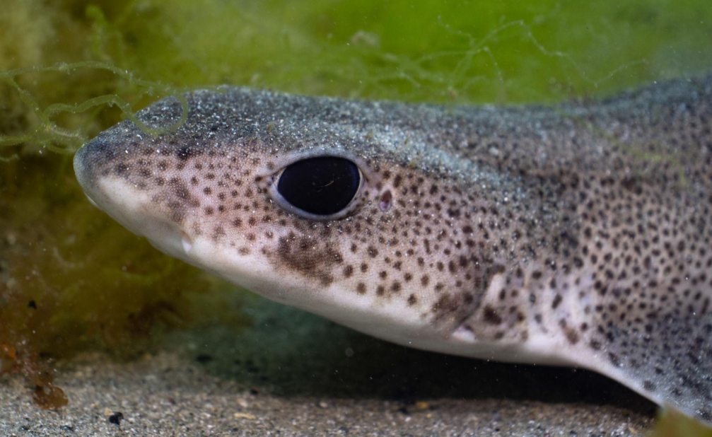
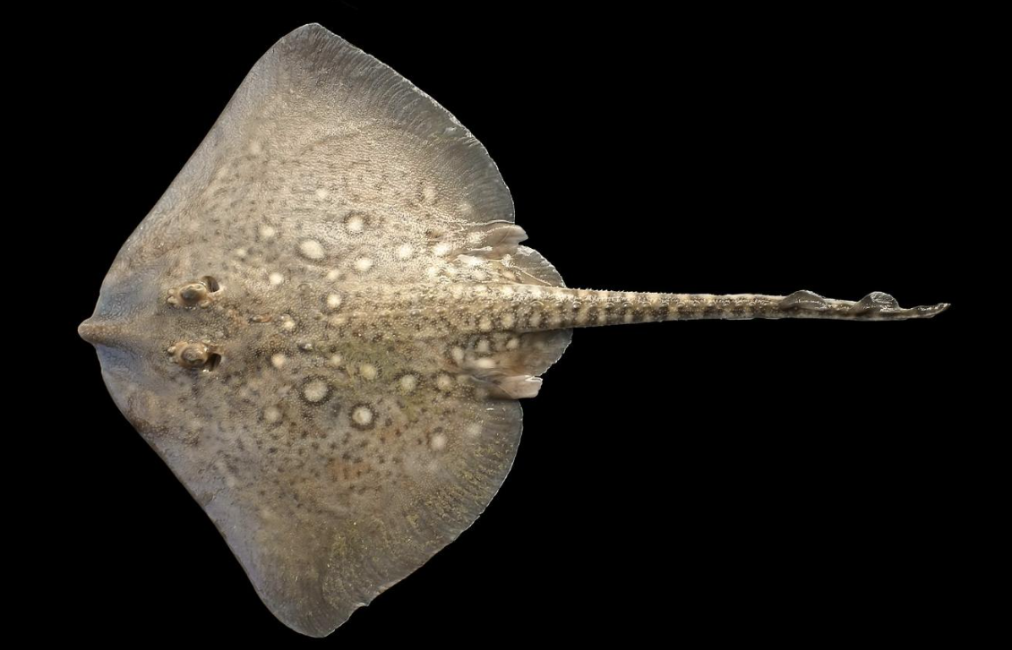
Hidden prey are located through their electric fields
Passive electroreception is detection of electric fields produced outside the sensing animal, without probing the environment with its own discharge. Kalmijn tested feeding in small-spotted catsharks, Scyliorhinus canicula, and thornback rays, Raja clavata, using living plaice concealed beneath sand.
Catsharks made directed feeding turns when they passed within approximately 15 cm of buried prey. Because sand could still transmit odor and water movements, concealment alone did not isolate the sensory cue. Kalmijn therefore enclosed the plaice in electrically conductive agar and manipulated the information escaping from it.
Kalmijn (1971), Fig. 2(b–c). Agar screening separates living prey from odor controls.
Predators continued attacking the concealed living fish through agar, whereas pieces of whiting redirected searching toward the chamber’s water outlet. Electrical localization and odor-induced feeding motivation were experimentally separable. Odor therefore acted on feeding motivation and the search for its source, whereas the electric field guided the final attack on the hidden fish.
Left: Small Spotted Catshark (Scyliorhinus canicula), Right: thornback rays (Raja clavata)
Kalmijn (1971)
02
Notes:
• Passive electroreception is detection of electric fields produced outside the sensing animal, without probing the environment with its own discharge. Kalmijn tested feeding in small-spotted catsharks, Scyliorhinus canicula, and thornback rays, Raja clavata, using living plaice concealed beneath sand.
– The plaice was a naturalistic bottom-dwelling prey item, 8–15 cm long. Whiting juice distributed through the pool promoted food searching without marking the prey’s precise location. The experimental question concerned directed attacks, rather than whether an animal could merely register the presence of another fish.
• Catsharks made directed feeding turns when they passed within approximately 15 cm of buried prey. Because sand could still transmit odor and water movements, concealment alone did not isolate the sensory cue. Kalmijn therefore enclosed the plaice in electrically conductive agar and manipulated the information escaping from it.
• Predators continued attacking the concealed living fish through agar, whereas pieces of whiting redirected searching toward the chamber’s water outlet. Electrical localization and odor-induced feeding motivation were experimentally separable. Odor therefore acted on feeding motivation and the search for its source, whereas the electric field guided the final attack on the hidden fish.
References:
Kalmijn AJ (1971). The Electric Sense of Sharks and Rays. Journal of Experimental Biology 55(2):371-383. https://doi.org/10.1242/jeb.55.2.371
Figure: Kalmijn (1971), Fig. 2(b–c). Agar screening separates living prey from odor controls.
Figure source: https://doi.org/10.1242/jeb.55.2.371

Slide 3
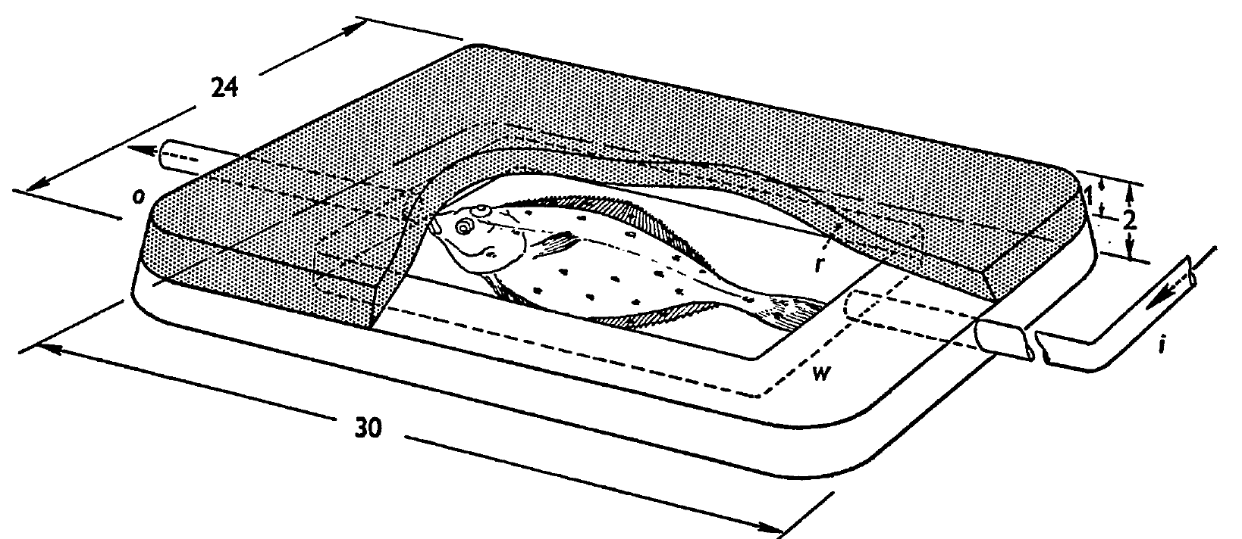
Conductive agar isolates the prey’s electrical cue
An electric field is a spatial voltage gradient that can drive current through a conductor. Kalmijn constructed a chamber from 3% agar in seawater, with thick sidewalls, a reinforced roof, and inlet and outlet tubes supplying the enclosed plaice with fresh seawater.
The chamber concealed the fish and attenuated mechanical disturbances while remaining conductive. A 1-Hz test current of 120 µA passed between electrodes 5 cm apart; field measurements with and without the chamber differed by no more than the reported 3% measurement limit.
Kalmijn (1971), Fig. 1. Conductive agar chamber and seawater circulation.
Water carried potential odorants toward the outlet, yet attacks on living plaice were directed toward the agar-covered head region. The conductivity measurement was an essential control: a barrier cannot isolate an electrical cue unless its effect on that cue is tested independently. Agar screening removed competing mechanical and visual cues while the sensory system of the predator stayed intact.
Kalmijn (1971)
03
Notes:
• An electric field is a spatial voltage gradient that can drive current through a conductor. Kalmijn constructed a chamber from 3% agar in seawater, with thick sidewalls, a reinforced roof, and inlet and outlet tubes supplying the enclosed plaice with fresh seawater.
– The plastic pools and electrically isolated circulation system avoided metal-generated galvanic fields. Agar structures equilibrated in the pool for at least 12 hours. These preparation details reduced unintended electrical targets and helped assign the response to the experimentally enclosed source.
• The chamber concealed the fish and attenuated mechanical disturbances while remaining conductive. A 1-Hz test current of 120 µA passed between electrodes 5 cm apart; field measurements with and without the chamber differed by no more than the reported 3% measurement limit.
• Water carried potential odorants toward the outlet, yet attacks on living plaice were directed toward the agar-covered head region. The conductivity measurement was an essential control: a barrier cannot isolate an electrical cue unless its effect on that cue is tested independently. Agar screening removed competing mechanical and visual cues while the sensory system of the predator stayed intact.
References:
Kalmijn AJ (1971). The Electric Sense of Sharks and Rays. Journal of Experimental Biology 55(2):371-383. https://doi.org/10.1242/jeb.55.2.371
Figure: Kalmijn (1971), Fig. 1. Conductive agar chamber and seawater circulation.
Figure source: https://doi.org/10.1242/jeb.55.2.371

Slide 4
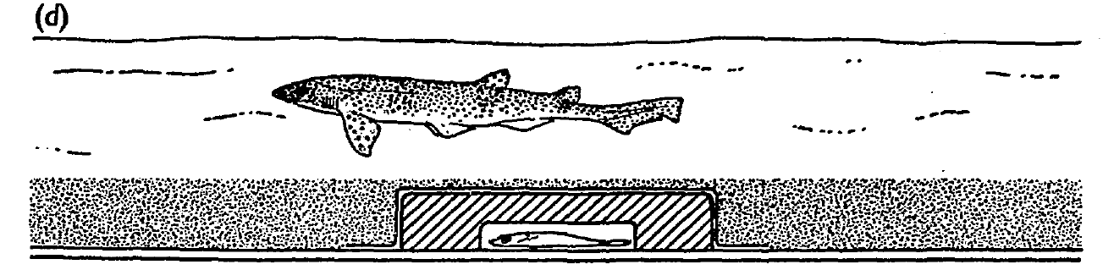
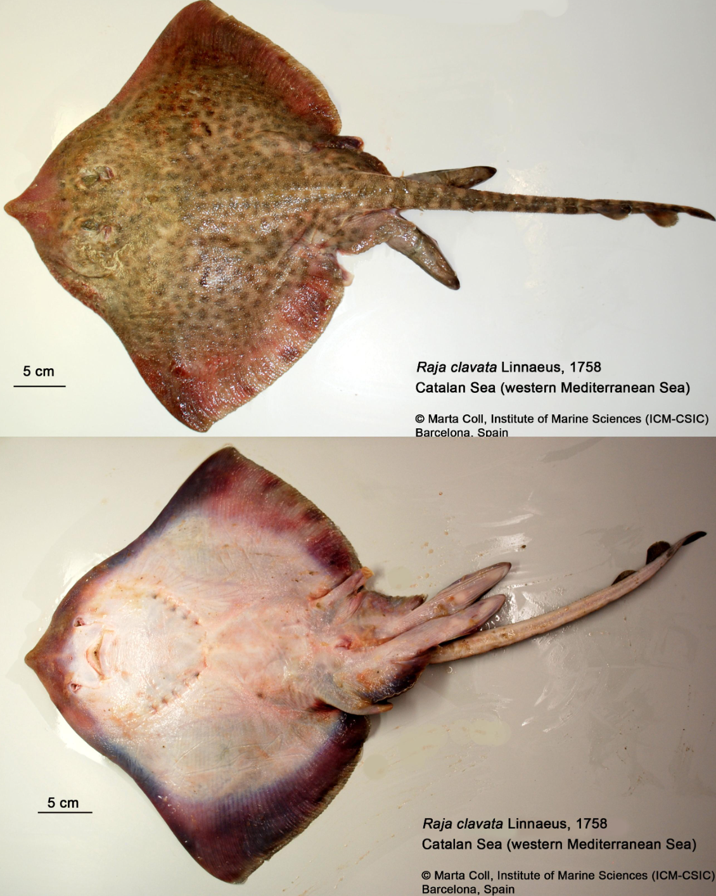
Electrical insulation abolishes directed attacks
Kalmijn covered the conductive agar chamber with polyethylene approximately 10 µm thick, then replaced the sand. The living plaice remained inside, and diffuse whiting odor still motivated the predators to search. The critical manipulation was electrical insulation around an otherwise similar concealed target.
Kalmijn (1971), Fig. 2(d). Electrical shielding blocks directed attacks.
Catsharks and rays passed close to the shielded fish without directed feeding responses. Removing the plastic restored attacks in control trials. The film had an area-specific resistance near 10¹² Ω·cm² and capacitance below 200 pF/cm², strongly attenuating direct-current and low-frequency fields.
The thin film added relatively little mechanical shielding compared with the reinforced agar roof. Reversible loss of localization therefore supports electrical guidance rather than an explanation based solely on sight, odor, or prey movement. This behavioral manipulation identifies a necessary available cue without measuring individual receptor-cell conductances.
Kalmijn (1971)
04
Notes:
• Kalmijn covered the conductive agar chamber with polyethylene approximately 10 µm thick, then replaced the sand. The living plaice remained inside, and diffuse whiting odor still motivated the predators to search. The critical manipulation was electrical insulation around an otherwise similar concealed target.
– The same predator could search vigorously while failing to localize the shielded plaice. Motivation and sensory access were thus distinct variables. Restoration after removing the film also limited explanations based on fatigue, permanent sensory injury, or an irreversible change in the prey.
• Catsharks and rays passed close to the shielded fish without directed feeding responses. Removing the plastic restored attacks in control trials. The film had an area-specific resistance near 10¹² Ω·cm² and capacitance below 200 pF/cm², strongly attenuating direct-current and low-frequency fields.
• The thin film added relatively little mechanical shielding compared with the reinforced agar roof. Reversible loss of localization therefore supports electrical guidance rather than an explanation based solely on sight, odor, or prey movement. This behavioral manipulation identifies a necessary available cue without measuring individual receptor-cell conductances.
References:
Kalmijn AJ (1971). The Electric Sense of Sharks and Rays. Journal of Experimental Biology 55(2):371-383. https://doi.org/10.1242/jeb.55.2.371
Figure: Kalmijn (1971), Fig. 2(d). Electrical shielding blocks directed attacks.
Figure source: https://doi.org/10.1242/jeb.55.2.371

Slide 5
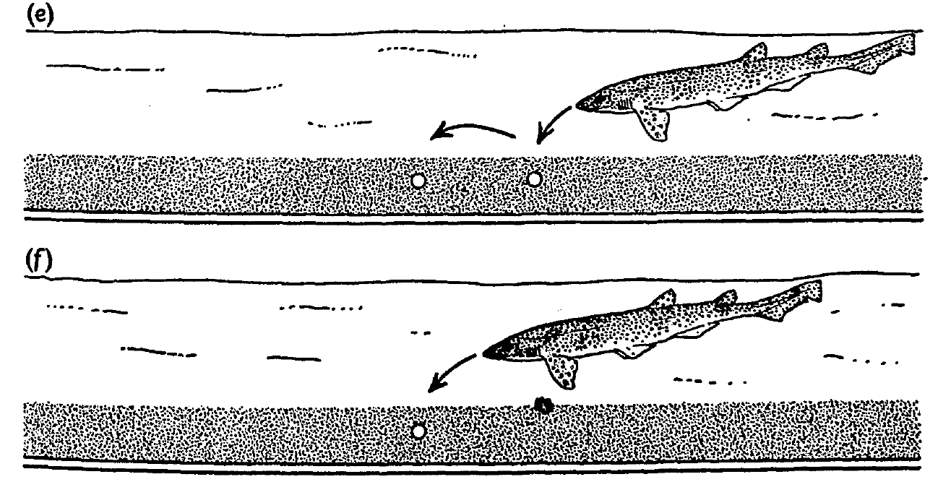
Artificial dipoles are sufficient to direct feeding
An electric dipole consists of a separated current source and sink. Kalmijn buried seawater-bridge outlets beneath sand and passed either a 1-Hz sinusoidal current or direct current of 4 µA between them, approximating the strength of a living plaice’s electrical signal.
After odor-induced arousal, catsharks and rays dug at the active outlets as though attacking prey. Identical buried outlets without current did not elicit these responses. In a competition test, a whiting piece 5 cm from the outlets supplied odor, but directed attacks favored the electrical source.
Kalmijn (1971), Fig. 2(e–f). Artificial dipoles elicit attacks and compete with food odor.
An artificial field was therefore sufficient for localization, while odor supplied a complementary motivational cue. Current-switching controls excluded the mere presence of electrodes as the target. Direct current and a 1-Hz sinusoid both directed attacks to the active outlets, so the dipole field itself was the target.
Kalmijn (1971)
05
Notes:
• An electric dipole consists of a separated current source and sink. Kalmijn buried seawater-bridge outlets beneath sand and passed either a 1-Hz sinusoidal current or direct current of 4 µA between them, approximating the strength of a living plaice’s electrical signal.
– The electrodes were connected through long seawater bridges to reduce chemical and polarization artifacts near the target. The predators sometimes left the outlets exposed after digging, despite no food reward there. Accurate localization could therefore occur independently of successful prey capture.
• After odor-induced arousal, catsharks and rays dug at the active outlets as though attacking prey. Identical buried outlets without current did not elicit these responses. In a competition test, a whiting piece 5 cm from the outlets supplied odor, but directed attacks favored the electrical source.
• An artificial field was therefore sufficient for localization, while odor supplied a complementary motivational cue. Current-switching controls excluded the mere presence of electrodes as the target. Direct current and a 1-Hz sinusoid both directed attacks to the active outlets, so the dipole field itself was the target.
References:
Kalmijn AJ (1971). The Electric Sense of Sharks and Rays. Journal of Experimental Biology 55(2):371-383. https://doi.org/10.1242/jeb.55.2.371
Figure: Kalmijn (1971), Fig. 2(e–f). Artificial dipoles elicit attacks and compete with food odor.
Figure source: https://doi.org/10.1242/jeb.55.2.371

Slide 6
An electric dipole has a source and a sink
An electric dipole consists of a current source and a nearby current sink. Current leaves the source, flows through the seawater and returns to the sink, so the field has a direction at every point around the pair. The dipole is a physical model of a small animal in seawater.
Kalmijn buried seawater-bridge outlets under sand and passed 4 µA between them, which approximates the strength of the electrical signal of a living plaice. Catsharks and rays dug at the active outlets and ignored identical outlets without current.
Kalmijn (1971), Fig. 2(e–f). Artificial dipoles elicit attacks and compete with food odor.
A dipole field is stronger near the outlets and weaker with distance. A predator that follows the field toward its strongest region reaches the outlets, which is the behavior seen in the experiment.
Kalmijn (1971)
05a
Notes:
• A dipole is the simplest electrical model of a small animal in seawater.
• Structure.
– A dipole consists of a current source and a sink.
– Current flows through the seawater from one to the other.
• Strength of the model.
– The buried outlets carried 4 microamperes, which approximates the signal of a living plaice.
• Waveforms.
– Either a 1-hertz sinusoidal current or direct current was used.
– Both directed attacks to the active outlets.
• Behavior.
– After odor-induced arousal, catsharks and rays dug at the active outlets as though attacking prey.
– Identical buried outlets without current did not elicit these responses.
• Competition test.
– A whiting piece placed 5 centimeters from the outlets supplied odor.
– Directed attacks nevertheless favored the electrical source.
• Field shape.
– The field is strongest near the outlets and weakens with distance, so the animal can follow it to the source.
• Why use artificial dipoles.
– An artificial dipole separates the electrical field from every other property of a living fish.
– If predators attack the outlets, the field alone is a sufficient cue.
References:
Kalmijn AJ (1971). The Electric Sense of Sharks and Rays. Journal of Experimental Biology 55(2):371-383. https://doi.org/10.1242/jeb.55.2.371

Slide 7
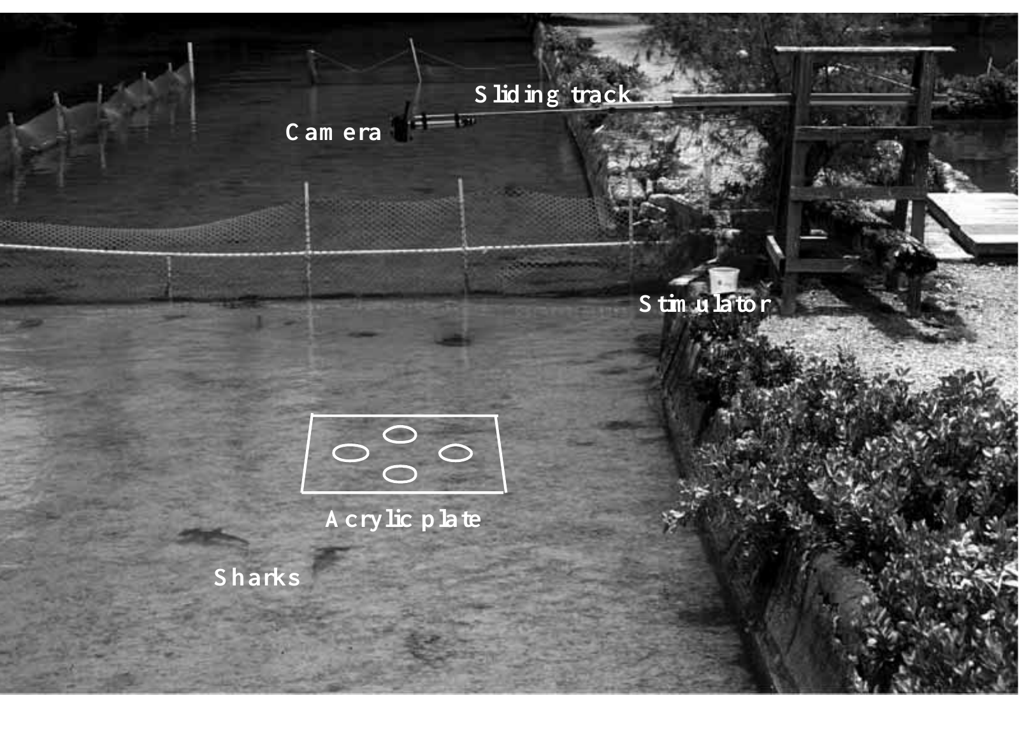
A semi-natural arena measures shark orientation
Kajiura and Holland compared juvenile scalloped hammerheads, Sphyrna lewini, with sandbar sharks, Carcharhinus plumbeus, in an enclosed reef habitat. Both species consume bottom-associated fishes and crustaceans, permitting comparison of similar feeding tasks despite markedly different head shapes.
An overhead camera recorded sharks crossing an acrylic electrode plate in water less than 0.5 m deep. Each shark was isolated from companions during testing. Feeding odor encouraged searching, while electric current selected the active dipole independently of the other inactive targets.
Orientation was identified from a course change greater than 20° or a bite. Calibrated video allowed distance and trajectory measurements rather than relying only on observer descriptions. The semi-natural setting preserved swimming behavior while the odor stimulation and the plate defined the encounter, so distance and trajectory could be compared between the two species.
Kajiura & Holland (2002), Fig. 2. Shallow-water arena, camera and electrode plate.
Kajiura & Holland (2002)
06
Notes:
• Kajiura and Holland compared juvenile scalloped hammerheads, Sphyrna lewini, with sandbar sharks, Carcharhinus plumbeus, in an enclosed reef habitat. Both species consume bottom-associated fishes and crustaceans, permitting comparison of similar feeding tasks despite markedly different head shapes.
– The surrounding pen included reef organisms and tidal exchange. Testing one shark at a time prevented a neighboring shark’s response from supplying the focal animal with an additional directional cue. The study measured behavioral orientation to an artificial prey-like source, rather than intracellular receptor sensitivity.
• An overhead camera recorded sharks crossing an acrylic electrode plate in water less than 0.5 m deep. Each shark was isolated from companions during testing. Feeding odor encouraged searching, while electric current selected the active dipole independently of the other inactive targets.
• Orientation was identified from a course change greater than 20° or a bite. Calibrated video allowed distance and trajectory measurements rather than relying only on observer descriptions. The semi-natural setting preserved swimming behavior while the odor stimulation and the plate defined the encounter, so distance and trajectory could be compared between the two species.
References:
Kajiura SM, Holland KN (2002). Electroreception in juvenile scalloped hammerhead and sandbar sharks. Journal of Experimental Biology 205(23):3609-3621. https://doi.org/10.1242/jeb.205.23.3609
Figure: Kajiura & Holland (2002), Fig. 2. Shallow-water arena, camera and electrode plate.
Figure source: https://doi.org/10.1242/jeb.205.23.3609

Slide 8
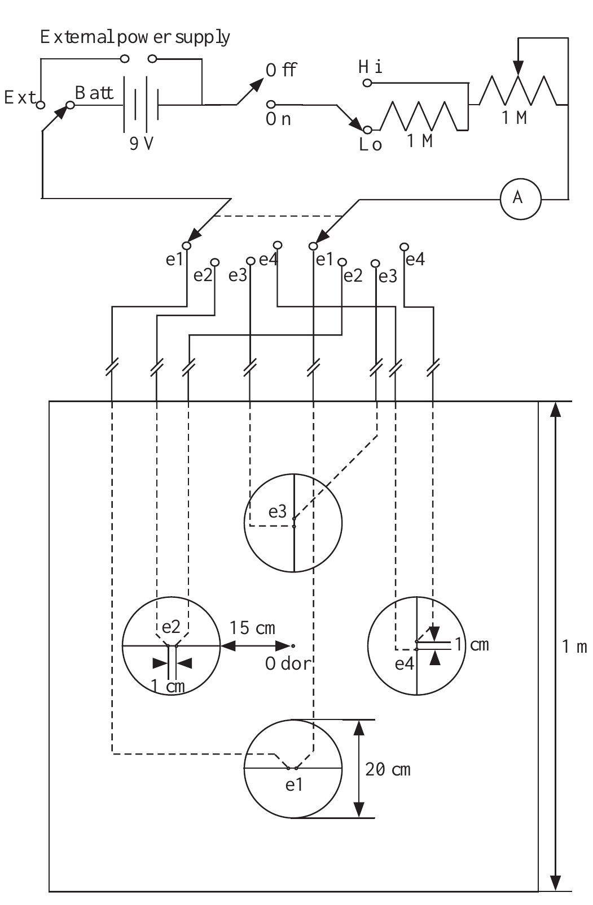
Controlled dipoles separate current from target position
The shark stimulus apparatus delivered a constant current of 6.0 µA through outlets separated by 1 cm. A battery-powered circuit and series ammeter controlled and monitored the stimulus. Four selectable dipoles allowed the experimenter to change the electrical target on the same plate.
Seawater-filled tubing separated the metal electrodes from the nearby swimming animal, reducing local chemical cues. Both species bit the active dipole and ignored inactive dipoles; repeated biting stopped when current was switched off. Target position and electrical activation were therefore independently manipulable.
Current in microamperes describes the source, whereas field strength in microvolts per centimeter describes the local stimulus encountered by the shark. These quantities are not interchangeable. The local field falls with distance from the dipole, so the same source current gives a weaker stimulus to a more distant shark.
Kajiura & Holland (2002), Fig. 1. Battery-powered dipole stimulation and electrode array.
Kajiura & Holland (2002)
07
Notes:
• The shark stimulus apparatus delivered a constant current of 6.0 µA through outlets separated by 1 cm. A battery-powered circuit and series ammeter controlled and monitored the stimulus. Four selectable dipoles allowed the experimenter to change the electrical target on the same plate.
– The 1-cm outlet spacing approximated a compact prey source. An ammeter verified delivered current, and the inactive pairs supplied spatial controls within the same apparatus. A shark’s response to the active pair cannot by itself specify the voltage acting across any one ampullary epithelium.
• Seawater-filled tubing separated the metal electrodes from the nearby swimming animal, reducing local chemical cues. Both species bit the active dipole and ignored inactive dipoles; repeated biting stopped when current was switched off. Target position and electrical activation were therefore independently manipulable.
• Current in microamperes describes the source, whereas field strength in microvolts per centimeter describes the local stimulus encountered by the shark. These quantities are not interchangeable. The local field falls with distance from the dipole, so the same source current gives a weaker stimulus to a more distant shark.
References:
Kajiura SM, Holland KN (2002). Electroreception in juvenile scalloped hammerhead and sandbar sharks. Journal of Experimental Biology 205(23):3609-3621. https://doi.org/10.1242/jeb.205.23.3609
Figure: Kajiura & Holland (2002), Fig. 1. Battery-powered dipole stimulation and electrode array.
Figure source: https://doi.org/10.1242/jeb.205.23.3609

Slide 9
Source current differs from local field strength
Source current is the current delivered through the outlets of a dipole, measured in microamperes. Field strength is the voltage gradient at the position of the animal, measured in microvolts per centimeter. The two quantities are related through the geometry of the dipole and the conductivity of seawater.
The apparatus delivered a constant 6.0 µA through outlets separated by 1 cm. The local field encountered by a shark depended on its distance from the dipole, on the angle of approach and on the properties of seawater.
A distant shark therefore experienced a weaker field from the same source current. Behavioral sensitivity is reported as the field at the position where an orientation began, which allows comparison with the thresholds of sensory cells.
Kajiura & Holland (2002), Fig. 1. Battery-powered dipole stimulation and electrode array.
Kajiura & Holland (2002)
07a
Notes:
• A source and the stimulus that it produces at a distance are different quantities.
• Source current.
– Current in microamperes describes what the apparatus delivers.
– The experiment used a constant 6.0 microamperes.
• Local field.
– Field strength in microvolts per centimeter is the gradient at the position of the shark.
– It is the stimulus that the receptors encounter.
• Dependence on geometry.
– The local field depends on distance, on the angle of approach and on seawater properties.
• Stimulus control.
– A battery-powered circuit and a series ammeter controlled and monitored the stimulus.
– Four selectable dipoles allowed the target to be changed on the same plate.
• Using the field.
– Reporting the field at the start of a turn allows sensitivity to be compared across species and with sensory cells.
• Controlling the apparatus.
– Seawater-filled tubing separated the metal electrodes from the swimming animal, which reduced local chemical cues.
– Both species bit the active dipole and ignored inactive dipoles.
• Switching off the current.
– Repeated biting stopped when the current was switched off, so the target position and the electrical activation could be manipulated independently.
References:
Kajiura SM, Holland KN (2002). Electroreception in juvenile scalloped hammerhead and sandbar sharks. Journal of Experimental Biology 205(23):3609-3621. https://doi.org/10.1242/jeb.205.23.3609

Slide 10
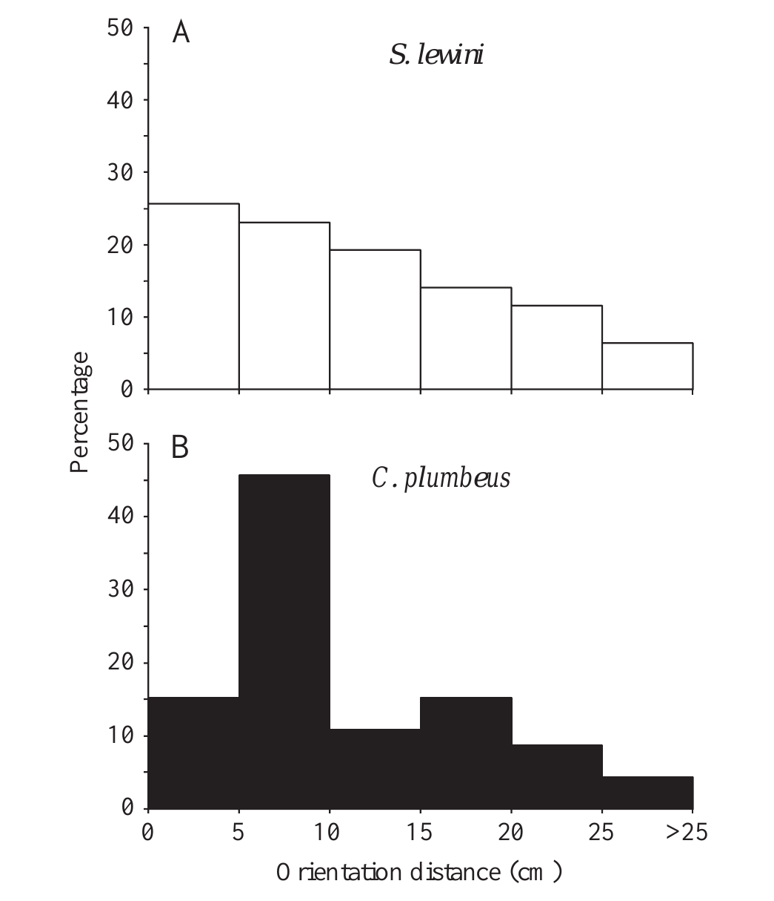
Hammerheads and sandbars have similar detection range
Kajiura and Holland measured distance from the dipole center when a shark initiated a directed turn. Hammerheads most often oriented within 5 cm, whereas sandbars most often oriented within 10 cm. The farthest responses were 30.6 cm and 31.6 cm, respectively.
The nearly identical maximum ranges did not support the prediction that the hammerhead’s expanded head necessarily produces a lower behavioral detection threshold. Both species searched the same apparatus with the same source current and dipole spacing, limiting differences caused by stimulus construction.
Maximum range and the most frequent response distance describe different aspects of performance. The most frequent responses occurred within 5 cm in hammerheads and within 10 cm in sandbars, whereas the farthest responses were beyond 30 cm in both species.
Kajiura & Holland (2002), Fig. 5(A–B). Orientation distance distributions for both shark species.
Kajiura & Holland (2002)
08
Notes:
• Kajiura and Holland measured distance from the dipole center when a shark initiated a directed turn. Hammerheads most often oriented within 5 cm, whereas sandbars most often oriented within 10 cm. The farthest responses were 30.6 cm and 31.6 cm, respectively.
– The animals’ swimming paths affected when and where they encountered the source. Detection range is consequently an organism-level measure that combines sensory input, movement, and response criteria. Equal farthest distances need not imply identical pore counts, receptor currents, or neural population responses.
• The nearly identical maximum ranges did not support the prediction that the hammerhead’s expanded head necessarily produces a lower behavioral detection threshold. Both species searched the same apparatus with the same source current and dipole spacing, limiting differences caused by stimulus construction.
• Maximum range and the most frequent response distance describe different aspects of performance. The most frequent responses occurred within 5 cm in hammerheads and within 10 cm in sandbars, whereas the farthest responses were beyond 30 cm in both species.
References:
Kajiura SM, Holland KN (2002). Electroreception in juvenile scalloped hammerhead and sandbar sharks. Journal of Experimental Biology 205(23):3609-3621. https://doi.org/10.1242/jeb.205.23.3609
Figure: Kajiura & Holland (2002), Fig. 5(A–B). Orientation distance distributions for both shark species.
Figure source: https://doi.org/10.1242/jeb.205.23.3609

Slide 11
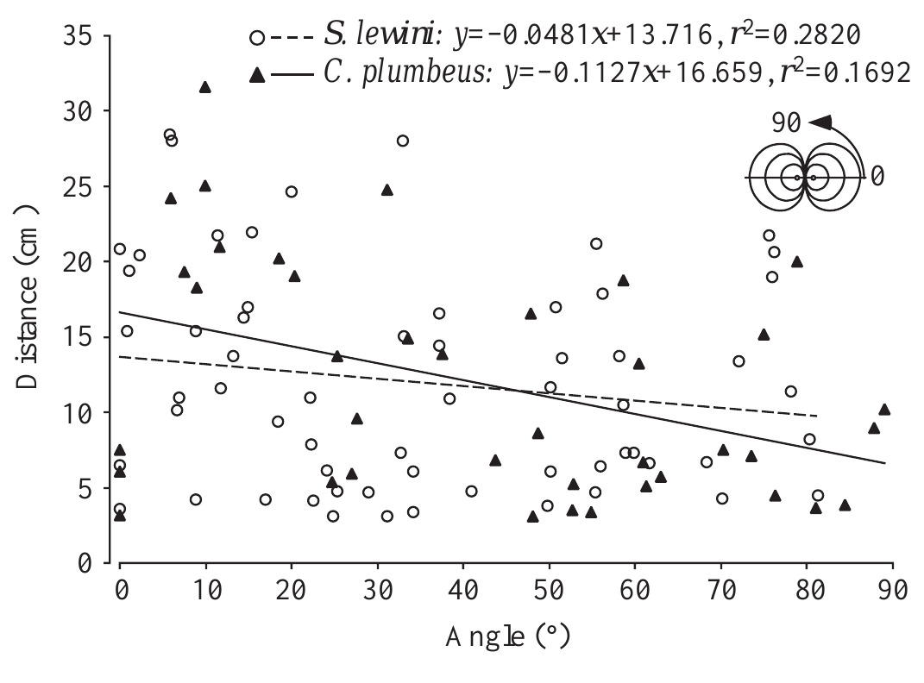
Encounter angle changes the detectable dipole field
A dipole’s field depends on direction as well as distance. Kajiura and Holland measured each shark’s approach angle relative to the line joining the two outlets. Orientations began farther away at smaller angles, where the relevant field component was stronger.
Both hammerheads and sandbars followed this relationship. Approaches nearer 90° required a closer encounter before an orientation began. Comparing orientation distance alone would therefore confound receptor sensitivity with the geometry of the sampled field; angle was needed to estimate the local electrical stimulus.
The two species encountered the source from many directions, so a distant response was not simply evidence of a preferred approach axis. The experiment relates swimming geometry to effective stimulation. Angle and distance together estimate the local field at the moment an orientation began.
Kajiura & Holland (2002), Fig. 6. Orientation distance depends on dipole-axis angle.
Kajiura & Holland (2002)
09
Notes:
• A dipole’s field depends on direction as well as distance. Kajiura and Holland measured each shark’s approach angle relative to the line joining the two outlets. Orientations began farther away at smaller angles, where the relevant field component was stronger.
– The original article calculated field intensity from a specified dipole model and measured seawater properties. The inference depends on those physical assumptions. Spatial sampling by a moving head also changes receptor input over time, even when the experimental current remains constant.
• Both hammerheads and sandbars followed this relationship. Approaches nearer 90° required a closer encounter before an orientation began. Comparing orientation distance alone would therefore confound receptor sensitivity with the geometry of the sampled field; angle was needed to estimate the local electrical stimulus.
• The two species encountered the source from many directions, so a distant response was not simply evidence of a preferred approach axis. The experiment relates swimming geometry to effective stimulation. Angle and distance together estimate the local field at the moment an orientation began.
References:
Kajiura SM, Holland KN (2002). Electroreception in juvenile scalloped hammerhead and sandbar sharks. Journal of Experimental Biology 205(23):3609-3621. https://doi.org/10.1242/jeb.205.23.3609
Figure: Kajiura & Holland (2002), Fig. 6. Orientation distance depends on dipole-axis angle.
Figure source: https://doi.org/10.1242/jeb.205.23.3609

Slide 12
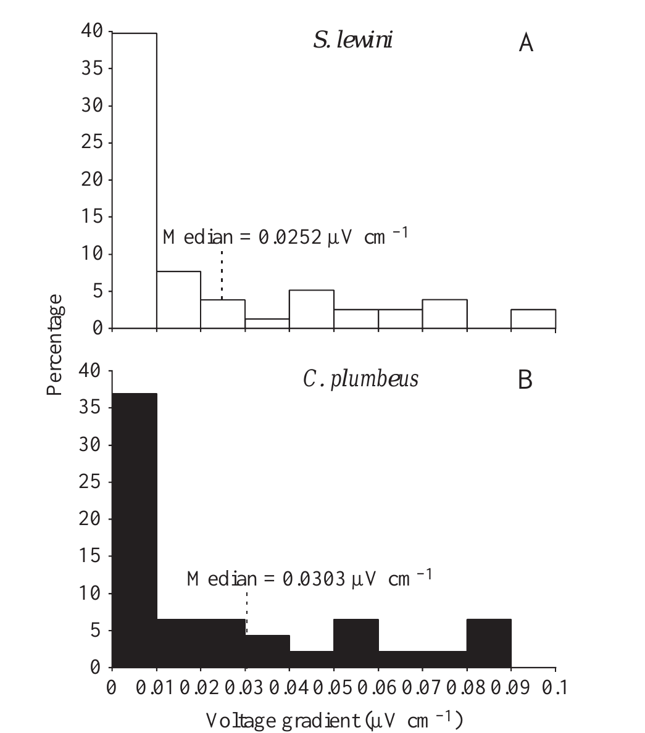
Feeding responses occur at nanovolt gradients
Kajiura and Holland converted measured encounter geometry into estimated field intensity at orientation onset. Both shark species initiated approximately 70% of orientations below 0.1 µV/cm, and approximately 35–40% below 0.01 µV/cm. Their most sensitive responses were below 1 nV/cm.
The 6.0-µA, 1-cm dipole and calibrated video provided the common reference for these estimates. Inactive outlets and current-switching trials constrained explanations involving visible target marks or electrode-associated cues. The distributions broadly overlapped despite the conspicuous difference in head morphology.
A behavioral threshold is defined by an observable response criterion; it is not necessarily the threshold of one sensory cell. The lowest measured responses came from the modeled field at orientation onset, and responses below 1 nV/cm show strong sensitivity of the whole sensory system.
Kajiura & Holland (2002), Fig. 8(A–B). Behavioral responses to fields below 0.1 µV/cm.
Kajiura & Holland (2002)
10
Notes:
• Kajiura and Holland converted measured encounter geometry into estimated field intensity at orientation onset. Both shark species initiated approximately 70% of orientations below 0.1 µV/cm, and approximately 35–40% below 0.01 µV/cm. Their most sensitive responses were below 1 nV/cm.
– The published histogram concentrates on encounters below 0.1 µV/cm because most responses occurred in this weak-field range. A field gradient expressed per centimeter cannot be equated directly with a voltage-clamp command expressed in millivolts. The two measures describe different levels of the sensory pathway.
• The 6.0-µA, 1-cm dipole and calibrated video provided the common reference for these estimates. Inactive outlets and current-switching trials constrained explanations involving visible target marks or electrode-associated cues. The distributions broadly overlapped despite the conspicuous difference in head morphology.
• A behavioral threshold is defined by an observable response criterion; it is not necessarily the threshold of one sensory cell. The lowest measured responses came from the modeled field at orientation onset, and responses below 1 nV/cm show strong sensitivity of the whole sensory system.
References:
Kajiura SM, Holland KN (2002). Electroreception in juvenile scalloped hammerhead and sandbar sharks. Journal of Experimental Biology 205(23):3609-3621. https://doi.org/10.1242/jeb.205.23.3609
Figure: Kajiura & Holland (2002), Fig. 8(A–B). Behavioral responses to fields below 0.1 µV/cm.
Figure source: https://doi.org/10.1242/jeb.205.23.3609

Slide 13
Behavioral thresholds depend on a response criterion
A behavioral threshold is the stimulus level at which an animal reliably performs a defined response. It is set by the criterion that the observer chooses and by the motivation of the animal. Approximately 35 to 40 percent of orientations began below 0.01 µV/cm.
Kajiura and Holland defined orientation as a course change greater than 20° or a bite. Approximately 70% of orientations began below 0.1 µV/cm, and the most sensitive responses were below 1 nV/cm.
The threshold of a sensory cell is defined by its own response criterion, such as a change in membrane voltage or firing. Behavioral and cellular thresholds measure different things, so comparing them requires knowing how each was defined.
Kajiura & Holland (2002), Fig. 8(A–B). Behavioral responses to fields below 0.1 µV/cm.
Kajiura & Holland (2002)
10a
Notes:
• A threshold is always defined by a criterion for what counts as a response.
• Behavioral criterion.
– An orientation was a course change greater than 20 degrees or a bite.
– The estimated field at the onset of each orientation was the stimulus.
• Distribution of responses.
– Both species began approximately 70 percent of orientations below 0.1 microvolt per centimeter.
– About 35 to 40 percent began below 0.01 microvolt per centimeter.
• Most sensitive responses.
– The lowest values were below 1 nanovolt per centimeter.
• Cellular thresholds.
– A sensory cell has its own criterion, such as a change in membrane voltage.
– The two kinds of threshold are not interchangeable.
• Dependence on motivation.
– Feeding odor motivated the sharks to search, and the lowest responses depend on modeling of the source field.
• Why criteria matter.
– A stricter criterion gives a higher threshold and a looser one gives a lower threshold.
– A threshold is therefore a property of the measurement as well as the animal.
• Species comparison.
– The distributions of the two species overlapped despite the difference in head shape.
References:
Kajiura SM, Holland KN (2002). Electroreception in juvenile scalloped hammerhead and sandbar sharks. Journal of Experimental Biology 205(23):3609-3621. https://doi.org/10.1242/jeb.205.23.3609

Slide 14
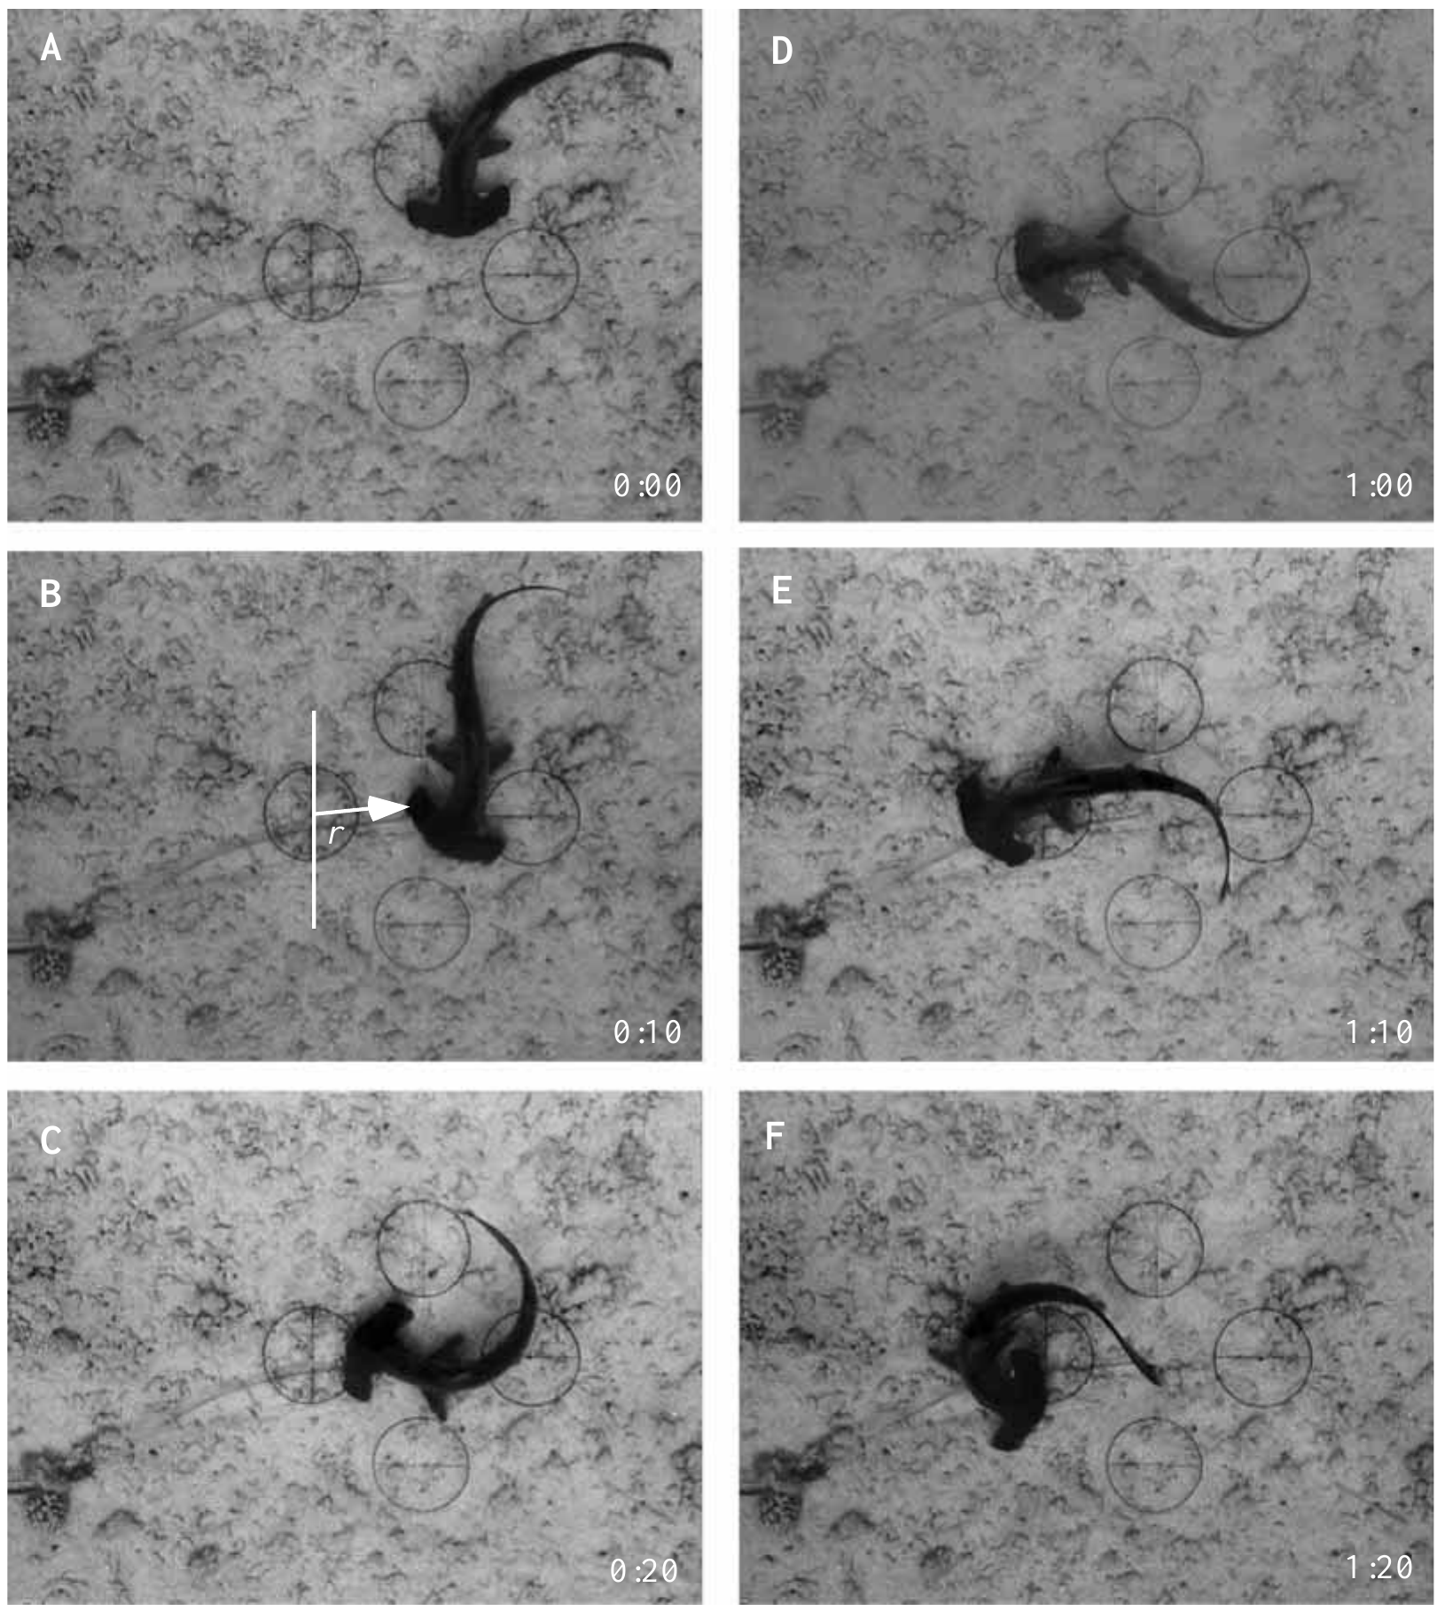
A broad head changes the mechanics of orientation
The cephalofoil is the laterally expanded head of a hammerhead shark. Video sequences recorded the position of the head while a scalloped hammerhead turned toward the active dipole. The head edge nearest the source could remain nearly stationary as the trunk pivoted around it.
Sandbar sharks generally followed broader arcs. Because the maximum orientation distances were similar, the different trajectories could not be attributed simply to earlier detection by hammerheads. Head shape and trunk flexibility changed how a detected electrical target was brought toward the mouth.
The cephalofoil also samples a wider lateral search area, potentially increasing encounters with sources beneath the animal. Improved search coverage and turning mechanics are distinct from greater receptor sensitivity. The wide head therefore contributes to search coverage and to the geometry of turning toward a detected source.
Kajiura & Holland (2002), Fig. 3(A–F). A hammerhead pivots toward an electric dipole.
Kajiura & Holland (2002)
11
Notes:
• The cephalofoil is the laterally expanded head of a hammerhead shark. Video sequences recorded the position of the head while a scalloped hammerhead turned toward the active dipole. The head edge nearest the source could remain nearly stationary as the trunk pivoted around it.
– The original photographs retain the temporal order of the approach and pivot. The investigators reconstructed paths from video instead of assuming that a straight approach followed field lines. Sensory detection and the motor maneuver that follows it can therefore vary independently between species.
• Sandbar sharks generally followed broader arcs. Because the maximum orientation distances were similar, the different trajectories could not be attributed simply to earlier detection by hammerheads. Head shape and trunk flexibility changed how a detected electrical target was brought toward the mouth.
• The cephalofoil also samples a wider lateral search area, potentially increasing encounters with sources beneath the animal. Improved search coverage and turning mechanics are distinct from greater receptor sensitivity. The wide head therefore contributes to search coverage and to the geometry of turning toward a detected source.
References:
Kajiura SM, Holland KN (2002). Electroreception in juvenile scalloped hammerhead and sandbar sharks. Journal of Experimental Biology 205(23):3609-3621. https://doi.org/10.1242/jeb.205.23.3609
Figure: Kajiura & Holland (2002), Fig. 3(A–F). A hammerhead pivots toward an electric dipole.
Figure source: https://doi.org/10.1242/jeb.205.23.3609

Slide 15
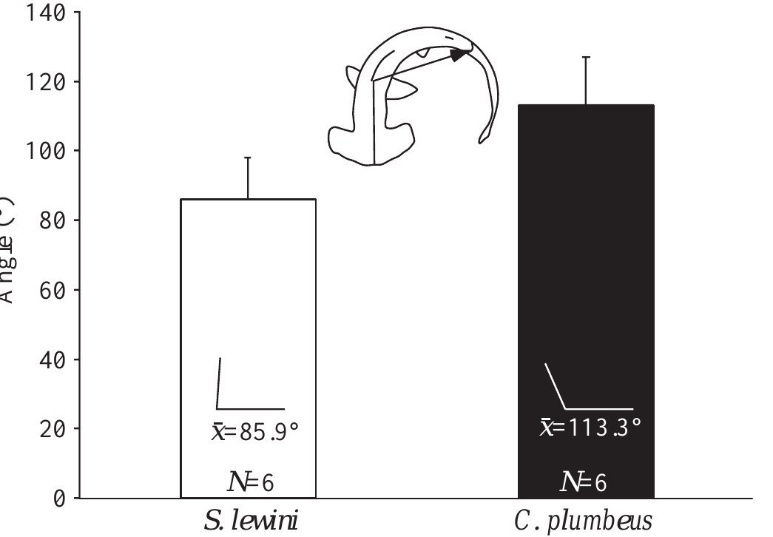
Body flexibility contributes to electrical prey capture
Kajiura and Holland quantified maximum trunk flexure during feeding turns. The mean measured angle was 85.9° in scalloped hammerheads and 113.3° in sandbars; the smaller angle represented a tighter bend. Body configuration was measured from video rather than inferred from the detection threshold.
The greater flexure of hammerheads was consistent with their rapid pivot orientations. Sandbars had broader trunks and typically used wider turning paths. The shared electrode apparatus distinguished these motor differences from differences in artificial-source spacing, current, or target availability.
Electroreception contributes to prey capture through a sensory-to-motor transformation, not merely by triggering a generic response. Equal detection range can coexist with different interception performance, because trunk flexure and trajectory determine how a detected target is brought to the mouth.
Kajiura & Holland (2002), Fig. 10. Body flexure differs between shark species.
Kajiura & Holland (2002)
12
Notes:
• Kajiura and Holland quantified maximum trunk flexure during feeding turns. The mean measured angle was 85.9° in scalloped hammerheads and 113.3° in sandbars; the smaller angle represented a tighter bend. Body configuration was measured from video rather than inferred from the detection threshold.
– The angle metric describes the geometry of body bending, so its direction must be interpreted correctly: a smaller included angle corresponds to stronger flexure. The article did not record motor-neuron activity or manipulate muscular force. Those causal steps cannot be assigned solely from behavioral images.
• The greater flexure of hammerheads was consistent with their rapid pivot orientations. Sandbars had broader trunks and typically used wider turning paths. The shared electrode apparatus distinguished these motor differences from differences in artificial-source spacing, current, or target availability.
• Electroreception contributes to prey capture through a sensory-to-motor transformation, not merely by triggering a generic response. Equal detection range can coexist with different interception performance, because trunk flexure and trajectory determine how a detected target is brought to the mouth.
References:
Kajiura SM, Holland KN (2002). Electroreception in juvenile scalloped hammerhead and sandbar sharks. Journal of Experimental Biology 205(23):3609-3621. https://doi.org/10.1242/jeb.205.23.3609
Figure: Kajiura & Holland (2002), Fig. 10. Body flexure differs between shark species.
Figure source: https://doi.org/10.1242/jeb.205.23.3609

Slide 16
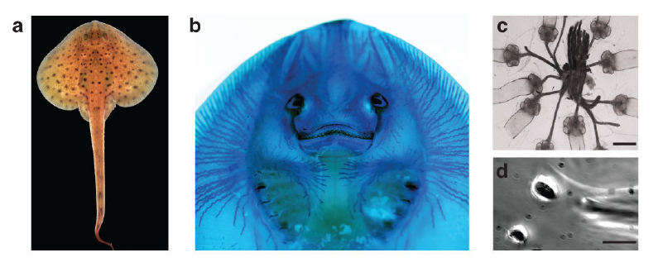
Skin pores connect to internal ampullary epithelia
The ampullae of Lorenzini are sensory organs in which skin pores connect through jelly-filled canals to an internal receptor epithelium. Bellono and colleagues examined the little skate, Leucoraja erinacea, using canal staining, organ dissection, and recordings from individual electrosensory cells.
Alcian Blue revealed the ventral canal network. Isolated ampullae retained short canal segments and attached afferent nerves, which carry sensory signals toward the brain; the published organ image has a 400-µm scale bar. Dissociated receptor cells were accessible to patch-clamp electrodes, with a 5-µm scale bar in the cellular preparation.
Bellono et al. (2017), Fig. 1(a–d). Skate, canal network, isolated ampullae and receptor cell.
The pore samples external voltage. Receptor cells convert it into activity and synaptic output, transmission to sensory nerves through released chemicals called neurotransmitters. The jelly-filled canal conducts the external voltage to the receptor epithelium, and dissociated receptor cells permit patch-clamp analysis of the channels that amplify it.
Bellono et al. (2017)
13
Notes:
• The ampullae of Lorenzini are sensory organs in which skin pores connect through jelly-filled canals to an internal receptor epithelium. Bellono and colleagues examined the little skate, Leucoraja erinacea, using canal staining, organ dissection, and recordings from individual electrosensory cells.
– The epithelium is a cellular sheet lining the sensory organ. Its lumen-facing surface and nerve-facing surface participate in different aspects of transduction and output. Maintaining an attached nerve in an organ preparation differs from dispersing cells for direct membrane-current measurements.
• Alcian Blue revealed the ventral canal network. Isolated ampullae retained short canal segments and attached afferent nerves, which carry sensory signals toward the brain; the published organ image has a 400-µm scale bar. Dissociated receptor cells were accessible to patch-clamp electrodes, with a 5-µm scale bar in the cellular preparation.
• The pore samples external voltage. Receptor cells convert it into activity and synaptic output, transmission to sensory nerves through released chemicals called neurotransmitters. The jelly-filled canal conducts the external voltage to the receptor epithelium, and dissociated receptor cells permit patch-clamp analysis of the channels that amplify it.
References:
Bellono NW, Leitch DB, Julius D (2017). Molecular basis of ancestral vertebrate electroreception. Nature 543(7645):391-396. https://doi.org/10.1038/nature21401
Figure: Bellono et al. (2017), Fig. 1(a–d). Skate, canal network, isolated ampullae and receptor cell.
Figure source: https://doi.org/10.1038/nature21401

Slide 17
Pores and canals connect skin to receptor cells
Each ampulla of Lorenzini opens to the skin through a pore and a jelly-filled canal. The canal conducts the voltage at the pore to a receptor epithelium at its inner end. The structure is organized so that a voltage at the pore reaches the receptor cells with little loss.
Bellono and colleagues stained the ventral canal network of the little skate with Alcian Blue. Isolated ampullae retained short canal segments and attached afferent nerves, and dissociated receptor cells were accessible to patch-clamp electrodes. Scale bars of 400 µm and 5 µm accompany the organ and cellular images.
Bellono et al. (2017), Fig. 1(a–d). Skate, canal network, isolated ampullae and receptor cell.
The receptor cells convert voltage into activity and release neurotransmitter onto the afferent nerves. The pore, canal, receptor cells and nerve therefore form a chain from external voltage to a neural signal.
Bellono et al. (2017)
13a
Notes:
• The ampulla is a series of structures that carries a voltage from the skin to a nerve.
• Pore and canal.
– A skin pore opens into a jelly-filled canal.
– The canal conducts the external voltage inward.
• Receptor epithelium.
– The receptor cells at the inner end convert the voltage into cellular activity.
• Nerves.
– Afferent nerves carry sensory signals toward the brain.
– Receptor cells transmit to them through released neurotransmitters.
• Preparations.
– Alcian Blue revealed the ventral canal network.
– Isolated ampullae kept short canal segments and nerves.
– Scale bars of 400 micrometers and 5 micrometers accompany the published images.
• Cellular access.
– Dissociated receptor cells could be recorded with patch-clamp electrodes.
• Why the structure helps.
– The canal is filled with jelly that conducts the voltage between the pore and the receptor cells.
– Separating the external opening from the receptors allows the receptors to sit deep in the skin.
• Preparations used.
– Whole-organ dissection kept the canal and nerve attachments.
– Dissociated cells allowed control of voltage and recording of single-channel currents.
References:
Bellono NW, Leitch DB, Julius D (2017). Molecular basis of ancestral vertebrate electroreception. Nature 543(7645):391-396. https://doi.org/10.1038/nature21401

Slide 18
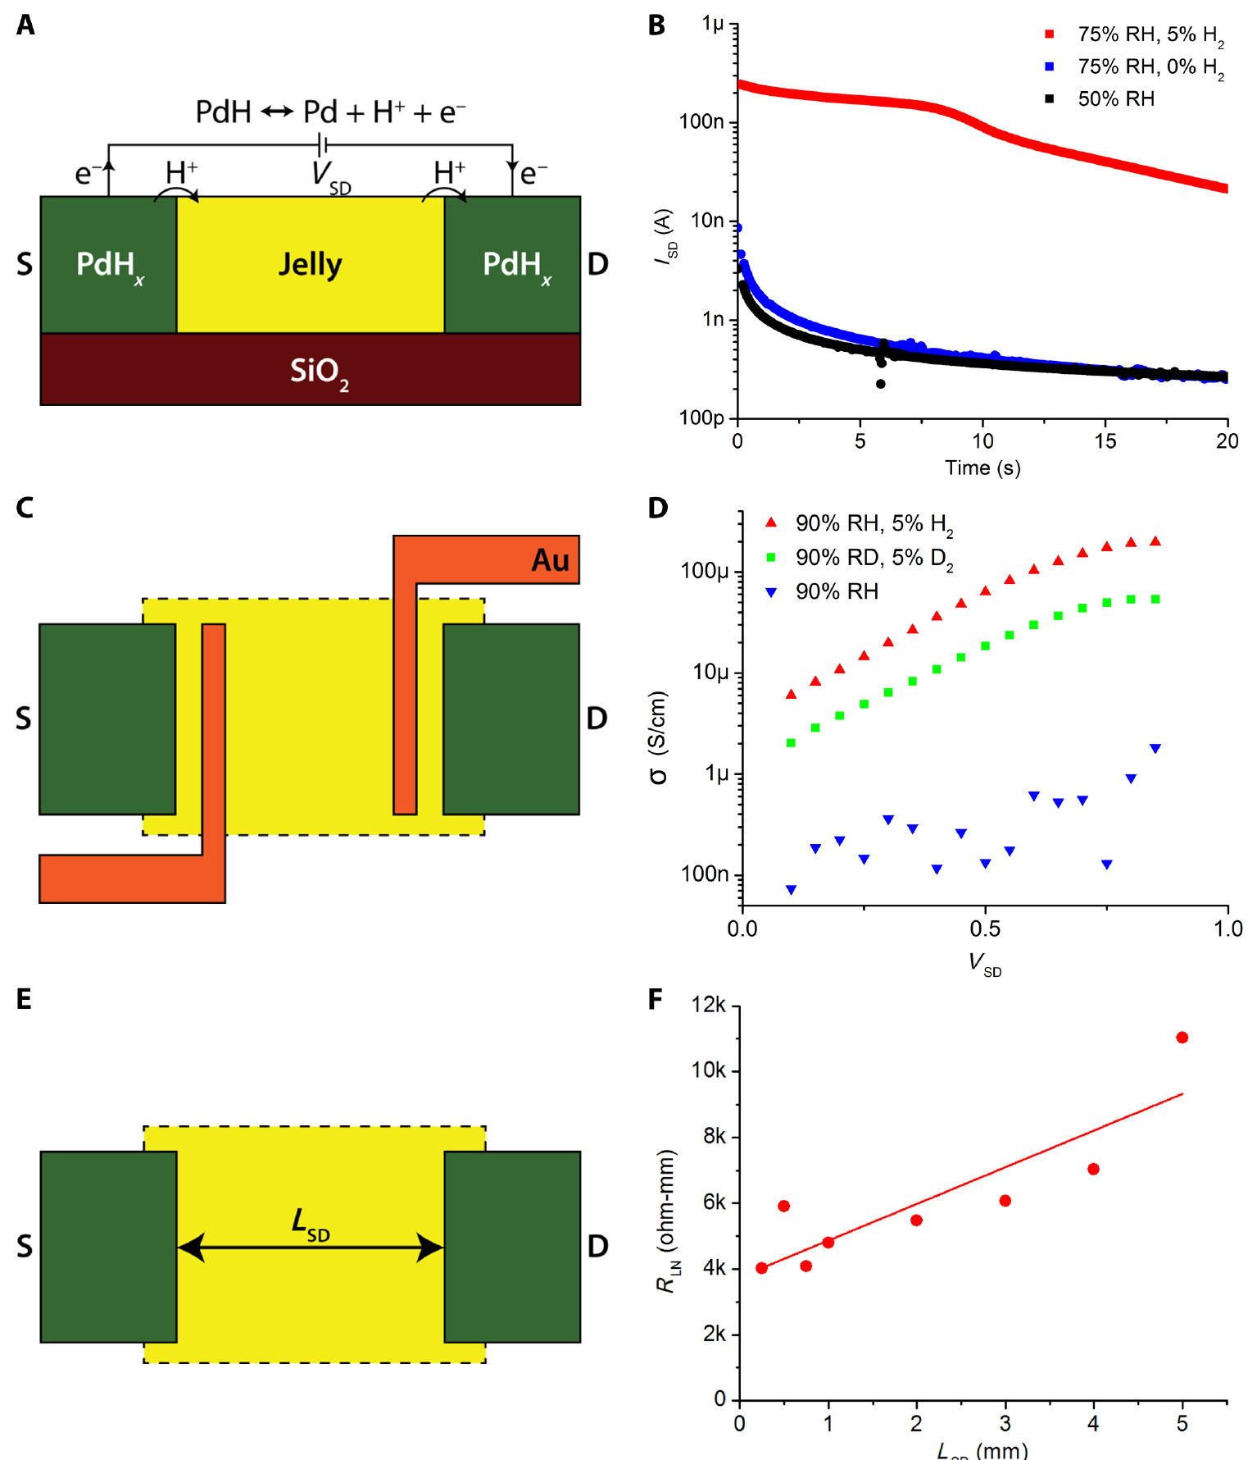
Ampullary jelly can conduct protons in vitro
Josberger and colleagues extracted ampullary jelly from sharks and skates and measured its electrical properties with controlled electrodes and humidity. A proton is a hydrogen ion, H⁺. Palladium-hydride contacts injected protons, whereas palladium contacts restricted their transfer into the sample.
At 75% relative humidity, a 1-V stimulus produced a proton-associated current peak near 250 nA, compared with approximately 10 nA for the ionic transient. Four-terminal measurements gave room-temperature proton conductivity near 2 mS/cm. Electrode comparisons separated charge-carrier behavior from a single undifferentiated current.
The authors proposed that proton conduction may contribute to ampullary function. The measured proton conductivity indicates that the jelly can serve as a conductive path for voltage from the pore to the receptor epithelium.
Josberger et al. (2016), Fig. 2(A–F). Electrode controls and proton conductivity measurements.
Josberger et al. (2016)
14
Notes:
• Josberger and colleagues extracted ampullary jelly from sharks and skates and measured its electrical properties with controlled electrodes and humidity. A proton is a hydrogen ion, H⁺. Palladium-hydride contacts injected protons, whereas palladium contacts restricted their transfer into the sample.
– The jelly was hydrated before testing, and measurements controlled humidity because water content affects charge transport. A 1-V device stimulus is much larger than natural sensory signals. The preparation establishes a material property without identifying the receptor-cell mechanism or explaining a behavioral threshold.
• At 75% relative humidity, a 1-V stimulus produced a proton-associated current peak near 250 nA, compared with approximately 10 nA for the ionic transient. Four-terminal measurements gave room-temperature proton conductivity near 2 mS/cm. Electrode comparisons separated charge-carrier behavior from a single undifferentiated current.
• The authors proposed that proton conduction may contribute to ampullary function. The measured proton conductivity indicates that the jelly can serve as a conductive path for voltage from the pore to the receptor epithelium.
References:
Josberger EE, Hassanzadeh P, Deng Y, Sohn J, Rego MJ, Amemiya CT, Rolandi M (2016). Proton conductivity in ampullae of Lorenzini jelly. Science Advances 2(5):e1600112. https://doi.org/10.1126/sciadv.1600112
Figure: Josberger et al. (2016), Fig. 2(A–F). Electrode controls and proton conductivity measurements.
Figure source: https://doi.org/10.1126/sciadv.1600112

Slide 19
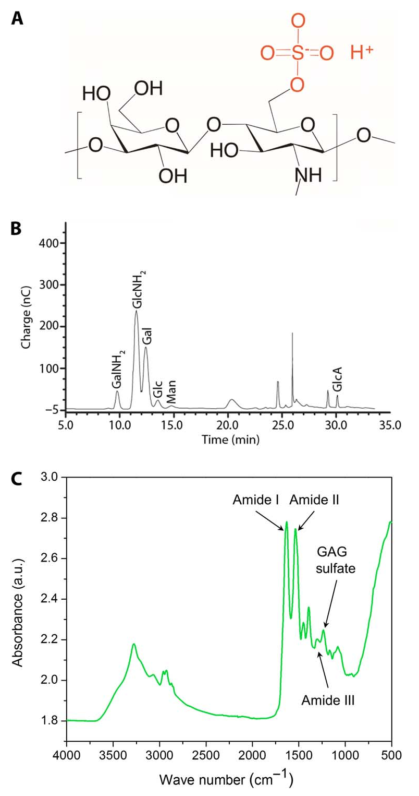
Jelly chemistry supports a conductive hydrogel
Josberger and colleagues characterized the jelly as a hydrogel, a hydrated polymer network. Prepared samples contained approximately 97% water. Drying reduced sample volume by about 80%, making hydration an essential experimental variable rather than a minor handling detail.
Chemical analyses identified sugars and sulfate-containing components consistent with keratan sulfate, a sulfated carbohydrate polymer. The original article combined compositional chromatography with infrared measurements. Sulfate groups could provide proton donors within a hydrated network, offering a possible material basis for measured proton conduction.
Chemical composition and electrical measurement together support a hydrated, sulfated matrix as the conductive medium of the canal. Membrane ion-channel amplification in the receptor cells provides a separate step in sensing the field.
Josberger et al. (2016), Fig. 3(A–C). Chemical analyses of ampullary jelly.
Josberger et al. (2016)
15
Notes:
• Josberger and colleagues characterized the jelly as a hydrogel, a hydrated polymer network. Prepared samples contained approximately 97% water. Drying reduced sample volume by about 80%, making hydration an essential experimental variable rather than a minor handling detail.
– The authors treated the link between polymer chemistry and high proton conductivity as a proposed explanation. A constituent detected in extracted jelly need not be the only electrically relevant component. The results cannot establish a channel-mediated neuronal response because no living receptor epithelium was included.
• Chemical analyses identified sugars and sulfate-containing components consistent with keratan sulfate, a sulfated carbohydrate polymer. The original article combined compositional chromatography with infrared measurements. Sulfate groups could provide proton donors within a hydrated network, offering a possible material basis for measured proton conduction.
• Chemical composition and electrical measurement together support a hydrated, sulfated matrix as the conductive medium of the canal. Membrane ion-channel amplification in the receptor cells provides a separate step in sensing the field.
References:
Josberger EE, Hassanzadeh P, Deng Y, Sohn J, Rego MJ, Amemiya CT, Rolandi M (2016). Proton conductivity in ampullae of Lorenzini jelly. Science Advances 2(5):e1600112. https://doi.org/10.1126/sciadv.1600112
Figure: Josberger et al. (2016), Fig. 3(A–C). Chemical analyses of ampullary jelly.
Figure source: https://doi.org/10.1126/sciadv.1600112

Slide 20
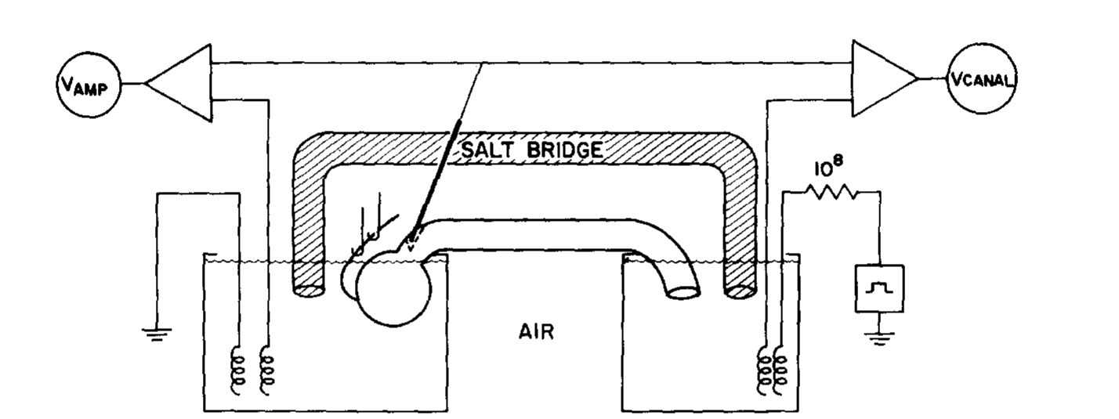
An isolated ampulla separates epithelial and nerve signals
Clusin and Bennett isolated skate ampullae with canals and afferent nerves attached. Separate saline compartments allowed current and voltage measurements across the receptor epithelium. A salt bridge shunted the canal, keeping transampullary voltage close to its resting operating range.
Current delivered between compartments imposed small voltage stimuli without requiring a freely swimming animal. The investigators simultaneously monitored epithelial current and postsynaptic, or receiving-side, nerve responses. Removing or restoring the shunt changed the electrical load, allowing spontaneous activity to be separated from stimulus-induced output.
Clusin & Bennett (1979), Fig. 1. Isolated ampulla, canal and recording compartments.
This preparation links an external electrical perturbation to receptor-organ current and a neural response. The preparation preserves a tissue-level circuit, and single-cell recordings add channel-level evidence about the conductances that generate the response.
Clusin & Bennett (1979)
16
Notes:
• Clusin and Bennett isolated skate ampullae with canals and afferent nerves attached. Separate saline compartments allowed current and voltage measurements across the receptor epithelium. A salt bridge shunted the canal, keeping transampullary voltage close to its resting operating range.
– The canal’s resistance and the salt bridge influence how the imposed current produces a voltage across the epithelium. Recording nerve activity in a separate compartment prevents epithelial current from being mistaken for propagated afferent spikes. Electrical loading is therefore part of the experimental mechanism, not merely apparatus geometry.
• Current delivered between compartments imposed small voltage stimuli without requiring a freely swimming animal. The investigators simultaneously monitored epithelial current and postsynaptic, or receiving-side, nerve responses. Removing or restoring the shunt changed the electrical load, allowing spontaneous activity to be separated from stimulus-induced output.
• This preparation links an external electrical perturbation to receptor-organ current and a neural response. The preparation preserves a tissue-level circuit, and single-cell recordings add channel-level evidence about the conductances that generate the response.
References:
Clusin WT, Bennett MVL (1979). The oscillatory responses of skate electroreceptors to small voltage stimuli. Journal of General Physiology 73(6):685-702. https://doi.org/10.1085/jgp.73.6.685
Figure: Clusin & Bennett (1979), Fig. 1. Isolated ampulla, canal and recording compartments.
Figure source: https://doi.org/10.1085/jgp.73.6.685

Slide 21
A salt bridge shunts the canal of an isolated ampulla
A shunt is a low-resistance path that carries current around part of a circuit. In the isolated ampulla, a salt bridge connected the canal side directly to the nerve side and held the transampullary voltage near its resting operating range. The preparation separates the receptor epithelium from the nerve that it drives.
Clusin and Bennett used separate saline compartments to deliver current and measure voltage across the receptor epithelium. Removing or restoring the shunt changed the electrical load on the organ.
Clusin & Bennett (1979), Fig. 1. Isolated ampulla, canal and recording compartments.
The change in load separated spontaneous activity from output evoked by the stimulus. Epithelial current and the response of the nerve on the receiving side of the synapse could be monitored together. Spontaneous activity is the baseline against which stimulus-evoked changes are measured.
Clusin & Bennett (1979)
16a
Notes:
• A shunt makes it possible to control the voltage across the receptor epithelium.
• Isolated organ.
– Skate ampullae were isolated with their canals and afferent nerves attached.
– Separate saline compartments held the canal and nerve sides.
• Shunt.
– A salt bridge shunted the canal.
– This kept the transampullary voltage close to its resting operating range.
• Stimulation.
– Current delivered between compartments imposed small voltage stimuli without a freely swimming animal.
• Monitoring.
– Epithelial current and the response of the nerve on the receiving side of the synapse were recorded together.
• Load.
– Removing or restoring the shunt changed the electrical load, which helped separate spontaneous activity from stimulus-evoked output.
• Questions answered by the preparation.
– The recordings relate an external perturbation to current through the receptor epithelium.
– The same recordings relate it to the response of the postsynaptic nerve.
• Spontaneous activity.
– The ampulla is active without a stimulus, so evoked responses are changes relative to that activity.
References:
Clusin WT, Bennett MVL (1979). The oscillatory responses of skate electroreceptors to small voltage stimuli. Journal of General Physiology 73(6):685-702. https://doi.org/10.1085/jgp.73.6.685

Slide 22
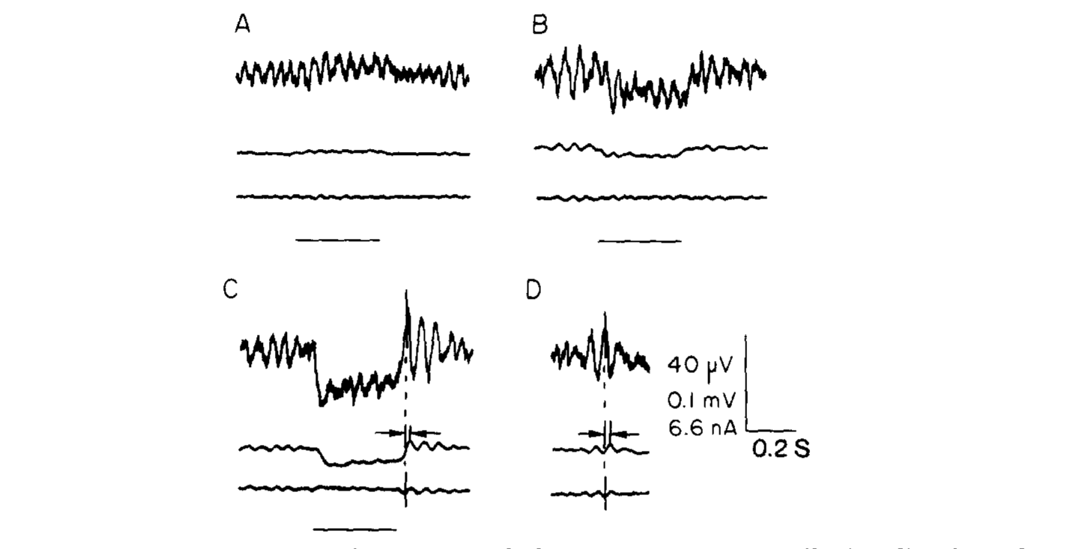
Stimulus polarity changes synaptic drive to afferents
Clusin and Bennett applied small voltage steps to a shunted skate ampulla. A lumen-negative stimulus of 5 µV depolarized the postsynaptic nerve, whereas a lumen-positive stimulus of 10 µV hyperpolarized it. Depolarization makes membrane voltage less negative; hyperpolarization makes it more negative.
Tetrodotoxin at 0.1 µM abolished postsynaptic action potentials so the underlying synaptic response could be measured. Small stimuli changed nerve potential without a comparably large change in total epithelial current. The same organ therefore transmitted changes much smaller than ordinary cellular membrane-voltage excursions.
Clusin & Bennett (1979), Fig. 3(A–D). Opposite stimulus polarities alter postsynaptic potential.
Opposite response signs constrain how the receptor converts an environmental voltage into afferent drive. Tetrodotoxin separates sodium-dependent spikes from the preceding synaptic potential, so the recorded nerve response reflects the synaptic drive from the receptor epithelium.
Clusin & Bennett (1979)
17
Notes:
• Clusin and Bennett applied small voltage steps to a shunted skate ampulla. A lumen-negative stimulus of 5 µV depolarized the postsynaptic nerve, whereas a lumen-positive stimulus of 10 µV hyperpolarized it. Depolarization makes membrane voltage less negative; hyperpolarization makes it more negative.
– The stimulus sign refers to the ampullary lumen relative to the external compartment. It is not interchangeable with the polarity of an electrode source in an arbitrary swimming orientation. The experiment preserved simultaneous epithelial and neural recordings, giving two distinct measures of the same perturbation.
• Tetrodotoxin at 0.1 µM abolished postsynaptic action potentials so the underlying synaptic response could be measured. Small stimuli changed nerve potential without a comparably large change in total epithelial current. The same organ therefore transmitted changes much smaller than ordinary cellular membrane-voltage excursions.
• Opposite response signs constrain how the receptor converts an environmental voltage into afferent drive. Tetrodotoxin separates sodium-dependent spikes from the preceding synaptic potential, so the recorded nerve response reflects the synaptic drive from the receptor epithelium.
References:
Clusin WT, Bennett MVL (1979). The oscillatory responses of skate electroreceptors to small voltage stimuli. Journal of General Physiology 73(6):685-702. https://doi.org/10.1085/jgp.73.6.685
Figure: Clusin & Bennett (1979), Fig. 3(A–D). Opposite stimulus polarities alter postsynaptic potential.
Figure source: https://doi.org/10.1085/jgp.73.6.685

Slide 23
Tetrodotoxin isolates the synaptic potential
Tetrodotoxin blocks voltage-gated sodium channels, which generate action potentials in nerve cells. With spikes blocked, the slower synaptic potential that precedes them can be measured by itself. The postsynaptic nerve is the afferent ending that receives transmitter from the receptor cells.
Clusin and Bennett applied 0.1 µM tetrodotoxin to the shunted ampulla. A lumen-negative stimulus of 5 µV depolarized the postsynaptic nerve, and a lumen-positive stimulus of 10 µV hyperpolarized it. The tissue therefore transmitted changes much smaller than ordinary cellular voltage excursions.
Clusin & Bennett (1979), Fig. 3(A–D). Opposite stimulus polarities alter postsynaptic potential.
The opposite signs show how the polarity of the stimulus changes the drive on the afferent. Small stimuli produced large changes in nerve potential without a comparably large change in total epithelial current. The sign of the stimulus determines whether the afferent is driven toward or away from threshold.
Clusin & Bennett (1979)
17a
Notes:
• Blocking spikes reveals the synaptic input that normally triggers them.
• Tetrodotoxin.
– It blocks voltage-gated sodium channels and abolishes action potentials.
– The synaptic potential remains and can be recorded.
• Polarity.
– A lumen-negative stimulus of 5 microvolts depolarized the nerve.
– A lumen-positive stimulus of 10 microvolts hyperpolarized it.
• Terms.
– Depolarization makes the membrane voltage less negative.
– Hyperpolarization makes it more negative.
• Size of the effect.
– The stimuli were far smaller than ordinary cellular voltage excursions.
– Total epithelial current changed little.
• Meaning.
– Opposite signs constrain how the receptor converts an environmental voltage into drive on the afferent.
• Why the sign matters.
– Depolarization of the nerve moves its voltage toward spike threshold, and hyperpolarization moves it away.
– A receptor that responds with opposite signs to opposite polarities can encode the direction of a field.
• Small stimuli.
– The stimuli were a few microvolts, much smaller than ordinary cellular voltage excursions.
– The organ therefore acts as a sensitive amplifier of weak voltages.
References:
Clusin WT, Bennett MVL (1979). The oscillatory responses of skate electroreceptors to small voltage stimuli. Journal of General Physiology 73(6):685-702. https://doi.org/10.1085/jgp.73.6.685

Slide 24
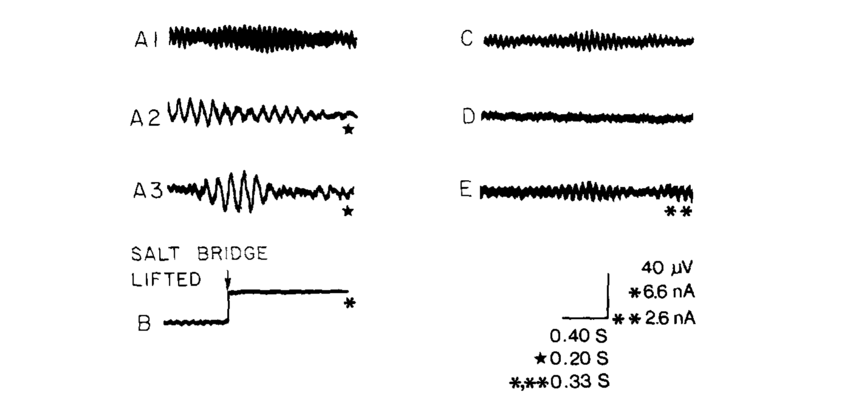
The receptor epithelium generates spontaneous oscillations
A membrane oscillation is a repeated fluctuation in electrical activity. Clusin and Bennett recorded small spontaneous currents in shunted skate ampullae. Their frequency lay approximately between 1 and 8 Hz under the reported conditions, even without a deliberately applied sensory stimulus.
Lifting the salt bridge interrupted canal current and exposed the organ’s steady receptor current. Comparing the shunted and unshunted conditions separated the small oscillatory component from the larger tonic current. The observations established endogenous epithelial activity rather than motion-induced electrical fluctuations in a swimming animal.
Clusin & Bennett (1979), Fig. 2(A1–A3, B–E). Spontaneous epithelial currents and oscillations.
Oscillations provide a time-varying presynaptic state upon which weak signals can act. Currents carried by calcium and potassium channels in single receptor cells are candidate sources of this activity.
Clusin & Bennett (1979)
18
Notes:
• A membrane oscillation is a repeated fluctuation in electrical activity. Clusin and Bennett recorded small spontaneous currents in shunted skate ampullae. Their frequency lay approximately between 1 and 8 Hz under the reported conditions, even without a deliberately applied sensory stimulus.
– A tonic current persists without periodic stimulation, whereas an oscillatory current repeatedly changes around its operating point. The receptor organ exhibited both. Altering the canal shunt also altered its electrical loading, so these records cannot be treated as unmodified measurements of a freely behaving skate.
• Lifting the salt bridge interrupted canal current and exposed the organ’s steady receptor current. Comparing the shunted and unshunted conditions separated the small oscillatory component from the larger tonic current. The observations established endogenous epithelial activity rather than motion-induced electrical fluctuations in a swimming animal.
• Oscillations provide a time-varying presynaptic state upon which weak signals can act. Currents carried by calcium and potassium channels in single receptor cells are candidate sources of this activity.
References:
Clusin WT, Bennett MVL (1979). The oscillatory responses of skate electroreceptors to small voltage stimuli. Journal of General Physiology 73(6):685-702. https://doi.org/10.1085/jgp.73.6.685
Figure: Clusin & Bennett (1979), Fig. 2(A1–A3, B–E). Spontaneous epithelial currents and oscillations.
Figure source: https://doi.org/10.1085/jgp.73.6.685

Slide 25
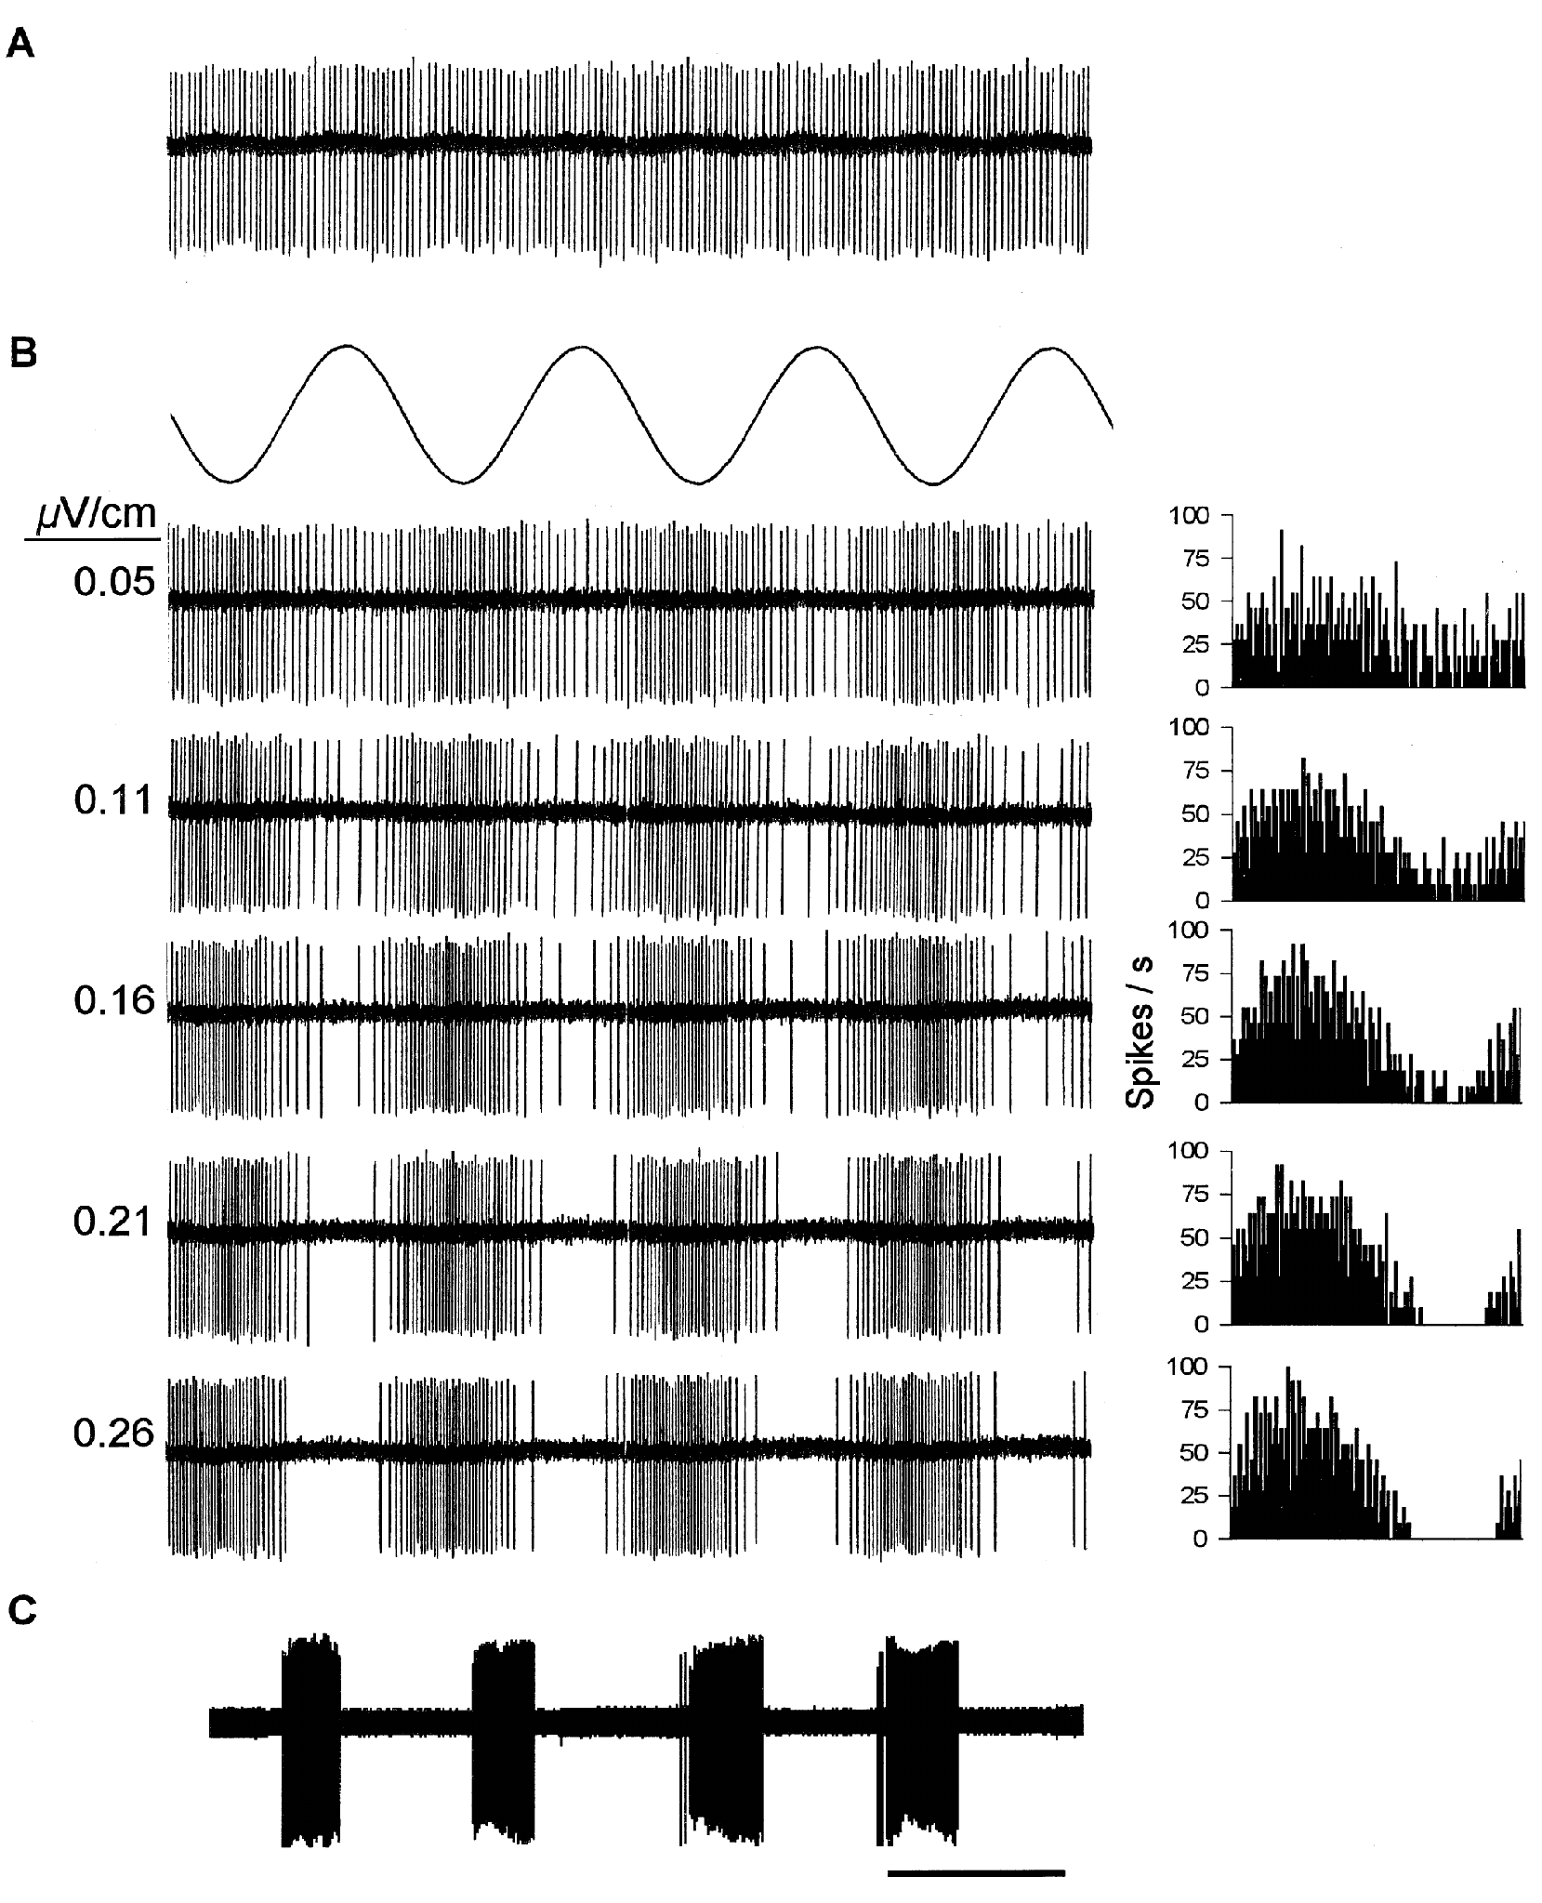
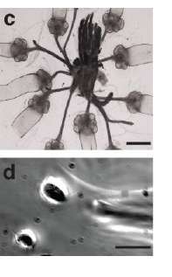
Afferent spikes encode electric-field phase
A primary afferent is a sensory neuron carrying receptor output toward the central nervous system. Tricas and New recorded these neurons in immobilized round stingrays, Urolophus halleri, while uniform electric fields were applied across the body and artificial ventilation maintained respiration.
A 1-Hz sinusoid modulated a regular resting spike train. Increasing peak-to-peak field intensity from 0.05 to 0.26 µV/cm increased firing during one phase and progressively silenced the neuron during the opposite phase. Period histograms aligned spikes to the recurring stimulus cycle.
Phase-dependent increases and decreases carry directional electrical information relative to spontaneous activity. At stronger stimulation, pauses can become complete even while firing during the excitatory phase remains high. Afferent output is therefore a temporally structured spike train that follows the polarity of the field as it alternates.
Tricas & New (1998), Fig. 2(A–C). Resting firing and phase-dependent afferent modulation.
Bellono et al. (2017), Fig. 1(c–d). Isolated ampulla and receptor cell.
Tricas & New (1998); Bellono et al. (2017)
19
Notes:
• A primary afferent is a sensory neuron carrying receptor output toward the central nervous system. Tricas and New recorded these neurons in immobilized round stingrays, Urolophus halleri, while uniform electric fields were applied across the body and artificial ventilation maintained respiration.
– The investigators cut sensory and motor branches that would otherwise permit bodily movements to contaminate the applied field. The uniform stimulus controlled field direction, but lacked the spatial complexity of an actual prey dipole. A primary nerve recording also includes receptor and synaptic processing before spikes are observed.
• A 1-Hz sinusoid modulated a regular resting spike train. Increasing peak-to-peak field intensity from 0.05 to 0.26 µV/cm increased firing during one phase and progressively silenced the neuron during the opposite phase. Period histograms aligned spikes to the recurring stimulus cycle.
• Phase-dependent increases and decreases carry directional electrical information relative to spontaneous activity. At stronger stimulation, pauses can become complete even while firing during the excitatory phase remains high. Afferent output is therefore a temporally structured spike train that follows the polarity of the field as it alternates.
References:
Tricas TC, New JG (1998). Sensitivity and response dynamics of elasmobranch electrosensory primary afferent neurons to near threshold fields. Journal of Comparative Physiology A: Sensory, Neural, and Behavioral Physiology 182(1):89-101. https://doi.org/10.1007/s003590050161
Bellono NW, Leitch DB, Julius D (2017). Molecular basis of ancestral vertebrate electroreception. Nature 543(7645):391-396. https://doi.org/10.1038/nature21401
Figure: Tricas & New (1998), Fig. 2(A–C). Resting firing and phase-dependent afferent modulation.
Figure source: https://doi.org/10.1007/s003590050161
Figure: Bellono et al. (2017), Fig. 1(c–d). Isolated ampulla and receptor cell.
Figure source: https://doi.org/10.1038/nature21401

Slide 26
Period histograms align spikes to the stimulus cycle
A period histogram groups spikes by their position within one cycle of a repeating stimulus. Spikes that cluster at one phase produce a peak, and a reduction in spikes at another phase produces a trough.
Tricas and New applied a 1-Hz sinusoidal field to a stingray afferent with a regular resting spike train. As the peak-to-peak intensity increased from 0.05 to 0.26 µV/cm, firing rose during one phase and the neuron became silent during the opposite phase.
The histogram separates temporal locking from a change in overall spontaneous discharge. A neuron can signal the direction of the field through the phase at which it fires, even when its average rate is unchanged.
Tricas & New (1998), Fig. 2(A–C). Resting firing and phase-dependent afferent modulation.
Bellono et al. (2017), Fig. 1(c–d). Isolated ampulla and receptor cell.
Tricas & New (1998)
19a
Notes:
• A period histogram shows the timing of spikes relative to the stimulus.
• Construction.
– Each spike is assigned its position within one cycle of the stimulus.
– Successive cycles are overlaid.
• Resting activity.
– The afferent fired a regular spike train in the absence of a stimulus.
• Responses to the field.
– A 1-hertz field increased firing during one phase.
– At greater intensity it silenced the neuron during the opposite phase.
• Intensity range.
– Peak-to-peak field intensity increased from 0.05 to 0.26 microvolt per centimeter.
• What the histogram reveals.
– It distinguishes a change in the timing of firing from a change in overall spontaneous discharge.
• Signal content.
– The phase at which the neuron fires carries directional information about the field.
– The neuron signals the sign of the field as well as its presence.
• Preparation.
– Round stingrays were immobilized, and artificial ventilation maintained respiration while uniform fields were applied across the body.
• Spike counts across a cycle.
– Each histogram shows spike counts across one stimulus cycle for a different field intensity.
– The change from a gentle modulation to a deep trough follows the increase in intensity.
References:
Tricas TC, New JG (1998). Sensitivity and response dynamics of elasmobranch electrosensory primary afferent neurons to near threshold fields. Journal of Comparative Physiology A: Sensory, Neural, and Behavioral Physiology 182(1):89-101. https://doi.org/10.1007/s003590050161

Slide 27
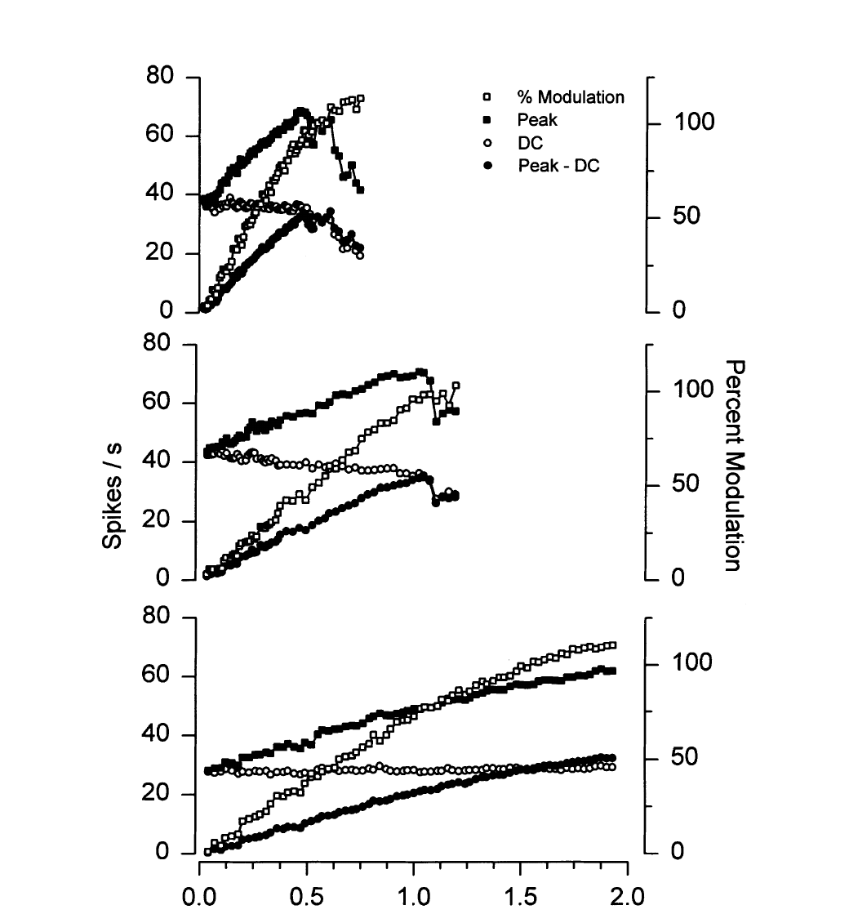
Near-threshold afferents have different response gains
Gain describes how strongly a neural response changes for a change in stimulus intensity. Tricas and New measured peak firing and resting firing while increasing a 1-Hz electric field. Different afferents had markedly different rate–intensity relationships under the same general preparation.
A high-gain example reached strong modulation near 0.5 µV/cm, while lower-gain units required larger gradients. The most sensitive afferents encoded peak gradients of approximately 20 nV/cm or less. Measuring the field rather than source current allowed neural sensitivity to be related to the local applied stimulus.
Higher sensitivity at weak fields comes with earlier saturation, because an afferent can reach a saturated response before another neuron becomes strongly modulated. Population diversity could therefore support detection and intensity representation over different ranges, with sensitive afferents covering weak fields and less sensitive ones covering stronger fields.
Tricas & New (1998), Fig. 5. Rate–intensity curves span distinct afferent gains.
Bellono et al. (2017), Fig. 1(c–d). Isolated ampulla and receptor cell.
Tricas & New (1998); Bellono et al. (2017)
20
Notes:
• Gain describes how strongly a neural response changes for a change in stimulus intensity. Tricas and New measured peak firing and resting firing while increasing a 1-Hz electric field. Different afferents had markedly different rate–intensity relationships under the same general preparation.
– Peak firing above the spontaneous rate and total peak firing are different quantities. Subtracting baseline isolates modulation, while the absolute spike rate indicates how much activity reaches the brain. The authors emphasized weak-field measurements because strong stimuli can conceal this variation through saturation.
• A high-gain example reached strong modulation near 0.5 µV/cm, while lower-gain units required larger gradients. The most sensitive afferents encoded peak gradients of approximately 20 nV/cm or less. Measuring the field rather than source current allowed neural sensitivity to be related to the local applied stimulus.
• Higher sensitivity at weak fields comes with earlier saturation, because an afferent can reach a saturated response before another neuron becomes strongly modulated. Population diversity could therefore support detection and intensity representation over different ranges, with sensitive afferents covering weak fields and less sensitive ones covering stronger fields.
References:
Tricas TC, New JG (1998). Sensitivity and response dynamics of elasmobranch electrosensory primary afferent neurons to near threshold fields. Journal of Comparative Physiology A: Sensory, Neural, and Behavioral Physiology 182(1):89-101. https://doi.org/10.1007/s003590050161
Bellono NW, Leitch DB, Julius D (2017). Molecular basis of ancestral vertebrate electroreception. Nature 543(7645):391-396. https://doi.org/10.1038/nature21401
Figure: Tricas & New (1998), Fig. 5. Rate–intensity curves span distinct afferent gains.
Figure source: https://doi.org/10.1007/s003590050161
Figure: Bellono et al. (2017), Fig. 1(c–d). Isolated ampulla and receptor cell.
Figure source: https://doi.org/10.1038/nature21401

Slide 28
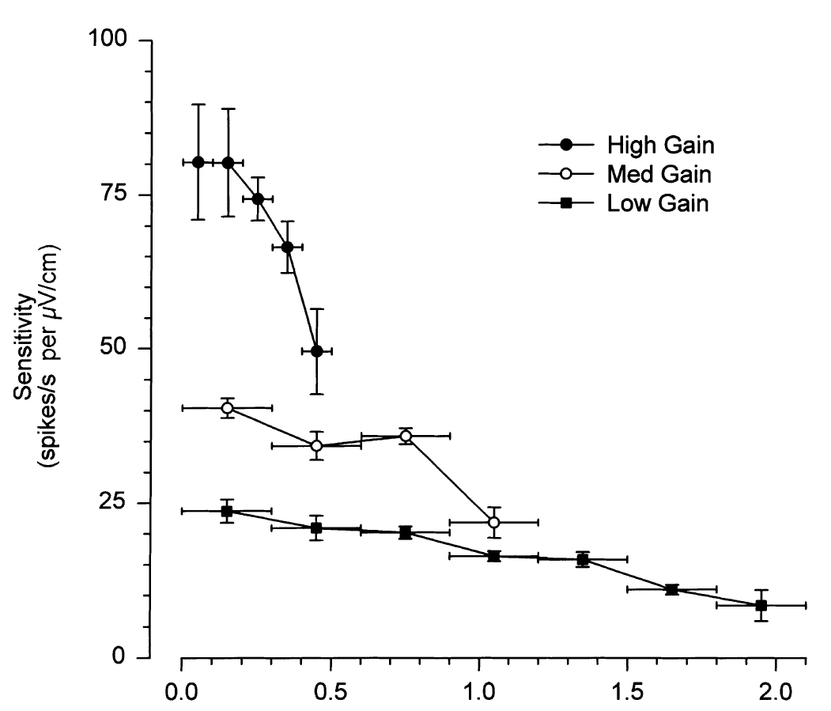
Saturation limits rate-based intensity encoding
Tricas and New calculated local slopes of each rate–intensity curve across successive stimulus intervals. The most sensitive example maintained a steep response only over the weakest range, then lost incremental gain as field intensity increased. Lower-gain afferents declined over different operating ranges.
For many units, peak-rate intensity encoding was lost below 1 µV/cm when peak firing roughly doubled resting discharge. Inhibitory phases were also clipped at zero spikes. A physical increase in the electric field therefore did not guarantee a proportional increase in the neuron’s available rate modulation.
Tricas & New (1998), Fig. 6. Incremental sensitivity falls as stimulus strength increases.
Saturation means that a response approaches a limit despite continued stimulus increase. It constrains what one afferent can report about source strength, while temporal information and the activity of afferents with other gains remain available.
Bellono et al. (2017), Fig. 1(c–d). Isolated ampulla and receptor cell.
Tricas & New (1998); Bellono et al. (2017)
21
Notes:
• Tricas and New calculated local slopes of each rate–intensity curve across successive stimulus intervals. The most sensitive example maintained a steep response only over the weakest range, then lost incremental gain as field intensity increased. Lower-gain afferents declined over different operating ranges.
– The analysis used successive portions of a measured response curve rather than assuming one linear gain for its full extent. A neuron’s weak-field slope can consequently overestimate its sensitivity to stronger fields. This distinction matters when comparing thresholds from experiments using very different stimulus amplitudes.
• For many units, peak-rate intensity encoding was lost below 1 µV/cm when peak firing roughly doubled resting discharge. Inhibitory phases were also clipped at zero spikes. A physical increase in the electric field therefore did not guarantee a proportional increase in the neuron’s available rate modulation.
• Saturation means that a response approaches a limit despite continued stimulus increase. It constrains what one afferent can report about source strength, while temporal information and the activity of afferents with other gains remain available.
References:
Tricas TC, New JG (1998). Sensitivity and response dynamics of elasmobranch electrosensory primary afferent neurons to near threshold fields. Journal of Comparative Physiology A: Sensory, Neural, and Behavioral Physiology 182(1):89-101. https://doi.org/10.1007/s003590050161
Bellono NW, Leitch DB, Julius D (2017). Molecular basis of ancestral vertebrate electroreception. Nature 543(7645):391-396. https://doi.org/10.1038/nature21401
Figure: Tricas & New (1998), Fig. 6. Incremental sensitivity falls as stimulus strength increases.
Figure source: https://doi.org/10.1007/s003590050161
Figure: Bellono et al. (2017), Fig. 1(c–d). Isolated ampulla and receptor cell.
Figure source: https://doi.org/10.1038/nature21401

Slide 29
Gain describes sensitivity to changes in intensity
Gain is the change in neural response per unit change in stimulus intensity. A high-gain neuron changes its firing steeply for a small change in field, and a low-gain neuron needs a larger change to produce the same effect. The slope is the quantity that describes gain at each stimulus level.
Tricas and New calculated local slopes of rate-intensity curves across successive stimulus intervals. The most sensitive example kept a steep response over the weakest range and then lost incremental gain.
Gain therefore varies with the stimulus level at which it is measured. Neurons with different gains cover different ranges of intensity, so a population of afferents can represent weak and strong fields. Gain also depends on whether the stimulus is weak or strong, so a single number does not describe a neuron.
Tricas & New (1998), Fig. 6. Incremental sensitivity falls as stimulus strength increases.
Bellono et al. (2017), Fig. 1(c–d). Isolated ampulla and receptor cell.
Tricas & New (1998)
21a
Notes:
• Sensitivity depends on where on the intensity axis a neuron is measured.
• Definition.
– Gain describes how strongly the response changes for a change in stimulus intensity.
• Local slope.
– Slopes were calculated across successive stimulus intervals of each rate-intensity curve.
• High-gain example.
– The most sensitive afferent had a steep response only over the weakest range.
– It then lost incremental gain as intensity increased.
• Lower-gain afferents.
– Lower-gain units declined over different operating ranges.
• Population.
– Different units operate over different ranges, so together they can represent a wide range of field strengths.
• Question addressed.
– The measurements ask how a single afferent changes its firing as the field becomes stronger.
– The answer depends on the range of intensities tested.
• Interpreting the curves.
– A steep part of a rate-intensity curve means that small changes in intensity change firing.
– A flat part means that the neuron no longer distinguishes stronger fields.
• Resting and peak rates.
– Peak firing and resting firing were both measured as the field increased.
– The difference between them describes how much the response can be modulated.
• Variation among units.
– Different afferents had markedly different rate-intensity relationships in the same preparation.
References:
Tricas TC, New JG (1998). Sensitivity and response dynamics of elasmobranch electrosensory primary afferent neurons to near threshold fields. Journal of Comparative Physiology A: Sensory, Neural, and Behavioral Physiology 182(1):89-101. https://doi.org/10.1007/s003590050161

Slide 30
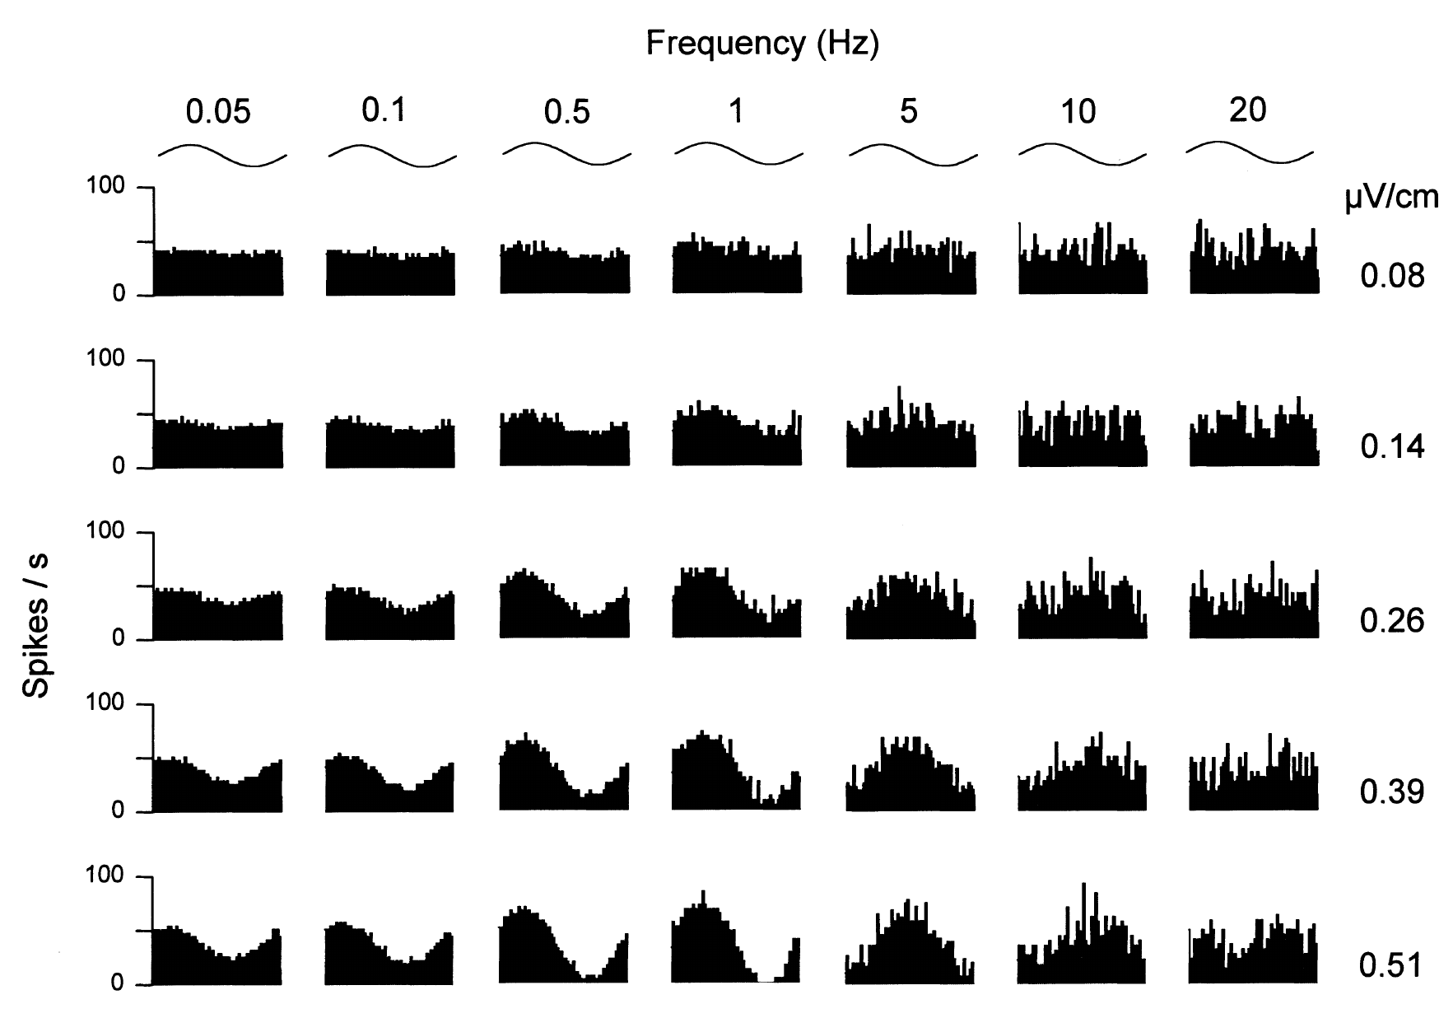
Frequency and intensity interact in afferent responses
Tricas and New varied both sinusoidal frequency and field intensity for individual round-stingray afferents. A period histogram groups spikes by their position within one stimulus cycle. It separates changes in temporal locking from a change in overall spontaneous discharge.
The published response matrix includes frequencies from 0.05 to 20 Hz and fields from 0.08 to 0.51 µV/cm. A representative unit was most sensitive near 1 Hz: approximately 0.08 µV/cm produced weak modulation, whereas around 0.4 µV/cm produced full modulation.
Frequency selectivity therefore depends on the response range used to measure it. Strong signals can saturate firing at favorable frequencies and conceal differences that are evident near threshold. The recordings connect receptor output to slow natural electrical fluctuations, with the most sensitive unit tuned near 1 Hz.
Tricas & New (1998), Fig. 7. Frequency and amplitude jointly determine afferent discharge.
Bellono et al. (2017), Fig. 1(c–d). Isolated ampulla and receptor cell.
Tricas & New (1998); Bellono et al. (2017)
22
Notes:
• Tricas and New varied both sinusoidal frequency and field intensity for individual round-stingray afferents. A period histogram groups spikes by their position within one stimulus cycle. It separates changes in temporal locking from a change in overall spontaneous discharge.
– At high frequencies the same amplitude could elicit much less modulation than near the best frequency. A best frequency is the stimulus rate yielding the strongest response under a specified condition, not a preferred acoustic tone. The tested input was an electric field changing over time.
• The published response matrix includes frequencies from 0.05 to 20 Hz and fields from 0.08 to 0.51 µV/cm. A representative unit was most sensitive near 1 Hz: approximately 0.08 µV/cm produced weak modulation, whereas around 0.4 µV/cm produced full modulation.
• Frequency selectivity therefore depends on the response range used to measure it. Strong signals can saturate firing at favorable frequencies and conceal differences that are evident near threshold. The recordings connect receptor output to slow natural electrical fluctuations, with the most sensitive unit tuned near 1 Hz.
References:
Tricas TC, New JG (1998). Sensitivity and response dynamics of elasmobranch electrosensory primary afferent neurons to near threshold fields. Journal of Comparative Physiology A: Sensory, Neural, and Behavioral Physiology 182(1):89-101. https://doi.org/10.1007/s003590050161
Bellono NW, Leitch DB, Julius D (2017). Molecular basis of ancestral vertebrate electroreception. Nature 543(7645):391-396. https://doi.org/10.1038/nature21401
Figure: Tricas & New (1998), Fig. 7. Frequency and amplitude jointly determine afferent discharge.
Figure source: https://doi.org/10.1007/s003590050161
Figure: Bellono et al. (2017), Fig. 1(c–d). Isolated ampulla and receptor cell.
Figure source: https://doi.org/10.1038/nature21401

Slide 31
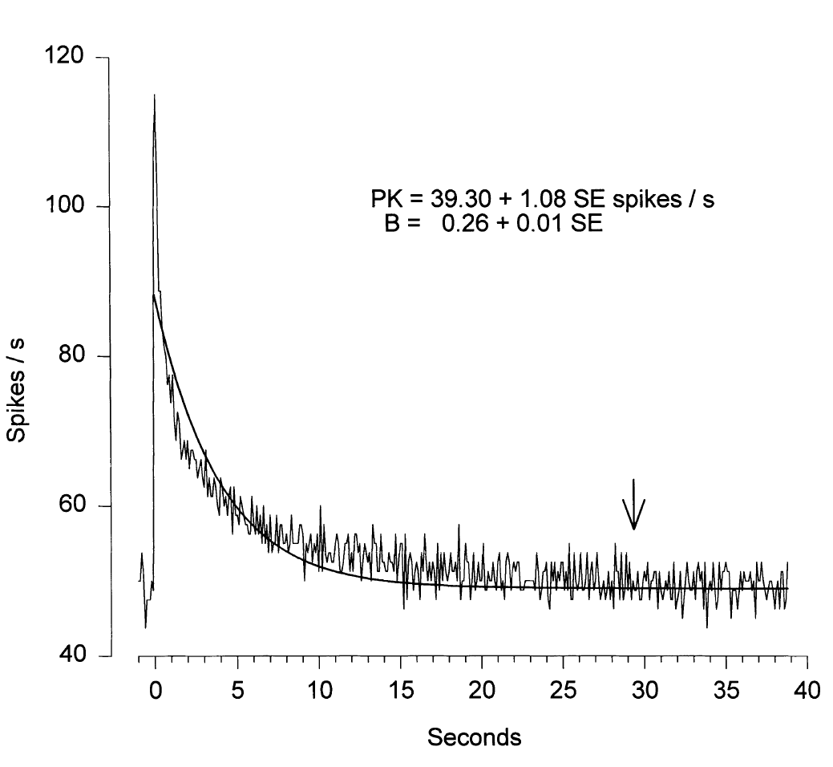
Sustained fields evoke adapting neural responses
Adaptation is a decline in response during maintained stimulation. Tricas and New applied direct-current field steps lasting 60 s to round-stingray afferents. A representative 2.2-µV/cm step caused a large initial increase in spike rate followed by a return toward the resting rate.
The measured decay had a time constant of approximately 4 s. Repeating steps allowed the response time course to be averaged without relying on a single spike train. The maintained physical input therefore differed from the transient information conveyed by the afferent output.
An adapting system can still detect a spatially stationary prey source because swimming changes the electrical input sampled at the pores. The physiological finding is the decline of the response during a maintained step, with a time constant of approximately 4 seconds, and adaptation emphasizes changes in the field over steady levels.
Tricas & New (1998), Fig. 9. Response to a sustained field adapts over seconds.
Bellono et al. (2017), Fig. 1(c–d). Isolated ampulla and receptor cell.
Tricas & New (1998); Bellono et al. (2017)
23
Notes:
• Adaptation is a decline in response during maintained stimulation. Tricas and New applied direct-current field steps lasting 60 s to round-stingray afferents. A representative 2.2-µV/cm step caused a large initial increase in spike rate followed by a return toward the resting rate.
– A time constant describes how rapidly the measured response approaches its adapted level. It does not mean that the stimulus lasted only four seconds or that all afferents adapt identically. The 60-second step was deliberately long enough to separate the initial response from sustained output.
• The measured decay had a time constant of approximately 4 s. Repeating steps allowed the response time course to be averaged without relying on a single spike train. The maintained physical input therefore differed from the transient information conveyed by the afferent output.
• An adapting system can still detect a spatially stationary prey source because swimming changes the electrical input sampled at the pores. The physiological finding is the decline of the response during a maintained step, with a time constant of approximately 4 seconds, and adaptation emphasizes changes in the field over steady levels.
References:
Tricas TC, New JG (1998). Sensitivity and response dynamics of elasmobranch electrosensory primary afferent neurons to near threshold fields. Journal of Comparative Physiology A: Sensory, Neural, and Behavioral Physiology 182(1):89-101. https://doi.org/10.1007/s003590050161
Bellono NW, Leitch DB, Julius D (2017). Molecular basis of ancestral vertebrate electroreception. Nature 543(7645):391-396. https://doi.org/10.1038/nature21401
Figure: Tricas & New (1998), Fig. 9. Response to a sustained field adapts over seconds.
Figure source: https://doi.org/10.1007/s003590050161
Figure: Bellono et al. (2017), Fig. 1(c–d). Isolated ampulla and receptor cell.
Figure source: https://doi.org/10.1038/nature21401

Slide 32
Adaptation emphasizes changes over steady fields
Adaptation is a decline in response during a maintained stimulus. The response is largest when the stimulus changes and smaller when the stimulus stays constant. Repeating steps allowed the response time course to be averaged across presentations.
Tricas and New applied direct-current field steps lasting 60 s to round-stingray afferents. A 2.2-µV/cm step caused a large initial rise in spike rate, followed by a return toward the resting rate with a time constant of approximately 4 s.
A swimming shark moves its pores through the field of a stationary prey source, so the input at the receptors changes with time. Adaptation therefore favors the changes that carry information about a source while a steady background is discounted.
Tricas & New (1998), Fig. 9. Response to a sustained field adapts over seconds.
Bellono et al. (2017), Fig. 1(c–d). Isolated ampulla and receptor cell.
Tricas & New (1998)
23a
Notes:
• A system that adapts reports changes, and a changing input is what a moving predator experiences.
• Definition.
– Adaptation is a decline of response during maintained stimulation.
• Step stimulus.
– Direct-current field steps lasted 60 seconds.
– A 2.2-microvolt-per-centimeter step produced a large initial increase in spike rate.
• Time course.
– The rate returned toward the resting rate with a time constant of approximately 4 seconds.
– Repeated steps allowed averaging of the response.
• Meaning for the animal.
– Swimming changes the field sampled at the pores, so a stationary prey source produces a changing input.
• Distinction.
– The physical input is maintained while the afferent output is transient.
• Why the decay matters.
– A decay time constant of about 4 seconds means that the response falls substantially within a few seconds of a step.
– Slow changes in the field are therefore reported less than fast changes.
• Sampling by swimming.
– As the shark swims past a source, the field at its pores changes continuously, which keeps the afferents responding.
References:
Tricas TC, New JG (1998). Sensitivity and response dynamics of elasmobranch electrosensory primary afferent neurons to near threshold fields. Journal of Comparative Physiology A: Sensory, Neural, and Behavioral Physiology 182(1):89-101. https://doi.org/10.1007/s003590050161

Slide 33
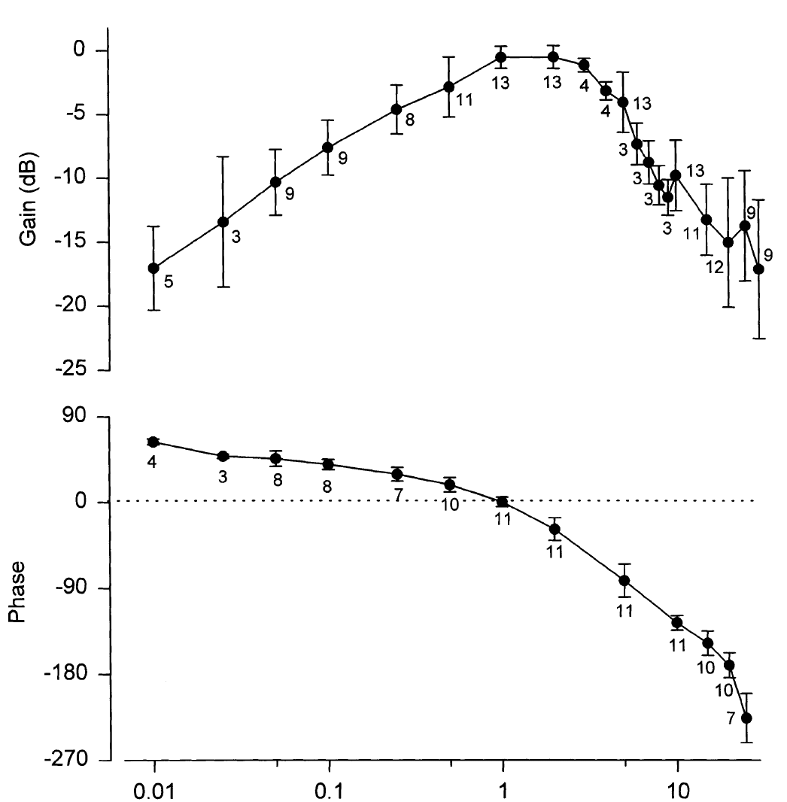
Round-stingray afferents favor slow field changes
Tricas and New measured response gain across sinusoidal electric-field frequencies while keeping stimulation weak enough to limit saturation. Nearly all tested round-stingray afferents had their best sensitivity at approximately 1–2 Hz. Responses fell at frequencies both below and above this range.
The normalized frequency response declined by 3 dB near 0.5 Hz and 4 Hz. Its low-frequency slope was approximately 8 dB per decade, and its high-frequency slope approximately −23 dB per decade. Normalizing each unit to its own maximum separated tuning shape from differences in absolute gain.
Tricas & New (1998), Fig. 10. Frequency-dependent gain and phase of primary afferents.
This band-pass tuning favors changes over a limited frequency range rather than either constant fields or arbitrarily rapid fluctuations. Slow prey and conspecific ventilation can supply relevant inputs. The slopes on the two sides of the optimum describe how steeply sensitivity falls for slower and faster fields.
Bellono et al. (2017), Fig. 1(c–d). Isolated ampulla and receptor cell.
Tricas & New (1998); Bellono et al. (2017)
24
Notes:
• Tricas and New measured response gain across sinusoidal electric-field frequencies while keeping stimulation weak enough to limit saturation. Nearly all tested round-stingray afferents had their best sensitivity at approximately 1–2 Hz. Responses fell at frequencies both below and above this range.
– A phase plot measures whether peak neural activity occurs before, with, or after a particular phase of the applied sinusoid. The representative population response was approximately in phase near 1 Hz. Frequency-dependent phase and gain together describe how an afferent transforms a changing field.
• The normalized frequency response declined by 3 dB near 0.5 Hz and 4 Hz. Its low-frequency slope was approximately 8 dB per decade, and its high-frequency slope approximately −23 dB per decade. Normalizing each unit to its own maximum separated tuning shape from differences in absolute gain.
• This band-pass tuning favors changes over a limited frequency range rather than either constant fields or arbitrarily rapid fluctuations. Slow prey and conspecific ventilation can supply relevant inputs. The slopes on the two sides of the optimum describe how steeply sensitivity falls for slower and faster fields.
References:
Tricas TC, New JG (1998). Sensitivity and response dynamics of elasmobranch electrosensory primary afferent neurons to near threshold fields. Journal of Comparative Physiology A: Sensory, Neural, and Behavioral Physiology 182(1):89-101. https://doi.org/10.1007/s003590050161
Bellono NW, Leitch DB, Julius D (2017). Molecular basis of ancestral vertebrate electroreception. Nature 543(7645):391-396. https://doi.org/10.1038/nature21401
Figure: Tricas & New (1998), Fig. 10. Frequency-dependent gain and phase of primary afferents.
Figure source: https://doi.org/10.1007/s003590050161
Figure: Bellono et al. (2017), Fig. 1(c–d). Isolated ampulla and receptor cell.
Figure source: https://doi.org/10.1038/nature21401

Slide 34
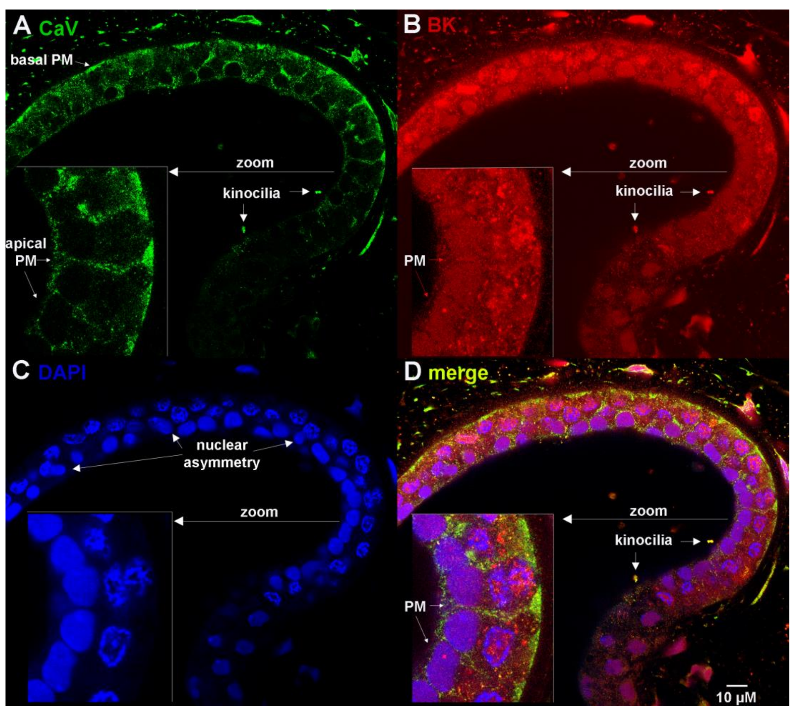
Channel proteins occupy specific receptor compartments
Chen and colleagues used whole-mount confocal microscopy to localize channel proteins in intact little-skate ampullae. CaV1.3 is a voltage-gated calcium channel; BK is a calcium-activated potassium channel. Antibody staining was combined with DAPI, a fluorescent label for nuclear DNA.
CaV1.3 and BK immunoreactivity occurred in receptor plasma membranes, nuclear envelopes, and kinocilia, the ciliary projections facing the lumen. Overlapping signals were measured in the preserved sensory epithelium rather than inferred solely from tissue-wide RNA expression. Blocking-peptide experiments supplied controls for the BK antibody.
Localization of CaV1.3 and BK in receptor membranes, nuclear envelopes and kinocilia identifies candidate cellular sites for the channels that shape receptor activity. A nuclear-localization sequence tested through mutations in transfected cells was proposed to account for the nuclear signal.
Chen et al. (2023), Fig. 2(A–D). CaV1.3 and BK localization in receptor epithelium.
Chen et al. (2023)
25
Notes:
• Chen and colleagues used whole-mount confocal microscopy to localize channel proteins in intact little-skate ampullae. CaV1.3 is a voltage-gated calcium channel; BK is a calcium-activated potassium channel. Antibody staining was combined with DAPI, a fluorescent label for nuclear DNA.
– A plasma membrane separates cytoplasm from extracellular fluid, whereas the nuclear envelope surrounds the nucleus. The same channel protein can occupy both compartments. Confocal sections distinguish their locations, but electrophysiology is still needed to assign each population a specific contribution to receptor signaling.
• CaV1.3 and BK immunoreactivity occurred in receptor plasma membranes, nuclear envelopes, and kinocilia, the ciliary projections facing the lumen. Overlapping signals were measured in the preserved sensory epithelium rather than inferred solely from tissue-wide RNA expression. Blocking-peptide experiments supplied controls for the BK antibody.
• Localization of CaV1.3 and BK in receptor membranes, nuclear envelopes and kinocilia identifies candidate cellular sites for the channels that shape receptor activity. A nuclear-localization sequence tested through mutations in transfected cells was proposed to account for the nuclear signal.
References:
Chen AL, Wu TH, Shi L, Clusin WT, Kao PN (2023). Calcium-Activated Big-Conductance (BK) Potassium Channels Traffic through Nuclear Envelopes into Kinocilia in Ray Electrosensory Cells. Cells 12(17):2125. https://doi.org/10.3390/cells12172125
Figure: Chen et al. (2023), Fig. 2(A–D). CaV1.3 and BK localization in receptor epithelium.
Figure source: https://doi.org/10.3390/cells12172125

Slide 35
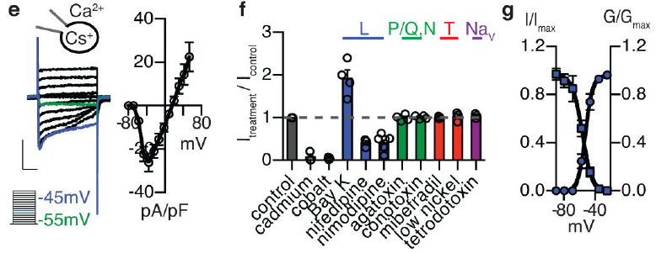
Low-threshold calcium current initiates receptor activity
Bellono and colleagues patch-clamped dissociated little-skate electrosensory cells. Voltage clamp holds membrane voltage at commanded values while measuring current. Intracellular cesium suppressed potassium currents, revealing an inward calcium current activated at unusually negative membrane potentials.
Native calcium conductance reached half-maximal activation near −52 mV. Inactivation reduces channel availability during sustained stimulation. Its slow development left a window current, persistent activity where activation and availability overlap, between approximately −70 and −30 mV. The window peaked near −58 mV, close to the receptor’s normal operating voltage.
Bellono et al. (2017), Fig. 1(e–g). Low-threshold calcium currents and channel pharmacology.
L-type calcium-channel modulators altered this current, whereas tested sodium-channel and several other calcium-channel antagonists did not. Pharmacology identified a functional channel class; transcript measurements subsequently implicated CaV1.3. Calcium entry can depolarize the receptor and drive release of transmitter onto the afferent.
Bellono et al. (2017), Fig. 1(c–d). Isolated ampulla and receptor cell.
Bellono et al. (2017)
26
Notes:
• Bellono and colleagues patch-clamped dissociated little-skate electrosensory cells. Voltage clamp holds membrane voltage at commanded values while measuring current. Intracellular cesium suppressed potassium currents, revealing an inward calcium current activated at unusually negative membrane potentials.
– An inward current reflects positive charge entering the cell under these conditions. Activation and inactivation were measured with distinct pulse protocols, so their overlap describes available sustained current rather than a separate ion-channel species. Direct membrane measurements complement organ-level amplification experiments.
• Native calcium conductance reached half-maximal activation near −52 mV. Inactivation reduces channel availability during sustained stimulation. Its slow development left a window current, persistent activity where activation and availability overlap, between approximately −70 and −30 mV. The window peaked near −58 mV, close to the receptor’s normal operating voltage.
• L-type calcium-channel modulators altered this current, whereas tested sodium-channel and several other calcium-channel antagonists did not. Pharmacology identified a functional channel class; transcript measurements subsequently implicated CaV1.3. Calcium entry can depolarize the receptor and drive release of transmitter onto the afferent.
References:
Bellono NW, Leitch DB, Julius D (2017). Molecular basis of ancestral vertebrate electroreception. Nature 543(7645):391-396. https://doi.org/10.1038/nature21401
Figure: Bellono et al. (2017), Fig. 1(e–g). Low-threshold calcium currents and channel pharmacology.
Figure source: https://doi.org/10.1038/nature21401
Figure: Bellono et al. (2017), Fig. 1(c–d). Isolated ampulla and receptor cell.
Figure source: https://doi.org/10.1038/nature21401

Slide 36
A window current sustains activity near rest
A window current is a persistent current that flows where the activation curve of a channel overlaps the curve of its availability. Over that voltage range, channels open and remain available at the same time.
Bellono and colleagues patch-clamped dissociated little-skate receptor cells with cesium inside to suppress potassium currents. The native calcium conductance reached half-maximal activation near −52 mV, and the window current extended from about −70 to −30 mV and peaked near −58 mV.
Bellono et al. (2017), Fig. 1(e–g). Low-threshold calcium currents and channel pharmacology.
The peak lies close to the normal operating voltage of the receptor. A calcium current that is active at rest allows small changes in membrane voltage to change calcium entry and therefore transmitter release.
Bellono et al. (2017), Fig. 1(c–d). Isolated ampulla and receptor cell.
Bellono et al. (2017)
26a
Notes:
• A window current allows a channel to contribute at voltages near rest.
• Definition.
– A window current flows where activation and availability overlap.
– Channels in that range are open and not inactivated.
• Recording method.
– Voltage clamp holds the membrane at commanded voltages while measuring current.
– Cesium inside the cell suppressed potassium currents.
• Numbers.
– Half-maximal activation was near minus 52 millivolts.
– The window extended from about minus 70 to minus 30 millivolts and peaked near minus 58 millivolts.
• Receptor operating voltage.
– The peak lies close to the normal operating voltage of the receptor.
• Consequence.
– Small voltage changes near rest change calcium entry, which controls release at the synapse.
• Pharmacology.
– L-type calcium-channel modulators altered the current.
– Tested sodium-channel antagonists and several other calcium-channel antagonists did not.
• Molecular identity.
– Transcript measurements implicated CaV1.3, an L-type channel.
• Reading the current.
– An inward current carries positive charge into the cell and depolarizes it.
– Activation at unusually negative voltages means the channel opens close to rest.
• Inactivation.
– Inactivation reduces the number of channels available during sustained stimulation, and its slow development leaves the window current.
References:
Bellono NW, Leitch DB, Julius D (2017). Molecular basis of ancestral vertebrate electroreception. Nature 543(7645):391-396. https://doi.org/10.1038/nature21401

Slide 37
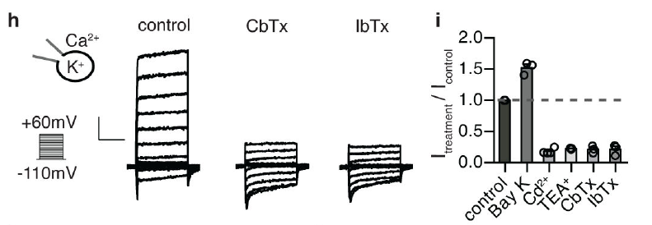
Calcium entry recruits an outward BK current
Bellono and colleagues replaced the cesium-based recording solution with a potassium-based solution to measure receptor outward currents. Calcium-activated potassium channels open more readily when intracellular calcium rises. Potassium efflux counteracts calcium-driven depolarization and can return the membrane toward negative voltages.
The outward current was reduced by tetraethylammonium and selective BK antagonists, including iberiotoxin and charybdotoxin. Calcium-channel inhibition also reduced it, whereas enhancing calcium entry increased potassium current. These linked perturbations support functional coupling between inward calcium current and BK-mediated outward current.
Bellono et al. (2017), Fig. 1(h–i). Calcium-dependent potassium current and BK blockade.
The coupling supplies negative feedback: depolarization opens calcium channels, calcium recruits BK, and potassium current promotes repolarization. Blockers of calcium entry and of BK channels each altered the current, so the dominant measured outward current of the receptor cell is BK mediated.
Bellono et al. (2017), Fig. 1(c–d). Isolated ampulla and receptor cell.
Bellono et al. (2017)
27
Notes:
• Bellono and colleagues replaced the cesium-based recording solution with a potassium-based solution to measure receptor outward currents. Calcium-activated potassium channels open more readily when intracellular calcium rises. Potassium efflux counteracts calcium-driven depolarization and can return the membrane toward negative voltages.
– The receptor’s outward current depended on calcium availability, distinguishing it from a purely voltage-gated potassium conductance. Drug effects were assessed on measured currents rather than assigned solely from gene names. A feedback relationship can exist through local calcium signaling without requiring a stable channel complex.
• The outward current was reduced by tetraethylammonium and selective BK antagonists, including iberiotoxin and charybdotoxin. Calcium-channel inhibition also reduced it, whereas enhancing calcium entry increased potassium current. These linked perturbations support functional coupling between inward calcium current and BK-mediated outward current.
• The coupling supplies negative feedback: depolarization opens calcium channels, calcium recruits BK, and potassium current promotes repolarization. Blockers of calcium entry and of BK channels each altered the current, so the dominant measured outward current of the receptor cell is BK mediated.
References:
Bellono NW, Leitch DB, Julius D (2017). Molecular basis of ancestral vertebrate electroreception. Nature 543(7645):391-396. https://doi.org/10.1038/nature21401
Figure: Bellono et al. (2017), Fig. 1(h–i). Calcium-dependent potassium current and BK blockade.
Figure source: https://doi.org/10.1038/nature21401
Figure: Bellono et al. (2017), Fig. 1(c–d). Isolated ampulla and receptor cell.
Figure source: https://doi.org/10.1038/nature21401

Slide 38
Negative feedback returns the membrane toward rest
Negative feedback is a process in which a change sets in motion an opposing change. In the receptor cell, calcium entry depolarizes the membrane, and the resulting rise in calcium recruits an outward potassium current that opposes the depolarization. The same feedback also sets how quickly the cell can respond to the next change in voltage.
Bellono and colleagues measured outward currents with a potassium-based solution. Tetraethylammonium, iberiotoxin and charybdotoxin reduced the current, calcium-channel inhibition also reduced it, and enhancing calcium entry increased it.
Bellono et al. (2017), Fig. 1(h–i). Calcium-dependent potassium current and BK blockade.
The linked effects of these manipulations indicate coupling between the inward calcium current and BK-mediated outward current. Potassium efflux returns the membrane toward negative voltages and sets the timing of the next depolarization. Each of these steps was tested with a drug or an ion substitution.
Bellono et al. (2017), Fig. 1(c–d). Isolated ampulla and receptor cell.
Bellono et al. (2017)
27a
Notes:
• The receptor cell contains its own mechanism for limiting depolarization.
• Sequence.
– Depolarization opens calcium channels.
– Calcium recruits BK channels, and potassium efflux repolarizes the membrane.
• Measurement.
– A potassium-based solution allowed the outward currents to be measured.
• Blockers.
– Tetraethylammonium, iberiotoxin and charybdotoxin reduced the current.
– Iberiotoxin and charybdotoxin are selective BK antagonists.
• Calcium dependence.
– Calcium-channel inhibition reduced the current.
– Enhancing calcium entry increased it.
• Meaning.
– The coupling supplies negative feedback that shapes the oscillations of the receptor.
• Why two features matter.
– A calcium current alone would depolarize the cell until calcium entry stopped.
– A potassium current activated by calcium returns the membrane toward rest.
• Evidence from perturbation.
– Changing the calcium current changed the potassium current in the same direction.
– This linked effect supports functional coupling between the two currents.
• Solutions.
– Replacing the cesium-based solution with a potassium-based solution allowed outward currents to be measured.
– Cesium had suppressed potassium currents in the earlier recordings.
• Role in the cell.
– Potassium efflux counteracts depolarization from calcium entry, so the membrane voltage can oscillate.
References:
Bellono NW, Leitch DB, Julius D (2017). Molecular basis of ancestral vertebrate electroreception. Nature 543(7645):391-396. https://doi.org/10.1038/nature21401

Slide 39
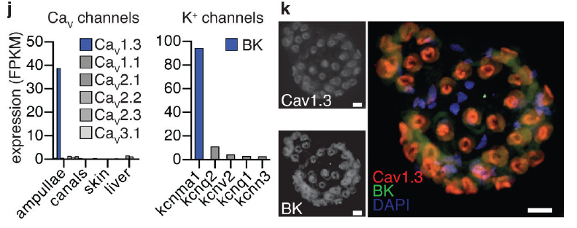
Receptor cells strongly enrich CaV1.3 and BK transcripts
Bellono and colleagues sequenced RNA from little-skate ampullary organs and comparison tissues. A transcript is an RNA copy of a gene. The gene cacna1d, encoding CaV1.3’s pore-forming subunit, was enriched more than 90-fold relative to other tissues examined.
The BK pore-forming gene kcnma1 was expressed more than 35-fold above other calcium-activated potassium-channel genes in ampullae. In situ hybridization localized CaV1.3 and BK transcripts together in electrosensory cells, with little detectable signal in supporting cells or canal structures.
Bellono et al. (2017), Fig. 1(j–k). Channel transcript enrichment and cellular colocalization.
Expression specificity links the pharmacologically identified currents to molecular candidates in the appropriate cells. Agreement among current recordings, blocker responses, expression and cellular localization strengthens the assignment of CaV1.3 and BK to the electrosensory cells.
Bellono et al. (2017), Fig. 1(c–d). Isolated ampulla and receptor cell.
Bellono et al. (2017)
28
Notes:
• Bellono and colleagues sequenced RNA from little-skate ampullary organs and comparison tissues. A transcript is an RNA copy of a gene. The gene cacna1d, encoding CaV1.3’s pore-forming subunit, was enriched more than 90-fold relative to other tissues examined.
– In situ hybridization uses complementary probes to locate particular RNA sequences in tissue. It differs from antibody staining of protein and from whole-tissue sequencing. Combining these methods reduces the possibility that an abundant transcript originated only from an unrelated cell type within the sampled organ.
• The BK pore-forming gene kcnma1 was expressed more than 35-fold above other calcium-activated potassium-channel genes in ampullae. In situ hybridization localized CaV1.3 and BK transcripts together in electrosensory cells, with little detectable signal in supporting cells or canal structures.
• Expression specificity links the pharmacologically identified currents to molecular candidates in the appropriate cells. Agreement among current recordings, blocker responses, expression and cellular localization strengthens the assignment of CaV1.3 and BK to the electrosensory cells.
References:
Bellono NW, Leitch DB, Julius D (2017). Molecular basis of ancestral vertebrate electroreception. Nature 543(7645):391-396. https://doi.org/10.1038/nature21401
Figure: Bellono et al. (2017), Fig. 1(j–k). Channel transcript enrichment and cellular colocalization.
Figure source: https://doi.org/10.1038/nature21401
Figure: Bellono et al. (2017), Fig. 1(c–d). Isolated ampulla and receptor cell.
Figure source: https://doi.org/10.1038/nature21401

Slide 40
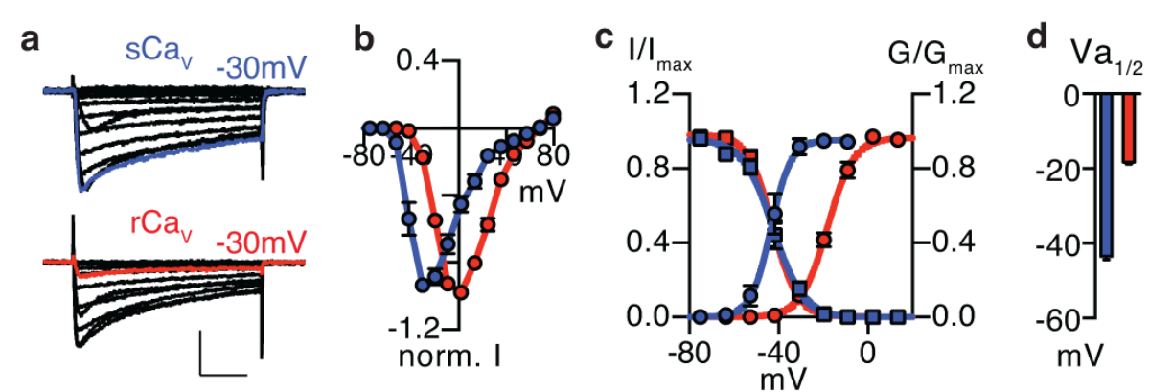
Skate CaV1.3 opens at more negative voltages
Bellono and colleagues expressed cloned skate and rat CaV1.3 channels in HEK293 cells, a mammalian cell line used for controlled channel measurements. Matched recording conditions tested whether low-threshold activation was intrinsic to the skate channel rather than unique to the intact receptor environment.
Half-maximal activation was approximately −42.7 mV for skate CaV1.3 and −18.2 mV for the rat long isoform. Their inactivation relations were similar, so the negative shift in activation enlarged the skate channel’s window-current range. Current traces and normalized conductance curves supported the same comparison.
Bellono et al. (2017), Fig. 2(a–d). Skate and rat CaV1.3 activation properties.
The channel sequence therefore contributes directly to low-voltage opening. The cloned channel’s activation value differs from the native receptor value near −52 mV because experimental context and associated proteins can modify gating. Heterologous expression isolates the molecular properties of the channel itself.
Bellono et al. (2017), Fig. 1(c–d). Isolated ampulla and receptor cell.
Bellono et al. (2017)
29
Notes:
• Bellono and colleagues expressed cloned skate and rat CaV1.3 channels in HEK293 cells, a mammalian cell line used for controlled channel measurements. Matched recording conditions tested whether low-threshold activation was intrinsic to the skate channel rather than unique to the intact receptor environment.
– Conductance describes the channel-mediated relation between electrical driving force and current. Normalization permits comparison of opening behavior despite differences in expression level. The rat comparison was to a specified isoform, so it should not be generalized to every mammalian CaV1.3 splice variant.
• Half-maximal activation was approximately −42.7 mV for skate CaV1.3 and −18.2 mV for the rat long isoform. Their inactivation relations were similar, so the negative shift in activation enlarged the skate channel’s window-current range. Current traces and normalized conductance curves supported the same comparison.
• The channel sequence therefore contributes directly to low-voltage opening. The cloned channel’s activation value differs from the native receptor value near −52 mV because experimental context and associated proteins can modify gating. Heterologous expression isolates the molecular properties of the channel itself.
References:
Bellono NW, Leitch DB, Julius D (2017). Molecular basis of ancestral vertebrate electroreception. Nature 543(7645):391-396. https://doi.org/10.1038/nature21401
Figure: Bellono et al. (2017), Fig. 2(a–d). Skate and rat CaV1.3 activation properties.
Figure source: https://doi.org/10.1038/nature21401
Figure: Bellono et al. (2017), Fig. 1(c–d). Isolated ampulla and receptor cell.
Figure source: https://doi.org/10.1038/nature21401

Slide 41
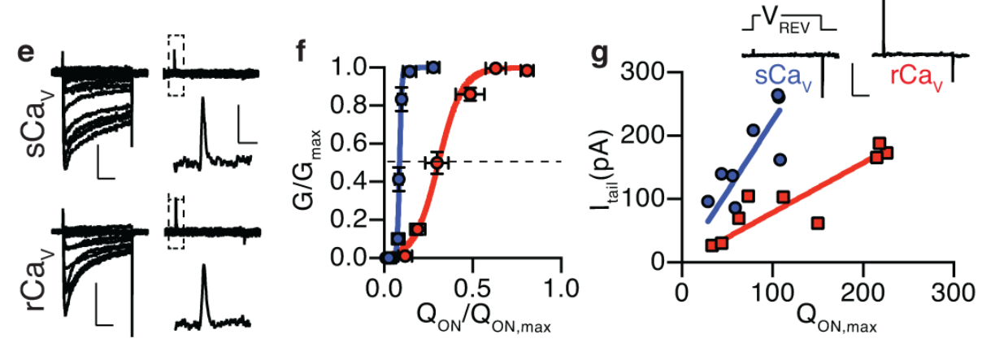
Efficient sensor–pore coupling lowers activation voltage
A voltage-gated channel contains voltage-sensitive elements coupled to an ion-conducting pore. Gating current records charge movement within these elements rather than ion flow through the open pore. Bellono and colleagues measured both gating charge and ionic conductance in cells expressing skate or rat CaV1.3.
Their voltage-dependent charge movement was broadly similar, yet skate channels achieved substantial conductance with less relative sensor movement. Returning from a depolarizing command to −100 mV also produced larger skate tail currents for comparable gating charge. A tail current reports open channels after the voltage change.
Bellono et al. (2017), Fig. 2(e–g). Gating charge and pore-opening efficiency.
The low threshold therefore reflects enhanced coupling between sensor movement and pore opening, rather than merely a larger number of moving charges. These functional measurements constrain gating mechanisms without resolving the channel’s complete three-dimensional structure. A small domain-specific sensor shift could also escape measurements combining all four channel domains.
Bellono et al. (2017), Fig. 1(c–d). Isolated ampulla and receptor cell.
Bellono et al. (2017)
30
Notes:
• A voltage-gated channel contains voltage-sensitive elements coupled to an ion-conducting pore. Gating current records charge movement within these elements rather than ion flow through the open pore. Bellono and colleagues measured both gating charge and ionic conductance in cells expressing skate or rat CaV1.3.
– A voltage sensor can move without producing maximal pore opening if coupling is inefficient. Ionic and gating recordings separate these two steps experimentally. The authors subsequently used sequence mutations to identify a region capable of changing that coupling, rather than relying on the comparison alone.
• Their voltage-dependent charge movement was broadly similar, yet skate channels achieved substantial conductance with less relative sensor movement. Returning from a depolarizing command to −100 mV also produced larger skate tail currents for comparable gating charge. A tail current reports open channels after the voltage change.
• The low threshold therefore reflects enhanced coupling between sensor movement and pore opening, rather than merely a larger number of moving charges. These functional measurements constrain gating mechanisms without resolving the channel’s complete three-dimensional structure. A small domain-specific sensor shift could also escape measurements combining all four channel domains.
References:
Bellono NW, Leitch DB, Julius D (2017). Molecular basis of ancestral vertebrate electroreception. Nature 543(7645):391-396. https://doi.org/10.1038/nature21401
Figure: Bellono et al. (2017), Fig. 2(e–g). Gating charge and pore-opening efficiency.
Figure source: https://doi.org/10.1038/nature21401
Figure: Bellono et al. (2017), Fig. 1(c–d). Isolated ampulla and receptor cell.
Figure source: https://doi.org/10.1038/nature21401

Slide 42
Gating charge and tail current report channel coupling
Gating current records the movement of charge inside the voltage-sensing parts of a channel. Ionic conductance records current through the open pore, and the relation between the two reports how efficiently sensor movement opens the pore. Both records are obtained from the same cell under voltage clamp.
Bellono and colleagues measured both in cells expressing skate or rat CaV1.3. Voltage-dependent charge movement was broadly similar, but skate channels reached substantial conductance with less relative sensor movement.
Bellono et al. (2017), Fig. 2(e–g). Gating charge and pore-opening efficiency.
A tail current is the current recorded after the voltage returns to a negative value, and it reports channels that were open at the end of the command. Skate channels produced larger tail currents for comparable gating charge, which indicates enhanced coupling.
Bellono et al. (2017), Fig. 1(c–d). Isolated ampulla and receptor cell.
Bellono et al. (2017)
30a
Notes:
• Two measurements separate sensor movement from pore opening.
• Gating current.
– Gating current records charge movement within the voltage sensors.
– It does not record ion flow through the open pore.
• Conductance.
– Ionic conductance records current through the open channel.
• Result.
– Charge movement was broadly similar in skate and rat channels.
– Skate channels reached substantial conductance with less relative sensor movement.
• Tail current.
– The voltage returned to minus 100 millivolts after a depolarizing command.
– The tail current reports the channels that were open.
• Meaning.
– A low activation voltage reflects enhanced coupling between sensor and pore and not a larger number of moving charges.
• Skate and rat comparison.
– Skate and rat CaV1.3 were expressed under matched recording conditions.
– Differences between them therefore belong to the channels.
• Interpretation.
– Efficient coupling means that a given movement of the voltage sensor opens more of the pore, which lowers the voltage required for activation.
• Voltage sensors and pore.
– A voltage-gated channel contains voltage-sensitive elements coupled to an ion-conducting pore.
– Coupling describes how well sensor movement opens the pore.
• Return to negative voltage.
– Returning from a depolarizing command to minus 100 millivolts produced larger skate tail currents for comparable gating charge.
References:
Bellono NW, Leitch DB, Julius D (2017). Molecular basis of ancestral vertebrate electroreception. Nature 543(7645):391-396. https://doi.org/10.1038/nature21401

Slide 43
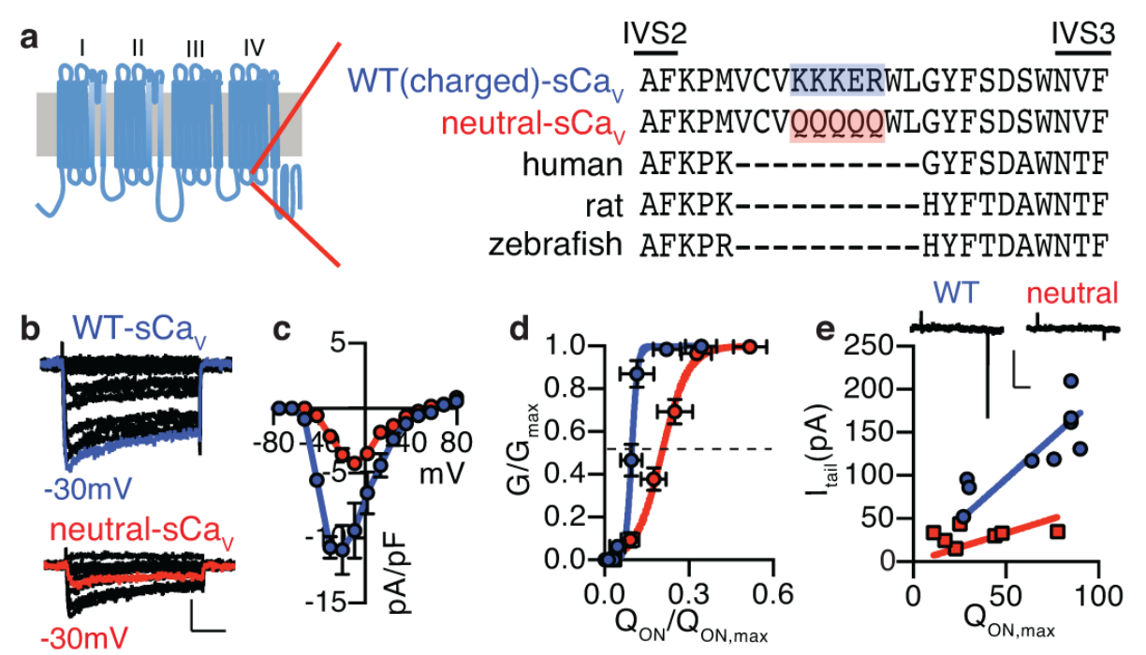
A charged CaV1.3 motif is necessary for low threshold
Comparing CaV1.3 sequences identified a skate insertion in an intracellular loop of domain IV. A motif is a short sequence with a characteristic structural or functional role. The insertion KKKER adds net positive charge between transmembrane segments S2 and S3.
Bellono and colleagues replaced its charged residues with neutral glutamines, producing QQQQQ. In the matched mutation experiment, half-maximal activation shifted from approximately −37.2 mV in the wild-type skate channel to −26.0 mV in the neutralized channel. Sensor–pore coupling also weakened without a comparable change in total gating-charge behavior.
Bellono et al. (2017), Fig. 3(a–e). Charge-neutralization tests the skate channel motif.
The controlled substitution establishes a causal contribution of these residues to low-threshold activation. Electrostatic repulsion of the nearby voltage sensor was proposed as an explanation, supported by kinetic tests. Neutralizing the charge weakened sensor-pore coupling, which links the positive charge of the motif to the efficient coupling that lowers the activation voltage.
Bellono et al. (2017), Fig. 1(c–d). Isolated ampulla and receptor cell.
Bellono et al. (2017)
31
Notes:
• Comparing CaV1.3 sequences identified a skate insertion in an intracellular loop of domain IV. A motif is a short sequence with a characteristic structural or functional role. The insertion KKKER adds net positive charge between transmembrane segments S2 and S3.
– A mutation changes the tested channel sequence while the expression system and recording protocol remain matched. The result concerns the effect of the charged insertion within this molecular background. Its causal importance does not imply that it is the only residue or regulatory influence governing native receptor sensitivity.
• Bellono and colleagues replaced its charged residues with neutral glutamines, producing QQQQQ. In the matched mutation experiment, half-maximal activation shifted from approximately −37.2 mV in the wild-type skate channel to −26.0 mV in the neutralized channel. Sensor–pore coupling also weakened without a comparable change in total gating-charge behavior.
• The controlled substitution establishes a causal contribution of these residues to low-threshold activation. Electrostatic repulsion of the nearby voltage sensor was proposed as an explanation, supported by kinetic tests. Neutralizing the charge weakened sensor-pore coupling, which links the positive charge of the motif to the efficient coupling that lowers the activation voltage.
References:
Bellono NW, Leitch DB, Julius D (2017). Molecular basis of ancestral vertebrate electroreception. Nature 543(7645):391-396. https://doi.org/10.1038/nature21401
Figure: Bellono et al. (2017), Fig. 3(a–e). Charge-neutralization tests the skate channel motif.
Figure source: https://doi.org/10.1038/nature21401
Figure: Bellono et al. (2017), Fig. 1(c–d). Isolated ampulla and receptor cell.
Figure source: https://doi.org/10.1038/nature21401

Slide 44
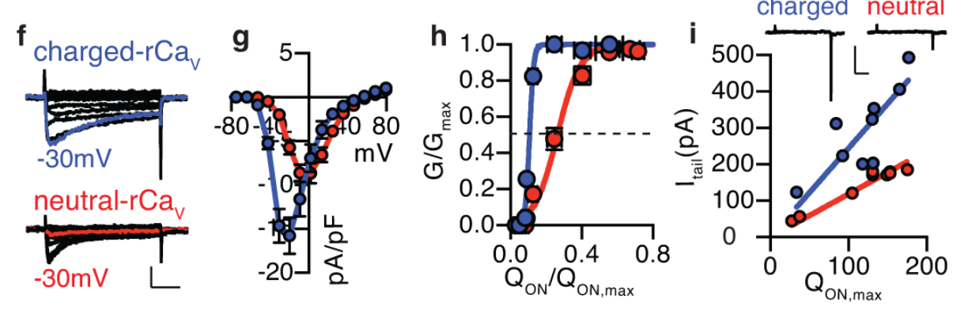
The skate motif transfers sensitivity to a rat channel
Bellono and colleagues inserted the charged skate motif into rat CaV1.3 and compared it with an otherwise comparable neutral insertion. This gain-of-function experiment asks whether the sequence can confer a property on a channel that normally lacks it, complementing its neutralization in skate.
The charged rat construct activated at more negative potentials than the neutral construct; reported half-activation values were approximately −37.2 and −19.6 mV. Conductance required less relative gating charge, and tail currents increased for comparable charge movement. The transferred motif altered coupling as well as the activation curve.
Bellono et al. (2017), Fig. 3(f–i). Transfer of the skate motif alters rat channel gating.
Necessity and transfer experiments together provide stronger causal evidence than sequence correlation alone. Neutralizing the motif in skate CaV1.3 and inserting it into rat CaV1.3 produce opposite changes in activation, which together identify the charged residues as a determinant of low-voltage opening.
Bellono et al. (2017), Fig. 1(c–d). Isolated ampulla and receptor cell.
Bellono et al. (2017)
32
Notes:
• Bellono and colleagues inserted the charged skate motif into rat CaV1.3 and compared it with an otherwise comparable neutral insertion. This gain-of-function experiment asks whether the sequence can confer a property on a channel that normally lacks it, complementing its neutralization in skate.
– The neutral insertion controlled for adding a short sequence without its positive charge. Comparisons within each experiment avoid treating values from different expression protocols as a single absolute threshold. The molecular result supplies a plausible amplification component rather than a complete explanation of behavioral field sensitivity.
• The charged rat construct activated at more negative potentials than the neutral construct; reported half-activation values were approximately −37.2 and −19.6 mV. Conductance required less relative gating charge, and tail currents increased for comparable charge movement. The transferred motif altered coupling as well as the activation curve.
• Necessity and transfer experiments together provide stronger causal evidence than sequence correlation alone. Neutralizing the motif in skate CaV1.3 and inserting it into rat CaV1.3 produce opposite changes in activation, which together identify the charged residues as a determinant of low-voltage opening.
References:
Bellono NW, Leitch DB, Julius D (2017). Molecular basis of ancestral vertebrate electroreception. Nature 543(7645):391-396. https://doi.org/10.1038/nature21401
Figure: Bellono et al. (2017), Fig. 3(f–i). Transfer of the skate motif alters rat channel gating.
Figure source: https://doi.org/10.1038/nature21401
Figure: Bellono et al. (2017), Fig. 1(c–d). Isolated ampulla and receptor cell.
Figure source: https://doi.org/10.1038/nature21401

Slide 45
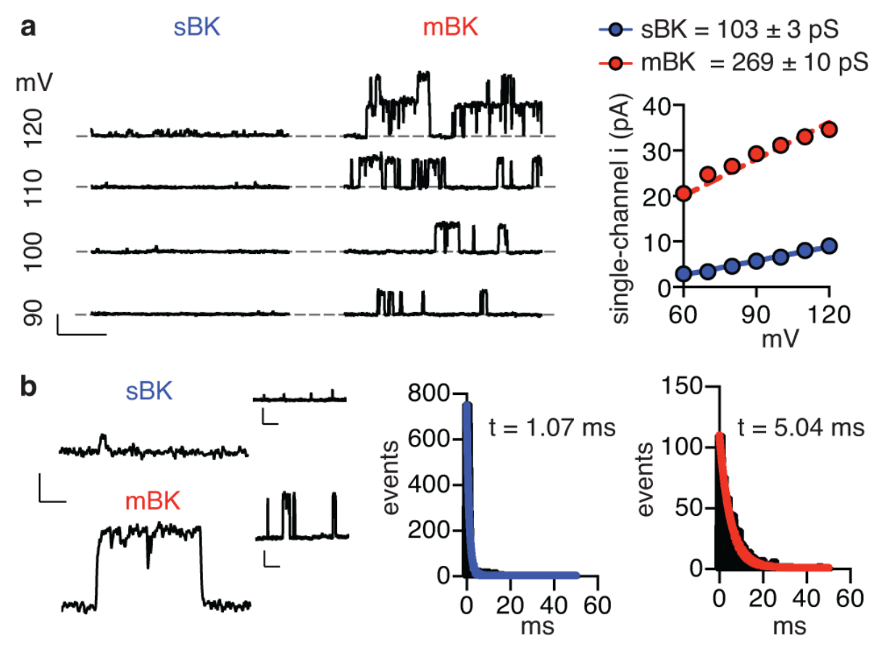
Skate BK passes less current per channel opening
Bellono and colleagues recorded individual BK channels in excised membrane patches from cells expressing skate or mouse subunits. Single-channel conductance measures current carried by one open channel for a specified driving force. This separates molecular pore behavior from whole-cell channel abundance.
The skate channel had smaller current amplitudes and shorter openings than mouse BK. At 80 mV, open-time constants were approximately 1.09 ms and 5.06 ms, respectively. Their calcium sensitivity was broadly similar, so the difference was not simply a failure of skate channels to respond to calcium.
Smaller and briefer potassium currents can restrain, rather than immediately terminate, calcium-driven depolarization. This provides a mechanism for tuning receptor oscillations. Skate BK channels therefore allow calcium-driven depolarization to build up before potassium feedback repolarizes the cell.
Bellono et al. (2017), Fig. 4(a–b). Single-channel currents and open-time distributions.
Bellono et al. (2017), Fig. 1(c–d). Isolated ampulla and receptor cell.
Bellono et al. (2017)
33
Notes:
• Bellono and colleagues recorded individual BK channels in excised membrane patches from cells expressing skate or mouse subunits. Single-channel conductance measures current carried by one open channel for a specified driving force. This separates molecular pore behavior from whole-cell channel abundance.
– Channel openings appear as discrete current steps in the original recordings. Their amplitudes and durations answer different questions: how rapidly ions pass through an open pore, and how long the pore remains open. Both can change the amount of potassium charge crossing the membrane.
• The skate channel had smaller current amplitudes and shorter openings than mouse BK. At 80 mV, open-time constants were approximately 1.09 ms and 5.06 ms, respectively. Their calcium sensitivity was broadly similar, so the difference was not simply a failure of skate channels to respond to calcium.
• Smaller and briefer potassium currents can restrain, rather than immediately terminate, calcium-driven depolarization. This provides a mechanism for tuning receptor oscillations. Skate BK channels therefore allow calcium-driven depolarization to build up before potassium feedback repolarizes the cell.
References:
Bellono NW, Leitch DB, Julius D (2017). Molecular basis of ancestral vertebrate electroreception. Nature 543(7645):391-396. https://doi.org/10.1038/nature21401
Figure: Bellono et al. (2017), Fig. 4(a–b). Single-channel currents and open-time distributions.
Figure source: https://doi.org/10.1038/nature21401
Figure: Bellono et al. (2017), Fig. 1(c–d). Isolated ampulla and receptor cell.
Figure source: https://doi.org/10.1038/nature21401

Slide 46
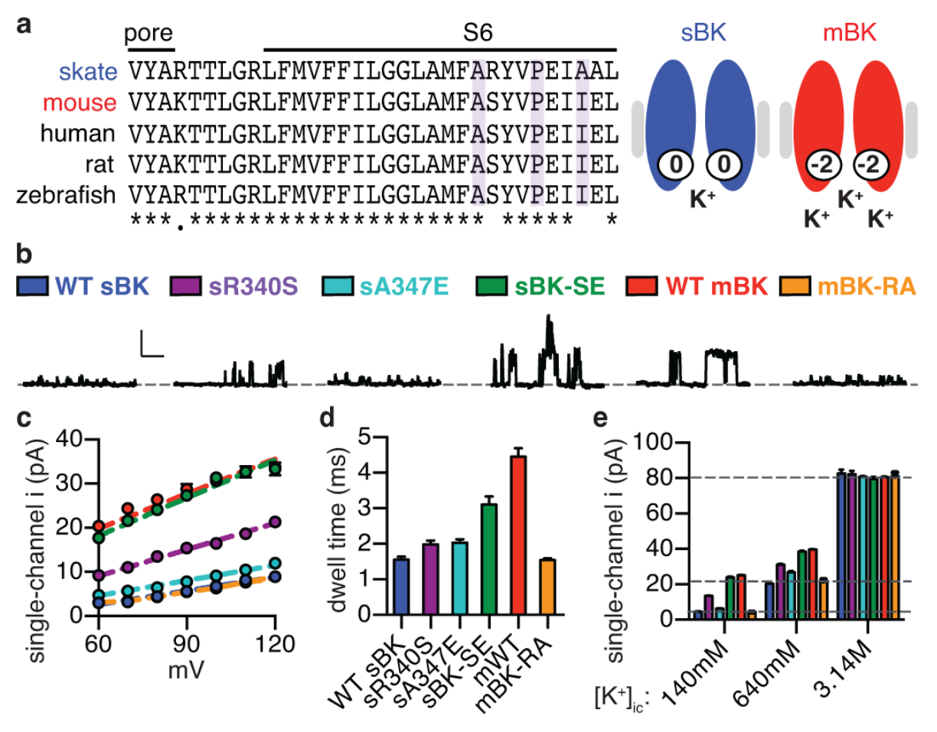
Reciprocal BK mutations identify pore adaptations
Bellono and colleagues substituted two skate BK residues with their mouse counterparts and performed the reciprocal substitutions in mouse BK. These residues lie near the intracellular pore, where local charge can influence potassium concentration. The comparison tested functional effects rather than sequence similarity alone.
Wild-type skate conductance was approximately 104 pS, versus 263 pS for mouse BK. The double-mutant skate channel reached approximately 287 pS, while the reciprocal mouse construct fell near 97 pS. Open-time behavior also shifted toward the species supplying the substituted residues.
Increasing intracellular potassium to a saturating 3.14 M equalized current amplitudes, supporting an electrostatic contribution to local ion availability rather than an intrinsically impassable skate pore. The reciprocal mutations moved conductance toward the species that supplied the substituted residues, which establishes a sequence-dependent contribution to pore function.
Bellono et al. (2017), Fig. 5(a–e). Reciprocal mutations alter BK conductance and kinetics.
Bellono et al. (2017), Fig. 1(c–d). Isolated ampulla and receptor cell.
Bellono et al. (2017)
34
Notes:
• Bellono and colleagues substituted two skate BK residues with their mouse counterparts and performed the reciprocal substitutions in mouse BK. These residues lie near the intracellular pore, where local charge can influence potassium concentration. The comparison tested functional effects rather than sequence similarity alone.
– A picosiemens is a unit of electrical conductance. The effect of a substitution on current amplitude was examined alongside opening duration, and the two properties were not assumed identical. High-potassium experiments tested whether the channels retained a common maximum ion-passage capacity.
• Wild-type skate conductance was approximately 104 pS, versus 263 pS for mouse BK. The double-mutant skate channel reached approximately 287 pS, while the reciprocal mouse construct fell near 97 pS. Open-time behavior also shifted toward the species supplying the substituted residues.
• Increasing intracellular potassium to a saturating 3.14 M equalized current amplitudes, supporting an electrostatic contribution to local ion availability rather than an intrinsically impassable skate pore. The reciprocal mutations moved conductance toward the species that supplied the substituted residues, which establishes a sequence-dependent contribution to pore function.
References:
Bellono NW, Leitch DB, Julius D (2017). Molecular basis of ancestral vertebrate electroreception. Nature 543(7645):391-396. https://doi.org/10.1038/nature21401
Figure: Bellono et al. (2017), Fig. 5(a–e). Reciprocal mutations alter BK conductance and kinetics.
Figure source: https://doi.org/10.1038/nature21401
Figure: Bellono et al. (2017), Fig. 1(c–d). Isolated ampulla and receptor cell.
Figure source: https://doi.org/10.1038/nature21401

Slide 47
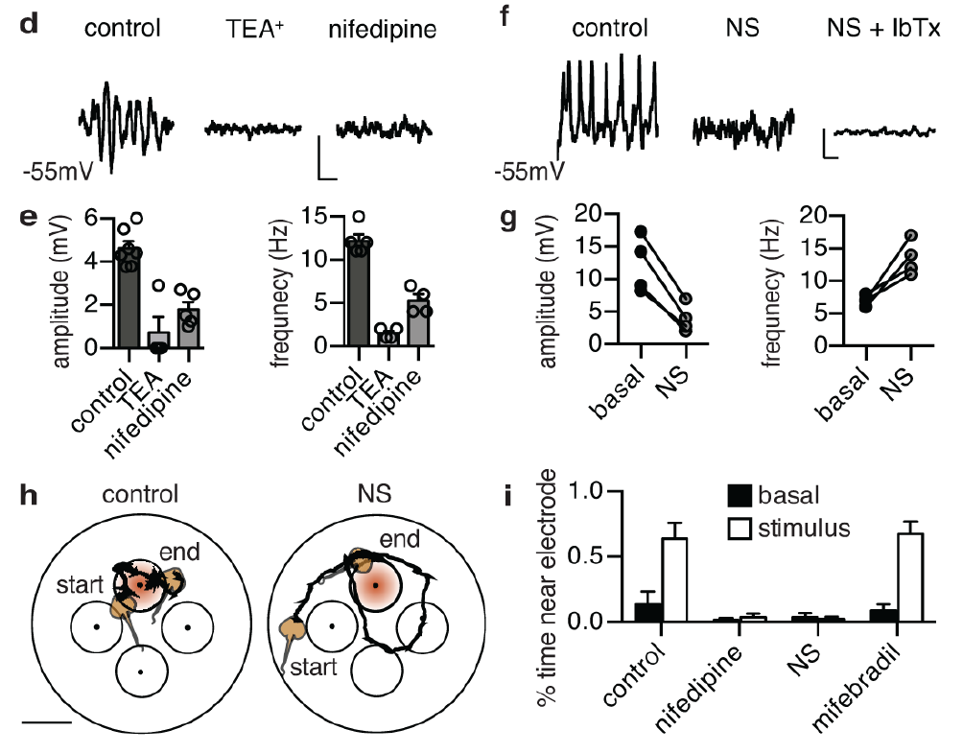
Channel modulation changes oscillations and behavior
Bellono and colleagues recorded spontaneous voltage oscillations in little-skate receptors and then manipulated channel activity. Nifedipine reduced calcium-dependent activity; BK blockade disrupted oscillations. The BK activator NS11021 reduced oscillation amplitude while increasing frequency, consistent with stronger repolarizing current.
Behaving skates were tested for preference toward a buried dipole during 30-minute trials. Vehicle and a calcium-channel drug ineffective against the measured current preserved target preference, whereas nifedipine and NS11021 reduced time near the active electrode. Subsequent startle tests checked for gross mobility impairment.
The paired physiological and behavioral perturbations connect channel activity to electrosensory performance. Startle tests checked that the reduced time near the active electrode was not a general impairment of mobility.
Bellono et al. (2017), Fig. 6(d–i). Channel modulation alters oscillations and dipole-zone preference.
Bellono et al. (2017), Fig. 1(c–d). Isolated ampulla and receptor cell.
Bellono et al. (2017)
35
Notes:
• Bellono and colleagues recorded spontaneous voltage oscillations in little-skate receptors and then manipulated channel activity. Nifedipine reduced calcium-dependent activity; BK blockade disrupted oscillations. The BK activator NS11021 reduced oscillation amplitude while increasing frequency, consistent with stronger repolarizing current.
– A BK activator is not equivalent to removing potassium feedback: stronger activity changes the balance between calcium-driven depolarization and repolarization. The behavioral result depends on that balance, rather than simply on the presence or absence of any potassium channel. Pharmacological specificity must be evaluated at both cellular and organismal levels.
• Behaving skates were tested for preference toward a buried dipole during 30-minute trials. Vehicle and a calcium-channel drug ineffective against the measured current preserved target preference, whereas nifedipine and NS11021 reduced time near the active electrode. Subsequent startle tests checked for gross mobility impairment.
• The paired physiological and behavioral perturbations connect channel activity to electrosensory performance. Startle tests checked that the reduced time near the active electrode was not a general impairment of mobility.
References:
Bellono NW, Leitch DB, Julius D (2017). Molecular basis of ancestral vertebrate electroreception. Nature 543(7645):391-396. https://doi.org/10.1038/nature21401
Figure: Bellono et al. (2017), Fig. 6(d–i). Channel modulation alters oscillations and dipole-zone preference.
Figure source: https://doi.org/10.1038/nature21401
Figure: Bellono et al. (2017), Fig. 1(c–d). Isolated ampulla and receptor cell.
Figure source: https://doi.org/10.1038/nature21401

Slide 48
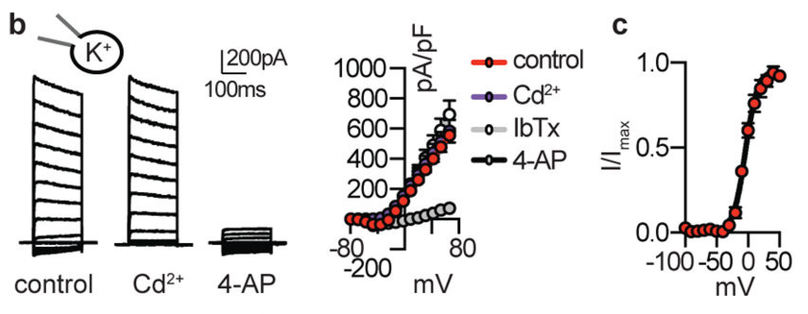
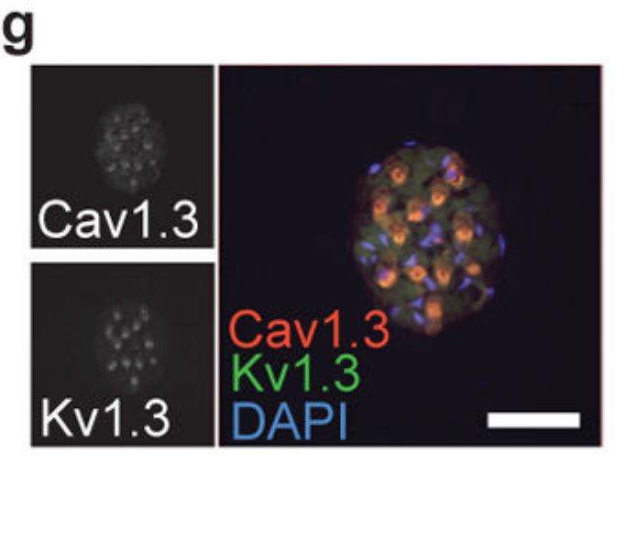
Shark receptor potassium current is voltage-gated
Bellono and colleagues compared chain catshark, Scyliorhinus retifer, receptors with little-skate receptors. Shark outward current activated at more positive voltages than the calcium current. Unlike skate current, it was not reduced by calcium-current blockade or the tested BK antagonist.
The voltage-gated potassium blocker 4-aminopyridine, or 4-AP, inhibited shark outward current. Rapid activation and deactivation, together with weak slow inactivation, supported repetitive responses. Repeated depolarizing commands did not appreciably diminish the measured outward-current amplitude under the tested conditions.
Bellono et al. (2018), Fig. 1(b–c). Shark potassium current activation and blocker sensitivity.
The results identify a different functional potassium mechanism despite both species using low-threshold calcium entry. The shark outward current was voltage-gated and was inhibited by 4-AP, whereas the skate outward current depended on calcium and BK channels.
Bellono et al. (2018), Fig. 1(g). Catshark receptor cells: CaV1.3 and KV1.3 transcripts.
Bellono et al. (2018); Bellono et al. (2017)
36
Notes:
• Bellono and colleagues compared chain catshark, Scyliorhinus retifer, receptors with little-skate receptors. Shark outward current activated at more positive voltages than the calcium current. Unlike skate current, it was not reduced by calcium-current blockade or the tested BK antagonist.
– An outward potassium current can be activated directly by voltage or indirectly through rising calcium. Blocker comparisons and calcium dependence distinguish these alternatives experimentally. A calcium-channel antagonist served as a causal test of functional coupling, rather than treating all receptor potassium currents as interchangeable.
• The voltage-gated potassium blocker 4-aminopyridine, or 4-AP, inhibited shark outward current. Rapid activation and deactivation, together with weak slow inactivation, supported repetitive responses. Repeated depolarizing commands did not appreciably diminish the measured outward-current amplitude under the tested conditions.
• The results identify a different functional potassium mechanism despite both species using low-threshold calcium entry. The shark outward current was voltage-gated and was inhibited by 4-AP, whereas the skate outward current depended on calcium and BK channels.
References:
Bellono NW, Leitch DB, Julius D (2018). Molecular tuning of electroreception in sharks and skates. Nature 558(7708):122-126. https://doi.org/10.1038/s41586-018-0160-9
Bellono NW, Leitch DB, Julius D (2017). Molecular basis of ancestral vertebrate electroreception. Nature 543(7645):391-396. https://doi.org/10.1038/nature21401
Figure: Bellono et al. (2018), Fig. 1(b–c). Shark potassium current activation and blocker sensitivity.
Figure source: https://doi.org/10.1038/s41586-018-0160-9
Figure: Bellono et al. (2018), Fig. 1(g). Catshark receptor cells: CaV1.3 and KV1.3 transcripts.
Figure source: https://doi.org/10.1038/s41586-018-0160-9

Slide 49
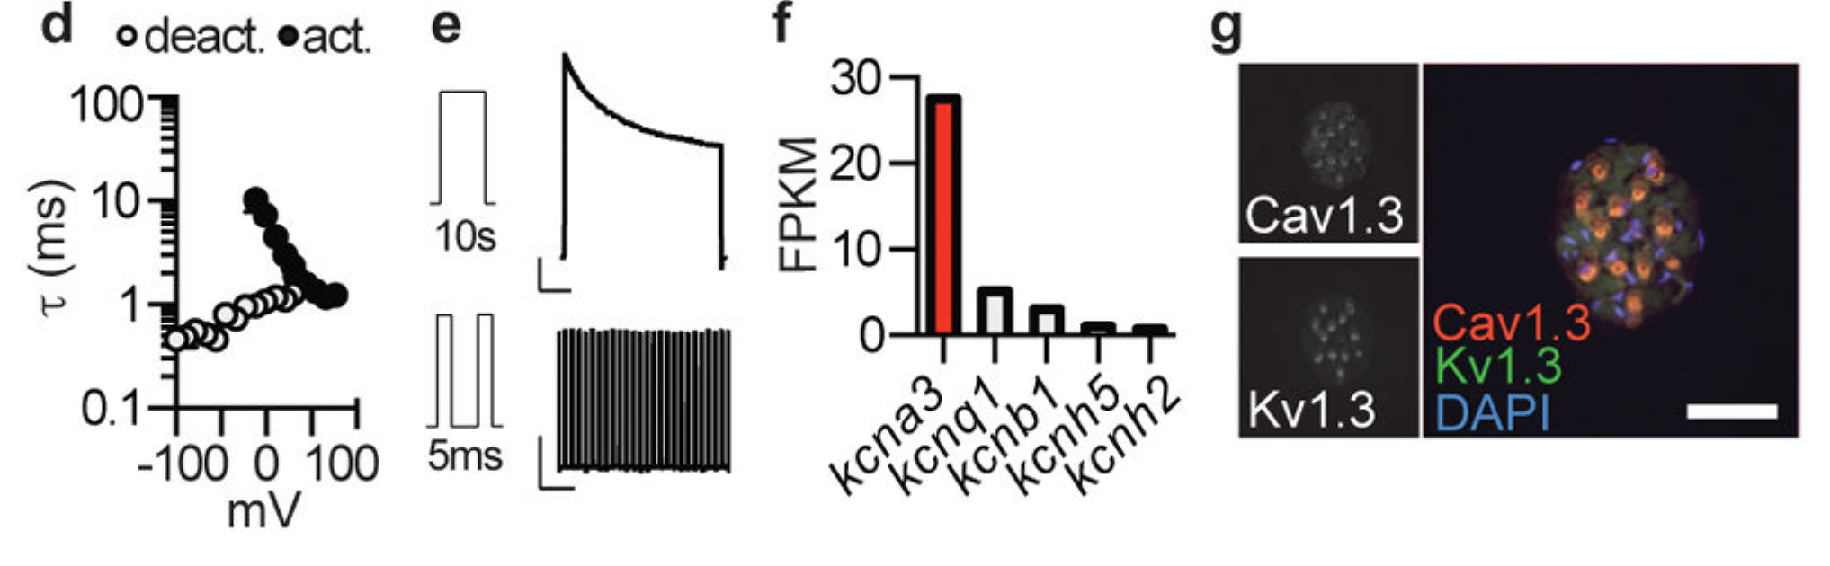
Catshark electrosensory cells enrich KV1.3
KV1.3 is a voltage-gated potassium channel assembled from pore-forming subunits encoded by a specific gene. Bellono and colleagues found its transcript predominant among voltage-gated potassium channels in chain-catshark ampullary organs. In situ hybridization localized KV1.3 together with CaV1.3 in receptor cells.
Shark KV1.3 expression was not detected in the tested skate ampullae, where BK dominated functional potassium feedback. Catshark receptor currents closed rapidly after repolarization and remained available during repeated stimulation. The expressed shark channel reproduced many native current properties when tested independently.
Bellono et al. (2018), Fig. 1(d–g). Fast deactivation, transcript enrichment and receptor localization.
Agreement among cellular localization, pharmacology, and cloned-channel function supports KV1.3 as the major measured shark potassium conductance. Accessory subunits or other cellular factors may account for the faster deactivation of native currents compared with cloned currents at some voltages.
Bellono et al. (2018), Fig. 1(g). Catshark receptor cells: CaV1.3 and KV1.3 transcripts.
Bellono et al. (2018); Bellono et al. (2017)
37
Notes:
• KV1.3 is a voltage-gated potassium channel assembled from pore-forming subunits encoded by a specific gene. Bellono and colleagues found its transcript predominant among voltage-gated potassium channels in chain-catshark ampullary organs. In situ hybridization localized KV1.3 together with CaV1.3 in receptor cells.
– The shark brain expressed a truncated KV1.3 transcript lacking an essential assembly region rather than the same full-length receptor form. Tissue expression patterns must therefore distinguish isoforms as well as gene identity. The study did not establish that the receptor form contributes identically in every organ.
• Shark KV1.3 expression was not detected in the tested skate ampullae, where BK dominated functional potassium feedback. Catshark receptor currents closed rapidly after repolarization and remained available during repeated stimulation. The expressed shark channel reproduced many native current properties when tested independently.
• Agreement among cellular localization, pharmacology, and cloned-channel function supports KV1.3 as the major measured shark potassium conductance. Accessory subunits or other cellular factors may account for the faster deactivation of native currents compared with cloned currents at some voltages.
References:
Bellono NW, Leitch DB, Julius D (2018). Molecular tuning of electroreception in sharks and skates. Nature 558(7708):122-126. https://doi.org/10.1038/s41586-018-0160-9
Bellono NW, Leitch DB, Julius D (2017). Molecular basis of ancestral vertebrate electroreception. Nature 543(7645):391-396. https://doi.org/10.1038/nature21401
Figure: Bellono et al. (2018), Fig. 1(d–g). Fast deactivation, transcript enrichment and receptor localization.
Figure source: https://doi.org/10.1038/s41586-018-0160-9
Figure: Bellono et al. (2018), Fig. 1(g). Catshark receptor cells: CaV1.3 and KV1.3 transcripts.
Figure source: https://doi.org/10.1038/s41586-018-0160-9

Slide 50
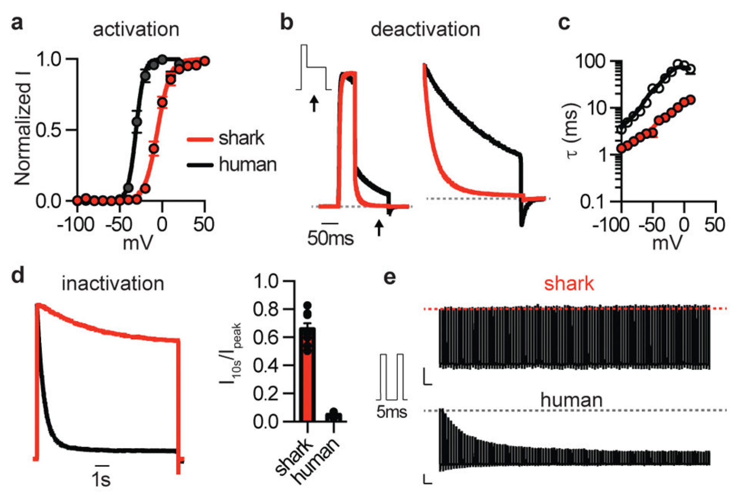
Shark KV1.3 closes rapidly and resists inactivation
Bellono and colleagues expressed shark and human KV1.3 channels under matched recording conditions. Shark half-maximal activation occurred near −5.4 mV, compared with −30.7 mV for human KV1.3. The shark channel therefore supplied outward current only after substantially greater depolarization.
Shark channels returned rapidly to a closed state and showed weak, slow inactivation during prolonged or repeated commands. Human channels progressively lost current during repetitive stimulation. The comparison separated activation threshold, deactivation, and inactivation, three distinct properties that jointly influence sustained receptor activity.
High activation voltage permits strong calcium-driven depolarization before potassium feedback intervenes; rapid closure then releases the membrane for another cycle. Sequence-swapping experiments implicated voltage-sensor regions and the outer pore in different properties. Reduced voltage-sensor relaxation was proposed from kinetic evidence to account for the weak inactivation of the shark channel.
Bellono et al. (2018), Fig. 2(a–e). Shark and human KV1.3 gating under matched stimulation.
Bellono et al. (2018), Fig. 1(g). Catshark receptor cells: CaV1.3 and KV1.3 transcripts.
Bellono et al. (2018); Bellono et al. (2017)
38
Notes:
• Bellono and colleagues expressed shark and human KV1.3 channels under matched recording conditions. Shark half-maximal activation occurred near −5.4 mV, compared with −30.7 mV for human KV1.3. The shark channel therefore supplied outward current only after substantially greater depolarization.
– Inactivation limits availability during sustained stimulation, whereas deactivation closes channels as voltage returns toward rest. A channel can deactivate rapidly yet remain ready to reopen. The distinction explains why repetitive currents can remain large without requiring channels to stay continuously open.
• Shark channels returned rapidly to a closed state and showed weak, slow inactivation during prolonged or repeated commands. Human channels progressively lost current during repetitive stimulation. The comparison separated activation threshold, deactivation, and inactivation, three distinct properties that jointly influence sustained receptor activity.
• High activation voltage permits strong calcium-driven depolarization before potassium feedback intervenes; rapid closure then releases the membrane for another cycle. Sequence-swapping experiments implicated voltage-sensor regions and the outer pore in different properties. Reduced voltage-sensor relaxation was proposed from kinetic evidence to account for the weak inactivation of the shark channel.
References:
Bellono NW, Leitch DB, Julius D (2018). Molecular tuning of electroreception in sharks and skates. Nature 558(7708):122-126. https://doi.org/10.1038/s41586-018-0160-9
Bellono NW, Leitch DB, Julius D (2017). Molecular basis of ancestral vertebrate electroreception. Nature 543(7645):391-396. https://doi.org/10.1038/nature21401
Figure: Bellono et al. (2018), Fig. 2(a–e). Shark and human KV1.3 gating under matched stimulation.
Figure source: https://doi.org/10.1038/s41586-018-0160-9
Figure: Bellono et al. (2018), Fig. 1(g). Catshark receptor cells: CaV1.3 and KV1.3 transcripts.
Figure source: https://doi.org/10.1038/s41586-018-0160-9

Slide 51
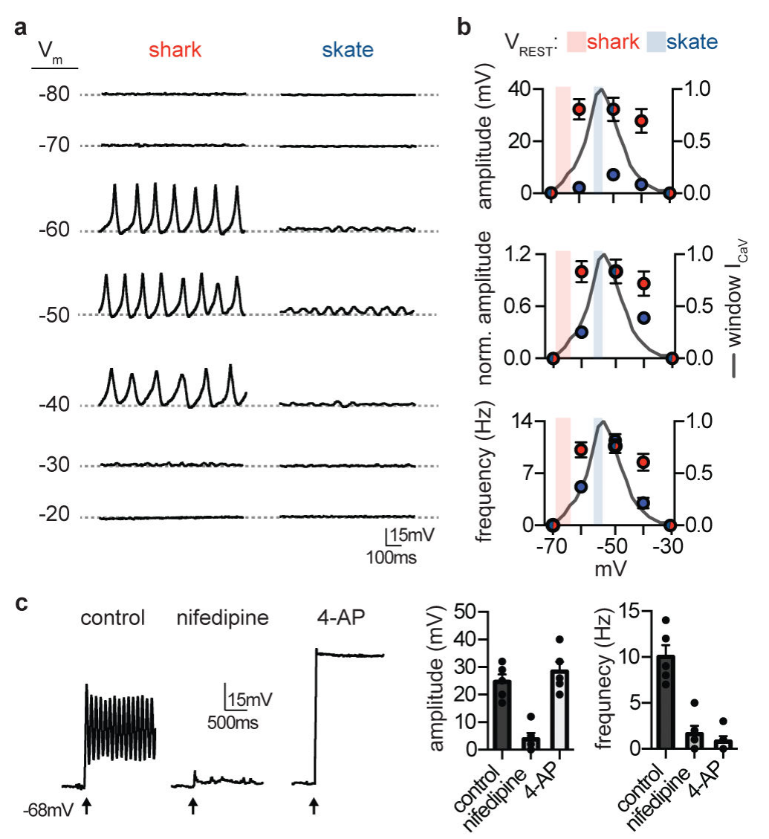
Shark cells spike while skate cells oscillate
Current clamp measures membrane voltage while current is injected to change the cell’s operating point. Bellono and colleagues compared shark and skate receptor activity across matched voltage ranges. Average resting voltage was approximately −66 mV in shark cells and −54 mV in skate cells.
Depolarizing shark cells into the calcium-current range triggered large repetitive voltage spikes. Skate cells generated smaller oscillations whose amplitude and frequency varied more strongly with membrane voltage. Nifedipine blocked shark depolarization, and 4-AP prevented or markedly slowed repolarization.
These receptor spikes are calcium-driven membrane events and should not be confused with sodium-dependent action potentials propagated by afferent nerves. The shared calcium mechanism and differing potassium feedback produce distinct cellular dynamics. Nifedipine blocked the shark depolarization and 4-AP slowed repolarization, which identifies calcium entry and KV channels as the two components of the spike.
Bellono et al. (2018), Fig. 3(a–c). Shark spikes and skate oscillations under current clamp.
Bellono et al. (2018), Fig. 1(g). Catshark receptor cells: CaV1.3 and KV1.3 transcripts.
Bellono et al. (2018); Bellono et al. (2017)
39
Notes:
• Current clamp measures membrane voltage while current is injected to change the cell’s operating point. Bellono and colleagues compared shark and skate receptor activity across matched voltage ranges. Average resting voltage was approximately −66 mV in shark cells and −54 mV in skate cells.
– The cells were placed at different membrane potentials by fixed current injection, rather than by changing the surrounding natural field. This controls the operating point and tests voltage-dependent dynamics directly. The same command can expose a different balance of inward and outward conductances in the two species.
• Depolarizing shark cells into the calcium-current range triggered large repetitive voltage spikes. Skate cells generated smaller oscillations whose amplitude and frequency varied more strongly with membrane voltage. Nifedipine blocked shark depolarization, and 4-AP prevented or markedly slowed repolarization.
• These receptor spikes are calcium-driven membrane events and should not be confused with sodium-dependent action potentials propagated by afferent nerves. The shared calcium mechanism and differing potassium feedback produce distinct cellular dynamics. Nifedipine blocked the shark depolarization and 4-AP slowed repolarization, which identifies calcium entry and KV channels as the two components of the spike.
References:
Bellono NW, Leitch DB, Julius D (2018). Molecular tuning of electroreception in sharks and skates. Nature 558(7708):122-126. https://doi.org/10.1038/s41586-018-0160-9
Bellono NW, Leitch DB, Julius D (2017). Molecular basis of ancestral vertebrate electroreception. Nature 543(7645):391-396. https://doi.org/10.1038/nature21401
Figure: Bellono et al. (2018), Fig. 3(a–c). Shark spikes and skate oscillations under current clamp.
Figure source: https://doi.org/10.1038/s41586-018-0160-9
Figure: Bellono et al. (2018), Fig. 1(g). Catshark receptor cells: CaV1.3 and KV1.3 transcripts.
Figure source: https://doi.org/10.1038/s41586-018-0160-9

Slide 52
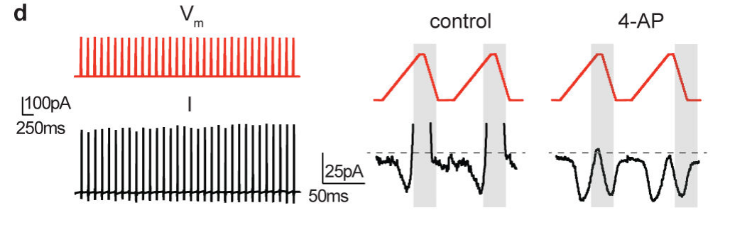
Sequential currents support repetitive shark spikes
Bellono and colleagues imposed voltage commands resembling recorded shark receptor spikes while measuring ionic currents. This protocol tested whether the identified currents could follow the timing of actual membrane activity. Inward calcium current preceded outward potassium current during the repeated commands.
At approximately −65 mV, calcium current was small; depolarization increased it before higher-voltage potassium activation opposed the inward flow. 4-AP removed the outward component and exposed renewed calcium current during the return toward negative voltage. Both conductances remained available across repeated cycles.
Bellono et al. (2018), Fig. 3(d). Calcium and potassium currents during voltage-spike commands.
The measured sequence supports calcium-driven depolarization followed by KV-mediated repolarization, with rapidly closing potassium channels allowing another depolarizing cycle. Both conductances remained available across repeated cycles.
Bellono et al. (2018), Fig. 1(g). Catshark receptor cells: CaV1.3 and KV1.3 transcripts.
Bellono et al. (2018); Bellono et al. (2017)
40
Notes:
• Bellono and colleagues imposed voltage commands resembling recorded shark receptor spikes while measuring ionic currents. This protocol tested whether the identified currents could follow the timing of actual membrane activity. Inward calcium current preceded outward potassium current during the repeated commands.
– A voltage-clamp command controls the membrane trajectory rather than allowing currents to determine it. Recording currents along that trajectory tests their timing and persistence. It is therefore complementary to current clamp, which records the voltage trajectory produced by the cell’s own conductances.
• At approximately −65 mV, calcium current was small; depolarization increased it before higher-voltage potassium activation opposed the inward flow. 4-AP removed the outward component and exposed renewed calcium current during the return toward negative voltage. Both conductances remained available across repeated cycles.
• The measured sequence supports calcium-driven depolarization followed by KV-mediated repolarization, with rapidly closing potassium channels allowing another depolarizing cycle. Both conductances remained available across repeated cycles.
References:
Bellono NW, Leitch DB, Julius D (2018). Molecular tuning of electroreception in sharks and skates. Nature 558(7708):122-126. https://doi.org/10.1038/s41586-018-0160-9
Bellono NW, Leitch DB, Julius D (2017). Molecular basis of ancestral vertebrate electroreception. Nature 543(7645):391-396. https://doi.org/10.1038/nature21401
Figure: Bellono et al. (2018), Fig. 3(d). Calcium and potassium currents during voltage-spike commands.
Figure source: https://doi.org/10.1038/s41586-018-0160-9
Figure: Bellono et al. (2018), Fig. 1(g). Catshark receptor cells: CaV1.3 and KV1.3 transcripts.
Figure source: https://doi.org/10.1038/s41586-018-0160-9

Slide 53
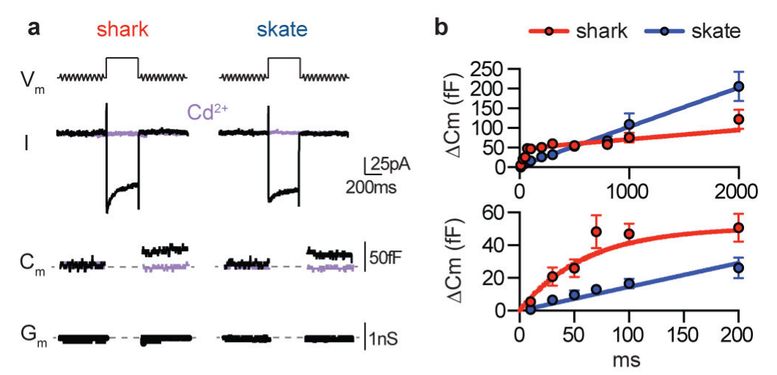
Calcium influx triggers vesicular membrane fusion
Bellono and colleagues measured membrane capacitance, the membrane’s ability to store charge, as a readout of synaptic-vesicle fusion. Fusion adds vesicle membrane to the cell surface. A 200-ms pulse to −20 mV elicited calcium current and a capacitance increase in both shark and skate receptors.
Cadmium blocked the inward current and capacitance change, supporting calcium-dependent release. Increasing stimulus duration produced larger release-associated responses, but shark responses approached saturation more rapidly; skate capacitance increased more steadily with duration. Membrane-conductance controls limited recording artifacts that could mimic capacitance changes.
Bellono et al. (2018), Fig. 4(a–b). Calcium-dependent capacitance changes during vesicle fusion.
The assay measures membrane addition associated with exocytosis, so the capacitance increase reports the amount of vesicle fusion. Calcium entry triggers vesicle fusion in both shark and skate receptors, and the steps that follow fusion lead to transmitter action on the afferent.
Bellono et al. (2017), Fig. 1(c–d). Isolated ampulla and receptor cell.
Bellono et al. (2018); Bellono et al. (2017)
41
Notes:
• Bellono and colleagues measured membrane capacitance, the membrane’s ability to store charge, as a readout of synaptic-vesicle fusion. Fusion adds vesicle membrane to the cell surface. A 200-ms pulse to −20 mV elicited calcium current and a capacitance increase in both shark and skate receptors.
– Exocytosis means fusion of an intracellular vesicle with the plasma membrane. Cadmium is a calcium-channel pore blocker, so its effect links release to calcium entry under this protocol. A change in membrane conductance can interfere with capacitance estimates, making the reported conductance checks essential.
• Cadmium blocked the inward current and capacitance change, supporting calcium-dependent release. Increasing stimulus duration produced larger release-associated responses, but shark responses approached saturation more rapidly; skate capacitance increased more steadily with duration. Membrane-conductance controls limited recording artifacts that could mimic capacitance changes.
• The assay measures membrane addition associated with exocytosis, so the capacitance increase reports the amount of vesicle fusion. Calcium entry triggers vesicle fusion in both shark and skate receptors, and the steps that follow fusion lead to transmitter action on the afferent.
References:
Bellono NW, Leitch DB, Julius D (2018). Molecular tuning of electroreception in sharks and skates. Nature 558(7708):122-126. https://doi.org/10.1038/s41586-018-0160-9
Bellono NW, Leitch DB, Julius D (2017). Molecular basis of ancestral vertebrate electroreception. Nature 543(7645):391-396. https://doi.org/10.1038/nature21401
Figure: Bellono et al. (2018), Fig. 4(a–b). Calcium-dependent capacitance changes during vesicle fusion.
Figure source: https://doi.org/10.1038/s41586-018-0160-9
Figure: Bellono et al. (2017), Fig. 1(c–d). Isolated ampulla and receptor cell.
Figure source: https://doi.org/10.1038/nature21401

Slide 54
Capacitance increases when vesicles fuse
Membrane capacitance is the ability of the membrane to store charge, and it increases with surface area. When a synaptic vesicle fuses with the cell surface, its membrane adds to the surface and capacitance rises. Capacitance is measured in the same cell that supplies the calcium current, so release and calcium entry can be compared directly.
Bellono and colleagues gave a 200-ms pulse to −20 mV, which elicited calcium current and a capacitance increase in both shark and skate receptors. Cadmium blocked the inward current and the capacitance change.
Bellono et al. (2018), Fig. 4(a–b). Calcium-dependent capacitance changes during vesicle fusion.
Longer pulses produced larger responses, but shark responses approached saturation more rapidly while skate capacitance increased more steadily. Capacitance therefore provides a readout of release that differs between the two receptor types. Skate cells release transmitter more gradually, and shark cells reach saturation sooner.
Bellono et al. (2017), Fig. 1(c–d). Isolated ampulla and receptor cell.
Bellono et al. (2018)
41a
Notes:
• Capacitance gives a way to follow exocytosis in a single cell.
• Principle.
– Capacitance reflects membrane surface area.
– Vesicle fusion adds membrane and increases capacitance.
• Stimulus.
– A 200-millisecond pulse to minus 20 millivolts elicited calcium current in both species.
• Calcium dependence.
– Cadmium blocked the inward current and the capacitance change.
• Duration.
– Longer pulses produced larger release-associated responses.
– Shark responses approached saturation more rapidly than skate responses.
• Controls.
– Membrane-conductance controls limited recording artifacts that could mimic capacitance changes.
• Controls for artifacts.
– Membrane-conductance controls limited recording artifacts that could mimic capacitance changes.
– Cadmium blocked both calcium current and capacitance change.
• Species difference.
– Shark cells approached saturation of release sooner than skate cells.
– Skate capacitance increased more steadily with pulse duration.
• Calcium and release.
– Release from receptor cells depends on calcium entry, as the cadmium experiment shows.
– The link supports a role for the calcium channel in driving the afferent.
• Readout limits.
– Capacitance measures membrane addition from vesicle fusion.
– It does not count transmitter molecules or postsynaptic receptor openings.
References:
Bellono NW, Leitch DB, Julius D (2018). Molecular tuning of electroreception in sharks and skates. Nature 558(7708):122-126. https://doi.org/10.1038/s41586-018-0160-9

Slide 55
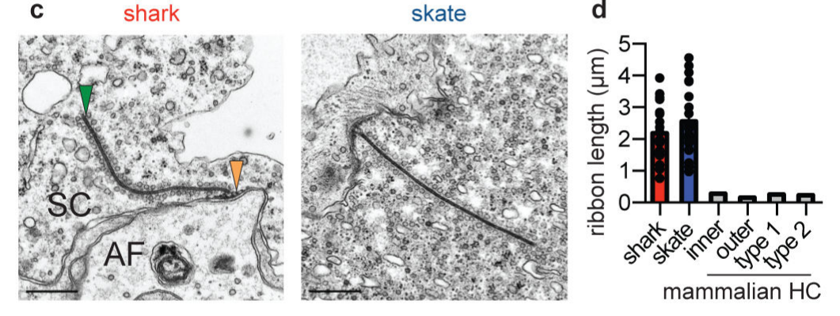
Ribbon synapses organize receptor-to-nerve output
A ribbon synapse contains an intracellular structure that tethers vesicles near the release membrane. Bellono and colleagues used electron microscopy to examine shark and skate receptor synapses. Both species contained unusually long ribbons associated with vesicles and postsynaptic afferent endings.
The ribbons had similar shapes and tethered vesicles of comparable size and number. Shark receptors contained a larger readily releasable vesicle pool, whereas skate receptors contained more free cytoplasmic vesicles. The anatomical comparison accompanied measurements of faster release saturation in shark cells and more sustained responses in skate cells.
Bellono et al. (2018), Fig. 4(c–d). Electron microscopy of shark and skate ribbon synapses.
A larger readily releasable pool offers an explanation for the faster release saturation in shark cells, and free cytoplasmic vesicles may refill the pool as proposed from other ribbon synapses. Electron microscopy establishes synaptic architecture while capacitance and current recordings test its functional output.
Bellono et al. (2018)
42
Notes:
• A ribbon synapse contains an intracellular structure that tethers vesicles near the release membrane. Bellono and colleagues used electron microscopy to examine shark and skate receptor synapses. Both species contained unusually long ribbons associated with vesicles and postsynaptic afferent endings.
– A readily releasable pool is positioned for rapid fusion, whereas a refilling pool can replenish release sites over time. The reported anatomical differences are compatible with these functional distinctions. They do not directly measure the recycling history or neurotransmitter content of every imaged vesicle.
• The ribbons had similar shapes and tethered vesicles of comparable size and number. Shark receptors contained a larger readily releasable vesicle pool, whereas skate receptors contained more free cytoplasmic vesicles. The anatomical comparison accompanied measurements of faster release saturation in shark cells and more sustained responses in skate cells.
• A larger readily releasable pool offers an explanation for the faster release saturation in shark cells, and free cytoplasmic vesicles may refill the pool as proposed from other ribbon synapses. Electron microscopy establishes synaptic architecture while capacitance and current recordings test its functional output.
References:
Bellono NW, Leitch DB, Julius D (2018). Molecular tuning of electroreception in sharks and skates. Nature 558(7708):122-126. https://doi.org/10.1038/s41586-018-0160-9
Figure: Bellono et al. (2018), Fig. 4(c–d). Electron microscopy of shark and skate ribbon synapses.
Figure source: https://doi.org/10.1038/s41586-018-0160-9

Slide 56
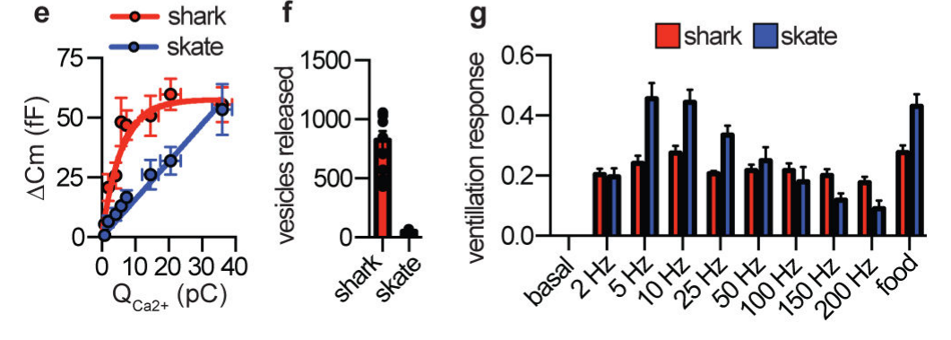
Cellular tuning parallels species-specific ventilation
Bellono and colleagues compared electrically evoked ventilation in chain catsharks and little skates, using equal-strength stimuli across frequencies. Ventilation is movement of water over the gills for gas exchange. Food odor supplied a comparison stimulus that verified a measurable response in both species.
Catsharks increased ventilation similarly across the tested electrical frequencies, whereas skates responded most strongly at lower frequencies. Cell measurements separately suggested at least tenfold greater vesicle release for a shark voltage spike than for a skate oscillation, based on calcium–capacitance relationships and vesicle-size estimates.
Bellono et al. (2018), Fig. 4(e–g). Calcium–release relationships and frequency-dependent ventilation.
The physiological and organismal comparisons support broad threshold-like detection in sharks and more selective tuning in skates. The estimated tenfold difference in vesicle release per voltage event parallels the broader ventilation response of catsharks and the lower-frequency preference of skates.
Bellono et al. (2018)
43
Notes:
• Bellono and colleagues compared electrically evoked ventilation in chain catsharks and little skates, using equal-strength stimuli across frequencies. Ventilation is movement of water over the gills for gas exchange. Food odor supplied a comparison stimulus that verified a measurable response in both species.
– The estimated fusion difference used measured calcium charge, capacitance changes, and vesicle diameter, not direct visual counting during a spike. Equal maximal odor responses helped compare the two species’ ventilatory readout. Species-specific ecology is a hypothesis informed by these results, not an experimentally manipulated variable.
• Catsharks increased ventilation similarly across the tested electrical frequencies, whereas skates responded most strongly at lower frequencies. Cell measurements separately suggested at least tenfold greater vesicle release for a shark voltage spike than for a skate oscillation, based on calcium–capacitance relationships and vesicle-size estimates.
• The physiological and organismal comparisons support broad threshold-like detection in sharks and more selective tuning in skates. The estimated tenfold difference in vesicle release per voltage event parallels the broader ventilation response of catsharks and the lower-frequency preference of skates.
References:
Bellono NW, Leitch DB, Julius D (2018). Molecular tuning of electroreception in sharks and skates. Nature 558(7708):122-126. https://doi.org/10.1038/s41586-018-0160-9
Figure: Bellono et al. (2018), Fig. 4(e–g). Calcium–release relationships and frequency-dependent ventilation.
Figure source: https://doi.org/10.1038/s41586-018-0160-9

Slide 57
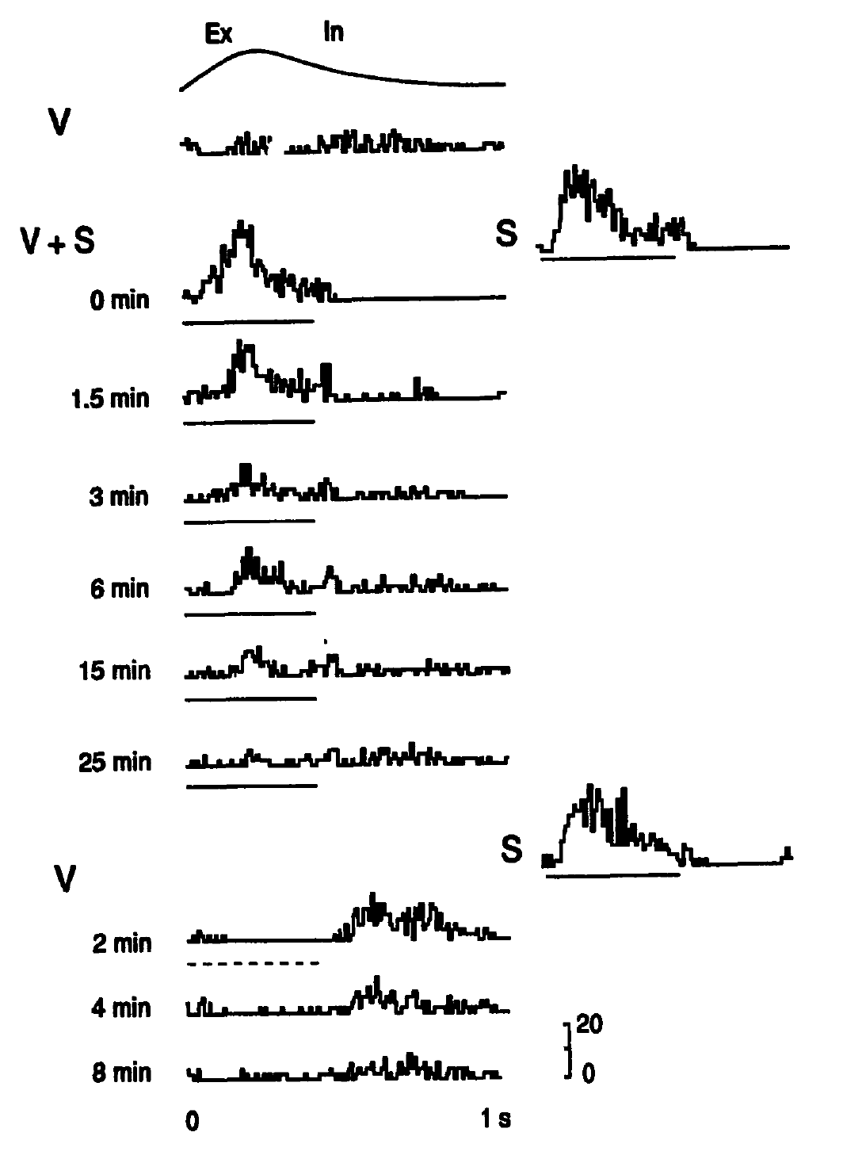
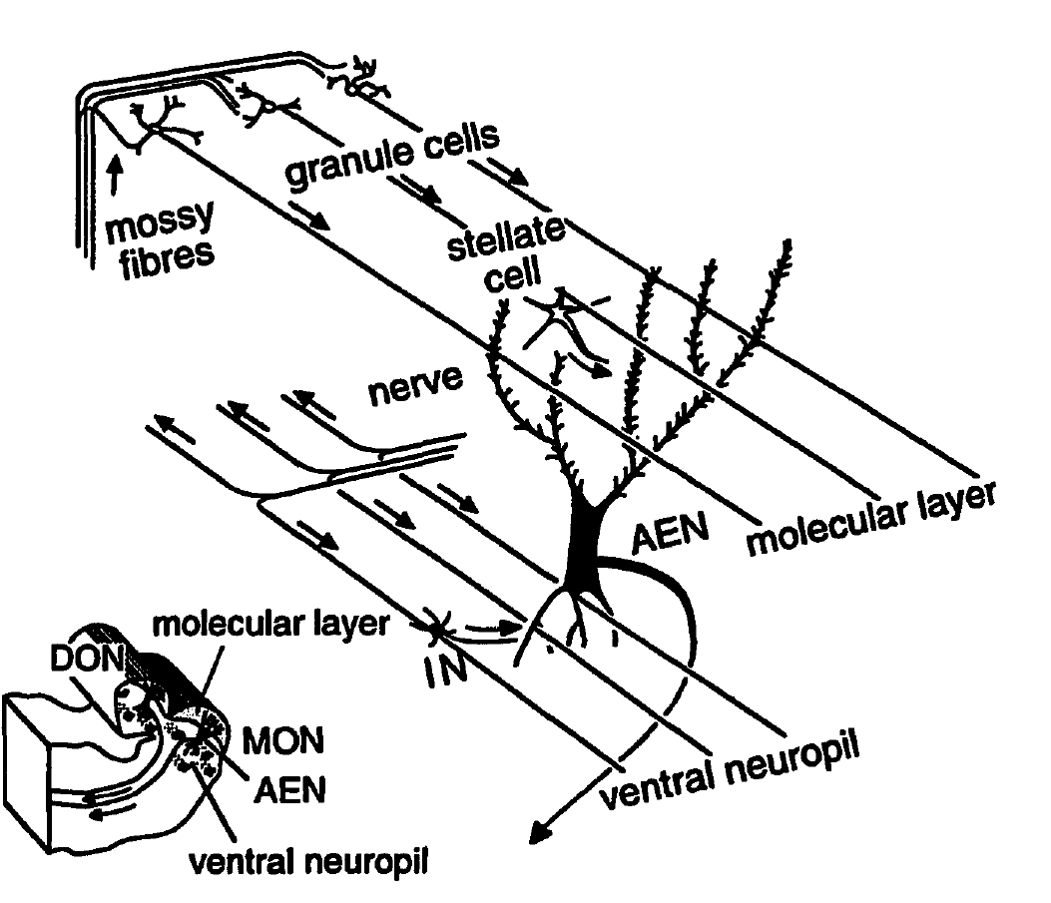
The hindbrain learns to cancel predictable self-input
Reafference is sensory stimulation caused by an animal’s own movement. Montgomery and Bodznick recorded ascending efferent neurons in the little skate’s dorsal octavolateralis nucleus, or DON, the first medullary electrosensory processing nucleus. Ventilation timing was measured with a force transducer near the gills.
A 2-µV dipole stimulus at the skin was repeatedly coupled to ventilation. Neural responses declined over minutes; uncoupled presentations still evoked responses. After 10 minutes of coupling, the mean reduction in responsive neurons was 44.3%. Turning the stimulus off revealed an opposite-sign cancellation response at the trained respiratory phase.
Montgomery & Bodznick (1994), Fig. 1. Ventilation-coupled stimulation induces adaptive cancellation.
The controls distinguish learned temporal cancellation from generalized fatigue. Primary afferents contact basal dendrites, while cerebellar parallel fibers and inhibitory interneurons contact apical dendrites. Plasticity in this circuit was proposed to generate the cancellation signal, which cancels the input that is predictable from the ventilation cycle.
Montgomery & Bodznick (1994), Fig. 3. Original published medullary anatomy.
Montgomery & Bodznick (1994)
44
Notes:
• Reafference is sensory stimulation caused by an animal’s own movement. Montgomery and Bodznick recorded ascending efferent neurons in the little skate’s dorsal octavolateralis nucleus, or DON, the first medullary electrosensory processing nucleus. Ventilation timing was measured with a force transducer near the gills.
– The animals were decerebrated and spinal cords transected, while natural ventilation continued. This reduced other movements but limits generalization to an intact hunting skate. Parallel fibers arise from cerebellar granule cells and can supply movement-related information to the same output neuron receiving electrical sensory input. When an expected signal is removed, the learned cancellation persists temporarily and becomes observable. The original article’s anatomical drawing is retained as a published source, not reconstructed.
• A 2-µV dipole stimulus at the skin was repeatedly coupled to ventilation. Neural responses declined over minutes; uncoupled presentations still evoked responses. After 10 minutes of coupling, the mean reduction in responsive neurons was 44.3%. Turning the stimulus off revealed an opposite-sign cancellation response at the trained respiratory phase.
• The controls distinguish learned temporal cancellation from generalized fatigue. Primary afferents contact basal dendrites, while cerebellar parallel fibers and inhibitory interneurons contact apical dendrites. Plasticity in this circuit was proposed to generate the cancellation signal, which cancels the input that is predictable from the ventilation cycle.
References:
Montgomery JC, Bodznick D (1994). An adaptive filter that cancels self-induced noise in the electrosensory and lateral line mechanosensory systems of fish. Neuroscience Letters 174(2):145-148. https://doi.org/10.1016/0304-3940(94)90007-8
Figure: Montgomery & Bodznick (1994), Fig. 1. Ventilation-coupled stimulation induces adaptive cancellation.
Figure source: https://doi.org/10.1016/0304-3940(94)90007-8
Figure: Montgomery & Bodznick (1994), Fig. 3. Original published medullary anatomy.
Figure source: https://doi.org/10.1016/0304-3940(94)90007-8

Slide 58
Reafference is self-generated sensory input
Reafference is sensory stimulation caused by an animal's own movement. For an electrosensory fish, breathing movements of the gills generate electrical signals at the skin that are predictable in time. The dorsal octavolateralis nucleus receives input from the electrosensory afferents.
Montgomery and Bodznick recorded ascending efferent neurons in the dorsal octavolateralis nucleus of the little skate while ventilation timing was measured near the gills. A 2-µV dipole stimulus coupled to ventilation produced responses that declined over minutes. Neurons were recorded in the little skate under controlled conditions.
After 10 minutes of coupling, the mean reduction in responsive neurons was 44.3%, and turning the stimulus off revealed an opposite-sign cancellation response at the trained respiratory phase. The circuit learns the predictable input and subtracts it.
Montgomery & Bodznick (1994), Fig. 1. Ventilation-coupled stimulation induces adaptive cancellation.
Montgomery & Bodznick (1994), Fig. 3. Original published medullary anatomy.
Montgomery & Bodznick (1994)
44a
Notes:
• A weak external signal can only be detected if the animal's own signal is removed.
• Definition.
– Reafference is sensory stimulation caused by the movement of the animal itself.
• Source in the skate.
– Ventilation moves the gills and produces predictable electrical input at the skin.
• Recording site.
– Ascending efferent neurons in the dorsal octavolateralis nucleus were recorded.
– This nucleus is the first medullary electrosensory processing nucleus.
• Training.
– A 2-microvolt dipole stimulus was coupled to ventilation.
– Responses declined over minutes, and uncoupled presentations still evoked responses.
• Cancellation.
– After 10 minutes the mean reduction in responsive neurons was 44.3 percent.
– Turning the stimulus off revealed an opposite-sign response at the trained phase.
• Controls.
– Uncoupled presentations of the stimulus still evoked responses, so the decline depended on pairing with ventilation and not on fatigue.
• Circuit.
– Primary afferents contact basal dendrites, while cerebellar parallel fibers and inhibitory interneurons contact apical dendrites.
– Plasticity in this circuit was proposed to generate the cancellation signal.
References:
Montgomery JC, Bodznick D (1994). An adaptive filter that cancels self-induced noise in the electrosensory and lateral line mechanosensory systems of fish. Neuroscience Letters 174(2):145-148. https://doi.org/10.1016/0304-3940(94)90007-8

Slide 59


Androgen state alters afferent frequency tuning
Sisneros and Tricas implanted male Atlantic stingrays, Dasyatis sabina, with dihydrotestosterone, or DHT, an androgen hormone. Empty implants provided treatment controls. After 10–21 days, they recorded electrosensory afferents while varying the frequency of uniform electric-field stimulation.
Control afferents had peak sensitivity near 7–8 Hz, compared with approximately 5–6 Hz after DHT treatment. Responses from 0.5 to 4 Hz were approximately 2–4 dB higher in treated animals. Canal-group comparisons associated different tuning patterns with receptor anatomy and canal length.
The manipulation establishes hormonal modulation of peripheral sensory coding rather than a fixed species-wide frequency filter. The recorded frequency shift is a direct experimental result, and tuning that matches the ventilation frequencies of conspecifics is a suggested ecological function.
Sisneros & Tricas (2000), Fig. 6. Androgen treatment shifts afferent frequency response.
Sisneros & Tricas (2000), Fig. 9. Ampullary canal distribution.
Sisneros & Tricas (2000)
45
Notes:
• Sisneros and Tricas implanted male Atlantic stingrays, Dasyatis sabina, with dihydrotestosterone, or DHT, an androgen hormone. Empty implants provided treatment controls. After 10–21 days, they recorded electrosensory afferents while varying the frequency of uniform electric-field stimulation.
– An androgen is a steroid hormone involved in reproductive state. Empty capsules controlled the implantation procedure, and the experiments distinguished short and long canal groups. Differences from round-stingray and little-skate results should preserve species, hormone state, canal identity, and preparation rather than be merged into one universal best frequency.
• Control afferents had peak sensitivity near 7–8 Hz, compared with approximately 5–6 Hz after DHT treatment. Responses from 0.5 to 4 Hz were approximately 2–4 dB higher in treated animals. Canal-group comparisons associated different tuning patterns with receptor anatomy and canal length.
• The manipulation establishes hormonal modulation of peripheral sensory coding rather than a fixed species-wide frequency filter. The recorded frequency shift is a direct experimental result, and tuning that matches the ventilation frequencies of conspecifics is a suggested ecological function.
References:
Sisneros JA, Tricas TC (2000). Androgen-Induced Changes in the Response Dynamics of Ampullary Electrosensory Primary Afferent Neurons. The Journal of Neuroscience 20(22):8586-8595. https://doi.org/10.1523/jneurosci.20-22-08586.2000
Figure: Sisneros & Tricas (2000), Fig. 6. Androgen treatment shifts afferent frequency response.
Figure source: https://doi.org/10.1523/jneurosci.20-22-08586.2000
Figure: Sisneros & Tricas (2000), Fig. 9. Ampullary canal distribution.
Figure source: https://doi.org/10.1523/JNEUROSCI.20-22-08586.2000

Slide 60
Key takeaways
Electrical guidance is experimentally isolated Conductive agar preserves attacks, insulation blocks them, and active dipoles restore directed feeding independently of target odor.
Sensitivity depends on geometry and sampling Nanovolt-gradient responses require source geometry, encounter angle and movement to be distinguished from cellular voltage thresholds.
Receptors amplify weak inputs Low-threshold CaV1.3 supports calcium entry; BK feedback in skates and KV1.3 feedback in catsharks produce distinct membrane dynamics.
Sequence changes alter channel function Neutralization and reciprocal mutations causally link particular CaV1.3 and BK residues to activation, conductance and opening behavior.
Synapses transform cellular activity into output Calcium-dependent ribbon-synapse release differs between shark and skate receptors; vesicle estimates and ventilation do not alone prove ecological function.
Sensory coding is adaptable Afferents saturate and adapt; hindbrain filtering cancels ventilation-linked input, and androgen treatment changes peripheral frequency tuning.
Kalmijn (1971); Bellono et al. (2017, 2018); Montgomery & Bodznick (1994)
46
Notes:
• Electrical guidance is experimentally isolated. Conductive agar preserves attacks, insulation blocks them, and active dipoles restore directed feeding independently of target odor.
• Sensitivity depends on geometry and sampling. Nanovolt-gradient responses require source geometry, encounter angle and movement to be distinguished from cellular voltage thresholds.
• Receptors amplify weak inputs. Low-threshold CaV1.3 supports calcium entry; BK feedback in skates and KV1.3 feedback in catsharks produce distinct membrane dynamics.
• Sequence changes alter channel function. Neutralization and reciprocal mutations causally link particular CaV1.3 and BK residues to activation, conductance and opening behavior.
• Synapses transform cellular activity into output. Calcium-dependent ribbon-synapse release differs between shark and skate receptors; vesicle estimates and ventilation do not alone prove ecological function.
• Sensory coding is adaptable. Afferents saturate and adapt; hindbrain filtering cancels ventilation-linked input, and androgen treatment changes peripheral frequency tuning.
References:
Kalmijn AJ (1971). The Electric Sense of Sharks and Rays. Journal of Experimental Biology 55(2):371-383. https://doi.org/10.1242/jeb.55.2.371
Kajiura SM, Holland KN (2002). Electroreception in juvenile scalloped hammerhead and sandbar sharks. Journal of Experimental Biology 205(23):3609-3621. https://doi.org/10.1242/jeb.205.23.3609
Tricas TC, New JG (1998). Sensitivity and response dynamics of elasmobranch electrosensory primary afferent neurons to near threshold fields. Journal of Comparative Physiology A: Sensory, Neural, and Behavioral Physiology 182(1):89-101. https://doi.org/10.1007/s003590050161
Bellono NW, Leitch DB, Julius D (2017). Molecular basis of ancestral vertebrate electroreception. Nature 543(7645):391-396. https://doi.org/10.1038/nature21401
Bellono NW, Leitch DB, Julius D (2018). Molecular tuning of electroreception in sharks and skates. Nature 558(7708):122-126. https://doi.org/10.1038/s41586-018-0160-9
Montgomery JC, Bodznick D (1994). An adaptive filter that cancels self-induced noise in the electrosensory and lateral line mechanosensory systems of fish. Neuroscience Letters 174(2):145-148. https://doi.org/10.1016/0304-3940(94)90007-8
Sisneros JA, Tricas TC (2000). Androgen-Induced Changes in the Response Dynamics of Ampullary Electrosensory Primary Afferent Neurons. The Journal of Neuroscience 20(22):8586-8595. https://doi.org/10.1523/jneurosci.20-22-08586.2000

