Slide 1

NEUR 411 · NEUROETHOLOGY · FALL 2026
Lecture 32
Vocal communication I: songbird song-system anatomy — HVC–RA–Area X & LMAN (Nottebohm, Bottjer, Doupe)
Monday, November 9, 2026
Jordan Lopez, Ph.D.
Professor of Neurobiology & Biomedical Engineering
Photo: Male and female zebra finches.
Notes:
• Vocal communication I: songbird song-system anatomy — HVC–RA–Area X (Nottebohm)
• Male zebra finches provide an experimentally tractable model of learned vocal motor behavior. Canary lesion experiments established foundational pathways controlling song.
• The title photograph is credited to Michael Hains, CC BY-NC 4.0. https://www.inaturalist.org/photos/147702462
References:
Nottebohm F, Stokes TM, Leonard CM (1976). Central control of song in the canary, Serinus canarius. Journal of Comparative Neurology 165(4):457-486. https://doi.org/10.1002/cne.901650405
Bottjer SW, Miesner EA, Arnold AP (1984). Forebrain Lesions Disrupt Development But Not Maintenance of Song in Passerine Birds. Science 224(4651):901-903. https://doi.org/10.1126/science.6719123
Benezra SE, Narayanan RT, Egger R, Oberlaender M, Long MA (2018). Morphological characterization of HVC projection neurons in the zebra finch (Taeniopygia guttata). Journal of Comparative Neurology 526(10):1673-1689. https://doi.org/10.1002/cne.24437
Doupe AJ (1997). Song- and Order-Selective Neurons in the Songbird Anterior Forebrain and their Emergence during Vocal Development. The Journal of Neuroscience 17(3):1147-1167. https://doi.org/10.1523/jneurosci.17-03-01147.1997

Slide 2
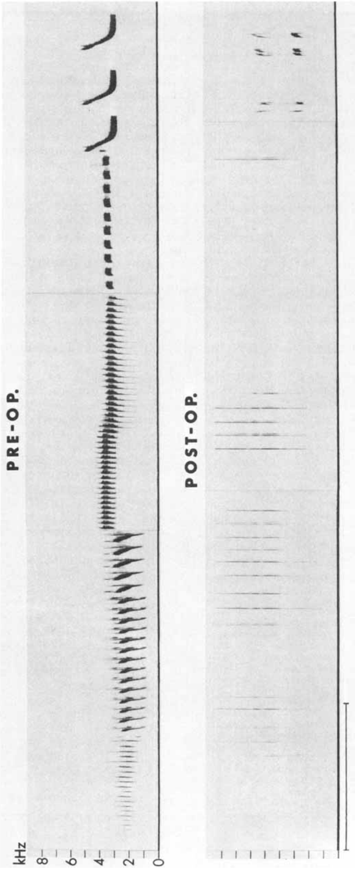
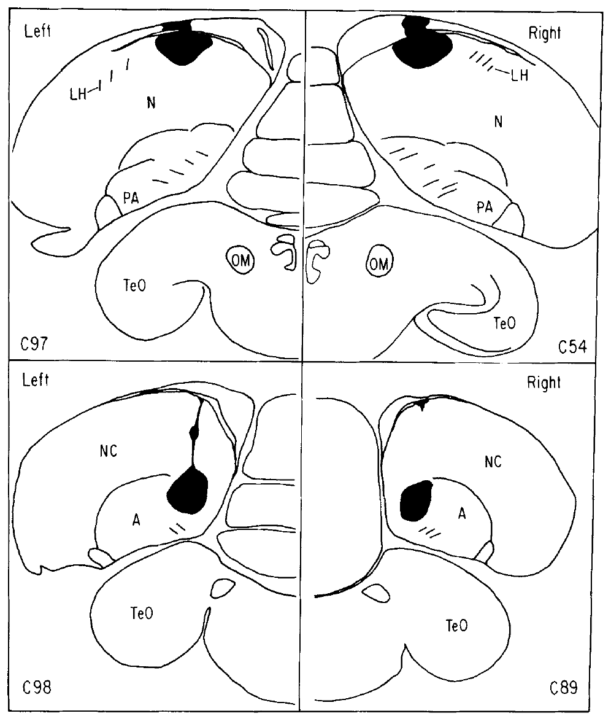
Song is a learned, organized motor sequence
Song consists of coordinated vocal elements, and their frequency and timing can be measured with a spectrogram, which displays acoustic energy across time and frequency. Nottebohm and colleagues recorded adult male canaries before brain surgery, which established each bird's own repertoire as the behavioral baseline. Later changes were judged against that record.
The team compared postoperative vocalizations with those recordings instead of treating every change in singing as the same. Damage could reduce the number of available syllables, disturb their acoustic structure, or disrupt the order of phrases while leaving vocal output possible. Each of these outcomes points to a different kind of motor deficit.
A bird that still vocalizes can therefore have a severe song-control deficit, because the deficit lies in the organization of the song rather than in the ability to sing. These lesion experiments identified components of a learned motor behavior in adults. The learning of a tutor's song is studied separately.
Nottebohm et al. (1976), Fig. 11. Lesion locations associated with song disruption.
Nottebohm et al. (1976)
02
Notes:
• Song consists of coordinated vocal elements whose frequency and timing can be measured with a spectrogram, a display of acoustic energy across time and frequency. Nottebohm and colleagues recorded adult male canaries before brain surgery, establishing each bird's own repertoire as the behavioral baseline.
• They compared postoperative vocalizations with those recordings rather than treating all changes in singing as equivalent. Damage could reduce the number of available syllables, disturb their acoustic structure, or disrupt the organization of phrases while leaving vocal output possible.
• A bird that still vocalizes can therefore have a severe song-control deficit. These experiments localized components of an established motor behavior; adult lesions alone did not identify where a juvenile stores or learns a tutor's song.
References:
Nottebohm F, Stokes TM, Leonard CM (1976). Central control of song in the canary, Serinus canarius. Journal of Comparative Neurology 165(4):457-486. https://doi.org/10.1002/cne.901650405
Figure: Nottebohm et al. (1976), Fig. 13. Canary song before and after a forebrain lesion.
Figure source: https://doi.org/10.1002/cne.901650405
Figure: Nottebohm et al. (1976), Fig. 11. Lesion locations associated with song disruption.
Figure source: https://doi.org/10.1002/cne.901650405

Slide 3
Song disruption depends on lesion location
A lesion is damage to tissue that tests whether a region contributes to a behavior. Nottebohm and colleagues made unilateral electrolytic lesions in adult male canaries and reconstructed each lesion's position histologically after repeated postoperative recordings. Matching every song change to its exact lesion site made the location of the effect the central variable.
Lesions involving HVC or the robust nucleus of the arcopallium, RA, severely altered song organization. Several lesions outside this pathway had little or no effect on song. Comparing effective and ineffective sites narrowed the search to a restricted set of forebrain territories.
Electrolytic current can damage both local neurons and the axons that pass through a site, so the lesion effect is read together with the histology. The results show that these restricted territories are needed for normal adult song. Lesion size and position are compared across birds, so the effect is attributed to the nucleus rather than to a single animal.
Nottebohm et al. (1976), Fig. 11. Lesion locations associated with song disruption.
Nottebohm et al. (1976)
03
Notes:
• A lesion is damage to tissue used to test whether a region contributes to a behavior. Nottebohm and colleagues made unilateral electrolytic lesions in adult male canaries and reconstructed their positions histologically after repeated postoperative song recordings.
• Lesions involving HVC or the robust nucleus of the arcopallium, RA, severely altered song organization, whereas several lesions outside the implicated pathway had little or no effect. Comparing effective and ineffective lesion sites constrained the anatomical interpretation beyond a simple surgery-versus-no-surgery comparison.
• Electrolytic current can damage both local neurons and passing axons. The results establish that these restricted forebrain territories are necessary for normal adult song, but do not isolate a particular cell type or prove that every nucleus performs the same computation.
References:
Nottebohm F, Stokes TM, Leonard CM (1976). Central control of song in the canary, Serinus canarius. Journal of Comparative Neurology 165(4):457-486. https://doi.org/10.1002/cne.901650405
Figure: Nottebohm et al. (1976), Fig. 11. Lesion locations associated with song disruption.
Figure source: https://doi.org/10.1002/cne.901650405

Slide 4
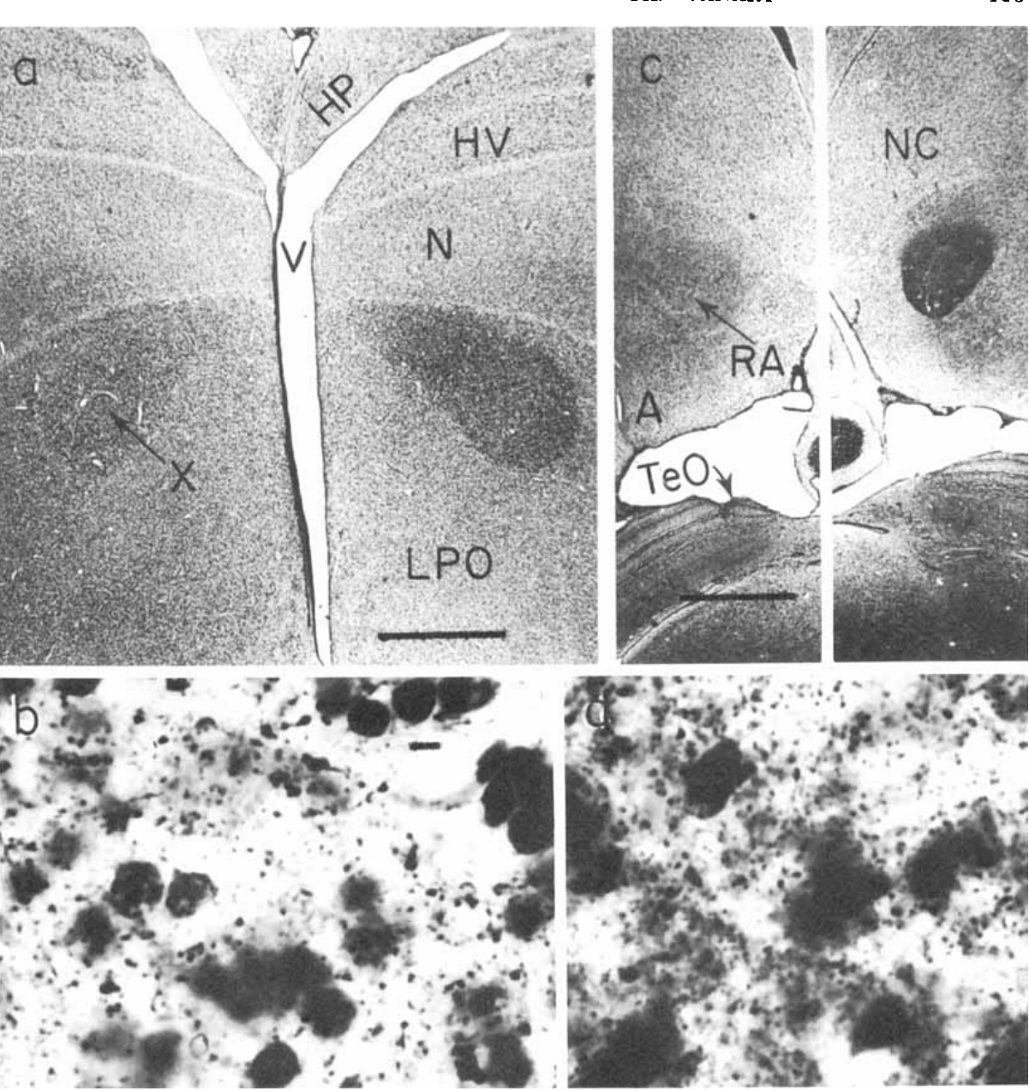
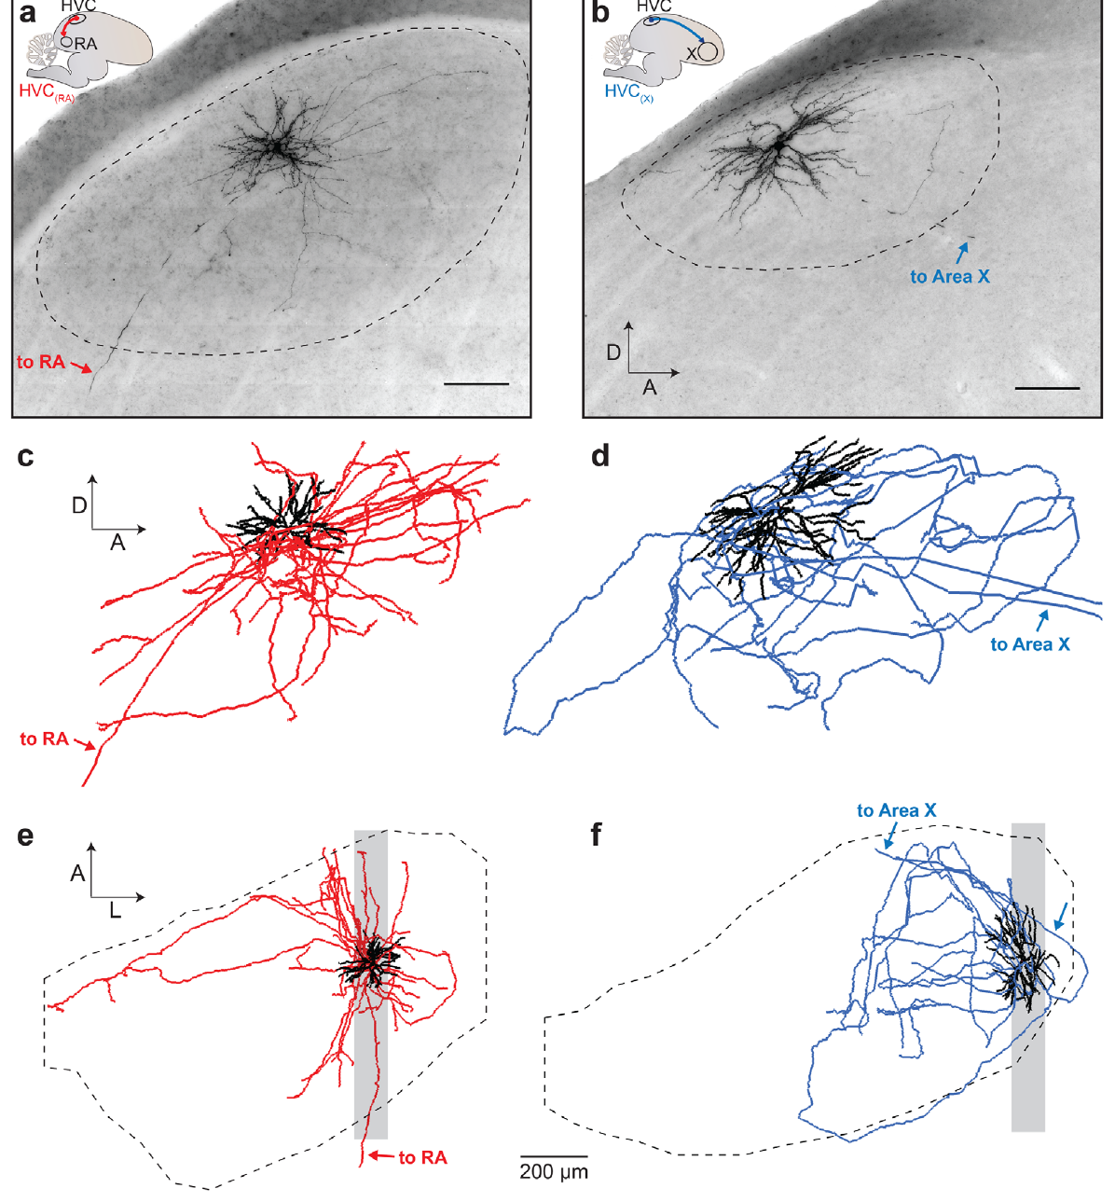
Degenerating axons reveal descending song pathways
An axon carries signals away from a neuron, and a projection is an axonal connection between two regions. A synapse is the junction where one neuron influences another cell. Nottebohm and colleagues combined the behavioral lesions with Fink–Heimer staining, a method that reveals degenerating fibers and terminals downstream of damaged neurons.
Degeneration linked the region historically called HVc to RA, and it connected RA with descending pathways toward vocal motor structures. Comparing the lesion locations with the distribution of degeneration gave anatomical evidence that is independent of the acoustic changes in song. The two kinds of evidence therefore support the same pathway.
The original article uses historical names that differ from current avian terminology: HVC is now a proper name, and RA lies in the arcopallium. Degeneration tracing shows the anatomical direction of a pathway. Its transmitter, synaptic sign and activity during singing are measured with the methods described on the following slides.
Nottebohm et al. (1976), Fig. 7(a–d). Degeneration staining in the canary song pathway.
Benezra et al. (2018), Fig. 2(a–f). Identified RA- and X-projecting HVC neurons.
Nottebohm et al. (1976); Benezra et al. (2018)
04
Notes:
• An axon carries signals away from a neuron; a projection is an axonal connection between regions. A synapse is a junction through which a neuron influences another cell. Nottebohm and colleagues combined behavioral lesions with Fink–Heimer staining, a method that reveals degenerating fibers and terminals downstream of damaged neurons.
• Degeneration linked the region historically called HVc to RA and connected RA with descending pathways toward vocal motor structures. Comparing the locations of lesions with the distributions of degeneration supplied anatomical evidence independent of the acoustic changes in song.
• The historical names in the original article differ from current avian terminology: HVC is now used as a proper name, and RA lies in the arcopallium. Degeneration tracing establishes a pathway's anatomical direction, but does not measure its transmitter, synaptic sign, or activity during singing.
References:
Nottebohm F, Stokes TM, Leonard CM (1976). Central control of song in the canary, Serinus canarius. Journal of Comparative Neurology 165(4):457-486. https://doi.org/10.1002/cne.901650405
Benezra SE, Narayanan RT, Egger R, Oberlaender M, Long MA (2018). Morphological characterization of HVC projection neurons in the zebra finch (Taeniopygia guttata). Journal of Comparative Neurology 526(10):1673-1689. https://doi.org/10.1002/cne.24437
Figure: Nottebohm et al. (1976), Fig. 7(a–d). Degeneration staining in the canary song pathway.
Figure source: https://doi.org/10.1002/cne.901650405
Figure: Benezra et al. (2018), Fig. 2(a–f). Identified RA- and X-projecting HVC neurons.
Figure source: https://doi.org/10.1002/cne.24437

Slide 5
Fink–Heimer staining marks downstream terminals
Fink–Heimer staining reveals degenerating fibers and terminals after a neuron is damaged. Because the stain marks only the processes that lost their cell body, it shows where a lesioned population sends its axons. Nottebohm and colleagues used this stain to follow the output of song nuclei in adult canaries.
After lesions of the region historically called HVc, degenerating fibers were found in RA. Degeneration in RA then pointed toward descending pathways that reach vocal motor structures in the brainstem. Each labeled tract starts at a known lesion and ends at a known target.
The anatomy therefore supplies a direction for the song pathway, independent of any change in the song itself. A lesion that disrupts song and a lesion that produces degeneration in RA point to the same chain of nuclei, which makes the pathway easier to trace. Each stained tract can be followed back to a lesioned population.
Nottebohm et al. (1976), Fig. 7(a–d). Degeneration staining in the canary song pathway.
Benezra et al. (2018), Fig. 2(a–f). Identified RA- and X-projecting HVC neurons.
Nottebohm et al. (1976)
04a
Notes:
• Degeneration staining follows the output of a lesioned region.
• Stain.
– Fink–Heimer staining reveals degenerating fibers and terminals.
– Only processes that lost their cell body are labeled.
• Lesion.
– The lesions targeted the region historically called HVc.
– Each lesion has a known starting point.
• Target.
– Degeneration appeared in RA.
– RA receives the output of HVc.
• Descending output.
– RA connects to descending pathways.
– These pathways reach the vocal motor structures.
• Combined evidence.
– Lesion location and degeneration pattern agree.
– Both point to the same chain of nuclei.
• Meaning.
– Anatomy gives the direction of the pathway.
– The direction is independent of the song changes.
• Source values.
– The published values and recording conditions come from the original paper.
– Each value is reported with the scale or condition used in the source.
• Why the measure matters.
– The result separates the measured property from the mechanism that produces it.
– The comparison stays within the same cells or the same birds.
• Interpretation.
– Each result is read within the preparation and the age group that produced it.
– The claim is restricted to the measured cells and conditions.
References:
Nottebohm F, Stokes TM, Leonard CM (1976). Central control of song in the canary, Serinus canarius. Journal of Comparative Neurology 165(4):457-486. https://doi.org/10.1002/cne.901650405

Slide 6
HVC contains neurons with distinct output targets
A projection neuron sends an axon outside its local region. Benezra and colleagues distinguished HVC neurons projecting to RA, designated HVC(RA), from neurons projecting to Area X, a song-related basal ganglia region involved in action control. The two populations are defined by where their axons end.
They labeled individual cells in adult male zebra finches and reconstructed their dendrites and axons in three dimensions. The analysis kept the target identity of each filled neuron rather than pooling every HVC cell into one morphological class. Each reconstruction therefore carries both its anatomy and its projection target.
HVC(RA) and HVC(X) neurons differed in their dendritic and local axonal organization. Target identity did not predict every anatomical feature, so the two groups share some features while differing in others. Each population therefore receives its own description within the same set of reconstructions.
Benezra et al. (2018), Fig. 2(a–f). Identified RA- and X-projecting HVC neurons.
Benezra et al. (2018)
05
Notes:
• A projection neuron sends an axon outside its local region. Benezra and colleagues distinguished HVC neurons projecting to RA, designated HVC(RA), from neurons projecting to Area X, a song-related basal ganglia region involved in action control, designated HVC(X).
• They labeled individual cells in adult male zebra finches and reconstructed their dendrites and axons in three dimensions. The analysis retained the target identity of each filled neuron rather than pooling every HVC cell into a single morphological population.
• HVC(RA) and HVC(X) neurons differed in their dendritic and local axonal organization, although target identity did not perfectly predict every anatomical feature. Separate output classes allow HVC to influence vocal execution and the anterior forebrain pathway; morphology alone does not reveal the precise signals transmitted along either branch.
References:
Benezra SE, Narayanan RT, Egger R, Oberlaender M, Long MA (2018). Morphological characterization of HVC projection neurons in the zebra finch (Taeniopygia guttata). Journal of Comparative Neurology 526(10):1673-1689. https://doi.org/10.1002/cne.24437
Figure: Benezra et al. (2018), Fig. 2(a–f). Identified RA- and X-projecting HVC neurons.
Figure source: https://doi.org/10.1002/cne.24437

Slide 7
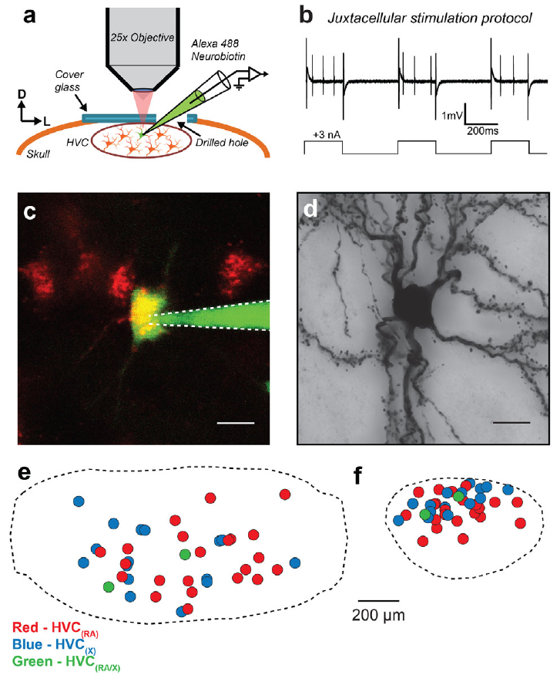
Two-photon targeting links cells to reconstructed arbors
Two-photon microscopy uses nonlinear excitation to resolve fluorescent structures within tissue. Benezra and colleagues combined retrograde labeling from an HVC output target with visually guided recordings and intracellular filling. The method linked each neuron's projection identity to its later anatomical reconstruction.
A fluorescently filled neuron was processed histologically so that its dendrites and axonal branches could be traced across sections. The approach resolved single-cell structure that would be obscured if many neighboring neurons were labeled together. Each traced cell therefore stands on its own.
Targeted filling bridges an identified neuron and its complete local arbor. Incomplete filling, section boundaries and optical resolution set the detail that each reconstruction can show. The resulting anatomical map describes the cell's structure, and its functional synapses are examined by other measurements.
Benezra et al. (2018), Fig. 1(a–f). Targeted labeling and single-cell filling in HVC.
Benezra et al. (2018)
06
Notes:
• Two-photon microscopy uses nonlinear excitation to resolve fluorescent structures within tissue. Benezra and colleagues combined retrograde labeling from an HVC output target with visually guided recordings and intracellular filling, connecting a neuron's projection identity with its later anatomical reconstruction.
• A fluorescently filled neuron was processed histologically so that its dendrites and axonal branches could be traced across sections. This approach resolved single-cell structure that would be obscured if many neighboring neurons were labeled together.
• Targeted filling provides a bridge between an identified neuron and its complete local arbor. However, incomplete filling, section boundaries, and finite optical resolution can hide fine processes; the resulting anatomical map is not a direct measurement of every functional synapse.
References:
Benezra SE, Narayanan RT, Egger R, Oberlaender M, Long MA (2018). Morphological characterization of HVC projection neurons in the zebra finch (Taeniopygia guttata). Journal of Comparative Neurology 526(10):1673-1689. https://doi.org/10.1002/cne.24437
Figure: Benezra et al. (2018), Fig. 1(a–f). Targeted labeling and single-cell filling in HVC.
Figure source: https://doi.org/10.1002/cne.24437

Slide 8
Single-cell filling reveals complete local arbors
Single-cell filling labels one neuron completely so that its dendrites and axons can be traced in full. Benezra and colleagues filled identified HVC neurons after labeling them through their output targets. A filled cell therefore carries both its anatomy and the target that defines it.
Two-photon imaging resolved the fine branches of these cells inside living tissue. The reconstructions were then built from serial sections, so each arbor could be followed across the boundaries of the slices. The complete branching pattern is visible only when a single cell is isolated from its neighbors.
A single reconstructed neuron can therefore be compared with the population of neurons that share its target. The filled cell links a projection identity to a measurable shape. Its branches tell the reader where that neuron's information can travel within HVC.
Benezra et al. (2018), Fig. 1(a–f). Targeted labeling and single-cell filling in HVC.
Benezra et al. (2018)
06a
Notes:
• Single-cell filling connects projection identity to structure.
• Filling.
– One neuron is labeled completely.
– Its dendrites and axons are then traced.
• Targeting.
– Cells were labeled through their output targets.
– The label identifies the projection.
• Imaging.
– Two-photon imaging resolved fine branches.
– The fine branches are often hidden in dense labeling.
• Reconstruction.
– Serial sections allow tracing across slices.
– Each arbor is followed from start to end.
• Isolation.
– A single cell is separated from its neighbors.
– Its branching pattern can be read clearly.
• Meaning.
– Each reconstruction gives one neuron's full shape.
– The shape can be compared across the population.
• Source values.
– The published values and recording conditions come from the original paper.
– Each value is reported with the scale or condition used in the source.
• Why the measure matters.
– The result separates the measured property from the mechanism that produces it.
– The comparison stays within the same cells or the same birds.
• Interpretation.
– Each result is read within the preparation and the age group that produced it.
– The claim is restricted to the measured cells and conditions.
References:
Benezra SE, Narayanan RT, Egger R, Oberlaender M, Long MA (2018). Morphological characterization of HVC projection neurons in the zebra finch (Taeniopygia guttata). Journal of Comparative Neurology 526(10):1673-1689. https://doi.org/10.1002/cne.24437

Slide 9
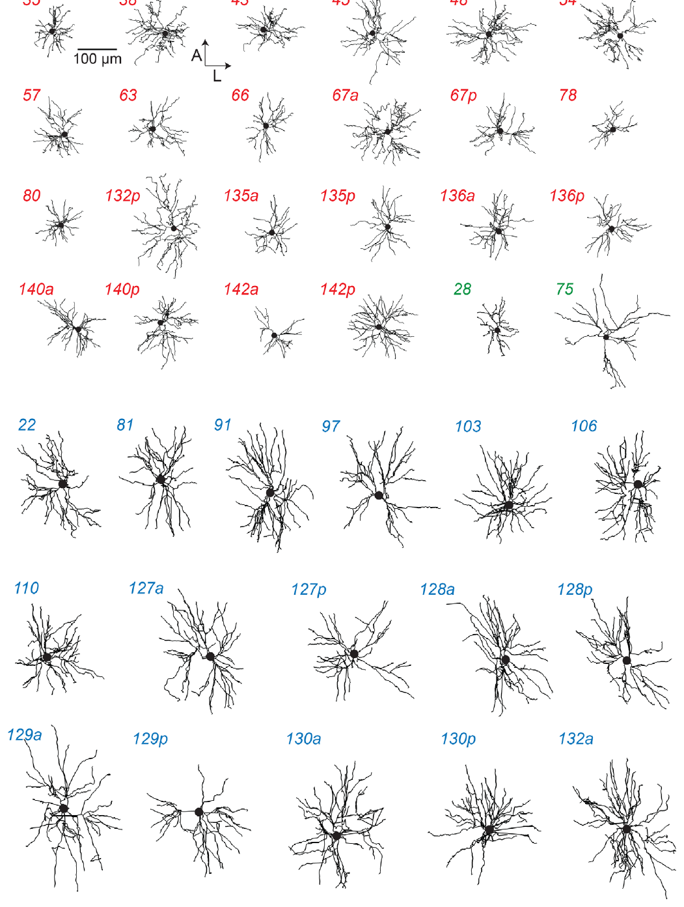
Dendrites occupy different territories in HVC
A dendrite is a neuronal process that receives synaptic input. Benezra and colleagues compared reconstructed dendritic trees of HVC(RA) and HVC(X) neurons after registering their positions within HVC. Registration places every cell in the same frame, so the territories of the two groups can be compared directly.
Most RA-projecting cells had relatively restricted dendritic territories, whereas X-projecting cells occupied larger territories. Displaying individual reconstructions kept the variation within each class visible. Individual reconstructions therefore remain the basis for every class average.
A broader dendritic field gives access to a different spatial distribution of potential inputs. Proximity of the dendrites to other cells is a separate matter from connectivity, and the synapses that form along the territory are measured separately.
Benezra et al. (2018), Fig. 3. Dendritic arbors grouped by projection target.
Benezra et al. (2018)
07
Notes:
• A dendrite is a neuronal process that receives synaptic input. Benezra and colleagues compared reconstructed dendritic trees of HVC(RA) and HVC(X) neurons after registering their positions within HVC, allowing cell types to be compared in a common anatomical frame.
• Most RA-projecting cells had relatively restricted dendritic territories, whereas X-projecting cells occupied larger territories. Displaying individual reconstructions preserved variation within each class rather than replacing the cells with an idealized average neuron.
• A broader dendritic field creates access to a different spatial distribution of potential inputs, but proximity is not equivalent to connectivity. The study measured anatomy, not the identities, strengths, or timing of all inputs contacting each dendritic branch during natural song.
References:
Benezra SE, Narayanan RT, Egger R, Oberlaender M, Long MA (2018). Morphological characterization of HVC projection neurons in the zebra finch (Taeniopygia guttata). Journal of Comparative Neurology 526(10):1673-1689. https://doi.org/10.1002/cne.24437
Figure: Benezra et al. (2018), Fig. 3. Dendritic arbors grouped by projection target.
Figure source: https://doi.org/10.1002/cne.24437

Slide 10
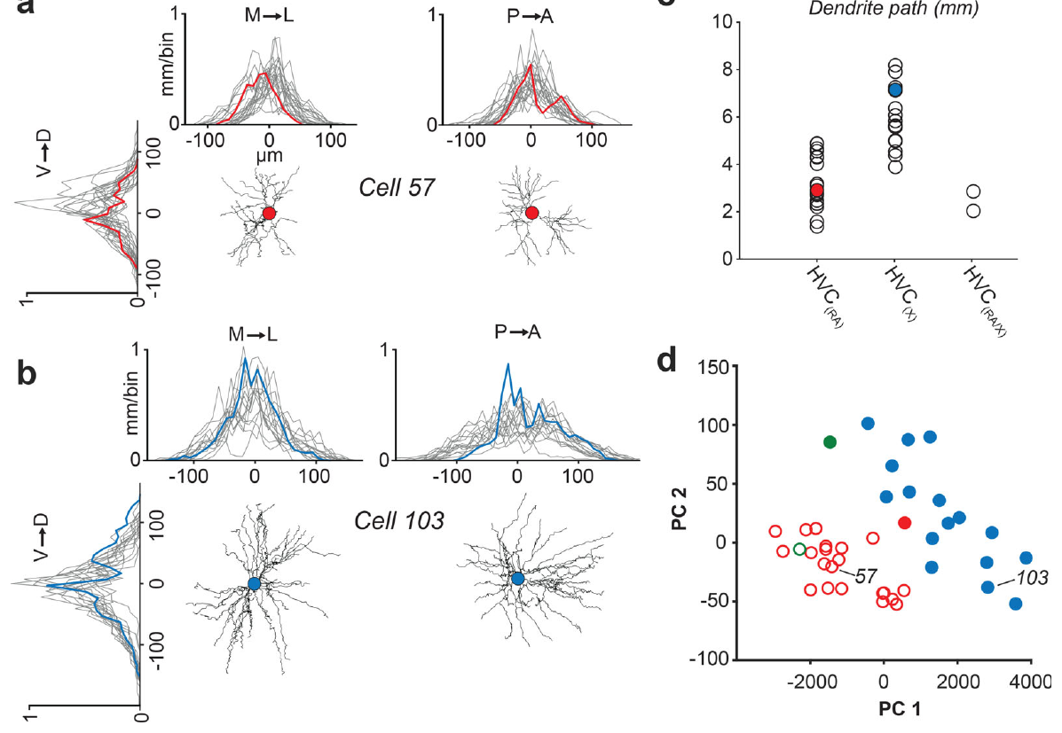
Target identity predicts dendritic scale imperfectly
Benezra and colleagues quantified dendritic length along three spatial axes and the total path length of each reconstructed HVC neuron. Centering these measurements on each cell body separated the extent of the dendrites from the neuron's absolute position within the nucleus. The two properties are therefore measured independently.
RA-projecting neurons generally formed a group with smaller dendrites, whereas X-projecting neurons formed a group with larger dendrites. The distributions included exceptions, and cells with branches to both targets did not form one uniform size class. Size therefore tracks projection target only in part.
These measurements show the spatial integration available to each projection population. Dendritic size is one feature among several, and the anatomical classes overlap in those other features even when their average organization differs. Each class is therefore described by its typical size and by the spread of individual cells around it.
Benezra et al. (2018), Fig. 4(a–d). Spatial distribution and size of HVC dendrites.
Benezra et al. (2018)
08
Notes:
• Benezra and colleagues quantified dendritic length along three spatial axes and the total path length of reconstructed HVC neurons. Centering these measurements on each cell body separated dendritic extent from the neuron's absolute position within the nucleus.
• RA-projecting neurons generally formed a smaller-dendrite group, whereas X-projecting neurons formed a larger-dendrite group. The distributions nevertheless included exceptions, and cells with branches to both targets did not constitute a single uniform size class.
• These measurements constrain the spatial integration available to each projection population. They do not justify assigning every small neuron a motor function or every large neuron a learning function without identifying its actual axonal target; anatomical classes overlap in some features even when their average organization differs.
References:
Benezra SE, Narayanan RT, Egger R, Oberlaender M, Long MA (2018). Morphological characterization of HVC projection neurons in the zebra finch (Taeniopygia guttata). Journal of Comparative Neurology 526(10):1673-1689. https://doi.org/10.1002/cne.24437
Figure: Benezra et al. (2018), Fig. 4(a–d). Spatial distribution and size of HVC dendrites.
Figure source: https://doi.org/10.1002/cne.24437

Slide 11
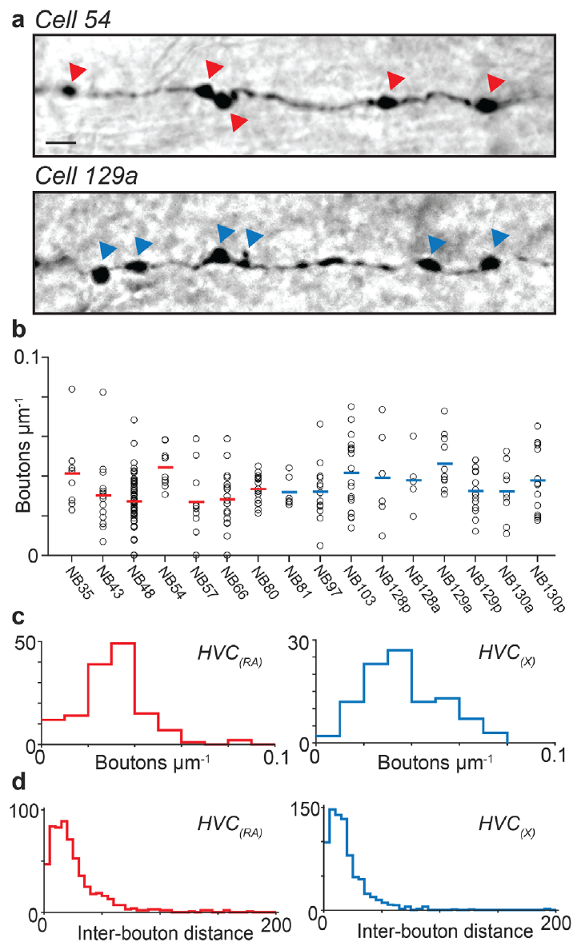
Axonal boutons mark potential local output sites
An axon collateral is a branch of an axon, and a bouton is a swelling at a potential presynaptic terminal. Benezra and colleagues counted boutons along the reconstructed local collateral branches of HVC(RA) and HVC(X) neurons. The count measures how much local output each cell can make.
Both projection classes carried abundant boutons within HVC, with broadly similar bouton densities. The reconstruction-based estimate was about 400 local boutons per HVC(RA) neuron. The labeled micrographs keep a 5 µm scale bar that sets the size of each bouton.
Long-range projection neurons therefore also contribute to local HVC communication, in addition to sending signals downstream. Light-microscopic boutons mark candidate contact sites, and the contacts themselves are confirmed by other methods.
Benezra et al. (2018), Fig. 5(a–d). Axonal boutons and their spatial density.
Benezra et al. (2018)
09
Notes:
• An axon collateral is a branch of an axon, and a bouton is a swelling associated with a potential presynaptic terminal. Benezra and colleagues counted boutons along reconstructed local collateral branches of HVC(RA) and HVC(X) neurons.
• Both projection classes carried abundant boutons within HVC, with broadly similar bouton densities. Their reconstruction-based estimate was about 400 local boutons per HVC(RA) neuron. The labeled micrographs preserve a 5 µm scale bar, making the spatial separation of adjacent swellings explicit rather than implying that a whole branch acts as one output site.
• Long-range projection neurons can therefore contribute to local HVC communication as well as sending signals downstream. Light-microscopic boutons are anatomical candidates for synapses; their presence does not identify the postsynaptic cell or establish the strength and sign of a particular connection.
References:
Benezra SE, Narayanan RT, Egger R, Oberlaender M, Long MA (2018). Morphological characterization of HVC projection neurons in the zebra finch (Taeniopygia guttata). Journal of Comparative Neurology 526(10):1673-1689. https://doi.org/10.1002/cne.24437
Figure: Benezra et al. (2018), Fig. 5(a–d). Axonal boutons and their spatial density.
Figure source: https://doi.org/10.1002/cne.24437

Slide 12
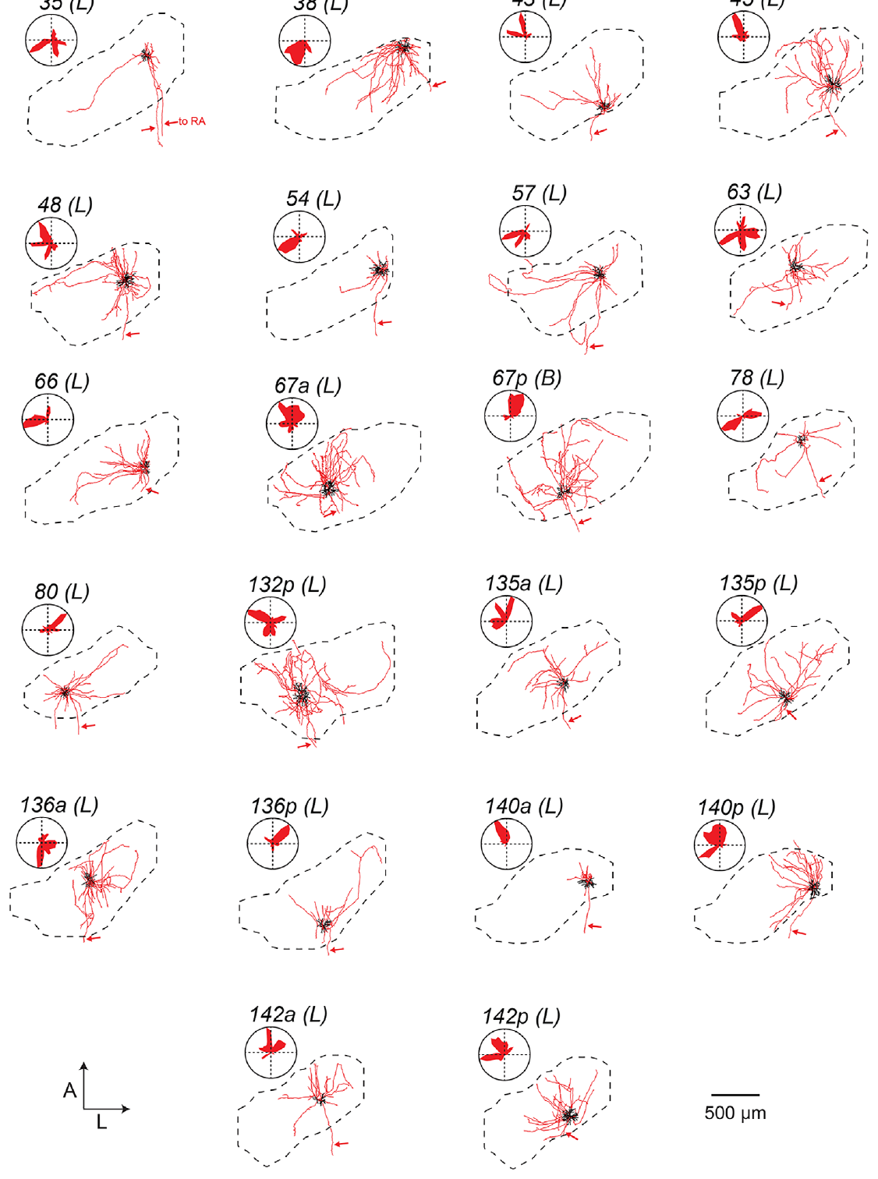
RA-projecting cells also innervate local HVC
Benezra and colleagues reconstructed the dendrites and axonal collaterals of individual HVC(RA) neurons within the boundary of HVC. The descending axon identifies the cell's long-range destination, while its local branches give a separate measure of output within the nucleus. Both measures come from the same cell.
Some cells confined most of their local branches near the cell body, whereas others spread branches across a broader portion of HVC. This variation was visible within the RA-projecting population, so it is not explained only by the difference between projection targets. Individual cells differ in how far their local output reaches.
Local output makes a purely feedforward description of HVC incomplete. An RA-projecting neuron can take part in HVC interactions before its axon reaches RA. The reconstruction identifies the contact partner only as a candidate, and the cell type of each partner is tested separately.
Benezra et al. (2018), Fig. 6. Local axons of RA-projecting HVC neurons.
Benezra et al. (2018)
10
Notes:
• Benezra and colleagues reconstructed the dendrites and axonal collaterals of individual HVC(RA) neurons within the boundary of HVC. The descending axon identified the cell's long-range destination, while its local branches provided a separate measure of intranuclear output.
• Some cells confined most local axonal branches near the cell body, whereas others distributed branches across a broader portion of HVC. This variation remained visible within the RA-projecting population rather than being explained solely by differences between projection targets.
• Local output makes a strictly feedforward description of HVC incomplete: an RA-projecting neuron can participate in HVC interactions before its axon reaches RA. The reconstruction does not determine whether the cell contacts another projection neuron, an inhibitory interneuron, or both.
References:
Benezra SE, Narayanan RT, Egger R, Oberlaender M, Long MA (2018). Morphological characterization of HVC projection neurons in the zebra finch (Taeniopygia guttata). Journal of Comparative Neurology 526(10):1673-1689. https://doi.org/10.1002/cne.24437
Figure: Benezra et al. (2018), Fig. 6. Local axons of RA-projecting HVC neurons.
Figure source: https://doi.org/10.1002/cne.24437

Slide 13
Local axons vary within the RA-projecting population
A local axon collateral is a branch that stays within the same nucleus as its parent cell. Benezra and colleagues measured these branches in HVC(RA) neurons, which send their long axons to RA. The branches show how much each cell contacts the tissue around it.
Some HVC(RA) neurons kept most of their local branches close to the cell body. Others spread their branches across a larger part of HVC. Both patterns appeared among cells that share the same long-range target, so the target alone does not fix the local arbor.
Local branches therefore give each RA-projecting cell its own position in the HVC network. A neuron with broad local branches can influence more of the surrounding tissue before its signal reaches RA. The branching pattern of each cell is therefore recorded as an individual property.
Benezra et al. (2018), Fig. 6. Local axons of RA-projecting HVC neurons.
Benezra et al. (2018)
10a
Notes:
• Local collaterals differ among cells with the same target.
• Definition.
– A local collateral stays within HVC.
– It is a branch of the same cell's axon.
• Target.
– HVC(RA) neurons send their long axons to RA.
– Those long axons define the projection.
• Local arbor.
– Some cells keep branches near the cell body.
– Others spread branches across HVC.
• Variation.
– The variation appears within one projection class.
– The target alone does not set the arbor.
• Network position.
– Local branches place each cell in the HVC network.
– Each cell contacts a different amount of tissue.
• Meaning.
– Local output is a property of each cell.
– It adds to the long-range projection.
• Source values.
– The published values and recording conditions come from the original paper.
– Each value is reported with the scale or condition used in the source.
• Why the measure matters.
– The result separates the measured property from the mechanism that produces it.
– The comparison stays within the same cells or the same birds.
• Interpretation.
– Each result is read within the preparation and the age group that produced it.
– The claim is restricted to the measured cells and conditions.
References:
Benezra SE, Narayanan RT, Egger R, Oberlaender M, Long MA (2018). Morphological characterization of HVC projection neurons in the zebra finch (Taeniopygia guttata). Journal of Comparative Neurology 526(10):1673-1689. https://doi.org/10.1002/cne.24437

Slide 14
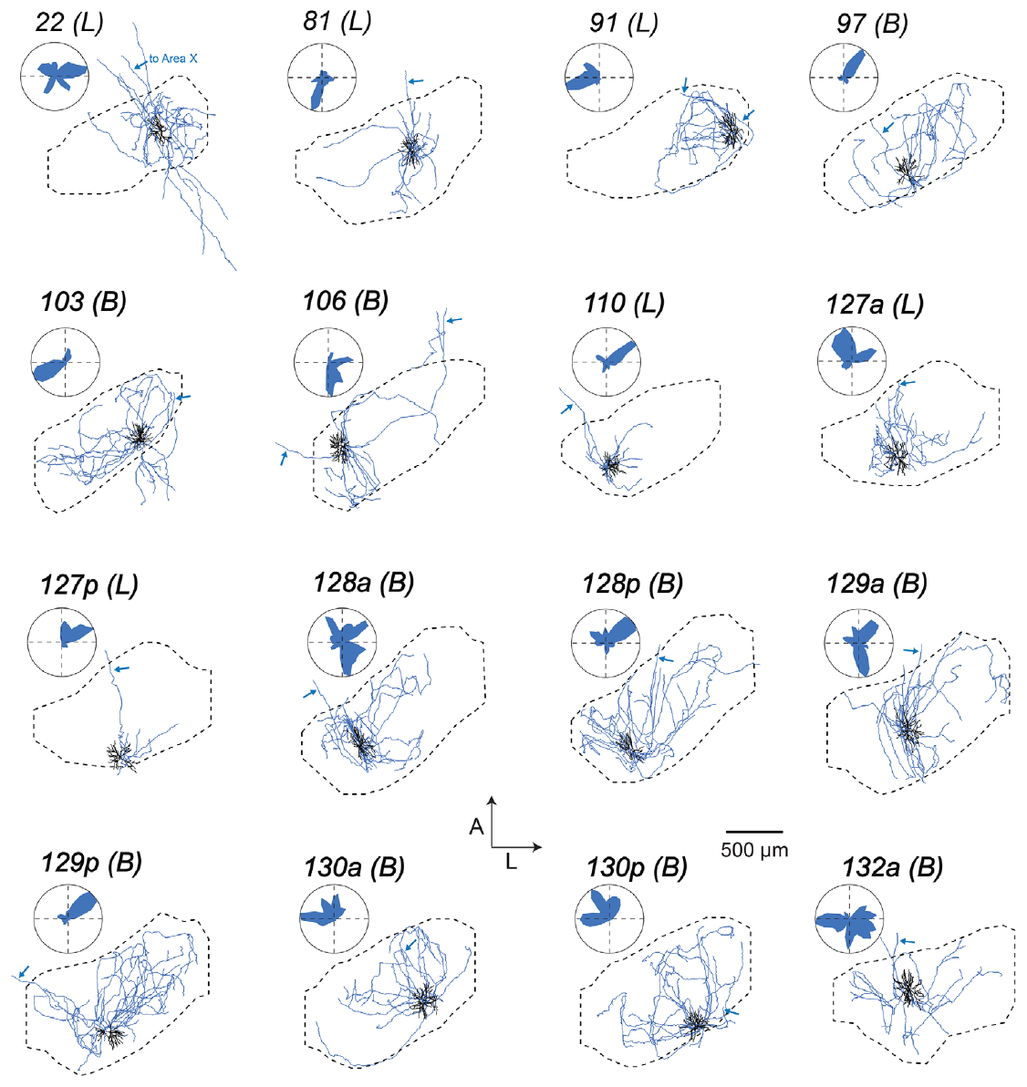
X-projecting cells have extensive local collaterals
Area X receives an HVC projection that is distinct from the direct HVC-to-RA motor pathway. Benezra and colleagues reconstructed HVC(X) neurons with their local axons, dendrites and descending projection, all identified in the same preparation.
Their local branches varied from restricted arbors to broad distributions within HVC. The authors compared these distributions with RA-projecting cells in a shared reference frame, which revealed an organization that a drawing of single cells would miss. The shared frame keeps the two populations comparable.
An HVC(X) neuron can therefore influence both the local HVC network and a distant basal ganglia region. The anatomy supports several routes by which HVC activity reaches its targets, and the timing of each route is measured separately. Comparing these cells with RA-projecting neurons shows which features each projection shares.
Benezra et al. (2018), Fig. 7. Local axons of X-projecting HVC neurons.
Benezra et al. (2018)
11
Notes:
• Area X receives an HVC projection distinct from the direct HVC-to-RA motor pathway. Benezra and colleagues reconstructed HVC(X) neurons with their local axons, dendrites, and descending projection identified in the same preparation.
• Their local branches varied from restricted arbors to broad distributions within HVC. The authors compared these distributions with RA-projecting cells in a shared reference frame, revealing organization that would be lost in a drawing of one generic HVC-to-X connection.
• An HVC(X) neuron can consequently influence both the local HVC network and a distant basal ganglia region. The anatomical data support multiple routes for distributing activity, but do not establish whether particular local branches carry a timing signal, an auditory signal, or a mixture during behavior.
References:
Benezra SE, Narayanan RT, Egger R, Oberlaender M, Long MA (2018). Morphological characterization of HVC projection neurons in the zebra finch (Taeniopygia guttata). Journal of Comparative Neurology 526(10):1673-1689. https://doi.org/10.1002/cne.24437
Figure: Benezra et al. (2018), Fig. 7. Local axons of X-projecting HVC neurons.
Figure source: https://doi.org/10.1002/cne.24437

Slide 15
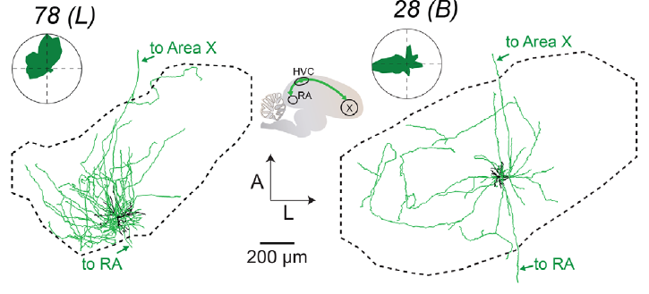
A few reconstructed cells project to both targets
Benezra and colleagues identified HVC neurons with axonal projections toward both RA and Area X. These HVC(RA/X) cells challenge the idea that all long-range HVC outputs belong to two completely separate populations. Their existence changes the simple two-population picture of HVC.
The dual-projecting cells differed from one another in dendritic organization. The authors kept each one as an individually identified cell rather than forcing it into a single class defined only by its pair of targets. The individual cells therefore show more variety than the label suggests.
Dual projections offer a possible route for distributing related activity to motor and anterior forebrain pathways. The cells are rare in the reconstructions, and whether both branches carry the same information is tested by recording both targets during singing.
Benezra et al. (2018), Fig. 8. Two dual-projecting HVC neurons.
Benezra et al. (2018)
12
Notes:
• Benezra and colleagues identified HVC neurons with axonal projections toward both RA and Area X. These HVC(RA/X) cells challenge an absolute rule that all long-range HVC outputs belong to two completely separate populations.
• The reconstructed dual-projecting cells differed from one another in dendritic organization. The authors retained them as individually identified cells rather than forcing them into a single stereotyped anatomical class defined only by their shared target combination.
• Dual projections provide a possible anatomical route for distributing related activity to motor and anterior forebrain pathways. Their existence does not establish how common such cells are throughout HVC, whether both branches transmit identical information, or whether they are necessary for coordinating the two pathways during singing.
References:
Benezra SE, Narayanan RT, Egger R, Oberlaender M, Long MA (2018). Morphological characterization of HVC projection neurons in the zebra finch (Taeniopygia guttata). Journal of Comparative Neurology 526(10):1673-1689. https://doi.org/10.1002/cne.24437
Figure: Benezra et al. (2018), Fig. 8. Two dual-projecting HVC neurons.
Figure source: https://doi.org/10.1002/cne.24437

Slide 16
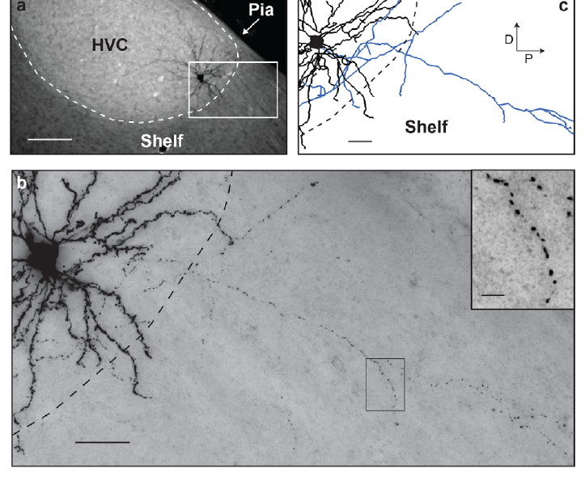
Some HVC processes extend into the surrounding shelf
The HVC shelf is the tissue that borders HVC and is distinguished from the nucleus itself. Benezra and colleagues observed dendrites and axonal collaterals of an identified HVC(X) neuron extending beyond the conventional HVC boundary into this shelf.
Fluorescent and brightfield images were combined with reconstruction of the labeled processes. The original panels keep scale bars of 100 µm for the wider field and 25 µm and 5 µm for the detailed views. Those scales separate the nucleus-scale anatomy from the fine processes.
A histological boundary is therefore not always a complete boundary for a neuron's connections. These processes give anatomical access to the adjacent tissue, and the connections they make there are examined in later experiments. The processes that reach the shelf are therefore part of the anatomy that each reconstruction describes.
Benezra et al. (2018), Fig. 9(a–c). Processes extending from HVC into the shelf.
Benezra et al. (2018)
13
Notes:
• The HVC shelf is tissue bordering HVC that is distinguished from the nucleus itself. Benezra and colleagues observed dendrites and axonal collaterals of an identified HVC(X) neuron extending beyond the conventional HVC boundary into this surrounding region.
• Fluorescent and brightfield images were combined with reconstruction of the labeled processes. The original panels retain scale bars of 100 µm for the wider field and 25 µm and 5 µm for the detailed views, separating nuclear-scale anatomy from fine branches.
• A histological boundary is therefore not necessarily a complete boundary for a neuron's connections. These processes provide anatomical access to adjacent tissue, but the study did not establish the sensory responses of their partners or prove a specific information flow between shelf and HVC.
References:
Benezra SE, Narayanan RT, Egger R, Oberlaender M, Long MA (2018). Morphological characterization of HVC projection neurons in the zebra finch (Taeniopygia guttata). Journal of Comparative Neurology 526(10):1673-1689. https://doi.org/10.1002/cne.24437
Figure: Benezra et al. (2018), Fig. 9(a–c). Processes extending from HVC into the shelf.
Figure source: https://doi.org/10.1002/cne.24437

Slide 17
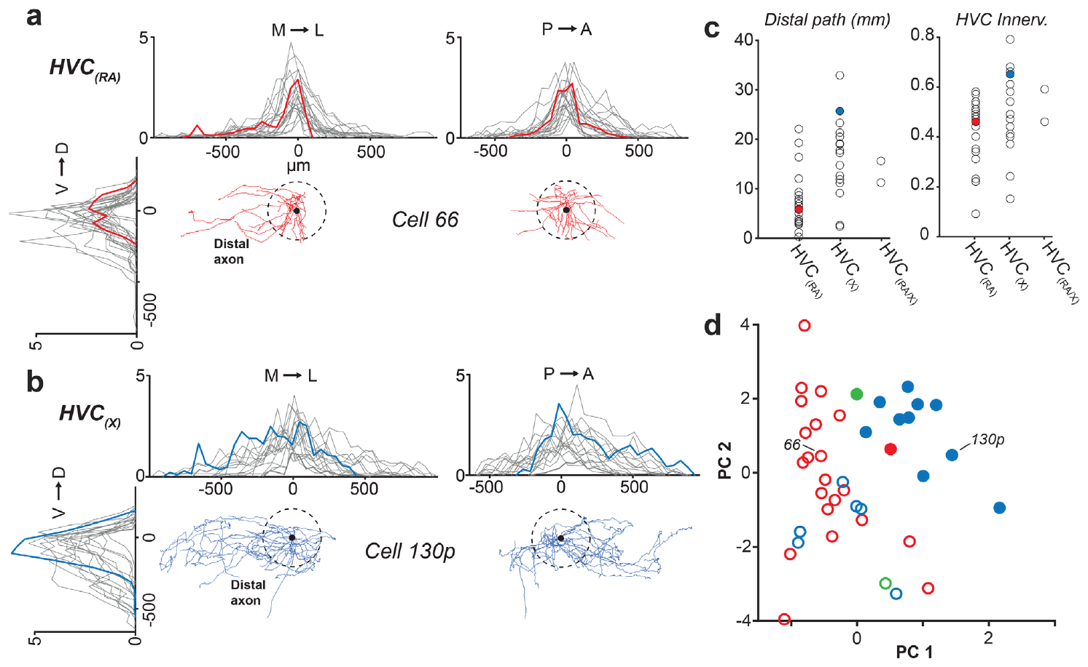
Local and broadcast axons differ within each class
A broadcast arbor distributes axonal branches across a relatively broad volume, whereas a local arbor stays more spatially restricted. Benezra and colleagues quantified the axonal extent of each HVC neuron and the share of the nucleus that it occupied.
Both RA-projecting and X-projecting populations contained cells with different local output territories. Quantifying axonal distribution separately from dendritic distribution keeps a large input field from being treated as a large output field. The two measures stay distinct.
These anatomical differences shape how activity could spread through the HVC network. The local and broadcast categories describe reconstructed geometry, and the partners that each arbor reaches are identified in the next steps of the analysis. Each category is defined by the measured geometry of its arbor.
Benezra et al. (2018), Fig. 10(a–d). Local axonal distributions within HVC.
Benezra et al. (2018)
14
Notes:
• A broadcast arbor distributes axonal branches across a relatively broad volume, whereas a local arbor remains more spatially restricted. Benezra and colleagues quantified HVC axonal extent and the proportion of the nucleus occupied by each reconstructed neuron.
• Both RA-projecting and X-projecting populations contained cells with different local output territories. Quantifying axonal distribution separately from dendritic distribution prevented a large input field from being treated automatically as a large output field.
• These anatomical differences constrain how activity might spread through the HVC network. The local-versus-broadcast distinction is a description of reconstructed geometry, not a demonstrated classification of neuronal function; identifying the actual partners and recording their responses would be necessary to establish the circuit consequences.
References:
Benezra SE, Narayanan RT, Egger R, Oberlaender M, Long MA (2018). Morphological characterization of HVC projection neurons in the zebra finch (Taeniopygia guttata). Journal of Comparative Neurology 526(10):1673-1689. https://doi.org/10.1002/cne.24437
Figure: Benezra et al. (2018), Fig. 10(a–d). Local axonal distributions within HVC.
Figure source: https://doi.org/10.1002/cne.24437

Slide 18
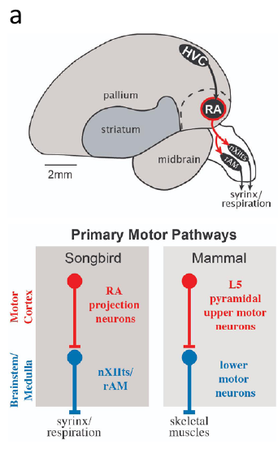
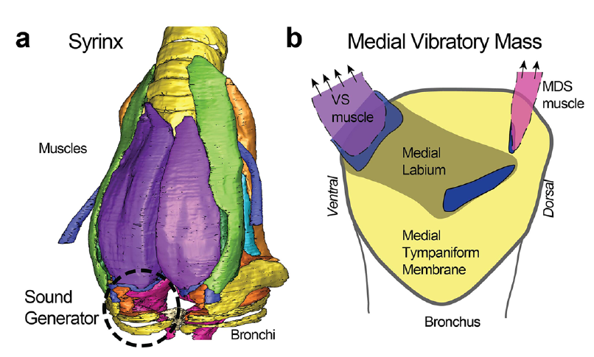
RA sends descending output to vocal motor structures
RA is a forebrain motor nucleus whose projection neurons send descending output to brainstem targets. Zemel and colleagues place RA within the vocal motor pathway that connects HVC with the tracheosyringeal hypoglossal nucleus, nXIIts, and the syrinx.
The syrinx is the avian vocal organ, and its muscles are controlled by lower motor neurons rather than directly by RA cell bodies. RA activity therefore reaches the vocal muscles through descending axons and brainstem motor connections, which coordinate the sound.
Maxwell and colleagues controlled air pressures around an isolated zebra finch syrinx and elicited sound without an intact brain. This preparation separates the sound-producing organ from the forebrain, so the organ's own contribution to the sound can be examined.
Maxwell et al. (2021), Fig. 1(a–b). Syrinx muscles and the medial vibratory mass.
Zemel et al. (2021); Maxwell et al. (2021)
15
Notes:
• RA is a forebrain motor nucleus whose projection neurons provide descending output to brainstem targets. Zemel and colleagues place RA within the vocal motor pathway connecting HVC with the tracheosyringeal hypoglossal nucleus, nXIIts, and respiratory-related brainstem circuitry.
• The syrinx is the avian vocal organ; its muscles are controlled by lower motor neurons rather than directly by RA cell bodies. RA activity thus reaches vocal musculature through descending axons and brainstem motor connections, coordinating sound production with respiratory activity.
• Maxwell and colleagues controlled air pressures around an isolated zebra finch syrinx and elicited sound without an intact brain. This preparation separates the mechanical sound generator from its neural commands; an anatomically intact vocal organ does not by itself establish normal neural control of song.
References:
Zemel BM, Nevue AA, Dagostin A, Lovell PV, Mello CV, von Gersdorff H (2021). Resurgent Na+ currents promote ultrafast spiking in projection neurons that drive fine motor control. Nature Communications 12(1):6762. https://doi.org/10.1038/s41467-021-26521-3
Maxwell A, Adam I, Larsen PS, Sørensen PG, Elemans CPH (2021). Syringeal vocal folds do not have a voice in zebra finch vocal development. Scientific Reports 11(1):6469. https://doi.org/10.1038/s41598-021-85929-5
Figure: Zemel et al. (2021), Fig. 1(a). RA and descending vocal motor pathways.
Figure source: https://doi.org/10.1038/s41467-021-26521-3
Figure: Maxwell et al. (2021), Fig. 1(a–b). Syrinx muscles and the medial vibratory mass.
Figure source: https://doi.org/10.1038/s41598-021-85929-5

Slide 19
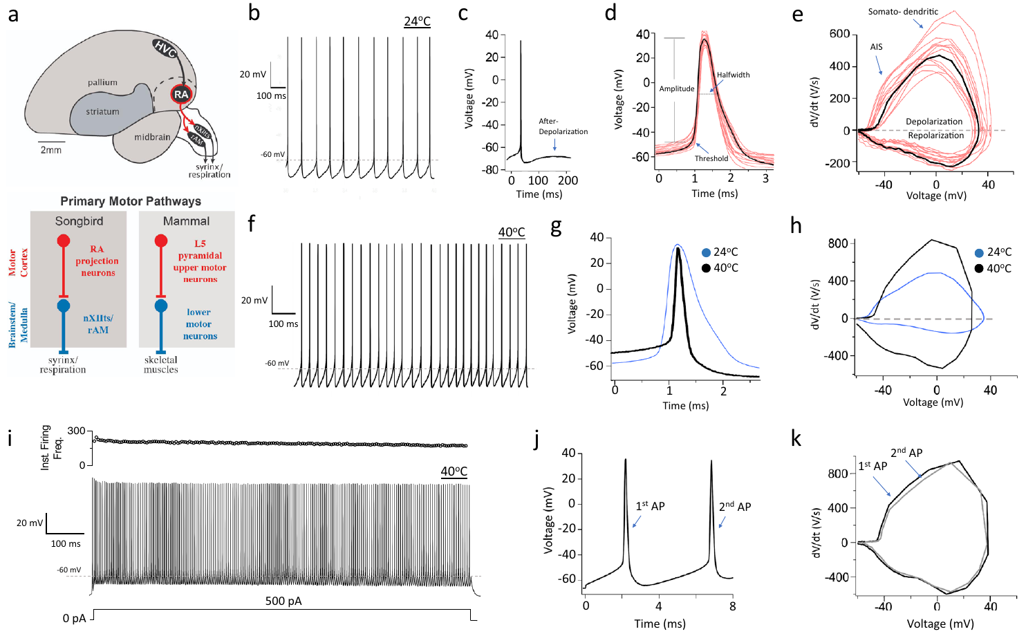
RA neurons generate exceptionally narrow spikes
An action potential is a rapid electrical spike produced by voltage-dependent membrane conductances. An ion channel is a membrane protein that allows ions to cross the membrane. Zemel and colleagues recorded identified RA projection neurons in zebra finch brain slices with whole-cell current clamp, which measures membrane voltage while current is controlled.
At about 40 °C, close to the avian body temperature, spontaneous spikes had a half-width of about 0.18 ms. Spontaneous firing was about fourfold faster than at room temperature, and depolarizing current evoked sustained rapid spike trains. The narrow spikes therefore show a fast firing capacity.
Temperature changes the quantitative description of these motor neurons. Slice recordings show the intrinsic firing capacity under controlled conditions. The commands issued during a particular song syllable are recorded during singing, where patterned synaptic input and behavioral state also act on the cell.
Zemel et al. (2021), Fig. 1(a–k). RA motor anatomy and temperature-dependent spikes.
Zemel et al. (2021)
16
Notes:
• An action potential is a rapid electrical spike produced by voltage-dependent membrane conductances. An ion channel is a membrane protein that permits ions to cross the membrane. Zemel and colleagues recorded identified RA projection neurons in zebra finch brain slices using whole-cell current clamp, which measures membrane voltage while current is controlled.
• At approximately 40 °C, near avian physiological temperature, spontaneous spikes had a half-width of about 0.18 ms. Spontaneous firing was approximately fourfold faster than at room temperature, and depolarizing current could evoke sustained rapid spike trains.
• Temperature therefore changes the quantitative description of these motor neurons. Slice recordings establish intrinsic firing capacity under controlled conditions, but are not recordings of the commands issued during a particular song syllable; intact singing additionally supplies patterned synaptic input and behavioral state.
References:
Zemel BM, Nevue AA, Dagostin A, Lovell PV, Mello CV, von Gersdorff H (2021). Resurgent Na+ currents promote ultrafast spiking in projection neurons that drive fine motor control. Nature Communications 12(1):6762. https://doi.org/10.1038/s41467-021-26521-3
Figure: Zemel et al. (2021), Fig. 1(a–k). RA motor anatomy and temperature-dependent spikes.
Figure source: https://doi.org/10.1038/s41467-021-26521-3

Slide 20
Temperature sets the width and rate of RA spikes
Spike half-width is the duration of an action potential measured at half its peak height. Zemel and colleagues measured this value in identified RA projection neurons at about 40 °C, close to the body temperature of the bird. The spikes were very brief, with a half-width near 0.18 ms. The temperature of the recording is part of the measurement, so the value applies to warm slices.
The same neurons fired about fourfold faster at this temperature than at room temperature. Depolarizing current evoked sustained trains of rapid spikes, so the neurons had the capacity to fire quickly when driven. The comparison across temperatures is what makes the spike width meaningful.
Temperature therefore changes the speed of the motor neuron's output. Spike width and firing rate both depend on conditions, so the same cell can have a different timing profile in a warm slice and in a cool one. Each recording therefore reflects the temperature at which it was made.
Zemel et al. (2021), Fig. 1(a–k). RA motor anatomy and temperature-dependent spikes.
Zemel et al. (2021)
16a
Notes:
• Temperature changes both spike width and firing rate.
• Half-width.
– Spike half-width is the duration at half the peak height.
– The spikes measured here were very brief.
• Temperature.
– The recordings were made at about 40 °C.
– This is close to the bird's body temperature.
• Value.
– The half-width was about 0.18 ms.
– This is a fast spike.
• Rate.
– Spontaneous firing was about fourfold faster than at room temperature.
– The difference is large.
• Trains.
– Depolarizing current evoked sustained rapid spikes.
– The neurons could fire quickly when driven.
• Meaning.
– Temperature changes the timing profile of the same cell.
– Spike timing depends on conditions.
• Source values.
– The published values and recording conditions come from the original paper.
– Each value is reported with the scale or condition used in the source.
• Why the measure matters.
– The result separates the measured property from the mechanism that produces it.
– The comparison stays within the same cells or the same birds.
• Interpretation.
– Each result is read within the preparation and the age group that produced it.
– The claim is restricted to the measured cells and conditions.
References:
Zemel BM, Nevue AA, Dagostin A, Lovell PV, Mello CV, von Gersdorff H (2021). Resurgent Na+ currents promote ultrafast spiking in projection neurons that drive fine motor control. Nature Communications 12(1):6762. https://doi.org/10.1038/s41467-021-26521-3

Slide 21
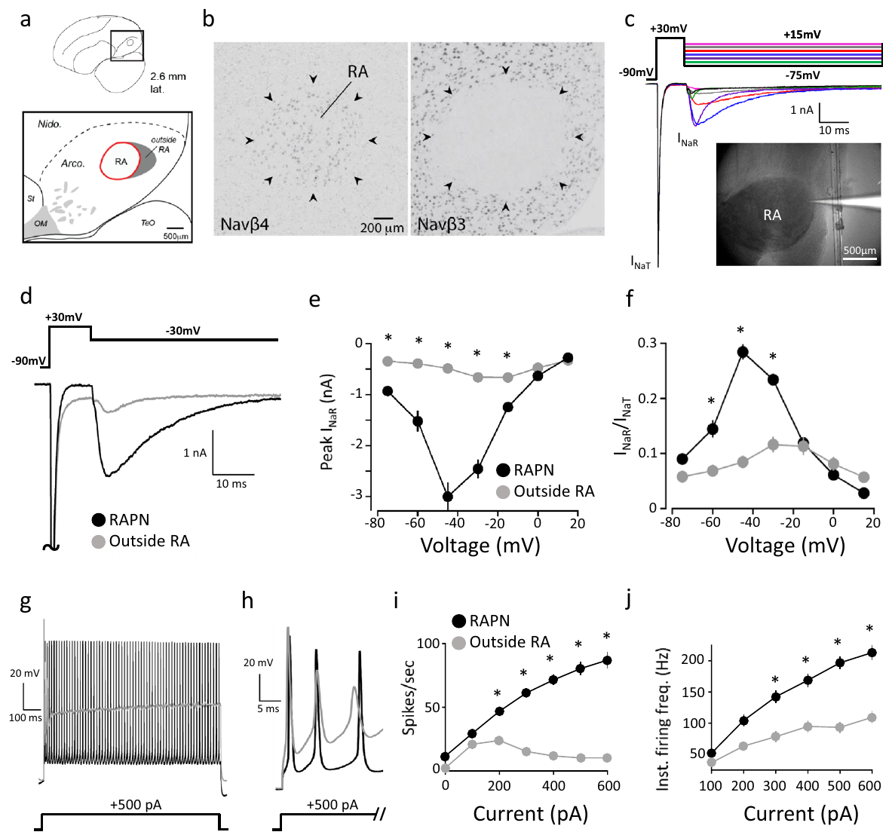
Resurgent sodium current follows repolarization
A resurgent sodium current is an inward sodium current that appears as the membrane repolarizes after a strong depolarization. Zemel and colleagues used voltage clamp, which controls membrane voltage while recording current, to isolate this component.
A step from −90 to +30 mV activated a transient current. Subsequent test voltages evoked resurgent current, with a peak near −3 nA at −45 mV in adult RA projection neurons. The sequence of voltage steps made the later inward current measurable.
Resurgent current supports renewed excitation during recovery from a spike. The recording measures the membrane current under the imposed voltage protocol, and its contribution to firing is tested in the current-clamp experiments.
Zemel et al. (2021), Fig. 2(a–j). RA sodium-subunit expression and resurgent current.
Zemel et al. (2021)
17
Notes:
• A resurgent sodium current is an inward sodium current that appears as a membrane repolarizes after strong depolarization. Zemel and colleagues used voltage clamp, which controls membrane voltage while recording current, to separate this component from the initial transient sodium current.
• A step from −90 to +30 mV activated transient current; subsequent test voltages elicited resurgent current, with a peak near −3 nA at −45 mV in adult RA projection neurons. The sequence of voltage steps made the later inward current experimentally distinguishable from the initial spike-generating component.
• Resurgent current can support renewed excitation during recovery from a spike. The recording establishes a membrane current under an imposed voltage protocol; its contribution to natural firing requires an additional manipulation of the conductance rather than inference from its presence alone.
References:
Zemel BM, Nevue AA, Dagostin A, Lovell PV, Mello CV, von Gersdorff H (2021). Resurgent Na+ currents promote ultrafast spiking in projection neurons that drive fine motor control. Nature Communications 12(1):6762. https://doi.org/10.1038/s41467-021-26521-3
Figure: Zemel et al. (2021), Fig. 2(a–j). RA sodium-subunit expression and resurgent current.
Figure source: https://doi.org/10.1038/s41467-021-26521-3

Slide 22
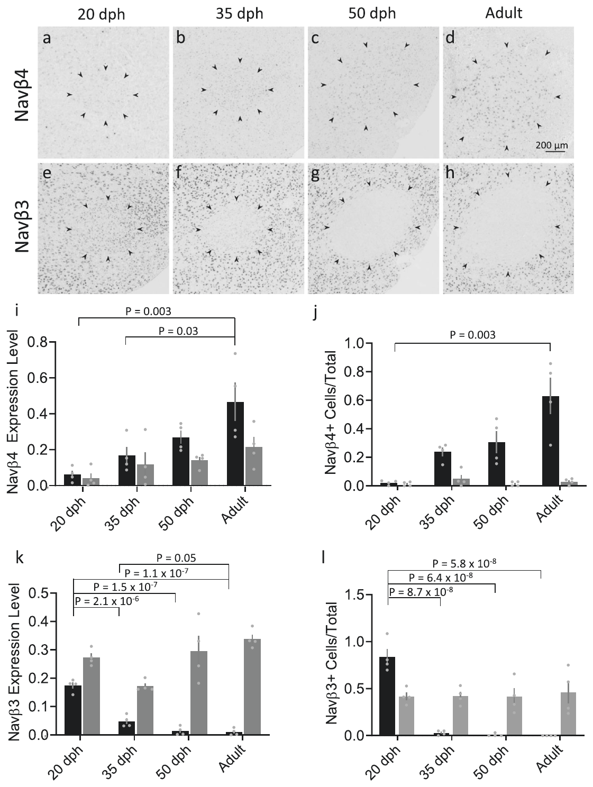
Sodium-channel subunit expression changes within RA
A sodium channel's β subunit is an accessory protein that changes how the channel functions. Zemel and colleagues applied in situ hybridization, which detects specific RNA sequences in tissue, to compare Navβ3 and Navβ4 expression across male zebra finch development.
The sampled stages were 20, 35 and 50 days after hatching and adulthood. RA changed from relatively strong Navβ3 expression toward stronger Navβ4 expression. Comparison with the surrounding arcopallium showed that the change is specific to RA rather than a uniform shift across nearby tissue.
RNA abundance identifies a candidate molecular mechanism. The expression data were paired with physiological recordings and with later manipulations of resurgent current, which together test whether the subunit change produces the current change.
Zemel et al. (2021), Fig. 3(a–l). Developmental sodium-subunit expression in RA.
Zemel et al. (2021)
18
Notes:
• A sodium channel's β subunit is an accessory protein that can modify channel function. Zemel and colleagues used in situ hybridization, a method that detects specific RNA sequences in tissue, to compare Navβ3 and Navβ4 expression across male zebra finch development.
• The sampled stages included 20, 35, and 50 days after hatching and adulthood. RA changed from relatively strong Navβ3 expression toward stronger Navβ4 expression; comparison with surrounding arcopallium helped distinguish an RA-related change from a uniform change throughout nearby tissue.
• RNA abundance identifies a candidate molecular mechanism but does not directly measure channel current or prove that a subunit causes a behavioral transition. The expression data were therefore paired with physiological recordings and later manipulations of resurgent current.
References:
Zemel BM, Nevue AA, Dagostin A, Lovell PV, Mello CV, von Gersdorff H (2021). Resurgent Na+ currents promote ultrafast spiking in projection neurons that drive fine motor control. Nature Communications 12(1):6762. https://doi.org/10.1038/s41467-021-26521-3
Figure: Zemel et al. (2021), Fig. 3(a–l). Developmental sodium-subunit expression in RA.
Figure source: https://doi.org/10.1038/s41467-021-26521-3

Slide 23
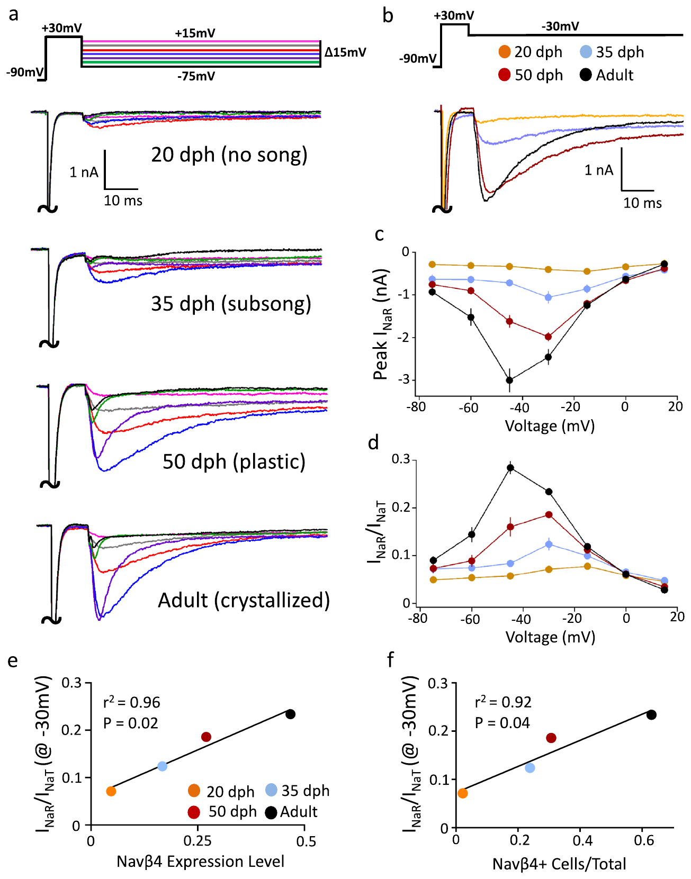
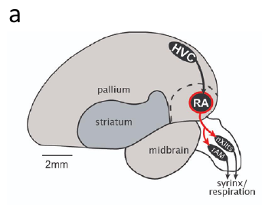
Resurgent current increases across male development
Zemel and colleagues recorded transient and resurgent sodium currents from RA projection neurons at 20, 35 and 50 days after hatching and in adult male zebra finches. Applying the same voltage protocol at each stage made the current components directly comparable.
Resurgent current increased with age, including when it was normalized to the transient current measured in the same sweep. That normalization shows that the developmental effect is not simply a general increase in all sodium current. The current specifically increases relative to the transient component.
The age-related current increase tracks the shift toward Navβ4 expression, and the two changes occur together across development. The developmental pairing is then tested by changing the current directly, as the later slides describe.
Zemel et al. (2021), Fig. 4(a–f). Developmental increase of resurgent current.
Zemel et al. (2021), Fig. 1(a, upper). RA and brainstem targets in the vocal motor pathway.
Zemel et al. (2021)
19
Notes:
• Zemel and colleagues recorded transient and resurgent sodium currents from RA projection neurons at 20, 35, and 50 days after hatching and in adult male zebra finches. Applying the same voltage protocol across stages made the current components directly comparable.
• Resurgent current increased with age, including when normalized to the transient current measured within the same sweep. That normalization tested whether the developmental effect was simply an increase in all measurable sodium current rather than a disproportionate change in the resurgent component.
• The age-related current increase tracked the shift toward Navβ4 expression, but a developmental correlation alone cannot identify causation. Intrinsic membrane maturation can accompany song development without being equivalent to learning a particular tutor's syllable sequence.
References:
Zemel BM, Nevue AA, Dagostin A, Lovell PV, Mello CV, von Gersdorff H (2021). Resurgent Na+ currents promote ultrafast spiking in projection neurons that drive fine motor control. Nature Communications 12(1):6762. https://doi.org/10.1038/s41467-021-26521-3
Figure: Zemel et al. (2021), Fig. 4(a–f). Developmental increase of resurgent current.
Figure source: https://doi.org/10.1038/s41467-021-26521-3
Figure: Zemel et al. (2021), Fig. 1(a, upper). RA and brainstem targets in the vocal motor pathway.
Figure source: https://doi.org/10.1038/s41467-021-26521-3

Slide 24
Resurgent current rises with age in males
A resurgent sodium current is a current that reappears as the membrane repolarizes after a strong depolarization. Zemel and colleagues measured it alongside the transient sodium current in the same RA neurons. Comparing the two currents within one sweep separates the resurgent component from the overall sodium current.
The recordings covered birds at 20, 35 and 50 days after hatching and adult males. Resurgent current increased with age, including after normalization to the transient current. The result shows that the increase is specific to the resurgent component rather than a general rise in all sodium current.
The developmental change therefore follows the maturation of the neuron's sodium channels. Because the current grows over the same period as song development, it is a candidate contributor to the faster firing of mature motor neurons. The developmental result is therefore a measurement of the current itself.
Zemel et al. (2021), Fig. 4(a–f). Developmental increase of resurgent current.
Zemel et al. (2021), Fig. 1(a, upper). RA and brainstem targets in the vocal motor pathway.
Zemel et al. (2021)
19a
Notes:
• Resurgent current grows with age in male RA neurons.
• Current.
– Resurgent current appears as the membrane repolarizes.
– It is distinct from the transient current.
• Comparison.
– Both currents were measured in the same sweep.
– The comparison isolates the resurgent component.
• Ages.
– Birds were recorded at 20, 35 and 50 days and in adulthood.
– The same voltage protocol was used at each age.
• Normalization.
– The increase persisted after normalizing to the transient current.
– The change is specific to the resurgent component.
• Development.
– The increase follows the maturation of the sodium channels.
– The current grows across the song-learning period.
• Meaning.
– Resurgent current is a candidate for faster firing.
– It may help mature neurons fire quickly.
• Source values.
– The published values and recording conditions come from the original paper.
– Each value is reported with the scale or condition used in the source.
• Why the measure matters.
– The result separates the measured property from the mechanism that produces it.
– The comparison stays within the same cells or the same birds.
• Interpretation.
– Each result is read within the preparation and the age group that produced it.
– The claim is restricted to the measured cells and conditions.
References:
Zemel BM, Nevue AA, Dagostin A, Lovell PV, Mello CV, von Gersdorff H (2021). Resurgent Na+ currents promote ultrafast spiking in projection neurons that drive fine motor control. Nature Communications 12(1):6762. https://doi.org/10.1038/s41467-021-26521-3

Slide 25
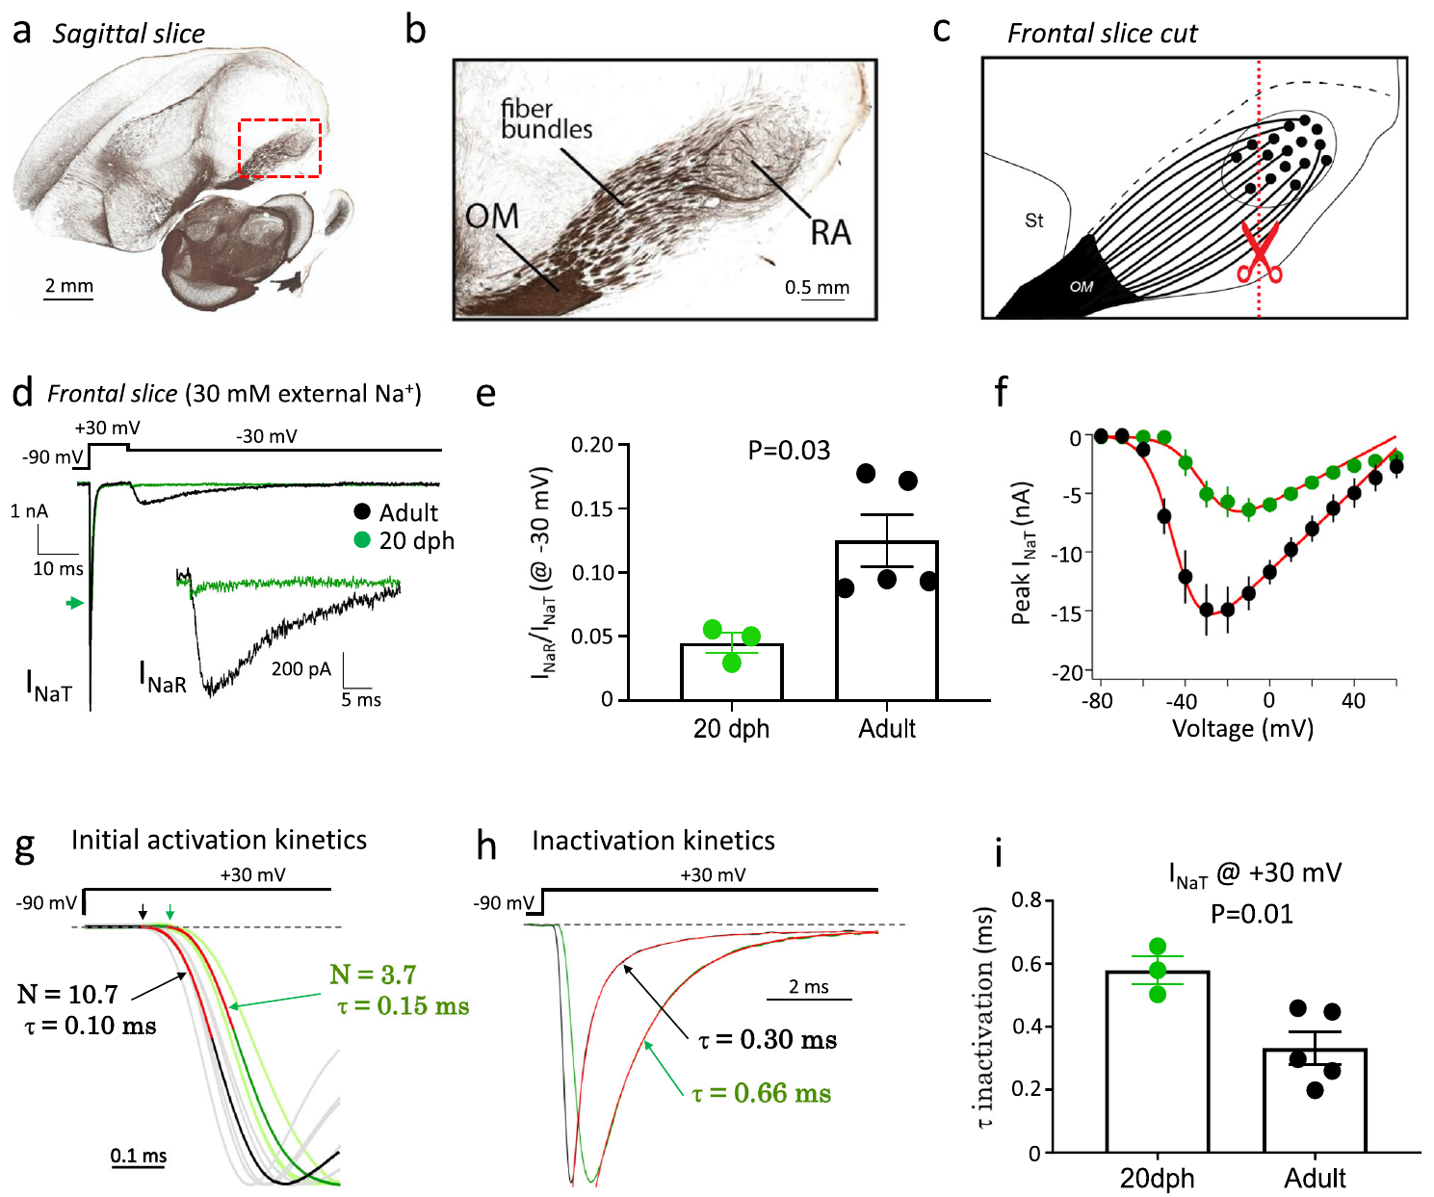
Voltage-clamp controls address axonal recording errors
Space clamp describes how well an electrode controls voltage throughout a neuron, and long axons make that control harder. Zemel and colleagues repeated the sodium-current measurements in frontal slices that shortened the initial axonal segments of RA projection neurons.
The team also lowered extracellular sodium to improve recording conditions, and they compared neurons from 20-day males with adult neurons. The developmental difference in resurgent current remained under these altered conditions. The difference therefore reflects the cells themselves rather than the recording of distant axons.
These controls strengthen the interpretation of the current measurement, and the voltage clamp still controls the cell as closely as the method allows. The comparison concerns isolated-cell membrane physiology, and the effect of the current on the acoustic structure of song is examined in the following experiments.
Zemel et al. (2021), Fig. 5(a–i). Axonal and voltage-clamp recording controls.
Zemel et al. (2021)
20
Notes:
• Space clamp describes how well an electrode controls voltage throughout a neuron; long axons can make that control incomplete. Zemel and colleagues repeated sodium-current measurements in frontal slices that shortened the initial axonal segments of RA projection neurons.
• They also reduced extracellular sodium to improve recording conditions and compared neurons from 20-day males with adult neurons. The developmental difference in resurgent current remained under these altered preparation conditions, supporting its biological origin rather than a simple difference in recording distant axons.
• These controls strengthen interpretation of the current measurement without making the voltage clamp perfect. The comparison concerns isolated-cell membrane physiology, and does not itself establish how much a change in resurgent current alters the acoustic structure of a freely singing bird.
References:
Zemel BM, Nevue AA, Dagostin A, Lovell PV, Mello CV, von Gersdorff H (2021). Resurgent Na+ currents promote ultrafast spiking in projection neurons that drive fine motor control. Nature Communications 12(1):6762. https://doi.org/10.1038/s41467-021-26521-3
Figure: Zemel et al. (2021), Fig. 5(a–i). Axonal and voltage-clamp recording controls.
Figure source: https://doi.org/10.1038/s41467-021-26521-3

Slide 26
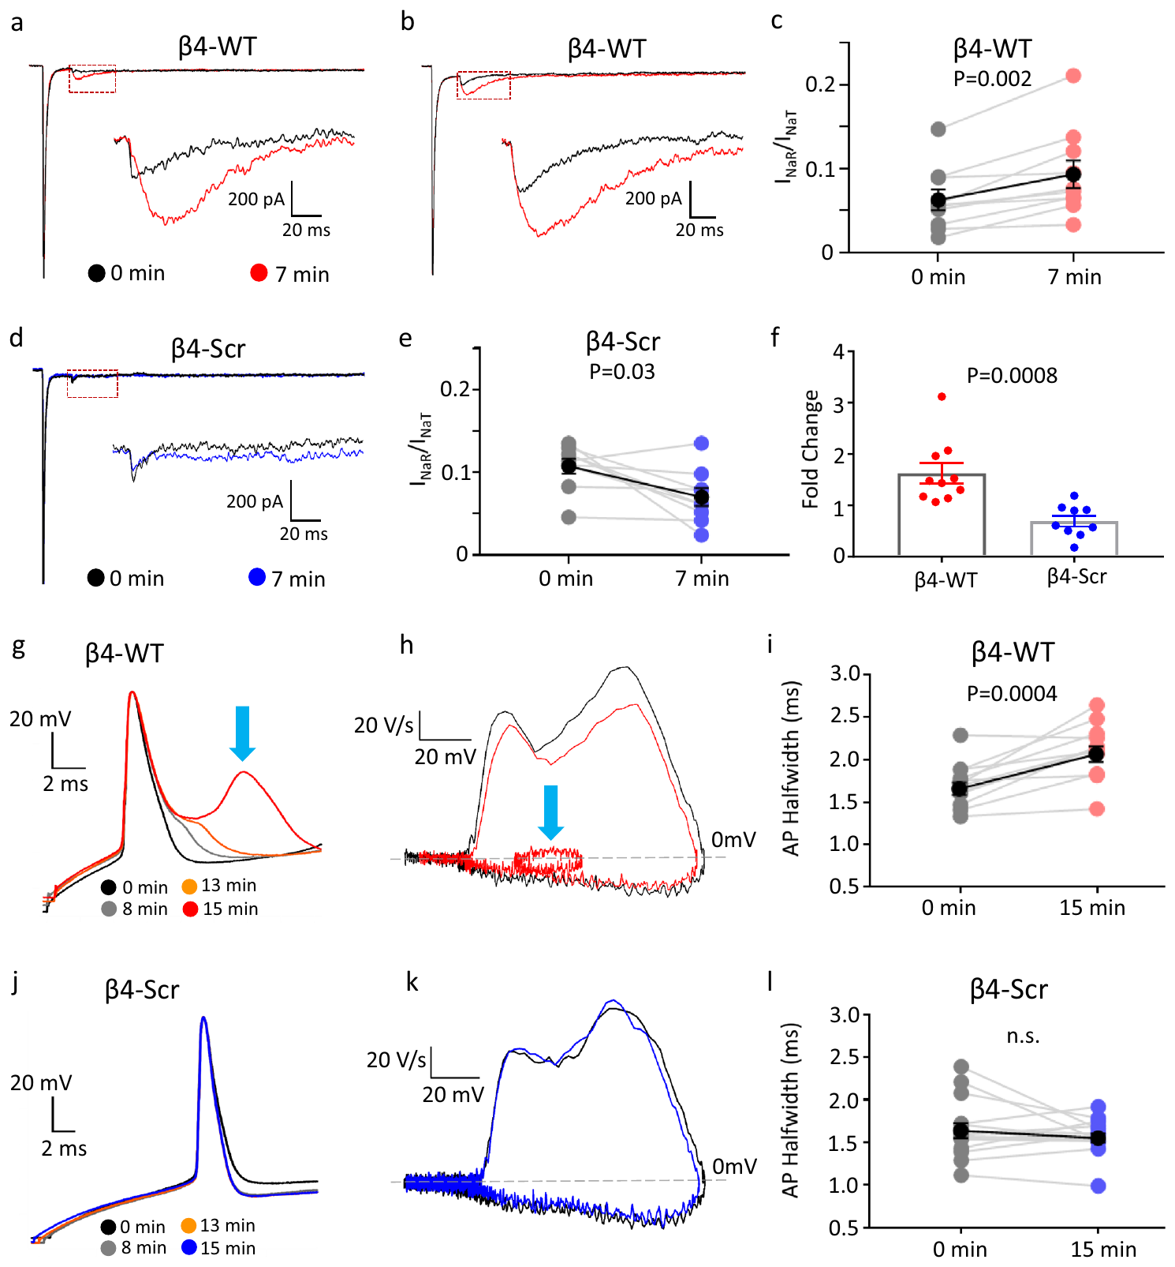
A Navβ4 peptide increases juvenile resurgent current
Zemel and colleagues introduced a peptide from the intracellular C-terminal region of Navβ4 through the recording pipette into RA neurons from 20-day male zebra finches. A peptide is a short chain of amino acids, used here to test a proposed channel mechanism.
Resurgent current increased over about 7 minutes after whole-cell access with the native peptide. A scrambled peptide containing the same amino acids in a different sequence did not produce the same increase, which controls for nonspecific effects of the peptide.
This intervention links a defined sequence to the current change more directly than RNA expression alone does. The effect is measured in isolated cells, and its consequences for the intact bird are tested in separate experiments.
Zemel et al. (2021), Fig. 7(a–l). Native and scrambled Navβ4 peptide interventions.
Zemel et al. (2021), Fig. 1(a, upper). RA and brainstem targets in the vocal motor pathway.
Zemel et al. (2021)
21
Notes:
• Zemel and colleagues introduced a peptide from the intracellular C-terminal region of Navβ4 through the recording pipette into RA neurons from 20-day male zebra finches. A peptide is a short amino-acid chain used here to test a proposed channel interaction.
• Resurgent current increased over approximately 7 minutes after whole-cell access with the native peptide. A scrambled peptide containing the same amino acids in a different sequence did not produce the same increase, controlling for nonspecific introduction of peptide material.
• This intervention links a defined sequence to the current phenotype more directly than RNA expression alone. It does not recreate every function of the intact β4 protein or establish that this peptide manipulation improves song learning in a behaving bird.
References:
Zemel BM, Nevue AA, Dagostin A, Lovell PV, Mello CV, von Gersdorff H (2021). Resurgent Na+ currents promote ultrafast spiking in projection neurons that drive fine motor control. Nature Communications 12(1):6762. https://doi.org/10.1038/s41467-021-26521-3
Figure: Zemel et al. (2021), Fig. 7(a–l). Native and scrambled Navβ4 peptide interventions.
Figure source: https://doi.org/10.1038/s41467-021-26521-3
Figure: Zemel et al. (2021), Fig. 1(a, upper). RA and brainstem targets in the vocal motor pathway.
Figure source: https://doi.org/10.1038/s41467-021-26521-3

Slide 27
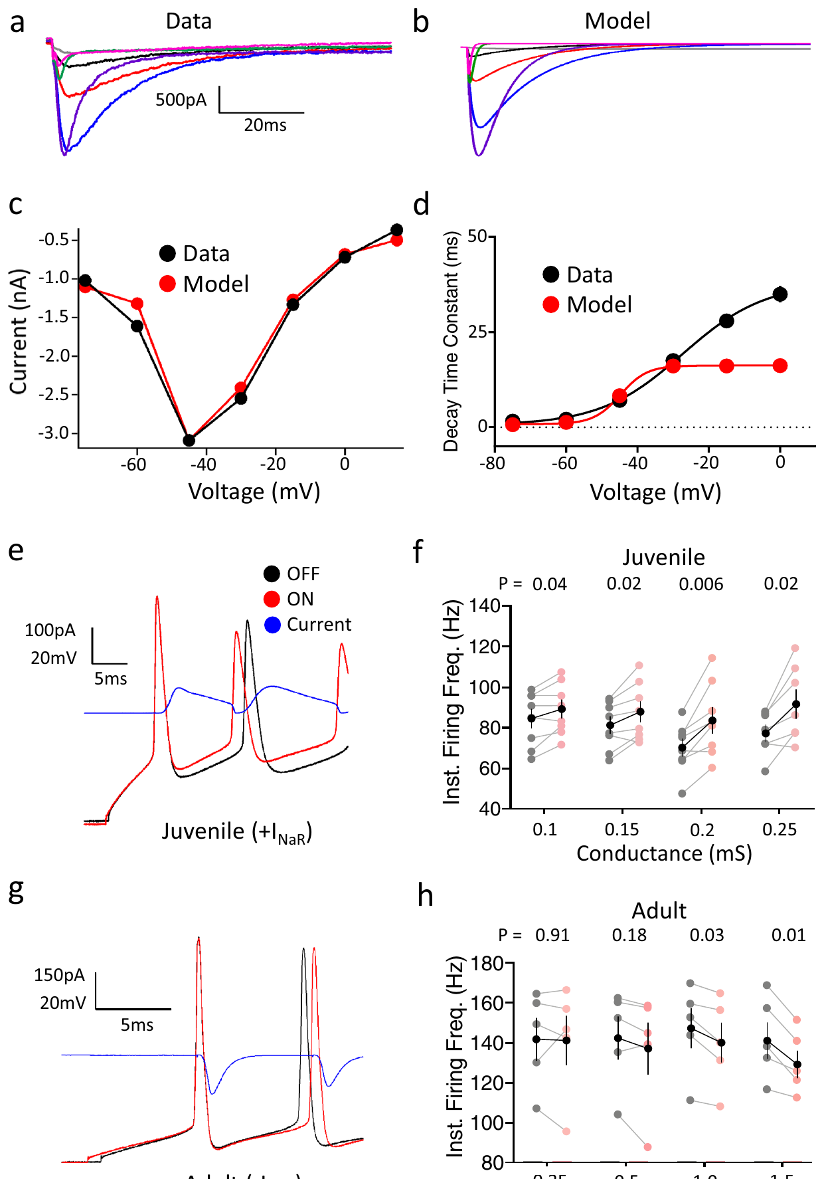
Dynamic clamp tests the effect of resurgent current
Dynamic clamp computes a voltage-dependent current during the recording and injects that current into a real neuron. Zemel and colleagues used this method to add a resurgent-current component to juvenile RA neurons and to subtract a matching component from adult neurons.
Adding the component increased juvenile firing frequency, whereas subtracting it reduced adult firing. The same cell was compared with the intervention off and on, which separated the immediate effect of the current from stable differences between the developmental groups.
The experiment supports a causal contribution of resurgent current to neuronal excitability. The injected conductance was calibrated to the measured sodium-current kinetics, and the match with the voltage-clamp recordings ties the injected current to the current measured in the cell. Its contribution to song timing is studied in the bird itself.
Zemel et al. (2021), Fig. 1(a, upper). RA and brainstem targets in the vocal motor pathway.
Zemel et al. (2021)
22
Notes:
• Dynamic clamp computes a voltage-dependent current during recording and injects that current into a real neuron. Zemel and colleagues used this method to add a resurgent-current component to juvenile RA neurons and subtract a corresponding component from adult neurons.
• Adding the component increased juvenile firing frequency, whereas subtraction reduced adult firing. The same cell could be compared with the intervention off and on, separating the immediate current effect from stable differences between developmental populations.
• The experiment supports a causal contribution of resurgent current to neuronal excitability. The injected conductance was calibrated to measured sodium-current kinetics. Agreement with voltage-clamp recordings does not establish that this conductance alone explains song timing or behavioral proficiency.
References:
Zemel BM, Nevue AA, Dagostin A, Lovell PV, Mello CV, von Gersdorff H (2021). Resurgent Na+ currents promote ultrafast spiking in projection neurons that drive fine motor control. Nature Communications 12(1):6762. https://doi.org/10.1038/s41467-021-26521-3
Figure: Zemel et al. (2021), Fig. 8(a–h). Current records and dynamic-clamp interventions.
Figure source: https://doi.org/10.1038/s41467-021-26521-3
Figure: Zemel et al. (2021), Fig. 1(a, upper). RA and brainstem targets in the vocal motor pathway.
Figure source: https://doi.org/10.1038/s41467-021-26521-3

Slide 28
Dynamic clamp moves resurgent current into real neurons
Dynamic clamp is a recording method that calculates a current from the membrane voltage in real time and injects it into a neuron. Zemel and colleagues used it to add a resurgent-current component to juvenile RA neurons. The same method subtracted a corresponding component from adult neurons.
Adding the component increased the firing frequency of juvenile neurons. Subtracting it reduced the firing of adult neurons. Because the same cell was tested with the intervention off and on, the immediate effect of the current could be separated from differences between cells of different ages.
This manipulation tests whether resurgent current contributes to firing, rather than only correlating with it. The injected conductance was calibrated against the measured sodium-current kinetics, so the added current matches the one recorded in the cells. Each manipulation is tested on the same cell before and after the intervention.
Zemel et al. (2021), Fig. 1(a, upper). RA and brainstem targets in the vocal motor pathway.
Zemel et al. (2021)
22a
Notes:
• Dynamic clamp tests the effect of a current directly.
• Method.
– Dynamic clamp computes a current from the voltage in real time.
– The current is injected into a real neuron.
• Juvenile.
– A resurgent-current component was added to juvenile neurons.
– Firing frequency increased.
• Adult.
– The component was subtracted from adult neurons.
– Firing decreased.
• Within-cell design.
– The same cell was tested with the intervention off and on.
– This isolates the immediate effect.
• Calibration.
– The conductance was matched to the measured kinetics.
– The added current resembles the recorded current.
• Meaning.
– The current contributes to firing rather than only correlating with it.
– The experiment is a causal test.
• Source values.
– The published values and recording conditions come from the original paper.
– Each value is reported with the scale or condition used in the source.
• Why the measure matters.
– The result separates the measured property from the mechanism that produces it.
– The comparison stays within the same cells or the same birds.
• Interpretation.
– Each result is read within the preparation and the age group that produced it.
– The claim is restricted to the measured cells and conditions.
References:
Zemel BM, Nevue AA, Dagostin A, Lovell PV, Mello CV, von Gersdorff H (2021). Resurgent Na+ currents promote ultrafast spiking in projection neurons that drive fine motor control. Nature Communications 12(1):6762. https://doi.org/10.1038/s41467-021-26521-3

Slide 29
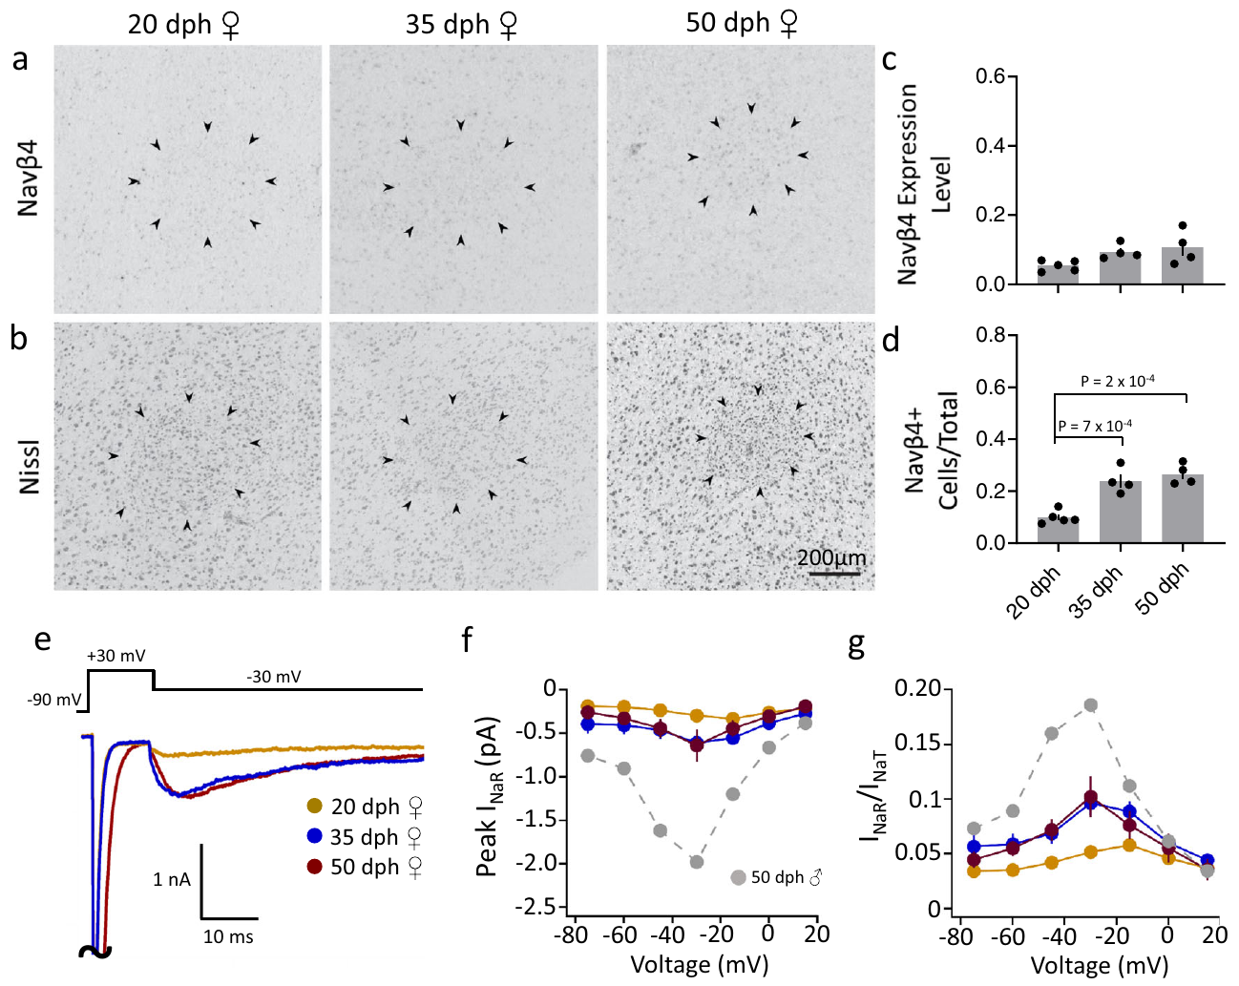
RA maturation differs between males and females
Zemel and colleagues compared Navβ4 expression and RA physiology across ages in female zebra finches, which do not produce the learned courtship song that males sing. In situ hybridization was assessed alongside adjacent Nissl-stained sections, so the expression pattern could be placed in the tissue.
Females did not show the male pattern of strong developmental Navβ4 upregulation or the mature resurgent-current specialization. The comparison separates a sex-related developmental program from a change that happens in every bird regardless of sex.
Male birds isolated from tutor song still developed mature firing properties, which separates intrinsic maturation from successful imitation. The result shows that maturation follows the bird's own program, and the imitation of a tutor's song is a different process.
Zemel et al. (2021), Fig. 9(a–g). Female RA expression and sodium-current measurements.
Zemel et al. (2021)
23
Notes:
• Zemel and colleagues compared Navβ4 expression and RA physiology across ages in female zebra finches, which do not produce the learned courtship song characteristic of males. In situ hybridization was assessed alongside adjacent Nissl-stained sections identifying the nucleus.
• Females did not exhibit the male pattern of strong developmental Navβ4 upregulation and mature resurgent-current specialization. This comparison separated a sex-related developmental program from a change that would necessarily occur in every zebra finch reaching the same chronological age.
• Male birds isolated from tutor song nevertheless developed mature firing properties, further separating intrinsic maturation from successful imitation. The results support sex-linked motor-system specialization; they do not establish that a single sodium-channel subunit is sufficient to create singing behavior.
References:
Zemel BM, Nevue AA, Dagostin A, Lovell PV, Mello CV, von Gersdorff H (2021). Resurgent Na+ currents promote ultrafast spiking in projection neurons that drive fine motor control. Nature Communications 12(1):6762. https://doi.org/10.1038/s41467-021-26521-3
Figure: Zemel et al. (2021), Fig. 9(a–g). Female RA expression and sodium-current measurements.
Figure source: https://doi.org/10.1038/s41467-021-26521-3

Slide 30
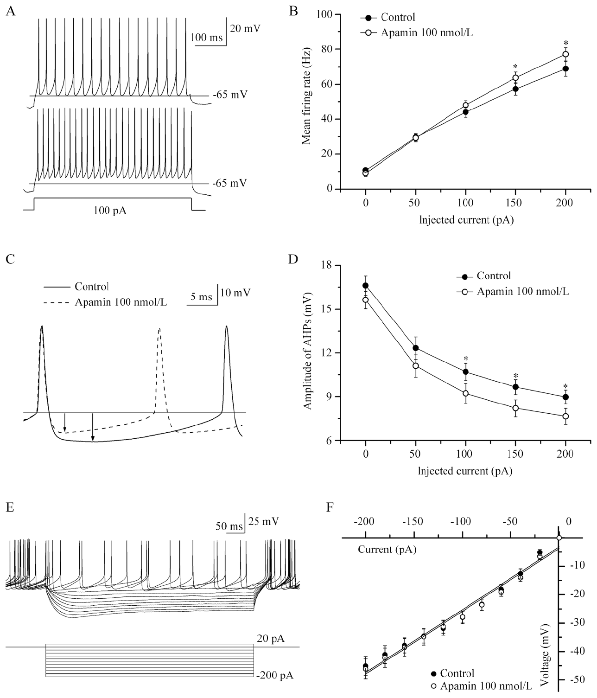
SK channels contribute to the afterhyperpolarization
SK channels are small-conductance calcium-activated potassium channels. Calcium-dependent potassium efflux produces an afterhyperpolarization, a period of more negative membrane voltage after a spike that sets when the next spike can occur.
Hou and colleagues recorded RA projection neurons in adult male zebra finch slices and applied apamin, an SK-channel blocker, at 100 nM. In one example, the firing rate for a 100 pA stimulus rose from 34 to about 53 Hz. Blocking the channels reduced the afterhyperpolarization and increased current-evoked firing, which links the target to both the spike waveform and the excitability of the cell.
The direction of the effect fits removal of a potassium-mediated brake on excitation. The pharmacology establishes this contribution under slice conditions, and the timing of a complete song is examined with the in vivo measurements that follow.
Hou et al. (2012), Fig. 1(A–F). SK blockade changes evoked firing and spike recovery.
Zemel et al. (2021), Fig. 1(a, upper). RA and brainstem targets in the vocal motor pathway.
Hou et al. (2012); Zemel et al. (2021)
24
Notes:
• SK channels are small-conductance calcium-activated potassium channels. Calcium-dependent potassium efflux can produce an afterhyperpolarization, a period of more negative membrane voltage following a spike that regulates when the next spike occurs.
• Hou and colleagues recorded RA projection neurons in adult male zebra finch slices and applied apamin, an SK-channel blocker, at 100 nM. An example response to 100 pA rose from 34 to about 53 Hz. Blocking the channels reduced the afterhyperpolarization and increased current-evoked firing, linking the pharmacological target to both the spike waveform and ongoing excitability.
• The direction of the effect is consistent with removal of a potassium-mediated brake on excitation. Pharmacology establishes a contribution under the slice conditions, but does not identify every SK subunit or prove how this manipulation would change the timing of a complete song.
References:
Hou GQ, Pan X, Liao CS, Wang SH, Li DF (2012). SK channels modulate the excitability and firing precision of projection neurons in the robust nucleus of the arcopallium in adult male zebra finches. Neuroscience Bulletin 28(3):271-281. https://doi.org/10.1007/s12264-012-1241-7
Zemel BM, Nevue AA, Dagostin A, Lovell PV, Mello CV, von Gersdorff H (2021). Resurgent Na+ currents promote ultrafast spiking in projection neurons that drive fine motor control. Nature Communications 12(1):6762. https://doi.org/10.1038/s41467-021-26521-3
Figure: Hou et al. (2012), Fig. 1(A–F). SK blockade changes evoked firing and spike recovery.
Figure source: https://doi.org/10.1007/s12264-012-1241-7
Figure: Zemel et al. (2021), Fig. 1(a, upper). RA and brainstem targets in the vocal motor pathway.
Figure source: https://doi.org/10.1038/s41467-021-26521-3

Slide 31
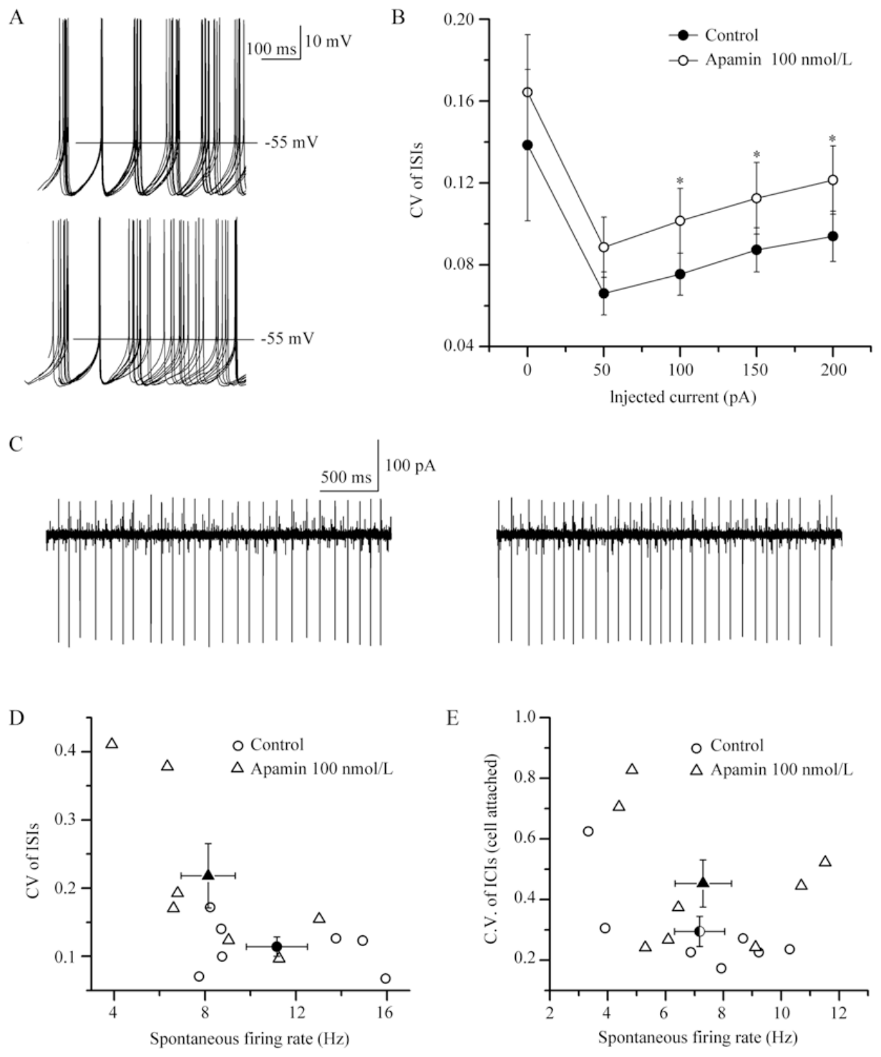
SK blockade makes RA firing less regular
Interspike intervals are the times that separate successive action potentials. Hou and colleagues compared spontaneous spike trains from the same RA projection neurons before and after apamin, so firing regularity could be assessed in each cell.
SK blockade increased the variability of the intervals between spikes without a clear change in the average spontaneous firing rate. The recordings therefore separate a neuron that fires faster from a neuron that fires more reproducibly.
Calcium-activated potassium feedback stabilizes the return toward spike threshold after each action potential. The result supports a contribution of SK channels to temporal regularity. The regularity of firing is therefore one property that the same cells can change without changing their mean rate.
Hou et al. (2012), Fig. 2(A–E). Spontaneous spike timing before and after apamin.
Zemel et al. (2021), Fig. 1(a, upper). RA and brainstem targets in the vocal motor pathway.
Hou et al. (2012); Zemel et al. (2021)
25
Notes:
• Interspike intervals are the times separating successive action potentials. Hou and colleagues compared spontaneous spike trains from the same RA projection neurons before and after apamin, allowing firing regularity to be assessed separately from the mean firing rate.
• SK blockade increased variability in the intervals between spikes without a clear change in average spontaneous firing rate. Recordings therefore distinguished a neuron that fires more rapidly from a neuron that fires with more reproducible timing; these are different physiological properties.
• Calcium-activated potassium feedback can stabilize the return toward spike threshold after each action potential. The result supports a contribution to temporal regularity in isolated RA cells, but natural song-related precision also depends on the timing of HVC and LMAN inputs and cannot be assigned entirely to SK channels.
References:
Hou GQ, Pan X, Liao CS, Wang SH, Li DF (2012). SK channels modulate the excitability and firing precision of projection neurons in the robust nucleus of the arcopallium in adult male zebra finches. Neuroscience Bulletin 28(3):271-281. https://doi.org/10.1007/s12264-012-1241-7
Zemel BM, Nevue AA, Dagostin A, Lovell PV, Mello CV, von Gersdorff H (2021). Resurgent Na+ currents promote ultrafast spiking in projection neurons that drive fine motor control. Nature Communications 12(1):6762. https://doi.org/10.1038/s41467-021-26521-3
Figure: Hou et al. (2012), Fig. 2(A–E). Spontaneous spike timing before and after apamin.
Figure source: https://doi.org/10.1007/s12264-012-1241-7
Figure: Zemel et al. (2021), Fig. 1(a, upper). RA and brainstem targets in the vocal motor pathway.
Figure source: https://doi.org/10.1038/s41467-021-26521-3

Slide 32
Apamin changes spike timing without changing mean rate
Apamin is a toxin that blocks SK channels, which are calcium-activated potassium channels. Hou and colleagues applied it to RA projection neurons and recorded their spontaneous spikes before and after the drug. The same cells were compared in both conditions.
The interval between successive spikes became more variable after apamin. The average firing rate changed little, so the regularity of the spike train changed independently of its speed. A neuron can therefore fire at the same rate with more or less reproducible timing.
SK channels help set the timing of spikes by shaping the return toward threshold after each action potential. Blocking them makes the spike train less regular, which shows that timing precision is a separate property from firing rate. Each spike train is compared with itself before and after the drug.
Hou et al. (2012), Fig. 2(A–E). Spontaneous spike timing before and after apamin.
Zemel et al. (2021), Fig. 1(a, upper). RA and brainstem targets in the vocal motor pathway.
Hou et al. (2012)
25a
Notes:
• Apamin separates spike timing from firing rate.
• Drug.
– Apamin blocks SK channels.
– SK channels are calcium-activated potassium channels.
• Design.
– The same RA neurons were recorded before and after the drug.
– Spontaneous spike trains were compared.
• Interval.
– Intervals between spikes became more variable.
– The variation was the main effect.
• Rate.
– The average firing rate changed little.
– Rate and regularity are separate properties.
• Threshold.
– SK channels shape the return toward threshold.
– This shapes the timing of the next spike.
• Meaning.
– Regularity and rate can be changed independently.
– Each property needs its own measure.
• Source values.
– The published values and recording conditions come from the original paper.
– Each value is reported with the scale or condition used in the source.
• Why the measure matters.
– The result separates the measured property from the mechanism that produces it.
– The comparison stays within the same cells or the same birds.
• Interpretation.
– Each result is read within the preparation and the age group that produced it.
– The claim is restricted to the measured cells and conditions.
References:
Hou GQ, Pan X, Liao CS, Wang SH, Li DF (2012). SK channels modulate the excitability and firing precision of projection neurons in the robust nucleus of the arcopallium in adult male zebra finches. Neuroscience Bulletin 28(3):271-281. https://doi.org/10.1007/s12264-012-1241-7

Slide 33
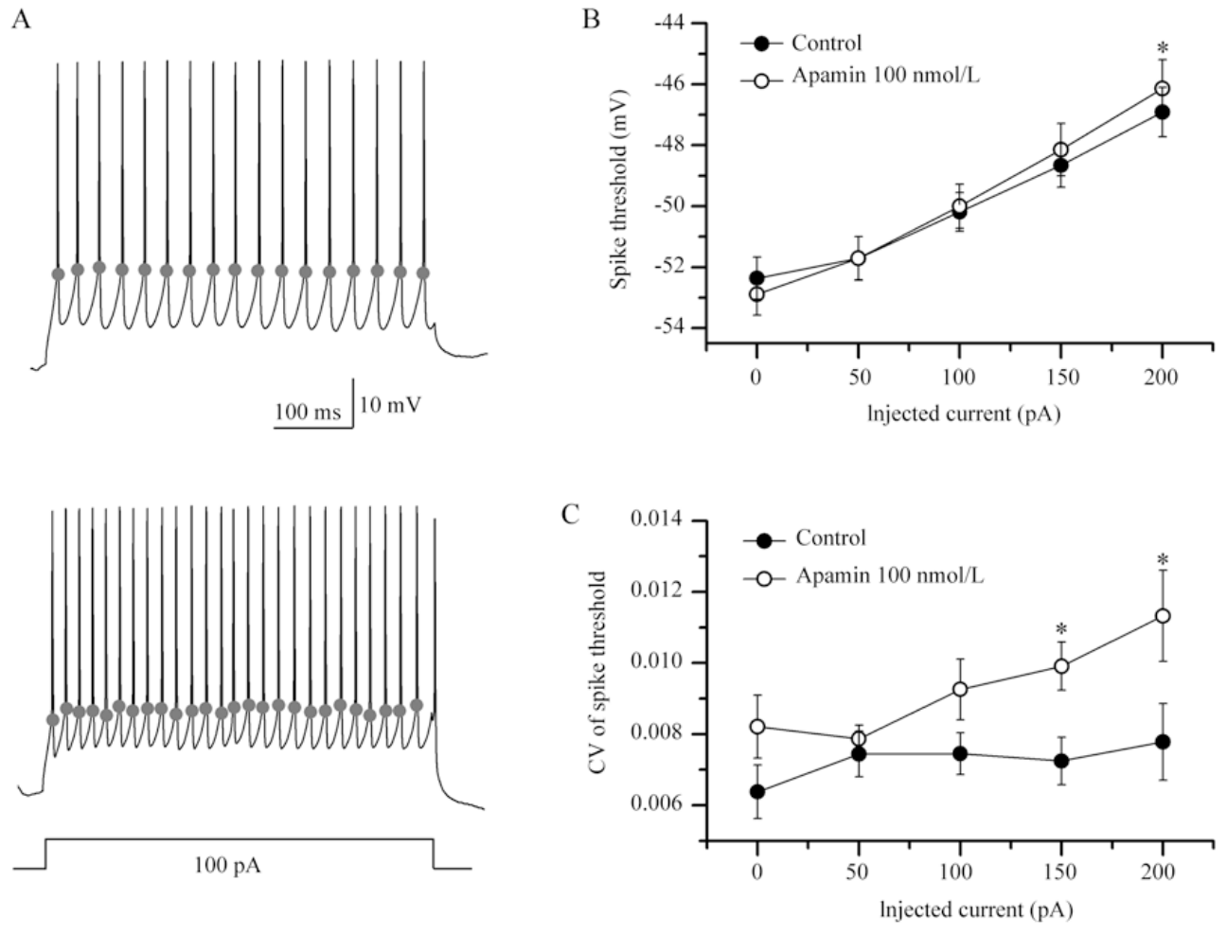
SK blockade destabilizes evoked spike threshold
A spike threshold is the membrane voltage at which regenerative excitation starts an action potential. Hou and colleagues evoked firing with a 100 pA depolarizing current and compared the thresholds measured before and after 100 nM apamin blocked SK channels.
Blockade increased the variation of the evoked thresholds and shifted them toward more depolarized voltages as the injected current increased. The recordings link irregular firing to less stable spike initiation, rather than assuming that every change in spike count has the same membrane cause.
The effect supports a role for calcium-activated potassium feedback in recovery between spikes. The specific calcium source that activates SK channels is identified by separate measurements, and spontaneous and current-evoked firing respond to the intervention in their own ways.
Hou et al. (2012), Fig. 3(A–C). Evoked threshold changes during SK blockade.
Zemel et al. (2021), Fig. 1(a, upper). RA and brainstem targets in the vocal motor pathway.
Hou et al. (2012); Zemel et al. (2021)
26
Notes:
• A spike threshold is the membrane voltage at which regenerative excitation initiates an action potential. Hou and colleagues evoked firing with a 100 pA depolarizing current and compared threshold measurements before and after 100 nM apamin blocked SK channels.
• Blockade increased the variation of evoked spike thresholds and shifted them toward more depolarized voltages as injected current increased. The recordings linked irregular firing with less stable spike initiation rather than assuming that every change in spike count reflected the same membrane mechanism.
• The measured effect supports a role for calcium-activated potassium feedback in recovery between spikes. It does not identify the complete sequence of sodium-channel recovery or the calcium source activating SK channels, and spontaneous and current-evoked firing need not respond identically to the same intervention.
References:
Hou GQ, Pan X, Liao CS, Wang SH, Li DF (2012). SK channels modulate the excitability and firing precision of projection neurons in the robust nucleus of the arcopallium in adult male zebra finches. Neuroscience Bulletin 28(3):271-281. https://doi.org/10.1007/s12264-012-1241-7
Zemel BM, Nevue AA, Dagostin A, Lovell PV, Mello CV, von Gersdorff H (2021). Resurgent Na+ currents promote ultrafast spiking in projection neurons that drive fine motor control. Nature Communications 12(1):6762. https://doi.org/10.1038/s41467-021-26521-3
Figure: Hou et al. (2012), Fig. 3(A–C). Evoked threshold changes during SK blockade.
Figure source: https://doi.org/10.1007/s12264-012-1241-7
Figure: Zemel et al. (2021), Fig. 1(a, upper). RA and brainstem targets in the vocal motor pathway.
Figure source: https://doi.org/10.1038/s41467-021-26521-3

Slide 34
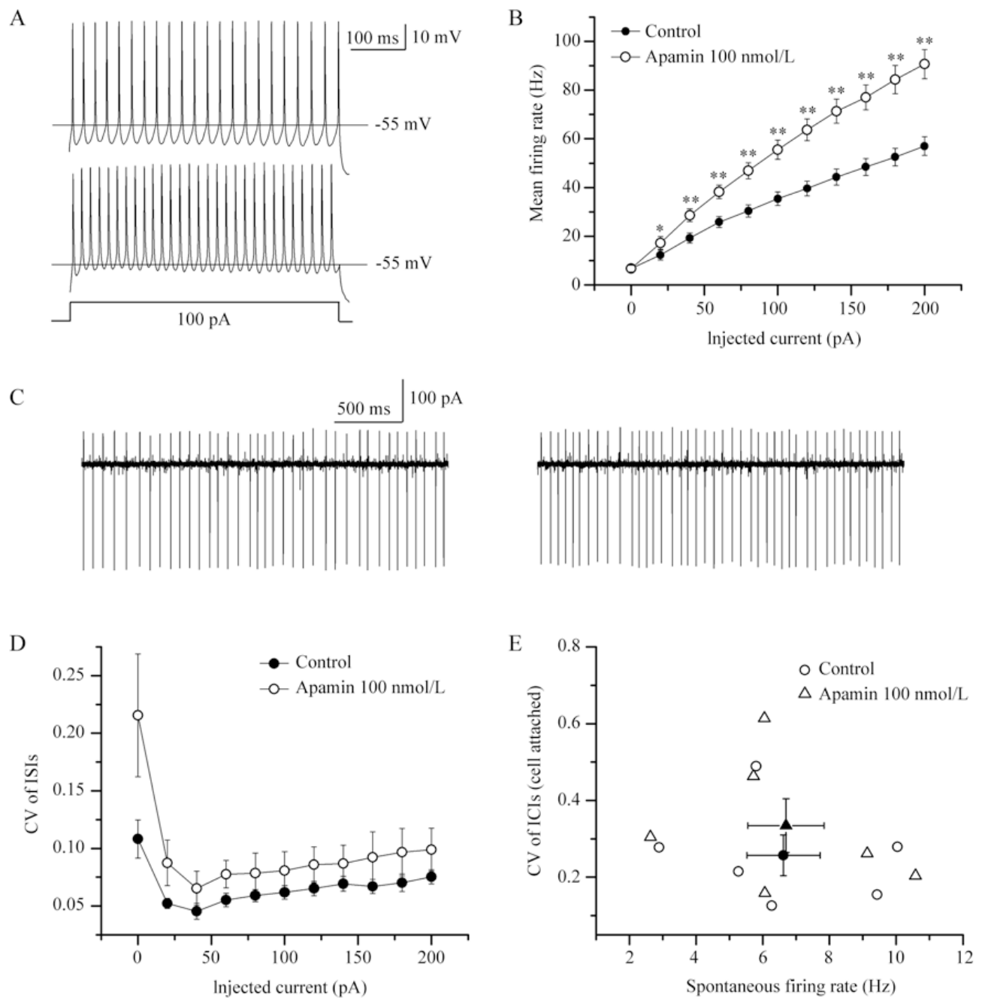
Synaptic input contributes to the SK regularity effect
Hou and colleagues blocked ionotropic glutamate receptors while recording RA projection neurons. AMPA receptors support relatively fast excitatory transmission, whereas NMDA receptors have slower kinetics and voltage-dependent gating.
Apamin still increased current-evoked firing after receptor blockade, but its effect on firing regularity was no longer clearly detectable. The comparison separates an excitability effect that persists without glutamatergic input from a regularity effect that depends on incoming excitation.
Intrinsic potassium conductance and incoming excitation interact to set spike timing. The control identifies the glutamatergic contribution to regularity, and the presynaptic source of that excitation is tested by separate experiments.
Hou et al. (2012), Fig. 4(A–E). Apamin effects after glutamate-receptor blockade.
Zemel et al. (2021), Fig. 1(a, upper). RA and brainstem targets in the vocal motor pathway.
Hou et al. (2012); Zemel et al. (2021)
27
Notes:
• Hou and colleagues blocked ionotropic glutamate receptors while recording RA projection neurons. AMPA receptors support relatively fast excitatory transmission, whereas NMDA receptors have slower kinetics and voltage-dependent gating; the antagonists DNQX and APV suppress these receptor components.
• Apamin still increased current-evoked firing after receptor blockade, but its effect on firing regularity was no longer clearly detectable. This comparison separated an excitability effect that persisted without glutamatergic input from a regularity effect that depended on the recording's synaptic conditions.
• Intrinsic potassium conductance and incoming excitation therefore interact in determining spike timing. The control does not identify the presynaptic source responsible for the difference or establish the corresponding effect during singing; it constrains a purely intrinsic explanation of all changes in temporal regularity.
References:
Hou GQ, Pan X, Liao CS, Wang SH, Li DF (2012). SK channels modulate the excitability and firing precision of projection neurons in the robust nucleus of the arcopallium in adult male zebra finches. Neuroscience Bulletin 28(3):271-281. https://doi.org/10.1007/s12264-012-1241-7
Zemel BM, Nevue AA, Dagostin A, Lovell PV, Mello CV, von Gersdorff H (2021). Resurgent Na+ currents promote ultrafast spiking in projection neurons that drive fine motor control. Nature Communications 12(1):6762. https://doi.org/10.1038/s41467-021-26521-3
Figure: Hou et al. (2012), Fig. 4(A–E). Apamin effects after glutamate-receptor blockade.
Figure source: https://doi.org/10.1007/s12264-012-1241-7
Figure: Zemel et al. (2021), Fig. 1(a, upper). RA and brainstem targets in the vocal motor pathway.
Figure source: https://doi.org/10.1038/s41467-021-26521-3

Slide 35
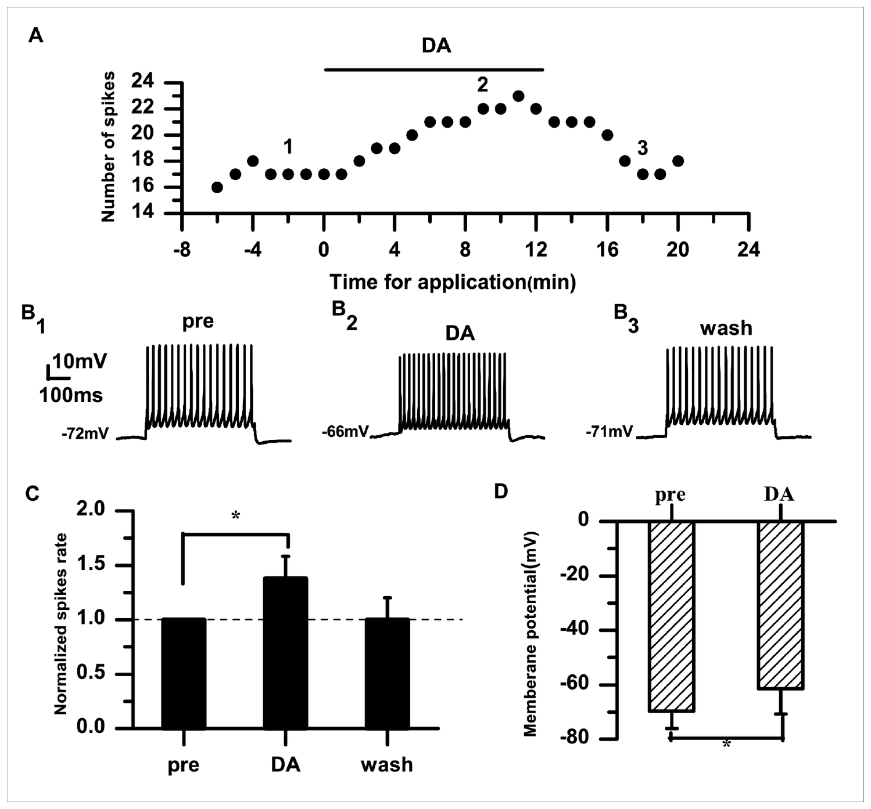
Dopamine increases RA neuronal excitability
Dopamine is a neurotransmitter that modulates neuronal properties through receptor-dependent intracellular signaling. Liao and colleagues recorded adult male zebra finch RA projection neurons and applied 50 µM dopamine while controlling the injected current.
During a 100 pA stimulus, normalized firing rose to about 1.38 times baseline and returned toward baseline after washout. The membrane potential became less negative, shifting from about −70 to −61 mV under the reported recording conditions.
The within-cell comparisons show reversible modulation of excitability in the same neuron, which is the direct test of the drug's effect. Bath application differs from physiological dopamine release in concentration and timing, so the recorded effect is read as a property of the cell rather than of a natural behavioral state.
Liao et al. (2013), Fig. 1(A–D). Reversible dopamine effects on RA firing and voltage.
Zemel et al. (2021), Fig. 1(a, upper). RA and brainstem targets in the vocal motor pathway.
Liao et al. (2013); Zemel et al. (2021)
28
Notes:
• Dopamine is a neurotransmitter that can modulate neuronal properties through receptor-dependent intracellular signaling. Liao and colleagues recorded adult male zebra finch RA projection neurons and applied 50 µM dopamine while controlling the injected current.
• During a 100 pA stimulus, normalized firing increased to approximately 1.38 times baseline and returned toward baseline after washout. The membrane potential became less negative, shifting from approximately −70 to −61 mV under the reported recording conditions.
• The within-cell drug and wash comparisons establish reversible modulation of excitability rather than a difference between cell populations. Bath application does not reproduce the concentration, duration, or spatial precision of physiological dopamine release, so these measurements should not be equated directly with a behavioral state during singing.
References:
Liao C, Wang S, Pan X, Hou G, Li D (2013). Dopamine Modulates the Excitability of Projection Neurons in the Robust Nucleus of the Arcopallium in Adult Zebra Finches. PLoS ONE 8(12):e82497. https://doi.org/10.1371/journal.pone.0082497
Zemel BM, Nevue AA, Dagostin A, Lovell PV, Mello CV, von Gersdorff H (2021). Resurgent Na+ currents promote ultrafast spiking in projection neurons that drive fine motor control. Nature Communications 12(1):6762. https://doi.org/10.1038/s41467-021-26521-3
Figure: Liao et al. (2013), Fig. 1(A–D). Reversible dopamine effects on RA firing and voltage.
Figure source: https://doi.org/10.1371/journal.pone.0082497
Figure: Zemel et al. (2021), Fig. 1(a, upper). RA and brainstem targets in the vocal motor pathway.
Figure source: https://doi.org/10.1038/s41467-021-26521-3

Slide 36
Dopamine raises RA neuronal firing reversibly
Dopamine is a neuromodulator that changes the excitability of neurons through receptor signaling. Liao and colleagues applied dopamine to adult RA projection neurons while controlling the injected current. The same cell was recorded before, during and after the drug.
Firing rose during the dopamine application and returned toward baseline after the wash. The membrane potential also shifted toward a less negative value. The reversal within each cell shows that the effect came from the drug rather than from a difference between neurons.
The depolarization makes RA neurons closer to firing for the same input. This change in excitability is a candidate mechanism for how dopamine alters the output of the motor nucleus during song-related activity. The effect is therefore a property of the cells in this preparation.
Liao et al. (2013), Fig. 1(A–D). Reversible dopamine effects on RA firing and voltage.
Zemel et al. (2021), Fig. 1(a, upper). RA and brainstem targets in the vocal motor pathway.
Liao et al. (2013)
28a
Notes:
• Dopamine increases the excitability of RA neurons.
• Preparation.
– Adult male RA projection neurons were recorded.
– The injected current was controlled.
• Application.
– Dopamine was applied at 50 µM.
– The drug was applied to the bath.
• Firing.
– Firing rose during the application.
– The rise was about 1.38 times baseline.
• Voltage.
– The membrane potential became less negative.
– The neuron moved closer to threshold.
• Reversal.
– The effect reversed after washout.
– The same cell returned toward baseline.
• Meaning.
– Dopamine makes RA neurons more likely to fire.
– The effect is a candidate for song-related modulation.
• Source values.
– The published values and recording conditions come from the original paper.
– Each value is reported with the scale or condition used in the source.
• Why the measure matters.
– The result separates the measured property from the mechanism that produces it.
– The comparison stays within the same cells or the same birds.
• Interpretation.
– Each result is read within the preparation and the age group that produced it.
– The claim is restricted to the measured cells and conditions.
References:
Liao C, Wang S, Pan X, Hou G, Li D (2013). Dopamine Modulates the Excitability of Projection Neurons in the Robust Nucleus of the Arcopallium in Adult Zebra Finches. PLoS ONE 8(12):e82497. https://doi.org/10.1371/journal.pone.0082497

Slide 37
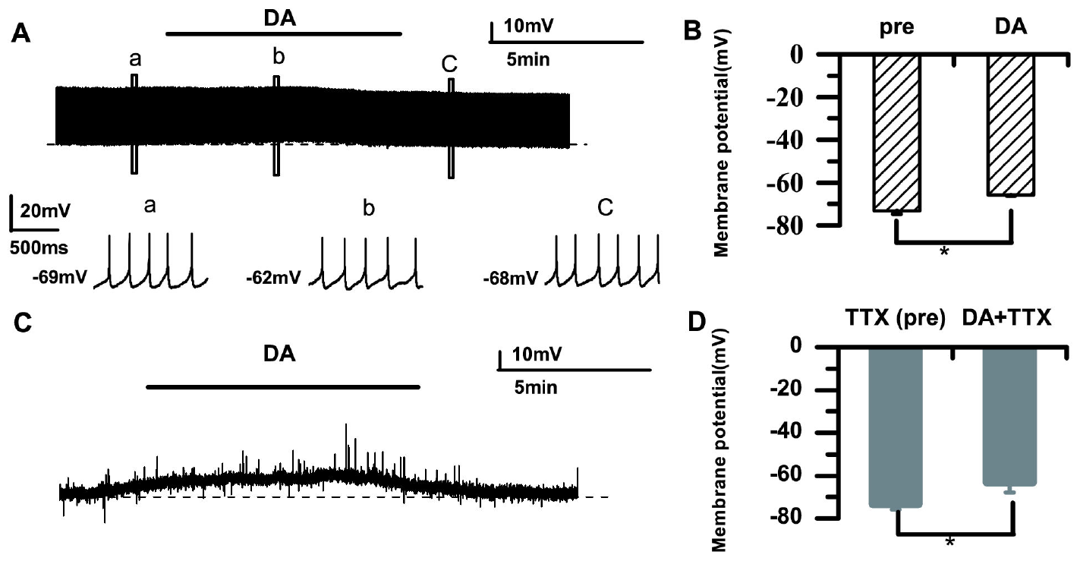
Dopamine depolarization persists without spikes
Liao and colleagues used tetrodotoxin, or TTX, to block voltage-gated sodium channels and prevent action potentials in the RA slice. The manipulation tests whether the dopamine-induced depolarization depended on spike-driven activity.
Dopamine still produced a depolarizing shift when sodium-dependent spikes were suppressed. The result separates the change in resting membrane behavior from the increase in evoked action potentials seen without TTX.
A direct or locally mediated membrane effect is therefore supported. The specific ionic conductance responsible is identified in later pharmacological work, because this control shows that spikes are not required for the depolarization.
Liao et al. (2013), Fig. 2(A–D). Depolarization with and without sodium-channel blockade.
Zemel et al. (2021), Fig. 1(a, upper). RA and brainstem targets in the vocal motor pathway.
Liao et al. (2013); Zemel et al. (2021)
29
Notes:
• Liao and colleagues used tetrodotoxin, or TTX, to block voltage-gated sodium channels and prevent action potentials in their RA slice preparation. This manipulation tested whether dopamine-induced depolarization depended on spike-driven activity in the surrounding network.
• Dopamine still produced a depolarizing membrane shift when sodium-dependent spikes were suppressed. The result separated the change in resting membrane behavior from the increased number of evoked action potentials observed in the unblocked preparation.
• A direct or locally mediated membrane effect is therefore supported, but the specific ionic conductance responsible was not isolated by this control. TTX also changes network activity broadly; persistence in its presence does not prove that all dopaminergic influences on RA during singing are exclusively postsynaptic.
References:
Liao C, Wang S, Pan X, Hou G, Li D (2013). Dopamine Modulates the Excitability of Projection Neurons in the Robust Nucleus of the Arcopallium in Adult Zebra Finches. PLoS ONE 8(12):e82497. https://doi.org/10.1371/journal.pone.0082497
Zemel BM, Nevue AA, Dagostin A, Lovell PV, Mello CV, von Gersdorff H (2021). Resurgent Na+ currents promote ultrafast spiking in projection neurons that drive fine motor control. Nature Communications 12(1):6762. https://doi.org/10.1038/s41467-021-26521-3
Figure: Liao et al. (2013), Fig. 2(A–D). Depolarization with and without sodium-channel blockade.
Figure source: https://doi.org/10.1371/journal.pone.0082497
Figure: Zemel et al. (2021), Fig. 1(a, upper). RA and brainstem targets in the vocal motor pathway.
Figure source: https://doi.org/10.1038/s41467-021-26521-3

Slide 38
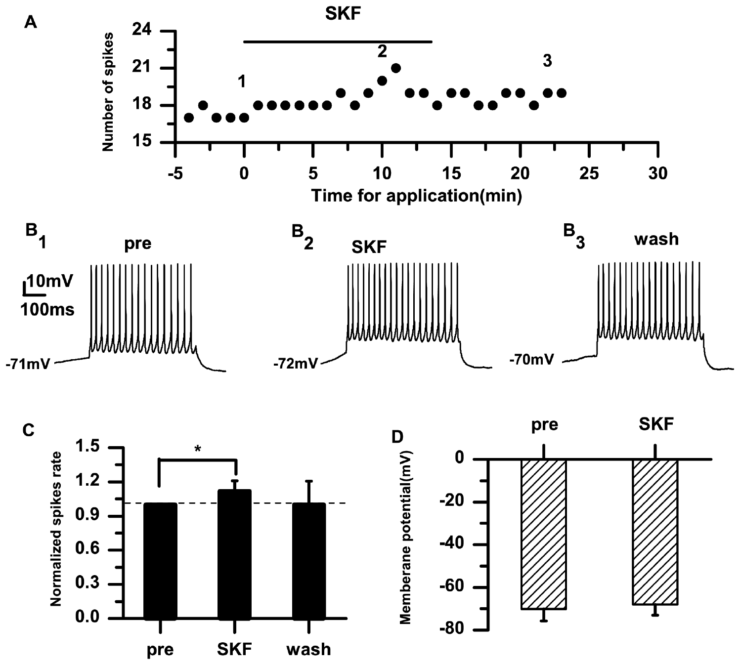
D1-like receptors mediate the RA dopamine effect
A D1-like receptor is a dopamine receptor class that modulates cell signaling rather than forming the spike-generating sodium pore. Liao and colleagues compared dopamine with the D1-like agonist SKF-38393 in adult male zebra finch RA projection neurons.
The agonist increased excitability, and the D1-like antagonist SCH-23390 prevented the dopamine-associated increase under the study's conditions. Comparing an agonist with a receptor blocker gives converging pharmacological evidence for the receptor class involved.
The experiments assign a functional role to D1-like signaling in RA. The recorded effect concerns RA membrane physiology, and the same signaling is examined in Area X, where circuit organization and receptor effects differ.
Liao et al. (2013), Fig. 3(A–D). D1-like agonist effects on RA neurons.
Zemel et al. (2021), Fig. 1(a, upper). RA and brainstem targets in the vocal motor pathway.
Liao et al. (2013); Zemel et al. (2021)
30
Notes:
• A D1-like receptor is a dopamine-receptor class that modulates cellular signaling rather than forming the spike-generating sodium pore. Liao and colleagues compared dopamine with the D1-like agonist SKF-38393 in adult male zebra finch RA projection neurons.
• The agonist increased excitability, and the D1-like antagonist SCH-23390 prevented the dopamine-associated increase under the study's conditions. Comparing an agonist with receptor blockade supplied converging pharmacological evidence for the receptor class involved.
• The experiments assign a functional contribution to D1-like signaling but do not resolve every receptor subtype, downstream enzyme, or target ion channel. The recorded effect concerns RA membrane physiology; it should not be generalized automatically to dopamine actions in Area X, where circuit organization and receptor effects differ.
References:
Liao C, Wang S, Pan X, Hou G, Li D (2013). Dopamine Modulates the Excitability of Projection Neurons in the Robust Nucleus of the Arcopallium in Adult Zebra Finches. PLoS ONE 8(12):e82497. https://doi.org/10.1371/journal.pone.0082497
Zemel BM, Nevue AA, Dagostin A, Lovell PV, Mello CV, von Gersdorff H (2021). Resurgent Na+ currents promote ultrafast spiking in projection neurons that drive fine motor control. Nature Communications 12(1):6762. https://doi.org/10.1038/s41467-021-26521-3
Figure: Liao et al. (2013), Fig. 3(A–D). D1-like agonist effects on RA neurons.
Figure source: https://doi.org/10.1371/journal.pone.0082497
Figure: Zemel et al. (2021), Fig. 1(a, upper). RA and brainstem targets in the vocal motor pathway.
Figure source: https://doi.org/10.1038/s41467-021-26521-3

Slide 39
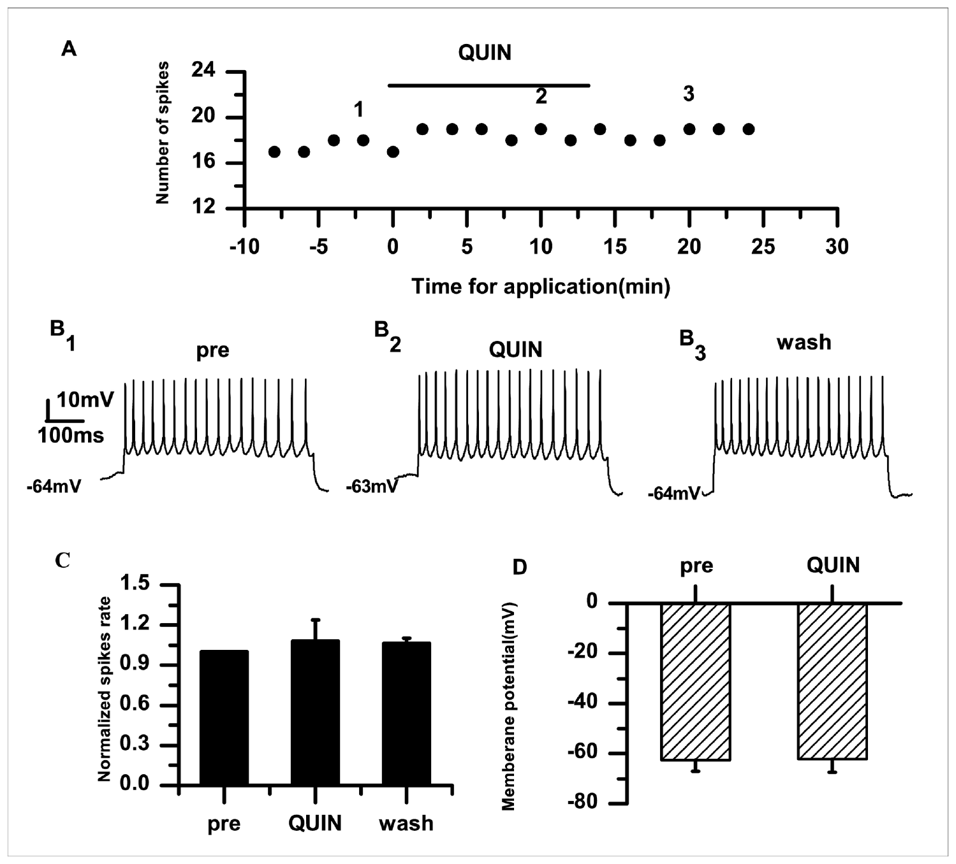
D2-like stimulation has a different effect in RA
D2-like receptors form a dopamine receptor class that is pharmacologically distinct from D1-like receptors. Liao and colleagues applied the D2-like agonist quinpirole to RA projection neurons and compared firing and membrane voltage before, during and after application.
Quinpirole did not reproduce the strong increase in excitability produced by dopamine and the D1-like agonist in this preparation. The comparison constrains receptor interpretation, so the D2-like effect is judged against the D1-like effect rather than assumed to match it.
A weak or absent effect under these conditions leaves D2-like function open in other parts of the song system. Receptor expression and release patterns in those regions are measured separately. The D2-like result therefore applies to this cell population and this preparation.
Liao et al. (2013), Fig. 5(A–D). D2-like agonist measurements in RA neurons.
Zemel et al. (2021), Fig. 1(a, upper). RA and brainstem targets in the vocal motor pathway.
Liao et al. (2013); Zemel et al. (2021)
31
Notes:
• D2-like receptors form a dopamine-receptor class pharmacologically distinct from D1-like receptors. Liao and colleagues applied the D2-like agonist quinpirole to RA projection neurons and compared firing and membrane voltage before, during, and after the application.
• Quinpirole did not reproduce the prominent increase in excitability produced by dopamine and the D1-like agonist in this preparation. The comparison constrained receptor interpretation instead of assuming that every dopamine receptor has the same effect on a neuron.
• A weak or absent effect under these conditions does not establish that D2-like receptors have no function anywhere in the song system. Receptor expression, release conditions, and network targets differ between regions; the study addresses the measured response of adult RA projection neurons in a controlled slice preparation.
References:
Liao C, Wang S, Pan X, Hou G, Li D (2013). Dopamine Modulates the Excitability of Projection Neurons in the Robust Nucleus of the Arcopallium in Adult Zebra Finches. PLoS ONE 8(12):e82497. https://doi.org/10.1371/journal.pone.0082497
Zemel BM, Nevue AA, Dagostin A, Lovell PV, Mello CV, von Gersdorff H (2021). Resurgent Na+ currents promote ultrafast spiking in projection neurons that drive fine motor control. Nature Communications 12(1):6762. https://doi.org/10.1038/s41467-021-26521-3
Figure: Liao et al. (2013), Fig. 5(A–D). D2-like agonist measurements in RA neurons.
Figure source: https://doi.org/10.1371/journal.pone.0082497
Figure: Zemel et al. (2021), Fig. 1(a, upper). RA and brainstem targets in the vocal motor pathway.
Figure source: https://doi.org/10.1038/s41467-021-26521-3

Slide 40
D1-like and D2-like agonists act differently on RA
A D1-like receptor and a D2-like receptor are two classes of dopamine receptor that act through different signaling pathways. Liao and colleagues compared the effect of a D1-like agonist with that of a D2-like agonist on RA neurons. The two drugs were tested on the same kind of cell. Each agonist was tested under the same recording conditions.
The D2-like agonist quinpirole did not reproduce the strong increase in excitability produced by dopamine. The D1-like agonist did produce a comparable increase. The two agonists therefore produced different effects in the same preparation.
The receptor class determines whether dopamine excites RA neurons. The result constrains how dopamine acts on the motor nucleus, because a single transmitter can produce different responses through different receptors. The receptor comparison uses the D1-like result as its reference.
Liao et al. (2013), Fig. 5(A–D). D2-like agonist measurements in RA neurons.
Zemel et al. (2021), Fig. 1(a, upper). RA and brainstem targets in the vocal motor pathway.
Liao et al. (2013)
31a
Notes:
• Receptor class determines how dopamine acts on RA.
• Receptor classes.
– D1-like and D2-like receptors signal through different pathways.
– They are pharmacologically distinct.
• Agonists.
– Each class was tested with its own agonist.
– The agonists were applied to RA neurons.
• D2-like result.
– Quinpirole did not produce the strong increase.
– The effect was weaker than that of dopamine.
• D1-like result.
– The D1-like agonist produced a comparable increase.
– This matches the effect of dopamine.
• Comparison.
– The two classes differ in their effect.
– The difference is what the experiment tests.
• Meaning.
– One transmitter can act through several receptor types.
– The receptor type controls the response.
• Source values.
– The published values and recording conditions come from the original paper.
– Each value is reported with the scale or condition used in the source.
• Why the measure matters.
– The result separates the measured property from the mechanism that produces it.
– The comparison stays within the same cells or the same birds.
• Interpretation.
– Each result is read within the preparation and the age group that produced it.
– The claim is restricted to the measured cells and conditions.
References:
Liao C, Wang S, Pan X, Hou G, Li D (2013). Dopamine Modulates the Excitability of Projection Neurons in the Robust Nucleus of the Arcopallium in Adult Zebra Finches. PLoS ONE 8(12):e82497. https://doi.org/10.1371/journal.pone.0082497

Slide 41
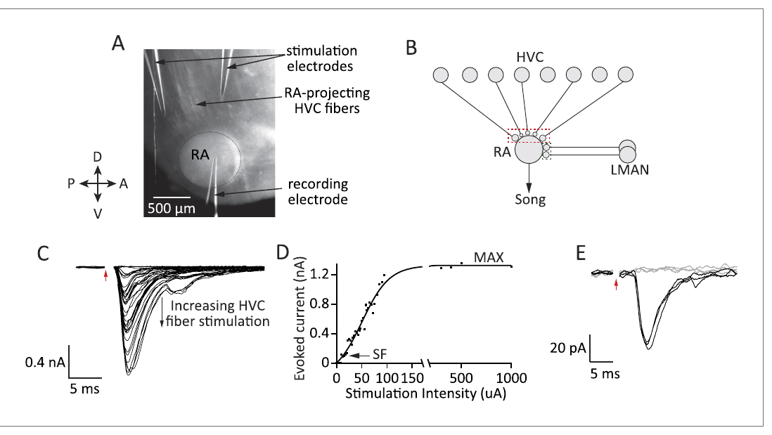
HVC and LMAN inputs converge on RA neurons
LMAN, the lateral magnocellular nucleus of the anterior nidopallium, is a forebrain output of the anterior forebrain pathway. Garst-Orozco and colleagues stimulated HVC and LMAN fiber tracts separately while recording excitatory postsynaptic currents in RA projection neurons.
An excitatory postsynaptic current is the membrane current produced when excitatory transmitter activates receptors on the recorded cell. Pathway-specific stimulation let the strength and receptor contributions of the two convergent inputs be compared in juvenile and adult zebra finches.
RA receives input from a direct motor-related pathway and from a basal ganglia–thalamic pathway. The slice stimulation activates the fibers that survive the preparation, and the natural activity of these inputs during a particular syllable is measured in the intact bird.
Garst-Orozco et al. (2014), Fig. 2(A–E). Pathway stimulation and currents recorded in RA.
Garst-Orozco et al. (2014)
32
Notes:
• The lateral magnocellular nucleus of the anterior nidopallium, or LMAN, is a forebrain output of the anterior forebrain pathway. Garst-Orozco and colleagues stimulated HVC and LMAN fiber tracts separately while recording excitatory postsynaptic currents in RA projection neurons.
• An excitatory postsynaptic current is the membrane current produced when excitatory transmitter activates receptors on the recorded cell. Pathway-specific stimulation allowed the strength and receptor contributions of the two convergent inputs to be compared in juvenile and adult zebra finches.
• RA therefore receives input from a direct motor-related pathway and from a basal ganglia–thalamic pathway. Electrical stimulation in slices samples surviving fibers rather than every connection present in the intact animal, and does not reveal the natural activity pattern of those inputs during a particular syllable.
References:
Garst-Orozco J, Babadi B, Ölveczky BP (2014). A neural circuit mechanism for regulating vocal variability during song learning in zebra finches. eLife 3:e03697. https://doi.org/10.7554/elife.03697
Figure: Garst-Orozco et al. (2014), Fig. 2(A–E). Pathway stimulation and currents recorded in RA.
Figure source: https://doi.org/10.7554/elife.03697

Slide 42
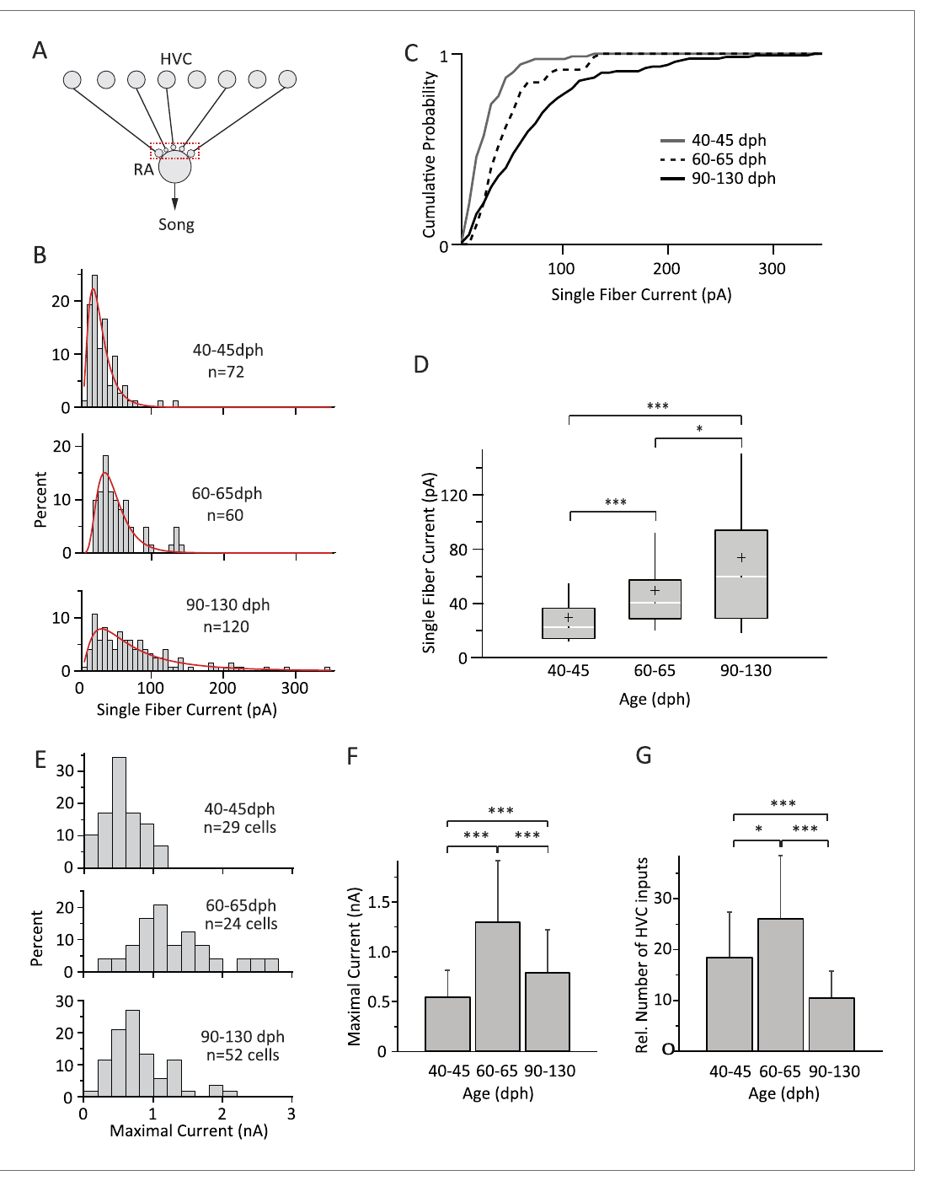
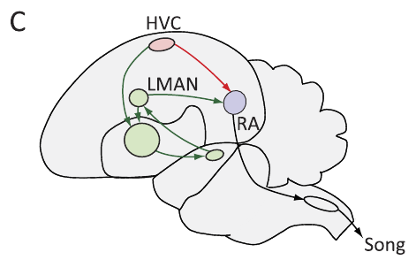
HVC inputs strengthen and undergo late refinement
Garst-Orozco and colleagues measured HVC-to-RA currents with weak stimulation, which produced either failures or a consistent single-fiber response. They also used stronger stimulation that recruited the available input population.
Median single-fiber HVC currents rose from about 23 pA in subsong birds to 60 pA in adults. The estimated number of inputs first increased and then declined during later development. The experiment therefore identifies refinement rather than a uniform strengthening.
Strengthening and pruning can alter how RA converts HVC activity into motor output. The measurements show which inputs are kept, and they show how the number of inputs changes across development. Each change is read from the measured currents at each developmental stage.
Garst-Orozco et al. (2014), Fig. 3(A–G). HVC input strengthening and refinement.
Garst-Orozco et al. (2014), Fig. 1(C). HVC, LMAN, and RA in the published pathway map.
Garst-Orozco et al. (2014)
33
Notes:
• Garst-Orozco and colleagues measured HVC-to-RA currents using weak stimulation that produced either failures or a consistent single-fiber response, and stronger stimulation that recruited the available input population. Comparing these measurements distinguished connection strength from the estimated number of recruited inputs.
• Median single-fiber HVC currents rose from about 23 pA in subsong birds to 60 pA in adults. Estimated input number initially increased, then declined during later development. The experiment therefore identified refinement rather than a uniform increase in every aspect of excitatory connectivity.
• Such strengthening and pruning can alter how RA converts HVC activity into motor output. The measurements do not establish that each lost input was an incorrect connection for a particular tutor song, and the fiber-number estimate is limited by slice preservation and assumptions about recruitment and current summation.
References:
Garst-Orozco J, Babadi B, Ölveczky BP (2014). A neural circuit mechanism for regulating vocal variability during song learning in zebra finches. eLife 3:e03697. https://doi.org/10.7554/elife.03697
Figure: Garst-Orozco et al. (2014), Fig. 3(A–G). HVC input strengthening and refinement.
Figure source: https://doi.org/10.7554/elife.03697
Figure: Garst-Orozco et al. (2014), Fig. 1(C). HVC, LMAN, and RA in the published pathway map.
Figure source: https://doi.org/10.7554/elife.03697

Slide 43
Stronger HVC synapses increase during development
A single-fiber response is a current evoked by activating one input fiber at a time. Garst-Orozco and colleagues used weak stimulation to isolate these responses on RA neurons. Stronger stimulation was used to recruit the full population of inputs, so the two measures can be compared.
Median single-fiber HVC currents rose from about 23 pA in subsong birds to about 60 pA in adults. The estimated number of recruited inputs first increased and then declined. The synapses therefore grew stronger while the number of active inputs was refined.
This pattern describes refinement rather than a uniform increase in every aspect of connectivity. The strengthening of individual HVC inputs can change how RA converts HVC activity into motor output over the course of development. Each measurement is kept separate so that connection strength is not confused with input number.
Garst-Orozco et al. (2014), Fig. 3(A–G). HVC input strengthening and refinement.
Garst-Orozco et al. (2014), Fig. 1(C). HVC, LMAN, and RA in the published pathway map.
Garst-Orozco et al. (2014)
33a
Notes:
• HVC inputs strengthen and are then refined.
• Stimulation.
– Weak stimulation isolates single-fiber responses.
– Stronger stimulation recruits the whole input population.
• Single fiber.
– A single fiber produces a consistent current.
– This is the basic unit of the measurement.
• Strength.
– Median currents rose from about 23 pA to 60 pA.
– Subsong and adult birds were compared.
• Number.
– The number of recruited inputs first increased.
– Later in development the number declined.
• Refinement.
– Connectivity was refined rather than uniformly increased.
– Some inputs were strengthened and others reduced.
• Meaning.
– Strengthening changes how HVC drives RA.
– Development shapes which inputs are active.
• Source values.
– The published values and recording conditions come from the original paper.
– Each value is reported with the scale or condition used in the source.
• Why the measure matters.
– The result separates the measured property from the mechanism that produces it.
– The comparison stays within the same cells or the same birds.
• Interpretation.
– Each result is read within the preparation and the age group that produced it.
– The claim is restricted to the measured cells and conditions.
References:
Garst-Orozco J, Babadi B, Ölveczky BP (2014). A neural circuit mechanism for regulating vocal variability during song learning in zebra finches. eLife 3:e03697. https://doi.org/10.7554/elife.03697

Slide 44
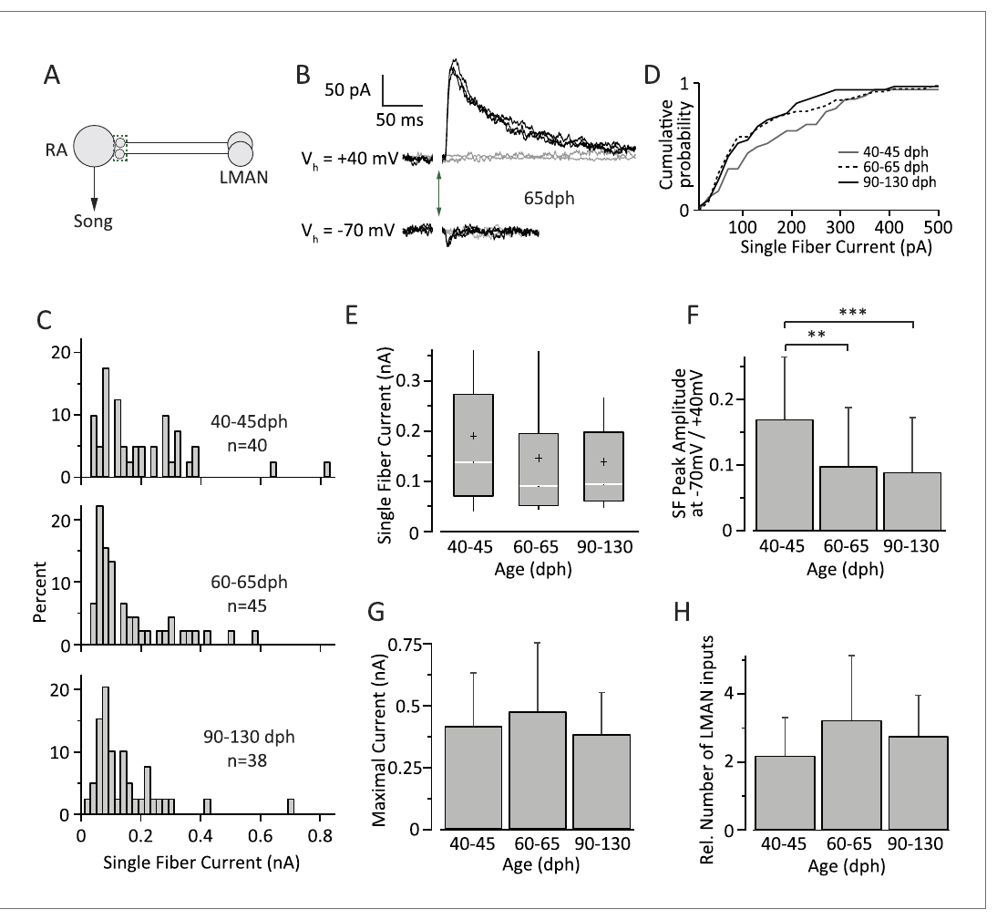
LMAN input strength remains relatively stable
Garst-Orozco and colleagues applied the same single-fiber and maximal-recruitment strategy to the LMAN input onto RA neurons. Recordings from subsong, plastic-song and adult birds tested whether the increase in song stereotypy reflected a simple loss of this excitatory pathway.
Mean single-fiber LMAN currents were about 146 pA in plastic-song birds and 142 pA in adults, and the estimated number of available inputs stayed relatively stable. The finding contrasted with the strengthening and pruning of HVC inputs measured in the same framework.
Reduced behavioral variability therefore coexists with persistent LMAN-to-RA connectivity. A preserved connection can have a different influence when other convergent inputs and network activity change, so the same connection supports different roles at different ages.
Garst-Orozco et al. (2014), Fig. 4(A–H). LMAN current strength and receptor contributions.
Garst-Orozco et al. (2014), Fig. 1(C). HVC, LMAN, and RA in the published pathway map.
Garst-Orozco et al. (2014)
34
Notes:
• Garst-Orozco and colleagues applied the same single-fiber and maximal-recruitment strategy to the LMAN input onto RA neurons. Recordings from subsong, plastic-song, and adult birds tested whether increasing song stereotypy reflected a simple disappearance of this excitatory pathway.
• Mean single-fiber LMAN currents were approximately 146 pA in plastic-song birds and 142 pA in adults; the estimated number of available inputs remained relatively stable. The finding contrasted with the strengthening and pruning of HVC inputs measured in the same experimental framework.
• Reduced behavioral variability can consequently coexist with persistent LMAN-to-RA connectivity. The result does not establish that LMAN firing patterns or synaptic effects are identical in behaving juveniles and adults; a preserved connection can have a different influence when other convergent inputs and network activity change.
References:
Garst-Orozco J, Babadi B, Ölveczky BP (2014). A neural circuit mechanism for regulating vocal variability during song learning in zebra finches. eLife 3:e03697. https://doi.org/10.7554/elife.03697
Figure: Garst-Orozco et al. (2014), Fig. 4(A–H). LMAN current strength and receptor contributions.
Figure source: https://doi.org/10.7554/elife.03697
Figure: Garst-Orozco et al. (2014), Fig. 1(C). HVC, LMAN, and RA in the published pathway map.
Figure source: https://doi.org/10.7554/elife.03697

Slide 45
LMAN currents depend strongly on NMDA receptors
Garst-Orozco and colleagues recorded LMAN-evoked currents at −70 and +40 mV. At negative voltages, extracellular magnesium blocks the NMDA receptor current. Depolarization relieves this block, which allows the slower receptor component to contribute.
The comparison separated the mostly AMPA-mediated response at −70 mV from the combined AMPA and NMDA response at +40 mV. The estimated NMDA-to-AMPA contribution in subsong birds was about 9:1, so NMDA receptors dominate the LMAN response.
Voltage-dependent gating means the effect of LMAN input depends partly on the postsynaptic state of RA. The receptor contributions are measured under these voltage conditions, and their role during singing follows from the same gating.
Garst-Orozco et al. (2014), Fig. 4(A–H). LMAN current strength and receptor contributions.
Garst-Orozco et al. (2014), Fig. 1(C). HVC, LMAN, and RA in the published pathway map.
Garst-Orozco et al. (2014)
35
Notes:
• Garst-Orozco and colleagues recorded LMAN-evoked currents at −70 and +40 mV. At negative voltages, extracellular magnesium limits NMDA-receptor current; depolarization relieves this voltage-dependent block, allowing the slower receptor component to contribute more strongly.
• The comparison distinguished predominantly AMPA-mediated responses at −70 mV from the combined AMPA and NMDA response at +40 mV. The estimated NMDA-to-AMPA contribution in subsong birds was approximately 9:1. LMAN responses had a substantial NMDA component, connecting pathway identity to a particular form of postsynaptic integration rather than treating all excitatory inputs as interchangeable.
• Voltage-dependent gating means that the effect of LMAN input depends partly on the postsynaptic state of RA. The recordings establish receptor contributions under imposed holding potentials, but cannot by themselves specify RA voltage trajectories or transmitter release during freely produced song.
References:
Garst-Orozco J, Babadi B, Ölveczky BP (2014). A neural circuit mechanism for regulating vocal variability during song learning in zebra finches. eLife 3:e03697. https://doi.org/10.7554/elife.03697
Figure: Garst-Orozco et al. (2014), Fig. 4(A–H). LMAN current strength and receptor contributions.
Figure source: https://doi.org/10.7554/elife.03697
Figure: Garst-Orozco et al. (2014), Fig. 1(C). HVC, LMAN, and RA in the published pathway map.
Figure source: https://doi.org/10.7554/elife.03697

Slide 46
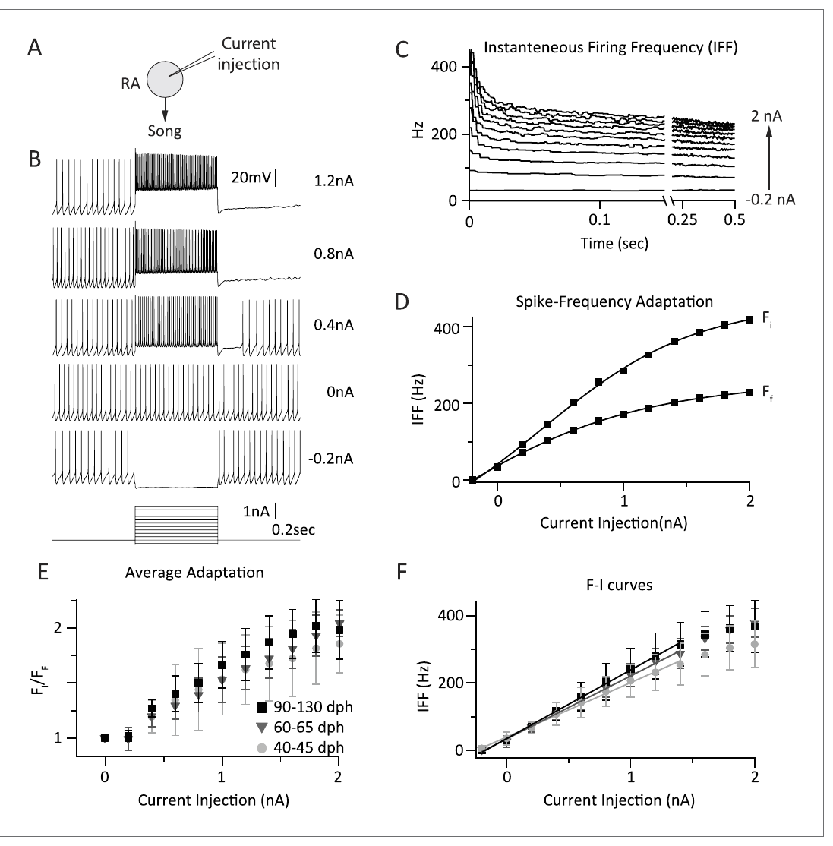
Developmental conclusions depend on the age window
Garst-Orozco and colleagues measured RA responses to 0.5-second current pulses at 35 °C across subsong, plastic-song and adult stages. Input-to-firing gain and spike-frequency adaptation were broadly similar across these groups, which constrains a simple intrinsic-excitability explanation of reduced song variability.
Zemel and colleagues included younger 20-day birds and isolated sodium-current components, and they found pronounced maturation of resurgent current and spike properties. The two studies differ in developmental window, recording conditions and the property measured.
A stable firing-rate response over one age interval fits with earlier maturation of a particular ion current. The two results together show that RA intrinsic properties change in some respects and remain stable in others. The developmental account therefore depends on which property is measured at which age.
Garst-Orozco et al. (2014), Fig. 5(A–F). RA firing responses across developmental stages.
Garst-Orozco et al. (2014), Fig. 1(C). HVC, LMAN, and RA in the published pathway map.
Garst-Orozco et al. (2014); Zemel et al. (2021)
36
Notes:
• Garst-Orozco and colleagues measured RA responses to 0.5-second current pulses at 35 °C across subsong, plastic-song, and adult stages. Input-to-firing gain and spike-frequency adaptation were broadly similar across these groups, constraining a simple intrinsic-excitability explanation of reduced song variability.
• Zemel and colleagues included younger 20-day birds and isolated sodium-current components, detecting pronounced maturation of resurgent current and spike properties. The studies differ in developmental window, recording conditions, and the physiological property being measured.
• A stable firing-rate response over one age interval does not contradict earlier maturation of a particular ion current. Neither experiment supports a universal statement that RA intrinsic properties never change, nor that all decreases in song variability are caused by sodium-channel maturation.
References:
Garst-Orozco J, Babadi B, Ölveczky BP (2014). A neural circuit mechanism for regulating vocal variability during song learning in zebra finches. eLife 3:e03697. https://doi.org/10.7554/elife.03697
Zemel BM, Nevue AA, Dagostin A, Lovell PV, Mello CV, von Gersdorff H (2021). Resurgent Na+ currents promote ultrafast spiking in projection neurons that drive fine motor control. Nature Communications 12(1):6762. https://doi.org/10.1038/s41467-021-26521-3
Figure: Garst-Orozco et al. (2014), Fig. 5(A–F). RA firing responses across developmental stages.
Figure source: https://doi.org/10.7554/elife.03697
Figure: Garst-Orozco et al. (2014), Fig. 1(C). HVC, LMAN, and RA in the published pathway map.
Figure source: https://doi.org/10.7554/elife.03697

Slide 47
Stage comparisons separate intrinsic and synaptic change
Input-to-firing gain is the change in output firing for a given increase in input current. Garst-Orozco and colleagues measured this gain in RA neurons across subsong, plastic-song and adult stages. The gain and spike-frequency adaptation were broadly similar across these groups.
Zemel and colleagues instead tested younger 20-day birds and isolated sodium-current components. They reported a pronounced maturation of resurgent current and spike properties over the same developmental period. The two studies used different ages and different measurements, so their results address different questions.
Firing responses that look stable across one age range do not contradict an earlier change in a specific ion current. Intrinsic change can be visible in one measure and absent in another, so the developmental account depends on which property is measured. The comparison across studies depends on which property each study measured.
Garst-Orozco et al. (2014), Fig. 5(A–F). RA firing responses across developmental stages.
Garst-Orozco et al. (2014), Fig. 1(C). HVC, LMAN, and RA in the published pathway map.
Garst-Orozco et al. (2014)
36a
Notes:
• Different measures can reveal different developmental changes.
• Gain.
– Input-to-firing gain relates input current to firing rate.
– It is one measure of excitability.
• Stages.
– Subsong, plastic-song and adult stages were compared.
– The same stimulus was used across stages.
• Adaptation.
– Spike-frequency adaptation was similar across the stages.
– This is a second firing property.
• Zemel comparison.
– Younger 20-day birds were included.
– Sodium-current components were isolated.
• Maturation.
– Resurgent current and spike properties changed strongly.
– The change followed the developmental window.
• Meaning.
– Different properties change at different times.
– The developmental account depends on the property measured.
• Source values.
– The published values and recording conditions come from the original paper.
– Each value is reported with the scale or condition used in the source.
• Why the measure matters.
– The result separates the measured property from the mechanism that produces it.
– The comparison stays within the same cells or the same birds.
• Interpretation.
– Each result is read within the preparation and the age group that produced it.
– The claim is restricted to the measured cells and conditions.
References:
Garst-Orozco J, Babadi B, Ölveczky BP (2014). A neural circuit mechanism for regulating vocal variability during song learning in zebra finches. eLife 3:e03697. https://doi.org/10.7554/elife.03697
Zemel BM, Nevue AA, Dagostin A, Lovell PV, Mello CV, von Gersdorff H (2021). Resurgent Na+ currents promote ultrafast spiking in projection neurons that drive fine motor control. Nature Communications 12(1):6762. https://doi.org/10.1038/s41467-021-26521-3

Slide 48
Juvenile and adult lesions separate LMAN functions
Bottjer and colleagues lesioned the region then called MAN in male zebra finches at different stages of song development. Postoperative vocalizations were recorded repeatedly, and histology sorted complete lesions from partial ones. The timing of each lesion defines the developmental stage at which the bird was operated.
Lesions made early in development produced abnormal vocal patterns, whereas adult birds with complete bilateral lesions kept normal song for as long as five weeks. Birds operated at intermediate stages differed according to how established their song was at the time of the lesion.
The age dependence separates a contribution to developing vocal behavior from a role in executing established adult song. LMAN therefore has different functions at different stages of the bird's life. Both roles are visible in the same nucleus across the lesion ages.
Garst-Orozco et al. (2014), Fig. 1(C). HVC, LMAN, and RA in the published pathway map.
Bottjer et al. (1984); Garst-Orozco et al. (2014)
37
Notes:
• Bottjer and colleagues lesioned the region then called MAN in male zebra finches at different stages of song development. Postoperative vocalizations were recorded repeatedly, and histology distinguished complete lesions from cases in which the intended region was largely spared.
• Lesions early in development produced abnormal vocal patterns, whereas adult birds with complete bilateral lesions retained normal song for as long as five weeks. Birds operated at intermediate stages differed according to how established their song pattern was before surgery.
• The age dependence separates a contribution to developing vocal behavior from an obligatory role in executing established adult song. It does not prove that LMAN stores the tutor memory or that adult LMAN has no function; later pathway-specific physiology identifies persistent input to RA even after song stabilizes.
References:
Bottjer SW, Miesner EA, Arnold AP (1984). Forebrain Lesions Disrupt Development But Not Maintenance of Song in Passerine Birds. Science 224(4651):901-903. https://doi.org/10.1126/science.6719123
Garst-Orozco J, Babadi B, Ölveczky BP (2014). A neural circuit mechanism for regulating vocal variability during song learning in zebra finches. eLife 3:e03697. https://doi.org/10.7554/elife.03697
Figure: Garst-Orozco et al. (2014), Fig. 1(C). HVC, LMAN, and RA in the published pathway map.
Figure source: https://doi.org/10.7554/elife.03697

Slide 49
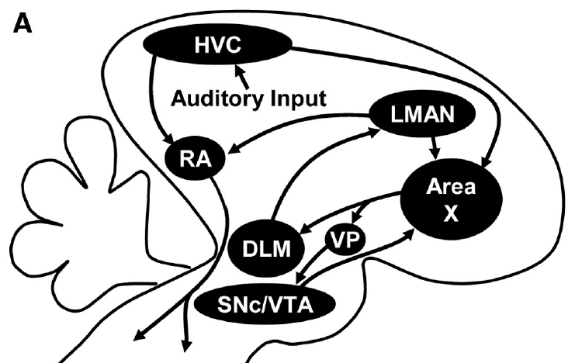
Area X links striatal processing with pallidal output
Area X is a song-related basal ganglia region that contains striatal-like neurons and pallidal-like output neurons. These cell classes occupy different positions in the circuit rather than forming one homogeneous population. Striatal-like input and pallidal-like output are the two ends of this processing chain.
Area X receives HVC and LMAN input and sends inhibitory output to the medial portion of the dorsolateral thalamic nucleus, DLM. DLM projects to LMAN, whose output returns to RA and also to Area X, which forms an anatomically connected forebrain loop.
GABA, gamma-aminobutyric acid, is the inhibitory transmitter of the pallidal-like output. The pathway constrains the possible mechanisms, and the moment-to-moment activity and learning rule of the loop are measured in the bird's song. The transmitter of the pallidal-like output is therefore central to how Area X shapes its target.
Gale & Perkel (2010a), Fig. 1(A). Area X, DLM, LMAN, and midbrain connections.
Gale & Perkel (2010b); Gale & Perkel (2010a)
38
Notes:
• Area X is a song-related basal ganglia region containing striatal-like neurons and pallidal-like output neurons. The basal ganglia are forebrain circuits involved in selecting and modifying actions; these cell classes have different positions within the circuit rather than forming one homogeneous population.
• Area X receives HVC and LMAN input and sends inhibitory output toward the medial portion of the dorsolateral thalamic nucleus, DLM. DLM projects to LMAN, whose output returns to RA and also to Area X, producing an anatomically connected forebrain loop.
• GABA, gamma-aminobutyric acid, is the inhibitory transmitter associated with the pallidal-like output. The published anatomical pathway constrains possible mechanisms, but a connection diagram alone does not determine the moment-to-moment activity or learning rule operating in that loop.
References:
Gale SD, Perkel DJ (2010b). Anatomy of a songbird basal ganglia circuit essential for vocal learning and plasticity. Journal of Chemical Neuroanatomy 39(2):124-131. https://doi.org/10.1016/j.jchemneu.2009.07.003
Gale SD, Perkel DJ (2010a). A Basal Ganglia Pathway Drives Selective Auditory Responses in Songbird Dopaminergic Neurons via Disinhibition. The Journal of Neuroscience 30(3):1027-1037. https://doi.org/10.1523/jneurosci.3585-09.2010
Figure: Gale & Perkel (2010a), Fig. 1(A). Area X, DLM, LMAN, and midbrain connections.
Figure source: https://doi.org/10.1523/jneurosci.3585-09.2010

Slide 50
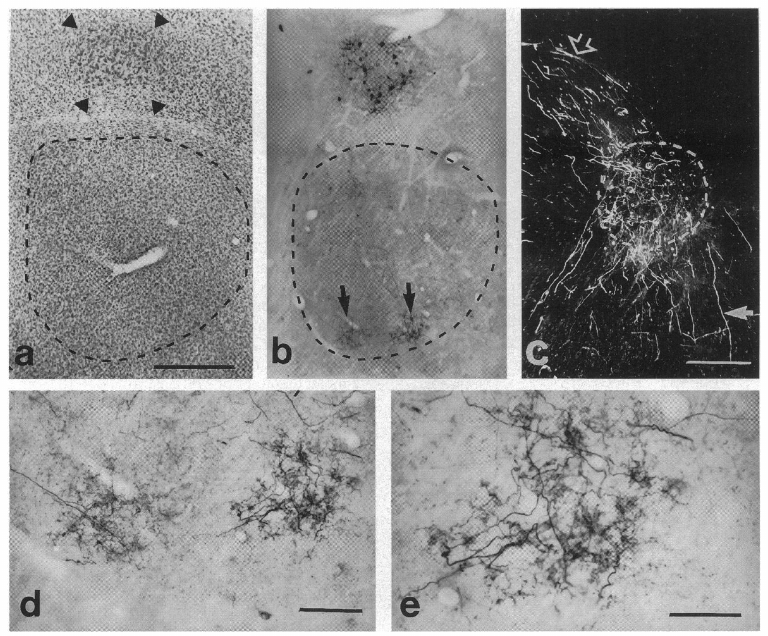
Tracer injections reveal reciprocal forebrain routes
A retrograde tracer labels neurons that project toward an injection site, whereas an anterograde tracer labels their axons and terminals downstream. Vates and Nottebohm used complementary tracing to investigate pathways linking the anterior forebrain with RA.
Injections associated with Area X and RA labeled neurons and terminal fields in LMAN. These distributions support an LMAN output route to both the basal ganglia region and the motor nucleus, which extends the circuit beyond a one-way chain. The pattern matches the projection described for Area X and RA together.
Using more than one tracer direction reduces ambiguity about which cells send and which receive a projection. The tracing identifies the projection, and the function of each route is tested with separate measurements. Two tracer directions therefore give complementary views of the same pathway.
Vates & Nottebohm (1995), Fig. 3(a–e). Tracer labeling linking LMAN, Area X, and RA.
Vates & Nottebohm (1995)
39
Notes:
• A retrograde tracer labels neurons projecting toward an injection site, whereas an anterograde tracer labels their axons and terminals downstream. Vates and Nottebohm used complementary tracing approaches to investigate pathways linking the song-related forebrain nuclei.
• Injections associated with Area X and RA labeled neurons and terminal fields in LMAN. These distributions supported an LMAN output route to both the basal ganglia region and the motor nucleus, extending the circuit beyond a one-way chain from HVC to the vocal organ.
• Using more than one tracer direction reduces ambiguity about which cells send and receive a projection. Tracer labeling nevertheless does not establish whether every anatomical connection is active during song, identify the transmitter at every terminal, or measure the temporal influence of a synapse on its target.
References:
Vates GE, Nottebohm F (1995). Feedback circuitry within a song-learning pathway.. Proceedings of the National Academy of Sciences 92(11):5139-5143. https://doi.org/10.1073/pnas.92.11.5139
Figure: Vates & Nottebohm (1995), Fig. 3(a–e). Tracer labeling linking LMAN, Area X, and RA.
Figure source: https://doi.org/10.1073/pnas.92.11.5139

Slide 51
Tracers show LMAN output to Area X and RA
A retrograde tracer labels neurons that project toward an injection site, whereas an anterograde tracer labels the axons and terminals that leave a site. Vates and Nottebohm used both kinds of tracer to map connections between song nuclei. The two directions together show which cells send a projection and where it ends.
Injections associated with Area X and RA labeled neurons and terminal fields in LMAN. These findings supported an output route from LMAN to both the basal ganglia region and the motor nucleus. The circuit therefore extends beyond the one-way chain from HVC to the vocal organ.
Projections in both directions make the song circuit more interconnected than a single chain. A forebrain nucleus can send information to the motor pathway as well as to the basal ganglia, which shapes how the song system can be studied as a network.
Vates & Nottebohm (1995), Fig. 3(a–e). Tracer labeling linking LMAN, Area X, and RA.
Vates & Nottebohm (1995)
39a
Notes:
• Two tracer directions reveal the connections in both directions.
• Retrograde.
– A retrograde tracer labels neurons projecting to the injection site.
– It identifies the cells that send the projection.
• Anterograde.
– An anterograde tracer labels the axons and terminals downstream.
– It shows where the projection ends.
• Injections.
– Injections were placed in Area X and RA.
– Labeled neurons and terminals appeared in LMAN.
• Output route.
– LMAN projects to the basal ganglia region and the motor nucleus.
– This route is in addition to the HVC chain.
• Combined directions.
– Each direction checks the other.
– The circuit map is less ambiguous.
• Meaning.
– The song system is a network with several routes.
– LMAN is part of the output side of the circuit.
• Source values.
– The published values and recording conditions come from the original paper.
– Each value is reported with the scale or condition used in the source.
• Why the measure matters.
– The result separates the measured property from the mechanism that produces it.
– The comparison stays within the same cells or the same birds.
• Interpretation.
– Each result is read within the preparation and the age group that produced it.
– The claim is restricted to the measured cells and conditions.
References:
Vates GE, Nottebohm F (1995). Feedback circuitry within a song-learning pathway.. Proceedings of the National Academy of Sciences 92(11):5139-5143. https://doi.org/10.1073/pnas.92.11.5139

Slide 52
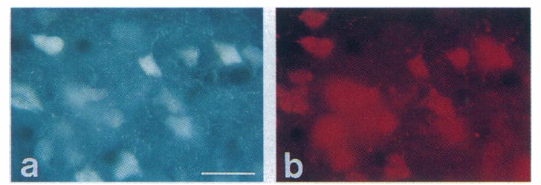
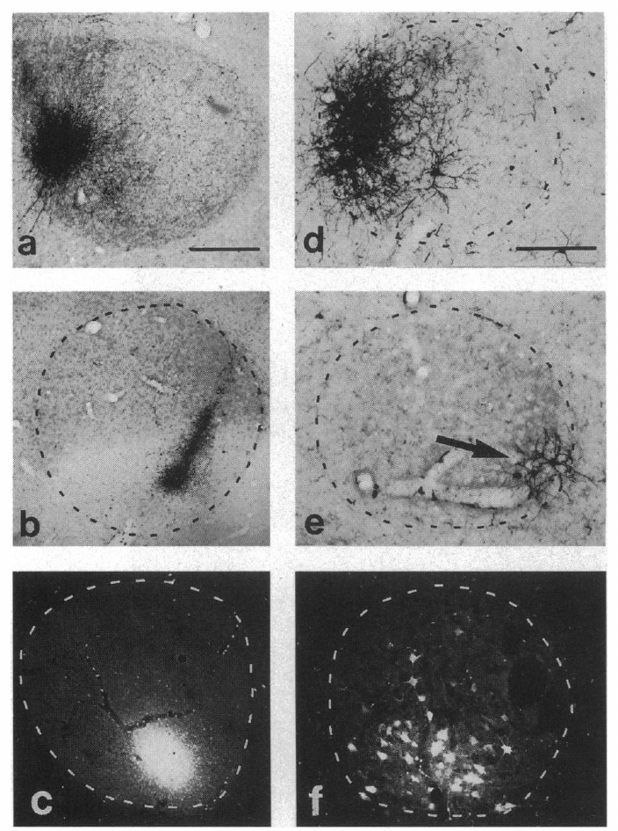
Some LMAN neurons send output to both RA and Area X
Vates and Nottebohm placed different retrograde tracers in RA and Area X to ask whether the two projections came from separate LMAN populations. Neurons containing both labels were found within LMAN, which shows output toward both targets from individual cells.
This result is more specific than overlapping terminal fields, because it links the two targets to a shared projecting neuron. A neuron with branching output can influence RA motor circuitry while also returning activity to the anterior forebrain loop through Area X.
Double labeling identifies collateral branches, not the information carried by each branch. Uptake and transport efficiency set how many double-labeled neurons are detected, so the count is a lower estimate of the collaterals.
Vates & Nottebohm (1995), Fig. 5(a–b). Two retrograde labels in LMAN neurons.
Vates & Nottebohm (1995), Fig. 4(a–f). Injection sites and retrogradely labeled LMAN cells.
Vates & Nottebohm (1995)
40
Notes:
• Vates and Nottebohm placed different retrograde tracers in RA and Area X to ask whether the two projections originated from separate LMAN populations. Neurons containing both labels were identified within LMAN, providing evidence of output toward both targets from individual cells.
• This result is more specific than overlapping terminal fields: it links the two target regions to a shared projecting neuron. A neuron with branching output can influence RA motor circuitry while also returning activity to the anterior forebrain loop through Area X.
• Double labeling identifies anatomical collateralization, not the information carried by each branch. Uptake and transport efficiencies also limit interpretation of unlabeled cells, so failure to detect a second label in one neuron does not prove that all of its axonal branches avoid the other target.
References:
Vates GE, Nottebohm F (1995). Feedback circuitry within a song-learning pathway.. Proceedings of the National Academy of Sciences 92(11):5139-5143. https://doi.org/10.1073/pnas.92.11.5139
Figure: Vates & Nottebohm (1995), Fig. 5(a–b). Two retrograde labels in LMAN neurons.
Figure source: https://doi.org/10.1073/pnas.92.11.5139
Figure: Vates & Nottebohm (1995), Fig. 4(a–f). Injection sites and retrogradely labeled LMAN cells.
Figure source: https://doi.org/10.1073/pnas.92.11.5139

Slide 53
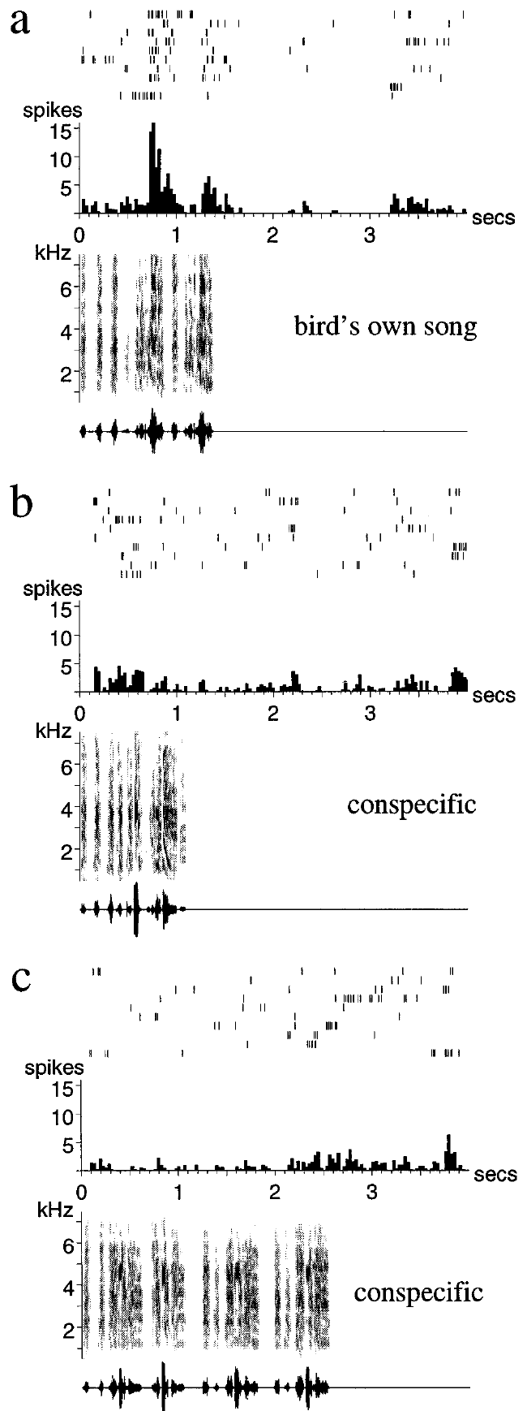
Adult LMAN neurons respond selectively to the bird's song
Doupe recorded extracellular spikes from LMAN while playing the bird's own song and comparison sounds to anesthetized adult zebra finches. A raster plot shows the spike times of each neuron across repeated trials, and averaging those trials gives the response profile.
Many neurons responded strongly to the bird's own song and weakly to other conspecific songs or simple acoustic stimuli. Comparisons with amplitude-modulated noise and tones tested whether the response could be explained by a generic sound-evoked response.
The selectivity links an anterior forebrain nucleus with the acoustic structure of learned vocal behavior. These are playback responses recorded under anesthesia, and their role in singing is examined in awake birds. The selectivity and the anesthetic condition are both part of the description of these responses.
Gale & Perkel (2010a), Fig. 1(A). Area X, DLM, LMAN, and midbrain connections.
Doupe (1997); Gale & Perkel (2010a)
41
Notes:
• Doupe recorded extracellular spikes from LMAN while playing the bird's own song and comparison sounds to anesthetized adult zebra finches. A raster plot records individual spike times across repeated trials; averaging these trials yields the time-dependent firing-rate response.
• Many neurons responded strongly to the bird's own song but weakly to other conspecific songs or simple acoustic stimuli. Comparisons with amplitude-modulated noise and tones tested whether a response could be explained by a generic sound-energy change alone.
• The selectivity links an anterior forebrain nucleus with the acoustic structure of learned vocal behavior. Because these were playback responses under anesthesia, they do not establish that LMAN monitors song identically during awake singing or that the selective response is itself an error signal.
References:
Doupe AJ (1997). Song- and Order-Selective Neurons in the Songbird Anterior Forebrain and their Emergence during Vocal Development. The Journal of Neuroscience 17(3):1147-1167. https://doi.org/10.1523/jneurosci.17-03-01147.1997
Gale SD, Perkel DJ (2010a). A Basal Ganglia Pathway Drives Selective Auditory Responses in Songbird Dopaminergic Neurons via Disinhibition. The Journal of Neuroscience 30(3):1027-1037. https://doi.org/10.1523/jneurosci.3585-09.2010
Figure: Doupe (1997), Fig. 2(a–c). LMAN responses to self-song and comparison songs.
Figure source: https://doi.org/10.1523/jneurosci.17-03-01147.1997
Figure: Gale & Perkel (2010a), Fig. 1(A). Area X, DLM, LMAN, and midbrain connections.
Figure source: https://doi.org/10.1523/jneurosci.3585-09.2010

Slide 54
Playback trials compare self-song with control sounds
A playback experiment presents a recorded sound to an animal while its neural responses are recorded. Doupe played the bird's own song and comparison sounds while recording LMAN spikes in anesthetized adult zebra finches. The responses to each stimulus were compared trial by trial.
Many neurons responded strongly to the bird's own song but weakly to other conspecific songs and simple sounds. Amplitude-modulated noise and tones served as controls that match the sound energy of the songs. A response that was only a generic reaction to loudness would appear with these controls as well.
The selective response therefore links an anterior forebrain nucleus to the acoustic structure of the bird's own learned song. The effect was measured under anesthesia during playback, so it describes the sensory response of the neurons rather than their behavior during singing. The selective response is a property of the neurons, not of the playback sound alone.
Gale & Perkel (2010a), Fig. 1(A). Area X, DLM, LMAN, and midbrain connections.
Doupe (1997)
41a
Notes:
• Playback responses separate song-specific activity from generic sound energy.
• Playback.
– A recorded sound is played while spikes are recorded.
– The response to each sound is compared.
• Stimuli.
– The bird's own song was compared with other songs.
– Simple sounds served as additional comparisons.
• Selectivity.
– Many neurons responded strongly to self-song.
– The response to other songs was weaker.
• Controls.
– Amplitude-modulated noise and tones match the sound energy.
– These controls test for a generic response.
• Anesthesia.
– The recordings were made in anesthetized adult birds.
– The condition limits the interpretation.
• Meaning.
– LMAN responds to the acoustic structure of learned song.
– The response is measured during playback.
• Source values.
– The published values and recording conditions come from the original paper.
– Each value is reported with the scale or condition used in the source.
• Why the measure matters.
– The result separates the measured property from the mechanism that produces it.
– The comparison stays within the same cells or the same birds.
• Interpretation.
– Each result is read within the preparation and the age group that produced it.
– The claim is restricted to the measured cells and conditions.
References:
Doupe AJ (1997). Song- and Order-Selective Neurons in the Songbird Anterior Forebrain and their Emergence during Vocal Development. The Journal of Neuroscience 17(3):1147-1167. https://doi.org/10.1523/jneurosci.17-03-01147.1997
Gale SD, Perkel DJ (2010a). A Basal Ganglia Pathway Drives Selective Auditory Responses in Songbird Dopaminergic Neurons via Disinhibition. The Journal of Neuroscience 30(3):1027-1037. https://doi.org/10.1523/jneurosci.3585-09.2010

Slide 55
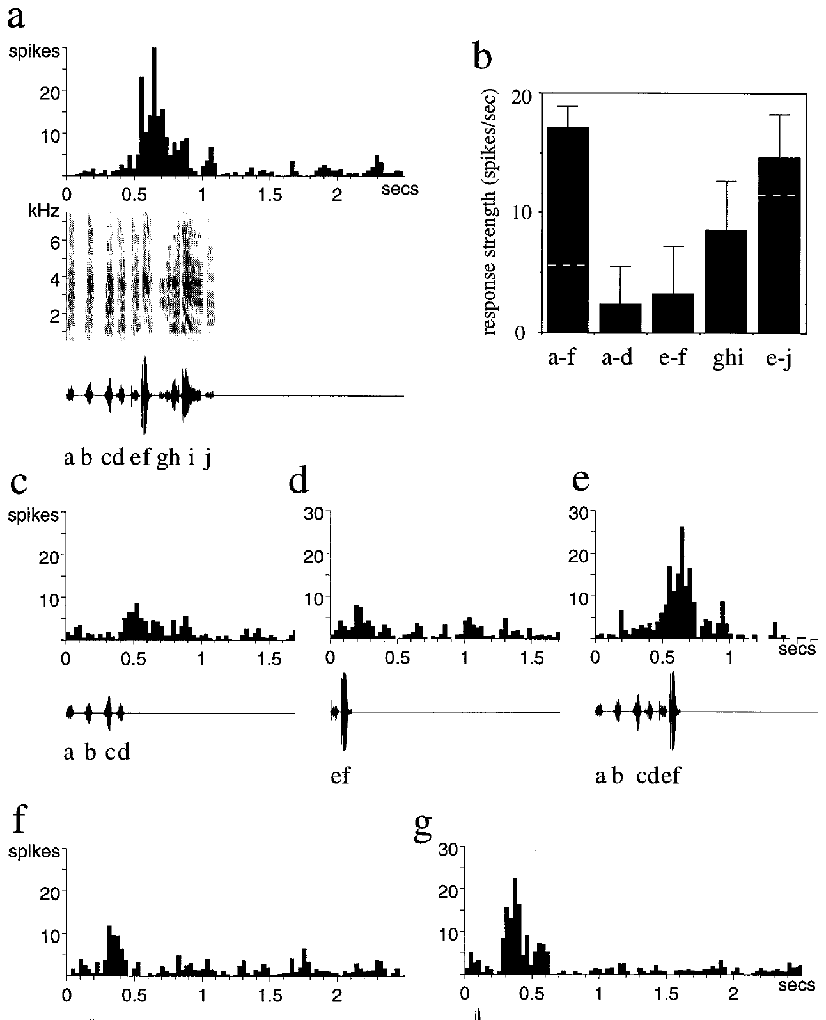
LMAN selectivity includes temporal order
Doupe compared responses to intact song with altered versions in which the order or arrangement of song elements was changed. A syllable is a recognizable acoustic unit, and reorganizing syllables keeps many local features while changing their temporal context.
Some LMAN neurons responded more strongly to the normal sequence than to rearrangements or isolated combinations. These comparisons test whether selectivity depends on one sound fragment alone or on the relation between fragments across time.
Sensitivity to temporal order fits integration of a learned sequence rather than detection of a single frequency. The selectivity mechanism at the synapse is identified by separate experiments, and the roles of recognition, prediction and vocal learning are tested in awake birds.
Doupe (1997), Fig. 7(a–g). Responses to combinations of song syllables.
Gale & Perkel (2010a), Fig. 1(A). Area X, DLM, LMAN, and midbrain connections.
Doupe (1997); Gale & Perkel (2010a)
42
Notes:
• Doupe compared responses to intact song with altered versions in which the order or arrangement of song elements was changed. A syllable is a recognizable acoustic unit; reorganizing syllables preserves many local acoustic features while changing their temporal context.
• Some LMAN neurons responded more strongly to the normal sequence than to rearrangements or isolated combinations. Such comparisons tested whether selectivity depended only on an individual sound fragment or also on the relationship between fragments across time.
• Temporal-order sensitivity is consistent with integration of a learned sequence rather than detection of a single frequency alone. It does not identify a complete synaptic mechanism for the selectivity, and responses to experimental rearrangements cannot by themselves distinguish recognition, prediction, and vocal-learning functions in the behaving animal.
References:
Doupe AJ (1997). Song- and Order-Selective Neurons in the Songbird Anterior Forebrain and their Emergence during Vocal Development. The Journal of Neuroscience 17(3):1147-1167. https://doi.org/10.1523/jneurosci.17-03-01147.1997
Gale SD, Perkel DJ (2010a). A Basal Ganglia Pathway Drives Selective Auditory Responses in Songbird Dopaminergic Neurons via Disinhibition. The Journal of Neuroscience 30(3):1027-1037. https://doi.org/10.1523/jneurosci.3585-09.2010
Figure: Doupe (1997), Fig. 7(a–g). Responses to combinations of song syllables.
Figure source: https://doi.org/10.1523/jneurosci.17-03-01147.1997
Figure: Gale & Perkel (2010a), Fig. 1(A). Area X, DLM, LMAN, and midbrain connections.
Figure source: https://doi.org/10.1523/jneurosci.3585-09.2010

Slide 56
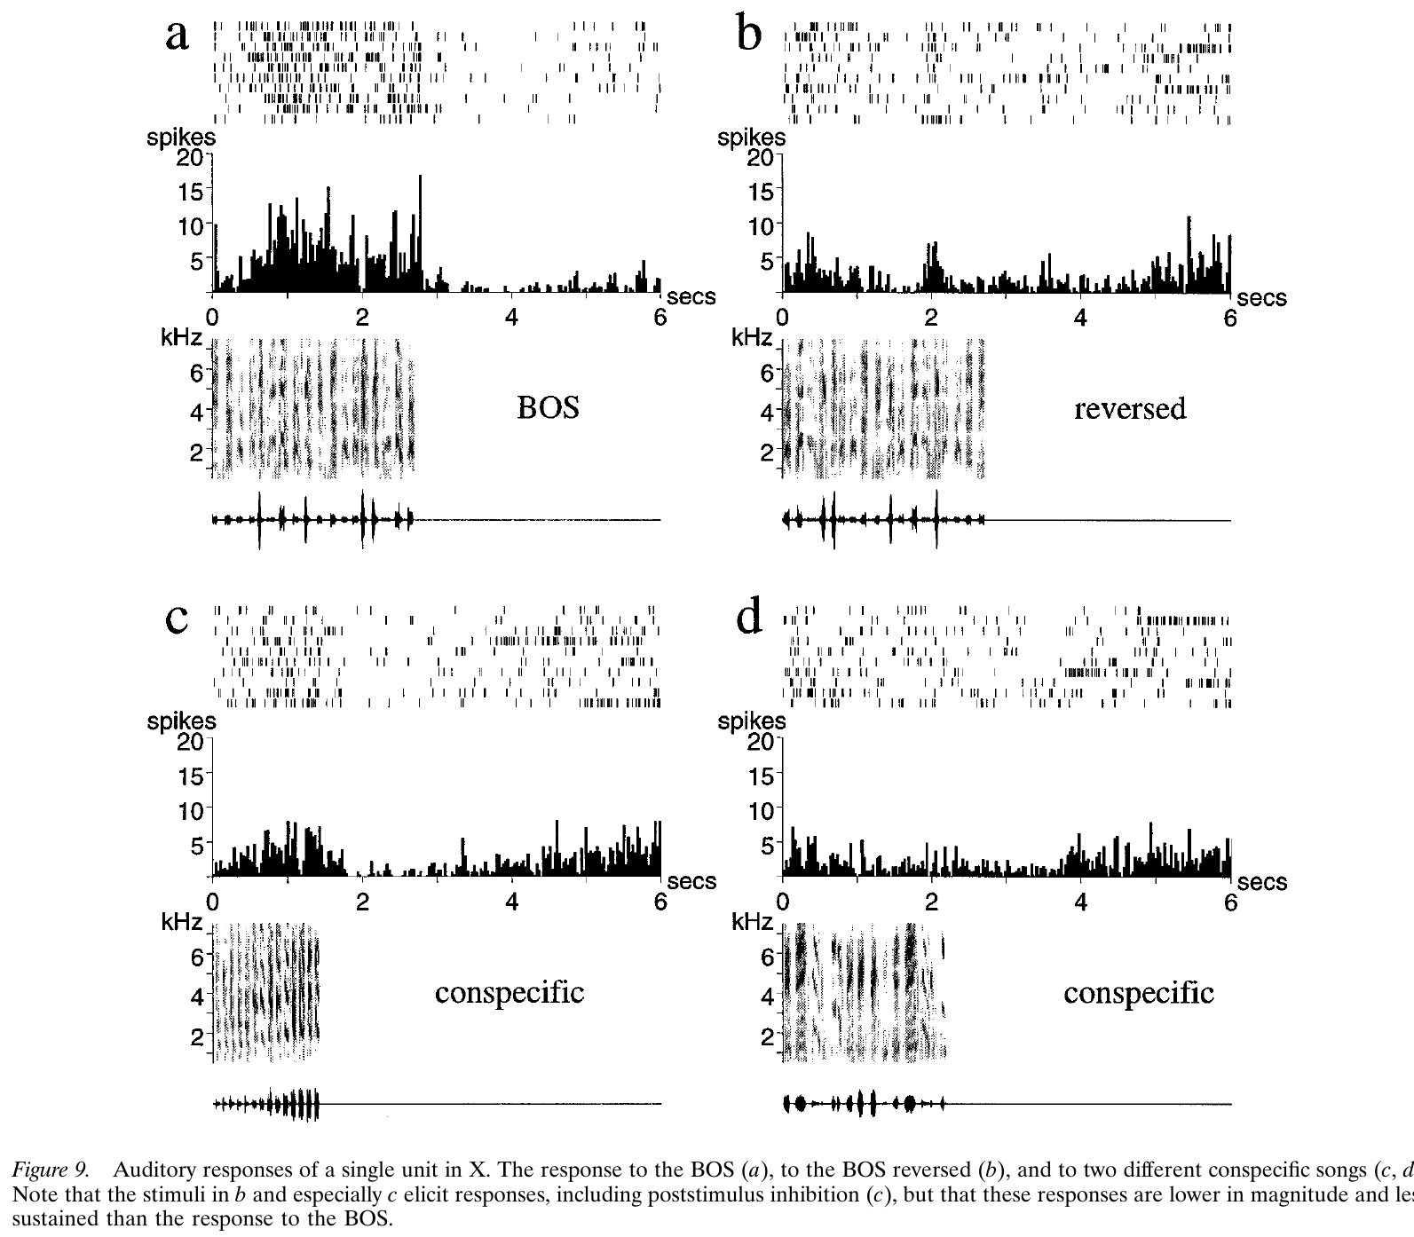
Area X also carries song-selective auditory responses
Doupe recorded auditory responses in Area X using the bird's own song, reversed song and songs from other zebra finches. Comparing several stimuli within the same neuron controlled for differences in overall excitability between cells.
Area X neurons responded selectively to familiar self-song, and the responses depended on the temporal structure of the playback. Auditory selectivity is therefore present in the basal ganglia portion of the anterior forebrain pathway.
These findings establish sensory responsiveness in a song-related circuit. Area X is characterized here as a sensory-responsive region, and its storage role is tested with separate measurements. The sensory responses are therefore part of the circuit's processing before any motor function is assigned.
Doupe (1997), Fig. 9(a–d). Song-selective auditory responses in Area X.
Gale & Perkel (2010a), Fig. 1(A). Area X, DLM, LMAN, and midbrain connections.
Doupe (1997); Gale & Perkel (2010a)
43
Notes:
• Doupe recorded auditory responses in Area X using the bird's own song, reversed song, and songs from other zebra finches. Comparing multiple stimuli within the same neuron controlled for differences in overall excitability between cells and recording sites.
• Area X neurons exhibited selective responses to familiar self-song, with responses influenced by the temporal structure of the playback. Auditory selectivity was therefore present within the basal ganglia portion of the anterior forebrain pathway, rather than being restricted to its LMAN output.
• These findings establish sensory responsiveness in a song-related circuit but do not equate Area X with an auditory storage site. The extracellular recording does not identify every neuron's cell class, and the anesthetized playback preparation differs from the sensory and motor conditions during natural courtship song.
References:
Doupe AJ (1997). Song- and Order-Selective Neurons in the Songbird Anterior Forebrain and their Emergence during Vocal Development. The Journal of Neuroscience 17(3):1147-1167. https://doi.org/10.1523/jneurosci.17-03-01147.1997
Gale SD, Perkel DJ (2010a). A Basal Ganglia Pathway Drives Selective Auditory Responses in Songbird Dopaminergic Neurons via Disinhibition. The Journal of Neuroscience 30(3):1027-1037. https://doi.org/10.1523/jneurosci.3585-09.2010
Figure: Doupe (1997), Fig. 9(a–d). Song-selective auditory responses in Area X.
Figure source: https://doi.org/10.1523/jneurosci.17-03-01147.1997
Figure: Gale & Perkel (2010a), Fig. 1(A). Area X, DLM, LMAN, and midbrain connections.
Figure source: https://doi.org/10.1523/jneurosci.3585-09.2010

Slide 57
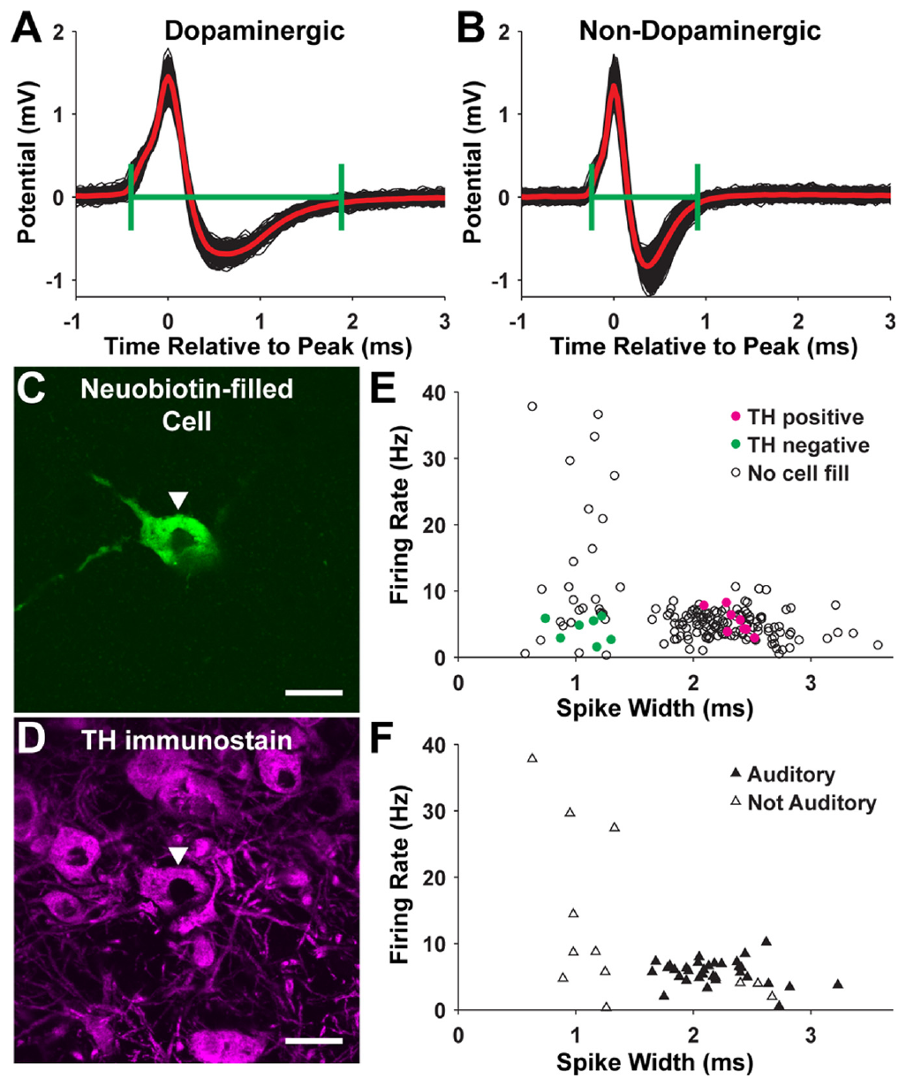
Cell labeling identifies dopaminergic midbrain neurons
Gale and Perkel recorded neurons in the substantia nigra pars compacta and the ventral tegmental area, SNc/VTA, while testing auditory responses. These midbrain regions provide dopaminergic input to Area X, and the transmitter of each recorded neuron is identified with a separate label.
They combined spike measurements with juxtacellular labeling and immunostaining for tyrosine hydroxylase, an enzyme involved in catecholamine synthesis. Labeled cells with the marker gave an anatomical and biochemical check on the classification based on firing properties.
The fluorescent micrographs keep 20 µm scale bars and connect each recorded cell with its tissue identity. Marker-positive cells support the dopaminergic interpretation in this preparation, and the histological identification of each recorded neuron is more specific than a waveform criterion.
Gale & Perkel (2010a), Fig. 4(A–F). Recorded cell labeling and transmitter-marker staining.
Gale & Perkel (2010a), Fig. 1(A). Area X, DLM, LMAN, and midbrain connections.
Gale & Perkel (2010a)
44
Notes:
• Gale and Perkel recorded neurons in the substantia nigra pars compacta and ventral tegmental area, SNc/VTA, while testing auditory responses. These midbrain regions provide dopaminergic input to Area X, but recording location alone does not establish a neuron's transmitter identity.
• They combined spike measurements with juxtacellular labeling and immunostaining for tyrosine hydroxylase, an enzyme involved in catecholamine synthesis. Labeled cells with the marker provided an anatomical and biochemical check on the classification based on firing properties.
• The fluorescent micrographs retain 20 µm scale bars and connect a recorded cell with its tissue identity. Marker-positive cells support the dopaminergic interpretation in this preparation, but a waveform criterion alone remains less specific than identifying the recorded neuron histologically.
References:
Gale SD, Perkel DJ (2010a). A Basal Ganglia Pathway Drives Selective Auditory Responses in Songbird Dopaminergic Neurons via Disinhibition. The Journal of Neuroscience 30(3):1027-1037. https://doi.org/10.1523/jneurosci.3585-09.2010
Figure: Gale & Perkel (2010a), Fig. 4(A–F). Recorded cell labeling and transmitter-marker staining.
Figure source: https://doi.org/10.1523/jneurosci.3585-09.2010
Figure: Gale & Perkel (2010a), Fig. 1(A). Area X, DLM, LMAN, and midbrain connections.
Figure source: https://doi.org/10.1523/jneurosci.3585-09.2010

Slide 58
Recorded midbrain cells are identified by their labeling
A juxtacellular label is a dye delivered to a single recorded neuron after its spikes have been measured. Gale and Perkel combined this label with immunostaining for tyrosine hydroxylase, an enzyme involved in catecholamine synthesis. Marker-positive cells provide a check on the identity assigned from firing properties.
The recordings were made in the substantia nigra pars compacta and the ventral tegmental area, SNc/VTA. Cells that were classified by their spike waveform were then checked against the marker. The fluorescent micrographs carry 20 µm scale bars, so the recorded cell and its tissue can be located together.
A waveform classification gives a provisional identity, and the labeled cell confirms or revises it. The combination of recording and staining links a cell's firing pattern to its neurochemical identity, which gives a stronger identification than the waveform alone.
Gale & Perkel (2010a), Fig. 4(A–F). Recorded cell labeling and transmitter-marker staining.
Gale & Perkel (2010a), Fig. 1(A). Area X, DLM, LMAN, and midbrain connections.
Gale & Perkel (2010a)
44a
Notes:
• Juxtacellular labeling confirms the identity of a recorded cell.
• Label.
– A dye is delivered to the recorded neuron.
– The cell is identified after its spikes are measured.
• Marker.
– Tyrosine hydroxylase marks catecholamine-synthesizing cells.
– Immunostaining reveals the marker.
• Regions.
– The recordings came from SNc and VTA.
– These regions supply dopaminergic input to Area X.
• Waveform.
– Cells were first classified by spike waveform.
– The waveform gives a provisional identity.
• Check.
– Marker-positive cells were compared with the classification.
– The check confirms or revises the identity.
• Meaning.
– Firing pattern is linked to neurochemical identity.
– Both measures are needed for the identification.
• Source values.
– The published values and recording conditions come from the original paper.
– Each value is reported with the scale or condition used in the source.
• Why the measure matters.
– The result separates the measured property from the mechanism that produces it.
– The comparison stays within the same cells or the same birds.
• Interpretation.
– Each result is read within the preparation and the age group that produced it.
– The claim is restricted to the measured cells and conditions.
References:
Gale SD, Perkel DJ (2010a). A Basal Ganglia Pathway Drives Selective Auditory Responses in Songbird Dopaminergic Neurons via Disinhibition. The Journal of Neuroscience 30(3):1027-1037. https://doi.org/10.1523/jneurosci.3585-09.2010

Slide 59
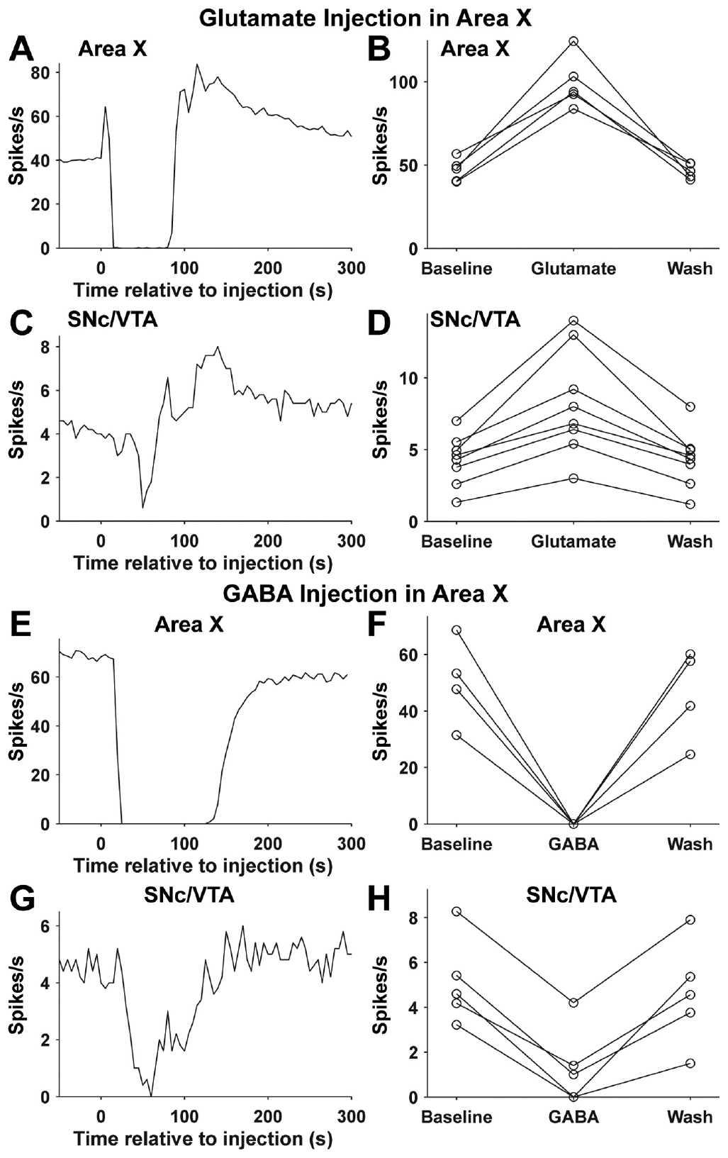
Area X activity can disinhibit dopaminergic neurons
Disinhibition is increased activity that follows the reduction of inhibitory input. Gale and Perkel found that song playback excited Area X neurons, inhibited neurons in the ventral pallidum and excited identified dopaminergic SNc/VTA neurons.
Activating Area X with glutamate increased downstream dopaminergic firing, whereas GABA injection reduced it. Blocking AMPA and NMDA receptors in Area X diminished song-evoked dopaminergic responses, and vehicle injections served as the control.
The convergent recordings and interventions support a route through which song-related forebrain activity regulates its own dopamine supply. The route is consistent with the anatomy in the preceding slides, and its behavioral role is measured separately.
Gale & Perkel (2010a), Fig. 1(A). Area X, DLM, LMAN, and midbrain connections.
Gale & Perkel (2010a)
45
Notes:
• Disinhibition is increased activity caused by reducing inhibitory input. Gale and Perkel found that song playback excited Area X neurons, inhibited neurons in the ventral pallidum, and excited identified dopaminergic SNc/VTA neurons, consistent with a serial inhibitory pathway.
• Activating Area X with glutamate increased downstream dopaminergic firing, whereas GABA injection reduced it. Blocking AMPA and NMDA receptors in Area X diminished song-evoked dopaminergic responses; vehicle injections provided a control for the injection procedure.
• The convergent recordings and interventions support a route through which song-related forebrain activity regulates its own dopamine supply. They do not establish that every evoked dopamine response encodes reward prediction or a vocal error; the experiments tested auditory responsiveness and circuit influence rather than a complete learning algorithm.
References:
Gale SD, Perkel DJ (2010a). A Basal Ganglia Pathway Drives Selective Auditory Responses in Songbird Dopaminergic Neurons via Disinhibition. The Journal of Neuroscience 30(3):1027-1037. https://doi.org/10.1523/jneurosci.3585-09.2010
Figure: Gale & Perkel (2010a), Fig. 8(A–H). Area X drug injections alter midbrain firing.
Figure source: https://doi.org/10.1523/jneurosci.3585-09.2010
Figure: Gale & Perkel (2010a), Fig. 1(A). Area X, DLM, LMAN, and midbrain connections.
Figure source: https://doi.org/10.1523/jneurosci.3585-09.2010

Slide 60
Key takeaways
Separate projection pathways HVC reaches RA directly for vocal motor control and reaches Area X through a distinct output population; DLM and LMAN form the anterior forebrain route back to RA.
Anatomical connections constrain mechanisms Lesions establish regional necessity, tracers establish projection direction, and single-cell reconstructions reveal local collaterals; none alone specifies the information transmitted at a synapse.
RA integrates different excitatory inputs HVC and LMAN converge on RA, but their developmental connectivity and receptor contributions differ; stronger, refined HVC input can coexist with persistent LMAN input.
Motor physiology has multiple controls Resurgent sodium current supports rapid RA firing, while SK channels regulate spike recovery and timing in interaction with synaptic input; dopamine modulates RA excitability through D1-like signaling.
LMAN contributes differently across ages Early lesions disrupt vocal development, whereas established adult song can persist after lesions; this difference does not imply that adult LMAN becomes anatomically disconnected or functionless.
Auditory selectivity is not an error signal by itself LMAN, Area X, and dopaminergic circuitry respond selectively to self-song, but anesthetized playback responses do not establish the complete teaching signal or learning rule used during singing.
Nottebohm et al. (1976); Bottjer et al. (1984); Doupe (1997)
46
Notes:
• Separate projection pathways. HVC reaches RA directly for vocal motor control and reaches Area X through a distinct output population; DLM and LMAN form the anterior forebrain route back to RA.
• Anatomical connections constrain mechanisms. Lesions establish regional necessity, tracers establish projection direction, and single-cell reconstructions reveal local collaterals; none alone specifies the information transmitted at a synapse.
• RA integrates different excitatory inputs. HVC and LMAN converge on RA, but their developmental connectivity and receptor contributions differ; stronger, refined HVC input can coexist with persistent LMAN input.
• Motor physiology has multiple controls. Resurgent sodium current supports rapid RA firing, while SK channels regulate spike recovery and timing in interaction with synaptic input; dopamine modulates RA excitability through D1-like signaling.
• LMAN contributes differently across ages. Early lesions disrupt vocal development, whereas established adult song can persist after lesions; this difference does not imply that adult LMAN becomes anatomically disconnected or functionless.
• Auditory selectivity is not an error signal by itself. LMAN, Area X, and dopaminergic circuitry respond selectively to self-song, but anesthetized playback responses do not establish the complete teaching signal or learning rule used during singing.
References:
Nottebohm F, Stokes TM, Leonard CM (1976). Central control of song in the canary, Serinus canarius. Journal of Comparative Neurology 165(4):457-486. https://doi.org/10.1002/cne.901650405
Bottjer SW, Miesner EA, Arnold AP (1984). Forebrain Lesions Disrupt Development But Not Maintenance of Song in Passerine Birds. Science 224(4651):901-903. https://doi.org/10.1126/science.6719123
Benezra SE, Narayanan RT, Egger R, Oberlaender M, Long MA (2018). Morphological characterization of HVC projection neurons in the zebra finch (Taeniopygia guttata). Journal of Comparative Neurology 526(10):1673-1689. https://doi.org/10.1002/cne.24437
Garst-Orozco J, Babadi B, Ölveczky BP (2014). A neural circuit mechanism for regulating vocal variability during song learning in zebra finches. eLife 3:e03697. https://doi.org/10.7554/elife.03697
Zemel BM, Nevue AA, Dagostin A, Lovell PV, Mello CV, von Gersdorff H (2021). Resurgent Na+ currents promote ultrafast spiking in projection neurons that drive fine motor control. Nature Communications 12(1):6762. https://doi.org/10.1038/s41467-021-26521-3
Hou GQ, Pan X, Liao CS, Wang SH, Li DF (2012). SK channels modulate the excitability and firing precision of projection neurons in the robust nucleus of the arcopallium in adult male zebra finches. Neuroscience Bulletin 28(3):271-281. https://doi.org/10.1007/s12264-012-1241-7
Liao C, Wang S, Pan X, Hou G, Li D (2013). Dopamine Modulates the Excitability of Projection Neurons in the Robust Nucleus of the Arcopallium in Adult Zebra Finches. PLoS ONE 8(12):e82497. https://doi.org/10.1371/journal.pone.0082497
Doupe AJ (1997). Song- and Order-Selective Neurons in the Songbird Anterior Forebrain and their Emergence during Vocal Development. The Journal of Neuroscience 17(3):1147-1167. https://doi.org/10.1523/jneurosci.17-03-01147.1997
Gale SD, Perkel DJ (2010a). A Basal Ganglia Pathway Drives Selective Auditory Responses in Songbird Dopaminergic Neurons via Disinhibition. The Journal of Neuroscience 30(3):1027-1037. https://doi.org/10.1523/jneurosci.3585-09.2010

