Slide 1
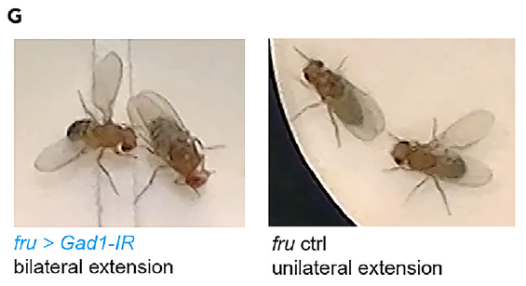
NEUR 411 · NEUROETHOLOGY · FALL 2026
Lecture 34
Acoustic Communication:
Drosophila courtship song and the fruitless circuit
Monday, November 16, 2026
Jordan Lopez, Ph.D.
Professor of Neurobiology & Biomedical Engineering
Amin et al. (2023), Fig. 1G. Bilateral wing extension after GAD1 depletion and unilateral control extension.
Notes:
Vocal communication III: Drosophila courtship song and the fruitless circuit
Lecture 34. NEUR 411 · NEUROETHOLOGY · FALL 2026. Monday, November 16, 2026.
Figure: Amin et al. (2023), Fig. 1G. Bilateral wing extension after GAD1 depletion and unilateral control extension.
Figure source: https://doi.org/10.1016/j.isci.2023.108069

Slide 2
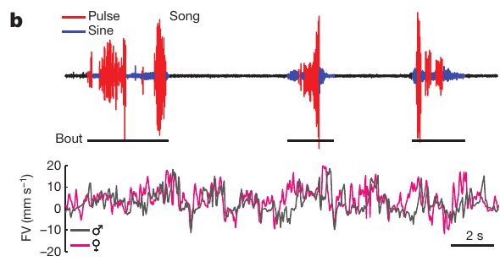
Wing vibration produces two courtship song modes
Courtship song is an acoustic signal that a male Drosophila melanogaster produces by vibrating an extended wing while following a female. Pulse song consists of separated sound pulses, whereas sine song is a relatively continuous, approximately sinusoidal vibration. Both modes come from the same male during one courtship, and each has its own acoustic signature that separates it in a recording.
Coen and colleagues recorded sound and the positions of both flies at the same time. Their recordings contain transitions between pulse and sine within individual bouts, so the switch between modes happens inside a single courtship event. Typical sine carrier frequencies fall between 120 and 170 Hz, and pulse carrier frequencies fall between 150 and 250 Hz.
Carrier frequency describes the oscillations within the sound, whereas the interpulse interval is the time separating successive pulses, commonly around 35 ms. These two measures capture different features of the same signal. Measuring both gives a complete description of each song mode, which is why the study reports them together.
Coen et al. (2014), Fig. 1b. Pulse and sine waveforms with simultaneous movement recordings.
Coen et al. (2014); von Philipsborn et al. (2014)
02
Notes:
• **Courtship song** is an acoustic signal produced when a male _Drosophila melanogaster_ vibrates an extended wing while following a female. **Pulse song** consists of separated sound pulses, whereas **sine song** is a relatively continuous, approximately sinusoidal vibration.
• Coen and colleagues recorded sound and the positions of both flies simultaneously. Their recordings contain transitions between pulse and sine within individual bouts. Related measurements place typical sine carrier frequency at 120–170 Hz and pulse carrier frequency at 150–250 Hz.
• **Carrier frequency** describes oscillations within the sound, whereas the **interpulse interval** is the time separating successive pulses, commonly around 35 ms in this species. Mode, carrier frequency and pulse spacing are distinct properties; changing one does not establish a change in all three.
References:
Coen P, Clemens J, Weinstein AJ, Pacheco DA, Deng Y, Murthy M (2014). Dynamic sensory cues shape song structure in Drosophila. Nature 507(7491):233–237. https://doi.org/10.1038/nature13131
von Philipsborn AC, Jörchel S, Tirian L, Demir E, Morita T, Stern DL, Dickson BJ (2014). Cellular and behavioral functions of fruitless isoforms in Drosophila courtship. Current Biology 24(3):242–251. https://doi.org/10.1016/j.cub.2013.12.015
Figure: Coen et al. (2014), Fig. 1b. Pulse and sine waveforms with simultaneous movement recordings.
Figure source: https://doi.org/10.1038/nature13131

Slide 3
Audio and tracking separate song from locomotion
An acoustic recording identifies sound production, while video tracking identifies the movements that accompany it. Coen and colleagues paired males and females in a small chamber above a microphone array and extracted their trajectories during about 25 min of courtship. Both data streams share one timeline, so each sound can be matched to the positions of the two flies at that moment.
Males sang during roughly 20% of courtship, and they produced many different pulse and sine sequences rather than repeating one stereotyped bout. Simultaneous traces separate male forward motion, female motion and sound. Movement-associated noise is therefore kept apart from the song itself, and the record shows the song choices across the whole courtship.
The preparation allows comparisons between sensory conditions and song choices at short timescales. Tracking data show where each fly is at each moment, which makes it possible to link a song choice to the immediate context. Each comparison uses the same chamber and recording setup, so the conditions can be contrasted directly.
Coen et al. (2014), Fig. 1b. Pulse and sine waveforms with simultaneous movement recordings.
Coen et al. (2014)
03
Notes:
• An acoustic recording identifies sound production, while video tracking identifies the movements that accompany it. Coen and colleagues paired males and females in a small chamber above a microphone array and extracted their trajectories during approximately 25 min of courtship.
• Males sang during roughly 20% of courtship, with many different pulse–sine sequences rather than repeatedly producing one stereotyped bout. Simultaneous traces distinguish male forward motion, female motion and sound rather than treating movement-associated noise as song.
• The preparation permits comparisons between sensory conditions and song choices at short timescales. It does not directly record the activity of an identified neuron, and temporal association between movement and sound cannot by itself distinguish sensory feedback from a shared motor command.
References:
Coen P, Clemens J, Weinstein AJ, Pacheco DA, Deng Y, Murthy M (2014). Dynamic sensory cues shape song structure in Drosophila. Nature 507(7491):233–237. https://doi.org/10.1038/nature13131
Figure: Coen et al. (2014), Fig. 1b. Pulse and sine waveforms with simultaneous movement recordings.
Figure source: https://doi.org/10.1038/nature13131

Slide 4
Movement and sound share one timeline
Video tracking and acoustic recording capture different sides of the same courtship. Song is identified from the microphone record, and each male's movement is identified from its trajectory. Both streams are kept on one clock, so every sound can be placed at the exact moment of each fly's movement. The record therefore links each sound to its exact moment in the courtship.
Pulse and sine bouts occur at irregular times during the approximately 25 min of courtship. The shared timeline allows the analysis to check whether a change in movement comes before or after a change in song mode. Each bout is therefore read against the movement that precedes it. Each bout is then compared with the movement recorded just before it.
Simultaneous traces also separate the male's own motion from the female's motion and from the sound source. This separation prevents movement-associated noise from being counted as song, and it keeps the measures for each partner distinct. Each partner's trajectory is kept separate in the analysis.
Coen et al. (2014), Fig. 1b. Pulse and sine waveforms with simultaneous movement recordings.
Coen et al. (2014)
03a
Notes:
• Tracking and sound are recorded on one timeline.
• Recording.
– Sound and trajectories share one clock.
– Each sound is matched to fly positions.
• Timing.
– Song changes can be compared with prior movement.
– Each bout is read against its preceding movement.
• Separation.
– Male, female and sound are traced separately.
– Noise is not counted as song.
• Meaning.
– The shared timeline supports short-timescale comparisons.
– Each partner is measured on its own.
• Source values.
– The published recordings and measurements come from the original paper.
– Each result is reported with the condition used in the source.
• Why the measure matters.
– The result separates the measured property from the mechanism that produces it.
– The comparison stays within the same flies, cells or recordings.
• Interpretation.
– Each result is read within the genetic background and condition that produced it.
– The claim is restricted to the measured animals and conditions.
• Context.
– The parent figure shows the measurement that the paragraphs describe.
– Each claim is tied to the recordings of the original study.
• Method.
– The measurements follow the methods described in the original paper.
– Each value is kept with the condition under which it was measured.
References:
Coen P, Clemens J, Weinstein AJ, Pacheco DA, Deng Y, Murthy M (2014). Dynamic sensory cues shape song structure in Drosophila. Nature 507(7491):233–237. https://doi.org/10.1038/nature13131

Slide 5
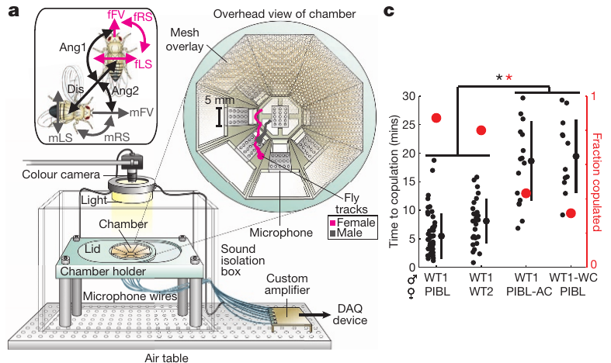
Disrupting hearing or song delays mating
Aristae are the antenna-associated structures removed to disrupt auditory input in this experiment. Cutting a male's wings instead prevents normal wing-generated song. Coen and colleagues compared these manipulations with intact animals, so each effect is measured against a matched control rather than inferred from courtship movements alone.
Deafened females and wing-cut males increased the time to copulation and reduced the fraction of pairs that copulated during the approximately 25 min assay. The male and female manipulations therefore affect different sides of the acoustic interaction. Song reception by the female and song production by the male each contribute to the outcome of courtship.
The outcomes support a contribution of song reception and production to successful courtship. Surgical manipulations can have additional effects beyond the targeted sense or structure, so the results are read together with the intact controls. Comparing the two sexes makes it possible to see which half of the acoustic exchange each manipulation changes.
Coen et al. (2014), Fig. 1a,c. Recording preparation and mating outcomes after auditory or wing manipulations.
Coen et al. (2014)
04
Notes:
• **Aristae** are the antenna-associated structures removed to disrupt auditory input in this experiment. Cutting a male’s wings instead prevents normal wing-generated song. Coen and colleagues compared these manipulations with intact animals rather than inferring song function from courtship movements alone.
• Deafened females and wing-cut males increased the time to copulation and reduced the fraction of pairs that copulated during the approximately 25 min assay. The male and female manipulations therefore affect different sides of the acoustic interaction.
• The outcomes support a contribution of song reception and production to successful courtship. Surgical manipulations can have additional effects, so they do not identify a particular auditory receptor or establish that every mating deficit is caused exclusively by loss of one song mode.
References:
Coen P, Clemens J, Weinstein AJ, Pacheco DA, Deng Y, Murthy M (2014). Dynamic sensory cues shape song structure in Drosophila. Nature 507(7491):233–237. https://doi.org/10.1038/nature13131
Figure: Coen et al. (2014), Fig. 1a,c. Recording preparation and mating outcomes after auditory or wing manipulations.
Figure source: https://doi.org/10.1038/nature13131

Slide 6
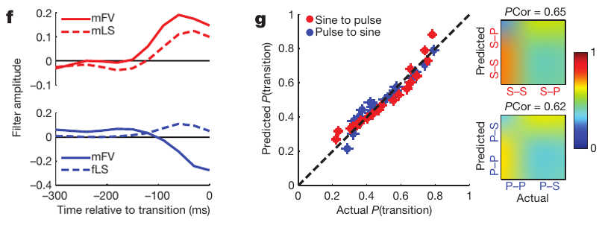
Recent movement predicts changes in song mode
Sensory history is the sequence of information available before a behavioral event. Coen and colleagues tested whether recent movement predicted the start of song and transitions between pulse and sine, using histories no longer than 600 ms. Short windows keep the comparison close to the moment of each song event, so the analysis asks which movements came just before each change of song mode.
A generalized linear model relates measured movement features to the probability of a song event. Male forward velocity and lateral speed predicted pulse starts. Forward velocity and inter-fly distance contributed to the distinction between pulse and sine starts, so the model separates the two song modes. Each predictor is weighed against the others in the same model.
Increasing male forward velocity and lateral speed favored transitions toward pulse, whereas decreases in forward velocity and increases in female lateral speed favored sine. Prediction of each song event therefore follows the movement that precedes it. Each movement feature points toward one song mode or the other, which makes movement patterns a source of information about the next song.
Coen et al. (2014), Fig. 2f–g. Movement predictors and prediction of pulse–sine transitions.
Coen et al. (2014)
05
Notes:
• **Sensory history** is the sequence of information available before a behavioral event. Coen and colleagues tested whether recent movement predicted the initiation of song and transitions between pulse and sine, using histories no longer than 600 ms.
• A **generalized linear model** relates measured movement features to the probability of a song event. Male forward velocity and lateral speed predicted pulse starts, while forward velocity and inter-fly distance contributed to the distinction between pulse and sine starts.
• Increasing male forward velocity and lateral speed favored transitions toward pulse; decreases in forward velocity and increases in female lateral speed favored sine. Prediction does not establish the direction of causation, because locomotor commands and sensory consequences can covary within the same courtship interaction.
References:
Coen P, Clemens J, Weinstein AJ, Pacheco DA, Deng Y, Murthy M (2014). Dynamic sensory cues shape song structure in Drosophila. Nature 507(7491):233–237. https://doi.org/10.1038/nature13131
Figure: Coen et al. (2014), Fig. 2f–g. Movement predictors and prediction of pulse–sine transitions.
Figure source: https://doi.org/10.1038/nature13131

Slide 7
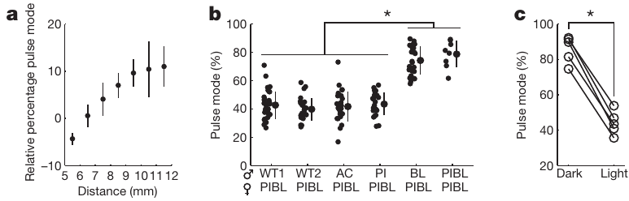
Visual information contributes to song composition
Visual feedback supplies information about a moving partner's relative position. Coen and colleagues found that the proportion of pulse song increased as the distance between the flies increased, rather than remaining fixed throughout courtship. The change followed the distance between the two animals, and each distance band was measured across the same sessions.
The relationship was evaluated across inter-fly distances of about 3 to 12 mm. Males tested in darkness produced more pulse song than males under illumination, which links the availability of visual information with song composition. Both groups still sang, so the change lies in the mix of song modes rather than in whether the male sings at all.
The finding is consistent with visual signals contributing to the choice between song modes. Darkness also changes other aspects of the interaction, so the behavioral effect is read alongside the distance data. This comparison places visual information among the cues that shape song composition, and each lighting condition is compared with its own illuminated control.
Coen et al. (2014), Fig. 3a–c. Distance dependence and visual manipulation of song composition.
Coen et al. (2014)
06
Notes:
• **Visual feedback** supplies information about a moving partner’s relative position. Coen and colleagues found that the proportion of pulse song increased as the distance between the flies increased, rather than remaining fixed throughout courtship.
• The relationship was evaluated across inter-fly distances of approximately 3–12 mm. Males tested in darkness produced more pulse song than under illumination, linking the availability of visual information with song composition while retaining the ability to sing.
• The finding is consistent with visual signals contributing to the choice between song modes. Darkness also changes other aspects of the interaction; these behavioral experiments do not identify the complete visual pathway or establish that distance is represented by one dedicated song-control neuron.
References:
Coen P, Clemens J, Weinstein AJ, Pacheco DA, Deng Y, Murthy M (2014). Dynamic sensory cues shape song structure in Drosophila. Nature 507(7491):233–237. https://doi.org/10.1038/nature13131
Figure: Coen et al. (2014), Fig. 3a–c. Distance dependence and visual manipulation of song composition.
Figure source: https://doi.org/10.1038/nature13131

Slide 8
Distance alters the balance between song modes
Distance between the two flies changes how much visual information each partner receives. In this experiment, the proportion of pulse song rose as the flies moved farther apart. The effect was measured across several distance bands so that each band could be compared against the others. The distance bands are defined on the same scale for every pair.
Darkness changed the mix of song modes, with males tested in the dark producing more pulse song. Both lighting conditions still produced song, so the change lies in the composition of the song rather than in the presence of singing. Each condition is compared with its own illuminated control. Each lighting condition used the same range of distances.
Visual information therefore takes part in choosing between pulse and sine. Distance and light act on the same song output, which allows the two cues to be compared in one framework and linked to the sensory conditions. The distance and light results are reported together.
Coen et al. (2014), Fig. 3a–c. Distance dependence and visual manipulation of song composition.
Coen et al. (2014)
06a
Notes:
• Distance changes the proportion of pulse song.
• Distance.
– Pulse proportion rises as the flies separate.
– Bands are compared against each other.
• Darkness.
– Dark-tested males produced more pulse song.
– Singing itself continued in both conditions.
• Controls.
– Each condition is compared with its illuminated control.
– The lighting is the only change.
• Meaning.
– Visual cues contribute to choosing a song mode.
– Distance and light act on the same output.
• Source values.
– The published recordings and measurements come from the original paper.
– Each result is reported with the condition used in the source.
• Why the measure matters.
– The result separates the measured property from the mechanism that produces it.
– The comparison stays within the same flies, cells or recordings.
• Interpretation.
– Each result is read within the genetic background and condition that produced it.
– The claim is restricted to the measured animals and conditions.
• Context.
– The parent figure shows the measurement that the paragraphs describe.
– Each claim is tied to the recordings of the original study.
• Method.
– The measurements follow the methods described in the original paper.
– Each value is kept with the condition under which it was measured.
References:
Coen P, Clemens J, Weinstein AJ, Pacheco DA, Deng Y, Murthy M (2014). Dynamic sensory cues shape song structure in Drosophila. Nature 507(7491):233–237. https://doi.org/10.1038/nature13131

Slide 9
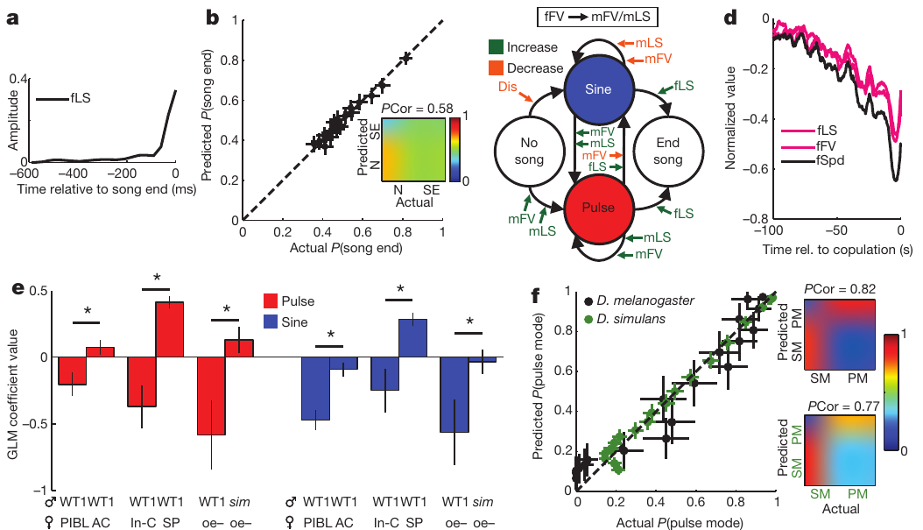
Song and female movement form a dynamic interaction
A female's movement can change the sensory information available to a singing male, while the male's song can influence the female's subsequent movement. Coen and colleagues compared movement and song in paired animals. Courtship is therefore treated as an exchange between two partners, with each partner's behavior tracked on the same timeline rather than as a one-way acoustic broadcast.
Song-related slowing was analyzed in 1 min windows. Female speed decreased before copulation, and the relation between song amount and female speed depended on the paired species and sensory condition. Comparisons included D. melanogaster and D. simulans, and the windows were the same across species, so the comparison stays matched.
These observations support a dynamic interaction between partner behavior and song patterning. Correlations across one minute show how the two partners' behaviors change together. Each minute-long window gives the average pattern for that period of courtship, and the shorter analyses on earlier slides address the immediate cause and effect.
Coen et al. (2014), Fig. 4a–f. Song decisions, female responses and species comparisons.
Coen et al. (2014)
07
Notes:
• A female’s movement can change the sensory information available to a singing male, while the male’s song can influence the female’s subsequent movement. Coen and colleagues compared movement and song in paired animals rather than treating courtship as a one-way acoustic broadcast.
• Song-related slowing was analyzed in 1 min windows. Female speed decreased before copulation, and relationships between song amount and female speed depended on the paired species and sensory condition. Comparisons included _D. melanogaster_ and _D. simulans_.
• These observations support a dynamic interaction between partner behavior and song patterning. Correlations across a minute do not resolve every immediate auditory response, and differences between species cannot be assigned solely to one song parameter without controlling the other cues available to each female.
References:
Coen P, Clemens J, Weinstein AJ, Pacheco DA, Deng Y, Murthy M (2014). Dynamic sensory cues shape song structure in Drosophila. Nature 507(7491):233–237. https://doi.org/10.1038/nature13131
Figure: Coen et al. (2014), Fig. 4a–f. Song decisions, female responses and species comparisons.
Figure source: https://doi.org/10.1038/nature13131

Slide 10
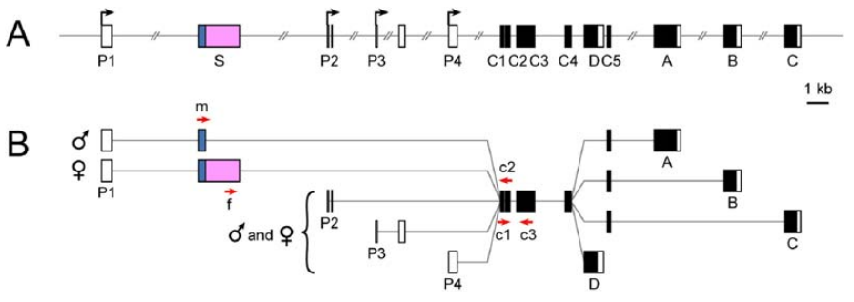
Sex-specific splicing changes fruitless products
RNA splicing joins selected regions of a precursor RNA to produce a mature transcript. The fruitless, or fru, locus spans about 130 kb and uses several promoters. Transcripts from promoter P1 undergo sex-specific splicing, so the same gene gives different products in males and females, and the P1 product is the one studied on the following slides.
In males, the default splice pattern produces FruM, a male-specific transcription factor with a 101-amino-acid amino-terminal extension. A transcription factor regulates gene expression. In females, Transformer-dependent splicing introduces an early stop that prevents production of the full-length FruM protein, so the sex difference starts at the level of RNA processing.
Transcripts from other promoters retain functions shared by both sexes. The sex-specific P1 product is therefore distinguished from the shared transcripts. Each product is identified by its promoter and its splicing pattern, which allows the male-specific form to be tested on its own and makes it possible to ask which courtship functions depend on it.
Demir & Dickson (2005), Fig. 1A–B. The fruitless locus and sex-specific transcript structure.
Demir & Dickson (2005)
08
Notes:
• **RNA splicing** joins selected regions of a precursor RNA to produce a mature transcript. The **fruitless**, or **fru**, locus spans approximately 130 kb and uses several promoters; transcripts from promoter P1 undergo sex-specific splicing.
• In males, the default splice pattern produces **FruM**, a male-specific transcription factor with a 101-amino-acid amino-terminal extension. A **transcription factor** regulates gene expression. In females, Transformer-dependent splicing introduces an early stop that prevents production of the corresponding full-length FruM proteins.
• Transcripts from other promoters retain functions shared by both sexes. The sex-specific P1 product must therefore be distinguished from the entire gene: eliminating a male-specific splice form is a more focused perturbation than removing every fruitless product.
References:
Demir E, Dickson BJ (2005). fruitless splicing specifies male courtship behavior in Drosophila. Cell 121(5):785–794. https://doi.org/10.1016/j.cell.2005.04.027
Figure: Demir & Dickson (2005), Fig. 1A–B. The fruitless locus and sex-specific transcript structure.
Figure source: https://doi.org/10.1016/j.cell.2005.04.027

Slide 11
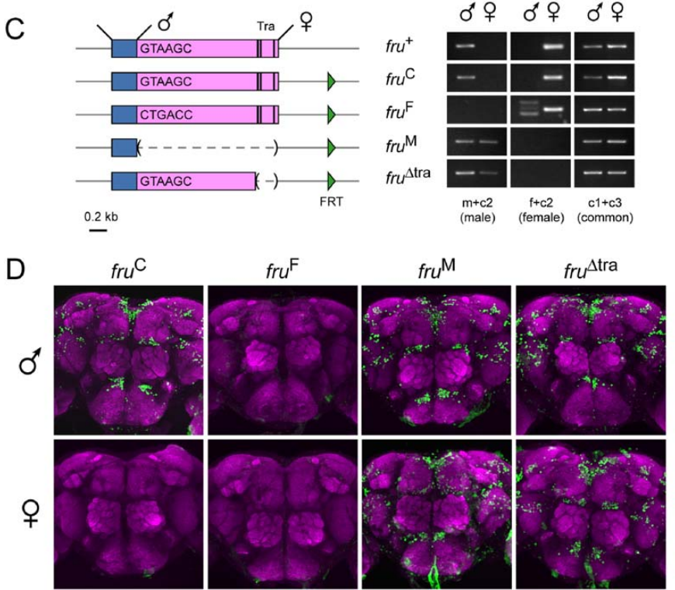
Engineered alleles isolate sex-specific splicing
An allele is a version of a gene. Demir and Dickson changed the sex-specific splice region while preserving other fruitless functions, which made it possible to test the consequences of the P1 splice decision directly. Each allele was designed to alter only that decision, so the alleles isolate the splice choice from the rest of the gene.
One allele disrupted the male splice donor and forced female-type splicing. A 1601-nucleotide deletion forced male-type splicing, and another allele removed 261 base pairs containing Transformer-binding sites. RNA assays and antibody labeling verified the transcripts and FruM expression in adult brains, confirming that each allele produced the intended product.
Male-spliced alleles produced FruM labeling in females as well as males. The female-spliced allele removed that labeling in males. The verification connects each behavioral result to a defined molecular change, so later phenotypes can be traced to the splice pattern, and each phenotype is compared against its own verified allele.
Demir & Dickson (2005), Fig. 1C–D. Engineered splice alleles and FruM expression in adult brains.
Demir & Dickson (2005)
09
Notes:
• An **allele** is a version of a gene. Demir and Dickson changed the sex-specific splice region while preserving other fruitless functions, allowing them to test the consequences of the P1 splice decision directly.
• One allele disrupted the male splice donor and forced female-type splicing. A 1601-nucleotide deletion forced male-type splicing, while another allele removed 261 base pairs containing Transformer-binding sites. RNA assays and antibody labeling verified the resulting transcripts and FruM expression in adult brains.
• Male-spliced alleles produced FruM labeling in females as well as males; the female-spliced allele removed that labeling in males. Verification connects the behavioral manipulation to its molecular target, but whole-brain labeling does not identify which individual neuronal change causes each courtship phenotype.
References:
Demir E, Dickson BJ (2005). fruitless splicing specifies male courtship behavior in Drosophila. Cell 121(5):785–794. https://doi.org/10.1016/j.cell.2005.04.027
Figure: Demir & Dickson (2005), Fig. 1C–D. Engineered splice alleles and FruM expression in adult brains.
Figure source: https://doi.org/10.1016/j.cell.2005.04.027

Slide 12
Splice alleles isolate the P1 decision
A splice allele changes the sequence that controls one step in RNA processing. Demir and Dickson designed alleles that alter only the sex-specific P1 splice decision, so each allele affects one choice while leaving other fruitless functions intact. This design isolates the P1 decision from the rest of the gene. Each allele is compared with the wild-type control under the same conditions.
The alleles were verified at the transcript level and at the level of FruM protein in adult brains. A forced female-type allele and a forced male-type allele were compared against each other. The verification ensures that each behavioral result can be linked to a known molecular change. Both alleles were checked in the same adult brain tissue.
Because each allele changes one decision, its phenotype can be attributed to that decision. The comparison between the two forced patterns then shows which courtship features follow from the male-type splice, and which follow from the female-type splice. Each phenotype can be tied back to its allele in this way.
Demir & Dickson (2005), Fig. 1C–D. Engineered splice alleles and FruM expression in adult brains.
Demir & Dickson (2005)
09a
Notes:
• Alleles that change only the P1 splice decision.
• Design.
– Each allele changes the P1 splice decision.
– Other fruitless functions are preserved.
• Verification.
– Transcripts and protein were checked in adult brains.
– The molecular change is confirmed.
• Comparison.
– Female-type and male-type alleles are contrasted.
– Each phenotype is traced to its allele.
• Meaning.
– Behavioral results can be linked to one splice decision.
– The gene effect is isolated.
• Source values.
– The published recordings and measurements come from the original paper.
– Each result is reported with the condition used in the source.
• Why the measure matters.
– The result separates the measured property from the mechanism that produces it.
– The comparison stays within the same flies, cells or recordings.
• Interpretation.
– Each result is read within the genetic background and condition that produced it.
– The claim is restricted to the measured animals and conditions.
• Context.
– The parent figure shows the measurement that the paragraphs describe.
– Each claim is tied to the recordings of the original study.
• Method.
– The measurements follow the methods described in the original paper.
– Each value is kept with the condition under which it was measured.
References:
Demir E, Dickson BJ (2005). fruitless splicing specifies male courtship behavior in Drosophila. Cell 121(5):785–794. https://doi.org/10.1016/j.cell.2005.04.027

Slide 13
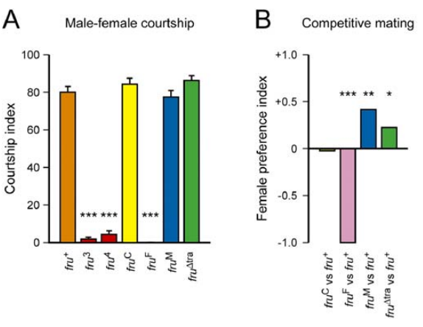
Male fruitless splicing is necessary for normal courtship
Necessity means that removing a factor disrupts an outcome under specified conditions. Demir and Dickson paired males carrying engineered fruitless splice alleles with wild-type virgin females. They measured the proportion of observation time devoted to courtship, using the same pairing and timing for every genotype so that each male is compared against the control under identical conditions.
Males forced into female-type splicing showed very little female-directed courtship, compared with courtship indices near 80% in control and male-spliced genotypes. Competitive mating assays also separated the female-spliced genotype from males that retained male-type splicing. Both assays point to the same P1 requirement, and each measure gives a separate readout of the same splice change.
The experiment supports a requirement for male P1 splicing in normal male courtship. FruM therefore acts during development, so the alleles change courtship across the male's life rather than through a brief command. The timing of this effect is set by when the splice change occurs, and each step in the chain is tied to a verified transcript.
Demir & Dickson (2005), Fig. 2A–B. Courtship toward females and competitive mating after splice changes.
Demir & Dickson (2005)
10
Notes:
• **Necessity** means that removing a factor disrupts an outcome under specified conditions. Demir and Dickson paired males carrying engineered fruitless splice alleles with wild-type virgin females and measured the proportion of observation time devoted to courtship.
• Males forced into female-type splicing showed very little female-directed courtship, compared with courtship indices near 80% in control and male-spliced genotypes. Competitive mating assays also separated the female-spliced genotype from males retaining male-type splicing.
• The experiment supports a requirement for male P1 splicing in normal male courtship. It does not make FruM an acute electrical command: these alleles act during development and can alter the sensory processing, anatomy and motor organization used by the adult animal.
References:
Demir E, Dickson BJ (2005). fruitless splicing specifies male courtship behavior in Drosophila. Cell 121(5):785–794. https://doi.org/10.1016/j.cell.2005.04.027
Figure: Demir & Dickson (2005), Fig. 2A–B. Courtship toward females and competitive mating after splice changes.
Figure source: https://doi.org/10.1016/j.cell.2005.04.027

Slide 14
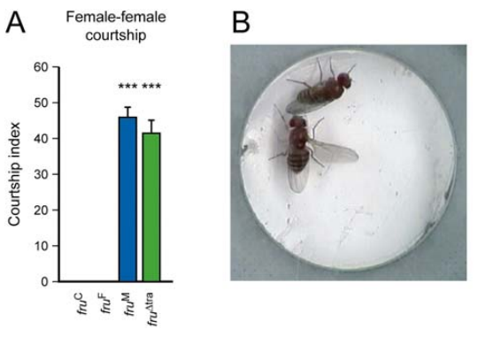
Male-spliced fruitless enables courtship in females
Sufficiency means that adding or enabling a factor produces an outcome in a defined background. Demir and Dickson tested females engineered to express male-spliced fruitless and paired them with wild-type virgin females to measure female-directed courtship. The same background is used for every comparison, so each genotype is evaluated against controls in the same setting.
These animals performed female-directed courtship with indices above 40%, whereas control females showed essentially none. Wing extension and tapping occurred, although the engineered females did not complete male copulation. The individual components were close to male patterns but not identical to them, so the courtship actions themselves are the outcome being measured.
The result supports developmental sufficiency for many male-typical courtship actions in this genetic background. The set of actions is broad, while copulation is missing, so the outcome separates the courtship program from the final step. Each action is recorded and scored separately, which shows which parts of courtship the splice change can produce.
Demir & Dickson (2005), Fig. 4A–B. Courtship by females engineered to express male-spliced fruitless.
Demir & Dickson (2005)
11
Notes:
• **Sufficiency** means that adding or enabling a factor produces an outcome in a defined background. Demir and Dickson tested females engineered to express male-spliced fruitless, pairing them with wild-type virgin females.
• These animals performed female-directed courtship with indices above 40%, while control females showed essentially none. Wing extension, tapping and other courtship actions occurred, although the engineered females did not complete male copulation and the individual components were not quantitatively identical to those of males.
• The result supports developmental sufficiency for many male-typical courtship actions in this genetic background. It does not establish that FruM alone supplies every male anatomical feature, that all behaviors become male-like, or that the same manipulation has identical effects in every species.
References:
Demir E, Dickson BJ (2005). fruitless splicing specifies male courtship behavior in Drosophila. Cell 121(5):785–794. https://doi.org/10.1016/j.cell.2005.04.027
Figure: Demir & Dickson (2005), Fig. 4A–B. Courtship by females engineered to express male-spliced fruitless.
Figure source: https://doi.org/10.1016/j.cell.2005.04.027

Slide 15
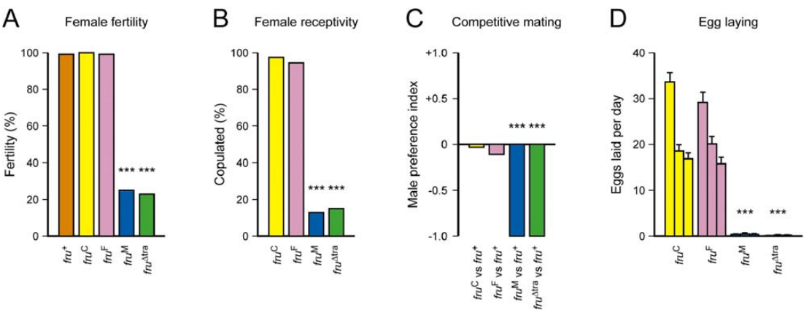
FruM also alters female reproductive behavior
Receptivity is a female's willingness to accept mating. Courtship production and reproductive receptivity are separable behavioral outcomes. Demir and Dickson tested whether forcing male fruitless splicing in females affected mating, fertility and egg laying, rather than examining only the newly expressed courtship actions. The reproductive measures were scored in the same females.
Most control females copulated within 60 min, whereas fewer than 16% of females carrying the male-spliced alleles did so. After mating, control females laid more than 65 eggs over three days on average, while engineered females laid fewer than two eggs. Mating and egg laying are both reduced in the same engineered females.
Gross genital anatomy is not the full explanation, so the reproductive phenotype is read as a behavioral effect. The findings associate FruM with suppression of female reproductive behaviors. The receptivity and egg-laying results are read together, so the reproductive phenotype is treated as one outcome spanning several measures that reinforce one another.
Demir & Dickson (2005), Fig. 3A–D. Fertility, mating receptivity and egg laying after splice changes.
Demir & Dickson (2005)
12
Notes:
• Courtship production and reproductive receptivity are separable behavioral outcomes. Demir and Dickson tested whether forcing male fruitless splicing in females affected mating, fertility and egg laying rather than examining only the newly expressed courtship actions.
• Most control females copulated within 60 min, whereas fewer than 16% of females carrying the male-spliced alleles did so. After mating, control females laid more than 65 eggs over three days on average, while engineered females laid fewer than two.
• No gross genital abnormality explained the entire phenotype. The findings associate FruM with suppression of female reproductive behaviors, but they do not identify a single inhibitory synapse or show that reduced receptivity and reduced egg laying arise from precisely the same neurons.
References:
Demir E, Dickson BJ (2005). fruitless splicing specifies male courtship behavior in Drosophila. Cell 121(5):785–794. https://doi.org/10.1016/j.cell.2005.04.027
Figure: Demir & Dickson (2005), Fig. 3A–D. Fertility, mating receptivity and egg laying after splice changes.
Figure source: https://doi.org/10.1016/j.cell.2005.04.027

Slide 16
Forced male splicing suppresses female egg laying
Receptivity is the willingness of a female to accept mating, and egg laying is a separate reproductive output. Demir and Dickson measured both in females carrying male-spliced alleles, so each female was scored for mating, fertility and egg production together. Both receptivity and egg laying are scored for each female.
Most control females mated within an hour, while fewer than one female in six carrying the male-spliced alleles mated during that time. After mating, control females laid many eggs over three days, whereas the engineered females laid very few. The reduction in egg laying is large and consistent across the females tested. The same females are measured for both outcomes across the assay.
Genital anatomy does not supply the full account of this phenotype, so the reproductive effect is interpreted as a change in behavior. The mating and egg-laying results agree, which makes the suppression of female reproductive behavior a coherent outcome of the male splice. The three readouts together describe one reproductive phenotype.
Demir & Dickson (2005), Fig. 3A–D. Fertility, mating receptivity and egg laying after splice changes.
Demir & Dickson (2005)
12a
Notes:
• Male splicing in females suppresses mating and egg laying.
• Receptivity.
– Mating within 60 min was scored in each female.
– Controls mated far more often.
• Egg laying.
– Control females laid many eggs after mating.
– Engineered females laid very few.
• Anatomy.
– Genital structure is not the full explanation.
– The effect is read as behavioral.
• Meaning.
– Mating and egg laying are both suppressed.
– The outcome is a single reproductive phenotype.
• Source values.
– The published recordings and measurements come from the original paper.
– Each result is reported with the condition used in the source.
• Why the measure matters.
– The result separates the measured property from the mechanism that produces it.
– The comparison stays within the same flies, cells or recordings.
• Interpretation.
– Each result is read within the genetic background and condition that produced it.
– The claim is restricted to the measured animals and conditions.
• Context.
– The parent figure shows the measurement that the paragraphs describe.
– Each claim is tied to the recordings of the original study.
• Method.
– The measurements follow the methods described in the original paper.
– Each value is kept with the condition under which it was measured.
References:
Demir E, Dickson BJ (2005). fruitless splicing specifies male courtship behavior in Drosophila. Cell 121(5):785–794. https://doi.org/10.1016/j.cell.2005.04.027

Slide 17
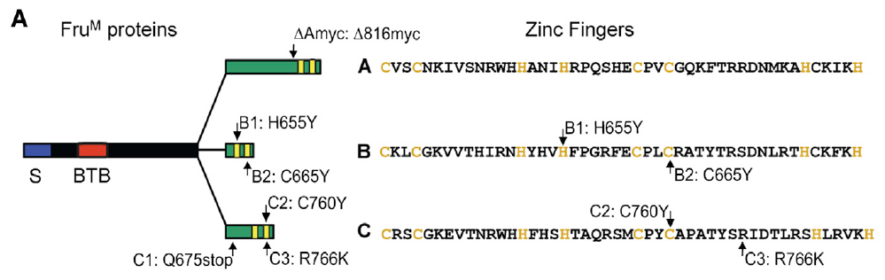
Distinct Fru isoforms have different DNA-binding domains
An isoform is one of several related protein products of a gene. Male-specific fruitless transcripts can produce FruA, FruB and FruC, which share amino-terminal regions. The three forms differ in their carboxy-terminal zinc-finger domains, which are protein regions involved in binding DNA, so each isoform has its own DNA-binding end.
von Philipsborn and colleagues selectively disrupted these isoforms and compared their effects with controls. The three forms retain a shared BTB domain, which is involved in protein interactions. Their distinct endings provide a molecular basis for different regulatory functions, and the shared domain and the distinct ends are both kept in view.
Sine carrier frequencies normally occupy about 120–170 Hz, and selective isoform disruption produced distinct song phenotypes. These results connect each isoform's protein structure to a particular song outcome. Each isoform is tested against the same song measures, and the phenotypes are then examined by isoform on the next slides.
von Philipsborn et al. (2014), Fig. 2A. Shared and distinct domains of the FruM isoforms.
von Philipsborn et al. (2014)
13
Notes:
• An **isoform** is one of several related protein products of a gene. Male-specific fruitless transcripts can produce FruA, FruB and FruC, which share amino-terminal regions but differ in their carboxy-terminal **zinc-finger domains**, protein regions involved in binding DNA.
• von Philipsborn and colleagues selectively disrupted these isoforms and compared their effects with controls. The three forms retain a shared **BTB domain**, involved in protein interactions, while their distinct endings provide a molecular basis for different regulatory functions.
• Sine carrier frequencies normally occupy roughly 120–170 Hz, and selective isoform disruption produced distinct song phenotypes. These results connect transcription-factor identity with behavior, but they do not by themselves specify the downstream genes or ion channels responsible for every altered song property.
References:
von Philipsborn AC, Jörchel S, Tirian L, Demir E, Morita T, Stern DL, Dickson BJ (2014). Cellular and behavioral functions of fruitless isoforms in Drosophila courtship. Current Biology 24(3):242–251. https://doi.org/10.1016/j.cub.2013.12.015
Figure: von Philipsborn et al. (2014), Fig. 2A. Shared and distinct domains of the FruM isoforms.
Figure source: https://doi.org/10.1016/j.cub.2013.12.015

Slide 18
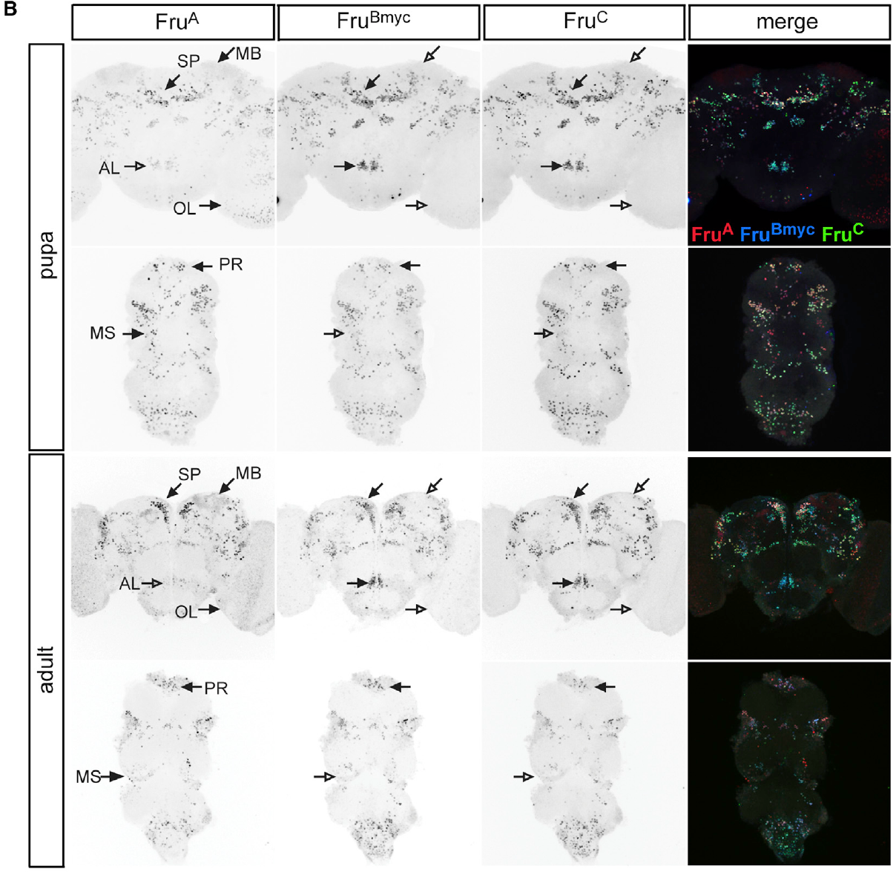
Fru isoforms overlap within brain and nerve cord
The ventral nerve cord, or VNC, contains the thoracic circuitry that controls the wings. Immunolabeling of pupal and adult nervous systems allowed von Philipsborn and colleagues to compare Fru isoform expression before and after adult emergence. The same labeling method was used at both stages, so timing is part of each expression pattern.
Most fruitless-positive neuronal classes coexpressed FruA, FruB and FruC rather than forming three separate populations. Expression extended through the brain and VNC. The different transcription-factor isoforms are therefore found in neurons that participate in sensory processing and motor control, and each class carries several isoforms at the same time.
Isoform mutants differed in their production of pulse song, whose usual interpulse interval is about 35 ms. Coexpression therefore allows distinct functions within the same neurons. Each isoform contributes its own effect within those neurons, so the mutants separate the functions that the overlap hides, and each mutant is compared with the same song measures.
von Philipsborn et al. (2014), Fig. 1B. Isoform expression in pupal and adult brain and nerve cord.
von Philipsborn et al. (2014)
14
Notes:
• The **ventral nerve cord**, or VNC, contains the thoracic circuitry controlling the wings. Immunolabeling of pupal and adult nervous systems allowed von Philipsborn and colleagues to compare Fru isoform expression before and after adult emergence.
• Most fruitless-positive neuronal classes coexpressed FruA, FruB and FruC rather than forming three mutually exclusive populations. Expression extended through brain and VNC, placing the different transcription-factor isoforms in neurons that participate in sensory processing and motor control.
• Despite this overlap, isoform mutants differed in their production of pulse song, whose usual interpulse interval is about 35 ms. Coexpression therefore does not imply interchangeable function. Antibody labeling establishes protein distribution, while genetic perturbation is needed to test the contribution of a particular isoform.
References:
von Philipsborn AC, Jörchel S, Tirian L, Demir E, Morita T, Stern DL, Dickson BJ (2014). Cellular and behavioral functions of fruitless isoforms in Drosophila courtship. Current Biology 24(3):242–251. https://doi.org/10.1016/j.cub.2013.12.015
Figure: von Philipsborn et al. (2014), Fig. 1B. Isoform expression in pupal and adult brain and nerve cord.
Figure source: https://doi.org/10.1016/j.cub.2013.12.015

Slide 19
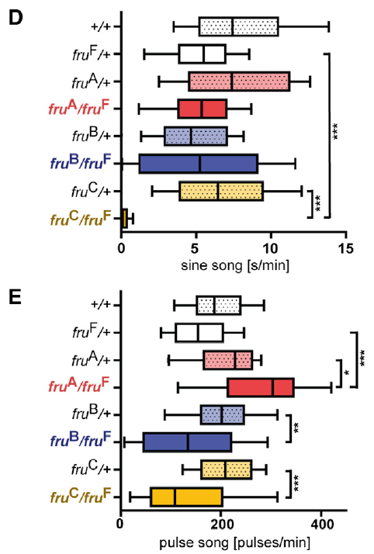
FruC disruption strongly impairs song and mating
Isoform-specific mutations distinguish a general requirement for fruitless from a requirement for one of its protein endings. von Philipsborn and colleagues paired mutant males with virgin females and recorded pulse song, sine song and copulation. Each measure was taken in every mutant, using the same pairing protocol for all genotypes, so each mutant is compared with its own control.
FruC mutants lacked normal sine song and had the strongest mating impairment among the isoform mutants. Sine normally has a carrier frequency of about 120–170 Hz, so its disappearance is a loss of a song mode rather than a small shift in pulse spacing. The loss is large and specific, and it affects the whole song mode.
FruA and FruB perturbations produced different, less severe combinations of defects. The contrast supports nonredundant isoform functions in the courtship network, so each isoform contributes a distinct part of the male's courtship behavior. The patterns of defect differ across the three isoforms, and each pattern points to a different role within the network.
von Philipsborn et al. (2014), Fig. 2D–E. Sine and pulse production in isoform mutants.
von Philipsborn et al. (2014)
15
Notes:
• Isoform-specific mutations distinguish a general requirement for fruitless from a requirement for one of its protein endings. von Philipsborn and colleagues paired mutant males with virgin females and recorded pulse song, sine song and copulation.
• FruC mutants lacked normal sine song and had the strongest mating impairment among the isoform mutants. Sine normally has a carrier frequency of approximately 120–170 Hz; its disappearance is therefore a loss of a song mode rather than merely a small shift in pulse spacing.
• FruA and FruB perturbations produced different, less severe combinations of defects. The contrast supports nonredundant isoform functions in the courtship network, but a lifelong mutation can influence multiple cell types and does not isolate the acute site at which sine production fails.
References:
von Philipsborn AC, Jörchel S, Tirian L, Demir E, Morita T, Stern DL, Dickson BJ (2014). Cellular and behavioral functions of fruitless isoforms in Drosophila courtship. Current Biology 24(3):242–251. https://doi.org/10.1016/j.cub.2013.12.015
Figure: von Philipsborn et al. (2014), Fig. 2D–E. Sine and pulse production in isoform mutants.
Figure source: https://doi.org/10.1016/j.cub.2013.12.015

Slide 20
Isoform mutants lose song modes differently
An isoform mutant removes one protein product of the fruitless gene while leaving the others in place. von Philipsborn and colleagues paired each mutant male with a virgin female and recorded pulse song, sine song and copulation, so each mutant is compared on the same measures. Each mutant is tested with the same pairing protocol and the same measures.
FruC mutants lost sine song and showed the strongest mating impairment among the isoform mutants. Sine song has a carrier frequency of about 120–170 Hz, so its loss removes an entire song mode. FruA and FruB perturbations produced different, milder combinations of defects. The loss of sine song is one of the clearest differences among the mutants.
The distinct profiles of the isoform mutants indicate that each isoform contributes a different part of the courtship network. The mutants show that a single gene can influence several outputs through separate protein products. Each isoform's profile is compared with the others in the same set of measures.
von Philipsborn et al. (2014), Fig. 2D–E. Sine and pulse production in isoform mutants.
von Philipsborn et al. (2014)
15a
Notes:
• Each isoform removes a different part of the song.
• Mutants.
– Each isoform mutant removes one protein product.
– Pulse, sine and copulation are scored.
• FruC.
– FruC mutants lost sine song.
– Mating was impaired more than in other mutants.
• FruA and FruB.
– These mutants showed milder, different defects.
– The profiles differ from FruC.
• Meaning.
– Isoforms contribute distinct parts of the network.
– One gene drives several outputs.
• Source values.
– The published recordings and measurements come from the original paper.
– Each result is reported with the condition used in the source.
• Why the measure matters.
– The result separates the measured property from the mechanism that produces it.
– The comparison stays within the same flies, cells or recordings.
• Interpretation.
– Each result is read within the genetic background and condition that produced it.
– The claim is restricted to the measured animals and conditions.
• Context.
– The parent figure shows the measurement that the paragraphs describe.
– Each claim is tied to the recordings of the original study.
• Method.
– The measurements follow the methods described in the original paper.
– Each value is kept with the condition under which it was measured.
References:
von Philipsborn AC, Jörchel S, Tirian L, Demir E, Morita T, Stern DL, Dickson BJ (2014). Cellular and behavioral functions of fruitless isoforms in Drosophila courtship. Current Biology 24(3):242–251. https://doi.org/10.1016/j.cub.2013.12.015

Slide 21
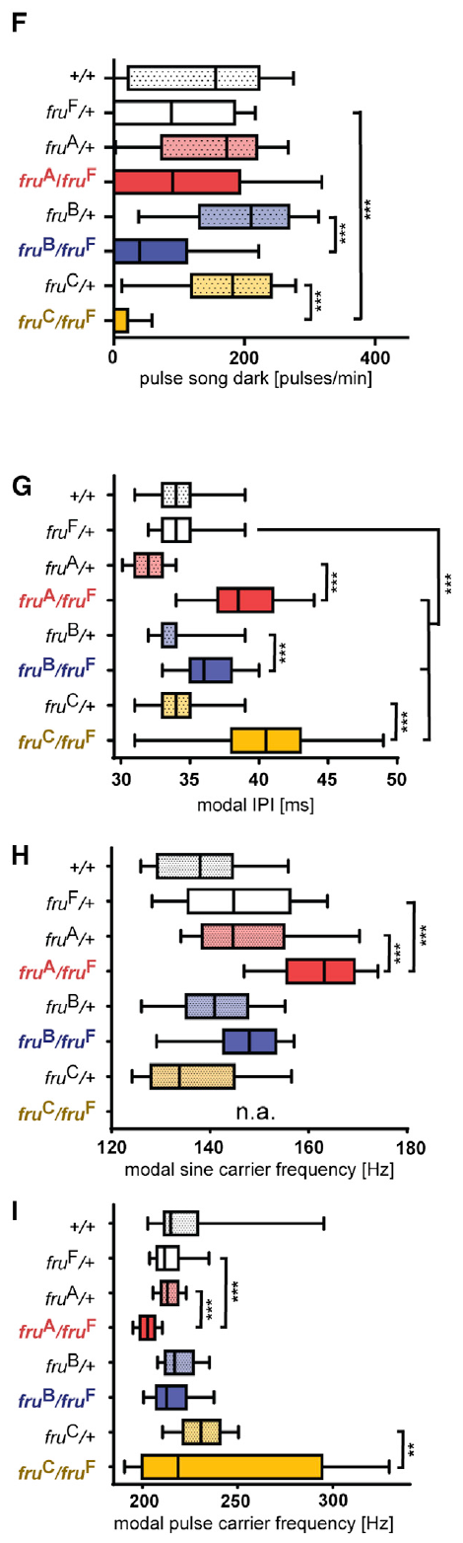
Isoform phenotypes include timing and sensory dependence
Song amount, carrier frequency and interpulse timing quantify different outputs of the courtship circuit. von Philipsborn and colleagues measured these parameters separately in selective Fru isoform mutants. They compared illuminated and dark courtship conditions, and each parameter is scored in both lighting conditions, giving three separate readouts of the same behavior.
FruC loss strongly reduced pulse production in darkness and lengthened interpulse timing relative to the control pattern of about 35 ms. Carrier frequencies also differed among isoform mutants rather than tracking the loss of song amount in one uniform way. The dark condition shows the sharpest reduction in pulse output, and each mutant shows a different combination of changes.
The dependence on illumination is consistent with altered access to nonvisual courtship information. The result links light availability with the FruC phenotype. Each measure is read against the light condition under which it was obtained, so the FruC mutants are examined in both light and dark, and the dark result is the most informative contrast.
von Philipsborn et al. (2014), Fig. 2F–I. Darkness, interpulse timing and carrier frequencies in isoform mutants.
von Philipsborn et al. (2014)
16
Notes:
• Song amount, carrier frequency and interpulse timing quantify different outputs of the courtship circuit. von Philipsborn and colleagues measured these parameters separately in selective Fru isoform mutants, comparing illuminated and dark courtship conditions.
• FruC loss strongly reduced pulse production in darkness and lengthened interpulse timing relative to the approximately 35 ms control pattern. Carrier frequencies also differed among isoform mutants rather than tracking the loss of song amount in one uniform way.
• The dependence on illumination is consistent with altered access to nonvisual courtship information. It does not establish that FruC is a photoreceptor protein or a pulse-timing channel: the developmental mutation can change the pathways that translate available sensory cues into motor activity.
References:
von Philipsborn AC, Jörchel S, Tirian L, Demir E, Morita T, Stern DL, Dickson BJ (2014). Cellular and behavioral functions of fruitless isoforms in Drosophila courtship. Current Biology 24(3):242–251. https://doi.org/10.1016/j.cub.2013.12.015
Figure: von Philipsborn et al. (2014), Fig. 2F–I. Darkness, interpulse timing and carrier frequencies in isoform mutants.
Figure source: https://doi.org/10.1016/j.cub.2013.12.015

Slide 22
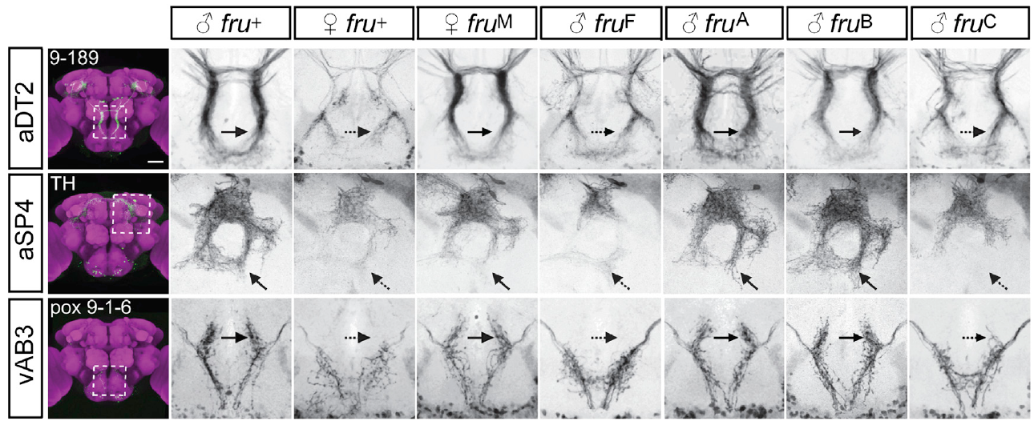
FruC specifies sexually differentiated neuronal arbors
A neuronal arbor is the branching region through which a neuron receives or distributes signals. von Philipsborn and colleagues labeled identified courtship-related classes and registered their anatomy across male, female and fruitless-mutant nervous systems. The registration makes the shapes directly comparable, and each class is compared across the same sexes and genotypes.
FruC was required for male-typical arborization in classes including aSP4 and vAB3. Mutants lacking this isoform also showed reduced pulse song without visual cues. Normal song spacing is about 35 ms, and the anatomy and the behavior measure the phenotype at different levels, which are read side by side for each mutant.
The results link a specific transcription-factor isoform with sex-dependent neuronal morphology. Arbor shape can constrain possible connectivity, which makes the anatomy a candidate basis for the song phenotype. Each arbor is described by its registered form in each genotype, so the shape differences are read as a sex-specific feature of the circuit.
von Philipsborn et al. (2014), Fig. 3. Sex-specific neuronal arbors across fruitless genotypes.
von Philipsborn et al. (2014)
17
Notes:
• A neuronal **arbor** is the branching region through which a neuron receives or distributes signals. von Philipsborn and colleagues labeled identified courtship-related classes and registered their anatomy across male, female and fruitless-mutant nervous systems.
• FruC was required for male-typical arborization in classes including aSP4 and vAB3. Mutants lacking this isoform also showed reduced pulse song without visual cues; normal song spacing is approximately 35 ms, but anatomical and behavioral changes measure different levels of the phenotype.
• The results link a specific transcription-factor isoform with sex-dependent neuronal morphology. Arbor shape can constrain possible connectivity, yet light-microscopic overlap does not establish a synapse or determine whether a particular connection is excitatory, inhibitory or behaviorally necessary.
References:
von Philipsborn AC, Jörchel S, Tirian L, Demir E, Morita T, Stern DL, Dickson BJ (2014). Cellular and behavioral functions of fruitless isoforms in Drosophila courtship. Current Biology 24(3):242–251. https://doi.org/10.1016/j.cub.2013.12.015
Figure: von Philipsborn et al. (2014), Fig. 3. Sex-specific neuronal arbors across fruitless genotypes.
Figure source: https://doi.org/10.1016/j.cub.2013.12.015

Slide 23
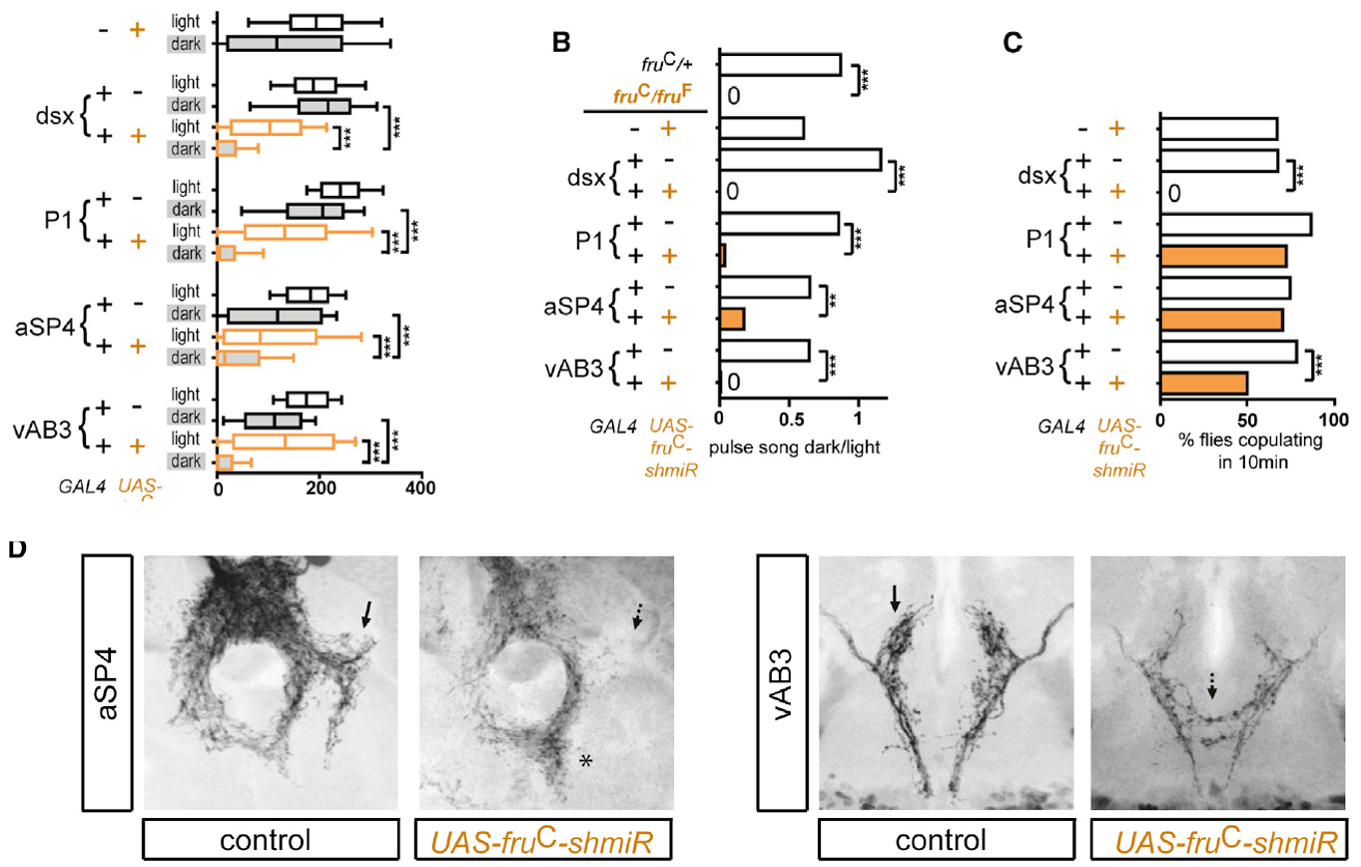
Cell-specific FruC loss impairs nonvisual courtship
Cell-specific knockdown reduces a gene product in selected neurons while preserving it elsewhere. von Philipsborn and colleagues depleted FruC in defined courtship-related classes and compared pulse production under illumination and in darkness. The knockdown affects only the targeted cells, so each class is compared under the same light conditions and its role is isolated.
Loss in aSP4 or vAB3 feminized characteristic arbors and impaired dark courtship. The copulation assay extended over 10 min. Song comparisons separated pulse amount in light from pulse amount in dark, so the two conditions are assessed on their own, and the dark measure isolates the nonvisual contribution.
P1 neuron presence depended on the sex-determination gene doublesex rather than on fruitless alone. FruM can enable broad courtship behavior without independently specifying every courtship element. Each neuronal class is therefore assessed for its dependence on both genes, and their combined effects are read from the same measures.
von Philipsborn et al. (2014), Fig. 4A–D. Cell-specific behavioral effects and associated courtship-pathway arbors.
von Philipsborn et al. (2014)
18
Notes:
• **Cell-specific knockdown** reduces a gene product in selected neurons while preserving it elsewhere. von Philipsborn and colleagues depleted FruC in defined courtship-related classes and compared pulse production under illumination and in darkness.
• Loss in aSP4 or vAB3 feminized characteristic arbors and impaired dark courtship. The copulation assay extended over 10 min, while song comparisons separated pulse amount in light from pulse amount in dark rather than assuming both conditions accessed identical sensory information.
• P1 neuron presence depended on the sex-determination gene doublesex rather than on fruitless alone. FruM can enable broad courtship behavior without independently specifying every male neuron; the developmental pathway involves several genetic contributions whose cellular consequences must be tested separately.
References:
von Philipsborn AC, Jörchel S, Tirian L, Demir E, Morita T, Stern DL, Dickson BJ (2014). Cellular and behavioral functions of fruitless isoforms in Drosophila courtship. Current Biology 24(3):242–251. https://doi.org/10.1016/j.cub.2013.12.015
Figure: von Philipsborn et al. (2014), Fig. 4A–D. Cell-specific behavioral effects and associated courtship-pathway arbors.
Figure source: https://doi.org/10.1016/j.cub.2013.12.015

Slide 24
Dark courtship depends on FruC in defined classes
Cell-specific knockdown reduces a gene product only in selected neurons. von Philipsborn and colleagues depleted FruC in defined courtship-related classes and compared pulse production under illumination and in darkness, so each class can be assessed separately. Each class receives its own knockdown and its own behavioral test.
Knockdown in aSP4 or vAB3 feminized characteristic arbors and impaired courtship in the dark. Comparing pulse amounts in light and in darkness separates the visual from the nonvisual contribution. The dark measure isolates the part of the behavior that does not depend on sight. Both light conditions use the same pairing and the same measures.
P1 neuron presence depended on the sex-determination gene doublesex as well as on fruitless. Each neuronal class is assessed for its dependence on both genes, and the combined effects are read from the same courtship measures. The combined results are read across all of the tested classes.
von Philipsborn et al. (2014), Fig. 4A–D. Cell-specific behavioral effects and associated courtship-pathway arbors.
von Philipsborn et al. (2014)
18a
Notes:
• Knockdown in specific classes reduces dark courtship.
• Knockdown.
– FruC is reduced in defined neuron classes.
– Other cells keep their expression.
• Light and dark.
– Pulse amounts are compared under both conditions.
– The dark measure isolates nonvisual input.
• Arbors.
– Knockdown in aSP4 or vAB3 changed characteristic arbors.
– Dark courtship was impaired.
• Doublesex.
– P1 presence depended on doublesex.
– The two genes are assessed together.
• Source values.
– The published recordings and measurements come from the original paper.
– Each result is reported with the condition used in the source.
• Why the measure matters.
– The result separates the measured property from the mechanism that produces it.
– The comparison stays within the same flies, cells or recordings.
• Interpretation.
– Each result is read within the genetic background and condition that produced it.
– The claim is restricted to the measured animals and conditions.
• Context.
– The parent figure shows the measurement that the paragraphs describe.
– Each claim is tied to the recordings of the original study.
• Method.
– The measurements follow the methods described in the original paper.
– Each value is kept with the condition under which it was measured.
References:
von Philipsborn AC, Jörchel S, Tirian L, Demir E, Morita T, Stern DL, Dickson BJ (2014). Cellular and behavioral functions of fruitless isoforms in Drosophila courtship. Current Biology 24(3):242–251. https://doi.org/10.1016/j.cub.2013.12.015

Slide 25
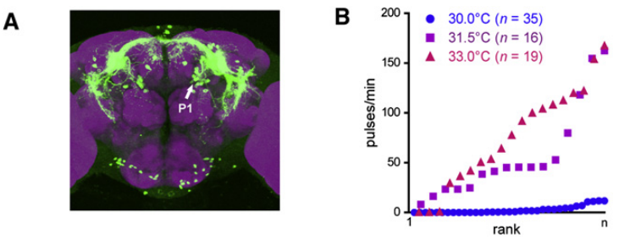
Activating P1-containing neurons initiates pulse song
P1 neurons are a male-specific brain population associated with courtship initiation. von Philipsborn and colleagues used intersecting genetic expression patterns to place the heat-gated TrpA1 cation channel in restricted fruitless-positive neurons. The intersection narrows expression to the target population, and the same channel is used to activate each population.
Heating isolated males to about 30–33 °C opened the channel, increasing inward cation current and neuronal excitability. Activation of a P1-containing population elicited pulse trains with timing close to natural courtship song. Each pulse train is scored against the natural interval, and the pattern is tested at the same temperature range.
Stochastic labeling helped associate singing with P1 expression rather than with every neuron in the driver pattern. Artificial activation establishes a song-promoting capacity, and the labeling identifies which neurons carry it. Each song event is linked to labeled cells, and each labeled cell is checked against the song it produces.
von Philipsborn et al. (2011), Fig. 2A–B. P1 labeling and temperature-dependent song activation.
von Philipsborn et al. (2011)
19
Notes:
• **P1 neurons** are a male-specific brain population associated with courtship initiation. von Philipsborn and colleagues used intersecting genetic expression patterns to place the heat-gated **TrpA1 cation channel** in restricted fruitless-positive neurons.
• Heating isolated males to approximately 30–33 °C opened the experimentally expressed channel, increasing inward cation current and neuronal excitability. Activation of a P1-containing population elicited pulse trains with timing close to natural courtship song.
• Stochastic labeling helped associate singing with P1 expression rather than with every neuron in the driver pattern. Artificial activation establishes a song-promoting capacity; it does not imply that normal courtship requires heating or that TrpA1 is the endogenous trigger for song production.
References:
von Philipsborn AC, Liu T, Yu JY, Masser C, Bidaye SS, Dickson BJ (2011). Neuronal control of Drosophila courtship song. Neuron 69(3):509–522. https://doi.org/10.1016/j.neuron.2011.01.011
Figure: von Philipsborn et al. (2011), Fig. 2A–B. P1 labeling and temperature-dependent song activation.
Figure source: https://doi.org/10.1016/j.neuron.2011.01.011

Slide 26
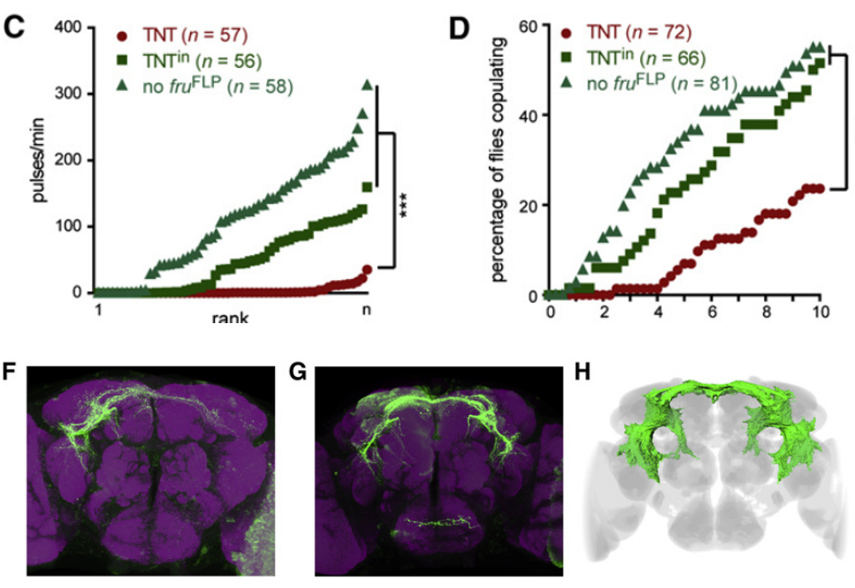
Silencing tests a requirement for P1 transmission
Synaptic silencing blocks communication from a neuron rather than removing its anatomy. The 2011 study expressed tetanus-toxin light chain in a P1-containing fruitless-positive population. This protein cleaves a component required for synaptic vesicle release, so the toxin silences transmission while the cells remain present, and each population is compared with its control.
Males paired with virgin females produced fewer pulse trains and had reduced copulation success during the 10 min assay. Controls expressed an inactive toxin or lacked the genetic intersection that directed the active toxin into the target population. Each control keeps the expression system constant, so the contrast is clear.
The contrast supports a requirement for transmission from these neurons under the tested conditions. Driver expression included additional cells, so the population-level silencing is read together with the activation results. The two directions of manipulation reinforce each other, and both results point to the same P1-containing population.
von Philipsborn et al. (2011), Fig. 2C–D,F–H. P1-containing neuronal silencing and the corresponding brain anatomy.
von Philipsborn et al. (2011)
20
Notes:
• **Synaptic silencing** blocks communication from a neuron rather than removing its anatomy. The 2011 study expressed tetanus-toxin light chain in a P1-containing fruitless-positive population; this protein cleaves a component required for synaptic vesicle release.
• Males paired with virgin females produced fewer pulse trains and had reduced copulation success during the 10 min assay. Controls expressed an inactive toxin or lacked the genetic intersection that directed the active toxin into the target population.
• The contrast supports a requirement for transmission from these neurons under the tested conditions. Driver expression included additional cells, so the population-level silencing result must be interpreted together with restricted activation and anatomical labeling rather than as a perfectly isolated single-neuron experiment.
References:
von Philipsborn AC, Liu T, Yu JY, Masser C, Bidaye SS, Dickson BJ (2011). Neuronal control of Drosophila courtship song. Neuron 69(3):509–522. https://doi.org/10.1016/j.neuron.2011.01.011
Figure: von Philipsborn et al. (2011), Fig. 2C–D,F–H. P1-containing neuronal silencing and the corresponding brain anatomy.
Figure source: https://doi.org/10.1016/j.neuron.2011.01.011

Slide 27
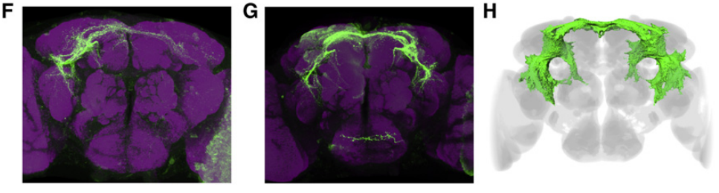
P1 activation does not fix which wing produces song
Laterality refers to the left–right organization of activity or behavior. A brain population that initiates song can leave the choice of wing to other circuits. von Philipsborn and colleagues compared unilateral and bilateral P1 activation using stochastic expression, and the two forms of activation are compared in the same animals.
At the song-inducing temperatures of about 30–33 °C, males could extend either the left or the right wing across repeated bouts. Unilateral P1 labeling did not impose a consistent ipsilateral wing choice, and the animals normally avoided simultaneous extension of both wings. The wing choice varies from bout to bout, and each male is scored for the wing it uses.
The dissociation places wing selection downstream of, or parallel to, the initiation function attributed to P1. Wing choice is a separate step in the motor program. Each bout is scored for the wing used, so the side of activation is tracked separately from the activation itself, and both records are compared across the same males.
von Philipsborn et al. (2011), Fig. 2F–H. Unilateral and bilateral P1 labeling and registered P1 anatomy.
von Philipsborn et al. (2011)
21
Notes:
• **Laterality** refers to the left–right organization of activity or behavior. A brain population that initiates song need not determine which wing performs the vibration. von Philipsborn and colleagues compared unilateral and bilateral P1 activation using stochastic expression.
• At the song-inducing temperatures of approximately 30–33 °C, males could extend either the left or the right wing across repeated bouts. Unilateral P1 labeling did not impose a consistent ipsilateral wing choice, and the animals normally avoided simultaneous extension of both wings.
• The dissociation places wing selection downstream of, or parallel to, the initiation function attributed to P1. It does not exclude lateralized contributions from individual P1 neurons under natural sensory conditions, because experimental activation recruits a restricted and variable subset of the population.
References:
von Philipsborn AC, Liu T, Yu JY, Masser C, Bidaye SS, Dickson BJ (2011). Neuronal control of Drosophila courtship song. Neuron 69(3):509–522. https://doi.org/10.1016/j.neuron.2011.01.011
Figure: von Philipsborn et al. (2011), Fig. 2F–H. Unilateral and bilateral P1 labeling and registered P1 anatomy.
Figure source: https://doi.org/10.1016/j.neuron.2011.01.011

Slide 28
Wing choice is separate from P1 initiation
A population that starts singing and a population that selects a wing can be separate circuits. von Philipsborn and colleagues compared unilateral and bilateral P1 activation using stochastic expression, so each male's wing choice could be scored against the side of activation. Each male is then scored for the wing it uses across all bouts.
Unilateral activation did not impose a consistent wing choice on the animals. Males chose either wing across repeated bouts and normally avoided extending both wings at once. The wing record is therefore independent of the side of the activated neurons. The wing record is kept separate from the activation record.
The dissociation places wing selection downstream of, or parallel to, the initiation function. Each bout is scored for its wing, and the activation record and the wing record are compared in the same animals. Both records are compared in the same set of males.
von Philipsborn et al. (2011), Fig. 2F–H. Unilateral and bilateral P1 labeling and registered P1 anatomy.
von Philipsborn et al. (2011)
21a
Notes:
• Wing choice and song initiation are dissociated.
• Initiation.
– P1 activation can start pulse song.
– Song initiation is one function.
• Wing choice.
– The chosen wing varied across bouts.
– The side of activation did not set it.
• Comparison.
– Unilateral and bilateral activation were compared.
– Stochastic labeling supplied the variation.
• Meaning.
– Wing selection is a separate motor step.
– Each bout is scored for its wing.
• Source values.
– The published recordings and measurements come from the original paper.
– Each result is reported with the condition used in the source.
• Why the measure matters.
– The result separates the measured property from the mechanism that produces it.
– The comparison stays within the same flies, cells or recordings.
• Interpretation.
– Each result is read within the genetic background and condition that produced it.
– The claim is restricted to the measured animals and conditions.
• Context.
– The parent figure shows the measurement that the paragraphs describe.
– Each claim is tied to the recordings of the original study.
• Method.
– The measurements follow the methods described in the original paper.
– Each value is kept with the condition under which it was measured.
References:
von Philipsborn AC, Liu T, Yu JY, Masser C, Bidaye SS, Dickson BJ (2011). Neuronal control of Drosophila courtship song. Neuron 69(3):509–522. https://doi.org/10.1016/j.neuron.2011.01.011

Slide 29
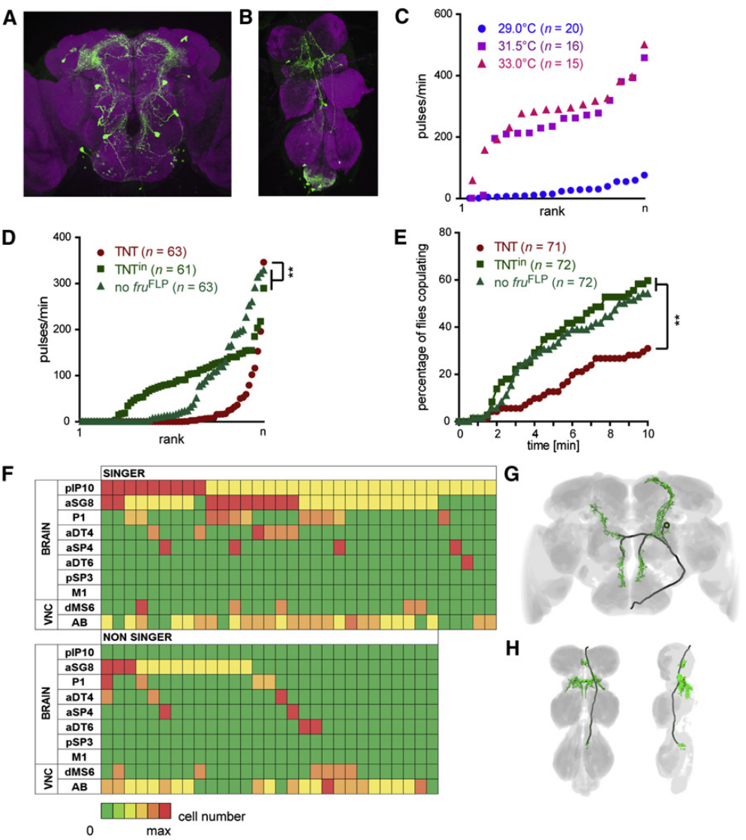
Descending pIP10 neurons link brain and wing circuitry
A descending neuron sends a process from the brain into the nerve cord. The pIP10 class arborizes in brain regions occupied by courtship-related neurons. Its processes descend into the anterior mesothoracic wing neuropil, the region containing dense neuronal processes associated with wing control, so the anatomy places pIP10 between the brain and the wing circuit.
Activation of a pIP10-containing genetic pattern elicited natural-like pulse trains. Mean interpulse intervals were about 33.3 ms at 29 °C and 35.4 ms at 33 °C, close to the natural pulse timing. Stochastic labeling associated singing specifically with pIP10 expression, so the song is tied to the labeled neurons.
Synaptic silencing of the broader pattern reduced song and mating. These findings identify a descending route capable of recruiting pulse production, which links brain courtship neurons to the wing circuit. The activation and silencing results confirm this route from both sides, so the descending link is central to pulse production.
von Philipsborn et al. (2011), Fig. 3A–H. pIP10-containing anatomy, activation, silencing and neuronal labeling.
von Philipsborn et al. (2011)
22
Notes:
• A **descending neuron** sends a process from the brain into the nerve cord. The pIP10 class arborizes in brain regions occupied by courtship-related neurons and descends into the anterior mesothoracic wing neuropil, the region containing dense neuronal processes associated with wing control.
• Activation of a pIP10-containing genetic pattern elicited natural-like pulse trains. Mean interpulse intervals were approximately 33.3 ms at 29 °C and 35.4 ms at 33 °C, while stochastic labeling associated singing specifically with pIP10 expression.
• Synaptic silencing of the broader pattern reduced song and mating. These findings identify a descending route capable of recruiting pulse production, but anatomical overlap with P1 does not independently verify a direct P1-to-pIP10 synapse or exclude other inputs to pIP10.
References:
von Philipsborn AC, Liu T, Yu JY, Masser C, Bidaye SS, Dickson BJ (2011). Neuronal control of Drosophila courtship song. Neuron 69(3):509–522. https://doi.org/10.1016/j.neuron.2011.01.011
Figure: von Philipsborn et al. (2011), Fig. 3A–H. pIP10-containing anatomy, activation, silencing and neuronal labeling.
Figure source: https://doi.org/10.1016/j.neuron.2011.01.011

Slide 30
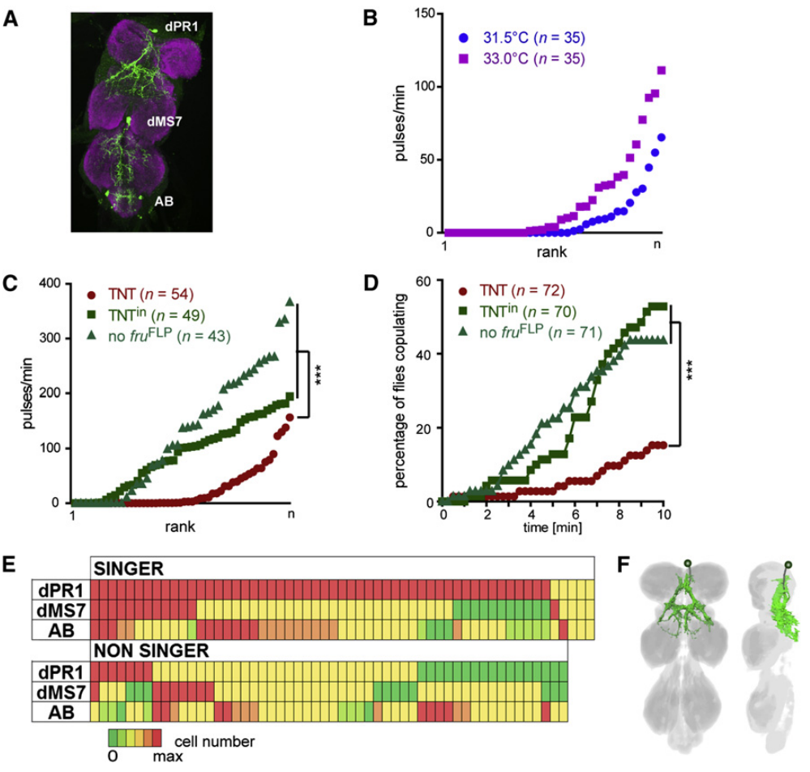
Thoracic dPR1 activation produces prolonged pulse spacing
dPR1 neurons occupy the thoracic nerve cord and extend processes into wing-related neuropil. A restricted expression pattern without labeled brain neurons allowed von Philipsborn and colleagues to test song production from a thoracic population. The pattern places the activation entirely in the nerve cord, so song produced by it comes from thoracic cells.
Heating TrpA1-expressing males above about 31.5 °C elicited pulse trains. Mean interpulse intervals were about 46 ms, longer than the natural-like intervals produced by the P1- and pIP10-containing patterns. Stochastic labeling associated bilateral dPR1 expression with singing, and the longer interval is a distinct feature of this activation.
Silenced males could still extend their wings while producing less pulse song. This separates wing posture from acoustic patterning, so the wing movement and the song are scored independently for each male. The activation supports a thoracic contribution to song production that is distinct from the brain-driven pattern, and both the posture and the pulse output are tracked.
von Philipsborn et al. (2011), Fig. 4A–F. dPR1-containing anatomy, perturbation and cell labeling.
von Philipsborn et al. (2011)
23
Notes:
• **dPR1 neurons** occupy the thoracic nerve cord and extend processes into wing-related neuropil. A restricted expression pattern without labeled brain neurons allowed von Philipsborn and colleagues to test song production from a thoracic population.
• Heating TrpA1-expressing males above approximately 31.5 °C elicited pulse trains, but mean interpulse intervals were about 46 ms, longer than natural-like intervals produced by the P1- and pIP10-containing patterns. Stochastic labeling associated bilateral dPR1 expression with singing.
• Silenced males could still extend their wings while producing less pulse song, separating wing posture from acoustic patterning. The activation supports a thoracic song-generating contribution, but the driver also labeled other cells, and an artificial temperature stimulus may recruit the network differently from natural descending input.
References:
von Philipsborn AC, Liu T, Yu JY, Masser C, Bidaye SS, Dickson BJ (2011). Neuronal control of Drosophila courtship song. Neuron 69(3):509–522. https://doi.org/10.1016/j.neuron.2011.01.011
Figure: von Philipsborn et al. (2011), Fig. 4A–F. dPR1-containing anatomy, perturbation and cell labeling.
Figure source: https://doi.org/10.1016/j.neuron.2011.01.011

Slide 31
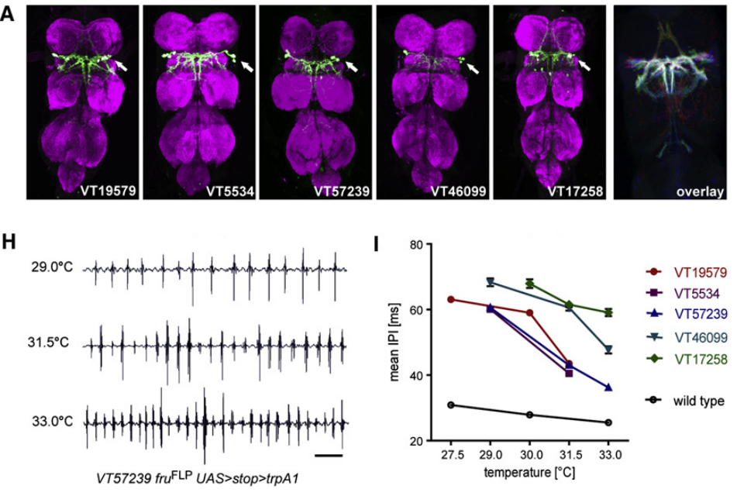
vPR6 activity influences the interval between pulses
vPR6 identifies a thoracic neuronal class with processes in wing neuropil. von Philipsborn and colleagues used several genetic patterns containing the vPR6-containing neurons. They tested whether activation changed pulse timing rather than merely triggering an undifferentiated wing movement, and pulse timing is the measure that separates these possibilities.
Across five patterns, increasing activation temperature shortened mean interpulse intervals at about 5.4–7.0 ms per °C. Wild-type intervals changed by about 1.0 ms per °C, which provides a comparison for the ordinary temperature dependence of song. The vPR6 change is much larger, and each pattern is scored on the same timing measure.
The excess shortening was associated with patterns containing vPR6 rather than with every song-promoting pattern. The result supports coupling between vPR6 activity and the interval between pulses. Each pattern is compared with the wild-type baseline on the same scale, so the vPR6 effect is specific to the vPR6-containing neurons and separate from simple song initiation.
von Philipsborn et al. (2011), Fig. 5A,H–I. vPR6 anatomy and activity-dependent interpulse timing.
von Philipsborn et al. (2011)
24
Notes:
• **vPR6** identifies a thoracic neuronal class with processes in wing neuropil. von Philipsborn and colleagues used several genetic patterns containing this class, testing whether activation changed pulse timing rather than merely triggering an undifferentiated wing movement.
• Across five patterns, increasing activation temperature shortened mean interpulse intervals at approximately 5.4–7.0 ms per °C. Wild-type intervals changed by only about 1.0 ms per °C, providing a comparison for the ordinary temperature dependence of song.
• The excess shortening was associated with patterns containing vPR6 rather than with every song-promoting pattern. It supports coupling between vPR6 activity and pulse spacing, while leaving unresolved the precise synapses, membrane currents and network dynamics that translate activity into each pulse interval.
References:
von Philipsborn AC, Liu T, Yu JY, Masser C, Bidaye SS, Dickson BJ (2011). Neuronal control of Drosophila courtship song. Neuron 69(3):509–522. https://doi.org/10.1016/j.neuron.2011.01.011
Figure: von Philipsborn et al. (2011), Fig. 5A,H–I. vPR6 anatomy and activity-dependent interpulse timing.
Figure source: https://doi.org/10.1016/j.neuron.2011.01.011

Slide 32
vPR6 shortens interpulse intervals with temperature
Interpulse interval is the time between successive pulses in a pulse train. von Philipsborn and colleagues tested whether activation of vPR6 changed this interval, rather than producing an undifferentiated wing movement. The interval is measured in each pulse train under the same conditions.
Across five genetic patterns, the interval shortened by about 5.4–7.0 ms for each degree of temperature increase. Wild-type intervals changed by about 1.0 ms per degree, so the vPR6 effect is several times larger than the ordinary temperature dependence of song. Each temperature step is compared with the same baseline.
The effect was associated with patterns containing vPR6 rather than with every song-promoting pattern. Each pattern is compared with the same wild-type baseline on the same scale, which links vPR6 activity to the timing of the pulses. The timing result is read against the wild-type pattern.
von Philipsborn et al. (2011), Fig. 5A,H–I. vPR6 anatomy and activity-dependent interpulse timing.
von Philipsborn et al. (2011)
24a
Notes:
• vPR6 activity shortens the interval between pulses.
• Interval.
– The interpulse interval is the time between pulses.
– It was measured in each pattern.
• Rate.
– The interval shortened about 5.4–7.0 ms per degree.
– The wild type changed about 1.0 ms per degree.
• Patterns.
– Five genetic patterns were compared.
– vPR6 was present in the strongest effect.
• Meaning.
– vPR6 couples to pulse timing.
– The effect is specific to this class.
• Source values.
– The published recordings and measurements come from the original paper.
– Each result is reported with the condition used in the source.
• Why the measure matters.
– The result separates the measured property from the mechanism that produces it.
– The comparison stays within the same flies, cells or recordings.
• Interpretation.
– Each result is read within the genetic background and condition that produced it.
– The claim is restricted to the measured animals and conditions.
• Context.
– The parent figure shows the measurement that the paragraphs describe.
– Each claim is tied to the recordings of the original study.
• Method.
– The measurements follow the methods described in the original paper.
– Each value is kept with the condition under which it was measured.
References:
von Philipsborn AC, Liu T, Yu JY, Masser C, Bidaye SS, Dickson BJ (2011). Neuronal control of Drosophila courtship song. Neuron 69(3):509–522. https://doi.org/10.1016/j.neuron.2011.01.011

Slide 33
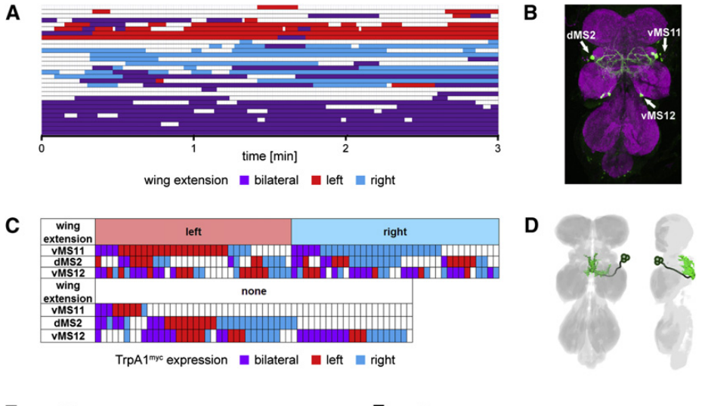
vMS11-containing neurons influence wing selection
vMS11 neurons have cell bodies in the mesothoracic nerve cord and processes in wing-related neuropil. Activation of a pattern containing vMS11 caused wing extension without reliably producing sustained wing vibration. The behavior is therefore a posture rather than a song, and the wing posture is recorded separately from the sound.
At about 30.5 °C, many males persistently extended one wing across repeated trials. Stochastic expression linked the side of extension with the side of vMS11 labeling. The behavior differed from P1 activation, which permitted either wing to be selected, and each male's wing choice is matched to its labeling.
Silencing the broader pattern also increased the fraction of pulses containing more than two oscillatory cycles to about 59%, compared with fewer than 3% in controls. Other labeled cells could contribute to this change. Each pulse is scored for its cycles, so the waveform change is measured directly and complements the wing posture result.
von Philipsborn et al. (2011), Fig. 6A–D. Wing-use patterns, neuronal labeling and vMS11 anatomy.
von Philipsborn et al. (2011)
25
Notes:
• **vMS11 neurons** have cell bodies in the mesothoracic nerve cord and processes in wing-related neuropil. Activation of a pattern containing vMS11 caused wing extension without reliably producing sustained wing vibration.
• At approximately 30.5 °C, many males persistently extended one wing across repeated trials, and stochastic expression linked the side of extension with the side of vMS11 labeling. The behavior differed from P1 activation, which permitted either wing to be selected.
• Silencing the broader pattern also increased the fraction of pulses containing more than two oscillatory cycles to about 59%, compared with fewer than 3% in controls. Other labeled cells could contribute to this waveform defect; the evidence for wing choice is more cell-specific than the evidence for pulse-shape control.
References:
von Philipsborn AC, Liu T, Yu JY, Masser C, Bidaye SS, Dickson BJ (2011). Neuronal control of Drosophila courtship song. Neuron 69(3):509–522. https://doi.org/10.1016/j.neuron.2011.01.011
Figure: von Philipsborn et al. (2011), Fig. 6A–D. Wing-use patterns, neuronal labeling and vMS11 anatomy.
Figure source: https://doi.org/10.1016/j.neuron.2011.01.011

Slide 34
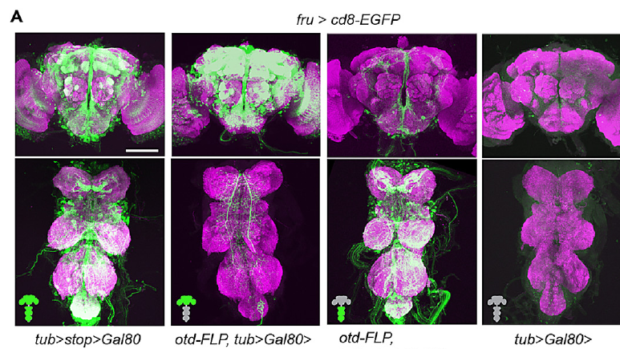
GABA synthesis and reception shape courtship output
GABA, gamma-aminobutyric acid, is an inhibitory neurotransmitter. GAD1, glutamic acid decarboxylase, synthesizes GABA. Rdl is an ionotropic GABA receptor, meaning that transmitter binding directly controls an ion-channel response. The synthesis enzyme and the receptor are the two ends of one signal, and each is targeted separately in the experiments below.
Amin and colleagues reduced GAD1 or Rdl with RNA interference, an RNA-based reduction of the targeted gene's expression. Anatomical mapping found roughly 220 neurons coexpressing fruitless and GAD1 across brain and nerve cord. The inhibitory population is therefore large, and the knockdown targets the same set of cells.
Reducing synthesis limits the available transmitter, while reducing the receptor changes the postsynaptic response to GABA. Both perturbations disrupted courtship motor coordination, and these breakdowns in coordination are read as the shared outcome of the two manipulations. Each perturbation is scored by the same motor measures throughout the following slides.
Amin et al. (2023), Fig. 3A. Brain- and nerve-cord-restricted transgene expression.
Amin et al. (2023)
26
Notes:
• **GABA**, gamma-aminobutyric acid, is an inhibitory neurotransmitter. **GAD1**, glutamic acid decarboxylase, synthesizes GABA; **Rdl** is an ionotropic GABA receptor, meaning that transmitter binding directly controls an ion-channel response.
• Amin and colleagues reduced GAD1 or Rdl with **RNA interference**, an RNA-based reduction of the targeted gene’s expression. Anatomical mapping found roughly 220 neurons coexpressing fruitless and GAD1 across brain and nerve cord, rather than one isolated inhibitory cell.
• Reducing synthesis limits the available transmitter, while reducing the receptor changes the postsynaptic response to GABA. Both perturbations disrupted courtship motor coordination. These broad manipulations establish a requirement for GABAergic signaling but do not identify every inhibitory connection or its reversal potential.
References:
Amin H, Nolte SS, Swain B, von Philipsborn AC (2023). GABAergic signaling shapes multiple aspects of Drosophila courtship motor behavior. iScience 26(11):108069. https://doi.org/10.1016/j.isci.2023.108069
Figure: Amin et al. (2023), Fig. 3A. Brain- and nerve-cord-restricted transgene expression.
Figure source: https://doi.org/10.1016/j.isci.2023.108069

Slide 35
GABA perturbation disrupts unilateral wing extension
Normal D. melanogaster courtship usually uses one extended wing at a time. Amin and colleagues scored wing posture in males with GAD1 or Rdl knockdown in fruitless-positive neurons. Genetic controls distinguish the targeted perturbation from the expression system itself, and posture is recorded for each male in the same way.
Many knockdown males extended both wings, whereas controls predominantly extended one. Control pulse trains were organized around 30–35 ms interpulse intervals. The posture defect is scored separately from the timing and waveform of the sound, so both the posture and the sound are kept as separate measures.
The result supports an inhibitory contribution to the coordination of competing wing movements. Bilateral extension is the defect that inhibition normally prevents. Each male's posture is compared with its matched control, so the defect is read against a clear baseline, and the contrast between bilateral and unilateral posture is the key measure in both genotypes.
Amin et al. (2023), Fig. 1G. Bilateral wing extension after GAD1 depletion and unilateral control extension.
Amin et al. (2023)
27
Notes:
• Normal _D. melanogaster_ courtship usually uses one extended wing at a time. Amin and colleagues scored wing posture in males with GAD1 or Rdl knockdown in fruitless-positive neurons, using genetic controls to distinguish the targeted perturbation from the expression system.
• Many knockdown males extended both wings, whereas controls predominantly extended one. Control pulse trains were organized around 30–35 ms interpulse intervals, but the posture defect was scored separately from the timing and waveform of the sound.
• The result supports an inhibitory contribution to the coordination of competing wing movements. It does not establish a uniquely identified left–right inhibitory synapse, and bilateral extension alone cannot explain all acoustic defects because pulse cycles, sine production and mating movements were altered as well.
References:
Amin H, Nolte SS, Swain B, von Philipsborn AC (2023). GABAergic signaling shapes multiple aspects of Drosophila courtship motor behavior. iScience 26(11):108069. https://doi.org/10.1016/j.isci.2023.108069
Figure: Amin et al. (2023), Fig. 1G. Bilateral wing extension after GAD1 depletion and unilateral control extension.
Figure source: https://doi.org/10.1016/j.isci.2023.108069

Slide 36
GABA knockdown produces bilateral wing extension
Normal courtship usually uses one extended wing at a time. Amin and colleagues knocked down GAD1 or Rdl in fruitless-positive neurons and scored the wing posture of each male. Genetic controls matched the expression system, so the posture change is attributed to the knockdown. Both genotypes are scored under the same conditions.
Many knockdown males extended both wings, whereas control males predominantly extended one. The posture defect was scored separately from the timing and waveform of the sound, which kept the motor and acoustic measures distinct. Each knockdown male is counted in the same posture category.
The result supports an inhibitory contribution to coordinating competing wing movements. Bilateral extension is the defect that inhibition normally prevents, and each male's posture is compared with its matched control. The bilateral and unilateral comparison is made within each genotype.
Amin et al. (2023), Fig. 1G. Bilateral wing extension after GAD1 depletion and unilateral control extension.
Amin et al. (2023)
27a
Notes:
• GABA knockdown removes control of wing posture.
• Posture.
– Control males usually extended one wing.
– Knockdown males extended both.
• Controls.
– Genetic controls matched the expression system.
– The knockdown is the variable.
• Measures.
– Posture is scored apart from sound.
– Waveform and timing are measured separately.
• Meaning.
– Inhibition helps coordinate competing wings.
– Bilateral extension is the defect.
• Source values.
– The published recordings and measurements come from the original paper.
– Each result is reported with the condition used in the source.
• Why the measure matters.
– The result separates the measured property from the mechanism that produces it.
– The comparison stays within the same flies, cells or recordings.
• Interpretation.
– Each result is read within the genetic background and condition that produced it.
– The claim is restricted to the measured animals and conditions.
• Context.
– The parent figure shows the measurement that the paragraphs describe.
– Each claim is tied to the recordings of the original study.
• Method.
– The measurements follow the methods described in the original paper.
– Each value is kept with the condition under which it was measured.
References:
Amin H, Nolte SS, Swain B, von Philipsborn AC (2023). GABAergic signaling shapes multiple aspects of Drosophila courtship motor behavior. iScience 26(11):108069. https://doi.org/10.1016/j.isci.2023.108069

Slide 37
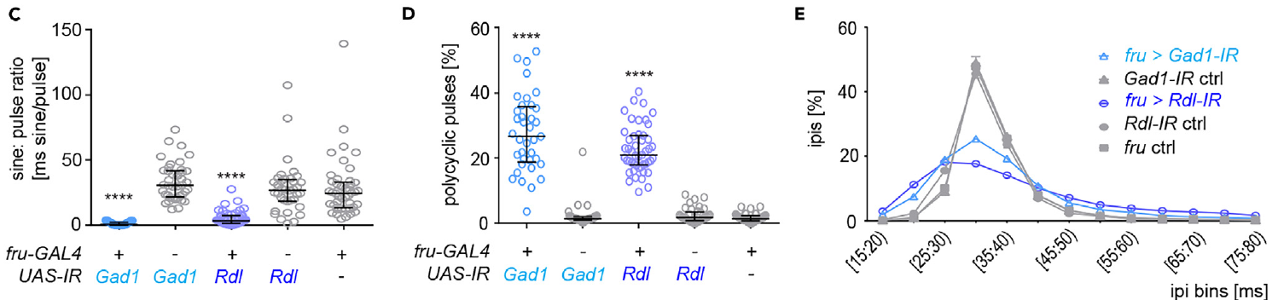
Loss of GABA signaling changes pulse and sine structure
A polycyclic pulse contains more oscillatory cycles than the usual brief pulse waveform. Amin and colleagues compared microphone recordings from GAD1- and Rdl-depleted males with recordings from the corresponding genetic controls. Every recording is paired with its control, so the genotype difference stays isolated, and waveforms are compared cycle by cycle.
Knockdown males produced less sine song, more polycyclic pulses and a broader distribution of interpulse intervals. The control distribution concentrated near 30–35 ms, and fewer intervals fell in the 30–40 ms range after either perturbation. Both measures move in the same direction, and the spread of intervals is the clearest difference.
The defects concern both the organization of successive pulses and the structure of individual pulses. They support a role for inhibition in shaping the motor pattern. Each measure is read at both the pulse level and the song level, which places the effect at two scales, and the pulse and song effects are described together.
Amin et al. (2023), Fig. 2C–E. Sine amount, pulse cycles and interpulse interval distributions.
Amin et al. (2023)
28
Notes:
• A **polycyclic pulse** contains more oscillatory cycles than the usual brief pulse waveform. Amin and colleagues compared microphone recordings from GAD1- and Rdl-depleted males with recordings from the corresponding genetic controls.
• Knockdown males produced less sine song, more polycyclic pulses and a broader distribution of interpulse intervals. The control distribution concentrated near 30–35 ms; fewer intervals fell in the 30–40 ms range after either perturbation.
• The defects concern both the organization of successive pulses and the structure of individual pulses. They support a role for inhibition in shaping the motor pattern, but do not show that a single inhibitory oscillator controls every song property or distinguish all direct effects from compensatory developmental changes.
References:
Amin H, Nolte SS, Swain B, von Philipsborn AC (2023). GABAergic signaling shapes multiple aspects of Drosophila courtship motor behavior. iScience 26(11):108069. https://doi.org/10.1016/j.isci.2023.108069
Figure: Amin et al. (2023), Fig. 2C–E. Sine amount, pulse cycles and interpulse interval distributions.
Figure source: https://doi.org/10.1016/j.isci.2023.108069

Slide 38
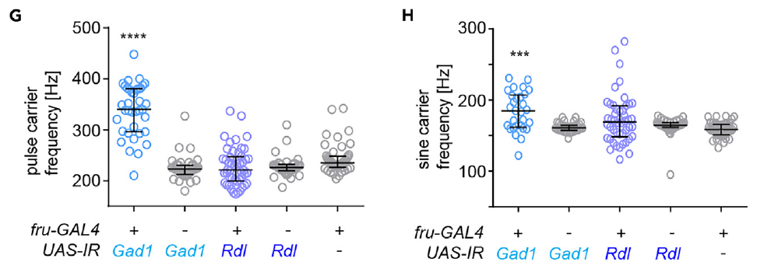
GABA perturbations differ in carrier frequency
The pulse carrier frequency measures oscillations within a pulse, while the sine carrier frequency measures the continuous vibration of sine song. Amin and colleagues quantified both rather than treating the interpulse interval as the frequency of the sound itself. The two carrier measures are kept separate in every analysis, so each sound is described by its carrier frequencies.
GAD1 knockdown increased pulse carrier frequency and sine carrier frequency. Rdl knockdown did not reproduce the same frequency shifts, although both perturbations strongly reduced normal sine production. Control pulse carriers occupied about the 200–250 Hz range in this preparation, and the two perturbations therefore differ in their frequency effects.
The difference shows that reducing GABA synthesis and reducing one receptor have different consequences across the song. The two perturbations are compared through the same frequency measures, and each is assigned its own frequency profile. Both profiles are shown on the same frequency scale, and the contrast is one of the central results of this study.
Amin et al. (2023), Fig. 2G–H. Carrier frequencies after GAD1 or Rdl depletion.
Amin et al. (2023)
29
Notes:
• The **pulse carrier frequency** measures oscillations within a pulse, while the **sine carrier frequency** measures the continuous vibration of sine song. Amin and colleagues quantified both rather than treating the interpulse interval as the frequency of the sound itself.
• GAD1 knockdown increased pulse carrier frequency and sine carrier frequency. Rdl knockdown did not reproduce the same frequency shifts, although both perturbations strongly reduced normal sine production. Control pulse carriers occupied approximately the 200–250 Hz range in this preparation.
• The difference indicates that reducing GABA synthesis and reducing one receptor do not have identical consequences across the entire circuit. It does not prove a particular receptor compensation mechanism, because the perturbations differ in target, affected cells and residual signaling capacity.
References:
Amin H, Nolte SS, Swain B, von Philipsborn AC (2023). GABAergic signaling shapes multiple aspects of Drosophila courtship motor behavior. iScience 26(11):108069. https://doi.org/10.1016/j.isci.2023.108069
Figure: Amin et al. (2023), Fig. 2G–H. Carrier frequencies after GAD1 or Rdl depletion.
Figure source: https://doi.org/10.1016/j.isci.2023.108069

Slide 39
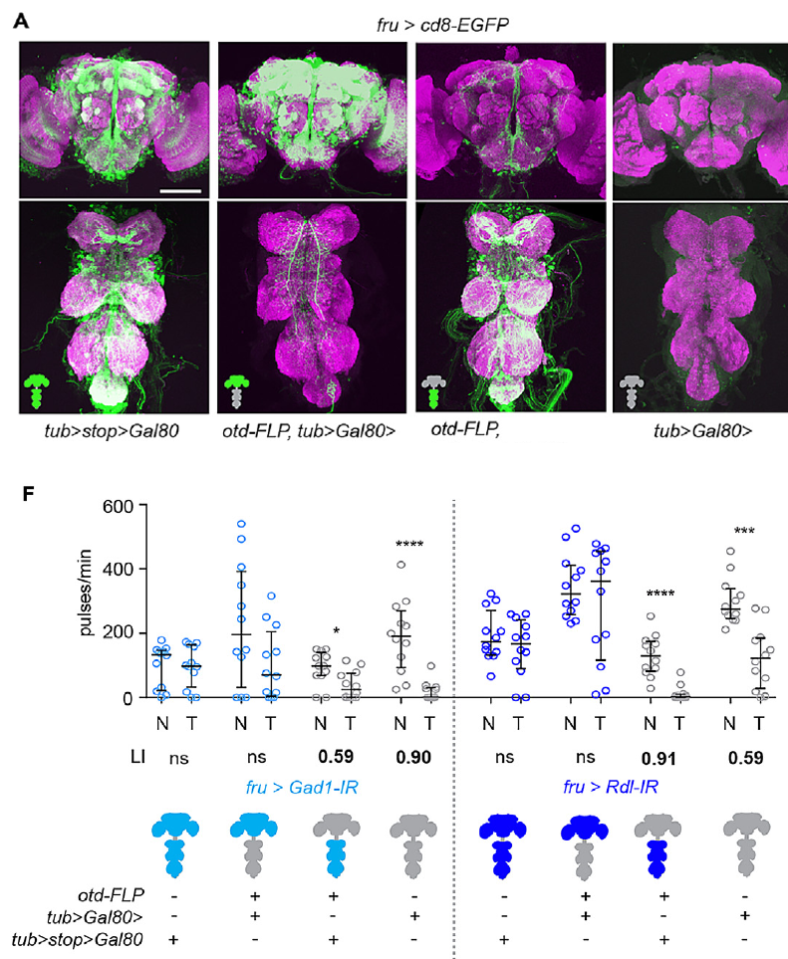
Brain and nerve cord inhibition have distinct functions
Regional restriction separates gene perturbation in the brain from perturbation in the nerve cord. Amin and colleagues used genetic repression and brain-specific recombination, verifying the resulting expression patterns anatomically before interpreting behavior. Each expression pattern is confirmed before its behavior is scored, so the anatomical check comes first in every experiment.
Nerve-cord GAD1 or Rdl knockdown recapitulated bilateral wing extension and abnormal song. Brain-restricted knockdown did not reproduce those motor defects. Brain knockdown instead impaired courtship conditioning after 1 h of exposure to an unreceptive mated female, so the two regions produce different outcomes and each region's effect is scored separately.
Courtship conditioning is a subsequent reduction in courtship after rejection experience. The regional dissociation assigns different inhibitory contributions to motor control and to learned changes in courtship. Each contribution is tied to the region where it was measured, so motor control and conditioning are studied as two outputs and compared with the same knockdown groups.
Amin et al. (2023), Fig. 3A,F. Regional expression and brain versus nerve-cord effects on conditioning.
Amin et al. (2023)
30
Notes:
• **Regional restriction** separates gene perturbation in the brain from perturbation in the nerve cord. Amin and colleagues used genetic repression and brain-specific recombination, verifying the resulting expression patterns anatomically before interpreting behavior.
• Nerve-cord GAD1 or Rdl knockdown recapitulated bilateral wing extension and abnormal song, whereas brain-restricted knockdown did not reproduce those motor defects. Brain knockdown instead impaired courtship conditioning after 1 h of exposure to an unreceptive mated female.
• **Courtship conditioning** is a subsequent reduction in courtship after rejection experience. The regional dissociation supports different inhibitory contributions to motor coordination and experience-dependent suppression. It does not locate a single memory trace or exclude communication between brain and nerve-cord populations during natural courtship.
References:
Amin H, Nolte SS, Swain B, von Philipsborn AC (2023). GABAergic signaling shapes multiple aspects of Drosophila courtship motor behavior. iScience 26(11):108069. https://doi.org/10.1016/j.isci.2023.108069
Figure: Amin et al. (2023), Fig. 3A,F. Regional expression and brain versus nerve-cord effects on conditioning.
Figure source: https://doi.org/10.1016/j.isci.2023.108069

Slide 40
Brain and nerve-cord GABA affect different outputs
Regional restriction separates a perturbation in the brain from a perturbation in the nerve cord. Amin and colleagues confirmed each expression pattern anatomically before scoring behavior, so the region of each effect is known. Each expression pattern is checked before its behavior is measured.
Nerve-cord knockdown reproduced bilateral wing extension and abnormal song. Brain-restricted knockdown did not reproduce those motor defects, and instead impaired courtship conditioning after exposure to an unreceptive mated female. The regional results are compared against the same conditioning test.
The regional dissociation assigns different inhibitory roles to motor control and to learned changes in courtship. Each role is tied to the region where it was measured, so the two outputs are compared with the same knockdown groups. Each region's output is reported separately.
Amin et al. (2023), Fig. 3A,F. Regional expression and brain versus nerve-cord effects on conditioning.
Amin et al. (2023)
30a
Notes:
• Brain and nerve-cord GABA support different outputs.
• Regions.
– Expression was restricted to the brain or nerve cord.
– Each region was confirmed anatomically.
• Nerve cord.
– Nerve-cord knockdown caused bilateral extension.
– Abnormal song followed.
• Brain.
– Brain knockdown impaired courtship conditioning.
– Motor defects were not reproduced.
• Meaning.
– Motor control and conditioning are separate outputs.
– Each is tied to its region.
• Source values.
– The published recordings and measurements come from the original paper.
– Each result is reported with the condition used in the source.
• Why the measure matters.
– The result separates the measured property from the mechanism that produces it.
– The comparison stays within the same flies, cells or recordings.
• Interpretation.
– Each result is read within the genetic background and condition that produced it.
– The claim is restricted to the measured animals and conditions.
• Context.
– The parent figure shows the measurement that the paragraphs describe.
– Each claim is tied to the recordings of the original study.
• Method.
– The measurements follow the methods described in the original paper.
– Each value is kept with the condition under which it was measured.
References:
Amin H, Nolte SS, Swain B, von Philipsborn AC (2023). GABAergic signaling shapes multiple aspects of Drosophila courtship motor behavior. iScience 26(11):108069. https://doi.org/10.1016/j.isci.2023.108069

Slide 41
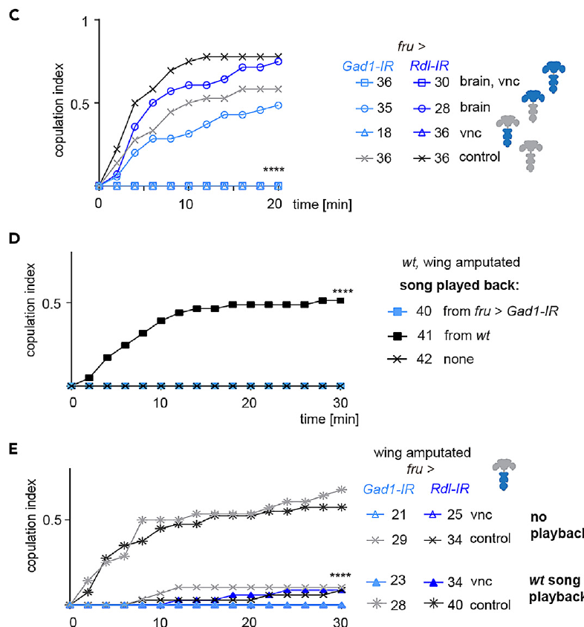
Playback separates song loss from other motor defects
An acoustic playback supplies song without requiring the male to produce it. Amin and colleagues amputated wings and compared mating with normal song playback, abnormal knockdown song playback and no playback. The three conditions use the same males, so the playback condition is the only variable changed, and each male is tested under all three conditions.
Normal song improved copulation in wing-amputated control males during the 30 min assay. Abnormal song did not provide the same rescue. Supplying normal song to males with nerve-cord GAD1 or Rdl knockdown still failed to restore normal mating success, which shows that the knockdown males remain impaired even with song supplied.
The positive control establishes that the playback could compensate for missing wing-generated sound. Failure in the knockdown males therefore implicates additional courtship motor defects beyond the missing song. Each male's copulation is compared with the playback group it belongs to, and the knockdown result is read against the rescued control.
Amin et al. (2023), Fig. 3C–E. Regional mating impairment and acoustic playback controls.
Amin et al. (2023)
31
Notes:
• An **acoustic playback** supplies song without requiring the male to produce it. Amin and colleagues amputated wings and compared mating with normal song playback, abnormal knockdown song playback and no playback.
• Normal song improved copulation in wing-amputated control males during the 30 min assay, whereas abnormal song did not provide the same rescue. Supplying normal song to males with nerve-cord GAD1 or Rdl knockdown still failed to restore normal mating success.
• The positive control establishes that the playback could compensate for missing wing-generated sound. Failure in the knockdown males therefore implicates additional courtship motor defects, rather than permitting the entire mating impairment to be assigned to reduced song quality alone.
References:
Amin H, Nolte SS, Swain B, von Philipsborn AC (2023). GABAergic signaling shapes multiple aspects of Drosophila courtship motor behavior. iScience 26(11):108069. https://doi.org/10.1016/j.isci.2023.108069
Figure: Amin et al. (2023), Fig. 3C–E. Regional mating impairment and acoustic playback controls.
Figure source: https://doi.org/10.1016/j.isci.2023.108069

Slide 42
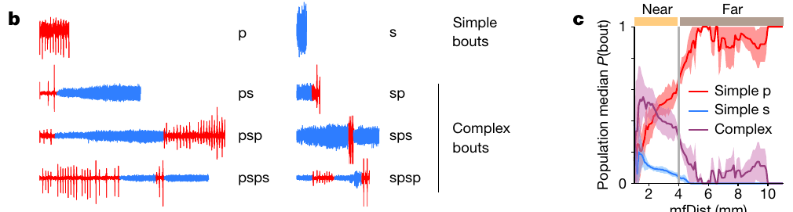
Distance changes the probability of complex song bouts
A simple bout contains one song mode, whereas a complex bout alternates between pulse and sine. Roemschied and colleagues recorded paired flies and classified sequences while retaining the changing distance between male and female. Each bout is assigned to one of these classes, applied to the same recordings, with distance recorded alongside each bout.
Using 4 mm to separate near and far interactions, the authors found that simple pulse bouts comprised more than 95% of far bouts but roughly 55% of near bouts. Complex bouts beginning with pulse contributed about 30% near the female. The near and far groups differ in their bout mix, and each group is scored with the same classes.
The classification exposes context-dependent sequencing within the same two song modes. The 4 mm division is an analytical threshold that sorts bouts into near and far groups. Proximity covaries with angle, tapping and other signals, which are examined on the next slide, and each threshold is applied to every bout in the same way.
Roemschied et al. (2023), Fig. 1b–c. Song sequences and distance-dependent bout probabilities.
Roemschied et al. (2023)
32
Notes:
• A **simple bout** contains one song mode; a **complex bout** alternates between pulse and sine. Roemschied and colleagues recorded paired flies and classified sequences while retaining the changing distance between male and female.
• Using 4 mm to separate near and far interactions, they found that simple pulse bouts comprised more than 95% of far bouts but roughly 55% of near bouts. Complex bouts beginning with pulse contributed about 30% near the female.
• The classification exposes context-dependent sequencing within the same two song modes. The 4 mm division is an analytical threshold rather than evidence for an abrupt sensory boundary, and proximity covaries with angle, tapping and other signals exchanged during courtship.
References:
Roemschied FA, Pacheco DA, Aragon MJ, Ireland EC, Li X, Thieringer K, Pang R, Murthy M (2023). Flexible circuit mechanisms for context-dependent song sequencing. Nature 622(7984):794–801. https://doi.org/10.1038/s41586-023-06632-1
Figure: Roemschied et al. (2023), Fig. 1b–c. Song sequences and distance-dependent bout probabilities.
Figure source: https://doi.org/10.1038/s41586-023-06632-1

Slide 43
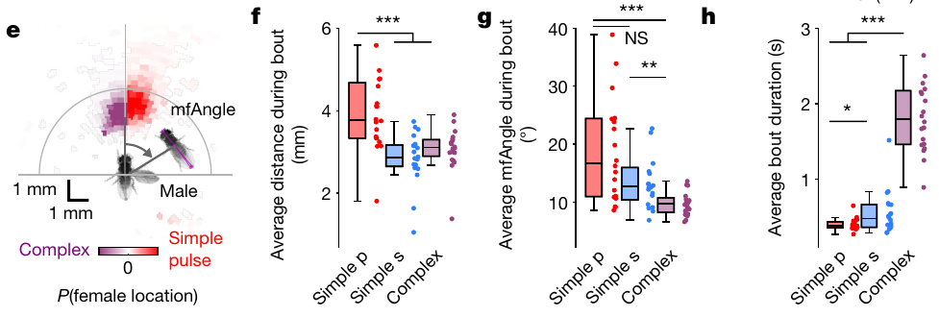
Close frontal interactions favor longer complex bouts
Relative bearing describes the female's position with respect to the male's body axis. Roemschied and colleagues compared that position, inter-fly distance and bout duration across simple pulse, simple sine and complex bouts. The three measures are recorded for each bout, so each bout type is compared on the same three measures.
Complex bouts tended to occur when the female was closer and more directly in front of the male. Their duration was longer than that of simple bouts, with the reported distributions spanning about 0 to 3 s. Close frontal positions go with longer complex bouts, and the duration difference is clear across the distributions.
The relationship connects the organization of song with the geometry of the interaction. Close frontal positioning also increases opportunities for contact and changes visual motion, so the geometry is read alongside those factors. Each bout is described by where the female stands, and position and song are linked in the same records.
Roemschied et al. (2023), Fig. 1e–h. Female position and the duration of simple and complex bouts.
Roemschied et al. (2023)
33
Notes:
• **Relative bearing** describes the female’s position with respect to the male’s body axis. Roemschied and colleagues compared that position, inter-fly distance and duration across simple pulse, simple sine and complex bouts.
• Complex bouts tended to occur when the female was closer and more directly in front of the male. Their duration was longer than that of simple bouts, with the reported distributions spanning approximately 0–3 s.
• The relationship connects the organization of song with the geometry of the interaction. It does not establish that angle alone triggers a specific sequence, because close frontal positioning also increases opportunities for contact and changes visual motion, chemical sampling and locomotor state.
References:
Roemschied FA, Pacheco DA, Aragon MJ, Ireland EC, Li X, Thieringer K, Pang R, Murthy M (2023). Flexible circuit mechanisms for context-dependent song sequencing. Nature 622(7984):794–801. https://doi.org/10.1038/s41586-023-06632-1
Figure: Roemschied et al. (2023), Fig. 1e–h. Female position and the duration of simple and complex bouts.
Figure source: https://doi.org/10.1038/s41586-023-06632-1

Slide 44
Complex bouts follow frontal female positions
Relative bearing describes where the female stands with respect to the male's body axis. Roemschied and colleagues compared bearing, inter-fly distance and bout duration for simple pulse, simple sine and complex bouts, so the geometry of each bout is recorded. Each bout is scored for its bearing, distance and duration.
Complex bouts occurred more often when the female was closer and more directly in front of the male. Their duration was longer than that of simple bouts, with distributions spanning about 0 to 3 s. The distributions are compared across the three bout types.
Close frontal positions also increase opportunities for contact and change visual motion. The geometry is therefore read together with those factors, and each bout is described by the female's position at the time it occurred. Each bout's geometry is recorded alongside its song.
Roemschied et al. (2023), Fig. 1e–h. Female position and the duration of simple and complex bouts.
Roemschied et al. (2023)
33a
Notes:
• Complex bouts are associated with frontal female positions.
• Bearing.
– Relative bearing is the female's position on the male's axis.
– It is recorded for each bout.
• Complex bouts.
– They occurred more often in close, frontal positions.
– Their duration was longer.
• Duration.
– Distributions spanned about 0 to 3 s.
– Simple bouts were shorter.
• Meaning.
– Geometry is linked to song sequencing.
– Contact and visual motion are also involved.
• Source values.
– The published recordings and measurements come from the original paper.
– Each result is reported with the condition used in the source.
• Why the measure matters.
– The result separates the measured property from the mechanism that produces it.
– The comparison stays within the same flies, cells or recordings.
• Interpretation.
– Each result is read within the genetic background and condition that produced it.
– The claim is restricted to the measured animals and conditions.
• Context.
– The parent figure shows the measurement that the paragraphs describe.
– Each claim is tied to the recordings of the original study.
• Method.
– The measurements follow the methods described in the original paper.
– Each value is kept with the condition under which it was measured.
References:
Roemschied FA, Pacheco DA, Aragon MJ, Ireland EC, Li X, Thieringer K, Pang R, Murthy M (2023). Flexible circuit mechanisms for context-dependent song sequencing. Nature 622(7984):794–801. https://doi.org/10.1038/s41586-023-06632-1

Slide 45
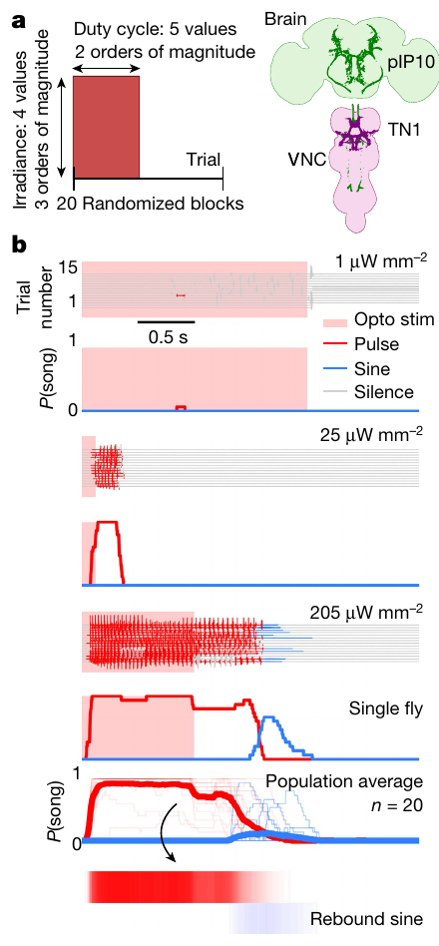
Optogenetic drive can produce delayed sine song
Optogenetics uses a light-sensitive protein to alter neuronal activity. Roemschied and colleagues expressed the red-light-gated cation channel CsChrimson in song-promoting neurons and varied stimulus intensity and duty cycle. Each protocol is tested in the same males, the stimulus strength is recorded for each trial, and the activation can be matched to the song produced.
Activation of descending pIP10 in solitary males primarily drove pulse song during stimulation. Strong stimulation could be followed by sine song after light offset. Example irradiances ranged from 1 to 205 µW/mm², so the response is tested across a range of activation strengths, and each strength produces its own song pattern.
Rebound activity is activity that occurs after removal of a preceding suppressive influence. Delayed sine production is consistent with a rebound-capable network. Each delayed sine bout is timed from light offset, so the rebound is measured directly, and sine that follows the stimulus is tied to its cause.
Roemschied et al. (2023), Fig. 2a–b. Optogenetic protocol and song during and after activation.
Roemschied et al. (2023)
34
Notes:
• **Optogenetics** uses a light-sensitive protein to alter neuronal activity. Roemschied and colleagues expressed the red-light-gated cation channel **CsChrimson** in song-promoting neurons and varied stimulus intensity and duty cycle.
• Activation of descending pIP10 in solitary males primarily drove pulse song during stimulation. Strong stimulation could be followed by sine song after light offset; example irradiances ranged from 1 to 205 µW/mm² rather than using only one activation strength.
• **Rebound activity** is activity occurring after removal of a preceding suppressive influence. Delayed sine production is consistent with a rebound-capable network, but the behavioral timing alone does not measure inhibition directly or identify which neuron carries the relevant membrane current.
References:
Roemschied FA, Pacheco DA, Aragon MJ, Ireland EC, Li X, Thieringer K, Pang R, Murthy M (2023). Flexible circuit mechanisms for context-dependent song sequencing. Nature 622(7984):794–801. https://doi.org/10.1038/s41586-023-06632-1
Figure: Roemschied et al. (2023), Fig. 2a–b. Optogenetic protocol and song during and after activation.
Figure source: https://doi.org/10.1038/s41586-023-06632-1

Slide 46
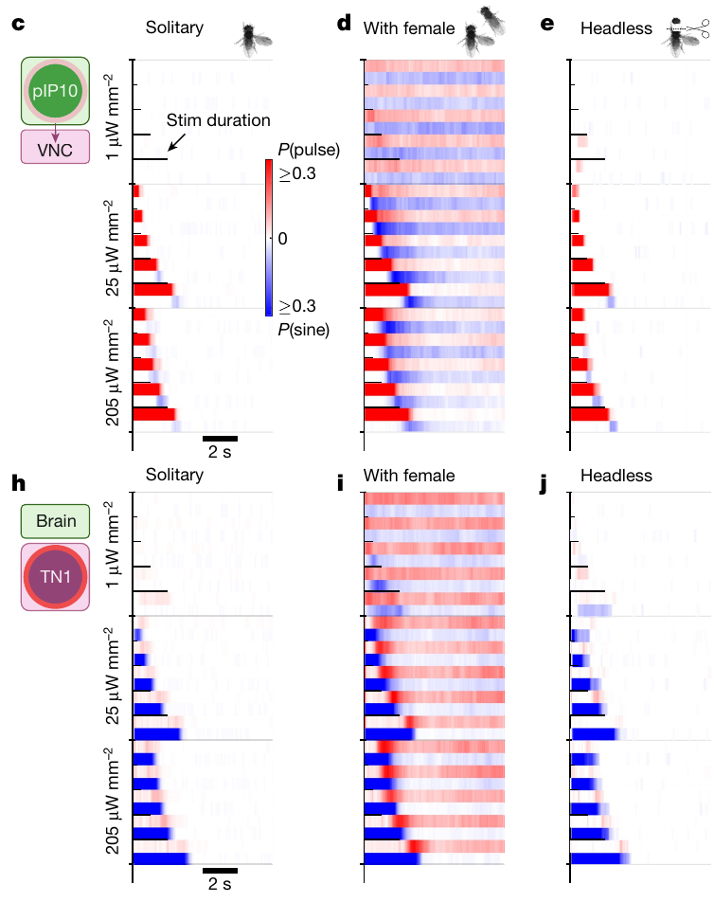
Female context changes the response to descending drive
A fixed neural stimulation can produce different outputs depending on the animal's context. Roemschied and colleagues activated pIP10 in solitary males, in males paired with a female, and in headless males. Song during and after the same stimulation protocol was compared across the three groups, and the stimulation is held constant across all groups.
Stimulus duration was varied over an 8 s range. Female-paired males produced longer and more reliable complex bouts than solitary males. Headless males could still produce rebound sine, which places a sufficient rebound-generating mechanism within the nerve cord. Each group is compared on the same duration scale, and the headless result shows a local capacity for rebound.
The contrast supports modulation of thoracic circuitry by signals associated with a female. Headless output establishes a retained local capacity under artificial activation. Each group's song is matched to the same stimulation, so the female effect is isolated, and the paired and solitary results are placed side by side.
Roemschied et al. (2023), Fig. 2c–e,h–j. pIP10 and TN1 activation in solitary, paired and headless males.
Roemschied et al. (2023)
35
Notes:
• A fixed neural stimulation can produce different outputs depending on the animal’s context. Roemschied and colleagues activated pIP10 in solitary males, males paired with a female and headless males, comparing song during and after the same stimulation protocol.
• Stimulus duration was varied over an 8 s range. Female-paired males produced longer and more reliable complex bouts than solitary males. Headless males could still produce rebound sine, placing a sufficient rebound-generating mechanism within the nerve cord.
• The contrast supports modulation of thoracic circuitry by signals associated with a female. Headless output establishes a retained local capacity under artificial activation; it does not establish that the intact brain is dispensable for natural initiation, partner tracking or normal courtship sequencing.
References:
Roemschied FA, Pacheco DA, Aragon MJ, Ireland EC, Li X, Thieringer K, Pang R, Murthy M (2023). Flexible circuit mechanisms for context-dependent song sequencing. Nature 622(7984):794–801. https://doi.org/10.1038/s41586-023-06632-1
Figure: Roemschied et al. (2023), Fig. 2c–e,h–j. pIP10 and TN1 activation in solitary, paired and headless males.
Figure source: https://doi.org/10.1038/s41586-023-06632-1

Slide 47
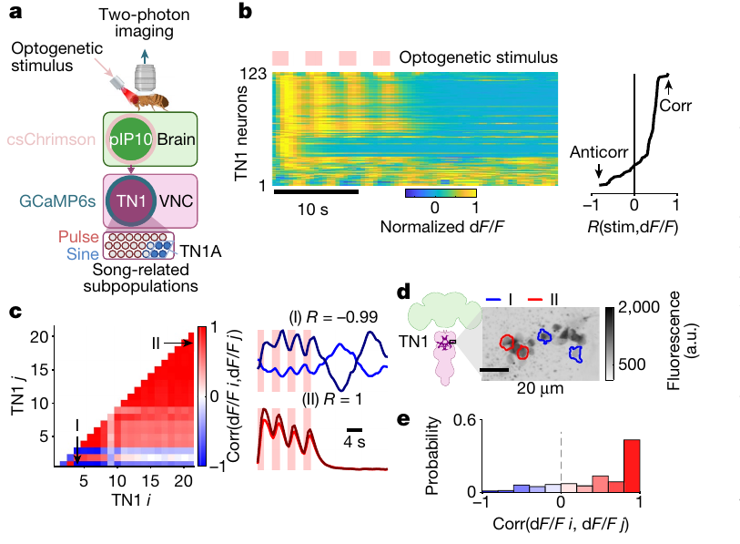
TN1 populations contain opposing activity dynamics
TN1 neurons form a heterogeneous thoracic population associated with wing neuropil. Roemschied and colleagues combined pIP10 optogenetic stimulation with two-photon imaging of a calcium-sensitive fluorescent protein in TN1 neurons. Each neuron is imaged during the same stimulation, and the response of each cell is recorded separately so that individual cells can be compared.
Individual neurons responded differently to repeated stimulation. Some calcium signals tracked the stimulus, whereas others were anticorrelated and peaked after stimulus removal. The recordings retained response timing over seconds and anatomical locations at a 20 µm scale, and both groups are shown on the same time axis.
Calcium imaging reports changes in intracellular calcium through fluorescence rather than measuring membrane voltage directly. Opposing response dynamics support functional subdivision within TN1. Each subgroup is defined by its response timing, which places the two groups in different roles, and the subdivision rests on the same imaging record.
Roemschied et al. (2023), Fig. 3a–e. The recording preparation and diverse TN1 calcium dynamics.
Roemschied et al. (2023)
36
Notes:
• **TN1 neurons** form a heterogeneous thoracic population associated with wing neuropil. Roemschied and colleagues combined pIP10 optogenetic stimulation with two-photon imaging of a calcium-sensitive fluorescent protein in TN1 neurons.
• Individual neurons responded differently to repeated stimulation: some calcium signals tracked the stimulus, whereas others were anticorrelated and peaked after stimulus removal. The recordings retained response timing over seconds and anatomical locations with a 20 µm scale.
• **Calcium imaging** reports changes in intracellular calcium through fluorescence, rather than measuring membrane voltage directly. Opposing response dynamics support functional subdivisions within TN1, but anticorrelation does not independently prove that the recorded cells inhibit each other through direct reciprocal synapses.
References:
Roemschied FA, Pacheco DA, Aragon MJ, Ireland EC, Li X, Thieringer K, Pang R, Murthy M (2023). Flexible circuit mechanisms for context-dependent song sequencing. Nature 622(7984):794–801. https://doi.org/10.1038/s41586-023-06632-1
Figure: Roemschied et al. (2023), Fig. 3a–e. The recording preparation and diverse TN1 calcium dynamics.
Figure source: https://doi.org/10.1038/s41586-023-06632-1

Slide 48
TN1 neurons show opposing calcium dynamics
Calcium imaging reports changes in intracellular calcium through fluorescence. Roemschied and colleagues combined pIP10 optogenetic stimulation with two-photon imaging in TN1 neurons, so each cell's response is recorded during the same stimulation. Each cell's response is aligned to the same stimulation protocol.
Some TN1 calcium signals tracked the stimulus. Others were anticorrelated and peaked after the stimulus was removed. The recordings kept response timing over several seconds and anatomical positions at a 20 µm scale. The two response types are compared across the same trials.
The opposing dynamics support a functional subdivision within TN1. Each subgroup is defined by its response timing, which places the two groups in different roles in the wing circuit. Each subgroup is then compared with the others in the same recordings.
Roemschied et al. (2023), Fig. 3a–e. The recording preparation and diverse TN1 calcium dynamics.
Roemschied et al. (2023)
36a
Notes:
• TN1 neurons respond with opposing dynamics.
• Imaging.
– Calcium signals are read through fluorescence.
– Each cell is recorded individually.
• Tracking.
– Some signals followed the stimulus.
– Others peaked after it ended.
• Scale.
– Timing was kept over seconds.
– The 20 µm scale locates each response.
• Meaning.
– TN1 contains functionally distinct subgroups.
– Timing defines each group.
• Source values.
– The published recordings and measurements come from the original paper.
– Each result is reported with the condition used in the source.
• Why the measure matters.
– The result separates the measured property from the mechanism that produces it.
– The comparison stays within the same flies, cells or recordings.
• Interpretation.
– Each result is read within the genetic background and condition that produced it.
– The claim is restricted to the measured animals and conditions.
• Context.
– The parent figure shows the measurement that the paragraphs describe.
– Each claim is tied to the recordings of the original study.
• Method.
– The measurements follow the methods described in the original paper.
– Each value is kept with the condition under which it was measured.
References:
Roemschied FA, Pacheco DA, Aragon MJ, Ireland EC, Li X, Thieringer K, Pang R, Murthy M (2023). Flexible circuit mechanisms for context-dependent song sequencing. Nature 622(7984):794–801. https://doi.org/10.1038/s41586-023-06632-1

Slide 49
Ih and GABA reception contribute to complex sequencing
Ih is a hyperpolarization-activated cation current that can facilitate renewed excitability after inhibition. Hyperpolarization makes the membrane potential more negative. Activation of such a current can oppose that change and contribute to rebound after the inhibitory input ends, so the current links inhibition to renewed firing.
Roemschied and colleagues found that males lacking Ih sang predominantly simple pulse bouts even near a female. Reducing Ih or the GABA receptor Rdl in TN1 neurons also reduced complexity. These effects complement the second-scale calcium responses after pIP10 stimulation, and both manipulations reduce the complex bouts.
The convergence supports an inhibitory and rebound contribution to sequencing. The inhibitory intermediary neurons are proposed from these results. Each proposed contribution is linked to a measured manipulation in TN1, so the model stays tied to the data, and each piece of the model traces back to a measurement.
Roemschied et al. (2023), Fig. 3a–e. The recording preparation and diverse TN1 calcium dynamics.
Roemschied et al. (2023); Amin et al. (2023)
37
Notes:
• **Ih** is a hyperpolarization-activated cation current that can facilitate renewed excitability after inhibition. **Hyperpolarization** makes the membrane potential more negative; activation of such a current can oppose that change and contribute to rebound after the inhibitory input ends.
• Roemschied and colleagues found that males lacking Ih sang predominantly simple pulse bouts even near a female. Reducing Ih or the GABA receptor Rdl in TN1 neurons also reduced complexity, complementing second-scale calcium responses after pIP10 stimulation.
• The convergence supports an inhibitory and rebound contribution to sequencing. The exact inhibitory intermediary neurons were proposed rather than identified conclusively, and a channel requirement does not imply that one membrane current alone generates every pulse–sine transition.
References:
Roemschied FA, Pacheco DA, Aragon MJ, Ireland EC, Li X, Thieringer K, Pang R, Murthy M (2023). Flexible circuit mechanisms for context-dependent song sequencing. Nature 622(7984):794–801. https://doi.org/10.1038/s41586-023-06632-1
Amin H, Nolte SS, Swain B, von Philipsborn AC (2023). GABAergic signaling shapes multiple aspects of Drosophila courtship motor behavior. iScience 26(11):108069. https://doi.org/10.1016/j.isci.2023.108069
Figure: Roemschied et al. (2023), Fig. 3a–e. The recording preparation and diverse TN1 calcium dynamics.
Figure source: https://doi.org/10.1038/s41586-023-06632-1

Slide 50
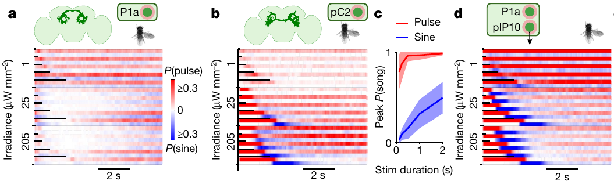
Sensory input and courtship state interact in song control
pC2 neurons integrate visual and auditory signals, while P1a is a courtship-related subset of P1 neurons. Roemschied and colleagues activated these populations separately and together with descending pIP10 to examine how brain input changes song sequencing. Each population is tested alone and in combination, and the combined activation is compared against each single population.
Joint P1a and pIP10 activation produced long complex bouts beyond those obtained from either population alone. pC2 activation could produce pulse followed by rebound sine. Longer stimulation increased rebound output over stimulus durations up to about 2 s, and each rebound is timed from the end of the stimulus.
The authors proposed functional disinhibition of a rebound-capable nerve-cord network. Disinhibition reduces an inhibitory influence on another element. The combined activation shows how brain input can release that network, so each contribution is tested by its own stimulus, and the release is measured through the rebound song.
Roemschied et al. (2023), Fig. 4a–d. P1a, pC2 and combined P1a–pIP10 stimulation affect song sequencing.
Roemschied et al. (2023)
38
Notes:
• **pC2 neurons** integrate visual and auditory signals, while **P1a** is a courtship-related subset of P1 neurons. Roemschied and colleagues activated these populations separately and together with descending pIP10 to examine how brain input changes song sequencing.
• Joint P1a and pIP10 activation produced long complex bouts beyond those obtained from either population alone. pC2 activation could produce pulse followed by rebound sine, and longer stimulation increased rebound output over stimulus durations up to approximately 2 s.
• The authors proposed functional disinhibition of a rebound-capable nerve-cord network. **Disinhibition** reduces an inhibitory influence on another element. The combined activation supports interaction between brain pathways, but the proposed inhibitory implementation remains distinct from direct identification of every intervening synapse.
References:
Roemschied FA, Pacheco DA, Aragon MJ, Ireland EC, Li X, Thieringer K, Pang R, Murthy M (2023). Flexible circuit mechanisms for context-dependent song sequencing. Nature 622(7984):794–801. https://doi.org/10.1038/s41586-023-06632-1
Figure: Roemschied et al. (2023), Fig. 4a–d. P1a, pC2 and combined P1a–pIP10 stimulation affect song sequencing.
Figure source: https://doi.org/10.1038/s41586-023-06632-1

Slide 51
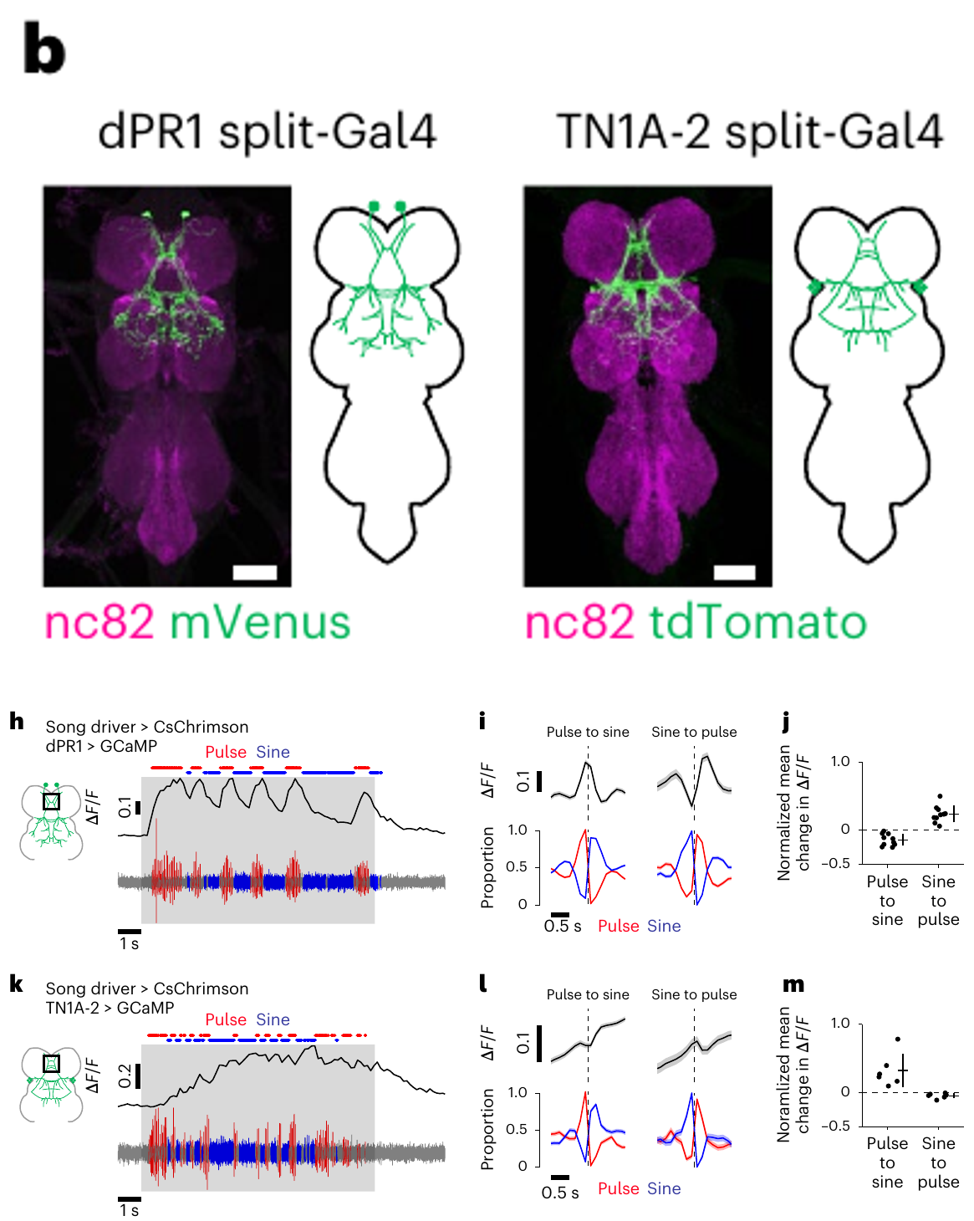
Singing engages nested rather than disjoint populations
Nested activation means that one active population includes another as a subset. Shiozaki and colleagues imaged identified nerve-cord neurons while flies alternated pulse and sine. Wing vibration was preserved by attaching parts of the legs instead of immobilizing the thorax, so each neuron is imaged during the song it produces.
dPR1 calcium signals preferred pulse and declined during sine. TN1A-2 signals remained active during both modes, with stronger activity during sine. Response changes were aligned around transitions on a 0.5 s timescale, which reveals the timing of each change, and each neuron is compared with the same transition.
The observations support shared circuit participation with an additional pulse-related population. They challenge a simple picture of two completely separate song circuits. The pulse and sine populations overlap in a defined way, which is the basis of the nested model, and the overlap is measured from the same imaging record.
Shiozaki et al. (2024), Fig. 1b,h–m. dPR1 and TN1A-2 anatomy and calcium signals across song types.
Shiozaki et al. (2024)
39
Notes:
• **Nested activation** means that one active population includes another as a subset. Shiozaki and colleagues imaged identified nerve-cord neurons while flies alternated pulse and sine, preserving wing vibration by attaching parts of the legs instead of immobilizing the thorax.
• dPR1 calcium signals preferred pulse and declined during sine. TN1A-2 signals remained active during both modes, with stronger activity during sine. Response changes were aligned around transitions on a 0.5 s timescale rather than inferred solely from activation-induced song.
• The observations support shared circuit participation with an additional pulse-related population. They challenge a simple picture of two completely separate inactive-versus-active populations, but fluorescence measurements do not exclude inhibitory interactions or resolve the precise spike pattern within each individual pulse.
References:
Shiozaki HM, Wang K, Lillvis JL, Xu M, Dickson BJ, Stern DL (2024). Activity of nested neural circuits drives different courtship songs in Drosophila. Nature Neuroscience 27(10):1954–1965. https://doi.org/10.1038/s41593-024-01738-9
Figure: Shiozaki et al. (2024), Fig. 1b,h–m. dPR1 and TN1A-2 anatomy and calcium signals across song types.
Figure source: https://doi.org/10.1038/s41593-024-01738-9

Slide 52
Nested populations share nerve-cord circuitry
A nested activation pattern means that one active population includes another as a subset. Shiozaki and colleagues imaged identified nerve-cord neurons while flies alternated pulse and sine, with wing vibration preserved by attaching parts of the legs. Each neuron is compared with the other recorded classes.
dPR1 signals preferred pulse, whereas TN1A-2 signals remained active during both modes and were stronger during sine. The responses were aligned around transitions on a 0.5 s timescale, so the timing of each change is visible. The transitions are compared in the same recordings.
The observations support shared circuit participation with an additional pulse-related population. The pulse and sine populations overlap in a defined way, which is the basis of the nested model. Each population is then placed within the nested framework.
Shiozaki et al. (2024), Fig. 1b,h–m. dPR1 and TN1A-2 anatomy and calcium signals across song types.
Shiozaki et al. (2024)
39a
Notes:
• Pulse and sine populations overlap in the nerve cord.
• Nesting.
– One population includes another as a subset.
– The overlap is defined by activity.
• dPR1.
– dPR1 preferred pulse and declined during sine.
– It is a pulse-associated population.
• TN1A-2.
– TN1A-2 stayed active in both modes.
– It was stronger during sine.
• Alignment.
– Responses were aligned to transitions.
– The timescale is 0.5 s.
• Meaning.
– Shared participation links the two modes.
– The nested model follows.
• Source values.
– The published recordings and measurements come from the original paper.
– Each result is reported with the condition used in the source.
• Why the measure matters.
– The result separates the measured property from the mechanism that produces it.
– The comparison stays within the same flies, cells or recordings.
• Interpretation.
– Each result is read within the genetic background and condition that produced it.
– The claim is restricted to the measured animals and conditions.
• Context.
– The parent figure shows the measurement that the paragraphs describe.
– Each claim is tied to the recordings of the original study.
• Method.
– The measurements follow the methods described in the original paper.
– Each value is kept with the condition under which it was measured.
References:
Shiozaki HM, Wang K, Lillvis JL, Xu M, Dickson BJ, Stern DL (2024). Activity of nested neural circuits drives different courtship songs in Drosophila. Nature Neuroscience 27(10):1954–1965. https://doi.org/10.1038/s41593-024-01738-9

Slide 53
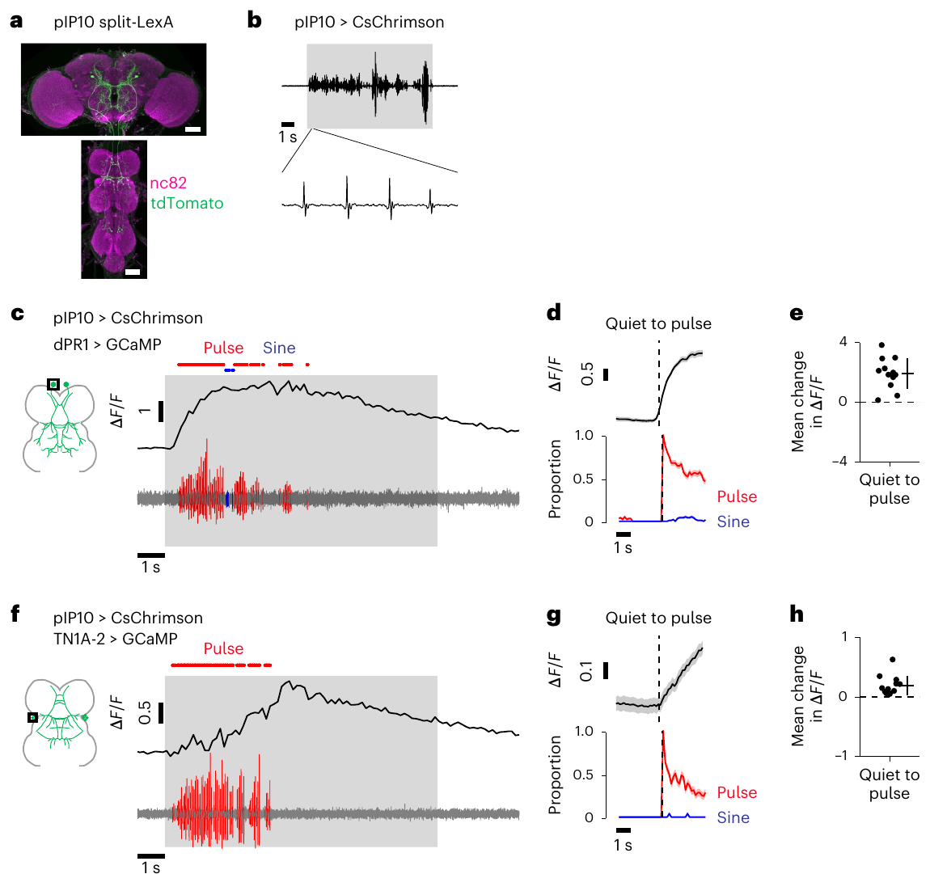
pIP10 recruits both pulse- and sine-associated neurons
Descending input can recruit a shared thoracic population even when the behavioral output is predominantly pulse. Shiozaki and colleagues activated pIP10 with CsChrimson while measuring calcium in dPR1 and TN1A-2. Both neuron types were tracked in the same animals, so the shared recruitment is measured in each animal.
Both populations increased calcium signals during pIP10-induced pulse song. The recordings retain a 1 s scale and neuronal labeling, which links the evoked sound to measured activity in anatomically identified nerve-cord classes. The sound and the activity are recorded together, and each class is identified by its anatomy.
TN1A-2 activity during pulse is therefore evidence that a neuron can take part in more than one mode. A neuron capable of promoting one mode when artificially activated can also participate in another mode within the intact network. Each pattern is matched to its own activity record, so the same neuron is followed through both modes.
Shiozaki et al. (2024), Fig. 2a–h. Nerve cord responses during pIP10-driven pulse song.
Shiozaki et al. (2024)
40
Notes:
• Descending input can recruit a shared thoracic population even when the behavioral output is predominantly pulse. Shiozaki and colleagues activated pIP10 with CsChrimson while measuring calcium in dPR1 and TN1A-2.
• Both populations increased calcium signals during pIP10-induced pulse song. The source recordings retain a 1 s scale and neuronal labeling, linking the evoked sound to measured activity in anatomically identified nerve-cord classes.
• TN1A-2 activity during pulse is therefore not evidence that sine must also be audible at that moment. A neuron capable of promoting one mode when artificially activated can participate in another mode within the intact network; sufficiency experiments and natural activity require separate interpretation.
References:
Shiozaki HM, Wang K, Lillvis JL, Xu M, Dickson BJ, Stern DL (2024). Activity of nested neural circuits drives different courtship songs in Drosophila. Nature Neuroscience 27(10):1954–1965. https://doi.org/10.1038/s41593-024-01738-9
Figure: Shiozaki et al. (2024), Fig. 2a–h. Nerve cord responses during pIP10-driven pulse song.
Figure source: https://doi.org/10.1038/s41593-024-01738-9

Slide 54
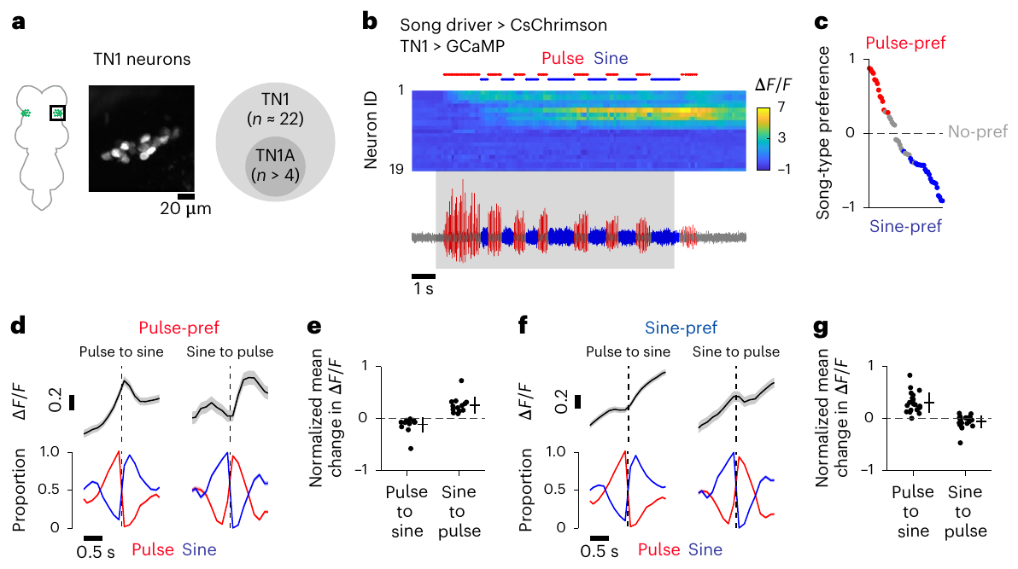
Song preferences differ across the TN1 population
A heterogeneous neuronal class can contain subpopulations with different activity preferences. Shiozaki and colleagues imaged broader TN1 populations during alternating song, comparing calcium signals aligned to the transitions between pulse and sine. Each neuron is aligned to the same transition, and the alignment is the basis of the comparison.
The sampled nerve-cord region contains about 22 TN1 neurons per hemisphere. Pulse-preferring neurons decreased their signals during sine, whereas sine-preferring neurons remained active during pulse as well. Transition analyses retained a 0.5 s timescale, so both subgroups are tracked on the same timescale and defined by their response pattern.
The asymmetry extends nested participation beyond one labeled pair of classes. It shows that TN1 contains neurons with different song preferences. Each neuron's preference is assigned from its aligned responses, which makes the population map concrete, and each population is placed in the same framework.
Shiozaki et al. (2024), Fig. 3a–g. TN1 population activity and song preferences.
Shiozaki et al. (2024)
41
Notes:
• A heterogeneous neuronal class can contain subpopulations with different activity preferences. Shiozaki and colleagues imaged broader TN1 populations during alternating song, comparing calcium signals aligned to the transitions between pulse and sine.
• The sampled nerve-cord region contains approximately 22 TN1 neurons per hemisphere. Pulse-preferring neurons decreased their signals during sine, whereas sine-preferring neurons remained active during pulse as well. Transition analyses retained a 0.5 s timescale.
• The asymmetry extends nested participation beyond one labeled pair of classes. It does not make every TN1 neuron functionally identical, and limited temporal resolution means that shared calcium elevation can conceal differences in spike timing, transmitter release and the strength of each neuron’s contribution to wing muscles.
References:
Shiozaki HM, Wang K, Lillvis JL, Xu M, Dickson BJ, Stern DL (2024). Activity of nested neural circuits drives different courtship songs in Drosophila. Nature Neuroscience 27(10):1954–1965. https://doi.org/10.1038/s41593-024-01738-9
Figure: Shiozaki et al. (2024), Fig. 3a–g. TN1 population activity and song preferences.
Figure source: https://doi.org/10.1038/s41593-024-01738-9

Slide 55
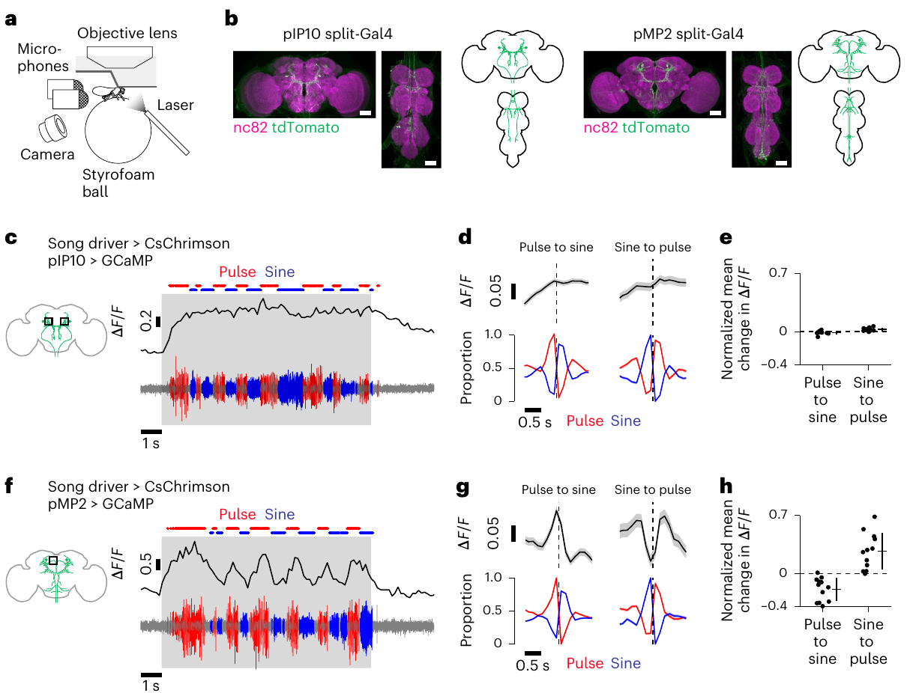
Descending pathways differ in song dynamics
pMP2 is another descending neuron class connecting brain and nerve cord. Shiozaki and colleagues compared its activity with pIP10 while recording song and calcium signals from the brain during alternating pulse and sine. Both classes are recorded during the same song sequence, so their activity is compared on one timeline.
pIP10 remained active during both song modes, whereas pMP2 showed pulse-selective activity. The pMP2 activity increased at sine-to-pulse transitions and declined at pulse-to-sine transitions. The aligned measurements retain a 0.5 s transition scale, and each transition is measured in both pathways.
The findings support differential input to the thoracic network rather than a single constant descending command for every song mode. Each descending pathway contributes according to its own dynamics. The labeled anatomy identifies which pathway carries each pattern, and the assignment follows the aligned records.
Shiozaki et al. (2024), Fig. 6a–h. Parallel descending pathways have different song-related calcium dynamics.
Shiozaki et al. (2024)
42
Notes:
• **pMP2** is another descending neuron class connecting brain and nerve cord. Shiozaki and colleagues compared its activity with pIP10 while recording song and calcium signals from the brain during alternating pulse and sine.
• pIP10 remained active during both song modes, whereas pMP2 showed pulse-selective activity that increased at sine-to-pulse transitions and declined at pulse-to-sine transitions. The aligned measurements retain a 0.5 s transition scale and labeled descending anatomy.
• The findings support differential input to the thoracic network rather than a single constant descending command for every song mode. They do not establish that either pathway exclusively determines behavior, because sensory context, other descending neurons and the ongoing nerve-cord state remain available to influence the output.
References:
Shiozaki HM, Wang K, Lillvis JL, Xu M, Dickson BJ, Stern DL (2024). Activity of nested neural circuits drives different courtship songs in Drosophila. Nature Neuroscience 27(10):1954–1965. https://doi.org/10.1038/s41593-024-01738-9
Figure: Shiozaki et al. (2024), Fig. 6a–h. Parallel descending pathways have different song-related calcium dynamics.
Figure source: https://doi.org/10.1038/s41593-024-01738-9

Slide 56
pMP2 and pIP10 carry different song dynamics
pMP2 is a descending neuron class that connects the brain and nerve cord. Shiozaki and colleagues recorded its calcium activity alongside pIP10 while flies alternated pulse and sine, so both pathways are compared on one timeline. The two pathways are imaged together in each fly.
pIP10 remained active during both song modes. pMP2 was pulse-selective, increasing at sine-to-pulse transitions and declining at pulse-to-sine transitions. Each transition is measured in both pathways on the same 0.5 s scale. Each transition is compared across both pathways.
The two pathways provide differential input to the thoracic network. Each descending pathway contributes according to its own dynamics, and the labeled anatomy identifies which pathway carries each pattern. The assignment of each pathway to its song mode is made from the same records.
Shiozaki et al. (2024), Fig. 6a–h. Parallel descending pathways have different song-related calcium dynamics.
Shiozaki et al. (2024)
42a
Notes:
• Two descending pathways carry different song dynamics.
• Pathways.
– pMP2 and pIP10 both connect brain and nerve cord.
– They were recorded together.
• pIP10.
– pIP10 stayed active during both modes.
– It did not change with the transitions.
• pMP2.
– pMP2 was pulse-selective.
– It rose at sine-to-pulse transitions.
• Timing.
– Transitions were aligned on a 0.5 s scale.
– Both pathways share the scale.
• Meaning.
– Descending input differs by pathway.
– No single command drives every mode.
• Source values.
– The published recordings and measurements come from the original paper.
– Each result is reported with the condition used in the source.
• Why the measure matters.
– The result separates the measured property from the mechanism that produces it.
– The comparison stays within the same flies, cells or recordings.
• Interpretation.
– Each result is read within the genetic background and condition that produced it.
– The claim is restricted to the measured animals and conditions.
• Context.
– The parent figure shows the measurement that the paragraphs describe.
– Each claim is tied to the recordings of the original study.
• Method.
– The measurements follow the methods described in the original paper.
– Each value is kept with the condition under which it was measured.
References:
Shiozaki HM, Wang K, Lillvis JL, Xu M, Dickson BJ, Stern DL (2024). Activity of nested neural circuits drives different courtship songs in Drosophila. Nature Neuroscience 27(10):1954–1965. https://doi.org/10.1038/s41593-024-01738-9

Slide 57
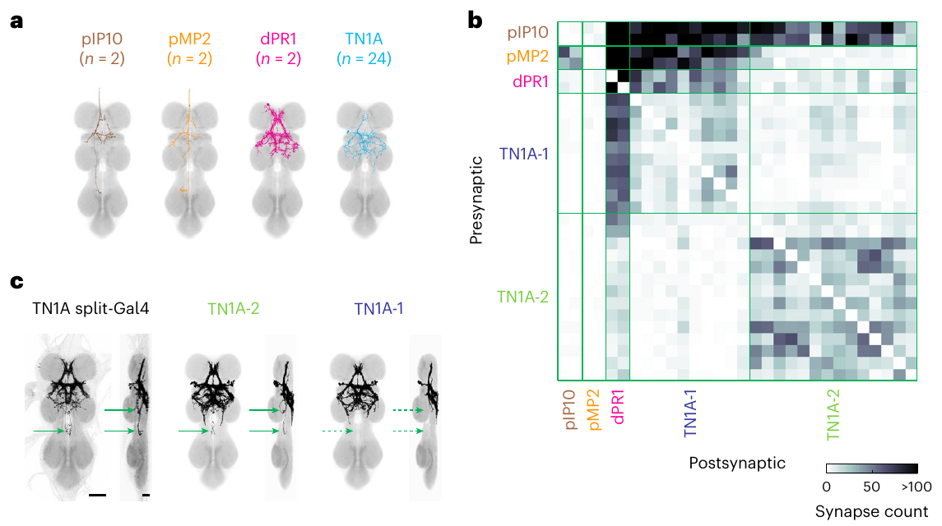
Connectomics distinguishes shared and selective inputs
Connectomics reconstructs neurons and their synaptic contacts from electron microscopy. Shiozaki and colleagues matched descending and thoracic song-related classes to reconstructed neurons, separating TN1A into two connectivity-defined subgroups. The subgroups are defined by their synaptic inputs, and each reconstructed neuron is matched to its class on a 50 µm scale.
pIP10 and pMP2 provided inputs to pulse-associated dPR1 and TN1A-1 neurons, whereas TN1A-2 had different input relationships. The reconstructed anatomy preserves the 50 µm scale. Synapse counts quantify contacts directly, so each connection is counted from the reconstruction, and the counts give the direct measure.
These neurons were classified as cholinergic and are therefore likely excitatory. Acetylcholine is the transmitter indicated by that classification. Each connection is read as an excitatory input, which is consistent with the pulse-related activity, and the transmitter classification is applied to each neuron.
Shiozaki et al. (2024), Fig. 8a–c. Electron-microscopy reconstructions and song-circuit synaptic connectivity.
Shiozaki et al. (2024)
43
Notes:
• **Connectomics** reconstructs neurons and their synaptic contacts from electron microscopy. Shiozaki and colleagues matched descending and thoracic song-related classes to reconstructed neurons, separating TN1A into two connectivity-defined subgroups.
• pIP10 and pMP2 provided inputs to pulse-associated dPR1 and TN1A-1 neurons, whereas TN1A-2 had different input relationships. The reconstructed anatomy preserves a 50 µm scale, and synapse counts quantify contacts rather than relying on light-microscopic arbor overlap.
• These neurons were classified as cholinergic and therefore likely excitatory. **Acetylcholine** is the transmitter indicated by that classification; actual effect still depends on the postsynaptic receptor. Structural contacts strengthen a circuit account but do not alone measure synaptic efficacy, receptor subtype or activity during each song transition.
References:
Shiozaki HM, Wang K, Lillvis JL, Xu M, Dickson BJ, Stern DL (2024). Activity of nested neural circuits drives different courtship songs in Drosophila. Nature Neuroscience 27(10):1954–1965. https://doi.org/10.1038/s41593-024-01738-9
Figure: Shiozaki et al. (2024), Fig. 8a–c. Electron-microscopy reconstructions and song-circuit synaptic connectivity.
Figure source: https://doi.org/10.1038/s41593-024-01738-9

Slide 58
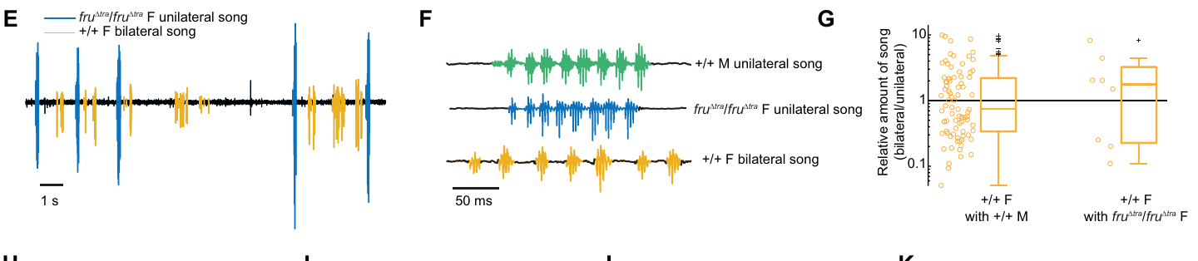
Fruitless-dependent song differs across Drosophila species
Comparative analysis tests whether a mechanism keeps the same behavioral consequences in different species. Baker and colleagues forced male-specific fruitless splicing in Drosophila virilis females using CRISPR-mediated removal of Transformer-binding sequences. The same test is run in each species, and the manipulation is matched in both species.
Two modified alleles were required for male-typical unilateral song, whereas one allele sufficed for broad male-like courtship in D. melanogaster females. D. virilis song recordings distinguish unilateral and bilateral signals with a 50 ms waveform scale. The two species are measured on the same song measures, and each allele is scored against the species it was built in.
Engineered D. virilis females produced male-typical song in only a subset of pairings, and at much lower total amounts than males. A conserved transcription factor therefore has a species-specific output. Each pairing is scored for its song, which makes the species difference measurable, and the song totals are compared with the male totals in the same units.
Baker et al. (2024), Fig. 2E–G. Unilateral and bilateral song recordings and the relative amount of song.
Baker et al. (2024); Demir & Dickson (2005)
44
Notes:
• **Comparative analysis** tests whether a mechanism retains the same behavioral consequences in different species. Baker and colleagues forced male-specific fruitless splicing in _Drosophila virilis_ females using CRISPR-mediated removal of Transformer-binding sequences.
• Two modified alleles were required for male-typical unilateral song, whereas one allele suffices for broad male-like courtship in _D. melanogaster_ females. _D. virilis_ song recordings distinguish unilateral and bilateral signals with a 50 ms waveform scale.
• Engineered _D. virilis_ females produced male-typical song in only a subset of pairings and at much lower total amounts than males. A conserved transcription factor therefore does not guarantee identical dosage requirements or a complete behavioral conversion across species.
References:
Baker CA, Guan XJ, Choi M, Murthy M (2024). The role of fruitless in specifying courtship behaviors across divergent Drosophila species. Science Advances 10(11):eadk1273. https://doi.org/10.1126/sciadv.adk1273
Demir E, Dickson BJ (2005). fruitless splicing specifies male courtship behavior in Drosophila. Cell 121(5):785–794. https://doi.org/10.1016/j.cell.2005.04.027
Figure: Baker et al. (2024), Fig. 2E–G. Unilateral and bilateral song recordings and the relative amount of song.
Figure source: https://doi.org/10.1126/sciadv.adk1273

Slide 59
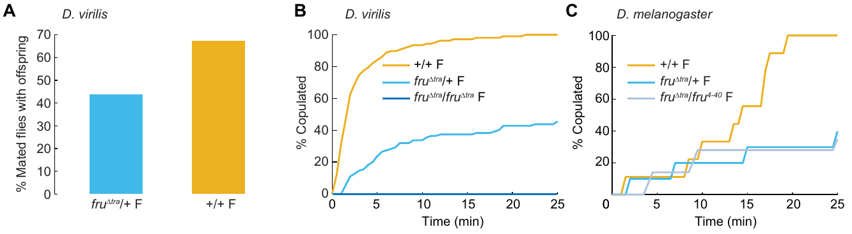
FruM effects on female reproduction differ by species
Genetic background includes the other genes and regulatory relationships in which a manipulation acts. Baker and colleagues compared mating and reproductive outcomes of FruM-expressing females in D. virilis and D. melanogaster. The same manipulation is applied in both backgrounds, and outcomes are compared on the same measures, so the background can be held as a variable.
D. virilis females carrying one modified allele retained egg laying and could produce offspring after mating. Their copulation rate during the 25 min assay was about 40% of the wild-type rate. Two modified alleles eliminated copulation within that interval, so the number of alleles changes the copulation outcome and the effect is graded by allele dose.
These outcomes differ from the strong suppression of egg laying in engineered D. melanogaster females. The comparison shows that fruitless effects vary by species, so a single binary-switch model of the gene is too simple. Effects on male song, female receptivity and fertility each vary by species and dose, and each outcome is read within its own genetic background.
Baker et al. (2024), Fig. 3A–C. Reproductive outcomes of FruM-expressing females in two species.
Baker et al. (2024)
45
Notes:
• **Genetic background** includes the other genes and regulatory relationships in which a manipulation acts. Baker and colleagues compared mating and reproductive outcomes of FruM-expressing females in _D. virilis_ and _D. melanogaster_.
• _D. virilis_ females carrying one modified allele retained egg laying and could produce offspring after mating. Their copulation rate during the 25 min assay was about 40% of the wild-type rate; two modified alleles eliminated copulation within that interval.
• These outcomes differ from the strong suppression of egg laying in engineered _D. melanogaster_ females. The comparison limits a universal binary-switch interpretation of fruitless: effects on male song, female receptivity and fertility depend on species, allele dosage and the behavior being measured.
References:
Baker CA, Guan XJ, Choi M, Murthy M (2024). The role of fruitless in specifying courtship behaviors across divergent Drosophila species. Science Advances 10(11):eadk1273. https://doi.org/10.1126/sciadv.adk1273
Figure: Baker et al. (2024), Fig. 3A–C. Reproductive outcomes of FruM-expressing females in two species.
Figure source: https://doi.org/10.1126/sciadv.adk1273

Slide 60
Key takeaways
Song dimensions include pulse–sine mode, carrier frequency and interpulse timing; movement and partner context change their expression.
fruitless development uses sex-specific splicing and distinct transcription-factor isoforms to specify courtship-related neuronal properties; developmental effects differ from acute activation.
Distributed control separates courtship initiation, descending recruitment, pulse timing and wing choice across brain and thoracic neurons.
GABAergic signaling supports motor coordination and song structure; playback controls show that mating defects extend beyond acoustic output.
Circuit dynamics combine context-dependent inhibition and rebound with nested neuronal recruitment; activity, perturbation and synaptic reconstruction answer different causal questions.
Comparative limits include species- and dosage-dependent fruitless effects; male song, female receptivity and fertility do not transform as one universal binary trait.
Demir & Dickson (2005); Roemschied et al. (2023); Shiozaki et al. (2024); Baker et al. (2024)
46
Notes:
Teaching transcript:
• Song dimensions include pulse–sine mode, carrier frequency and interpulse timing; movement and partner context change their expression.
• fruitless development uses sex-specific splicing and distinct transcription-factor isoforms to specify courtship-related neuronal properties; developmental effects differ from acute activation.
• Distributed control separates courtship initiation, descending recruitment, pulse timing and wing choice across brain and thoracic neurons.
• GABAergic signaling supports motor coordination and song structure; playback controls show that mating defects extend beyond acoustic output.
• Circuit dynamics combine context-dependent inhibition and rebound with nested neuronal recruitment; activity, perturbation and synaptic reconstruction answer different causal questions.
• Comparative limits include species- and dosage-dependent fruitless effects; male song, female receptivity and fertility do not transform as one universal binary trait.
References:
Demir E, Dickson BJ (2005). fruitless splicing specifies male courtship behavior in Drosophila. Cell 121(5):785–794. https://doi.org/10.1016/j.cell.2005.04.027
von Philipsborn AC, Liu T, Yu JY, Masser C, Bidaye SS, Dickson BJ (2011). Neuronal control of Drosophila courtship song. Neuron 69(3):509–522. https://doi.org/10.1016/j.neuron.2011.01.011
von Philipsborn AC, Jörchel S, Tirian L, Demir E, Morita T, Stern DL, Dickson BJ (2014). Cellular and behavioral functions of fruitless isoforms in Drosophila courtship. Current Biology 24(3):242–251. https://doi.org/10.1016/j.cub.2013.12.015
Coen P, Clemens J, Weinstein AJ, Pacheco DA, Deng Y, Murthy M (2014). Dynamic sensory cues shape song structure in Drosophila. Nature 507(7491):233–237. https://doi.org/10.1038/nature13131
Amin H, Nolte SS, Swain B, von Philipsborn AC (2023). GABAergic signaling shapes multiple aspects of Drosophila courtship motor behavior. iScience 26(11):108069. https://doi.org/10.1016/j.isci.2023.108069
Roemschied FA, Pacheco DA, Aragon MJ, Ireland EC, Li X, Thieringer K, Pang R, Murthy M (2023). Flexible circuit mechanisms for context-dependent song sequencing. Nature 622(7984):794–801. https://doi.org/10.1038/s41586-023-06632-1
Shiozaki HM, Wang K, Lillvis JL, Xu M, Dickson BJ, Stern DL (2024). Activity of nested neural circuits drives different courtship songs in Drosophila. Nature Neuroscience 27(10):1954–1965. https://doi.org/10.1038/s41593-024-01738-9
Baker CA, Guan XJ, Choi M, Murthy M (2024). The role of fruitless in specifying courtship behaviors across divergent Drosophila species. Science Advances 10(11):eadk1273. https://doi.org/10.1126/sciadv.adk1273

