Slide 1
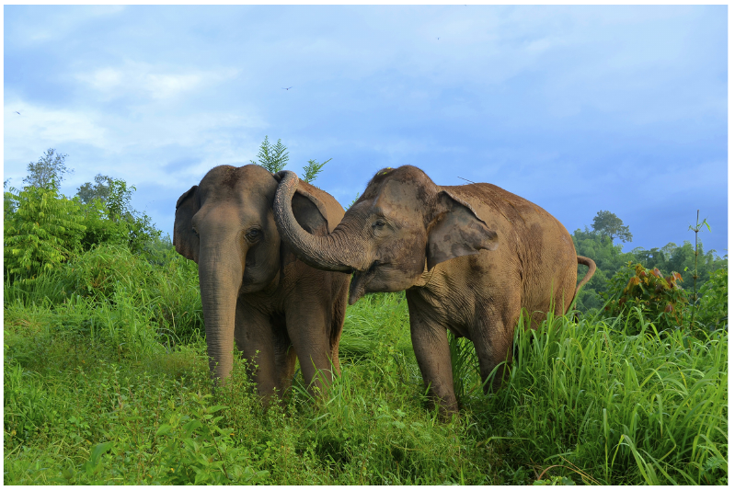
NEUR 411 · NEUROETHOLOGY · FALL 2026
Lecture 51
Elephants II: Comparative Cognition, Vocal Learning, and Social Neurobiology
Date TBD
Jordan Lopez, Ph.D.
Professor of Neurobiology & Biomedical Engineering
Plotnik & de Waal (2014), Fig. 1. Asian elephants in affiliative contact.
Notes:
Elephants II: Comparative Cognition, Vocal Learning, and Social Neurobiology
Lecture 51. NEUR 411 · NEUROETHOLOGY · FALL 2026. Date TBD.
Figure: Plotnik & de Waal (2014), Fig. 1. Asian elephants in affiliative contact.
Figure source: https://doi.org/10.7717/peerj.278
References:
Joshua M. Plotnik, Frans B.M. de Waal (2014). Asian elephants ( Elephas maximus ) reassure others in distress. PeerJ 2: e278. https://doi.org/10.7717/peerj.278

Slide 2
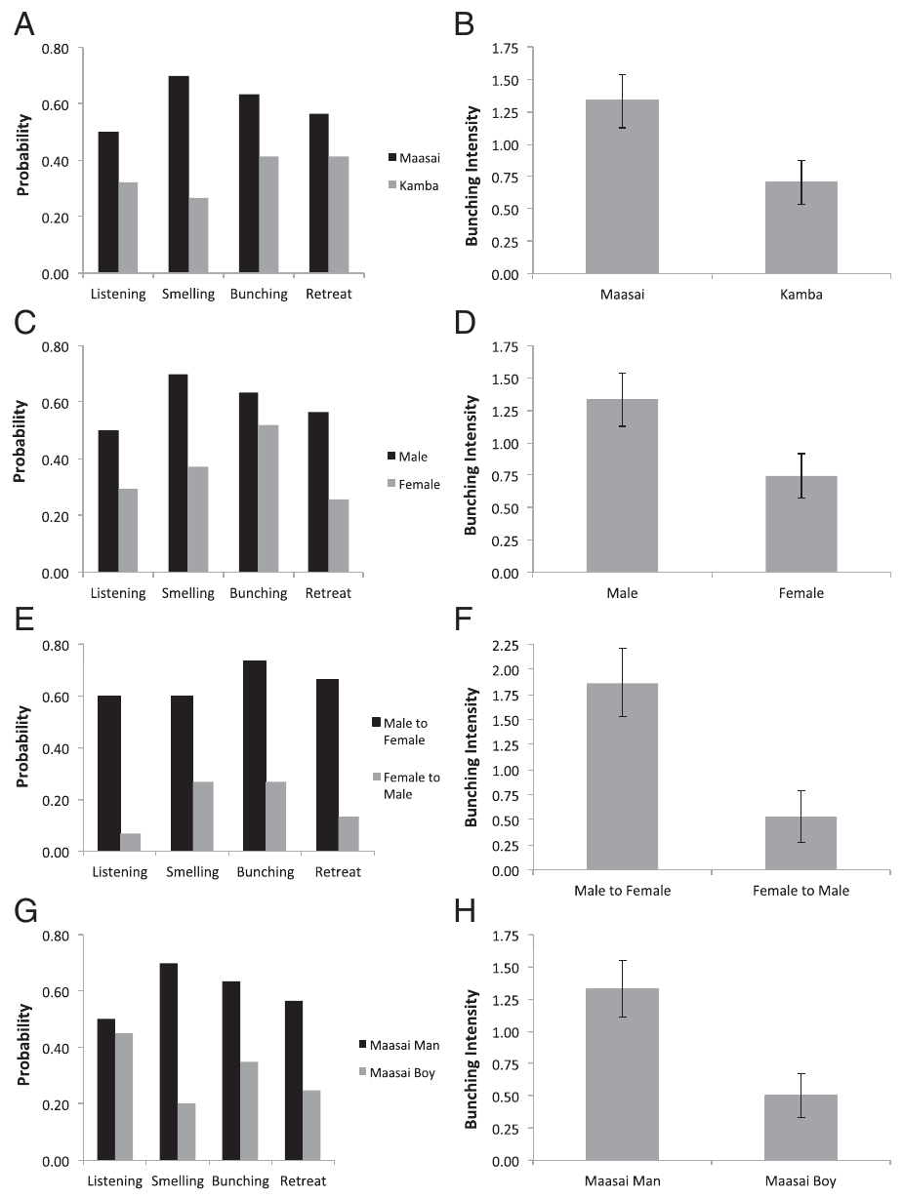
Voice playback isolates socially relevant decisions
Comparative cognition investigates how animals acquire, retain and use information, while accounting for differences in sensory access and natural behavior. McComb and colleagues tested wild African elephant families with recordings of human speech rather than confronting them with people.
The speakers repeated the same sentence, allowing voice categories to vary while verbal content remained comparable. Maasai men elicited stronger defensive bunching and investigative smelling than Kamba men; adult male Maasai voices also elicited stronger defenses than female or boy voices.
Defensive bunching is the formation of a tight protective group. Recorded voices were sufficient to change this collective response, but the experiments did not locate the neurons storing human-associated danger or establish comprehension of the sentence.
McComb et al. (2014), Fig. 1(A–H). Threat-dependent responses to recorded human voices.
McComb et al. (2014)
02
Notes:
• Comparative cognition investigates how animals acquire, retain and use information, while accounting for differences in sensory access and natural behavior. McComb and colleagues tested wild African elephant families with recordings of human speech rather than confronting them with people.
• The speakers repeated the same sentence, allowing voice categories to vary while verbal content remained comparable. Maasai men elicited stronger defensive bunching and investigative smelling than Kamba men; adult male Maasai voices also elicited stronger defenses than female or boy voices.
• Defensive bunching is the formation of a tight protective group. Recorded voices were sufficient to change this collective response, but the experiments did not locate the neurons storing human-associated danger or establish comprehension of the sentence.
– The behavior is a response to acoustic evidence of risk, not a direct measurement of language understanding or the subjective emotion of each elephant.
References:
Karen McComb, Graeme Shannon, Katito N. Sayialel, Cynthia Moss (2014). Elephants can determine ethnicity, gender, and age from acoustic cues in human voices. Proceedings of the National Academy of Sciences 111: 5433-5438. https://doi.org/10.1073/pnas.1321543111
Figure: McComb et al. (2014), Fig. 1(A–H). Threat-dependent responses to recorded human voices.
Figure source: https://doi.org/10.1073/pnas.1321543111

Slide 3
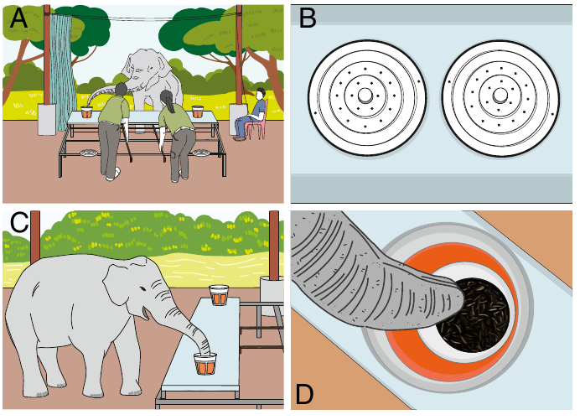
Olfactory access permits food-quantity choices
Plotnik and colleagues presented captive Asian elephants with two opaque buckets containing sunflower seeds. Olfaction, the detection of airborne chemicals, supplied the information: locked perforated lids admitted odors while preventing visual inspection and access to the food.
The table was withdrawn after sampling, the lids were unlocked, and the elephant chose one bucket. Experimental seed quantities ranged from 4 to 24 g. Solid lids prevented successful discrimination, supporting an olfactory basis rather than guidance from visible food or other available cues.
This preparation separated sensory investigation from the choice action. Its results concern judgments about relative food amounts; they do not establish that elephants counted individual seeds or encoded an abstract numerical symbol.
Plotnik et al. (2019), Fig. 1(A–D). Odor sampling and subsequent bucket choice.
Plotnik et al. (2019)
03
Notes:
• Plotnik and colleagues presented captive Asian elephants with two opaque buckets containing sunflower seeds. Olfaction, the detection of airborne chemicals, supplied the information: locked perforated lids admitted odors while preventing visual inspection and access to the food.
• The table was withdrawn after sampling, the lids were unlocked, and the elephant chose one bucket. Experimental seed quantities ranged from 4 to 24 g. Solid lids prevented successful discrimination, supporting an olfactory basis rather than guidance from visible food or other available cues.
• This preparation separated sensory investigation from the choice action. Its results concern judgments about relative food amounts; they do not establish that elephants counted individual seeds or encoded an abstract numerical symbol.
– A sensory-appropriate task can reveal a competence that a visual-only comparison would miss, without making the task a test of every form of quantitative reasoning.
References:
Joshua M. Plotnik, Daniel L. Brubaker, Rachel Dale, Lydia N. Tiller, Hannah S. Mumby, Nicola S. Clayton (2019). Elephants have a nose for quantity. Proceedings of the National Academy of Sciences 116: 12566-12571. https://doi.org/10.1073/pnas.1818284116
Figure: Plotnik et al. (2019), Fig. 1(A–D). Odor sampling and subsequent bucket choice.
Figure source: https://doi.org/10.1073/pnas.1818284116

Slide 4
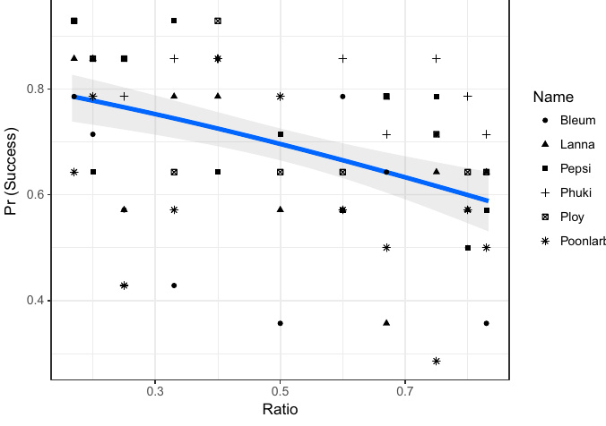
Quantity discrimination depends on relative difference
The seed experiment varied the quantity ratio, the smaller food amount relative to the larger amount. Elephants chose the greater amount more reliably when the amounts differed markedly, and their performance declined as the ratio approached equality.
Pairs with the same ratio but different total amounts tested whether overall food magnitude controlled performance. For example, the published experiment compared 4 versus 8 g with 12 versus 24 g. Total magnitude did not account for the choice pattern.
Metal-bucket and double-blind controls retained successful discrimination, reducing explanations based on residual plastic-container odor or experimenter guidance. Ratio dependence is consistent with approximate quantity assessment, but a learned comparison of odor strength remains possible; no numerical neurons were recorded.
Plotnik et al. (2019), Fig. 2. Choice success decreases as quantities approach equality.
Plotnik et al. (2019)
04
Notes:
• The seed experiment varied the quantity ratio, the smaller food amount relative to the larger amount. Elephants chose the greater amount more reliably when the amounts differed markedly, and their performance declined as the ratio approached equality.
• Pairs with the same ratio but different total amounts tested whether overall food magnitude controlled performance. For example, the published experiment compared 4 versus 8 g with 12 versus 24 g. Total magnitude did not account for the choice pattern.
• Metal-bucket and double-blind controls retained successful discrimination, reducing explanations based on residual plastic-container odor or experimenter guidance. Ratio dependence is consistent with approximate quantity assessment, but a learned comparison of odor strength remains possible; no numerical neurons were recorded.
– In the double-blind condition, the people presenting the choice did not know which bucket held the larger amount, reducing inadvertent behavioral guidance.
References:
Joshua M. Plotnik, Daniel L. Brubaker, Rachel Dale, Lydia N. Tiller, Hannah S. Mumby, Nicola S. Clayton (2019). Elephants have a nose for quantity. Proceedings of the National Academy of Sciences 116: 12566-12571. https://doi.org/10.1073/pnas.1818284116
Figure: Plotnik et al. (2019), Fig. 2. Choice success decreases as quantities approach equality.
Figure source: https://doi.org/10.1073/pnas.1818284116

Slide 5
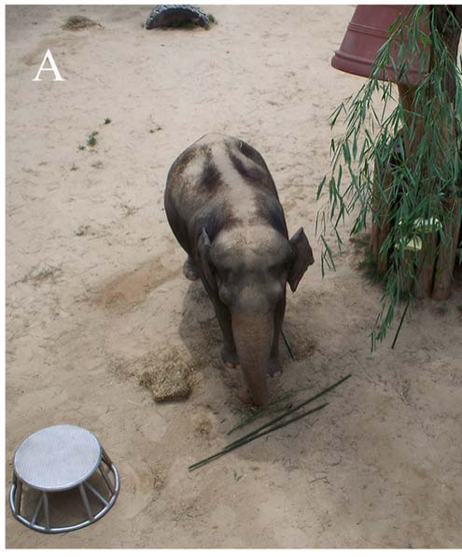
A trunk-held tool can interfere with food sampling
Foerder and colleagues offered Asian elephants suspended fruit and branches beyond ordinary trunk reach, together with movable objects and sticks. Tool use requires using an external object to alter the relationship between the animal and its goal, rather than merely handling it.
The elephants reached and sniffed toward the food but did not use sticks to retrieve it. This failure differed from the later successful use of a standing platform by the juvenile male Kandula. The authors proposed that holding a stick may obstruct the trunk’s simultaneous olfactory and tactile investigation.
The proposed sensory interference was not independently manipulated. Failure with a primate-style reaching tool therefore cannot be equated with an absence of physical problem-solving ability, but neither does it prove that sensory interference caused every failure.
Foerder et al. (2011), Fig. 1(A). Original stick-and-platform food-reaching preparation.
Foerder et al. (2011)
05
Notes:
• Foerder and colleagues offered Asian elephants suspended fruit and branches beyond ordinary trunk reach, together with movable objects and sticks. Tool use requires using an external object to alter the relationship between the animal and its goal, rather than merely handling it.
• The elephants reached and sniffed toward the food but did not use sticks to retrieve it. This failure differed from the later successful use of a standing platform by the juvenile male Kandula. The authors proposed that holding a stick may obstruct the trunk’s simultaneous olfactory and tactile investigation.
• The proposed sensory interference was not independently manipulated. Failure with a primate-style reaching tool therefore cannot be equated with an absence of physical problem-solving ability, but neither does it prove that sensory interference caused every failure.
– The study distinguished interest in the reward from successful use of a particular tool; food-directed reaching persisted during unsuccessful stick trials.
References:
Preston Foerder, Marie Galloway, Tony Barthel, Donald E. Moore III, Diana Reiss (2011). Insightful Problem Solving in an Asian Elephant. PLoS ONE 6: e23251. https://doi.org/10.1371/journal.pone.0023251
Figure: Foerder et al. (2011), Fig. 1(A). Original stick-and-platform food-reaching preparation.
Figure source: https://doi.org/10.1371/journal.pone.0023251

Slide 6
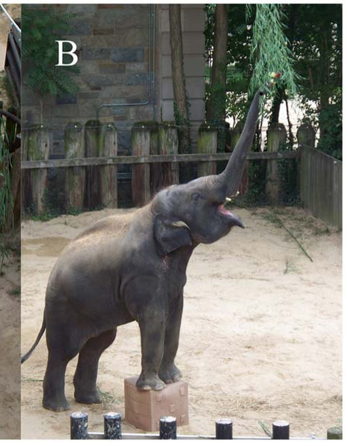
A movable platform increases effective reach
Kandula rolled a large plastic cube beneath suspended food, placed his forefeet on it and reached with his trunk. The cube changed his body position while leaving the trunk available for grasping. Its functional contribution was increased reach, not direct contact with the food.
The first successful sequence occurred after earlier object exploration without food retrieval. On subsequent sessions he repositioned the cube beneath changed food locations and also used it to investigate an elevated enrichment object and overhanging blossoms.
The authors described the initial solution as insight-like because an organized sequence appeared without a documented series of reinforced partial solutions. Earlier cube experience prevents concluding that the solution arose without learning, and the behavior does not reveal the underlying neural computation.
Foerder et al. (2011), Fig. 1(B). Kandula stands on a cube beneath suspended food.
Foerder et al. (2011)
06
Notes:
• Kandula rolled a large plastic cube beneath suspended food, placed his forefeet on it and reached with his trunk. The cube changed his body position while leaving the trunk available for grasping. Its functional contribution was increased reach, not direct contact with the food.
• The first successful sequence occurred after earlier object exploration without food retrieval. On subsequent sessions he repositioned the cube beneath changed food locations and also used it to investigate an elevated enrichment object and overhanging blossoms.
• The authors described the initial solution as insight-like because an organized sequence appeared without a documented series of reinforced partial solutions. Earlier cube experience prevents concluding that the solution arose without learning, and the behavior does not reveal the underlying neural computation.
– Insight describes the inferred organization of the solution, not a measured mental event; the documented action sequence is stronger evidence than a claim about subjective realization.
References:
Preston Foerder, Marie Galloway, Tony Barthel, Donald E. Moore III, Diana Reiss (2011). Insightful Problem Solving in an Asian Elephant. PLoS ONE 6: e23251. https://doi.org/10.1371/journal.pone.0023251
Figure: Foerder et al. (2011), Fig. 1(B). Kandula stands on a cube beneath suspended food.
Figure source: https://doi.org/10.1371/journal.pone.0023251

Slide 7
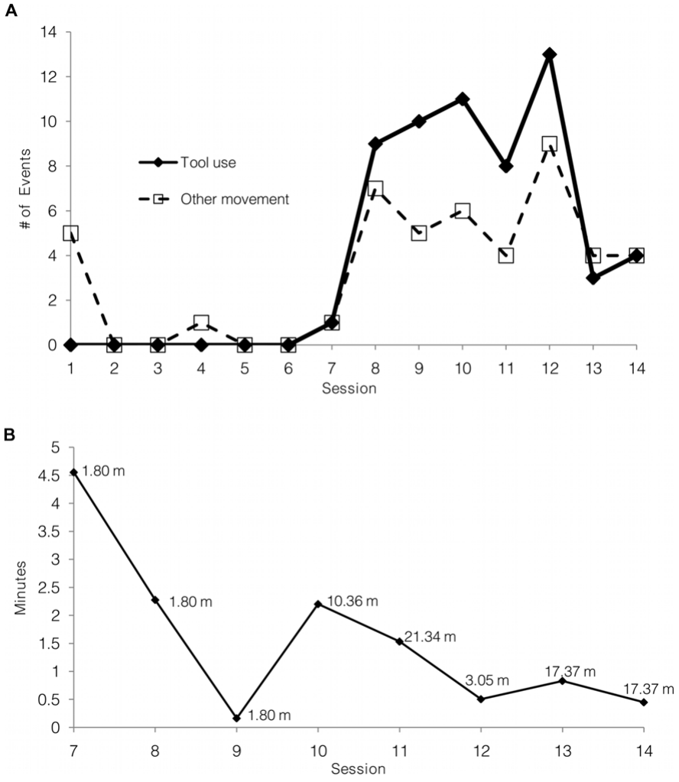
Tool transfer tests more than one learned location
After successful cube use, Foerder and colleagues displaced it within the enclosure to test whether Kandula had learned only a fixed feeding location. He searched for the cube, moved it to the suspended reward and used it as a standing platform.
When the cube was hidden in a passageway, he retrieved it and later returned directly to the previously successful hiding location. Replacing the cube with a large tire also produced platform use, supporting transfer beyond one particular object.
These manipulations distinguish flexible object use from repeatedly standing at the original location. They still permit contributions from remembered rewards and prior manipulation experience. The evidence establishes behavioral flexibility in the tested individual, rather than a species-wide rate of insight or a causal memory circuit.
Foerder et al. (2011), Fig. 2(A–B). Acquisition and retrieval of a relocated cube.
Foerder et al. (2011)
07
Notes:
• After successful cube use, Foerder and colleagues displaced it within the enclosure to test whether Kandula had learned only a fixed feeding location. He searched for the cube, moved it to the suspended reward and used it as a standing platform.
• When the cube was hidden in a passageway, he retrieved it and later returned directly to the previously successful hiding location. Replacing the cube with a large tire also produced platform use, supporting transfer beyond one particular object.
• These manipulations distinguish flexible object use from repeatedly standing at the original location. They still permit contributions from remembered rewards and prior manipulation experience. The evidence establishes behavioral flexibility in the tested individual, rather than a species-wide rate of insight or a causal memory circuit.
– The relocation and replacement conditions tested different aspects of transfer: remembering an object location and using a new object with a similar supporting function.
References:
Preston Foerder, Marie Galloway, Tony Barthel, Donald E. Moore III, Diana Reiss (2011). Insightful Problem Solving in an Asian Elephant. PLoS ONE 6: e23251. https://doi.org/10.1371/journal.pone.0023251
Figure: Foerder et al. (2011), Fig. 2(A–B). Acquisition and retrieval of a relocated cube.
Figure source: https://doi.org/10.1371/journal.pone.0023251

Slide 8
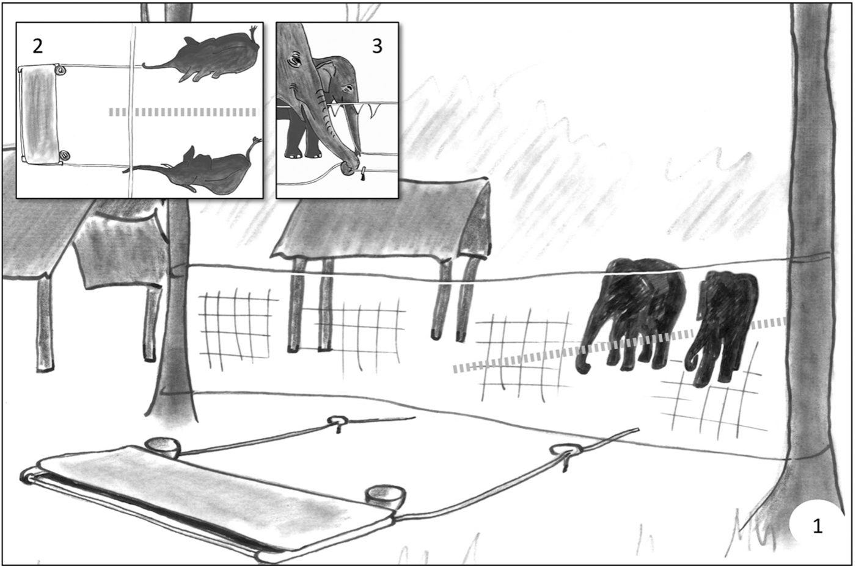
Cooperation requires simultaneous control of a rope
Plotnik and colleagues adapted a loose-rope cooperation task for Asian elephants. One rope passed around a sliding food platform, with an end available to each partner. Pulling alone unthreaded the rope; coordinated holding and pulling brought the food within reach.
Initial single-rope training taught the pulling action. During paired testing the animals approached through separate lanes from 10 m away, while caretakers remained silent and looked away after release. These precautions reduced immediate human guidance without eliminating the elephants’ training history.
Successful simultaneous release established that the apparatus could be operated jointly. It did not alone establish that either animal understood the partner’s necessity, because both could simply repeat a previously rewarded pulling response upon reaching the rope.
Plotnik et al. (2011), Fig. 1(views 1–3). Published loose-rope cooperation apparatus.
Plotnik et al. (2011)
08
Notes:
• Plotnik and colleagues adapted a loose-rope cooperation task for Asian elephants. One rope passed around a sliding food platform, with an end available to each partner. Pulling alone unthreaded the rope; coordinated holding and pulling brought the food within reach.
• Initial single-rope training taught the pulling action. During paired testing the animals approached through separate lanes from 10 m away, while caretakers remained silent and looked away after release. These precautions reduced immediate human guidance without eliminating the elephants’ training history.
• Successful simultaneous release established that the apparatus could be operated jointly. It did not alone establish that either animal understood the partner’s necessity, because both could simply repeat a previously rewarded pulling response upon reaching the rope.
– The apparatus required both rope ends to remain engaged; one animal pulling alone removed the other’s opportunity to contribute.
References:
Joshua M. Plotnik, Richard Lair, Wirot Suphachoksahakun, Frans B. M. de Waal (2011). Elephants know when they need a helping trunk in a cooperative task. Proceedings of the National Academy of Sciences 108: 5116-5121. https://doi.org/10.1073/pnas.1101765108
Figure: Plotnik et al. (2011), Fig. 1(views 1–3). Published loose-rope cooperation apparatus.
Figure source: https://doi.org/10.1073/pnas.1101765108

Slide 9
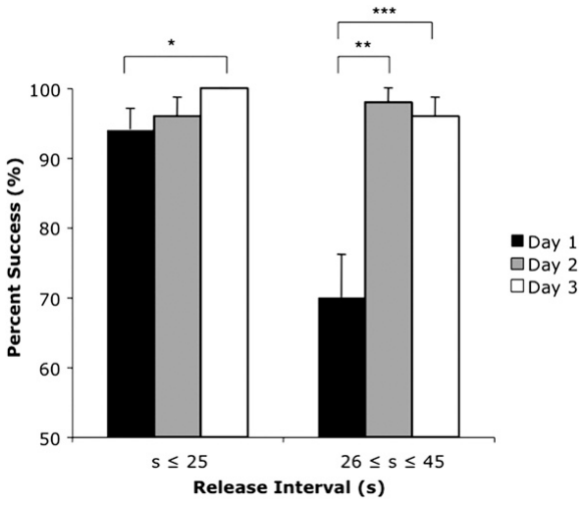
Delayed arrival requires inhibition of immediate pulling
Response inhibition means withholding an available action when acting immediately would prevent success. In delayed-release trials, the first elephant had to leave the rope available until its partner arrived rather than pull as soon as it reached the apparatus.
Training increased release delays in 5-s steps to 25 s. Tests then included previously untrained intervals of 26–45 s. Waiting succeeded on approximately 88–97% of trials across the lead elephants, and performance on longer delays improved after the first test day.
Transfer to longer intervals argues against one rigidly learned short waiting period. The preparation nevertheless involved shaping and repeated rewards, so successful waiting does not establish spontaneous cooperative understanding in an untrained animal or identify a specific inhibitory neuronal pathway.
Plotnik et al. (2011), Fig. 2. Performance with trained and longer partner delays.
Plotnik et al. (2011)
09
Notes:
• Response inhibition means withholding an available action when acting immediately would prevent success. In delayed-release trials, the first elephant had to leave the rope available until its partner arrived rather than pull as soon as it reached the apparatus.
• Training increased release delays in 5-s steps to 25 s. Tests then included previously untrained intervals of 26–45 s. Waiting succeeded on approximately 88–97% of trials across the lead elephants, and performance on longer delays improved after the first test day.
• Transfer to longer intervals argues against one rigidly learned short waiting period. The preparation nevertheless involved shaping and repeated rewards, so successful waiting does not establish spontaneous cooperative understanding in an untrained animal or identify a specific inhibitory neuronal pathway.
– The delayed interval was measured between releases, while the behavioral requirement was to preserve the usable rope until the partner reached its end.
References:
Joshua M. Plotnik, Richard Lair, Wirot Suphachoksahakun, Frans B. M. de Waal (2011). Elephants know when they need a helping trunk in a cooperative task. Proceedings of the National Academy of Sciences 108: 5116-5121. https://doi.org/10.1073/pnas.1101765108
Figure: Plotnik et al. (2011), Fig. 2. Performance with trained and longer partner delays.
Figure source: https://doi.org/10.1073/pnas.1101765108

Slide 10
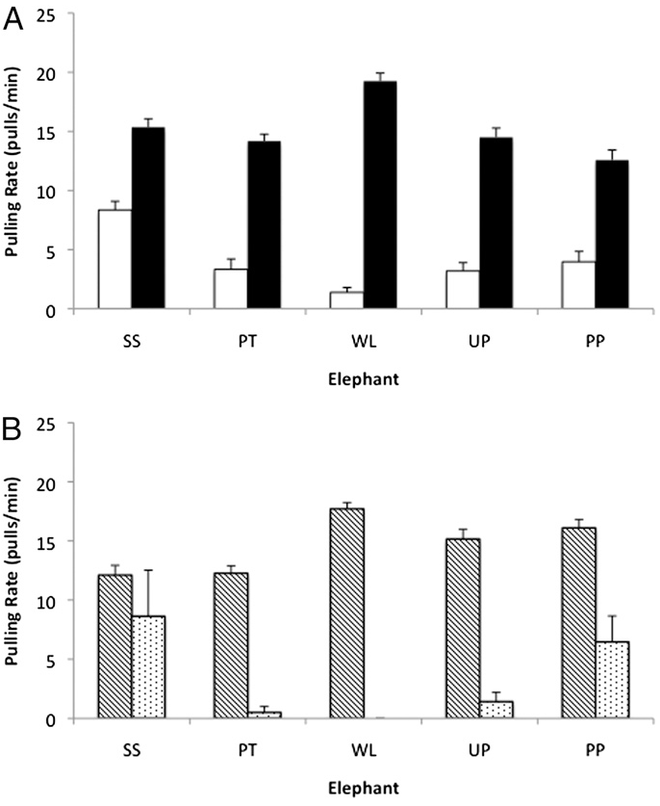
A partner’s presence is insufficient without rope access
The no-rope control left the partner present but placed its rope end out of reach. This separated social proximity from the partner’s ability to contribute mechanically. The lead elephant still had access to its own rope and could attempt to pull.
Most tested lead elephants reduced pulling when the partner lacked access, while normal joint trials remained successful. During delayed trials, pulling also increased after the partner arrived at the rope compared with the period before arrival.
The contrast supports sensitivity to conditions required for joint success, not merely another elephant’s presence. Feeling rope tension when the partner grasps it remains a possible learned cue. The results therefore do not require attributing intentions or a human-like theory of mind to the partner.
Plotnik et al. (2011), Fig. 3(A–B). Pulling rates before arrival and with no partner rope.
Plotnik et al. (2011)
10
Notes:
• The no-rope control left the partner present but placed its rope end out of reach. This separated social proximity from the partner’s ability to contribute mechanically. The lead elephant still had access to its own rope and could attempt to pull.
• Most tested lead elephants reduced pulling when the partner lacked access, while normal joint trials remained successful. During delayed trials, pulling also increased after the partner arrived at the rope compared with the period before arrival.
• The contrast supports sensitivity to conditions required for joint success, not merely another elephant’s presence. Feeling rope tension when the partner grasps it remains a possible learned cue. The results therefore do not require attributing intentions or a human-like theory of mind to the partner.
– A theory of mind would involve representing another individual’s mental state; recognizing a useful mechanical contingency is a narrower interpretation of this experiment.
References:
Joshua M. Plotnik, Richard Lair, Wirot Suphachoksahakun, Frans B. M. de Waal (2011). Elephants know when they need a helping trunk in a cooperative task. Proceedings of the National Academy of Sciences 108: 5116-5121. https://doi.org/10.1073/pnas.1101765108
Figure: Plotnik et al. (2011), Fig. 3(A–B). Pulling rates before arrival and with no partner rope.
Figure source: https://doi.org/10.1073/pnas.1101765108

Slide 11
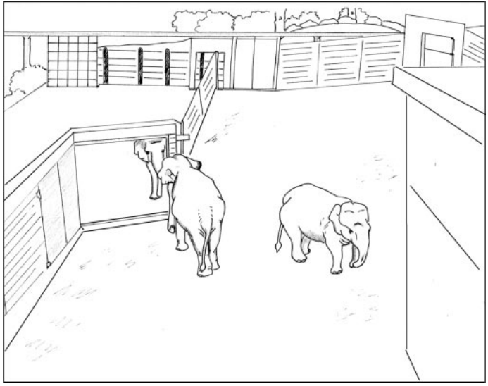
Mirror access changes opportunities for self-investigation
Plotnik, de Waal and Reiss installed an elephant-accessible mirror measuring 244 by 244 cm. Mirror self-recognition is tested through behavior directed toward one’s own body using the reflection, rather than through attention to the mirror alone.
Baseline and covered-mirror phases established comparison behavior before the reflective surface was available. Elephants could approach and inspect the large mirror closely with their trunks, unlike earlier arrangements that kept a small reflective surface beyond reach.
All subjects developed mirror-associated testing and self-directed behavior, including unusual trunk and head movements and inspection of their mouths. The preparation makes bodily information available; exploration of a mirror by itself still cannot establish that an animal recognizes its reflected identity.
Plotnik et al. (2006), Fig. 1. Original accessible-mirror enclosure preparation.
Plotnik et al. (2006)
11
Notes:
• Plotnik, de Waal and Reiss installed an elephant-accessible mirror measuring 244 by 244 cm. Mirror self-recognition is tested through behavior directed toward one’s own body using the reflection, rather than through attention to the mirror alone.
• Baseline and covered-mirror phases established comparison behavior before the reflective surface was available. Elephants could approach and inspect the large mirror closely with their trunks, unlike earlier arrangements that kept a small reflective surface beyond reach.
• All subjects developed mirror-associated testing and self-directed behavior, including unusual trunk and head movements and inspection of their mouths. The preparation makes bodily information available; exploration of a mirror by itself still cannot establish that an animal recognizes its reflected identity.
– Physical access matters because the animal can test whether movement of the reflection covaries with its own actions rather than merely viewing a distant unfamiliar shape.
References:
Joshua M. Plotnik, Frans B. M. de Waal, Diana Reiss (2006). Self-recognition in an Asian elephant. Proceedings of the National Academy of Sciences 103: 17053-17057. https://doi.org/10.1073/pnas.0608062103
Figure: Plotnik et al. (2006), Fig. 1. Original accessible-mirror enclosure preparation.
Figure source: https://doi.org/10.1073/pnas.0608062103

Slide 12
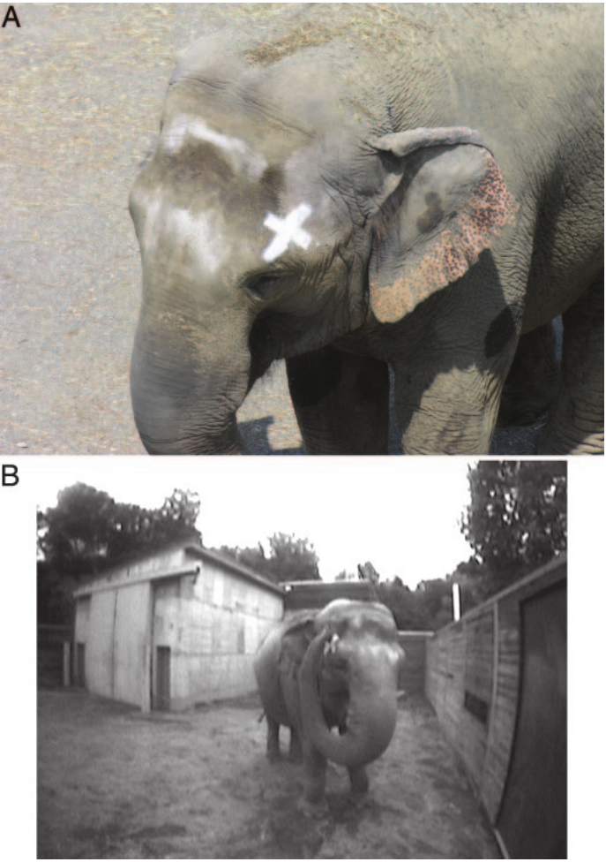
A sham mark controls touch and odor explanations
The mark test placed a visible mark on an otherwise unseen part of the elephant’s head. An invisible sham mark on the opposite side controlled for application-related tactile and olfactory cues, leaving visual appearance as the intended difference.
Happy repeatedly investigated the visible mark during or soon after mirror proximity, while the sham-mark side did not receive equivalent touching. Prior covered-mirror sham tests had not elicited mark-directed investigation. The other elephants explored the mirror but did not pass the mark test.
Selective touching supports using the reflection to obtain information about one’s own body. The result is individual-specific and does not establish the prevalence of mirror recognition in elephants or prove that all forms of self-awareness depend on this particular visual task.
Plotnik et al. (2006), Fig. 2(A–B). Visible head mark and mirror-associated mark touching.
Plotnik et al. (2006)
12
Notes:
• The mark test placed a visible mark on an otherwise unseen part of the elephant’s head. An invisible sham mark on the opposite side controlled for application-related tactile and olfactory cues, leaving visual appearance as the intended difference.
• Happy repeatedly investigated the visible mark during or soon after mirror proximity, while the sham-mark side did not receive equivalent touching. Prior covered-mirror sham tests had not elicited mark-directed investigation. The other elephants explored the mirror but did not pass the mark test.
• Selective touching supports using the reflection to obtain information about one’s own body. The result is individual-specific and does not establish the prevalence of mirror recognition in elephants or prove that all forms of self-awareness depend on this particular visual task.
– The visible and sham marks were counterbalanced across sides on consecutive marking days; the positive outcome should not be described as universal success by the tested elephants.
References:
Joshua M. Plotnik, Frans B. M. de Waal, Diana Reiss (2006). Self-recognition in an Asian elephant. Proceedings of the National Academy of Sciences 103: 17053-17057. https://doi.org/10.1073/pnas.0608062103
Figure: Plotnik et al. (2006), Fig. 2(A–B). Visible head mark and mirror-associated mark touching.
Figure source: https://doi.org/10.1073/pnas.0608062103

Slide 13
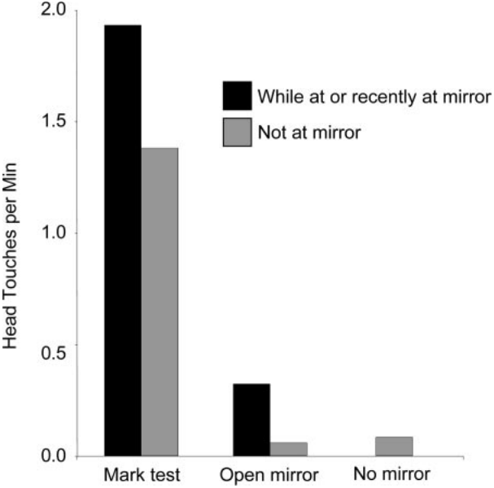
A positive mark test has a defined evidential scope
Happy’s head touching increased during the initial mark session, especially during mirror exposure or within 90 s after it. The temporal association matters because a purely tactile response to application would not specifically require visual access to the reflective surface.
The paper compared these responses with earlier open-mirror sessions and nonmirror conditions. Husbandry constraints prevented an ideal visible-mark, covered-mirror control while isolating the subject from its partner, leaving an explicitly acknowledged limitation in the design.
Mirror-guided self-investigation is evidence about processing bodily information. Its association with empathy or social complexity is a comparative hypothesis, not a demonstrated causal relationship in this experiment. Neither mirror behavior nor mark touching identified the responsible cortical cells.
Plotnik et al. (2006), Fig. 3. Head-touching rates across mirror and mark conditions.
Plotnik et al. (2006)
13
Notes:
• Happy’s head touching increased during the initial mark session, especially during mirror exposure or within 90 s after it. The temporal association matters because a purely tactile response to application would not specifically require visual access to the reflective surface.
• The paper compared these responses with earlier open-mirror sessions and nonmirror conditions. Husbandry constraints prevented an ideal visible-mark, covered-mirror control while isolating the subject from its partner, leaving an explicitly acknowledged limitation in the design.
• Mirror-guided self-investigation is evidence about processing bodily information. Its association with empathy or social complexity is a comparative hypothesis, not a demonstrated causal relationship in this experiment. Neither mirror behavior nor mark touching identified the responsible cortical cells.
– A positive behavioral assay can support a restricted cognitive inference without becoming a general measure of consciousness, empathy, or every capacity of the species.
References:
Joshua M. Plotnik, Frans B. M. de Waal, Diana Reiss (2006). Self-recognition in an Asian elephant. Proceedings of the National Academy of Sciences 103: 17053-17057. https://doi.org/10.1073/pnas.0608062103
Figure: Plotnik et al. (2006), Fig. 3. Head-touching rates across mirror and mark conditions.
Figure source: https://doi.org/10.1073/pnas.0608062103

Slide 14
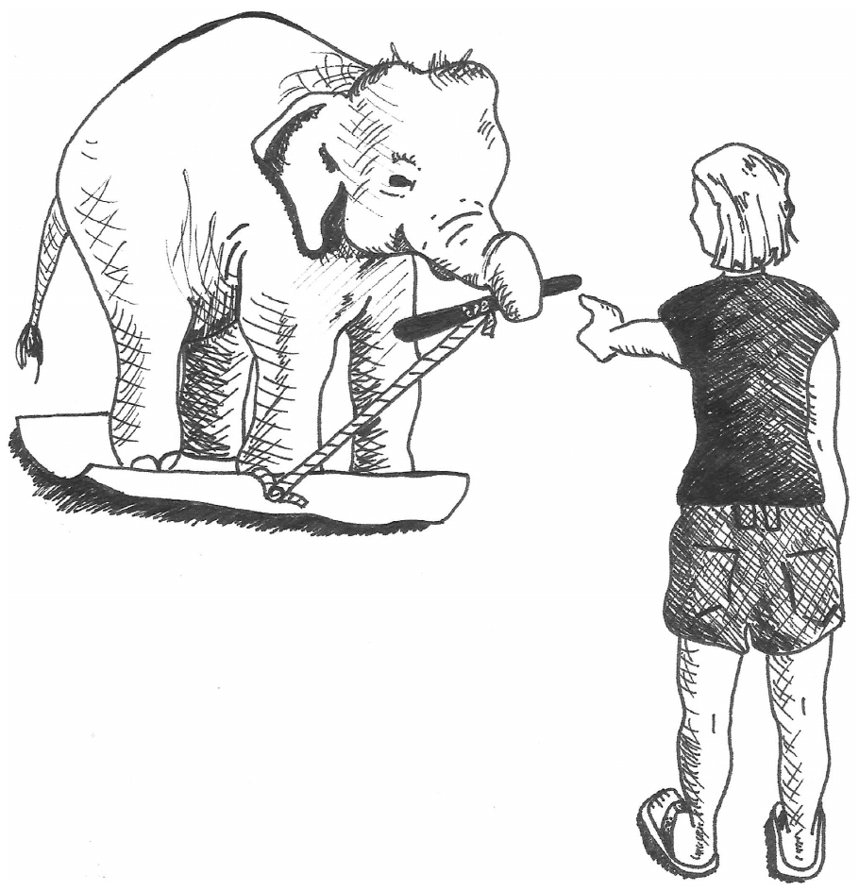
Body weight can obstruct a goal
Dale and Plotnik tested body awareness, the ability to treat one’s own body as a relevant object in a task. Asian elephants stood on a rubber mat while attempting to pass a stick to an experimenter in front of them.
In the test condition, a rope attached the stick to the mat. The elephant’s weight prevented the mat and attached stick from moving freely. Stepping off removed this obstruction and enabled the transfer, whereas an unattached-stick control permitted transfer without stepping off.
Elephants left the mat much more often when their weight obstructed the required action. The result concerns a functional body–environment relationship, not recognition of a visual identity, and should not be treated as the same assay as mirror self-recognition.
Dale & Plotnik (2017), Fig. 1. Original mat-and-stick transfer task.
Dale & Plotnik (2017)
14
Notes:
• Dale and Plotnik tested body awareness, the ability to treat one’s own body as a relevant object in a task. Asian elephants stood on a rubber mat while attempting to pass a stick to an experimenter in front of them.
• In the test condition, a rope attached the stick to the mat. The elephant’s weight prevented the mat and attached stick from moving freely. Stepping off removed this obstruction and enabled the transfer, whereas an unattached-stick control permitted transfer without stepping off.
• Elephants left the mat much more often when their weight obstructed the required action. The result concerns a functional body–environment relationship, not recognition of a visual identity, and should not be treated as the same assay as mirror self-recognition.
– The crucial relation is mechanical: the elephant’s own weight maintains the constraint until it changes its body position.
References:
Rachel Dale, Joshua M. Plotnik (2017). Elephants know when their bodies are obstacles to success in a novel transfer task. Scientific Reports 7: 46309. https://doi.org/10.1038/srep46309
Figure: Dale & Plotnik (2017), Fig. 1. Original mat-and-stick transfer task.
Figure source: https://doi.org/10.1038/srep46309

Slide 15
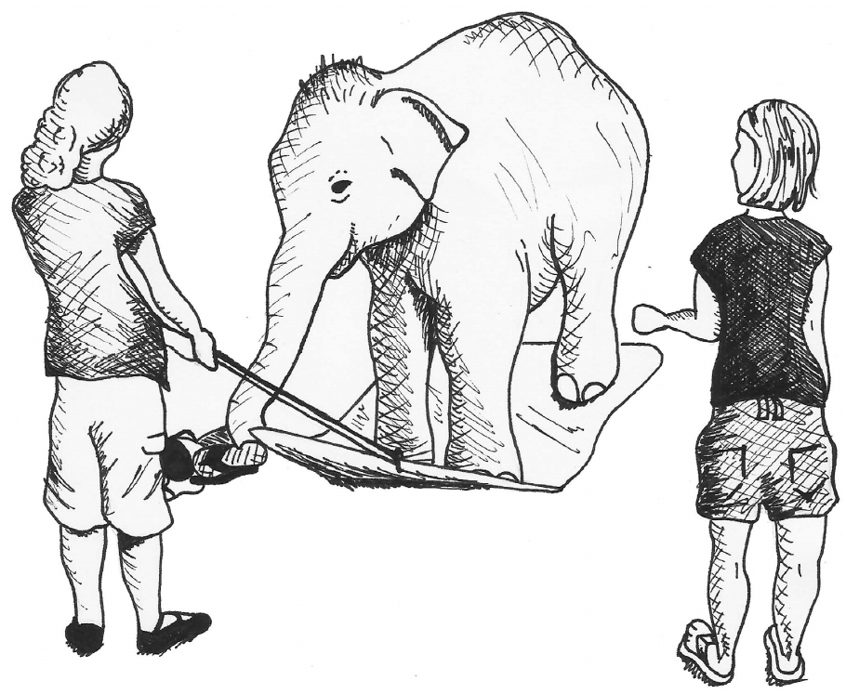
Discomfort differs from self-obstruction
A second control tested whether elephants stepped off the mat simply because pulling created an uncomfortable sensation under their feet. The animal transferred footwear sideways between experimenters while another experimenter tugged the mat’s attached rope.
The tug produced underfoot disturbance without making body weight an obstacle to the required transfer. Elephants left the mat less often in this control than in the attached-stick test, making discomfort alone an inadequate explanation of the test response.
The control does not reveal whether the animal explicitly conceptualized its own body. It supports a narrower account in which behavior distinguishes an obstructing body position from an irrelevant physical disturbance. Movement, tactile feedback and previous task learning remain components of that solution.
Dale & Plotnik (2017), Fig. 5. Published foot-discomfort control arrangement.
Dale & Plotnik (2017)
15
Notes:
• A second control tested whether elephants stepped off the mat simply because pulling created an uncomfortable sensation under their feet. The animal transferred footwear sideways between experimenters while another experimenter tugged the mat’s attached rope.
• The tug produced underfoot disturbance without making body weight an obstacle to the required transfer. Elephants left the mat less often in this control than in the attached-stick test, making discomfort alone an inadequate explanation of the test response.
• The control does not reveal whether the animal explicitly conceptualized its own body. It supports a narrower account in which behavior distinguishes an obstructing body position from an irrelevant physical disturbance. Movement, tactile feedback and previous task learning remain components of that solution.
– Changing the direction and object of transfer allowed disturbance underfoot while preserving a task that did not require leaving the mat.
References:
Rachel Dale, Joshua M. Plotnik (2017). Elephants know when their bodies are obstacles to success in a novel transfer task. Scientific Reports 7: 46309. https://doi.org/10.1038/srep46309
Figure: Dale & Plotnik (2017), Fig. 5. Published foot-discomfort control arrangement.
Figure source: https://doi.org/10.1038/srep46309

Slide 16
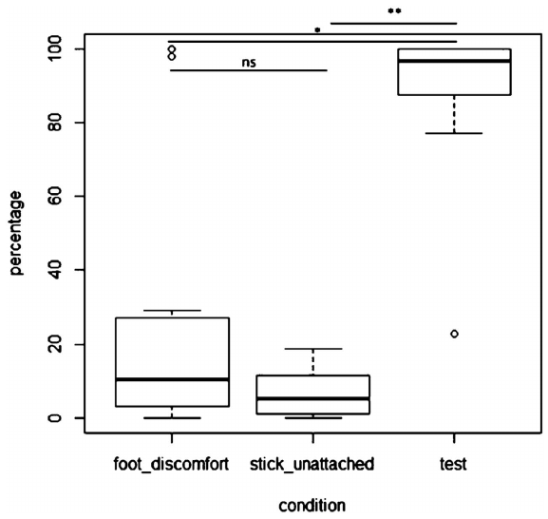
Early success limits a repeated-training explanation
Across testing, elephants removed their weight from the mat far more often when the stick was attached than when it was unattached or when the mat was tugged during the discomfort control. The conditions therefore differed according to the task’s physical requirement.
The investigators separately examined the first test session because repeated trials could teach a specific escape response. Early successful transfers were common, and some occurred on the first trial, reducing the explanation that success required extensive training within the experiment.
Prior handling and transfer experience was not absent. The evidence supports practical sensitivity to self-obstruction under these conditions, while leaving open how the relationship was represented and whether it generalizes to novel body–object problems outside the tested setting.
Dale & Plotnik (2017), Fig. 2. Mat departure in test and control conditions.
Dale & Plotnik (2017)
16
Notes:
• Across testing, elephants removed their weight from the mat far more often when the stick was attached than when it was unattached or when the mat was tugged during the discomfort control. The conditions therefore differed according to the task’s physical requirement.
• The investigators separately examined the first test session because repeated trials could teach a specific escape response. Early successful transfers were common, and some occurred on the first trial, reducing the explanation that success required extensive training within the experiment.
• Prior handling and transfer experience was not absent. The evidence supports practical sensitivity to self-obstruction under these conditions, while leaving open how the relationship was represented and whether it generalizes to novel body–object problems outside the tested setting.
– Early performance weakens one particular learning explanation; it does not establish that an elephant had no relevant experience before entering the experiment.
References:
Rachel Dale, Joshua M. Plotnik (2017). Elephants know when their bodies are obstacles to success in a novel transfer task. Scientific Reports 7: 46309. https://doi.org/10.1038/srep46309
Figure: Dale & Plotnik (2017), Fig. 2. Mat departure in test and control conditions.
Figure source: https://doi.org/10.1038/srep46309

Slide 17
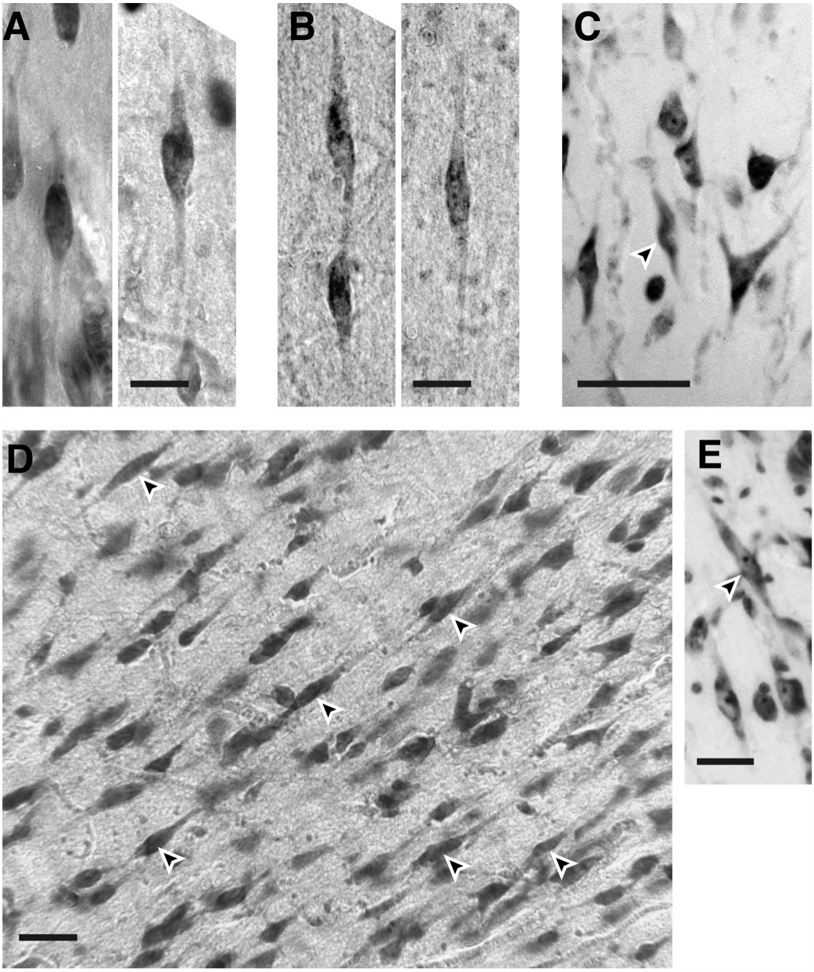
Von Economo neurons have a distinctive bipolar form
Von Economo neurons, or VENs, are identified here by an elongated spindle-shaped cell body with one large apical dendrite and one large basal dendrite, with little branching near the soma. Dendrites are neuronal processes that receive and integrate synaptic input.
Hakeem and colleagues examined postmortem elephant cortex using Nissl staining, which reveals cell bodies and cortical architecture. Cells with this morphology occurred in African elephant frontoinsular and dorsolateral frontal tissue and in Asian elephant anterior cingulate tissue.
Shape and regional location establish an anatomical cell category in these specimens. They do not measure synaptic input, firing rate or transmitter release. A proposal that these cells rapidly transmit socially important information remained an interpretation requiring direct physiological and connectional tests.
Hakeem et al. (2009), Fig. 1(A–E). Original elephant and dolphin VEN photomicrographs.
Hakeem et al. (2009)
17
Notes:
• Von Economo neurons, or VENs, are identified here by an elongated spindle-shaped cell body with one large apical dendrite and one large basal dendrite, with little branching near the soma. Dendrites are neuronal processes that receive and integrate synaptic input.
• Hakeem and colleagues examined postmortem elephant cortex using Nissl staining, which reveals cell bodies and cortical architecture. Cells with this morphology occurred in African elephant frontoinsular and dorsolateral frontal tissue and in Asian elephant anterior cingulate tissue.
• Shape and regional location establish an anatomical cell category in these specimens. They do not measure synaptic input, firing rate or transmitter release. A proposal that these cells rapidly transmit socially important information remained an interpretation requiring direct physiological and connectional tests.
– The apical process points toward the cortical surface and the basal process toward deeper tissue; bipolar morphology should not be confused with a complete map of the cell’s axonal targets.
References:
Atiya Y. Hakeem, Chet C. Sherwood, Christopher J. Bonar, Camilla Butti, Patrick R. Hof, John M. Allman (2009). Von Economo Neurons in the Elephant Brain. The Anatomical Record 292: 242-248. https://doi.org/10.1002/ar.20829
Figure: Hakeem et al. (2009), Fig. 1(A–E). Original elephant and dolphin VEN photomicrographs.
Figure source: https://doi.org/10.1002/ar.20829

Slide 18
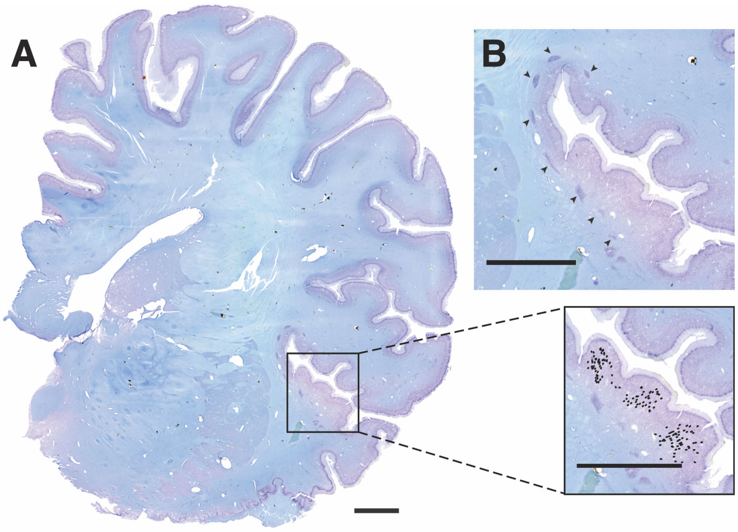
Frontoinsular tissue concentrates VENs
The frontoinsular cortex, abbreviated FI, is a cortical region at the frontal–insular transition. Hakeem and colleagues mapped VEN locations in serial Nissl-stained sections rather than assigning cells from overall brain size or presumed social intelligence.
The largest elephant VEN concentration occupied tissue comparable in location to FI in humans and apes. VENs were more prevalent near gyral crowns and sparse near sulcal depths. A gyrus is a cortical fold’s raised part; a sulcus is the intervening groove.
Regional concentration and folding relationships support organized distribution rather than uniform scattering across cortex. The anatomical correspondence does not establish identical human and elephant functions, and no FI activity was recorded during social decisions in this study.
Hakeem et al. (2009), Fig. 2(A–B). Nissl section and original frontoinsular distribution map.
Hakeem et al. (2009)
18
Notes:
• The frontoinsular cortex, abbreviated FI, is a cortical region at the frontal–insular transition. Hakeem and colleagues mapped VEN locations in serial Nissl-stained sections rather than assigning cells from overall brain size or presumed social intelligence.
• The largest elephant VEN concentration occupied tissue comparable in location to FI in humans and apes. VENs were more prevalent near gyral crowns and sparse near sulcal depths. A gyrus is a cortical fold’s raised part; a sulcus is the intervening groove.
• Regional concentration and folding relationships support organized distribution rather than uniform scattering across cortex. The anatomical correspondence does not establish identical human and elephant functions, and no FI activity was recorded during social decisions in this study.
– The source’s dots are the authors’ mapped cell locations in a tissue section, not behavioral activation signals or a reconstructed map made for the lecture.
References:
Atiya Y. Hakeem, Chet C. Sherwood, Christopher J. Bonar, Camilla Butti, Patrick R. Hof, John M. Allman (2009). Von Economo Neurons in the Elephant Brain. The Anatomical Record 292: 242-248. https://doi.org/10.1002/ar.20829
Figure: Hakeem et al. (2009), Fig. 2(A–B). Nissl section and original frontoinsular distribution map.
Figure source: https://doi.org/10.1002/ar.20829

Slide 19
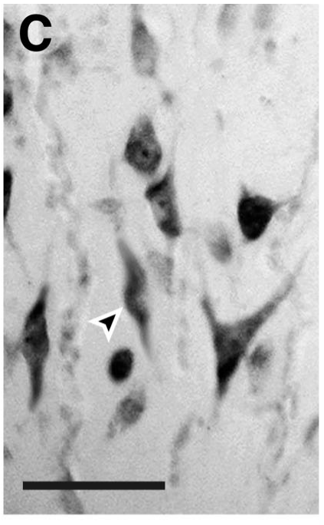
ACC anatomy does not establish an empathy circuit
The anterior cingulate cortex, or ACC, lies on the medial cerebral surface. Hakeem and colleagues found VENs in subgenual anterior cingulate tissue and documented the same morphology in an Asian elephant ACC specimen, at lower density than in FI.
Earlier tissue removal limited mapping in parts of ACC and in one hemisphere. Such incomplete sampling matters when distinguishing a sparse population from an unexamined region. The paper’s regional descriptions are based on available histology, not a complete functional atlas.
Connections between ACC, social awareness and emotional evaluation were discussed largely from comparative human evidence. The elephant specimens establish cellular presence; they do not establish that ACC VENs are necessary for reassurance, cooperation or mirror-guided self-investigation.
Hakeem et al. (2009), Fig. 1(C). Original anterior cingulate VEN; 70 µm scale bar.
Hakeem et al. (2009)
19
Notes:
• The anterior cingulate cortex, or ACC, lies on the medial cerebral surface. Hakeem and colleagues found VENs in subgenual anterior cingulate tissue and documented the same morphology in an Asian elephant ACC specimen, at lower density than in FI.
• Earlier tissue removal limited mapping in parts of ACC and in one hemisphere. Such incomplete sampling matters when distinguishing a sparse population from an unexamined region. The paper’s regional descriptions are based on available histology, not a complete functional atlas.
• Connections between ACC, social awareness and emotional evaluation were discussed largely from comparative human evidence. The elephant specimens establish cellular presence; they do not establish that ACC VENs are necessary for reassurance, cooperation or mirror-guided self-investigation.
– Subgenual refers to a position beneath the genu, the curved anterior part of the corpus callosum; a regional analogy does not by itself prove functional equivalence.
References:
Atiya Y. Hakeem, Chet C. Sherwood, Christopher J. Bonar, Camilla Butti, Patrick R. Hof, John M. Allman (2009). Von Economo Neurons in the Elephant Brain. The Anatomical Record 292: 242-248. https://doi.org/10.1002/ar.20829
Figure: Hakeem et al. (2009), Fig. 1(C). Original anterior cingulate VEN; 70 µm scale bar.
Figure source: https://doi.org/10.1002/ar.20829

Slide 20
Frontal VENs extend beyond the frontoinsular region
Hakeem and colleagues also identified VENs in a dorsolateral frontal cortical area, located toward the upper outer frontal surface. The original photomicrograph includes both paired and isolated cells with elongated bodies and prominent opposing dendrites.
The investigators searched the frontal cortex in mounted stained sections, using cell morphology to identify candidate VENs. Additional small populations occurred in other frontal locations, so the reported specialization was not confined to one precisely bounded frontoinsular field.
This wider distribution complicates claims that one cell shape corresponds to a single social function. The study did not determine elephant-specific projection targets, neurotransmitter identities or response selectivity. Similar morphology across regions is evidence of a shared anatomical feature, not proof of identical circuitry.
Hakeem et al. (2009), Fig. 1(A–E). Dorsolateral frontal VENs in panel B.
Hakeem et al. (2009)
20
Notes:
• Hakeem and colleagues also identified VENs in a dorsolateral frontal cortical area, located toward the upper outer frontal surface. The original photomicrograph includes both paired and isolated cells with elongated bodies and prominent opposing dendrites.
• The investigators searched the frontal cortex in mounted stained sections, using cell morphology to identify candidate VENs. Additional small populations occurred in other frontal locations, so the reported specialization was not confined to one precisely bounded frontoinsular field.
• This wider distribution complicates claims that one cell shape corresponds to a single social function. The study did not determine elephant-specific projection targets, neurotransmitter identities or response selectivity. Similar morphology across regions is evidence of a shared anatomical feature, not proof of identical circuitry.
– The dorsolateral designation is a positional description from the anatomical study; it should not be equated automatically with a experimentally mapped executive-control area in elephants.
References:
Atiya Y. Hakeem, Chet C. Sherwood, Christopher J. Bonar, Camilla Butti, Patrick R. Hof, John M. Allman (2009). Von Economo Neurons in the Elephant Brain. The Anatomical Record 292: 242-248. https://doi.org/10.1002/ar.20829
Figure: Hakeem et al. (2009), Fig. 1(A–E). Dorsolateral frontal VENs in panel B.
Figure source: https://doi.org/10.1002/ar.20829

Slide 21
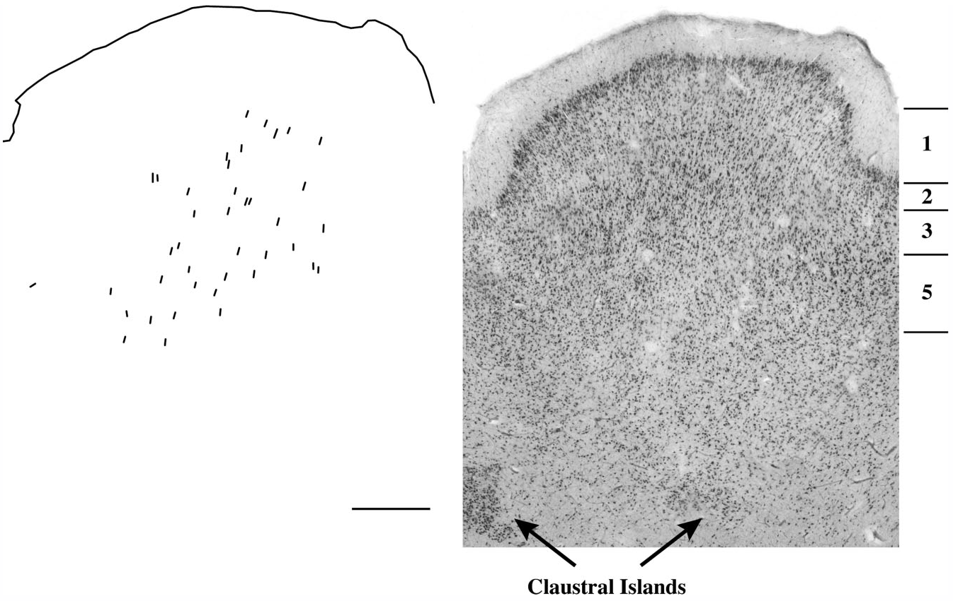
VENs concentrate in cortical layer five
A cortical layer is a band defined by differences in cell composition and arrangement through cortical depth. In the mapped elephant FI region, VENs occurred primarily in layer 5, alongside other large neurons with different shapes.
Serial sections and higher-magnification inspection connected cell morphology to laminar position. The authors also described dense clusters beneath the cortex as possible “claustral islands”; that identification was proposed from their location and appearance rather than established by tracing connections.
Laminar position provides a hypothesis about participation in cortical output, but does not reveal an elephant VEN’s exact target or synaptic effect. Neither the source’s section map nor its photomicrograph records active information flow through a social-decision circuit.
Hakeem et al. (2009), Fig. 4. VEN distribution and layers in a frontoinsular gyrus.
Hakeem et al. (2009)
21
Notes:
• A cortical layer is a band defined by differences in cell composition and arrangement through cortical depth. In the mapped elephant FI region, VENs occurred primarily in layer 5, alongside other large neurons with different shapes.
• Serial sections and higher-magnification inspection connected cell morphology to laminar position. The authors also described dense clusters beneath the cortex as possible “claustral islands”; that identification was proposed from their location and appearance rather than established by tracing connections.
• Laminar position provides a hypothesis about participation in cortical output, but does not reveal an elephant VEN’s exact target or synaptic effect. Neither the source’s section map nor its photomicrograph records active information flow through a social-decision circuit.
– The claustrum label was tentative in this paper. The dense clusters should remain candidate anatomical counterparts rather than being taught as a confirmed circuit node.
References:
Atiya Y. Hakeem, Chet C. Sherwood, Christopher J. Bonar, Camilla Butti, Patrick R. Hof, John M. Allman (2009). Von Economo Neurons in the Elephant Brain. The Anatomical Record 292: 242-248. https://doi.org/10.1002/ar.20829
Figure: Hakeem et al. (2009), Fig. 4. VEN distribution and layers in a frontoinsular gyrus.
Figure source: https://doi.org/10.1002/ar.20829

Slide 22
Cell abundance differs from proportion within a region
Stereology estimates cell abundance from systematically sampled tissue rather than counting only conspicuous cells in a selected image. Hakeem and colleagues used this approach to estimate frontoinsular VEN numbers in the two hemispheres of one African elephant.
The estimates were approximately 10,200 VENs on the right and 9,110 on the left. The proportions differed more sharply: about 0.78% of counted neurons in the relevant right FI layers versus 2.6% on the left, which was smaller but more densely populated.
Absolute abundance and regional percentage therefore answer different questions. These estimates do not establish a population-wide hemispheric rule, greater intelligence on one side, or a relationship between an individual’s VEN number and its measured social behavior.
Hakeem et al. (2009), Fig. 2(A–B). Original tissue basis for regional VEN estimates.
Hakeem et al. (2009)
22
Notes:
• Stereology estimates cell abundance from systematically sampled tissue rather than counting only conspicuous cells in a selected image. Hakeem and colleagues used this approach to estimate frontoinsular VEN numbers in the two hemispheres of one African elephant.
• The estimates were approximately 10,200 VENs on the right and 9,110 on the left. The proportions differed more sharply: about 0.78% of counted neurons in the relevant right FI layers versus 2.6% on the left, which was smaller but more densely populated.
• Absolute abundance and regional percentage therefore answer different questions. These estimates do not establish a population-wide hemispheric rule, greater intelligence on one side, or a relationship between an individual’s VEN number and its measured social behavior.
– The denominator refers to neurons in the sampled VEN-containing frontoinsular layers, not all neurons in the cerebral hemisphere or the entire elephant brain.
References:
Atiya Y. Hakeem, Chet C. Sherwood, Christopher J. Bonar, Camilla Butti, Patrick R. Hof, John M. Allman (2009). Von Economo Neurons in the Elephant Brain. The Anatomical Record 292: 242-248. https://doi.org/10.1002/ar.20829
Figure: Hakeem et al. (2009), Fig. 2(A–B). Original tissue basis for regional VEN estimates.
Figure source: https://doi.org/10.1002/ar.20829

Slide 23
Similar cell shapes suggest evolutionary convergence
Convergent evolution is the independent emergence of similar traits in lineages without a recent shared origin of that trait. Hakeem and colleagues compared elephant VEN morphology with cells reported in hominids and cetaceans and examined several other mammalian groups.
Comparable elongated cells occurred in the elephant material and the dolphin comparison, while the surveyed close relatives generally lacked comparable VEN populations. The authors proposed independent emergence associated with large brains and possibly demands for rapid long-distance information transmission.
The comparative distribution supports an evolutionary hypothesis, not a demonstrated conduction mechanism. Axon dimensions, connection targets and conduction times were not measured in the elephant cells. Nor does a shared cell shape establish equal cognitive capacities across these distantly related animals.
Hakeem et al. (2009), Fig. 1(A–E). Elephant VENs and a bottlenose dolphin comparison.
Hakeem et al. (2009)
23
Notes:
• Convergent evolution is the independent emergence of similar traits in lineages without a recent shared origin of that trait. Hakeem and colleagues compared elephant VEN morphology with cells reported in hominids and cetaceans and examined several other mammalian groups.
• Comparable elongated cells occurred in the elephant material and the dolphin comparison, while the surveyed close relatives generally lacked comparable VEN populations. The authors proposed independent emergence associated with large brains and possibly demands for rapid long-distance information transmission.
• The comparative distribution supports an evolutionary hypothesis, not a demonstrated conduction mechanism. Axon dimensions, connection targets and conduction times were not measured in the elephant cells. Nor does a shared cell shape establish equal cognitive capacities across these distantly related animals.
– The source’s dolphin panel is a real comparative specimen. It must not be identified as an elephant neuron merely because the slide centers on elephant neurobiology.
References:
Atiya Y. Hakeem, Chet C. Sherwood, Christopher J. Bonar, Camilla Butti, Patrick R. Hof, John M. Allman (2009). Von Economo Neurons in the Elephant Brain. The Anatomical Record 292: 242-248. https://doi.org/10.1002/ar.20829
Figure: Hakeem et al. (2009), Fig. 1(A–E). Elephant VENs and a bottlenose dolphin comparison.
Figure source: https://doi.org/10.1002/ar.20829

Slide 24
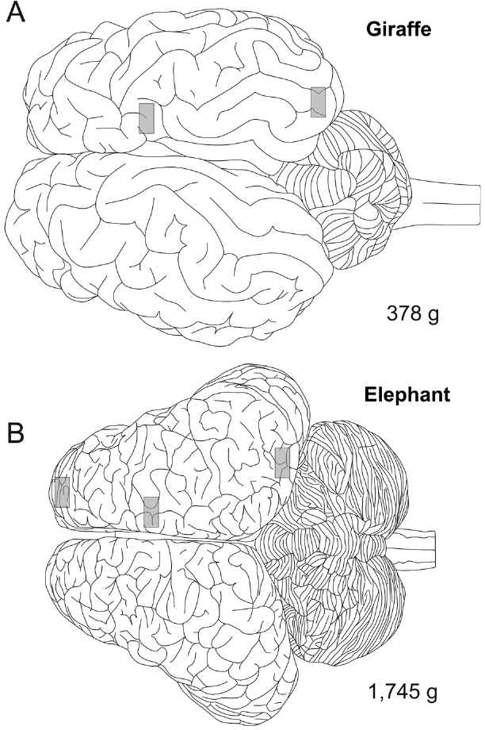
Newborn cortex supplies developmental anatomy
Jacobs and colleagues examined cortical tissue from a stillborn African elephant and a newborn giraffe. The elephant brain weighed 1,745 g; these specimens represent an early developmental stage, not normal adult brain size or an adult cognitive performance comparison.
Samples came from elephant frontal, motor and occipital cortex, with anatomical locations documented before staining. Blocks were approximately 3–5 mm thick. Comparing defined regions reduced ambiguity about where the analyzed neuronal forms originated.
The design permits comparisons of cellular morphology across species and developmental datasets. The sampling outlines used adult brains because newborn specimens were fragmented; clinical history and fixation also limit inference. Newborn architecture cannot by itself identify the neural basis of the adult’s learned vocal repertoire or social experience.
Jacobs et al. (2016), Fig. 1(A–B). Sampling locations on adult-based outlines, with newborn brain weights.
Jacobs et al. (2016)
24
Notes:
• Jacobs and colleagues examined cortical tissue from a stillborn African elephant and a newborn giraffe. The elephant brain weighed 1,745 g; these specimens represent an early developmental stage, not normal adult brain size or an adult cognitive performance comparison.
• Samples came from elephant frontal, motor and occipital cortex, with anatomical locations documented before staining. Blocks were approximately 3–5 mm thick. Comparing defined regions reduced ambiguity about where the analyzed neuronal forms originated.
• The design permits comparisons of cellular morphology across species and developmental datasets. The sampling outlines used adult brains because newborn specimens were fragmented; clinical history and fixation also limit inference. Newborn architecture cannot by itself identify the neural basis of the adult’s learned vocal repertoire or social experience.
– The figure includes both species; elephant tissue-sampling locations are in panel B. Occipital tissue was designated putative visual cortex from anatomical position.
References:
Bob Jacobs, Laura Lee, Matthew Schall, Mary Ann Raghanti, Albert H. Lewandowski, Jack J. Kottwitz, John F. Roberts, Patrick R. Hof, Chet C. Sherwood (2016). Neocortical neuronal morphology in the newborn giraffe (Giraffa camelopardalis tippelskirchi) and African elephant (Loxodonta africana). Journal of Comparative Neurology 524: 257-287. https://doi.org/10.1002/cne.23841
Figure: Jacobs et al. (2016), Fig. 1(A–B). Sampling locations on adult-based outlines, with newborn brain weights.
Figure source: https://doi.org/10.1002/cne.23841

Slide 25
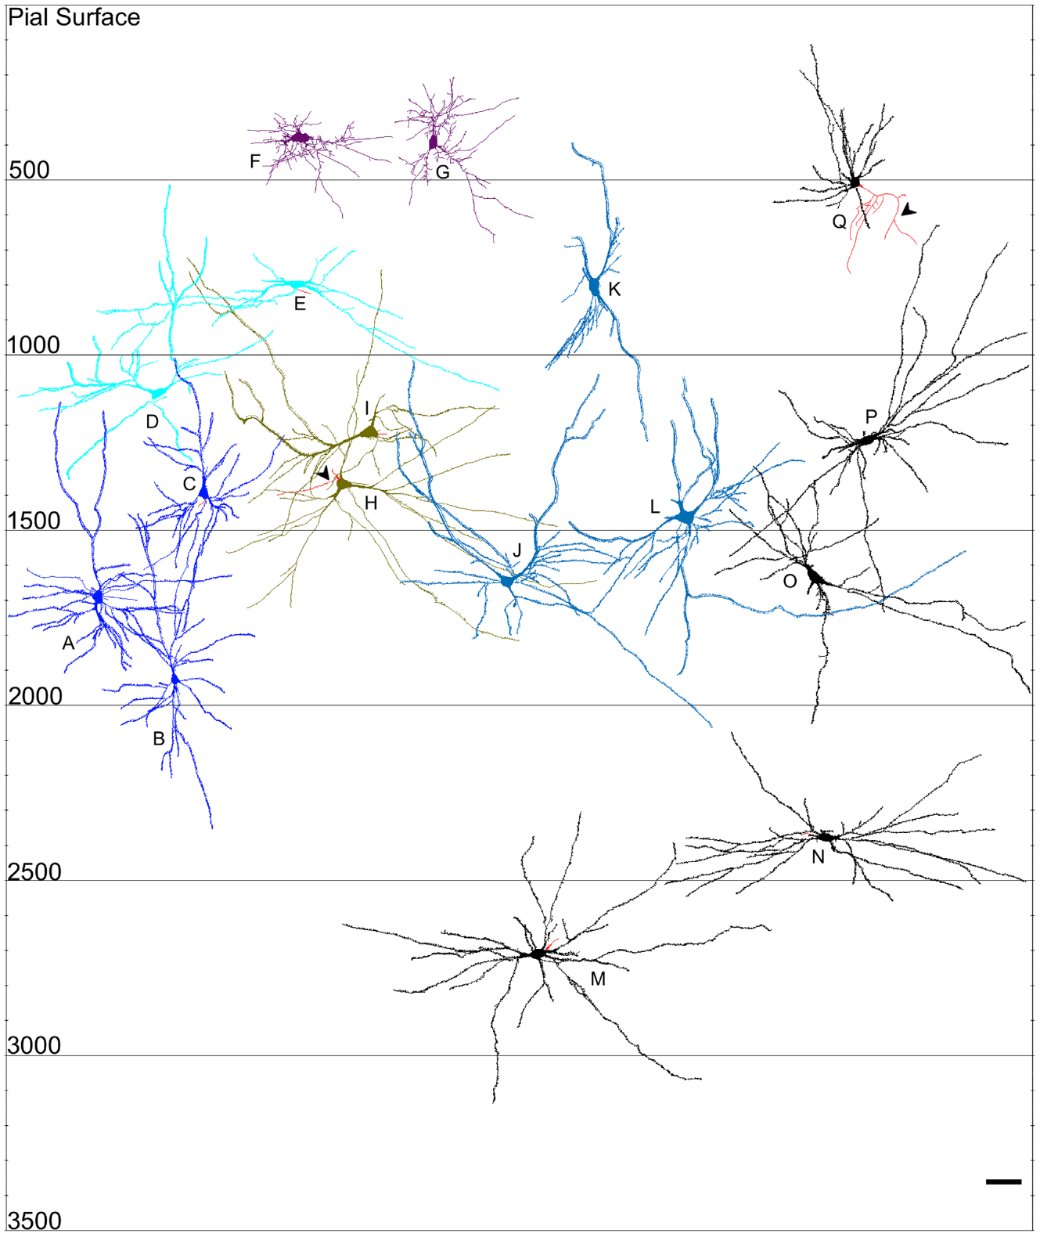
Golgi staining exposes whole dendritic configurations
The Golgi method impregnates a subset of neurons so that their cell bodies and dendritic branches can be examined against relatively unstained tissue. Jacobs and colleagues used a modified Golgi technique and computer-assisted tracing of newborn elephant cortical neurons.
Selection favored neurons whose processes could be followed and were not excessively obscured or truncated. The source’s motor-cortex tracings retain the positions of cell bodies relative to the pial surface, the outer cortical boundary. Different morphologies occupied overlapping rather than perfectly isolated depths.
Selective staining provides detailed shape information but is not a census of all cell types. An anatomical tracing neither establishes which synapses were functional nor measures electrical responses. Selected cells had to permit reliable tracing of branches within the tissue section.
Jacobs et al. (2016), Fig. 10(A–Q). Published motor-cortex neuron tracings and depth scale.
Jacobs et al. (2016)
25
Notes:
• The Golgi method impregnates a subset of neurons so that their cell bodies and dendritic branches can be examined against relatively unstained tissue. Jacobs and colleagues used a modified Golgi technique and computer-assisted tracing of newborn elephant cortical neurons.
• Selection favored neurons whose processes could be followed and were not excessively obscured or truncated. The source’s motor-cortex tracings retain the positions of cell bodies relative to the pial surface, the outer cortical boundary. Different morphologies occupied overlapping rather than perfectly isolated depths.
• Selective staining provides detailed shape information but is not a census of all cell types. An anatomical tracing neither establishes which synapses were functional nor measures electrical responses. Selected cells had to permit reliable tracing of branches within the tissue section.
– Because Golgi impregnation samples only some cells, relative frequency in the selected tracing dataset must not be treated as the proportion of every neuronal class in the brain.
References:
Bob Jacobs, Laura Lee, Matthew Schall, Mary Ann Raghanti, Albert H. Lewandowski, Jack J. Kottwitz, John F. Roberts, Patrick R. Hof, Chet C. Sherwood (2016). Neocortical neuronal morphology in the newborn giraffe (Giraffa camelopardalis tippelskirchi) and African elephant (Loxodonta africana). Journal of Comparative Neurology 524: 257-287. https://doi.org/10.1002/cne.23841
Figure: Jacobs et al. (2016), Fig. 10(A–Q). Published motor-cortex neuron tracings and depth scale.
Figure source: https://doi.org/10.1002/cne.23841

Slide 26
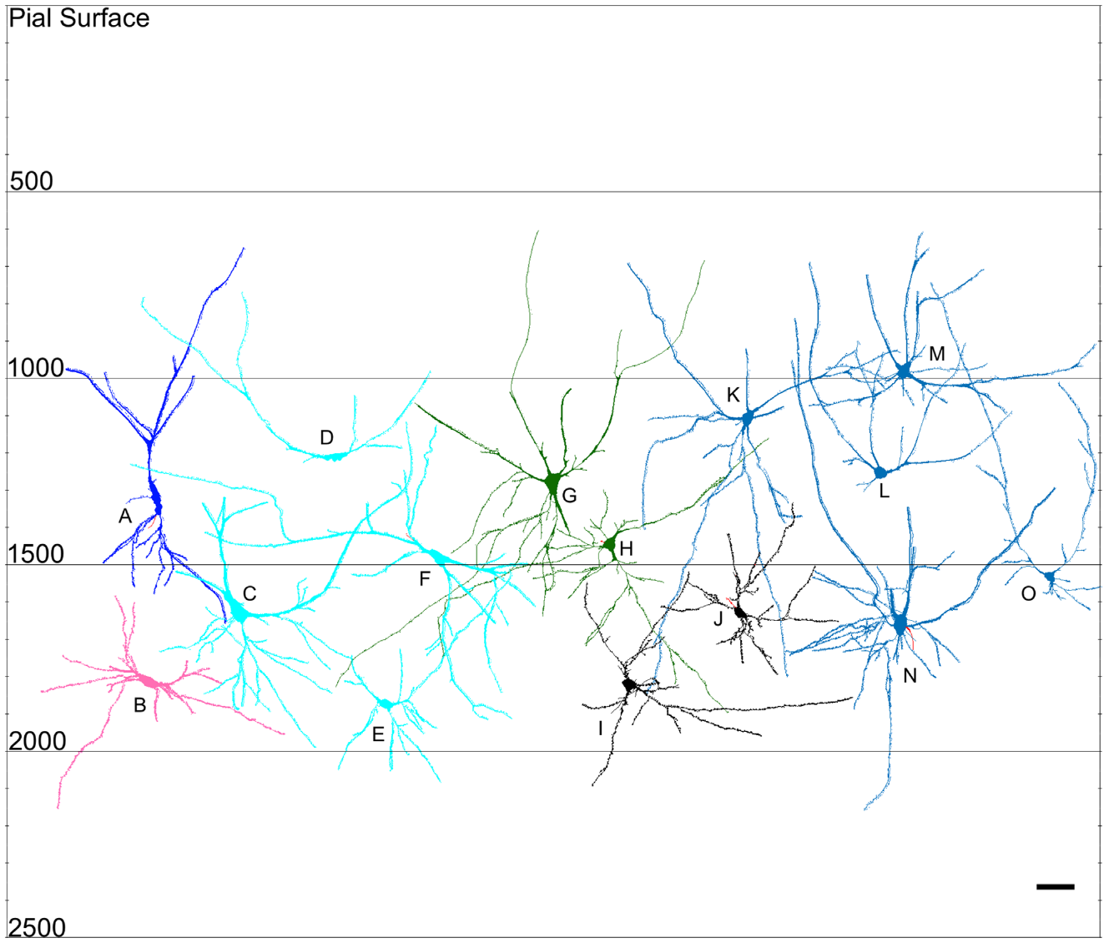
Flattened pyramidal cells broaden dendritic geometry
A pyramidal neuron typically has a prominent apical dendrite and several basal dendrites. Jacobs and colleagues described elephant forms whose apical dendrites bifurcated widely or extended laterally, including flattened pyramidal neurons distinct from a narrow upright configuration.
The newborn frontal material already contained multiple projection-neuron morphologies. Published tracings placed these forms within cortical depth and supported comparisons with ordinary pyramidal and inverted pyramidal cells, rather than assuming one canonical cortical shape.
A wider dendritic configuration could sample inputs over a different tissue extent, but the study did not map the actual presynaptic partners. Morphological diversity is established; a particular role in elephant social learning, vocal imitation or behavioral flexibility is not established by these images.
Jacobs et al. (2016), Fig. 11(A–O). Original newborn frontal-cortex neuronal reconstructions.
Jacobs et al. (2016)
26
Notes:
• A pyramidal neuron typically has a prominent apical dendrite and several basal dendrites. Jacobs and colleagues described elephant forms whose apical dendrites bifurcated widely or extended laterally, including flattened pyramidal neurons distinct from a narrow upright configuration.
• The newborn frontal material already contained multiple projection-neuron morphologies. Published tracings placed these forms within cortical depth and supported comparisons with ordinary pyramidal and inverted pyramidal cells, rather than assuming one canonical cortical shape.
• A wider dendritic configuration could sample inputs over a different tissue extent, but the study did not map the actual presynaptic partners. Morphological diversity is established; a particular role in elephant social learning, vocal imitation or behavioral flexibility is not established by these images.
– A projection neuron sends an axon to other tissue, but assigning a morphological class does not specify the complete route or behavioral function of that axon.
References:
Bob Jacobs, Laura Lee, Matthew Schall, Mary Ann Raghanti, Albert H. Lewandowski, Jack J. Kottwitz, John F. Roberts, Patrick R. Hof, Chet C. Sherwood (2016). Neocortical neuronal morphology in the newborn giraffe (Giraffa camelopardalis tippelskirchi) and African elephant (Loxodonta africana). Journal of Comparative Neurology 524: 257-287. https://doi.org/10.1002/cne.23841
Figure: Jacobs et al. (2016), Fig. 11(A–O). Original newborn frontal-cortex neuronal reconstructions.
Figure source: https://doi.org/10.1002/cne.23841

Slide 27
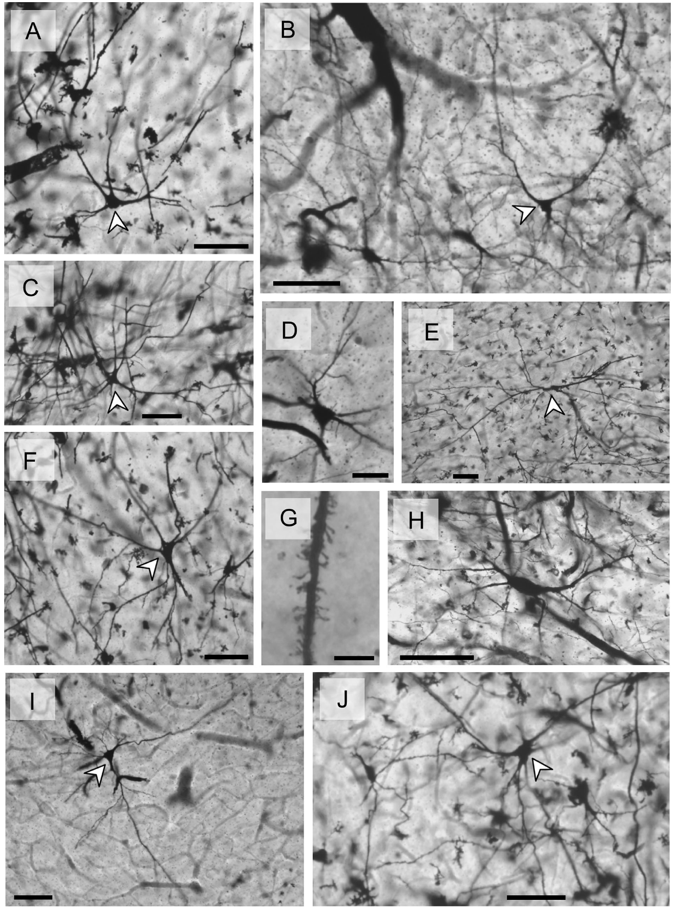
Multipolar forms enlarge the cortical cell repertoire
Multipolar neurons have several processes extending from the cell body rather than one dominant apical and one basal dendrite. The newborn elephant frontal tissue contained nonpyramidal multipolar forms alongside inverted pyramidal, flattened pyramidal and other configurations.
Jacobs and colleagues documented these cells in Golgi photomicrographs and traced their dendritic trees. The photomicrographs preserve the actual tissue appearance, while the source’s companion reconstructions aid comparisons of branching geometry and cortical position.
The study reported greater morphological variety among elephant projection cells than in the newborn giraffe material. This is a comparison of sampled stained neurons, not an experimental demonstration that each additional shape supplies a distinct cognitive operation. Axonal targets and activity during behavior remain unresolved.
Jacobs et al. (2016), Fig. 6(A–J). Original frontal-cortex Golgi photomicrographs.
Jacobs et al. (2016)
27
Notes:
• Multipolar neurons have several processes extending from the cell body rather than one dominant apical and one basal dendrite. The newborn elephant frontal tissue contained nonpyramidal multipolar forms alongside inverted pyramidal, flattened pyramidal and other configurations.
• Jacobs and colleagues documented these cells in Golgi photomicrographs and traced their dendritic trees. The photomicrographs preserve the actual tissue appearance, while the source’s companion reconstructions aid comparisons of branching geometry and cortical position.
• The study reported greater morphological variety among elephant projection cells than in the newborn giraffe material. This is a comparison of sampled stained neurons, not an experimental demonstration that each additional shape supplies a distinct cognitive operation. Axonal targets and activity during behavior remain unresolved.
– Inverted pyramidal refers to a cell whose prominent dendritic orientation differs from the usual surface-directed configuration; it is an anatomical description, not a reversed flow of synaptic signaling.
References:
Bob Jacobs, Laura Lee, Matthew Schall, Mary Ann Raghanti, Albert H. Lewandowski, Jack J. Kottwitz, John F. Roberts, Patrick R. Hof, Chet C. Sherwood (2016). Neocortical neuronal morphology in the newborn giraffe (Giraffa camelopardalis tippelskirchi) and African elephant (Loxodonta africana). Journal of Comparative Neurology 524: 257-287. https://doi.org/10.1002/cne.23841
Figure: Jacobs et al. (2016), Fig. 6(A–J). Original frontal-cortex Golgi photomicrographs.
Figure source: https://doi.org/10.1002/cne.23841

Slide 28
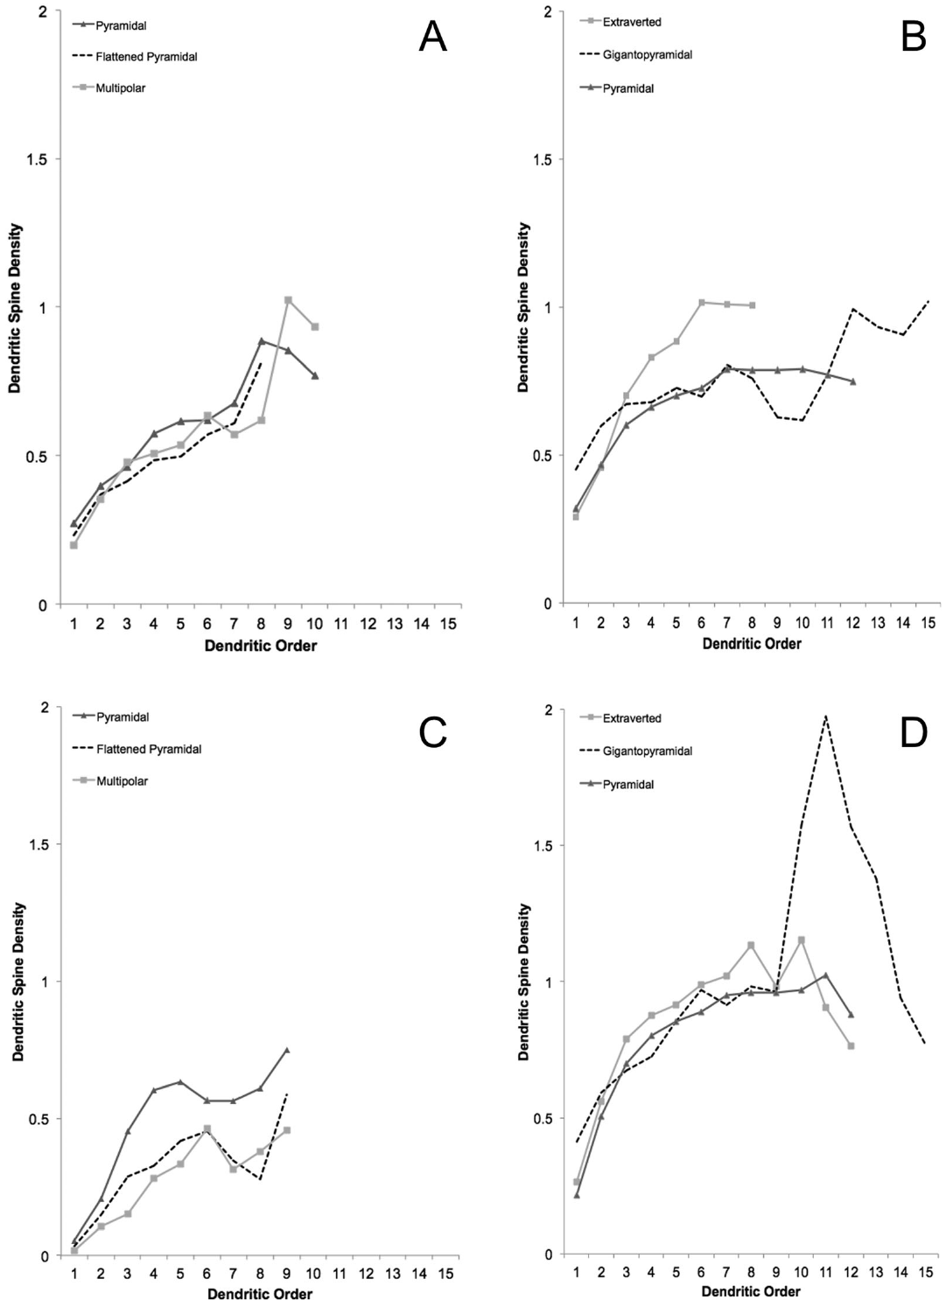
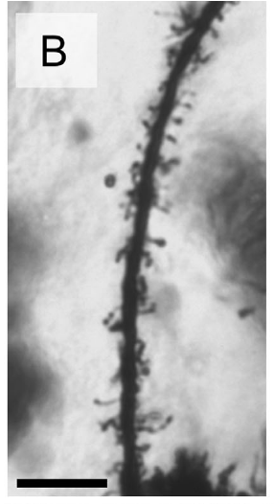
Dendritic spines vary with cell type and development
Dendritic spines are small protrusions on dendrites that commonly receive synaptic contacts. Jacobs and colleagues measured spine distributions along traced dendritic segments, using spine density to describe the number of visible spines per unit dendritic length.
Several newborn local-circuit morphologies carried spines despite comparatively aspiny adult counterparts. The source compared spine-density profiles by cell type and distance from the soma, revealing that developing neuronal surface organization is not simply a scaled-down adult configuration.
Visible spines are structural observations, not measurements of synaptic strength, release probability or receptor composition. The authors discussed maturation of presumed inhibitory and excitatory classes comparatively, but transmitter identity and functional inhibition were not established by the Golgi staining itself.
Jacobs et al. (2016), Fig. 16(A–D). Published spine-density profiles across distance and age.
Jacobs et al. (2016), Fig. 5(B). Golgi-stained dendritic spines; original 10 µm scale bar.
Jacobs et al. (2016)
28
Notes:
• Dendritic spines are small protrusions on dendrites that commonly receive synaptic contacts. Jacobs and colleagues measured spine distributions along traced dendritic segments, using spine density to describe the number of visible spines per unit dendritic length.
• Several newborn local-circuit morphologies carried spines despite comparatively aspiny adult counterparts. The source compared spine-density profiles by cell type and distance from the soma, revealing that developing neuronal surface organization is not simply a scaled-down adult configuration.
• Visible spines are structural observations, not measurements of synaptic strength, release probability or receptor composition. The authors discussed maturation of presumed inhibitory and excitatory classes comparatively, but transmitter identity and functional inhibition were not established by the Golgi staining itself.
– The soma is the neuronal cell body. The plotted distance is along the dendritic extent; a density profile does not directly measure how many behavioral associations the animal has learned.
References:
Bob Jacobs, Laura Lee, Matthew Schall, Mary Ann Raghanti, Albert H. Lewandowski, Jack J. Kottwitz, John F. Roberts, Patrick R. Hof, Chet C. Sherwood (2016). Neocortical neuronal morphology in the newborn giraffe (Giraffa camelopardalis tippelskirchi) and African elephant (Loxodonta africana). Journal of Comparative Neurology 524: 257-287. https://doi.org/10.1002/cne.23841
Figure: Jacobs et al. (2016), Fig. 16(A–D). Published spine-density profiles across distance and age.
Figure source: https://doi.org/10.1002/cne.23841
Figure: Jacobs et al. (2016), Fig. 5(B). Golgi-stained dendritic spines; original 10 µm scale bar.
Figure source: https://doi.org/10.1002/cne.23841

Slide 29
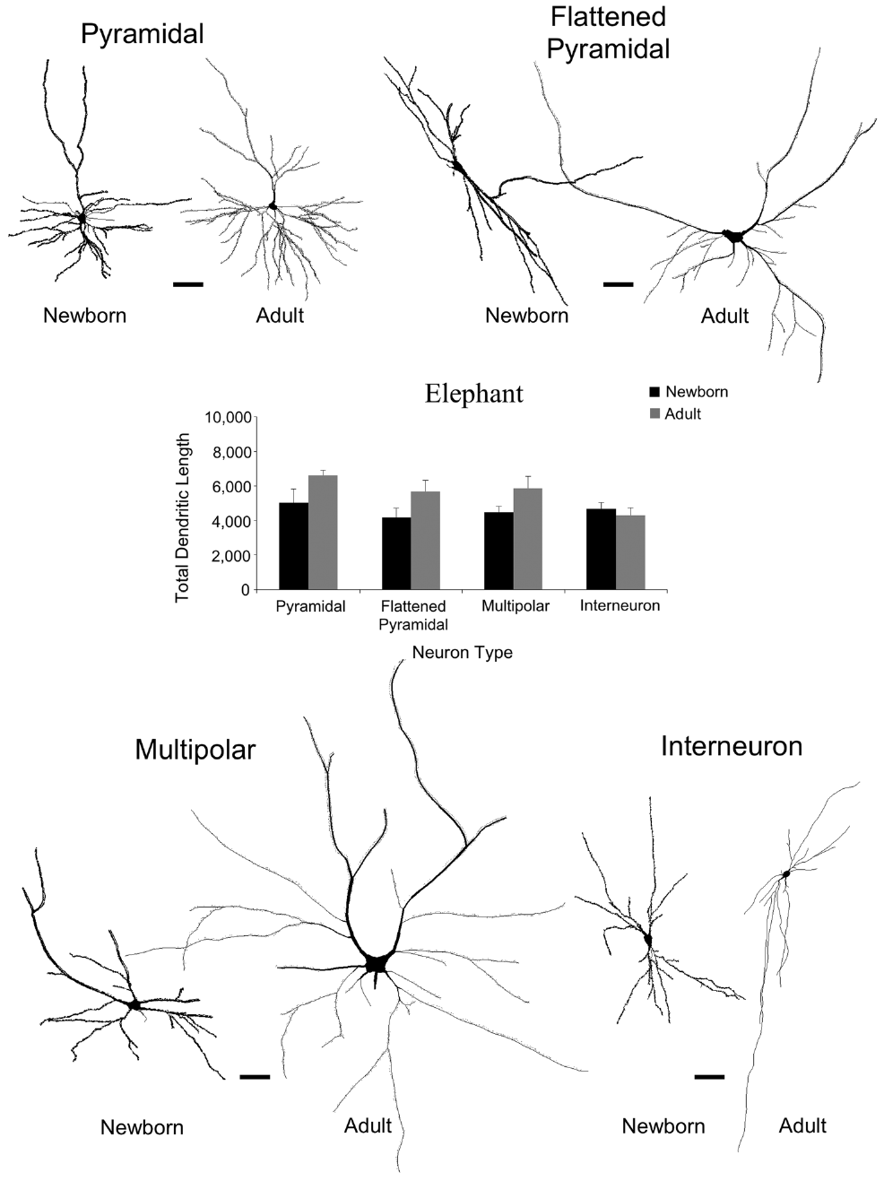
Projection dendrites continue growing after birth
Total dendritic length sums the lengths of the traced branches in a neuronal tree. Jacobs and colleagues compared newborn elephant cells with previously collected adult material using a matched subset of neuronal types.
Adult projection cells had more extensive dendrites: reported total lengths were approximately 32% greater for pyramidal, 36% greater for flattened pyramidal and 30% greater for nonpyramidal multipolar neurons. In contrast, the compared interneuron dendritic lengths were not similarly enlarged in adults.
These cross-sectional differences support prolonged growth of projection-neuron dendritic systems. They do not track the same cells through development, and they cannot separate maturation from particular social or sensory experiences. Structural growth should not be equated automatically with a measured increase in cognitive competence.
Jacobs et al. (2016), Fig. 15. Newborn and adult elephant dendritic-length comparisons.
Jacobs et al. (2016)
29
Notes:
• Total dendritic length sums the lengths of the traced branches in a neuronal tree. Jacobs and colleagues compared newborn elephant cells with previously collected adult material using a matched subset of neuronal types.
• Adult projection cells had more extensive dendrites: reported total lengths were approximately 32% greater for pyramidal, 36% greater for flattened pyramidal and 30% greater for nonpyramidal multipolar neurons. In contrast, the compared interneuron dendritic lengths were not similarly enlarged in adults.
• These cross-sectional differences support prolonged growth of projection-neuron dendritic systems. They do not track the same cells through development, and they cannot separate maturation from particular social or sensory experiences. Structural growth should not be equated automatically with a measured increase in cognitive competence.
– The adult comparison is published within this uploaded source; it is used as that paper’s comparison rather than as an independent reanalysis of the unavailable earlier adult paper.
References:
Bob Jacobs, Laura Lee, Matthew Schall, Mary Ann Raghanti, Albert H. Lewandowski, Jack J. Kottwitz, John F. Roberts, Patrick R. Hof, Chet C. Sherwood (2016). Neocortical neuronal morphology in the newborn giraffe (Giraffa camelopardalis tippelskirchi) and African elephant (Loxodonta africana). Journal of Comparative Neurology 524: 257-287. https://doi.org/10.1002/cne.23841
Figure: Jacobs et al. (2016), Fig. 15. Newborn and adult elephant dendritic-length comparisons.
Figure source: https://doi.org/10.1002/cne.23841

Slide 30
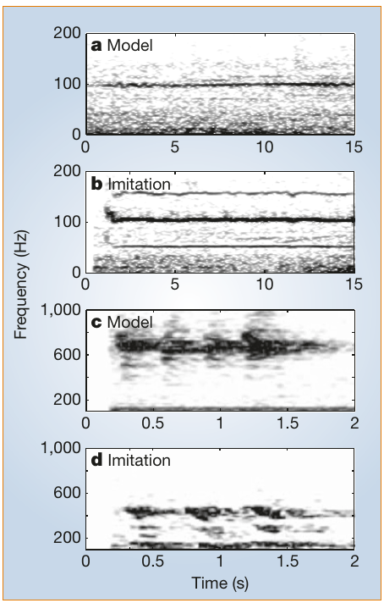
An African elephant copied environmental sounds
Vocal production learning is modification of the sounds an animal produces through experience of an acoustic model. Poole and colleagues recorded truck-like calls from Mlaika, an adolescent African elephant whose night enclosure was approximately 3 km from a major highway.
Her imitations resembled recorded truck sounds in duration and fundamental-frequency characteristics while differing from ordinary African elephant calls. Fundamental frequency is the repetition rate underlying a periodic vocal sound, represented by its lowest harmonic when detectable.
The calls were no more similar to simultaneously recorded trucks than to trucks recorded at other times, favoring imitation of general acoustic features rather than exact immediate copying. The case establishes an unusual learned production pattern, not its neural pathway or prevalence in wild elephants.
Poole et al. (2005), Fig. 1(a–d). Truck and elephant models with their imitations.
Poole et al. (2005)
30
Notes:
• Vocal production learning is modification of the sounds an animal produces through experience of an acoustic model. Poole and colleagues recorded truck-like calls from Mlaika, an adolescent African elephant whose night enclosure was approximately 3 km from a major highway.
• Her imitations resembled recorded truck sounds in duration and fundamental-frequency characteristics while differing from ordinary African elephant calls. Fundamental frequency is the repetition rate underlying a periodic vocal sound, represented by its lowest harmonic when detectable.
• The calls were no more similar to simultaneously recorded trucks than to trucks recorded at other times, favoring imitation of general acoustic features rather than exact immediate copying. The case establishes an unusual learned production pattern, not its neural pathway or prevalence in wild elephants.
– A spectrogram retains time, frequency and signal-energy information from the actual recordings; no synthetic truck or elephant signal has been added.
References:
Joyce H. Poole, Peter L. Tyack, Angela S. Stoeger-Horwath, Stephanie Watwood (2005). Elephants are capable of vocal learning. Nature 434: 455-456. https://doi.org/10.1038/434455a
Figure: Poole et al. (2005), Fig. 1(a–d). Truck and elephant models with their imitations.
Figure source: https://doi.org/10.1038/434455a

Slide 31
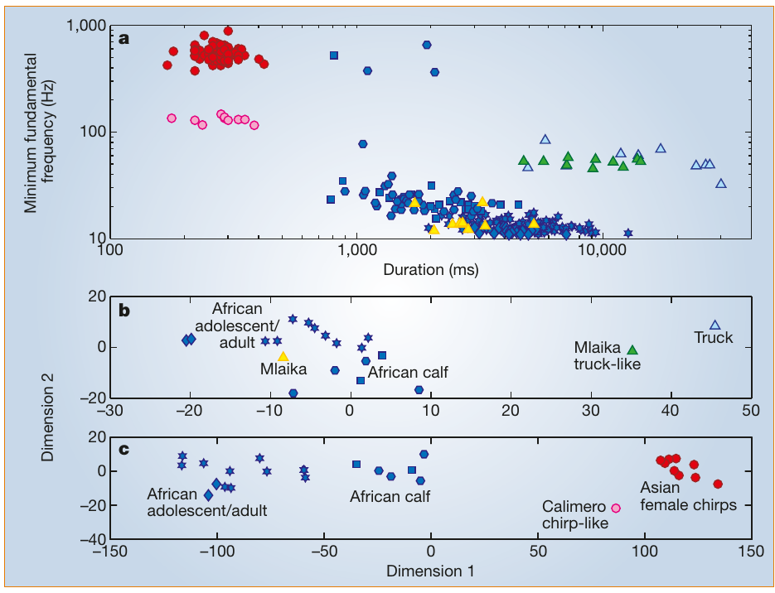
Long-term companions can supply a heterospecific model
Heterospecific imitation copies a sound associated with another species. Poole and colleagues described Calimero, an African male elephant that had lived for 18 years with Asian female elephants and produced chirp-like sounds unusual for African elephants.
His chirps resembled the Asian models in acoustic comparisons and differed from ordinary African adult, adolescent and calf calls. The authors analyzed duration and frequency-related properties, rather than relying only on a listener’s impression that the calls sounded similar.
Long-term social exposure is consistent with learning a companion-associated vocal pattern. The record was not a randomized exposure experiment, so it does not establish that social bonding caused the change or that every African elephant would imitate chirps under comparable housing conditions.
Poole et al. (2005), Fig. 2(a–c). Acoustic comparisons of ordinary calls and imitations.
Poole et al. (2005)
31
Notes:
• Heterospecific imitation copies a sound associated with another species. Poole and colleagues described Calimero, an African male elephant that had lived for 18 years with Asian female elephants and produced chirp-like sounds unusual for African elephants.
• His chirps resembled the Asian models in acoustic comparisons and differed from ordinary African adult, adolescent and calf calls. The authors analyzed duration and frequency-related properties, rather than relying only on a listener’s impression that the calls sounded similar.
• Long-term social exposure is consistent with learning a companion-associated vocal pattern. The record was not a randomized exposure experiment, so it does not establish that social bonding caused the change or that every African elephant would imitate chirps under comparable housing conditions.
– The comparison separates similarity to the Asian model from similarity to the producing animal’s normal species repertoire; the inference concerns acoustic form, not inferred word meaning.
References:
Joyce H. Poole, Peter L. Tyack, Angela S. Stoeger-Horwath, Stephanie Watwood (2005). Elephants are capable of vocal learning. Nature 434: 455-456. https://doi.org/10.1038/434455a
Figure: Poole et al. (2005), Fig. 2(a–c). Acoustic comparisons of ordinary calls and imitations.
Figure source: https://doi.org/10.1038/434455a

Slide 32
Acoustic controls distinguish imitation
The Poole study compared imitations with both their proposed models and ordinary elephant vocalizations. Including adult, adolescent and calf calls reduced the explanation that an unusual imitation was simply an age-related or sex-related member of the normal repertoire.
Mlaika’s truck-like calls occupied acoustic space near truck sounds, whereas Calimero’s chirp-like calls resembled Asian chirps. The published multidimensional comparisons summarize combinations of acoustic features; their axes are not anatomical brain dimensions or measures of intelligence.
Evidence of acoustic matching supports experience-related flexibility in vocal production. It does not identify whether changes were learned through spontaneous practice, reinforcement or another route. The authors’ social-bond hypothesis explains a possible adaptive function, while the measured result remains the altered call structure.
Poole et al. (2005), Fig. 2(a–c). Original frequency-duration and multivariate comparisons.
Poole et al. (2005)
32
Notes:
• The Poole study compared imitations with both their proposed models and ordinary elephant vocalizations. Including adult, adolescent and calf calls reduced the explanation that an unusual imitation was simply an age-related or sex-related member of the normal repertoire.
• Mlaika’s truck-like calls occupied acoustic space near truck sounds, whereas Calimero’s chirp-like calls resembled Asian chirps. The published multidimensional comparisons summarize combinations of acoustic features; their axes are not anatomical brain dimensions or measures of intelligence.
• Evidence of acoustic matching supports experience-related flexibility in vocal production. It does not identify whether changes were learned through spontaneous practice, reinforcement or another route. The authors’ social-bond hypothesis explains a possible adaptive function, while the measured result remains the altered call structure.
– The plotted color categories distinguish model sounds, ordinary species calls and the imitations; the comparison depends on measured acoustic properties rather than a listener’s label.
References:
Joyce H. Poole, Peter L. Tyack, Angela S. Stoeger-Horwath, Stephanie Watwood (2005). Elephants are capable of vocal learning. Nature 434: 455-456. https://doi.org/10.1038/434455a
Figure: Poole et al. (2005), Fig. 2(a–c). Original frequency-duration and multivariate comparisons.
Figure source: https://doi.org/10.1038/434455a

Slide 33
Imitation suggests a possible social function
Elephant fission–fusion societies involve groups that separate and reunite while maintaining longer-lasting relationships. Poole and colleagues proposed that vocal convergence could help sustain individual-specific bonds when companions are not continuously together.
Calimero’s resemblance to Asian companions supplies a social context for this proposal, whereas Mlaika’s truck imitation establishes flexibility beyond ordinary social calls. Neither case manipulated bond strength or measured a subsequent improvement in recognition or affiliation.
A capacity and its evolutionary function are different claims. The documented imitations establish learned acoustic flexibility in particular elephants. Selection for maintaining social contact remains a plausible adaptive explanation, requiring evidence that the resulting vocal changes affect communication or relationships in natural groups.
Poole et al. (2005), Fig. 2(a–c). Published comparisons underlying the vocal-learning inference.
Poole et al. (2005)
33
Notes:
• Elephant fission–fusion societies involve groups that separate and reunite while maintaining longer-lasting relationships. Poole and colleagues proposed that vocal convergence could help sustain individual-specific bonds when companions are not continuously together.
• Calimero’s resemblance to Asian companions supplies a social context for this proposal, whereas Mlaika’s truck imitation establishes flexibility beyond ordinary social calls. Neither case manipulated bond strength or measured a subsequent improvement in recognition or affiliation.
• A capacity and its evolutionary function are different claims. The documented imitations establish learned acoustic flexibility in particular elephants. Selection for maintaining social contact remains a plausible adaptive explanation, requiring evidence that the resulting vocal changes affect communication or relationships in natural groups.
– Vocal convergence means becoming acoustically more similar. It should not be described as a demonstrated necessity for elephant bonding on the basis of these case records alone.
References:
Joyce H. Poole, Peter L. Tyack, Angela S. Stoeger-Horwath, Stephanie Watwood (2005). Elephants are capable of vocal learning. Nature 434: 455-456. https://doi.org/10.1038/434455a
Figure: Poole et al. (2005), Fig. 2(a–c). Published comparisons underlying the vocal-learning inference.
Figure source: https://doi.org/10.1038/434455a

Slide 34
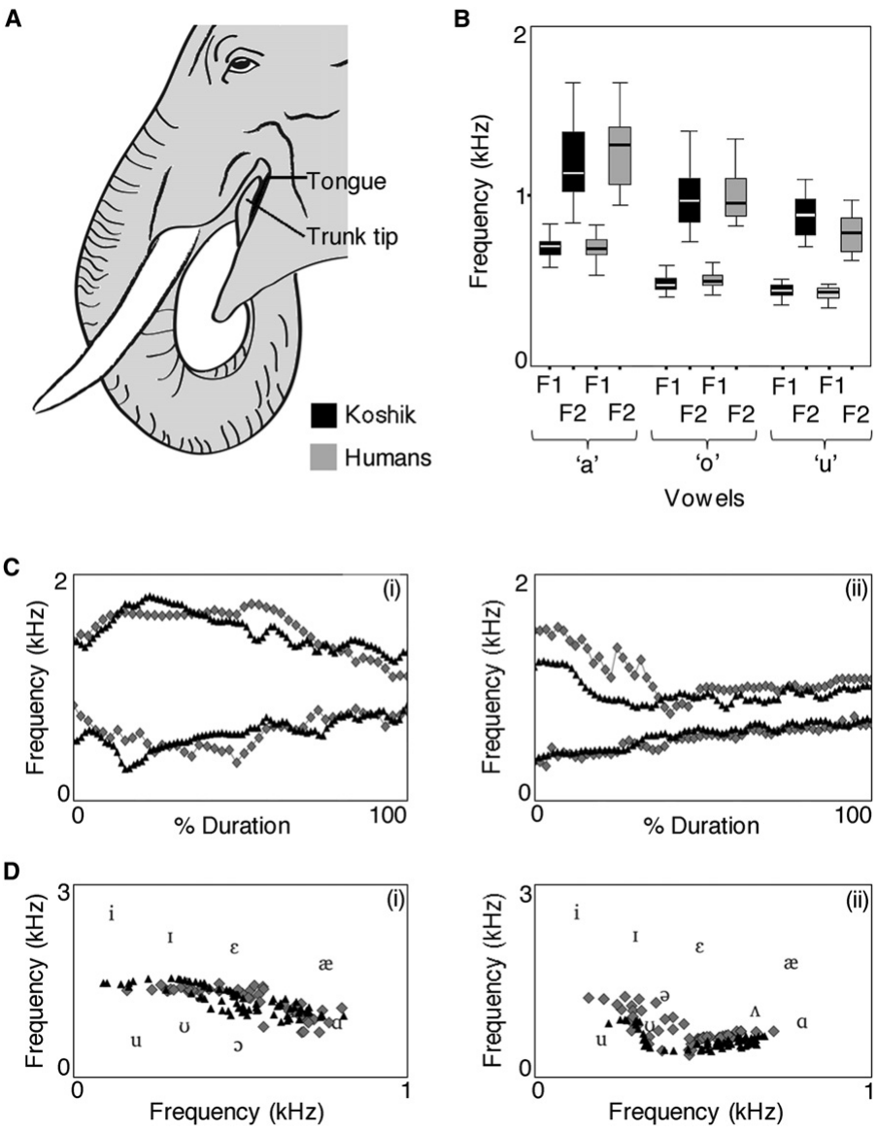
Koshik modified his vocal tract with his trunk
Stoeger and colleagues analyzed Koshik, an Asian elephant producing speech-like Korean sounds. He inserted his trunk tip into his mouth from the right and raised his lower jaw during phonation. Phonation is production of the periodic source sound by the vocal apparatus.
Trunk insertion occurred about 0.3 s before vocal onset, and removal about 0.4 s after vocalization. The coordinated movement changed the vocal-tract configuration rather than simply emitting an ordinary elephant call in response to a spoken command.
The authors inferred that the trunk helped overcome anatomical constraints on vowel production. Without internal imaging they could not determine whether tongue movements also contributed. The external movement sequence was documented together with measured acoustic changes.
Stoeger et al. (2012), Fig. 3(A–D). Original articulation panel and formant measurements.
Stoeger et al. (2012)
34
Notes:
• Stoeger and colleagues analyzed Koshik, an Asian elephant producing speech-like Korean sounds. He inserted his trunk tip into his mouth from the right and raised his lower jaw during phonation. Phonation is production of the periodic source sound by the vocal apparatus.
• Trunk insertion occurred about 0.3 s before vocal onset, and removal about 0.4 s after vocalization. The coordinated movement changed the vocal-tract configuration rather than simply emitting an ordinary elephant call in response to a spoken command.
• The authors inferred that the trunk helped overcome anatomical constraints on vowel production. Without internal imaging they could not determine whether tongue movements also contributed. The external movement sequence was documented together with measured acoustic changes.
– The researchers documented external articulation but lacked internal X-ray imaging, so the contribution of tongue movements remained unresolved.
References:
Angela S. Stoeger, Daniel Mietchen, Sukhun Oh, Shermin de Silva, Christian T. Herbst, Soowhan Kwon, W. Tecumseh Fitch (2012). An Asian Elephant Imitates Human Speech. Current Biology 22: 2144-2148. https://doi.org/10.1016/j.cub.2012.09.022
Figure: Stoeger et al. (2012), Fig. 3(A–D). Original articulation panel and formant measurements.
Figure source: https://doi.org/10.1016/j.cub.2012.09.022

Slide 35
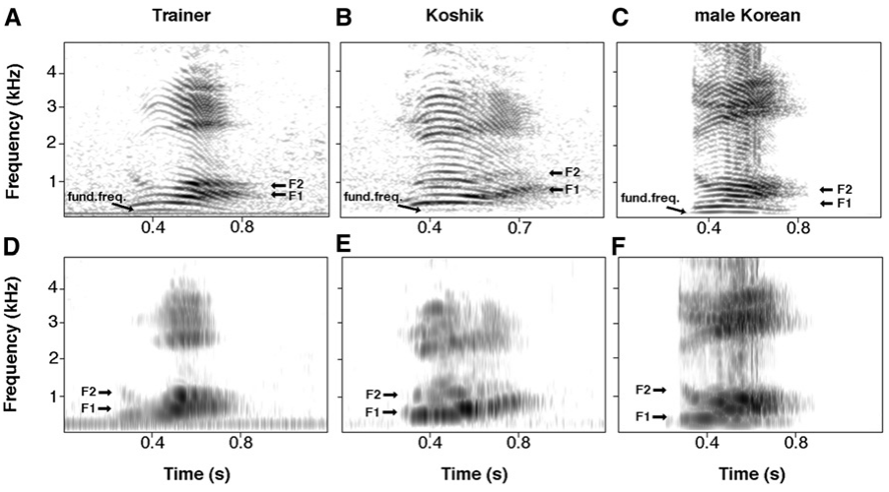
Spectral structure separates pitch from vowel quality
Formants are resonant frequency bands shaped by the vocal tract; they contribute to vowel quality. Fundamental frequency instead reflects the periodic source. Stoeger and colleagues compared both properties in Koshik’s imitations and Korean human utterances.
The word-like utterance “nuo” was recorded from a trainer, Koshik and an independent Korean speaker. Narrow-band and wide-band spectrograms retained the different information needed to distinguish harmonics from broader resonance patterns, with F1 and F2 marked in the original panels.
Matching formants requires control beyond simply producing a similar pitch. The recordings support detailed acoustic imitation, while not establishing that the elephant understood the human utterance’s meaning or that an elephant vocal tract normally produces the same vowels without modification.
Stoeger et al. (2012), Fig. 1(A–F). Trainer, Koshik and independent speaker utterances.
Stoeger et al. (2012)
35
Notes:
• Formants are resonant frequency bands shaped by the vocal tract; they contribute to vowel quality. Fundamental frequency instead reflects the periodic source. Stoeger and colleagues compared both properties in Koshik’s imitations and Korean human utterances.
• The word-like utterance “nuo” was recorded from a trainer, Koshik and an independent Korean speaker. Narrow-band and wide-band spectrograms retained the different information needed to distinguish harmonics from broader resonance patterns, with F1 and F2 marked in the original panels.
• Matching formants requires control beyond simply producing a similar pitch. The recordings support detailed acoustic imitation, while not establishing that the elephant understood the human utterance’s meaning or that an elephant vocal tract normally produces the same vowels without modification.
– F1 and F2 are the first and second formants. Similar fundamental frequencies can occur with different formants, so source periodicity and vocal-tract filtering must remain separate concepts.
References:
Angela S. Stoeger, Daniel Mietchen, Sukhun Oh, Shermin de Silva, Christian T. Herbst, Soowhan Kwon, W. Tecumseh Fitch (2012). An Asian Elephant Imitates Human Speech. Current Biology 22: 2144-2148. https://doi.org/10.1016/j.cub.2012.09.022
Figure: Stoeger et al. (2012), Fig. 1(A–F). Trainer, Koshik and independent speaker utterances.
Figure source: https://doi.org/10.1016/j.cub.2012.09.022

Slide 36
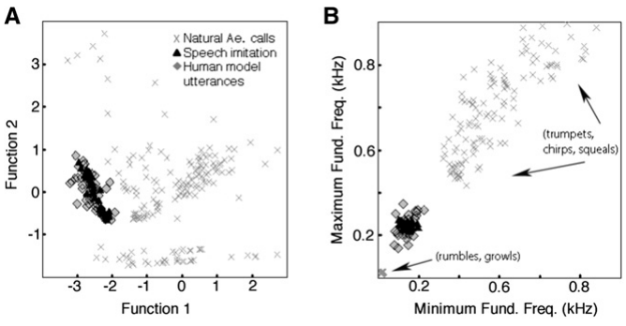
Learned utterances differ from natural Asian calls
Stoeger and colleagues compared Koshik’s imitations with natural Asian elephant vocalizations recorded from animals of different ages and sexes in captive and wild settings. Duration, fundamental-frequency extremes and the first spectral peak or formant supplied acoustic comparison measures.
The imitations grouped with human model utterances and differed strongly from the natural Asian elephant calls. This control addresses the explanation that trainers merely assigned word labels to ordinary calls already present in the species’ repertoire.
The acoustic contrast supports production learning of a human-associated sound pattern. It does not establish how many other elephants could learn it, and the observed similarity does not determine which auditory or motor neurons are necessary to perceive, practice or reproduce the sounds.
Stoeger et al. (2012), Fig. 2(A–B). Imitations, human models and natural elephant calls.
Stoeger et al. (2012)
36
Notes:
• Stoeger and colleagues compared Koshik’s imitations with natural Asian elephant vocalizations recorded from animals of different ages and sexes in captive and wild settings. Duration, fundamental-frequency extremes and the first spectral peak or formant supplied acoustic comparison measures.
• The imitations grouped with human model utterances and differed strongly from the natural Asian elephant calls. This control addresses the explanation that trainers merely assigned word labels to ordinary calls already present in the species’ repertoire.
• The acoustic contrast supports production learning of a human-associated sound pattern. It does not establish how many other elephants could learn it, and the observed similarity does not determine which auditory or motor neurons are necessary to perceive, practice or reproduce the sounds.
– The original comparison uses combinations of measured acoustic features. Its plotted classification space is not a map of the elephant’s auditory cortex.
References:
Angela S. Stoeger, Daniel Mietchen, Sukhun Oh, Shermin de Silva, Christian T. Herbst, Soowhan Kwon, W. Tecumseh Fitch (2012). An Asian Elephant Imitates Human Speech. Current Biology 22: 2144-2148. https://doi.org/10.1016/j.cub.2012.09.022
Figure: Stoeger et al. (2012), Fig. 2(A–B). Imitations, human models and natural elephant calls.
Figure source: https://doi.org/10.1016/j.cub.2012.09.022

Slide 37
Blind listening reveals better vowels than consonants
Native Korean listeners transcribed Koshik’s recordings without being told the trainers’ proposed spellings or meanings. This blind transcription reduced the possibility that a suggested word would determine what listeners reported hearing.
The analysis supported five word-like imitations, with much better agreement for vowels than consonants: approximately 67% versus 21% overall. The trainers’ labels therefore did not correspond to equally accurate reproduction of every speech component.
The asymmetry fits the formant-matching evidence and places a concrete limit on imitation fidelity. Recognition by human listeners is an acoustic outcome, not proof of semantic understanding by the elephant. A remembered sound can be copied without representing the referent or instruction associated with a human word.
Stoeger et al. (2012), Fig. 1(A–F). Original speech-like utterance recordings.
Stoeger et al. (2012)
37
Notes:
• Native Korean listeners transcribed Koshik’s recordings without being told the trainers’ proposed spellings or meanings. This blind transcription reduced the possibility that a suggested word would determine what listeners reported hearing.
• The analysis supported five word-like imitations, with much better agreement for vowels than consonants: approximately 67% versus 21% overall. The trainers’ labels therefore did not correspond to equally accurate reproduction of every speech component.
• The asymmetry fits the formant-matching evidence and places a concrete limit on imitation fidelity. Recognition by human listeners is an acoustic outcome, not proof of semantic understanding by the elephant. A remembered sound can be copied without representing the referent or instruction associated with a human word.
– Blind means the listeners were not given the expected answer. The experiment tested what humans could recover from the sound, not whether Koshik could define or productively combine words.
References:
Angela S. Stoeger, Daniel Mietchen, Sukhun Oh, Shermin de Silva, Christian T. Herbst, Soowhan Kwon, W. Tecumseh Fitch (2012). An Asian Elephant Imitates Human Speech. Current Biology 22: 2144-2148. https://doi.org/10.1016/j.cub.2012.09.022
Figure: Stoeger et al. (2012), Fig. 1(A–F). Original speech-like utterance recordings.
Figure source: https://doi.org/10.1016/j.cub.2012.09.022

Slide 38
Formants require sensory–motor coordination
Koshik’s first two formants for commonly produced vowels resembled those of his trainers, despite the elephant’s much longer unmodified vocal tract. The observed trunk–mouth configuration supplied a distinctive way of adjusting the resonant filter during controlled sound production.
Matching a heard target requires a relationship between acoustic perception and motor output. The paper inferred transfer of auditory information to planning systems controlling phonation and trunk movement, based on the precision of the behavior and acoustic match.
That relationship is a functional inference, not a mapped elephant neural circuit. The study did not trace cortical projections or manipulate neurotransmitters, receptors or ion channels. A specific songbird-like pathway cannot be assigned to elephants from successful imitation alone.
Stoeger et al. (2012), Fig. 3(A–D). Vowel formants and coordinated vocal-tract modification.
Stoeger et al. (2012)
38
Notes:
• Koshik’s first two formants for commonly produced vowels resembled those of his trainers, despite the elephant’s much longer unmodified vocal tract. The observed trunk–mouth configuration supplied a distinctive way of adjusting the resonant filter during controlled sound production.
• Matching a heard target requires a relationship between acoustic perception and motor output. The paper inferred transfer of auditory information to planning systems controlling phonation and trunk movement, based on the precision of the behavior and acoustic match.
• That relationship is a functional inference, not a mapped elephant neural circuit. The study did not trace cortical projections or manipulate neurotransmitters, receptors or ion channels. A specific songbird-like pathway cannot be assigned to elephants from successful imitation alone.
– The measured link is between the acoustic target, coordinated movement and output sound. The intervening neural implementation remains a research question.
References:
Angela S. Stoeger, Daniel Mietchen, Sukhun Oh, Shermin de Silva, Christian T. Herbst, Soowhan Kwon, W. Tecumseh Fitch (2012). An Asian Elephant Imitates Human Speech. Current Biology 22: 2144-2148. https://doi.org/10.1016/j.cub.2012.09.022
Figure: Stoeger et al. (2012), Fig. 3(A–D). Vowel formants and coordinated vocal-tract modification.
Figure source: https://doi.org/10.1016/j.cub.2012.09.022

Slide 39
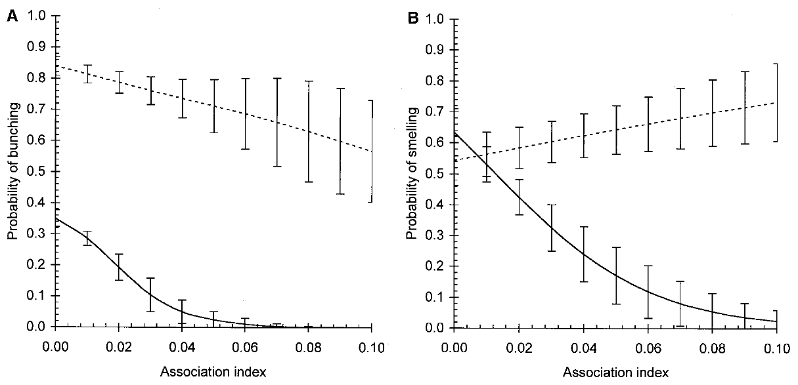
Older matriarchs discriminate familiarity
McComb and colleagues played female contact calls to wild African elephant families whose association histories were known. An association index describes how often families encountered one another, supplying a behavioral measure of caller familiarity independent of the immediate playback response.
Families led by older matriarchs differentiated low- and high-association callers more sharply. The published curves compare representative matriarch ages of 35 and 55 years; the analysis treated age continuously rather than as only two fixed categories.
Greater discrimination cannot be reduced to uniformly lower defensiveness in older-led groups. The study supports accumulated social knowledge, but age was not experimentally assigned. Experience, survival history and family characteristics remain relevant when interpreting why older leadership was associated with better discrimination.
McComb et al. (2001), Fig. 1(A–B). Playback responses by caller association and matriarch age.
McComb et al. (2001)
39
Notes:
• McComb and colleagues played female contact calls to wild African elephant families whose association histories were known. An association index describes how often families encountered one another, supplying a behavioral measure of caller familiarity independent of the immediate playback response.
• Families led by older matriarchs differentiated low- and high-association callers more sharply. The published curves compare representative matriarch ages of 35 and 55 years; the analysis treated age continuously rather than as only two fixed categories.
• Greater discrimination cannot be reduced to uniformly lower defensiveness in older-led groups. The study supports accumulated social knowledge, but age was not experimentally assigned. Experience, survival history and family characteristics remain relevant when interpreting why older leadership was associated with better discrimination.
– The association index supplies a measure of familiarity from encounter records, whereas defensive behavior supplies the response to a particular playback.
References:
Karen McComb, Cynthia Moss, Sarah M. Durant, Lucy Baker, Soila Sayialel (2001). Matriarchs As Repositories of Social Knowledge in African Elephants. Science 292: 491-494. https://doi.org/10.1126/science.1057895
Figure: McComb et al. (2001), Fig. 1(A–B). Playback responses by caller association and matriarch age.
Figure source: https://doi.org/10.1126/science.1057895

Slide 40
Social knowledge influences group responses
Social recognition distinguishes individuals or relationship categories from available cues. In the Amboseli playback study, contact-call familiarity predicted both defensive bunching and investigative smelling, linking acoustic identity information to coordinated protective behavior.
The investigators considered group composition, calf-related variables and the ages of females other than the matriarch. The association with matriarch age persisted beyond these measured alternatives, and older-led families were also associated with higher reproductive performance in the observational records.
These results connect social information with group-level consequences but do not demonstrate that one matriarch stores every member’s knowledge. They also do not locate a memory trace in FI, ACC or any other structure. Behavioral leadership and anatomical specialization remain different forms of evidence.
McComb et al. (2001), Fig. 1(A–B). Defensive bunching and investigative smelling responses.
McComb et al. (2001)
40
Notes:
• Social recognition distinguishes individuals or relationship categories from available cues. In the Amboseli playback study, contact-call familiarity predicted both defensive bunching and investigative smelling, linking acoustic identity information to coordinated protective behavior.
• The investigators considered group composition, calf-related variables and the ages of females other than the matriarch. The association with matriarch age persisted beyond these measured alternatives, and older-led families were also associated with higher reproductive performance in the observational records.
• These results connect social information with group-level consequences but do not demonstrate that one matriarch stores every member’s knowledge. They also do not locate a memory trace in FI, ACC or any other structure. Behavioral leadership and anatomical specialization remain different forms of evidence.
– The reproductive relationship was observational, not the outcome of experimentally replacing matriarchs. It should not be taught as proof that age alone causes increased reproduction.
References:
Karen McComb, Cynthia Moss, Sarah M. Durant, Lucy Baker, Soila Sayialel (2001). Matriarchs As Repositories of Social Knowledge in African Elephants. Science 292: 491-494. https://doi.org/10.1126/science.1057895
Figure: McComb et al. (2001), Fig. 1(A–B). Defensive bunching and investigative smelling responses.
Figure source: https://doi.org/10.1126/science.1057895

Slide 41
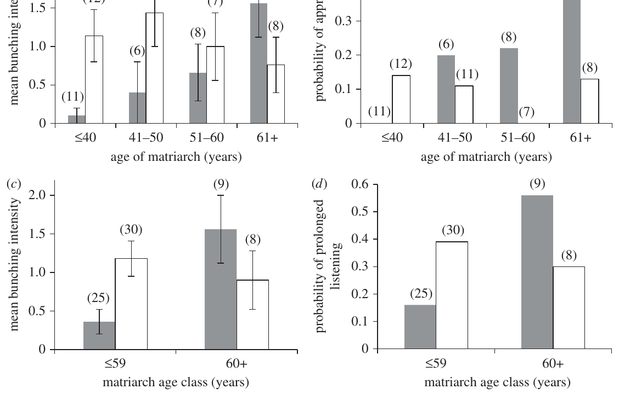
Experienced leadership distinguishes predator categories
McComb and colleagues used lion-roar playbacks to distinguish judgments about predator number from judgments about predator category. Three lions elicited stronger defensive responses than one, consistent with assessment of the scale of an approaching threat.
Sensitivity to male rather than female lion roars increased with matriarch age. Older matriarchs and their groups devoted stronger listening and defensive responses to the category associated with greater danger to elephants, rather than responding equally strongly to all lion sounds.
Different threat features therefore showed different relationships with experience. Playback isolates the acoustic stimulus, while observational age comparisons leave the acquisition route unresolved. The study did not establish that older matriarchs possess a generally superior sensory threshold or identify a predator-category neuron.
McComb et al. (2011), Fig. 2(a–d). Male- and female-lion playback responses by age.
McComb et al. (2011)
41
Notes:
• McComb and colleagues used lion-roar playbacks to distinguish judgments about predator number from judgments about predator category. Three lions elicited stronger defensive responses than one, consistent with assessment of the scale of an approaching threat.
• Sensitivity to male rather than female lion roars increased with matriarch age. Older matriarchs and their groups devoted stronger listening and defensive responses to the category associated with greater danger to elephants, rather than responding equally strongly to all lion sounds.
• Different threat features therefore showed different relationships with experience. Playback isolates the acoustic stimulus, while observational age comparisons leave the acquisition route unresolved. The study did not establish that older matriarchs possess a generally superior sensory threshold or identify a predator-category neuron.
– The distinction concerns the content of the detected threat. More intense behavior toward one category is not a direct measurement of how faint a sound the elephant can hear.
References:
Karen McComb, Graeme Shannon, Sarah M. Durant, Katito Sayialel, Rob Slotow, Joyce Poole, Cynthia Moss (2011). Leadership in elephants: the adaptive value of age. Proceedings of the Royal Society B: Biological Sciences 278: 3270-3276. https://doi.org/10.1098/rspb.2011.0168
Figure: McComb et al. (2011), Fig. 2(a–d). Male- and female-lion playback responses by age.
Figure source: https://doi.org/10.1098/rspb.2011.0168

Slide 42
Voice resynthesis tests which acoustic cues are sufficient
McComb and colleagues resynthesized human voices so that fundamental frequency and formant values resembled those of the opposite sex. This manipulation tested whether those prominent acoustic properties alone accounted for the elephants’ differential responses to men and women.
Defensive reactions retained the original direction: male-origin voices still elicited stronger responses despite the modified pitch and formant pattern. The experiment therefore did not support a simple classification rule based only on those two manipulated features.
Other retained acoustic characteristics could carry information about the original speaker category. The results support flexible auditory risk assessment but do not identify every effective cue. They also do not show that elephants use the same representation or linguistic categories that human listeners assign to the voices.
McComb et al. (2014), Fig. 1(A–H). Natural and resynthesized human-voice playback responses.
McComb et al. (2014)
42
Notes:
• McComb and colleagues resynthesized human voices so that fundamental frequency and formant values resembled those of the opposite sex. This manipulation tested whether those prominent acoustic properties alone accounted for the elephants’ differential responses to men and women.
• Defensive reactions retained the original direction: male-origin voices still elicited stronger responses despite the modified pitch and formant pattern. The experiment therefore did not support a simple classification rule based only on those two manipulated features.
• Other retained acoustic characteristics could carry information about the original speaker category. The results support flexible auditory risk assessment but do not identify every effective cue. They also do not show that elephants use the same representation or linguistic categories that human listeners assign to the voices.
– Resynthesis changed selected properties of recordings while retaining other speaker characteristics; the remaining discrimination implies that the manipulated features were not sufficient explanations.
References:
Karen McComb, Graeme Shannon, Katito N. Sayialel, Cynthia Moss (2014). Elephants can determine ethnicity, gender, and age from acoustic cues in human voices. Proceedings of the National Academy of Sciences 111: 5433-5438. https://doi.org/10.1073/pnas.1321543111
Figure: McComb et al. (2014), Fig. 1(A–H). Natural and resynthesized human-voice playback responses.
Figure source: https://doi.org/10.1073/pnas.1321543111

Slide 43
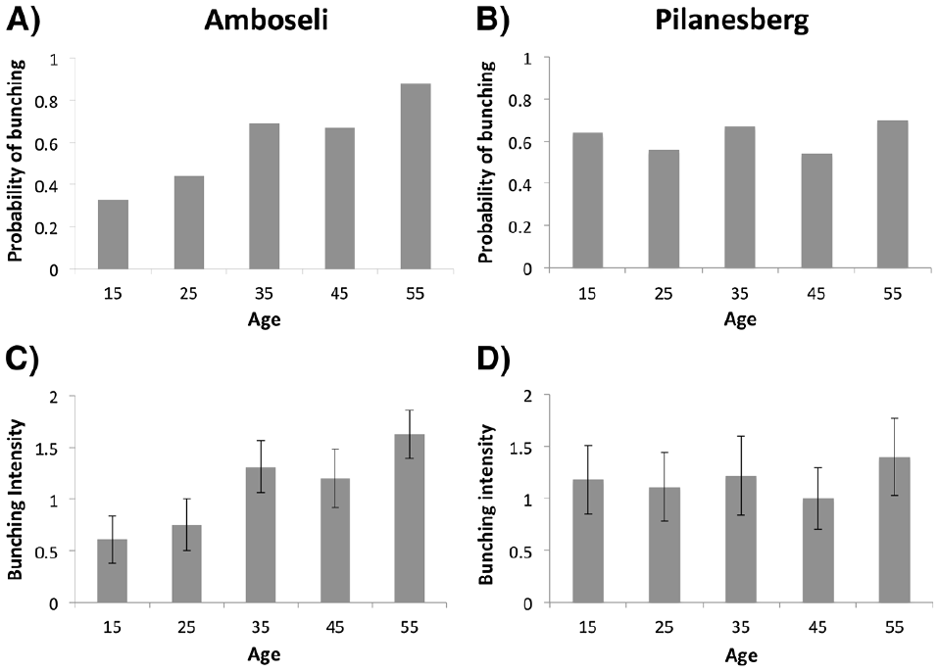
Social disruption has long-lasting behavioral correlates
Shannon and colleagues compared Amboseli families with a Pilanesberg population founded by young elephants translocated after culling. Social disruption involved loss of older family members and a break in normal opportunities to acquire socially relevant information.
Contact-call playbacks and resynthesized calls tested familiarity and caller-age-related dominance cues. Amboseli responses were adjusted to social category and age-related information; Pilanesberg families did not show the same appropriate pattern of discrimination decades after the founding disturbance.
The comparison supports lasting consequences associated with disrupted social history. It was not a randomized culling experiment, and differences between locations and population histories remain possible contributors. No brain lesion, synaptic alteration or hormone pathway was directly measured by these playback responses.
Shannon et al. (2013), Fig. 2(A–D). Responses to resynthesized caller-age categories.
Shannon et al. (2013)
43
Notes:
• Shannon and colleagues compared Amboseli families with a Pilanesberg population founded by young elephants translocated after culling. Social disruption involved loss of older family members and a break in normal opportunities to acquire socially relevant information.
• Contact-call playbacks and resynthesized calls tested familiarity and caller-age-related dominance cues. Amboseli responses were adjusted to social category and age-related information; Pilanesberg families did not show the same appropriate pattern of discrimination decades after the founding disturbance.
• The comparison supports lasting consequences associated with disrupted social history. It was not a randomized culling experiment, and differences between locations and population histories remain possible contributors. No brain lesion, synaptic alteration or hormone pathway was directly measured by these playback responses.
– The authors used systematic resynthesis to test a cue available to both populations, reducing the possibility that unfamiliarity alone explained every population difference.
References:
Graeme Shannon, Rob Slotow, Sarah M Durant, Katito N Sayialel, Joyce Poole, Cynthia Moss, Karen McComb (2013). Effects of social disruption in elephants persist decades after culling. Frontiers in Zoology 10: 62. https://doi.org/10.1186/1742-9994-10-62
Figure: Shannon et al. (2013), Fig. 2(A–D). Responses to resynthesized caller-age categories.
Figure source: https://doi.org/10.1186/1742-9994-10-62

Slide 44
Bystanders contact distressed companions
Plotnik and de Waal observed captive Asian elephants after naturally occurring distress and compared behavior with matched control periods. Affiliative contact is nonaggressive social contact, including trunk touches directed toward another animal’s head, mouth or other body regions.
Bystanders contacted the distressed animal sooner and more frequently during post-distress observations than during matched periods. Bystander initiation mattered because it separated another animal’s approach from contact elicited solely by the distressed elephant actively seeking company.
The pattern supports reassurance as a behavioral description. The observers did not measure the recipient’s subjective state, establish that contact reduced physiological stress, or test a causal role for oxytocin, dopamine or a particular cortical population. Functional and neural interpretations remain narrower than the observed contact pattern.
Plotnik & de Waal (2014), Fig. 1. Original affiliative trunk contact photograph.
Plotnik & de Waal (2014)
44
Notes:
• Plotnik and de Waal observed captive Asian elephants after naturally occurring distress and compared behavior with matched control periods. Affiliative contact is nonaggressive social contact, including trunk touches directed toward another animal’s head, mouth or other body regions.
• Bystanders contacted the distressed animal sooner and more frequently during post-distress observations than during matched periods. Bystander initiation mattered because it separated another animal’s approach from contact elicited solely by the distressed elephant actively seeking company.
• The pattern supports reassurance as a behavioral description. The observers did not measure the recipient’s subjective state, establish that contact reduced physiological stress, or test a causal role for oxytocin, dopamine or a particular cortical population. Functional and neural interpretations remain narrower than the observed contact pattern.
– A matched control was a comparable observation period without the preceding distress event, allowing ordinary rates of affiliation to be separated from post-distress changes.
References:
Joshua M. Plotnik, Frans B.M. de Waal (2014). Asian elephants ( Elephas maximus ) reassure others in distress. PeerJ 2: e278. https://doi.org/10.7717/peerj.278
Figure: Plotnik & de Waal (2014), Fig. 1. Original affiliative trunk contact photograph.
Figure source: https://doi.org/10.7717/peerj.278

Slide 45
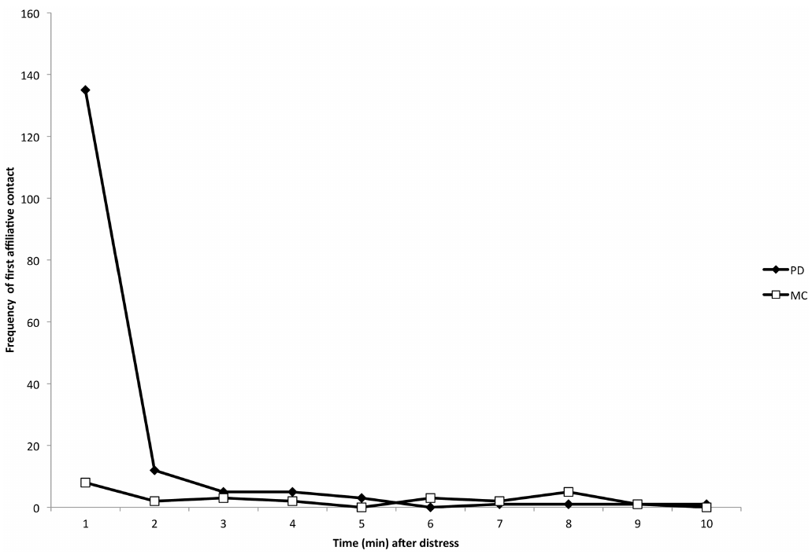
Rapid affiliation supports reassurance
The reassurance study concentrated first affiliative contacts within the first minute after distress, compared with matched control observations. Emotional contagion describes a proposed sharing of another individual’s state; synchronized distress-related behavior among bystanders supplied behavioral evidence consistent with that interpretation.
Physical contacts and vocal responses were recorded separately. This distinguished changes in approach or touch from changes in calling and allowed the timing of affiliation to be compared against ordinary social interaction rather than merely noting that elephants sometimes touched one another.
Coordinated behavior is compatible with social-state sensitivity, but does not establish a specific internal emotion or its neural cause. Together, the cognition, imitation and anatomy studies support multiple specialized capacities while leaving the causal circuits linking elephant experience, cellular physiology and social decisions largely untested.
Plotnik & de Waal (2014), Fig. 2. Timing of first affiliation after distress and in controls.
Plotnik & de Waal (2014)
45
Notes:
• The reassurance study concentrated first affiliative contacts within the first minute after distress, compared with matched control observations. Emotional contagion describes a proposed sharing of another individual’s state; synchronized distress-related behavior among bystanders supplied behavioral evidence consistent with that interpretation.
• Physical contacts and vocal responses were recorded separately. This distinguished changes in approach or touch from changes in calling and allowed the timing of affiliation to be compared against ordinary social interaction rather than merely noting that elephants sometimes touched one another.
• Coordinated behavior is compatible with social-state sensitivity, but does not establish a specific internal emotion or its neural cause. Together, the cognition, imitation and anatomy studies support multiple specialized capacities while leaving the causal circuits linking elephant experience, cellular physiology and social decisions largely untested.
– The final comparison connects distinct evidential levels: anatomical presence, controlled behavioral discrimination, and acoustic production learning. None alone supplies a complete social-neurobiology mechanism.
References:
Joshua M. Plotnik, Frans B.M. de Waal (2014). Asian elephants ( Elephas maximus ) reassure others in distress. PeerJ 2: e278. https://doi.org/10.7717/peerj.278
Figure: Plotnik & de Waal (2014), Fig. 2. Timing of first affiliation after distress and in controls.
Figure source: https://doi.org/10.7717/peerj.278

Slide 46
Key takeaways
Sensory-appropriate comparisons. Olfactory quantity judgments and alternative tool tasks reveal capacities that a visual or trunk-held task can miss.
Controlled cognitive inference. Partner-access controls, sham marks and nonobstructing-mat controls distinguish specific contingencies from simple alternative explanations.
Vocal production learning. African imitations and Koshik’s acoustic matching establish flexible sound production; they do not establish human language comprehension.
Cortical anatomy. VEN morphology, regional distribution and developing dendritic architecture are established anatomical findings; their exact social functions remain untested.
Experience and social knowledge. Older-led groups discriminate socially relevant calls and predator categories more finely; disrupted social histories are associated with persistent deficits.
Evidence across levels. Reassurance, recognition and cooperation are behavioral findings; no cited study establishes a complete elephant social circuit or its necessary transmitter mechanism.
Poole et al. (2005); Hakeem et al. (2009); Plotnik & de Waal (2014)
46
Notes:
• Sensory-appropriate comparisons. Olfactory quantity judgments and alternative tool tasks reveal capacities that a visual or trunk-held task can miss.
• Controlled cognitive inference. Partner-access controls, sham marks and nonobstructing-mat controls distinguish specific contingencies from simple alternative explanations.
• Vocal production learning. African imitations and Koshik’s acoustic matching establish flexible sound production; they do not establish human language comprehension.
• Cortical anatomy. VEN morphology, regional distribution and developing dendritic architecture are established anatomical findings; their exact social functions remain untested.
• Experience and social knowledge. Older-led groups discriminate socially relevant calls and predator categories more finely; disrupted social histories are associated with persistent deficits.
• Evidence across levels. Reassurance, recognition and cooperation are behavioral findings; no cited study establishes a complete elephant social circuit or its necessary transmitter mechanism.
References:
Joyce H. Poole, Peter L. Tyack, Angela S. Stoeger-Horwath, Stephanie Watwood (2005). Elephants are capable of vocal learning. Nature 434: 455-456. https://doi.org/10.1038/434455a
Angela S. Stoeger, Daniel Mietchen, Sukhun Oh, Shermin de Silva, Christian T. Herbst, Soowhan Kwon, W. Tecumseh Fitch (2012). An Asian Elephant Imitates Human Speech. Current Biology 22: 2144-2148. https://doi.org/10.1016/j.cub.2012.09.022
Joshua M. Plotnik, Frans B. M. de Waal, Diana Reiss (2006). Self-recognition in an Asian elephant. Proceedings of the National Academy of Sciences 103: 17053-17057. https://doi.org/10.1073/pnas.0608062103
Joshua M. Plotnik, Richard Lair, Wirot Suphachoksahakun, Frans B. M. de Waal (2011). Elephants know when they need a helping trunk in a cooperative task. Proceedings of the National Academy of Sciences 108: 5116-5121. https://doi.org/10.1073/pnas.1101765108
Karen McComb, Cynthia Moss, Sarah M. Durant, Lucy Baker, Soila Sayialel (2001). Matriarchs As Repositories of Social Knowledge in African Elephants. Science 292: 491-494. https://doi.org/10.1126/science.1057895
Karen McComb, Graeme Shannon, Sarah M. Durant, Katito Sayialel, Rob Slotow, Joyce Poole, Cynthia Moss (2011). Leadership in elephants: the adaptive value of age. Proceedings of the Royal Society B: Biological Sciences 278: 3270-3276. https://doi.org/10.1098/rspb.2011.0168
Karen McComb, Graeme Shannon, Katito N. Sayialel, Cynthia Moss (2014). Elephants can determine ethnicity, gender, and age from acoustic cues in human voices. Proceedings of the National Academy of Sciences 111: 5433-5438. https://doi.org/10.1073/pnas.1321543111
Graeme Shannon, Rob Slotow, Sarah M Durant, Katito N Sayialel, Joyce Poole, Cynthia Moss, Karen McComb (2013). Effects of social disruption in elephants persist decades after culling. Frontiers in Zoology 10: 62. https://doi.org/10.1186/1742-9994-10-62
Joshua M. Plotnik, Frans B.M. de Waal (2014). Asian elephants ( Elephas maximus ) reassure others in distress. PeerJ 2: e278. https://doi.org/10.7717/peerj.278
Rachel Dale, Joshua M. Plotnik (2017). Elephants know when their bodies are obstacles to success in a novel transfer task. Scientific Reports 7: 46309. https://doi.org/10.1038/srep46309
Preston Foerder, Marie Galloway, Tony Barthel, Donald E. Moore III, Diana Reiss (2011). Insightful Problem Solving in an Asian Elephant. PLoS ONE 6: e23251. https://doi.org/10.1371/journal.pone.0023251
Joshua M. Plotnik, Daniel L. Brubaker, Rachel Dale, Lydia N. Tiller, Hannah S. Mumby, Nicola S. Clayton (2019). Elephants have a nose for quantity. Proceedings of the National Academy of Sciences 116: 12566-12571. https://doi.org/10.1073/pnas.1818284116
Atiya Y. Hakeem, Chet C. Sherwood, Christopher J. Bonar, Camilla Butti, Patrick R. Hof, John M. Allman (2009). Von Economo Neurons in the Elephant Brain. The Anatomical Record 292: 242-248. https://doi.org/10.1002/ar.20829
Bob Jacobs, Laura Lee, Matthew Schall, Mary Ann Raghanti, Albert H. Lewandowski, Jack J. Kottwitz, John F. Roberts, Patrick R. Hof, Chet C. Sherwood (2016). Neocortical neuronal morphology in the newborn giraffe (Giraffa camelopardalis tippelskirchi) and African elephant (Loxodonta africana). Journal of Comparative Neurology 524: 257-287. https://doi.org/10.1002/cne.23841

