Slide 1
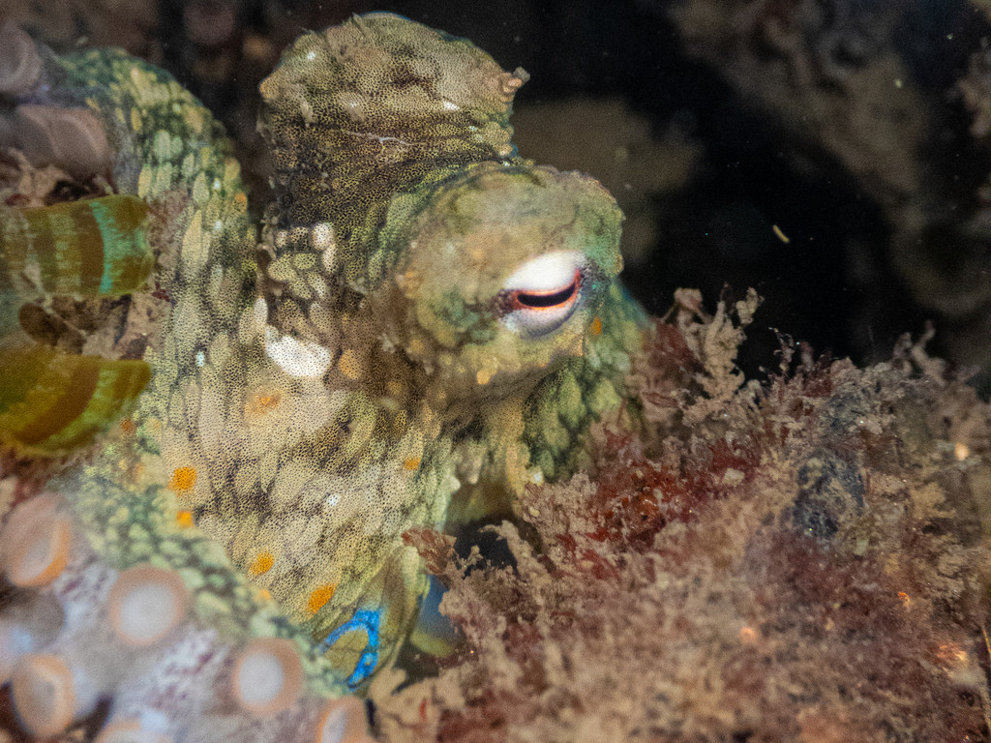
NEUR 411 · NEUROETHOLOGY · FALL 2026
Lecture 104C
Animals on drugs: psychoactive substances, altered perception, drug-seeking and self-administration, and how social environments influence reward and addiction.
Date TBD
Jordan Lopez, Ph.D.
Professor of Neurobiology & Biomedical Engineering
Photo: California two-spot octopus, Octopus bimaculoides.
Notes:
Animals on drugs: psychoactive substances, altered perception, drug-seeking and self-administration, and how social environments influence reward and addiction.
Lecture 104C. Date TBD.
Figure: Photo: California two-spot octopus, Octopus bimaculoides.
Figure source: https://www.inaturalist.org/observations/406683268
References:
Edsinger E, Dölen G. (2018). A Conserved Role for Serotonergic Neurotransmission in Mediating Social Behavior in Octopus. Current biology : CB 28:3136-3142.e4. https://doi.org/10.1016/j.cub.2018.07.061
Image: Photo: California two-spot octopus, Octopus bimaculoides. Credit: (c) Gavin Skeen, some rights reserved (CC BY). License: CC BY 4.0. Source: https://www.inaturalist.org/observations/406683268

Slide 2
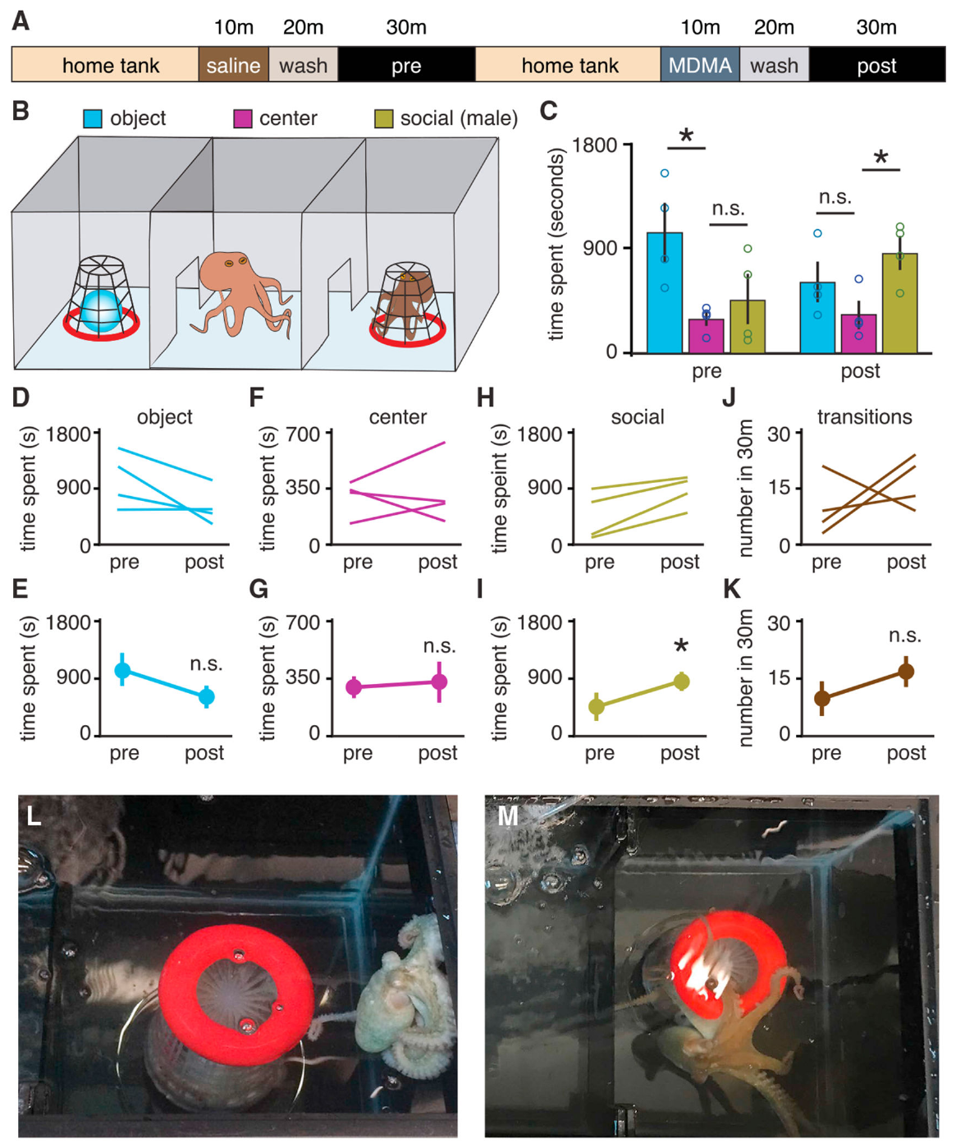
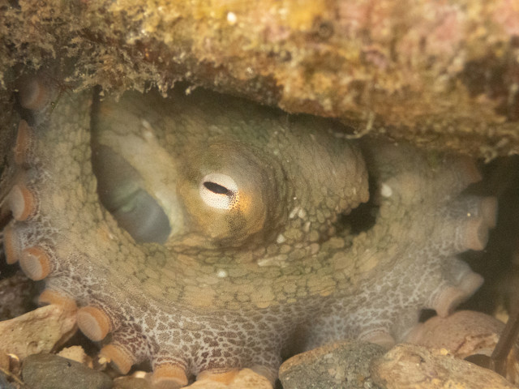
MDMA increases social approach in octopuses
MDMA, 3,4-methylenedioxymethamphetamine, altered social approach in the California two-spot octopus, Octopus bimaculoides. Edsinger and Dölen compared exploration before and after drug exposure. A three-chamber aquarium offered access to an unfamiliar male, an unfamiliar object and an empty central compartment. The other octopus remained inside a perforated container. This arrangement permitted social investigation while preventing a fight between the animals.
After MDMA treatment, subjects spent more time in the compartment containing the male. Their time near the unfamiliar object did not increase correspondingly. Transitions between compartments also failed to increase. The behavioral shift therefore concerned the social stimulus rather than a general rise in swimming activity. The same animal supplied a pre-treatment comparison for its later exploration.
The experimental change included direct investigation of the container holding the other octopus. Before treatment, contact was often restricted to an extended arm. After treatment, animals used more extensive contact involving the ventral body surface. Social approach here means measurable proximity and contact with another individual. The experiment connects a psychoactive substance to a change in an otherwise predominantly solitary animal’s social behavior.
Edsinger & Dölen (2018), Fig. 4. Social approach and contact before and after MDMA.
Photo: Octopus bimaculoides. Gavin Skeen. CC BY 4.0.
Edsinger & Dölen (2018)
02
Notes:
• **MDMA**, 3,4-methylenedioxymethamphetamine, altered social approach in the California two-spot octopus, _Octopus bimaculoides_. Edsinger and Dölen compared exploration before and after drug exposure. A three-chamber aquarium offered access to an unfamiliar male, an unfamiliar object and an empty central compartment. The other octopus remained inside a perforated container. This arrangement permitted social investigation while preventing a fight between the animals.
• After MDMA treatment, subjects spent more time in the compartment containing the male. Their time near the unfamiliar object did not increase correspondingly. Transitions between compartments also failed to increase. The behavioral shift therefore concerned the social stimulus rather than a general rise in swimming activity. The same animal supplied a pre-treatment comparison for its later exploration.
• The experimental change included direct investigation of the container holding the other octopus. Before treatment, contact was often restricted to an extended arm. After treatment, animals used more extensive contact involving the ventral body surface. **Social approach** here means measurable proximity and contact with another individual. The experiment connects a psychoactive substance to a change in an otherwise predominantly solitary animal’s social behavior.
References:
Edsinger E, Dölen G. (2018). A Conserved Role for Serotonergic Neurotransmission in Mediating Social Behavior in Octopus. Current biology : CB 28:3136-3142.e4. https://doi.org/10.1016/j.cub.2018.07.061
Figure: Edsinger & Dölen (2018), Fig. 4. Social approach and contact before and after MDMA.
Figure source: https://doi.org/10.1016/j.cub.2018.07.061
Image: Photo: Octopus bimaculoides. Credit: (c) Gavin Skeen, some rights reserved (CC BY). License: CC BY 4.0. Source: https://www.inaturalist.org/observations/404915175

Slide 3
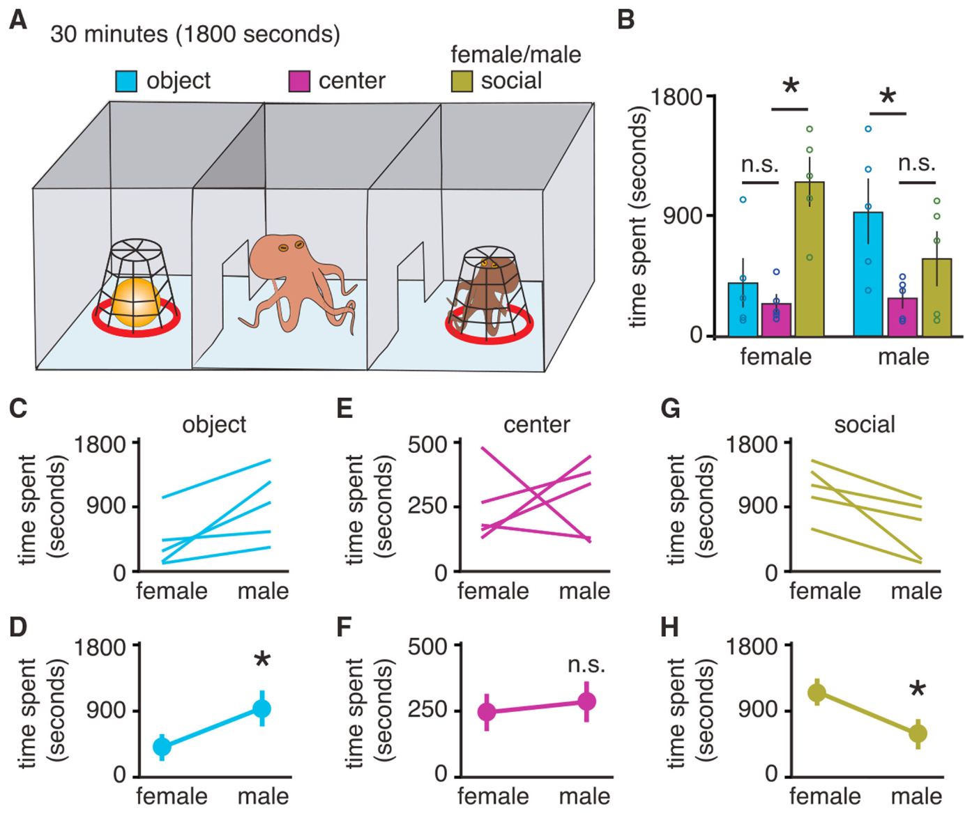
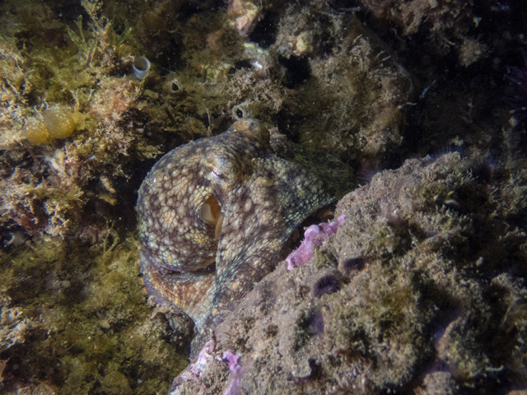
Social contact includes a change in exploratory touch
The identity of a social partner affected untreated octopus exploration. Both male and female subjects approached an unfamiliar female more readily than an unfamiliar male. A conspecific is another individual of the same species. The study compared conspecific investigation with exploration of a novel object. Partner sex consequently formed part of the biological stimulus rather than an interchangeable feature of the apparatus.
The perforated container allowed visual, tactile and chemical information to pass between animals. The subject could approach or withdraw throughout the 30 min session. Investigators measured time in each compartment separately. Time in the central compartment was similar across the partner-sex conditions. Differences were concentrated in the relative allocation of exploration to social and object compartments.
MDMA testing used the less-preferred male social stimulus. Drug exposure increased the time allocated to that compartment and changed the pattern of bodily contact. Proximity and touch therefore supplied complementary descriptions of the response. The object compartment retained a separate measure of non-social exploration. Social behavior in this preparation depended jointly on the partner being encountered and the subject’s pharmacological state.
Edsinger & Dölen (2018), Fig. 3. Partner sex changes social approach.
Photo: Octopus bimaculoides. Nathan. CC BY 4.0.
Edsinger & Dölen (2018)
03
Notes:
• The identity of a social partner affected untreated octopus exploration. Both male and female subjects approached an unfamiliar female more readily than an unfamiliar male. A **conspecific** is another individual of the same species. The study compared conspecific investigation with exploration of a novel object. Partner sex consequently formed part of the biological stimulus rather than an interchangeable feature of the apparatus.
• The perforated container allowed visual, tactile and chemical information to pass between animals. The subject could approach or withdraw throughout the 30 min session. Investigators measured time in each compartment separately. Time in the central compartment was similar across the partner-sex conditions. Differences were concentrated in the relative allocation of exploration to social and object compartments.
• MDMA testing used the less-preferred male social stimulus. Drug exposure increased the time allocated to that compartment and changed the pattern of bodily contact. Proximity and touch therefore supplied complementary descriptions of the response. The object compartment retained a separate measure of non-social exploration. Social behavior in this preparation depended jointly on the partner being encountered and the subject’s pharmacological state.
References:
Edsinger E, Dölen G. (2018). A Conserved Role for Serotonergic Neurotransmission in Mediating Social Behavior in Octopus. Current biology : CB 28:3136-3142.e4. https://doi.org/10.1016/j.cub.2018.07.061
Figure: Edsinger & Dölen (2018), Fig. 3. Partner sex changes social approach.
Figure source: https://doi.org/10.1016/j.cub.2018.07.061
Image: Photo: Octopus bimaculoides. Credit: (c) Nathan, some rights reserved (CC BY). License: CC BY 4.0. Source: https://www.inaturalist.org/observations/401656719

Slide 4
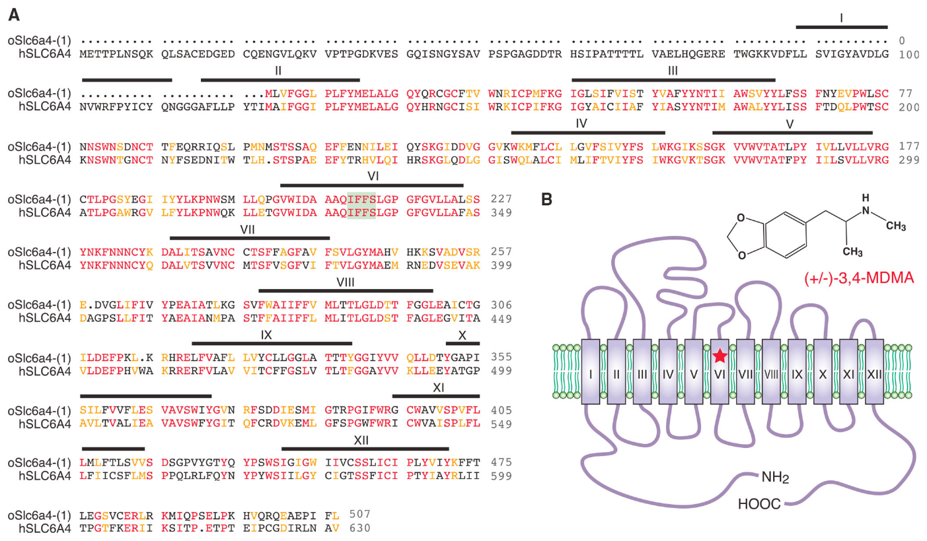
The octopus serotonin transporter retains a drug target
Serotonin is a signaling molecule used by neurons in many animal lineages. A transporter is a membrane protein that moves a substance across the cell membrane. The serotonin transporter, abbreviated SERT, participates in clearing released serotonin from extracellular space. MDMA interacts with this transporter in mammals. The octopus study examined whether the corresponding protein retained relevant molecular features.
The investigators identified two octopus copies of the transporter gene family corresponding to vertebrate SLC6A4. Their analysis compared protein sequences across animal groups. The transporter contains multiple membrane-spanning segments that form a binding pocket. A short region of transmembrane segment 6 implicated in MDMA binding was identical in the compared human and octopus sequences. Other parts of the proteins were more divergent.
The molecular comparison and the behavioral experiment concerned different levels of organization. Sequence conservation identified a plausible shared drug target. Pharmacological treatment then altered social investigation in the living octopus. The study proposes that ancient serotonergic machinery can modulate social behavior despite major differences in brain organization. The precise octopus neurons mediating the response were not localized by these experiments.
Edsinger & Dölen (2018), Fig. 2. Serotonin transporter alignment and membrane-spanning segments.
Photo: Octopus bimaculoides. Gavin Skeen. CC BY 4.0.
Edsinger & Dölen (2018)
04
Notes:
• **Serotonin** is a signaling molecule used by neurons in many animal lineages. A **transporter** is a membrane protein that moves a substance across the cell membrane. The serotonin transporter, abbreviated **SERT**, participates in clearing released serotonin from extracellular space. MDMA interacts with this transporter in mammals. The octopus study examined whether the corresponding protein retained relevant molecular features.
• The investigators identified two octopus copies of the transporter gene family corresponding to vertebrate SLC6A4. Their analysis compared protein sequences across animal groups. The transporter contains multiple membrane-spanning segments that form a binding pocket. A short region of transmembrane segment 6 implicated in MDMA binding was identical in the compared human and octopus sequences. Other parts of the proteins were more divergent.
• The molecular comparison and the behavioral experiment concerned different levels of organization. Sequence conservation identified a plausible shared drug target. Pharmacological treatment then altered social investigation in the living octopus. The study proposes that ancient serotonergic machinery can modulate social behavior despite major differences in brain organization. The precise octopus neurons mediating the response were not localized by these experiments.
References:
Edsinger E, Dölen G. (2018). A Conserved Role for Serotonergic Neurotransmission in Mediating Social Behavior in Octopus. Current biology : CB 28:3136-3142.e4. https://doi.org/10.1016/j.cub.2018.07.061
Figure: Edsinger & Dölen (2018), Fig. 2. Serotonin transporter alignment and membrane-spanning segments.
Figure source: https://doi.org/10.1016/j.cub.2018.07.061
Image: Photo: Octopus bimaculoides. Credit: (c) Gavin Skeen, some rights reserved (CC BY). License: CC BY 4.0. Source: https://www.inaturalist.org/observations/406683268

Slide 5
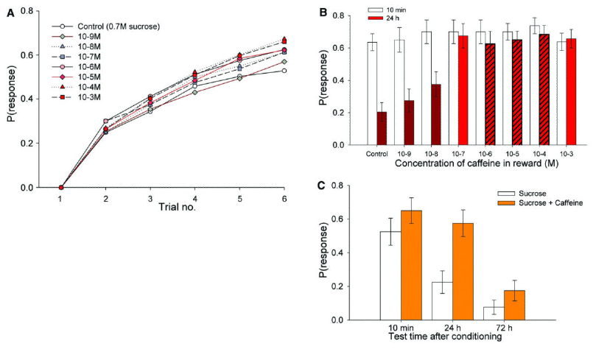

Caffeine strengthens honeybee odor memory
Honeybees, Apis mellifera, encounter caffeine, a plant alkaloid, in some floral nectars. An alkaloid is a nitrogen-containing natural compound that can affect animal physiology. Wright and colleagues paired a floral odor with a sucrose reward. Some rewards also contained caffeine within the range found in nectar. The learned response was extension of the proboscis, the bee’s feeding apparatus.
During testing, the odor was presented without the reward. A bee that extended its proboscis had retained the odor–reward association. Caffeine-treated bees were more likely to respond at later memory tests than bees trained with sucrose alone. The difference persisted at 24 h and 72 h. At the longer retention intervals, caffeine approximately tripled the likelihood of remembering the rewarded scent.
The treatment changed memory even though the odor itself was unchanged. The plant-derived compound accompanied ingestion of the reward during learning. Later odor presentation could then guide behavior after caffeine was no longer being supplied as a reward. Retention refers to the persistence of a learned association over time. A nectar constituent can therefore alter the future attractiveness of a flower’s sensory identity.
Wright et al. (2013), Fig. 2. Odor–reward acquisition and later retention.
Photo: Apis mellifera. no rights reserved. CC0 1.0.
Wright et al. (2013)
05
Notes:
• Honeybees, _Apis mellifera_, encounter **caffeine**, a plant alkaloid, in some floral nectars. An **alkaloid** is a nitrogen-containing natural compound that can affect animal physiology. Wright and colleagues paired a floral odor with a sucrose reward. Some rewards also contained caffeine within the range found in nectar. The learned response was extension of the proboscis, the bee’s feeding apparatus.
• During testing, the odor was presented without the reward. A bee that extended its proboscis had retained the odor–reward association. Caffeine-treated bees were more likely to respond at later memory tests than bees trained with sucrose alone. The difference persisted at 24 h and 72 h. At the longer retention intervals, caffeine approximately tripled the likelihood of remembering the rewarded scent.
• The treatment changed memory even though the odor itself was unchanged. The plant-derived compound accompanied ingestion of the reward during learning. Later odor presentation could then guide behavior after caffeine was no longer being supplied as a reward. **Retention** refers to the persistence of a learned association over time. A nectar constituent can therefore alter the future attractiveness of a flower’s sensory identity.
References:
Wright GA, Baker DD, Palmer MJ, Stabler D, Mustard JA, Power EF, Borland AM, Stevenson PC. (2013). Caffeine in floral nectar enhances a pollinator's memory of reward. Science (New York, N.Y.) 339:1202-1204. https://doi.org/10.1126/science.1228806
Figure: Wright et al. (2013), Fig. 2. Odor–reward acquisition and later retention.
Figure source: https://doi.org/10.1126/science.1228806
Image: Photo: Apis mellifera. Credit: no rights reserved. License: CC0 1.0. Source: https://www.inaturalist.org/observations/408383888

Slide 6
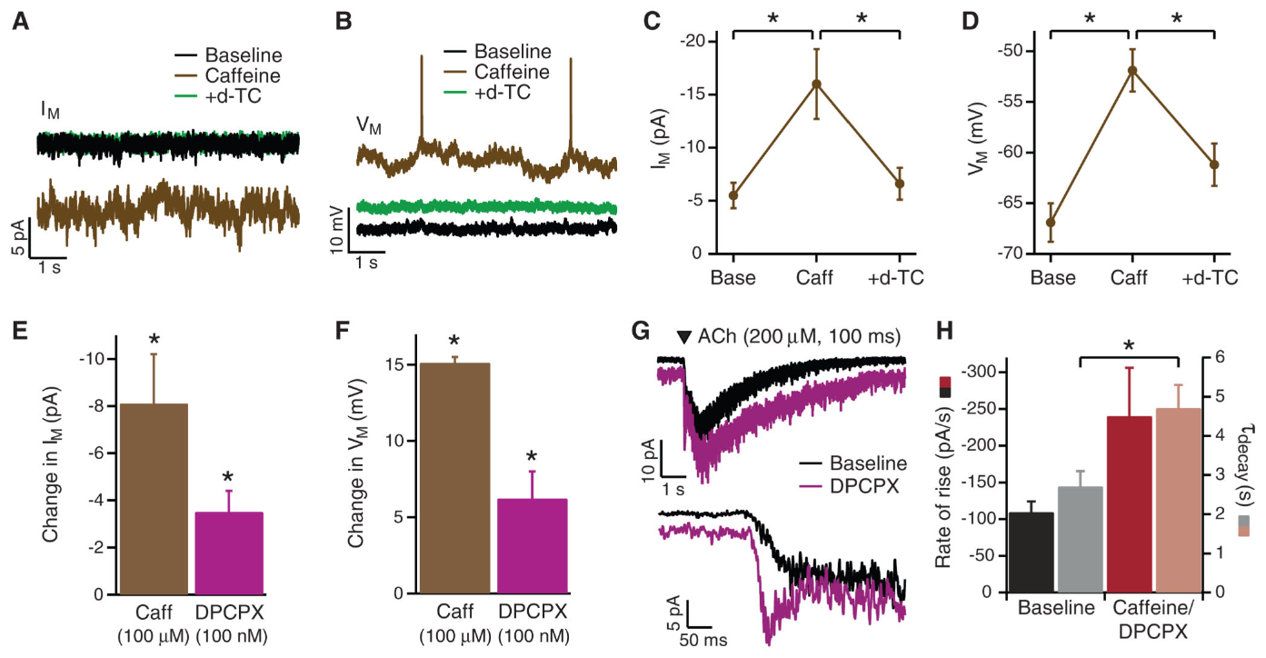
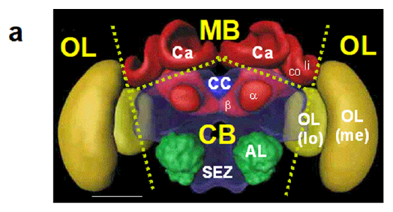
Kenyon-cell responses link caffeine to learned value
The honeybee mushroom bodies contain Kenyon cells, neurons involved in associative learning. Wright and colleagues recorded electrical responses from these cells in an isolated brain preparation. Acetylcholine is an excitatory transmitter in this insect circuit. Applying it produced a depolarizing response, a shift of membrane voltage toward neuronal activation. Caffeine increased the responsiveness of the recorded Kenyon cells.
The study tested caffeine at 100 μM, a concentration relevant to the measured nectar range. Caffeine depolarized the membrane and altered responses to acetylcholine. The investigators also examined an antagonist of adenosine receptors. An antagonist blocks the action of a signaling molecule at its receptor. The pharmacological comparison supported adenosine-receptor antagonism as a route through which caffeine changed neuronal excitability.
Enhanced excitability supplies a cellular connection to the stronger odor memory measured in behaving bees. A learned odor activates neural pathways carrying information about the flower. Changing the responsiveness of memory-associated neurons can alter the consequences of that input. The physiological experiment measured voltage responses rather than a bee’s choice of flowers. Together with the conditioning experiment, it links nectar chemistry, neuronal activity and later reward-related behavior.
Wright et al. (2013), Fig. 3. Kenyon-cell voltage responses under caffeine.
Geng et al. (2022), Fig. 5(a). Optic lobes, mushroom-body calyces, and central-brain anatomy.
Wright et al. (2013)
06
Notes:
• The honeybee **mushroom bodies** contain Kenyon cells, neurons involved in associative learning. Wright and colleagues recorded electrical responses from these cells in an isolated brain preparation. **Acetylcholine** is an excitatory transmitter in this insect circuit. Applying it produced a depolarizing response, a shift of membrane voltage toward neuronal activation. Caffeine increased the responsiveness of the recorded Kenyon cells.
• The study tested caffeine at 100 μM, a concentration relevant to the measured nectar range. Caffeine depolarized the membrane and altered responses to acetylcholine. The investigators also examined an antagonist of adenosine receptors. An **antagonist** blocks the action of a signaling molecule at its receptor. The pharmacological comparison supported adenosine-receptor antagonism as a route through which caffeine changed neuronal excitability.
• Enhanced excitability supplies a cellular connection to the stronger odor memory measured in behaving bees. A learned odor activates neural pathways carrying information about the flower. Changing the responsiveness of memory-associated neurons can alter the consequences of that input. The physiological experiment measured voltage responses rather than a bee’s choice of flowers. Together with the conditioning experiment, it links nectar chemistry, neuronal activity and later reward-related behavior.
References:
Wright GA, Baker DD, Palmer MJ, Stabler D, Mustard JA, Power EF, Borland AM, Stevenson PC. (2013). Caffeine in floral nectar enhances a pollinator's memory of reward. Science (New York, N.Y.) 339:1202-1204. https://doi.org/10.1126/science.1228806
Geng H, Lafon G, Avarguès-Weber A, Buatois A, Massou I, Giurfa M (2022). Visual learning in a virtual reality environment upregulates immediate early gene expression in the mushroom bodies of honey bees. Communications biology 5:130. https://doi.org/10.1038/s42003-022-03075-8
Figure: Wright et al. (2013), Fig. 3. Kenyon-cell voltage responses under caffeine.
Figure source: https://doi.org/10.1126/science.1228806
Figure: Geng et al. (2022), Fig. 5(a). Optic lobes, mushroom-body calyces, and central-brain anatomy.
Figure source: https://doi.org/10.1038/s42003-022-03075-8

Slide 7
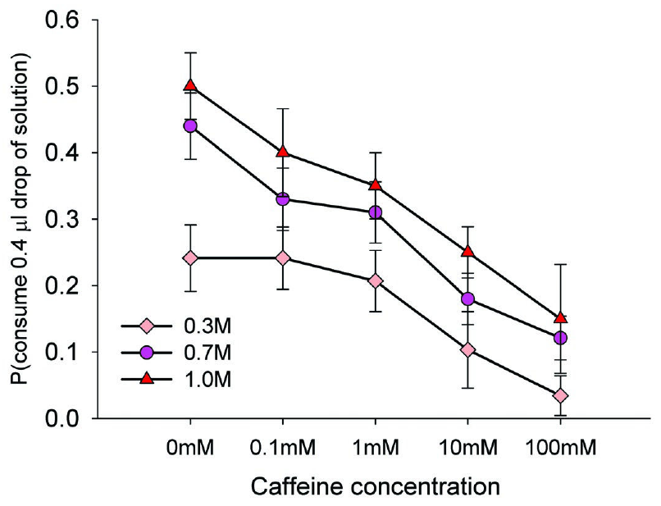

High caffeine concentrations trigger rejection
A useful nectar concentration must affect the bee without making the reward unacceptable. Wright and colleagues measured caffeine in nectars of coffee and citrus plants. Those concentrations were below the levels that strongly deterred feeding. They then tested bees with sucrose solutions containing progressively more caffeine. Acceptance declined as the concentration rose above the natural nectar range.
The feeding assay measured proboscis extension after contact with the solution. Increasing sucrose concentration changed the acceptance of caffeine-containing solutions. Sweetness and the deterrent compound therefore contributed jointly to the feeding response. Caffeine above approximately 1 mM was increasingly rejected in the tested mixtures. The same chemical could enhance memory at lower concentrations and discourage consumption at higher concentrations.
These effects act at different stages of a foraging visit. Acceptance determines whether a bee consumes the nectar that it encounters. Memory changes the probability that the bee subsequently responds to the associated scent. A concentration producing rejection cannot supply the same repeated feeding experience as an accepted reward. The measured nectar concentrations occupy a range in which pharmacological effects can occur without strong feeding deterrence.
Wright et al. (2013), Fig. 4. Sucrose and caffeine jointly affect feeding acceptance.
Photo: Apis mellifera. no rights reserved. CC0 1.0.
Wright et al. (2013)
07
Notes:
• A useful nectar concentration must affect the bee without making the reward unacceptable. Wright and colleagues measured caffeine in nectars of coffee and citrus plants. Those concentrations were below the levels that strongly deterred feeding. They then tested bees with sucrose solutions containing progressively more caffeine. Acceptance declined as the concentration rose above the natural nectar range.
• The feeding assay measured proboscis extension after contact with the solution. Increasing sucrose concentration changed the acceptance of caffeine-containing solutions. Sweetness and the deterrent compound therefore contributed jointly to the feeding response. Caffeine above approximately 1 mM was increasingly rejected in the tested mixtures. The same chemical could enhance memory at lower concentrations and discourage consumption at higher concentrations.
• These effects act at different stages of a foraging visit. Acceptance determines whether a bee consumes the nectar that it encounters. Memory changes the probability that the bee subsequently responds to the associated scent. A concentration producing rejection cannot supply the same repeated feeding experience as an accepted reward. The measured nectar concentrations occupy a range in which pharmacological effects can occur without strong feeding deterrence.
References:
Wright GA, Baker DD, Palmer MJ, Stabler D, Mustard JA, Power EF, Borland AM, Stevenson PC. (2013). Caffeine in floral nectar enhances a pollinator's memory of reward. Science (New York, N.Y.) 339:1202-1204. https://doi.org/10.1126/science.1228806
Figure: Wright et al. (2013), Fig. 4. Sucrose and caffeine jointly affect feeding acceptance.
Figure source: https://doi.org/10.1126/science.1228806
Image: Photo: Apis mellifera. Credit: no rights reserved. License: CC0 1.0. Source: https://www.inaturalist.org/observations/408384616

Slide 8
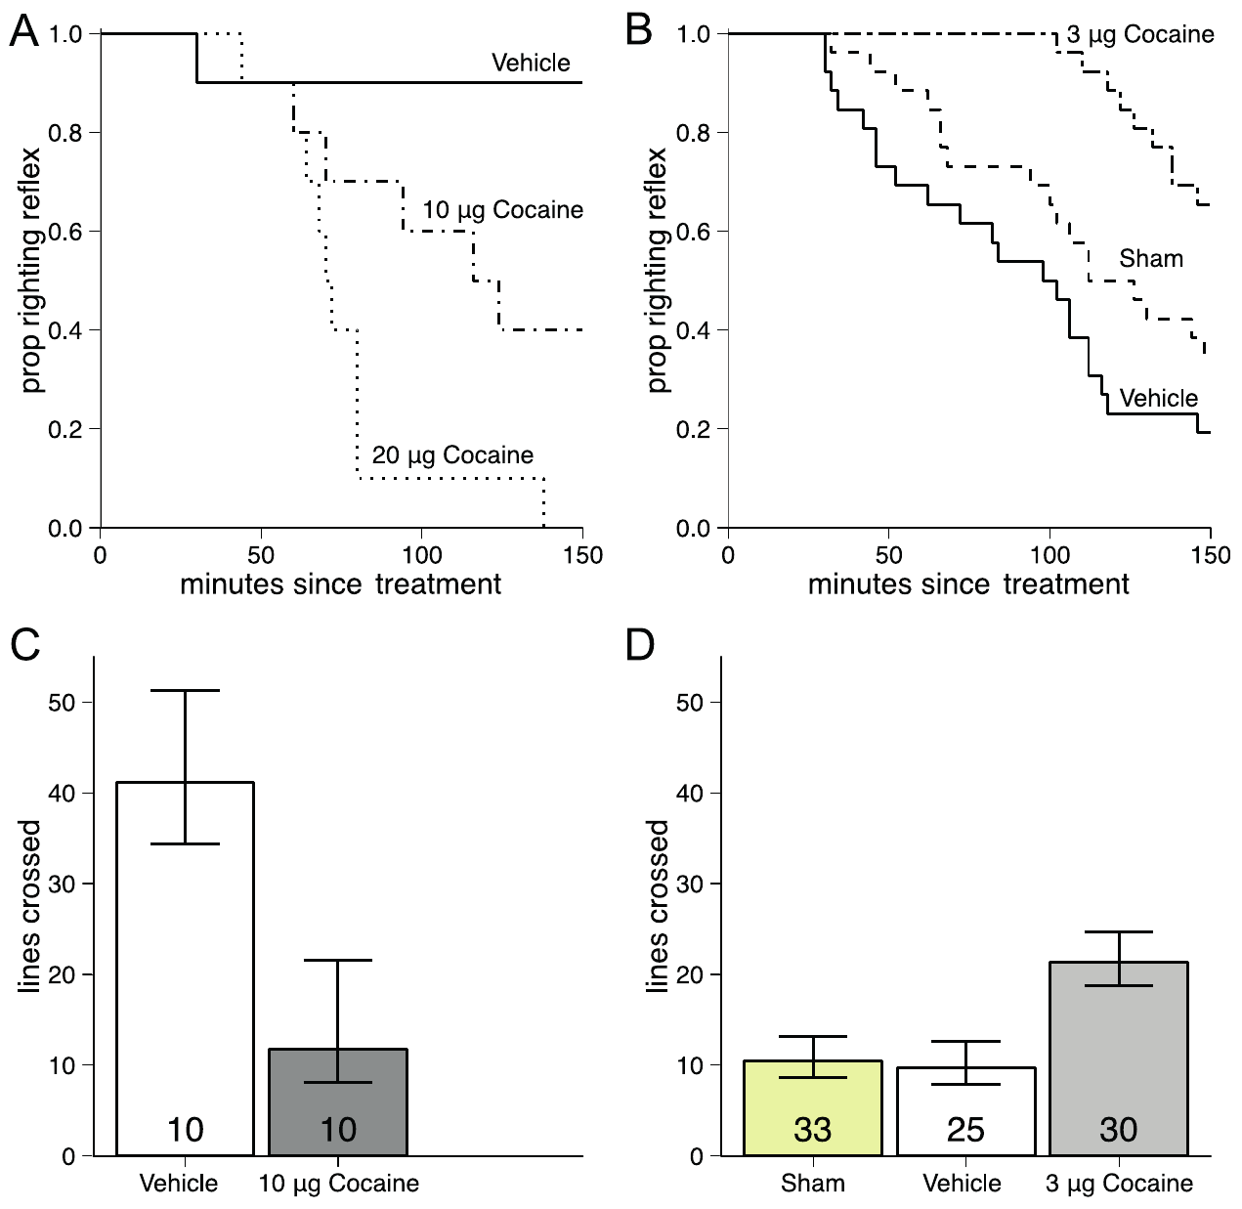

Repeated cocaine changes honeybee responsiveness
Repeated cocaine treatment produced tolerance in honeybees, meaning a smaller response to a later drug challenge. Søvik and colleagues applied cocaine topically to foraging bees. A larger challenge dose impaired locomotion and the ability to right the body. The righting reflex is the coordinated action that restores an overturned animal to its normal orientation. Researchers measured how rapidly bees lost this ability after treatment.
Bees previously given repeated low-dose cocaine were less affected by the later challenge. Their locomotor impairment was reduced relative to drug-naive comparison bees. Vehicle-treated and sham-handled groups separated the drug effect from application and handling. The repeated exposure was administered by the investigators. This experiment measured physiological adaptation rather than voluntary selection of cocaine.
Cocaine interferes with the reuptake of biogenic amines, transmitters including dopamine, serotonin and octopamine in insects. Reuptake normally removes released transmitter from extracellular space through membrane transporters. Whole-brain amine measurements did not detect a corresponding treatment-related change in total amine content. Behavioral adaptation can occur while the total amount measured across the brain remains similar. Local transmitter release and receptor responses are distinct from the size of the whole-brain chemical pool.
Søvik et al. (2013), Fig. 1. Acute impairment and repeated-exposure tolerance.
Photo: Apis mellifera. Carl Ramirez. CC BY 4.0.
Søvik et al. (2013)
08
Notes:
• Repeated cocaine treatment produced **tolerance** in honeybees, meaning a smaller response to a later drug challenge. Søvik and colleagues applied cocaine topically to foraging bees. A larger challenge dose impaired locomotion and the ability to right the body. The **righting reflex** is the coordinated action that restores an overturned animal to its normal orientation. Researchers measured how rapidly bees lost this ability after treatment.
• Bees previously given repeated low-dose cocaine were less affected by the later challenge. Their locomotor impairment was reduced relative to drug-naive comparison bees. Vehicle-treated and sham-handled groups separated the drug effect from application and handling. The repeated exposure was administered by the investigators. This experiment measured physiological adaptation rather than voluntary selection of cocaine.
• Cocaine interferes with the reuptake of **biogenic amines**, transmitters including dopamine, serotonin and octopamine in insects. Reuptake normally removes released transmitter from extracellular space through membrane transporters. Whole-brain amine measurements did not detect a corresponding treatment-related change in total amine content. Behavioral adaptation can occur while the total amount measured across the brain remains similar. Local transmitter release and receptor responses are distinct from the size of the whole-brain chemical pool.
References:
Søvik E, Cornish JL, Barron AB. (2013). Cocaine tolerance in honey bees. PloS one 8:e64920. https://doi.org/10.1371/journal.pone.0064920
Figure: Søvik et al. (2013), Fig. 1. Acute impairment and repeated-exposure tolerance.
Figure source: https://doi.org/10.1371/journal.pone.0064920
Image: Photo: Apis mellifera. Credit: (c) Carl Ramirez, some rights reserved (CC BY). License: CC BY 4.0. Source: https://www.inaturalist.org/observations/408419672

Slide 9
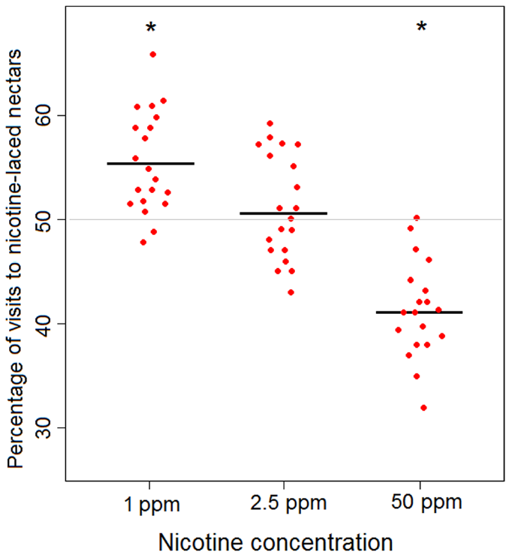

Nicotine alters bumblebee choices between flowers
Bumblebees, Bombus terrestris, encountered nicotine in an artificial-flower choice task. Nicotine is a plant alkaloid that acts on nicotinic acetylcholine receptors. Baracchi and colleagues offered flower types with equal sucrose rewards. One type also contained nicotine and the other did not. This arrangement separated the compound’s contribution from a difference in the available sugar reward.
The investigators tested 1 ppm, 2.5 ppm and 50 ppm nicotine. Here ppm, parts per million, expresses the concentration of nicotine in the solution. Bees preferred the 1 ppm nicotine-associated flowers over equally rewarded nicotine-free alternatives. At 2.5 ppm, their choices were closer to an equal division. The much higher 50 ppm concentration deterred visits to the nicotine-containing flowers.
Low and high concentrations consequently produced different patterns of choice. Nectar-relevant nicotine concentrations were not automatically rejected as toxins. High concentrations reduced attraction even though sugar remained available. The preference experiment measured repeated visits by freely moving individual bees. A flower’s pharmacological composition can alter foraging choices independently of its caloric reward.
Baracchi et al. (2017), Fig. 1. Nicotine concentration changes flower choice.
Photo: Bombus terrestris. guywallbanks. CC BY 4.0.
Baracchi et al. (2017)
09
Notes:
• Bumblebees, _Bombus terrestris_, encountered nicotine in an artificial-flower choice task. **Nicotine** is a plant alkaloid that acts on nicotinic acetylcholine receptors. Baracchi and colleagues offered flower types with equal sucrose rewards. One type also contained nicotine and the other did not. This arrangement separated the compound’s contribution from a difference in the available sugar reward.
• The investigators tested 1 ppm, 2.5 ppm and 50 ppm nicotine. Here **ppm**, parts per million, expresses the concentration of nicotine in the solution. Bees preferred the 1 ppm nicotine-associated flowers over equally rewarded nicotine-free alternatives. At 2.5 ppm, their choices were closer to an equal division. The much higher 50 ppm concentration deterred visits to the nicotine-containing flowers.
• Low and high concentrations consequently produced different patterns of choice. Nectar-relevant nicotine concentrations were not automatically rejected as toxins. High concentrations reduced attraction even though sugar remained available. The preference experiment measured repeated visits by freely moving individual bees. A flower’s pharmacological composition can alter foraging choices independently of its caloric reward.
References:
Baracchi D, Marples A, Jenkins AJ, Leitch AR, Chittka L. (2017). Nicotine in floral nectar pharmacologically influences bumblebee learning of floral features. Scientific reports 7:1951. https://doi.org/10.1038/s41598-017-01980-1
Figure: Baracchi et al. (2017), Fig. 1. Nicotine concentration changes flower choice.
Figure source: https://doi.org/10.1038/s41598-017-01980-1
Image: Photo: Bombus terrestris. Credit: (c) guywallbanks, some rights reserved (CC BY). License: CC BY 4.0. Source: https://www.inaturalist.org/observations/408121740

Slide 10
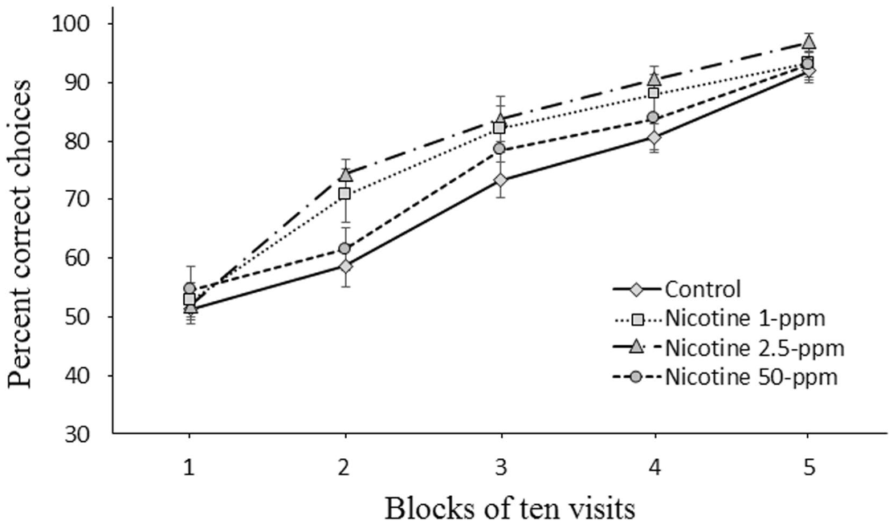
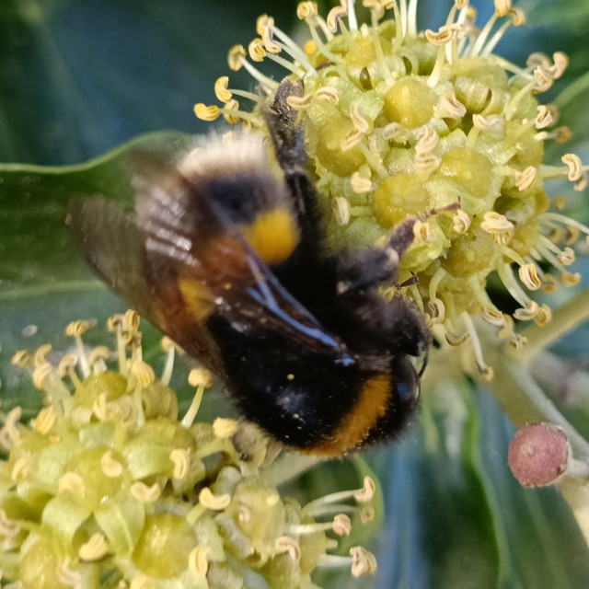
Nicotine changes acquisition of floral associations
Learning a flower’s color allows a bumblebee to direct later visits toward a rewarding source. Baracchi and colleagues assigned sucrose to one flower color and water to another. Some bees received nicotine with the sucrose reward. The other color remained unrewarding throughout the acquisition phase. Acquisition is the development of the association through repeated experience.
Bees in all treatment groups improved their choices across visits. Nicotine at 2.5 ppm accelerated the acquisition of the rewarded color. The 1 ppm and 50 ppm treatments did not produce the same clear acceleration. Equal initial performance separated this later divergence from a starting preference for the rewarded color. By the end of training, performance was high across the groups.
Nicotine altered the rate at which reward information guided choices. The effect depended on concentration rather than increasing steadily with dose. An aversive concentration and a naturally encountered concentration could have different consequences for behavior. The experiment followed individual sequences of visits rather than testing a single approach. Drug exposure during feeding therefore changed the development of a sensory association used during foraging.
Baracchi et al. (2017), Fig. 2. Acquisition of the rewarded flower color.
Photo: Bombus terrestris. Adam Leigh. CC BY 4.0.
Baracchi et al. (2017)
10
Notes:
• Learning a flower’s color allows a bumblebee to direct later visits toward a rewarding source. Baracchi and colleagues assigned sucrose to one flower color and water to another. Some bees received nicotine with the sucrose reward. The other color remained unrewarding throughout the acquisition phase. **Acquisition** is the development of the association through repeated experience.
• Bees in all treatment groups improved their choices across visits. Nicotine at 2.5 ppm accelerated the acquisition of the rewarded color. The 1 ppm and 50 ppm treatments did not produce the same clear acceleration. Equal initial performance separated this later divergence from a starting preference for the rewarded color. By the end of training, performance was high across the groups.
• Nicotine altered the rate at which reward information guided choices. The effect depended on concentration rather than increasing steadily with dose. An aversive concentration and a naturally encountered concentration could have different consequences for behavior. The experiment followed individual sequences of visits rather than testing a single approach. Drug exposure during feeding therefore changed the development of a sensory association used during foraging.
References:
Baracchi D, Marples A, Jenkins AJ, Leitch AR, Chittka L. (2017). Nicotine in floral nectar pharmacologically influences bumblebee learning of floral features. Scientific reports 7:1951. https://doi.org/10.1038/s41598-017-01980-1
Figure: Baracchi et al. (2017), Fig. 2. Acquisition of the rewarded flower color.
Figure source: https://doi.org/10.1038/s41598-017-01980-1
Image: Photo: Bombus terrestris. Credit: (c) Adam Leigh, some rights reserved (CC BY). License: CC BY 4.0. Source: https://www.inaturalist.org/observations/407622501

Slide 11
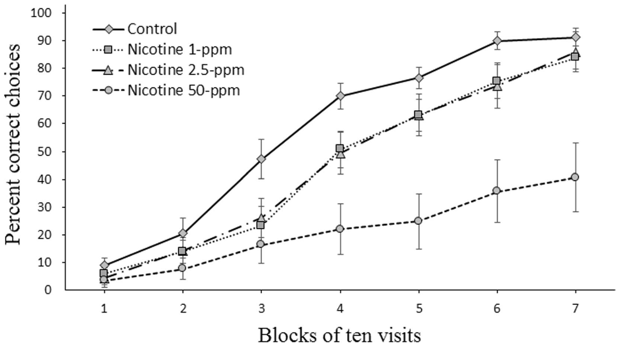

A learned flower preference persists after reversal
Reversal learning requires an animal to change a previously successful choice after reward contingencies change. The bumblebee experiment switched which flower color supplied sucrose. The previously rewarded color then supplied water. No nicotine was added to the rewards during this reversal phase. The researchers could therefore measure the consequences of the bees’ earlier nicotine experience.
All groups initially continued to visit the formerly rewarding color. Bees trained with nicotine changed their choices more slowly, particularly after the 50 ppm treatment. Their earlier association persisted despite the loss of its sugar reward. The effect concerned updating the value of a familiar sensory cue. Faster initial acquisition and flexible reversal were consequently separable components of learning.
Flower constancy is the tendency to keep visiting a particular flower type. Earlier nicotine exposure increased persistence with that type when it became a poor source of reward. A stable preference can benefit a plant receiving repeated visits. The same persistence becomes costly to a bee when the reward distribution changes. The experiment connects a nectar compound to the balance between retaining an association and updating it through new experience.
Baracchi et al. (2017), Fig. 3. Reversal after earlier nicotine exposure.
Photo: Bombus terrestris audax. krickard0505. CC BY 4.0.
Baracchi et al. (2017)
11
Notes:
• **Reversal learning** requires an animal to change a previously successful choice after reward contingencies change. The bumblebee experiment switched which flower color supplied sucrose. The previously rewarded color then supplied water. No nicotine was added to the rewards during this reversal phase. The researchers could therefore measure the consequences of the bees’ earlier nicotine experience.
• All groups initially continued to visit the formerly rewarding color. Bees trained with nicotine changed their choices more slowly, particularly after the 50 ppm treatment. Their earlier association persisted despite the loss of its sugar reward. The effect concerned updating the value of a familiar sensory cue. Faster initial acquisition and flexible reversal were consequently separable components of learning.
• **Flower constancy** is the tendency to keep visiting a particular flower type. Earlier nicotine exposure increased persistence with that type when it became a poor source of reward. A stable preference can benefit a plant receiving repeated visits. The same persistence becomes costly to a bee when the reward distribution changes. The experiment connects a nectar compound to the balance between retaining an association and updating it through new experience.
References:
Baracchi D, Marples A, Jenkins AJ, Leitch AR, Chittka L. (2017). Nicotine in floral nectar pharmacologically influences bumblebee learning of floral features. Scientific reports 7:1951. https://doi.org/10.1038/s41598-017-01980-1
Figure: Baracchi et al. (2017), Fig. 3. Reversal after earlier nicotine exposure.
Figure source: https://doi.org/10.1038/s41598-017-01980-1
Image: Photo: Bombus terrestris audax. Credit: (c) krickard0505, some rights reserved (CC BY). License: CC BY 4.0. Source: https://www.inaturalist.org/observations/407252708

Slide 12
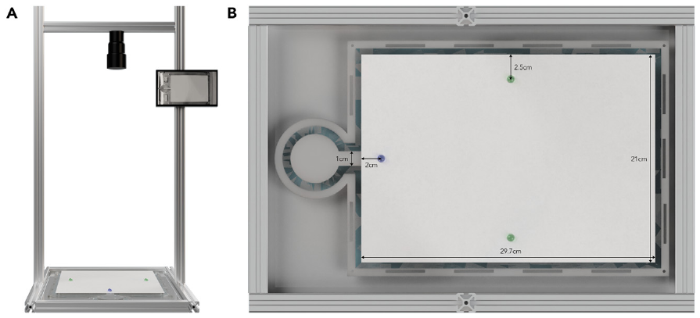
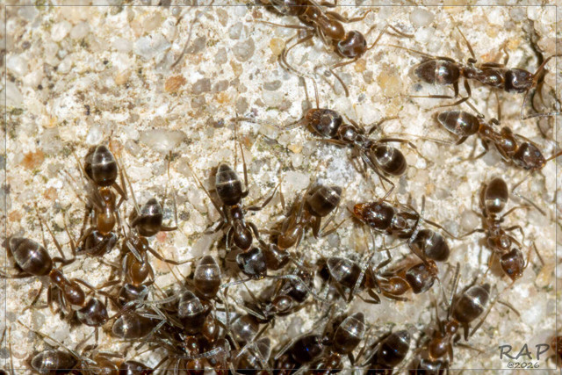

Ant foraging separates learning from running speed
Argentine ants, Linepithema humile, repeatedly searched an open arena for a sucrose reward. Galante and colleagues used this task to measure caffeine’s effect on foraging. An ant left the nest, located food and returned before making another journey. Researchers recorded the route and the time required to reach the reward. These measurements distinguished efficient navigation from simply moving faster.
The reward contained 0 ppm, 25 ppm, 250 ppm or 2000 ppm caffeine. The initial foodward journey occurred before the ant had consumed its first experimental reward. Later journeys followed ingestion and experience of the reward’s location. This sequence made repeated visits central to the comparison. Ants could acquire information about the arena while encountering the assigned caffeine concentration.
Moderate caffeine exposure improved reward-finding over successive visits. The improvement was associated with straighter foodward routes rather than a general increase in walking speed. The source recording follows an individual ant receiving 250 ppm caffeine. Its route preserves the turns and pauses that contribute to journey duration. Population-level comparisons across the experimental treatments established the relationship between concentration and foraging performance.
Galante et al. (2024), Fig. 1. Open-arena preparation for repeated foraging.
Photo: Linepithema humile. RAP. CC BY 4.0.
Galante et al. (2024), Dataset sample_video_ant_140_visit_2.mp4. Ant 140, visit 2, 250 ppm caffeine; original recording excerpt 10–100 s.
Galante et al. (2024)
12
Notes:
• Argentine ants, _Linepithema humile_, repeatedly searched an open arena for a sucrose reward. Galante and colleagues used this task to measure caffeine’s effect on foraging. An ant left the nest, located food and returned before making another journey. Researchers recorded the route and the time required to reach the reward. These measurements distinguished efficient navigation from simply moving faster.
• The reward contained 0 ppm, 25 ppm, 250 ppm or 2000 ppm caffeine. The initial foodward journey occurred before the ant had consumed its first experimental reward. Later journeys followed ingestion and experience of the reward’s location. This sequence made repeated visits central to the comparison. Ants could acquire information about the arena while encountering the assigned caffeine concentration.
• Moderate caffeine exposure improved reward-finding over successive visits. The improvement was associated with straighter foodward routes rather than a general increase in walking speed. The source recording follows an individual ant receiving 250 ppm caffeine. Its route preserves the turns and pauses that contribute to journey duration. Population-level comparisons across the experimental treatments established the relationship between concentration and foraging performance.
References:
Galante H, De Agrò M, Koch A, Kau S, Czaczkes TJ. (2024). Acute exposure to caffeine improves foraging in an invasive ant. iScience 27:109935. https://doi.org/10.1016/j.isci.2024.109935
Figure: Galante et al. (2024), Fig. 1. Open-arena preparation for repeated foraging.
Figure source: https://doi.org/10.1016/j.isci.2024.109935
Image: Photo: Linepithema humile. Credit: (c) RAP, some rights reserved (CC BY). License: CC BY 4.0. Source: https://www.inaturalist.org/observations/408241376
Embedded video: Galante et al. (2024), Dataset sample_video_ant_140_visit_2.mp4. Ant 140, visit 2, 250 ppm caffeine; original recording excerpt 10–100 s.
Exact identifier: Dataset sample_video_ant_140_visit_2.mp4
Article DOI: https://doi.org/10.1016/j.isci.2024.109935
Original URL: https://zenodo.org/records/10894114/files/sample_videos.zip?download=1
Credit: Galante H, De Agrò M, Koch A, Kau S, Czaczkes TJ.
License: CC BY 4.0, as declared by the research data archive
Conversion: 90-second excerpt from 10 to 100 seconds of the original research recording; original dimensions, scene order, playback speed and available audio preserved. Exact slide placement and final contextual interval review pending.
Playback: native embedded MP4, fullscreen flag enabled. Desktop PowerPoint GUI playback and Google Slides import have not been tested. Google Slides may require separate insertion of the video from Drive.

Slide 13
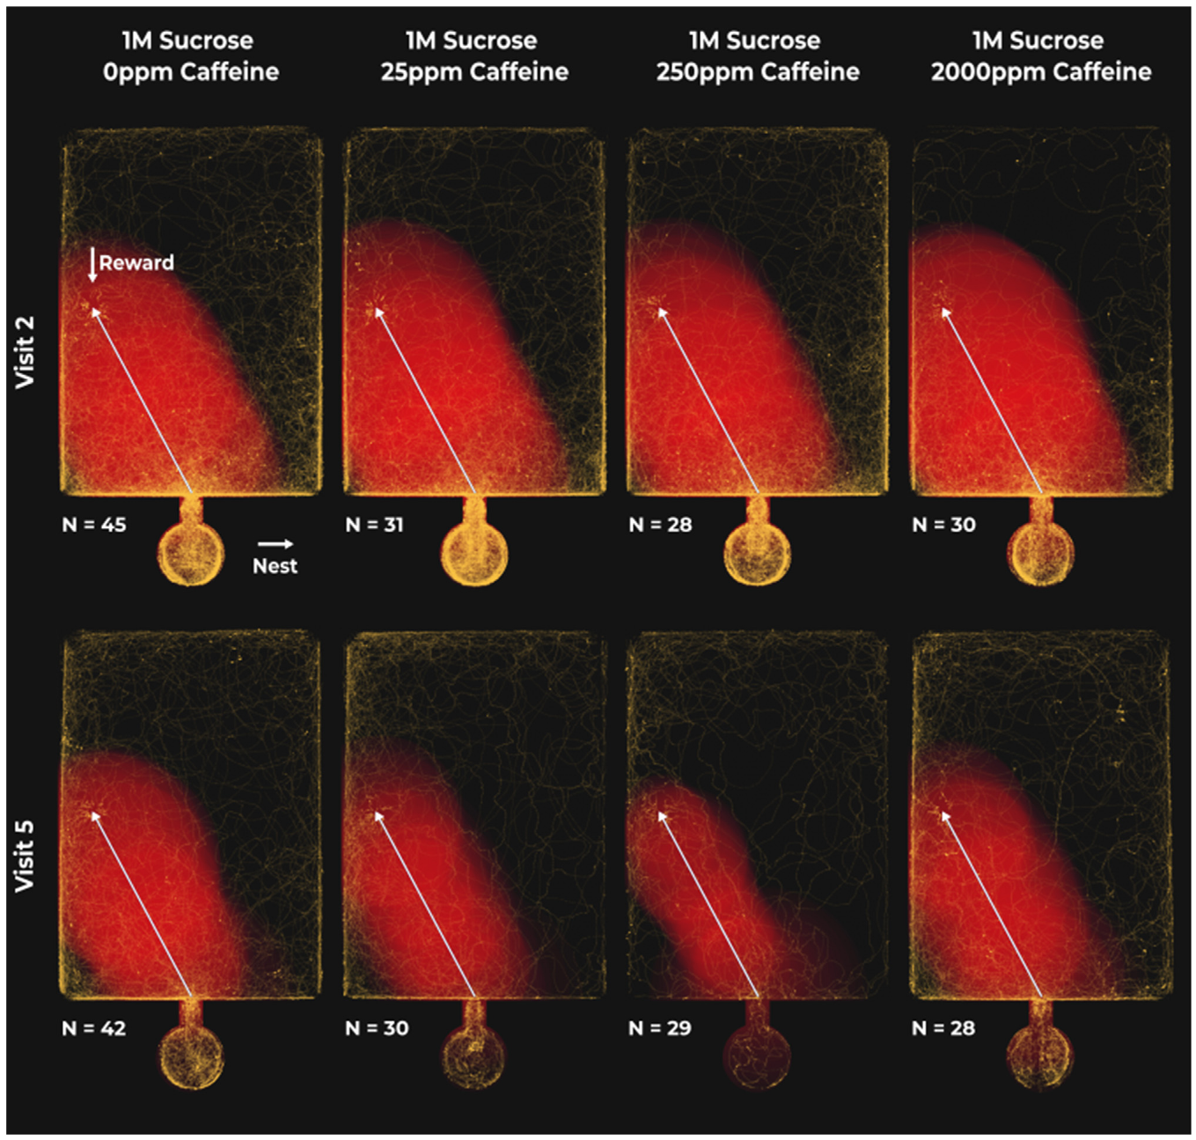
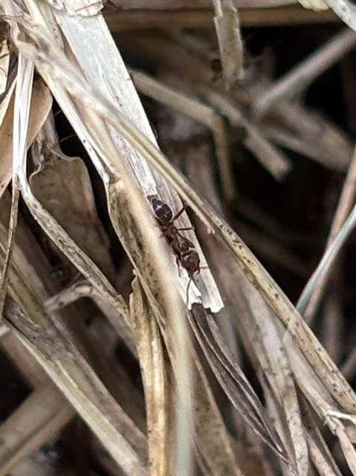

Caffeine concentration changes foodward routes
The foodward route changed differently across caffeine concentrations. Ants receiving low or intermediate caffeine found the reward more efficiently with repeated visits. Ants given sucrose alone showed little comparable improvement. The highest tested concentration, 2000 ppm, also failed to retain the moderate-dose benefit. The response therefore followed a concentration-dependent pattern rather than a uniform stimulant effect.
Researchers tracked where an ant walked throughout the arena. A direct route required less travel than a route containing wide detours. Improved straightness shortened the journey even without a rise in walking speed. The source trajectories retained the spatial organization of the search. Repeated experience and pharmacological exposure acted together on the route used to obtain food.
The embedded recording follows a later visit by the same 250 ppm ant used in the earlier clip. Comparing visits preserves individual identity while displaying successive foraging attempts. A single trajectory remains one instance within the broader experiment. The primary analysis compared changes across many repeated journeys and treatment groups. Caffeine’s measured benefit concerned how the ants reached food, not an indiscriminate acceleration of movement.
Galante et al. (2024), Fig. 2. Foodward trajectories across visits and concentrations.
Photo: Linepithema humile. Samantha Knight. CC BY 4.0.
Galante et al. (2024), Dataset sample_video_ant_140_visit_5.mp4. Ant 140, visit 5, 250 ppm caffeine; original recording excerpt 10–100 s.
Galante et al. (2024)
13
Notes:
• The foodward route changed differently across caffeine concentrations. Ants receiving low or intermediate caffeine found the reward more efficiently with repeated visits. Ants given sucrose alone showed little comparable improvement. The highest tested concentration, 2000 ppm, also failed to retain the moderate-dose benefit. The response therefore followed a concentration-dependent pattern rather than a uniform stimulant effect.
• Researchers tracked where an ant walked throughout the arena. A direct route required less travel than a route containing wide detours. Improved straightness shortened the journey even without a rise in walking speed. The source trajectories retained the spatial organization of the search. Repeated experience and pharmacological exposure acted together on the route used to obtain food.
• The embedded recording follows a later visit by the same 250 ppm ant used in the earlier clip. Comparing visits preserves individual identity while displaying successive foraging attempts. A single trajectory remains one instance within the broader experiment. The primary analysis compared changes across many repeated journeys and treatment groups. Caffeine’s measured benefit concerned how the ants reached food, not an indiscriminate acceleration of movement.
References:
Galante H, De Agrò M, Koch A, Kau S, Czaczkes TJ. (2024). Acute exposure to caffeine improves foraging in an invasive ant. iScience 27:109935. https://doi.org/10.1016/j.isci.2024.109935
Figure: Galante et al. (2024), Fig. 2. Foodward trajectories across visits and concentrations.
Figure source: https://doi.org/10.1016/j.isci.2024.109935
Image: Photo: Linepithema humile. Credit: (c) Samantha Knight, some rights reserved (CC BY). License: CC BY 4.0. Source: https://www.inaturalist.org/observations/407873996
Embedded video: Galante et al. (2024), Dataset sample_video_ant_140_visit_5.mp4. Ant 140, visit 5, 250 ppm caffeine; original recording excerpt 10–100 s.
Exact identifier: Dataset sample_video_ant_140_visit_5.mp4
Article DOI: https://doi.org/10.1016/j.isci.2024.109935
Original URL: https://zenodo.org/records/10894114/files/sample_videos.zip?download=1
Credit: Galante H, De Agrò M, Koch A, Kau S, Czaczkes TJ.
License: CC BY 4.0, as declared by the research data archive
Conversion: 90-second excerpt from 10 to 100 seconds of the original research recording; original dimensions, scene order, playback speed and available audio preserved. Exact slide placement and final contextual interval review pending.
Playback: native embedded MP4, fullscreen flag enabled. Desktop PowerPoint GUI playback and Google Slides import have not been tested. Google Slides may require separate insertion of the video from Drive.

Slide 14

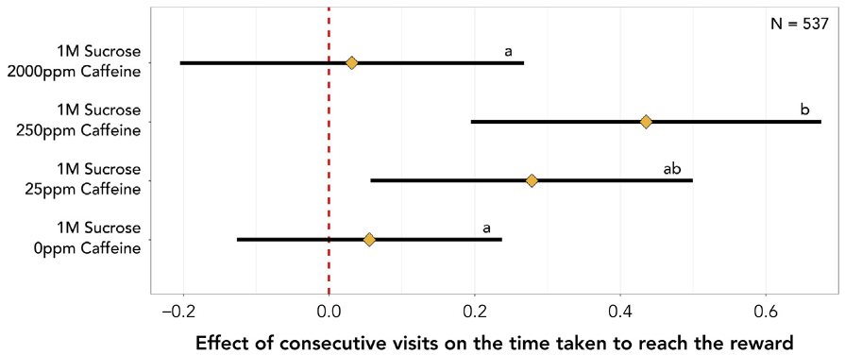

Repeated journeys change reward-finding time
The time needed to find a reward decreased across successive visits under moderate caffeine exposure. At low and intermediate concentrations, the reported improvement was approximately 38% per consecutive visit. Untreated ants did not exhibit the same consistent reduction. The very high concentration removed the improvement found at moderate doses. Dose dependence can therefore include a loss of benefit as exposure increases.
Foodward time includes departures, turns, pauses and detours before arrival. Walking speed describes movement during the path rather than the entire search outcome. Measuring both prevented a shorter journey from being attributed automatically to stronger motor activation. The trajectories linked reduced search time to more efficient travel. The reward’s fixed location supplied information that the ant could reuse on later visits.
The accompanying source recording follows an ant in the 2000 ppm condition. Its movement supplies a concrete example of foraging under the high-concentration treatment. The quantitative comparison concerns the distribution of repeated journeys across treatments. A compound that improves learning at moderate exposure need not improve performance at every exposure. The observed concentration range connects pharmacological action to the ecological task of locating food.
Galante et al. (2024), Fig. 3. Changes in reward-finding time across repeated visits.
Photo: Linepithema humile. Roberto Daniel Avila. CC BY 4.0.
Galante et al. (2024), Dataset sample_video_ant_40_visit_4.mp4. Ant 40, visit 4, 2000 ppm caffeine; original recording excerpt 10–100 s.
Galante et al. (2024)
14
Notes:
• The time needed to find a reward decreased across successive visits under moderate caffeine exposure. At low and intermediate concentrations, the reported improvement was approximately 38% per consecutive visit. Untreated ants did not exhibit the same consistent reduction. The very high concentration removed the improvement found at moderate doses. **Dose dependence** can therefore include a loss of benefit as exposure increases.
• Foodward time includes departures, turns, pauses and detours before arrival. Walking speed describes movement during the path rather than the entire search outcome. Measuring both prevented a shorter journey from being attributed automatically to stronger motor activation. The trajectories linked reduced search time to more efficient travel. The reward’s fixed location supplied information that the ant could reuse on later visits.
• The accompanying source recording follows an ant in the 2000 ppm condition. Its movement supplies a concrete example of foraging under the high-concentration treatment. The quantitative comparison concerns the distribution of repeated journeys across treatments. A compound that improves learning at moderate exposure need not improve performance at every exposure. The observed concentration range connects pharmacological action to the ecological task of locating food.
References:
Galante H, De Agrò M, Koch A, Kau S, Czaczkes TJ. (2024). Acute exposure to caffeine improves foraging in an invasive ant. iScience 27:109935. https://doi.org/10.1016/j.isci.2024.109935
Figure: Galante et al. (2024), Fig. 3. Changes in reward-finding time across repeated visits.
Figure source: https://doi.org/10.1016/j.isci.2024.109935
Image: Photo: Linepithema humile. Credit: (c) Roberto Daniel Avila, some rights reserved (CC BY). License: CC BY 4.0. Source: https://www.inaturalist.org/observations/407690608
Embedded video: Galante et al. (2024), Dataset sample_video_ant_40_visit_4.mp4. Ant 40, visit 4, 2000 ppm caffeine; original recording excerpt 10–100 s.
Exact identifier: Dataset sample_video_ant_40_visit_4.mp4
Article DOI: https://doi.org/10.1016/j.isci.2024.109935
Original URL: https://zenodo.org/records/10894114/files/sample_videos.zip?download=1
Credit: Galante H, De Agrò M, Koch A, Kau S, Czaczkes TJ.
License: CC BY 4.0, as declared by the research data archive
Conversion: 90-second excerpt from 10 to 100 seconds of the original research recording; original dimensions, scene order, playback speed and available audio preserved. Exact slide placement and final contextual interval review pending.
Playback: native embedded MP4, fullscreen flag enabled. Desktop PowerPoint GUI playback and Google Slides import have not been tested. Google Slides may require separate insertion of the video from Drive.

Slide 15
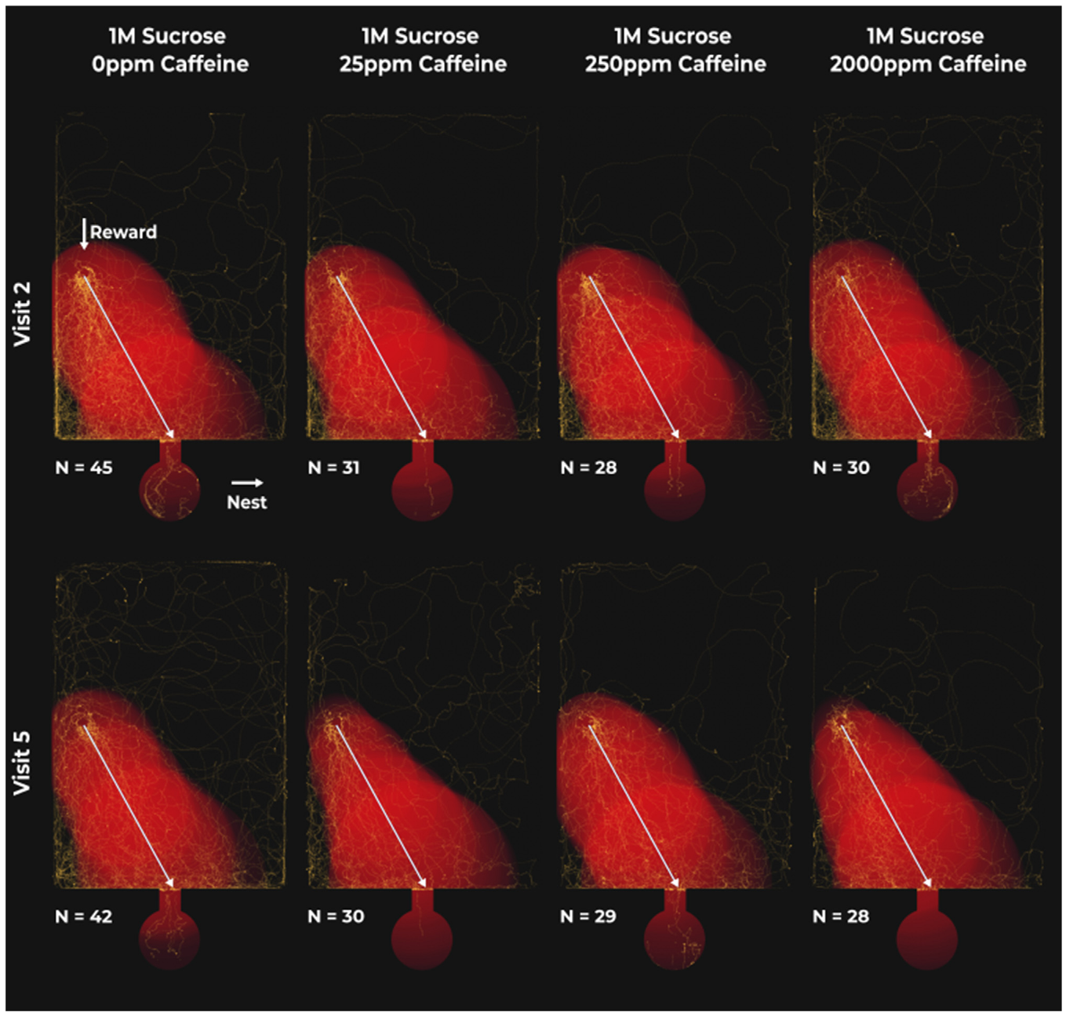

Nestward and foodward journeys respond differently
Returning to the nest imposed a different navigational task from finding the food reward. After feeding, an ant traveled toward the nest entrance. Galante and colleagues analyzed these nestward trajectories separately from foodward journeys. Caffeine did not produce the same improvement in homing performance. Direction of travel therefore changed the behavioral expression of the treatment effect.
The outward and return journeys occurred in the same experimental setting. They differed in destination and in the information available after feeding. Separating them retained the functional distinction between obtaining food and carrying resources home. A general locomotor stimulant would be expected to affect movement more broadly. The measured improvement was concentrated in the foodward search instead.
The source recording follows another return visit by an ant receiving 2000 ppm caffeine. Its preserved sequence includes the movements that generated the recorded trajectory. The experiment assessed homing with journey time and path measures rather than a food-choice test. Caffeine’s effects were selective for particular components of the foraging cycle. Learning the route to a reward and navigating back to the nest responded differently to the same experimental exposure.
Galante et al. (2024), Fig. 4. Nestward trajectories across treatment conditions.
Photo: Linepithema humile. RAP. CC BY 4.0.
Galante et al. (2024), Dataset sample_video_ant_40_visit_5.mp4. Ant 40, visit 5, 2000 ppm caffeine; original recording excerpt 10–100 s.
Galante et al. (2024)
15
Notes:
• Returning to the nest imposed a different navigational task from finding the food reward. After feeding, an ant traveled toward the nest entrance. Galante and colleagues analyzed these nestward trajectories separately from foodward journeys. Caffeine did not produce the same improvement in homing performance. Direction of travel therefore changed the behavioral expression of the treatment effect.
• The outward and return journeys occurred in the same experimental setting. They differed in destination and in the information available after feeding. Separating them retained the functional distinction between obtaining food and carrying resources home. A general locomotor stimulant would be expected to affect movement more broadly. The measured improvement was concentrated in the foodward search instead.
• The source recording follows another return visit by an ant receiving 2000 ppm caffeine. Its preserved sequence includes the movements that generated the recorded trajectory. The experiment assessed homing with journey time and path measures rather than a food-choice test. Caffeine’s effects were selective for particular components of the foraging cycle. Learning the route to a reward and navigating back to the nest responded differently to the same experimental exposure.
References:
Galante H, De Agrò M, Koch A, Kau S, Czaczkes TJ. (2024). Acute exposure to caffeine improves foraging in an invasive ant. iScience 27:109935. https://doi.org/10.1016/j.isci.2024.109935
Figure: Galante et al. (2024), Fig. 4. Nestward trajectories across treatment conditions.
Figure source: https://doi.org/10.1016/j.isci.2024.109935
Image: Photo: Linepithema humile. Credit: (c) RAP, some rights reserved (CC BY). License: CC BY 4.0. Source: https://www.inaturalist.org/observations/408241376
Embedded video: Galante et al. (2024), Dataset sample_video_ant_40_visit_5.mp4. Ant 40, visit 5, 2000 ppm caffeine; original recording excerpt 10–100 s.
Exact identifier: Dataset sample_video_ant_40_visit_5.mp4
Article DOI: https://doi.org/10.1016/j.isci.2024.109935
Original URL: https://zenodo.org/records/10894114/files/sample_videos.zip?download=1
Credit: Galante H, De Agrò M, Koch A, Kau S, Czaczkes TJ.
License: CC BY 4.0, as declared by the research data archive
Conversion: 90-second excerpt from 10 to 100 seconds of the original research recording; original dimensions, scene order, playback speed and available audio preserved. Exact slide placement and final contextual interval review pending.
Playback: native embedded MP4, fullscreen flag enabled. Desktop PowerPoint GUI playback and Google Slides import have not been tested. Google Slides may require separate insertion of the video from Drive.

Slide 16
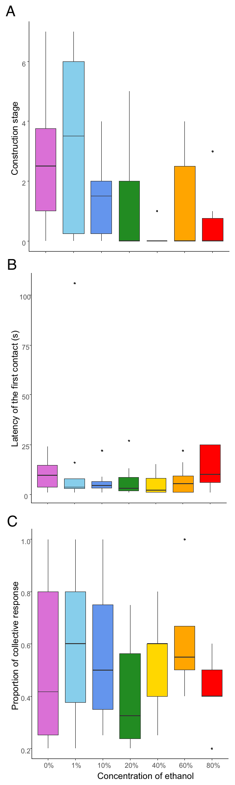

Oriental hornets tolerate unusually strong ethanol
Oriental hornets, Vespa orientalis, tolerate ethanol concentrations that strongly affect many other animals. Ethanol is the alcohol produced when microorganisms ferment sugars. Bouchebti and colleagues supplied hornets with ethanol-containing solutions over repeated days. Their treatments extended to 80% ethanol. They assessed survival and behavior rather than assuming that consumption implied obvious intoxication.
Nest construction remained detectable across the tested concentration groups. Researchers measured the production of nest material during the experimental period. They also introduced an intruder and measured agonistic responses. Agonistic behavior includes actions associated with conflict, such as approaching and confronting another animal. Neither construction nor these confrontation measures declined systematically with increasing ethanol concentration in the tested conditions.
Survival comparisons also indicated an unusually high tolerance. The investigators tested workers and males and examined newly emerged workers over longer exposure. Hornets consumed substantial amounts rather than maintaining a fixed low ethanol intake through strict avoidance. Behavioral persistence was therefore accompanied by actual access and consumption. The physiological handling of ethanol supplies a complementary explanation for this extreme tolerance.
Bouchebti et al. (2024), Fig. 2. Nest construction and responses to intruders.
Photo: Vespa orientalis. no rights reserved. CC0 1.0.
Bouchebti et al. (2024)
16
Notes:
• Oriental hornets, _Vespa orientalis_, tolerate ethanol concentrations that strongly affect many other animals. **Ethanol** is the alcohol produced when microorganisms ferment sugars. Bouchebti and colleagues supplied hornets with ethanol-containing solutions over repeated days. Their treatments extended to 80% ethanol. They assessed survival and behavior rather than assuming that consumption implied obvious intoxication.
• Nest construction remained detectable across the tested concentration groups. Researchers measured the production of nest material during the experimental period. They also introduced an intruder and measured agonistic responses. **Agonistic behavior** includes actions associated with conflict, such as approaching and confronting another animal. Neither construction nor these confrontation measures declined systematically with increasing ethanol concentration in the tested conditions.
• Survival comparisons also indicated an unusually high tolerance. The investigators tested workers and males and examined newly emerged workers over longer exposure. Hornets consumed substantial amounts rather than maintaining a fixed low ethanol intake through strict avoidance. Behavioral persistence was therefore accompanied by actual access and consumption. The physiological handling of ethanol supplies a complementary explanation for this extreme tolerance.
References:
Bouchebti S, Gershon Y, Gordin A, Huchon D, Levin E. (2024). Tolerance and efficient metabolization of extremely high ethanol concentrations by a social wasp. Proceedings of the National Academy of Sciences of the United States of America 121:e2410874121. https://doi.org/10.1073/pnas.2410874121
Figure: Bouchebti et al. (2024), Fig. 2. Nest construction and responses to intruders.
Figure source: https://doi.org/10.1073/pnas.2410874121
Image: Photo: Vespa orientalis. Credit: no rights reserved. License: CC0 1.0. Source: https://www.inaturalist.org/observations/407732347

Slide 17
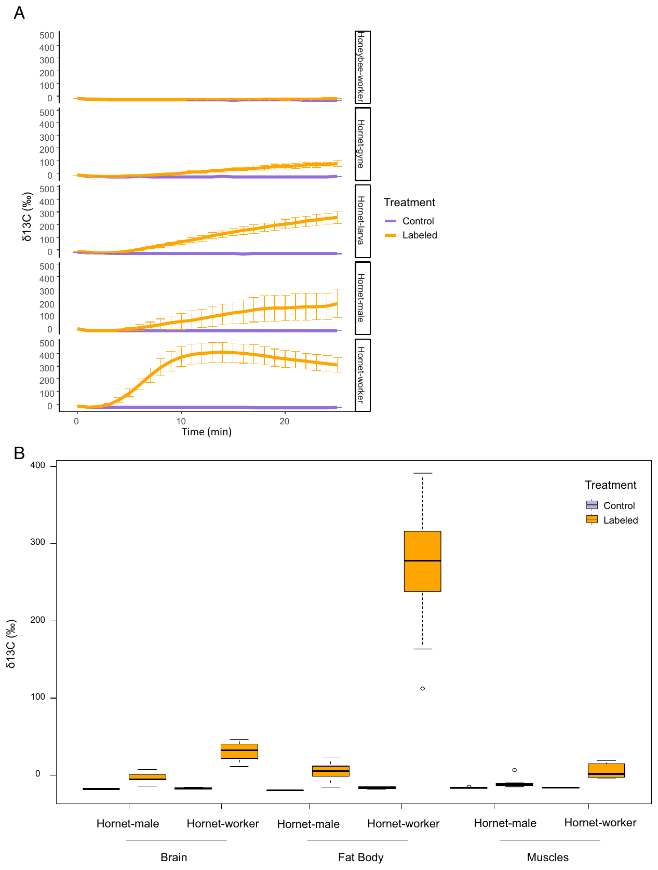
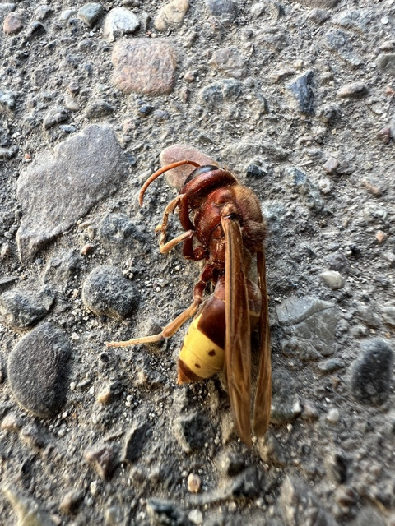
Ethanol tolerance includes rapid metabolic handling
Ethanol metabolism converts the ingested compound into other molecules that can enter energy metabolism. The hornet study followed ethanol labeled with carbon-13, a stable carbon isotope. A stable isotope is a non-radioactive form of an element that can be distinguished by its mass. Researchers measured labeled carbon in exhaled carbon dioxide. This traced the processing of ethanol-derived carbon within the animal.
Hornets metabolized the labeled ethanol more rapidly than the compared honeybees. Measurements included several hornet life stages and worker bees. Label also appeared in hornet body tissues after ingestion. Ethanol therefore entered metabolic pathways rather than merely passing through the digestive system unchanged. The tracer measurements linked high behavioral tolerance to efficient chemical processing.
The investigators also compared genes encoding alcohol dehydrogenase, an enzyme involved in alcohol metabolism. Several Vespa species carried multiple copies of the examined alcohol dehydrogenase gene. The authors propose that these copies may contribute to the hornets’ metabolic capacity. Gene copy number was a candidate mechanism rather than a direct experimental deletion of the copies. Behavioral tests, isotope tracing and genomic comparison addressed distinct components of the tolerance phenotype.
Bouchebti et al. (2024), Fig. 4. Carbon-13 tracing of ethanol metabolism.
Photo: Vespa orientalis. dschigel. CC BY 4.0.
Bouchebti et al. (2024)
17
Notes:
• Ethanol metabolism converts the ingested compound into other molecules that can enter energy metabolism. The hornet study followed ethanol labeled with **carbon-13**, a stable carbon isotope. A stable isotope is a non-radioactive form of an element that can be distinguished by its mass. Researchers measured labeled carbon in exhaled carbon dioxide. This traced the processing of ethanol-derived carbon within the animal.
• Hornets metabolized the labeled ethanol more rapidly than the compared honeybees. Measurements included several hornet life stages and worker bees. Label also appeared in hornet body tissues after ingestion. Ethanol therefore entered metabolic pathways rather than merely passing through the digestive system unchanged. The tracer measurements linked high behavioral tolerance to efficient chemical processing.
• The investigators also compared genes encoding **alcohol dehydrogenase**, an enzyme involved in alcohol metabolism. Several _Vespa_ species carried multiple copies of the examined alcohol dehydrogenase gene. The authors propose that these copies may contribute to the hornets’ metabolic capacity. Gene copy number was a candidate mechanism rather than a direct experimental deletion of the copies. Behavioral tests, isotope tracing and genomic comparison addressed distinct components of the tolerance phenotype.
References:
Bouchebti S, Gershon Y, Gordin A, Huchon D, Levin E. (2024). Tolerance and efficient metabolization of extremely high ethanol concentrations by a social wasp. Proceedings of the National Academy of Sciences of the United States of America 121:e2410874121. https://doi.org/10.1073/pnas.2410874121
Figure: Bouchebti et al. (2024), Fig. 4. Carbon-13 tracing of ethanol metabolism.
Figure source: https://doi.org/10.1073/pnas.2410874121
Image: Photo: Vespa orientalis. Credit: (c) dschigel, some rights reserved (CC BY). License: CC BY 4.0. Source: https://www.inaturalist.org/observations/408023623

Slide 18

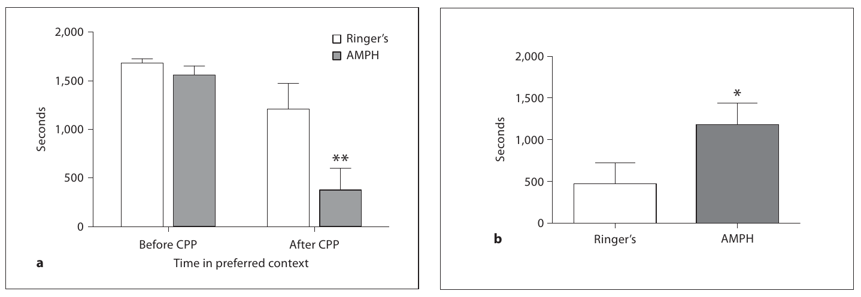
Tree frogs learn associations with amphetamine
Male green tree frogs, Hyla cinerea, learned to prefer a context paired with amphetamine. Amphetamine increases monoamine signaling and acts as an indirect dopamine agonist. An agonist increases signaling through a receptor system, directly or through the available transmitter. Presley and colleagues paired the drug with a compartment that the frog initially avoided. The alternative compartment was paired with vehicle treatment.
The conditioning period lasted 14 d. Frogs in the drug group received 20 mg/kg amphetamine during the assigned pairings. Comparison frogs received vehicle in both contexts. After conditioning, drug-treated frogs shifted their preference toward the previously non-preferred context. Vehicle-treated animals did not display the same reversal of their initial preference.
The later test measured where the frog spent time when it could choose between contexts. The learned change persisted beyond the individual training episode. Conditioned place preference names this association between a context and the effects of a treatment. It differs from an animal performing an action to obtain the drug itself. In this amphibian, drug exposure altered the learned value of environmental cues.
Presley et al. (2010), Fig. 3. Context preference before and after conditioning.
Photo: Dryophytes cinereus. northerly. CC BY 4.0.
Presley et al. (2010)
18
Notes:
• Male green tree frogs, _Hyla cinerea_, learned to prefer a context paired with amphetamine. **Amphetamine** increases monoamine signaling and acts as an indirect dopamine agonist. An **agonist** increases signaling through a receptor system, directly or through the available transmitter. Presley and colleagues paired the drug with a compartment that the frog initially avoided. The alternative compartment was paired with vehicle treatment.
• The conditioning period lasted 14 d. Frogs in the drug group received 20 mg/kg amphetamine during the assigned pairings. Comparison frogs received vehicle in both contexts. After conditioning, drug-treated frogs shifted their preference toward the previously non-preferred context. Vehicle-treated animals did not display the same reversal of their initial preference.
• The later test measured where the frog spent time when it could choose between contexts. The learned change persisted beyond the individual training episode. **Conditioned place preference** names this association between a context and the effects of a treatment. It differs from an animal performing an action to obtain the drug itself. In this amphibian, drug exposure altered the learned value of environmental cues.
References:
Presley GM, Lonergan W, Chu J. (2010). Effects of amphetamine on conditioned place preference and locomotion in the male green tree frog, Hyla cinerea. Brain, behavior and evolution 75:262-270. https://doi.org/10.1159/000314901
Figure: Presley et al. (2010), Fig. 3. Context preference before and after conditioning.
Figure source: https://doi.org/10.1159/000314901
Image: Photo: Dryophytes cinereus. Credit: (c) northerly, some rights reserved (CC BY). License: CC BY 4.0. Source: https://www.inaturalist.org/observations/407891030

Slide 19

Place conditioning measures a learned context choice
The tree-frog place-conditioning experiment began with a strong baseline preference. Frogs could choose between compartments with different visual features. Researchers measured each animal’s allocation of time before drug pairing. The initially non-preferred compartment then became the amphetamine-associated context. This design tested whether experience could overcome an existing environmental preference.
A context is the combined set of environmental cues accompanying an experience. In this preparation, the compartments supplied distinct cues during drug and vehicle sessions. The comparison group experienced the apparatus and injections without amphetamine. Its stable preference separated ordinary repeated exposure from the drug-associated change. The critical outcome was a shift in where the animal subsequently chose to remain.
Preference was assessed with free access to both sides of the apparatus. The drug-associated context gained behavioral value despite starting as the less attractive option. Time allocation consequently reflected the history of the pairing. The study extended a reward-learning procedure to an amphibian species. Its experimental outcome concerned learned context selection rather than the frog’s momentary level of motor activation.
Presley et al. (2010), Fig. 3. Reversal of the initial context preference.
Photo: Dryophytes cinereus. Jacob Saucier. CC BY 4.0.
Presley et al. (2010)
19
Notes:
• The tree-frog place-conditioning experiment began with a strong baseline preference. Frogs could choose between compartments with different visual features. Researchers measured each animal’s allocation of time before drug pairing. The initially non-preferred compartment then became the amphetamine-associated context. This design tested whether experience could overcome an existing environmental preference.
• A **context** is the combined set of environmental cues accompanying an experience. In this preparation, the compartments supplied distinct cues during drug and vehicle sessions. The comparison group experienced the apparatus and injections without amphetamine. Its stable preference separated ordinary repeated exposure from the drug-associated change. The critical outcome was a shift in where the animal subsequently chose to remain.
• Preference was assessed with free access to both sides of the apparatus. The drug-associated context gained behavioral value despite starting as the less attractive option. Time allocation consequently reflected the history of the pairing. The study extended a reward-learning procedure to an amphibian species. Its experimental outcome concerned learned context selection rather than the frog’s momentary level of motor activation.
References:
Presley GM, Lonergan W, Chu J. (2010). Effects of amphetamine on conditioned place preference and locomotion in the male green tree frog, Hyla cinerea. Brain, behavior and evolution 75:262-270. https://doi.org/10.1159/000314901
Figure: Presley et al. (2010), Fig. 3. Reversal of the initial context preference.
Figure source: https://doi.org/10.1159/000314901
Image: Photo: Dryophytes cinereus. Credit: (c) Jacob Saucier, some rights reserved (CC BY). License: CC BY 4.0. Source: https://www.inaturalist.org/observations/408398985

Slide 20

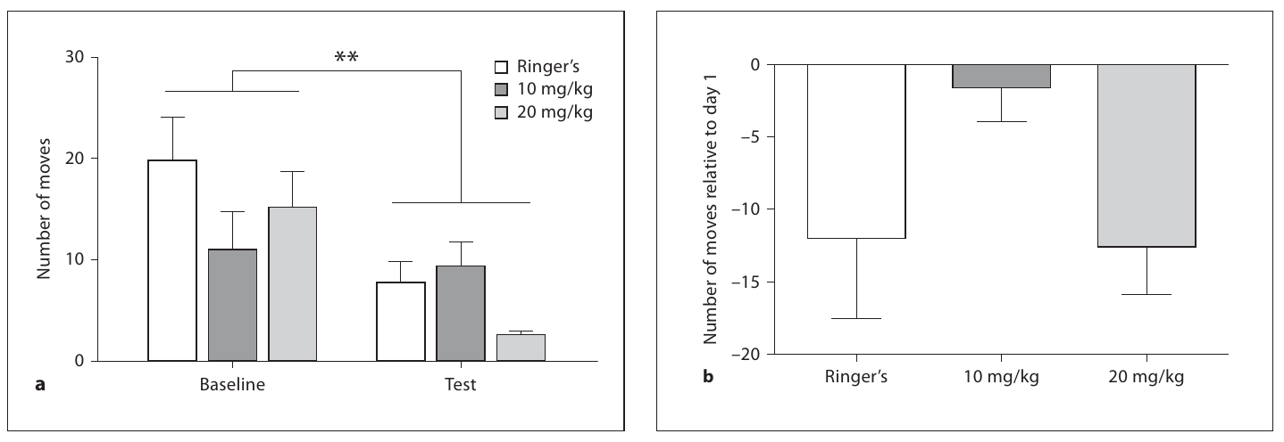
Locomotor effects and conditioned preference differ
Amphetamine can change locomotion as well as the value of a learned context. The tree-frog study measured movement in a separate open-field assay. Frogs received vehicle, 10 mg/kg amphetamine or 20 mg/kg amphetamine. Researchers recorded their movement and other visible behaviors after treatment. The tested doses did not produce a clear increase in these motor measures.
The place-conditioning result therefore occurred without a parallel stimulant response in the open field. Locomotor activation means increased movement, whereas conditioned preference means changed allocation of time between learned contexts. These outcomes require different measurements. A drug can influence learning-related behavior without increasing every measured action. The frog results separated those two behavioral consequences under the tested conditions.
The movement assay used an arena rather than a choice between drug-paired compartments. It assessed immediate behavioral expression after the administered dose. The conditioning assay instead accumulated experience across repeated pairings. Different time scales and task demands exposed different effects of the same substance. In these frogs, the strongest measured consequence was altered context preference after training.
Presley et al. (2010), Fig. 4. Open-field locomotor and behavioral comparisons.
Photo: Dryophytes cinereus. Jacob Saucier. CC BY 4.0.
Presley et al. (2010)
20
Notes:
• Amphetamine can change locomotion as well as the value of a learned context. The tree-frog study measured movement in a separate open-field assay. Frogs received vehicle, 10 mg/kg amphetamine or 20 mg/kg amphetamine. Researchers recorded their movement and other visible behaviors after treatment. The tested doses did not produce a clear increase in these motor measures.
• The place-conditioning result therefore occurred without a parallel stimulant response in the open field. **Locomotor activation** means increased movement, whereas conditioned preference means changed allocation of time between learned contexts. These outcomes require different measurements. A drug can influence learning-related behavior without increasing every measured action. The frog results separated those two behavioral consequences under the tested conditions.
• The movement assay used an arena rather than a choice between drug-paired compartments. It assessed immediate behavioral expression after the administered dose. The conditioning assay instead accumulated experience across repeated pairings. Different time scales and task demands exposed different effects of the same substance. In these frogs, the strongest measured consequence was altered context preference after training.
References:
Presley GM, Lonergan W, Chu J. (2010). Effects of amphetamine on conditioned place preference and locomotion in the male green tree frog, Hyla cinerea. Brain, behavior and evolution 75:262-270. https://doi.org/10.1159/000314901
Figure: Presley et al. (2010), Fig. 4. Open-field locomotor and behavioral comparisons.
Figure source: https://doi.org/10.1159/000314901
Image: Photo: Dryophytes cinereus. Credit: (c) Jacob Saucier, some rights reserved (CC BY). License: CC BY 4.0. Source: https://www.inaturalist.org/observations/408398861

Slide 21
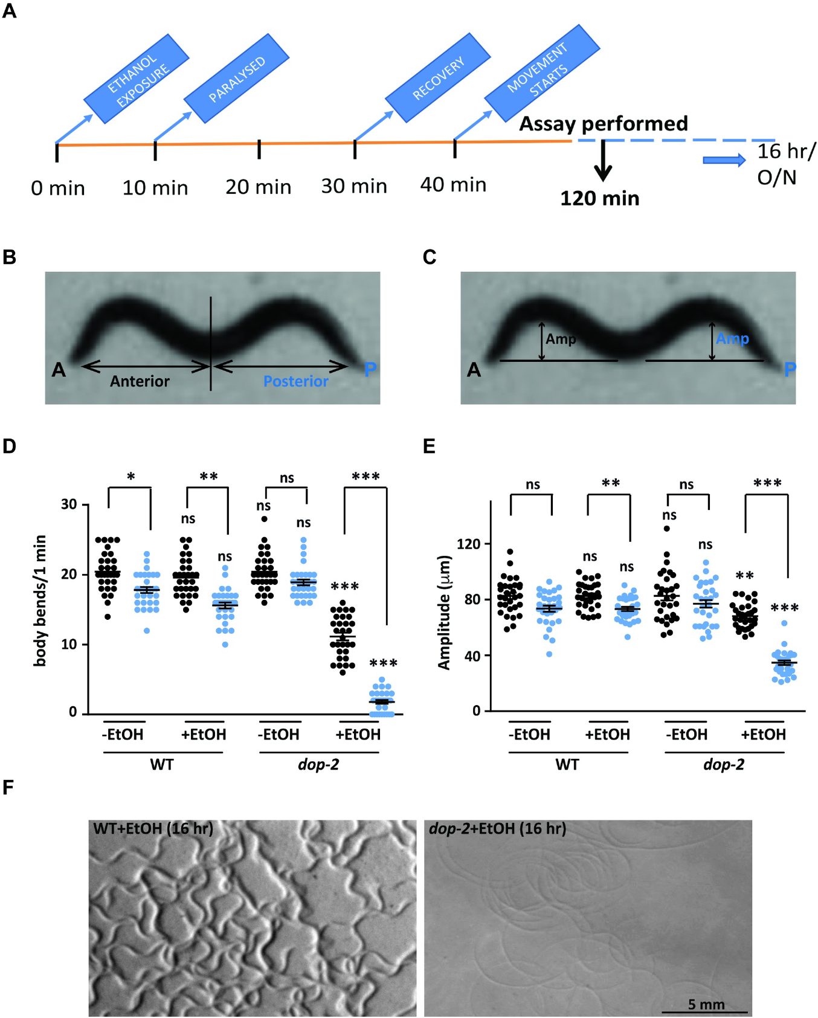
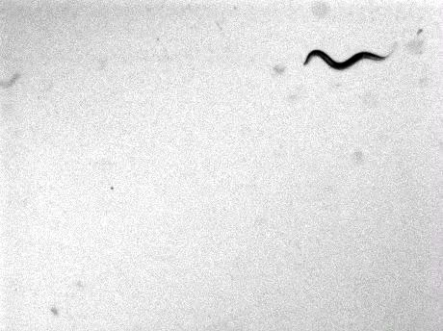
Ethanol sensitivity depends on dopamine signaling
The nematode Caenorhabditis elegans changes its movement under ethanol exposure. Pandey and colleagues examined animals lacking DOP-2, a D2-like dopamine receptor. Dopamine is a transmitter that modulates the activity of other neurons. A receptor converts the presence of a transmitter into a cellular response. The mutation altered the way an identified signaling system influenced intoxicated movement.
The researchers exposed worms to 400 mM ethanol in the external medium. This bath concentration is distinct from the concentration inside the animal. Wild-type worms continued to generate coordinated body movements under the assay conditions. Mutant worms increasingly dragged the posterior body while moving in circles. The study termed this pattern ethanol-induced sedative behavior.
The original wild-type recording preserves movement after prolonged ethanol exposure. It provides the behavioral comparison for the mutant and intervention recordings. Researchers quantified posture and movement rather than assigning a human psychological state to the worm. Genetic restoration of receptor function tested whether the altered behavior depended on DOP-2. A compact nervous system allowed the pathway from transmitter regulation to motor output to be examined cell by cell.
Pandey et al. (2021), Fig. 1. Ethanol-dependent locomotor phenotype.
Pandey et al. (2021), S1 Movie. Wild type after ethanol exposure.
Pandey et al. (2021)
21
Notes:
• The nematode _Caenorhabditis elegans_ changes its movement under ethanol exposure. Pandey and colleagues examined animals lacking **DOP-2**, a D2-like dopamine receptor. Dopamine is a transmitter that modulates the activity of other neurons. A receptor converts the presence of a transmitter into a cellular response. The mutation altered the way an identified signaling system influenced intoxicated movement.
• The researchers exposed worms to 400 mM ethanol in the external medium. This bath concentration is distinct from the concentration inside the animal. Wild-type worms continued to generate coordinated body movements under the assay conditions. Mutant worms increasingly dragged the posterior body while moving in circles. The study termed this pattern ethanol-induced sedative behavior.
• The original wild-type recording preserves movement after prolonged ethanol exposure. It provides the behavioral comparison for the mutant and intervention recordings. Researchers quantified posture and movement rather than assigning a human psychological state to the worm. Genetic restoration of receptor function tested whether the altered behavior depended on DOP-2. A compact nervous system allowed the pathway from transmitter regulation to motor output to be examined cell by cell.
References:
Pandey P, Singh A, Kaur H, Ghosh-Roy A, Babu K. (2021). Increased dopaminergic neurotransmission results in ethanol dependent sedative behaviors in Caenorhabditis elegans. PLoS genetics 17:e1009346. https://doi.org/10.1371/journal.pgen.1009346
Figure: Pandey et al. (2021), Fig. 1. Ethanol-dependent locomotor phenotype.
Figure source: https://doi.org/10.1371/journal.pgen.1009346
Embedded video: Pandey et al. (2021), S1 Movie. Wild type after ethanol exposure.
Exact identifier: S1 Movie
Article DOI: https://doi.org/10.1371/journal.pgen.1009346
Original URL: https://journals.plos.org/plosgenetics/article/file?id=10.1371/journal.pgen.1009346.s008&type=supplementary
Credit: Pandey P, Singh A, Kaur H, Ghosh-Roy A, Babu K.
License: CC BY
Conversion: Original scene order, speed, dimensions and available audio preserved; H.264/AAC playback conversion only.
Playback: native embedded MP4, fullscreen flag enabled. Desktop PowerPoint GUI playback and Google Slides import have not been tested. Google Slides may require separate insertion of the video from Drive.

Slide 22
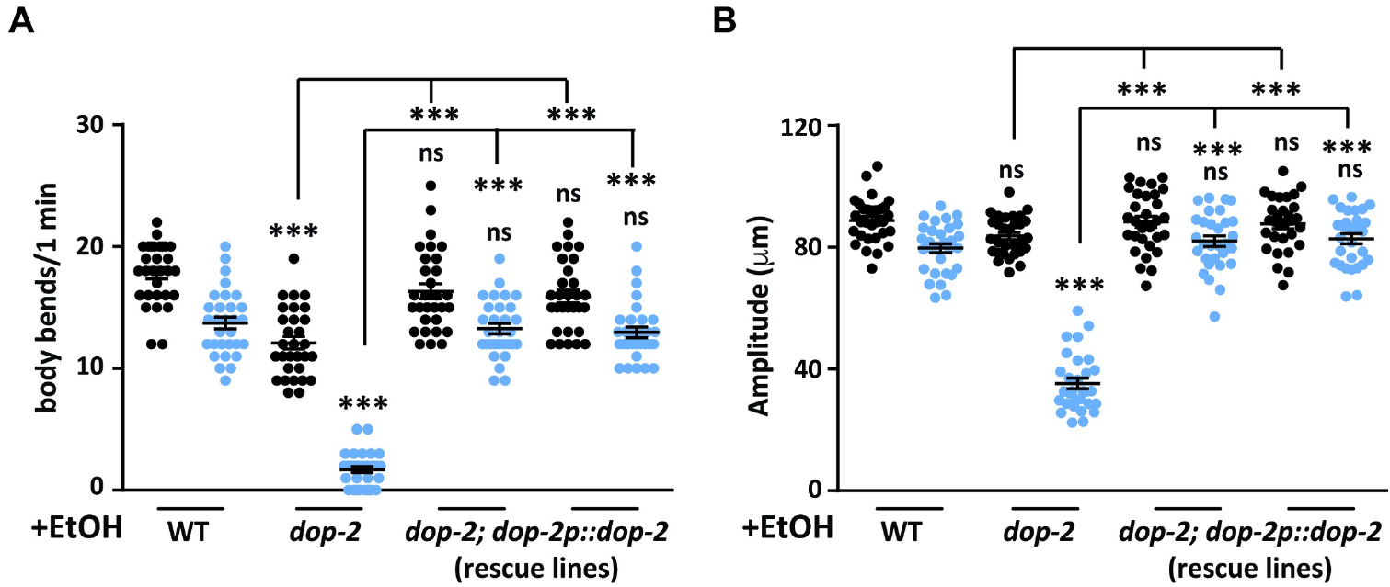
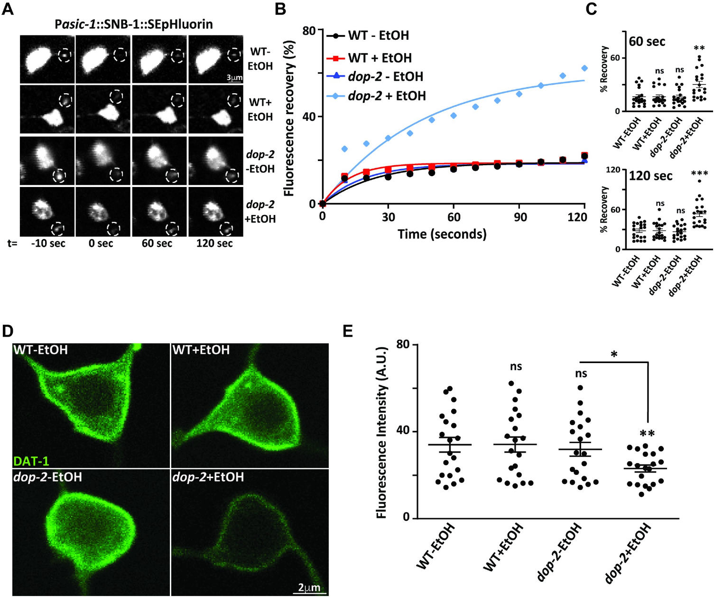
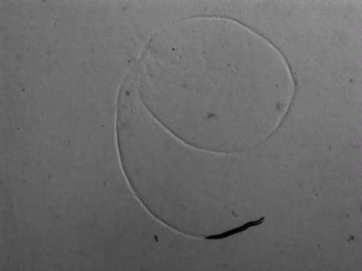
DOP-2 loss changes the movement response to ethanol
DOP-2 acts as a dopamine autoreceptor, a receptor through which a dopamine neuron regulates its own signaling. Such feedback can limit transmitter output. Removing the receptor can therefore increase downstream dopamine signaling rather than simply remove all dopamine effects. The worm experiment tested this relationship during ethanol exposure. The mutant’s circular movement combined abnormal posture with reduced effective forward travel.
Restoring DOP-2 in dopaminergic neurons improved the movement phenotype. The investigators also examined other dopamine-pathway mutants. Reducing dopamine production suppressed the abnormal response associated with DOP-2 loss. These interventions placed dopamine availability upstream of the observed motor pattern. The phenotype depended on both the receptor genotype and the ethanol condition.
The mutant recording contains the dragging and turning described in the assay. Its posterior body fails to contribute the coordinated movement seen in wild type. The difference concerns the organization of a motor sequence, not merely total displacement. Ethanol exposed a regulatory function of dopamine feedback within the locomotor circuit. Receptor loss changed the amount of signaling reaching the rest of that circuit.
Pandey et al. (2021), Fig. 2(A–B). DOP-2 localization and cell-specific intervention.
Pandey et al. (2021), Fig. 4. PDE neuronal labeling.
Pandey et al. (2021), S2 Movie. dop-2 mutant movement under ethanol.
Pandey et al. (2021)
22
Notes:
• DOP-2 acts as a dopamine **autoreceptor**, a receptor through which a dopamine neuron regulates its own signaling. Such feedback can limit transmitter output. Removing the receptor can therefore increase downstream dopamine signaling rather than simply remove all dopamine effects. The worm experiment tested this relationship during ethanol exposure. The mutant’s circular movement combined abnormal posture with reduced effective forward travel.
• Restoring DOP-2 in dopaminergic neurons improved the movement phenotype. The investigators also examined other dopamine-pathway mutants. Reducing dopamine production suppressed the abnormal response associated with DOP-2 loss. These interventions placed dopamine availability upstream of the observed motor pattern. The phenotype depended on both the receptor genotype and the ethanol condition.
• The mutant recording contains the dragging and turning described in the assay. Its posterior body fails to contribute the coordinated movement seen in wild type. The difference concerns the organization of a motor sequence, not merely total displacement. Ethanol exposed a regulatory function of dopamine feedback within the locomotor circuit. Receptor loss changed the amount of signaling reaching the rest of that circuit.
References:
Pandey P, Singh A, Kaur H, Ghosh-Roy A, Babu K. (2021). Increased dopaminergic neurotransmission results in ethanol dependent sedative behaviors in Caenorhabditis elegans. PLoS genetics 17:e1009346. https://doi.org/10.1371/journal.pgen.1009346
Figure: Pandey et al. (2021), Fig. 2(A–B). DOP-2 localization and cell-specific intervention.
Figure source: https://doi.org/10.1371/journal.pgen.1009346
Figure: Pandey et al. (2021), Fig. 4. PDE neuronal labeling.
Figure source: https://doi.org/10.1371/journal.pgen.1009346
Embedded video: Pandey et al. (2021), S2 Movie. dop-2 mutant movement under ethanol.
Exact identifier: S2 Movie
Article DOI: https://doi.org/10.1371/journal.pgen.1009346
Original URL: https://journals.plos.org/plosgenetics/article/file?id=10.1371/journal.pgen.1009346.s009&type=supplementary
Credit: Pandey P, Singh A, Kaur H, Ghosh-Roy A, Babu K.
License: CC BY
Conversion: Original scene order, speed, dimensions and available audio preserved; H.264/AAC playback conversion only.
Playback: native embedded MP4, fullscreen flag enabled. Desktop PowerPoint GUI playback and Google Slides import have not been tested. Google Slides may require separate insertion of the video from Drive.

Slide 23
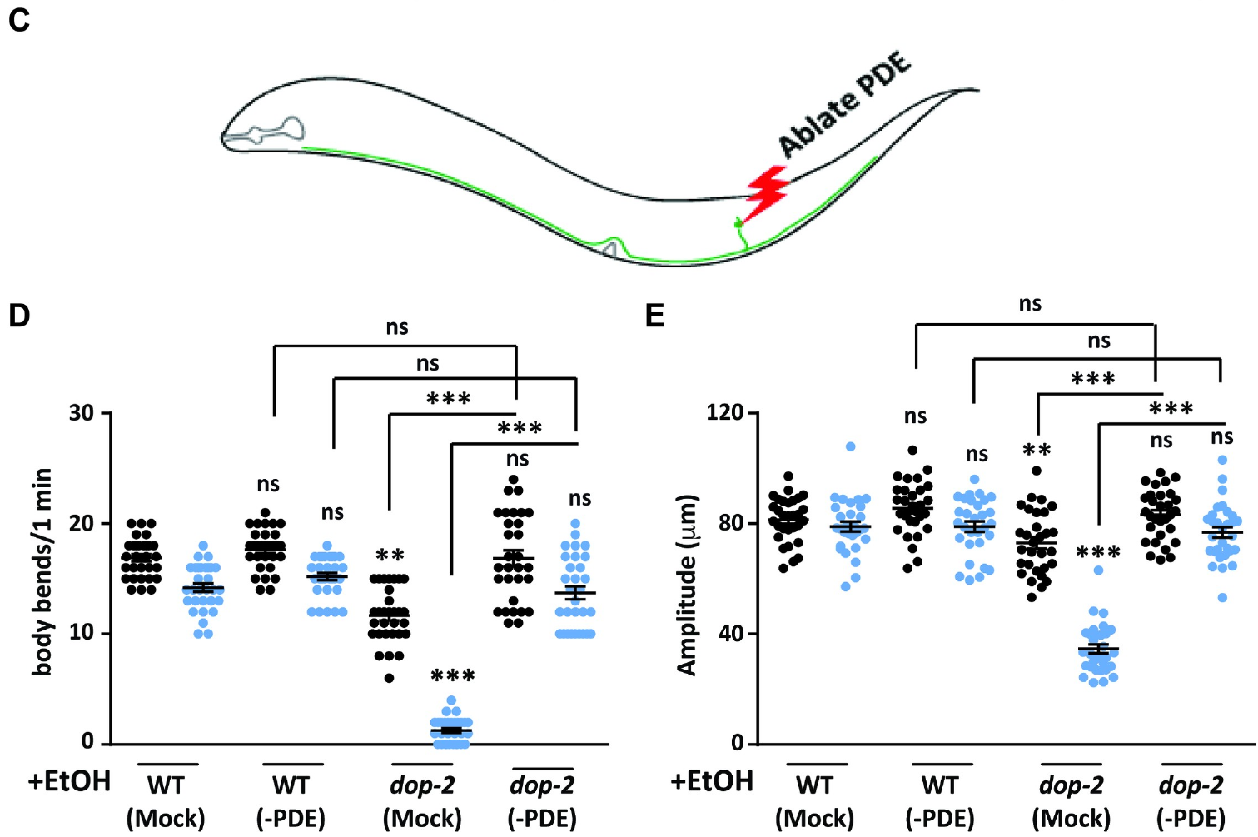
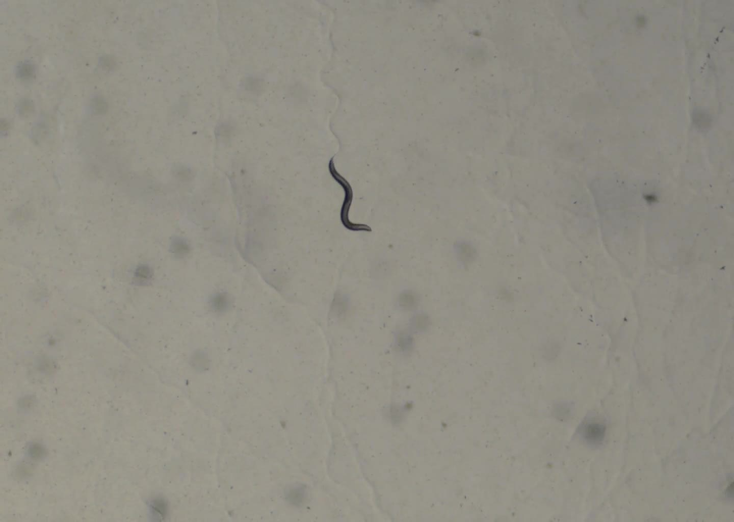
PDE neurons contribute to ethanol-dependent sedation
The worm’s posterior dopamine neurons, named PDE, contributed strongly to the ethanol-induced movement defect. These sensory neurons are positioned in the posterior part of the animal. Pandey and colleagues manipulated the cells within the identified dopamine system. Restoring DOP-2 function in the relevant neurons reduced the abnormal behavior. The experiment localized a functional contribution within the small nervous system.
Ablating PDE neurons also suppressed the mutant phenotype. Ablation removes or destroys a selected cell so that its contribution can be tested. The intervention reduced the dopamine source implicated in excessive signaling. The accompanying recording contains a mutant animal after this cell-specific manipulation. More coordinated movement followed removal of the relevant neurons despite the continued ethanol condition.
The result places the posterior dopamine cells upstream of the altered motor output. Their effect was not inferred only from where a fluorescent label appeared. Cell-specific restoration and cell removal supplied complementary interventions. Increased dopamine release during ethanol exposure provided a chemical link to the behavior. The pathway converted the state of a small sensory-neuron population into a whole-body movement pattern.
Pandey et al. (2021), Fig. 2(C–E). PDE manipulation and ethanol-induced behavior.
Pandey et al. (2021), S6 Movie. dop-2 movement after PDE ablation under ethanol.
Pandey et al. (2021)
23
Notes:
• The worm’s posterior dopamine neurons, named **PDE**, contributed strongly to the ethanol-induced movement defect. These sensory neurons are positioned in the posterior part of the animal. Pandey and colleagues manipulated the cells within the identified dopamine system. Restoring DOP-2 function in the relevant neurons reduced the abnormal behavior. The experiment localized a functional contribution within the small nervous system.
• Ablating PDE neurons also suppressed the mutant phenotype. **Ablation** removes or destroys a selected cell so that its contribution can be tested. The intervention reduced the dopamine source implicated in excessive signaling. The accompanying recording contains a mutant animal after this cell-specific manipulation. More coordinated movement followed removal of the relevant neurons despite the continued ethanol condition.
• The result places the posterior dopamine cells upstream of the altered motor output. Their effect was not inferred only from where a fluorescent label appeared. Cell-specific restoration and cell removal supplied complementary interventions. Increased dopamine release during ethanol exposure provided a chemical link to the behavior. The pathway converted the state of a small sensory-neuron population into a whole-body movement pattern.
References:
Pandey P, Singh A, Kaur H, Ghosh-Roy A, Babu K. (2021). Increased dopaminergic neurotransmission results in ethanol dependent sedative behaviors in Caenorhabditis elegans. PLoS genetics 17:e1009346. https://doi.org/10.1371/journal.pgen.1009346
Figure: Pandey et al. (2021), Fig. 2(C–E). PDE manipulation and ethanol-induced behavior.
Figure source: https://doi.org/10.1371/journal.pgen.1009346
Embedded video: Pandey et al. (2021), S6 Movie. dop-2 movement after PDE ablation under ethanol.
Exact identifier: S6 Movie
Article DOI: https://doi.org/10.1371/journal.pgen.1009346
Original URL: https://journals.plos.org/plosgenetics/article/file?id=10.1371/journal.pgen.1009346.s013&type=supplementary
Credit: Pandey P, Singh A, Kaur H, Ghosh-Roy A, Babu K.
License: CC BY
Conversion: Original scene order, speed, dimensions and available audio preserved; H.264/AAC playback conversion only.
Playback: native embedded MP4, fullscreen flag enabled. Desktop PowerPoint GUI playback and Google Slides import have not been tested. Google Slides may require separate insertion of the video from Drive.

Slide 24
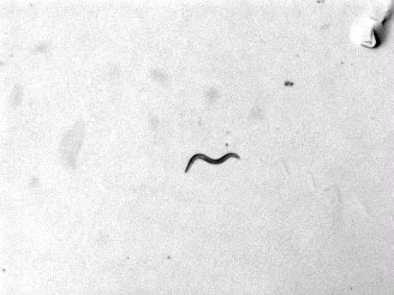
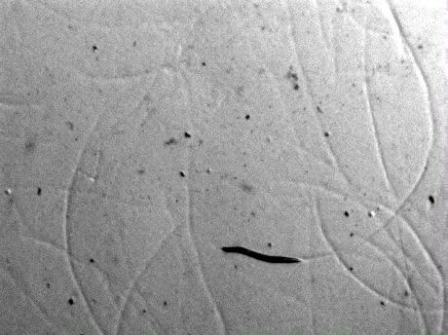
Dopamine and ethanol interact within a motor circuit
Adding dopamine to wild-type worms tested whether increased transmitter could reproduce the mutant response. The animals were examined with and without ethanol. Dopamine alone did not produce the same sedative movement pattern. Dopamine combined with ethanol generated abnormal locomotion resembling the DOP-2 mutant phenotype. The outcome depended on an interaction between the transmitter condition and the drug exposure.
The study measured dopamine release using a fluorescent secretion reporter in PDE neurons. A reporter produces a detectable signal linked to the process being measured. In this preparation, changes in the reporter reflected vesicle release from the dopamine cells. Ethanol exposure increased the measured release in the receptor mutant. The chemical measurement supported the pathway inferred from genetic and behavioral interventions.
The paired recordings preserve the dopamine-only and dopamine-plus-ethanol conditions. Coordinated movement in the first condition contrasts with abnormal movement in the second. DOP-2 feedback normally regulates the signal available to downstream cells. Removing that restraint changes the circuit’s response during ethanol exposure. The behavioral state consequently arises from the combination of pharmacological exposure and transmitter regulation.
Pandey et al. (2021), Fig. 4. Dopamine release reporter and neuronal labeling.
Pandey et al. (2021), S7 Movie. Wild type with dopamine, without ethanol.
Pandey et al. (2021), S8 Movie. Wild type with dopamine and ethanol.
Pandey et al. (2021)
24
Notes:
• Adding dopamine to wild-type worms tested whether increased transmitter could reproduce the mutant response. The animals were examined with and without ethanol. Dopamine alone did not produce the same sedative movement pattern. Dopamine combined with ethanol generated abnormal locomotion resembling the DOP-2 mutant phenotype. The outcome depended on an interaction between the transmitter condition and the drug exposure.
• The study measured dopamine release using a fluorescent secretion reporter in PDE neurons. A **reporter** produces a detectable signal linked to the process being measured. In this preparation, changes in the reporter reflected vesicle release from the dopamine cells. Ethanol exposure increased the measured release in the receptor mutant. The chemical measurement supported the pathway inferred from genetic and behavioral interventions.
• The paired recordings preserve the dopamine-only and dopamine-plus-ethanol conditions. Coordinated movement in the first condition contrasts with abnormal movement in the second. DOP-2 feedback normally regulates the signal available to downstream cells. Removing that restraint changes the circuit’s response during ethanol exposure. The behavioral state consequently arises from the combination of pharmacological exposure and transmitter regulation.
References:
Pandey P, Singh A, Kaur H, Ghosh-Roy A, Babu K. (2021). Increased dopaminergic neurotransmission results in ethanol dependent sedative behaviors in Caenorhabditis elegans. PLoS genetics 17:e1009346. https://doi.org/10.1371/journal.pgen.1009346
Figure: Pandey et al. (2021), Fig. 4. Dopamine release reporter and neuronal labeling.
Figure source: https://doi.org/10.1371/journal.pgen.1009346
Embedded video: Pandey et al. (2021), S7 Movie. Wild type with dopamine, without ethanol.
Exact identifier: S7 Movie
Article DOI: https://doi.org/10.1371/journal.pgen.1009346
Original URL: https://journals.plos.org/plosgenetics/article/file?id=10.1371/journal.pgen.1009346.s014&type=supplementary
Credit: Pandey P, Singh A, Kaur H, Ghosh-Roy A, Babu K.
License: CC BY
Conversion: Original scene order, speed, dimensions and available audio preserved; H.264/AAC playback conversion only.
Playback: native embedded MP4, fullscreen flag enabled. Desktop PowerPoint GUI playback and Google Slides import have not been tested. Google Slides may require separate insertion of the video from Drive.
Embedded video: Pandey et al. (2021), S8 Movie. Wild type with dopamine and ethanol.
Exact identifier: S8 Movie
Article DOI: https://doi.org/10.1371/journal.pgen.1009346
Original URL: https://journals.plos.org/plosgenetics/article/file?id=10.1371/journal.pgen.1009346.s015&type=supplementary
Credit: Pandey P, Singh A, Kaur H, Ghosh-Roy A, Babu K.
License: CC BY
Conversion: Original scene order, speed, dimensions and available audio preserved; H.264/AAC playback conversion only.
Playback: native embedded MP4, fullscreen flag enabled. Desktop PowerPoint GUI playback and Google Slides import have not been tested. Google Slides may require separate insertion of the video from Drive.

Slide 25
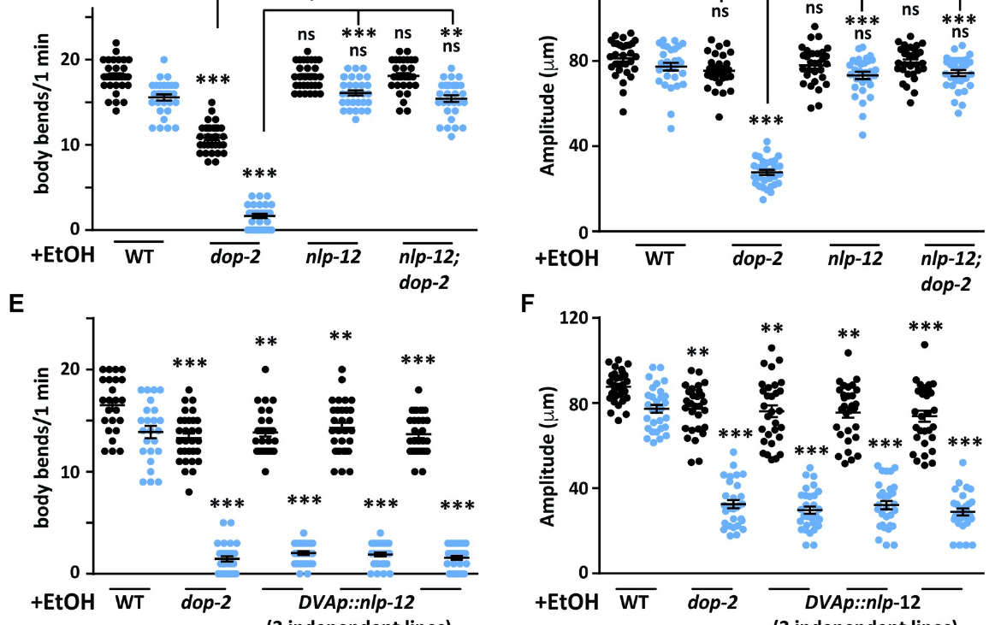
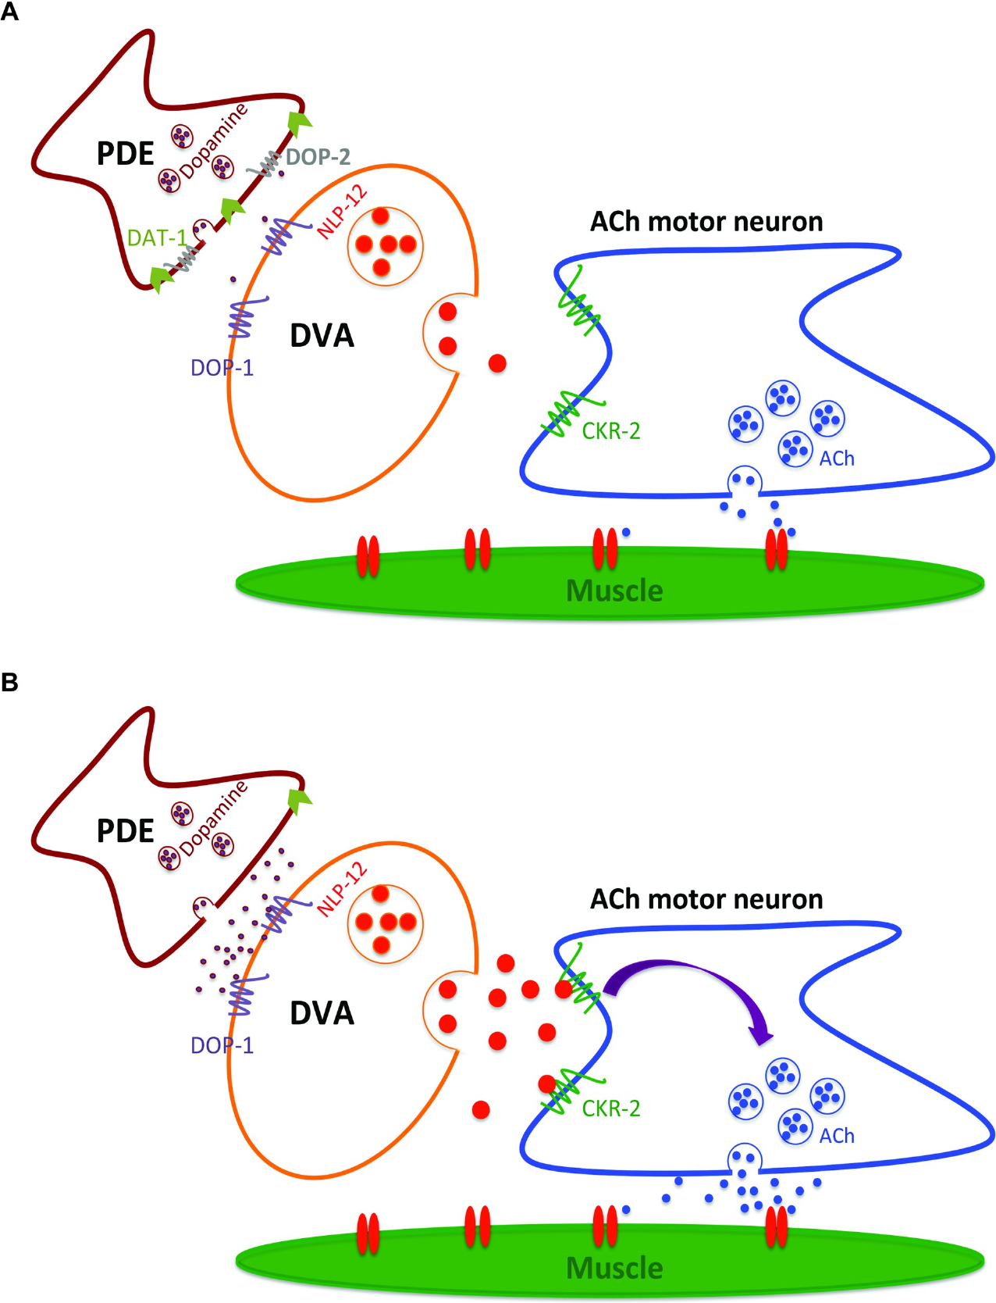
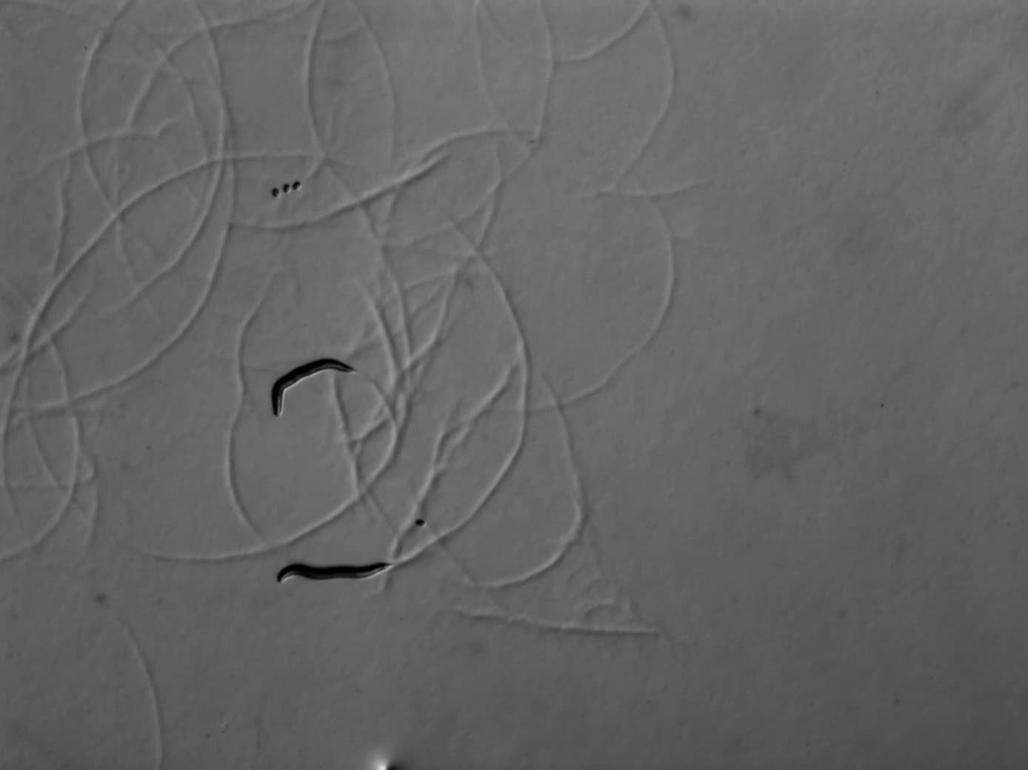
Neuropeptide signaling changes motor output
The worm pathway continued through DVA, an interneuron that links sensory information to motor regulation. An interneuron relays and transforms signals within a neural circuit. DVA releases NLP-12, a neuropeptide that modulates locomotion. A neuropeptide is a small protein signal released by neurons. Pandey and colleagues tested whether this cell and peptide carried the consequences of excess dopamine.
Removing DVA function or reducing NLP-12 suppressed the abnormal ethanol response. Conversely, increased NLP-12 expression promoted the sedative movement phenotype. D1-like dopamine signaling contributed to the downstream effect. The pathway therefore included dopamine reception by a different cell from the one releasing dopamine. Transmitter feedback in PDE and downstream excitation were distinct steps in the circuit.
NLP-12 acted through signaling that altered cholinergic motor output. Cholinergic neurons release acetylcholine, the transmitter used to activate worm body-wall muscle. Excess modulation disrupted the coordinated bending that normally advances the animal. The source recording contains an NLP-12-overexpressing worm under ethanol exposure. Its motor pattern connects peptide signaling to the movement outcome measured across the genetic interventions.
Pandey et al. (2021), Fig. 5(C–F). DVA and neuropeptide signaling interventions.
Pandey et al. (2021), Fig. 7. Source-proposed circuit locating PDE, DVA and motor output.
Pandey et al. (2021), S9 Movie. NLP-12 overexpression under ethanol.
Pandey et al. (2021)
25
Notes:
• The worm pathway continued through **DVA**, an interneuron that links sensory information to motor regulation. An interneuron relays and transforms signals within a neural circuit. DVA releases **NLP-12**, a neuropeptide that modulates locomotion. A neuropeptide is a small protein signal released by neurons. Pandey and colleagues tested whether this cell and peptide carried the consequences of excess dopamine.
• Removing DVA function or reducing NLP-12 suppressed the abnormal ethanol response. Conversely, increased NLP-12 expression promoted the sedative movement phenotype. D1-like dopamine signaling contributed to the downstream effect. The pathway therefore included dopamine reception by a different cell from the one releasing dopamine. Transmitter feedback in PDE and downstream excitation were distinct steps in the circuit.
• NLP-12 acted through signaling that altered cholinergic motor output. **Cholinergic** neurons release acetylcholine, the transmitter used to activate worm body-wall muscle. Excess modulation disrupted the coordinated bending that normally advances the animal. The source recording contains an NLP-12-overexpressing worm under ethanol exposure. Its motor pattern connects peptide signaling to the movement outcome measured across the genetic interventions.
References:
Pandey P, Singh A, Kaur H, Ghosh-Roy A, Babu K. (2021). Increased dopaminergic neurotransmission results in ethanol dependent sedative behaviors in Caenorhabditis elegans. PLoS genetics 17:e1009346. https://doi.org/10.1371/journal.pgen.1009346
Figure: Pandey et al. (2021), Fig. 5(C–F). DVA and neuropeptide signaling interventions.
Figure source: https://doi.org/10.1371/journal.pgen.1009346
Figure: Pandey et al. (2021), Fig. 7. Source-proposed circuit locating PDE, DVA and motor output.
Figure source: https://doi.org/10.1371/journal.pgen.1009346
Embedded video: Pandey et al. (2021), S9 Movie. NLP-12 overexpression under ethanol.
Exact identifier: S9 Movie
Article DOI: https://doi.org/10.1371/journal.pgen.1009346
Original URL: https://journals.plos.org/plosgenetics/article/file?id=10.1371/journal.pgen.1009346.s016&type=supplementary
Credit: Pandey P, Singh A, Kaur H, Ghosh-Roy A, Babu K.
License: CC BY
Conversion: Original scene order, speed, dimensions and available audio preserved; H.264/AAC playback conversion only.
Playback: native embedded MP4, fullscreen flag enabled. Desktop PowerPoint GUI playback and Google Slides import have not been tested. Google Slides may require separate insertion of the video from Drive.

Slide 26
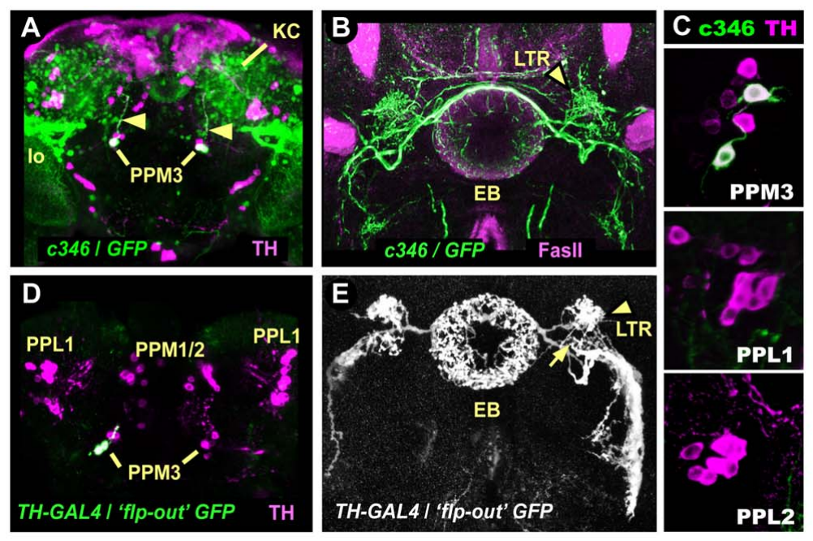
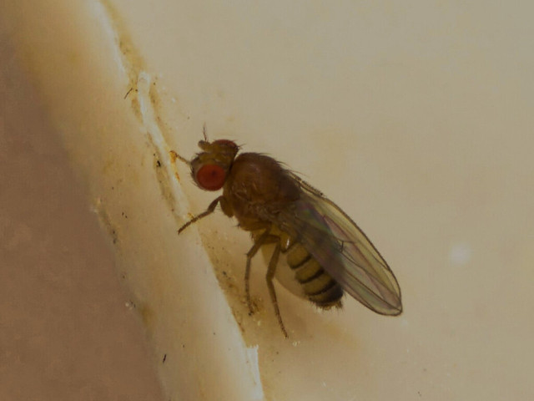
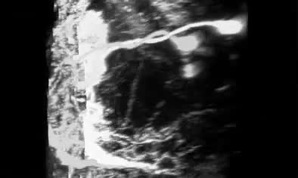
Dopamine neurons recruit ethanol-stimulated walking
Fruit flies respond to ethanol vapor with a sequence of different motor states. Kong and colleagues first observed a brief odor-triggered startle response. A quieter interval preceded a more sustained period of increased walking. Peak hyperactivity occurred approximately 10–12 min after exposure began. Continued ethanol accumulation eventually produced incoordination and sedation.
The investigators blocked transmitter release from dopamine neurons using a genetically targeted toxin. The sustained hyperactive phase was reduced. The initial odor-startle response remained comparatively intact. These outcomes separated the sensory detection of ethanol vapor from its later locomotor effect. Hyperactivity here denotes elevated walking speed during the defined intoxication phase.
A small group of dopamine neurons in the PPM3 cluster projected toward the central complex. The central complex is a set of insect brain structures involved in organizing movement. Genetic activation and inactivation implicated this restricted pathway in ethanol-stimulated walking. The source confocal recording preserves the labeled neuronal projections in three dimensions. Anatomical targeting and behavioral intervention connected dopamine release to a specific motor-control pathway.
Kong et al. (2010), Fig. 2(A–E). PPM3 projections and locomotor circuit interventions.
Photo: Drosophila melanogaster. lvicatko. CC BY 4.0.
Kong et al. (2010), Movie S1. Confocal reconstruction of labeled PPM3 projections.
Kong et al. (2010)
26
Notes:
• Fruit flies respond to ethanol vapor with a sequence of different motor states. Kong and colleagues first observed a brief odor-triggered startle response. A quieter interval preceded a more sustained period of increased walking. Peak hyperactivity occurred approximately 10–12 min after exposure began. Continued ethanol accumulation eventually produced incoordination and sedation.
• The investigators blocked transmitter release from dopamine neurons using a genetically targeted toxin. The sustained hyperactive phase was reduced. The initial odor-startle response remained comparatively intact. These outcomes separated the sensory detection of ethanol vapor from its later locomotor effect. **Hyperactivity** here denotes elevated walking speed during the defined intoxication phase.
• A small group of dopamine neurons in the **PPM3** cluster projected toward the central complex. The central complex is a set of insect brain structures involved in organizing movement. Genetic activation and inactivation implicated this restricted pathway in ethanol-stimulated walking. The source confocal recording preserves the labeled neuronal projections in three dimensions. Anatomical targeting and behavioral intervention connected dopamine release to a specific motor-control pathway.
References:
Kong EC, Woo K, Li H, Lebestky T, Mayer N, Sniffen MR, Heberlein U, Bainton RJ, Hirsh J, Wolf FW. (2010). A pair of dopamine neurons target the D1-like dopamine receptor DopR in the central complex to promote ethanol-stimulated locomotion in Drosophila. PloS one 5:e9954. https://doi.org/10.1371/journal.pone.0009954
Figure: Kong et al. (2010), Fig. 2(A–E). PPM3 projections and locomotor circuit interventions.
Figure source: https://doi.org/10.1371/journal.pone.0009954
Image: Photo: Drosophila melanogaster. Credit: (c) lvicatko, some rights reserved (CC BY). License: CC BY 4.0. Source: https://www.inaturalist.org/observations/400942185
Embedded video: Kong et al. (2010), Movie S1. Confocal reconstruction of labeled PPM3 projections.
Exact identifier: Movie S1
Article DOI: https://doi.org/10.1371/journal.pone.0009954
Original URL: https://journals.plos.org/plosone/article/file?id=10.1371/journal.pone.0009954.s009&type=supplementary
Credit: Kong EC, Woo K, Li H, Lebestky T, Mayer N, Sniffen MR, Heberlein U, Bainton RJ, Hirsh J, Wolf FW.
License: CC BY
Conversion: Original scene order, speed, dimensions and available audio preserved; H.264/AAC playback conversion only.
Playback: native embedded MP4, fullscreen flag enabled. Desktop PowerPoint GUI playback and Google Slides import have not been tested. Google Slides may require separate insertion of the video from Drive.

Slide 27
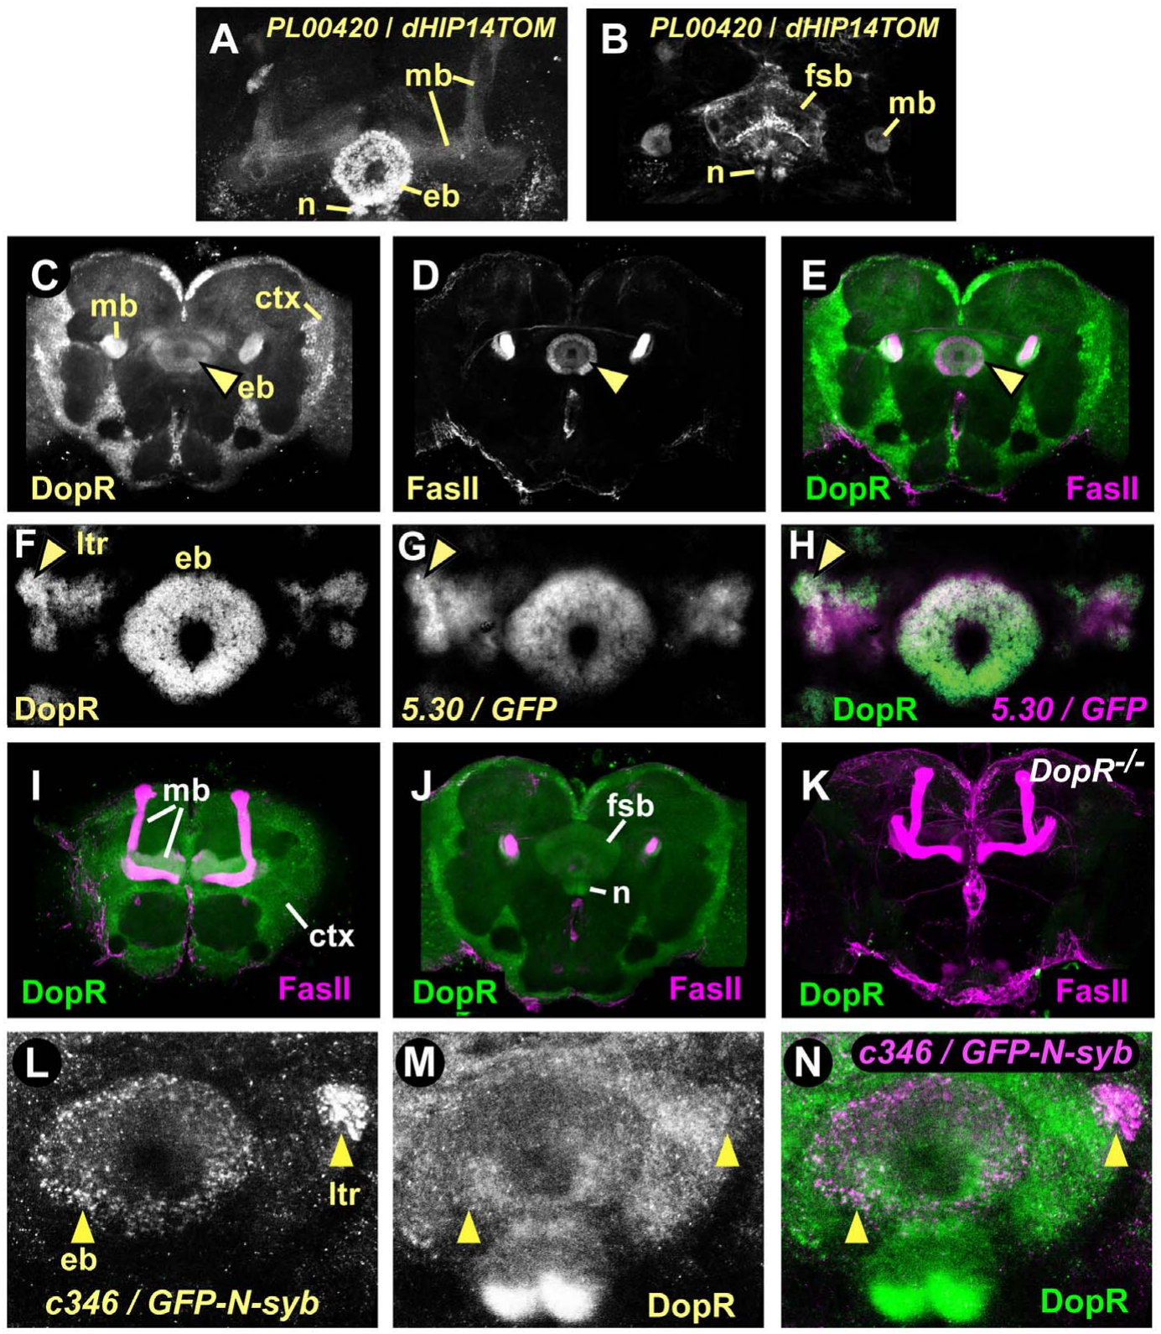
DopR function links a brain target to intoxication
The ellipsoid body is a ring-shaped component of the fly central complex. It receives projections from the dopamine neurons implicated in ethanol hyperactivity. Kong and colleagues examined DopR, a D1-like dopamine receptor, in this target region. A D1-like receptor activates intracellular signaling after dopamine binds. Receptor location consequently determines which target cells respond to the released transmitter.
DopR mutant flies exhibited reduced ethanol-stimulated hyperactivity. Reintroducing receptor function in the appropriate ellipsoid-body neurons improved the response. Rescue in selected cells tested where receptor activity could restore the behavior. The investigators distinguished these effects from baseline movement and the initial odor startle. The receptor contribution concerned a specific component of the intoxication sequence.
The study’s labeled brain preparations identified receptor expression and the associated neuronal populations. Dopamine release and DopR reception occupied successive positions in the proposed functional pathway. Manipulating either position altered the walking response. The experiment connected a molecular receptor with anatomically restricted target cells. Ethanol-dependent behavior therefore depended on which cells received dopamine, as well as on the presence of the transmitter.
Kong et al. (2010), Fig. 4. DopR localization in the ellipsoid-body pathway.
Kong et al. (2010)
27
Notes:
• The **ellipsoid body** is a ring-shaped component of the fly central complex. It receives projections from the dopamine neurons implicated in ethanol hyperactivity. Kong and colleagues examined **DopR**, a D1-like dopamine receptor, in this target region. A D1-like receptor activates intracellular signaling after dopamine binds. Receptor location consequently determines which target cells respond to the released transmitter.
• DopR mutant flies exhibited reduced ethanol-stimulated hyperactivity. Reintroducing receptor function in the appropriate ellipsoid-body neurons improved the response. Rescue in selected cells tested where receptor activity could restore the behavior. The investigators distinguished these effects from baseline movement and the initial odor startle. The receptor contribution concerned a specific component of the intoxication sequence.
• The study’s labeled brain preparations identified receptor expression and the associated neuronal populations. Dopamine release and DopR reception occupied successive positions in the proposed functional pathway. Manipulating either position altered the walking response. The experiment connected a molecular receptor with anatomically restricted target cells. Ethanol-dependent behavior therefore depended on which cells received dopamine, as well as on the presence of the transmitter.
References:
Kong EC, Woo K, Li H, Lebestky T, Mayer N, Sniffen MR, Heberlein U, Bainton RJ, Hirsh J, Wolf FW. (2010). A pair of dopamine neurons target the D1-like dopamine receptor DopR in the central complex to promote ethanol-stimulated locomotion in Drosophila. PloS one 5:e9954. https://doi.org/10.1371/journal.pone.0009954
Figure: Kong et al. (2010), Fig. 4. DopR localization in the ellipsoid-body pathway.
Figure source: https://doi.org/10.1371/journal.pone.0009954

Slide 28
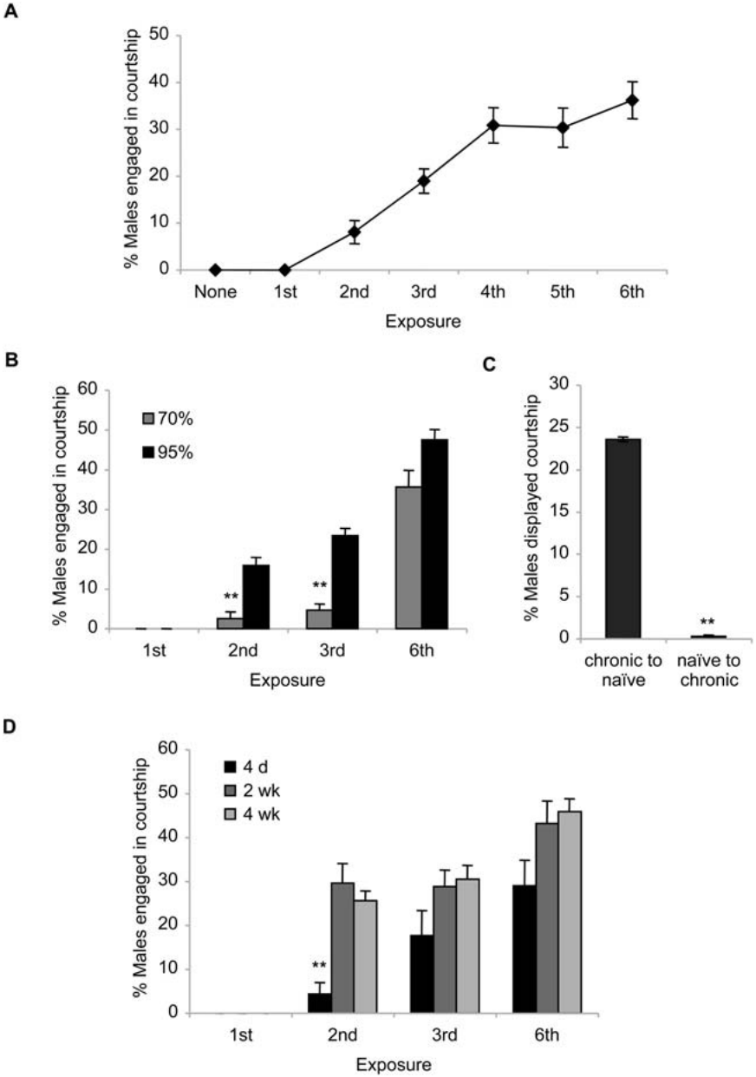
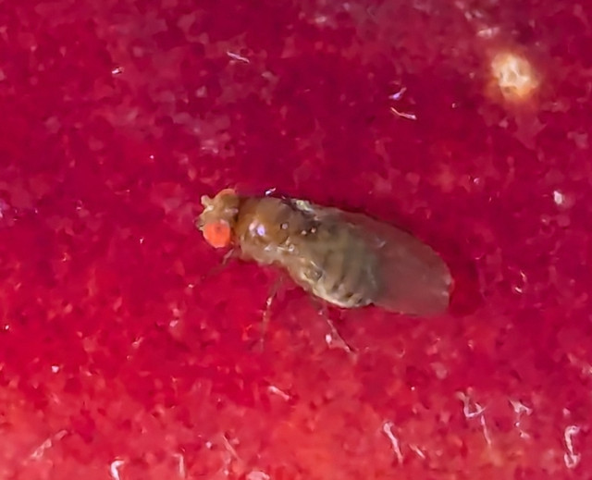

Repeated ethanol exposure changes fly courtship
Repeated ethanol exposure changed male fruit-fly courtship in Lee and colleagues’ experiments. Untreated males ordinarily direct most courtship toward females. Following repeated daily exposure, males increasingly courted other males during intoxication. The researchers recorded orientation, following and other components of the courtship sequence. These actions supplied a defined behavioral measure of disinhibition.
The response strengthened across repeated exposures, a pattern called behavioral sensitization. Sensitization is an increased response after earlier experience with a substance. The same flies also developed tolerance to ethanol’s sedating effects. Stronger courtship and reduced sedation therefore emerged together under recurring exposure. Different components of intoxication changed in different directions.
The original recording compares behavior before exposure and during early and later ethanol sessions. Courtship after repeated treatment differed from the initial drug response. Manipulations of dopamine signaling reduced the ethanol-induced intermale courtship. The circuit controlling courtship remained necessary for the disinhibited action sequence. Repeated drug experience recruited an existing social behavior under conditions that ordinarily elicited little of it.
Lee et al. (2008), Fig. 2. Intermale courtship across ethanol exposures.
Photo: Drosophila melanogaster. David Anderson. CC BY 4.0.
Lee et al. (2008), Movie S1. Wild-type courtship before and across ethanol exposures.
Lee et al. (2008)
28
Notes:
• Repeated ethanol exposure changed male fruit-fly courtship in Lee and colleagues’ experiments. Untreated males ordinarily direct most courtship toward females. Following repeated daily exposure, males increasingly courted other males during intoxication. The researchers recorded orientation, following and other components of the courtship sequence. These actions supplied a defined behavioral measure of disinhibition.
• The response strengthened across repeated exposures, a pattern called **behavioral sensitization**. Sensitization is an increased response after earlier experience with a substance. The same flies also developed tolerance to ethanol’s sedating effects. Stronger courtship and reduced sedation therefore emerged together under recurring exposure. Different components of intoxication changed in different directions.
• The original recording compares behavior before exposure and during early and later ethanol sessions. Courtship after repeated treatment differed from the initial drug response. Manipulations of dopamine signaling reduced the ethanol-induced intermale courtship. The circuit controlling courtship remained necessary for the disinhibited action sequence. Repeated drug experience recruited an existing social behavior under conditions that ordinarily elicited little of it.
References:
Lee HG, Kim YC, Dunning JS, Han KA. (2008). Recurring ethanol exposure induces disinhibited courtship in Drosophila. PloS one 3:e1391. https://doi.org/10.1371/journal.pone.0001391
Figure: Lee et al. (2008), Fig. 2. Intermale courtship across ethanol exposures.
Figure source: https://doi.org/10.1371/journal.pone.0001391
Image: Photo: Drosophila melanogaster. Credit: (c) David Anderson, some rights reserved (CC BY). License: CC BY 4.0. Source: https://www.inaturalist.org/observations/405056794
Embedded video: Lee et al. (2008), Movie S1. Wild-type courtship before and across ethanol exposures.
Exact identifier: Movie S1
Article DOI: https://doi.org/10.1371/journal.pone.0001391
Original URL: https://journals.plos.org/plosone/article/file?id=10.1371/journal.pone.0001391.s001&type=supplementary
Credit: Lee HG, Kim YC, Dunning JS, Han KA.
License: CC BY
Conversion: Original scene order, speed, dimensions and available audio preserved; H.264/AAC playback conversion only.
Playback: native embedded MP4, fullscreen flag enabled. Desktop PowerPoint GUI playback and Google Slides import have not been tested. Google Slides may require separate insertion of the video from Drive.

Slide 29
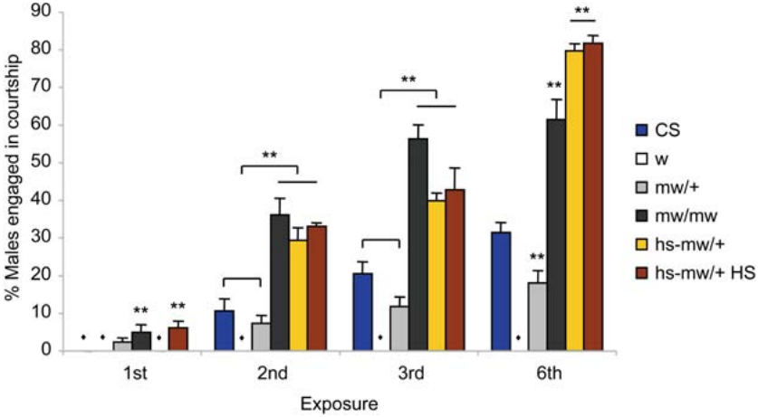
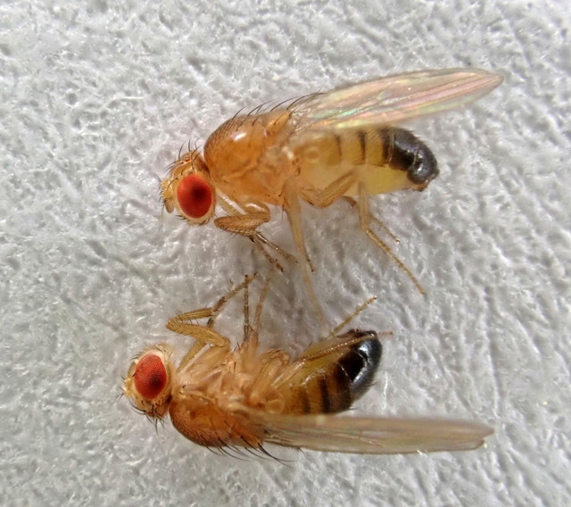
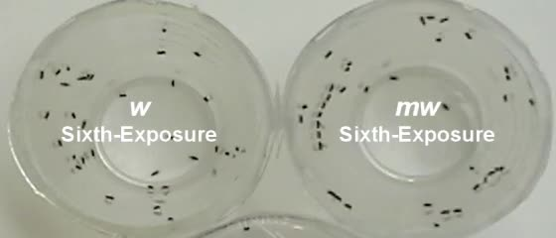
Genetic background modifies ethanol disinhibition
The fly courtship response depended on genetic background as well as ethanol history. Lee and colleagues examined the white gene, which encodes a transporter-associated protein best known for its role in eye pigmentation. Its effects extend beyond the visible eye phenotype. Males lacking normal white function exhibited a reduced disinhibited courtship response. The researchers compared mutant and genetically restored animals under repeated ethanol exposure.
Restoring white expression increased the intermale courtship response under the tested conditions. The recording preserves the behavioral contrast between the compared genotypes. Genetic rescue links the phenotype to the manipulated gene more directly than a comparison of unrelated fly strains. The measured actions were components of courtship rather than an undifferentiated increase in movement. Genotype changed which behavior emerged during intoxication.
The study also tested genes and signaling pathways involved in ordinary courtship control. Fruitless is a gene involved in organizing male courtship circuitry. Disrupting this pathway reduced the drug-associated courtship response. Ethanol therefore acted through an existing behavioral organization rather than creating an entirely new action sequence. Repeated exposure, transmitter signaling and genetic background jointly determined the social outcome.
Lee et al. (2008), Fig. 4. Genetic background and disinhibited courtship.
Photo: Drosophila melanogaster. Darren Obbard. CC BY 4.0.
Lee et al. (2008), Movie S2. Courtship under ethanol in the compared white genotypes.
Lee et al. (2008)
29
Notes:
• The fly courtship response depended on genetic background as well as ethanol history. Lee and colleagues examined the **white** gene, which encodes a transporter-associated protein best known for its role in eye pigmentation. Its effects extend beyond the visible eye phenotype. Males lacking normal white function exhibited a reduced disinhibited courtship response. The researchers compared mutant and genetically restored animals under repeated ethanol exposure.
• Restoring white expression increased the intermale courtship response under the tested conditions. The recording preserves the behavioral contrast between the compared genotypes. Genetic rescue links the phenotype to the manipulated gene more directly than a comparison of unrelated fly strains. The measured actions were components of courtship rather than an undifferentiated increase in movement. Genotype changed which behavior emerged during intoxication.
• The study also tested genes and signaling pathways involved in ordinary courtship control. **Fruitless** is a gene involved in organizing male courtship circuitry. Disrupting this pathway reduced the drug-associated courtship response. Ethanol therefore acted through an existing behavioral organization rather than creating an entirely new action sequence. Repeated exposure, transmitter signaling and genetic background jointly determined the social outcome.
References:
Lee HG, Kim YC, Dunning JS, Han KA. (2008). Recurring ethanol exposure induces disinhibited courtship in Drosophila. PloS one 3:e1391. https://doi.org/10.1371/journal.pone.0001391
Figure: Lee et al. (2008), Fig. 4. Genetic background and disinhibited courtship.
Figure source: https://doi.org/10.1371/journal.pone.0001391
Image: Photo: Drosophila melanogaster. Credit: (c) Darren Obbard, some rights reserved (CC BY). License: CC BY 4.0. Source: https://www.inaturalist.org/observations/401327932
Embedded video: Lee et al. (2008), Movie S2. Courtship under ethanol in the compared white genotypes.
Exact identifier: Movie S2
Article DOI: https://doi.org/10.1371/journal.pone.0001391
Original URL: https://journals.plos.org/plosone/article/file?id=10.1371/journal.pone.0001391.s002&type=supplementary
Credit: Lee HG, Kim YC, Dunning JS, Han KA.
License: CC BY
Conversion: Original scene order, speed, dimensions and available audio preserved; H.264/AAC playback conversion only.
Playback: native embedded MP4, fullscreen flag enabled. Desktop PowerPoint GUI playback and Google Slides import have not been tested. Google Slides may require separate insertion of the video from Drive.

Slide 30
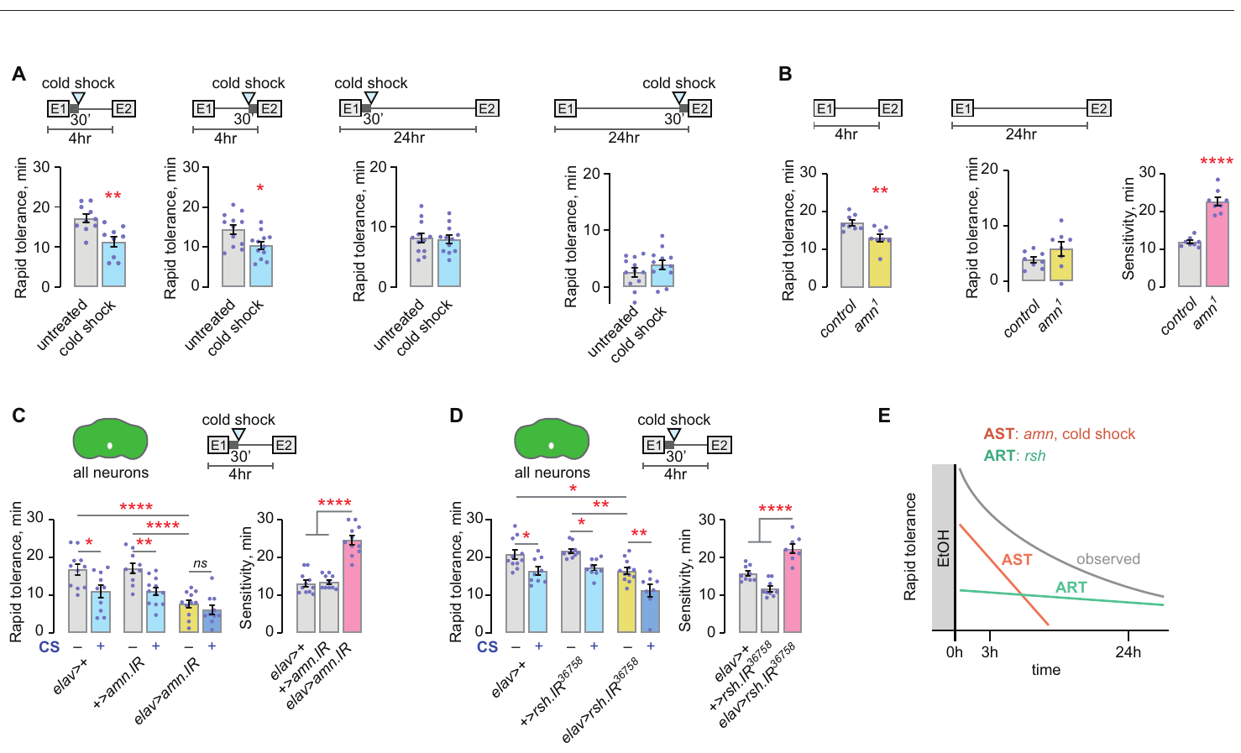
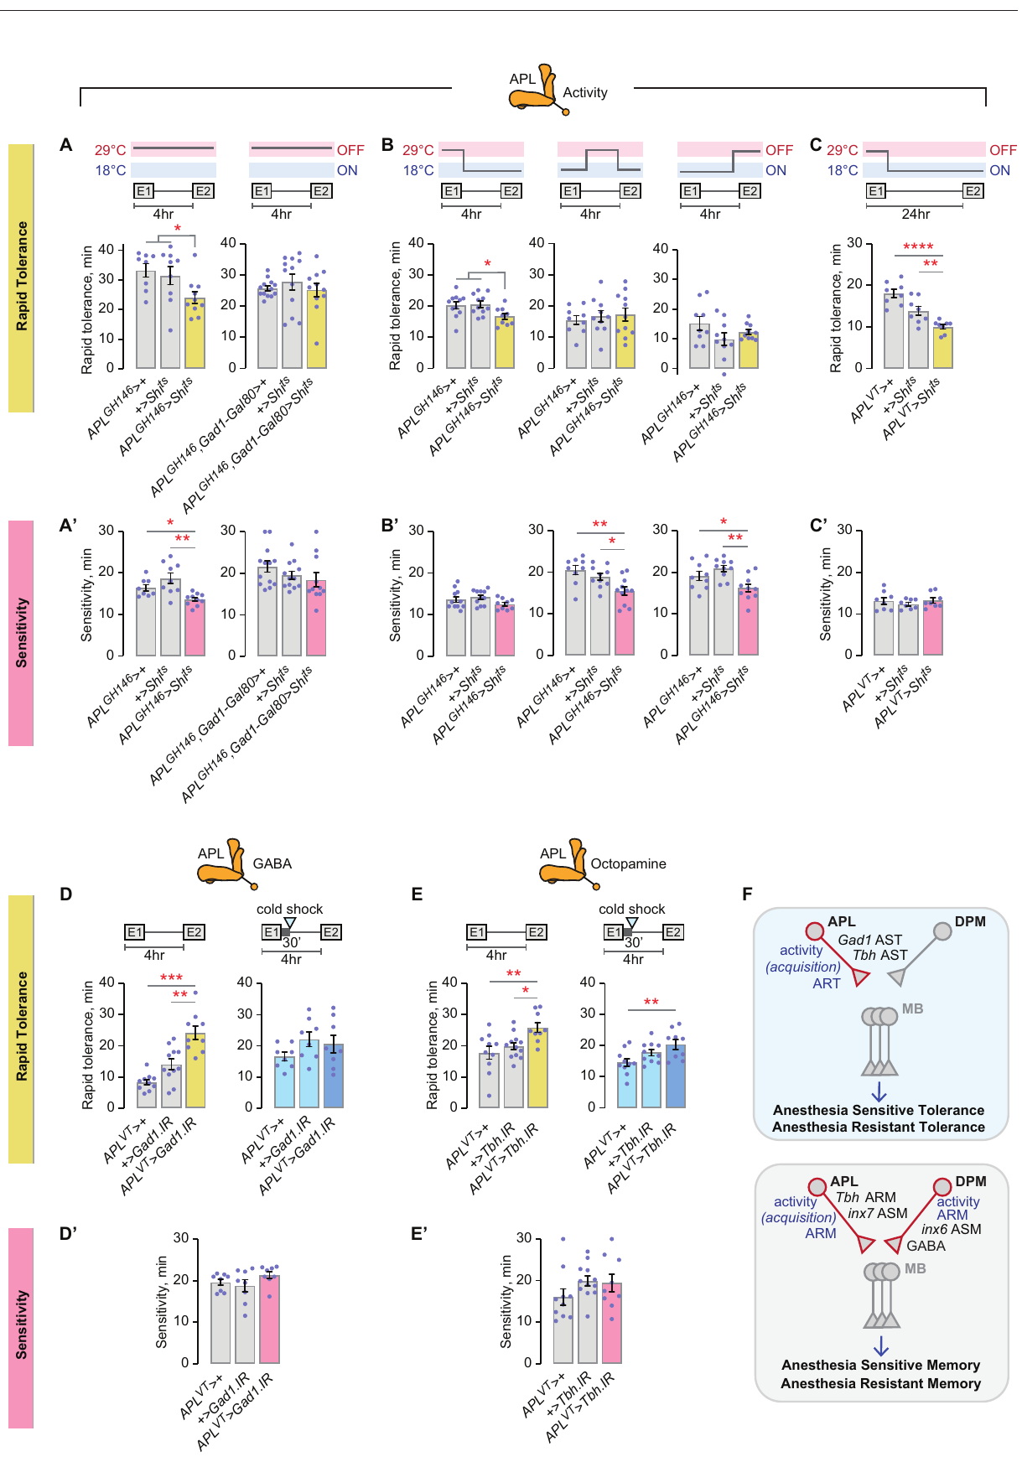
A first ethanol experience leaves a neural memory
A first sedating ethanol exposure can change the response to a later exposure in fruit flies. Larnerd and colleagues separated several forms of this tolerance. Rapid tolerance develops after an earlier drug episode and is measured during a subsequent challenge. A cold-shock intervention removed part of the early tolerance response. The remaining component persisted despite that intervention.
The researchers named these components anesthesia-sensitive tolerance and anesthesia-resistant tolerance. Their contributions differed between tests at 4 h and 24 h. The gene amnesiac, associated with memory processes, contributed to the sensitive component. The gene radish contributed to the resistant component. Distinct genetic requirements separated adaptations that would otherwise be combined in one behavioral score.
The mushroom bodies contain Kenyon cells that participate in fly learning. Manipulations of these cells affected particular tolerance components. Other required encoding steps were located outside the mushroom bodies. Tolerance was therefore distributed across more than one cell population and signaling process. An earlier ethanol episode left several experimentally separable effects on later drug responsiveness.
Larnerd et al. (2025), Fig. 1. Separable components of rapid ethanol tolerance.
Larnerd et al. (2025), Fig. 4. APL neurons and mushroom-body circuit anatomy.
Larnerd et al. (2025)
30
Notes:
• A first sedating ethanol exposure can change the response to a later exposure in fruit flies. Larnerd and colleagues separated several forms of this tolerance. **Rapid tolerance** develops after an earlier drug episode and is measured during a subsequent challenge. A cold-shock intervention removed part of the early tolerance response. The remaining component persisted despite that intervention.
• The researchers named these components **anesthesia-sensitive tolerance** and **anesthesia-resistant tolerance**. Their contributions differed between tests at 4 h and 24 h. The gene **amnesiac**, associated with memory processes, contributed to the sensitive component. The gene **radish** contributed to the resistant component. Distinct genetic requirements separated adaptations that would otherwise be combined in one behavioral score.
• The **mushroom bodies** contain Kenyon cells that participate in fly learning. Manipulations of these cells affected particular tolerance components. Other required encoding steps were located outside the mushroom bodies. Tolerance was therefore distributed across more than one cell population and signaling process. An earlier ethanol episode left several experimentally separable effects on later drug responsiveness.
References:
Larnerd C, Nolazco M, Valdez A, Sanchez V, Wolf FW. (2025). Memory-like states created by the first ethanol experience are encoded into the Drosophila mushroom body learning and memory circuitry in an ethanol-specific manner. PLoS genetics 21:e1011582. https://doi.org/10.1371/journal.pgen.1011582
Figure: Larnerd et al. (2025), Fig. 1. Separable components of rapid ethanol tolerance.
Figure source: https://doi.org/10.1371/journal.pgen.1011582
Figure: Larnerd et al. (2025), Fig. 4. APL neurons and mushroom-body circuit anatomy.
Figure source: https://doi.org/10.1371/journal.pgen.1011582

Slide 31
GABA circuits distinguish forms of ethanol tolerance
GABA, gamma-aminobutyric acid, is an inhibitory transmitter in the fly brain. The anterior paired lateral neurons, abbreviated APL, provide GABAergic regulation within the mushroom-body system. Larnerd and colleagues manipulated their activity during different phases of ethanol exposure. The timing of the manipulation separated acquisition of tolerance from later expression. A neuron could contribute while the adaptation formed without serving the same role during its measurement.
Reducing APL activity during acquisition decreased rapid tolerance. The investigators also altered GABA-related signaling in Kenyon cells. These interventions distinguished the early tolerance components from adaptations produced by a longer low-concentration exposure. Chronic tolerance here refers to that prolonged-exposure condition. Its dependence on protein synthesis and circuit activity differed from the short-exposure forms.
Inhibitory signaling can regulate whether experience produces a lasting change in responsiveness. The relevant cells were components of the same broad learning system but participated differently across conditions. Exposure duration and the time of intervention consequently mattered alongside cell identity. The original anatomical labels locate the manipulated neurons relative to the mushroom bodies. Separate cellular requirements explain why a single total-tolerance score can conceal multiple adaptations.
Larnerd et al. (2025), Fig. 4. APL anatomy and intervention during tolerance acquisition.
Larnerd et al. (2025)
31
Notes:
• **GABA**, gamma-aminobutyric acid, is an inhibitory transmitter in the fly brain. The anterior paired lateral neurons, abbreviated **APL**, provide GABAergic regulation within the mushroom-body system. Larnerd and colleagues manipulated their activity during different phases of ethanol exposure. The timing of the manipulation separated acquisition of tolerance from later expression. A neuron could contribute while the adaptation formed without serving the same role during its measurement.
• Reducing APL activity during acquisition decreased rapid tolerance. The investigators also altered GABA-related signaling in Kenyon cells. These interventions distinguished the early tolerance components from adaptations produced by a longer low-concentration exposure. **Chronic tolerance** here refers to that prolonged-exposure condition. Its dependence on protein synthesis and circuit activity differed from the short-exposure forms.
• Inhibitory signaling can regulate whether experience produces a lasting change in responsiveness. The relevant cells were components of the same broad learning system but participated differently across conditions. Exposure duration and the time of intervention consequently mattered alongside cell identity. The original anatomical labels locate the manipulated neurons relative to the mushroom bodies. Separate cellular requirements explain why a single total-tolerance score can conceal multiple adaptations.
References:
Larnerd C, Nolazco M, Valdez A, Sanchez V, Wolf FW. (2025). Memory-like states created by the first ethanol experience are encoded into the Drosophila mushroom body learning and memory circuitry in an ethanol-specific manner. PLoS genetics 21:e1011582. https://doi.org/10.1371/journal.pgen.1011582
Figure: Larnerd et al. (2025), Fig. 4. APL anatomy and intervention during tolerance acquisition.
Figure source: https://doi.org/10.1371/journal.pgen.1011582

Slide 32
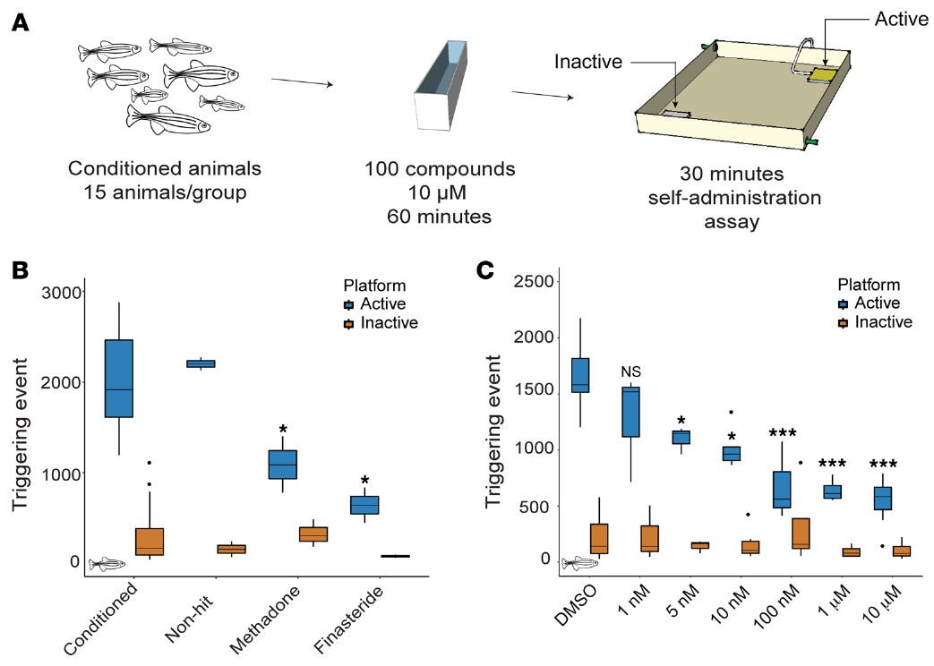

Zebrafish can obtain an opioid through their actions
Adult zebrafish learned to obtain hydrocodone by swimming across an active platform. Hydrocodone is an opioid, a substance acting at opioid receptors. Bosse and colleagues used a group self-administration assay in which crossing the platform delivered drug locally. An inactive platform provided a comparison without the same delivery consequence. The animal’s action therefore controlled exposure through a defined contingency.
Self-administration means that the subject performs an action that produces delivery of the substance. This differs from an injection scheduled by the experimenter. Fish were conditioned over 4 d before candidate treatments were tested. The later session measured platform activations over 30 min. Comparing active and inactive responses retained information about the learned drug-associated action.
The researchers screened compounds for their ability to reduce the active-platform response. Methadone, a clinically used opioid treatment, reduced hydrocodone self-administration in this assay. Finasteride also reduced responding after pretreatment. Finasteride inhibits an enzyme involved in steroid metabolism. The screen connected an action-based drug-taking measure with a molecular pathway outside the opioid receptor itself.
Bosse et al. (2021), Fig. 1. Opioid self-administration screen and treatment response.
Photo: Danio rerio. Vikas D Prasad. CC BY-SA 4.0.
Bosse et al. (2021)
32
Notes:
• Adult zebrafish learned to obtain hydrocodone by swimming across an active platform. **Hydrocodone** is an opioid, a substance acting at opioid receptors. Bosse and colleagues used a group self-administration assay in which crossing the platform delivered drug locally. An inactive platform provided a comparison without the same delivery consequence. The animal’s action therefore controlled exposure through a defined contingency.
• **Self-administration** means that the subject performs an action that produces delivery of the substance. This differs from an injection scheduled by the experimenter. Fish were conditioned over 4 d before candidate treatments were tested. The later session measured platform activations over 30 min. Comparing active and inactive responses retained information about the learned drug-associated action.
• The researchers screened compounds for their ability to reduce the active-platform response. Methadone, a clinically used opioid treatment, reduced hydrocodone self-administration in this assay. Finasteride also reduced responding after pretreatment. **Finasteride** inhibits an enzyme involved in steroid metabolism. The screen connected an action-based drug-taking measure with a molecular pathway outside the opioid receptor itself.
References:
Bosse GD, Cadeddu R, Floris G, Farero RD, Vigato E, Lee SJ, Zhang T, Gaikwad NW, Keefe KA, Phillips PE, Bortolato M, Peterson RT. (2021). The 5α-reductase inhibitor finasteride reduces opioid self-administration in animal models of opioid use disorder. The Journal of clinical investigation 131:143990. https://doi.org/10.1172/jci143990
Figure: Bosse et al. (2021), Fig. 1. Opioid self-administration screen and treatment response.
Figure source: https://doi.org/10.1172/jci143990
Image: Photo: Danio rerio. Credit: (c) Vikas D Prasad, some rights reserved (CC BY-SA). License: CC BY-SA 4.0. Source: https://www.inaturalist.org/observations/376149715

Slide 33


Drug seeking can change without suppressing all behavior
Finasteride reduced zebrafish self-administration of several opioids. The researchers tested hydrocodone, morphine and fentanyl after conditioning. The reduction was concentrated in responses at the active platform. Responses at the inactive platform supplied a separate movement-related comparison. A lower drug-associated response was therefore examined alongside behavior that did not deliver opioid.
Researchers also measured general locomotion and feeding after finasteride treatment. Those behaviors remained available under conditions that reduced opioid self-administration. This control changes the interpretation of the reduced active-platform response. A treatment that simply immobilized the fish would suppress several behaviors at once. Finasteride’s profile instead separated the drug-related response from broad motor or feeding suppression.
The targeted enzyme, 5α-reductase, participates in producing neuroactive steroids. Neuroactive steroids are steroid molecules that influence nervous-system signaling. Fish brain measurements detected increased dehydroepiandrosterone sulfate after finasteride treatment. Related precursor treatments also reduced opioid self-administration. The authors propose that altered steroid metabolism contributes to the behavioral effect, and tested corresponding drug-taking outcomes in rats.
Bosse et al. (2021), Fig. 2. Opioid responses with locomotion and feeding controls.
Photo: Danio rerio. Aadi Kulkarni. CC BY 4.0.
Bosse et al. (2021)
33
Notes:
• Finasteride reduced zebrafish self-administration of several opioids. The researchers tested hydrocodone, morphine and fentanyl after conditioning. The reduction was concentrated in responses at the active platform. Responses at the inactive platform supplied a separate movement-related comparison. A lower drug-associated response was therefore examined alongside behavior that did not deliver opioid.
• Researchers also measured general locomotion and feeding after finasteride treatment. Those behaviors remained available under conditions that reduced opioid self-administration. This control changes the interpretation of the reduced active-platform response. A treatment that simply immobilized the fish would suppress several behaviors at once. Finasteride’s profile instead separated the drug-related response from broad motor or feeding suppression.
• The targeted enzyme, **5α-reductase**, participates in producing neuroactive steroids. **Neuroactive steroids** are steroid molecules that influence nervous-system signaling. Fish brain measurements detected increased dehydroepiandrosterone sulfate after finasteride treatment. Related precursor treatments also reduced opioid self-administration. The authors propose that altered steroid metabolism contributes to the behavioral effect, and tested corresponding drug-taking outcomes in rats.
References:
Bosse GD, Cadeddu R, Floris G, Farero RD, Vigato E, Lee SJ, Zhang T, Gaikwad NW, Keefe KA, Phillips PE, Bortolato M, Peterson RT. (2021). The 5α-reductase inhibitor finasteride reduces opioid self-administration in animal models of opioid use disorder. The Journal of clinical investigation 131:143990. https://doi.org/10.1172/jci143990
Figure: Bosse et al. (2021), Fig. 2. Opioid responses with locomotion and feeding controls.
Figure source: https://doi.org/10.1172/jci143990
Image: Photo: Danio rerio. Credit: (c) Aadi Kulkarni, some rights reserved (CC BY). License: CC BY 4.0. Source: https://www.inaturalist.org/observations/370868820

Slide 34



Nicotine produces a concentration-dependent response
Larval zebrafish respond to nicotine with concentration-dependent changes in swimming. Petzold and colleagues measured movement using digital imaging. A water stimulus supplied the baseline comparison. Low and intermediate nicotine concentrations increased the locomotor response. Higher concentrations reduced activity relative to the peak response, producing an inverted-U concentration profile.
The researchers selected 10 μM nicotine for much of the subsequent assay. A functional acute response was present at 4 d after fertilization but not at 3 d. Developmental competence means that the relevant behavioral response has become available at that age. The emergence of nicotine responsiveness therefore depended on maturation. Concentration alone did not predict the outcome without information about developmental stage.
Nicotine activates nicotinic acetylcholine receptors, ion channels opened by binding of an appropriate chemical signal. Opening these channels changes the electrical activity of responsive cells. The antagonist mecamylamine blocked nicotine-induced locomotor activation. It did not produce the same reduction in baseline movement. The pharmacological comparison linked the measured swimming response to nicotinic receptor signaling.
Petzold et al. (2009), Fig. 1(B–C). Nicotine concentration, age and exposure-history responses.
Photo: Danio rerio. Rainer Breitling. CC BY 4.0.
Petzold et al. (2009), Movie S1. Larval locomotion in the nicotine-response assay.
Petzold et al. (2009)
34
Notes:
• Larval zebrafish respond to nicotine with concentration-dependent changes in swimming. Petzold and colleagues measured movement using digital imaging. A water stimulus supplied the baseline comparison. Low and intermediate nicotine concentrations increased the locomotor response. Higher concentrations reduced activity relative to the peak response, producing an inverted-U concentration profile.
• The researchers selected 10 μM nicotine for much of the subsequent assay. A functional acute response was present at 4 d after fertilization but not at 3 d. **Developmental competence** means that the relevant behavioral response has become available at that age. The emergence of nicotine responsiveness therefore depended on maturation. Concentration alone did not predict the outcome without information about developmental stage.
• Nicotine activates **nicotinic acetylcholine receptors**, ion channels opened by binding of an appropriate chemical signal. Opening these channels changes the electrical activity of responsive cells. The antagonist mecamylamine blocked nicotine-induced locomotor activation. It did not produce the same reduction in baseline movement. The pharmacological comparison linked the measured swimming response to nicotinic receptor signaling.
References:
Petzold AM, Balciunas D, Sivasubbu S, Clark KJ, Bedell VM, Westcot SE, Myers SR, Moulder GL, Thomas MJ, Ekker SC. (2009). Nicotine response genetics in the zebrafish. Proceedings of the National Academy of Sciences of the United States of America 106:18662-18667. https://doi.org/10.1073/pnas.0908247106
Figure: Petzold et al. (2009), Fig. 1(B–C). Nicotine concentration, age and exposure-history responses.
Figure source: https://doi.org/10.1073/pnas.0908247106
Image: Photo: Danio rerio. Credit: (c) Rainer Breitling, some rights reserved (CC BY). License: CC BY 4.0. Source: https://www.inaturalist.org/observations/385193921
Embedded video: Petzold et al. (2009), Movie S1. Larval locomotion in the nicotine-response assay.
Exact identifier: Movie S1
Article DOI: https://doi.org/10.1073/pnas.0908247106
Original URL: https://www.pnas.org/doi/suppl/10.1073/pnas.0908247106
Credit: Petzold AM, Balciunas D, Sivasubbu S, Clark KJ, Bedell VM, Westcot SE, Myers SR, Moulder GL, Thomas MJ, Ekker SC.
License: Original article recording; no additional open license stated
Conversion: Full recording; compatibility conversion only, preserving the original frame content, scene order, speed and available audio; at most one border pixel added for even-sized H.264 encoding.
Playback: native embedded MP4, fullscreen flag enabled. Desktop PowerPoint GUI playback and Google Slides import have not been tested. Google Slides may require separate insertion of the video from Drive.

Slide 35


Repeated nicotine exposure changes later responsiveness
Prior nicotine exposure increased the response to a later nicotine challenge in zebrafish larvae. The investigators called this effect sensitization, an enhanced response following earlier treatment. Acute responsiveness and sensitization appeared at different developmental stages. Five- and six-day-old larvae could express the sensitized response. Four-day-old larvae responded acutely but did not yet exhibit the same sensitization.
The study tested whether glutamate receptor signaling contributed to this adaptation. Glutamate is an excitatory transmitter, and NMDA receptors are one class of its receptors. The antagonist APV interferes with NMDA-receptor activation. Coadministration during nicotine exposure prevented the development of sensitization. The intervention separated the response to nicotine from the processes that changed later responsiveness.
Repeated exposure consequently recruited more than the receptor directly activated by nicotine. Cholinergic signaling supplied the initial drug-sensitive pathway. NMDA-receptor involvement connected prior exposure with a later behavioral change. The locomotor recordings retain the assay’s swimming movements and temporal pattern. Behavioral history and developmental stage determined how strongly the same nicotine concentration altered movement.
Petzold et al. (2009), Fig. 1(A). Acute and sensitized locomotor response profiles.
Petzold et al. (2009), Movie S2. Article-provided larval locomotion recording.
Petzold et al. (2009)
35
Notes:
• Prior nicotine exposure increased the response to a later nicotine challenge in zebrafish larvae. The investigators called this effect **sensitization**, an enhanced response following earlier treatment. Acute responsiveness and sensitization appeared at different developmental stages. Five- and six-day-old larvae could express the sensitized response. Four-day-old larvae responded acutely but did not yet exhibit the same sensitization.
• The study tested whether glutamate receptor signaling contributed to this adaptation. **Glutamate** is an excitatory transmitter, and NMDA receptors are one class of its receptors. The antagonist APV interferes with NMDA-receptor activation. Coadministration during nicotine exposure prevented the development of sensitization. The intervention separated the response to nicotine from the processes that changed later responsiveness.
• Repeated exposure consequently recruited more than the receptor directly activated by nicotine. Cholinergic signaling supplied the initial drug-sensitive pathway. NMDA-receptor involvement connected prior exposure with a later behavioral change. The locomotor recordings retain the assay’s swimming movements and temporal pattern. Behavioral history and developmental stage determined how strongly the same nicotine concentration altered movement.
References:
Petzold AM, Balciunas D, Sivasubbu S, Clark KJ, Bedell VM, Westcot SE, Myers SR, Moulder GL, Thomas MJ, Ekker SC. (2009). Nicotine response genetics in the zebrafish. Proceedings of the National Academy of Sciences of the United States of America 106:18662-18667. https://doi.org/10.1073/pnas.0908247106
Figure: Petzold et al. (2009), Fig. 1(A). Acute and sensitized locomotor response profiles.
Figure source: https://doi.org/10.1073/pnas.0908247106
Embedded video: Petzold et al. (2009), Movie S2. Article-provided larval locomotion recording.
Exact identifier: Movie S2
Article DOI: https://doi.org/10.1073/pnas.0908247106
Original URL: https://www.pnas.org/doi/suppl/10.1073/pnas.0908247106
Credit: Petzold AM, Balciunas D, Sivasubbu S, Clark KJ, Bedell VM, Westcot SE, Myers SR, Moulder GL, Thomas MJ, Ekker SC.
License: Original article recording; no additional open license stated
Conversion: Full recording; compatibility conversion only, preserving the original frame content, scene order, speed and available audio; at most one border pixel added for even-sized H.264 encoding.
Playback: native embedded MP4, fullscreen flag enabled. Desktop PowerPoint GUI playback and Google Slides import have not been tested. Google Slides may require separate insertion of the video from Drive.

Slide 36


A genetic screen separates nicotine-response pathways
Petzold and colleagues used the nicotine assay to identify genes affecting drug responsiveness. A forward genetic screen begins with altered behavior and then identifies the associated genetic change. Gene-breaking transposons disrupted selected genes while supplying fluorescent tags. A transposon is a DNA element that can insert into another genomic location. The tag allowed researchers to track inherited insertions through families.
The screen excluded lines with obvious baseline swimming defects. Remaining candidates were tested for altered acute and sensitized nicotine responses. One affected gene was cct8, which encodes a component of a protein-folding complex. Its mutant line was named bette davis. These fish had reduced nicotine responses while retaining responses to several other tested stimuli.
The investigators followed the insertion through breeding and molecular analysis. They measured the reduction in intact gene transcript and examined its expression in neural tissue. These steps connected the behavioral phenotype to a defined genomic location. The source figures preserve neural expression and the resulting movement-response comparisons. A drug-responsive behavior can identify cellular machinery beyond the receptor to which the drug initially binds.
Petzold et al. (2009), Fig. 3. cct8 insertion, neural expression and behavioral phenotype.
Petzold et al. (2009), Movie S3. Article-provided larval locomotion recording.
Petzold et al. (2009)
36
Notes:
• Petzold and colleagues used the nicotine assay to identify genes affecting drug responsiveness. A **forward genetic screen** begins with altered behavior and then identifies the associated genetic change. Gene-breaking transposons disrupted selected genes while supplying fluorescent tags. A **transposon** is a DNA element that can insert into another genomic location. The tag allowed researchers to track inherited insertions through families.
• The screen excluded lines with obvious baseline swimming defects. Remaining candidates were tested for altered acute and sensitized nicotine responses. One affected gene was **cct8**, which encodes a component of a protein-folding complex. Its mutant line was named bette davis. These fish had reduced nicotine responses while retaining responses to several other tested stimuli.
• The investigators followed the insertion through breeding and molecular analysis. They measured the reduction in intact gene transcript and examined its expression in neural tissue. These steps connected the behavioral phenotype to a defined genomic location. The source figures preserve neural expression and the resulting movement-response comparisons. A drug-responsive behavior can identify cellular machinery beyond the receptor to which the drug initially binds.
References:
Petzold AM, Balciunas D, Sivasubbu S, Clark KJ, Bedell VM, Westcot SE, Myers SR, Moulder GL, Thomas MJ, Ekker SC. (2009). Nicotine response genetics in the zebrafish. Proceedings of the National Academy of Sciences of the United States of America 106:18662-18667. https://doi.org/10.1073/pnas.0908247106
Figure: Petzold et al. (2009), Fig. 3. cct8 insertion, neural expression and behavioral phenotype.
Figure source: https://doi.org/10.1073/pnas.0908247106
Embedded video: Petzold et al. (2009), Movie S3. Article-provided larval locomotion recording.
Exact identifier: Movie S3
Article DOI: https://doi.org/10.1073/pnas.0908247106
Original URL: https://www.pnas.org/doi/suppl/10.1073/pnas.0908247106
Credit: Petzold AM, Balciunas D, Sivasubbu S, Clark KJ, Bedell VM, Westcot SE, Myers SR, Moulder GL, Thomas MJ, Ekker SC.
License: Original article recording; no additional open license stated
Conversion: Full recording; compatibility conversion only, preserving the original frame content, scene order, speed and available audio; at most one border pixel added for even-sized H.264 encoding.
Playback: native embedded MP4, fullscreen flag enabled. Desktop PowerPoint GUI playback and Google Slides import have not been tested. Google Slides may require separate insertion of the video from Drive.

Slide 37


GABA-B signaling contributes to nicotine responses
A second zebrafish nicotine-response mutation affected gabbr1.2, a gene encoding a GABA-B receptor subunit. GABA-B receptors signal through G proteins rather than forming the rapidly opening channel characteristic of GABA-A receptors. A G protein relays receptor activation to intracellular signaling pathways. The mutant line was named humphrey bogart. Its nicotine response was strongly reduced despite relatively preserved baseline movement.
The gene-breaking insertion also supplied a red fluorescent reporter. Neural labeling located expression associated with the disrupted locus. Researchers then used Cre recombinase, an enzyme that cuts DNA at specified recognition sites, to remove the disruptive cassette. Reversing the insertion restored the nicotine-response phenotype toward normal. This reversal supplied a direct test linking the genomic intervention with behavior.
The original three-dimensional recording contains the red reporter-labeled neural preparation. Its fluorescence identifies the cells carrying the tagged expression pattern. The behavioral rescue and anatomical expression address complementary questions about the affected pathway. GABA-B signaling contributed to how the larva responded to a cholinergic drug. Nicotine responsiveness therefore depended on interactions among transmitter systems rather than on nicotinic receptors alone.
Petzold et al. (2009), Fig. 4. gabbr1.2 labeling, genetic disruption and rescue.
Petzold et al. (2009), Movie S4. Three-dimensional neural reporter fluorescence.
Petzold et al. (2009)
37
Notes:
• A second zebrafish nicotine-response mutation affected **gabbr1.2**, a gene encoding a GABA-B receptor subunit. GABA-B receptors signal through G proteins rather than forming the rapidly opening channel characteristic of GABA-A receptors. A **G protein** relays receptor activation to intracellular signaling pathways. The mutant line was named humphrey bogart. Its nicotine response was strongly reduced despite relatively preserved baseline movement.
• The gene-breaking insertion also supplied a red fluorescent reporter. Neural labeling located expression associated with the disrupted locus. Researchers then used **Cre recombinase**, an enzyme that cuts DNA at specified recognition sites, to remove the disruptive cassette. Reversing the insertion restored the nicotine-response phenotype toward normal. This reversal supplied a direct test linking the genomic intervention with behavior.
• The original three-dimensional recording contains the red reporter-labeled neural preparation. Its fluorescence identifies the cells carrying the tagged expression pattern. The behavioral rescue and anatomical expression address complementary questions about the affected pathway. GABA-B signaling contributed to how the larva responded to a cholinergic drug. Nicotine responsiveness therefore depended on interactions among transmitter systems rather than on nicotinic receptors alone.
References:
Petzold AM, Balciunas D, Sivasubbu S, Clark KJ, Bedell VM, Westcot SE, Myers SR, Moulder GL, Thomas MJ, Ekker SC. (2009). Nicotine response genetics in the zebrafish. Proceedings of the National Academy of Sciences of the United States of America 106:18662-18667. https://doi.org/10.1073/pnas.0908247106
Figure: Petzold et al. (2009), Fig. 4. gabbr1.2 labeling, genetic disruption and rescue.
Figure source: https://doi.org/10.1073/pnas.0908247106
Embedded video: Petzold et al. (2009), Movie S4. Three-dimensional neural reporter fluorescence.
Exact identifier: Movie S4
Article DOI: https://doi.org/10.1073/pnas.0908247106
Original URL: https://www.pnas.org/doi/suppl/10.1073/pnas.0908247106
Credit: Petzold AM, Balciunas D, Sivasubbu S, Clark KJ, Bedell VM, Westcot SE, Myers SR, Moulder GL, Thomas MJ, Ekker SC.
License: Original article recording; no additional open license stated
Conversion: Full recording; compatibility conversion only, preserving the original frame content, scene order, speed and available audio; at most one border pixel added for even-sized H.264 encoding.
Playback: native embedded MP4, fullscreen flag enabled. Desktop PowerPoint GUI playback and Google Slides import have not been tested. Google Slides may require separate insertion of the video from Drive.

Slide 38


A partner’s drinking changes the vole social context
Prairie voles, Microtus ochrogaster, can maintain a preference for a familiar mating partner. Walcott and Ryabinin allowed pairs to cohabit for 1 week before manipulating alcohol access. Males then received access to water and 10% ethanol. Their partners either received the same choice or water alone. A control condition supplied water to both members of the pair.
Concordant drinking means that both partners have access to alcohol in this design. Discordant drinking means that alcohol access differs between partners. The comparison changed the social context of the male’s drinking. Males whose partners also received alcohol consumed more than males whose partners received only water. Amount consumed and the later social preference were measured separately.
The partner-preference test offered a familiar partner and an unfamiliar female. Investigators measured time spent huddling with each animal. Huddling is sustained close bodily contact rather than simple occupancy of the same chamber. All treatment groups retained a measurable partner preference. The strength of that preference was lower when only the male had alcohol access.
Walcott & Ryabinin (2017), Fig. 1. Drinking and partner-preference comparisons.
Photo: Microtus ochrogaster. Ryan Donnelly. CC BY 4.0.
Walcott & Ryabinin (2017)
38
Notes:
• Prairie voles, _Microtus ochrogaster_, can maintain a preference for a familiar mating partner. Walcott and Ryabinin allowed pairs to cohabit for 1 week before manipulating alcohol access. Males then received access to water and 10% ethanol. Their partners either received the same choice or water alone. A control condition supplied water to both members of the pair.
• **Concordant drinking** means that both partners have access to alcohol in this design. **Discordant drinking** means that alcohol access differs between partners. The comparison changed the social context of the male’s drinking. Males whose partners also received alcohol consumed more than males whose partners received only water. Amount consumed and the later social preference were measured separately.
• The partner-preference test offered a familiar partner and an unfamiliar female. Investigators measured time spent huddling with each animal. Huddling is sustained close bodily contact rather than simple occupancy of the same chamber. All treatment groups retained a measurable partner preference. The strength of that preference was lower when only the male had alcohol access.
References:
Walcott AT, Ryabinin AE. (2017). Alcohol's Effects on Pair-Bond Maintenance in Male Prairie Voles. Frontiers in psychiatry 8:226. https://doi.org/10.3389/fpsyt.2017.00226
Figure: Walcott & Ryabinin (2017), Fig. 1. Drinking and partner-preference comparisons.
Figure source: https://doi.org/10.3389/fpsyt.2017.00226
Image: Photo: Microtus ochrogaster. Credit: (c) Ryan Donnelly, some rights reserved (CC BY). License: CC BY 4.0. Source: https://www.inaturalist.org/observations/112442437

Slide 39

Discordant alcohol intake alters partner preference
Discordant drinking reduced male prairie voles’ partner preference relative to the comparison conditions. The effect occurred after the relationship had already formed. The experiment therefore examined pair-bond maintenance, the persistence of an established selective attachment. It differed from testing whether a new pair bond could form during intoxication. The partner’s drinking condition altered the outcome of the male’s alcohol exposure.
Both-drinking pairs retained a stronger partner preference than pairs in which only the male drank. Alcohol consumption alone consequently did not predict the social outcome. Researchers also measured drinking outside the immediate presence of the partner. The preference difference remained associated with the treatment history. The social effect reflected more than the male merely approaching another animal during simultaneous drinking.
The study examined oxytocin, a neuropeptide involved in social regulation, in the paraventricular nucleus of the hypothalamus. Alcohol-exposed males had reduced oxytocin immunoreactivity in this region. This reduction occurred regardless of the female partner’s drinking status. Immunoreactivity measures the signal detected by an antibody directed at the target molecule. The shared oxytocin change therefore differed from the partner-dependent behavioral pattern.
Walcott & Ryabinin (2017), Fig. 1. Partner huddling across drinking conditions.
Walcott & Ryabinin (2017), Fig. 3. Paraventricular nucleus oxytocin labeling.
Walcott & Ryabinin (2017)
39
Notes:
• Discordant drinking reduced male prairie voles’ partner preference relative to the comparison conditions. The effect occurred after the relationship had already formed. The experiment therefore examined **pair-bond maintenance**, the persistence of an established selective attachment. It differed from testing whether a new pair bond could form during intoxication. The partner’s drinking condition altered the outcome of the male’s alcohol exposure.
• Both-drinking pairs retained a stronger partner preference than pairs in which only the male drank. Alcohol consumption alone consequently did not predict the social outcome. Researchers also measured drinking outside the immediate presence of the partner. The preference difference remained associated with the treatment history. The social effect reflected more than the male merely approaching another animal during simultaneous drinking.
• The study examined **oxytocin**, a neuropeptide involved in social regulation, in the paraventricular nucleus of the hypothalamus. Alcohol-exposed males had reduced oxytocin immunoreactivity in this region. This reduction occurred regardless of the female partner’s drinking status. **Immunoreactivity** measures the signal detected by an antibody directed at the target molecule. The shared oxytocin change therefore differed from the partner-dependent behavioral pattern.
References:
Walcott AT, Ryabinin AE. (2017). Alcohol's Effects on Pair-Bond Maintenance in Male Prairie Voles. Frontiers in psychiatry 8:226. https://doi.org/10.3389/fpsyt.2017.00226
Figure: Walcott & Ryabinin (2017), Fig. 1. Partner huddling across drinking conditions.
Figure source: https://doi.org/10.3389/fpsyt.2017.00226
Figure: Walcott & Ryabinin (2017), Fig. 3. Paraventricular nucleus oxytocin labeling.
Figure source: https://doi.org/10.3389/fpsyt.2017.00226

Slide 40


Alcohol affects different social behaviors differently
Aggression and partner preference were assessed with different social tests in the prairie vole study. A resident–intruder test places an unfamiliar animal into the subject’s environment. Researchers counted aggressive responses toward a stranger male. Aggression frequency did not differ clearly across the drinking conditions. The partner-preference difference therefore did not generalize to every measured social behavior.
The researchers also examined FosB-family protein signals in the periaqueductal gray, a midbrain region surrounding the cerebral aqueduct. Males in the discordant-drinking condition had increased FosB immunoreactivity there. Both-drinking males did not display the same regional increase. This molecular pattern corresponded more closely to the partner-dependent preference effect than did the shared oxytocin reduction. The measurement supplied a candidate neural association for the social difference.
An antibody signal identifies a protein-related response within sampled cells. It does not by itself establish that the region caused the change in attachment. The behavioral comparisons nevertheless separated selective contact with a partner from aggression toward a stranger. Region-specific measurements further separated common alcohol effects from partner-dependent ones. The animal’s social environment altered which behavioral and neural outcomes accompanied its drinking history.
Walcott & Ryabinin (2017), Fig. 2. Resident–intruder aggression across drinking conditions.
Walcott & Ryabinin (2017), Fig. 4. Periaqueductal-gray FosB immunoreactivity.
Walcott & Ryabinin (2017)
40
Notes:
• Aggression and partner preference were assessed with different social tests in the prairie vole study. A **resident–intruder test** places an unfamiliar animal into the subject’s environment. Researchers counted aggressive responses toward a stranger male. Aggression frequency did not differ clearly across the drinking conditions. The partner-preference difference therefore did not generalize to every measured social behavior.
• The researchers also examined FosB-family protein signals in the **periaqueductal gray**, a midbrain region surrounding the cerebral aqueduct. Males in the discordant-drinking condition had increased FosB immunoreactivity there. Both-drinking males did not display the same regional increase. This molecular pattern corresponded more closely to the partner-dependent preference effect than did the shared oxytocin reduction. The measurement supplied a candidate neural association for the social difference.
• An antibody signal identifies a protein-related response within sampled cells. It does not by itself establish that the region caused the change in attachment. The behavioral comparisons nevertheless separated selective contact with a partner from aggression toward a stranger. Region-specific measurements further separated common alcohol effects from partner-dependent ones. The animal’s social environment altered which behavioral and neural outcomes accompanied its drinking history.
References:
Walcott AT, Ryabinin AE. (2017). Alcohol's Effects on Pair-Bond Maintenance in Male Prairie Voles. Frontiers in psychiatry 8:226. https://doi.org/10.3389/fpsyt.2017.00226
Figure: Walcott & Ryabinin (2017), Fig. 2. Resident–intruder aggression across drinking conditions.
Figure source: https://doi.org/10.3389/fpsyt.2017.00226
Figure: Walcott & Ryabinin (2017), Fig. 4. Periaqueductal-gray FosB immunoreactivity.
Figure source: https://doi.org/10.3389/fpsyt.2017.00226

Slide 41


Social rank influences reinstatement in macaques
Socially housed cynomolgus macaques, Macaca fascicularis, learned to choose between drug-associated and food-associated options. Roberts and colleagues examined reinstatement, the return of a previously reduced drug-associated response. Saline replaced drug during extinction sessions. Extinction is the decline in responding when its previous consequence is removed. Later drug pretreatment tested whether the response returned.
Cocaine and cocaethylene both increased choice of the previously drug-associated option. Cocaethylene is an active metabolite formed when cocaine and ethanol are used together. Cocaine produced reinstatement at lower doses than cocaethylene in the comparison. The study examined socially dominant and subordinate animals of both sexes. Dominant animals generally displayed greater reinstatement than subordinates under these conditions.
Social rank was therefore relevant to a specific stage of drug-related behavior. The measured outcome was renewed drug-associated choice after extinction. It was not a general ranking of which social group was always most vulnerable to every drug effect. Food remained an available alternative during the choice procedure. The assay connected social position with competition between a drug-associated action and another reinforced action.
Roberts et al. (2026), Fig. 1. Drug-associated choice, social rank and relative potency.
Photo: Macaca fascicularis. no rights reserved. CC0 1.0.
Roberts et al. (2026)
41
Notes:
• Socially housed cynomolgus macaques, _Macaca fascicularis_, learned to choose between drug-associated and food-associated options. Roberts and colleagues examined **reinstatement**, the return of a previously reduced drug-associated response. Saline replaced drug during extinction sessions. **Extinction** is the decline in responding when its previous consequence is removed. Later drug pretreatment tested whether the response returned.
• Cocaine and **cocaethylene** both increased choice of the previously drug-associated option. Cocaethylene is an active metabolite formed when cocaine and ethanol are used together. Cocaine produced reinstatement at lower doses than cocaethylene in the comparison. The study examined socially dominant and subordinate animals of both sexes. Dominant animals generally displayed greater reinstatement than subordinates under these conditions.
• Social rank was therefore relevant to a specific stage of drug-related behavior. The measured outcome was renewed drug-associated choice after extinction. It was not a general ranking of which social group was always most vulnerable to every drug effect. Food remained an available alternative during the choice procedure. The assay connected social position with competition between a drug-associated action and another reinforced action.
References:
Roberts BF, Clark MA, Nader MA, Rough MI. (2026). Sex, social rank, and nicotine co-administration shape cocaine- and cocaethylene-induced reinstatement in monkeys. Frontiers in behavioral neuroscience 20:1770940. https://doi.org/10.3389/fnbeh.2026.1770940
Figure: Roberts et al. (2026), Fig. 1. Drug-associated choice, social rank and relative potency.
Figure source: https://doi.org/10.3389/fnbeh.2026.1770940
Image: Photo: Macaca fascicularis. Credit: no rights reserved. License: CC0 1.0. Source: https://www.inaturalist.org/observations/406914108

Slide 42


Nicotine changes cocaine-related responding by sex
Nicotine altered cocaine-related reinstatement differently in male and female macaques. Roberts and colleagues tested nicotine alone and together with cocaine or cocaethylene. The drug-associated choice measure was the same response used during extinction and reinstatement. Nicotine alone increased that choice primarily in females. Its effect consequently depended on the subject’s sex and the existing history of the drug-associated option.
Adding nicotine increased cocaine-induced drug-associated choice in females more consistently than in males. The tested nicotine range was 0.01–0.056 mg/kg. The corresponding interaction with cocaethylene did not produce the same clear group effect. Polysubstance exposure means exposure to more than one psychoactive substance. Interactions between substances were specific rather than interchangeable across the tested combinations.
Social rank did not account for the female-selective nicotine effect. Both dominant and subordinate females could display enhanced cocaine-related responding. Sex and rank therefore contributed differently to the experimental outcomes. The task retained food as the competing alternative rather than measuring movement alone. A social and biological context can alter which action is selected after renewed exposure to a drug combination.
Roberts et al. (2026), Fig. 2. Nicotine interactions with cocaine and cocaethylene.
Photo: Macaca fascicularis. no rights reserved. CC0 1.0.
Roberts et al. (2026)
42
Notes:
• Nicotine altered cocaine-related reinstatement differently in male and female macaques. Roberts and colleagues tested nicotine alone and together with cocaine or cocaethylene. The drug-associated choice measure was the same response used during extinction and reinstatement. Nicotine alone increased that choice primarily in females. Its effect consequently depended on the subject’s sex and the existing history of the drug-associated option.
• Adding nicotine increased cocaine-induced drug-associated choice in females more consistently than in males. The tested nicotine range was 0.01–0.056 mg/kg. The corresponding interaction with cocaethylene did not produce the same clear group effect. **Polysubstance exposure** means exposure to more than one psychoactive substance. Interactions between substances were specific rather than interchangeable across the tested combinations.
• Social rank did not account for the female-selective nicotine effect. Both dominant and subordinate females could display enhanced cocaine-related responding. Sex and rank therefore contributed differently to the experimental outcomes. The task retained food as the competing alternative rather than measuring movement alone. A social and biological context can alter which action is selected after renewed exposure to a drug combination.
References:
Roberts BF, Clark MA, Nader MA, Rough MI. (2026). Sex, social rank, and nicotine co-administration shape cocaine- and cocaethylene-induced reinstatement in monkeys. Frontiers in behavioral neuroscience 20:1770940. https://doi.org/10.3389/fnbeh.2026.1770940
Figure: Roberts et al. (2026), Fig. 2. Nicotine interactions with cocaine and cocaethylene.
Figure source: https://doi.org/10.3389/fnbeh.2026.1770940
Image: Photo: Macaca fascicularis. Credit: no rights reserved. License: CC0 1.0. Source: https://www.inaturalist.org/observations/406914109

Slide 43



A single intoxication changes neuronal organization
A single ethanol intoxication altered neuronal proteins and organization in mice. Knabbe and colleagues first measured proteins associated with hippocampal synapses. A synapse is a specialized contact through which a neuron communicates with another cell. Several proteins changed their abundance in the synaptic preparation after ethanol exposure. The affected proteins included molecules involved in neuronal structure and mitochondrial function.
The investigators then examined selected changes in living-animal preparations and stained tissue. Ankyrin-G helps organize the axon initial segment, the specialized region near the start of the axon. The axon carries signals away from the neuronal cell body. Ethanol changed synaptic ankyrin-G abundance and altered the length of the initial segment in the tested preparation. The molecular screen therefore led to measurements of a defined neuronal structure.
The study also followed organelles within cortical axons using repeated microscopy. Mitochondria support cellular energy metabolism and can move along axons. Baseline imaging established which organelles were stationary or mobile before treatment. The source recording preserves this transport before the ethanol-associated change. Measurements within the same neuronal stretches connected the acute exposure with subsequent cellular dynamics.
Knabbe et al. (2022), Fig. 3(D–E). Axon initial segments and length after ethanol; scale bar, 10 μm.
Photo: Mus musculus. Jason Alexander. CC BY 4.0.
Knabbe et al. (2022), Movie S1. Baseline mitochondrial transport in cortical axons.
Knabbe et al. (2022)
43
Notes:
• A single ethanol intoxication altered neuronal proteins and organization in mice. Knabbe and colleagues first measured proteins associated with hippocampal synapses. A **synapse** is a specialized contact through which a neuron communicates with another cell. Several proteins changed their abundance in the synaptic preparation after ethanol exposure. The affected proteins included molecules involved in neuronal structure and mitochondrial function.
• The investigators then examined selected changes in living-animal preparations and stained tissue. **Ankyrin-G** helps organize the axon initial segment, the specialized region near the start of the axon. The axon carries signals away from the neuronal cell body. Ethanol changed synaptic ankyrin-G abundance and altered the length of the initial segment in the tested preparation. The molecular screen therefore led to measurements of a defined neuronal structure.
• The study also followed organelles within cortical axons using repeated microscopy. **Mitochondria** support cellular energy metabolism and can move along axons. Baseline imaging established which organelles were stationary or mobile before treatment. The source recording preserves this transport before the ethanol-associated change. Measurements within the same neuronal stretches connected the acute exposure with subsequent cellular dynamics.
References:
Knabbe J, Protzmann J, Schneider N, Berger M, Dannehl D, Wei S, Strahle C, Tegtmeier M, Jaiswal A, Zheng H, Krüger M, Rohr K, Spanagel R, Bilbao A, Engelhardt M, Scholz H, Cambridge SB. (2022). Single-dose ethanol intoxication causes acute and lasting neuronal changes in the brain. Proceedings of the National Academy of Sciences of the United States of America 119:e2122477119. https://doi.org/10.1073/pnas.2122477119
Figure: Knabbe et al. (2022), Fig. 3(D–E). Axon initial segments and length after ethanol; scale bar, 10 μm.
Figure source: https://doi.org/10.1073/pnas.2122477119
Image: Photo: Mus musculus. Credit: (c) Jason Alexander, some rights reserved (CC BY). License: CC BY 4.0. Source: https://www.inaturalist.org/observations/408397338
Embedded video: Knabbe et al. (2022), Movie S1. Baseline mitochondrial transport in cortical axons.
Exact identifier: Movie S1
Article DOI: https://doi.org/10.1073/pnas.2122477119
Original URL: https://www.pnas.org/doi/suppl/10.1073/pnas.2122477119
Credit: Knabbe J, Protzmann J, Schneider N, Berger M, Dannehl D, Wei S, Strahle C, Tegtmeier M, Jaiswal A, Zheng H, Krüger M, Rohr K, Spanagel R, Bilbao A, Engelhardt M, Scholz H, Cambridge SB.
License: Original article recording; no additional open license stated
Conversion: Full recording; compatibility conversion only, preserving the original frame content, scene order, speed and available audio; at most one border pixel added for even-sized H.264 encoding.
Playback: native embedded MP4, fullscreen flag enabled. Desktop PowerPoint GUI playback and Google Slides import have not been tested. Google Slides may require separate insertion of the video from Drive.

Slide 44



Ethanol increases mitochondrial mobility in axons
Ethanol increased the fraction of axonal mitochondria that moved in the mouse imaging experiment. Investigators repeatedly imaged labeled axons in the motor cortex. The motor cortex is a cerebral cortical region involved in movement control. Saline and ethanol sessions provided within-animal comparisons. Images were collected repeatedly over the hours following treatment.
The increase in mitochondrial mobility became apparent after approximately 60 min. It reached roughly twice the baseline level around 180 min. The effect persisted for at least 4 h but was absent at the 24 h measurement. Mobility here refers to the proportion of mitochondria moving during observation. The velocity of moving mitochondria did not increase in parallel.
The distinction separates recruitment into movement from faster transport once movement begins. A stationary mitochondrion can become mobile without changing the speed of the moving population. The ethanol-condition recording preserves the individual transport events used to assess this process. Repeated imaging retained the location and direction of movement within the same axons. Acute intoxication consequently changed organelle dynamics on a time scale extending beyond the immediate drug administration.
Knabbe et al. (2022), Fig. 4(C–E). Imaging schedule, axonal transport and mitochondrial mobility.
Photo: Mus musculus. Kalvin Chan. CC BY 4.0.
Knabbe et al. (2022), Movie S2. Mitochondrial transport following ethanol intoxication.
Knabbe et al. (2022)
44
Notes:
• Ethanol increased the fraction of axonal mitochondria that moved in the mouse imaging experiment. Investigators repeatedly imaged labeled axons in the motor cortex. The **motor cortex** is a cerebral cortical region involved in movement control. Saline and ethanol sessions provided within-animal comparisons. Images were collected repeatedly over the hours following treatment.
• The increase in mitochondrial mobility became apparent after approximately 60 min. It reached roughly twice the baseline level around 180 min. The effect persisted for at least 4 h but was absent at the 24 h measurement. **Mobility** here refers to the proportion of mitochondria moving during observation. The velocity of moving mitochondria did not increase in parallel.
• The distinction separates recruitment into movement from faster transport once movement begins. A stationary mitochondrion can become mobile without changing the speed of the moving population. The ethanol-condition recording preserves the individual transport events used to assess this process. Repeated imaging retained the location and direction of movement within the same axons. Acute intoxication consequently changed organelle dynamics on a time scale extending beyond the immediate drug administration.
References:
Knabbe J, Protzmann J, Schneider N, Berger M, Dannehl D, Wei S, Strahle C, Tegtmeier M, Jaiswal A, Zheng H, Krüger M, Rohr K, Spanagel R, Bilbao A, Engelhardt M, Scholz H, Cambridge SB. (2022). Single-dose ethanol intoxication causes acute and lasting neuronal changes in the brain. Proceedings of the National Academy of Sciences of the United States of America 119:e2122477119. https://doi.org/10.1073/pnas.2122477119
Figure: Knabbe et al. (2022), Fig. 4(C–E). Imaging schedule, axonal transport and mitochondrial mobility.
Figure source: https://doi.org/10.1073/pnas.2122477119
Image: Photo: Mus musculus. Credit: (c) Kalvin Chan, some rights reserved (CC BY). License: CC BY 4.0. Source: https://www.inaturalist.org/observations/408206176
Embedded video: Knabbe et al. (2022), Movie S2. Mitochondrial transport following ethanol intoxication.
Exact identifier: Movie S2
Article DOI: https://doi.org/10.1073/pnas.2122477119
Original URL: https://www.pnas.org/doi/suppl/10.1073/pnas.2122477119
Credit: Knabbe J, Protzmann J, Schneider N, Berger M, Dannehl D, Wei S, Strahle C, Tegtmeier M, Jaiswal A, Zheng H, Krüger M, Rohr K, Spanagel R, Bilbao A, Engelhardt M, Scholz H, Cambridge SB.
License: Original article recording; no additional open license stated
Conversion: Full recording; compatibility conversion only, preserving the original frame content, scene order, speed and available audio; at most one border pixel added for even-sized H.264 encoding.
Playback: native embedded MP4, fullscreen flag enabled. Desktop PowerPoint GUI playback and Google Slides import have not been tested. Google Slides may require separate insertion of the video from Drive.

Slide 45

Vesicle transport provides a distinct cellular comparison
The mouse study compared mitochondrial transport with transport of dense-core vesicles. These vesicles carry secreted neuronal materials in membrane-bound packages. Both vesicles and mitochondria can travel along microtubules, structural tracks within the axon. Measuring another cargo tested whether ethanol caused a general acceleration of axonal transport. The comparison used labeled vesicles in the same broad imaging approach.
Dense-core-vesicle mobility did not increase under the ethanol condition. Their transport velocity also remained similar across the compared conditions. Mitochondrial mobility therefore changed selectively relative to this cargo. The source recording preserves the vesicle movements used for that comparison. The result narrows the cellular effect from all axonal transport to a particular organelle process.
The investigators also examined mitochondrial trafficking in a separate fruit-fly reward-learning experiment. Reducing the transport-associated proteins Miro or Milton in dopamine neurons disrupted conditioned ethanol preference. Responses to a sucrose-associated reward supplied a separate learning comparison. Mouse organelle imaging and fly genetic intervention addressed related processes in different preparations. Together they connected ethanol exposure, neuronal cargo regulation and a measured drug-associated learned behavior.
Knabbe et al. (2022), Fig. 4(C–E). Mitochondrial and dense-core-vesicle transport comparisons.
Knabbe et al. (2022), Movie S3. Dense-core-vesicle transport in cortical axons.
Knabbe et al. (2022)
45
Notes:
• The mouse study compared mitochondrial transport with transport of **dense-core vesicles**. These vesicles carry secreted neuronal materials in membrane-bound packages. Both vesicles and mitochondria can travel along **microtubules**, structural tracks within the axon. Measuring another cargo tested whether ethanol caused a general acceleration of axonal transport. The comparison used labeled vesicles in the same broad imaging approach.
• Dense-core-vesicle mobility did not increase under the ethanol condition. Their transport velocity also remained similar across the compared conditions. Mitochondrial mobility therefore changed selectively relative to this cargo. The source recording preserves the vesicle movements used for that comparison. The result narrows the cellular effect from all axonal transport to a particular organelle process.
• The investigators also examined mitochondrial trafficking in a separate fruit-fly reward-learning experiment. Reducing the transport-associated proteins Miro or Milton in dopamine neurons disrupted conditioned ethanol preference. Responses to a sucrose-associated reward supplied a separate learning comparison. Mouse organelle imaging and fly genetic intervention addressed related processes in different preparations. Together they connected ethanol exposure, neuronal cargo regulation and a measured drug-associated learned behavior.
References:
Knabbe J, Protzmann J, Schneider N, Berger M, Dannehl D, Wei S, Strahle C, Tegtmeier M, Jaiswal A, Zheng H, Krüger M, Rohr K, Spanagel R, Bilbao A, Engelhardt M, Scholz H, Cambridge SB. (2022). Single-dose ethanol intoxication causes acute and lasting neuronal changes in the brain. Proceedings of the National Academy of Sciences of the United States of America 119:e2122477119. https://doi.org/10.1073/pnas.2122477119
Figure: Knabbe et al. (2022), Fig. 4(C–E). Mitochondrial and dense-core-vesicle transport comparisons.
Figure source: https://doi.org/10.1073/pnas.2122477119
Embedded video: Knabbe et al. (2022), Movie S3. Dense-core-vesicle transport in cortical axons.
Exact identifier: Movie S3
Article DOI: https://doi.org/10.1073/pnas.2122477119
Original URL: https://www.pnas.org/doi/suppl/10.1073/pnas.2122477119
Credit: Knabbe J, Protzmann J, Schneider N, Berger M, Dannehl D, Wei S, Strahle C, Tegtmeier M, Jaiswal A, Zheng H, Krüger M, Rohr K, Spanagel R, Bilbao A, Engelhardt M, Scholz H, Cambridge SB.
License: Original article recording; no additional open license stated
Conversion: Full recording; compatibility conversion only, preserving the original frame content, scene order, speed and available audio; at most one border pixel added for even-sized H.264 encoding.
Playback: native embedded MP4, fullscreen flag enabled. Desktop PowerPoint GUI playback and Google Slides import have not been tested. Google Slides may require separate insertion of the video from Drive.

Slide 46

Repeated drug exposure recruits ΔFosB in defined neurons
ΔFosB is a shortened protein produced from an alternatively spliced transcript of the FosB gene. It acts as a transcription factor, a protein that regulates the expression of other genes. Repeated stimulation can change neuronal responses beyond an individual exposure. Lobo and colleagues measured ΔFosB in identified mouse striatal neurons after repeated drug treatment. Cell labeling distinguished populations mixed together in whole-tissue measurements.
Medium spiny neurons are inhibitory projection neurons named for the small protrusions on their dendrites. The nucleus accumbens, a ventral part of the striatum, contains core and shell subdivisions. The investigators distinguished neurons expressing D1-type dopamine receptors from those expressing D2-type receptors. Seven daily cocaine treatments increased ΔFosB predominantly in D1-type neurons in the examined striatal regions. Measurement 24 h after treatment separated persistent induction from immediate exposure.
Different substances recruited different cell populations in the same study. Voluntary cocaine self-administration also favored ΔFosB induction in D1-type neurons. Morphine treatment and heroin self-administration recruited both D1-type and D2-type populations. Sucrose exposure and environmental enrichment could also increase ΔFosB in both populations. Gene regulation depended on substance, cell population and exposure conditions.
Lobo et al. (2013), Fig. 1. Cell-type labeling and cocaine-induced ΔFosB in mouse striatum.
Lobo et al. (2013)
46
Notes:
• **ΔFosB** is a shortened protein produced from an alternatively spliced transcript of the FosB gene. It acts as a **transcription factor**, a protein that regulates the expression of other genes. Repeated stimulation can change neuronal responses beyond an individual exposure. Lobo and colleagues measured ΔFosB in identified mouse striatal neurons after repeated drug treatment. Cell labeling distinguished populations mixed together in whole-tissue measurements.
• **Medium spiny neurons** are inhibitory projection neurons named for the small protrusions on their dendrites. The **nucleus accumbens**, a ventral part of the striatum, contains core and shell subdivisions. The investigators distinguished neurons expressing D1-type dopamine receptors from those expressing D2-type receptors. Seven daily cocaine treatments increased ΔFosB predominantly in D1-type neurons in the examined striatal regions. Measurement 24 h after treatment separated persistent induction from immediate exposure.
• Different substances recruited different cell populations in the same study. Voluntary cocaine self-administration also favored ΔFosB induction in D1-type neurons. Morphine treatment and heroin self-administration recruited both D1-type and D2-type populations. Sucrose exposure and environmental enrichment could also increase ΔFosB in both populations. Gene regulation depended on substance, cell population and exposure conditions.
References:
Lobo MK, Zaman S, Damez-Werno DM, Koo JW, Bagot RC, DiNieri JA, Nugent A, Finkel E, Chaudhury D, Chandra R, Riberio E, Rabkin J, Mouzon E, Cachope R, Cheer JF, Han MH, Dietz DM, Self DW, Hurd YL, Vialou V, Nestler EJ. (2013). ΔFosB induction in striatal medium spiny neuron subtypes in response to chronic pharmacological, emotional, and optogenetic stimuli. The Journal of neuroscience : the official journal of the Society for Neuroscience 33:18381-18395. https://doi.org/10.1523/jneurosci.1875-13.2013
Figure: Lobo et al. (2013), Fig. 1. Cell-type labeling and cocaine-induced ΔFosB in mouse striatum.
Figure source: https://doi.org/10.1523/jneurosci.1875-13.2013

Slide 47


Phosphorylation helps ΔFosB resist degradation
Protein half-life is the time over which half of a labeled protein population disappears. Ulery and colleagues measured ΔFosB turnover using a pulse of labeled amino acids followed by an unlabeled chase. In PC12 cells, a rat-derived neuron-like preparation, ΔFosB had a half-life of approximately 10 h. Full-length FosB was already known to turn over much faster in cell culture. These measurements concern cellular protein persistence rather than behavioral duration.
Phosphorylation adds a phosphate group to a protein and can change its interactions or stability. The investigators identified serine at position 27, termed Ser27, as a stabilizing phosphorylation site. Replacing serine with alanine prevented phosphorylation there. In PC12 cells, this substitution shortened the measured half-life from approximately 11 h to approximately 4 h. Mimicking the phosphate’s negative charge instead increased stability.
A proteasome is a cellular complex that breaks down selected proteins. Two different proteasome inhibitors reversed the accelerated loss of the alanine-substituted ΔFosB protein. The altered amino acid affected this degradation pathway. The study also identified casein kinase 2, an enzyme that transfers phosphate groups, as a regulator of Ser27 phosphorylation. Protein stabilization supplies a molecular mechanism through which repeated activation can sustain a transcriptional response after the initiating stimulus has ended.
Ulery et al. (2006), Fig. 6. Ser27 substitutions change ΔFosB protein turnover.
Photo: Rattus norvegicus. Florin Feneru. CC BY 4.0.
Ulery et al. (2006)
47
Notes:
• **Protein half-life** is the time over which half of a labeled protein population disappears. Ulery and colleagues measured ΔFosB turnover using a pulse of labeled amino acids followed by an unlabeled chase. In PC12 cells, a rat-derived neuron-like preparation, ΔFosB had a half-life of approximately 10 h. Full-length FosB was already known to turn over much faster in cell culture. These measurements concern cellular protein persistence rather than behavioral duration.
• **Phosphorylation** adds a phosphate group to a protein and can change its interactions or stability. The investigators identified serine at position 27, termed **Ser27**, as a stabilizing phosphorylation site. Replacing serine with alanine prevented phosphorylation there. In PC12 cells, this substitution shortened the measured half-life from approximately 11 h to approximately 4 h. Mimicking the phosphate’s negative charge instead increased stability.
• A **proteasome** is a cellular complex that breaks down selected proteins. Two different proteasome inhibitors reversed the accelerated loss of the alanine-substituted ΔFosB protein. The altered amino acid affected this degradation pathway. The study also identified **casein kinase 2**, an enzyme that transfers phosphate groups, as a regulator of Ser27 phosphorylation. Protein stabilization supplies a molecular mechanism through which repeated activation can sustain a transcriptional response after the initiating stimulus has ended.
References:
Ulery PG, Rudenko G, Nestler EJ. (2006). Regulation of DeltaFosB stability by phosphorylation. The Journal of neuroscience : the official journal of the Society for Neuroscience 26:5131-5142. https://doi.org/10.1523/jneurosci.4970-05.2006
Figure: Ulery et al. (2006), Fig. 6. Ser27 substitutions change ΔFosB protein turnover.
Figure source: https://doi.org/10.1523/jneurosci.4970-05.2006
Image: Photo: Rattus norvegicus. Credit: (c) Florin Feneru, some rights reserved (CC BY). License: CC BY 4.0. Source: https://www.inaturalist.org/observations/408025942

Slide 48


ΔFosB and CaMKII couple gene regulation to plasticity
CaMKII is calcium/calmodulin-dependent protein kinase II, an enzyme whose activation links calcium signals to protein phosphorylation. Robison and colleagues examined its relationship with ΔFosB in the nucleus accumbens. Repeated cocaine exposure in rats increased CaMKII particularly in the accumbens shell under the tested conditions. ΔFosB promoted expression of the gene encoding the alpha form of CaMKII in D1-type neurons. This transcriptional relationship connects a persistent nuclear protein with a signaling enzyme that acts within neurons.
The investigators manipulated ΔFosB using viral expression in mouse accumbens neurons. Increasing ΔFosB increased the density of dendritic spines, small neuronal protrusions that receive many excitatory synaptic contacts. Coexpressing a peptide inhibitor of CaMKII prevented this structural effect. The manipulation also prevented the ΔFosB-associated enhancement of cocaine locomotion. The interventions connected this pathway to neuronal structure and drug-related behavior.
CaMKII also phosphorylated ΔFosB at Ser27, linking the kinase back to the transcription factor’s stability. The proteins formed a positive regulatory loop in this preparation. Sensitization refers here to an increased behavioral response following repeated drug exposure. Cocaine-induced locomotion supplied the behavioral measurement alongside molecular and structural changes. Cell identity and accumbens subregion determine where this particular loop is engaged.
Robison et al. (2013), Fig. 6. Mouse accumbens spine changes and cocaine responses under pathway manipulation.
Robison et al. (2013), Fig. 1. Accumbens core and shell sampling with regional protein responses.
Robison et al. (2013)
48
Notes:
• **CaMKII** is calcium/calmodulin-dependent protein kinase II, an enzyme whose activation links calcium signals to protein phosphorylation. Robison and colleagues examined its relationship with ΔFosB in the nucleus accumbens. Repeated cocaine exposure in rats increased CaMKII particularly in the accumbens shell under the tested conditions. ΔFosB promoted expression of the gene encoding the alpha form of CaMKII in D1-type neurons. This transcriptional relationship connects a persistent nuclear protein with a signaling enzyme that acts within neurons.
• The investigators manipulated ΔFosB using viral expression in mouse accumbens neurons. Increasing ΔFosB increased the density of **dendritic spines**, small neuronal protrusions that receive many excitatory synaptic contacts. Coexpressing a peptide inhibitor of CaMKII prevented this structural effect. The manipulation also prevented the ΔFosB-associated enhancement of cocaine locomotion. The interventions connected this pathway to neuronal structure and drug-related behavior.
• CaMKII also phosphorylated ΔFosB at Ser27, linking the kinase back to the transcription factor’s stability. The proteins formed a positive regulatory loop in this preparation. **Sensitization** refers here to an increased behavioral response following repeated drug exposure. Cocaine-induced locomotion supplied the behavioral measurement alongside molecular and structural changes. Cell identity and accumbens subregion determine where this particular loop is engaged.
References:
Robison AJ, Vialou V, Mazei-Robison M, Feng J, Kourrich S, Collins M, Wee S, Koob G, Turecki G, Neve R, Thomas M, Nestler EJ. (2013). Behavioral and structural responses to chronic cocaine require a feedforward loop involving ΔFosB and calcium/calmodulin-dependent protein kinase II in the nucleus accumbens shell. The Journal of neuroscience : the official journal of the Society for Neuroscience 33:4295-4307. https://doi.org/10.1523/jneurosci.5192-12.2013
Figure: Robison et al. (2013), Fig. 6. Mouse accumbens spine changes and cocaine responses under pathway manipulation.
Figure source: https://doi.org/10.1523/jneurosci.5192-12.2013
Figure: Robison et al. (2013), Fig. 1. Accumbens core and shell sampling with regional protein responses.
Figure source: https://doi.org/10.1523/jneurosci.5192-12.2013

Slide 49

Social stress recruits different ΔFosB cell populations
Lobo and colleagues exposed mice to 10 d of repeated social defeat and then measured their social interaction. Susceptible animals displayed reduced interaction under the study’s behavioral classification. Resilient animals maintained social interaction despite exposure to the same defeat procedure. Researchers measured ΔFosB in D1-type and D2-type medium spiny neurons separately. Separate measurements identified which population responded.
Susceptible mice had increased ΔFosB in D2-type neurons in accumbens core, accumbens shell and dorsal striatum. Resilient mice instead had increased ΔFosB in D1-type neurons in those regions. Measurement followed defeat and social-interaction assessment. Opposite behavioral outcomes accompanied induction in different populations. Total ΔFosB alone would omit this cell-type distinction.
The study also examined repeated treatment with fluoxetine, an antidepressant that inhibits serotonin reuptake. Fourteen days of treatment increased ΔFosB predominantly in D1-type neurons in the examined striatal regions. Cocaine, resilience and antidepressant treatment shared a cell-type pattern under different conditions. ΔFosB is part of experience-dependent gene regulation across rewarding, stressful and pharmacological contexts. The behavioral meaning of its induction depends on the cells and the experience that recruited it.
Lobo et al. (2013), Fig. 6. Susceptibility, resilience and fluoxetine recruit distinct neuron subtypes.
Lobo et al. (2013), Fig. 1. Cell-type markers and accumbens anatomy used for neuronal classification.
Lobo et al. (2013)
49
Notes:
• Lobo and colleagues exposed mice to 10 d of repeated social defeat and then measured their social interaction. **Susceptible** animals displayed reduced interaction under the study’s behavioral classification. **Resilient** animals maintained social interaction despite exposure to the same defeat procedure. Researchers measured ΔFosB in D1-type and D2-type medium spiny neurons separately. Separate measurements identified which population responded.
• Susceptible mice had increased ΔFosB in D2-type neurons in accumbens core, accumbens shell and dorsal striatum. Resilient mice instead had increased ΔFosB in D1-type neurons in those regions. Measurement followed defeat and social-interaction assessment. Opposite behavioral outcomes accompanied induction in different populations. Total ΔFosB alone would omit this cell-type distinction.
• The study also examined repeated treatment with **fluoxetine**, an antidepressant that inhibits serotonin reuptake. Fourteen days of treatment increased ΔFosB predominantly in D1-type neurons in the examined striatal regions. Cocaine, resilience and antidepressant treatment shared a cell-type pattern under different conditions. ΔFosB is part of experience-dependent gene regulation across rewarding, stressful and pharmacological contexts. The behavioral meaning of its induction depends on the cells and the experience that recruited it.
References:
Lobo MK, Zaman S, Damez-Werno DM, Koo JW, Bagot RC, DiNieri JA, Nugent A, Finkel E, Chaudhury D, Chandra R, Riberio E, Rabkin J, Mouzon E, Cachope R, Cheer JF, Han MH, Dietz DM, Self DW, Hurd YL, Vialou V, Nestler EJ. (2013). ΔFosB induction in striatal medium spiny neuron subtypes in response to chronic pharmacological, emotional, and optogenetic stimuli. The Journal of neuroscience : the official journal of the Society for Neuroscience 33:18381-18395. https://doi.org/10.1523/jneurosci.1875-13.2013
Figure: Lobo et al. (2013), Fig. 6. Susceptibility, resilience and fluoxetine recruit distinct neuron subtypes.
Figure source: https://doi.org/10.1523/jneurosci.1875-13.2013
Figure: Lobo et al. (2013), Fig. 1. Cell-type markers and accumbens anatomy used for neuronal classification.
Figure source: https://doi.org/10.1523/jneurosci.1875-13.2013

Slide 50


Human ΔFosB findings depend on the sampled brain region
Human research compared postmortem tissue from cocaine-dependent and comparison subjects. Robison and colleagues found increased ΔFosB and CaMKII in the sampled human nucleus accumbens. Rodent interventions linked these proteins to cocaine-responsive cellular and behavioral changes. Human measurements identified a corresponding regional molecular association. Postmortem comparisons leave its timing relative to drug use unresolved.
Gajewski and colleagues examined two additional regions: the hippocampus, involved in memory processing, and the prefrontal cortex, involved in the regulation of behavior. A Western blot, an antibody-based assay, separated FosB-family proteins by molecular mass. Cocaine-dependent subjects had lower hippocampal ΔFosB and other FosB-family signals. The sampled prefrontal cortex did not exhibit the same group differences. The direction of the finding depended on the sampled region.
The hippocampal samples also had reduced GluA2, a subunit of AMPA-type receptors that carry excitatory glutamate signals. Reduced GluA2 accompanied the altered FosB-family pattern. Human and mouse samples shared major FosB-family protein bands, while human tissue contained additional detected bands. Mouse controls tested whether delayed collection explained those additional signals. Regional sampling and protein identification shape comparisons between animal mechanisms and human observations.
Gajewski et al. (2016), Fig. 4. FosB-family protein measurements in human hippocampus and prefrontal cortex.
Gajewski et al. (2016), Fig. 1. Human tissue sampling locations for prefrontal cortex and hippocampus.
Gajewski et al. (2016); Robison et al. (2013)
50
Notes:
• Human research compared postmortem tissue from cocaine-dependent and comparison subjects. Robison and colleagues found increased ΔFosB and CaMKII in the sampled human nucleus accumbens. Rodent interventions linked these proteins to cocaine-responsive cellular and behavioral changes. Human measurements identified a corresponding regional molecular association. Postmortem comparisons leave its timing relative to drug use unresolved.
• Gajewski and colleagues examined two additional regions: the **hippocampus**, involved in memory processing, and the **prefrontal cortex**, involved in the regulation of behavior. A **Western blot**, an antibody-based assay, separated FosB-family proteins by molecular mass. Cocaine-dependent subjects had lower hippocampal ΔFosB and other FosB-family signals. The sampled prefrontal cortex did not exhibit the same group differences. The direction of the finding depended on the sampled region.
• The hippocampal samples also had reduced **GluA2**, a subunit of AMPA-type receptors that carry excitatory glutamate signals. Reduced GluA2 accompanied the altered FosB-family pattern. Human and mouse samples shared major FosB-family protein bands, while human tissue contained additional detected bands. Mouse controls tested whether delayed collection explained those additional signals. Regional sampling and protein identification shape comparisons between animal mechanisms and human observations.
References:
Gajewski PA, Turecki G, Robison AJ. (2016). Differential Expression of FosB Proteins and Potential Target Genes in Select Brain Regions of Addiction and Depression Patients. PloS one 11:e0160355. https://doi.org/10.1371/journal.pone.0160355
Robison AJ, Vialou V, Mazei-Robison M, Feng J, Kourrich S, Collins M, Wee S, Koob G, Turecki G, Neve R, Thomas M, Nestler EJ. (2013). Behavioral and structural responses to chronic cocaine require a feedforward loop involving ΔFosB and calcium/calmodulin-dependent protein kinase II in the nucleus accumbens shell. The Journal of neuroscience : the official journal of the Society for Neuroscience 33:4295-4307. https://doi.org/10.1523/jneurosci.5192-12.2013
Figure: Gajewski et al. (2016), Fig. 4. FosB-family protein measurements in human hippocampus and prefrontal cortex.
Figure source: https://doi.org/10.1371/journal.pone.0160355
Figure: Gajewski et al. (2016), Fig. 1. Human tissue sampling locations for prefrontal cortex and hippocampus.
Figure source: https://doi.org/10.1371/journal.pone.0160355

Slide 51
Key takeaways
Exposure and choice differ. Drug administration, conditioned preference and self-administration measure different behavioral processes.
Concentration changes the outcome. Caffeine, nicotine and ethanol can improve one response while impairing another; dose and task determine the effect.
Cell identity specifies drug effects. Dopamine feedback, target receptors and neuropeptide signaling link molecular interventions to organized animal behavior.
Repeated exposure produces several adaptations. Tolerance and sensitization can coexist and depend on different genes, circuits and time scales.
Social conditions alter drug-related behavior. Partner drinking, social rank and sex change selective social responses or renewed drug-associated choice.
ΔFosB links experience to gene regulation. Its stability and cell-specific induction connect repeated exposure with plasticity; human findings depend on the sampled brain region.
Edsinger & Dölen (2018); Larnerd et al. (2025); Walcott & Ryabinin (2017); Lobo et al. (2013)
51
Notes:
Edsinger E, Dölen G. (2018). A Conserved Role for Serotonergic Neurotransmission in Mediating Social Behavior in Octopus. Current biology : CB 28:3136-3142.e4. https://doi.org/10.1016/j.cub.2018.07.061
Galante H, De Agrò M, Koch A, Kau S, Czaczkes TJ. (2024). Acute exposure to caffeine improves foraging in an invasive ant. iScience 27:109935. https://doi.org/10.1016/j.isci.2024.109935
Baracchi D, Marples A, Jenkins AJ, Leitch AR, Chittka L. (2017). Nicotine in floral nectar pharmacologically influences bumblebee learning of floral features. Scientific reports 7:1951. https://doi.org/10.1038/s41598-017-01980-1
Petzold AM, Balciunas D, Sivasubbu S, Clark KJ, Bedell VM, Westcot SE, Myers SR, Moulder GL, Thomas MJ, Ekker SC. (2009). Nicotine response genetics in the zebrafish. Proceedings of the National Academy of Sciences of the United States of America 106:18662-18667. https://doi.org/10.1073/pnas.0908247106
Knabbe J, Protzmann J, Schneider N, Berger M, Dannehl D, Wei S, Strahle C, Tegtmeier M, Jaiswal A, Zheng H, Krüger M, Rohr K, Spanagel R, Bilbao A, Engelhardt M, Scholz H, Cambridge SB. (2022). Single-dose ethanol intoxication causes acute and lasting neuronal changes in the brain. Proceedings of the National Academy of Sciences of the United States of America 119:e2122477119. https://doi.org/10.1073/pnas.2122477119
Bouchebti S, Gershon Y, Gordin A, Huchon D, Levin E. (2024). Tolerance and efficient metabolization of extremely high ethanol concentrations by a social wasp. Proceedings of the National Academy of Sciences of the United States of America 121:e2410874121. https://doi.org/10.1073/pnas.2410874121
Wright GA, Baker DD, Palmer MJ, Stabler D, Mustard JA, Power EF, Borland AM, Stevenson PC. (2013). Caffeine in floral nectar enhances a pollinator's memory of reward. Science (New York, N.Y.) 339:1202-1204. https://doi.org/10.1126/science.1228806
Presley GM, Lonergan W, Chu J. (2010). Effects of amphetamine on conditioned place preference and locomotion in the male green tree frog, Hyla cinerea. Brain, behavior and evolution 75:262-270. https://doi.org/10.1159/000314901
Bosse GD, Cadeddu R, Floris G, Farero RD, Vigato E, Lee SJ, Zhang T, Gaikwad NW, Keefe KA, Phillips PE, Bortolato M, Peterson RT. (2021). The 5α-reductase inhibitor finasteride reduces opioid self-administration in animal models of opioid use disorder. The Journal of clinical investigation 131:143990. https://doi.org/10.1172/jci143990
Pandey P, Singh A, Kaur H, Ghosh-Roy A, Babu K. (2021). Increased dopaminergic neurotransmission results in ethanol dependent sedative behaviors in Caenorhabditis elegans. PLoS genetics 17:e1009346. https://doi.org/10.1371/journal.pgen.1009346
Larnerd C, Nolazco M, Valdez A, Sanchez V, Wolf FW. (2025). Memory-like states created by the first ethanol experience are encoded into the Drosophila mushroom body learning and memory circuitry in an ethanol-specific manner. PLoS genetics 21:e1011582. https://doi.org/10.1371/journal.pgen.1011582
Lee HG, Kim YC, Dunning JS, Han KA. (2008). Recurring ethanol exposure induces disinhibited courtship in Drosophila. PloS one 3:e1391. https://doi.org/10.1371/journal.pone.0001391
Kong EC, Woo K, Li H, Lebestky T, Mayer N, Sniffen MR, Heberlein U, Bainton RJ, Hirsh J, Wolf FW. (2010). A pair of dopamine neurons target the D1-like dopamine receptor DopR in the central complex to promote ethanol-stimulated locomotion in Drosophila. PloS one 5:e9954. https://doi.org/10.1371/journal.pone.0009954
Søvik E, Cornish JL, Barron AB. (2013). Cocaine tolerance in honey bees. PloS one 8:e64920. https://doi.org/10.1371/journal.pone.0064920
Roberts BF, Clark MA, Nader MA, Rough MI. (2026). Sex, social rank, and nicotine co-administration shape cocaine- and cocaethylene-induced reinstatement in monkeys. Frontiers in behavioral neuroscience 20:1770940. https://doi.org/10.3389/fnbeh.2026.1770940
Walcott AT, Ryabinin AE. (2017). Alcohol's Effects on Pair-Bond Maintenance in Male Prairie Voles. Frontiers in psychiatry 8:226. https://doi.org/10.3389/fpsyt.2017.00226
Ulery PG, Rudenko G, Nestler EJ. (2006). Regulation of DeltaFosB stability by phosphorylation. The Journal of neuroscience : the official journal of the Society for Neuroscience 26:5131-5142. https://doi.org/10.1523/jneurosci.4970-05.2006
Lobo MK, Zaman S, Damez-Werno DM, Koo JW, Bagot RC, DiNieri JA, Nugent A, Finkel E, Chaudhury D, Chandra R, Riberio E, Rabkin J, Mouzon E, Cachope R, Cheer JF, Han MH, Dietz DM, Self DW, Hurd YL, Vialou V, Nestler EJ. (2013). ΔFosB induction in striatal medium spiny neuron subtypes in response to chronic pharmacological, emotional, and optogenetic stimuli. The Journal of neuroscience : the official journal of the Society for Neuroscience 33:18381-18395. https://doi.org/10.1523/jneurosci.1875-13.2013
Robison AJ, Vialou V, Mazei-Robison M, Feng J, Kourrich S, Collins M, Wee S, Koob G, Turecki G, Neve R, Thomas M, Nestler EJ. (2013). Behavioral and structural responses to chronic cocaine require a feedforward loop involving ΔFosB and calcium/calmodulin-dependent protein kinase II in the nucleus accumbens shell. The Journal of neuroscience : the official journal of the Society for Neuroscience 33:4295-4307. https://doi.org/10.1523/jneurosci.5192-12.2013
Gajewski PA, Turecki G, Robison AJ. (2016). Differential Expression of FosB Proteins and Potential Target Genes in Select Brain Regions of Addiction and Depression Patients. PloS one 11:e0160355. https://doi.org/10.1371/journal.pone.0160355

