Slide 1
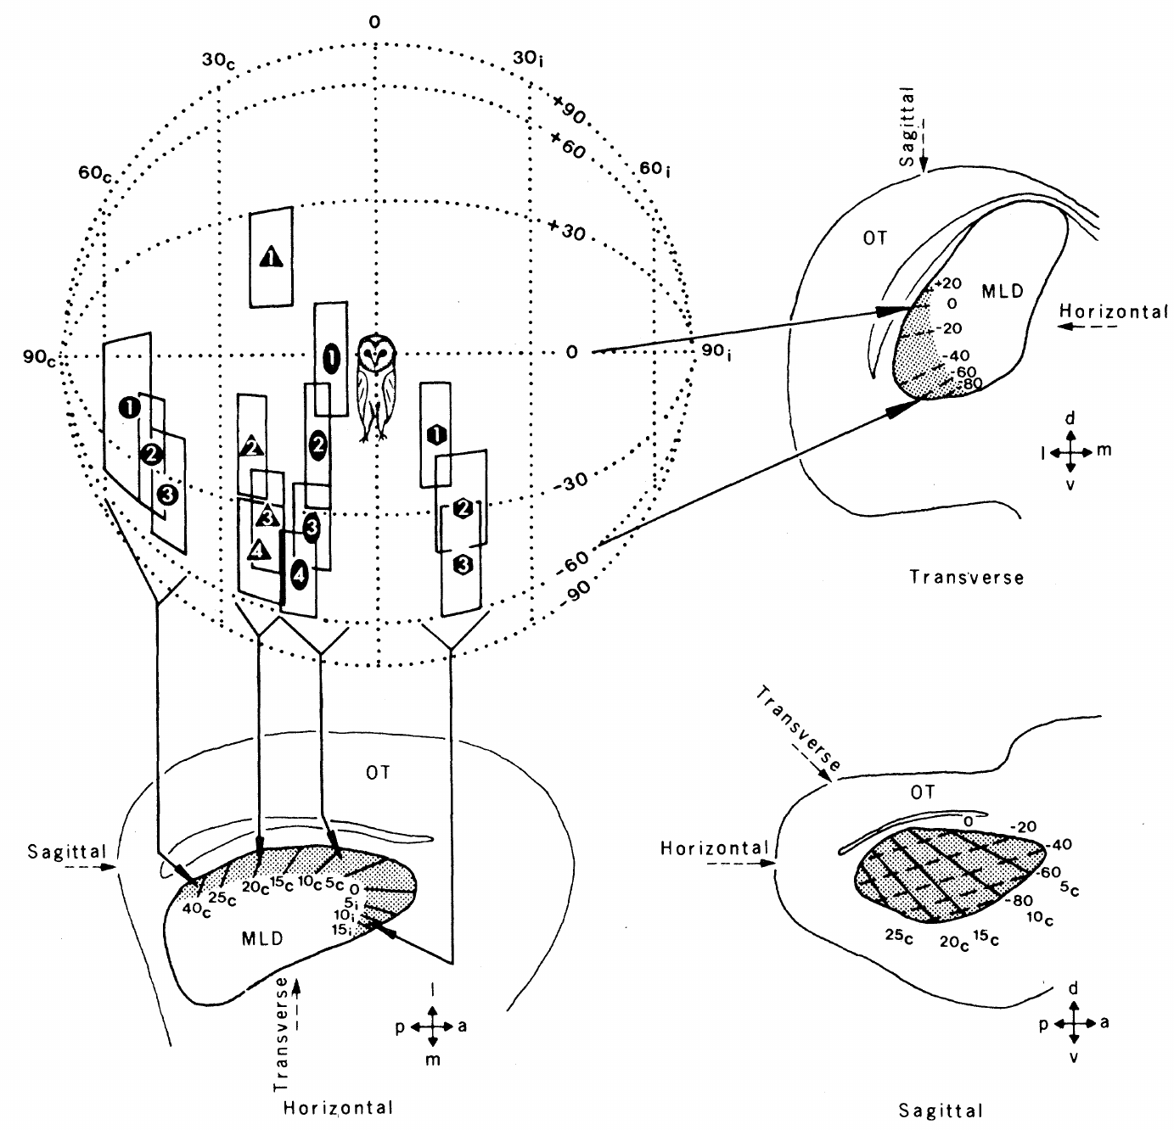
NEUR 411 · NEUROETHOLOGY · FALL 2026
Lecture 18
Owl sound localization I: ITD/ILD maps in the inferior colliculus (Konishi & Knudsen)
Monday, October 5, 2026
Jordan Lopez, Ph.D.
Professor of Neurobiology & Biomedical Engineering
Knudsen & Konishi (1978), Fig. 1. Ordered receptive fields and their measured midbrain locations.
Notes:
Owl sound localization I: ITD/ILD maps in the inferior colliculus (Konishi & Knudsen)
Lecture 18. NEUR 411 · NEUROETHOLOGY · FALL 2026. Monday, October 5, 2026.
Figure: Knudsen & Konishi (1978), Fig. 1. Ordered receptive fields and their measured midbrain locations.
Figure source: https://doi.org/10.1126/science.644324
References:
Knudsen EI, Konishi M (1978). A Neural Map of Auditory Space in the Owl. Science 200(4343):795-797. https://doi.org/10.1126/science.644324

Slide 2
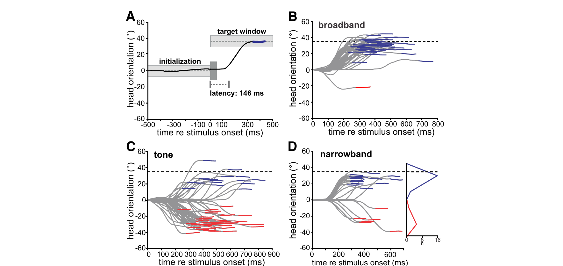
Owls orient toward sounds without visual guidance
The barn owl, Tyto alba, is a nocturnal predator whose auditory system converts prey-generated sound into directed head movements. Azimuth is horizontal direction; elevation is vertical direction. Head turns provide a behavioral measure of the location the owl perceives.
Kettler and colleagues recorded head orientation while presenting sounds through earphones. At an interaural delay of 100 µs, broadband noise produced turns toward the corresponding target. A 5-kHz tone could instead elicit turns toward an alternative location in the opposite hemifield.
This phantom source is a localization illusion, not a second physical loudspeaker. Broadband and 1.5-kHz-wide narrowband stimuli distinguished spectral effects from a change in the imposed delay. The behavior connects auditory timing ambiguity to an observable orienting decision.
Kettler et al. (2017), Fig. 2(A–D). Head-turn trajectories for broadband, tonal, and narrowband sounds.
Kettler et al. (2017)
02
Notes:
• The barn owl, Tyto alba, is a nocturnal predator whose auditory system converts prey-generated sound into directed head movements. Azimuth is horizontal direction; elevation is vertical direction. Head turns provide a behavioral measure of the location the owl perceives.
– A head-turn trajectory measures the animal’s response to an auditory percept, rather than neuronal tuning itself. The earphone conditions control the acoustic difference between ears while the bird remains able to orient. The published comparisons include broadband sounds, pure tones, and narrowband noise under the same timing manipulation.
• Kettler and colleagues recorded head orientation while presenting sounds through earphones. At an interaural delay of 100 µs, broadband noise produced turns toward the corresponding target. A 5-kHz tone could instead elicit turns toward an alternative location in the opposite hemifield.
• This phantom source is a localization illusion, not a second physical loudspeaker. Broadband and 1.5-kHz-wide narrowband stimuli distinguished spectral effects from a change in the imposed delay. The behavior connects auditory timing ambiguity to an observable orienting decision.
References:
Kettler L, Griebel H, Ferger R, Wagner H (2017). Combination of Interaural Level and Time Difference in Azimuthal Sound Localization in Owls. eNeuro 4(6):ENEURO.0238-17.2017. https://doi.org/10.1523/eneuro.0238-17.2017
Figure: Kettler et al. (2017), Fig. 2(A–D). Head-turn trajectories for broadband, tonal, and narrowband sounds.
Figure source: https://doi.org/10.1523/eneuro.0238-17.2017

Slide 3
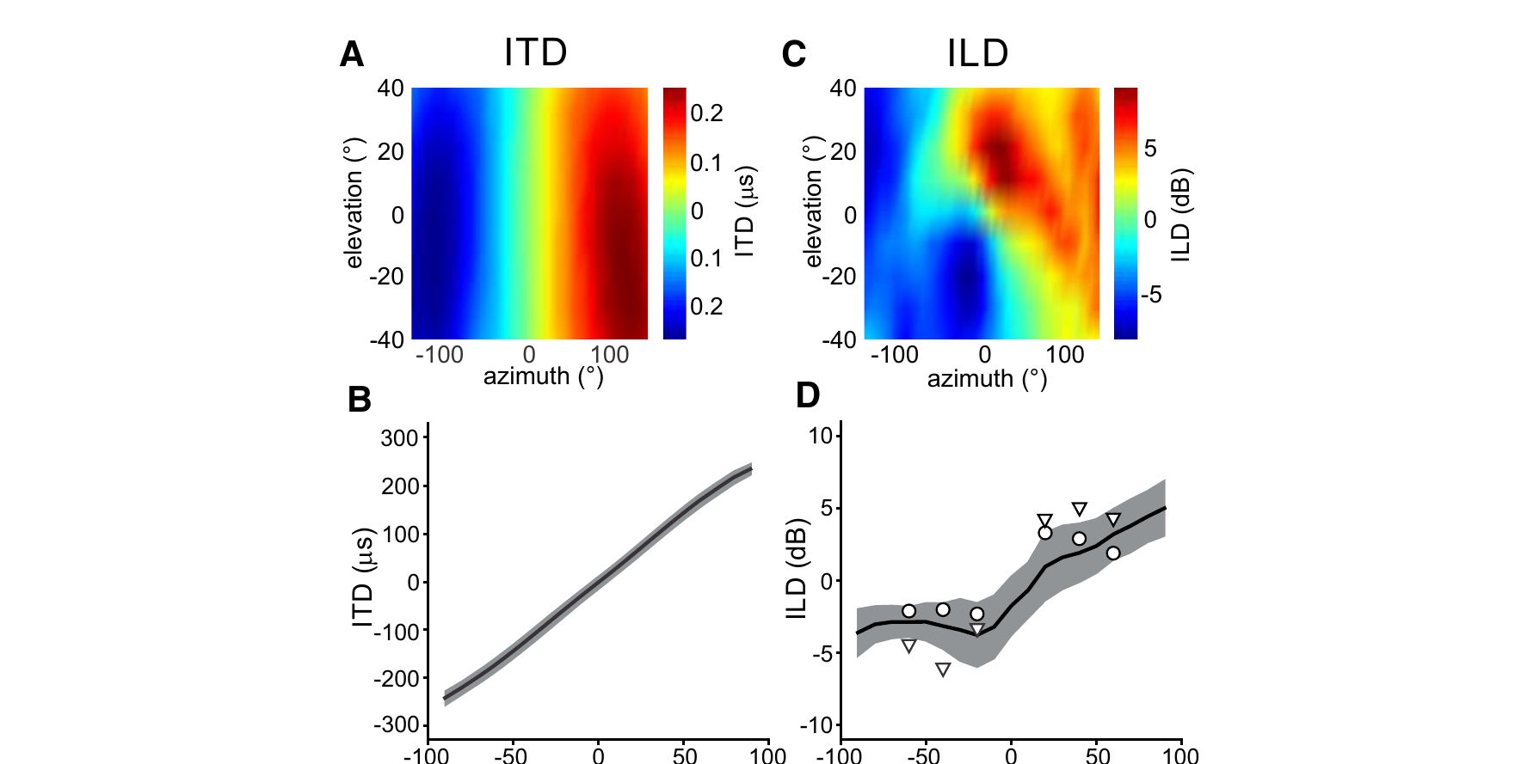
The two ears supply time and level differences
Interaural time difference, or ITD, is the difference in sound arrival time between ears, measured in microseconds. Interaural level difference, or ILD, is the difference in sound pressure level, measured in decibels. Neither cue is a location label at the auditory nerve.
Kettler and colleagues used ear-canal probe microphones to measure the head’s acoustic filtering. The frontal ITD map varied chiefly with azimuth; ILD varied strongly with elevation and also contained an azimuthal component. The facial ruff and asymmetric ears contribute to this filtering.
Kettler et al. (2017), Fig. 1(A–D). Measured timing and level differences across acoustic space.
Acoustic measurements and playback tests used directions corresponding to delays of 50, 100, and 150 µs. Natural level cues reduced timing ambiguities. The familiar association of ITD with horizontal direction and ILD with vertical direction is a useful specialization, and ILD also carries an azimuthal component.
Kettler et al. (2017)
03
Notes:
• Interaural time difference, or ITD, is the difference in sound arrival time between ears, measured in microseconds. Interaural level difference, or ILD, is the difference in sound pressure level, measured in decibels. Neither cue is a location label at the auditory nerve.
– The head-related transfer function describes how the head and external ears change the level and phase of each frequency arriving from a particular direction. Measuring it close to the eardrum includes the filtering actually available to the animal. A small horizontal level component can matter when timing information admits two competing locations.
• Kettler and colleagues used ear-canal probe microphones to measure the head’s acoustic filtering. The frontal ITD map varied chiefly with azimuth; ILD varied strongly with elevation and also contained an azimuthal component. The facial ruff and asymmetric ears contribute to this filtering.
• Acoustic measurements and playback tests used directions corresponding to delays of 50, 100, and 150 µs. Natural level cues reduced timing ambiguities. The familiar association of ITD with horizontal direction and ILD with vertical direction is a useful specialization, and ILD also carries an azimuthal component.
References:
Kettler L, Griebel H, Ferger R, Wagner H (2017). Combination of Interaural Level and Time Difference in Azimuthal Sound Localization in Owls. eNeuro 4(6):ENEURO.0238-17.2017. https://doi.org/10.1523/eneuro.0238-17.2017
Figure: Kettler et al. (2017), Fig. 1(A–D). Measured timing and level differences across acoustic space.
Figure source: https://doi.org/10.1523/eneuro.0238-17.2017

Slide 4
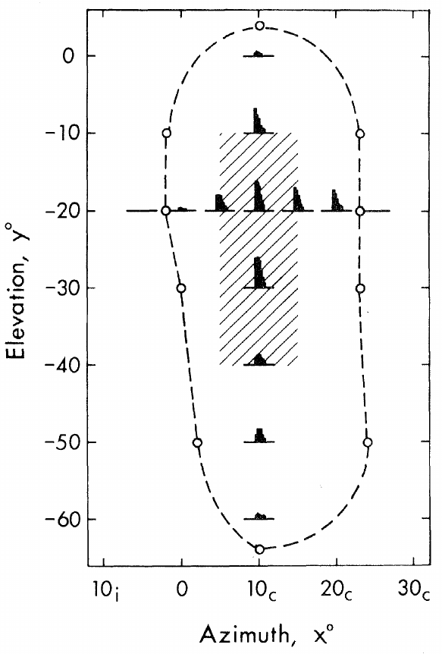
Midbrain neurons respond to restricted auditory space
A receptive field is the set of stimulus conditions that changes a neuron’s activity. Knudsen and Konishi mapped auditory receptive fields by moving a loudspeaker around the head of a lightly anesthetized owl in an anechoic chamber, which minimized reflected sound.
Noise bursts lasted 100 ms and were delivered 10 dB above each unit’s threshold. Speaker positions were sampled in azimuth and elevation while extracellular spikes were recorded. A smaller best area was defined by the positions producing maximal rather than merely detectable responses.
Most mapped fields were vertically elongated. Their widths ranged from 7° to 40° in azimuth, with a mean of 25°. The response boundary and the smaller best area describe different aspects of selectivity, with the best area marking the positions that evoke maximal responses.
Knudsen & Konishi (1978), Fig. 2. Measured receptive-field boundaries and best area.
Knudsen & Konishi (1978)
04
Notes:
• A receptive field is the set of stimulus conditions that changes a neuron’s activity. Knudsen and Konishi mapped auditory receptive fields by moving a loudspeaker around the head of a lightly anesthetized owl in an anechoic chamber, which minimized reflected sound.
– An extracellular electrode detects the action potentials of a unit while the experimenter controls speaker position. The published field includes responses collected at different positions, not a spatial image received by the cochlea. The neurons were recorded in darkness, and tests with visual stimuli did not evoke the reported auditory responses.
• Noise bursts lasted 100 ms and were delivered 10 dB above each unit’s threshold. Speaker positions were sampled in azimuth and elevation while extracellular spikes were recorded. A smaller best area was defined by the positions producing maximal rather than merely detectable responses.
• Most mapped fields were vertically elongated. Their widths ranged from 7° to 40° in azimuth, with a mean of 25°. The response boundary and the smaller best area describe different aspects of selectivity, with the best area marking the positions that evoke maximal responses.
References:
Knudsen EI, Konishi M (1978). A Neural Map of Auditory Space in the Owl. Science 200(4343):795-797. https://doi.org/10.1126/science.644324
Figure: Knudsen & Konishi (1978), Fig. 2. Measured receptive-field boundaries and best area.
Figure source: https://doi.org/10.1126/science.644324

Slide 5
A receptive field is the region that drives a neuron
A receptive field is the set of stimulus conditions that changes the activity of a neuron. For an auditory space-specific neuron, the conditions are sound locations described by azimuth, the horizontal angle, and elevation, the vertical angle. The receptive field therefore describes where in space a sound must lie to drive the cell.
Knudsen and Konishi moved a loudspeaker around the head of a lightly anesthetized owl in an anechoic chamber. Noise bursts 10 dB above threshold were presented at many positions while extracellular spikes were recorded.
The best area is the subset of positions that evoke maximal responses, and the broader response boundary includes positions that evoke weaker responses. Most fields were vertically elongated, so a neuron specified horizontal direction more narrowly than elevation.
Knudsen & Konishi (1978), Fig. 2. Measured receptive-field boundaries and best area.
Knudsen & Konishi (1978)
04a
Notes:
• A receptive field is a map of where in space a sound makes a neuron fire.
• Definition.
– A receptive field is the set of stimulus conditions that changes the activity of a neuron.
– For these neurons the conditions are directions in azimuth and elevation.
• Method.
– A loudspeaker was moved around the head of a lightly anesthetized owl.
– The anechoic chamber minimized reflected sound, so the speaker position defined the direction of the sound.
• Stimuli.
– Noise bursts lasted 100 milliseconds and were delivered 10 decibels above the threshold of each unit.
• Best area.
– The best area contains the positions that produced maximal responses, and the response boundary is wider.
– The two describe different aspects of selectivity.
• Shape of the fields.
– Most fields were vertically elongated, with widths from 7 to 40 degrees in azimuth and a mean near 25 degrees.
• Reading the numbers.
– A width of 7 degrees describes a very sharply tuned neuron, and 40 degrees describes a broadly tuned one.
– The mean width in azimuth was about 25 degrees.
• Selectivity and behavior.
– Neither the response boundary nor the best area is itself a behavioral threshold for localizing a sound.
References:
Knudsen EI, Konishi M (1978). A Neural Map of Auditory Space in the Owl. Science 200(4343):795-797. https://doi.org/10.1126/science.644324

Slide 6
Midbrain neighbors represent neighboring sound locations
Knudsen and Konishi reconstructed electrode tracks histologically and compared recording position with the center of each neuron’s best area. The auditory region was called MLD, nucleus mesencephalicus lateralis dorsalis, the avian homolog of the inferior colliculus.
Best-area azimuth shifted from approximately 60° contralateral in the posterolateral region to 15° ipsilateral anteromedially. Best-area elevation ranged from about +20° to −90°, with higher directions represented dorsally and lower directions ventrally. Neighboring neurons generally had overlapping receptive fields.
Tone bursts, clicks, and noise usually preserved best-area location; changing level from 10 to 30 dB above threshold also preserved its position. The orderly representation supports a computed map of auditory space rather than a simple map of acoustic frequency or overall loudness.
Knudsen & Konishi (1978), Fig. 1. Ordered receptive fields and their measured midbrain locations.
Knudsen & Konishi (1978)
05
Notes:
• Knudsen and Konishi reconstructed electrode tracks histologically and compared recording position with the center of each neuron’s best area. The auditory region was called MLD, nucleus mesencephalicus lateralis dorsalis, the avian homolog of the inferior colliculus.
– Contralateral means on the side opposite the recording hemisphere; ipsilateral means on the same side. Histological lesions identified track endpoints so that receptive-field order could be matched to tissue position. The original report established an orderly physiological map, while later experiments identified the separate computations that supply its coordinates.
• Best-area azimuth shifted from approximately 60° contralateral in the posterolateral region to 15° ipsilateral anteromedially. Best-area elevation ranged from about +20° to −90°, with higher directions represented dorsally and lower directions ventrally. Neighboring neurons generally had overlapping receptive fields.
• Tone bursts, clicks, and noise usually preserved best-area location; changing level from 10 to 30 dB above threshold also preserved its position. The orderly representation supports a computed map of auditory space rather than a simple map of acoustic frequency or overall loudness.
References:
Knudsen EI, Konishi M (1978). A Neural Map of Auditory Space in the Owl. Science 200(4343):795-797. https://doi.org/10.1126/science.644324
Figure: Knudsen & Konishi (1978), Fig. 1. Ordered receptive fields and their measured midbrain locations.
Figure source: https://doi.org/10.1126/science.644324

Slide 7
Neighboring neurons represent neighboring locations
A topographic map places neurons with similar preferences next to one another in the tissue. In the auditory midbrain of the owl, the preferred location of a neuron changed in an orderly way along the electrode track.
Best-area azimuth shifted from approximately 60° contralateral in the posterolateral region to 15° ipsilateral anteromedially. Best-area elevation ranged from about +20° down to −90°, with higher directions represented dorsally.
The cochlea represents sound frequency along its length and does not represent location, so the map of space is computed in the brain. The preserved best-area location across tones, clicks, noise and levels indicates that the neurons represent where a sound is and not what it sounds like.
Knudsen & Konishi (1978), Fig. 1. Ordered receptive fields and their measured midbrain locations.
Knudsen & Konishi (1978)
05a
Notes:
• The midbrain contains an orderly map of auditory space, and the map has to be computed.
• Topography.
– In a topographic map, neighboring neurons have neighboring preferences.
– Here the preference is a location in space.
• Orderly progression.
– Azimuth shifted from about 60 degrees contralateral in the posterolateral region to 15 degrees ipsilateral anteromedially.
– Elevation ranged from about plus 20 to minus 90 degrees, with higher directions dorsal.
• Overlap.
– Neighboring neurons generally had overlapping receptive fields.
• Why the map is computed.
– The cochlea is organized by sound frequency and not by location.
– Location must be derived from differences between the two ears.
• Stable location.
– Tone bursts, clicks and noise usually preserved the best-area location, and so did a change in level from 10 to 30 decibels above threshold.
• Midbrain structure.
– The auditory region is called MLD, nucleus mesencephalicus lateralis dorsalis, which is the avian homolog of the inferior colliculus.
– Electrode tracks were reconstructed histologically.
• Recording position and best area.
– The position of each recording was compared with the center of the best area of the neuron.
– The orderly relation between the two is the evidence for a map.
References:
Knudsen EI, Konishi M (1978). A Neural Map of Auditory Space in the Owl. Science 200(4343):795-797. https://doi.org/10.1126/science.644324

Slide 8
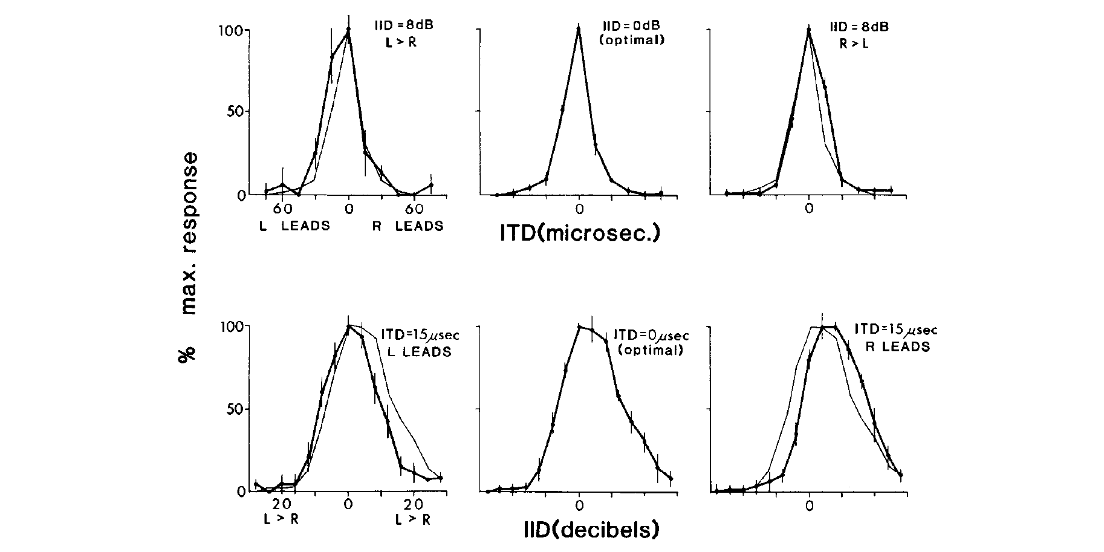
Timing and level preferences can vary independently
A tuning curve relates neuronal response to a controlled stimulus parameter. Takahashi, Moiseff, and Konishi varied ITD while holding ILD fixed, then varied ILD while holding ITD fixed, recording from space-specific midbrain neurons through calibrated earphone stimulation.
Changing the level difference over a 20-dB range did not systematically displace the timing preference. Conversely, changes in timing altered response magnitude without systematically displacing the preferred level difference. The positions of the two response peaks were separable.
Takahashi et al. (1984), Fig. 4. Independent tuning to timing and level differences.
A space-specific neuron therefore represents preferred ITD and preferred ILD separately, and it fires most strongly when both cues are favorable. The experiments separate how each cue is represented from how the two representations jointly determine the output.
Takahashi et al. (1984)
06
Notes:
• A tuning curve relates neuronal response to a controlled stimulus parameter. Takahashi, Moiseff, and Konishi varied ITD while holding ILD fixed, then varied ILD while holding ITD fixed, recording from space-specific midbrain neurons through calibrated earphone stimulation.
– Earphones allow one binaural cue to change without the acoustically coupled changes produced by moving a real speaker. The critical observation concerns the location of the tuning peak, rather than complete invariance of all spike counts. Holding the other cue fixed tests whether one preference shifts when the other input changes.
• Changing the level difference over a 20-dB range did not systematically displace the timing preference. Conversely, changes in timing altered response magnitude without systematically displacing the preferred level difference. The positions of the two response peaks were separable.
• A space-specific neuron therefore represents preferred ITD and preferred ILD separately, and it fires most strongly when both cues are favorable. The experiments separate how each cue is represented from how the two representations jointly determine the output.
References:
Takahashi T, Moiseff A, Konishi M (1984). Time and intensity cues are processed independently in the auditory system of the owl. The Journal of Neuroscience 4(7):1781-1786. https://doi.org/10.1523/jneurosci.04-07-01781.1984
Figure: Takahashi et al. (1984), Fig. 4. Independent tuning to timing and level differences.
Figure source: https://doi.org/10.1523/jneurosci.04-07-01781.1984

Slide 9
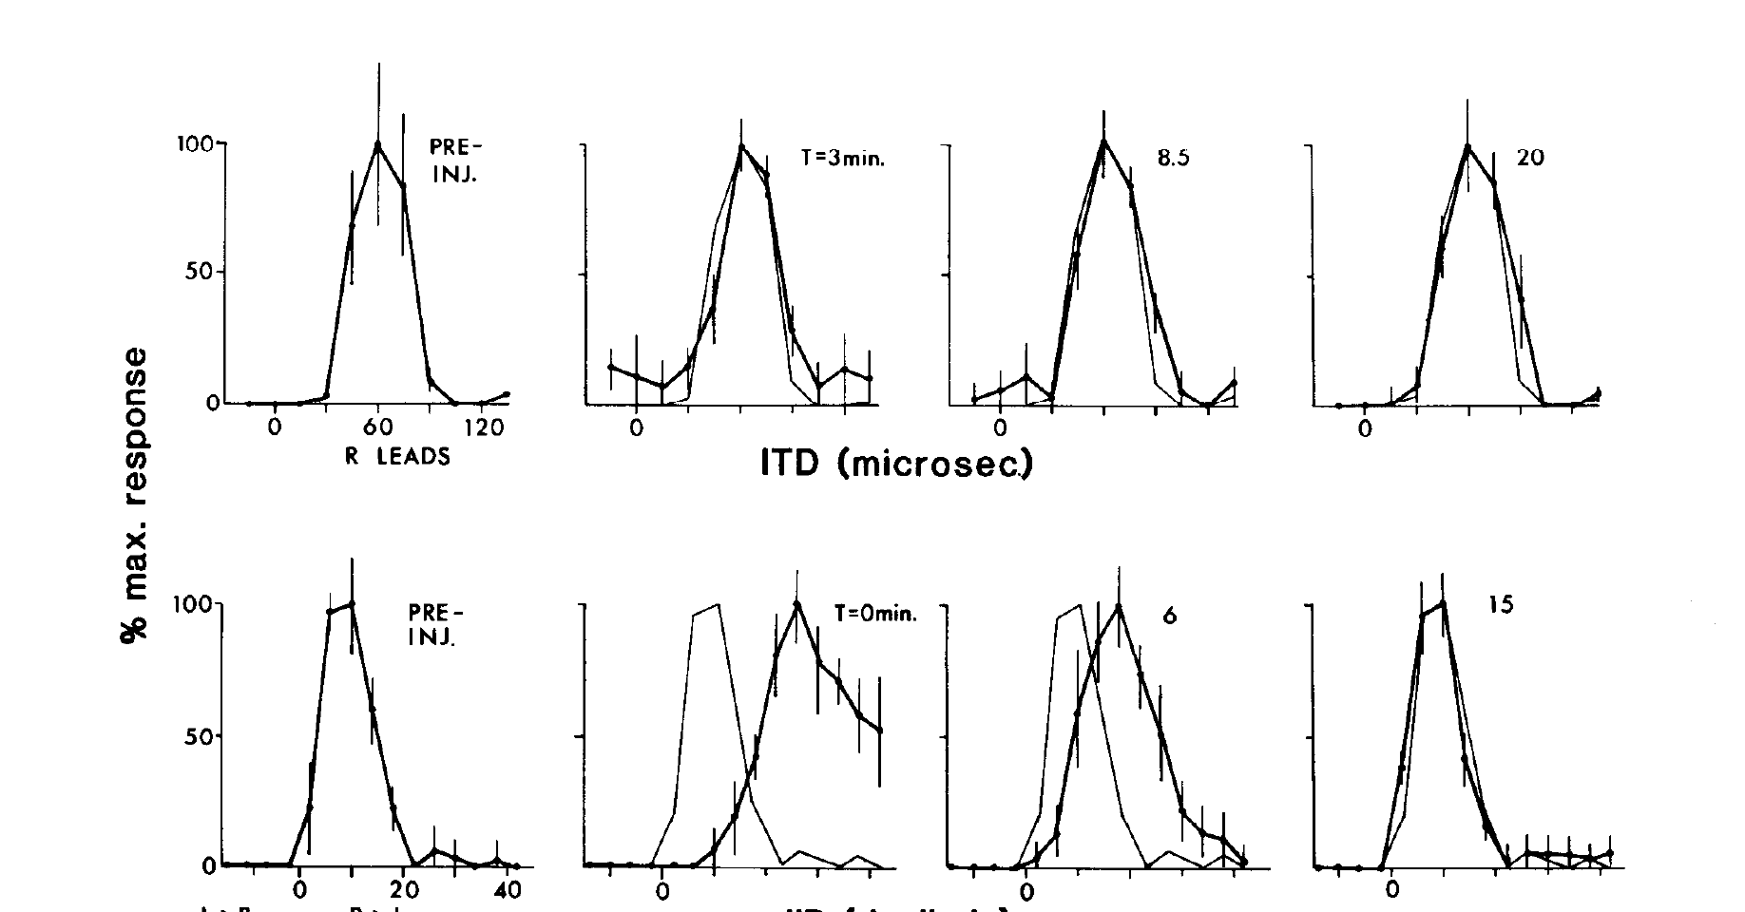
Angularis activity is necessary for normal level tuning
Nucleus angularis, or NA, is a cochlear nucleus receiving auditory-nerve input. Takahashi and colleagues locally injected lidocaine into NA while recording a space-specific neuron in the inferior colliculus. Lidocaine is a local anesthetic that blocks neuronal impulse conduction.
After unilateral NA inactivation, the neuron’s ILD response shifted toward the injected side’s altered effective input. In the same preparation, the ITD response peak remained essentially stable. Recovery measurements and an injection-site marker linked the change to a localized, reversible manipulation.
Takahashi et al. (1984), Fig. 1. Angularis inactivation changes level tuning while sparing time tuning.
The selective alteration supports a level-processing pathway originating in NA. Its monaural output is subsequently compared with information from the other ear, and the stable ITD peak shows that the timing pathway continued to function.
Takahashi et al. (1984)
07
Notes:
• Nucleus angularis, or NA, is a cochlear nucleus receiving auditory-nerve input. Takahashi and colleagues locally injected lidocaine into NA while recording a space-specific neuron in the inferior colliculus. Lidocaine is a local anesthetic that blocks neuronal impulse conduction.
– When one cochlear nucleus contributes less activity, the downstream circuit receives an unbalanced representation even though the earphone stimulus itself has not changed. The timing curve serves as a within-neuron control against a general collapse of midbrain responsiveness. Histological localization distinguishes an angularis injection from neighboring magnocellularis tissue.
• After unilateral NA inactivation, the neuron’s ILD response shifted toward the injected side’s altered effective input. In the same preparation, the ITD response peak remained essentially stable. Recovery measurements and an injection-site marker linked the change to a localized, reversible manipulation.
• The selective alteration supports a level-processing pathway originating in NA. Its monaural output is subsequently compared with information from the other ear, and the stable ITD peak shows that the timing pathway continued to function.
References:
Takahashi T, Moiseff A, Konishi M (1984). Time and intensity cues are processed independently in the auditory system of the owl. The Journal of Neuroscience 4(7):1781-1786. https://doi.org/10.1523/jneurosci.04-07-01781.1984
Figure: Takahashi et al. (1984), Fig. 1. Angularis inactivation changes level tuning while sparing time tuning.
Figure source: https://doi.org/10.1523/jneurosci.04-07-01781.1984

Slide 10
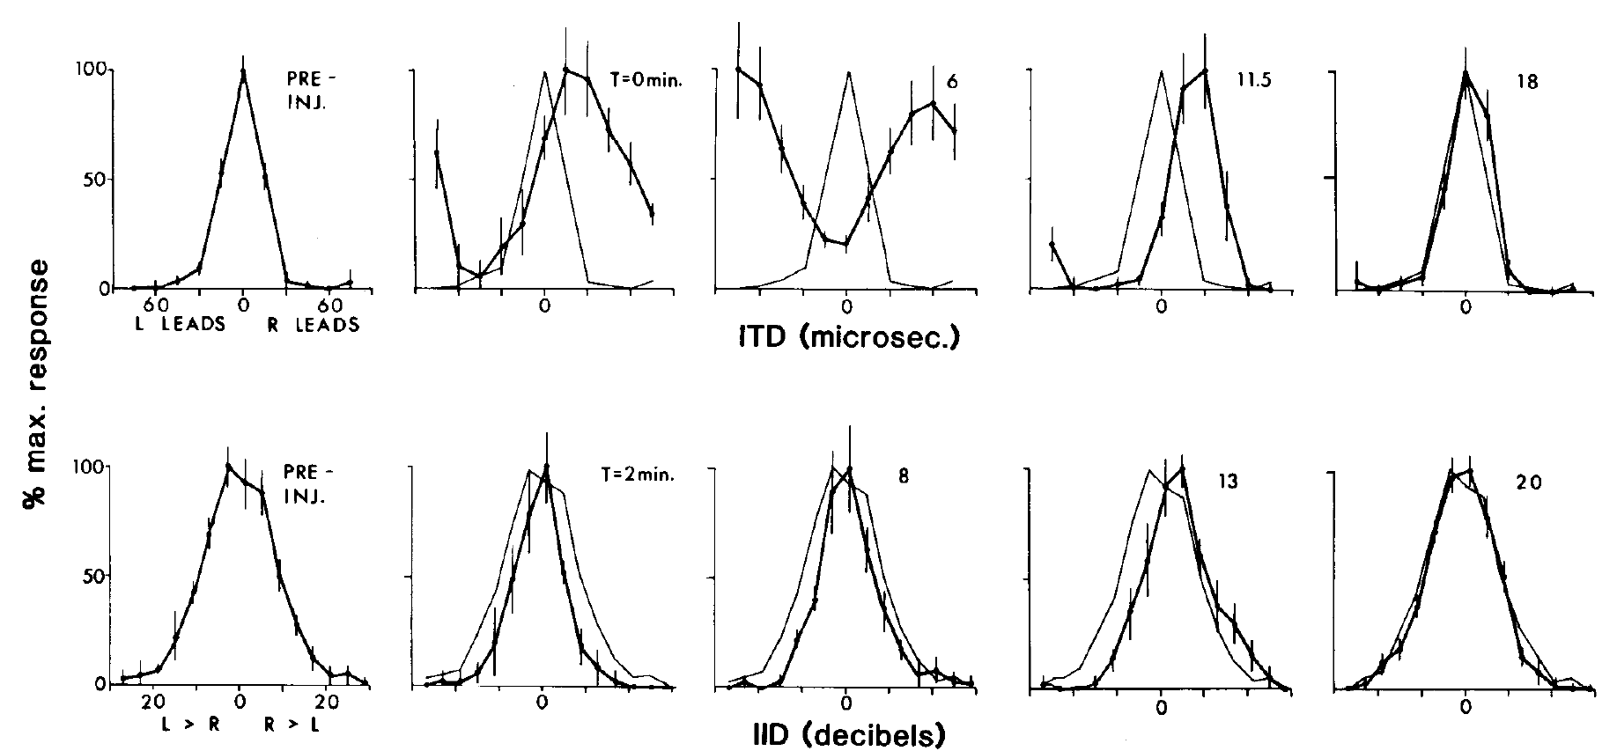
Magnocellularis activity is necessary for normal time tuning
Nucleus magnocellularis, or NM, is a second cochlear nucleus receiving auditory-nerve input. Takahashi and colleagues injected lidocaine into NM and measured the same two binaural tuning dimensions used in the angularis experiments, separating neural impairment from an acoustic change.
NM inactivation altered the ITD tuning of a space-specific neuron, while its preferred ILD remained approximately unchanged. Recordings before injection, during the effect, and after recovery supplied a temporal control. Injection-site histology checked the anatomical locus of the manipulation.
Takahashi et al. (1984), Fig. 3. Magnocellularis inactivation changes time tuning while sparing level tuning.
The reciprocal effects of NM and NA inactivation form a double dissociation: disrupting one pathway selectively changes timing, whereas disrupting the other selectively changes level. The final spatial response combines the two pathways, with the NM pathway carrying timing and the NA pathway carrying level.
Takahashi et al. (1984)
08
Notes:
• Nucleus magnocellularis, or NM, is a second cochlear nucleus receiving auditory-nerve input. Takahashi and colleagues injected lidocaine into NM and measured the same two binaural tuning dimensions used in the angularis experiments, separating neural impairment from an acoustic change.
– A double dissociation is stronger than observing two kinds of tuning in separate neurons. Each intervention is evaluated against both response dimensions. The result constrains the origin of the information reaching the midbrain, while leaving open the precise transformations carried out between the cochlear nuclei and the recorded space-specific cell.
• NM inactivation altered the ITD tuning of a space-specific neuron, while its preferred ILD remained approximately unchanged. Recordings before injection, during the effect, and after recovery supplied a temporal control. Injection-site histology checked the anatomical locus of the manipulation.
• The reciprocal effects of NM and NA inactivation form a double dissociation: disrupting one pathway selectively changes timing, whereas disrupting the other selectively changes level. The final spatial response combines the two pathways, with the NM pathway carrying timing and the NA pathway carrying level.
References:
Takahashi T, Moiseff A, Konishi M (1984). Time and intensity cues are processed independently in the auditory system of the owl. The Journal of Neuroscience 4(7):1781-1786. https://doi.org/10.1523/jneurosci.04-07-01781.1984
Figure: Takahashi et al. (1984), Fig. 3. Magnocellularis inactivation changes time tuning while sparing level tuning.
Figure source: https://doi.org/10.1523/jneurosci.04-07-01781.1984

Slide 11
A double dissociation separates two pathways
A double dissociation occurs when disrupting one pathway impairs one function and spares another, whereas disrupting a second pathway produces the reverse pattern. The pattern shows that the two functions depend on different pathways. The result is a selective effect on one binaural cue for each nucleus.
Lidocaine injected into nucleus angularis altered the ILD tuning of a space-specific midbrain neuron and left the ITD peak stable. Injected into nucleus magnocellularis, it altered ITD tuning and left the preferred ILD approximately unchanged.
Takahashi et al. (1984), Fig. 3. Magnocellularis inactivation changes time tuning while sparing level tuning.
Recovery after each injection and histology of the injection sites linked the changes to a reversible, localized manipulation. The two cochlear nuclei therefore feed separate processing streams for timing and level before the cues converge in the midbrain.
Takahashi et al. (1984)
08a
Notes:
• Two manipulations with opposite selective effects show that two functions rely on separate pathways.
• Logic.
– Disrupting pathway one changes function A and spares function B.
– Disrupting pathway two changes function B and spares function A.
• Angularis.
– Lidocaine in nucleus angularis shifted the ILD response of a midbrain neuron.
– The ITD response peak remained essentially stable.
• Magnocellularis.
– Lidocaine in nucleus magnocellularis altered ITD tuning.
– The preferred ILD remained approximately unchanged.
• Controls.
– Recordings before injection, during the effect and after recovery supplied a temporal control.
– Injection-site histology checked the location of each manipulation.
• Interpretation.
– The timing and level cues are processed in separate streams from the cochlear nuclei onward.
• Why a double dissociation is strong evidence.
– A single inactivation could reflect a nonspecific impairment of the animal.
– Opposite selective effects from two sites make the pathways functionally distinct.
• Limits of the manipulation.
– The result separates the two pathways at the cochlear nuclei.
– The final spatial response still requires both pathways, and the nuclei converge later in the midbrain.
References:
Takahashi T, Moiseff A, Konishi M (1984). Time and intensity cues are processed independently in the auditory system of the owl. The Journal of Neuroscience 4(7):1781-1786. https://doi.org/10.1523/jneurosci.04-07-01781.1984

Slide 12
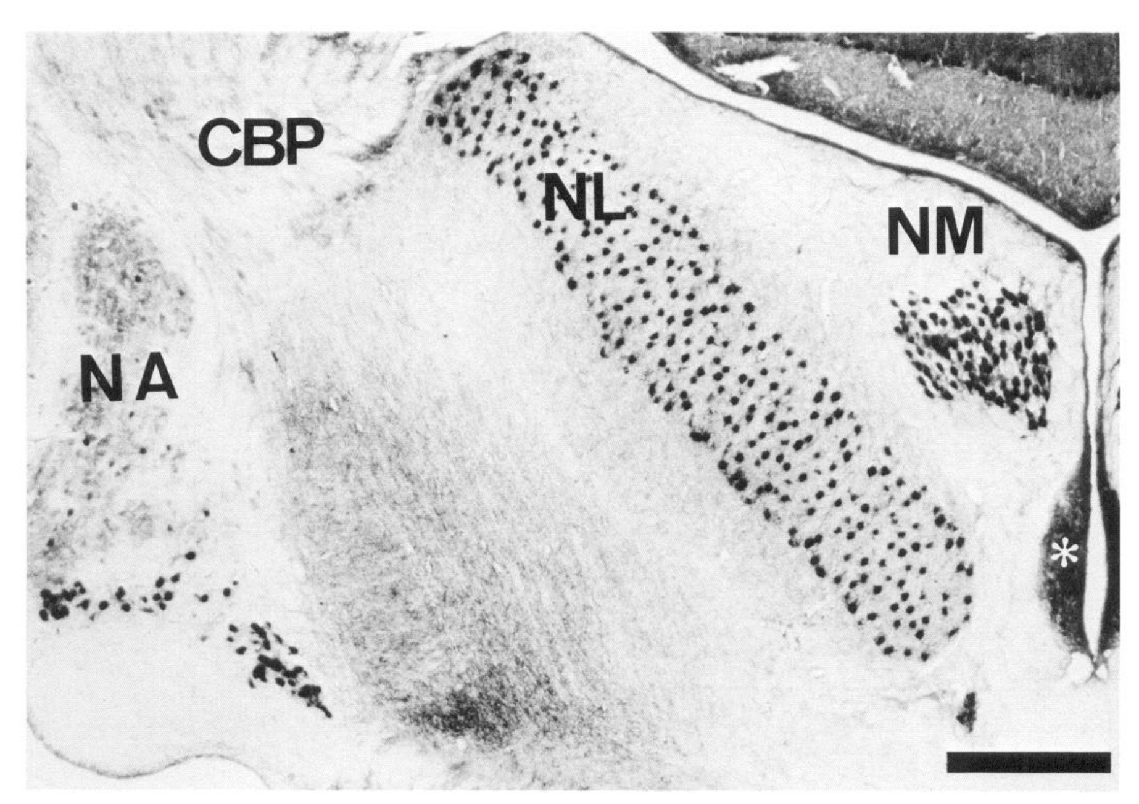
Distinct brainstem nuclei preserve different sound variables
The eighth cranial nerve carries auditory information from the cochlea into the brainstem. Carr and Konishi identified NA, NM, and nucleus laminaris, or NL, in transverse tissue sections. NL lies in the timing pathway downstream of bilateral NM input.
A neurofilament stain distinguished fiber-rich laminaris from neighboring nuclei and the cerebellar peduncle. Histology supplied landmarks for intracellular recording and tracer experiments, preventing recording depth alone from being treated as proof of a particular nucleus.
The anatomical separation is compatible with parallel timing and level computations. The phase-locking, rate-level, binaural and inactivation experiments connect these structures to particular acoustic variables, with NM and NL in the timing pathway and NA in the level pathway.
Carr & Konishi (1990), Fig. 1. Histological positions of the owl auditory brainstem nuclei.
Carr & Konishi (1990)
09
Notes:
• The eighth cranial nerve carries auditory information from the cochlea into the brainstem. Carr and Konishi identified NA, NM, and nucleus laminaris, or NL, in transverse tissue sections. NL lies in the timing pathway downstream of bilateral NM input.
– Auditory-nerve fibers carry both temporal and level information. Parallel nuclei need not receive completely different acoustic signals to emphasize different variables. The relevant distinction is how neurons transform their shared peripheral input. The original micrograph supplies anatomical positions and a scale bar; its labeled nuclei are experimental tissue, not an invented circuit.
• A neurofilament stain distinguished fiber-rich laminaris from neighboring nuclei and the cerebellar peduncle. Histology supplied landmarks for intracellular recording and tracer experiments, preventing recording depth alone from being treated as proof of a particular nucleus.
• The anatomical separation is compatible with parallel timing and level computations. The phase-locking, rate-level, binaural and inactivation experiments connect these structures to particular acoustic variables, with NM and NL in the timing pathway and NA in the level pathway.
References:
Carr CE, Konishi M (1990). A circuit for detection of interaural time differences in the brain stem of the barn owl. The Journal of Neuroscience 10(10):3227-3246. https://doi.org/10.1523/jneurosci.10-10-03227.1990
Figure: Carr & Konishi (1990), Fig. 1. Histological positions of the owl auditory brainstem nuclei.
Figure source: https://doi.org/10.1523/jneurosci.10-10-03227.1990

Slide 13
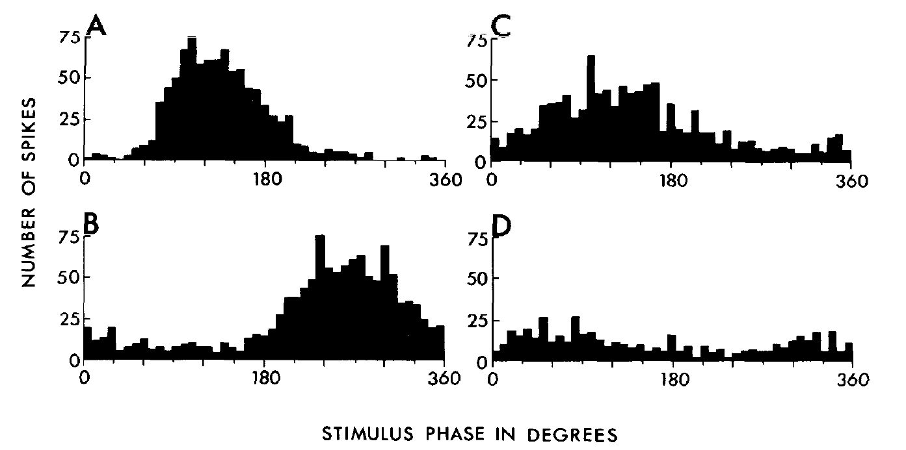
Magnocellular spikes retain the phase of acoustic cycles
Phase locking means that spikes occur preferentially at a particular phase of a repeating sound waveform. Sullivan and Konishi recorded NM neurons during tonal stimulation and grouped spike times into period histograms, which align successive stimulus cycles.
NM neurons retained phase locking at frequencies up to 9 kHz in that study. The distributions were not identical at every frequency: spikes could occur on different cycles while remaining concentrated near a preferred position within the cycle. Timing information therefore survived without one spike per cycle.
Sullivan & Konishi (1984), Fig. 1(A–D). Phase-locked magnocellular spike distributions.
NM rate-level functions were comparatively narrow and often changed little above spontaneous discharge. This specialization supports timing transmission to NL. A phase histogram measures temporal alignment, so it describes timing in NM, and sensitivity to differences between the two ears arises later when inputs from both sides are compared.
Sullivan & Konishi (1984)
10
Notes:
• Phase locking means that spikes occur preferentially at a particular phase of a repeating sound waveform. Sullivan and Konishi recorded NM neurons during tonal stimulation and grouped spike times into period histograms, which align successive stimulus cycles.
– A high spontaneous rate does not prevent a sound from reorganizing spike timing. A neuron can convey more temporal information without greatly increasing its average spike count. The comparison with angularis is functional: magnocellularis emphasizes phase, whereas angularis supplies a more informative rate representation of sound level.
• NM neurons retained phase locking at frequencies up to 9 kHz in that study. The distributions were not identical at every frequency: spikes could occur on different cycles while remaining concentrated near a preferred position within the cycle. Timing information therefore survived without one spike per cycle.
• NM rate-level functions were comparatively narrow and often changed little above spontaneous discharge. This specialization supports timing transmission to NL. A phase histogram measures temporal alignment, so it describes timing in NM, and sensitivity to differences between the two ears arises later when inputs from both sides are compared.
References:
Sullivan WE, Konishi M (1984). Segregation of stimulus phase and intensity coding in the cochlear nucleus of the barn owl. The Journal of Neuroscience 4(7):1787-1799. https://doi.org/10.1523/jneurosci.04-07-01787.1984
Figure: Sullivan & Konishi (1984), Fig. 1(A–D). Phase-locked magnocellular spike distributions.
Figure source: https://doi.org/10.1523/jneurosci.04-07-01787.1984

Slide 14
Phase locking keeps spike timing within a sound cycle
A sound wave repeats in cycles, and phase is the position within a cycle. A phase-locked neuron fires at a preferred phase, so its spike times carry the timing of the waveform. Phase locking is the property that allows timing information to be carried by spike times.
Sullivan and Konishi grouped spike times from NM neurons into period histograms that align successive stimulus cycles. NM neurons retained phase locking at frequencies up to 9 kHz. A period histogram of a strongly phase-locked neuron has a sharp peak at one phase.
Sullivan & Konishi (1984), Fig. 1(A–D). Phase-locked magnocellular spike distributions.
Spikes could occur on different cycles and still cluster at one position within the cycle, so timing survives without one spike per cycle. The narrow rate-level functions of NM suggest that its output is specialized for transmitting timing.
Sullivan & Konishi (1984)
10a
Notes:
• Phase locking is the way a neuron preserves the fine timing of a sound wave in its spikes.
• Phase.
– A sound wave repeats in cycles, and phase is the position within a cycle.
• Phase-locked firing.
– A phase-locked neuron fires at a preferred phase of the wave.
– Its spike times therefore carry the timing of the waveform.
• Period histograms.
– Spike times were grouped into histograms that align successive cycles of the tone.
– A peak in the histogram shows concentration at one phase.
• Frequency range.
– NM neurons retained phase locking at frequencies up to 9 kilohertz.
• Missing cycles.
– A neuron need not fire on every cycle.
– Timing information survives when spikes on different cycles occupy the same position within the cycle.
• Cycles and spikes.
– A tone of high frequency has many cycles per second, and a neuron firing a few spikes per second cannot respond to each one.
– Phase locking means the spikes that do occur fall at a consistent phase.
• Nucleus magnocellularis.
– NM is a cochlear nucleus that receives auditory-nerve input.
– Its neurons transmit timing to nucleus laminaris, where the two ears are compared.
References:
Sullivan WE, Konishi M (1984). Segregation of stimulus phase and intensity coding in the cochlear nucleus of the barn owl. The Journal of Neuroscience 4(7):1787-1799. https://doi.org/10.1523/jneurosci.04-07-01787.1984

Slide 15
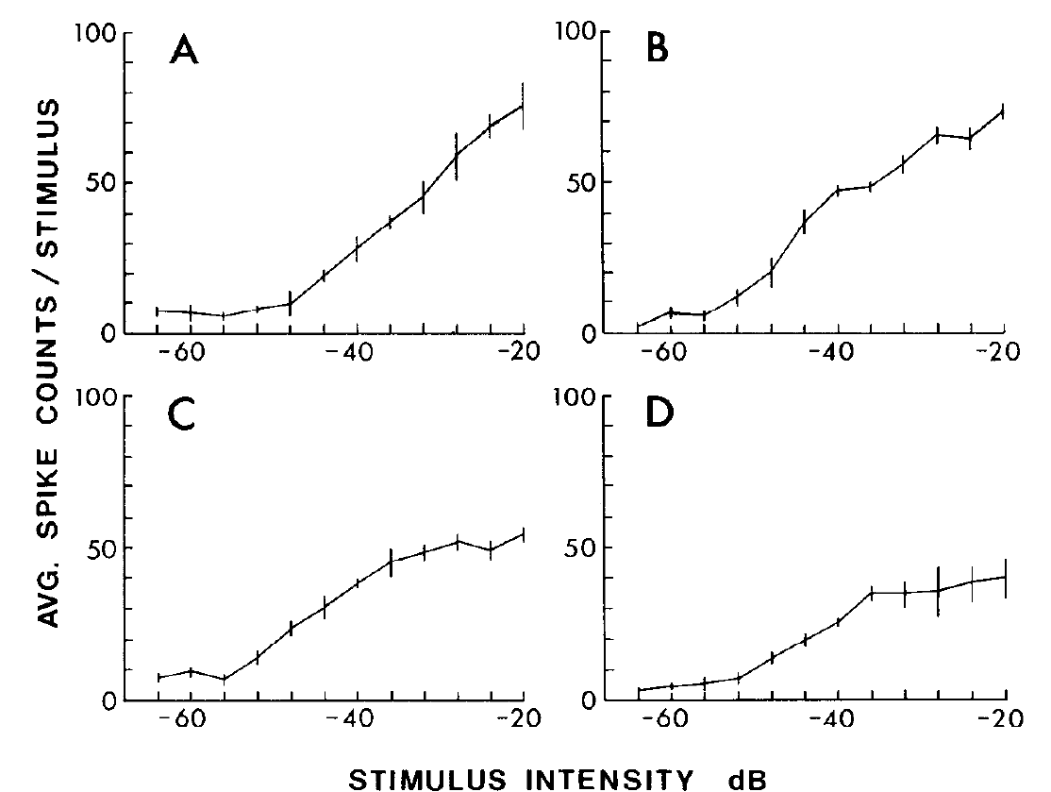
Angularis firing rates represent changes in sound level
Sullivan and Konishi measured rate-level functions, the relation between stimulus level and spike count, in NA neurons. Compared with NM, NA typically had lower spontaneous discharge and larger increases in firing as the level of a tone rose.
Angularis responses commonly changed over more than 20 dB, often 30 dB or more. The dynamic range is the range of levels over which the response changes substantially. Different cells showed different slopes and saturation levels, preserving a population representation of level.
NA showed little or no phase locking at higher frequencies, although weak locking occurred below about 3.5 kHz. NM emphasizes timing and NA emphasizes level, and the monaural level-sensitive discharge of NA provides input for later comparison between the ears.
Sullivan & Konishi (1984), Fig. 10(A–D). Angularis spike counts increase over a broad sound-level range.
Sullivan & Konishi (1984)
11
Notes:
• Sullivan and Konishi measured rate-level functions, the relation between stimulus level and spike count, in NA neurons. Compared with NM, NA typically had lower spontaneous discharge and larger increases in firing as the level of a tone rose.
– The two cochlear nuclei can have similar frequency selectivity while differing substantially in temporal and intensity responses. Frequency tuning therefore cannot substitute for testing rate-level and phase-locking properties. The plotted decibel scale is the original experimental level scale; it should not be relabeled as an absolute environmental sound level.
• Angularis responses commonly changed over more than 20 dB, often 30 dB or more. The dynamic range is the range of levels over which the response changes substantially. Different cells showed different slopes and saturation levels, preserving a population representation of level.
• NA showed little or no phase locking at higher frequencies, although weak locking occurred below about 3.5 kHz. NM emphasizes timing and NA emphasizes level, and the monaural level-sensitive discharge of NA provides input for later comparison between the ears.
References:
Sullivan WE, Konishi M (1984). Segregation of stimulus phase and intensity coding in the cochlear nucleus of the barn owl. The Journal of Neuroscience 4(7):1787-1799. https://doi.org/10.1523/jneurosci.04-07-01787.1984
Figure: Sullivan & Konishi (1984), Fig. 10(A–D). Angularis spike counts increase over a broad sound-level range.
Figure source: https://doi.org/10.1523/jneurosci.04-07-01787.1984

Slide 16
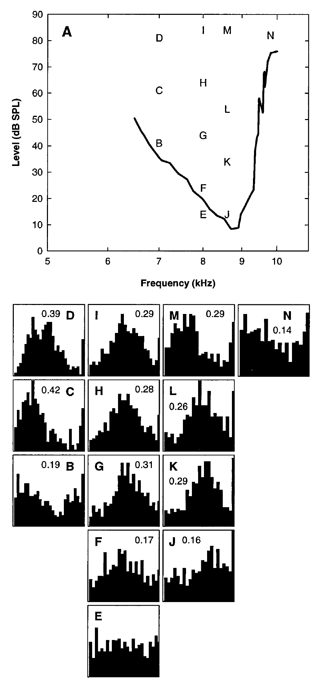
Auditory-nerve phase locking reaches approximately 10 kHz
Köppl recorded single auditory-nerve fibers with calibrated tones and compared their spike timing across frequency and sound level. Vector strength quantifies concentration of spike phases: values near one indicate tight phase alignment, whereas values near zero indicate dispersed phases.
Auditory-nerve phase locking extended to approximately 10 kHz. Its quality declined with frequency, but the decline included a plateau around 1.5–3 kHz. Phase organization could be detected below the level at which a clear increase in average spike rate appeared.
The peripheral temporal code supplies the brainstem with information needed for ITD processing. Phase locking declines in quality with frequency, and rate threshold and timing sensitivity are different response measurements, since phase organization could be detected below the level at which a clear increase in average rate appeared.
Köppl (1997), Fig. 1(A–N). Auditory-nerve phase locking at high stimulus frequencies.
Köppl (1997)
12
Notes:
• Köppl recorded single auditory-nerve fibers with calibrated tones and compared their spike timing across frequency and sound level. Vector strength quantifies concentration of spike phases: values near one indicate tight phase alignment, whereas values near zero indicate dispersed phases.
– The study used ear-canal calibration for individual animals, so stimulus level was measured at the auditory input rather than inferred from a speaker setting. Vector strength compares phases across many cycles. A high-frequency neuron need not fire on every cycle to retain information about a preferred stimulus phase.
• Auditory-nerve phase locking extended to approximately 10 kHz. Its quality declined with frequency, but the decline included a plateau around 1.5–3 kHz. Phase organization could be detected below the level at which a clear increase in average spike rate appeared.
• The peripheral temporal code supplies the brainstem with information needed for ITD processing. Phase locking declines in quality with frequency, and rate threshold and timing sensitivity are different response measurements, since phase organization could be detected below the level at which a clear increase in average rate appeared.
References:
Köppl C (1997). Phase Locking to High Frequencies in the Auditory Nerve and Cochlear Nucleus Magnocellularis of the Barn Owl,Tyto alba. The Journal of Neuroscience 17(9):3312-3321. https://doi.org/10.1523/jneurosci.17-09-03312.1997
Figure: Köppl (1997), Fig. 1(A–N). Auditory-nerve phase locking at high stimulus frequencies.
Figure source: https://doi.org/10.1523/jneurosci.17-09-03312.1997

Slide 17
Vector strength measures how tightly spikes align
Vector strength is a number between zero and one that describes how tightly spikes cluster at one phase of a repeating sound. Values near one mean that spikes occur at nearly the same phase, and values near zero mean that the phases are dispersed.
Köppl measured vector strength in single auditory-nerve fibers across frequency and level. Phase locking extended to approximately 10 kHz, with its quality declining as frequency rose and showing a plateau around 1.5 to 3 kHz.
Phase organization could be detected below the level at which average spike rate clearly increased, so timing and rate carry different information. The auditory nerve therefore supplies the brainstem with a temporal code for ITD processing.
Köppl (1997), Fig. 1(A–N). Auditory-nerve phase locking at high stimulus frequencies.
Köppl (1997)
12a
Notes:
• Vector strength gives one number for the quality of phase locking.
• Scale.
– A value near one means spikes fall at nearly the same phase of the sound.
– A value near zero means the spike phases are spread across the cycle.
• Recordings.
– Single auditory-nerve fibers were recorded with calibrated tones, and frequency and level were varied.
• Frequency dependence.
– Phase locking extended to approximately 10 kilohertz.
– Its quality declined with frequency, with a plateau around 1.5 to 3 kilohertz.
• Rate and timing.
– Phase organization could be detected below the sound level at which average spike rate began to increase clearly.
– Rate threshold and timing sensitivity are different measurements.
• Role.
– The temporal code in the auditory nerve provides the brainstem with the information needed for ITD processing.
• Why high frequencies matter.
– The owl localizes sounds that include frequencies up to several kilohertz.
– Phase locking in the nerve must extend into that range to support ITD.
• Comparing measures.
– Vector strength describes timing, whereas average spike rate describes how many spikes occur.
– The two measures were compared as frequency and sound level changed.
References:
Köppl C (1997). Phase Locking to High Frequencies in the Auditory Nerve and Cochlear Nucleus Magnocellularis of the Barn Owl,Tyto alba. The Journal of Neuroscience 17(9):3312-3321. https://doi.org/10.1523/jneurosci.17-09-03312.1997

Slide 18
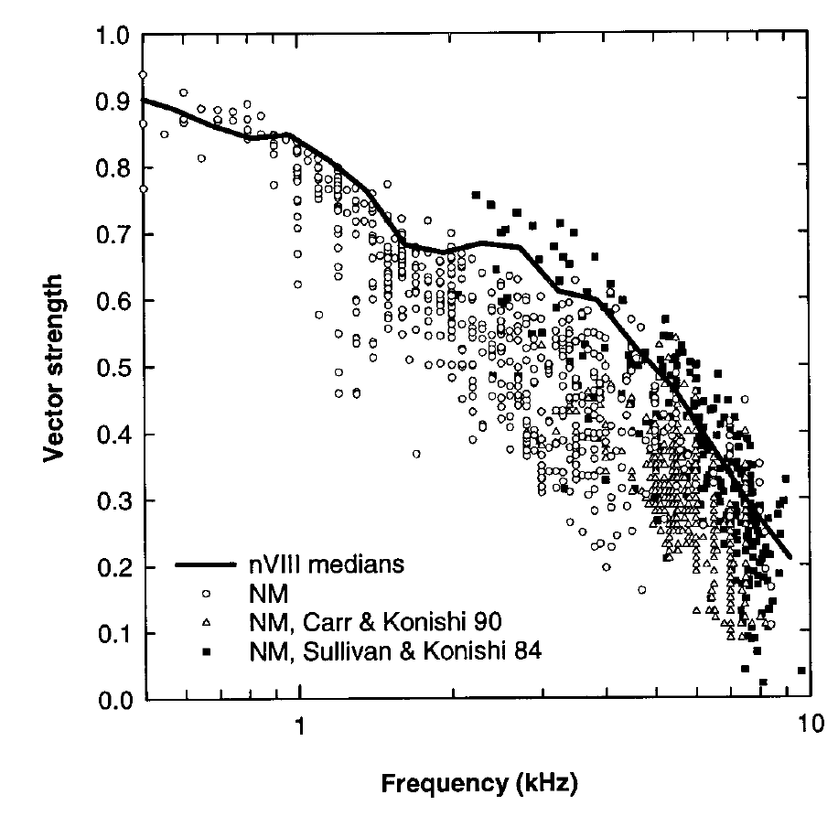
The NM synapse limits some temporal precision
Köppl obtained auditory-nerve and NM recordings in the same animals, permitting a direct comparison of temporal information before and after the first central relay. Tone frequency and level were controlled while saturated phase-locking quality was assessed.
Above approximately 1 kHz, NM vector strength was consistently lower than auditory-nerve vector strength. The comparison does not support a universal sharpening of phase locking at this relay. Both populations retained locking well into the frequency range used for owl localization.
The additional synaptic transformation can introduce temporal dispersion even in a highly specialized pathway. The NM recordings identify this loss as a functional property of transmission at the first central relay.
Köppl (1997), Fig. 12. Direct comparison of auditory-nerve and magnocellular phase locking.
Köppl (1997)
13
Notes:
• Köppl obtained auditory-nerve and NM recordings in the same animals, permitting a direct comparison of temporal information before and after the first central relay. Tone frequency and level were controlled while saturated phase-locking quality was assessed.
– Saturated phase locking refers to the response after increasing sound level no longer improves timing alignment substantially. Comparisons at appropriate levels avoid attributing a level-dependent improvement to the relay itself. Earlier NM studies remain plotted in the original article, but the same-animal nerve-versus-NM comparison supplies the direct experimental test.
• Above approximately 1 kHz, NM vector strength was consistently lower than auditory-nerve vector strength. The comparison does not support a universal sharpening of phase locking at this relay. Both populations retained locking well into the frequency range used for owl localization.
• The additional synaptic transformation can introduce temporal dispersion even in a highly specialized pathway. The NM recordings identify this loss as a functional property of transmission at the first central relay.
References:
Köppl C (1997). Phase Locking to High Frequencies in the Auditory Nerve and Cochlear Nucleus Magnocellularis of the Barn Owl,Tyto alba. The Journal of Neuroscience 17(9):3312-3321. https://doi.org/10.1523/jneurosci.17-09-03312.1997
Figure: Köppl (1997), Fig. 12. Direct comparison of auditory-nerve and magnocellular phase locking.
Figure source: https://doi.org/10.1523/jneurosci.17-09-03312.1997

Slide 19
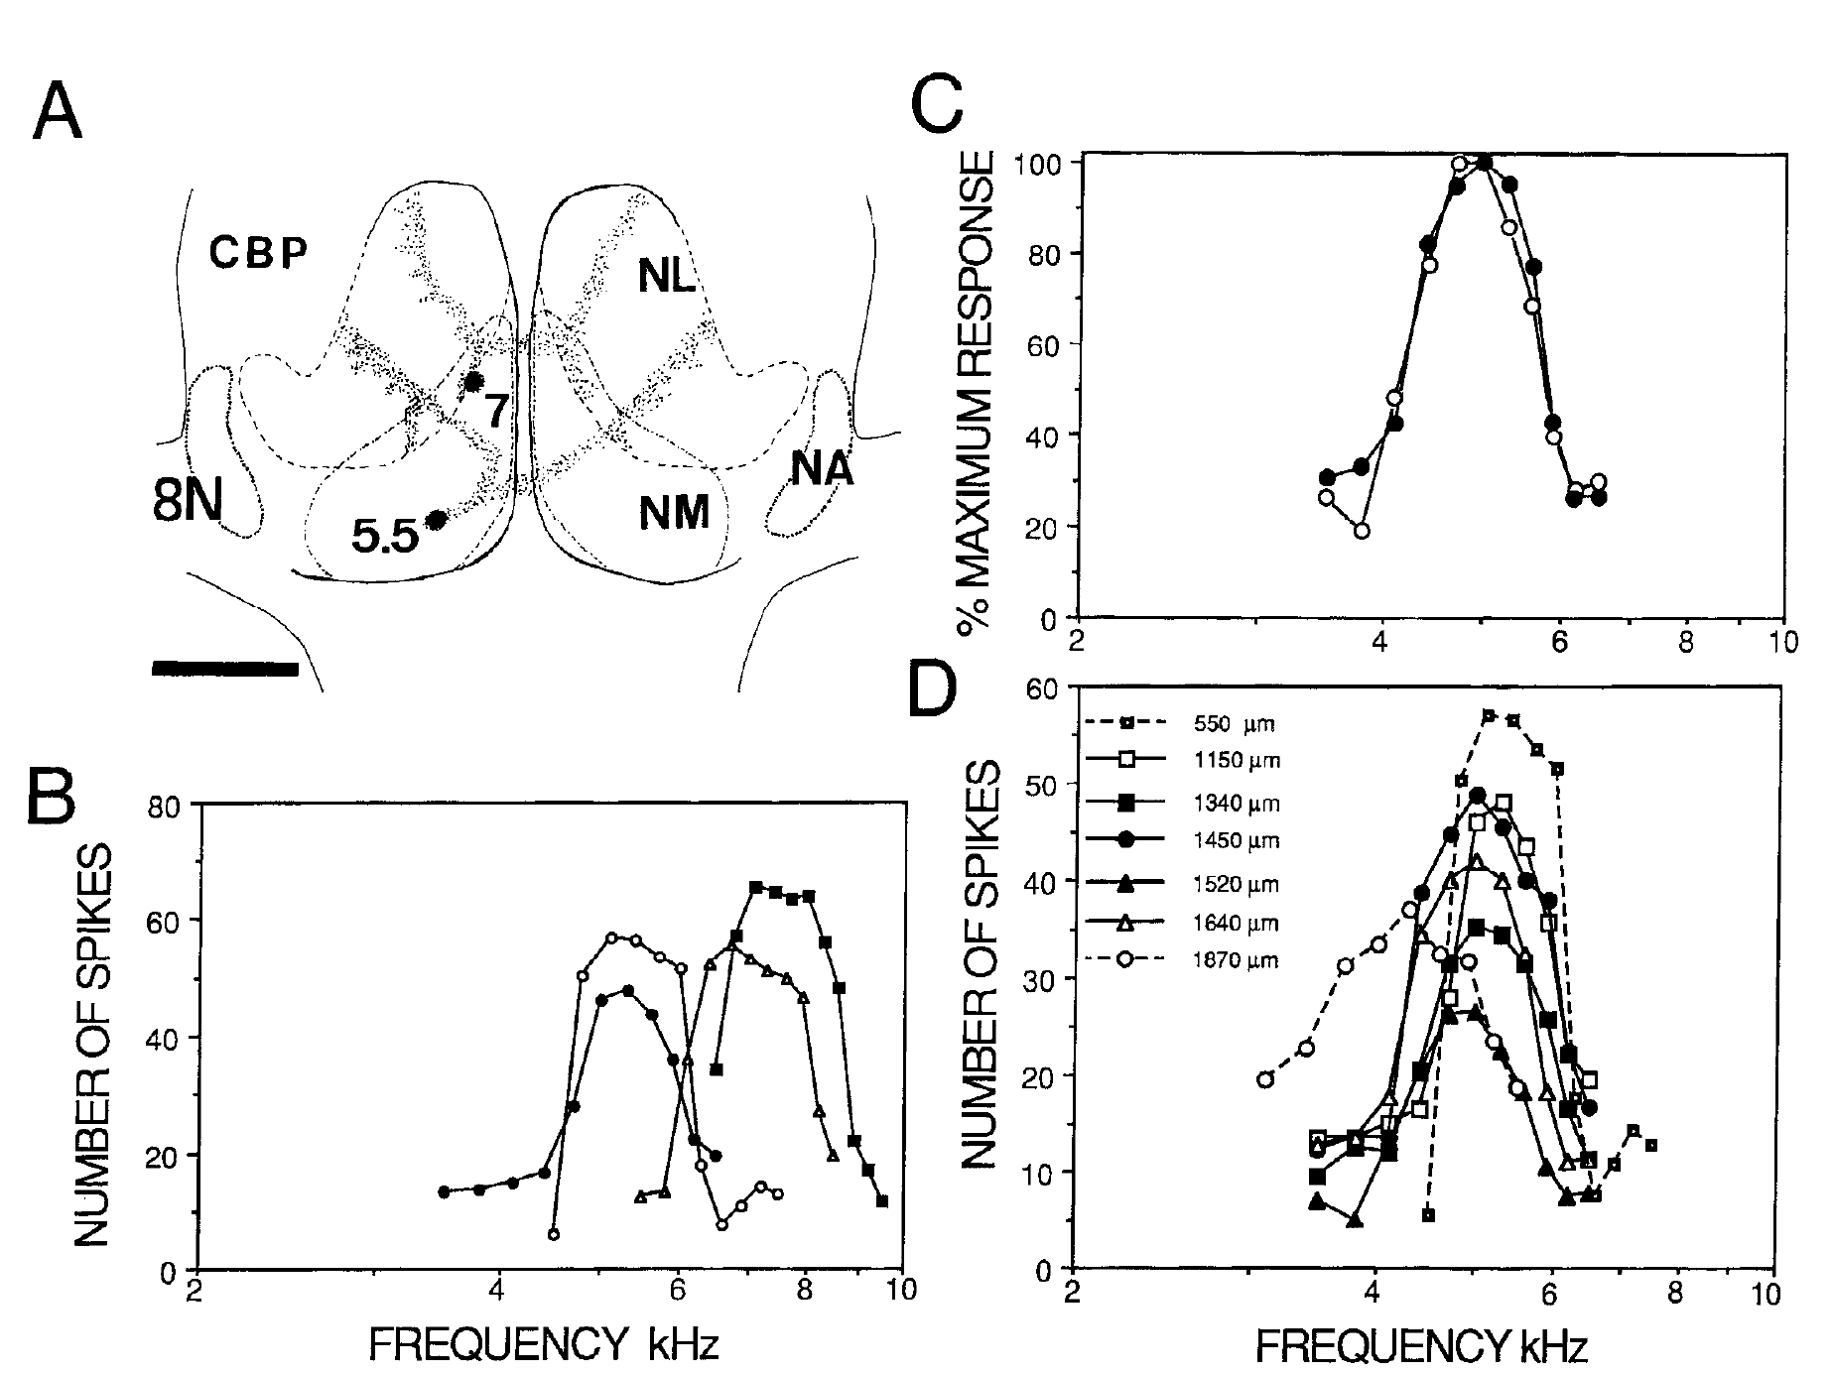
Laminaris receives frequency-matched input from both ears
Tonotopy is the orderly anatomical representation of acoustic frequency. Carr and Konishi traced NM projections and recorded afferent fibers within NL. Inputs from opposite ears entered corresponding frequency regions rather than mixing all frequencies indiscriminately.
Injections into NM regions tuned near 5.5 and 7 kHz labeled different projection territories. Physiological recordings from a single NL penetration found closely matched ipsilateral and contralateral frequency tuning, including fibers encountered at depths of 1320 and 1400 µm.
Frequency matching permits comparison of the timing of corresponding waveform components. Comparing unrelated frequencies would not preserve a stable phase relation. Anatomical tracing establishes the order of the projections, and the paired frequency-response measurements establish the functional matching needed by a timing comparator.
Carr & Konishi (1990), Fig. 3(A–D). Frequency-matched bilateral inputs to nucleus laminaris.
Carr & Konishi (1990)
14
Notes:
• Tonotopy is the orderly anatomical representation of acoustic frequency. Carr and Konishi traced NM projections and recorded afferent fibers within NL. Inputs from opposite ears entered corresponding frequency regions rather than mixing all frequencies indiscriminately.
– The best frequency is the frequency producing the strongest response under the measurement conditions. The original normalized curves permit comparison of tuning shape even when absolute spike counts differ. The study also found mismatched fibers near borders, which limits any claim that every axon encountered around NL belongs to the same frequency channel.
• Injections into NM regions tuned near 5.5 and 7 kHz labeled different projection territories. Physiological recordings from a single NL penetration found closely matched ipsilateral and contralateral frequency tuning, including fibers encountered at depths of 1320 and 1400 µm.
• Frequency matching permits comparison of the timing of corresponding waveform components. Comparing unrelated frequencies would not preserve a stable phase relation. Anatomical tracing establishes the order of the projections, and the paired frequency-response measurements establish the functional matching needed by a timing comparator.
References:
Carr CE, Konishi M (1990). A circuit for detection of interaural time differences in the brain stem of the barn owl. The Journal of Neuroscience 10(10):3227-3246. https://doi.org/10.1523/jneurosci.10-10-03227.1990
Figure: Carr & Konishi (1990), Fig. 3(A–D). Frequency-matched bilateral inputs to nucleus laminaris.
Figure source: https://doi.org/10.1523/jneurosci.10-10-03227.1990

Slide 20
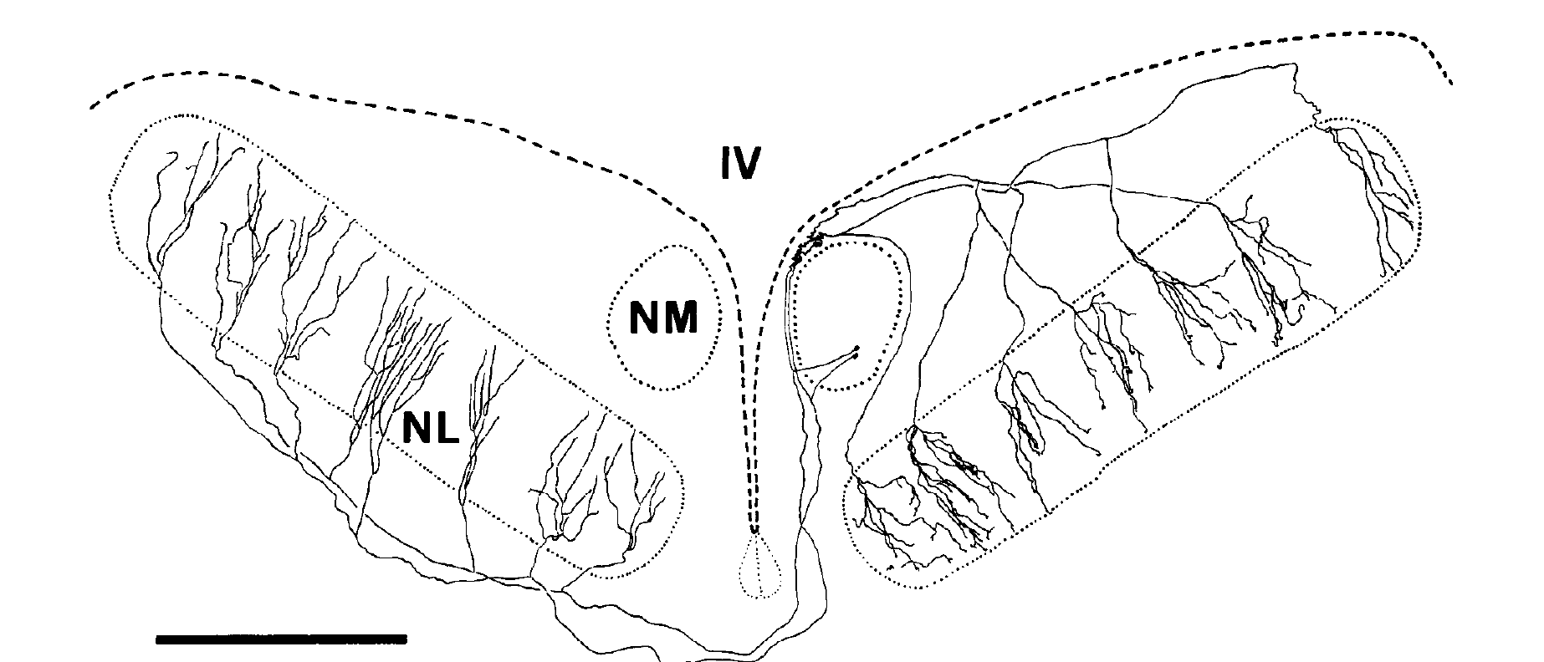
NM axons enter laminaris from opposite borders
Carr and Konishi injected horseradish peroxidase, or HRP, into NM and followed labeled axons through serial brain sections. HRP is a tracer that permits projection pathways to be visualized after a histochemical reaction.
An NM neuron sends branches to NL on both sides. Ipsilateral afferents approach the dorsal border, whereas contralateral afferents approach the ventral border. The published reconstruction preserves this opposing arrangement and includes a 1-mm scale bar.
Carr & Konishi (1990), Fig. 2. Published traced magnocellular axons entering laminaris from opposite borders.
Opposing entry directions supply an anatomical basis for position-dependent differences in arrival time. A delay line is a pathway whose travel time changes with position, and the dorsal and ventral entry of the two inputs places the axons from the two ears on opposite sides of the nucleus.
Carr & Konishi (1990)
15
Notes:
• Carr and Konishi injected horseradish peroxidase, or HRP, into NM and followed labeled axons through serial brain sections. HRP is a tracer that permits projection pathways to be visualized after a histochemical reaction.
– The original authors reconstructed three-dimensional arbors across serial sections and adjusted their projection onto the published two-dimensional view. The drawing is their published anatomical result, cropped unchanged from the article. Its geometry should not be interpreted as an exact flattened measurement of every branch length or physical separation.
• An NM neuron sends branches to NL on both sides. Ipsilateral afferents approach the dorsal border, whereas contralateral afferents approach the ventral border. The published reconstruction preserves this opposing arrangement and includes a 1-mm scale bar.
• Opposing entry directions supply an anatomical basis for position-dependent differences in arrival time. A delay line is a pathway whose travel time changes with position, and the dorsal and ventral entry of the two inputs places the axons from the two ears on opposite sides of the nucleus.
References:
Carr CE, Konishi M (1990). A circuit for detection of interaural time differences in the brain stem of the barn owl. The Journal of Neuroscience 10(10):3227-3246. https://doi.org/10.1523/jneurosci.10-10-03227.1990
Figure: Carr & Konishi (1990), Fig. 2. Published traced magnocellular axons entering laminaris from opposite borders.
Figure source: https://doi.org/10.1523/jneurosci.10-10-03227.1990

Slide 21
A delay line makes travel time depend on position
A delay line is a pathway in which travel time changes with position along its length. Axons that enter a nucleus from opposite borders create such an arrangement when each input reaches successive neurons at systematically different times.
Carr and Konishi labeled NM axons with HRP and followed them through serial sections. Ipsilateral branches approached the dorsal border of laminaris, and contralateral branches approached the ventral border. The published reconstruction includes a scale bar of 1 mm.
Carr & Konishi (1990), Fig. 2. Published traced magnocellular axons entering laminaris from opposite borders.
A neuron deep in the nucleus receives the ipsilateral input after a longer path than the contralateral input, whereas a neuron near the dorsal edge shows the reverse. Position within laminaris therefore corresponds to a particular difference in arrival time.
Carr & Konishi (1990)
15a
Notes:
• A delay line converts position into time, which is the anatomical basis for mapping ITD.
• Definition.
– A delay line is a pathway in which travel time changes with position.
– Inputs arriving from opposite borders create opposing gradients.
• Tracing.
– HRP injected into NM labels axons that can be followed through serial sections after a histochemical reaction.
• Opposite borders.
– Each NM neuron sends branches to laminaris on both sides.
– Ipsilateral afferents approach the dorsal border, and contralateral afferents approach the ventral border.
• Consequence for arrival times.
– Deeper neurons receive the ipsilateral input later than the contralateral input.
– Neurons near the dorsal edge receive the contralateral input later.
• Physiology.
– Recordings of spike timing at different depths test whether conduction time actually changes along the projection.
• Visualizing a projection.
– HRP is a tracer that makes a projection visible after a histochemical reaction.
– Serial brain sections allow an axon to be followed through the tissue.
• Opposing arrangement.
– The published reconstruction preserves the opposing arrangement of the ipsilateral and contralateral inputs.
– The anatomy supplies the layout, and the physiology that follows tests whether delays change along the axons.
References:
Carr CE, Konishi M (1990). A circuit for detection of interaural time differences in the brain stem of the barn owl. The Journal of Neuroscience 10(10):3227-3246. https://doi.org/10.1523/jneurosci.10-10-03227.1990

Slide 22
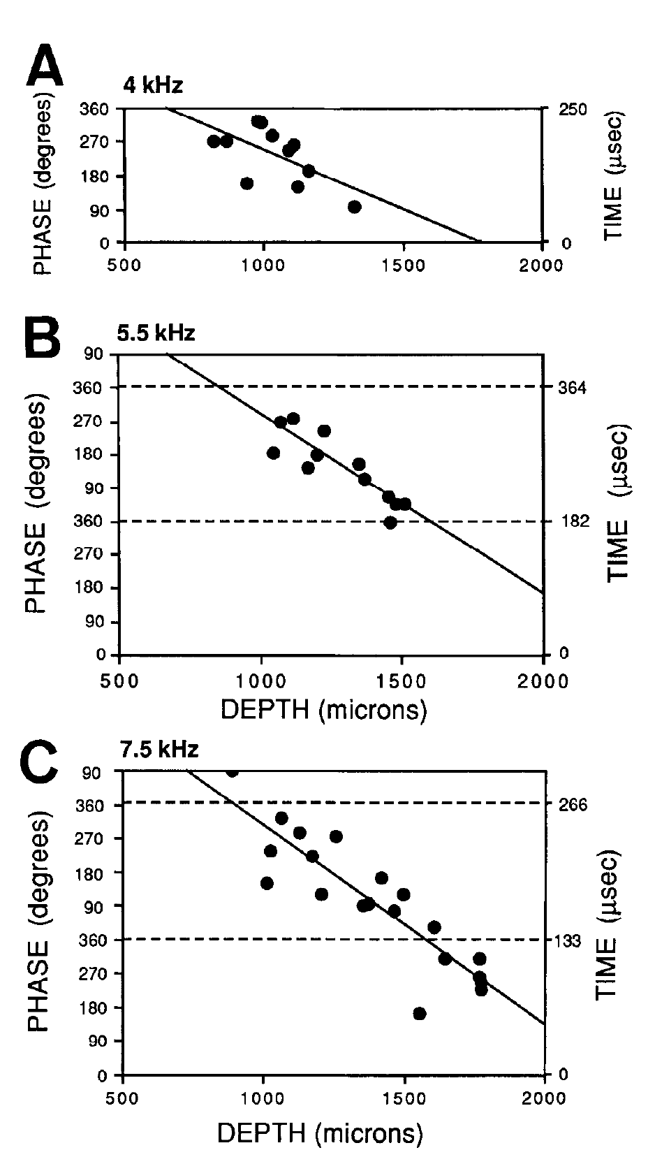
Input spike timing changes systematically through laminaris
Carr and Konishi recorded phase-locked NM afferents at different depths within NL. They stimulated one ear with a tone and measured the mean phase of the resulting intracellularly recorded spikes, testing whether conduction time changed along the projection.
At 4 kHz, the tonal period was 250 µs; at 5.5 kHz it was approximately 182 µs. Mean phase changed regularly with depth. In a 7-kHz region, abrupt apparent phase jumps corresponded to crossing into the next stimulus cycle.
Phase wrapping occurs because phase repeats after a complete cycle even when physical delay continues increasing. The data support orderly neural delays rather than independent random timing at each site. Reading phase alone without recognizing cycle repetition would misidentify these continuous gradients.
Carr & Konishi (1990), Fig. 7(A–C). Input spike phase changes systematically with recording depth.
Carr & Konishi (1990)
16
Notes:
• Carr and Konishi recorded phase-locked NM afferents at different depths within NL. They stimulated one ear with a tone and measured the mean phase of the resulting intracellularly recorded spikes, testing whether conduction time changed along the projection.
– The physiological measurement concerns the arrival time of afferent spikes, not the external arrival time of sound at the ears. A longer axonal travel path shifts spike phase systematically. At a high enough stimulus frequency, a real delay can span more than one cycle, requiring the authors to track the neighboring cycle.
• At 4 kHz, the tonal period was 250 µs; at 5.5 kHz it was approximately 182 µs. Mean phase changed regularly with depth. In a 7-kHz region, abrupt apparent phase jumps corresponded to crossing into the next stimulus cycle.
• Phase wrapping occurs because phase repeats after a complete cycle even when physical delay continues increasing. The data support orderly neural delays rather than independent random timing at each site. Reading phase alone without recognizing cycle repetition would misidentify these continuous gradients.
References:
Carr CE, Konishi M (1990). A circuit for detection of interaural time differences in the brain stem of the barn owl. The Journal of Neuroscience 10(10):3227-3246. https://doi.org/10.1523/jneurosci.10-10-03227.1990
Figure: Carr & Konishi (1990), Fig. 7(A–C). Input spike phase changes systematically with recording depth.
Figure source: https://doi.org/10.1523/jneurosci.10-10-03227.1990

Slide 23
Phase repeats each cycle, so phase appears to wrap
Phase is measured within one cycle of a tone, so it returns to its starting value after a complete period. A delay that keeps increasing therefore produces a phase that repeats. The same logic applies to every frequency, but the length of the period depends on the frequency of the tone.
At 4 kHz the period is 250 µs, and at 5.5 kHz it is approximately 182 µs. In a 7-kHz region, abrupt phase jumps corresponded to crossing into the next stimulus cycle. The period is the reciprocal of the frequency, and a higher frequency has a shorter period.
Unwrapping the phase shows a continuous gradient of delay with depth. The mean phase changed regularly across the nucleus, which indicates orderly neural delays and not independent timing at each recording site.
Carr & Konishi (1990), Fig. 7(A–C). Input spike phase changes systematically with recording depth.
Carr & Konishi (1990)
16a
Notes:
• Phase wraps because it is defined within one cycle, and delay keeps increasing across cycles.
• Period.
– A 4-kilohertz tone has a period of 250 microseconds.
– A 5.5-kilohertz tone has a period of approximately 182 microseconds.
• Wrapping.
– After a delay of one full period the phase returns to the same value.
– A measurement of phase alone therefore cannot say how many complete periods have elapsed.
• Phase jumps.
– In a 7-kilohertz region, abrupt apparent jumps in phase corresponded to crossing into the next stimulus cycle.
• Continuous gradient.
– After allowing for the repeating cycles, mean phase changed regularly with depth.
– The gradient indicates orderly neural delays across the nucleus.
• Why it matters.
– A gradient of delay with depth is the physiological requirement for a delay line.
• Experimental design.
– A tone was presented to one ear, and the mean phase of intracellularly recorded spikes was measured at different depths.
– A regular change in phase with depth indicates a change in conduction time.
• Interpreting jumps.
– An abrupt jump of a full cycle does not indicate an abrupt change in delay.
– It reflects the repetition of phase.
References:
Carr CE, Konishi M (1990). A circuit for detection of interaural time differences in the brain stem of the barn owl. The Journal of Neuroscience 10(10):3227-3246. https://doi.org/10.1523/jneurosci.10-10-03227.1990

Slide 24
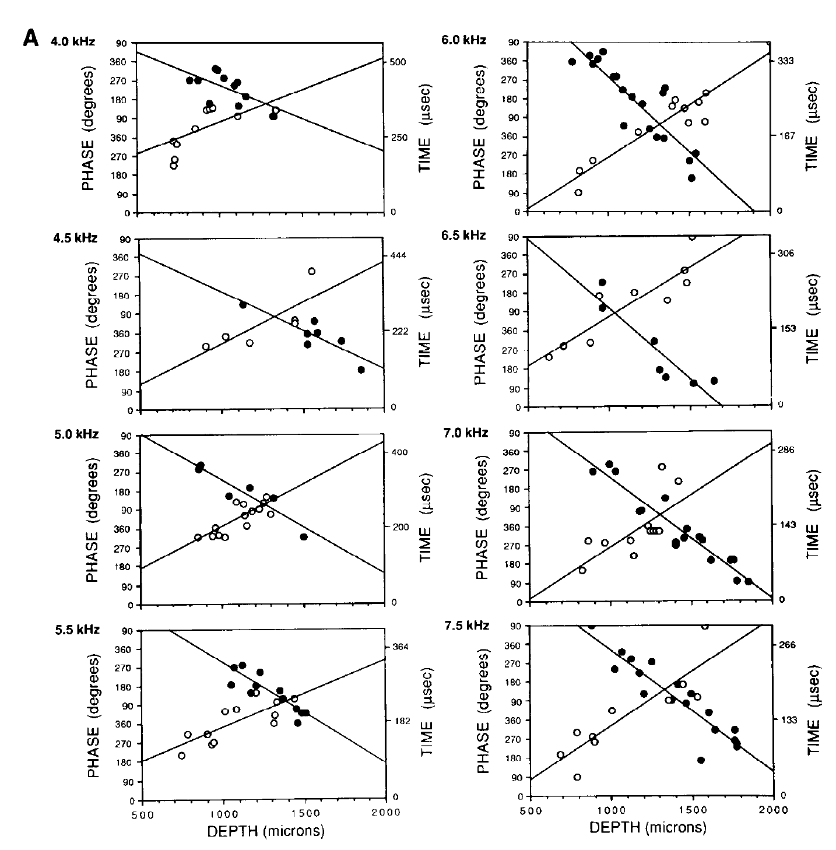
Opposed delay gradients support binaural coincidence
Within a common frequency region, Carr and Konishi found that ipsilateral afferent delay increased with recording depth while contralateral delay decreased. Intracellular recordings distinguished the two input populations during separate stimulation of the ears.
Across NL’s approximately 700-µm depth, conduction time changed by about 160 µs for frequencies between 4 and 7.5 kHz. Similar delay ranges across frequency channels support comparison of common external timing differences rather than unrelated phase preferences.
At a particular position, an external ITD can compensate for the difference in internal path delays. The two spike trains then arrive together. This spatially ordered compensation explains how a physical time difference can be represented by the location of strongly activated NL neurons.
Carr & Konishi (1990), Fig. 8(A). Opposed timing gradients in ipsilateral and contralateral afferents.
Carr & Konishi (1990)
17
Notes:
• Within a common frequency region, Carr and Konishi found that ipsilateral afferent delay increased with recording depth while contralateral delay decreased. Intracellular recordings distinguished the two input populations during separate stimulation of the ears.
– The original Figure 8A contains paired gradients from multiple penetrations. The plotted time axes preserve the authors’ conversion of phase to delay. A coincidence detector responds to arrival times after both external acoustic travel and internal neural conduction have contributed; changing either contribution can change the favored ITD.
• Across NL’s approximately 700-µm depth, conduction time changed by about 160 µs for frequencies between 4 and 7.5 kHz. Similar delay ranges across frequency channels support comparison of common external timing differences rather than unrelated phase preferences.
• At a particular position, an external ITD can compensate for the difference in internal path delays. The two spike trains then arrive together. This spatially ordered compensation explains how a physical time difference can be represented by the location of strongly activated NL neurons.
References:
Carr CE, Konishi M (1990). A circuit for detection of interaural time differences in the brain stem of the barn owl. The Journal of Neuroscience 10(10):3227-3246. https://doi.org/10.1523/jneurosci.10-10-03227.1990
Figure: Carr & Konishi (1990), Fig. 8(A). Opposed timing gradients in ipsilateral and contralateral afferents.
Figure source: https://doi.org/10.1523/jneurosci.10-10-03227.1990

Slide 25
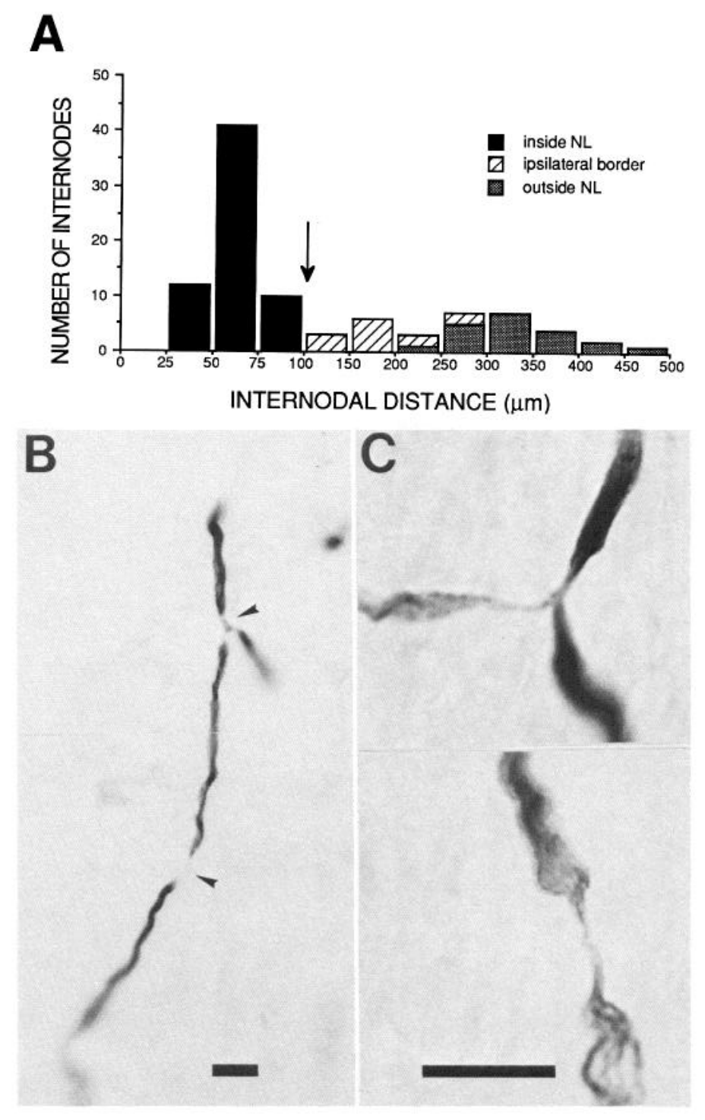
Short myelin internodes can contribute to slow conduction
A myelin internode is the insulated axonal segment between successive nodes where impulse propagation is renewed. Carr and Konishi measured internodal spacing in HRP-labeled NM axons inside and outside NL, comparing anatomy with physiological delay gradients.
Internodes within NL were about 60 µm long and more regularly spaced than many segments outside the nucleus. The physiological estimates placed local conduction velocity around 3–5 m/s. Published micrographs identify nodes at branch points and along axon segments.
The authors proposed that short internodes help regulate the slow propagation needed for delay lines. Internodal spacing of about 60 µm inside the nucleus and conduction velocities near 3 to 5 m/s are observations from anatomy and physiology that fit this proposal.
Carr & Konishi (1990), Fig. 10(A–C). Short myelin internodes within laminaris and labeled axons.
Carr & Konishi (1990)
18
Notes:
• A myelin internode is the insulated axonal segment between successive nodes where impulse propagation is renewed. Carr and Konishi measured internodal spacing in HRP-labeled NM axons inside and outside NL, comparing anatomy with physiological delay gradients.
– Nodes are interruptions of the myelin sheath, and nodal spacing is one anatomical contributor to impulse propagation. The experiment does not establish a particular sodium- or potassium-channel density at each node. Its interpretation combines measured axonal anatomy with measured conduction delays while keeping that mechanistic inference separate from direct intervention.
• Internodes within NL were about 60 µm long and more regularly spaced than many segments outside the nucleus. The physiological estimates placed local conduction velocity around 3–5 m/s. Published micrographs identify nodes at branch points and along axon segments.
• The authors proposed that short internodes help regulate the slow propagation needed for delay lines. Internodal spacing of about 60 µm inside the nucleus and conduction velocities near 3 to 5 m/s are observations from anatomy and physiology that fit this proposal.
References:
Carr CE, Konishi M (1990). A circuit for detection of interaural time differences in the brain stem of the barn owl. The Journal of Neuroscience 10(10):3227-3246. https://doi.org/10.1523/jneurosci.10-10-03227.1990
Figure: Carr & Konishi (1990), Fig. 10(A–C). Short myelin internodes within laminaris and labeled axons.
Figure source: https://doi.org/10.1523/jneurosci.10-10-03227.1990

Slide 26
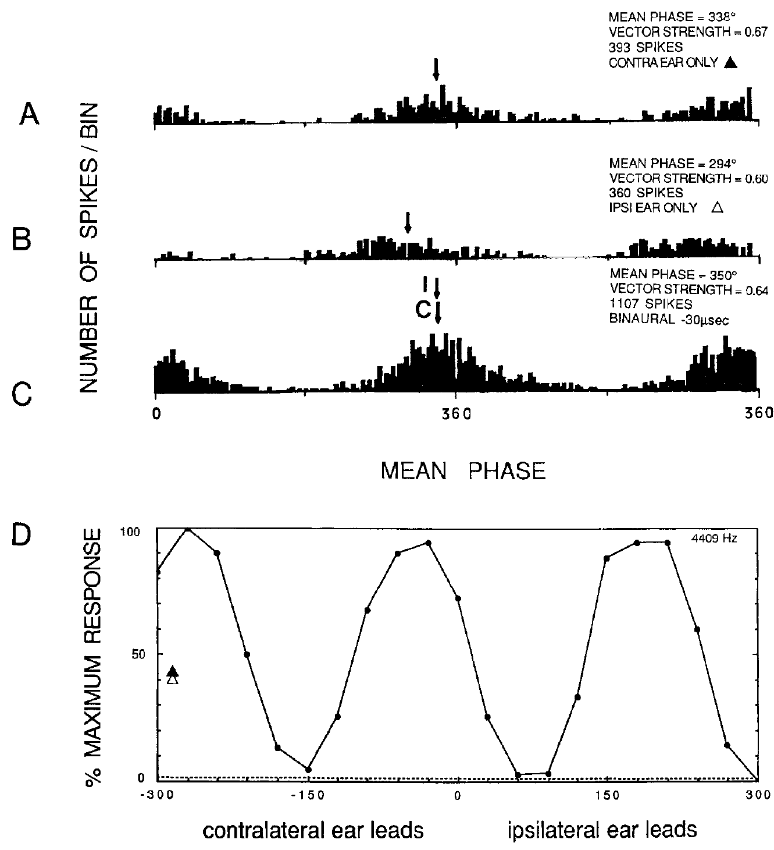
Laminaris detects bilateral spike coincidence
Coincidence detection is enhanced firing when two inputs arrive within a short interval. Carr and Konishi recorded NL neurons intracellularly, first stimulating each ear separately and then varying ITD during binaural stimulation.
For a neuron tested at 4409 Hz, monaural response phases were approximately 338° and 294°. A favorable delay of 30 µs, with the contralateral ear leading, increased the recorded response to 1107 spikes, compared with 393 and 360 for the separate-ear conditions.
The same neuron responded much less at unfavorable delays. The binaural enhancement therefore depended on relative timing rather than simply the presence of two sounds. Across the study, favorable binaural responses were roughly twice monaural responses, consistent with coincidence-sensitive integration.
Carr & Konishi (1990), Fig. 13(A–D). Monaural and binaural spikes in a coincidence-detecting neuron.
Carr & Konishi (1990)
19
Notes:
• Coincidence detection is enhanced firing when two inputs arrive within a short interval. Carr and Konishi recorded NL neurons intracellularly, first stimulating each ear separately and then varying ITD during binaural stimulation.
– The displayed totals come from the published stimulus-repetition protocol and are not firing rates in spikes per second. Separate-ear histograms supply a prediction of which delay aligns the inputs; the binaural delay curve tests that prediction. Intracellular recording avoids confusing the strong population field potential in NL with a single neuron’s spikes.
• For a neuron tested at 4409 Hz, monaural response phases were approximately 338° and 294°. A favorable delay of 30 µs, with the contralateral ear leading, increased the recorded response to 1107 spikes, compared with 393 and 360 for the separate-ear conditions.
• The same neuron responded much less at unfavorable delays. The binaural enhancement therefore depended on relative timing rather than simply the presence of two sounds. Across the study, favorable binaural responses were roughly twice monaural responses, consistent with coincidence-sensitive integration.
References:
Carr CE, Konishi M (1990). A circuit for detection of interaural time differences in the brain stem of the barn owl. The Journal of Neuroscience 10(10):3227-3246. https://doi.org/10.1523/jneurosci.10-10-03227.1990
Figure: Carr & Konishi (1990), Fig. 13(A–D). Monaural and binaural spikes in a coincidence-detecting neuron.
Figure source: https://doi.org/10.1523/jneurosci.10-10-03227.1990

Slide 27
Coincidence detectors fire when inputs arrive together
A coincidence detector responds strongly when two inputs arrive within a short interval and weakly when they arrive apart. Such a neuron signals simultaneity of its inputs. In the owl the two inputs come from the two ears through the delay-line axons of nucleus magnocellularis.
Carr and Konishi stimulated each ear separately and then varied ITD during binaural stimulation. At a favorable delay the response of one neuron rose to 1107 spikes, compared with 393 and 360 for the two separate-ear conditions. The recordings were made inside the nucleus laminaris with intracellular electrodes.
The binaural response was much larger than either monaural response, and unfavorable delays gave much smaller responses. The response therefore depended on the relative timing of the inputs from the two ears.
Carr & Konishi (1990), Fig. 13(A–D). Monaural and binaural spikes in a coincidence-detecting neuron.
Carr & Konishi (1990)
19a
Notes:
• A coincidence detector reports that two signals arrived at the same moment.
• Definition.
– Firing is enhanced when two inputs arrive within a short interval.
– Inputs that arrive apart give a smaller response.
• Procedure.
– Each ear was stimulated separately, and then ITD was varied during binaural stimulation.
– Recordings were intracellular.
• Example neuron.
– At a favorable delay of 30 microseconds the neuron fired 1107 spikes.
– Separate stimulation of each ear gave 393 and 360 spikes.
• Dependence on timing.
– The same neuron responded much less at unfavorable delays.
• Link to the delay line.
– Opposing delay gradients mean that an external ITD compensates the internal delay at one position, where the two inputs coincide.
• Intracellular recording.
– Recording inside the cell shows the response of an identified neuron to each ear separately and to both ears together.
• Across the study.
– Favorable binaural responses were roughly twice monaural responses.
– The enhancement fits coincidence-sensitive integration of input from the two ears.
References:
Carr CE, Konishi M (1990). A circuit for detection of interaural time differences in the brain stem of the barn owl. The Journal of Neuroscience 10(10):3227-3246. https://doi.org/10.1523/jneurosci.10-10-03227.1990

Slide 28
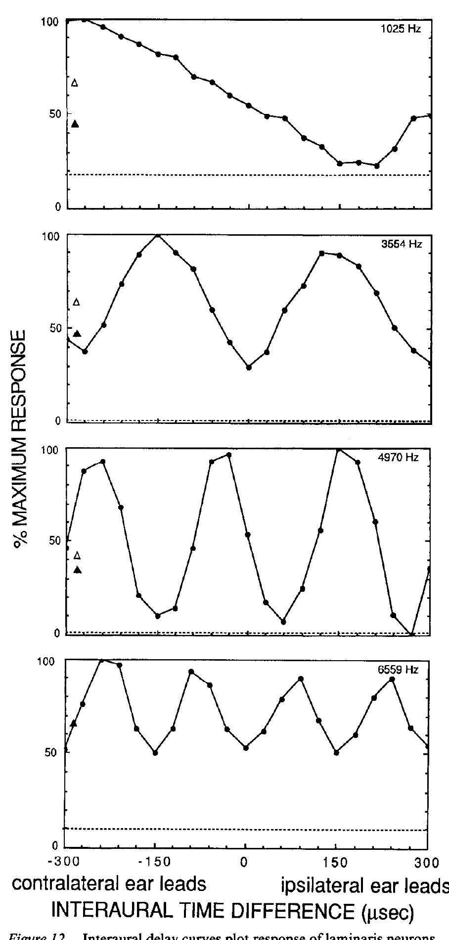
A narrow frequency channel represents time ambiguously
NL neurons receive frequency-selective, phase-locked inputs. With a tone, the same phase alignment recurs whenever the interaural delay changes by a whole stimulus period. Carr and Konishi measured periodic firing peaks across a range of imposed delays.
The delay curves differed in preferred timing and modulation depth, but their repeated maxima were consistent with the frequency of the stimulus. At 4 kHz, the 250-µs period gives repeated opportunities for alignment, including delays beyond the strongest peak near the physiological range.
Phase ambiguity is this inability of a single narrowband channel to identify one unique ITD from its firing rate. Precise coincidence detection and an unambiguous estimate of sound direction are different computations. Later integration must distinguish the true timing relation from repeated phase matches.
Carr & Konishi (1990), Fig. 12. Periodic interaural-delay response curves of laminaris neurons.
Carr & Konishi (1990)
20
Notes:
• NL neurons receive frequency-selective, phase-locked inputs. With a tone, the same phase alignment recurs whenever the interaural delay changes by a whole stimulus period. Carr and Konishi measured periodic firing peaks across a range of imposed delays.
– The original curves also preserve monaural response markers and spontaneous levels. Responses at unfavorable binaural timing could fall below the monaural level, so the entire curve cannot be explained by simple summation of two independent firing rates. Repeated response peaks reflect waveform periodicity rather than multiple real sound sources.
• The delay curves differed in preferred timing and modulation depth, but their repeated maxima were consistent with the frequency of the stimulus. At 4 kHz, the 250-µs period gives repeated opportunities for alignment, including delays beyond the strongest peak near the physiological range.
• Phase ambiguity is this inability of a single narrowband channel to identify one unique ITD from its firing rate. Precise coincidence detection and an unambiguous estimate of sound direction are different computations. Later integration must distinguish the true timing relation from repeated phase matches.
References:
Carr CE, Konishi M (1990). A circuit for detection of interaural time differences in the brain stem of the barn owl. The Journal of Neuroscience 10(10):3227-3246. https://doi.org/10.1523/jneurosci.10-10-03227.1990
Figure: Carr & Konishi (1990), Fig. 12. Periodic interaural-delay response curves of laminaris neurons.
Figure source: https://doi.org/10.1523/jneurosci.10-10-03227.1990

Slide 29
Periodic channels confuse delays one period apart
A narrowband channel is driven by a tone, which repeats every period. The same phase relationship between the two ears recurs whenever the interaural delay changes by one period of the tone. The firing rate of the neuron therefore peaks repeatedly as the delay changes.
At 4 kHz the period is 250 µs, so alignment recurs at delays separated by 250 µs. Carr and Konishi measured repeated firing maxima across a range of imposed delays, and the spacing of the maxima matched the stimulus frequency.
Phase ambiguity is the inability of one narrowband channel to identify a unique ITD from its firing rate. Information from other frequency channels, which have different periods, can identify the one delay that all channels share.
Carr & Konishi (1990), Fig. 12. Periodic interaural-delay response curves of laminaris neurons.
Carr & Konishi (1990)
20a
Notes:
• A single frequency channel cannot tell apart delays that differ by a whole number of periods.
• Periodic input.
– A tone repeats every period, so the same alignment between the ears occurs again after each period.
• Example.
– At 4 kilohertz the period is 250 microseconds.
– Alignment recurs at delays separated by 250 microseconds.
• Measurement.
– Firing was measured across a range of imposed delays.
– The repeated maxima had spacing consistent with the stimulus frequency.
• Ambiguity.
– A single narrowband channel cannot assign one unique ITD from its firing rate.
• Resolution.
– Channels at other frequencies have different periods, so only the true delay is shared by all of them.
• Delay curves.
– A delay curve plots firing against imposed interaural delay.
– Different neurons differed in preferred timing and in the depth of modulation.
• Beyond the physiological range.
– Repeated opportunities for alignment occur at delays beyond the strongest peak near the physiological range.
– The ambiguity belongs to the narrow frequency channel and not to the whole system.
References:
Carr CE, Konishi M (1990). A circuit for detection of interaural time differences in the brain stem of the barn owl. The Journal of Neuroscience 10(10):3227-3246. https://doi.org/10.1523/jneurosci.10-10-03227.1990

Slide 30
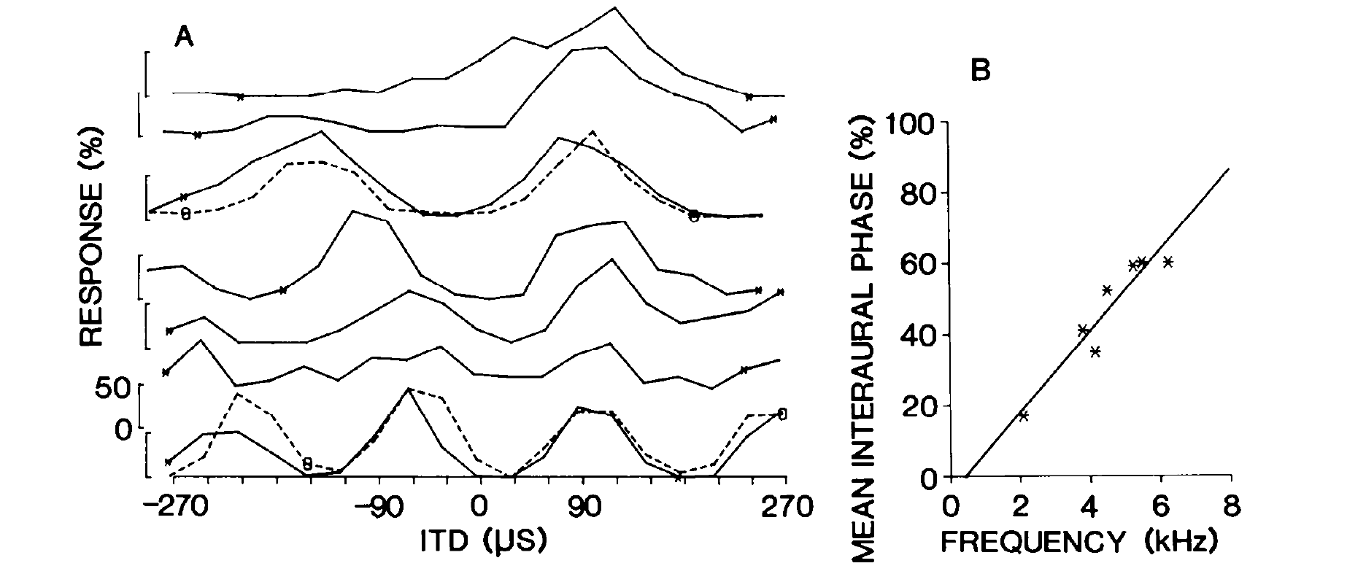
Collicular arrays conserve timing across frequency channels
Wagner, Takahashi, and Konishi recorded neurons while advancing an electrode through the central nucleus of the inferior colliculus, or ICC. Individual cells were narrowly frequency tuned and had periodic ITD response curves.
One penetration sampled best frequencies from approximately 2100 to 6700 Hz. Despite different peak spacings, its neurons shared an array-specific ITD at which their relative responses aligned. Mean interaural phase changed systematically with frequency across the array.
Wagner et al. (1987), Fig. 1(A–B). Frequency channels in one neuronal array share a timing preference.
An array is a group of neurons arranged across frequency laminae with a common timing relation. Convergence from such an array can supply a downstream neuron with agreement across frequencies at one delay, even when each contributing channel remains individually ambiguous.
Wagner et al. (1987)
21
Notes:
• Wagner, Takahashi, and Konishi recorded neurons while advancing an electrode through the central nucleus of the inferior colliculus, or ICC. Individual cells were narrowly frequency tuned and had periodic ITD response curves.
– The curves are normalized to each recording’s maximum, so alignment refers to relative response levels rather than identical absolute firing. The study compared single-unit and multi-unit recordings and found closely matching peak positions. A preferred phase for one frequency is insufficient to identify the array-specific ITD without the cross-frequency relation.
• One penetration sampled best frequencies from approximately 2100 to 6700 Hz. Despite different peak spacings, its neurons shared an array-specific ITD at which their relative responses aligned. Mean interaural phase changed systematically with frequency across the array.
• An array is a group of neurons arranged across frequency laminae with a common timing relation. Convergence from such an array can supply a downstream neuron with agreement across frequencies at one delay, even when each contributing channel remains individually ambiguous.
References:
Wagner H, Takahashi T, Konishi M (1987). Representation of interaural time difference in the central nucleus of the barn owl's inferior colliculus. The Journal of Neuroscience 7(10):3105-3116. https://doi.org/10.1523/jneurosci.07-10-03105.1987
Figure: Wagner et al. (1987), Fig. 1(A–B). Frequency channels in one neuronal array share a timing preference.
Figure source: https://doi.org/10.1523/jneurosci.07-10-03105.1987

Slide 31
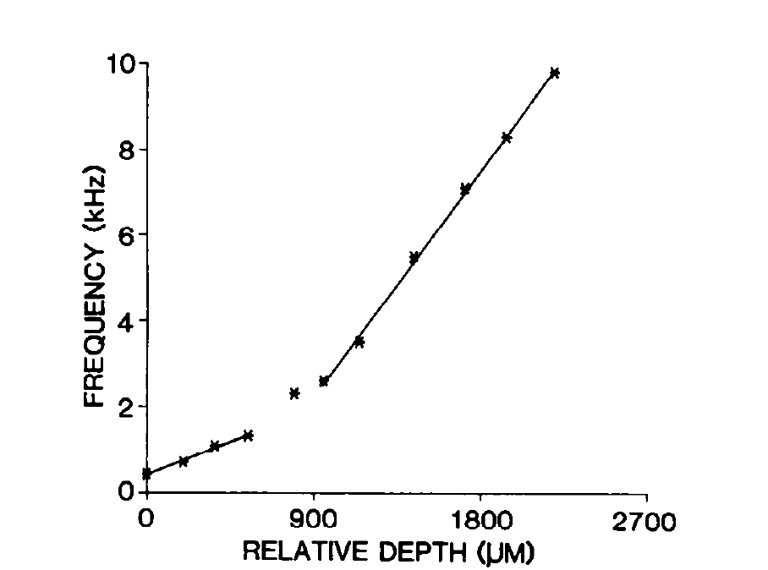
Frequency changes systematically along a collicular array
An isofrequency lamina is a sheet of neurons with similar frequency tuning. Wagner and colleagues used dorsoventral electrode penetrations through ICC to sample multiple laminae and establish the anatomical orientation of the physiological arrays.
In a representative penetration, best frequency rose monotonically with depth from approximately 500 Hz to 10 kHz. This organization provided the frequency diversity needed to test whether different channels share a common delay rather than merely a common preferred phase.
The recording trajectory crossed frequency laminae and sampled the tonotopic organization of the population. Connectivity to the external nucleus was established separately with tracer measurements.
Wagner et al. (1987), Fig. 4. Best frequency varies with depth through an array.
Wagner et al. (1987)
22
Notes:
• An isofrequency lamina is a sheet of neurons with similar frequency tuning. Wagner and colleagues used dorsoventral electrode penetrations through ICC to sample multiple laminae and establish the anatomical orientation of the physiological arrays.
– A shared delay produces different preferred phase values at different frequencies, because each waveform has a different period. Sampling a broad frequency range makes that relation testable. Electrode depth supplies an anatomical coordinate, while the measured frequency at each site provides the functional coordinate of the lamina.
• In a representative penetration, best frequency rose monotonically with depth from approximately 500 Hz to 10 kHz. This organization provided the frequency diversity needed to test whether different channels share a common delay rather than merely a common preferred phase.
• The recording trajectory crossed frequency laminae and sampled the tonotopic organization of the population. Connectivity to the external nucleus was established separately with tracer measurements.
References:
Wagner H, Takahashi T, Konishi M (1987). Representation of interaural time difference in the central nucleus of the barn owl's inferior colliculus. The Journal of Neuroscience 7(10):3105-3116. https://doi.org/10.1523/jneurosci.07-10-03105.1987
Figure: Wagner et al. (1987), Fig. 4. Best frequency varies with depth through an array.
Figure source: https://doi.org/10.1523/jneurosci.07-10-03105.1987

Slide 32
Isofrequency laminae stack frequency channels
An isofrequency lamina is a sheet of neurons with similar frequency tuning. Moving an electrode across laminae samples neurons with different best frequencies. Frequency tuning is the property that organizes the array.
Wagner and colleagues advanced electrodes dorsoventrally through the central nucleus of the inferior colliculus. In a representative penetration, best frequency rose from approximately 500 Hz to 10 kHz with depth. The recording sites were reconstructed histologically in the experiment.
A neuron in each lamina has its own period, so the array provides a range of frequencies for testing whether different channels share a common delay. The penetration samples the tonotopic order of the population. The tonotopic order is the basis on which the timing relation across frequency can then be compared.
Wagner et al. (1987), Fig. 4. Best frequency varies with depth through an array.
Wagner et al. (1987)
22a
Notes:
• The central nucleus of the inferior colliculus is organized in frequency layers.
• Laminae.
– An isofrequency lamina is a sheet of neurons with similar frequency tuning.
– Different laminae have different best frequencies.
• Penetrations.
– Electrodes were advanced dorsoventrally through the central nucleus.
– Reconstructed positions established the orientation of the arrays.
• Tonotopy.
– In a representative penetration best frequency rose monotonically from approximately 500 hertz to 10 kilohertz.
• Why frequency diversity matters.
– Each lamina has a different period, so testing across laminae asks whether channels share one delay.
– A shared preferred phase would not be enough.
• Sampling.
– The trajectory samples the population and does not follow a single neuron through every channel.
• Relation to arrays.
– The earlier slides described neurons that share a timing relation across frequency.
– An array is a group of neurons arranged across laminae with a common timing relation.
• Anatomical orientation.
– Seven penetrations were reconstructed histologically, which established the orientation of the arrays in the colliculus.
References:
Wagner H, Takahashi T, Konishi M (1987). Representation of interaural time difference in the central nucleus of the barn owl's inferior colliculus. The Journal of Neuroscience 7(10):3105-3116. https://doi.org/10.1523/jneurosci.07-10-03105.1987

Slide 33
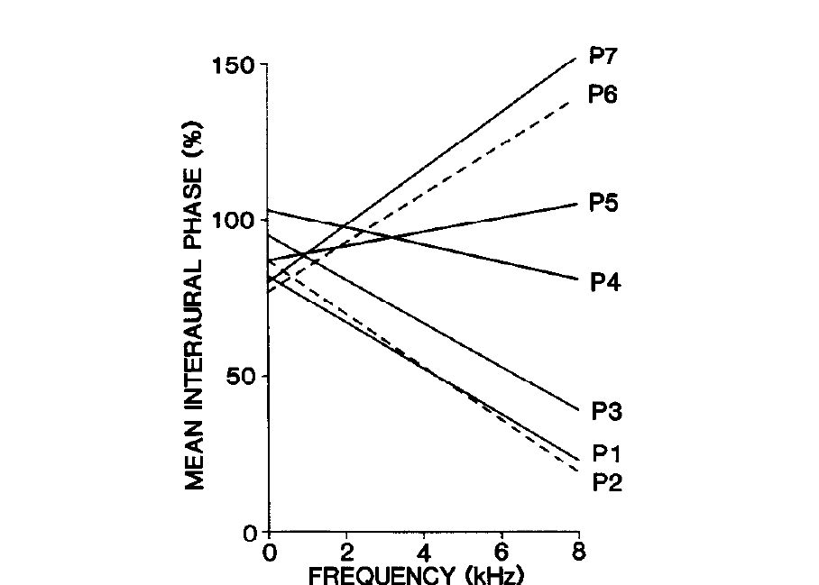
Array-specific delays form an ordered central-nucleus map
Wagner and colleagues compared ITD-frequency relations across seven penetrations whose positions were reconstructed histologically. Each penetration contained an array, but the slope of its phase-frequency relation differed from slopes in neighboring arrays.
Mean interaural phase was plotted against frequencies up to approximately 8 kHz. The different slopes identified different array-specific delays. Their orderly change across ICC established a map of timing preference superimposed on the frequency organization.
The representation is a map of a computed binaural timing variable distributed across frequency channels. ILD selectivity and broader integration produce the restricted spatial receptive fields of the external nucleus.
Wagner et al. (1987), Fig. 9. Systematic differences in array-specific timing across penetrations.
Wagner et al. (1987)
23
Notes:
• Wagner and colleagues compared ITD-frequency relations across seven penetrations whose positions were reconstructed histologically. Each penetration contained an array, but the slope of its phase-frequency relation differed from slopes in neighboring arrays.
– The characteristic delay is the delay associated with a frequency-dependent phase relation. The original authors distinguished a neuron exhibiting such a relation across tests from its ability to signal an unambiguous delay in a single narrowband response. Population organization can preserve the relation even when each cell’s rate curve repeats.
• Mean interaural phase was plotted against frequencies up to approximately 8 kHz. The different slopes identified different array-specific delays. Their orderly change across ICC established a map of timing preference superimposed on the frequency organization.
• The representation is a map of a computed binaural timing variable distributed across frequency channels. ILD selectivity and broader integration produce the restricted spatial receptive fields of the external nucleus.
References:
Wagner H, Takahashi T, Konishi M (1987). Representation of interaural time difference in the central nucleus of the barn owl's inferior colliculus. The Journal of Neuroscience 7(10):3105-3116. https://doi.org/10.1523/jneurosci.07-10-03105.1987
Figure: Wagner et al. (1987), Fig. 9. Systematic differences in array-specific timing across penetrations.
Figure source: https://doi.org/10.1523/jneurosci.07-10-03105.1987

Slide 34
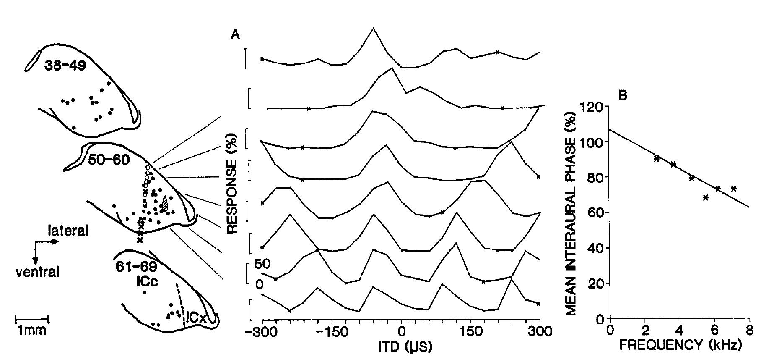
ICx receives inputs with matching timing preferences
The external nucleus of the inferior colliculus, or ICx, contains space-specific neurons. Wagner and colleagues recorded timing preference at an ICx site, injected HRP there, and located retrogradely labeled neurons in ICC.
Labeled somata occupied an array crossing frequency laminae. Nearby physiological measurements in ICC shared the timing preference measured at the injection site. The published example includes a −120-µs array-specific relation and a 1-mm anatomical scale bar.
Wagner et al. (1987), Fig. 6(A–B). Physiological timing preferences matched to retrogradely labeled arrays.
Retrograde tracing identifies neurons projecting toward the injection region. Matching tracer distribution with measured tuning supports convergence from an appropriate ICC array to a localized ICx region. The labeled cells lay in an array that crossed frequency laminae, as expected for convergence of different frequency channels onto one space-specific neuron.
Wagner et al. (1987)
24
Notes:
• The external nucleus of the inferior colliculus, or ICx, contains space-specific neurons. Wagner and colleagues recorded timing preference at an ICx site, injected HRP there, and located retrogradely labeled neurons in ICC.
– The experiment combines two independent kinds of evidence: physiological cue tuning and anatomical projection labeling. An injection region can encompass more than one cell, so the result concerns a restricted target region rather than a complete single-cell wiring diagram. The preserved original sections and response curves retain that distinction.
• Labeled somata occupied an array crossing frequency laminae. Nearby physiological measurements in ICC shared the timing preference measured at the injection site. The published example includes a −120-µs array-specific relation and a 1-mm anatomical scale bar.
• Retrograde tracing identifies neurons projecting toward the injection region. Matching tracer distribution with measured tuning supports convergence from an appropriate ICC array to a localized ICx region. The labeled cells lay in an array that crossed frequency laminae, as expected for convergence of different frequency channels onto one space-specific neuron.
References:
Wagner H, Takahashi T, Konishi M (1987). Representation of interaural time difference in the central nucleus of the barn owl's inferior colliculus. The Journal of Neuroscience 7(10):3105-3116. https://doi.org/10.1523/jneurosci.07-10-03105.1987
Figure: Wagner et al. (1987), Fig. 6(A–B). Physiological timing preferences matched to retrogradely labeled arrays.
Figure source: https://doi.org/10.1523/jneurosci.07-10-03105.1987

Slide 35
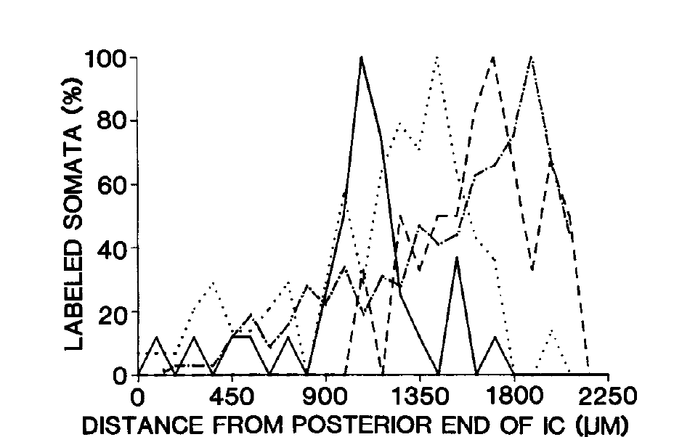
Projection position shifts with the target’s timing preference
Wagner and colleagues repeated retrograde labeling at ICx sites with different timing preferences. They counted labeled ICC somata as a function of distance from the posterior end of the colliculus, testing whether projection origins moved systematically.
The ICx injection sites preferred delays of 120, 90, and 60 µs with the contralateral ear leading, or 15 µs with the ipsilateral ear leading. The distributions of labeled cells shifted with these target preferences rather than remaining at one fixed ICC position.
The covariation supports an ordered transformation from an ICC timing map into the horizontal coordinate of the ICx space map. Cell-count distributions locate the populations that project to each target, and the distributions shifted with the timing preference of the target.
Wagner et al. (1987), Fig. 7. Projection position shifts with timing preference at the injection site.
Wagner et al. (1987)
25
Notes:
• Wagner and colleagues repeated retrograde labeling at ICx sites with different timing preferences. They counted labeled ICC somata as a function of distance from the posterior end of the colliculus, testing whether projection origins moved systematically.
– A target with a different preferred timing cue receives input from a differently positioned array. Frequency convergence can therefore preserve one timing relation while passing through the broad set of frequencies represented in that array. This anatomical selectivity is compatible with the physiological absence of strong phase ambiguity for broadband ICx stimulation.
• The ICx injection sites preferred delays of 120, 90, and 60 µs with the contralateral ear leading, or 15 µs with the ipsilateral ear leading. The distributions of labeled cells shifted with these target preferences rather than remaining at one fixed ICC position.
• The covariation supports an ordered transformation from an ICC timing map into the horizontal coordinate of the ICx space map. Cell-count distributions locate the populations that project to each target, and the distributions shifted with the timing preference of the target.
References:
Wagner H, Takahashi T, Konishi M (1987). Representation of interaural time difference in the central nucleus of the barn owl's inferior colliculus. The Journal of Neuroscience 7(10):3105-3116. https://doi.org/10.1523/jneurosci.07-10-03105.1987
Figure: Wagner et al. (1987), Fig. 7. Projection position shifts with timing preference at the injection site.
Figure source: https://doi.org/10.1523/jneurosci.07-10-03105.1987

Slide 36
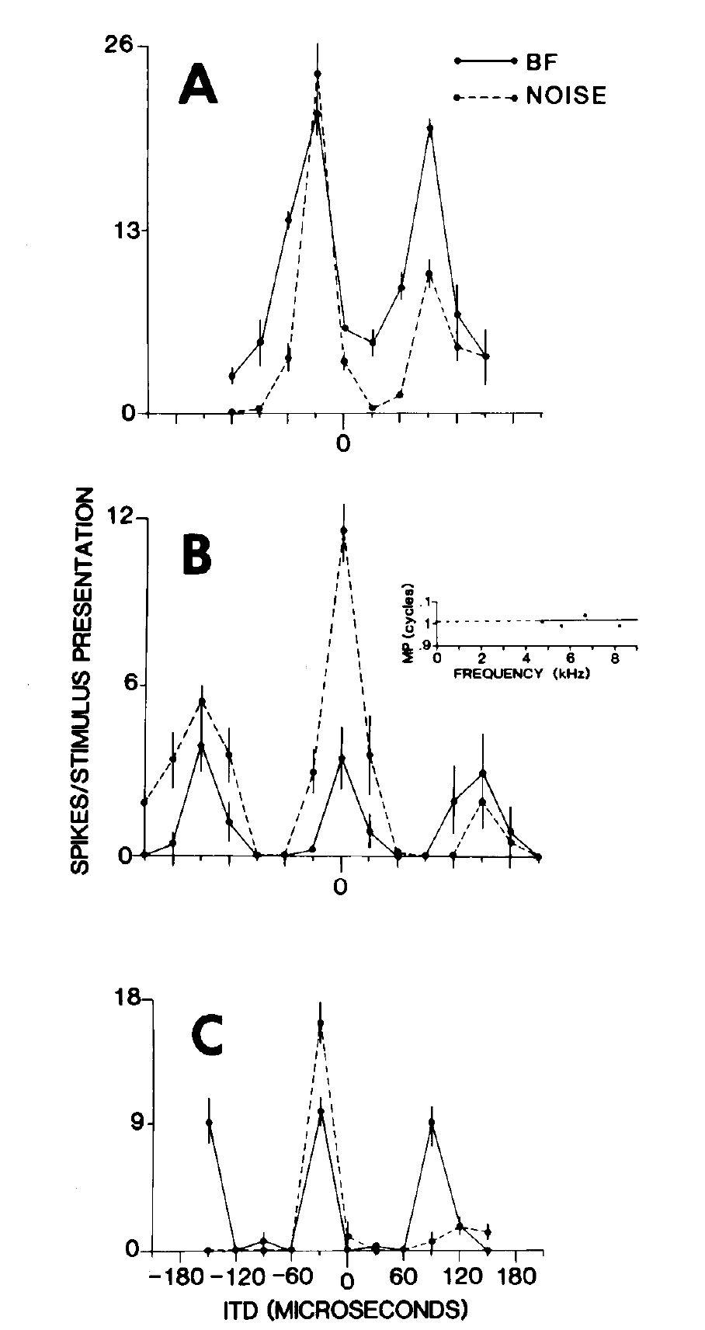
Broadband input suppresses repeated peaks in ICx
Takahashi and Konishi compared ICx delay curves evoked by a tone at the neuron’s best frequency with curves evoked by broadband noise. A tone contains a repeated cycle, whereas broadband noise supplies multiple frequency components with different periods.
Tonal stimulation commonly produced a principal peak and repeated secondary peaks. Noise greatly reduced the secondary responses while preserving the timing near the principal peak. The comparison was performed within the same neuron, holding recording site constant.
Cross-frequency agreement is strongest at the actual delay shared by the broadband components. Convergence across frequency channels therefore suppresses the repeated peaks that each narrowband channel produces, and the principal peak survives because all components agree on it.
Takahashi & Konishi (1986), Fig. 7(A–C). Broadband stimulation suppresses the secondary peaks present for tones.
Takahashi & Konishi (1986)
26
Notes:
• Takahashi and Konishi compared ICx delay curves evoked by a tone at the neuron’s best frequency with curves evoked by broadband noise. A tone contains a repeated cycle, whereas broadband noise supplies multiple frequency components with different periods.
– The best frequency describes the channel most effective for that neuron; broadband input recruits additional channels. The authors compared response levels for tones and noise because a weaker tone could otherwise create an apparent difference in selectivity merely by lowering firing. The neural output becomes less ambiguous when independent spectral components agree.
• Tonal stimulation commonly produced a principal peak and repeated secondary peaks. Noise greatly reduced the secondary responses while preserving the timing near the principal peak. The comparison was performed within the same neuron, holding recording site constant.
• Cross-frequency agreement is strongest at the actual delay shared by the broadband components. Convergence across frequency channels therefore suppresses the repeated peaks that each narrowband channel produces, and the principal peak survives because all components agree on it.
References:
Takahashi T, Konishi M (1986). Selectivity for interaural time difference in the owl's midbrain. The Journal of Neuroscience 6(12):3413-3422. https://doi.org/10.1523/jneurosci.06-12-03413.1986
Figure: Takahashi & Konishi (1986), Fig. 7(A–C). Broadband stimulation suppresses the secondary peaks present for tones.
Figure source: https://doi.org/10.1523/jneurosci.06-12-03413.1986

Slide 37
Broadband sounds contain many frequency periods
A tone contains a single period, whereas broadband noise contains many frequency components with different periods. Each component produces its own repeated pattern of delay matches. The comparison tests how a neuron treats a single frequency period relative to the combined periods of a broad sound.
Takahashi and Konishi compared ICx delay curves evoked by a best-frequency tone with curves evoked by broadband noise in the same neuron. Tones produced a principal peak and secondary peaks, and noise greatly reduced the secondary peaks.
Repeated peaks of different components fall at different delays and do not coincide, but the true delay is common to all components. Summing across frequency channels therefore reinforces the shared delay and diminishes the repeated matches. The principal peak is the one that all frequency components share.
Takahashi & Konishi (1986), Fig. 7(A–C). Broadband stimulation suppresses the secondary peaks present for tones.
Takahashi & Konishi (1986)
26a
Notes:
• Natural sounds are broadband, which helps remove the ambiguity of single channels.
• Tone and noise.
– A tone has one period, and broadband noise has many components with different periods.
• Same neuron.
– Recording the same ICx neuron with both stimuli holds the recording site constant.
• Result.
– Tones produced a principal peak with repeated secondary peaks.
– Noise greatly reduced the secondary peaks while keeping the timing near the principal peak.
• Reason.
– Secondary peaks of different components occur at different delays.
– The true delay is the one that every component shares.
• Convergence.
– Input from many frequency channels onto one neuron reinforces the shared delay.
• Same neuron comparison.
– Each neuron served as its own control, so differences between tone and noise belong to the stimulus and not to the sample of cells.
– The best-frequency tone was matched to the neuron.
• Ambiguity resolution.
– A tone gives a principal peak and secondary peaks.
– Broadband input keeps the principal peak and greatly weakens the secondary peaks.
References:
Takahashi T, Konishi M (1986). Selectivity for interaural time difference in the owl's midbrain. The Journal of Neuroscience 6(12):3413-3422. https://doi.org/10.1523/jneurosci.06-12-03413.1986

Slide 38
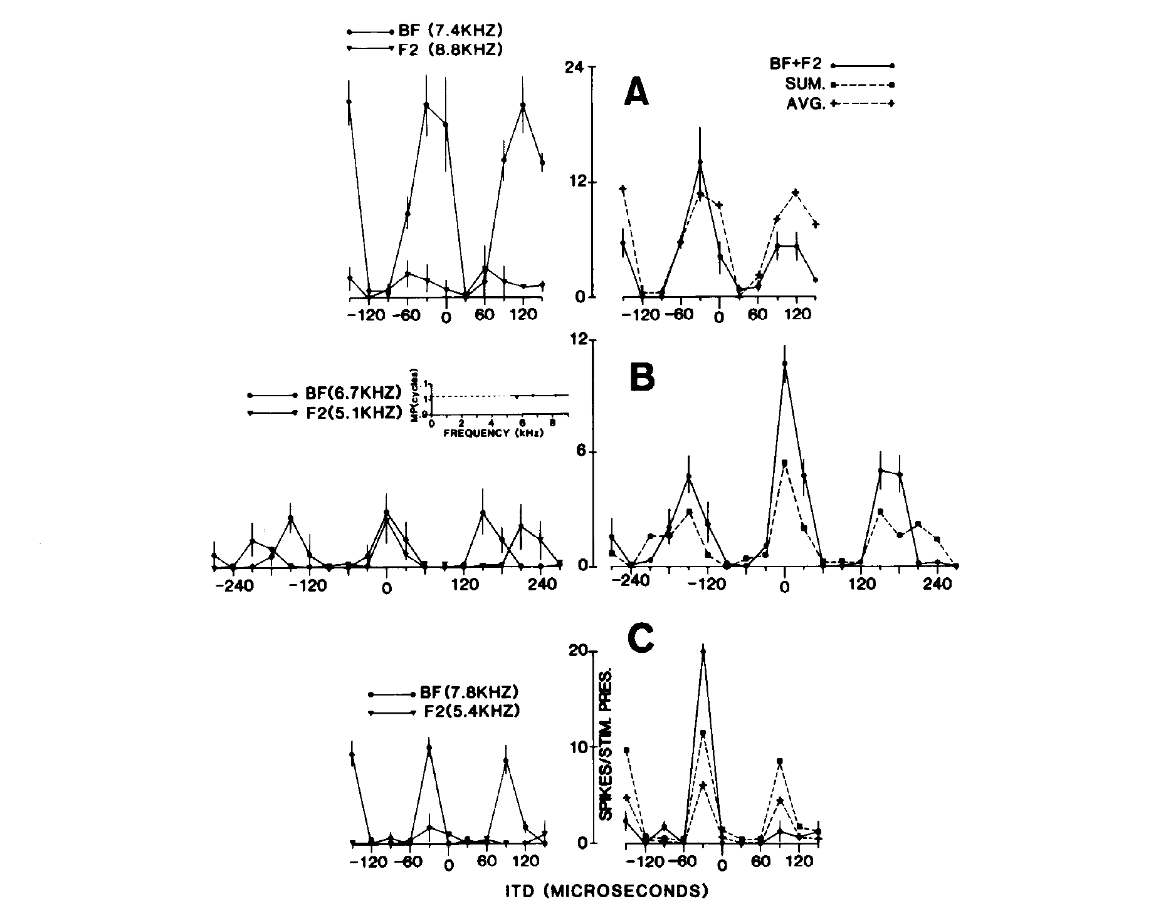
Two-tone stimulation tests cross-frequency convergence
Takahashi and Konishi presented two tones individually and together while varying ITD. The tones were selected within a neuron’s frequency-response range, permitting a controlled test of integration rather than comparing one tone with an unrestricted noise spectrum.
In the published examples, tones near 7 and 8 kHz generated differently spaced delay peaks. Their joint presentation favored the common principal delay and altered secondary responses. The combined response was compared with the responses to each component alone.
This preparation tests whether timing evidence from different frequency channels interacts at a space-specific neuron. The joint presentation favored the common principal delay, which supports a convergence mechanism, and the final selectivity can include inhibitory and spike-generation nonlinearities as well as excitatory agreement.
Takahashi & Konishi (1986), Fig. 9(A–C). Two-tone responses test convergence across frequency channels.
Takahashi & Konishi (1986)
27
Notes:
• Takahashi and Konishi presented two tones individually and together while varying ITD. The tones were selected within a neuron’s frequency-response range, permitting a controlled test of integration rather than comparing one tone with an unrestricted noise spectrum.
– Two tones share a true imposed interaural delay while their repeated phase matches occur at different delays. Component-only conditions supply the control needed to distinguish spectral integration from simply increasing the sound level. The source article analyzes how the joint response compares with the expected combination of the separate component responses.
• In the published examples, tones near 7 and 8 kHz generated differently spaced delay peaks. Their joint presentation favored the common principal delay and altered secondary responses. The combined response was compared with the responses to each component alone.
• This preparation tests whether timing evidence from different frequency channels interacts at a space-specific neuron. The joint presentation favored the common principal delay, which supports a convergence mechanism, and the final selectivity can include inhibitory and spike-generation nonlinearities as well as excitatory agreement.
References:
Takahashi T, Konishi M (1986). Selectivity for interaural time difference in the owl's midbrain. The Journal of Neuroscience 6(12):3413-3422. https://doi.org/10.1523/jneurosci.06-12-03413.1986
Figure: Takahashi & Konishi (1986), Fig. 9(A–C). Two-tone responses test convergence across frequency channels.
Figure source: https://doi.org/10.1523/jneurosci.06-12-03413.1986

Slide 39
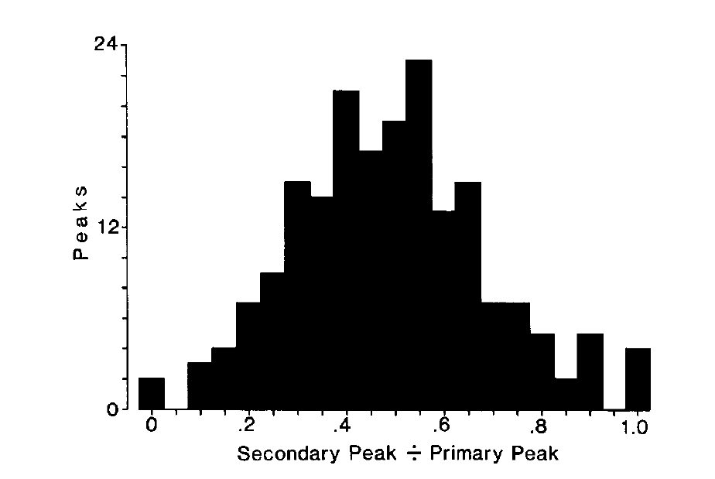
Secondary peaks are reduced rather than universally absent
Takahashi and Konishi quantified the strongest secondary response relative to the principal response during broadband stimulation. The secondary-to-primary peak ratio describes residual ambiguity, with a ratio near one indicating similarly strong competing peaks.
The published distribution spans approximately zero to one, with many neurons retaining a substantial but smaller secondary response. Broadband selectivity therefore varied across ICx cells rather than forming a perfectly uniform all-or-none solution.
Population firing, inhibitory sharpening, and output thresholds can reduce the impact of residual peaks. A low peak ratio indicates improved single-cell selectivity, and the ratios across the population measure how much ambiguity each ICx cell retains.
Takahashi & Konishi (1986), Fig. 6. Distribution of secondary-to-primary peak response ratios.
Takahashi & Konishi (1986)
28
Notes:
• Takahashi and Konishi quantified the strongest secondary response relative to the principal response during broadband stimulation. The secondary-to-primary peak ratio describes residual ambiguity, with a ratio near one indicating similarly strong competing peaks.
– The principal peak is identified by its relation to the neuron’s characteristic delay, while the secondary peak is a different local maximum. The ratio measures relative response within one neuron and should not be interpreted as a response rate. Neural suppression and behavioral disambiguation are related, but they require different experimental readouts.
• The published distribution spans approximately zero to one, with many neurons retaining a substantial but smaller secondary response. Broadband selectivity therefore varied across ICx cells rather than forming a perfectly uniform all-or-none solution.
• Population firing, inhibitory sharpening, and output thresholds can reduce the impact of residual peaks. A low peak ratio indicates improved single-cell selectivity, and the ratios across the population measure how much ambiguity each ICx cell retains.
References:
Takahashi T, Konishi M (1986). Selectivity for interaural time difference in the owl's midbrain. The Journal of Neuroscience 6(12):3413-3422. https://doi.org/10.1523/jneurosci.06-12-03413.1986
Figure: Takahashi & Konishi (1986), Fig. 6. Distribution of secondary-to-primary peak response ratios.
Figure source: https://doi.org/10.1523/jneurosci.06-12-03413.1986

Slide 40
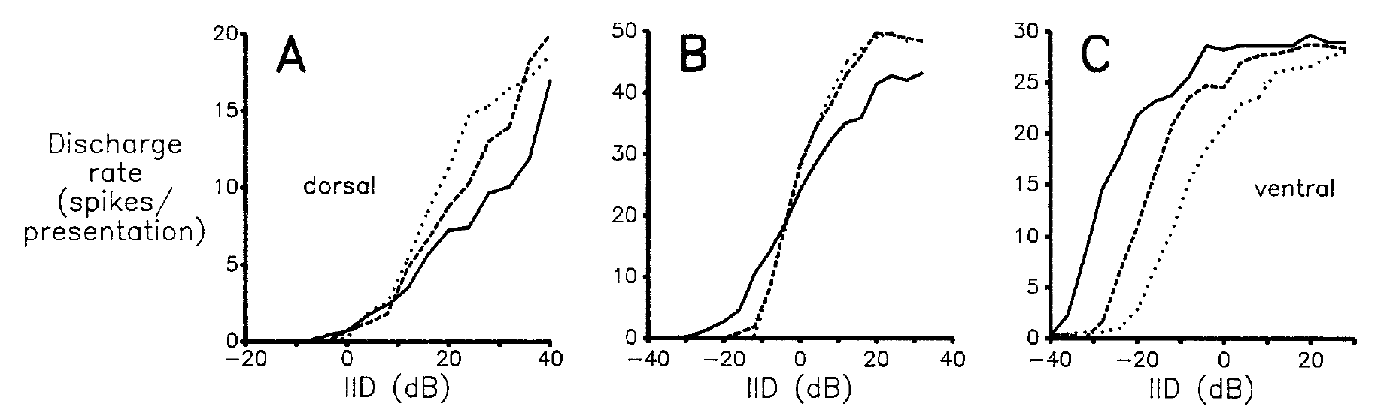
VLVp combines excitation from one ear with inhibition
VLVp, the posterior part of the ventral nucleus of the lateral lemniscus, is an early binaural station in the level pathway. Manley, Köppl, and Konishi recorded its responses while independently changing sound levels at the two ears.
Contralateral stimulation excited VLVp cells; ipsilateral stimulation inhibited them. Dorsal, intermediate, and ventral sites differed in inhibitory strength. The published examples include a strongly inhibited dorsal cell at 7.9 kHz and an intermediate cell with approximately 60% inhibition at 8.6 kHz.
Manley et al. (1988), Fig. 3(A–C). Level-difference functions at dorsal, intermediate, and ventral sites.
Varying ILD while holding average binaural level constant separated interaural balance from overall loudness. These largely monotonic response functions supply a graded code for level disparity. Sharply peaked ILD tuning emerges at later collicular stages from these graded inputs.
Manley et al. (1988)
29
Notes:
• VLVp, the posterior part of the ventral nucleus of the lateral lemniscus, is an early binaural station in the level pathway. Manley, Köppl, and Konishi recorded its responses while independently changing sound levels at the two ears.
– Monotonic means that response changes mainly in one direction as the cue increases across the tested range. The same binaural difference can be produced at several absolute levels, so testing multiple average levels assesses how robust the response is to source intensity. VLVp contributes an intermediate representation rather than a complete spatial receptive field.
• Contralateral stimulation excited VLVp cells; ipsilateral stimulation inhibited them. Dorsal, intermediate, and ventral sites differed in inhibitory strength. The published examples include a strongly inhibited dorsal cell at 7.9 kHz and an intermediate cell with approximately 60% inhibition at 8.6 kHz.
• Varying ILD while holding average binaural level constant separated interaural balance from overall loudness. These largely monotonic response functions supply a graded code for level disparity. Sharply peaked ILD tuning emerges at later collicular stages from these graded inputs.
References:
Manley GA, Köppl C, Konishi M (1988). A neural map of interaural intensity differences in the brain stem of the barn owl. The Journal of Neuroscience 8(8):2665-2676. https://doi.org/10.1523/jneurosci.08-08-02665.1988
Figure: Manley et al. (1988), Fig. 3(A–C). Level-difference functions at dorsal, intermediate, and ventral sites.
Figure source: https://doi.org/10.1523/jneurosci.08-08-02665.1988

Slide 41
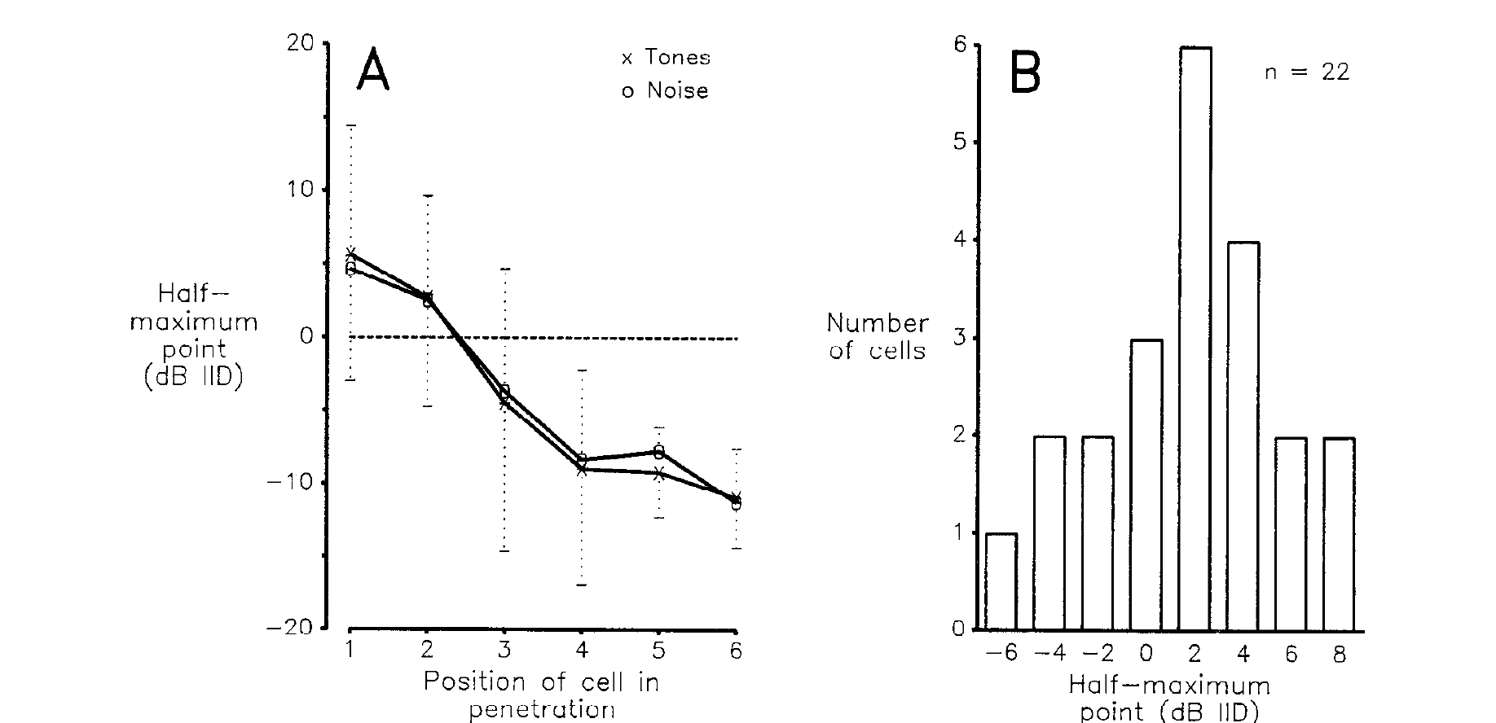
VLVp level thresholds are ordered dorsoventrally
Manley and colleagues described a VLVp response by its half-maximum point, the ILD at which firing reaches half of the response maximum. Sequential recording sites within a penetration were compared to test for an anatomical order of this response criterion.
Dorsal sites had more contralaterally biased half-maximum points; progressively ventral sites shifted toward ipsilateral values. Some cells changed their half-maximum point by 2 dB or less when average binaural level rose by 10 dB, providing a measure of level stability.
Manley et al. (1988), Fig. 4(A–B). Dorsoventral ordering and level-stable half-maximum points.
This is an ordered map of response thresholds along a binaural level axis. It differs from a spatial map of receptive-field centers. A half-maximum point can be well defined for a monotonic curve even when the neuron has no sharply bounded preferred ILD.
Manley et al. (1988)
30
Notes:
• Manley and colleagues described a VLVp response by its half-maximum point, the ILD at which firing reaches half of the response maximum. Sequential recording sites within a penetration were compared to test for an anatomical order of this response criterion.
– Average binaural level is the mean of the two ear levels expressed in decibels in this experiment. Opposite changes at the ears vary ILD while preserving that average. The authors grouped cells by their relative position within each penetration, so the ordering is a physiological-anatomical relation rather than a measurement of external elevation in degrees.
• Dorsal sites had more contralaterally biased half-maximum points; progressively ventral sites shifted toward ipsilateral values. Some cells changed their half-maximum point by 2 dB or less when average binaural level rose by 10 dB, providing a measure of level stability.
• This is an ordered map of response thresholds along a binaural level axis. It differs from a spatial map of receptive-field centers. A half-maximum point can be well defined for a monotonic curve even when the neuron has no sharply bounded preferred ILD.
References:
Manley GA, Köppl C, Konishi M (1988). A neural map of interaural intensity differences in the brain stem of the barn owl. The Journal of Neuroscience 8(8):2665-2676. https://doi.org/10.1523/jneurosci.08-08-02665.1988
Figure: Manley et al. (1988), Fig. 4(A–B). Dorsoventral ordering and level-stable half-maximum points.
Figure source: https://doi.org/10.1523/jneurosci.08-08-02665.1988

Slide 42
Half-maximum ILD summarizes a monotonic level curve
A monotonic response keeps rising or keeps falling as a stimulus parameter increases. When the parameter is the interaural level difference, the curve has no peak, so a summary other than a preferred value is needed.
Manley and colleagues described each VLVp response by its half-maximum point, the ILD at which firing reaches half of its maximum. Dorsal sites had more contralaterally biased half-maximum points, and ventral sites shifted toward ipsilateral values.
Manley et al. (1988), Fig. 4(A–B). Dorsoventral ordering and level-stable half-maximum points.
The half-maximum point is therefore a position along the binaural level axis, and it varies in an orderly way with recording position. Some cells changed their half-maximum point by 2 dB or less when average binaural level rose by 10 dB.
Manley et al. (1988)
30a
Notes:
• A curve without a peak can still be summarized by a single criterion point.
• Monotonic curves.
– A monotonic response keeps rising or falling with the stimulus parameter.
– VLVp responses to interaural level difference were largely of this type.
• Half-maximum point.
– The half-maximum point is the ILD at which firing reaches half of its maximum.
– It marks where along the level axis the response changes.
• Anatomical order.
– Dorsal sites had more contralaterally biased half-maximum points.
– Ventral sites shifted toward ipsilateral values.
• Level stability.
– Some cells changed their half-maximum point by 2 decibels or less when average binaural level rose by 10 decibels.
• Comparison with spatial maps.
– The ordering concerns response thresholds on a level axis and differs from a map of receptive-field centers.
• Sequential sites.
– Sequential recording sites within a penetration were compared to test for an anatomical order.
– The ordered criterion is the result.
• Comparison with direction.
– The map is an ordering of thresholds along a level axis and is not a map of locations in space.
References:
Manley GA, Köppl C, Konishi M (1988). A neural map of interaural intensity differences in the brain stem of the barn owl. The Journal of Neuroscience 8(8):2665-2676. https://doi.org/10.1523/jneurosci.08-08-02665.1988

Slide 43
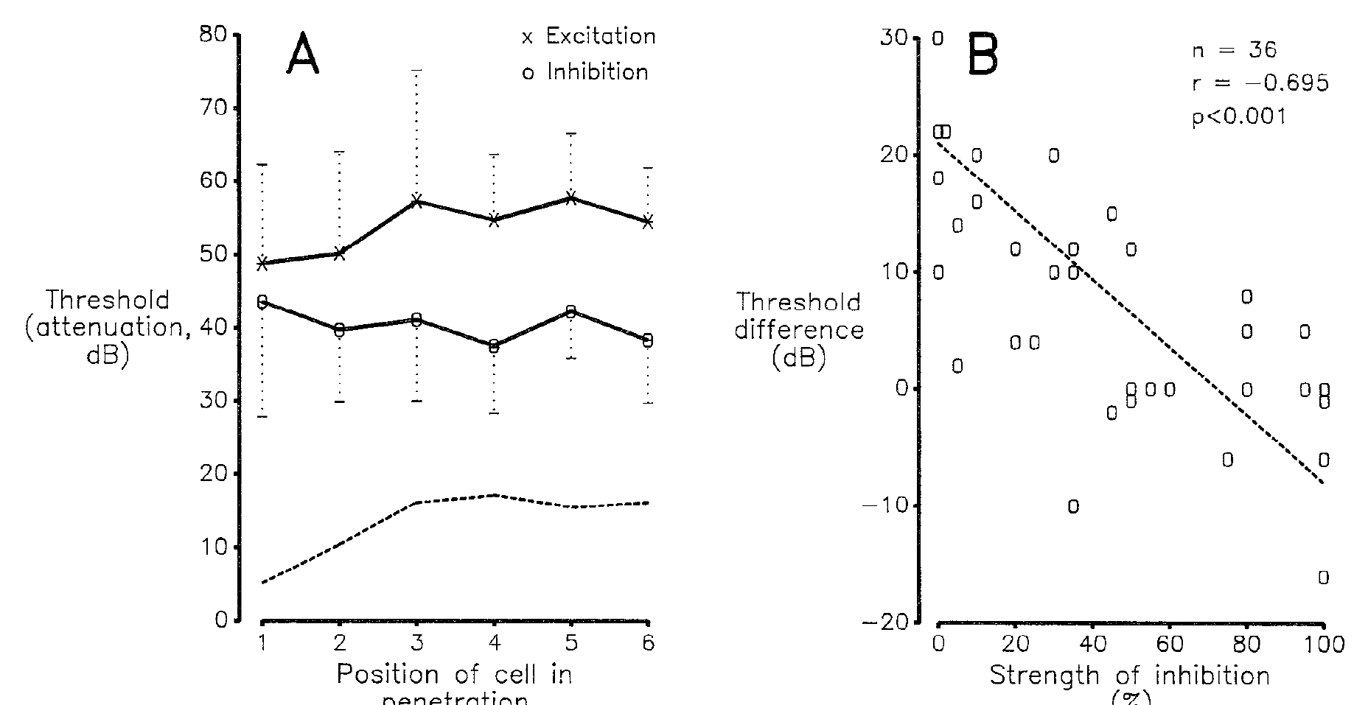
Excitatory and inhibitory thresholds shape level sensitivity
Manley and colleagues measured monaural excitatory and inhibitory thresholds in VLVp. Inhibition was assessed against an established discharge produced by contralateral stimulation, allowing reductions in spikes to be measured rather than requiring a cell to fire below zero.
The difference between excitatory and inhibitory thresholds covaried with the strength of inhibition. Threshold relationships and ILD half-maximum points changed along the dorsoventral recording sequence. The interaction, rather than one ear’s absolute sensitivity alone, shaped the binaural response.
Manley et al. (1988), Fig. 6(A–B). Excitatory and inhibitory thresholds vary with position and inhibition.
This physiology supports an excitation-inhibition comparison as the basis of level sensitivity. Later pharmacological experiments tested the contribution of GABAergic inhibition and the effects of manipulating the two VLVp populations independently.
Manley et al. (1988)
31
Notes:
• Manley and colleagues measured monaural excitatory and inhibitory thresholds in VLVp. Inhibition was assessed against an established discharge produced by contralateral stimulation, allowing reductions in spikes to be measured rather than requiring a cell to fire below zero.
– An inhibitory threshold is meaningful only when activity is available to suppress. Background excitation supplies that activity, so an apparent absence of spikes is not mistaken for proof that an inhibitory input is absent. The difference between the thresholds determines when inhibition begins relative to the growth of excitatory firing.
• The difference between excitatory and inhibitory thresholds covaried with the strength of inhibition. Threshold relationships and ILD half-maximum points changed along the dorsoventral recording sequence. The interaction, rather than one ear’s absolute sensitivity alone, shaped the binaural response.
• This physiology supports an excitation-inhibition comparison as the basis of level sensitivity. Later pharmacological experiments tested the contribution of GABAergic inhibition and the effects of manipulating the two VLVp populations independently.
References:
Manley GA, Köppl C, Konishi M (1988). A neural map of interaural intensity differences in the brain stem of the barn owl. The Journal of Neuroscience 8(8):2665-2676. https://doi.org/10.1523/jneurosci.08-08-02665.1988
Figure: Manley et al. (1988), Fig. 6(A–B). Excitatory and inhibitory thresholds vary with position and inhibition.
Figure source: https://doi.org/10.1523/jneurosci.08-08-02665.1988

Slide 44
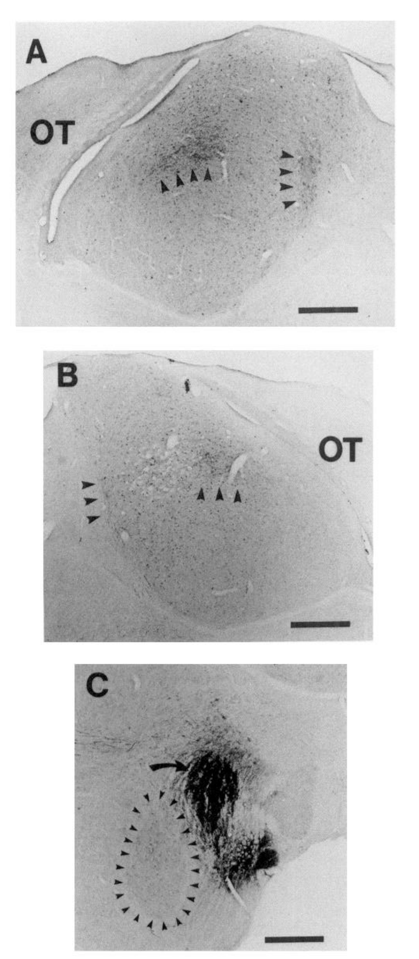
Both VLVp populations project to collicular level circuits
Adolphs injected PHA-L, an anterograde tract tracer, into VLVp and examined labeled terminals in the inferior colliculus. Anterograde tracing follows projections away from the injected neuronal population toward its targets.
Label appeared in the lateral shell of ICC on both sides of the brain. The published tissue sections include the VLVp injection site and 500-µm scale bars. The injection was anatomically separated from the adjacent anterior subdivision, VLVa, in the illustrated preparation.
Bilateral connectivity gives the colliculus access to two differently biased level signals. Functional manipulations and receptor-sensitive interventions establish the signs and consequences of the connections that the tracer labeling reveals.
Adolphs (1993), Fig. 2(A–C). Tracer labeling of bilateral collicular projections and the VLVp injection site.
Adolphs (1993)
32
Notes:
• Adolphs injected PHA-L, an anterograde tract tracer, into VLVp and examined labeled terminals in the inferior colliculus. Anterograde tracing follows projections away from the injected neuronal population toward its targets.
– The lateral shell is a subdivision of the central inferior colliculus that supplies input to the spatial map. Anatomical localization prevents a timing-pathway injection from being misclassified as a level-pathway experiment. The source photographs preserve the labeled terminals, injection region, and scale bars needed to evaluate that localization.
• Label appeared in the lateral shell of ICC on both sides of the brain. The published tissue sections include the VLVp injection site and 500-µm scale bars. The injection was anatomically separated from the adjacent anterior subdivision, VLVa, in the illustrated preparation.
• Bilateral connectivity gives the colliculus access to two differently biased level signals. Functional manipulations and receptor-sensitive interventions establish the signs and consequences of the connections that the tracer labeling reveals.
References:
Adolphs R (1993). Bilateral inhibition generates neuronal responses tuned to interaural level differences in the auditory brainstem of the barn owl. The Journal of Neuroscience 13(9):3647-3668. https://doi.org/10.1523/jneurosci.13-09-03647.1993
Figure: Adolphs (1993), Fig. 2(A–C). Tracer labeling of bilateral collicular projections and the VLVp injection site.
Figure source: https://doi.org/10.1523/jneurosci.13-09-03647.1993

Slide 45
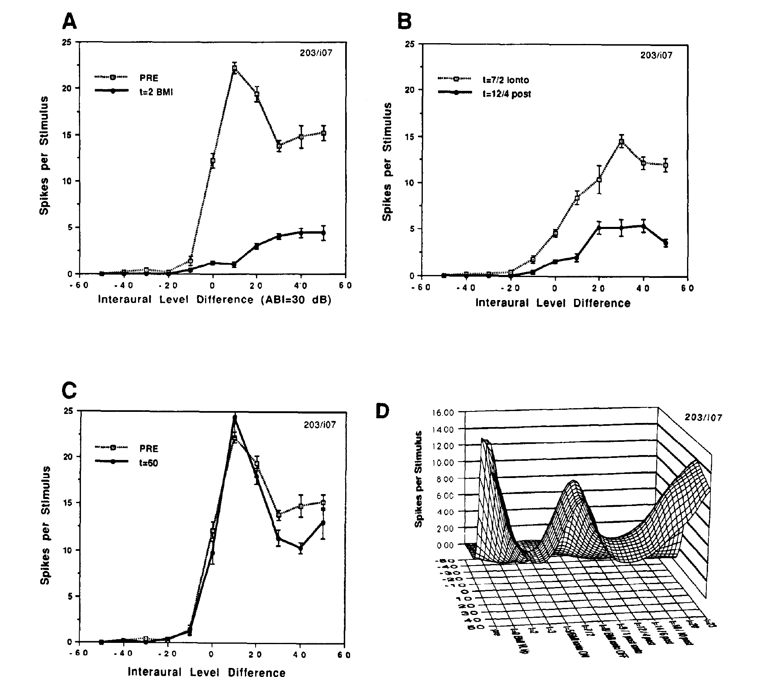
Increasing VLVp activity can suppress collicular responses
Adolphs manipulated VLVp while recording an ICC lateral-shell neuron. GABA, gamma-aminobutyric acid, is an inhibitory transmitter; bicuculline methiodide, or BMI, blocks GABA-A receptors. Blocking inhibition within VLVp can increase the activity sent to its targets.
In the published experiment, a 0.5-µL BMI injection into contralateral VLVp nearly eliminated the lateral-shell response. Responses were measured before injection, 2 and 7 minutes afterward, and during recovery. The response returned toward its original ILD dependence by about 60 minutes.
The remote reduction supports an inhibitory influence from that VLVp population onto the collicular circuit. Blocking an inhibitory receptor upstream can decrease downstream firing by disinhibiting an inhibitory projection. Recovery of the original ILD dependence indicates a reversible, local manipulation of the VLVp population.
Adolphs (1993), Fig. 11(A–D). Increasing contralateral VLVp activity suppresses lateral-shell responses.
Adolphs (1993)
33
Notes:
• Adolphs manipulated VLVp while recording an ICC lateral-shell neuron. GABA, gamma-aminobutyric acid, is an inhibitory transmitter; bicuculline methiodide, or BMI, blocks GABA-A receptors. Blocking inhibition within VLVp can increase the activity sent to its targets.
– Disinhibition means increased activity after an inhibitory influence is removed. The sign of a drug’s effect at its injection site need not match the sign of the effect at a distant recording site. Reversible changes and the time course of recovery help distinguish acute circuit modulation from irreversible tissue damage.
• In the published experiment, a 0.5-µL BMI injection into contralateral VLVp nearly eliminated the lateral-shell response. Responses were measured before injection, 2 and 7 minutes afterward, and during recovery. The response returned toward its original ILD dependence by about 60 minutes.
• The remote reduction supports an inhibitory influence from that VLVp population onto the collicular circuit. Blocking an inhibitory receptor upstream can decrease downstream firing by disinhibiting an inhibitory projection. Recovery of the original ILD dependence indicates a reversible, local manipulation of the VLVp population.
References:
Adolphs R (1993). Bilateral inhibition generates neuronal responses tuned to interaural level differences in the auditory brainstem of the barn owl. The Journal of Neuroscience 13(9):3647-3668. https://doi.org/10.1523/jneurosci.13-09-03647.1993
Figure: Adolphs (1993), Fig. 11(A–D). Increasing contralateral VLVp activity suppresses lateral-shell responses.
Figure source: https://doi.org/10.1523/jneurosci.13-09-03647.1993

Slide 46
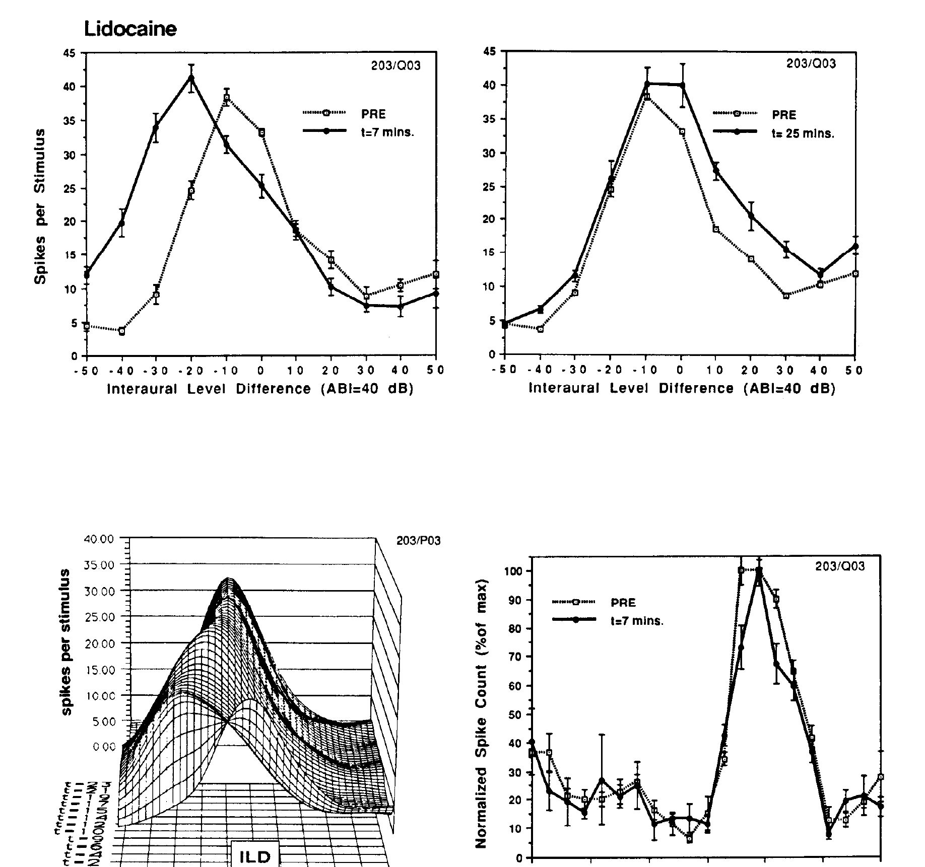
Reversible VLVp inactivation selectively changes ILD tuning
Adolphs injected lidocaine into one VLVp and recorded a neuron in contralateral ICx. The earphone stimulus remained controlled while ILD and ITD response curves were tested separately, providing a comparison of level and timing effects in the same downstream cell.
At approximately 7 minutes after injection, responses at large ipsilateral ILDs increased and the ILD peak shifted. The original response recovered by about 25 minutes. The neuron’s ITD curve remained nearly unchanged during the same manipulation.
The result supports an inhibitory level signal that normally limits responses on one side of the ILD range. Removing that signal broadens or shifts level tuning while sparing the timing preference. The unchanged ITD tuning during the same manipulation indicates that the effect is specific to level processing.
Adolphs (1993), Fig. 12. Reversible VLVp inactivation alters ILD tuning while sparing ITD tuning.
Adolphs (1993)
34
Notes:
• Adolphs injected lidocaine into one VLVp and recorded a neuron in contralateral ICx. The earphone stimulus remained controlled while ILD and ITD response curves were tested separately, providing a comparison of level and timing effects in the same downstream cell.
– The intact ITD response is a within-cell control against a general loss of auditory responsiveness. Recovery supplies an additional control against permanent damage. The experiment links a brainstem population to a particular dimension of an ICx receptive field, without equating drug-induced tuning shifts with the owl’s immediate orienting behavior.
• At approximately 7 minutes after injection, responses at large ipsilateral ILDs increased and the ILD peak shifted. The original response recovered by about 25 minutes. The neuron’s ITD curve remained nearly unchanged during the same manipulation.
• The result supports an inhibitory level signal that normally limits responses on one side of the ILD range. Removing that signal broadens or shifts level tuning while sparing the timing preference. The unchanged ITD tuning during the same manipulation indicates that the effect is specific to level processing.
References:
Adolphs R (1993). Bilateral inhibition generates neuronal responses tuned to interaural level differences in the auditory brainstem of the barn owl. The Journal of Neuroscience 13(9):3647-3668. https://doi.org/10.1523/jneurosci.13-09-03647.1993
Figure: Adolphs (1993), Fig. 12. Reversible VLVp inactivation alters ILD tuning while sparing ITD tuning.
Figure source: https://doi.org/10.1523/jneurosci.13-09-03647.1993

Slide 47
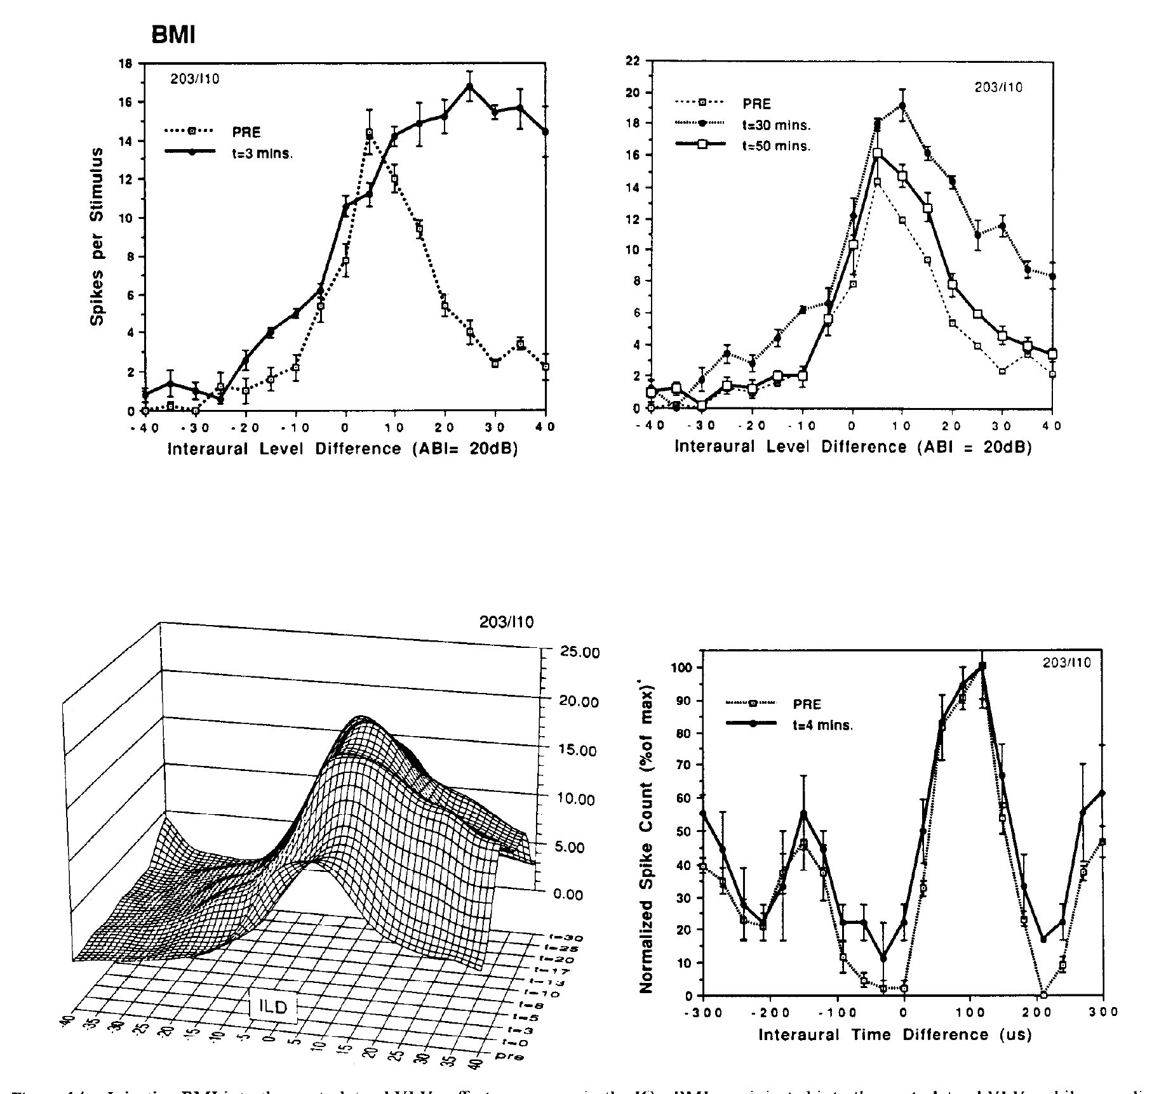
Opposing inhibitory influences can create a level peak
A sharply peaked ILD curve requires reduced firing on both sides of its preferred range. Adolphs tested whether the two VLVp populations supply opposing inhibitory influences by increasing activity in one population with local BMI injection.
At about 3 minutes, ICx responses decreased at large ipsilateral ILDs, opposite to the effect of inactivating that VLVp. The ILD response recovered toward its baseline over approximately 50 minutes. The ITD response measured during the experiment remained stable.
Combined anatomical and manipulation evidence supports bilateral inhibition as a mechanism for peaked collicular level tuning. The circuit transforms two graded, differently biased inputs into a restricted response range. Inactivating one VLVp and increasing the activity of the same population produced opposite changes at large ipsilateral ILDs, which fits opposing inhibitory influences from the two populations.
Adolphs (1993), Fig. 14. VLVp disinhibition changes ILD selectivity and preserves ITD responses.
Adolphs (1993)
35
Notes:
• A sharply peaked ILD curve requires reduced firing on both sides of its preferred range. Adolphs tested whether the two VLVp populations supply opposing inhibitory influences by increasing activity in one population with local BMI injection.
– The original study used complementary increases and decreases of VLVp activity, rather than relying on a single drug condition. Opposite physiological effects strengthen the interpretation that level tuning depends on the upstream population. Preserved timing sensitivity limits the effect to the level-processing contribution under the tested stimulus conditions.
• At about 3 minutes, ICx responses decreased at large ipsilateral ILDs, opposite to the effect of inactivating that VLVp. The ILD response recovered toward its baseline over approximately 50 minutes. The ITD response measured during the experiment remained stable.
• Combined anatomical and manipulation evidence supports bilateral inhibition as a mechanism for peaked collicular level tuning. The circuit transforms two graded, differently biased inputs into a restricted response range. Inactivating one VLVp and increasing the activity of the same population produced opposite changes at large ipsilateral ILDs, which fits opposing inhibitory influences from the two populations.
References:
Adolphs R (1993). Bilateral inhibition generates neuronal responses tuned to interaural level differences in the auditory brainstem of the barn owl. The Journal of Neuroscience 13(9):3647-3668. https://doi.org/10.1523/jneurosci.13-09-03647.1993
Figure: Adolphs (1993), Fig. 14. VLVp disinhibition changes ILD selectivity and preserves ITD responses.
Figure source: https://doi.org/10.1523/jneurosci.13-09-03647.1993

Slide 48
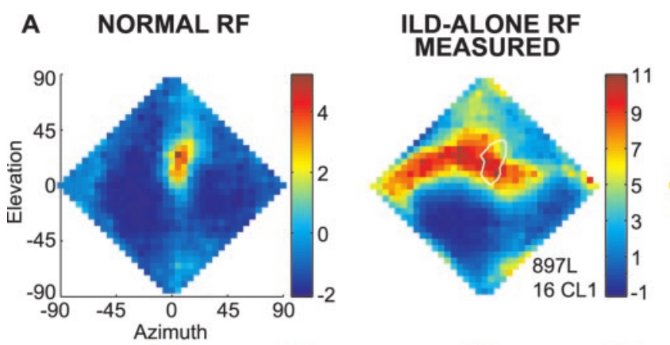
An ILD spectrum contributes to the vertical receptive field
An ILD spectrum is the set of level differences across acoustic frequencies at one sound direction. Euston and Takahashi measured head-related transfer functions and used them to deliver virtual sources through earphones, preserving frequency-dependent acoustic filtering.
For 100-ms stimuli, they compared normal receptive fields with ILD-alone fields, in which ITD was fixed at the neuron’s preferred value while natural ILD spectra varied with location. ILD-alone responses typically formed a horizontal band containing the normal receptive field.
Euston & Takahashi (2002), Fig. 3(A, columns 1–2). Normal and ILD-alone receptive fields of the same neuron.
An ILD spectrum therefore supplies substantial vertical selectivity, while timing information restricts the horizontal region. The two conditions often had different response maxima. The normal preferred direction therefore reflects the combination of timing and level information and is not found by selecting the largest ILD-alone response.
Euston & Takahashi (2002)
36
Notes:
• An ILD spectrum is the set of level differences across acoustic frequencies at one sound direction. Euston and Takahashi measured head-related transfer functions and used them to deliver virtual sources through earphones, preserving frequency-dependent acoustic filtering.
– Virtual acoustic space is an experimental playback method using measured head filtering; the published response maps are recordings from neurons under those conditions. The surrounding inhibitory regions were retained in the authors’ maps. The comparison holds timing favorable to isolate level contributions without moving a real sound source.
• For 100-ms stimuli, they compared normal receptive fields with ILD-alone fields, in which ITD was fixed at the neuron’s preferred value while natural ILD spectra varied with location. ILD-alone responses typically formed a horizontal band containing the normal receptive field.
• An ILD spectrum therefore supplies substantial vertical selectivity, while timing information restricts the horizontal region. The two conditions often had different response maxima. The normal preferred direction therefore reflects the combination of timing and level information and is not found by selecting the largest ILD-alone response.
References:
Euston DR, Takahashi TT (2002). From Spectrum to Space: The Contribution of Level Difference Cues to Spatial Receptive Fields in the Barn Owl Inferior Colliculus. The Journal of Neuroscience 22(1):284-293. https://doi.org/10.1523/jneurosci.22-01-00284.2002
Figure: Euston & Takahashi (2002), Fig. 3(A, columns 1–2). Normal and ILD-alone receptive fields of the same neuron.
Figure source: https://doi.org/10.1523/jneurosci.22-01-00284.2002

Slide 49
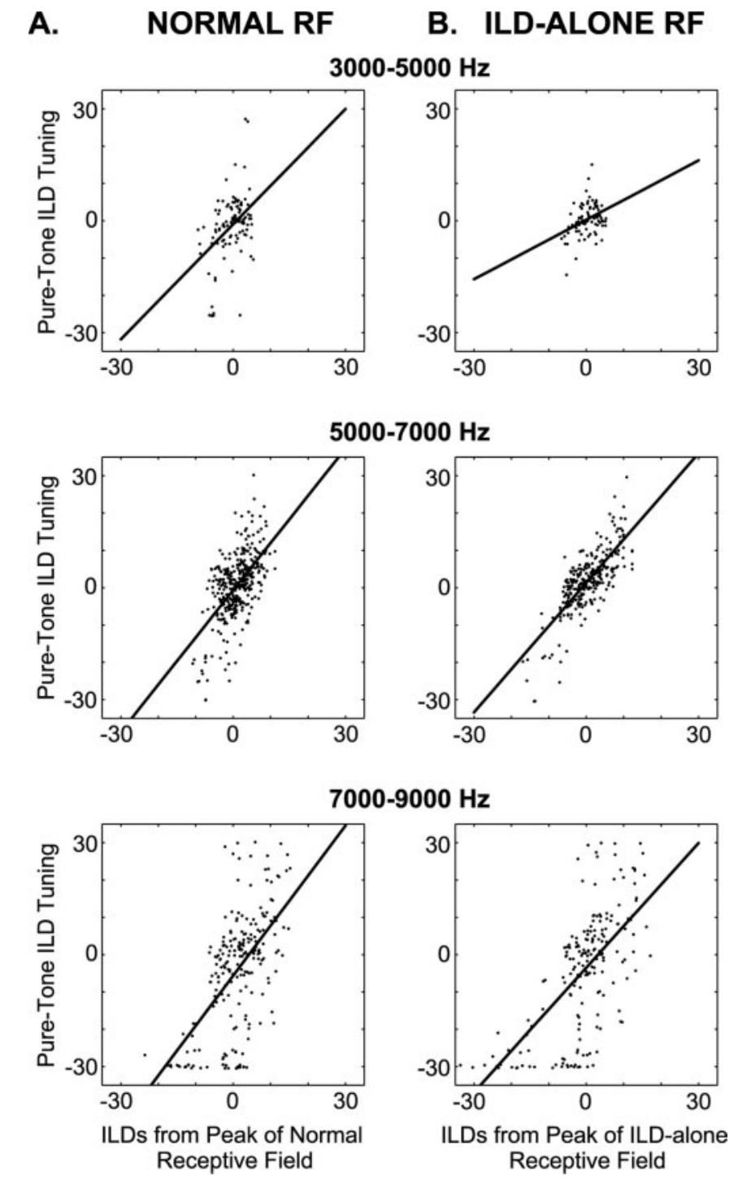
Normal spatial tuning need not maximize each ILD
Euston and Takahashi measured pure-tone ILD tuning across frequency and compared preferred ILDs with the values occurring at the peaks of normal and ILD-alone receptive fields. They examined bands spanning 3–5, 5–7, and 7–9 kHz.
Frequency-specific preferences matched the ILDs at the ILD-alone peak more closely than those at the normal receptive-field peak. A sum of frequency-specific inputs accounted for approximately 56% of the variance in measured ILD-alone fields, leaving substantial unexplained structure.
The normal receptive field reflects a balance of inputs rather than independent maximization of every frequency-specific channel. A sum of frequency-specific ILD preferences predicted much of the ILD-alone field, which supports a contribution from spectral integration.
Euston & Takahashi (2002), Fig. 7(A–B). Preferred frequency-specific ILDs compared with ILDs at receptive-field peaks.
Euston & Takahashi (2002)
37
Notes:
• Euston and Takahashi measured pure-tone ILD tuning across frequency and compared preferred ILDs with the values occurring at the peaks of normal and ILD-alone receptive fields. They examined bands spanning 3–5, 5–7, and 7–9 kHz.
– The regression comparisons separate a neuron’s favorite level difference for a tone from the actual spectral values at a spatial response peak. A direction can be preferred under broadband stimulation without providing the best ILD at every frequency. The remaining prediction error limits a simple account based only on summing measured tonal responses.
• Frequency-specific preferences matched the ILDs at the ILD-alone peak more closely than those at the normal receptive-field peak. A sum of frequency-specific inputs accounted for approximately 56% of the variance in measured ILD-alone fields, leaving substantial unexplained structure.
• The normal receptive field reflects a balance of inputs rather than independent maximization of every frequency-specific channel. A sum of frequency-specific ILD preferences predicted much of the ILD-alone field, which supports a contribution from spectral integration.
References:
Euston DR, Takahashi TT (2002). From Spectrum to Space: The Contribution of Level Difference Cues to Spatial Receptive Fields in the Barn Owl Inferior Colliculus. The Journal of Neuroscience 22(1):284-293. https://doi.org/10.1523/jneurosci.22-01-00284.2002
Figure: Euston & Takahashi (2002), Fig. 7(A–B). Preferred frequency-specific ILDs compared with ILDs at receptive-field peaks.
Figure source: https://doi.org/10.1523/jneurosci.22-01-00284.2002

Slide 50
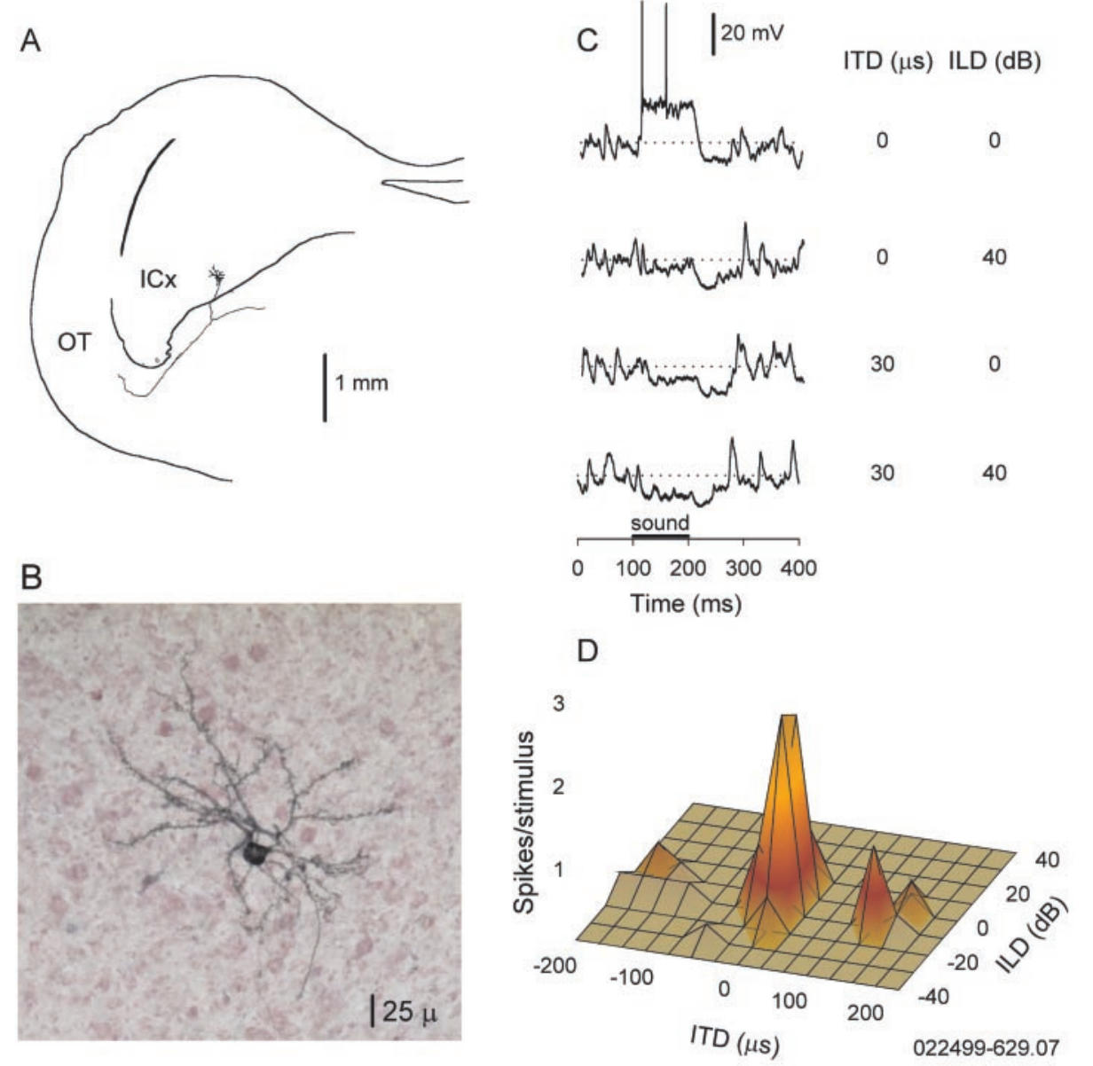
ICx membranes integrate timing and level before spikes
Peña and Konishi recorded identified ICx neurons intracellularly and labeled them with neurobiotin. A postsynaptic potential is a membrane-voltage change caused by synaptic input; it can depolarize toward spike threshold or hyperpolarize away from it.
Broadband noise bursts lasted 100 ms and were presented 30 dB above threshold. Testing ITD-ILD pairs produced depolarizing responses near a preferred combination and hyperpolarizing responses outside it. Spike output formed a more restricted excitatory center surrounded by reduced firing.
The intracellular measurement distinguishes input integration from the thresholded spike response. Depolarization at an unfavorable cue pair need not produce spikes. Hyperpolarizing responses outside the preferred combination reflect inhibition, so the membrane voltage carries both excitatory and inhibitory influences before thresholding.
Peña & Konishi (2001), Fig. 1(A–D). Identified ICx neuron, intracellular potentials, and spatially selective spikes.
Peña & Konishi (2001)
38
Notes:
• Peña and Konishi recorded identified ICx neurons intracellularly and labeled them with neurobiotin. A postsynaptic potential is a membrane-voltage change caused by synaptic input; it can depolarize toward spike threshold or hyperpolarize away from it.
– The paper verified inhibitory voltage behavior by changing membrane potential, rather than identifying inhibition solely from absent spikes. Neurobiotin labeling connects the physiological recording to an ICx cell with a tectal projection. The figure retains the original 25-µm cellular scale bar and the 1-mm projection scale.
• Broadband noise bursts lasted 100 ms and were presented 30 dB above threshold. Testing ITD-ILD pairs produced depolarizing responses near a preferred combination and hyperpolarizing responses outside it. Spike output formed a more restricted excitatory center surrounded by reduced firing.
• The intracellular measurement distinguishes input integration from the thresholded spike response. Depolarization at an unfavorable cue pair need not produce spikes. Hyperpolarizing responses outside the preferred combination reflect inhibition, so the membrane voltage carries both excitatory and inhibitory influences before thresholding.
References:
Peña JL, Konishi M (2001). Auditory Spatial Receptive Fields Created by Multiplication. Science 292(5515):249-252. https://doi.org/10.1126/science.1059201
Figure: Peña & Konishi (2001), Fig. 1(A–D). Identified ICx neuron, intracellular potentials, and spatially selective spikes.
Figure source: https://doi.org/10.1126/science.1059201

Slide 51
Subthreshold potentials precede spike generation
A neuron integrates synaptic inputs as changes in membrane voltage before it produces any spikes. Depolarization moves the voltage toward threshold, and hyperpolarization moves it away. Subthreshold recording therefore gives access to the inputs that the neuron receives, which spikes alone do not show.
Peña and Konishi recorded identified ICx neurons intracellularly and presented ITD and ILD pairs. Responses were depolarizing near a preferred combination and hyperpolarizing outside it, with spike output restricted to a smaller center. The spike output is a thresholded version of the membrane response.
Intracellular recording therefore separates the integration of timing and level from the later thresholding that produces spikes. A depolarization at an unfavorable cue pair may stay below threshold and produce no spikes. The neurons were labeled with neurobiotin, which identified them as ICx cells.
Peña & Konishi (2001), Fig. 1(A–D). Identified ICx neuron, intracellular potentials, and spatially selective spikes.
Peña & Konishi (2001)
38a
Notes:
• Membrane voltage shows the result of synaptic integration before spikes are produced.
• Membrane potential.
– Depolarization moves the voltage toward spike threshold.
– Hyperpolarization moves it away from threshold.
• Recording.
– Identified ICx neurons were recorded intracellularly and labeled with neurobiotin.
– Broadband noise bursts 100 milliseconds long were presented 30 decibels above threshold.
• Tuning.
– Combinations of ITD and ILD near the preferred pair gave depolarization.
– Combinations outside it gave hyperpolarization.
• Spikes.
– The spike output formed a smaller excitatory center surrounded by reduced firing.
• Mixture of inputs.
– The recorded voltage can contain both excitatory and inhibitory influences, so it is not the response of one conductance.
• Why record intracellularly.
– Extracellular spikes show only the output of a neuron.
– The membrane potential shows the sum of excitatory and inhibitory inputs before the spike threshold is applied.
• Stimulus pairs.
– Pairs of ITD and ILD were tested systematically.
– Each pair gave a depolarizing or a hyperpolarizing response, and the pattern across pairs forms the tuning.
References:
Peña JL, Konishi M (2001). Auditory Spatial Receptive Fields Created by Multiplication. Science 292(5515):249-252. https://doi.org/10.1126/science.1059201

Slide 52
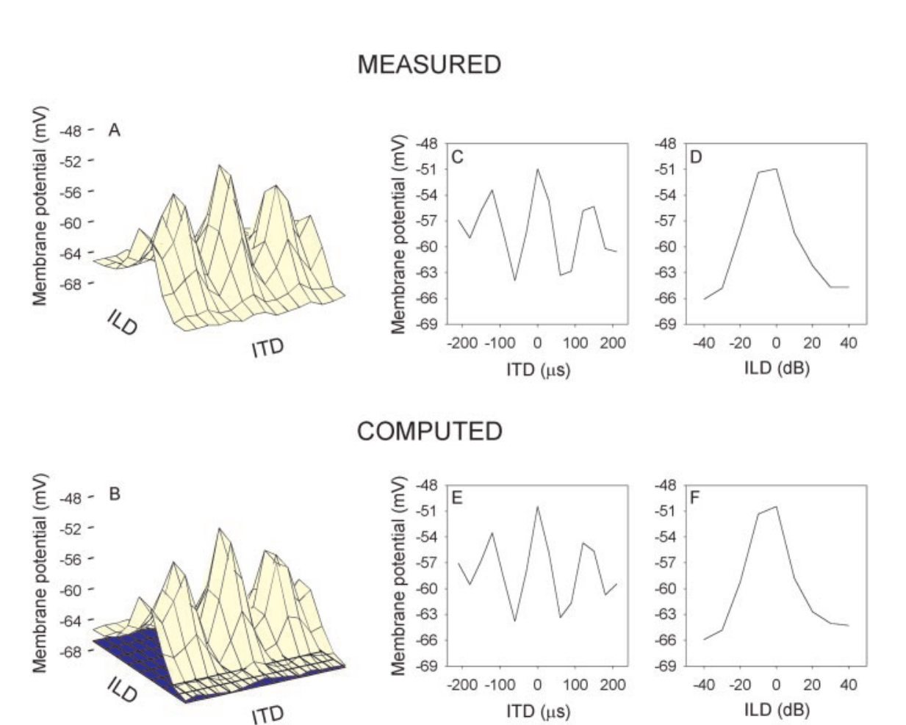
Timing and level interact approximately multiplicatively
Peña and Konishi arranged subthreshold membrane responses into a matrix of ITD-ILD combinations. A multiplicative interaction means that the effectiveness of one cue depends on the strength of the other, rather than two cue-dependent responses simply being added.
After accounting for a constant membrane-voltage offset, a separable multiplicative component described about 96.6% of the response structure in the studied neurons. Singular value decomposition separated the measured matrix into ranked components, allowing multiplicative and additive accounts to be compared.
Multiplication captured the data better than a simple additive alternative. This describes an experimentally supported computation at the membrane-response level. In the multiplicative description the effectiveness of one cue scales with the strength of the other, which yields a restricted combined preference for timing and level.
Peña & Konishi (2001), Fig. 2(A–F). Recorded response matrix and the authors’ multiplicative decomposition.
Peña & Konishi (2001)
39
Notes:
• Peña and Konishi arranged subthreshold membrane responses into a matrix of ITD-ILD combinations. A multiplicative interaction means that the effectiveness of one cue depends on the strength of the other, rather than two cue-dependent responses simply being added.
– An analog conjunction can permit firing only when both timing and level are favorable. The measured response matrix and the authors’ fitted matrix are reproduced directly from the paper, including their original units and axes. The fit is the authors’ published analysis; no response surfaces have been reconstructed for this deck.
• After accounting for a constant membrane-voltage offset, a separable multiplicative component described about 96.6% of the response structure in the studied neurons. Singular value decomposition separated the measured matrix into ranked components, allowing multiplicative and additive accounts to be compared.
• Multiplication captured the data better than a simple additive alternative. This describes an experimentally supported computation at the membrane-response level. In the multiplicative description the effectiveness of one cue scales with the strength of the other, which yields a restricted combined preference for timing and level.
References:
Peña JL, Konishi M (2001). Auditory Spatial Receptive Fields Created by Multiplication. Science 292(5515):249-252. https://doi.org/10.1126/science.1059201
Figure: Peña & Konishi (2001), Fig. 2(A–F). Recorded response matrix and the authors’ multiplicative decomposition.
Figure source: https://doi.org/10.1126/science.1059201

Slide 53
Multiplication makes one cue scale the other
In an additive interaction the effects of two cues sum, whereas in a multiplicative interaction the effectiveness of one cue depends on the strength of the other. A multiplicative neuron responds strongly only when both cues are favorable. The distinction determines whether a neuron can act as an AND-like detector for the location of a source.
Peña and Konishi arranged subthreshold responses in a matrix of ITD and ILD combinations. A matrix analysis separated the responses into ranked components, and a multiplicative component described most of the response structure.
Multiplication captured the data better than addition. If either cue is absent the product is small, so the response of the neuron is restricted to the combination of timing and level that falls at its preferred location.
Peña & Konishi (2001), Fig. 2(A–F). Recorded response matrix and the authors’ multiplicative decomposition.
Peña & Konishi (2001)
39a
Notes:
• Whether timing and level add or multiply determines how a neuron's spatial tuning is shaped.
• Addition and multiplication.
– With addition the two cue effects sum.
– With multiplication the effectiveness of one cue depends on the strength of the other.
• The matrix.
– Subthreshold responses were arranged by ITD and ILD, so each cell of the matrix is one cue pair.
• Analysis.
– A matrix analysis separated the responses into ranked components.
– A multiplicative component described most of the structure after a constant offset was accounted for.
• Result.
– Multiplication captured the data better than a simple additive alternative.
• Consequence.
– If either cue is absent the product is small.
– The neuron therefore responds strongly only at the location that favors both timing and level.
• Constant offset.
– A constant membrane-voltage offset was accounted for before testing the interaction.
– The remaining structure was compared with additive and multiplicative accounts.
• Level of description.
– The result describes a computation at the level of membrane responses.
– It does not assign multiplication to one receptor or one dendritic compartment.
References:
Peña JL, Konishi M (2001). Auditory Spatial Receptive Fields Created by Multiplication. Science 292(5515):249-252. https://doi.org/10.1126/science.1059201

Slide 54
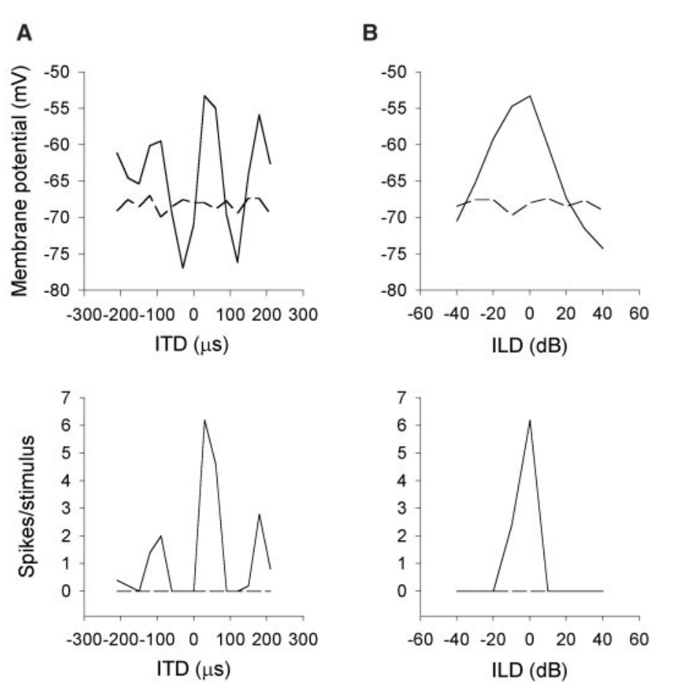
Spike generation sharpens spatial selectivity
Peña and Konishi compared membrane-potential and spike tuning in the same ICx neurons. The spike threshold is the voltage-dependent boundary above which the neuron can generate an action potential; small depolarizations need not cross it.
The example retained several subthreshold timing peaks but produced spikes mainly near the dominant timing peak. ILD tuning was also narrower in spike output than in membrane voltage. The original records use milliseconds for the stimulus traces and microseconds for imposed interaural timing.
The quality of a multiplicative description was lower for spike output than for subthreshold responses. Additional nonlinear processes therefore intervene between synaptic integration and discharge. Thresholding is consistent with this sharpening, while inhibition can also change the underlying voltage response before spikes occur.
Peña & Konishi (2001), Fig. 5(A–D). Additional sharpening between postsynaptic potentials and spike output.
Peña & Konishi (2001)
40
Notes:
• Peña and Konishi compared membrane-potential and spike tuning in the same ICx neurons. The spike threshold is the voltage-dependent boundary above which the neuron can generate an action potential; small depolarizations need not cross it.
– A small secondary depolarization can be visible in an intracellular record yet fail to produce any spike output. The disappearance of a firing peak does not prove that the corresponding input has vanished. The experiment separates membrane integration from the output transformation and limits conclusions based only on extracellular spike tuning.
• The example retained several subthreshold timing peaks but produced spikes mainly near the dominant timing peak. ILD tuning was also narrower in spike output than in membrane voltage. The original records use milliseconds for the stimulus traces and microseconds for imposed interaural timing.
• The quality of a multiplicative description was lower for spike output than for subthreshold responses. Additional nonlinear processes therefore intervene between synaptic integration and discharge. Thresholding is consistent with this sharpening, while inhibition can also change the underlying voltage response before spikes occur.
References:
Peña JL, Konishi M (2001). Auditory Spatial Receptive Fields Created by Multiplication. Science 292(5515):249-252. https://doi.org/10.1126/science.1059201
Figure: Peña & Konishi (2001), Fig. 5(A–D). Additional sharpening between postsynaptic potentials and spike output.
Figure source: https://doi.org/10.1126/science.1059201

Slide 55
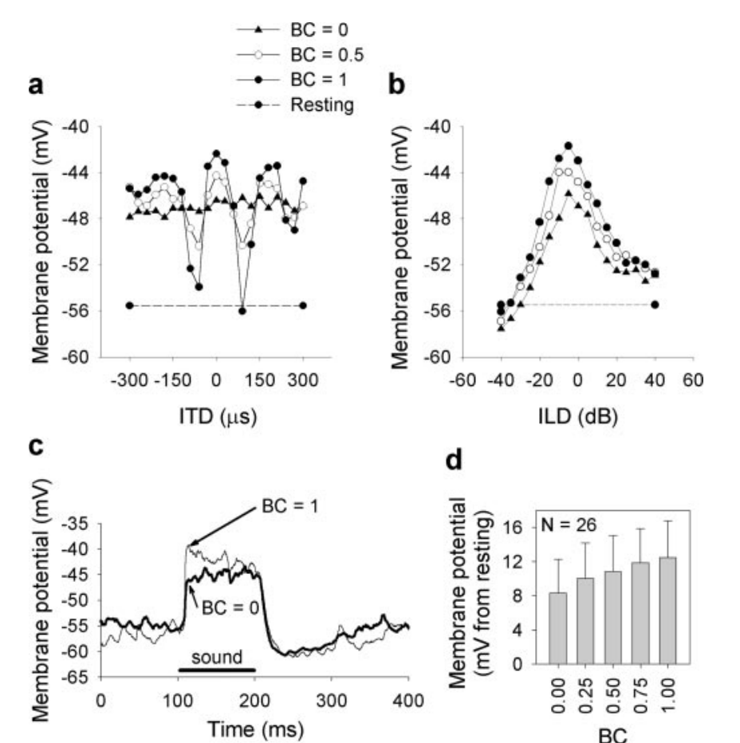
Binaural correlation controls the strength of timing input
Binaural correlation measures similarity of the fine temporal waveform at the two ears. Peña and Konishi varied correlation while recording intracellular responses, changing timing reliability without simply replacing the level difference with a different spatial cue.
Correlation values of zero, 0.25, 0.5, 0.75, and one altered the amplitude of ITD-dependent membrane responses. ILD tuning was comparatively stable. At zero correlation, the timing component became nearly flat even though level-dependent responses could remain.
Multiplicative descriptions remained effective across much of the manipulated range. When one input is almost constant, additive and multiplicative alternatives become harder to distinguish. Correlation manipulations therefore test the robustness of multiplication, because reducing the timing signal until it is nearly flat leaves little for the multiplicative term to act on.
Peña & Konishi (2004), Fig. 1(a–d). Binaural correlation changes timing tuning and synaptic response amplitude.
Peña & Konishi (2004)
41
Notes:
• Binaural correlation measures similarity of the fine temporal waveform at the two ears. Peña and Konishi varied correlation while recording intracellular responses, changing timing reliability without simply replacing the level difference with a different spatial cue.
– The same nominal delay becomes unreliable when the two ear signals no longer share matching fine structure. The study changed the temporal relationship independently of the level tuning measurement. A flat timing response under uncorrelated noise does not imply deafness; it indicates loss of evidence for one specific interaural delay.
• Correlation values of zero, 0.25, 0.5, 0.75, and one altered the amplitude of ITD-dependent membrane responses. ILD tuning was comparatively stable. At zero correlation, the timing component became nearly flat even though level-dependent responses could remain.
• Multiplicative descriptions remained effective across much of the manipulated range. When one input is almost constant, additive and multiplicative alternatives become harder to distinguish. Correlation manipulations therefore test the robustness of multiplication, because reducing the timing signal until it is nearly flat leaves little for the multiplicative term to act on.
References:
Peña JL, Konishi M (2004). Robustness of Multiplicative Processes in Auditory Spatial Tuning. The Journal of Neuroscience 24(40):8907-8910. https://doi.org/10.1523/jneurosci.2924-04.2004
Figure: Peña & Konishi (2004), Fig. 1(a–d). Binaural correlation changes timing tuning and synaptic response amplitude.
Figure source: https://doi.org/10.1523/jneurosci.2924-04.2004

Slide 56
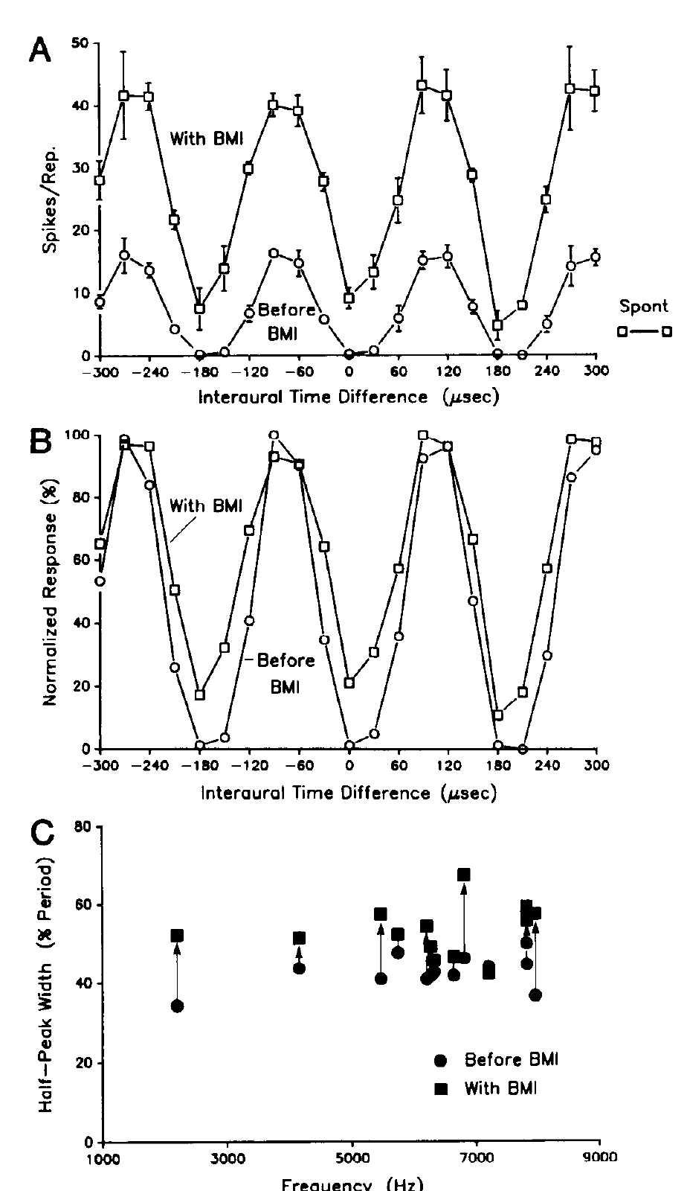
GABA-A inhibition sharpens collicular timing selectivity
Fujita and Konishi applied BMI locally while recording timing-sensitive neurons across auditory nuclei. GABA-A receptors are ligand-gated chloride channels. GABA binding changes chloride conductance and can reduce the effectiveness of excitatory input. Antagonist application tests whether this inhibitory transmission contributes to the response curve.
In ICC and ICx, BMI broadened tonal ITD tuning and increased responses at unfavorable delays. The lateral-shell example compares tuning before, during, and after application; a 3-kHz tonal condition was followed through recovery. VLVa timing selectivity was comparatively unaffected.
GABAergic inhibition therefore sharpens the timing representation at selected collicular stages rather than uniformly creating timing sensitivity everywhere. Local drug application establishes a receptor-sensitive contribution of GABA-A inhibition, and VLVa timing selectivity was comparatively unaffected.
Fujita & Konishi (1991), Fig. 8(A–C). GABA-receptor blockade broadens timing tuning in the lateral shell.
Fujita & Konishi (1991)
42
Notes:
• Fujita and Konishi applied BMI locally while recording timing-sensitive neurons across auditory nuclei. GABA-A receptors are ligand-gated chloride channels. GABA binding changes chloride conductance and can reduce the effectiveness of excitatory input. Antagonist application tests whether this inhibitory transmission contributes to the response curve.
– The half-peak width measures the range of delays over which a response remains above half of its peak. A broader curve indicates weaker selectivity even if the maximum response rises. GABA application produced opposite effects, and simultaneous BMI could antagonize those effects, supporting a GABA-receptor-mediated interpretation.
• In ICC and ICx, BMI broadened tonal ITD tuning and increased responses at unfavorable delays. The lateral-shell example compares tuning before, during, and after application; a 3-kHz tonal condition was followed through recovery. VLVa timing selectivity was comparatively unaffected.
• GABAergic inhibition therefore sharpens the timing representation at selected collicular stages rather than uniformly creating timing sensitivity everywhere. Local drug application establishes a receptor-sensitive contribution of GABA-A inhibition, and VLVa timing selectivity was comparatively unaffected.
References:
Fujita I, Konishi M (1991). The role of GABAergic inhibition in processing of interaural time difference in the owl's auditory system. The Journal of Neuroscience 11(3):722-739. https://doi.org/10.1523/jneurosci.11-03-00722.1991
Figure: Fujita & Konishi (1991), Fig. 8(A–C). GABA-receptor blockade broadens timing tuning in the lateral shell.
Figure source: https://doi.org/10.1523/jneurosci.11-03-00722.1991

Slide 57
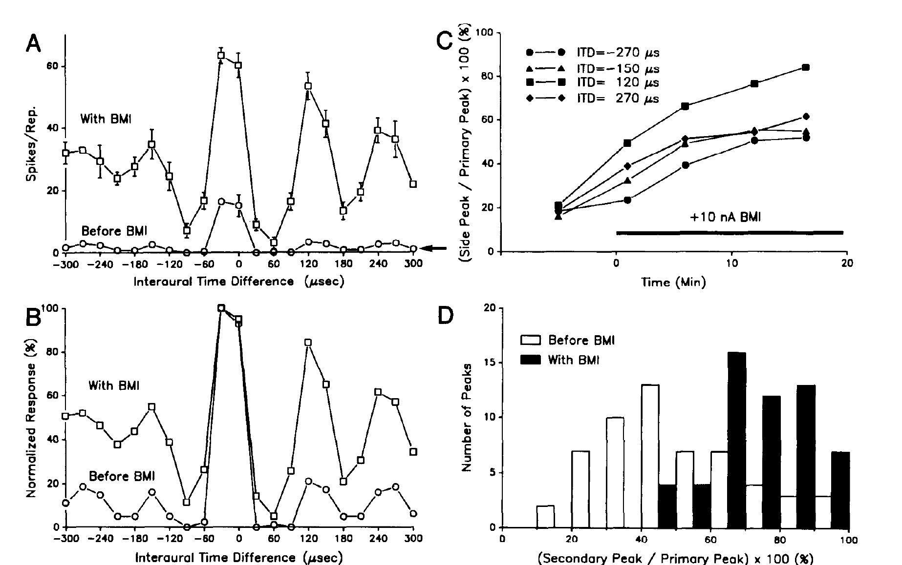
GABAergic inhibition helps suppress false timing peaks
Fujita and Konishi compared broadband ICx timing responses before and during local GABA-A receptor blockade. Broadband input normally emphasizes a principal timing peak while suppressing repeated matches inherited from narrowband channels.
BMI increased secondary-peak responses and could restore phase ambiguity for noise. The published records include time-dependent increases at delays such as −270 and +120 µs while the principal timing preference remained distinguishable. Recovery measurements tested reversibility after drug application.
Cross-frequency convergence and inhibitory suppression jointly support unique broadband timing selectivity. Blocking GABA-A receptors restored secondary peaks for noise, so inhibition contributes to suppressing the repeated matches while frequency-matched excitation supplies the principal timing preference.
Fujita & Konishi (1991), Fig. 12(A–D). GABA-receptor blockade releases secondary timing-response peaks.
Fujita & Konishi (1991)
43
Notes:
• Fujita and Konishi compared broadband ICx timing responses before and during local GABA-A receptor blockade. Broadband input normally emphasizes a principal timing peak while suppressing repeated matches inherited from narrowband channels.
– An increase in all responses can differ from a selective release of secondary peaks. The source compares the secondary-to-primary relation as well as response time courses, helping distinguish these possibilities. Phase ambiguity can therefore reappear when inhibition is weakened even though the excitatory inputs still carry the same physical sound timing.
• BMI increased secondary-peak responses and could restore phase ambiguity for noise. The published records include time-dependent increases at delays such as −270 and +120 µs while the principal timing preference remained distinguishable. Recovery measurements tested reversibility after drug application.
• Cross-frequency convergence and inhibitory suppression jointly support unique broadband timing selectivity. Blocking GABA-A receptors restored secondary peaks for noise, so inhibition contributes to suppressing the repeated matches while frequency-matched excitation supplies the principal timing preference.
References:
Fujita I, Konishi M (1991). The role of GABAergic inhibition in processing of interaural time difference in the owl's auditory system. The Journal of Neuroscience 11(3):722-739. https://doi.org/10.1523/jneurosci.11-03-00722.1991
Figure: Fujita & Konishi (1991), Fig. 12(A–D). GABA-receptor blockade releases secondary timing-response peaks.
Figure source: https://doi.org/10.1523/jneurosci.11-03-00722.1991

Slide 58
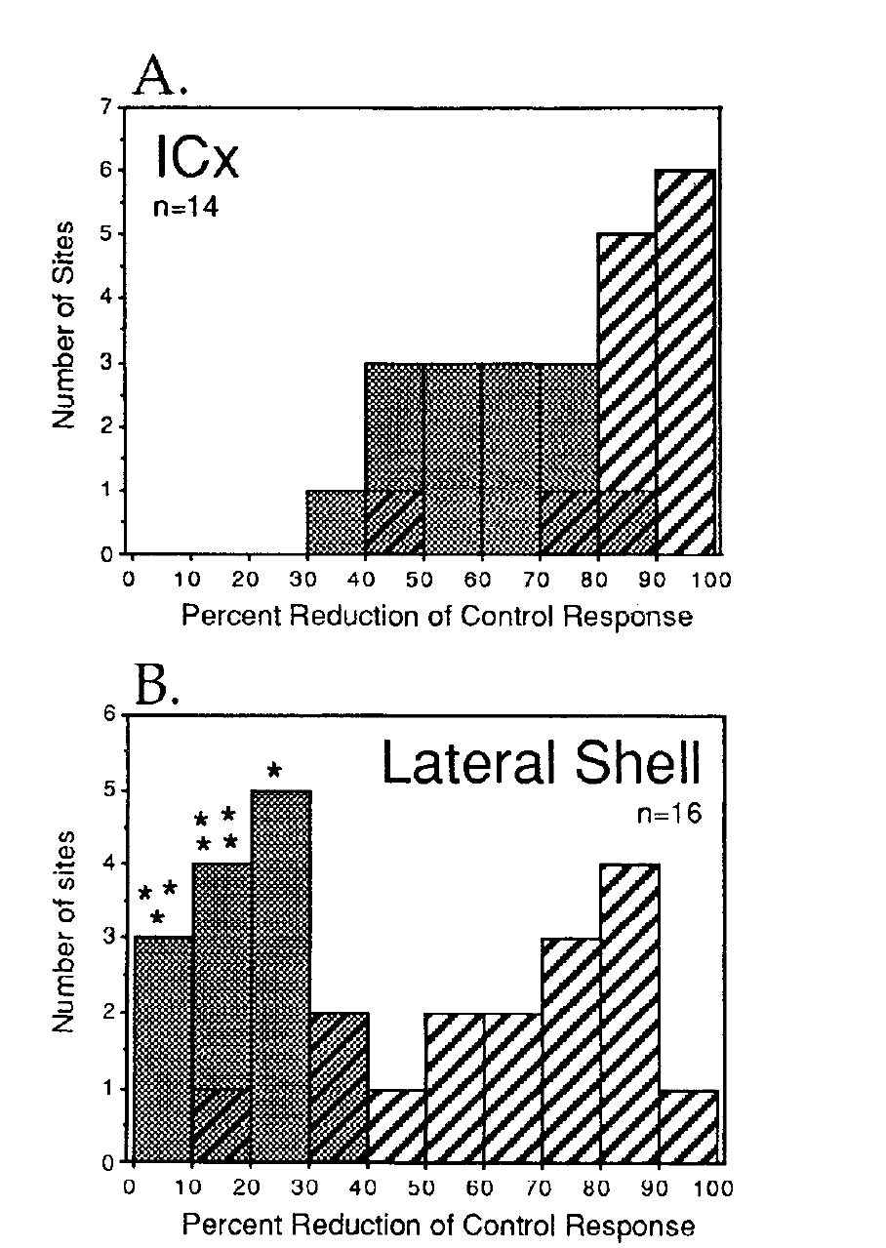
Glutamate contributions differ across collicular stages
Glutamate is an excitatory transmitter. Feldman and Knudsen applied AP5, an antagonist of NMDA (N-methyl-D-aspartate) receptors, and CNQX, a non-NMDA glutamate-receptor antagonist, by iontophoresis while recording from ICx and the ICC lateral shell.
AP5 removed about 55% of auditory-evoked spikes at ICx multiunit sites and 64% at single units, compared with approximately 19% and 25% in the lateral shell. Combined AP5 and CNQX strongly suppressed responses in both subdivisions, often eliminating them.
NMDA-dependent transmission contributes more prominently to ICx responses, while non-NMDA transmission is substantial in both regions. Normalizing AP5 blockade against combined blockade addressed variation in drug efficacy across sites. Spike reduction measures the functional contribution of each receptor class to auditory-evoked responses.
Feldman & Knudsen (1994), Fig. 8(A–B). NMDA blockade differs between ICx and lateral shell.
Feldman & Knudsen (1994)
44
Notes:
• Glutamate is an excitatory transmitter. Feldman and Knudsen applied AP5, an antagonist of NMDA (N-methyl-D-aspartate) receptors, and CNQX, a non-NMDA glutamate-receptor antagonist, by iontophoresis while recording from ICx and the ICC lateral shell.
– Iontophoresis uses an electrical current to deliver a drug locally. The two-antagonist comparison constrains whether a weak AP5 effect reflects little NMDA contribution or generally ineffective local delivery. NMDA and non-NMDA receptors are distinct glutamate-sensitive ion-channel families. NMDA channels have voltage-dependent magnesium block that can be relieved by depolarization. The ICx responses retained an NMDA contribution across their tested dynamic range, rather than recruiting it only above a separate high-level threshold. Antagonist-sensitive spikes do not constitute a complete molecular census.
• AP5 removed about 55% of auditory-evoked spikes at ICx multiunit sites and 64% at single units, compared with approximately 19% and 25% in the lateral shell. Combined AP5 and CNQX strongly suppressed responses in both subdivisions, often eliminating them.
• NMDA-dependent transmission contributes more prominently to ICx responses, while non-NMDA transmission is substantial in both regions. Normalizing AP5 blockade against combined blockade addressed variation in drug efficacy across sites. Spike reduction measures the functional contribution of each receptor class to auditory-evoked responses.
References:
Feldman DE, Knudsen EI (1994). NMDA and non-NMDA glutamate receptors in auditory transmission in the barn owl inferior colliculus. The Journal of Neuroscience 14(10):5939-5958. https://doi.org/10.1523/jneurosci.14-10-05939.1994
Figure: Feldman & Knudsen (1994), Fig. 8(A–B). NMDA blockade differs between ICx and lateral shell.
Figure source: https://doi.org/10.1523/jneurosci.14-10-05939.1994

Slide 59
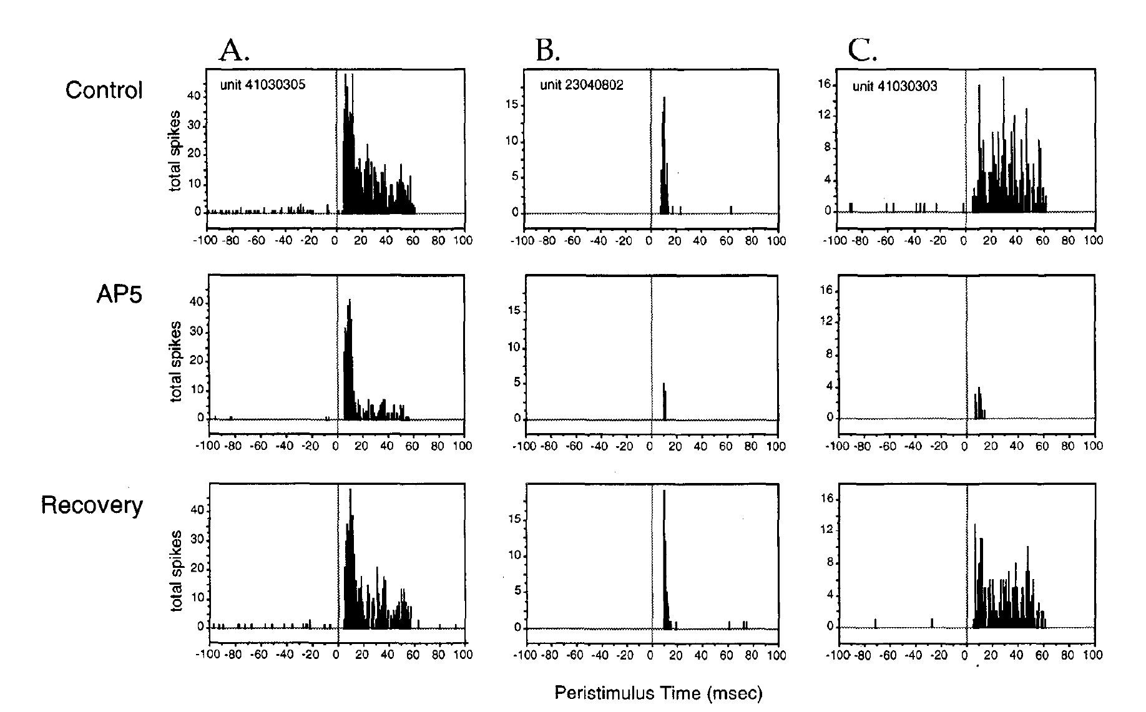
NMDA-dependent transmission sustains late ICx responses
Feldman and Knudsen analyzed peristimulus time histograms, which align repeated spike trains to sound onset. They tested ICx units with transient, sustained, or mixed responses to 50-ms broadband stimuli at their preferred ITD and ILD.
AP5 at 25 nA reduced spikes, with a larger effect on late activity in mixed transient-sustained responses. Responses were measured before application, during blockade, and after recovery. CNQX, in contrast, reduced activity more uniformly across the response time course.
The temporal difference is consistent with slower NMDA-dependent excitation supplementing faster non-NMDA transmission. Together with coincidence detection, bilateral inhibition and cross-frequency convergence, synaptic integration supports the sustained spatial signals available for owl orienting.
Feldman & Knudsen (1994), Fig. 9(A–C). NMDA blockade alters the time course of auditory spike responses.
Feldman & Knudsen (1994)
45
Notes:
• Feldman and Knudsen analyzed peristimulus time histograms, which align repeated spike trains to sound onset. They tested ICx units with transient, sustained, or mixed responses to 50-ms broadband stimuli at their preferred ITD and ILD.
– An iontophoretic current is a drug-delivery setting, not the synaptic current flowing through a neuron. The 50-ms sound duration and the sequence of control, blockade, and recovery remain in the original figure. A slow excitatory postsynaptic current can persist between successive inputs and summate during a sustained spike train. The authors proposed this mechanism for the growing late NMDA contribution. These experiments concern transmission in established spatial circuits; a role in developmental plasticity requires separate evidence.
• AP5 at 25 nA reduced spikes, with a larger effect on late activity in mixed transient-sustained responses. Responses were measured before application, during blockade, and after recovery. CNQX, in contrast, reduced activity more uniformly across the response time course.
• The temporal difference is consistent with slower NMDA-dependent excitation supplementing faster non-NMDA transmission. Together with coincidence detection, bilateral inhibition and cross-frequency convergence, synaptic integration supports the sustained spatial signals available for owl orienting.
References:
Feldman DE, Knudsen EI (1994). NMDA and non-NMDA glutamate receptors in auditory transmission in the barn owl inferior colliculus. The Journal of Neuroscience 14(10):5939-5958. https://doi.org/10.1523/jneurosci.14-10-05939.1994
Figure: Feldman & Knudsen (1994), Fig. 9(A–C). NMDA blockade alters the time course of auditory spike responses.
Figure source: https://doi.org/10.1523/jneurosci.14-10-05939.1994

Slide 60
Key takeaways
Computed spatial maps ICx receptive-field centers are ordered by sound direction; the map is computed from binaural signals rather than copied from a spatial receptor surface.
Parallel cue pathways NM preserves timing and NA emphasizes sound level. Selective inactivation dissociates their contributions before the cues converge.
Delay lines and coincidence Opposed NM conduction gradients and coincidence-sensitive NL neurons transform interaural timing into place-dependent activity.
Convergence and inhibition Frequency-matched ICC arrays provide cross-frequency agreement, while GABAergic inhibition suppresses competing timing peaks in ICx.
Level tuning and cue combination Bilateral inhibitory influences create peaked ILD tuning; approximately multiplicative membrane integration combines timing and level selectivity.
Mechanisms have experimental limits NMDA and non-NMDA antagonists identify transmission contributions. Natural ILDs can also aid horizontal disambiguation, so ITD and ILD are not exclusive behavioral axes.
Knudsen & Konishi (1978); Carr & Konishi (1990); Adolphs (1993); Peña & Konishi (2001); Kettler et al. (2017)
46
Notes:
• Computed spatial maps. ICx receptive-field centers are ordered by sound direction; the map is computed from binaural signals rather than copied from a spatial receptor surface.
• Parallel cue pathways. NM preserves timing and NA emphasizes sound level. Selective inactivation dissociates their contributions before the cues converge.
• Delay lines and coincidence. Opposed NM conduction gradients and coincidence-sensitive NL neurons transform interaural timing into place-dependent activity.
• Convergence and inhibition. Frequency-matched ICC arrays provide cross-frequency agreement, while GABAergic inhibition suppresses competing timing peaks in ICx.
• Level tuning and cue combination. Bilateral inhibitory influences create peaked ILD tuning; approximately multiplicative membrane integration combines timing and level selectivity.
• Mechanisms have experimental limits. NMDA and non-NMDA antagonists identify transmission contributions. Natural ILDs can also aid horizontal disambiguation, so ITD and ILD are not exclusive behavioral axes.
References:
Knudsen EI, Konishi M (1978). A Neural Map of Auditory Space in the Owl. Science 200(4343):795-797. https://doi.org/10.1126/science.644324
Sullivan WE, Konishi M (1984). Segregation of stimulus phase and intensity coding in the cochlear nucleus of the barn owl. The Journal of Neuroscience 4(7):1787-1799. https://doi.org/10.1523/jneurosci.04-07-01787.1984
Takahashi T, Moiseff A, Konishi M (1984). Time and intensity cues are processed independently in the auditory system of the owl. The Journal of Neuroscience 4(7):1781-1786. https://doi.org/10.1523/jneurosci.04-07-01781.1984
Carr CE, Konishi M (1990). A circuit for detection of interaural time differences in the brain stem of the barn owl. The Journal of Neuroscience 10(10):3227-3246. https://doi.org/10.1523/jneurosci.10-10-03227.1990
Wagner H, Takahashi T, Konishi M (1987). Representation of interaural time difference in the central nucleus of the barn owl's inferior colliculus. The Journal of Neuroscience 7(10):3105-3116. https://doi.org/10.1523/jneurosci.07-10-03105.1987
Manley GA, Köppl C, Konishi M (1988). A neural map of interaural intensity differences in the brain stem of the barn owl. The Journal of Neuroscience 8(8):2665-2676. https://doi.org/10.1523/jneurosci.08-08-02665.1988
Adolphs R (1993). Bilateral inhibition generates neuronal responses tuned to interaural level differences in the auditory brainstem of the barn owl. The Journal of Neuroscience 13(9):3647-3668. https://doi.org/10.1523/jneurosci.13-09-03647.1993
Fujita I, Konishi M (1991). The role of GABAergic inhibition in processing of interaural time difference in the owl's auditory system. The Journal of Neuroscience 11(3):722-739. https://doi.org/10.1523/jneurosci.11-03-00722.1991
Peña JL, Konishi M (2001). Auditory Spatial Receptive Fields Created by Multiplication. Science 292(5515):249-252. https://doi.org/10.1126/science.1059201
Feldman DE, Knudsen EI (1994). NMDA and non-NMDA glutamate receptors in auditory transmission in the barn owl inferior colliculus. The Journal of Neuroscience 14(10):5939-5958. https://doi.org/10.1523/jneurosci.14-10-05939.1994
Kettler L, Griebel H, Ferger R, Wagner H (2017). Combination of Interaural Level and Time Difference in Azimuthal Sound Localization in Owls. eNeuro 4(6):ENEURO.0238-17.2017. https://doi.org/10.1523/eneuro.0238-17.2017

