Slide 1

NEUR 411 · NEUROETHOLOGY · FALL 2026 · Lecture 19
Owl sound localization II: developmental plasticity of the auditory map
Wednesday, October 7, 2026
Jordan Lopez, Ph.D.
Photo: Barn owl (Tyto alba). Michael Gäbler, CC BY 3.0.
Notes:
Owl sound localization II: developmental plasticity of the auditory map
Wednesday, October 7, 2026
Photo: Barn owl (Tyto alba). Michael Gäbler, CC BY 3.0.
Credit: Michael Gäbler / Wikimedia Commons
License: CC BY 3.0
Source: https://commons.wikimedia.org/wiki/File:Tyto_alba_(Scopoli,_1769).jpg

Slide 2
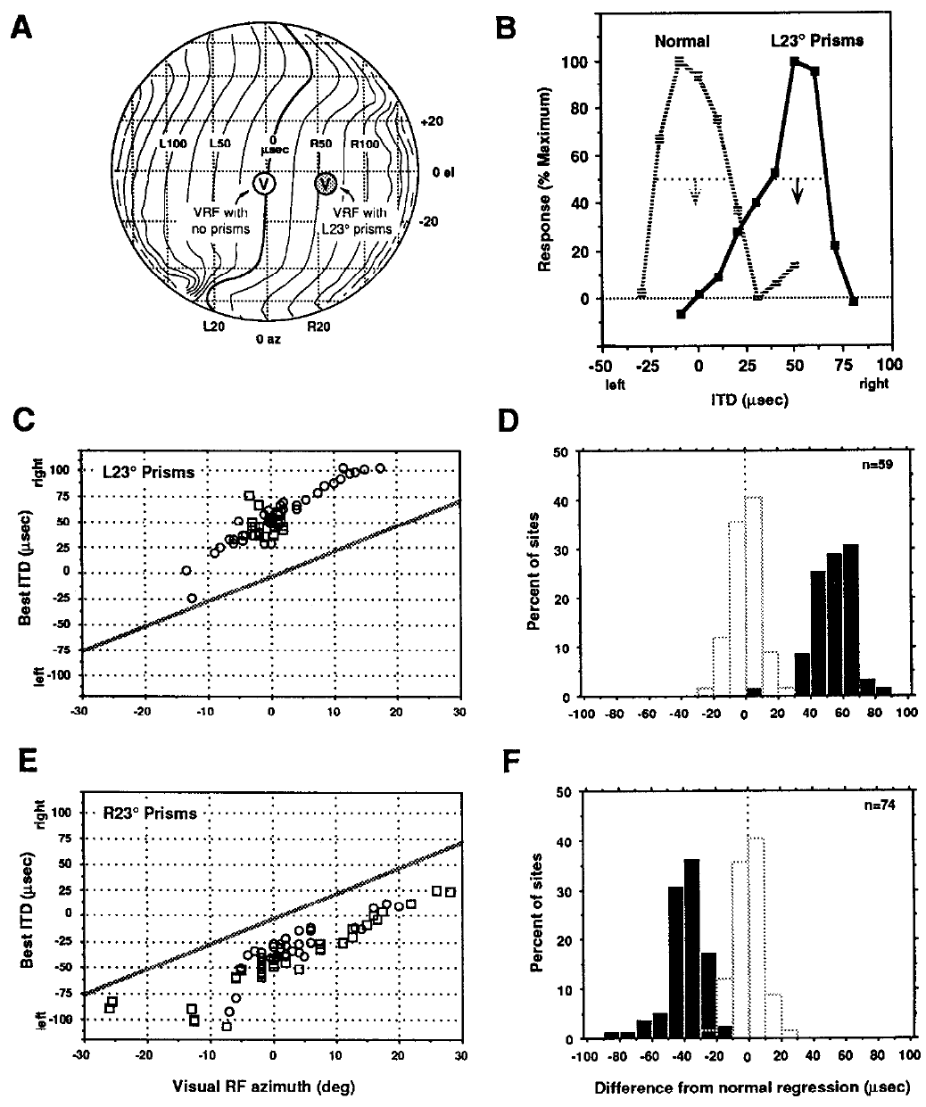
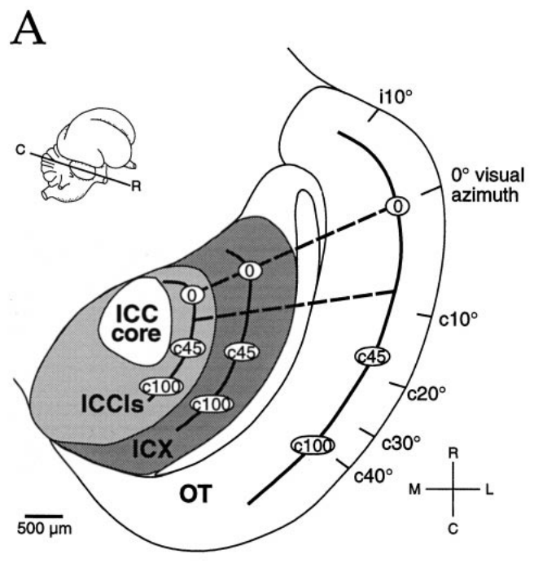
Visual experience recalibrates auditory space
A neural map is an ordered representation in which neighboring locations in tissue represent neighboring stimulus locations. In the barn owl, Tyto alba, the optic tectum contains auditory and visual maps that normally assign the same location to a sound and a visible object.
Brainard and Knudsen raised juvenile owls with prisms that displaced vision by 23° horizontally. Neurons acquired auditory timing preferences appropriate for the displaced visual field. Their visual receptive fields were measured without the prisms to establish the normal anatomical reference.
Brainard & Knudsen (1993), Fig. 5. Prism rearing shifts tectal ITD tuning.
The adaptation changed the correspondence between auditory cues and represented space. It did not require sound sources to move or auditory signals to pass through the prisms. The measured change is a calibration of the sensory map by visual experience, so the same acoustic timing cue comes to represent a different location.
Feldman & Knudsen (1998), Fig. 2(A). ICCls, ICX, and optic-tectum locations.
Brainard & Knudsen (1993)
2
Notes:
Teaching transcript:
A neural map is an ordered representation in which neighboring locations in tissue represent neighboring stimulus locations. In the barn owl, Tyto alba, the optic tectum contains auditory and visual maps that normally assign the same location to a sound and a visible object.
Brainard and Knudsen raised juvenile owls with prisms that displaced vision by 23° horizontally. Neurons acquired auditory timing preferences appropriate for the displaced visual field. Their visual receptive fields were measured without the prisms to establish the normal anatomical reference.
The adaptation changed the correspondence between auditory cues and represented space. It did not require sound sources to move or auditory signals to pass through the prisms. The measured change is a calibration of the sensory map by visual experience, so the same acoustic timing cue comes to represent a different location.
A receptive field is the stimulus region that drives a neuron. The prismatic displacement changes the visual reference used to associate an auditory cue with a location.
References:
MS Brainard; EI Knudsen (1993). Experience-dependent plasticity in the inferior colliculus: a site for visual calibration of the neural representation of auditory space in the barn owl. The Journal of Neuroscience 13(11):4589-4608. https://doi.org/10.1523/jneurosci.13-11-04589.1993
Daniel E. Feldman; Eric I. Knudsen (1998). Pharmacological Specialization of Learned Auditory Responses in the Inferior Colliculus of the Barn Owl. The Journal of Neuroscience 18(8):3073-3087. https://doi.org/10.1523/jneurosci.18-08-03073.1998
Brainard & Knudsen (1993), Fig. 5. Prism rearing shifts tectal ITD tuning.
Figure source: https://doi.org/10.1523/jneurosci.13-11-04589.1993
Feldman & Knudsen (1998), Fig. 2(A). ICCls, ICX, and optic-tectum locations.
Figure source: https://doi.org/10.1523/jneurosci.18-08-03073.1998

Slide 3
The optic tectum aligns auditory and visual maps
The optic tectum is a midbrain structure that receives visual input and auditory space information. In the barn owl, a sound and a visible object at the same place normally drive neurons at the same tectal location.
Alignment of the two maps requires that each acoustic timing cue corresponds to the right place in visual space. Brainard and Knudsen tested this correspondence by displacing vision 23° horizontally with prisms in juvenile owls.
After prism rearing the auditory timing preference at a tectal site was appropriate for the displaced visual field and no longer for the original one. The auditory map moved to realign with vision. The tectal auditory and visual maps normally agree, and the prism experiment tests how that agreement is established.
Brainard & Knudsen (1993), Fig. 5. Prism rearing shifts tectal ITD tuning.
Feldman & Knudsen (1998), Fig. 2(A). ICCls, ICX, and optic-tectum locations.
Brainard & Knudsen (1993)
2a
Notes:
The tectum holds a visual map and an auditory map that normally agree.
Two maps.
A neural map places neighboring locations in tissue at neighboring stimulus locations.
The optic tectum contains an auditory map and a visual map.
Normal alignment.
A sound and a visible object at one location normally activate the same part of the tectum.
Prism rearing.
Juvenile owls wore prisms that displaced vision by 23 degrees horizontally.
Visual receptive fields were measured without the prisms to give the normal anatomical reference.
Result.
Neurons acquired auditory timing preferences appropriate for the displaced visual field.
Meaning.
Sounds did not move, and signals did not pass through the prisms.
The correspondence between timing cues and represented space changed.
Why alignment matters.
If the maps disagreed, a sound would draw the owl to a place that differs from the visible object that made it.
Alignment allows one command to point the head at both.
What the prisms test.
Prisms change the visual map relative to the world while leaving the acoustic cues alone.
A change in the auditory map therefore reflects recalibration.
References:
MS Brainard; EI Knudsen (1993). Experience-dependent plasticity in the inferior colliculus: a site for visual calibration of the neural representation of auditory space in the barn owl. The Journal of Neuroscience 13(11):4589-4608. https://doi.org/10.1523/jneurosci.13-11-04589.1993

Slide 4
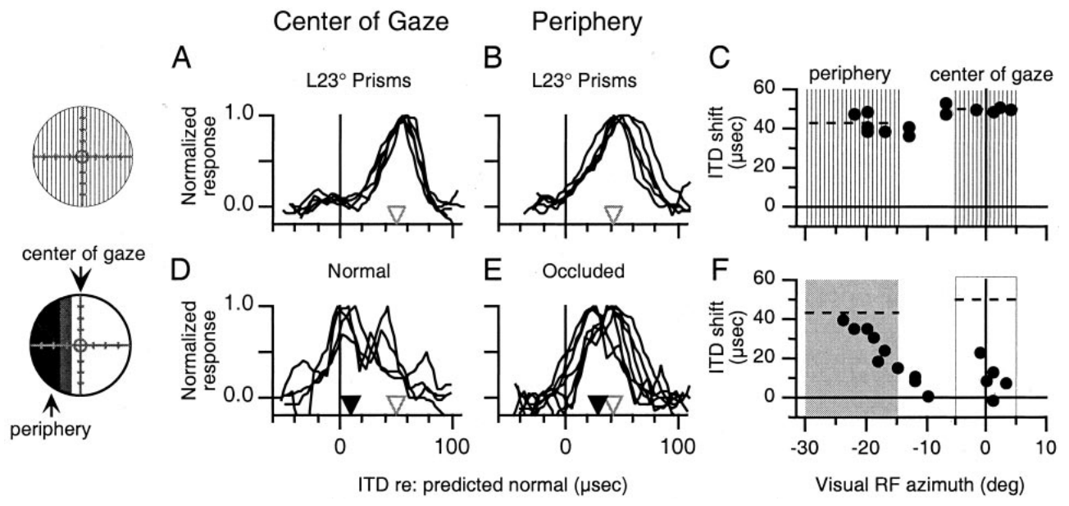
Prisms change the visual reference for sound
A prism refracts light, displacing the apparent direction of an object while leaving its sound unchanged. A visual receptive field, or VRF, identifies the position in visual space that activates a neuron. Comparing auditory tuning with that field separates altered sensory registration from the location of the recording site.
Hyde and Knudsen used 23° prisms and then altered vision separately in central and peripheral regions. The resulting auditory adjustments depended on which part of visual space remained available. A single direction of displacement did not force every portion of the auditory map to change equally.
Hyde & Knudsen (2001), Fig. 1(A–F). Regional visual manipulations and auditory tuning.
These manipulations test the information that guides calibration. Altering vision separately in central and peripheral regions tests which information guides calibration, since the auditory adjustments depended on which part of visual space remained available.
Feldman & Knudsen (1998), Fig. 2(A). ICCls, ICX, and optic-tectum locations.
Hyde & Knudsen (2001)
3
Notes:
Teaching transcript:
A prism refracts light, displacing the apparent direction of an object while leaving its sound unchanged. A visual receptive field, or VRF, identifies the position in visual space that activates a neuron. Comparing auditory tuning with that field separates altered sensory registration from the location of the recording site.
Hyde and Knudsen used 23° prisms and then altered vision separately in central and peripheral regions. The resulting auditory adjustments depended on which part of visual space remained available. A single direction of displacement did not force every portion of the auditory map to change equally.
These manipulations test the information that guides calibration. Altering vision separately in central and peripheral regions tests which information guides calibration, since the auditory adjustments depended on which part of visual space remained available.
Occlusion removes regional visual information; it differs from an optical displacement that preserves visible objects while moving their apparent positions.
References:
Peter S. Hyde; Eric I. Knudsen (2001). A Topographic Instructive Signal Guides the Adjustment of the Auditory Space Map in the Optic Tectum. The Journal of Neuroscience 21(21):8586-8593. https://doi.org/10.1523/jneurosci.21-21-08586.2001
Daniel E. Feldman; Eric I. Knudsen (1998). Pharmacological Specialization of Learned Auditory Responses in the Inferior Colliculus of the Barn Owl. The Journal of Neuroscience 18(8):3073-3087. https://doi.org/10.1523/jneurosci.18-08-03073.1998
Hyde & Knudsen (2001), Fig. 1(A–F). Regional visual manipulations and auditory tuning.
Figure source: https://doi.org/10.1523/jneurosci.21-21-08586.2001
Feldman & Knudsen (1998), Fig. 2(A). ICCls, ICX, and optic-tectum locations.
Figure source: https://doi.org/10.1523/jneurosci.18-08-03073.1998

Slide 5
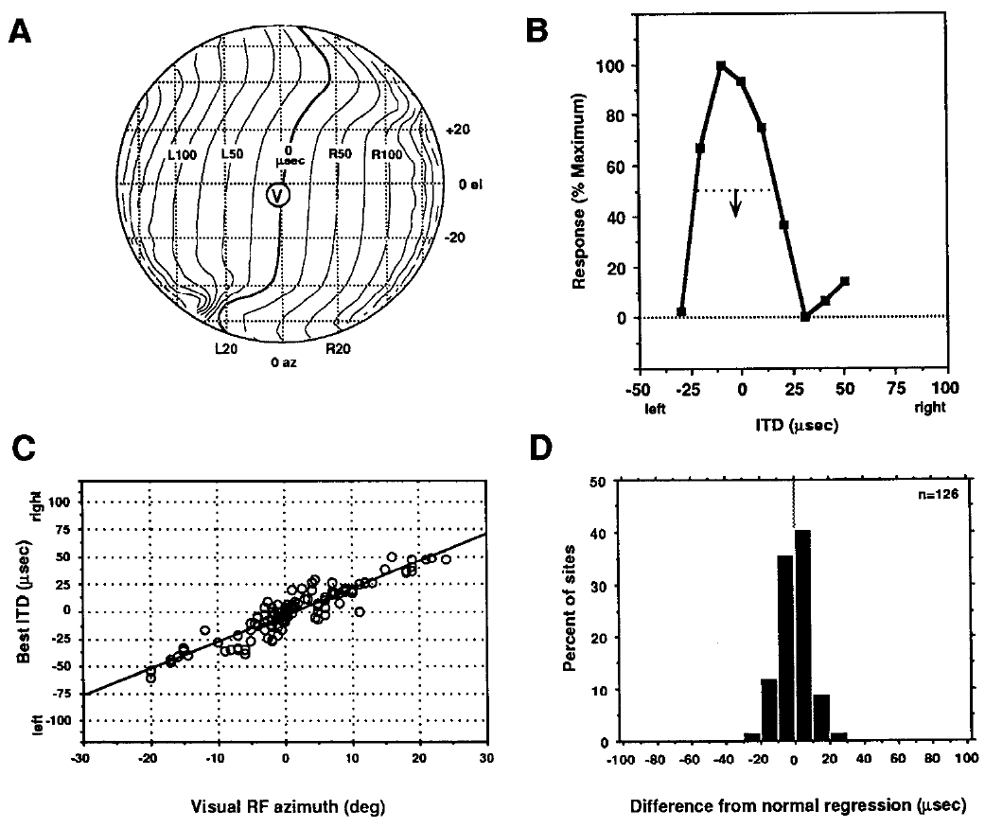
Microsecond timing is assigned to a spatial location
Interaural time difference, or ITD, is the difference in arrival time of a sound at the two ears. Ear-leading labels indicate which ear receives the waveform first. In these experiments, timing differences are measured in microseconds, whereas the perceived horizontal direction, or azimuth, is measured in degrees.
Brainard and Knudsen measured best ITDs and visual receptive-field positions at tectal sites. In normal owls, preferred timing changed systematically with visual azimuth. Best ITD means the timing difference producing the strongest response in a tuning curve, rather than the only timing value that can activate the neuron.
Brainard & Knudsen (1993), Fig. 3. Normal relationships among visual position and ITD.
The relationship supplies a reference for assessing prism-induced shifts. Optical displacement changes which timing value is appropriate for a mapped location, while the physical ITD delivered to the ears keeps its meaning as a time difference.
Feldman & Knudsen (1998), Fig. 2(A). ICCls, ICX, and optic-tectum locations.
Brainard & Knudsen (1993)
4
Notes:
Teaching transcript:
Interaural time difference, or ITD, is the difference in arrival time of a sound at the two ears. Ear-leading labels indicate which ear receives the waveform first. In these experiments, timing differences are measured in microseconds, whereas the perceived horizontal direction, or azimuth, is measured in degrees.
Brainard and Knudsen measured best ITDs and visual receptive-field positions at tectal sites. In normal owls, preferred timing changed systematically with visual azimuth. Best ITD means the timing difference producing the strongest response in a tuning curve, rather than the only timing value that can activate the neuron.
The relationship supplies a reference for assessing prism-induced shifts. Optical displacement changes which timing value is appropriate for a mapped location, while the physical ITD delivered to the ears keeps its meaning as a time difference.
A tuning curve records neuronal response across stimulus values. Its preferred value and its width describe different properties of the response.
References:
MS Brainard; EI Knudsen (1993). Experience-dependent plasticity in the inferior colliculus: a site for visual calibration of the neural representation of auditory space in the barn owl. The Journal of Neuroscience 13(11):4589-4608. https://doi.org/10.1523/jneurosci.13-11-04589.1993
Daniel E. Feldman; Eric I. Knudsen (1998). Pharmacological Specialization of Learned Auditory Responses in the Inferior Colliculus of the Barn Owl. The Journal of Neuroscience 18(8):3073-3087. https://doi.org/10.1523/jneurosci.18-08-03073.1998
Brainard & Knudsen (1993), Fig. 3. Normal relationships among visual position and ITD.
Figure source: https://doi.org/10.1523/jneurosci.13-11-04589.1993
Feldman & Knudsen (1998), Fig. 2(A). ICCls, ICX, and optic-tectum locations.
Figure source: https://doi.org/10.1523/jneurosci.18-08-03073.1998

Slide 6
Best ITD is the peak of a timing tuning curve
A tuning curve plots the response of a neuron against a stimulus parameter. Best ITD is the timing difference at the peak of the curve, and it is not the only value that can activate the neuron. Best ITD therefore summarizes where along the timing axis the response is largest.
Brainard and Knudsen compared best ITD with the position of the visual receptive field at tectal sites. In normal owls, best ITD changed systematically with visual azimuth, so each ear-leading value corresponded to a direction.
Brainard & Knudsen (1993), Fig. 3. Normal relationships among visual position and ITD.
The normal relationship between best ITD and azimuth is the reference against which prism-induced shifts are measured. A shift of best ITD at a site with the same visual receptive field indicates a change in calibration.
Feldman & Knudsen (1998), Fig. 2(A). ICCls, ICX, and optic-tectum locations.
Brainard & Knudsen (1993)
4a
Notes:
Best ITD summarizes where a timing tuning curve peaks, and it gives a way to compare sites and animals.
Tuning curve.
A tuning curve relates response to a controlled stimulus parameter.
Here the parameter is the interaural time difference in microseconds.
Best ITD.
Best ITD is the timing difference that produced the strongest response.
Other timing values can also activate the neuron.
Normal relation.
In normal owls best ITD changed systematically with visual azimuth.
Ear-leading labels indicate which ear receives the waveform first.
Reference for prisms.
A visual receptive field marks the location that the site represents.
A change of best ITD at a fixed visual location measures the shift in calibration.
Units.
Timing differences are measured in microseconds, and direction is measured in degrees.
Why not the only value.
A tuning curve has a width, so values near the peak also drive the neuron.
Best ITD marks the center of the response.
Using the relation.
Because best ITD changes systematically with azimuth in normal owls, a measured best ITD predicts which visual location the site represents.
Departures from the prediction measure calibration shifts.
References:
MS Brainard; EI Knudsen (1993). Experience-dependent plasticity in the inferior colliculus: a site for visual calibration of the neural representation of auditory space in the barn owl. The Journal of Neuroscience 13(11):4589-4608. https://doi.org/10.1523/jneurosci.13-11-04589.1993

Slide 7
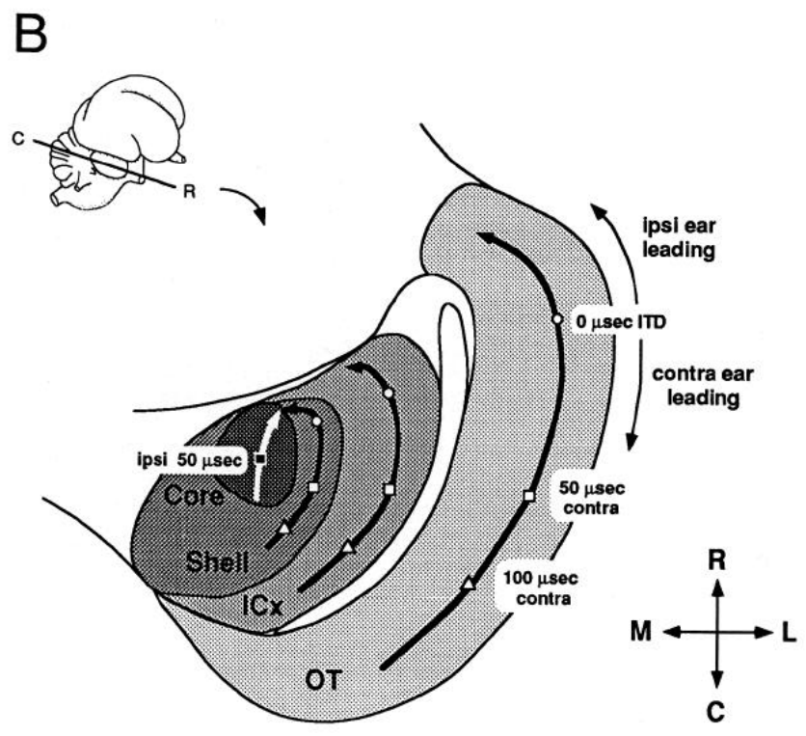
The external colliculus constructs a space map
The inferior colliculus is a midbrain auditory structure. Its central nucleus, ICC, contains frequency-organized auditory representations. The external nucleus, ICX, combines information across frequency channels and supplies a spatially ordered auditory representation to the optic tectum.
Brainard and Knudsen distinguished recording locations using anatomical reconstructions and response properties. The lateral shell of the central nucleus and the external nucleus occupy different parts of the same midbrain complex. That distinction is necessary because prism adaptation could alter their auditory responses differently.
A 23° visual displacement shifted timing preferences downstream in ICX while upstream timing representations remained normal. The lateral shell of the central nucleus and the external nucleus lie in the same midbrain complex but differ in plasticity, and the physiological comparison localized a major adaptive change to the transformation between the two representations.
Brainard & Knudsen (1993), Fig. 1(B). Anatomical locations of the auditory midbrain nuclei.
Brainard & Knudsen (1993)
5
Notes:
Teaching transcript:
The inferior colliculus is a midbrain auditory structure. Its central nucleus, ICC, contains frequency-organized auditory representations. The external nucleus, ICX, combines information across frequency channels and supplies a spatially ordered auditory representation to the optic tectum.
Brainard and Knudsen distinguished recording locations using anatomical reconstructions and response properties. The lateral shell of the central nucleus and the external nucleus occupy different parts of the same midbrain complex. That distinction is necessary because prism adaptation could alter their auditory responses differently.
A 23° visual displacement shifted timing preferences downstream in ICX while upstream timing representations remained normal. The lateral shell of the central nucleus and the external nucleus lie in the same midbrain complex but differ in plasticity, and the physiological comparison localized a major adaptive change to the transformation between the two representations.
Topographic projections preserve an ordered relationship between source and target locations. Such projections connect the ICX spatial representation with the tectal map.
References:
MS Brainard; EI Knudsen (1993). Experience-dependent plasticity in the inferior colliculus: a site for visual calibration of the neural representation of auditory space in the barn owl. The Journal of Neuroscience 13(11):4589-4608. https://doi.org/10.1523/jneurosci.13-11-04589.1993
Brainard & Knudsen (1993), Fig. 1(B). Anatomical locations of the auditory midbrain nuclei.
Figure source: https://doi.org/10.1523/jneurosci.13-11-04589.1993

Slide 8
ICCls and ICX are successive collicular stages
The lateral shell of the central nucleus, ICCls, provides timing-specific input to the external nucleus, ICX. ICX combines information across frequency channels and sends a spatially ordered auditory representation to the optic tectum. ICCls therefore precedes ICX in the pathway that reaches the tectum.
Brainard and Knudsen distinguished the two regions using anatomical reconstructions and response properties. Adaptation could alter their auditory responses differently, so recording location had to be known for each site.
In owls raised with a 23° visual displacement, ICX timing preferences shifted while ICCls timing representations remained normal. The change in calibration therefore occurs in the transformation from the first stage to the second. The first stage preserves the normal timing code, and the second stage expresses the adapted code.
Brainard & Knudsen (1993), Fig. 1(B). Anatomical locations of the auditory midbrain nuclei.
Brainard & Knudsen (1993)
5a
Notes:
Two neighboring stages in the same midbrain complex behaved differently after prism rearing.
ICCls.
The lateral shell of the central nucleus contains frequency-organized representations with timing-specific output.
ICX.
The external nucleus combines information across frequency channels.
It supplies a spatially ordered auditory representation to the optic tectum.
Locating recordings.
Sites were assigned using anatomical reconstructions and response properties.
Result.
ICX timing preferences shifted after 23-degree prism rearing.
Upstream timing representations remained normal.
Meaning.
Proximity in the tissue does not imply identical plasticity.
The adaptive change was localized to the transformation between the two stages.
Two measurements.
Anatomical reconstructions and response properties identified each recording region.
Both were needed because the regions neighbor one another.
Where plasticity appears.
A change that appears in ICX and is absent in ICCls implies that the first stage still supplies a normal timing code.
The adaptation must therefore occur in how ICX uses that code.
References:
MS Brainard; EI Knudsen (1993). Experience-dependent plasticity in the inferior colliculus: a site for visual calibration of the neural representation of auditory space in the barn owl. The Journal of Neuroscience 13(11):4589-4608. https://doi.org/10.1523/jneurosci.13-11-04589.1993

Slide 9
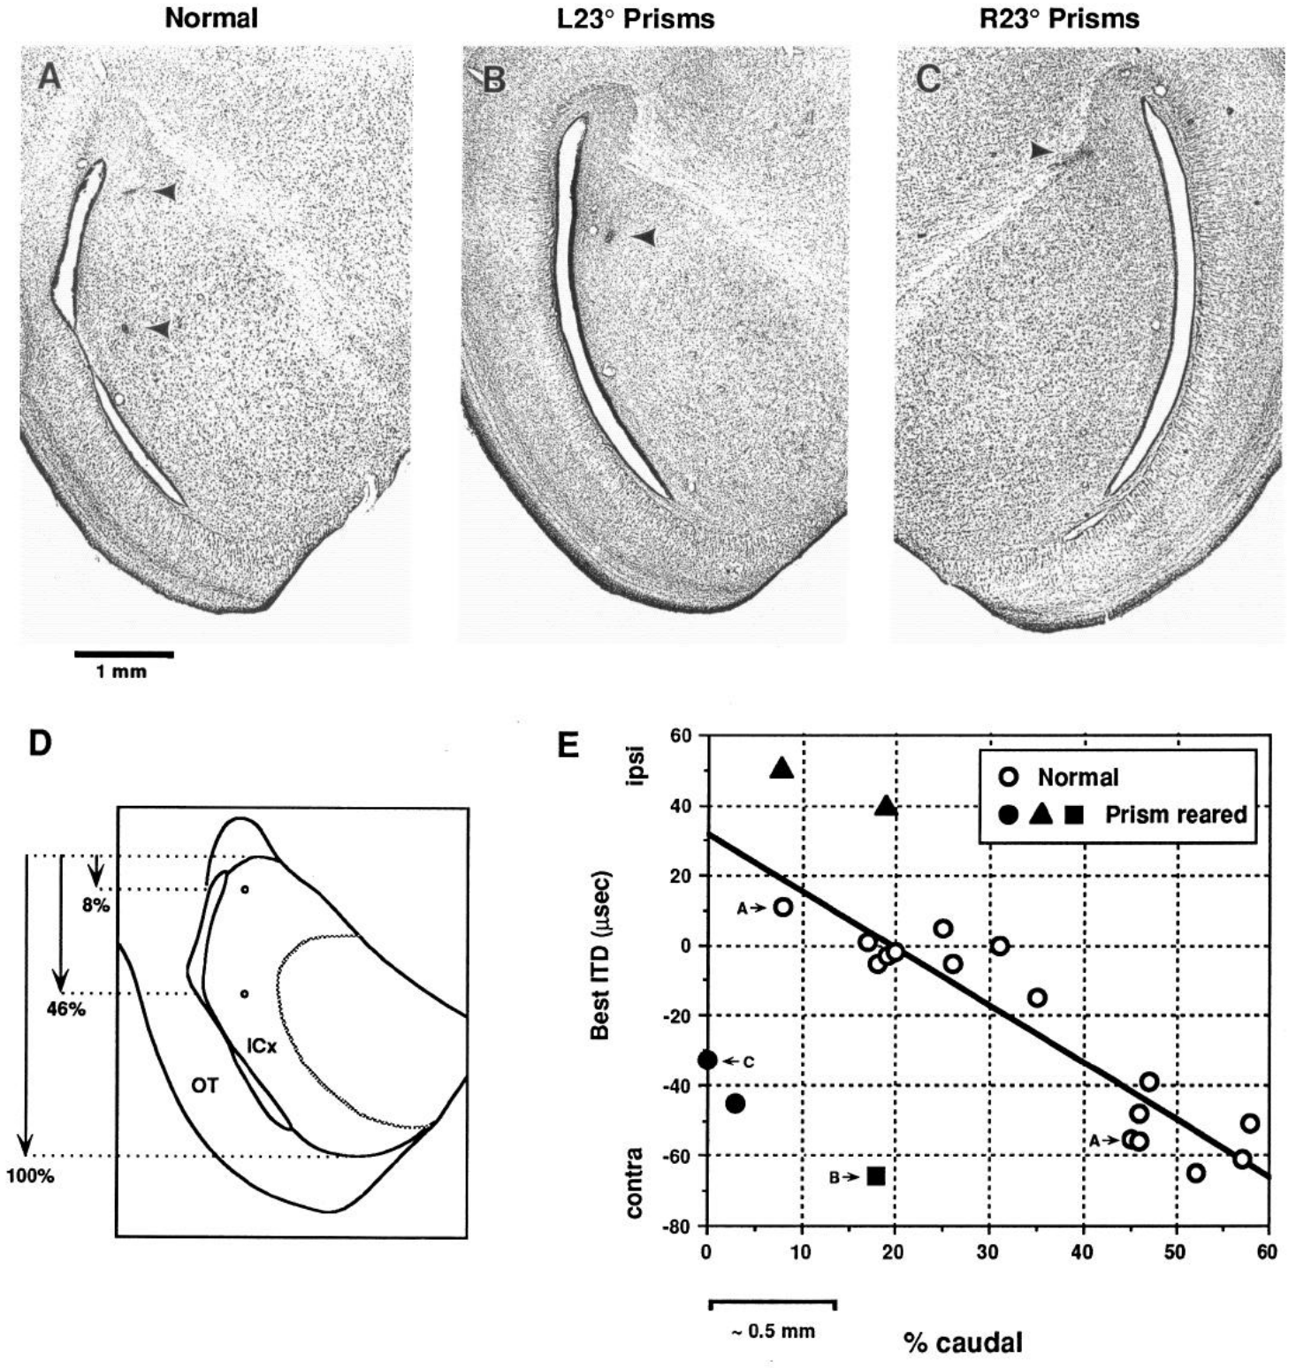
Adaptive timing shifts are already present in ICX
Brainard and Knudsen marked recording sites in histological sections and compared best ITD with position within ICX. Histology identifies tissue structures in thin stained sections. Electrode-site lesions linked each measured response to an anatomical location rather than relying only on the shape of its tuning curve.
Owls reared with leftward and rightward 23° displacements acquired timing preferences shifted in opposite adaptive directions. The shifts were present in ICX, before its output reached the optic tectum. Normal animals supplied the comparison between location and expected best ITD.
The experiment identifies ICX as a site that expresses adaptive plasticity. The opposite adaptive shifts in owls raised with leftward and rightward displacements link the measured timing change to the direction of the visual shift.
Brainard & Knudsen (1993), Fig. 13(A–E). Histological recording sites and ICX ITD preferences.
Brainard & Knudsen (1993)
6
Notes:
Teaching transcript:
Brainard and Knudsen marked recording sites in histological sections and compared best ITD with position within ICX. Histology identifies tissue structures in thin stained sections. Electrode-site lesions linked each measured response to an anatomical location rather than relying only on the shape of its tuning curve.
Owls reared with leftward and rightward 23° displacements acquired timing preferences shifted in opposite adaptive directions. The shifts were present in ICX, before its output reached the optic tectum. Normal animals supplied the comparison between location and expected best ITD.
The experiment identifies ICX as a site that expresses adaptive plasticity. The opposite adaptive shifts in owls raised with leftward and rightward displacements link the measured timing change to the direction of the visual shift.
The one-millimeter scale bar belongs to the original histological figure. Anatomical coordinates constrain the interpretation of the physiological shift.
References:
MS Brainard; EI Knudsen (1993). Experience-dependent plasticity in the inferior colliculus: a site for visual calibration of the neural representation of auditory space in the barn owl. The Journal of Neuroscience 13(11):4589-4608. https://doi.org/10.1523/jneurosci.13-11-04589.1993
Brainard & Knudsen (1993), Fig. 13(A–E). Histological recording sites and ICX ITD preferences.
Figure source: https://doi.org/10.1523/jneurosci.13-11-04589.1993

Slide 10
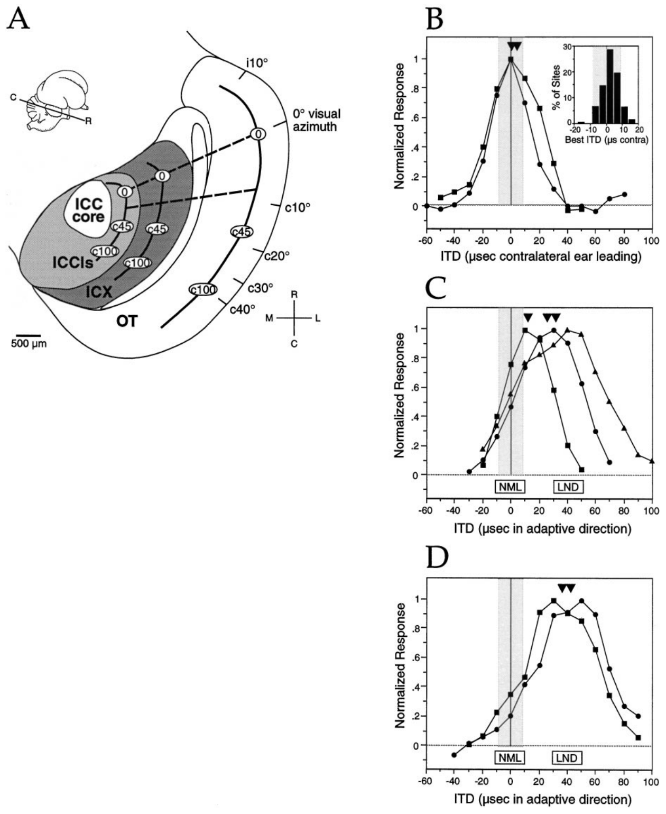
Learned and normal responses can coexist
During adaptation, ICX neurons can respond to both their original timing range and newly acquired timing values. Feldman and Knudsen called this transition-state tuning. A broad or double-peaked curve can therefore represent coexistence of normal and learned responses rather than an intermediate response to one timing value.
The authors compared recordings along anatomical transects that normally represented the same ITD. After 20–60 days of prism experience, units often retained a normal component while expressing an additional adaptive component. Longer prism experience produced more strongly shifted tuning at many sites.
The coexistence allowed pharmacological comparisons within a single recording. A drug could be tested against normal and learned responses in the same tissue, reducing the ambiguity associated with comparing unrelated neurons or regions.
Feldman & Knudsen (1998), Fig. 2(A–D). Anatomical transects and transition-state tuning.
Feldman & Knudsen (1998)
7
Notes:
Teaching transcript:
During adaptation, ICX neurons can respond to both their original timing range and newly acquired timing values. Feldman and Knudsen called this transition-state tuning. A broad or double-peaked curve can therefore represent coexistence of normal and learned responses rather than an intermediate response to one timing value.
The authors compared recordings along anatomical transects that normally represented the same ITD. After 20–60 days of prism experience, units often retained a normal component while expressing an additional adaptive component. Longer prism experience produced more strongly shifted tuning at many sites.
The coexistence allowed pharmacological comparisons within a single recording. A drug could be tested against normal and learned responses in the same tissue, reducing the ambiguity associated with comparing unrelated neurons or regions.
An iso-ITD transect is a recording trajectory joining locations that normally share the same preferred interaural timing difference.
References:
Daniel E. Feldman; Eric I. Knudsen (1998). Pharmacological Specialization of Learned Auditory Responses in the Inferior Colliculus of the Barn Owl. The Journal of Neuroscience 18(8):3073-3087. https://doi.org/10.1523/jneurosci.18-08-03073.1998
Feldman & Knudsen (1998), Fig. 2(A–D). Anatomical transects and transition-state tuning.
Figure source: https://doi.org/10.1523/jneurosci.18-08-03073.1998

Slide 11
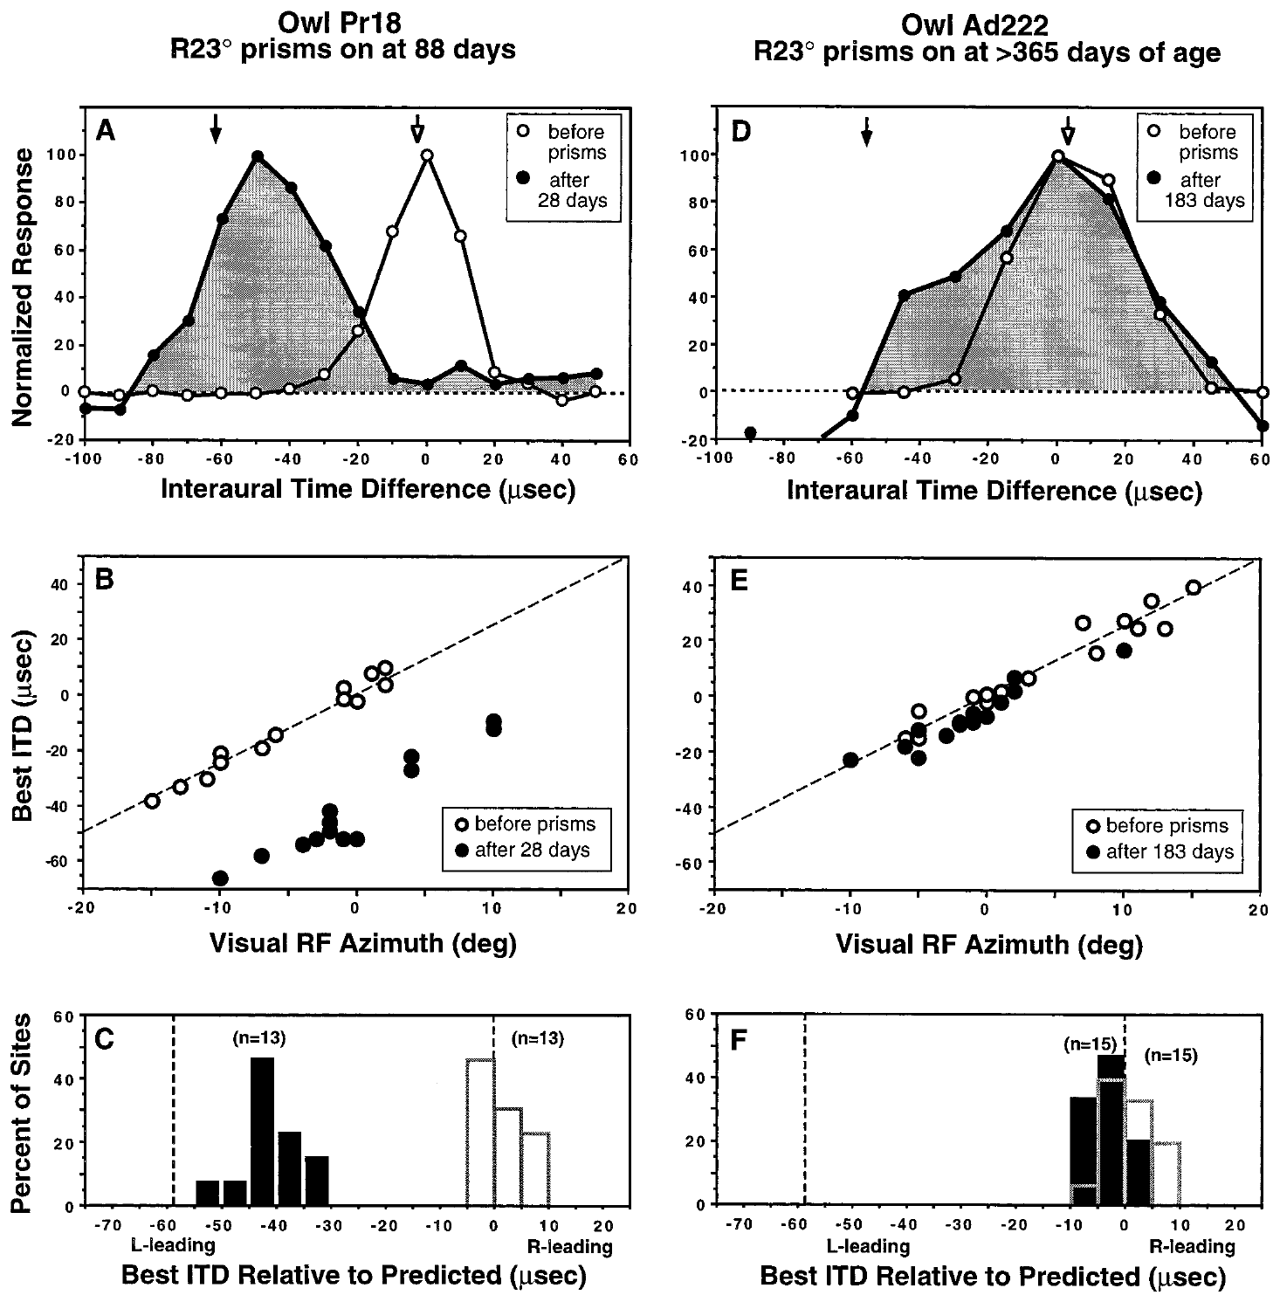
The same visual displacement has age-dependent effects
A sensitive period is an age range during which a particular experience can alter a circuit especially strongly. Brainard and Knudsen compared the response to 23° prisms in juvenile and adult barn owls, measuring preferred ITDs against visual receptive-field locations.
An owl fitted at 88 days of age showed a substantial adaptive shift after 28 days of prism experience. An adult fitted after one year of age exhibited much less change even after 183 days. The difference concerned the same kind of sensory mismatch and the same neural response measure.
Brainard & Knudsen (1998), Fig. 1(A–F). Juvenile and adult tuning before and after prisms.
Longer exposure therefore did not automatically compensate for older age. The comparison supports developmental regulation of auditory-map plasticity, with the juvenile owl adapting after 28 days and the adult showing little change after 183 days.
Feldman & Knudsen (1998), Fig. 2(A). ICCls, ICX, and optic-tectum locations.
Brainard & Knudsen (1998)
8
Notes:
Teaching transcript:
A sensitive period is an age range during which a particular experience can alter a circuit especially strongly. Brainard and Knudsen compared the response to 23° prisms in juvenile and adult barn owls, measuring preferred ITDs against visual receptive-field locations.
An owl fitted at 88 days of age showed a substantial adaptive shift after 28 days of prism experience. An adult fitted after one year of age exhibited much less change even after 183 days. The difference concerned the same kind of sensory mismatch and the same neural response measure.
Longer exposure therefore did not automatically compensate for older age. The comparison supports developmental regulation of auditory-map plasticity, with the juvenile owl adapting after 28 days and the adult showing little change after 183 days.
The relevant outcome is the displacement of auditory preference relative to the normal visual reference, rather than the total number of days wearing spectacles.
References:
Michael S. Brainard; Eric I. Knudsen (1998). Sensitive Periods for Visual Calibration of the Auditory Space Map in the Barn Owl Optic Tectum. The Journal of Neuroscience 18(10):3929-3942. https://doi.org/10.1523/jneurosci.18-10-03929.1998
Daniel E. Feldman; Eric I. Knudsen (1998). Pharmacological Specialization of Learned Auditory Responses in the Inferior Colliculus of the Barn Owl. The Journal of Neuroscience 18(8):3073-3087. https://doi.org/10.1523/jneurosci.18-08-03073.1998
Brainard & Knudsen (1998), Fig. 1(A–F). Juvenile and adult tuning before and after prisms.
Figure source: https://doi.org/10.1523/jneurosci.18-10-03929.1998
Feldman & Knudsen (1998), Fig. 2(A). ICCls, ICX, and optic-tectum locations.
Figure source: https://doi.org/10.1523/jneurosci.18-08-03073.1998

Slide 12
A sensitive period is a window of heightened plasticity
A sensitive period is an age range during which a particular experience can alter a circuit especially strongly. Outside the window, the same experience produces little change. Sensitive periods are defined by comparing animals of different ages that receive the same experience.
Brainard and Knudsen compared the response to 23° prisms in juvenile and adult barn owls, measuring preferred ITD against visual receptive-field locations. An owl fitted at 88 days of age showed a substantial adaptive shift after 28 days.
Brainard & Knudsen (1998), Fig. 1(A–F). Juvenile and adult tuning before and after prisms.
An adult fitted after one year of age showed much less change even after 183 days. The same sensory mismatch and the same neural response measure produced different results at the two ages. The comparison isolates age as the variable that changes the outcome.
Feldman & Knudsen (1998), Fig. 2(A). ICCls, ICX, and optic-tectum locations.
Brainard & Knudsen (1998)
8a
Notes:
Age determines how much the auditory map can change in response to the same visual displacement.
Definition.
A sensitive period is an age range of especially strong plasticity for a given experience.
Comparison.
Juvenile and adult barn owls received the same 23-degree prisms.
Preferred ITD was measured against visual receptive-field location.
Juvenile owl.
An owl fitted at 88 days showed a substantial adaptive shift after 28 days.
Adult owl.
An adult fitted after one year of age showed much less change after 183 days.
Longer exposure did not compensate for older age.
Meaning.
Auditory-map plasticity is regulated by development.
Same mismatch.
Every owl received a 23-degree displacement, so differences in outcome belong to age and not to the size of the visual error.
Reading the numbers.
The juvenile owl adapted substantially in 28 days, and the adult showed much less change in 183 days.
Time under prisms was not the limiting factor.
References:
Michael S. Brainard; Eric I. Knudsen (1998). Sensitive Periods for Visual Calibration of the Auditory Space Map in the Barn Owl Optic Tectum. The Journal of Neuroscience 18(10):3929-3942. https://doi.org/10.1523/jneurosci.18-10-03929.1998

Slide 13
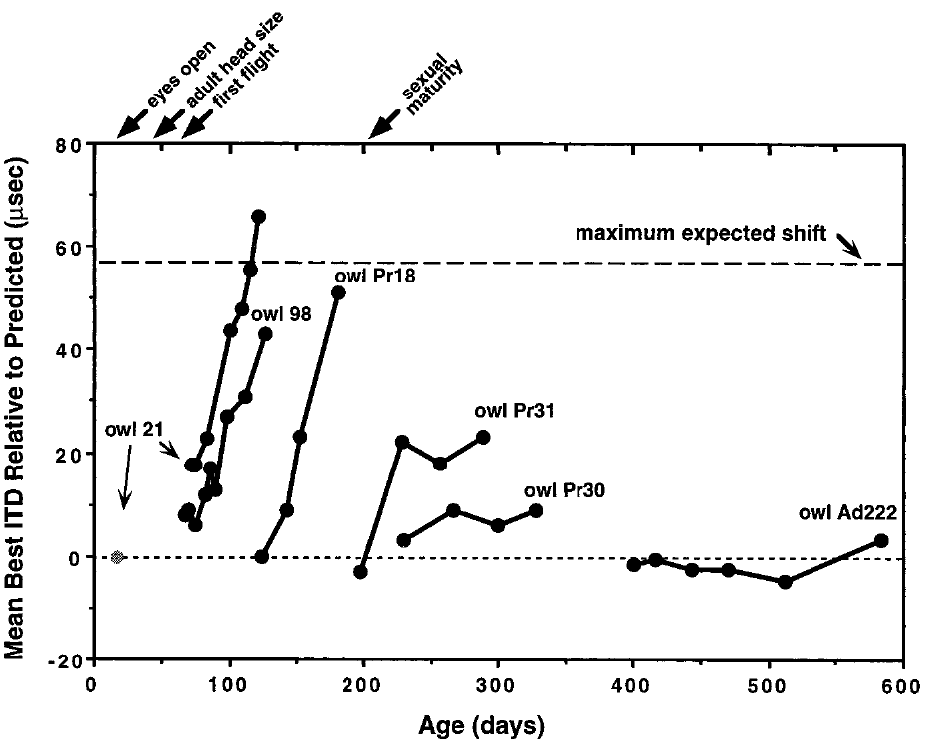
Map adjustment develops over repeated experience
Repeated recordings distinguish a stable preexisting map from a map that changes during experience. Brainard and Knudsen followed tectal timing preferences with chronic electrodes or by sampling multiple sites across successive sessions after prisms were attached.
With 23° prisms, the expected full adaptive change was approximately 57 µs. Younger owls progressed toward that value over days and weeks, whereas older owls often remained near the normal reference. The time courses differed across ages and individuals rather than following one universal rate.
Brainard & Knudsen (1998), Fig. 2. Time courses of preferred-ITD adjustment.
Chronic recording means returning to a recording preparation over time. These measurements establish the temporal course of functional adaptation, and a changing best ITD can result from altered weighting of several inputs.
Feldman & Knudsen (1998), Fig. 2(A). ICCls, ICX, and optic-tectum locations.
Brainard & Knudsen (1998)
9
Notes:
Teaching transcript:
Repeated recordings distinguish a stable preexisting map from a map that changes during experience. Brainard and Knudsen followed tectal timing preferences with chronic electrodes or by sampling multiple sites across successive sessions after prisms were attached.
With 23° prisms, the expected full adaptive change was approximately 57 µs. Younger owls progressed toward that value over days and weeks, whereas older owls often remained near the normal reference. The time courses differed across ages and individuals rather than following one universal rate.
Chronic recording means returning to a recording preparation over time. These measurements establish the temporal course of functional adaptation, and a changing best ITD can result from altered weighting of several inputs.
A complete adaptive shift is a reference predicted from the visual displacement. It is not an assumption that every animal must reach the same endpoint.
References:
Michael S. Brainard; Eric I. Knudsen (1998). Sensitive Periods for Visual Calibration of the Auditory Space Map in the Barn Owl Optic Tectum. The Journal of Neuroscience 18(10):3929-3942. https://doi.org/10.1523/jneurosci.18-10-03929.1998
Daniel E. Feldman; Eric I. Knudsen (1998). Pharmacological Specialization of Learned Auditory Responses in the Inferior Colliculus of the Barn Owl. The Journal of Neuroscience 18(8):3073-3087. https://doi.org/10.1523/jneurosci.18-08-03073.1998
Brainard & Knudsen (1998), Fig. 2. Time courses of preferred-ITD adjustment.
Figure source: https://doi.org/10.1523/jneurosci.18-10-03929.1998
Feldman & Knudsen (1998), Fig. 2(A). ICCls, ICX, and optic-tectum locations.
Figure source: https://doi.org/10.1523/jneurosci.18-08-03073.1998

Slide 14
Chronic recording follows the same preparation over time
Chronic recording means returning to a recording preparation across days and weeks. The map of a single animal can be measured before and during adaptation. Repeated measurement distinguishes a stable preexisting map from one that changes during experience.
Brainard and Knudsen followed tectal timing preferences with chronic electrodes or by sampling multiple sites across successive sessions after prisms were attached. With 23° prisms the full adaptive change was about 57 µs.
Brainard & Knudsen (1998), Fig. 2. Time courses of preferred-ITD adjustment.
Younger owls progressed toward that value over days and weeks, whereas older owls often remained near the normal reference. Time courses differed across ages and individuals and did not follow one universal rate. Rates of adaptation therefore vary with the age and history of each owl.
Feldman & Knudsen (1998), Fig. 2(A). ICCls, ICX, and optic-tectum locations.
Brainard & Knudsen (1998)
9a
Notes:
A map can only be shown to change if it is measured repeatedly.
Chronic recording.
The recording preparation is revisited over time, so each animal serves as its own baseline.
Expected change.
With 23-degree prisms the full adaptive change in best ITD was approximately 57 microseconds.
Younger owls.
They progressed toward the full shift over days and weeks.
Older owls.
They often remained near the normal reference.
Variability.
Time courses differed across ages and individuals.
A changing best ITD can reflect altered weighting of several inputs.
Time courses.
Some owls changed over days and others over weeks.
Older owls often stayed near the normal reference.
Population sampling.
Repeated sampling of tectal sites tracks the map as a population and does not follow one synapse.
A changing best ITD can come from new weighting of several inputs.
Why 57 microseconds.
The value is the expected full change for a 23-degree displacement, so a shift can be read as a fraction of complete adaptation.
Progress toward it measures how far the map has adapted.
References:
Michael S. Brainard; Eric I. Knudsen (1998). Sensitive Periods for Visual Calibration of the Auditory Space Map in the Barn Owl Optic Tectum. The Journal of Neuroscience 18(10):3929-3942. https://doi.org/10.1523/jneurosci.18-10-03929.1998

Slide 15
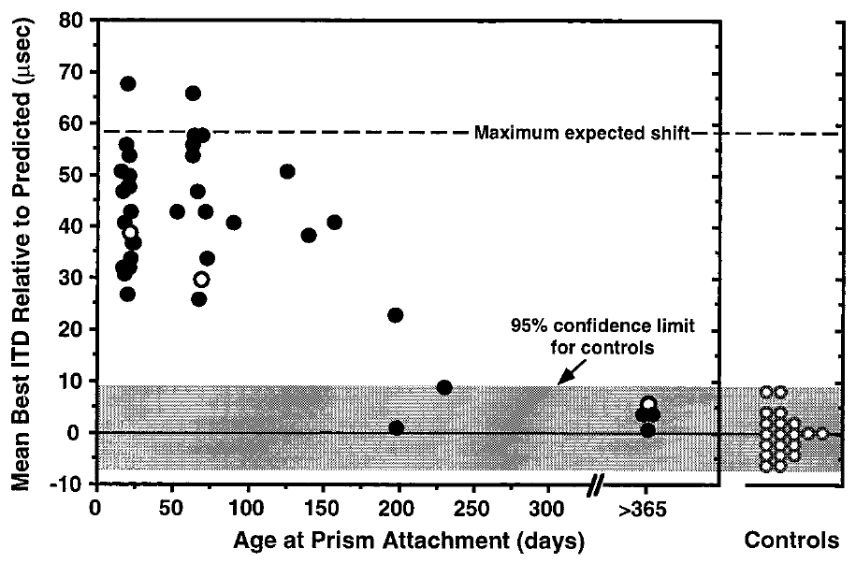
Novel map acquisition declines near 200 days
Brainard and Knudsen assessed the amount of tectal adjustment after at least two months of prism experience. The comparison asked how much a new visual displacement could change auditory timing preferences when introduced at different developmental ages.
In the communal-aviary conditions, the capacity to acquire a large shift declined around 200 days of age. Older owls generally produced small shifts despite sustained 23° optical displacement. The paper also identified animals with elevated auditory thresholds, because impaired sound sensitivity can affect the measured response.
Brainard & Knudsen (1998), Fig. 3. Adaptive shift versus age at prism attachment.
The approximately 200-day boundary describes a particular manipulation and environment. Acquisition of a new map and recovery of a previously established map are different experimental demands, and the communal aviary conditions defined the boundary of about 200 days.
Feldman & Knudsen (1998), Fig. 2(A). ICCls, ICX, and optic-tectum locations.
Brainard & Knudsen (1998)
10
Notes:
Teaching transcript:
Brainard and Knudsen assessed the amount of tectal adjustment after at least two months of prism experience. The comparison asked how much a new visual displacement could change auditory timing preferences when introduced at different developmental ages.
In the communal-aviary conditions, the capacity to acquire a large shift declined around 200 days of age. Older owls generally produced small shifts despite sustained 23° optical displacement. The paper also identified animals with elevated auditory thresholds, because impaired sound sensitivity can affect the measured response.
The approximately 200-day boundary describes a particular manipulation and environment. Acquisition of a new map and recovery of a previously established map are different experimental demands, and the communal aviary conditions defined the boundary of about 200 days.
An auditory threshold is the minimum sound level that reliably evokes a response. Threshold changes must be distinguished from changes in the preferred timing cue.
References:
Michael S. Brainard; Eric I. Knudsen (1998). Sensitive Periods for Visual Calibration of the Auditory Space Map in the Barn Owl Optic Tectum. The Journal of Neuroscience 18(10):3929-3942. https://doi.org/10.1523/jneurosci.18-10-03929.1998
Daniel E. Feldman; Eric I. Knudsen (1998). Pharmacological Specialization of Learned Auditory Responses in the Inferior Colliculus of the Barn Owl. The Journal of Neuroscience 18(8):3073-3087. https://doi.org/10.1523/jneurosci.18-08-03073.1998
Brainard & Knudsen (1998), Fig. 3. Adaptive shift versus age at prism attachment.
Figure source: https://doi.org/10.1523/jneurosci.18-10-03929.1998
Feldman & Knudsen (1998), Fig. 2(A). ICCls, ICX, and optic-tectum locations.
Figure source: https://doi.org/10.1523/jneurosci.18-08-03073.1998

Slide 16
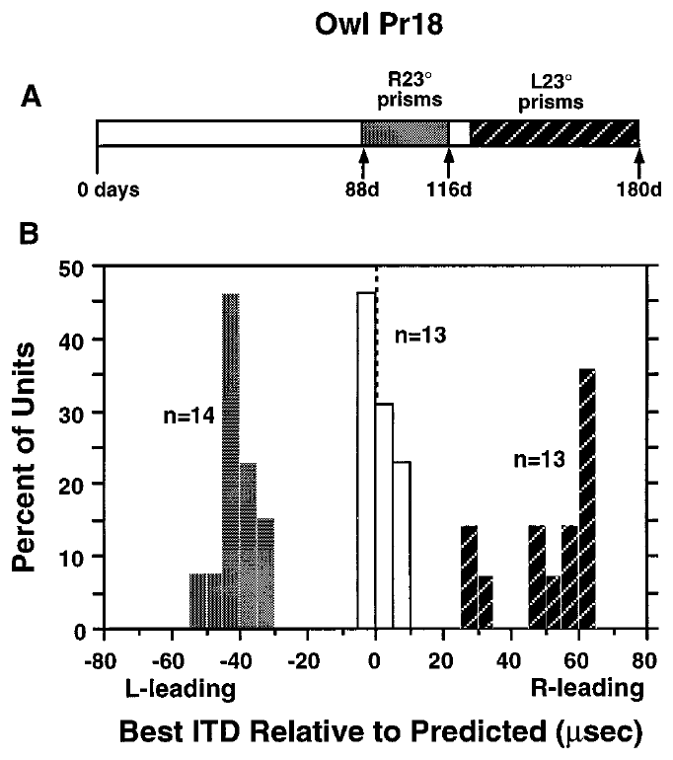
A juvenile map can learn opposite displacements
A developmental sensitive period permits more than a single irreversible adjustment. Brainard and Knudsen changed the direction of the visual displacement in a juvenile owl and measured how tectal timing preferences responded to the new sensory relationship.
An owl fitted with rightward 23° prisms at 88 days shifted its auditory map after 28 days. After the prisms were changed to leftward 23°, a subsequent 56-day period produced adjustment in the opposite direction. The same animal therefore acquired different cue-to-location relationships within development.
Brainard & Knudsen (1998), Fig. 5(A–B). Tuning distributions after opposite prism directions.
This reversal argues against a fixed anatomical offset being the entire explanation for prism adaptation. The reversal supports experience-dependent selection of timing inputs, whether through new connections, altered synaptic strengths or changes in inhibition.
Feldman & Knudsen (1998), Fig. 2(A). ICCls, ICX, and optic-tectum locations.
Brainard & Knudsen (1998)
11
Notes:
Teaching transcript:
A developmental sensitive period permits more than a single irreversible adjustment. Brainard and Knudsen changed the direction of the visual displacement in a juvenile owl and measured how tectal timing preferences responded to the new sensory relationship.
An owl fitted with rightward 23° prisms at 88 days shifted its auditory map after 28 days. After the prisms were changed to leftward 23°, a subsequent 56-day period produced adjustment in the opposite direction. The same animal therefore acquired different cue-to-location relationships within development.
This reversal argues against a fixed anatomical offset being the entire explanation for prism adaptation. The reversal supports experience-dependent selection of timing inputs, whether through new connections, altered synaptic strengths or changes in inhibition.
Reversal of the imposed displacement changes which ITDs are adaptive. The measured response must be evaluated relative to the new optical condition.
References:
Michael S. Brainard; Eric I. Knudsen (1998). Sensitive Periods for Visual Calibration of the Auditory Space Map in the Barn Owl Optic Tectum. The Journal of Neuroscience 18(10):3929-3942. https://doi.org/10.1523/jneurosci.18-10-03929.1998
Daniel E. Feldman; Eric I. Knudsen (1998). Pharmacological Specialization of Learned Auditory Responses in the Inferior Colliculus of the Barn Owl. The Journal of Neuroscience 18(8):3073-3087. https://doi.org/10.1523/jneurosci.18-08-03073.1998
Brainard & Knudsen (1998), Fig. 5(A–B). Tuning distributions after opposite prism directions.
Figure source: https://doi.org/10.1523/jneurosci.18-10-03929.1998
Feldman & Knudsen (1998), Fig. 2(A). ICCls, ICX, and optic-tectum locations.
Figure source: https://doi.org/10.1523/jneurosci.18-08-03073.1998

Slide 17
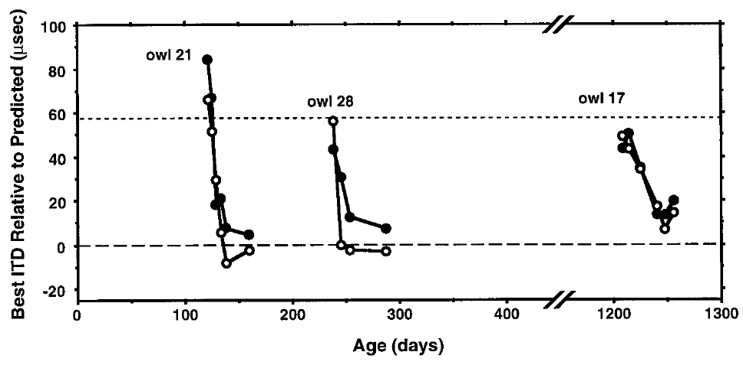
Normal vision can restore a previously calibrated map
Restoring normal vision asks the system to return to a previously established cue-to-location relationship. Brainard and Knudsen removed prisms and followed preferred ITDs using chronic tectal recordings, providing a direct comparison with the shifted map immediately before removal.
Owls whose prisms were removed at 108, 238, and 1,208 days of age recovered normal tuning over the subsequent period of normal vision. Recovery occurred even in the oldest animal when it lived in the rich communal environment.
Brainard & Knudsen (1998), Fig. 6. Recovery after prism removal at different ages.
The result separates recovery from the acquisition of a novel displacement. An adult circuit can retain access to a normal calibration that it does not express under prism conditions. The oldest animal recovered when housed in the rich communal environment, so access to the normal calibration persisted into adulthood.
Feldman & Knudsen (1998), Fig. 2(A). ICCls, ICX, and optic-tectum locations.
Brainard & Knudsen (1998)
12
Notes:
Teaching transcript:
Restoring normal vision asks the system to return to a previously established cue-to-location relationship. Brainard and Knudsen removed prisms and followed preferred ITDs using chronic tectal recordings, providing a direct comparison with the shifted map immediately before removal.
Owls whose prisms were removed at 108, 238, and 1,208 days of age recovered normal tuning over the subsequent period of normal vision. Recovery occurred even in the oldest animal when it lived in the rich communal environment.
The result separates recovery from the acquisition of a novel displacement. An adult circuit can retain access to a normal calibration that it does not express under prism conditions. The oldest animal recovered when housed in the rich communal environment, so access to the normal calibration persisted into adulthood.
Prism removal restores the visual reference without reversing the direction of the auditory waveform. The experimental outcome is the reappearance of normal auditory preferences.
References:
Michael S. Brainard; Eric I. Knudsen (1998). Sensitive Periods for Visual Calibration of the Auditory Space Map in the Barn Owl Optic Tectum. The Journal of Neuroscience 18(10):3929-3942. https://doi.org/10.1523/jneurosci.18-10-03929.1998
Daniel E. Feldman; Eric I. Knudsen (1998). Pharmacological Specialization of Learned Auditory Responses in the Inferior Colliculus of the Barn Owl. The Journal of Neuroscience 18(8):3073-3087. https://doi.org/10.1523/jneurosci.18-08-03073.1998
Brainard & Knudsen (1998), Fig. 6. Recovery after prism removal at different ages.
Figure source: https://doi.org/10.1523/jneurosci.18-10-03929.1998
Feldman & Knudsen (1998), Fig. 2(A). ICCls, ICX, and optic-tectum locations.
Figure source: https://doi.org/10.1523/jneurosci.18-08-03073.1998

Slide 18
Recovery restores a previously calibrated map
Recovery is a return to a cue-to-location relationship that the animal established earlier. It differs from acquiring a new displacement, which requires an unfamiliar mapping. The shifted map just before prism removal provided the comparison for recovery.
Brainard and Knudsen removed prisms and followed preferred ITDs with chronic tectal recordings. Owls whose prisms were removed at 108, 238 and 1,208 days of age recovered normal tuning over a period of normal vision.
Brainard & Knudsen (1998), Fig. 6. Recovery after prism removal at different ages.
Recovery occurred in the oldest animal when it lived in the rich communal environment. An adult circuit can therefore retain access to a normal calibration that it does not express while the prisms are worn. Recovery shows that the normal mapping remains available as an alternative state of the same circuit.
Feldman & Knudsen (1998), Fig. 2(A). ICCls, ICX, and optic-tectum locations.
Brainard & Knudsen (1998)
12a
Notes:
Returning to a familiar mapping is easier for an adult circuit than acquiring a new one.
Recovery and acquisition.
Recovery returns to a mapping that was established before.
Acquisition requires an unfamiliar displacement.
Procedure.
Prisms were removed, and preferred ITDs were followed with chronic tectal recordings.
The shifted map just before removal gave the comparison.
Ages.
Prisms were removed at 108, 238 and 1,208 days of age.
All owls recovered normal tuning during normal vision.
Environment.
Recovery occurred even in the oldest animal when it lived in the communal environment.
Meaning.
A normal calibration remains accessible in adults.
Why recovery is informative.
If adult circuits lost the normal mapping, removing prisms would leave the shifted map in place.
Return to normal tuning shows that the mapping was retained.
Rich environment.
The oldest owl lived in a communal aviary.
Its recovery depended on that environment, as later experiments on housing show.
References:
Michael S. Brainard; Eric I. Knudsen (1998). Sensitive Periods for Visual Calibration of the Auditory Space Map in the Barn Owl Optic Tectum. The Journal of Neuroscience 18(10):3929-3942. https://doi.org/10.1523/jneurosci.18-10-03929.1998

Slide 19
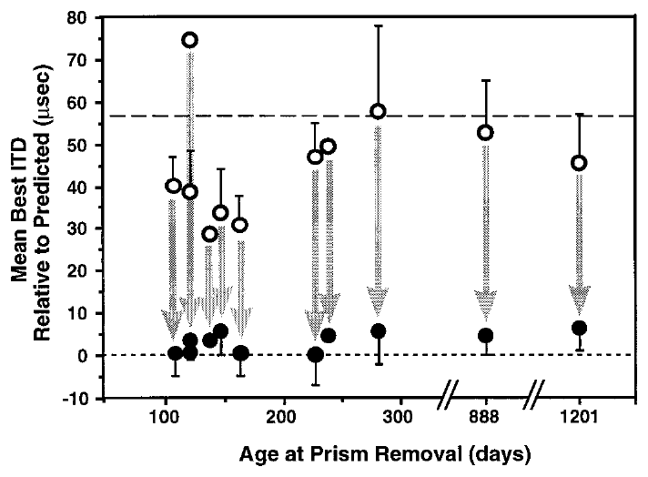
Recovery and new learning have different age limits
A circuit’s capacity for plasticity depends on the adjustment required. Brainard and Knudsen compared auditory tuning immediately before prism removal with tuning after at least one month of normal visual experience in owls of different ages.
Recovery toward the normal auditory map occurred across the tested age range in communal aviaries, including animals older than two years. By contrast, acquisition of a large novel shift was strongly reduced when a 23° displacement was first introduced late in life.
Brainard & Knudsen (1998), Fig. 7. Preferred timing before and after prism removal.
These outcomes do not support a single age at which all auditory-map change becomes impossible. They support distinct constraints on establishing an unfamiliar mapping and returning to a familiar one. Recovery was observed in owls older than two years, whereas a large novel shift was strongly reduced when a displacement was first introduced late in life.
Feldman & Knudsen (1998), Fig. 2(A). ICCls, ICX, and optic-tectum locations.
Brainard & Knudsen (1998)
13
Notes:
Teaching transcript:
A circuit’s capacity for plasticity depends on the adjustment required. Brainard and Knudsen compared auditory tuning immediately before prism removal with tuning after at least one month of normal visual experience in owls of different ages.
Recovery toward the normal auditory map occurred across the tested age range in communal aviaries, including animals older than two years. By contrast, acquisition of a large novel shift was strongly reduced when a 23° displacement was first introduced late in life.
These outcomes do not support a single age at which all auditory-map change becomes impossible. They support distinct constraints on establishing an unfamiliar mapping and returning to a familiar one. Recovery was observed in owls older than two years, whereas a large novel shift was strongly reduced when a displacement was first introduced late in life.
Prior calibration provides a different starting circuit state from the state of an adult encountering an unfamiliar optical displacement.
References:
Michael S. Brainard; Eric I. Knudsen (1998). Sensitive Periods for Visual Calibration of the Auditory Space Map in the Barn Owl Optic Tectum. The Journal of Neuroscience 18(10):3929-3942. https://doi.org/10.1523/jneurosci.18-10-03929.1998
Daniel E. Feldman; Eric I. Knudsen (1998). Pharmacological Specialization of Learned Auditory Responses in the Inferior Colliculus of the Barn Owl. The Journal of Neuroscience 18(8):3073-3087. https://doi.org/10.1523/jneurosci.18-08-03073.1998
Brainard & Knudsen (1998), Fig. 7. Preferred timing before and after prism removal.
Figure source: https://doi.org/10.1523/jneurosci.18-10-03929.1998
Feldman & Knudsen (1998), Fig. 2(A). ICCls, ICX, and optic-tectum locations.
Figure source: https://doi.org/10.1523/jneurosci.18-08-03073.1998

Slide 20
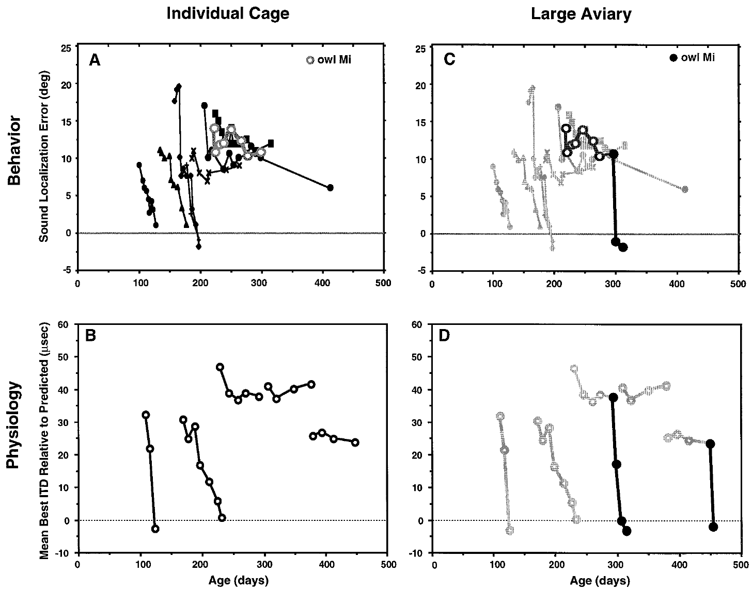
An impoverished environment restricts recovery
Brainard and Knudsen tested whether housing conditions contributed to apparently different sensitive periods. Owls in small individual cages could see and hear other owls but could not fly or interact directly with them as they could in a communal aviary.
After normal vision was restored, younger animals recovered accurate localization and normal tectal timing. Animals older than approximately 200 days often failed to recover while they remained in the small cages. Both neural tuning and auditory orienting were assessed, linking environmental conditions with the expressed adjustment.
Brainard & Knudsen (1998), Fig. 8(A–B). Recovery while owls lived in individual cages.
The cage manipulation changed several aspects of experience together. Flight, social interaction, attention and sensory richness differed between the cage and the aviary, so recovery depended on the environment in which the owls lived, and the age limit applied to the restricted cage conditions.
Feldman & Knudsen (1998), Fig. 2(A). ICCls, ICX, and optic-tectum locations.
Brainard & Knudsen (1998)
14
Notes:
Teaching transcript:
Brainard and Knudsen tested whether housing conditions contributed to apparently different sensitive periods. Owls in small individual cages could see and hear other owls but could not fly or interact directly with them as they could in a communal aviary.
After normal vision was restored, younger animals recovered accurate localization and normal tectal timing. Animals older than approximately 200 days often failed to recover while they remained in the small cages. Both neural tuning and auditory orienting were assessed, linking environmental conditions with the expressed adjustment.
The cage manipulation changed several aspects of experience together. Flight, social interaction, attention and sensory richness differed between the cage and the aviary, so recovery depended on the environment in which the owls lived, and the age limit applied to the restricted cage conditions.
Auditory orienting error measures the difference between sound-source direction and the owl’s head orientation. It is a behavioral quantity distinct from neuronal best ITD.
References:
Michael S. Brainard; Eric I. Knudsen (1998). Sensitive Periods for Visual Calibration of the Auditory Space Map in the Barn Owl Optic Tectum. The Journal of Neuroscience 18(10):3929-3942. https://doi.org/10.1523/jneurosci.18-10-03929.1998
Daniel E. Feldman; Eric I. Knudsen (1998). Pharmacological Specialization of Learned Auditory Responses in the Inferior Colliculus of the Barn Owl. The Journal of Neuroscience 18(8):3073-3087. https://doi.org/10.1523/jneurosci.18-08-03073.1998
Brainard & Knudsen (1998), Fig. 8(A–B). Recovery while owls lived in individual cages.
Figure source: https://doi.org/10.1523/jneurosci.18-10-03929.1998
Feldman & Knudsen (1998), Fig. 2(A). ICCls, ICX, and optic-tectum locations.
Figure source: https://doi.org/10.1523/jneurosci.18-08-03073.1998

Slide 21
A richer environment can reopen expressed recovery
Environmental conditions can change the expression of adult auditory plasticity after an initial failure to adapt. Brainard and Knudsen transferred prism-reared owls from individual cages to a large aviary after normal vision had been restored.
One owl had prisms removed at 219 days and showed little behavioral correction during 76 days in a cage. After transfer at 295 days, its localization accuracy improved. Adult owls that had failed to restore normal tectal timing in cages also recovered after transfer to the aviary.
Brainard & Knudsen (1998), Fig. 8(C–D). Recovery after transfer from cages to an aviary.
These comparisons constrain explanations based only on irreversible loss of developmental capacity. Some capacity remained available but depended on the animal’s environment. Transfer from cages to the aviary was sufficient for localization accuracy and tectal timing to recover in adults that had failed to recover in cages.
Feldman & Knudsen (1998), Fig. 2(A). ICCls, ICX, and optic-tectum locations.
Brainard & Knudsen (1998)
15
Notes:
Teaching transcript:
Environmental conditions can change the expression of adult auditory plasticity after an initial failure to adapt. Brainard and Knudsen transferred prism-reared owls from individual cages to a large aviary after normal vision had been restored.
One owl had prisms removed at 219 days and showed little behavioral correction during 76 days in a cage. After transfer at 295 days, its localization accuracy improved. Adult owls that had failed to restore normal tectal timing in cages also recovered after transfer to the aviary.
These comparisons constrain explanations based only on irreversible loss of developmental capacity. Some capacity remained available but depended on the animal’s environment. Transfer from cages to the aviary was sufficient for localization accuracy and tectal timing to recover in adults that had failed to recover in cages.
The change in housing occurred after the visual manipulation was reversed. This sequence separates availability of normal visual information from the conditions needed to use it.
References:
Michael S. Brainard; Eric I. Knudsen (1998). Sensitive Periods for Visual Calibration of the Auditory Space Map in the Barn Owl Optic Tectum. The Journal of Neuroscience 18(10):3929-3942. https://doi.org/10.1523/jneurosci.18-10-03929.1998
Daniel E. Feldman; Eric I. Knudsen (1998). Pharmacological Specialization of Learned Auditory Responses in the Inferior Colliculus of the Barn Owl. The Journal of Neuroscience 18(8):3073-3087. https://doi.org/10.1523/jneurosci.18-08-03073.1998
Brainard & Knudsen (1998), Fig. 8(C–D). Recovery after transfer from cages to an aviary.
Figure source: https://doi.org/10.1523/jneurosci.18-10-03929.1998
Feldman & Knudsen (1998), Fig. 2(A). ICCls, ICX, and optic-tectum locations.
Figure source: https://doi.org/10.1523/jneurosci.18-08-03073.1998

Slide 22
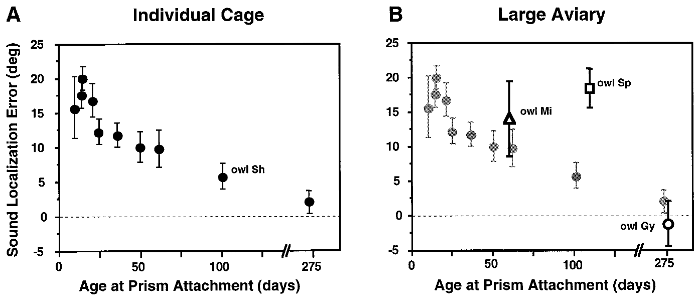
Housing conditions shift the apparent sensitive period
Sensitive-period measurements depend on the experience provided to the animal. Brainard and Knudsen compared auditory orienting after at least 60 days of 23° prism exposure in owls housed individually and in owls housed in a large aviary.
In the earlier cage conditions, substantial behavioral adjustment was restricted to much younger animals, around 70 days at prism attachment. In the richer environment, later juvenile experience could still support adjustment. This difference helped reconcile behavioral age limits with the longer period measured in neural recordings.
Brainard & Knudsen (1998), Fig. 9(A–B). Age-dependent behavioral adjustment in two environments.
Age and environment jointly influence the amount of adaptation that is expressed. Accounting for housing conditions turns an apparently universal biological deadline into a condition-dependent sensitive period.
Feldman & Knudsen (1998), Fig. 2(A). ICCls, ICX, and optic-tectum locations.
Brainard & Knudsen (1998)
16
Notes:
Teaching transcript:
Sensitive-period measurements depend on the experience provided to the animal. Brainard and Knudsen compared auditory orienting after at least 60 days of 23° prism exposure in owls housed individually and in owls housed in a large aviary.
In the earlier cage conditions, substantial behavioral adjustment was restricted to much younger animals, around 70 days at prism attachment. In the richer environment, later juvenile experience could still support adjustment. This difference helped reconcile behavioral age limits with the longer period measured in neural recordings.
Age and environment jointly influence the amount of adaptation that is expressed. Accounting for housing conditions turns an apparently universal biological deadline into a condition-dependent sensitive period.
The comparison concerns the strength of adaptation to a novel displacement. It differs from the ability to recover a normal mapping after prism removal.
References:
Michael S. Brainard; Eric I. Knudsen (1998). Sensitive Periods for Visual Calibration of the Auditory Space Map in the Barn Owl Optic Tectum. The Journal of Neuroscience 18(10):3929-3942. https://doi.org/10.1523/jneurosci.18-10-03929.1998
Daniel E. Feldman; Eric I. Knudsen (1998). Pharmacological Specialization of Learned Auditory Responses in the Inferior Colliculus of the Barn Owl. The Journal of Neuroscience 18(8):3073-3087. https://doi.org/10.1523/jneurosci.18-08-03073.1998
Brainard & Knudsen (1998), Fig. 9(A–B). Age-dependent behavioral adjustment in two environments.
Figure source: https://doi.org/10.1523/jneurosci.18-10-03929.1998
Feldman & Knudsen (1998), Fig. 2(A). ICCls, ICX, and optic-tectum locations.
Figure source: https://doi.org/10.1523/jneurosci.18-08-03073.1998

Slide 23
Regional visual information can instruct local tuning
A topographic instructive signal supplies location-specific information about how a neural representation should change. Hyde and Knudsen distinguished this possibility from instruction based only on whether an auditory orienting movement ended at the correct central visual position.
After initial adaptation to leftward 23° prisms, one owl experienced normal vision centrally while the peripheral field beyond 15° was occluded. After 11 days, central tectal timing moved toward normal while the occluded peripheral representation changed much less.
Hyde & Knudsen (2001), Fig. 1(A–F). Central recovery with peripheral visual occlusion.
Different regional adjustments support a point-by-point visual contribution to calibration. A teaching signal derived solely from central gaze would predict a more uniform change. The experiment identifies the spatial organization of instruction without directly recording the neurons that carry it.
Feldman & Knudsen (1998), Fig. 2(A). ICCls, ICX, and optic-tectum locations.
Hyde & Knudsen (2001)
17
Notes:
Teaching transcript:
A topographic instructive signal supplies location-specific information about how a neural representation should change. Hyde and Knudsen distinguished this possibility from instruction based only on whether an auditory orienting movement ended at the correct central visual position.
After initial adaptation to leftward 23° prisms, one owl experienced normal vision centrally while the peripheral field beyond 15° was occluded. After 11 days, central tectal timing moved toward normal while the occluded peripheral representation changed much less.
Different regional adjustments support a point-by-point visual contribution to calibration. A teaching signal derived solely from central gaze would predict a more uniform change. The experiment identifies the spatial organization of instruction without directly recording the neurons that carry it.
Center-of-gaze and peripheral manipulations create different visual conditions within one animal, providing an internal comparison between regions of the map.
References:
Peter S. Hyde; Eric I. Knudsen (2001). A Topographic Instructive Signal Guides the Adjustment of the Auditory Space Map in the Optic Tectum. The Journal of Neuroscience 21(21):8586-8593. https://doi.org/10.1523/jneurosci.21-21-08586.2001
Daniel E. Feldman; Eric I. Knudsen (1998). Pharmacological Specialization of Learned Auditory Responses in the Inferior Colliculus of the Barn Owl. The Journal of Neuroscience 18(8):3073-3087. https://doi.org/10.1523/jneurosci.18-08-03073.1998
Hyde & Knudsen (2001), Fig. 1(A–F). Central recovery with peripheral visual occlusion.
Figure source: https://doi.org/10.1523/jneurosci.21-21-08586.2001
Feldman & Knudsen (1998), Fig. 2(A). ICCls, ICX, and optic-tectum locations.
Figure source: https://doi.org/10.1523/jneurosci.18-08-03073.1998

Slide 24
An instructive signal specifies the direction of change
An instructive signal carries information about how a representation should change, not only that a change is needed. A topographic instructive signal specifies the change separately for each location in the map. The distinction matters because the two possibilities make different predictions about where in the map changes occur.
Hyde and Knudsen adapted owls to leftward 23° prisms and then gave normal vision centrally while the peripheral field beyond 15° was occluded. After 11 days, central tectal timing moved toward normal while the occluded peripheral representation changed much less.
Hyde & Knudsen (2001), Fig. 1(A–F). Central recovery with peripheral visual occlusion.
Different regions adjusted differently within the same animal. Visual information therefore contributes to calibration point by point and is not a single signal derived from where the owl directs its gaze.
Feldman & Knudsen (1998), Fig. 2(A). ICCls, ICX, and optic-tectum locations.
Hyde & Knudsen (2001)
17a
Notes:
The experiment asks what kind of visual information instructs the auditory map.
Instructive signal.
An instructive signal specifies the direction of change in addition to signaling error.
A topographic signal does so separately for each location.
Alternative.
Instruction could depend only on whether an orienting movement ended at the correct central visual position.
Manipulation.
After adaptation to leftward prisms, normal vision was given centrally while the periphery beyond 15 degrees was occluded.
Result.
After 11 days central tectal timing moved toward normal.
The occluded peripheral representation changed much less.
Meaning.
A signal derived only from central gaze would predict a more uniform change.
Two hypotheses.
One hypothesis ties instruction to the correctness of an orienting movement toward the center of gaze.
The other supplies instruction separately for each region of the map.
Comparison within an animal.
Central and peripheral representations were compared in the same owl, so both regions shared the same age, history and environment.
References:
Peter S. Hyde; Eric I. Knudsen (2001). A Topographic Instructive Signal Guides the Adjustment of the Auditory Space Map in the Optic Tectum. The Journal of Neuroscience 21(21):8586-8593. https://doi.org/10.1523/jneurosci.21-21-08586.2001

Slide 25
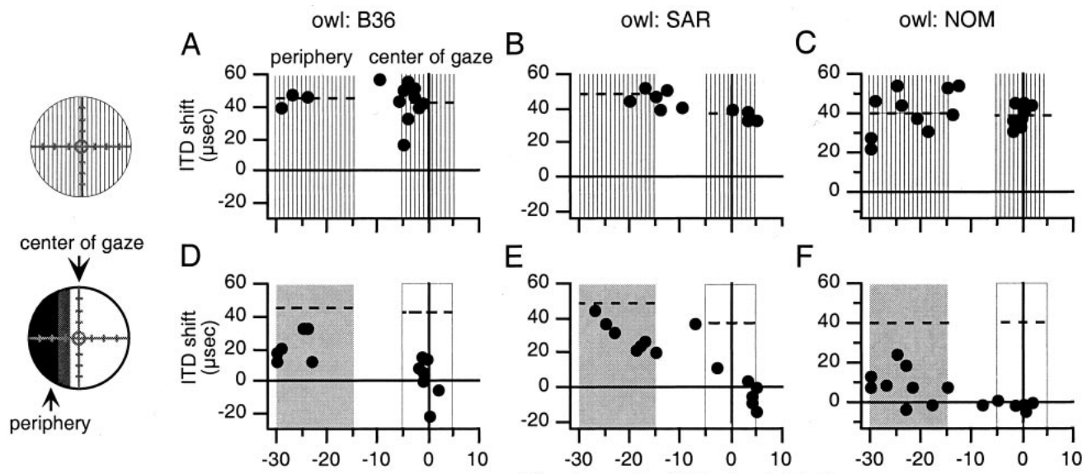
Occluded map regions receive less effective instruction
Hyde and Knudsen repeated regional manipulations in several prism-adapted owls. They compared preferred auditory timing across tectal sites representing the center of gaze and sites representing an occluded peripheral visual region.
Following 14–35 days with normal central vision and peripheral occlusion, changes in auditory tuning were generally larger in the centrally instructed region. The comparison used each owl’s previously measured prism-adapted map as the reference and preserved the regional distinction in visual experience.
Hyde & Knudsen (2001), Fig. 2(A–F). Regional responses after peripheral occlusion.
Occlusion therefore did more than reduce the total amount of visual stimulation. It limited the effective information available to a corresponding part of the map. The centrally instructed region changed more, so instruction acted regionally on the part of the map that received appropriate visual experience.
Feldman & Knudsen (1998), Fig. 2(A). ICCls, ICX, and optic-tectum locations.
Hyde & Knudsen (2001)
18
Notes:
Teaching transcript:
Hyde and Knudsen repeated regional manipulations in several prism-adapted owls. They compared preferred auditory timing across tectal sites representing the center of gaze and sites representing an occluded peripheral visual region.
Following 14–35 days with normal central vision and peripheral occlusion, changes in auditory tuning were generally larger in the centrally instructed region. The comparison used each owl’s previously measured prism-adapted map as the reference and preserved the regional distinction in visual experience.
Occlusion therefore did more than reduce the total amount of visual stimulation. It limited the effective information available to a corresponding part of the map. The centrally instructed region changed more, so instruction acted regionally on the part of the map that received appropriate visual experience.
A location-specific difference within the same brain is especially informative when the animal’s age, general housing conditions, and prismatic history are shared.
References:
Peter S. Hyde; Eric I. Knudsen (2001). A Topographic Instructive Signal Guides the Adjustment of the Auditory Space Map in the Optic Tectum. The Journal of Neuroscience 21(21):8586-8593. https://doi.org/10.1523/jneurosci.21-21-08586.2001
Daniel E. Feldman; Eric I. Knudsen (1998). Pharmacological Specialization of Learned Auditory Responses in the Inferior Colliculus of the Barn Owl. The Journal of Neuroscience 18(8):3073-3087. https://doi.org/10.1523/jneurosci.18-08-03073.1998
Hyde & Knudsen (2001), Fig. 2(A–F). Regional responses after peripheral occlusion.
Figure source: https://doi.org/10.1523/jneurosci.21-21-08586.2001
Feldman & Knudsen (1998), Fig. 2(A). ICCls, ICX, and optic-tectum locations.
Figure source: https://doi.org/10.1523/jneurosci.18-08-03073.1998

Slide 26
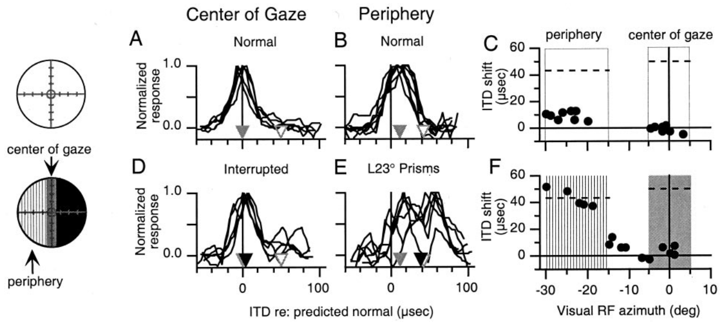
Peripheral vision can drive peripheral remapping
A local teaching signal should work in the periphery as well as at the center of gaze. Hyde and Knudsen tested this by interrupting central vision intermittently while imposing a 23° prismatic displacement on the peripheral visual field.
After 21 days, auditory timing changed more in the peripheral representation that experienced the displaced visual scene. The central representation, whose visual input was interrupted, adjusted less. Normal-vision measurements immediately before the manipulation established each region’s starting condition.
Hyde & Knudsen (2001), Fig. 3(A–F). Displaced peripheral vision with interrupted central vision.
This result is difficult to explain by a teaching signal that depends exclusively on the accuracy of central foveation. It supports spatially distributed visual instruction. Peripheral and central representations can each be instructed by the visual experience of the corresponding region of visual space.
Feldman & Knudsen (1998), Fig. 2(A). ICCls, ICX, and optic-tectum locations.
Hyde & Knudsen (2001)
19
Notes:
Teaching transcript:
A local teaching signal should work in the periphery as well as at the center of gaze. Hyde and Knudsen tested this by interrupting central vision intermittently while imposing a 23° prismatic displacement on the peripheral visual field.
After 21 days, auditory timing changed more in the peripheral representation that experienced the displaced visual scene. The central representation, whose visual input was interrupted, adjusted less. Normal-vision measurements immediately before the manipulation established each region’s starting condition.
This result is difficult to explain by a teaching signal that depends exclusively on the accuracy of central foveation. It supports spatially distributed visual instruction. Peripheral and central representations can each be instructed by the visual experience of the corresponding region of visual space.
Foveation means directing the visual axis toward a target. A purely foveation-based signal would use the outcome of that movement as its teaching information.
References:
Peter S. Hyde; Eric I. Knudsen (2001). A Topographic Instructive Signal Guides the Adjustment of the Auditory Space Map in the Optic Tectum. The Journal of Neuroscience 21(21):8586-8593. https://doi.org/10.1523/jneurosci.21-21-08586.2001
Daniel E. Feldman; Eric I. Knudsen (1998). Pharmacological Specialization of Learned Auditory Responses in the Inferior Colliculus of the Barn Owl. The Journal of Neuroscience 18(8):3073-3087. https://doi.org/10.1523/jneurosci.18-08-03073.1998
Hyde & Knudsen (2001), Fig. 3(A–F). Displaced peripheral vision with interrupted central vision.
Figure source: https://doi.org/10.1523/jneurosci.21-21-08586.2001
Feldman & Knudsen (1998), Fig. 2(A). ICCls, ICX, and optic-tectum locations.
Figure source: https://doi.org/10.1523/jneurosci.18-08-03073.1998

Slide 27
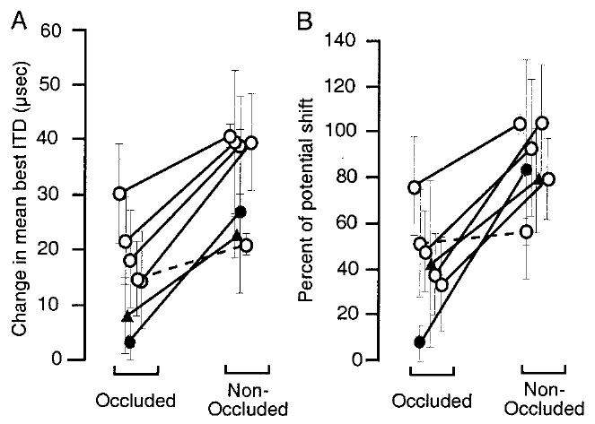
Visual instruction does not require uniform map change
The auditory map can adjust differently in regions subjected to different optical conditions. Hyde and Knudsen compared changes in the tectal representation of visually occluded and nonoccluded regions across their experimental manipulations.
In most experiments, the nonoccluded region changed more in the direction specified by its visual experience. The imposed displacements were 23°, but their effective instruction was regional rather than a command to move every auditory preference by one identical amount.
Hyde & Knudsen (2001), Fig. 5(A–B). Changes in occluded and nonoccluded map regions.
The findings support topographic instruction while allowing additional influences on map alignment. Topographic instruction means that each part of the map receives its own information about how it should change, whereas a global error signal would shift the whole map uniformly.
Feldman & Knudsen (1998), Fig. 2(A). ICCls, ICX, and optic-tectum locations.
Hyde & Knudsen (2001)
20
Notes:
Teaching transcript:
The auditory map can adjust differently in regions subjected to different optical conditions. Hyde and Knudsen compared changes in the tectal representation of visually occluded and nonoccluded regions across their experimental manipulations.
In most experiments, the nonoccluded region changed more in the direction specified by its visual experience. The imposed displacements were 23°, but their effective instruction was regional rather than a command to move every auditory preference by one identical amount.
The findings support topographic instruction while allowing additional influences on map alignment. Topographic instruction means that each part of the map receives its own information about how it should change, whereas a global error signal would shift the whole map uniformly.
The experiment distinguishes the spatial pattern of instruction from the cellular implementation of learning. A topographic outcome does not uniquely specify a learning algorithm.
References:
Peter S. Hyde; Eric I. Knudsen (2001). A Topographic Instructive Signal Guides the Adjustment of the Auditory Space Map in the Optic Tectum. The Journal of Neuroscience 21(21):8586-8593. https://doi.org/10.1523/jneurosci.21-21-08586.2001
Daniel E. Feldman; Eric I. Knudsen (1998). Pharmacological Specialization of Learned Auditory Responses in the Inferior Colliculus of the Barn Owl. The Journal of Neuroscience 18(8):3073-3087. https://doi.org/10.1523/jneurosci.18-08-03073.1998
Hyde & Knudsen (2001), Fig. 5(A–B). Changes in occluded and nonoccluded map regions.
Figure source: https://doi.org/10.1523/jneurosci.21-21-08586.2001
Feldman & Knudsen (1998), Fig. 2(A). ICCls, ICX, and optic-tectum locations.
Figure source: https://doi.org/10.1523/jneurosci.18-08-03073.1998

Slide 28
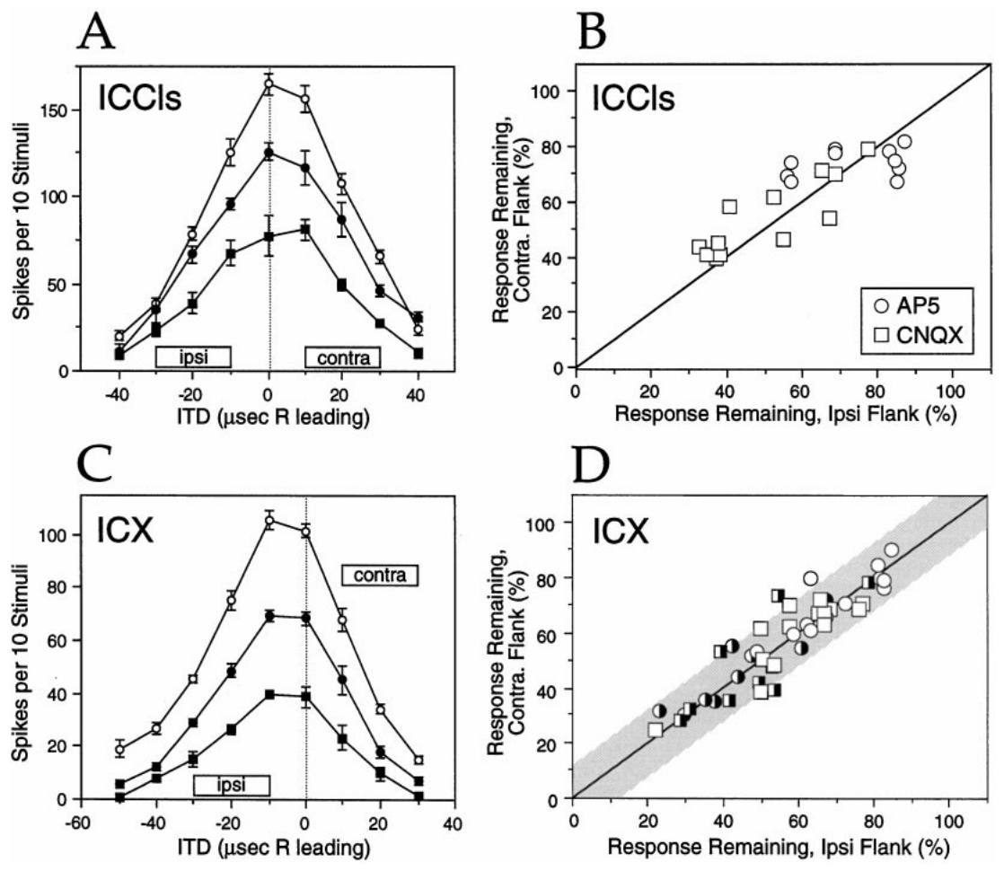
Glutamate receptors support auditory excitation
Glutamate is the excitatory transmitter considered in Feldman and Knudsen’s collicular pharmacology experiments. NMDA and non-NMDA receptors are glutamate-activated ion channels whose contributions can be tested by applying receptor antagonists near a recording site.
The authors used AP-5 to antagonize NMDA receptors and CNQX to antagonize non-NMDA receptors. In normal ICCls and ICX recordings, both drugs reduced auditory responses. Control and recovery measurements checked that the response change followed reversible local drug application.
Feldman & Knudsen (1998), Fig. 3(A–D). Receptor blockade in normal collicular recordings.
An extracellular spike response measures the combined effect of synaptic currents and neuronal integration. Drug sensitivity establishes a receptor contribution to that response, and the normal recordings supplied the baseline for interpreting learned responses.
Feldman & Knudsen (1998), Fig. 2(A). ICCls, ICX, and optic-tectum locations.
Feldman & Knudsen (1998)
21
Notes:
Teaching transcript:
Glutamate is the excitatory transmitter considered in Feldman and Knudsen’s collicular pharmacology experiments. NMDA and non-NMDA receptors are glutamate-activated ion channels whose contributions can be tested by applying receptor antagonists near a recording site.
The authors used AP-5 to antagonize NMDA receptors and CNQX to antagonize non-NMDA receptors. In normal ICCls and ICX recordings, both drugs reduced auditory responses. Control and recovery measurements checked that the response change followed reversible local drug application.
An extracellular spike response measures the combined effect of synaptic currents and neuronal integration. Drug sensitivity establishes a receptor contribution to that response, and the normal recordings supplied the baseline for interpreting learned responses.
Iontophoresis uses electrical current to eject charged drug molecules from a recording pipette. The drug acts locally, although its precise concentration at each synapse is not directly measured.
References:
Daniel E. Feldman; Eric I. Knudsen (1998). Pharmacological Specialization of Learned Auditory Responses in the Inferior Colliculus of the Barn Owl. The Journal of Neuroscience 18(8):3073-3087. https://doi.org/10.1523/jneurosci.18-08-03073.1998
Feldman & Knudsen (1998), Fig. 3(A–D). Receptor blockade in normal collicular recordings.
Figure source: https://doi.org/10.1523/jneurosci.18-08-03073.1998
Feldman & Knudsen (1998), Fig. 2(A). ICCls, ICX, and optic-tectum locations.
Figure source: https://doi.org/10.1523/jneurosci.18-08-03073.1998

Slide 29
NMDA and non-NMDA receptors are glutamate-gated channels
Glutamate is the main excitatory transmitter in these collicular circuits. NMDA and non-NMDA receptors are two classes of glutamate-activated ion channel, and each class can be blocked with a selective antagonist. Antagonists block receptor activation without removing the receptors.
Feldman and Knudsen applied AP-5 to antagonize NMDA receptors and CNQX to antagonize non-NMDA receptors near a recording site. In normal ICCls and ICX recordings, both drugs reduced auditory responses. The antagonists were ejected near the recorded neurons with small currents.
Feldman & Knudsen (1998), Fig. 3(A–D). Receptor blockade in normal collicular recordings.
Control and recovery measurements checked that the change followed reversible local drug application. The reduction by each antagonist measures the contribution of that receptor class to the spike response. A reduction of firing therefore indicates that the receptor class contributes to expressing the response.
Feldman & Knudsen (1998), Fig. 2(A). ICCls, ICX, and optic-tectum locations.
Feldman & Knudsen (1998)
21a
Notes:
Receptor antagonists reveal which kind of glutamate receptor supports a response.
Glutamate.
Glutamate is the excitatory transmitter considered in these experiments.
Two classes.
NMDA receptors are blocked by AP-5.
Non-NMDA receptors are blocked by CNQX.
Local application.
Drugs were applied near a recording site, so the effect remains local to the recorded neurons.
Normal responses.
In normal ICCls and ICX recordings both drugs reduced auditory responses.
These recordings supplied the baseline for interpreting learned responses.
Controls.
Control and recovery periods checked that the effect was reversible.
Receptor classes.
NMDA receptors and non-NMDA receptors respond to the same transmitter but can contribute differently to a response.
Selective antagonists separate their contributions.
Baseline for later slides.
Normal ICCls and ICX responses depended on both classes.
Differences in later experiments are interpreted against this baseline.
Selective antagonists.
AP-5 blocks the activation of NMDA receptors, and CNQX blocks non-NMDA receptors.
A drug that reduces firing identifies a receptor class that contributes to the response.
Reversibility.
Responses returned toward their original size after the drug was removed, which links the effect to the local application.
References:
Daniel E. Feldman; Eric I. Knudsen (1998). Pharmacological Specialization of Learned Auditory Responses in the Inferior Colliculus of the Barn Owl. The Journal of Neuroscience 18(8):3073-3087. https://doi.org/10.1523/jneurosci.18-08-03073.1998

Slide 30
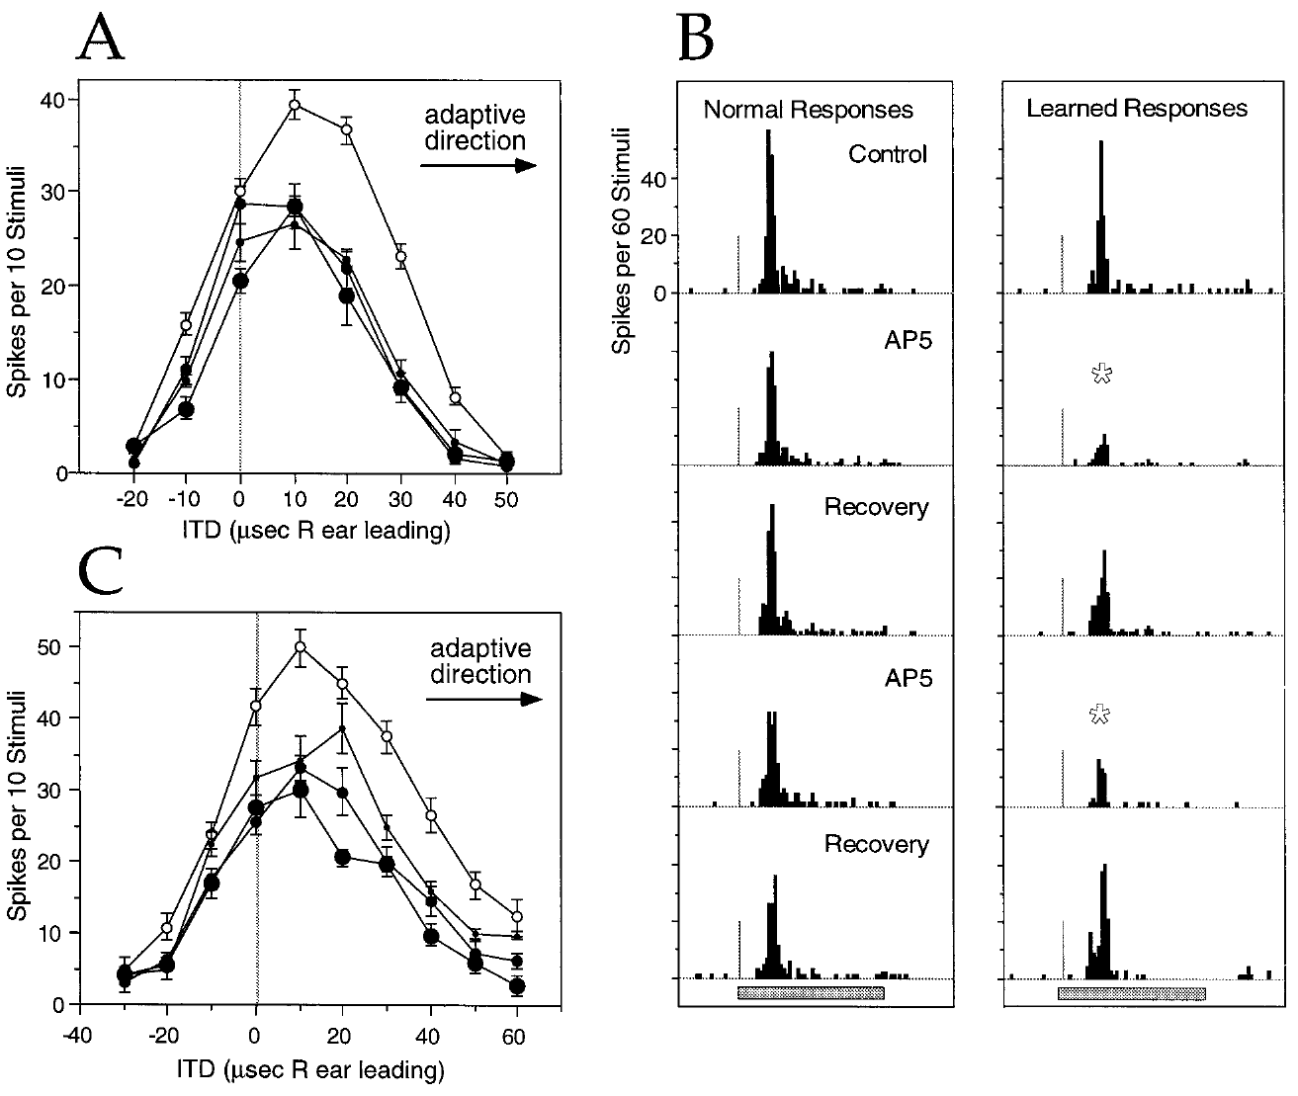
AP-5 preferentially reduces newly learned responses
Feldman and Knudsen compared normal and learned timing responses during local AP-5 application in ICX. NMDA names a class of glutamate receptor identified pharmacologically by N-methyl-D-aspartate sensitivity; AP-5 blocks its activation.
In a transition-state example, the control best ITD had shifted 13 µs from the normal transect value. Responses to learned timing values were preferentially reduced during AP-5 ejection at 10–40 nA, while control and recovery responses confirmed reversibility. The resulting tuning moved toward its normal component.
Feldman & Knudsen (1998), Fig. 5(A–C). AP-5 effects on transition-state tuning and spike timing.
The result supports a greater NMDA-receptor contribution to expression of newly learned responses. Local application of AP-5 after the responses had developed tests their expression, and the tuning moved toward its normal component as the learned responses were reduced.
Feldman & Knudsen (1998), Fig. 2(A). ICCls, ICX, and optic-tectum locations.
Feldman & Knudsen (1998)
22
Notes:
Teaching transcript:
Feldman and Knudsen compared normal and learned timing responses during local AP-5 application in ICX. NMDA names a class of glutamate receptor identified pharmacologically by N-methyl-D-aspartate sensitivity; AP-5 blocks its activation.
In a transition-state example, the control best ITD had shifted 13 µs from the normal transect value. Responses to learned timing values were preferentially reduced during AP-5 ejection at 10–40 nA, while control and recovery responses confirmed reversibility. The resulting tuning moved toward its normal component.
The result supports a greater NMDA-receptor contribution to expression of newly learned responses. Local application of AP-5 after the responses had developed tests their expression, and the tuning moved toward its normal component as the learned responses were reduced.
Expression is the ability of an established input to evoke a response during measurement. Induction is the process that originally changed the circuit; these are different causal questions.
References:
Daniel E. Feldman; Eric I. Knudsen (1998). Pharmacological Specialization of Learned Auditory Responses in the Inferior Colliculus of the Barn Owl. The Journal of Neuroscience 18(8):3073-3087. https://doi.org/10.1523/jneurosci.18-08-03073.1998
Feldman & Knudsen (1998), Fig. 5(A–C). AP-5 effects on transition-state tuning and spike timing.
Figure source: https://doi.org/10.1523/jneurosci.18-08-03073.1998
Feldman & Knudsen (1998), Fig. 2(A). ICCls, ICX, and optic-tectum locations.
Figure source: https://doi.org/10.1523/jneurosci.18-08-03073.1998

Slide 31
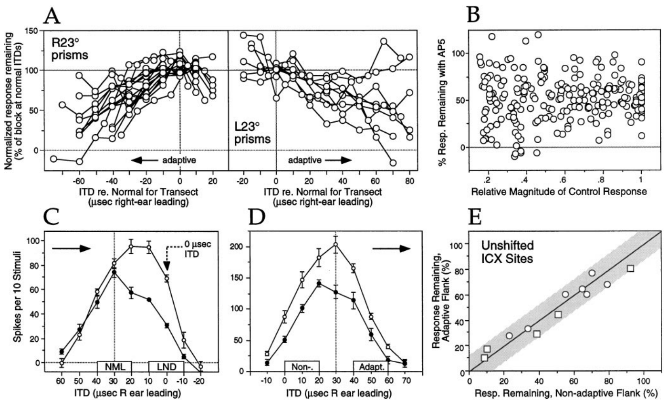
Drug sensitivity follows the learned timing component
A drug effect tied to one absolute ITD could mimic a selective effect on learning. Feldman and Knudsen therefore compared owls adapted in opposite directions and examined cases where the learned response occurred near zero ITD.
AP-5 sensitivity increased toward the adaptive side of the tuning curve in both prism directions. Preferential blockade also occurred when the learned response was at 0 µs. The authors examined response magnitude and unshifted ICX sites to test alternative explanations based on firing strength or stimulus timing alone.
Feldman & Knudsen (1998), Fig. 7(A–E). Controls for response size and stimulus timing.
These controls support a relationship between pharmacology and learned response identity. Experience changes the circuit properties that determine how different inputs generate spikes, and AP-5 sensitivity followed the learned side in both prism directions.
Feldman & Knudsen (1998), Fig. 2(A). ICCls, ICX, and optic-tectum locations.
Feldman & Knudsen (1998)
23
Notes:
Teaching transcript:
A drug effect tied to one absolute ITD could mimic a selective effect on learning. Feldman and Knudsen therefore compared owls adapted in opposite directions and examined cases where the learned response occurred near zero ITD.
AP-5 sensitivity increased toward the adaptive side of the tuning curve in both prism directions. Preferential blockade also occurred when the learned response was at 0 µs. The authors examined response magnitude and unshifted ICX sites to test alternative explanations based on firing strength or stimulus timing alone.
These controls support a relationship between pharmacology and learned response identity. Experience changes the circuit properties that determine how different inputs generate spikes, and AP-5 sensitivity followed the learned side in both prism directions.
The adaptive direction reverses with prism direction. Selectivity that follows that reversal is stronger evidence than selectivity observed for only one physical stimulus range.
References:
Daniel E. Feldman; Eric I. Knudsen (1998). Pharmacological Specialization of Learned Auditory Responses in the Inferior Colliculus of the Barn Owl. The Journal of Neuroscience 18(8):3073-3087. https://doi.org/10.1523/jneurosci.18-08-03073.1998
Feldman & Knudsen (1998), Fig. 7(A–E). Controls for response size and stimulus timing.
Figure source: https://doi.org/10.1523/jneurosci.18-08-03073.1998
Feldman & Knudsen (1998), Fig. 2(A). ICCls, ICX, and optic-tectum locations.
Figure source: https://doi.org/10.1523/jneurosci.18-08-03073.1998

Slide 32
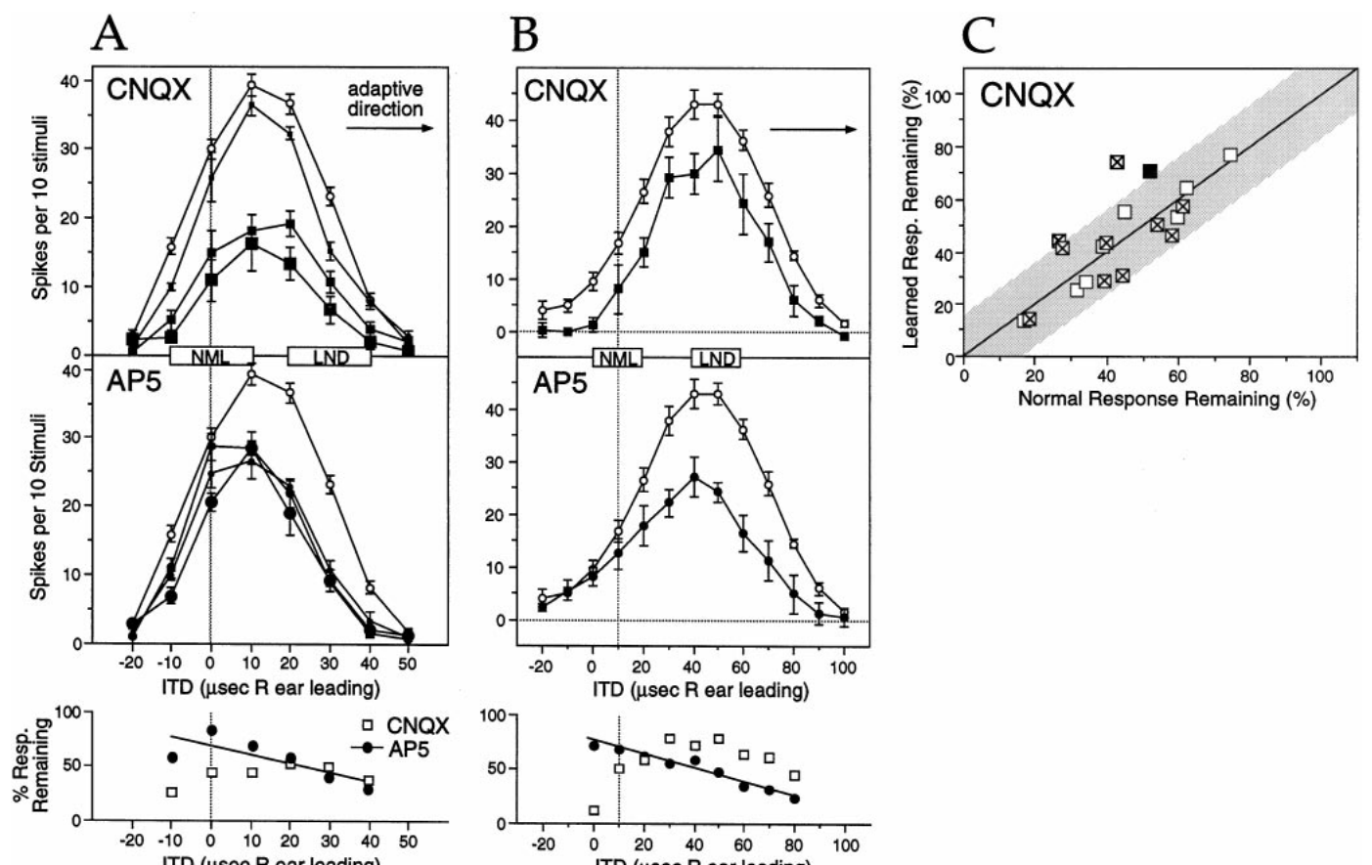
CNQX reduces both normal and learned responses
Non-NMDA receptors in this experiment refer to the glutamate receptor currents sensitive to CNQX, interpreted primarily as AMPA-mediated excitation. AMPA receptors contribute depolarization that helps convert auditory synaptic input into neuronal firing.
At transition-state ICX sites in owls with 30–154 days of prism experience, CNQX generally reduced normal and learned responses similarly. At matched sites, AP-5 could produce a preferential reduction on the learned side. The contrasting drug effects therefore did not reflect a universal tendency for every antagonist to suppress learned responses more strongly.
Feldman & Knudsen (1998), Fig. 8(A–C). CNQX and AP-5 effects on transition-state tuning.
CNQX therefore reduced normal and learned responses similarly, whereas AP-5 could reduce the learned side preferentially. Reducing non-NMDA depolarization can also reduce the voltage-dependent contribution of NMDA receptors, so the two receptor classes contribute together to the spike response.
Feldman & Knudsen (1998), Fig. 2(A). ICCls, ICX, and optic-tectum locations.
Feldman & Knudsen (1998)
24
Notes:
Teaching transcript:
Non-NMDA receptors in this experiment refer to the glutamate receptor currents sensitive to CNQX, interpreted primarily as AMPA-mediated excitation. AMPA receptors contribute depolarization that helps convert auditory synaptic input into neuronal firing.
At transition-state ICX sites in owls with 30–154 days of prism experience, CNQX generally reduced normal and learned responses similarly. At matched sites, AP-5 could produce a preferential reduction on the learned side. The contrasting drug effects therefore did not reflect a universal tendency for every antagonist to suppress learned responses more strongly.
CNQX therefore reduced normal and learned responses similarly, whereas AP-5 could reduce the learned side preferentially. Reducing non-NMDA depolarization can also reduce the voltage-dependent contribution of NMDA receptors, so the two receptor classes contribute together to the spike response.
The measured endpoint is spikes. Interactions between excitatory receptor currents can make that endpoint differ from the effect of a blocker on one receptor class alone.
References:
Daniel E. Feldman; Eric I. Knudsen (1998). Pharmacological Specialization of Learned Auditory Responses in the Inferior Colliculus of the Barn Owl. The Journal of Neuroscience 18(8):3073-3087. https://doi.org/10.1523/jneurosci.18-08-03073.1998
Feldman & Knudsen (1998), Fig. 8(A–C). CNQX and AP-5 effects on transition-state tuning.
Figure source: https://doi.org/10.1523/jneurosci.18-08-03073.1998
Feldman & Knudsen (1998), Fig. 2(A). ICCls, ICX, and optic-tectum locations.
Figure source: https://doi.org/10.1523/jneurosci.18-08-03073.1998

Slide 33
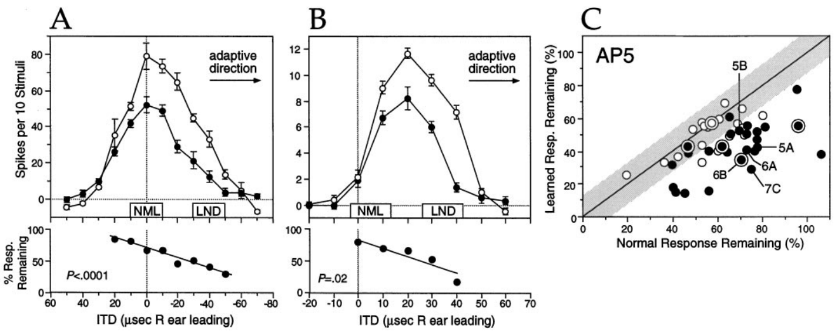
NMDA currents depend on synaptic and membrane state
NMDA-receptor currents depend on receptor activation and on the postsynaptic membrane’s electrical state. A postsynaptic neuron receives a synaptic input; depolarization makes its membrane voltage less negative and can increase the contribution of NMDA currents to excitation.
Feldman and Knudsen’s AP-5 experiments found greater sensitivity of newly learned ICX responses than of normal responses during 30–154 days of prism experience. Their interpretation allowed changes intrinsic to the synapse and changes in the surrounding circuit that altered the neuron’s voltage during a response.
Feldman & Knudsen (1998), Fig. 6(A–C). Functional NMDA sensitivity of learned responses.
The established result is a differential dependence of the spike response on NMDA-receptor activation. Receptor number, receptor subunits and the NMDA-to-AMPA current ratio are mechanisms consistent with the observed pharmacology.
Feldman & Knudsen (1998), Fig. 2(A). ICCls, ICX, and optic-tectum locations.
Feldman & Knudsen (1998)
25
Notes:
Teaching transcript:
NMDA-receptor currents depend on receptor activation and on the postsynaptic membrane’s electrical state. A postsynaptic neuron receives a synaptic input; depolarization makes its membrane voltage less negative and can increase the contribution of NMDA currents to excitation.
Feldman and Knudsen’s AP-5 experiments found greater sensitivity of newly learned ICX responses than of normal responses during 30–154 days of prism experience. Their interpretation allowed changes intrinsic to the synapse and changes in the surrounding circuit that altered the neuron’s voltage during a response.
The established result is a differential dependence of the spike response on NMDA-receptor activation. Receptor number, receptor subunits and the NMDA-to-AMPA current ratio are mechanisms consistent with the observed pharmacology.
The paper discusses voltage dependence as one reason that antagonist sensitivity cannot uniquely reveal receptor abundance. Mechanistic alternatives must remain distinct from the measured drug effect.
References:
Daniel E. Feldman; Eric I. Knudsen (1998). Pharmacological Specialization of Learned Auditory Responses in the Inferior Colliculus of the Barn Owl. The Journal of Neuroscience 18(8):3073-3087. https://doi.org/10.1523/jneurosci.18-08-03073.1998
Feldman & Knudsen (1998), Fig. 6(A–C). Functional NMDA sensitivity of learned responses.
Figure source: https://doi.org/10.1523/jneurosci.18-08-03073.1998
Feldman & Knudsen (1998), Fig. 2(A). ICCls, ICX, and optic-tectum locations.
Figure source: https://doi.org/10.1523/jneurosci.18-08-03073.1998

Slide 34
NMDA currents depend on the membrane voltage
NMDA-receptor currents depend on receptor activation and on the electrical state of the postsynaptic membrane. Depolarization makes the membrane voltage less negative and can increase the contribution of NMDA currents to excitation. The voltage dependence makes the effect of AP-5 a measure of NMDA contribution under the voltage reached during the response.
Feldman and Knudsen found greater AP-5 sensitivity of newly learned ICX responses than of normal responses during 30 to 154 days of prism experience. Their interpretation allowed changes intrinsic to the synapse and changes in the circuit that altered the voltage of the neuron during a response.
Feldman & Knudsen (1998), Fig. 6(A–C). Functional NMDA sensitivity of learned responses.
AP-5 sensitivity therefore reflects the synapse and the state of the neuron around it. Non-NMDA depolarization can raise the NMDA contribution, so the two receptor classes interact.
Feldman & Knudsen (1998), Fig. 2(A). ICCls, ICX, and optic-tectum locations.
Feldman & Knudsen (1998)
25a
Notes:
The size of an NMDA contribution depends on the membrane voltage as well as on the synapse.
Voltage dependence.
NMDA currents depend on receptor activation and on the electrical state of the membrane.
Depolarization can increase the NMDA contribution.
Observed pharmacology.
Newly learned ICX responses were more sensitive to AP-5 than normal responses.
The experience ranged from 30 to 154 days.
Two readings.
A change intrinsic to the synapse could produce the sensitivity.
A change in the surrounding circuit that alters the voltage during a response could also produce it.
Interacting receptors.
Reducing non-NMDA depolarization can reduce the NMDA contribution.
Measurement.
The recordings captured spikes, so receptor numbers and subunits were not measured directly.
Why membrane state matters.
The same synaptic input can produce a different NMDA current when the membrane is more or less depolarized.
An altered circuit can change the voltage reached during a response.
What was and was not measured.
The experiments recorded spikes extracellularly.
They did not measure receptor subunits or the ratio of NMDA to AMPA current.
References:
Daniel E. Feldman; Eric I. Knudsen (1998). Pharmacological Specialization of Learned Auditory Responses in the Inferior Colliculus of the Barn Owl. The Journal of Neuroscience 18(8):3073-3087. https://doi.org/10.1523/jneurosci.18-08-03073.1998

Slide 35
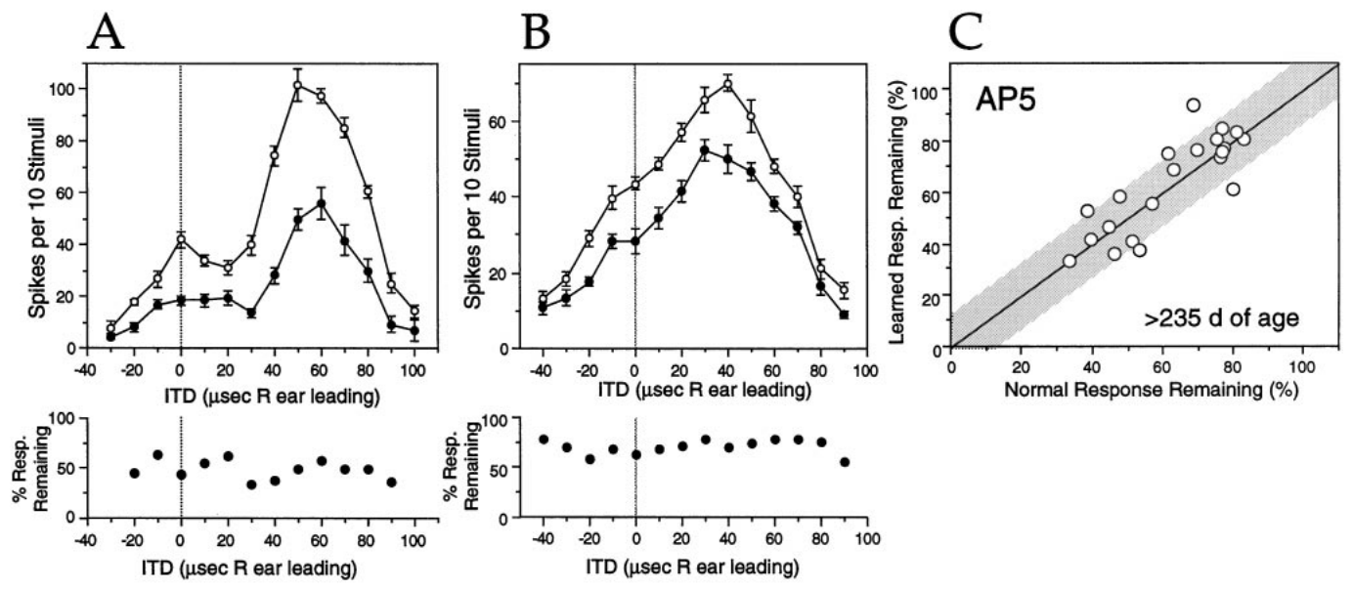
Learned-response pharmacology changes with experience
A newly acquired response need not retain its initial receptor dependence. Feldman and Knudsen tested ICX sites after more than 175 days of prism experience, when shifted auditory tuning had been established for a prolonged period.
AP-5 no longer preferentially blocked learned responses. Examples from owls with 259 and 386 days of experience showed more uniform reduction across the tuning curve. Normal response components remained measurable at the sites used for the within-site comparison.
Feldman & Knudsen (1998), Fig. 9(A–C). AP-5 effects after extended prism experience.
The change is consistent with maturation of the circuit supporting learned responses. AP-5 still reduced auditory firing, so NMDA receptors continued to contribute, and what changed was the differential sensitivity between normal and learned inputs.
Feldman & Knudsen (1998), Fig. 2(A). ICCls, ICX, and optic-tectum locations.
Feldman & Knudsen (1998)
26
Notes:
Teaching transcript:
A newly acquired response need not retain its initial receptor dependence. Feldman and Knudsen tested ICX sites after more than 175 days of prism experience, when shifted auditory tuning had been established for a prolonged period.
AP-5 no longer preferentially blocked learned responses. Examples from owls with 259 and 386 days of experience showed more uniform reduction across the tuning curve. Normal response components remained measurable at the sites used for the within-site comparison.
The change is consistent with maturation of the circuit supporting learned responses. AP-5 still reduced auditory firing, so NMDA receptors continued to contribute, and what changed was the differential sensitivity between normal and learned inputs.
An equal drug effect on two response components can emerge from changes in one component. It should not be interpreted as proof that both components changed equally.
References:
Daniel E. Feldman; Eric I. Knudsen (1998). Pharmacological Specialization of Learned Auditory Responses in the Inferior Colliculus of the Barn Owl. The Journal of Neuroscience 18(8):3073-3087. https://doi.org/10.1523/jneurosci.18-08-03073.1998
Feldman & Knudsen (1998), Fig. 9(A–C). AP-5 effects after extended prism experience.
Figure source: https://doi.org/10.1523/jneurosci.18-08-03073.1998
Feldman & Knudsen (1998), Fig. 2(A). ICCls, ICX, and optic-tectum locations.
Figure source: https://doi.org/10.1523/jneurosci.18-08-03073.1998

Slide 36
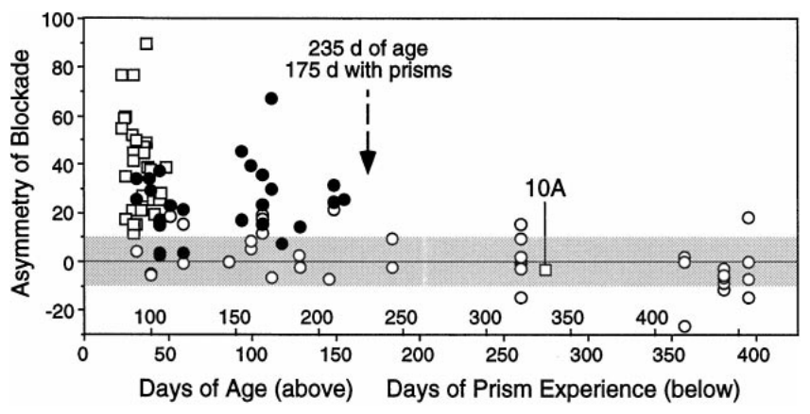
Age and experience duration are confounded
Learning-associated pharmacology changes over a timescale that overlaps development. Feldman and Knudsen plotted differential AP-5 blockade against both age and the number of days wearing prisms, retaining the relationship between these two variables.
The preferential effect on learned responses was absent after roughly 235 days of age, corresponding to about 175 days of prism experience in this preparation. Because prisms were generally attached at similar ages, older animals also had longer exposure.
Feldman & Knudsen (1998), Fig. 11. AP-5 asymmetry versus age and prism experience.
The preferential effect on learned responses disappeared as age and days of prism experience increased together. A proposed increase in AMPA contribution, a decrease in NMDA contribution or altered inhibition are candidate explanations for the change, which tracks both chronological maturation and accumulated sensory experience.
Feldman & Knudsen (1998), Fig. 2(A). ICCls, ICX, and optic-tectum locations.
Feldman & Knudsen (1998)
27
Notes:
Teaching transcript:
Learning-associated pharmacology changes over a timescale that overlaps development. Feldman and Knudsen plotted differential AP-5 blockade against both age and the number of days wearing prisms, retaining the relationship between these two variables.
The preferential effect on learned responses was absent after roughly 235 days of age, corresponding to about 175 days of prism experience in this preparation. Because prisms were generally attached at similar ages, older animals also had longer exposure.
The preferential effect on learned responses disappeared as age and days of prism experience increased together. A proposed increase in AMPA contribution, a decrease in NMDA contribution or altered inhibition are candidate explanations for the change, which tracks both chronological maturation and accumulated sensory experience.
Separating age from experience would require animals of comparable age with different exposure histories, or comparable exposure durations beginning at different ages.
References:
Daniel E. Feldman; Eric I. Knudsen (1998). Pharmacological Specialization of Learned Auditory Responses in the Inferior Colliculus of the Barn Owl. The Journal of Neuroscience 18(8):3073-3087. https://doi.org/10.1523/jneurosci.18-08-03073.1998
Feldman & Knudsen (1998), Fig. 11. AP-5 asymmetry versus age and prism experience.
Figure source: https://doi.org/10.1523/jneurosci.18-08-03073.1998
Feldman & Knudsen (1998), Fig. 2(A). ICCls, ICX, and optic-tectum locations.
Figure source: https://doi.org/10.1523/jneurosci.18-08-03073.1998

Slide 37
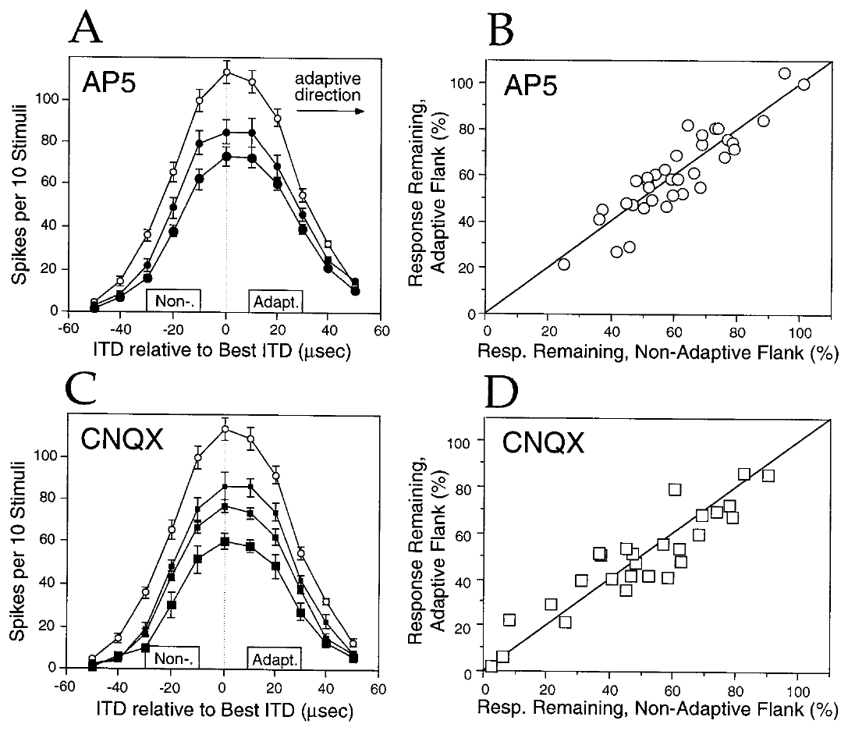
Upstream responses lack the learned pharmacological bias
The lateral shell of ICC, called ICCls, provides timing-specific input to ICX. Feldman and Knudsen tested whether the pharmacological asymmetry of learned responses was inherited from this upstream representation.
In prism-reared owls, AP-5 and CNQX generally reduced the adaptive and nonadaptive flanks of ICCls tuning similarly. Ejection currents were varied, and the direction of the downstream ICX adjustment provided the adaptive reference. These recordings contrasted with the preferential AP-5 effect on learned ICX responses.
Feldman & Knudsen (1998), Fig. 4(A–D). AP-5 and CNQX effects in prism-reared ICCls.
The distinctive pharmacology of learned responses is expressed downstream of the tested ICCls responses. AP-5 and CNQX reduced both flanks of ICCls tuning similarly, whereas AP-5 preferentially reduced learned responses in ICX.
Feldman & Knudsen (1998), Fig. 2(A). ICCls, ICX, and optic-tectum locations.
Feldman & Knudsen (1998)
28
Notes:
Teaching transcript:
The lateral shell of ICC, called ICCls, provides timing-specific input to ICX. Feldman and Knudsen tested whether the pharmacological asymmetry of learned responses was inherited from this upstream representation.
In prism-reared owls, AP-5 and CNQX generally reduced the adaptive and nonadaptive flanks of ICCls tuning similarly. Ejection currents were varied, and the direction of the downstream ICX adjustment provided the adaptive reference. These recordings contrasted with the preferential AP-5 effect on learned ICX responses.
The distinctive pharmacology of learned responses is expressed downstream of the tested ICCls responses. AP-5 and CNQX reduced both flanks of ICCls tuning similarly, whereas AP-5 preferentially reduced learned responses in ICX.
An adaptive flank is the side of a tuning curve toward the ITD values instructed by the prism displacement. It is defined by the animal’s experimental condition.
References:
Daniel E. Feldman; Eric I. Knudsen (1998). Pharmacological Specialization of Learned Auditory Responses in the Inferior Colliculus of the Barn Owl. The Journal of Neuroscience 18(8):3073-3087. https://doi.org/10.1523/jneurosci.18-08-03073.1998
Feldman & Knudsen (1998), Fig. 4(A–D). AP-5 and CNQX effects in prism-reared ICCls.
Figure source: https://doi.org/10.1523/jneurosci.18-08-03073.1998
Feldman & Knudsen (1998), Fig. 2(A). ICCls, ICX, and optic-tectum locations.
Figure source: https://doi.org/10.1523/jneurosci.18-08-03073.1998

Slide 38
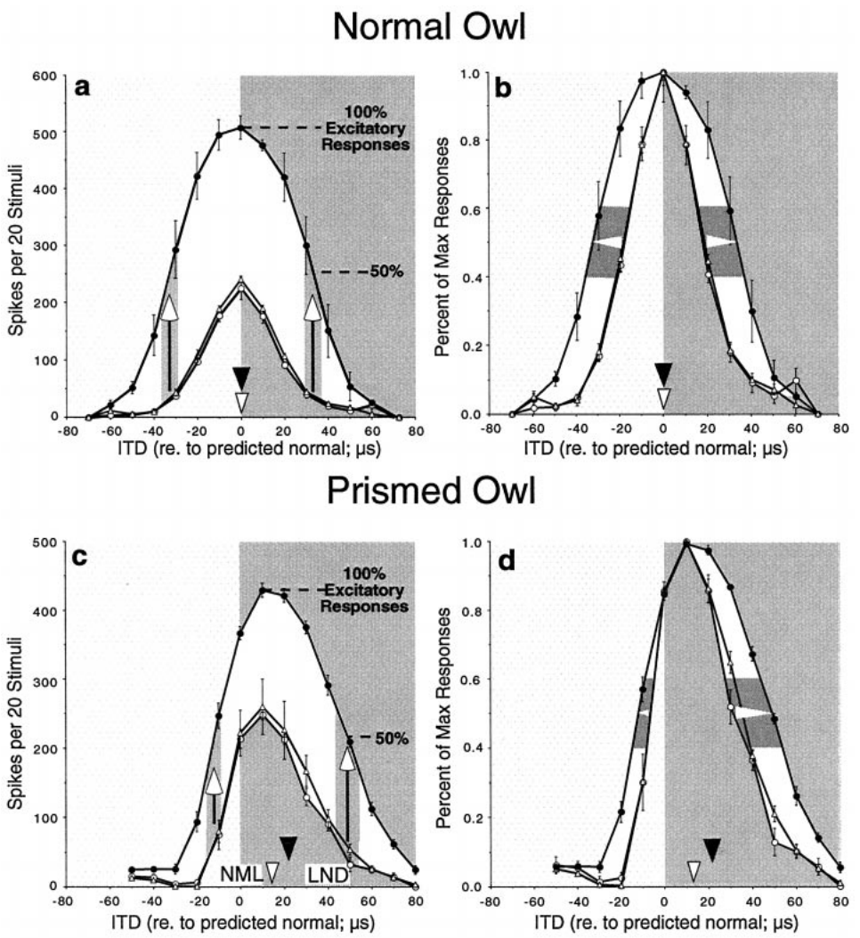
GABAergic inhibition limits expression of excitation
GABA, gamma-aminobutyric acid, mediates inhibitory input in the ICX experiments of Zheng and Knudsen. GABA_A receptors are the receptor class blocked by bicuculline. Reducing their action tests how inhibition shapes the spike responses generated by auditory excitation.
In a normal owl, bicuculline increased responses while leaving the weighted timing preference approximately unchanged. During early prism adaptation, the same manipulation could shift the response toward learned ITDs. Control, drug, and recovery periods linked these changes to reversible local application.
Zheng & Knudsen (2001), Fig. 2(a–d). Bicuculline effects in normal and adapting ICX.
A response revealed by disinhibition was already supported by functional excitatory input. Bicuculline acted on an existing circuit during the recording session, so the revealed response separates the available excitatory information from the timing information expressed in spikes when inhibition is active.
Feldman & Knudsen (1998), Fig. 2(A). ICCls, ICX, and optic-tectum locations.
Zheng & Knudsen (2001)
29
Notes:
Teaching transcript:
GABA, gamma-aminobutyric acid, mediates inhibitory input in the ICX experiments of Zheng and Knudsen. GABAA receptors are the receptor class blocked by bicuculline. Reducing their action tests how inhibition shapes the spike responses generated by auditory excitation.
In a normal owl, bicuculline increased responses while leaving the weighted timing preference approximately unchanged. During early prism adaptation, the same manipulation could shift the response toward learned ITDs. Control, drug, and recovery periods linked these changes to reversible local application.
A response revealed by disinhibition was already supported by functional excitatory input. Bicuculline acted on an existing circuit during the recording session, so the revealed response separates the available excitatory information from the timing information expressed in spikes when inhibition is active.
Disinhibition is removal or reduction of inhibition. A weighted-average ITD summarizes the distribution of responses across timing values rather than identifying only the strongest point.
References:
Weimin Zheng; Eric I. Knudsen (2001). GABAergic Inhibition Antagonizes Adaptive Adjustment of the Owl's Auditory Space Map during the Initial Phase of Plasticity. The Journal of Neuroscience 21(12):4356-4365. https://doi.org/10.1523/jneurosci.21-12-04356.2001
Daniel E. Feldman; Eric I. Knudsen (1998). Pharmacological Specialization of Learned Auditory Responses in the Inferior Colliculus of the Barn Owl. The Journal of Neuroscience 18(8):3073-3087. https://doi.org/10.1523/jneurosci.18-08-03073.1998
Zheng & Knudsen (2001), Fig. 2(a–d). Bicuculline effects in normal and adapting ICX.
Figure source: https://doi.org/10.1523/jneurosci.21-12-04356.2001
Feldman & Knudsen (1998), Fig. 2(A). ICCls, ICX, and optic-tectum locations.
Figure source: https://doi.org/10.1523/jneurosci.18-08-03073.1998

Slide 39
Disinhibition reveals hidden excitatory input
Disinhibition is the removal of inhibition, which can reveal excitation that the inhibition was suppressing. GABA mediates inhibition in the ICX experiments of Zheng and Knudsen, and bicuculline blocks GABA-A receptors. Excitation and inhibition converge on the same neuron, so the spike output reflects their balance.
In a normal owl, bicuculline increased responses while leaving the weighted timing preference approximately unchanged. During early prism adaptation, the same manipulation could shift the response toward learned ITDs.
Zheng & Knudsen (2001), Fig. 2(a–d). Bicuculline effects in normal and adapting ICX.
Control, drug and recovery periods linked the changes to reversible local application. A response revealed by disinhibition was already supported by excitatory input, which inhibition had kept from appearing in the spikes. The balance between the two sets which timing values appear in the spike tuning.
Feldman & Knudsen (1998), Fig. 2(A). ICCls, ICX, and optic-tectum locations.
Zheng & Knudsen (2001)
29a
Notes:
Blocking inhibition shows how much excitation is present but not expressed.
Disinhibition.
Removing inhibition can reveal excitation that was suppressed.
Pharmacology.
GABA is the inhibitory transmitter, and bicuculline blocks GABA-A receptors.
Normal owl.
Bicuculline increased responses.
The weighted timing preference stayed approximately the same.
Early adaptation.
The same drug shifted the response toward learned ITDs.
Meaning.
Excitatory input for the learned timing existed already.
Inhibition limited what the spikes expressed.
Why block inhibition.
Spikes show only the net result of excitation and inhibition.
Blocking GABA-A receptors reveals the excitation underneath.
Timing preference.
The weighted timing preference summarizes the whole tuning curve.
Its shift under bicuculline shows which inputs inhibition had been suppressing.
Recovery and control.
Control, drug and recovery periods were compared in the same recording.
A return toward baseline shows that the change followed the local drug application.
Interpretation.
The response revealed during early adaptation shows that excitatory input for learned timing already existed.
The excitation was suppressed by inhibition at that stage.
References:
Weimin Zheng; Eric I. Knudsen (2001). GABAergic Inhibition Antagonizes Adaptive Adjustment of the Owl's Auditory Space Map during the Initial Phase of Plasticity. The Journal of Neuroscience 21(12):4356-4365. https://doi.org/10.1523/jneurosci.21-12-04356.2001

Slide 40
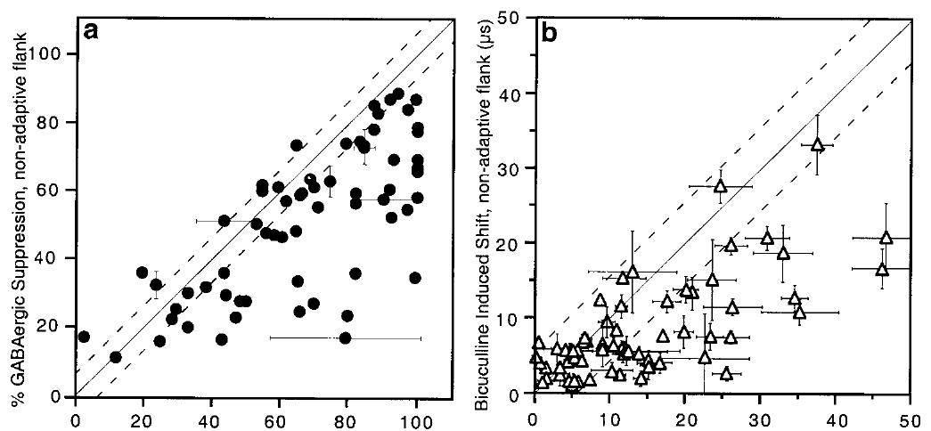
Early inhibition preferentially masks learned inputs
Early adaptive excitation can remain partly hidden by inhibition. Zheng and Knudsen compared bicuculline-induced changes on the adaptive and nonadaptive sides of ICX tuning curves in prism-wearing and normal owls.
During the initial phase, GABAergic inhibition suppressed the learned side more strongly. At a representative site, removing inhibition shifted the weighted preference from approximately 13 to 21 µs in the adaptive direction. Recovery restored the preference toward its pre-drug value.
Zheng & Knudsen (2001), Fig. 3(a–b). Asymmetric suppression during initial map adjustment.
The additional adaptive shift means that the excitatory circuit had changed more than the ordinary spike tuning revealed. Adaptive excitation had already formed at this stage, and inhibition held part of it hidden from the spike tuning.
Feldman & Knudsen (1998), Fig. 2(A). ICCls, ICX, and optic-tectum locations.
Zheng & Knudsen (2001)
30
Notes:
Teaching transcript:
Early adaptive excitation can remain partly hidden by inhibition. Zheng and Knudsen compared bicuculline-induced changes on the adaptive and nonadaptive sides of ICX tuning curves in prism-wearing and normal owls.
During the initial phase, GABAergic inhibition suppressed the learned side more strongly. At a representative site, removing inhibition shifted the weighted preference from approximately 13 to 21 µs in the adaptive direction. Recovery restored the preference toward its pre-drug value.
The additional adaptive shift means that the excitatory circuit had changed more than the ordinary spike tuning revealed. Adaptive excitation had already formed at this stage, and inhibition held part of it hidden from the spike tuning.
The asymmetric effect concerns which timing inputs are suppressed, not simply how much total firing increases when an inhibitory receptor is blocked.
References:
Weimin Zheng; Eric I. Knudsen (2001). GABAergic Inhibition Antagonizes Adaptive Adjustment of the Owl's Auditory Space Map during the Initial Phase of Plasticity. The Journal of Neuroscience 21(12):4356-4365. https://doi.org/10.1523/jneurosci.21-12-04356.2001
Daniel E. Feldman; Eric I. Knudsen (1998). Pharmacological Specialization of Learned Auditory Responses in the Inferior Colliculus of the Barn Owl. The Journal of Neuroscience 18(8):3073-3087. https://doi.org/10.1523/jneurosci.18-08-03073.1998
Zheng & Knudsen (2001), Fig. 3(a–b). Asymmetric suppression during initial map adjustment.
Figure source: https://doi.org/10.1523/jneurosci.21-12-04356.2001
Feldman & Knudsen (1998), Fig. 2(A). ICCls, ICX, and optic-tectum locations.
Figure source: https://doi.org/10.1523/jneurosci.18-08-03073.1998

Slide 41
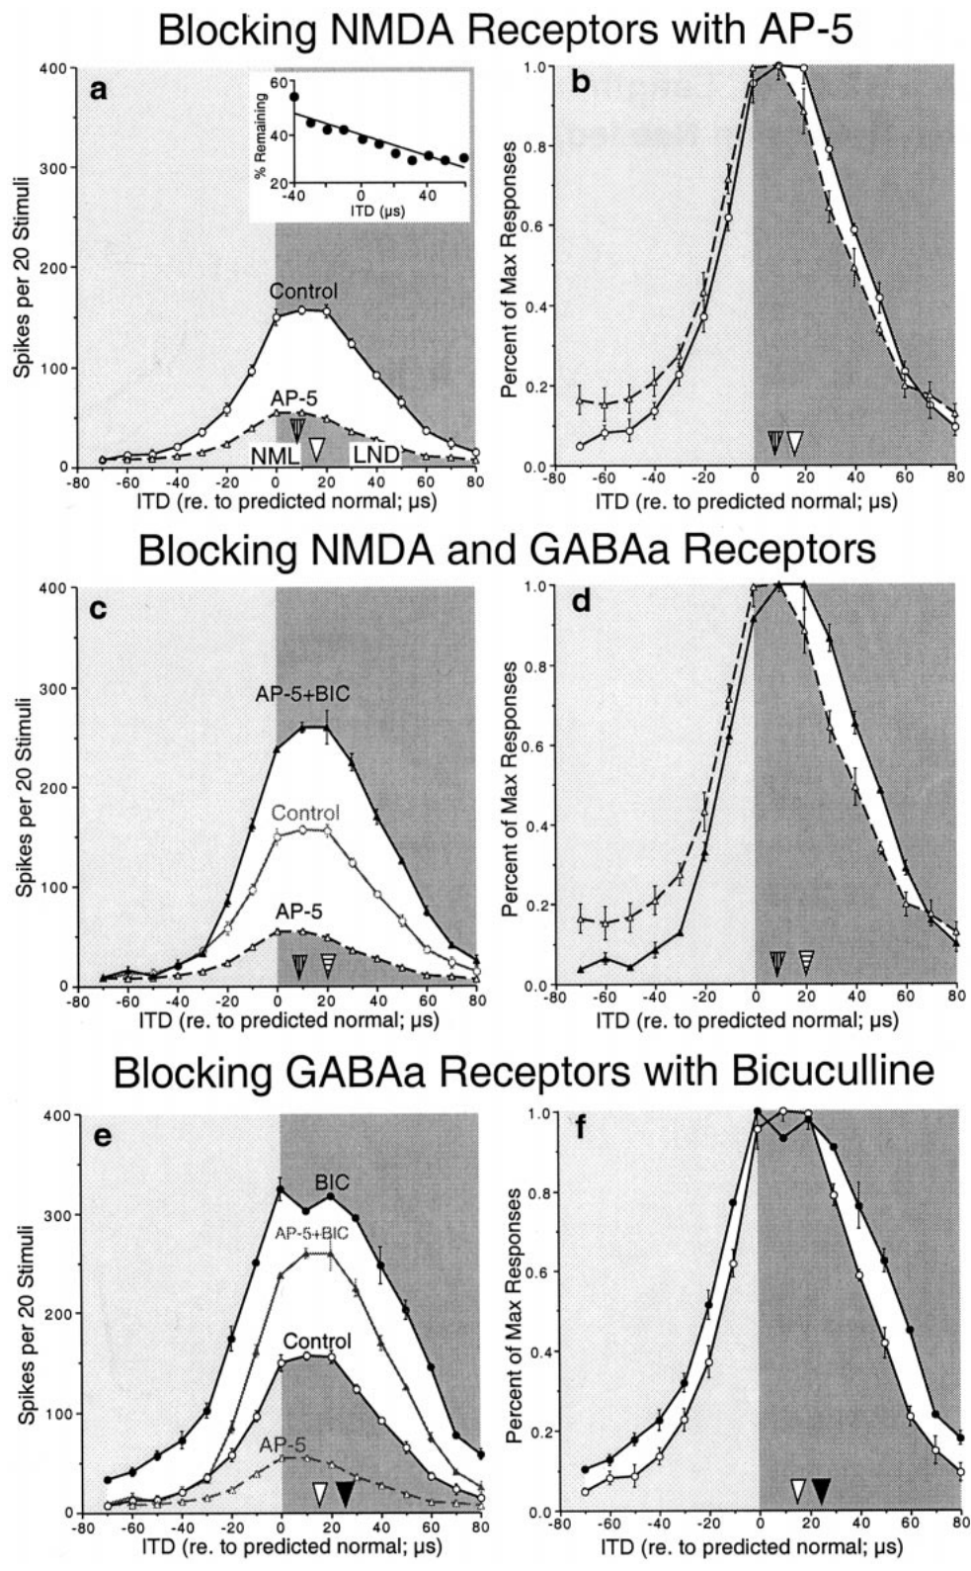
NMDA blockade does not remove inhibitory asymmetry
A voltage-dependent interaction between excitation and inhibition could potentially explain an asymmetric bicuculline effect. Zheng and Knudsen tested this possibility by blocking NMDA receptors with AP-5 while measuring the effect of removing GABA_A-mediated inhibition.
At an ICX site with preferential NMDA support for learned responses, AP-5 shifted weighted tuning about 8 µs in the nonadaptive direction. Adding bicuculline nevertheless revealed an asymmetric increase toward adaptive timing values. The disinhibitory effect therefore persisted when NMDA-receptor activation was reduced.
Zheng & Knudsen (2001), Fig. 4(a–f). Sequential AP-5 and bicuculline effects.
The result argues that the learned-side suppression was not merely an indirect consequence of NMDA voltage dependence. It supports an ITD-specific inhibitory influence. The inhibitory influence acted on learned timing values even when NMDA-receptor activation was reduced, so it is separable from the NMDA dependence of the response.
Feldman & Knudsen (1998), Fig. 2(A). ICCls, ICX, and optic-tectum locations.
Zheng & Knudsen (2001)
31
Notes:
Teaching transcript:
A voltage-dependent interaction between excitation and inhibition could potentially explain an asymmetric bicuculline effect. Zheng and Knudsen tested this possibility by blocking NMDA receptors with AP-5 while measuring the effect of removing GABAA-mediated inhibition.
At an ICX site with preferential NMDA support for learned responses, AP-5 shifted weighted tuning about 8 µs in the nonadaptive direction. Adding bicuculline nevertheless revealed an asymmetric increase toward adaptive timing values. The disinhibitory effect therefore persisted when NMDA-receptor activation was reduced.
The result argues that the learned-side suppression was not merely an indirect consequence of NMDA voltage dependence. It supports an ITD-specific inhibitory influence. The inhibitory influence acted on learned timing values even when NMDA-receptor activation was reduced, so it is separable from the NMDA dependence of the response.
Sequential receptor blockade compares excitation and inhibition within the same local preparation. The surviving effect is evidence against a mechanism requiring the blocked receptor contribution.
References:
Weimin Zheng; Eric I. Knudsen (2001). GABAergic Inhibition Antagonizes Adaptive Adjustment of the Owl's Auditory Space Map during the Initial Phase of Plasticity. The Journal of Neuroscience 21(12):4356-4365. https://doi.org/10.1523/jneurosci.21-12-04356.2001
Daniel E. Feldman; Eric I. Knudsen (1998). Pharmacological Specialization of Learned Auditory Responses in the Inferior Colliculus of the Barn Owl. The Journal of Neuroscience 18(8):3073-3087. https://doi.org/10.1523/jneurosci.18-08-03073.1998
Zheng & Knudsen (2001), Fig. 4(a–f). Sequential AP-5 and bicuculline effects.
Figure source: https://doi.org/10.1523/jneurosci.21-12-04356.2001
Feldman & Knudsen (1998), Fig. 2(A). ICCls, ICX, and optic-tectum locations.
Figure source: https://doi.org/10.1523/jneurosci.18-08-03073.1998

Slide 42
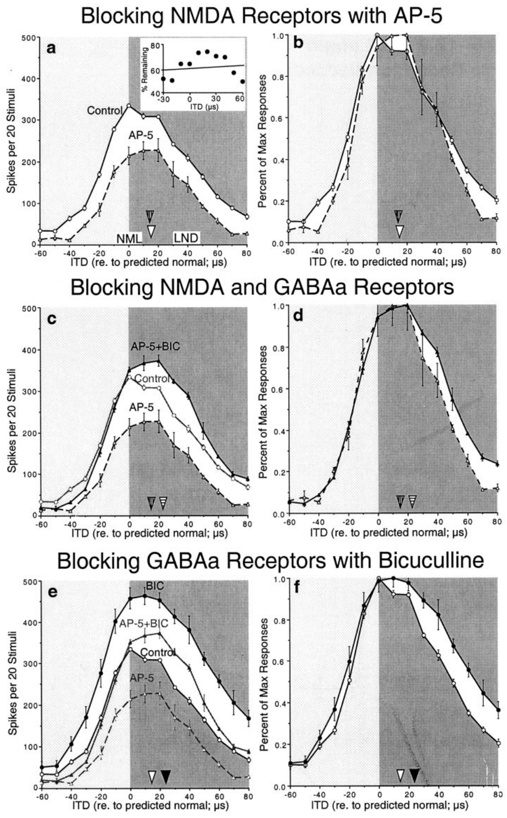
Inhibitory bias can occur without selective NMDA support
Not every adapting ICX site exhibits greater NMDA dependence for learned responses. Zheng and Knudsen examined a site where AP-5 reduced normal and learned responses similarly and did not shift the weighted timing preference.
Bicuculline still produced a greater increase on the adaptive side of the tuning curve, including when NMDA receptors were blocked. Thus, selective GABAergic suppression of learned timing inputs could exist without a corresponding selective AP-5 effect at that recording site.
Zheng & Knudsen (2001), Fig. 5(a–f). Disinhibition at a site with uniform AP-5 effects.
The two pharmacological properties are separable. A site can show selective GABAergic suppression of learned timing inputs without a selective AP-5 effect, so differential inhibition is evaluated directly with bicuculline and not inferred from differential NMDA sensitivity.
Feldman & Knudsen (1998), Fig. 2(A). ICCls, ICX, and optic-tectum locations.
Zheng & Knudsen (2001)
32
Notes:
Teaching transcript:
Not every adapting ICX site exhibits greater NMDA dependence for learned responses. Zheng and Knudsen examined a site where AP-5 reduced normal and learned responses similarly and did not shift the weighted timing preference.
Bicuculline still produced a greater increase on the adaptive side of the tuning curve, including when NMDA receptors were blocked. Thus, selective GABAergic suppression of learned timing inputs could exist without a corresponding selective AP-5 effect at that recording site.
The two pharmacological properties are separable. A site can show selective GABAergic suppression of learned timing inputs without a selective AP-5 effect, so differential inhibition is evaluated directly with bicuculline and not inferred from differential NMDA sensitivity.
Normal and learned components are defined by stimulus timing and the anatomical reference. Their inhibitory and excitatory pharmacology need not mature at identical rates.
References:
Weimin Zheng; Eric I. Knudsen (2001). GABAergic Inhibition Antagonizes Adaptive Adjustment of the Owl's Auditory Space Map during the Initial Phase of Plasticity. The Journal of Neuroscience 21(12):4356-4365. https://doi.org/10.1523/jneurosci.21-12-04356.2001
Daniel E. Feldman; Eric I. Knudsen (1998). Pharmacological Specialization of Learned Auditory Responses in the Inferior Colliculus of the Barn Owl. The Journal of Neuroscience 18(8):3073-3087. https://doi.org/10.1523/jneurosci.18-08-03073.1998
Zheng & Knudsen (2001), Fig. 5(a–f). Disinhibition at a site with uniform AP-5 effects.
Figure source: https://doi.org/10.1523/jneurosci.21-12-04356.2001
Feldman & Knudsen (1998), Fig. 2(A). ICCls, ICX, and optic-tectum locations.
Figure source: https://doi.org/10.1523/jneurosci.18-08-03073.1998

Slide 43
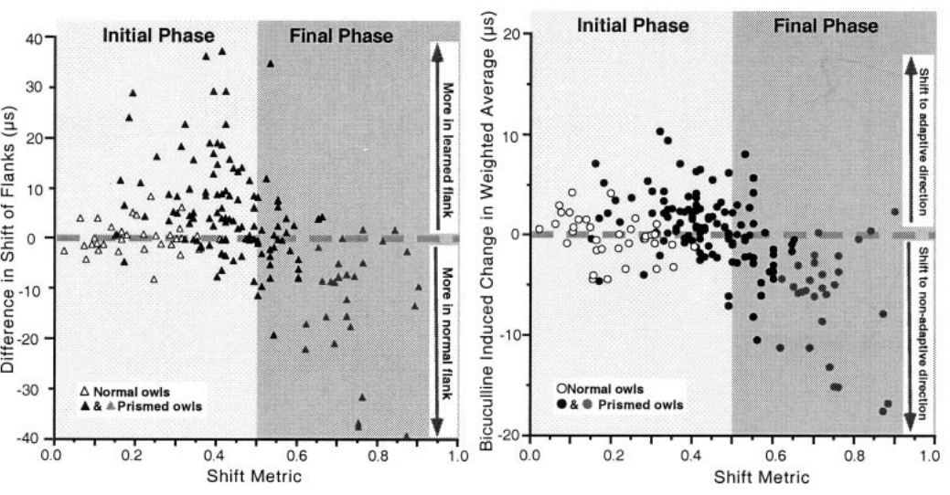
Inhibition changes its bias as the map consolidates
The influence of inhibition depends on the stage of auditory-map adaptation. Zheng and Knudsen compared the effects of bicuculline across early adjustment, established adjustment, and normal auditory maps.
During the initial phase, disinhibition favored learned timing values. At later stages represented in the comparison, inhibition preferentially suppressed the original normal inputs, helping the learned mapping dominate expressed tuning. Both stages involved an inhibitory contribution, but its timing selectivity differed.
Zheng & Knudsen (2001), Fig. 7(a–b). Inhibitory effects across stages of map adjustment.
These observations support a changing relationship between excitatory and inhibitory input. The proposed explanation is that inhibitory connectivity adjusts differently from adaptive excitation. Early inhibition masked learned inputs, whereas later inhibition suppressed the original normal inputs, so the same inhibitory system favored different timing values at different stages of adaptation.
Feldman & Knudsen (1998), Fig. 2(A). ICCls, ICX, and optic-tectum locations.
Zheng & Knudsen (2001)
33
Notes:
Teaching transcript:
The influence of inhibition depends on the stage of auditory-map adaptation. Zheng and Knudsen compared the effects of bicuculline across early adjustment, established adjustment, and normal auditory maps.
During the initial phase, disinhibition favored learned timing values. At later stages represented in the comparison, inhibition preferentially suppressed the original normal inputs, helping the learned mapping dominate expressed tuning. Both stages involved an inhibitory contribution, but its timing selectivity differed.
These observations support a changing relationship between excitatory and inhibitory input. The proposed explanation is that inhibitory connectivity adjusts differently from adaptive excitation. Early inhibition masked learned inputs, whereas later inhibition suppressed the original normal inputs, so the same inhibitory system favored different timing values at different stages of adaptation.
A functional bias can reverse without inhibition becoming globally stronger or weaker. What matters for map expression is the relation between inhibitory tuning and the competing excitatory inputs.
References:
Weimin Zheng; Eric I. Knudsen (2001). GABAergic Inhibition Antagonizes Adaptive Adjustment of the Owl's Auditory Space Map during the Initial Phase of Plasticity. The Journal of Neuroscience 21(12):4356-4365. https://doi.org/10.1523/jneurosci.21-12-04356.2001
Daniel E. Feldman; Eric I. Knudsen (1998). Pharmacological Specialization of Learned Auditory Responses in the Inferior Colliculus of the Barn Owl. The Journal of Neuroscience 18(8):3073-3087. https://doi.org/10.1523/jneurosci.18-08-03073.1998
Zheng & Knudsen (2001), Fig. 7(a–b). Inhibitory effects across stages of map adjustment.
Figure source: https://doi.org/10.1523/jneurosci.21-12-04356.2001
Feldman & Knudsen (1998), Fig. 2(A). ICCls, ICX, and optic-tectum locations.
Figure source: https://doi.org/10.1523/jneurosci.18-08-03073.1998

Slide 44
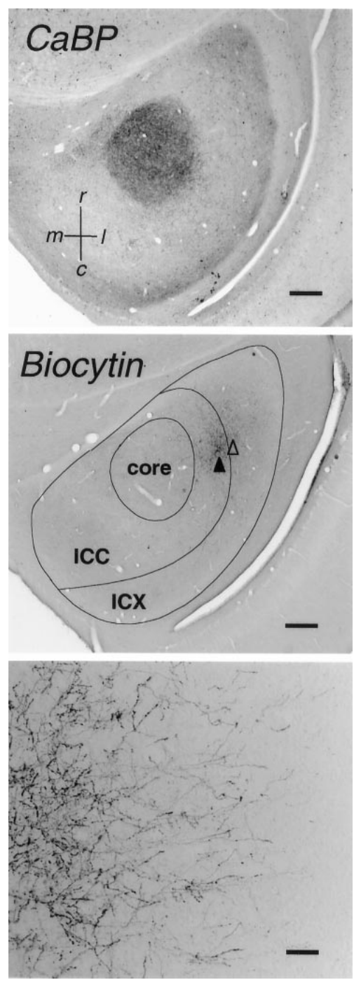
Tracer anatomy identifies the ICC-to-ICX projection
Anterograde tracing labels projections from neuronal cell bodies toward their axon terminals. DeBello and colleagues injected biocytin into timing-defined ICC sites and reconstructed the labeled axons extending into ICX.
A calcium-binding-protein stain identified the ICC core as an anatomical reference. Biocytin labeling revealed the projection field and individual bouton-bearing axons. The published sections include scale bars of 500 µm for anatomical organization and 100 µm for the higher-magnification projection image.
This approach measures the physical distribution of axons rather than their momentary firing. It can distinguish a change in projection geometry from a change in physiological weighting alone. Tracer anatomy therefore tests whether physiological map shifts are accompanied by structural remodeling of the pathway that carries timing input.
DeBello et al. (2001), Fig. 2. Histological tracing of central-to-external collicular axons.
DeBello et al. (2001)
34
Notes:
Teaching transcript:
Anterograde tracing labels projections from neuronal cell bodies toward their axon terminals. DeBello and colleagues injected biocytin into timing-defined ICC sites and reconstructed the labeled axons extending into ICX.
A calcium-binding-protein stain identified the ICC core as an anatomical reference. Biocytin labeling revealed the projection field and individual bouton-bearing axons. The published sections include scale bars of 500 µm for anatomical organization and 100 µm for the higher-magnification projection image.
This approach measures the physical distribution of axons rather than their momentary firing. It can distinguish a change in projection geometry from a change in physiological weighting alone. Tracer anatomy therefore tests whether physiological map shifts are accompanied by structural remodeling of the pathway that carries timing input.
A bouton is a localized swelling along or at the end of an axon, commonly associated with a presynaptic release site. Its appearance is anatomical evidence, not a measurement of release efficacy.
References:
William M. DeBello; Daniel E. Feldman; Eric I. Knudsen (2001). Adaptive Axonal Remodeling in the Midbrain Auditory Space Map. The Journal of Neuroscience 21(9):3161-3174. https://doi.org/10.1523/jneurosci.21-09-03161.2001
DeBello et al. (2001), Fig. 2. Histological tracing of central-to-external collicular axons.
Figure source: https://doi.org/10.1523/jneurosci.21-09-03161.2001

Slide 45
Anterograde tracing follows axons to their targets
Anterograde tracing labels projections from neuronal cell bodies toward their axon terminals. A tracer injected at one site fills the axons that leave it and shows where they end. The tracer is transported along the axons from the injection site to the terminals.
DeBello and colleagues injected biocytin into timing-defined ICC sites and reconstructed the labeled axons extending into ICX. A calcium-binding-protein stain identified the ICC core as an anatomical reference. The projection field is the region of ICX that contains the labeled terminals.
The labeling revealed the projection field and individual bouton-bearing axons. Anatomy separates a change in projection geometry from a change in physiological weighting alone. Quantifying axon length and boutons in the field gives a structural measure of the pathway.
DeBello et al. (2001), Fig. 2. Histological tracing of central-to-external collicular axons.
DeBello et al. (2001)
34a
Notes:
Tracing measures the structure of the pathway that carries timing input.
Anterograde tracing.
A tracer labels the projections that leave the injected cells and reach their terminals.
Injection sites.
Biocytin was injected into ICC sites with defined timing preferences.
Reconstruction.
Labeled axons extending into ICX were reconstructed.
A calcium-binding-protein stain marked the ICC core.
What was visible.
The projection field and individual axons with boutons were visible.
Scale bars of 500 and 100 micrometers accompany the published sections.
Use.
The anatomy distinguishes geometry from physiological weighting.
Reference stain.
The calcium-binding-protein stain marks the ICC core and provides landmarks for comparing animals.
Scale.
The published sections include scale bars of 500 micrometers for anatomical organization and 100 micrometers for the higher-magnification projection image.
Question addressed.
The anatomy asks whether the physiological map shift is accompanied by a structural change in the pathway.
Why anatomy complements physiology.
Spikes show what a neuron expresses.
Axons and boutons show the structure that supplies the input.
Timing-defined sites.
The injected ICC sites were defined by their timing preference, so the labeled axons can be related to the timing that the sites represent.
References:
William M. DeBello; Daniel E. Feldman; Eric I. Knudsen (2001). Adaptive Axonal Remodeling in the Midbrain Auditory Space Map. The Journal of Neuroscience 21(9):3161-3174. https://doi.org/10.1523/jneurosci.21-09-03161.2001

Slide 46
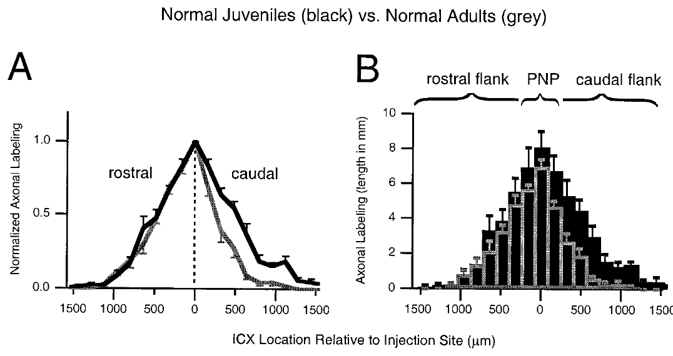
Normal development refines the projection field
DeBello and colleagues compared ICC-to-ICX projections in normal juvenile and adult owls using equivalent tracing procedures. A projection field is the spatial region containing axons from the labeled source population.
Adult fields were narrower and sparser than juvenile fields. The reduction was strongest on the caudal flank, where total axonal labeling was about 68% lower in adults. Caudal means toward the rear; rostral means toward the front. The peak region and rostral flank changed less.
DeBello et al. (2001), Fig. 6(A–B). Juvenile and adult distributions of traced axons.
The pattern supports selective developmental refinement rather than uniform scaling of the entire projection. Because different animals supplied the age groups, the study measures net anatomical differences rather than observing individual axons retract. The result provides the normal developmental reference for evaluating prism-dependent remodeling.
Feldman & Knudsen (1998), Fig. 2(A). ICCls, ICX, and optic-tectum locations.
DeBello et al. (2001)
35
Notes:
Teaching transcript:
DeBello and colleagues compared ICC-to-ICX projections in normal juvenile and adult owls using equivalent tracing procedures. A projection field is the spatial region containing axons from the labeled source population.
Adult fields were narrower and sparser than juvenile fields. The reduction was strongest on the caudal flank, where total axonal labeling was about 68% lower in adults. Caudal means toward the rear; rostral means toward the front. The peak region and rostral flank changed less.
The pattern supports selective developmental refinement rather than uniform scaling of the entire projection. Because different animals supplied the age groups, the study measures net anatomical differences rather than observing individual axons retract. The result provides the normal developmental reference for evaluating prism-dependent remodeling.
Spatially selective loss can sharpen a projection without moving every surviving axon. The cross-sectional comparison does not distinguish each individual elimination event.
References:
William M. DeBello; Daniel E. Feldman; Eric I. Knudsen (2001). Adaptive Axonal Remodeling in the Midbrain Auditory Space Map. The Journal of Neuroscience 21(9):3161-3174. https://doi.org/10.1523/jneurosci.21-09-03161.2001
Daniel E. Feldman; Eric I. Knudsen (1998). Pharmacological Specialization of Learned Auditory Responses in the Inferior Colliculus of the Barn Owl. The Journal of Neuroscience 18(8):3073-3087. https://doi.org/10.1523/jneurosci.18-08-03073.1998
DeBello et al. (2001), Fig. 6(A–B). Juvenile and adult distributions of traced axons.
Figure source: https://doi.org/10.1523/jneurosci.21-09-03161.2001
Feldman & Knudsen (1998), Fig. 2(A). ICCls, ICX, and optic-tectum locations.
Figure source: https://doi.org/10.1523/jneurosci.18-08-03073.1998

Slide 47
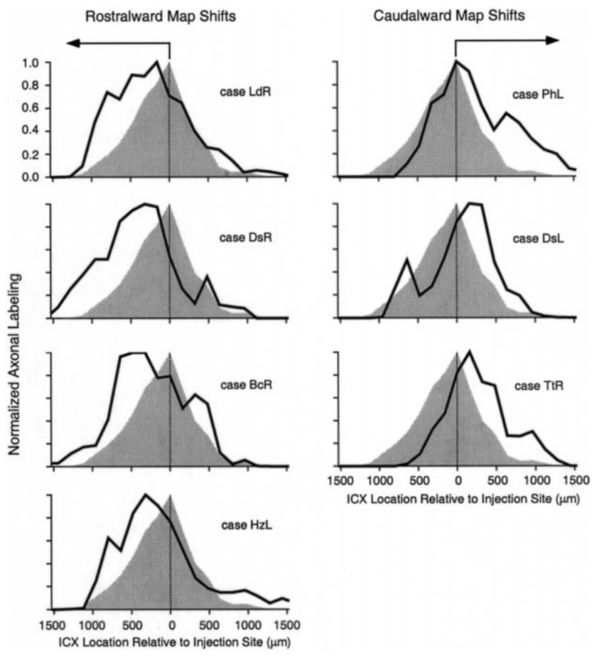
Prism experience changes where projections extend
DeBello and colleagues compared labeled ICC-to-ICX projections in prism-reared owls with the normal adult pattern. Injection sites represented similar timing values, so differences in target distribution could be related to the direction of the adaptive map shift.
Projections associated with rostralward physiological shifts extended more strongly toward the rostral side of ICX. Caudalward shifts were associated with a different pattern of extension and preservation. The approximately 23° optical manipulation therefore corresponded to spatially appropriate anatomical changes rather than indiscriminate expansion.
The tracing supports remodeling of the auditory input pathway. The direction of the extension corresponded to the direction of the physiological map shift, so the anatomical and physiological changes fit together.
DeBello et al. (2001), Fig. 9. Projection distributions in prism-adapted owls.
DeBello et al. (2001)
36
Notes:
Teaching transcript:
DeBello and colleagues compared labeled ICC-to-ICX projections in prism-reared owls with the normal adult pattern. Injection sites represented similar timing values, so differences in target distribution could be related to the direction of the adaptive map shift.
Projections associated with rostralward physiological shifts extended more strongly toward the rostral side of ICX. Caudalward shifts were associated with a different pattern of extension and preservation. The approximately 23° optical manipulation therefore corresponded to spatially appropriate anatomical changes rather than indiscriminate expansion.
The tracing supports remodeling of the auditory input pathway. The direction of the extension corresponded to the direction of the physiological map shift, so the anatomical and physiological changes fit together.
The direction of map adjustment differs between the two sides of the brain. Anatomical comparisons must therefore distinguish rostralward and caudalward shifts rather than pooling them.
References:
William M. DeBello; Daniel E. Feldman; Eric I. Knudsen (2001). Adaptive Axonal Remodeling in the Midbrain Auditory Space Map. The Journal of Neuroscience 21(9):3161-3174. https://doi.org/10.1523/jneurosci.21-09-03161.2001
DeBello et al. (2001), Fig. 9. Projection distributions in prism-adapted owls.
Figure source: https://doi.org/10.1523/jneurosci.21-09-03161.2001

Slide 48
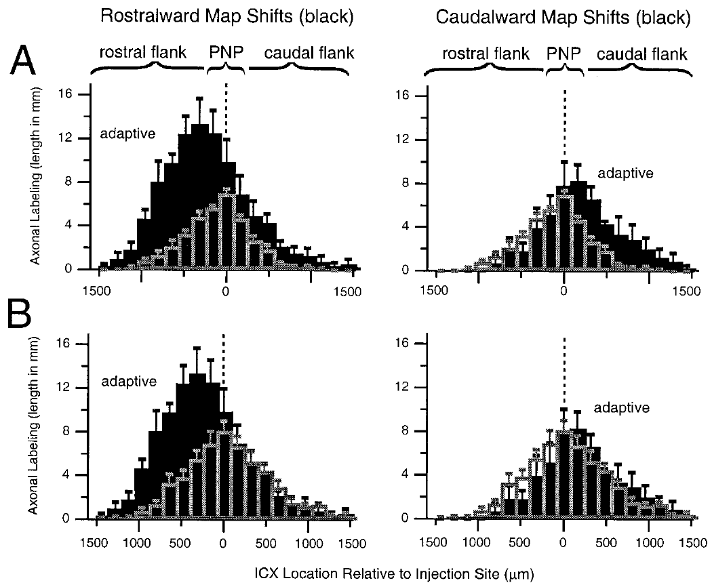
Adaptive expansion exceeds normal juvenile labeling
A broad projection in a prism-reared adult could reflect retained juvenile axons or growth beyond the juvenile pattern. DeBello and colleagues compared the regional amounts of labeled axon with both normal juvenile and normal adult projections.
For rostralward shifts, the adaptive flank contained about 2.3 times the axonal density and bouton number measured on the corresponding juvenile flank. This exceeded simple preservation of the normal juvenile distribution. The comparisons used projection subregions defined relative to the normal peak.
DeBello et al. (2001), Fig. 10(A–B). Prism-reared projection fields compared with age controls.
The result supports net elaboration in the adaptive region. Prism-reared adults therefore added axon to the adaptive region and did not merely retain juvenile axons.
Feldman & Knudsen (1998), Fig. 2(A). ICCls, ICX, and optic-tectum locations.
DeBello et al. (2001)
37
Notes:
Teaching transcript:
A broad projection in a prism-reared adult could reflect retained juvenile axons or growth beyond the juvenile pattern. DeBello and colleagues compared the regional amounts of labeled axon with both normal juvenile and normal adult projections.
For rostralward shifts, the adaptive flank contained about 2.3 times the axonal density and bouton number measured on the corresponding juvenile flank. This exceeded simple preservation of the normal juvenile distribution. The comparisons used projection subregions defined relative to the normal peak.
The result supports net elaboration in the adaptive region. Prism-reared adults therefore added axon to the adaptive region and did not merely retain juvenile axons.
Preservation predicts an adult retaining approximately the earlier anatomical amount. An increase beyond the juvenile reference requires an additional net contribution to the projection.
References:
William M. DeBello; Daniel E. Feldman; Eric I. Knudsen (2001). Adaptive Axonal Remodeling in the Midbrain Auditory Space Map. The Journal of Neuroscience 21(9):3161-3174. https://doi.org/10.1523/jneurosci.21-09-03161.2001
Daniel E. Feldman; Eric I. Knudsen (1998). Pharmacological Specialization of Learned Auditory Responses in the Inferior Colliculus of the Barn Owl. The Journal of Neuroscience 18(8):3073-3087. https://doi.org/10.1523/jneurosci.18-08-03073.1998
DeBello et al. (2001), Fig. 10(A–B). Prism-reared projection fields compared with age controls.
Figure source: https://doi.org/10.1523/jneurosci.21-09-03161.2001
Feldman & Knudsen (1998), Fig. 2(A). ICCls, ICX, and optic-tectum locations.
Figure source: https://doi.org/10.1523/jneurosci.18-08-03073.1998

Slide 49
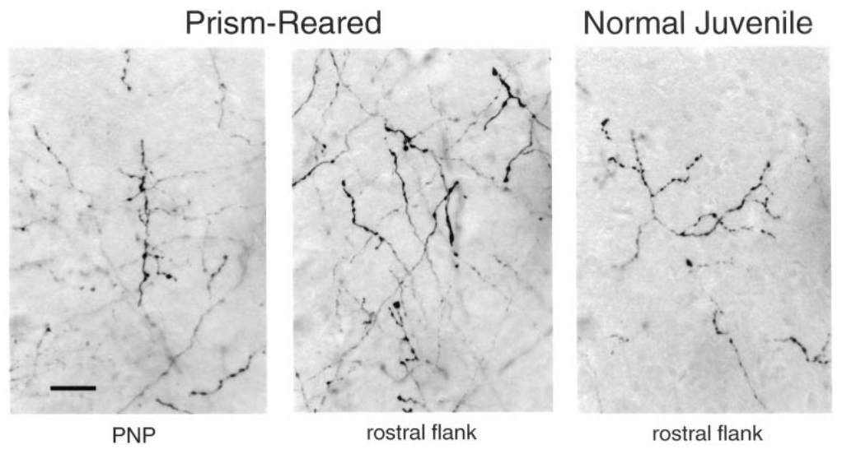
Adaptive axons carry presynaptic boutons
An additional axon branch is more relevant to circuit function when it contains potential synaptic contacts. DeBello and colleagues examined the labeled axons in the adaptive flank and at the peak of the normal ICC-to-ICX projection.
The prism-associated axons were branched and carried boutons. The original micrographs retain a 20 µm scale bar. Bouton-bearing axons were present in the newly expanded region as well as in the normal projection region, linking altered projection geometry with potential presynaptic input.
The anatomy supports an adaptive circuit containing opportunities for synaptic transmission. Boutons are the presynaptic swellings at which transmitter release can occur, so bouton-bearing branches in the expanded region are potential sites of new input.
DeBello et al. (2001), Fig. 11. Bouton-bearing axons in normal and prism-reared ICX.
DeBello et al. (2001)
38
Notes:
Teaching transcript:
An additional axon branch is more relevant to circuit function when it contains potential synaptic contacts. DeBello and colleagues examined the labeled axons in the adaptive flank and at the peak of the normal ICC-to-ICX projection.
The prism-associated axons were branched and carried boutons. The original micrographs retain a 20 µm scale bar. Bouton-bearing axons were present in the newly expanded region as well as in the normal projection region, linking altered projection geometry with potential presynaptic input.
The anatomy supports an adaptive circuit containing opportunities for synaptic transmission. Boutons are the presynaptic swellings at which transmitter release can occur, so bouton-bearing branches in the expanded region are potential sites of new input.
A presynaptic structure belongs to the transmitting side of a synapse. The receiving dendrite and its receptor currents require additional methods to characterize.
References:
William M. DeBello; Daniel E. Feldman; Eric I. Knudsen (2001). Adaptive Axonal Remodeling in the Midbrain Auditory Space Map. The Journal of Neuroscience 21(9):3161-3174. https://doi.org/10.1523/jneurosci.21-09-03161.2001
DeBello et al. (2001), Fig. 11. Bouton-bearing axons in normal and prism-reared ICX.
Figure source: https://doi.org/10.1523/jneurosci.21-09-03161.2001

Slide 50
Boutons mark potential presynaptic contacts
A bouton is a swelling along an axon at which synaptic contacts can form. An additional branch is more relevant to circuit function when it carries boutons. Counting boutons therefore estimates the number of potential contacts.
DeBello and colleagues examined labeled axons in the adaptive flank and at the peak of the normal ICC-to-ICX projection. The prism-associated axons were branched and carried boutons, and bouton-bearing axons were present in both the newly expanded region and the normal region.
Boutons in the expanded region link altered projection geometry with potential presynaptic input. The sites of transmitter release in the adaptive region therefore added to those of the normal projection. Light microscopy resolves the swellings along each labeled axon.
DeBello et al. (2001), Fig. 11. Bouton-bearing axons in normal and prism-reared ICX.
DeBello et al. (2001)
38a
Notes:
Branches matter for circuit function when they bear boutons.
Bouton.
A bouton is a swelling at which an axon can make a synaptic contact.
Regions examined.
The adaptive flank and the peak of the normal projection were examined.
Observation.
Prism-associated axons were branched and carried boutons.
Bouton-bearing axons were present in the newly expanded region and in the normal region.
Image detail.
The micrographs retain a 20-micrometer scale bar.
Meaning.
The anatomy supplies potential sites for new synaptic input in the adaptive region.
Adaptive flank and peak.
The adaptive flank is the part of ICX where prism-reared owls had extra projection.
The peak is the center of the normal projection.
Count of contacts.
Bouton number and axon density estimate potential contacts.
Their strength and efficacy need physiological measurement.
Image detail.
The original micrographs retain a 20-micrometer scale bar.
Expanded and normal regions.
Bouton-bearing axons appeared in the expanded region as well as in the normal projection region, which links a change in geometry to potential presynaptic input.
References:
William M. DeBello; Daniel E. Feldman; Eric I. Knudsen (2001). Adaptive Axonal Remodeling in the Midbrain Auditory Space Map. The Journal of Neuroscience 21(9):3161-3174. https://doi.org/10.1523/jneurosci.21-09-03161.2001

Slide 51
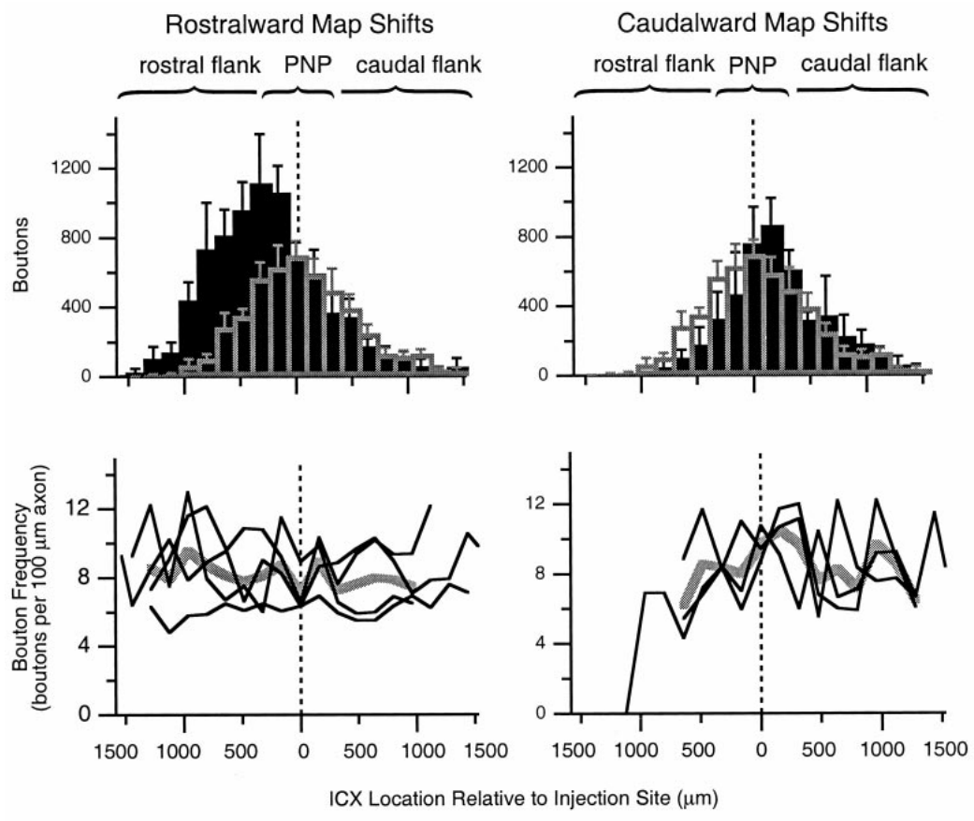
Bouton distributions follow adaptive projection changes
A circuit can change its number of potential contacts by changing axon length, bouton frequency along axons, or both. DeBello and colleagues quantified bouton distributions together with the spatial distribution of traced projection axons.
Prism-reared cases contained increased bouton labeling in the adaptive portions of the projection. The analysis compared rostralward and caudalward shifts with the normal juvenile pattern and examined frequency along measured axonal segments. The regional increase corresponded to the projection remodeling rather than a uniform addition throughout ICX.
DeBello et al. (2001), Fig. 12. Regional bouton distributions and bouton frequency.
These measures describe structural opportunities for auditory input in the adaptive portions of the projection. A larger anatomical projection can coexist with physiological suppression when inhibitory input or synaptic efficacy limits its expression.
Feldman & Knudsen (1998), Fig. 2(A). ICCls, ICX, and optic-tectum locations.
DeBello et al. (2001)
39
Notes:
Teaching transcript:
A circuit can change its number of potential contacts by changing axon length, bouton frequency along axons, or both. DeBello and colleagues quantified bouton distributions together with the spatial distribution of traced projection axons.
Prism-reared cases contained increased bouton labeling in the adaptive portions of the projection. The analysis compared rostralward and caudalward shifts with the normal juvenile pattern and examined frequency along measured axonal segments. The regional increase corresponded to the projection remodeling rather than a uniform addition throughout ICX.
These measures describe structural opportunities for auditory input in the adaptive portions of the projection. A larger anatomical projection can coexist with physiological suppression when inhibitory input or synaptic efficacy limits its expression.
Bouton frequency is the number of boutons per measured axonal length. It differs from the total number of boutons contributed by an entire projection field.
References:
William M. DeBello; Daniel E. Feldman; Eric I. Knudsen (2001). Adaptive Axonal Remodeling in the Midbrain Auditory Space Map. The Journal of Neuroscience 21(9):3161-3174. https://doi.org/10.1523/jneurosci.21-09-03161.2001
Daniel E. Feldman; Eric I. Knudsen (1998). Pharmacological Specialization of Learned Auditory Responses in the Inferior Colliculus of the Barn Owl. The Journal of Neuroscience 18(8):3073-3087. https://doi.org/10.1523/jneurosci.18-08-03073.1998
DeBello et al. (2001), Fig. 12. Regional bouton distributions and bouton frequency.
Figure source: https://doi.org/10.1523/jneurosci.21-09-03161.2001
Feldman & Knudsen (1998), Fig. 2(A). ICCls, ICX, and optic-tectum locations.
Figure source: https://doi.org/10.1523/jneurosci.18-08-03073.1998

Slide 52
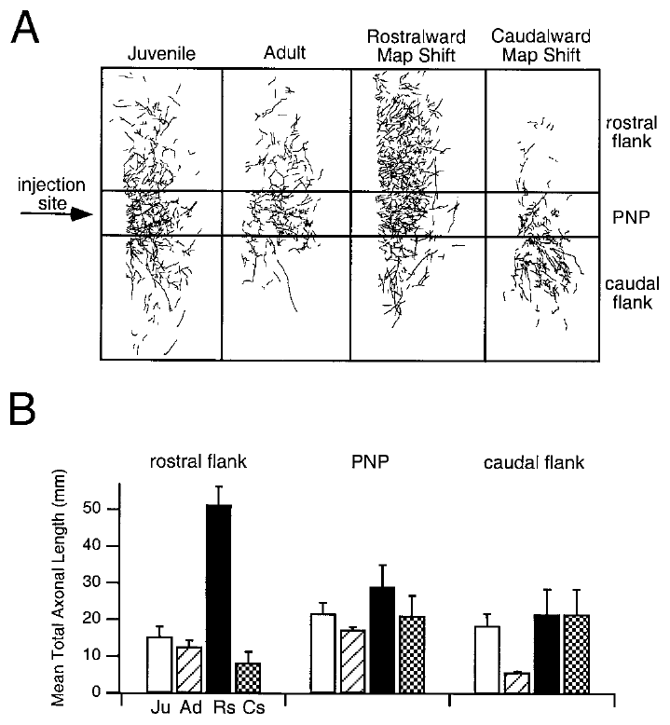
The normal projection survives alongside adaptive inputs
Prism adaptation does not require complete removal of the original auditory pathway. DeBello and colleagues found that axonal and bouton labeling around the peak of the normal projection remained comparable to, or greater than, that in normal control groups.
Prism-reared owls therefore retained the anatomical substrate for normal timing inputs while also possessing appropriately placed adaptive projections. The spatial comparisons used the same normal-peak reference and separated rostralward from caudalward map shifts.
Coexistence of these projections provides a plausible substrate for recovery after prism removal. Axons and boutons around the peak of the normal projection remained, so the anatomical substrate for normal timing inputs persisted alongside the adaptive inputs, and their physiological expression is regulated by synaptic strength and inhibition.
DeBello et al. (2001), Fig. 15(A–B). Normal projection regions retained in prism-reared owls.
DeBello et al. (2001)
40
Notes:
Teaching transcript:
Prism adaptation does not require complete removal of the original auditory pathway. DeBello and colleagues found that axonal and bouton labeling around the peak of the normal projection remained comparable to, or greater than, that in normal control groups.
Prism-reared owls therefore retained the anatomical substrate for normal timing inputs while also possessing appropriately placed adaptive projections. The spatial comparisons used the same normal-peak reference and separated rostralward from caudalward map shifts.
Coexistence of these projections provides a plausible substrate for recovery after prism removal. Axons and boutons around the peak of the normal projection remained, so the anatomical substrate for normal timing inputs persisted alongside the adaptive inputs, and their physiological expression is regulated by synaptic strength and inhibition.
A pathway can persist anatomically while contributing little to the measured spike response. Re-expression can require changes in functional weighting even when no new axon is necessary.
References:
William M. DeBello; Daniel E. Feldman; Eric I. Knudsen (2001). Adaptive Axonal Remodeling in the Midbrain Auditory Space Map. The Journal of Neuroscience 21(9):3161-3174. https://doi.org/10.1523/jneurosci.21-09-03161.2001
DeBello et al. (2001), Fig. 15(A–B). Normal projection regions retained in prism-reared owls.
Figure source: https://doi.org/10.1523/jneurosci.21-09-03161.2001

Slide 53
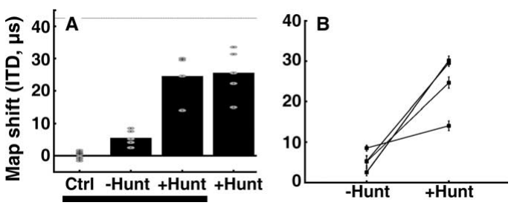
Adult hunting increases expressed map plasticity
Bergan and colleagues tested whether an ecologically important behavior could increase adult auditory plasticity. Adult owls experienced 17° prisms while either receiving dead mice or hunting live mice during one-hour daily feeding sessions in communal aviaries.
After 10 weeks without hunting, the median map shift was about 5 µs. With hunting, it was about 25 µs, approximately five times larger. A separate group introduced directly to hunting showed a similar 26 µs median shift after eight weeks, reducing concern that previous prism exposure alone explained the effect.
Bergan et al. (2005), Fig. 2(A–B). Adult timing-map shifts with and without hunting.
Hunting increased adult adaptation but did not restore the full juvenile response. Hunting combined several features of experience, including live prey, movement, sound and consequences for errors, and the adult shift of about 25 µs was smaller than the juvenile response.
Feldman & Knudsen (1998), Fig. 2(A). ICCls, ICX, and optic-tectum locations.
Bergan et al. (2005)
41
Notes:
Teaching transcript:
Bergan and colleagues tested whether an ecologically important behavior could increase adult auditory plasticity. Adult owls experienced 17° prisms while either receiving dead mice or hunting live mice during one-hour daily feeding sessions in communal aviaries.
After 10 weeks without hunting, the median map shift was about 5 µs. With hunting, it was about 25 µs, approximately five times larger. A separate group introduced directly to hunting showed a similar 26 µs median shift after eight weeks, reducing concern that previous prism exposure alone explained the effect.
Hunting increased adult adaptation but did not restore the full juvenile response. Hunting combined several features of experience, including live prey, movement, sound and consequences for errors, and the adult shift of about 25 µs was smaller than the juvenile response.
The predicted full shift for the 17-degree displacement was approximately 42.5 microseconds. The adult hunting response was substantial but remained incomplete.
References:
Joseph F. Bergan; Peter Ro; Daniel Ro; Eric I. Knudsen (2005). Hunting Increases Adaptive Auditory Map Plasticity in Adult Barn Owls. The Journal of Neuroscience 25(42):9816-9820. https://doi.org/10.1523/jneurosci.2533-05.2005
Daniel E. Feldman; Eric I. Knudsen (1998). Pharmacological Specialization of Learned Auditory Responses in the Inferior Colliculus of the Barn Owl. The Journal of Neuroscience 18(8):3073-3087. https://doi.org/10.1523/jneurosci.18-08-03073.1998
Bergan et al. (2005), Fig. 2(A–B). Adult timing-map shifts with and without hunting.
Figure source: https://doi.org/10.1523/jneurosci.2533-05.2005
Feldman & Knudsen (1998), Fig. 2(A). ICCls, ICX, and optic-tectum locations.
Figure source: https://doi.org/10.1523/jneurosci.18-08-03073.1998

Slide 54
Hunting couples sound, vision and consequence
Hunting combines moving live prey, sounds made by the prey, visual information about its position and an immediate consequence for an inaccurate strike. Bergan and colleagues asked whether this behavior increases adult auditory plasticity.
Adult owls wore 17° prisms and received either dead mice or live mice during one-hour daily sessions in communal aviaries. After 10 weeks without hunting the median map shift was about 5 µs, and with hunting it was about 25 µs.
Bergan et al. (2005), Fig. 2(A–B). Adult timing-map shifts with and without hunting.
A separate group introduced directly to hunting showed a similar 26 µs shift after eight weeks. The behavior therefore increased adaptation in adults, and the larger shift was not explained by prior prism exposure alone.
Feldman & Knudsen (1998), Fig. 2(A). ICCls, ICX, and optic-tectum locations.
Bergan et al. (2005)
41a
Notes:
A natural behavior was added to the prism experience of adult owls.
Hunting features.
Live prey provide movement and rustling sounds, coupled visual and auditory information, and a consequence for inaccurate strikes.
Groups.
Adult owls wore 17-degree prisms.
They received dead mice or hunted live mice in one-hour daily sessions.
Shifts.
Without hunting the median shift after 10 weeks was about 5 microseconds.
With hunting it was about 25 microseconds.
Control group.
A separate group introduced directly to hunting showed a median shift of 26 microseconds after eight weeks.
Meaning.
Hunting increased adult map plasticity.
Prism size.
The prisms displaced vision by 17 degrees, smaller than the 23 degrees used in the juvenile experiments.
Housing.
Both groups lived in communal aviaries and had one-hour feeding sessions, so only the demand to capture live prey differed.
Question asked.
The study tested whether a behavior with ecological importance could raise adult plasticity above the level seen with prism wearing alone.
Interpretation of the groups.
Introducing a separate group directly to hunting reduced concern that earlier prism exposure explained the larger shift.
References:
Joseph F. Bergan; Peter Ro; Daniel Ro; Eric I. Knudsen (2005). Hunting Increases Adaptive Auditory Map Plasticity in Adult Barn Owls. The Journal of Neuroscience 25(42):9816-9820. https://doi.org/10.1523/jneurosci.2533-05.2005

Slide 55
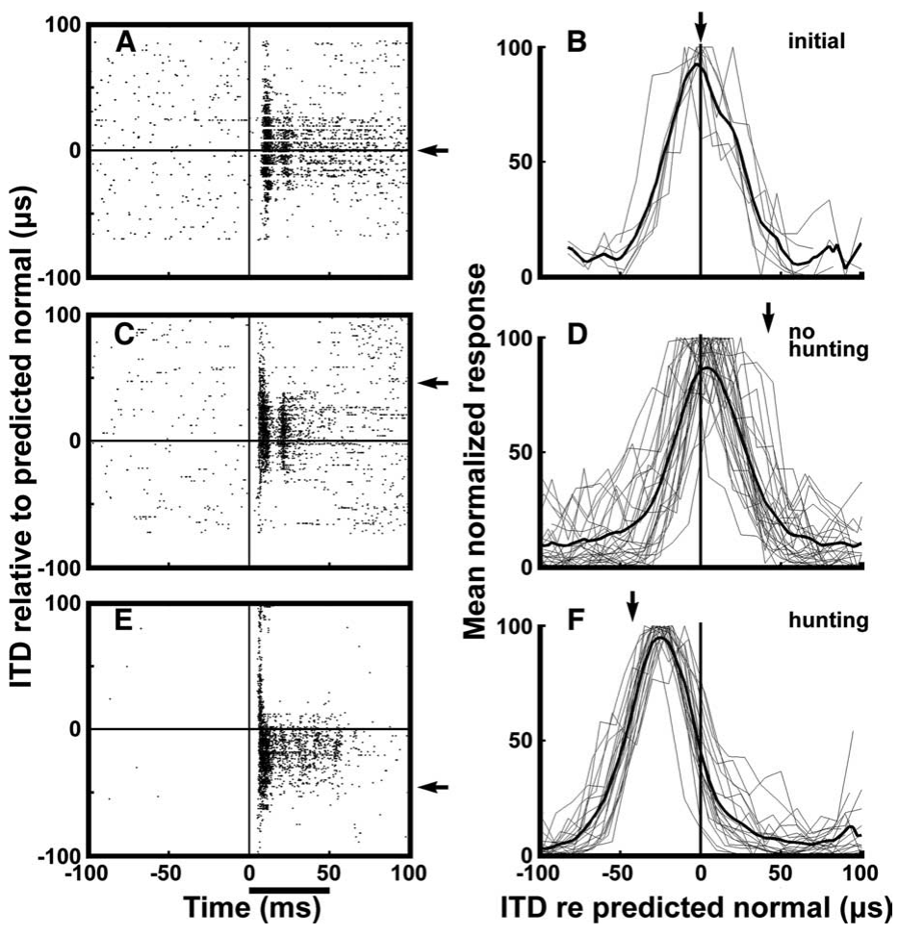
Hunting produces more consistent timing-map shifts
Bergan and colleagues recorded tectal responses to 50 ms broadband noise bursts delivered independently to the two ears. The 2–10 kHz stimuli were presented 20–30 dB above auditory threshold, while visual receptive fields established the normal timing reference.
In a representative adult, 10 weeks of prism experience without hunting produced a small shift. After normal calibration was restored and an opposite displacement was paired with hunting, responses shifted substantially farther and individual sites agreed more consistently with the adaptive mapping.
Bergan et al. (2005), Fig. 1(A–F). Adult neural responses before and after hunting experience.
The raster displays and population tuning therefore connect the behavioral condition with neuronal response organization. Under controlled stimulation the responses of individual sites agreed more consistently with the adaptive mapping after hunting than after prism experience alone.
Feldman & Knudsen (1998), Fig. 2(A). ICCls, ICX, and optic-tectum locations.
Bergan et al. (2005)
42
Notes:
Teaching transcript:
Bergan and colleagues recorded tectal responses to 50 ms broadband noise bursts delivered independently to the two ears. The 2–10 kHz stimuli were presented 20–30 dB above auditory threshold, while visual receptive fields established the normal timing reference.
In a representative adult, 10 weeks of prism experience without hunting produced a small shift. After normal calibration was restored and an opposite displacement was paired with hunting, responses shifted substantially farther and individual sites agreed more consistently with the adaptive mapping.
The raster displays and population tuning therefore connect the behavioral condition with neuronal response organization. Under controlled stimulation the responses of individual sites agreed more consistently with the adaptive mapping after hunting than after prism experience alone.
A raster display marks individual spike times across repeated stimulus presentations. Population tuning combines the timing preferences of multiple recording sites.
References:
Joseph F. Bergan; Peter Ro; Daniel Ro; Eric I. Knudsen (2005). Hunting Increases Adaptive Auditory Map Plasticity in Adult Barn Owls. The Journal of Neuroscience 25(42):9816-9820. https://doi.org/10.1523/jneurosci.2533-05.2005
Daniel E. Feldman; Eric I. Knudsen (1998). Pharmacological Specialization of Learned Auditory Responses in the Inferior Colliculus of the Barn Owl. The Journal of Neuroscience 18(8):3073-3087. https://doi.org/10.1523/jneurosci.18-08-03073.1998
Bergan et al. (2005), Fig. 1(A–F). Adult neural responses before and after hunting experience.
Figure source: https://doi.org/10.1523/jneurosci.2533-05.2005
Feldman & Knudsen (1998), Fig. 2(A). ICCls, ICX, and optic-tectum locations.
Figure source: https://doi.org/10.1523/jneurosci.18-08-03073.1998

Slide 56
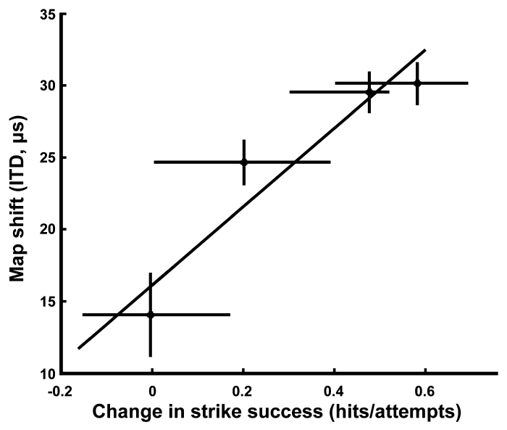
Improved prey capture accompanies auditory remapping
Strike success is the proportion of attempts in which the owl captures the target mouse. Bergan and colleagues measured this behavioral outcome while adult owls hunted with prismatic displacement, linking neural adjustment with a natural localization task.
Average success was about 89% without prisms and fell to about 27% immediately after prism attachment. During subsequent hunting experience, improved capture performance covaried with the amount of adaptive timing-map shift. The prism condition challenged cross-modal localization during an action with a clear behavioral consequence.
The association supports the functional relevance of auditory remapping. Strike success covaried with the amount of adaptive timing-map shift, so neural tuning and behavioral outcome tracked each other during hunting experience.
Bergan et al. (2005), Fig. 3. Map adjustment versus improvement in strike success.
Bergan et al. (2005)
43
Notes:
Teaching transcript:
Strike success is the proportion of attempts in which the owl captures the target mouse. Bergan and colleagues measured this behavioral outcome while adult owls hunted with prismatic displacement, linking neural adjustment with a natural localization task.
Average success was about 89% without prisms and fell to about 27% immediately after prism attachment. During subsequent hunting experience, improved capture performance covaried with the amount of adaptive timing-map shift. The prism condition challenged cross-modal localization during an action with a clear behavioral consequence.
The association supports the functional relevance of auditory remapping. Strike success covaried with the amount of adaptive timing-map shift, so neural tuning and behavioral outcome tracked each other during hunting experience.
The study compared change in strike performance with change in the map. Correlation constrains the functional interpretation but does not replace a selective causal manipulation.
References:
Joseph F. Bergan; Peter Ro; Daniel Ro; Eric I. Knudsen (2005). Hunting Increases Adaptive Auditory Map Plasticity in Adult Barn Owls. The Journal of Neuroscience 25(42):9816-9820. https://doi.org/10.1523/jneurosci.2533-05.2005
Bergan et al. (2005), Fig. 3. Map adjustment versus improvement in strike success.
Figure source: https://doi.org/10.1523/jneurosci.2533-05.2005

Slide 57
Strike success measures behavioral accuracy
Strike success is the proportion of attempts in which the owl captures the target mouse. It provides a behavioral outcome that can be compared with the neural map shift in the same animals. It is a direct measure of how well the owl uses its map.
Average success was about 89% without prisms and about 27% immediately after prism attachment. During hunting experience, improved capture performance covaried with the amount of adaptive timing-map shift.
A prism displaces the visual location of the prey relative to its sound, so accurate strikes require the auditory and visual estimates of position to agree. Recovery of strike success accompanies realignment of the auditory map. Better strikes therefore indicate a better match between where the owl hears and sees the prey.
Bergan et al. (2005), Fig. 3. Map adjustment versus improvement in strike success.
Bergan et al. (2005)
43a
Notes:
Behavior and neural tuning were measured together in the same experiment.
Strike success.
Strike success is the proportion of attempts in which the owl captures the mouse.
Effect of prisms.
Average success was about 89 percent without prisms.
It fell to about 27 percent immediately after prism attachment.
Why prisms impair hunting.
The prism shifts the apparent visual position of the prey, and the sound of the prey indicates a different position.
Improvement.
During hunting, improved capture performance covaried with the amount of adaptive timing-map shift.
Meaning.
Neural tuning and behavior are related outcomes of recalibration.
Experimental logic.
The owl hunts live mice, so each strike is a test of whether sound and vision agree.
Strike success is the behavioral readout.
Link to neurons.
The amount of timing-map shift measured in the tectum was related to improvement in capture.
Why success falls.
With prisms attached, an owl aims at the visual position of the mouse while the sound of the mouse indicates a different position.
Strikes miss until the maps realign.
Behavioral consequence.
Capture of live prey has a clear consequence, which makes strike success a meaningful measure of accuracy.
References:
Joseph F. Bergan; Peter Ro; Daniel Ro; Eric I. Knudsen (2005). Hunting Increases Adaptive Auditory Map Plasticity in Adult Barn Owls. The Journal of Neuroscience 25(42):9816-9820. https://doi.org/10.1523/jneurosci.2533-05.2005

Slide 58
Natural experience changes the conditions for learning
The hunting manipulation preserved many aspects of the adult owls’ environment while changing the task of obtaining food. Both groups had one-hour feeding periods, lived in aviaries, and oriented and flew toward mice. Only the hunting condition required capturing live prey.
Live mice supplied movement and rustling sounds, coupled visual and auditory information, and a consequence for inaccurate strikes. Adult map shifts increased from roughly 5 to 25 µs under the hunting condition. These differences suggest several possible routes by which natural behavior could enhance plasticity.
Bergan et al. (2005), Fig. 2(A–B). Adult adaptation depends on the feeding condition.
Attention, arousal, sensory information and reward are proposed contributors to the enhanced plasticity. The compound hunting experience increased adaptive plasticity in the adult map.
Feldman & Knudsen (1998), Fig. 2(A). ICCls, ICX, and optic-tectum locations.
Bergan et al. (2005)
44
Notes:
Teaching transcript:
The hunting manipulation preserved many aspects of the adult owls’ environment while changing the task of obtaining food. Both groups had one-hour feeding periods, lived in aviaries, and oriented and flew toward mice. Only the hunting condition required capturing live prey.
Live mice supplied movement and rustling sounds, coupled visual and auditory information, and a consequence for inaccurate strikes. Adult map shifts increased from roughly 5 to 25 µs under the hunting condition. These differences suggest several possible routes by which natural behavior could enhance plasticity.
Attention, arousal, sensory information and reward are proposed contributors to the enhanced plasticity. The compound hunting experience increased adaptive plasticity in the adult map.
A behavioral state manipulation can identify a condition that promotes learning without establishing a molecular pathway. Naming a candidate neuromodulator would require additional source evidence.
References:
Joseph F. Bergan; Peter Ro; Daniel Ro; Eric I. Knudsen (2005). Hunting Increases Adaptive Auditory Map Plasticity in Adult Barn Owls. The Journal of Neuroscience 25(42):9816-9820. https://doi.org/10.1523/jneurosci.2533-05.2005
Daniel E. Feldman; Eric I. Knudsen (1998). Pharmacological Specialization of Learned Auditory Responses in the Inferior Colliculus of the Barn Owl. The Journal of Neuroscience 18(8):3073-3087. https://doi.org/10.1523/jneurosci.18-08-03073.1998
Bergan et al. (2005), Fig. 2(A–B). Adult adaptation depends on the feeding condition.
Figure source: https://doi.org/10.1523/jneurosci.2533-05.2005
Feldman & Knudsen (1998), Fig. 2(A). ICCls, ICX, and optic-tectum locations.
Figure source: https://doi.org/10.1523/jneurosci.18-08-03073.1998

Slide 59
Map plasticity combines instruction and circuit change
Auditory-map adaptation involves distinct processes supported by different experiments. Regional visual manipulations identify the spatial information guiding change; recordings identify shifted timing preferences; receptor blockade identifies contributions to response expression; tracing identifies altered projection anatomy.
The normal and adaptive projections can coexist after 23° prism experience. Recovery of normal tuning, differential NMDA dependence, and inhibitory suppression are therefore compatible with a circuit that retains several potential mappings but expresses them differently under different conditions.
Developmental age, prior calibration, environmental richness and behavioral engagement all affect the amount or form of plasticity expressed. Complementary evidence from regional manipulations, recordings, receptor blockade and tracing together supports an account in which visual information shapes the circuit that localizes sound.
DeBello et al. (2001), Fig. 15(A–B). Coexisting normal and adaptive anatomical projections.
DeBello et al. (2001)
45
Notes:
Teaching transcript:
Auditory-map adaptation involves distinct processes supported by different experiments. Regional visual manipulations identify the spatial information guiding change; recordings identify shifted timing preferences; receptor blockade identifies contributions to response expression; tracing identifies altered projection anatomy.
The normal and adaptive projections can coexist after 23° prism experience. Recovery of normal tuning, differential NMDA dependence, and inhibitory suppression are therefore compatible with a circuit that retains several potential mappings but expresses them differently under different conditions.
Developmental age, prior calibration, environmental richness and behavioral engagement all affect the amount or form of plasticity expressed. Complementary evidence from regional manipulations, recordings, receptor blockade and tracing together supports an account in which visual information shapes the circuit that localizes sound.
The anatomical persistence measured by DeBello and colleagues supports an available substrate. Connecting that substrate to receptor changes and behavioral recovery remains a synthesis across studies.
References:
William M. DeBello; Daniel E. Feldman; Eric I. Knudsen (2001). Adaptive Axonal Remodeling in the Midbrain Auditory Space Map. The Journal of Neuroscience 21(9):3161-3174. https://doi.org/10.1523/jneurosci.21-09-03161.2001
DeBello et al. (2001), Fig. 15(A–B). Coexisting normal and adaptive anatomical projections.
Figure source: https://doi.org/10.1523/jneurosci.21-09-03161.2001

Slide 60
Key takeaways
Vision calibrates auditory space. Prismatic displacement alters the association between acoustic timing cues and represented location; regional visual information provides topographic instruction.
Sensitive periods depend on the task and environment. Learning an unfamiliar displacement and recovering normal tuning have different age constraints, and rich experience can permit recovery after failure in cages.
ICX expresses adaptive circuit change. Timing-specific central-collicular input is transformed into a shifted auditory-space representation, supported by experience-dependent projection remodeling.
Learned responses initially depend more on NMDA receptors. AP-5 preferentially reduces newly learned responses; that differential effect disappears after extended prism experience.
Inhibition controls which inputs are expressed. Early GABAergic inhibition can mask learned excitation, whereas later inhibition favors expression of the established adaptive mapping.
Adult learning retains behavioral relevance. Hunting increases adult map shifts and accompanies improved prey capture, while the normal anatomical projection persists alongside adaptive inputs.
Brainard & Knudsen (1993); Hyde & Knudsen (2001); Feldman & Knudsen (1998); Brainard & Knudsen (1998); Zheng & Knudsen (2001); DeBello et al. (2001); Bergan et al. (2005)
46
Notes:
Vision calibrates auditory space. Prismatic displacement alters the association between acoustic timing cues and represented location; regional visual information provides topographic instruction.
Sensitive periods depend on the task and environment. Learning an unfamiliar displacement and recovering normal tuning have different age constraints, and rich experience can permit recovery after failure in cages.
ICX expresses adaptive circuit change. Timing-specific central-collicular input is transformed into a shifted auditory-space representation, supported by experience-dependent projection remodeling.
Learned responses initially depend more on NMDA receptors. AP-5 preferentially reduces newly learned responses; that differential effect disappears after extended prism experience.
Inhibition controls which inputs are expressed. Early GABAergic inhibition can mask learned excitation, whereas later inhibition favors expression of the established adaptive mapping.
Adult learning retains behavioral relevance. Hunting increases adult map shifts and accompanies improved prey capture, while the normal anatomical projection persists alongside adaptive inputs.
References:
MS Brainard; EI Knudsen (1993). Experience-dependent plasticity in the inferior colliculus: a site for visual calibration of the neural representation of auditory space in the barn owl. The Journal of Neuroscience 13(11):4589-4608. https://doi.org/10.1523/jneurosci.13-11-04589.1993
Peter S. Hyde; Eric I. Knudsen (2001). A Topographic Instructive Signal Guides the Adjustment of the Auditory Space Map in the Optic Tectum. The Journal of Neuroscience 21(21):8586-8593. https://doi.org/10.1523/jneurosci.21-21-08586.2001
Daniel E. Feldman; Eric I. Knudsen (1998). Pharmacological Specialization of Learned Auditory Responses in the Inferior Colliculus of the Barn Owl. The Journal of Neuroscience 18(8):3073-3087. https://doi.org/10.1523/jneurosci.18-08-03073.1998
Michael S. Brainard; Eric I. Knudsen (1998). Sensitive Periods for Visual Calibration of the Auditory Space Map in the Barn Owl Optic Tectum. The Journal of Neuroscience 18(10):3929-3942. https://doi.org/10.1523/jneurosci.18-10-03929.1998
Weimin Zheng; Eric I. Knudsen (2001). GABAergic Inhibition Antagonizes Adaptive Adjustment of the Owl's Auditory Space Map during the Initial Phase of Plasticity. The Journal of Neuroscience 21(12):4356-4365. https://doi.org/10.1523/jneurosci.21-12-04356.2001
William M. DeBello; Daniel E. Feldman; Eric I. Knudsen (2001). Adaptive Axonal Remodeling in the Midbrain Auditory Space Map. The Journal of Neuroscience 21(9):3161-3174. https://doi.org/10.1523/jneurosci.21-09-03161.2001
Joseph F. Bergan; Peter Ro; Daniel Ro; Eric I. Knudsen (2005). Hunting Increases Adaptive Auditory Map Plasticity in Adult Barn Owls. The Journal of Neuroscience 25(42):9816-9820. https://doi.org/10.1523/jneurosci.2533-05.2005

