Slide 1

NEUR 411 · NEUROETHOLOGY · FALL 2026 · Lecture 21
Electroreception II: active electrolocation in weakly electric fish (Bullock)
Wednesday, October 14, 2026
Jordan Lopez, Ph.D.
Photo: Elephantnose fish (Gnathonemus petersii). Jutta234, CC BY-SA 3.0.
Notes:
Electroreception II: active electrolocation in weakly electric fish (Bullock)
Wednesday, October 14, 2026
Photo: Elephantnose fish (Gnathonemus petersii). Jutta234, CC BY-SA 3.0.
Credit: Jutta234 / Wikimedia Commons
License: CC BY-SA 3.0
Source: https://commons.wikimedia.org/wiki/File:Gnathonemus_petersii_-_Zoo_Frankfurt.jpg

Slide 2
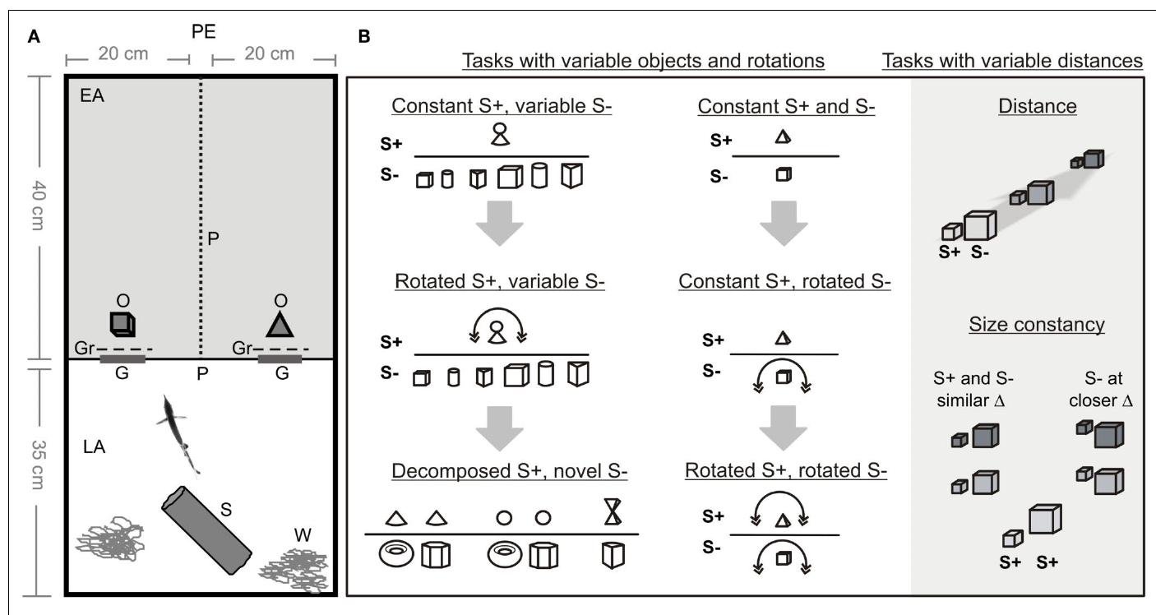
Self-generated electric fields support object recognition
Active electrolocation is detection of nearby objects through changes in an electric field generated by the animal. The weakly electric elephantnose fish, Gnathonemus petersii, emits brief electric organ discharges, or EODs, and senses how surrounding objects alter the resulting current at its skin.
Von der Emde and colleagues trained fish to choose between three-dimensional objects using a two-alternative task. Recognition persisted in complete darkness, including tests of size and rotation, establishing that visible appearance was unnecessary under these conditions.
The behavior concerns near-field sensing rather than a long-range image of the environment. Object recognition failed beyond approximately 4 cm in the tested tasks, even though physical electric fields extend farther.
von der Emde et al. (2010), Fig. 1(A–B). Object-choice apparatus and experimental manipulations.
von der Emde et al. (2010)
2
Notes:
Teaching transcript:
Active electrolocation is detection of nearby objects through changes in an electric field generated by the animal. The weakly electric elephantnose fish, Gnathonemus petersii, emits brief electric organ discharges, or EODs, and senses how surrounding objects alter the resulting current at its skin.
Von der Emde and colleagues trained fish to choose between three-dimensional objects using a two-alternative task. Recognition persisted in complete darkness, including tests of size and rotation, establishing that visible appearance was unnecessary under these conditions.
The behavior concerns near-field sensing rather than a long-range image of the environment. Object recognition failed beyond approximately 4 cm in the tested tasks, even though physical electric fields extend farther.
A two-alternative choice measures which of two objects the animal selects. Accurate choice in darkness establishes a nonvisual capacity under the controlled task conditions.
References:
G. von der Emde; K. Behr; B. Bouton; J. Engelmann; S. Fetz; C. Folde (2010). 3-Dimensional scene perception during active electrolocation in a weakly electric pulse fish. Frontiers in Behavioral Neuroscience 4:26. https://doi.org/10.3389/fnbeh.2010.00026
von der Emde et al. (2010), Fig. 1(A–B). Object-choice apparatus and experimental manipulations.
Figure source: https://doi.org/10.3389/fnbeh.2010.00026

Slide 3
Electric organ discharges are the active probe
A weakly electric fish generates brief electric organ discharges, or EODs, with a specialized organ and senses the current that returns through the water to receptors in its skin. The fish supplies the signal that it senses, so it does not depend on external fields.
Von der Emde and colleagues studied the elephantnose fish, Gnathonemus petersii, which emits a series of short pulses. Objects that conduct better or worse than the water change the current at the skin during each pulse.
Because each pulse is a discrete sample, the interval between discharges determines how often the fish updates its picture of the nearby scene. The fish can change this rate while it inspects an object.
von der Emde et al. (2010), Fig. 1(A–B). Object-choice apparatus and experimental manipulations.
von der Emde et al. (2010)
2a
Notes:
Active electrolocation uses a signal that the animal generates itself.
The probe.
The electric organ produces brief discharges, called EODs.
The fish senses the current that returns to its skin.
Why objects matter.
An object with conductivity different from the water changes the local electric field.
The change appears as a perturbation in current at the skin.
Species.
The elephantnose fish, Gnathonemus petersii, is a weakly electric fish that emits brief pulses.
Sampling in time.
Each discharge is a separate sample of the scene.
The interval between discharges sets how often the sample is updated.
Control by the animal.
The fish can change its discharge rate as it approaches an object.
Sensing therefore depends on both the object and the behavior of the fish.
Why a probe helps.
An animal that emits its own signal can sense in darkness and in murky water.
The fish controls when and how often it samples the surroundings.
Link to behavior.
Von der Emde and colleagues showed that recognition persisted in complete darkness, so the electric sense alone supported it.
References:
G. von der Emde; K. Behr; B. Bouton; J. Engelmann; S. Fetz; C. Folde (2010). 3-Dimensional scene perception during active electrolocation in a weakly electric pulse fish. Frontiers in Behavioral Neuroscience 4:26. https://doi.org/10.3389/fnbeh.2010.00026

Slide 4
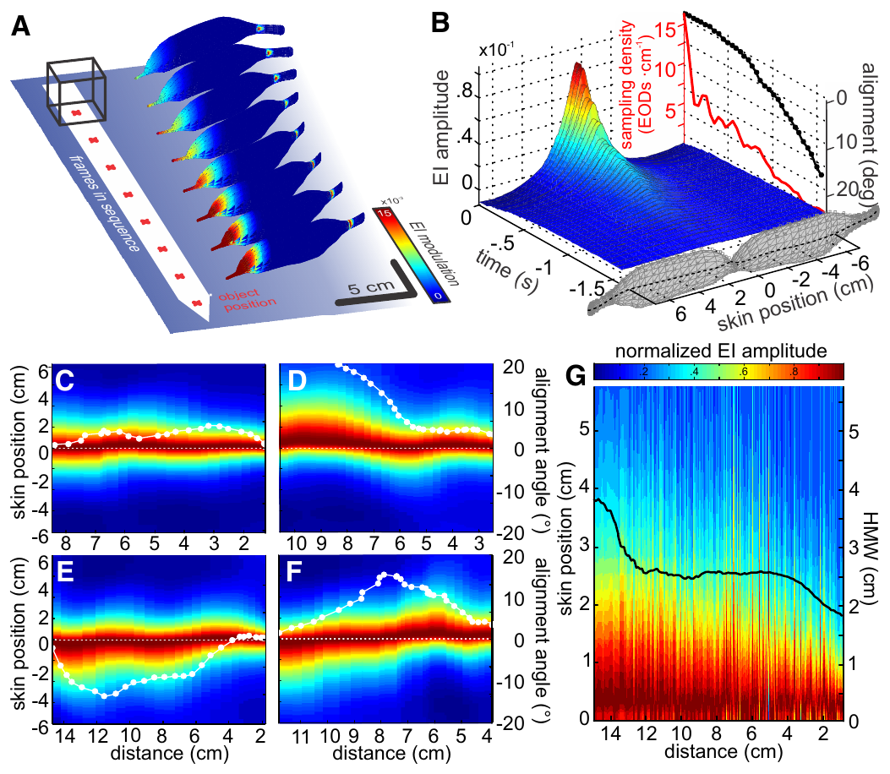
An electric image is a pattern across the sensory skin
An electric image is the spatial pattern of object-induced change in current across the fish’s skin. An object whose conductivity differs from the surrounding water changes the local electric field; the pattern therefore depends on both the object and the fish’s position.
Hofmann and colleagues recorded spontaneous approaches to metal cubes and reconstructed electric images with a biophysical model. Their comparison of object-present and object-absent conditions isolated the perturbation attributable to the object along the sensory surface.
The reconstructed images changed over successive discharges during approach. Each discharge therefore samples a different image, because the fish and the object change position between pulses, and the model estimates the image from measured behavior and a biophysical description of the field.
Hofmann et al. (2017), Fig. 2(A–G). Published reconstruction of electric images during approach.
Hofmann et al. (2017)
3
Notes:
Teaching transcript:
An electric image is the spatial pattern of object-induced change in current across the fish’s skin. An object whose conductivity differs from the surrounding water changes the local electric field; the pattern therefore depends on both the object and the fish’s position.
Hofmann and colleagues recorded spontaneous approaches to metal cubes and reconstructed electric images with a biophysical model. Their comparison of object-present and object-absent conditions isolated the perturbation attributable to the object along the sensory surface.
The reconstructed images changed over successive discharges during approach. Each discharge therefore samples a different image, because the fish and the object change position between pulses, and the model estimates the image from measured behavior and a biophysical description of the field.
Conductivity describes how readily a material carries electric current. The reconstruction compared otherwise matched simulated scenes with and without the object.
References:
V. Hofmann; J.I. Sanguinetti-Scheck; L. Gómez-Sena; J. Engelmann (2017). Sensory Flow as a Basis for a Novel Distance Cue in Freely Behaving Electric Fish. Journal of Neuroscience 37(2):302–312. https://doi.org/10.1523/JNEUROSCI.1361-16.2016
Hofmann et al. (2017), Fig. 2(A–G). Published reconstruction of electric images during approach.
Figure source: https://doi.org/10.1523/JNEUROSCI.1361-16.2016

Slide 5
Conductivity contrast perturbs the electric field
Conductivity is the ability of a material to carry electric current. An object that conducts better than water draws current toward it, and an object that conducts worse deflects current away. A smaller conductivity difference produces a weaker perturbation, so the size of the effect depends on how different the object is from the water.
Hofmann and colleagues used metal cubes, which conduct far better than water, and compared object-present and object-absent conditions. The difference between the two conditions isolates the perturbation caused by the object along the sensory surface.
The size and position of the perturbation depend on the object and on the position of the fish. The fish therefore reads the perturbation as a spatial pattern of increased or decreased current across its skin.
Hofmann et al. (2017), Fig. 2(A–G). Published reconstruction of electric images during approach.
Hofmann et al. (2017)
3a
Notes:
The electric image arises from a difference in conductivity between an object and its surroundings.
Conductivity.
Conductivity describes how well a material carries current.
The tank water had a conductivity near 100 microsiemens per centimeter.
Direction of the effect.
A better conductor draws current toward itself.
A poorer conductor deflects current.
Experimental comparison.
Metal cubes were compared with the object-absent condition.
The difference isolates the perturbation caused by the object.
Dependence on position.
The pattern depends on both the object and the position of the fish.
What the fish receives.
The perturbation appears as a spatial pattern across the sensory skin.
Reading the field.
The perturbation is spread across many receptors in the skin.
Each receptor reports the current at its own position.
Metal cubes.
Metal is a much better conductor than water, so metal cubes produce a strong perturbation.
This makes them convenient objects for measuring the electric image.
References:
V. Hofmann; J.I. Sanguinetti-Scheck; L. Gómez-Sena; J. Engelmann (2017). Sensory Flow as a Basis for a Novel Distance Cue in Freely Behaving Electric Fish. Journal of Neuroscience 37(2):302–312. https://doi.org/10.1523/JNEUROSCI.1361-16.2016

Slide 6
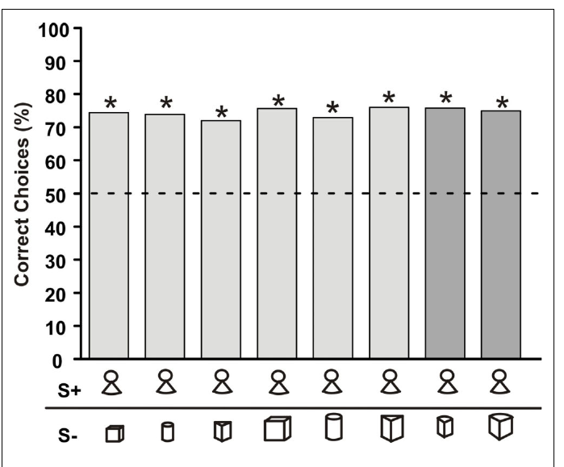
Object choice can generalize to unfamiliar alternatives
Generalization is preservation of a learned response when conditions differ from training. Von der Emde and colleagues trained an elephantnose fish to recognize a compound object consisting of a cone with a sphere above it while varying the alternative object across trials.
After approximately three months of training, the fish preferred the rewarded object against both familiar alternatives and two previously unfamiliar objects. Test trials were neither rewarded nor punished, reducing the possibility that the test itself taught each new comparison.
Recognition therefore did not require memorizing one fixed pair. The fish identified features associated with the positive object, and test trials with unfamiliar alternatives showed that the learned preference was not tied to a single comparison.
von der Emde et al. (2010), Fig. 2. Recognition with familiar and novel negative objects.
von der Emde et al. (2010)
4
Notes:
Teaching transcript:
Generalization is preservation of a learned response when conditions differ from training. Von der Emde and colleagues trained an elephantnose fish to recognize a compound object consisting of a cone with a sphere above it while varying the alternative object across trials.
After approximately three months of training, the fish preferred the rewarded object against both familiar alternatives and two previously unfamiliar objects. Test trials were neither rewarded nor punished, reducing the possibility that the test itself taught each new comparison.
Recognition therefore did not require memorizing one fixed pair. The fish identified features associated with the positive object, and test trials with unfamiliar alternatives showed that the learned preference was not tied to a single comparison.
The positive object is the rewarded training stimulus, conventionally S+. The negative object, S−, is the alternative; changing S− tests whether learning extends beyond one stimulus pair.
References:
G. von der Emde; K. Behr; B. Bouton; J. Engelmann; S. Fetz; C. Folde (2010). 3-Dimensional scene perception during active electrolocation in a weakly electric pulse fish. Frontiers in Behavioral Neuroscience 4:26. https://doi.org/10.3389/fnbeh.2010.00026
von der Emde et al. (2010), Fig. 2. Recognition with familiar and novel negative objects.
Figure source: https://doi.org/10.3389/fnbeh.2010.00026

Slide 7
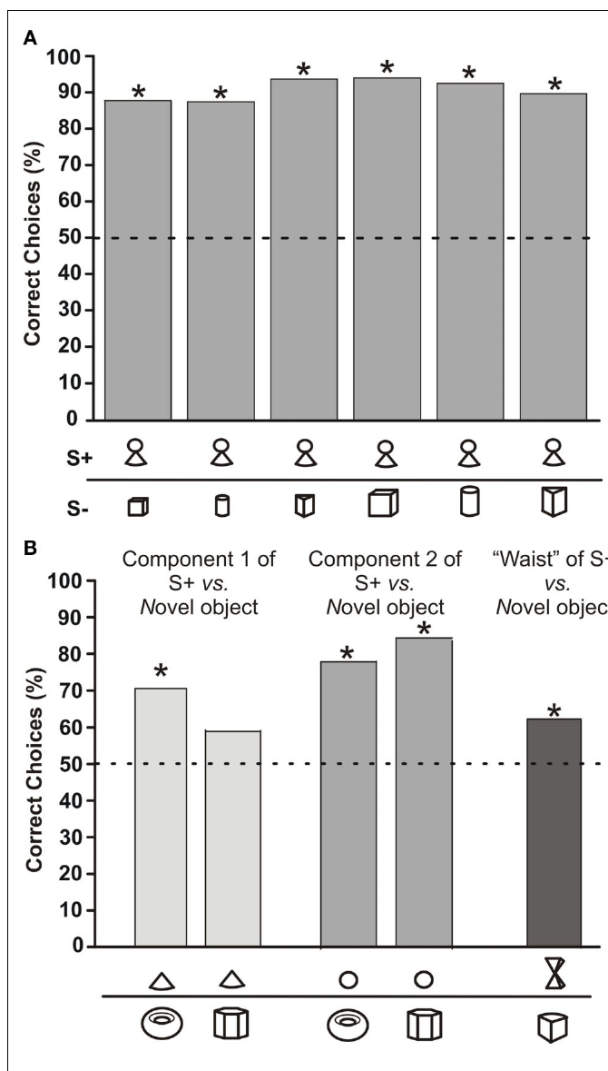
Recognition can depend unequally on object components
A component cue is an identifiable part of a larger object that can contribute to recognition. The compound training object contained a sphere, a cone, and a narrow junction, allowing von der Emde and colleagues to test parts separately against novel alternatives.
The sphere preserved much of the preference obtained with the intact object. The cone produced lower choice frequencies, approximately 70% or 59% depending on the alternative, and a stimulus mimicking the narrow junction also reduced recognition.
The parts were therefore not equally effective. The sphere carried most of the preference, so recognition relied selectively on learned features of the object, and the cone and the narrow junction contributed less.
von der Emde et al. (2010), Fig. 3(A–B). Choices for the compound object and its components.
von der Emde et al. (2010)
5
Notes:
Teaching transcript:
A component cue is an identifiable part of a larger object that can contribute to recognition. The compound training object contained a sphere, a cone, and a narrow junction, allowing von der Emde and colleagues to test parts separately against novel alternatives.
The sphere preserved much of the preference obtained with the intact object. The cone produced lower choice frequencies, approximately 70% or 59% depending on the alternative, and a stimulus mimicking the narrow junction also reduced recognition.
The parts were therefore not equally effective. The sphere carried most of the preference, so recognition relied selectively on learned features of the object, and the cone and the narrow junction contributed less.
Removing a component changes the current pattern available to the animal. Part-based behavioral recognition should not be equated with a directly measured neural representation of that part.
References:
G. von der Emde; K. Behr; B. Bouton; J. Engelmann; S. Fetz; C. Folde (2010). 3-Dimensional scene perception during active electrolocation in a weakly electric pulse fish. Frontiers in Behavioral Neuroscience 4:26. https://doi.org/10.3389/fnbeh.2010.00026
von der Emde et al. (2010), Fig. 3(A–B). Choices for the compound object and its components.
Figure source: https://doi.org/10.3389/fnbeh.2010.00026

Slide 8
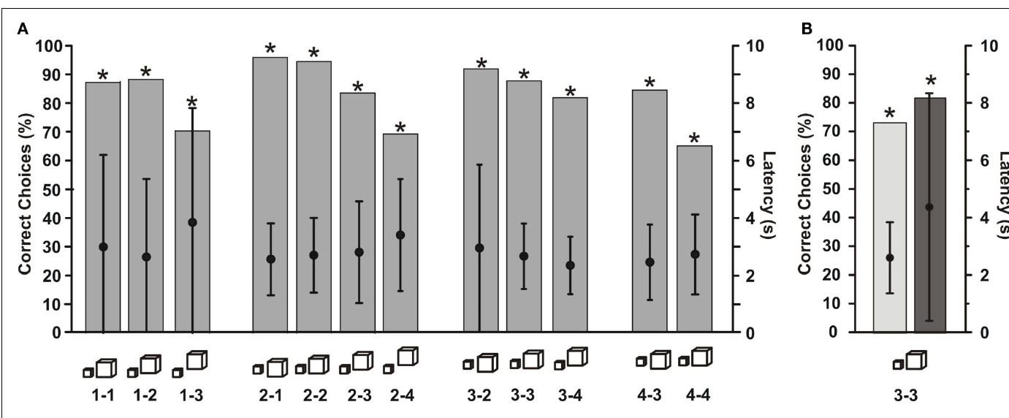
Physical size can be recognized despite image changes
Size constancy means identifying physical object size despite changes in the sensory image caused by distance. Von der Emde and colleagues trained a fish to choose a smaller cube rather than a larger cube, initially placing them 2 cm and 3 cm from the gates, respectively.
The distances of the cubes were then varied independently. The fish continued to prefer the smaller cube across distance combinations, with useful performance extending to approximately 4 cm. Control tests in darkness preserved the size discrimination.
Measured image diameter increased when a small cube moved farther away, so image width alone did not preserve physical size. The fish nevertheless chose the smaller cube across distance combinations, which shows compensation for distance-dependent changes in the electric image.
von der Emde et al. (2010), Fig. 4(A–B). Size-constancy tests across object-distance combinations.
von der Emde et al. (2010)
6
Notes:
Teaching transcript:
Size constancy means identifying physical object size despite changes in the sensory image caused by distance. Von der Emde and colleagues trained a fish to choose a smaller cube rather than a larger cube, initially placing them 2 cm and 3 cm from the gates, respectively.
The distances of the cubes were then varied independently. The fish continued to prefer the smaller cube across distance combinations, with useful performance extending to approximately 4 cm. Control tests in darkness preserved the size discrimination.
Measured image diameter increased when a small cube moved farther away, so image width alone did not preserve physical size. The fish nevertheless chose the smaller cube across distance combinations, which shows compensation for distance-dependent changes in the electric image.
The distance manipulation prevents a fixed image-intensity rule from consistently matching the rewarded physical size. Size constancy is a behavioral property, not proof of a particular distance estimator.
References:
G. von der Emde; K. Behr; B. Bouton; J. Engelmann; S. Fetz; C. Folde (2010). 3-Dimensional scene perception during active electrolocation in a weakly electric pulse fish. Frontiers in Behavioral Neuroscience 4:26. https://doi.org/10.3389/fnbeh.2010.00026
von der Emde et al. (2010), Fig. 4(A–B). Size-constancy tests across object-distance combinations.
Figure source: https://doi.org/10.3389/fnbeh.2010.00026

Slide 9
Size constancy requires compensating for distance
Size constancy is the identification of physical object size despite changes in the sensory image. A distant object produces a weaker and broader electric image than a near one, so an observer that reads only the image would confuse a small near object with a large distant one.
Von der Emde and colleagues trained a fish to choose a smaller cube over a larger cube and then varied the distances independently. The fish kept choosing the smaller cube across distance combinations, with useful performance to about 4 cm.
Measured image diameter increased when a small cube moved farther away, so image width alone did not preserve physical size. The choices therefore show that the fish used distance information together with the image to identify the physical size of the cube.
von der Emde et al. (2010), Fig. 4(A–B). Size-constancy tests across object-distance combinations.
von der Emde et al. (2010)
6a
Notes:
Size constancy asks whether an animal judges the object and not just the image.
The problem.
Distance changes the size and strength of the electric image.
Image alone does not specify the size of the object.
Training.
A fish was trained to choose a smaller cube over a larger cube.
The cubes were initially placed at 2 and 3 centimeters from the gates.
Test.
The distances of the two cubes were varied independently.
The fish kept choosing the smaller cube.
Image measurements.
Image diameter increased when a small cube moved farther away.
Controls.
Tests in darkness preserved the size discrimination, so the choices did not depend on vision.
Why distance matters.
A distant object produces a broader and weaker image than a near one.
The same image could come from a small near object or a large distant one.
Range of performance.
Useful performance extended to about 4 centimeters.
Beyond that the discrimination was no longer reliable.
References:
G. von der Emde; K. Behr; B. Bouton; J. Engelmann; S. Fetz; C. Folde (2010). 3-Dimensional scene perception during active electrolocation in a weakly electric pulse fish. Frontiers in Behavioral Neuroscience 4:26. https://doi.org/10.3389/fnbeh.2010.00026

Slide 10
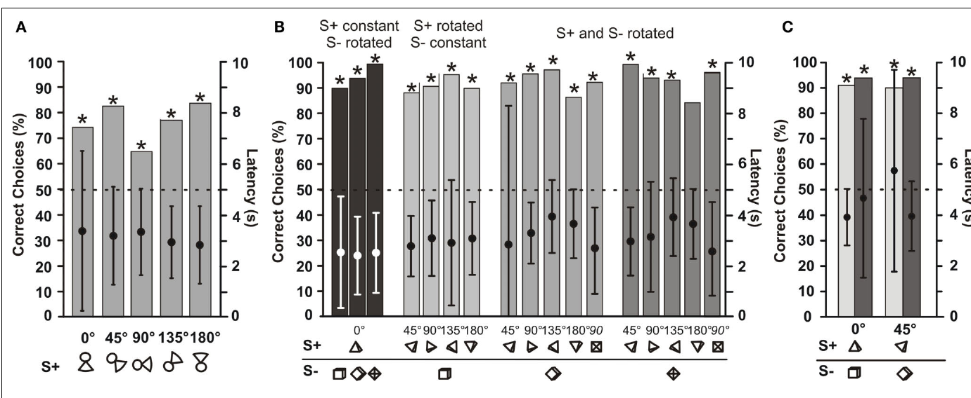
Rotation invariance varies across trained individuals
Rotation invariance is recognition that persists when an object changes orientation in space. Von der Emde and colleagues rotated trained objects through several angles while preserving the choice task, thereby changing the electrical patterns generated during inspection.
A fish trained with the compound object continued to identify it across tested rotations; another trained to choose a pyramid over a cube retained at least 80% correct choices across the tested combinations. Dark-condition controls supported an electrosensory basis for the latter performance.
Other object pairs produced stronger rotation-dependent effects. The findings establish a capacity for orientation-tolerant recognition, while cautioning against treating every fish or learned comparison as equally invariant. The specific geometry and acquired cues remain relevant.
von der Emde et al. (2010), Fig. 5(A–C). Recognition after rotating positive and negative objects.
von der Emde et al. (2010)
7
Notes:
Teaching transcript:
Rotation invariance is recognition that persists when an object changes orientation in space. Von der Emde and colleagues rotated trained objects through several angles while preserving the choice task, thereby changing the electrical patterns generated during inspection.
A fish trained with the compound object continued to identify it across tested rotations; another trained to choose a pyramid over a cube retained at least 80% correct choices across the tested combinations. Dark-condition controls supported an electrosensory basis for the latter performance.
Other object pairs produced stronger rotation-dependent effects. The findings establish a capacity for orientation-tolerant recognition, while cautioning against treating every fish or learned comparison as equally invariant. The specific geometry and acquired cues remain relevant.
An invariant behavior remains stable across a defined transformation. That does not require all receptor signals to remain unchanged; the transformed input can still support the same object choice.
References:
G. von der Emde; K. Behr; B. Bouton; J. Engelmann; S. Fetz; C. Folde (2010). 3-Dimensional scene perception during active electrolocation in a weakly electric pulse fish. Frontiers in Behavioral Neuroscience 4:26. https://doi.org/10.3389/fnbeh.2010.00026
von der Emde et al. (2010), Fig. 5(A–C). Recognition after rotating positive and negative objects.
Figure source: https://doi.org/10.3389/fnbeh.2010.00026

Slide 11
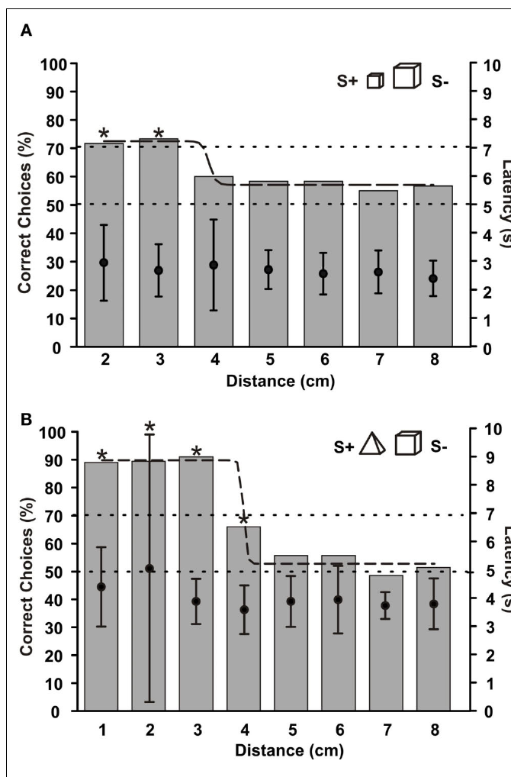
Recognition range differs from mere field propagation
The recognition range is the distance over which an animal can identify a tested object reliably. Von der Emde and colleagues moved metal objects from 1 to 8 cm away from a grid that prevented fish from approaching closer before making their choices.
Performance declined with increasing distance, and the tested shape and size discriminations failed beyond approximately 4 cm. The grid maintained a defined minimum inspection distance rather than allowing the fish to solve every trial by moving directly beside the object.
Recognition depends on the usable object-induced perturbation relative to sensory noise and on the task, so the 4 cm range describes the tested discriminations. An electric field is physically present beyond this distance, and the grid held the minimum inspection distance fixed.
von der Emde et al. (2010), Fig. 7(A–B). Choice performance as object distance increases.
von der Emde et al. (2010)
8
Notes:
Teaching transcript:
The recognition range is the distance over which an animal can identify a tested object reliably. Von der Emde and colleagues moved metal objects from 1 to 8 cm away from a grid that prevented fish from approaching closer before making their choices.
Performance declined with increasing distance, and the tested shape and size discriminations failed beyond approximately 4 cm. The grid maintained a defined minimum inspection distance rather than allowing the fish to solve every trial by moving directly beside the object.
Recognition depends on the usable object-induced perturbation relative to sensory noise and on the task, so the 4 cm range describes the tested discriminations. An electric field is physically present beyond this distance, and the grid held the minimum inspection distance fixed.
Detection asks whether an object is present; recognition asks which object it is. Their distance limits need not coincide because identification requires additional discriminating information.
References:
G. von der Emde; K. Behr; B. Bouton; J. Engelmann; S. Fetz; C. Folde (2010). 3-Dimensional scene perception during active electrolocation in a weakly electric pulse fish. Frontiers in Behavioral Neuroscience 4:26. https://doi.org/10.3389/fnbeh.2010.00026
von der Emde et al. (2010), Fig. 7(A–B). Choice performance as object distance increases.
Figure source: https://doi.org/10.3389/fnbeh.2010.00026

Slide 12
A grid fixes the minimum inspection distance
A grid between the fish and the objects prevents the fish from approaching closer than a set distance before it chooses. The grid therefore fixes the distance at which each choice is made. The distances were measured from the grid to the metal objects, which stayed fixed during a trial.
Von der Emde and colleagues moved metal objects from 1 to 8 cm from the grid. Performance declined with increasing distance, and the tested shape and size discriminations failed beyond approximately 4 cm.
Fixing the distance prevents the fish from solving a trial by swimming directly beside the object. The measured range describes how far from an object the fish can still extract the features needed for the choice.
von der Emde et al. (2010), Fig. 7(A–B). Choice performance as object distance increases.
von der Emde et al. (2010)
8a
Notes:
Distance has to be controlled to measure a range.
The grid.
A grid prevented the fish from approaching closer before making a choice.
Distances tested.
Metal objects were moved from 1 to 8 centimeters from the grid.
Result.
Performance declined with distance.
The tested discriminations failed beyond approximately 4 centimeters.
Why the grid matters.
Without it, the fish could solve every trial by moving directly beside the object.
Meaning of the range.
The recognition range is the distance over which the animal identifies a tested object reliably.
Why a minimum distance.
If the fish could approach each object freely, the closest approach would determine the choice.
The grid prevents that shortcut.
Interpreting the limit.
The tested shape and size discriminations failed beyond about 4 centimeters.
An electric field extends farther than this, so the limit describes the usable information.
Summary of the range.
Within about 4 centimeters the fish identified shapes and sizes of metal objects, and it failed at greater distances in the same tasks.
References:
G. von der Emde; K. Behr; B. Bouton; J. Engelmann; S. Fetz; C. Folde (2010). 3-Dimensional scene perception during active electrolocation in a weakly electric pulse fish. Frontiers in Behavioral Neuroscience 4:26. https://doi.org/10.3389/fnbeh.2010.00026

Slide 13
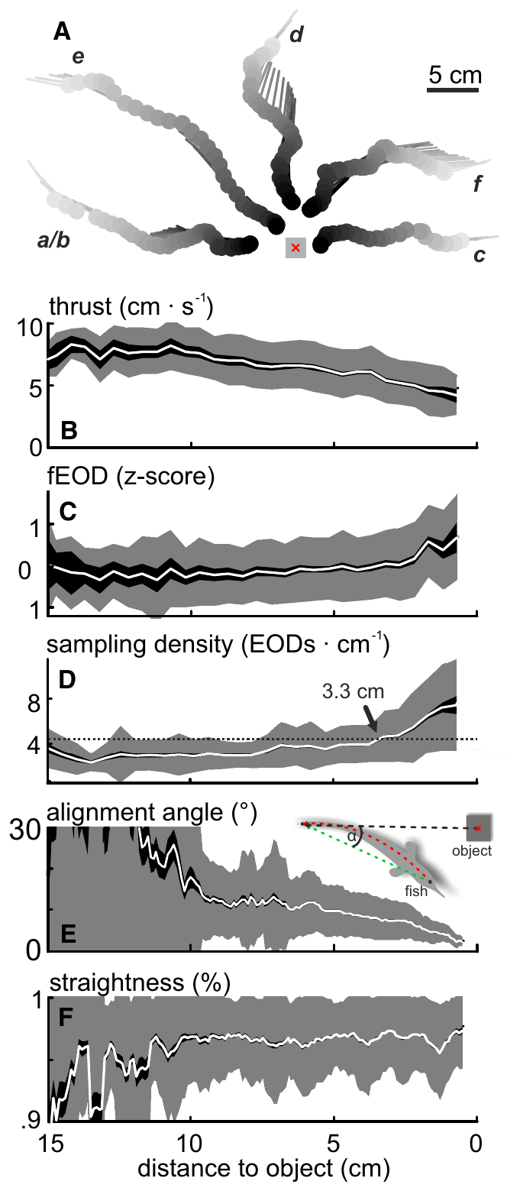
Approach movements change when electric samples arrive
Active sensing includes movements and emission patterns that alter the sensory information acquired by an animal. Hofmann and colleagues tracked spontaneous approaches of elephantnose fish to objects while recording EOD timing in water with conductivity near 100 µS/cm.
As fish approached, thrust decreased while discharge activity and spatial sampling density increased. The fish also became more directly aligned with the object and adopted straighter postures, linking the geometry of inspection to the sequence of electric samples.
The coordinated changes show that natural electrolocation input is sampled through changing movements and pulse intervals, so the sequence of electric samples depends on how the fish inspects the object.
Hofmann et al. (2017), Fig. 1(A–F). Measured movement and discharge patterns during approaches.
Hofmann et al. (2017)
9
Notes:
Teaching transcript:
Active sensing includes movements and emission patterns that alter the sensory information acquired by an animal. Hofmann and colleagues tracked spontaneous approaches of elephantnose fish to objects while recording EOD timing in water with conductivity near 100 µS/cm.
As fish approached, thrust decreased while discharge activity and spatial sampling density increased. The fish also became more directly aligned with the object and adopted straighter postures, linking the geometry of inspection to the sequence of electric samples.
The coordinated changes show that natural electrolocation input is sampled through changing movements and pulse intervals, so the sequence of electric samples depends on how the fish inspects the object.
Spatial sampling density is the number of electric discharges per distance traveled. It depends jointly on emission timing and swimming speed.
References:
V. Hofmann; J.I. Sanguinetti-Scheck; L. Gómez-Sena; J. Engelmann (2017). Sensory Flow as a Basis for a Novel Distance Cue in Freely Behaving Electric Fish. Journal of Neuroscience 37(2):302–312. https://doi.org/10.1523/JNEUROSCI.1361-16.2016
Hofmann et al. (2017), Fig. 1(A–F). Measured movement and discharge patterns during approaches.
Figure source: https://doi.org/10.1523/JNEUROSCI.1361-16.2016

Slide 14
Each discharge samples a changing electrical scene
Electrosensory flow is the change in electric input across successive samples as the fish moves relative to objects. Hofmann and colleagues combined measured approach trajectories with a model that reconstructed object-induced current along the fish’s sensory surface.
Successive images changed in amplitude and spatial position. The reconstructed scene therefore supplied both the current electric pattern and its recent history, while measured posture determined which receptors were positioned near the strongest perturbation.
The reconstruction describes the information available to the fish: the current electric pattern and its recent history. Using that history to estimate object distance is a proposal that links electrosensory flow to the approach behavior.
Hofmann et al. (2017), Fig. 2(A–G). Spatiotemporal electric-image structure during natural behavior.
Hofmann et al. (2017)
10
Notes:
Teaching transcript:
Electrosensory flow is the change in electric input across successive samples as the fish moves relative to objects. Hofmann and colleagues combined measured approach trajectories with a model that reconstructed object-induced current along the fish’s sensory surface.
Successive images changed in amplitude and spatial position. The reconstructed scene therefore supplied both the current electric pattern and its recent history, while measured posture determined which receptors were positioned near the strongest perturbation.
The reconstruction describes the information available to the fish: the current electric pattern and its recent history. Using that history to estimate object distance is a proposal that links electrosensory flow to the approach behavior.
The reconstruction omitted some three-dimensional postural variables, including pitch and roll. Consequently, modeled input variability need not include every fluctuation encountered by a freely swimming fish.
References:
V. Hofmann; J.I. Sanguinetti-Scheck; L. Gómez-Sena; J. Engelmann (2017). Sensory Flow as a Basis for a Novel Distance Cue in Freely Behaving Electric Fish. Journal of Neuroscience 37(2):302–312. https://doi.org/10.1523/JNEUROSCI.1361-16.2016
Hofmann et al. (2017), Fig. 2(A–G). Spatiotemporal electric-image structure during natural behavior.
Figure source: https://doi.org/10.1523/JNEUROSCI.1361-16.2016

Slide 15
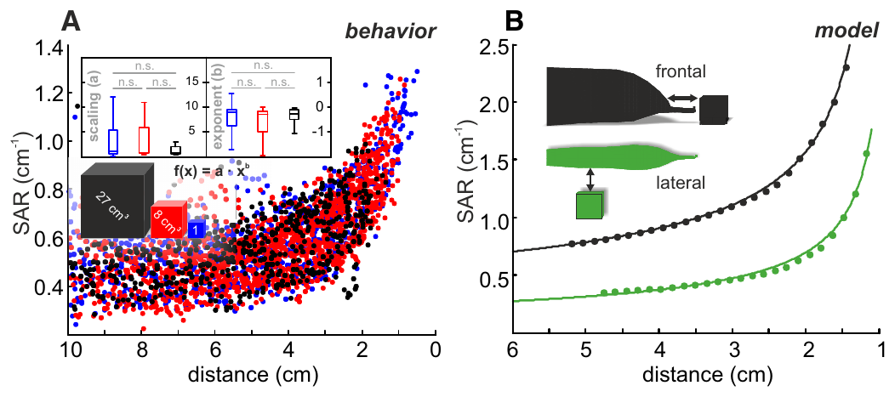
Static image blur is sensitive to inspection geometry
A static distance cue is information available within one sensory sample. Electric-image blur changes with object distance, and the slope-to-amplitude ratio summarizes a spatial property of that image. Hofmann and colleagues evaluated this measure during spontaneous approaches.
The measure varied with distance, but natural changes in posture and body curvature introduced substantial variability. Comparisons with controlled straight approaches separated distance-related structure from variation produced by inspection geometry.
A single spatial measurement is less reliable under natural postures and body curvature, which motivates examining information distributed across successive samples. Static cues remain available within each sample.
Hofmann et al. (2017), Fig. 3(A–B). Static distance cue during natural approaches and simulations.
Hofmann et al. (2017)
11
Notes:
Teaching transcript:
A static distance cue is information available within one sensory sample. Electric-image blur changes with object distance, and the slope-to-amplitude ratio summarizes a spatial property of that image. Hofmann and colleagues evaluated this measure during spontaneous approaches.
The measure varied with distance, but natural changes in posture and body curvature introduced substantial variability. Comparisons with controlled straight approaches separated distance-related structure from variation produced by inspection geometry.
A single spatial measurement is less reliable under natural postures and body curvature, which motivates examining information distributed across successive samples. Static cues remain available within each sample.
Blur refers to the broadening of the electric pattern across the skin. A spatial ratio can reduce some dependence on amplitude while remaining affected by posture and sampling geometry.
References:
V. Hofmann; J.I. Sanguinetti-Scheck; L. Gómez-Sena; J. Engelmann (2017). Sensory Flow as a Basis for a Novel Distance Cue in Freely Behaving Electric Fish. Journal of Neuroscience 37(2):302–312. https://doi.org/10.1523/JNEUROSCI.1361-16.2016
Hofmann et al. (2017), Fig. 3(A–B). Static distance cue during natural approaches and simulations.
Figure source: https://doi.org/10.1523/JNEUROSCI.1361-16.2016

Slide 16
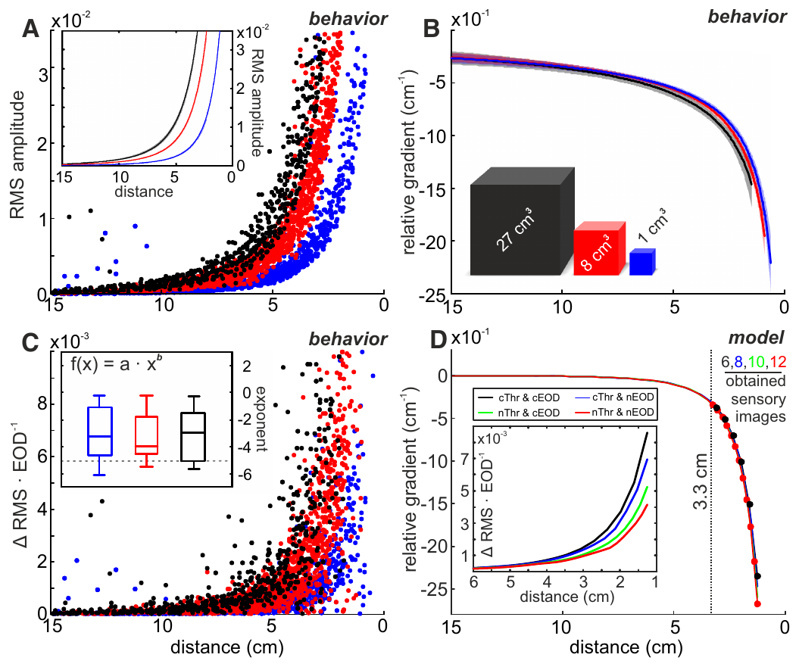
A relative gradient reduces object-size ambiguity
A relative gradient expresses how rapidly electric-image amplitude changes during movement relative to the current amplitude. Hofmann and colleagues reconstructed approaches to differently sized metal cubes and compared absolute image amplitude with this movement-dependent measure.
Absolute amplitude depended strongly on object size. The relative-gradient curves overlapped much more closely across sizes, preserving a systematic relationship with distance. Near the objects, naturally adapted sampling also supplied more measurements than a comparison using unadapted emission and movement patterns.
The relative gradient is a candidate cue in the reconstructed sensory input that reduces the dependence of the signal on object size. Using it requires an estimate of the movement of the fish, which links the approach behavior to the electric images.
Hofmann et al. (2017), Fig. 4(A–D). Amplitude, relative gradient, and sampling during approach.
Hofmann et al. (2017)
12
Notes:
Teaching transcript:
A relative gradient expresses how rapidly electric-image amplitude changes during movement relative to the current amplitude. Hofmann and colleagues reconstructed approaches to differently sized metal cubes and compared absolute image amplitude with this movement-dependent measure.
Absolute amplitude depended strongly on object size. The relative-gradient curves overlapped much more closely across sizes, preserving a systematic relationship with distance. Near the objects, naturally adapted sampling also supplied more measurements than a comparison using unadapted emission and movement patterns.
The relative gradient is a candidate cue in the reconstructed sensory input that reduces the dependence of the signal on object size. Using it requires an estimate of the movement of the fish, which links the approach behavior to the electric images.
Normalizing a change by the current signal can reduce scale differences across objects. The paper evaluates this operation within its reconstruction, rather than demonstrating a particular cellular arithmetic mechanism.
References:
V. Hofmann; J.I. Sanguinetti-Scheck; L. Gómez-Sena; J. Engelmann (2017). Sensory Flow as a Basis for a Novel Distance Cue in Freely Behaving Electric Fish. Journal of Neuroscience 37(2):302–312. https://doi.org/10.1523/JNEUROSCI.1361-16.2016
Hofmann et al. (2017), Fig. 4(A–D). Amplitude, relative gradient, and sampling during approach.
Figure source: https://doi.org/10.1523/JNEUROSCI.1361-16.2016

Slide 17
A relative gradient divides change by amplitude
A gradient is the rate at which a quantity changes. A relative gradient divides the rate of change of the electric image amplitude during movement by the amplitude itself, so it expresses the change in proportion to the signal. The measure is calculated from the movement of the fish through the field.
Hofmann and colleagues compared absolute amplitude with the relative gradient for approaches to cubes of different sizes. Absolute amplitude depended strongly on size, whereas the relative-gradient curves overlapped much more closely across sizes.
Dividing by amplitude removes the factor that depends on the size of the object. The remaining value changes systematically with distance, which makes it a candidate cue for how far away an object is.
Hofmann et al. (2017), Fig. 4(A–D). Amplitude, relative gradient, and sampling during approach.
Hofmann et al. (2017)
12a
Notes:
Dividing a change by its own size can cancel something that is not wanted.
Definition.
A relative gradient expresses how rapidly the amplitude changes during movement relative to the current amplitude.
Comparison.
Approaches to metal cubes of different sizes were reconstructed.
Absolute amplitude and the relative gradient were compared.
Result.
Absolute amplitude depended strongly on object size.
Relative-gradient curves overlapped across sizes.
Why this helps.
The size of the object scales the amplitude, and division removes that scaling.
The remaining value keeps a systematic relation to distance.
Sampling.
Naturally adapted sampling supplied more measurements near the object than unadapted emission and movement patterns.
Candidate cue.
The relative gradient is an analysis of the reconstructed sensory input.
It is a candidate distance cue and is not a measured neural signal.
Near the object.
Near the objects, naturally adapted sampling supplied more measurements than a comparison pattern of unadapted emission and movement.
References:
V. Hofmann; J.I. Sanguinetti-Scheck; L. Gómez-Sena; J. Engelmann (2017). Sensory Flow as a Basis for a Novel Distance Cue in Freely Behaving Electric Fish. Journal of Neuroscience 37(2):302–312. https://doi.org/10.1523/JNEUROSCI.1361-16.2016

Slide 18
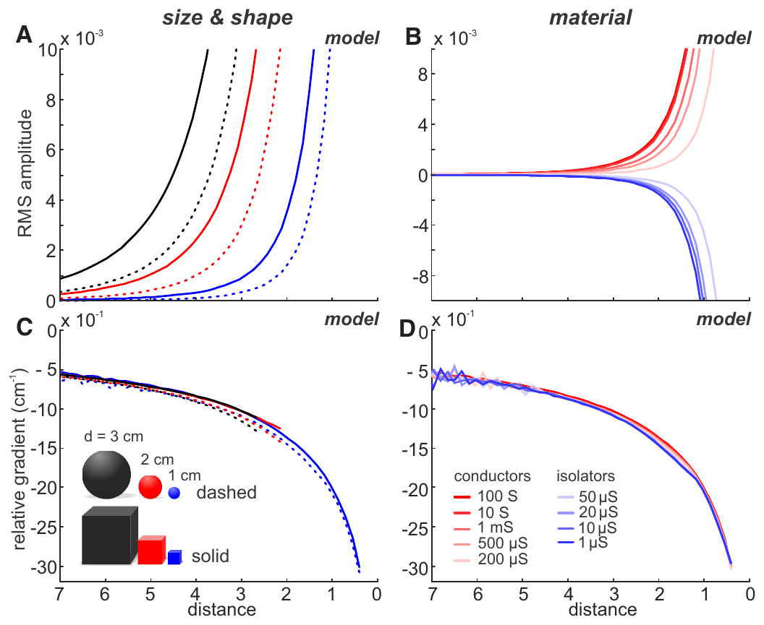
Candidate distance cues can resist material differences
Cue invariance is reduced sensitivity to an irrelevant property while retaining information about the property being estimated. Hofmann and colleagues simulated straight approaches to cubes and spheres with characteristic dimensions of 1, 2, and 3 cm, and varied electrical material properties.
Absolute image amplitude changed markedly with size, shape, and conductivity. Relative-gradient curves overlapped across these modeled conditions, suggesting that distance information could survive changes that strongly alter the absolute signal.
Simulations of cubes and spheres of 1, 2 and 3 cm with different electrical properties specify the conditions under which the proposed cue is robust. Distance information in the relative gradient survives changes in size, shape and conductivity that strongly alter the absolute signal.
Hofmann et al. (2017), Fig. 5(A–D). Published simulations across object size, shape, and material.
Hofmann et al. (2017)
13
Notes:
Teaching transcript:
Cue invariance is reduced sensitivity to an irrelevant property while retaining information about the property being estimated. Hofmann and colleagues simulated straight approaches to cubes and spheres with characteristic dimensions of 1, 2, and 3 cm, and varied electrical material properties.
Absolute image amplitude changed markedly with size, shape, and conductivity. Relative-gradient curves overlapped across these modeled conditions, suggesting that distance information could survive changes that strongly alter the absolute signal.
Simulations of cubes and spheres of 1, 2 and 3 cm with different electrical properties specify the conditions under which the proposed cue is robust. Distance information in the relative gradient survives changes in size, shape and conductivity that strongly alter the absolute signal.
A result from a published model remains model evidence. It can establish what information the modeled physics contains without proving how an animal reads that information.
References:
V. Hofmann; J.I. Sanguinetti-Scheck; L. Gómez-Sena; J. Engelmann (2017). Sensory Flow as a Basis for a Novel Distance Cue in Freely Behaving Electric Fish. Journal of Neuroscience 37(2):302–312. https://doi.org/10.1523/JNEUROSCI.1361-16.2016
Hofmann et al. (2017), Fig. 5(A–D). Published simulations across object size, shape, and material.
Figure source: https://doi.org/10.1523/JNEUROSCI.1361-16.2016

Slide 19
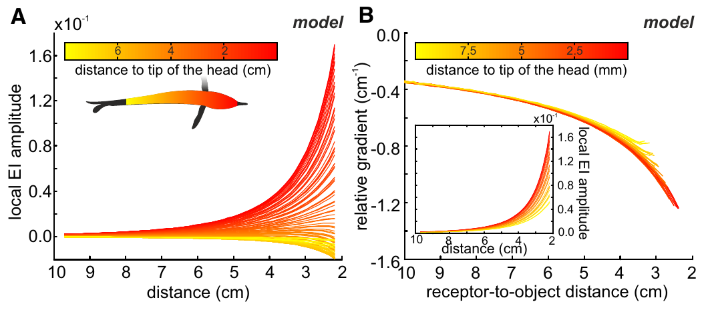
Local sensory position need not define one distance cue
A local amplitude is the object-induced signal measured at a particular point on the sensory surface. Hofmann and colleagues simulated a straight approach to a metal cube with volume 8 cm³ and compared estimates at different positions along the fish’s body.
The local amplitudes differed across positions, while their relative gradients overlapped more closely when distance was expressed relative to the receptor location. The proposed distance information was therefore less tied to one specially selected point on the skin.
Overlapping gradients at different positions mean that receptors along the body can contribute to the same distance estimate in the tested reconstruction. A cue of this kind tolerates changes in posture and body curvature better than a local amplitude.
Hofmann et al. (2017), Fig. 6(A–B). Modeled local amplitudes and relative gradients along the skin.
Hofmann et al. (2017)
14
Notes:
Teaching transcript:
A local amplitude is the object-induced signal measured at a particular point on the sensory surface. Hofmann and colleagues simulated a straight approach to a metal cube with volume 8 cm³ and compared estimates at different positions along the fish’s body.
The local amplitudes differed across positions, while their relative gradients overlapped more closely when distance was expressed relative to the receptor location. The proposed distance information was therefore less tied to one specially selected point on the skin.
Overlapping gradients at different positions mean that receptors along the body can contribute to the same distance estimate in the tested reconstruction. A cue of this kind tolerates changes in posture and body curvature better than a local amplitude.
The object-to-head distance and the object-to-receptor distance differ for receptors distributed along the body. Distinguishing these references prevents a geometric shift from being mistaken for a change in cue meaning.
References:
V. Hofmann; J.I. Sanguinetti-Scheck; L. Gómez-Sena; J. Engelmann (2017). Sensory Flow as a Basis for a Novel Distance Cue in Freely Behaving Electric Fish. Journal of Neuroscience 37(2):302–312. https://doi.org/10.1523/JNEUROSCI.1361-16.2016
Hofmann et al. (2017), Fig. 6(A–B). Modeled local amplitudes and relative gradients along the skin.
Figure source: https://doi.org/10.1523/JNEUROSCI.1361-16.2016

Slide 20
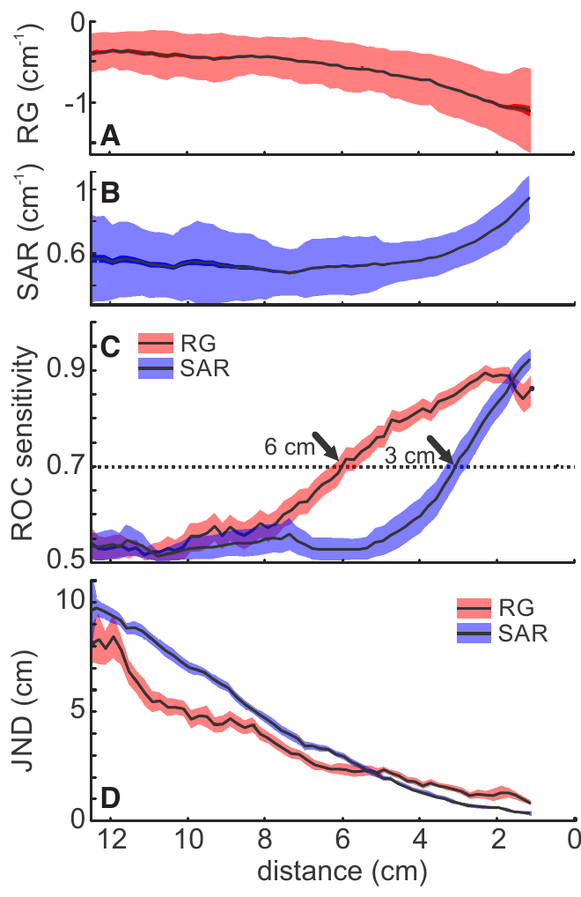
Reconstructed flow outperforms a static cue at range
Hofmann and colleagues compared the discriminability of reconstructed relative-gradient values with that of the static image measure. Both were evaluated against a distant reference condition, preserving a common basis for judging when object-related information emerged from variability.
Under the paper’s defined detection criterion, the relative gradient reached the criterion at approximately 6 cm, whereas the static measure reached it at approximately 3 cm. The dynamic measure also provided finer modeled distance resolution at longer distances.
The values describe cue analysis. The 6 cm criterion of the dynamic cue and the 3 cm criterion of the static measure are consistent with the roughly 4 cm recognition range of the choice tasks, because identifying shape and extracting a distance-related signal are distinct demands.
Hofmann et al. (2017), Fig. 7(A–D). Comparison of reconstructed dynamic and static distance cues.
Hofmann et al. (2017)
15
Notes:
Teaching transcript:
Hofmann and colleagues compared the discriminability of reconstructed relative-gradient values with that of the static image measure. Both were evaluated against a distant reference condition, preserving a common basis for judging when object-related information emerged from variability.
Under the paper’s defined detection criterion, the relative gradient reached the criterion at approximately 6 cm, whereas the static measure reached it at approximately 3 cm. The dynamic measure also provided finer modeled distance resolution at longer distances.
The values describe cue analysis. The 6 cm criterion of the dynamic cue and the 3 cm criterion of the static measure are consistent with the roughly 4 cm recognition range of the choice tasks, because identifying shape and extracting a distance-related signal are distinct demands.
The published comparison uses distributions of reconstructed cue values. Its distance estimates should not be relabeled as measured detection thresholds of the fish.
References:
V. Hofmann; J.I. Sanguinetti-Scheck; L. Gómez-Sena; J. Engelmann (2017). Sensory Flow as a Basis for a Novel Distance Cue in Freely Behaving Electric Fish. Journal of Neuroscience 37(2):302–312. https://doi.org/10.1523/JNEUROSCI.1361-16.2016
Hofmann et al. (2017), Fig. 7(A–D). Comparison of reconstructed dynamic and static distance cues.
Figure source: https://doi.org/10.1523/JNEUROSCI.1361-16.2016

Slide 21
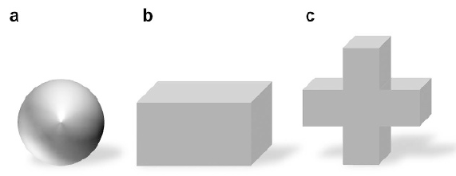
Electrical transparency isolates visual object learning
Electrical transparency means that an object produces little discriminating electrical contrast against the surrounding water. Schumacher and colleagues used colored agarose objects with conductivity close to the tank water to supply visible shapes while reducing active electrolocation cues.
A 3 cm sphere served as the rewarded object, and a cross or cuboid served as the alternative. Metal objects supplied electric contrast; opaque, electrically transparent covers reduced visible shape differences in electric-only conditions. Objects were placed 1 cm behind the gates.
The material and lighting manipulations separated sensory availability while preserving the choice format. Their interpretation depended on control tests of electrical and lateral-line cues, rather than assuming that darkness or matched conductivity automatically isolates every possible sensory contribution.
Schumacher et al. (2017), Fig. 2(a–c). Objects used for multisensory and single-sense conditions.
Schumacher et al. (2017)
16
Notes:
Teaching transcript:
Electrical transparency means that an object produces little discriminating electrical contrast against the surrounding water. Schumacher and colleagues used colored agarose objects with conductivity close to the tank water to supply visible shapes while reducing active electrolocation cues.
A 3 cm sphere served as the rewarded object, and a cross or cuboid served as the alternative. Metal objects supplied electric contrast; opaque, electrically transparent covers reduced visible shape differences in electric-only conditions. Objects were placed 1 cm behind the gates.
The material and lighting manipulations separated sensory availability while preserving the choice format. Their interpretation depended on control tests of electrical and lateral-line cues, rather than assuming that darkness or matched conductivity automatically isolates every possible sensory contribution.
Agarose is a gel whose conductivity can be adjusted. Matching its measured electrical resistance to water reduced the contrast that an active electric image would otherwise provide.
References:
S. Schumacher; T. Burt de Perera; G. von der Emde (2017). Electrosensory capture during multisensory discrimination of nearby objects in the weakly electric fish Gnathonemus petersii. Scientific Reports 7:43665. https://doi.org/10.1038/srep43665
Schumacher et al. (2017), Fig. 2(a–c). Objects used for multisensory and single-sense conditions.
Figure source: https://doi.org/10.1038/srep43665

Slide 22
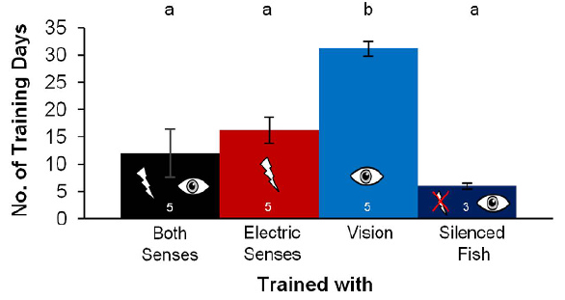
Available senses change the rate of task acquisition
Task acquisition is the development of the learned choice during training. Schumacher and colleagues trained elephantnose fish with both senses, electric information alone, or visual information alone, using a criterion above 75% correct choices on three consecutive training days.
Mean training durations were about 12.5 days with both senses, 16.2 days with electric input, and 31.5 days with visual input in intact fish. Electrically silenced fish learned the visual task in about 6 days under the tested conditions.
Learning speed depended on which senses were available and on whether the fish was emitting discharges. Training with both senses was fastest, and electrically silenced fish learned the visual task in about 6 days.
Schumacher et al. (2017), Fig. 3. Training duration under different sensory conditions.
Schumacher et al. (2017)
17
Notes:
Teaching transcript:
Task acquisition is the development of the learned choice during training. Schumacher and colleagues trained elephantnose fish with both senses, electric information alone, or visual information alone, using a criterion above 75% correct choices on three consecutive training days.
Mean training durations were about 12.5 days with both senses, 16.2 days with electric input, and 31.5 days with visual input in intact fish. Electrically silenced fish learned the visual task in about 6 days under the tested conditions.
Learning speed depended on which senses were available and on whether the fish was emitting discharges. Training with both senses was fastest, and electrically silenced fish learned the visual task in about 6 days.
Electrically silenced fish could not emit their normal sensing pulses. Their visual learning outcome helps separate an effect of electric-sense conflict from a general inability to learn visually.
References:
S. Schumacher; T. Burt de Perera; G. von der Emde (2017). Electrosensory capture during multisensory discrimination of nearby objects in the weakly electric fish Gnathonemus petersii. Scientific Reports 7:43665. https://doi.org/10.1038/srep43665
Schumacher et al. (2017), Fig. 3. Training duration under different sensory conditions.
Figure source: https://doi.org/10.1038/srep43665

Slide 23
A learning criterion defines when a task is acquired
A learning criterion is a fixed level of performance that marks acquisition of a task. Schumacher and colleagues used more than 75% correct choices on three consecutive training days. Training days were counted from the start of the task until the criterion was met.
Mean training durations in intact fish were about 12.5 days with both senses, 16.2 days with electric input and 31.5 days with visual input. Electrically silenced fish learned the visual task in about 6 days.
A common criterion makes the durations comparable across conditions. The differences show how the available senses and the emission of discharges affected the speed of learning. A longer duration means that more training was required to reach the same level of accuracy, and a shorter duration means less.
Schumacher et al. (2017), Fig. 3. Training duration under different sensory conditions.
Schumacher et al. (2017)
17a
Notes:
A criterion allows learning speeds to be compared between groups.
Definition.
Task acquisition is the development of the learned choice during training.
Criterion.
More than 75 percent correct choices on three consecutive training days marked acquisition.
Conditions.
Fish were trained with both senses, with electric information alone or with visual information alone.
Durations.
Both senses took about 12.5 days, electric input about 16.2 days and visual input about 31.5 days in intact fish.
Silenced fish.
Electrically silenced fish learned the visual task in about 6 days under the tested conditions.
What differs between conditions.
With both senses the fish could use electric and visual information together.
With one sense removed it relied on the remaining sense.
Interpretation.
The fastest learning occurred with both senses, and learning with vision alone was slowest in intact fish.
Why compare groups.
The same criterion applied to every group means that a longer training duration reflects slower learning.
Differences in duration are the measure of task acquisition.
References:
S. Schumacher; T. Burt de Perera; G. von der Emde (2017). Electrosensory capture during multisensory discrimination of nearby objects in the weakly electric fish Gnathonemus petersii. Scientific Reports 7:43665. https://doi.org/10.1038/srep43665

Slide 24
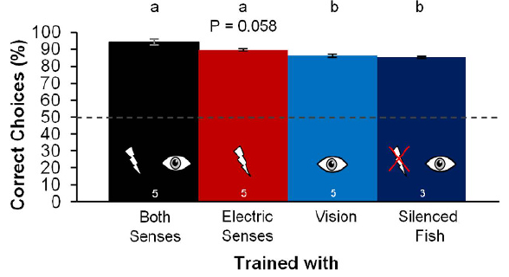
Combined senses improve asymptotic discrimination
Asymptotic performance is the relatively stable accuracy reached after a task has been learned. Schumacher and colleagues compared trained fish under conditions permitting both vision and electrolocation, electrolocation alone, or vision alone, while maintaining the same rewarded-object choice.
Accuracy reached at least 84% in every group. The combined-sense group averaged approximately 94.5% correct choices, exceeding the visual-only accuracy in intact fish. The objects remained close, approximately 1 cm behind the inspection gates.
The result supports a benefit of combined sensory information in this task. Two sensory streams about the same near object improved accuracy above that of vision alone.
Schumacher et al. (2017), Fig. 4. Accuracy after training under different sensory conditions.
Schumacher et al. (2017)
18
Notes:
Teaching transcript:
Asymptotic performance is the relatively stable accuracy reached after a task has been learned. Schumacher and colleagues compared trained fish under conditions permitting both vision and electrolocation, electrolocation alone, or vision alone, while maintaining the same rewarded-object choice.
Accuracy reached at least 84% in every group. The combined-sense group averaged approximately 94.5% correct choices, exceeding the visual-only accuracy in intact fish. The objects remained close, approximately 1 cm behind the inspection gates.
The result supports a benefit of combined sensory information in this task. Two sensory streams about the same near object improved accuracy above that of vision alone.
Training duration and final accuracy describe different aspects of behavior. A modality can support successful discrimination while producing a different acquisition rate or final performance level.
References:
S. Schumacher; T. Burt de Perera; G. von der Emde (2017). Electrosensory capture during multisensory discrimination of nearby objects in the weakly electric fish Gnathonemus petersii. Scientific Reports 7:43665. https://doi.org/10.1038/srep43665
Schumacher et al. (2017), Fig. 4. Accuracy after training under different sensory conditions.
Figure source: https://doi.org/10.1038/srep43665

Slide 25
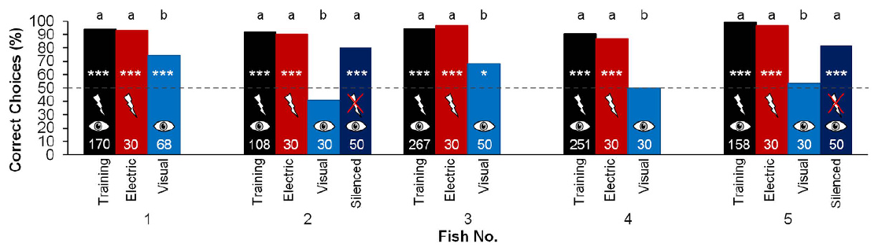
Sensory conflict reveals electrosensory dominance nearby
Electrosensory capture is dominance of electric information over conflicting visual information in a perceptual task. Schumacher and colleagues trained fish with electrically conspicuous metal objects and then tested choices with electric-only or visual-only information available.
At the short inspection distance of 1 cm, electric information strongly supported the trained discrimination, while removing discriminating electric cues could impair use of visual shape. The result depends on the specific near-field task and the animal’s training history.
Electric dominance is conditional on the near-field task and the training history of the animal. The tests measure which sensory information controls the choice at a 1 cm inspection distance.
Schumacher et al. (2017), Fig. 5. Multisensory training followed by single-sense tests.
Schumacher et al. (2017)
19
Notes:
Teaching transcript:
Electrosensory capture is dominance of electric information over conflicting visual information in a perceptual task. Schumacher and colleagues trained fish with electrically conspicuous metal objects and then tested choices with electric-only or visual-only information available.
At the short inspection distance of 1 cm, electric information strongly supported the trained discrimination, while removing discriminating electric cues could impair use of visual shape. The result depends on the specific near-field task and the animal’s training history.
Electric dominance is conditional on the near-field task and the training history of the animal. The tests measure which sensory information controls the choice at a 1 cm inspection distance.
The term sensory weighting describes the contribution of each modality to the observable decision. A behavioral weight should not be treated as a measured molecular or synaptic parameter.
References:
S. Schumacher; T. Burt de Perera; G. von der Emde (2017). Electrosensory capture during multisensory discrimination of nearby objects in the weakly electric fish Gnathonemus petersii. Scientific Reports 7:43665. https://doi.org/10.1038/srep43665
Schumacher et al. (2017), Fig. 5. Multisensory training followed by single-sense tests.
Figure source: https://doi.org/10.1038/srep43665

Slide 26
Cue conflict tests which sense controls a choice
A cue conflict presents two senses with different information about the same object. The choice that the animal makes shows which sense controls the behavior when the two disagree. A conflict can be created by removing the useful information from one sense.
Schumacher and colleagues trained fish with electrically conspicuous metal objects and then tested choices with only electric or only visual information available. At an inspection distance of 1 cm, electric information strongly supported the trained discrimination. Tests were conducted with electric-only or visual-only information available.
Removing discriminating electric cues could impair use of visual shape. Electrosensory capture, the dominance of electric over visual information, therefore operates in the near field and depends on the training of the animal.
Schumacher et al. (2017), Fig. 5. Multisensory training followed by single-sense tests.
Schumacher et al. (2017)
19a
Notes:
Conflict between senses reveals their relative weight.
Cue conflict.
Two senses carry different information about one object.
The choice shows which sense controls the behavior.
Training.
Fish learned with electrically conspicuous metal objects.
Tests.
Choices were then tested with electric-only or visual-only information.
Result at 1 centimeter.
Electric information strongly supported the trained discrimination.
Removing the electric contrast could impair the use of visual shape.
Scope.
The dominance depends on the near-field task and on the training history of the animal.
Training history.
The fish learned the task with metal objects that gave strong electric contrast.
That experience made the electric stream a reliable source of information.
Scope.
The result depends on the 1 centimeter inspection distance and on the learned task.
Electric dominance.
Electrosensory capture is dominance of electric information over conflicting visual information.
It was strongest when the objects were close to the fish.
Measured quantity.
The tests measure which information controls the choice and not the strength of any particular synapse.
References:
S. Schumacher; T. Burt de Perera; G. von der Emde (2017). Electrosensory capture during multisensory discrimination of nearby objects in the weakly electric fish Gnathonemus petersii. Scientific Reports 7:43665. https://doi.org/10.1038/srep43665

Slide 27
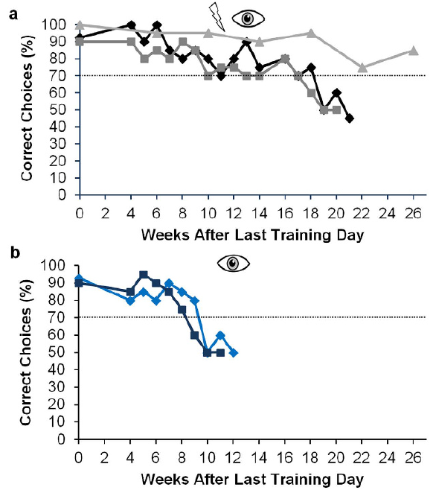
Repeated visual tests can expose a training conflict
A training conflict occurs when one available sensory stream carries the learned distinguishing features while another offers little useful contrast. Schumacher and colleagues repeatedly tested visual object discrimination after training that emphasized electrically conspicuous objects.
The longitudinal tests documented changes in visual-only performance across weeks of training. Comparisons of combined-sense and visual conditions preserved the near-field choice task, while electrically transparent stimuli reduced the previously useful electric distinction.
The results support experience-dependent sensory weighting, including interference from electric information under particular training conditions. Visually trained and electrically silenced fish could learn the task, so the reliability of each stimulus stream determines how much it contributes.
Schumacher et al. (2017), Fig. 7(a–b). Choice changes across continued training and visual tests.
Schumacher et al. (2017)
20
Notes:
Teaching transcript:
A training conflict occurs when one available sensory stream carries the learned distinguishing features while another offers little useful contrast. Schumacher and colleagues repeatedly tested visual object discrimination after training that emphasized electrically conspicuous objects.
The longitudinal tests documented changes in visual-only performance across weeks of training. Comparisons of combined-sense and visual conditions preserved the near-field choice task, while electrically transparent stimuli reduced the previously useful electric distinction.
The results support experience-dependent sensory weighting, including interference from electric information under particular training conditions. Visually trained and electrically silenced fish could learn the task, so the reliability of each stimulus stream determines how much it contributes.
Repeated measurements track performance in the same behavioral context. Changes across weeks need not specify the location or cellular mechanism of the underlying plasticity.
References:
S. Schumacher; T. Burt de Perera; G. von der Emde (2017). Electrosensory capture during multisensory discrimination of nearby objects in the weakly electric fish Gnathonemus petersii. Scientific Reports 7:43665. https://doi.org/10.1038/srep43665
Schumacher et al. (2017), Fig. 7(a–b). Choice changes across continued training and visual tests.
Figure source: https://doi.org/10.1038/srep43665

Slide 28
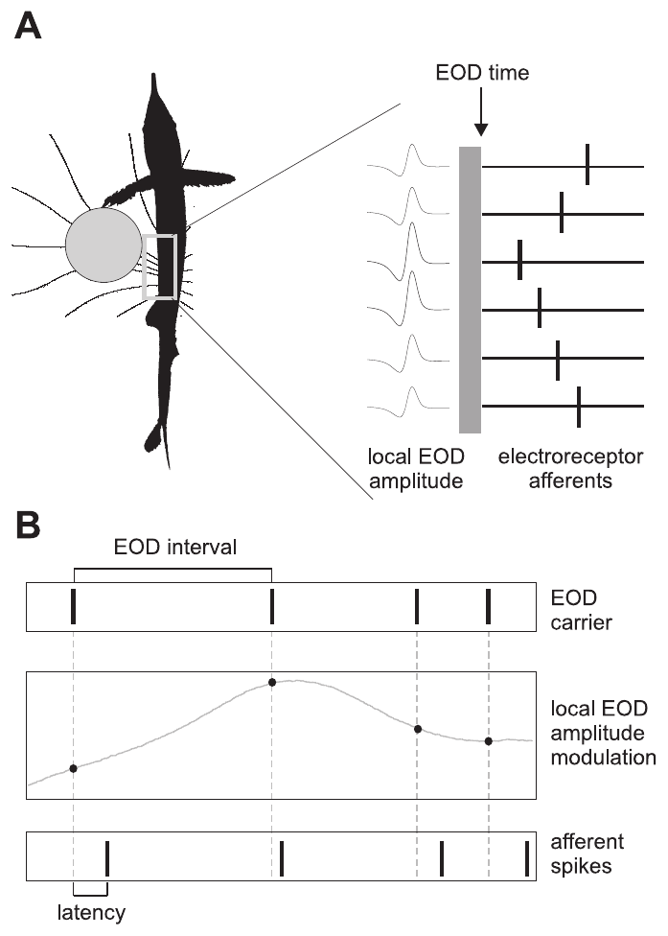
Mormyromast afferents encode amplitude through timing
A mormyromast is an electroreceptor organ used in mormyrid active electrolocation. Its sensory afferent carries information from the skin toward the brain. Spike latency is the interval between the electric stimulus and the first recorded afferent action potential.
Sawtell and colleagues varied local electric-pulse amplitude and pulse timing while recording afferent spikes. Their brief stimuli mimicked an EOD, allowing amplitude changes associated with objects to be examined separately from changes in the sampling interval.
An amplitude increase generally shortened first-spike latency. Thus, receptor input is represented partly by when a spike occurs, not simply by how many spikes occur. The timing of the first spike therefore carries local amplitude, and the interval between sensing pulses influences that timing.
Sawtell et al. (2006), Fig. 1(A–B). Spatial receptor input and controlled sensing-interval stimuli.
Sawtell et al. (2006)
21
Notes:
Teaching transcript:
A mormyromast is an electroreceptor organ used in mormyrid active electrolocation. Its sensory afferent carries information from the skin toward the brain. Spike latency is the interval between the electric stimulus and the first recorded afferent action potential.
Sawtell and colleagues varied local electric-pulse amplitude and pulse timing while recording afferent spikes. Their brief stimuli mimicked an EOD, allowing amplitude changes associated with objects to be examined separately from changes in the sampling interval.
An amplitude increase generally shortened first-spike latency. Thus, receptor input is represented partly by when a spike occurs, not simply by how many spikes occur. The timing of the first spike therefore carries local amplitude, and the interval between sensing pulses influences that timing.
An afferent action potential is the propagated electrical output of the sensory fiber. The latency code refers to its timing relative to a controlled electric pulse, not to object distance measured directly.
References:
N.B. Sawtell; A. Williams; P.D. Roberts; G. von der Emde; C.C. Bell (2006). Effects of Sensing Behavior on a Latency Code. Journal of Neuroscience 26(32):8221–8234. https://doi.org/10.1523/JNEUROSCI.1508-06.2006
Sawtell et al. (2006), Fig. 1(A–B). Spatial receptor input and controlled sensing-interval stimuli.
Figure source: https://doi.org/10.1523/JNEUROSCI.1508-06.2006

Slide 29
First-spike latency encodes stimulus amplitude
Latency is the time from a stimulus to the first spike of a neuron. A neuron can signal a stimulus by when it fires as well as by how often it fires. In mormyrids the mormyromast is the electroreceptor organ used for active electrolocation.
Sawtell and colleagues varied the amplitude of brief electric pulses that mimicked an EOD while recording mormyromast afferents. A larger amplitude shortened the first-spike latency, so the time of the first spike reported local amplitude.
A latency code is fast, because it needs only one spike per pulse. The brain can read amplitude from spike time within each discharge cycle, which suits an animal that samples the scene in discrete pulses.
Sawtell et al. (2006), Fig. 1(A–B). Spatial receptor input and controlled sensing-interval stimuli.
Sawtell et al. (2006)
21a
Notes:
Spike timing carries amplitude in the electroreceptor afferents.
Definition.
Spike latency is the interval between the stimulus and the first action potential of the afferent.
Experiment.
Local electric pulses mimicked an EOD.
Their amplitude and timing were varied while afferent spikes were recorded.
Result.
An amplitude increase generally shortened first-spike latency.
Meaning.
Receptor input is represented partly by when a spike occurs and not only by how many spikes occur.
Why latency suits discrete sampling.
One spike per pulse is enough to report amplitude.
The code operates within each discharge cycle.
Spike counts and spike times.
A neuron can encode a stimulus in how many spikes it fires and in when it fires them.
Here the time of the first spike carried the amplitude.
Link to sampling.
The latency depends on the recent sequence of sensing events, which later slides examine.
Terminology.
A mormyromast is an electroreceptor organ, and its afferent carries information toward the brain.
Latency refers to the first recorded afferent spike.
References:
N.B. Sawtell; A. Williams; P.D. Roberts; G. von der Emde; C.C. Bell (2006). Effects of Sensing Behavior on a Latency Code. Journal of Neuroscience 26(32):8221–8234. https://doi.org/10.1523/JNEUROSCI.1508-06.2006

Slide 30
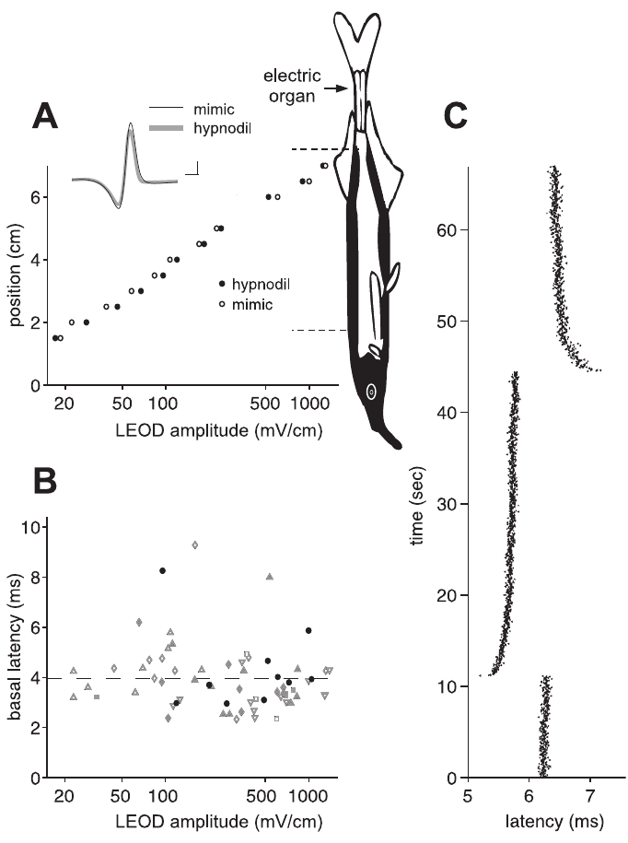
Sensory adaptation changes the amplitude reference
Adaptation is a change in responsiveness associated with recent stimulation. Sawtell and colleagues compared afferent responses over different mean local EOD amplitudes, distinguishing the steady carrier level from smaller amplitude changes superimposed on it.
The latency relationship shifted with the mean electric stimulus. Responses were therefore not determined solely by the instantaneous voltage at a receptor; the preceding stimulus environment established part of the reference against which amplitude modulation was encoded.
Adaptation means that the same immediate amplitude can occur under different sensory histories and evoke different latencies. A central decoder interpreting latency must therefore take into account the mean level that precedes the amplitude change.
Sawtell et al. (2006), Fig. 2(A–C). Latency adaptation to the mean local electric amplitude.
Sawtell et al. (2006)
22
Notes:
Teaching transcript:
Adaptation is a change in responsiveness associated with recent stimulation. Sawtell and colleagues compared afferent responses over different mean local EOD amplitudes, distinguishing the steady carrier level from smaller amplitude changes superimposed on it.
The latency relationship shifted with the mean electric stimulus. Responses were therefore not determined solely by the instantaneous voltage at a receptor; the preceding stimulus environment established part of the reference against which amplitude modulation was encoded.
Adaptation means that the same immediate amplitude can occur under different sensory histories and evoke different latencies. A central decoder interpreting latency must therefore take into account the mean level that precedes the amplitude change.
The carrier is the baseline pulse amplitude. Modulation is the deviation from that baseline; separating them avoids conflating object-related changes with a different overall stimulation level.
References:
N.B. Sawtell; A. Williams; P.D. Roberts; G. von der Emde; C.C. Bell (2006). Effects of Sensing Behavior on a Latency Code. Journal of Neuroscience 26(32):8221–8234. https://doi.org/10.1523/JNEUROSCI.1508-06.2006
Sawtell et al. (2006), Fig. 2(A–C). Latency adaptation to the mean local electric amplitude.
Figure source: https://doi.org/10.1523/JNEUROSCI.1508-06.2006

Slide 31
Adaptation sets the reference for amplitude coding
Adaptation is a change in the responsiveness of a neuron after recent stimulation. A neuron that adapts reports changes relative to the level that it has recently experienced. The carrier is the background level of the signal, and the modulation is the part that an object changes.
Sawtell and colleagues compared afferent responses at different mean local EOD amplitudes, separating the steady carrier level from small amplitude changes superimposed on it. The latency relationship shifted with the mean stimulus.
The same instantaneous amplitude can therefore evoke different latencies under different sensory histories. A decoder in the brain must take the preceding stimulus environment into account when it reads latency as amplitude. The latency therefore reports amplitude relative to a baseline that adaptation adjusts.
Sawtell et al. (2006), Fig. 2(A–C). Latency adaptation to the mean local electric amplitude.
Sawtell et al. (2006)
22a
Notes:
The meaning of a spike time depends on the history of the receptor.
Adaptation.
Adaptation is a change in responsiveness associated with recent stimulation.
Carrier and modulation.
The steady carrier level is the mean EOD amplitude at the receptor.
Small amplitude changes are superimposed on it.
Result.
The latency relationship shifted with the mean electric stimulus.
Consequence.
Responses were not determined only by the instantaneous voltage at the receptor.
The preceding stimulus set part of the reference.
Decoding.
The same immediate amplitude can occur under different histories.
Why adaptation exists.
Receptors that adapt keep their responses within a useful range when the mean level changes.
They then report changes around the new level.
Latency relation.
The latency relationship shifted with the mean stimulus, so the same amplitude could give different latencies.
Carrier level.
The carrier level is the steady EOD amplitude at the receptor.
It is distinguished from the smaller modulation that an object introduces.
References:
N.B. Sawtell; A. Williams; P.D. Roberts; G. von der Emde; C.C. Bell (2006). Effects of Sensing Behavior on a Latency Code. Journal of Neuroscience 26(32):8221–8234. https://doi.org/10.1523/JNEUROSCI.1508-06.2006

Slide 32
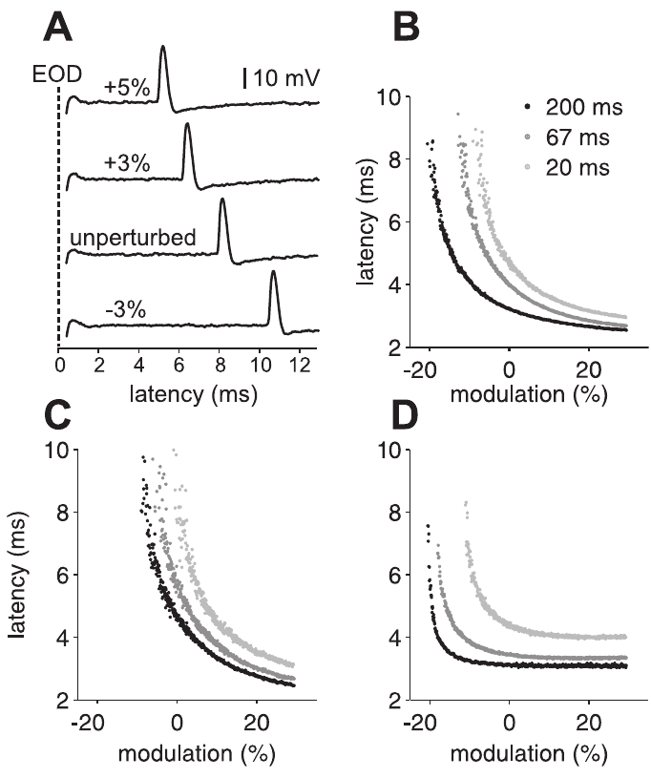
Pulse interval shifts the latency–amplitude relationship
An inter-discharge interval is the time between successive sensing pulses. Sawtell and colleagues ramped pulse amplitude from approximately −30% to +30% while presenting pulses at fixed intervals of 200, 67, or 20 ms, then recorded afferent first-spike latency.
Increasing amplitude shortened latency, but shorter sensing intervals produced longer latencies at the same amplitude. Individual afferents differed in the slope and position of their latency–amplitude relationships, so the interval effect did not amount to one identical offset for all fibers.
The motor sampling pattern therefore influences the sensory code before central decoding. A latency shift is therefore interpreted together with how recently the receptor was stimulated, and individual afferents differ in the slope and position of their relationships.
Sawtell et al. (2006), Fig. 3(A–D). First-spike latency across amplitude ramps and pulse intervals.
Sawtell et al. (2006)
23
Notes:
Teaching transcript:
An inter-discharge interval is the time between successive sensing pulses. Sawtell and colleagues ramped pulse amplitude from approximately −30% to +30% while presenting pulses at fixed intervals of 200, 67, or 20 ms, then recorded afferent first-spike latency.
Increasing amplitude shortened latency, but shorter sensing intervals produced longer latencies at the same amplitude. Individual afferents differed in the slope and position of their latency–amplitude relationships, so the interval effect did not amount to one identical offset for all fibers.
The motor sampling pattern therefore influences the sensory code before central decoding. A latency shift is therefore interpreted together with how recently the receptor was stimulated, and individual afferents differ in the slope and position of their relationships.
The experiment held interval constant within each ramp. Comparing ramps across intervals isolates an effect of pulse spacing from the amplitude dependence within a ramp.
References:
N.B. Sawtell; A. Williams; P.D. Roberts; G. von der Emde; C.C. Bell (2006). Effects of Sensing Behavior on a Latency Code. Journal of Neuroscience 26(32):8221–8234. https://doi.org/10.1523/JNEUROSCI.1508-06.2006
Sawtell et al. (2006), Fig. 3(A–D). First-spike latency across amplitude ramps and pulse intervals.
Figure source: https://doi.org/10.1523/JNEUROSCI.1508-06.2006

Slide 33
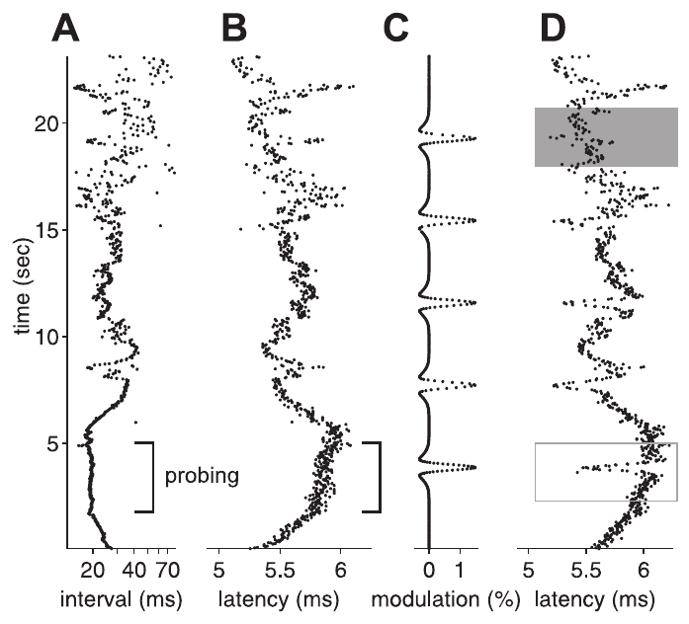
Natural sampling histories alter afferent responses
A sampling history is the sequence of preceding pulses rather than only the latest interval. Sawtell and colleagues replayed natural patterns of EOD intervals while measuring first-spike latency and comparing responses with controlled amplitude modulation.
The afferent latency changed as the natural pulse sequence changed, even when an instantaneous amplitude alone could not account for the response. The measured code therefore reflected the time structure of active sampling as well as the electrical contrast being sampled.
The replay experiment establishes history dependence at the sensory afferent. Latency followed the natural sequence of pulse intervals, so the afferent code carries the time structure of active sampling together with the electrical contrast being sampled.
Sawtell et al. (2006), Fig. 4(A–D). Afferent latencies under natural sensing-interval sequences.
Sawtell et al. (2006)
24
Notes:
Teaching transcript:
A sampling history is the sequence of preceding pulses rather than only the latest interval. Sawtell and colleagues replayed natural patterns of EOD intervals while measuring first-spike latency and comparing responses with controlled amplitude modulation.
The afferent latency changed as the natural pulse sequence changed, even when an instantaneous amplitude alone could not account for the response. The measured code therefore reflected the time structure of active sampling as well as the electrical contrast being sampled.
The replay experiment establishes history dependence at the sensory afferent. Latency followed the natural sequence of pulse intervals, so the afferent code carries the time structure of active sampling together with the electrical contrast being sampled.
Replaying a natural sequence preserves temporal structure that fixed-rate stimulation removes. The experimental separation permits response changes to be attributed to sampling history under controlled input conditions.
References:
N.B. Sawtell; A. Williams; P.D. Roberts; G. von der Emde; C.C. Bell (2006). Effects of Sensing Behavior on a Latency Code. Journal of Neuroscience 26(32):8221–8234. https://doi.org/10.1523/JNEUROSCI.1508-06.2006
Sawtell et al. (2006), Fig. 4(A–D). Afferent latencies under natural sensing-interval sequences.
Figure source: https://doi.org/10.1523/JNEUROSCI.1508-06.2006

Slide 34
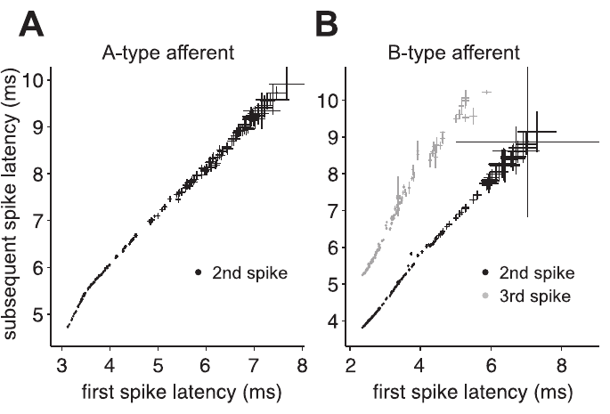
Later afferent spikes largely follow the first spike
A spike train is a sequence of action potentials emitted by one neuron. Some recorded mormyromast afferents produced more than one spike after a pulse, raising the possibility that later spikes might provide additional independent information about local electric amplitude.
Sawtell and colleagues compared the times of subsequent spikes with the first-spike latency. Their tight relationships supported treating the first spike as the principal effective timing variable for the responses examined, rather than regarding every spike as an independent new estimate.
The first spike is therefore the principal timing variable for these responses. Later spikes can still influence synaptic transmission, even though their timing contributes little independent information about stimulus amplitude.
Sawtell et al. (2006), Fig. 5(A–B). Relationships between first and subsequent afferent spike times.
Sawtell et al. (2006)
25
Notes:
Teaching transcript:
A spike train is a sequence of action potentials emitted by one neuron. Some recorded mormyromast afferents produced more than one spike after a pulse, raising the possibility that later spikes might provide additional independent information about local electric amplitude.
Sawtell and colleagues compared the times of subsequent spikes with the first-spike latency. Their tight relationships supported treating the first spike as the principal effective timing variable for the responses examined, rather than regarding every spike as an independent new estimate.
The first spike is therefore the principal timing variable for these responses. Later spikes can still influence synaptic transmission, even though their timing contributes little independent information about stimulus amplitude.
Independent information is different from physiological influence. A later spike can drive a postsynaptic response while remaining strongly predictable from the first-spike latency.
References:
N.B. Sawtell; A. Williams; P.D. Roberts; G. von der Emde; C.C. Bell (2006). Effects of Sensing Behavior on a Latency Code. Journal of Neuroscience 26(32):8221–8234. https://doi.org/10.1523/JNEUROSCI.1508-06.2006
Sawtell et al. (2006), Fig. 5(A–B). Relationships between first and subsequent afferent spike times.
Figure source: https://doi.org/10.1523/JNEUROSCI.1508-06.2006

Slide 35
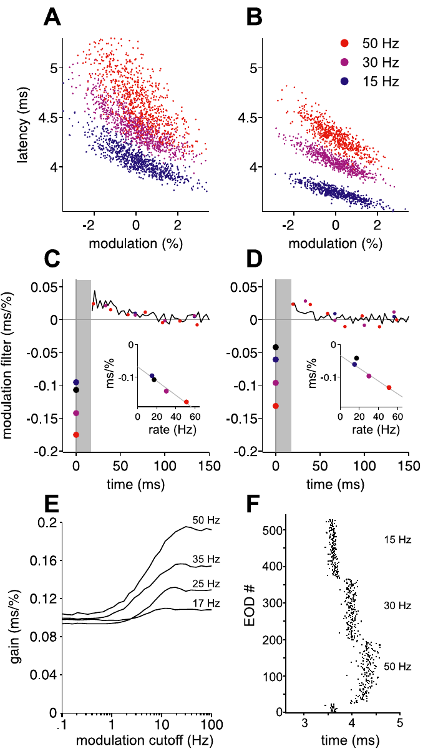
Afferent sensitivity changes with sustained sampling rate
Sensitivity here means the change in afferent latency associated with a given amplitude modulation. Sawtell and colleagues compared responses at constant pulse rates, including 15, 30, and 50 Hz, while estimating how current and previous amplitudes influenced timing.
Sensitivity to present amplitude increased with constant sensing rate. This rate dependence differed from what a fixed linear filter estimated under another stimulation regime would predict, particularly when amplitude changes were correlated across successive pulses.
Sensitivity to amplitude is a state-dependent transformation that changes with the sustained sampling rate and is not a fixed gain of the fiber. Coding models of the afferent therefore include the sampling rate as a variable.
Sawtell et al. (2006), Fig. 11(A–F). Amplitude sensitivity and filters at constant EOD rates.
Sawtell et al. (2006)
26
Notes:
Teaching transcript:
Sensitivity here means the change in afferent latency associated with a given amplitude modulation. Sawtell and colleagues compared responses at constant pulse rates, including 15, 30, and 50 Hz, while estimating how current and previous amplitudes influenced timing.
Sensitivity to present amplitude increased with constant sensing rate. This rate dependence differed from what a fixed linear filter estimated under another stimulation regime would predict, particularly when amplitude changes were correlated across successive pulses.
Sensitivity to amplitude is a state-dependent transformation that changes with the sustained sampling rate and is not a fixed gain of the fiber. Coding models of the afferent therefore include the sampling rate as a variable.
Gain refers to the size of a response change per input change. A fixed filter can approximate one regime while failing when gain changes under another temporal stimulation regime.
References:
N.B. Sawtell; A. Williams; P.D. Roberts; G. von der Emde; C.C. Bell (2006). Effects of Sensing Behavior on a Latency Code. Journal of Neuroscience 26(32):8221–8234. https://doi.org/10.1523/JNEUROSCI.1508-06.2006
Sawtell et al. (2006), Fig. 11(A–F). Amplitude sensitivity and filters at constant EOD rates.
Figure source: https://doi.org/10.1523/JNEUROSCI.1508-06.2006

Slide 36
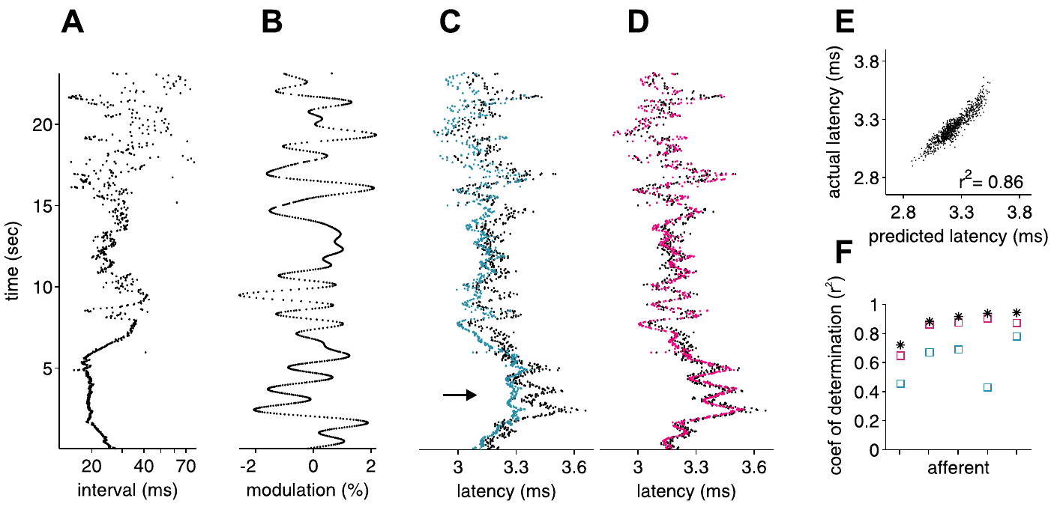
History-aware models improve latency predictions
A coding model predicts neuronal responses from specified stimulus variables. Sawtell and colleagues tested models using both EOD amplitude and prior intervals, then examined prediction failures when natural interval patterns were combined with slowly correlated amplitude changes.
Incorporating interval-dependent changes in amplitude sensitivity improved predictions of measured afferent latencies. The comparison retained the same recorded responses, so the improvement came from accounting for sensory context rather than collecting a different type of neural output.
Published models fitted to afferent data support a description of history-dependent coding in which latency depends on both the current amplitude and the preceding intervals. Models that include interval-dependent sensitivity predict the measured latencies better than models that use amplitude alone.
Sawtell et al. (2006), Fig. 12(A–F). Published predictions incorporating interval-dependent sensitivity.
Sawtell et al. (2006)
27
Notes:
Teaching transcript:
A coding model predicts neuronal responses from specified stimulus variables. Sawtell and colleagues tested models using both EOD amplitude and prior intervals, then examined prediction failures when natural interval patterns were combined with slowly correlated amplitude changes.
Incorporating interval-dependent changes in amplitude sensitivity improved predictions of measured afferent latencies. The comparison retained the same recorded responses, so the improvement came from accounting for sensory context rather than collecting a different type of neural output.
Published models fitted to afferent data support a description of history-dependent coding in which latency depends on both the current amplitude and the preceding intervals. Models that include interval-dependent sensitivity predict the measured latencies better than models that use amplitude alone.
A model prediction should remain distinct from an observed spike latency. Agreement constrains possible coding mechanisms; it does not by itself identify the implementation in a neuron.
References:
N.B. Sawtell; A. Williams; P.D. Roberts; G. von der Emde; C.C. Bell (2006). Effects of Sensing Behavior on a Latency Code. Journal of Neuroscience 26(32):8221–8234. https://doi.org/10.1523/JNEUROSCI.1508-06.2006
Sawtell et al. (2006), Fig. 12(A–F). Published predictions incorporating interval-dependent sensitivity.
Figure source: https://doi.org/10.1523/JNEUROSCI.1508-06.2006

Slide 37
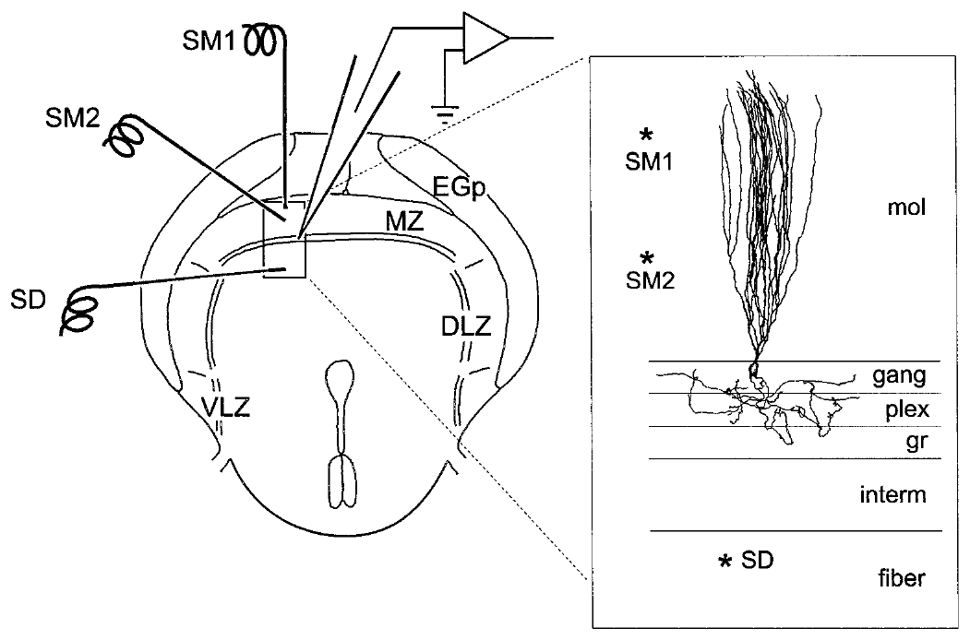
ELL integrates peripheral and descending synaptic input
The electrosensory lateral line lobe, or ELL, is a hindbrain structure receiving input from skin electroreceptors. Grant and colleagues studied elephantnose ELL slices, recording cells intracellularly and stimulating deep afferent pathways separately from molecular-layer parallel fibers.
Parallel fibers are axons carrying central information across the apical dendrites of ELL neurons. The slice preparation preserved the organization needed to compare these inputs while using brief 0.1 ms stimulation pulses and receptor antagonists.
The slice preparation establishes local synaptic properties of ELL. Anatomical identification and pharmacology identify which pathways and receptors contribute to the recorded response, and brief stimulation of deep afferents and parallel fibers allows the two inputs to be compared.
Grant et al. (1998), Fig. 1. Published slice anatomy and stimulation pathways.
Grant et al. (1998)
28
Notes:
Teaching transcript:
The electrosensory lateral line lobe, or ELL, is a hindbrain structure receiving input from skin electroreceptors. Grant and colleagues studied elephantnose ELL slices, recording cells intracellularly and stimulating deep afferent pathways separately from molecular-layer parallel fibers.
Parallel fibers are axons carrying central information across the apical dendrites of ELL neurons. The slice preparation preserved the organization needed to compare these inputs while using brief 0.1 ms stimulation pulses and receptor antagonists.
The slice preparation establishes local synaptic properties of ELL. Anatomical identification and pharmacology identify which pathways and receptors contribute to the recorded response, and brief stimulation of deep afferents and parallel fibers allows the two inputs to be compared.
Intracellular recording measures membrane voltage inside a cell. The anatomical reconstruction links a recorded response to tissue layers and cell type rather than inferring identity from waveform alone.
References:
K. Grant; Y. Sugawara; L. Gómez; V.Z. Han; C.C. Bell (1998). The Mormyrid Electrosensory Lobe In Vitro: Physiology and Pharmacology of Cells and Circuits. Journal of Neuroscience 18(15):6009–6025. https://doi.org/10.1523/JNEUROSCI.18-15-06009.1998
Grant et al. (1998), Fig. 1. Published slice anatomy and stimulation pathways.
Figure source: https://doi.org/10.1523/JNEUROSCI.18-15-06009.1998

Slide 38
Brain slices preserve local circuits for recording
A brain slice is a thin section of tissue that is kept alive in solution. The slice preserves the local connections of a region while allowing the experimenter to control stimulation and apply drugs directly. Slice recordings were made intracellularly from identified cells.
Grant and colleagues recorded from cells in slices of the elephantnose ELL, the electrosensory lateral line lobe, a hindbrain structure that receives input from skin electroreceptors. They stimulated deep afferent pathways separately from molecular-layer parallel fibers using 0.1 ms pulses.
Because the organization of the layers is preserved, the two inputs can be compared in the same preparation. Receptor antagonists identify which neurotransmitter receptors mediate each response.
Grant et al. (1998), Fig. 1. Published slice anatomy and stimulation pathways.
Grant et al. (1998)
28a
Notes:
A slice trades the intact animal for control over the circuit.
What a slice is.
A thin section of the brain is kept alive in solution.
Local connections remain intact.
The ELL.
The electrosensory lateral line lobe is a hindbrain structure that receives input from skin electroreceptors.
Two inputs.
Deep afferent pathways and molecular-layer parallel fibers were stimulated separately.
Parallel fibers carry central information across apical dendrites.
Stimulation.
Brief pulses of 0.1 millisecond were used.
Pharmacology.
Receptor antagonists applied to the slice identify which receptors contribute to each response.
Why use pulses of 0.1 milliseconds.
A brief pulse activates fibers at a defined time, so responses can be related to the stimulus.
Interpreting results.
Anatomical identification and pharmacology constrain which pathways and receptors contribute to each recorded response.
Where the recordings were made.
Cells in the elephantnose ELL were recorded intracellularly.
The slice preserved the organization needed to compare the two inputs.
References:
K. Grant; Y. Sugawara; L. Gómez; V.Z. Han; C.C. Bell (1998). The Mormyrid Electrosensory Lobe In Vitro: Physiology and Pharmacology of Cells and Circuits. Journal of Neuroscience 18(15):6009–6025. https://doi.org/10.1523/JNEUROSCI.18-15-06009.1998

Slide 39
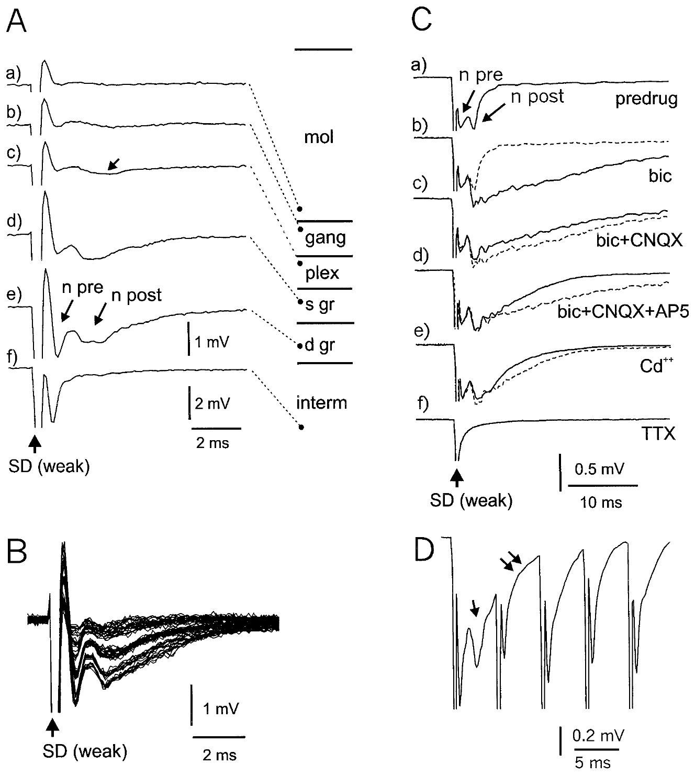
Afferent volleys precede postsynaptic ELL responses
A field potential is an extracellular voltage generated by nearby neural activity. Grant and colleagues stimulated deep ELL layers and separated an early afferent volley from a later postsynaptic component by recording across tissue layers and applying channel blockers.
Cadmium, which blocks calcium-dependent synaptic transmission in this preparation, removed the postsynaptic component while leaving the afferent component. Tetrodotoxin removed the remaining component, consistent with action potentials propagating through sodium-channel-dependent afferent fibers.
The pharmacological dissociation separates arriving spikes from the local postsynaptic response they evoke. Cadmium and tetrodotoxin identify the two components more securely than the latency or polarity of the waveform alone.
Grant et al. (1998), Fig. 2(A–D). Deep-layer field responses and pharmacological separation.
Grant et al. (1998), Fig. 1. ELL layers and input pathways in the slice.
Grant et al. (1998)
29
Notes:
Teaching transcript:
A field potential is an extracellular voltage generated by nearby neural activity. Grant and colleagues stimulated deep ELL layers and separated an early afferent volley from a later postsynaptic component by recording across tissue layers and applying channel blockers.
Cadmium, which blocks calcium-dependent synaptic transmission in this preparation, removed the postsynaptic component while leaving the afferent component. Tetrodotoxin removed the remaining component, consistent with action potentials propagating through sodium-channel-dependent afferent fibers.
The pharmacological dissociation separates arriving spikes from the local postsynaptic response they evoke. Cadmium and tetrodotoxin identify the two components more securely than the latency or polarity of the waveform alone.
A volley is activity arriving across a group of afferent fibers. Calcium-channel dependence of synaptic transmission differs from sodium-channel dependence of the propagated action potential.
References:
K. Grant; Y. Sugawara; L. Gómez; V.Z. Han; C.C. Bell (1998). The Mormyrid Electrosensory Lobe In Vitro: Physiology and Pharmacology of Cells and Circuits. Journal of Neuroscience 18(15):6009–6025. https://doi.org/10.1523/JNEUROSCI.18-15-06009.1998
Grant et al. (1998), Fig. 2(A–D). Deep-layer field responses and pharmacological separation.
Figure source: https://doi.org/10.1523/JNEUROSCI.18-15-06009.1998
Grant et al. (1998), Fig. 1. ELL layers and input pathways in the slice.
Figure source: https://doi.org/10.1523/JNEUROSCI.18-15-06009.1998

Slide 40
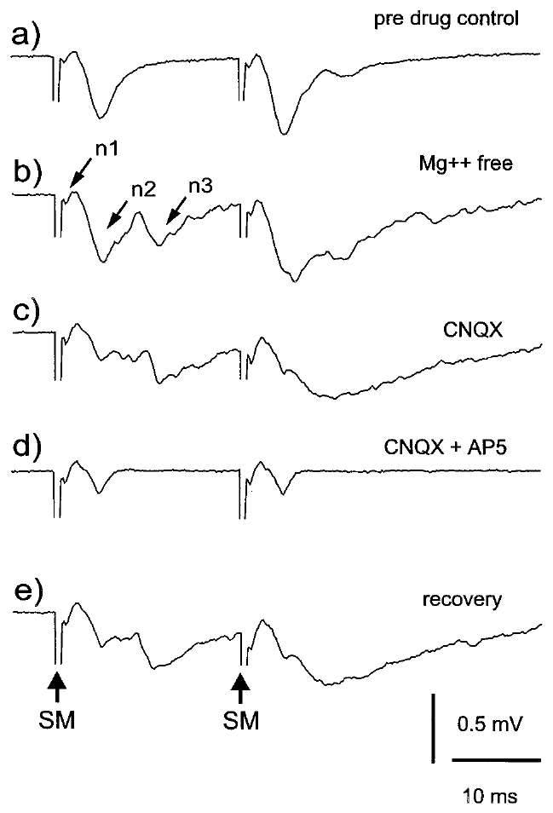
Glutamate receptors mediate excitatory ELL responses
An excitatory postsynaptic potential, or EPSP, is a synaptically evoked voltage change favoring neuronal firing. Grant and colleagues stimulated molecular-layer pathways and applied CNQX, an AMPA-receptor antagonist, and AP-5, an NMDA-receptor antagonist, to identify glutamate-mediated excitation.
Removing extracellular magnesium enhanced components associated with NMDA-receptor activation. Applying CNQX and AP-5 reduced distinct portions of the evoked response, and recovery after washout supported a reversible pharmacological effect rather than irreversible tissue failure.
AMPA and NMDA receptors are glutamate-activated ion channels. Their contribution links transmitter release to postsynaptic depolarization, and the reduced portions of the evoked response indicate that both receptor classes participate.
Grant et al. (1998), Fig. 7(a–e). Parallel-fiber responses under magnesium and glutamate antagonists.
Grant et al. (1998), Fig. 1. Anatomical relationship of molecular layer and ELL cells.
Grant et al. (1998)
30
Notes:
Teaching transcript:
An excitatory postsynaptic potential, or EPSP, is a synaptically evoked voltage change favoring neuronal firing. Grant and colleagues stimulated molecular-layer pathways and applied CNQX, an AMPA-receptor antagonist, and AP-5, an NMDA-receptor antagonist, to identify glutamate-mediated excitation.
Removing extracellular magnesium enhanced components associated with NMDA-receptor activation. Applying CNQX and AP-5 reduced distinct portions of the evoked response, and recovery after washout supported a reversible pharmacological effect rather than irreversible tissue failure.
AMPA and NMDA receptors are glutamate-activated ion channels. Their contribution links transmitter release to postsynaptic depolarization, and the reduced portions of the evoked response indicate that both receptor classes participate.
Magnesium limits NMDA-channel current in a voltage-dependent manner. Removing it experimentally changes the conditions for observing that receptor contribution; it is not a normal behavior of the fish.
References:
K. Grant; Y. Sugawara; L. Gómez; V.Z. Han; C.C. Bell (1998). The Mormyrid Electrosensory Lobe In Vitro: Physiology and Pharmacology of Cells and Circuits. Journal of Neuroscience 18(15):6009–6025. https://doi.org/10.1523/JNEUROSCI.18-15-06009.1998
Grant et al. (1998), Fig. 7(a–e). Parallel-fiber responses under magnesium and glutamate antagonists.
Figure source: https://doi.org/10.1523/JNEUROSCI.18-15-06009.1998
Grant et al. (1998), Fig. 1. Anatomical relationship of molecular layer and ELL cells.
Figure source: https://doi.org/10.1523/JNEUROSCI.18-15-06009.1998

Slide 41
Magnesium and antagonists separate glutamate receptors
AMPA and NMDA receptors are both activated by glutamate, but the NMDA receptor is blocked by extracellular magnesium at negative voltages. Removing magnesium therefore enhances the component of a response that depends on NMDA receptors. A voltage change that favors firing is called an excitatory postsynaptic potential, or EPSP.
Grant and colleagues removed extracellular magnesium and applied CNQX, an antagonist of AMPA receptors, and AP-5, an antagonist of NMDA receptors. Each drug reduced a distinct portion of the evoked response. The experiment measured the effect of each treatment on the evoked response in the same preparation.
Recovery after washout showed that the drug effects were reversible and not caused by tissue failure. The portions removed by the two antagonists identify separate AMPA and NMDA components of excitation.
Grant et al. (1998), Fig. 7(a–e). Parallel-fiber responses under magnesium and glutamate antagonists.
Grant et al. (1998), Fig. 1. Anatomical relationship of molecular layer and ELL cells.
Grant et al. (1998)
30a
Notes:
Two receptor classes can be separated by their voltage dependence and by their antagonists.
Two receptors.
AMPA and NMDA receptors are glutamate-activated ion channels.
Magnesium.
Extracellular magnesium blocks NMDA receptors at negative voltages.
Removing it enhances the NMDA component.
Antagonists.
CNQX blocks AMPA receptors.
AP-5 blocks NMDA receptors.
Result.
Each antagonist reduced a distinct portion of the evoked response.
Reversibility.
Recovery after washout supported a reversible pharmacological effect rather than irreversible tissue failure.
Reading the drugs.
A drug that reduces the response shows that its target receptor contributes to the response.
Two antagonists acting on different receptors can remove different portions.
Controls.
After the drug was washed out, the response recovered.
Recovery shows that the effect is reversible and that the tissue remained healthy.
Excitatory potentials.
An excitatory postsynaptic potential is a synaptically evoked voltage change that favors neuronal firing.
It is the response that the antagonists reduced, and its time course shows how long excitation lasts after the stimulus.
References:
K. Grant; Y. Sugawara; L. Gómez; V.Z. Han; C.C. Bell (1998). The Mormyrid Electrosensory Lobe In Vitro: Physiology and Pharmacology of Cells and Circuits. Journal of Neuroscience 18(15):6009–6025. https://doi.org/10.1523/JNEUROSCI.18-15-06009.1998

Slide 42
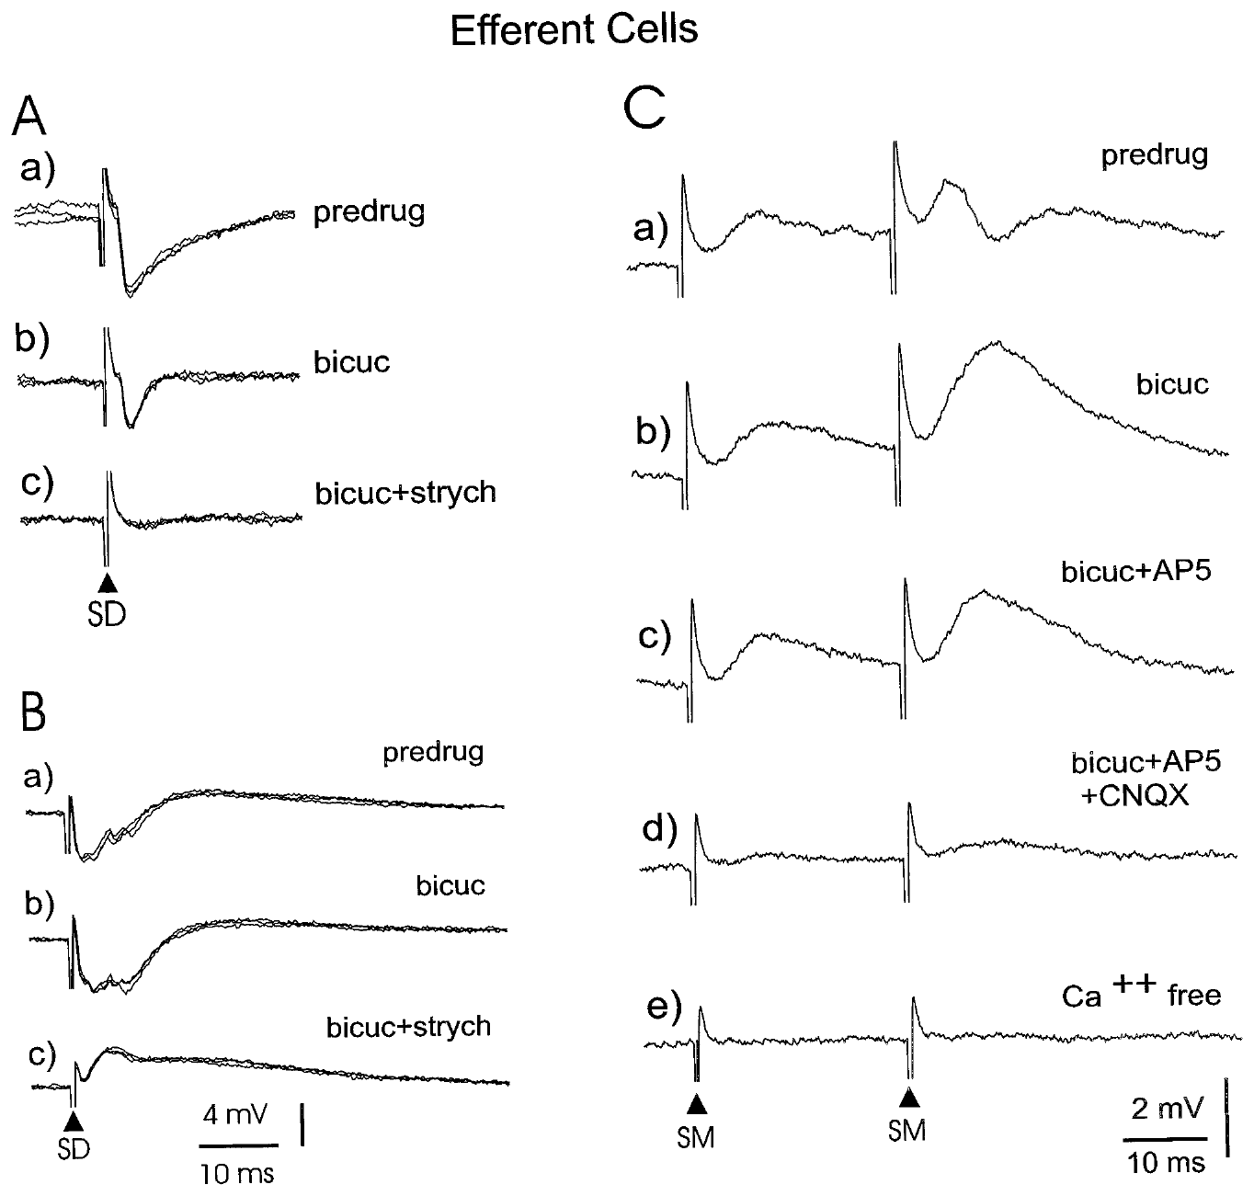
GABA and glycine contribute to deep-input inhibition
An inhibitory postsynaptic potential, or IPSP, is a synaptic response that reduces excitability under the recorded conditions. Grant and colleagues stimulated deep ELL pathways while recording identified output cells and used bicuculline and strychnine to test inhibitory receptor contributions.
Bicuculline blocks GABA-A receptors, while strychnine blocks glycine receptors. Sequential blockade reduced or abolished inhibitory responses, revealing that deep-input inhibition could involve both transmitter systems rather than one uniform inhibitory mechanism.
Ligand-gated receptors provide the ionic conductances through which synaptic input changes membrane voltage. GABA-A and glycine receptors both contribute to deep-input inhibition in the slice, so the inhibition is not mediated by one transmitter system.
Grant et al. (1998), Fig. 13(A–C). Inhibitory and excitatory responses in identified efferent cells.
Grant et al. (1998), Fig. 1. Locations of ELL input layers and efferent neurons.
Grant et al. (1998)
31
Notes:
Teaching transcript:
An inhibitory postsynaptic potential, or IPSP, is a synaptic response that reduces excitability under the recorded conditions. Grant and colleagues stimulated deep ELL pathways while recording identified output cells and used bicuculline and strychnine to test inhibitory receptor contributions.
Bicuculline blocks GABA-A receptors, while strychnine blocks glycine receptors. Sequential blockade reduced or abolished inhibitory responses, revealing that deep-input inhibition could involve both transmitter systems rather than one uniform inhibitory mechanism.
Ligand-gated receptors provide the ionic conductances through which synaptic input changes membrane voltage. GABA-A and glycine receptors both contribute to deep-input inhibition in the slice, so the inhibition is not mediated by one transmitter system.
GABA is gamma-aminobutyric acid, an inhibitory transmitter in the studied circuit. Glycine supplies a distinct inhibitory receptor pathway that the second antagonist helps separate.
References:
K. Grant; Y. Sugawara; L. Gómez; V.Z. Han; C.C. Bell (1998). The Mormyrid Electrosensory Lobe In Vitro: Physiology and Pharmacology of Cells and Circuits. Journal of Neuroscience 18(15):6009–6025. https://doi.org/10.1523/JNEUROSCI.18-15-06009.1998
Grant et al. (1998), Fig. 13(A–C). Inhibitory and excitatory responses in identified efferent cells.
Figure source: https://doi.org/10.1523/JNEUROSCI.18-15-06009.1998
Grant et al. (1998), Fig. 1. Locations of ELL input layers and efferent neurons.
Figure source: https://doi.org/10.1523/JNEUROSCI.18-15-06009.1998

Slide 43
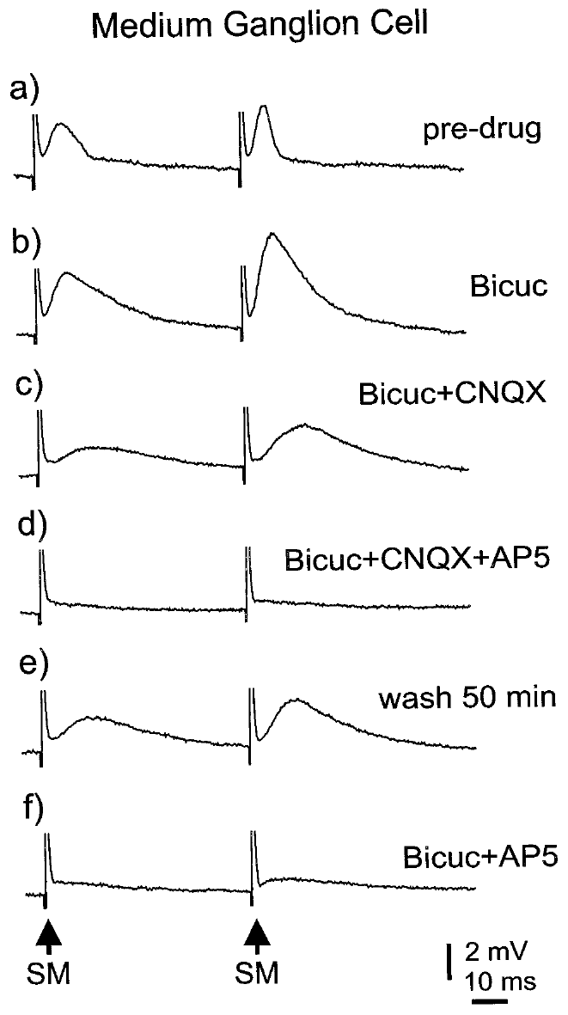
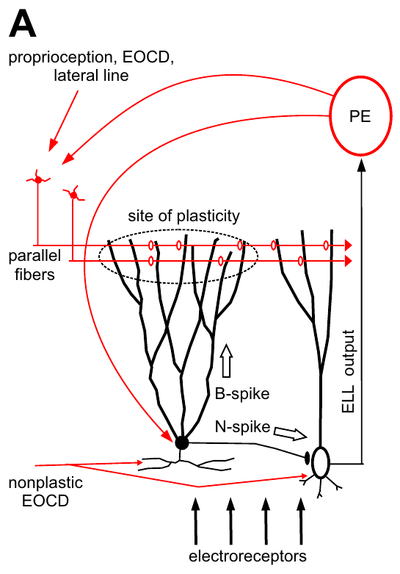
Parallel fibers evoke excitation followed by inhibition
A medium ganglion cell is a Purkinje-like ELL interneuron whose apical dendrites receive parallel-fiber input. Grant and colleagues stimulated those fibers and recorded a sequence of excitation followed by inhibition, then used antagonists to separate its components.
Bicuculline removed the inhibitory portion, while CNQX and AP-5 reduced glutamate-mediated excitation. Unlike inhibition recruited through deep inputs, the parallel-fiber-evoked inhibitory response was attributed to GABA-A receptors rather than a combined GABA-A and glycine contribution.
The ordering of excitation and inhibition shapes the interval during which synaptic drive can produce firing. Parallel-fiber input to the medium ganglion cell therefore produces a brief window of excitation that inhibition through GABA-A receptors then limits.
Grant et al. (1998), Fig. 11(a–f). Pharmacology of parallel-fiber responses in a medium ganglion cell.
Sawtell et al. (2007), Fig. 1(A). Published anatomy of the medium ganglion cell circuit.
Grant et al. (1998)
32
Notes:
Teaching transcript:
A medium ganglion cell is a Purkinje-like ELL interneuron whose apical dendrites receive parallel-fiber input. Grant and colleagues stimulated those fibers and recorded a sequence of excitation followed by inhibition, then used antagonists to separate its components.
Bicuculline removed the inhibitory portion, while CNQX and AP-5 reduced glutamate-mediated excitation. Unlike inhibition recruited through deep inputs, the parallel-fiber-evoked inhibitory response was attributed to GABA-A receptors rather than a combined GABA-A and glycine contribution.
The ordering of excitation and inhibition shapes the interval during which synaptic drive can produce firing. Parallel-fiber input to the medium ganglion cell therefore produces a brief window of excitation that inhibition through GABA-A receptors then limits.
An interneuron influences local circuit activity rather than constituting the principal long-range sensory output. Purkinje-like describes the dendritic and circuit organization, not identity with a cerebellar Purkinje cell.
References:
K. Grant; Y. Sugawara; L. Gómez; V.Z. Han; C.C. Bell (1998). The Mormyrid Electrosensory Lobe In Vitro: Physiology and Pharmacology of Cells and Circuits. Journal of Neuroscience 18(15):6009–6025. https://doi.org/10.1523/JNEUROSCI.18-15-06009.1998
N.B. Sawtell; A. Williams; C.C. Bell (2007). Central Control of Dendritic Spikes Shapes the Responses of Purkinje-Like Cells through Spike Timing-Dependent Synaptic Plasticity. Journal of Neuroscience 27(7):1552–1565. https://doi.org/10.1523/JNEUROSCI.5302-06.2007
Grant et al. (1998), Fig. 11(a–f). Pharmacology of parallel-fiber responses in a medium ganglion cell.
Figure source: https://doi.org/10.1523/JNEUROSCI.18-15-06009.1998
Sawtell et al. (2007), Fig. 1(A). Published anatomy of the medium ganglion cell circuit.
Figure source: https://doi.org/10.1523/JNEUROSCI.5302-06.2007

Slide 44
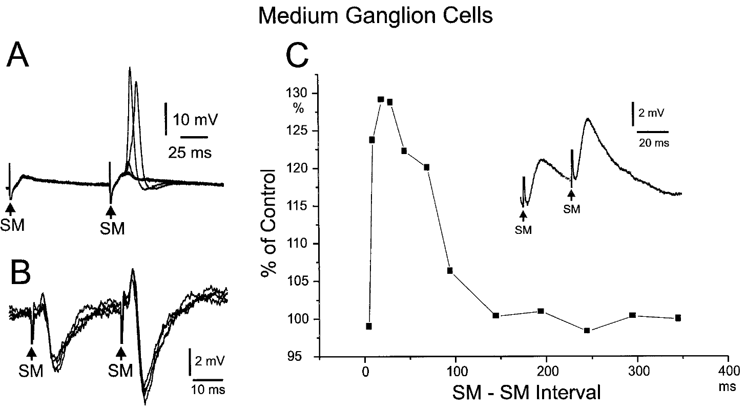
Paired pulses reveal history-dependent synaptic strength
Paired-pulse facilitation is an increase in the response to a second closely spaced stimulus. Grant and colleagues stimulated parallel fibers twice and recorded larger second EPSPs in medium ganglion cells, with facilitation depending on the spacing of the two pulses.
The experiment varied intervals across tens to hundreds of milliseconds; comparisons using independent stimulation sites distinguished repeated recruitment of the same fiber population from activation of another population. Strong facilitation occurred at short intervals, including approximately 30 ms.
The result establishes short-term dependence of synaptic efficacy on recent activity. Facilitation at intervals near 30 ms means that a second parallel-fiber volley evokes a larger response than the first.
Grant et al. (1998), Fig. 10(A–C). Parallel-fiber paired-pulse facilitation in medium ganglion cells.
Sawtell et al. (2007), Fig. 1(A). Published anatomy of the medium ganglion cell circuit.
Grant et al. (1998)
33
Notes:
Teaching transcript:
Paired-pulse facilitation is an increase in the response to a second closely spaced stimulus. Grant and colleagues stimulated parallel fibers twice and recorded larger second EPSPs in medium ganglion cells, with facilitation depending on the spacing of the two pulses.
The experiment varied intervals across tens to hundreds of milliseconds; comparisons using independent stimulation sites distinguished repeated recruitment of the same fiber population from activation of another population. Strong facilitation occurred at short intervals, including approximately 30 ms.
The result establishes short-term dependence of synaptic efficacy on recent activity. Facilitation at intervals near 30 ms means that a second parallel-fiber volley evokes a larger response than the first.
Short-term facilitation modifies how a recent input affects the next response. It can shape temporal integration even before any durable learning-related change in synaptic strength is considered.
References:
K. Grant; Y. Sugawara; L. Gómez; V.Z. Han; C.C. Bell (1998). The Mormyrid Electrosensory Lobe In Vitro: Physiology and Pharmacology of Cells and Circuits. Journal of Neuroscience 18(15):6009–6025. https://doi.org/10.1523/JNEUROSCI.18-15-06009.1998
N.B. Sawtell; A. Williams; C.C. Bell (2007). Central Control of Dendritic Spikes Shapes the Responses of Purkinje-Like Cells through Spike Timing-Dependent Synaptic Plasticity. Journal of Neuroscience 27(7):1552–1565. https://doi.org/10.1523/JNEUROSCI.5302-06.2007
Grant et al. (1998), Fig. 10(A–C). Parallel-fiber paired-pulse facilitation in medium ganglion cells.
Figure source: https://doi.org/10.1523/JNEUROSCI.18-15-06009.1998
Sawtell et al. (2007), Fig. 1(A). Published anatomy of the medium ganglion cell circuit.
Figure source: https://doi.org/10.1523/JNEUROSCI.5302-06.2007

Slide 45
Short-term facilitation depends on pulse spacing
Short-term facilitation is an increase in the response to a second stimulus that follows the first closely. The synapse is temporarily stronger because of its recent activity. The increase is temporary and returns to baseline after a delay.
Grant and colleagues stimulated parallel fibers twice and recorded larger second EPSPs in medium ganglion cells. Facilitation depended on the interval between the pulses and was strong at short intervals, including about 30 ms. The experiment tested several intervals so the time course of facilitation could be mapped.
Stimulation at independent sites distinguished repeated recruitment of one fiber population from activation of another. The strength of a parallel-fiber synapse therefore depends on how recently it was active. This form of plasticity lasts for a short time and differs from long-lasting changes.
Grant et al. (1998), Fig. 10(A–C). Parallel-fiber paired-pulse facilitation in medium ganglion cells.
Sawtell et al. (2007), Fig. 1(A). Published anatomy of the medium ganglion cell circuit.
Grant et al. (1998)
33a
Notes:
A synapse can change its strength within milliseconds of its own activity.
Definition.
Paired-pulse facilitation is an increase in the response to a second closely spaced stimulus.
Experiment.
Parallel fibers were stimulated twice.
Second EPSPs in medium ganglion cells were larger.
Interval dependence.
Intervals ranged across tens to hundreds of milliseconds.
Facilitation was strong at short intervals, including about 30 milliseconds.
Control.
Independent stimulation sites distinguished repeated recruitment of the same fibers from activation of another population.
Meaning.
Synaptic efficacy depends on recent activity.
Facilitation.
A second stimulus evokes a larger response than the first because the synapse was recently active.
The effect fades as the interval lengthens.
Intervals.
The experiment varied intervals from tens to hundreds of milliseconds.
Strong facilitation occurred at short intervals such as 30 milliseconds.
Distinguishing populations.
Using independent stimulation sites shows whether a larger second response comes from repeated activation of the same fibers or from a different population.
References:
K. Grant; Y. Sugawara; L. Gómez; V.Z. Han; C.C. Bell (1998). The Mormyrid Electrosensory Lobe In Vitro: Physiology and Pharmacology of Cells and Circuits. Journal of Neuroscience 18(15):6009–6025. https://doi.org/10.1523/JNEUROSCI.18-15-06009.1998

Slide 46
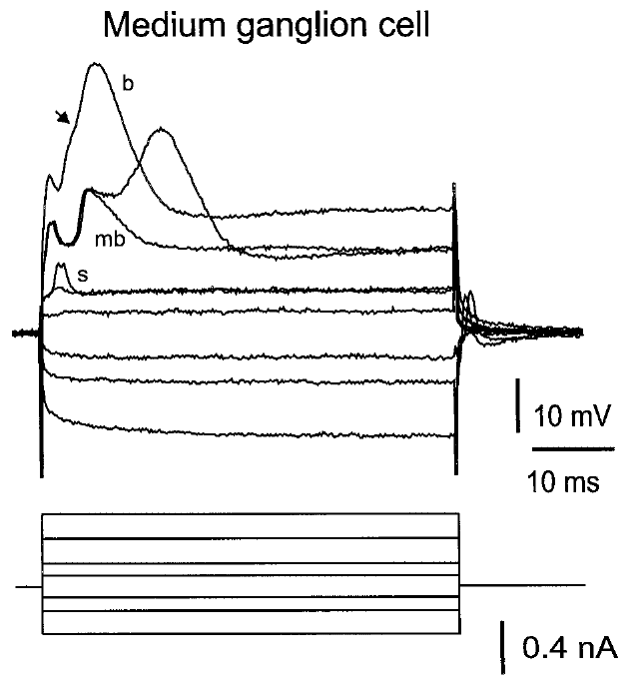
Medium ganglion cells generate distinct spike forms
An intrinsic response is generated by a cell’s membrane properties during controlled current injection. Grant and colleagues injected depolarizing and hyperpolarizing currents into medium ganglion cells and recorded a large broad spike together with smaller, narrower spikes.
The broad spikes had durations of approximately 8–15 ms and amplitudes of 40–60 mV in the intracellular recordings. Narrow spikes were approximately 1–2 ms wide, establishing that one identified cell could express distinct electrical events.
A single identified cell can express a large broad spike and smaller narrow spikes. The waveform differences constrain propagation and integration mechanisms, and in vivo experiments relate these spike types to circuit output and learning.
Grant et al. (1998), Fig. 8. Responses of an identified medium ganglion cell to current.
Sawtell et al. (2007), Fig. 1(A). Published anatomy of the medium ganglion cell circuit.
Grant et al. (1998)
34
Notes:
Teaching transcript:
An intrinsic response is generated by a cell’s membrane properties during controlled current injection. Grant and colleagues injected depolarizing and hyperpolarizing currents into medium ganglion cells and recorded a large broad spike together with smaller, narrower spikes.
The broad spikes had durations of approximately 8–15 ms and amplitudes of 40–60 mV in the intracellular recordings. Narrow spikes were approximately 1–2 ms wide, establishing that one identified cell could express distinct electrical events.
A single identified cell can express a large broad spike and smaller narrow spikes. The waveform differences constrain propagation and integration mechanisms, and in vivo experiments relate these spike types to circuit output and learning.
Depolarizing current makes membrane voltage less negative, while hyperpolarizing current makes it more negative. Different spike forms can reflect distinct initiation and propagation compartments within a single cell.
References:
K. Grant; Y. Sugawara; L. Gómez; V.Z. Han; C.C. Bell (1998). The Mormyrid Electrosensory Lobe In Vitro: Physiology and Pharmacology of Cells and Circuits. Journal of Neuroscience 18(15):6009–6025. https://doi.org/10.1523/JNEUROSCI.18-15-06009.1998
N.B. Sawtell; A. Williams; C.C. Bell (2007). Central Control of Dendritic Spikes Shapes the Responses of Purkinje-Like Cells through Spike Timing-Dependent Synaptic Plasticity. Journal of Neuroscience 27(7):1552–1565. https://doi.org/10.1523/JNEUROSCI.5302-06.2007
Grant et al. (1998), Fig. 8. Responses of an identified medium ganglion cell to current.
Figure source: https://doi.org/10.1523/JNEUROSCI.18-15-06009.1998
Sawtell et al. (2007), Fig. 1(A). Published anatomy of the medium ganglion cell circuit.
Figure source: https://doi.org/10.1523/JNEUROSCI.5302-06.2007

Slide 47
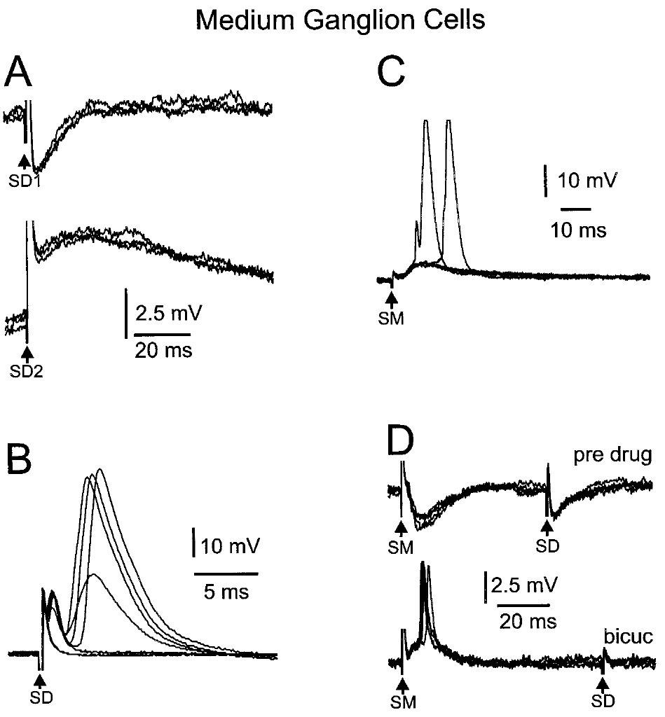
Synaptic pathway and spike threshold jointly shape firing
A spike threshold is the level of depolarizing drive needed to initiate a spike under specified conditions. Grant and colleagues stimulated deep pathways and parallel fibers while recording medium ganglion cells, comparing synaptic responses with the distinct spike forms of the same cell.
Deep stimulation could evoke inhibitory or excitatory potentials depending on stimulation position. Removing inhibition with bicuculline exposed broad-spike responses, while parallel-fiber stimulation could generate excitation and smaller spike events before stronger depolarization recruited broad spikes.
The results connect pathway recruitment to membrane excitability. Deep stimulation and parallel-fiber stimulation produce different synaptic potentials, and the firing of the recorded neuron reflects the combined influence of those potentials and the spike threshold.
Grant et al. (1998), Fig. 9(A–D). Medium ganglion responses to deep and molecular-layer stimuli.
Sawtell et al. (2007), Fig. 1(A). Published anatomy of the medium ganglion cell circuit.
Grant et al. (1998)
35
Notes:
Teaching transcript:
A spike threshold is the level of depolarizing drive needed to initiate a spike under specified conditions. Grant and colleagues stimulated deep pathways and parallel fibers while recording medium ganglion cells, comparing synaptic responses with the distinct spike forms of the same cell.
Deep stimulation could evoke inhibitory or excitatory potentials depending on stimulation position. Removing inhibition with bicuculline exposed broad-spike responses, while parallel-fiber stimulation could generate excitation and smaller spike events before stronger depolarization recruited broad spikes.
The results connect pathway recruitment to membrane excitability. Deep stimulation and parallel-fiber stimulation produce different synaptic potentials, and the firing of the recorded neuron reflects the combined influence of those potentials and the spike threshold.
A threshold is conditional on membrane state and inhibition. Unmasking a spike with an antagonist does not mean the antagonist created a new pathway; it can reveal excitation that was already present.
References:
K. Grant; Y. Sugawara; L. Gómez; V.Z. Han; C.C. Bell (1998). The Mormyrid Electrosensory Lobe In Vitro: Physiology and Pharmacology of Cells and Circuits. Journal of Neuroscience 18(15):6009–6025. https://doi.org/10.1523/JNEUROSCI.18-15-06009.1998
N.B. Sawtell; A. Williams; C.C. Bell (2007). Central Control of Dendritic Spikes Shapes the Responses of Purkinje-Like Cells through Spike Timing-Dependent Synaptic Plasticity. Journal of Neuroscience 27(7):1552–1565. https://doi.org/10.1523/JNEUROSCI.5302-06.2007
Grant et al. (1998), Fig. 9(A–D). Medium ganglion responses to deep and molecular-layer stimuli.
Figure source: https://doi.org/10.1523/JNEUROSCI.18-15-06009.1998
Sawtell et al. (2007), Fig. 1(A). Published anatomy of the medium ganglion cell circuit.
Figure source: https://doi.org/10.1523/JNEUROSCI.5302-06.2007

Slide 48
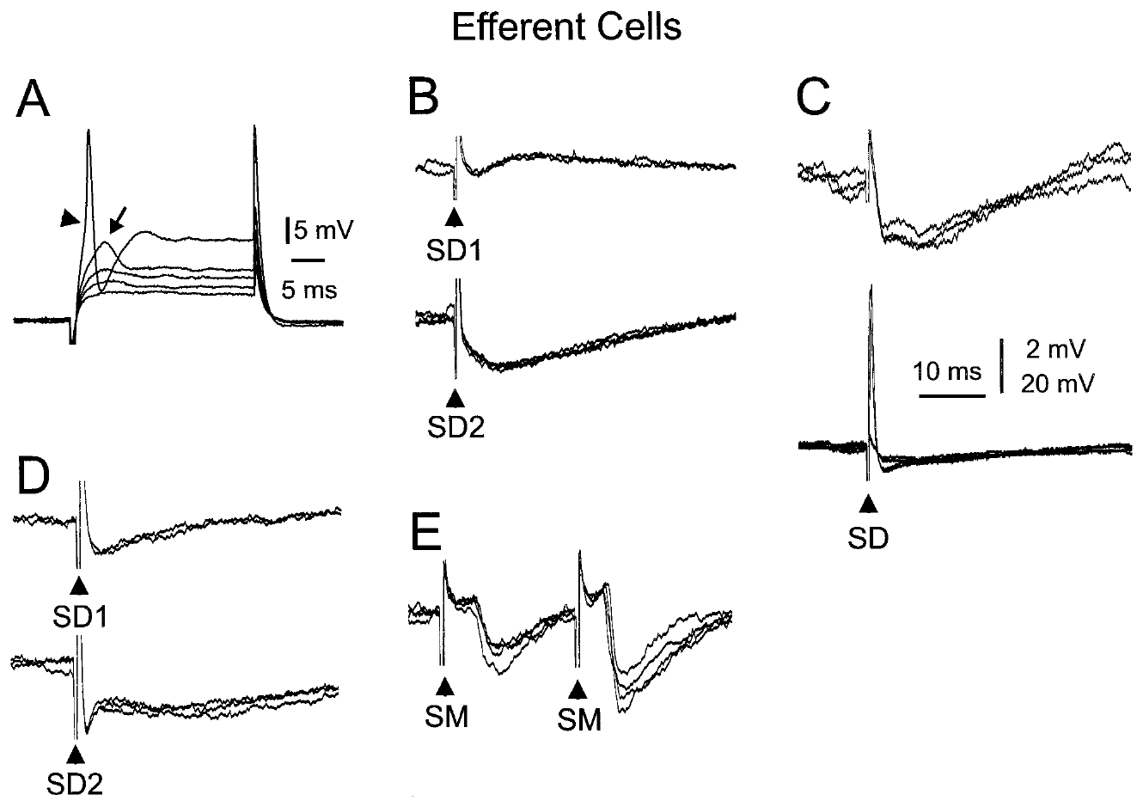
ELL output cells differ from local learning interneurons
An efferent cell is a neuron whose axon carries output away from the local sensory structure. Grant and colleagues recorded large ganglion and large fusiform cells, comparing their current-evoked firing and synaptic responses with those of medium ganglion interneurons.
The output cells responded to both deep-layer and molecular-layer stimulation, receiving excitatory and inhibitory influences whose balance depended on pathway and cell. These recordings place the medium ganglion cell’s local role within a circuit that also contains distinct sensory output neurons.
A local spike or synaptic potential is therefore not automatically the final signal delivered to downstream structures. The slice comparisons establish cellular and pathway diversity, while behavior-specific interpretation requires measurements linking output activity to controlled object stimuli in the intact animal.
Grant et al. (1998), Fig. 12(A–E). Current and synaptic responses of identified efferent cells.
Grant et al. (1998), Fig. 1. Anatomical organization of ELL cells and input layers.
Grant et al. (1998)
36
Notes:
Teaching transcript:
An efferent cell is a neuron whose axon carries output away from the local sensory structure. Grant and colleagues recorded large ganglion and large fusiform cells, comparing their current-evoked firing and synaptic responses with those of medium ganglion interneurons.
The output cells responded to both deep-layer and molecular-layer stimulation, receiving excitatory and inhibitory influences whose balance depended on pathway and cell. These recordings place the medium ganglion cell’s local role within a circuit that also contains distinct sensory output neurons.
A local spike or synaptic potential is therefore not automatically the final signal delivered to downstream structures. The slice comparisons establish cellular and pathway diversity, while behavior-specific interpretation requires measurements linking output activity to controlled object stimuli in the intact animal.
A fusiform cell has an elongated cell body. Cell morphology and axonal role distinguish these recorded efferent neurons from the Purkinje-like medium ganglion interneuron.
References:
K. Grant; Y. Sugawara; L. Gómez; V.Z. Han; C.C. Bell (1998). The Mormyrid Electrosensory Lobe In Vitro: Physiology and Pharmacology of Cells and Circuits. Journal of Neuroscience 18(15):6009–6025. https://doi.org/10.1523/JNEUROSCI.18-15-06009.1998
Grant et al. (1998), Fig. 12(A–E). Current and synaptic responses of identified efferent cells.
Figure source: https://doi.org/10.1523/JNEUROSCI.18-15-06009.1998
Grant et al. (1998), Fig. 1. Anatomical organization of ELL cells and input layers.
Figure source: https://doi.org/10.1523/JNEUROSCI.18-15-06009.1998

Slide 49
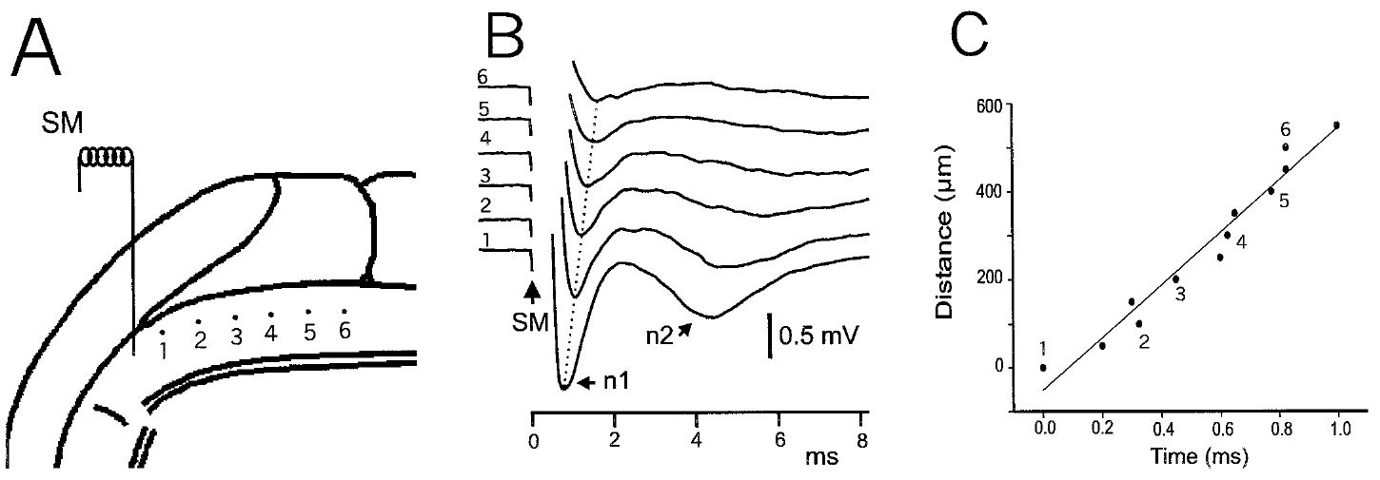
Parallel-fiber conduction distributes input through ELL
Conduction is propagation of an electrical signal along an axon. Grant and colleagues stimulated molecular-layer fibers and moved the recording site along the parallel-fiber beam, measuring how response latency changed with distance from the stimulation electrode.
Latency increased with the separation between stimulation and recording positions. The distance–time relationship supported propagation along the stimulated pathway, rather than simultaneous activation of every measured location by a single local postsynaptic event.
Spatially distributed input can reach dendrites across an organized sensory structure, because the parallel fibers conduct the signal along their length. The distance-dependent latency is a physical transmission property of the pathway in the slice.
Grant et al. (1998), Fig. 5(A–C). Field recordings along a stimulated parallel-fiber beam.
Grant et al. (1998), Fig. 1. ELL geometry and molecular-layer stimulation sites.
Grant et al. (1998)
37
Notes:
Teaching transcript:
Conduction is propagation of an electrical signal along an axon. Grant and colleagues stimulated molecular-layer fibers and moved the recording site along the parallel-fiber beam, measuring how response latency changed with distance from the stimulation electrode.
Latency increased with the separation between stimulation and recording positions. The distance–time relationship supported propagation along the stimulated pathway, rather than simultaneous activation of every measured location by a single local postsynaptic event.
Spatially distributed input can reach dendrites across an organized sensory structure, because the parallel fibers conduct the signal along their length. The distance-dependent latency is a physical transmission property of the pathway in the slice.
The parallel-fiber beam is the aligned bundle recruited by molecular-layer stimulation. Measuring distance and arrival time tests propagation without assigning a perceptual meaning to the signal.
References:
K. Grant; Y. Sugawara; L. Gómez; V.Z. Han; C.C. Bell (1998). The Mormyrid Electrosensory Lobe In Vitro: Physiology and Pharmacology of Cells and Circuits. Journal of Neuroscience 18(15):6009–6025. https://doi.org/10.1523/JNEUROSCI.18-15-06009.1998
Grant et al. (1998), Fig. 5(A–C). Field recordings along a stimulated parallel-fiber beam.
Figure source: https://doi.org/10.1523/JNEUROSCI.18-15-06009.1998
Grant et al. (1998), Fig. 1. ELL geometry and molecular-layer stimulation sites.
Figure source: https://doi.org/10.1523/JNEUROSCI.18-15-06009.1998

Slide 50
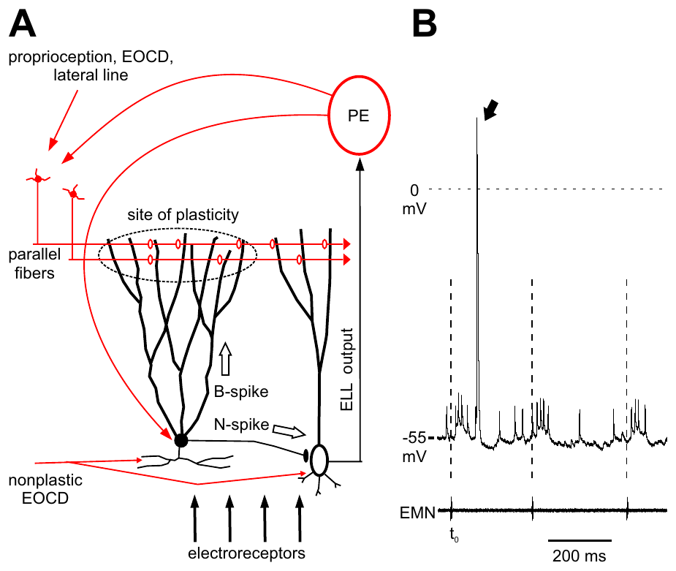
A motor command supplies context for sensory processing
A corollary discharge is an internal signal associated with a motor command. In mormyrid ELL, electric-organ command-related input accompanies peripheral electrosensory input, providing timing information about the animal’s own sensing action rather than only the external perturbation.
Sawtell and colleagues recorded medium ganglion cells in vivo and compared command-evoked activity, sensory responses, and broad versus narrow spikes. Their preparation separated the motor command signal from an experimentally delivered electric stimulus, allowing each contribution to be assessed.
The recordings support integration of self-generated context with sensory information. A corollary signal marks the timing of the discharge of the animal itself, and the neuron combines it with input from the electroreceptors.
Sawtell et al. (2007), Fig. 1(A–B). Published circuit anatomy and command-linked cell responses.
Sawtell et al. (2007)
38
Notes:
Teaching transcript:
A corollary discharge is an internal signal associated with a motor command. In mormyrid ELL, electric-organ command-related input accompanies peripheral electrosensory input, providing timing information about the animal’s own sensing action rather than only the external perturbation.
Sawtell and colleagues recorded medium ganglion cells in vivo and compared command-evoked activity, sensory responses, and broad versus narrow spikes. Their preparation separated the motor command signal from an experimentally delivered electric stimulus, allowing each contribution to be assessed.
The recordings support integration of self-generated context with sensory information. A corollary signal marks the timing of the discharge of the animal itself, and the neuron combines it with input from the electroreceptors.
The corollary signal follows the command pathway even when the experimental preparation prevents the usual movement or electric emission. This permits a controlled comparison with separately supplied sensory stimulation.
References:
N.B. Sawtell; A. Williams; C.C. Bell (2007). Central Control of Dendritic Spikes Shapes the Responses of Purkinje-Like Cells through Spike Timing-Dependent Synaptic Plasticity. Journal of Neuroscience 27(7):1552–1565. https://doi.org/10.1523/JNEUROSCI.5302-06.2007
Sawtell et al. (2007), Fig. 1(A–B). Published circuit anatomy and command-linked cell responses.
Figure source: https://doi.org/10.1523/JNEUROSCI.5302-06.2007

Slide 51
A corollary discharge marks the animal's own command
A corollary discharge is an internal copy of a motor command that is sent to sensory areas. In the mormyrid ELL, a signal associated with the electric-organ command accompanies the input from the electroreceptors. The signal accompanies each motor command, whether or not an object is nearby.
Sawtell and colleagues recorded medium ganglion cells in vivo and compared command-evoked activity with sensory responses. The preparation separated the motor command signal from an electric stimulus delivered by the experimenter. The recordings were made in the intact animal under controlled conditions.
The command signal tells the cell when the fish itself discharged. The cell can then interpret incoming electrosensory input relative to the timing of the self-generated pulse. Self-generated context allows the cell to relate sensory input to the sensing action.
Sawtell et al. (2007), Fig. 1(A–B). Published circuit anatomy and command-linked cell responses.
Sawtell et al. (2007)
38a
Notes:
The brain keeps a record of the animal's own sensing actions.
Definition.
A corollary discharge is an internal signal associated with a motor command.
In the ELL.
Electric-organ command-related input accompanies peripheral electrosensory input.
Experiment.
Medium ganglion cells were recorded in vivo.
Command-evoked activity, sensory responses and spike types were compared.
Separating signals.
The preparation separated the motor command from a stimulus that the experimenter delivered.
Meaning.
The command timing provides context about the sensing action and not an image of an object.
The ELL circuit.
Medium ganglion cells receive electroreceptor input and command-related input.
They are Purkinje-like interneurons with apical dendrites.
Not an image.
A corollary signal marks timing and does not carry an electric image of an object.
Why context is useful.
A cell that knows when the fish discharged can interpret the arriving electric input relative to the pulse that the fish generated, and the same input means something different at different moments of the command cycle.
References:
N.B. Sawtell; A. Williams; C.C. Bell (2007). Central Control of Dendritic Spikes Shapes the Responses of Purkinje-Like Cells through Spike Timing-Dependent Synaptic Plasticity. Journal of Neuroscience 27(7):1552–1565. https://doi.org/10.1523/JNEUROSCI.5302-06.2007

Slide 52
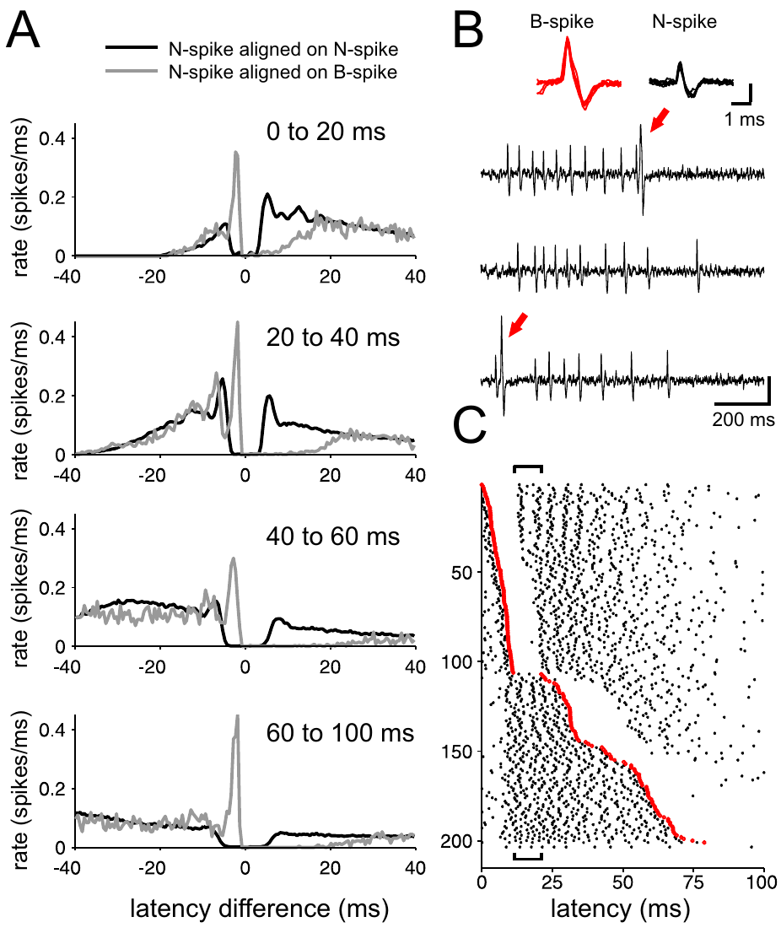
Broad and narrow spikes have different circuit roles
N spikes are narrow axonal spikes forming the principal medium ganglion output, whereas B spikes are broad dendritic events associated with parallel-fiber plasticity. Sawtell and colleagues recorded both event types to determine how one cell’s output and learning-related signals interact.
B spikes were associated with distinct patterns of nearby N spikes, and their timing varied within the electric-organ command cycle. The relationship established that the two event types can interact while remaining distinguishable in the same recordings.
The circuit interpretation separates immediate output from an event that regulates subsequent synaptic change. N spikes deliver the output of the cell, and B spikes carry information that guides plasticity at the parallel-fiber synapses.
Sawtell et al. (2007), Fig. 2(A–C). Broad-spike events and neighboring narrow-spike patterns.
Sawtell et al. (2007), Fig. 1(A). Published anatomy of the medium ganglion cell circuit.
Sawtell et al. (2007)
39
Notes:
Teaching transcript:
N spikes are narrow axonal spikes forming the principal medium ganglion output, whereas B spikes are broad dendritic events associated with parallel-fiber plasticity. Sawtell and colleagues recorded both event types to determine how one cell’s output and learning-related signals interact.
B spikes were associated with distinct patterns of nearby N spikes, and their timing varied within the electric-organ command cycle. The relationship established that the two event types can interact while remaining distinguishable in the same recordings.
The circuit interpretation separates immediate output from an event that regulates subsequent synaptic change. N spikes deliver the output of the cell, and B spikes carry information that guides plasticity at the parallel-fiber synapses.
An axonal event travels along the output pathway; a dendritic event changes activity in the input-receiving compartment. Distinguishing them avoids equating all spikes in one neuron with the same functional signal.
References:
N.B. Sawtell; A. Williams; C.C. Bell (2007). Central Control of Dendritic Spikes Shapes the Responses of Purkinje-Like Cells through Spike Timing-Dependent Synaptic Plasticity. Journal of Neuroscience 27(7):1552–1565. https://doi.org/10.1523/JNEUROSCI.5302-06.2007
Sawtell et al. (2007), Fig. 2(A–C). Broad-spike events and neighboring narrow-spike patterns.
Figure source: https://doi.org/10.1523/JNEUROSCI.5302-06.2007
Sawtell et al. (2007), Fig. 1(A). Published anatomy of the medium ganglion cell circuit.
Figure source: https://doi.org/10.1523/JNEUROSCI.5302-06.2007

Slide 53
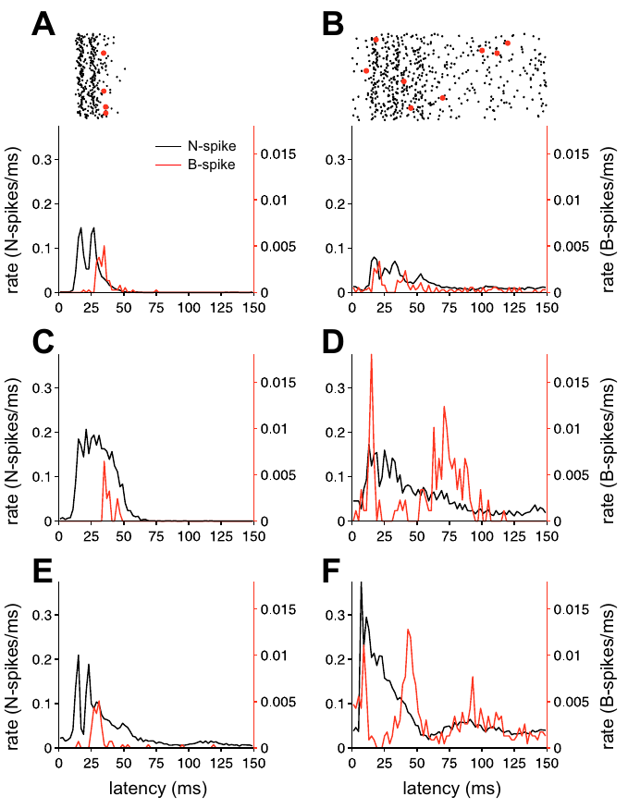
Command timing can dissociate excitation and B spikes
A command cycle is the interval following one electric-organ motor command. Sawtell and colleagues aligned medium ganglion recordings to that command and compared the time courses of narrow-spike output with broad-spike probability.
B-spike probability could fall during an interval approximately 10–20 ms after the command even while N-spike output was elevated. The different time courses indicated that increased output did not require a matching increase in the learning-related dendritic event.
The dissociation supports control at distinct compartments or input pathways rather than one scalar excitability change affecting every spike equally. The recordings establish temporal relationships between the two spike types, and pharmacological manipulation and conductance measurements supplied additional evidence about the inhibitory mechanism.
Sawtell et al. (2007), Fig. 3(A–F). Command-evoked patterns of narrow and broad spikes.
Sawtell et al. (2007), Fig. 1(A). Published anatomy of the medium ganglion cell circuit.
Sawtell et al. (2007)
40
Notes:
Teaching transcript:
A command cycle is the interval following one electric-organ motor command. Sawtell and colleagues aligned medium ganglion recordings to that command and compared the time courses of narrow-spike output with broad-spike probability.
B-spike probability could fall during an interval approximately 10–20 ms after the command even while N-spike output was elevated. The different time courses indicated that increased output did not require a matching increase in the learning-related dendritic event.
The dissociation supports control at distinct compartments or input pathways rather than one scalar excitability change affecting every spike equally. The recordings establish temporal relationships between the two spike types, and pharmacological manipulation and conductance measurements supplied additional evidence about the inhibitory mechanism.
Command alignment compares repeated trials on a common temporal reference. A pause in one spike class during a burst in another constrains how inhibition can act on the cell.
References:
N.B. Sawtell; A. Williams; C.C. Bell (2007). Central Control of Dendritic Spikes Shapes the Responses of Purkinje-Like Cells through Spike Timing-Dependent Synaptic Plasticity. Journal of Neuroscience 27(7):1552–1565. https://doi.org/10.1523/JNEUROSCI.5302-06.2007
Sawtell et al. (2007), Fig. 3(A–F). Command-evoked patterns of narrow and broad spikes.
Figure source: https://doi.org/10.1523/JNEUROSCI.5302-06.2007
Sawtell et al. (2007), Fig. 1(A). Published anatomy of the medium ganglion cell circuit.
Figure source: https://doi.org/10.1523/JNEUROSCI.5302-06.2007

Slide 54
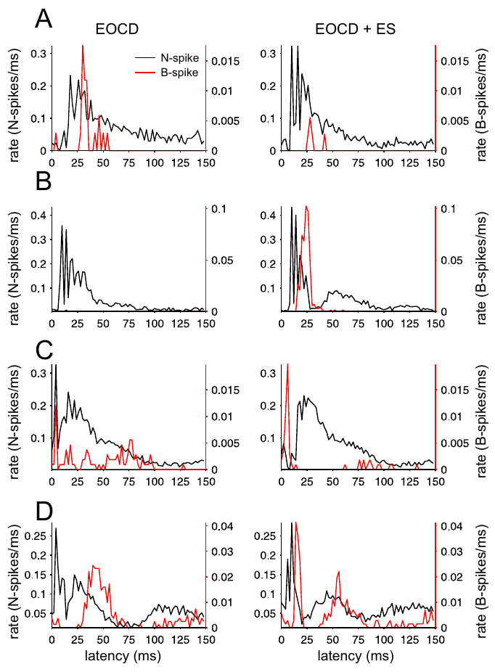
Electrosensory stimuli affect the two spike types unequally
A compartment-specific response is a change that differs across a neuron’s axonal and dendritic events. Sawtell and colleagues varied electrosensory stimuli while recording N spikes and B spikes in medium ganglion cells, holding the command reference available for comparison.
Some stimuli increased N spikes while decreasing B spikes, and other conditions produced the opposite pattern. Thus, sensory excitation and learning-related dendritic firing could not be summarized reliably by one pooled spike rate.
The result supports functional separation within the recorded cell. The compartments participate in one circuit, and output and plasticity are influenced differently by incoming sensory and central signals.
Sawtell et al. (2007), Fig. 4(A–D). Narrow and broad responses to controlled electrosensory stimuli.
Sawtell et al. (2007), Fig. 1(A). Published anatomy of the medium ganglion cell circuit.
Sawtell et al. (2007)
41
Notes:
Teaching transcript:
A compartment-specific response is a change that differs across a neuron’s axonal and dendritic events. Sawtell and colleagues varied electrosensory stimuli while recording N spikes and B spikes in medium ganglion cells, holding the command reference available for comparison.
Some stimuli increased N spikes while decreasing B spikes, and other conditions produced the opposite pattern. Thus, sensory excitation and learning-related dendritic firing could not be summarized reliably by one pooled spike rate.
The result supports functional separation within the recorded cell. The compartments participate in one circuit, and output and plasticity are influenced differently by incoming sensory and central signals.
Pooling broad and narrow events would conceal changes in opposite directions. Their separate classification preserves information about how sensory input affects immediate output and the event associated with synaptic adaptation.
References:
N.B. Sawtell; A. Williams; C.C. Bell (2007). Central Control of Dendritic Spikes Shapes the Responses of Purkinje-Like Cells through Spike Timing-Dependent Synaptic Plasticity. Journal of Neuroscience 27(7):1552–1565. https://doi.org/10.1523/JNEUROSCI.5302-06.2007
Sawtell et al. (2007), Fig. 4(A–D). Narrow and broad responses to controlled electrosensory stimuli.
Figure source: https://doi.org/10.1523/JNEUROSCI.5302-06.2007
Sawtell et al. (2007), Fig. 1(A). Published anatomy of the medium ganglion cell circuit.
Figure source: https://doi.org/10.1523/JNEUROSCI.5302-06.2007

Slide 55
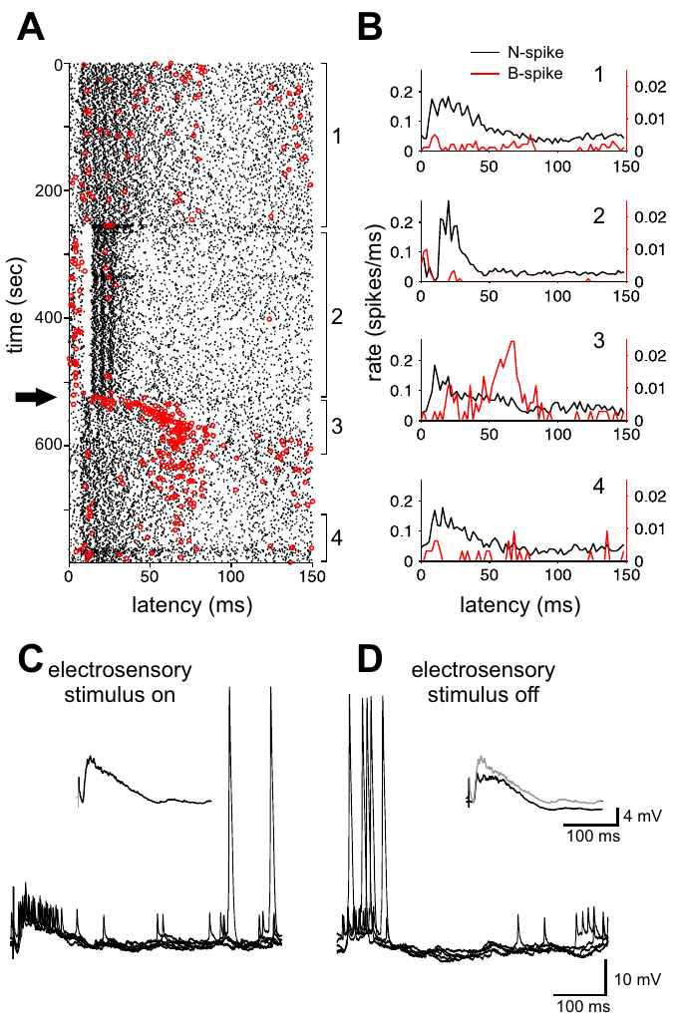
Recent stimulation changes command-linked B spikes
Recent context includes the stimulus sequence experienced before the currently measured command. Sawtell and colleagues examined B-spike responses during and after repeated electrosensory stimulation, distinguishing immediate stimulus effects from changes that persisted into subsequent command cycles.
The history of stimulation altered the probability and timing of B spikes. In some conditions, switching off the electrosensory stimulus produced a transient increase in early B-spike activity, even though the command signal remained the temporal reference.
The observation connects sensory history to the event controlling plasticity. B-spike activity after the stimulus ends reflects the preceding stimulation, with the command signal as the temporal reference.
Sawtell et al. (2007), Fig. 5(A–D). Broad-spike patterns before and after electrosensory stimulation.
Sawtell et al. (2007), Fig. 1(A). Published anatomy of the medium ganglion cell circuit.
Sawtell et al. (2007)
42
Notes:
Teaching transcript:
Recent context includes the stimulus sequence experienced before the currently measured command. Sawtell and colleagues examined B-spike responses during and after repeated electrosensory stimulation, distinguishing immediate stimulus effects from changes that persisted into subsequent command cycles.
The history of stimulation altered the probability and timing of B spikes. In some conditions, switching off the electrosensory stimulus produced a transient increase in early B-spike activity, even though the command signal remained the temporal reference.
The observation connects sensory history to the event controlling plasticity. B-spike activity after the stimulus ends reflects the preceding stimulation, with the command signal as the temporal reference.
A response after stimulus removal can reflect the circuit state established during stimulation. The experiment measures that change in state without requiring the external stimulus to remain present.
References:
N.B. Sawtell; A. Williams; C.C. Bell (2007). Central Control of Dendritic Spikes Shapes the Responses of Purkinje-Like Cells through Spike Timing-Dependent Synaptic Plasticity. Journal of Neuroscience 27(7):1552–1565. https://doi.org/10.1523/JNEUROSCI.5302-06.2007
Sawtell et al. (2007), Fig. 5(A–D). Broad-spike patterns before and after electrosensory stimulation.
Figure source: https://doi.org/10.1523/JNEUROSCI.5302-06.2007
Sawtell et al. (2007), Fig. 1(A). Published anatomy of the medium ganglion cell circuit.
Figure source: https://doi.org/10.1523/JNEUROSCI.5302-06.2007

Slide 56
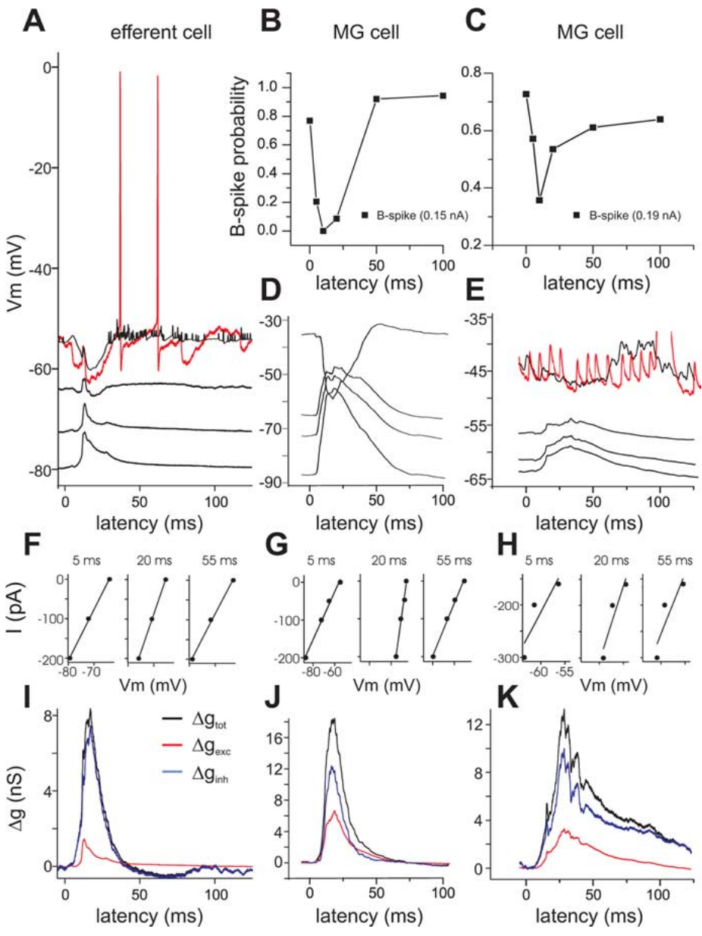
Command-evoked inhibition can coexist with excitation
A synaptic conductance is a change in membrane ion permeability produced by synaptic input. Sawtell and colleagues examined command-evoked membrane responses over different holding potentials, using their voltage dependence to separate excitatory and inhibitory contributions in ELL cells.
The recordings supported inhibition occurring during command-evoked excitation, including in medium ganglion cells. A reduced B-spike probability therefore did not require a complete absence of excitatory synaptic drive during that interval.
Concurrent inputs can affect dendritic firing and axonal output differently because their timing, location, and reversal properties differ. The conductance analysis separates the excitatory and inhibitory contributions to the command-evoked response.
Sawtell et al. (2007), Fig. 7(A–K). Conductance and voltage evidence for concurrent inhibition.
Sawtell et al. (2007), Fig. 1(A). Published anatomy of the medium ganglion cell circuit.
Sawtell et al. (2007)
43
Notes:
Teaching transcript:
A synaptic conductance is a change in membrane ion permeability produced by synaptic input. Sawtell and colleagues examined command-evoked membrane responses over different holding potentials, using their voltage dependence to separate excitatory and inhibitory contributions in ELL cells.
The recordings supported inhibition occurring during command-evoked excitation, including in medium ganglion cells. A reduced B-spike probability therefore did not require a complete absence of excitatory synaptic drive during that interval.
Concurrent inputs can affect dendritic firing and axonal output differently because their timing, location, and reversal properties differ. The conductance analysis separates the excitatory and inhibitory contributions to the command-evoked response.
A holding potential is the membrane voltage imposed during the comparison. Changes in the response across holding potentials help distinguish synaptic currents with different reversal properties.
References:
N.B. Sawtell; A. Williams; C.C. Bell (2007). Central Control of Dendritic Spikes Shapes the Responses of Purkinje-Like Cells through Spike Timing-Dependent Synaptic Plasticity. Journal of Neuroscience 27(7):1552–1565. https://doi.org/10.1523/JNEUROSCI.5302-06.2007
Sawtell et al. (2007), Fig. 7(A–K). Conductance and voltage evidence for concurrent inhibition.
Figure source: https://doi.org/10.1523/JNEUROSCI.5302-06.2007
Sawtell et al. (2007), Fig. 1(A). Published anatomy of the medium ganglion cell circuit.
Figure source: https://doi.org/10.1523/JNEUROSCI.5302-06.2007

Slide 57
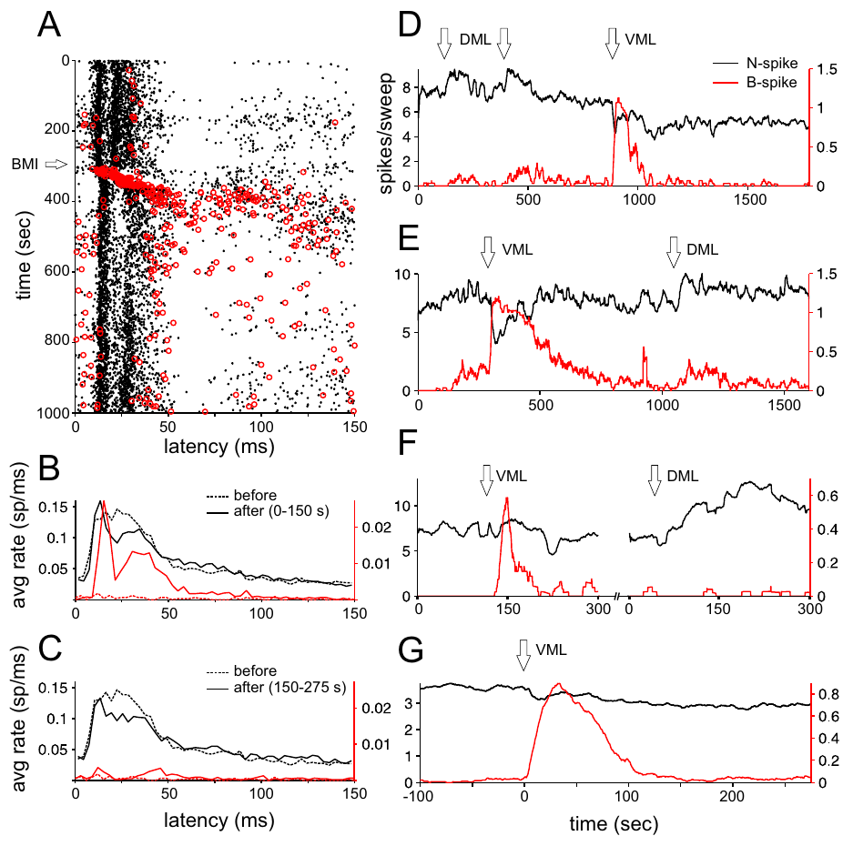
Blocking inhibition preferentially releases B spikes
Disinhibition is increased activity following removal of an inhibitory influence. Sawtell and colleagues injected bicuculline locally into the ventral molecular layer, blocking GABA-A receptor-mediated inhibition while recording command-linked medium ganglion spikes.
B-spike probability increased strongly just after the injection, with much less immediate change in N-spike output. More superficial injections had weaker effects on B spikes, supplying a spatial comparison rather than treating all local antagonist application as equivalent.
The manipulation supports a potent inhibitory control over dendritic events. Disinhibition therefore releases the dendritic event at the ventral molecular layer, where the injection was made.
Sawtell et al. (2007), Fig. 8(A–G). Effects of local bicuculline on narrow and broad spikes.
Sawtell et al. (2007), Fig. 1(A). Published anatomy of the medium ganglion cell circuit.
Sawtell et al. (2007)
44
Notes:
Teaching transcript:
Disinhibition is increased activity following removal of an inhibitory influence. Sawtell and colleagues injected bicuculline locally into the ventral molecular layer, blocking GABA-A receptor-mediated inhibition while recording command-linked medium ganglion spikes.
B-spike probability increased strongly just after the injection, with much less immediate change in N-spike output. More superficial injections had weaker effects on B spikes, supplying a spatial comparison rather than treating all local antagonist application as equivalent.
The manipulation supports a potent inhibitory control over dendritic events. Disinhibition therefore releases the dendritic event at the ventral molecular layer, where the injection was made.
A local antagonist provides causal evidence that the blocked receptor pathway contributes to suppression. The deeper and more superficial injection comparisons constrain where the effective inhibitory influence is expressed.
References:
N.B. Sawtell; A. Williams; C.C. Bell (2007). Central Control of Dendritic Spikes Shapes the Responses of Purkinje-Like Cells through Spike Timing-Dependent Synaptic Plasticity. Journal of Neuroscience 27(7):1552–1565. https://doi.org/10.1523/JNEUROSCI.5302-06.2007
Sawtell et al. (2007), Fig. 8(A–G). Effects of local bicuculline on narrow and broad spikes.
Figure source: https://doi.org/10.1523/JNEUROSCI.5302-06.2007
Sawtell et al. (2007), Fig. 1(A). Published anatomy of the medium ganglion cell circuit.
Figure source: https://doi.org/10.1523/JNEUROSCI.5302-06.2007

Slide 58
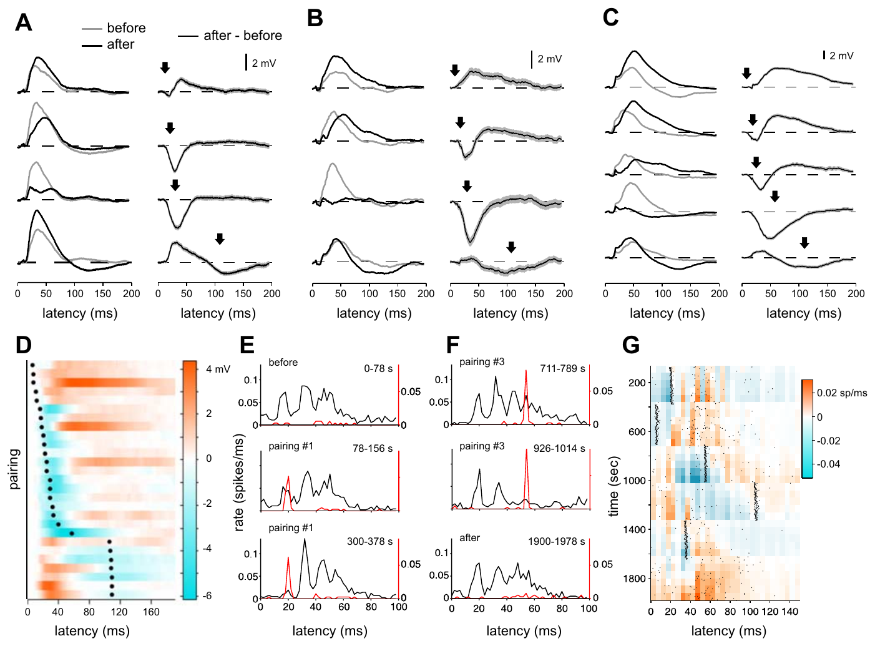
B-spike timing determines the direction of plasticity
Spike-timing-dependent plasticity is a lasting synaptic change whose direction depends on relative activity timing. Sawtell and colleagues repeatedly evoked a B spike at defined delays, approximately 8–110 ms after the electric-organ command, then compared command-evoked responses before and after pairing.
Pairing near the peak of the command response tended to reduce subsequent excitation, whereas earlier or later pairings could enhance it. Corresponding changes in N-spike output linked the altered synaptic response to the cell’s principal output event.
The results establish timing-dependent adaptation in the studied circuit. The results connect command context, dendritic events, synaptic strength and axonal activity, so the timing of a B spike determines whether the response to a command is reduced or enhanced.
Sawtell et al. (2007), Fig. 9(A–G). Pairing effects on synaptic responses and narrow-spike output.
Sawtell et al. (2007), Fig. 1(A). Published anatomy of the medium ganglion cell circuit.
Sawtell et al. (2007)
45
Notes:
Teaching transcript:
Spike-timing-dependent plasticity is a lasting synaptic change whose direction depends on relative activity timing. Sawtell and colleagues repeatedly evoked a B spike at defined delays, approximately 8–110 ms after the electric-organ command, then compared command-evoked responses before and after pairing.
Pairing near the peak of the command response tended to reduce subsequent excitation, whereas earlier or later pairings could enhance it. Corresponding changes in N-spike output linked the altered synaptic response to the cell’s principal output event.
The results establish timing-dependent adaptation in the studied circuit. The results connect command context, dendritic events, synaptic strength and axonal activity, so the timing of a B spike determines whether the response to a command is reduced or enhanced.
Repeated pairing isolates the timing relationship experimentally. A change in output after pairing supports a functional consequence of synaptic adaptation, while the actual behavioral readout remains a separate level of evidence.
References:
N.B. Sawtell; A. Williams; C.C. Bell (2007). Central Control of Dendritic Spikes Shapes the Responses of Purkinje-Like Cells through Spike Timing-Dependent Synaptic Plasticity. Journal of Neuroscience 27(7):1552–1565. https://doi.org/10.1523/JNEUROSCI.5302-06.2007
Sawtell et al. (2007), Fig. 9(A–G). Pairing effects on synaptic responses and narrow-spike output.
Figure source: https://doi.org/10.1523/JNEUROSCI.5302-06.2007
Sawtell et al. (2007), Fig. 1(A). Published anatomy of the medium ganglion cell circuit.
Figure source: https://doi.org/10.1523/JNEUROSCI.5302-06.2007

Slide 59
Spike-timing-dependent plasticity depends on relative timing
In spike-timing-dependent plasticity, the direction of a lasting synaptic change depends on the relative timing of two events. The same pairing can strengthen a synapse at one delay and weaken it at another.
Sawtell and colleagues repeatedly evoked a B spike at delays between about 8 and 110 ms after the electric-organ command and compared command-evoked responses before and after pairing. Pairing near the peak of the response tended to reduce later excitation, whereas earlier or later pairings could enhance it.
Changes in N-spike output accompanied the altered synaptic response. The timing of the B spike relative to the command therefore determines whether the cell's response to the command is reduced or enhanced.
Sawtell et al. (2007), Fig. 9(A–G). Pairing effects on synaptic responses and narrow-spike output.
Sawtell et al. (2007), Fig. 1(A). Published anatomy of the medium ganglion cell circuit.
Sawtell et al. (2007)
45a
Notes:
Plasticity in this circuit depends on when a dendritic event occurs relative to the command.
Definition.
Spike-timing-dependent plasticity is a lasting synaptic change whose direction depends on relative timing.
Pairing.
A B spike was repeatedly evoked at delays from about 8 to 110 milliseconds after the command.
Result.
Pairing near the peak of the command response reduced later excitation.
Earlier or later pairings could enhance it.
Link to output.
N-spike output changed with the altered synaptic response.
Meaning.
Command context, dendritic events, synaptic strength and axonal activity are connected in one adaptive mechanism.
Pairing protocol.
A B spike was evoked repeatedly at a defined delay.
Command-evoked responses were compared before and after pairing.
Direction of change.
Pairing near the peak of the command response reduced later excitation.
Earlier or later pairings enhanced it.
Output of the cell.
N spikes are the principal output of the medium ganglion cell.
Changes in N-spike output tie the altered synaptic response to the output event.
References:
N.B. Sawtell; A. Williams; C.C. Bell (2007). Central Control of Dendritic Spikes Shapes the Responses of Purkinje-Like Cells through Spike Timing-Dependent Synaptic Plasticity. Journal of Neuroscience 27(7):1552–1565. https://doi.org/10.1523/JNEUROSCI.5302-06.2007

Slide 60
Key takeaways
Active electrolocation samples self-generated fields. Object-induced current changes form electric images across the skin; recognition in darkness is a near-field capacity.
Object recognition can tolerate sensory transformations. Size constancy, rotation tolerance, and generalization depend on the tested geometry, distance, and learning conditions.
Movement creates additional distance information. Natural approaches shape sampling density and electrosensory flow; reconstructed relative gradients are candidate cues, not proven neural computations.
Afferent timing depends on sensory history. Local amplitude changes alter first-spike latency, but pulse intervals, baseline adaptation, and sensing rate also modify the code.
ELL integration is pathway and receptor specific. AMPA and NMDA receptors contribute excitation; GABA-A and glycine receptors contribute inhibition in pathway-dependent combinations.
Dendritic events regulate adaptation separately from output. Command-linked inhibition can suppress B spikes while N spikes persist; B-spike timing changes synaptic responses and subsequent output.
von der Emde et al. (2010); Hofmann et al. (2017); Schumacher et al. (2017); Sawtell et al. (2006); Grant et al. (1998); Sawtell et al. (2007)
46
Notes:
Active electrolocation samples self-generated fields. Object-induced current changes form electric images across the skin; recognition in darkness is a near-field capacity.
Object recognition can tolerate sensory transformations. Size constancy, rotation tolerance, and generalization depend on the tested geometry, distance, and learning conditions.
Movement creates additional distance information. Natural approaches shape sampling density and electrosensory flow; reconstructed relative gradients are candidate cues, not proven neural computations.
Afferent timing depends on sensory history. Local amplitude changes alter first-spike latency, but pulse intervals, baseline adaptation, and sensing rate also modify the code.
ELL integration is pathway and receptor specific. AMPA and NMDA receptors contribute excitation; GABA-A and glycine receptors contribute inhibition in pathway-dependent combinations.
Dendritic events regulate adaptation separately from output. Command-linked inhibition can suppress B spikes while N spikes persist; B-spike timing changes synaptic responses and subsequent output.
References:
G. von der Emde; K. Behr; B. Bouton; J. Engelmann; S. Fetz; C. Folde (2010). 3-Dimensional scene perception during active electrolocation in a weakly electric pulse fish. Frontiers in Behavioral Neuroscience 4:26. https://doi.org/10.3389/fnbeh.2010.00026
V. Hofmann; J.I. Sanguinetti-Scheck; L. Gómez-Sena; J. Engelmann (2017). Sensory Flow as a Basis for a Novel Distance Cue in Freely Behaving Electric Fish. Journal of Neuroscience 37(2):302–312. https://doi.org/10.1523/JNEUROSCI.1361-16.2016
S. Schumacher; T. Burt de Perera; G. von der Emde (2017). Electrosensory capture during multisensory discrimination of nearby objects in the weakly electric fish Gnathonemus petersii. Scientific Reports 7:43665. https://doi.org/10.1038/srep43665
N.B. Sawtell; A. Williams; P.D. Roberts; G. von der Emde; C.C. Bell (2006). Effects of Sensing Behavior on a Latency Code. Journal of Neuroscience 26(32):8221–8234. https://doi.org/10.1523/JNEUROSCI.1508-06.2006
K. Grant; Y. Sugawara; L. Gómez; V.Z. Han; C.C. Bell (1998). The Mormyrid Electrosensory Lobe In Vitro: Physiology and Pharmacology of Cells and Circuits. Journal of Neuroscience 18(15):6009–6025. https://doi.org/10.1523/JNEUROSCI.18-15-06009.1998
N.B. Sawtell; A. Williams; C.C. Bell (2007). Central Control of Dendritic Spikes Shapes the Responses of Purkinje-Like Cells through Spike Timing-Dependent Synaptic Plasticity. Journal of Neuroscience 27(7):1552–1565. https://doi.org/10.1523/JNEUROSCI.5302-06.2007

