Slide 1
Othello
By: Taylor Spooner
Jordan White
Stephen Robinson
Chandler Underwood

Slide 2
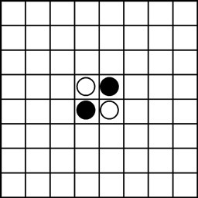
Object of othello
Played on 8x8 board, with black and white discs
One player controls black discs, the other controls white
Have the most discs of your color on the board at end of game
End of game occurs when no one can make a move

Slide 3
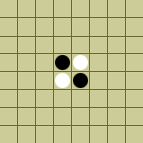
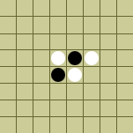

Rules
Players take turns placing discs one at a time onto the board
For a move to be legal, disc must flank discs of other color
“Flank” means to have a piece of your color on both sides of one or more pieces of other color
When a flank occurs, all flanked discs change color
If a legal move cannot be made, player must pass
Game ends when there are no more legal moves for either player

Slide 4
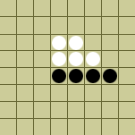
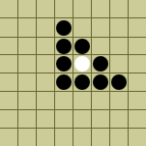
Rules Continued
Flanks may be done horizontally, vertically, or diagonally
It is possible to flank in more than one direction at a time

Slide 5
Scoring Rules
Each disc on the board of your color is one point
Player with the most points at end of game wins
You lose points for every disc that gets flanked
You earn points by flanking opponents discs

Slide 6
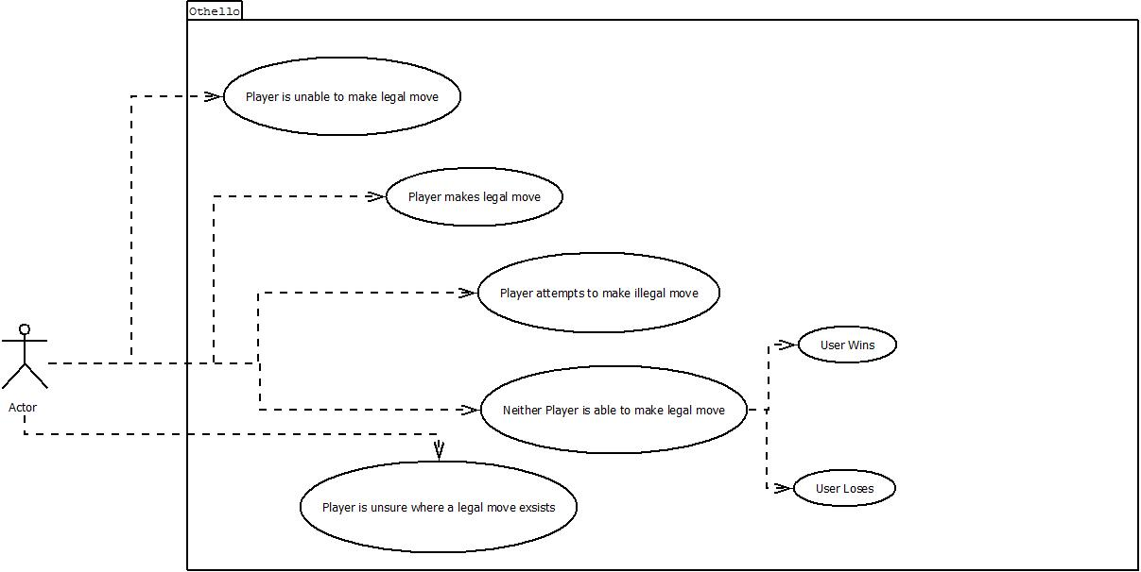

Slide 7
Use cases
Player makes legal move
Discs that the player flanked change color
Turn ends, and GUI updates score and player turn
Next player repeats process
Player attempts to make illegal move
Screen flashes
It is still their turn
Player is unable to make legal move
GUI notifies player of this
Player must press “Pass” button and end turn

Slide 8
Use Cases continued
Neither player is able to make legal move
Game is over
GUI updates with final scores and announces the winner
Player is unsure where a legal move exists
Player presses “Hint” button on GUI
Any legal moves are highlighted in a special color
Player makes move
Turn ends

Slide 9
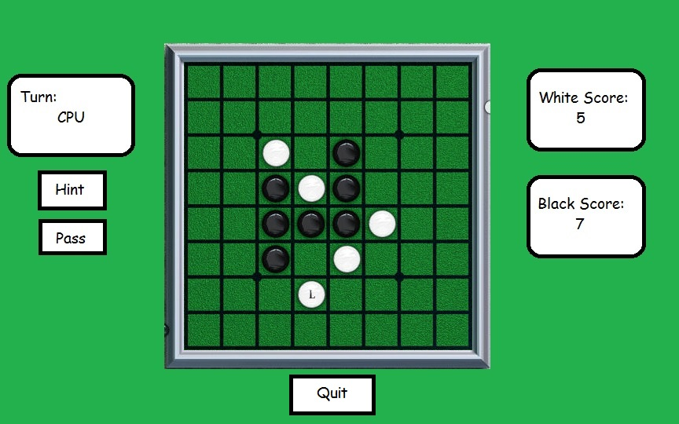
User Interface

Slide 10
AI Player
Two types of AI players “Dumb” and “Smart”
Dumb player makes random legal move
Smart player will make move that will earn the most points in the long run
Game tree will be examined multiple moves down.
Branch will be selected on
Maximizing number of points gained.
Minimizing points lost
Gaining edges and corners.
AI players will have a timer so they wait a set amount of time before they move

Slide 11
Project details
Team Member Assignments:
AI – Stephen
Game State – Jordan
GUI – Taylor/Chandler
Player Interface – Chandler/Taylor

Slide 12
Project Schedule
Week of 9/29 – 10/05
Work on requirements document (3 hours)
Week of 10/06 – 10/12
Turn in requirements document and start design specification (3 hours)
Week of 10/13 – 10/19
Fall Break
Week of 10/20 – 10/26
Finish design specification and start coding Game State and GUI (6 hours)
Week of 10/27 – 11/02
Continue developing Game State/GUI, start coding AI and player interface (6 hours)
Week of 11/03 – 11/09
Finish Game State/GUI, continue developing AI and player interface (8 hours)
Continued on next slide….

Slide 13
Continued schedule
Week of 11/10 – 11/16
Complete AI and player interface, begin testing to succeed (4 hours)
Week of 11/17 – 11/23
Continue testing and polishing (3 hours)
Week of 11/24 – 11/30
Thanksgiving Break
Week of 12/01 – 12/07
Finish Game (2 hours)

Slide 14
Conclusion
In summary:
We are implementing the game of Othello
Game is played by converting opponents pieces to your own color
Whichever player has the most discs at the end of the game wins
We will have two AI players, one “dumb” and one “smart”
Major Challenges
Coding the AI to be “smart”
Coordinating our code between all four team members
Keeping track of variable/method names.
When multiple flankings occur

Slide 15
Thank You. Any Questions?

Slide 16
Sources
http://gamesmuseum.uwaterloo.ca/VirtualExhibits/Whitehill/othello/hoyle.jpg
http://www.cs.vassar.edu/~weltyc/oldcourses/265.98f/assign/othello/rules.html

