Slide 1

Scrumptious Finance
COSC 310 project

Slide 2







Our Goal
Our goal with scrumptious finance was to create a centralized hub for all of ones finances
With Scrumptious Finance we wanted to make it easy for users to see the status of all their different accounts along with anlysis on their finances

Slide 3
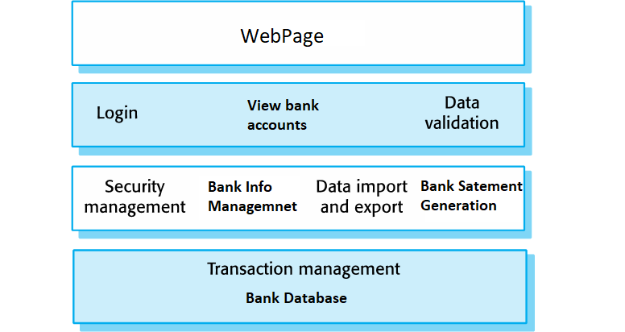
System Structure
User Interface: Web Browser
Authentication and Authorization: Login, view Bank Accounts, Data validation
Info Retrieval: Security, Bank data management, Bank Statement generation
Transaction Management: Our site Database

Slide 4
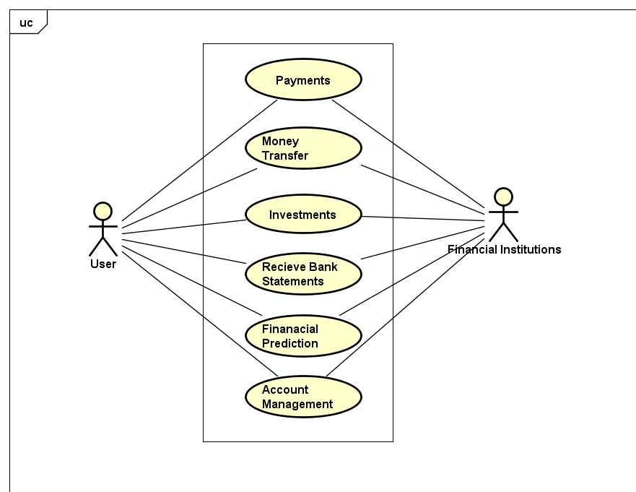
User Requirements
To determine our user requirements we used user stories to create scenarios of users utilizing our site
The user requirements are shown by the use case diagram
User Story Examples:
As a user I would like to be able to securely register
As a user I would like to safely send money to another user

Slide 5
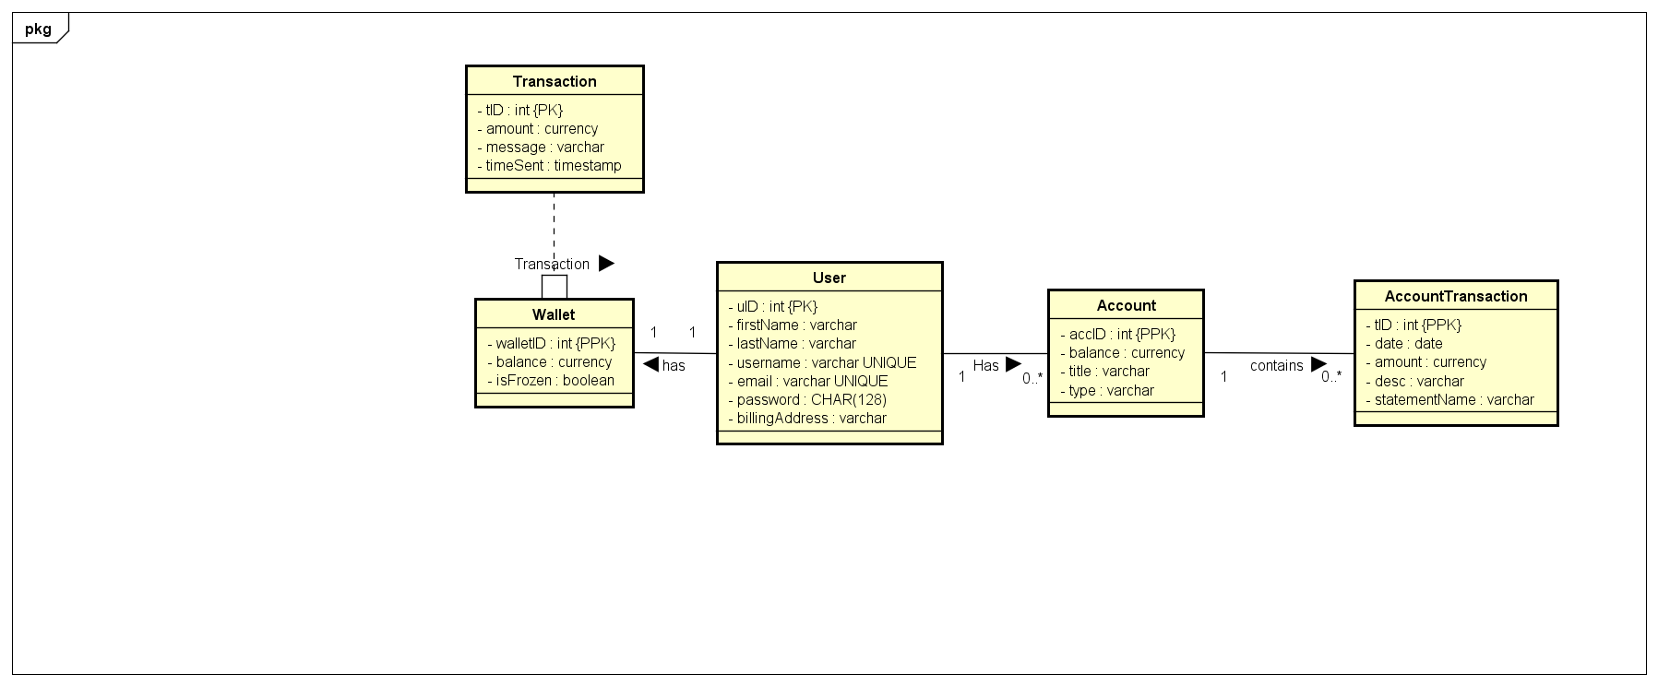
ER Diagram
Classes: User, Account, Wallet, Transaction, AccountTransaction
Relationships: All of the class relationships are centralized around the User class. A user has a wallet which is used for transactions. A user has an account which contains AccountTransactions

Slide 6
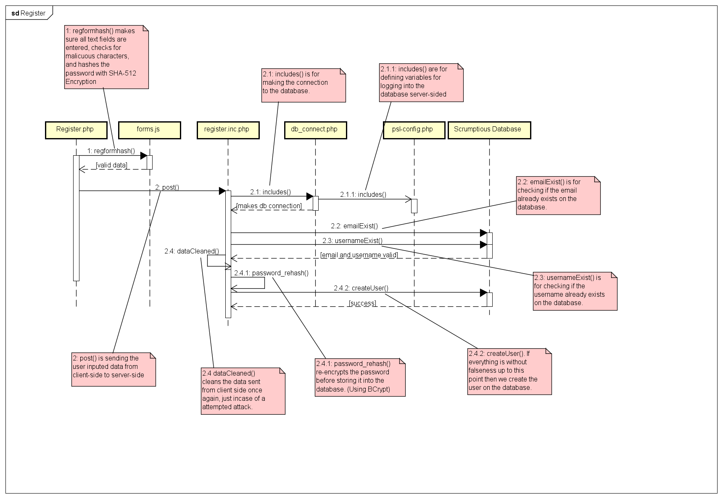
Sequence Diagram
Registering process sequence Diagram

Slide 7
Register Sequence Diagram
This Sequence Diagram will show the system process of registering on Scrumptious Finance
First, on the register page a user enters all the requested information
This data is then validated and hashed and a connection is made to the database
Once the connection is made the password gets rehashed for security and all the information is inserted into the database
The user then receives a confirmation that they have successfully registered

Slide 8
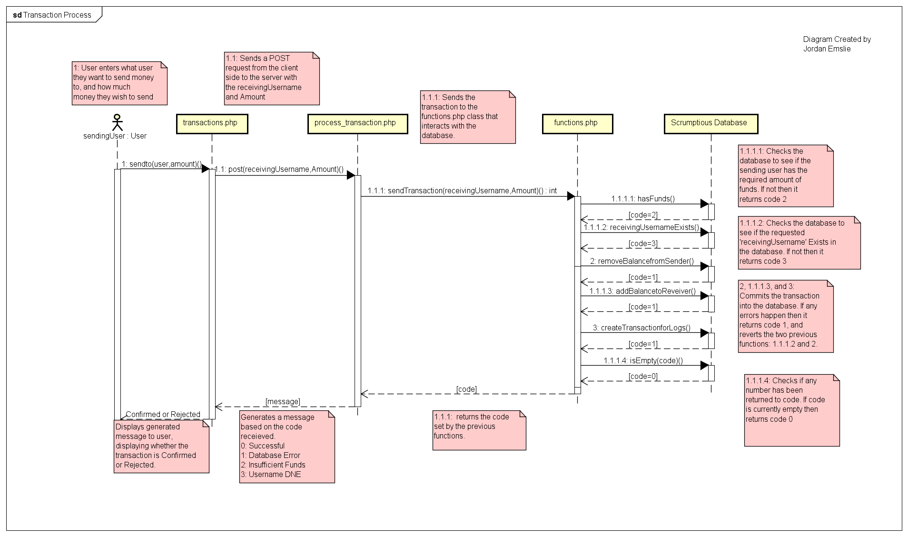
Sequence Diagram
Transaction Sequence Diagram

Slide 9
Transaction Sequence Diagram
For the Transaction the first step was the user to enter the recipient and the amount of the transaction
This data would then be sent to the server to be validated
The data is validated by checking that database to see if the recipient user exists as well as if the user has sufficient funds to send
Once all the data is validated the money is sent from the user to the recipient and the user is provided a confirmation of the transaction

Slide 10
In Summary
What We’ve Done
What’s next
Main page layout and styling
Log in
Register/create account
Add bank account
Upload csv file
Investments
Finance analysis
Debugging and fine tuning

