Slide 1

Data types
Jordi Cortadella / Jordi Petit
Department of Computer Science

Slide 2
Outline
Data representation
Boolean expressions
Integer numbers
Real numbers

Slide 3
Data types in C++
int (fixed-precision arithmetic)
bool
float / double
char
string (#include <string>)

Slide 4
Data types in Python
int (arbitrary-precision arithmetic)
bool
float
complex
str

Slide 5
The memory
int
Address
1036
1040
1044
1048
1052
1056
1060
1064
1068
1072
1076
1080
1084
0
0
1
0
0
1
0
0
1
1
1
0
0
0
1
0
1
0
1
0
0
1
0
0
1
0
1
0
0
0
1
0
0
19
0
0
0
0
0
0
0
0
0
0
0
0
0
0
0
0
0
0
0
0
0
0
0
0
0
0
1
0
0
1
1
0
0
1
0
0
1
0
0
0
1
1
1
0
0
0
0
0
1
1
0
1
0
0
1
0
1
0
1
0
0
0
0
1
0
0
1
0
0
1
1
0
byte
0
0
0
1
0
1
0
1
0
0
0
0
0
0
0
0
0
0
0
0
0
0
0
0
1
0
0
1
0
1
0
1
0
0
0
0
1
0
0
0
0
1
0
1
0
0
0
0
0
0
0
0
1
0
0
0
0
1
0
0
1
0
1
1
1
1
0
0
0
0
0
0
1
0
0
0
0
1
0
0
1
0
0
0
0
0
1
1
H
1
0
1
1
0
1
0
0
e
0
0
1
0
0
1
0
0
l
0
0
0
1
0
0
0
1
l
0
0
1
0
0
1
0
0
o
1
0
1
0
1
0
1
0
1
0
0
0
1
1
1
1
w
1
0
1
0
0
0
0
0
o
0
0
0
1
0
0
1
0
r
0
1
0
1
0
0
0
1
l
0
0
1
0
1
1
0
0
d
0
1
0
0
1
0
0
0
1
0
1
0
1
1
0
0
1
1
1
0
0
1
1
0
1
0
0
1
0
0
0
1
0
0
0
1
0
1
0
1
0
0
0
0
0
0
0
0
0
0
0
0
0
0
0
0
0
0
0
0
0
0
0
0
0
0
0
0
0
0
0
0
0
0
0
0
0
0
0
0
0
0
1
0
1
1
0
1
0
0
0
0
0
1
0
0
0
0
1
1
1
1
1
0
0
1
0
0
0
1
0
0
0
0
1
0
0
0
1
0
0
1
0
0
0
0
0
1
1
0
0
1
0
0
0
0
0
0
1
0
0
0
0
1
string (“Hello world”)

Slide 6
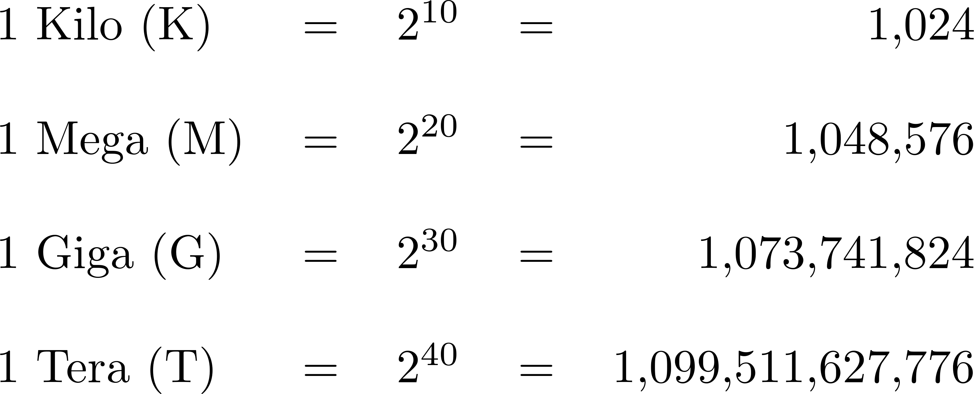
How much memory do we have?
Our laptop has few Gbytes of memory:

Slide 7
Number representation
100
10
1
2
1
7
base 10
125
25
5
1
1
3
3
2
base 5
81
27
9
3
1
2
2
0
0
1
base 3
128
64
32
16
8
4
2
1
1
1
0
1
1
0
0
1
base 2
CCXVII
Roman

Slide 8
Write the binary representation
Design a procedure that, given a number n, writes its binary representation (in reverse order). // Pre: n ≥ 0 // Writes the binary representation of n // in reverse order. void base2(int n);
128
64
32
16
8
4
2
1
1
1
0
1
1
0
0
1
Write: 10011011
n/2
n%2
1
1
0
1
1
0
0
1

Slide 9
Write the binary representation
// Pre: n ≥ 0 // Writes the binary representation of n // in reverse order.
void base2(int n) { while (n > 1) { cout << n%2; n = n/2; } cout << n << endl; }
n | cout
217 | 1
108 | 0
54 | 0
27 | 1
13 | 1
6 | 0
3 | 1
1 | 1

Slide 10
Boolean expressions

Slide 11
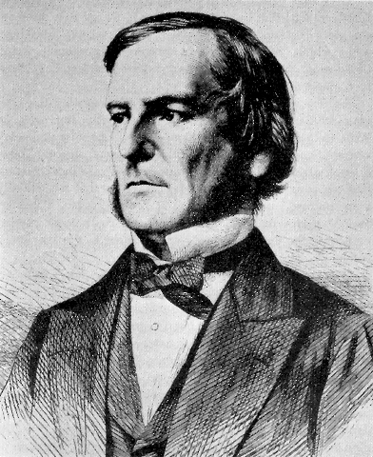
Boolean Algebra
George Boole, 1815-1864

Slide 12
Maximum of three numbers
// Returns max(a, b, c) int max3(int a, int b, int c);
a,b,c
a,b,c
a > b and a > c
a >= b and a >= c
else
else
a
b,c
a
b,c
b > c
else
b >= c
else
b
c
b
c

Slide 13
Maximum of three numbers
// Returns max(a, b, c) int max3(int a, int b, int c) { if (a > b and a > c) { return a; } else { if (b > c) { return b; } else { return c; } } }
a,b,c
Choose between b and c
a > b and a > c
else
a
b,c
b > c
else
b
c

Slide 14
Maximum of three numbers
// Returns max(a, b, c) int max3(int a, int b, int c) { if (a > b and a > c) return a; if (b > c) return b; return c; }

Slide 15
Boolean operators
if (a > b and a > c) …
while (i >= 10 or c == 0) …
if (not (a < b and a < c)) …

Slide 16
Truth tables
a | b | a and b
false | false | false
false | true | false
true | false | false
true | true | true
a | b | a or b
false | false | false
false | true | true
true | false | true
true | true | true
a | not a
false | true
true | false

Slide 17
Complement of and/or
…
…
-3
-2
-1
0
1
2
3
4
5
6
7
8
9
10
11
12
13
(x > 2 and x < 7)
not (x > 2 and x < 7)
not
not
x <= 2 or x >= 7
De Morgan’s law

Slide 18
De Morgan’s law
not (e₁ and e₂) ≡ not e₁ or not e₂
not (e₁ or e₂) ≡ not e₁ and not e₂
Exercise
Simplify: not (x >= y or y%2 == 0)
x < y and y%2 != 0

Slide 19
Operator precedence
a + b∗c (a + b)∗c
a or b and c (a or b) and c

Slide 20
Real numbers

Slide 21
Real numbers
Two types:
float (single precision, 32 bits)
double (double precision, 64 bits)
Arithmetic operations: + - ∗ / (no remainder)
Real constants: 2 -5.003 3.1416 1.4e9 0.6E-15
1.4 $∙{10}^{9}$
0.6 $∙{10}^{−15}$

Slide 22
Type conversion
Arithmetic operations between integer and real values usually imply an implicit type conversion.
Be careful:
int i=3, j=2; double x; x = i/j; // x = 1.0 x = i/double(j); // x = 1.5 x = double(i)/j; // x = 1.5 x = double(i/j); // x = 1.0 x = i/2; // x = 1.0 x = i/2.0; // x = 1.5 i = x; // i = 1 j = 3.14159265; // j = 3

Slide 23
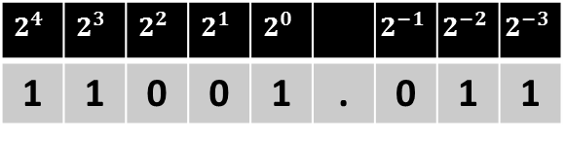
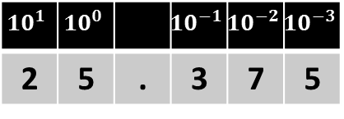
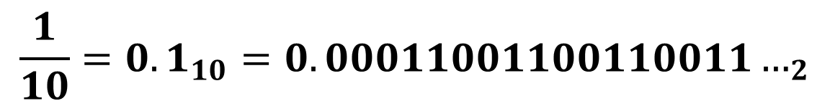


Representation of real numbers
Decimal notation
Binary notation
$$10^{1}$$ | $$10^{0}$$ |  | $$10^{−1}$$ | $$10^{−2}$$ | $$10^{−3}$$
2 | 5 | . | 3 | 7 | 5
$$2^{4}$$ | $$2^{3}$$ | $$2^{2}$$ | $$2^{1}$$ | $$2^{0}$$ |  | $$2^{−1}$$ | $$2^{−2}$$ | $$2^{−3}$$
1 | 1 | 0 | 0 | 1 | . | 0 | 1 | 1
Scientific notation (decimal):
Scientific notation (floating point):
$$25375⋅{10}^{−3}$$
$$1.1001011⋅2^{4}$$
Every binary number can be represented in decimal, but not vice versa!
$${\frac{1}{10}=0.1}_{10}=0.00011001100110011…_{2}$$

Slide 24

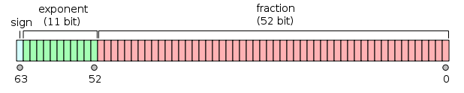
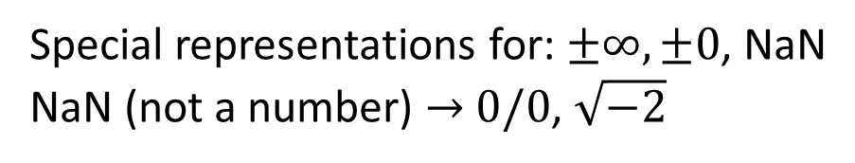

Single and double-precision FP numbers
float:
double:
sign
fraction
exponent
$$−1.01101001101001⋅2^{1001}$$
Special representations for: $±∞, ±0$, NaN
NaN (not a number) $→$ $0/0$, $\sqrt{−2}$

Slide 25
Beware when operating with real numbers
Example (C++): double x, y; cin >> x >> y; // 1.1 3.1 cout.precision(20); cout << x + y << endl;
Example (Python): >>> a = 1/3 >>> b = 1/2 >>> a+b 0.8333333333333333 >>> a+b-a-b
// 4.2000000000000001776
-5.551115123125783e-17

Slide 26
Comparing floating-point numbers
Comparisons: a = b + c if a – b == c: … # may be false
Allow certain tolerance for equality comparisons: if expr1 == expr2: … # Wrong! if abs(expr1 – expr2) < 1e-7: … # Ok. # 1e-7 == 0.0000001

