Slide 1

Text Inference Application
Jordi Castro

Slide 2

Problem Statement
NLP
Processing and Interpreting data derived from natural language.
Text Inference
Email: Outlook, Gmail.
Search Engines: Google suggest related queries.
Code: GitHub Copilot.

Slide 3
Problem Statement Cont.
AI Powered note application
Text inference and information retrieval.
Importance
College lectures are fast paced.
Efficient note taking, planning, and studying.

Slide 4



Background: N-grams
Brilliant
How LLMs Work.
Bigrams
Higher Order N-grams
If
be
be
the
the
food
of
If
music
be
love
music
music
context
bigram
trigram
4-gram
next word

Slide 5
Sliding Window: 4-gram
3 context words
1 adjacent (predictor) word
music
the
music
be
the
food
love
of
If
of
If
be
food
food
of
If
love
context
next word

Slide 6
N-gram Cont.
Successor Map
An object that contains key-value pairs of words in the corpus.
KEY: context.
String for bigram, tuple of strings for N-grams, N>2.
VALUE: next adjacent word.
Brilliant’s Bigram:(‘romeo’: [‘and’, ‘and’, or’, ...])
My Bigram: (‘romeo’: [ (‘and’, 7), (‘or’, 4), ...])
Brilliant’s Bigram:(‘romeo’: [‘and’, ‘and’, or’, ...])
My Bigram: (‘romeo’: [ (‘and’, 7), (‘or’, 4), ...])
Brilliant’s Bigram:(‘romeo’: [‘and’, ‘and’, or’, ...])
My Bigram: (‘romeo’: [ (‘and’, 7), (‘or’, 4), ...])
key
value
freq

Slide 7
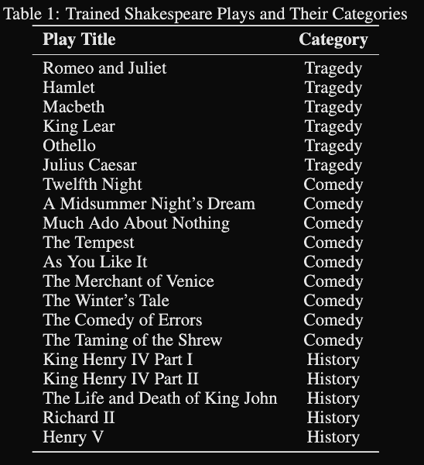
Experiment: N-gram models trained on Shakespeare plays
N-grams 2-7 trained on 20 Shakespeare plays for text inference

Slide 8
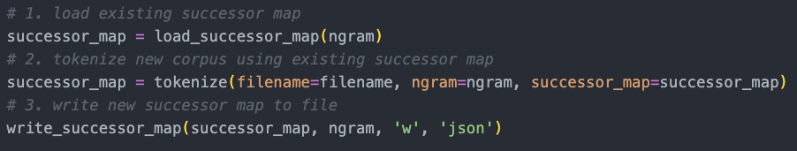
Adding a play to the successor map

Slide 9
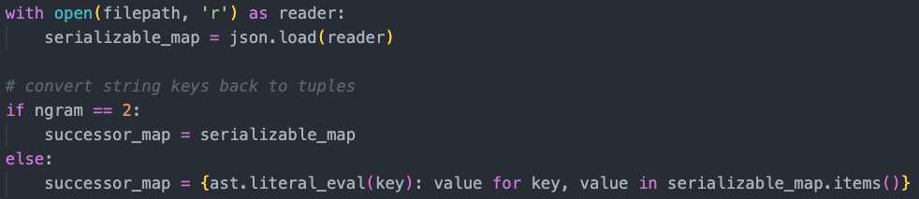
Loading the map

Slide 10
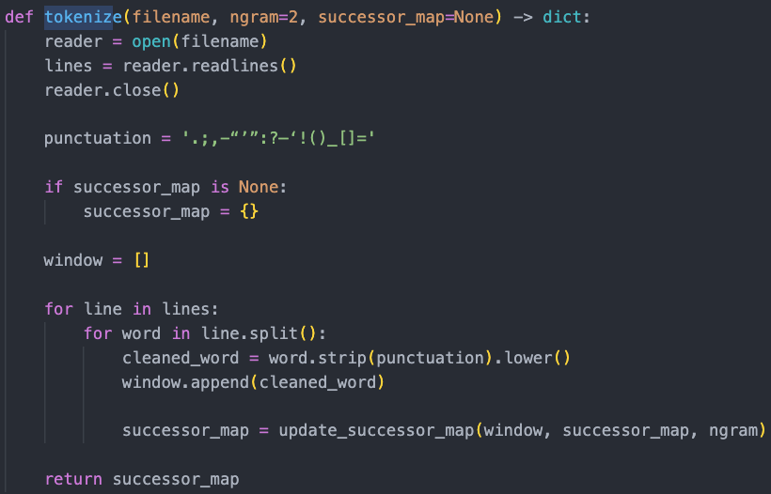
Tokenizing a play
Tokenize the word
Slide the window, update successor map

Slide 11
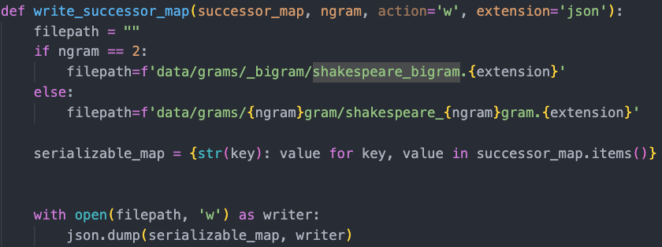
Saving the map

Slide 12
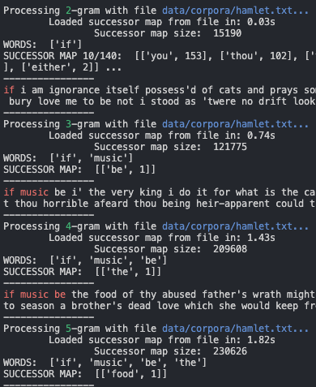
Experimental Results

Slide 13
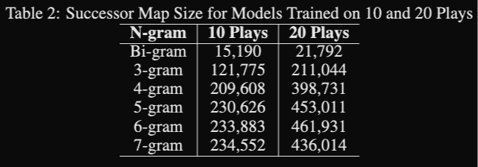
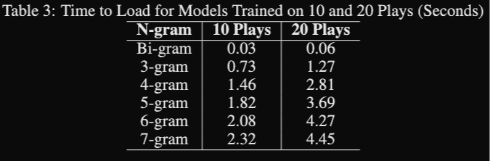
Experimental Results

Slide 14
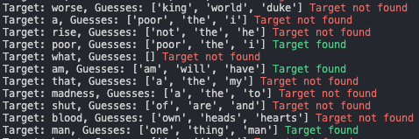
Evaluation: top-k neighbors
Common in NLP
Select 100 quotes from 10 unseen plays
For each quote, the model predicts the next word
Returns a list of the top-k most likely words
‘worse’ not found
No results in successor map
‘man’ found in top 3

Slide 15
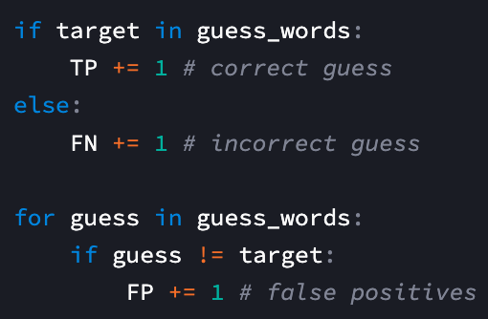
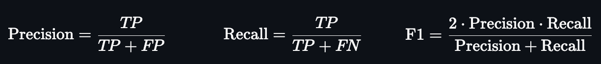
Evaluation: logic & equations

Slide 16
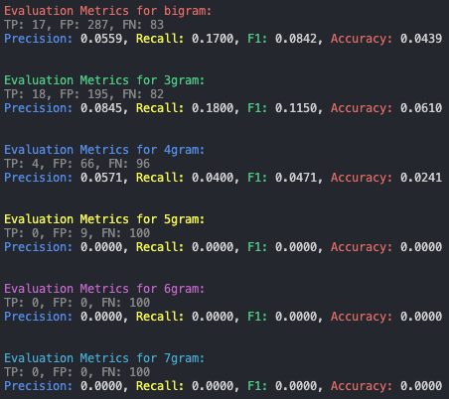
Evaluation Results

Slide 17
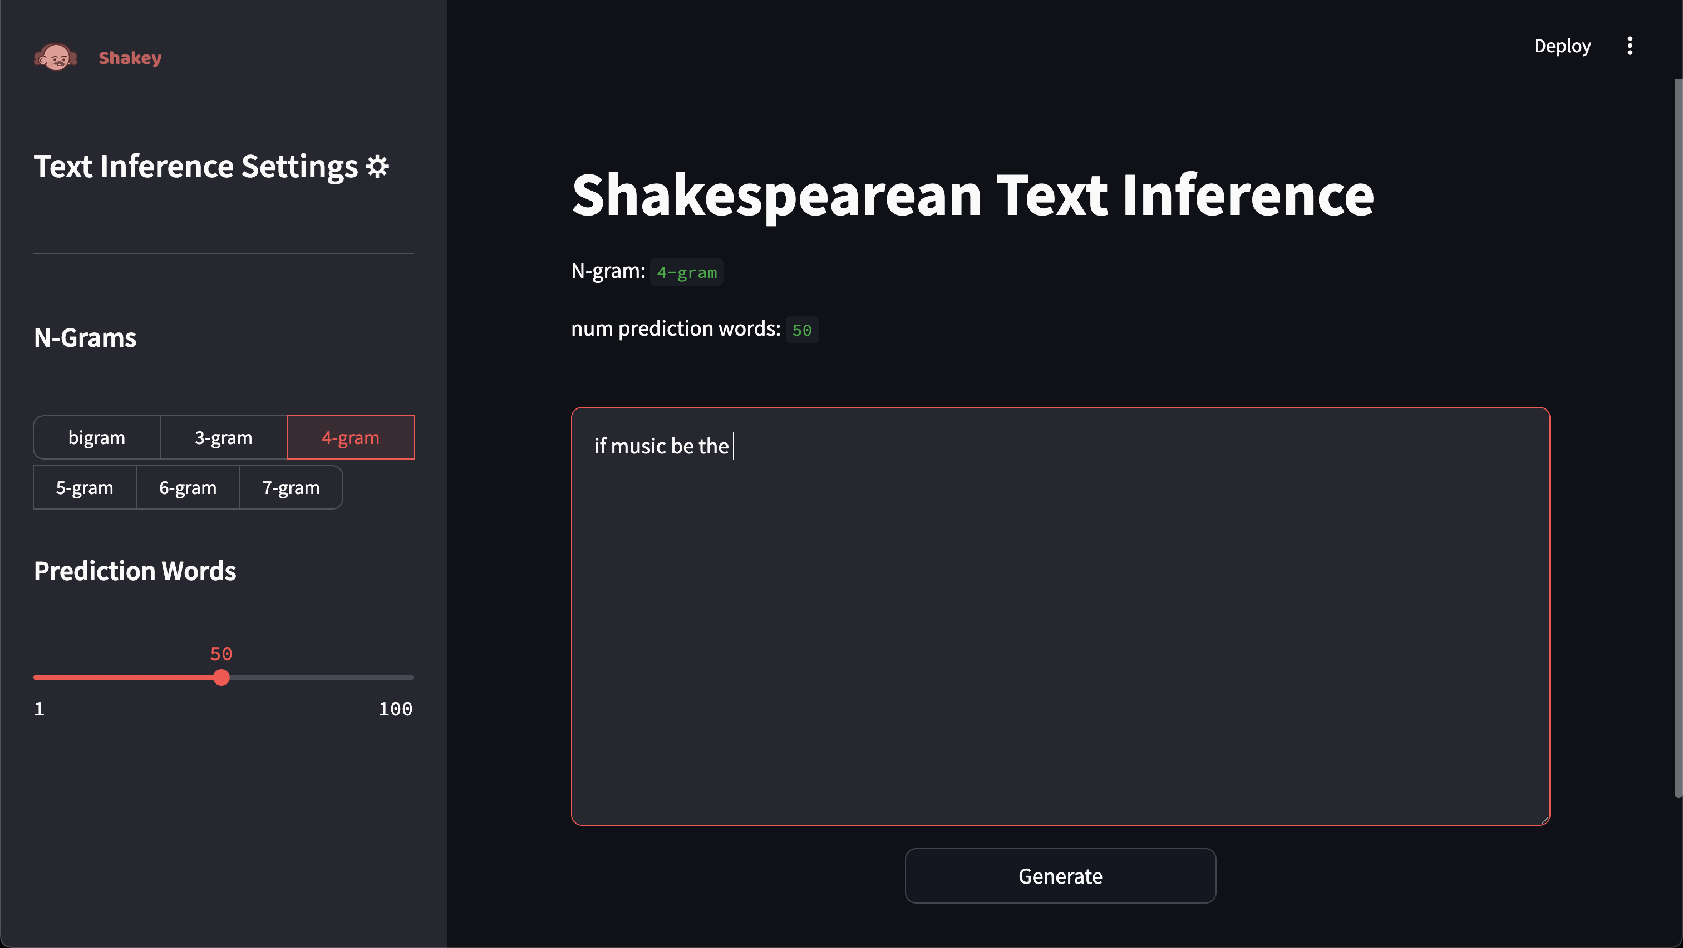
Streamlit demo

Slide 18
Conclusion and Next Steps
N-grams are easy to implement, but often fail to form coherent sentences
4-gram is best at quote retrieval.
3-gram is best at “speaking” like Shakespeare (11.5% F1)
5-7-grams failed evaluation because they require too much context
N-grams do not scale well
Large corpora will yield long inference times
Research into NLP transformers
Test new models, add to Streamlit and deploy.

Slide 19
Questions

