Slide 1
Pin assignment during floorplanning
Jordi Cortadella

Slide 2
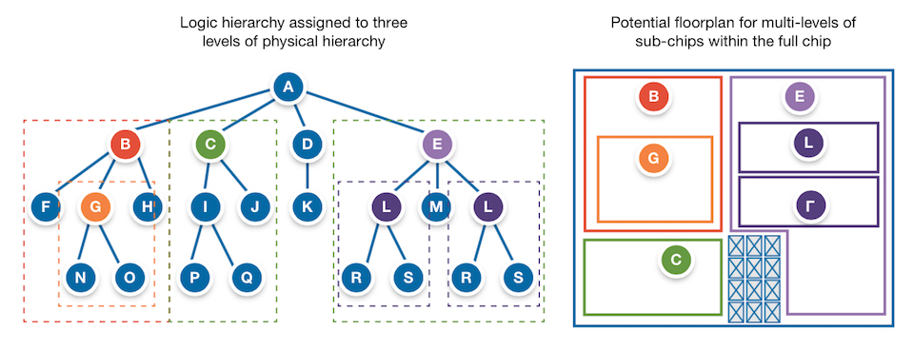
Floorplanning is hierarchical
Source: Synopsys https://www.techdesignforums.com/practice/technique/floor-planning-complex-socs-with-multiple-levels-of-physical-hierarchy/

Slide 3
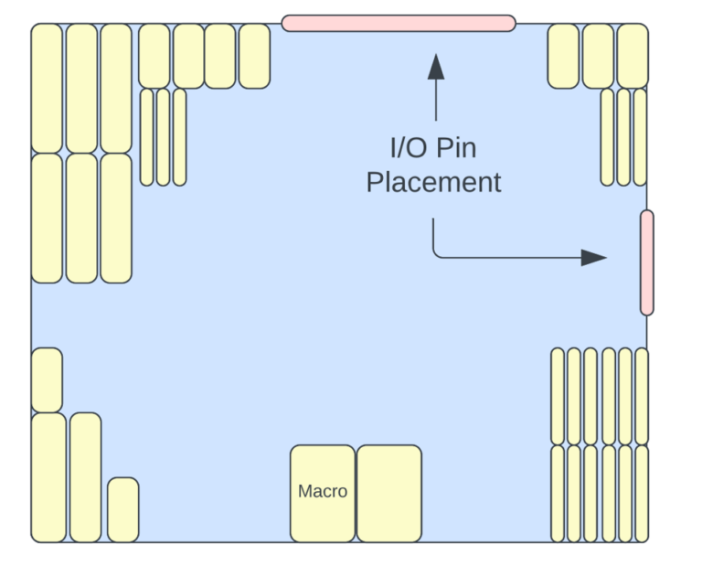
Pin assignment
Pin assignment is one of the subproblems of floorplanning
Pins are typically at the boundaries of the chip
In hierarchical floorplanning, the sub-chip may have an arbitrary rectilinear shape and pins may be located at non-conventional places
Pins
Source: https://anysilicon.com/soc-floorplan/
Proposal: let us represent terminals as rectangular modules
Sub-chip

Slide 4



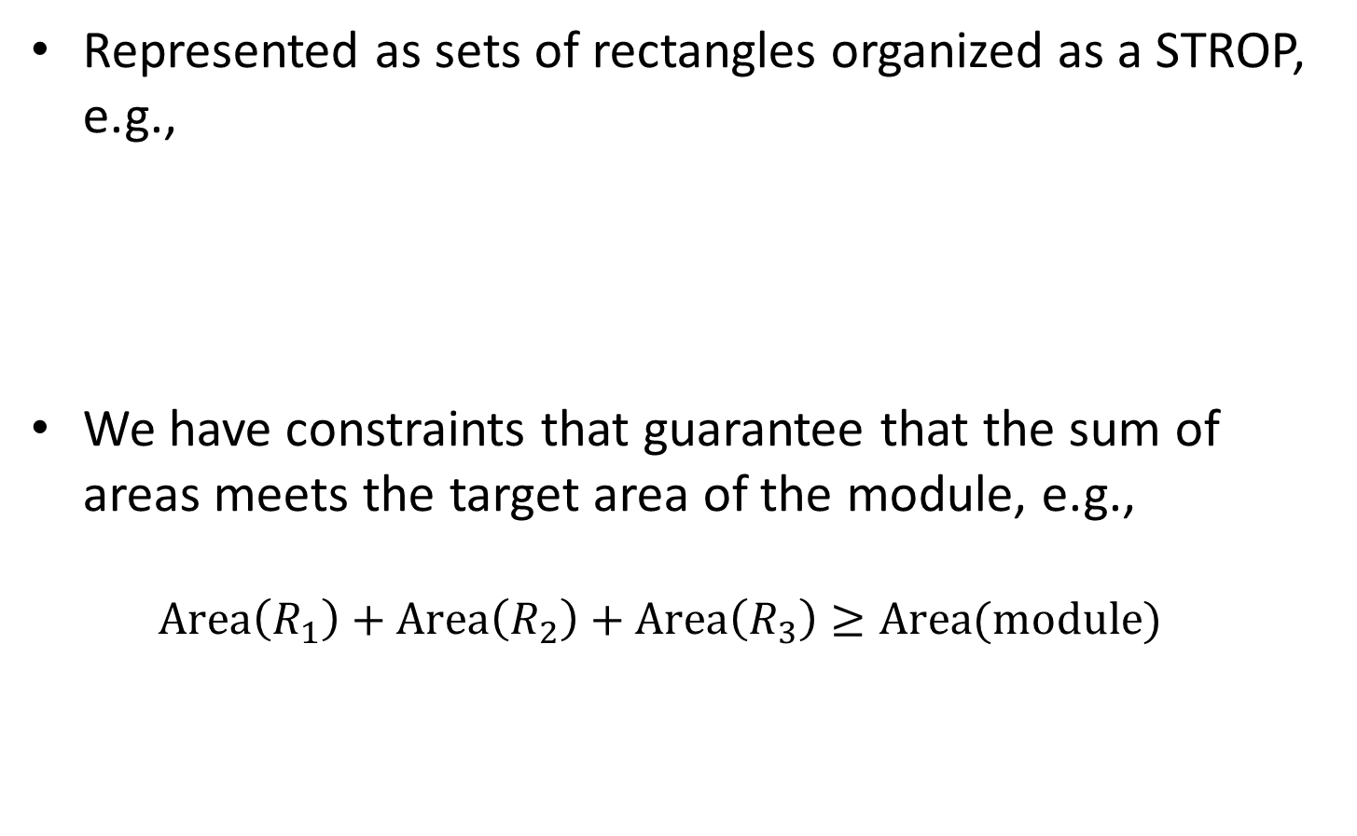



Modules in FRAME
Represented as sets of rectangles organized as a STROP, e.g.,
We have constraints that guarantee that the sum of areas meets the target area of the module, e.g., $\text{Area}\left(R_{1}\right)+\text{Area}\left(R_{2}\right)+\text{Area}\left(R_{3}\right)≥\text{Area}(\text{module})$
Every rectangle is represented by 4 numbers: coordinates of the center, width and height
$$R_{1}$$
$$R_{2}$$
$$R_{3}$$
$$(x_{c},y_{c})$$
$$h$$
$$w$$

Slide 5

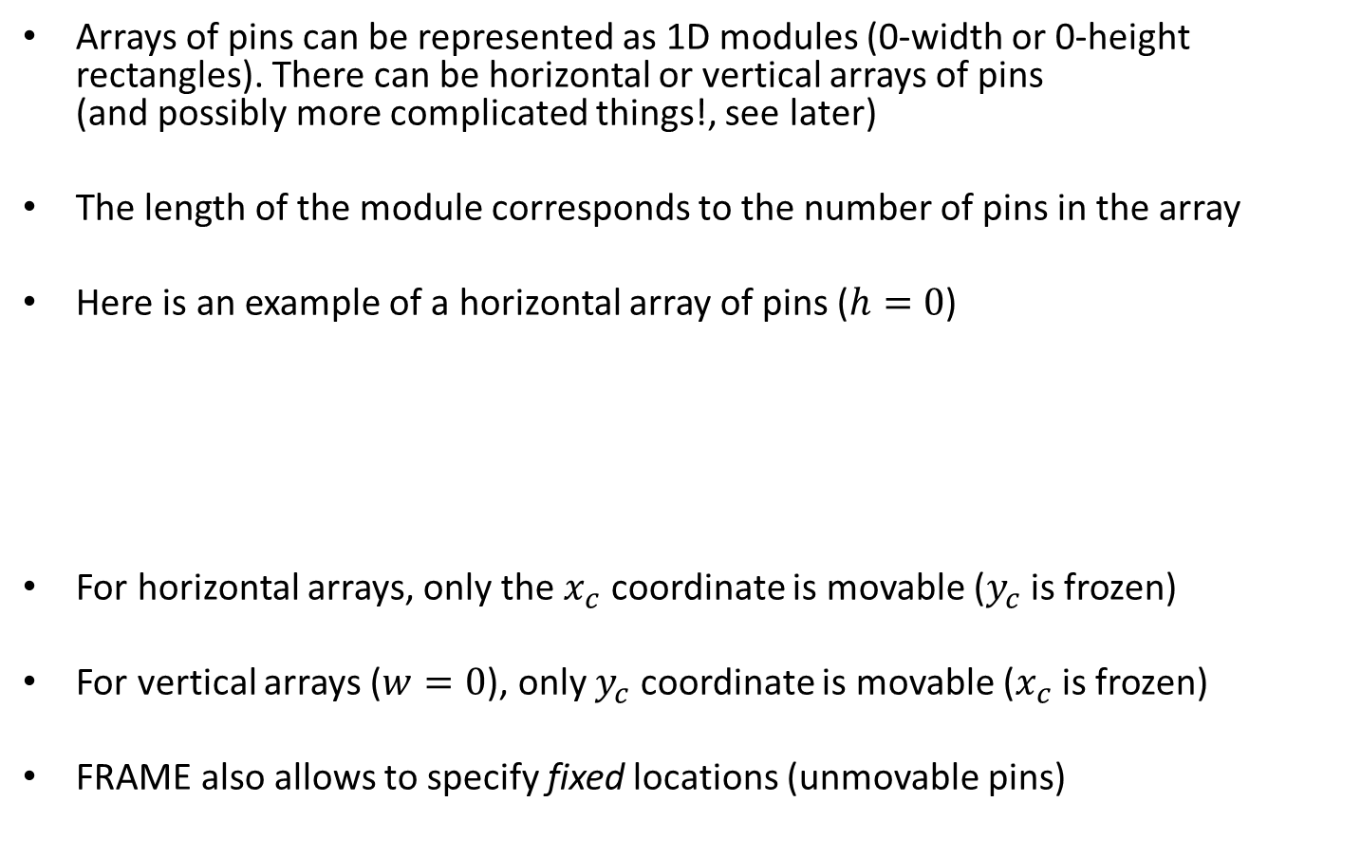


Pins in FRAME
Arrays of pins can be represented as 1D modules (0-width or 0-height rectangles). There can be horizontal or vertical arrays of pins (and possibly more complicated things!, see later)
The length of the module corresponds to the number of pins in the array
Here is an example of a horizontal array of pins ($h=0$)
For horizontal arrays, only the $x_{c}$ coordinate is movable ($y_{c}$ is frozen)
For vertical arrays ($w=0$), only $y_{c}$ coordinate is movable ($x_{c}$ is frozen)
FRAME also allows to specify fixed locations (unmovable pins)
$$w=\#pins×pin pitch$$
$$h=0$$
$$(x_{c},y_{c})$$

Slide 6
Specifying locations of pins: proposal
Identify the edges of the sub-chip polygon (A,B,C,…,J in the figure)
Associate an edge or a vertex to each pin array
Example:
P1 → A
P2 → FG
Pin arrays can be fixed or movable along the edge/vertex
P1
A
B
J
C
D
I
E
H
F
G
P2

Slide 7
Pin constraints
Each pin array must have a fixed length
Pins at the corners can be represented as adjacent rectangles (1D STROPs!). The sum of lengths must be equal to the length of the array
Overlapping constraints only between pin arrays that can share the same edge
No overlapping constraints applied between pin arrays and the rest of modules of the floorplan.

