Slide 1


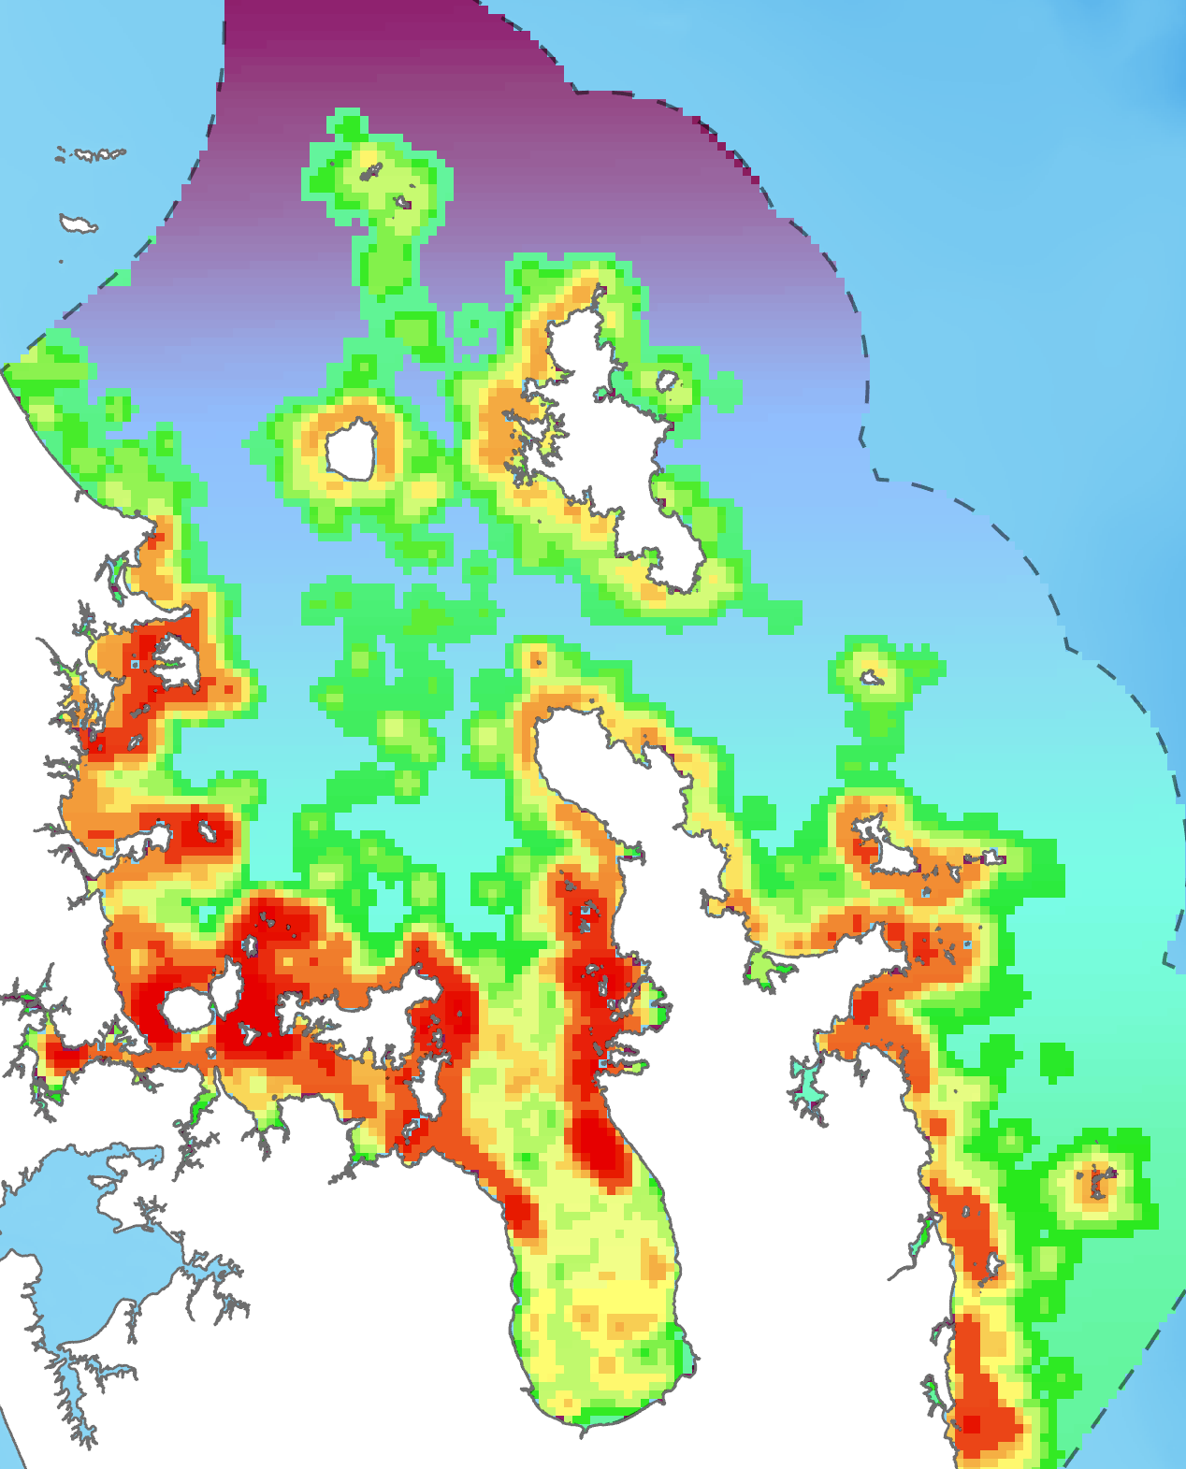
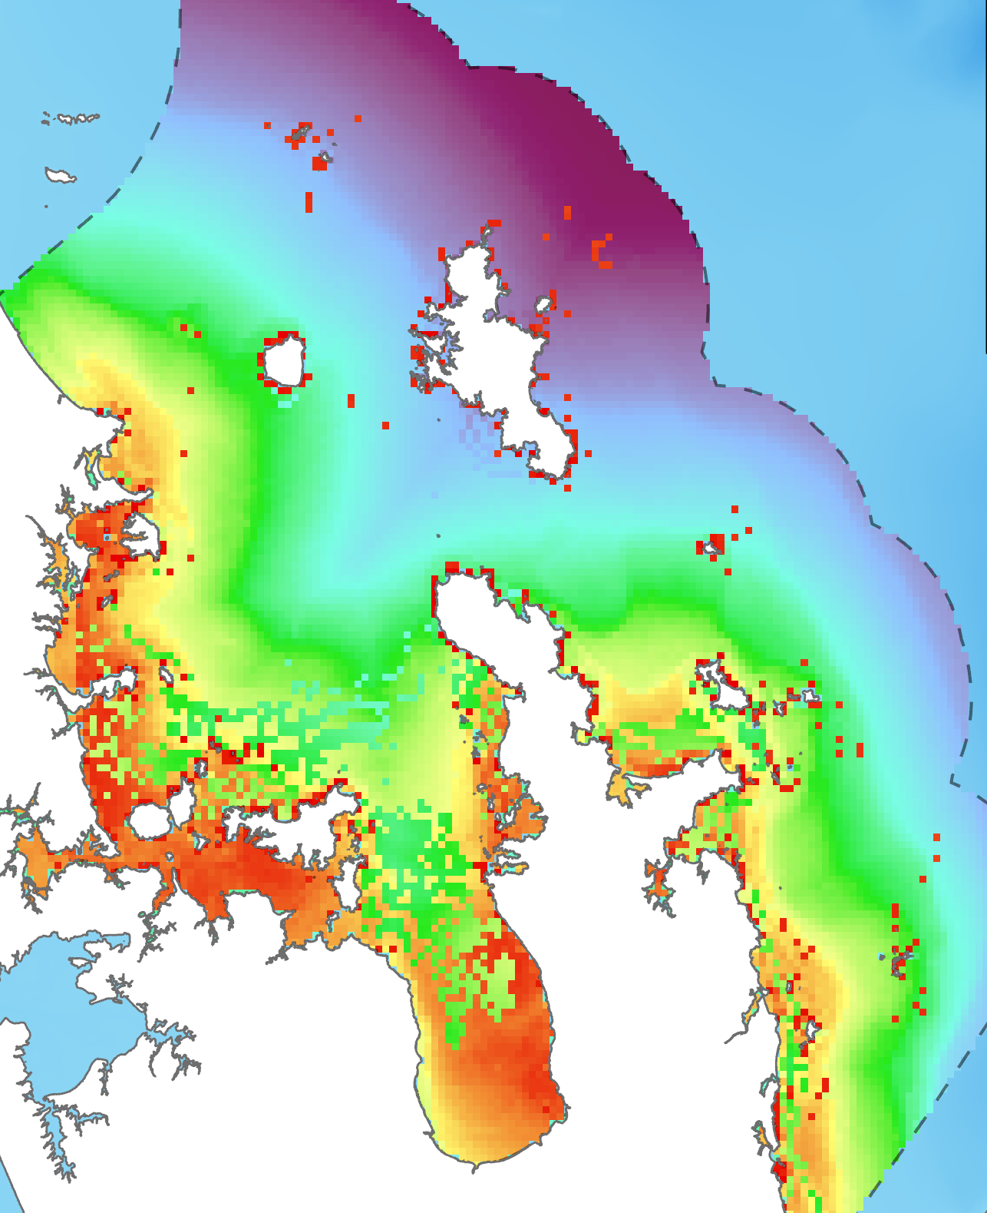

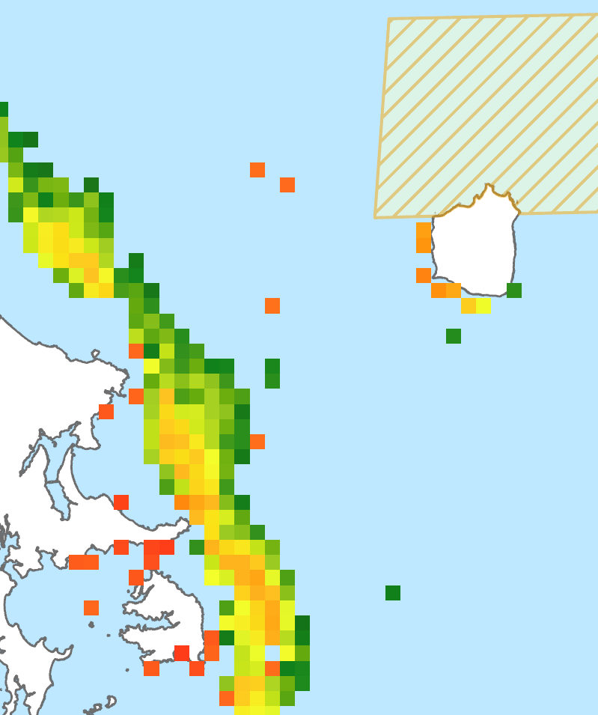
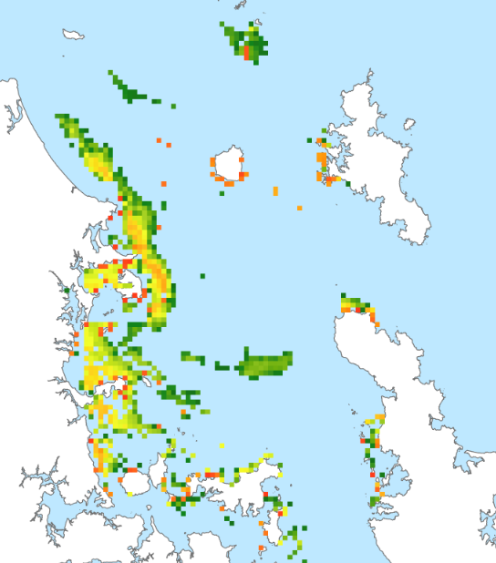
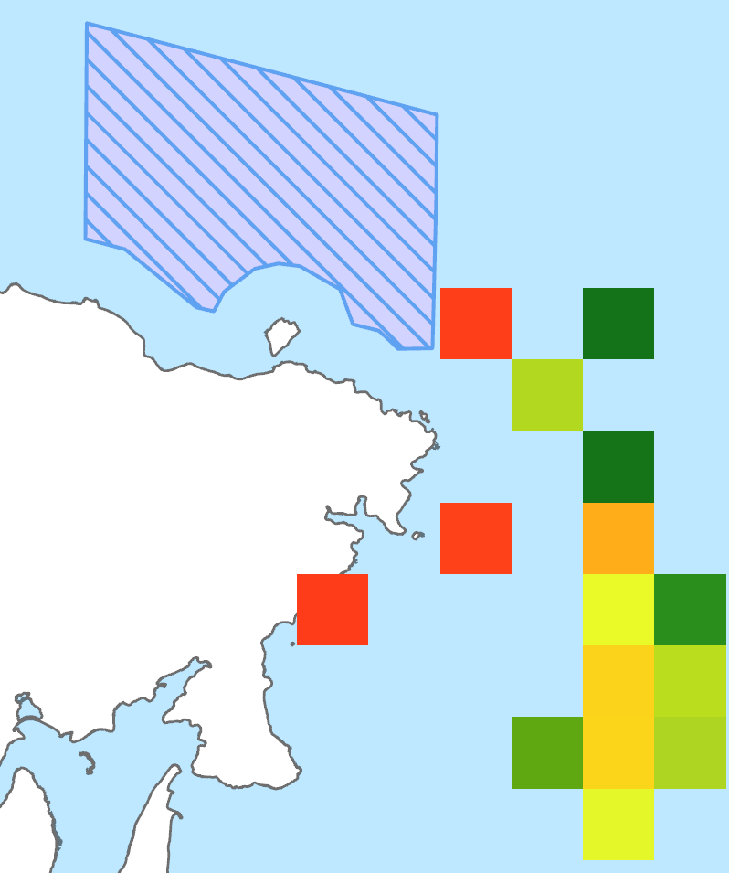
1. Assessing spatial relationship between fishing and targeted species
Displaced fishing scenario
- Recreational fishing
Spatial correlation between 2 scenarios
Zonation
- SDMs (snapper, kahawai) - Euclidean distance
Targeted species scenario
2. Calculating MPA and Total displaced effort index
Displaced cells scenarios (N = 847)
* Area of analysis restricted by distance to nearest 3 ramps
MPA displaced effort
* 10% top cells grouped by MPA (N = 14)
Total displaced effort
* Merging 14 MPA displaced effort layers
- SDMs (snapper, kahawai) - Physical habitats
Zonation

