Slide 1
Tasks completed (19 Mar)
Normalized data and stacked data instead of overlap

Slide 2
NuMI vs BNB simulation sample
Parameter | NuMI | BNB
Pot Size | 147e20 | 174e20
Number of reconstructed selected interactions | 3566 | 4249
Number of true signal interactions | 3815 | 5532

Slide 3
Categorizing interactions
For easier analysis of truth-level information of the reconstructed interactions, a variablE known as category_topology_ccpi0_simple2 was extracted. This variable tells us which of the following 5 categories does the reconstructed interaction fall under based on its matched true interaction
Category | definition
0 | Neutrino interaction with 1 primary muon, 0 primary charged pions, and 1 primary neutral pion
1 | Neutrino interaction with 1 primary muon, 0 primary charged pions, and 2 or more neutral pions
2 | Neutrino interaction with 1 primary muon, 1 or more primary charged pions, and any number of primary neutral pions
3 | Neutrino interaction with 0 primary muons, and 1 or more primary neutral pions
4 | Neutrino interactions that do not fall within these categories
NaN | cosmics

Slide 4
NuMI vs BNB: Interaction category type percentage
Differences between the percentage of selected reconstructed interactions within the interaction categories after selection
Category | NuMI (%) | BNB (%) | BNB (%) (Lane’s paper)
0 | 68.3 | 89.6 | 88.8
1 | 0.6 | 0.5 | 0.3
2 | 9 | 5.1 | 5.3
3 | 2.4 | 1.2 | 1.1
4 | 19.5 | 3.5 | 3.5
NaN | 0.3 | 0.2 | 1.0

Slide 5
NuMI: Looking into ‘other v’ category
Due to the large percentage for the ‘other v’ interaction category, looked further into what type of interactions fall into this category
Table below shows the 5 most common interaction types within the ‘other v’ category
Anti-neutrino interactions account for ~78% of all ‘other v’ interactions (547 out of 694)
Much larger amount of anti-neutrino interactions in NuMI selection compared to BNB (566 vs 31)
Interaction type | PDG code | Fiducialized | Percentage of ‘other v’interactions falling into this type (%)
1u0π±1π | -14 | Yes | 60.5
1u1π±1π | -14 | Yes | 6.6
1u0π±0π | 14 | Yes | 4.6
1u0π±0π | -14 | Yes | 4.0
1u0π±1π | 14 | no | 3.6

Slide 6
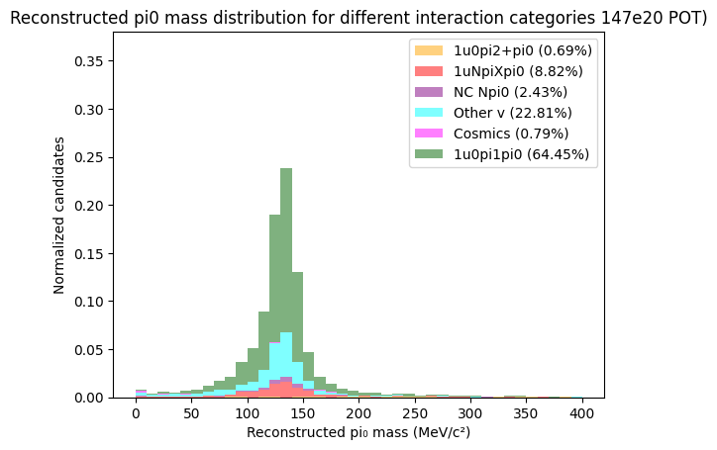
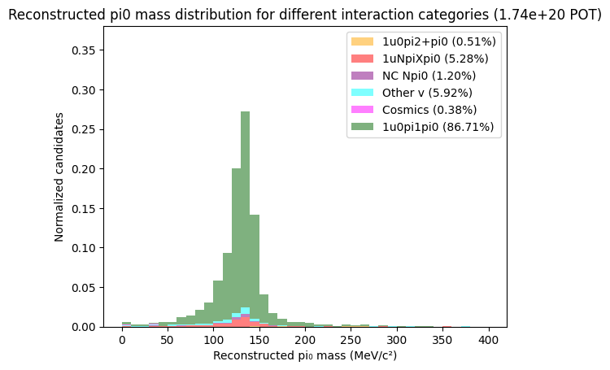
Initial selection: neutral pion mass distribution
A plot of the reconstructed neutral pion mass distribution for reconstructed interactions split into their true interaction categories is shown
Reconstructed neutral pion mass plot from NuMI selection
Reconstructed neutral pion mass plot from my BNB selection

Slide 7
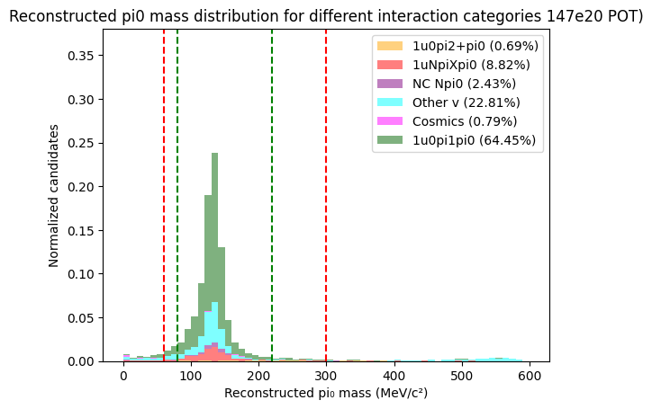
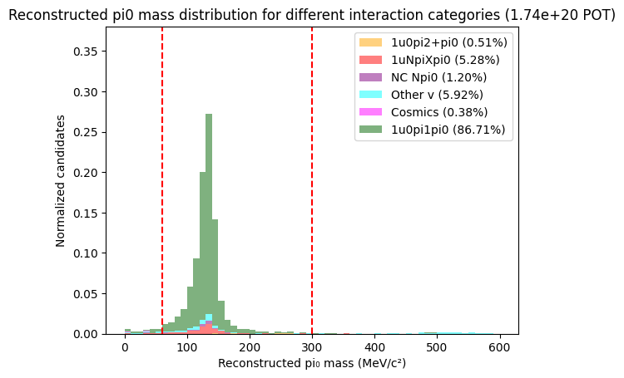
Cuts on reconstructed neutral pion mass
For NuMI. Pi0 mass distribution between 0 to 80 MeV and 220 to 600 MeV still contain primarily non signal interactions
For NuMI, a more suitable pi0 mass cut would be at 80 MeV and 220 MeV, as opposed to 60 MeV and 300 MeV
Reconstructed Pi0 mass plot from NuMI selection
Reconstructed Pi0 mass plot from BNB selection

Slide 8
Selection performance analysis

Slide 9
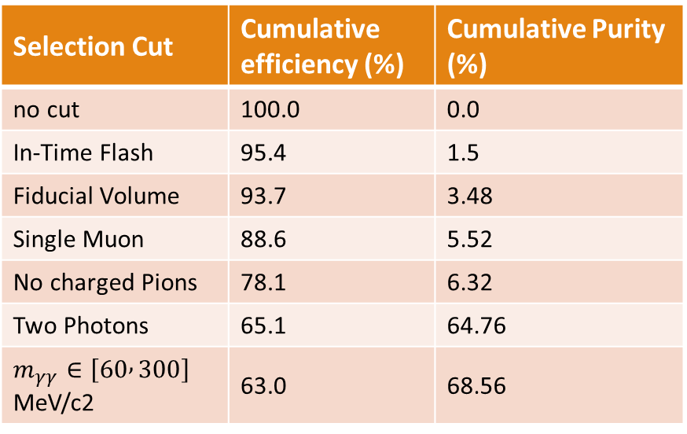
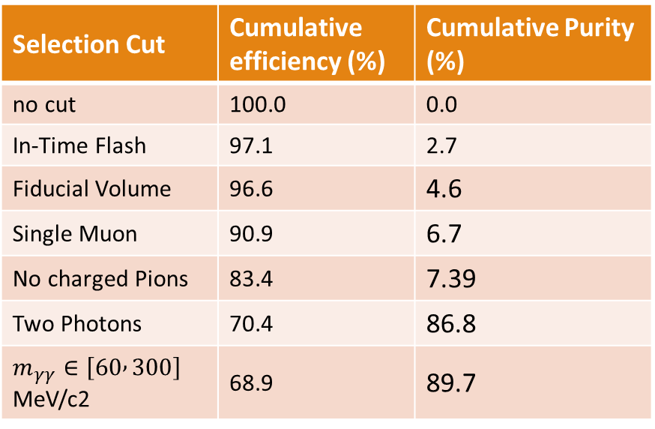
Efficiency and Purity analysis
Efficiency defined as fraction of true signal interactions that are matched to selected interactions
Purity defined as the fraction of selected interactions that are matched to true signal interactions
Selection Cut | Cumulative efficiency (%) | Cumulative Purity (%)
no cut | 100.0 | 0.0
In-Time Flash | 95.4 | 1.5
Fiducial Volume | 93.7 | 3.48
Single Muon | 88.6 | 5.52
No charged Pions | 78.1 | 6.32
Two Photons | 65.1 | 64.76
$m_{γγ}∈\left[60 , 300\right]$﻿ MeV/c2 | 63.0 | 68.56
Selection Cut | Cumulative efficiency (%) | Cumulative Purity (%)
no cut | 100.0 | 0.0
In-Time Flash | 97.1 | 2.7
Fiducial Volume | 96.6 | 4.6
Single Muon | 90.9 | 6.7
No charged Pions | 83.4 | 7.39
Two Photons | 70.4 | 86.8
$m_{γγ}∈\left[60 , 300\right]$﻿ MeV/c2 | 68.9 | 89.7
Efficiency and Purity from NuMI selection
Efficiency and Purity from BNB selection

Slide 10
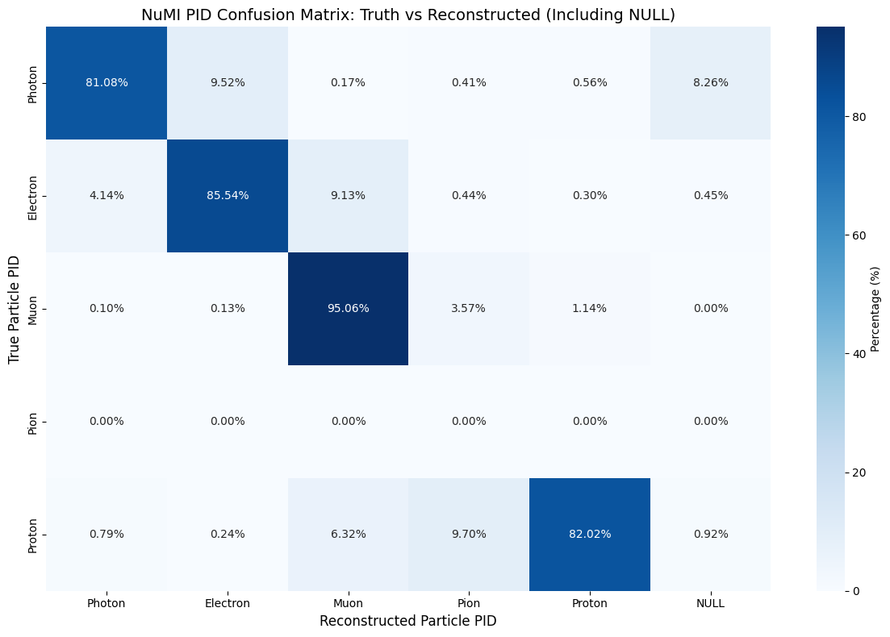

PID Truth to Reco confusion matrix
Plotting confusion matrix for PID particle type for true signal interactions
primary reason for inefficiency is due to true final state protons misidentified as muons or pions
Truth to Reco confusion matrix from NuMI selection
Truth to Reco confusion matrix from BNB selection

Slide 11
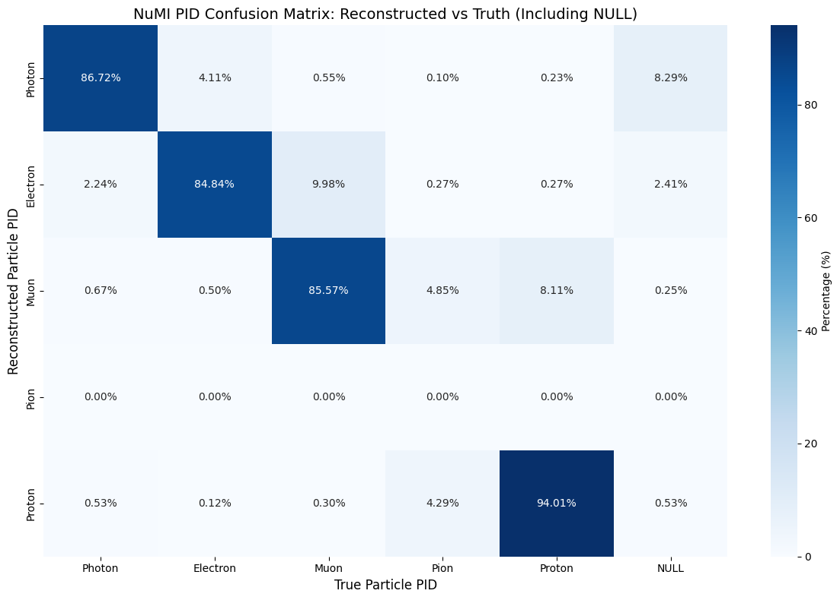

PID Reco to Truth confusion matrix
Plotting confusion matrix for PID particle type for true signal interactions
primary reason for impurity is due to misidentification of true pions as protons
Reco to Truth confusion matrix from NuMI selection
Reco to Truth confusion matrix from BNB selection

Slide 12
Reconstructed observables in simulation

Slide 13
Reconstructed observables in simulation
The following observables relevant to the analysis are seperated into the following
Low-level observables to assess basic reconstruction performance and eventually data/simulation agreement
Transverse kinematic imbalance (TKI) observables that are sensitive to nuclear effects like FSI
Observables related to four-momentum transfer and hadronic invariant mass
Neutral pion mass observables relevant to calibration of electromagnetic showers
Cross section analysis observables for which single differential cross section will be extracted as a function of

Slide 14
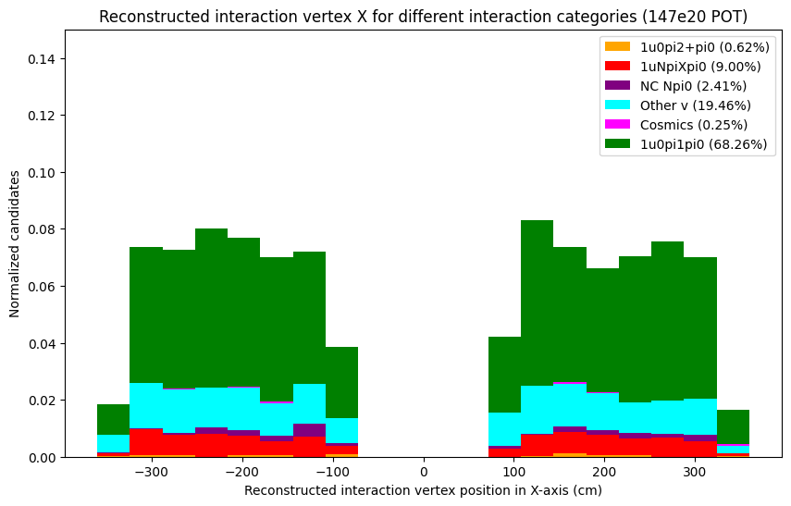
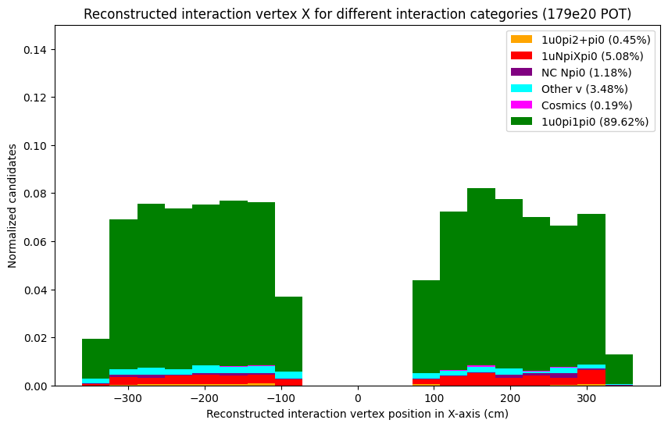
Low-level observables
Plotting Reconstructed Interaction vertex in x-axis
Interaction vertex in x-axis from NuMI selection
Interaction vertex in x-axis from BNB selection

Slide 15
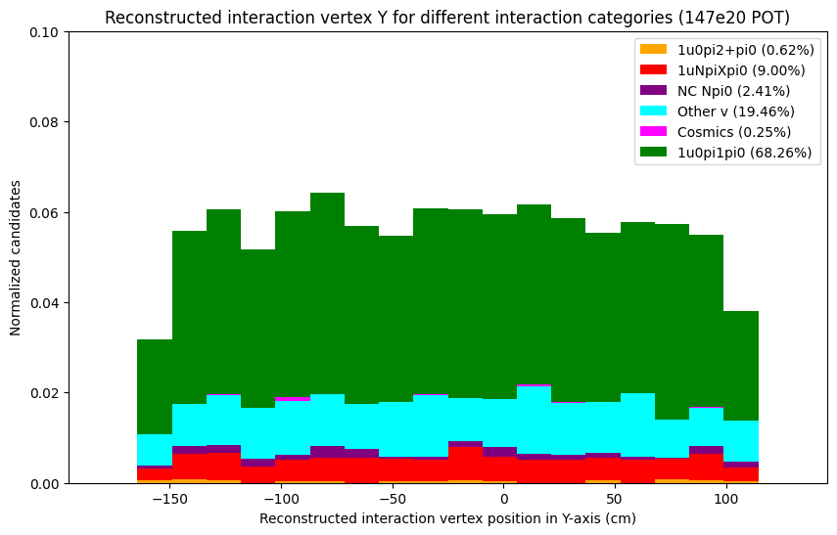
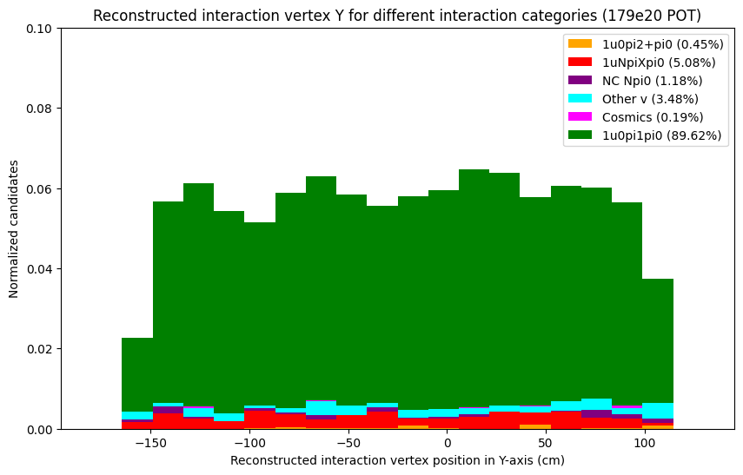
Low-level observables
Plotting Reconstructed Interaction vertex in Y-axis
Interaction vertex in Y-axis from NuMI selection
Interaction vertex in Y-axis from BNB selection

Slide 16
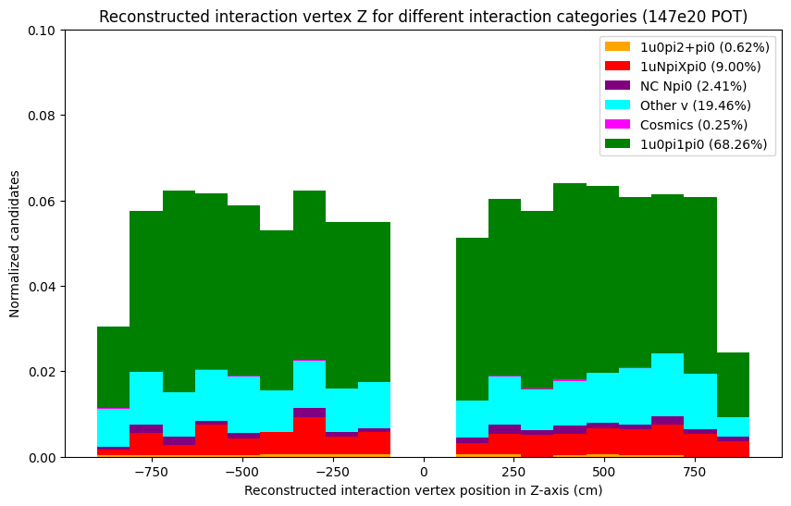
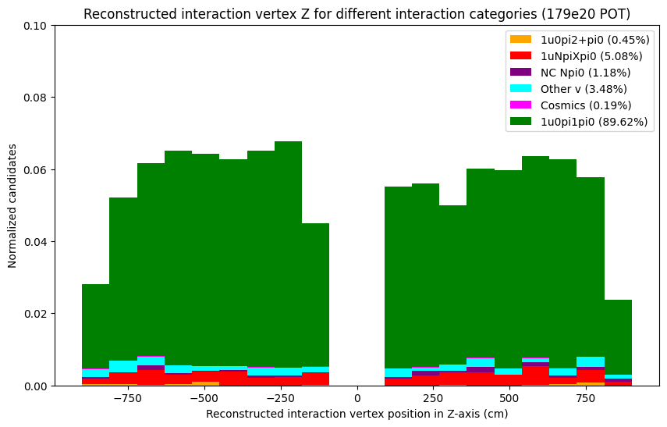
Low-level observables
Plotting Reconstructed Interaction vertex in Z-axis
Interaction vertex in Z-axis from NuMI selection
Interaction vertex in Z-axis from BNB selection

Slide 17
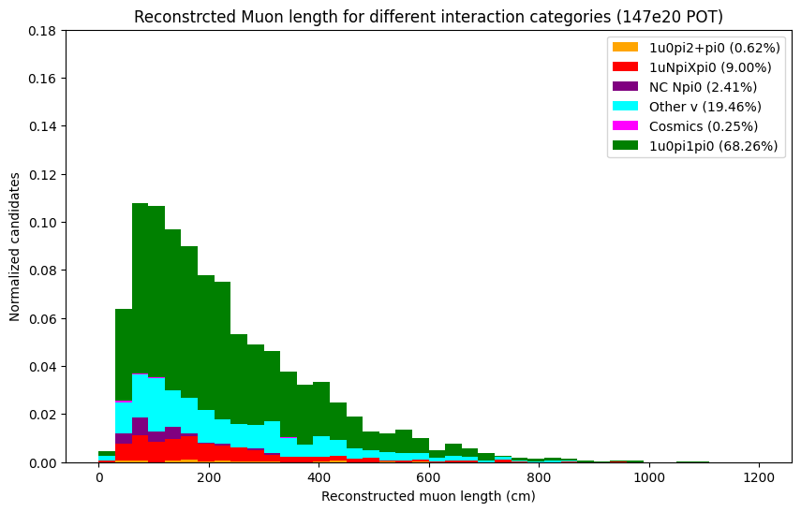
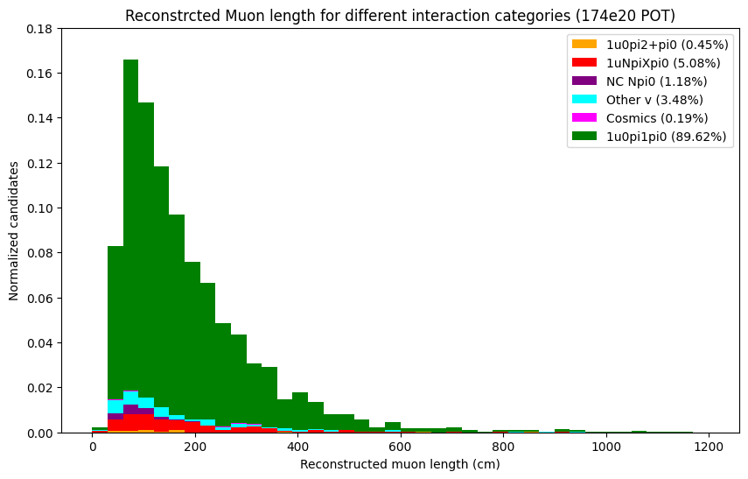
Low-level observables
Plotting Reconstructed primary Muon length
Muon length from NuMI selection
Muon length from BNB selection

Slide 18
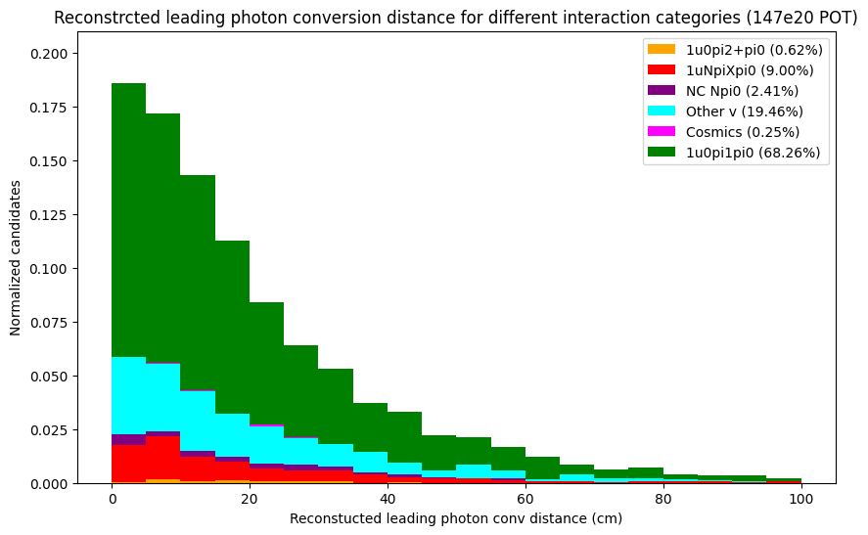
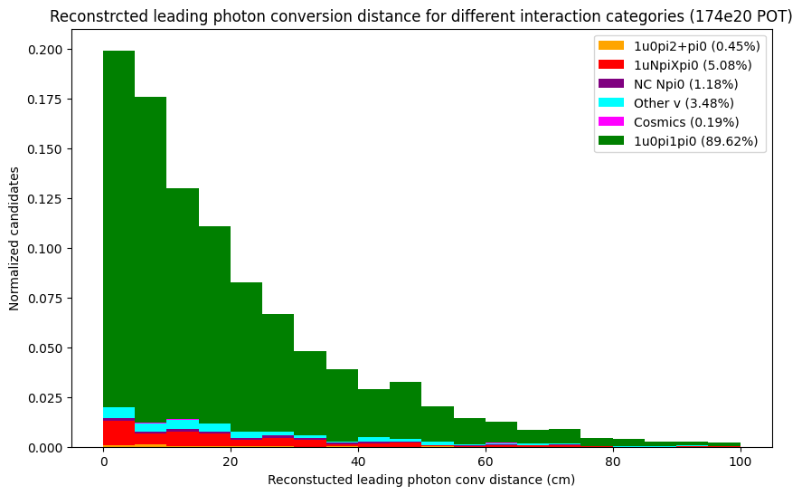
Low-level observables
Plotting Reconstructed leading photon conversion distance
leading photon conversion distance from NuMI selection
leading photon conversion distance from BNB selection

Slide 19
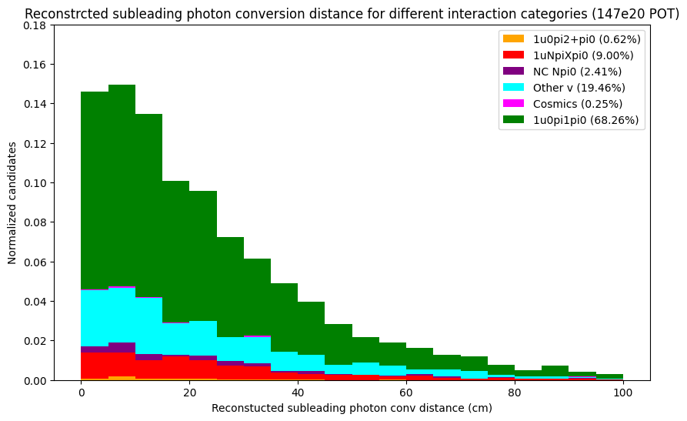
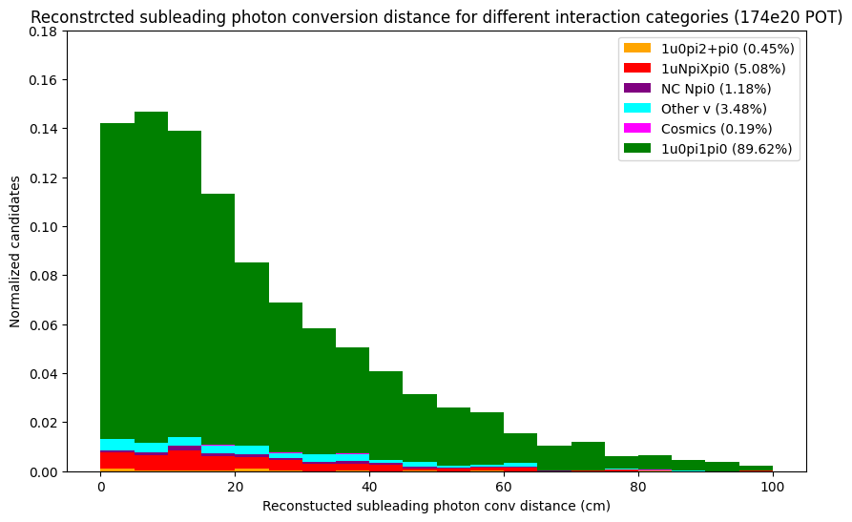
Low-level observables
Plotting Reconstructed subleading photon conversion distance
subleading photon conversion distance from NuMI selection
subleading photon conversion distance from BNB selection

Slide 20
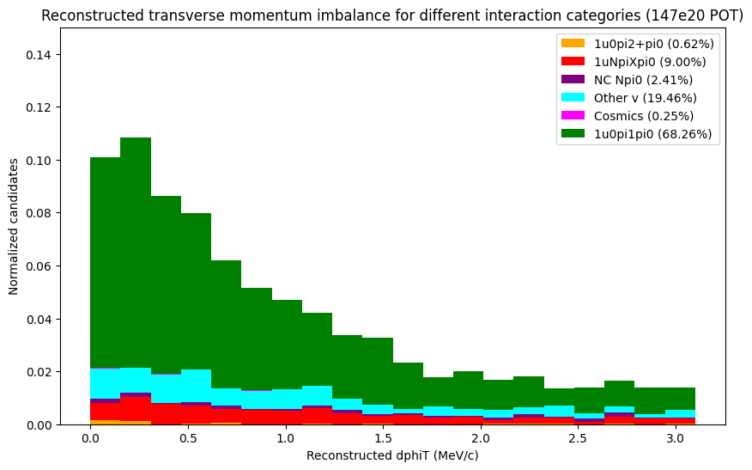
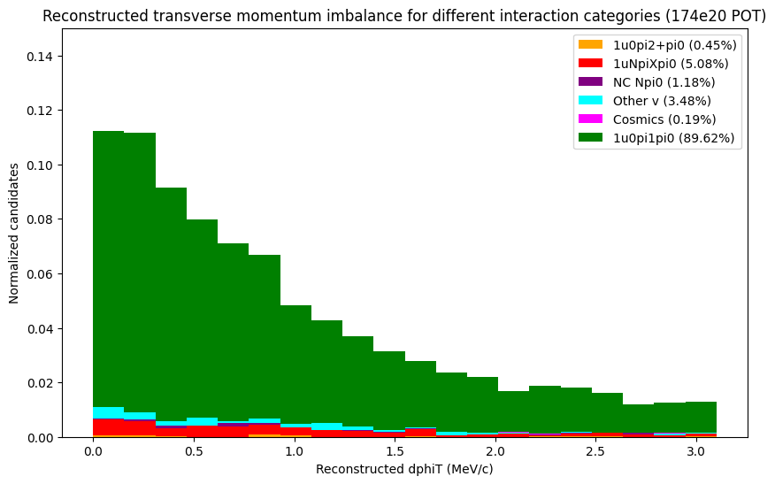
Transverse kinematic imbalance observables
Plotting Reconstructed Transverse momentum imbalance
subleading Transverse momentum imbalance from NuMI selection
subleading Transverse momentum imbalance from BNB selection

Slide 21
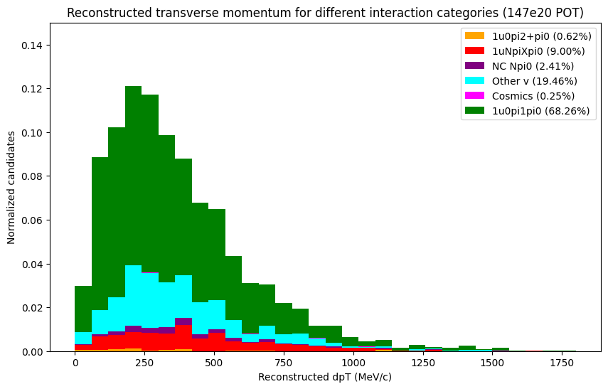
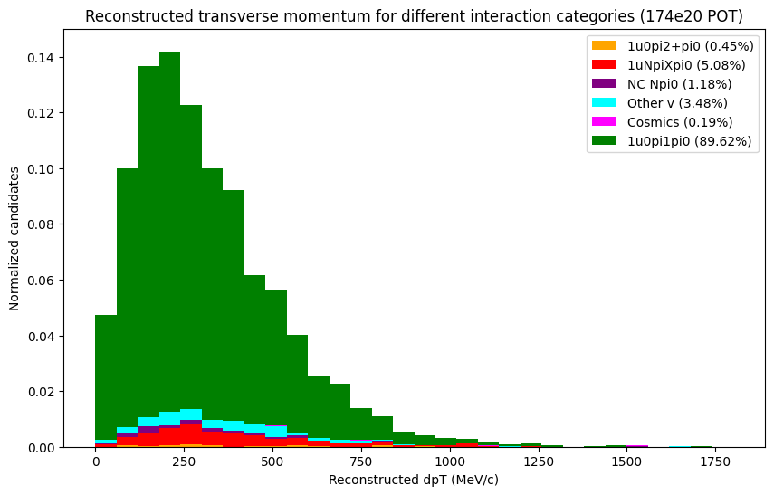
Transverse kinematic imbalance observables
Plotting Reconstructed Transverse momentum
Transverse momentum from NuMI selection
Transverse momentum from BNB selection

Slide 22
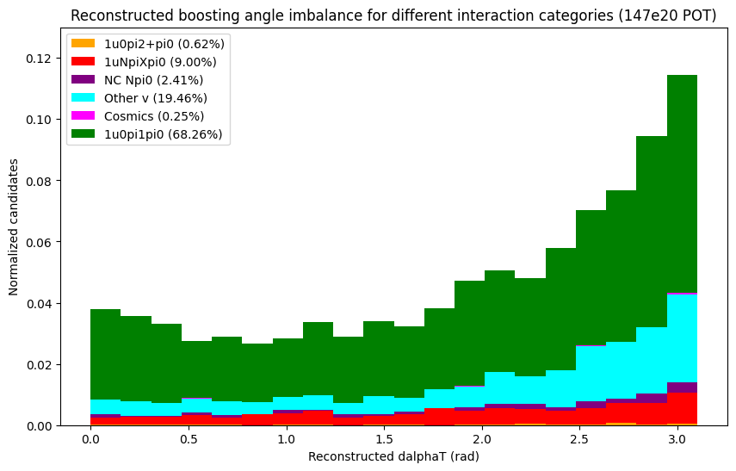
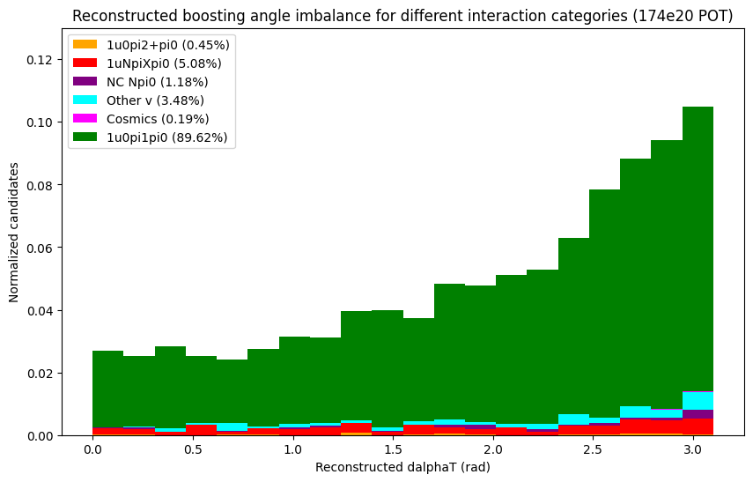
Transverse kinematic imbalance observables
Plotting Reconstructed transverse boosting angle
Transverse boosting angle, or the angle between the transverse momentum imbalance vector and the negative transverse momentum of the muon
Boosting angle from NuMi selection
Boosting angle from BNB selection

Slide 23
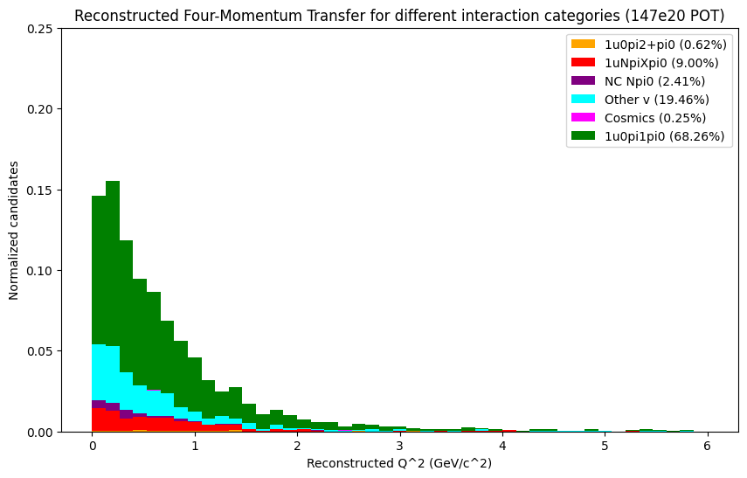
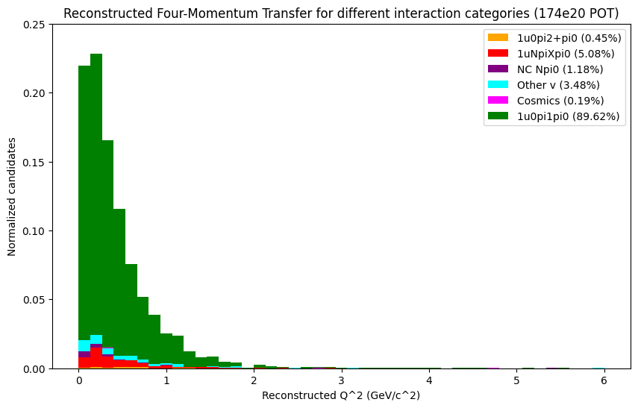
Four-Momentum Transfer and Hadronic Invariant Mass observables
Plotting Four-Momentum Transfer
Squared four-momentum transfer to target nucleon
Four-Momentum Transfer from NuMI selection
Four-Momentum Transfer from BNB selection

Slide 24
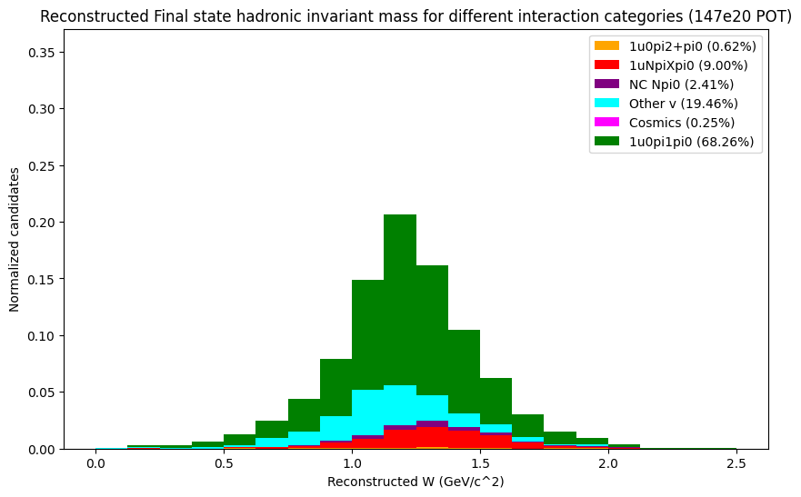
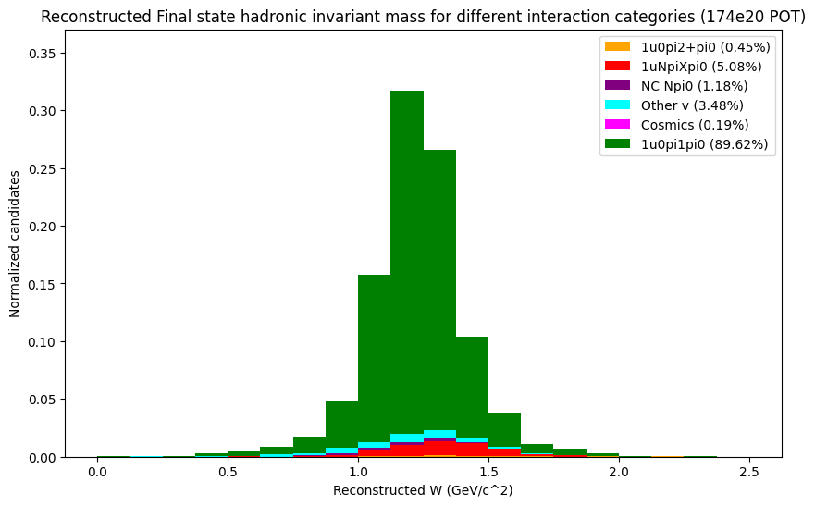
Four-Momentum Transfer and Hadronic Invariant Mass observables
Plotting Hadronic Invariant Mass
Hadronic invariant mass of the ﬁnal state
Hadronic Invariant Mass from NuMI selection
Hadronic Invariant Mass from BNB selection

Slide 25
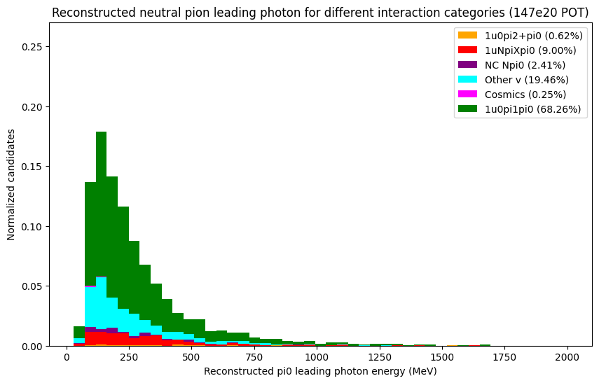
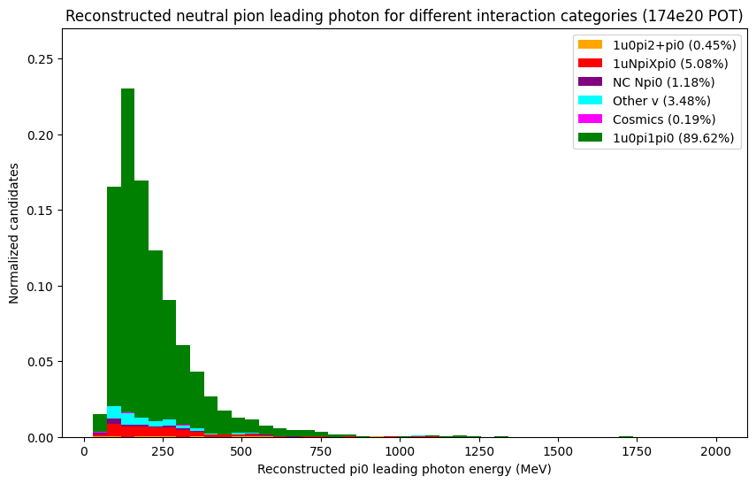
Neutral Pion Mass observables
Plotting leading photon KE
leading photon KE from NuMI selection
leading photon KE from BNB selection

Slide 26
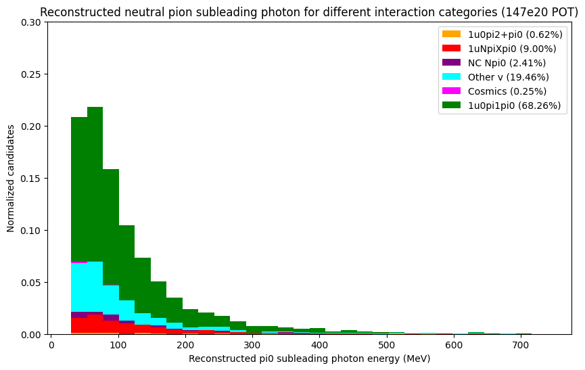
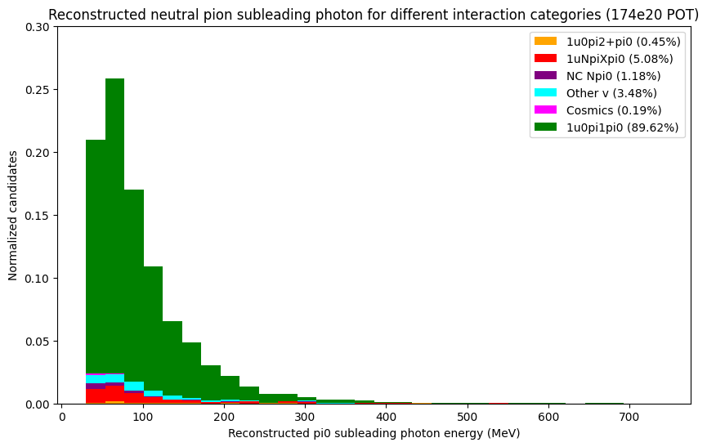
Neutral Pion Mass observables
Plotting subleading photon KE
subleading photon KE from NuMI selection
subleading photon KE from BNB selection

Slide 27
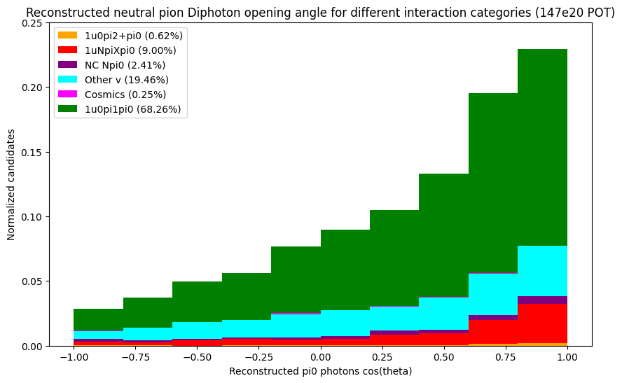
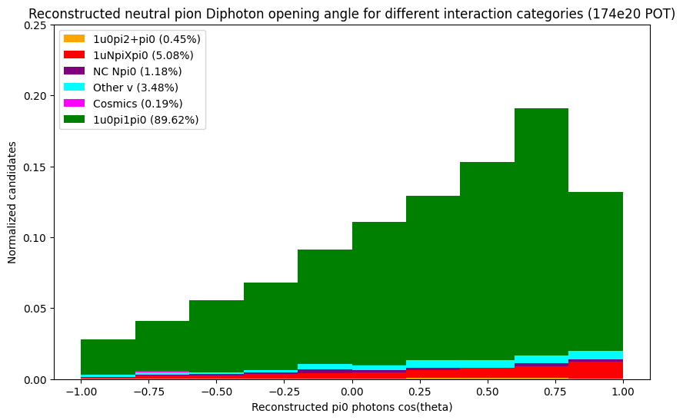
Neutral Pion Mass observables
Plotting pi0 di-photon opening angle
pi0 di-photon opening angle from NuMI selection
pi0 di-photon opening angle from BNB selection

Slide 28
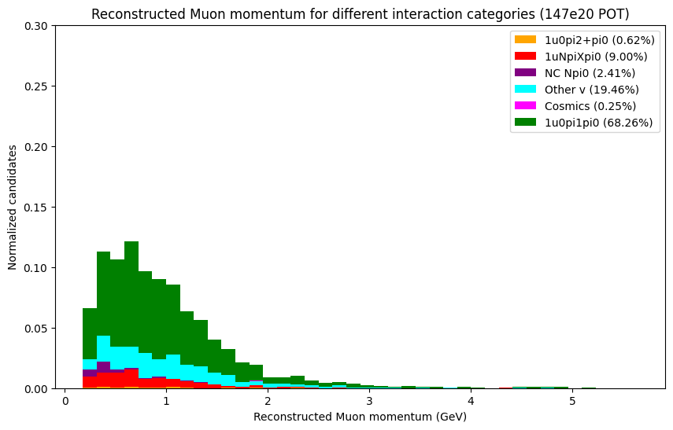
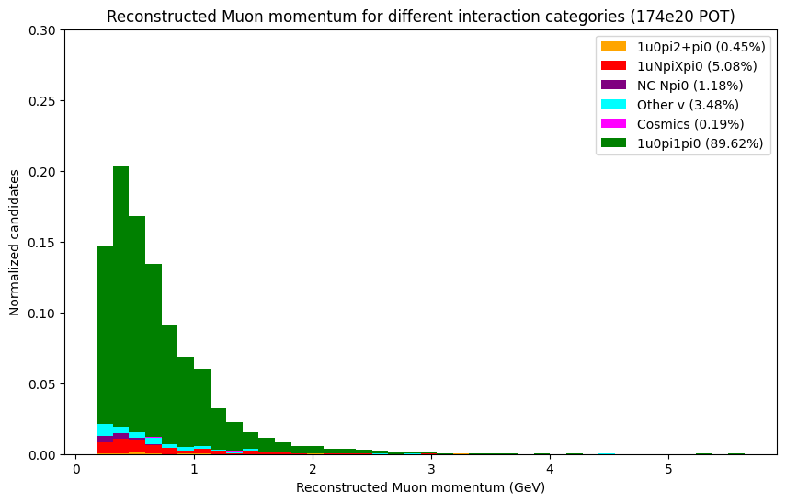
Cross Section Analysis Observables
Plotting Muon momentum
Muon momentum from NuMI selection
Muon momentum from BNB selection

Slide 29
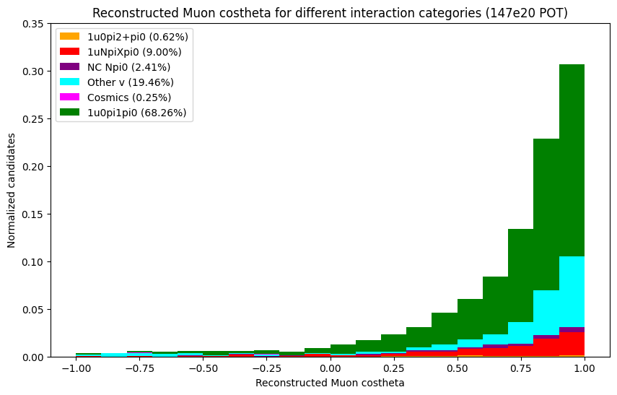
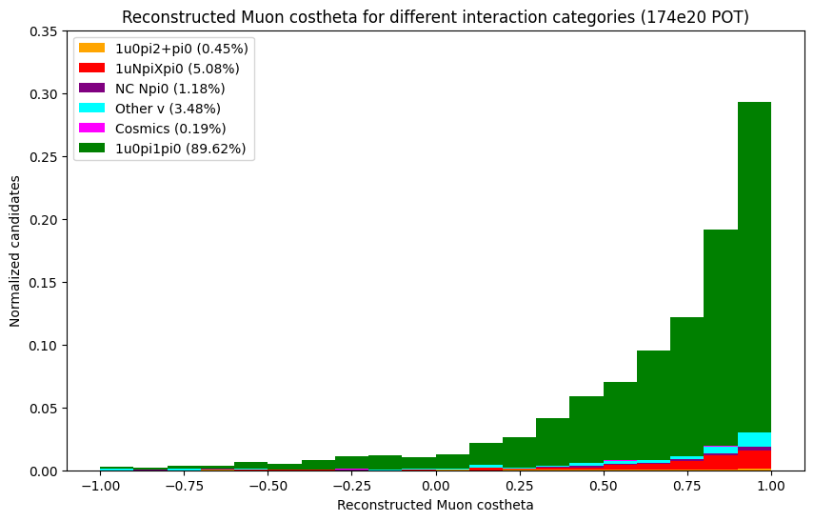
Cross Section Analysis Observables
Plotting Muon beam costheta
angle the true muon makes with the beam
Muon beam costheta from NuMI selection
Muon beam costheta from my BNB selection

Slide 30
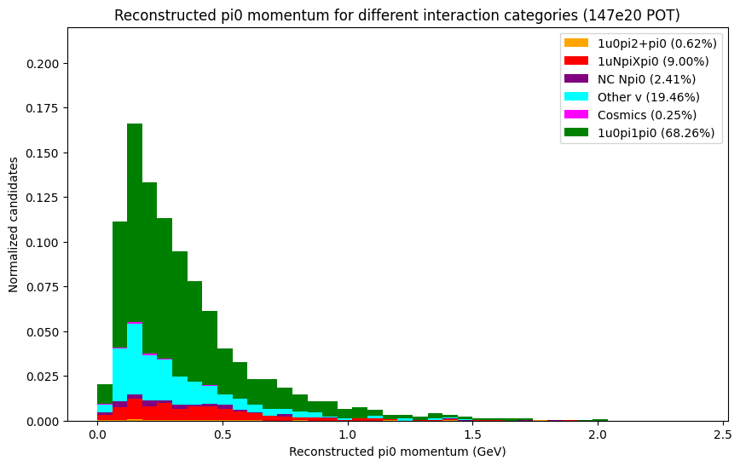
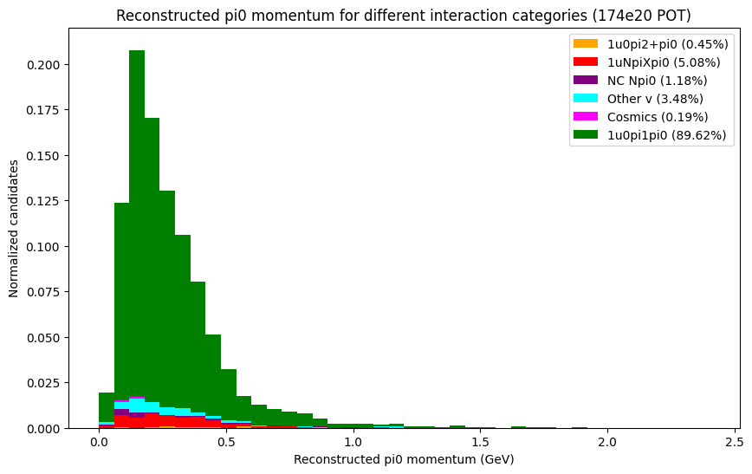
Cross Section Analysis Observables
Plotting pi0 momentum
pi0 momentum from NuMI selection
pi0 momentum from BNB selection

Slide 31
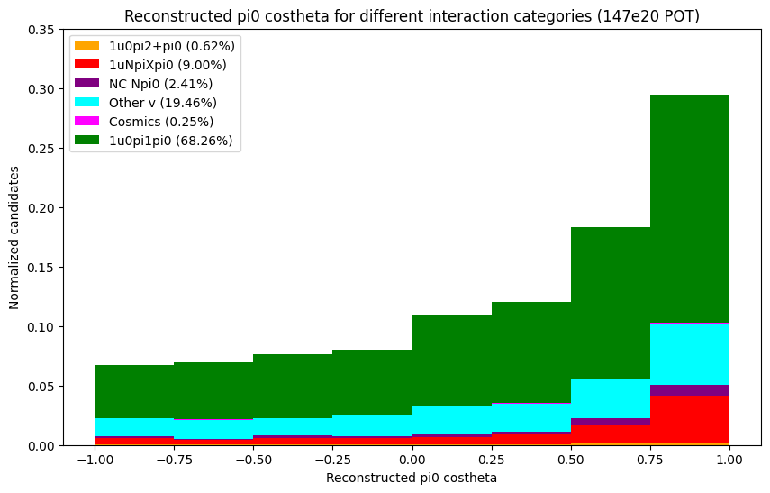
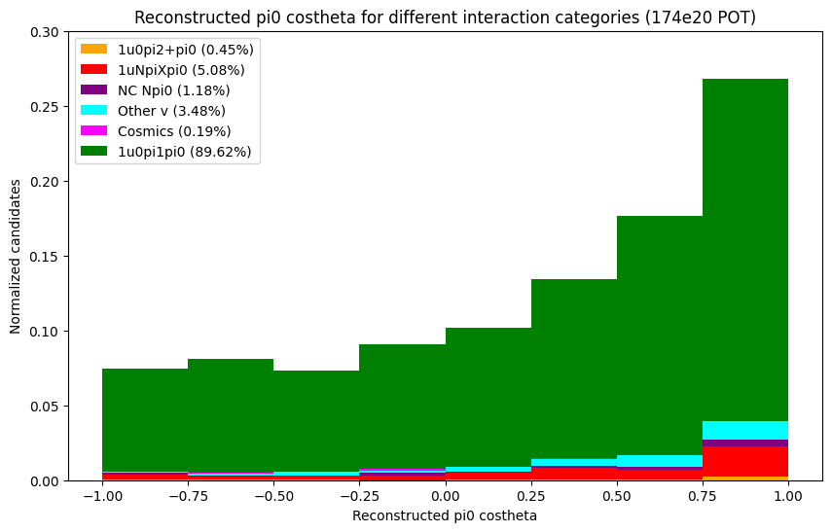
Cross Section Analysis Observables
Plotting pi0 beam costheta
angle the true neutral pion makes with the beam
pi0 beam costheta from NuMI selection
pi0 beam costheta from BNB selection

Slide 32
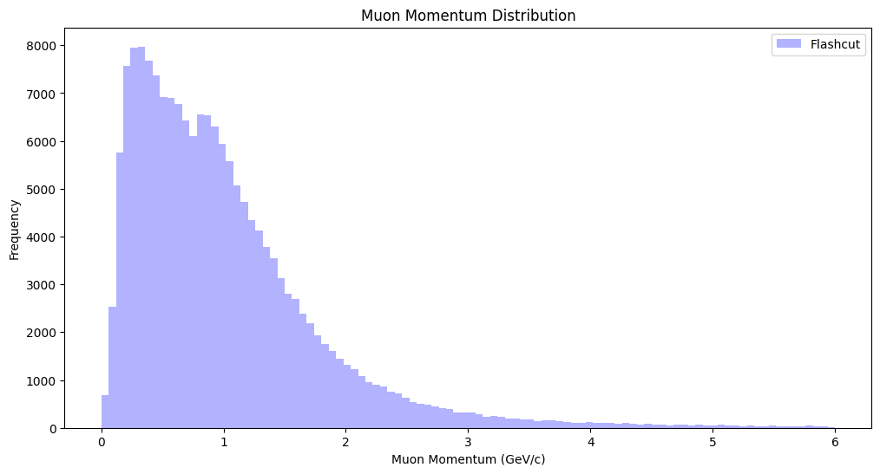
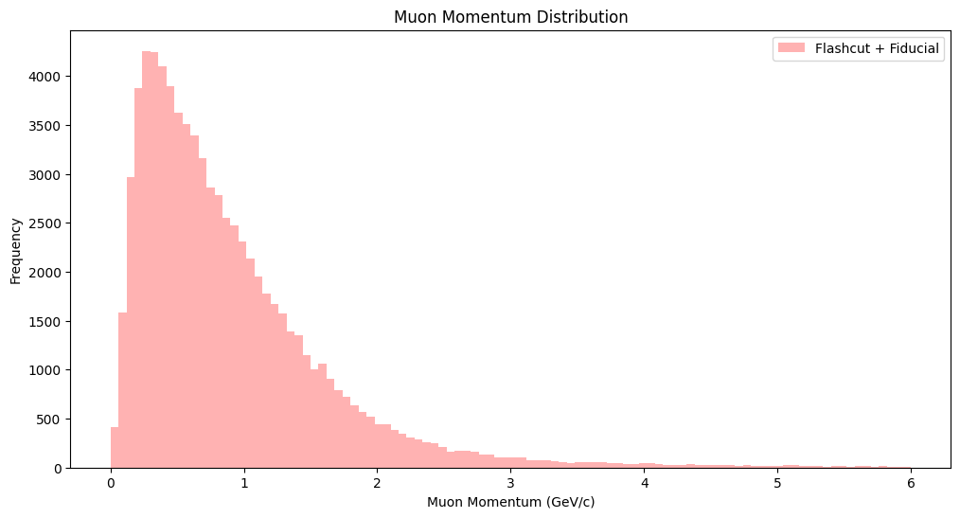
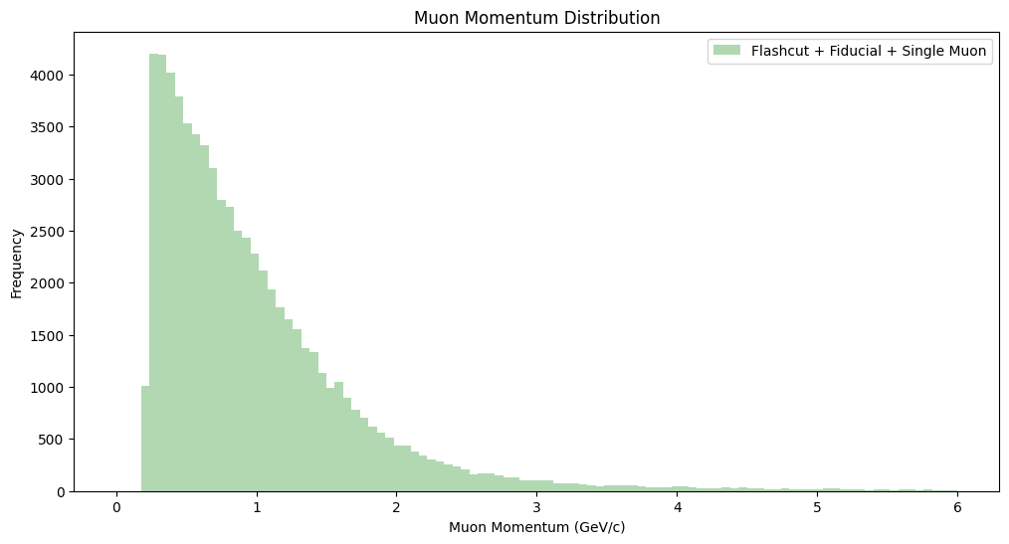
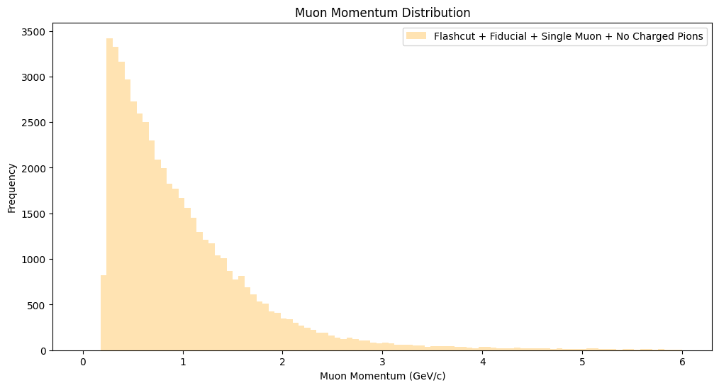
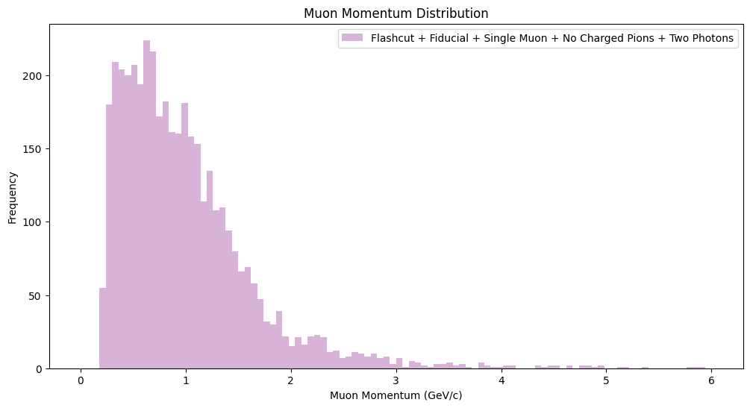
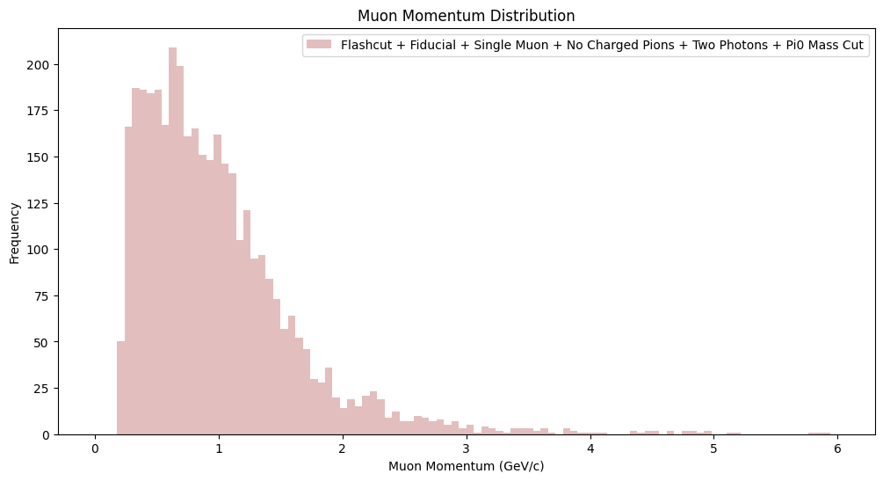
Muon momentum
Plotting NuMI sample reconstructed leading muon momentum for each cumulative cut

Slide 33


Muon momentum
Overlapping NuMI and BNB reconstructed and true leading muon momentum

Slide 34

Muon length
Overlapping NuMI and BNB reconstructed leading muon momentum

