Slide 1
Two-shower selection of HNL candidates
Jordon koh, Nanyang technological university
Notes:
Hello everyone im Jordon Koh, and im here to present on my research on two-shower selection for HNL candidates

Slide 2
About myself
Final year Physics undergraduate at Nanyang Technological University
Undertaking Final Year Project under Dr. Animesh Chatterjee and Dr. Albert De Roeck
Working with Dr. Animesh, Dr. Gajendra Gurung, and Dr. Harry Hausner’s group
Started in August last year
Notes:
So a little bit about myself, I am a final year physics undergraduate at Nanyang Technological university in Singapore.
I am undertaking my Final Year Project under Dr Animesh Chatterjee and Dr albert De Roeck as supervisors.
So im currently working alongside in a group with Dr Animesh, Dr Gajendra, and Dr harry. And I have been doing so since last year august

Slide 3
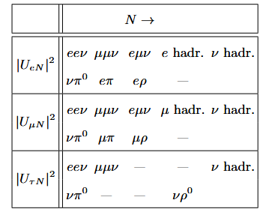

Background
Looking for Heavy Neutral Leptons (HNLs) decay product candidates
Focusing on NuMI beam and ICARUS detector
Particularly looking at final state two-shower particles
Examples
Di-electron shower (eev)
Di-photon shower from neutral pion production channel (v$π^{0}$)
Most relevant HNL decay channels into SM particles, from (Chatterjee et al., 2025)
Notes:
Moving on to some background on the research. We are specifically looking for right-handed neutrinos above the MeV scale, also known as Heavy Neutral Leptons via its decay products in various decay channels listed on the right.
We are focusing on the ICARUS LArTPC detector and data from the NuMI to look for these HNLs.
While all the possible decay channels will be eventually looked into, I am currently particularly focusing on final state two shower particles as HNL candidates, so the ones circled in red. So specifically Di-electron and Di-photon shower signatures in ICARUS detector via the NuMI beam

Slide 4
Motivations
Reasons for choosing ICARUS and NuMI beam
Higher energy of NuMI beam compared to BNB beam results in greater meson production rate and potentially increased HNL production
NuMI beam is directed off-axis to ICARUS, thus neutrino background is significantly lower than that of on-axis BNB beam
ICARUS is the largest operational LArTPC detector with excellent calorimetric and Particle PID reconstruction, enabling identification of all promising decay channels
Reasons for two-shower channel
Two-shower channels are significant in searches for HNL, being able to characterize two-shower interactions from neutrinos and HNLs will be crucial
Notes:
So I wanna talk our motivations for choosing ICARUS and NuMI. Firstly, the higher energy of NuMI compared to the BNB beam should result in greater meson production and thus potentially increased HNL production, which leads to higher chance of detection and data to analyse.
Second is that the NuMI beam is directed off-axis to ICARUS, and thus neutrino background will be significantly lower than that of the on-axis BNB beam, allowing for easier background rejection of standard neutrino interactions
Lastly is that the ICARUS detector is that largest operational LArTPC detector, and has excellent calorimetric and Particle identification reconstruction efficiency, so it’s an ideal detector for searching in all the promising decay channels for any final state particles
The reason for focusing on two-shower channel is that they will be significant in searches for HNL, and being able to characterize two shower signatures arising from standard neutrinos and HNLs will be crucial in background rejection and identification.

Slide 5
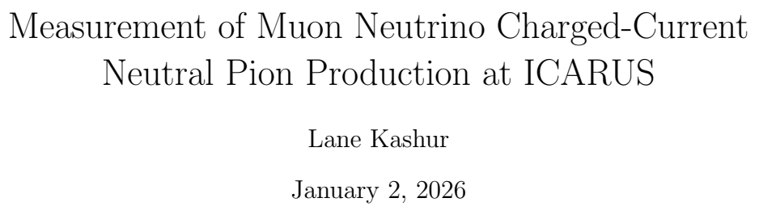

Event selection plan
For Di-photon shower selection
Referencing and verifying Lane Kashur’s thesis work
Lane’s work focused on BNB beam data and MC sample
Eventually recreate selection for NuMI beam data and MC sample and compare distributions
Differences
Used much smaller MC BNB sample for recreation (1.68e21 vs 1.74e20)
Only focused on MC sample, no data comparison
Some data and beam quality cuts not applied
Notes:
Moving on to initial event selection plan. For the Di-photon shower selection channel, I will be largely referencing Lane Kashur’s thesis work and using many of his kinematical and topological cuts and variables from justin’s medulla event selection tool.
My aim for this is to utilize lane’s results and validate it for background rejection for our eventual HNL search in a dedicated HNL simulation sample.
I will be using Lane’s thesis work and verifying his results for BNB Monte Carlo samples of muon neutrino and cosmics, and then moving on to applying the same selection in the NuMI MC sample and comparing
For

Slide 6
Signal and Selected definitions
Signal: defined as a true Charged Current muon neutrino interaction that is
Fiducialized
Not within the region deﬁning the central 200 cm of the detector (z-axis not within -100cm to 100cm in detector coordinates)
Exactly one primary muon (KE ≥ 143.425 MeV)
Zero primary charged pions (KE ≥ 25 MeV)
Exactly one neutral pion (no KE threshold)
Any number of particles that are not muons or pions
Selection: Cuts applied for selection of reconstructed interactions
Fiducial
z-axis not within -100cm to 100cm in detector coordinates
Flash time
Single primary muon (KE ≥ 143.425 MeV)
No primary charged pions (KE ≥ 25 MeV)
Two primary photons (KE ≥ 25 MeV)
Pi0 mass cut
Notes:
Based on Lane’s thesis. I followed the same signal and selected definitions. This z-axis requirement is made in an eﬀort to
159 avoid potential eﬀects in data and simulation related to the split ﬁrst induction
160 wire plane geometry
A signal will be defined as

Slide 7
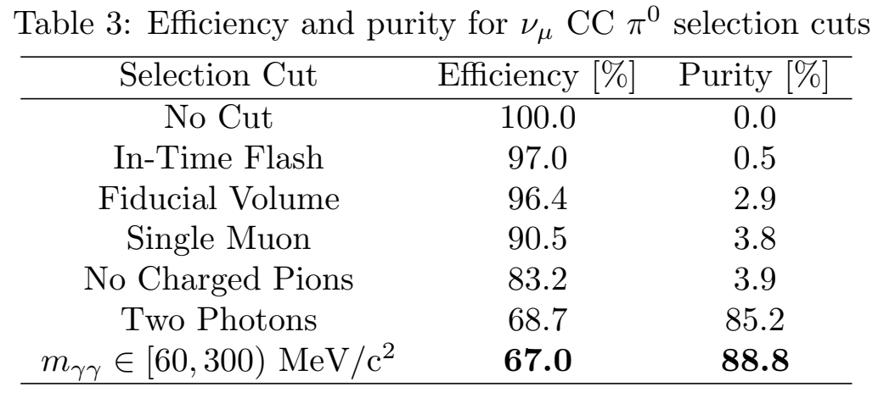
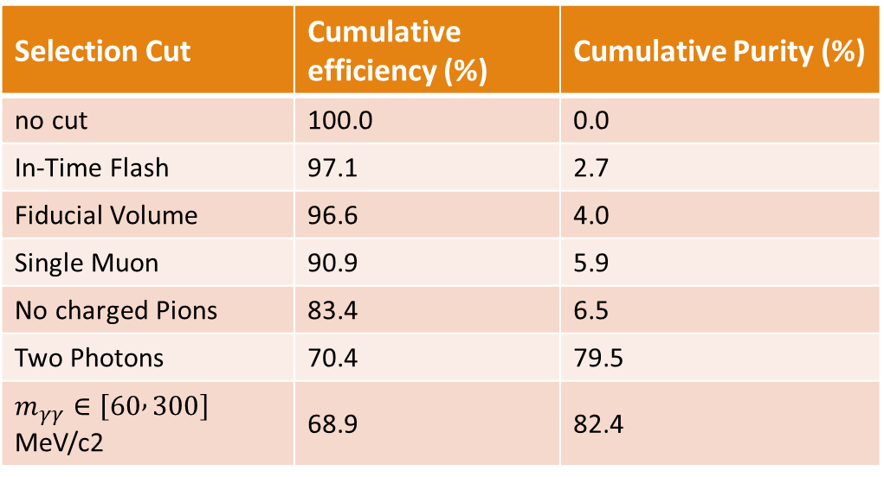
Efficiency and Purity analysis
Efficiency defined as fraction of true signal interactions that are matched to selected interactions
Purity defined as the fraction of selected interactions that are matched to true signal interactions
Selection Cut | Cumulative efficiency (%) | Cumulative Purity (%)
no cut | 100.0 | 0.0
In-Time Flash | 97.1 | 2.7
Fiducial Volume | 96.6 | 4.0
Single Muon | 90.9 | 5.9
No charged Pions | 83.4 | 6.5
Two Photons | 70.4 | 79.5
$m_{γγ}∈\left[60 , 300\right]$﻿ MeV/c2 | 68.9 | 82.4
Efficiency and Purity from Lane’s paper
Efficiency and Purity from my BNB sample

Slide 8
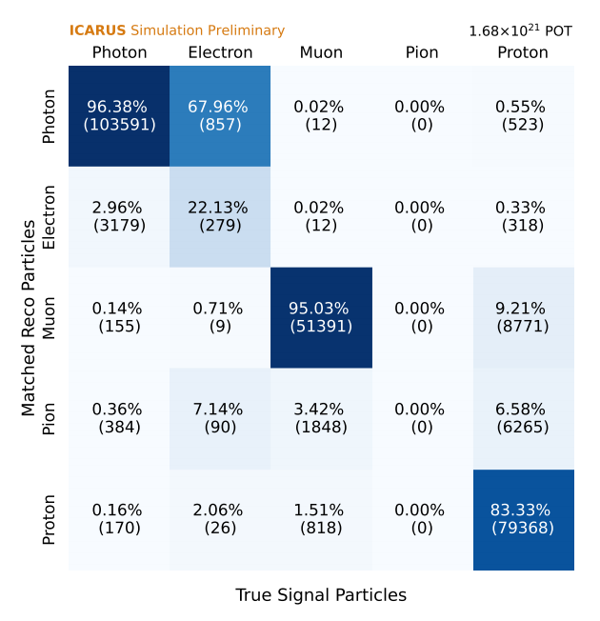
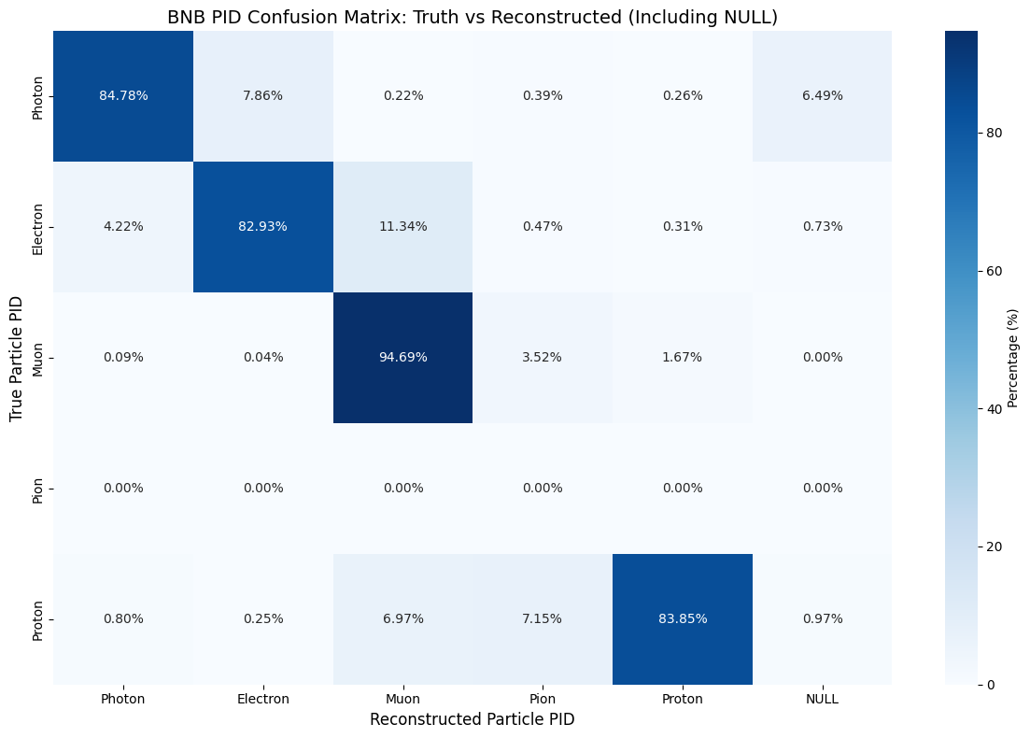
PID Truth to Reco confusion matrix
Plotting confusion matrix for PID particle type for true signal interactions
primary reason for inefficiency is due to true final state protons misidentified as muons or pions
Truth to Reco confusion matrix from lane’s paper
Truth to Reco confusion matrix from my BNB sample
Notes:
Electron efficiency is vastly different from lane’s with mine significantly higher. Will need to look into this more. Other than that, most of the other values are similar, with the primary reason for inefficiency being the same with final state protons misidentified as muons or pions

Slide 9
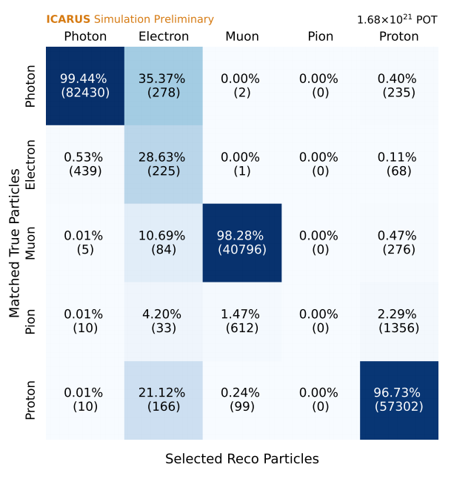
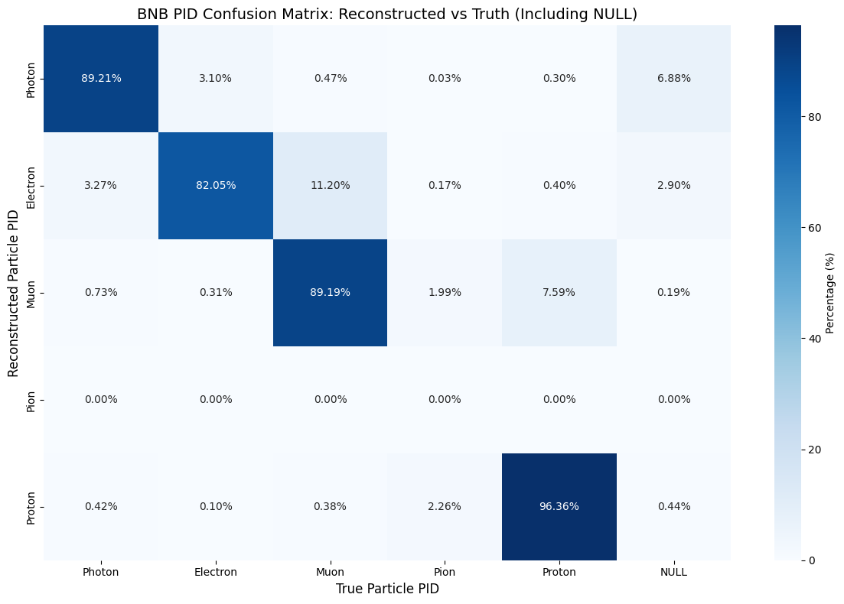
PID Reco to Truth confusion matrix
Plotting confusion matrix for PID particle type for true signal interactions
primary reason for impurity is due to misidentification of true pions as protons
Reco to Truth confusion matrix from lane’s paper
Truth to Reco confusion matrix from my BNB sample
Notes:
Same issue here with the electron. The muon is also lower by about 10% for the efficiency. So ill need to look into as well, but it could be due to the small differences in our cuts and POT size

Slide 10
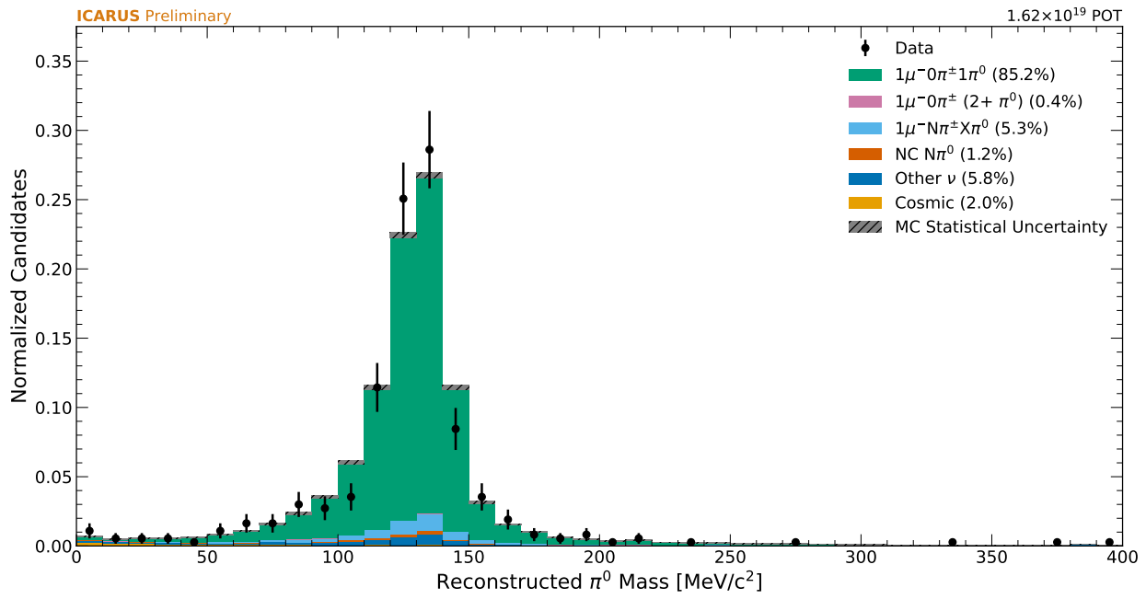
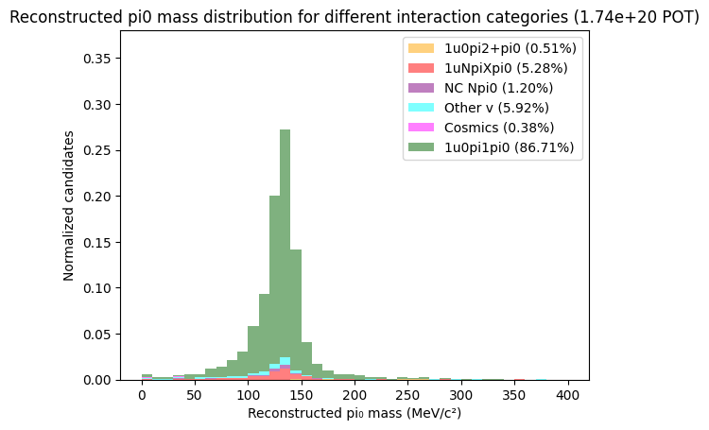
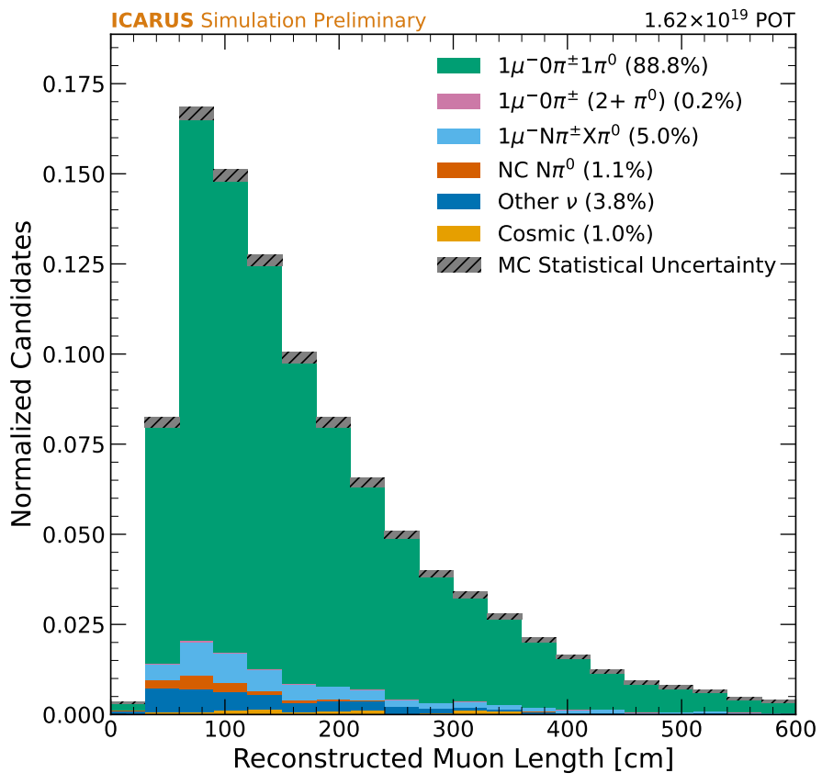
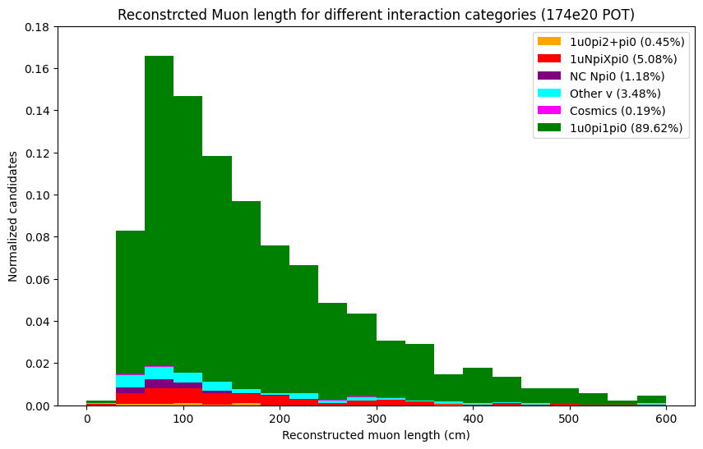
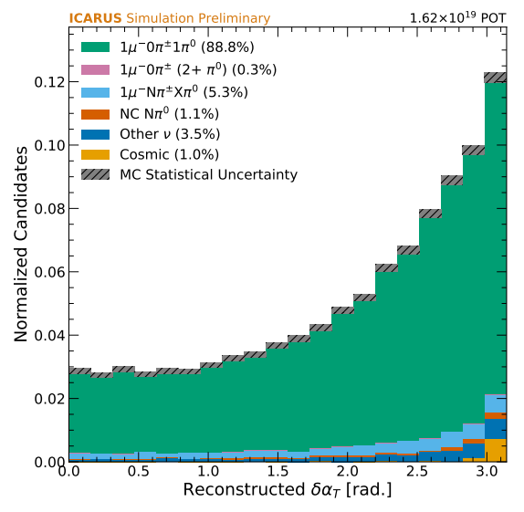
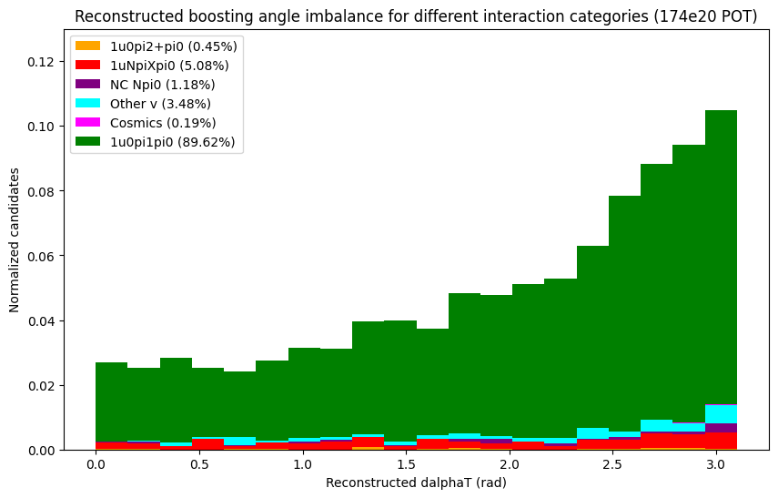
Plot comparison
Reconstructed neutral pion mass
Reconstructed Hadronic Invariant Mass
lane’s paper
My selection
lane’s paper
My selection
Reconstructed primary muon length
Reconstructed boosting angle
lane’s paper
My selection
lane’s paper
My selection
Notes:
Some recreated plots and comparing to lanes paper, the reconstructed neutral pion mass is basically identical with some small differences that could be due to slight binning differences.
Primary muon length to assess basic reconstruction performance, very similar,
Boosting angle is the the angle between the transverse momentum imbalance vector and the negative transverse momentum of the muon
Transverse momentum imbalance, or the magnitude of the vector diﬀer-
275 ence between the transverse momentum of the muon and the hadronic
276 system

Slide 11
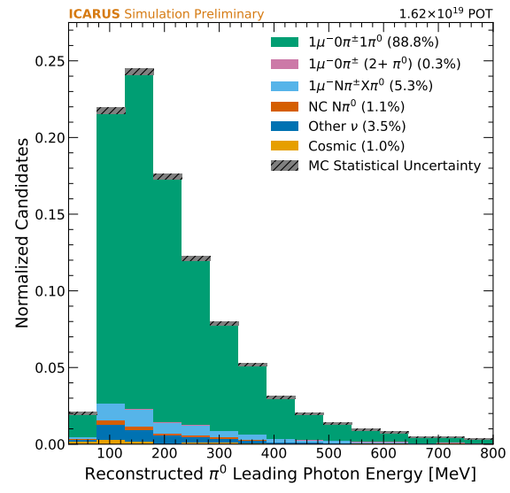
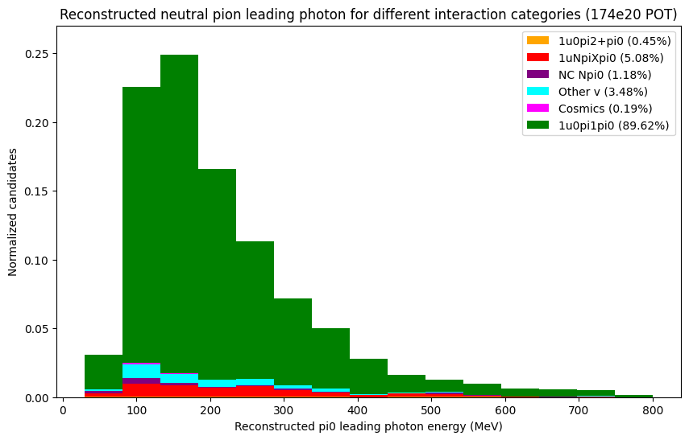
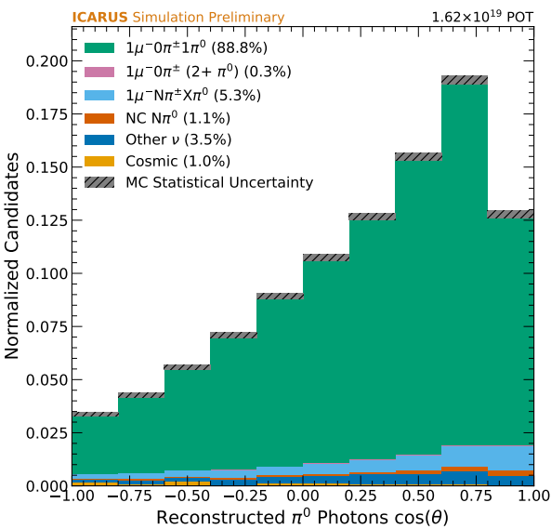
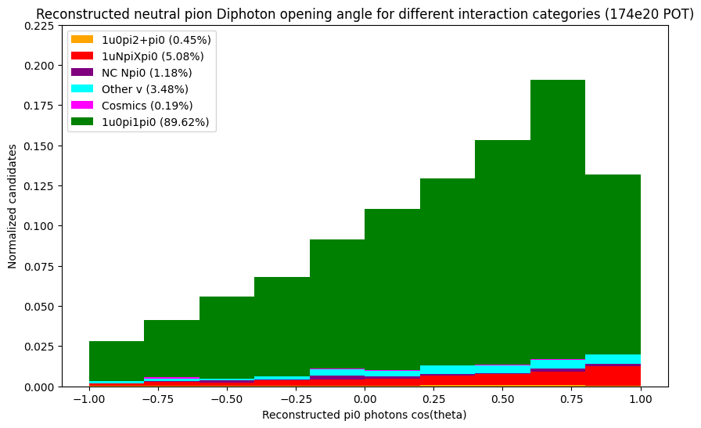
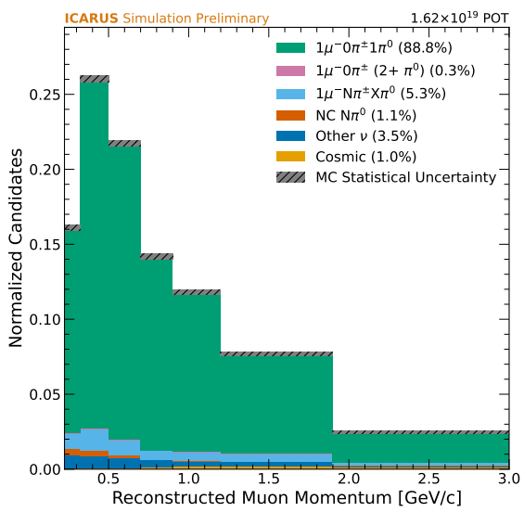
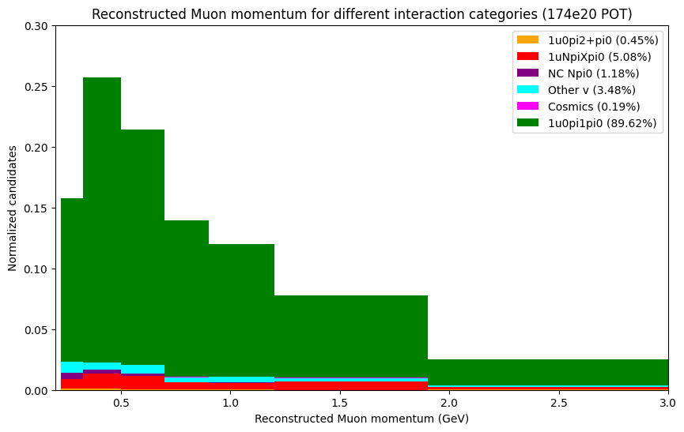
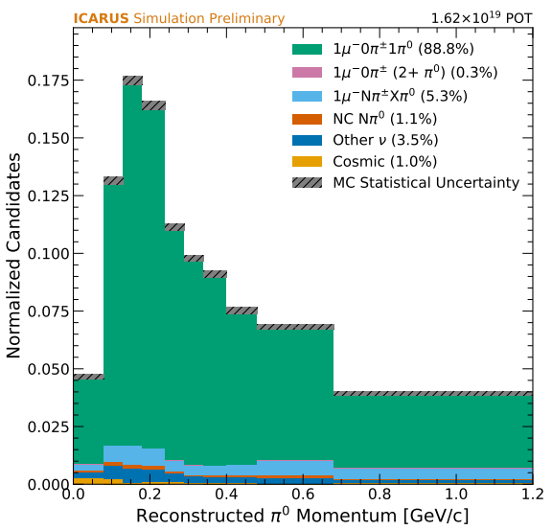
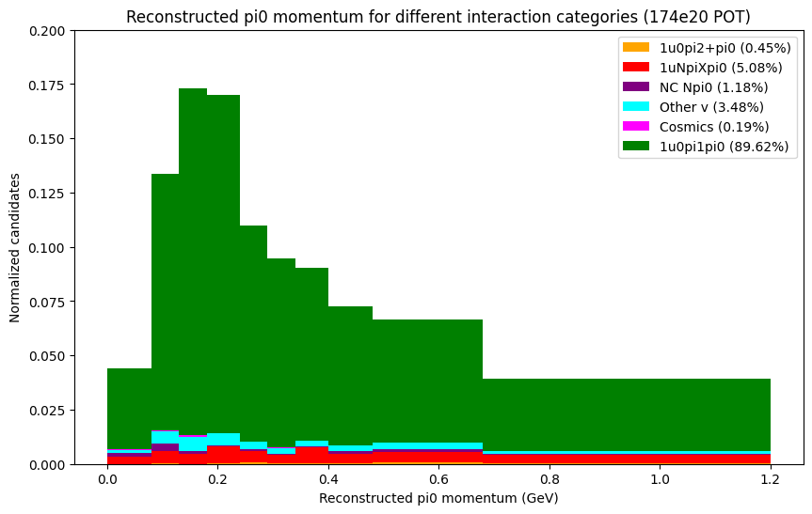
Plot comparison
Reconstructed leading photon KE
Reconstructed Di-photon opening angle
lane’s paper
My selection
lane’s paper
My selection
Reconstructed muon momentum
Reconstructed Pi0 momentum
lane’s paper
My selection
lane’s paper
My selection
Notes:
Leading photon KE and Diphoton opening angle relevant to the calibration of electromagnetic showers
Muon momentum and pi0 momentum which are relevant to Cross section analysis observables for which single diﬀerential cross sec-tions will be extracted as a function of

Slide 12
NuMI selection
NuMI MC sample
Muon neutrino + cosmics
File path
/pnfs/icarus/persistent/users/dcarber/spine/combined_files/NuMI_CV_flat_cafs_2/*.root
POT size = 147e20
Parameter | NuMI | BNB
Pot Size | 147e20 | 174e20
Number of reconstructed selected interactions | 3566 | 4249
Number of true signal interactions | 3815 | 5532

Slide 13
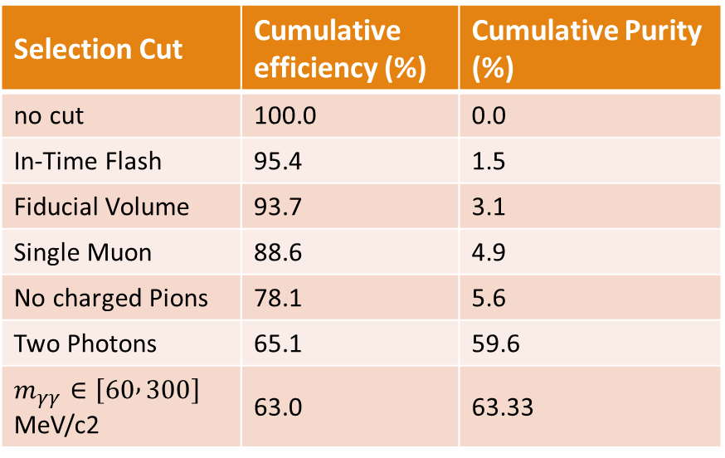
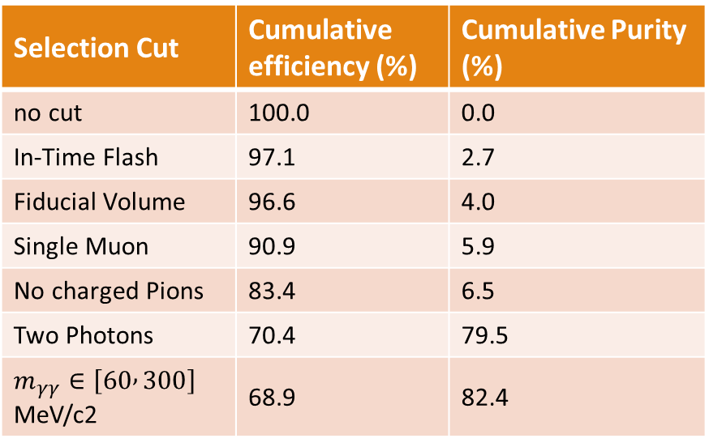
Efficiency and Purity analysis
Efficiency defined as fraction of true signal interactions that are matched to selected interactions
Purity defined as the fraction of selected interactions that are matched to true signal interactions
Selection Cut | Cumulative efficiency (%) | Cumulative Purity (%)
no cut | 100.0 | 0.0
In-Time Flash | 95.4 | 1.5
Fiducial Volume | 93.7 | 3.1
Single Muon | 88.6 | 4.9
No charged Pions | 78.1 | 5.6
Two Photons | 65.1 | 59.6
$m_{γγ}∈\left[60 , 300\right]$﻿ MeV/c2 | 63.0 | 63.33
Selection Cut | Cumulative efficiency (%) | Cumulative Purity (%)
no cut | 100.0 | 0.0
In-Time Flash | 97.1 | 2.7
Fiducial Volume | 96.6 | 4.0
Single Muon | 90.9 | 5.9
No charged Pions | 83.4 | 6.5
Two Photons | 70.4 | 79.5
$m_{γγ}∈\left[60 , 300\right]$﻿ MeV/c2 | 68.9 | 82.4
Efficiency and Purity from NuMI selection
Efficiency and Purity from BNB selection

Slide 14

PID Truth to Reco confusion matrix
Plotting confusion matrix for PID particle type for true signal interactions
primary reason for inefficiency is due to true final state protons misidentified as muons or pions
Truth to Reco confusion matrix from NuMI selection
Truth to Reco confusion matrix from BNB selection

Slide 15

PID Reco to Truth confusion matrix
Plotting confusion matrix for PID particle type for true signal interactions
primary reason for impurity is due to misidentification of true pions as protons
Reco to Truth confusion matrix from NuMI selection
Reco to Truth confusion matrix from BNB selection

Slide 16
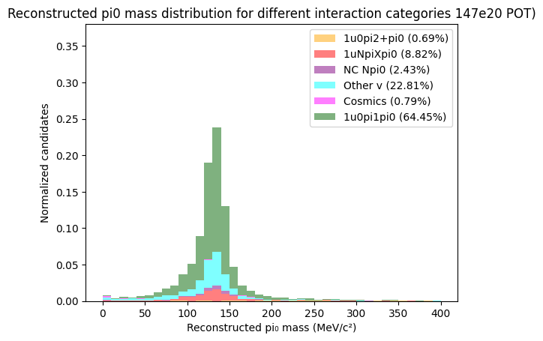
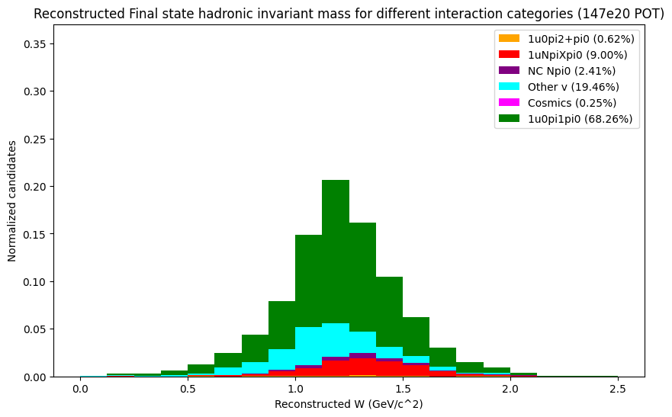
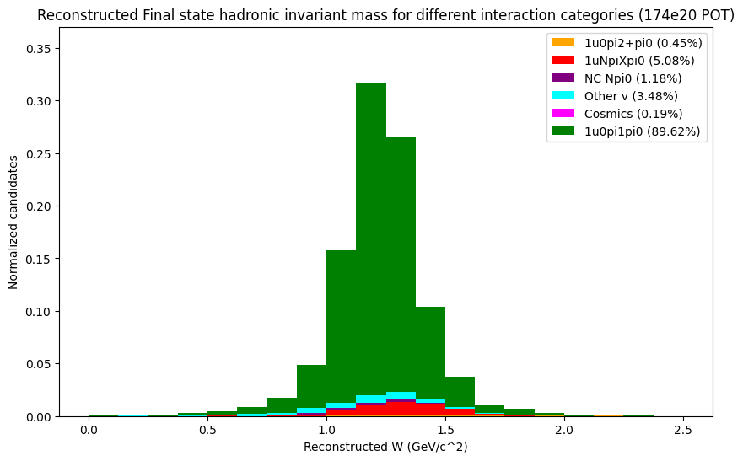
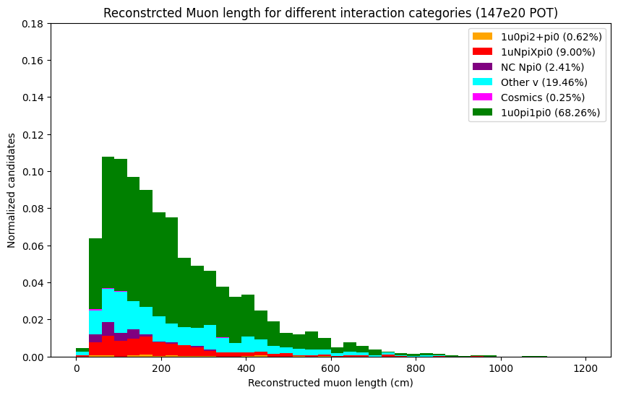
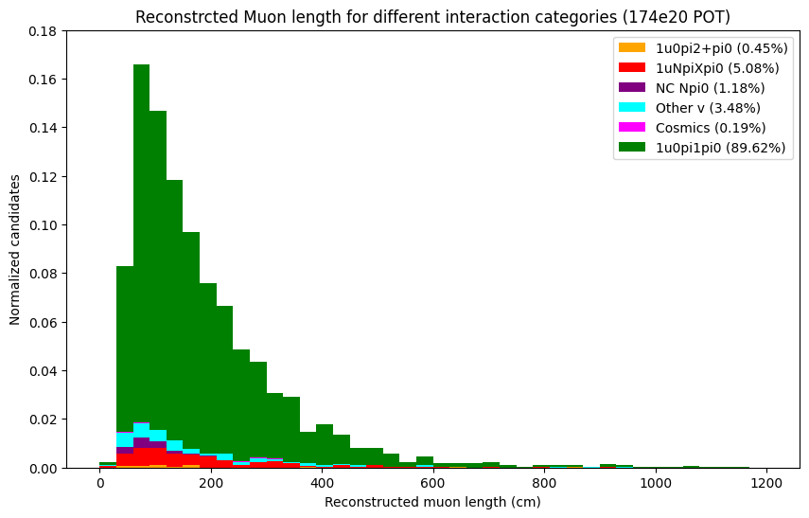
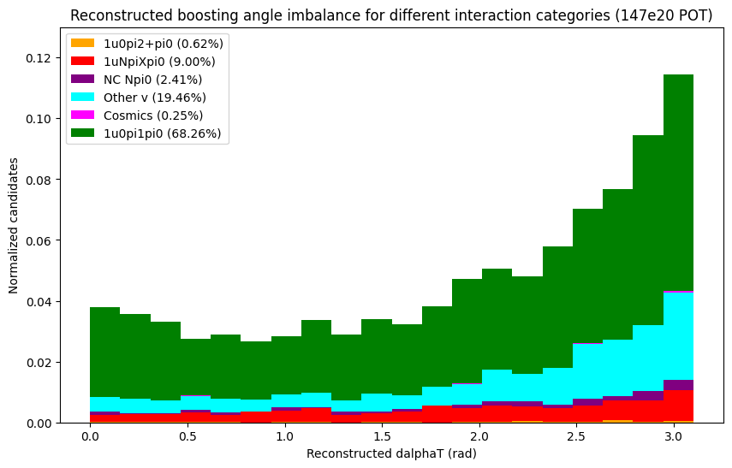
Plot comparison (NuMI vs BNB selection)
Reconstructed neutral pion mass
Reconstructed Hadronic Invariant Mass
NuMI selection
BNB selection
NuMI selection
BNB selection
Reconstructed primary muon length
Reconstructed boosting angle
NuMI selection
BNB selection
NuMI selection
BNB selection

Slide 17
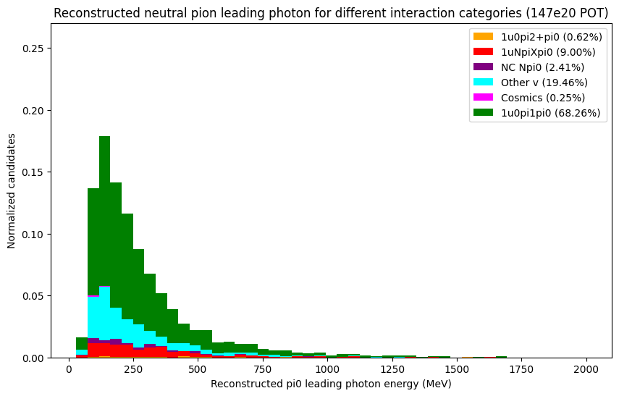
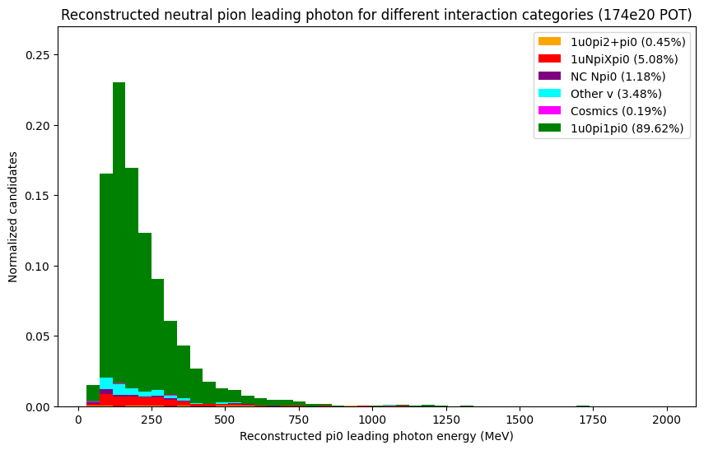
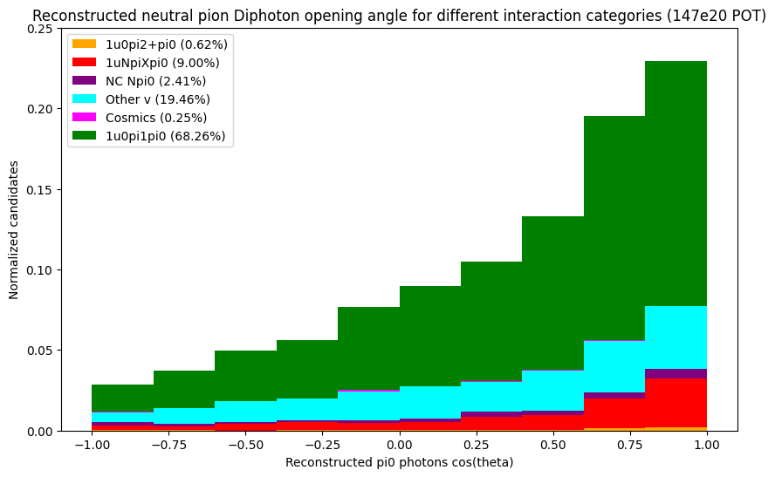
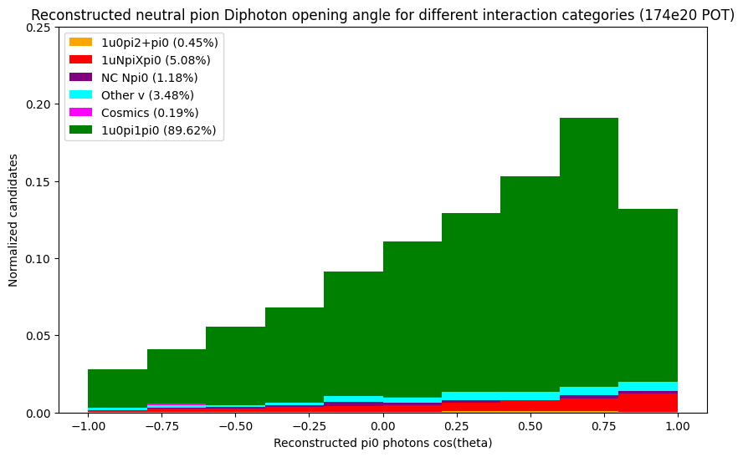
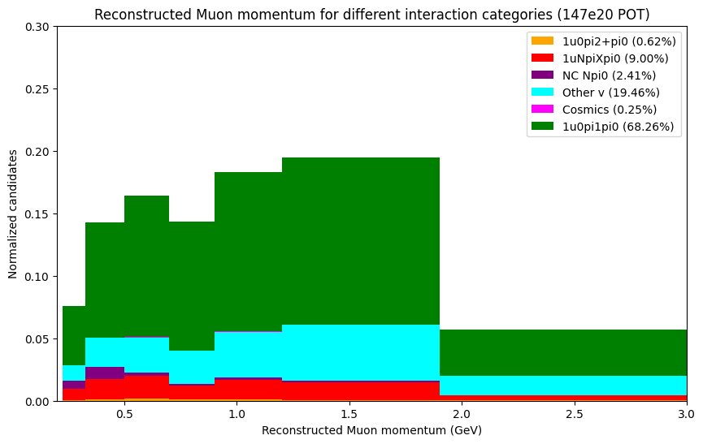
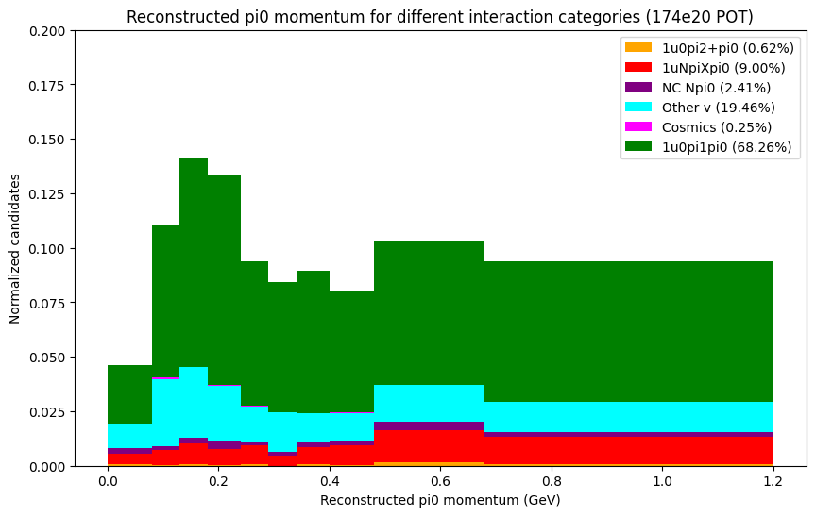
Plot comparison (NuMI vs BNB selection)
Reconstructed leading photon KE
Reconstructed di-photon opening angle
NuMI selection
BNB selection
NuMI selection
BNB selection
Reconstructed muon momentum
Reconstructed pi0 momentum
NuMI selection
BNB selection
NuMI selection
BNB selection

Slide 18
NuMI: Looking into ‘other v’ category
Due to the large percentage for the ‘other v’ interaction category, looked further into what type of interactions fall into this category
Table below shows the 5 most common interaction types within the ‘other v’ category
Anti-neutrino interactions account for ~78% of all ‘other v’ interactions (547 out of 694)
Much larger amount of anti-neutrino interactions in NuMI selection compared to BNB (566 vs 31)
Interaction type | PDG code | Fiducialized | Percentage of ‘other v’interactions falling into this type (%)
1u0π±1π | -14 | Yes | 60.5
1u1π±1π | -14 | Yes | 6.6
1u0π±0π | 14 | Yes | 4.6
1u0π±0π | -14 | Yes | 4.0
1u0π±1π | 14 | no | 3.6

Slide 19
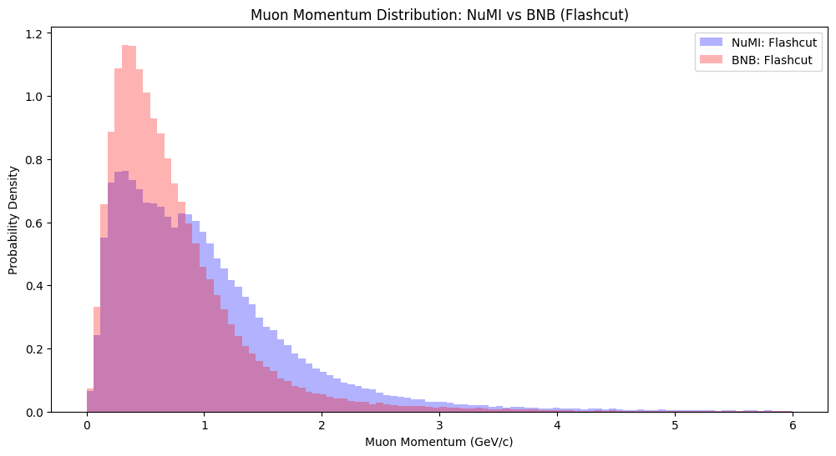
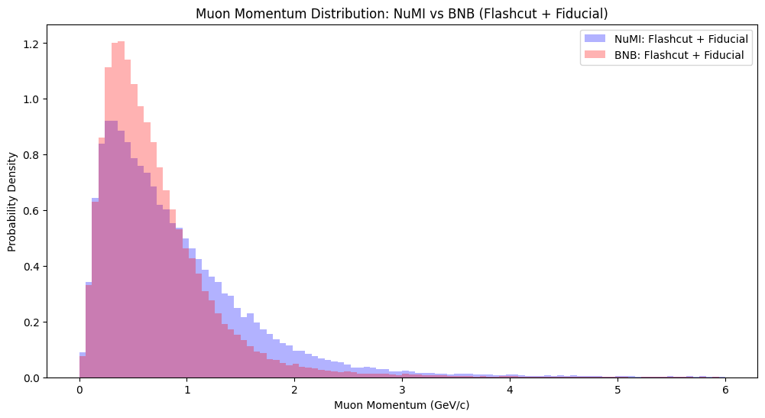
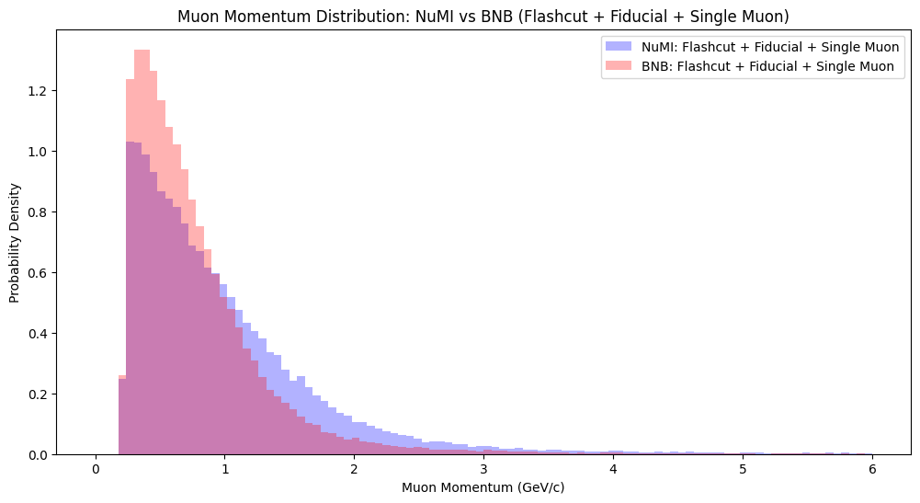
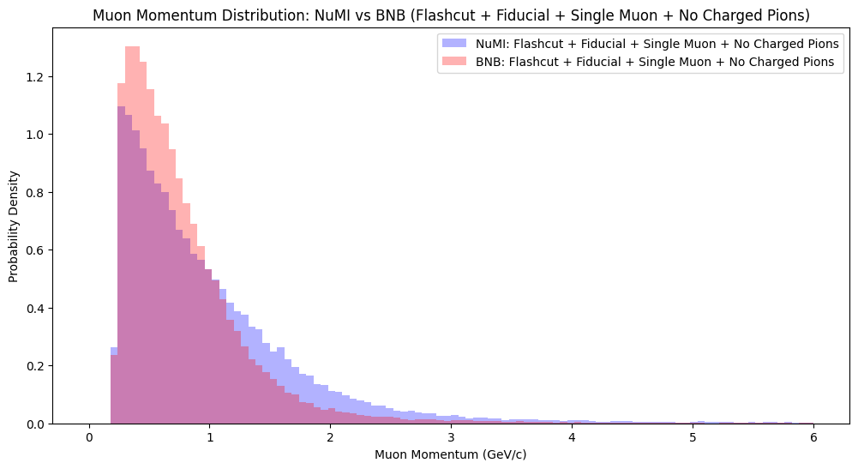
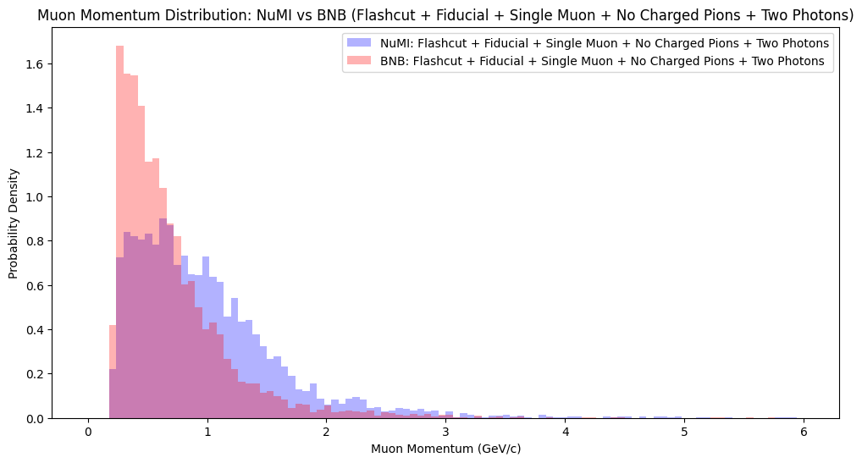
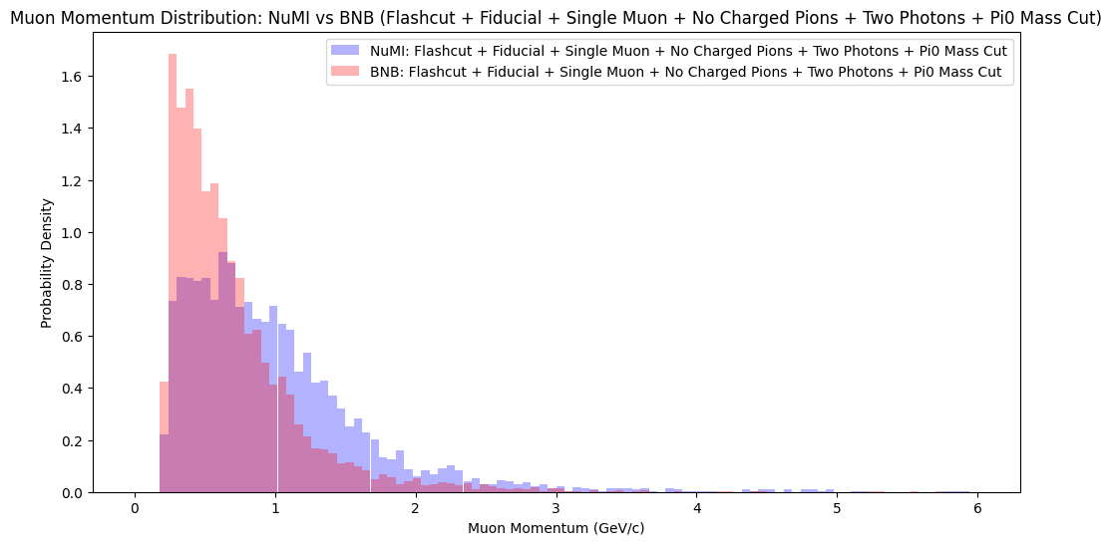
Reconstructed Muon momentum
Plotting NuMI and BNB normalized reconstructed leading muon momentum for each cumulative cut

Slide 20
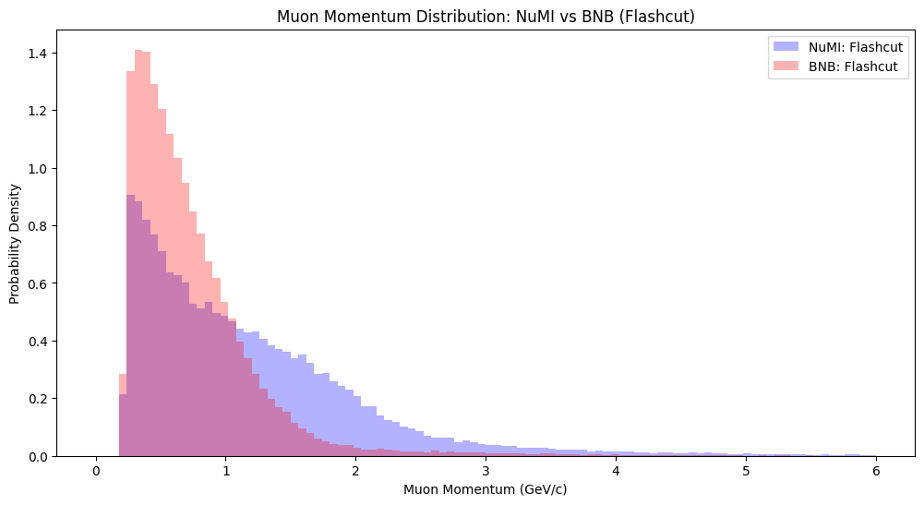
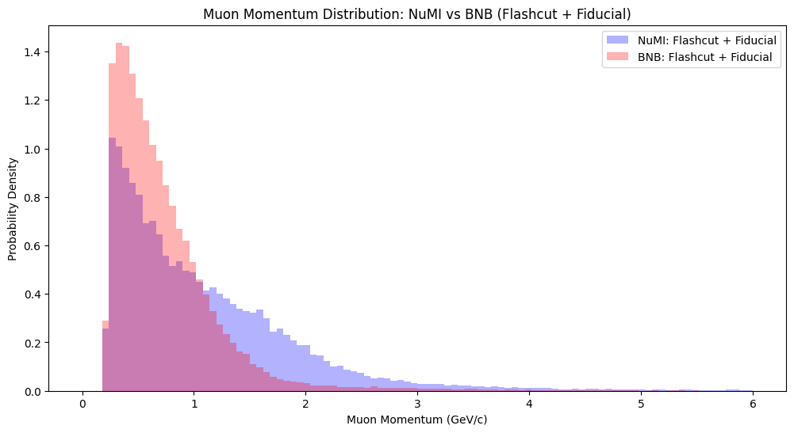
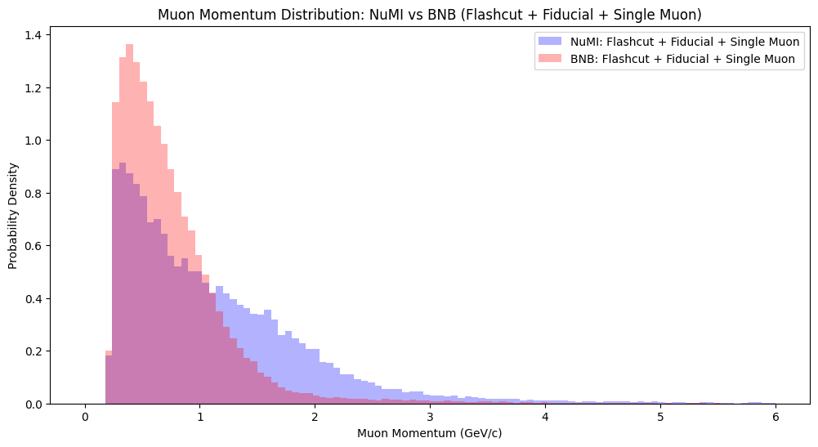
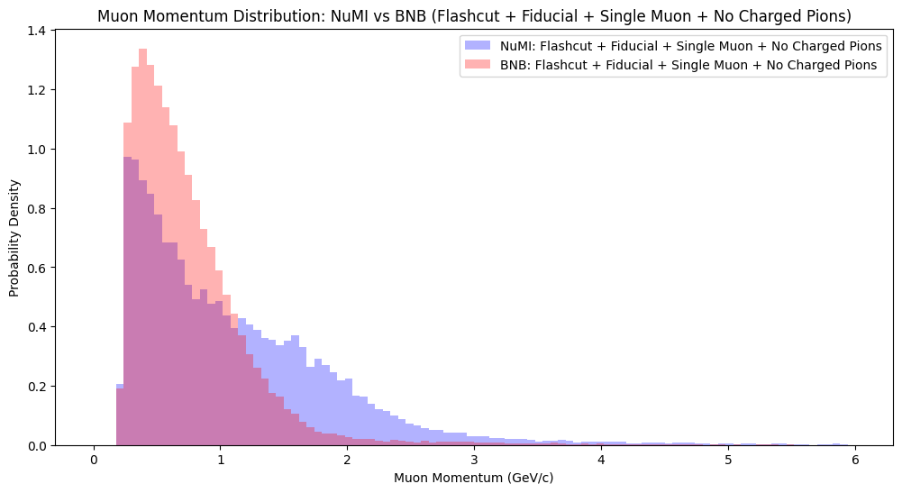
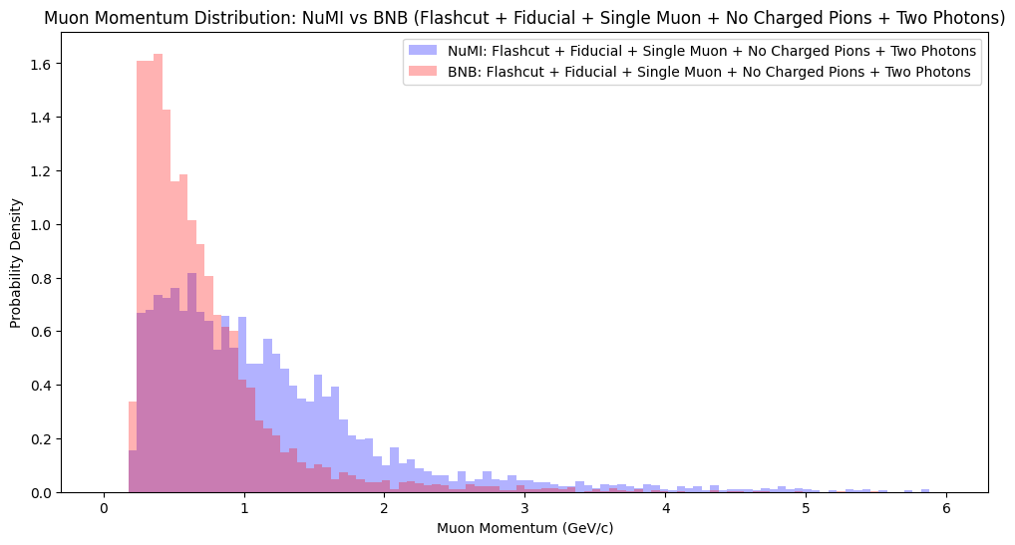
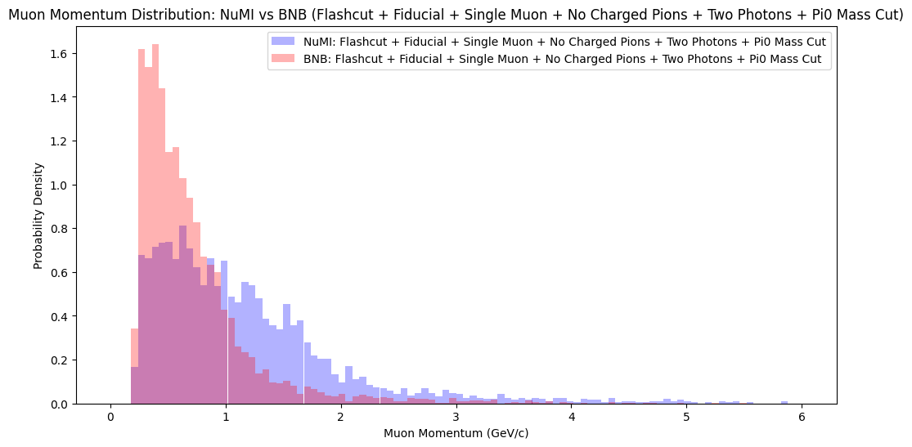
True Muon momentum
Plotting NuMI and BNB combined and normalized reconstructed leading muon momentum for each cumulative cut

Slide 21
Future work
Di-electron selection
Preliminary selection for Di-electron showers performed, showing very little Di-electron candidates in NuMI MC sample
Looking to use other MC sample files and optimizing selection parameters and cuts in the future
Selection using HNL simulation sample file
Once HNL simulation flat CAF file has been generated, utilize optimized event selection parameters and cuts for the HNL simulation file and analyse output
Moving to NuMI data and unblinding
Once event selection on HNL simulation has been conducted, move on to event selection using NuMI data files, and eventually unblinding to compare with MC distributions

Slide 22
Thank you

Slide 23
Appendix/ Table of contents
Slide number | Detail
4 | background
5 | motivations
6 | Event selection plan
7 | Efficiency and Purity (Thesis vs BNB)
8 | PID Truth to Reco matrix (Thesis vs BNB)
9 | PID Reco to Truth matrix (Thesis vs BNB)
10 | Plot comparison (Thesis vs BNB)
11 | Plot comparison (Thesis vs BNB)
12 | NuMi selection
13 | Efficiency and Purity (NuMI vs BNB)
14 | PID Truth to Reco matrix (NuMI vs BNB)
15 | PID Reco to Truth matrix (NuMI vs BNB)
16 | Plot comparison (NuMI vs BNB)
17 | Plot comparison (NuMI vs BNB)
18 | NuMI: Looking into ‘other v’ category
19 | Reconstructed Muon momentum (NuMI vs BNB)
20 | True Muon momentum (NuMI vs BNB)
21 | Future work

