Slide 1
NuMI vs BNB simulation sample
Parameter | NuMI | BNB
Pot Size | 147e20 | 174e20
Number of reconstructed selected interactions | 3566 | 4249
Number of true signal interactions | 3815 | 5532
BNB file (muon 𝜈 + Cosmic Simulation)
/pnfs/icarus/persistent/users/mueller/production/simulation/nominal/input*.flat.root
NuMI file (muon 𝜈 + Cosmic Simulation)
/pnfs/icarus/persistent/users/dcarber/spine/combined_files/NuMI_CV_flat_cafs_2/*.root

Slide 2
Reconstructed Muon analysis

Slide 3
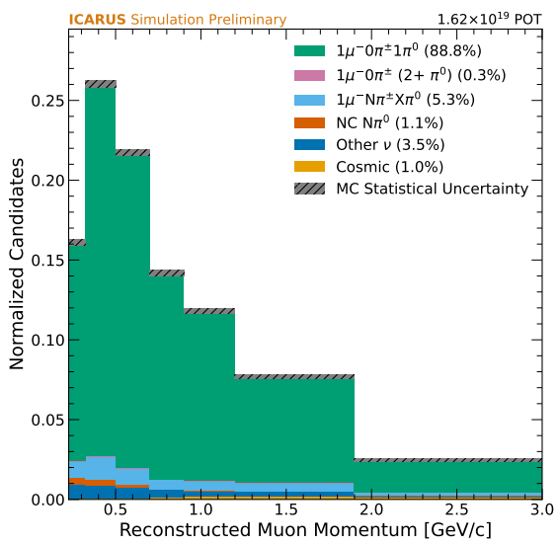
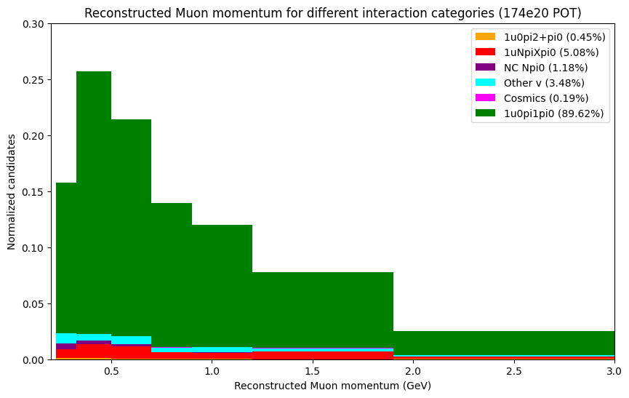
Reconstructed muon momentum
Resolved binning issue for muon and pi0 momentum
Muon momentum from lane’s paper
Muon momentum from my BNB sample

Slide 4
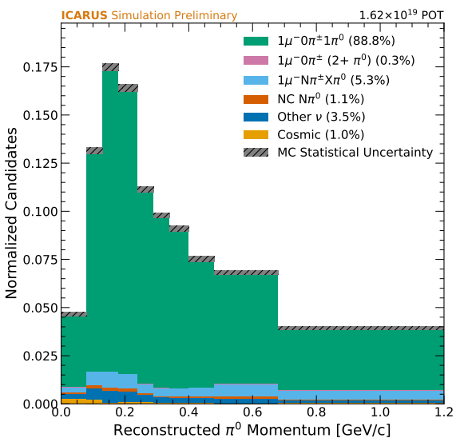
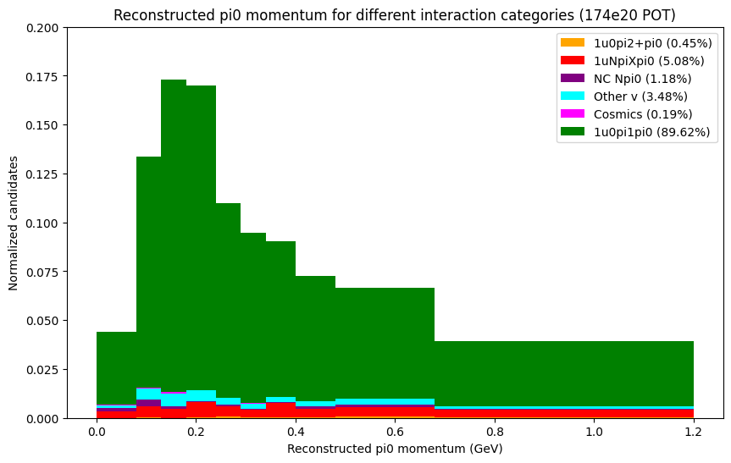
Reconstructed Pi0 momentum
Resolved binning issue for muon and pi0 momentum
Pi0 momentum from lane’s paper
Pi0 momentum from my BNB sample

Slide 5
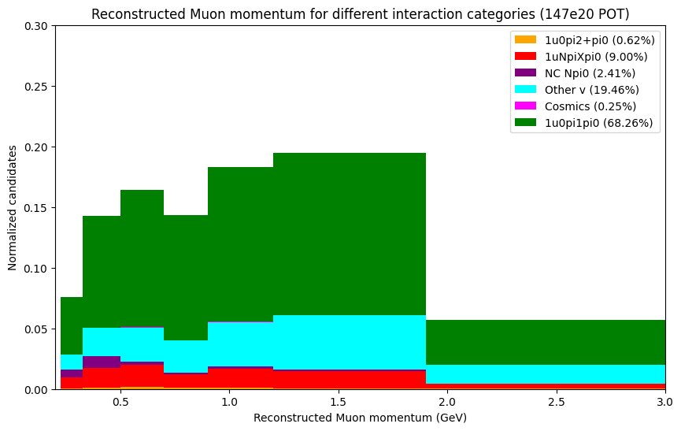
Reconstructed muon momentum
Resolved binning issue for muon and pi0 momentum
Muon momentum from NuMI selection
Muon momentum from BNB selection

Slide 6
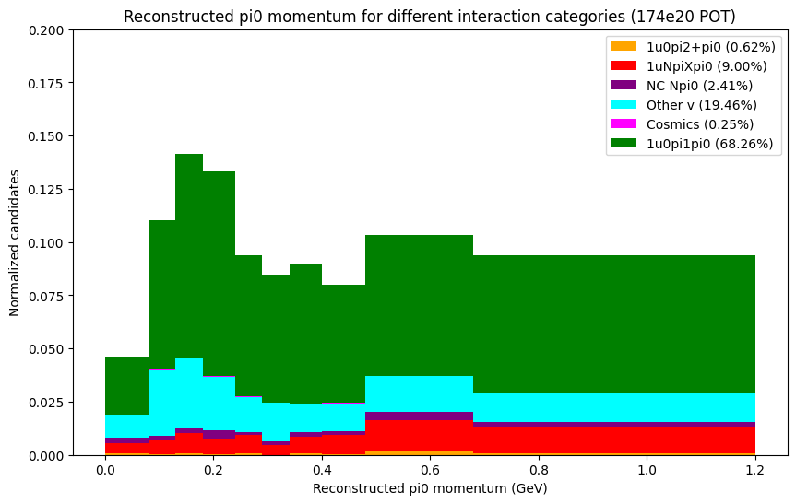
Reconstructed Pi0 momentum
Resolved binning issue for muon and pi0 momentum
Pi0 momentum from NuMI selection
Pi0 momentum from BNB selection

Slide 7
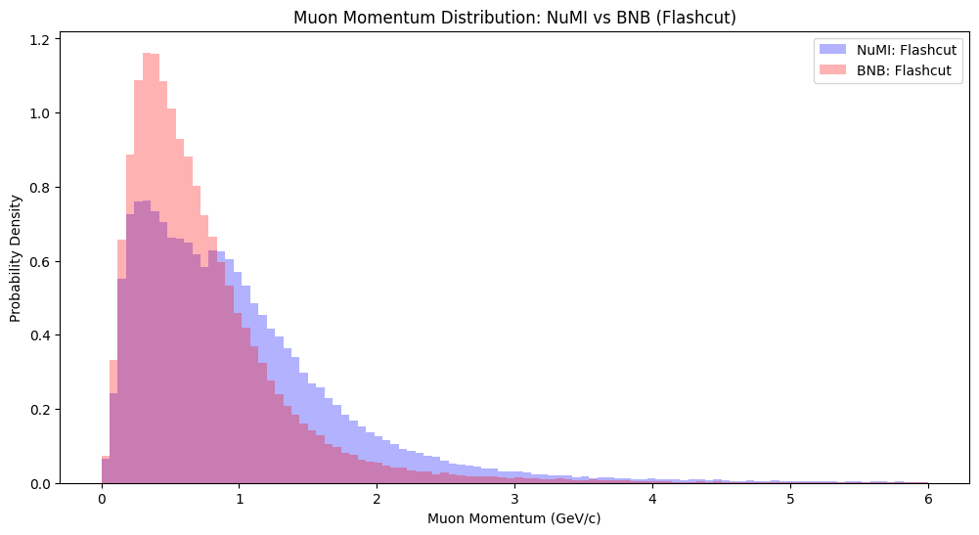
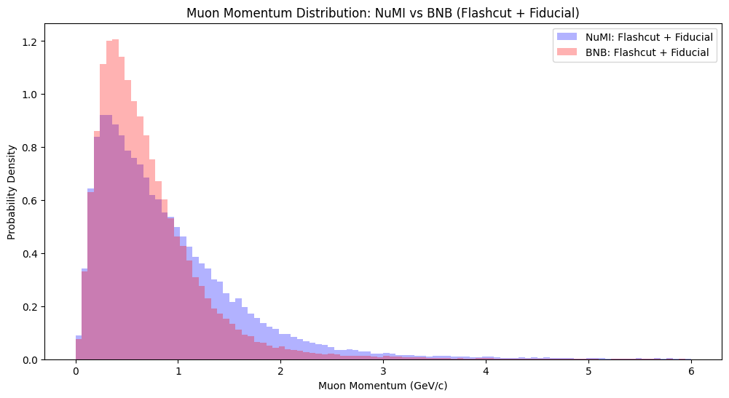
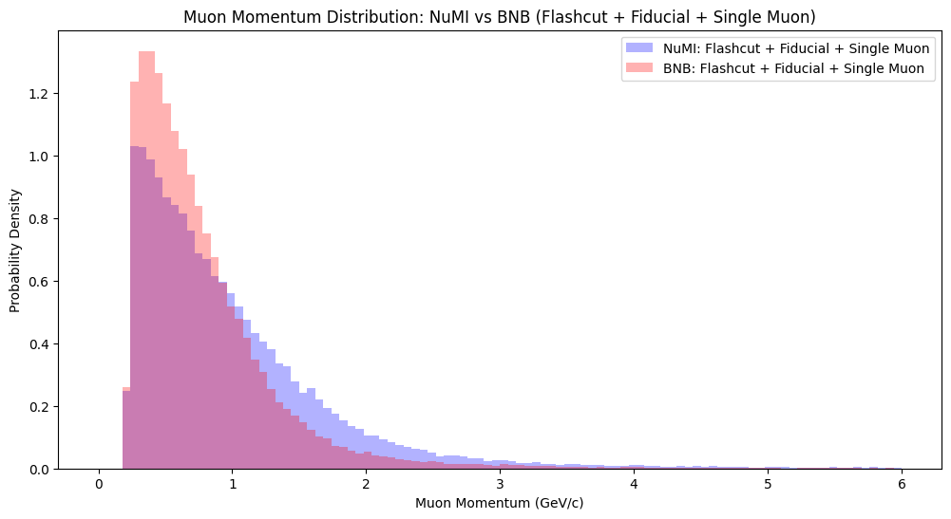
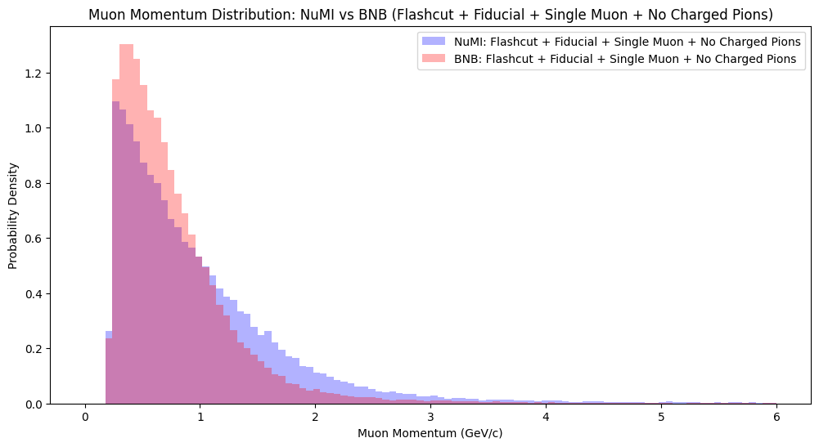
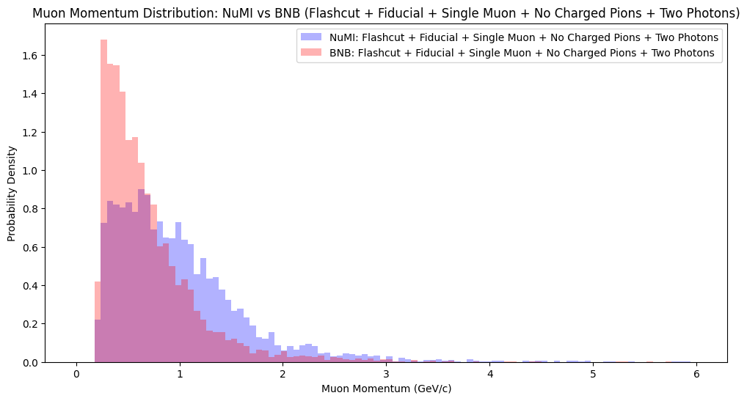
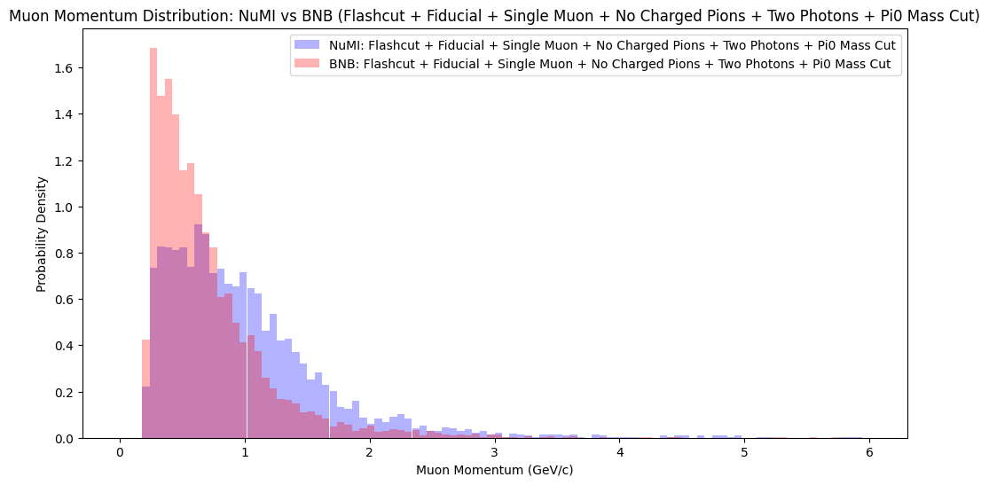
Reconstructed Muon momentum
Plotting NuMI and BNB normalized reconstructed leading muon momentum for each cumulative cut

Slide 8
True Muon analysis

Slide 9
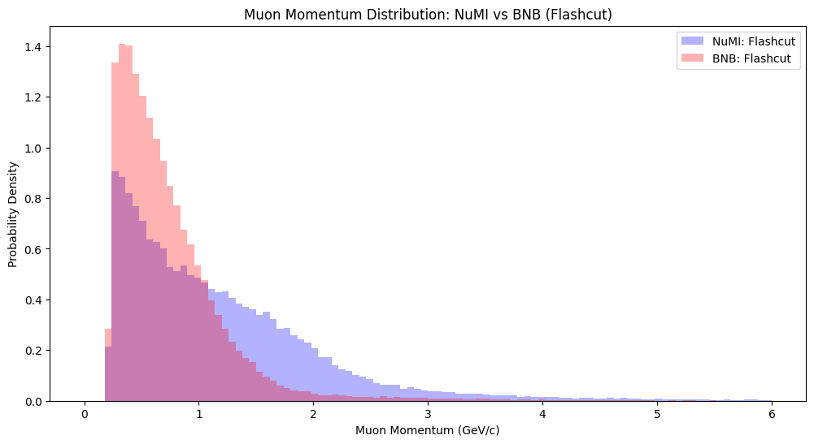
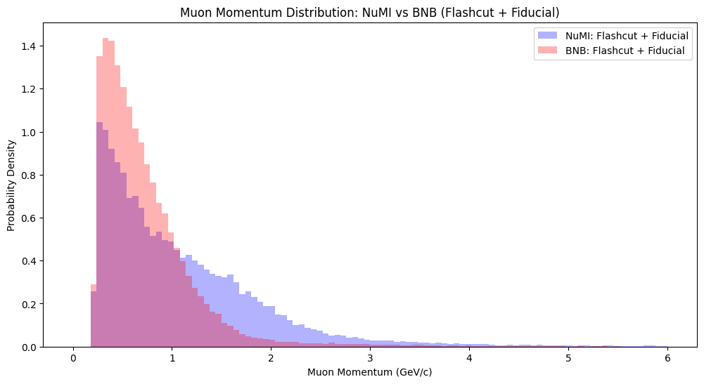
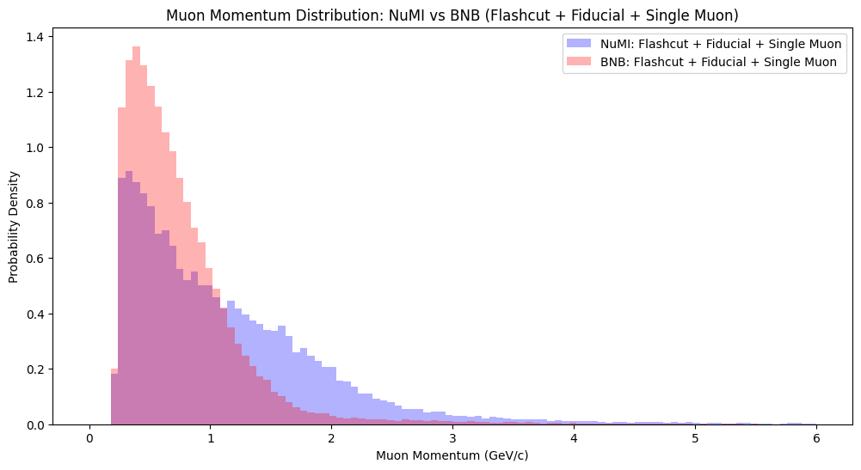
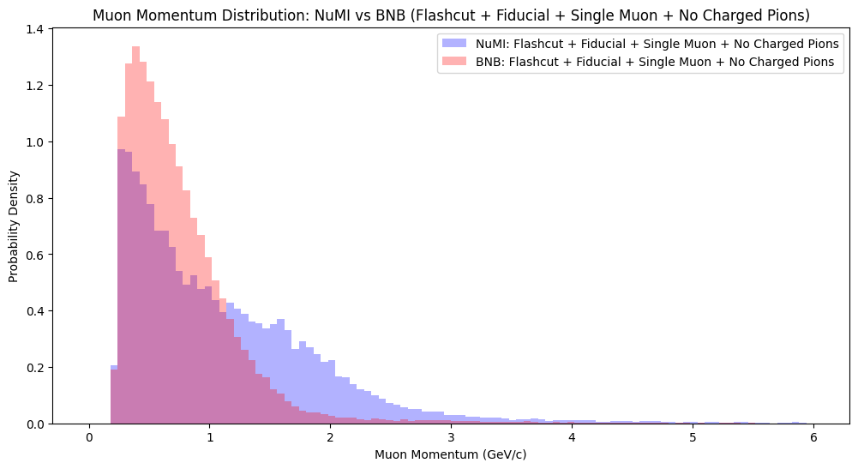
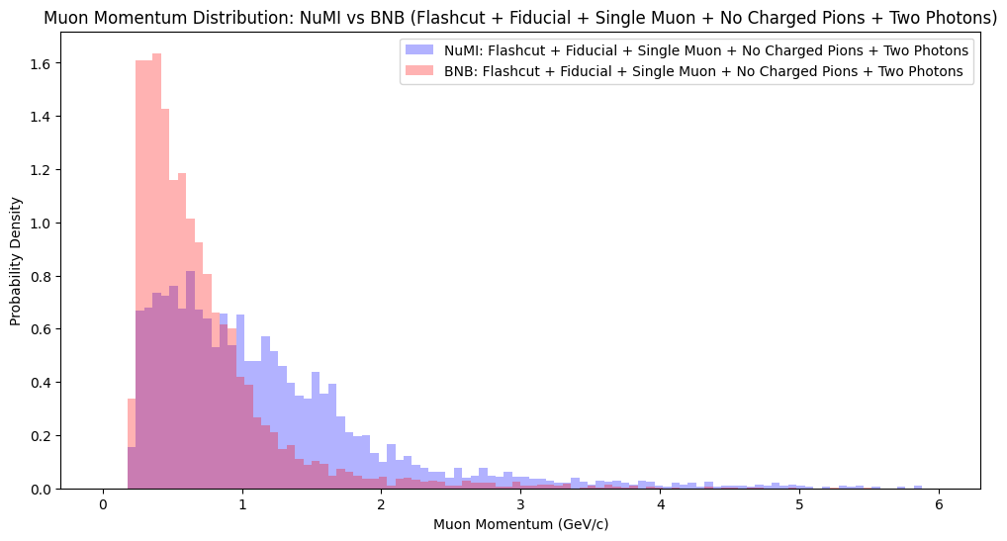
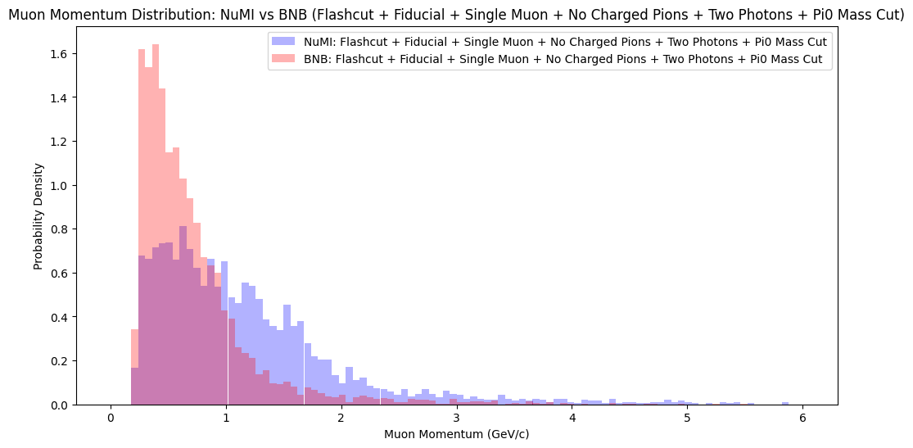
True Muon momentum
Plotting NuMI and BNB combined and normalized reconstructed leading muon momentum for each cumulative cut

Slide 10
Removing non-muon interactions

Slide 11
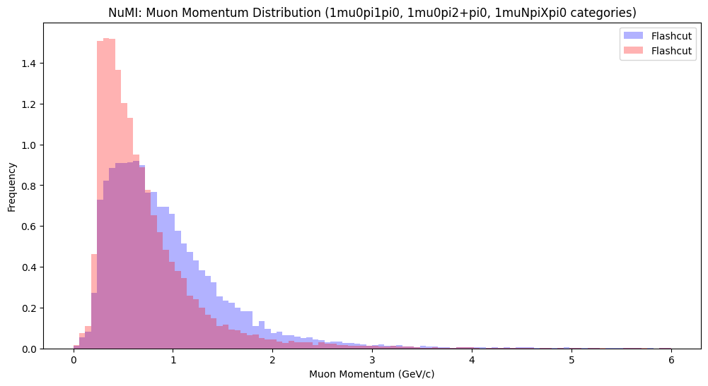

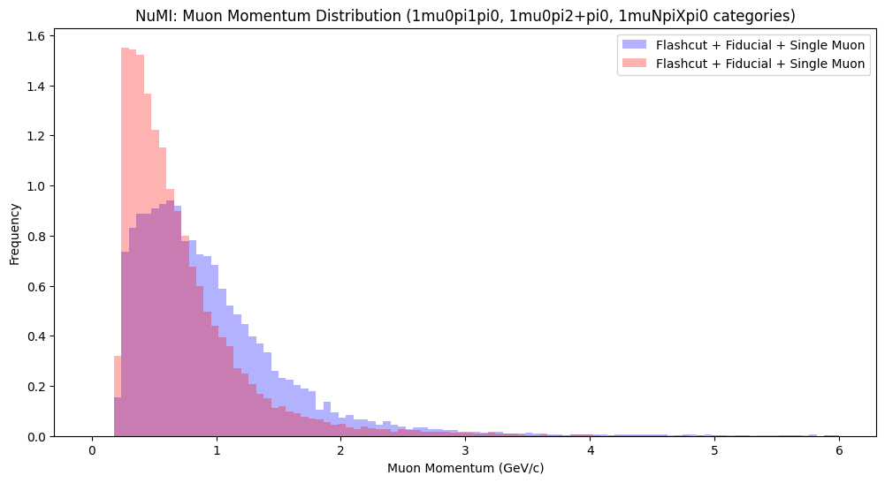
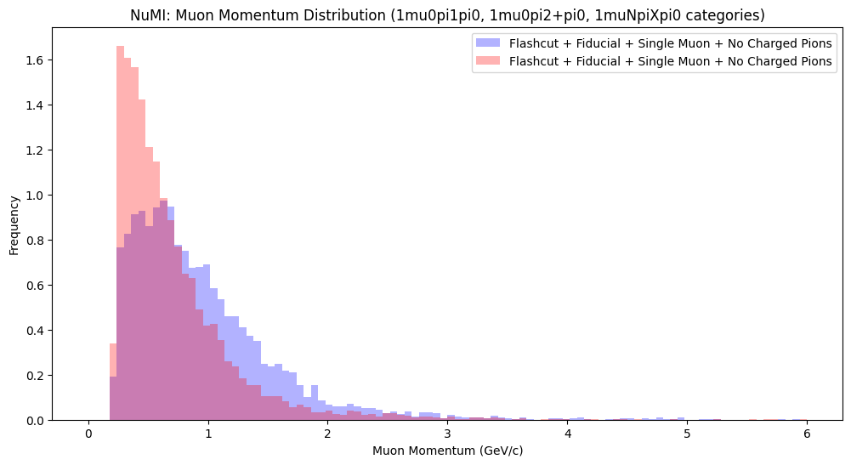
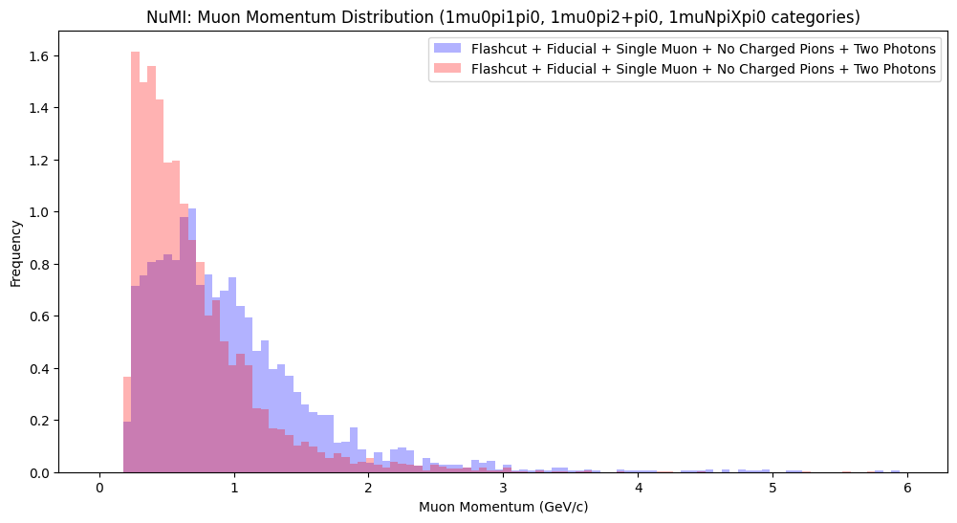
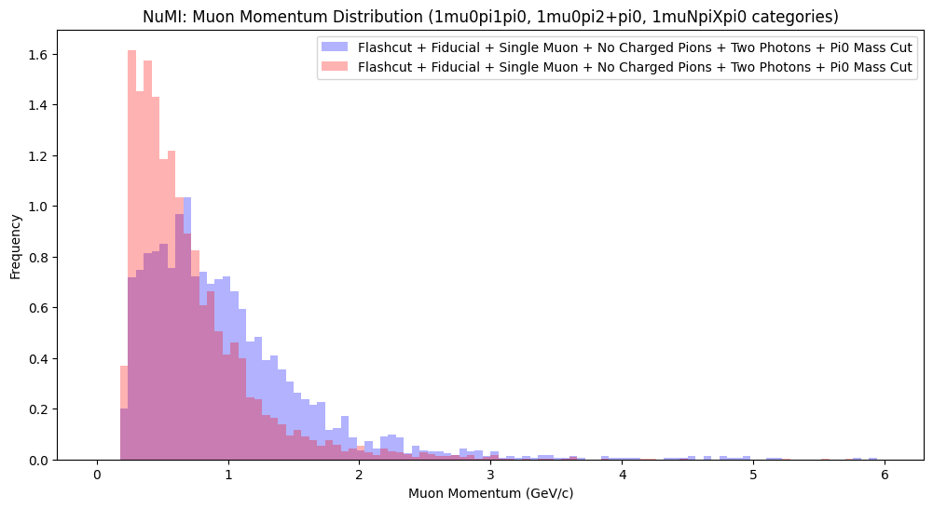
Reconstructed muon momentum (Removing non primary muon-interactions)
Removing interactions that do not contain a primary muon ("other v", "NC Npi0", and "cosmics“)

Slide 12
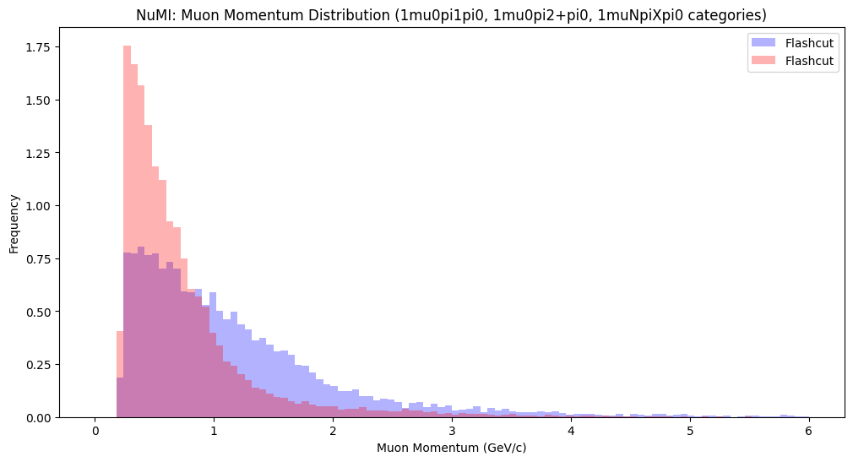

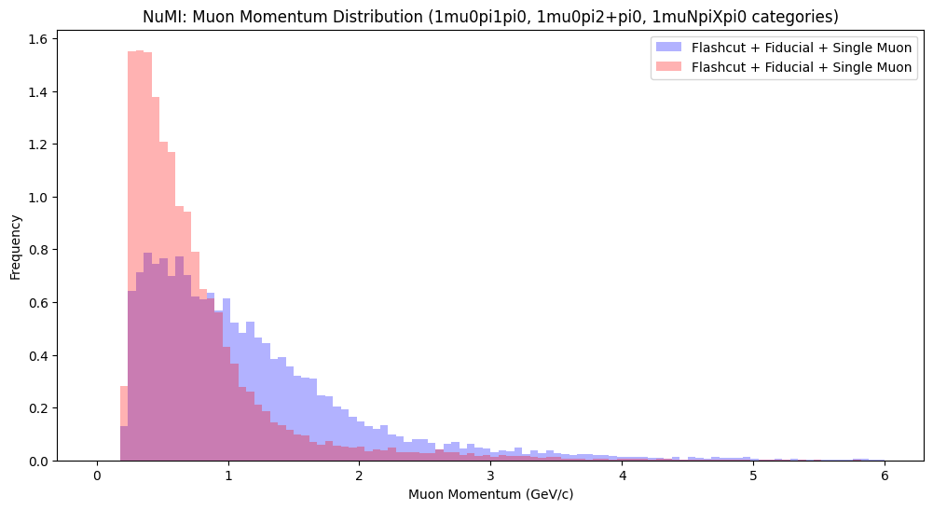
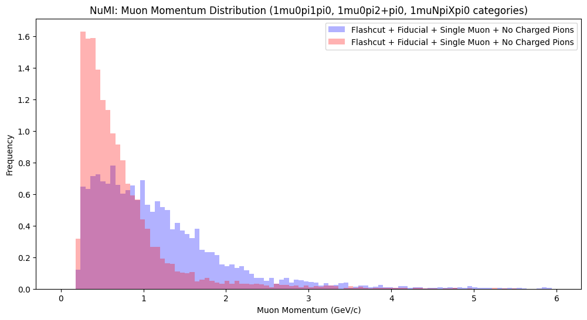

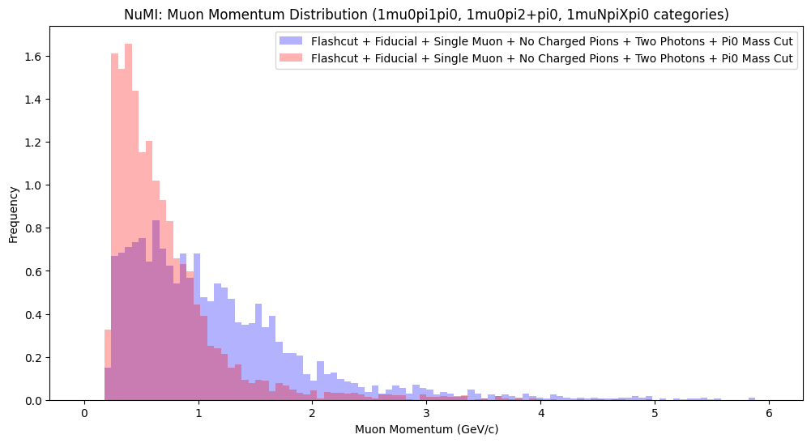
True muon momentum (Removing non primary muon-interactions)
Removing interactions that do not contain a primary muon ("other v", "NC Npi0", and "cosmics“)

