Slide 1
Weekly FYP update meeting slides
Table of contents
Week | Slide number
12 November | 2
27 November | 8
4 December | 16
15 January | 24
22 January
Jordon koh ntu

Slide 2
Tasks completed (12 Nov)
Downloaded medulla
Read up on medulla tutorial, variables, cuts, and TOML files
Opened BNB test root files for viewing
Ran Particles.toml file through medulla using BNB test root file
Plotted some variables for viewing

Slide 3
Understanding medulla
Chosen input flat.root file for analysis: /pnfs/icarus/persistent/users/mueller/production/simulation/nominal/input000.flat.root
Chosen example TOML configuration for selection development: particles.toml
TOML file was edited to enable sample block using input000.flat.root file and disable all other sample blocks
Generated test.root file in path: exp/icarus/data/users/jkoh1/
Opened root file via root test.root command
Observed contents of TTree files, chose some branches in various trees to plot and save
Analysed plots and understand what cuts/sélections are applied, and how they work

Slide 4
Analysis of reproduced plots
Tree Block | Cuts applied | Variables chosen to plot
Pid efficiency | Neutrino, containtment_cut | True_particle_start_x, True_particle_start_x, reco_particle_start_x, reco_particle_start_x
Interactions | Neutrino, fiducial_cut, containment_cut | Reco_fiducial, true_neutrino_energy
events | no_cut (no cuts applied) | Nnu, nintime

Slide 5
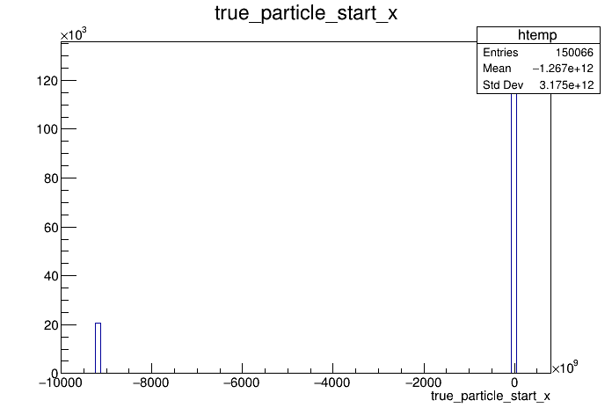
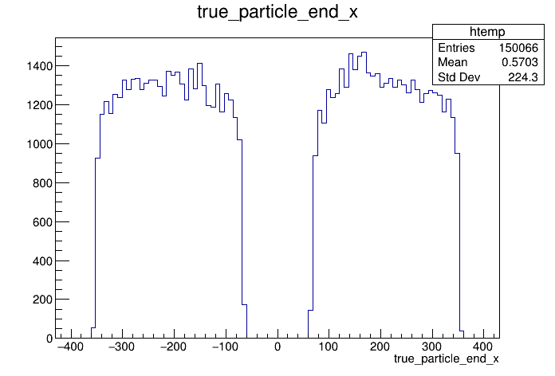
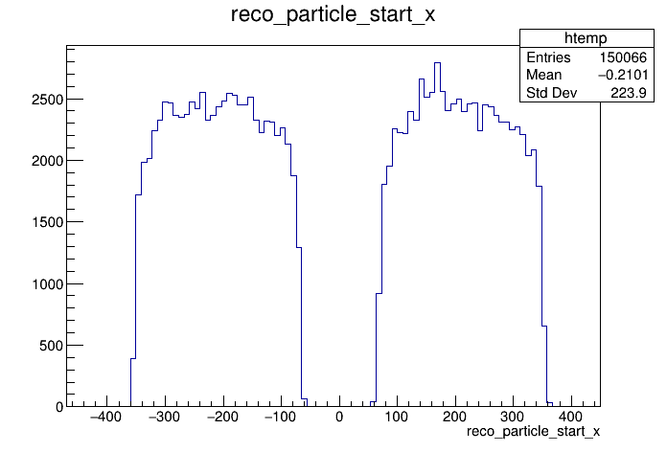
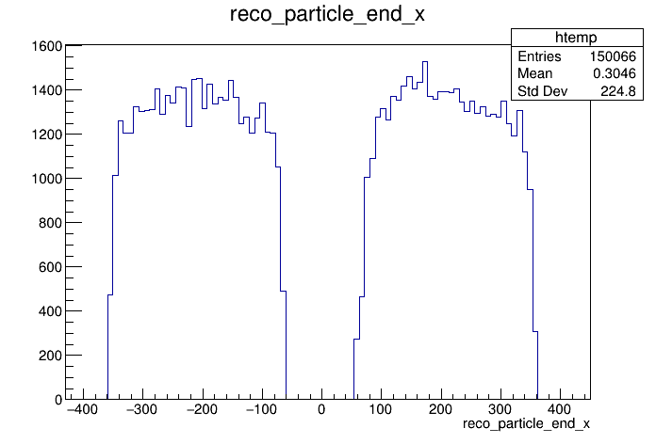
Analysis of reproduced plots: pid efficiency
Belongs to pid effiency tree block, which contains variables relating to efficiency in particle identification of medulla
Cuts applied are neutrino and containment_cut. Which are cuts that take in an input and return a Boolean. In this case we want the particles labelled TRUE (meaning they are neutrinos and are contained)
Variables plotted are the true and reconstructed particle start and end positions in the x-axis. Which are self-explanatory in what they feature they describe for the particle

Slide 6
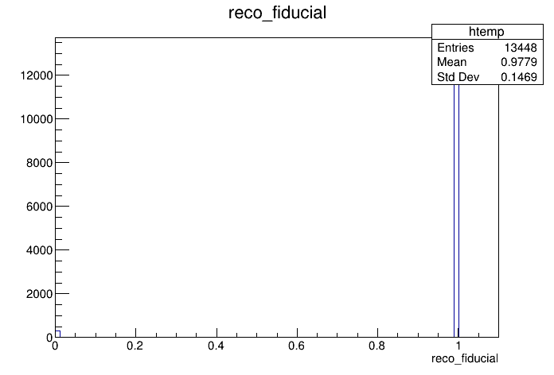
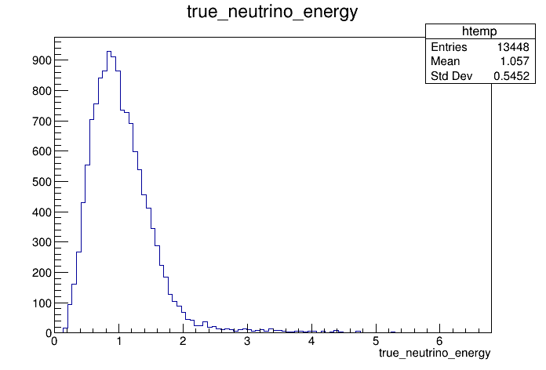
Analysis of reproduced plots: interactions
Belongs to interactions tree block, which contains variables relating to interaction parameters for the particle
Cuts applied are neutrino, containment_cut, and fiducial cuts. Fiducial cut will give only particles contained within the fiducial volume of the LaRTPC
Variables plotted are the reconstructed fiducial and true neutrino energythey describe for the particle

Slide 7
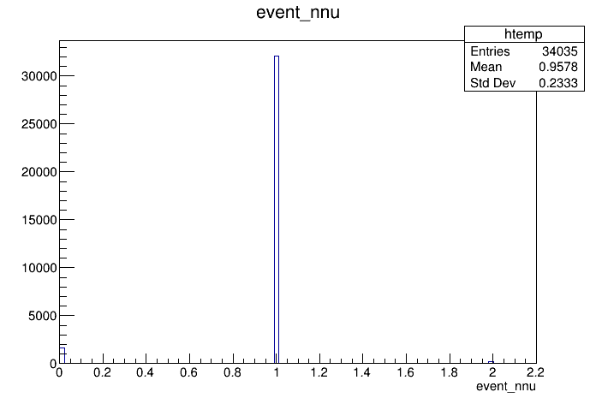
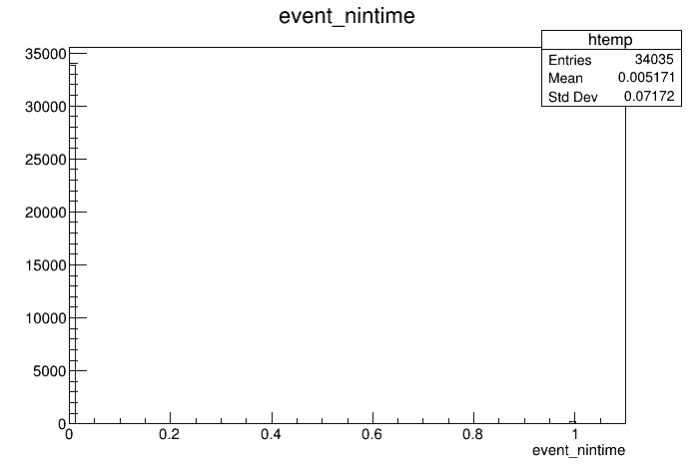
Analysis of reproduced plots: events
Belongs to events tree block, which contains variables relating to event parameters
No cuts applied
Variables plotted are the nintime and nnu. Not sure what these variables describe, will need to read more

Slide 8
Upcoming tasks
Continue reading tutorial and selection files to understand more what exactly variables describe
Run more TOML files and use other flat.root input files
Run NuMI root files

Slide 9
Tasks completed (12 Nov)
Read up further on true vs reco modes on medulla
Ran NuMI CAF file through medulla using particles.toml configuration file
Plotted differences in true and reconstructed variable data, as well as superimposed them into one plot for comparison
Started writing my own TOML file

Slide 10
NuMI Selection
For testing, used particles.toml example file
Intend to eventually write my own toml file to use and for good practice
Compared efficiency of some particle and interaction variables by taking plotting difference between true and reconstructed variable
Variables used for comparison
Particle type variable | Interaction type variable
Ending position Z | vertex x
Starting position x | Visible energy

Slide 11
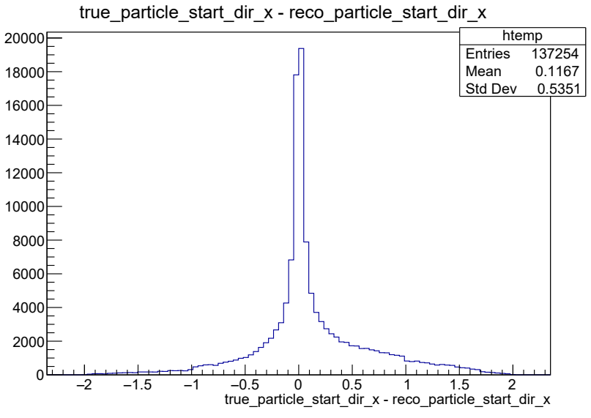
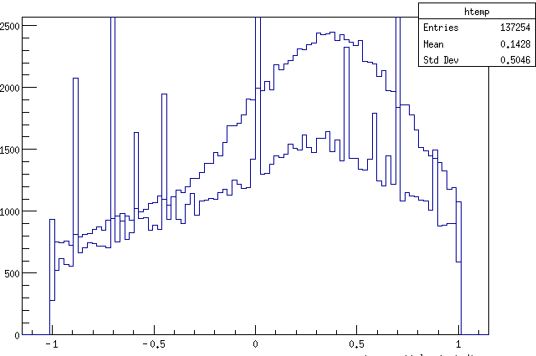
Efficiency of particle start x
difference
Superimposed with each other to visualize difference
Plotted difference in true/reconstructed
X-axis is the value of the difference
Y-axis is number of particles
Realised that this difference plot does not take into account difference in number of particles for each bin, only difference in values
Superimposed
True
Reconstructed

Slide 12
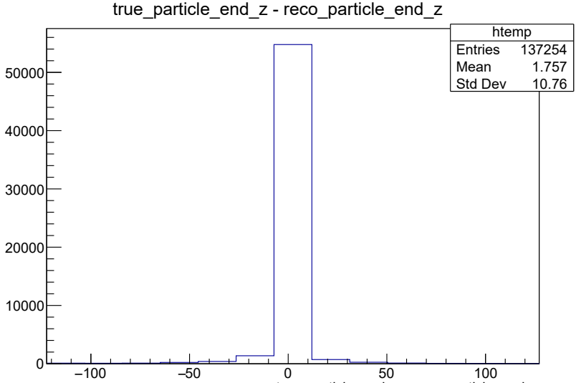
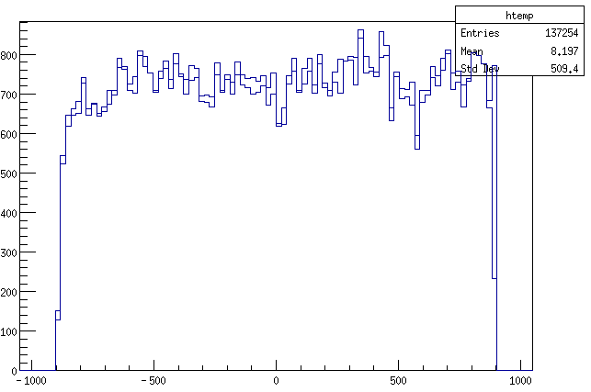
Efficiency of particle end z
difference
Superimposed with each other to visualize difference
Plotted difference in true/reconstructed
X-axis is the value of the difference
Y-axis is number of particles
Realised that this difference plot does not take into account difference in number of particles for each bin, only difference in values
Superimposed
Reconstructed
True

Slide 13
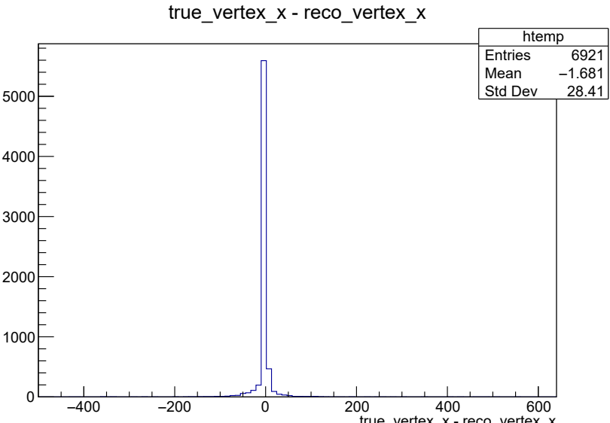
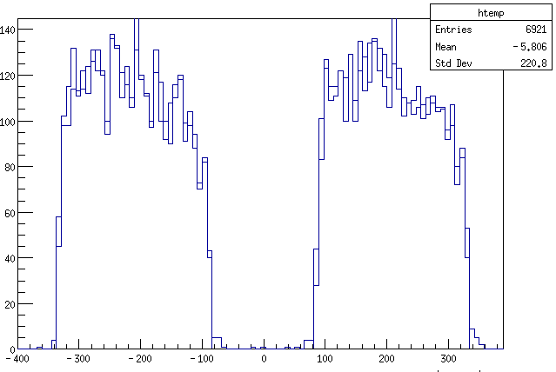
Efficiency of interaction vertex x
difference
Superimposed with each other to visualize difference
Plotted difference in true/reconstructed
X-axis is the value of the difference
Y-axis is number of particles
Realised that this difference plot does not take into account difference in number of particles for each bin, only difference in values
Superimposed
Reconstructed
True

Slide 14
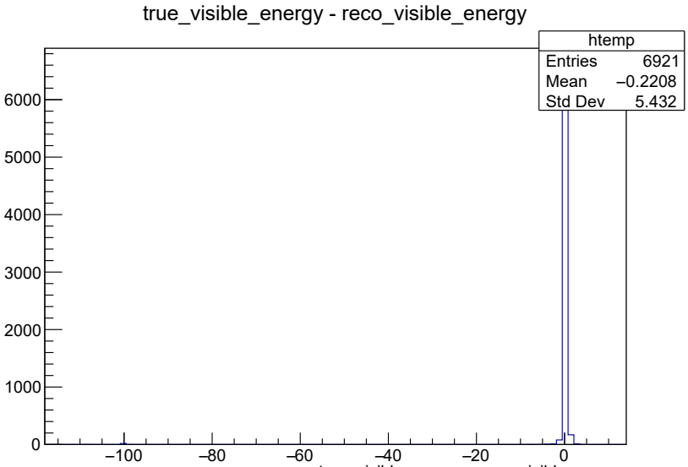
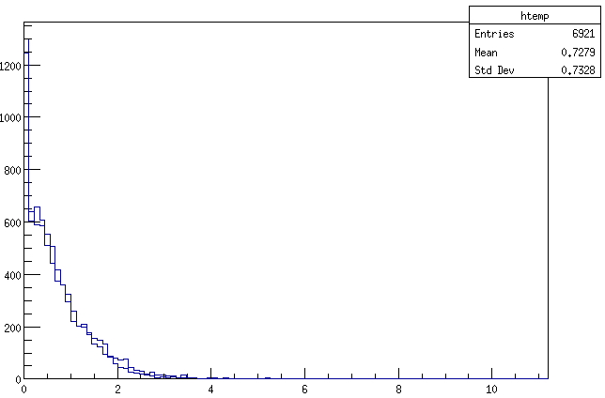
Efficiency of interaction visible energy
difference
Superimposed with each other to visualize difference
Plotted difference in true/reconstructed
X-axis is the value of the difference
Y-axis is number of particles
Realised that this difference plot does not take into account difference in number of particles for each bin, only difference in values
Superimposed
Reconstructed
True

Slide 15
Upcoming tasks
Get more familiar with ROOT plotting
Get more familiar with medulla, specifically important variable and cut definitions
Write my own TOML file and run it through NuMI simulation file and analyze results

Slide 16
Tasks completed (4th Dec)
Checked on meaning of some variables (PID, Semantic type) in medulla
Went through and understood more variables and their physical meanings
Wrote/modified my own TOML file to select 1muon1proton interactions as well as muon only interactions and ran it through medulla
Compared PID reconstructed and true efficiency
Investigated ways to calculate energy loss in tracks and showers

Slide 17
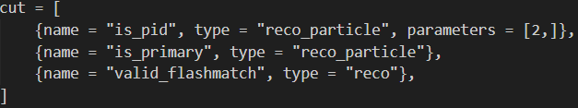
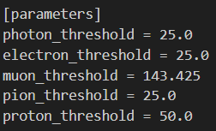
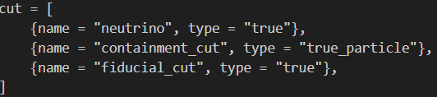
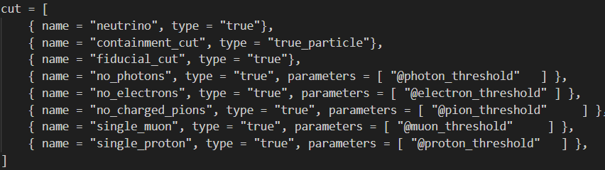
Creating TOML file for practice
Modified particles.TOML file to include
Added in particle threshold parameters for use in particle cuts
Added fiducial cut for some trees
Additional trees for 1muon1proton selection and muon only selection
Cuts applied on muon only selection
Particle threshold parameters
Cuts applied on normal pid efficiency selection
Cuts applied on 1muon1proton selection

Slide 18
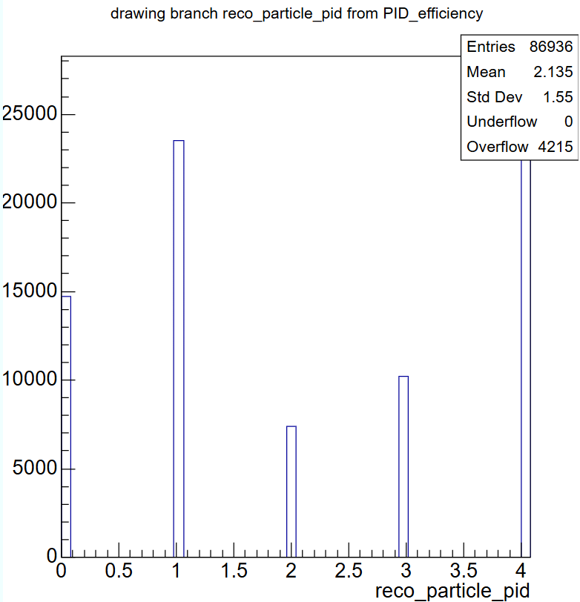
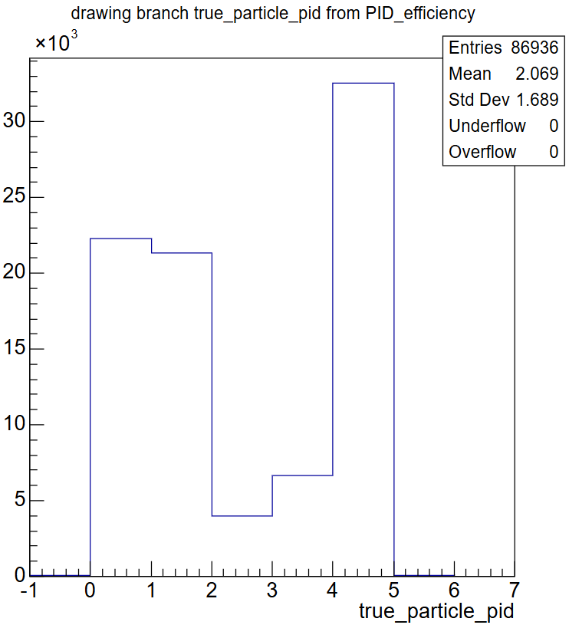
PID variable numbers
Pid variable for NuMI simulation particles, reconstructed and true
Cuts applied
Neutrino interactions only
Containment cut on true
Fiducial cut on true
X-axis number | Particle type
0 | Photon
1 | Electron
2 | Muon
3 | Pion
4 | Proton

Slide 19
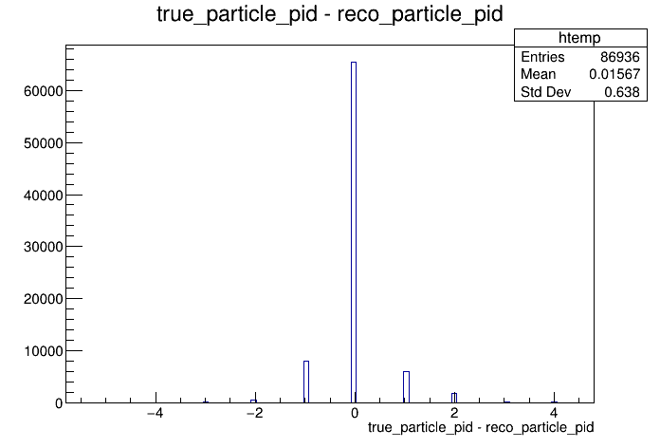
PID reconstruction efficiency
Pid variable for NuMI simulation particles, reconstructed and true
Cuts applied
Neutrino interactions only
Containment cut on true
Fiducial cut on true
X-axis number | Particle type
0 | Photon
1 | Electron
2 | Muon
3 | Pion
4 | Proton

Slide 20
Calculating energy loss
For Track-like particles, it should be a simple method of dividing CSDA energy by total track length.
Limitations due to assumption that track is straight and contained
For Shower-like particles, it is more difficult as track is ill-defined, best to follow calorimetric kinetic energy given by medulla
For seperation of photons and électrons in initial starting points of showers, can use starting dE/dx variable given by medulla

Slide 21
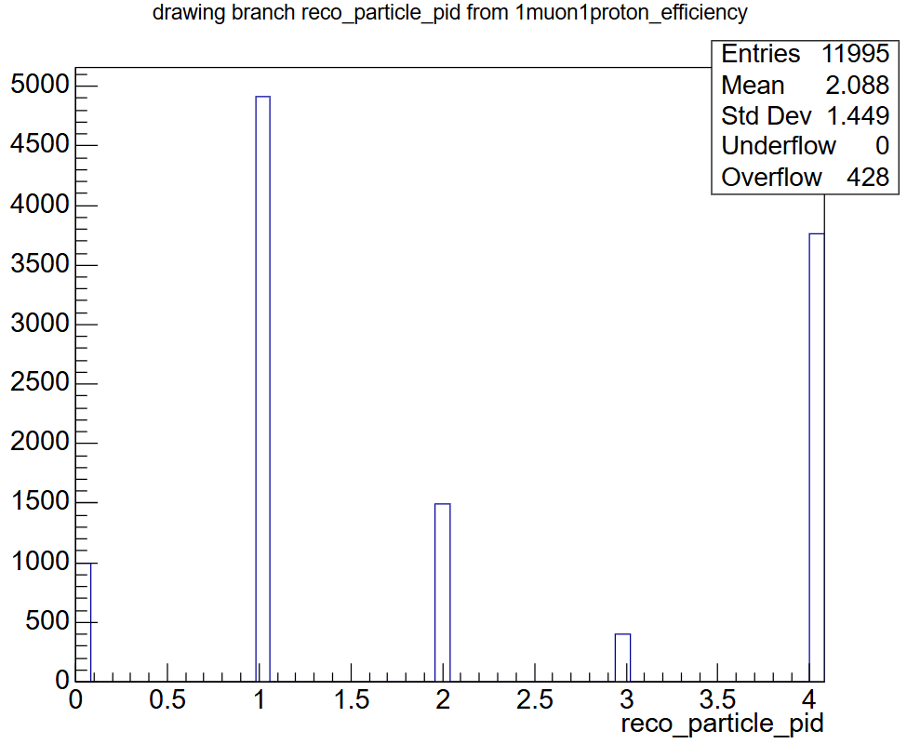
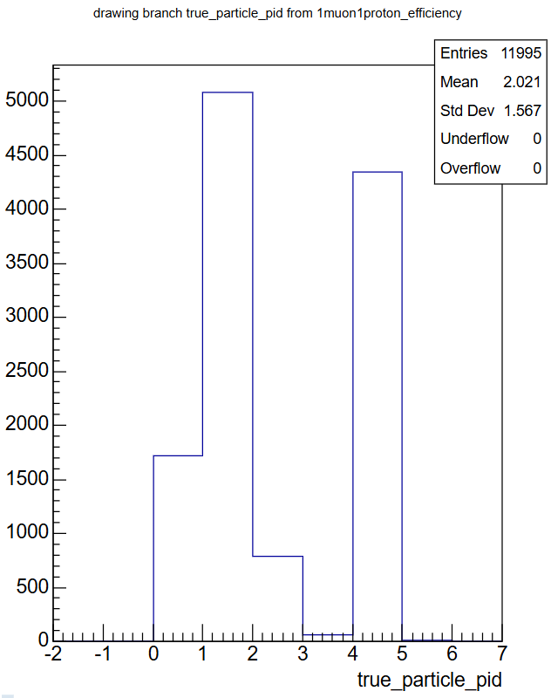
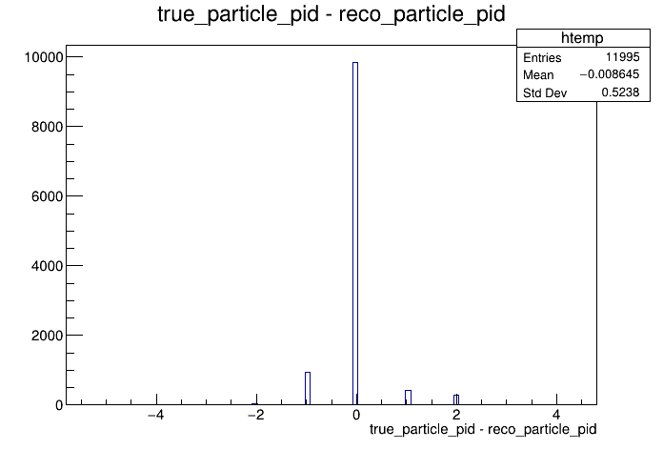
Results of 1muon1proton and muon only selections
X-axis number | Particle type
0 | Photon
1 | Electron
2 | Muon
3 | Pion
4 | Proton
Reconstruction efficiency
Reconstructed particle PID
True particle PID

Slide 22
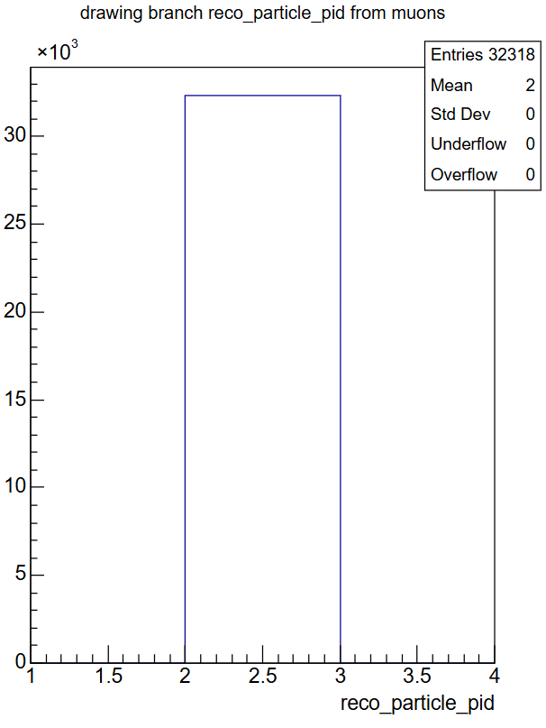
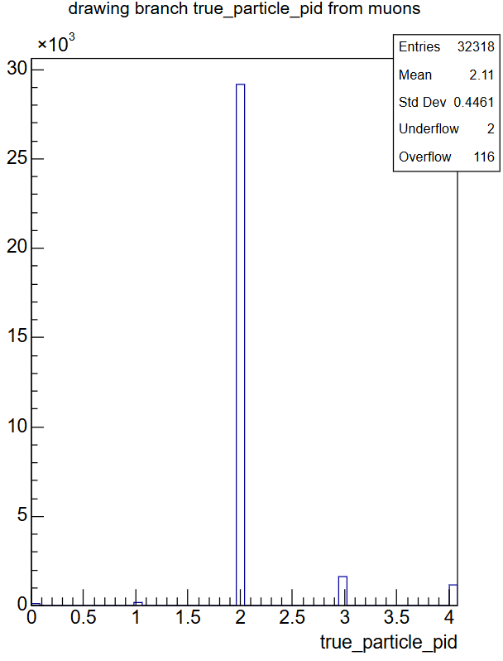
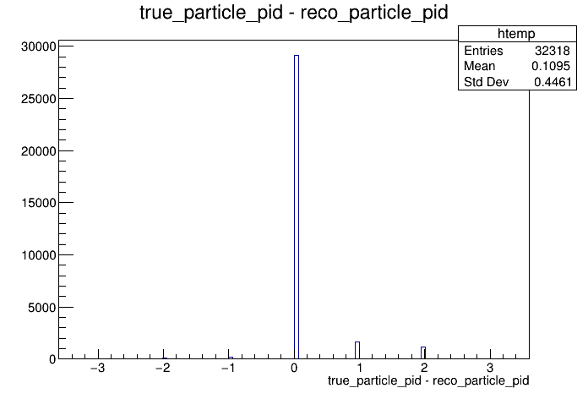
Results of muon only selection
X-axis number | Particle type
0 | Photon
1 | Electron
2 | Muon
3 | Pion
4 | Proton
Reconstruction efficiency
Reconstructed particle PID
True particle PID

Slide 23
Upcoming tasks
Plot energy loss for track-like particles
Improve on TOML file selection

Slide 24
Tasks completed (15 Jan)
Wrote/modified my own TOML file to select
1muon1proton interactions
Specific particles according to PID
Specific semantic types (michel, showers)
Ran it through BNB and NuMI simulation files
Compared reconstructed and true efficiencies
Compared differences in particle variable distributions for each particle type
Writing Mid-Progress report for Final Year Project

Slide 25
PID reconstruction efficiency
Pid variable for NuMI simulation particles, reconstructed and true
Mode is set to true, runs the selection on true interactions within each event
Cuts applied on true interactions only
Neutrino interactions only
PID cut to select specific particle types
Containment cut on true
Fiducial cut on true
Branch variables are both true and reconstructed
Reconstructed branches show reconstructed interactions that are matched to a true interaction
X-axis number | Particle type
0 | Photon
1 | Electron
2 | Muon
3 | Pion
4 | Proton

Slide 26
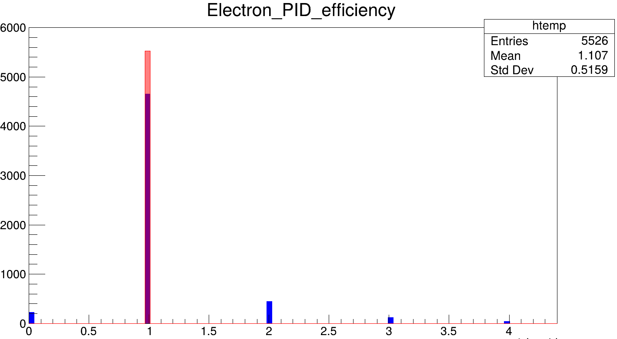
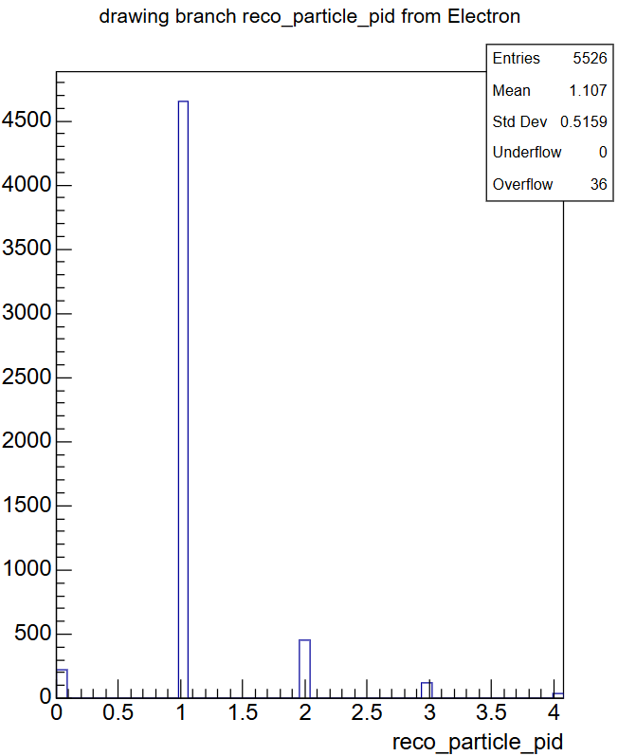
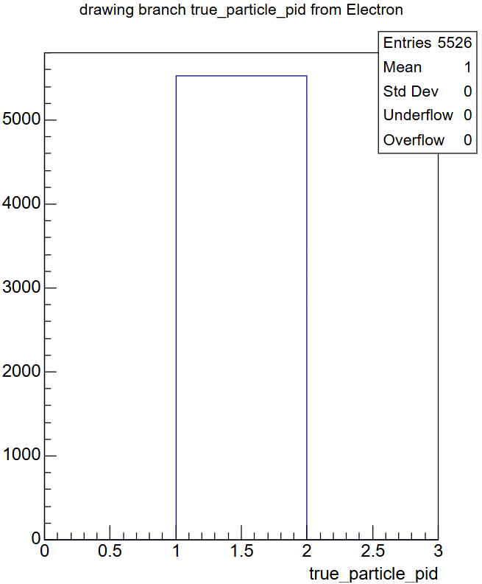
Results of electron only selection
X-axis number | Particle type
0 | Photon
1 | Electron
2 | Muon
3 | Pion
4 | Proton
Reconstruction efficiency, red is true, blue is reco
Reconstructed particle PID
True particle PID

Slide 27
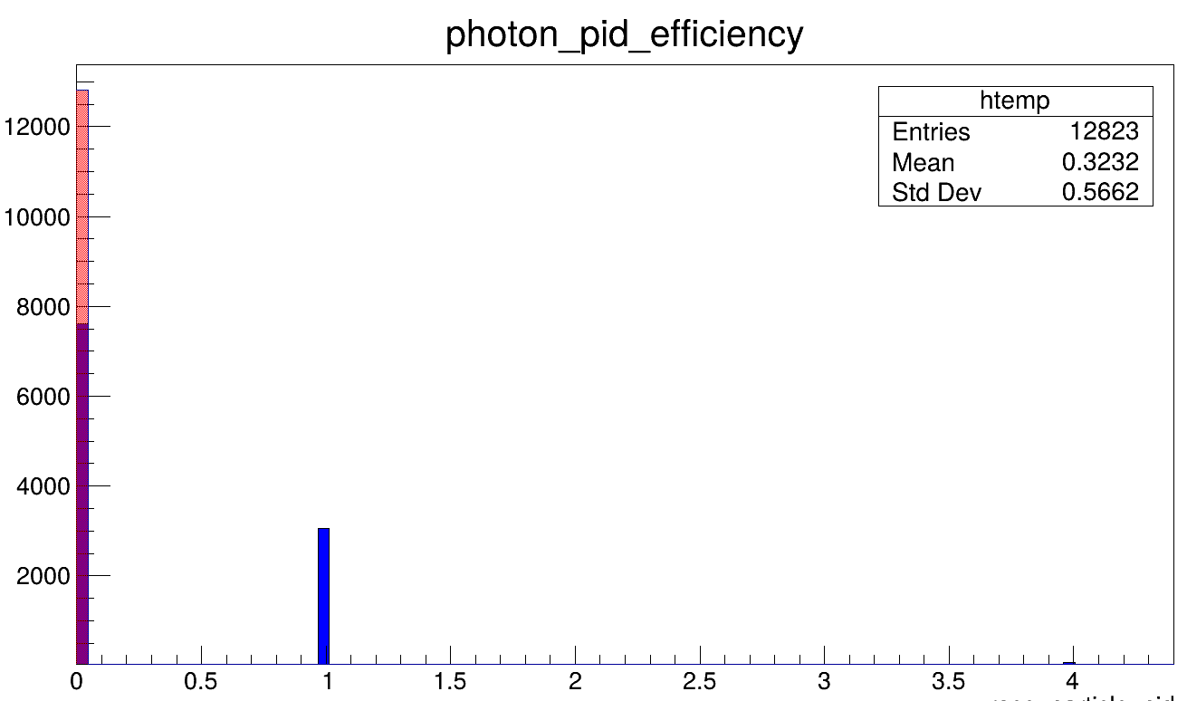
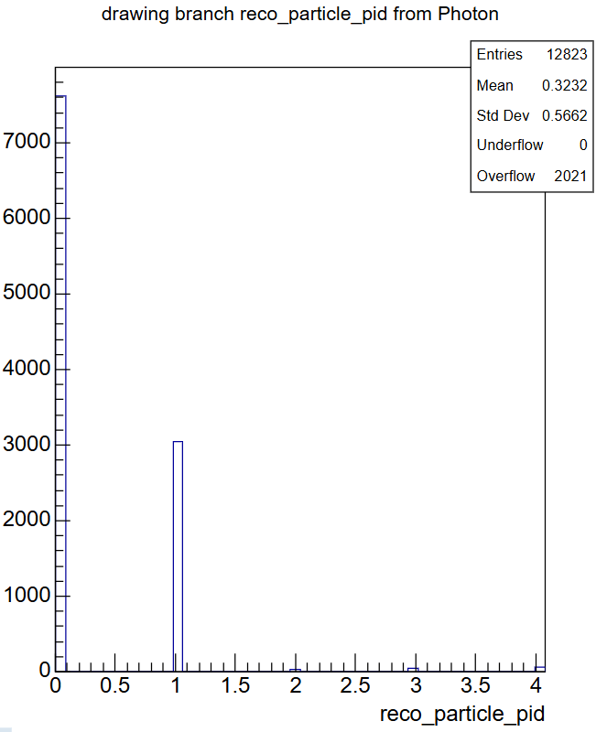
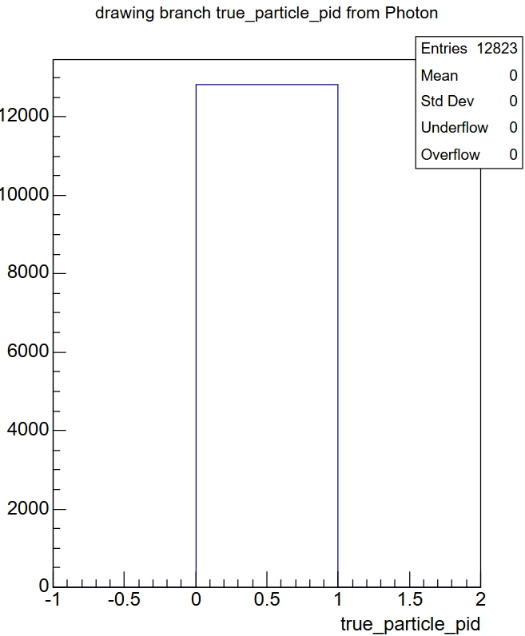
Results of photon only selection
X-axis number | Particle type
0 | Photon
1 | Electron
2 | Muon
3 | Pion
4 | Proton
Reconstruction efficiency, red is true, blue is reco
Reconstructed particle PID
True particle PID

Slide 28
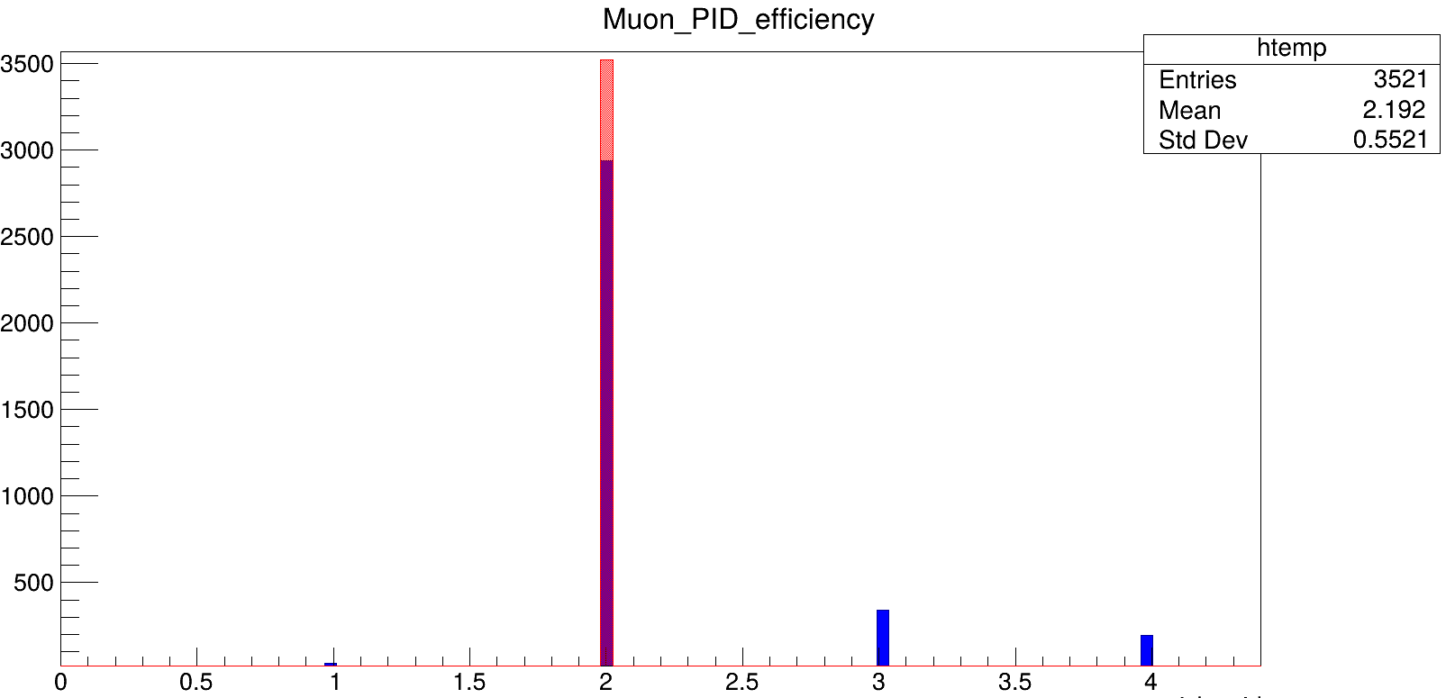
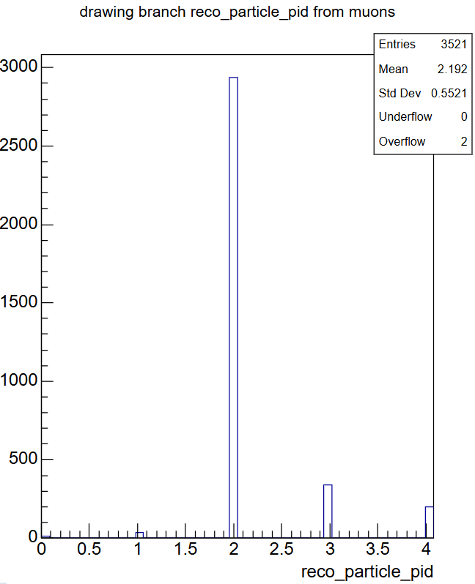

Results of muon only selection
X-axis number | Particle type
0 | Photon
1 | Electron
2 | Muon
3 | Pion
4 | Proton
Reconstruction efficiency, red is true, blue is reco
Reconstructed particle PID
True particle PID

Slide 29
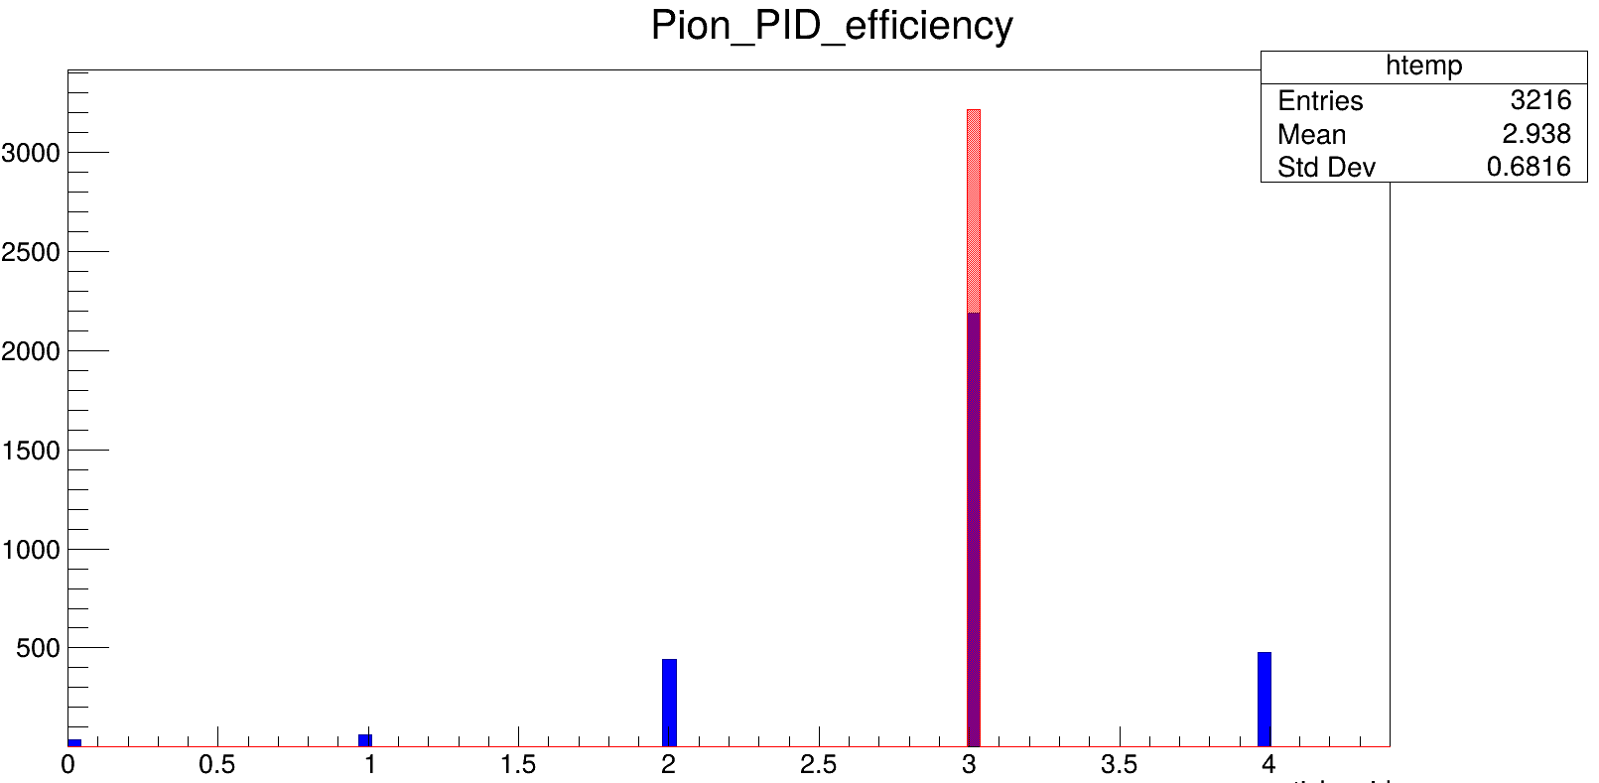
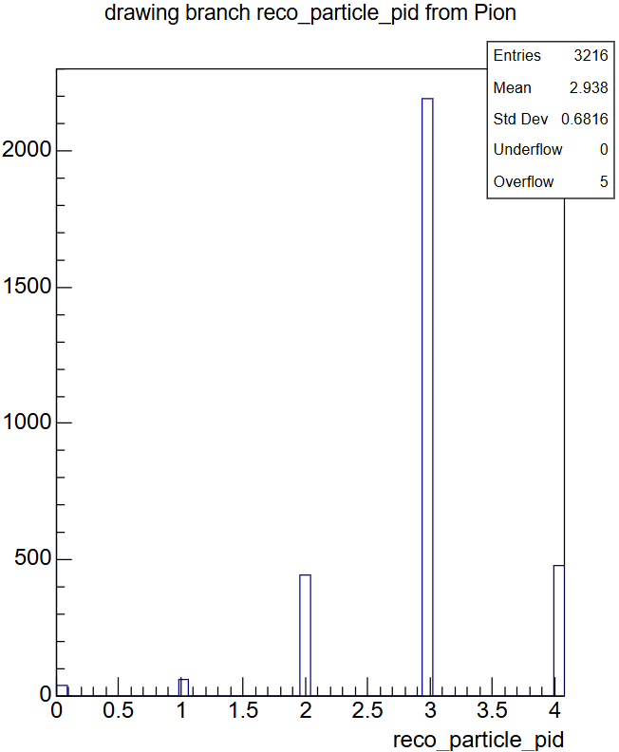
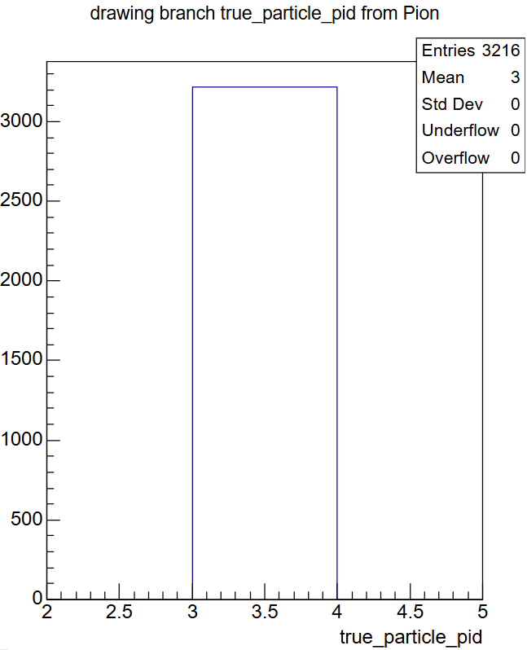
Results of pion only selection
X-axis number | Particle type
0 | Photon
1 | Electron
2 | Muon
3 | Pion
4 | Proton
Reconstruction efficiency, red is true, blue is reco
Reconstructed particle PID
True particle PID

Slide 30
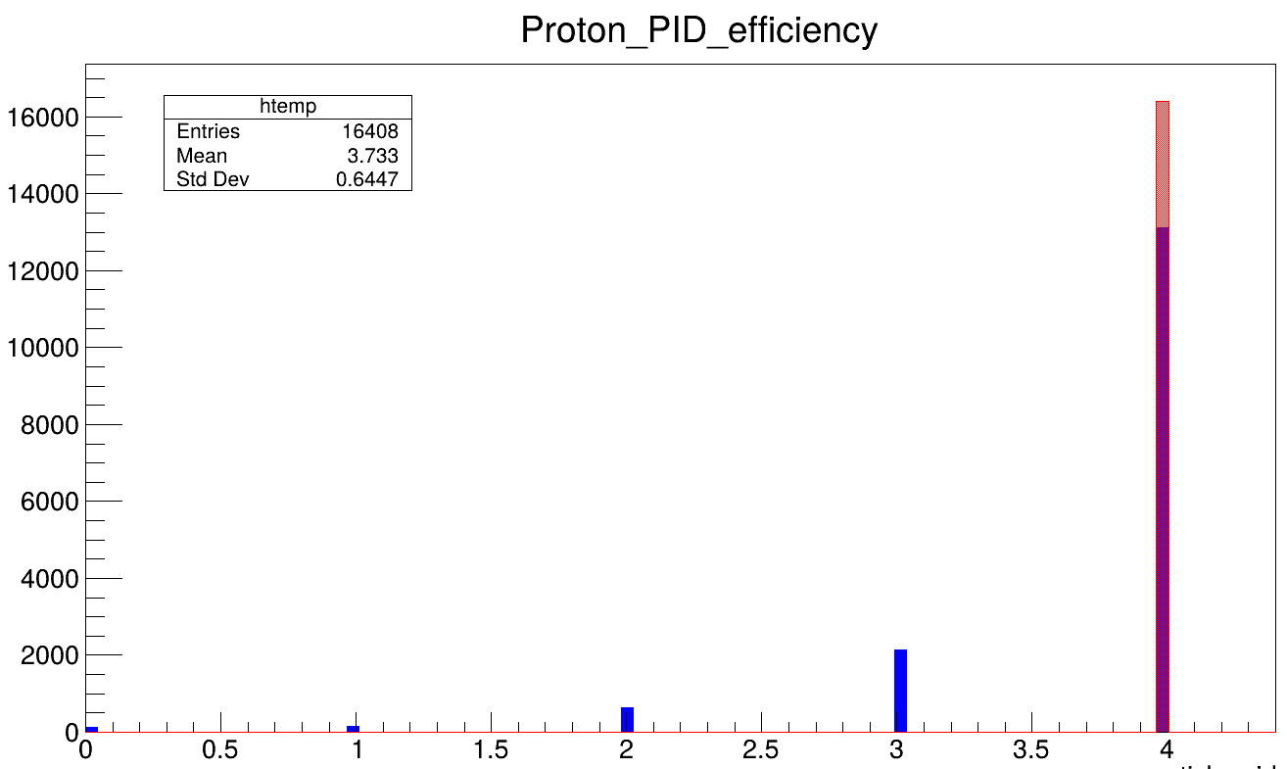
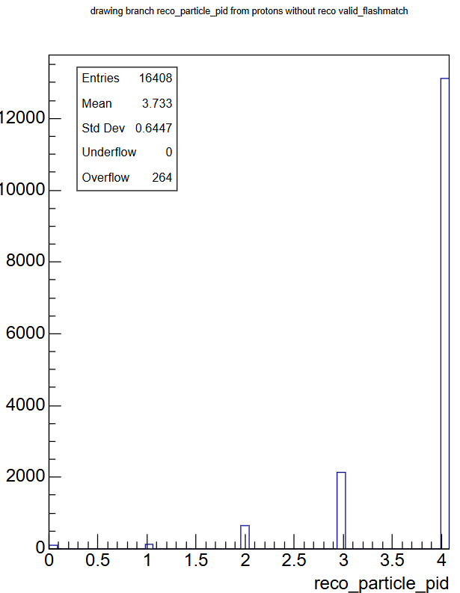
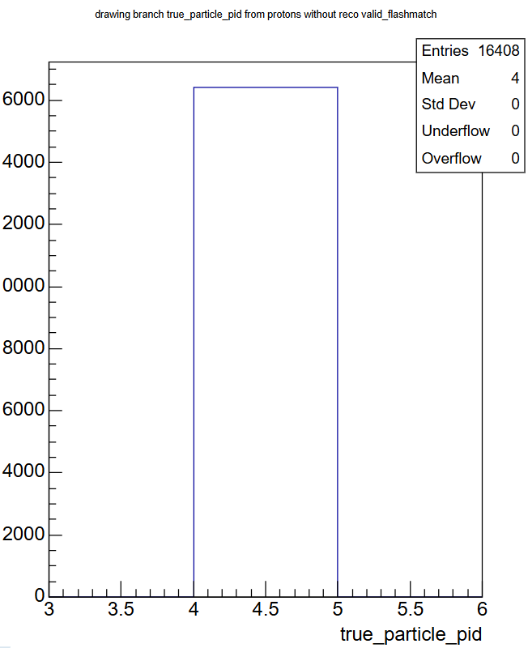
Results of proton only selection
X-axis number | Particle type
0 | Photon
1 | Electron
2 | Muon
3 | Pion
4 | Proton
Reconstruction efficiency, red is true, blue is reco
Reconstructed particle PID
True particle PID

Slide 31
Discussion of particle type reconstruction efficiency
From the reconstruction efficiency graphs. the order of best reconstruction efficiency to worst are as follows
1. electron
2. muon
3. proton
4. pion
5. photon
Photon was noticeably shown to be worse compared to other particle types, with a significant possibility of misidentification of the photon into an electron
The particle shown to have the second worse reconstruction efficiency was the pion. This is to be expected

Slide 32
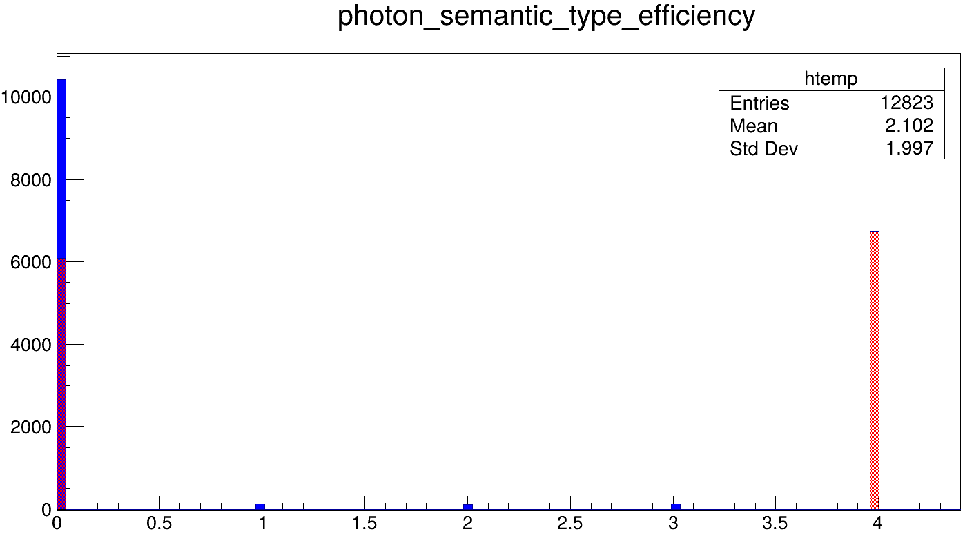
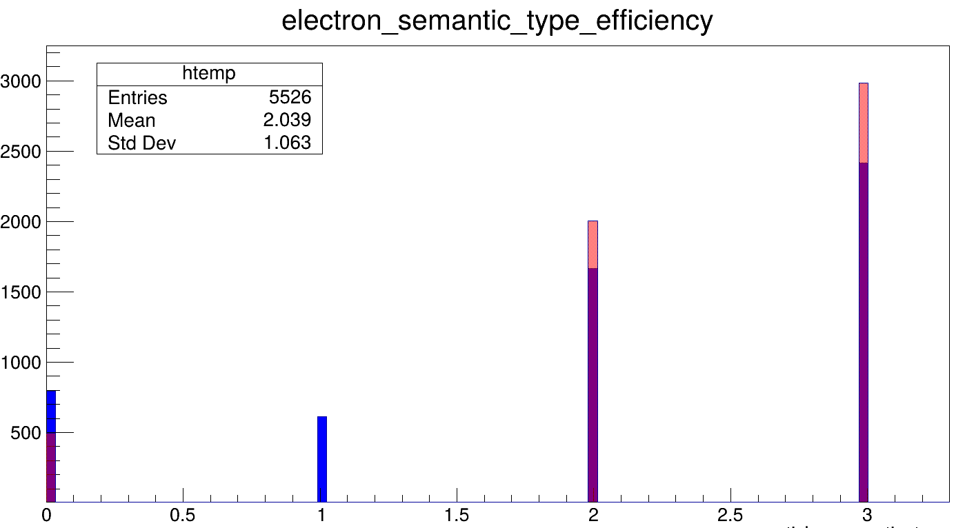
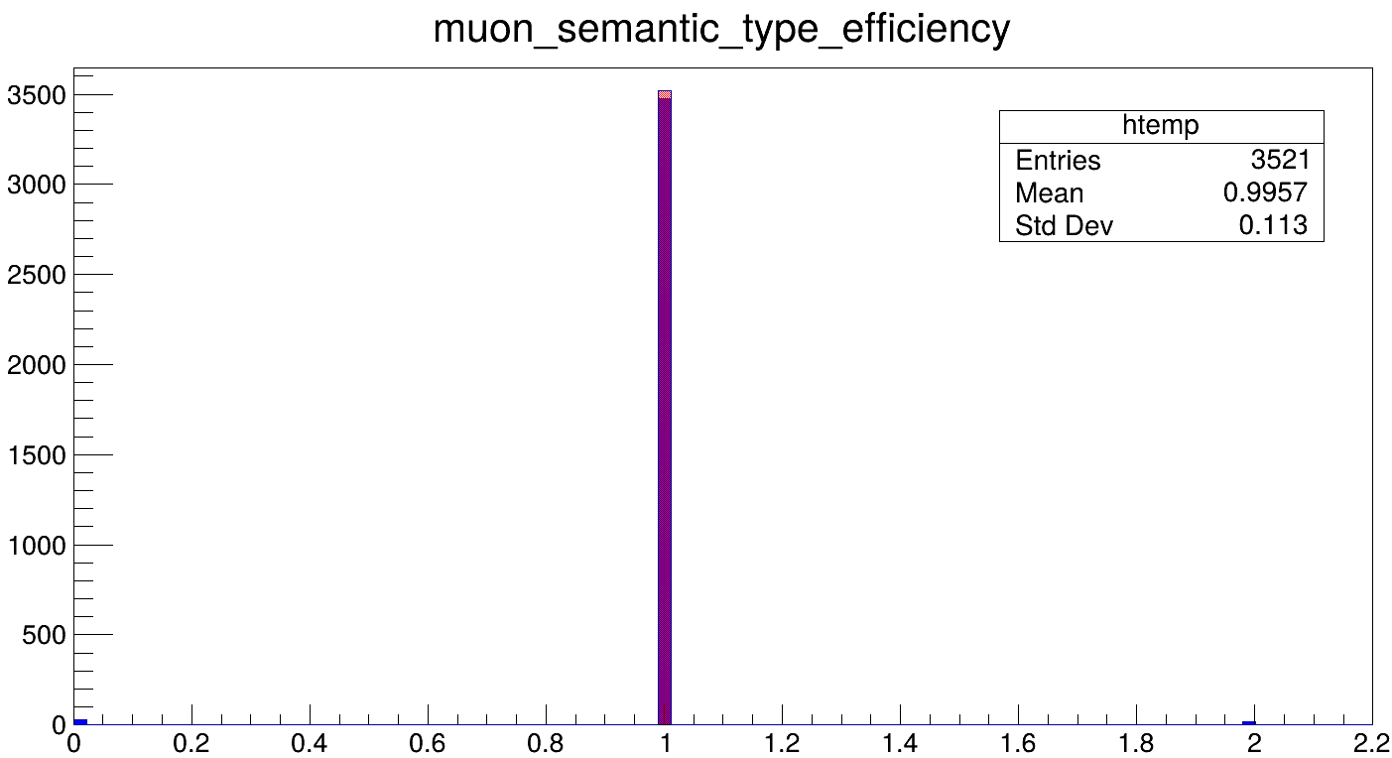
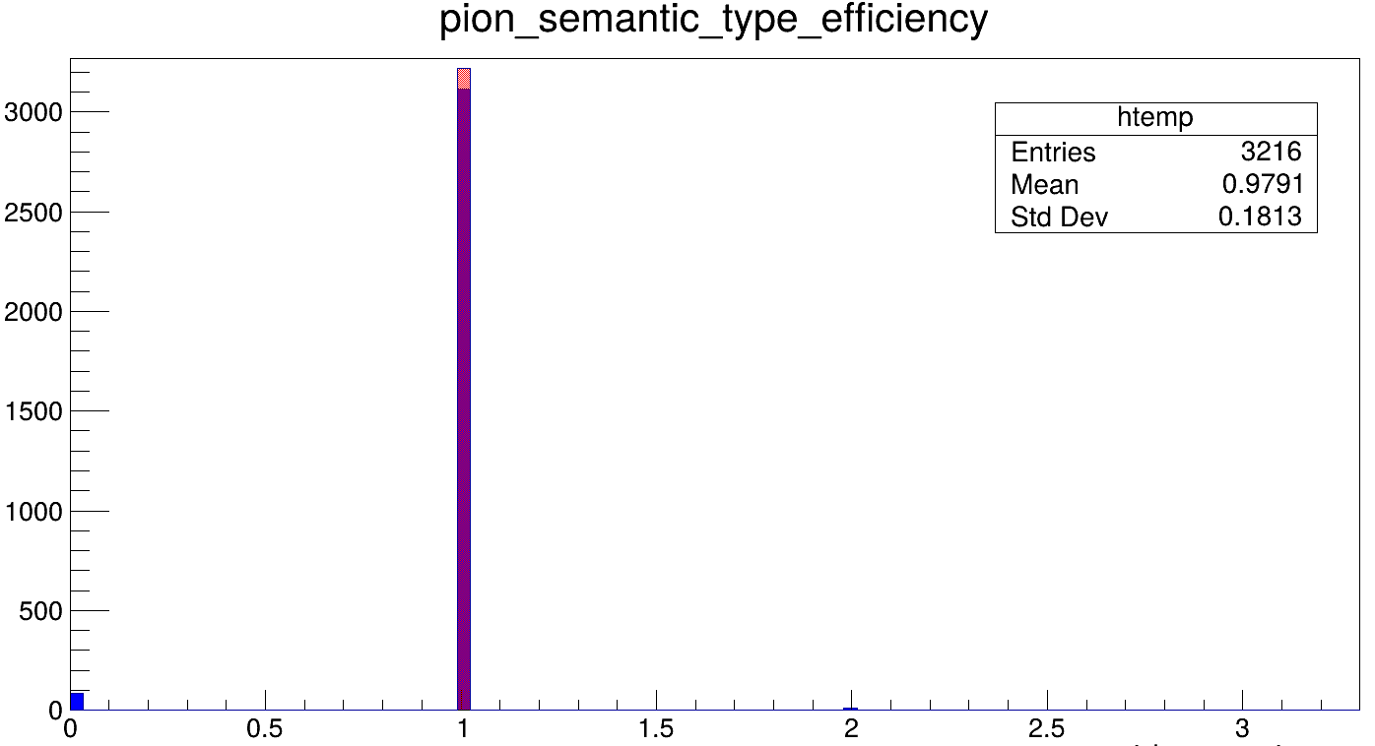
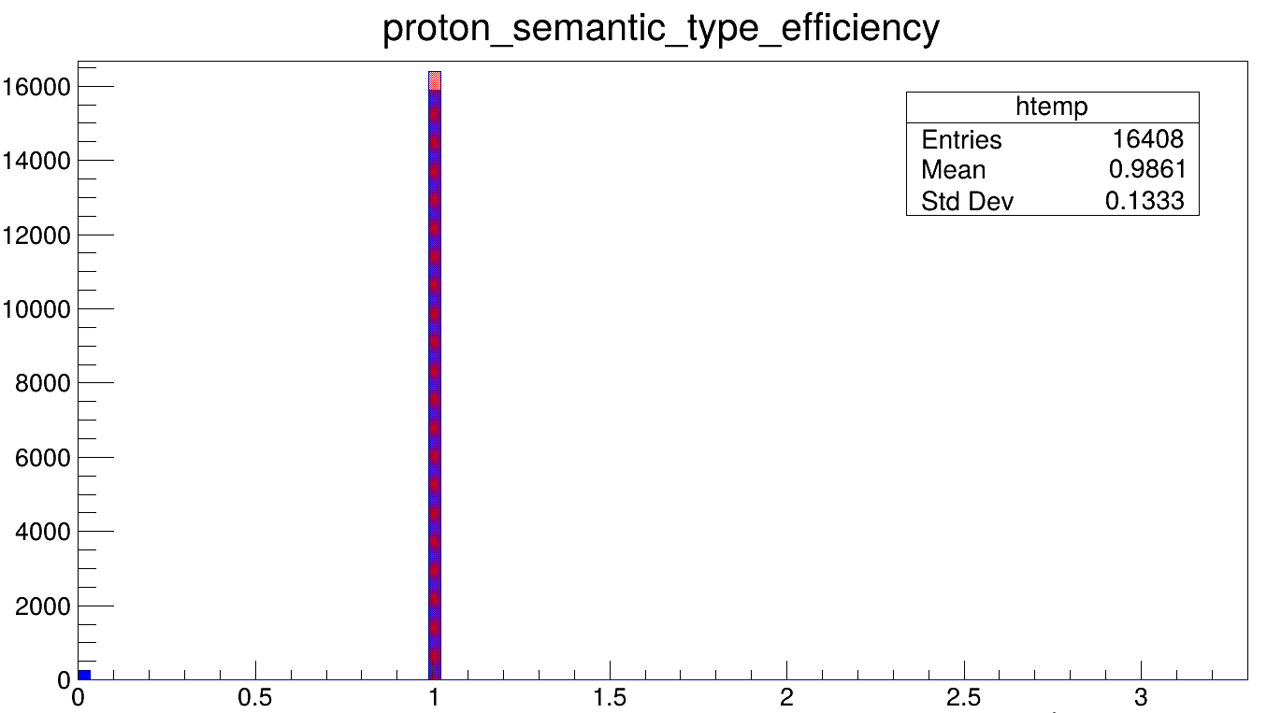
Semantic Type reconstruction efficiency
X-axis number | Semantic type
0 | Shower
1 | Track
2 | Michel electron
3 | Delta electron
4 | Low-energy

Slide 33
Discussion of semantic type reconstruction efficiency
From the reconstruction efficiency graphs. the order of best reconstruction efficiency to worst are as follows
1. muon
2. proton
3. pion
4. electron
5. photon
Photon was noticeably shown to be worse compared to other particle types, with most low-energy semantic types identified to be showers
The particle shown to have the second worse reconstruction efficiency was the electron, with some being classified as tracks

Slide 34
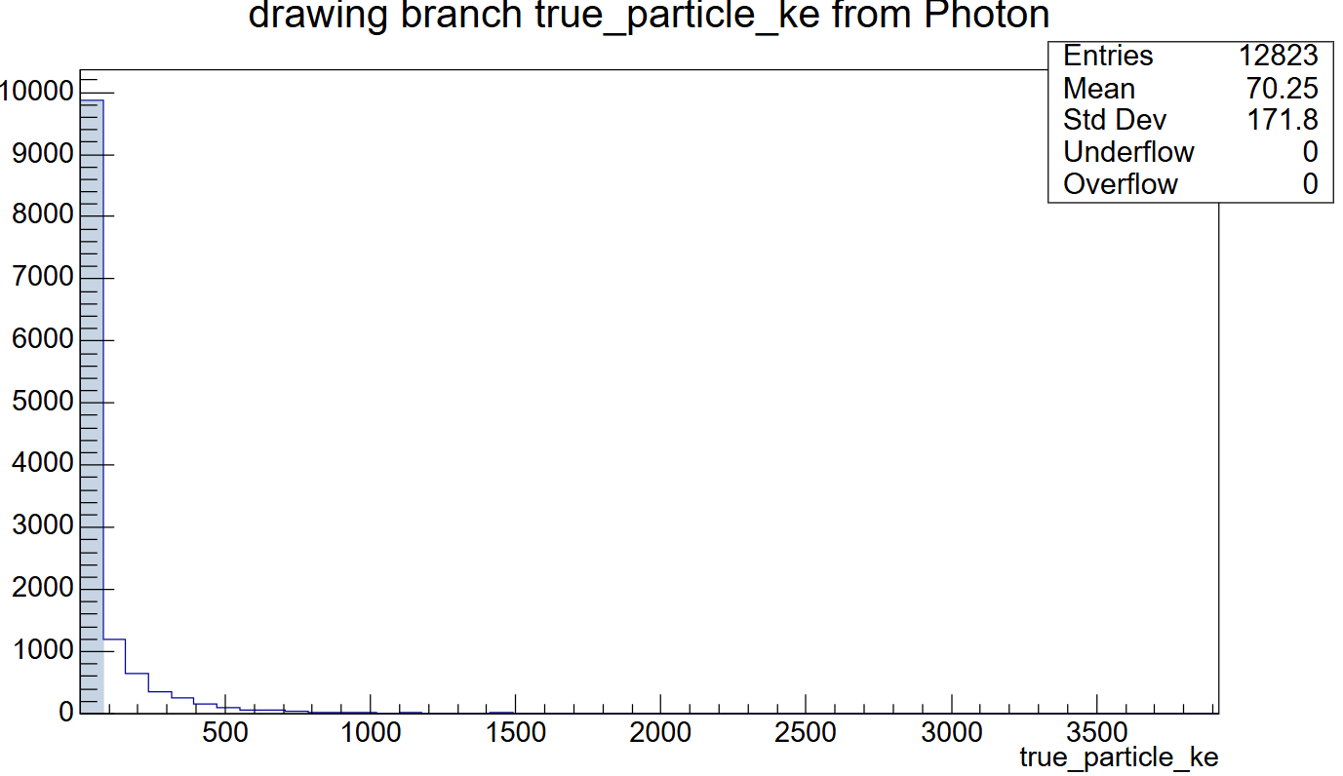
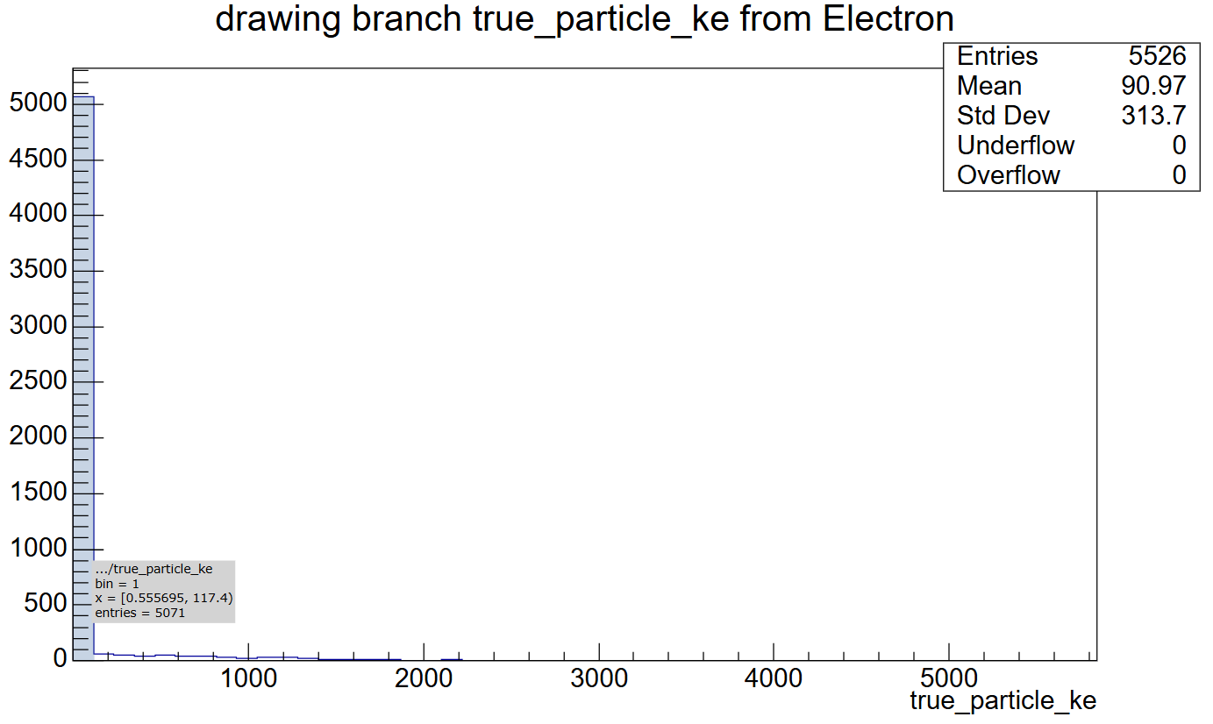



Comparing distributions for each particle type – Kinetic Energy

Slide 35
Discussion of KE distributions for each particle
For electrons and photons, their kinetic energy distributions is very centralised into a specific range. With a large majority of electrons and photons with kinetic energies between 0.55 to 117 and 1 to 79 MeV respectively
Muons have a wide kinetic energy spread, with majority within 4 to 279 MeV
Pions and protons are similar to muons but with a narrower energy spread, and kinetic energies within 0.27 to 198 and 0.72 to 111 MeV respectively. Pions thus have a wider energy spread compared to protons, which is one way to tell them apart.

Slide 36





Interaction level – 1u1p signal graphs

Slide 37


Interaction level – 1u1p signal graphs
total visible energy of the interaction by summing the energy of all particles that are identified as counting towards the final state of the interaction.

Slide 38

Shower selection
Attempted to create a Ttree containing only reconstructed particles with shower semantic type
Flashmatch cut to reduce cosmics, testing size cut meant to reduce noise or reconstruction artefacts

Slide 39


Shower selection

Slide 40
Tasks completed (22 Jan)
Writing TOML file to select
ee showers
yy showers
ey showers
Looking at particle variables for leading shower particle and subleading shower particle
Finished Writing Mid-Progress report for Final Year Project

Slide 41



TOML file
3 different sélections in reconstructed mode, ee-showers, yy-showers, and ey-showers for background
Running in reco mode, all cuts are for reconstructed interactions/particles
ee-shower selection
yy-shower selection
ey-shower selection

Slide 42



Creating new cuts
In order to select interactions with 2 primary shower-like particles (ee, yy). Created a cut by modifying pre-existing ‘single_electron’ cut
Added the two new cuts ‘two_électrons’ and ‘two_photons’ directly into the ‘cuts.h’ file within my medulla directory in the remote shell
Pre-existing single_electron cut
Two_electrons cut to register
Two_photons cut to register

Slide 43

Using g0re selectors from harry
To select subleading shower particles for ee and yy sélections, and leading and subleading shower particles for ey selection, used harry’s selector code for g0re particles.
Added selector directly into ‘selectors.h’ file in my medulla directory in remote shell

Slide 44

Recompiling
Ran into these errors
Could be due to me still using the old sbnana from sbnana@feature/smithja_BNBQuality, and not the tagged version referenced in the medulla installation guide?
Tried to run setup sbnana v10_01_02_01 -q e26:prof and got a version conflict.
Could use some help on this

Slide 45
Tasks completed (29 Jan)
Writing TOML file to select
Pre-event selection with cuts including
Fiducial cut
Containment cut
Valid flash match cut
Looking at efficiency of pre-selection cuts by plotting cuts as variables in branch
No. of particles that pass each cut
No. of particles that pass all 3 cuts
Event selection of events with ee, ey, yy primary shower candidates
Running TOML file with BNB and NuMI samples to look for ee, yy, and ey shower candidates
Analysing important variables such as
Start dedx
transverse momentum/dpT
opening angles
distance from particle start point to parent interaction vertex
Distance between leading and subleading particle start positions

Slide 46
Preselection cut criteria
Fiducial cut
defined in a SPINE post-processor as a 25 cm border around the x and y detector faces, a 50 cm border around the downstream (+) z face, and 30 cm border around the upstream (-) z face.
Containment cut
The interaction is considered contained if all particles and all space points are contained within 5cm of the detector edges (configured in a SPINE post-processor)
Valid_Flashmatch
A "valid" flash match is defined as a flash-interaction association with a flash time that is not NaN and a flash match status of 1

Slide 47


Preselection
Selection with no cuts applied, and fiducial, containment and valid_flashmatch plotted as variables
We can see the total efficiency of the cuts, which is the number of candidates that pass the following cuts over the total number of all candidates in the ROOT file
Pre-event selection for analysing efficiency of fiducial, containment, and valid_flashmatch cuts
With cuts applied and then plotted as variables, we can see the reconstruction efficiency of the cuts

Slide 48



NuMI Preselection total efficiency (reco)
Working in reconstructed mode,
Parameter | Value | Percentage over tot no. of particles
Root file used | NuMI_CV_flat_cafs_2
Total no. of particles | 1589446
No. of particles that passes fiducial cut | 579617 | 36.5%
No. of particles that passes containment cut | 131342 | 8.3%
No. of particles that passes valid_flashmatch cut | 41832 | 2.6%
No. of particles that passes all 3 cuts | 8486 | 0.5%

Slide 49
BNB Preselection total efficiency (reco)
Working in reconstructed mode,
Parameter | Value | Percentage over tot no. of particles
Root file used | NuMI_CV_flat_cafs_2
Total no. of particles | 1347460
No. of particles that passes fiducial cut | 499317 | 37.1%
No. of particles that passes containment cut | 116685 | 8.7%
No. of particles that passes valid_flashmatch cut | 35353 | 2.6%
No. of particles that passes all 3 cuts | 13785 | 1.0%

Slide 50


Preselection reconstruction efficiency (reco)
Working in reconstructed mode, comparing reco particles passing the cuts against the actual truth-level particles passing the cut
Valid_Flashmatch cut has no truth counterpart, should use ‘neutrino-only’ cut as replacement for truth-level selection
Parameter | Value | Percentage over tot no. of particles | Reconstruction efficiency of cuts
Root file used | NuMI_CV_flat_cafs_2
Total no. of particles that passed all 3 cuts | 8486
No. of truth particles that shouldn’t have passed fiducial cut | 1472 | 17.4% | 82.6%
No. of truth particles that shouldn’t have passed containment cut | 740 | 8.7% | 91.3%

Slide 51
Looking for ee, ey, and yy shower candidates in NuMI and BNB samples
Selecting events using the following cuts, and comparing with truth-level information
Interaction-level information and particle-level information split into seperate Ttrees
Presenting selection on reconstructed interactions, but did perform selection on true interactions as well for comparison
ee-shower selection
yy-shower selection
ey-shower selection

Slide 52
Looking for ee, ey, and yy shower candidates in NuMI and BNB samples
Based on truth selection, no actual ee-shower candidates, reconstructed candidates are due to photons misidentified as électrons
There are a good number of yy-shower candidates from both BNB and NuMI samples
There are only a very small number of actual ey-shower candidates
Based on this selection, will only conduct analysis of particle variables for the yy-selection
Parameter | Value from reco selection | Value from truth selection | Value from reco selection | Value from truth selection
Root file used | NuMI_CV_flat_cafs_2_00 |  | input000.flat.root
no. of interactions that passed ee-selection | 6 | 0 | 1 | 0
no. of interactions that passed yy-selection | 131 | 177 | 215 | 332
no. of interactions that passed ey-selection | 38 | 3 | 37 | 1

Slide 53
yy-shower selection analysis
Important variables relating to position, direction, momentum, spread, energy, and distance of particle start position to parent interaction vertex plotted
Difference between distance of leading shower and subleading shower start position calculated

