Slide 1
Tasks completed (12 Feb)
Extended TOML file to include all BNB and NuMI samples
/pnfs/icarus/persistent/users/dcarber/spine/combined_files/NuMI_CV_flat_cafs_2/*.root
/pnfs/icarus/persistent/users/mueller/production/simulation/nominal/input*.flat.root
Created TOML files

Slide 2
Pre-event selection

Slide 3
Preselection cut criteria
Fiducial cut
defined in a SPINE post-processor as a 25 cm border around the x and y detector faces, a 50 cm border around the downstream (+) z face, and 30 cm border around the upstream (-) z face.
Containment cut
The interaction is considered contained if all particles and all space points are contained within 5cm of the detector edges (configured in a SPINE post-processor)
Valid_Flashmatch
A "valid" flash match is defined as a flash-interaction association with a flash time that is not NaN and a flash match status of 1

Slide 4
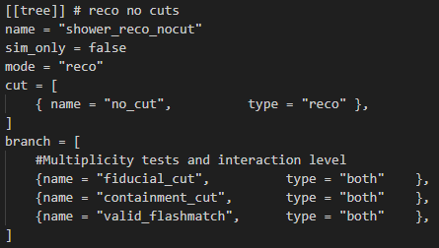
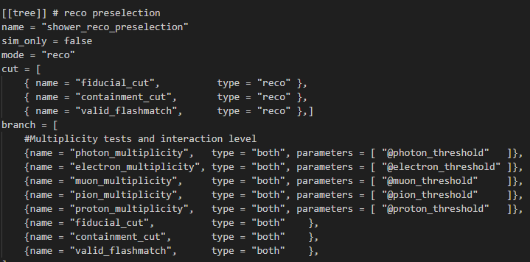
Preselection
There were two types of selection configurations performed for analysing pre-selection data,
Selection with no cuts applied, and fiducial, containment and valid_flashmatch plotted as variables
We can see the total efficiency of the cuts as branches plotted, which is the number of particles that pass the following cuts over the total number of all particles in the ROOT file
Pre-event selection for analysing efficiency of fiducial, containment, and valid_flashmatch cuts
With cuts applied and then plotted as variables, we can see the reconstruction efficiency of the cuts (No of reco particles that should not have passed the cut but did, based on true particle information)

Slide 5
Preselection total efficiency (reco)
NuMI
BNB
Parameter | Value | Percentage over tot no. of particles
Root file used | /pnfs/icarus/persistent/users/dcarber/spine/combined_files/NuMI_CV_flat_cafs_2/*.root
POT (Protons On Target) | 147e18
Total no. of particles | 11306582
No. of particles that passes fiducial cut | 4130763 | 36.5%
No. of particles that passes containment cut | 932228 | 8.3%
No. of particles that passes valid_flashmatch cut | 296748 | 2.6%
No. of particles that passes all 3 cuts | 60382 | 0.53%
Parameter | Value | Percentage over tot no. of particles
Root file used | /pnfs/icarus/persistent/users/mueller/production/simulation/nominal/input*.flat.root
POT (Protons On Target) | 174e18
Total no. of particles | 8021469
No. of particles that passes fiducial cut | 2970566 | 37%
No. of particles that passes containment cut | 693716 | 8.6%
No. of particles that passes valid_flashmatch cut | 209746 | 2.6%
No. of particles that passes all 3 cuts | 82160 | 1.0%
Notes:
This is for the selection in reconstructed mode with no cuts applied, and the preselection cuts placed as variables, allowing us to see the number of particles that would pass each cut w.r.t the total number of all particles within the root file.
The final row shoes the number of particles that pass all 3 cuts, obtained from the other selection with all 3 cuts applied

Slide 6
Preselection total efficiency (Truth)
NuMI
BNB
Parameter | Value | Percentage over tot no. of particles
Root file used | /pnfs/icarus/persistent/users/dcarber/spine/combined_files/NuMI_CV_flat_cafs_2/*.root
POT (Protons On Target) | 147e18
Total no. of particles | 8271435
No. of particles that passes fiducial cut | 91618 | 1.1%
No. of particles that passes containment cut | 407464 | 4.9%
No. of particles that passes neutrino cut | 207662 | 2.5%
No. of particles that passes all 3 cuts | 48907 | 0.59%
Parameter | Value | Percentage over tot no. of particles
Root file used | /pnfs/icarus/persistent/users/mueller/production/simulation/nominal/input*.flat.root
POT (Protons On Target) | 174e18
Total no. of particles | 5890669
No. of particles that passes fiducial cut | 128989 | 2.2%
No. of particles that passes containment cut | 197954 | 3.4%
No. of particles that passes neutrino cut | 193363 | 3.3%
No. of particles that passes all 3 cuts | 80472 | 1.4%
Notes:
This is for the selection in true mode with no cuts applied, and the preselection cuts placed as variables, allowing us to see the number of particles that would pass each cut w.r.t the total number of all particles within the root file.
The final row shoes the number of particles that pass all 3 cuts, obtained from the other selection with all 3 cuts applied
It is interesting to note the much smaller percentage of particles passing the fiducial cut when considering their true particle information

Slide 7
Preselection cut purity (reco)
True information
We look at the reconstructed-level selection mode, and the true particle information matched to the reconstructed particle
NuMI | Passes | Fails | Overflow
Passes fiducial | 78.4% | 17.6% | 4%
Passes containment | 86.9% | 9.1% | 4%
Reco information
True information
BNB | Passes | Fails | Overflow
Passes fiducial | 93.6% | 5.1% | 1.3%
Passes containment | 94.9% | 3.8% | 1.3%
Reco information
Notes:
This is for the reconstructed selection with all 3 cuts applied as cuts and placed as variables as well. Therefore, only particles that pass all 3 of the cuts together will be plotted.
When the cuts are plotted as variables in true mode. This allows us to see the false positives of each cut, meaning we can see the number of reconstructed particles that passed the cut, but should’nt have when considering their true particle information

Slide 8
Preselection cut purity (True)
reco information
We look at the truth-level selection mode, and the reconstructed particle information matched to the true particle
NuMI | Passes | Fails | Overflow
Passes fiducial | 96.7% | 2.4% | 0.86%
Passes containment | 97.7% | 1.5% | 0.86%
true information
reco information
BNB | Passes | Fails | Overflow
Passes fiducial | 97.1% | 2.3% | 0.58%
Passes containment | 98.2% | 1.2% | 0.58%
true information
Notes:
This is for the true selection with all 3 cuts applied as cuts and placed as variables as well. Therefore, only particles that pass all 3 of the cuts together will be plotted.
When the cuts are plotted as variables in reco mode. This allows us to see the false positives of each cut, meaning we can see the number of true particles that passed the cut, but should’nt have when considering their reco particle information

Slide 9
2-shower event selection

Slide 10
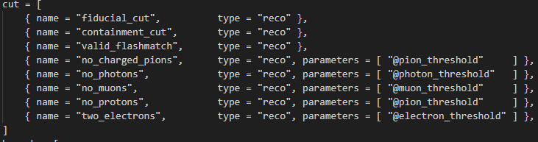
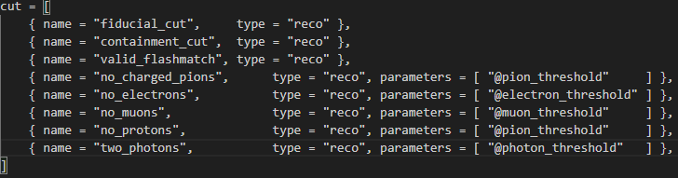
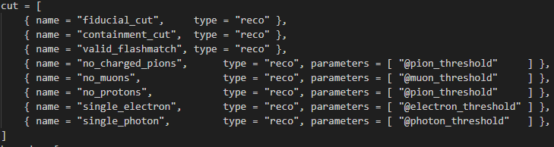
Looking for ee, ey, and yy shower candidates in NuMI and BNB samples
Selecting events using the following cuts, and comparing with truth-level information
Interaction-level information and particle-level information split into seperate Ttrees
Leading and subleading shower particles selected for plotting of variables
ee-shower selection
yy-shower selection
ey-shower selection

Slide 11
Looking for ee, ey, and yy shower candidates in NuMI and BNB samples
Based on comparison of reco and truth selection
Only 1 ee-shower candidate
There are a good number of yy-shower candidates from both BNB and NuMI samples
There are only a very small number of actual ey-shower candidates
Based on this selection, will only conduct analysis of particle variables for the yy-selection
Parameter | Value from reco selection | Value from truth selection | Value from reco selection | Value from truth selection
Root file sample | NuMI |  | BNB
no. of interactions that passed ee-selection | 46 | 1 | 10 | 1
no. of interactions that passed yy-selection | 990 | 1400 | 1304 | 2048
no. of interactions that passed ey-selection | 218 | 15 | 230 | 5
Notes:
Now we look at the selection for 2 shower candidates for all the root files corresponding to NuMI and BNB.
I managed to find one singular ee-candidate, a large number of yy-candidates, and some ey-candidates

Slide 12
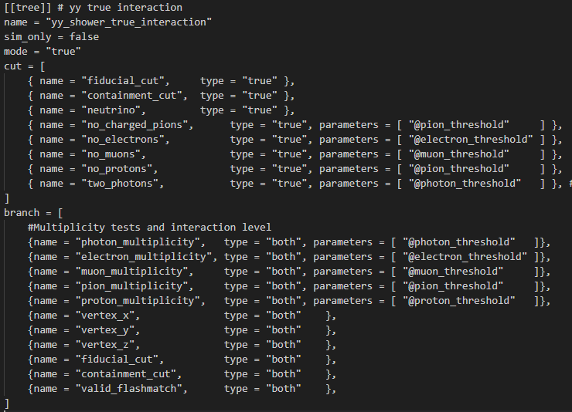
True and reco interaction-level analysis
Analysed reconstructed vs truth interaction-level multiplicities for yy-showers
Looked at discrepancy between true and reco particle multiplicities in selected interactions
Looked at particle multiplicities for wrongly reconstructed interactions

Slide 13
Reco-level interaction analysis
Parameter | Reco value | True value | Purity | Reco value | True value | Purity
Root file sample | NuMI |  |  | BNB
No of 2-electron multiplicity interactions | 46 | 0 | 0% | 10 | 1 | 10%
No. of 2-photon multiplicity interactions | 990 | 788 | 79.6% | 1304 | 1135 | 87%
No. of 1 electron 1 photon multiplicity interactions | 218 | 7 | 3.2% | 230 | 0 | 0%
Notes:
I wanna firstly focus on the selection in reconstructed mode. You can see if you were to run the selection using reconstructed interactions, there would not be a single true ee-candidate within the reconstructed candidates for NuMI, but BNB manages to include the single ee-candidate. For 2 photon candidates, the purity is about 80 and 87% for NuMI and BNB.
For ey, the purity is very small, at about 3.2% and 0% for NuMI and BNB

Slide 14
Truth-level interaction analysis
Parameter | true value | reco value | Percentage of reco over true | true | Reco value | Percentage of reco over true
Root file sample | NuMI |  |  | BNB
No. of 2-electron multiplicity interactions | 1 | 0 | 0% | 1 | 0 | 0%
No. of 2-photon multiplicity interactions | 1400 | 815 | 58.2% | 2048 | 1305 | 63.7%
No. of 1 electron 1 photon multiplicity interactions | 15 | 5 | 33.3% | 5 | 0 | 0%
Notes:
For the selection in true mode. You can see if you were to run the selection using true interactions, there would not be a single reco ee-candidate within the true candidates for NuMI and BNB. For 2 photon candidates, the purity is about 59 and 64 for NuMI and BNB
For ey, the purity is small, at about 33% and 0% for NuMI and BNB

Slide 15
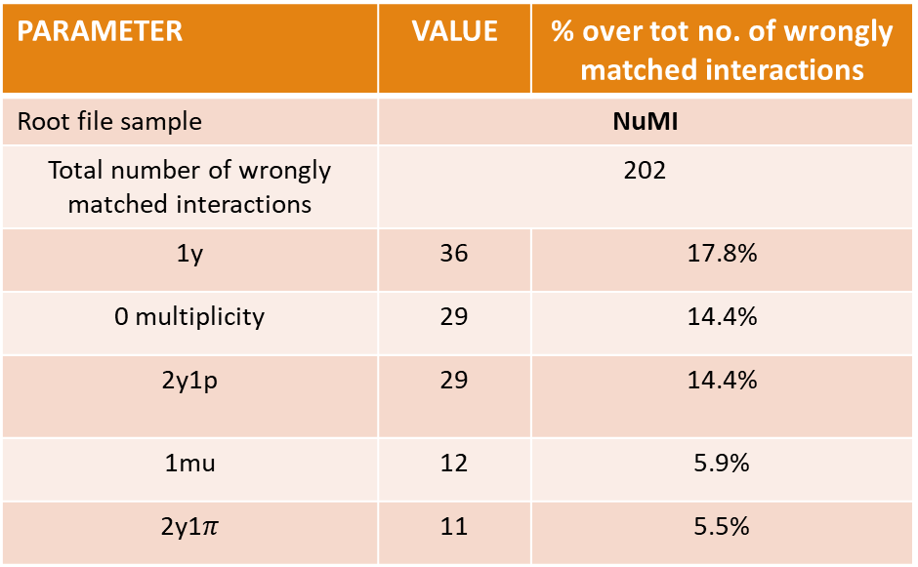
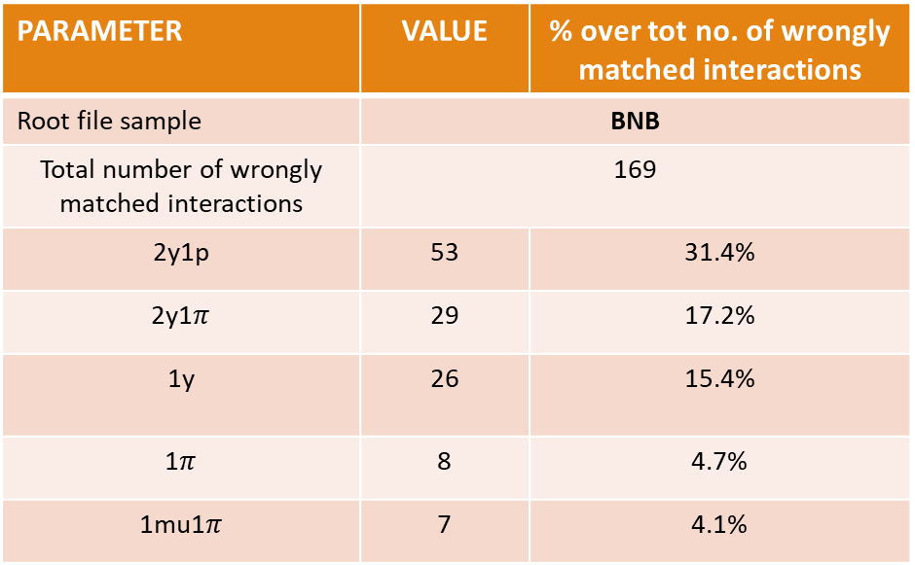
Analysis of wrongly matched true interactions to reco yy interactions (reco)
PARAMETER | VALUE | % over tot no. of wrongly matched interactions
Root file sample | NuMI
Total number of wrongly matched interactions | 202
1y | 36 | 17.8%
0 multiplicity | 29 | 14.4%
2y1p | 29 | 14.4%
1mu | 12 | 5.9%
2y1$π$ | 11 | 5.5%
PARAMETER | VALUE | % over tot no. of wrongly matched interactions
Root file sample | BNB
Total number of wrongly matched interactions | 169
2y1p | 53 | 31.4%
2y1$π$ | 29 | 17.2%
1y | 26 | 15.4%
1$π$ | 8 | 4.7%
1mu1$π$ | 7 | 4.1%
Notes:
Now I would like to focus on what are the most common types of wrongly matched true interactions to the reconstructed interactions in the reconstructed selection.

Slide 16
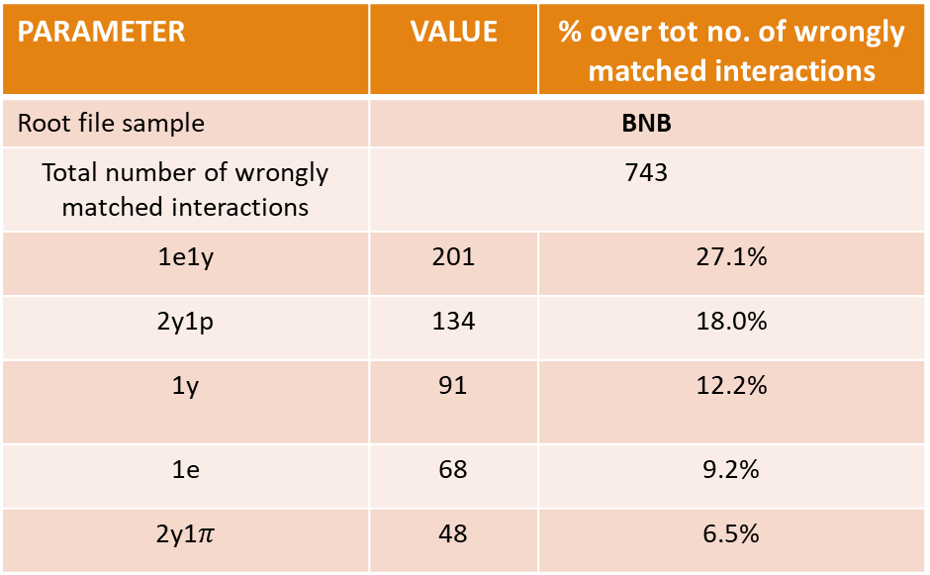
Analysis of wrongly matched reco interactions to true yy interactions (Truth)
PARAMETER | VALUE | % over tot no. of wrongly matched interactions
Root file sample | NuMI
Total number of wrongly matched interactions | 585
1e1y | 146 | 25.0%
2y1p | 100 | 17.1%
1e | 66 | 11.3%
1y | 50 | 8.6%
2y2p | 25 | 4.3%
PARAMETER | VALUE | % over tot no. of wrongly matched interactions
Root file sample | BNB
Total number of wrongly matched interactions | 743
1e1y | 201 | 27.1%
2y1p | 134 | 18.0%
1y | 91 | 12.2%
1e | 68 | 9.2%
2y1$π$ | 48 | 6.5%
Notes:
And here are the most common types of wrongly matched reco interactions to the true interactions in the true selection.

