Slide 1
Weekly FYP update meeting slides
Jordon koh ntu

Slide 2
Tasks completed
Wrote/modified my own TOML file to select
1muon1proton interactions
Specific particles according to PID
Specific semantic types (michel, showers)
Ran it through BNB and NuMI simulation files
Compared reconstructed and true efficiencies
Compared differences in particle variable distributions for each particle type
Writing Mid-Progress report for Final Year Project

Slide 3
PID reconstruction efficiency
Pid variable for NuMI simulation particles, reconstructed and true
Mode is set to true, runs the selection on true interactions within each event
Cuts applied on true interactions only
Neutrino interactions only
PID cut to select specific particle types
Containment cut on true
Fiducial cut on true
Branch variables are both true and reconstructed
Reconstructed branches show reconstructed interactions that are matched to a true interaction
X-axis number | Particle type
0 | Photon
1 | Electron
2 | Muon
3 | Pion
4 | Proton

Slide 4
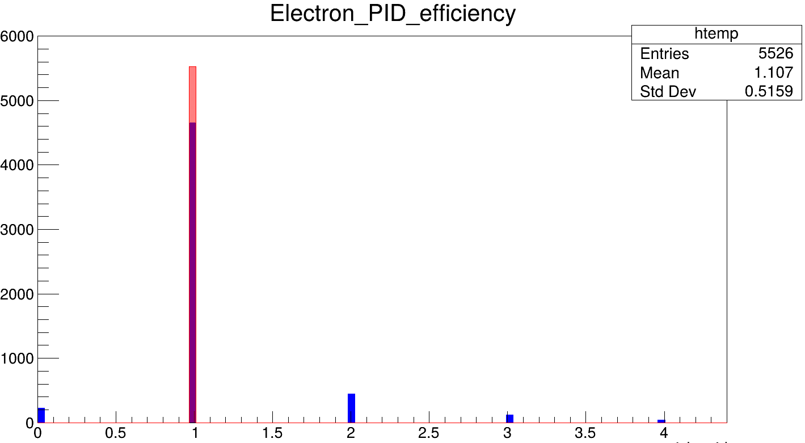
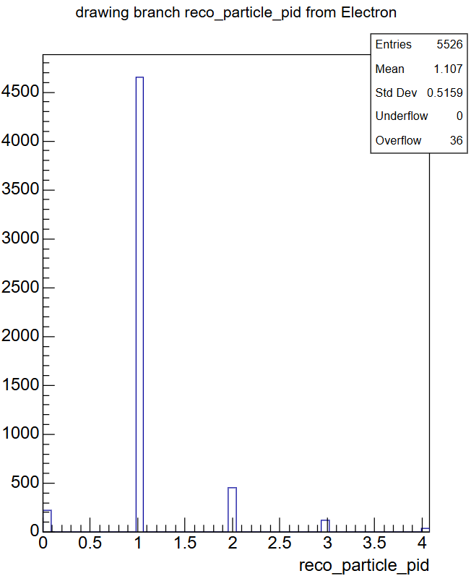
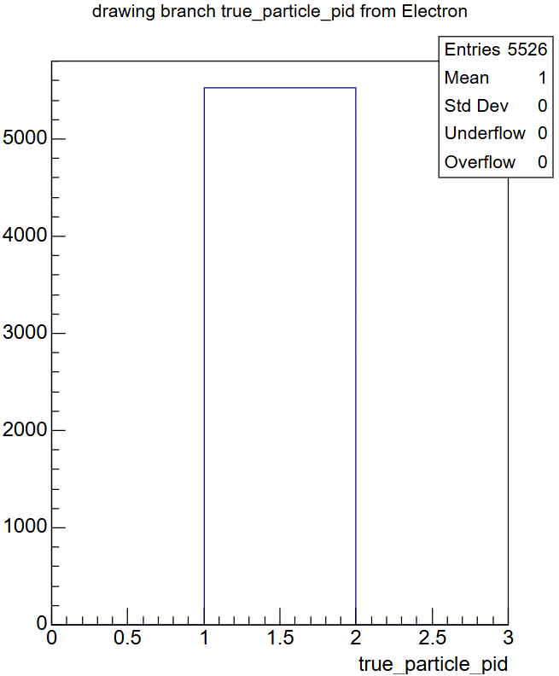
Results of electron only selection
X-axis number | Particle type
0 | Photon
1 | Electron
2 | Muon
3 | Pion
4 | Proton
Reconstruction efficiency, red is true, blue is reco
Reconstructed particle PID
True particle PID

Slide 5
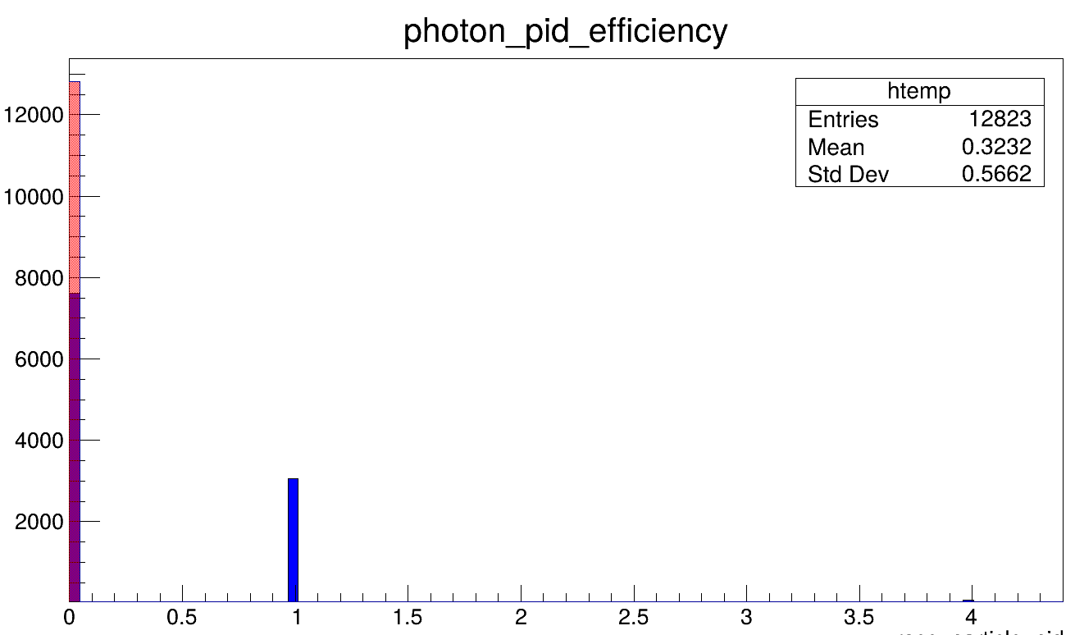
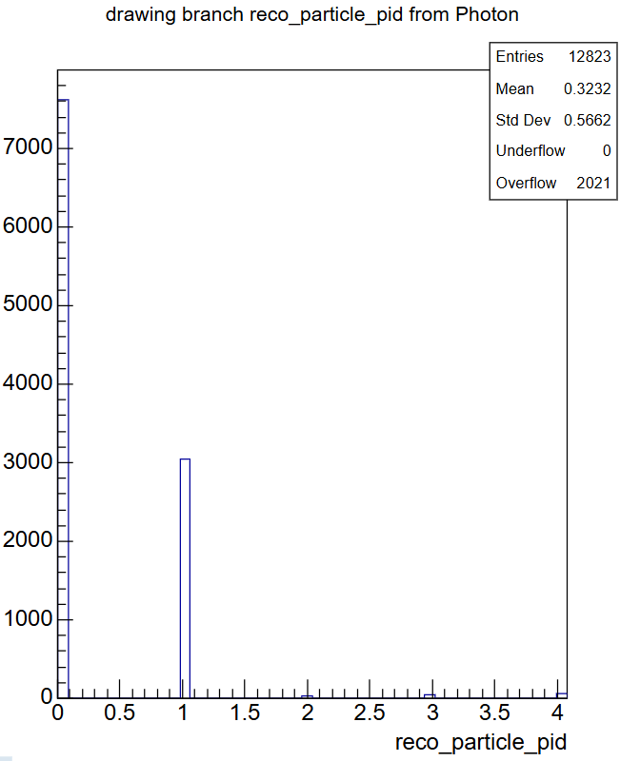
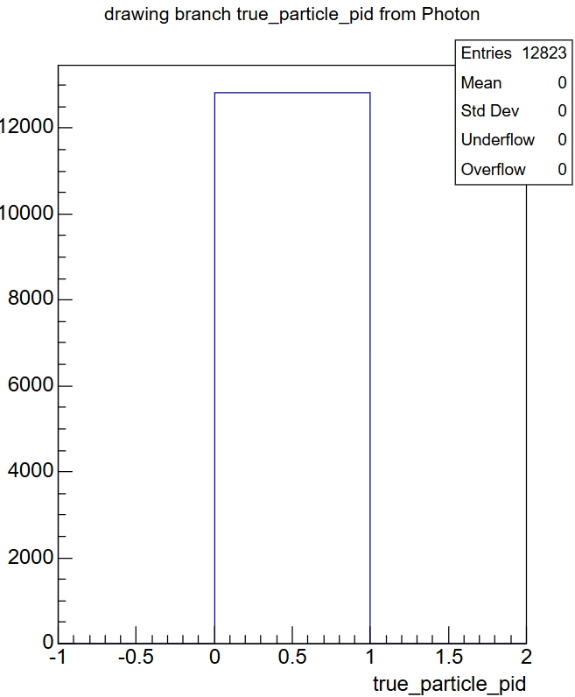
Results of photon only selection
X-axis number | Particle type
0 | Photon
1 | Electron
2 | Muon
3 | Pion
4 | Proton
Reconstruction efficiency, red is true, blue is reco
Reconstructed particle PID
True particle PID

Slide 6
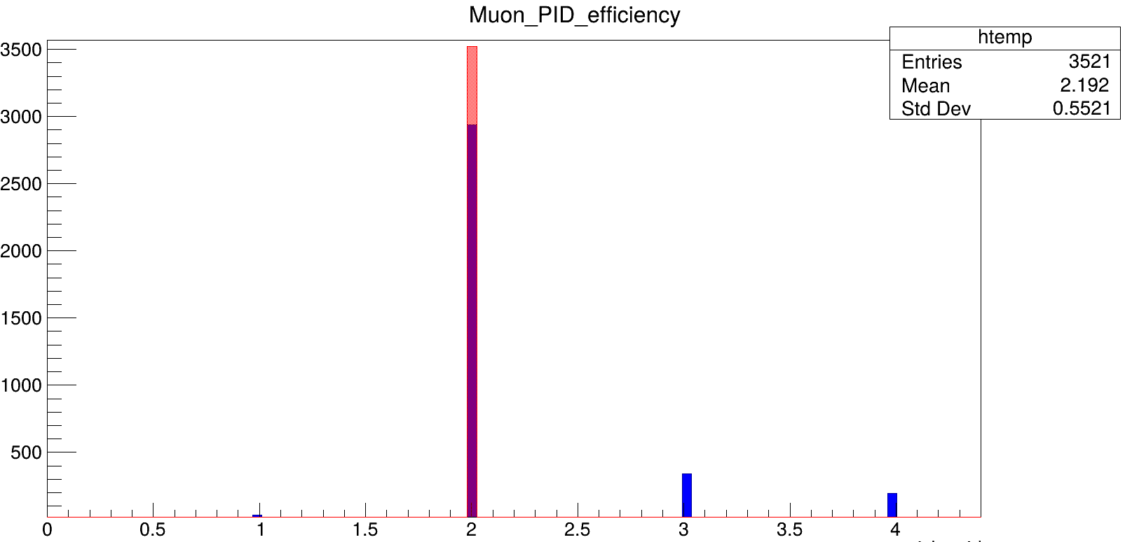
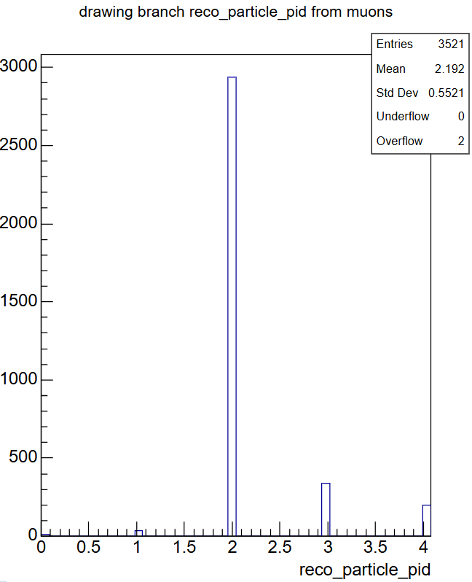

Results of muon only selection
X-axis number | Particle type
0 | Photon
1 | Electron
2 | Muon
3 | Pion
4 | Proton
Reconstruction efficiency, red is true, blue is reco
Reconstructed particle PID
True particle PID

Slide 7
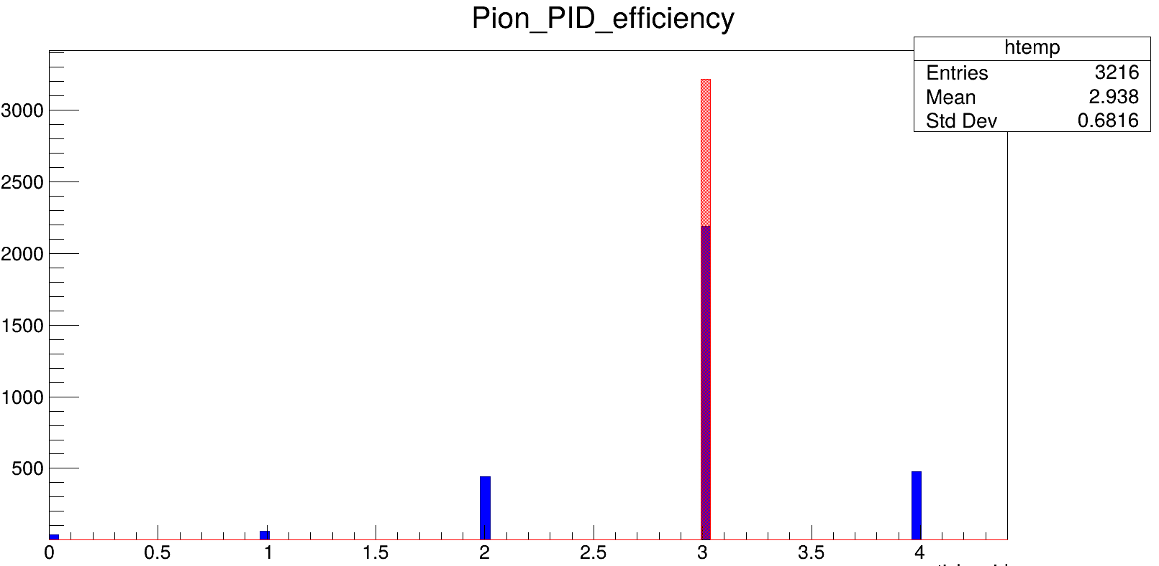
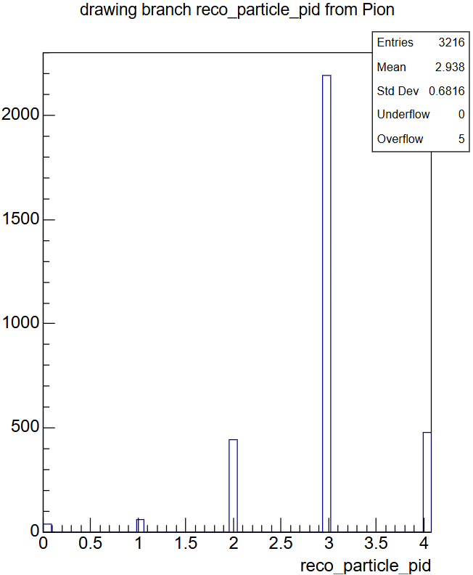
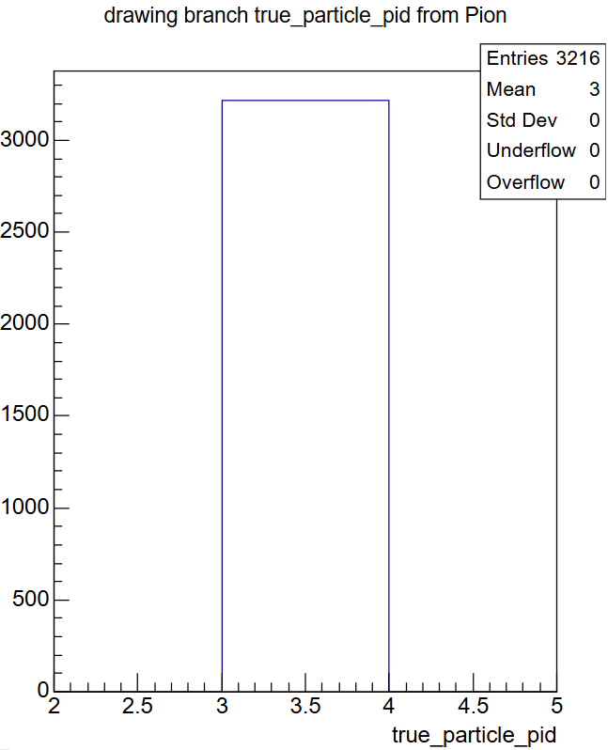
Results of pion only selection
X-axis number | Particle type
0 | Photon
1 | Electron
2 | Muon
3 | Pion
4 | Proton
Reconstruction efficiency, red is true, blue is reco
Reconstructed particle PID
True particle PID

Slide 8
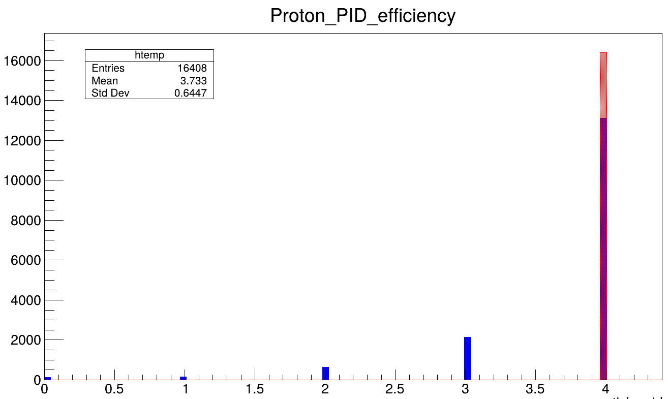
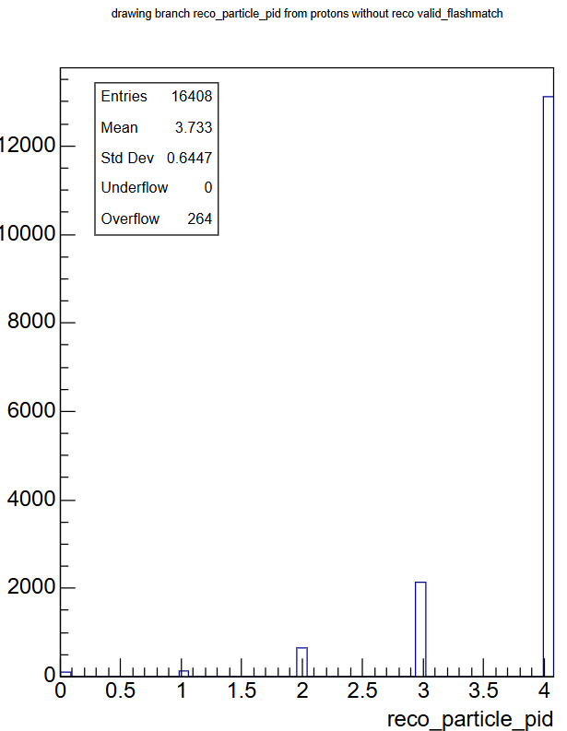
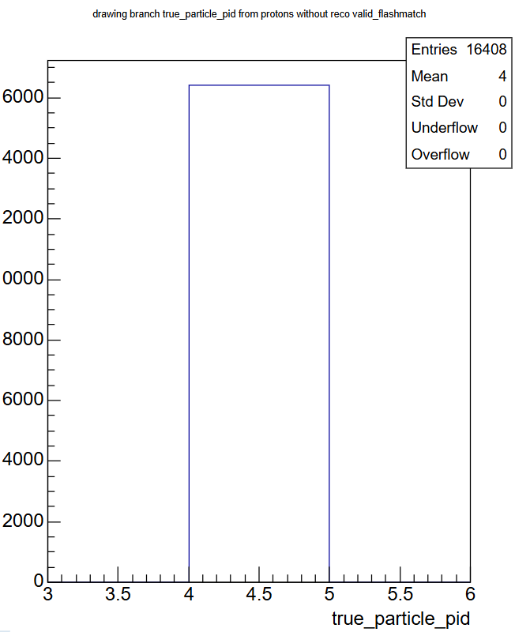
Results of proton only selection
X-axis number | Particle type
0 | Photon
1 | Electron
2 | Muon
3 | Pion
4 | Proton
Reconstruction efficiency, red is true, blue is reco
Reconstructed particle PID
True particle PID

Slide 9
Discussion of particle type reconstruction efficiency
From the reconstruction efficiency graphs. the order of best reconstruction efficiency to worst are as follows
1. electron
2. muon
3. proton
4. pion
5. photon
Photon was noticeably shown to be worse compared to other particle types, with a significant possibility of misidentification of the photon into an electron
The particle shown to have the second worse reconstruction efficiency was the pion. This is to be expected

Slide 10
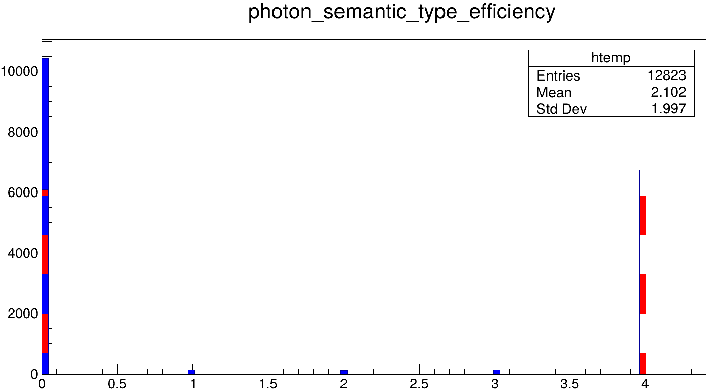
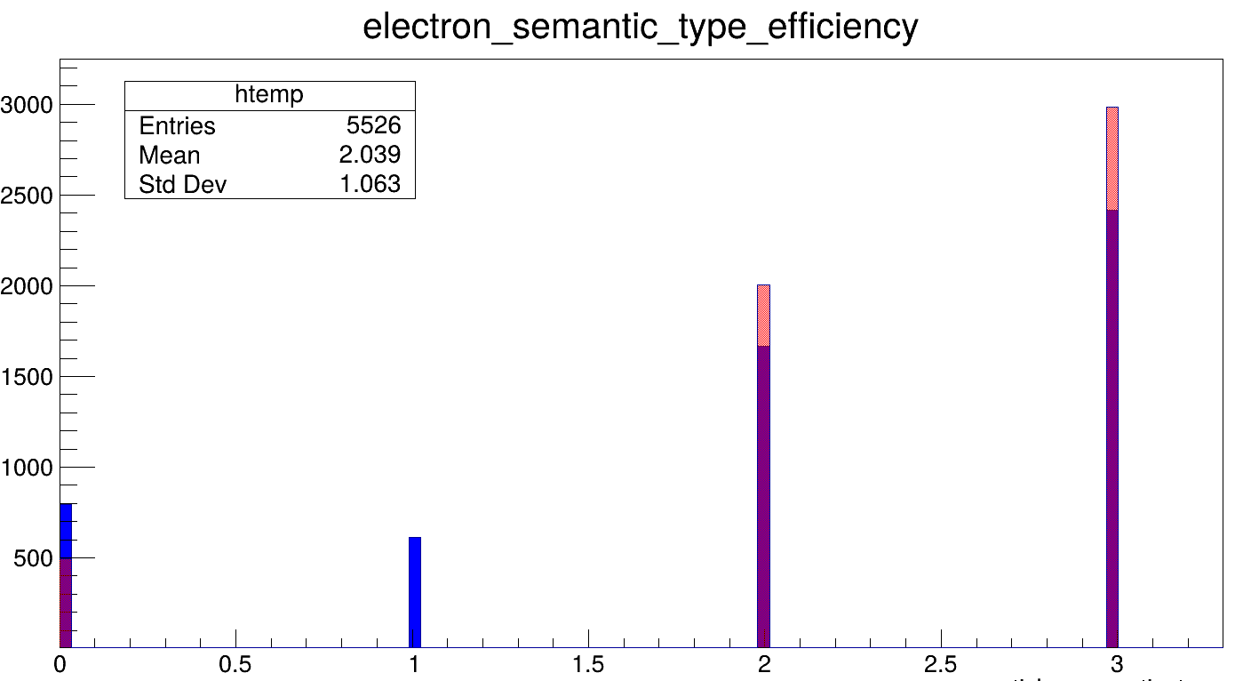
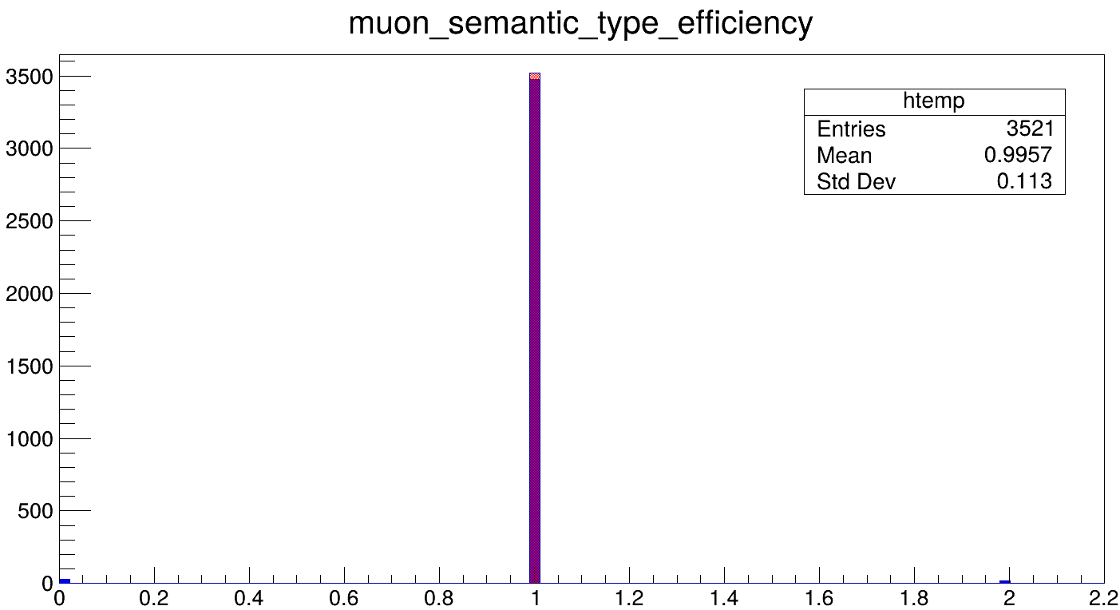
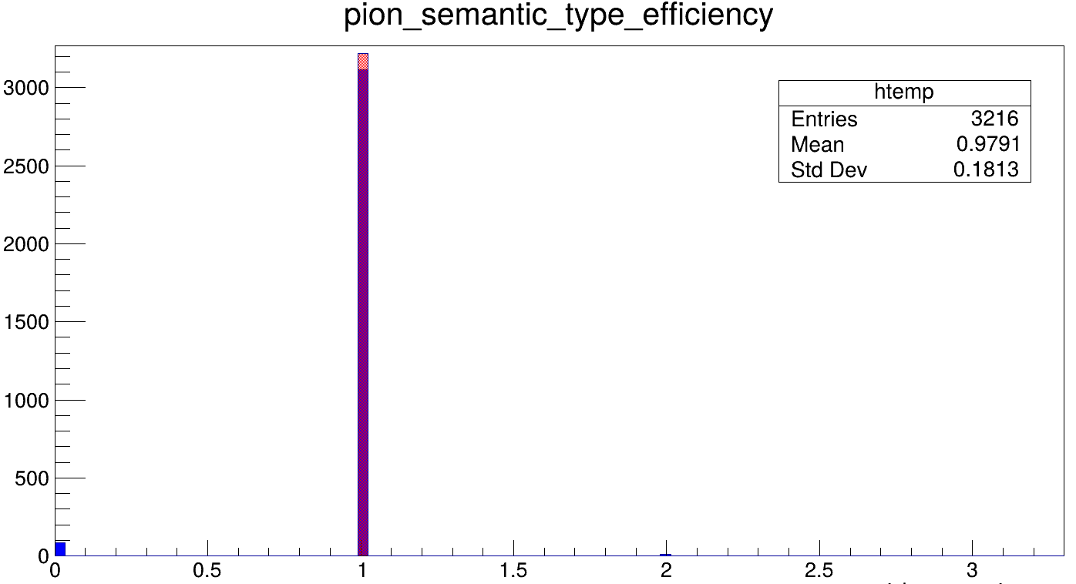
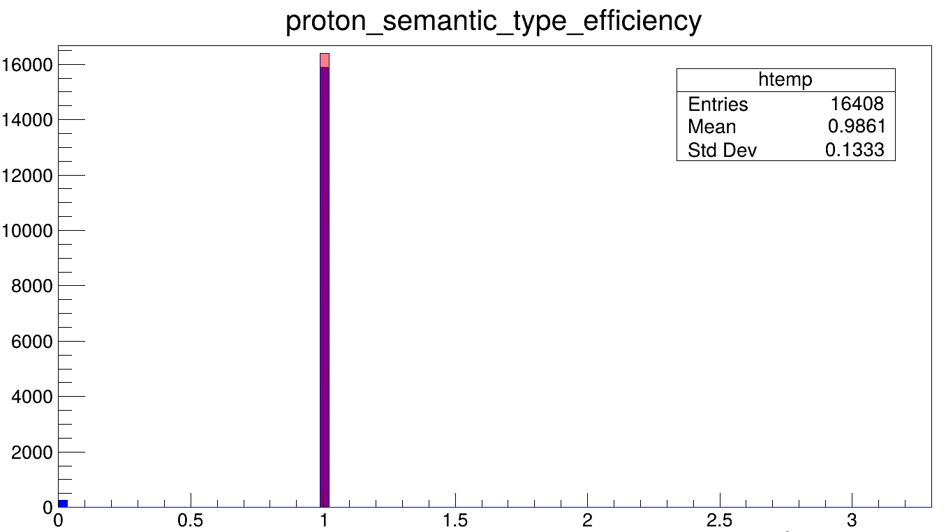
Semantic Type reconstruction efficiency
X-axis number | Semantic type
0 | Shower
1 | Track
2 | Michel electron
3 | Delta electron
4 | Low-energy

Slide 11
Discussion of semantic type reconstruction efficiency
From the reconstruction efficiency graphs. the order of best reconstruction efficiency to worst are as follows
1. muon
2. proton
3. pion
4. electron
5. photon
Photon was noticeably shown to be worse compared to other particle types, with most low-energy semantic types identified to be showers
The particle shown to have the second worse reconstruction efficiency was the electron, with some being classified as tracks

Slide 12
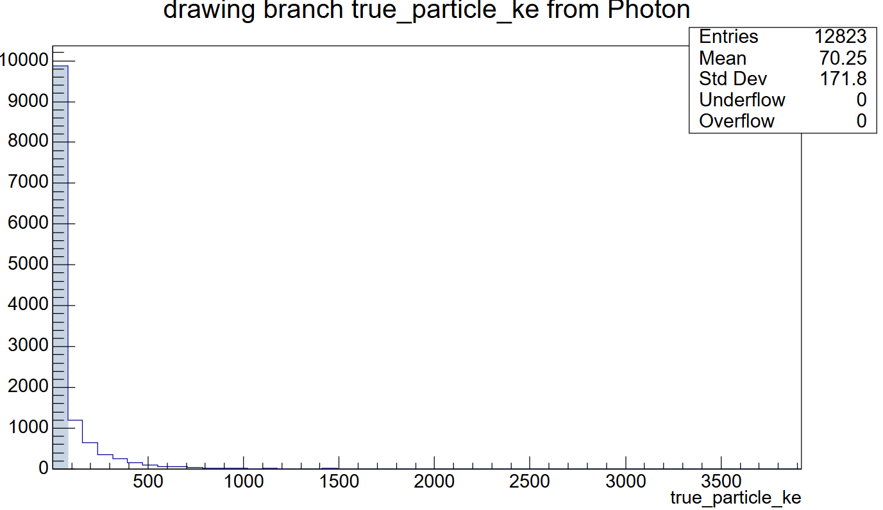
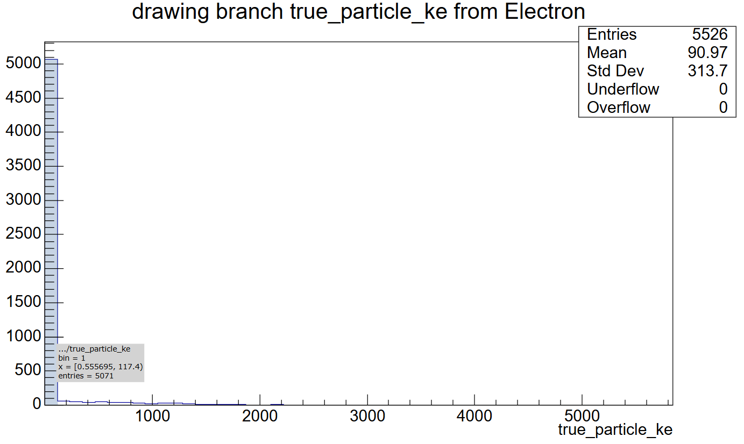
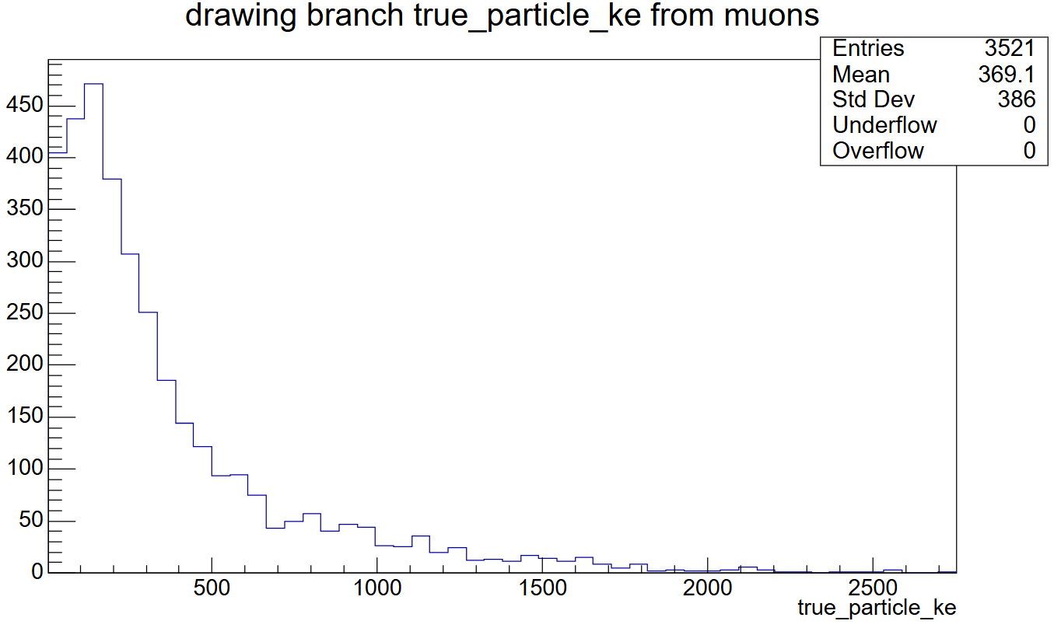
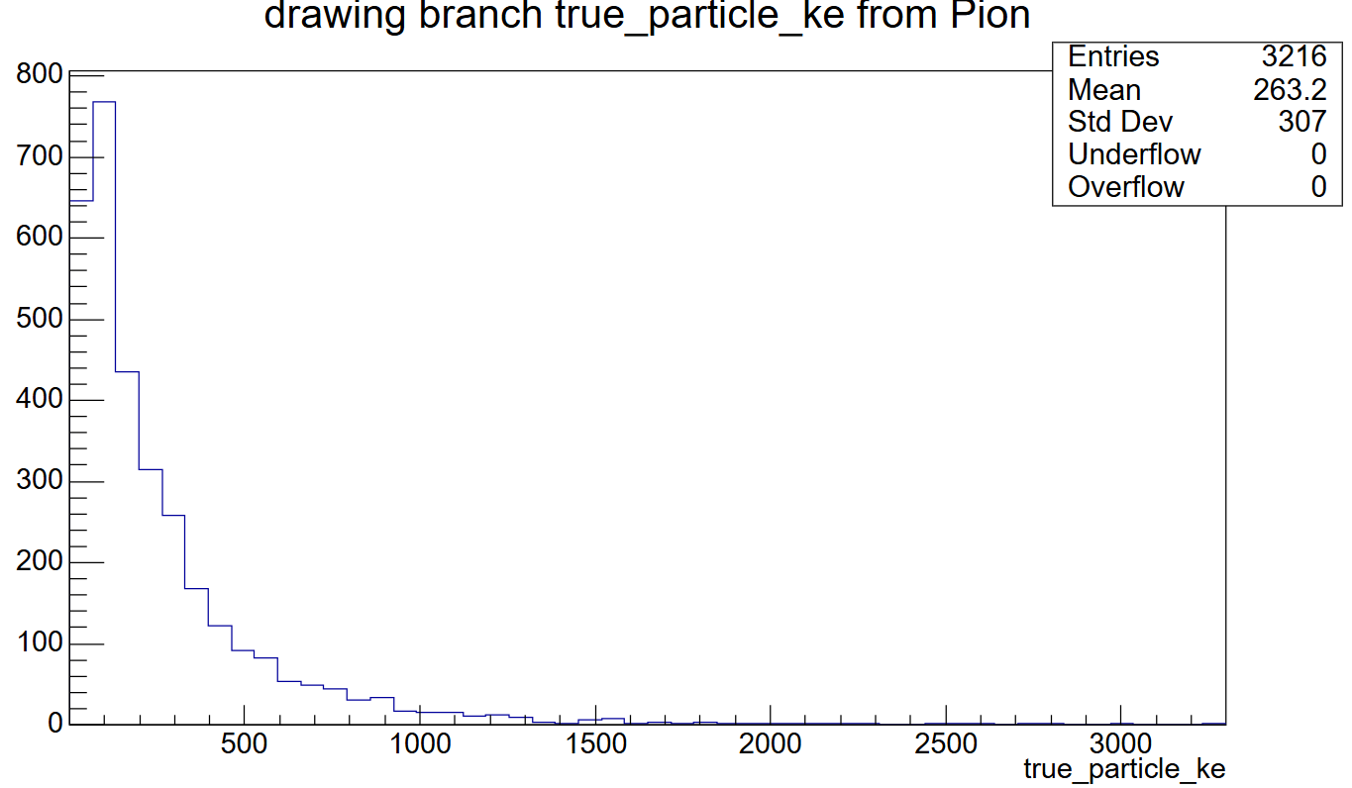
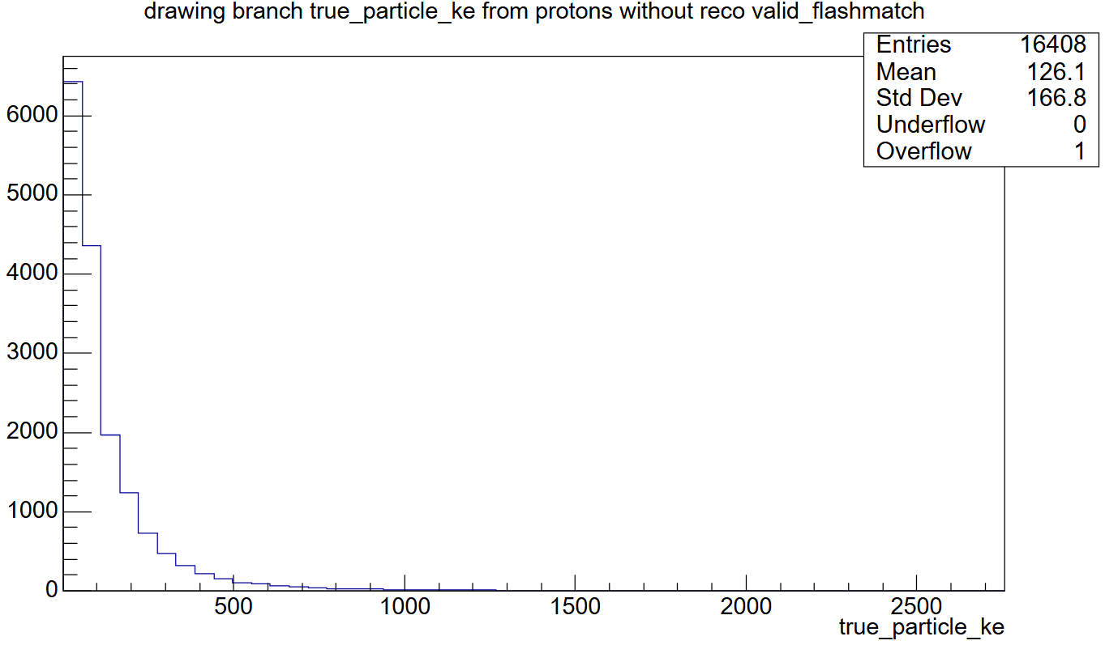
Comparing distributions for each particle type – Kinetic Energy

Slide 13
Discussion of KE distributions for each particle
For electrons and photons, their kinetic energy distributions is very centralised into a specific range. With a large majority of electrons and photons with kinetic energies between 0.55 to 117 and 1 to 79 MeV respectively
Muons have a wide kinetic energy spread, with majority within 4 to 279 MeV
Pions and protons are similar to muons but with a narrower energy spread, and kinetic energies within 0.27 to 198 and 0.72 to 111 MeV respectively. Pions thus have a wider energy spread compared to protons, which is one way to tell them apart.

Slide 14
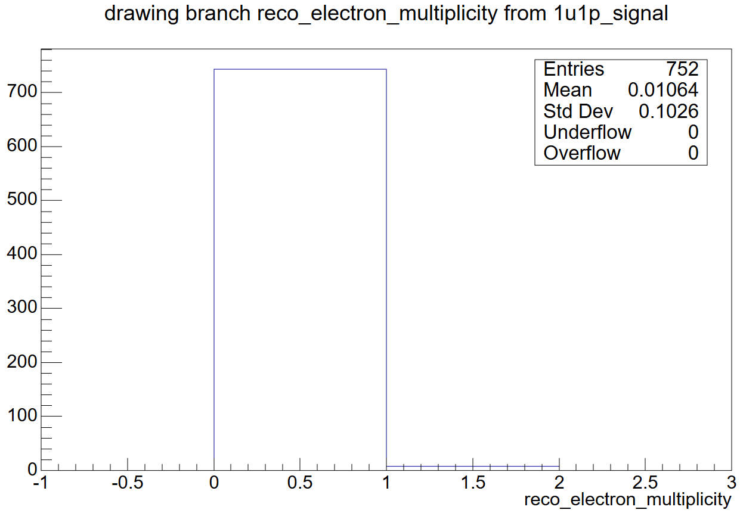
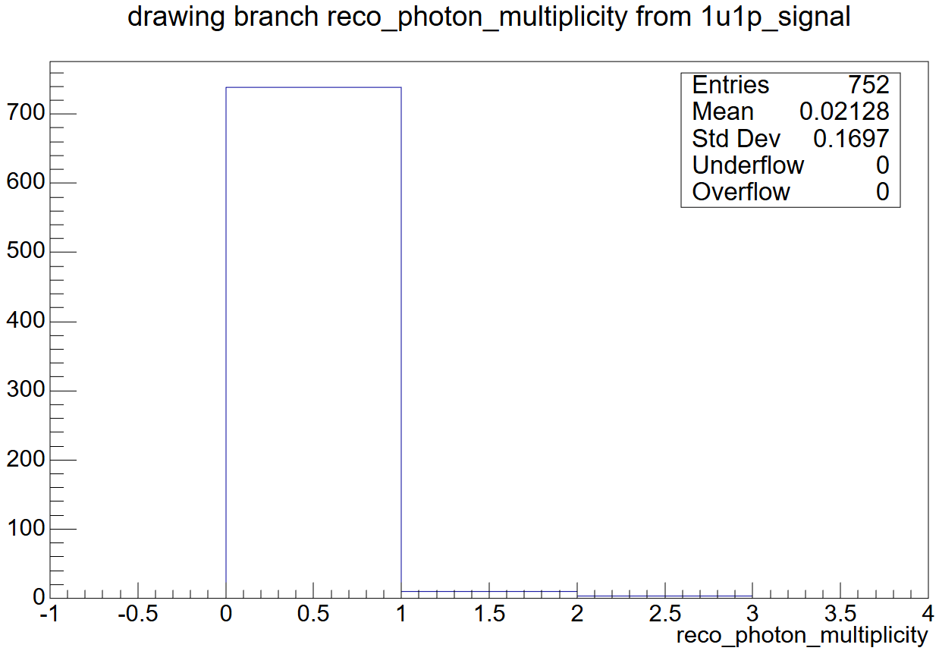
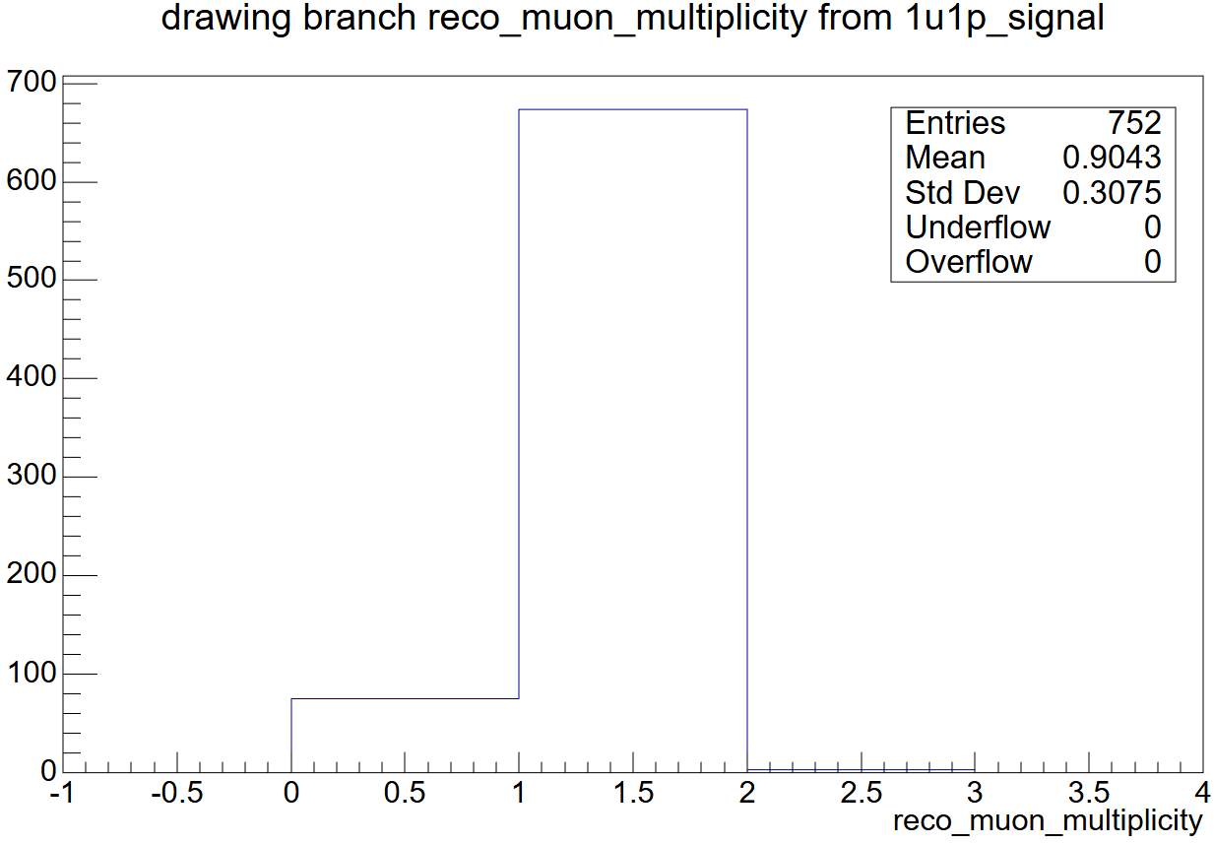
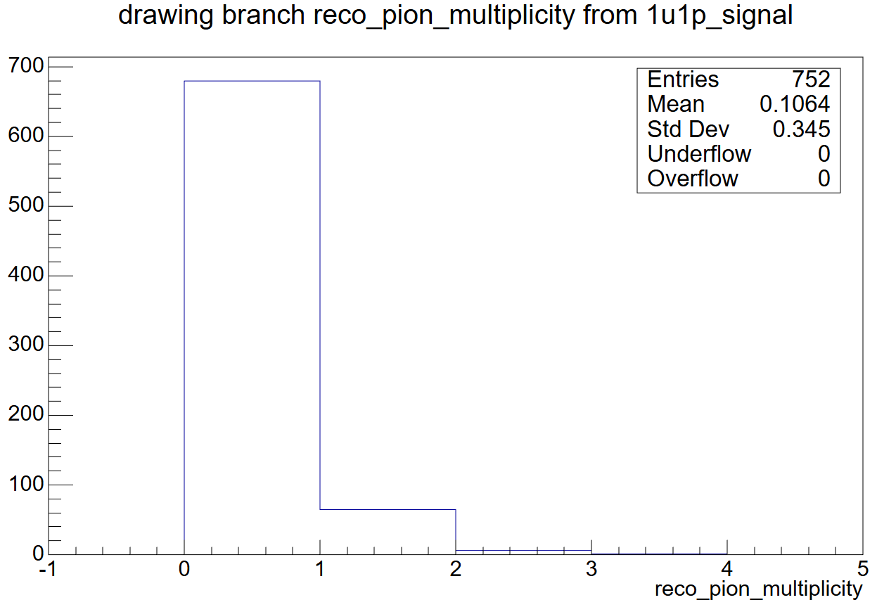
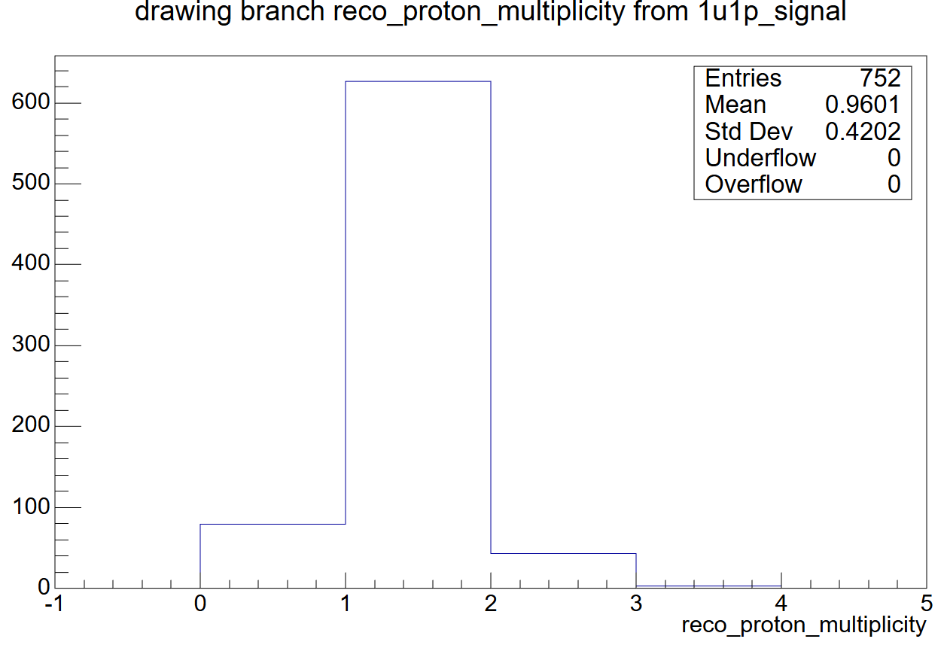
Interaction level – 1u1p signal graphs

Slide 15
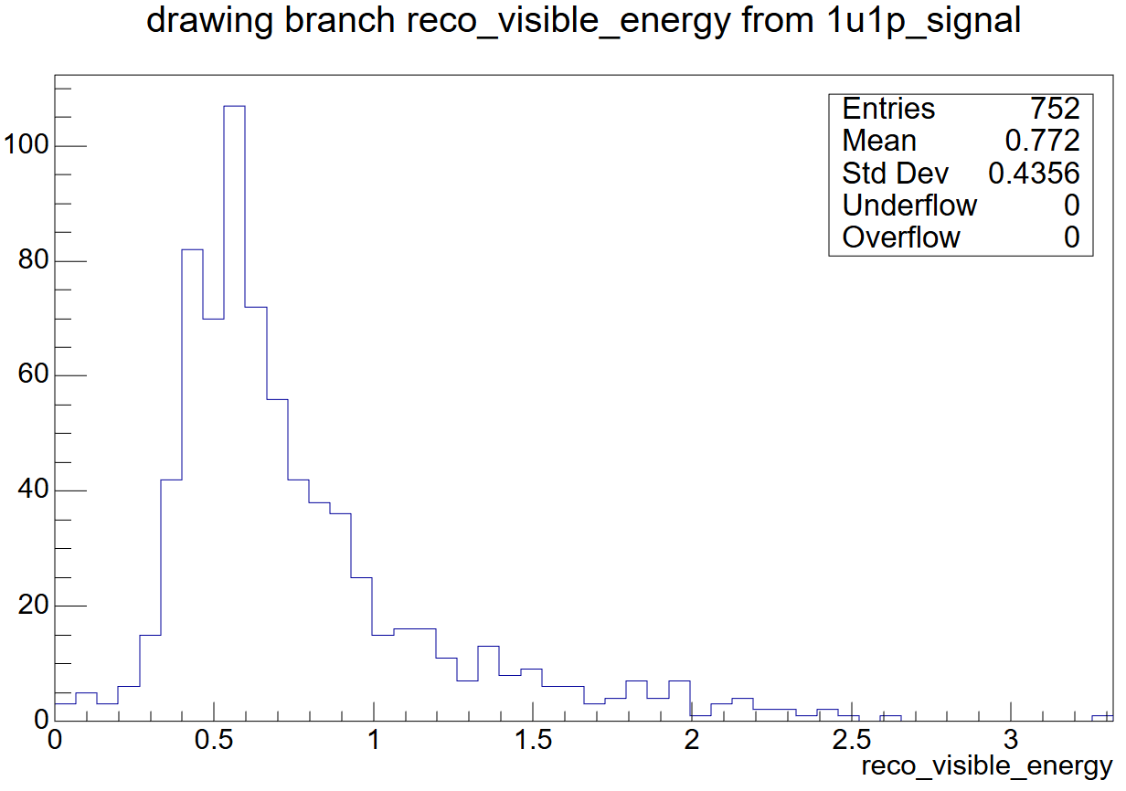
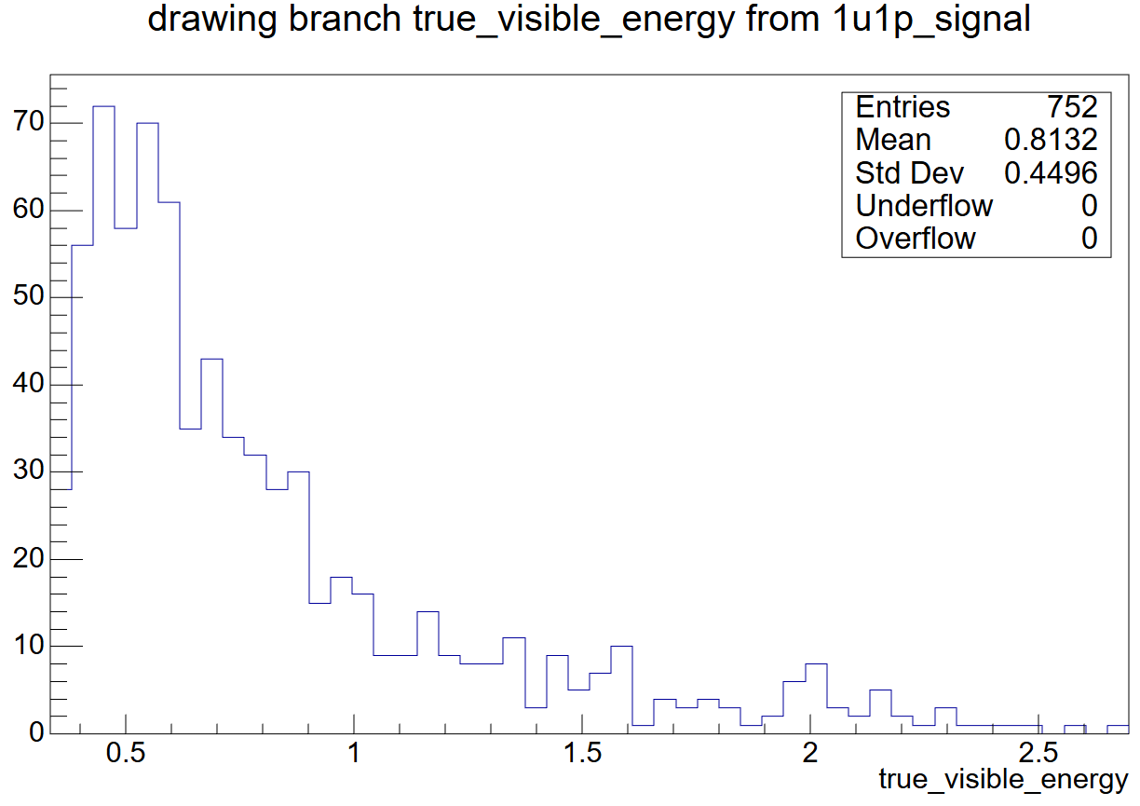
Interaction level – 1u1p signal graphs
total visible energy of the interaction by summing the energy of all particles that are identified as counting towards the final state of the interaction.

Slide 16
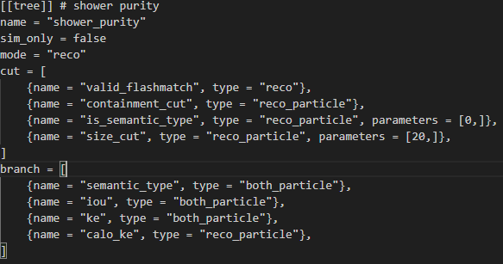
Shower selection
Attempted to create a Ttree containing only reconstructed particles with shower semantic type
Flashmatch cut to reduce cosmics, testing size cut meant to reduce noise or reconstruction artefacts

Slide 17
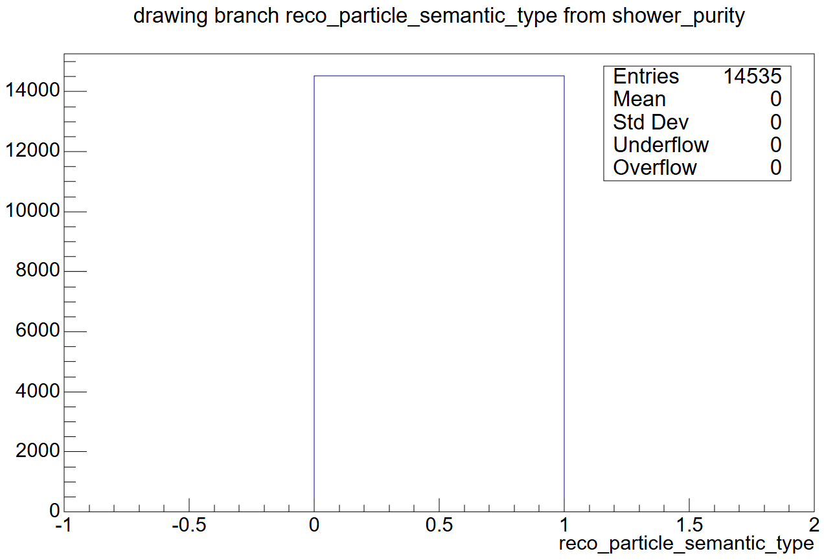
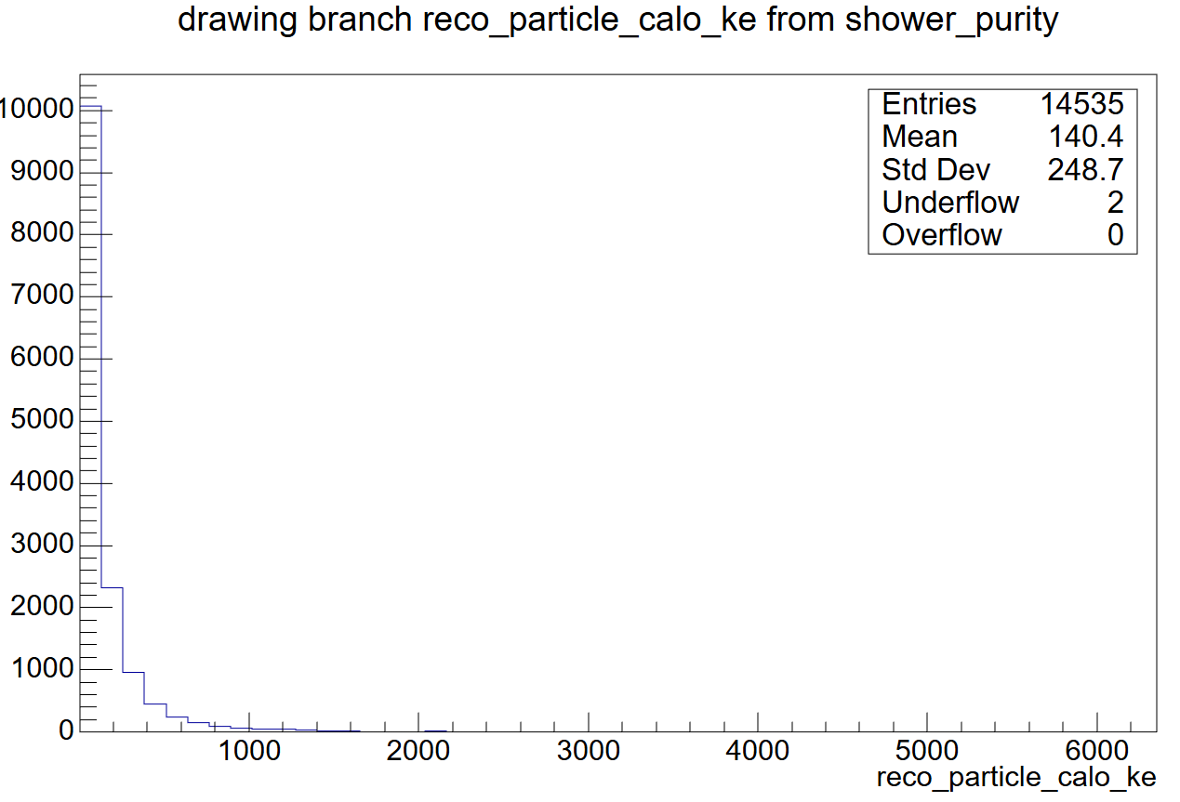
Shower selection

