Slide 1
Tasks completed (19 Feb)
Checking on discrepancy of fiducial cut
Reco-to-truth matching and vice versa for photons, electrons, muons, pions, and protons after preselection
Plotting variables for 2-shower-selection
Created TOML files

Slide 2
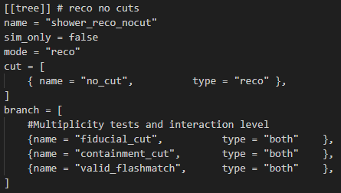
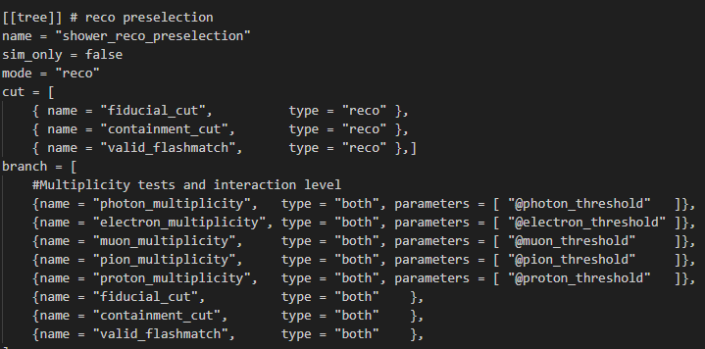
Mistake
Previously presented pre-selection values as number of particles, but it was actually number of interactions
Variables where values were obtained from last week are interaction-level, so the values correspond to number of interactions.
Cuts applied where also at the interaction-level.
Fiducial cut and valid_flashmatch cut has no particle-level type, therefore I am unable to plot the number of particles passing the cut, only number of interactions

Slide 3
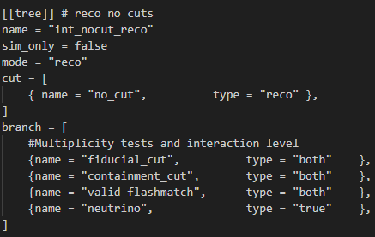
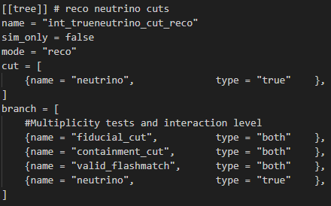
Discrepancy in fiducial cut
The problem
Previously there was a discrepancy found between percentage of reco interactions passing the fiducial cut vs number of true interactions
Justin Mueller suggested discrepancy is due to out-of-time cosmics wrongly reconstructed
Testing the hypothesis
Creating a selection in reco and true mode with a true neutrino only cut
Plotting the fiducial cut as a variable
Observing the difference in percentage of interactions passing fiducial cut in selection with no cuts vs selection with neutrino cut
Selection with no cut, containing the discrepancy
Selection with neutrino cut, discrepancy should significantly reduce if hypothesis is true

Slide 4
Preselection total efficiency
NuMI
BNB
Parameter | Percentage over tot no. of interactions | Discrepancy
Root file used | /pnfs/icarus/persistent/users/dcarber/spine/combined_files/NuMI_CV_flat_cafs_2/*.root
RECO interactions passing fiducial cut (NO CUTS) | 36.5% | 35.4%
TRUE interactions passing fiducial cut (NO CUTS APPLIED) | 1.1%
RECO interactions passing fiducial cut (NEUTRINO CUT APPLIED) | 53.7% | 9.6%
TRUE interactions passing fiducial cut (NEUTRINO CUT APPLIED) | 44.1%
Parameter | Percentage over tot no. of interactions | Discrepancy
Root file used | /pnfs/icarus/persistent/users/mueller/production/simulation/nominal/input*.flat.root
RECO interactions passing fiducial cut (NO CUTS) | 37% | 34.8%
TRUE interactions passing fiducial cut (NO CUTS APPLIED) | 2.2%
RECO interactions passing fiducial cut (NEUTRINO CUT APPLIED) | 67% | 0.3%
TRUE interactions passing fiducial cut (NEUTRINO CUT APPLIED) | 66.7%
Notes:
This is for the selection in reconstructed mode with no cuts applied, and the preselection cuts placed as variables, allowing us to see the number of particles that would pass each cut w.r.t the total number of all particles within the root file.
The final row shoes the number of particles that pass all 3 cuts, obtained from the other selection with all 3 cuts applied

Slide 5
Discussion
Based on the number of interactions, the neutrino cut does not change how many true interactions pass the fiducial cut
However, the neutrino cut will severely reduce how many reco interactions pass the fiducial cut
This lowers the discrepancy between reco and true fiducial cut percentage
There is still a 9.6% difference for NuMI sample compared to only a 0.3% difference for BNB sample
Conclusion
wrongly reconstructed Out-of-time cosmics are being fiducialized, causing a discprecancy between reco and true percentage
Selection with no cut, containing the discrepancy
Selection with neutrino cut, discrepancy should significantly reduce if hypothesis is true

Slide 6
PID preselection

Slide 7
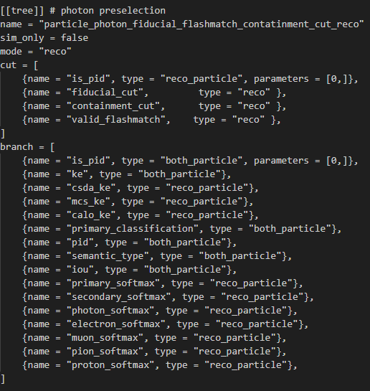
Preselection with PID cuts
Applying preselection cuts along with a PID cut to select specific particle types
Plotting the truth vs reco matching for the PID variable of the particles
For ‘is_pid’ cut, apply a parameter = [i,] to select specific particle types, following enumeration below
Number | 0 | 1 | 2 | 3 | 4
Particle type | photon | electron | muon | pion | proton

Slide 8
NuMI Reco to truth matching (Reco mode)
Reconstructed
Reconstructed
Reconstructed
Reconstructed
Reconstructed
NuMI | Is photon
Is photon | 74.6%
Is not photon | 25.4%
NuMI | Is electron
Is electron | 56.0%
Is not electron | 44.0%
NuMI | Is muon
Is muon | 78.6%
Is not muon | 21.4%
NuMI | Is pion
Is pion | 51.5%
Is not pion | 48.5%
NuMI | Is proton
Is proton | 92.0%
Is not proton | 8.0%
Truth
Truth
Truth
Truth
Truth
type | photon | electron | muon | pion | proton
Most common wrong PID | Null (19.3%) / electron (4.6%) | Photon (22.8%) | Pion (10.2%) | Proton (32.7%) | Pion (4.2%)
Notes:
This is for the true selection with all 3 cuts applied as cuts and placed as variables as well. Therefore, only particles that pass all 3 of the cuts together will be plotted.
When the cuts are plotted as variables in reco mode. This allows us to see the false positives of each cut, meaning we can see the number of true particles that passed the cut, but should’nt have when considering their reco particle information

Slide 9
NuMI Truth to reco matching (True mode)
Truth
Truth
Truth
Truth
Truth
NuMI | Is photon
Is photon | 59.8%
Is not photon | 40.2%
NuMI | Is electron
Is electron | 85.0%
Is not electron | 15%
NuMI | Is muon
Is muon | 83.6%
Is not muon | 16.4%
NuMI | Is pion
Is pion | 67.2%
Is not pion | 32.8%
NuMI | Is proton
Is proton | 79.6%
Is not proton | 20.4%
Reconstructed
Reconstructed
Reconstructed
Reconstructed
Reconstructed
type | photon | electron | muon | pion | proton
Most common wrong PID | Null (15.4%) / Electron (23.8%) | Photon (4.4%) / Muon (7.3%) | Pion (10%) | Muon (13.5%) / Proton (16.5%) | Pion (13.5%)
Notes:
This is for the true selection with all 3 cuts applied as cuts and placed as variables as well. Therefore, only particles that pass all 3 of the cuts together will be plotted.
When the cuts are plotted as variables in reco mode. This allows us to see the false positives of each cut, meaning we can see the number of true particles that passed the cut, but should’nt have when considering their reco particle information

Slide 10
BNB Reco to truth matching (Reco mode)
Reconstructed
Reconstructed
Reconstructed
Reconstructed
Reconstructed
BNB | Is photon
Is photon | 75.9%
Is not photon | 24.1%
BNB | Is electron
Is electron | 66.8%
Is not electron | 33.2%
BNB | Is muon
Is muon | 84.4%
Is not muon | 15.6%
BNB | Is pion
Is pion | 47.8%
Is not pion | 52.2%
BNB | Is proton
Is proton | 93.5%
Is not proton | 6.5%
Truth
Truth
Truth
Truth
Truth
type | photon | electron | muon | pion | proton
Most common wrong PID | Null (18.4%) / electron (4.3%) | Photon (15.8%) | Pion (6.5%) / Proton (7.1%) | Proton (32.3%) | Pion (3%) / Muon (2.2%)
Notes:
This is for the true selection with all 3 cuts applied as cuts and placed as variables as well. Therefore, only particles that pass all 3 of the cuts together will be plotted.
When the cuts are plotted as variables in reco mode. This allows us to see the false positives of each cut, meaning we can see the number of true particles that passed the cut, but should’nt have when considering their reco particle information

Slide 11
BNB Truth to reco matching (True mode)
Truth
Truth
Truth
Truth
Truth
BNB | Is photon
Is photon | 59.7%
Is not photon | 40.3%
BNB | Is electron
Is electron | 86.0%
Is not electron | 14%
BNB | Is muon
Is muon | 85%
Is not muon | 15%
BNB | Is pion
Is pion | 65.7%
Is not pion | 34.3%
BNB | Is proton
Is proton | 80.8%
Is not proton | 19.2%
Reconstructed
Reconstructed
Reconstructed
Reconstructed
Reconstructed
type | photon | electron | muon | pion | proton
Most common wrong PID | Null (15.9%) / Electron (23.4%) | Photon (2.9%) / Muon (8.8%) | Pion (9%) | Muon (15.8%) / Proton (16.1%) | Pion (10.7%)
Notes:
This is for the true selection with all 3 cuts applied as cuts and placed as variables as well. Therefore, only particles that pass all 3 of the cuts together will be plotted.
When the cuts are plotted as variables in reco mode. This allows us to see the false positives of each cut, meaning we can see the number of true particles that passed the cut, but should’nt have when considering their reco particle information

Slide 12
Tasks completed (19 Feb)
Extra: particle semantic type reconstruction efficiency confusion matrix
Out-of-time cosmics investigation
Created TOML files

Slide 13
Particle Semantic type Confusion matrix
The diagonal elements represent the percentage of particle semantic types classified correctly, while the off-diagonal elements represent the percentage of particles misclassified as another species.
For Reco to Truth tables, they are based on selection in reconstructed mode, with percentages defined as the fraction of a reconstructed particle type matched to the corresponding true PID counterpart
For Truth to Reco tables, they are based on selection in true mode, with percentages defined as the fraction of a true particle type matched to the corresponding reconstructed PID counterpart
The snapshot on the left of the confusion matrix shows the written selection tree used to create the corresponding matrix, with the corresponding cuts shown. Only the ‘semantic_type’ variable from the Tbranch was used for the confusion matrix
A reconstructed semantic type of “null” is intended to represent cases where no activity attributable to the true particle was reconstructed
A true semantic type of “null” is intended to represent cases where no activity attributable to the reconstructed particle was matched

Slide 14
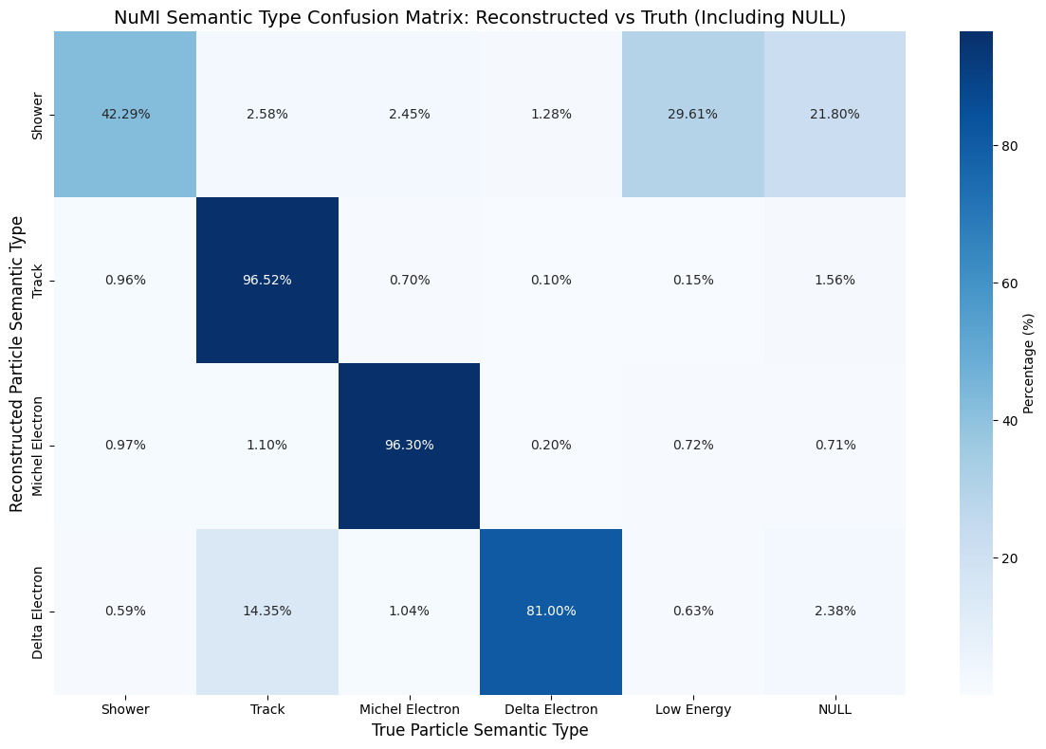
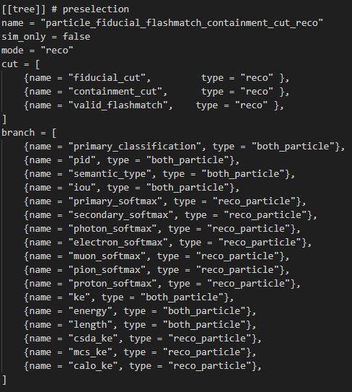
NuMI Reco to truth matching (Reco mode)
Corresponding selection tree in TOML file
Notes:
This is for the true selection with all 3 cuts applied as cuts and placed as variables as well. Therefore, only particles that pass all 3 of the cuts together will be plotted.
When the cuts are plotted as variables in reco mode. This allows us to see the false positives of each cut, meaning we can see the number of true particles that passed the cut, but should’nt have when considering their reco particle information

Slide 15
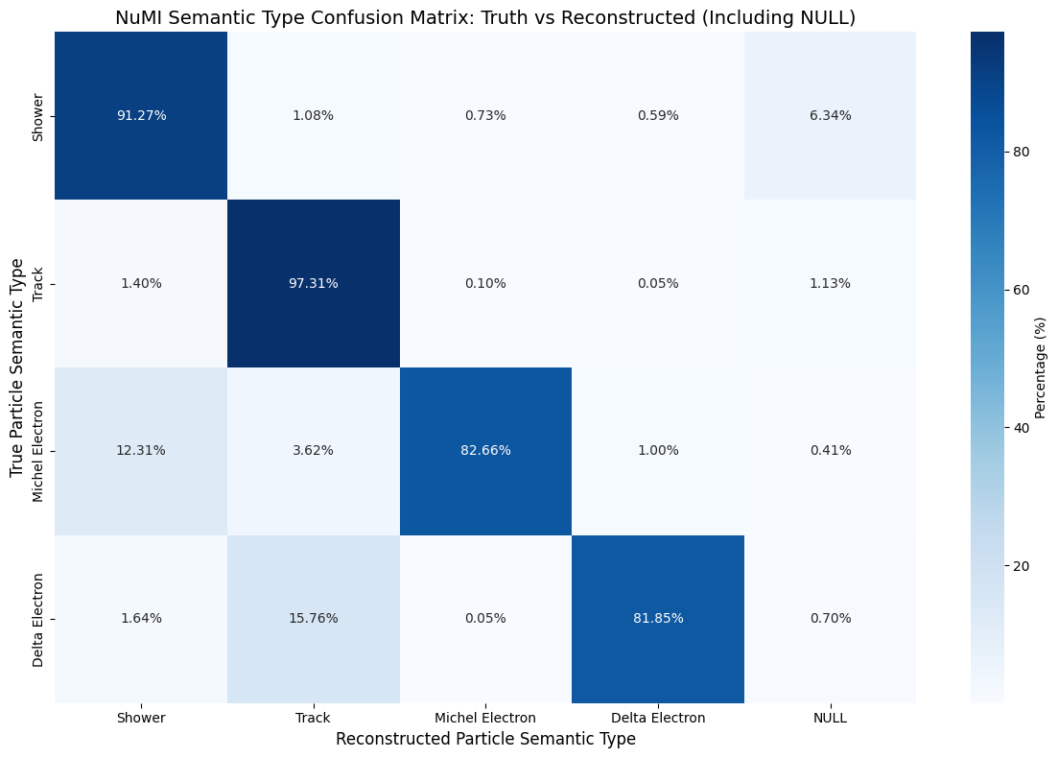
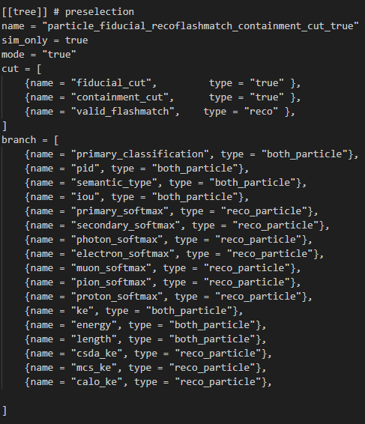
NuMI Truth to reco matching (True mode)
Corresponding selection tree in TOML file
Notes:
This is for the true selection with all 3 cuts applied as cuts and placed as variables as well. Therefore, only particles that pass all 3 of the cuts together will be plotted.
When the cuts are plotted as variables in reco mode. This allows us to see the false positives of each cut, meaning we can see the number of true particles that passed the cut, but should’nt have when considering their reco particle information

Slide 16

BNB Reco to truth matching (Reco mode)
Corresponding selection tree in TOML file
Notes:
This is for the true selection with all 3 cuts applied as cuts and placed as variables as well. Therefore, only particles that pass all 3 of the cuts together will be plotted.
When the cuts are plotted as variables in reco mode. This allows us to see the false positives of each cut, meaning we can see the number of true particles that passed the cut, but should’nt have when considering their reco particle information

Slide 17

BNB Truth to reco matching (True mode)
Corresponding selection tree in TOML file
Notes:
This is for the true selection with all 3 cuts applied as cuts and placed as variables as well. Therefore, only particles that pass all 3 of the cuts together will be plotted.
When the cuts are plotted as variables in reco mode. This allows us to see the false positives of each cut, meaning we can see the number of true particles that passed the cut, but should’nt have when considering their reco particle information

Slide 18
Reducing effect of cosmics
We are interested in the reconstructed out-of-time cosmics that pass the fiducial cut
However, when looking at their truth information, they should not pass the cut
We need to select these reconstructed and fiducialized out-of-time interactions
We then select in-time fiducialized neutrino interactions,
We then observe the true fiducial cut percentage from these out-of-time reco interactions

Slide 19
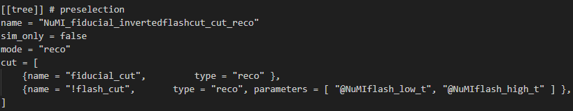
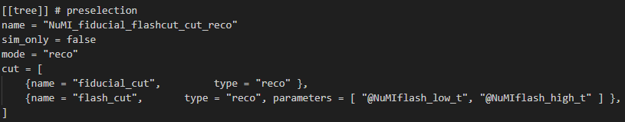
Reducing effect of cosmics
How do we select reconstructed out-of-time cosmics that are fiducialized?
Create a selection in reconstructed mode
Apply a reco fiducial cut and reco inverted flash cut
Inverting the flash cut allows us to select any reconstructed interactions that are out-of-time with beam spill
This selection will thus select reconstructed interactions that are out-of-time AND fiducialized
We can select reconstructed and fiducialized neutrino interactions by applying a normal flash cut and fiducial cut

Slide 20
Out-of-time cosmic selection
Looking at the selection for reconstructed fiducialized out-of-time interactions
When plotting the true fiducial cut, we can see how many of these reconstructed interactions would have failed the fiducial cut based on their truth data
We can say that out-of-time cosmic interactions are poorly reconstructed based on the large majority of false positives in the true fiducial cut
Reconstructed
Reconstructed
NuMI | Passes fiducial
Passes fiducial | 0.8%
fails fiducial | 96.6%
NaN | 2.6%
BNB | Passes fiducial
Passes fiducial | 1.1%
fails fiducial | 96.3%
NaN | 2.5%
Truth
Truth

Slide 21
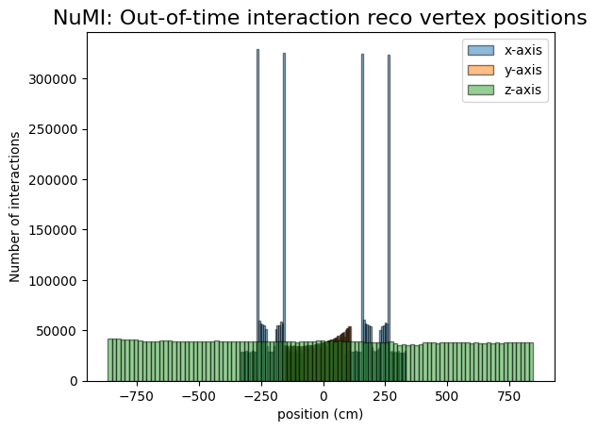
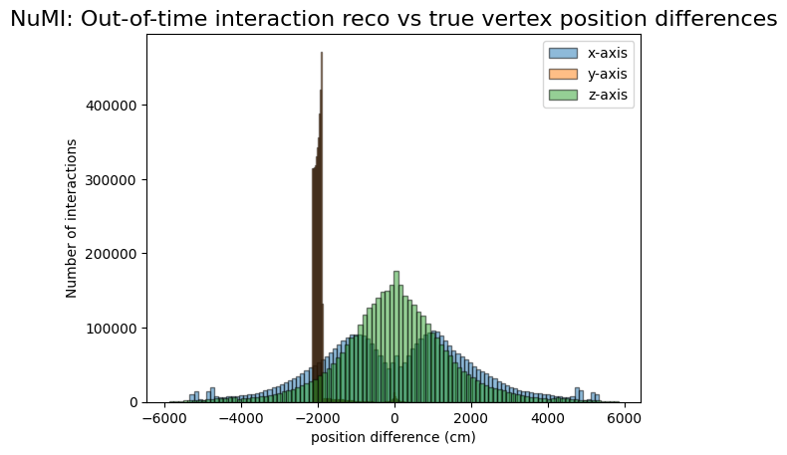
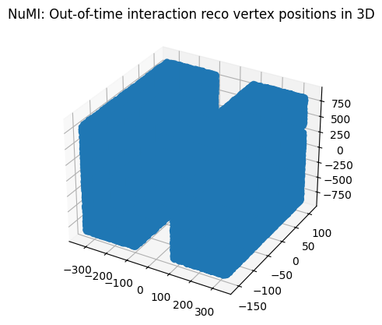
Out-of-time cosmic selection
There are large differences between true and reco interaction vertex positions

Slide 22
Out-of-time cosmic selection
Referring back to NuMI fiducial cut discrepancy
The reconstructed out-of-time and fiducialized interactions account for 97% of wrongly fiducialized reconstructed interactions
Removing these interactions using a flash_cut will select 123209 reconstructed fiducialized interactions, which will give a percentage of 2.9% of all reconstructed interactions fiducialized
Discrepancy between percentage of interactions passing reco vs true fiducial cut thus reduces from 35.4% to 1.8%
For BNB, discrepancy reduces from 34.8% to 0.5%

Slide 23
Preselection total efficiency
NuMI
BNB
Parameter | Percentage over tot no. of ALL interactions | Discrepancy
Sample Root file used | NuMI
RECO interactions passing fiducial cut (NO CUTS) | 36.5% | 35.4%
TRUE interactions passing fiducial cut (NO CUTS APPLIED) | 1.1%
RECO interactions passing fiducial cut (FLASH CUT APPLIED) | 2.9% | 1.8%
TRUE interactions passing fiducial cut (NO CUTS APPLIED) | 1.1%
Parameter | Percentage over tot no. of interactions | Discrepancy
Root file used | BNB
RECO interactions passing fiducial cut (NO CUTS) | 37% | 34.8%
TRUE interactions passing fiducial cut (NO CUTS APPLIED) | 2.2%
RECO interactions passing fiducial cut (FLASH CUT APPLIED) | 1.7% | 0.5%
TRUE interactions passing fiducial cut (NO CUTS APPLIED) | 2.2%
Notes:
This is for the selection in reconstructed mode with no cuts applied, and the preselection cuts placed as variables, allowing us to see the number of particles that would pass each cut w.r.t the total number of all particles within the root file.
The final row shoes the number of particles that pass all 3 cuts, obtained from the other selection with all 3 cuts applied

Slide 24
In-time interaction selection
Selection with reconstructed interactions that are in-time and fiducialized
We look at the percentage of interactions that pass the fiducial cut based on truth data
27.6% of NuMI reconstructed interactions would fail the cut when comparing to their true data
Reconstructed
Reconstructed
NuMI | Passes fiducial
Passes fiducial | 70.5%
fails fiducial | 27.6%
NaN | 1.9%
BNB | Passes fiducial
Passes fiducial | 90.3%
fails fiducial | 8.9%
NaN | 0.8%
Truth
Truth

