Slide 1
Tasks completed (26 Feb)
Extra: particle semantic type reconstruction efficiency confusion matrix
Out-of-time cosmics investigation
Created TOML files

Slide 2
PID Type confusion matrix

Slide 3
Particle PID type Confusion matrix
The diagonal elements represent the percentage of particles classified correctly, while the off-diagonal elements represent the percentage of particles misclassified as another species.
For Reco to Truth tables, they are based on selection in reconstructed mode, with percentages defined as the fraction of a reconstructed particle type matched to the corresponding true PID counterpart
For Truth to Reco tables, they are based on selection in true mode, with percentages defined as the fraction of a true particle type matched to the corresponding reconstructed PID counterpart
There are two types preselections, ones using a reco flashmatch cut, and one using a true neutrino cut. Confusion matrices for both types of selections have been plotted and labelled with the corresponding cut used
The snapshot on the left of the confusion matrix shows the written selection tree used to create the corresponding matrix, with the corresponding cuts shown. Only the ‘pid’ variable from the Tbranch was used for the confusion matrix

Slide 4
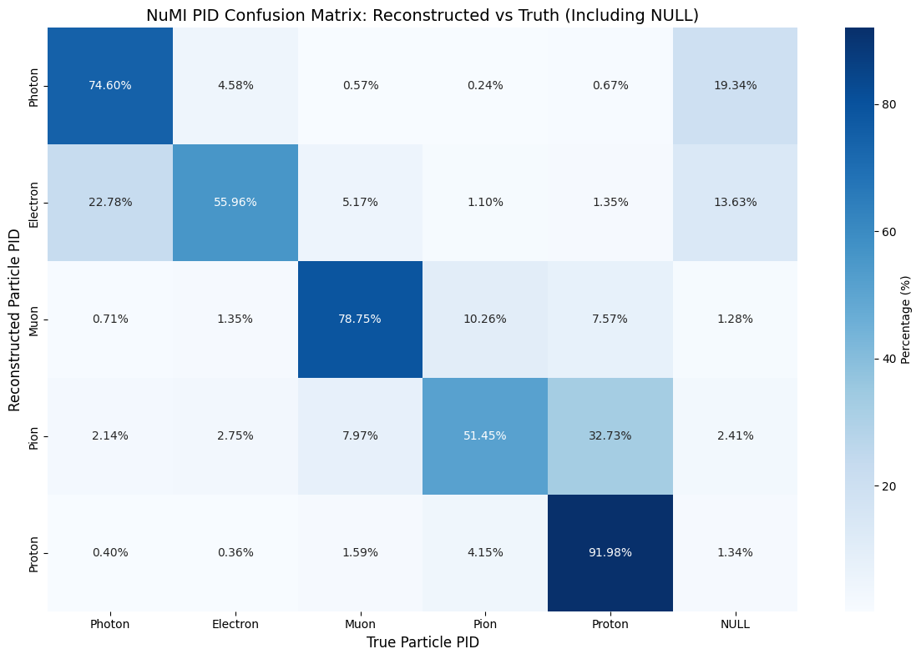
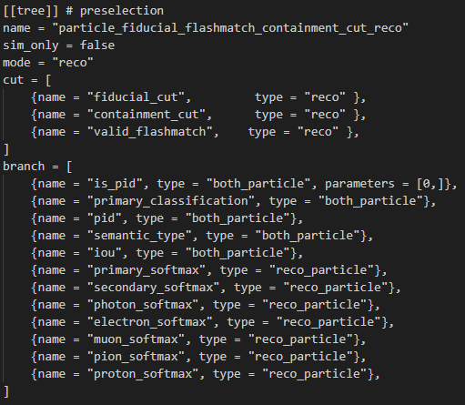
NuMI PID Reco to truth matching (Reco mode) - using reco valid_flashmatch cut
Corresponding selection tree in TOML file
Notes:
This is for the true selection with all 3 cuts applied as cuts and placed as variables as well. Therefore, only particles that pass all 3 of the cuts together will be plotted.
When the cuts are plotted as variables in reco mode. This allows us to see the false positives of each cut, meaning we can see the number of true particles that passed the cut, but should’nt have when considering their reco particle information

Slide 5
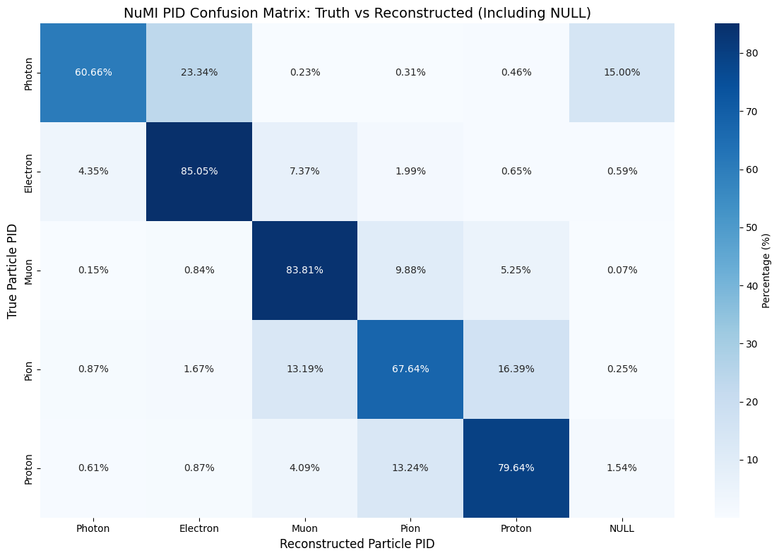
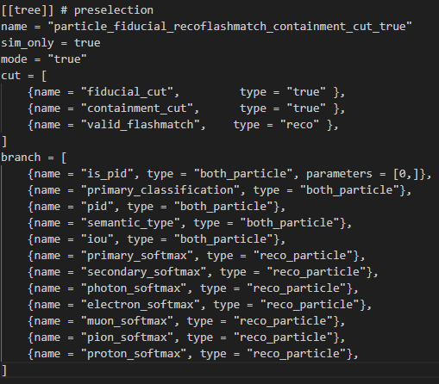
NuMI PID Truth to reco matching (True mode) - using reco valid_flashmatch cut
Corresponding selection tree in TOML file
Notes:
This is for the true selection with all 3 cuts applied as cuts and placed as variables as well. Therefore, only particles that pass all 3 of the cuts together will be plotted.
When the cuts are plotted as variables in reco mode. This allows us to see the false positives of each cut, meaning we can see the number of true particles that passed the cut, but should’nt have when considering their reco particle information

Slide 6

BNB PID Reco to truth matching (Reco mode) - using reco valid_flashmatch cut
Corresponding selection tree in TOML file
Notes:
This is for the true selection with all 3 cuts applied as cuts and placed as variables as well. Therefore, only particles that pass all 3 of the cuts together will be plotted.
When the cuts are plotted as variables in reco mode. This allows us to see the false positives of each cut, meaning we can see the number of true particles that passed the cut, but should’nt have when considering their reco particle information

Slide 7

BNB PID Truth to reco matching (True mode) - using reco valid_flashmatch cut
Corresponding selection tree in TOML file
Notes:
This is for the true selection with all 3 cuts applied as cuts and placed as variables as well. Therefore, only particles that pass all 3 of the cuts together will be plotted.
When the cuts are plotted as variables in reco mode. This allows us to see the false positives of each cut, meaning we can see the number of true particles that passed the cut, but should’nt have when considering their reco particle information

Slide 8
Semantic Type confusion matrix

Slide 9
Particle Semantic type Confusion matrix
The diagonal elements represent the percentage of particle semantic types classified correctly, while the off-diagonal elements represent the percentage of particles misclassified as another species.
For Reco to Truth tables, they are based on selection in reconstructed mode, with percentages defined as the fraction of a reconstructed particle type matched to the corresponding true PID counterpart
For Truth to Reco tables, they are based on selection in true mode, with percentages defined as the fraction of a true particle type matched to the corresponding reconstructed PID counterpart
The snapshot on the left of the confusion matrix shows the written selection tree used to create the corresponding matrix, with the corresponding cuts shown. Only the ‘semantic_type’ variable from the Tbranch was used for the confusion matrix
A reconstructed semantic type of “null” is intended to represent cases where no activity attributable to the true particle was reconstructed
A true semantic type of “null” is intended to represent cases where no activity attributable to the reconstructed particle was matched

Slide 10
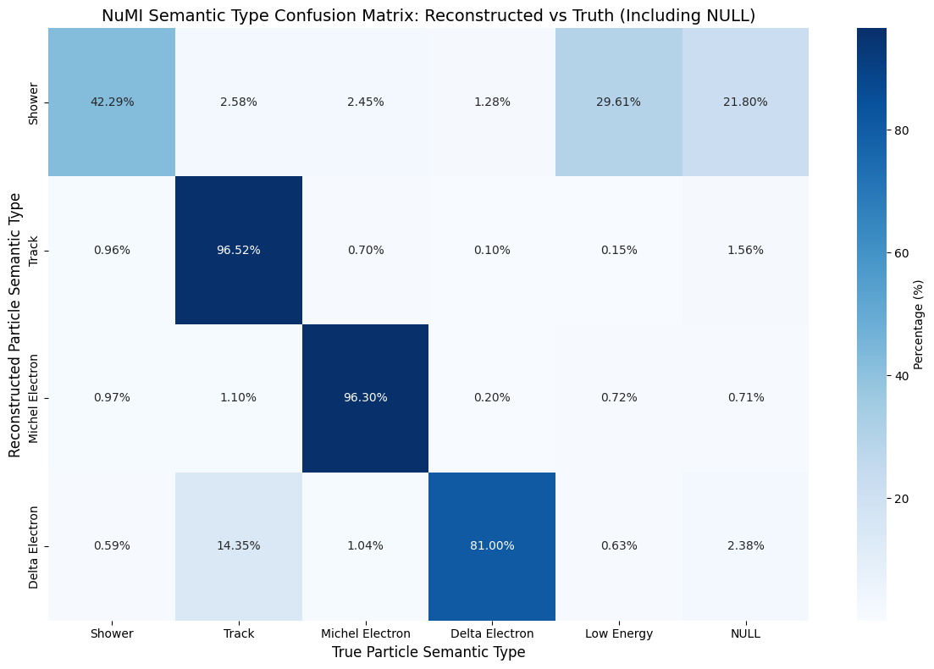
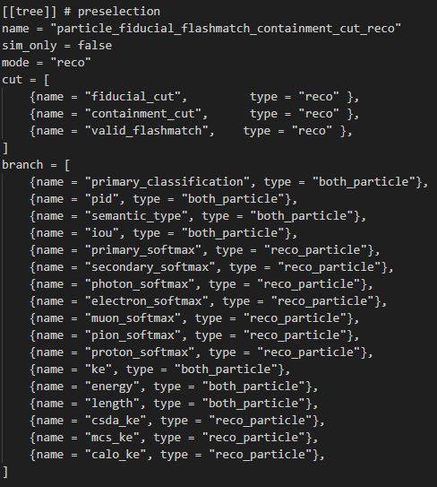
NuMI Semantic type Reco to truth matching (Reco mode)
Corresponding selection tree in TOML file
Notes:
This is for the true selection with all 3 cuts applied as cuts and placed as variables as well. Therefore, only particles that pass all 3 of the cuts together will be plotted.
When the cuts are plotted as variables in reco mode. This allows us to see the false positives of each cut, meaning we can see the number of true particles that passed the cut, but should’nt have when considering their reco particle information

Slide 11
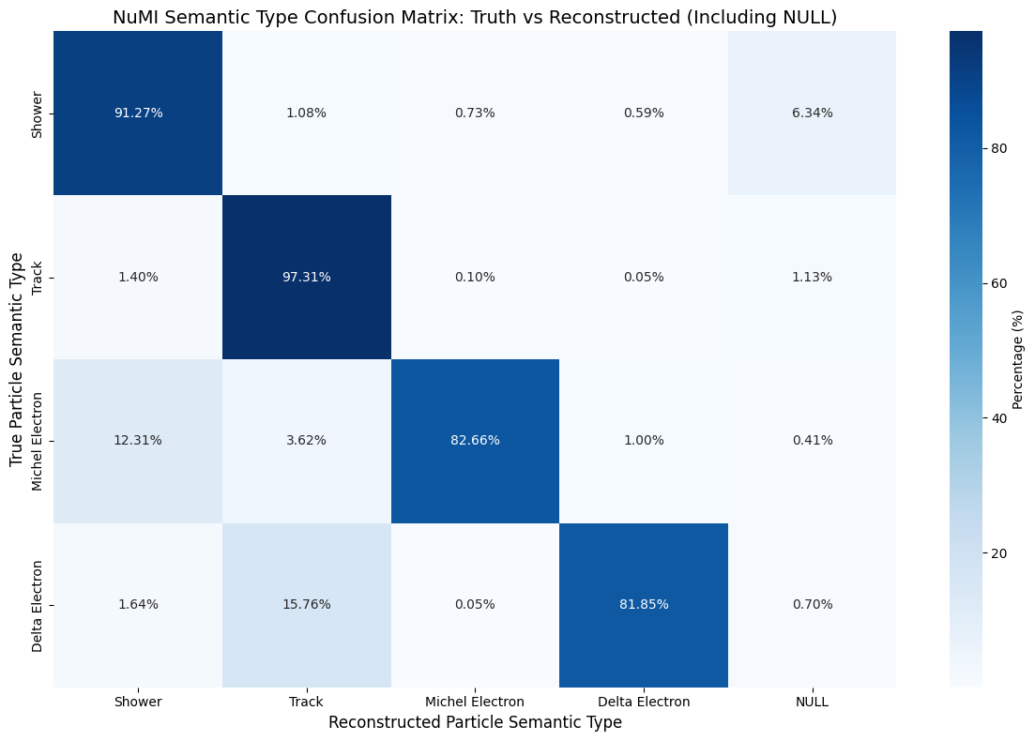
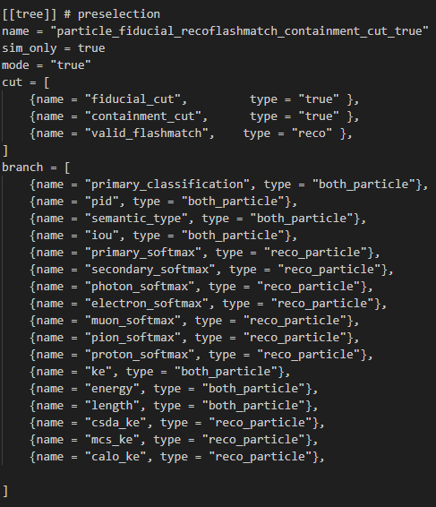
NuMI Semantic type Truth to reco matching (True mode)
Corresponding selection tree in TOML file
Notes:
This is for the true selection with all 3 cuts applied as cuts and placed as variables as well. Therefore, only particles that pass all 3 of the cuts together will be plotted.
When the cuts are plotted as variables in reco mode. This allows us to see the false positives of each cut, meaning we can see the number of true particles that passed the cut, but should’nt have when considering their reco particle information

Slide 12

BNB Semantic type Reco to truth matching (Reco mode)
Corresponding selection tree in TOML file
Notes:
This is for the true selection with all 3 cuts applied as cuts and placed as variables as well. Therefore, only particles that pass all 3 of the cuts together will be plotted.
When the cuts are plotted as variables in reco mode. This allows us to see the false positives of each cut, meaning we can see the number of true particles that passed the cut, but should’nt have when considering their reco particle information

Slide 13

BNB Semantic type Truth to reco matching (True mode)
Corresponding selection tree in TOML file
Notes:
This is for the true selection with all 3 cuts applied as cuts and placed as variables as well. Therefore, only particles that pass all 3 of the cuts together will be plotted.
When the cuts are plotted as variables in reco mode. This allows us to see the false positives of each cut, meaning we can see the number of true particles that passed the cut, but should’nt have when considering their reco particle information

Slide 14
Removing low energy particles
To increase efficiency of semantic and PID type reconstruction, we remove particles with energy lower than 10 MeV
Reason is that low energy particles are more likely to be poorly reconstructed
For Reco to Truth, we apply the energy cut on reco particles
For Truth to Reco, we apply the energy cut on true particles

Slide 15
PID Type confusion matrix

Slide 16
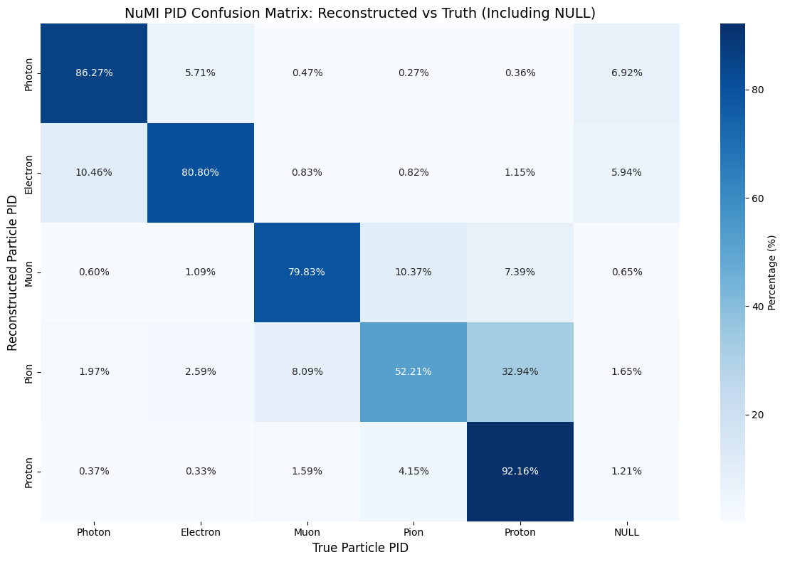
NuMI PID type Reco to truth matching (Reco mode) - Removing reco particles with ke < 10 MeV
Before energy cut
After energy cut
Notes:
This is for the true selection with all 3 cuts applied as cuts and placed as variables as well. Therefore, only particles that pass all 3 of the cuts together will be plotted.
When the cuts are plotted as variables in reco mode. This allows us to see the false positives of each cut, meaning we can see the number of true particles that passed the cut, but should’nt have when considering their reco particle information

Slide 17
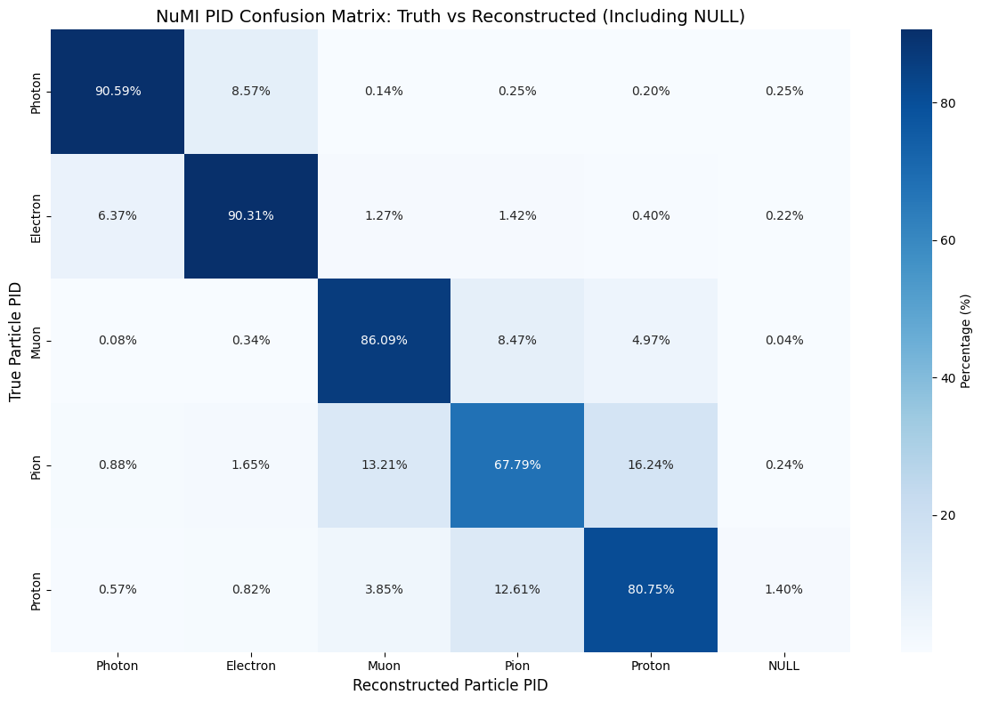
NuMI PID type Truth to Reco matching (True mode) - Removing truth particles with ke < 10 MeV
Before energy cut
After energy cut
Notes:
This is for the true selection with all 3 cuts applied as cuts and placed as variables as well. Therefore, only particles that pass all 3 of the cuts together will be plotted.
When the cuts are plotted as variables in reco mode. This allows us to see the false positives of each cut, meaning we can see the number of true particles that passed the cut, but should’nt have when considering their reco particle information

Slide 18

BNB PID type Reco to Truth matching (Reco mode) - Removing reco particles with ke < 10 MeV
Before energy cut
After energy cut
Notes:
This is for the true selection with all 3 cuts applied as cuts and placed as variables as well. Therefore, only particles that pass all 3 of the cuts together will be plotted.
When the cuts are plotted as variables in reco mode. This allows us to see the false positives of each cut, meaning we can see the number of true particles that passed the cut, but should’nt have when considering their reco particle information

Slide 19

BNB PID type Truth to Reco matching (True mode) - Removing truth particles with ke < 10 MeV
Before energy cut
After energy cut
Notes:
This is for the true selection with all 3 cuts applied as cuts and placed as variables as well. Therefore, only particles that pass all 3 of the cuts together will be plotted.
When the cuts are plotted as variables in reco mode. This allows us to see the false positives of each cut, meaning we can see the number of true particles that passed the cut, but should’nt have when considering their reco particle information

Slide 20
Semantic Type confusion matrix

Slide 21
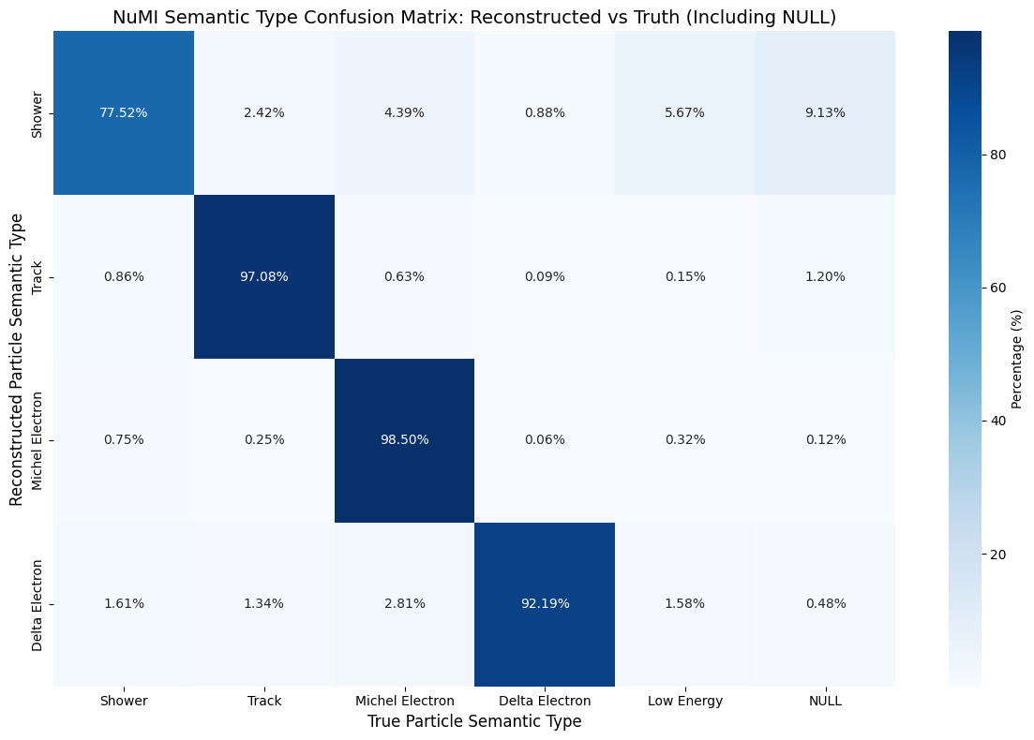
NuMI Semantic type Reco to truth matching (Reco mode) - Removing reco particles with ke < 10 MeV
Before energy cut
After energy cut
Notes:
This is for the true selection with all 3 cuts applied as cuts and placed as variables as well. Therefore, only particles that pass all 3 of the cuts together will be plotted.
When the cuts are plotted as variables in reco mode. This allows us to see the false positives of each cut, meaning we can see the number of true particles that passed the cut, but should’nt have when considering their reco particle information

Slide 22
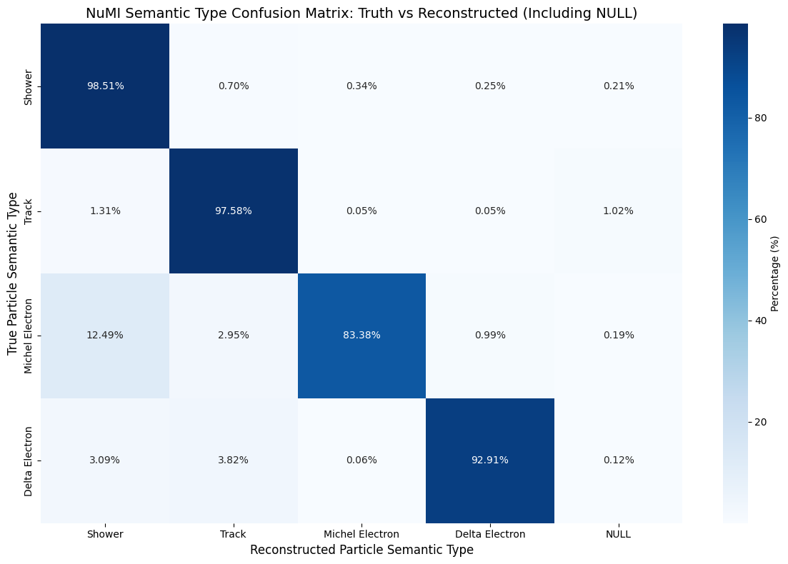
NuMI Semantic type Truth to reco matching (True mode) - Removing true particles with ke < 10 MeV
Before energy cut
After energy cut
Notes:
This is for the true selection with all 3 cuts applied as cuts and placed as variables as well. Therefore, only particles that pass all 3 of the cuts together will be plotted.
When the cuts are plotted as variables in reco mode. This allows us to see the false positives of each cut, meaning we can see the number of true particles that passed the cut, but should’nt have when considering their reco particle information

Slide 23
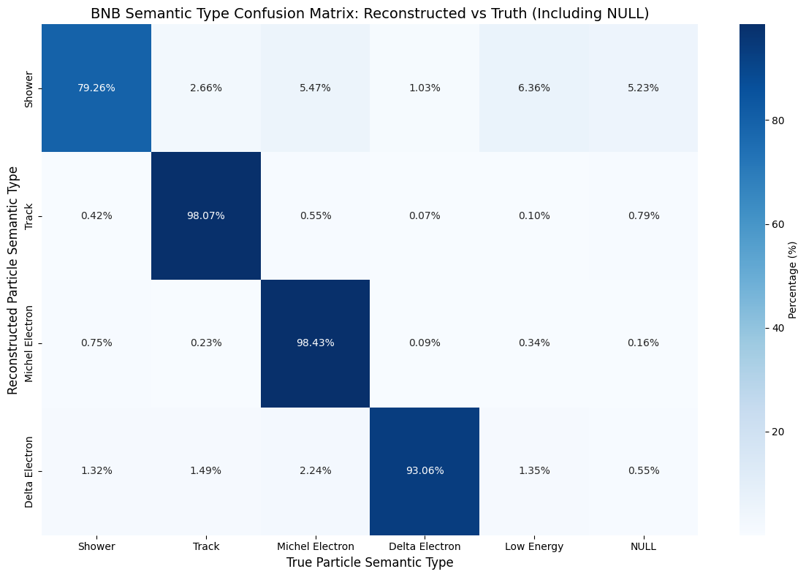
BNB Semantic type Reco to truth matching (Reco mode) - Removing reco particles with ke < 10 MeV
Before energy cut
After energy cut
Notes:
This is for the true selection with all 3 cuts applied as cuts and placed as variables as well. Therefore, only particles that pass all 3 of the cuts together will be plotted.
When the cuts are plotted as variables in reco mode. This allows us to see the false positives of each cut, meaning we can see the number of true particles that passed the cut, but should’nt have when considering their reco particle information

Slide 24

BNB Semantic type Truth to reco matching (True mode) - Removing true particles with ke < 10 MeV
Before energy cut
After energy cut
Notes:
This is for the true selection with all 3 cuts applied as cuts and placed as variables as well. Therefore, only particles that pass all 3 of the cuts together will be plotted.
When the cuts are plotted as variables in reco mode. This allows us to see the false positives of each cut, meaning we can see the number of true particles that passed the cut, but should’nt have when considering their reco particle information

Slide 25
Out-of-time cosmic interaction selection

Slide 26
Reducing effect of cosmics
We are interested in the reconstructed out-of-time cosmics that pass the fiducial cut
However, when looking at their truth information, they should not pass the cut
We need to select these reconstructed and fiducialized out-of-time interactions
We then select in-time fiducialized neutrino interactions,
We then observe the true fiducial cut percentage from these out-of-time reco interactions

Slide 27
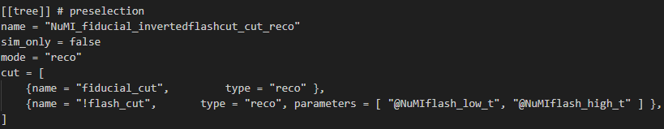
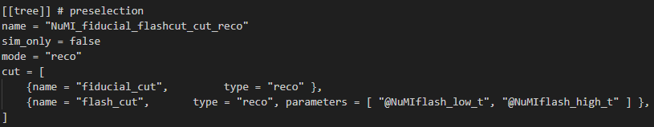
Reducing effect of cosmics
How do we select reconstructed out-of-time cosmics that are fiducialized?
Create a selection in reconstructed mode
Apply a reco fiducial cut and reco inverted flash cut
Inverting the flash cut allows us to select any reconstructed interactions that are out-of-time with beam spill
This selection will thus select reconstructed interactions that are out-of-time AND fiducialized
We can select reconstructed and fiducialized neutrino interactions by applying a normal flash cut and fiducial cut

Slide 28
Out-of-time cosmic selection
Looking at the selection for reconstructed fiducialized out-of-time interactions
When plotting the true fiducial cut, we can see how many of these reconstructed out-of-time interactions would have failed the fiducial cut based on their truth data
We can say that out-of-time cosmic interactions are poorly reconstructed based on the large majority of false positives in the true fiducial cut
Reconstructed
Reconstructed
NuMI | Passes fiducial
Passes fiducial | 0.8%
fails fiducial | 96.6%
NaN | 2.6%
BNB | Passes fiducial
Passes fiducial | 1.1%
fails fiducial | 96.3%
NaN | 2.5%
Truth
Truth

Slide 29
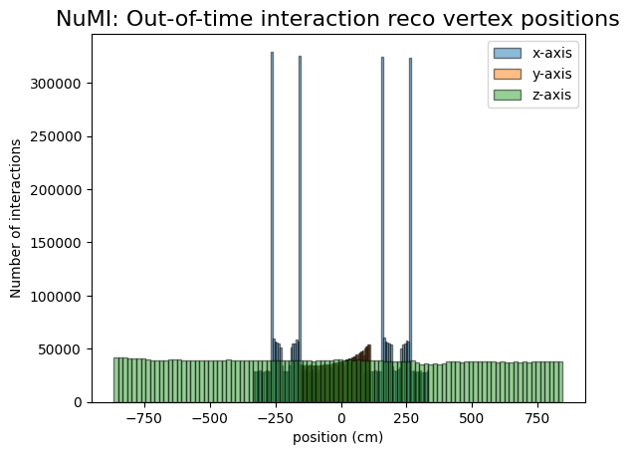
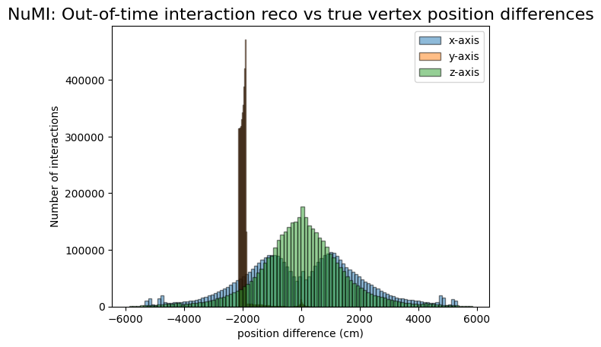
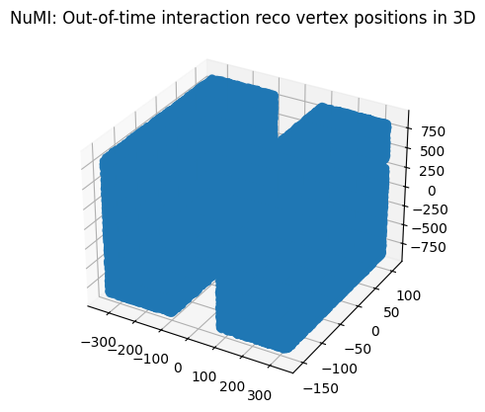
Out-of-time cosmic selection
There are large differences between true and reco interaction vertex positions

Slide 30
Out-of-time cosmic selection
Referring back to NuMI fiducial cut discrepancy
The reconstructed out-of-time and fiducialized interactions account for 97% of wrongly fiducialized reconstructed interactions
Removing these interactions using a flash_cut will select 123209 reconstructed fiducialized interactions, which will give a percentage of 2.9% of all reconstructed interactions fiducialized
Discrepancy between percentage of interactions passing reco vs true fiducial cut thus reduces from 35.4% to 1.8%
For BNB, discrepancy reduces from 34.8% to 0.5%

Slide 31
Preselection total efficiency
NuMI
BNB
Parameter | Percentage over tot no. of ALL interactions | Discrepancy
Sample Root file used | NuMI
RECO interactions passing fiducial cut (NO CUTS) | 36.5% | 35.4%
TRUE interactions passing fiducial cut (NO CUTS APPLIED) | 1.1%
RECO interactions passing fiducial cut (FLASH CUT APPLIED) | 2.9% | 1.8%
TRUE interactions passing fiducial cut (NO CUTS APPLIED) | 1.1%
Parameter | Percentage over tot no. of interactions | Discrepancy
Root file used | BNB
RECO interactions passing fiducial cut (NO CUTS) | 37% | 34.8%
TRUE interactions passing fiducial cut (NO CUTS APPLIED) | 2.2%
RECO interactions passing fiducial cut (FLASH CUT APPLIED) | 1.7% | 0.5%
TRUE interactions passing fiducial cut (NO CUTS APPLIED) | 2.2%
Notes:
This is for the selection in reconstructed mode with no cuts applied, and the preselection cuts placed as variables, allowing us to see the number of particles that would pass each cut w.r.t the total number of all particles within the root file.
The final row shoes the number of particles that pass all 3 cuts, obtained from the other selection with all 3 cuts applied

Slide 32
In-time interaction selection
Selection with reconstructed interactions that are in-time and fiducialized
We look at the percentage of interactions that pass the fiducial cut based on truth data
27.6% of NuMI reconstructed interactions would fail the cut when comparing to their true data
Reconstructed
Reconstructed
NuMI | Passes fiducial
Passes fiducial | 70.5%
fails fiducial | 27.6%
NaN | 1.9%
BNB | Passes fiducial
Passes fiducial | 90.3%
fails fiducial | 8.9%
NaN | 0.8%
Truth
Truth

