Slide 1
Details of Confusion matrix creation
The diagonal elements represent the percentage of particles classified correctly, while the off-diagonal elements represent the percentage of particles misclassified as another species.
For Reco to Truth tables, they are based on selection in reconstructed mode, with percentages defined as the fraction of a reconstructed particle type matched to the corresponding true PID counterpart
For Truth to Reco tables, they are based on selection in true mode, with percentages defined as the fraction of a true particle type matched to the corresponding reconstructed PID counterpart
There are two types preselections, ones using a reco flashmatch cut, and one using a true neutrino cut. Confusion matrices for both types of selections have been plotted and labelled with the corresponding cut used
The snapshot on the left of the confusion matrix shows the written selection tree used to create the corresponding matrix, with the corresponding cuts shown. Only the ‘pid’ variable from the Tbranch was used for the confusion matrix

Slide 2
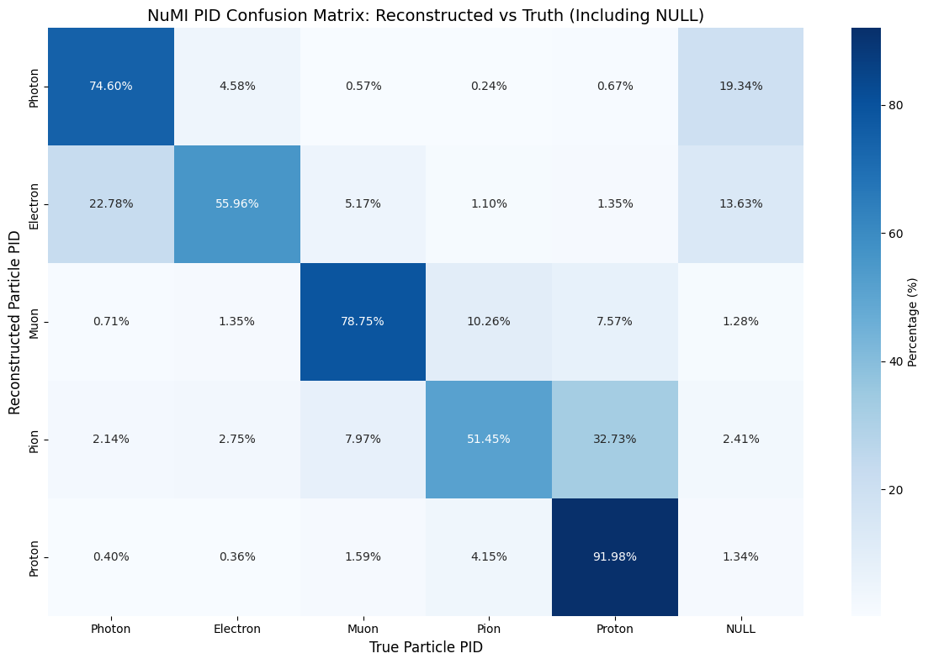
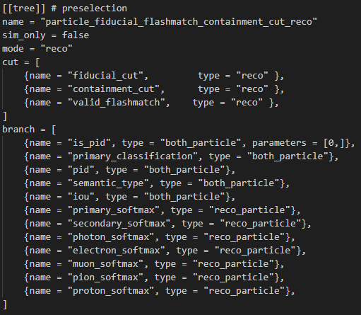
NuMI Reco to truth matching (Reco mode) - using reco valid_flashmatch cut
Corresponding selection tree in TOML file
Notes:
This is for the true selection with all 3 cuts applied as cuts and placed as variables as well. Therefore, only particles that pass all 3 of the cuts together will be plotted.
When the cuts are plotted as variables in reco mode. This allows us to see the false positives of each cut, meaning we can see the number of true particles that passed the cut, but should’nt have when considering their reco particle information

Slide 3
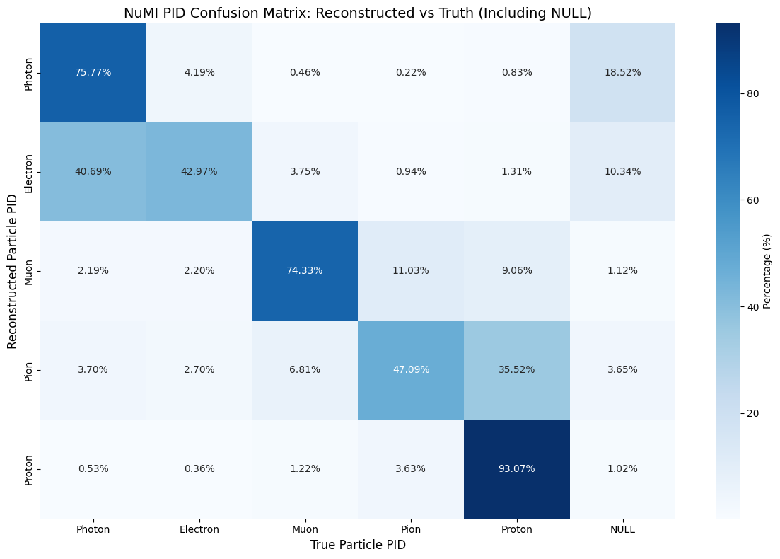
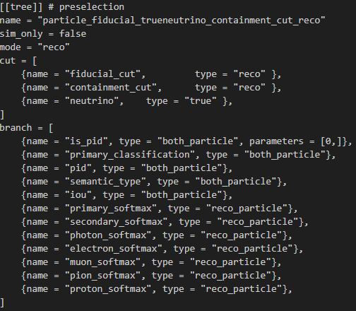
NuMI Reco to truth matching (Reco mode) - using true neutrino cut
Corresponding selection tree in TOML file
Notes:
This is for the true selection with all 3 cuts applied as cuts and placed as variables as well. Therefore, only particles that pass all 3 of the cuts together will be plotted.
When the cuts are plotted as variables in reco mode. This allows us to see the false positives of each cut, meaning we can see the number of true particles that passed the cut, but should’nt have when considering their reco particle information

Slide 4
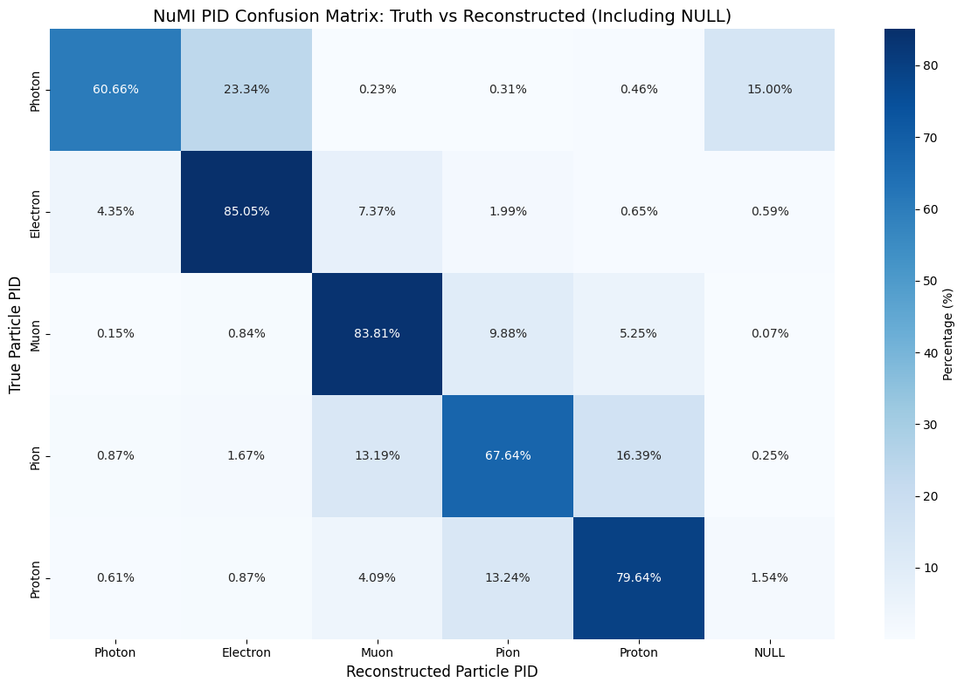
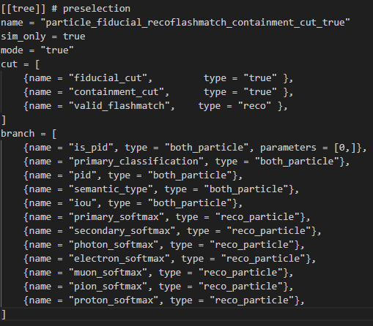
NuMI Truth to reco matching (True mode) - using reco valid_flashmatch cut
Corresponding selection tree in TOML file
Notes:
This is for the true selection with all 3 cuts applied as cuts and placed as variables as well. Therefore, only particles that pass all 3 of the cuts together will be plotted.
When the cuts are plotted as variables in reco mode. This allows us to see the false positives of each cut, meaning we can see the number of true particles that passed the cut, but should’nt have when considering their reco particle information

Slide 5

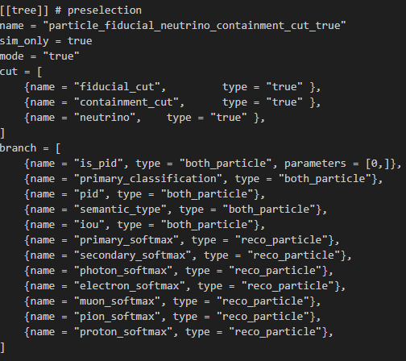
NuMI Truth to reco matching (True mode) - using true neutrino cut
Corresponding selection tree in TOML file
Notes:
This is for the true selection with all 3 cuts applied as cuts and placed as variables as well. Therefore, only particles that pass all 3 of the cuts together will be plotted.
When the cuts are plotted as variables in reco mode. This allows us to see the false positives of each cut, meaning we can see the number of true particles that passed the cut, but should’nt have when considering their reco particle information

Slide 6

BNB Reco to truth matching (Reco mode) - using reco valid_flashmatch cut
Corresponding selection tree in TOML file
Notes:
This is for the true selection with all 3 cuts applied as cuts and placed as variables as well. Therefore, only particles that pass all 3 of the cuts together will be plotted.
When the cuts are plotted as variables in reco mode. This allows us to see the false positives of each cut, meaning we can see the number of true particles that passed the cut, but should’nt have when considering their reco particle information

Slide 7

BNB Reco to truth matching (Reco mode) - using true neutrino cut
Corresponding selection tree in TOML file
Notes:
This is for the true selection with all 3 cuts applied as cuts and placed as variables as well. Therefore, only particles that pass all 3 of the cuts together will be plotted.
When the cuts are plotted as variables in reco mode. This allows us to see the false positives of each cut, meaning we can see the number of true particles that passed the cut, but should’nt have when considering their reco particle information

Slide 8

BNB Truth to reco matching (True mode) - using reco valid_flashmatch cut
Corresponding selection tree in TOML file
Notes:
This is for the true selection with all 3 cuts applied as cuts and placed as variables as well. Therefore, only particles that pass all 3 of the cuts together will be plotted.
When the cuts are plotted as variables in reco mode. This allows us to see the false positives of each cut, meaning we can see the number of true particles that passed the cut, but should’nt have when considering their reco particle information

Slide 9

BNB Truth to reco matching (True mode) - using true neutrino cut
Corresponding selection tree in TOML file
Notes:
This is for the true selection with all 3 cuts applied as cuts and placed as variables as well. Therefore, only particles that pass all 3 of the cuts together will be plotted.
When the cuts are plotted as variables in reco mode. This allows us to see the false positives of each cut, meaning we can see the number of true particles that passed the cut, but should’nt have when considering their reco particle information

