Slide 1
Tasks completed (5 Mar)
Recreated some results from Lane’s paper “Measurement of Muon Neutrino Charged-Current Neutral Pion Production at ICARUS

Slide 2

Reference paper
Selection and analysis of Charged Current (CC) muon neutrino interactions producing final state neutral pions
Used data and Monte Carlo (MC) BNB samples
What I focused on
Focused on recreating results and plots from section 2 of paper using the BNB MC sample I have been working with
Focused only on simulation plots, not data, no MC statistical uncertainties as well for now
Utilized many of lane’s customized cuts and variables that he created for his paper
Medulla branch used
feature/lkashur_pi0_thesis
Decay channel we are interested in

Slide 3
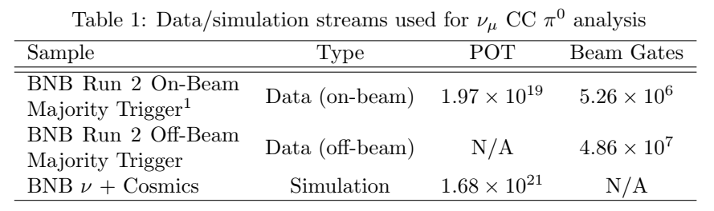
Key differences
There are some differences in the BNB sample that I used and his thesis simulation sample
According to paper, his POT for BNB v + cosmics is 1.68e21, while the POT for the BNB simulation sample I used is 1.74e20
Believe that he added on /pnfs/icarus/persistent/users/mueller/production/simulation/cvext/input*.flat.root to simulation analysis
For my analysis I only used /pnfs/icarus/persistent/users/mueller/production/simulation/nominal/input*.flat.root
Therefore there is less data to work with, about x10 lesser considering POT size
Some cuts I did not apply to my selection which he may have applied to his
Table of samples used with POT size and Beam gates for lane’s paper
Cuts that I did not apply that he may have applied in his paper

Slide 4
Signal definition selection

Slide 5
Signal definition
Signal is defined as a true Charged Current muon neutrino interaction that is
Fiducialized
Not within the region deﬁning the central 200 cm of the detector (z-axis not within -100cm to 100cm in detector coordinates)
Exactly one primary muon (KE ≥ 143.425 MeV)
Zero primary charged pions (KE ≥ 25 MeV)
Exactly one neutral pion (no KE threshold)
Any number of particles that are not muons or pions
Requirement for interaction to not lie within central 200 cm of detector is made in an eﬀort to avoid potential eﬀects in data and simulation related to the split ﬁrst induction wire plane geometry

Slide 6
Signal selection
Cuts applied to select true signal interactions
Cut name | definition
Neutrino | Selects true neutrino interactions only
Isnumu | Selects true muon neutrino interactions only
Fiducial_cut | Selects true interactions with vertex within the fiducial volume of the ICARUS detector
Avoid_mystery_zgap | Selects true interactions with vertex outside of the area between -100 cm and 100 cm in the z-axis of the detector.
Iscc | Selects true Charged Current (CC) interactions.
Single_muon | Selects true interactions containing a primary muon with energy equal to or above 143.425 MeV.
No_charged_pions | Selects true interactions that do not contain primary charged pions with energy equal to or above 25 MeV.
Single_pi0 | Selects true interactions that contain a single primary neutral pion.

Slide 7
Selected definition selection

Slide 8
Selected selection process
The selection of reconstructed selected interactions performed in 3 stages
Initial selection
Electromagnetic shower energy scale adjustment
Cuts on reconstructed neutral pion mass

Slide 9
Initial selection: cuts
An initial selection will first be performed, with the following initial reconstructed cuts applied
Cut name | definition
Fiducial_cut | Selects reconstructed interactions with vertex within the fiducial volume of the ICARUS detector.
Avoid_mystery_zgap | Selects reconstructed interactions with vertex outside of the area between -100 cm and 100 cm in the z-axis of the detector.
flash_cut | Selects reconstructed interactions with a flash time within a specified duration. In this case we refer to the BNB beam gate time between -0.5 and 1.6 us
single_muon | Selects reconstructed interactions containing a primary muon with energy equal to or above 143.425 MeV.
no_charged_pions | Selects reconstructed interactions that do not contain primary charged pions with energy equal to or above 25 MeV.
two_photons | Selects reconstructed interactions that contain 2 primary photons with energy equal to or above 25 MeV

Slide 10

Initial selection: neutral pion mass calculation
With the following cuts applied, next was to extract and plot a variable known as pi0_mass. This variable is obtained from the following equation
Where E1 and E2 is the kinetic energy of the leading and subleading shower, θ is the angle between the leading and subleading shower direction vector.

Slide 11
Initial selection: Categorizing interactions
For easier analysis of truth-level information of the reconstructed interactions, a variablE known as category_topology_ccpi0_simple2 was extracted. This variable tells us which of the following 5 categories does the reconstructed interaction fall under based on its matched true interaction
Category | definition
0 | Neutrino interaction with 1 primary muon, 0 primary charged pions, and 1 primary neutral pion
1 | Neutrino interaction with 1 primary muon, 0 primary charged pions, and 2 or more neutral pions
2 | Neutrino interaction with 1 primary muon, 1 or more primary charged pions, and any number of primary neutral pions
3 | Neutrino interaction with 0 primary muons, and 1 or more primary neutral pions
4 | Neutrino interactions that do not fall within these categories
NaN | cosmics

Slide 12
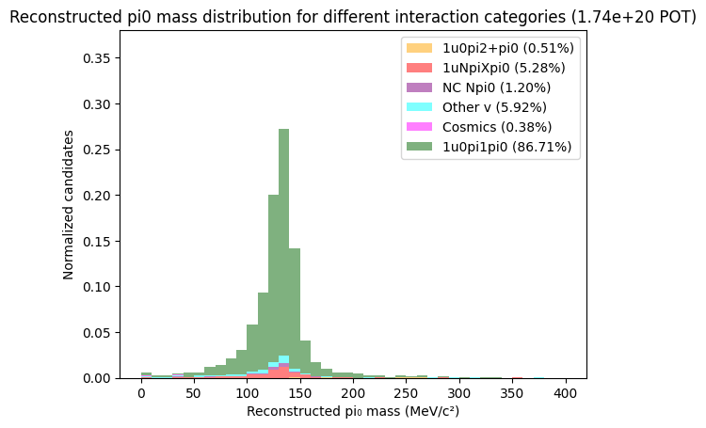
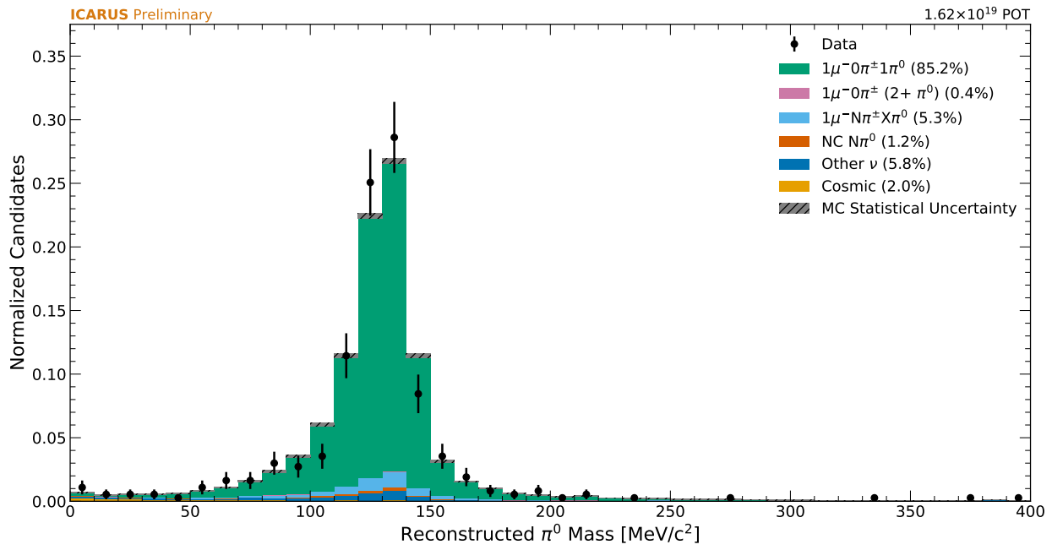
Initial selection: neutral pion mass distribution
A plot of the reconstructed neutral pion mass distribution for reconstructed interactions split into their true interaction categories is shown
Reconstructed neutral pion mass plot from lane’s paper, normalised to unity
Reconstructed neutral pion mass plot from my BNB sample

Slide 13
Shower energy correction: Crystal ball fitting
As bias between the location of the reconstructed neutral pion mass peak and true neutral pion mass (∼135 MeV/c2 ) is driven by reconstructed shower energy, the reconstructed distribution can be used to inform the shower energy scale in the next selection stage
Crystal ball fits are applied to the distribution, and the ratio of the gaussian mean to the true neutral pion mass (~135 MeV/c^2 ) can be used as a correction factor to adjust the reconstructed shower energy and bring the reconstructed pion mass towards true neutral pion peak.

Slide 14
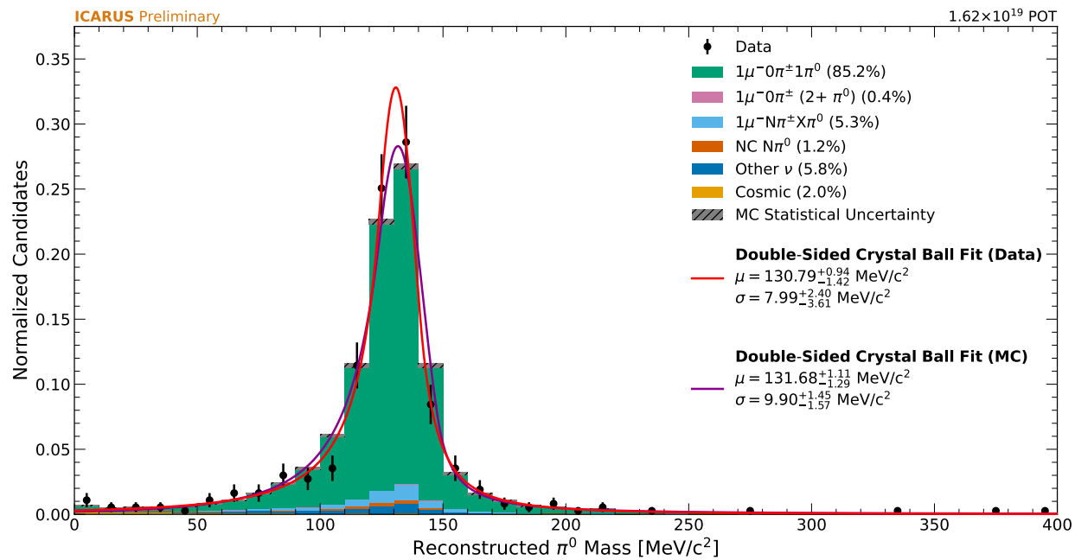
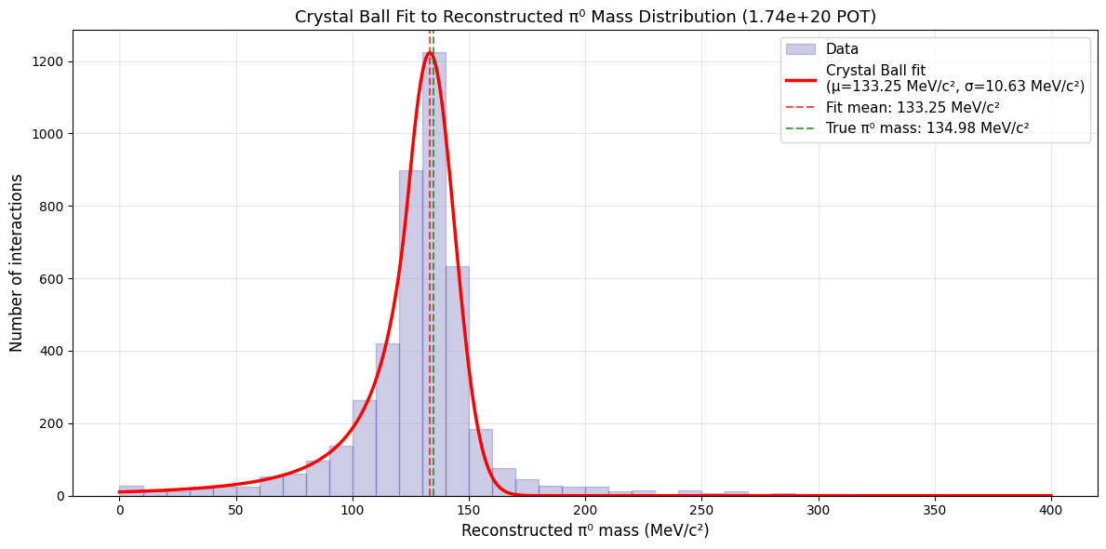
Shower energy correction: Crystal ball fitting
Applying a quick single sided crystal ball function from scipy in python to the reconstructed neutral pion mass distribution
Crystal ball fit for my plot is not as good as lane’s. This result should be taken with caution
I used a single-sided crystal ball fit form scipy in python, while he used a double-sided crystal ball fit, likely built into spineplot.
Crystal ball fitting plot from lane’s paper
Crystal ball fitting plot from my BNB sample analysis

Slide 15
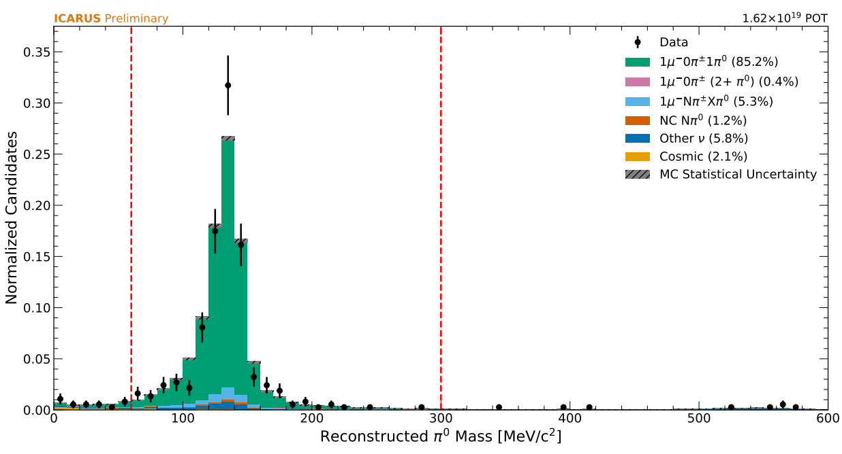
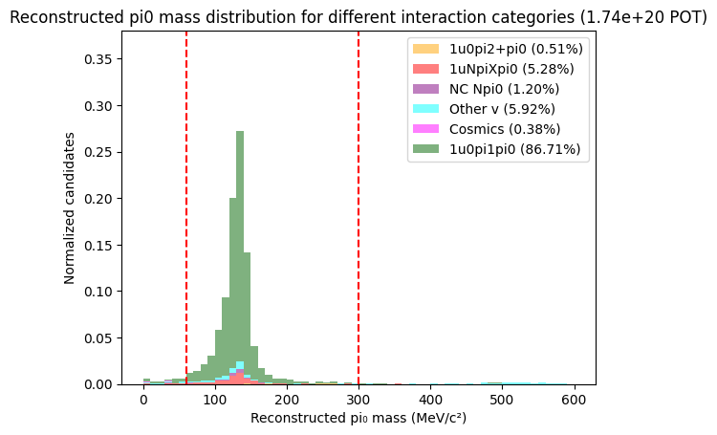
Cuts on reconstructed neutral pion mass
Extending the mass plot from 400 to 600 MeV/c^2 shows a noticeable uptick in selected events belonging to other neutrino interactions category due to η mesons. region from 0 to about 60 MeV is also primarily filled by non-true signal interactions
A cut on the pi0 mass is thus applied in the next selection at 60 MeV/c^2 and 300 MeV/c^2
Reconstructed Pi0 mass plot from lane’s paper
Reconstructed Pi0 mass plot from my BNB sample analysis

Slide 16
Selection performance analysis

Slide 17
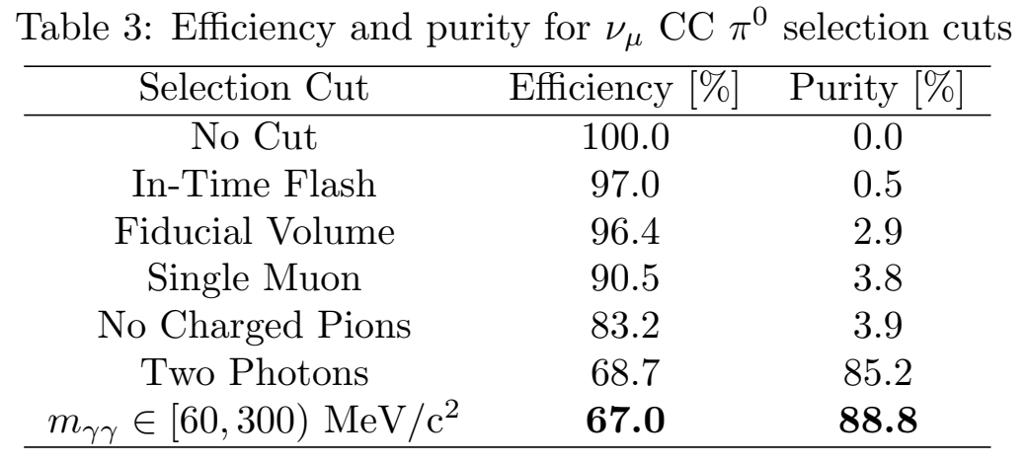
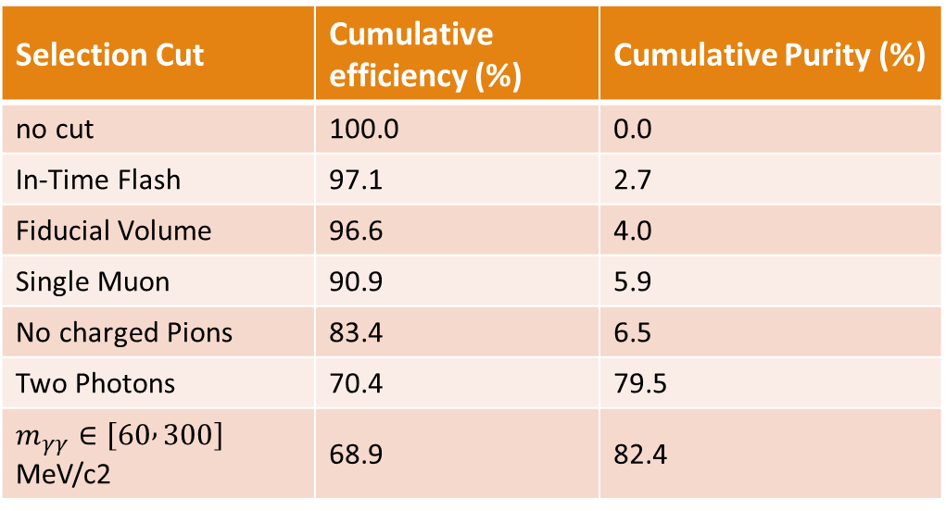
Efficiency and Purity analysis
Efficiency defined as fraction of true signal interactions that are matched to selected interactions
Purity defined as the fraction of selected interactions that are matched to true signal interactions
Selection Cut | Cumulative efficiency (%) | Cumulative Purity (%)
no cut | 100.0 | 0.0
In-Time Flash | 97.1 | 2.7
Fiducial Volume | 96.6 | 4.0
Single Muon | 90.9 | 5.9
No charged Pions | 83.4 | 6.5
Two Photons | 70.4 | 79.5
$m_{γγ}∈\left[60 , 300\right]$﻿ MeV/c2 | 68.9 | 82.4
Efficiency and Purity from Lane’s paper
Efficiency and Purity from my BNB sample

Slide 18
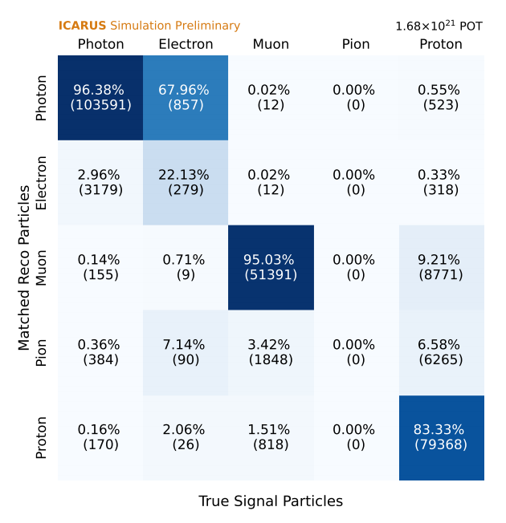
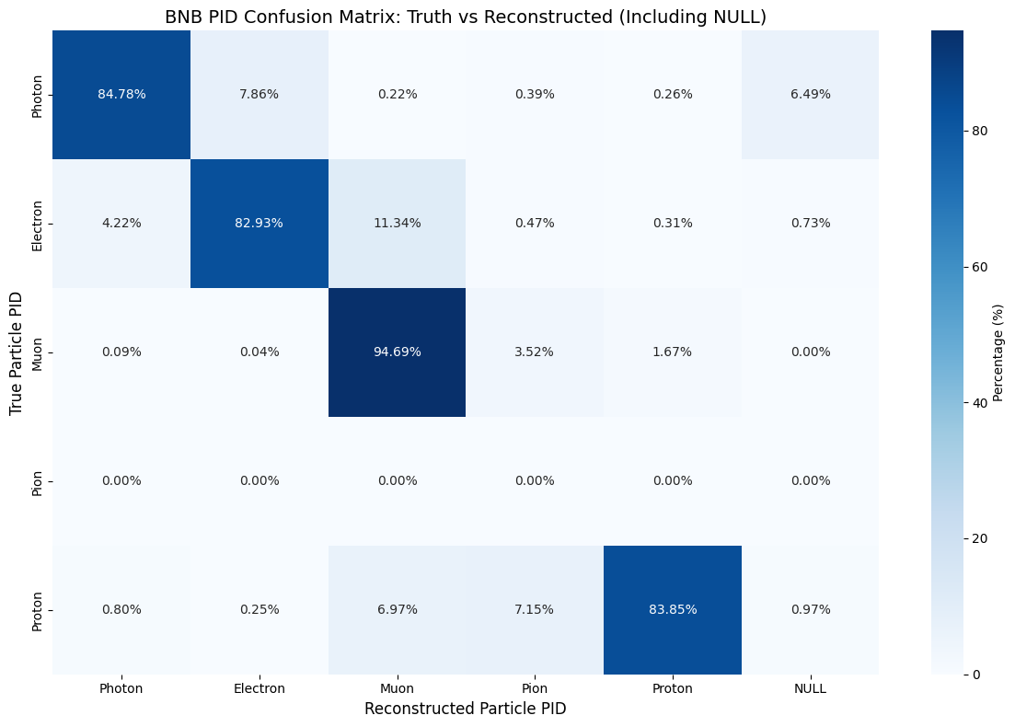
PID Truth to Reco confusion matrix
Plotting confusion matrix for PID particle type for true signal interactions
primary reason for inefficiency is due to true final state protons misidentified as muons or pions
Truth to Reco confusion matrix from lane’s paper
Truth to Reco confusion matrix from my BNB sample

Slide 19
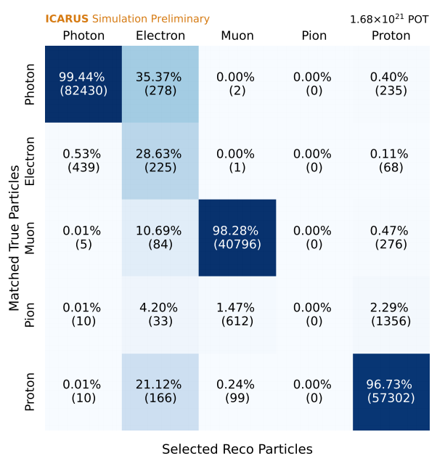
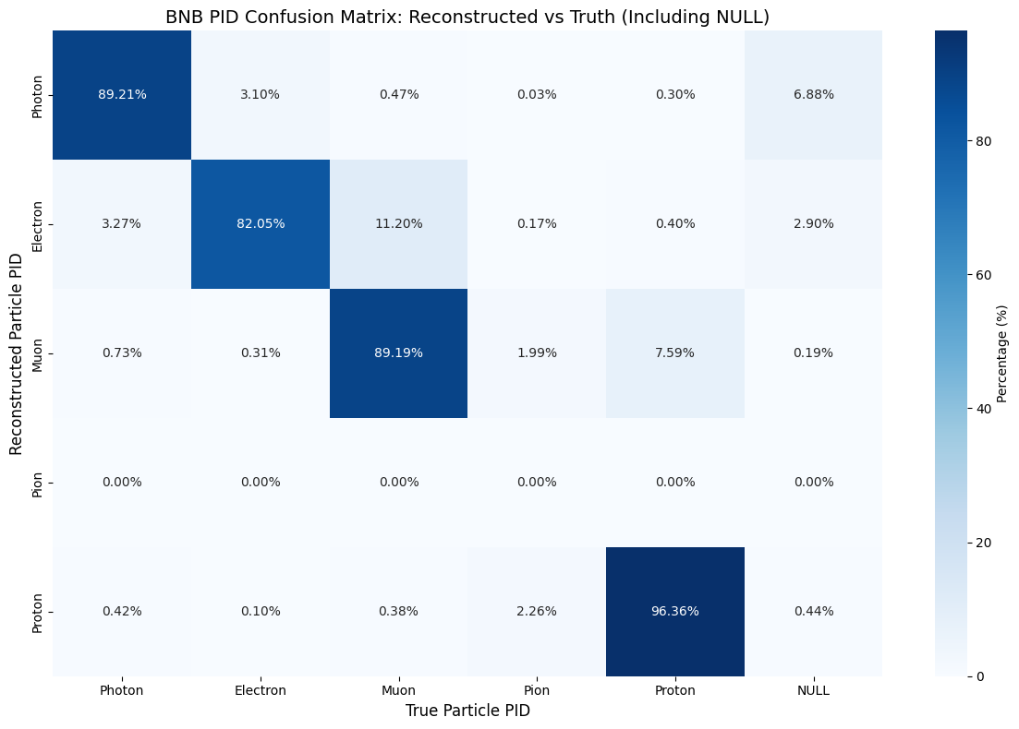
PID Reco to Truth confusion matrix
Plotting confusion matrix for PID particle type for true signal interactions
primary reason for impurity is due to misidentification of true pions as protons
Reco to Truth confusion matrix from lane’s paper
Truth to Reco confusion matrix from my BNB sample

Slide 20
Reconstructed observables in simulation

Slide 21
Reconstructed observables in simulation
The following observables relevant to the analysis are seperated into the following
Low-level observables to assess basic reconstruction performance and eventually data/simulation agreement
Transverse kinematic imbalance (TKI) observables that are sensitive to nuclear effects like FSI
Observables related to four-momentum transfer and hadronic invariant mass
Neutral pion mass observables relevant to calibration of electromagnetic showers
Cross section analysis observables for which single differential cross section will be extracted as a function of

Slide 22
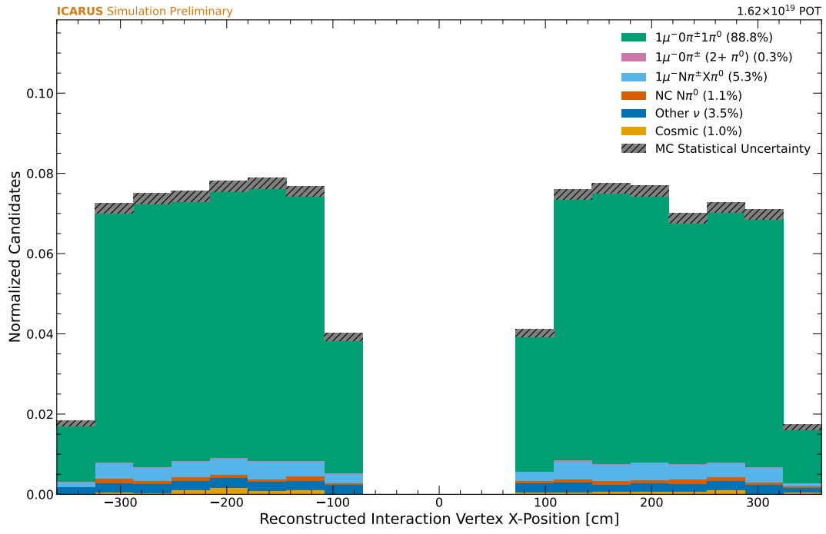
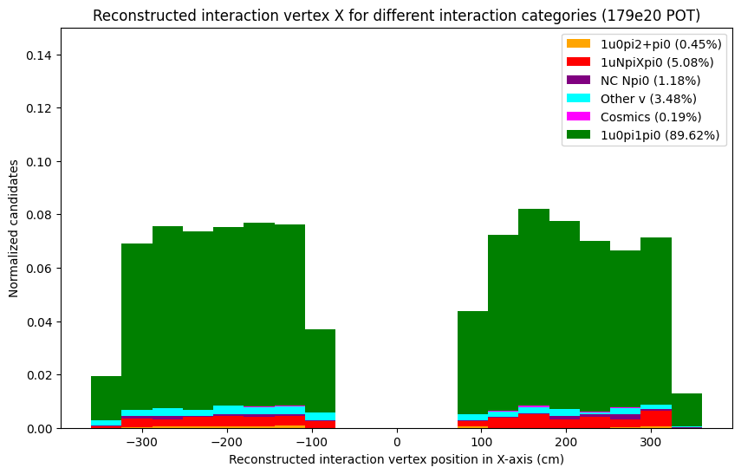
Low-level observables
Plotting Reconstructed Interaction vertex in x-axis
Interaction vertex in x-axis from lane’s paper
Interaction vertex in x-axis from my BNB sample

Slide 23
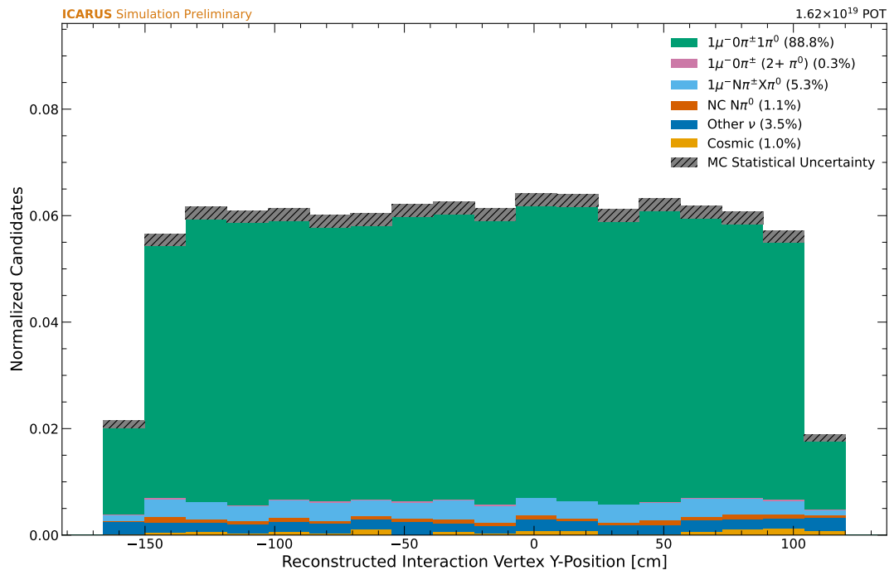
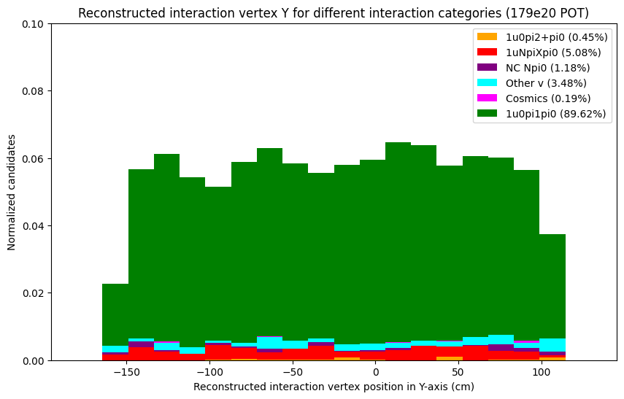
Low-level observables
Plotting Reconstructed Interaction vertex in Y-axis
Interaction vertex in Y-axis from lane’s paper
Interaction vertex in Y-axis from my BNB sample

Slide 24
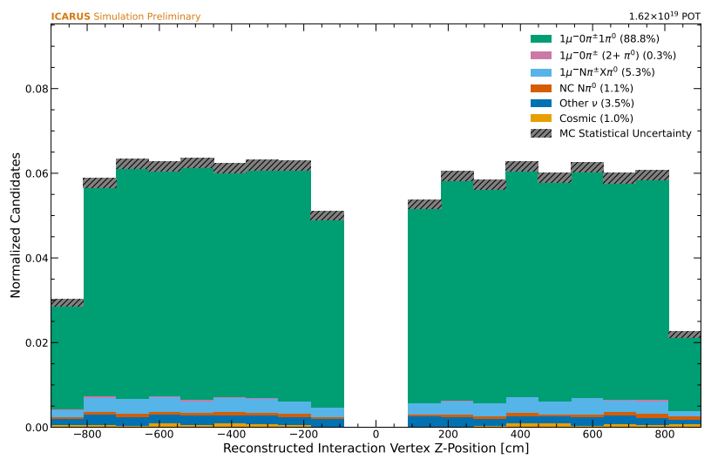
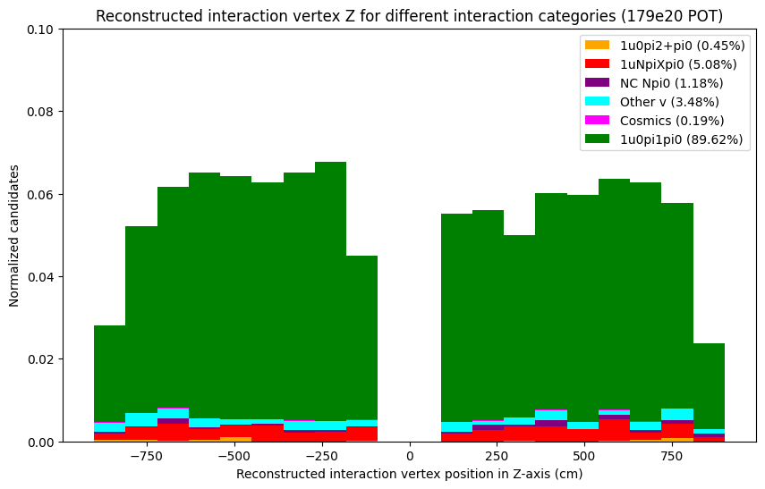
Low-level observables
Plotting Reconstructed Interaction vertex in Z-axis
Interaction vertex in Z-axis from lane’s paper
Interaction vertex in Z-axis from my BNB sample

Slide 25
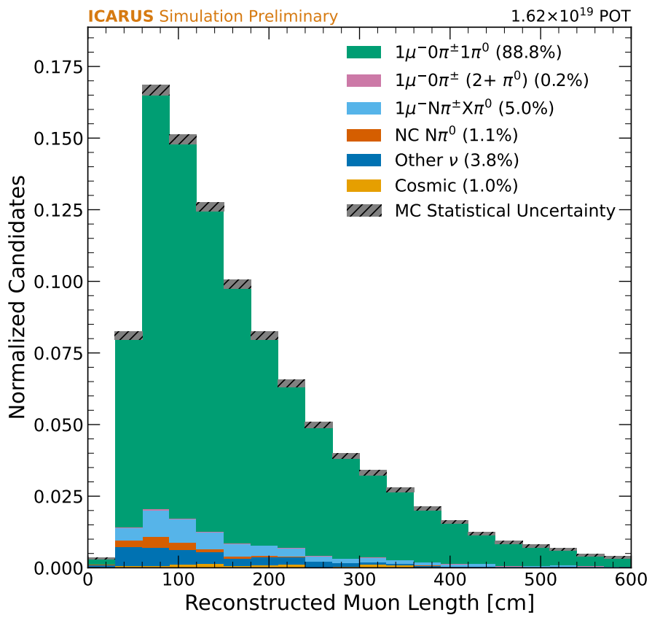
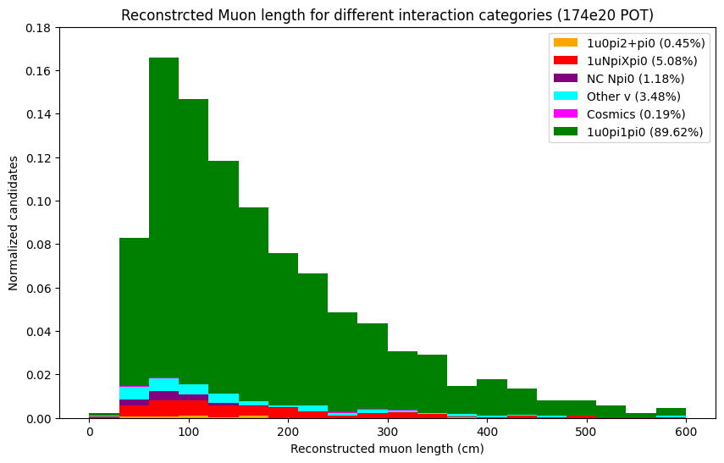
Low-level observables
Plotting Reconstructed primary Muon length
Muon length from lane’s paper
Muon length from my BNB sample

Slide 26
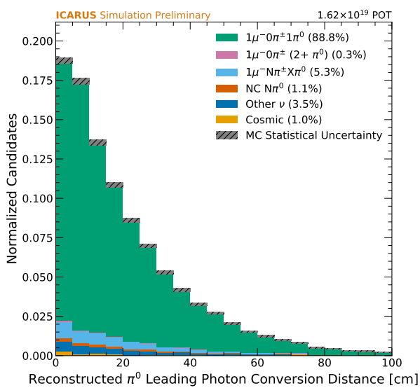
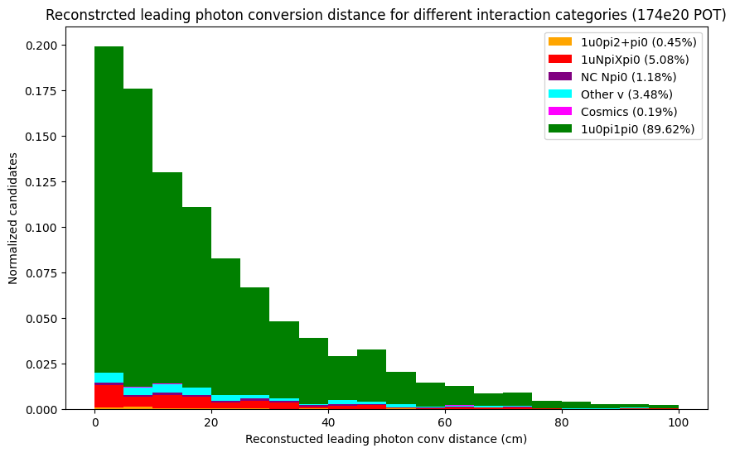
Low-level observables
Plotting Reconstructed leading photon conversion distance
leading photon conversion distance from lane’s paper
leading photon conversion distance from my BNB sample

Slide 27
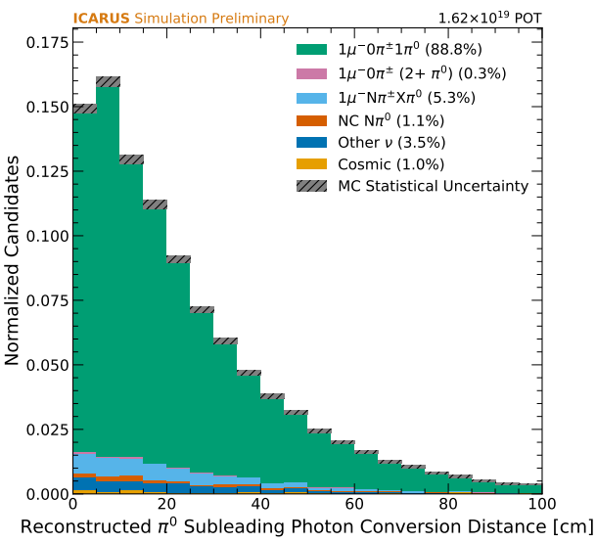
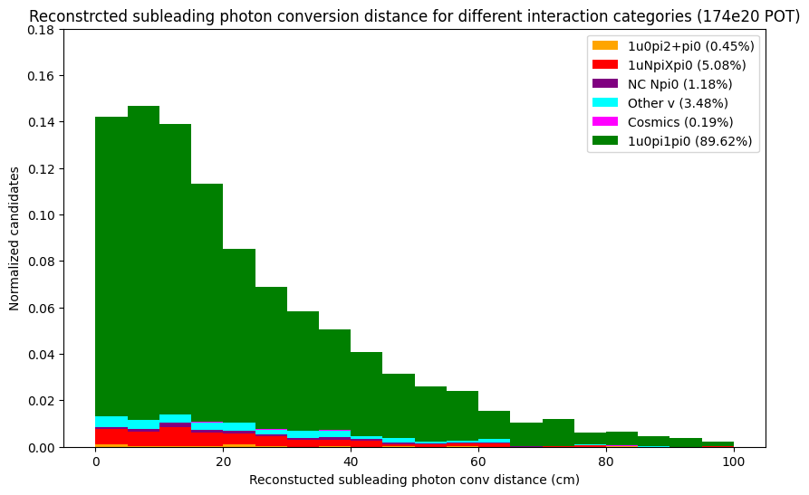
Low-level observables
Plotting Reconstructed subleading photon conversion distance
subleading photon conversion distance from lane’s paper
subleading photon conversion distance from my BNB sample

Slide 28
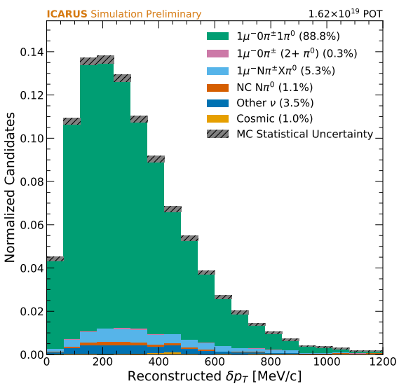
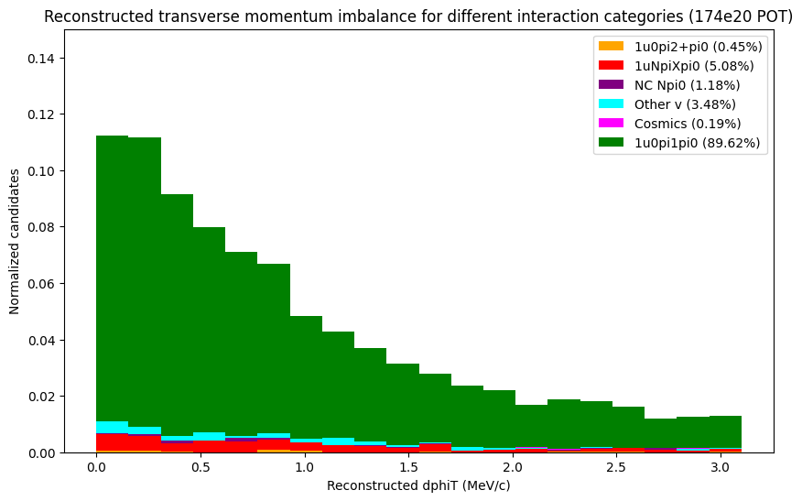
Transverse kinematic imbalance observables
Plotting Reconstructed Transverse momentum imbalance
Transverse momentum imbalance, or the magnitude of the vector diﬀerence between the transverse momentum of the muon and the hadronic system
NOTE: seems like his plot in the paper is actually the reconstructed transverse momentum, and not the transverse momentum imbalance
subleading photon conversion distance from lane’s paper
subleading Transverse momentum imbalance from my BNB sample

Slide 29
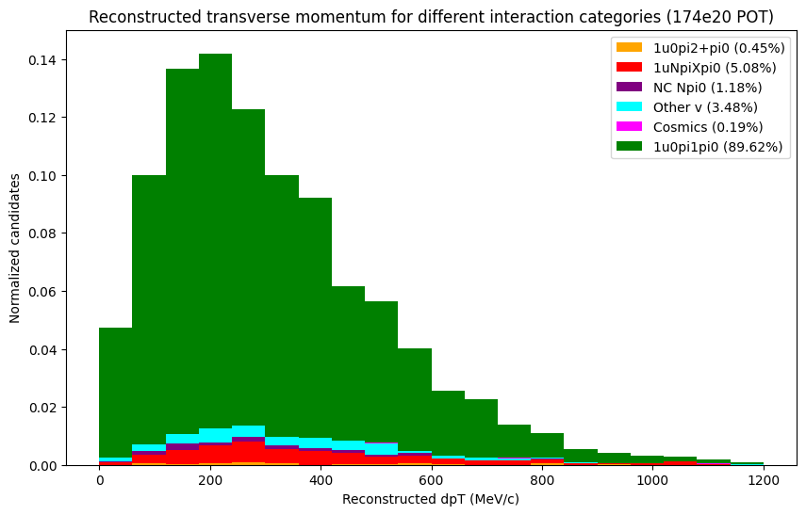
Transverse kinematic imbalance observables
Plotting Reconstructed Transverse momentum imbalance
Transverse momentum imbalance, or the magnitude of the vector diﬀerence between the transverse momentum of the muon and the hadronic system
NOTE: seems like his plot in the paper is actually the reconstructed transverse momentum, and not the transverse momentum imbalance
Transverse momentum imbalance from lane’s paper
Transverse momentum imbalance from my BNB sample

Slide 30
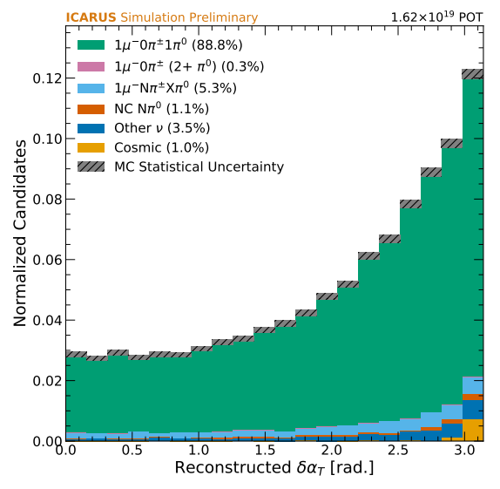
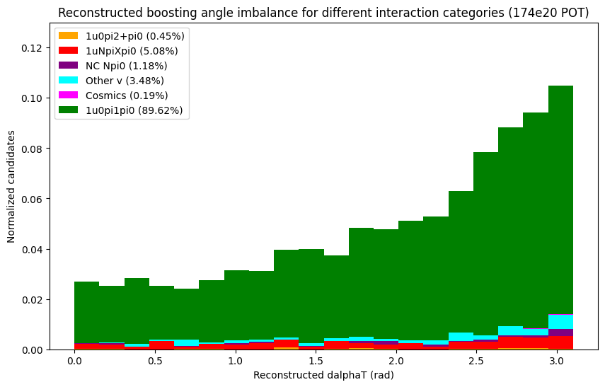
Transverse kinematic imbalance observables
Plotting Reconstructed transverse boosting angle
Transverse boosting angle, or the angle between the transverse momentum imbalance vector and the negative transverse momentum of the muon
Boosting angle from lane’s paper
Boosting angle from my BNB sample

Slide 31
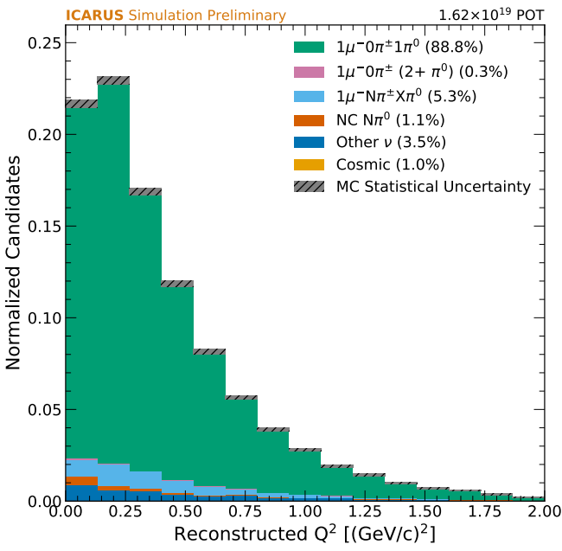
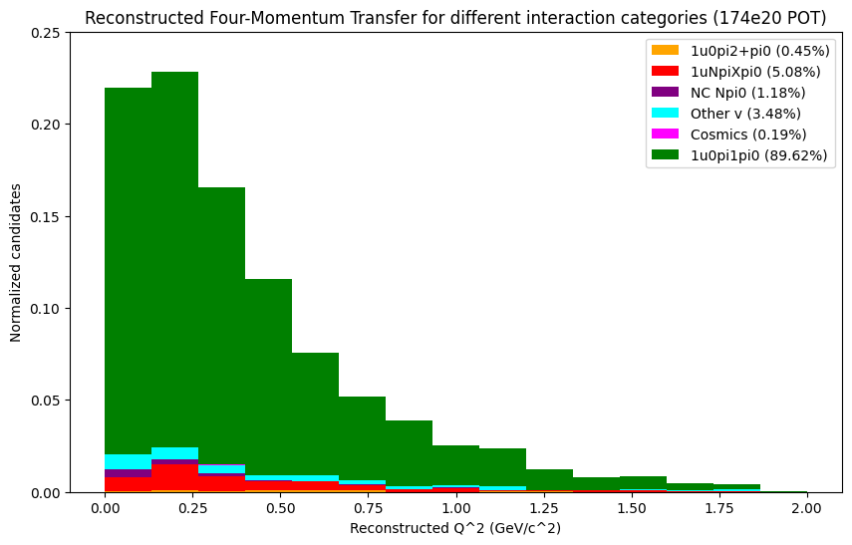
Four-Momentum Transfer and Hadronic Invariant Mass observables
Plotting Four-Momentum Transfer
Squared four-momentum transfer to target nucleon
Four-Momentum Transfer from lane’s paper
Four-Momentum Transfer from my BNB sample

Slide 32
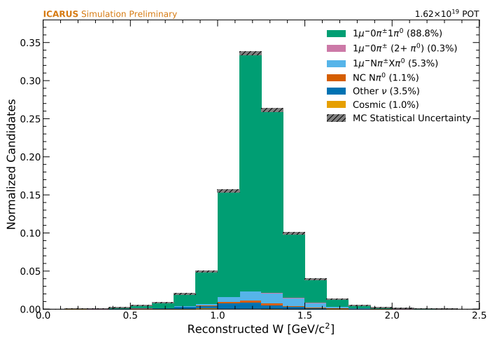
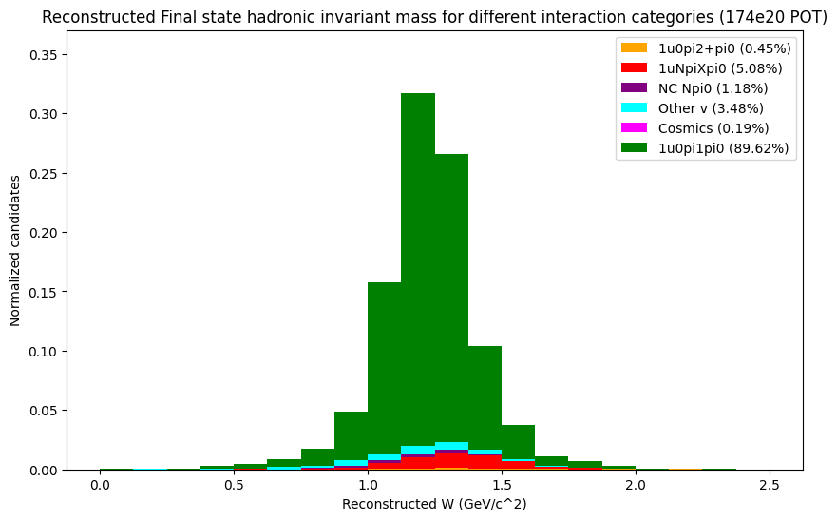
Four-Momentum Transfer and Hadronic Invariant Mass observables
Plotting Hadronic Invariant Mass
Hadronic invariant mass of the ﬁnal state
Hadronic Invariant Mass from lane’s paper
Hadronic Invariant Mass from my BNB sample

Slide 33
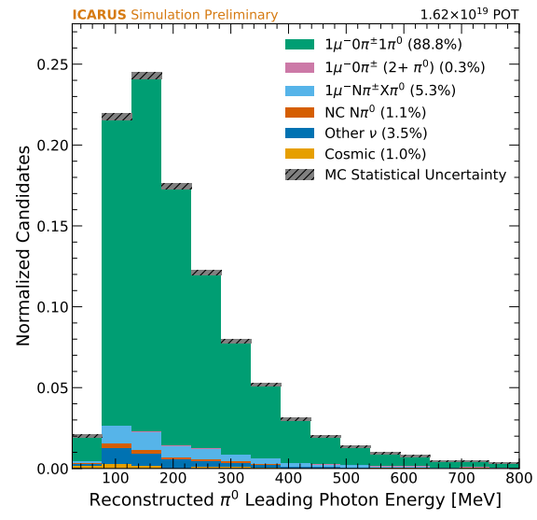
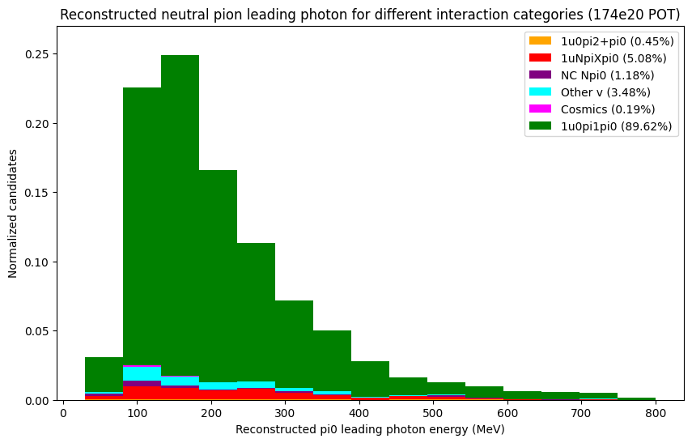
Neutral Pion Mass observables
Plotting leading photon KE
leading photon KE from lane’s paper
leading photon KE from my BNB sample

Slide 34
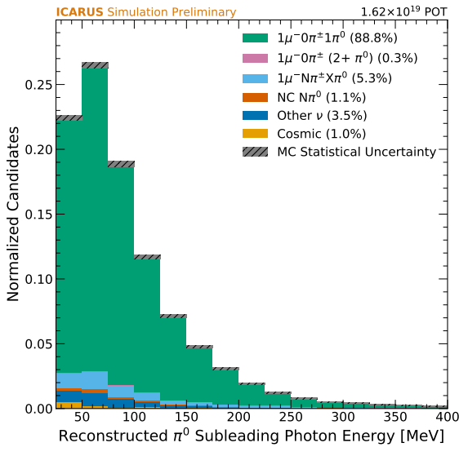
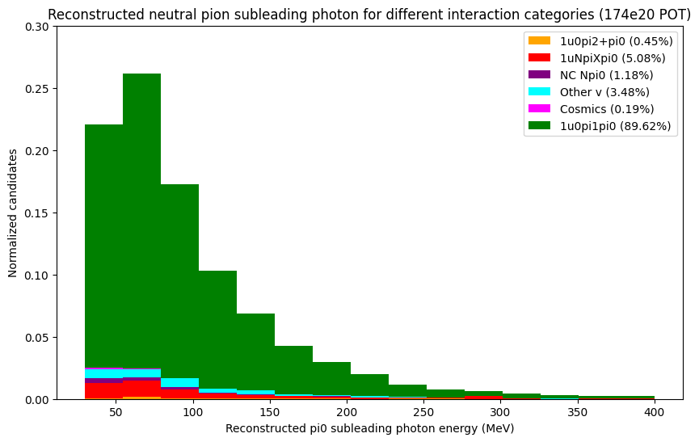
Neutral Pion Mass observables
Plotting subleading photon KE
subleading photon KE from lane’s paper
subleading photon KE from my BNB sample

Slide 35
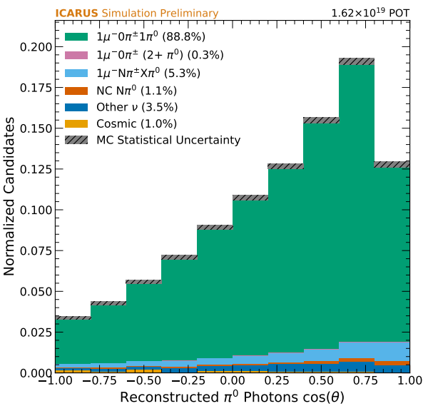
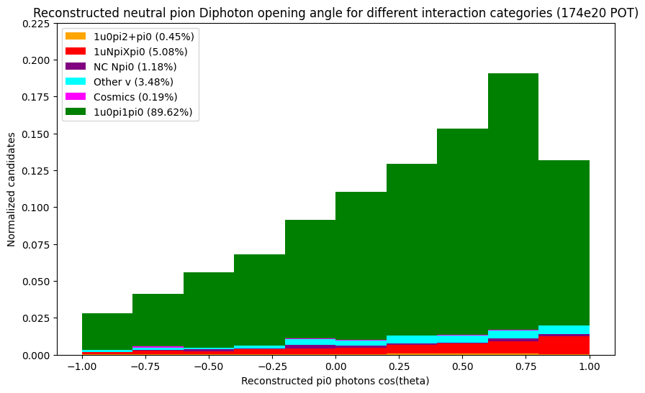
Neutral Pion Mass observables
Plotting pi0 di-photon opening angle
pi0 di-photon opening angle from lane’s paper
pi0 di-photon opening angle from my BNB sample

Slide 36
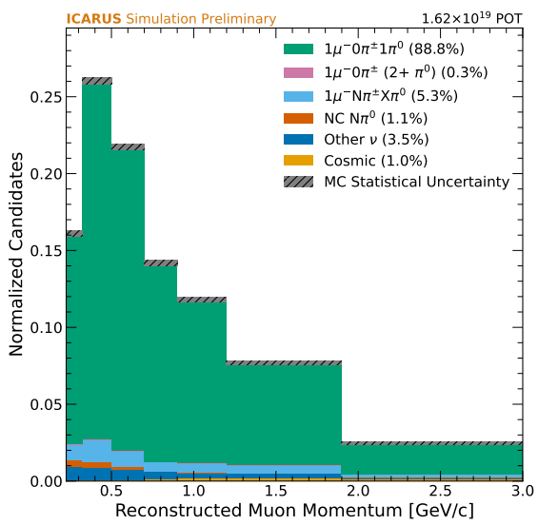
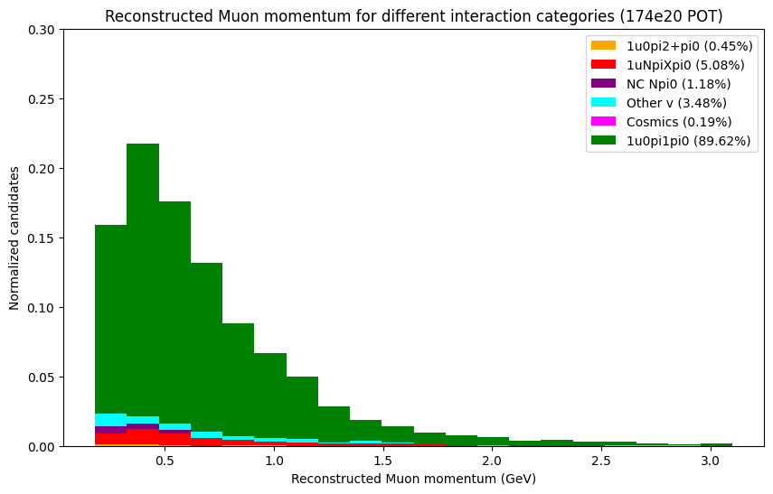
Cross Section Analysis Observables
Plotting Muon momentum
Muon momentum from lane’s paper
Muon momentum from my BNB sample

Slide 37
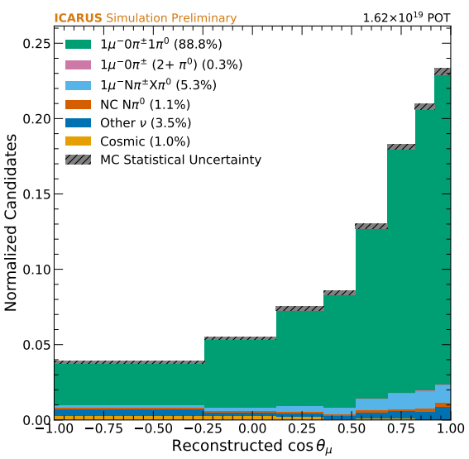
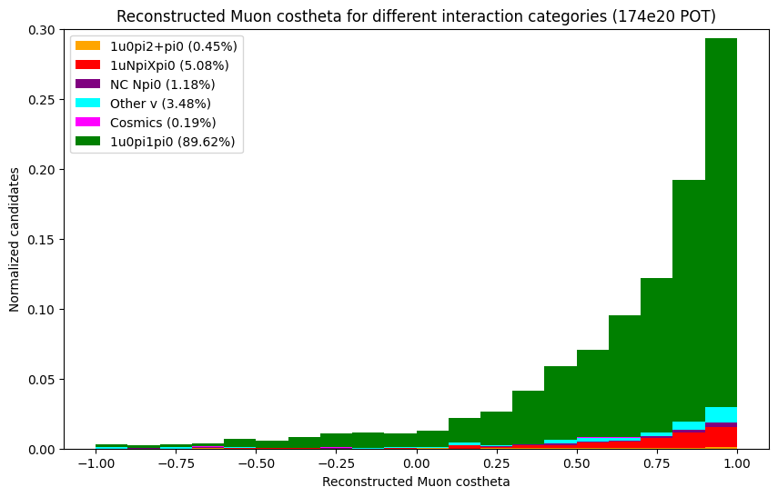
Cross Section Analysis Observables
Plotting Muon beam costheta
angle the true muon makes with the beam
Muon beam costheta from lane’s paper
Muon beam costheta from my BNB sample

Slide 38
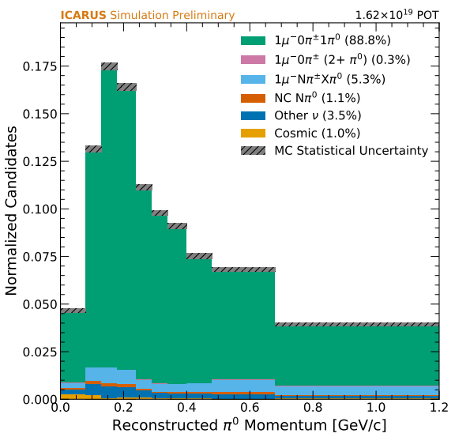
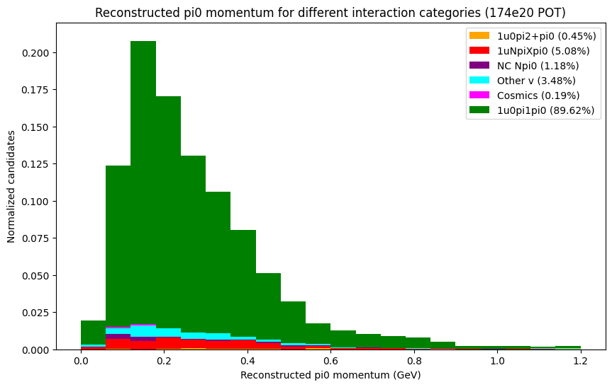
Cross Section Analysis Observables
Plotting pi0 momentum
pi0 momentum from lane’s paper
pi0 momentum from my BNB sample

Slide 39
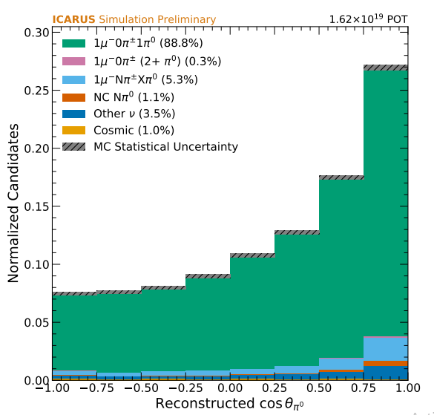
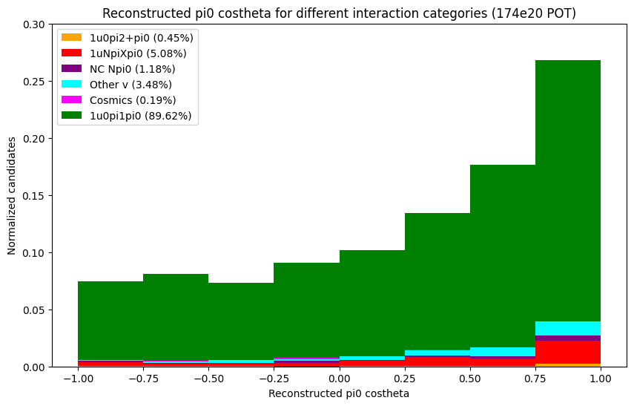
Cross Section Analysis Observables
Plotting pi0 beam costheta
angle the true neutral pion makes with the beam
pi0 beam costheta from lane’s paper
pi0 beam costheta from my BNB sample

