Slide 1
Two-shower selection of HNL candidates
Jordon koh, Nanyang technological university

Slide 2
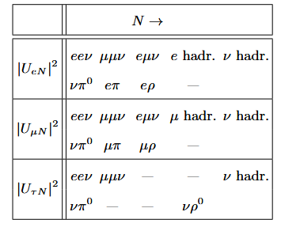

Background
Looking for Heavy Neutral Leptons (HNLs) decay product candidates
Focusing on NuMI beam and ICARUS detector
Particularly looking at final state two-shower particles
Examples
Di-electron shower (eev)
Di-photon shower from neutral pion production channel (v$π^{0}$)
Most relevant HNL decay channels into SM particles, from (Chatterjee et al., 2025)

Slide 3
Motivations
Reasons for choosing ICARUS and NuMI beam
Higher energy of NuMI beam compared to BNB beam results in greater meson production rate and potentially increased HNL production
NuMI beam is directed off-axis to ICARUS, thus neutrino background is significantly lower than that of on-axis BNB beam
ICARUS is the largest operational LArTPC detector with excellent calorimetric and Particle PID reconstruction, enabling identification of all promising decay channels

Slide 4
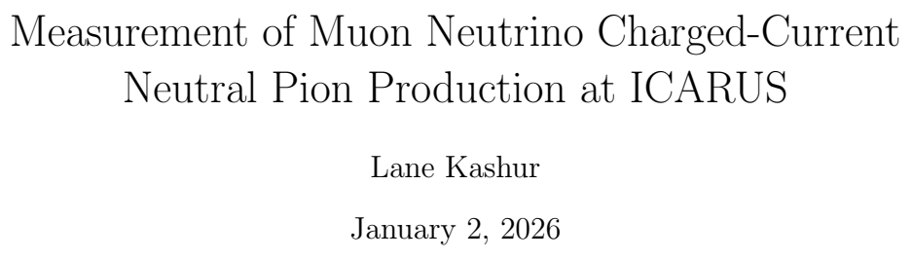

Event selection plan
For Di-photon shower selection
Referencing and verifying Lane Kashur’s thesis work
Lane’s work focused on BNB beam data and MC sample
Eventually recreate selection for NuMI beam data and MC sample and compare distributions
Differences
Used much smaller MC BNB sample for recreation (1.68e21 vs 1.74e20)
Only focused on MC sample, no data comparison
Some data and beam quality cuts not applied
Binning may be slightly different

Slide 5
Signal and Selected definitions
Signal: defined as a true Charged Current muon neutrino interaction that is
Fiducialized
Not within the region deﬁning the central 200 cm of the detector (z-axis not within -100cm to 100cm in detector coordinates)
Exactly one primary muon (KE ≥ 143.425 MeV)
Zero primary charged pions (KE ≥ 25 MeV)
Exactly one neutral pion (no KE threshold)
Any number of particles that are not muons or pions
Selection: Cuts applied for selection of reconstructed interactions
Fiducial
z-axis not within -100cm to 100cm in detector coordinates
Flash time
Single primary muon (KE ≥ 143.425 MeV)
No primary charged pions (KE ≥ 25 MeV)
Two primary photons (KE ≥ 25 MeV)
Pi0 mass cut

Slide 6
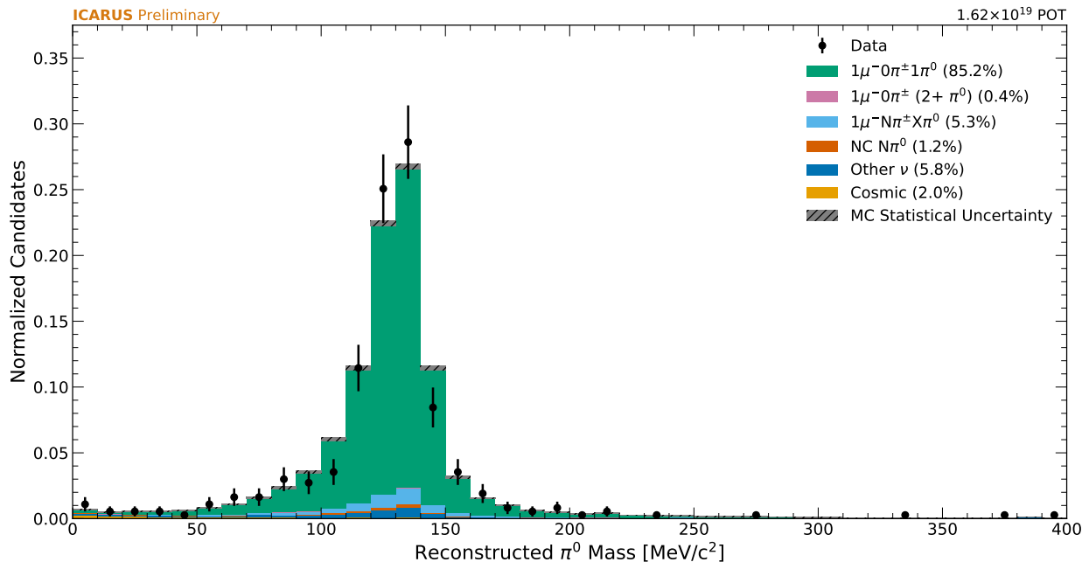
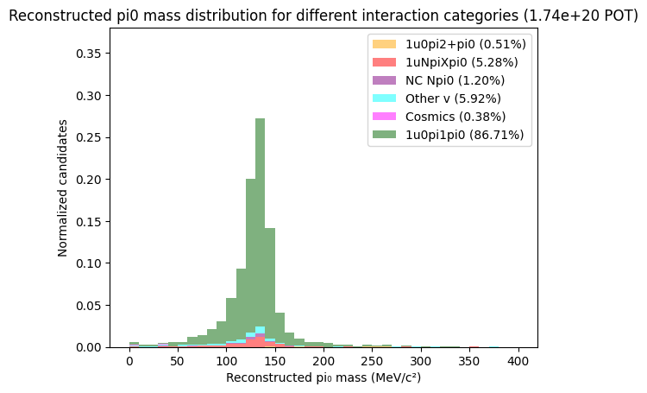
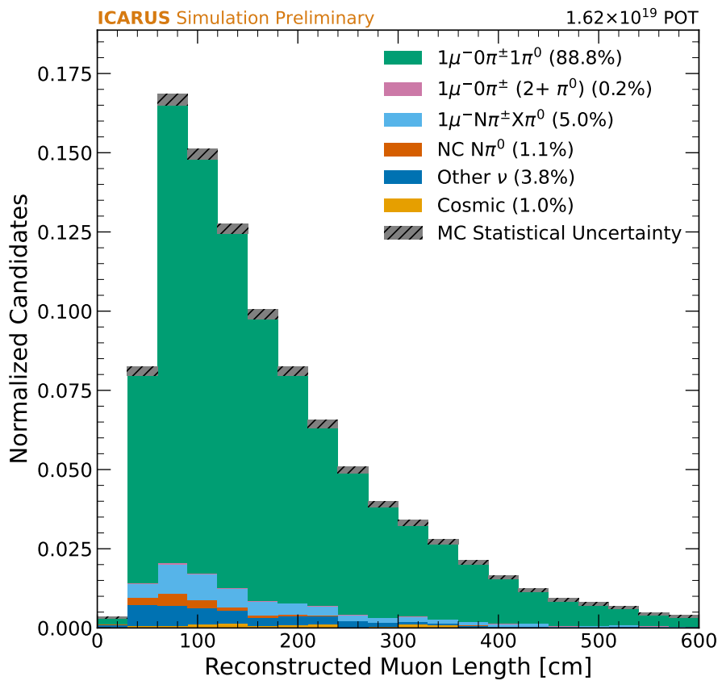
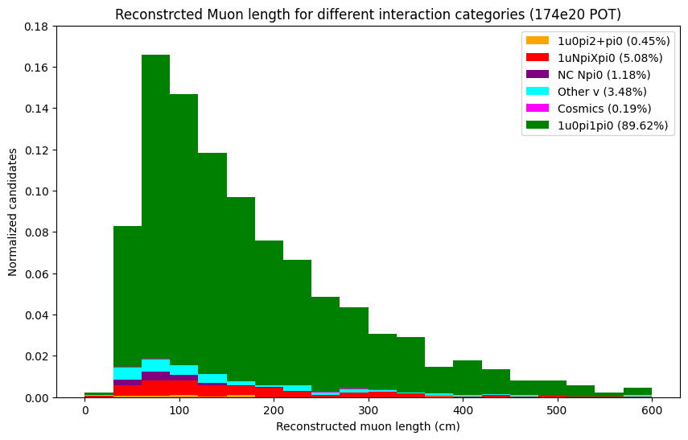
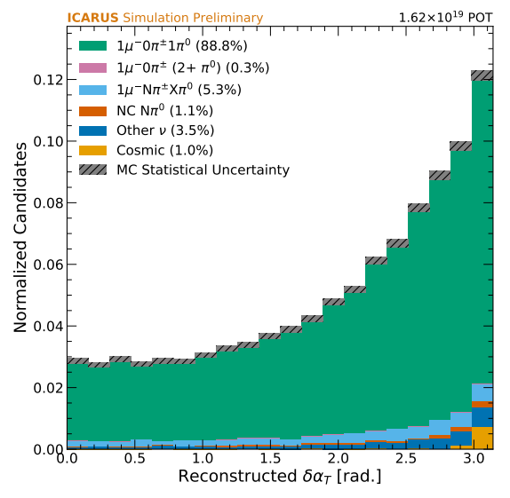
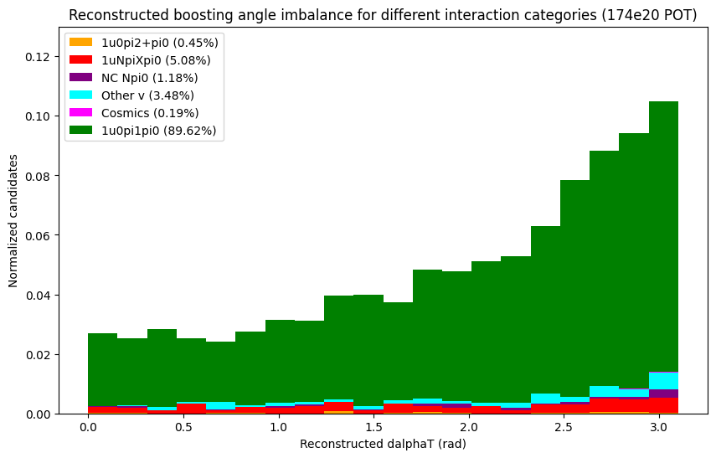
Plot comparison
Reconstructed neutral pion mass
Reconstructed Hadronic Invariant Mass
lane’s paper
My selection
lane’s paper
My selection
Reconstructed primary muon length
Reconstructed boosting angle
lane’s paper
My selection
lane’s paper
My selection

Slide 7
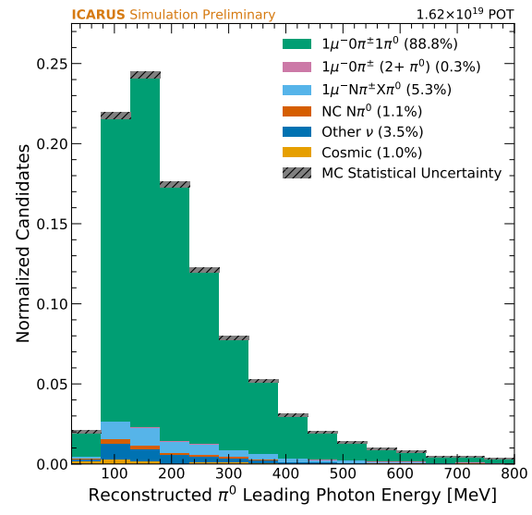
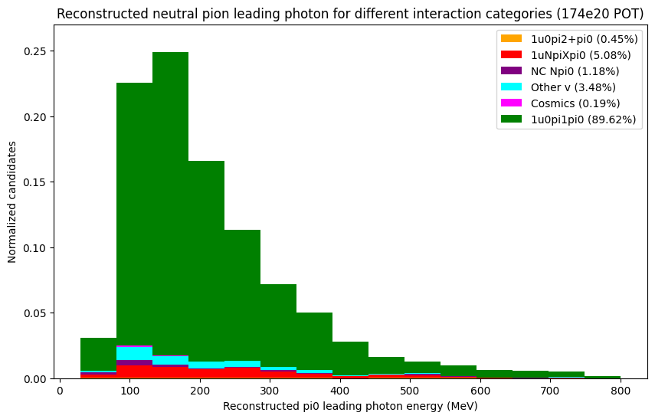
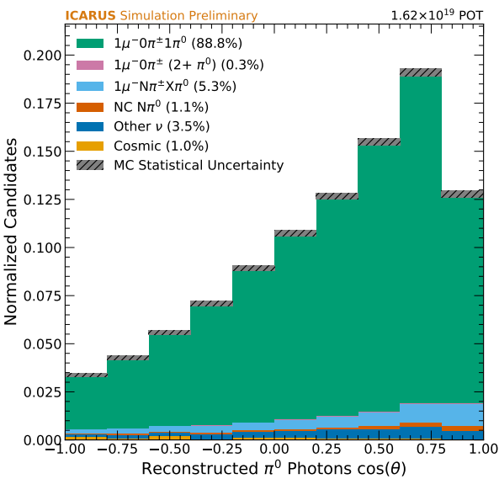
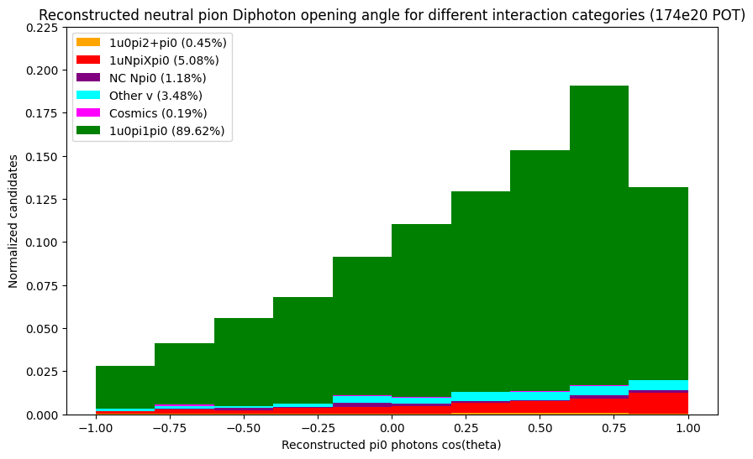
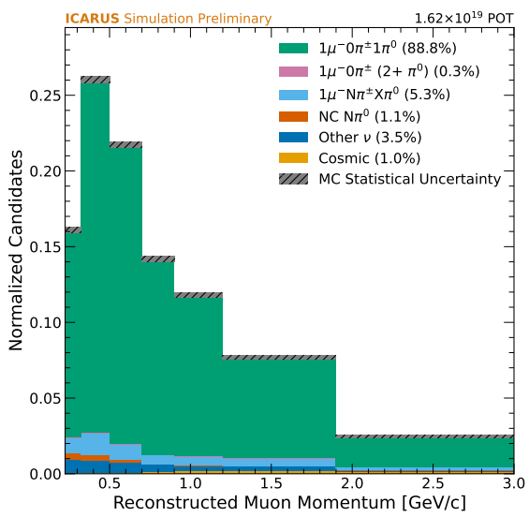
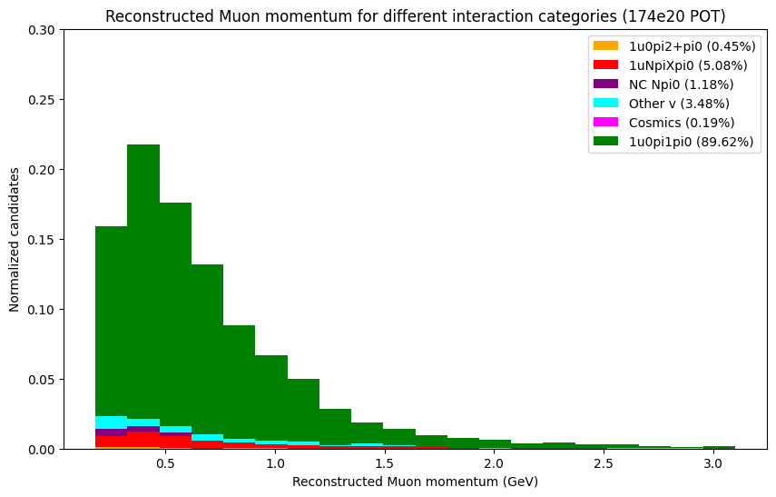
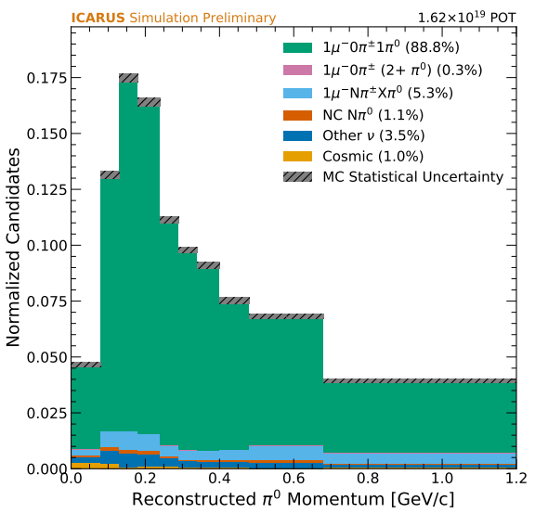
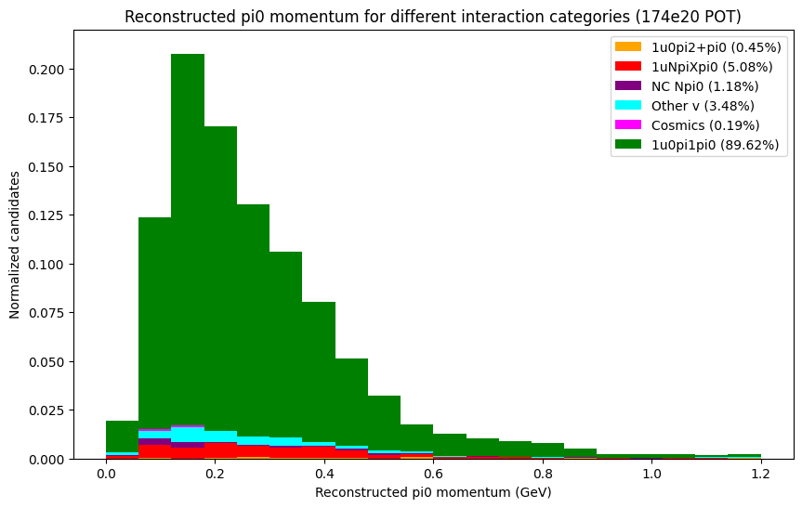
Plot comparison
Reconstructed leading photon KE
Reconstructed Di-photon opening angle
lane’s paper
My selection
lane’s paper
My selection
Reconstructed muon momentum
Reconstructed Pi0 momentum
lane’s paper
My selection
lane’s paper
My selection

Slide 8
NuMI selection
NuMI MC sample
Muon neutrino + cosmics
File path
/pnfs/icarus/persistent/users/dcarber/spine/combined_files/NuMI_CV_flat_cafs_2/*.root
POT size = 147e20
Parameter | NuMI | BNB
Pot Size | 147e20 | 174e20
Number of reconstructed selected interactions | 3566 | 4249
Number of true signal interactions | 3815 | 5532

Slide 9
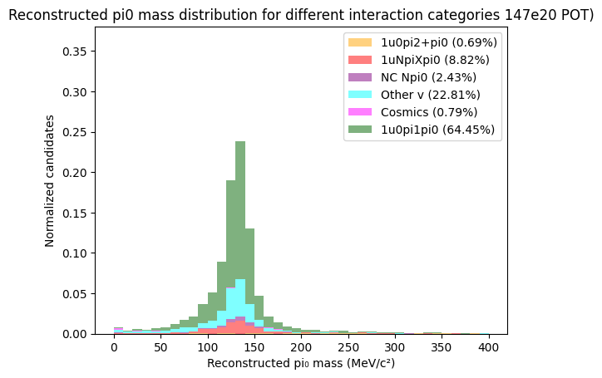
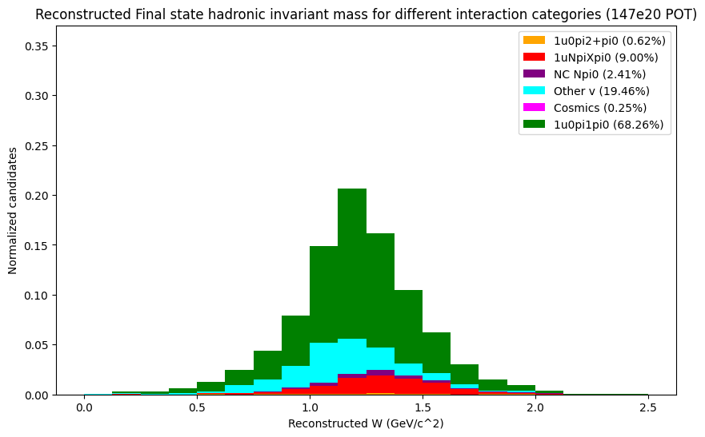
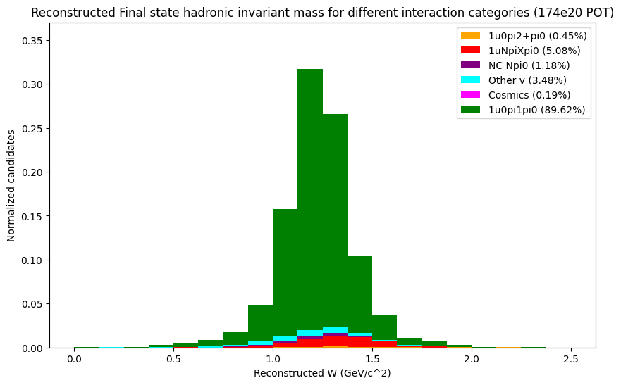
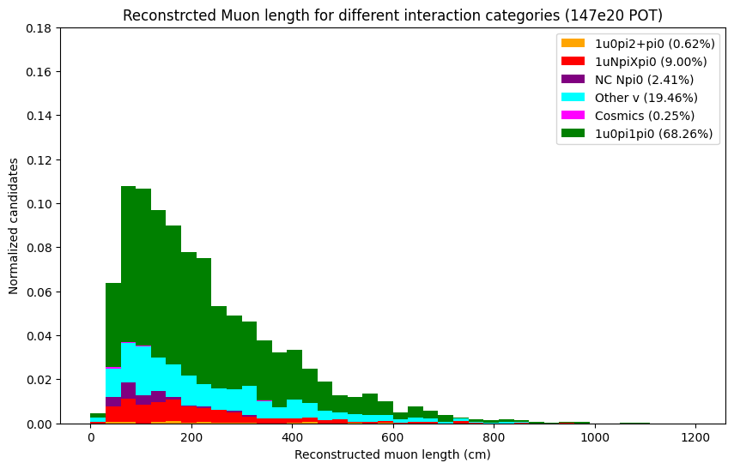
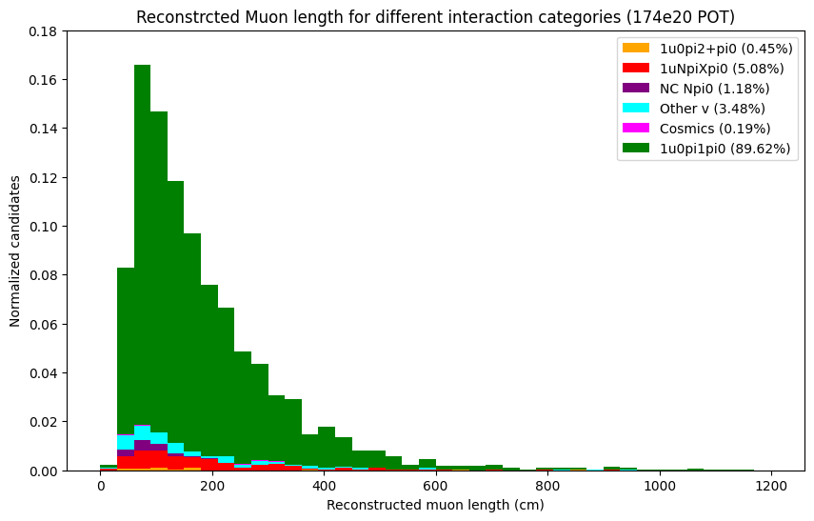
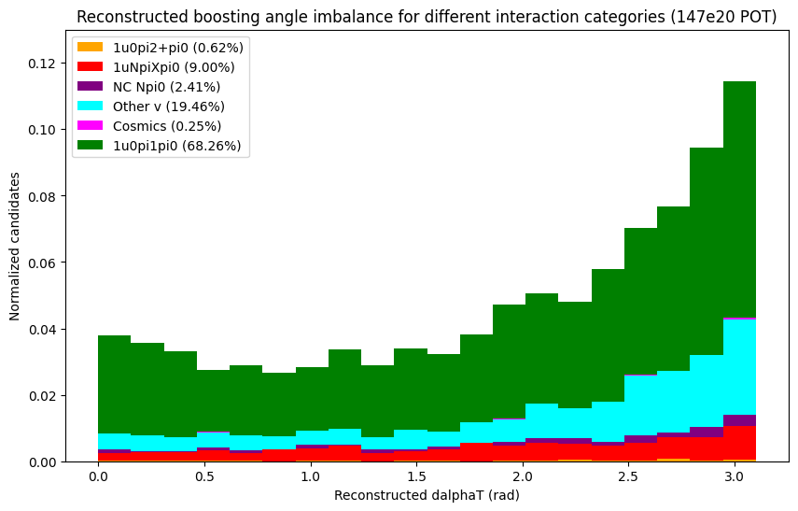
Plot comparison (NuMI vs BNB selection)
Reconstructed neutral pion mass
Reconstructed Hadronic Invariant Mass
NuMI selection
BNB selection
NuMI selection
BNB selection
Reconstructed primary muon length
Reconstructed boosting angle
NuMI selection
BNB selection
NuMI selection
BNB selection

Slide 10
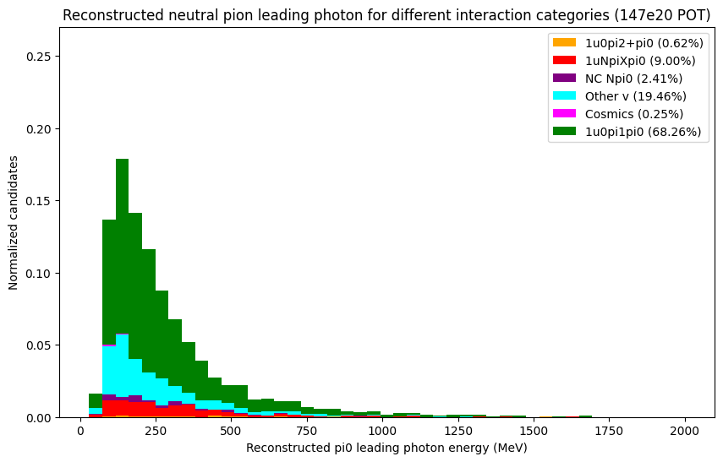
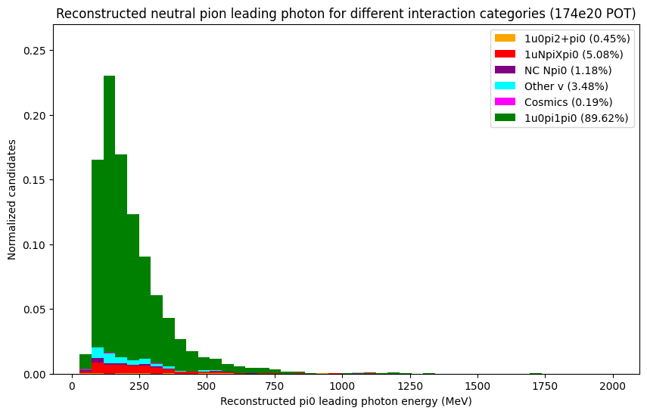
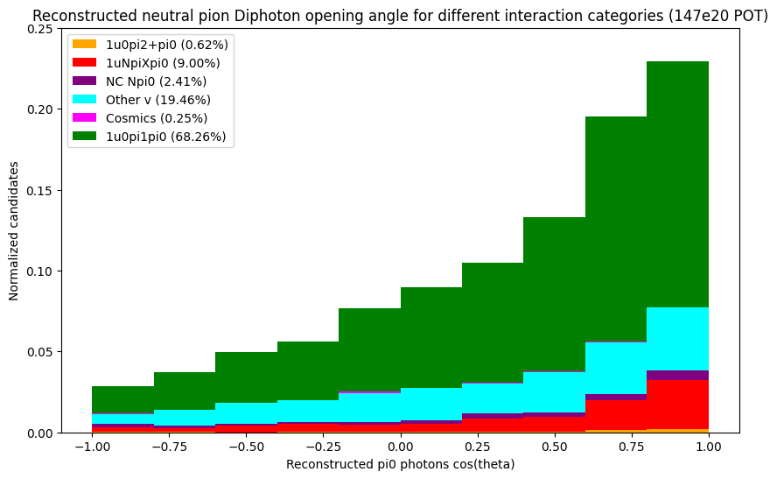
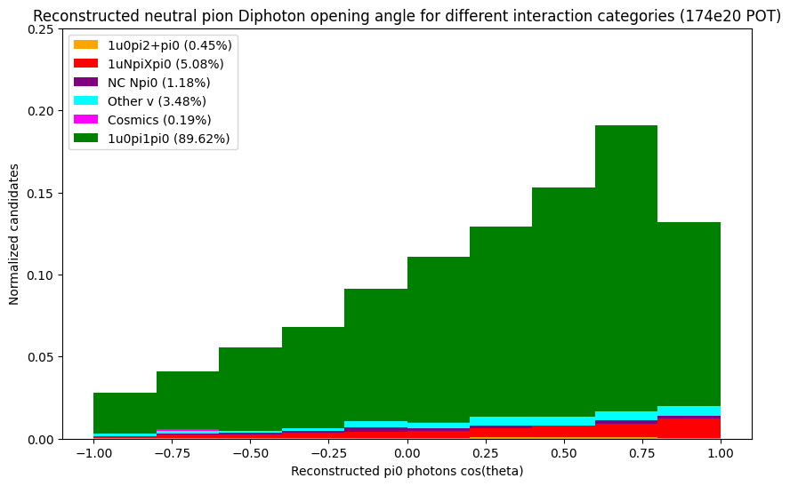
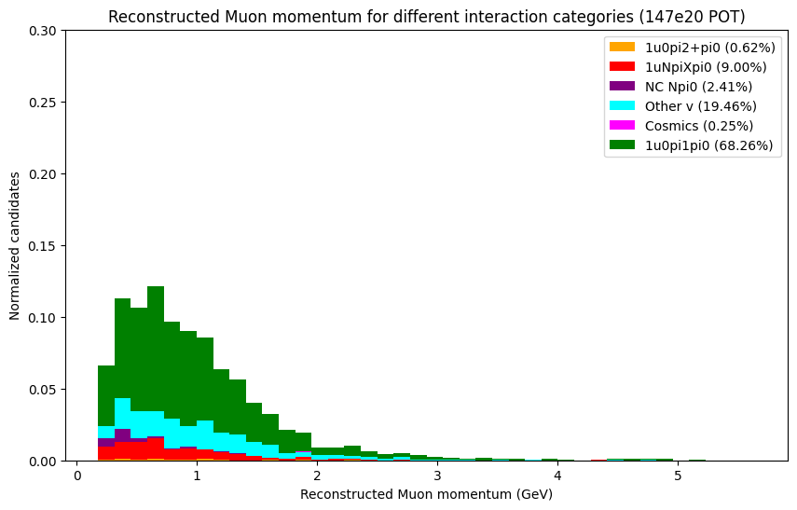
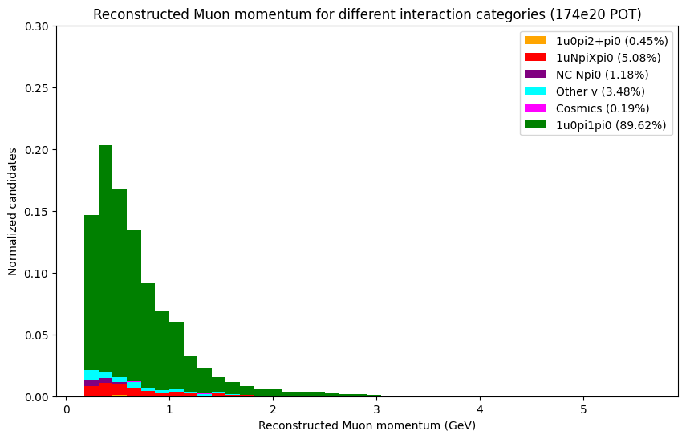
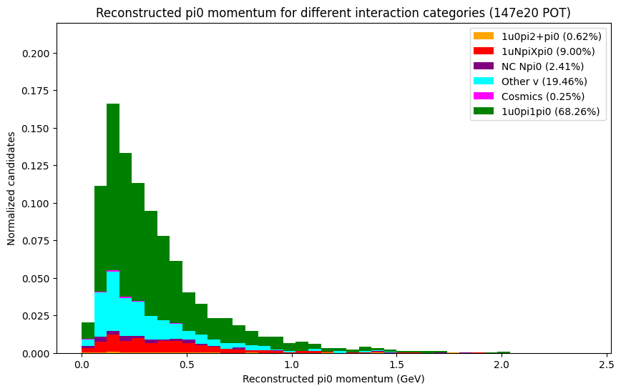
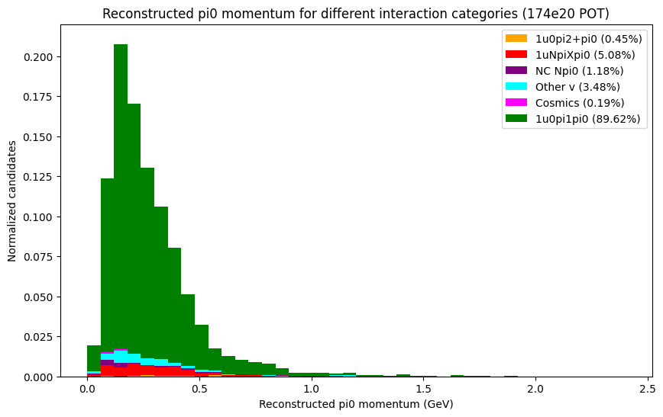
Plot comparison (NuMI vs BNB selection)
Reconstructed leading photon KE
Reconstructed di-photon opening angle
NuMI selection
BNB selection
NuMI selection
BNB selection
Reconstructed muon momentum
Reconstructed pi0 momentum
NuMI selection
BNB selection
NuMI selection
BNB selection

Slide 11
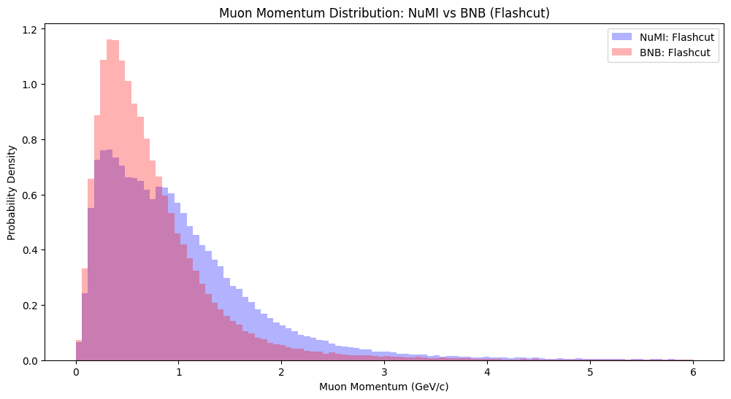
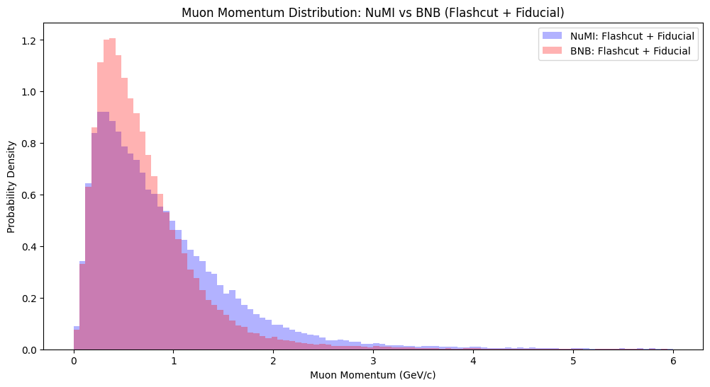
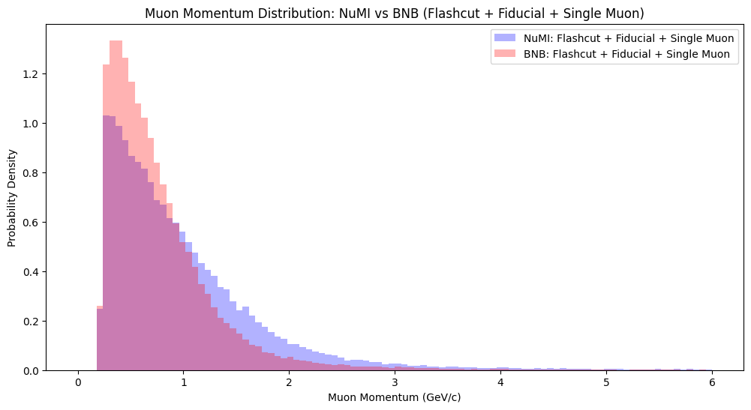
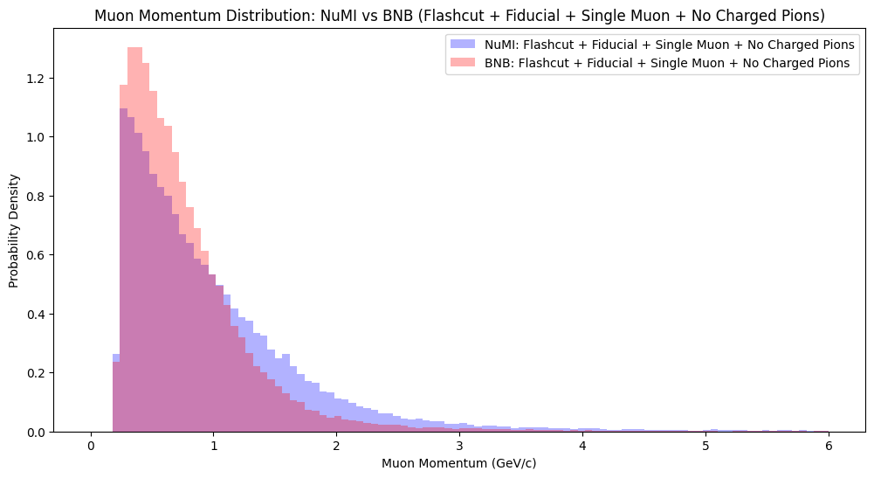
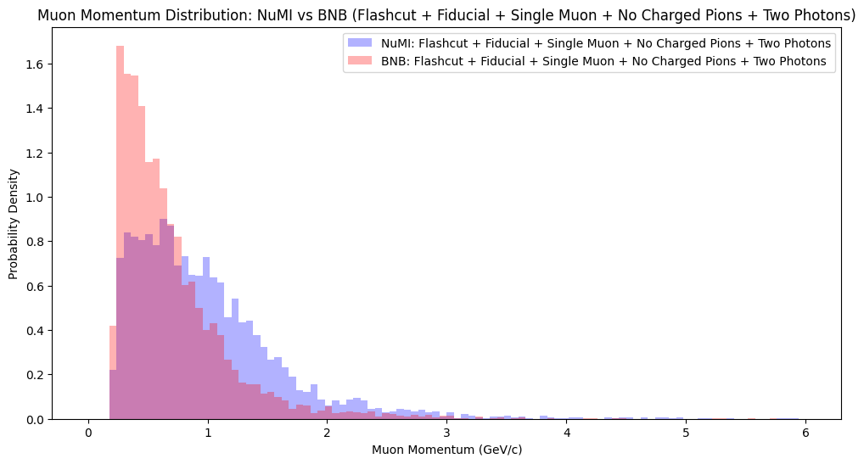
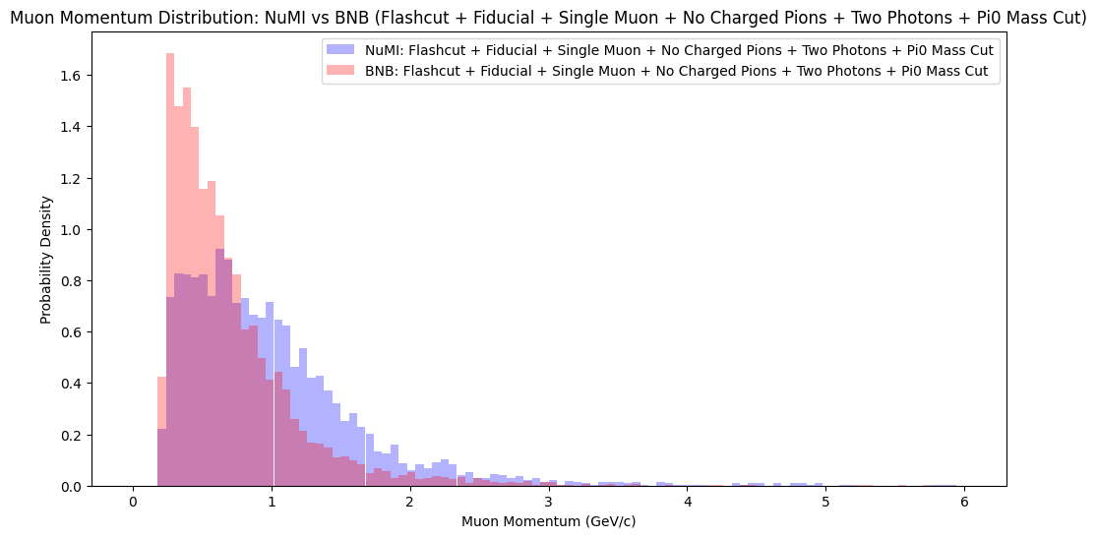
Reconstructed Muon momentum
Plotting NuMI and BNB normalized reconstructed leading muon momentum for each cumulative cut

Slide 12
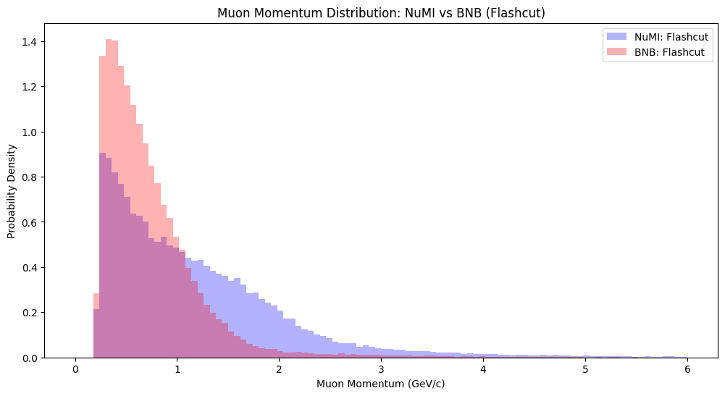
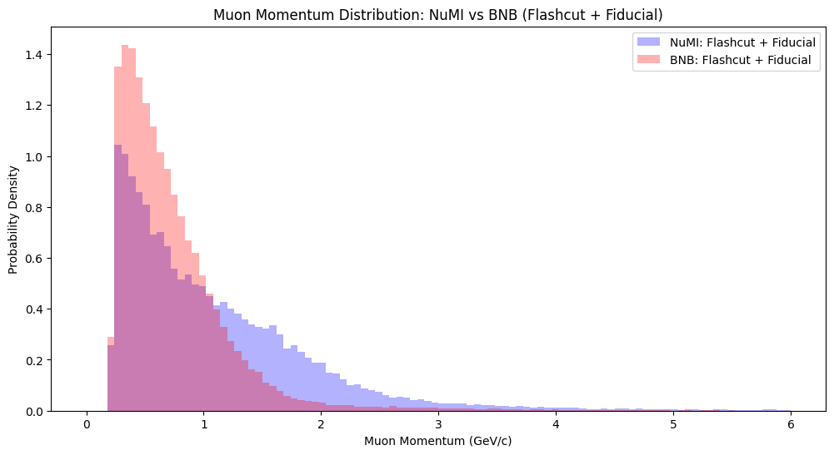
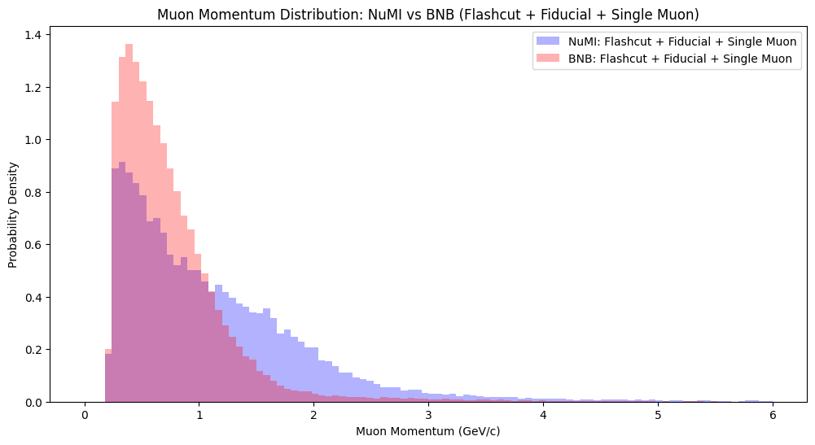
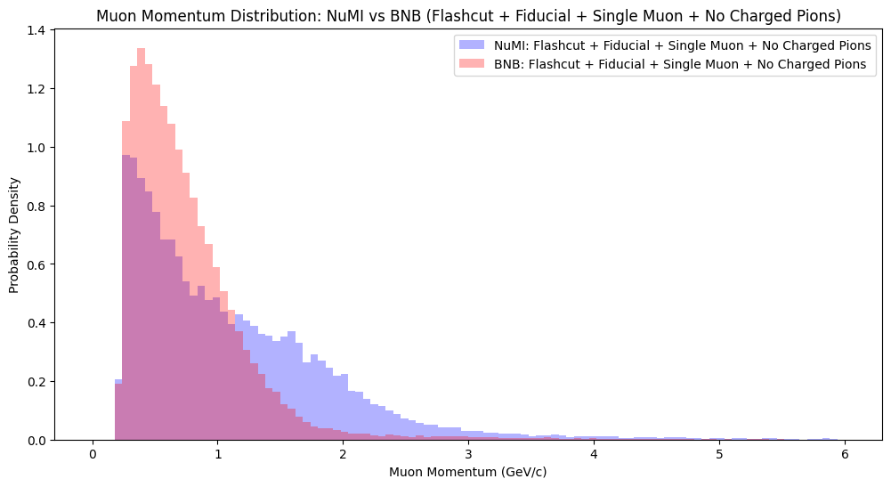
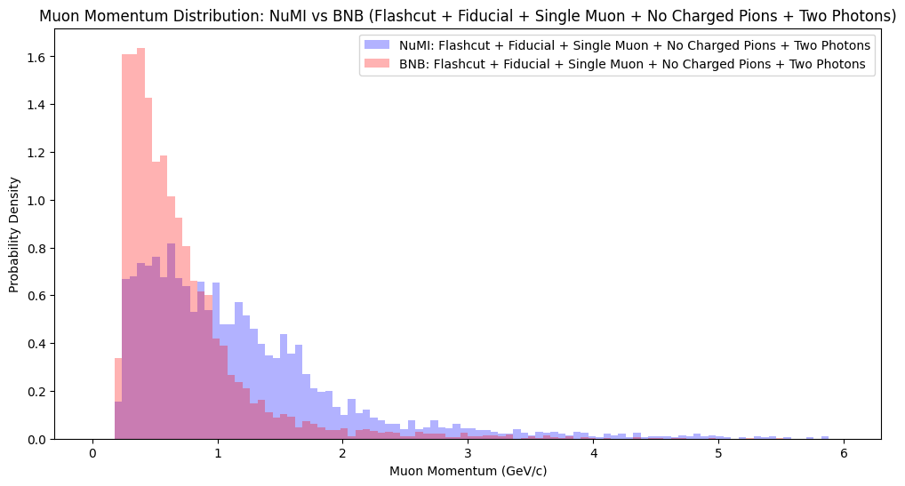
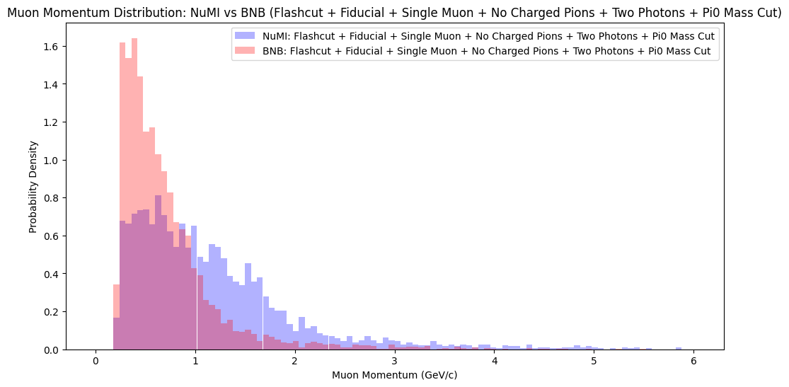
True Muon momentum
Plotting NuMI and BNB combined and normalized reconstructed leading muon momentum for each cumulative cut

Slide 13
Future work
Di-electron selection
Preliminary selection for Di-electron showers performed, showing very little Di-electron candidates in NuMI MC sample
Looking to use other MC sample files and optimizing selection parameters and cuts in the future
Selection using HNL simulation sample file
Once HNL simulation flat CAF file has been generated, utilize optimized event selection parameters and cuts for the HNL simulation file and analyse output
Moving to NuMI data and unblinding
Once event selection on HNL simulation has been conducted, move on to event selection using NuMI data files, and eventually unblinding to compare with MC distributions

Slide 14
Thank you

