Slide 1
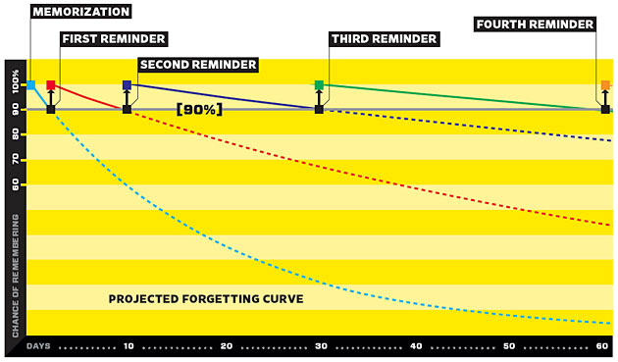
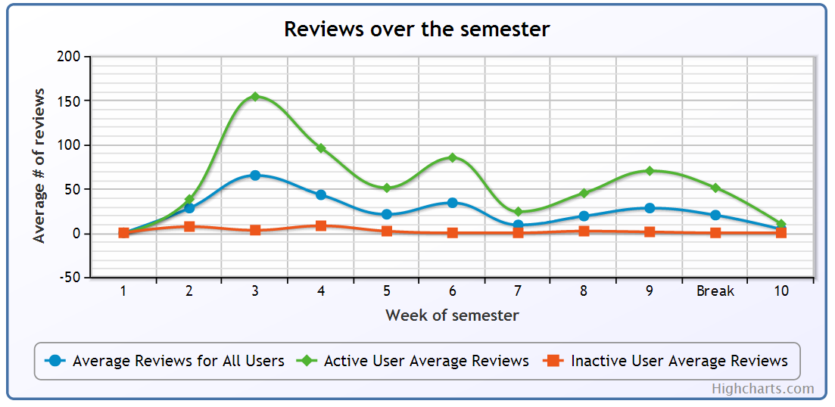
PREDICTING FOREIGN VOCABULARY RECALL
Jordan West (Supervised by Dr. Mark Schulz)
INTRODUCTION
The aim of this study is to build software for student memorisation of foreign vocabulary, record the reviews and finally to analyse the review data with various machine learning algorithms to predict the chance that a student will correctly recall a particular word.
This is achieved with a review mechanism called Spaced Repetition.
SPACED REPETITION
What is Spaced Repetition?
Spaced Repetition is a method of reviewing facts for rote memorisation based on the psychological “Spacing Effect” of memory. Knowing that each review of a fact solidifies the fact in the person’s memory, we can review the fact at increasingly longer and longer periods to retain that fact. This avoids the unnecessary need to review facts every single day, instead aiming to review facts only when necessary.
How does it work?
When you review a fact on a flash-card, the following review is scheduled based on how long since you last reviewed the fact, and whether you correctly recalled the fact. Computer software generally follows a simple algorithm to schedule reviews for the future and keeps a database with several variables pertaining to each fact. This database essentially becomes a model of the user’s knowledge of all facts.
REVIEW SOFTWARE (MEMBIT)
Software was developed which implements the well-known SuperMemo spaced repetition scheduling algorithm for the nearly 100 students in JAPN1023 to review vocabulary while recording every review. The software was populated with 240 vocabulary facts from the course textbook.
Students have been using the software since Week 2 of semester. As of week 11, over 7500 reviews have been recorded.
PREDICTION OF ANSWERS
Using the thousands of recorded student reviews as a dataset, various machine learning algorithms were trialled to attempt to predict whether a particular review of a word would be successful given a set of parameters related to the word. The black box in Figure 3 represents the prediction model which takes as input the parameters, and attempts to predict whether a review of a particular word at a particular time will be correct.
Easiness Factor – Refers to the relative easiness of the word for that user based on their history of responses.
Interval – The time expected between reviews. This increases as the user recalls the word for longer periods of time.
Overdue Time – As the user is not expected to use the review software every day, the overdue time represents how long after a card is due that it is reviewed.
Review Correct – Whether the user correctly recalled the fact (self assessed)
Results
Currently the model is accurately predicting whether the user correctly recalls a fact for 67% of reviews. This is a 34% improvement over chance; given that the study involves humans and their unpredictability this is not an insignificant result.
Inputs
Output
Easiness Factor
Interval
Overdue Time
Review Correct
# of times correct/incorrect
Review Number
Figure 3: Algorithm parameters
Figure 1: Projected Forgetting Curve
Figure 2: Usage of the software over semester

