Slide 1
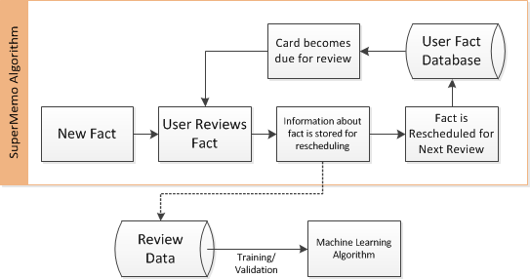
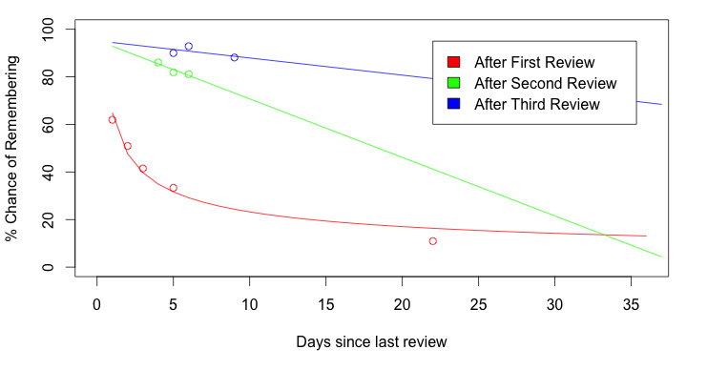
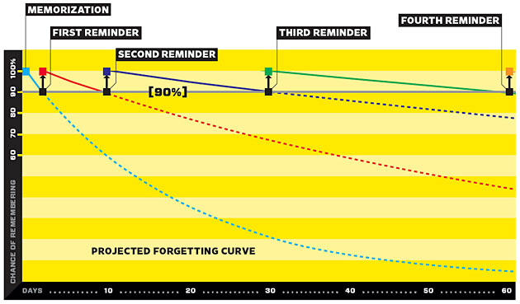
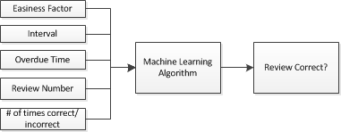
PREDICTING FOREIGN VOCABULARY RECALL
Jordan West (Supervised by Dr. Mark Schulz)
INTRODUCTION
The aim of this study is to build software for student memorisation of foreign vocabulary, record the reviews and finally to analyse the review data with various machine learning algorithms to then predict whether a student will correctly recall a particular word at any point in time.
This could potentially be used in education to identify struggling students by predicting future test scores.
METHODOLOGY
In order to space out reviews, a “Spaced Repetition” algorithm is employed – a method of reviewing facts for rote memorisation exploiting the psychological “Spacing Effect” of memory. Knowing that each review of a fact solidifies the fact in the person’s memory, one can review the fact at increasingly longer periods to retain that fact. This is actually beneficial when compared with massed repetitions in immediate succession^{[1].}
As a useful side-effect, spaced repetition algorithms must keep a database with several variables pertaining to each fact. This database essentially becomes a model of the user’s knowledge of all facts.
Software was developed which implements the popular SuperMemo^{[3]} spaced repetition scheduling algorithm for the nearly 100 students in JAPN1023 to review vocabulary while recording every review. The software was populated with 240 vocabulary facts from the course textbook.
Students have been using the software since Week 2 of semester.
Figure 3 shows some of the variables stored in the review data and used for training and validation of a model.
RESULTS
As of week 12, 28 users have made over 7,500 total reviews with the software.
The recorded review data was grouped to produce a forgetting curve as shown in Figure 4.
Running the review data through various machine learning algorithms yielded accuracies shown in Table 1 (values averages over 5 runs with a 60% training set size).
DISCUSSION
The experimental forgetting curve shows a close similarity to the projected forgetting curve in Figure 1. Although the values do not line up, the graph supports the theory that chance of recall improves with each review.
The accuracy of the machine learning algorithms at predicting whether a fact will be correctly recalled is low at under 70%, however considering the unpredictability of the human mind, this is still a significant result.
Unfortunately the number of users actively reviewing was relatively low, thus the data tended to be biased towards a few individuals. Additionally a large portion of the reviews were of newly introduced facts which contain no useful data and so were filtered out.
REFERENCES
[1] T. C. Toppino and L. C. Bloom, “The spacing effect, free recall, and two-process theory: A closer look.,” Journal of Experimental Psychology: Learning, Memory, and Cognition, vol. 28, no. 3, pp. 437–444, 2002.
[2] G. Wolf, “Want to Remember Everything You’ll Ever Learn? Surrender to This Algorithm,” WIRED, vol. 16, no. 05, 21 Apr 08.
[3] P. Wozniak, “Optimization of learning,” University of Technology in Poznan, 1990.
Figure 2: Use of Spaced Repetition Algorithm
Figure 4: Experimentally Produced Forgetting Curves
Algorithm | Training Accuracy (%) | Validation Accuracy (%)
SVM (Linear Kernel) | 68.65 | 68.43
SVM (Radial Kernel) | 69.97 | 68.24
Neural Net 1
Neural Net 2
Figure 3: Machine Learning Variables
Figure 1: Projected Forgetting Curve ^{[2]}
Table 1: Accuracy of machine learning algorithms at predicting whether a user will correctly recall a fact

