Slide 1
Spaced Repetition Systems for Predicting Foreign Language Vocabulary Test Scores
Jordan West

Slide 2

Why Predict Test Scores?
Find gaps in student knowledge
Detect struggling students early
Advise students
Adjust course materials

Slide 3
Predicting Test Scores
Japanese English
猫 _______
天気 _______
春 _______
天気予報 _______
夏 _______
46%
p
0.86
0.95
0.64
0.97
0.44
26%
?
22%
3/5 with 26% chance
4/5 with 46% chance
5/5 with 22% chance
3/5
4/5
5/5

Slide 4
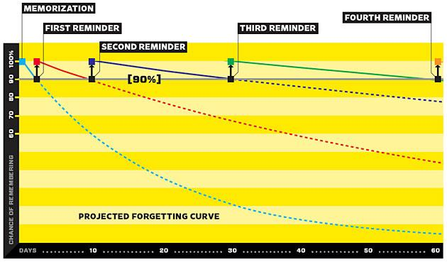
Spaced Repetition
http://www.wired.com/medtech/health/magazine/16-05/ff_wozniak?currentPage=all

Slide 5
Spaced Repetition Platform
What is the meaning of this word?
天気予報
Show

Slide 6
Spaced Repetition Platform
天気予報
Weather Forecast
How well did you recall the meaning?
Forgot
Difficult
Easy

Slide 7
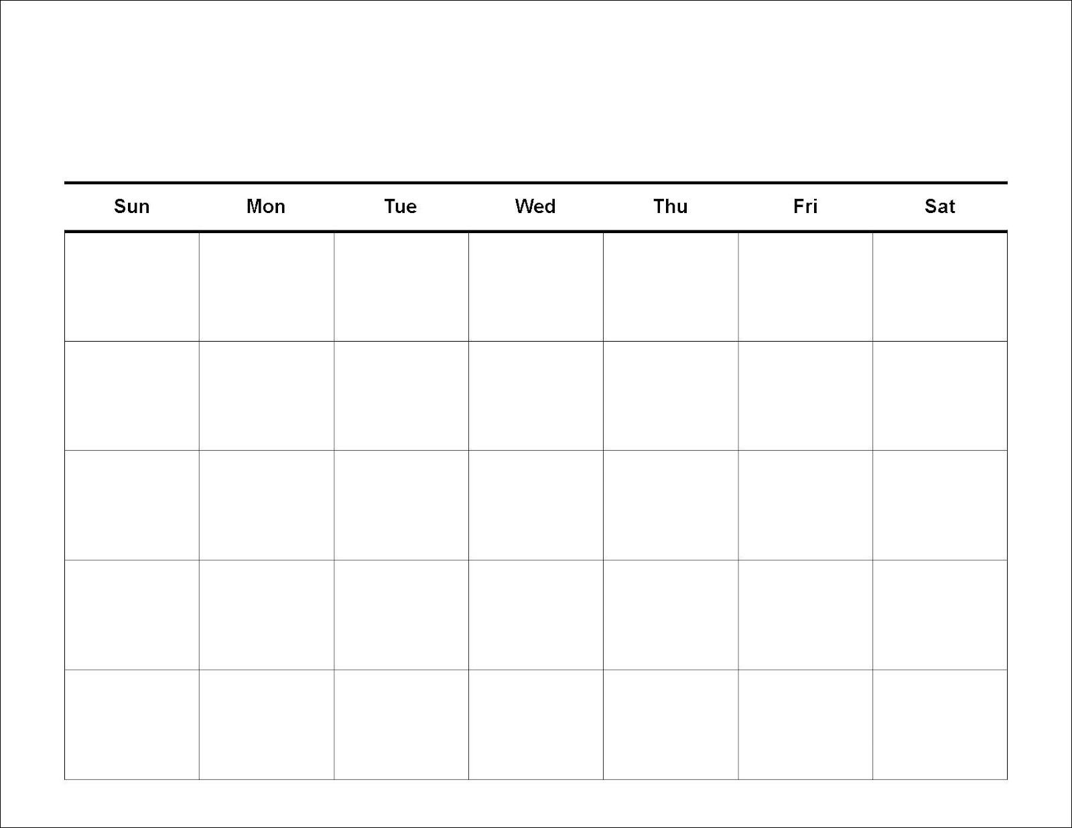
Spaced Repetition
0
1
2
5
8
1
3
10

Slide 8
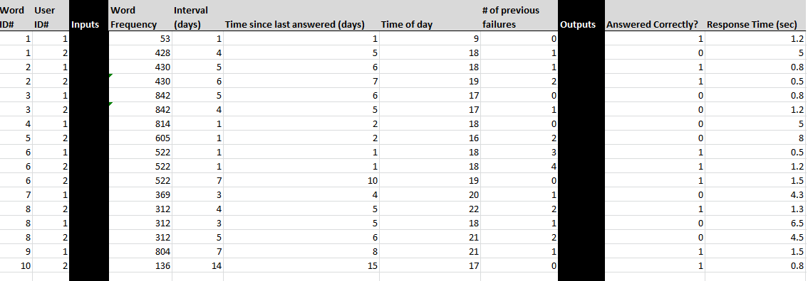
Data Model
Word Frequency
Interval (Days)
Time since last answered (Days)
Time of day
# of previous failures
Answered Correctly
Response Time

Slide 9




Solution
Web based platform to collect data and perform testing
Built-in vocabulary list for a university Japanese class (~200 words)

Slide 10
Method
Run spaced repetition platform over several weeks to gather student data
Generate probability model of student's memory using machine learning techniques
Test student and compare test results to probability model

Slide 11


Potential Uses
Estimate test scores
Improve spaced repetition algorithms
Gain more understanding of human memory
Profile facts on difficulty to memorise
Notes:
Improve spaced repetition algorithms - By more accurately estimating the user's ability to remember a word, the system could better schedule cards.
Estimate readiness for a test - The system could give both teachers and students an indication of how prepared they are for an upcoming test without directly giving them the answers

Slide 12
Work completed
Research/Topic development
Class confirmed
Spaced Repetition System UI Prototypes

Slide 13
Remaining Work
Ethics Committee Approval
Build Spaced Repetition Platform (by Week 1, Semester 2)
Collect Data
Apply Machine Learning Algorithm
Test Students (within online platform)
Compare Results

Slide 14
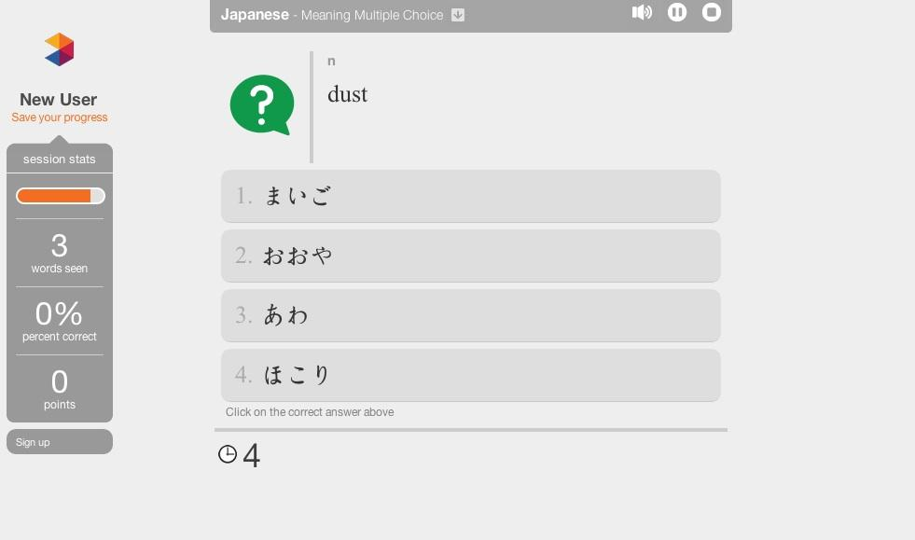
Existing Projects
Memrise
Web-based Spaced Repetition Platform
www.memrise.com

Slide 15
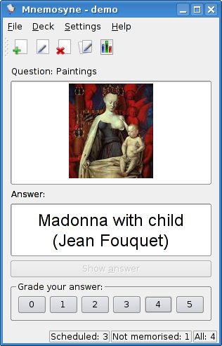
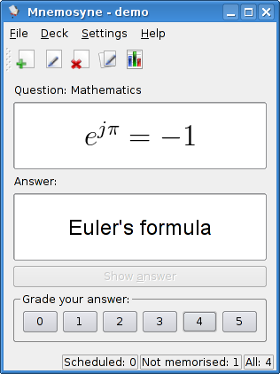
Existing Projects
Mnemosyne
Personal spaced-repetition software
www.mnemosyne.com

Slide 16
Acknowledgements
Prof. Phillip Long
Dr. Yuriko Nagata
Dr. Michael Harrington
The CEIT Team
Dr. Mark Schulz

Slide 17
