Slide 1
COVID-19 Cases Per State:

Slide 2
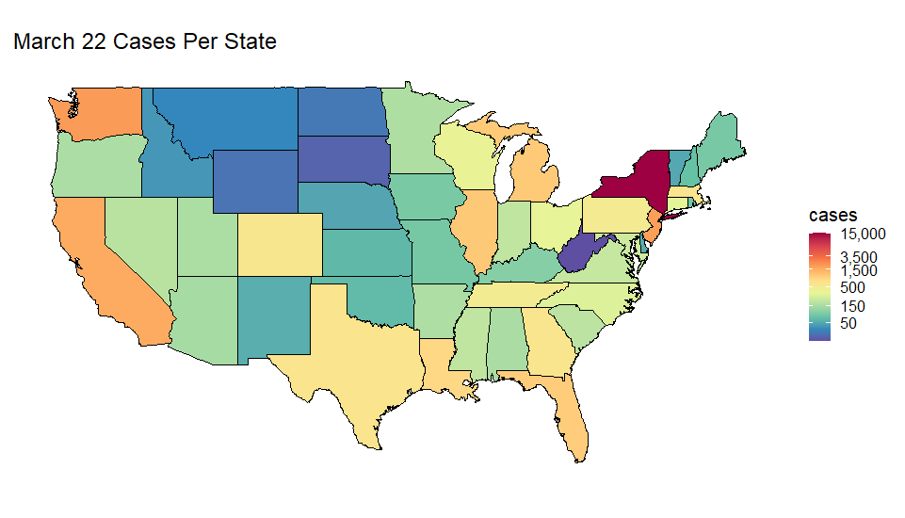

Slide 3
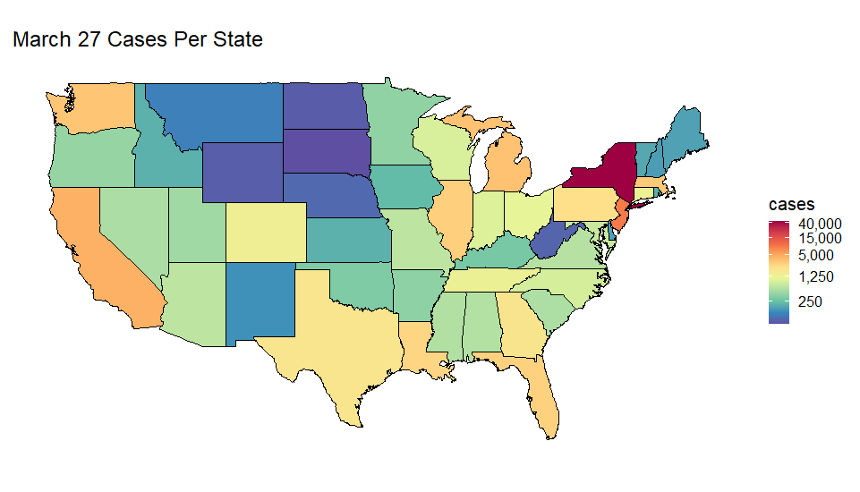

Slide 4


Slide 5
Percent of State Population Infected with COVID-19

Slide 6
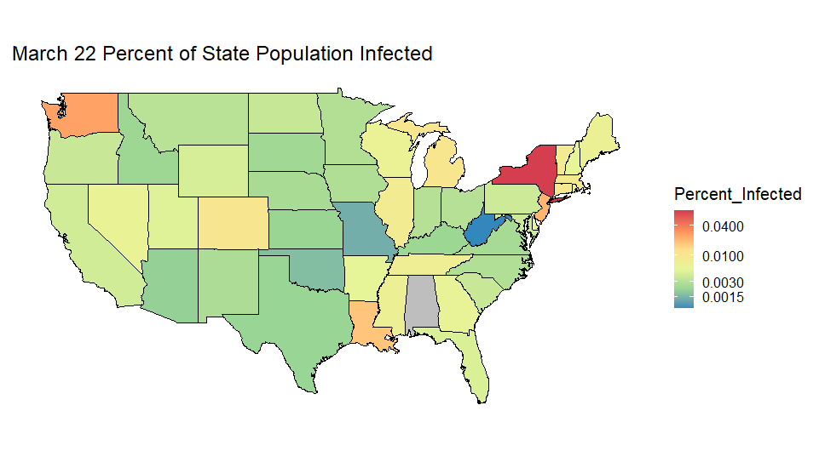

Slide 7
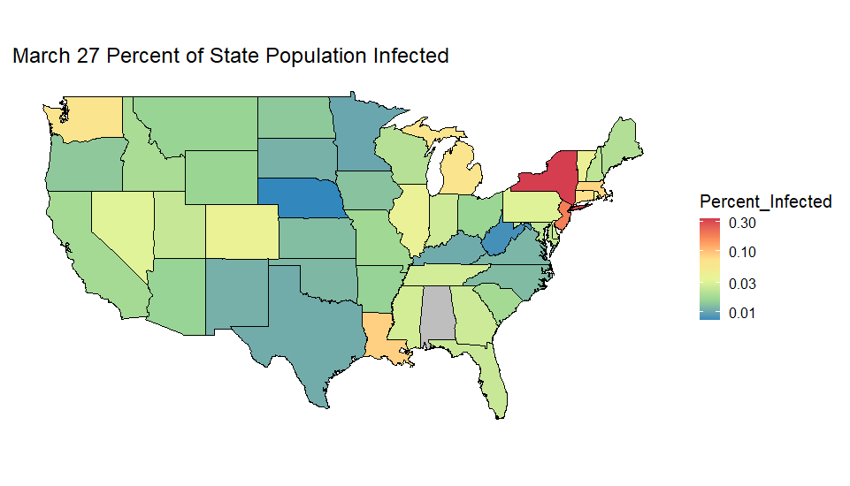

Slide 8


