Slide 1
Chicago Police Department Analysis
Jordan Whitaker
BAN 502

Slide 2

Problem Statement & Purpose
This analysis supports the broader effort to help the Chicago Police Department (CPD) become more positively engaged with the community.
The following slides will show plots that compare the relationship between certain variables and Arrest. The objective is to isolate certain variables that will be key indicators of whether or not an arrest will occur.
Source: innerself.com

Slide 3
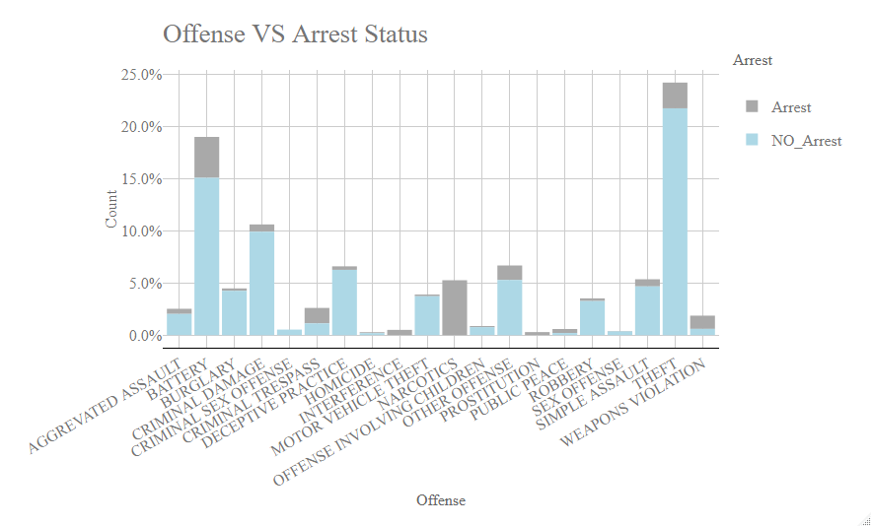
This plot looks at certain offenses and the proportion of Arrest vs No Arrests for a given offense.

Slide 4
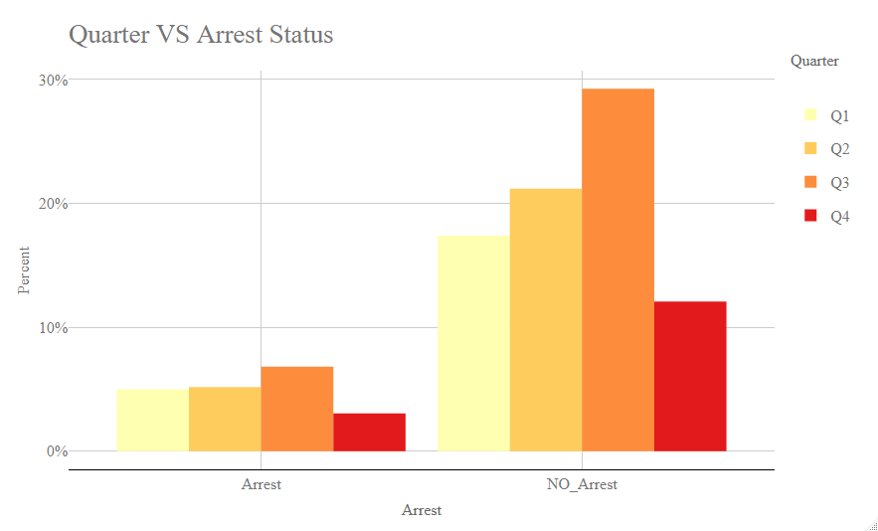
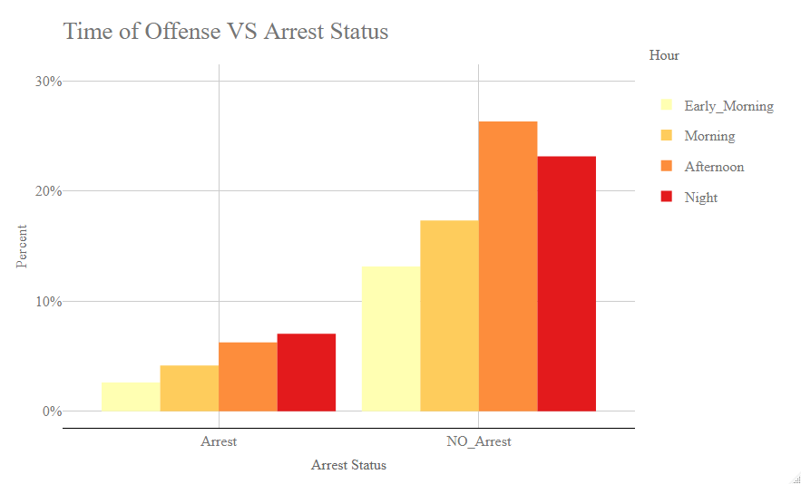
Time Variables
The plots above examine the relationship between time and Arrest. On the left, the plot shows the Quarter of the Year in relation to the Arrest Status. On the right, time of day is shown in relation to Arrest Status.

Slide 5
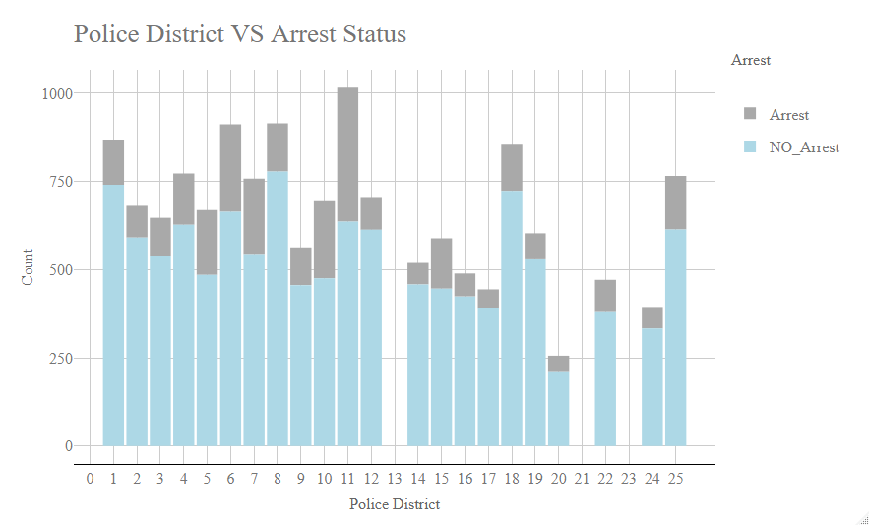
This plot highlights Police Districts and their proportion of Arrest versus No Arrests.

Slide 6
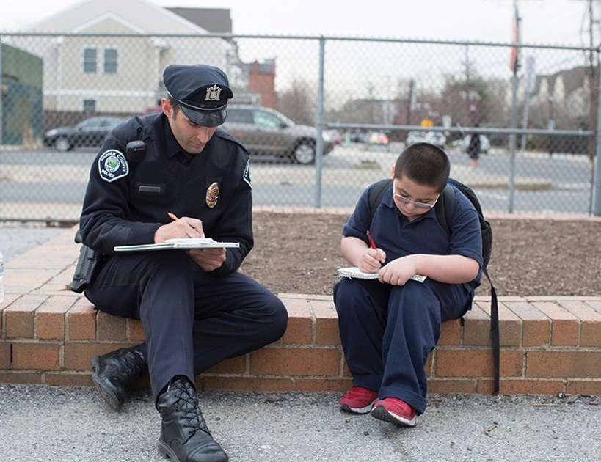
Conclusion
This analysis will enable CPD to be more proactive in their work. Examples of this may include staging more officers in what are deemed Low-Arrest areas, so that the community feels more confident that if a crime were to occur, it would lead to a just arrest.
Source: govtech.com

