Slide 1





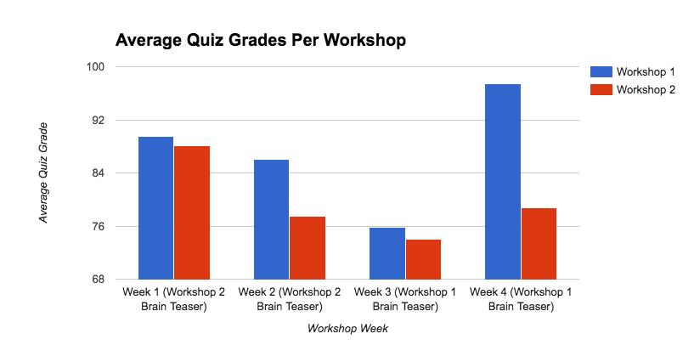
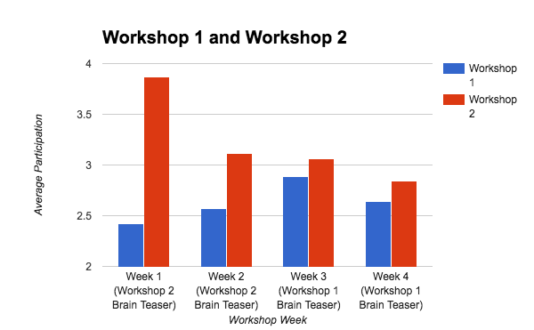
DOES A GROUP BRAIN TEASER BEFORE A WORKSHOP LEAD TO IMPROVED DISCUSSION AND UNDERSTANDING?
Patrick Ferner | Jordy Guntur
INTRODUCTION
METHOD
Brain teasers allow students to engage their critical thinking abilities prior to course related material. Research shows brain teasers improve concentration and reduce boredom. According to a Google conducted research, social behavior before a meeting leads to a more productive outcome. Overall, a brain teaser before workshop should simulate social and critical skills and thus improve a student’s ability to succeed in workshop.
We gathered data from two workshops over four weeks, where one workshop had a 10 minute discussion of a brain teaser for the first two weeks and the other workshop immediately started the problem set. After the two weeks, the roles of the workshops switched. Every workshop, we enumerated the amount each person participated in the initial thirty minutes and calculated the average number of times participated per person. We also recorded average quiz scores for both workshops.
HYPOTHESIS
DISCUSSION
If we utilize a brain teaser at the start of the workshop, it will serve as a mental and social warm up for students, and will lead to better overall discussion and comprehension of the workshop material.
In weeks one and two, Workshop 2 led with a brain teaser. In weeks three and four, Workshop 1 led with a brain teaser. For average quiz scores, there is little correlation of better quiz scores on weeks with brain teasers. After week 3, Workshop 2 had a drop in performance but had a better score than week 2 in week 4. Workshop 1 actually did better on average in the past two weeks of no brain teasers than it did afterwards. Average participation did show some results, however, in the two weeks that Workshop 2 had the brain teaser, participation was very high. Likewise, participation for Workshop 1 in the first two weeks was very low, and improved in the following two weeks.
RESULT
CONCLUSION
In conclusion, a brain teaser before a workshop may not be enough to improve student understanding, but the social time spent to solve it definitely helps to promote more participation. This echoes the research Google did in creating the perfect team. A good future study for this question is to increase the sample size, and take into account each students feedback through a survey or analyze different types of brain teasers and its effectiveness.
REFERENCES
Lukez, Alex. "Effect of Mental Exercises on Student Learning." Effect of Mental Exercises on Student Learning. University of Rochester, n.d. Web. 16 Nov. 2016.
"Positive Behavior Support." Encyclopedia of Autism Spectrum Disorders (2013): 2298. 2005. Web.
"SOCIAL CONSTRUCTIVIST PERSPECTIVES ON TEACHING AND LEARNING." SOCIAL CONSTRUCTIVIST PERSPECTIVES ON TEACHING AND LEARNING - Annual Review of Psychology. University of South Florida, n.d. Web. 16 Nov. 2016.
Duhigg, Charles. "What Google Learned From Its Quest to Build the Perfect Team." The New York Times. The New York Times, 27 Feb. 2016. Web
DEPARTMENT OF COMPUTER SCIENCE CSC 171

