Slide 1
EDES 301
Reaction Tug-of-War Proposal
10/01/2026
Jordyn Mariam

Slide 2
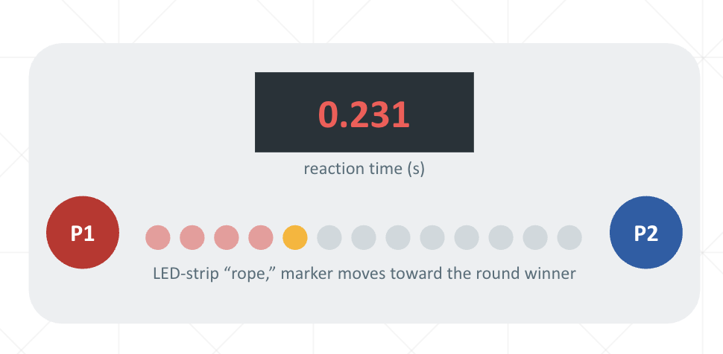
Background Information
What is being proposed?
  A 2-player reaction game on the PocketBeagle
    After a random “GO” cue, whoever reacts first and hits their button first pulls a light on an LED-strip “rope” one step toward their side
    First player to pull the rope to their end wins
    The display will show each round’s reaction time
      Possibly build in a punishment if react too early (move one step towards the opponent)
Improvements / additions over existing project
  This game was inspired and builds on the Whac-a-Mole Game with PocketBeagle (Welsh & Wicks, Hackster.io)
  Libraries: Adafruit_BBIO (GPIO, PWM, ADC), HT16K33 7-segment driver, spidev (WS2812 LED strip over SPI)
  From 1 player chasing a score → 2 players head-to-head (maybe add a 1-player mode)
  4 single LEDs → addressable LED strip “rope”
  Hit/miss scoring → millisecond reaction timing with first-press detection
  New: false-start penalty, best reaction stats saved across reboots
My story:
I originally was going to focus my project on something to help with studying, but I instead decided I wanted to do something more fun ☺. I wanted to build upon Whac-a-Mole by making it a head-to-head game that can be played with my friends and family to hopefully illustrate all that I’ve learned in EDES 301.

Slide 3
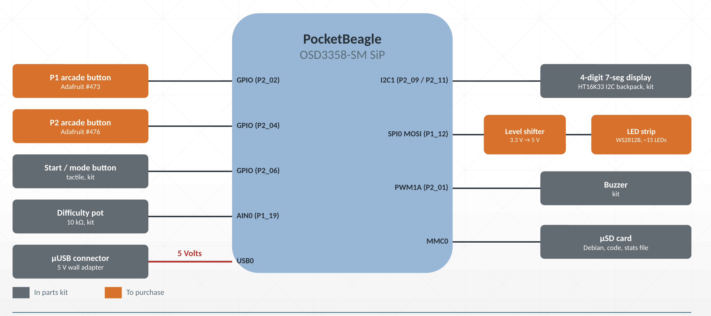
System Block Diagram
Notes:
Left side, inputs:
Two arcade buttons, one per player, plus a start button. Each is a GPIO connection.
Difficulty knob (potentiometer) uses AIN, an analog input. Reads how far the knob is turned. Likely will be used for single-player mode: sets how fast the computer “reacts.”
The micro-USB connector brings power in (the red line)
Right side, outputs:
7-segment display, over I2C. A two-wire conversation where the PocketBeagle sends numbers to show.
LED strip, over SPI: a fast data line that tells each LED what color to be. Goes through a level shifter first because PocketBeagle speaks at 3.3V and the strip expects 5V.
Buzzer, over PWM: the pin switches on and off very fast, and the speed sets the pitch of the sound.
µSD card: where Linux, code and saved stats live.

Slide 4
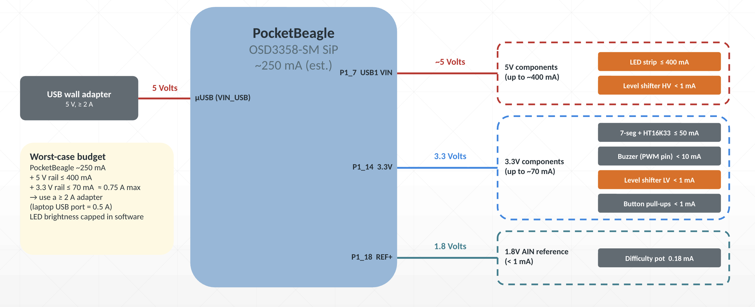
Power Block Diagram
Notes:
Power comes in from a 5V wall adapter through the micro USB port
Pocketbeagle hands it out on three rails
5V (red) for the LED strip
3.3V (blue) for the display, buzzer, and buttons
1.8V (green): only for difficulty knob. The analog input can’t handle more than 1.8V, so the knob must be wired here

Slide 5
Components / Budget
Component | EDES301 to Buy? | Cost
PocketBeagle, jumper wires | No | In Kit
4-digit, 7-segment display w/I2C backpack | No | In Kit
Buzzer, potentiometer, button | No | In Kit
Addressable LED strip (WS2812B, small strips) [Amazon link] | Yes | $17.99
Level shifter (1 in 5 pack) [Amazon link] | Yes | $1.60
Arcade buttons (not necessary but fun add) x 2 [Adafruit link] | Yes | $11.90
5 V / 2 A USB wall adapter | No | I own
Total purchasing cost: |  | $31.49

