Slide 1
Object-oriented programming
DatZB028-LV, DatZB028-EN, Spring 2025

Slide 2
Prerequisites
Prerequisites
  DatZ1166, Fundamentals of Software Development
  Software (Concept) Design, Requirements Specification
  DatZ1165, Algorithms and Programming

Slide 3
Course information
Credit points: 6
Total contact hours: 64
Lecture hours: 32
Laboratory hours: 32
  16 × 2 lectures 2 laboratory work
Home work hours: 86
Tuesdays, 16:30..19:50
Course pages:
  https://estudijas.lu.lv/user/index.php?id=17121
  https://estudijas.lu.lv/user/index.php?id=17120
https://odo.lv/Training/DatZ4019
Related courses
  DatZ4019 Object-oriented programming

Slide 4
Teacher contacts
Valdis Vitolins
  Senior Software Engineer at Netcracker
  https://odo.lv/valdis_vitolins_cv
  valdis.vitolins@odo.lv

Slide 5
Course description
The goal of the course "Object-Oriented Programming" is to apply the object-oriented approach both in the design of task solutions and in the implementation of solutions.
Course objectives:
  Learn the principles and techniques of object-oriented programming.
  Learn the typical features of the Java language — processing of different types of values, packages, creating user interfaces, handling exceptions, lambda expressions, creating mobile applications.
  Implement solutions in the development environments: Eclipse, IntelliJ IDEA, Android Studio
  Learn the basic capabilities of the object-oriented languages ​​Kotlin, Groovy, Scala and Clojure.
The course is conducted in English

Slide 6
Study results
Knowledge
  Describes the principles and techniques of object-oriented programming;
  Describes the capabilities of the Java programming language to implement an object-oriented approach to programming;
  Describes the capabilities of a programmer to create Java programs in interactive programming environments: Eclipse, IntelliJ IDEA, Android Studio
Skills
  Uses the Java language in programming small mobile applications;
  Uses the object-oriented languages ​​Kotlin, Groovy, Scala and Clojure in creating small programs.
Competence
  Evaluates the principles and techniques of object-oriented programming.
  Arguments justify the suitability of the Kotlin, Groovy, Scala and Clojure languages ​​for solving a specific task.

Slide 7
Requirements for obtaining credit points
Grading weights:
  30% 4 online knowledge tests
  35% laboratory work results
  35% individual work results
  15% final exam
Except online knowledge checks, attendance is not mandatory and is not checked
Deadline for lab works will be at the end of the course

Slide 8
Course plan
Java language syntax
OOP principles
Inheritance
Interfaces
Exceptions
Collections
Input and Output
Network
Threads
Java advanced features
Java Design patterns
XML, JSON
JDBC framework
Junit framework
Java Web frameworks
Java graphical interface
Features of the latest Java versions
Version control
JVM languages
Android development

Slide 9
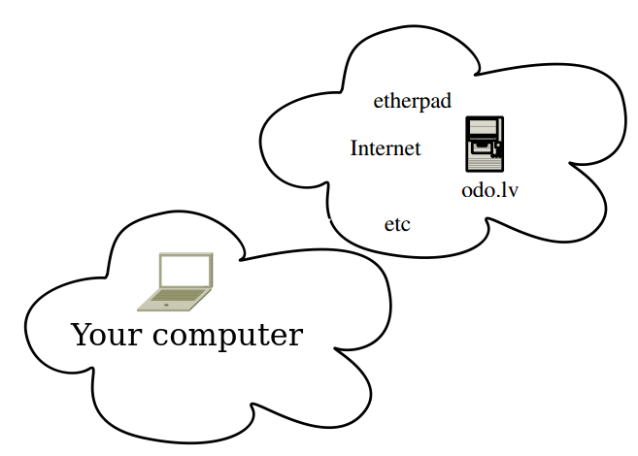

Classroom resources

Slide 10
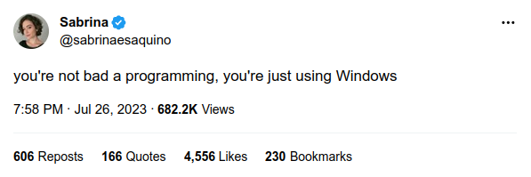
Why a Linux-based system?

Slide 11


Creation vs Consumption
How it is consumed and how it is prepared:
Users use proprietary Microsoft Windows and Office
Developers use Open Source e.g. Linux,
GNU tools, Java, MySQL, Tomcat, etc.

Slide 12

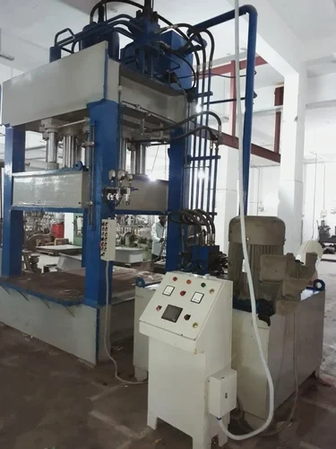
Which tools to use
There are two kinds of tools:
Tools you can take with you
  + you can make your own tool set
  – you have to carry and maintain by yourself
Tools only your company provide to you
  + everything is prepared and maintained by company
  – you cannot choose by yourself and carry with you
I always recommend 1st kind of tools

Slide 13

Preparing a Linux workstation
I recommend using a Linux-based workstation for the course because:
  Linux-based systems are easier and more predictable to use Java
  Linux-based systems are mostly used for Java infrastructure on servers
Open and follow the instructions on the page
https://odo.lv/Training/DatZ4019Exercise01

Slide 14
Questions, comments?

