Slide 1
JSON

Slide 2
What is JSON
JSON stands for JavaScript Object Notation
Was designed as a light-weight human-readable data interchange alternative to XML
It’s really language independent
  Most programming languages can easily read it and instantiate objects or some other data structure
Defined in RFC 4627
The filename extension is .json
JSON Internet Media type is application/json
Official web site https://json.org/

Slide 3
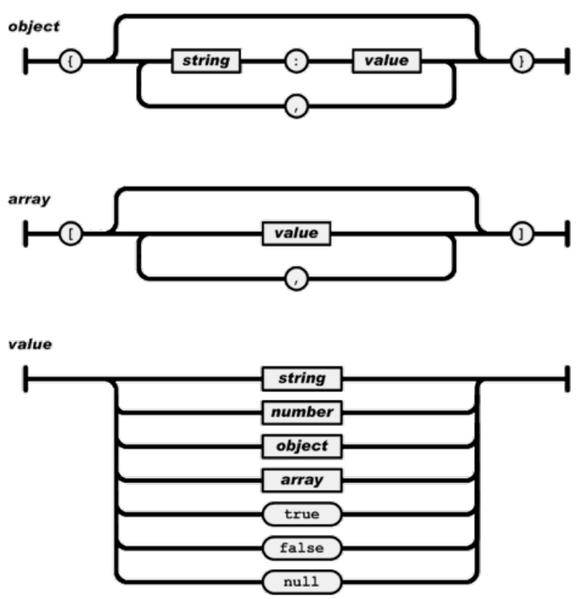
JSON syntax
Comments are NOT possible in JSON!

Slide 4
JSON example
{
"book": [
{
"id":1,
"language": "Java",
"published": "2012-04-23",
"author": "Foo Bar"
},
{
"id":7,
"language": "C++",
"published": "2018-03-21",
"author": "Bar Buz"
}
]
}

Slide 5
JSON data types
Type | Description
Array | an ordered sequence of comma separated values
Object | an unordered collection of key:value pairs
Number | double-precision floating-point format in JavaScript (can be integer, floating point or exponent-like)
String | double-quoted Unicode string with backslash escaping
Boolean | true or false
Date | Date is String with parseable date format (Usually ISO format YYYY-MM-dd HH:mm:ss)
null | Null value

Slide 6
Special characters
Special character | Escaped output
Quotation mark (B) | \"
Backslash (\) | \\
Slash (/) | \/
Backspace | \b
Form feed | \f
New line | \n
Carriage return | \r
Horizontal tab | \t
CHAR(0) | \u0000
CHAR(hhhh) | \uhhhh

Slide 7
JSON vs XML
Better
  JSON has simpler and more compact syntax
  Simpler escaping rules for specific characters (backslash)
  Easier to read and write by human
Equal:
  both are open standards
  both are language independent
Worse:
  JSON is not as extensible as XML
  No precise meaning for objects
  No schemas to validate structure and values

Slide 8
JSON in Java
There are no built-in libraries in Java for JSON, but are many 3rd party libraries.
Most popular ones are:
  https://github.com/FasterXML/jackson
  https://github.com/google/gson
  https://stleary.github.io/JSON-java/
To work with them:
  a) search jar, put in project, add to classpath, or
  b) add e.g. as maven dependency:
  <dependency>
  <groupId>org.json</groupId>
  <artifactId>json</artifactId>
  <version>20180813</version>
  </dependency>

