Slide 1
More Java features
Notes:
<skaitlis>
<skaitlis>

Slide 2
Java 8 features

Slide 3
Interfaces in Java 8
In any OO language, an interface
  cannot be instantiated, and
  defines a “contract” which any realization of the interface must fulfil.
Java is a strongly-typed language.
  Java compilers can enforce contracts, by refusing to compile classes whose implementations might “partially realize” an interface.
Java is a tightly-specified language.
  If a compiler allows instantiations of incompletely-implemented interfaces, then it is not a Java compiler.
In Java 8, an interface may contain:
  default implementations of instance methods, and
  implementations of static methods.

Slide 4
Static methods in interfaces
Java 7 and earlier prohibited static methods in interfaces. Java 8 now allows this
Motivation
  Seems natural to put operations related to the general type in the interface
  Does not violate the "spirit" of interfaces
  Shape.sumAreas(arrayOfShapes);
Notes
  You must use interface name in the method call, even from code within a class that implements the interface
    Shape.sumAreas, not sumAreas
  The static methods cannot manipulate static variables
  Java 8 interfaces continue to prohibit mutable fields

Slide 5
Default methods
Default methods are methods which are implemented in interface
Reasons to introduce default methods:
  To have backward compatibility with existing published interfaces and
  To add functionality to existing Collection interfaces
  To support lambda expressions
Difference between interfaces with default methods and abstract classes:
  Abstract class can hold state of object. Abstract class can have constructors and member variables.
  Interfaces with default method cannot maintain state.

Slide 6
Functional interfaces
Design decision: Java 8 lambdas are assigned to functional interfaces.
A functional interface is a Java interface with exactly one non-default method. E.g.,
public interface Consumer<T> {
void accept(T t);
}
The package java.util.function defines many new useful functional interfaces.
Notes:
Functional interfaces are a common idiom in Java code.
Examples of existing JDK functional interfaces: Runnable, Comparable<T>, Callable<V>.
Design decision: Java 8 lambdas should work with existing Java code without requiring recompilation.
<skaitlis>

Slide 7
4 categories of functional interfaces
Functional Interface archetypes | Example used in
Consumer | forEach(Consumer), peek(Consumer)
Predicate | filter(Predicate)
Function | map(Function)
Supplier | reduce(Supplier) collect(Supplier)

Slide 8
Lambdas

Slide 9
Lambda expressions
Lambda Expressions are new language feature which allows to treat function as a method argument (i.e. use code as data).
Lambda expressions are used primarily to define inline implementation of a functional interface, i.e., an interface with a single method only.
Lambda expression eliminates the need of anonymous class.

Slide 10
Lambda expression sample
...
processPersons(
p -> p.getGender() == Person.Sex.MALE
&& p.getAge() >= 18
&& p.getAge() <= 25,
p -> p.getEmailAddress(),
email -> System.out.println(email)
);
...

Slide 11
Typical use cases for lambdas
Anonymous classes (GUI listeners)
Runnables / Callables
Comparators
Iterators via Iterator.forEach() method

Slide 12
SAM type/functional interface
Single Abstract Method
A functional interface is an interface that has just one abstract method, and thus represents a single function contract.
(Can have other methods with bodies)
Abstract classes may be considered in the future
The @FunctionalInterface annotation helps ensure the Functional Interface contract is honored

Slide 13
Imperative versus declarative
Imperative: is a style of programming where you program the algorithm with control flow and explicit steps. Think pseudocode algorithm with branching and looping logic.
  Object-oriented programming is a Imperative programming paradigm based on the concept of "objects", which may contain data, in fields or attributes; and code, in the form of procedures or methods.
Declarative: is a style of programming where you declare what needs be done without concern for the control flow.
  Functional programming: is a declarative programming paradigm that treats computation as a series of functions and avoids state and mutable data to facilitate concurrency an in particular parallelism.

Slide 14
Behavior parameterization
What is the problem with a “STRICTLY” object-oriented programming language?
Everything is either a primitive or an object.
What's good about the OO paradigm?
OO is extremely powerful. It affords inheritence, polymorphism, and reflection….however...
  Strict OO forces you to think in terms of Objects living on the heap and your code is highly imperative (branching and explicit looping).
  OO was a great leap forward from procedural programming.
  OO is not going to be replaced any time soon. It's way too powerful. Rather it will live alongside functional programming.

Slide 15
What is functional programming?
A style of programming that treats computation as the evaluation of mathematical functions
Eliminates side effects
Treats data as being immutable
Expressions have referential transparency – this reference will do this and this only.
Functions can take functions as arguments and return functions as results
Prefers recursion over explicit for-loops

Slide 16
Why do functional programming?
Allows us to write easier-to-understand, more declarative programs than imperative programming
Allows us to focus on the problem rather than the code
Facilitates parallelism

Slide 17
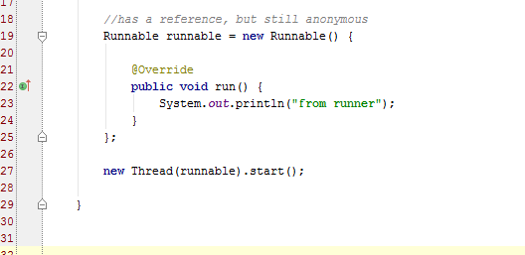
Anon (inner) classes
The way Java deal with “functional” programming prior to Java8.

Slide 18
Lambda expressions
The concept of “Functional Interface” is new, but many of the interfaces in Java7 and before are “functional interfaces” such as Runnable, Comparable, etc.
Older (Java7 and earlier) interfaces have been decorated with default methods to preserve backwards compatibility

Slide 19
Lambda expressions
A more brief and clearly expressive way to implement functional interfaces
The lambda calculus was introduced in the 1930s by Alonzo Church as a mathematical system for defining computable functions.
The lambda calculus serves as the computational model underlying functional programming languages such as Prolog, Lisp, Haskell, Scheme, Ocaml, etc.
Features from the lambda calculus such as lambda expressions have been incorporated into many widely used programming languages like C++ and now very recently Java 8.
Functions are now first-class citizens
Store a method in a Lambda for deferred execution.
Lambdas are not objects (reflection and “this” do not work

Slide 20
Syntax of Java 8 lambdas
A Java 8 lambda is basically a method in Java without a declaration usually written as (parameters) -> { body }. Examples,
(int x, int y) -> { return x + y; }
x -> x * x;
( ) -> x;
A lambda can have zero or more parameters separated by commas and their type can be explicitly declared or inferred from the context.
Parenthesis are not needed around a single parameter.
( ) is used to denote zero parameters.
The body can contain zero or more statements.
Braces are not needed around a single-statement body.

Slide 21
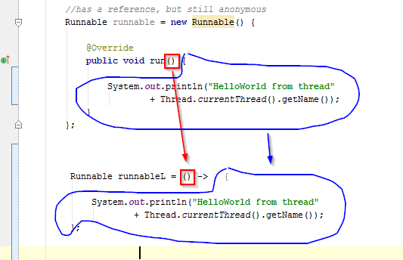
Lambda example

Slide 22
The “Type” of lambda expression
The java ‘Type’ of a lambda expression is a “Functional Interface”
Functional Interface is an interface with exactly ONE non-default, non-overriding method.
A Lambda can NOT use reflection as it is NOT an object.
A lambda can not use the “this” keyword as it is NOT an object.
Much like instance methods, a lambda does not live on the heap.

Slide 23
Is a lambda expression an object?
Not really. It is an ‘object without identity’.
It does not inherit from Object and so you can’t call the .equals(), .hashcode(), etc.
There is no ‘new’ keyword in lambda, so there is far less overhead both at compile- and run-time.
You can't use 'this' keyword to identify it using reflection.

Slide 24
The java.util.function.* library
Functional Interfaces:
Examine the SDK java.util.function
Consumers
Predicates
Suppliers
Functions
Numeric Performance Functional Interfaces
Operators
Notes:
Functional interfaces are a common idiom in Java code.
Examples of existing JDK functional interfaces: Runnable, Comparable<T>, Callable<V>.
Design decision: Java 8 lambdas should work with existing Java code without requiring recompilation.
<skaitlis>

Slide 25
Implementation of Java 8 lambdas
The Java 8 compiler first converts a lambda expression into a function
It then calls the generated function
For example, x -> System.out.println(x) could be converted into a generated static function
public static void genName(Integer x) {
System.out.println(x);
}
Notes:
What type should be generated for this function? How should it be called?
What class should the translated lambda expression function be placed it?
Should the generated method be a static or an instance method?
The Java 8 designers spent a lot of time thinking about how to implement lambdas!
<skaitlis>

Slide 26
Method references
Method references can be used to pass an existing function in places where a lambda is expected
The signature of the referenced method needs to match the signature of the functional interface method

Slide 27
Summary of method references
Method Reference Type | Syntax | Example
static | ClassName::StaticMethodName | String::valueOf
constructor | ClassName::new | ArrayList::new
specific object instance | objectReference::MethodName | x::toString
arbitrary object of a given type | ClassName::InstanceMethodName | Object::toString

Slide 28
Streams

Slide 29
What is NOT Stream
java.util.stream.Stream is NOT:
  java.io.InputStream — this abstract class is the superclass of all classes representing an input stream of bytes.
  java.io.OutputStream — this abstract class is the superclass of all classes representing an output stream of bytes

Slide 30
What is a Stream
java.util.stream.Stream is sequence of elements supporting sequential and parallel aggregate operations.
It is a limitless iterator that allows you to process collections.
Streams are created on-demand and they are infinite.
You can chain operations. This chain is called a pipeline.
You must have at least one terminal operation and zero or more intermediary operations.
The pipeline usually takes the form of map-reduce pattern.
Any stream operation that returns a Stream<T> is an intermediate operation, and any object that returns void is terminal.
May be parallelized and optimized across cores.

Slide 31
Sequence of elements
Sequence of elements— Like a collection, a stream provides an interface to a sequenced set of values of a specific element type.
Because collections are data structures, they’re mostly about storing and accessing elements, but streams are also about expressing computations such as filter, sorted, and map.

Slide 32
Data processing
Data processing — Streams support database-like operations and common operations
from functional programming languages to manipulate data, such as filter, map, reduce, find, match, sort, and so on.
Stream operations can be executed either sequentially or in parallel.

Slide 33
Pipelining
Pipelining— Many stream operations return a stream themselves, allowing operations to be chained and form a larger pipeline. This enables certain optimizations such as laziness and short-circuiting. A pipeline of operations can be viewed as a database-like query on the data source.

Slide 34
A Stream Pipeline
A stream pipeline has three components:
  A source such as a Collection, an array, a generator function, or an IO channel;
  Zero or more intermediate operations; and
  A terminal operation

Slide 35
Source
Source— Streams consume from a data-providing source such as collections, arrays, or I/O resources.
Note that generating a stream from an ordered collection preserves the ordering. The elements of a stream coming from a list will have the same order as the list.

Slide 36

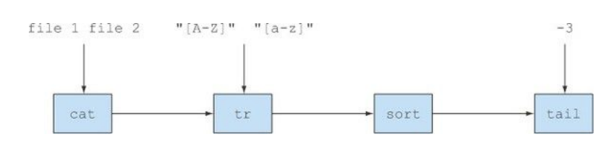
Streams are like Unix pipes
$ cat a.txt b.txt | tr "[a-z]" "[A-Z]" | sort | tail -3

Slide 37
Stream operations
An intermediate operation keeps a stream open for further operations. Intermediate operations are lazy.
A terminal operation must be the final operation on a stream. Once a terminal operation is invoked, the stream is consumed and is no longer usable.

Slide 38
Intermediary operation
Intermediary operation: A method that takes a Stream and returns a Stream.
They are lazily loaded and will only be executed if you include a terminal operation at the end.
  peek returns a stream consisting of the elements of this stream, allowing to do action on each element and consume it.
  filter excludes all elements that don’t match a Predicate.
  map performs a one-to-one transformation of elements using a Function.

Slide 39
Terminal operation
Terminal operation: A method that takes a Stream<T> and returns void.
They are eagerly loaded and will cause the entire pipeline to be executed.
A terminal operation will “spend” the stream.
  forEach performs an action for each element of this stream.
  count returns the count of elements in this stream.
  max returns the maximum element of this stream according to the provided Comparator
  collect performs a mutable reduction operation on the elements of this stream using a Collector
  reduce performs a reduction on the elements of this stream, using an associative accumulation function, and returns an Optional describing the reduced value, if any.

Slide 40
Iteration
Internal iteration— In contrast to collections, which are iterated explicitly using an iterator,
stream operations do the iteration behind the scenes for you.
Streams are consumed. You can iterate over them only once.
You can get a new stream from the initial data source to traverse it again just like for an iterator (assuming it’s a repeatable source like a collection;
  if it’s an I/O channel, you’re out of luck.

Slide 41
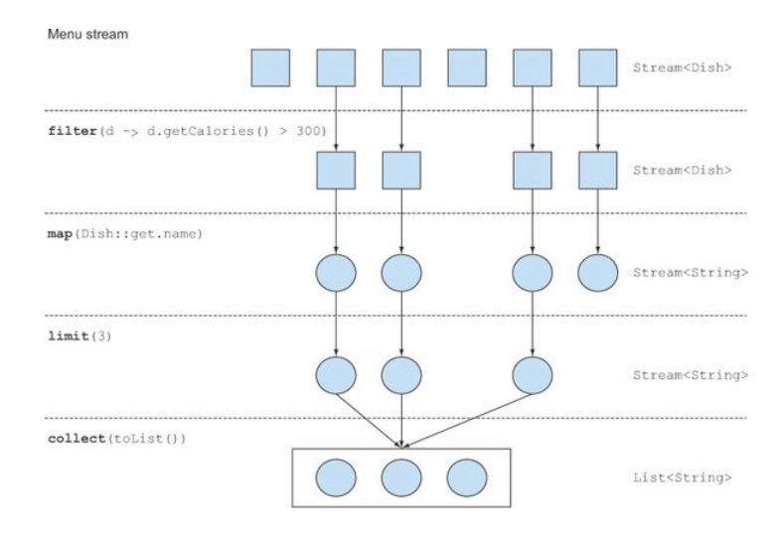
Typical operations

Slide 42
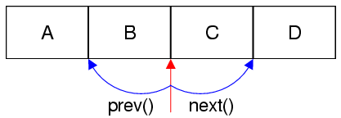
Iterator

Slide 43
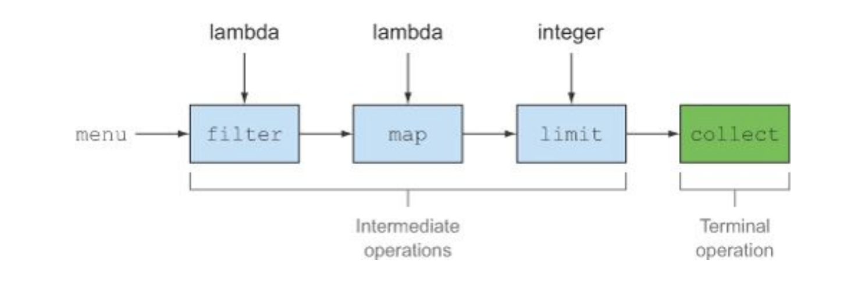
Intermediate versus terminal ops
Only the terminal operation can consume the stream which is done in a lazy manner – or on-demand.

Slide 44
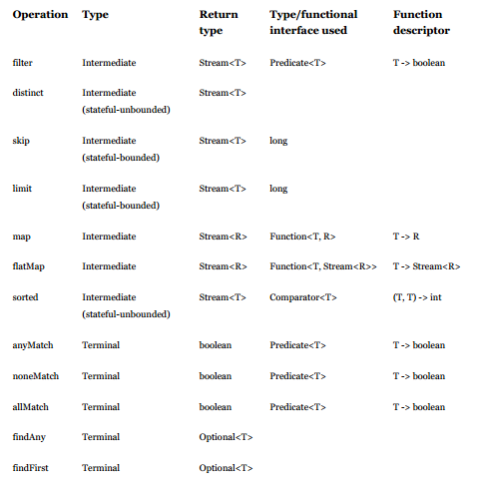
Table of ops

Slide 45
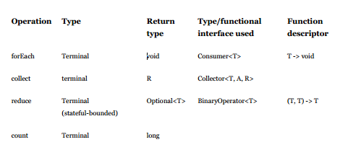
Table of ops (cont)

Slide 46
Stream example
int sum = widgets.stream()
.filter(w -> w.getColor() == RED)
.mapToInt(w -> w.getWeight())
.sum();
Here, widgets is a Collection<Widget>. We create a stream of Widget objects via Collection.stream(), filter it to produce a stream containing only the red widgets, and then transform it into a stream of int values representing the weight of each red widget. Then this stream is summed to produce a total weight.

Slide 47
Map-Reduce example
List<Integer> list = Arrays.asList(1,2,3);
int sum = list.stream().map(x -> x*x).reduce((x,y) -> x + y).get();
System.out.println(sum);
Here map(x -> x*x) squares each element and then reduce((x,y) -> x + y) reduces all elements into a single number

Slide 48
Java 11 Features

Slide 49
New String methods
Java 11 adds a few to the String class: isBlank, lines, strip, stripLeading, stripTrailing, and repeat.
Let's see how we can make use of the new methods to extract non-blank, stripped lines from a multi-line string:
String multilineString = "Baeldung helps \n \n developers \n explore Java.";
List<String> lines = multilineString.lines()
.filter(line -> !line.isBlank())
.map(String::strip)
.collect(Collectors.toList());
assertThat(lines).containsExactly("Baeldung helps", "developers", "explore Java.");
These methods can reduce the amount of boilerplate involved in manipulating string objects, and save us from having to import libraries.
In the case of the strip methods, they provide similar functionality to the more familiar trim method; however, with finer control and Unicode support.

Slide 50
New File methods
Additionally, it's now easier to read and write Strings from files.
We can use the new readString and writeString static methods from the Files class:
Path filePath = Files.writeString(Files.createTempFile(tempDir, "demo", ".txt"), "Sample text");
String fileContent = Files.readString(filePath);
assertThat(fileContent).isEqualTo("Sample text");

Slide 51
Collection to an Array
The java.util.Collection interface contains a new default toArray method which takes an IntFunction argument.
This makes it easier to create an array of the right type from a collection:
List sampleList = Arrays.asList("Java", "Kotlin");
String[] sampleArray = sampleList.toArray(String[]::new);
assertThat(sampleArray).containsExactly("Java", "Kotlin");

Slide 52
The not predicate method
A static not method has been added to the Predicate interface. We can use it to negate an existing predicate, much like the negate method:
List<String> sampleList = Arrays.asList("Java", "\n \n", "Kotlin", " ");
List withoutBlanks = sampleList.stream()
.filter(Predicate.not(String::isBlank))
.collect(Collectors.toList());
assertThat(withoutBlanks).containsExactly("Java", "Kotlin");
While not(isBlank) reads more naturally than isBlank.negate(), the big advantage is that we can also use not with method references, like not(String:isBlank).

Slide 53
Local-variable syntax for lambda
Support for using the local variable syntax (var keyword) in lambda parameters was added
We can make use of this feature to apply modifiers to our local variables, like defining a type annotation:
List<String> sampleList = Arrays.asList("Java", "Kotlin");
String resultString = sampleList.stream()
.map((@Nonnull var x) -> x.toUpperCase())
.collect(Collectors.joining(", "));
assertThat(resultString).isEqualTo("JAVA, KOTLIN");

Slide 54
HTTP client
The new HTTP client from the java.net.http package was introduced in Java 9. It has now become a standard feature in Java 11.
The new HTTP API improves overall performance and provides support for both HTTP/1.1 and HTTP/2:
HttpClient httpClient = HttpClient.newBuilder()
.version(HttpClient.Version.HTTP_2)
.connectTimeout(Duration.ofSeconds(20))
.build();
HttpRequest httpRequest = HttpRequest.newBuilder()
.GET()
.uri(URI.create("http://localhost:" + port))
.build();
HttpResponse httpResponse = httpClient.send(httpRequest, HttpResponse.BodyHandlers.ofString());
assertThat(httpResponse.body()).isEqualTo("Hello from the server!");

Slide 55
Nest based access control
Java 11 introduces the notion of nestmates and the associated access rules within the JVM.
A nest of classes in Java implies both the outer/main class and all its nested classes:
  assertThat(MainClass.class.isNestmateOf(MainClass.NestedClass.class)).isTrue();
Nested classes are linked to the NestMembers attribute, while the outer class is linked to the NestHost attribute:
  assertThat(MainClass.NestedClass.class.getNestHost()).isEqualTo(MainClass.class);
JVM access rules allow access to private members between nestmates; however, in previous Java versions, the reflection API denied the same access.
Java 11 fixes this issue and provides means to query the new class file attributes using the reflection API:
  Set<String> nestedMembers = Arrays.stream(MainClass.NestedClass.class.getNestMembers())
  .map(Class::getName)
  .collect(Collectors.toSet());
  assertThat(nestedMembers).contains(MainClass.class.getName(), MainClass.NestedClass.class.getName());

Slide 56
Running Java files
A major change in this version is that we don't need to compile the Java source files with javac explicitly anymore:
$ javac HelloWorld.java
$ java HelloWorld
Hello Java 8!
Instead, we can directly run the file using the java command:
$ java HelloWorld.java
Hello Java 11!

Slide 57
Miscellaneous changes
Java 11 introduced a few more changes that are important to mention:
New ChaCha20 and ChaCha20-Poly1305 cipher implementations replace the insecure RC4 stream cipher
Support for cryptographic key agreement with Curve25519 and Curve448 replace the existing ECDH scheme
Upgraded Transport Layer Security (TLS) to version 1.3 brings security and performance improvements
Introduced a low latency garbage collector, ZGC, as an experimental feature with low pause times
Support for Unicode 10 brings more characters, symbols, and emojis

Slide 58
Java 14 features
Switch expressions:
boolean isTodayHoliday = switch (day) {
case "MONDAY", "TUESDAY", "WEDNESDAY", "THURSDAY", "FRIDAY" -> false;
case "SATURDAY", "SUNDAY" -> true;
default -> throw new IllegalArgumentException("What's a " + day);
};
Text blocks:
String multiline = """
A quick brown fox jumps over a lazy dog; \
the lazy dog howls loudly.""";

Slide 59
Records
Were introduced to reduce repetitive boilerplate code in data model POJOs.
Specifies fields in record declaration;
They are “Value Objects” in contrast with “Identity Objects” instatiated from class.
Accessors, constructor, equals, hashCode, and toString methods are created automatically.
Fields are final, to ensure consistency of values
record Rectangle(double length, double width) { }

Slide 60
Java 17 features

Slide 61
Pattern matching for Switch
This is another step toward pattern matching by enhancing pattern matching for switch expressions and statements. It reduces the boilerplate necessary to define those expressions and improves the expressiveness of the language.
Let's see two examples of the new capabilities:
static record Human (String name, int age, String profession) {}
public String checkObject(Object obj) {
return switch (obj) {
case Human h -> "Name: %s, age: %s and profession: %s".formatted(h.name(),
h.age(), h.profession());
case Circle c -> "This is a circle";
case Shape s -> "It is just a shape";
case null -> "It is null";
default -> "It is an object";
};
}
public String checkShape(Shape shape) {
return switch (shape) {
case Triangle t && (t.getNumberOfSides() != 3) -> "This is a weird
triangle";
case Circle c && (c.getNumberOfSides() != 0) -> "This is a weird circle";
default -> "Just a normal shape";
};
}

Slide 62
Sealed classes
Sealed classes are part of Project Amber, and this JEP officially introduces a new feature to the language, although it was available in preview mode in the JDK versions 15 and 16.
The feature restricts which other classes or interfaces may extend or implement a sealed component. Showing another improvement related to pattern matching combined with the JEP 406 will allow a more sophisticated and cleaner inspection of the type, cast and act code pattern.
int getNumberOfSides(Shape shape) {
return switch (shape) {
case WeirdTriangle t -> t.getNumberOfSides();
case Circle c -> c.getNumberOfSides();
case Triangle t -> t.getNumberOfSides();
case Rectangle r -> r.getNumberOfSides();
case Square s -> s.getNumberOfSides();
};
}

Slide 63
Foreign function and memory API
The Foreign Function and Memory API allow Java developers to access code from outside the JVM and manage memory out of the heap. The goal is to replace the JNI API and improve the security and performance compared to the old one. With this feature, we can make a call to a C library from a Java class:
private static final SymbolLookup libLookup;
static {
// loads a particular C library
var path = JEP412.class.getResource("/print_name.so").getPath();
System.load(path);
libLookup = SymbolLookup.loaderLookup();
}
First, it is necessary to load the target library we wish to invoke via the API. Next, we need to specify the signature of the target method and finally call it:
public String getPrintNameFormat(String name) {
var printMethod = libLookup.lookup("printName");
if (printMethod.isPresent()) {
var methodReference = Clinker.getInstance()
.downcallHandle(
printMethod.get(),
MethodType.methodType(MemoryAddress.class, MemoryAddress.class),
FunctionDescriptor.of(CLinker.C_POINTER, Clinker.C_POINTER)
);
try {
var nativeString = CLinker.toCString(name, newImplicitScope());
var invokeReturn = methodReference.invoke(nativeString.address());
var memoryAddress = (MemoryAddress) invokeReturn;
return Clinker.toJavaString(memoryAddress);
} catch (Throwable throwable) {
throw new RuntimeException(throwable);
}
}
throw new RuntimeException("printName function not found.");
}

Slide 64
Vector API
The Vector API deals with the SIMD (Single Instruction, Multiple Data) type of operation, meaning various sets of instructions executed in parallel. It leverages specialized CPU hardware that supports vector instructions and allows the execution of such instructions as pipelines.
As a result, the new API will enable developers to implement more efficient code, leveraging the potential of the underlying hardware.
Everyday use cases for this operation are scientific algebra linear applications, image processing, character processing, and any heavy arithmetic application or any application that needs to apply an operation for multiple independent operands.
public void newVectorComputation(float[] a, float[] b, float[] c) {
for (var i = 0; i < a.length; i += SPECIES.length()) {
var m = SPECIES.indexInRange(i, a.length);
var va = FloatVector.fromArray(SPECIES, a, i, m);
var vb = FloatVector.fromArray(SPECIES, b, i, m);
var vc = va.mul(vb);
vc.intoArray(c, i, m);
}
}
public void commonVectorComputation(float[] a, float[] b, float[] c) {
for (var i = 0; i < a.length; i ++) {
c[i] = a[i] * b[i];
}
}

Slide 65
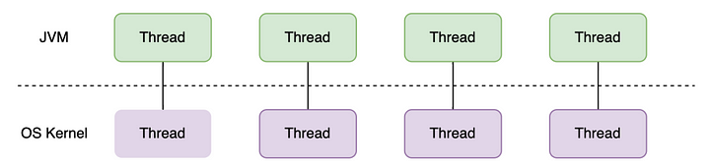
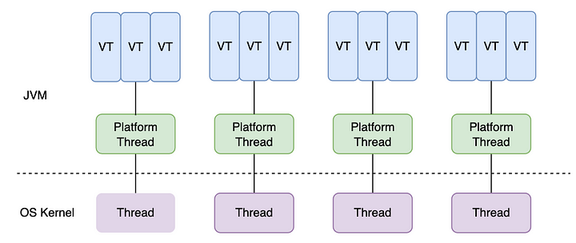
Java 19 virtual threads
Classic threads
Virtual threads

Slide 66
Basics of virtual thread API
No prinicpial difference from classic platform threads:
// Construct classic platform or virtual threads
Runnable runnable = () ->
System.out.println(Thread.currentThread().threadId());
Thread thread = Thread.ofVirtual().name("testVT").unstarted(runnable);
Thread testPT = Thread.ofPlatform().name("testPT").unstarted(runnable);
// Start, join virtual thread explicitly
thread.start();
thread.join();
// Start virtual thread as child of current thread
Runnable runnable = () -> System.out.println(Thread.currentThread().threadId());
Thread thread = Thread.startVirtualThread(runnable);
// Check if thread is virtual
Runnable runnable = () -> System.out.println(Thread.currentThread().isVirtual());
Thread thread = Thread.startVirtualThread(runnable);

Slide 67
Short overview
https://www.youtube.com/watch?v=P7SI9mLwiqw

