Slide 1
JVM languages

Slide 2
Sources
DatZ4019-LV : Objektorientētā programmēšana
https://estudijas.lu.lv/course/view.php?id=1445
Uldis Straujums, University of Latvia, 2022

Slide 3
How JVM languages work
Java is compiled language
You can get the same bytecode from different sources and different compilers
Java
Java compiler
*.class file
Kotlin
Kotlin compiler
Scala
Scala compiler
Other
Other compiler

Slide 4
Short history of JVM languages
Rhino (1997) was originally developed by Netscape, and later the Mozilla project. It provides an implementation of JavaScript on the JVM.
Jython (2001) was started in 1997 by Jim Hugunin as a way to use high-performance Java libraries from Python.
JRuby (2001) is a JVM reimplementation of the Ruby programming language. Ruby is a dynamically typed OO language with some functional features.
Scala (2001) is an object-oriented and functional programming language.
Groovy (2003) is an object-oriented programming language for the Java platform.
Clojure (2008)is a dialect of the Lisp programming language created by Rich Hickey. It is a functional general-purpose language.
Kotlin (2011) cross-platform, statically typed, general-purpose high-level programming language with type inference initially developed by JetBrains
Kawa (2020) an implementation of Lisp
Many more in https://en.wikipedia.org/wiki/List_of_JVM_languages

Slide 5
High-profile JVM languages
Groovy
Scala
Clojure
Kotlin

Slide 6
Groovy
Paradigm | Multi-paradigm: object-oriented, imperative, functional, aspect-oriented, scripting
Designed by | James Strachan
Developer | Guillaume Laforge (PMC Chair) Jochen Theodorou (Tech Lead) Paul King Cedric Champeau
First appeared | 2003
Stable release | 4.0.5 (September 6, 2022)
Typing discipline | Dynamic, static, strong, duck
Platform | Java SE
License | Apache License 2.0
Filename extensions | .groovy, .gvy, .gy, .gsh
Website | groovy-langhttps://groovy-lang.org/

Slide 7
Groovy
Groovy is an OO, dynamically typed language that, like Java, runs on the JVM. In fact, it can be seen as a language that provides dynamic capabilities to complement the static world of Java.
The Groovy project was initially founded by James Strachan and Bob McWhirter in late 2003, with its leadership changed to Guillaume Laforge in 2004.
Unlike Java, Groovy source code can be executed as a script. For example, if you have code outside of a class definition, that code will still execute.
Like other dynamic scripting languages, such as Ruby or Python, a Groovy script is fully parsed, compiled, and generated in memory before execution on the JVM.
Any code that you can execute in the Groovy console can also be saved in a .groovy file, compiled, and then run as a script.
System.out.println("It's Groovy baby, yeah!");

Slide 8
Everything is object
The Groovy designers decided to do away with primitive types.
When Groovy needs to store values that would have used Java’s primitive types, Groovy uses the wrapper classes already provided by the Java platform.

Slide 9
Numbers are objects
Groovy makes a point of using objects for everything.
def x = 1
def y = 2
assert x + y == 3
assert x.plus(y) == 3
assert x instanceof Integer

Slide 10
Groovy and BigDecimal
BEDMAS (Brackets, Exponents, Division, Multiplication, Addition, Subtraction — the standard order of operations for arithmetic) is properly implemented in Groovy
Groovy seamlessly swaps between numeric types (such as int and double) as required.
3 + 0.2;

Slide 11
Dynamic versus Static
You don’t have to specify the type of the variable you’re declaring (or returning).
x = new Date();
X = 1;
Date x = new Date();

Slide 12
Syntax for lists and maps 1/2
Groovy treats lists and maps (including sets) as first-class citizens in the language, so there’s no need to explicitly declare a List or a Map construct like you would in Java.
jvmLanguages = ["Java", "Groovy", "Scala", "Clojure"];
println(jvmLanguages[0]);
println(jvmLanguages.size());
jvmLanguages = [];
println(jvmLanguages);

Slide 13
Syntax for lists and maps 2/2
Groovy treats lists and maps (including sets) as first-class citizens in the language, so there’s no need to explicitly declare a List or a Map construct like you would in Java.
languageRatings = [Java:100, Groovy:99, Clojure:"N/A"];
println(languageRatings["Java"]);
println(languageRatings.Clojure);
languageRatings["Clojure"] = 75;
println(languageRatings["Clojure"]);
languageRatings = [:];
println languageRatings;

Slide 14
For loops in lists and maps
Groovy simplifies property access, allowing
for far more readable code..
def classes = [String, List, File]
for (clazz in classes) {
println clazz.package.name
}
or even
println( [String, List, File]*.package*.name )

Slide 15
Groovy closures (function literals)
In Groovy, function literals are called closures.
Closures are functions that can be put into variables, passed to methods, and manipulated in the same ways as any other value.
[1, 2, 3].each { entry -> println entry}

Slide 16
Function literals (1)
A function literal is a representation of a block of code that can be passed around as a value and can be manipulated just like any other value.
def sayHello =
{
name ->
if (name == "Martijn" || name == "Ben")
"Hello author " + name + "!"
else
"Hello reader " + name + "!"
}
println(sayHello("Martijn"))
Hello author Martinj

Slide 17
Function literals (2)
"
When there is only one parameter passed into the closure, its declaration is optional.
The magic variable it can be used instead.
log = ''
(1..10).each{ counter -> log += counter }
assert log == ‘12345678910’
println log
log = ''
(1..10).each{ log += it }
assert log == '12345678910‘
println log

Slide 18
Function literals (3)
A second way of declaring a closure is to directly assign it to a variable.
def printer = { line -> println line }
def Closure getPrinter() {
return { line -> println line }
}
println getPrinter()

Slide 19
Function literals (4)
The third way of declaring a closure is to reuse something that is already declared: a method.
map = ['a':4, 'b':8]
def doubleMethod (entry){
map[entry.key] = entry.value * 2
}
doubler = this.&doubleMethod
map.each(doubler)
assert map == ['a':8, 'b':16]
println map

Slide 20
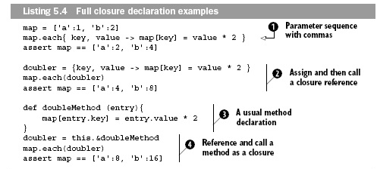
Function literals (5)
All of ways of creating and using closures:
through simple declaration, assignment to variables,
and method closures.

Slide 21
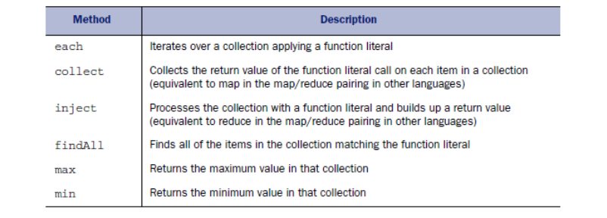
Groovy functions on collections
movieTitles = ["Seven", "SnowWhite", "Die Hard"]
movieTitles.each({x -> println x})

Slide 22
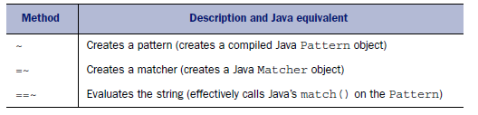
First class support for regular expressions 1/2
// Groovy
def pattern = /1010/
def input = "1010"
def matcher = input =~ pattern
if (input ==~ pattern)
{
input = matcher.replaceFirst("0101")
println input
}
// Java
Pattern pattern = Pattern.compile("1010");
String input = "1010";
Matcher matcher = pattern.matcher(input);
if (input.matches("1010"))
{
input = matcher.replaceFirst("0101");
System.out.println(input);
}

Slide 23
First class support for regular expressions 2/2
Groovy supports the full semantics of regular expressions
in the same way that Java does.
Regular expressions can also be combined nicely with function literals.
For example,
you could print out the details of a person by parsing a String and pulling out
the name and age.
("Hazel 1" =~ /(\w+) (\d+)/).each {full, name, age
-> println "$name is $age years old."}

Slide 24
Safe dereferencing with ?. operator
When a reference doesn’t point to any specific object, its value is null.
When calling a method or accessing a field on a null reference, a NullPointerException (NPE) is thrown.
We can use explicit if checks or use the try-catch mechanism.
Groovy provides the additional ?. operator for safe dereferencing.
When the reference before that operator is a null reference,
the evaluation of the current expression stops, and null is returned.
def map = [a:[b:[c:1]]]
assert map?.a?.x?.c == null

Slide 25
Operator overloading
When Java has no support for operator overloading, how does Groovy get away with that?
It’s really simple: each operator has a standard mapping to methods.
for(ch = 'a'; ch < 'd'; ch++) { println ch }
We’re looping through the characters a through c using the ++ operator. This operator maps to the next() method on the String class.

Slide 26
Summary
Groovy has several compelling features that make it a great language to use alongside Java. You can write syntax that’s very similar to that of Java, but you also have the choice of writing the same logical code in a more concise manner.
Groovy has several new language features that many Java developers hope to see in the Java language itself one day. The most difficult to grasp, yet most powerful, of these is function literals, a powerful programming technique that (amongst other capabilities) helps you execute operations over collections with ease.

Slide 27
Scala
Paradigm | Multi-paradigm: concurrent, functional, imperative, object-oriented
Designed by | Martin Odersky
Developer | Programming Methods Laboratory of École Polytechnique Fédérale de Lausanne
First appeared | 20 January 2004
Stable release | 3.2.2 / 30 January 2023
Preview release | 3.0.0-RC3 / 19 April 2021;
Typing discipline | Inferred, static, strong, structural
Implementation language | Scala
Platform | Java virtual machine (JVM), JavaScript (Scala.js), LLVM (Scala Native) (experimental)
Filename extensions | .scala, .sc
Website | http://www.scala-lang.org/

Slide 28
Scala
Scala is an universal programming language developed to express commonly used programming patterns in a concise, elegant and type-safe way. Scala smoothly integrates object-oriented and functional approach boosting programmer’s productivity.
Martin Odersky (the creator of Scala) and his team began to develop Scala in 2001 EPFL (École Polytechnique Fédérale de Lausanne) programming methods lab. Scala became publicly available in January 2004 in JVM platform and some months later in .NET platform.
Scala dokumentation, downloads and community is available at http://www.scala-lang.org/

Slide 29
«object» in Scala
«object» in Scala is a special term not «object» in general
object Hello extends App means in Scala that object Hello is a special kind of class – a class constructed according to Singleton design pattern.
Singleton instances are instances that you should initialize at most once. Scala offers a dedicated syntax for them: you usually refer to them as “objects”.
Term “object” in other languages refers to an instance.

Slide 30
Object-oriented and functional
Scala language uses pure object-oriented model similar to Smaltalk (pure object-oriented language created by Alan Kay at about 1980), where every value is an object and every action is a message sending.
1+2 is interpreted as 1.+ (2)
You call +operation for integer object (in this case1),
passing 2 as an argument.

Slide 31
Object-oriented and functional
Fuctional programming is a programming paradigm which treates computing as matematical function evaluating and avoiding states and mutable values.
List(1, 2, 3).map((x: Int) => x + 1) creates List(2, 3, 4)
You pass adding function to another function called map.

Slide 32
Scala as a multiparadigm language
In Scala language functions are treated as objects.
List(1, 2, 3).map((x: Int) => x + 1) is translated into
List(1, 2, 3).map(new Function1[Int, Int]{ def apply(x:Int): Int = x + 1})
When Scala compiler meets a function with one parameter it replaces function call with a scala.Function1 instance which implements the method apply.

Slide 33
Scala as a scalable and extensible language
Scala means scalable language.
Closure is a first-class function with free variables tied to the context.
Closures in Scala may be passed as “pass by name” arguments to other functions.
def loopTill(cond: => Boolean)(body: => Unit): Unit = {
if (cond) {
body
loopTill(cond)(body)
}
}
var i = 10
loopTill (i > 0) {
println(i)
i -= 1
}

Slide 34
Scala’s approch to concurrency 1/2
Actor model provides a high abstraction level for concurrent and distributed system development. Aktor model allows developer to get rid of direct programming of thread management and blocking. Actors were introduced in 1973 in Carl Hewitt’s publication and were implemented in Erlang language.
Starting with Scala 2.10 users should use «Akka actors» from package akka.actor. Akka is a toolkit based on Scala.

Slide 35
Scala’s approch to concurrency 2/2
To make concurrent programming more convenient Scala introduces higher abstraction in parallel collections. Collections hide parallel algorithms.
List(1, 2, 3).par.map(x => x * x)
Parallel collections library is a new Scala extension and supports parallel versions for most collection types.

Slide 36
Scala does more with less code
boolean hasUpperCase = false;
for(int i = 0; i < name.length(); i++) {
if(Character.isUpperCase(name.charAt(i))) {
hasUpperCase = true;
break;
}
}
val hasUpperCase = name.exists(_.isUpper)
Java
Scala

Slide 37
For-comprehension
Generally, a for-comprehension is of the form
for ( s ) yield e
Here, s is a sequence of generators, definitions and filters. A generator is of the form
val x <- e,
where e is a list-valued expression. It binds x to successive values in the list.
A definition is of the form val x = e. It introduces x as a name for the value of e
in the rest of the comprehension.
A filter is an expression f of type Boolean. It omits from consideration all bindings for which f is false. The sequence s starts in each case with a generator.
If there are several generators in a sequence, later generators vary more rapidly than earlier ones.
for (p <-persons if p.age > 20) yield p.name

Slide 38
Dynamic language
Scala version 2.10 adds Dynamic10 type support. This feature allows dynamically add fields and methods to class during run-time.
val someMap = Map("foo" -> 1, "bar" -> 2)
someMap.get("foo")
class MyMap extends Dynamic {
...
def selectDynamic(fieldName: String) = map.get(fieldName)
private val map = Map("foo" -> "1", "bar" -> 2)
}
val someMap = new MyMap
someMap.foo
someMap.bar
If compiler detects that foo is not a member of class it does not generate an error.
If the class is a class derived from Dynamic class, then compiler searches for selectDynamic method and calls it.

Slide 39
Universal access principle in Scala
In Scala the same syntax is used
to access fields and functions without parameters.
class UAPExample {
val someField = "hi"
def someMethod = "there"
}
val o = new UAPExample
o.someField
o.someMethod

Slide 40
First-class functions
A function in Scala is a “first-class value”. Like any other value, it may be passed as a parameter or returned as a result.
Functions which take other functions as parameters or return them as results are called higher-order functions.
def sum(f: Int => Int, a: Int, b: Int): Int =
if (a > b) 0 else f(a) + sum(f, a + 1, b)
The type Int => Int is the type of functions that take arguments of type Int and return results of type Int. So sum is a function which takes another function as a parameter. In other words, sum is a higher-order function.
def id(x: Int): Int = x
def square(x: Int): Int = x * x
sum(id, a, b) //computes sum from no a to b
sum (square, a, b) // computes sum of squares from a to b

Slide 41
Summary
Scala is a language that differs significantly from Java:
  Functional techniques can be used to provide a more flexible style of programming.
  Type inference can make a statically typed language feel like a dynamic language.
  Scala’s advanced type system can extend the notion of object orientation that you see in Java.

Slide 42
Clojure
Paradigm | multi-paradigm: agent-oriented, functional, logic , macro, pipeline
Family | Lisp
Designed by | Rich Hickey
First appeared | 2007
Stable release | 1.11.1 / 5 April 2022
Typing discipline | dynamic strong
Platform | Java , JavaScript , .NET
License | Eclipse Public
Filename extensions | .clj .cljs .cljc .edn
Website | https://clojure.org/clojure

Slide 43
Clojure
Clojure is a JVM reboot of one of the oldest programming languages — Lisp (List Processing).
Clojure is a dynamic programming language that targets the Java Virtual Machine (and the .NET, and JavaScript). Clojure is a compiled language - it compiles directly to JVM bytecode.
Rich Hickey is the creator of the Clojure programming language(2007). Before Clojure, he developed dotLisp.
Clojure's name, according to Hickey, is a word play on the programming concept "closure" incorporating the letters C, L, and J for C#, Lisp, and Java respectively—three languages which had a major influence on Clojure's design.
The Clojure documentation, downloads and community is located at http://clojure.org/

Slide 44
Clojure: safer programming
The important concept is that of a value. Values can be numbers, strings, lists, vectors, maps, sets, or a number of other things. Once created, values never alter – they are immutable.
The imperative language model of a box that has contents that change isn’t the way Clojure works.
Clojure creates an association between a name and a value.
Clojure does not have statements like Java - only expressions.
in Clojure we write (myFunction someObj). This syntax is called Polish notation (prefix notation)
(def <name> <value>)
You can pretend that you’re calling a function like this:
def(<name>, <value>).

Slide 45
Structure of Clojure program
In Clojure we write (myFunction someObj). This syntax is called Polish notation (prefix notation).
Code and data are very interchangeable.
Lisp-like languages blur the distinction between built-in primitives and user and library code.

Slide 46
Hello World in Clojure
You start off by binding the identifier hello to a value. (def) always binds identifiers (which Clojure calls symbols) to values. Behind the scenes, it will also create an object, called a var, that represents the binding (and the name of the symbol).
(def hello (fn [] "Hello world"))
(hello) ;=> "Hello world"
hello is a function that takes no arguments and returns the string "Hello world“
The function syntax is the Polish notation.

Slide 47
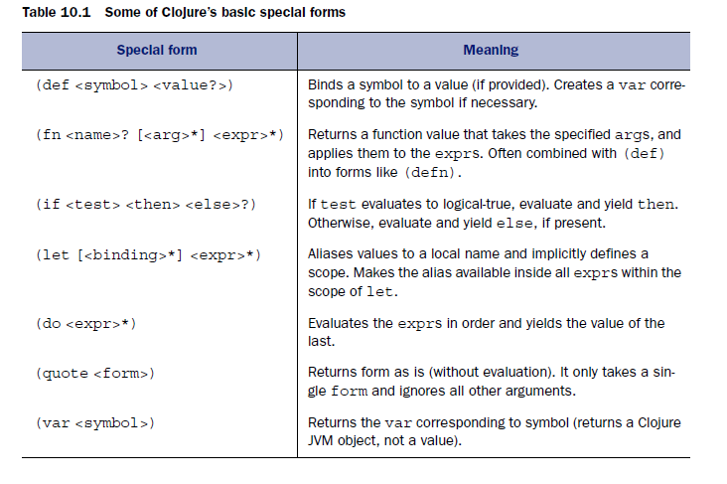
Forms - a basic vocabulary
In Clojure functions rather than variables have center stage.
In the table ? represents a single optional value, and * represents zero or more values.

Slide 48
Native data structures
Lists, vectors, maps and sets
(1 2 3) ; list
[1 2 3] ; vector
{"1" "value1 " "3" " value3 " "4" "value4" } ; map
#{1 2 3}; set

Slide 49
Lists
List is a sequence of values typically surrounded with parentheses, which presents a slight syntactic hurdle because round brackets are also used for general forms.
(quote (1 2 3)) ;=> (1 2 3)
'(1 2 3) ;=> (1 2 3)
(quote) handles its arguments in a special way. In particular, there is no
attempt made to evaluate the argument, so there’s no error arising from a lack of a function value in the first slot.
(quote)has a handy short form, which is '.

Slide 50
Lists
Typical list processing is with a recursion (using functions first and rest ).
First and rest are the same functions as in LISP – the list processing language from 1958; Lisp is the second-oldest high-level programming language in widespead use today (2021), after Fortran.
(ns sum_list)
(defn sum_list [coll]
(if (empty? coll)
0
(+ (first coll)
(sum_list (rest coll)))))
(sum_list[1 2 3 4]) ;=> 10

Slide 51
Vectors
Clojure has vectors, which are like arrays (ArrayList in Java).
(vector 1 2 3)
[1 2 3]
(vec '(1 2 3)) ; converts list to vector
[1 2 3]
[1 2 3]
(vec {:a 1 :b 2 :c 3}) ; converts map to vector
[[:a 1] [:b 2] [:c 3]]

Slide 52
Maps
Clojure supports maps (which you can think of as being very similar to Java’s HashMap).
(def foo {"aaa" "111" "bbb" "2222"})
foo ;=> {"aaa" "111" "bbb" "2222"}
(foo "aaa") ;=> "111"
The example shows how to get a value back out of a map.

Slide 53
Sets
Clojure has sets.
(set '(1 1 2 3 2)) ;=> #{1 3 2}
(set {:one 1 :two 2 :three 3}) ;=> #{[:three 3] [:two 2] [:one 1]}
(def s #{2 34 1})
(count s) ;=> 3 ; number of elements
(conj s 17) ;=> #{1 34 17 2} ; add element to set

Slide 54
Arithmetic operations
Clojure has no operators in the sense that you might expect them in Java.
(+ 1 2 3) ; => 6
Clojure’s functions are in many cases variadic (they take a variable number of inputs).

Slide 55
Loops in Clojure
How can we express a for loop, for example, when there are no mutable variables to act as the loop index?
(defn like-for [counter]
(loop [ctr counter]
(println ctr)
(if (< ctr 10)
(recur (inc ctr))
ctr
)))
The (loop) form takes a vector of arguments of local names for symbols—effectively aliases as (let) does. Then, when execution reaches the (recur) form (which it will only do in this example if the ctr alias is less than 10), the (recur) causes control to branch back to the (loop) form, but with the new value specified.
(like-for 1) ;=> 1 2 3 4 5 6 7 8 9 10

Slide 56
Implicite Loops in Clojure
; Combine a set of collections into a single collection:
(reduce into [[1 2 3] [:a :b :c] '([4 5] 6)])
;=> [1 2 3 :a :b :c [4 5] 6]
(reduce f coll)
f should be a function of 2 arguments.
Returns the result of applying f to the first 2 items in coll, then applying f to that result and the 3rd item, etc.
If coll contains no items, f must accept no arguments as well, and reduce returns the result of calling f with no arguments.

Slide 57
Closures
Functions that “close over”(capture) some values in their environment are called closures.
(defn adder [constToAdd] #(+ constToAdd %1))
(def plus2 (adder 2))
(plus2 3) ;=> 5
(plus2 5) ;=> 7
This example uses the shorthand form #() for an anonymous function
literal. The function (adder) takes in a number and returns a function, and the function returned from (adder) takes one argument.
You then use (adder) to define a new form: (plus2). This is a function that takes one numeric argument and adds 2 to it. That means the value that was bound to constToAdd inside (adder) was 2.

Slide 58
Sequences
Sequence (seq) is a logical list with the interface:
(first coll) – returns the first item in the collection coll.
(rest coll) – returns a sequence of the items after the first.
(cons item seq) – returns a new seq where item is the first element and seq is the rest.
(first ‘(1 2 3)) ;=> 1
(rest ‘(1 2 3) ;=> (2 3)
(cons 1 [2 3]) ;=> (1 2 3)

Slide 59
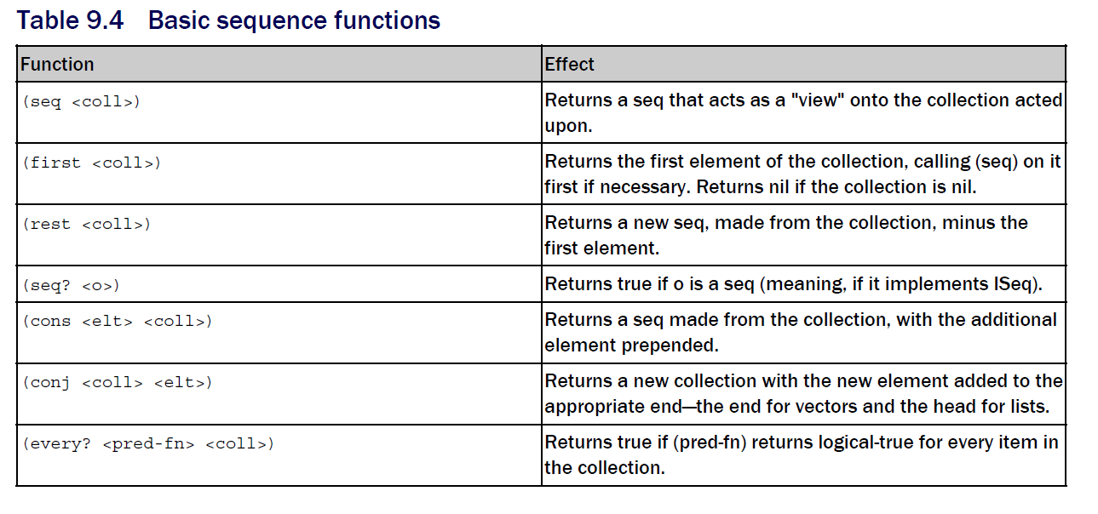
Basic sequence functions

Slide 60
Summary
Clojure is different from Java. Its Lisp heritage, emphasis on immutability, and different approaches seem to make it into an entirely separate language.
Clojure’s tight integration with the JVM, and the power of exploratory programming make it a very complementary language to Java.

Slide 61
Kotlin
Paradigm | Multi-paradigm: object-oriented, functional, imperative, block structured, declarative, generic, reflective, concurrent
Developer | JetBrains
First appeared | July 22, 2011
Stable release | 1.8.10 / 2 February 2023
Typing discipline | Inferred, static, strong
Platform | Android, JVM , JavaScript (Kotlin/JS) , macOS (incl. Apple silicon support) , iOS, tvOS, watchOS , Linux , Windows , WebAssembly LLVM (Kotlin/Native)
OS | Cross-platform
License | Apache License 2.0
Filename extensions | .kt, .kts
Website | kotlinlang

Slide 62
Kotlin language
Kotlin was developed by JetBrains in 2011. JetBrains built the powerful IDE for Java development – Intellij IDEA.
  Android Studio is based on Intellij.
Kotlin is named after an island near St. Petersburg, Russia, where most of the Kotlin development team is located. In using an island name, developers followed the precedent established by Java and Ceylon.
In English, the name Kotlin is usually pronounced
“cot-lin,” not “coat-lin” or “caught-lin.”.
Kotlin is a statically typed programming language that runs on the Java virtual machine and also can be compiled to JavaScript source code.

Slide 63
Kotlin language advantages against Java
Expresiveness – more with much less code,
Null safe – deal with possible null situations at compile time to prevent run time exceptions,
Functional – Kotlin is fundamentally an object-oriented language, but it uses many concepts from functional programming such as lambda expressions and nice dealing with collections,
Extension functions – we can extend any class with new features if we do not have access to the source code,
Interoperable – you can continue using most libraries and code written in Java; you can create mixed projects (Kotlin, Java).

Slide 64
Kotlin program structure
fun main() { // No arguments possible,
// starting with Kotlin 1.3
println("Hello, World")
}
fun main(args: Array<String>) {
}

Slide 65
Kotlin variables
var i = 1
var s = "String"
var i2: Int = 1
var s2: String = "String«
val s3 = "String« // Immutable,
// cannot reassign

Slide 66
Equality
var s: String = retrieveString()
if (s == "A value") { // compares values
// in Java == compares references
s=== y // compares references in Kotlin

Slide 67
Functions
fun doTheThing(value: Int): Boolean {
println("Done $value!")
return true
}
fun checkCondition(n: Int) = n == 42
// type inference

Slide 68
First-class functions
Support for first-class functions.
Functions in Kotlin may be passed as arguments, stored in variables and properties, and returned from other functions.
fun checkCondition(n: Int) = n == 42
val check = ::checkCondition
println(check(42)) // true

Slide 69
Lambda expression for storing function in variable
val anotherCheck = { n: Int -> n > 100 }
println(anotherCheck.invoke(42)) // false
or
println(anotherCheck(42)) // false

Slide 70
Lambda expression for passing function as argument
fun callsAnother(funky: (Int) -> Unit) {
funky(42)
}
callsAnother({ n: Int -> println("Got $n") })
// Got 42

Slide 71
Type inference in lambdas
fun callsAnother(funky: (Int) -> Unit) {
funky(42)
}
callsAnother({ n: Int -> println("Got $n") })
callsAnother({ n -> println("Got $n") })
callsAnother({ println("Got $it") })
// Kotlin provides special support with an implicit it parameter

Slide 72
Shorthand for lambdas
fun callsAnother(funky: (Int) -> Unit) {
funky(42)
}
callsAnother({ println("Got $it") })
callsAnother() { println("Got $it") }
callsAnother { println("Got $it") }

Slide 73
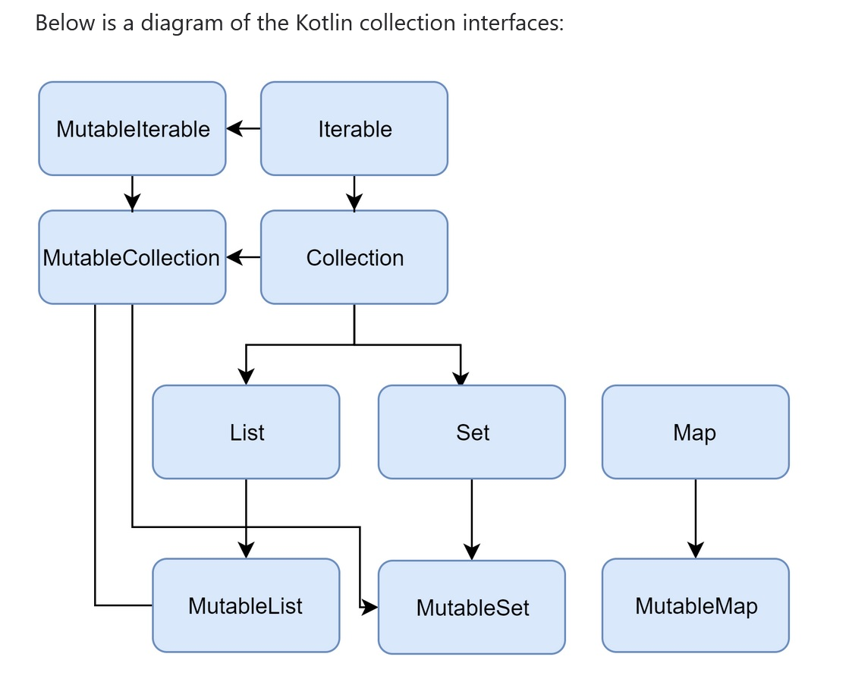
Collections

Slide 74
Collections
val readOnlyList = listOf("a", "b", "c")
val mutableList = mutableListOf("a", "b", "c")
val readOnlyMap = mapOf("a" to 1, "b" to 2, "c" to 3)
val mutableMap = mutableMapOf("a" to 1, "b" to 2, "c" to 3)
println(readOnlyList)
println(readOnlyMap)

Slide 75
Iteration over a collection
val l = listOf("a", "b", "c")
for (s in l) {
println(s)
}

Slide 76
Transform each element in a collection
val l = listOf("a", "b", "c")
val result = l.map { it.toUpperCase() }
println(result) // [A, B, C]
// map transforms each element (it) using the function we pass in.

Slide 77
Remove certain values from a collection
val l = listOf("a", "b", "c")
val result = l.filter { it != "b" }
println(result) // [a, c]

Slide 78
Mutable vs Immutable collection
val systemUsers: MutableList<Int> = mutableListOf(1, 2, 3)
val sudoers: List<Int> = systemUsers
fun addSudoer(newUser: Int) {
systemUsers.add(newUser) }
fun getSysSudoers(): List<Int> {
return sudoers }
fun main() {
addSudoer(4)
println("Tot sudoers: ${getSysSudoers().size}")
getSysSudoers().forEach {
i -> println("Some useful info on user $i") }
// sudoers.add(5) // Attempting to write to the read-only
}

Slide 79
Expressions over statements
var a = 18
val iffy = if (a > 17) {
"sure"
} else {
"nope"
}
println (iffy) // sure

Slide 80
Switch analog
val valid = listOf(1, 2, 3)
val invalid = listOf(4, 5, 6)
var x = 2
val w = when (x) {
in valid -> "valid"
in invalid -> "invalid"
else -> "unknown" }
println(w) // valid

Slide 81
Expresiveness
Data class Artist(
var id: Long,
var name: String,
var url: String,
var mbid: String)
This data class auto-generates all the fields and property accessors, as well as some useful methods such as toString().
Immutable variables can be defined with val.
In Java you should write setters and getters for all fields and implement method toString().

Slide 82
Data class
class PlainPoint(val x: Int, val y: Int)
val pl1 = PlainPoint(1, 1)
val pl2 = PlainPoint(1, 1)
println(pl1 == pl2)
// reference equality ->false
data class DataPoint(val x: Int, val y: Int)
val pd1 = DataPoint(1, 1)
val pd2 = DataPoint(1, 1)
println(pd1 == pd2) // value equality ->true

Slide 83
Null safety
Kotlin is null-safe because the type explicitly defines whether an object can be null by using the safe call operator (written ?).
// Artist can be null
var artist: Artist? = null
// Will print only if artist !=null
artist?.print()
// Use Elvis operator to give alternative in case the object is null
val name = artist?name ?: «empty»

Slide 84
Extension functions
You can add new functions to any class. You could, for instance, add a new method to Android class Fragment. Class Fragment represents a behaviour or a portion of user interface in a FragmentActivity.
// New method toast
fun Fragment.toast(message: CharSequence,
duration: Int = Toast.LENGTH_SHORT)
{ Toast.makeText(getActivity(), message, duration).show()}
// Use the new method
fragment.toast(«Hello world!»)

Slide 85
Functional support (lambdas)
Instead of having to declare an anonymous class every time we need to implement a click listener, we can just define what we want to do.
// Shorthand for lambda expression
view.setOnClickListener { toast(«Hello world!»)}

