Slide 1
Java Persistence API
(JPA)

Slide 2
Using the Java Persistence Architecture
You have seen how to access a database with JDBC.
Nowadays, many programmers prefer to use an object/relational (O/R) mapper rather than raw SQL commands.
The Java Persistence Architecture (JPA) provides a standard O/R mapper for the Java EE technology stack.

Slide 3

What is JPA
An O/R mapper translates between database tables and Java objects that you manipulate in your program.
Your program never touches the database directly. In JPA, you use annotations to mark the classes that should be stored in the database. (These classes are called entities.)
For example, here is a
Invoice class with
annotations:

Slide 4

Entity Requirements
For a class to be an entity, there are three requirements:
  The class must be annotated with @Entity.
  Each object must have a unique primary key, marked with the @Id annotation.
  The class must have a default constructor.
You use additional annotations to denote relationships between entities.
For example, here is how you express the fact that each one Invoice has with many Items
The O/R mapper translates these
annotations into foreign keys
or join tables.

Slide 5
Entity Mapper
You use an entity manager to create, read, update, and delete entity objects. The following call adds a new entity to the database:
  EntityManager em = ...;
  em.persist(entity);
To change an existing entity, modify the Java object and commit the current transaction. The changes are automatically saved.
You remove an entity by calling em.remove(entity).

Slide 6

JPQL
To read data, you issue a query in JPQL, an object-oriented query language that is similar to SQL. For example, the following query finds the Credentials objects for a given username:
  SELECT c FROM Credentials c WHERE c.username = :username
The colon indicates a parameter that should be set when issuing the query. Here is how to get the query results:

Slide 7
Behind the Scenes
@SuppressWarnings can be used because getResultList() method returns a raw List, and that list is assigned to a parameterized List<Invoce>.
We want a list with the appropriate type parameter so that we can get the elements as Invoce objects.
Behind the scenes, the entity manager:
  issues an SQL query,
  constructs Credentials objects from the result (or finds them in its cache),
  and returns them in a list.

Slide 8
Using JPA in Application
When using JPA in a web application, you need to deal with two issues:
  1. Obtaining an entity manager
  2. Handling transactions
Both of these issues are much simpler when you use an EJB session bean.
To get an entity manager, you first obtain an entity manager factory, which the JSF implementation will inject into a managed bean. Place this annotated field into the managed bean class:
  @PersistenceUnit(unitName="default") private EntityManagerFactory emf;
“Persistence units” are configured in an XML file:
  src/main/resources/META-INF/persistence.xml
Each unit has a name (here, "default"), a data source, and various configuration parameters.
You obtain an entity manager by calling:
  EntityManager em = emf.createEntityManager();
When you are done with the entity manager, call: em.close();

Slide 9
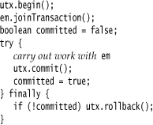
Transactions
In a request scoped managed bean, you can inject an entity manager directly. This is not feasible for other scopes because the entity manager is not threadsafe. However, the entity manager factory is threadsafe.
You should wrap any work with the entity manager into a transaction. Obtain a transaction manager with the injection:
  @Resource private UserTransaction utx;
Then use this outline:

Slide 10
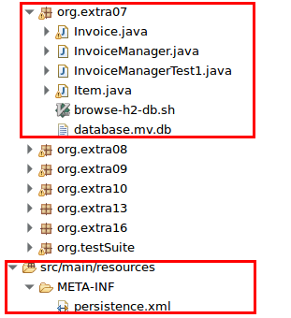
Directory structure of the demo package
Our example program uses JPA to access the database instead of SQL.

Slide 11
Persistence API
The Java Persistence API (JPA) was introduced as part of the Java EE 5 platform.
Its goal is to facilitate data acquisition from relational databases without the complexity of numerous sql statements.
The idea is to use an object oriented approach to data storage.
Data is handled without the need to create deployment descriptors.
  Instead annotations are used which are read by the container.

Slide 12
Java Transaction API-JTA
The Java Transaction API (JTA) is part of the J2EE platform.
The API gives you the ability to perform distributed transactions, that is, an application can use the API to perform transactions on more than one data store in the network at the same time.
But to do this efficiently, it helps to have another component operating in the application server: a J2EE transaction manager.
A transaction manager helps to efficiently schedule and execute the potentially large number of transactions coming in through the application server.

Slide 13
Java Transaction API
The data source must be registered on the server and is specified using the JNDI name.
Transactions can be:
  Container Managed
  Application Managed.
If the transactions are container-managed JTA transactions, the data source must be a JTA data source. This is the preferred way.
  It must be specified in the descriptor file persistence.xml
If the transactions are application-managed, the data source is specified according to the JDBC database connection registered with the IDE

Slide 14
Persistence API-Entities
Entity
  A table in a database
  An Entity is represented by a class
  Instance of entity corresponds to a row in the database
  A number of rules cover the implementation of an entity class
Note: The database is sometimes referred as
  Data Source or Data Store

Slide 15
Persistence API-Entity Relationships
Relationships are the same as relationships between tables in a database:
  One-To-One — Each instance of the entity (row) is related to single instance of another entity (to a single row of another table).
  One-To-Many — An entity instance can be related to more than one instance of another entity. But an instance of the other Entity can only relate to one instance of the first.
  Many-To-One — Multiple instances (rows) of an Entity can be related to one instance of another Entity. But an instance of the other Entity can relate to only one instance of the first Entity.
  Many-To-Many — An instance of one Entity relates to many instances of another Entity and vice versa.
For every relationship there is an owning side and inverse side.
  The relationship can be unidirectional — it has only an owning side.
  Or, bidirectional — it ha s both an owning side and an inverse side.

Slide 16
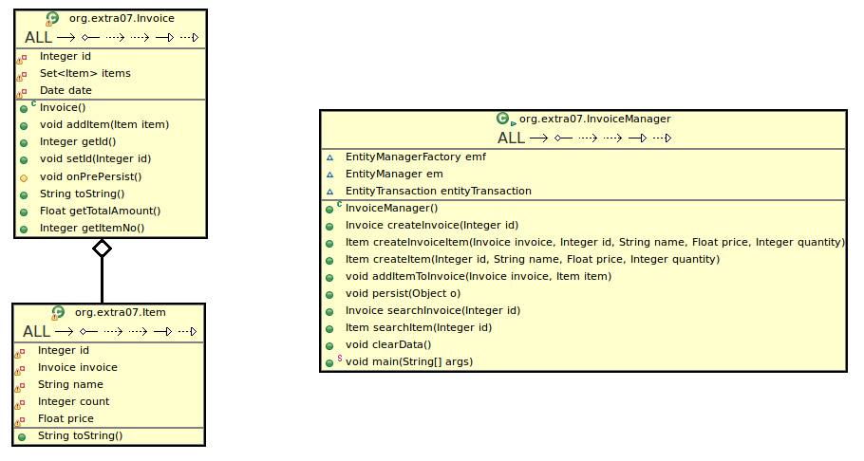
Relationships in JPA demo

Slide 17
Persistence API-Entity Class
Entity Class
  The class has instance variables
  The class has accessor and mutator methods that follow the Java Beans convention for naming the methods.
  The persistent state can be accessed either through the instance variables or through the getter methods (accessors).
    Persistent Fields (if fields are mapped with annotations)
    Persistent Properties (if getter methods are mapped with annotations)
      This is done through annotations to one or the other but not both in a class.

Slide 18
Persistence API-Entity Class
Annotations are handled by package javax.persistence
  Fields annotated with Transient are not persisted (saved).
  Annotations apply to other parts of the program i.e.
    The class needs to be annotated with the @Entity annotation.
    The type of relationship needs to be annotated with @OneToOne for example.
    Other annotations apply to different parts of the class.

Slide 19
Persistence API-Entity Class
Every Entity must have a unique primary key field that enables clients to locate instances (rows) of an Entity.
  Primary Keys can be:
    simple (consisting of a single field) or
    Composite (consting of one or more persistent field)s and or properties)
      Composite primary keys are represented by a primary key class.

Slide 20
Persistence API-Entity Class
Entities support:
  Inheritance. An Entity class can inherit a non Entity class and a non Entity class can inherit an Entity class.
    The non Entity classes can have persistent states information (annotations on their fields or properties).
      If , however, the non Entity class is a super class, it has no persistent state as such.
  Polymorphism.
    You can have an abstract Entity class and subclasses of the abstract Entity class that implement parts of the abstract class in different ways each.
  Association (using another class by instantiating an object of that class).

Slide 21
Persistence API-Entity Inheritance Strategies
Single Table of the database per class hierarchical inheritance.
A Table of the database per concrete Entity class.
A “Join” strategy
  Fields/properties of a subclass are mapped to a different table than the super class.

Slide 22
Persistence API-Entity Management
There is an Entity Manager object represented by an instance of: javax.persistence.EntityManager
  Each manager object is associated with a persistent context (scope).
  Each manager object:
    Removes persistent entity instances.
    Finds Entities by using the primary key.
    Allows queries to be run on Entities.

Slide 23
Persistence API-Entity Management
An Entity Manager can be:
  Container-managed in which case it (persistence) propagates to all application components (EJBs) with a single Java Transaction Architecture (JTA) transaction via a special annotation.
  Application-managed in which case the persistence does not propagate to other applications (EJBs).

Slide 24
Persistence API-Persistence Units
Persistence Unit defines all Entity classes that are managed by EntityManager instances within an application.
  A name should be provided to describe the Persistence Unit in your application.
  A Persistence Unit is defined in the persistence.xml configuration file.
  Location of the file within the application in the server varies depending dependent on if the client is a client application or a web application.
    The IDE will place it in the proper directory.

