Slide 1
Java Native Interface
(JNI)

Slide 2
Introduction
What is native method and JNI
Why to use JNI
How to use JNI:
  Calling C from Java
  Calling Java from C

Slide 3
What is JNI
Java interface to non-Java code. It is Java's link to the "outside world"
Native methods are compiled into a dynamic link library (.dll, .so, etc.)
Java Virtual Machine loads and links the library into the process that calls the native methods
Part of the Java Developer Kit (JDK), serves as a glue between java side and native side of an application
Allows Java code that runs inside a Java Virtual Machine (JVM) to interoperate with applications and libraries written in other programming languages, such as C, C++, and assembly

Slide 4
Reasons for using JNI
Reuse: code already written in another language, don’t want to rewrite it in Java (typical)
Efficiency: use other language for tasks with bigger hardware management constraints (possible)
Missing feature: other language has additional features or has better syntax for handling certain operations (rare)
Low-level drives/devices specific to some OS (rare)

Slide 5
Problems with JNI
Only provides C/C++ bindings
  Going to Fortran, COBOL, Ada, etc. requires extra work
Not portable (calls to native libraries for particular platform)
Mapping is not trivial
Can be unsafe
Cannot run from applet (security constraints)

Slide 6
What is Native Method
Native method is:
  function implemented in language other than Java, that is compiled to native binary code for particular platform (hardware, operating system)
  It could be implemented in C, C++, or even assembly

Slide 7

General Desing of JNI
Notes:
Java Native Interface provides an means of interacting with native platform classes and functions through the creation of shared libraries.
JNI can be used with most languages such as C, C++, Fortran, Cobol, etc...

Slide 8
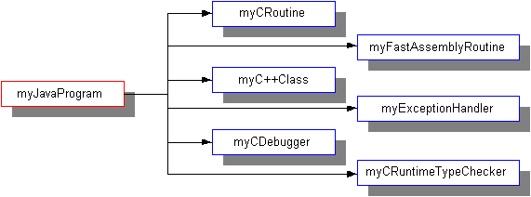
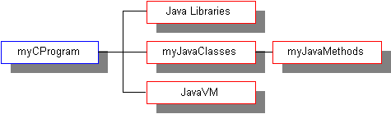
Interactions with Native libraries
Accessing native library from Java
Accesing Java from native library
Notes:
Full two-way interaction.
Native code can interact with Java objects and their methods. Can also generate and throw exceptions that can be handled by Java code.
Java code has full access to functionality contained with the native code through the generated interface definitions.
Full passing of primitive parameters after conversion (strings to UTF)

Slide 9
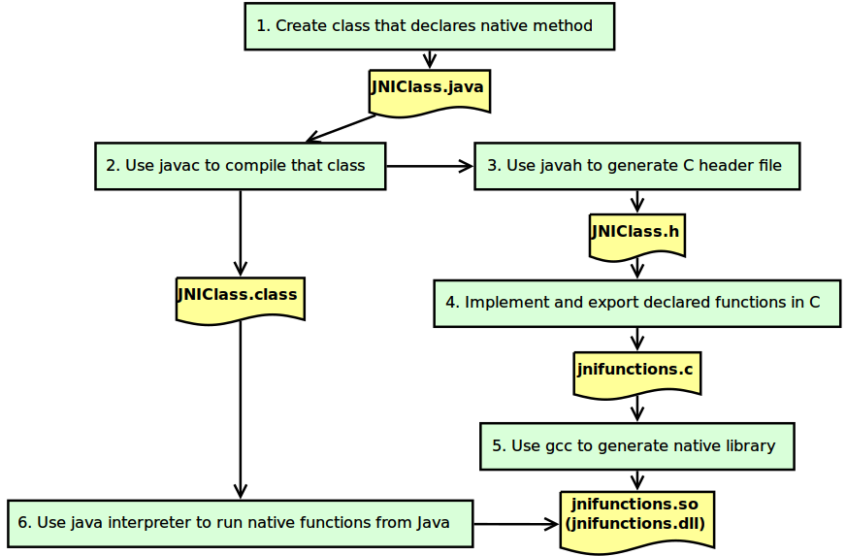
JNI General Compilation Tasks

Slide 10
Java to C

Slide 11
What Java passes to C function?
JNIEnv* : A pointer to the the JNI environment. This pointer is a handle to the current thread in the JVM, and contains mapping functions and other housekeeping information
jobject/jclass :
  jobject reference to the object that called the native code. (like “this”) for object methods
  Jclass reference to the class (like “.getClass()” for static methods
Any other arguments specified by the method

Slide 12
Native datatype mappings
Java Type | Native Type | Size in bits
boolean | jboolean | 8, unsigned
byte | jbyte | 8
char | jchar | 16, unsigned
short | jshort | 16
int | jint | 32
long | jlong | 64
float | jfloat | 32
double | jdouble | 64
void | void | N/a

Slide 13

Java object Mappings
Object passed by reference
All objects have type jobject as:

Slide 14
JNI Advice
Can seem like a bewildering number of functions.
Do not try to learn it all.
Keep interfaces very simple.
  Preferably, only native datatypes, Strings, and arrays.
Be careful about
  Copies vs. rerences
  Freeing memory
Best not to allocate memory from with native code.

Slide 15
Accessing Java strings
Do NOT do the following:
  JNIEXPORT jstring JNICALL Java_Prompt_getLine(JNIEnv *env, jobject obj, jstring prompt){
  printf(“%s”, prompt);
  }
Why is this bad?

Slide 16
Getting Strings from Java
jstring is different from C string:
/* Incorrect way */
JNIEXPORT void JNICALL Java_ClassName_MethodName(JNIEnv *env, jobject obj, jstring javaString) {
printf("%s", javaString);
}
/* Correct way */
JNIEXPORT void JNICALL Java_ClassName_MethodName (JNIEnv * env, jobject obj, jstring string) {
const char *nativeString = (*env)->GetStringUTFChars(env, string, 0);
printf(“%s\n”, nativeString);
(*env)->ReleaseStringUTFChars(env, string, nativeString);
}

Slide 17
Returning Strings to Java
Previous technique allows us to use a String passed in from Java.
What if we want to return a String?
Can use NewStringUTF as:
  JNIEXPORT jstring JNICALL Java_ClassName_MethodName
  (JNIEnv * env, jobject obj, jint size) {
  char *buf = createArray(100);
  jstring jstrBuf = (*env)->NewStringUTF(env, buf);
  return jstrBuf;
  }

Slide 18
Other JNI String methods
GetStringChars
  Takes the Java String and returns a pointer to an array of Unicode characters that comprise it.
ReleaseStringChars
  Releases the pointer to the array of Unicode characters
NewString
  Constructs a new String object from an array of Unicode Characters
GetStringLength
  Returns the length of a string of Unicode characters

Slide 19
Java arrays
Note that you can NOT do the following:
  JNIExport jint JNICALL Java_IntArray_sumArray(JNIEnv *env, jobject obj, jintArray arr){
  int i, sum = 0;
  for (i = 0; i<10; i++){
  sum += arr[i]; /* NO! – why not?
  }
  ...
Again, must use Java methods to access array data in C

Slide 20
Getting Array from Java
/* correct way */
JNIEXPORT jint JNICALL Java_IntArray_sumArray(JNIEnv *env, jobject obj, jintArray arr) {
int i, sum = 0;
/* 1. obstain the length of the array */
jsize len = (*env)->GetArrayLength(env, arr);
/* 2. obtain a pointer to the elements of the array */
jint *body = (*env)->GetIntArrayElements(env, arr, 0);
/* 3. operate on each individual primitive or jobjects */
for (i=0; i<len; i++) {
sum += body[i];
}
/* 4. release the memory allocated for array */
(*env)->ReleaseIntArrayElements(env, arr, body, 0);
}

Slide 21
Function for accessing Java arrays
Function | Array Type
GetBooleanArrayElements | boolean
GetByteArrayElements | byte
GetShortArrayElements | short
GetIntArrayElements | int
GetLongArrayElements | long
GetFloatArrayElements | float
GetDoubleArrayElements | double
GetObjectArrayElements | object

Slide 22
Functions for releasing Java arrays
Function | Array Type
ReleaseBooleanArrayElements | boolean
ReleaseByteArrayElements | byte
ReleaseShortArrayElements | short
RelaseIntArrayElements | int
ReleaseLongArrayElements | long
ReleaseFloatArrayElements | float
ReleaseDoubleArrayElements | double
ReleaseObjectArrayElements | object

Slide 23
Garbage Collection
Only Arrays and explicitly globally created objects are “pinned” down and must be explicitly released
Everything else is released upon the native method returning

Slide 24
C to Java

Slide 25
Calling a Java Method from C
Find the class of the object
  Call GetObjectClass
Find the method ID of the object
  Call GetMethodID, which performs a lookup for the Java method in a given class
Call the method
  JNI provides an API for each type of method
    e.g., CallVoidMethod(), etc.
  You pass the object, method ID, and the actual arguments to the method (e.g., CallVoidMethod)
Example of Call:
  jclass cls = (*env)->GetObjectClass(env, obj);
  jmethodID mid = (*env)->GetMethodID(env, cls, “hello”, “(I)V”);
  (*env)->CallVoidMethod(env, obj, mid, parm1);

Slide 26
Steps to follow
Native method calls JNI function GetObjectClass
  returns the jclass object that is type of that obj
Native method calls JNI function GetMethodID
  returns jmethodID of method in class (0 for no such method)
Finally, native method calls JNI function CallVoidMethod.
  invokes an instance of method with void return type. You pass object, methodID, and actual arguments.

Slide 27
Examples
Following slides show
  Commands to:
    compile java class
    generate header file
    compile c file as shared library
    execute simple JNI application
  excerpts for extra12 activity for single native printHello() method:
    JNIClass.java file located in jtm.extra12 package
    jtm_extra12_JNIClass.h located in lib folder
    jnifunctions.c file located in src/main/c folder
Notes:
The JNIEXPORT and JNICALL macros are defined in jni_md.h which contains platform specific definitions.
JNIENV is an interface pointer used to invoke JNI calls.
jobject is the Java object on which the call is invoked.

Slide 28
Commands for exercise
For practical exercise location and classpath info is included
  (Steps from diagram in Slide 10):
Step 2: compile JNIClass.java file considering classpath and target location:
  javac -cp target/classes \
  src/main/java/jtm/extra12/JNIClass.java
Step 3: generate jtm_extra12_JNIClass.h file in lib folder:
  javac -cp target/classes -h lib/ org.extra12.JNIClass
Step 5.1: Compile jnifunctions.c file including JNI libraries for 64-bit Linux:
  gcc -fPIC -I/usr/lib/jvm/java-8-openjdk-amd64/include \
  -I/usr/lib/jvm/java-8-openjdk-amd64/include/linux \
  ./src/main/c/jnifunctions.c -c -o ./lib/jnifunctions.o
5.2. step: make shared library for Linux
  gcc -shared ./lib/jnifunctions.o -o ./lib/jnifunctions.so
5. step: test application
  java -cp target/classes/ org.extra12.JNIClass

Slide 29
JNIClass.java
package org.extra12;
public class JNIClass {
// Declarations of native methods
public native void printHello();
// Load shared native library
static {
try {
System.load(System.getProperty("user.dir") + "/lib/jnifunctions.so");
} catch (UnsatisfiedLinkError e) {
System.out.println("Native code library failed to load.\n" + e);
System.exit(1);
}
}
// Call native methods from main method
public static void main(String[] args) {
JNIClass test = new JNIClass();
test.printHello();
}
}

Slide 30
org_extra12_JNIClass.h file
/* DO NOT EDIT THIS FILE - it is machine generated */
#include <jni.h>
/* Header for class org_extra12_JNIClass */
#ifndef _Included_org_extra12_JNIClass
#define _Included_org_extra12_JNIClass
#ifdef __cplusplus
extern "C" {
#endif
/*
* Class: org_extra12_JNIClass
* Method: printHello
* Signature: ()V
*/
JNIEXPORT void JNICALL Java_org_extra12_JNIClass_printHello
(JNIEnv *, jobject);
#ifdef __cplusplus
}
#endif
#endif
This file is generated by javah

Slide 31
jnifunctions.c
Included header file
#include <stdio.h>
#include <stdlib.h>
#include "../../../lib/org_extra12_JNIClass.h"
JNIEXPORT void JNICALL Java_jtm_extra12_JNIClass_printHello
(JNIEnv * env, jobject obj) {
printHello();
}
void printHello() {
printf("Hello!\n");
}
Signature should be the same as
in org_extra14_JNIClass.h file
variables should have names
Notes:
The JNIEXPORT and JNICALL macros are defined in jni_md.h which contains platform specific definitions.
JNIENV is an interface pointer used to invoke JNI calls.
jobject is the Java object on which the call is invoked.

Slide 32
References
https://docs.oracle.com/javase/8/docs/technotes/guides/jni/
https://docs.oracle.com/javase/8/docs/technotes/guides/jni/spec/jniTOC.html
https://www3.ntu.edu.sg/home/ehchua/programming/java/JavaNativeInterface.html
https://www.fer.unizg.hr/_download/repository/jni.pdf

