Slide 1
Building Tools
Notes:
<skaitlis>

Slide 2




From Make to Gradle
GNU Make
  Originally for building C/C++, Fortran (compiled and linked languages)
  Platform specific builds (need Autoconf)
Apache Ant
  Originated to build Tomcat in early 2000’s
Apache Maven
  Originated from Jakarta Alexandria project 2001
Gradle (gradle.org)
  Build automation from command line to IDE to Continuous Integration
Notes:
All can do incremental builds: compiles only the files that have been touched

Slide 3

Apache Ant
Implemented in Java, best suited for building java projects
Built into IDEs for running build scripts
Uses XML to describe the build process
Platform-independent tool (unlike Make)
Integrates JUnit testing in the build process
Ant is not good with complex programming constructs: need to write extension tasks in Java for more more complex build logic or GUIs
Must build in explicit target dependencies – including all jarfiles and their dependencies
Notes:
Make relied on OS commands, which were platform-specific (e.g make have different options). Ant’s built-in commands run on each platform the same way. Interprets file separators and path separates appropriately, which also makes it portable. Show cfmv3 build.xml.

Slide 4
build.xml
<?xml version="1.0" encoding="UTF-8"?>
<project default = "compile">
<property name = "classesdir = " " value = "..."/>
<property name = "libdir" value = "..."/>
<target name = "compile">
<mkdir dir = "${classesdir}"/>
<javac destdir = "${classesdir}">
<src>
<pathelement location = "src/main/java"/>
</src>
<classpath>
<fileset dir = "${libdir}">
<include name = "*.jar"/>
</fileset>
</classpath>
</javac>
</target>
</project>
Execute target by invoking:
ant compile
Notes:
By following the standard Maven conventions you can get a lot done with very little effort! Just as a casual comparison, let's take a look at what you might have had to do in Ant to accomplish the same thing. Now, this is simply to compile a single tree of application sources and the Ant script shown is pretty much the same size as the POM shown above. But we'll see how much more we can do with just that simple POM! There is far more functionality available to you from Maven without requiring any additions to our POM as it currently stands. To get any more functionality out of our example Ant build file you must keep making error-prone additions. So what else can you get for free? There are a great number of Maven plug-ins that work out of the box with even a simple POM like we have above. We'll mention one here specifically as it is one of the highly prized features of Maven: without any work on your part this POM has enough information to generate a web site for your project! You will most likely want to customize your Maven site but if you're pressed for time all you need to do to provide basic information about your project is execute the following command:
<skaitlis>

Slide 5
Maven

Slide 6
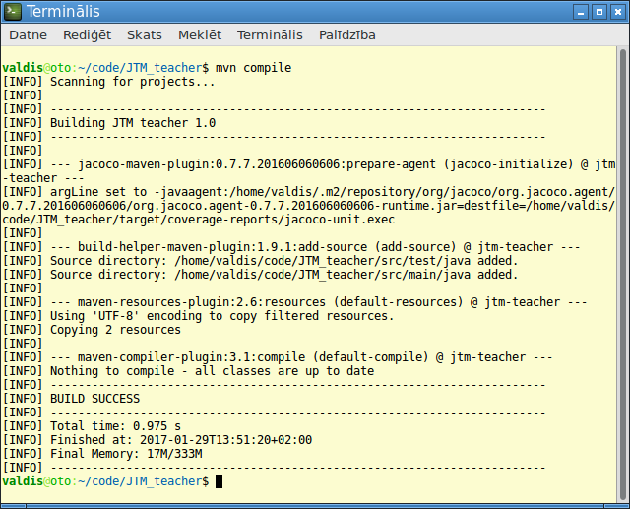
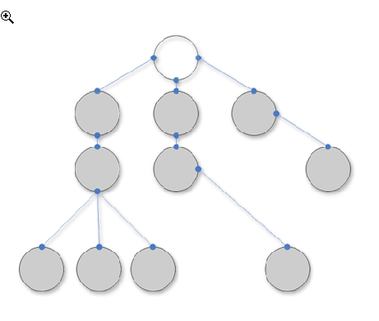
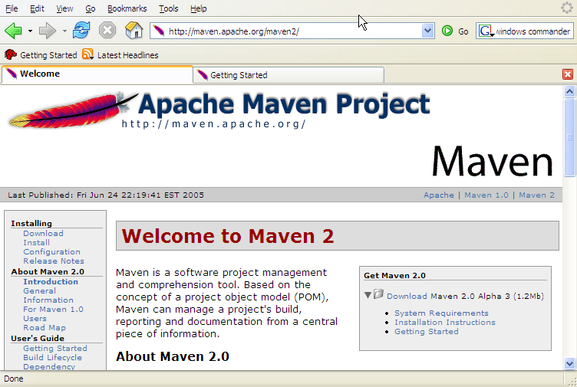
What is Maven?
A build tool
A dependency management tool
A documentation tool
Notes:
<skaitlis>

Slide 7
Benefits
Standardization
Fast and easy to set up a powerful build process
Less maintenance
Dependency management (automatic downloads)
Project website generation, Javadoc
Repository management
Automatic downloads
Higher level of reusability between builds
Faster turn around time to set up a powerful build
Notes:
<skaitlis>

Slide 8
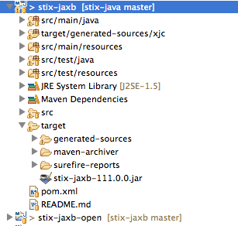
Maven Control of the Life Cycle
Based on the Project Object Model (pom.xml) and guidelines for “best practices”
Shared plugin repository
Dependencies are defined: groupId (organization), artifactId (name of the jar/project), version.
Goals are defined
(instead of targets)
Unified directory structure:
  src/main/java, src/main/resources
  src/test/java, src/test/resources
  Build artifacts in target directory

Slide 9
Overview of common Goals
validate - validate the project is correct and all necessary information is available
compile - compile the source code of the project
test - test the compiled source code using a suitable unit testing framework. These tests should not require the code be packaged or deployed.
package - take the compiled code and package it in its distributable format, such as a JAR
integration-test - process and deploy the package if necessary into an environment where integration tests can be run
install - install the package into the local repository, for use as a dependency in other projects locally
deploy - done in an integration or release environment, copies the final package to the remote repository for sharing with other developers and projects
Notes:
<skaitlis>

Slide 10

Common way to build applications
M2
generate-
sources
mojo
compile
mojo
test
mojo
package
plugins
integration-
test
user
mojo
install
mojo
e.g. mvn install
deploy
bindings
Well-known phases
MOJO – Maven 2 Plugins Project
http://mojo.codehaus.org/
Notes:
<skaitlis>

Slide 11
Project Object Model
Maven is based on the concept of a Project Object Model
Maven features such as:
  builds
  dependency management
  documentation creation
  site publication
  distribution publication
are all controlled from the declarative file
File is named pom.xml and is located in the project root
Notes:
<skaitlis>

Slide 12
Common project metadata format
POM = Project Object Model = pom.xml
Contains metadata about the project
  Location of directories, Developers/Contributors, Issue tracking system, Dependencies, Repositories to use, etc
Example:
<project>
<modelVersion>4.0.0</modelVersion>
<groupId>org.codehaus.cargo</groupId>
<artifactId>cargo-core-api-container</artifactId>
<name>Cargo Core Container API</name>
<version>0.7-SNAPSHOT</version>
<packaging>jar</packaging>
<dependencies/>
<build/>
[…]
Minimal POM

Slide 13
Dependency management
Transitive dependencies
  Possibility to exclude some dependencies
  Need good metadata
  Ideally projects should be split
SNAPSHOT handling
  Always get latest
Automatic dependency updates
  By default every day
A
Only need to include A
B
C
D
Notes:
<skaitlis>

Slide 14
Add a dependency
Add a new dependency in pom.xml
<project>
<modelVersion>4.0.0</modelVersion>
<groupId>com.web.music</groupId>
<artifactId>my_project</artifactId>
<packaging>jar</packaging>
<version>1</version>
<name>my_project</name>
<dependencies>
<dependency>
<groupId>log4j</groupId>
<artifactId>log4j</artifactId>
<version>1.2.17</version>
</dependency>
</dependencies>
<build/>
</project>
Notes:
<skaitlis>

Slide 15
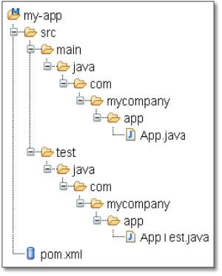
Standard directory organization
Having a common directory layout would allow for users familiar with one Maven project to immediately feel at home in another Maven project.
src/main/java
Application/Library sources
src/main/resources
Application/Library resources
src/main/filters
Resource filter files
src/main/assembly
Assembly descriptors
src/main/config
Configuration files
src/main/webapp
Web application sources
src/test/java
Test sources
src/test/resources
Test resources
src/test/filters
Test resource filter files
src/site
Site
LICENSE.txt
Project's license
README.txt
Project's readme

Slide 16
Installation and Setup
Debian-like Linux:
sudo apt-get install maven
Windows:
  Download Maven from http://maven.apache.org/
  Add Maven’s bin directory to PATH
  Ensure JAVA_HOME is set to SD
To test install, run:
mvn -version

Slide 17
Creating a project
In test directory execute the following command:
mvn archetype:create
-DgroupId=com.mycompany.app
-DartifactId=my-app
The archetype:create signals to create a project with a standard file structure.
Notice that dependencies download automatically, and directory structure is created accordingly
An additional parameter is available that’ll select a specific template, like:
... -DarchetypeArtifactId=maven-archetype-webapp for instance

Slide 18
Archetypes
For reuse, create archetypes that work as project templates with build settings, etc
An archetype is a project, with its own pom.xml
An archetype has a descriptor called archetype.xml
Allows easy generation of Maven projects
http://www.ibiblio.org/maven2/org/apache/maven/archetypes/
To get list of known archetypes run:
mvn archetype:generate

Slide 19
Generating Eclipse project files
To generate the Eclipse project files from your POM execute the following command:
mvn eclipse:eclipse
Command generates the following Eclipse configuration files:
  .project and .classpath files
  .setting/org.eclipse.jdt.core.prefs with project specific compiler settings
  various configuration files for Eclipse WTP
  (Eclipse Web Tools Project flawor)

Slide 20
The local repository
What does M2 do with all the dependencies?
  Unix/Linux
  ~/.m2/repository/
  Windows
  C:\Documents and Settings\Username\.m2\repository
Advantages: No need to keep anything in the repo other than your own source code, saves space in the repo and rebuild / transfer time
Can download dependencies from a local intranet repo instead of ibiblio, etc
Eclipse needs to know the path to the local Maven repository. Therefore the classpath variable M2_REPO has to be set:
  Java > Build Path > Classpath Variables

Slide 21
Plugin for Eclipse
Help > Software Updates > Search & Install
Remote Site
Name: m2 plugin
URL: http://m2eclipse.codehaus.org
Will list newest version
Wait for download to complete
The URL also has Flash demos

Slide 22
Setting the M2_REPO variable
Eclipse needs to know the path to the local Maven repository
Therefore the classpath variable M2_REPO has to be set. Execute the following command
mvn -Declipse.workspace=/home/student/workspace/ eclipse:configure-workspace
You can also define a new classpath variable inside Eclipse. From the menu bar, select
Window > Preferences > Java > Build Path > Classpath Variables
Notes:
<skaitlis>

Slide 23
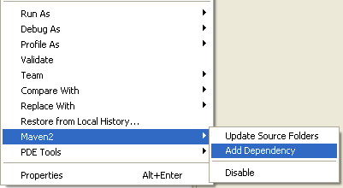
Using from Eclipse
Enable Maven:
  right click on the project > Maven 2 > Enable
Add dependency:
  right click on the project
  ... Maven 2 > Add Dependency
Executing goals:
  right click pom.xml and ‘Run As > Maven2 build’ to set a goal
It’s possible to debug during the build process

Slide 24
Using Maven Plugins
Whenever you want to customise the build for a Maven project, this is done by adding or reconfiguring plugins
For example, configure the Java compiler to allow JDK 5.0 sources
Plugins in
Maven 2.0
look much like
a dependency
...
<build>
<plugins>
<plugin>
<groupId>org.apache.maven.plugins</groupId>
<artifactId>maven-compiler-plugin</artifactId>
<configuration>
<source>1.5</source>
<target>1.5</target>
</configuration>
</plugin>
</plugins>
</build>
...

Slide 25
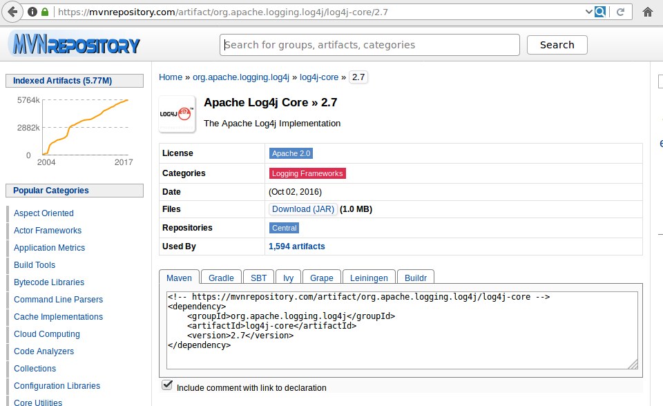
How to find required dependency?
Go to
https://mvnrepository.com/
Find required library; e.g. log4j
Notes:
<skaitlis>

Slide 26



Alternatives
There are also alternative build tools
  Gradle
  *.gradle config file
  Buildr
  settings.yaml config file
  Ant with Ivy
  ivysettings.xml config file

Slide 27
References
Maven Home
http://maven.apache.org/
Maven Getting Started Guide
http://maven.apache.org/guides/getting-started/index.html
Maven 2 Plugins Project
http://mojo.codehaus.org/
Maven Integration for Eclipse
http://eclipse.org/m2e/
Notes:
<skaitlis>

