Slide 1
IO
CPU
Memory
Control Unit
Output Devices
Program
ALU
Registers
Input Devices
R1
Data
⋮
Rn

Slide 2
IO
CPU
Program Memory
Control Unit
Output Devices
ALU
Registers
Input Devices
R1
⋮
Data
Memory
Rn

Slide 3
A,V
Control Unit
Control Unit
⋮
⋮
2
8
FA
LS
Control signals
A,V
S
4
Flags
Cycle
3
FB
CC
Z
Instruction
8
16
ROM
16
D
IP
DP
Data Bus
RAM
Address Bus
Input
Output
SP
8

Slide 4
Address:
0
1
2
3
4
5
6
...
Data Array:
0
0
0
0
0
0
0
0
Data Pointer

Slide 5
Address:
0
1
2
3
4
5
6
7
8
9
10
11
12
13
14
...
Data (RAM)
0
0
15
16
17
0
0
0
0
41
0
0
0
0
0
...
Data Pointer
(DP = 4)

Slide 6
Microcode ROM’s
ROM 2
ROM 1
ROM 0
State
Instruction
Cycle
K
V
A
S
Z
I3
I2
I1
I0
C2
C1
C0
Address
16-23
8-15
0-7
⋮

Slide 7
PLACEHOLDER

Slide 8
555 Output
Flip-Flop Output
Decoder Clock
Module Clock

Slide 9
Button
Monostable 1
Monostable 2

Slide 10
+
1
S
0
0
A
1
Inc(D)
Set(V,1)
Set(A,0)
Enable(RAM)
Load(D)
Inc(IP)
Reset(CC)

Slide 11
>
1
S
0
0
V
1
Inc(DP)
Set(A,1)
Set(V,0)
Enable(RAM)
Load(D)
Inc(IP)
Reset(CC)

Slide 12
[
1
Inc(LS)
S
0
0
Z
0
A
1
Enable(SP)
Enable(IP)
Write(RAM)
1
Inc(LS)
Enable(RAM)
Load(D)
Set(A,0)
Reset(CC)
Inc(SP)
Set(A,1)
Inc(IP)
Reset(CC)

Slide 13
]
1
Dec(LS)
S
0
0
Z
0
A
1
Enable(RAM)
Enable(SP)
Load(IP)
1
Inc(LS)
Inc(IP)
Reset(CC)
Enable(RAM)
Load(D)
Set(A,0)
Reset(CC)

Slide 14
.
1
Inc(IP)
Reset(CC)
S
0
0
A
1
Enable(OUT)
Enable(D)
Enable(OUT)
Enable(RAM)
Reset(K)
INC(IP)
Reset(CC)
0
K
1
1
K
0

Slide 15
Reset(K)
Inc(IP)
Reset(CC)
,
1
S
0
Enable(IN)
1
Load(D)
Set(V, 1)
K
0

Slide 16
Acknowledge
Reset(K)
Inc(IP)
Reset(CC)
WAIT
EXT
1
K
0

Slide 17
Acknowledge
Reset(K)
Inc(IP)
Reset(CC)
INIT
1
K
0

Slide 18
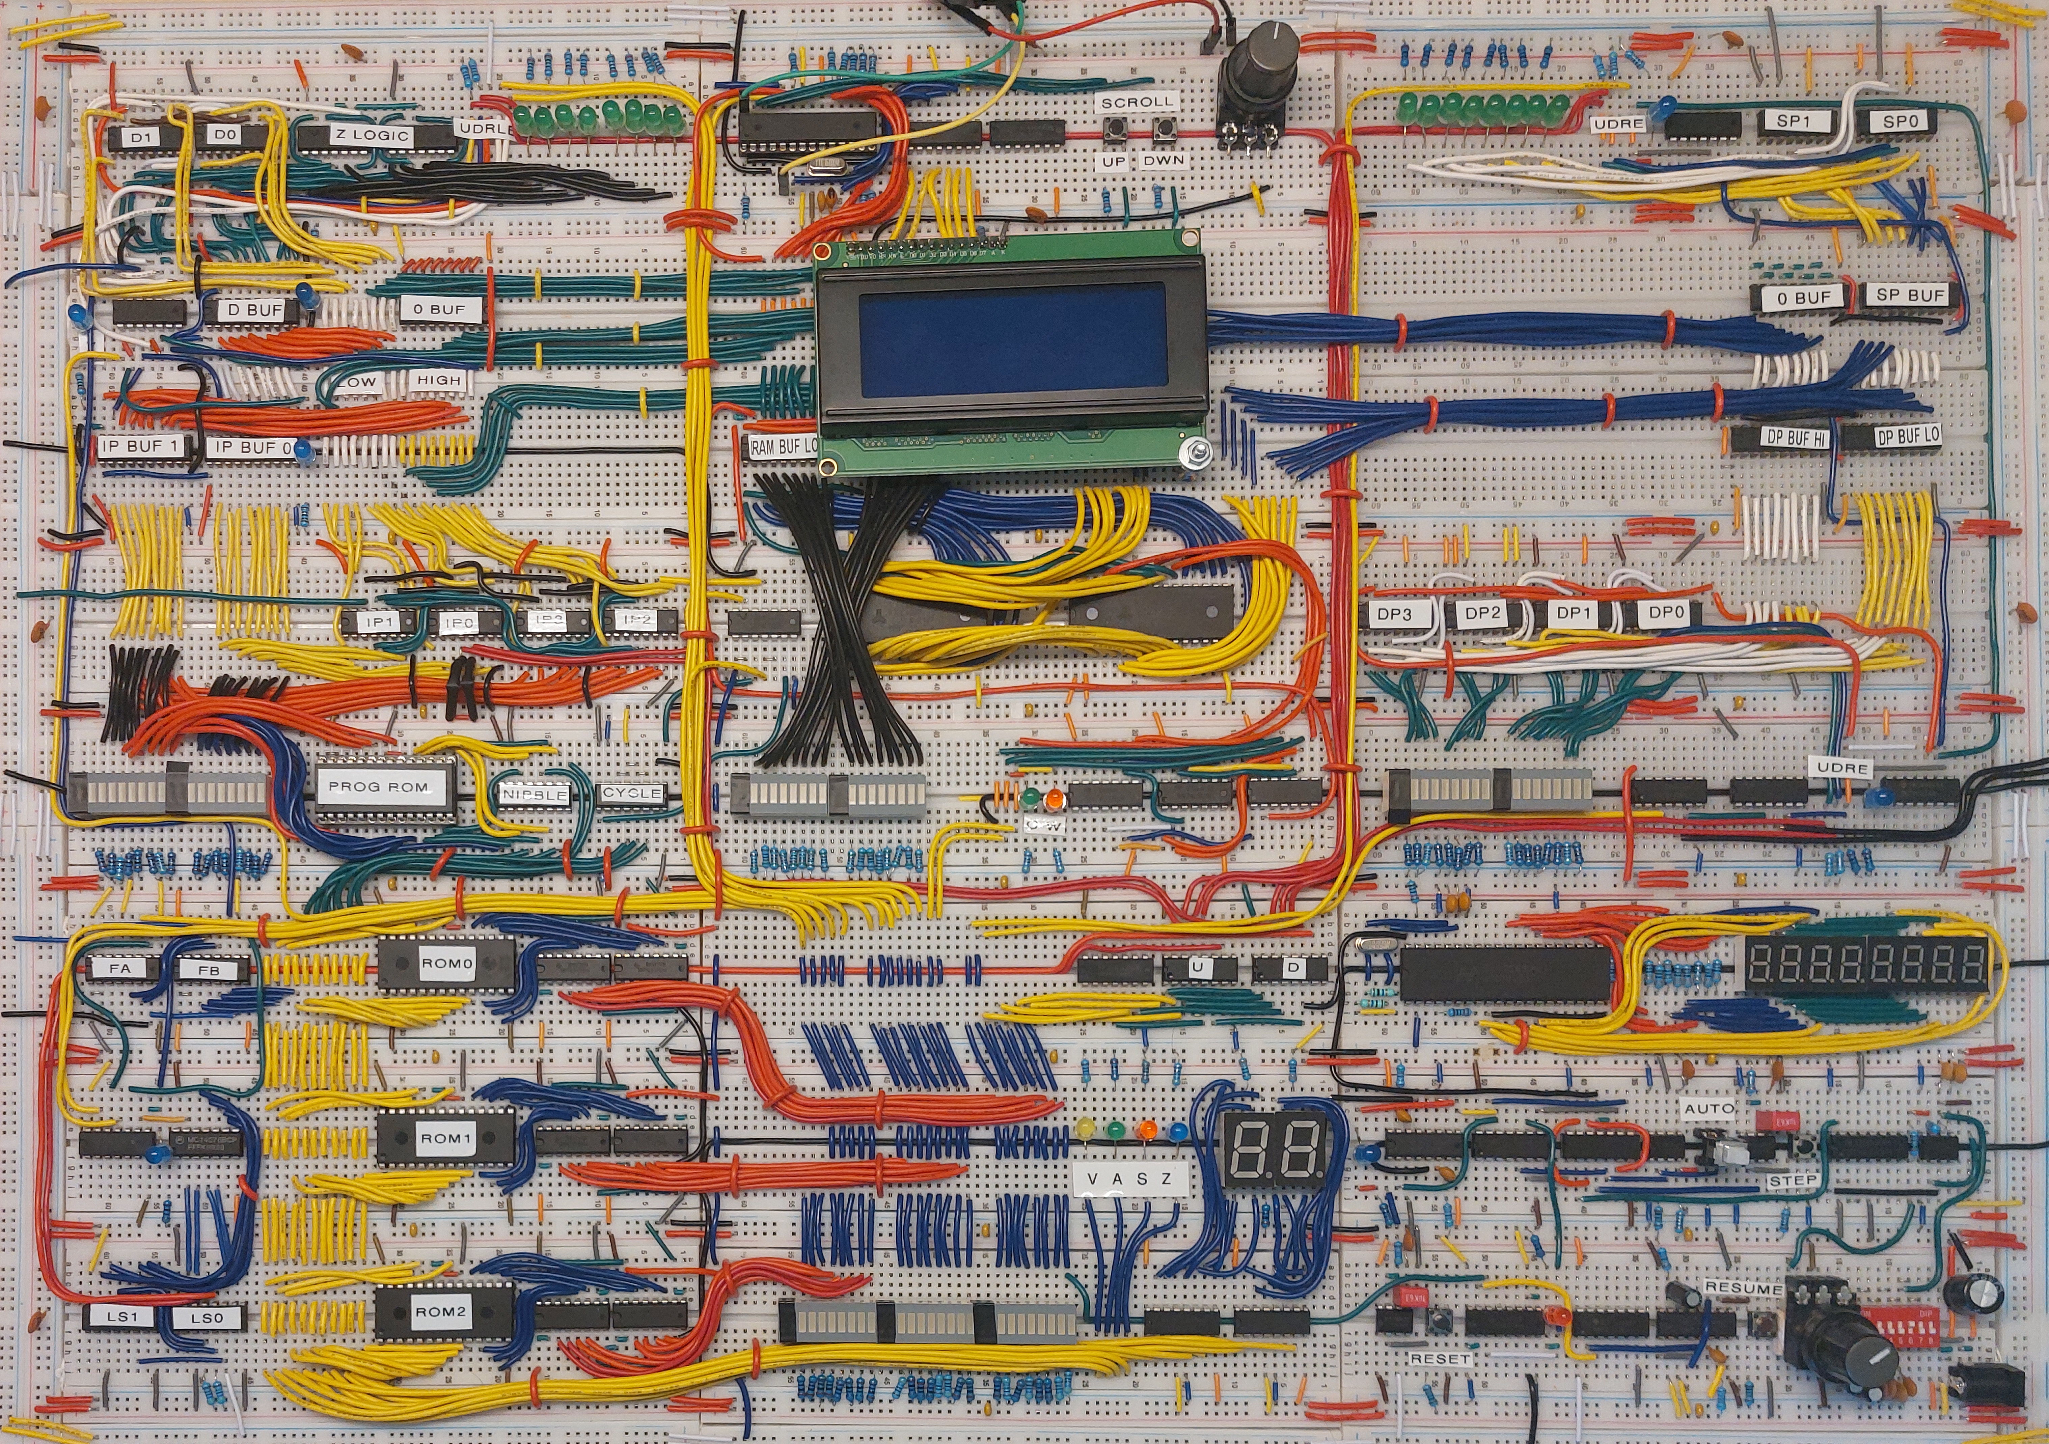
D
I/O
SP
IP
DP
RAM
CU
F
Register Driver
CLK
LS
CU Display

Slide 19
IDLE
Wait for rising edge of M_CLK
IDLE
Put byte from KB onto bus
WAIT
STATE
Other
STATE
WAIT
Do nothing
RESET
IDLE
1
0
RESET
Reset
IDLE
EN_OUT
EN_IN
1
0
Send byte to screen

Slide 20
Start
Copy the value from the bus into the output buffer and set K. Change state to WAIT_SYS.
Disable outputs and change state to IDLE.
Wait for rising edge of M_CLK.
0
EN_OUT
Generate a random number and write this to the bus. Then set K and change state to WAIT_SYS.
1
K?
WAIT_SYS
STATE?
IDLE
EN_OUT?
EN_IN?
Both
WAIT_KB
EN_IN
Put buffered byte on the bus, set K and change state to WAIT_SYS.
Put a 0-byte on the bus, set K and change state to WAIT_SYS.
Yes
Byte(s) Avail.?
Input-Mode?
Imm.
No
Buffered
Change state to WAIT_KB.

Slide 21
NOP
INIT
HLT
BF-COMMANDS
HLT

