Slide 1
Space Invaders on FPGA with WII-remote
Soclab Project

Slide 2
Introduction
Space Invaders
Wii-remote

Slide 3
Memories
ROM
Sprites
Color palette
RAM
Enemy locations
Bullet locations

Slide 4
ROM
1-Port ROM (color palette)
4-bit addresses
24-bit words (8bits for R, G & B)
Keeps the sprite memories small
1-Port ROM 3x (sprite ship, bullet, enemy)
8-bit addresses (16x16px)
4-bit words
will be resolved to 24-bit color in color palette
ship_image image(.address(address), .clock(clock), .q(color_address));
colorpalette cp(.address(color_address), .clock(clock), .q(color));

Slide 5
RAM
2-Port RAM (bullets)
6-bit addresses
24-bit words ({y, x, active})
Active-bit is for control
2-port RAM (enemies)
Idem bullets

Slide 6
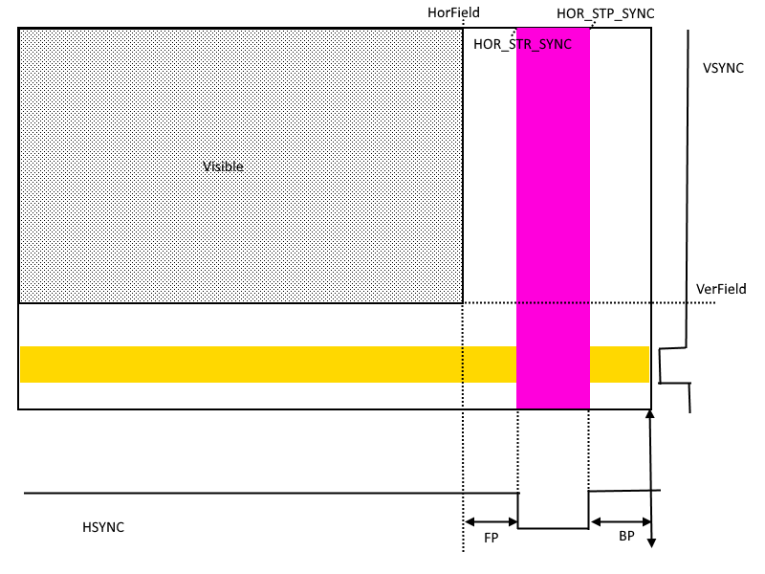
Logic

Slide 7
Logic
!calc
All pixels are calculated one by one
Compare for collision
If collision write 0 to address
This is why 2-port rams are handy
Draw if active-bit is 1
If something from memory is drawn
get next from memory
Sorted memory from left to right and top to bottom
{y, x}
Else background
LFSR red & white for moving effect

Slide 8
Logic
calc - statemachines
Remove empty memory slots
1,2,0,4,5 -> 1,2,4,5,0
Insert/create new memory entries
Insert in order
3 -> 1,2,4,5,0
1,2,3,4,5
Move memory entries
Idle
Nothing left to be done wait for next calc

Slide 9
Demonstration
Demonstration

